Slide 1



FEEBLY-INTERACTING
PARTICLE SEARCHES
ICHEP 2026, Natal, Brazil
Jonathan Feng, UC Irvine, 3 August 2026

Slide 2
INTRODUCTION
In the last several years, FIPs have moved from “exotica” to the mainstream of particle physics.
FIP searches featured in ICHEP 2026 parallel talks:
  Belle II, BESIII, ATLAS, CMS, LHCb, NA62, NA64, FASER, PADME, MEG II, SBND, SHiP/NA67, DarkShine, ATUCHA II, LDMX, MATHUSLA, …
  Far too many to summarize in this talk.
And, of course, there were also more theory- and cosmologically-oriented FIP talks, and there is a lot of activity that is not represented at ICHEP.
Why all this interest? At least 3 good motivations.

Slide 3
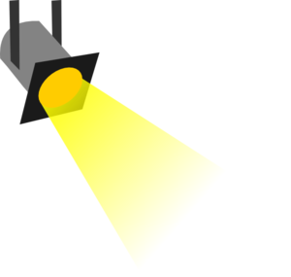





















1. FIPS ARE ONE OF TWO BSM POSSIBILITIES
Particle
Expts
Mass
MeV
GeV
TeV
For BSM particle discovery, FIPs are 1 of only 2 broad possibilities.
FIPs can be discovered at an enormous variety of experiments and facilities, and they challenge us to use them to their full potential.
1
$$←$$
$$g$$
$$u$$
$$d$$
$$s$$
$$p$$
$$n$$
$$c$$
$$b$$
$$t$$
$$←$$
$$γ$$
$$e$$
$$μ$$
$$τ$$
$$W$$
$$Z$$
$$h$$
Already
Discovered
Strongly Interacting
Heavy Particles
Interaction Strength
10⁻³
$$ν_{e}$$
$$ν_{μ}$$
$$ν_{τ}$$
FIPs
$$←$$
Weakly Interacting
Light Particles
Impossible to
Discover
10⁻⁶

Slide 4
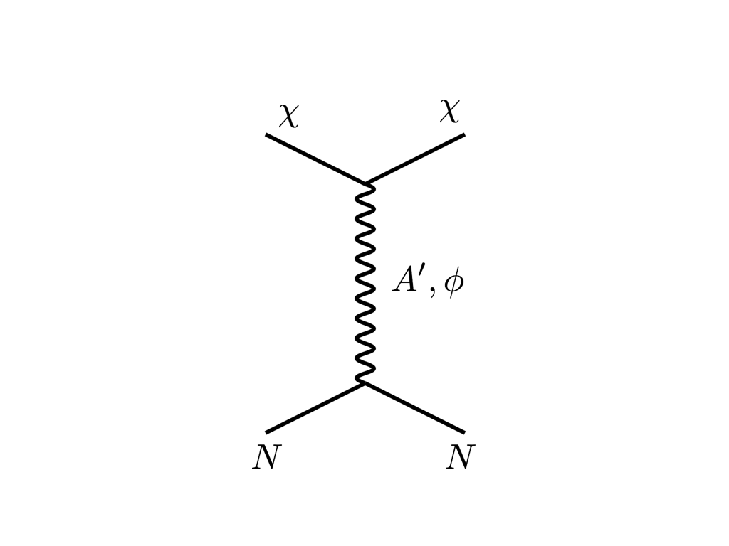






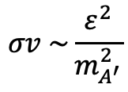



2. FIPS ARE MOTIVATED BY DARK MATTER
Particle
Expts
Mass
MeV
GeV
TeV
The WIMP Miracle
1
$$←$$
$$g$$
$$u$$
$$d$$
$$s$$
$$p$$
$$n$$
$$c$$
$$b$$
$$t$$
$$←$$
$$γ$$
$$e$$
$$μ$$
$$τ$$
$$W$$
$$Z$$
$$h$$
DM
$$e$$
Too Little to be
Dark Matter
$$ε$$
$$ε$$
$$A′$$
Boehm, Fayet (2003)
Pospelov, Ritz, Voloshin (2007)
Feng, Kumar (2008)
Interaction Strength
Just Right to be Dark Matter
The
WIMPless
Miracle
$$e$$
10⁻³
DM
$$σv \sim \frac{ε^{2}}{m_{A^{′}}^{2}}$$
$$ν_{e}$$
$$ν_{μ}$$
$$ν_{τ}$$
$$←$$
Too Much to be
Dark Matter
Cosmologically, FIPs are as well-motivated as WIMPs
10⁻⁶

Slide 5
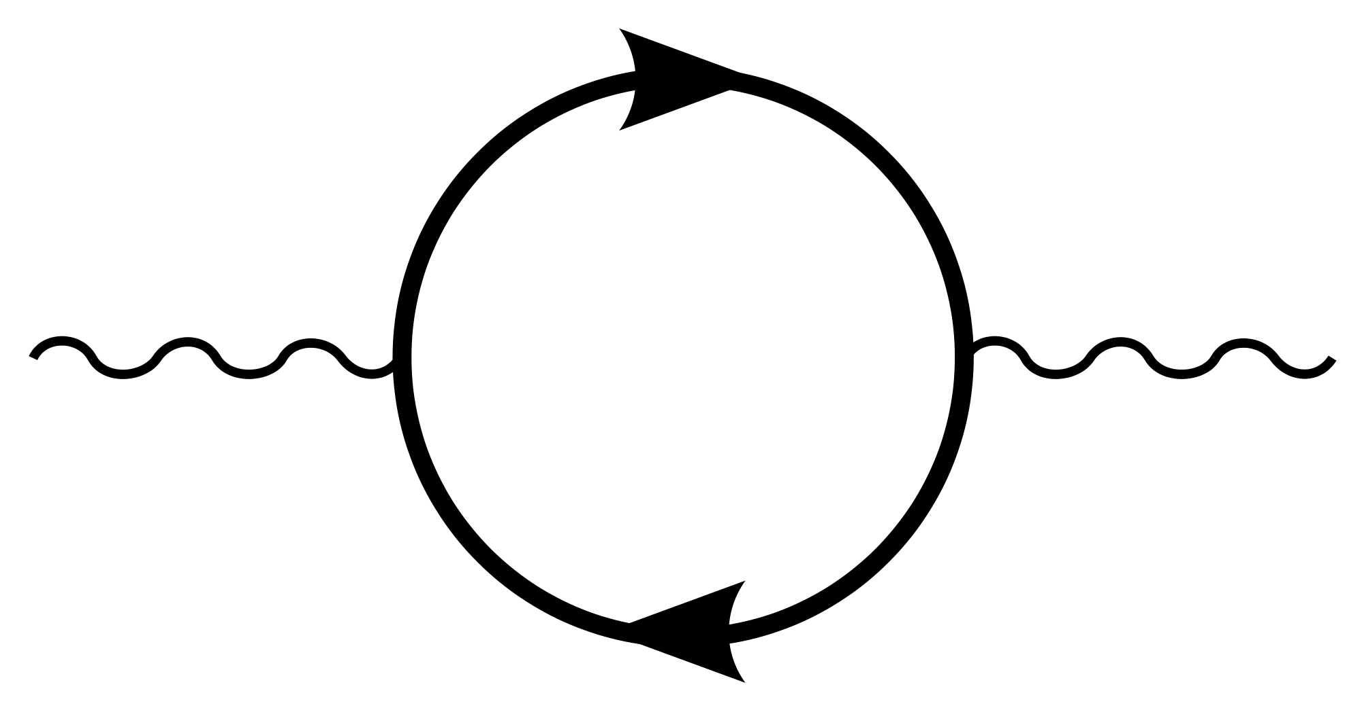


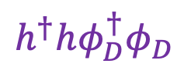

3. FIPS ARE CONNECTED TO IMPORTANT PROBLEMS
THE BIG 4: Axion-Like Particles and the 3 Portal Particles from models in which a dark sector interacts with the SM through renormalizable interactions.
Axion-Like Particle (ALP)
Dark Photon
$g_{aγγ}{aF}_{μν}{\tilde{F}}^{μν}+ g_{aWW}{aW}_{μν}{\tilde{W}}^{μν}$ + $g_{agg}{aG}_{μν}{\tilde{G}}^{μν}+…$
$$F_{μν}F_{D}^{μν}$$
Heavy Neutral Lepton (HNL)
Dark Scalar
$$hLψ_{D}$$
$$h^{†}hφ_{D}^{†}φ_{D}$$
The renormalizable interactions are not suppressed by a large mass scale, and so are expected to be both relatively large and generic (mediated by arbitrarily heavy particles X – non-decoupling, probes the Planck scale!).
A
$${εF}_{μν}F_{D}^{μν}$$
A_{D}
X
Holdom (1986)
These particles are connected to central problems of our field: the strong CP problem, dark matter, neutrino masses, electroweak symmetry breaking.

Slide 6
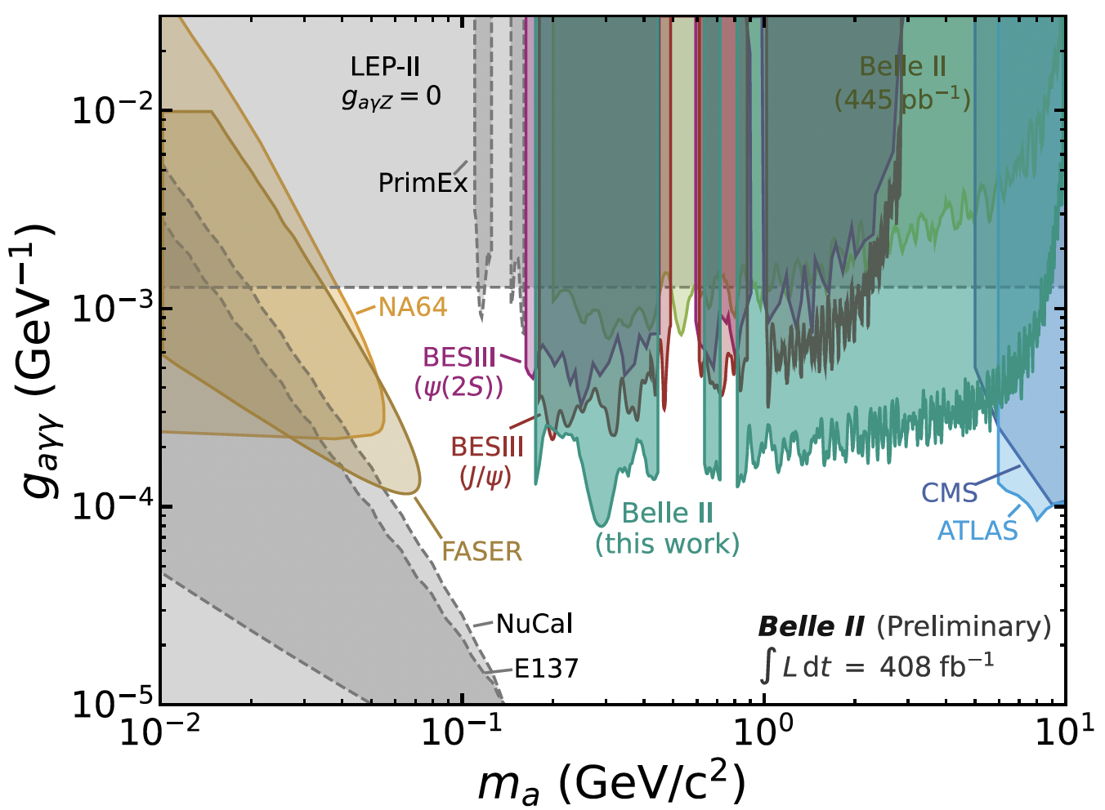
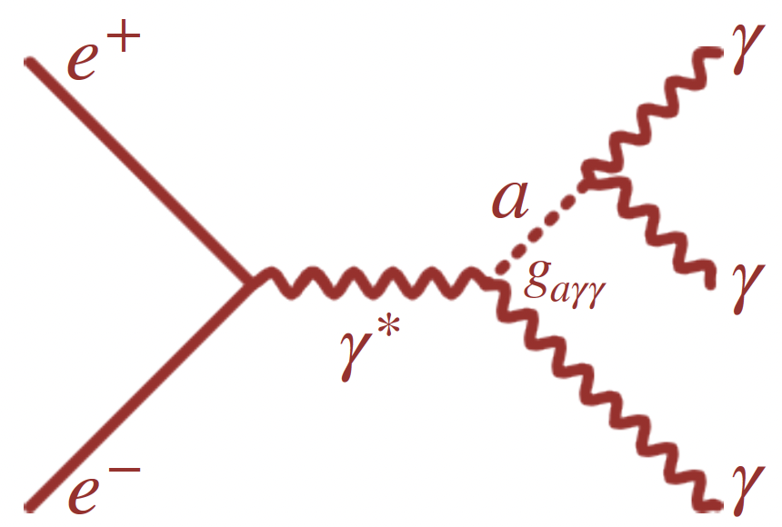
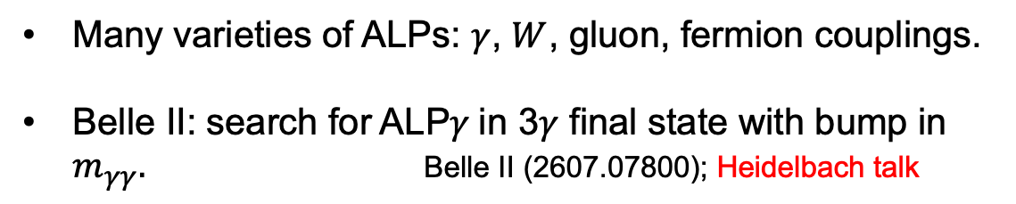
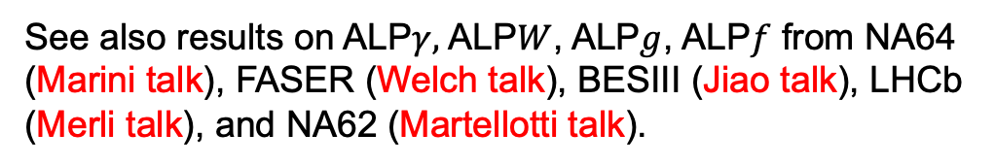
AXION-LIKE PARTICLES
Many varieties of ALPs: $γ$, $W$, gluon, fermion couplings.
Belle II: search for ALP$γ$in 3$γ$ final state with bump in $m_{γγ}.$ Belle II (2607.07800); Heidelbach talk
See also results on ALP$γ,$ALP$W$, ALP$g$, ALP$f$ from NA64 (Marini talk), FASER (Welch talk), BESIII (Jiao talk), LHCb (Merli talk), and NA62 (Martellotti talk).
Interesting features
  Gray regions are reinterpretations of ancient data; colored regions are more recent results from experimental collaborations (in this case NA64, FASER, BESIII, CMS, ATLAS, all since 2019).
  Significant improvement: signals typically proportional to (coupling)² or (coupling)⁴; depending on background, improvements of an order of magnitude in coupling → could have seen ~100 or 10⁴ events.
  The new experimental efforts are highly complementary.

Slide 7
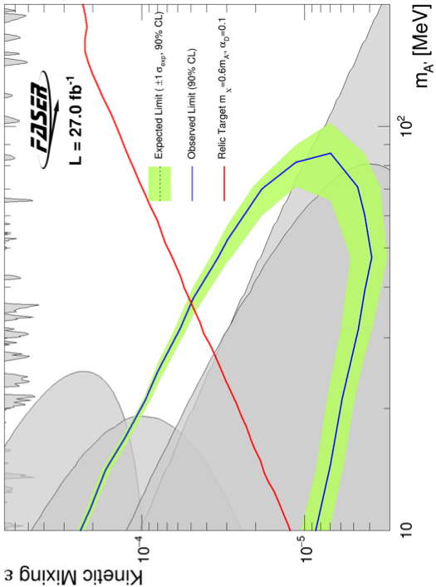
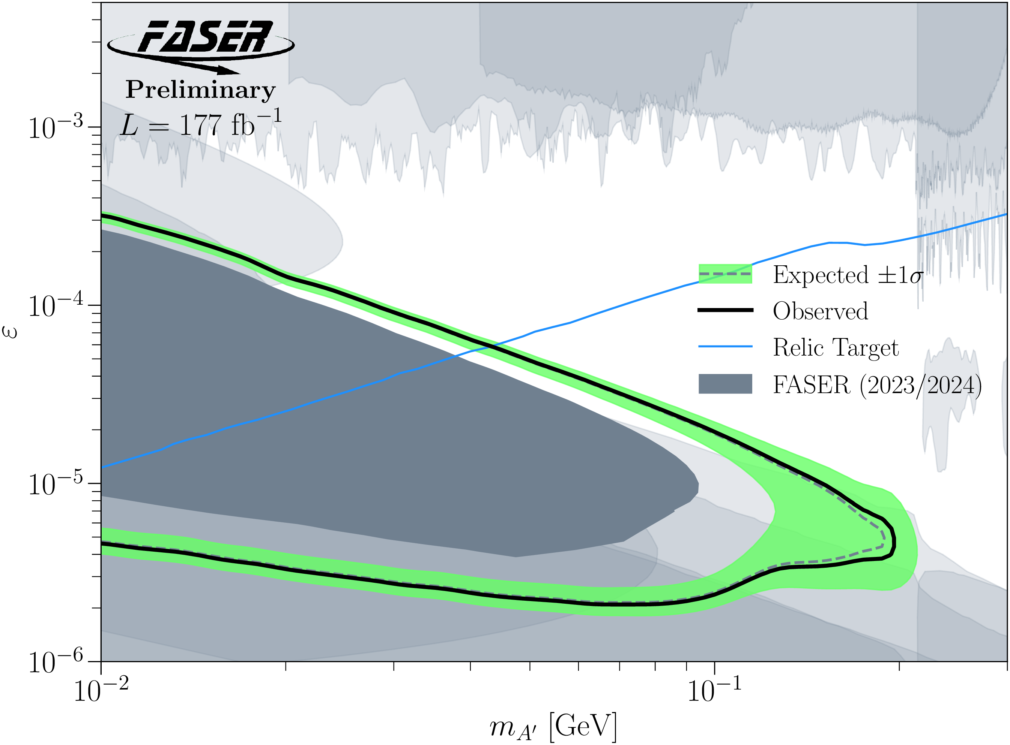
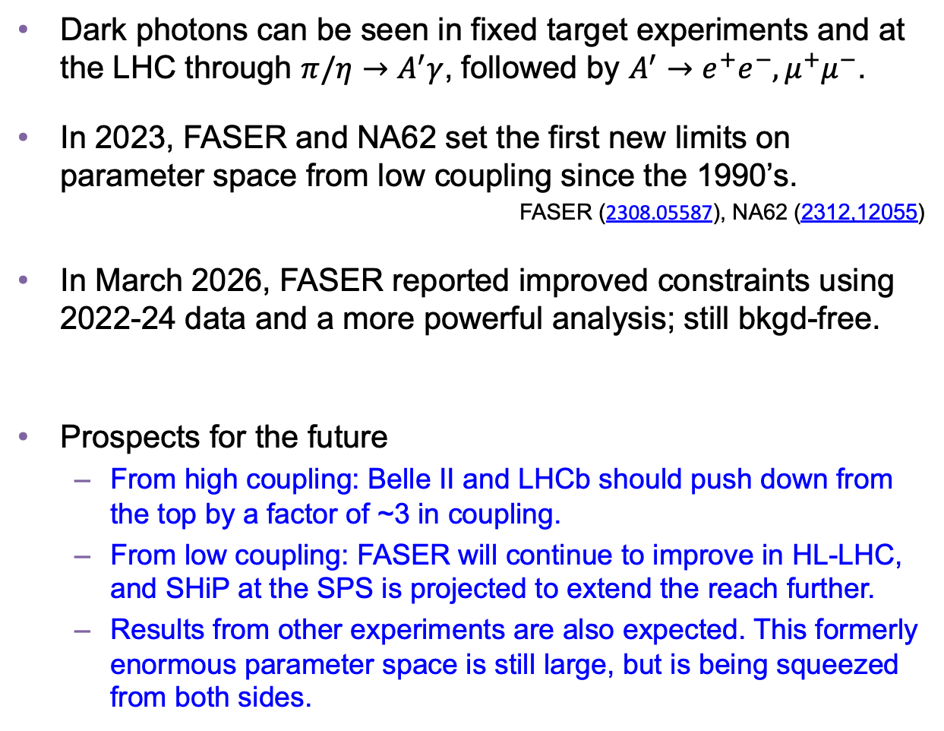
VISIBLE DARK PHOTONS
Dark photons can be seen in fixed target experiments and at the LHC through $π/η→$ $A^{′}γ$, followed by $A^{′}→e^{+}e^{−}, μ^{+}μ^{−}$.
In 2023, FASER and NA62 set the first new limits on parameter space from low coupling since the 1990’s.
FASER (2308.05587), NA62 (2312,12055)
In March 2026, FASER reported improved constraints using 2022-24 data and a more powerful analysis; still bkgd-free.
Prospects for the future
  From high coupling: Belle II and LHCb should push down from the top by a factor of ~3 in coupling.
  From low coupling: FASER will continue to improve in HL-LHC, and SHiP at the SPS is projected to extend the reach further.
  Results from other experiments are also expected. This formerly enormous parameter space is still large, but is being squeezed from both sides.
Existing bounds from DarkCast
FASER 2023
FASER (CERN-FASER-CONF-2026-001); Welch talk
Belle II, LHCb
FASER 2026
FASER 2023
NA62 2023

Slide 8
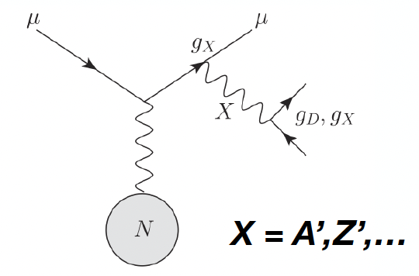
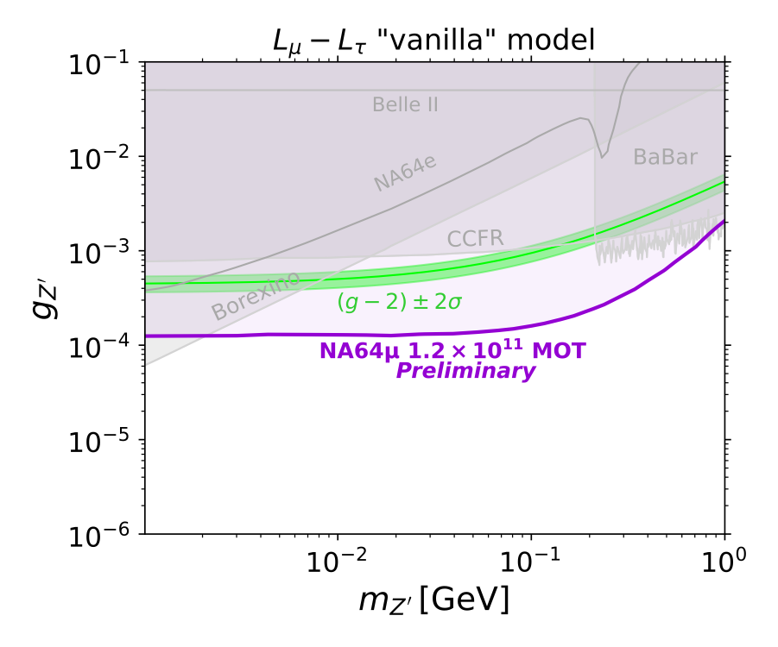
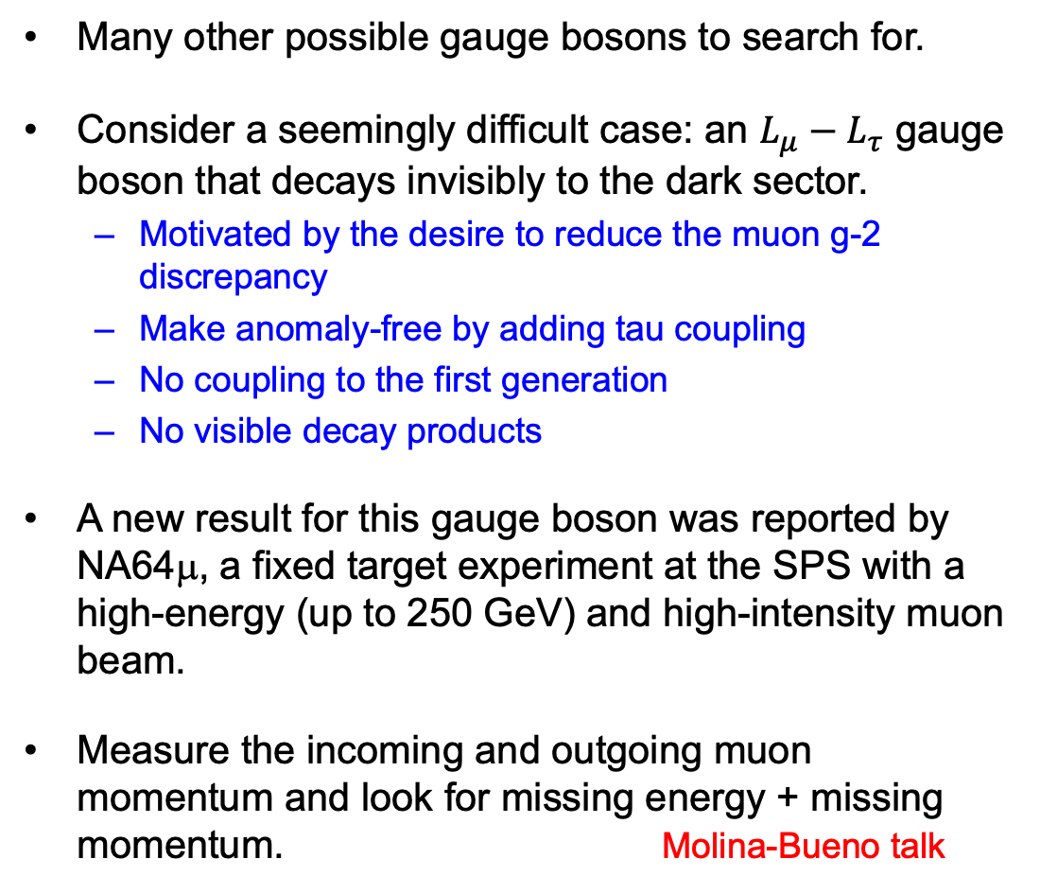
OTHER GAUGE BOSONS
Many other possible gauge bosons to search for.
Consider a seemingly difficult case: an $L_{μ}−L_{τ}$ gauge boson that decays invisibly to the dark sector.
  Motivated by the desire to reduce the muon g-2 discrepancy
  Make anomaly-free by adding tau coupling
  No coupling to the first generation
  No visible decay products
A new result for this gauge boson was reported by NA64μ, a fixed target experiment at the SPS with a high-energy (up to 250 GeV) and high-intensity muon beam.
Measure the incoming and outgoing muon momentum and look for missing energy + missing momentum. Molina-Bueno talk

Slide 9
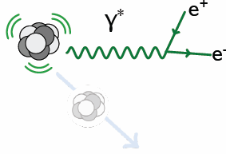
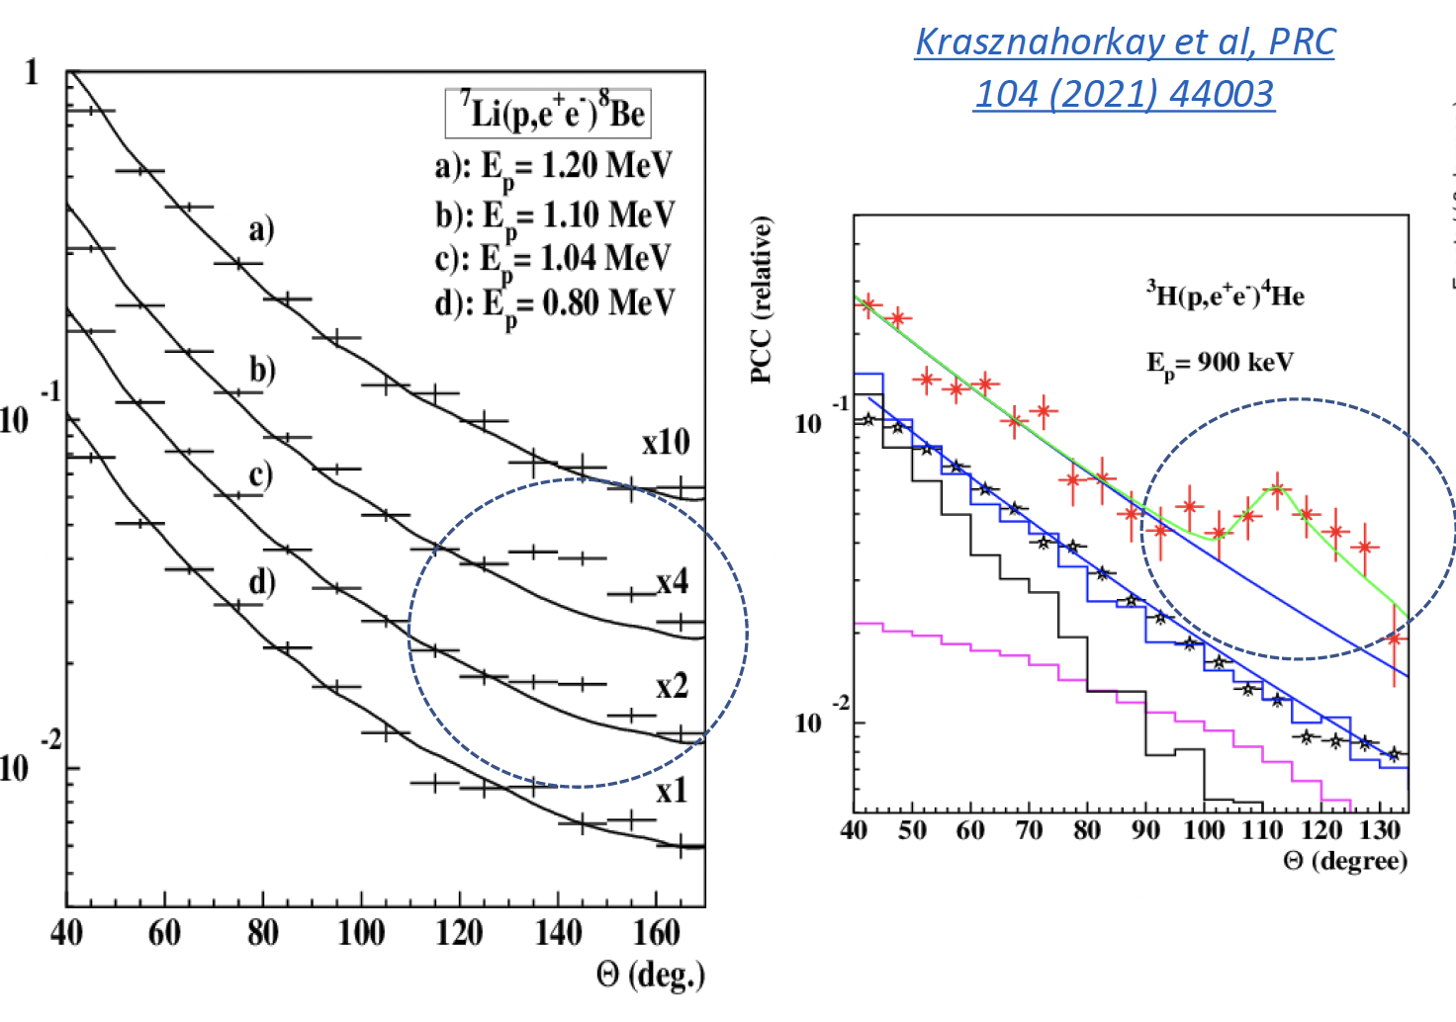
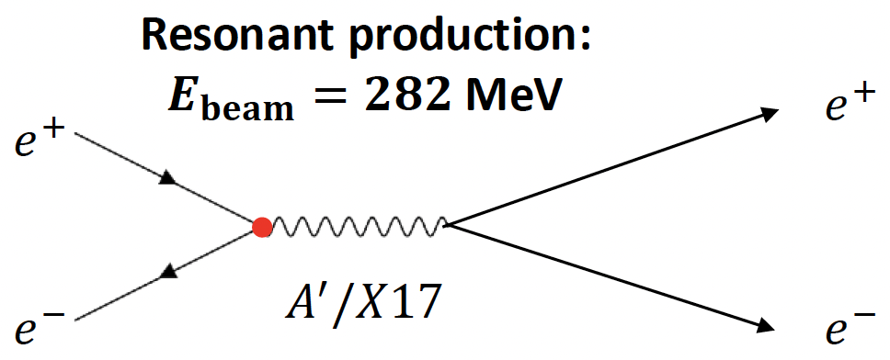
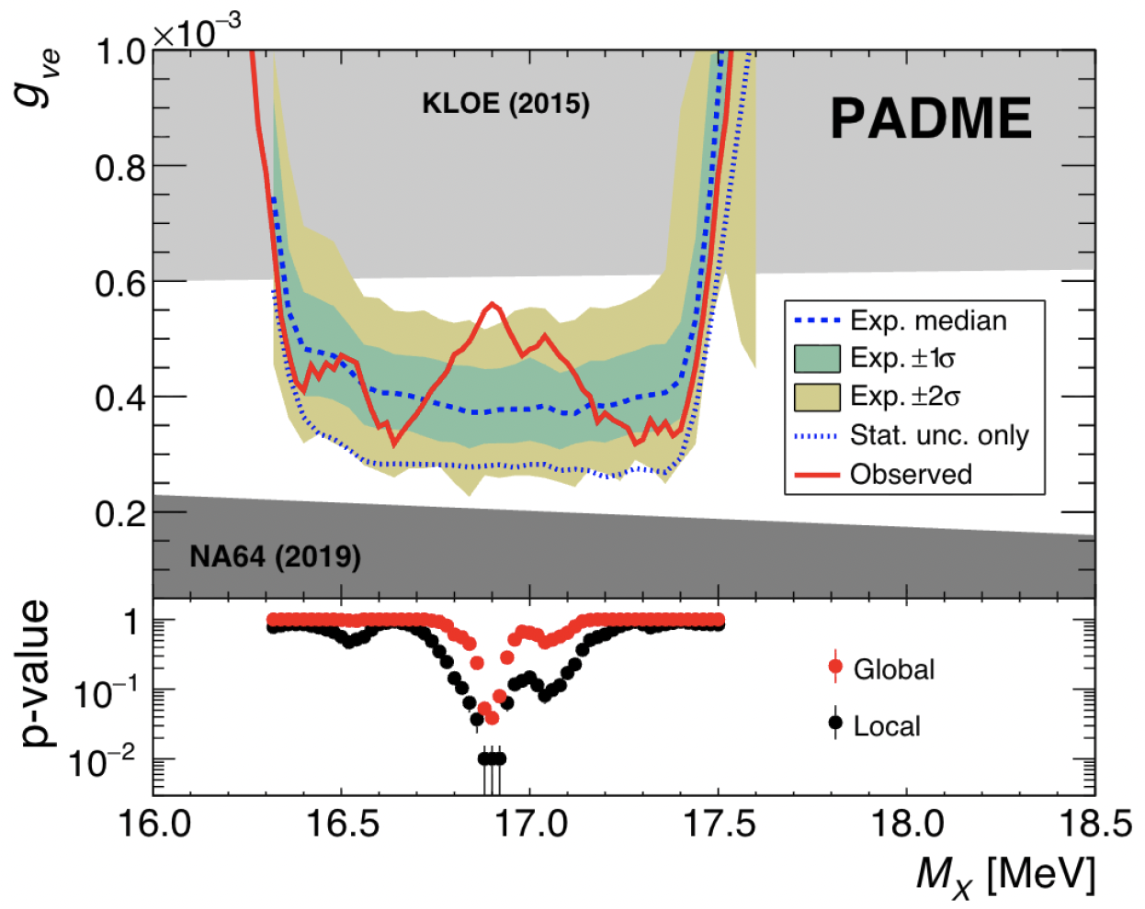
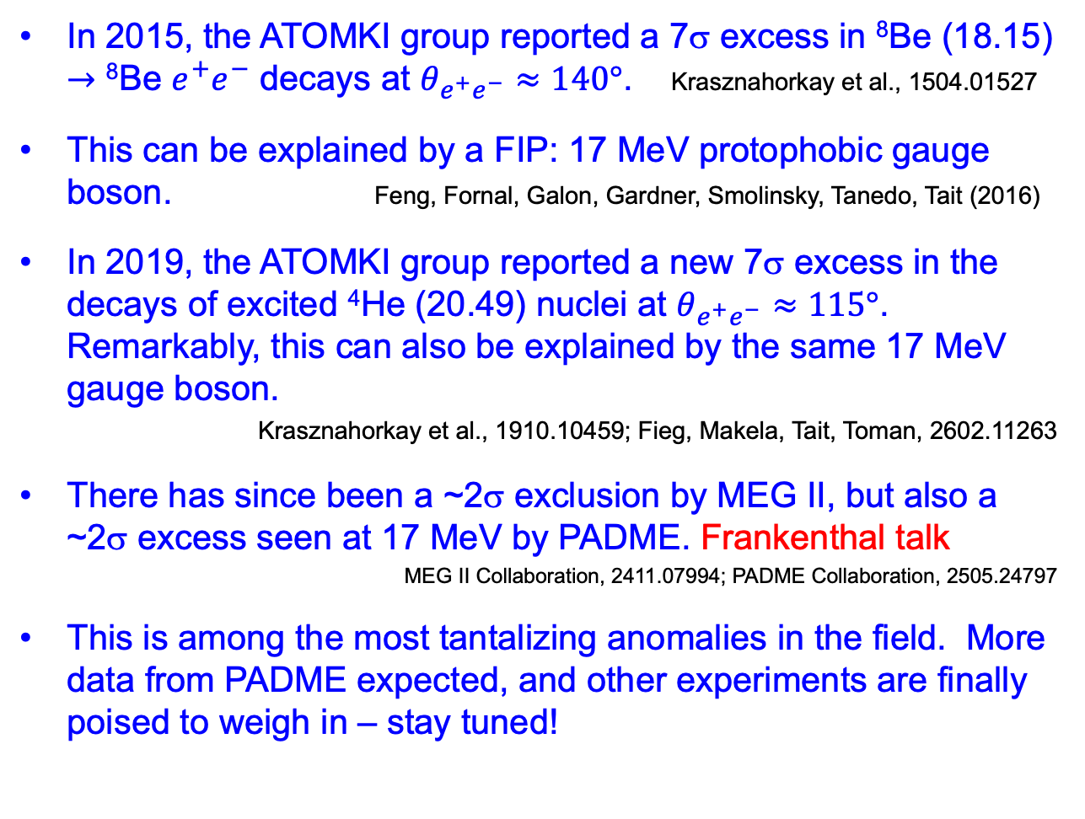
X17 AND THE ATOMKI ANOMALIES
In 2015, the ATOMKI group reported a 7σ excess in ⁸Be (18.15) $→$ ⁸Be $e^{+}e^{−}$ decays at $θ_{e^{+}e^{−}}≈140°$. Krasznahorkay et al., 1504.01527
This can be explained by a FIP: 17 MeV protophobic gauge boson. Feng, Fornal, Galon, Gardner, Smolinsky, Tanedo, Tait (2016)
In 2019, the ATOMKI group reported a new 7σ excess in the decays of excited ⁴He (20.49) nuclei at $θ_{e^{+}e^{−}}≈115°$. Remarkably, this can also be explained by the same 17 MeV gauge boson.
Krasznahorkay et al., 1910.10459; Fieg, Makela, Tait, Toman, 2602.11263
There has since been a ~2σ exclusion by MEG II, but also a ~2σ excess seen at 17 MeV by PADME. Frankenthal talk
MEG II Collaboration, 2411.07994; PADME Collaboration, 2505.24797
This is among the most tantalizing anomalies in the field. More data from PADME expected, and other experiments are finally poised to weigh in – stay tuned!
γ, X
θ

Slide 10
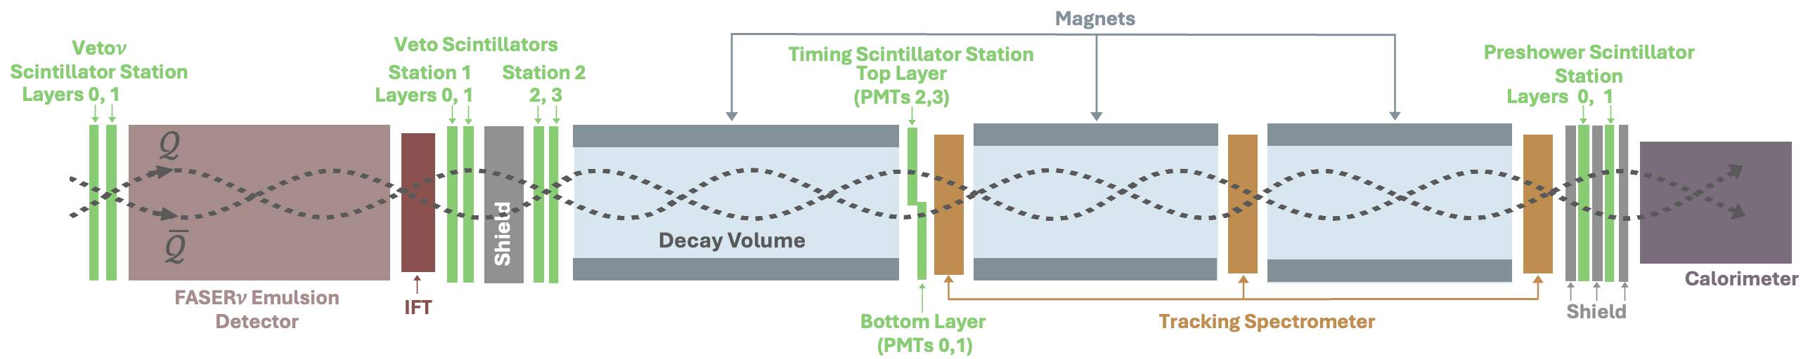
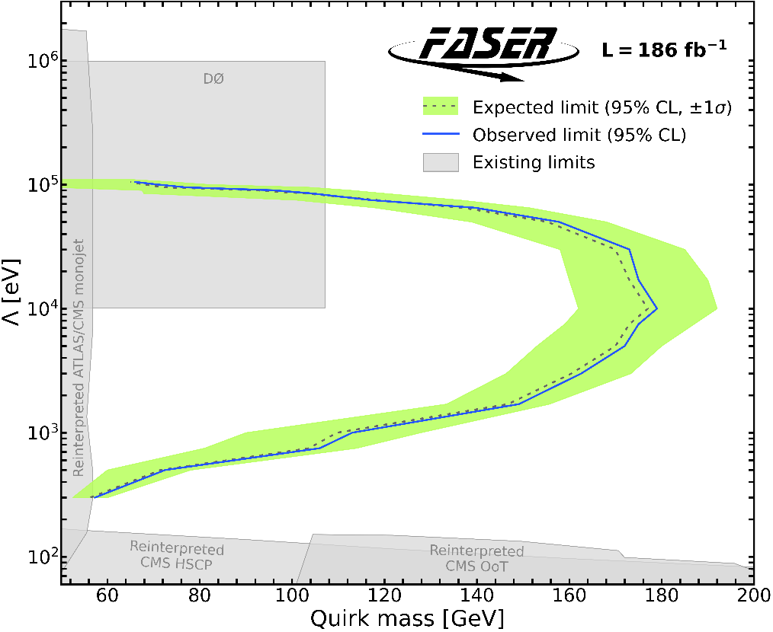
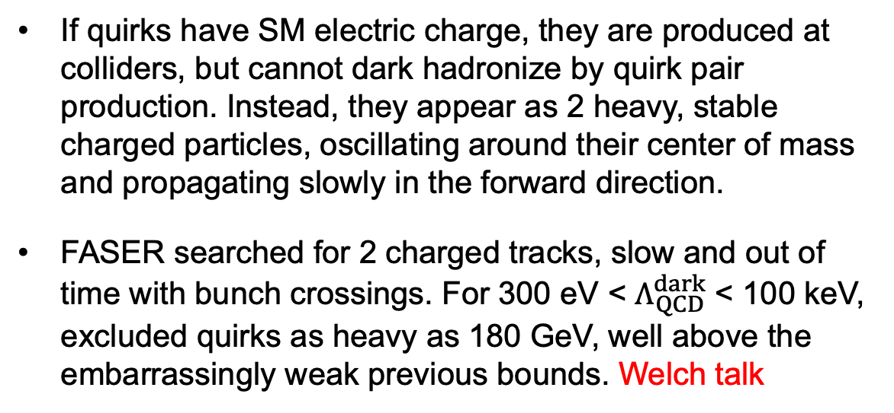
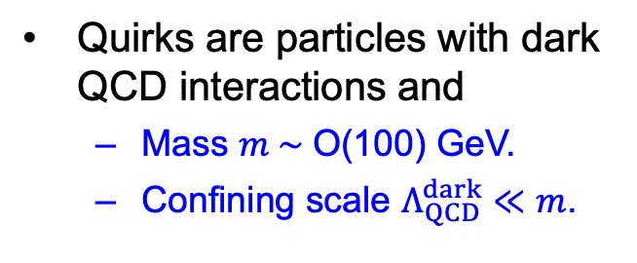
FIRST DEDICATED LHC SEARCH FOR QUIRKS
What if the dark sector has particles bound together by a strong force, “dark QCD”? A generic possibility (cf. neutral naturalness), but leads to particles with bizarre new signatures.
Kang, Luty (2008)
Quirks are particles with dark QCD interactions and
  Mass $m \sim$O(100) GeV.
  Confining scale $Λ_{QCD}^{dark}≪m$.
If quirks have SM electric charge, they are produced at colliders, but cannot dark hadronize by quirk pair production. Instead, they appear as 2 heavy, stable charged particles, oscillating around their center of mass and propagating slowly in the forward direction.
FASER searched for 2 charged tracks, slow and out of time with bunch crossings. For 300 eV < $Λ_{QCD}^{dark}$ < 100 keV, excluded quirks as heavy as 180 GeV, well above the embarrassingly weak previous bounds. Welch talk
FASER Collaboration (2607.26195)

Slide 11
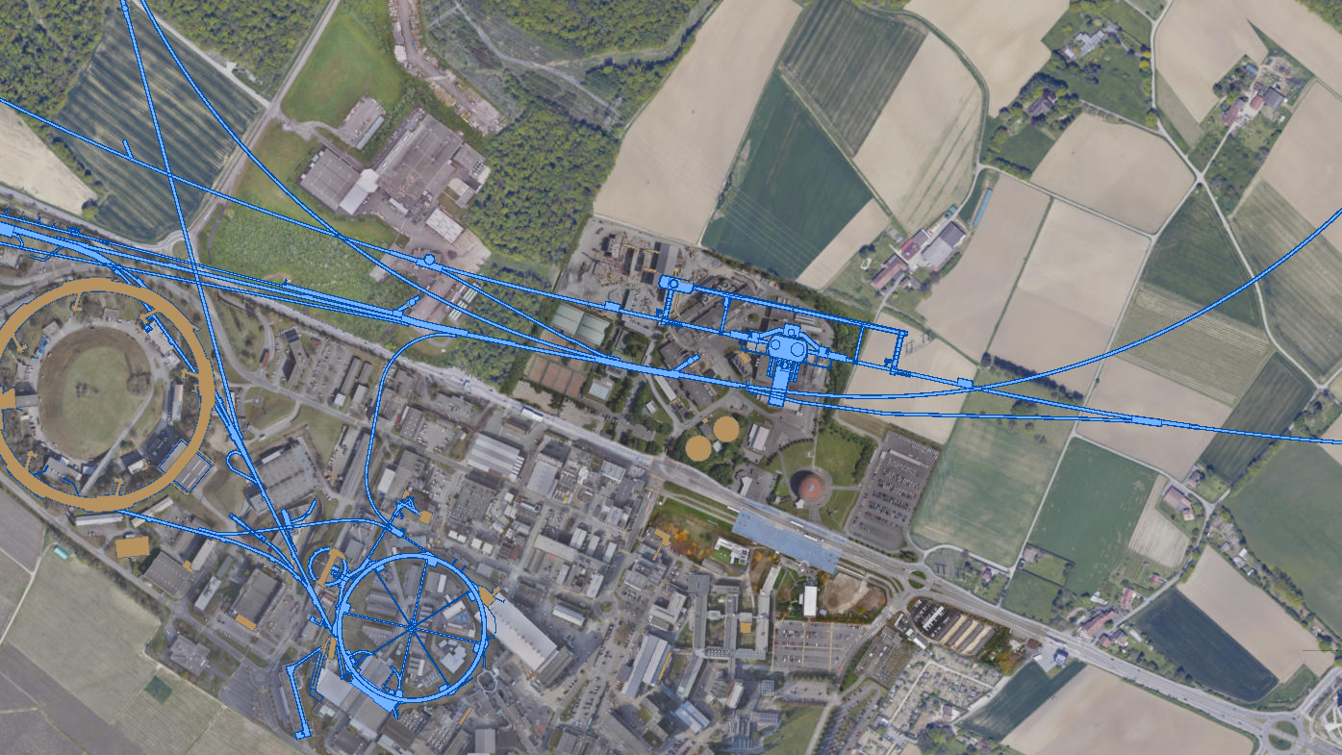


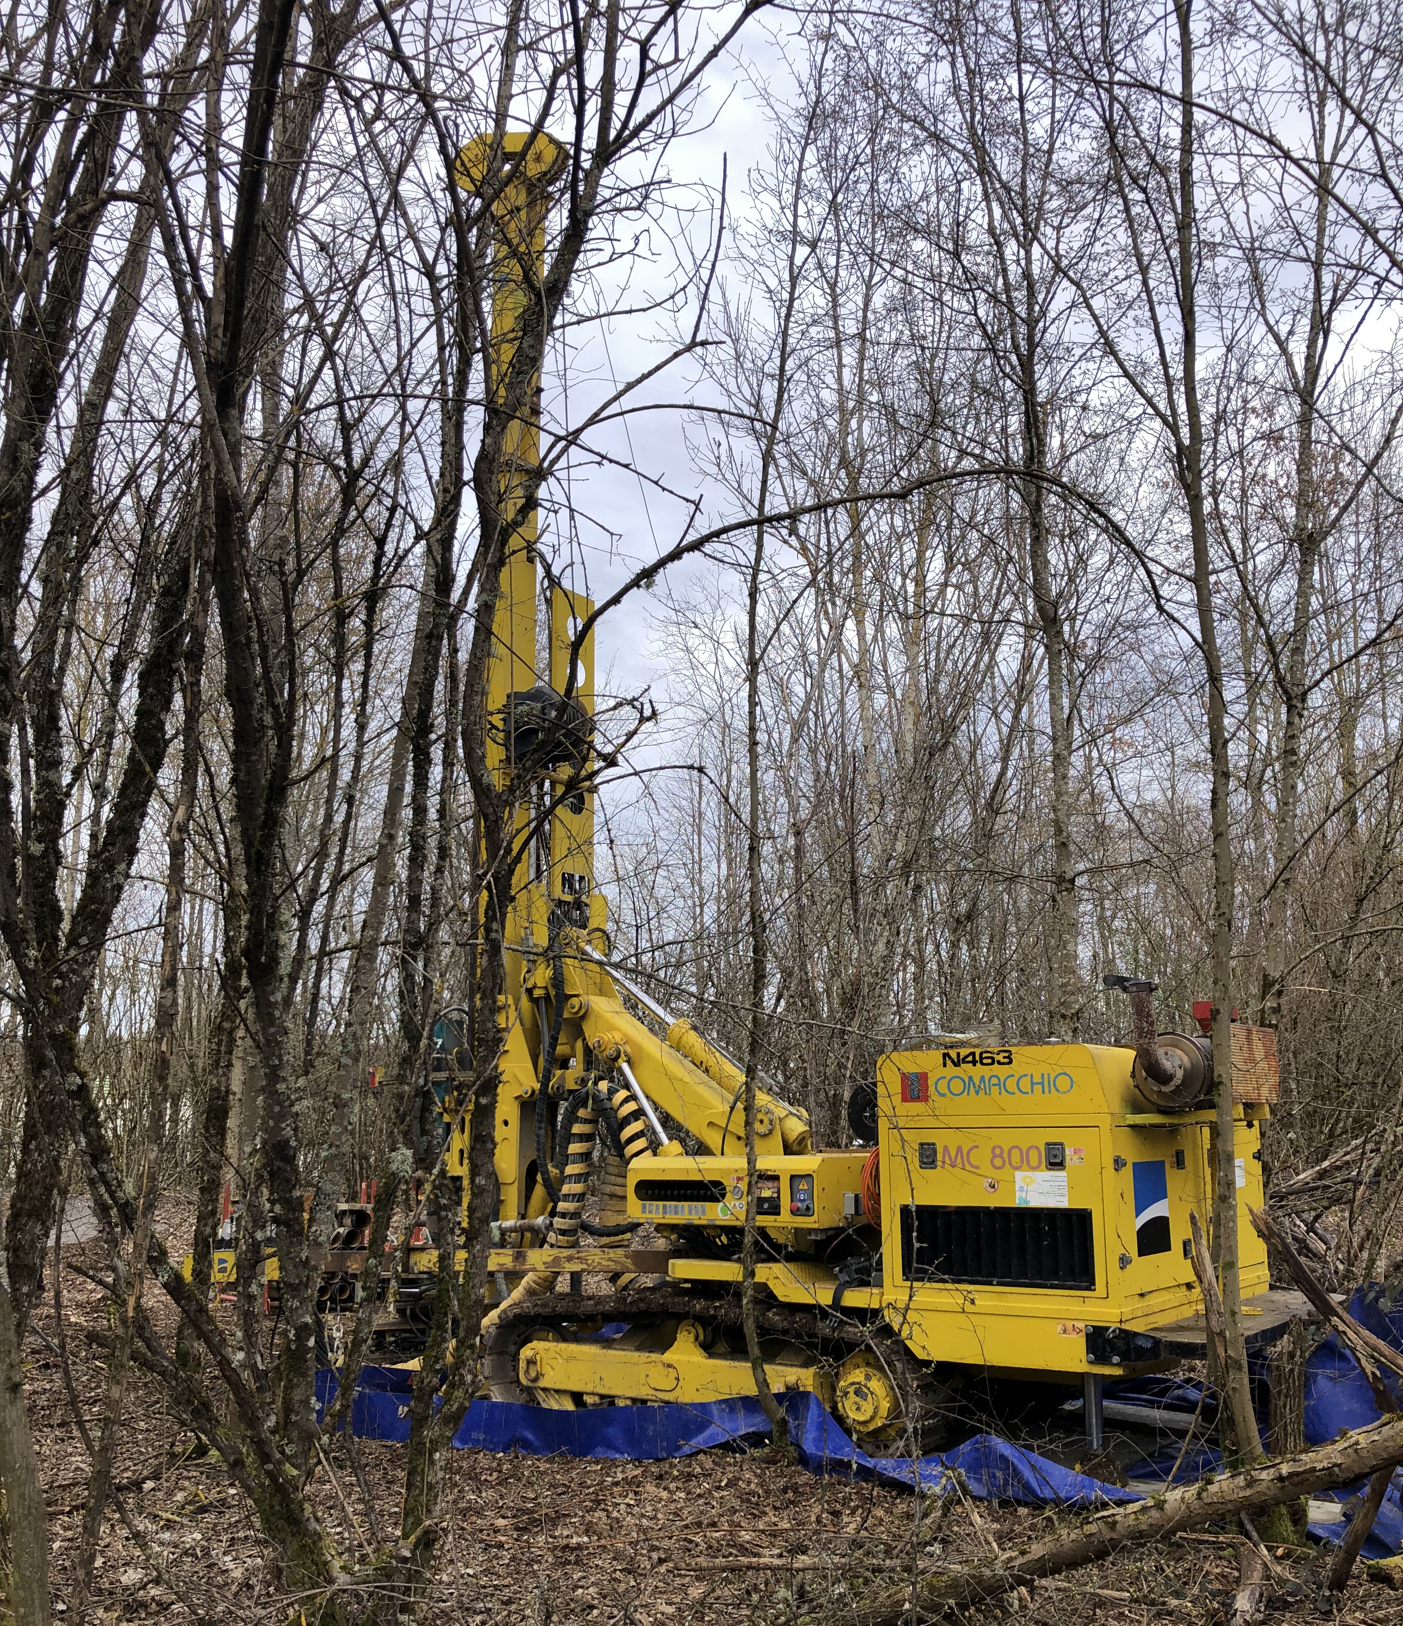

FUTURE PLANS
SHiP/NA67: approved fixed target experiment at the SPS, planned to start operation c. 2033. Cristinziani talk
Forward Physics Facility: proposed underground detector hall at the LHC.
SPS
ATLAS
LHC
LOS
FPF site selection and core studies have identified an ideal site in France just outside the CERN main gate
https://cds.cern.ch/record/2851822
CERN GIS

Slide 12
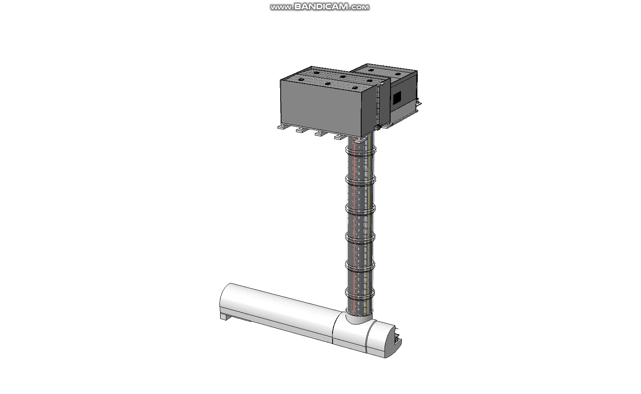


FORWARD PHYSICS FACILITY
Engineering Department
Anastasiya Magazinik, Julien Prosic, talk at FPF9, 5 March 2026
Notes:
All these elements: civil engineering design, buildings, services from the design offices, safety elements, experiments 3D models and so much more need to be integrated in the FPF model.
This is necessary to work together and make a concrete project.

Slide 13
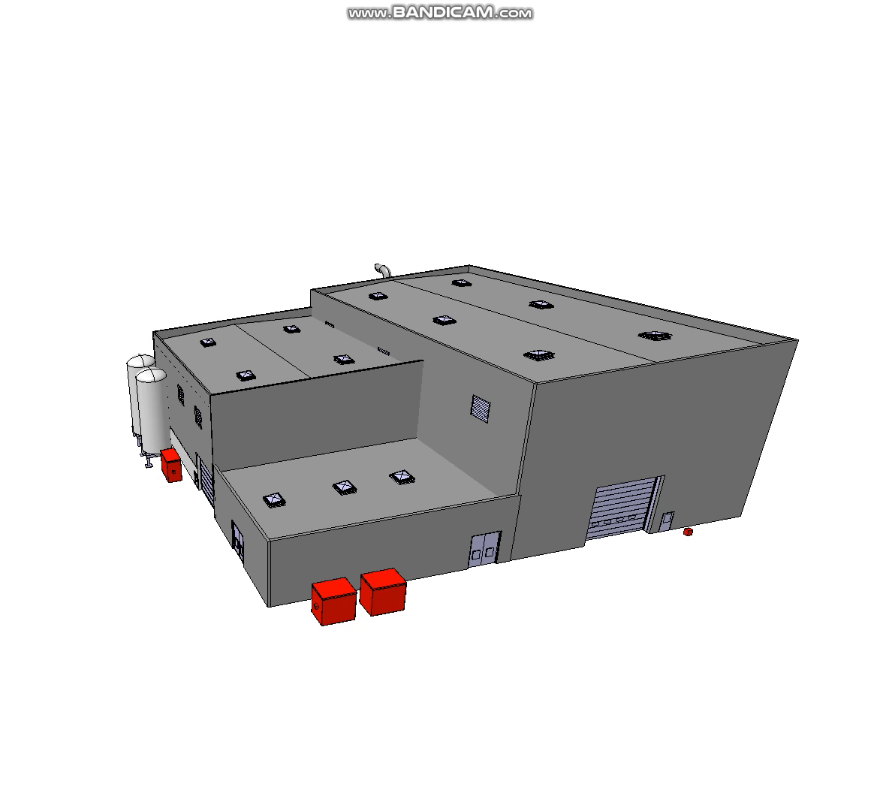
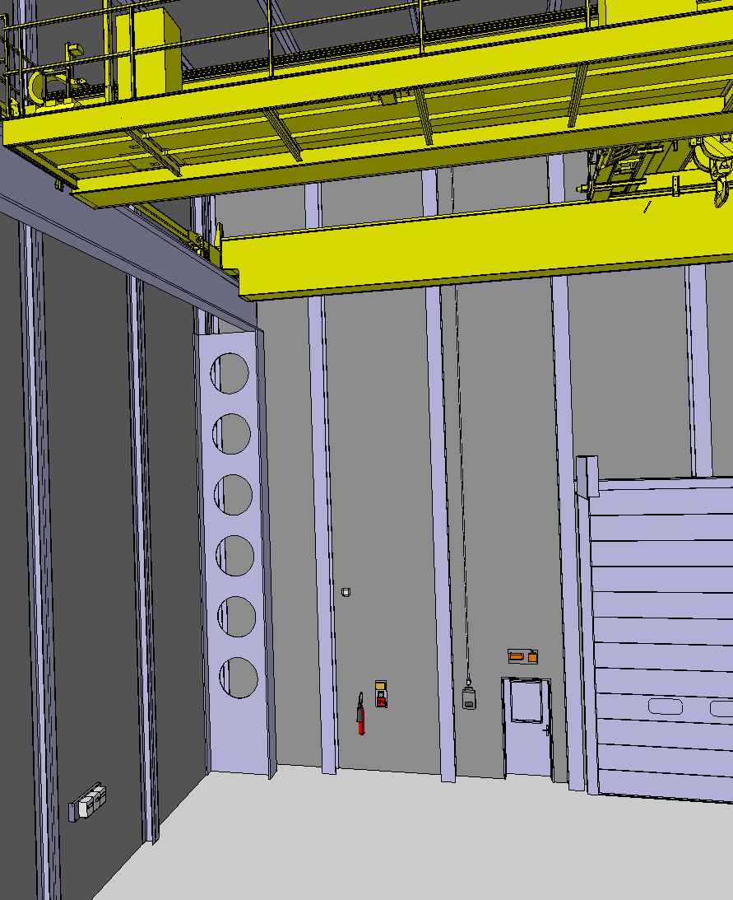
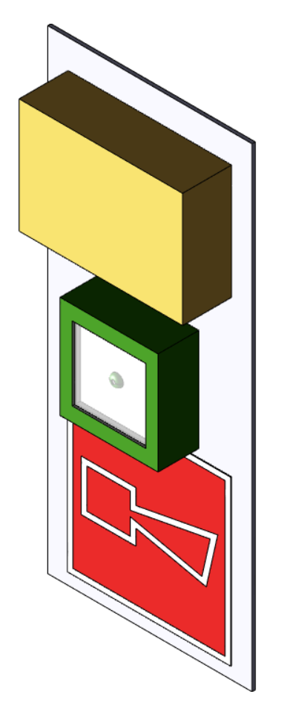
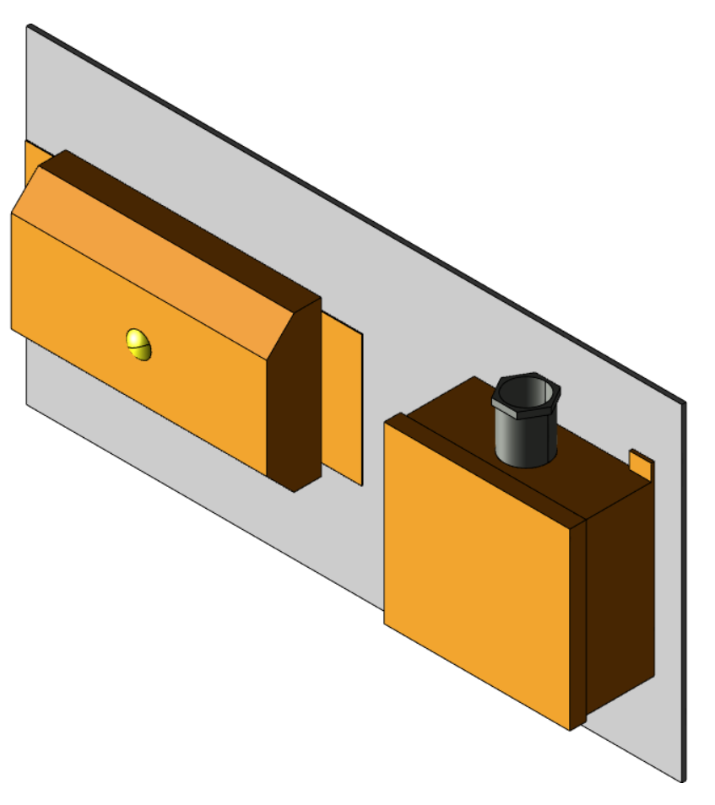
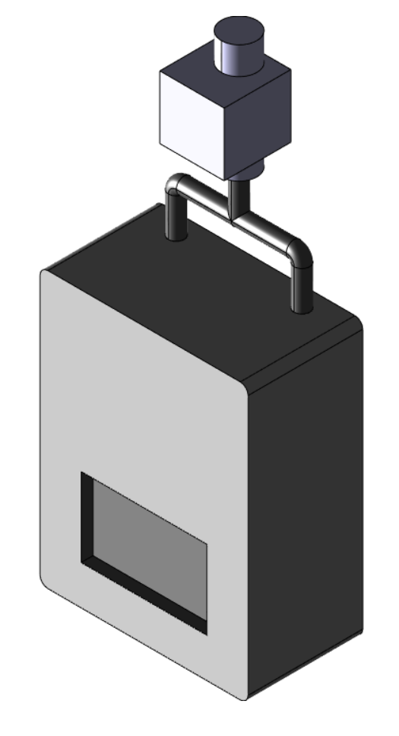
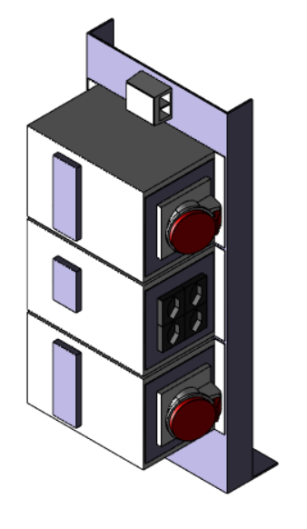
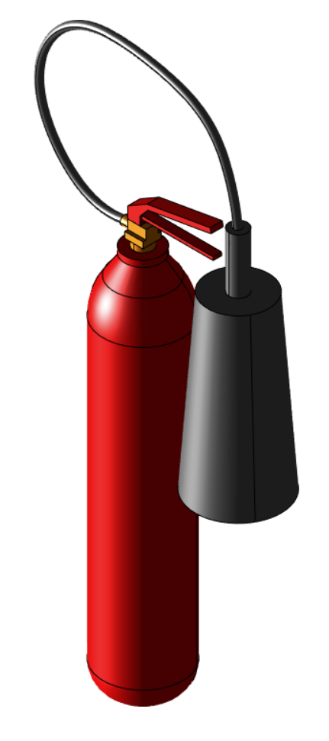
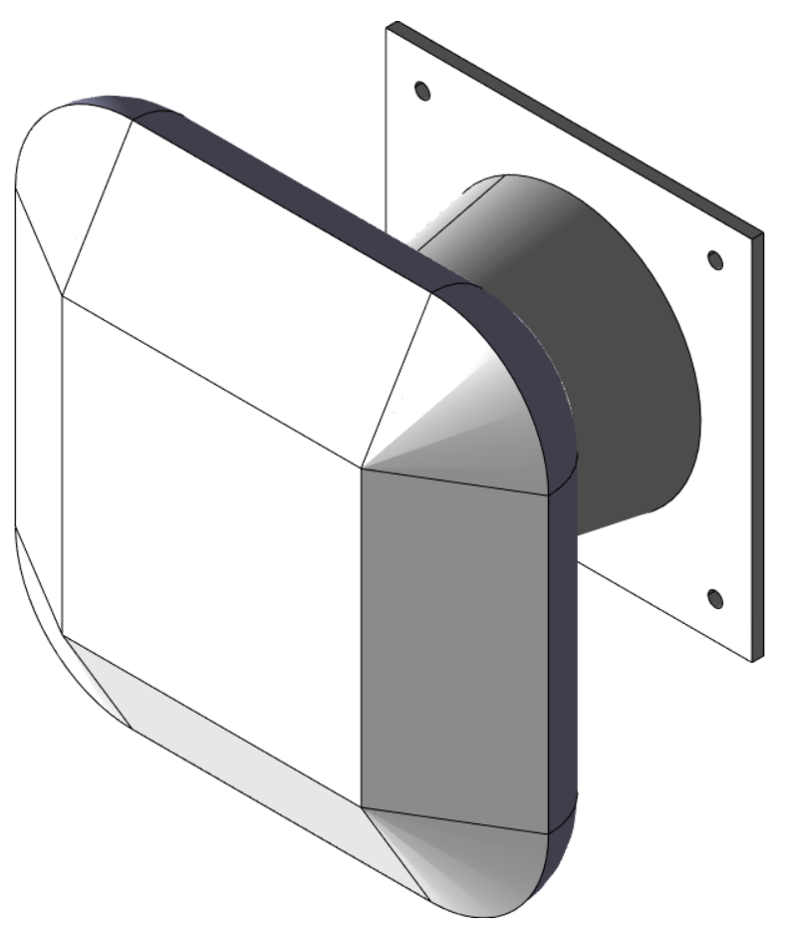
FPF SURFACE BUILDING
Engineering Department
Fire detector
Evacuation panel
Anti Panic light
Fire extinguisher
WIFI
Electrical boxes
Anastasiya Magazinik, Julien Prosic, talk at FPF9, 5 March 2026
Notes:
All these elements: civil engineering design, buildings, services from the design offices, safety elements, experiments 3D models and so much more need to be integrated in the FPF model.
This is necessary to work together and make a concrete project.

Slide 14
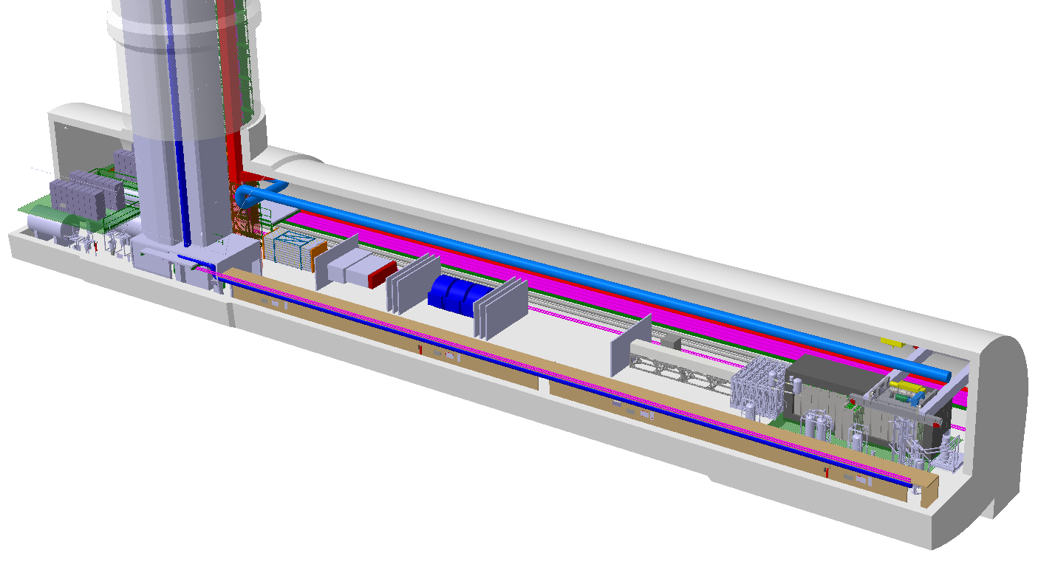
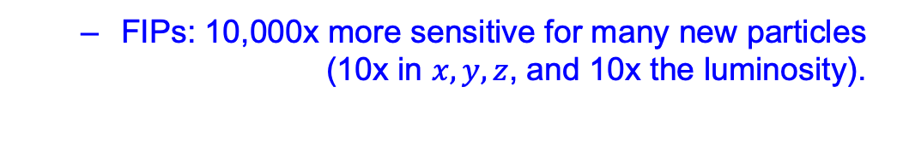
FPF EXPERIMENTS
4 experiments, all on the LOS to maximize the discovery potential of the LHC.
  FIPs: 10,000x more sensitive for many new particles (10x in $x, y,z$, and 10x the luminosity).
  Neutrinos: 10⁶ (1000 per day) at TeV energies, highest from a lab source, including 1000s of tau neutrinos.
FASER2
FASERnu2
FLArE
Engineering Department
Nominal Beam Axis
FORMOSA
Anastasiya Magazinik, Julien Prosic, talk at FPF9, 5 March 2026
Notes:
Here is the baseline layout of detectors in the FPF cavern.
All these detectors are centered on the beam axis line-of-sight.

Slide 15
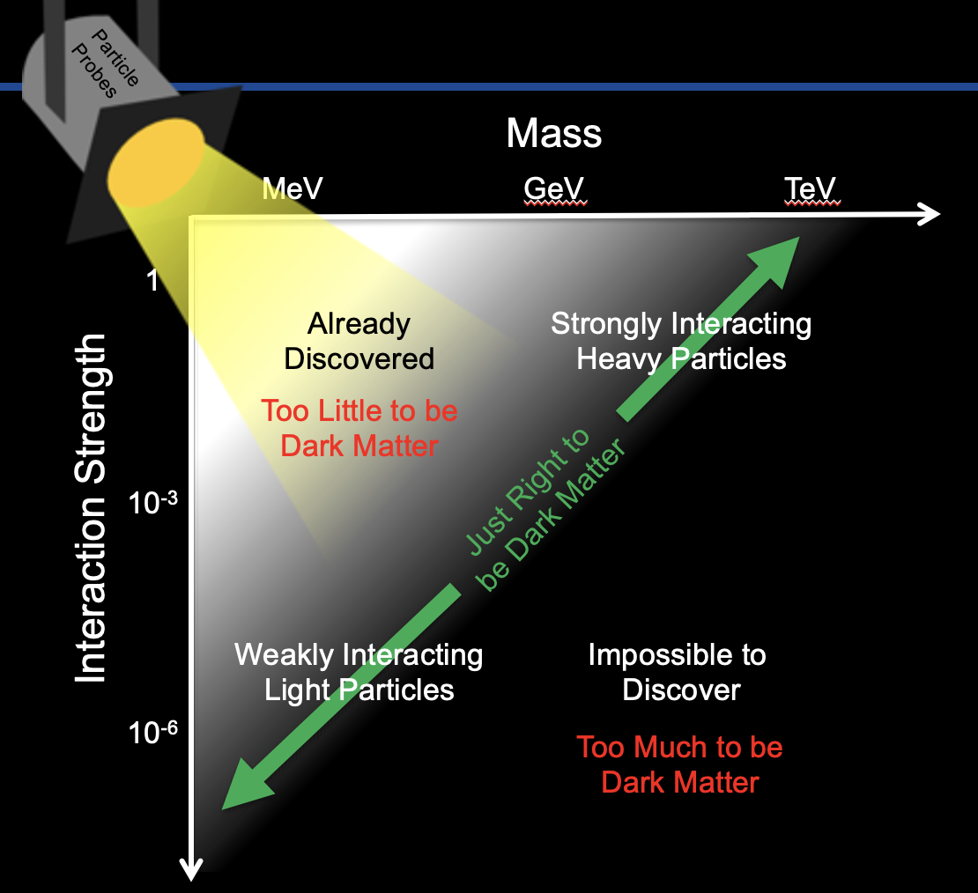
CONCLUSIONS
There are good reasons to think that the next breakthrough in particle physics will be the discovery of a FIP.
  1 of 2 possibilities for BSM particles.
  Accessible parameter space is well-motivated by cosmology.
  Connected to important problems central to our field: strong CP, dark matter, neutrino mass, EWSB.
  Still in the “low-hanging fruit” era, with many opportunities for innovative, fast, small, and cheap experiments to make huge strides forward. We are already seeing impressive results, with much more to come.
FIPs

