Slide 1





MOTIVATIONS AND SIGNALS
1st FASER Collaboration Meeting, CERN
Jonathan Feng, UC Irvine
1 April 2019

Slide 2
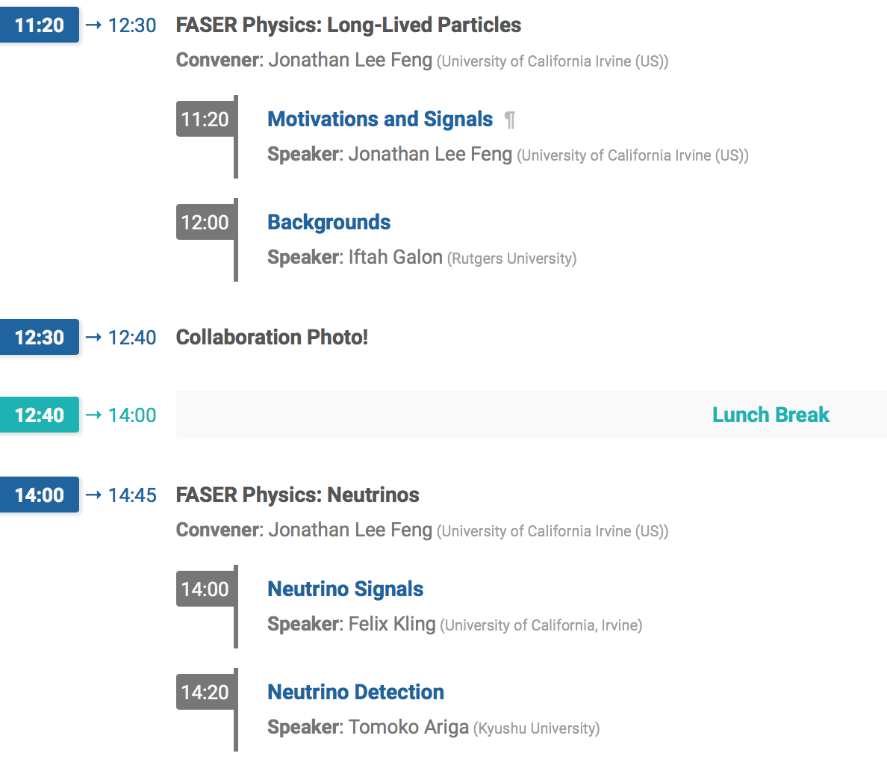
PHYSICS SESSION

Slide 3
OUTLINE
Motivations
  Particle Physics
  Cosmology
Signals
  Concrete Models
  Dark Photons
  Dark Higgs Bosons
  Axion-Like Particles

Slide 4

MOTIVATIONS: PARTICLE PHYSICS
Mass
MeV
GeV
TeV
1
Already
Discovered
Strongly Interacting
Heavy Particles
New Targets of Small Experiments
Traditional Targets
of Big Science
Interaction Strength
10⁻³
Weakly Interacting
Light Particles
Impossible to
Discover
10⁻⁶

Slide 5
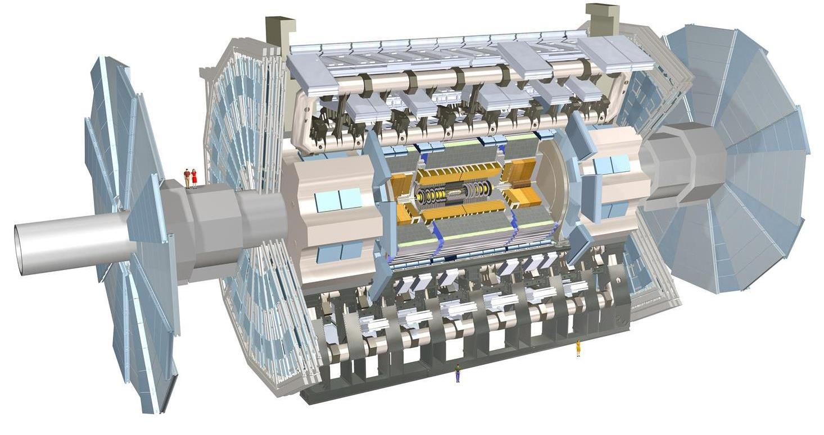
NEW PHYSICS SEARCHES AT THE LHC
The traditional targets are heavy, strongly interacting particles
  σ ~ fb to pb → N_{Run3} ~ 10²–10⁵, produced ~isotropically →high p_{T}
However, if new particles are light and weakly interacting, this may be completely misguided
  Light → they may be produced in π, K, D, B decays…
  Weakly-interacting → …but extremely rarely in π, K, D, B decays
More promising to look where most of the pions (and other mesons) are: along the beamline at low p_{T}
  σ_{inel} ~ 100 mb → N_{Run3} ~ 10¹⁶, and 10% of the pions are produced within 2 mrad of the beamline (η > 7)

Slide 6
THE IDEA
Of course, we can’t put a reasonably-sized detector on the beamline near the IP – it would block the proton beams
However, weakly-interacting particles are also typically long-lived, so we can place the detector O(100) m away, after the beam curves away
(100 m) (mrad) = 10 cm → particles are still highly collimated
These general considerations motivate a small, fast, inexpensive experiment placed in the very forward region of ATLAS/CMS, a few 100m downstream: FASER, the Forward Search Experiment at the LHC.

Slide 7
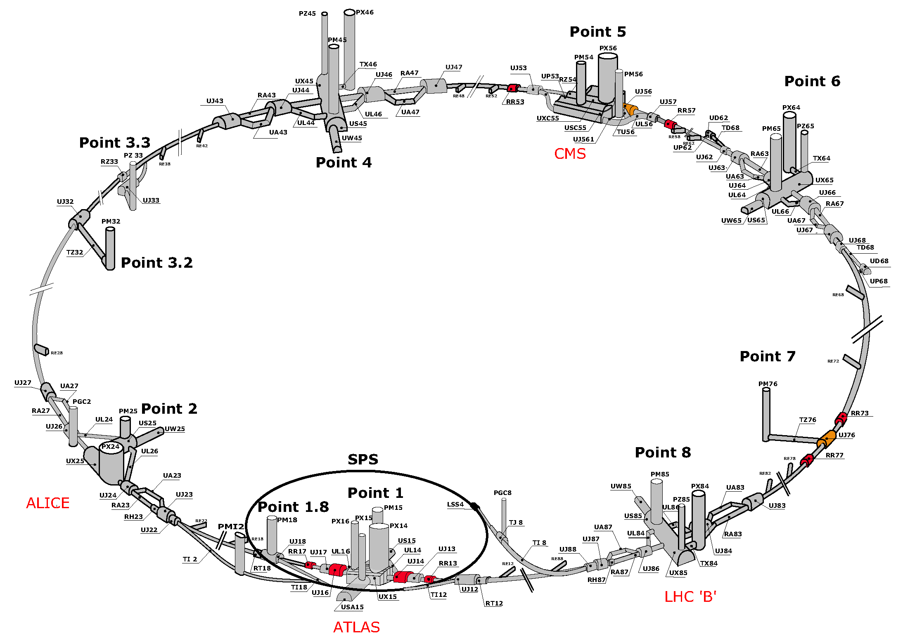
FASER LOCATION
FASER

Slide 8
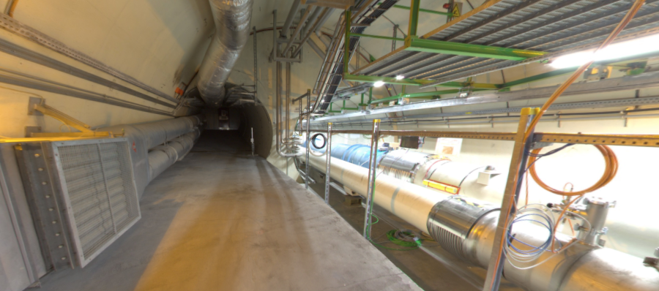
FASER LOCATION
The view looking west
New Physics
(Dark Sector)
LHC Beamline
(Visible Sector)

Slide 9
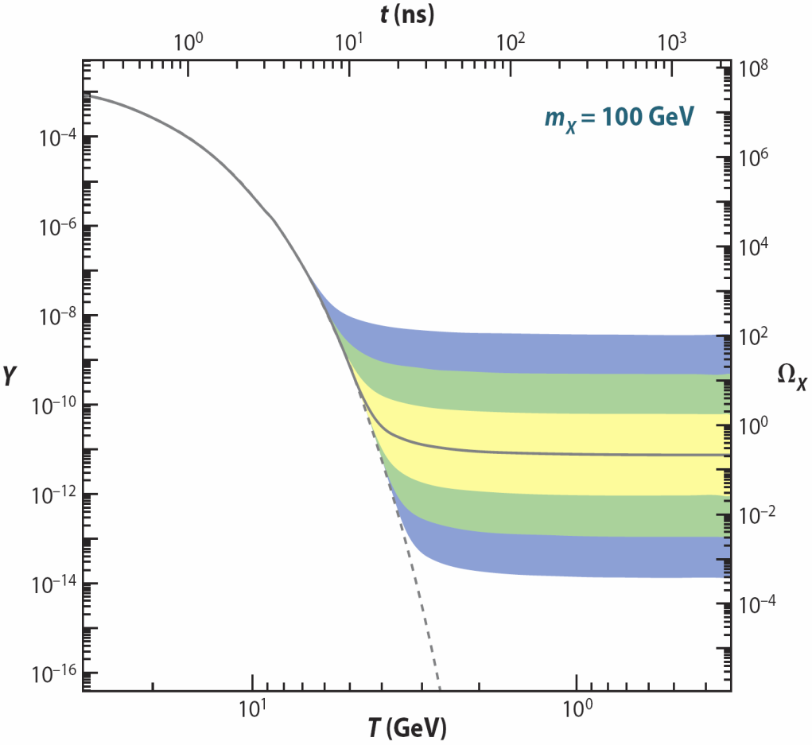
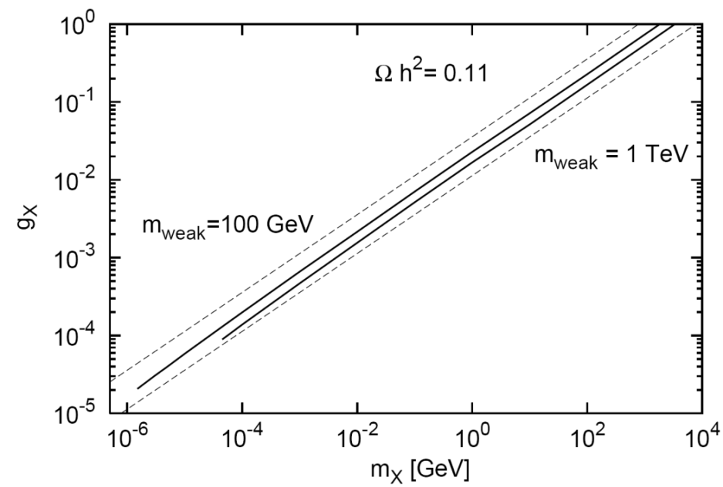
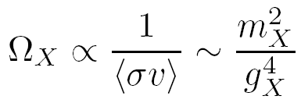
MOTIVATIONS: COSMOLOGY
Thermal freezeout is a simple mechanism for generating dark matter in the early universe
The WIMP Miracle: 100 GeV - TeV mass particles with weak interaction couplings to the SM freezeout with the right thermal relic density
_{WIMPs}
Feng, Kumar (2008); Feng, Tu, Yu (2010)
_{WIMPless DM}
The WIMPless Miracle: lighter particles with even weaker interactions with the SM can also freezeout with the right thermal relic density, providing a cosmological motivation that enhances the particle physics motivation

Slide 10
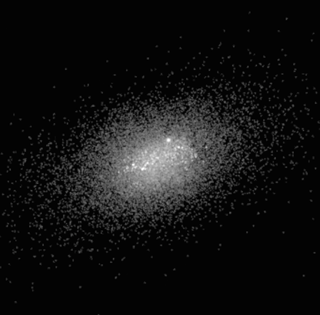
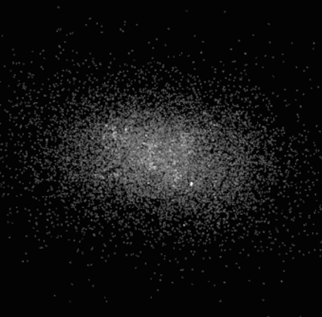



DARK MATTER
There are even tentative indications that there is a new “mediator” particle with mass 10 – 100 MeV that mediates large DM-DM self-interactions
Collisionless cold DM
More cuspy
Strongly self-interacting DM
More smooth
Brooks et al. (2017)
Such scenarios predict a 10-100 MeV weakly-interacting particle

Slide 11

SIGNALS: CONCRETE MODELS
We want to determine signals, FASER’s potential in concrete models. Seems like a Pandora’s box of possibilities.
But suppose there is a dark sector with its own U(1)_{EM}. There are infinitely many possible SM-dark sector interactions, but only one is induced by arbitrarily heavy mediators:
It is “most likely” because it is non-decoupling. Cf.
It is also naturally small, since it is induced by a loop.
SM
Dark
U(1)
M
Okun (1982), Galison, Manohar (1984), Holdom (1986)

Slide 12
DARK PHOTON, DARK HIGGS, STERILE NUS
This provides an organizing principle that motivates specific examples of new, weakly interacting light particles. There are just a few options:
Spin 1
→ dark photon, couples to SM fermions with suppressed couplings proportional to charge: εq_{f}.
Spin 0
→ dark Higgs boson, couples to SM fermions with suppressed coupling proportional to mass: sin θ m_{f}.
Spin 1/2
→ Heavy neutral lepton, mixes with SM νs with suppressed mixing sin θ.
SM
Dark
Force
SM
Dark
Scalar
SM
Dark
Fermion

Slide 13
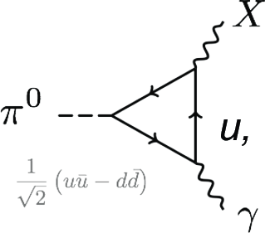
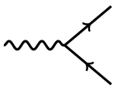
SIGNALS: DARK PHOTONS
Consider some “typical” parameters: m_{A’} = 100 MeV, ε = 10⁻⁵.
Production: for example, pion decay:
Branching ratio suppressed by ε² = 10⁻¹⁰. Need lots of pions!
Decay
Decay lengths of ~100 m
A’
e⁺
ε
ε
A’
e⁻

Slide 14
SIGNALS: DARK PHOTONS
Pions at the IP
Simulations greatly refined by LHC data
Production is peaked at p_{T} ~ Λ_{QCD} ~ 250 MeV
Enormous event rates: N_{π}~10¹⁵ per bin
A’s at the IP
Production is peaked at p_{T} ~ Λ_{QCD} ~ 250 MeV
Rates highly suppressed by ε² ~ 10⁻¹⁰
But still N_{A’} ~ 10⁵ per bin
A’s decay in [480m, 483m]
Only highly boosted ~TeV A’s decay in FASER
Rates again suppressed by decay requirement
But still N_{A’} ~ 100 e⁺e⁻ signal events, most within 20 cm of “on axis”
300 fb⁻¹

Slide 15
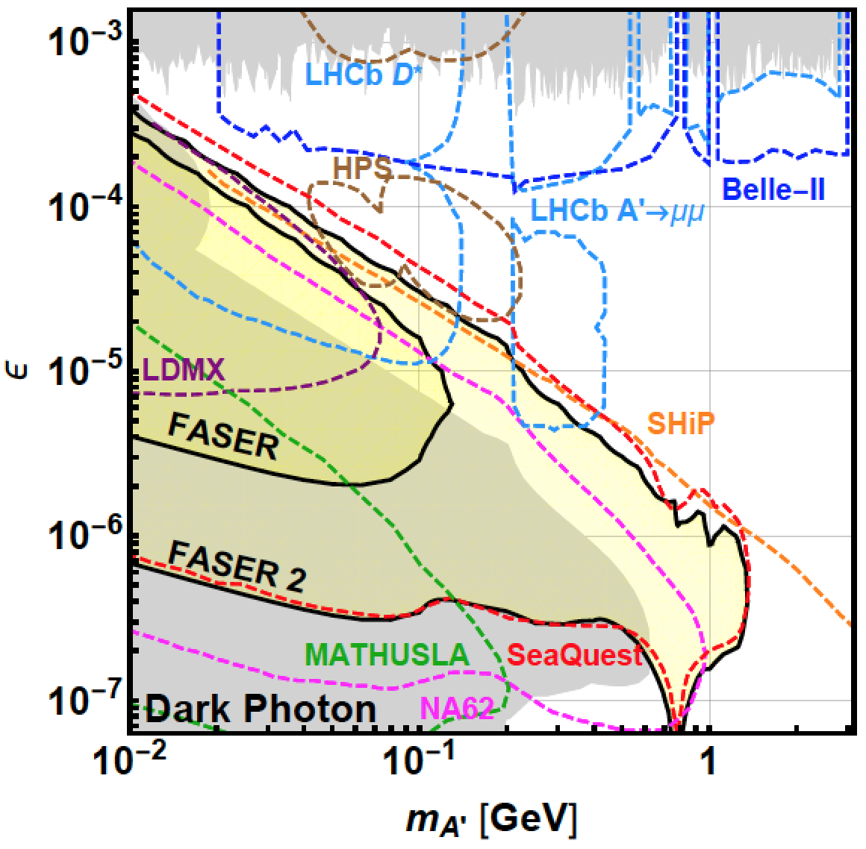
DARK PHOTON SENSITIVITY REACH
_{FASER Collaboration (2018)}
FASER 1: R=10cm, L=1.5 m, Run 3; FASER 2: R=1m, L=5m, HL-LHC
For low ε, FASER is not competitive with SHiP.
For high ε, FASER may have world-leading sensitivity.
Discovery contours assume no background. But note: signal contours are very closely spaced: ~50% signal efficiency, N=3 vs.10, e⁺e⁻ vs. e⁺e⁻ + μ⁺μ⁻, L=3m vs. 5m, … each lead to nearly imperceptible shifts in reach.

Slide 16
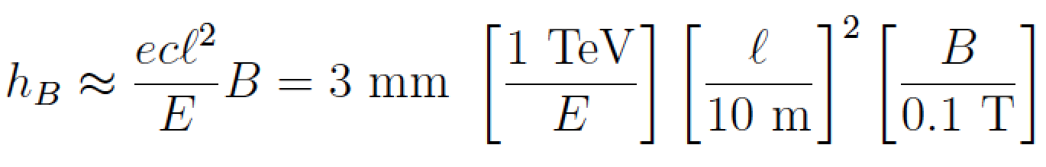
THE DARK PHOTON SIGNAL
A’
e⁺
e⁻
No signal in the veto scintillator
2 high-energy, oppositely charged tracks consistent with originating from a common vertex in the decay volume and with a combined momentum pointing back to the IP
For e⁺e⁻ signature, also get a large EM deposit in the calorimeter
Magnets are needed to separate the 2 charged tracks sufficiently to resolve them in the tracker

Slide 17
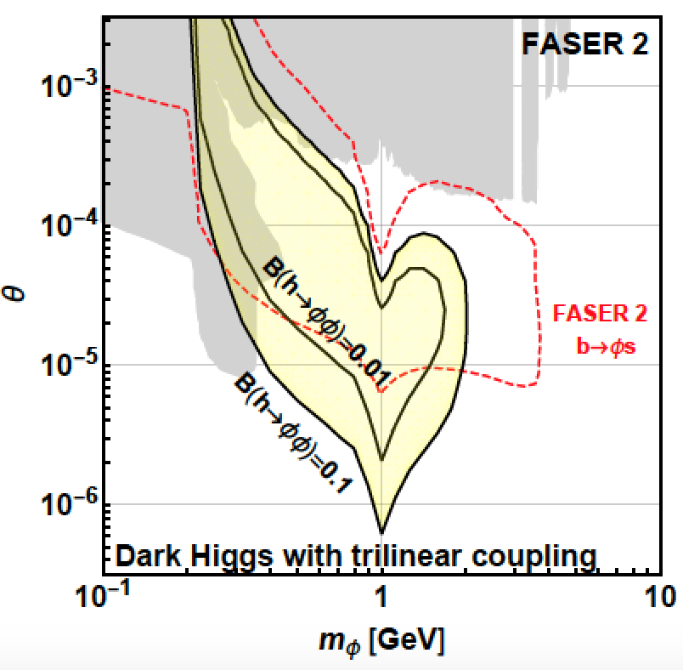
SIGNALS: DARK HIGGS BOSONS
SINGLE PRODUCTION
Dark Higgs produced in B decays. N_{B}/N_{π}~10⁻² at FASER (N_{B}/N_{π}~10⁻⁷ at beam dumps)
Signal is μ⁺μ⁻, π⁺π⁻, K⁺K⁻
Probes h-φ mixing, reach is complementary to other experiments
DOUBLE PRODUCTION
Probes hφφ trilinear coupling
Complementary to probes of exotic Higgs decays h→φφ
FASER probes SM Higgs properties!
φ
Feng, Galon, Kling, Trojanowski (2017)

Slide 18
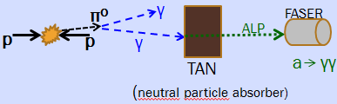
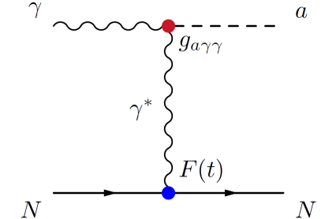
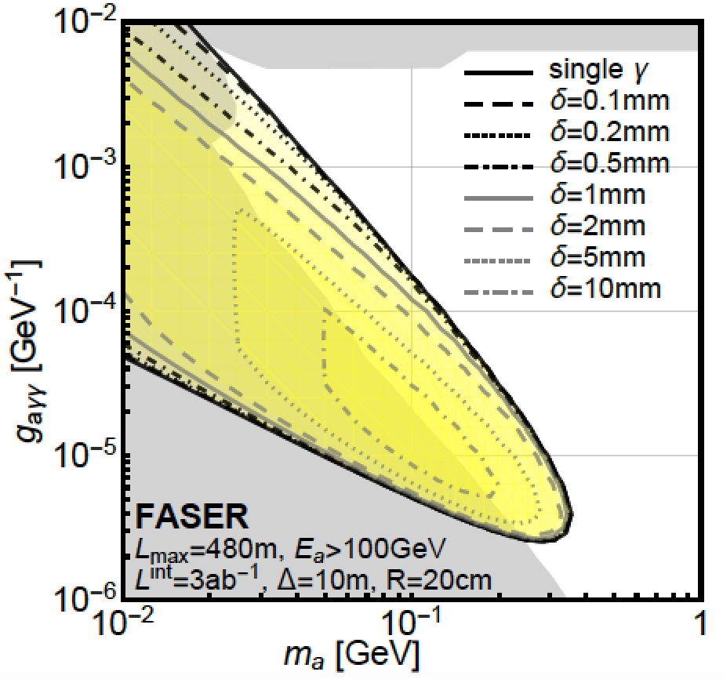
SIGNALS: ALPS COUPLED TO PHOTONS
~TeV photon from IP collides with TA(X)N, creates ALP through Primakoff process and a → γγ in FASER. “light shining through (100 m) wall expt”
Signal is 2 photons separated by 0.1 – few mm. Distinguishing 2 photons is very challenging, but already some FASER upgrades proposed
Feng, Galon, Kling, Trojanowski (2018)

Slide 19
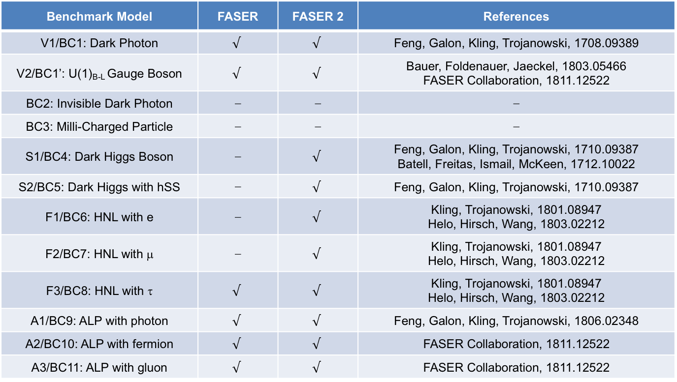
PHYSICS SUMMARY
FASER has a full physics program: can discover all candidates with renormalizable couplings (dark photon, dark Higgs, HNL); ALPs with all types of couplings (γ, f, g); and many other examples; see FASER’s Physics Reach for LLPs, 1811.12522.
Benchmark Model | FASER | FASER 2 | References
V1/BC1: Dark Photon | $$√$$ | $$√$$ | Feng, Galon, Kling, Trojanowski, 1708.09389
V2/BC1’: U(1)_{B-L} Gauge Boson | $$√$$ | $$√$$ | Bauer, Foldenauer, Jaeckel, 1803.05466 FASER Collaboration, 1811.12522
BC2: Invisible Dark Photon | ⎼ | ⎼ | ⎼
BC3: Milli-Charged Particle | ⎼ | ⎼ | ⎼
S1/BC4: Dark Higgs Boson | ⎼ | $$√$$ | Feng, Galon, Kling, Trojanowski, 1710.09387 Batell, Freitas, Ismail, McKeen, 1712.10022
S2/BC5: Dark Higgs with hSS | ⎼ | $$√$$ | Feng, Galon, Kling, Trojanowski, 1710.09387
F1/BC6: HNL with e | ⎼ | $$√$$ | Kling, Trojanowski, 1801.08947 Helo, Hirsch, Wang, 1803.02212
F2/BC7: HNL with μ | ⎼ | $$√$$ | Kling, Trojanowski, 1801.08947 Helo, Hirsch, Wang, 1803.02212
F3/BC8: HNL with τ | $$√$$ | $$√$$ | Kling, Trojanowski, 1801.08947 Helo, Hirsch, Wang, 1803.02212
A1/BC9: ALP with photon | $$√$$ | $$√$$ | Feng, Galon, Kling, Trojanowski, 1806.02348
A2/BC10: ALP with fermion | $$√$$ | $$√$$ | FASER Collaboration, 1811.12522
A3/BC11: ALP with gluon | $$√$$ | $$√$$ | FASER Collaboration, 1811.12522

Slide 20
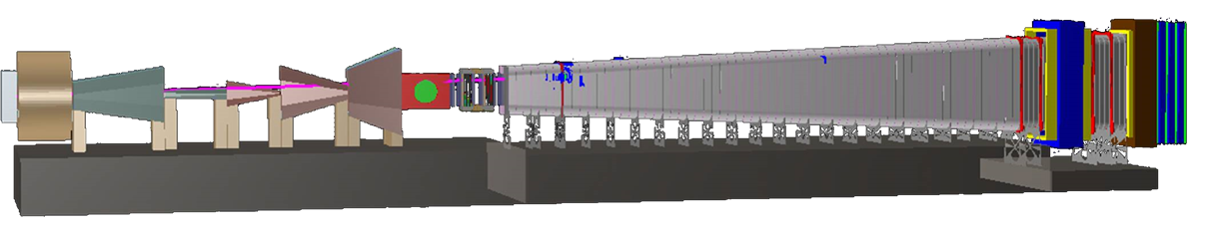
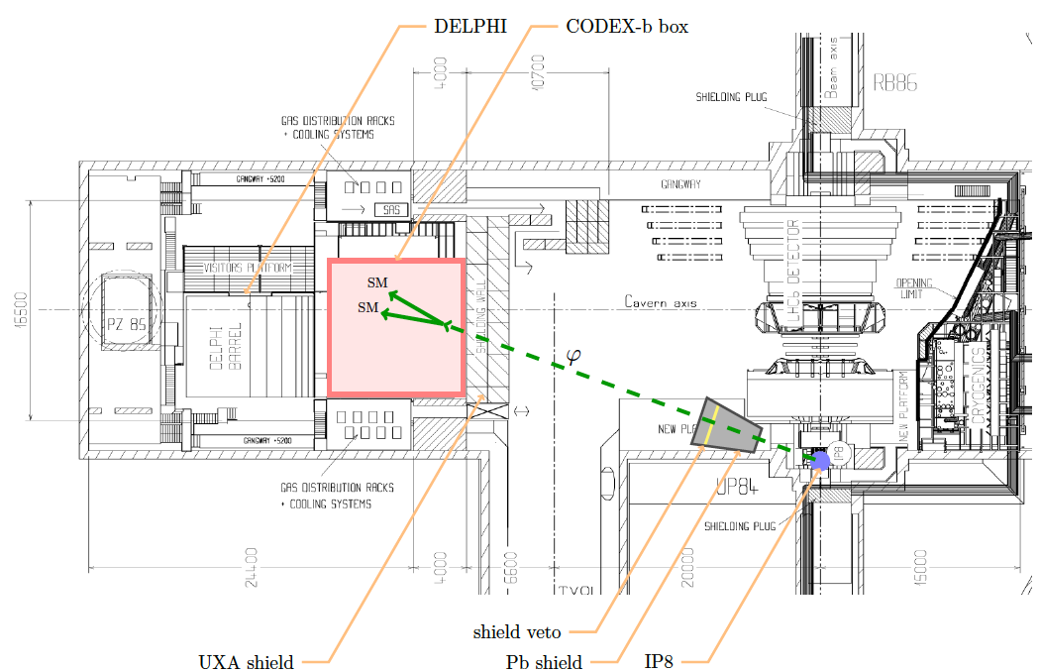
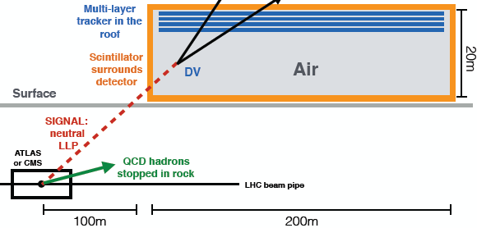
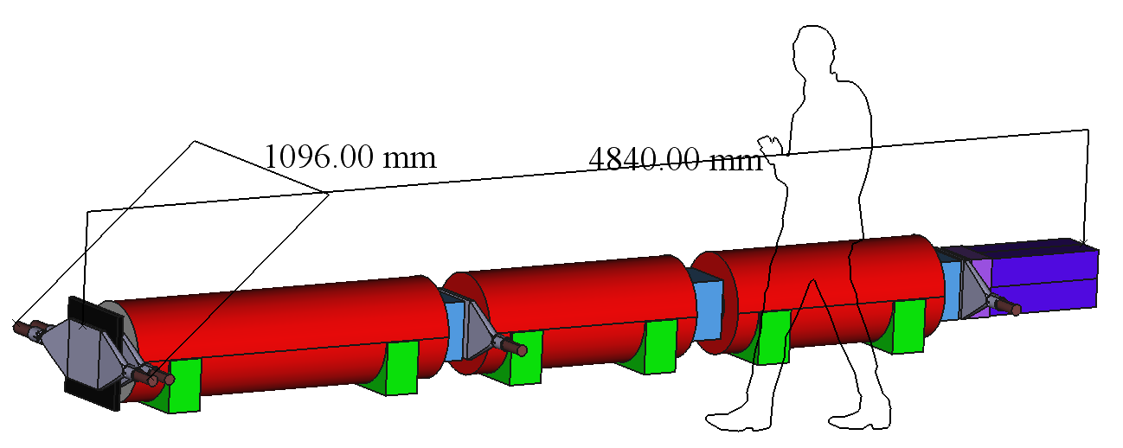
COMPLEMENTARY PROPOSED EXPERIMENTS
SHiP
CODEX-b
~1000 m³, ~100M CHF + beam
Alekhin et al. (2015)
~1000 m³ ~ 1 mIKEAs
Gligorov, Knapen, Papucci, Robinson (2017)
FASER
MATHUSLA
~1 m³ ~ 1 μIKEAs
~800,000 m³ ~ 1 IKEA, ~$50M
Feng, Galon, Kling, Trojanowski (2017)
Chou, Curtin, Lubatti (2016)

Slide 21
SUMMARY AND SEARCH PROSPECTS
FASER is an opportunity for a small and inexpensive experiment to search for light and weakly-interacting particles, complementing other experiments and extending the discovery prospects of the LHC.
Discovery prospects for LLPs
Install FASER in LS2 (2019-20) for Run 3 (2021-23, 150 fb⁻¹)
    Decay volume: R = 10 cm, L = 1.5 m.
    Discovery prospects for dark photons, B-L gauge bosons, ALPs, etc.
After successful operation of FASER, FASER 2 could be installed in LS3 (2023-25) for HL-LHC (2026-35, 3 ab⁻¹)
    Decay volume: R = 1 m, L = 5 m. Requires extension of existing tunnel (widening of UJ12 or UJ18 areas).
    Full physics program: dark photons, B-L, ALPs, dark Higgs, HNLs, etc.
Also interesting prospects for detecting the first LHC neutrinos, measuring their properties.

