Slide 1



COLLIDER NEUTRINOS
Neutrino University, Neutrino Physics Center, Fermilab
Jonathan Feng, UC Irvine, 1 July 2026

Slide 2
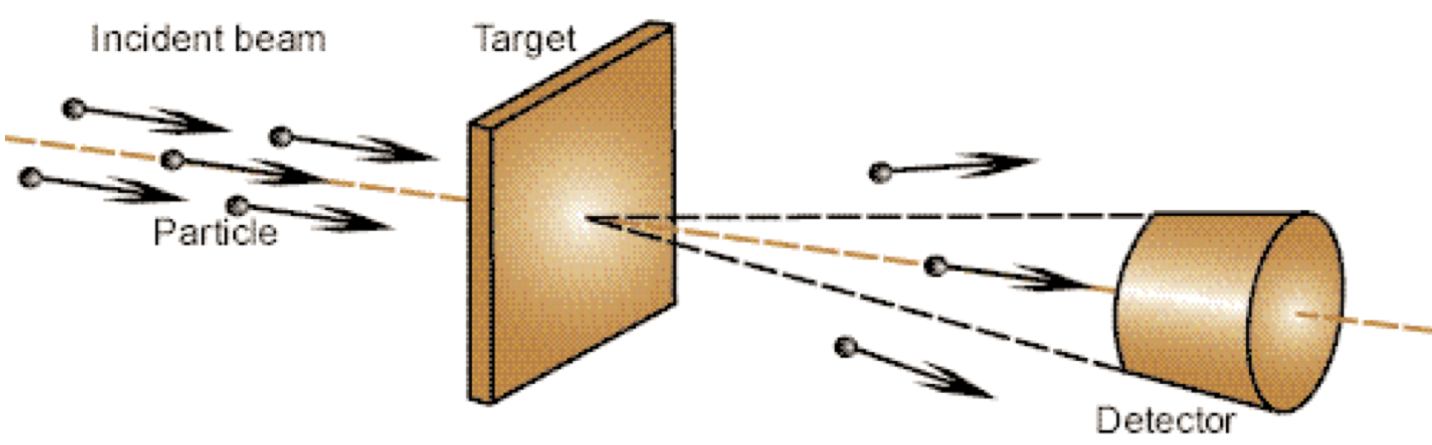
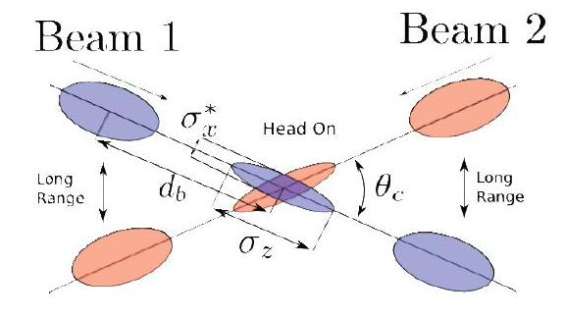
WHAT IS THE DEFINITION OF “COLLIDER”?
Previous Neutrino University lectures this year have covered Atmospheric, Solar, and Astrophysical Neutrinos, Reactor Neutrinos, and Accelerator Neutrinos. How many of you have attended these?
This lecture is about Collider Neutrinos. What distinguishes Accelerator Neutrinos from Collider Neutrinos?
  Accelerator: 1 beam. Collider: 2 beams.
Shooting a beam of protons into a block of matter is easy – with just a little bit of matter, almost every proton interacts, produces neutrinos. In fact, we characterize the number of interactions by POT: protons on target.
Getting two beams of protons to interact is hard – have to focus them, most don’t interact, don’t produce neutrinos. We characterize the number of interactions by the luminosity, which depends on the number of protons in each beam, but also how much we are able to focus the beams.
Accelerator
Collider

Slide 3
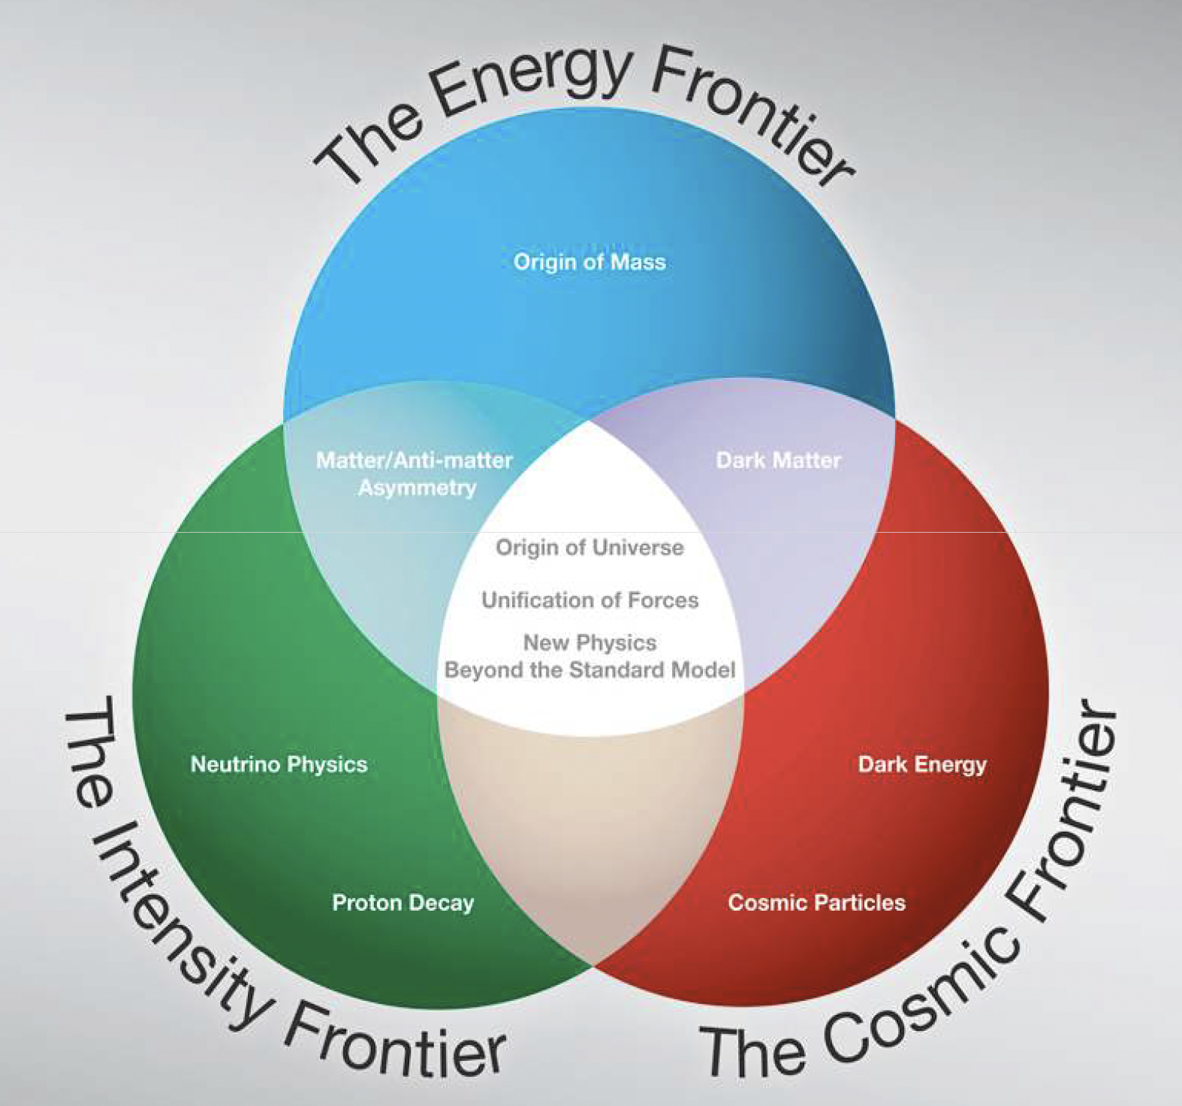
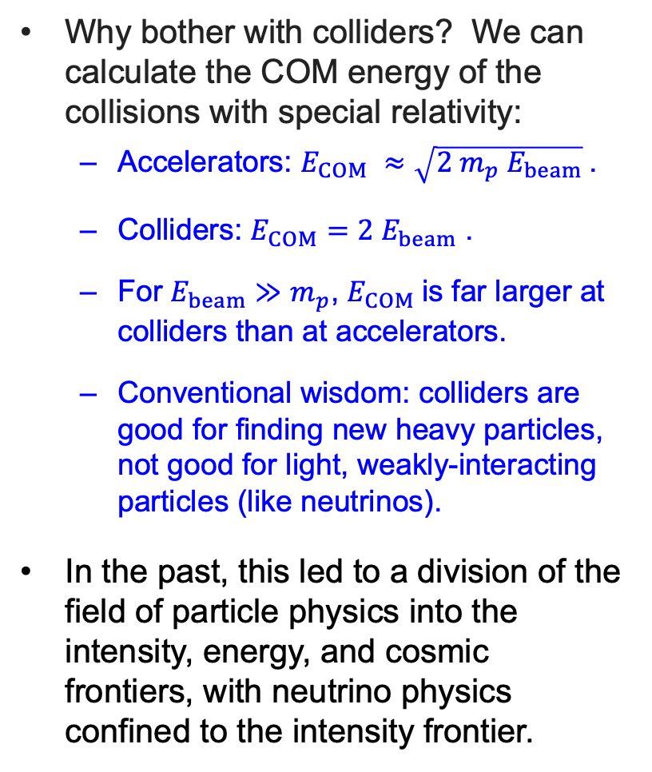
NEUTRINOS AND THE THREE FRONTIERS
Why bother with colliders? We can calculate the COM energy of the collisions with special relativity:
  Accelerators: $E_{COM} ≈\sqrt{2 m_{p} E_{beam}}$.
  Colliders: $E_{COM}=2 E_{beam}$ .
  For $E_{beam}≫m_{p}$, $E_{COM}$is far larger at colliders than at accelerators.
  Conventional wisdom: colliders are good for finding new heavy particles, not good for light, weakly-interacting particles (like neutrinos).
In the past, this led to a division of the field of particle physics into the intensity, energy, and cosmic frontiers, with neutrino physics confined to the intensity frontier.

Slide 4
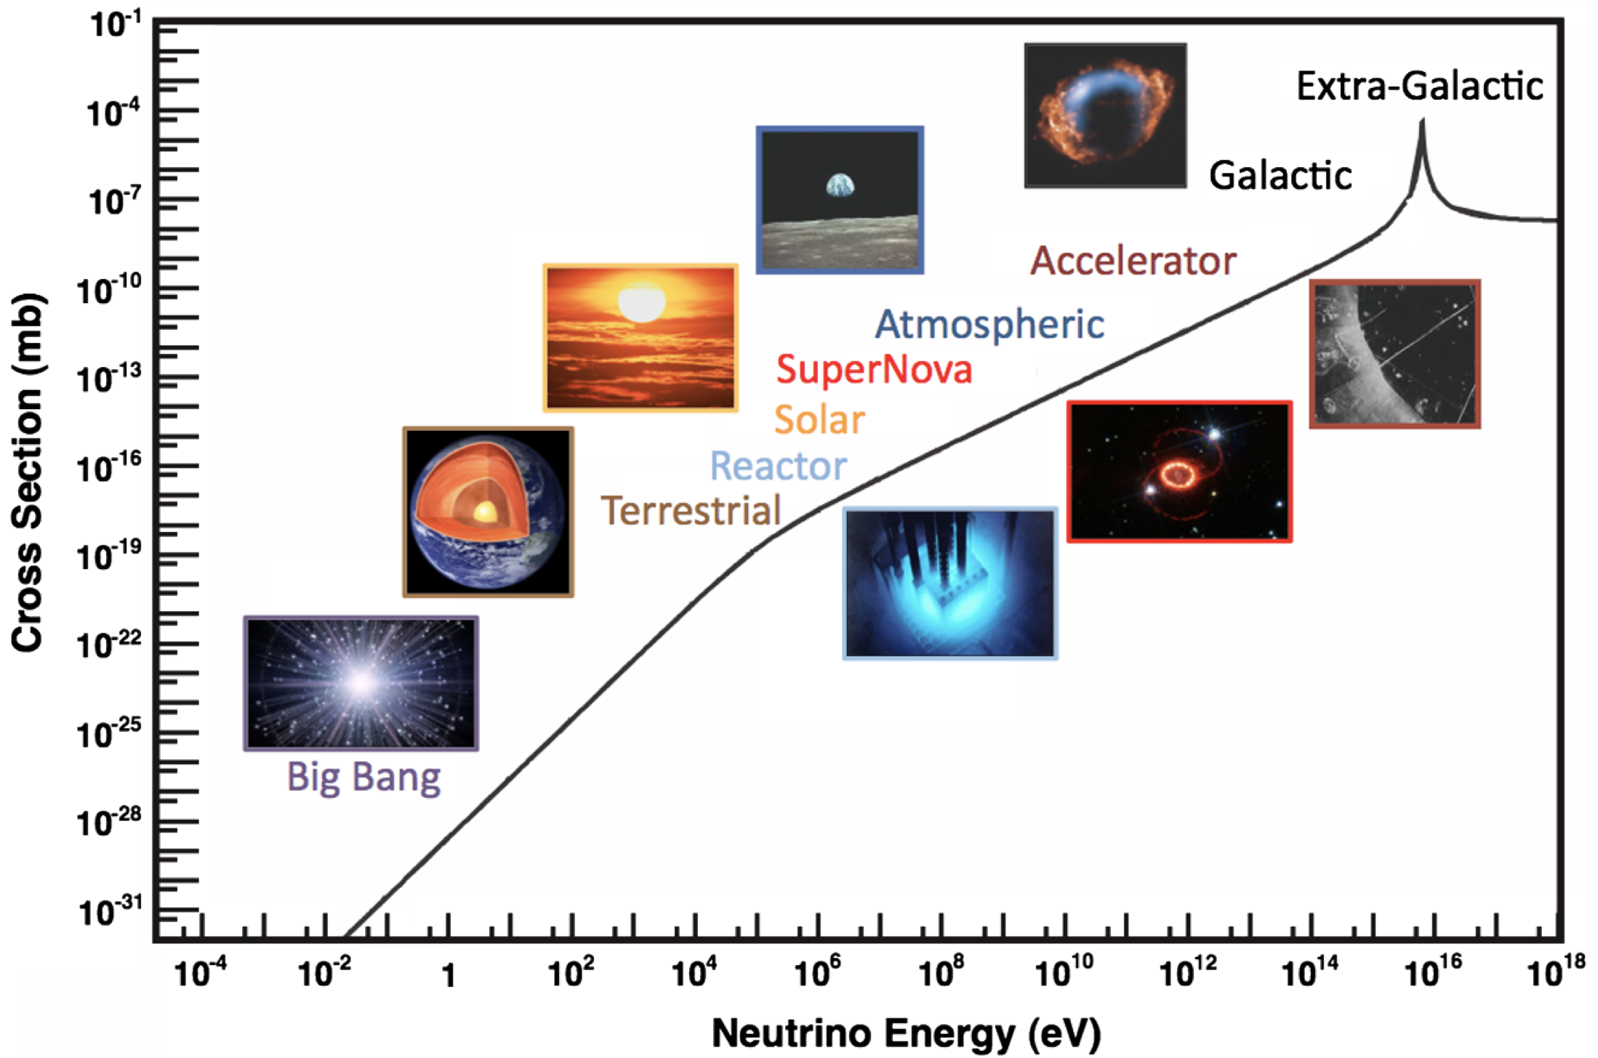
NEUTRINOS AT COLLIDERS
In the last ~5 years, we have learned a lot, and the truth is far more interesting!
Neutrinos are not confined to the intensity frontier.
Neutrinos can be directly detected at particle colliders at the energy frontier.
Neutrinos can be directly detected at particle colliders with small, fast, and inexpensive detectors.
Neutrinos at colliders are opening up an entirely new window on the universe.
Every time neutrinos are discovered from a new source, they tell us something fascinating. Collider neutrinos are the latest new source, and no exception. This is “hot off the press,” and a fast-developing subfield; we are learning new things, and also learning what we can learn.
Formaggio, Zeller (2012)

Slide 5
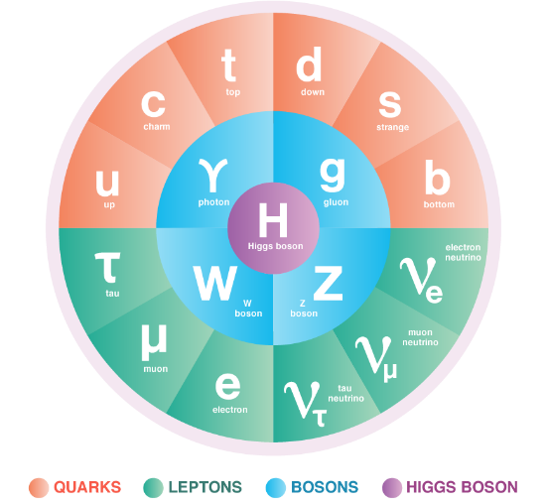
THE STANDARD MODEL OF PARTICLE PHYSICS
The Standard Model is the reigning theory of fundamental particles and their interactions. The last particle predicted by the SM, the Higgs boson, was discovered at CERN in 2012.
But the SM is not the last word, because many fundamental questions remain. For example:
  Neutrino Masses: the SM predicts that neutrinos are massless, but they aren’t.
  Dark Matter: The particles of the SM make up only ~15% of the matter in the universe.
These questions imply that there is physics beyond the SM to discover, and probably much more.

Slide 6
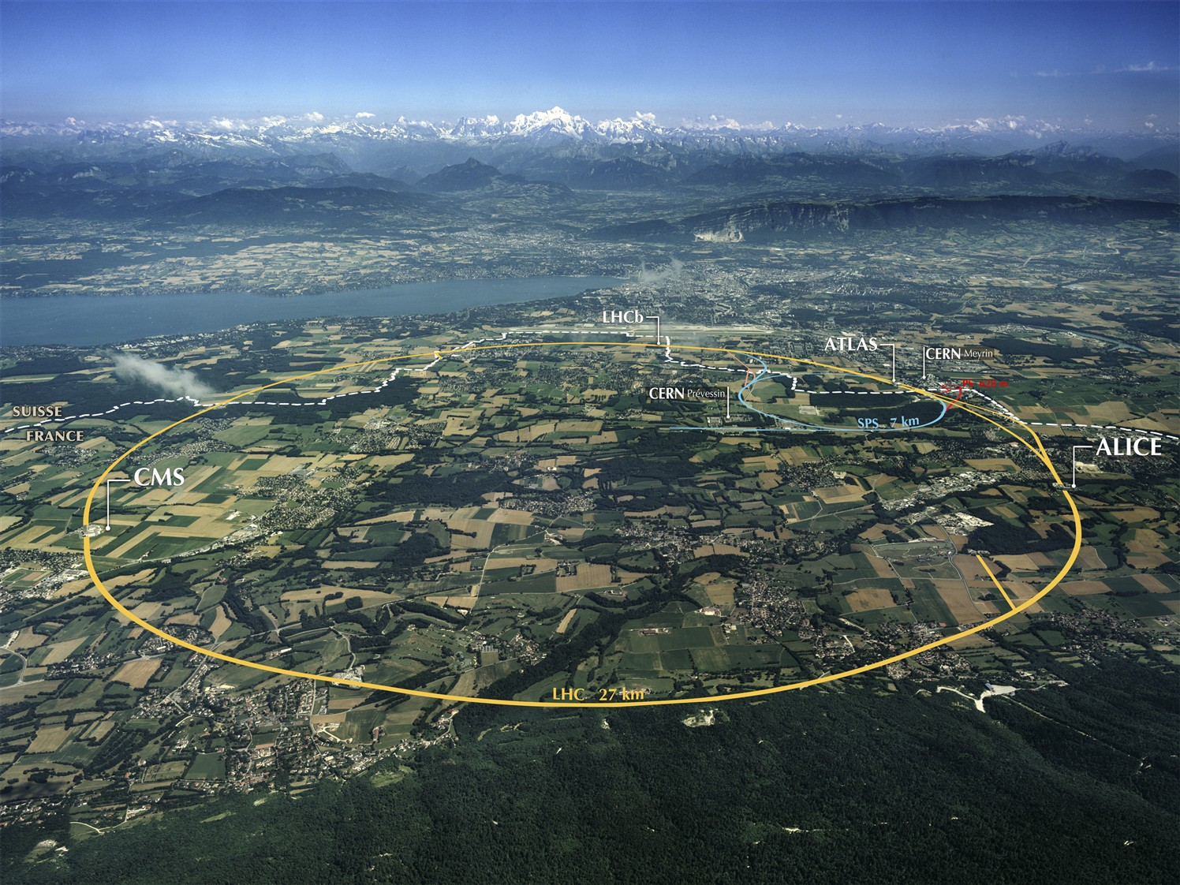
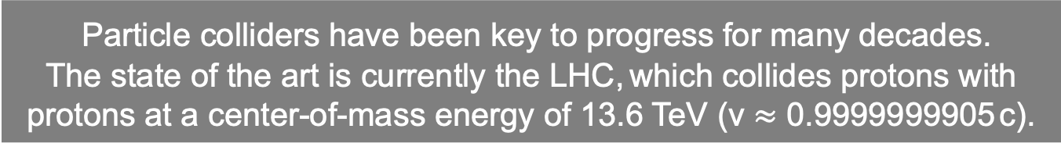
THE LARGE HADRON COLLIDER
.
FASER
Particle colliders have been key to progress for many decades.
The state of the art is currently the LHC, which collides protons with protons at a center-of-mass energy of 13.6 TeV (v $≈$ 0.9999999905 c).
Notes:
6

Slide 7
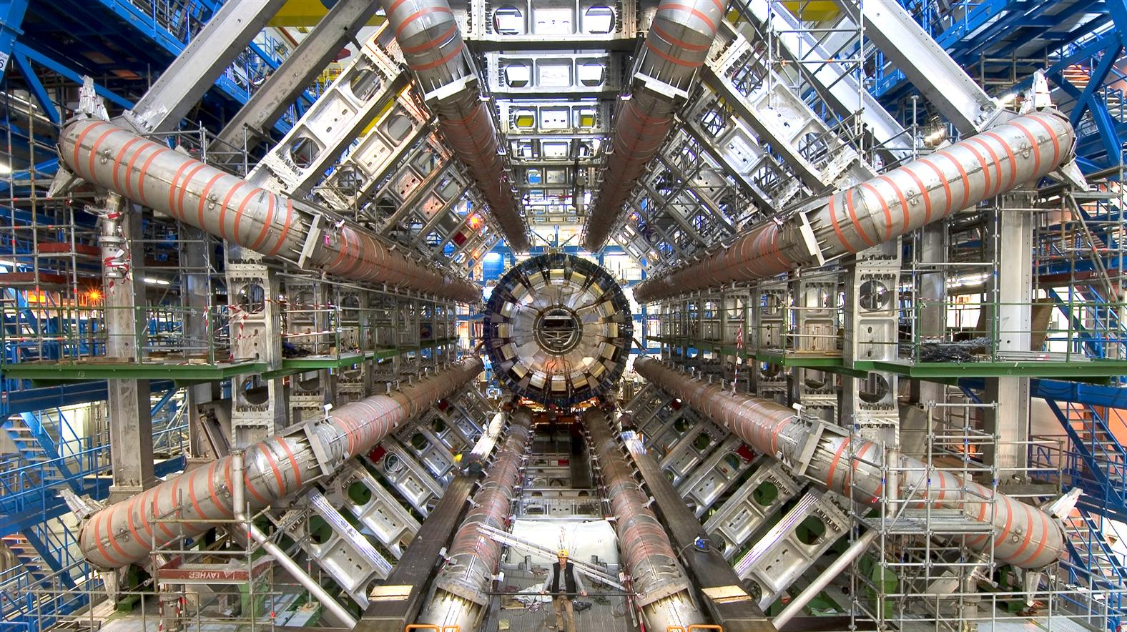
LHC DETECTORS
The protons collide at 4 interaction points, and each point is surrounded by a large detector to view the results of the collisions. These detectors cost billions of dollars and were constructed over decades by thousands of collaborators.
The ATLAS Detector
Notes:
7

Slide 8
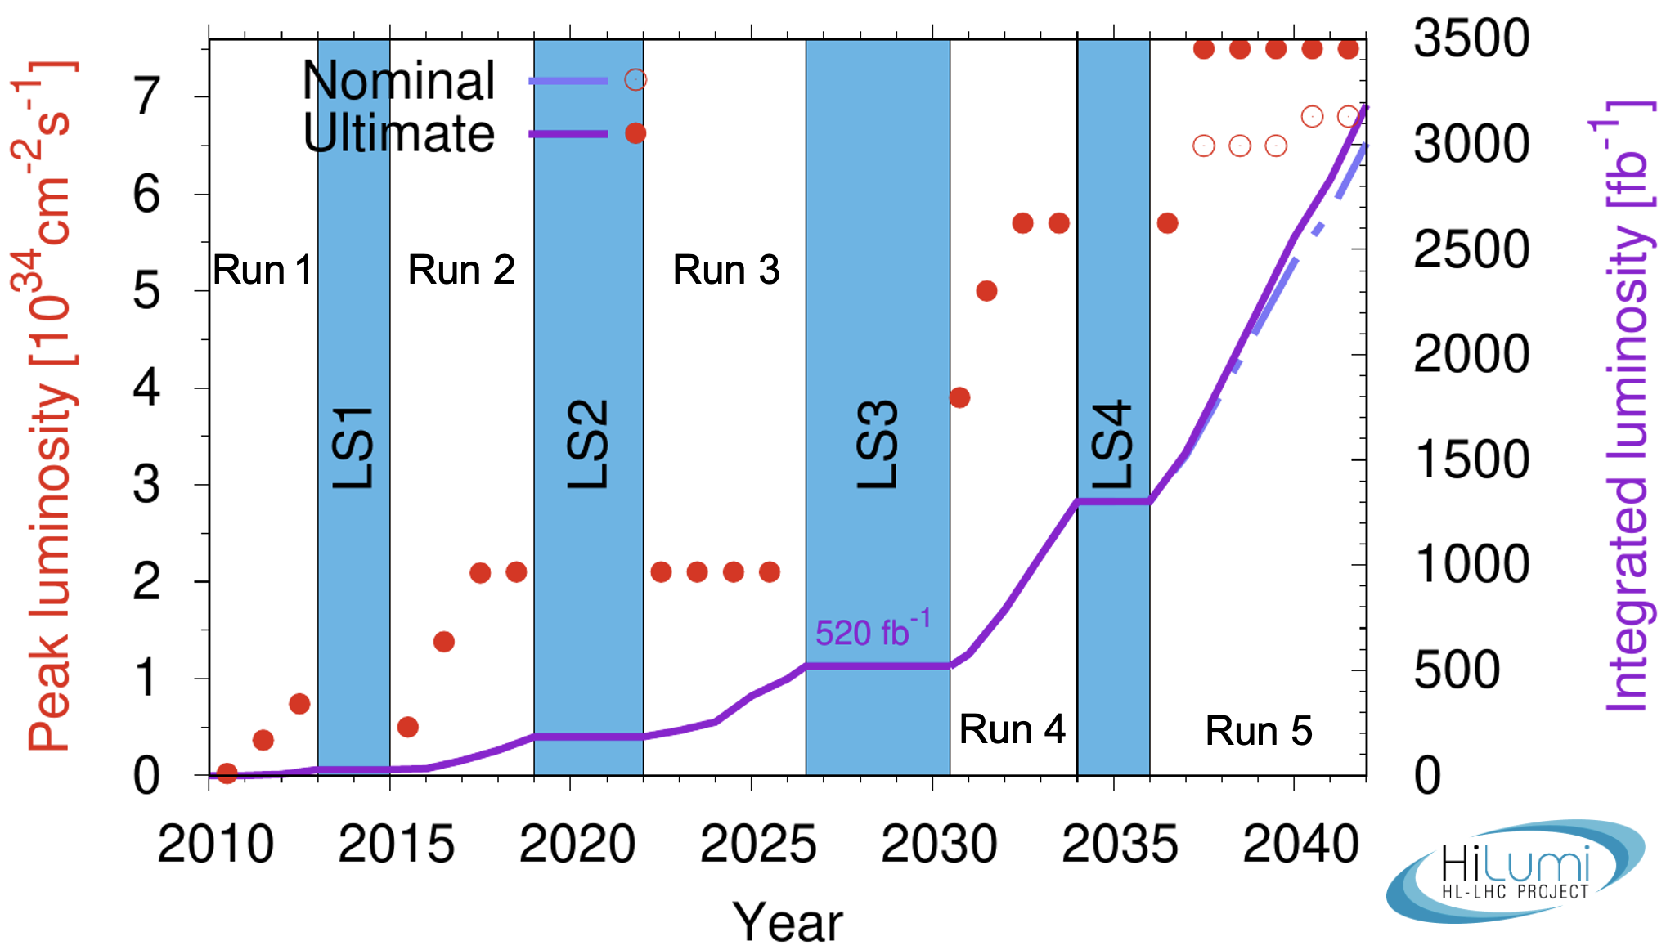
LIFETIME OF THE LHC
The LHC became the future of particle colliders in 1993 when the US canceled the SSC.
The LHC started running in 2010 and is scheduled to run until ~2042.
  Middle-aged in terms of years
  But a 12-year-old in terms of integrated luminosity (number of collisions)
Are we using the LHC to its full potential? What can we do to enhance its discovery prospects?

Slide 9
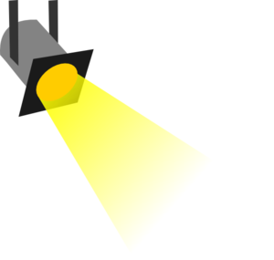
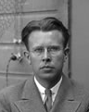
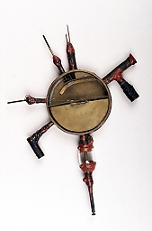
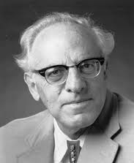





















THE PARTICLE PHYSICS LANDSCAPE
Particle
Colliders
Mass
MeV
GeV
TeV
1
$$←$$
$$g$$
$$u$$
$$d$$
$$s$$
$$p$$
$$n$$
$$c$$
$$b$$
$$t$$
$$←$$
$$γ$$
$$e$$
$$μ$$
$$τ$$
$$W$$
$$Z$$
$$h$$
Already
Discovered
Strongly Interacting
Heavy Particles
Interaction Strength
10⁻³
$$ν_{e}$$
$$ν_{μ}$$
$$ν_{τ}$$
$$←$$
Weakly Interacting
Light Particles
Impossible to
Discover
10⁻⁶

Slide 10
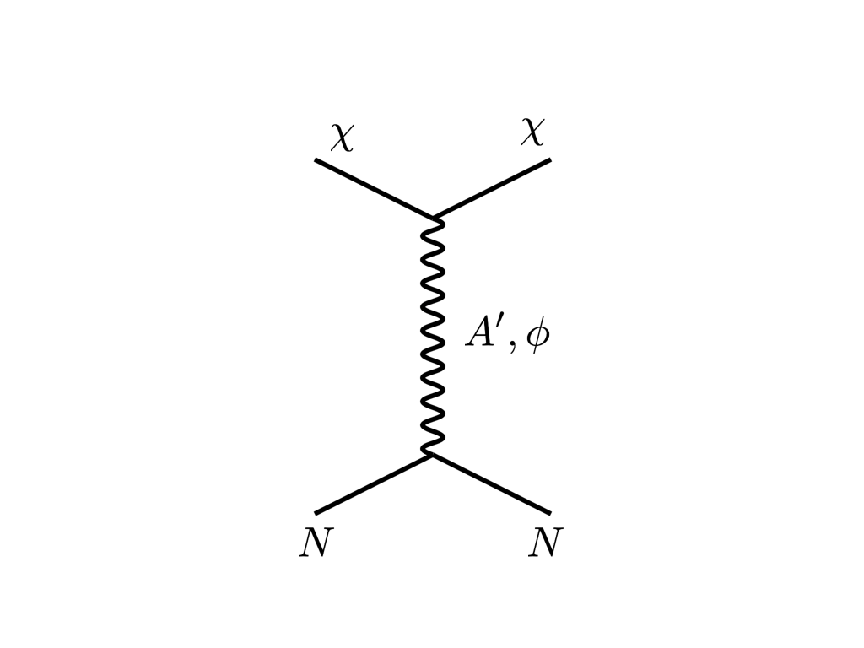



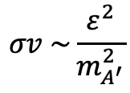


THE COSMOLOGY LANDSCAPE
Particle
Colliders
Mass
MeV
GeV
TeV
1
Already
Discovered
Strongly Interacting
Heavy Particles
DM
$$e$$
Too Little to be
Dark Matter
$$ε$$
$$ε$$
Interaction Strength
Just Right to
be Dark Matter
$$A′$$
10⁻³
$$e$$
DM
$$σv \sim \frac{ε^{2}}{m_{A^{′}}^{2}}$$
Weakly Interacting
Light Particles
Impossible to
Discover
Boehm, Fayet (2003)
Pospelov, Ritz, Voloshin (2007)
Feng, Kumar (2008)
10⁻⁶
Too Much to be
Dark Matter

Slide 11
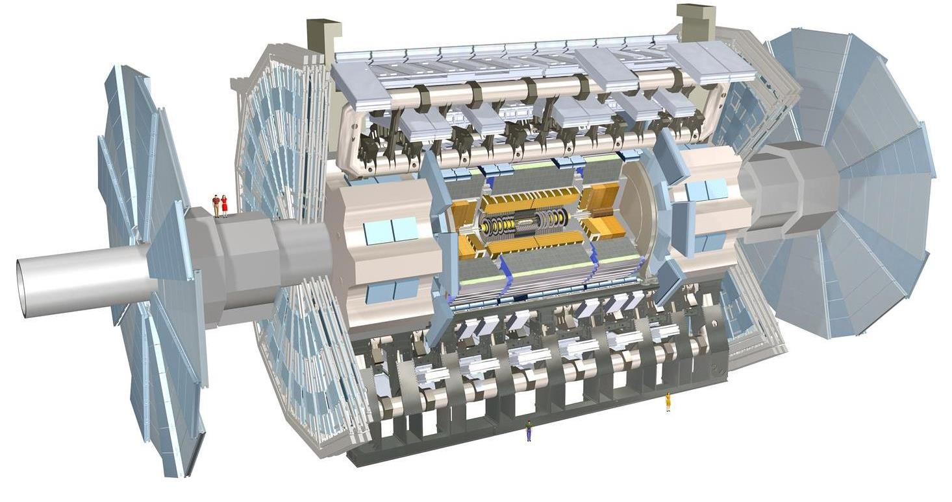
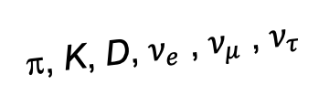
FORWARD PHYSICS
In 2017, we realized that the large LHC detectors, while beautifully optimized to discover new heavy particles, are also almost optimally configured to miss new light particles.
Heavy particles (W, Z, t, h, …) are produced at low velocity and decay roughly isotropically to other particles.
But high-energy light particles are dominantly produced in the forward (and far-forward) direction (parallel to the beamline) and escape through the blind spots of these detectors.
  This is true for all known light particles: pions, kaons, D mesons, all neutrinos.
  It is also true for new, weakly-interacting particles motivated by neutrino mass and dark matter.
“These blind spots are the Achilles heels of the large LHC detectors.” – Dave Casper
Feng, Galon, Kling, Trojanowski (2017)
A’, a, mCPs, χ, …
π, K, D, $ν_{e}$ , $ν_{μ}$ , $ν_{τ}$
De Rujula, Ruckl (1984)

Slide 12
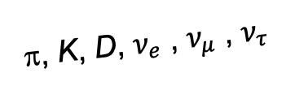
DETECTING FORWARD PARTICLES
Problem: How can we detect forward particles? We can’t just put a detector there, because it will block the protons from coming in and colliding.
Solution: the LHC is a circular collider! If we go far enough away, the LHC proton beam will be bent away, while all the light, weakly-interacting particles we are looking for will go straight.
!!
A’, a, mCPs, χ, …
π, K, D, $ν_{e}$ , $ν_{μ}$ , $ν_{τ}$

Slide 13
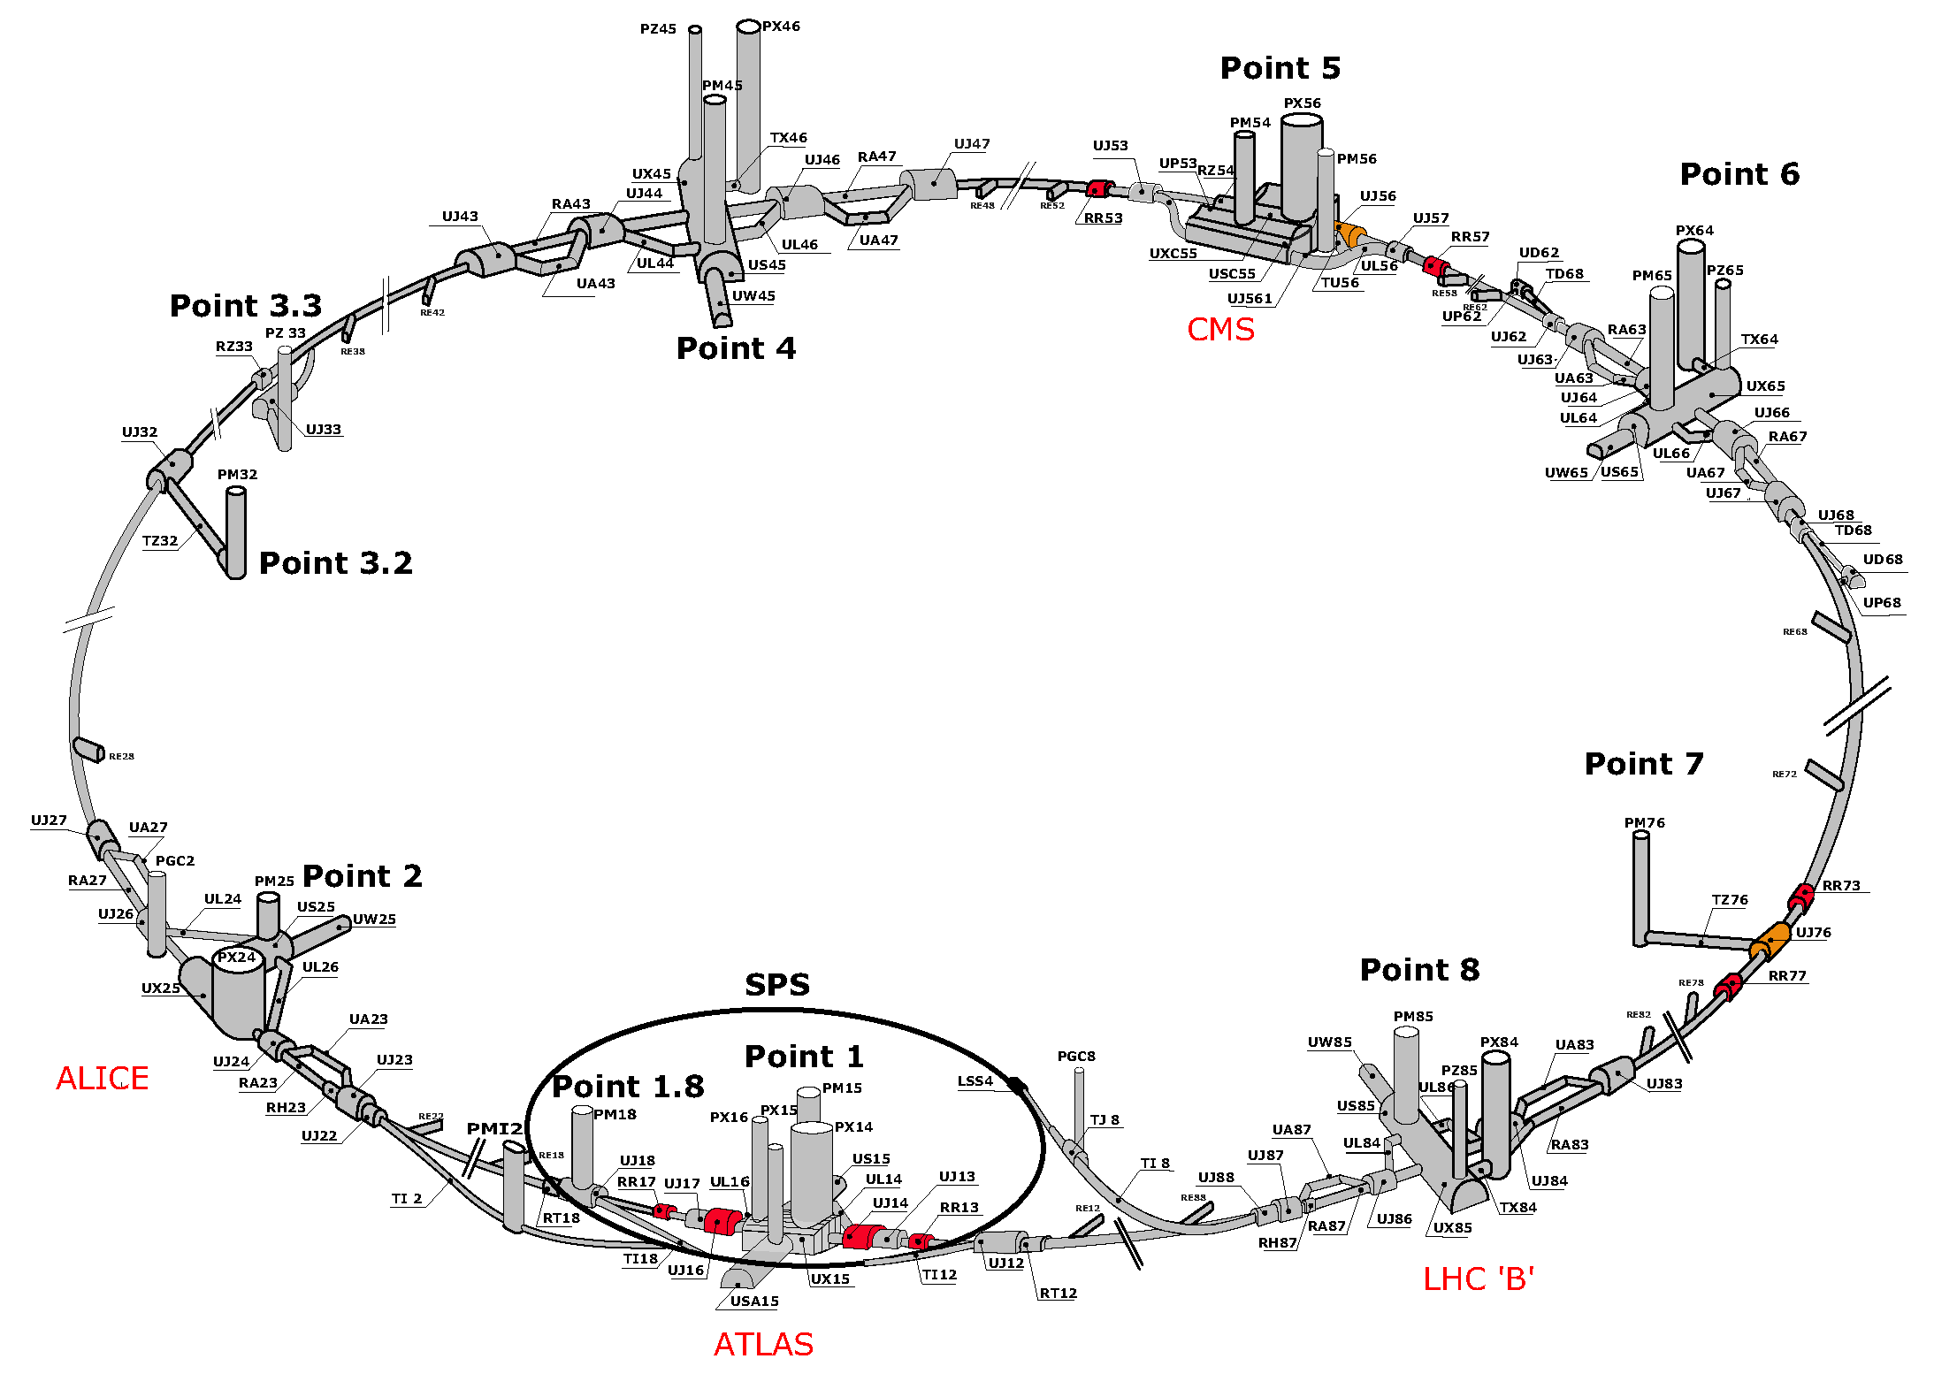
MAP OF LHC

Slide 14
MAP OF LHC
!!!

Slide 15
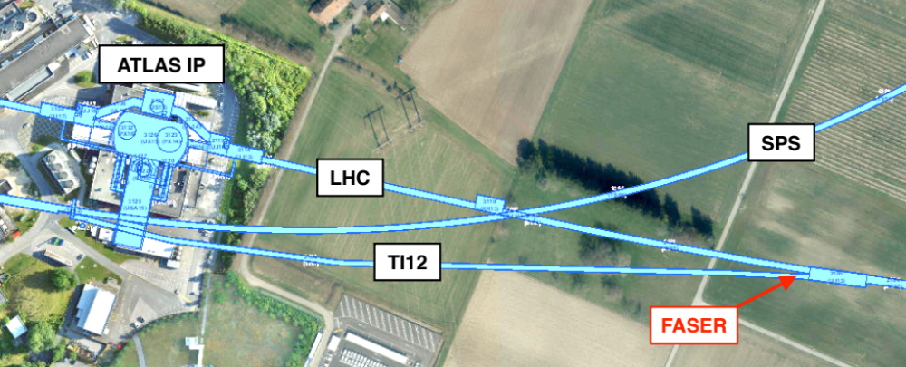
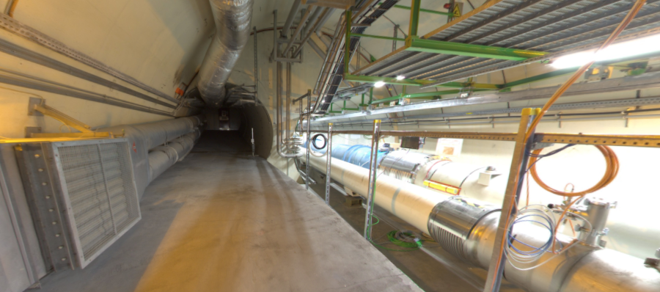
THE FORWARD REGION
Beam collision axis passes
through 100 m of rock, emerges in tunnel TI12, 480 m from ATLAS
UJ12
TI12 near UJ12
The view in UJ12 looking west in 2018
TI12
Beam collision axis:
Neutrinos, and possibly new particles, are streaming through this tunnel!
LHC beamline

Slide 16
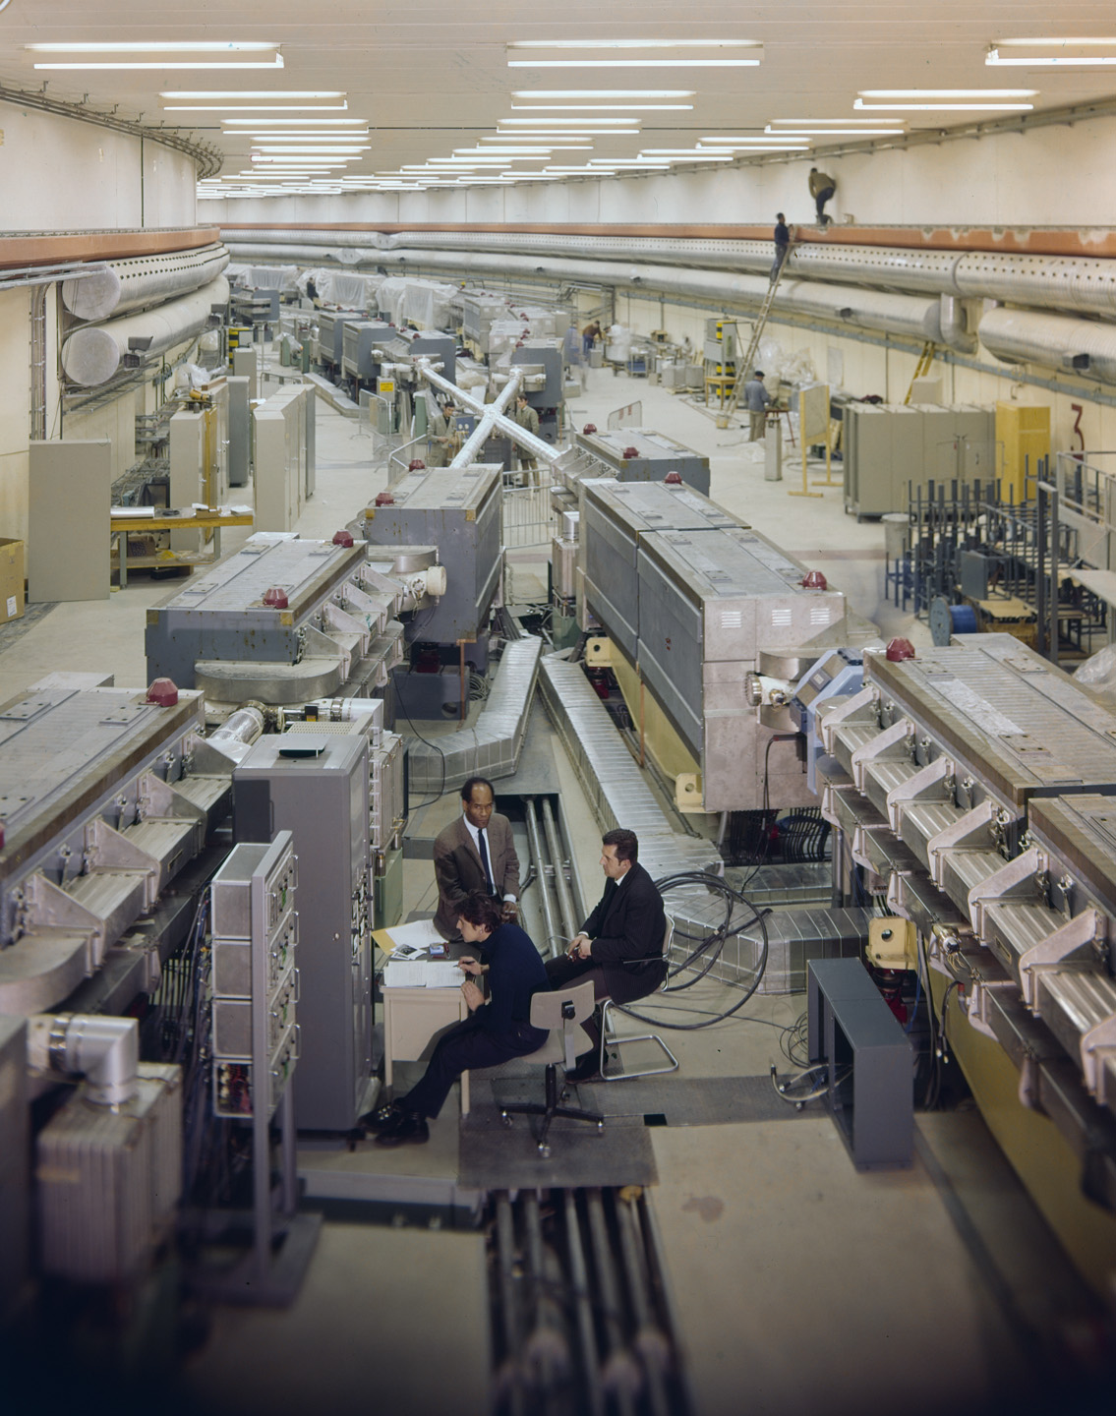
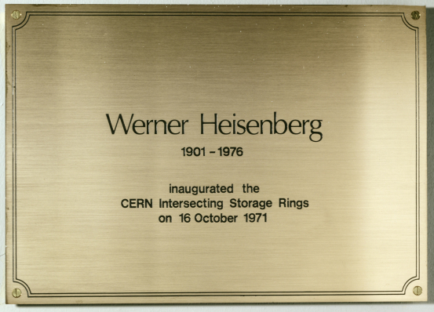
HISTORY: THE FALL OF FORWARD PHYSICS
Is it really possible that a collider is making new particles, and we are missing them simply because we are looking in the wrong place?
Yes. In fact, it has happened before at CERN.
In 1971, the first hadron collider, CERN’s Intersecting Storage Rings (ISR), began operation.
It had a circumference of ~1 km and collided protons with protons at center-of-mass energies from 30-60 GeV.

Slide 17

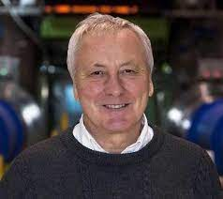
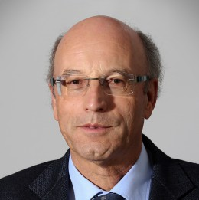
HISTORY: THE FALL OF FORWARD PHYSICS
During the ISR’s 50th anniversary, there were many fascinating articles and talks by eminent physicists
  “Enormous impact on accelerator physics, but sadly little effect on particle physics.” – Steve Myers, talk at “The 50th Anniversary of Hadron Colliders at CERN,” October 2021.
  “There was initially a broad belief that physics action would be in the forward directions at a hadron collider…. It is easy to say after the fact, still with regrets, that with an earlier availability of more complete… experiments at the ISR, CERN would not have been left as a spectator during the famous November revolution of 1974 with the J/ψ discoveries at Brookhaven and SLAC .” – Lyn Evans and Peter Jenni, CERN Courier (2021).
Bottom line: The collider was creating charm quarks, but experimentalists focused on the forward region and so missed them. (Good for SLAC!)
Since that time, forward physics at colliders has been almost completely ignored for new particle searches.
But are we making the same mistake now (in reverse)? And could there be another November revolution waiting for us in the forward direction?

Slide 18


Slide 19
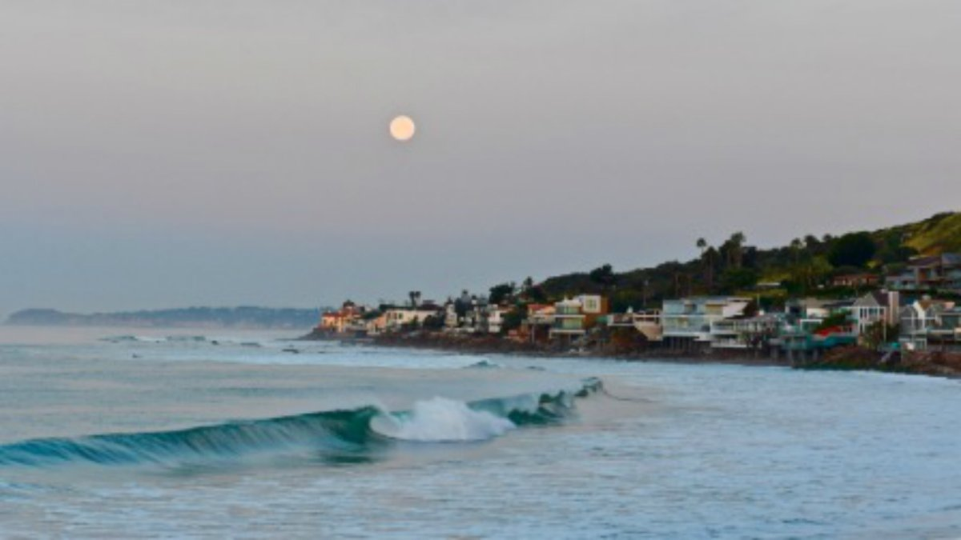
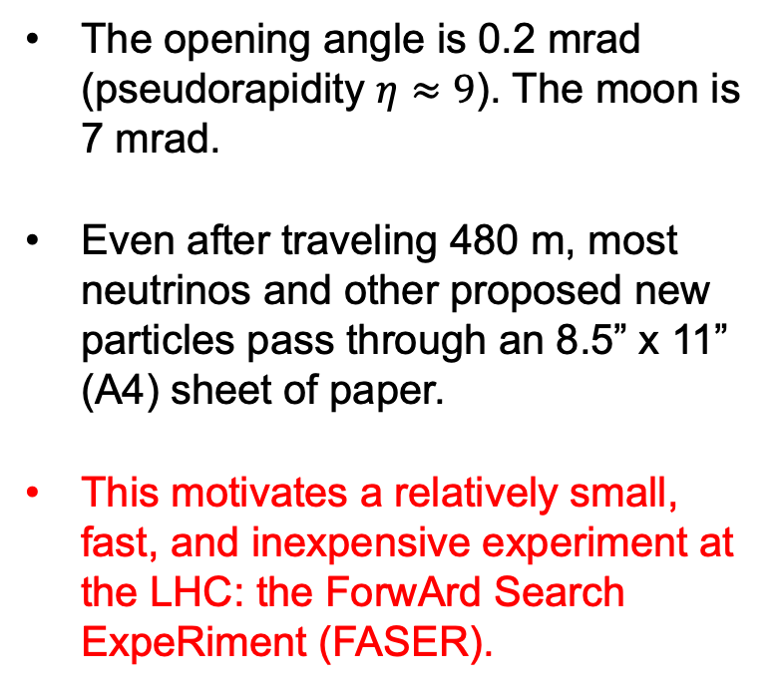
HOW BIG DOES THE DETECTOR HAVE TO BE?
Momentum:
Space:
250 MeV
1 TeV
12 cm
480 m
The opening angle is 0.2 mrad (pseudorapidity $η≈9$). The moon is 7 mrad.
Even after traveling 480 m, most neutrinos and other proposed new particles pass through an 8.5” x 11” (A4) sheet of paper.
This motivates a relatively small, fast, and inexpensive experiment at the LHC: the ForwArd Search ExpeRiment (FASER).

Slide 20
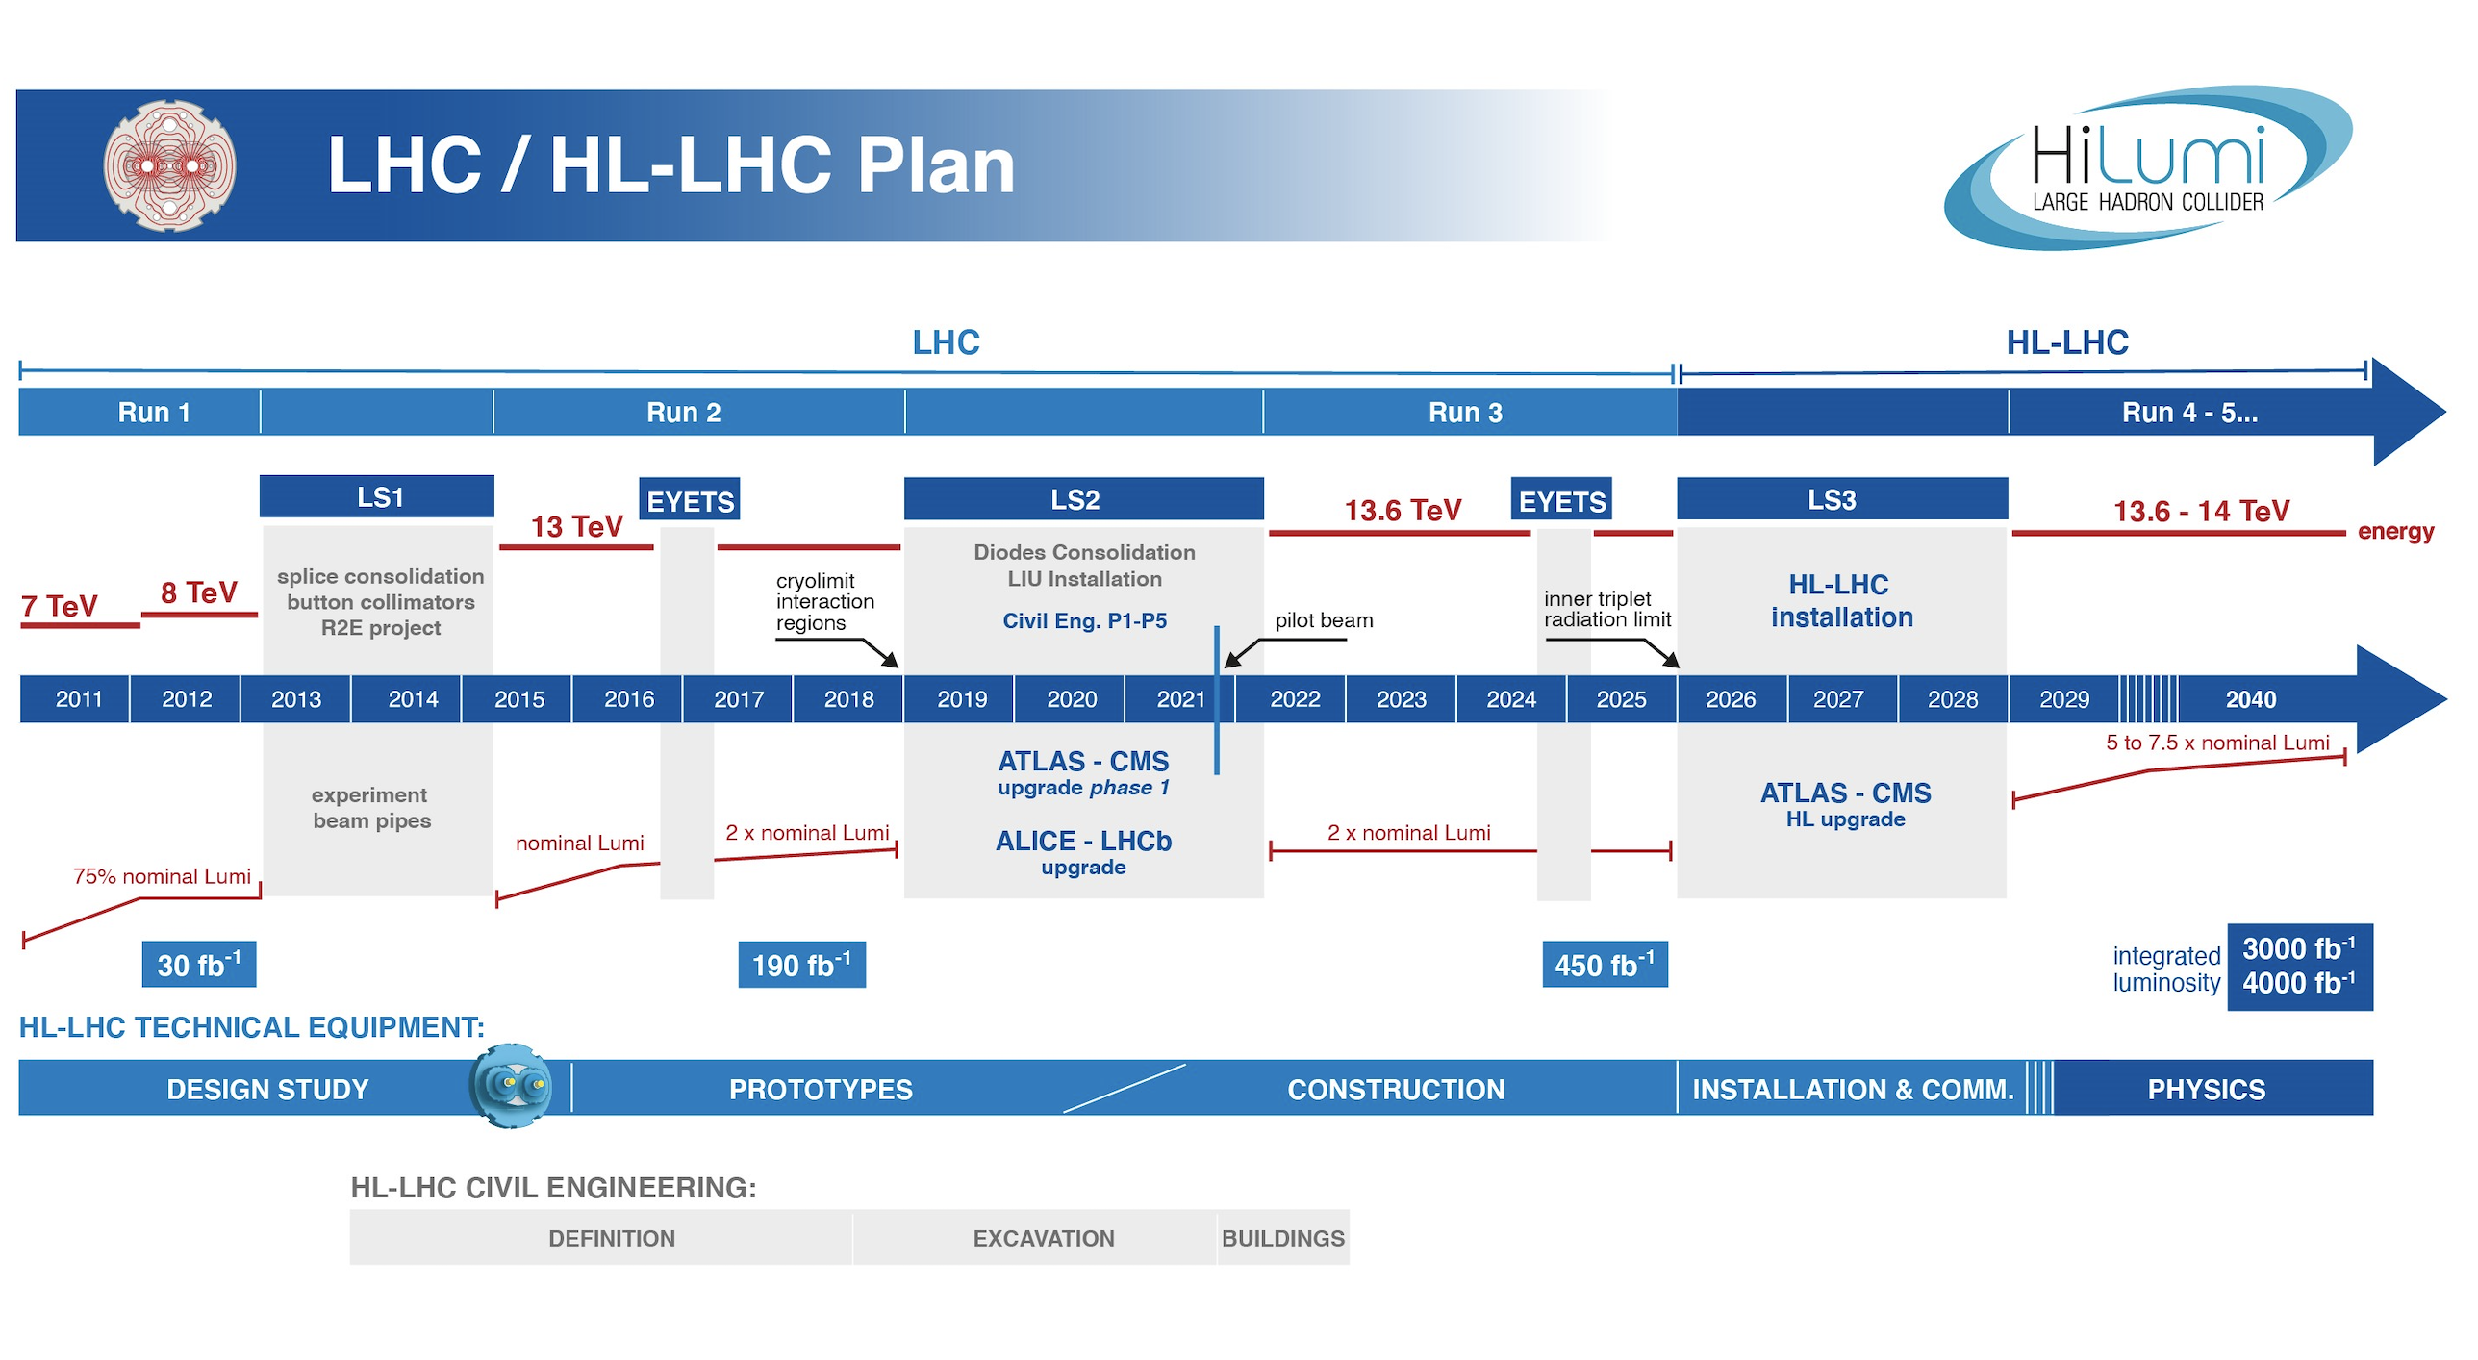
FASER TIMELINE
LOI submitted to CERN LHCC
FASER fully constructed and installed
Neutrino cross sections, ALP search
FASERν fully constructed and installed
Neutrino cross section energy dependence
Technical Proposal submitted to CERN LHCC
FASER approved as 8th LHC detector by CERN
Concept paper: Feng, Galon, Kling, Trojanowski
FASERν approved as 9th LHC detector by CERN
Discovery of collider neutrinos, dark photon search
Funding from Heising-Simons and Simons Foundations
FASER and FASERν begin collecting data in Run 3
Spare detector parts from ATLAS and LHCb Collaborations
Neutrino doubly differential cross sections, quirk search

Slide 21
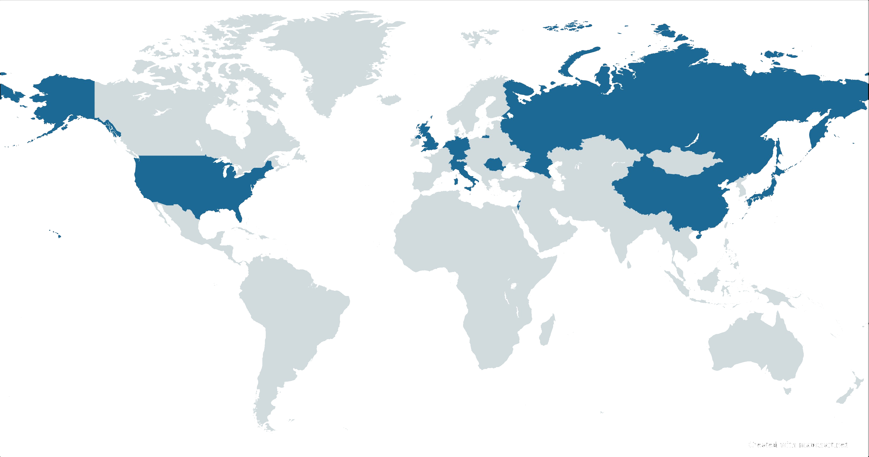


























FASER COLLABORATION
127 collaborators, 27 institutions, 11 countries

Slide 22
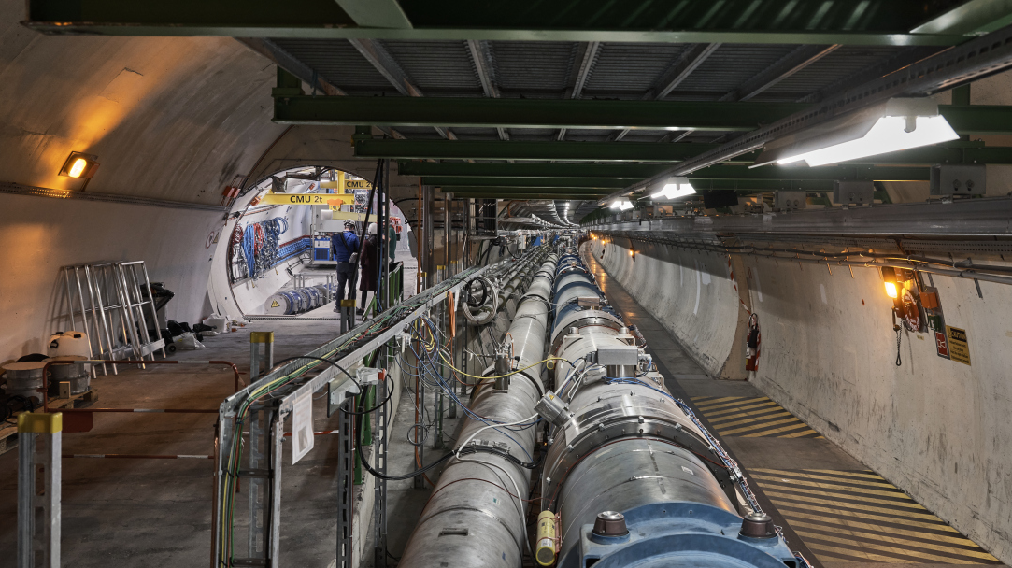
FASER AND THE LHC

Slide 23
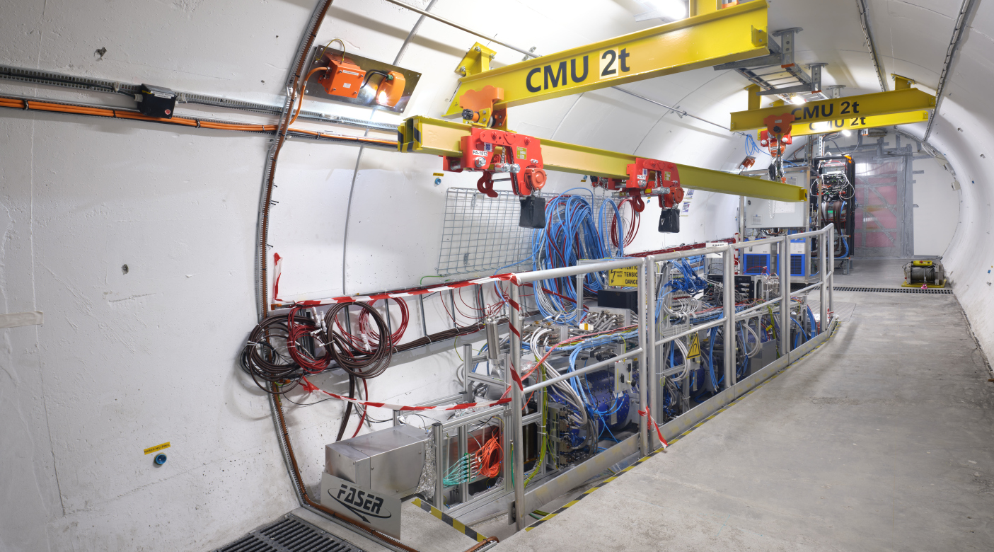
THE FASER DETECTOR

Slide 24
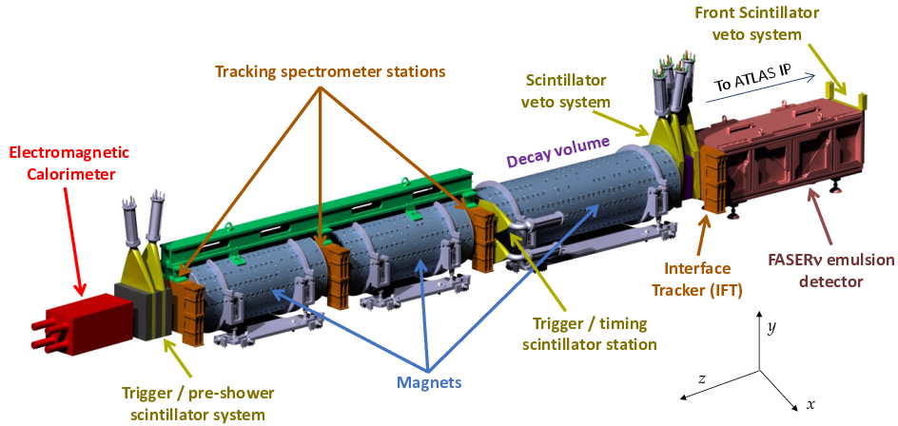
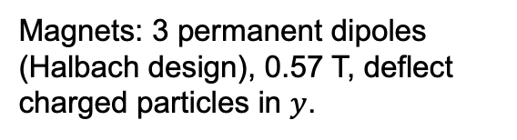
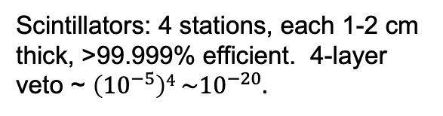
THE FASER DETECTOR
2207.11427
The experimental environment: 88 m underground, shielded from ATLAS by 100 m of rock → extremely quiet. Trigger on everything, ~kHz trigger rate dominated by muons from ATLAS.
Design challenges:
no space, no time, no access.
Size: Total length ~ 5 m, decay volume: R = 10 cm, L = 1.5 m.
FASERν: 730 interleaved sheets of tungsten + emulsion. 1 m long, 1.1 ton total mass. Micron-level spatial resolution, but no timing. Becomes over-exposed from muons, must be replaced after ~30 fb⁻¹.
Calorimeter: 2 x 2 LHCb ECAL modules.
Magnets: 3 permanent dipoles (Halbach design), 0.57 T, deflect charged particles in $y$.
Scintillators: 4 stations, each 1-2 cm thick, >99.999% efficient. 4-layer veto ~ $\left({10}^{−5}\right)4 \sim {10}^{−20}.$
Trackers: 4 stations x 3 layers x 8 modules = 96 ATLAS SCT modules.

Slide 25
NEUTRINOS

Slide 26
COLLIDER NEUTRINOS
Neutrinos are the least understood of all particles, and the only ones with confirmed BSM properties (their mass).
They have been discovered from many sources, each time with stunning implications for particle physics, astrophysics, and cosmology.
But before FASER, neutrinos produced at a particle collider had never been directly detected.
  Conventional wisdom: neutrinos interact too weakly to be seen.
  The truth: the real problem is that most of the highest energy (most interacting) neutrinos pass through the blind spots of existing detectors.
Formaggio, Zeller (2012)

Slide 27
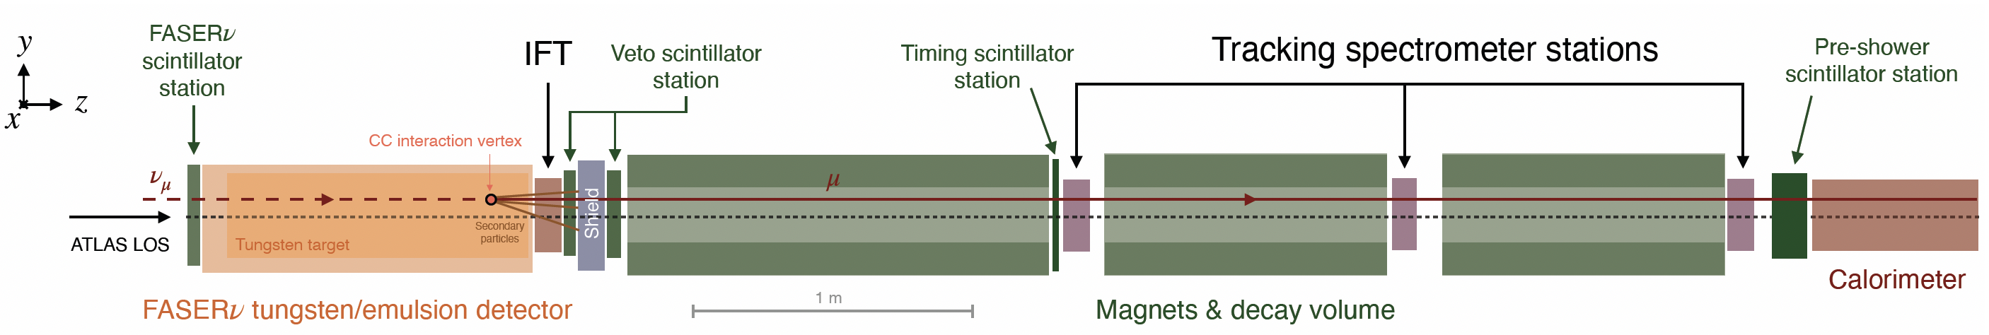
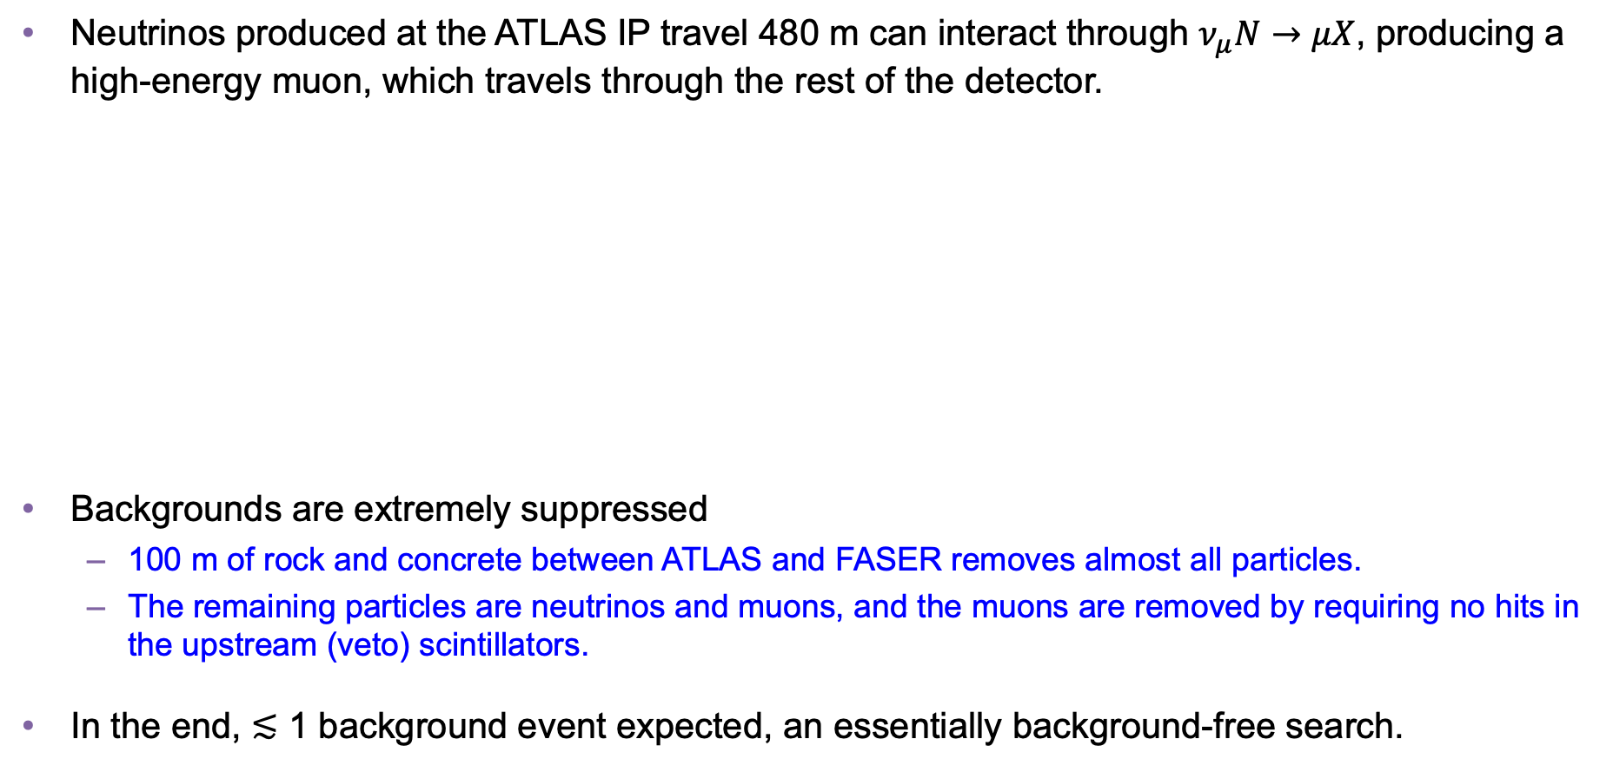
COLLIDER NEUTRINO SEARCH
Neutrinos produced at the ATLAS IP travel 480 m can interact through $ν_{μ}N→μX$, producing a high-energy muon, which travels through the rest of the detector.
Backgrounds are extremely suppressed
  100 m of rock and concrete between ATLAS and FASER removes almost all particles.
  The remaining particles are neutrinos and muons, and the muons are removed by requiring no hits in the upstream (veto) scintillators.
In the end, $≲$ 1 background event expected, an essentially background-free search.
FASER Collaboration (2303.14185, PRL)
Notes:
typical A’ that decays in FASER has ~TeV energy

Slide 28
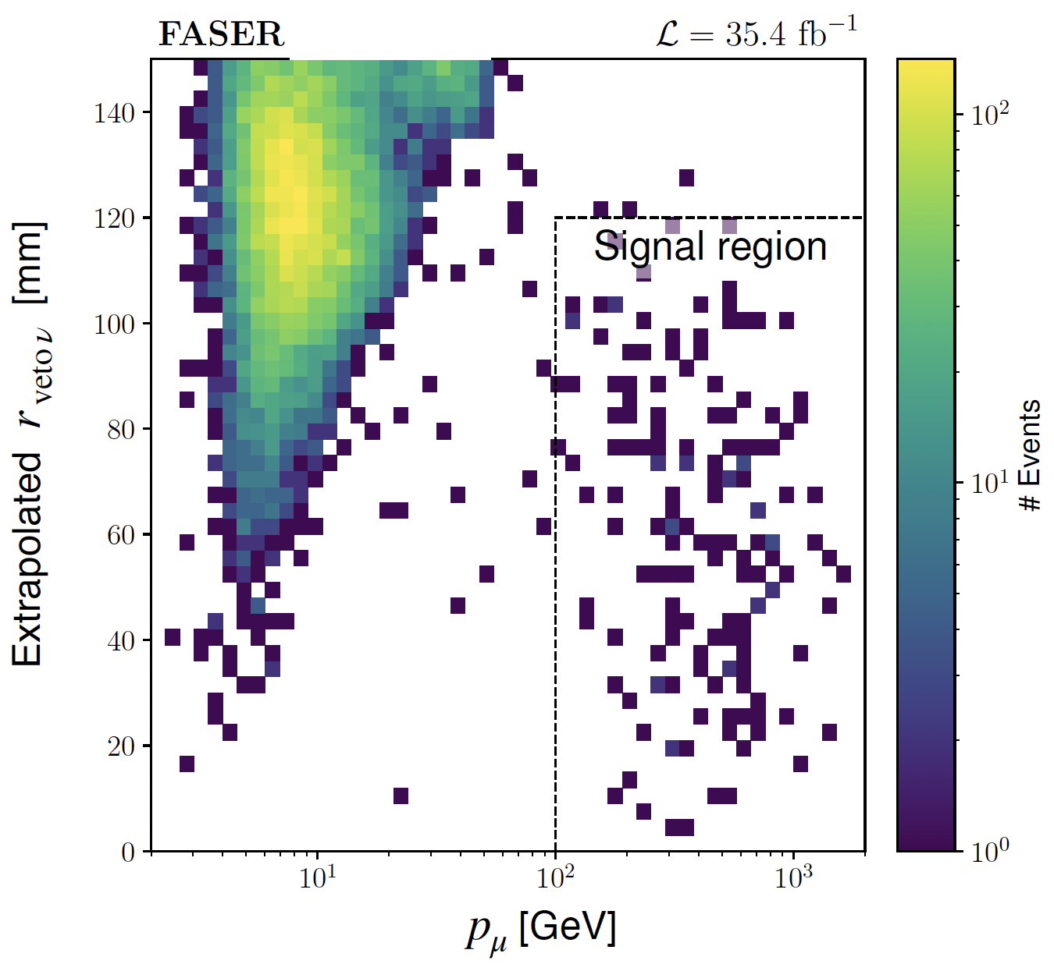
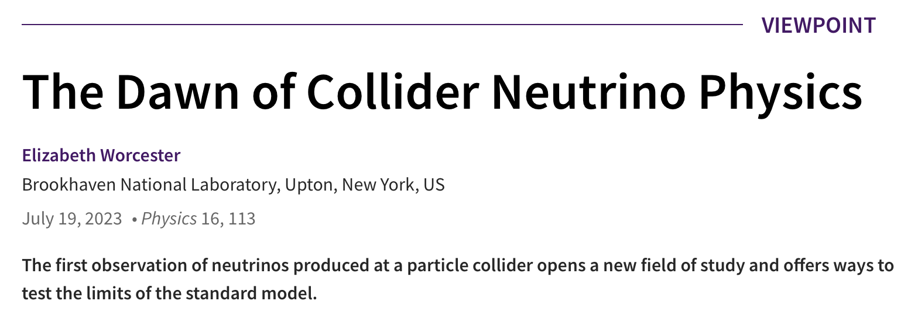
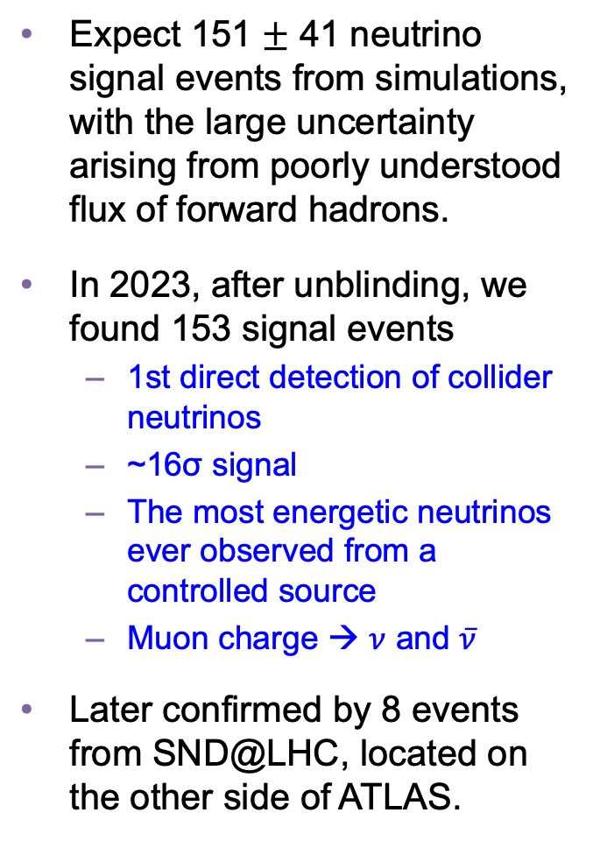
COLLIDER NEUTRINO RESULTS
Expect 151 $±$ 41 neutrino signal events from simulations, with the large uncertainty arising from poorly understood flux of forward hadrons.
In 2023, after unblinding, we found 153 signal events
  1st direct detection of collider neutrinos
  ~16σ signal
  The most energetic neutrinos ever observed from a controlled source
  Muon charge → $ν$ and $\overline{ν}$
Later confirmed by 8 events from SND@LHC, located on the other side of ATLAS.
FASER Collaboration (2303.14185, PRL)

Slide 29
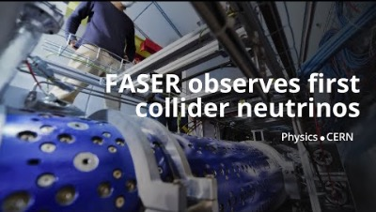
DISCOVERY OF COLLIDER NEUTRINOS

Slide 30
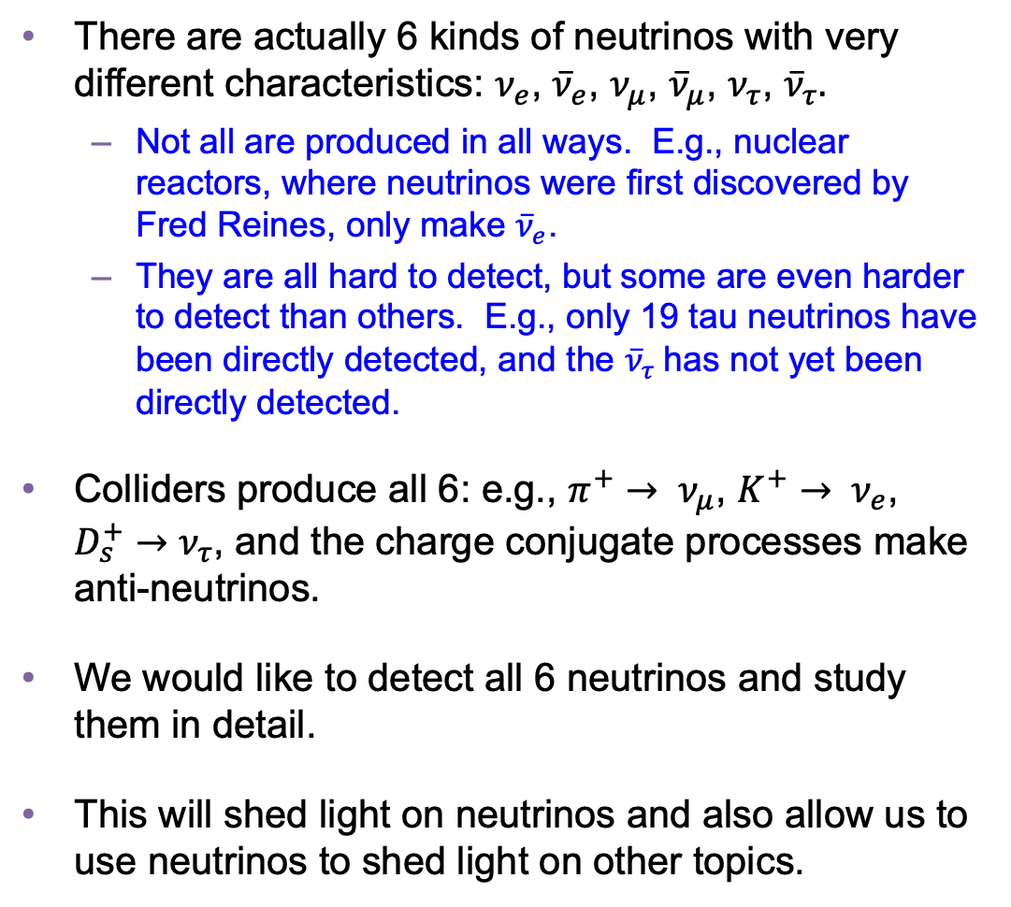
AFTER DISCOVERY: WHAT ARE THESE NEUTRINOS GOOD FOR?
There are actually 6 kinds of neutrinos with very different characteristics: $ν_{e}$, ${\overline{ν}}_{e}$, $ν_{μ}$, ${\overline{ν}}_{μ}$, $ν_{τ}$, ${\overline{ν}}_{τ}.$
  Not all are produced in all ways. E.g., nuclear reactors, where neutrinos were first discovered by Fred Reines, only make ${\overline{ν}}_{e}$.
  They are all hard to detect, but some are even harder to detect than others. E.g., only 19 tau neutrinos have been directly detected, and the ${\overline{ν}}_{τ}$has not yet been directly detected.
Colliders produce all 6: e.g., $π^{+}→ ν_{μ}$, $K^{+}→ ν_{e}$, $D_{s}^{+}→ν_{τ}$, and the charge conjugate processes make anti-neutrinos.
We would like to detect all 6 neutrinos and study them in detail.
This will shed light on neutrinos and also allow us to use neutrinos to shed light on other topics.

Slide 31
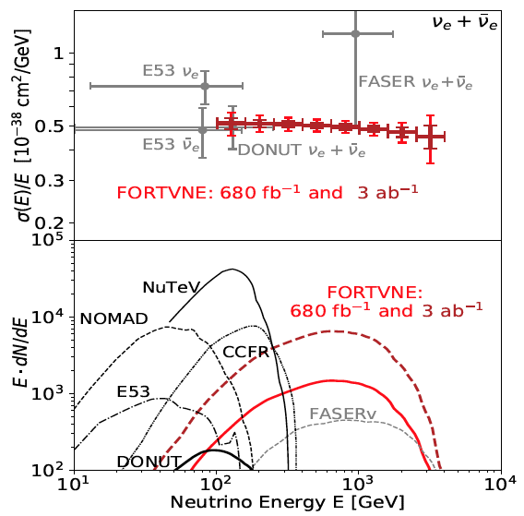
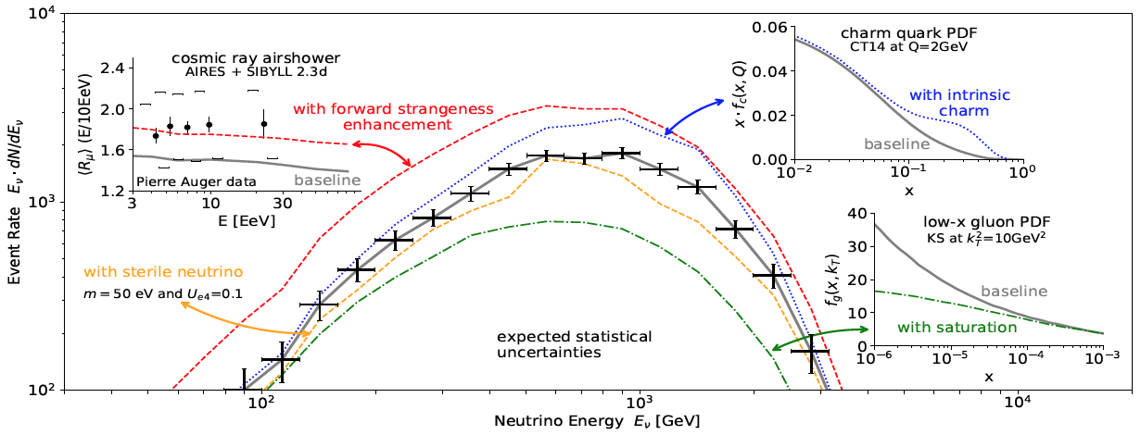
PHYSICS POTENTIAL OF COLLIDER NEUTRINO STUDIES
An example: the electron neutrino event rate as a function of energy will tell us about
  New forms of matter (sterile neutrinos)
  The structure of protons and nuclei (gluon and quark parton distribution functions)
  The properties of cosmic ray air showers (the cosmic muon puzzle)

Slide 32
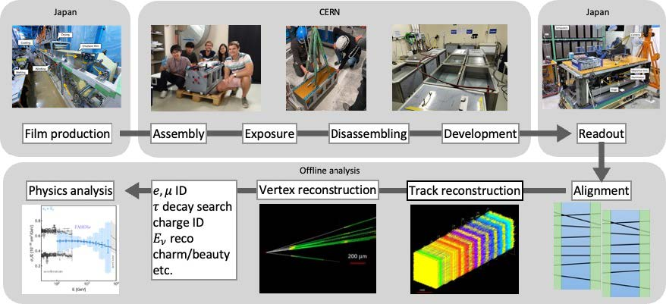
FASERν
The first neutrinos detected were muon neutrinos in FASER’s electronic detector.
But at the front of FASER is FASERν, a 1.1-ton block of 730 interleaved tungsten and emulsion plates. The first neutrino analysis treated this as a big block of matter, but the emulsion provides a photographic image with extraordinary spatial resolution (0.3 microns).

Slide 33

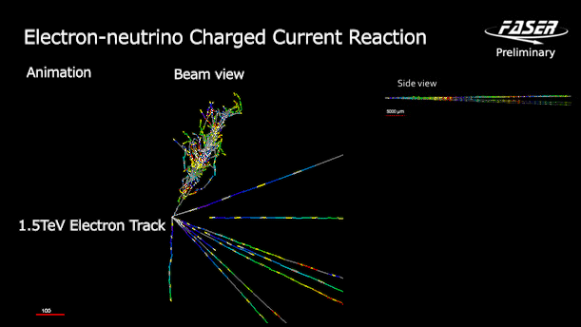
FIRST DETECTION OF COLLIDER ELECTRON NEUTRINOS
With FASERν, we observed the first collider electron neutrinos, including the “Pika-$ν$” event, the highest energy (>1.5 TeV) electron neutrino ever seen from a lab source.
FASER Collaboration (2403.12520)

Slide 34
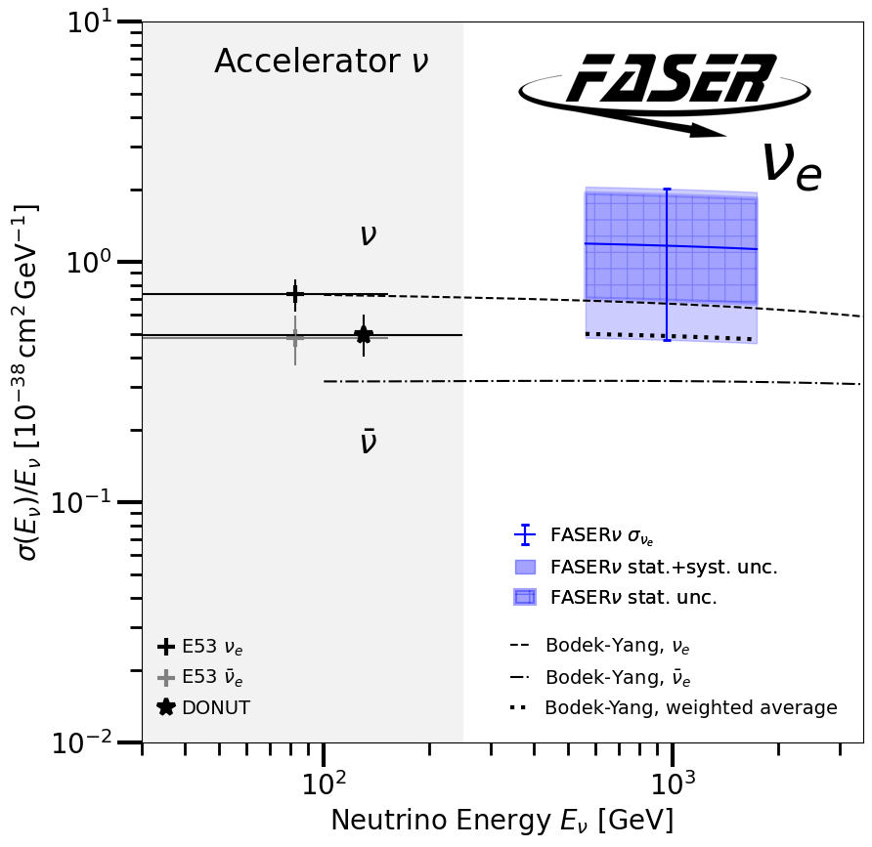
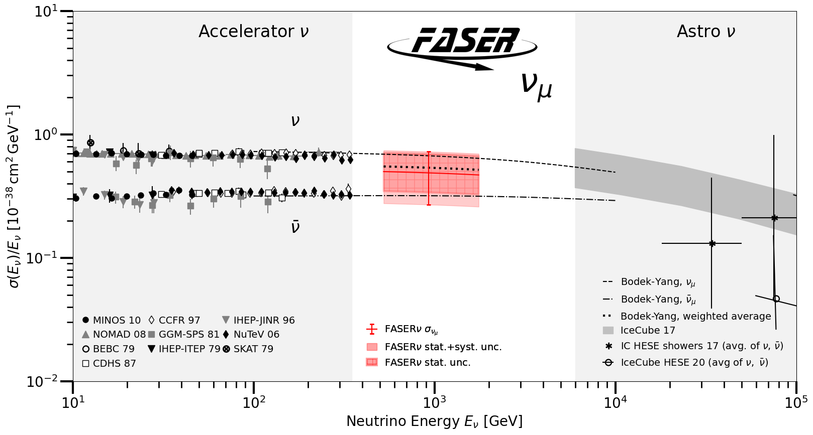

TEV NEUTRINO INTERACTION STRENGTHS
After these discoveries, we have moved on to studies, including the first measurement of neutrino cross sections at TeV energies and doubly differential cross sections. So far, all consistent with SM DIS predictions.
Highlighted as 1 of 6 particle physics papers selected for the PRL Collection of 2024.
These measurements used only 1.7% of the data collected in 2022 and 2023. Much more to come.
FASER Collaboration (2403.12520)
CERN-FASER-CONF-2026-005

Slide 35
DARK SECTORS
NEW PARTICLES

Slide 36
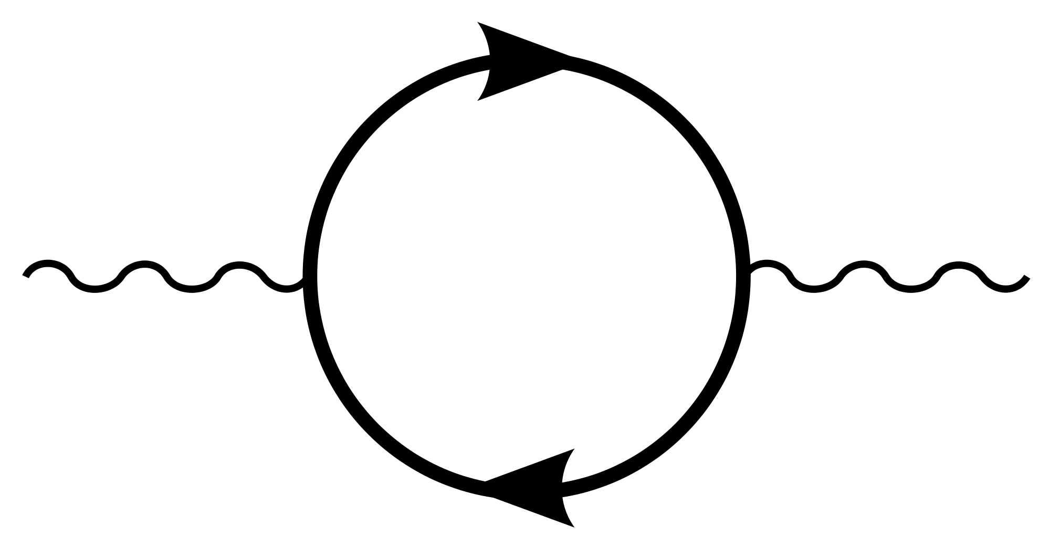
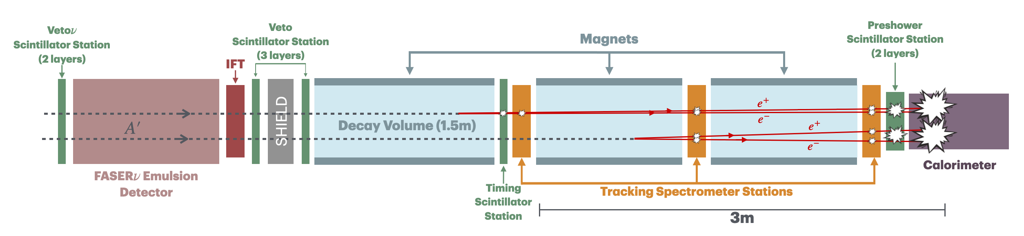


NEW PARTICLE SEARCHES
FASER is also looking for new dark particles, new fundamental forces, and new forms of matter.
For example: suppose there is a dark sector that contains a dark force: dark electromagnetism.
The result? Dark photons $A′$, like photons, but with a mass $m_{A′}$, couplings suppressed by $ε$.
For low $ε$, dark photons are very weakly-interacting, long-lived particles. Like neutrinos, but decay through $A^{′}$ $→ e^{+}e^{−}$, producing a 2 ~TeV-energy charged particles emerging from 100 m of rock.
SM
EM
Dark Sector
EM, X
A
$${εF}_{μν}F_{D}^{μν}$$
A_{D}
Holdom (1986)

Slide 37


DARK PHOTON SEARCH
In 2023, in a blind analysis of 2022 data, no events were seen, and FASER set limits on previously unexplored parameter space.
  First new probe of the parameter space favored by dark matter relic density arguments from low coupling since the 1990’s.
  Started probing new parameter space on Day 1 (0.3 fb⁻¹)
  In this region of parameter space, ended up ~100 times more sensitive than previous experiments
In 2026, in another blind analysis, based on 2022-24 data, again no events were seen.
  ~6x the amount of data.
  ~3x more powerful analysis (more general signatures).
Prospects for the future
  The analyses have been essentially background-free.
  ~20x more data expected at the LHC.
Existing bounds from DarkCast
FASER Collaboration (2308.05587, PLB)
FASER Collaboration (CERN-FASER-CONF-2026-001)

Slide 38







MORE NEW PARTICLE SEARCHES
We are also looking for many other new particles: other new force carriers (U(1)_{B-L}, U(1)_{B}, protophobic), axion-like particles with photon, W, gluon couplings, up-philic scalars, two Higgs doublet models, etc., all with world-leading sensitivities in interesting regions of parameter space.
FASER Collaboration (2308.05587, PLB; 2410.10363 )

Slide 39
FUTURE DETECTORS

Slide 40
DETECTOR UPGRADES
LHC Run 3 from 2022-2026 has just concluded.
LHC now enters Long Shutdown 3 from 2026-2029, will start up again as the High-Luminosity LHC with Run 4 from 2030-2033, and Run 5 from 2036-2042.
FASER is approved for Run 4, and there are many proposals to upgrade the detector.
In addition, there are plans to build the Forward Physics Facility, an entirely new detector hall.

Slide 41



FORTVNE
For Run 4, a group of us at UC Irvine has proposed the Forward TeV Neutrino Experiment (FORTVNE), a scintillator / tungsten detector, which will detect ~10,000 neutrinos.
Different types of neutrinos produce different patterns of light in the detector; machine learning can help distinguish these neutrinos, measure their properties.
Such detectors provide a remarkable opportunity for students to build an LHC detector from scratch, commission and install it, and collect and analyze data, all in the typical time it takes to get a PhD.

Slide 42







OTHER RUN 4 UPGRADE PROPOSALS
There are also many other Run 4 upgrade ideas from leading groups around the world, all vying to be placed on or near the LOS, with prototype detectors already built and installed, proposals being sent to funding agencies around the world. It has become a crowded field (literally).

Slide 43






FORWARD PHYSICS FACILITY
CERN is also considering the possibility of excavating a new underground detector hall to house diverse forward experiments for the rest of the LHC’s lifetime into the 2040s.
SPS
ATLAS
LHC
LOS
FPF site selection and core studies have identified an ideal site in France just outside the CERN main gate
https://cds.cern.ch/record/2851822
CERN GIS

Slide 44
CONCLUSIONS

Slide 45




SUMMARY AND ACKNOWLEDGEMENTS
After 60+ years, we have now detected neutrinos produced at a particle collider. This is “hot off the press,” and we are still learning many things.
But it is clear that this opens up many ways for small, fast, and inexpensive experiments to study neutrinos and look for new particles.
Is there another November revolution waiting for us in the forward region?

