Slide 1



FASER RESULTS
AND
A PERSONAL PERSPECTIVE ON
WHERE WE ARE AND WHERE WE’RE GOING
Topic of the Week, LHC Physics Center, Fermilab
Jonathan Feng, UC Irvine, 30 June 2026

Slide 2
OUTLINE
INTRODUCTION
FASER
NEUTRINOS
NEW PARTICLE SEARCHES
UPGRADES AND PLANS
WHERE WE ARE AND WHERE WE’RE GOING

Slide 3
INTRODUCTION

Slide 4

FORWARD PHYSICS AT FERMILAB

Slide 5
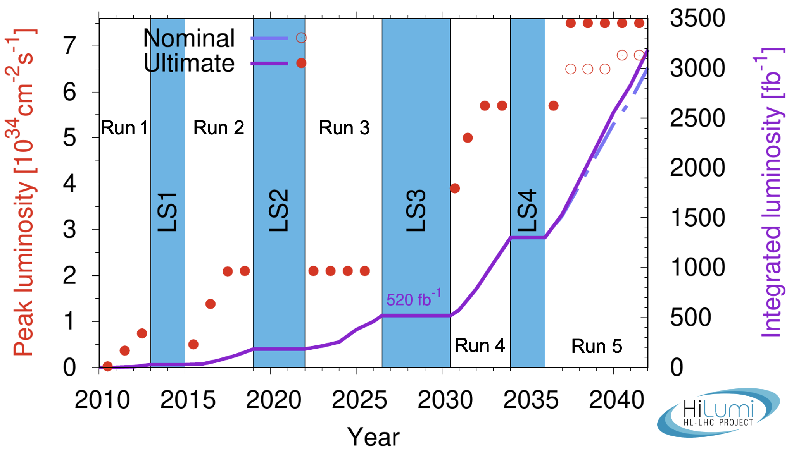
LIFETIME OF THE LHC
The LHC has just finished Run 3 (2022-26) and now enters Long Shutdown 3 (2026-2030).
The LHC started running in 2010 and is scheduled to run until ~2042.
  Middle-aged in terms of years
  But a 12-year-old in terms of integrated luminosity (number of collisions)
Are we using the LHC to its full potential? What can we do to enhance its discovery prospects?

Slide 6
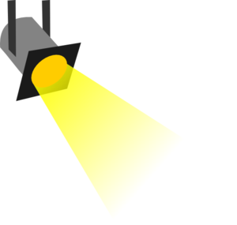





















THE PARTICLE LANDSCAPE
Particle
Colliders
Mass
MeV
GeV
TeV
1
$$←$$
$$g$$
$$u$$
$$d$$
$$s$$
$$p$$
$$n$$
$$c$$
$$b$$
$$t$$
$$←$$
$$γ$$
$$e$$
$$μ$$
$$τ$$
$$W$$
$$Z$$
$$h$$
Already
Discovered
Strongly Interacting
Heavy Particles
Interaction Strength
10⁻³
$$ν_{e}$$
$$ν_{μ}$$
$$ν_{τ}$$
$$←$$
Weakly Interacting
Light Particles
Impossible to
Discover
10⁻⁶

Slide 7
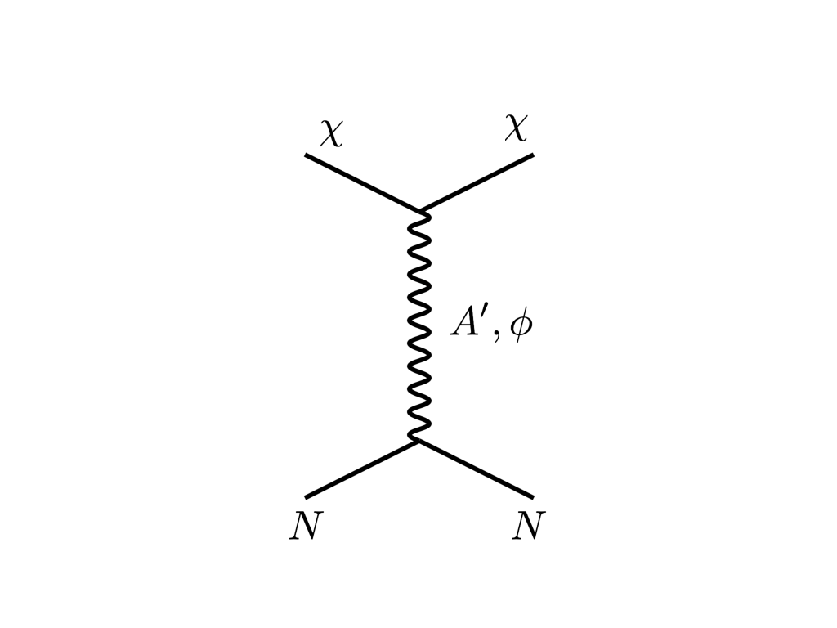



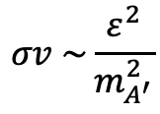


THE THERMAL RELIC LANDSCAPE
Particle
Colliders
Mass
MeV
GeV
TeV
1
Already
Discovered
Strongly Interacting
Heavy Particles
DM
$$e$$
Too Little to be
Dark Matter
$$ε$$
$$ε$$
Interaction Strength
Just Right to
be Dark Matter
$$A′$$
10⁻³
$$e$$
DM
$$σv \sim \frac{ε^{2}}{m_{A^{′}}^{2}}$$
Weakly Interacting
Light Particles
Impossible to
Discover
Boehm, Fayet (2003)
Pospelov, Ritz, Voloshin (2007)
Feng, Kumar (2008)
10⁻⁶
Too Much to be
Dark Matter

Slide 8
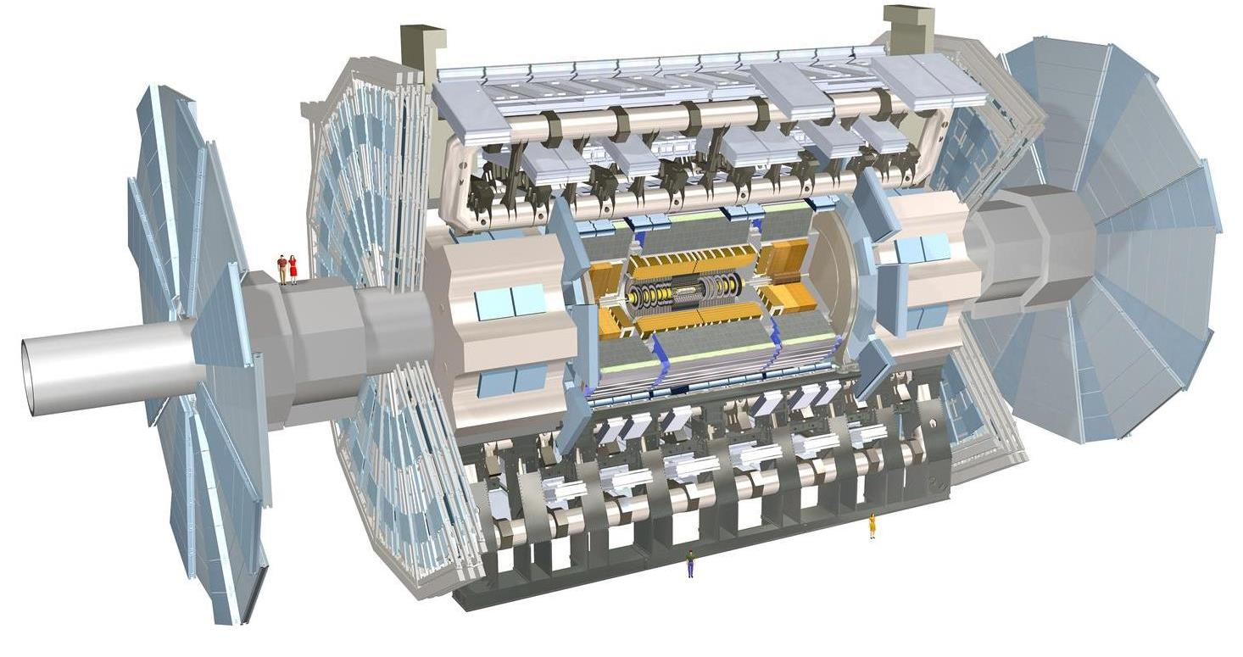
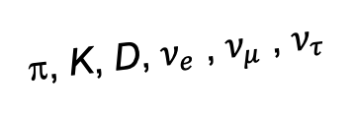
FORWARD PHYSICS
In 2017, we realized that the large LHC detectors, while beautifully optimized to discover new heavy particles, are also almost optimally configured to miss new light particles.
Heavy particles (W, Z, t, h, …) are produced at low velocity and decay roughly isotropically to other particles.
But high-energy light particles are dominantly produced in the forward (and far-forward) direction (parallel to the beamline) and escape through the blind spots of these detectors.
  This is true for all known light particles: pions, kaons, D mesons, all neutrinos.
  It is also true for new, weakly-interacting particles motivated by neutrino mass and dark matter.
“These blind spots are the Achilles heels of the large LHC detectors.” – Dave Casper
Feng, Galon, Kling, Trojanowski (2017)
A’, a, mCPs, χ, …
π, K, D, $ν_{e}$ , $ν_{μ}$ , $ν_{τ}$
De Rujula, Ruckl (1984)

Slide 9
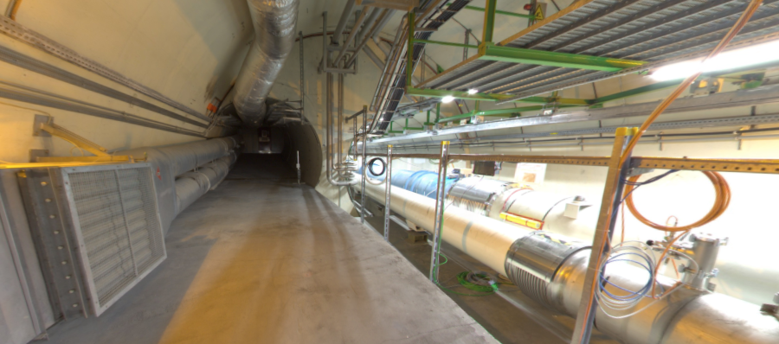
THE FORWARD REGION
Beam collision axis passes
through 100 m of rock, emerges in tunnel TI12, 480 m from ATLAS
UJ12
TI12 near UJ12
The view in UJ12 looking west in 2018
TI12
Beam collision axis:
Neutrinos, and possibly new particles, are streaming through this tunnel!
LHC beamline

Slide 10
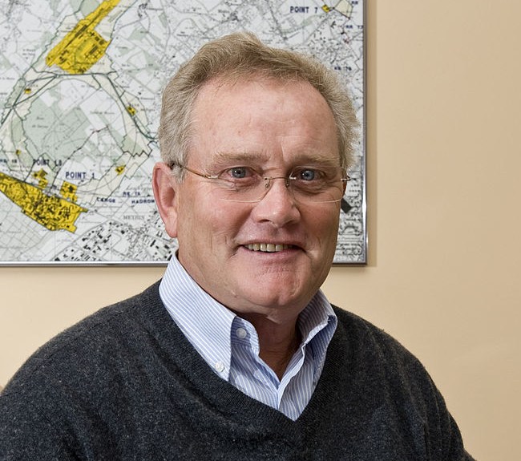
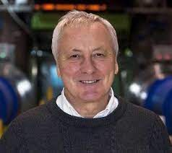
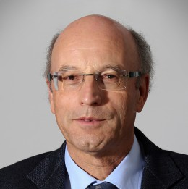
HISTORICAL PRECEDENT
Is it really possible that a collider is making new particles, and we are missing them simply because we are looking in the wrong place?
Yes. In fact, it has happened before at CERN.
In 1971, the first hadron collider, CERN’s Intersecting Storage Rings (ISR), began operation. At the ISR’s 50th anniversary:
  “Enormous impact on accelerator physics, but sadly little effect on particle physics.” – Steve Myers, talk at “The 50th Anniversary of Hadron Colliders at CERN,” October 2021.
  “There was initially a broad belief that physics action would be in the forward directions at a hadron collider…. It is easy to say after the fact, still with regrets, that with an earlier availability of more complete… experiments at the ISR, CERN would not have been left as a spectator during the famous November revolution of 1974 with the J/ψ discoveries at Brookhaven and SLAC .” – Lyn Evans and Peter Jenni, CERN Courier (2021).
Is there another November revolution waiting in the forward direction? It would be better not to wait for the next hadron collider to find out.

Slide 11


Slide 12
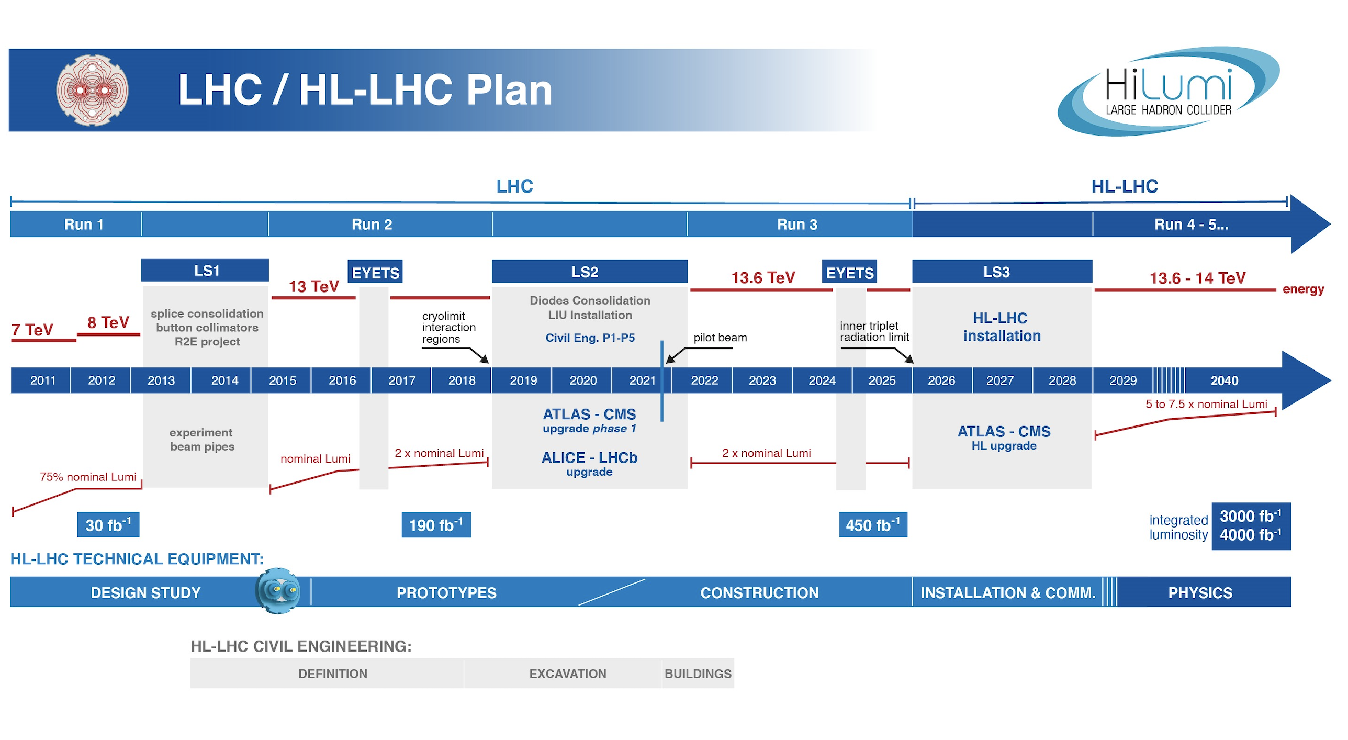
FASER TIMELINE
LOI submitted to CERN LHCC
Feng, Galon, Kling, Trojanowski
Neutrino cross sections, ALP search
FASER fully constructed and installed
FASERν fully constructed and installed
Neutrino cross section energy dependence
Technical Proposal submitted to CERN LHCC
FASER approved as 8th LHC detector by CERN
FASERν approved as 9th LHC detector by CERN
Discovery of collider neutrinos, dark photon search
Funding from Heising-Simons and Simons Foundations
FASER and FASERν begin collecting data in Run 3
Spare detector parts from ATLAS and LHCb Collaborations
Neutrino doubly differential cross sections, quirk search

Slide 13
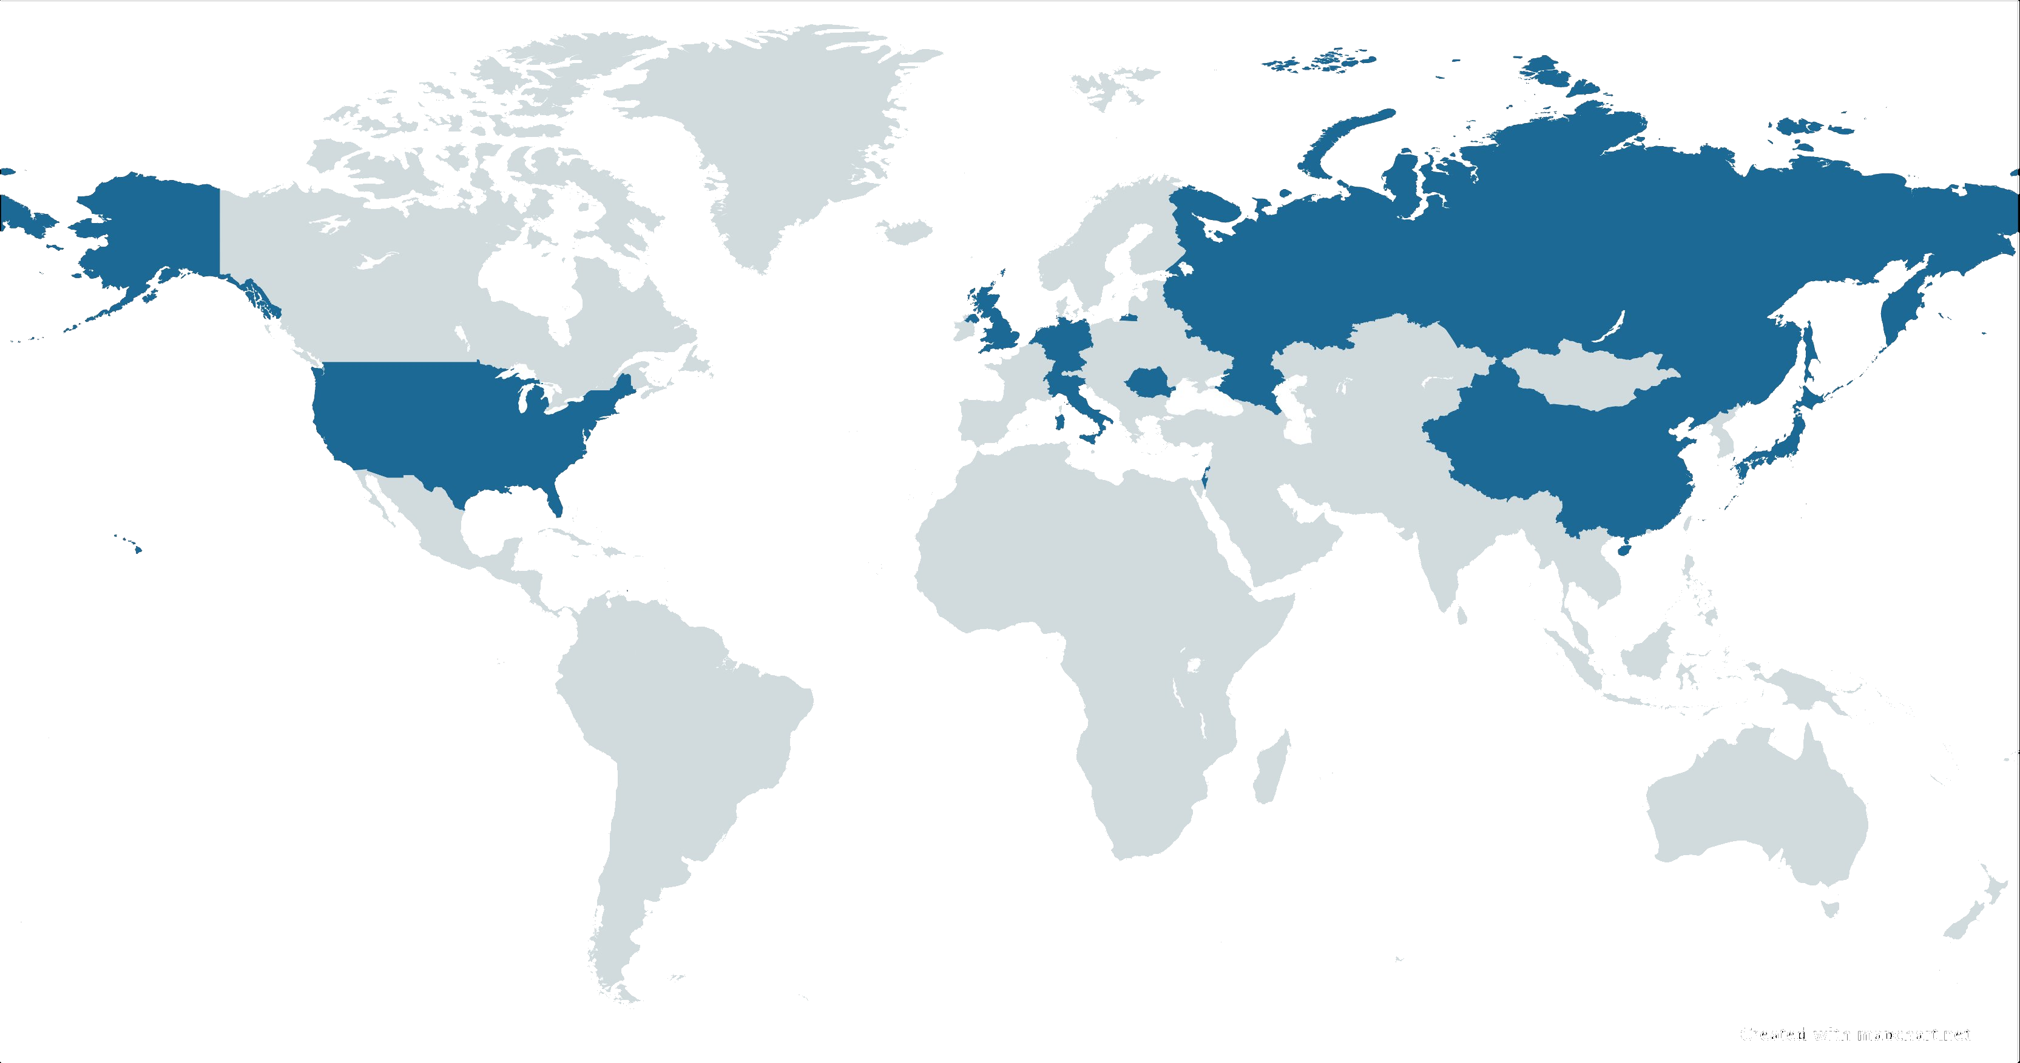


























FASER COLLABORATION
130 collaborators, 28 institutions, 11 countries

Slide 14
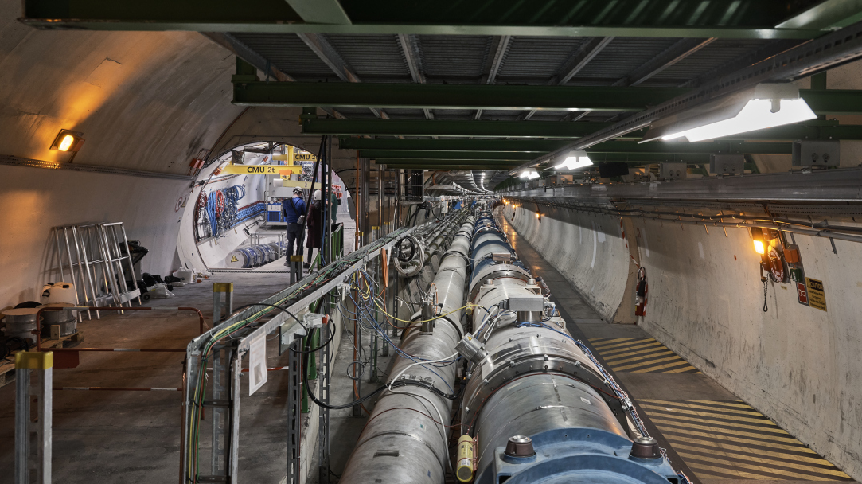
FASER AND THE LHC

Slide 15
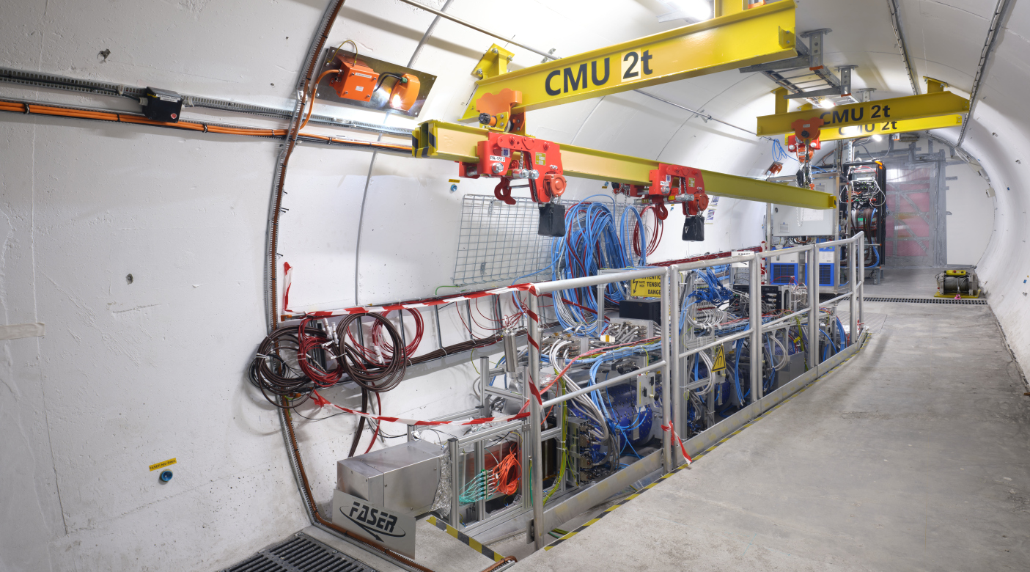
THE FASER DETECTOR

Slide 16
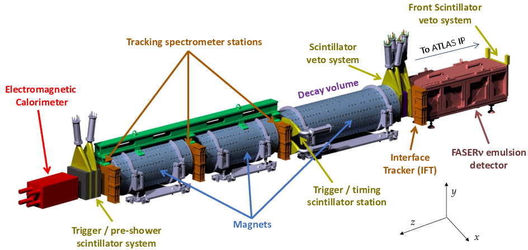
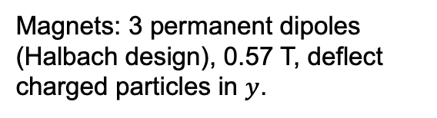
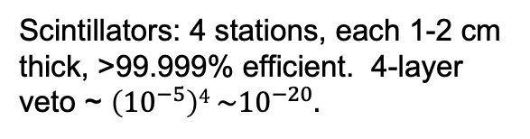
THE FASER DETECTOR
2207.11427
The experimental environment: 88 m underground, shielded from ATLAS by 100 m of rock → extremely quiet. Trigger on everything, ~kHz trigger rate dominated by muons from ATLAS.
Design challenges:
no space, no time, no access.
Size: Total length ~ 5 m, decay volume: R = 10 cm, L = 1.5 m.
FASERν: 730 interleaved sheets of tungsten + emulsion. 1 m long, 1.1 ton total mass. Micron-level spatial resolution, but no timing. Becomes over-exposed from muons, must be replaced after ~30 fb⁻¹.
Calorimeter: 2 x 2 LHCb ECAL modules.
Magnets: 3 permanent dipoles (Halbach design), 0.57 T, deflect charged particles in $y$.
Scintillators: 4 stations, each 1-2 cm thick, >99.999% efficient. 4-layer veto ~ $\left({10}^{−5}\right)4 \sim {10}^{−20}.$
Trackers: 4 stations x 3 layers x 8 modules = 96 ATLAS SCT modules.

Slide 17
NEUTRINOS

Slide 18
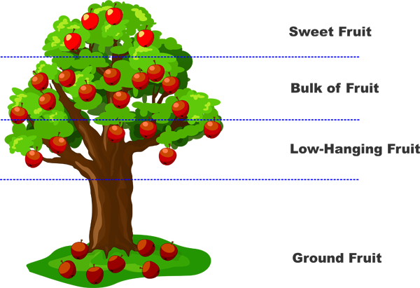
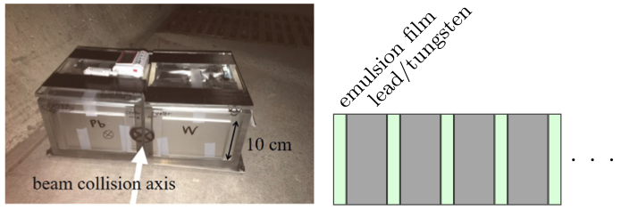
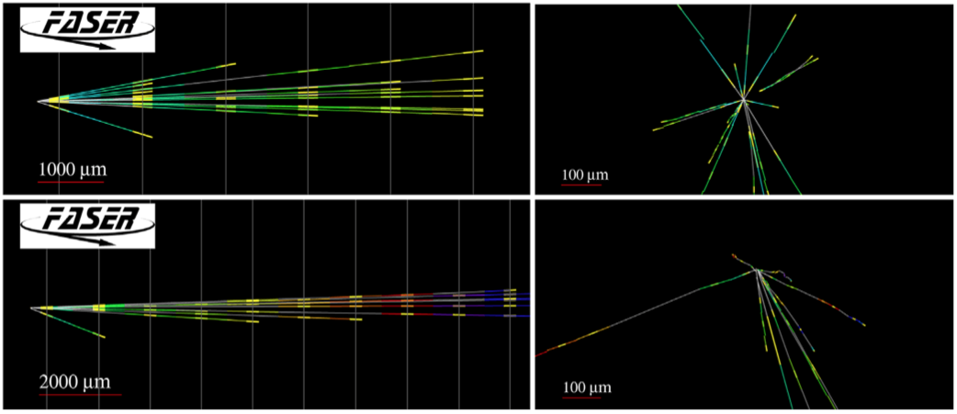
FIRST COLLIDER NEUTRINO CANDIDATES
The first collider neutrino candidates were found by placing a 29 kg box of emulsion on the ground in TI12 for 4 weeks in 2018 (LHC Run 2) for a 2.9σ signal.
FASER Collaboration (2105.06197, PRD)
This is not low-hanging fruit – this is fruit that has fallen off the tree and can be picked up off the ground (almost literally).
Notes:
typical A’ that decays in FASER has ~TeV energy

Slide 19
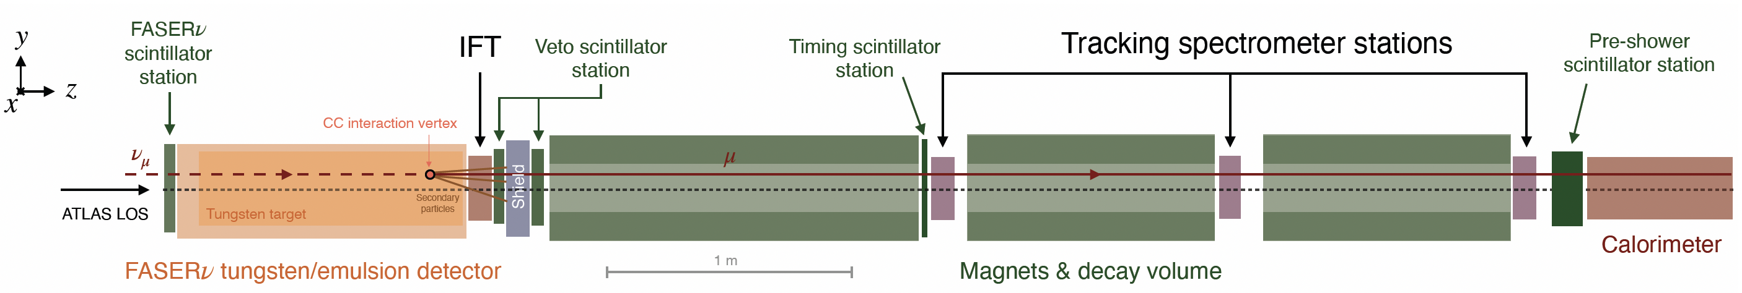

FASER COLLIDER NEUTRINO SEARCH
Muon neutrinos produced at the ATLAS IP travel 480 m can interact through $ν_{μ}N→μX$ in FASERν, producing a high-energy muon, which travels through the rest of the detector.
Backgrounds are extremely suppressed
  100 m of rock and concrete between ATLAS and FASER removes almost all particles.
  The remaining particles are neutrinos and muons, and the muons are removed by requiring no hits in the upstream veto scintillators.
In the end, $≲$ 1 background event expected, an essentially background-free search.
FASER Collaboration (2303.14185, PRL)
Notes:
typical A’ that decays in FASER has ~TeV energy

Slide 20
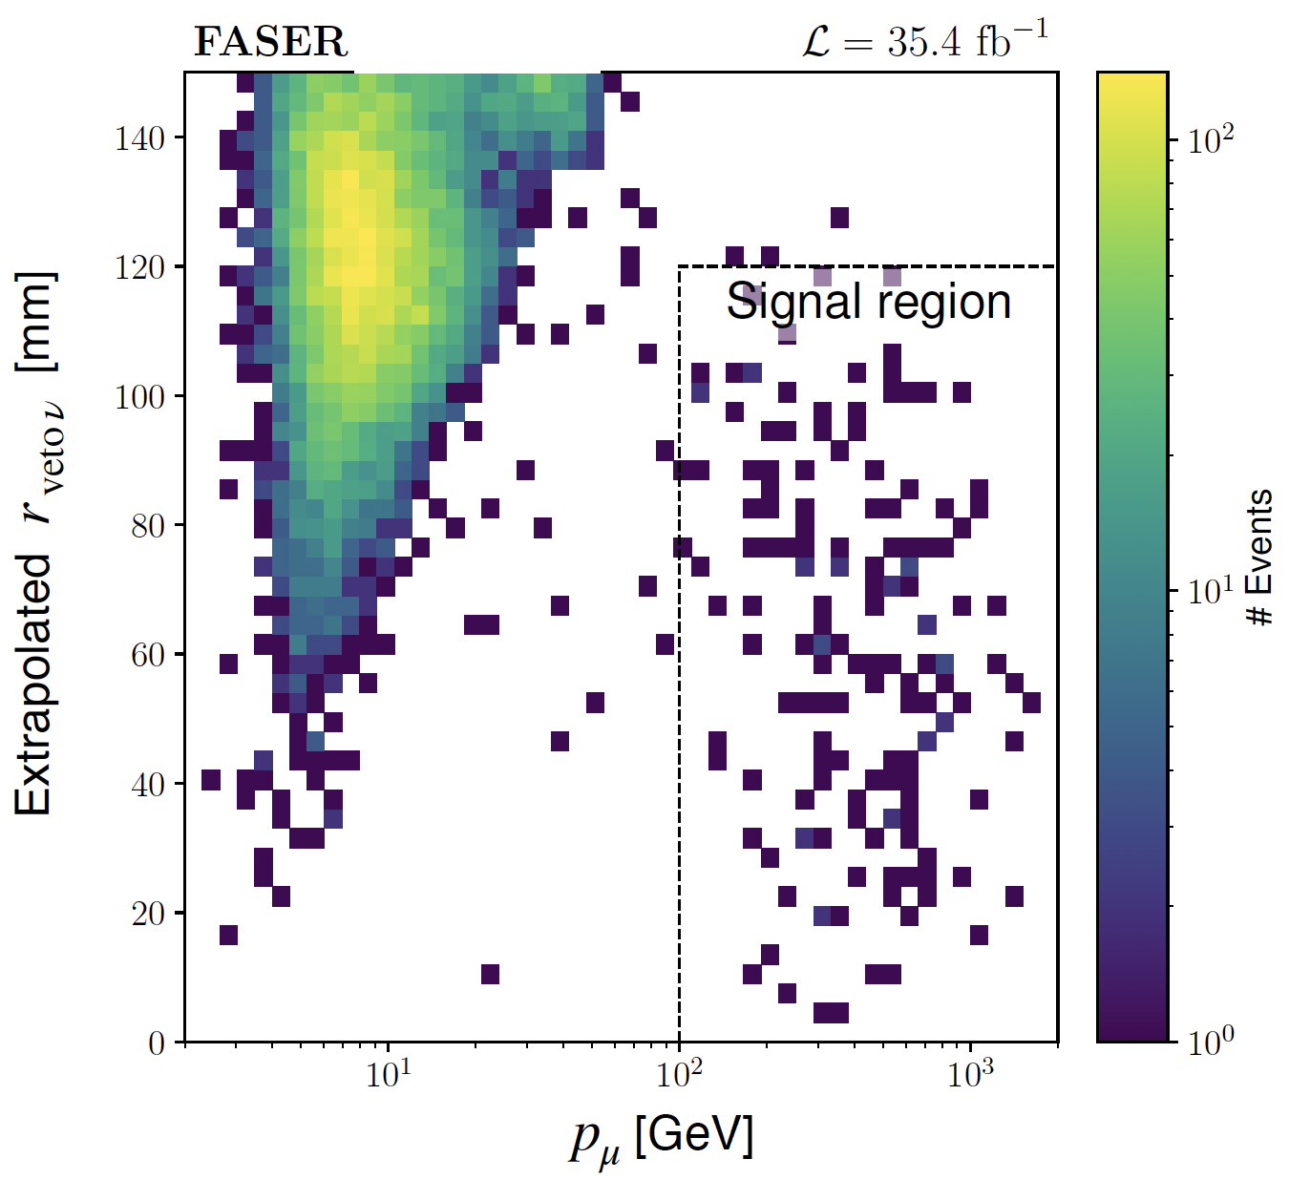
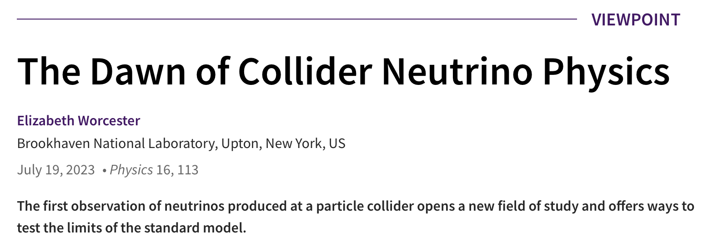
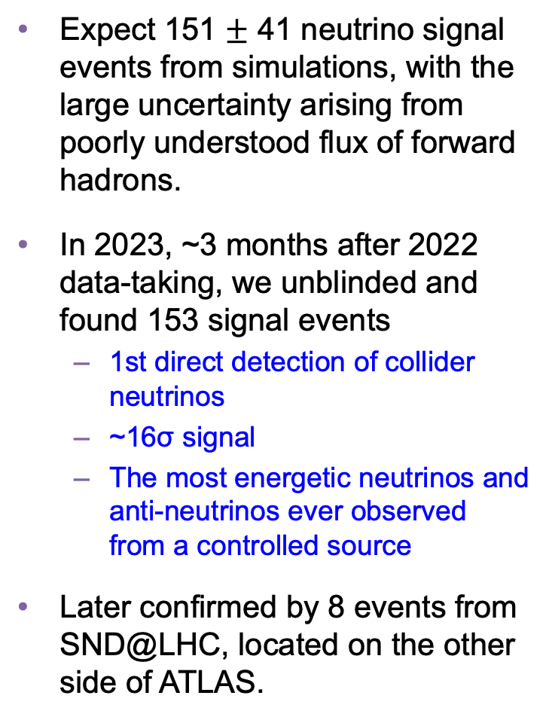
FIRST DIRECT OBSERVATION OF COLLIDER NEUTRINOS
Expect 151 $±$ 41 neutrino signal events from simulations, with the large uncertainty arising from poorly understood flux of forward hadrons.
In 2023, ~3 months after 2022 data-taking, we unblinded and found 153 signal events
  1st direct detection of collider neutrinos
  ~16σ signal
  The most energetic neutrinos and anti-neutrinos ever observed from a controlled source
Later confirmed by 8 events from SND@LHC, located on the other side of ATLAS.
FASER Collaboration (2303.14185, PRL)

Slide 21
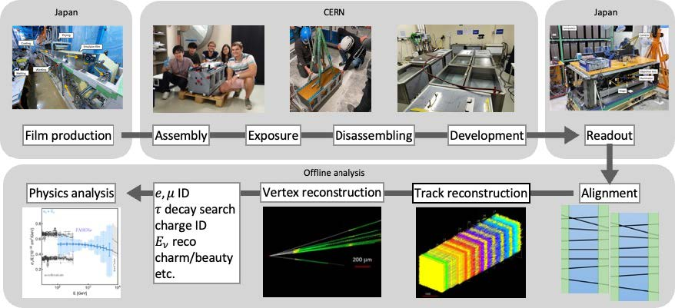
FASERν
The first neutrinos detected were muon neutrinos in FASER’s electronic detector.
But at the front of FASER is FASERν, a 1.1-ton block of 730 interleaved tungsten and emulsion plates. The first neutrino analysis treated this as a big block of matter, but the emulsion provides a photographic image with extraordinary spatial resolution (0.3 microns).

Slide 22

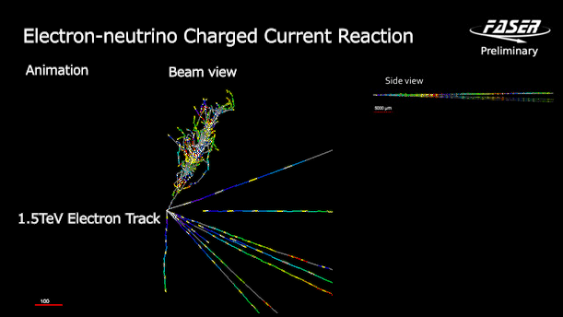
FIRST DETECTION OF COLLIDER ELECTRON NEUTRINOS
With FASERν, we observed the first collider electron neutrinos, including the “Pika-$ν$” event, the highest energy (>1.5 TeV) electron neutrino ever seen from a lab source.
FASER Collaboration (2403.12520)

Slide 23
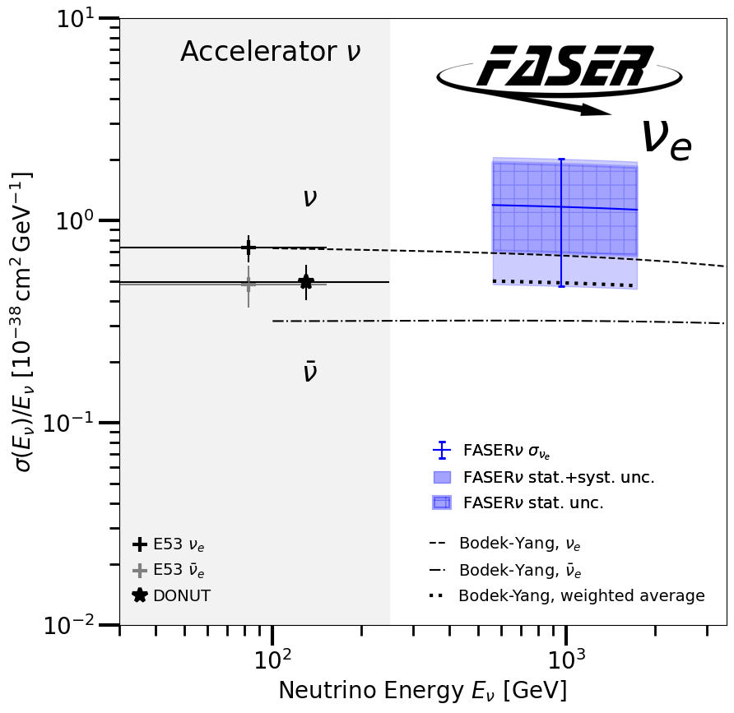
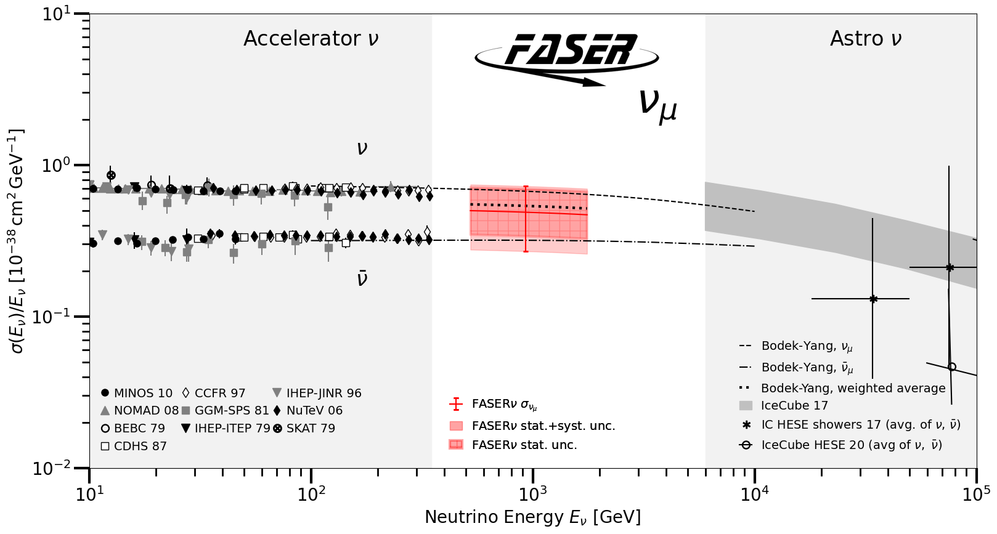

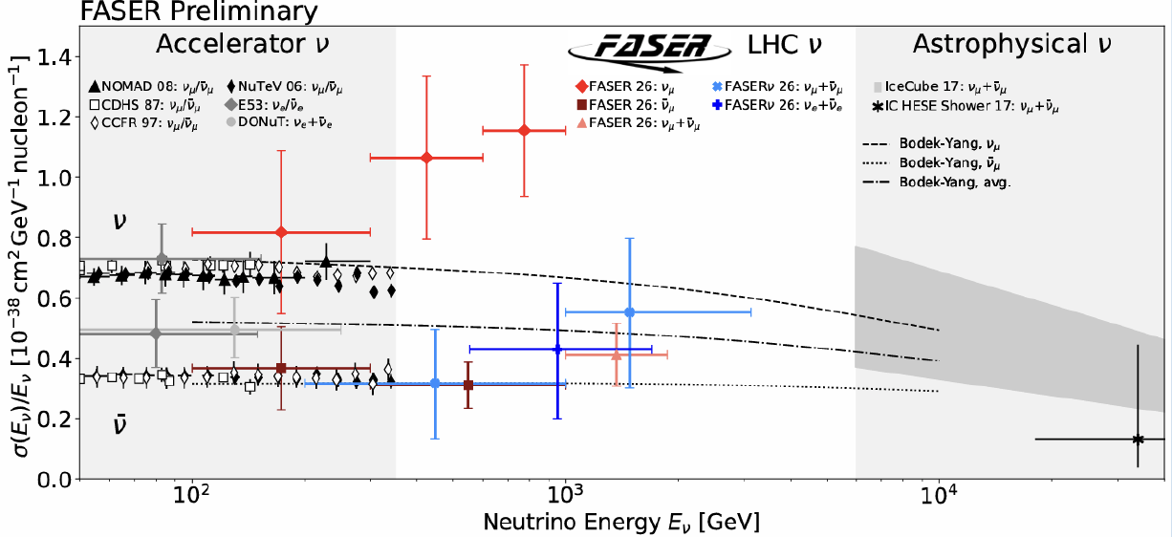
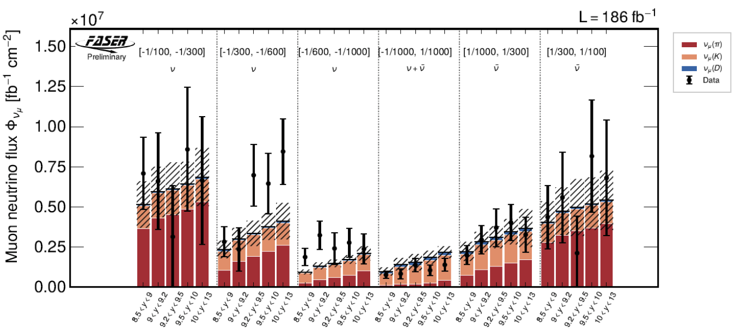
TEV NEUTRINO STUDIES
After discoveries: studies.
  Assuming forward hadron production models, first probe of neutrino propagation and cross sections at TeV energies → sterile neutrinos, NSI, ….
  Assuming SM DIS cross section, constrain forward hadron production → proton structure (x ~ 10⁻⁶ gluon pdf, intrinsic charm, avoid BSM being absorbed into pdf fits), astroparticle physics (prompt atmospheric neutrinos, cosmic muon puzzle).
FASER Collaboration (2403.12520)
New (preliminary) results presented at Moriond 2026, Neutrino 2026; see FASER Briefings.
  TeV electron neutrino detection with electronic detector.
  Neutrino cross sections (1) as a function of energy and (2) as a function of pseudorapidity and energy.
  First search for neutrino-induced charm production (milestone toward tau neutrino observation).

Slide 24
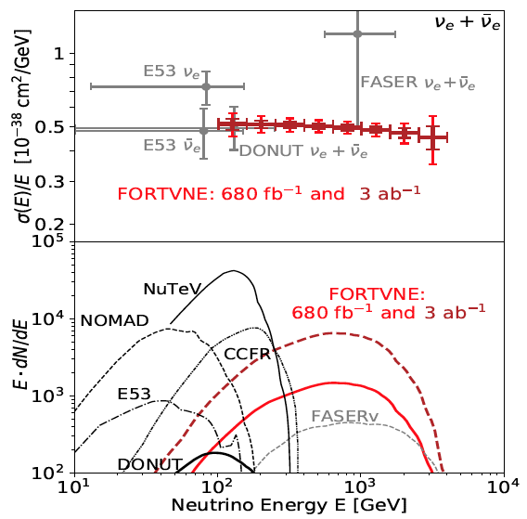
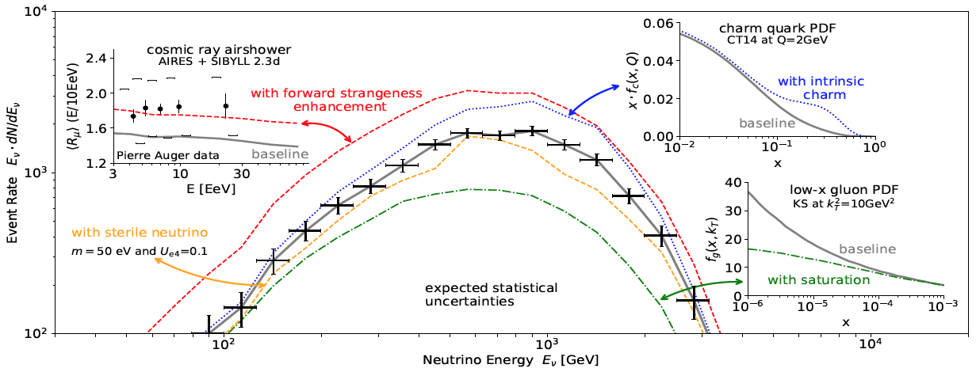
PHYSICS POTENTIAL OF COLLIDER NEUTRINO STUDIES
An example: the electron neutrino event rate as a function of energy will tell us about
  New forms of matter (sterile neutrinos)
  The structure of protons and nuclei (gluon and quark parton distribution functions)
  The properties of cosmic ray air showers (the cosmic muon puzzle)

Slide 25
NEW PARTICLE SEARCHES

Slide 26
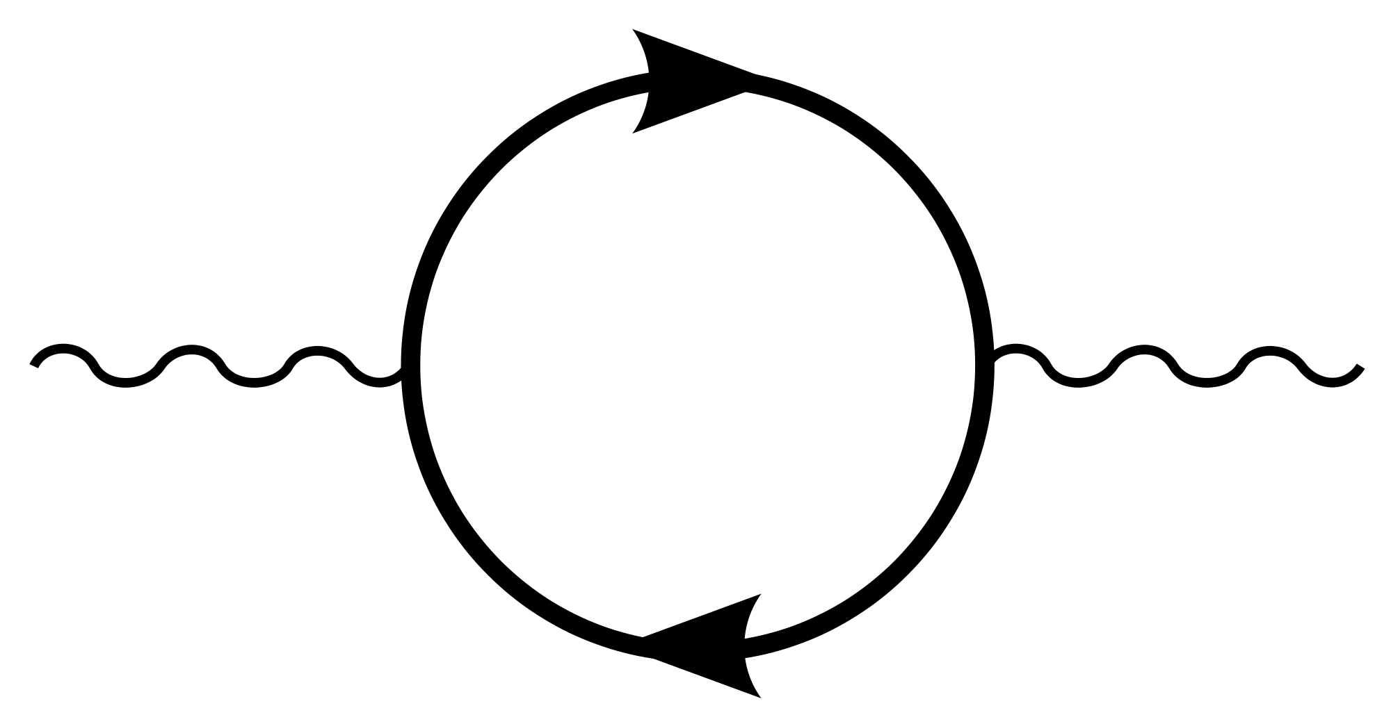
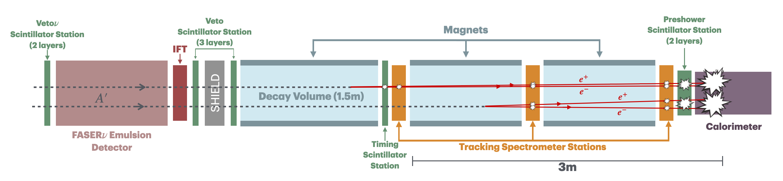


NEW PARTICLE SEARCHES
FASER is also looking for new dark particles, new fundamental forces, and new forms of matter.
For example: suppose there is a dark sector that contains a dark force: dark electromagnetism.
The result? Dark photons $A′$, like photons, but with a mass $m_{A′}$, couplings suppressed by $ε$.
For low $ε$, dark photons are very weakly-interacting, long-lived particles. Like neutrinos, but decay through $A^{′}$ $→ e^{+}e^{−}$, producing 2 charged particles with ~TeV-energy emerging from 100 m of rock.
SM
EM
Dark Sector
EM, X
A
$${εF}_{μν}F_{D}^{μν}$$
A_{D}
Holdom (1986)

Slide 27
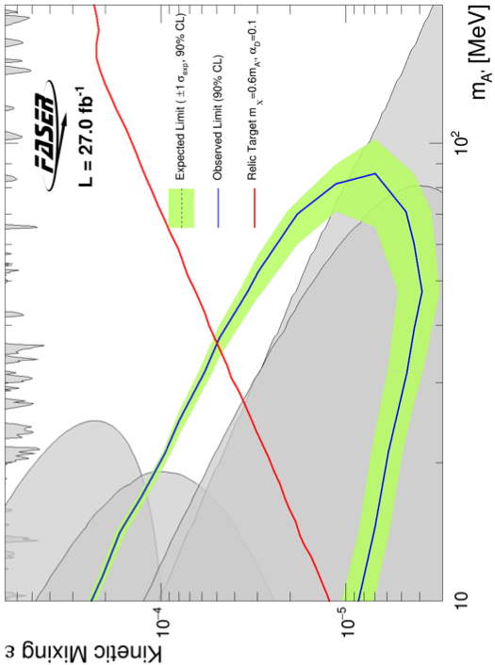
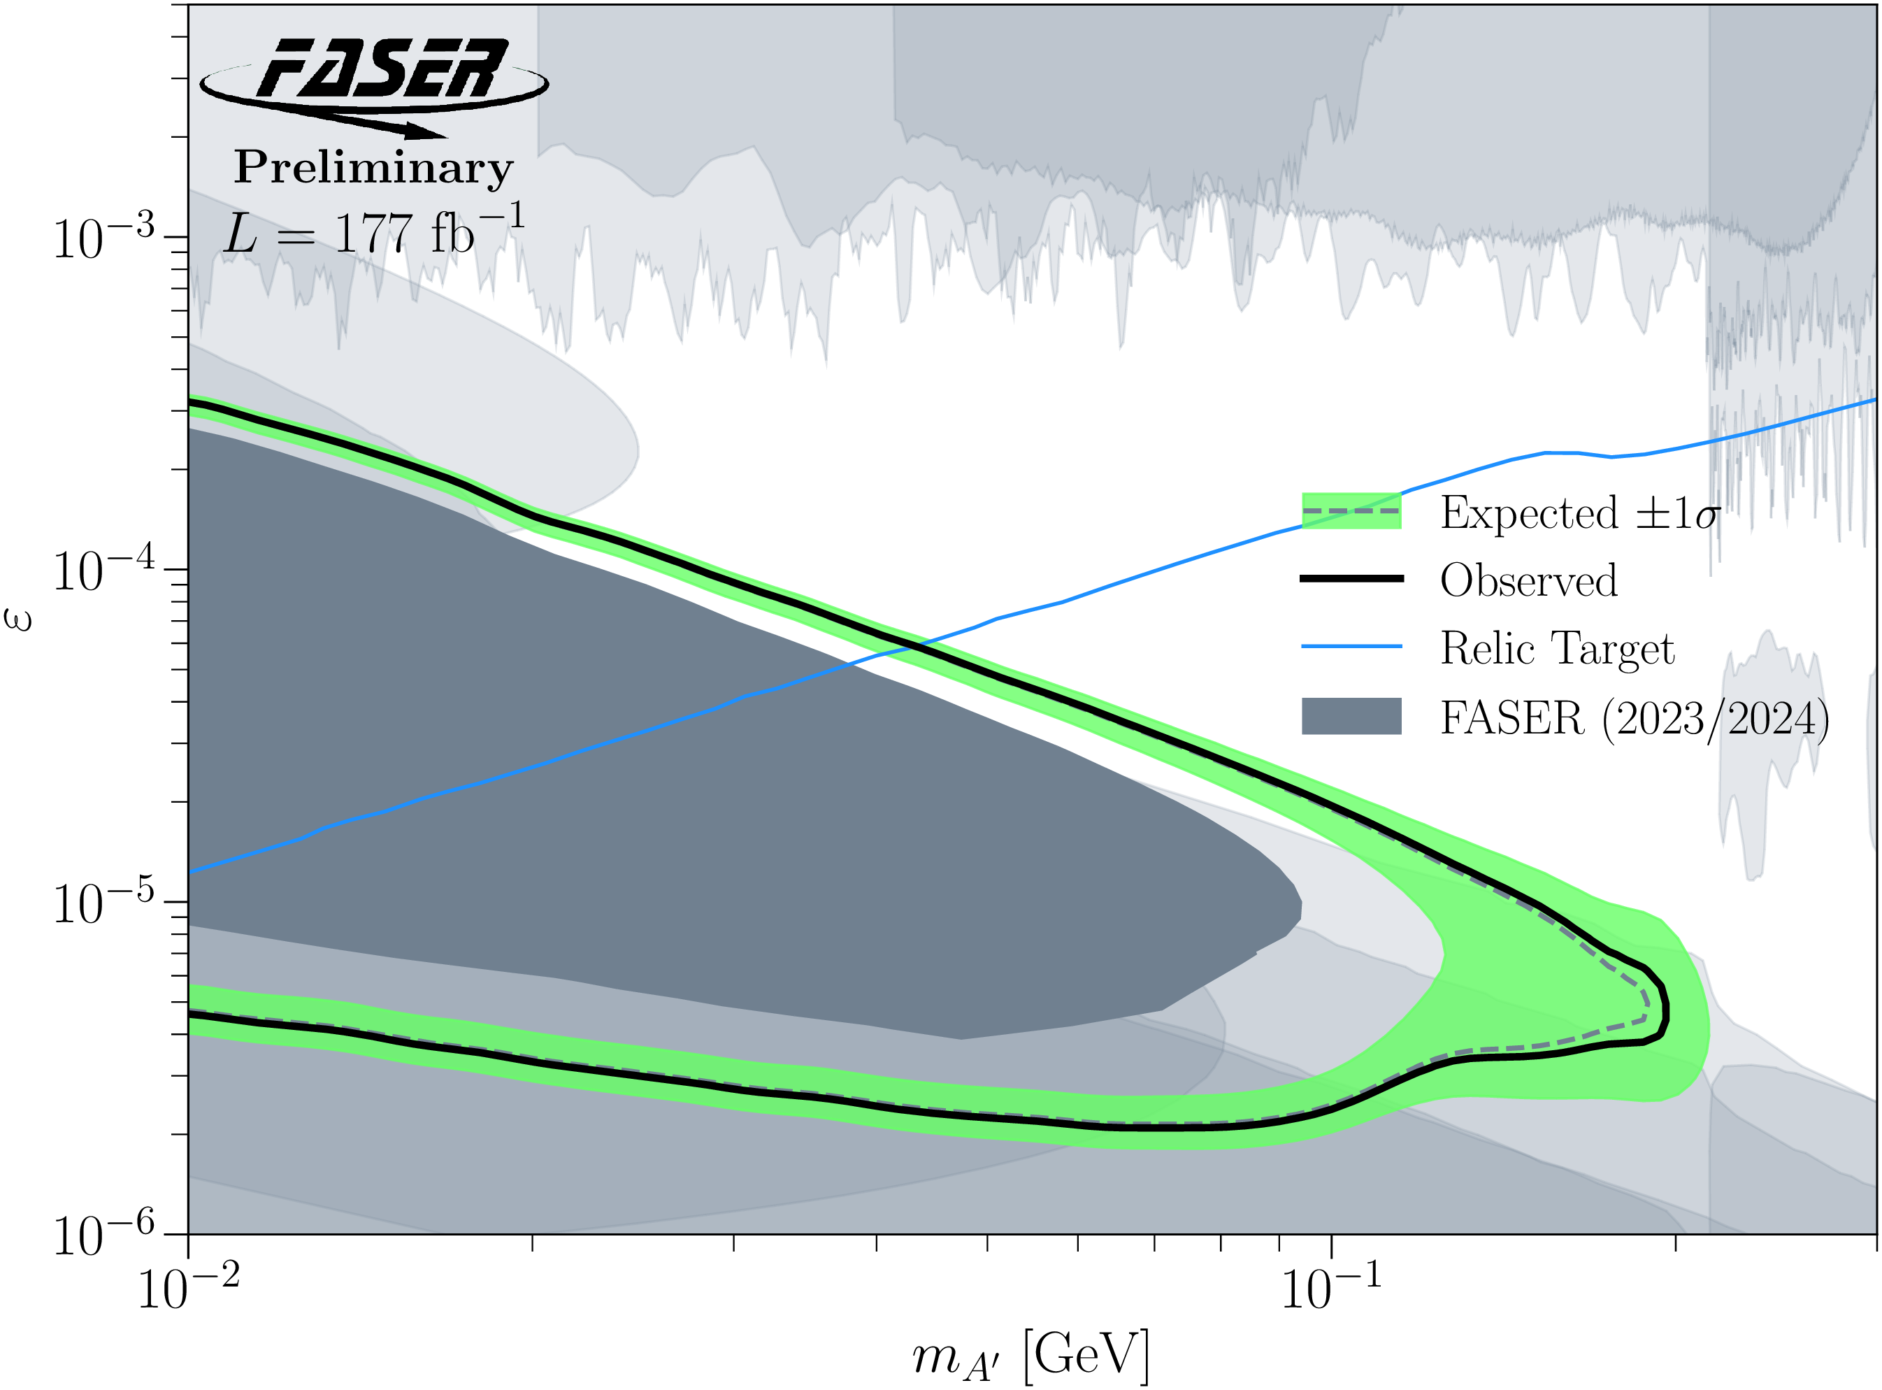
DARK PHOTON SEARCH
In 2023, in a blind analysis of 2022 data, no events were seen, and FASER set limits on previously unexplored parameter space.
  First new probe of the parameter space favored by dark matter relic density arguments from low coupling since the 1990’s.
  Started probing new parameter space on Day 1 (0.3 fb⁻¹)
  In this region of parameter space, ended up ~100 times more sensitive than previous experiments
In 2026, in another blind analysis, based on 2022-24 data, again no events were seen.
  ~6x the amount of data.
  ~3x more powerful analysis (more general signatures).
Prospects for the future
  The analyses have been essentially background-free.
  ~20x more data expected at the LHC.
Existing bounds from DarkCast
FASER Collaboration (2308.05587, PLB)
FASER Collaboration (CERN-FASER-CONF-2026-001)

Slide 28
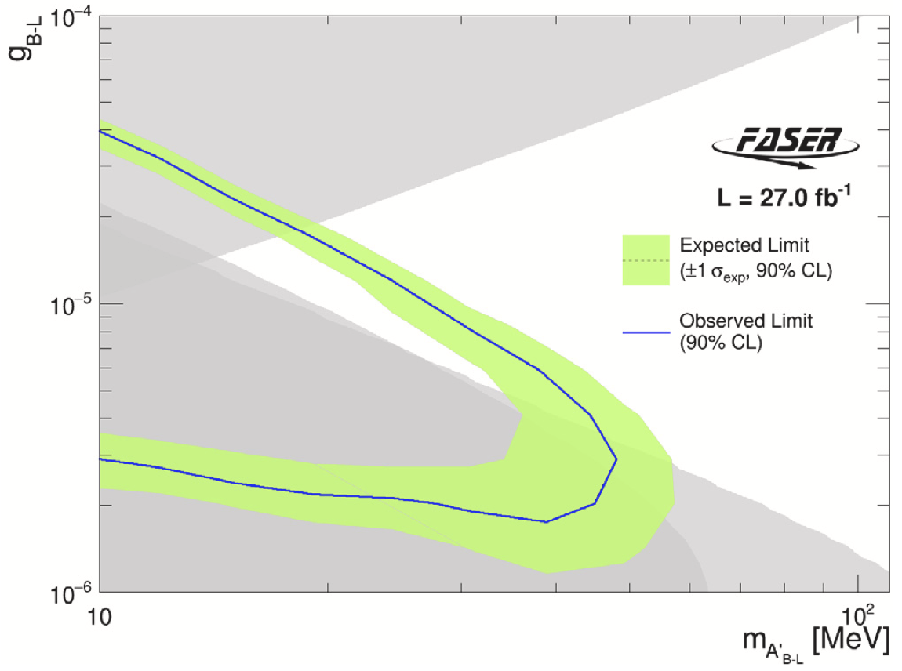
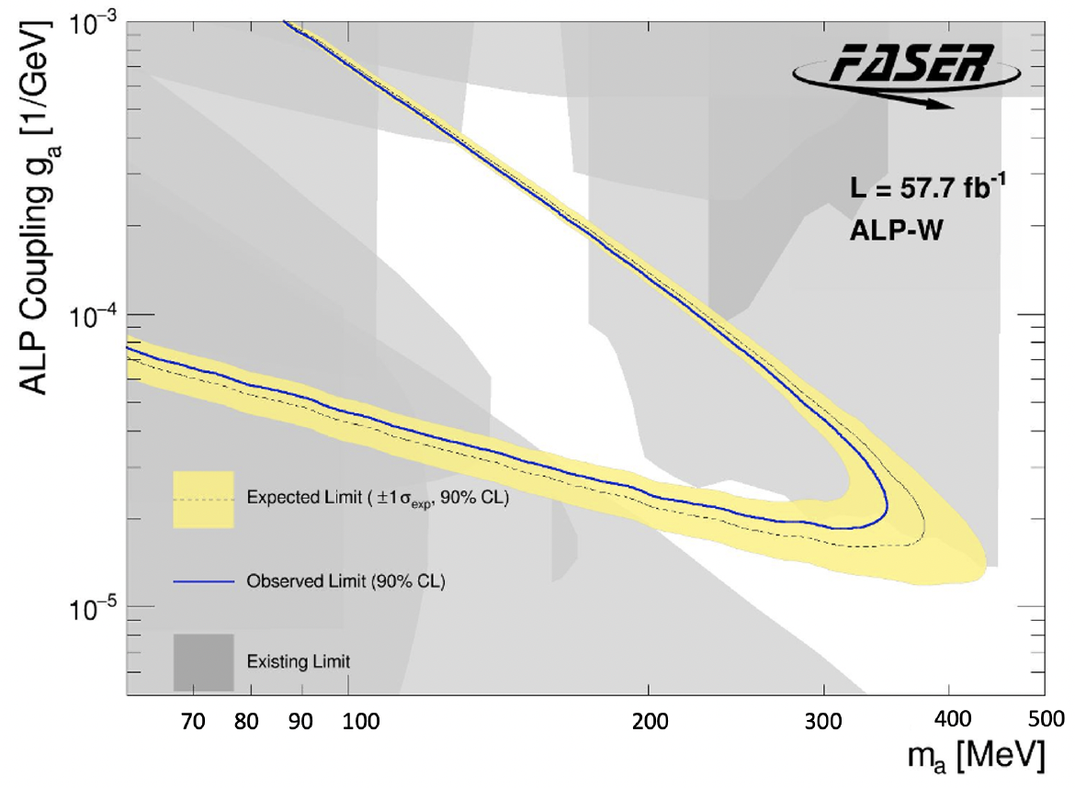
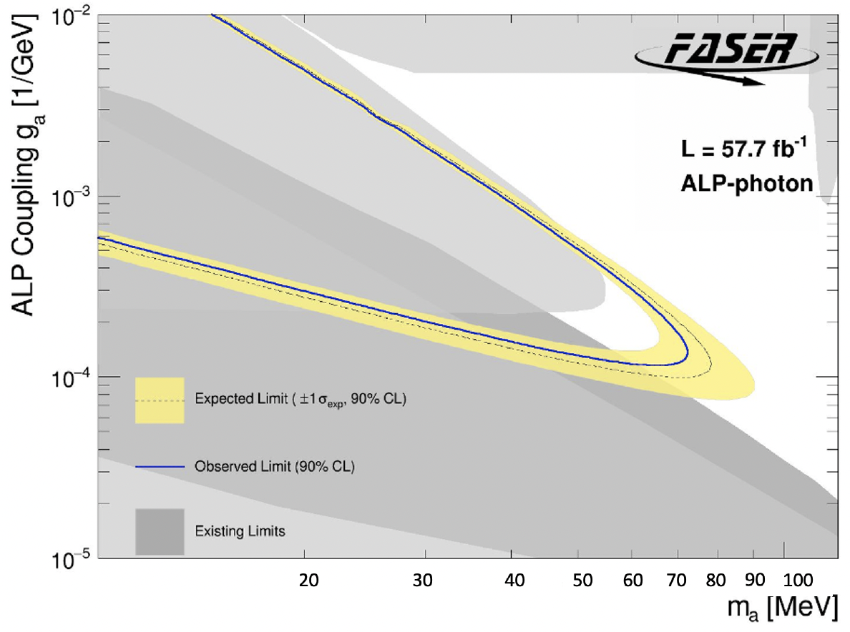
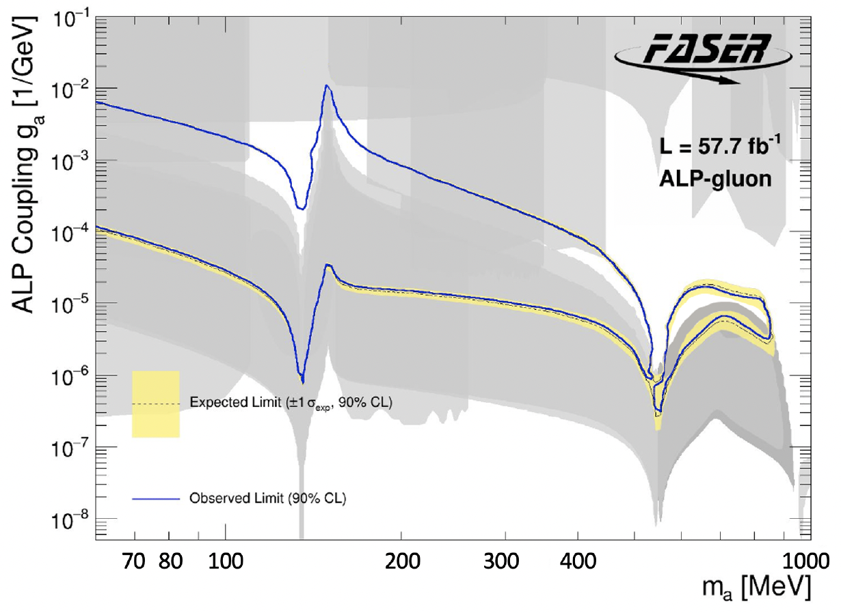
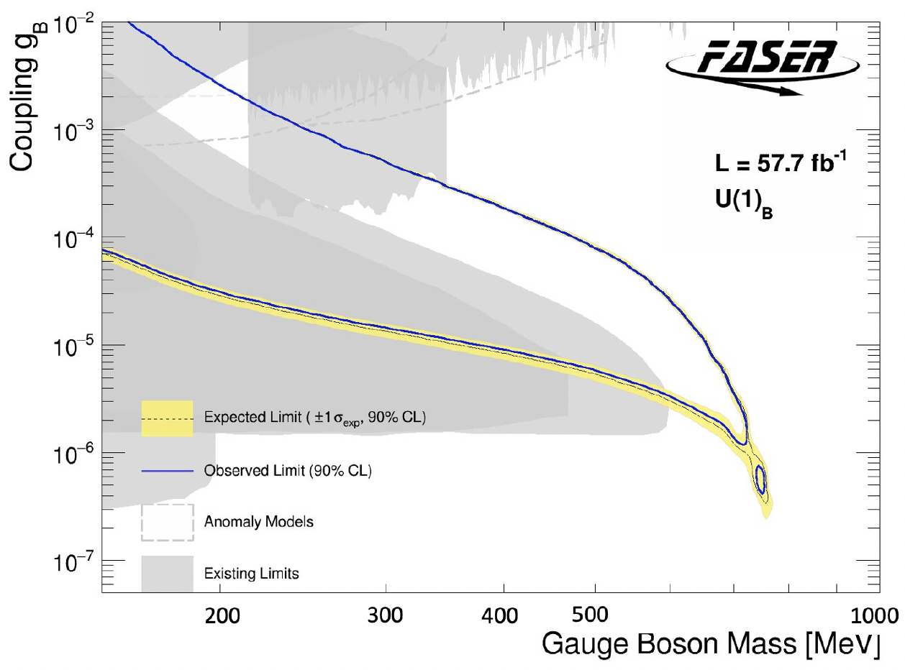
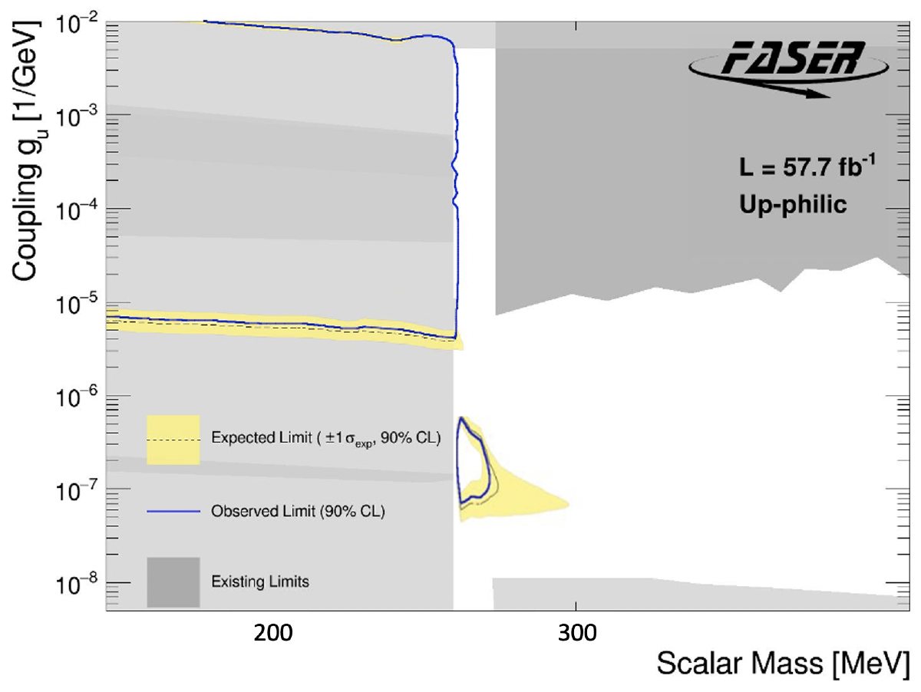
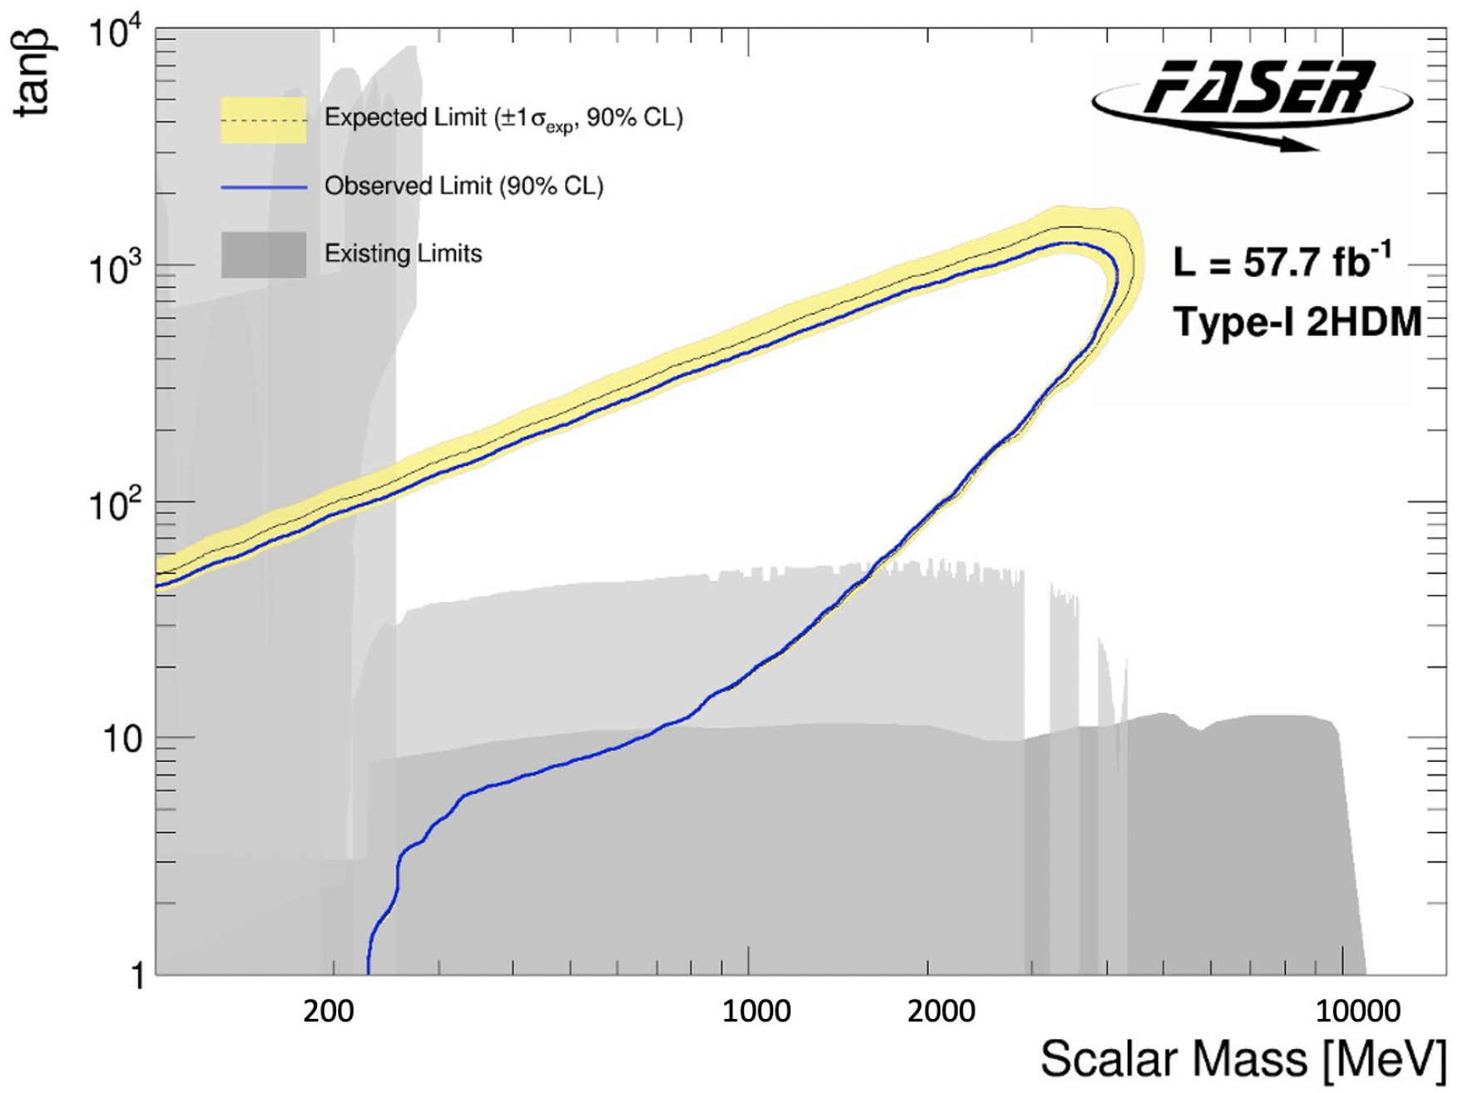
MORE NEW PARTICLE SEARCHES
We are also looking for many other new particles: other new force carriers (U(1)_{B-L}, U(1)_{B}, protophobic), axion-like particles with photon, W, gluon couplings, up-philic scalars, two Higgs doublet models, etc., all with world-leading sensitivities in interesting regions of parameter space.
FASER Collaboration (2308.05587, PLB; 2410.10363 )

Slide 29
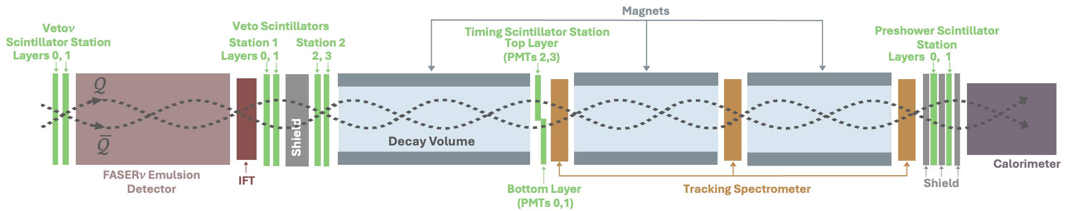
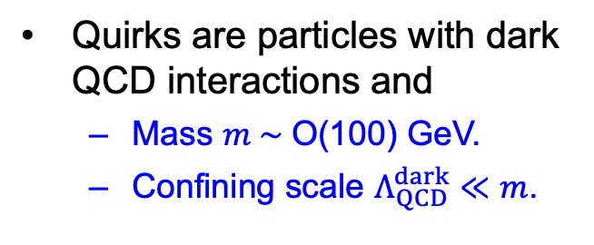
QUIRK SEARCH
What if the dark sector does not have electromagnetism, but instead has particles bound together by a strong force, similar to QCD? Can get bizarre new particles: quirks.
Kang, Luty (2008)
Quirks are particles with dark QCD interactions and
  Mass $m \sim$O(100) GeV.
  Confining scale $Λ_{QCD}^{dark}≪m$.
These particles cannot neutralize their color charge by popping pairs of quirks out of the vacuum. Instead, they oscillate around their center of mass and propagate slowly in the forward direction.
By looking for 2 coincident tracks that are slow and delayed (out of time with bunch crossings), can discover quirks with masses well beyond current bounds. Turns FASER’s liability (distance from ATLAS) into a virtue! Results coming soon (Eli Welch, UC Irvine student).
Feng, Li, Liao, Ni, Pei (2024)

Slide 30
UPGRADES AND PLANS

Slide 31
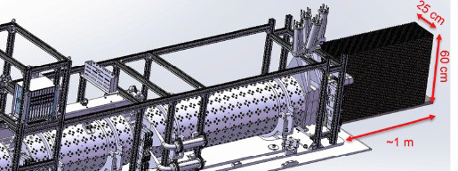
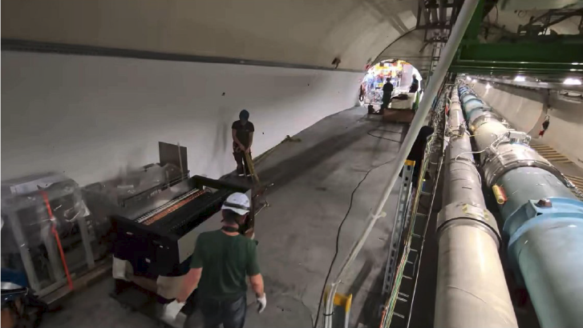
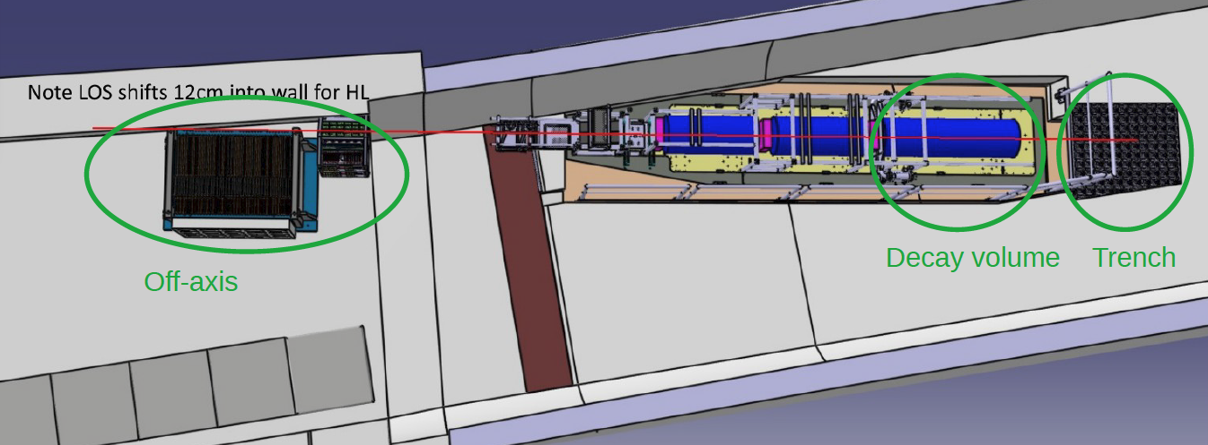




FASER AT LHC RUN 4
FASER is approved to run in its current location for LHC Run 4. Many upgrade proposals, downselected to 4, prototype detectors have been installed and collected data. It has become a crowded field (literally). A good time for adding collaborators!

Slide 32


FORTVNE
One idea: Forward TeV Neutrino Experiment (FORTVNE), a ~1 ton detector, 25cm x 60cm x 1m. Will detector O(10,000) neutrinos in LHC Run 4.
66 modules, each module consisting of 5mm-thick tungsten, 5mm-thick V scintillator bars, 5mm-thick H scintillator bars.
The FASER Run4 upgrade detectors provide a remarkable opportunity for students to build an LHC detector from scratch, commission and install it, and collect and analyze data, all in the typical time it takes to get a PhD.

Slide 33





FLOUNDER
2501.06142
2501.06142
2501.06142
Another interesting idea is to place a detector where the neutrino / new particle beams emerge from the ground. One proposal is FLOUNDER (Forward LHC Observatory Underwater for Neutrinos and the Dark sEctoR), led at UC Irvine by Steve Barwick (expt) and Toni Makela (theory postdoc). Another is by Nicholas Kamp and collaborators.
Beam emerges ~30 m under the surface of Lake Geneva. Building on experience with neutrino detectors in the Antarctic (IceCube), could place a row of shipping containers filled with water and PMTs in Lake Geneva.
2501.06142, JHEP

Slide 34


Slide 35




FORWARD PHYSICS FACILITY
CERN is also considering the possibility of excavating a new underground detector hall to house diverse forward experiments for the rest of the LHC’s lifetime into the 2040s.
SPS
ATLAS
LHC
LOS
FPF site selection and core studies have identified an ideal site in France just outside the CERN main gate
https://cds.cern.ch/record/2851822
CERN GIS

Slide 36



FORWARD PHYSICS FACILITY
Engineering Department
Anastasiya Magazinik, Julien Prosic, talk at FPF9, 5 March 2026
Notes:
All these elements: civil engineering design, buildings, services from the design offices, safety elements, experiments 3D models and so much more need to be integrated in the FPF model.
This is necessary to work together and make a concrete project.

Slide 37








FORWARD PHYSICS FACILITY: SAFETY DESIGN
Engineering Department
Fire detector
Evacuation panel
Anti Panic light
Fire extinguisher
WIFI
Electrical boxes
Anastasiya Magazinik, Julien Prosic, talk at FPF9, 5 March 2026
Notes:
All these elements: civil engineering design, buildings, services from the design offices, safety elements, experiments 3D models and so much more need to be integrated in the FPF model.
This is necessary to work together and make a concrete project.

Slide 38


FORWARD PHYSICS FACILITY
4 experiments, all on the LOS to maximize the discovery potential of the LHC.
  Neutrinos: 10⁶ (1000 per day) at the highest energies ever from a controlled source, including 1000s of tau neutrinos.
  New particles: 10,000 more sensitive for many new particle searches (10x in $x, y,z$, and 10x the luminosity).
FASER2
FASERnu2
FLArE
Engineering Department
Nominal Beam Axis
FORMOSA
  Facility: ~$35M, similar for all experiments combined, input to ”Non-Collider Roadmap” at CERN
  FPF Physics Opportunities and Conceptual Design, 2510,26260, NPB
Anastasiya Magazinik, Julien Prosic, talk at FPF9, 5 March 2026
Notes:
Here is the baseline layout of detectors in the FPF cavern.
All these detectors are centered on the beam axis line-of-sight.

Slide 39




OUTLOOK
The forward region at particle colliders, neglected for decades, turns out to be a treasure trove of interesting physics. This can be mined with small, fast, inexpensive experiments to study neutrinos and look for new particles.
Is there another November revolution waiting for us in the forward region?

Slide 40
WHERE WE ARE AND
WHERE WE’RE GOING

Slide 41
PROLOGUE
What follows is a personal perspective. It is heavily dependent on my experiences, some common, some not so common. See above, but briefly:
  Professor teaching and mentoring students at a university, while doing research at a particle physics lab.
  Theorist and accidental founding Co-Spokesperson of an LHC collaboration for the last 8 years.
  Studying neutrinos and BSM physics at the energy frontier.
  Funded by federal grants and private foundations, service on 2014 P5, Astro 2010, various advisory boards.
  Asian-American working in Europe.
  …
I hope to leave some time at the end for open discussion.

Slide 42
WHERE WE ARE
Many of us took part in, experienced, or witnessed the discovery of the Higgs boson.
To discover the Higgs boson, the world came together to build a truly monumental machine which produced a truly monumental discovery. We are still recovering.
Two extreme reactions:
  This is the greatest time in particle physics! No, it is not. Please familiarize yourself with some of the history of our field (one of Steve Weinberg’s Four Golden Lessons). We should stop over-selling, and simply accept that we are in a new era, with no guaranteed discoveries, but lots of interesting trails to follow.
  Particle physics is dead! No, it is not. We do not have a no-lose proposition like the Higgs boson, but this is not necessary to make revolutionary progress. Remember the muon: Who ordered that? We can be surprised, as long as we keep our eyes and minds open.

Slide 43
WHERE WE’RE GOING
The Higgs discovery has had a huge impact on the structure of our field.
Last year I had a medical problem that resulted in me being weak and bedridden for months. I read many books, including Loonshots, by Safi Bahcall. In it, he discusses how to catalyze breakthroughs. He also discusses conditions that stifle creativity and innovation:
  The Napolean complex: leaders do something great, but then stick around too long and surround themselves with people who agree with them. Sphere of influence >> sphere of competence.
  Silos: communities seal themselves off from others, removing cross-fertilization of ideas.
  Stake vs. rank (I’d call it “The Rule of 150”): as organizations grow past 150 members, they stop innovating. People are more concerned with their rank within the organization than the overall health and mission of the organization.
Do you recognize any of these problems in particle physics?
Example: “Our entire community of thousands of people have signed on to this plan that maps out the future of our field until to 2060.”
  Particle physicists: Great!
  Other physicists: Your field is dead. We should put our FTEs elsewhere.

Slide 44
A FEW SUGGESTIONS
How to fix this? There are no silver bullets: see the reports of P5 and NASEM in the US, and EPPSU in Europe. But just as a lack of a flagship project is an existential crisis for our labs, a lack of a diversity of smaller projects is an existential crisis for our field.
We can:
In planning committees, include people who are more concerned with stake than rank, people who have been a voice in the wilderness, people who have started new things.
Lower the barrier between theory and experiment. Value theorists (experimentalists) who really know some experiment (theory), and who can generate good ideas that can be tested realistically, quickly, and inexpensively.
Fence off funding for smaller projects, which can be distributed quickly. The relative cost is small, and at the very least, we will train the next generation of physicists, give them leadership opportunities, and preserve their enthusiasm.
Have small meetings (< 150 people), bringing together diverse expertise (no silos), with the freedom to challenge and question (no Napoleon).

