Slide 1



DARK MATTER
AT COLLIDERS
UCLA Dark Matter 2025
Jonathan Feng, UC Irvine, 24 March 2025

Slide 2
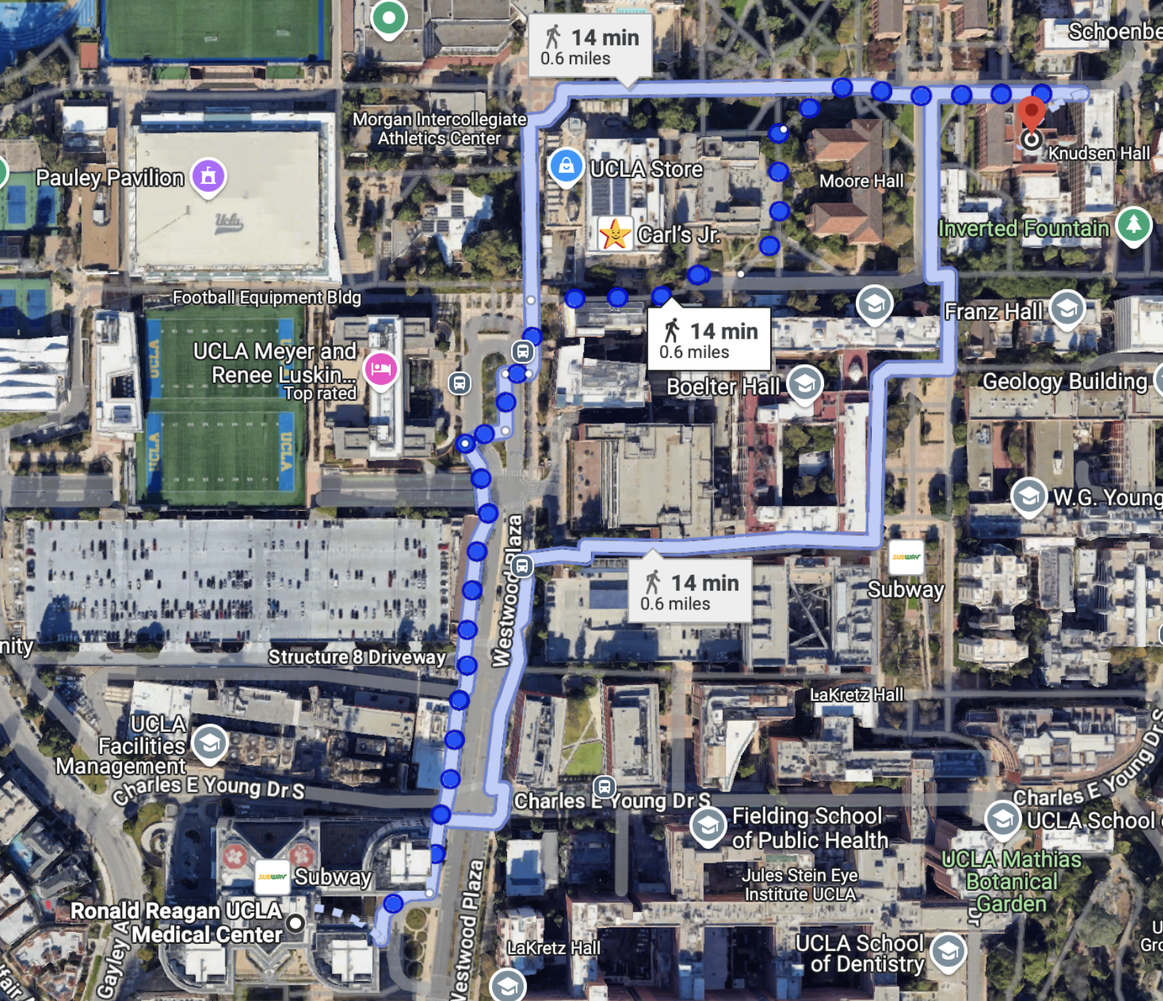
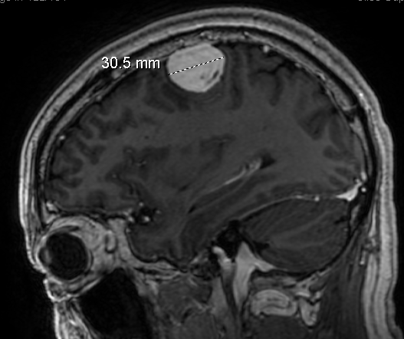
GRAY MATTER
This is my second time at UCLA in two months.
But the last time, I was not visiting Physics and Astronomy, but was a 10 minute walk from here having a golf ball-sized brain tumor removed by the wonderful people at UCLA’s Ronald Reagan Medical Center.
So please excuse me if I say something crazy (and the hat).

Slide 3
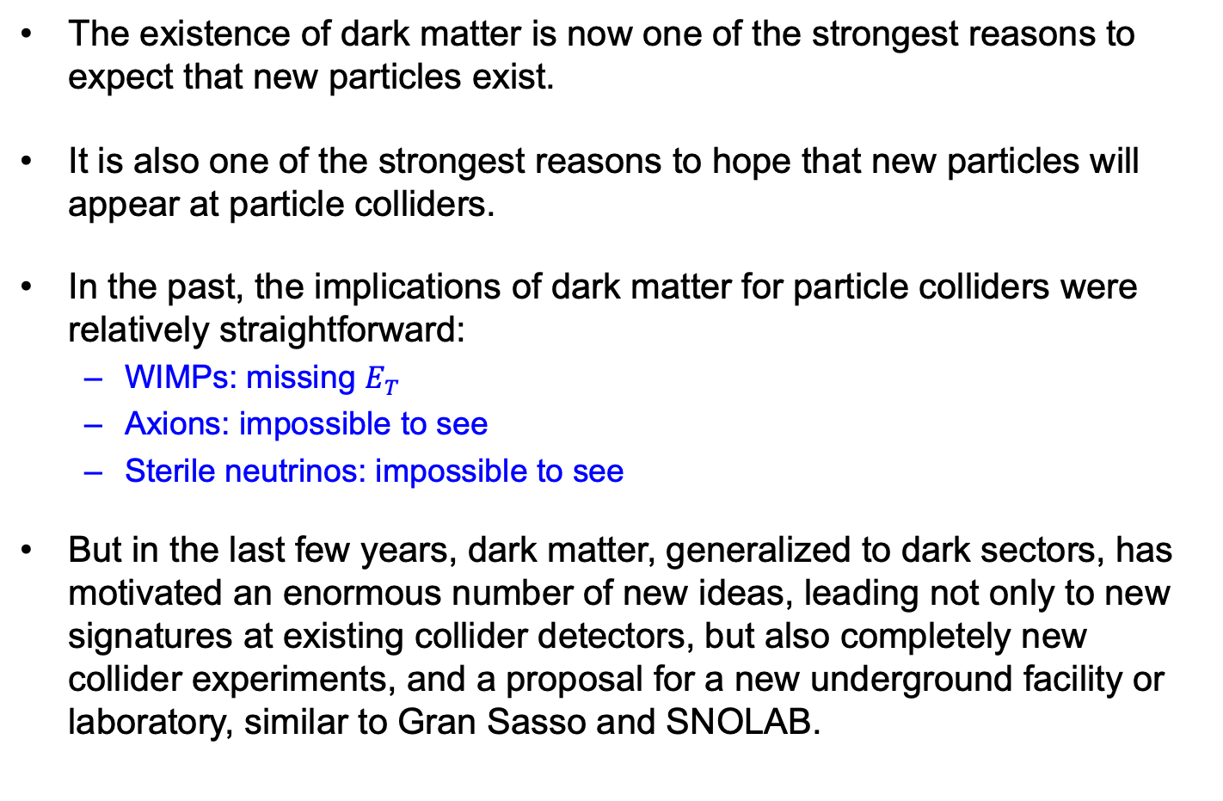
INTRODUCTION
The existence of dark matter is now one of the strongest reasons to expect that new particles exist.
It is also one of the strongest reasons to hope that new particles will appear at particle colliders.
In the past, the implications of dark matter for particle colliders were relatively straightforward:
  WIMPs: missing $E_{T}$
  Axions: impossible to see
  Sterile neutrinos: impossible to see
But in the last few years, dark matter, generalized to dark sectors, has motivated an enormous number of new ideas, leading not only to new signatures at existing collider detectors, but also completely new collider experiments, and a proposal for a new underground facility or laboratory, similar to Gran Sasso and SNOLAB.

Slide 4
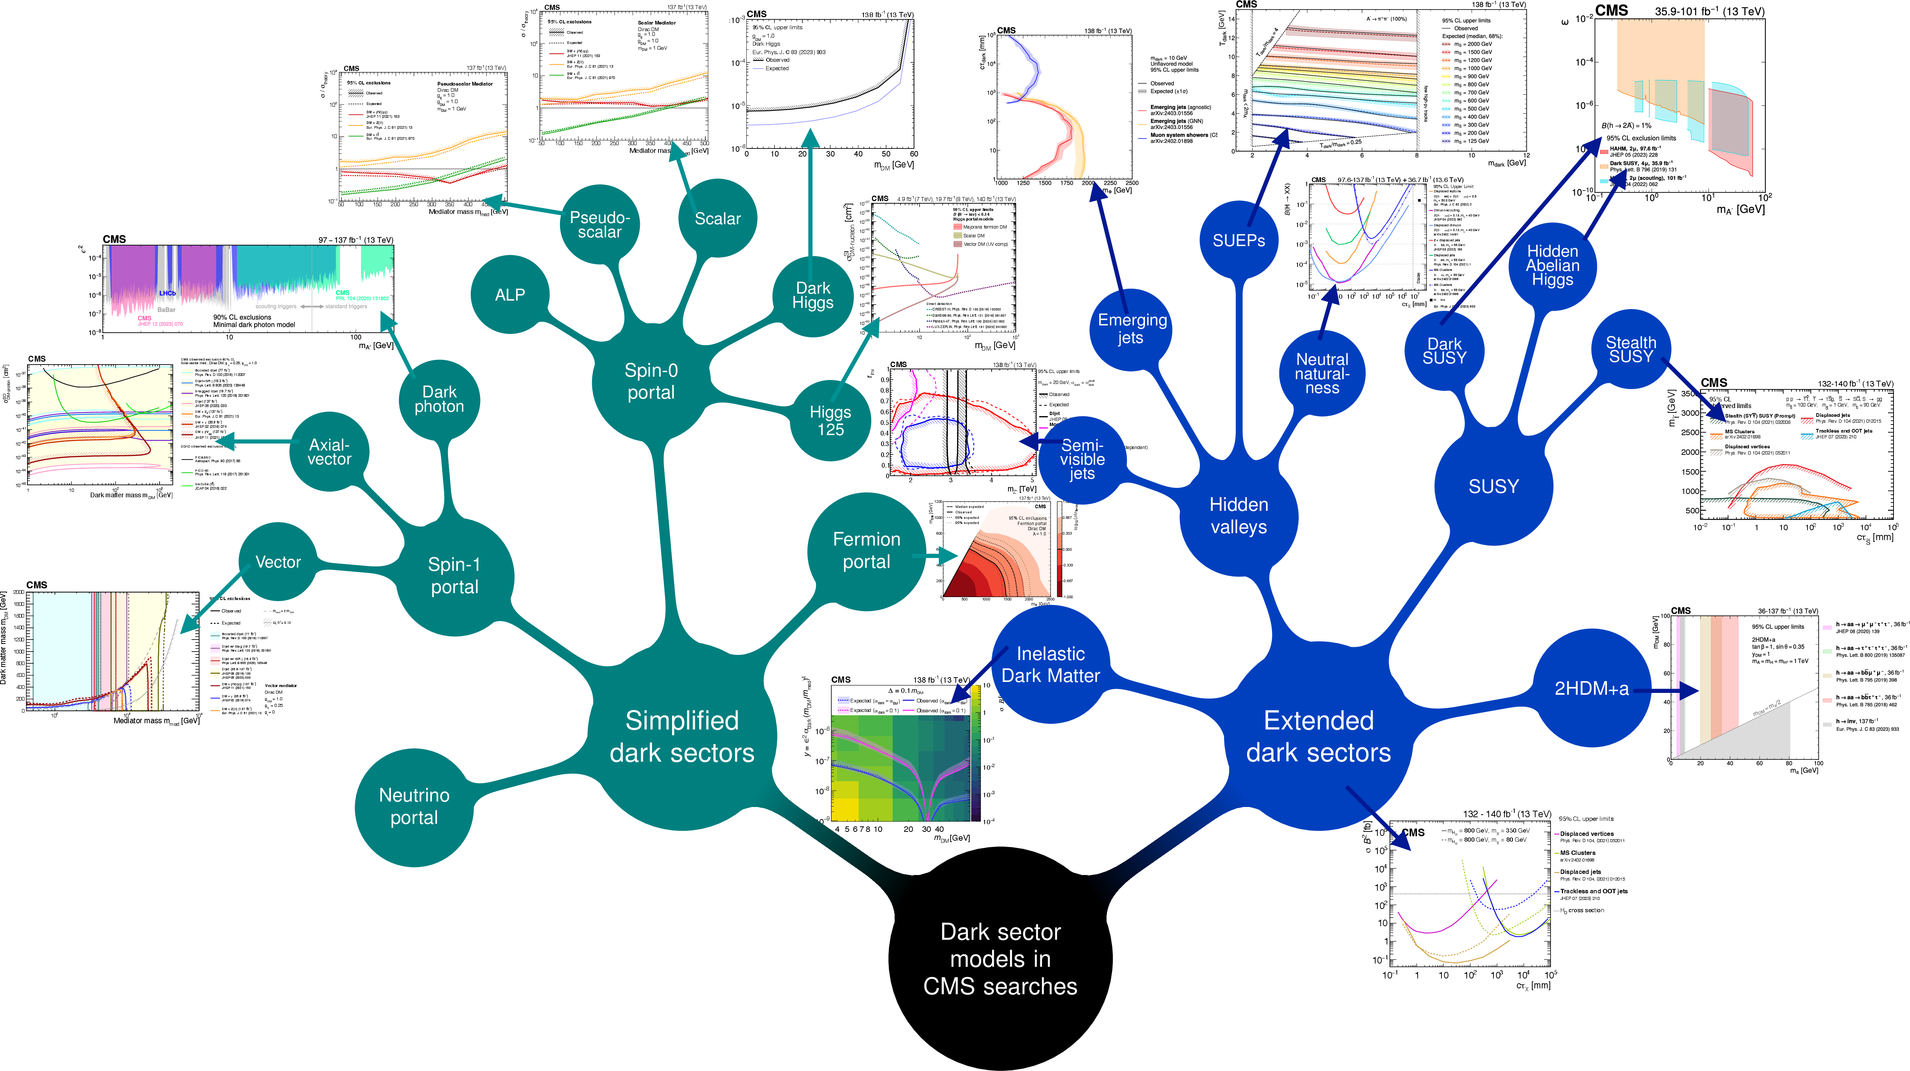
THE MULTITUDE OF DARK MATTER SCENARIOS
CMS Collaboration, 2405.13778 (to appear in Physics Reports special volume, “CMS Physics Results
from the First Decade of LHC Data,” with an accompanying ATLAS special volume, eds. Feng, Zanderighi)

Slide 5
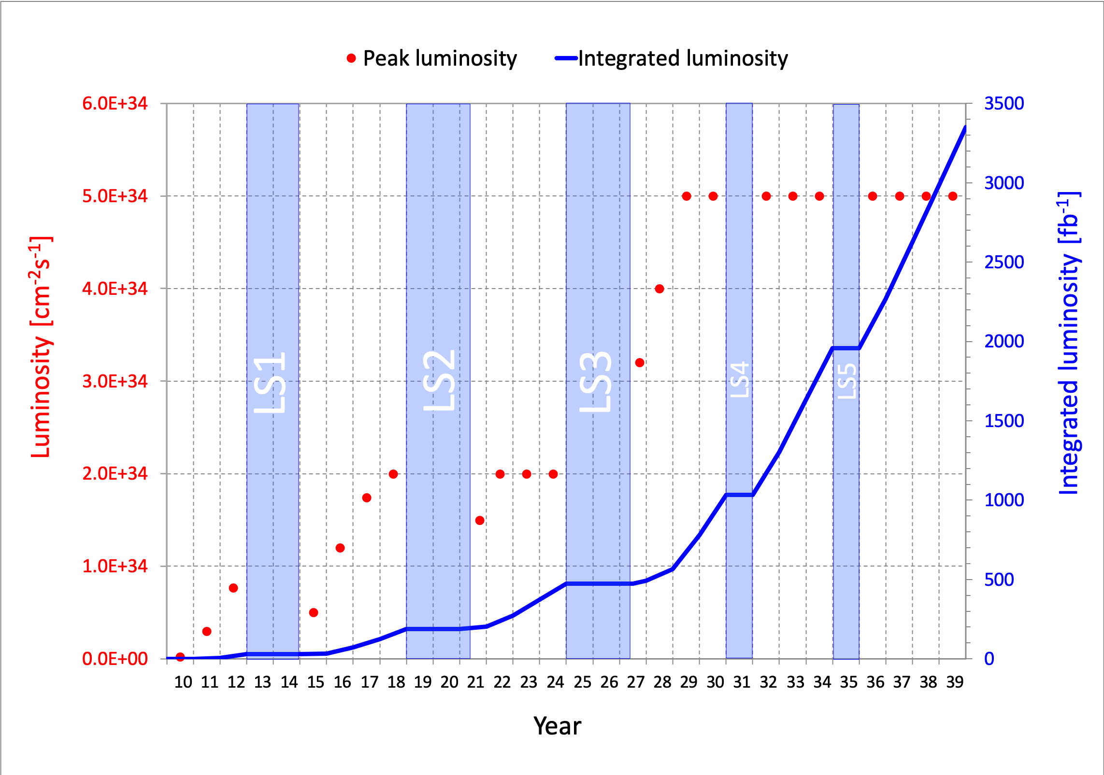
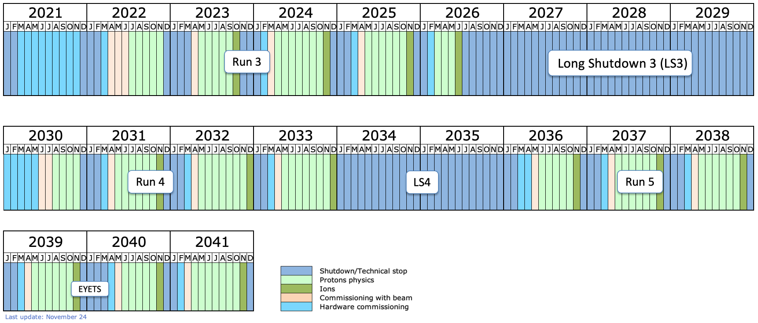
LARGE HADRON COLLIDER
To keep this talk manageable, focus on particle colliders (two colliding beams, so not fixed target experiments), and in fact, the LHC. There are other important colliders; for Belle II, see talk by Cristina Martellini.
The LHC started running in 2010 and is scheduled to run to ~2041.
  Middle-aged in terms of years
  But a 4th grader in terms of integrated luminosity
The schedule was revised in 2024:
In addition, focus on thermal relics.
COVID

Slide 6

THE THERMAL RELIC LANDSCAPE
Particle
Colliders
Mass
MeV
GeV
TeV
1
Already
Discovered
WIMPs and other
Heavy Particles
Too Little to be
Dark Matter
Interaction Strength
Just Right to
be Dark Matter
10⁻³
Dark Sectors and other
Light Particles
Impossible to
Discover
10⁻⁶
Too Much to be
Dark Matter

Slide 7
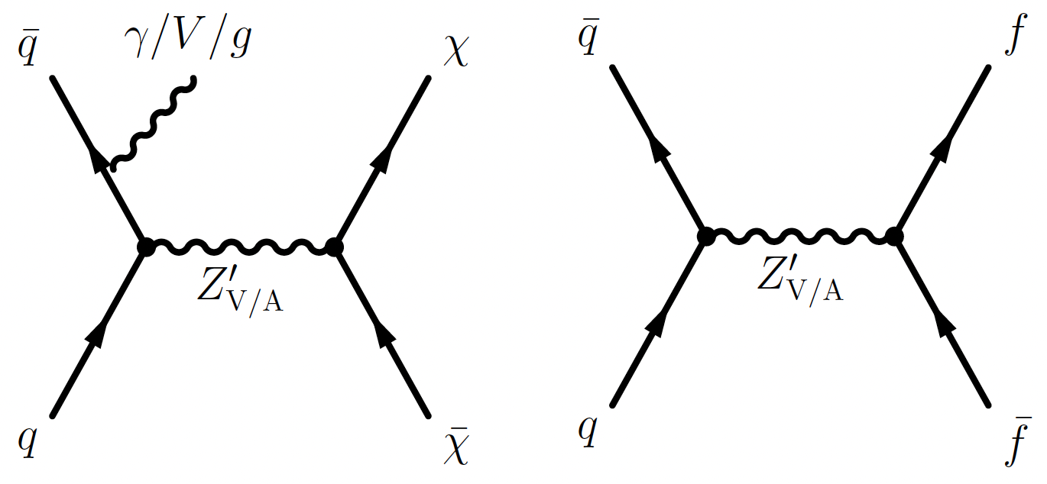
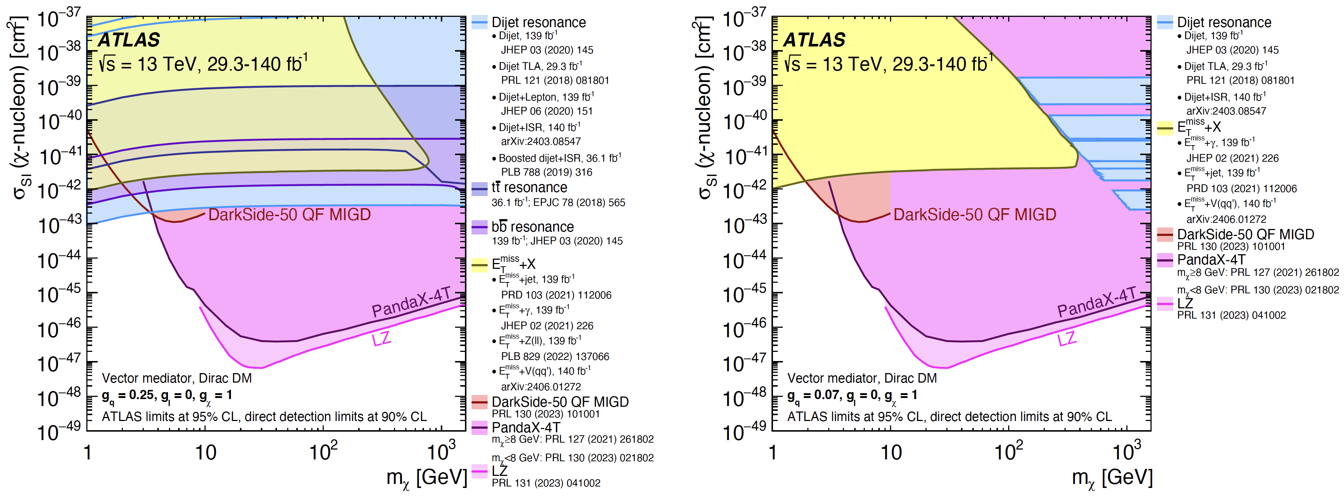
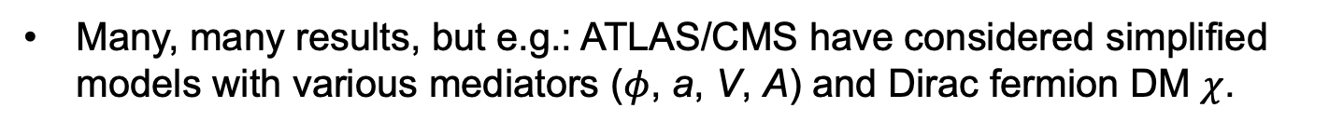
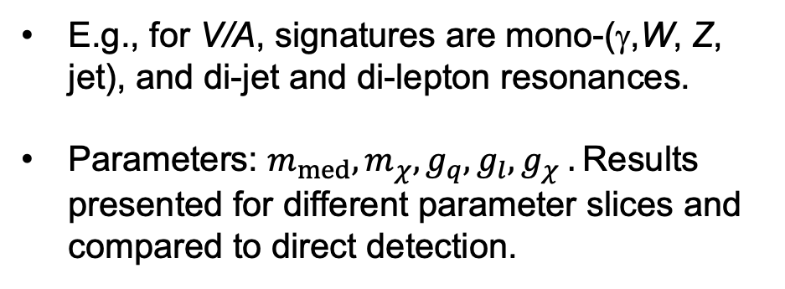
WIMPS AND OTHER HEAVY PARTICLES
Many, many results, but e.g.: ATLAS/CMS have considered simplified models with various mediators ($φ$, a, V, A) and Dirac fermion DM $χ$.
E.g., for V/A, signatures are mono-(γ,W, Z, jet), and di-jet and di-lepton resonances.
Parameters: $m_{med}, m_{χ}, g_{q}, g_{l}, g_{χ} .$Results presented for different parameter slices and compared to direct detection.
ATLAS Collaboration, 2404.15930
Highly model-dependent, but colliders typically do well for light DM.

Slide 8
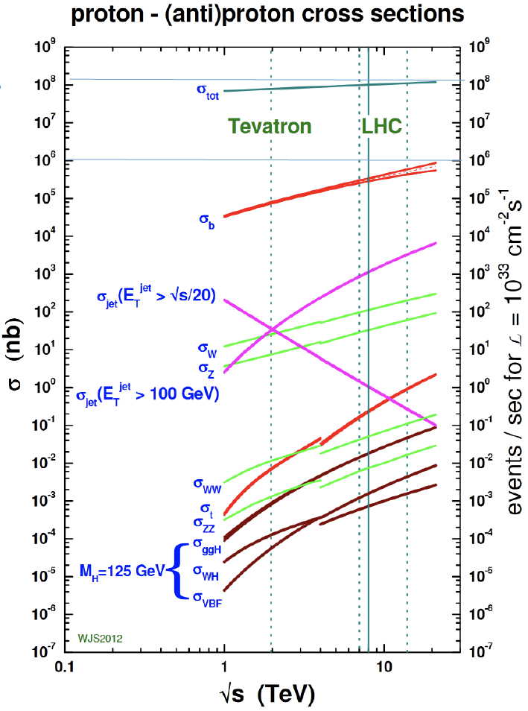
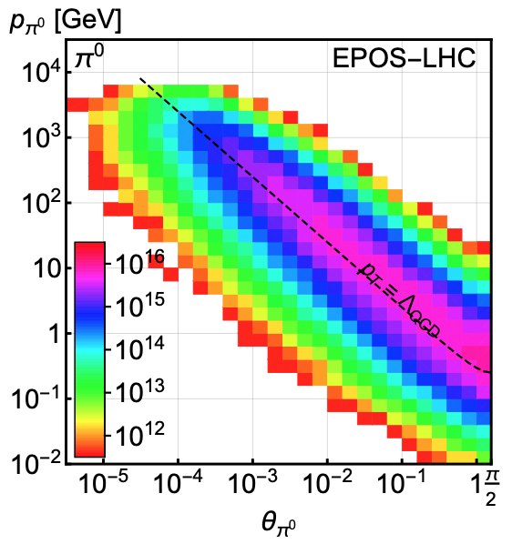
DARK SECTORS AND OTHER LIGHT PARTICLES
What if DM is light, with mass ~MeV to GeV? It turns out this merits a complete re-think of how to search for DM and BSM physics.
300 fb⁻¹
Feng, Galon, Kling, Trojanowski (2017)
Most BSM searches have focused on heavy particles, processes with σ ~ fb, pb.
E.g., we can look for h → γ A’, where A’ is a 100 MeV dark photon.
But why go to all the trouble of making a Higgs boson?
Such dark photons can be created in pion decays, π → γ A’, and the cross section for π production is ~ 100 mb.

Slide 9

A HOLLYWOOD ANALOGY
A scene from Blazing Saddles, a 1974 absurd, Western comedy classic, in which Gene Wilder’s character is being chased by a bunch of bad guys through the desert and devises an ingenious method to slow them down.

Slide 10

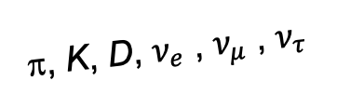
DETECTING FORWARD PARTICLES
Energetic pions and other light particles are produced in the forward direction along the beamline, where ATLAS and CMS have holes to let the protons in.
Problem: We can’t just put a new detector there: they will block the protons from coming in.
Solution: The LHC is a circular collider! If we go far enough away, the LHC proton beam will curl away, while all the light, weakly-interacting particles we are looking for will go straight.
A’, a, mCPs, χ, …
π, K, D, $ν_{e}$ , $ν_{μ}$ , $ν_{τ}$

Slide 11
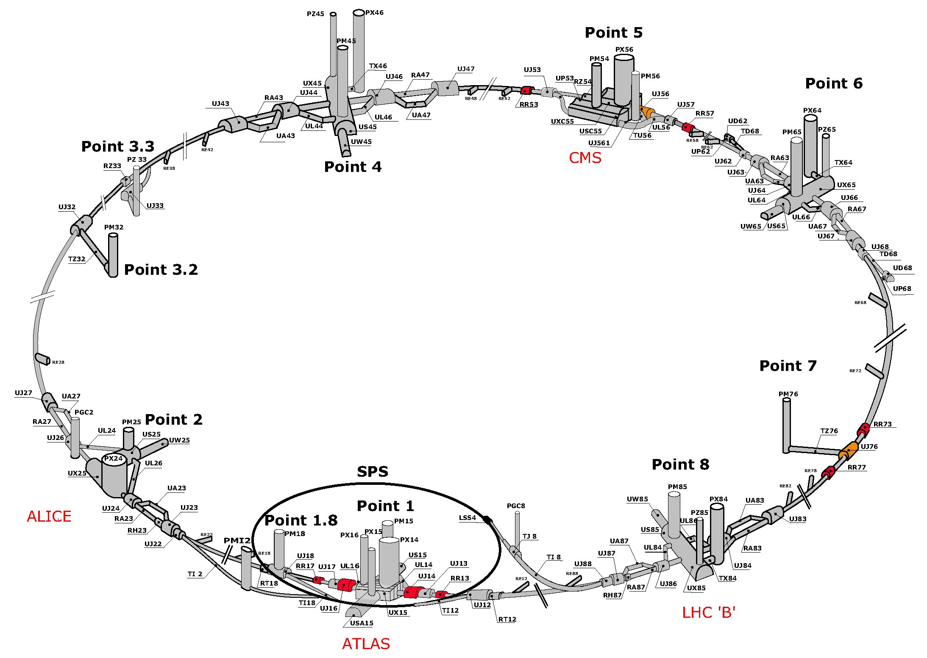
MAP OF LHC

Slide 12
MAP OF LHC
!!!

Slide 13
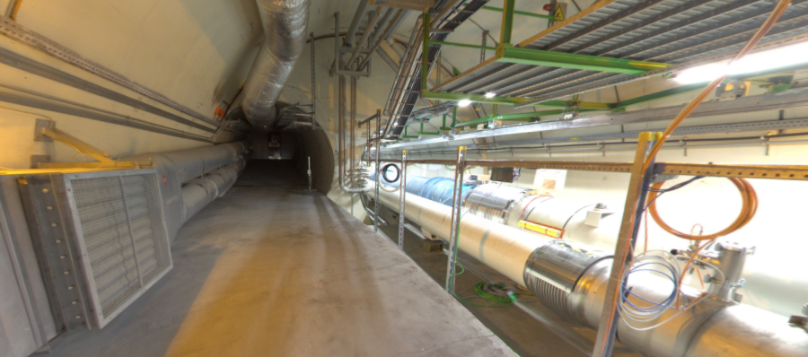
THE FORWARD REGION
Beam collision axis passes
through 100 m of rock, emerges in tunnel TI12, 480 m from ATLAS
UJ12
TI12 near UJ12
The view in UJ12 looking west in 2018
TI12
Beam collision axis:
dark matter, new particles could be streaming through this tunnel!
LHC beamline

Slide 14
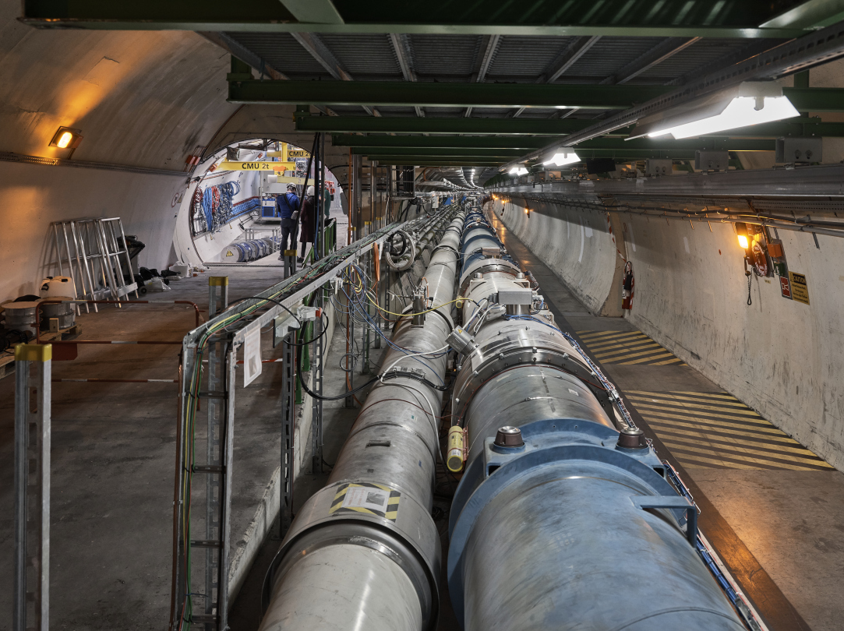
FASER AT THE LHC
The FASER detector was constructed and installed along the beam collision
axis near ATLAS from 2019-2021and has been collecting data since 2022.
Also FASERν and SND@LHC, focused on detecting and studying TeV neutrinos.

Slide 15
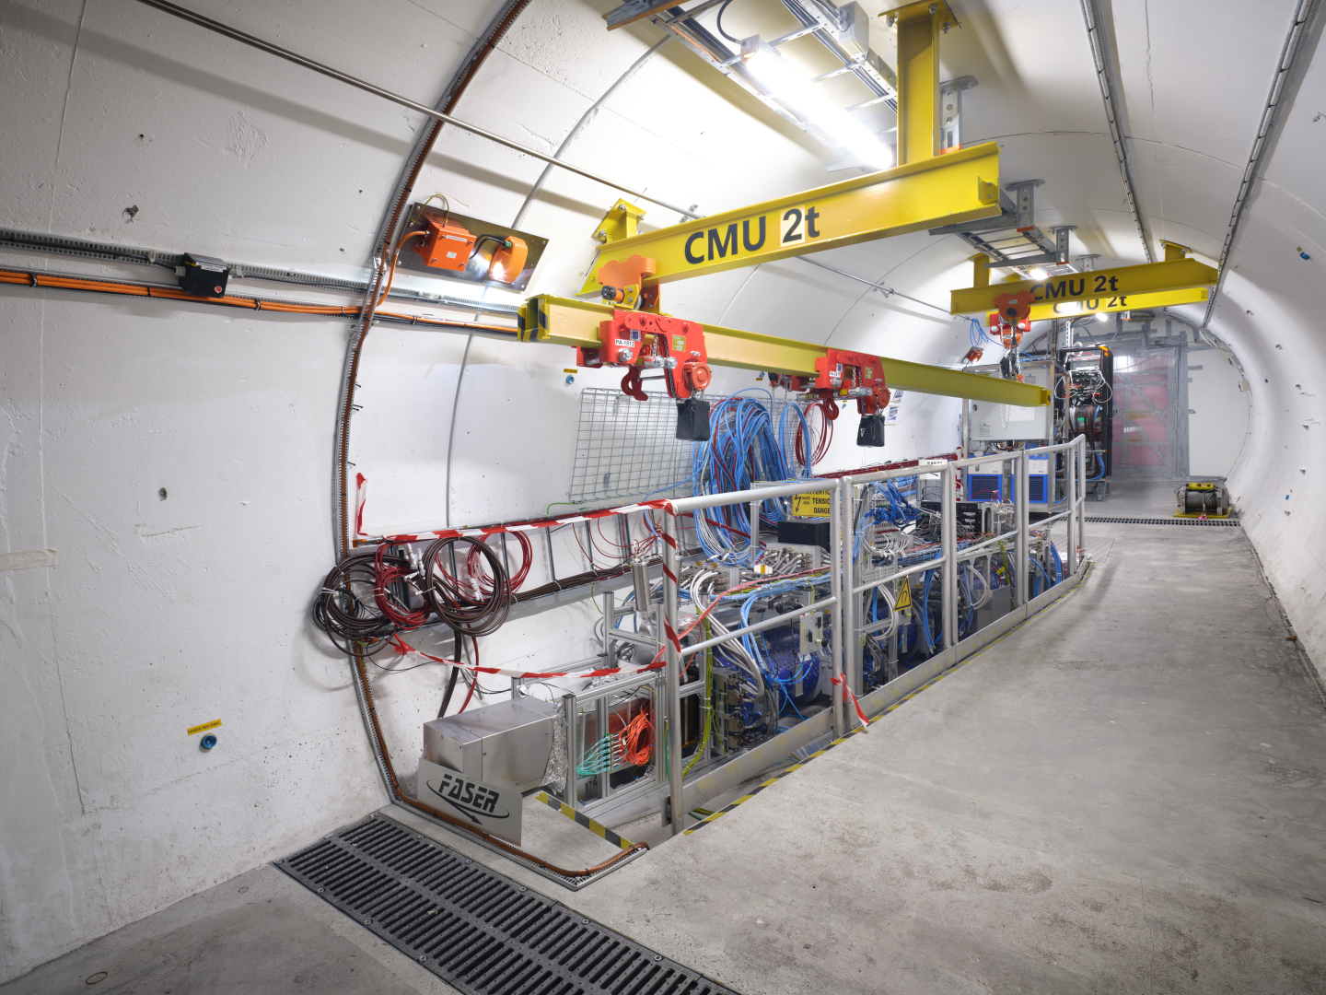
THE FASER DETECTOR

Slide 16
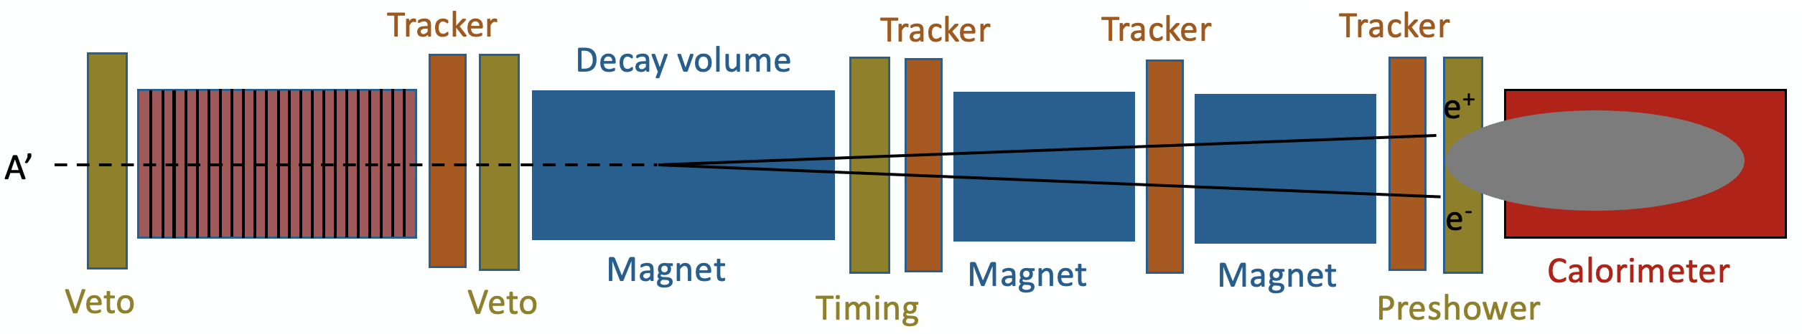
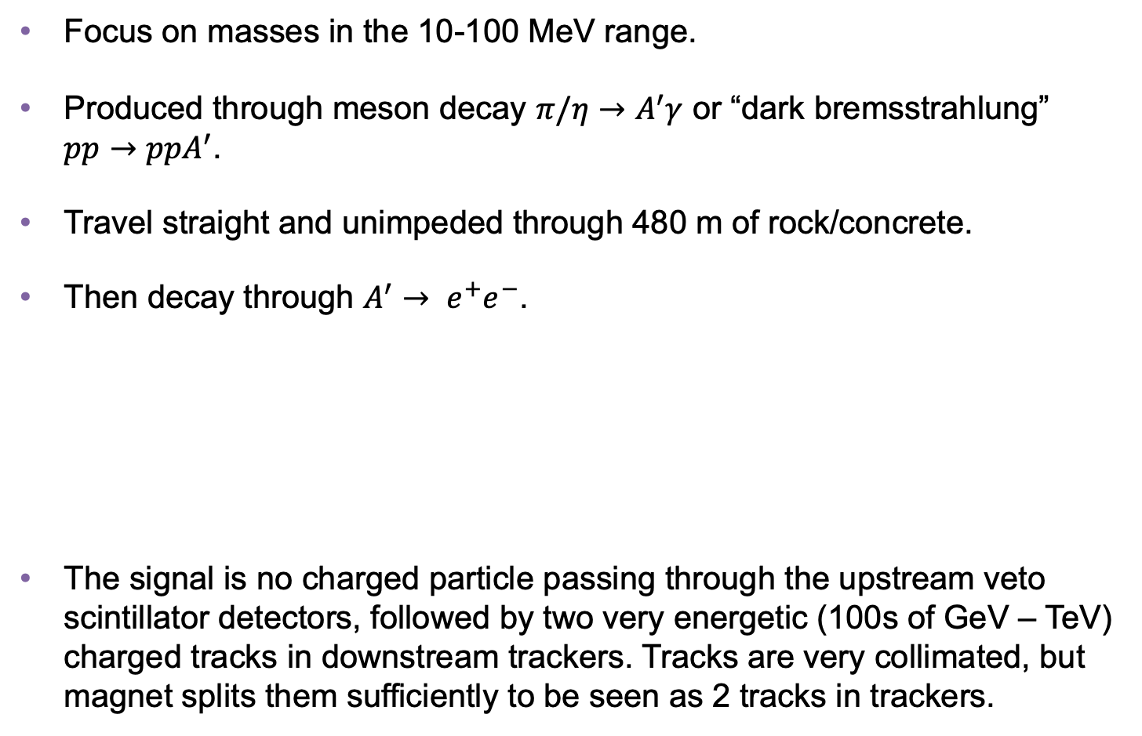
DARK PHOTON SEARCH
Focus on masses in the 10-100 MeV range.
Produced through meson decay $π/η→A^{′}γ$ or “dark bremsstrahlung” $pp→{ppA}^{′}$.
Travel straight and unimpeded through 480 m of rock/concrete.
Then decay through $A^{′}$ $→ e^{+}e^{−}$.
The signal is no charged particle passing through the upstream veto scintillator detectors, followed by two very energetic (100s of GeV – TeV) charged tracks in downstream trackers. Tracks are very collimated, but magnet splits them sufficiently to be seen as 2 tracks in trackers.
Notes:
typical A’ that decays in FASER has ~TeV energy

Slide 17
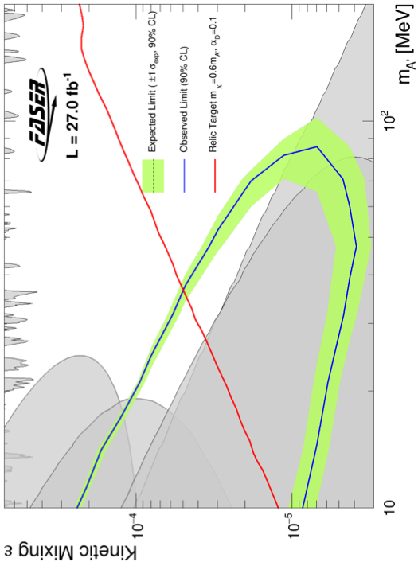
DARK PHOTON RESULTS
After unblinding, no events seen, FASER sets limits on previously unexplored parameter space.
First new probe (along with NA62) of the parameter space favored by dark matter from low coupling since the 1990’s.
Bodes well for the future
  Background-free analysis
  Started probing new parameter space with the first day of data
  Ended up ~100 times more sensitive than previous experiments
  Improvements in analysis and 40 times more data to come
Existing bounds from DarkCast
FASER Collaboration (2308.05587, PLB)

Slide 18
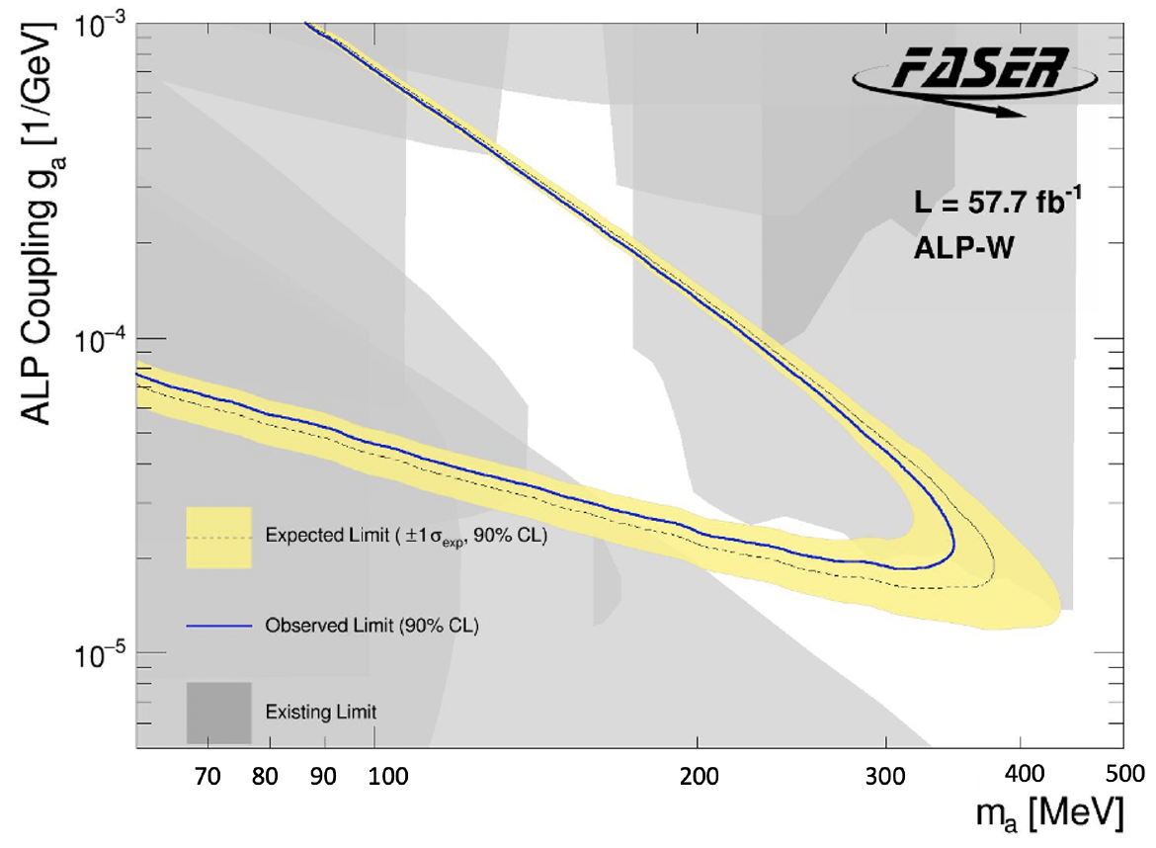
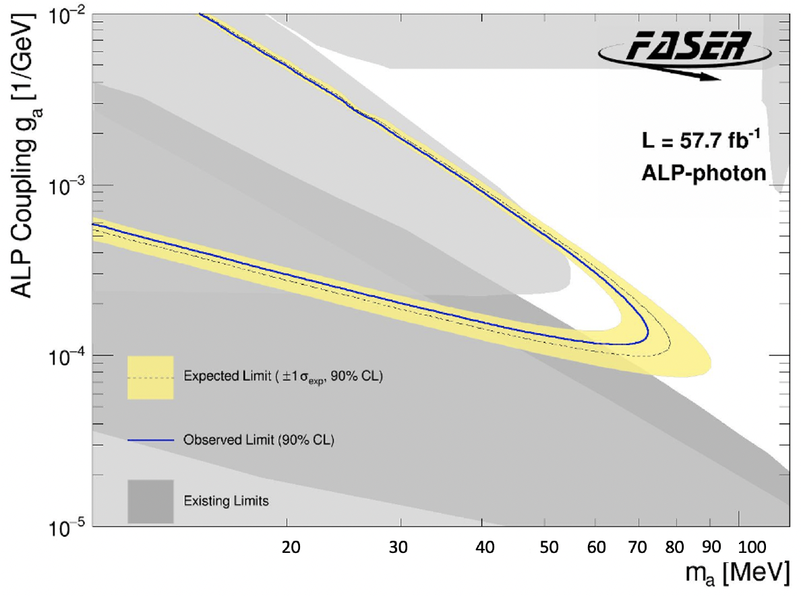
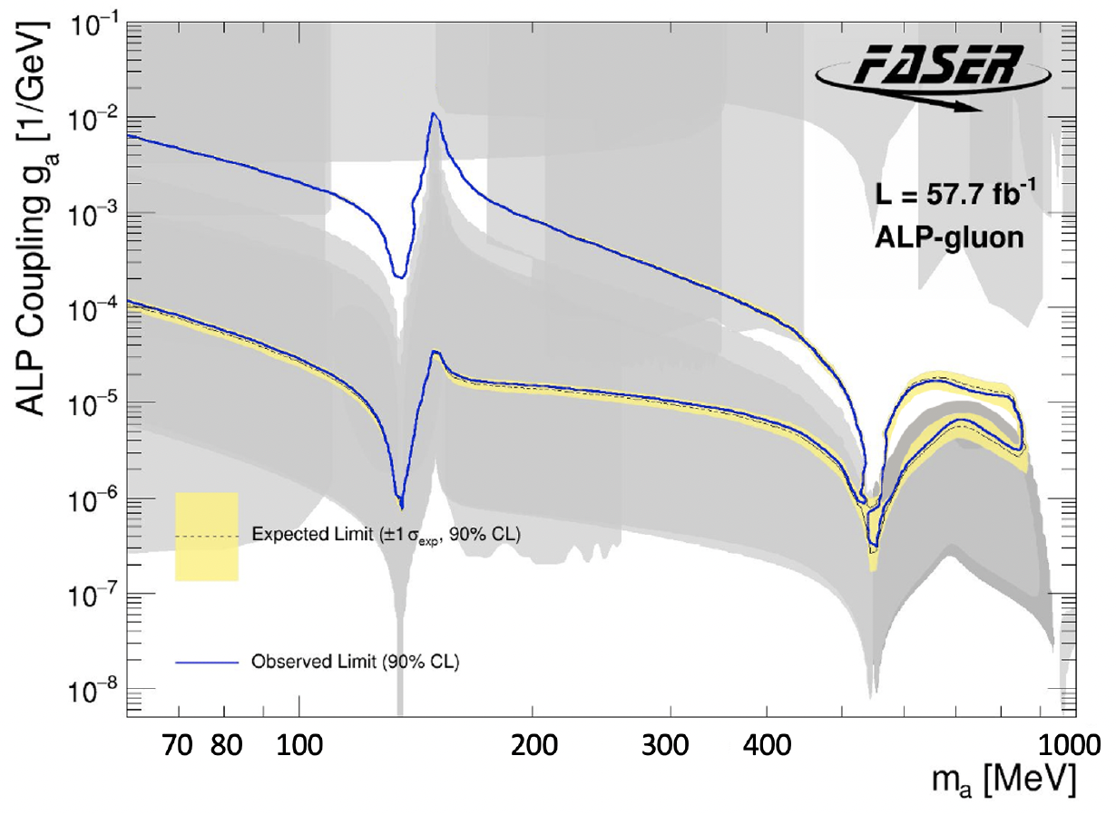
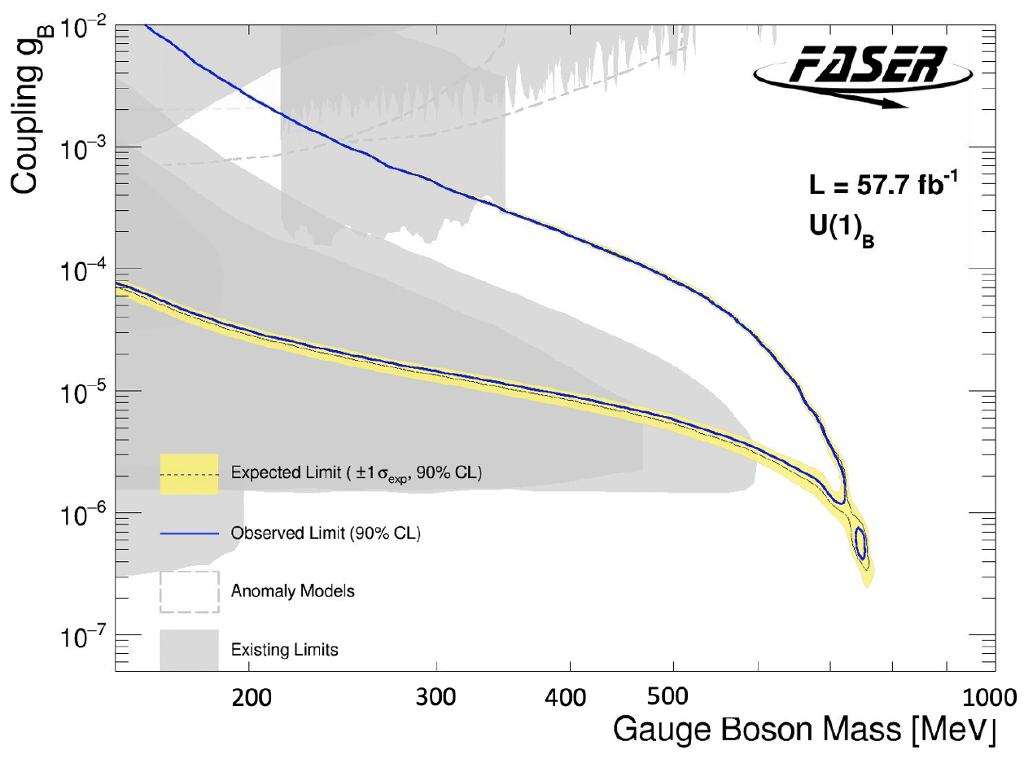
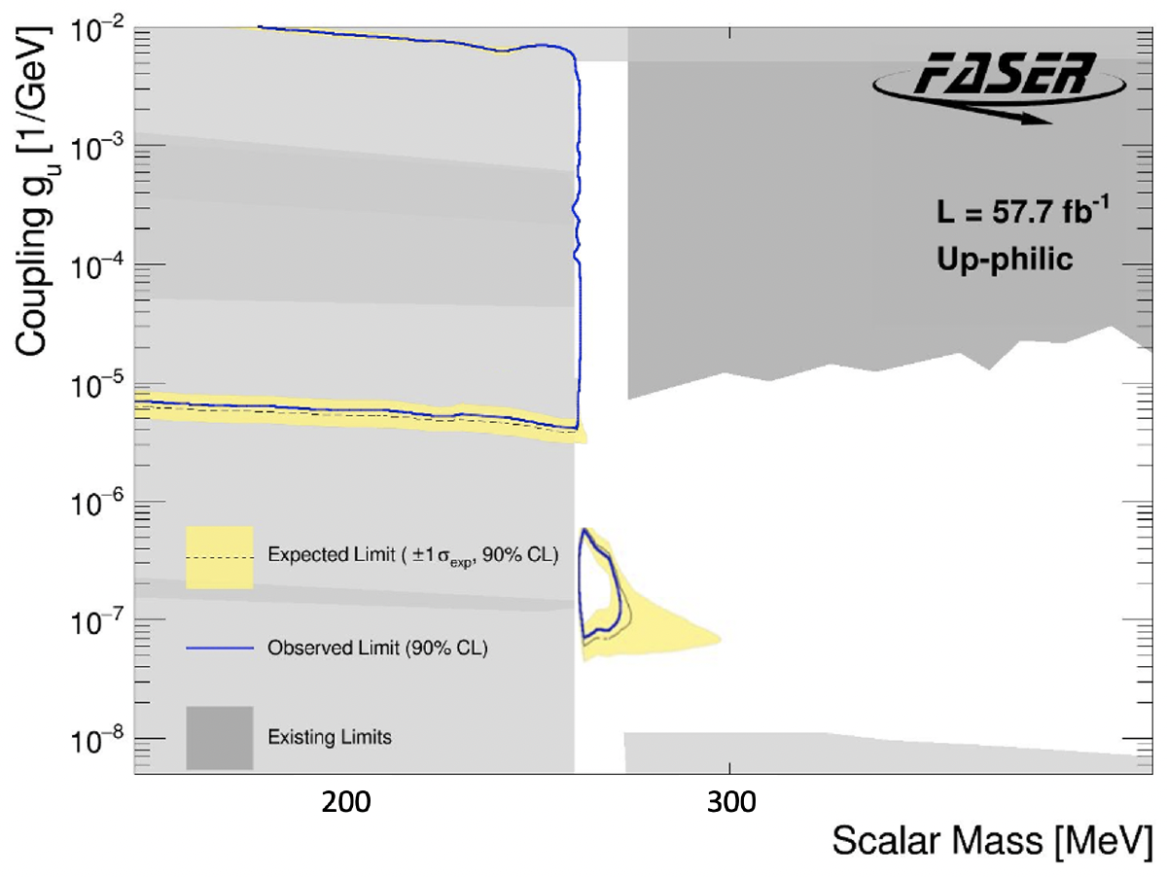
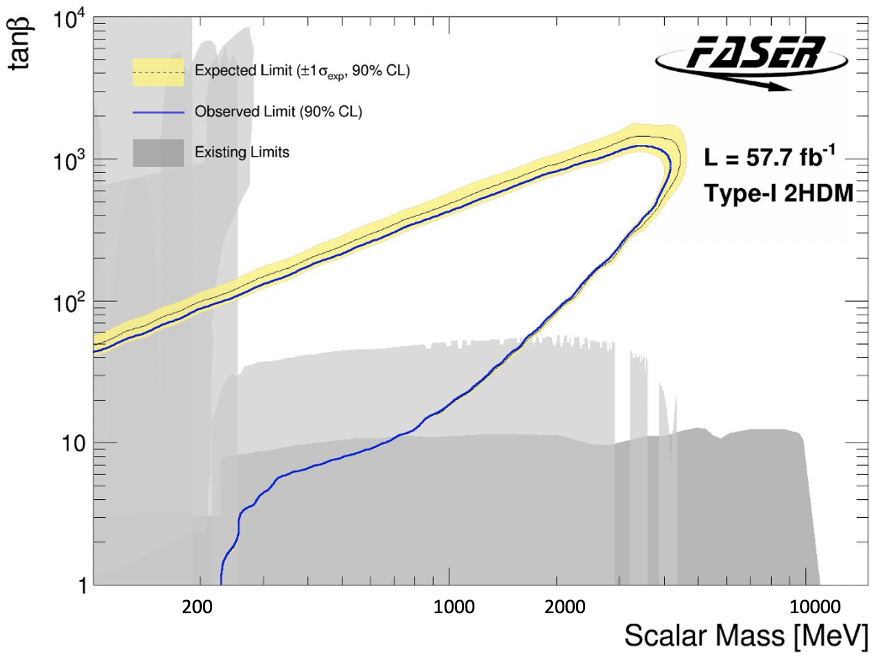
MORE DARK SECTOR RESULTS
Also many other search results: axion-like particles with W, photon, gluon couplings, U(1)_{B} gauge bosons, up-philic scalars, two Higgs doublet models.
Qualitatively different signals: some with charged tracks, some with only photons, some mainly produced in π decay, some mainly produced in B decay. Shows the characteristic versatility of searches at high-energy colliders.
FASER Collaboration (2410.10363 , JHEP)

Slide 19


Slide 20
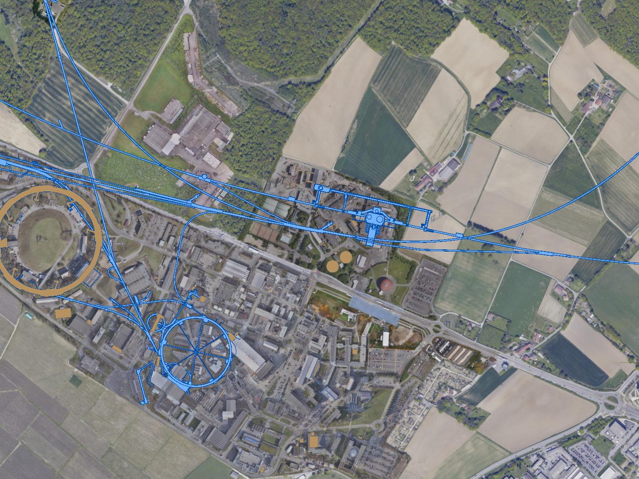
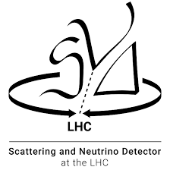

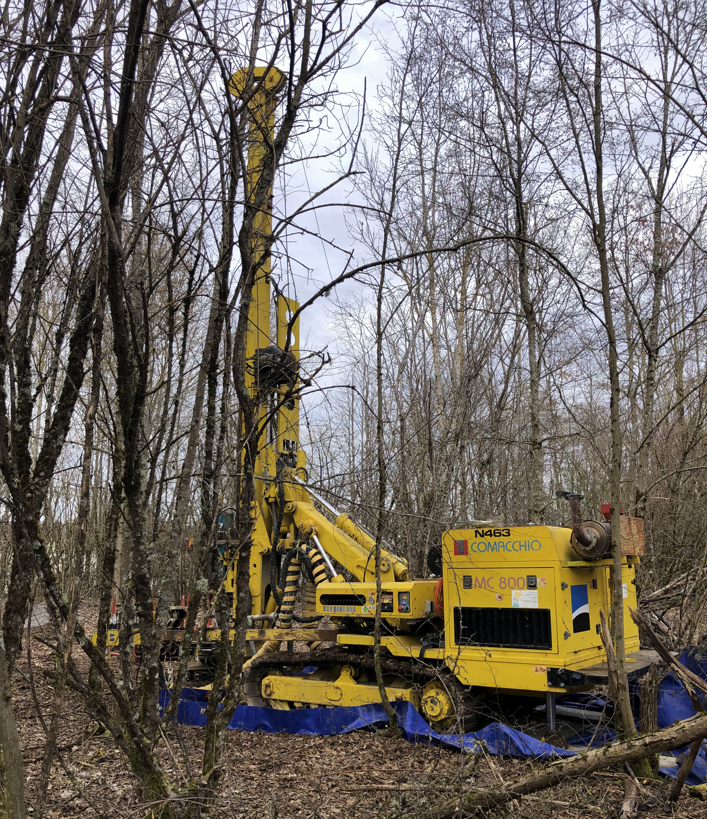
FORWARD PHYSICS FACILITY
Following the results of FASER, FASERν, and SND@LHC, CERN is considering the possibility of creating a dedicated Forward Physics Facility to house far-forward experiments for the rest of the LHC era until the 2040s.
UJ18
ATLAS
SPS
LHC
LOS
FPF site selection study and core study have identified an ideal site in France just outside the CERN main gate
https://cds.cern.ch/record/2851822
CERN GIS

Slide 21
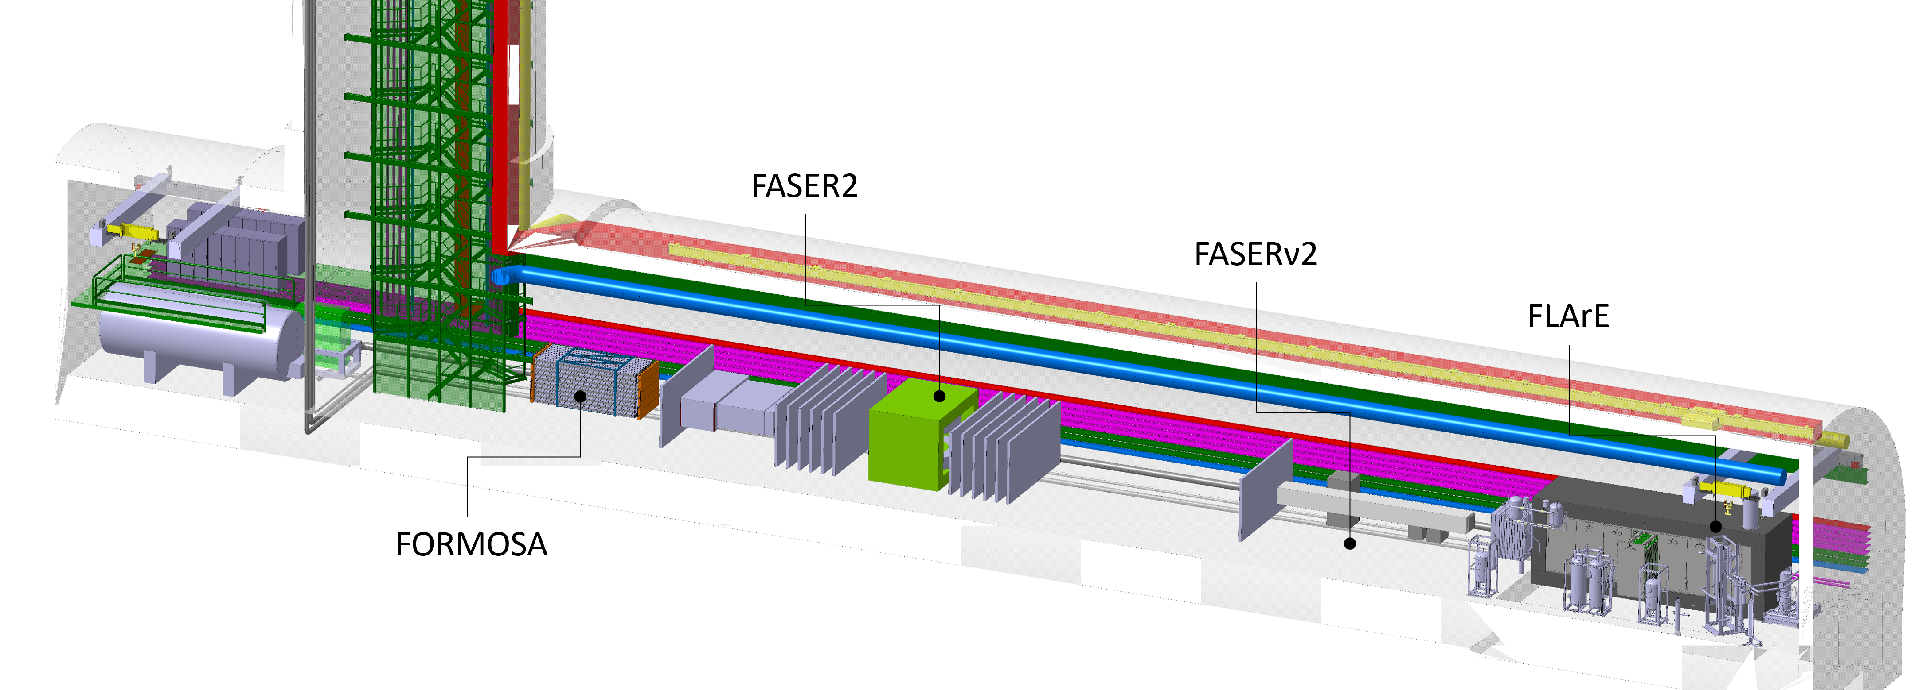
THE FPF AND ITS EXPERIMENTS
At present there are 4 experiments being designed for the FPF
  FASER2: magnetized spectrometer for BSM searches
  FASERν2: emulsion-based neutrino detector
  FLArE: LArTPC neutrino detector
  FORMOSA: scintillator array for BSM searches (successor to MilliQan)
These experiments will probe dark sector models with 10⁴ times the sensitivity of current experiments and detect 10⁶ TeV neutrinos, including 10⁴ tau neutrinos.
CERN PBC has produced a detailed design. Estimated cost (Class 4) is 35 MCHF for Facility, core costs of the experiments vary from 2 to 15 MCHF.
FPF Working Groups, 2411.04175

Slide 22
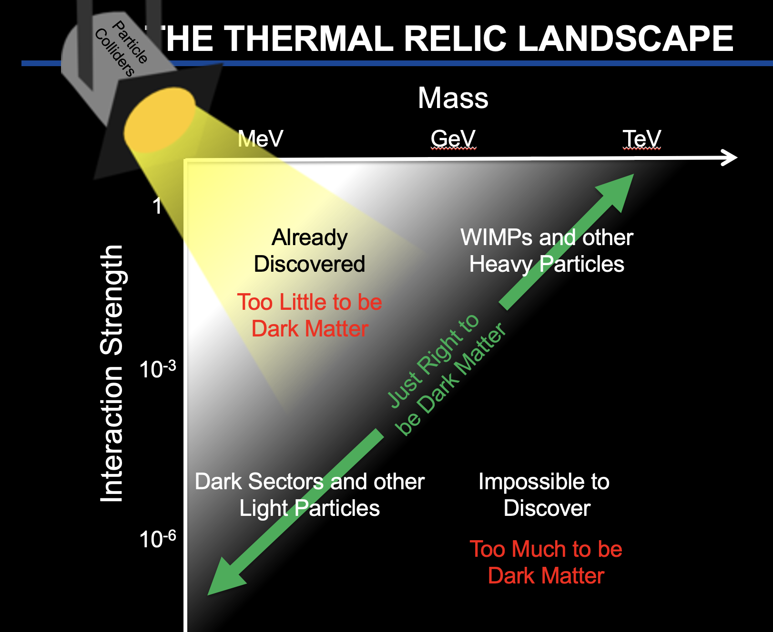
SUMMARY
DM at colliders is an extremely diverse and active topic. Thermal relic targets are especially interesting.
Heavy DM, ~10 GeV–TeV, WIMPs
  missing E_{T} , mono-X searches will continue at the LHC now through the 2040s.
  Many more exotic, LLP signals also being studied with great activity.
Light DM, ~ MeV – GeV, Dark Sectors
  New ideas have motivated novel collider experiments, which are already probing new models and thermal targets, with much more to come.
  These also have motivated work on a new underground facility: the Forward Physics Facility at CERN.

Slide 23
BACKUP

Slide 24
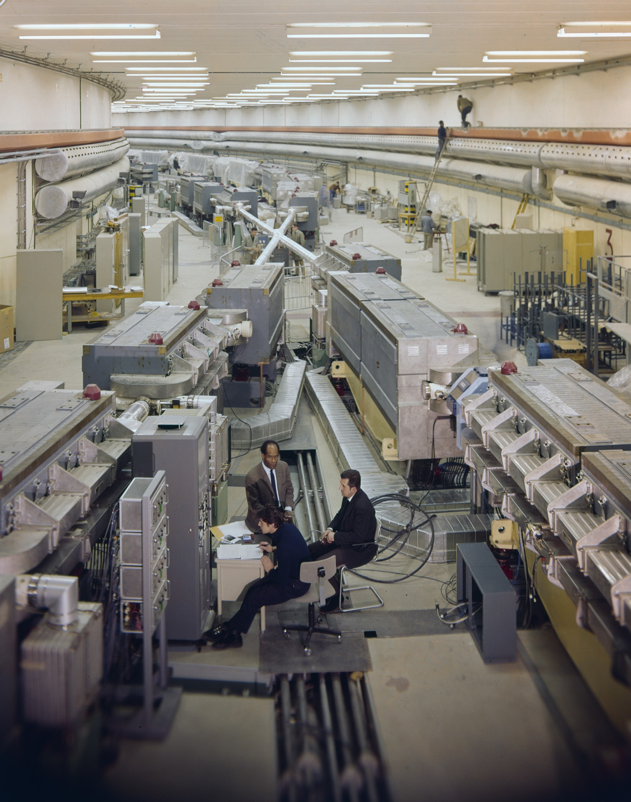
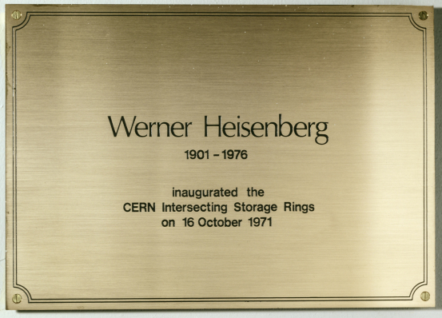
A CAUTIONARY TALE
Is it really possible that a collider is making new particles, and we are missing them simply because we are looking in the wrong place?
Yes. In fact, it happened before at CERN.
In 1971, the first hadron collider, CERN’s Intersecting Storage Rings (ISR), began operation.
It had a circumference of ~1 km, collided protons with protons at center-of-mass energy 30 GeV.

Slide 25

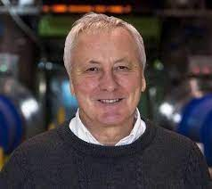
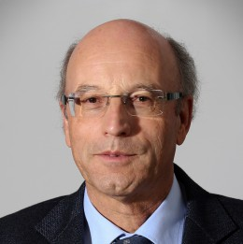
A CAUTIONARY TALE
During ISR’s 50th anniversary, there were many fascinating articles and talks by eminent physicists
  “Enormous impact on accelerator physics, but sadly little effect on particle physics.” – Steve Myers, talk at “The 50th Anniversary of Hadron Colliders at CERN,” October 2021.
  “There was initially a broad belief that physics action would be in the forward directions at a hadron collider…. It is easy to say after the fact, still with regrets, that with an earlier availability of more complete… experiments at the ISR, CERN would not have been left as a spectator during the famous November revolution of 1974 with the J/ψ discoveries at Brookhaven and SLAC .” – Lyn Evans and Peter Jenni, “Discovery Machines,” CERN Courier (2021).
Bottom line: The collider was creating charm quarks, but, based on theoretical prejudice, experimentalists focused on the forward region and so missed them.
Since that time, forward physics at colliders has been almost completely ignored for new particle searches.
But are we making the same mistake now (in reverse)? And could there be another November revolution waiting for us in the forward direction?

Slide 26
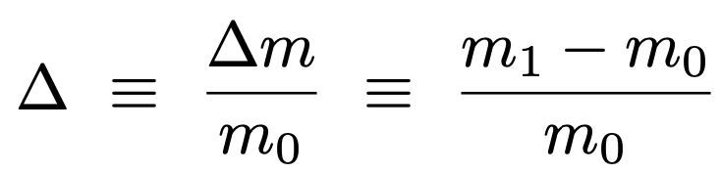
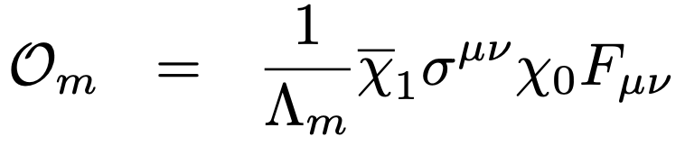



INELASTIC DARK MATTER
The FPF can discover dark matter in scenarios that cannot be probed anywhere else.
E.g., one generic DM possibility that is infamously hard to detect: inelastic dark matter, where there are two nearly-degenerate dark states with off-diagonal couplings to the SM.
These generically lead to long-lived particles, but with soft decay products, and so are invisible at ATLAS/CMS, SHiP, and other fixed target expts, direct and indirect DM searches.
At the FPF, however, these are highly boosted to observable energies, can probe thermal target.
$$m_{1}$$
$$χ_{1} →χ_{0}γ$$
$$m_{0}$$
0
Dienes, Fieg, et al. (2023)

Slide 27
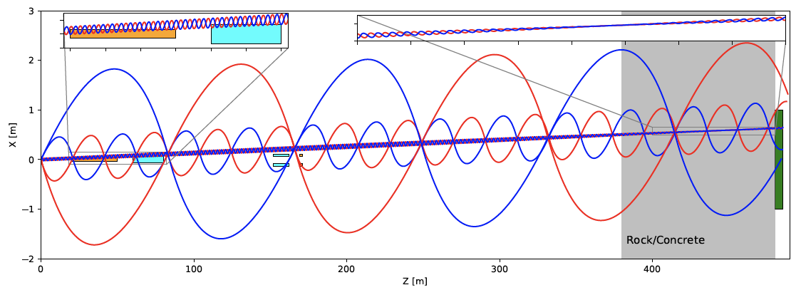
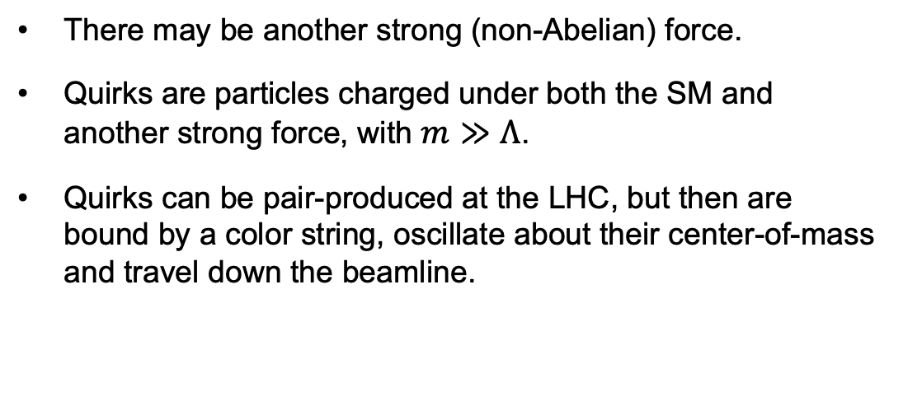
QUIRKS
There may be another strong (non-Abelian) force.
Quirks are particles charged under both the SM and another strong force, with $m≫Λ$.
Quirks can be pair-produced at the LHC, but then are bound by a color string, oscillate about their center-of-mass and travel down the beamline.
By looking for 2 coincident slow or delayed tracks (out of time with the bunch crossing), FPF experiments can discover quirks with masses up to ~TeV, as motivated by neutral naturalness solutions to the gauge hierarchy problem.
Unique discovery potential at the FPF: very challenging at ATLAS/CMS, impossible at fixed target experiments.
Feng, Li, Liao, Ni, Pei (2024)

