Slide 1



THE DAWN OF
MULTI-MESSENGER
COLLIDER PHYSICS
Maryland Johns Hopkins Joint Particle Physics Seminar
Jonathan Feng, UC Irvine, 8 May 2024

Slide 2
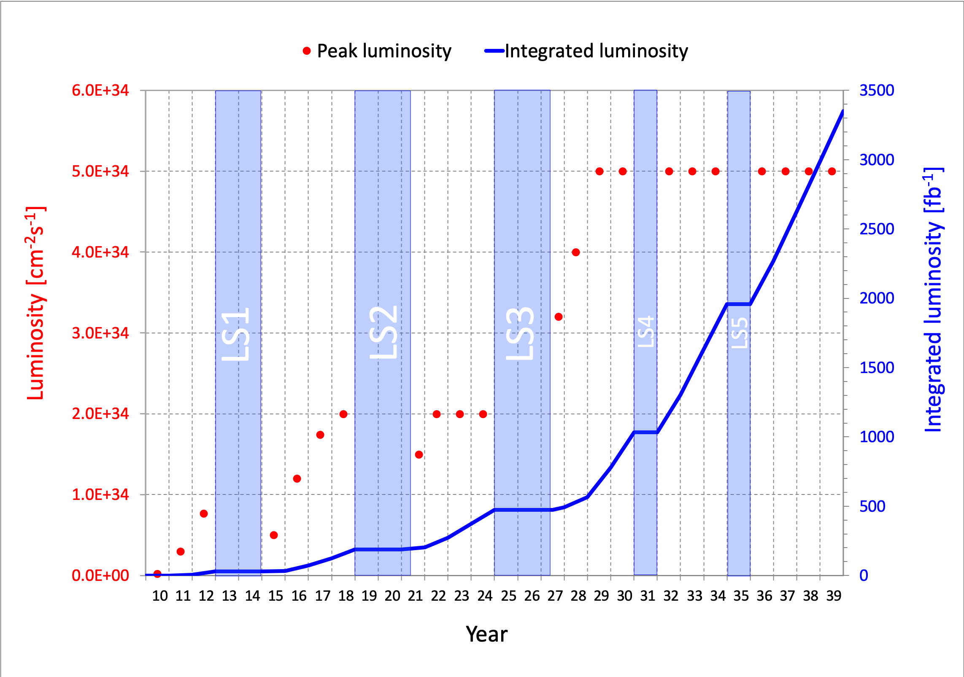
LIFETIME OF THE LHC
The LHC has been a focus of particle physics for as long as most of us can remember. Its lifetime is my (professional) lifetime:
  1993 SSC canceled.
  2010: LHC starts.
  2040s: LHC ends.
But the LHC is still in its youth!
  a postdoc in terms of years
  a kindergartener in terms of integrated luminosity
Are we using the LHC to its full potential? If not, what can we do to enhance its discovery prospects?
COVID

Slide 3
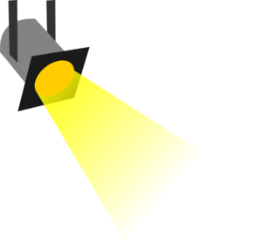
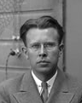
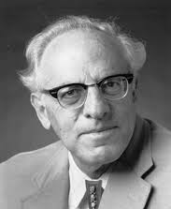





















THE PARTICLE LANDSCAPE
Particle
Expts
Mass
MeV
GeV
TeV
1
$$←$$
$$g$$
$$u$$
$$d$$
$$s$$
$$p$$
$$n$$
$$c$$
$$b$$
$$t$$
$$←$$
$$γ$$
$$e$$
$$μ$$
$$τ$$
$$W$$
$$Z$$
$$h$$
Already
Discovered
Strongly Interacting
Heavy Particles
Interaction Strength
10⁻³
$$ν_{e}$$
$$ν_{μ}$$
$$ν_{τ}$$
$$←$$
Weakly Interacting
Light Particles
Impossible to
Discover
10⁻⁶

Slide 4
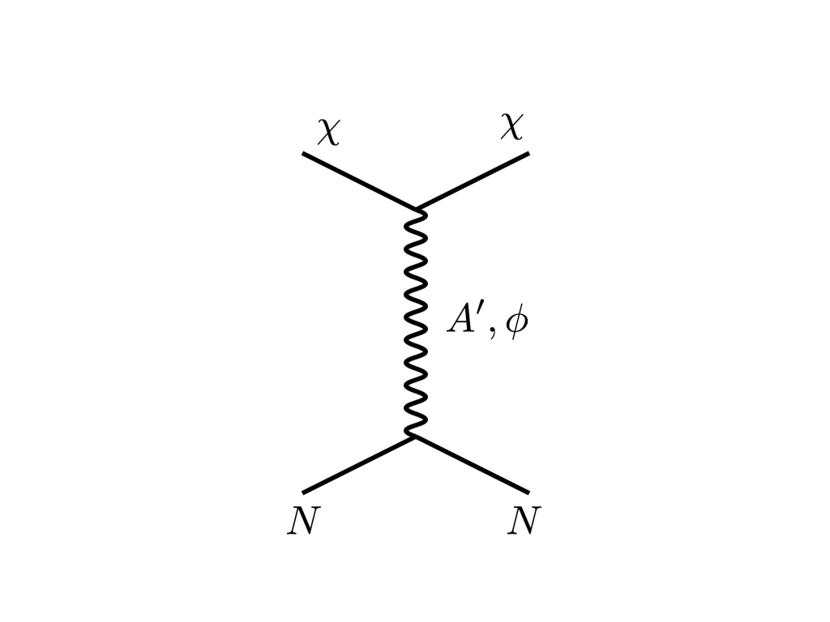





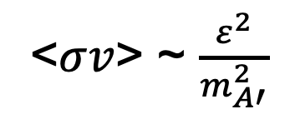
THE COSMOLOGICAL LANDSCAPE
Particle
Colliders
Mass
MeV
GeV
TeV
1
Already
Discovered
Strongly Interacting
Heavy Particles
Too Little to be
Dark Matter
$$e$$
DM
$$ε$$
$$A’$$
$$ε$$
Interaction Strength
Just Right to
be Dark Matter
10⁻³
DM
$$e$$
<$σv$> ~ $\frac{ε^{2}}{m_{A′}^{2}}$
Weakly Interacting
Light Particles
Impossible to
Discover
10⁻⁶
Too Much to be
Dark Matter
Boehm, Fayet (2003)
Pospelov, Ritz, Voloshin (2007)
Feng, Kumar (2008)

Slide 5

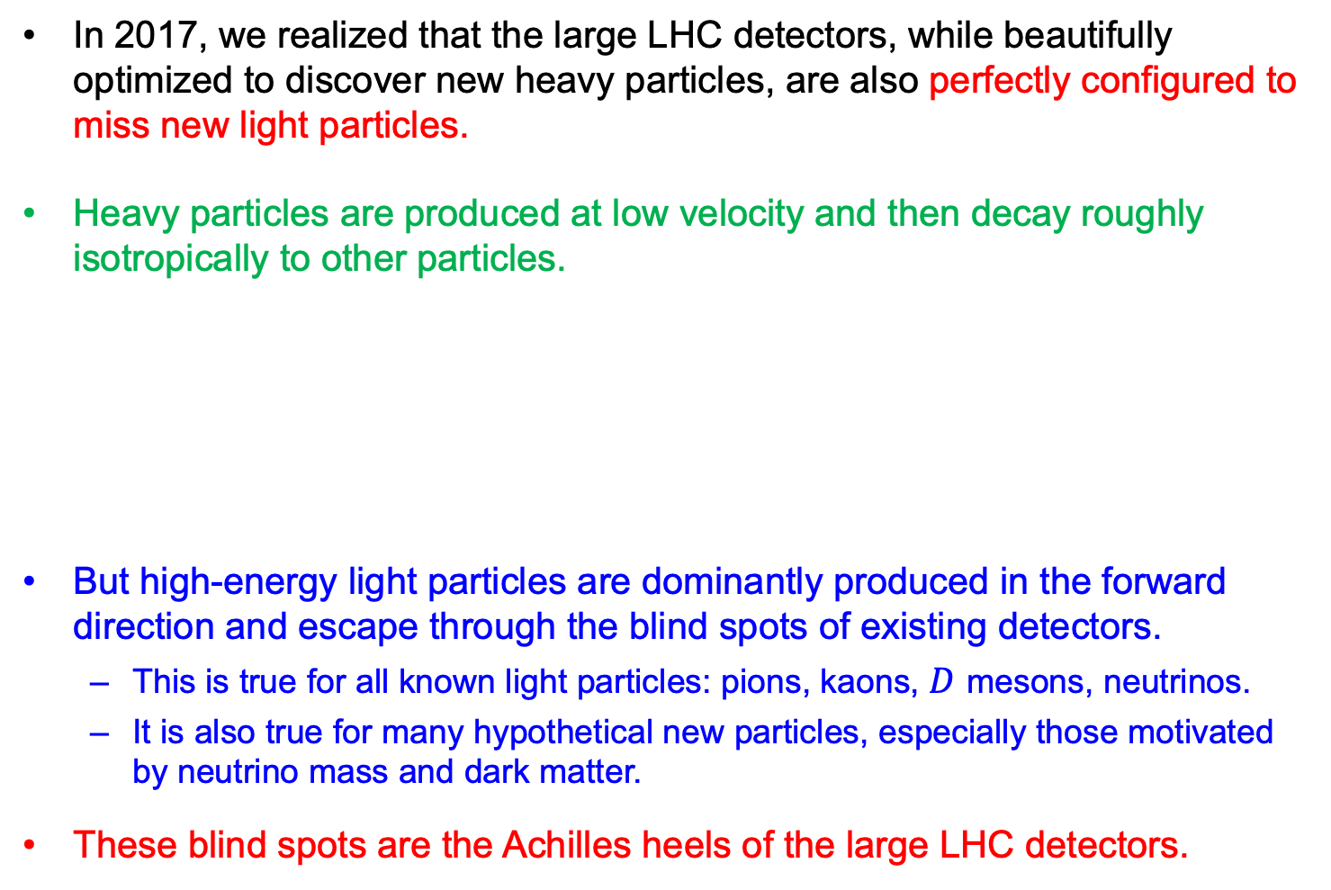

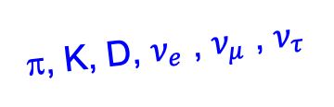
FORWARD PHYSICS
In 2017, we realized that the large LHC detectors, while beautifully optimized to discover new heavy particles, are also perfectly configured to miss new light particles.
Heavy particles are produced at low velocity and then decay roughly isotropically to other particles.
But high-energy light particles are dominantly produced in the forward direction and escape through the blind spots of existing detectors.
  This is true for all known light particles: pions, kaons, $D$ mesons, neutrinos.
  It is also true for many hypothetical new particles, especially those motivated by neutrino mass and dark matter.
These blind spots are the Achilles heels of the large LHC detectors.
Feng, Galon, Kling, Trojanowski (2017)
$$W, Z, t, h$$
A’, a, mCPs, χ, …
π, K, D, $ν_{e}$ , $ν_{μ}$ , $ν_{τ}$
De Rujula, Ruckl (1984)

Slide 6
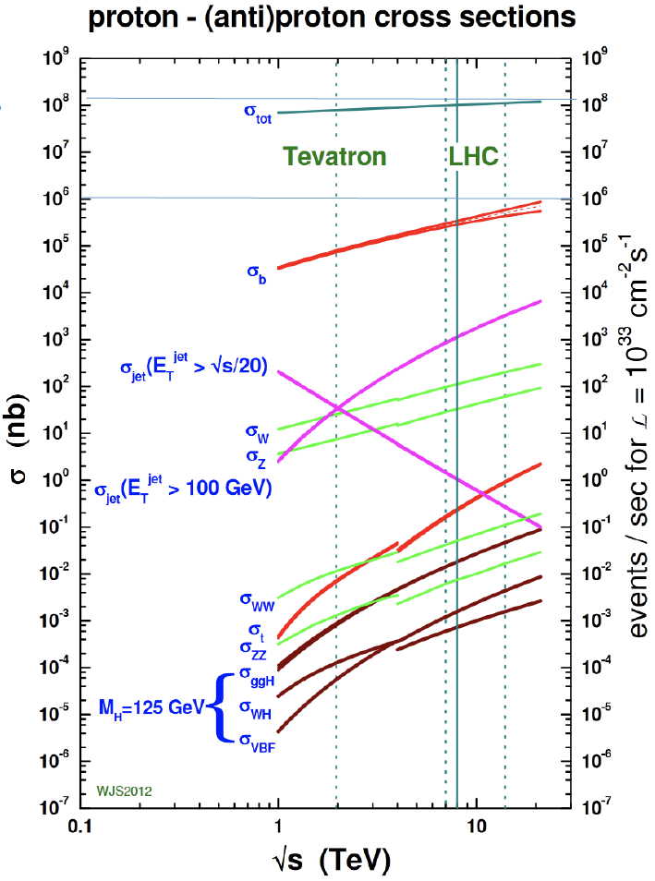
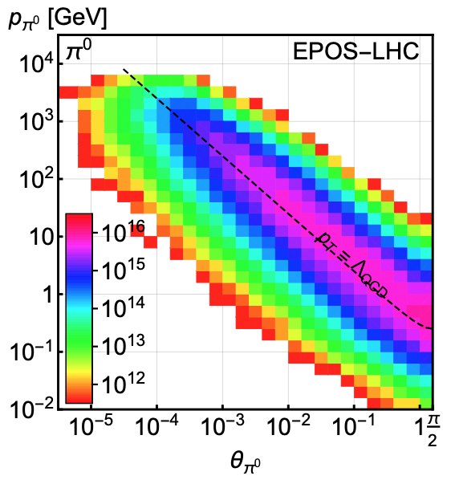
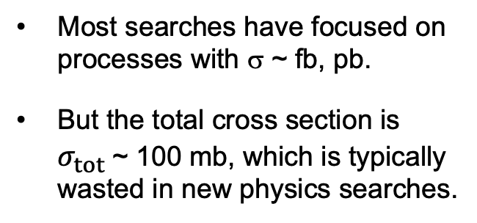
LIGHT PARTICLES AT THE LHC
300 fb⁻¹
Feng, Galon, Kling, Trojanowski (2017)
Most searches have focused on processes with σ ~ fb, pb.
But the total cross section is $σ_{tot}$~ 100 mb, which is typically wasted in new physics searches.
What do these events look like? Consider pions.
Enormous event rates. Typical p_{T} ~ 250 MeV, but many with p ~ TeV within 1 mrad (η > 7.6) of the beamline.

Slide 7
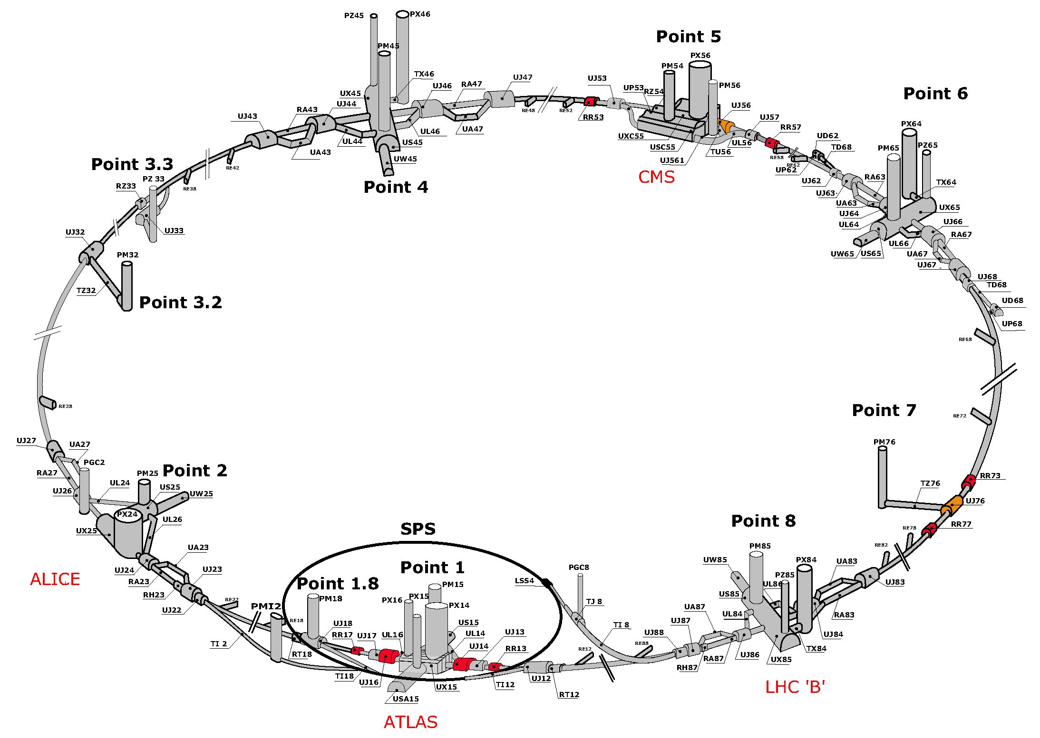
MAP OF THE LHC
To instrument the forward region, one can’t simply plug up the holes – we need to let the protons in. But the LHC is a circular collider!
!!!

Slide 8
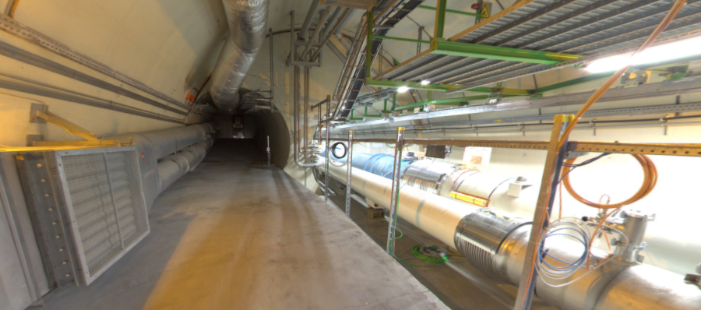
THE FORWARD REGION
Beam collision axis passes
through 100 m of rock, emerges in tunnel TI12, 480 m from ATLAS
UJ12
TI12 near UJ12
The view in UJ12 looking west in 2018
TI12
Beam collision axis
LHC beamline

Slide 9
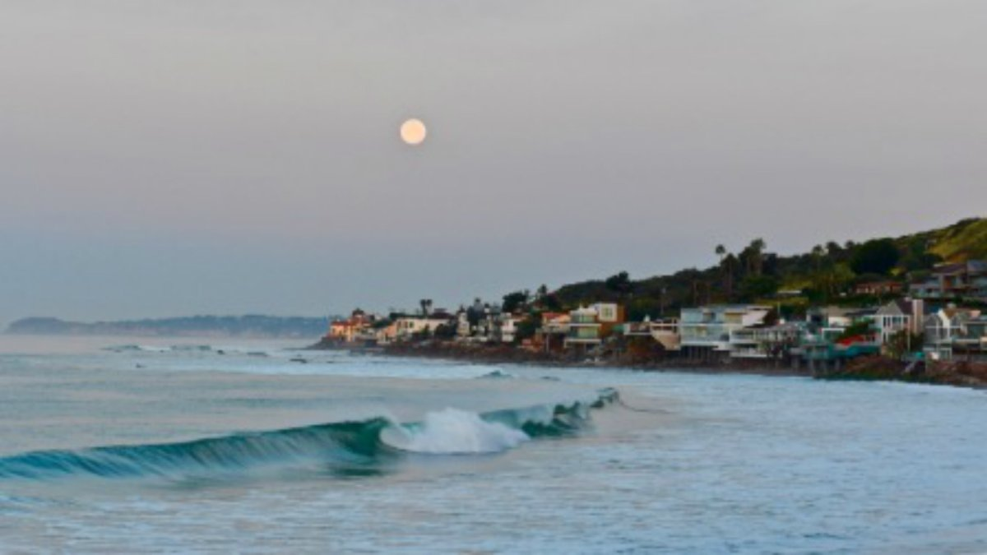
HOW BIG DOES THE DETECTOR HAVE TO BE?
Momentum:
Space:
250 MeV
1 TeV
12 cm
480 m
The opening angle is 0.2 mrad (the moon is 7 mrad). Even 480 m away, most of the signal passes through an 8.5” x 11” (A4) sheet of paper.
Neutrinos and many new particles are therefore far more collimated than shown below, motivating a relatively small, fast, and inexpensive experiment at the LHC: the ForwArd Search ExpeRiment (FASER).

Slide 10
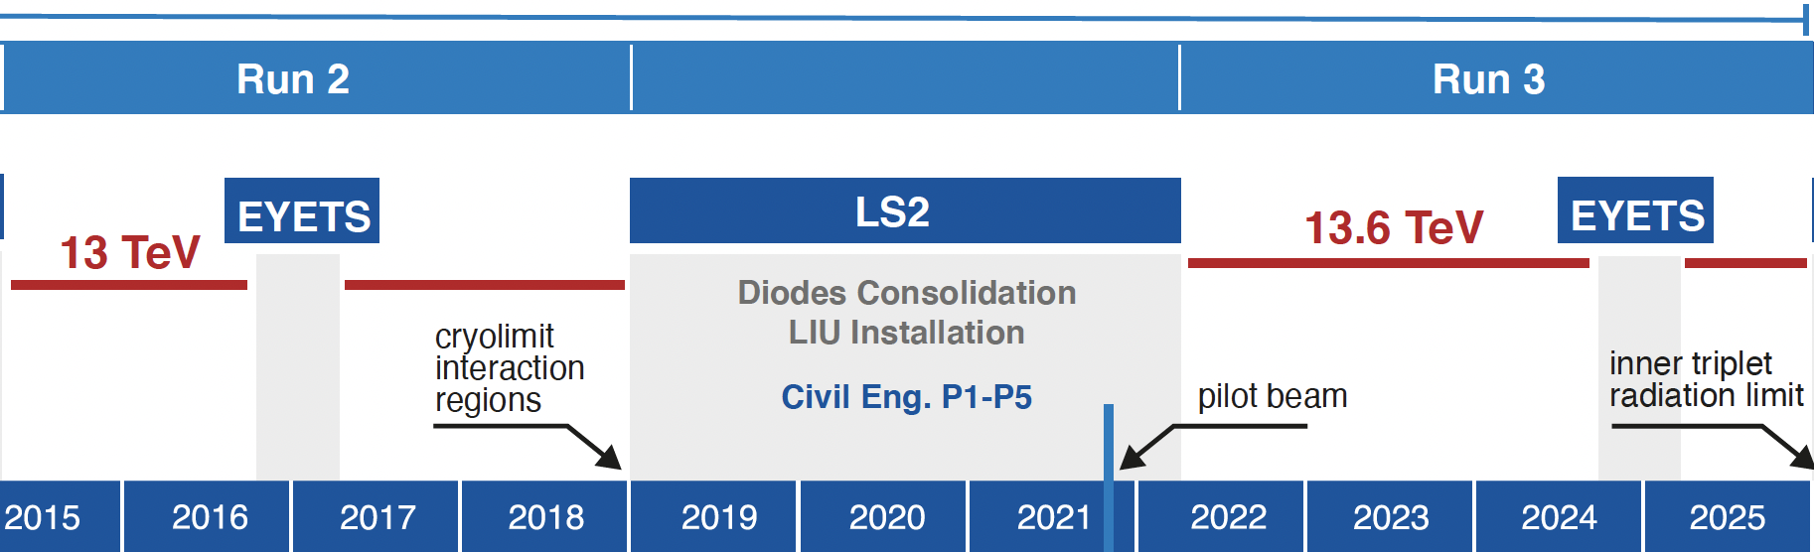
FASER AND FASERν TIMELINE
LOI submitted to CERN LHCC
FASER fully constructed and installed
Observation of TeV electron neutrinos
FASERν fully constructed and installed
Technical Proposal submitted to CERN LHCC
FASER approved as 8th LHC detector by CERN
Concept paper Feng, Galon, Kling, Trojanowski
FASERν approved as 9th LHC detector by CERN
Funding from Heising-Simons and Simons Foundations
FASER and FASERν begin collecting data in Run 3
Spare detector parts from ATLAS and LHCb Collaborations
TeV neutrino cross section measurements, ALP search
First physics results Discovery of collider neutrinos, dark photon search

Slide 11














THE FASER COLABORATION NOW
97 collaborators, 26 institutions, 10 countries
International laboratory covered by a cooperation agreement with CERN

Slide 12
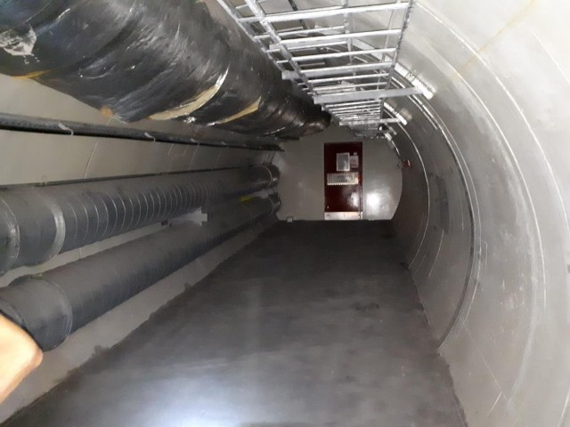
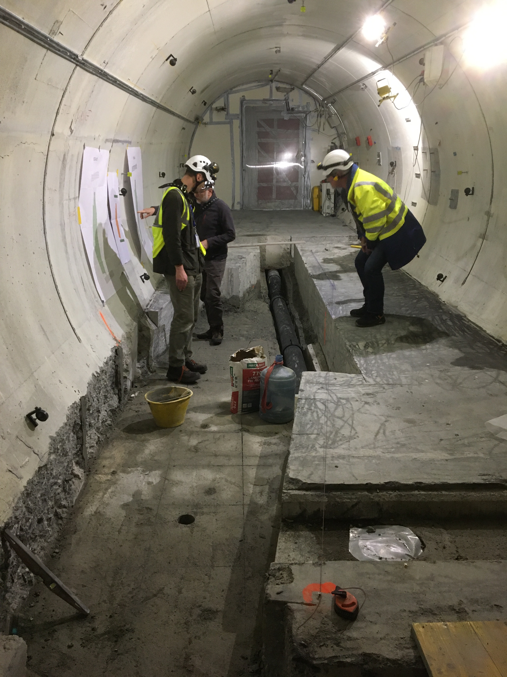
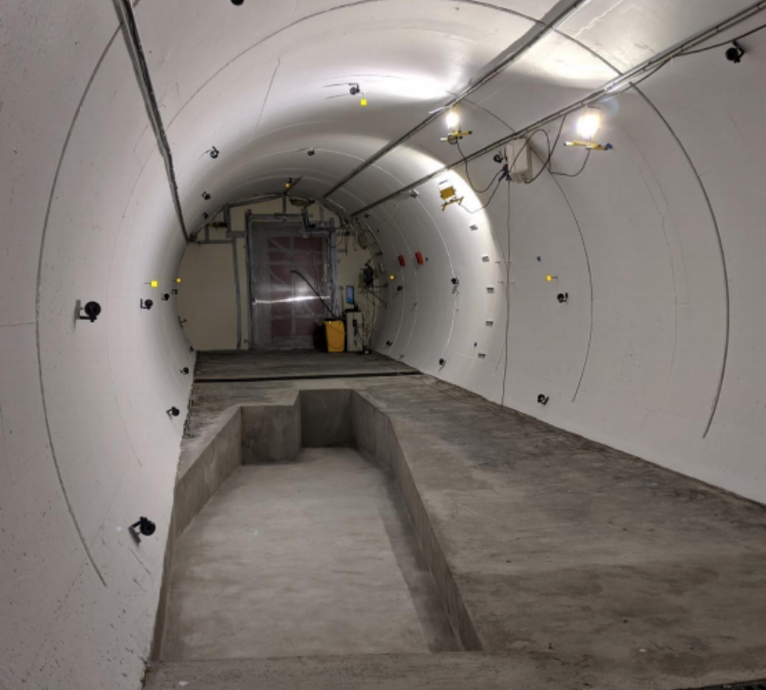
PREPARATION OF THE FASER LOCATION
The beam collision axis or line of sight (LOS) was located to mm accuracy by the CERN survey department. To place FASER on this axis, a trench was required to lower the floor by 46 cm.
The trench was completed by an Italian firm just hours before COVID shut down CERN in March 2020.
2019
Spring 2020
Summer 2020

Slide 13
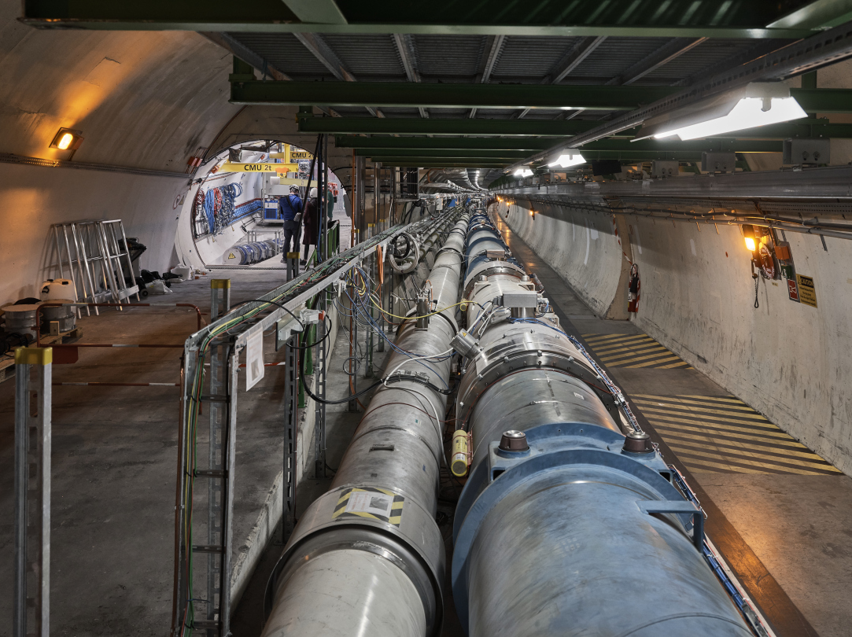
FASER AND THE LHC

Slide 14
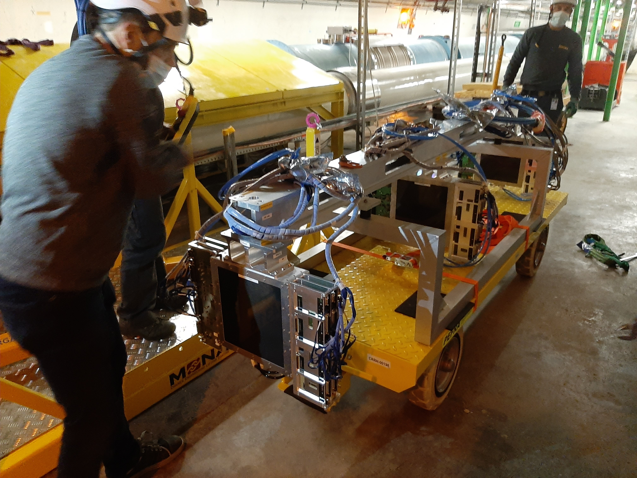
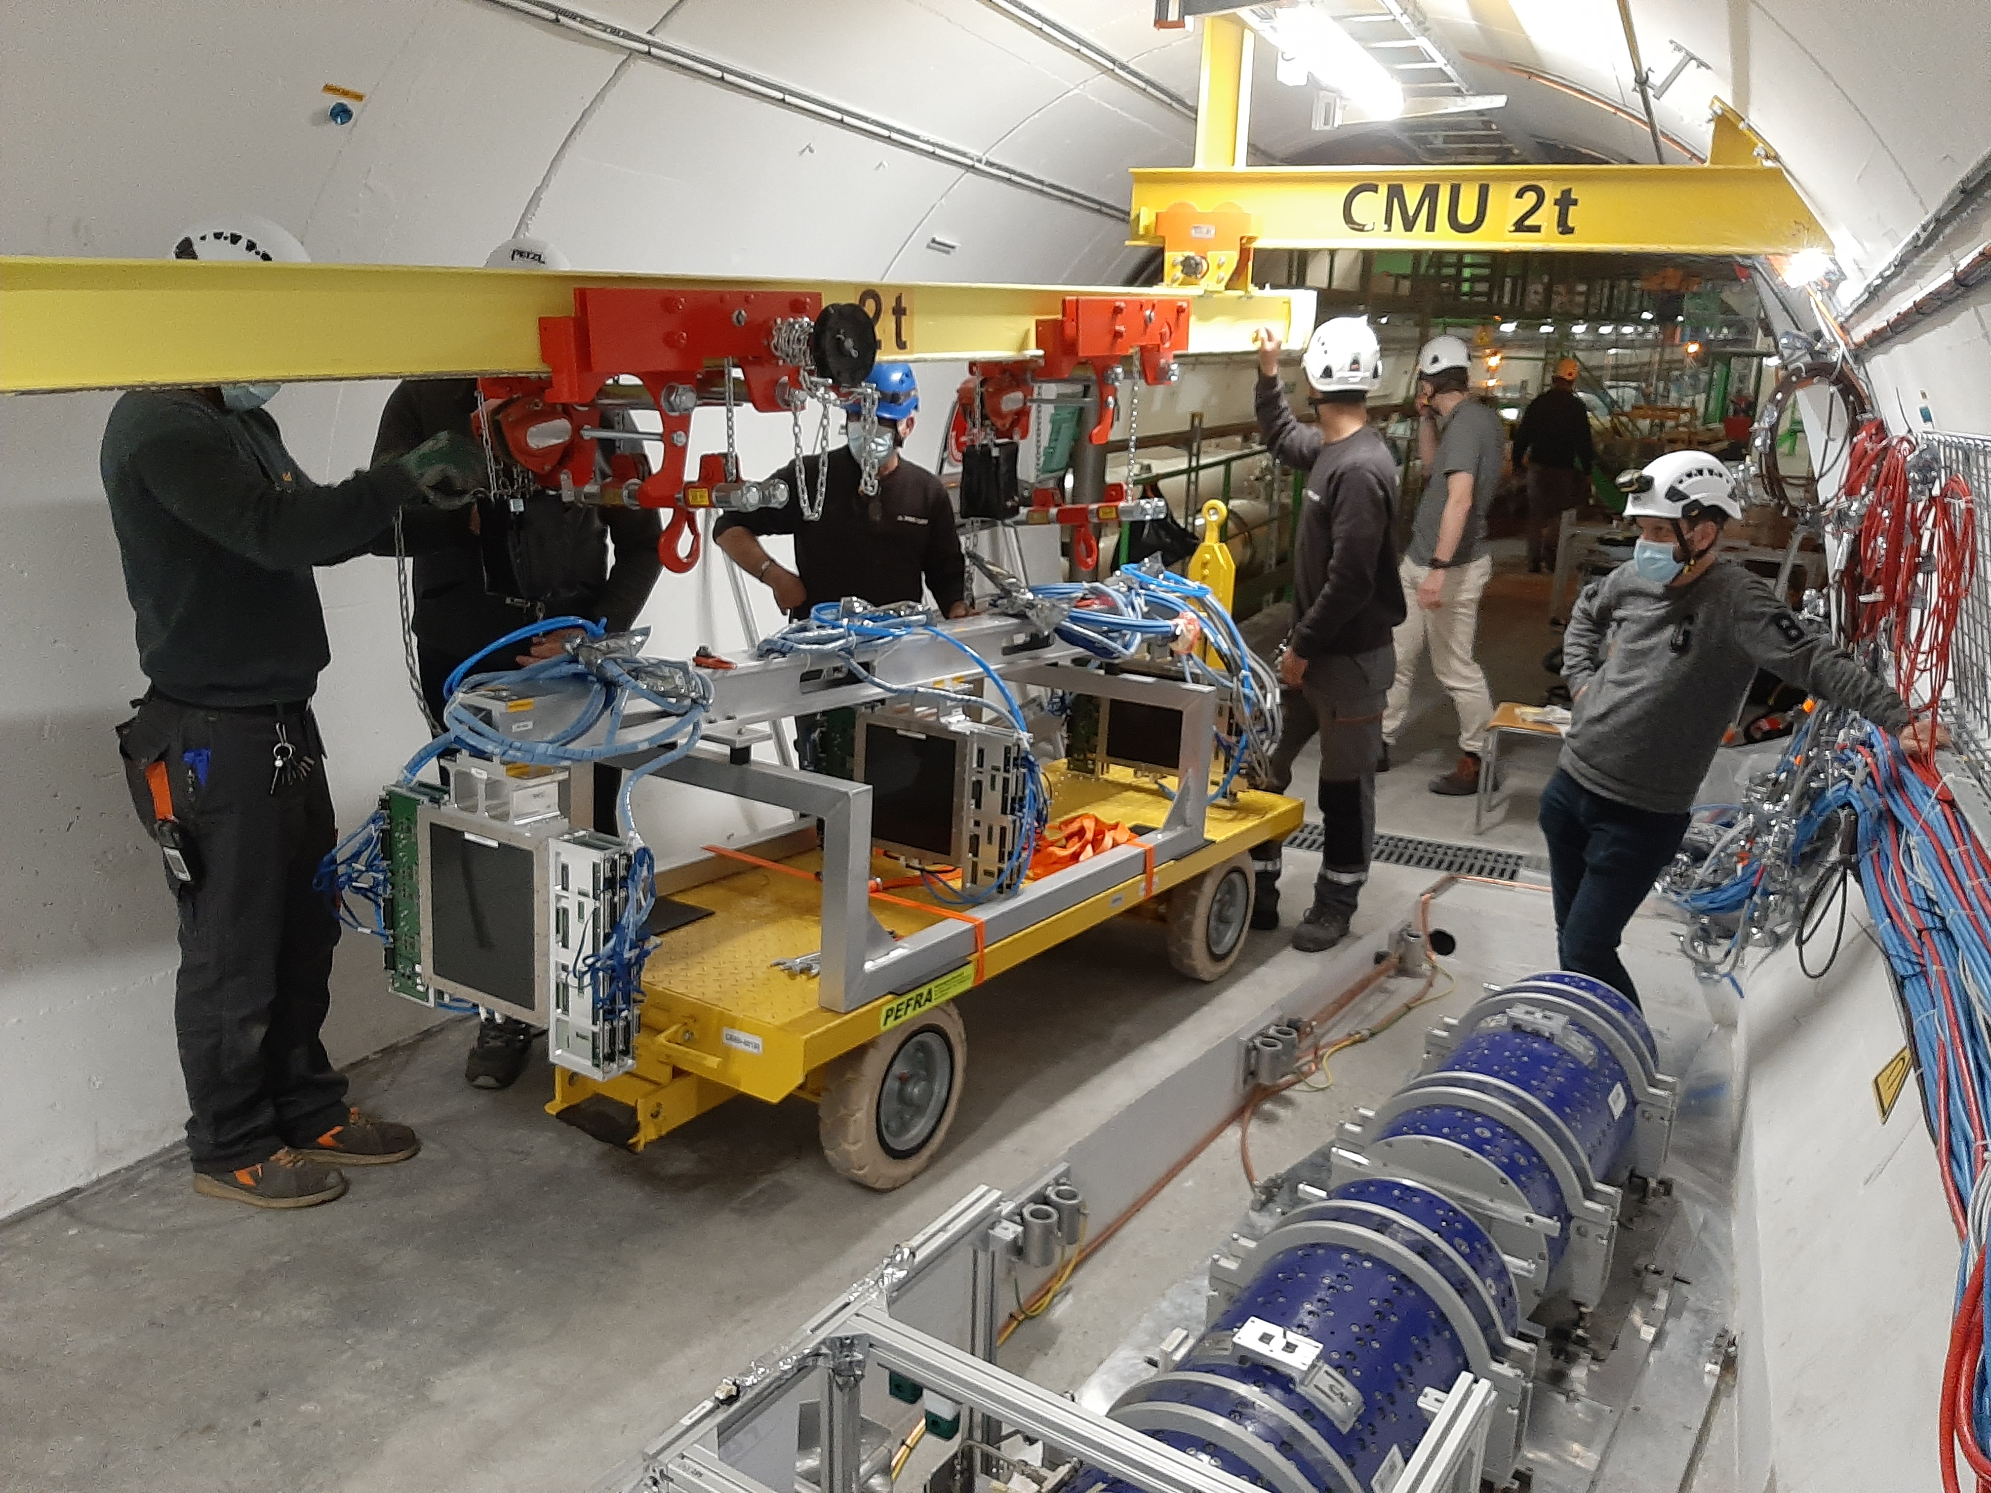
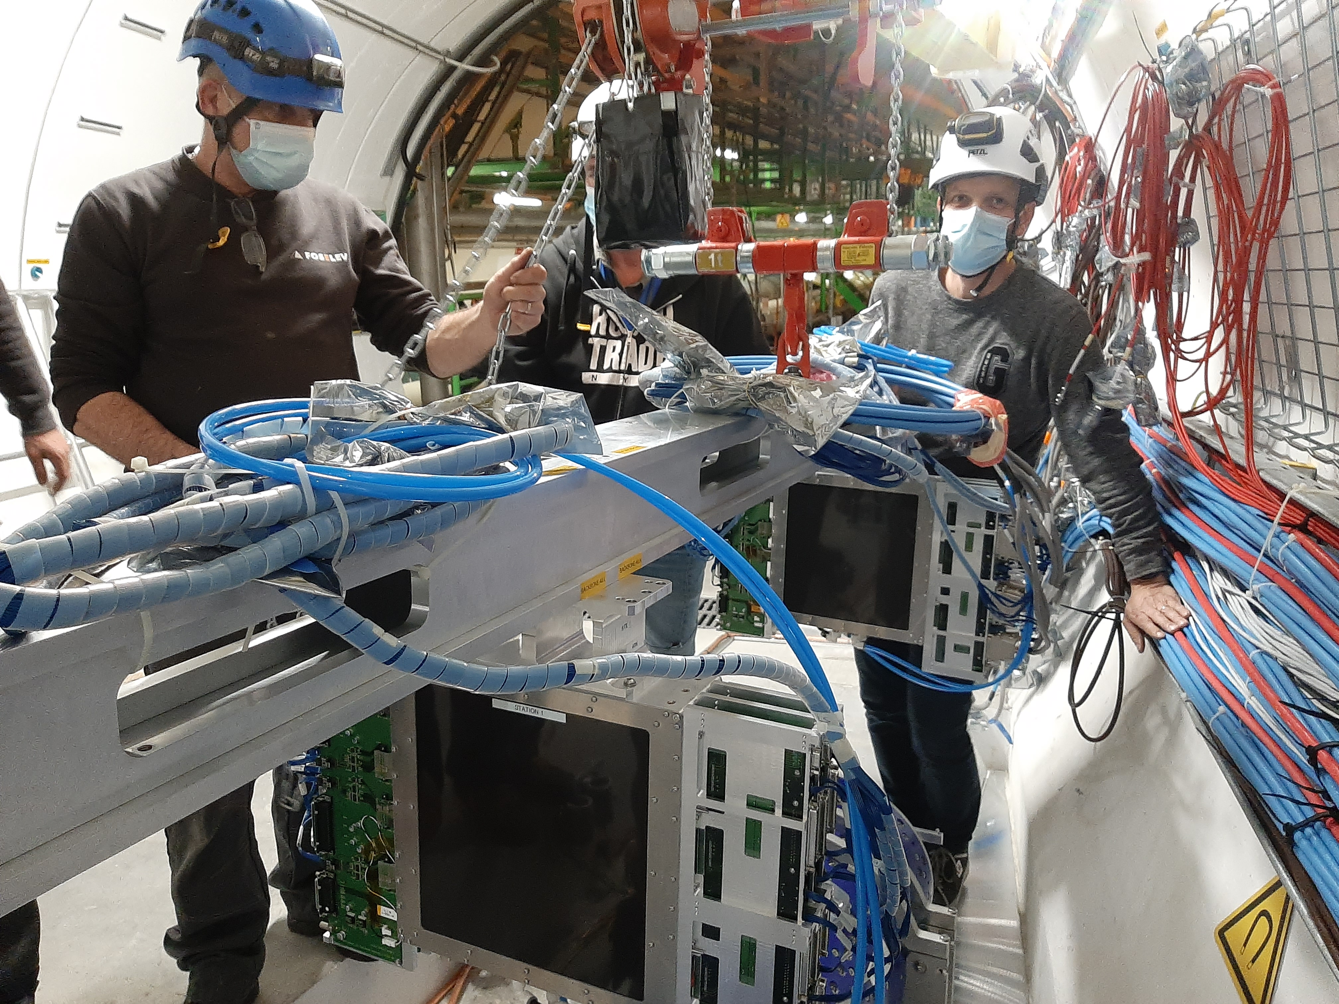
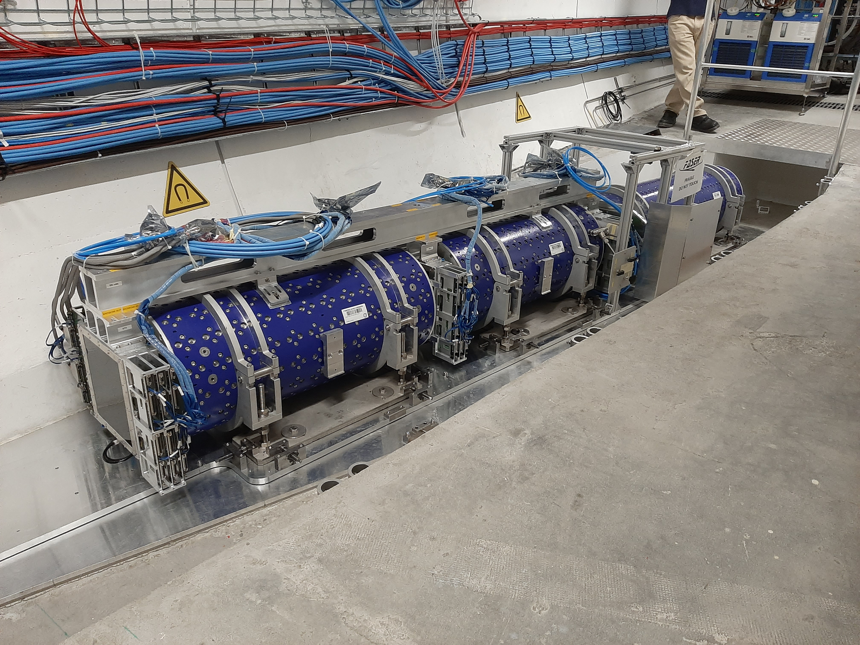
FASER INSTALLATION

Slide 15
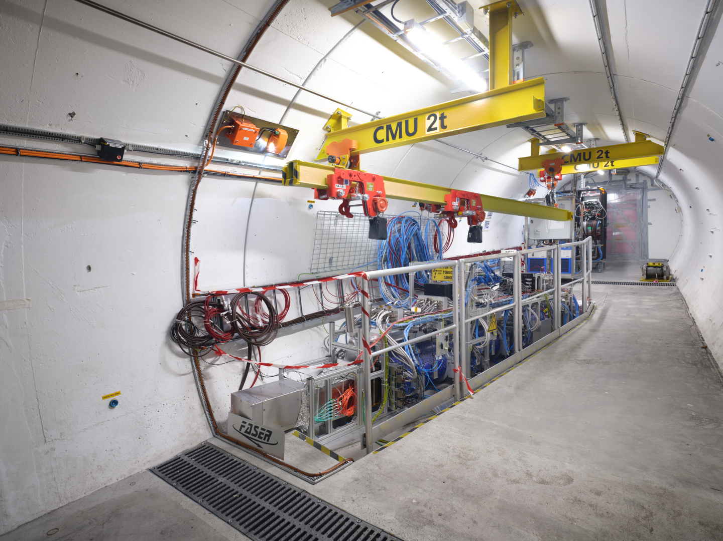
THE FASER DETECTOR

Slide 16
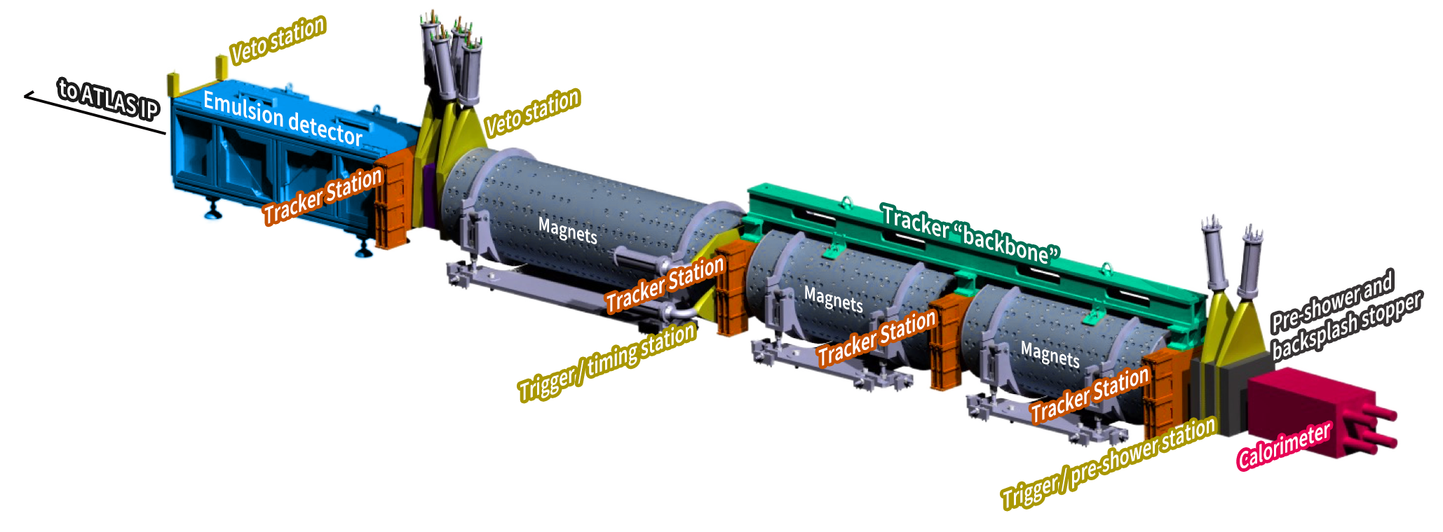
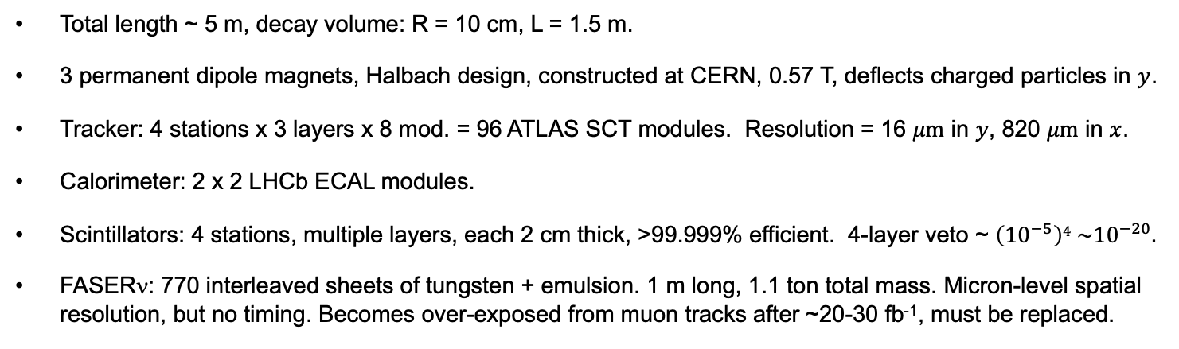



THE FASER DETECTOR
Total length ~ 5 m, decay volume: R = 10 cm, L = 1.5 m.
3 permanent dipole magnets, Halbach design, constructed at CERN, 0.57 T, deflects charged particles in $y$.
Tracker: 4 stations x 3 layers x 8 mod. = 96 ATLAS SCT modules. Resolution = 16 $μm$ in $y$, 820 $μm$ in $x$.
Calorimeter: 2 x 2 LHCb ECAL modules.
Scintillators: 4 stations, multiple layers, each 2 cm thick, >99.999% efficient. 4-layer veto ~ $\left({10}^{−5}\right)4 \sim {10}^{−20}.$
FASERν: 770 interleaved sheets of tungsten + emulsion. 1 m long, 1.1 ton total mass. Micron-level spatial resolution, but no timing. Becomes over-exposed from muon tracks after ~20-30 fb⁻¹, must be replaced.
88 m underground, shielded from ATLAS by 100 m of rock and concrete → extremely quiet environment. Trigger on everything, ~kHz trigger rate dominated by muons
produced at the ATLAS IP, also some beam
backgrounds, cosmic muons.
$$y$$
$$x$$
$$z$$
FASER Collaboration (2207.11427)

Slide 17
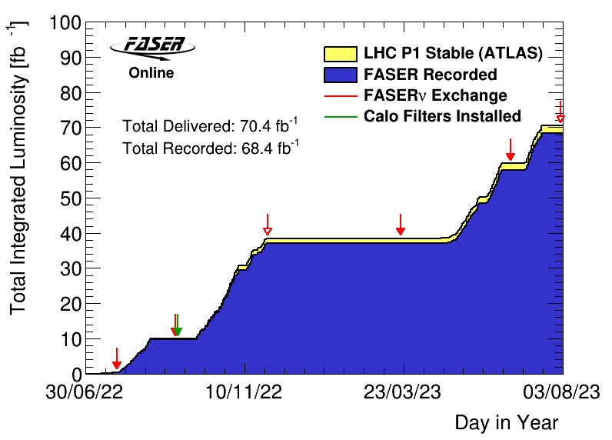
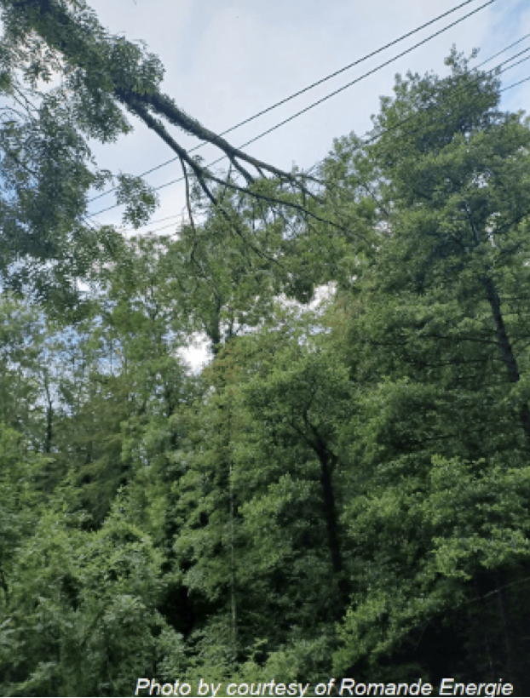
FASER DATA TAKING IN 2022 AND 2023
FASER was ready to go in early 2021, and saw its first cosmic ray event on 18 March 2021.
After LS2 from 2018-2021, the LHC started running again from Jul to Nov 2022 and Apr to Jul 2023.
FASER began recording data immediately.
  Recorded 97% of total lumi.
  Largely automated: no control room, 2 shifters controlling and monitoring the expt from their laptops.
FASERν emulsion exchanged periodically to prevent overexposure
  3 boxes in 2022 (0.5, 10, 30 fb⁻¹)
  2 boxes in 2023 (20, 10 fb⁻¹)

Slide 18
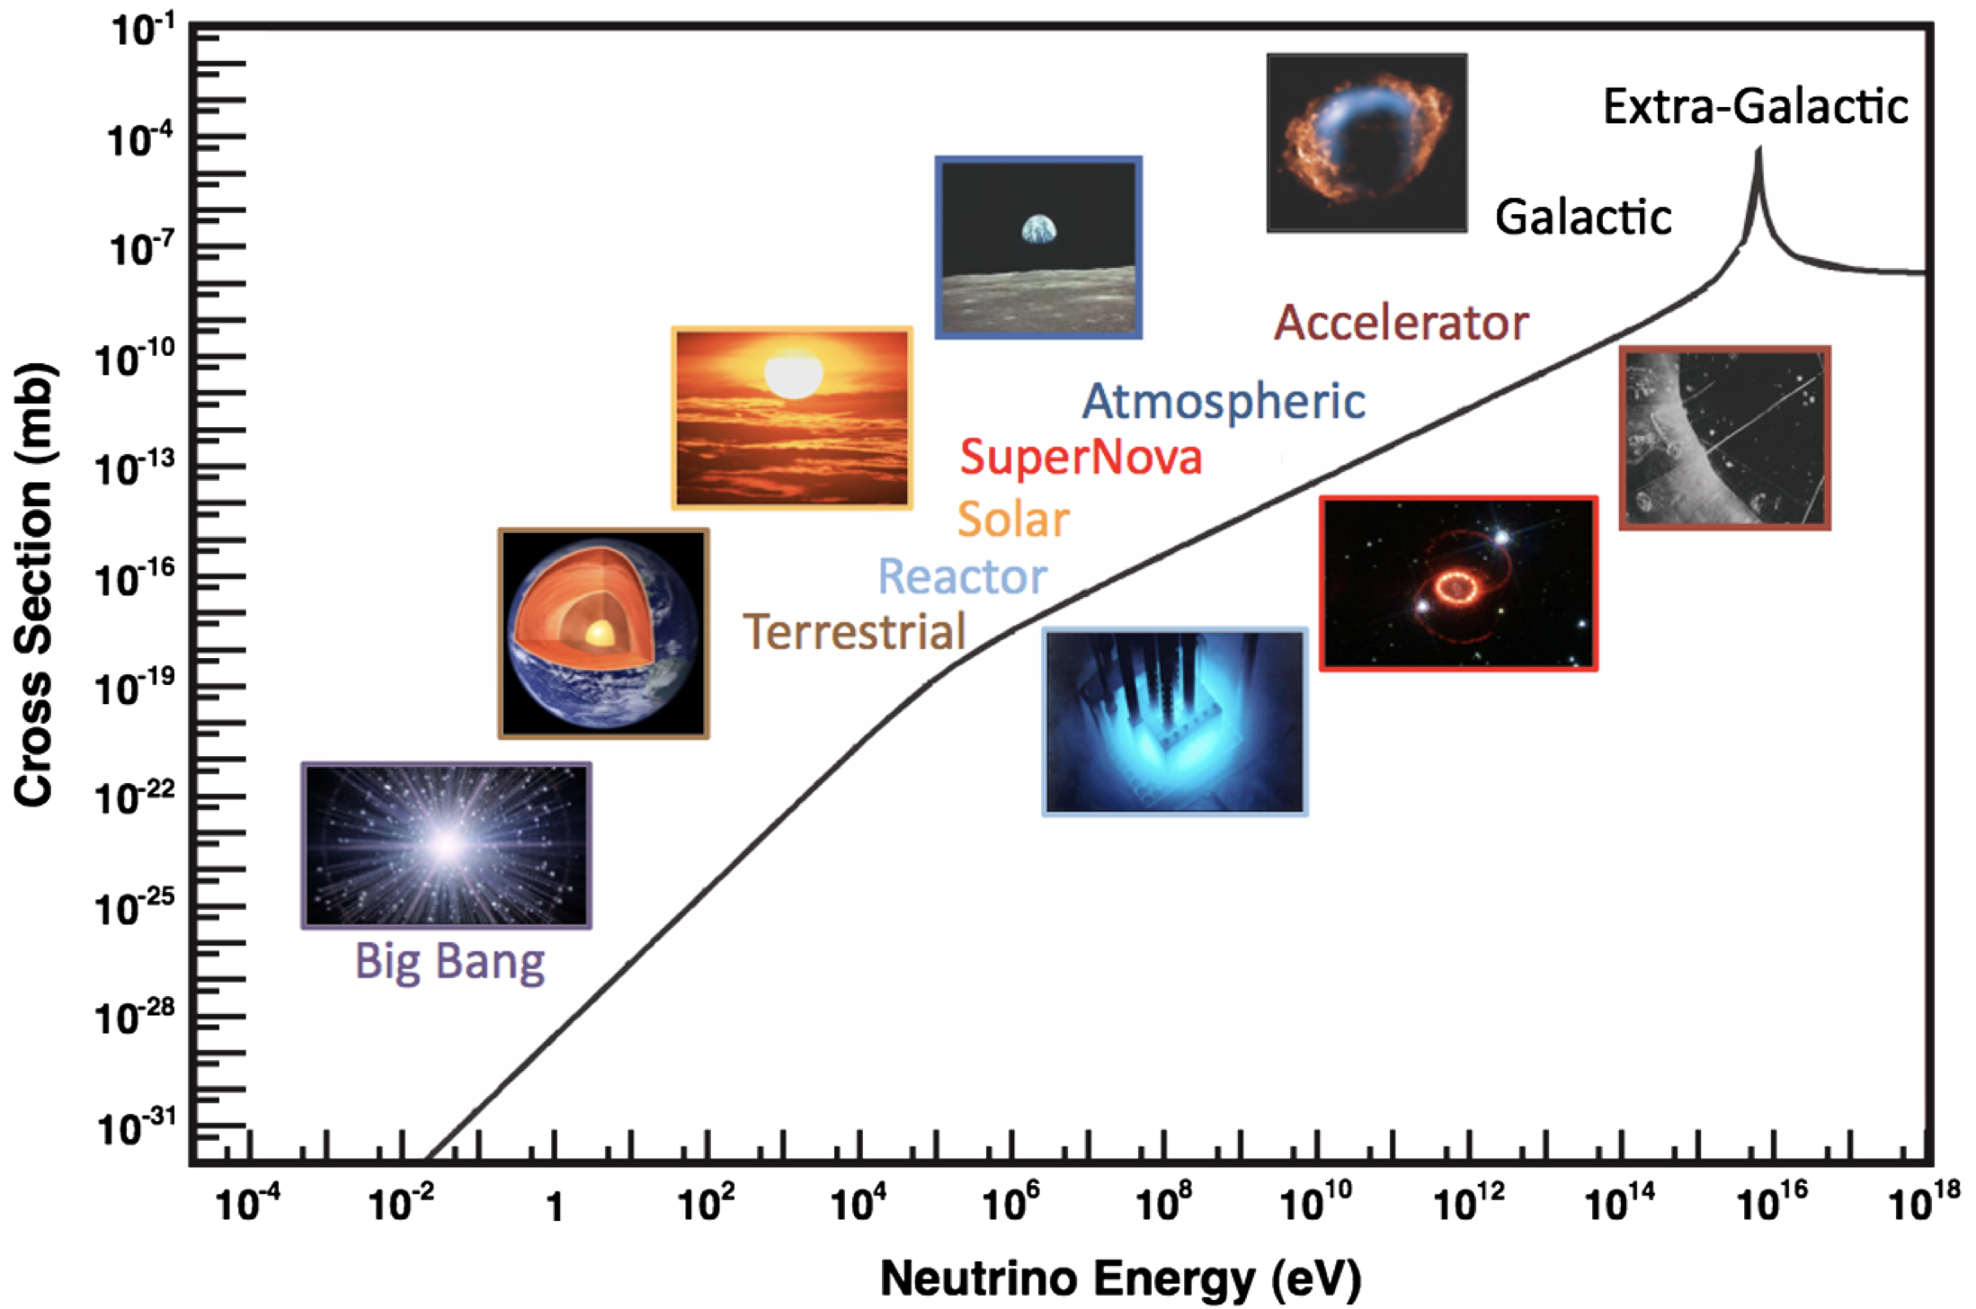
COLLIDER NEUTRINOS
Neutrinos are the least understood of all known particles, and the only ones with confirmed BSM properties.
They have been discovered from many sources, each time with stunning implications for particle physics, astrophysics, and cosmology.
Formaggio, Zeller (2012)
But before FASER, neutrinos produced at particle colliders had never been direct observed before: they interact very weakly, and the highest energy ones pass through the blind spots of existing detectors.

Slide 19
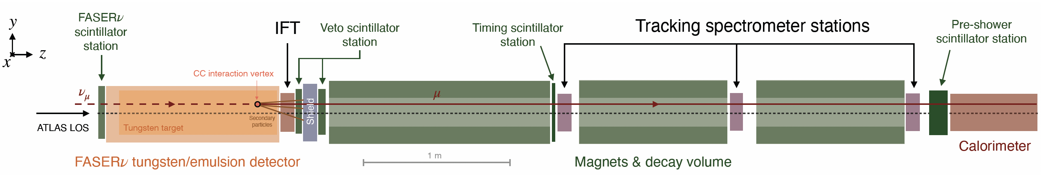
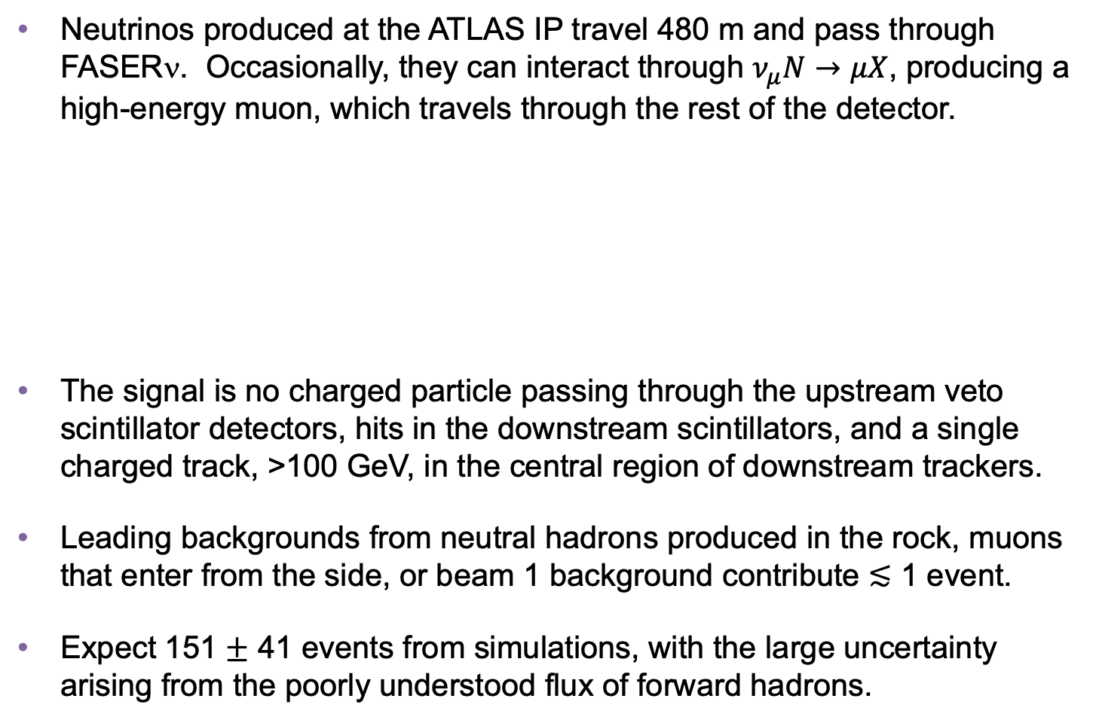
COLLIDER NEUTRINO SEARCH
Neutrinos produced at the ATLAS IP travel 480 m and pass through FASERν. Occasionally, they can interact through $ν_{μ}N→μX$, producing a high-energy muon, which travels through the rest of the detector.
The signal is no charged particle passing through the upstream veto scintillator detectors, hits in the downstream scintillators, and a single charged track, >100 GeV, in the central region of downstream trackers.
Leading backgrounds from neutral hadrons produced in the rock, muons that enter from the side, or beam 1 background contribute $≲$ 1 event.
Expect 151 $±$ 41 events from simulations, with the large uncertainty arising from the poorly understood flux of forward hadrons.
FASER Collaboration (2303.14185, PRL)
Notes:
typical A’ that decays in FASER has ~TeV energy

Slide 20
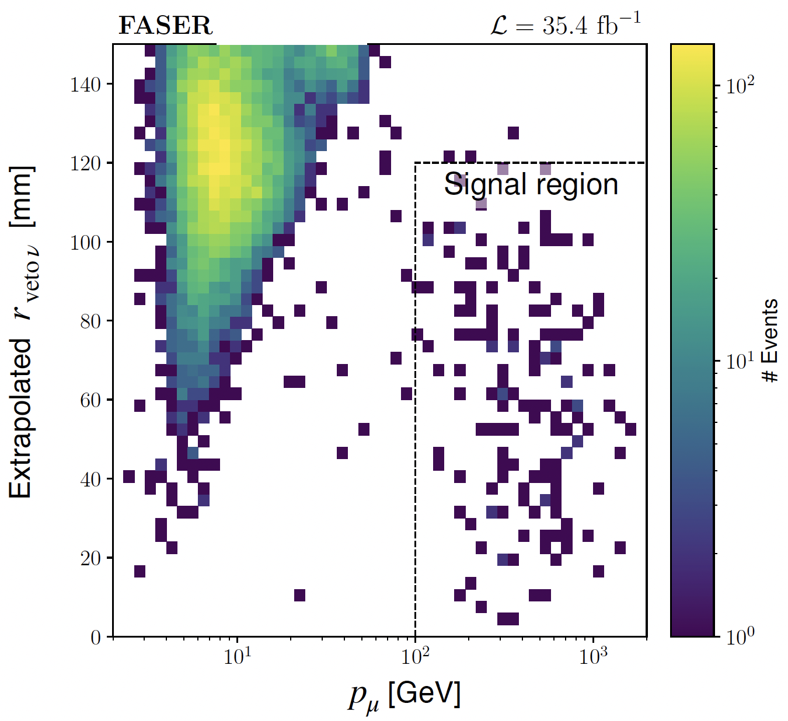
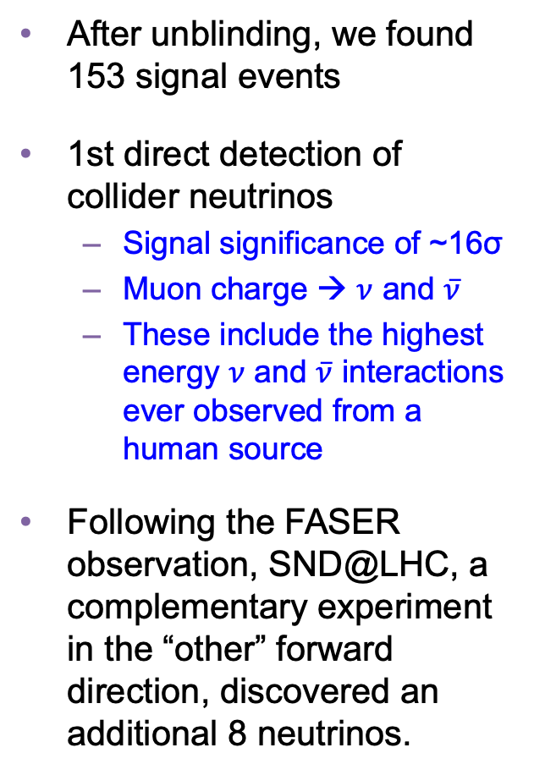
COLLIDER NEUTRINO RESULTS
After unblinding, we found 153 signal events
1st direct detection of collider neutrinos
  Signal significance of ~16σ
  Muon charge → $ν$ and $\overline{ν}$
  These include the highest energy $ν$ and $\overline{ν}$ interactions ever observed from a human source
Following the FASER observation, SND@LHC, a complementary experiment in the “other” forward direction, discovered an additional 8 neutrinos.
FASER Collaboration (2303.14185, PRL)

Slide 21
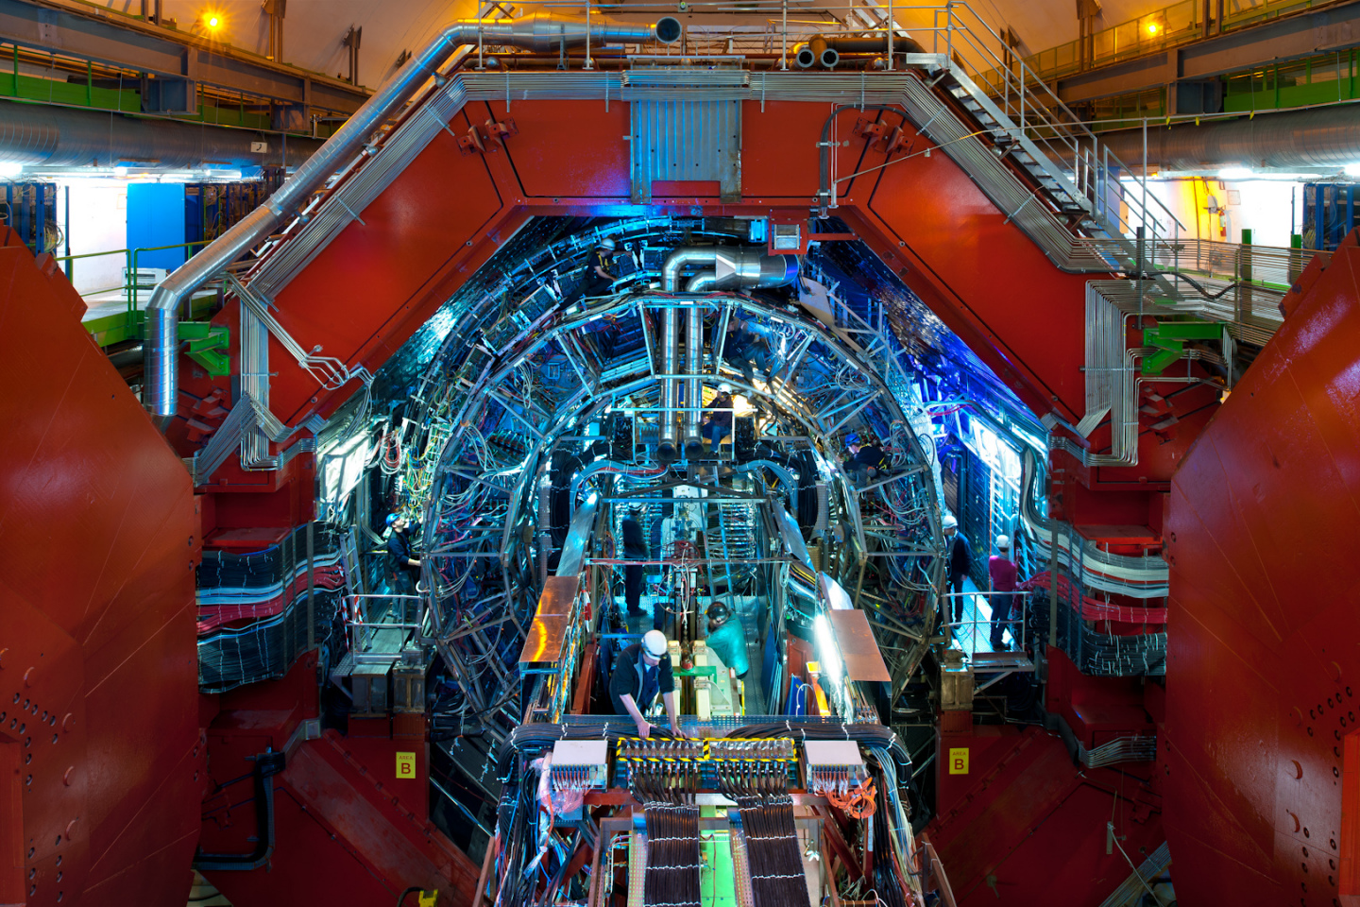
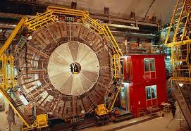
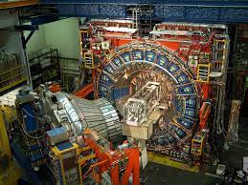
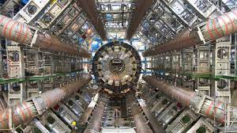
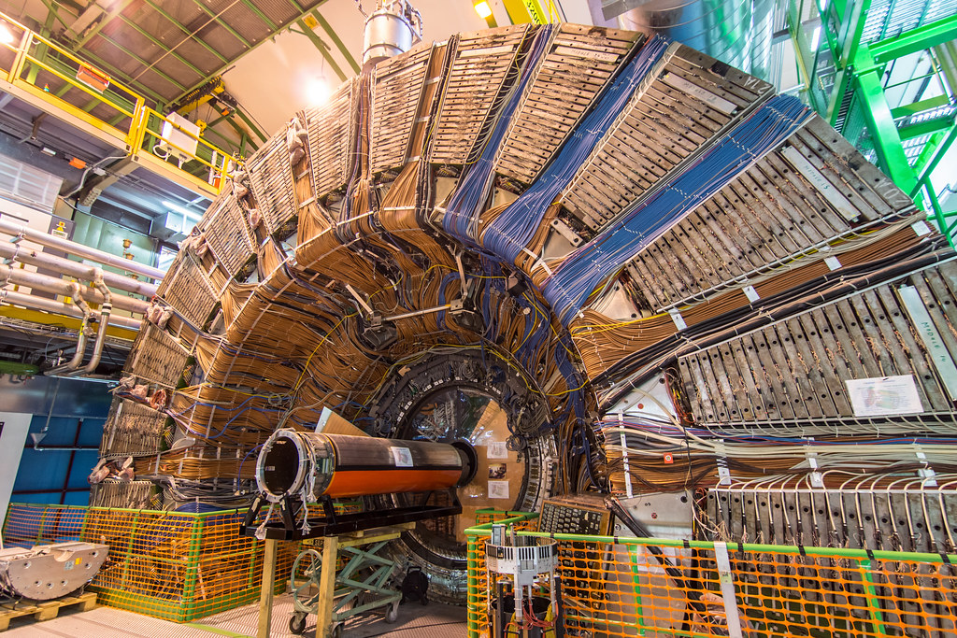
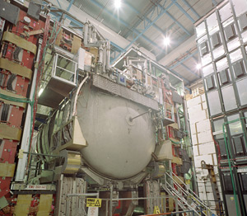
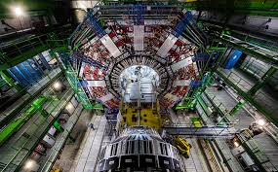
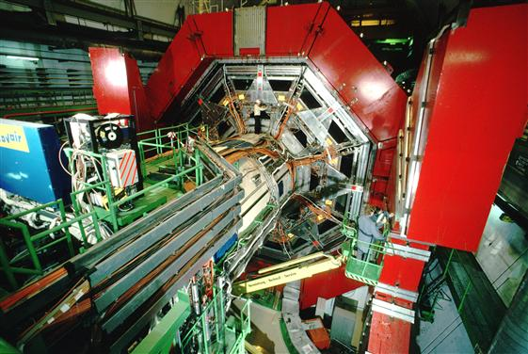

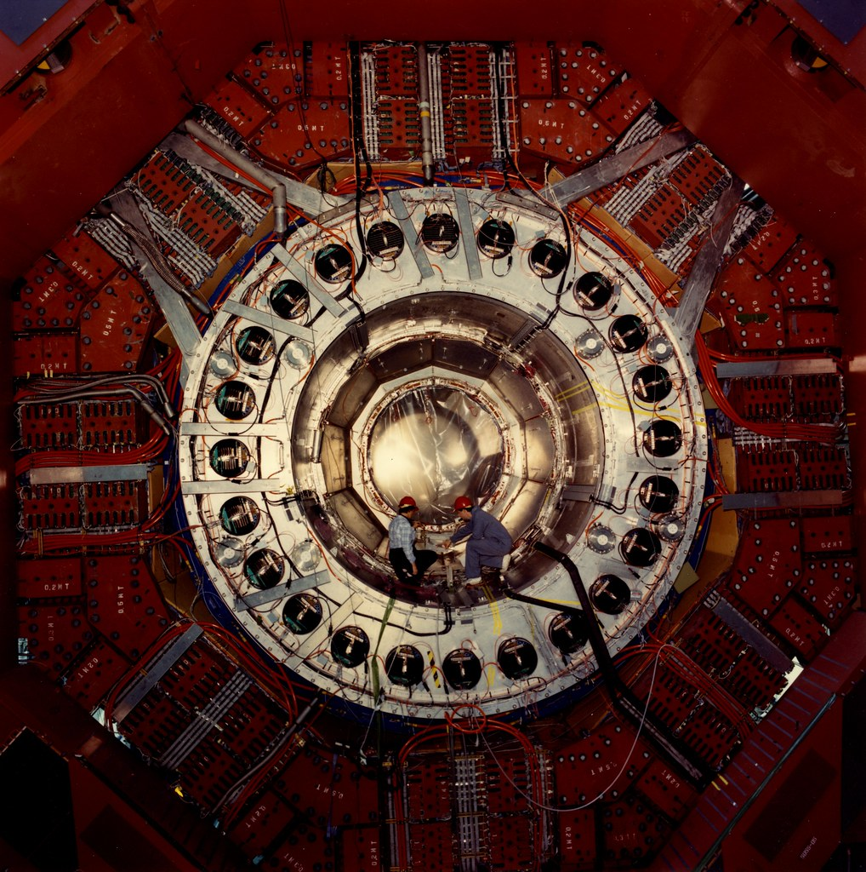
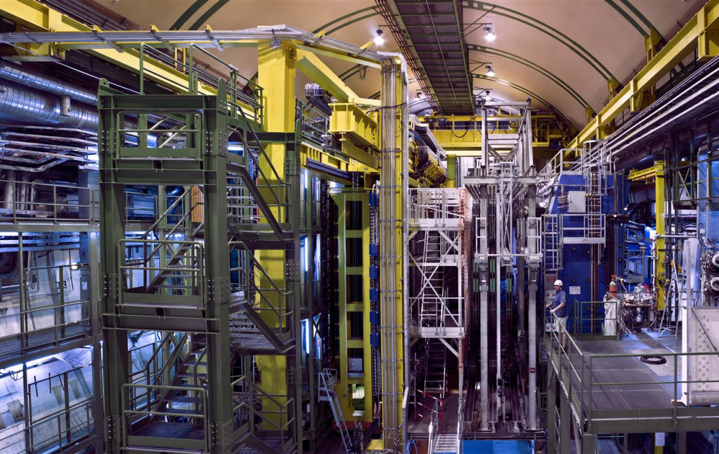
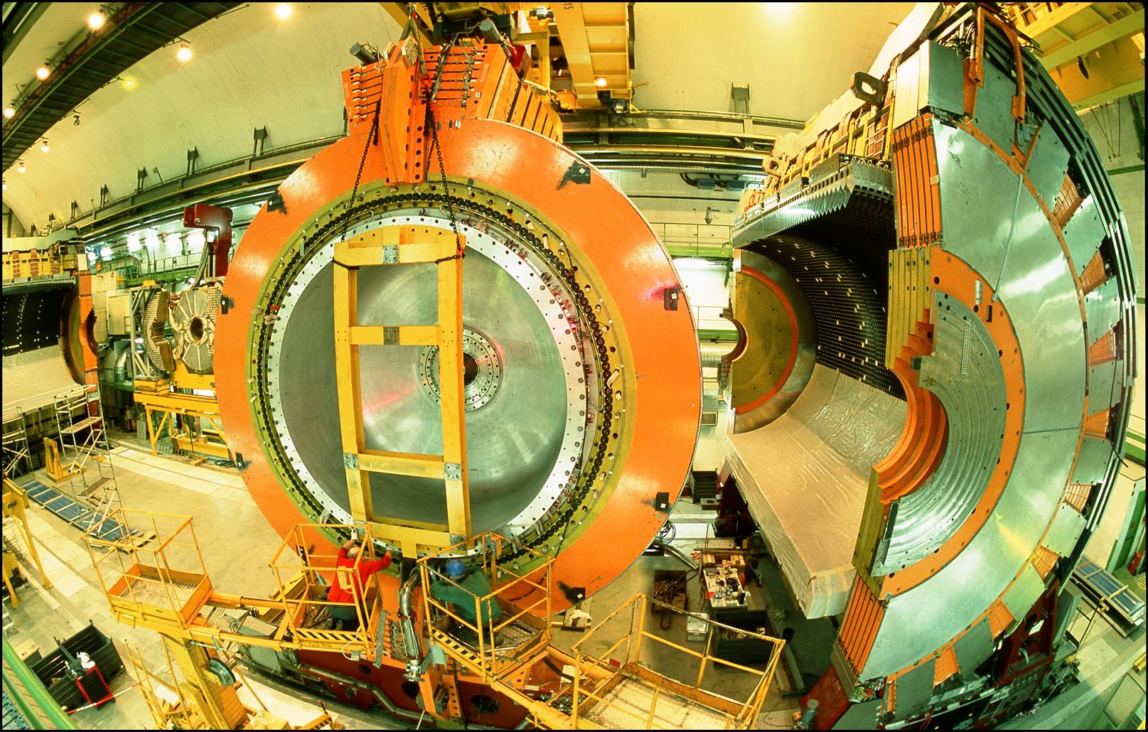
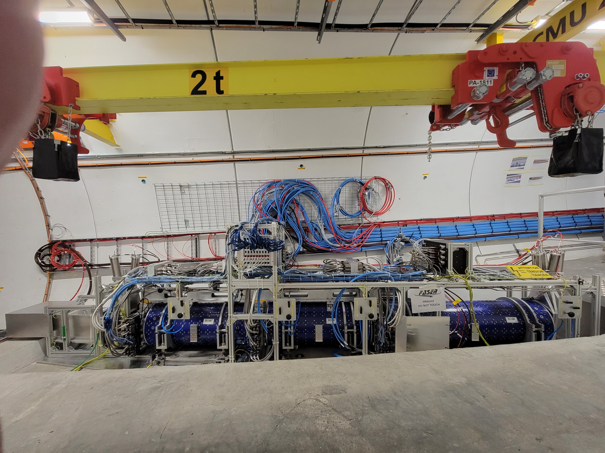
LOCATION, LOCATION, LOCATION
…
ALICE
ALEPH
CDF
FASER
“Tabletop,” 18 months,
~$1M
153 neutrinos
ATLAS
DELPHI
D0
CMS
L3
LHCb
SLD
OPAL
All previous
collider detectors
Building-size, decades,
~$1B
0 neutrinos
16σ discovery, opening a new window at the high energy frontier

Slide 22
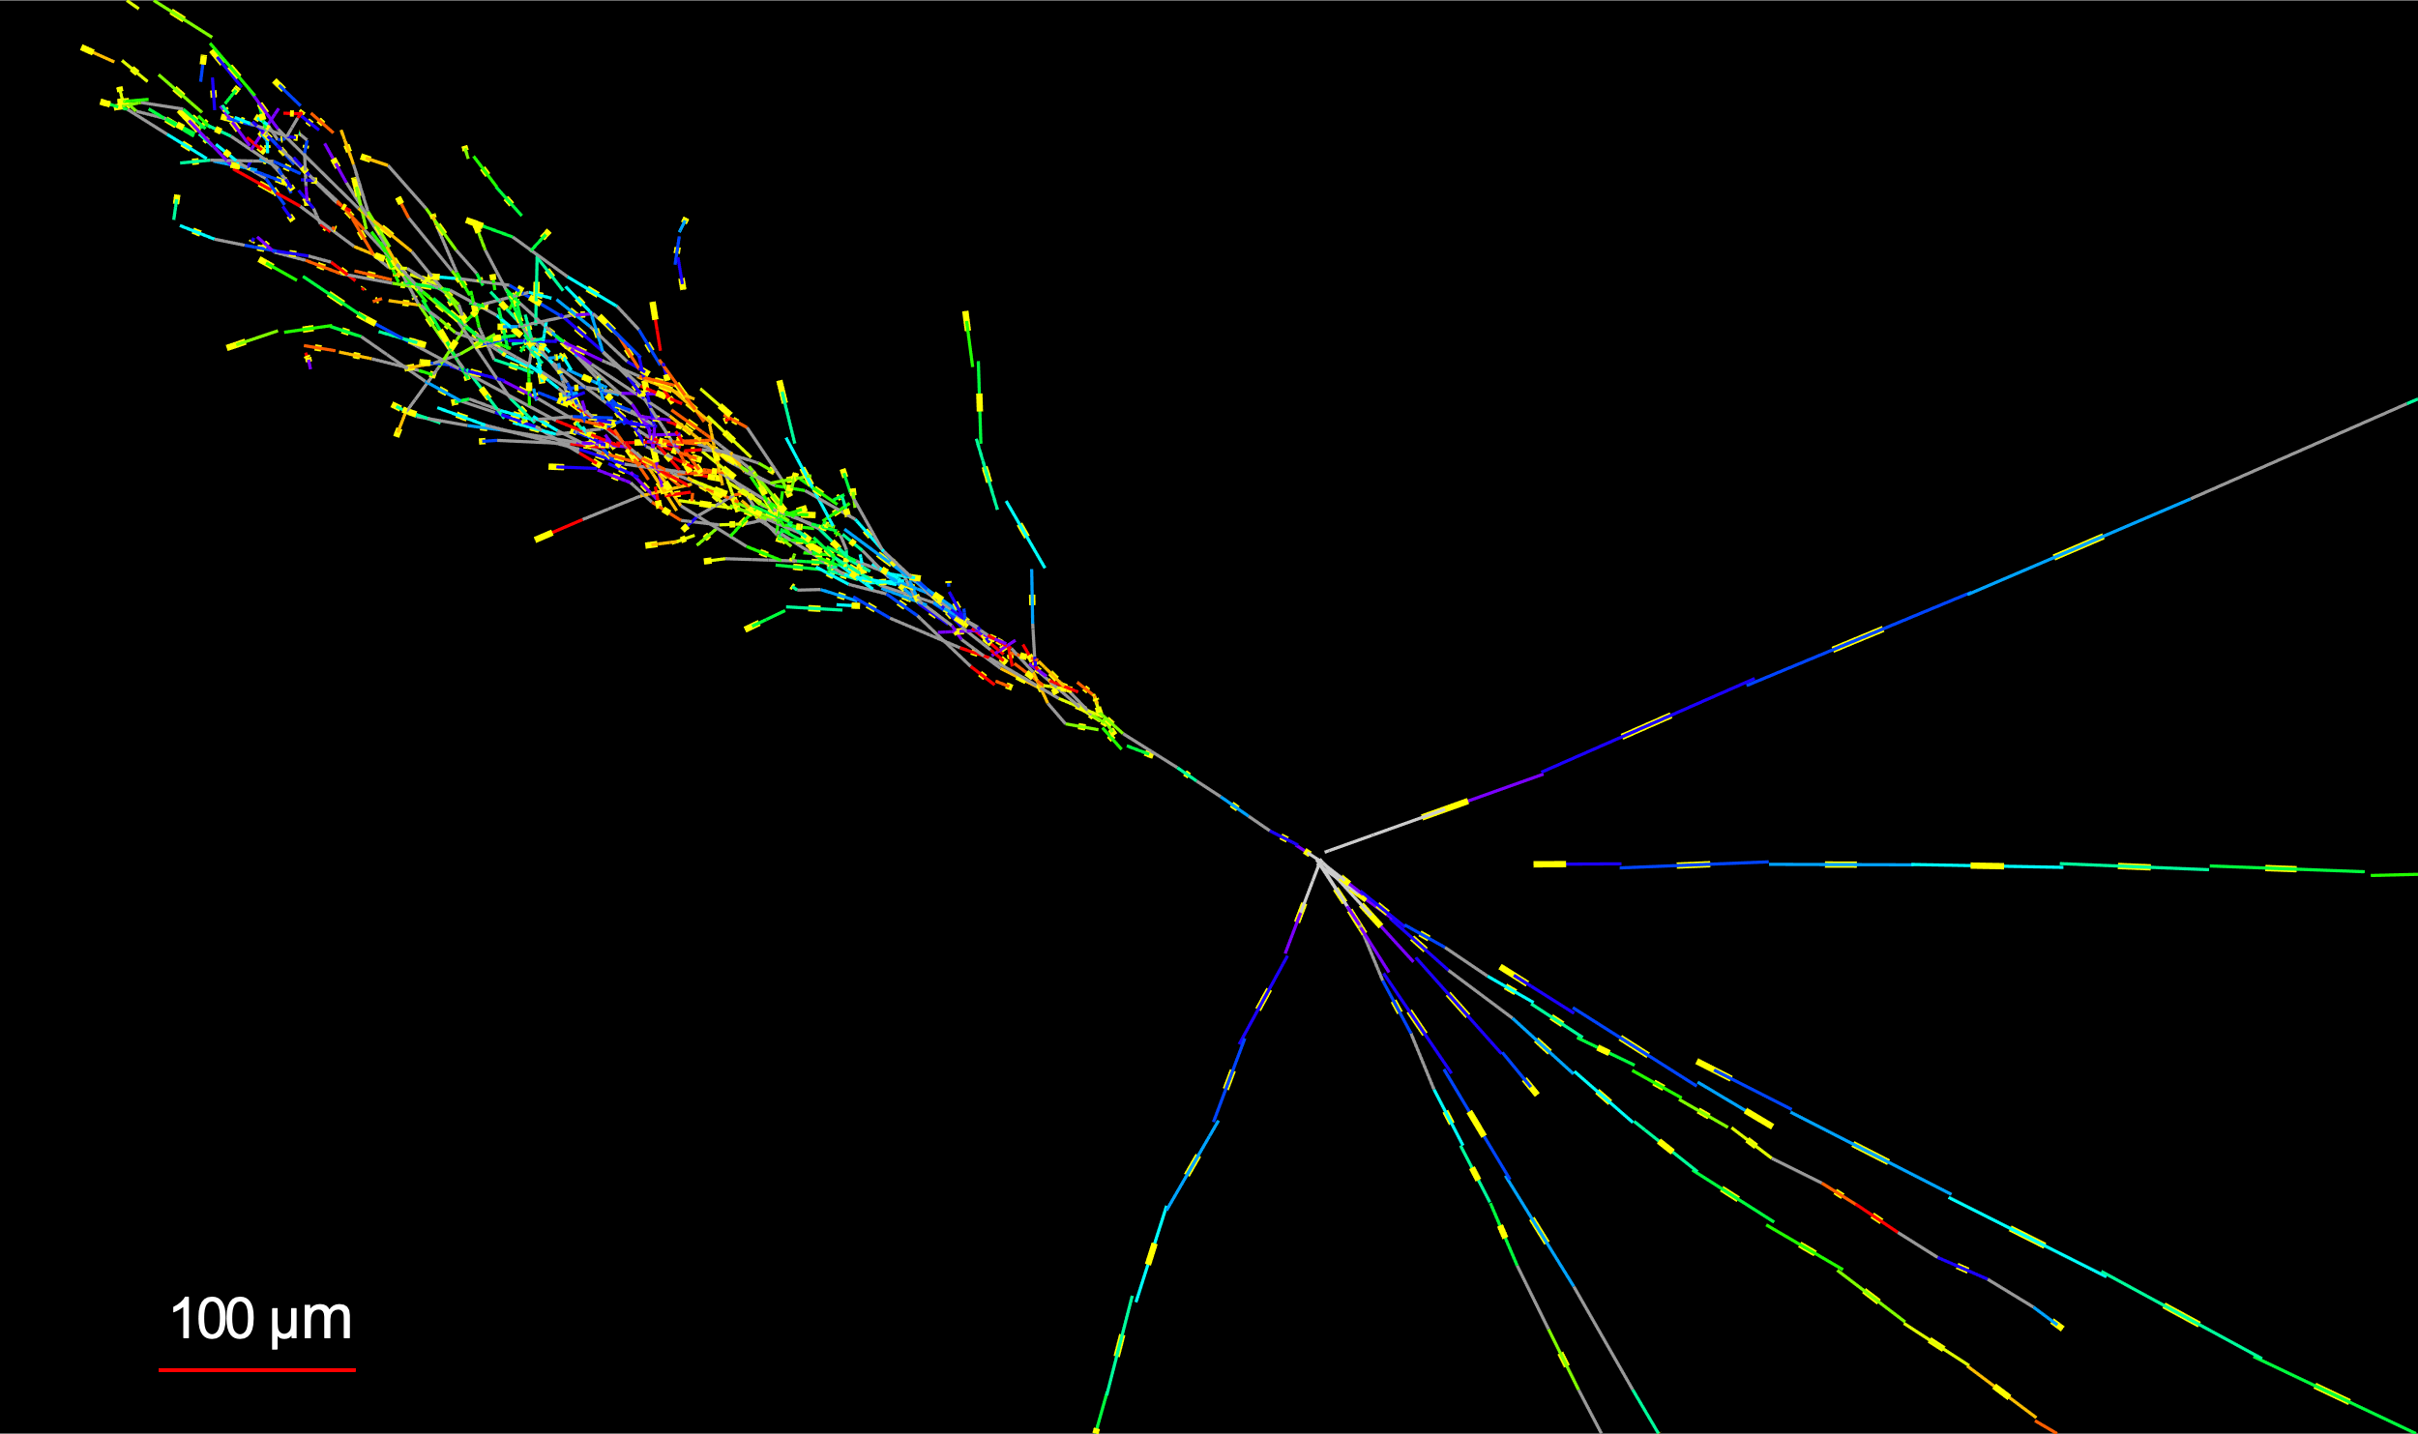

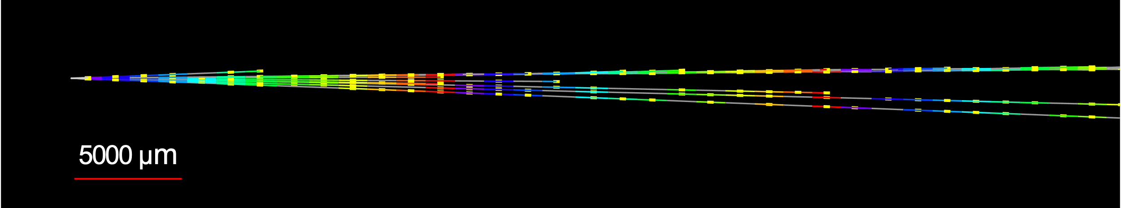


NEUTRINOS FROM EMULSION IN FASERν
The discovery analysis did not even use the emulsion data! With the emulsion, we have now observed the first collider electron neutrinos, including the “Pika-$ν$” event, the highest energy (1.5 TeV) electron neutrino from a lab source.
Side View
Vertex with 11 tracks
  615 µm inside tungsten
e-like track from vertex
  Single track for 2X₀
  Shower max @ 7.8Χ₀
  θ_{e} = 11 mrad to beam
Back-to-back topology
  175° between e & rest
$$e$$
Beam View
FASER Collaboration (2403.12520)

Slide 23
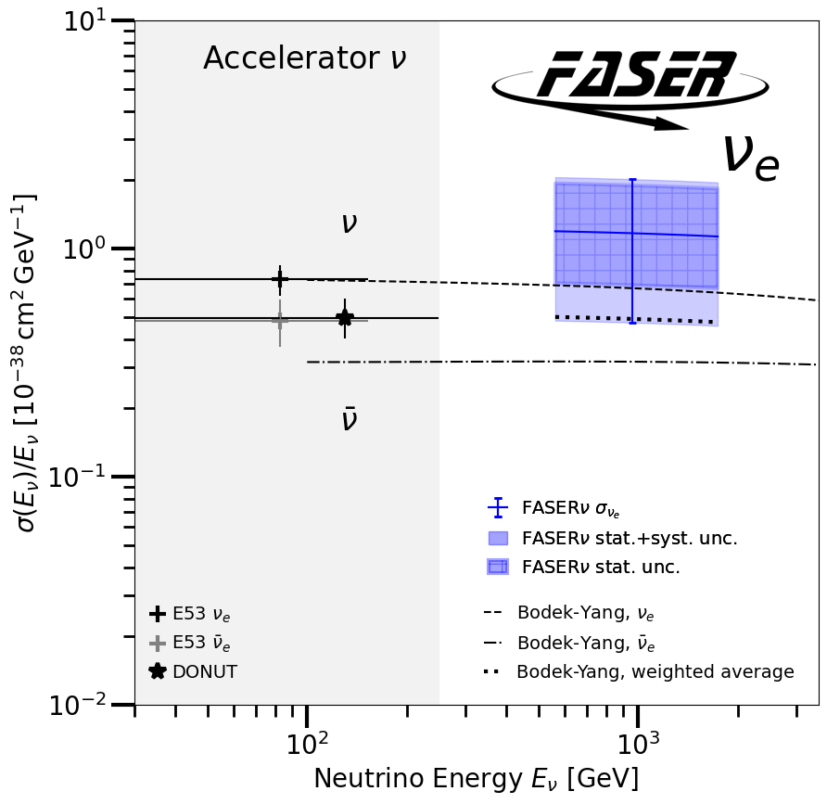
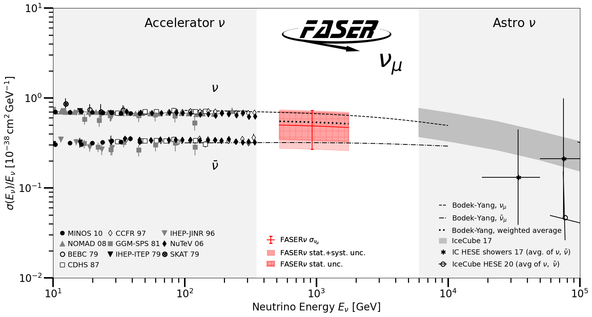
TEV NEUTRINO CROSS SECTIONS
Following these discoveries, we can then move on to studies, including the first measurement of neutrino cross sections at TeV energies.
Results are consistent with SM DIS predictions.
These measurements use only 1.7% of the data already collected in 2022 and 2023.
FASER Collaboration (2403.12520)

Slide 24
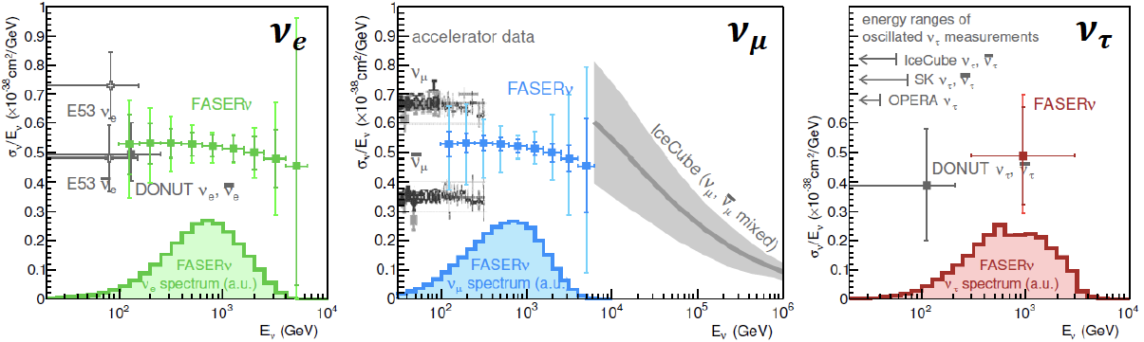
NEUTRINO PROJECTIONS
By the end of Run 3 (~300 fb⁻¹, 2025), we expect to
  Record ~3000 ν_{e} , ~10,000 ν_{μ} , and ~50 ν_{τ} interactions at TeV energies, the first direct exploration of this energy range for all 3 flavors.
  Distinguish muon neutrinos from anti-neutrinos by combining FASER and FASERν data, and so measure their cross sections independently.
  More than triple the world’s supply of tau neutrinos, and detect the first ant-tau neutrino.
FASER Collaboration (1908.02310)

Slide 25



NEW PARTICLE SEARCHES
Neutrinos are the only known light and weakly-interaction particles. But such particles appear generically in many BSM theories especially those addressing the neutrino mass and dark matter puzzles.
For example: suppose there is a dark sector that contains dark matter X and also a dark force: dark electromagnetism.
The result? Dark photons $A′$ , like photons, but with mass $m_{A′}$, couplings suppressed by $ε$.
For low $ε$dark photons are long-lived particles (LLPs), can be produced in ATLAS, pass through rock and magnetic fields unhindered, and decay in FASER.
Many other examples: sterile neutrinos, dark Higgs bosons, axion-like particles, light gauge bosons, light Binos, inflatons, …
SM
EM
Dark Sector
EM, X
A
$${εF}_{μν}F_{D}^{μν}$$
A_{D}
Holdom (1986)

Slide 26


DARK PHOTON SIGNAL
Focus on masses in the 10-100 MeV range.
Produced through meson decay $π/η→A^{′}γ$ or “dark bremsstrahlung” $pp→{ppA}^{′}$.
Travel straight and unimpeded through 480 m of rock/concrete.
Then decay through $A^{′}$ $→ e^{+}e^{−}$.
The signal is no charged particle passing through the upstream veto scintillator detectors, followed by two very energetic (100s of GeV) charged tracks in downstream trackers. Tracks are very collimated, but magnet splits them sufficiently to be seen as 2 tracks in trackers.
Notes:
typical A’ that decays in FASER has ~TeV energy

Slide 27


DARK PHOTON RESULTS
After unblinding, no events seen, FASER sets limits on previously unexplored parameter space.
First new probe of the parameter space favored by dark matter from low coupling since the 1990’s. Started probing new parameter space with the first day of data, ended up ~100 times more sensitive than previous experiments.
Background-free analysis; contrary to conventional wisdom, $N=3$ contours are conservative.
Existing bounds from DarkCast
FASER Collaboration (2308.05587, PLB)
For the future, factor of ~10 more luminosity and other improvements in Run 3 from 2023-25 data.

Slide 28




ALP-W SEARCH RESULTS
Can also look for LLPs with purely photonic final states. E.g., ALP-Ws
production
decay
Signal is no hits in veto scintillators, >1 TeV energy deposit in ECAL.
Background: Expect 0.42 $±$ 0.32 from $ν$ interactions in 58 fb⁻¹.
1 event seen, excludes new parameter space. Benefits from LHC’s high energy, lots of B’s.
FASER Collaboration (CERN-FASER-CONF-2024-001)
Future BSM searches: factor of ~10 more luminosity, improved analyses, hardware upgrades (high resolution preshower calorimeter).
Improved sensitivity for all of these models, as well as many more particles to look for: U(1)_{B}, protophobic gauge bosons, ALP-γ, ALP-g, up-philic scalar, light-shining through walls axions, quirks, etc.

Slide 29


Slide 30





FORWARD PHYSICS FACILITY
Following the results of FASER and SND@LHC, CERN is considering the possibility of creating a dedicated Forward Physics Facility to house far-forward experiments for the rest of the LHC era from 2028-2040s.
UJ18
ATLAS
SPS
LHC
LOS
FPF site selection study and core study have identified an ideal site in France just outside the CERN main gate
https://cds.cern.ch/record/2851822
CERN GIS

Slide 31



THE FACILITY
A cylindrical cavern surrounding the LOS, 620-695 m west of the ATLAS IP.
75 m long, 12.5 m in diameter, covers $η>5.1$.
Preliminary (Class 4) cost estimate: 30 MCHF.
Can be constructed independently of the LHC, does not disrupt LHC running.
Timeline: construct in LS3/early Run 4, physics starts in late Run 4/Run5.
Bud, Magazinik, Pál, Osborne, et al. CERN CE (2024)

Slide 32

FPF EXPERIMENTS
At present there are 4 experiments being designed for the FPF
  FASER2: magnetized spectrometer for BSM searches
  FASERν2: emulsion-based neutrino detector
  FLArE: LArTPC neutrino detector
  FORMOSA: scintillator array for BSM searches (successor to MilliQan)
These represent a huge jump relative to the existing experiments:
  10,000 times greater (decay volume * luminosity) for BSM searches.
  Will detect miilions of TeV neutrinos (~1000 neutrinos/day).

Slide 33
FORWARD PHYSICS FACILITY
The physics program in the far-forward region has been developed in a series of meetings and papers.
FPF Meetings
  FPF Kickoff Meeting, 9-10 Nov 2020
  FPF2 Meeting, 27-28 May 2021
  FPF3 Meeting, 25-26 Oct 2021
  FPF4 Meeting, 31 Jan - 1 Feb 2022
  FPF5 Meeting, 15-16 Nov 2022
  FPF6 Meeting, 8-9 Jun 2023
  FPF7 Meeting, 29 Feb – 1 Mar 2024
FPF Papers
  FPF “Short” Paper: 75 pages, 80 authors, Phys. Rept. 968, 1 (2022), 2109.10905.
  FPF White Paper: 429 pages, 392 authors+endorsers representing over 200 institutions, J. Phys. G (2023), 2203.05090.
Snowmass 2022: “Our highest immediate priority accelerator and project is the HL-LHC, … including the construction of auxiliary experiments that extend the reach of HL-LHC in kinematic regions uncovered by the detector upgrades.”

Slide 34

NEW PHYSICS AT THE FPF
The FPF is proposed to run at the HL-LHC with implications for
  New physics in neutrino properties: neutrino blind → neutrino factory (10⁶ neutrinos at the highest human-made energies ever).
  New particles: dark matter, dark sectors, milli-charged particles, new force particles, new Higgs-like particles, sterile neutrinos, quirks, …

Slide 35




NEUTRINOS AT THE FPF
The FPF experiments will see ${10}^{5} ν_{e}$, ${10}^{6} ν_{μ}$, and ${10}^{4} ν_{τ}$ interactions at ~ TeV energies where there is currently almost no data.
Neutrinos are produced by forward hadron production: $π, K, D, …$. Dependence on E, $η$ will inform
  Astroparticle physics: muon puzzle, …
  QCD: pdfs at x $\sim {10}^{−1}$, x $\sim {10}^{−7}$, intrinsic charm, small-x gluon saturation, …
  Neutrino oscillations: $ν_{s}$ with $∆m^{2}\sim {10}^{3}$ ${eV}^{2}$

Slide 36




QCD AT THE FPF
The FPF will enable a rich program of QCD and hadron structure studies.
Forward neutrino production is a probe of forward hadron production, BFKL dynamics, intrinsic charm, and proton structure at ultra small x ~ 10⁻⁷ to 10⁻⁶.
Important implications for UHE cosmic ray experiments, ATLAS/CMS at HL-LHC, …
$$4m_{c}^{2 }\sim x_{1}x_{2}s$$
FASER White Paper (2022); Rojo et al. (2024)

Slide 37


COMPLEMENTARITY WITH HIGH PT PHYSICS
The FPF will provide new constraints on pdfs that will sharpen studies at ATLAS and CMS.
For example, W, Z, and Higgs boson studies.
Will also remove degeneracies between pdfs and new physics (fitting away new physics), enhancing the reach for, e.g., new resonance searches.
_{Ubiali et al., in progress}
Cruz-Martinez, Fieg, Giani, Krack, Makela, Rabemananjara, Rojo (2023)

Slide 38



QUIRKS: STRONGLY-INTERACTING DARK SECTORS
Quirks are particles charged under both the SM and a strong-interacting dark force, with $m≫Λ$.
Quirks can be pair-produced at the LHC, but the quirk-anti-quirk pair is bound together and has $p_{T} ≈0.$ They therefore preferentially travel down the beampipe, and may pass through FPF detectors.
By looking for 2 coincident slow or delayed tracks (out of time with the bunch crossing), FASER and FASER2 can discover quirks with masses up to ~ hundreds of GeV to TeV, as motivated by neutral naturalness solutions to the gauge hierarchy problem.
Only possible at the EF, not at fixed target experiments.
Feng, Li, Liao, Ni, Pei (2024)

Slide 39


MILLI-CHARGED PARTICLES AT THE FPF
A completely generic possibility motivated by dark matter, dark sectors. Currently the target of the MilliQan experiment, located at the LHC near the CMS experiment in a “non-forward” tunnel.
The MilliQan Demonstrator (Proto-MilliQan) already probes new region. Full MilliQan can also run in this location in the HL-LHC era, but the sensitivity may be improved significantly by moving it to the FPF (FORMOSA).
Foroughi-Abari, Kling, Tsai (2020)

Slide 40




ASTROPARTICLE PHYSICS AT THE FPF
The current IceCube cosmic nu flux can be fit by a power law, a power law with cutoff, ...
More data may be able to distinguish these, but only if the atmospheric neutrino background from charm is better determined.
IceCube 2001.09520
Power law
Power law
with cutoff
Bhattacharya et al. (1502.01076)
This can be measured in the controlled environment of a particle collider if
  $\sqrt{s} \sim \sqrt{2E_{ν}m_{p}} \sim$10 TeV for $E_{ν} \sim$10⁷ GeV : Requires the energy of the LHC
  $x_{1,2} \sim \frac{m_{c}}{\sqrt{s}} e^{±η} ⇒ η \sim$ 7 to 9 : Requires the far forward angular coverage of the FPF
Anchordoqui (2022)

Slide 41







LLPS FROM COMPRESSED SPECTRA
LLPs can result from weak couplings.
But they can also arise generically from compressed spectra (e.g., inelastic DM), where decays are phase-space suppressed by degeneracies.
$$m_{1}$$
$$χ_{1} →χ_{0}γ$$
$$m_{0}$$
0
In this case, decays $χ_{1} →χ_{0}γ$ lead to very soft photons that can be difficult to detect.
But these are boosted at the LHC by $γ \sim 1000$, FASER2 can detect GeV particles with even ~MeV mass splittings, thermal relic target.
Difficult at SHiP (sensitivity contour assumes $E_{γ}$ threshold of 300 MeV, 2 10²⁰ POT).
Dienes et al. (2023)

Slide 42



A CAUTIONARY TALE
Sometimes to look forward, it pays to first look back.
2021 was the 50th anniversary of the birth of hadron colliders.
In 1971, CERN’s Intersecting Storage Rings (ISR), with a circumference of ~1 km, collided protons with protons at center-of-mass energy 30 GeV.

Slide 43



ISR’S LEGACY
During ISR’s 50th anniversary, there were many fascinating articles and talks by eminent physicists looking back on the ISR’s legacy.
  “Enormous impact on accelerator physics, but sadly little effect on particle physics.” – Steve Myers, talk at “The 50th Anniversary of Hadron Colliders at CERN,” October 2021.
  “There was initially a broad belief that physics action would be in the forward directions at a hadron collider…. It is easy to say after the fact, still with regrets, that with an earlier availability of more complete… experiments at the ISR, CERN would not have been left as a spectator during the famous November revolution of 1974 with the J/ψ discoveries at Brookhaven and SLAC .” – Lyn Evans and Peter Jenni, “Discovery Machines,” CERN Courier (2021).
Bottom line: The collider was creating new forms of matter (charm), but the detectors focused on the forward region (along the beamline) and so missed them. Let’s not follow this precedent!

Slide 44

CONCLUSIONS
In the last year, we have directly detected collider neutrinos for the first time, opening up a new window at the energy frontier.
Forward experiments have a broad physics program
  The study of collider neutrinos at TeV energies, with implications for neutrinos, QCD, astroparticle physics, and high $p_{T}$ physics.
  Searches for light (and also heavy), weakly-interacting BSM particles, including many motivated by dark matter.
I have no doubt that neutrino detectors will be included in all future collider plans, just like trackers and calorimeters. It would be good to do this for the HL-LHC as well. The Forward Physics Facility is now being considered for the HL-LHC (2028-2040s).

