Slide 1



COLLIDER SEARCHES FOR X17 AND OTHER LIGHT GAUGE BOSONS
52nd International Symposium on Multiparticle Dynamics
Gyöngyös, Hungary, 25 August 2023
Jonathan Feng, University of California, Irvine

Slide 2
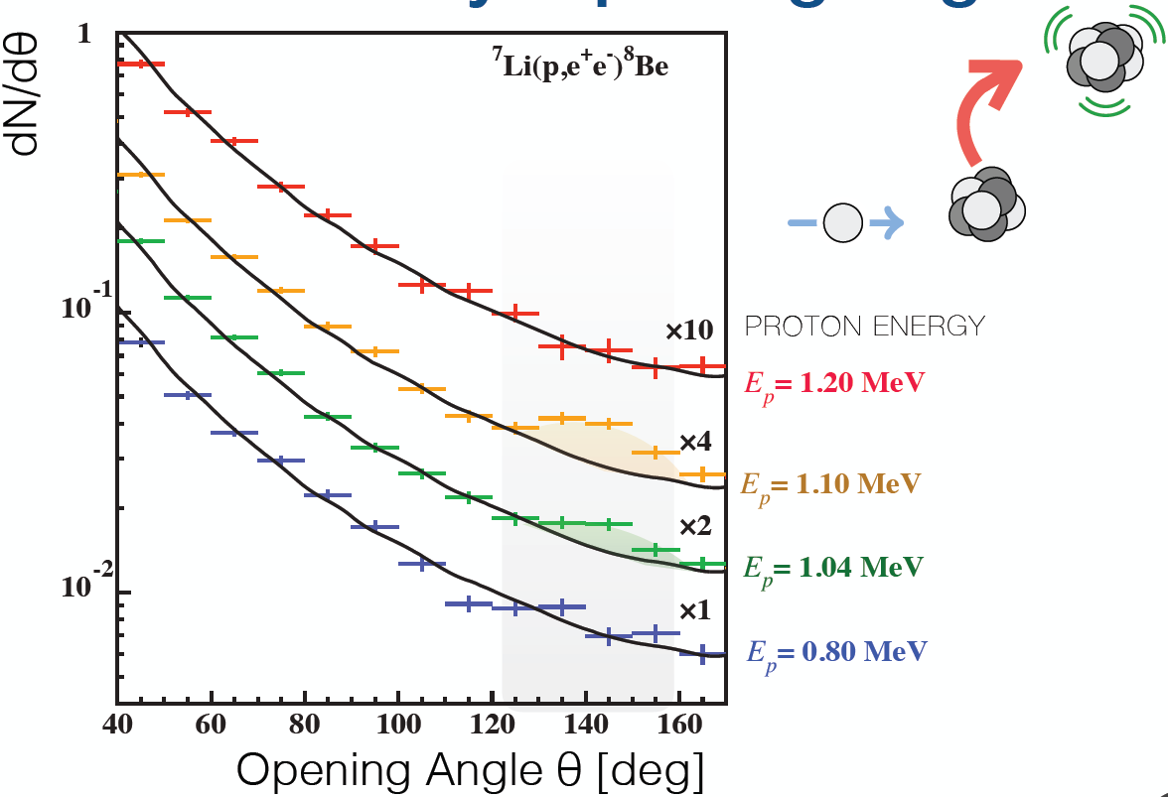
THE ATOMKI ANOMALY
The ATOMKI ⁸Be is the most interesting anomaly to appear in the last several years.
Key considerations for a BSM theorist
  ∼7σ statistical significance – not likely to disappear with more data
  A bump, not a general excess
  Rises and falls as one goes through resonance
  Fit improves drastically with the introduction of a new particle
  No compelling SM explanation
  No experimental problem identified
Zhang, Miller (2017); Viviani et al. (2021)
Krasznahorkay et al. (2015)
And last, in general terms, it fits beautifully with current ideas for BSM physics and cosmology that motivate weakly interacting, light particles.

Slide 3
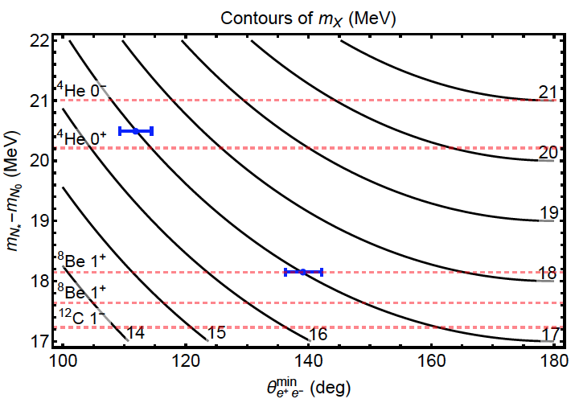
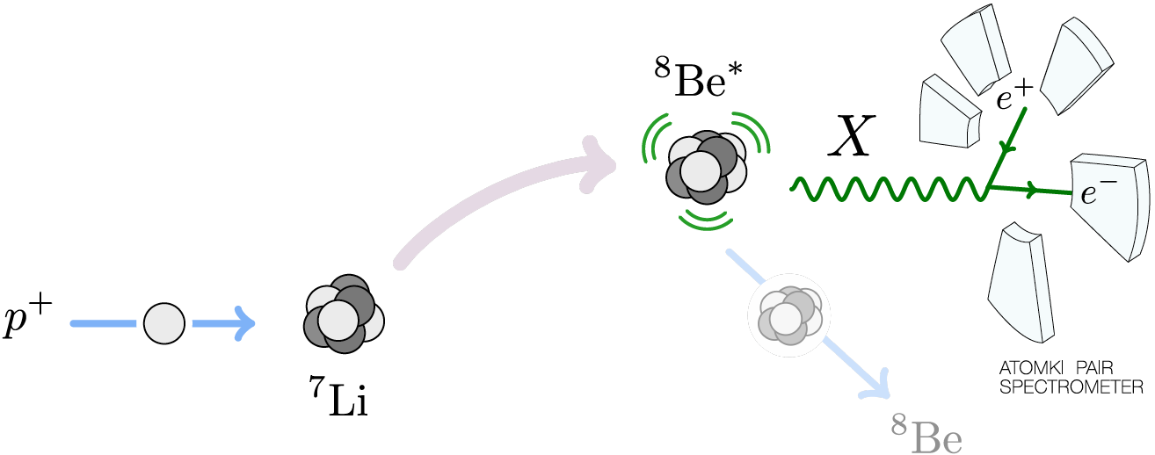
CONFIRMATIONS OF THE ATOMKI ANOMALY
The ⁸Be anomaly has now been strengthened by supporting observations in other nuclear decays, and other experiments
  ⁴He from ATOMKI 2019
  ¹²C from ATOMKI 2022
  ⁸Be from HUS 2023 (reported here!)
  _{See talks of Kraznahorkay, Anh}
  The opening angle excess changes exactly as required for the X17 explanation
Feng, Tait, Verhaaren (2020)
The ⁸Be anomaly has also generated many works on possible BSM interpretations
  It is not at all easy to explain all of these data without violating 70 years of constraints on ~17 MeV particles
  X cannot be a scalar
  X cannot be a dark photon
  Feng, Fornal, Galon, Gardner, Smolinsky, Tait, Tanedo, 1604.07411, Phys. Rev. Lett. 117, 071803 (2016); 1608.03591, Phys. Rev. D 95, 035017 (2017)
Tanedo (2016)

Slide 4
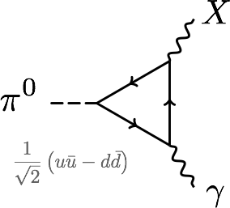
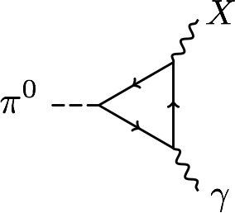


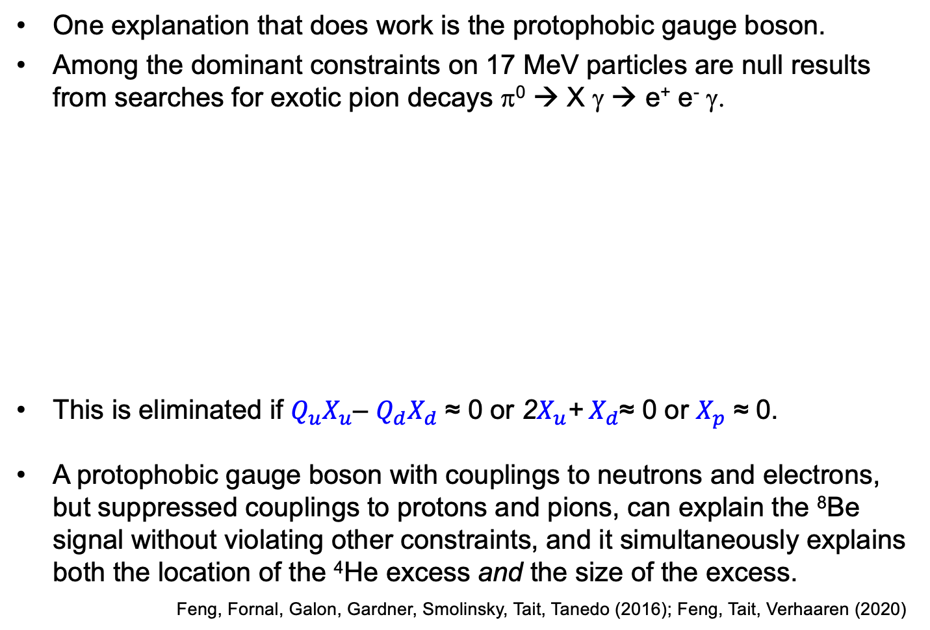


THE PROTOPHOBIC GAUGE BOSON
One explanation that does work is the protophobic gauge boson.
Among the dominant constraints on 17 MeV particles are null results from searches for exotic pion decays π⁰ → X γ → e⁺ e⁻ γ.
This is eliminated if $Q_{u}X_{u}$– $Q_{d}X_{d}$ ≈ 0 or 2$X_{u}$+${ X}_{d}$≈ 0 or $X_{p}$ ≈ 0.
A protophobic gauge boson with couplings to neutrons and electrons, but suppressed couplings to protons and pions, can explain the ⁸Be signal without violating other constraints, and it simultaneously explains both the location of the ⁴He excess and the size of the excess.
Feng, Fornal, Galon, Gardner, Smolinsky, Tait, Tanedo (2016); Feng, Tait, Verhaaren (2020)
$$X_{f}$$
$$X_{f}$$
u, d
p, n
$$Q_{f}$$
$$Q_{f}$$

Slide 5

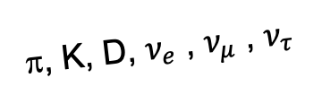
LIGHT GAUGE BOSONS AT COLLIDERS?
X17 and other light, weakly interacting gauge bosons are produced in large numbers at the LHC and other colliders.
Unfortunately, ATLAS, CMS, and the other large detectors are optimized to detect heavy particles, which are produced at low velocity and then decay roughly isotropically to other particles.
But high-energy light particles are dominantly produced in the forward direction and escape through the blind spots of these detectors.
  This is true for all known light particles: pions, kaons, D mesons, neutrinos.
  It is also true for many hypothetical new particles: X17 gauge bosons, dark photons, dark scalars, HNLs, ALPs, milli-charged particles, dark matter, …
These blind spots are the Achilles heels of the large LHC detectors.
X17, A’, a, mCPs, χ, …
π, K, D, $ν_{e}$ , $ν_{μ}$ , $ν_{τ}$

Slide 6
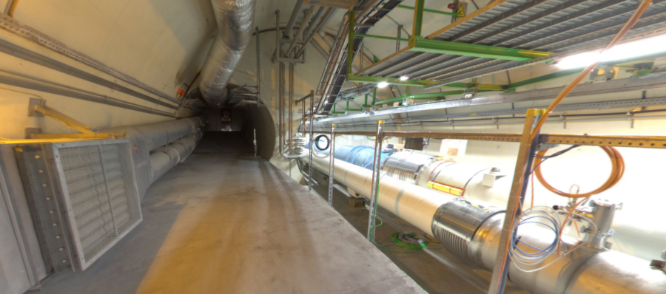
FASER: FORWARD SEARCH EXPERIMENT
Beam collision axis passes
through 100 m of rock, emerges in tunnel TI12, 480 m from ATLAS
UJ12
FASER
The view in UJ12 looking west (2018)
TI12
Beam collision axis
LHC beamline

Slide 7
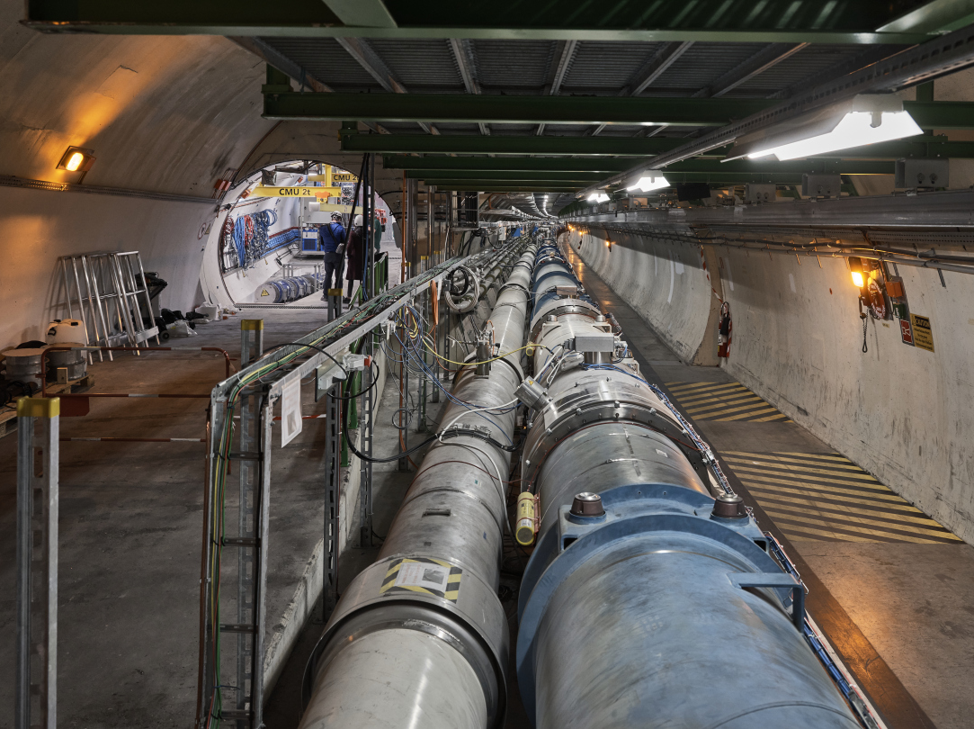
FASER AND THE LHC

Slide 8
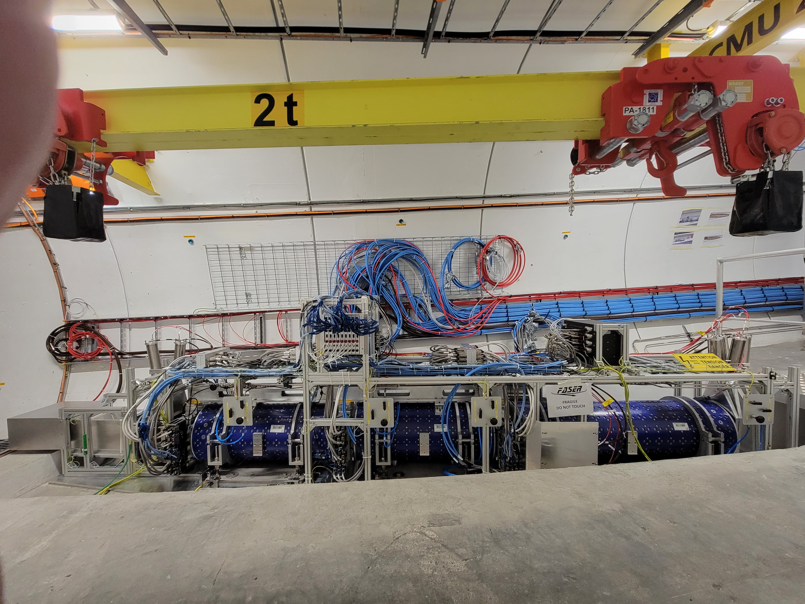
FULLY INSTALLED FASER DETECTOR

Slide 9
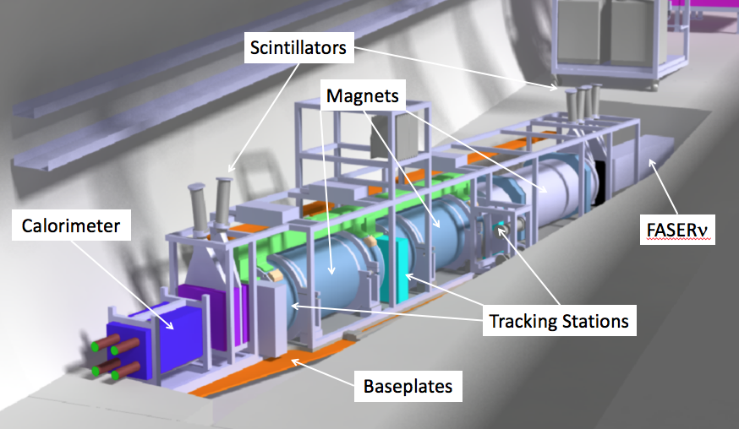

SIGNALS AT FASER
Light gauge bosons: Nothing incoming and 2 ~TeV, e+/e- tracks pointing back to the ATLAS IP: a “light shining through (100 m-thick) wall” experiment.
Collider neutrinos: Nothing incoming and a high energy lepton seen in the detector from $ν_{e,μ}N→\left(e,μ\right) X$.
Scintillators veto incoming charged tracks (muons), magnets split the charged tracks, which are detected by tracking stations and a calorimeter.
LLP
ν
e⁺
e⁻

Slide 10
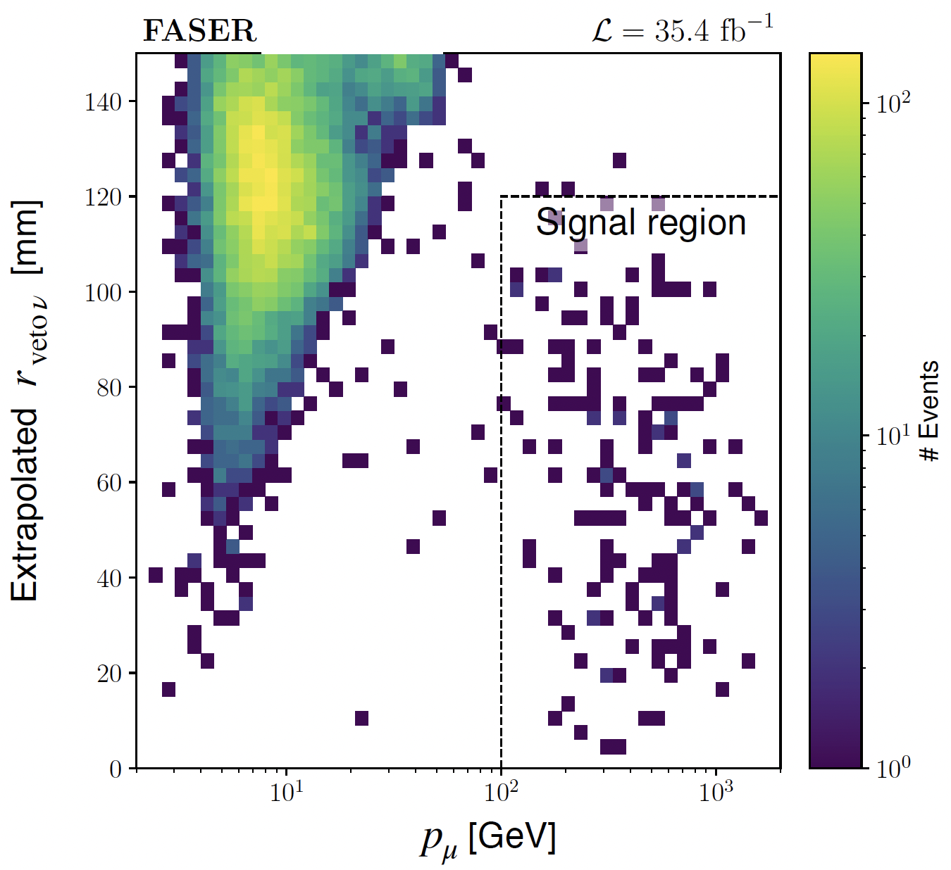
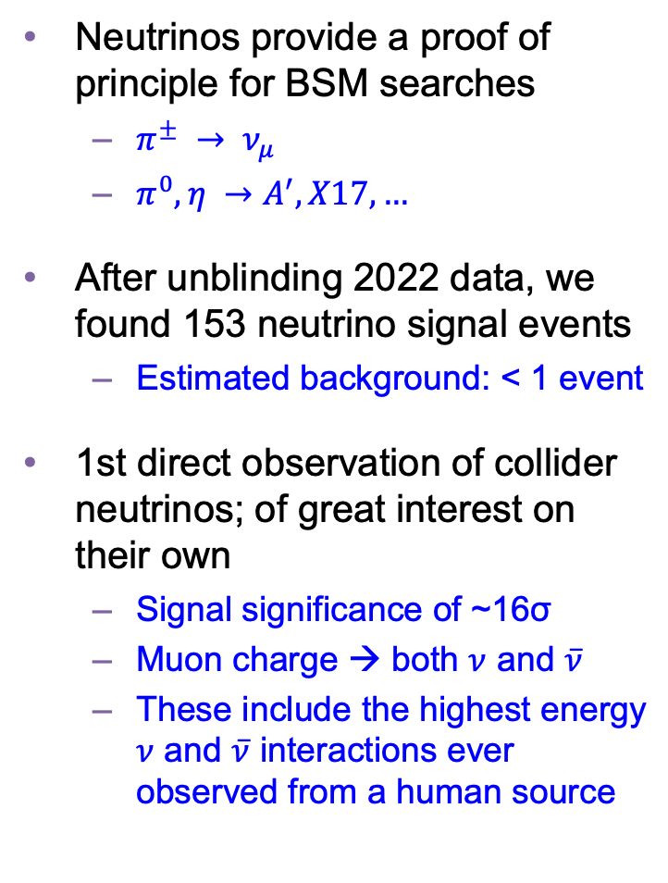
COLLIDER NEUTRINO RESULTS
Neutrinos provide a proof of principle for BSM searches
  $π^{±} → ν_{μ}$
  $π^{0}, η →A^{′}, X17, …$
After unblinding 2022 data, we found 153 neutrino signal events
  Estimated background: < 1 event
1st direct observation of collider neutrinos; of great interest on their own
  Signal significance of ~16σ
  Muon charge → both $ν$ and $\overline{ν}$
  These include the highest energy $ν$ and $\overline{ν}$ interactions ever observed from a human source
FASER Collaboration (2303.14185, Physical Review Letters)

Slide 11
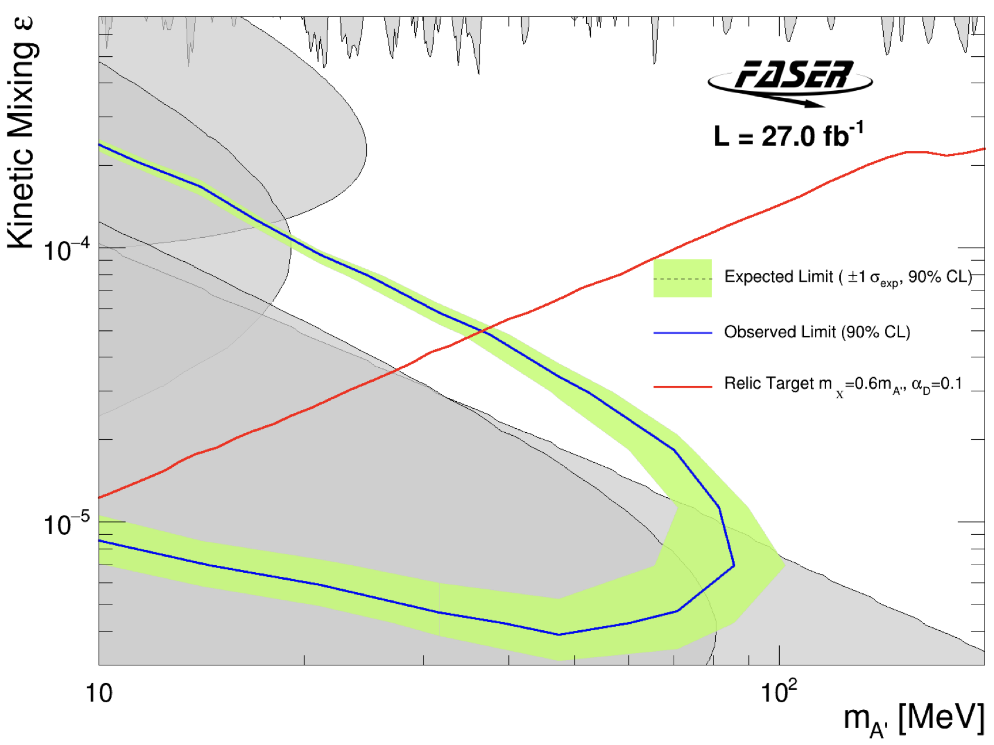
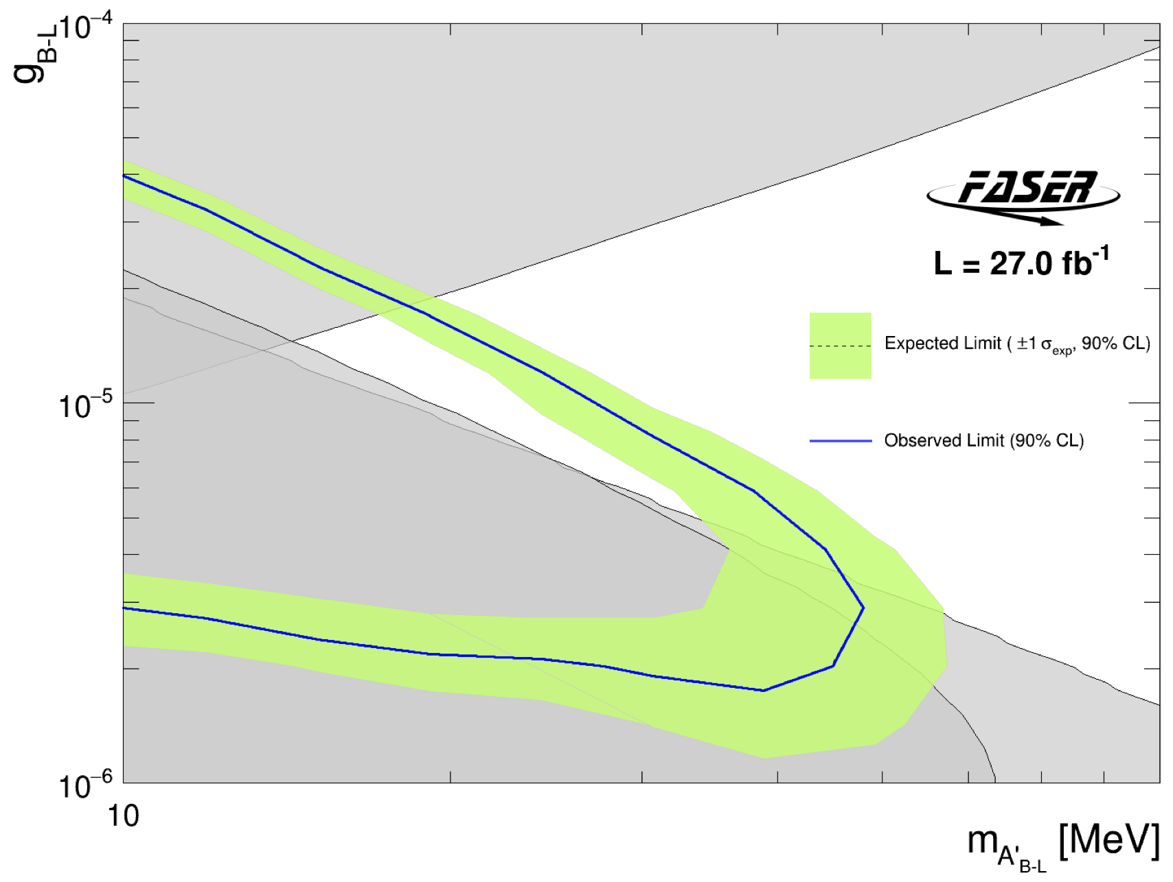
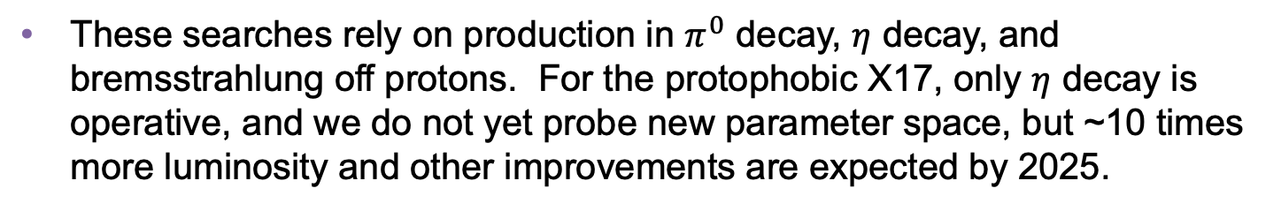
LIGHT GAUGE BOSON RESULTS
After unblinding 2022 data, no events seen, FASER excluded previously unexplored parameter space for both dark photons and B-L gauge bosons.
First new probe of light gageug bosons from low coupling since the 1990’s (roughly 30 times the sensitivity of previous experiments).
FASER Collaboration, 2308.05587
FASER Collaboration, 2308.05587
These searches rely on production in $π^{0}$ decay, $η$ decay, and bremsstrahlung off protons. For the protophobic X17, only $η$ decay is operative, and we do not yet probe new parameter space, but ~10 times more luminosity and other improvements are expected by 2025.

Slide 12
SUMMARY
The ATOMKI ⁸Be is the most interesting anomaly to appear in the last several years.
The original anomaly is now supported by additional observations in ⁴He, ¹²C, and at another facility.
Tests from other sources, other approaches are of paramount importance; see the many other talks at this conference.
Collider searches for new light gauge bosons are now underway at the LHC at the FASER experiment.
Based on 2022 data, new bounds on light dark photons and B-L gauge bosons have been announced recently by FASER.
For the protophobic X17, we do not yet probe new parameter space, but we expect ~10 times more luminosity and other improvements in LHC Run 3 by 2025.

