Slide 1

WELCOME AND INTRODUCTION
6th Forward Physics Facility Meeting, CERN
Jonathan Feng, UC Irvine, 8 June 2023

Slide 2
WELCOME
This is the 6th in a series of meetings held every ~6 months since 2020.
These meetings bring together the large, rapidly growing FPF community, including multiple CERN technical teams, ~300 experimentalists on pathfinder experiments, and ~200 theorists with important contributions.
FPF Meetings
  FPF Kickoff Meeting, 9-10 Nov 2020
  FPF2 Meeting, 27-28 May 2021
  FPF3 Meeting, 25-26 Oct 2021
  FPF4 Meeting, 31 Jan-1 Feb 2022
  FPF5 Meeting, 15-16 Nov 2022
  FPF6 Meeting, 8-9 June 2023
FPF Papers
  FPF “Short” Paper: 75 pages, 80 authors, Phys. Rept. 968, 1 (2022), 2109.10905.
  FPF White Paper: 429 pp, 392 authors + endorsers representing over 200 institutes, J. Phys. G 3, 030501 (2023), 2203.05090.

Slide 3
WELCOME
Many opportunities for new participants, new ideas. The meeting is organized to catalyze discussion and interaction; please ask questions, reach out.
See https://pbc.web.cern.ch/fpf-mandate for documents, Slack, meetings, etc.
Steering Committee: Jamie Boyd, Albert De Roeck, Milind Diwan, Jonathan Feng, Felix Kling
WG0 Facility: Jamie Boyd
WG1 Neutrino Interactions: Juan Rojo
WG2 Charm Production: Hallsie Reno, Anna Stasto
WG3 Light Hadron Prod: Luis Anchordoqui, Dennis Soldin
WG4 BSM: Brian Batell, Sebastian Trojanowski
WG5 FASER2: Alan Barr, Josh McFayden, Hide Otono
WG6 FASERnu2: Aki Ariga, Tomoko Ariga
WG7 FLArE: Jianming Bian, Milind Diwan
WG8 AdvSND: Giovanni De Lellis
WG9 FORMOSA: Matthew Citron, Chris Hill
Detector WGs
Physics WGs
WG Liaisons | WG5 FASER2 | WG6 FASERnu2 | WG7 FLArE | WG8 AdvSND | WG9 FORMOSA
WG1 | Josh McFayden | Aki Ariga, Tomoko Ariga | Steve Linden, Wenjie Wu | Antonia Di Crescenzo | Matthew Citron
WG2 | Josh McFayden | Aki Ariga, Tomoko Ariga | Steve Linden, Wenjie Wu | Antonia Di Crescenzo | Matthew Citron
WG3 | Josh McFayden | Aki Ariga, Tomoko Ariga | Steve Linden, Wenjie Wu | Antonia Di Crescenzo | Matthew Citron
WG4 | Josh McFayden | Aki Ariga, Tomoko Ariga | Steve Linden, Wenjie Wu | Cristovao Vilela | Matthew Citron

Slide 4
CONCLUSIONS CIRCA 2022
The FPF will greatly enhance the HL-LHC physics program.
  Neutrinos: Neutrino blind → Neutrino factory, insights into neutrinos, QCD, astroparticle physics.
  BSM: Modest extension of weak-scale searches → New sensitivity to MeV-GeV FIPs, LLPs, milli-charged particles, quirks, light dark matter, and many other groundbreaking discoveries.
Much of this physics program relies essentially on the LHC’s high center-of-mass energy, is inaccessible at fixed target experiments and unique to the FPF, and will disappear for decades (or forever) if not explored at the HL-LHC.
The FPF could not be better aligned with the highest priority EPPSU and Snowmass recommendations.
2020 EPPSU 1st Recommendation
The successful completion of the high-luminosity upgrade of the machine and detectors should remain the focal point of European particle physics, together with continued innovation in experimental techniques. The full physics potential of the LHC and the HL-LHC, including the study of flavour physics and the quark-gluon plasma, should be exploited.
2022 Snowmass Energy Frontier Summary
Our highest immediate priority accelerator and project is the HL-LHC, the successful completion of the detector upgrades, operations of the detectors at the HL-LHC, data taking and analysis, including the construction of auxiliary experiments that extend the reach of HL-LHC in kinematic regions uncovered by the detector upgrades.
Resource needs and plan for the 5-year period starting 2025:
1. Prioritize HL-LHC physics program, including auxiliary experiments.

Slide 5
NEW DEVELOPMENTS
Since FPF5 in November 2022, there has been great progress on all fronts
  First physics results from FASER and SND@LHC
  The facility
  Physics studies
  Experiments
  Budgets and timelines

Slide 6
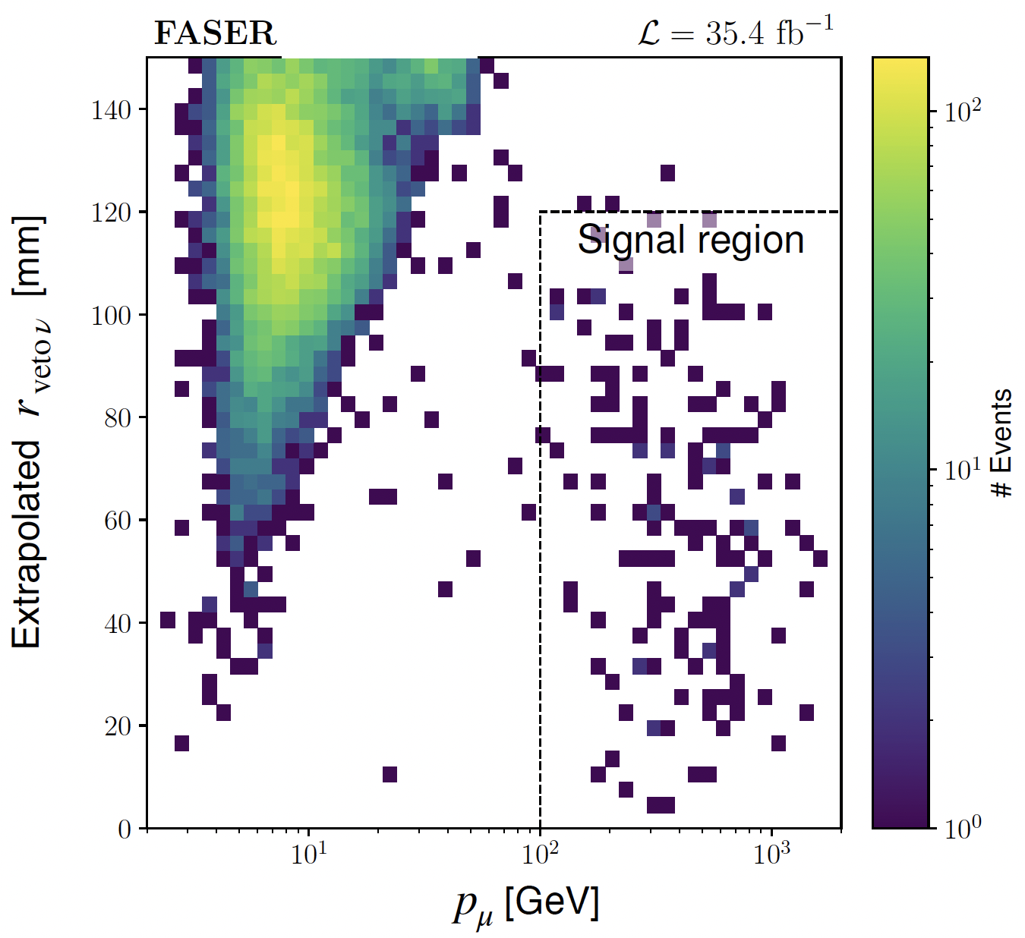
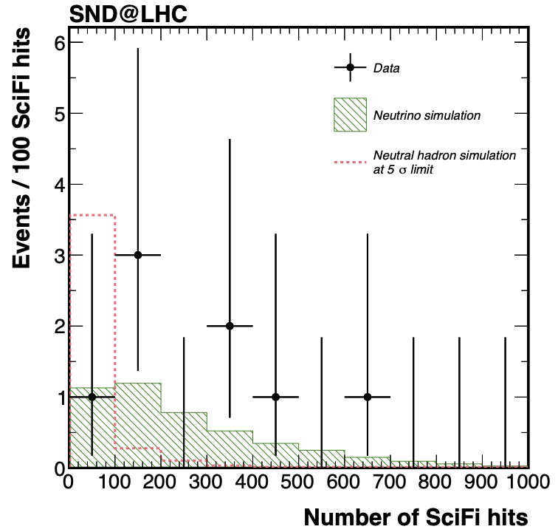
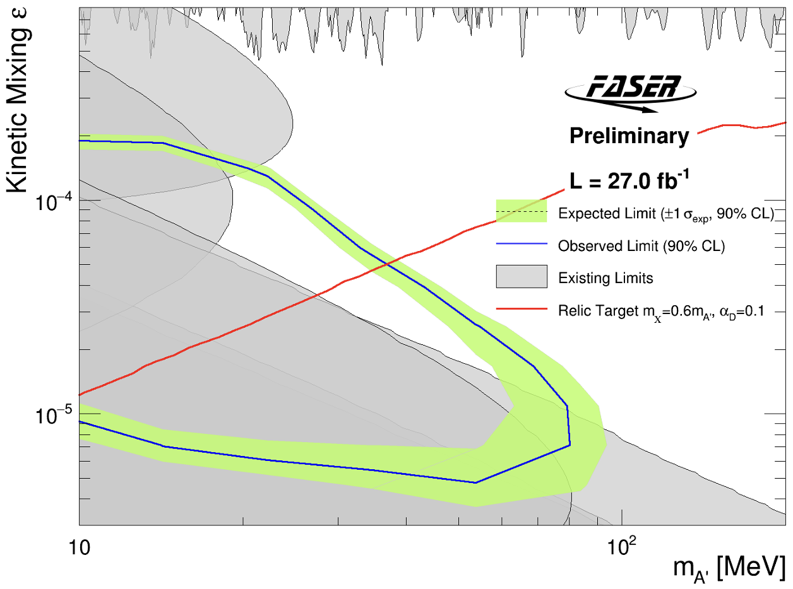
SINCE FPF5: FIRST PHYSICS RESULTS
Pathfinder experiments (FASER, SND@LHC) have demonstrated the ability of small far-forward experiments to do groundbreaking physics.
With 2022 data (only ~30 fb⁻¹):
  First direct observation of collider neutrinos at the highest energies ever from a human source: 153 events (FASER) + 8 events (SND@LHC), ~0 background.
  World-leading bounds on dark photons, first new probe of dark photon thermal target parameter space from low coupling in 30 years.
2303.14185, PRL
2305.09383
CERN-FASER-CONF-2023-001

Slide 7
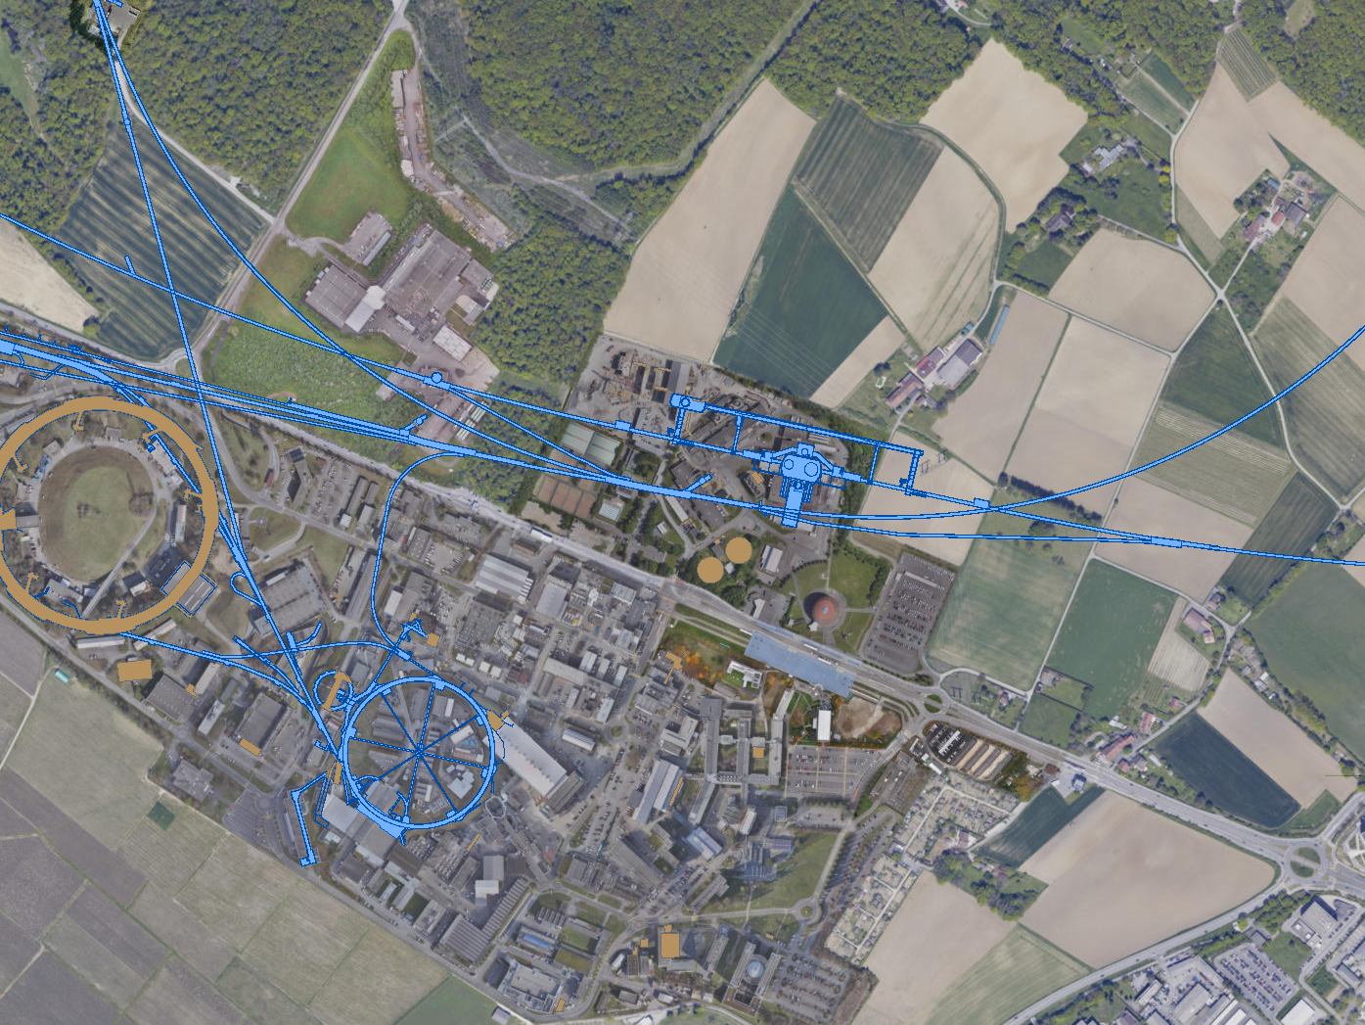
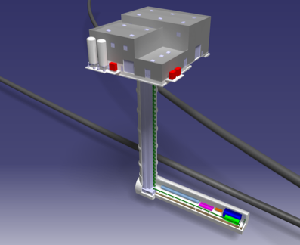
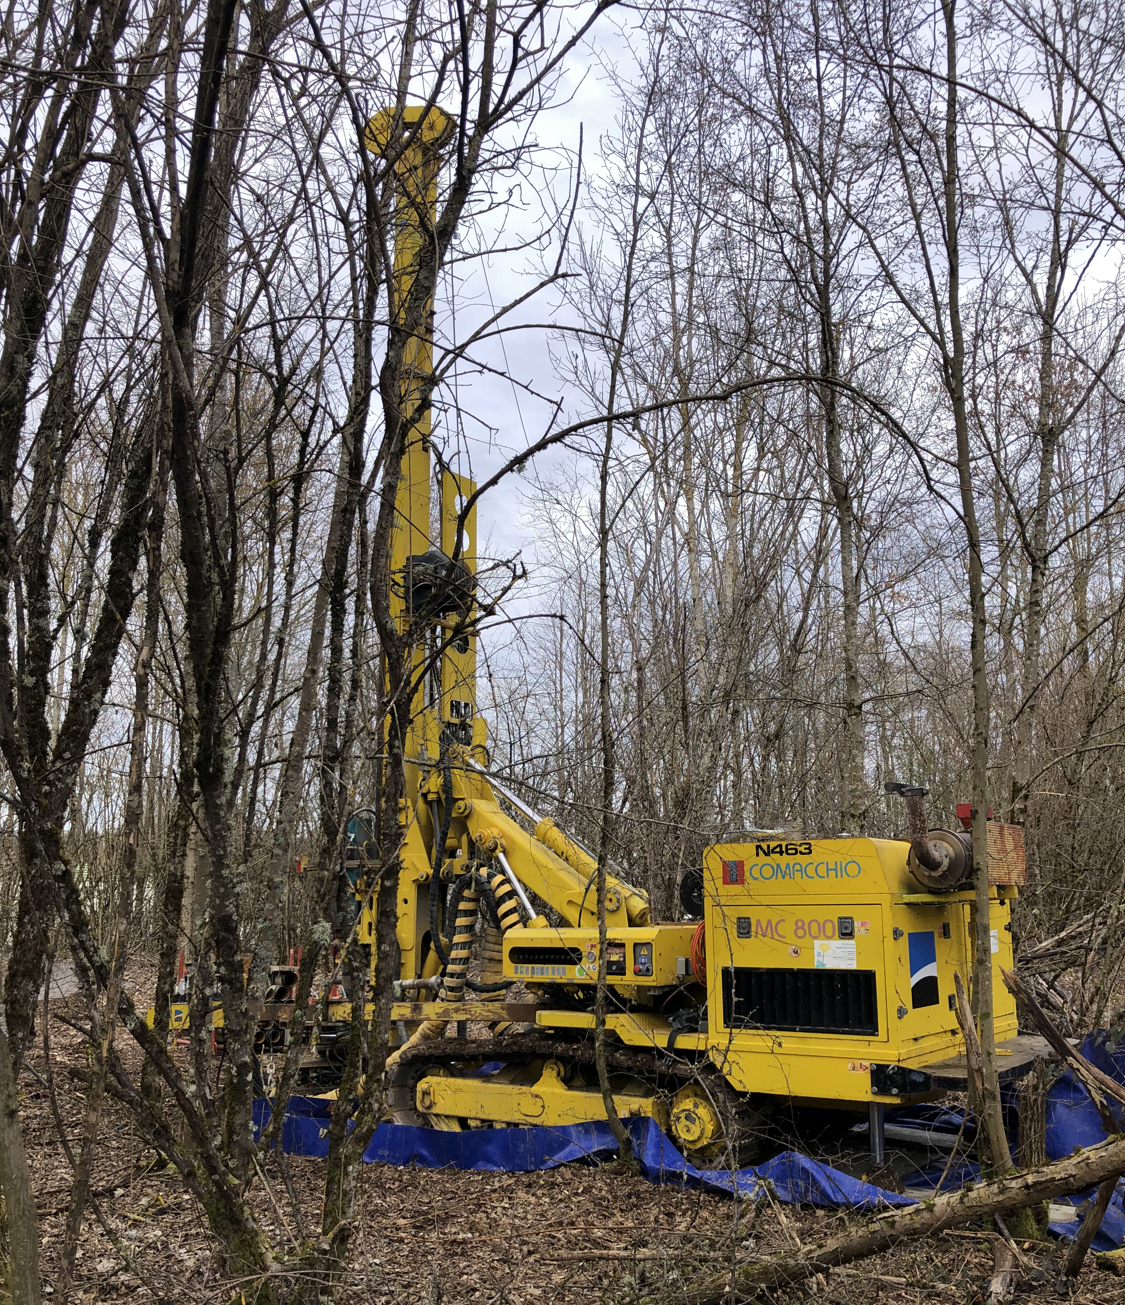
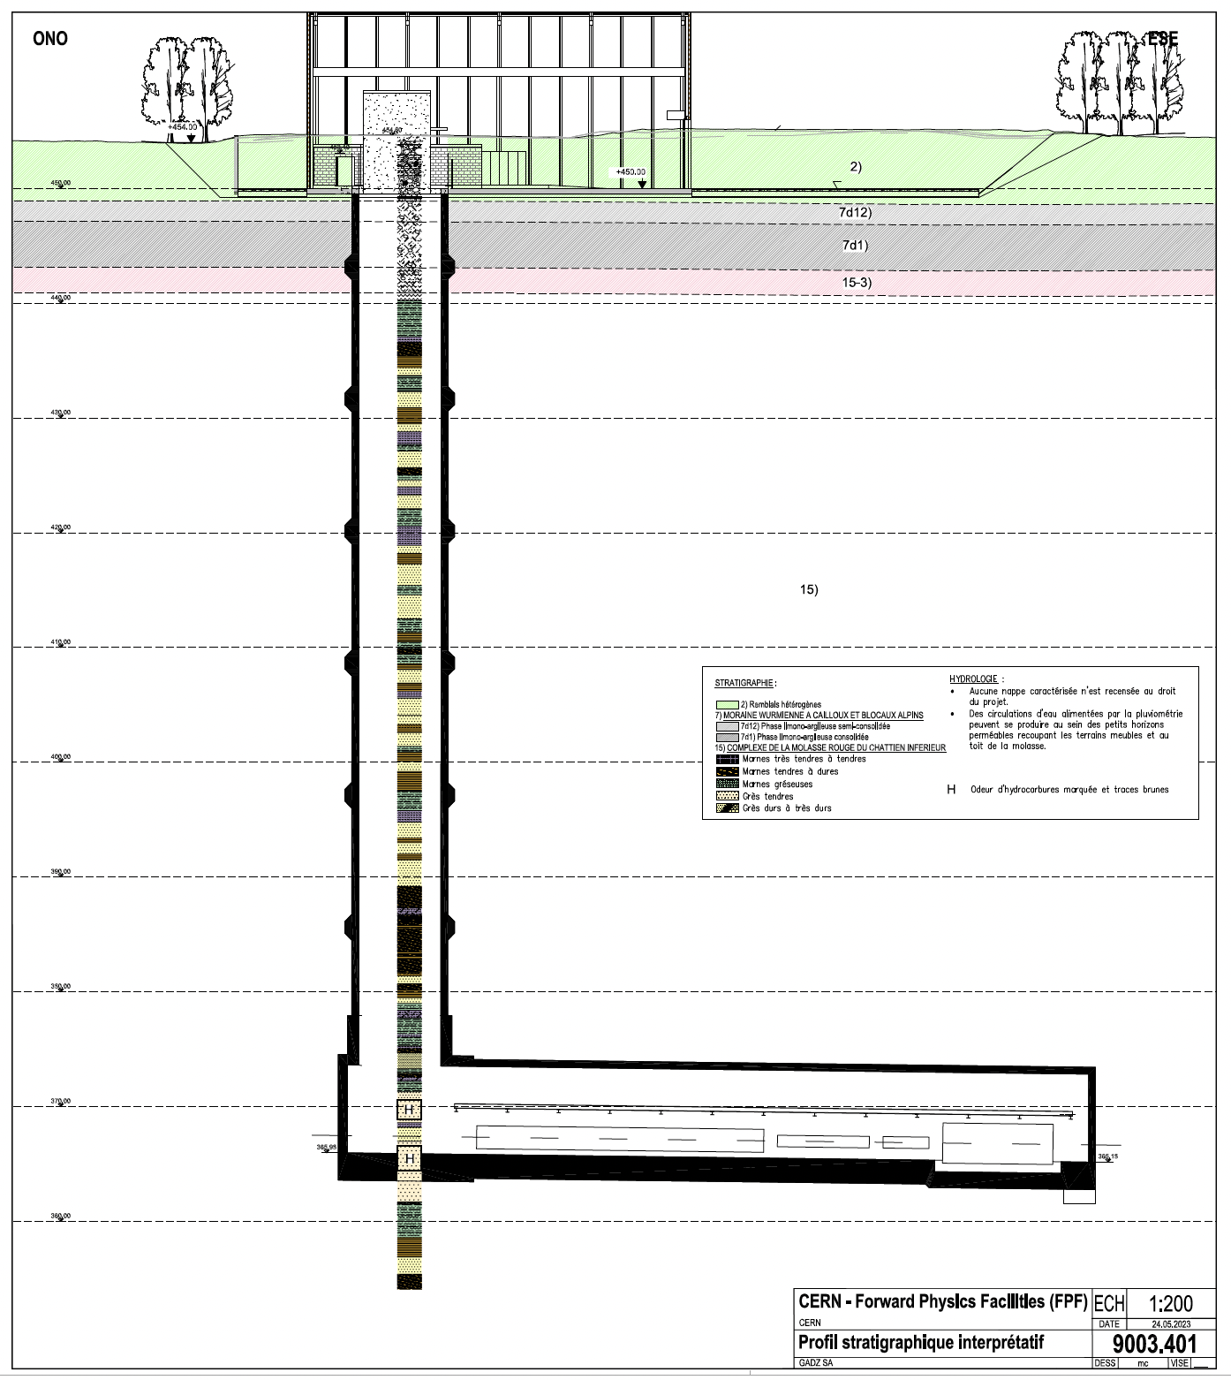
SINCE FPF5: THE FACILITY
Continued strong support from Physics Beyond Colliders at CERN
  New results on civil engineering, ventilation, background particle rate, radiation protection studies, vibration studies
  100 m-deep core sample taken to study geology at the site
CERN-PBC-Notes-2023- 002
ATLAS
SPS
LHC
LOS
https://cds.cern.ch/record/2851822
CERN GIS

Slide 8
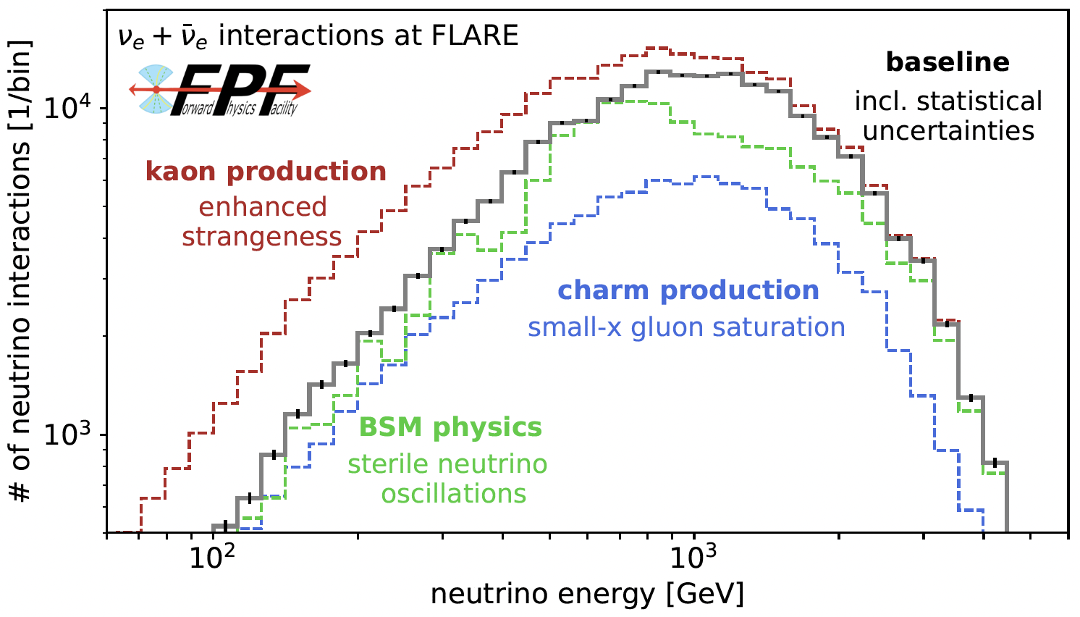
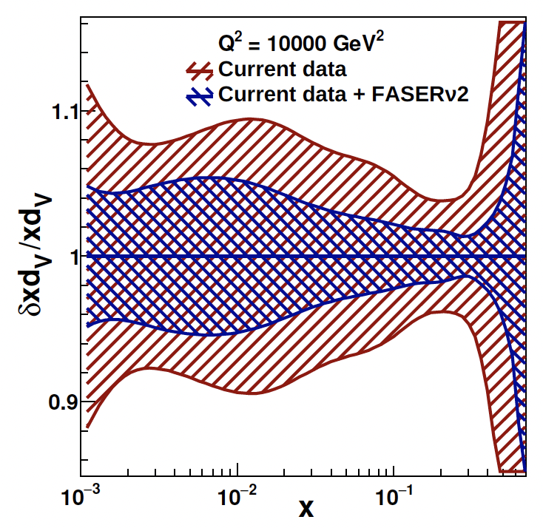
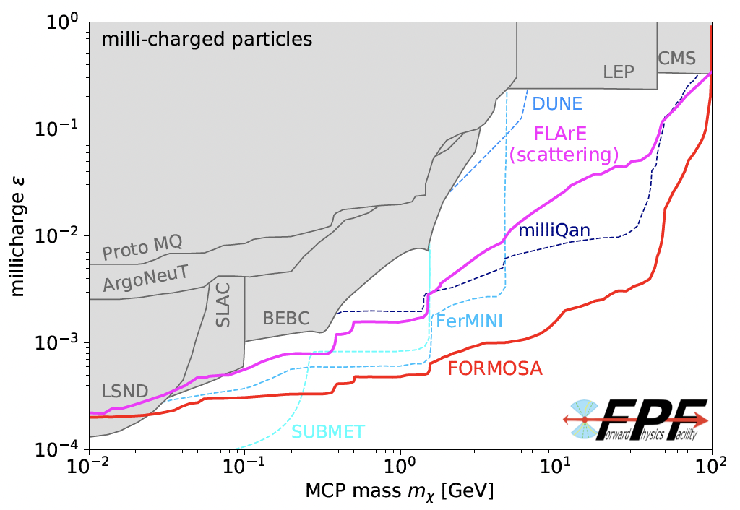
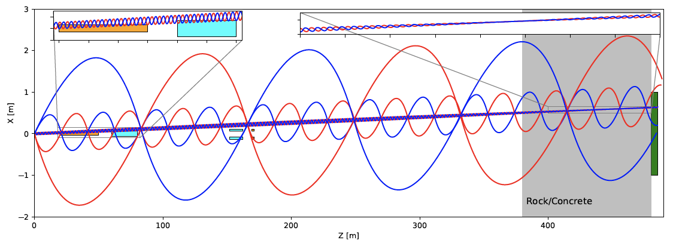
SINCE FPF5: PHYSICS STUDIES
New quantitative results from SM studies, guaranteed interesting physics
New BSM studies, including models where the FPF is uniquely sensitive

Slide 9
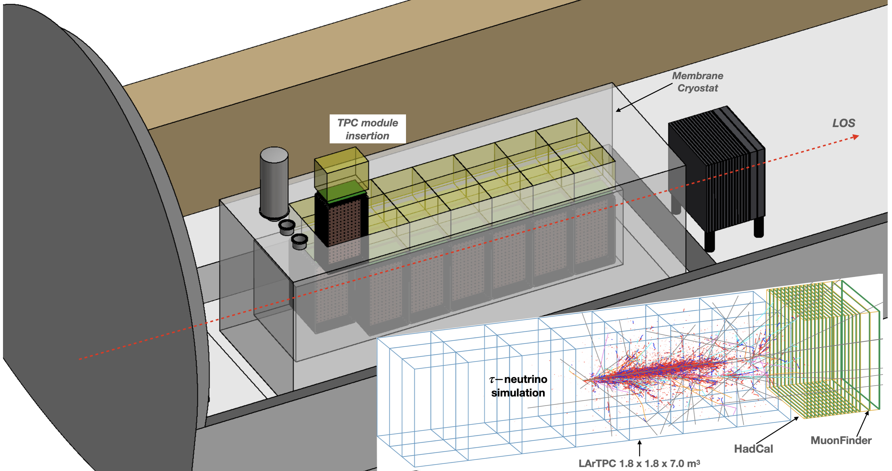
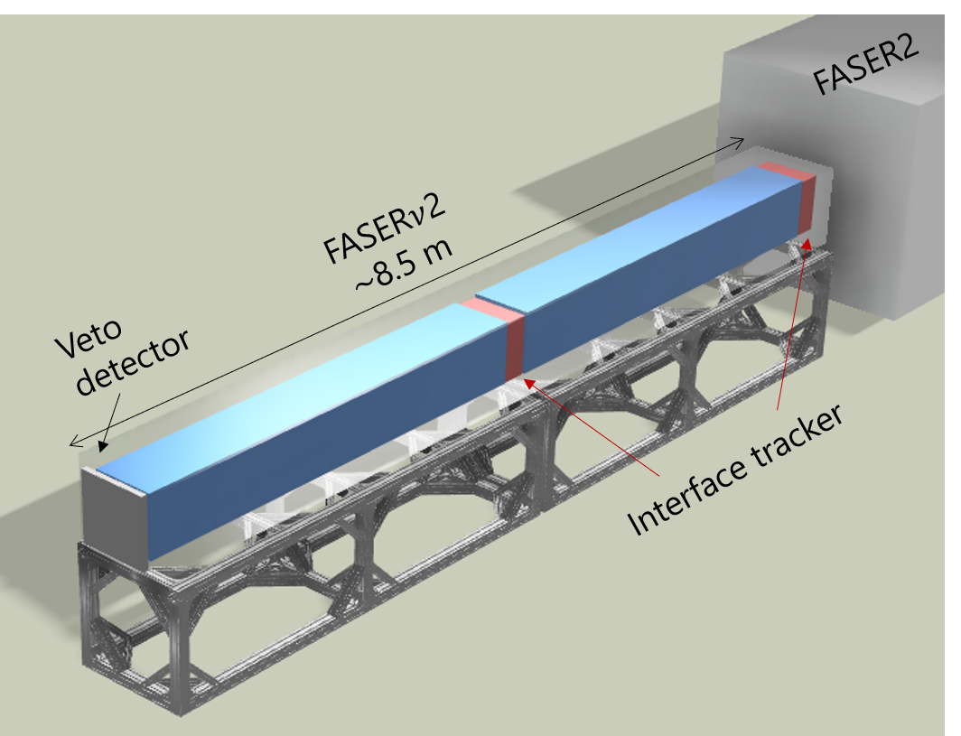
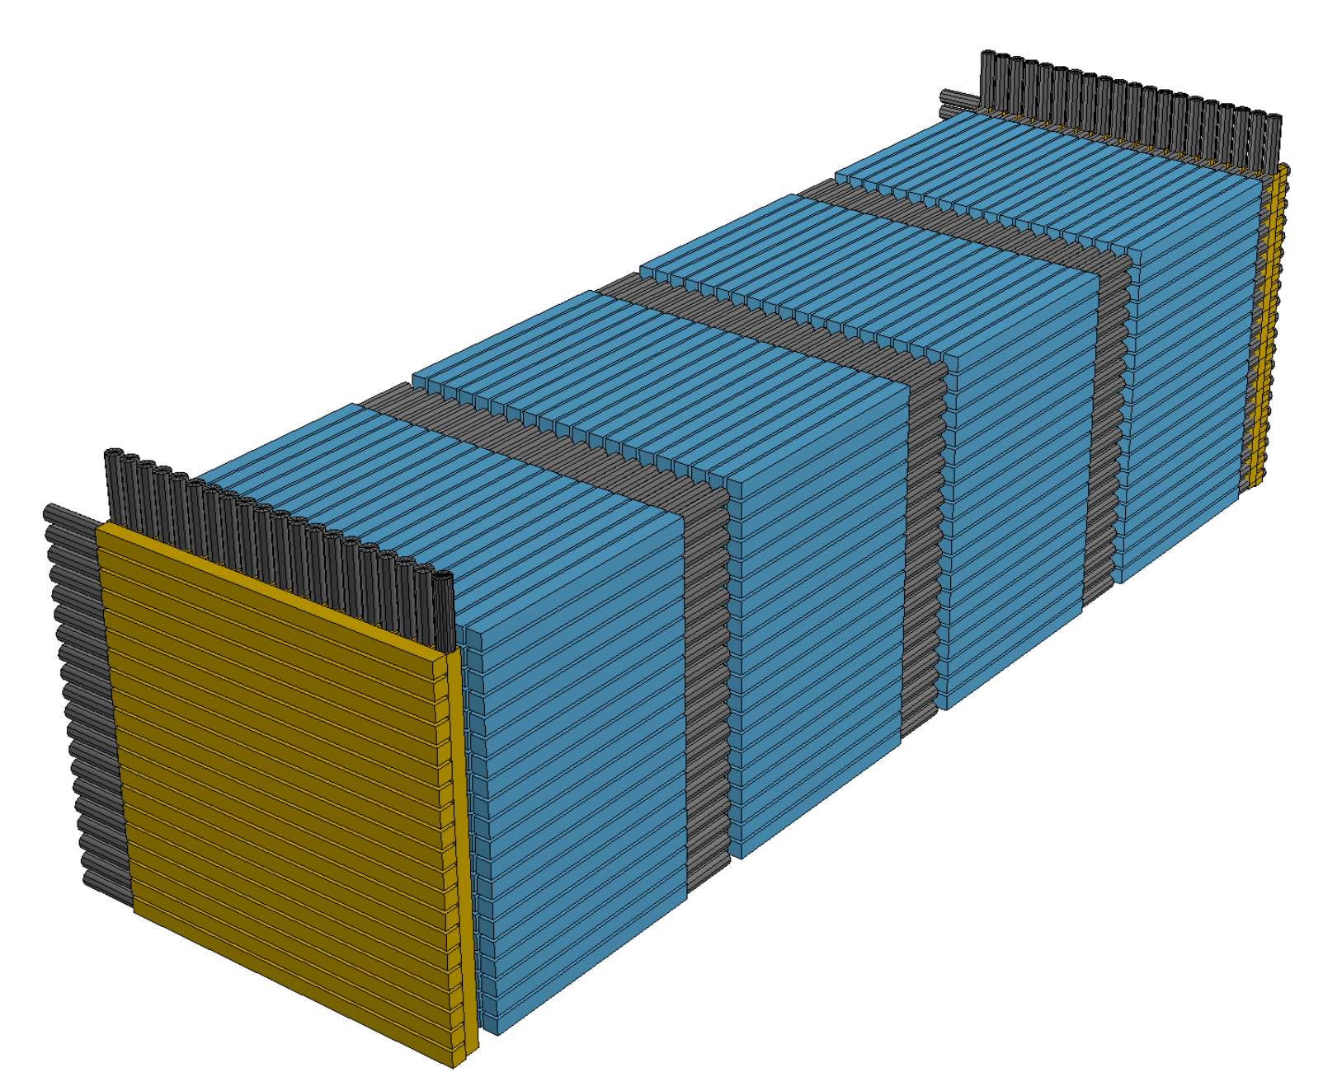
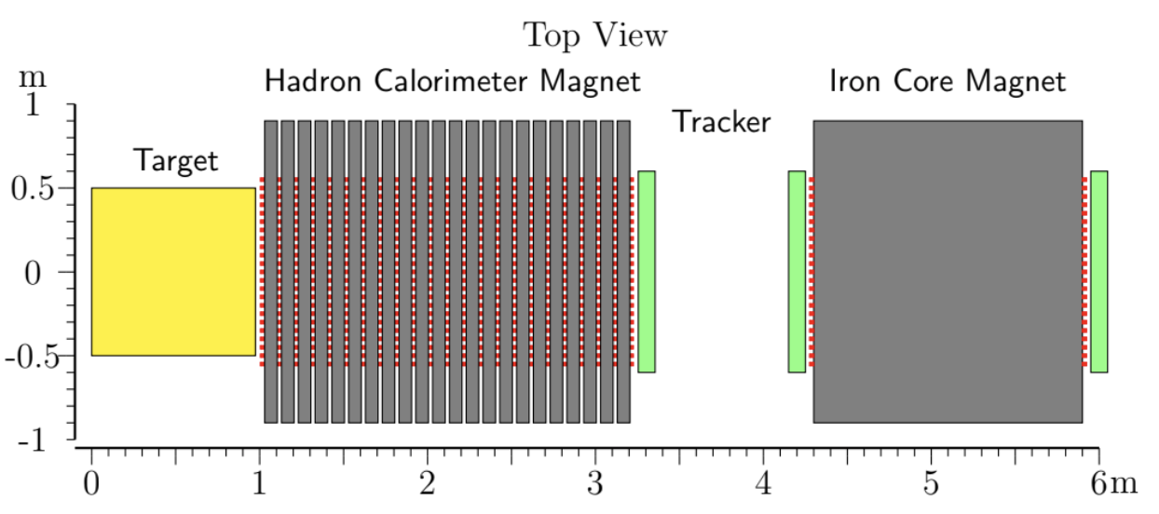
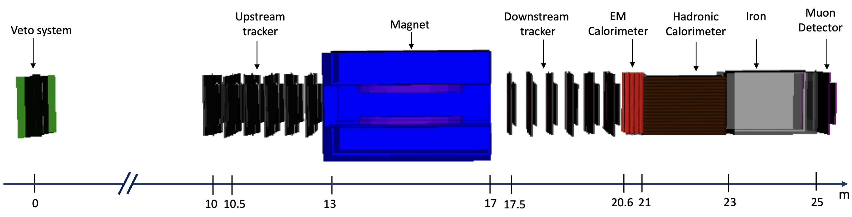
SINCE FPF5: EXPERIMENTS
Continued progress in defining the design of 5 proposed FPF experiments, diverse detectors for a broad physics program

Slide 10
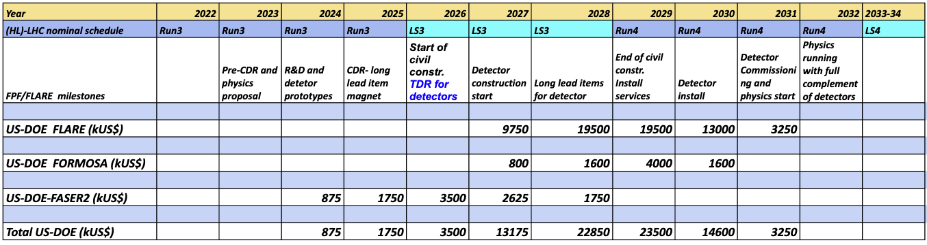
SINCE FPF5: BUDGETS AND TIMELINES
To fully realize the LHC’s potential, the FPF and its experiments should be ready for physics in the HL-LHC era as early as possible in Run 4 (2029-32).
Preliminary budget profile and timeline have been developed and presented to P5:
  Build FPF during Long Shutdown 3 from 2026-28.
  Install support services and experiments starting in 2029.
  Experiments begin taking data not long after the beginning of Run 4.

Slide 11
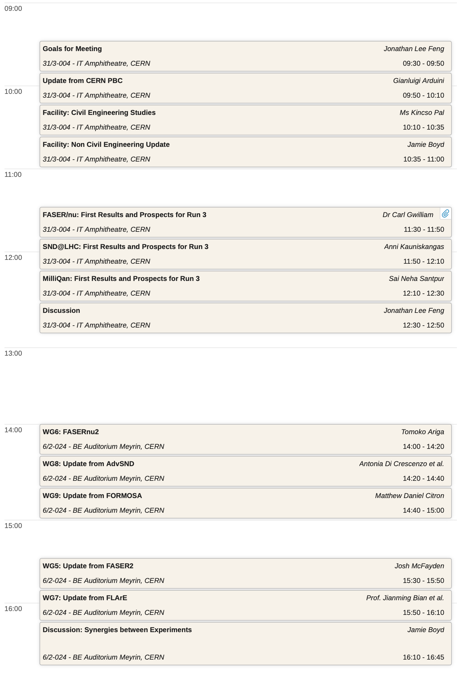
FPF6 THURSDAY
All sessions are hybrid
  Same Zoom link; not recorded, use microphones so online people can hear questions
  Different rooms
Morning IT Amph: 31/3-004
  Update from CERN PBC
  News from WG0: Facilities, Core Study
  First physics results from FASER, SND@LHC, MilliQan
  Discussion
Afternoon BE Aud: 6/2-024
  Updates from Expt WGs 5-9
  Discussion: synergies between experiments

Slide 12
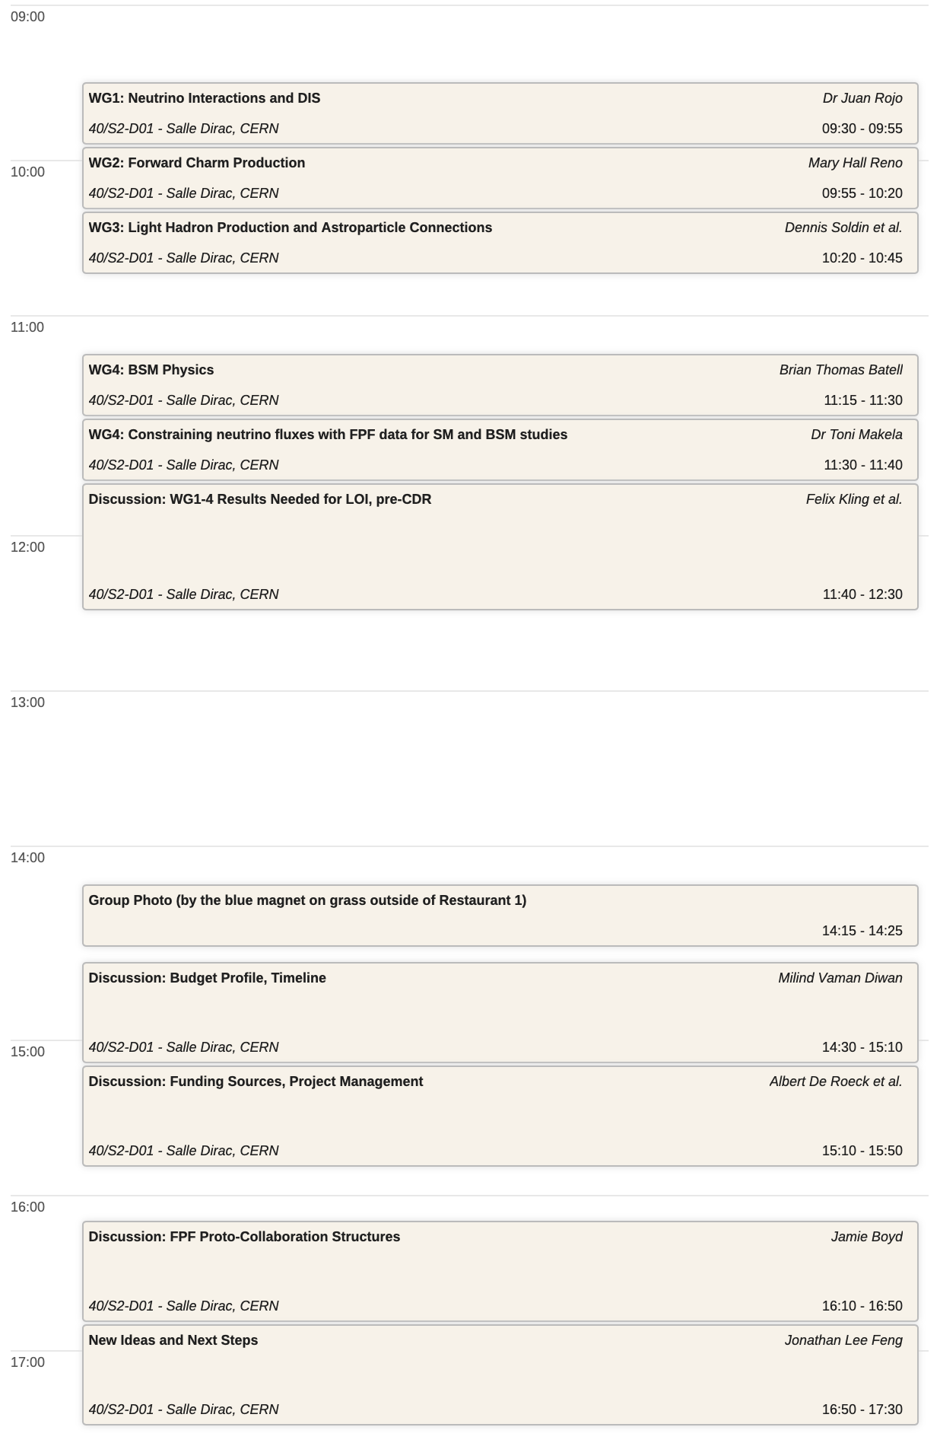
FPF6 FRIDAY
Morning Salle Dirac: 40/S2-D01
  Reports from Physics WGs 1-4
  Discussion: Planned studies for pre-CDR, publications, theory day
Afternoon Salle Dirac: 40/S2-D01
  14:15: Group photo by the blue magnet outside Restaurant 1
  Discussions
    Budget profile, timeline
    Funding sources, project management
    Proto-collaboration structure
    New ideas, next steps

