Slide 1

Jonathan Feng, UC Irvine
on behalf of the FPF Working Groups
P5 Town Hall Meeting on the Future of High Energy Physics
Brookhaven National Laboratory, 12 April 2023
Captions

Slide 2

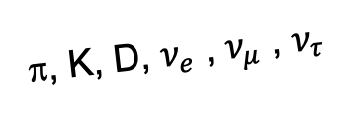
THE NEED FOR FORWARD-LOOKING PHYSICS
Collisions at the LHC produce an enormous number of particles along the beam collision axis line of sight (LOS), which escape existing LHC detectors.
We now know that, without new detectors, the LHC is blind to a beautiful program of SM and BSM physics in the far-forward direction.
The Forward Physics Facility is a proposal to build a new underground cavern to host a suite of far-forward experiments to capture this physics and greatly enhance the LHC’s potential for groundbreaking discoveries in the HL-LHC era.
A’, a, mCPs, χ, …
π, K, D, $ν_{e}$ , $ν_{μ}$ , $ν_{τ}$
Our highest immediate priority accelerator and project is the HL-LHC, …including the construction of auxiliary experiments that extend the reach of HL-LHC in kinematic regions uncovered by the detector upgrades. – 2022 Snowmass Energy Frontier Report
The full physics potential of the LHC and the HL-LHC...should be exploited. — 1st recommendation of the 2020 European Strategy Update

Slide 3
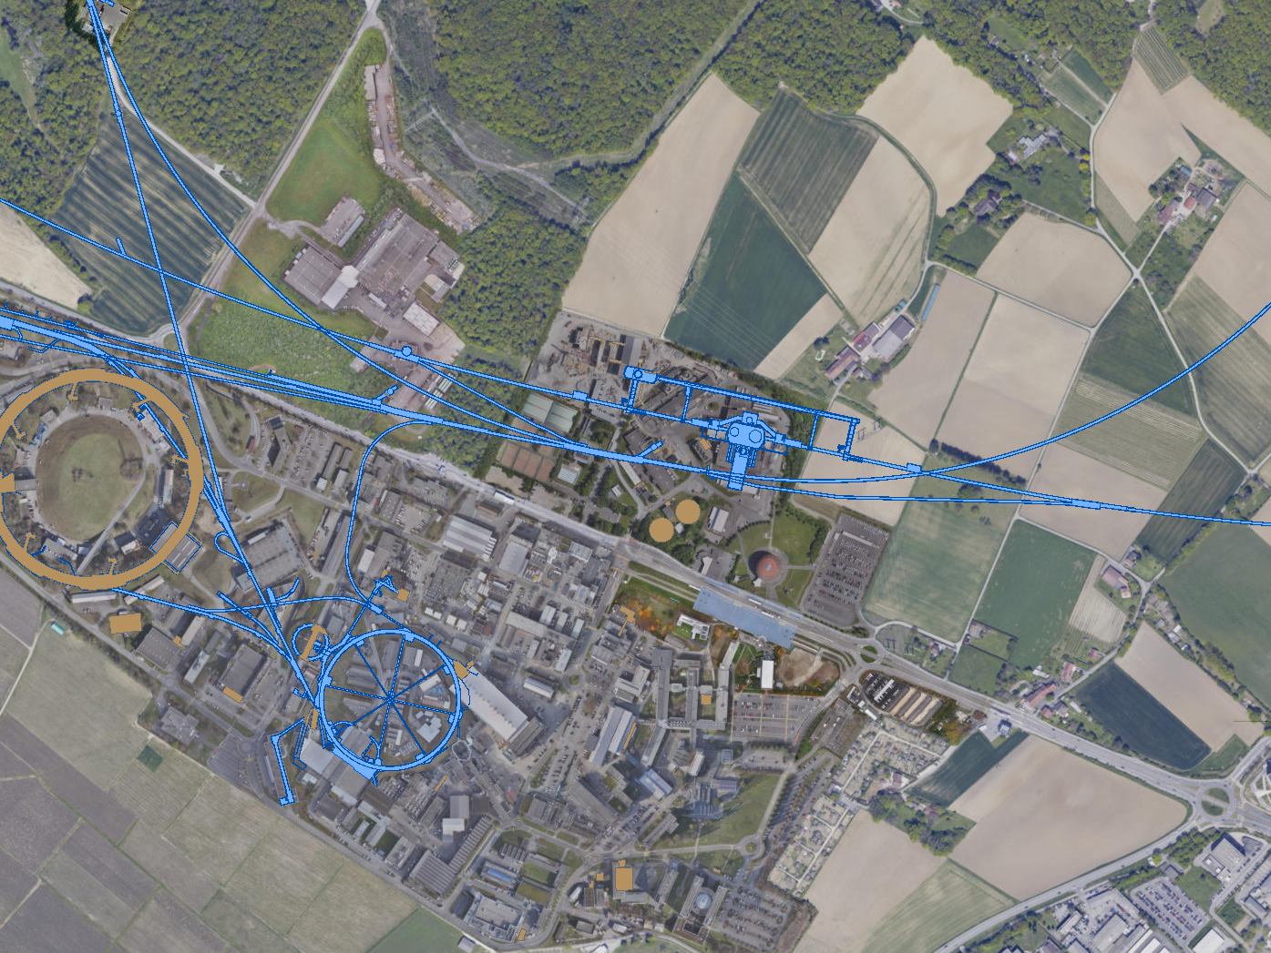
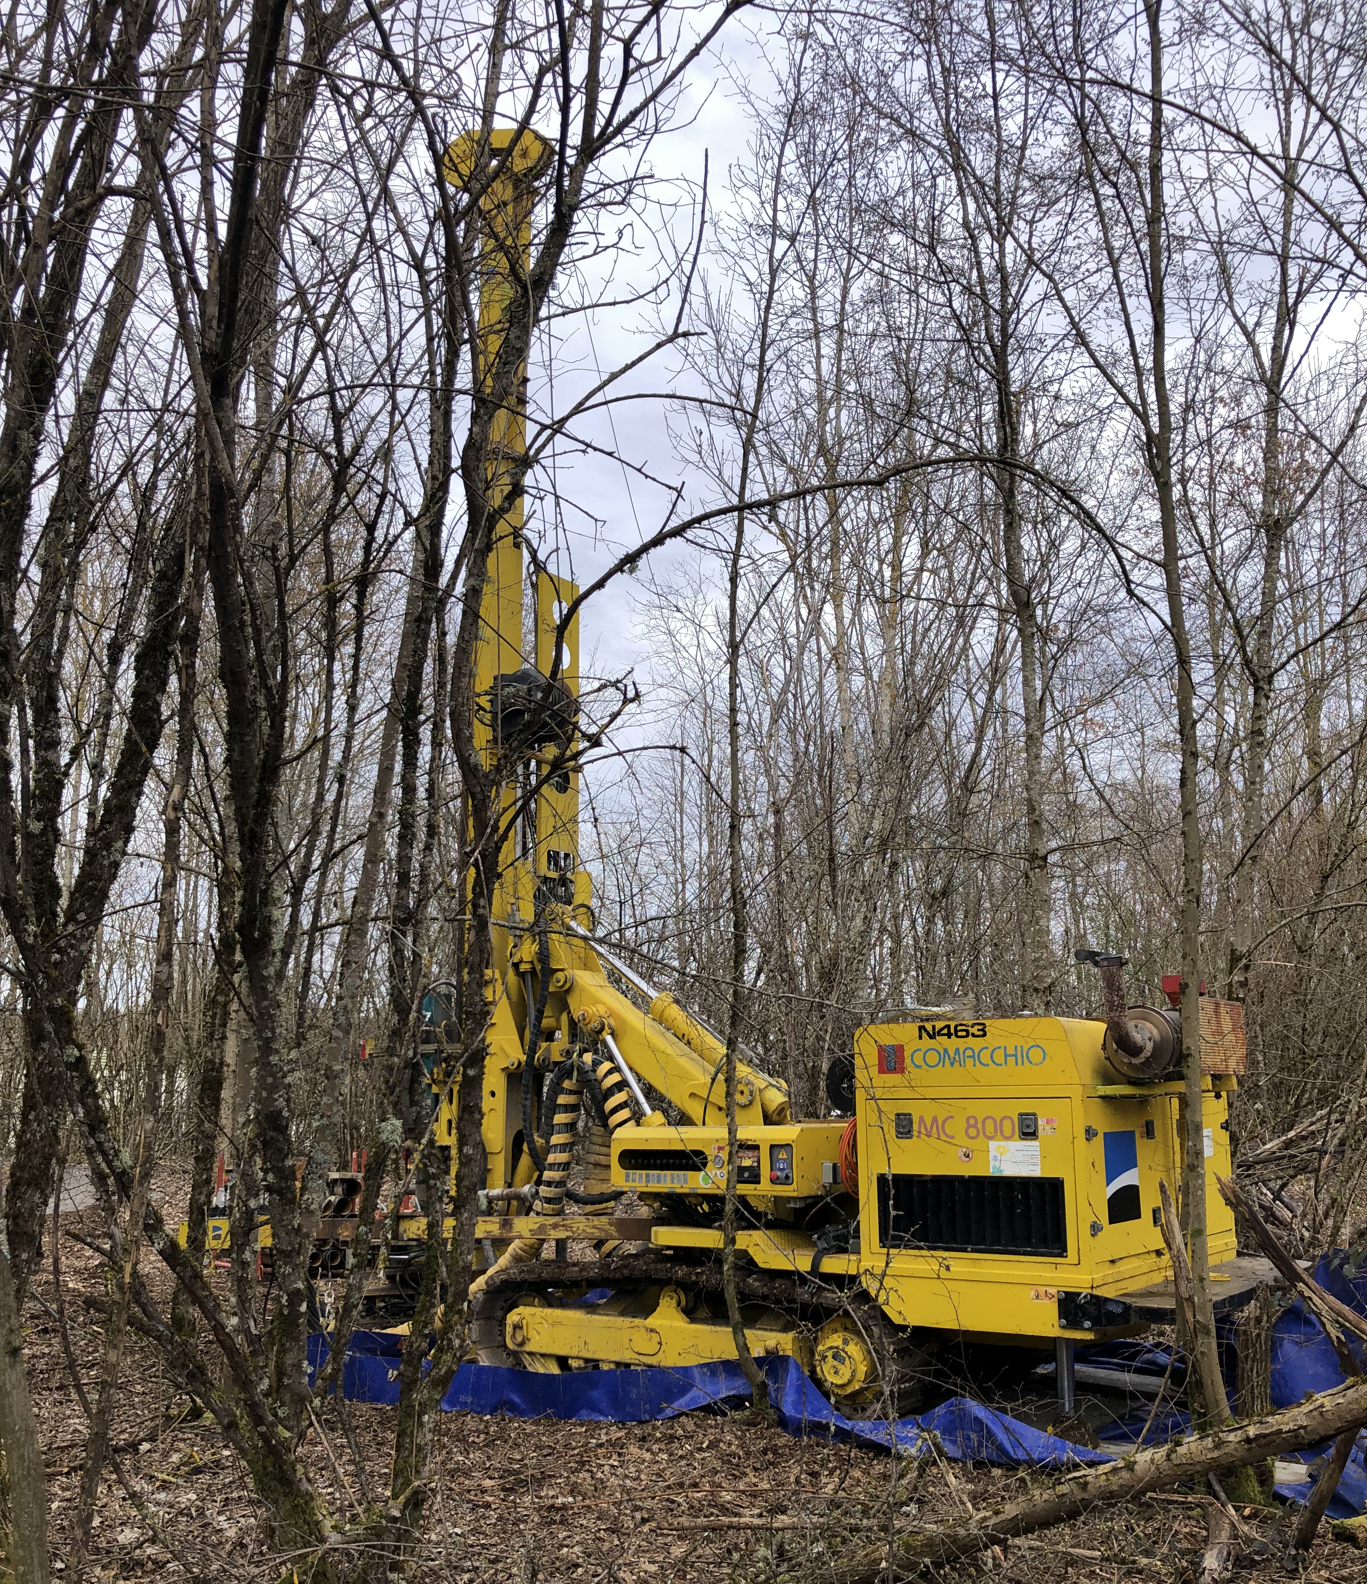
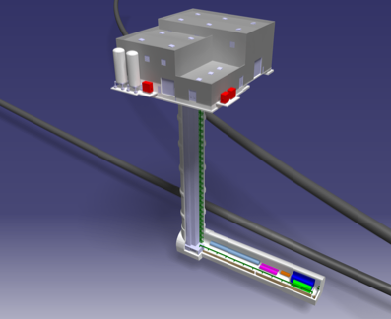
FORWARD PHYSICS FACILITY
A comprehensive site selection study by the CERN Civil Engineering group has identified an ideal location ~600 m west of ATLAS.
FPF core sample to study site geology, just completed
ATLAS
SPS
LHC
LOS
The site is on CERN land in France
The cavern is 65 m-long, 9 m-wide/high
Shielded from ATLAS by 200m of rock
Disconnected from LHC tunnel
Vibration, safety studies: can construct FPF without disrupting LHC operations
Radiation studies: can work in FPF while LHC is running (HL-LHC starts 2029)
https://cds.cern.ch/record/2851822
CERN GIS

Slide 4
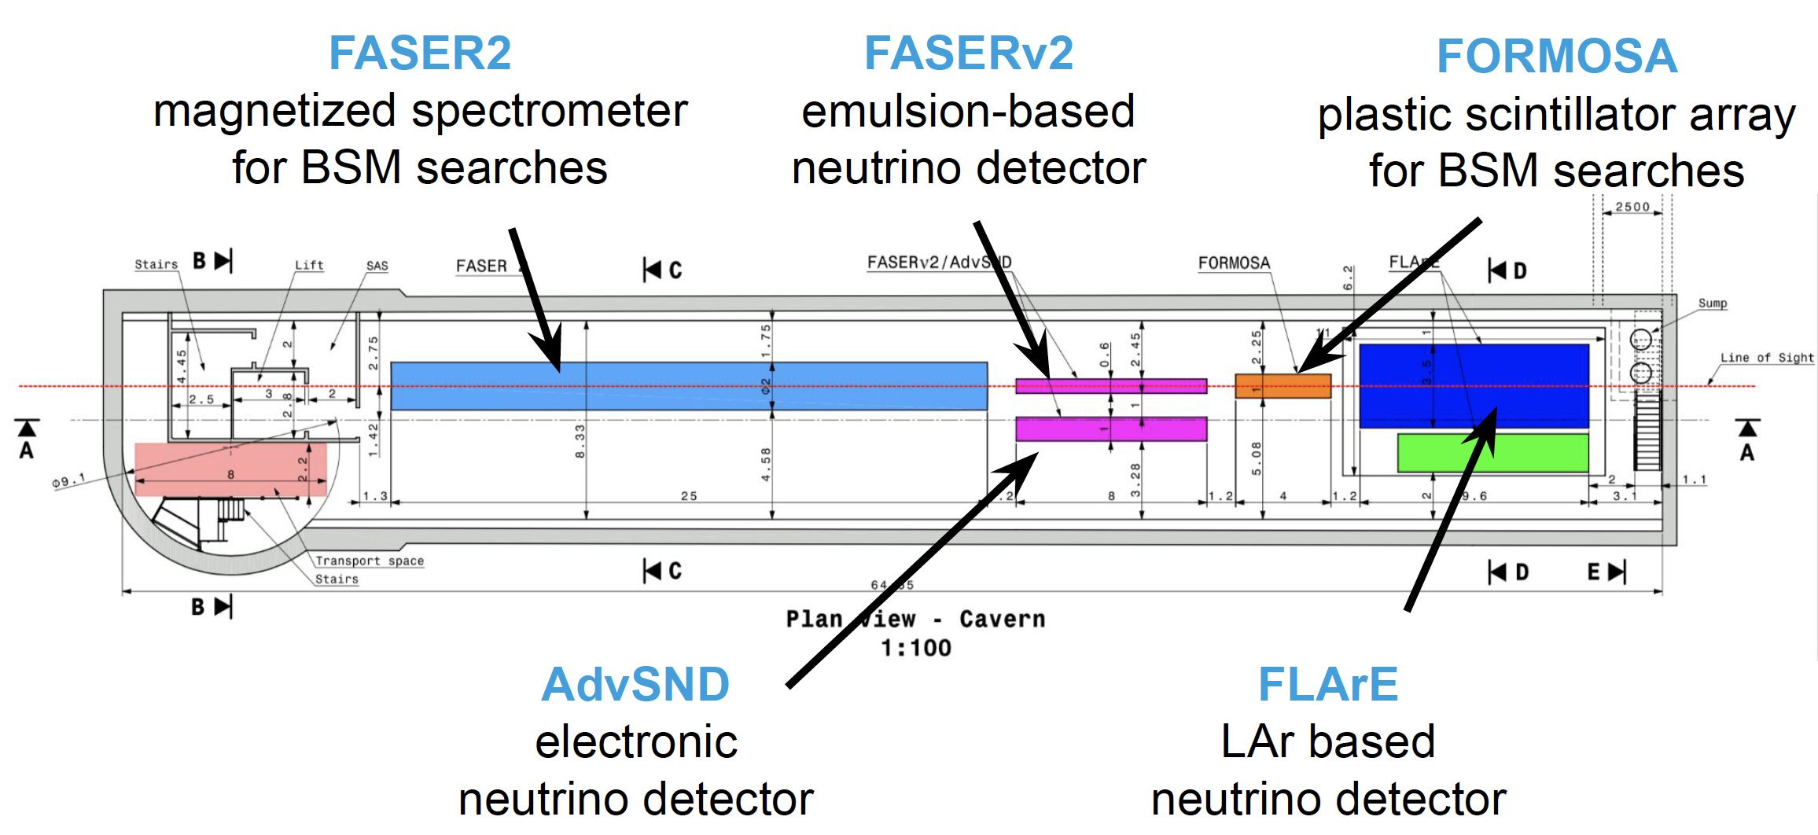
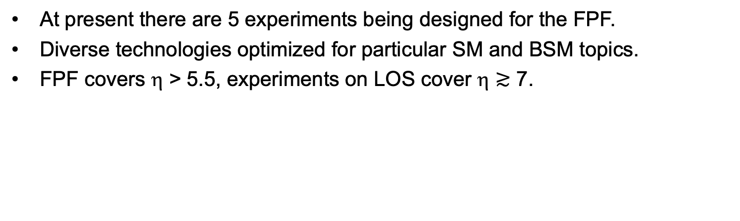
FPF EXPERIMENTS
At present there are 5 experiments being designed for the FPF.
Diverse technologies optimized for particular SM and BSM topics.
FPF covers η > 5.5, experiments on LOS cover η $≳$ 7.

Slide 5
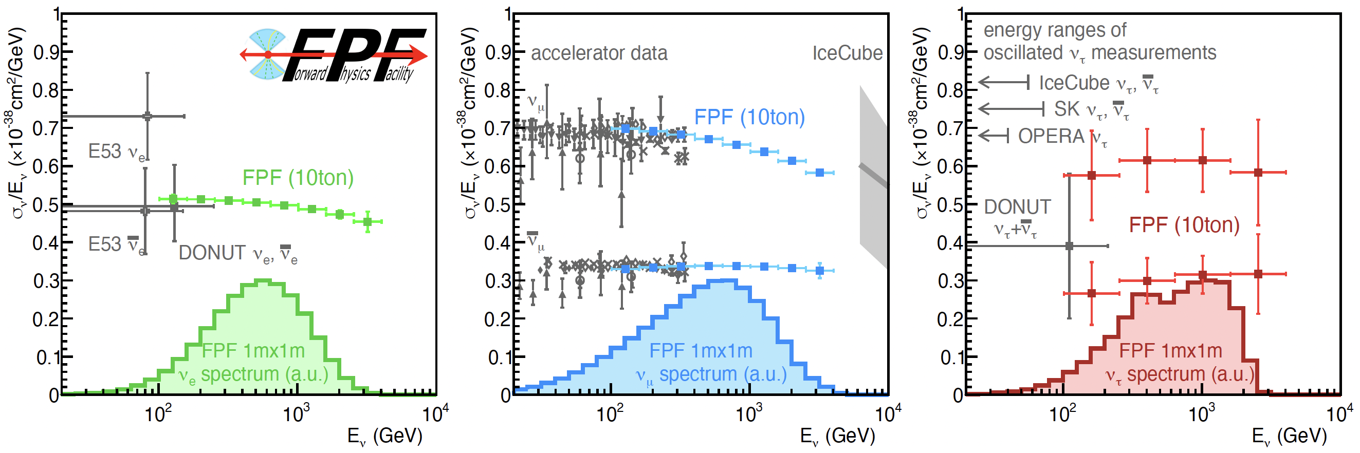
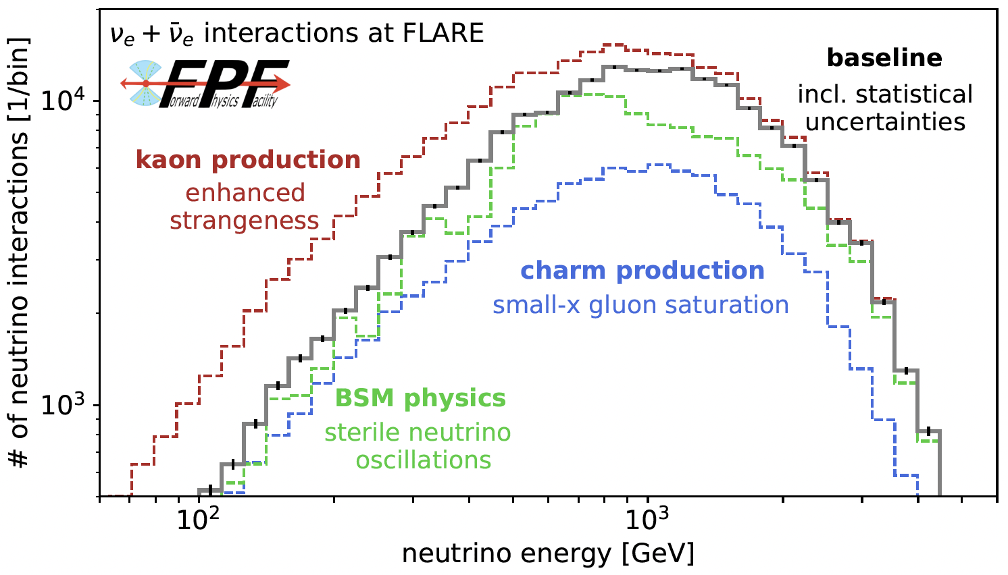
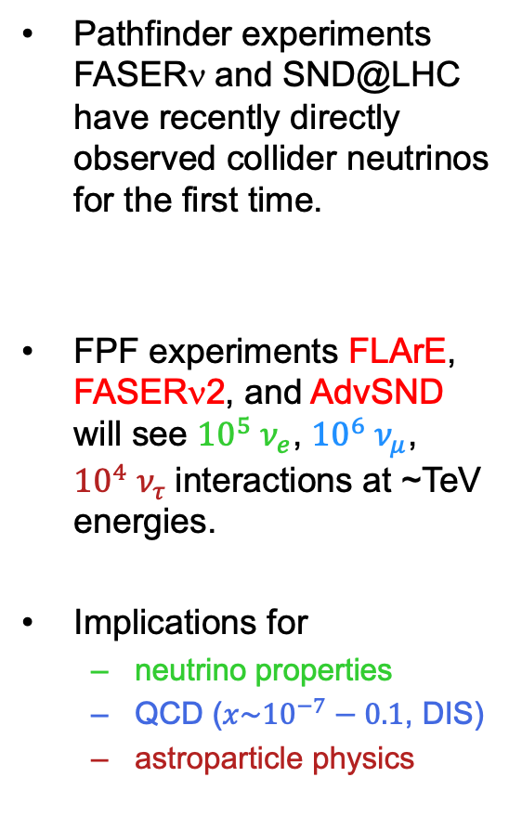
THE FPF NEUTRINO PROGRAM
Pathfinder experiments FASERν and SND@LHC have recently directly observed collider neutrinos for the first time.
FPF experiments FLArE, FASERν2, and AdvSND will see ${10}^{5} ν_{e}$, ${10}^{6} ν_{μ}$, ${10}^{4} ν_{τ}$interactions at ~TeV energies.
Implications for
  neutrino properties
  QCD ($x\sim {10}^{−7}−0.1$, DIS)
  astroparticle physics
Moriond 2023 2303.14185

Slide 6
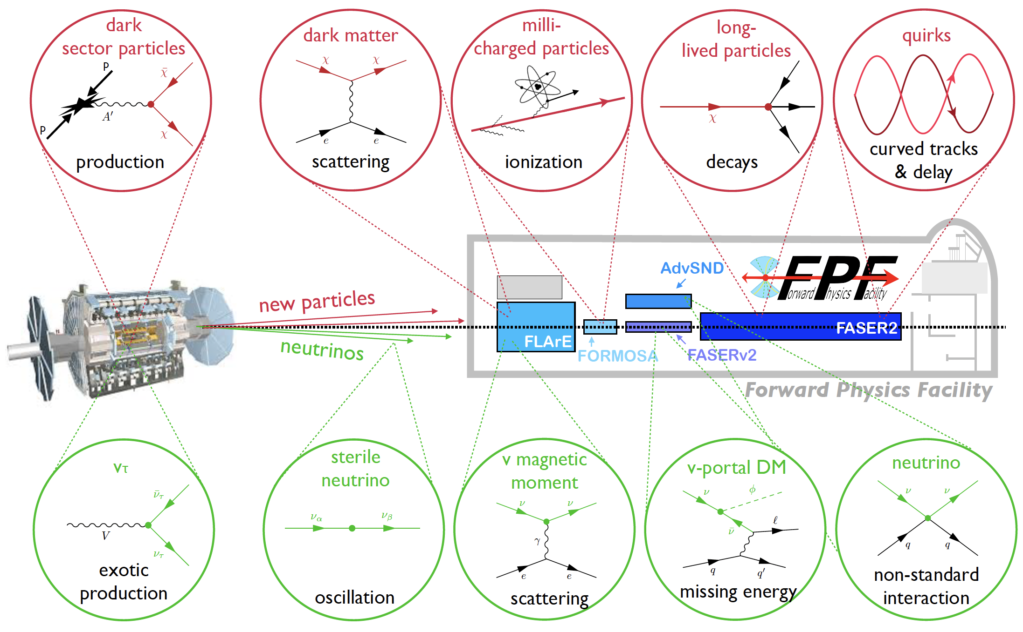
THE FPF BSM PROGRAM
Wide variety of BSM probes: new physics in neutrino production, propagation, and interaction, FIPs, LLPs, DM scattering, inelastic DM, and dark sectors.
The FPF detectors each have unique capabilities to probe BSM topics. E.g.:
  Pathfinder experiment FASER has recently set new limits on dark photons, extended sensitivity in the thermal target region from low coupling for the first time in 3 decades.
  FPF experiment FASER2 increases sensitivity by ~60,000 for many particles.
  Pathfinder experiment milliQan has already set stringent bounds on mCPs for m ~ GeV.
  FPF experiment FORMOSA will extend to leading sensitivity for m ~ 100 MeV–100 GeV.

Slide 7
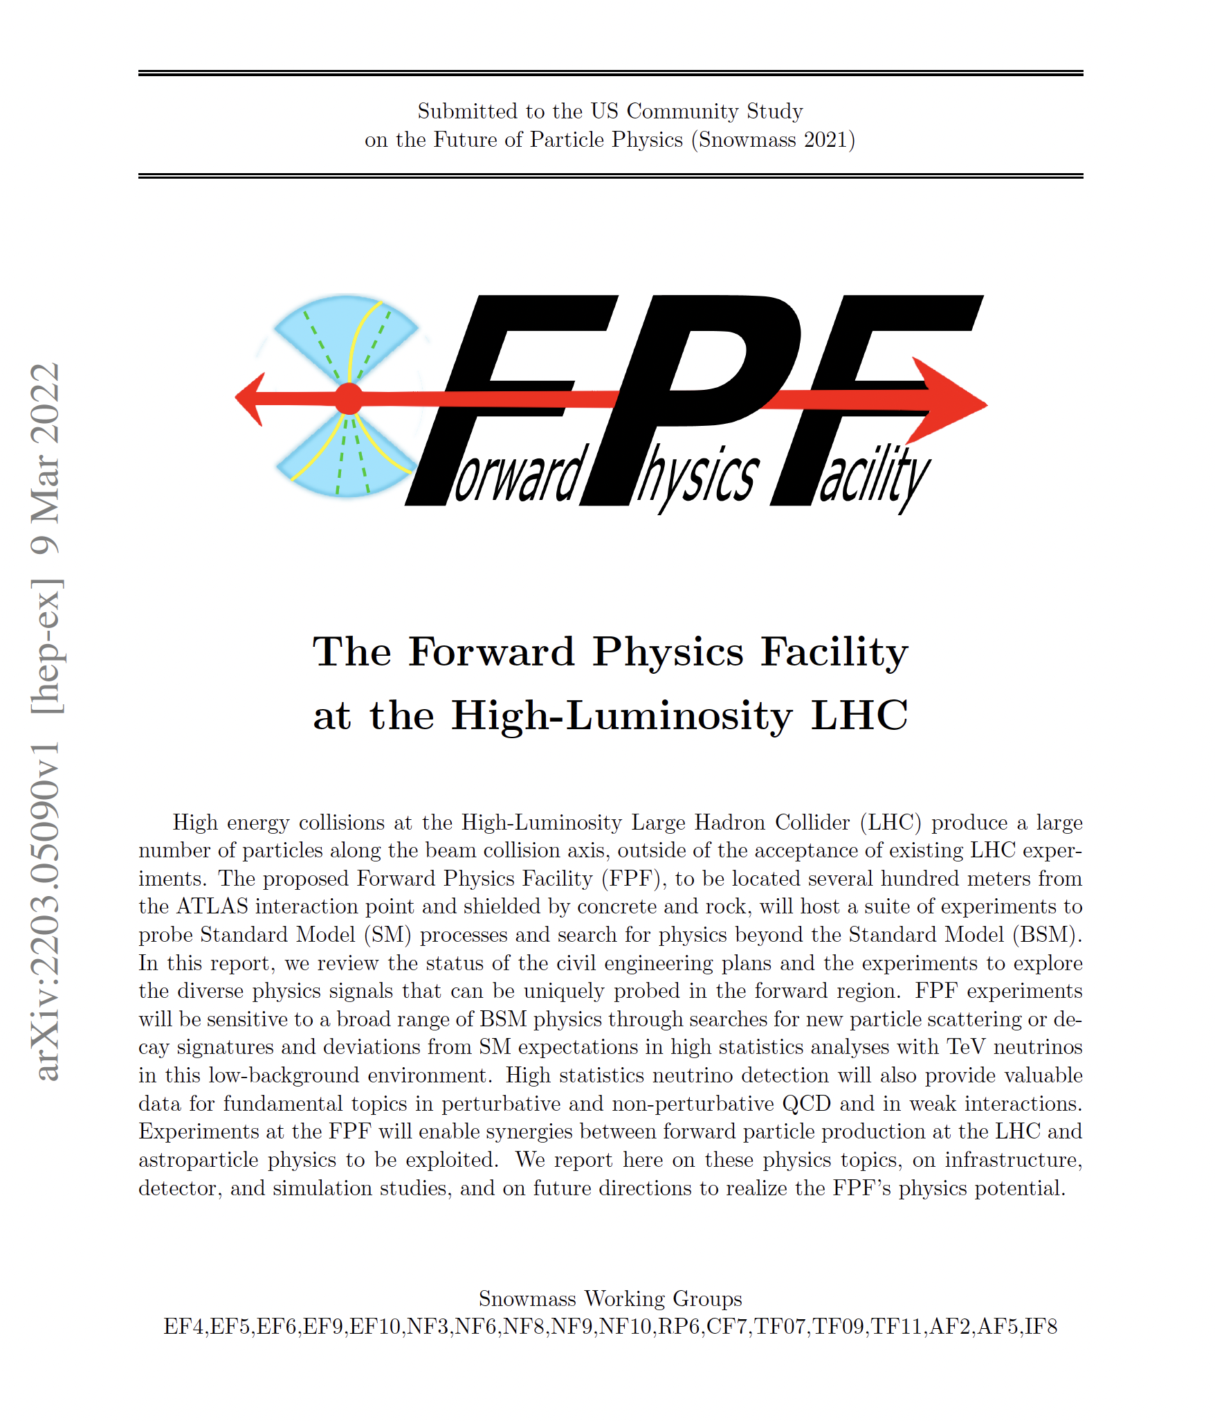
FPF USER COMMUNITY
The FPF user community is large, vibrant, and growing.
  Strong base provided by the collaborations of the current pathfinder detectors (FASER, FASERν, SND@LHC, milliQan) and the FLArE working group, ~300 people, over 60 institutions.
  FPF White Paper: 429 pages, 392 authors+endorsers, over 200 institutions, J. Phys. G, 2203.05090.
  5 dedicated FPF meetings since 2020; exciting exchange of ideas across frontiers; rapid progress; new ideas, new experiments welcome.
  Fully international.

Slide 8
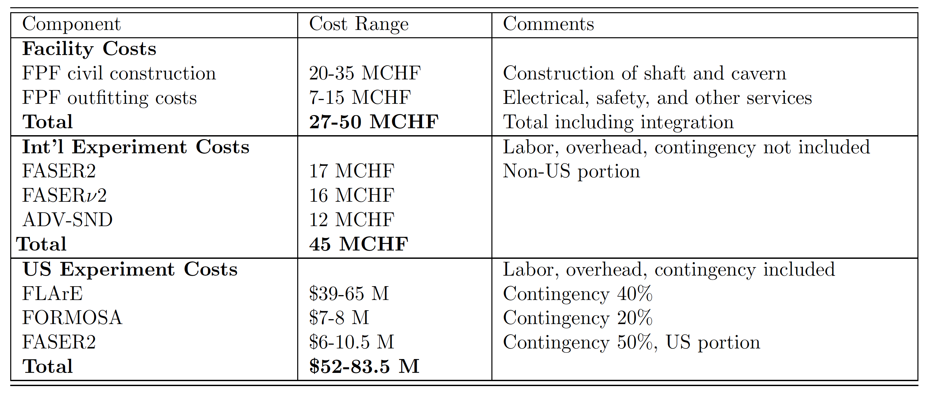
COST
Very preliminary budget and schedule assembled by CERN groups and experiment proponents. For details, see the FPF Summary document submitted to P5.
  Facility Costs: civil construction and outfitting costs (electrical service, safety, ventilation, transportation, and lift service) provided by CERN civil engineering and technical infrastructure groups, respectively. Class 4 estimate based on HL-LHC experience.
  International Experiment Costs: FASERν2, AdvSND, and a share of FASER2.
  US Experiment Costs: FLArE, FORMOSA, and a share of FASER2. US-style accounting, includes labor, overhead, contingency. Range depends on technical decisions.

Slide 9
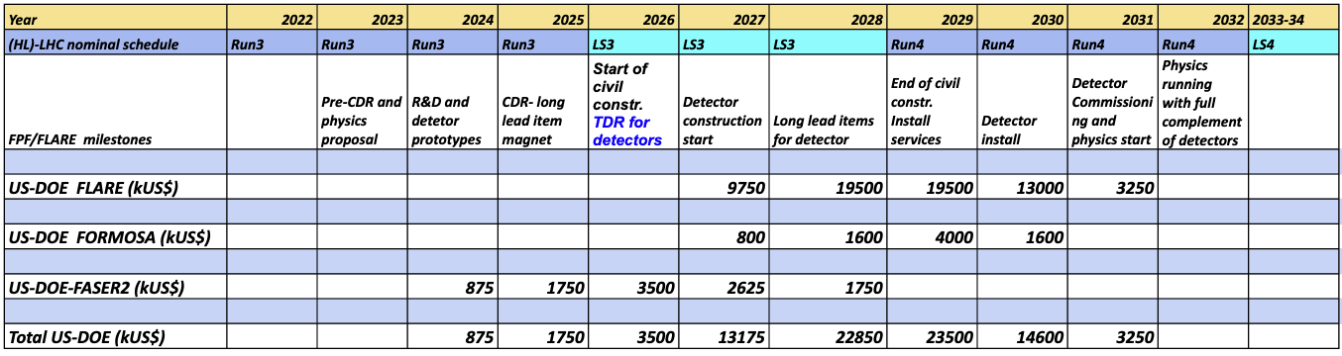
SCHEDULE AND BUDGET PROFILE
All of the planned experiments are relatively small and inexpensive, require limited R&D, and can be constructed in a timely way.
To fully realize the LHC’s potential, the FPF and its experiments should be ready for physics in the HL-LHC era as early as possible in Run 4 (2029-32).
A possible timeline:
  Build FPF during Long Shutdown 3 from 2026-28.
  Install support services and experiments starting in 2029.
  Experiments begin taking data not long after the beginning of Run 4.
Budget profile based on the maximum cost estimate.

Slide 10
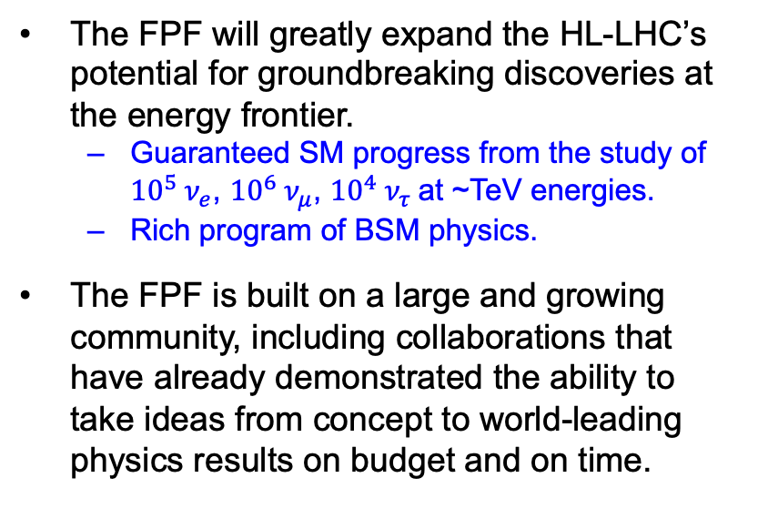
FPF SUMMARY
The FPF will greatly expand the HL-LHC’s potential for groundbreaking discoveries at the energy frontier.
  Guaranteed SM progress from the study of ${10}^{5} ν_{e}$, ${10}^{6} ν_{μ}$, ${10}^{4} ν_{τ}$at ~TeV energies.
  Rich program of BSM physics.
The FPF is built on a large and growing community, including collaborations that have already demonstrated the ability to take ideas from concept to world-leading physics results on budget and on time.
The FPF is a sustainable program, requiring no modifications to the LHC and no additional energy for the beam beyond the existing LHC program.
The FPF is a mid-scale project composed of smaller experiments that can be realized on short timescales, with new ideas possible and very welcome. It will provide a multitude of scientific and leadership opportunities for junior researchers, who can make important contributions from construction to data analysis in a single graduate student lifetime.

Slide 11
EXTRAS

Slide 12
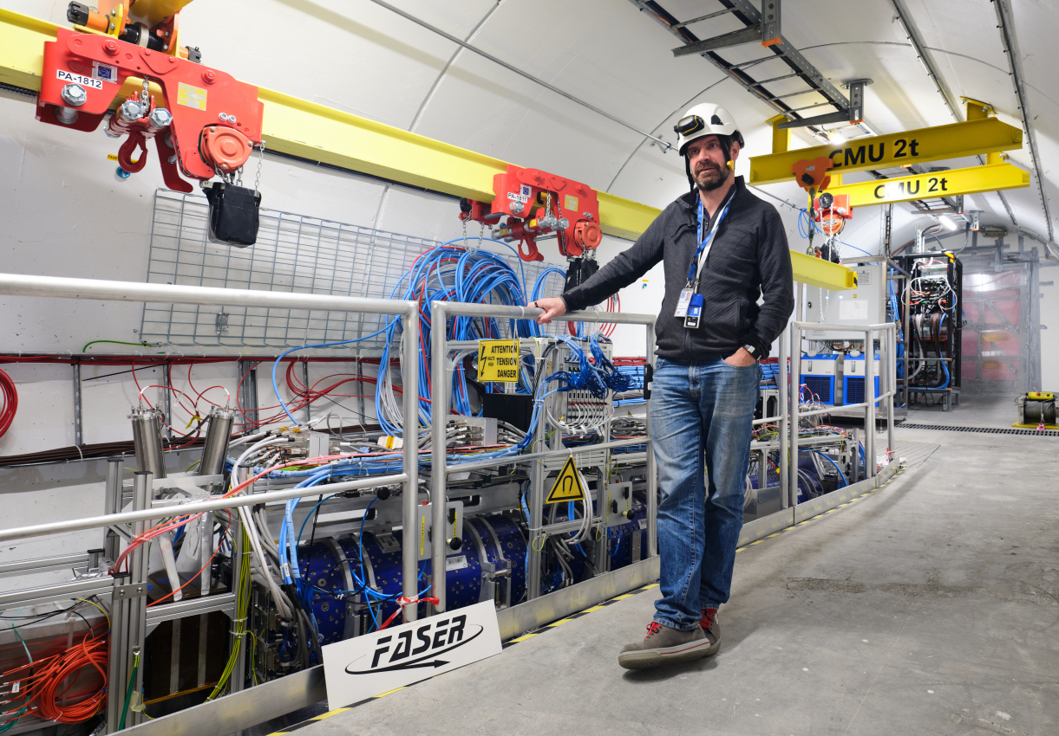
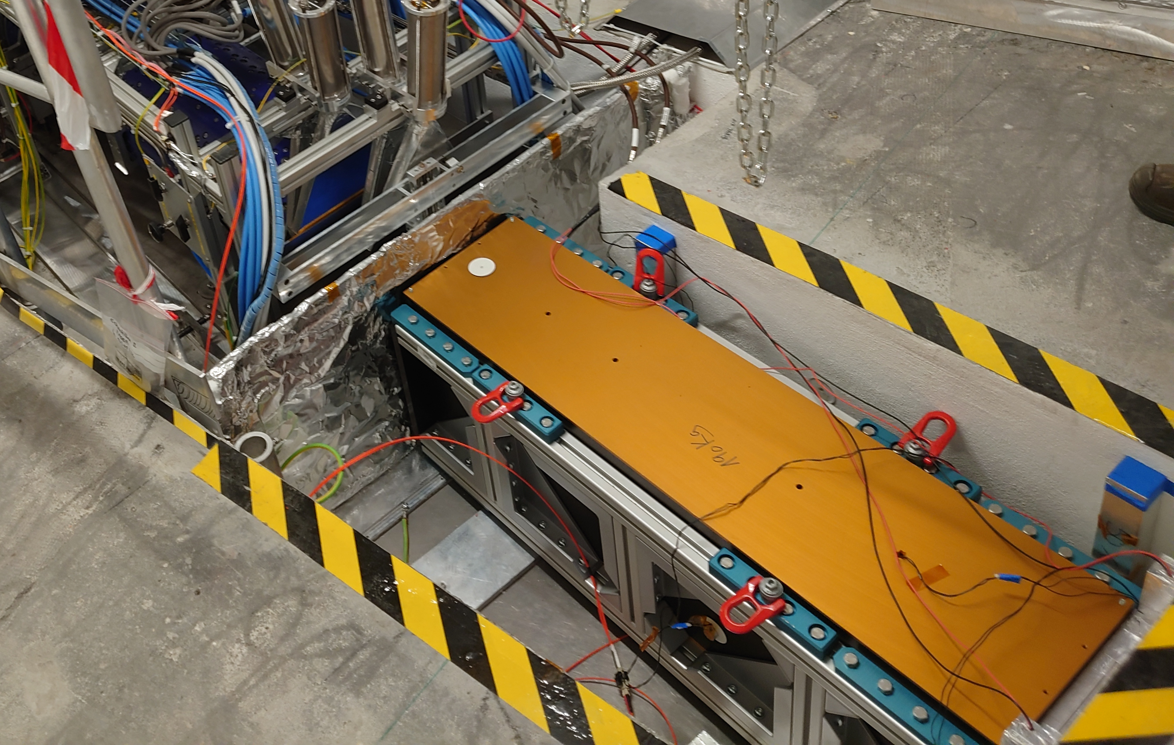
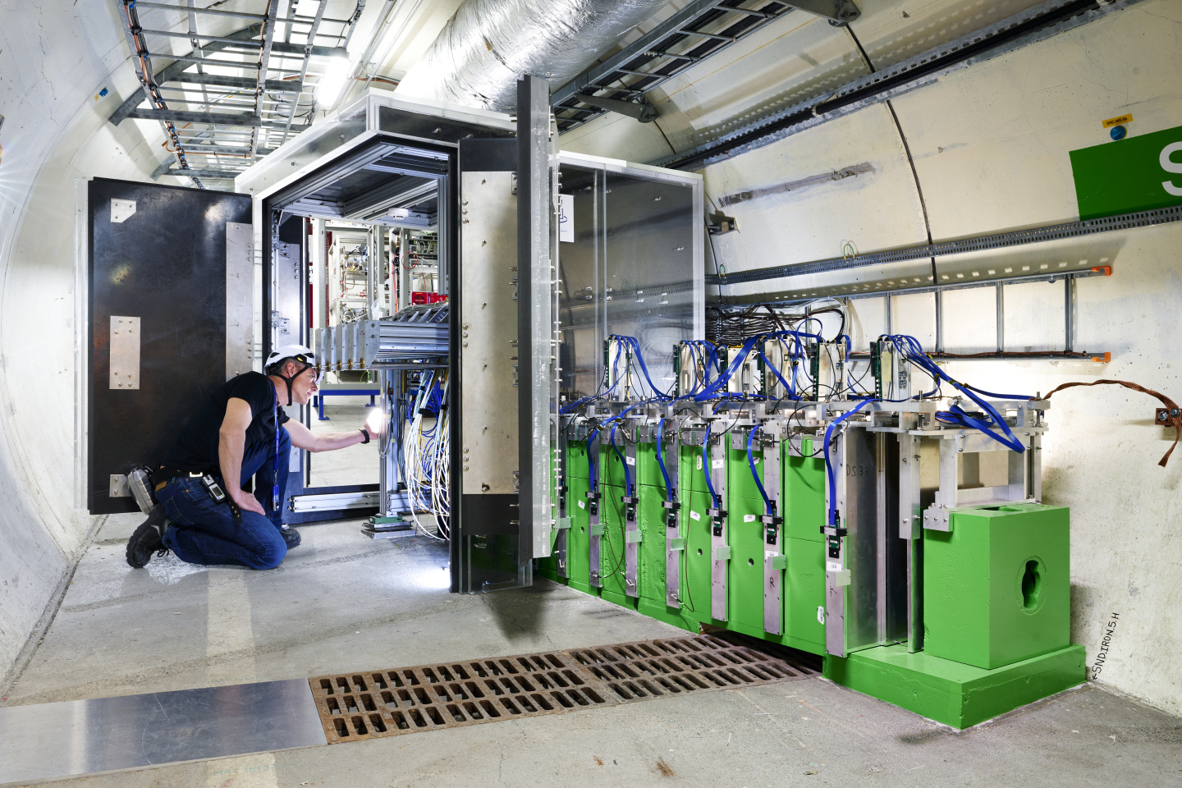
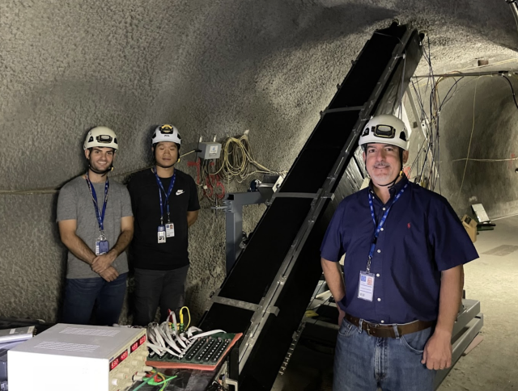
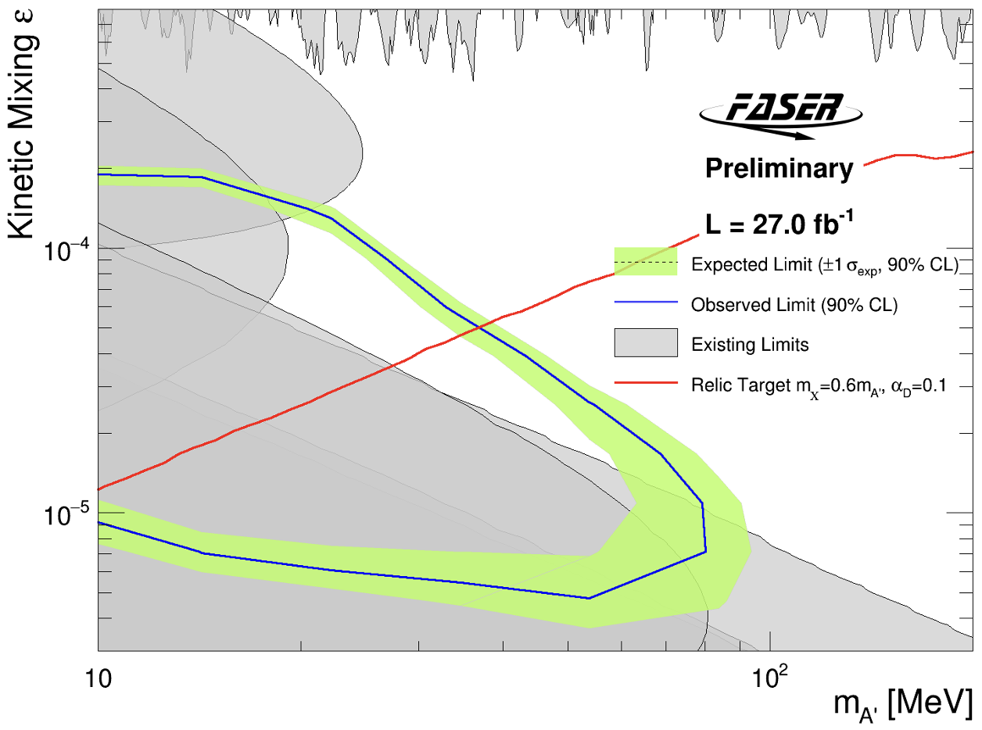
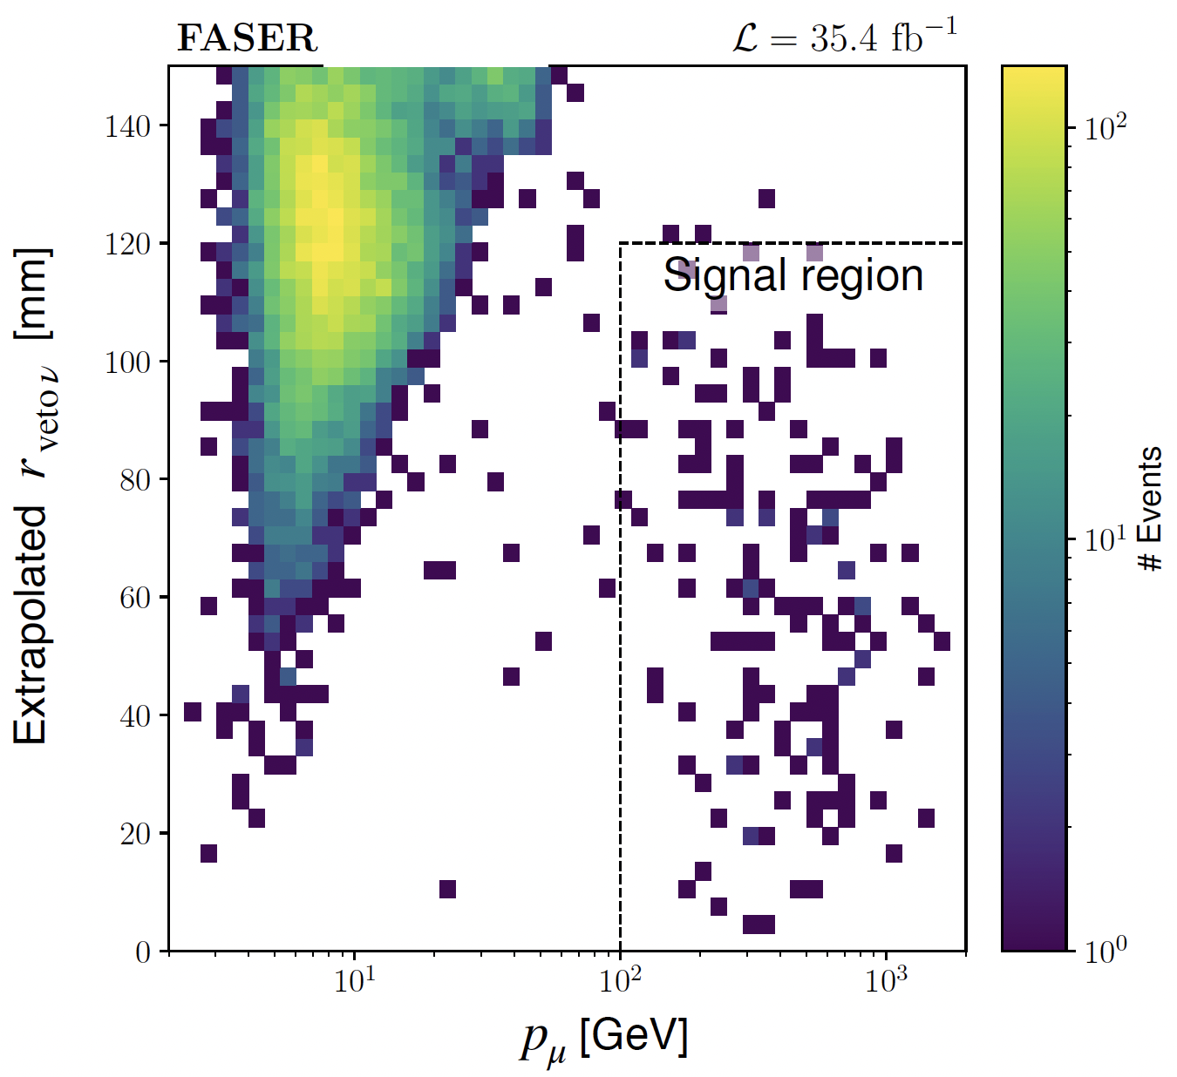
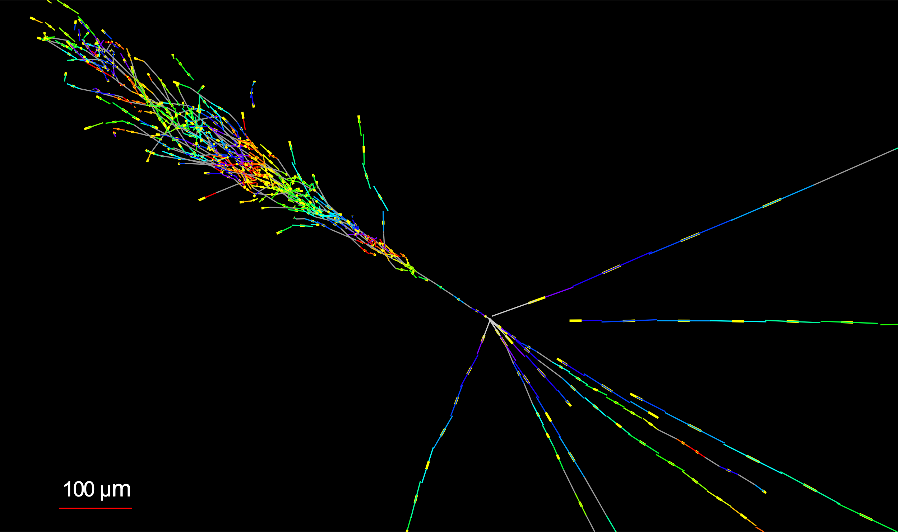
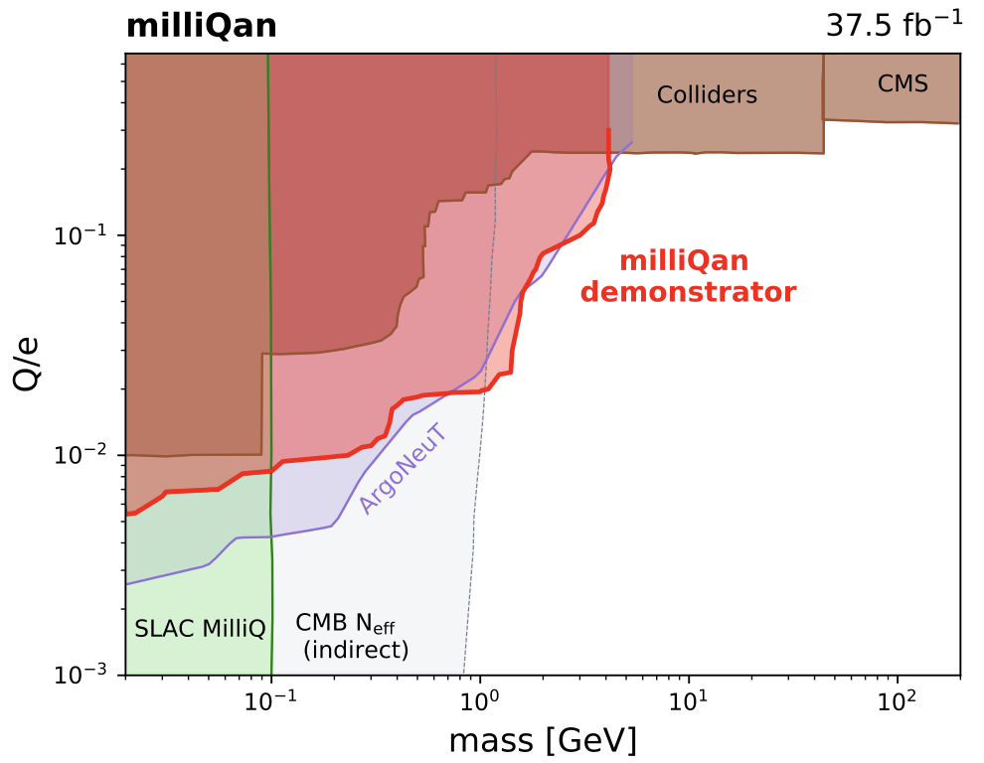
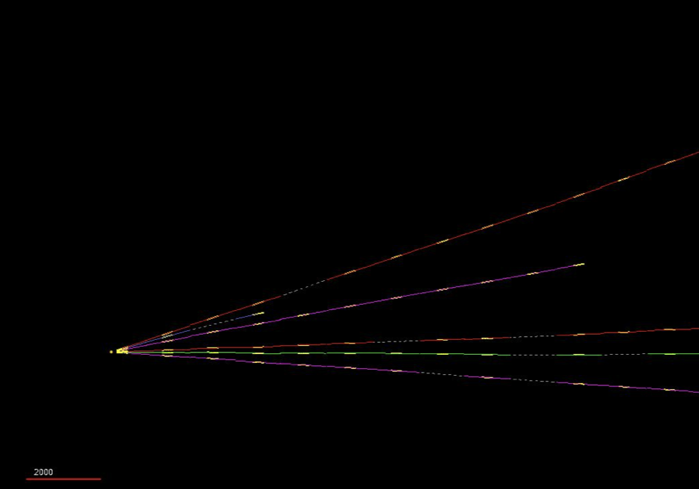
FPF PATHFINDER EXPERIMENTS
De Rujula et al. (1984)
Four detectors have recently demonstrated the potential to do ground-breaking science in the far-forward region with small, fast, and inexpensive detectors.
Exciting results now, demonstrate technical readiness of FPF expts, provide a base for the large and growing FPF user community (~300 people from ~60 institutions).
FASER
FASERν
SND@LHC
milliQan
CERN-FASER-CONF-2023-001]
2005.06518
2303.14185
First new probe of dark photon thermal target from low ε in 30 years
First direct observation of collider neutrinos and the highest energy neutrinos from a human source
Leading bound on ~GeV milli-charged particles

Slide 13
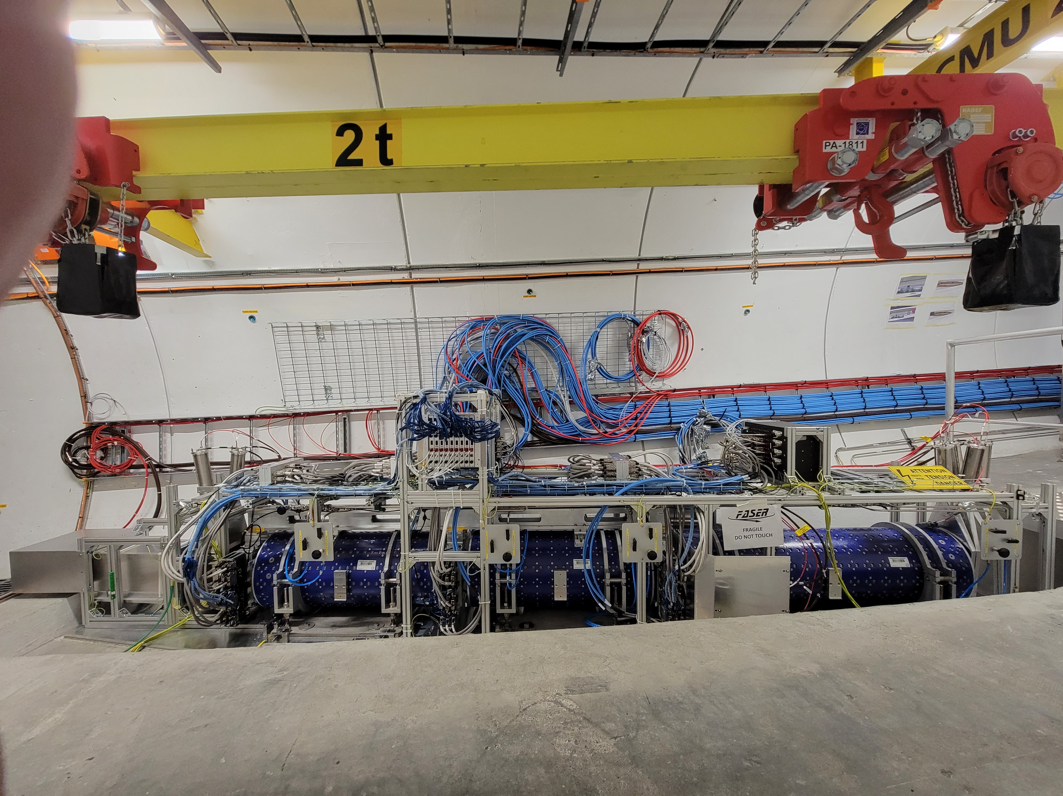
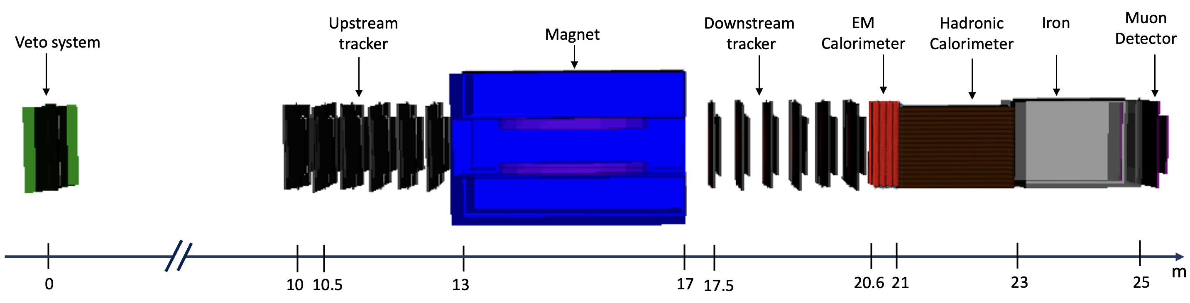
FASER2
On-axis magnetic spectrometer
  Superconducting magnet with 4 Tm bending power
  Trackers based on LHCb’s SciFi detector
FASER → FASER2
  R = 10 cm, L = 1.5 m (V = 0.05 m³) → 3 m x 1 m x 10 m (V = 30 m³)
  Luminosity ~ 30 fb⁻¹ → 3 ab⁻¹
  Sensitivity increases over current bounds by ~60,000 for many models
FASER
FASER2

Slide 14
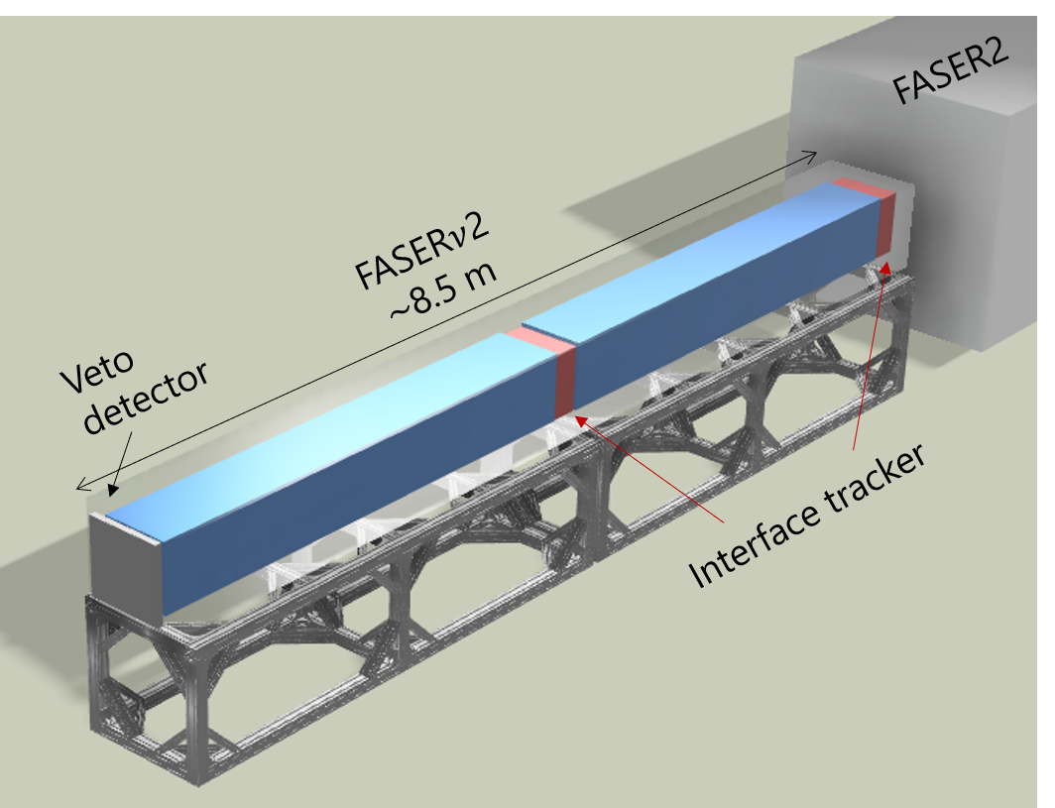
FASERν2
On-axis tungsten/emulsion detector
  Scaled up version of FASERν
  40 cm x 40 cm x 6.6 m, 20 ton tungsten target
  Intrinsic position resolution ~50 nm

Slide 15
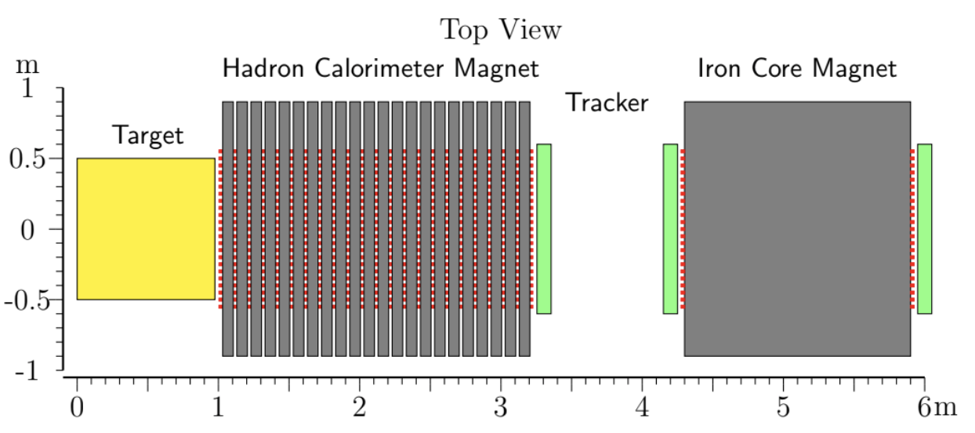
ADVANCED SND
Off-axis electronic neutrino detector
Magnet to identify lepton charge, distinguish muon and tau neutrinos from anti-neutrinos

Slide 16
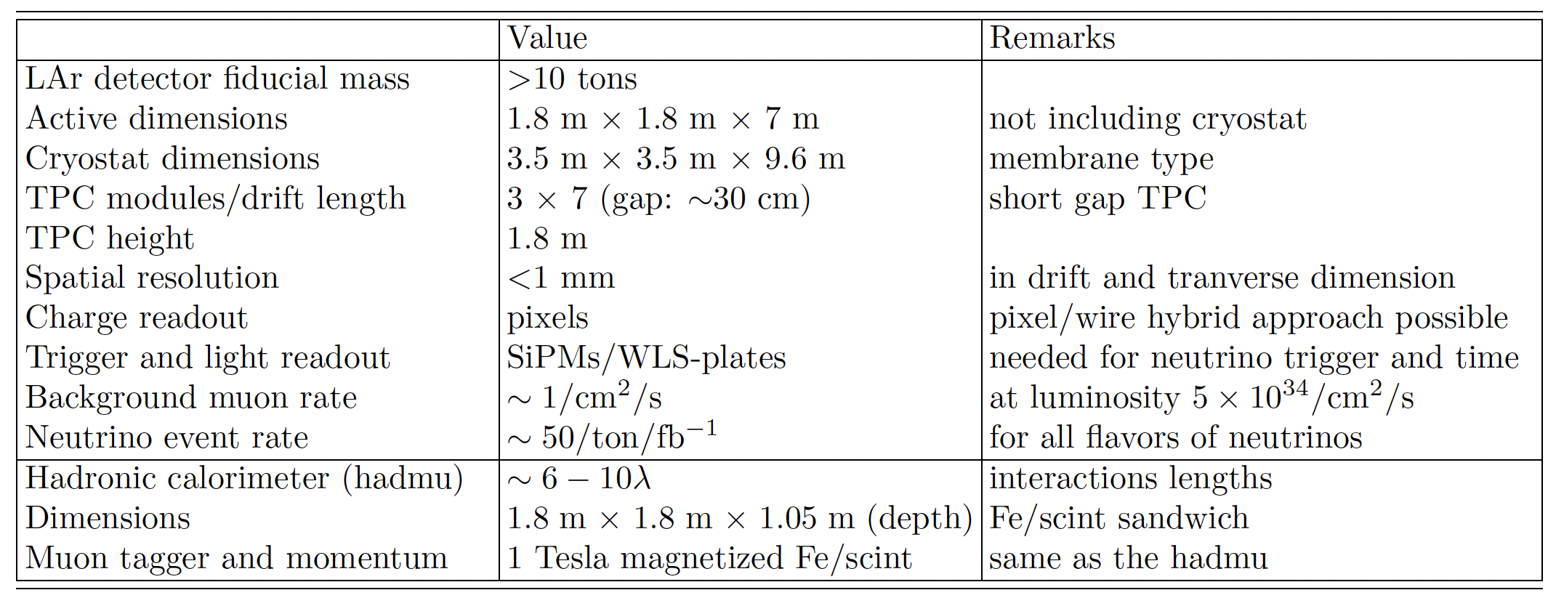
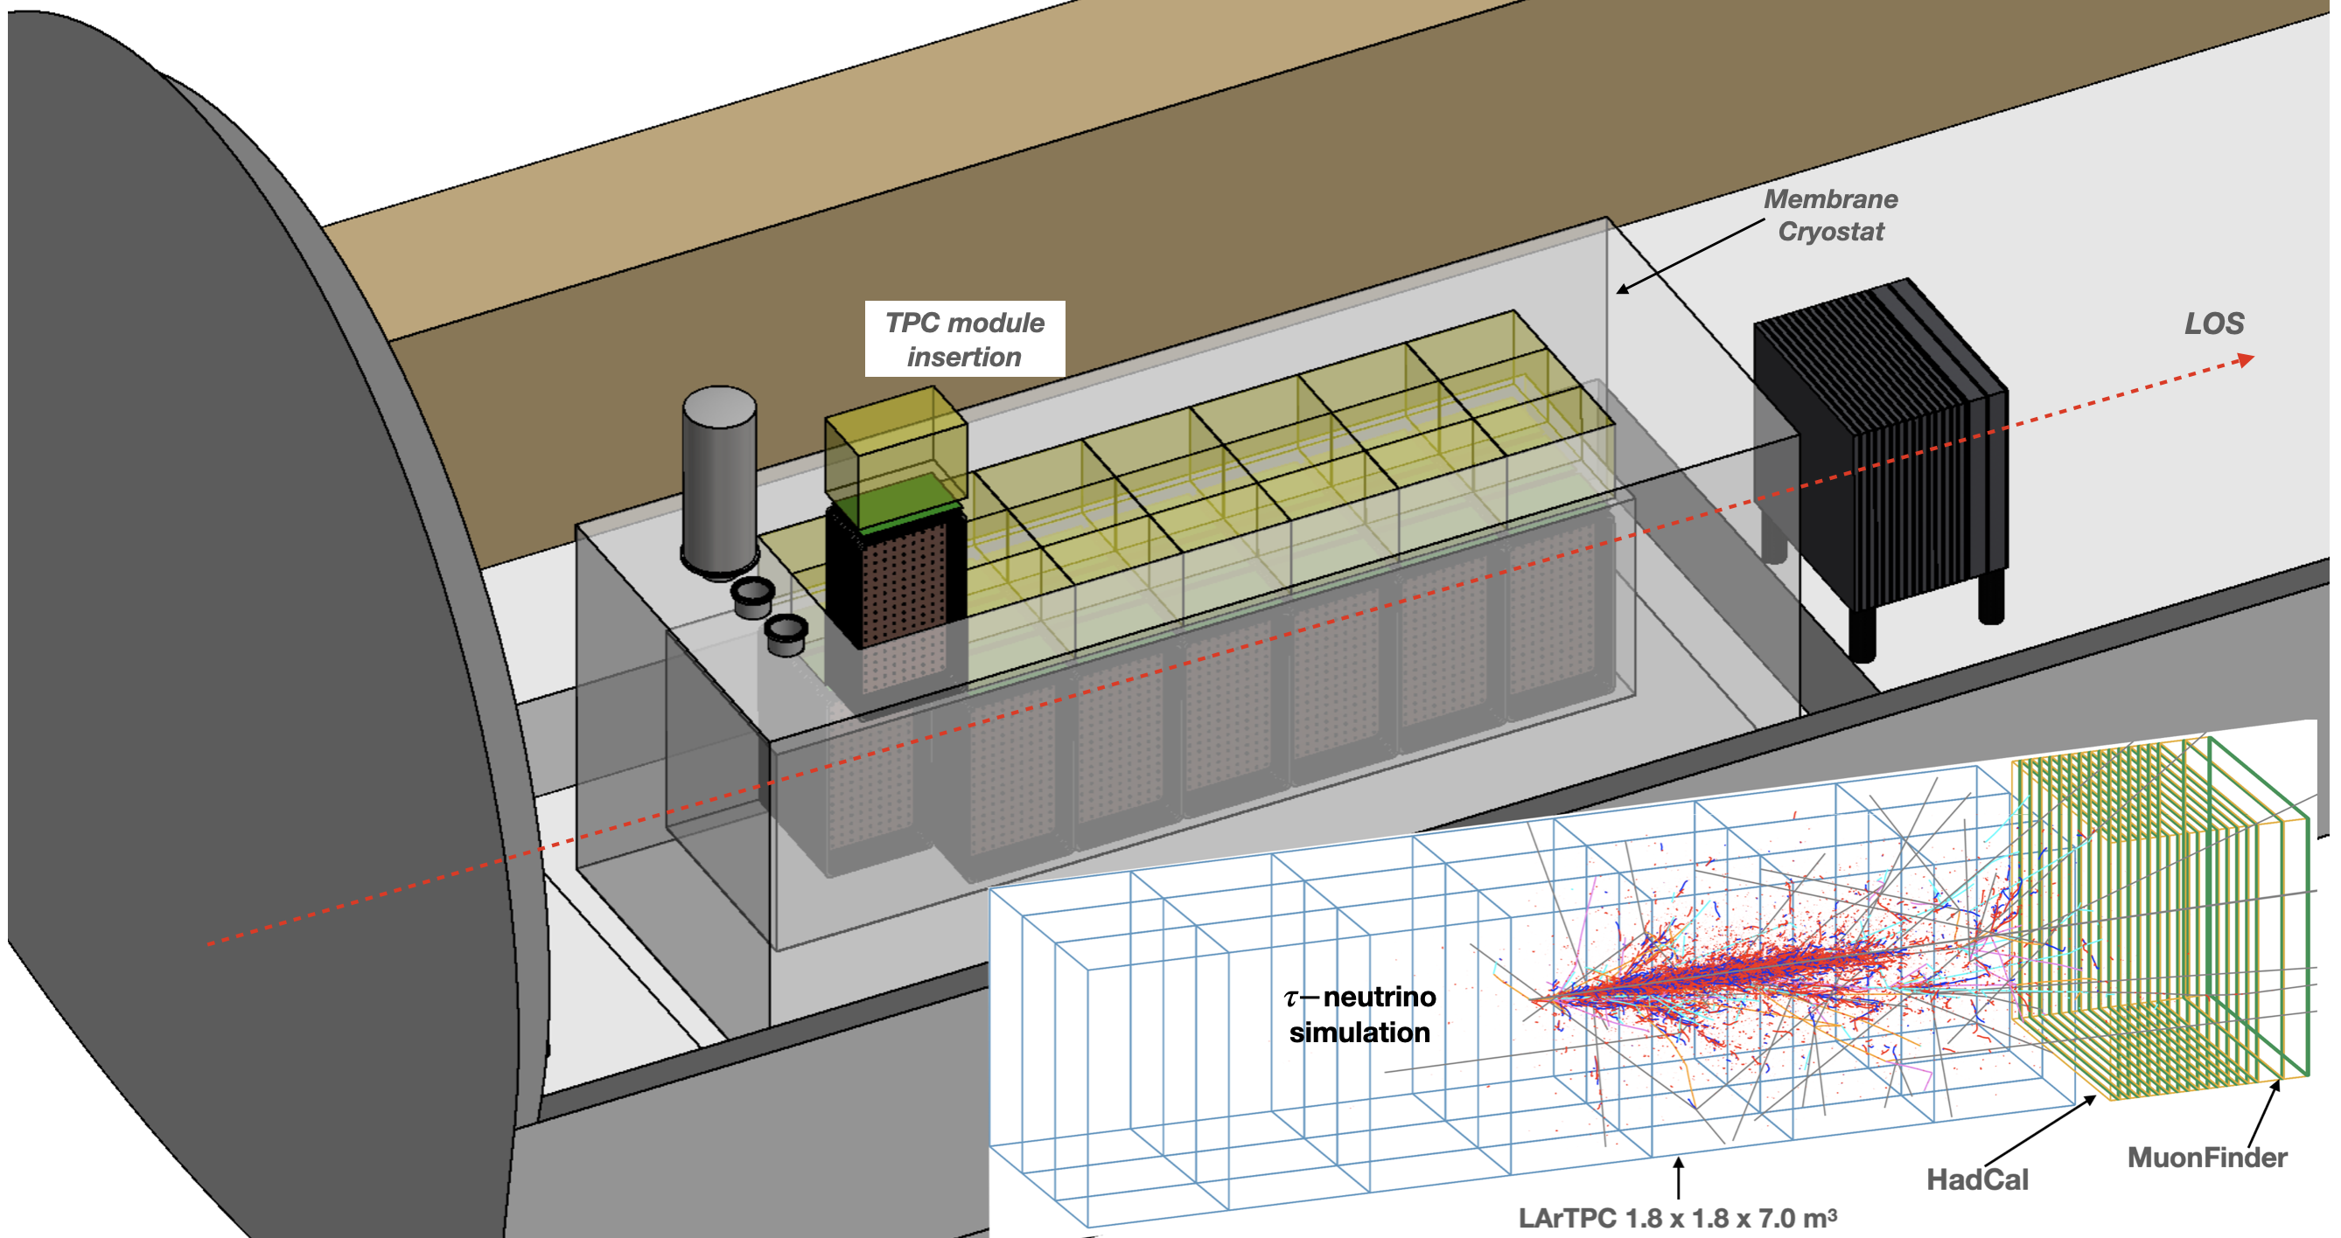
FLARE
On-axis LArTPC neutrino and light DM detector
1.8 m x 1.8 m x 7 m, ~10 ton LAr mass
FLArE with simulated
500 GeV tau neutrino

Slide 17
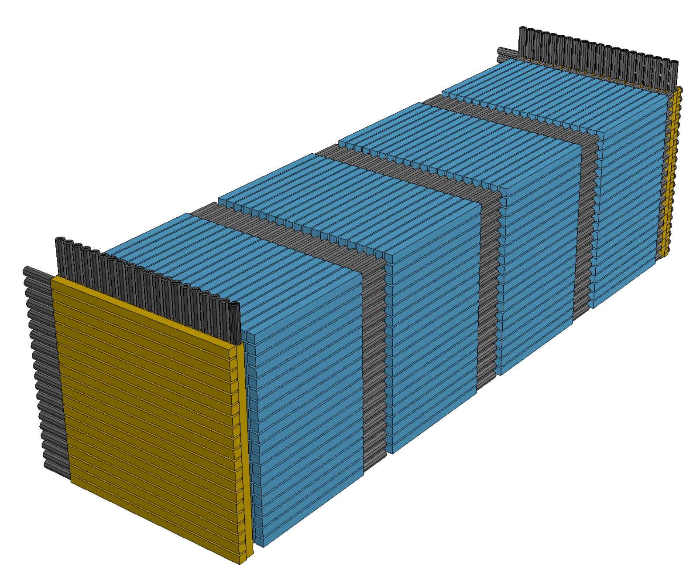
FORMOSA
4 layers, each containing 20 x 20 array of 5 cm x 5 cm x 1 m scintillator bars (blue) connected to PMTs (black)

Slide 18
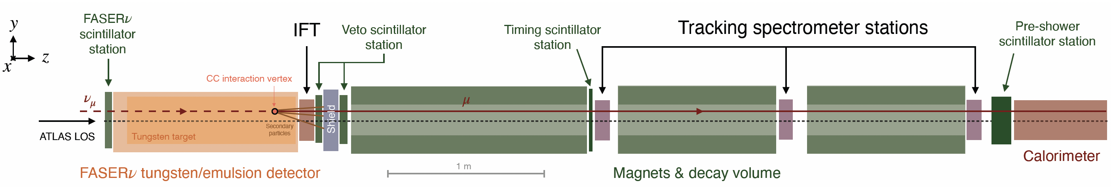
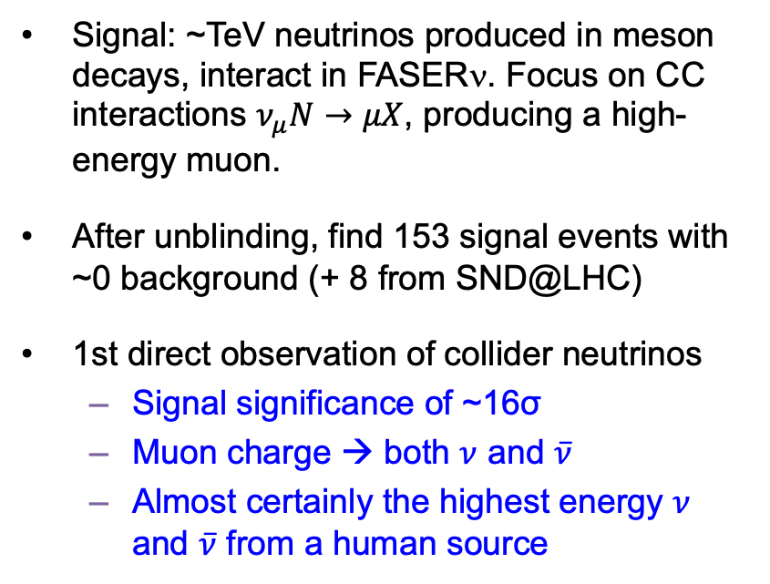
FIRST OBSERVATION OF COLLIDER NEUTRINOS
Signal: ~TeV neutrinos produced in meson decays, interact in FASERν. Focus on CC interactions $ν_{μ}N→μX$, producing a high-energy muon.
After unblinding, find 153 signal events with ~0 background (+ 8 from SND@LHC)
1st direct observation of collider neutrinos
  Signal significance of ~16σ
  Muon charge → both $ν$ and $\overline{ν}$
  Almost certainly the highest energy $ν$ and $\overline{ν}$ from a human source
FASER Collaboration (2303.14185)
Notes:
typical A’ that decays in FASER has ~TeV energy

Slide 19

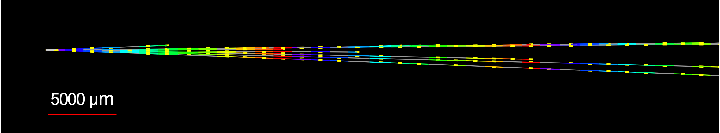


NEUTRINOS FROM EMULSION IN FASERν
Much more to come: 1st direct observation does not even use the emulsion data! Analysis underway, but already many neutrino candidates, including this highly $ν_{e}$–like (and very high energy) CC event
Side View
Vertex with 11 tracks
  615 µm inside tungsten
e-like track from vertex
  Single track for 2X₀
  Shower max @ 7.8Χ₀
  θ_{e} = 11 mrad to beam
Back-to-back topology
  175° between e & rest
Beam View

Slide 20
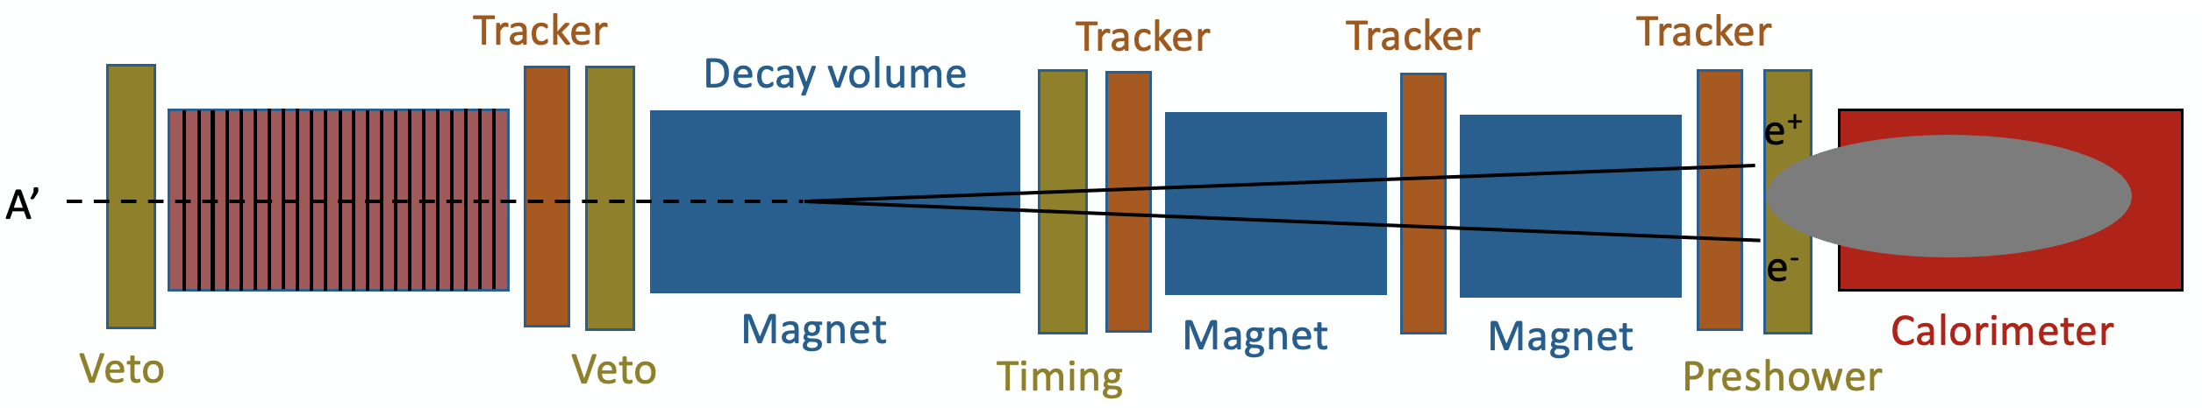
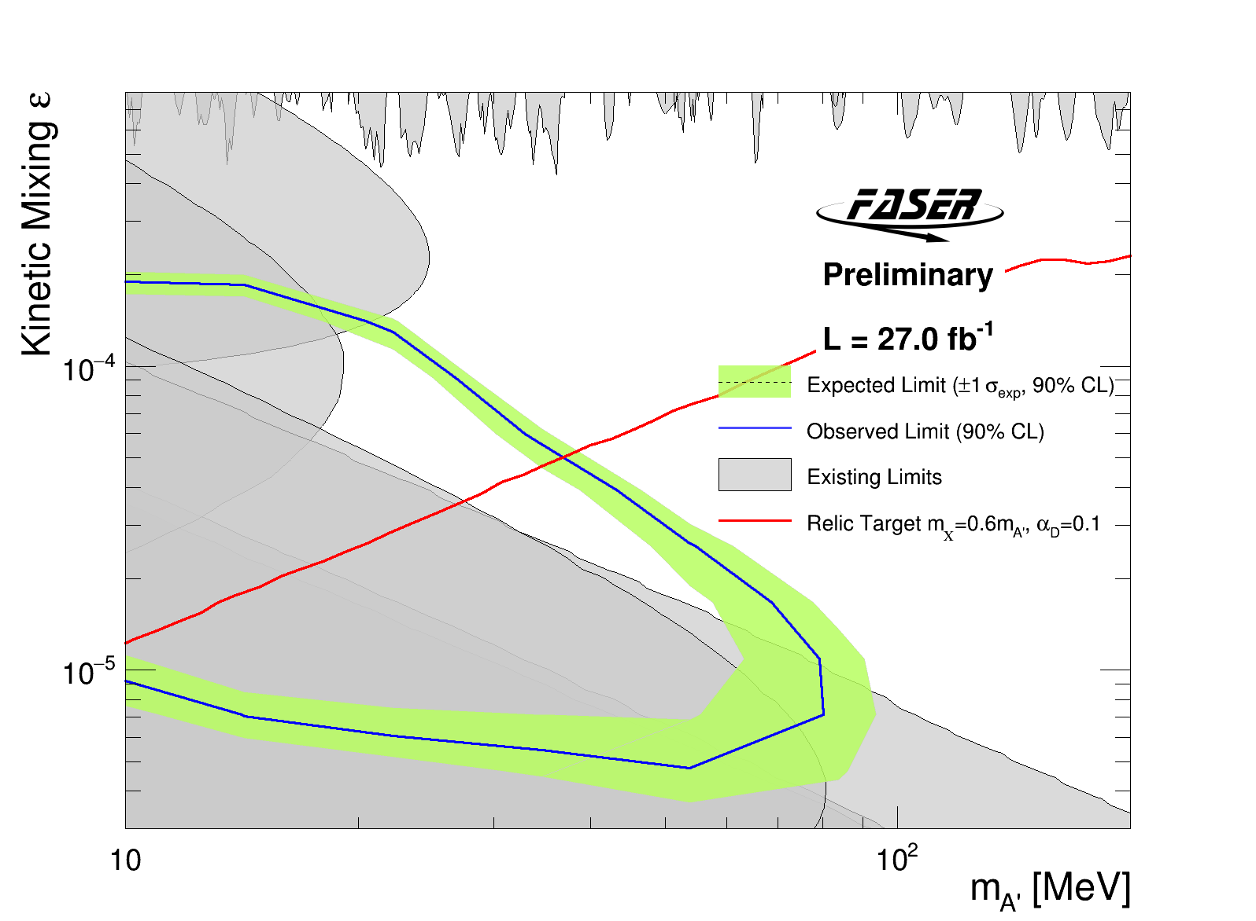

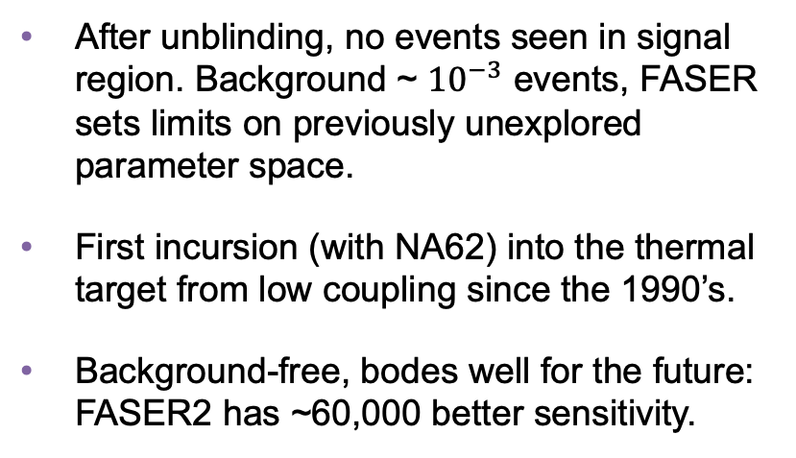
NEW DARK PHOTON RESULTS
Signal: $π/η→A^{′}γ$ or $pp→{ppA}^{′}$, $A^{′}$travels 476 m through rock/concrete, then decays $A^{′}$ $→ e^{+}e^{−}$. Probes thermal target: m ~ $10−100$MeV, $ε \sim {10}^{−5}−{10}^{−4}$.
After unblinding, no events seen in signal region. Background ~ ${10}^{−3}$ events, FASER sets limits on previously unexplored parameter space.
First incursion (with NA62) into the thermal target from low coupling since the 1990’s.
Background-free, bodes well for the future: FASER2 has ~60,000 better sensitivity.
Notes:
typical A’ that decays in FASER has ~TeV energy

Slide 21
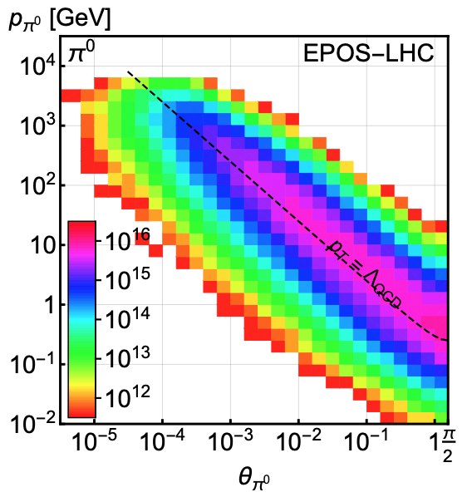
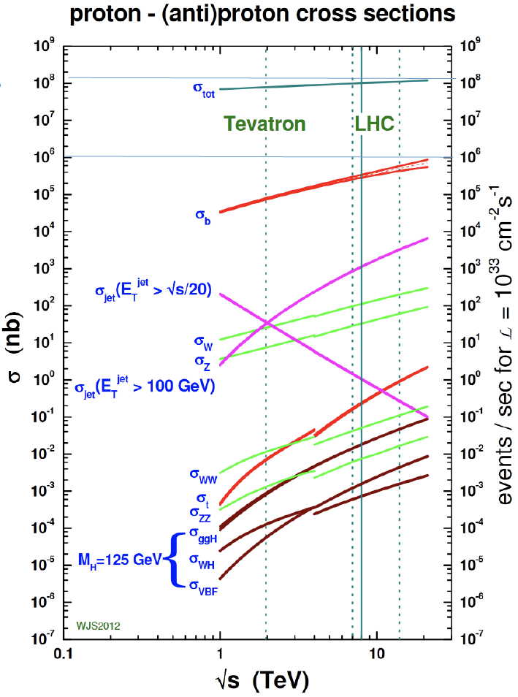
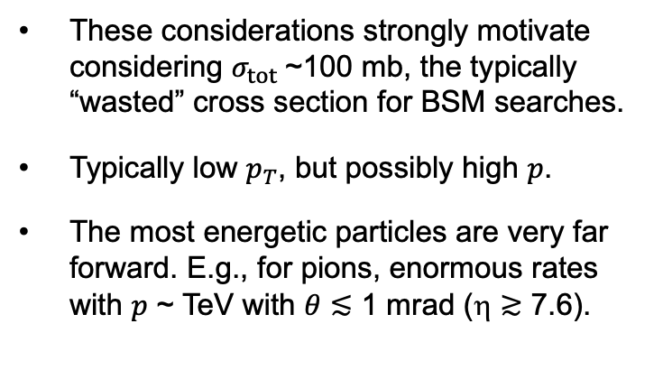
LIGHT, WEAKLY INTERACTING PARTICLES
300 fb⁻¹
Feng, Galon, Kling, Trojanowski (2017)
Most BSM searches focus on σ ~ fb, pb.
But if the new particles are
  light → can be produced in decays of light SM particles.
  weakly-interacting → need large numbers of SM particles to see rare processes.
These considerations strongly motivate considering $σ_{tot}$~100 mb, the typically “wasted” cross section for BSM searches.
Typically low $p_{T}$, but possibly high $p$.
The most energetic particles are very far forward. E.g., for pions, enormous rates with $p$ ~ TeV with $θ≲$ 1 mrad (η $≳$ 7.6).

Slide 22
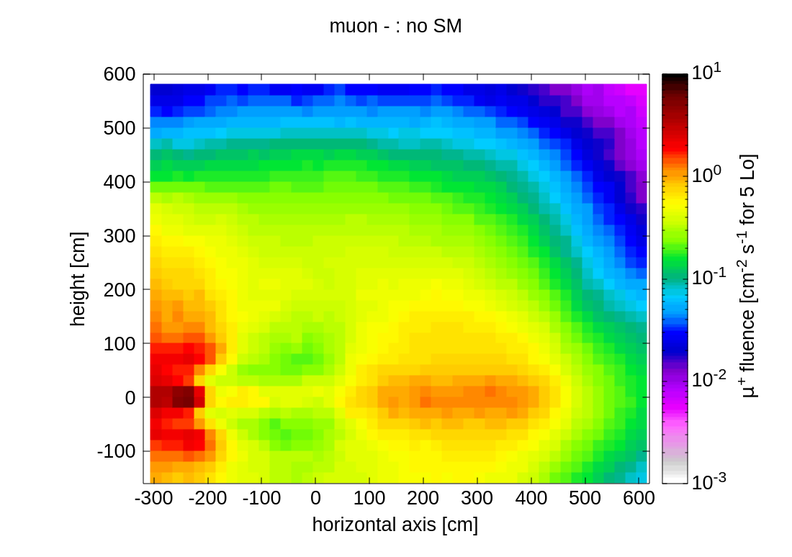
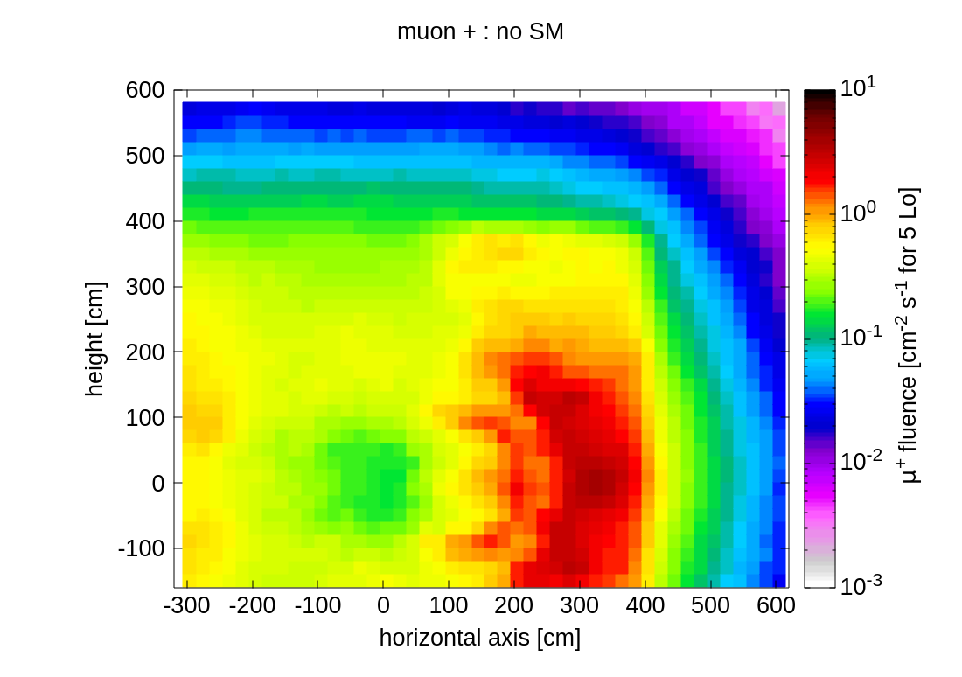
MUON FLUX AT THE FPF
Muons from ATLAS IP are the main background for most FPF signals.
FLUKA results for the LHC have been validated to ~30% in Run 3 by FASER and SND@LHC.
FLUKA results for the HL-LHC are 0.6 Hz/cm² at LOS, much larger at some locations ~1 m from the LOS; easy to veto for most FPF signals.

Slide 23
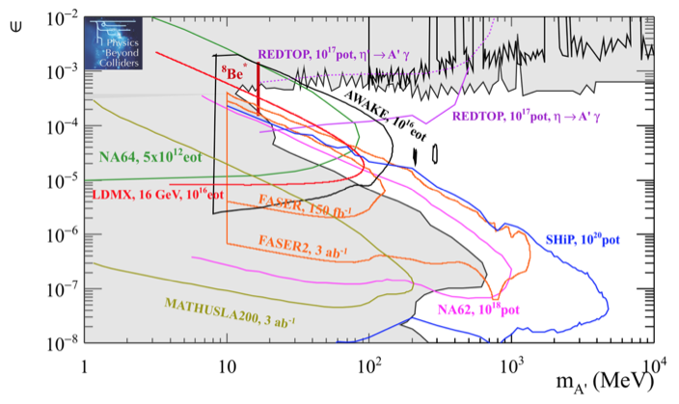
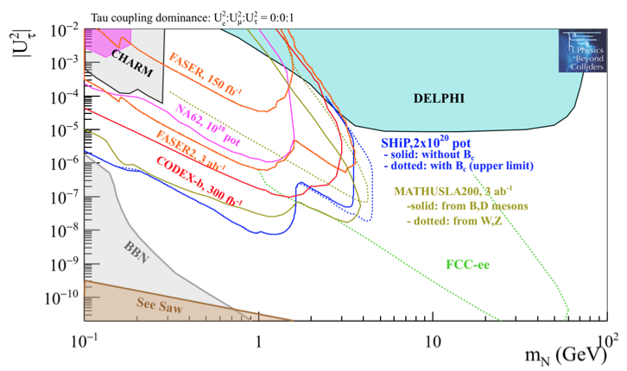
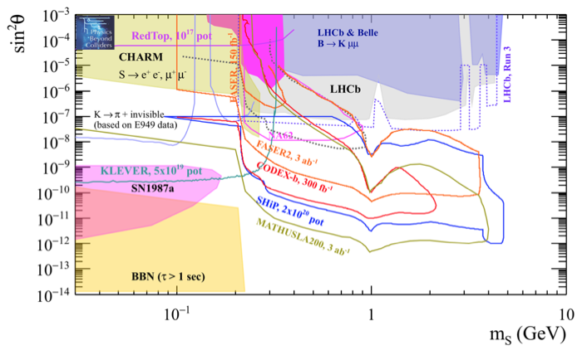
DARK SECTOR SEARCHES
FPF detectors have significant discovery potential for a wide variety of BSM/LLP models: dark photons; B-L and related gauge bosons; dark Higgs bosons; HNLs with couplings to e, mu, tau; ALPs with photon, gluon, fermion couplings; light neutralinos, inflatons, relaxions, and many others.
_{FPF White Paper (2022)}
Dark Photon
Dark Fermion
Dark Scalar

Slide 24
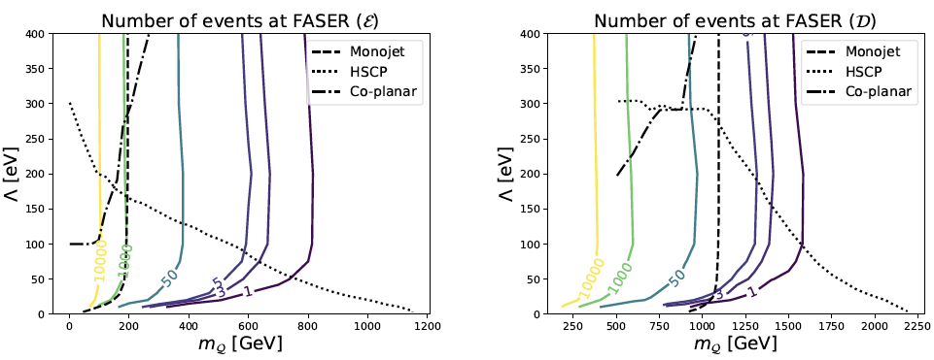
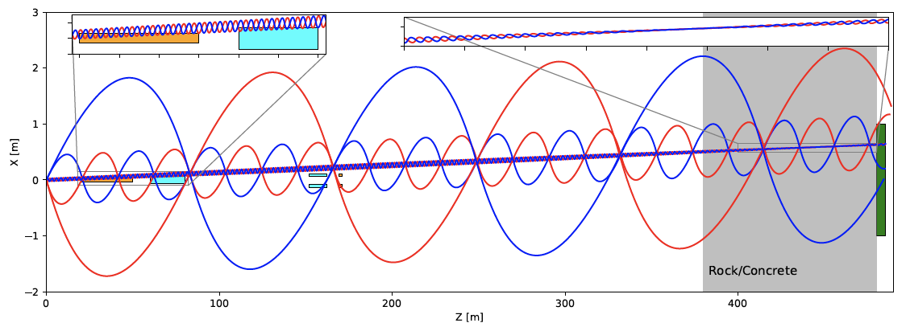
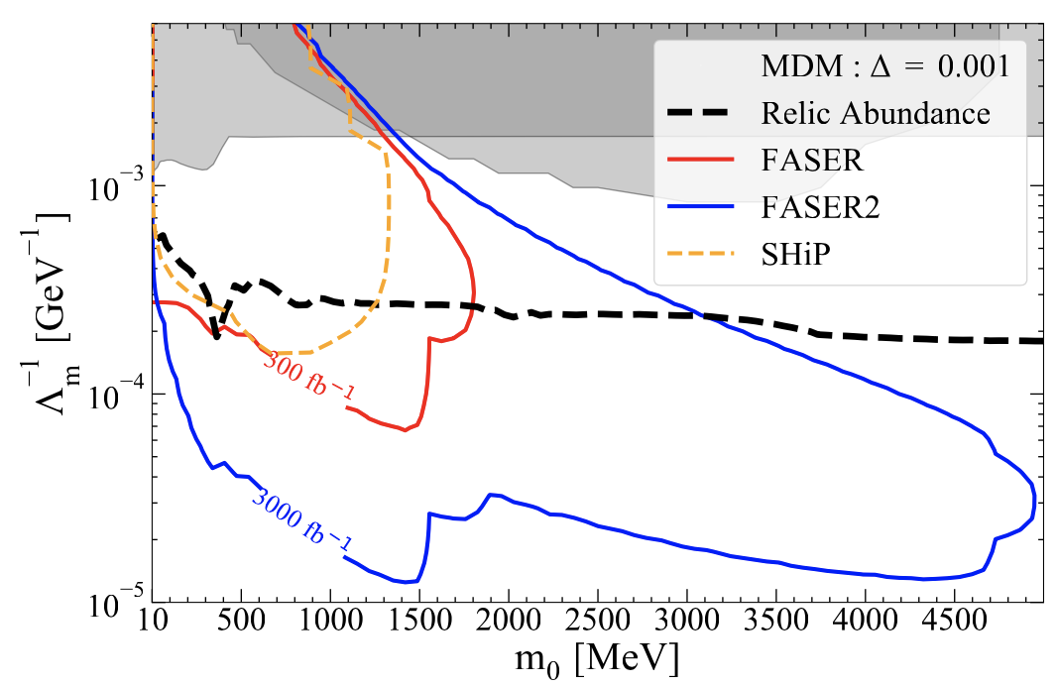
FPF BSM SEARCHES
Complementarity of high energy and fixed target experiments. High energy experiments probe
  High mass states (e.g., quirks)
  High mass mediators
  Compressed spectra by boosting soft decay products to high energy
Li, Pei, Ran, Zhang, 2108.06748
Berlin, Kling, 1810.01879
Dienes et al., 2301.05252

Slide 25
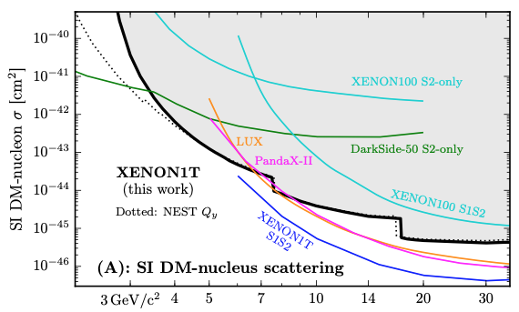
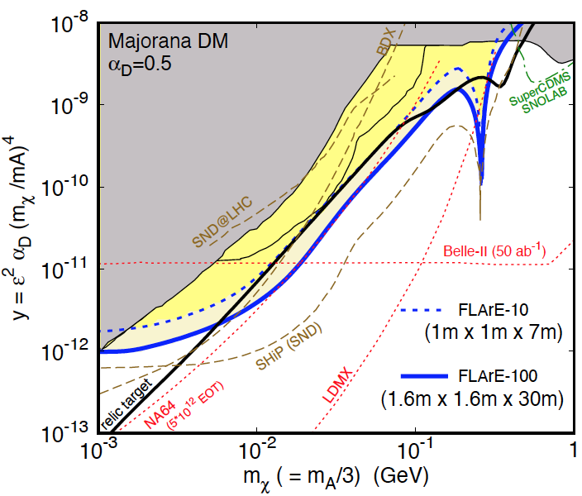


DARK MATTER DIRECT DETECTION
Light DM with masses at the GeV scale and below is famously hard to detect.
  Galactic halo velocity ~ 10⁻³ c, so kinetic energy ~ keV or below.
At the LHC, we can produce DM at high energies, look for the resulting DM to scatter in FLArE, Forward Liquid Argon Experiment, a proposed 10 to 100 tonne LArTPC.
FLArE is powerful in the region favored/allowed by thermal freezeout.
Batell, Feng, Trojanowski (2021)

Slide 26



QCD
The FPF will also support a rich program of QCD and hadron structure studies.
Forward neutrino production is a probe of forward hadron production, BFKL dynamics, intrinsic charm, and proton structure at ultra small x ~ 10⁻⁷ to 10⁻⁶.
Fully differential DIS cross sections will improve PDF constraints by factor of ~2.
FASER White Paper (2022)
$$4m_{c}^{2 }\sim x_{1}x_{2}s$$
Rojo et al. (2023)

Slide 27




ASTROPARTICLE PHYSICS: COSMIC NEUTRINOS
The current IceCube cosmic nu flux can be fit by a power law, a power law with cutoff, ...
More data may be able to distinguish these, but only if the atmospheric neutrino background from charm is better determined.
IceCube 2001.09520
Power law
Power law
with cutoff
Bhattacharya et al. (1502.01076)
This can be measured in the controlled environment of a particle collider if
  $\sqrt{s} \sim \sqrt{2E_{ν}m_{p}} \sim$10 TeV for $E_{ν} \sim$10⁷ GeV : Requires the energy of the LHC
  $x_{1,2} \sim \frac{m_{c}}{\sqrt{s}} e^{±η} ⇒ η \sim$ 7 to 9 : Requires the far forward angular coverage of the FPF
Anchordoqui (2022)

Slide 28
FPF MEETINGS AND PAPERS
The physics program in the far-forward region has been developed in a series of meetings and papers.
FPF Meetings
  FPF Kickoff Meeting, 9-10 Nov 2020
  FPF2 Meeting, 27-28 May 2021
  FPF3 Meeting, 25-26 Oct 2021
  FPF4 Meeting, 31 Jan-1 Feb 2022
  FPF5 Meeting, 15-16 Nov 2022
  FPF6 Meeting, 8-9 June 2023
FPF Papers
  FPF “Short” Paper: 75 pages, 80 authors, Phys. Rept. 968, 1 (2022), 2109.10905.
  FPF White Paper: 429 pages, 392 authors+endorsers representing over 200 institutions, J. Phys. G (2023), 2203.05090.
Snowmass 2022: “Our highest immediate priority accelerator and project is the HL-LHC, …including the construction of auxiliary experiments that extend the reach of HL-LHC in kinematic regions uncovered by the detector upgrades.”

Slide 29
ORGANIZATIONAL INFRASTRUCTURE
FPF Working Group structure established to organize the work and provide contact names for new people interested in the FPF.
Steering Committee: Jamie Boyd, Albert De Roeck, Milind Diwan, Jonathan Feng, Felix Kling
WG0 Facility: Jamie Boyd
WG1 Neutrino Interactions: Juan Rojo
WG2 Charm Production: Hallsie Reno
WG3 Light Hadron Prod: Luis Anchordoqui, Dennis Soldin
WG4 BSM: Brian Batell, Sebastian Trojanowski
WG5 FASER2: Alan Barr, Josh McFayden
WG6 FASERnu2: Aki Ariga, Tomoko Ariga
WG7 FLArE: Jianming Bian, Milind Diwan
WG8 AdvSND: Giovanni De Lellis
WG9 FORMOSA: Matthew Citron, Chris Hill
Detector WGs
Physics WGs
Exp/Th Liaisons | WG5 FASER2 | WG6 FASERnu2 | WG7 FLArE | WG8 AdvSND | WG9 FORMOSA
WG1 | Josh McFayden | Aki Ariga, Tomoko Ariga | Steve Linden, Wenjie Wu | Antonia Di Crescenzo | Matthew Citron
WG2 | Josh McFayden | Aki Ariga, Tomoko Ariga | Steve Linden, Wenjie Wu | Antonia Di Crescenzo | Matthew Citron
WG3 | Josh McFayden | Aki Ariga, Tomoko Ariga | Steve Linden, Wenjie Wu | Antonia Di Crescenzo | Matthew Citron
WG4 | Josh McFayden | Aki Ariga, Tomoko Ariga | Steve Linden, Wenjie Wu | Cristovao Vilela | Matthew Citron

