Slide 1




Jonathan Feng
Ting Mini-Symposium, 22 February 2023

Slide 2
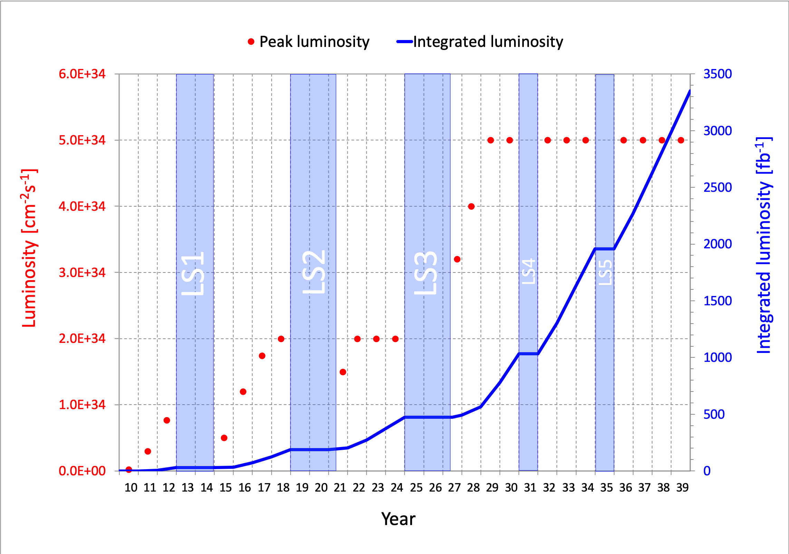
PARTICLE PHYSICS NOW
This is a critical time in particle physics: many outstanding problems (neutrino masses, dark matter, …)
At the energy frontier, the Large Hadron Collider at CERN started running again in 2022 and will run until ~2040.
What can we do to enhance the LHC’s prospects for discovering new particles and shedding light on the many outstanding problems?

Slide 3
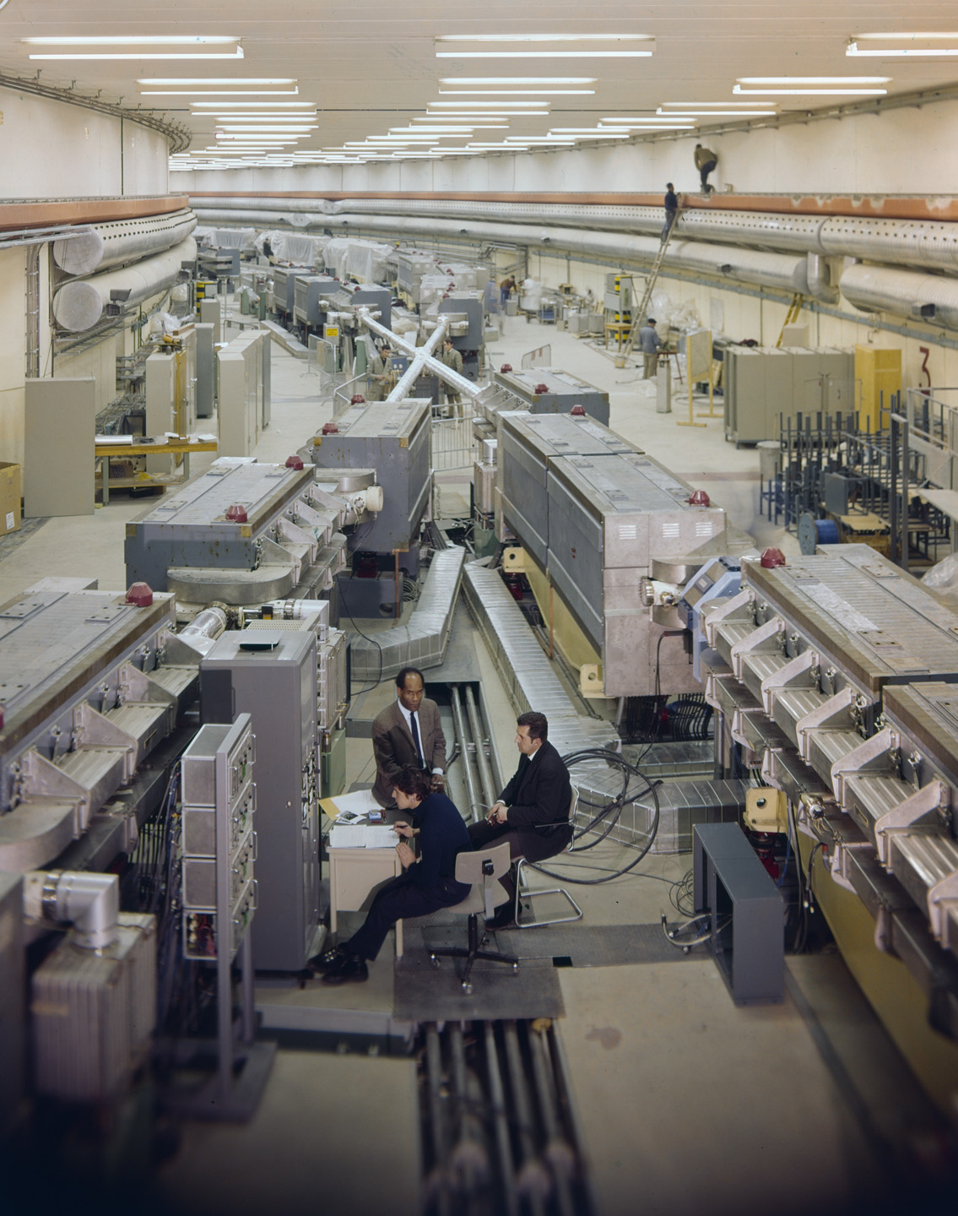
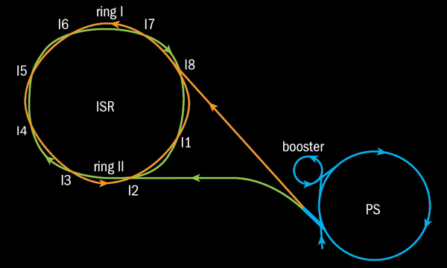
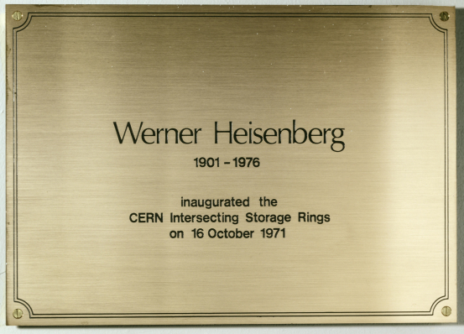
SOME HISTORY
Sometimes to look forward, it pays to first look back.
2021 was the 50th anniversary of the birth of hadron colliders.
In 1971, CERN’s Intersecting Storage Rings (ISR), with a circumference of ~1 km, collided protons with protons at center-of-mass energy 30 GeV.

Slide 4
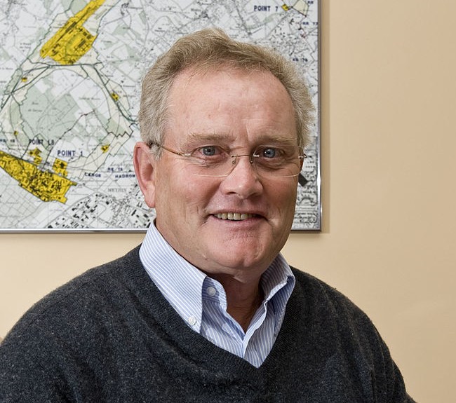
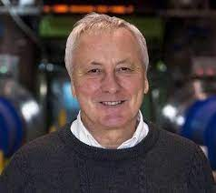
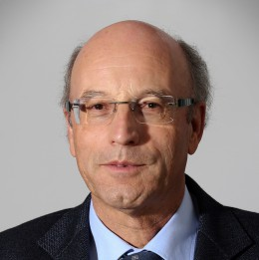
ISR’S LEGACY
During ISR’s 50th anniversary, there were many fascinating articles and talks by eminent physicists looking back on the ISR’s legacy.
  “Enormous impact on accelerator physics, but sadly little effect on particle physics.” – Steve Myers, talk at “The 50th Anniversary of Hadron Colliders at CERN,” October 2021.
  “There was initially a broad belief that physics action would be in the forward directions at a hadron collider…. It is easy to say after the fact, still with regrets, that with an earlier availability of more complete… experiments at the ISR, CERN would not have been left as a spectator during the famous November revolution of 1974 with the J/ψ discoveries at Brookhaven and SLAC .” – Lyn Evans and Peter Jenni, “Discovery Machines,” CERN Courier (2021).
Bottom line: They seem to be saying that the collider was creating new forms of matter (charm), but the detectors focused on the forward region (along the beamline) and so missed them.

Slide 5

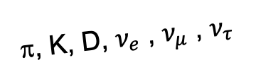
FORWARD PHYSICS
Are we now making a similar mistake at the LHC? Yes! We are now so focused on the transverse direction, that we are missing opportunities in the forward direction.
Existing detectors are designed to find new heavy particles. These particles are produced at low velocities and decay roughly isotropically.
But if new particles are light and weakly interacting, they are dominantly produced along the beam axis, and the existing big LHC detectors are perfectly designed NOT to see them.
We are missing both SM and BSM opportunities: we need a detector to exploit the “wasted” σ_{inelastic} ~ 100 mb and cover these “blind spots” in the far-forward region.
A’, a, mCPs, DM, …
π, K, D, $ν_{e}$ , $ν_{μ}$ , $ν_{τ}$

Slide 6
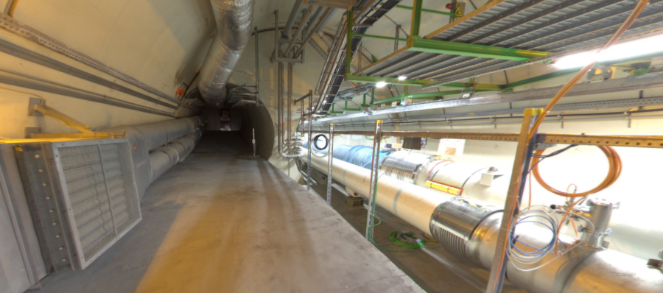


THE FAR-FORWARD REGION
New particle A’ is produced at ATLAS, travels along the beam collision axis and through 100 m of rock, and finally decays in tunnel TI12, 480 m from ATLAS
$π^{0}$→ $γ$A’
→ A’ →
A’ → $e^{+}e^{−}$
TI12 near UJ12
UJ12
The view in UJ12 looking west (2019)
TI12
$$e^{+}$$
$e^{−}$
Beam collision axis
LHC beamline

Slide 7
FASER TIMELINE
September 2017: Initial proposal (Feng, Galon, Kling, Trojanowski)
July 2018: Submitted LOI to CERN LHCC
October 2018: Approval from ATLAS SCT and LHCb Collaborations for use of spare detector modules
November 2018: Submitted Technical Proposal to LHCC
November 2018 – January 2019: Experiment funded by the Heising-Simons and Simons Foundations
March 2019: FASER approved as 8th LHC detector by CERN
December 2019: FASERν approved as 9th LHC detector by CERN
March 2021: FASER fully installed, commissioning of the detector begins
May 2021: FASERν announces first candidate collider neutrinos
June 2022: FASER and FASERν collected data in Run 3
March 2023: First physics results presented at Moriond (expected!)

Slide 8











FASER COLLABORATION TODAY
80 collaborators, 22 institutions, 9 countries

Slide 9
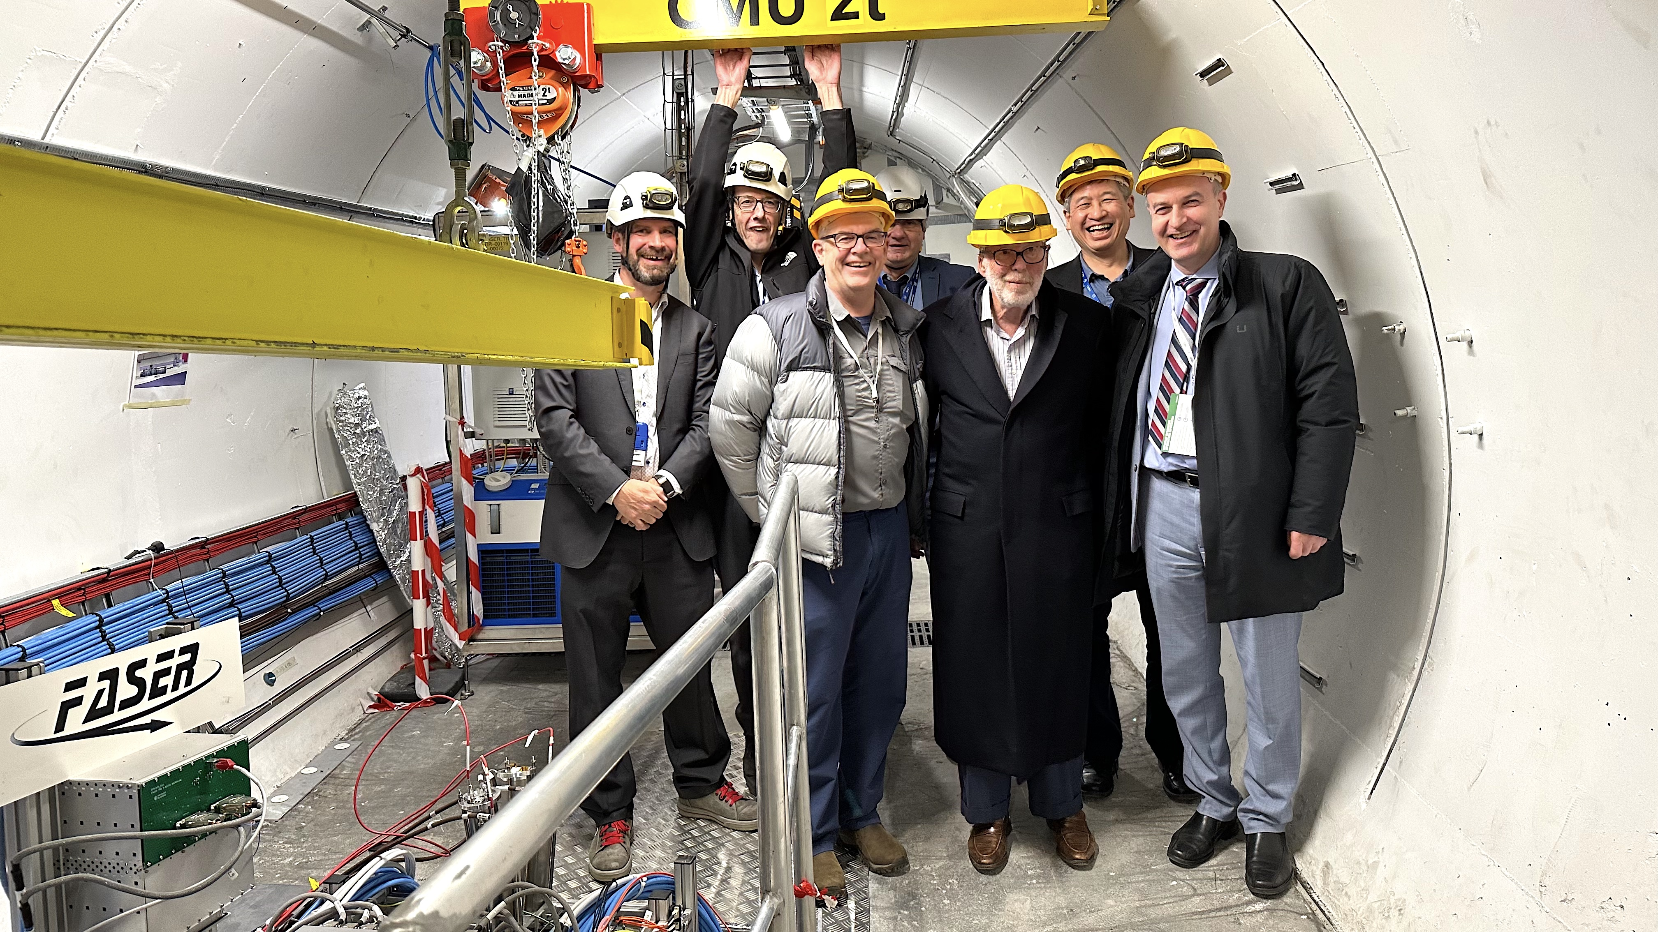
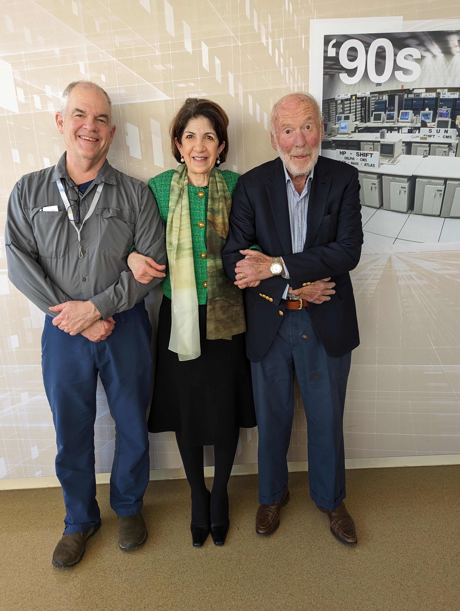
VIP TOUR OF FASER, JANUARY 2023
Left to Right:
Jamie Boyd FASER Co-Spokesperson
Mike Lamont CERN Director of Accelerators and Technology
Mark Heising, Heising-Simons Foundation
Joachim Mnich, CERN Director of Research and Computing
Jim Simons, Simons Foundation
Jonathan Feng, FASER Co-Spokesperson
Greg Gabadadze, Associate Director, Simons Foundation
Left to Right:
Mark Heising, Heising-Simons Foundation
Fabiola Gianotti, CERN Director General
Jim Simons, Simons Foundation

Slide 10
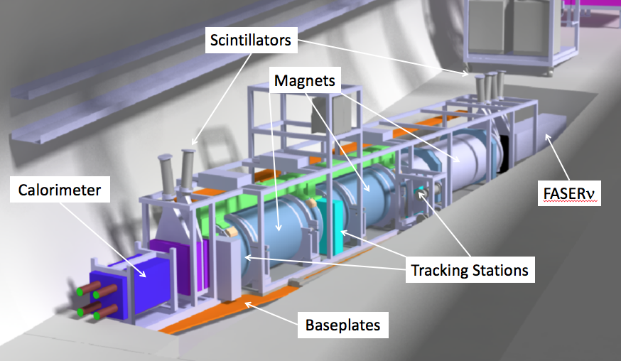
THE FASER DETECTOR
Neutrino signal: nothing incoming, detect CC or NC interaction.
BSM signal: nothing incoming, and 2 ~TeV, opposite-sign charged tracks pointing back to the ATLAS IP: a “light shining through (100 m-thick) wall” experiment.
Scintillators veto incoming charged tracks (muons), magnets split the charged tracks, which are detected by tracking stations and a calorimeter.
LLP
ν
e⁺
e⁻

Slide 11
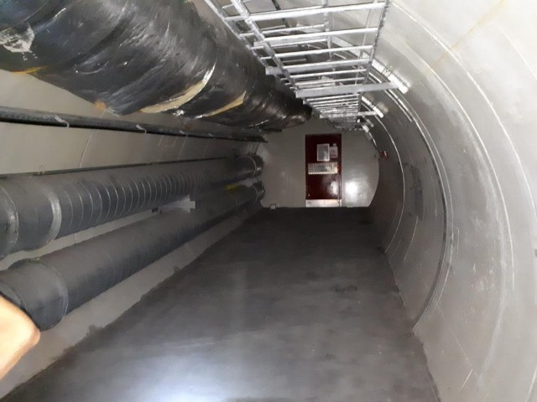
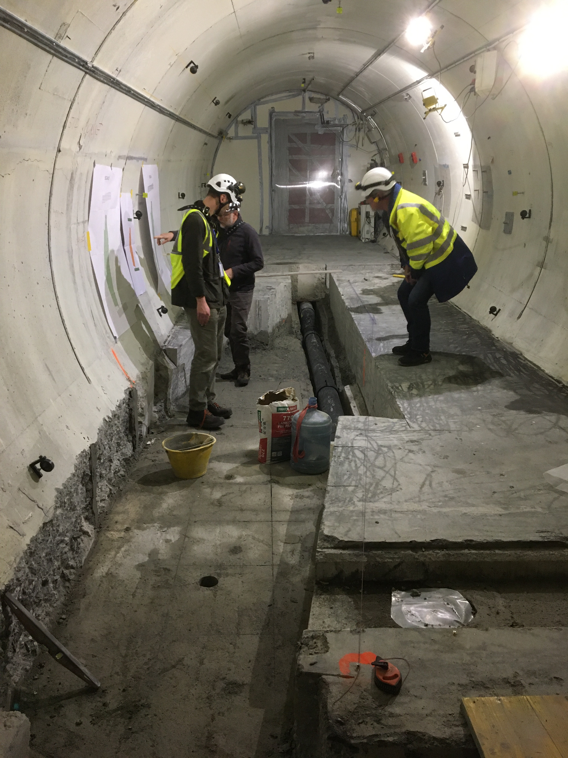
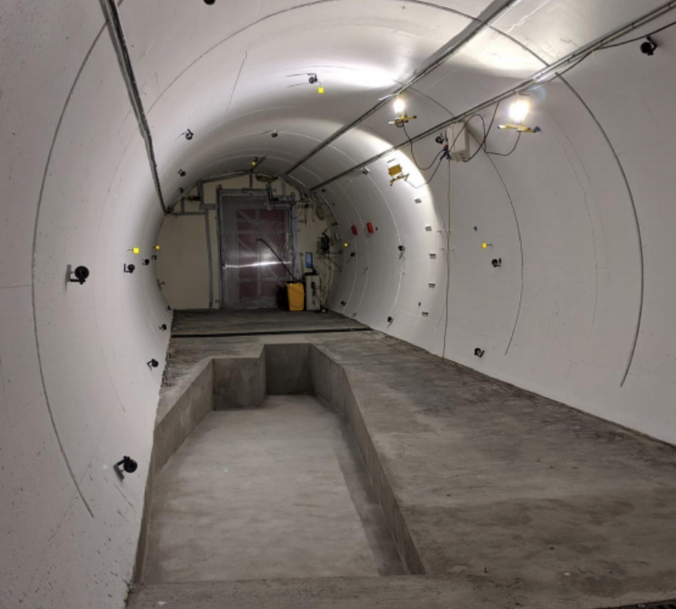
FASER IN TUNNEL TI12
The beam collision axis was located to mm accuracy by the CERN survey department. To place FASER on this axis, a trench was required to lower the floor by 46 cm.
The trench was completed by an Italian firm just hours before COVID shut down CERN in Spring 2020.
2019
Spring 2020
Summer 2020

Slide 12
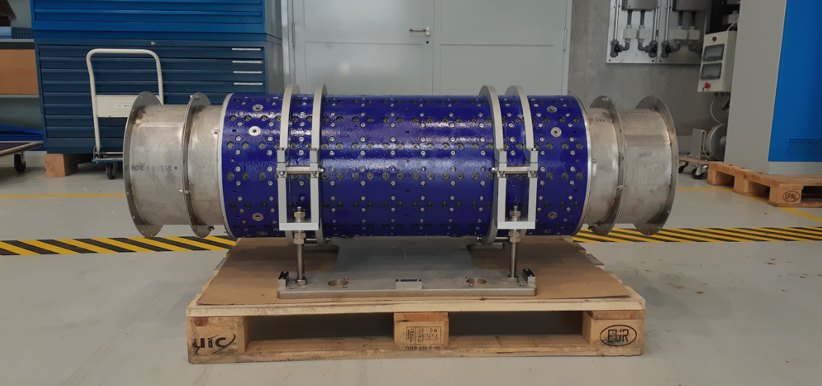
MAGNETS
FASER includes 3 magnets: 1.5 m, 1 m, and 1m long.
0.57 T permanent dipoles with an inner diameter of 20 cm, require little maintenance.
Constructed by the CERN magnet group.

Slide 13
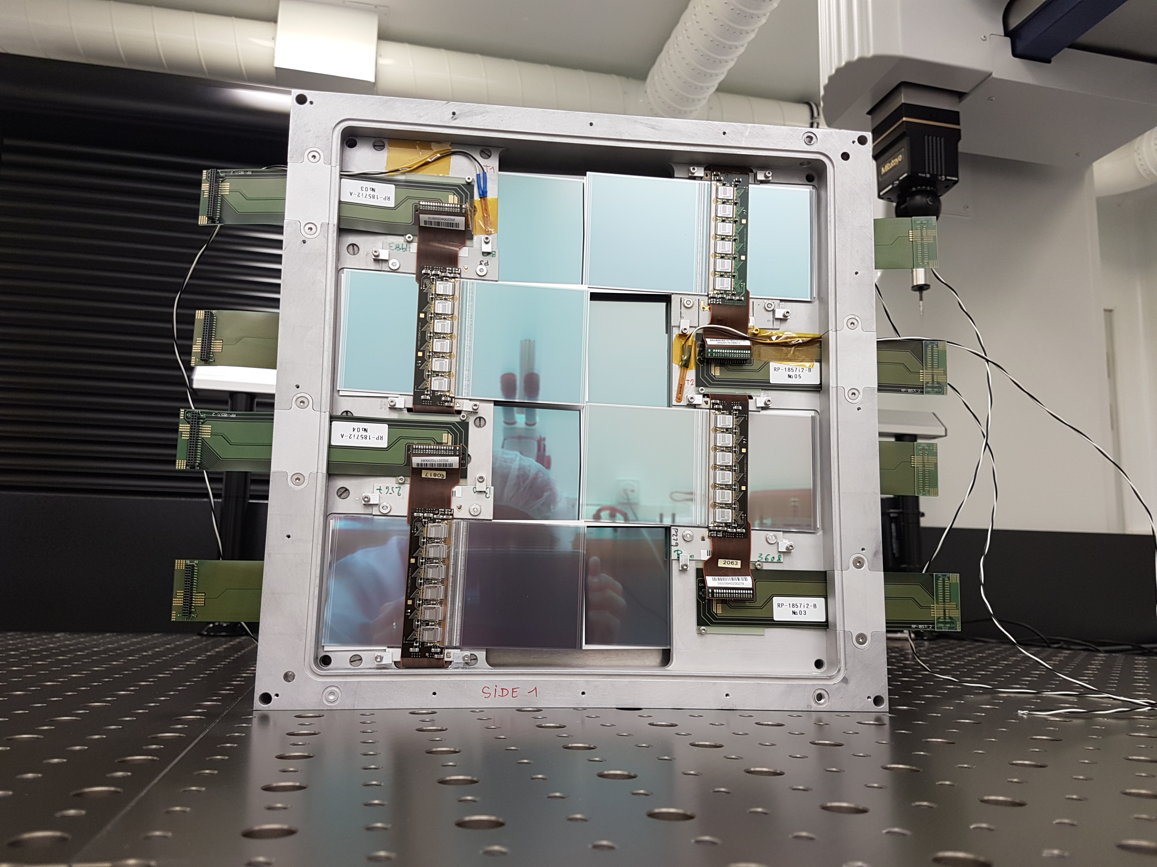
TRACKERS
ATLAS tracker consists of ~3000 SCT modules.
~300 spares were never used. ~100 of these were generously donated to FASER: 8 modules x 3 tracking planes x 4 tracking stations at FASER.

Slide 14
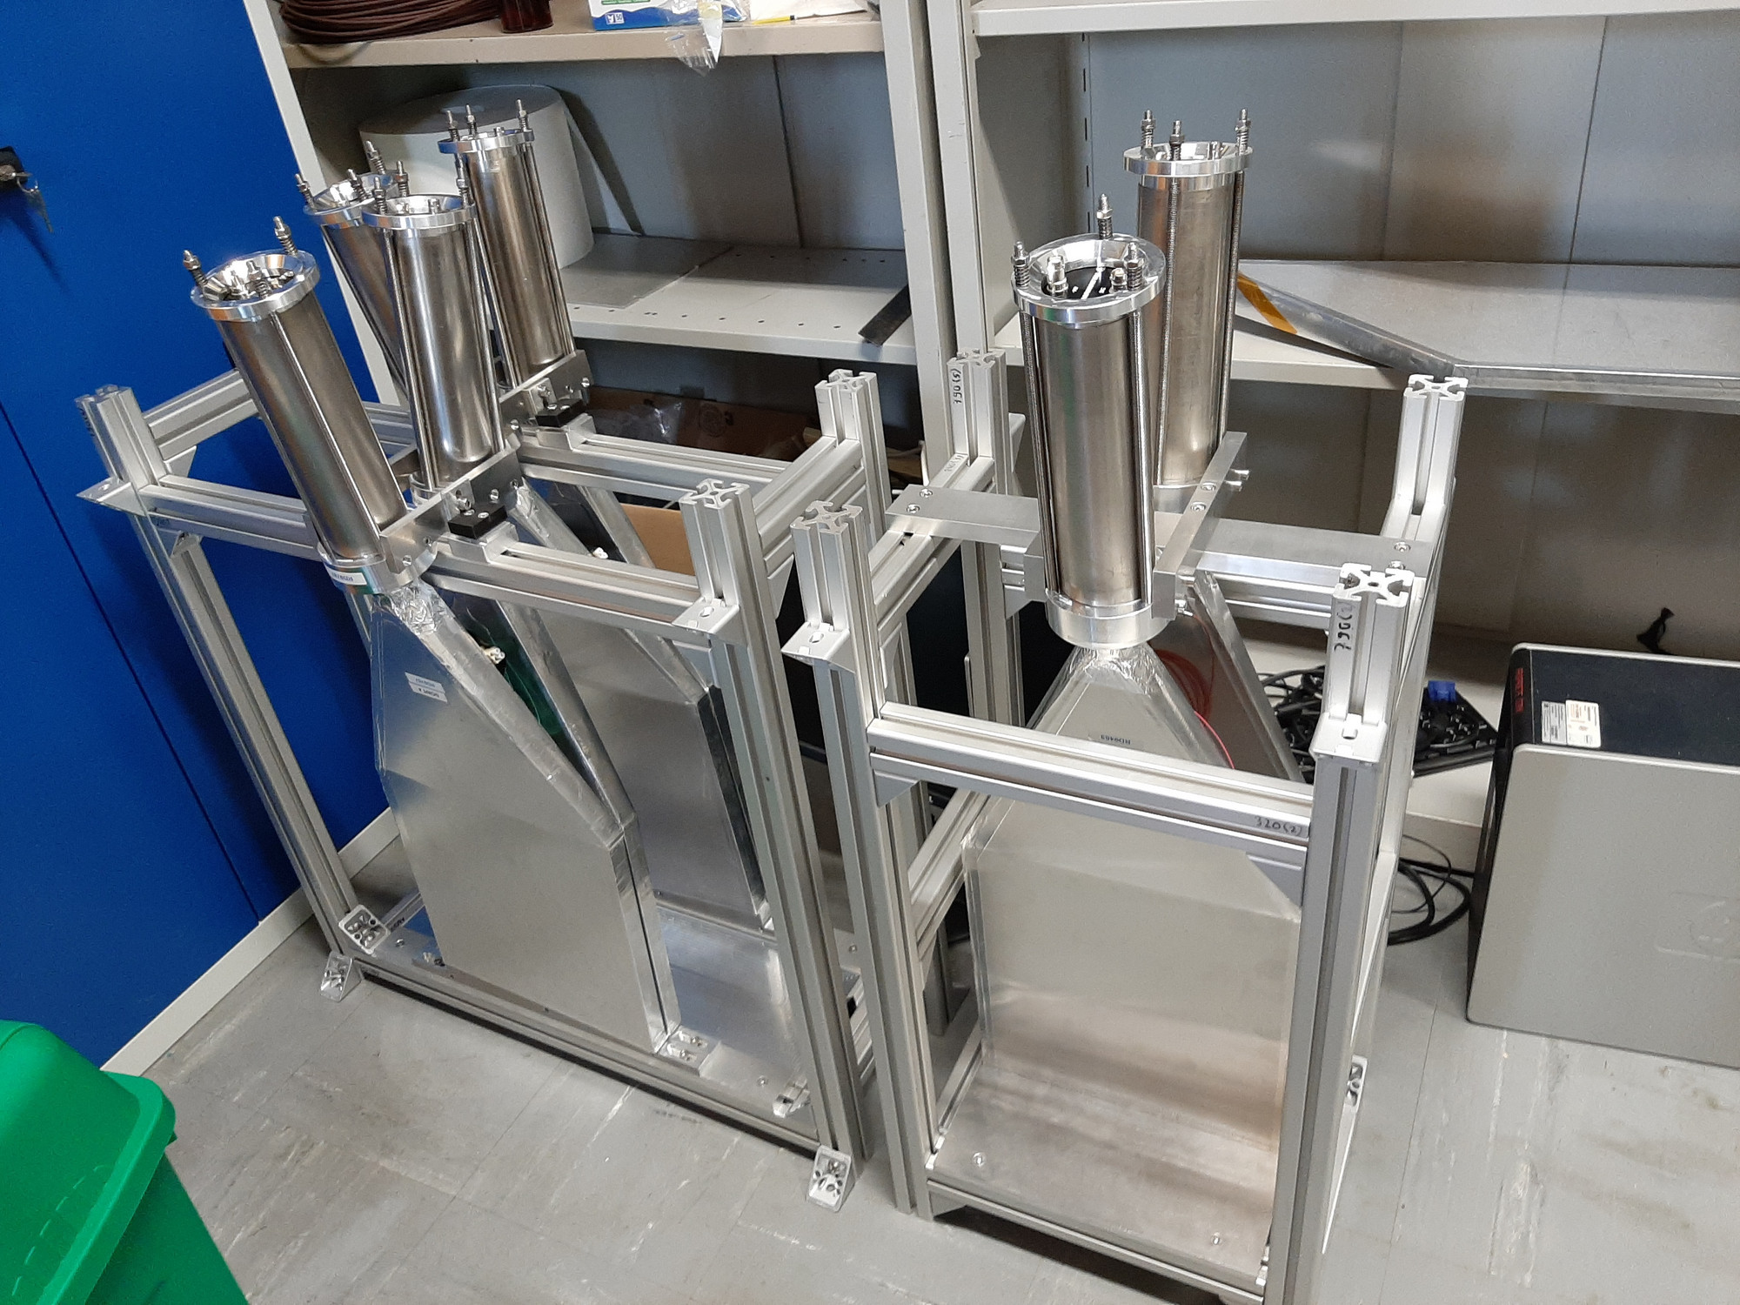
SCINTILLATORS
4 veto scintillators, each 2cm x 30cm x 30cm. Efficiency of each one is > 99.99%, reduces muon background by (10⁻⁴)⁴, makes negligible.
Additional beam backgrounds, simulated with FLUKA and validated with pilot detectors in 2018, are also expected to be negligible.

Slide 15
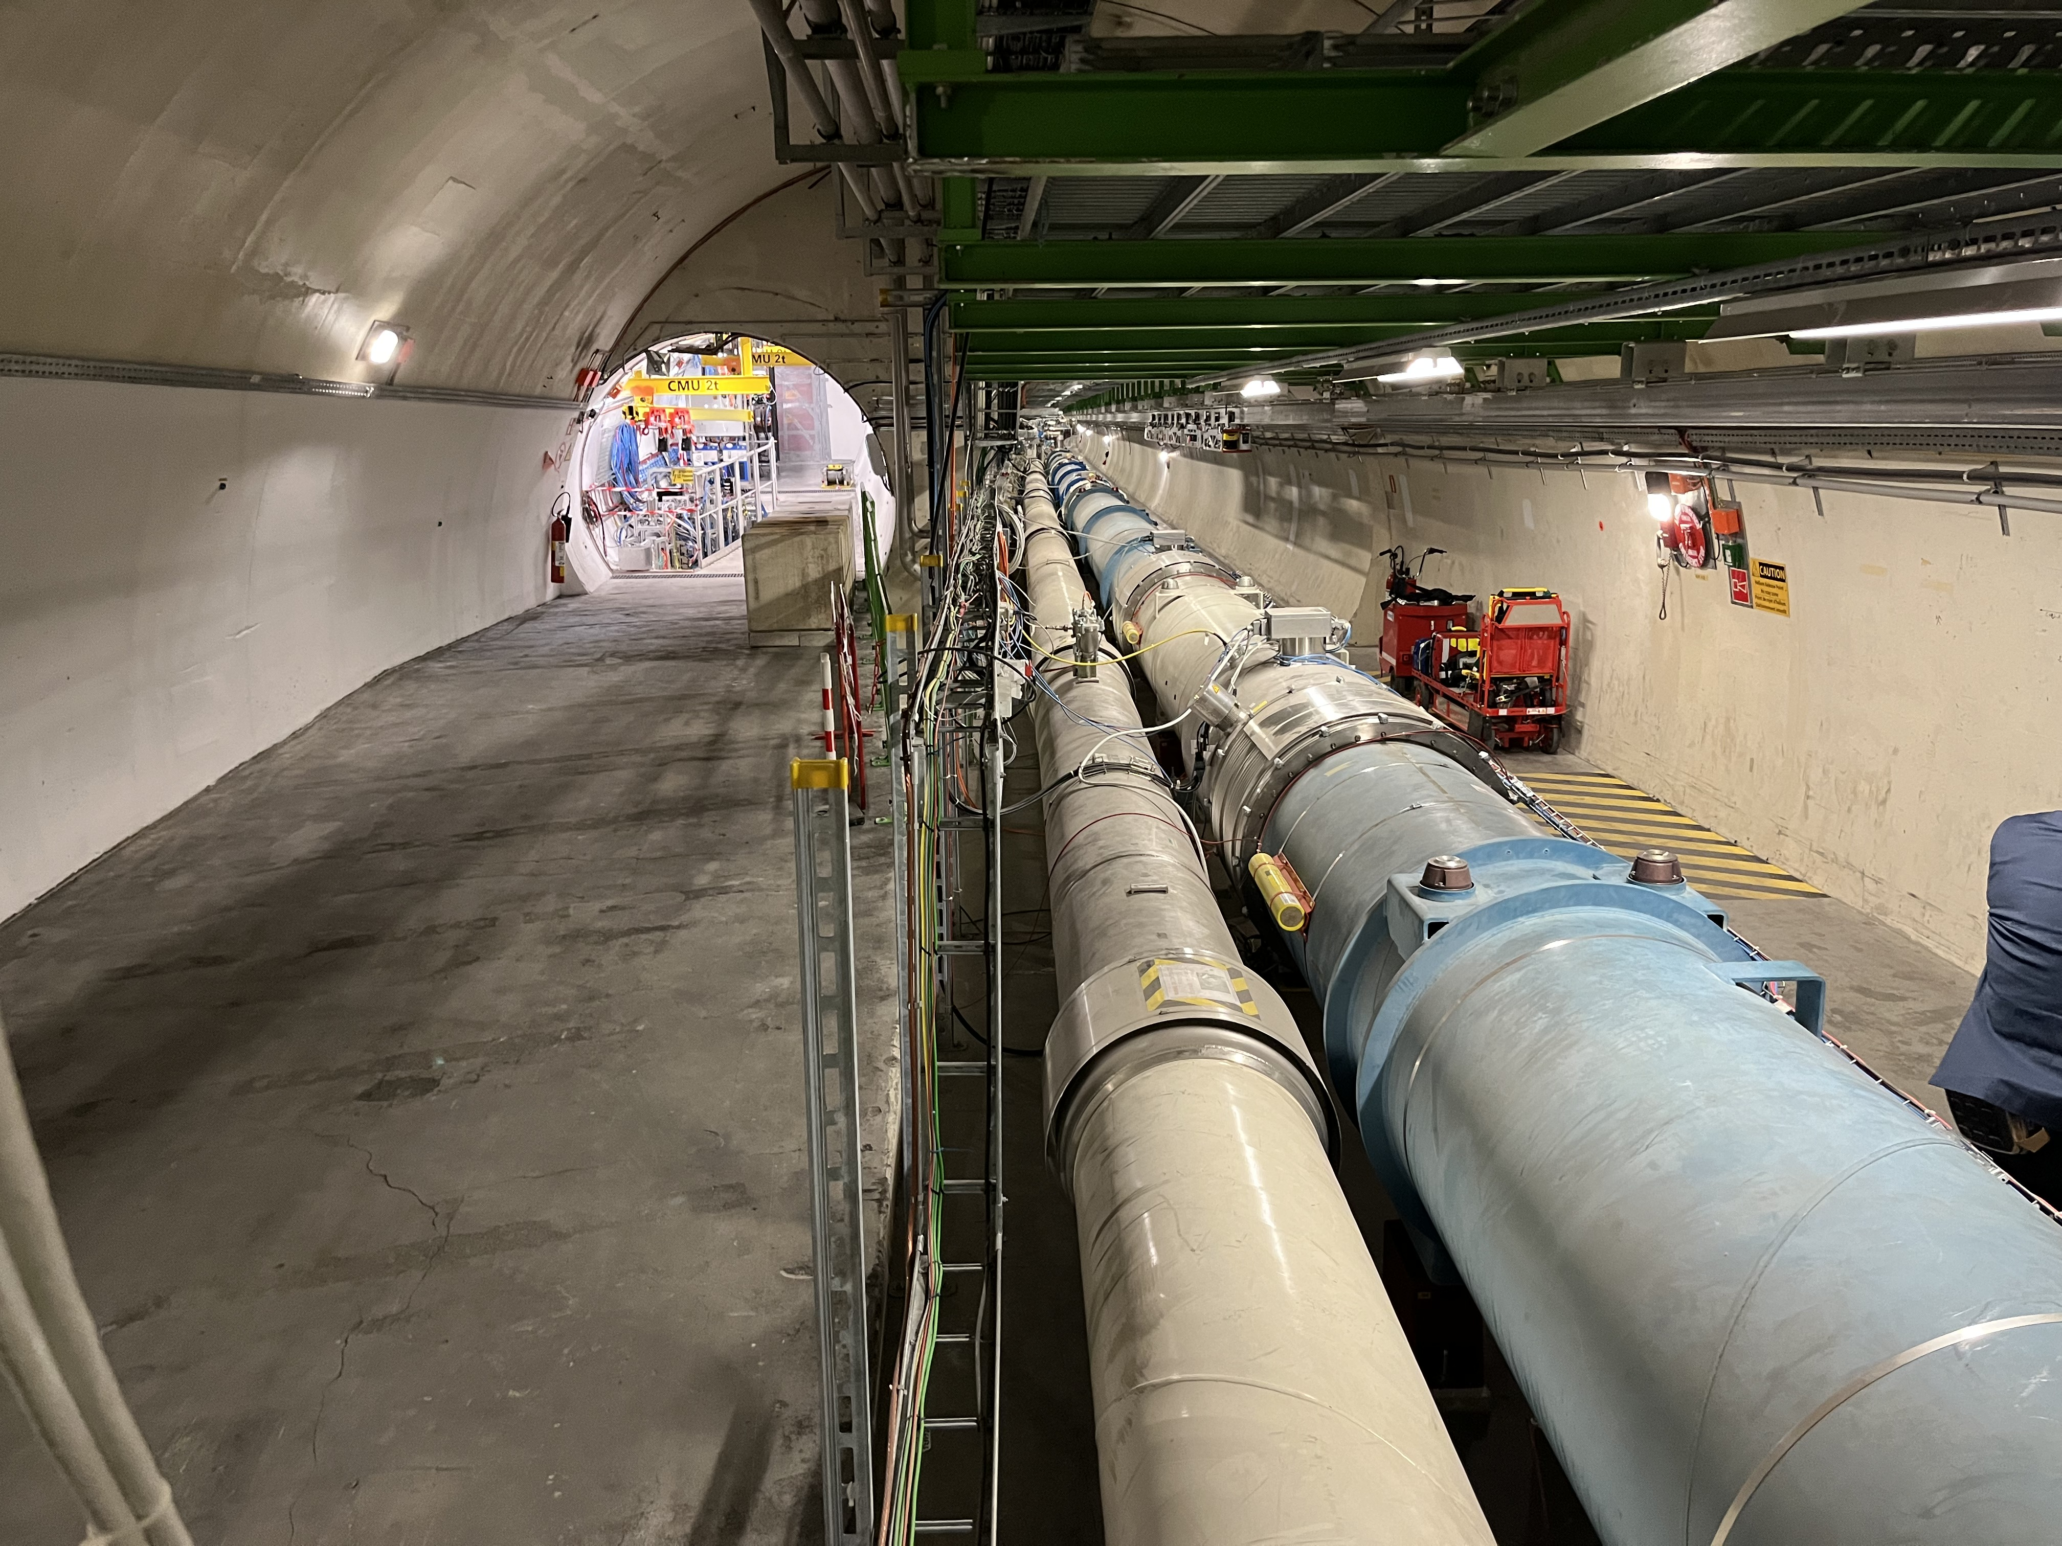
FASER CURRENT STATUS

Slide 16
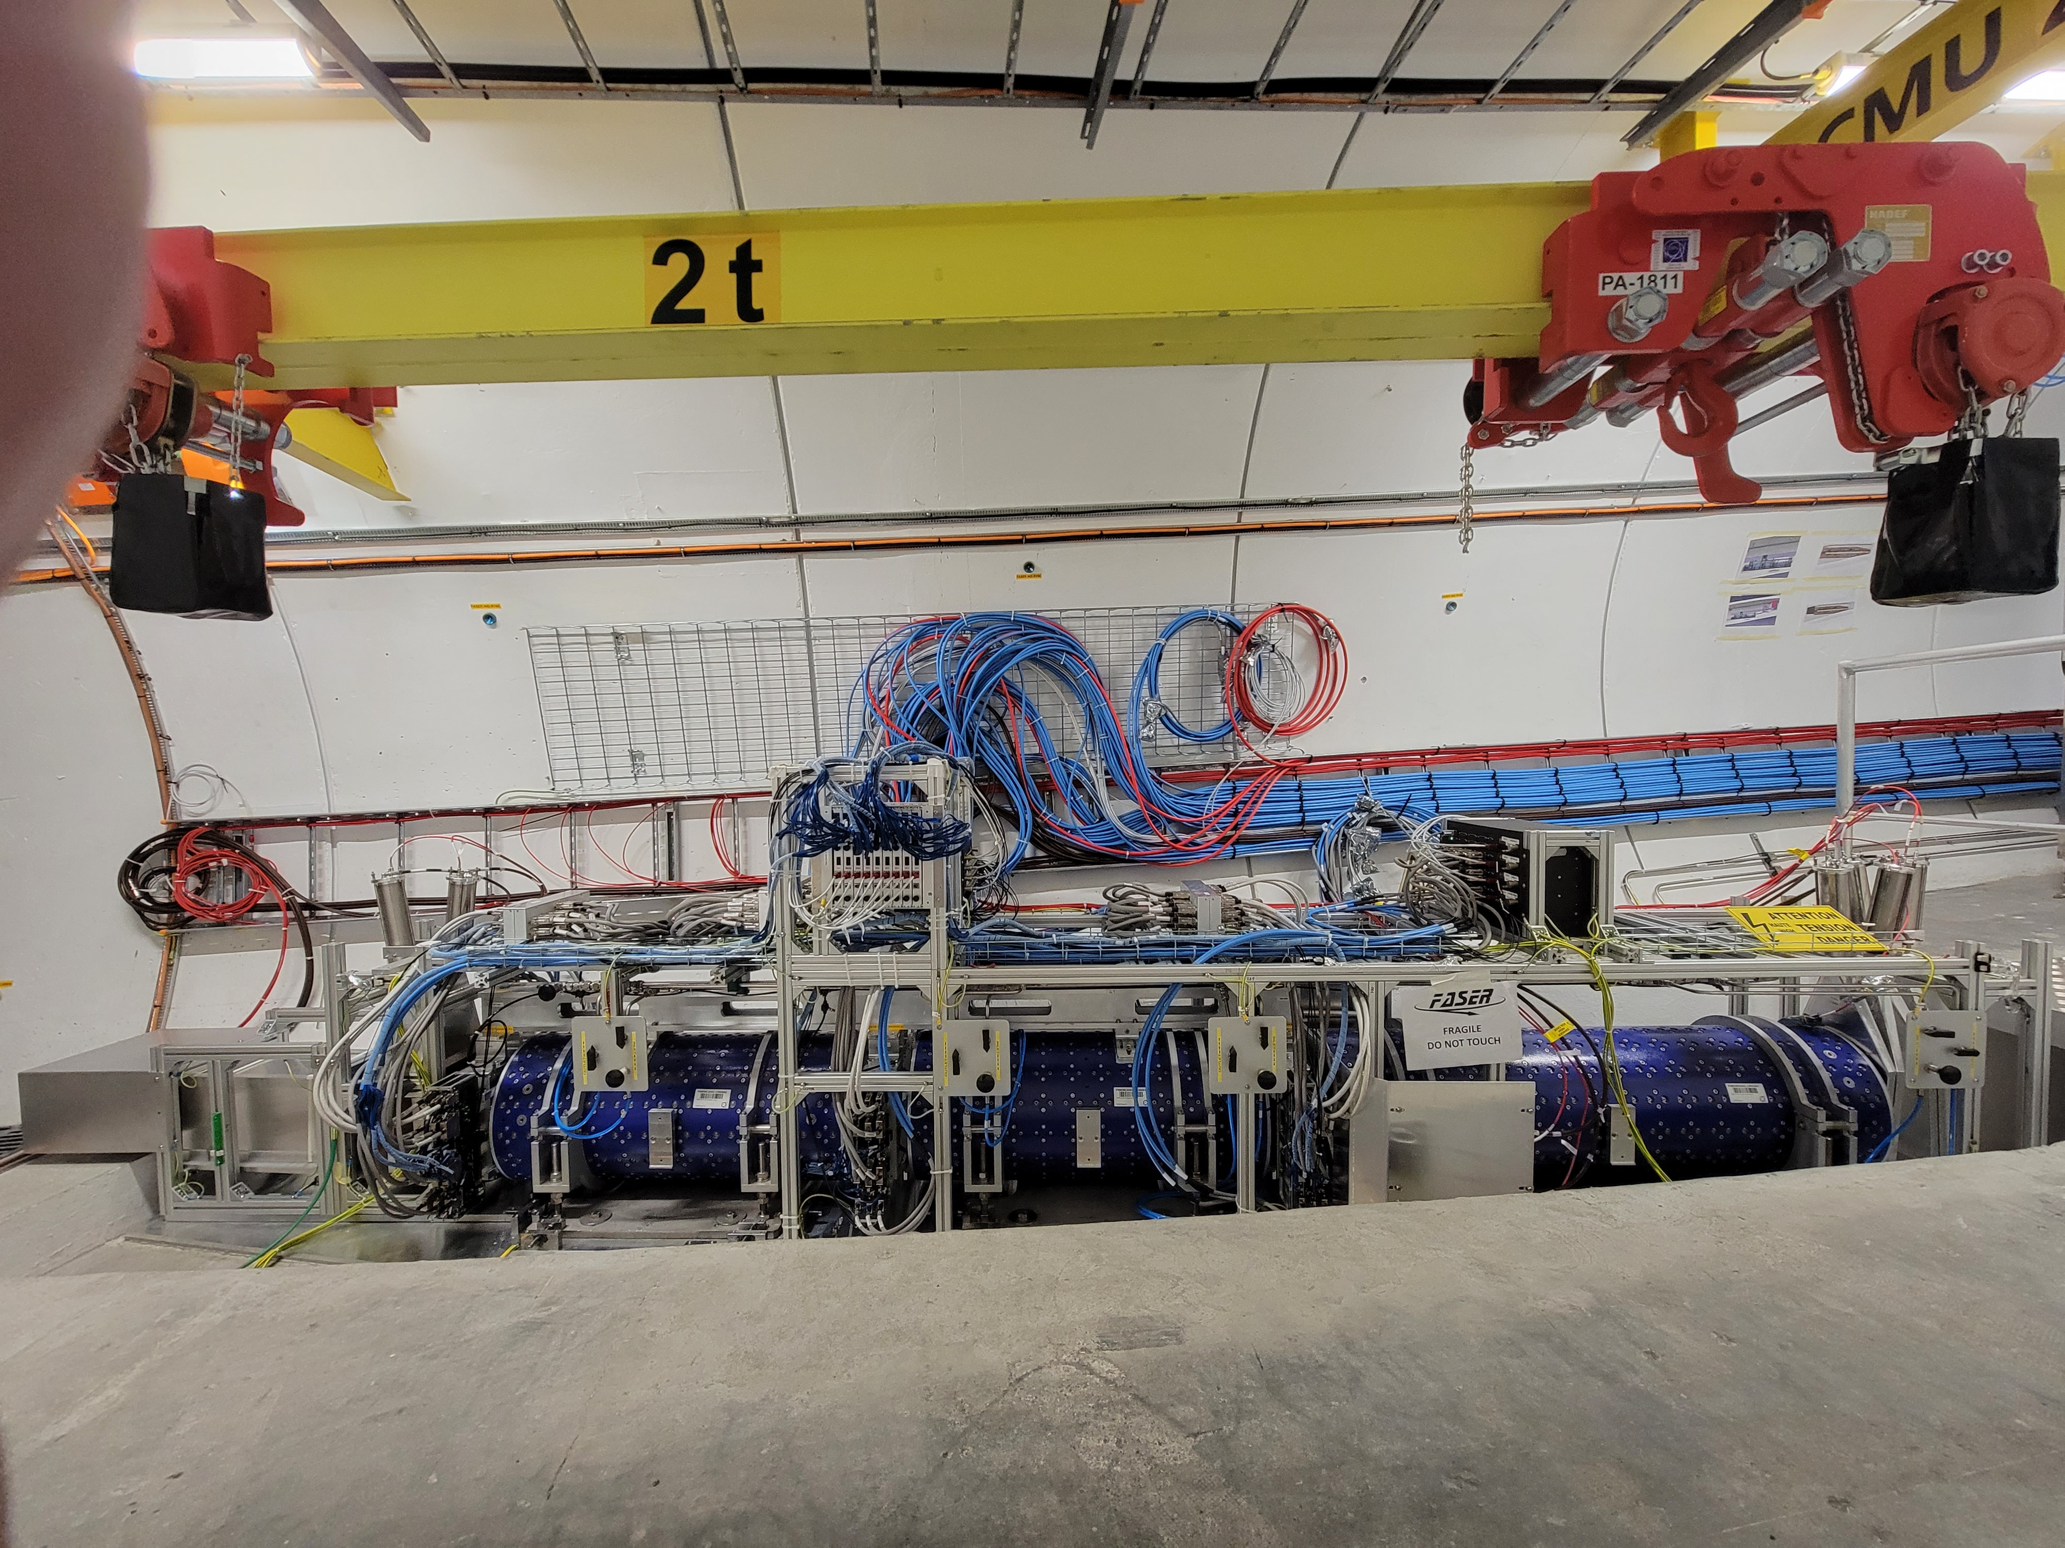
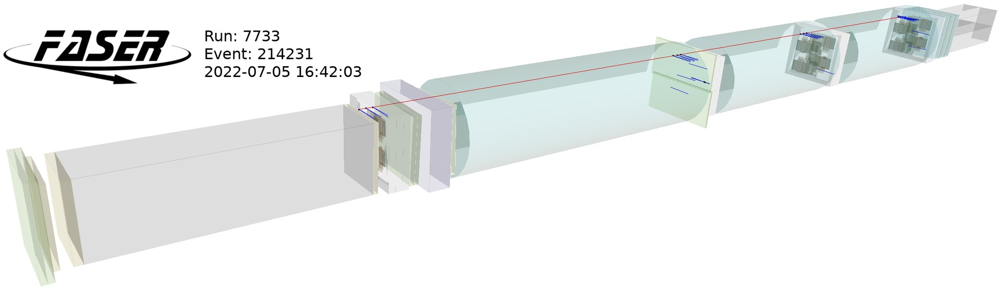
FASER CURRENT STATUS
FASER collected data during LHC Run 3 from July – November 2022.
FASER performed well, collected enough data to detect 100s of TeV neutrinos and probe new regions of parameter space in many BSM models. Analyses are currently underway.

Slide 17
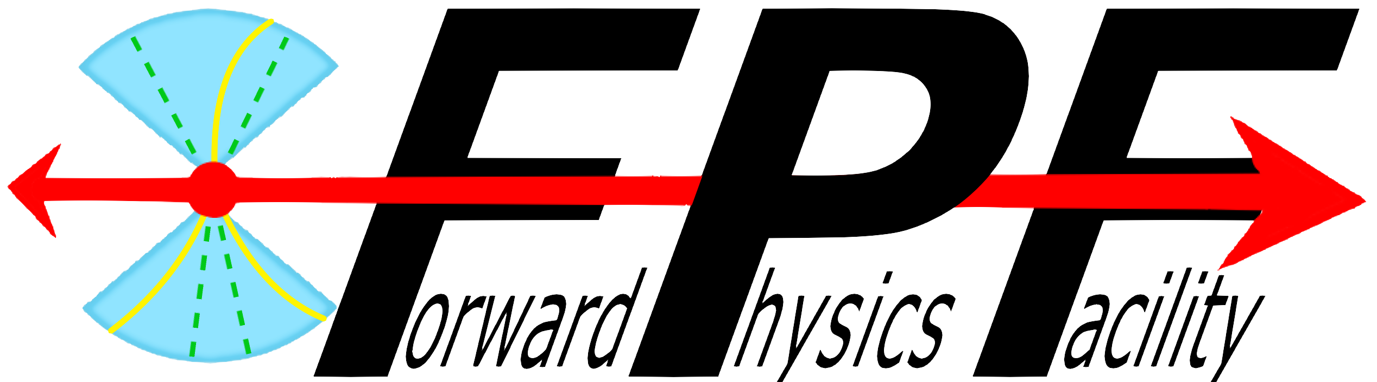

Slide 18
FORWARD PHYSICS FACILITY
FASER, FASERν, and other proposed far-forward detectors are currently highly constrained by 1980’s infrastructure (LEP!) that was never intended to support experiments.
The rich physics program in the far-forward region therefore strongly motivates creating a dedicated Forward Physics Facility to house far-forward experiments for the HL-LHC era from 2029-40.
FPF Meetings
  FPF Kickoff Meeting, 9-10 Nov 2020, https://indico.cern.ch/event/955956
  FPF2 Meeting, 27-28 May 2021, https://indico.cern.ch/event/1022352
  FPF3 Meeting, 25-26 Oct 2021, https://indico.cern.ch/event/1076733
  FPF4 Meeting, 31 Jan-1 Feb 2022, https://indico.cern.ch/event/1110746
  FPF5 Meeting, 15-16 Nov 2022, https://indico.cern.ch/event/1196506
FPF Papers
  “Short” Paper: 75 pages, 80 authors (2109.10905, Phys. Rept. 968, 1 (2022)).
  White Paper: 429 pages, 392-authors+endorsers (2203.05090, J. Phys. G).

Slide 19
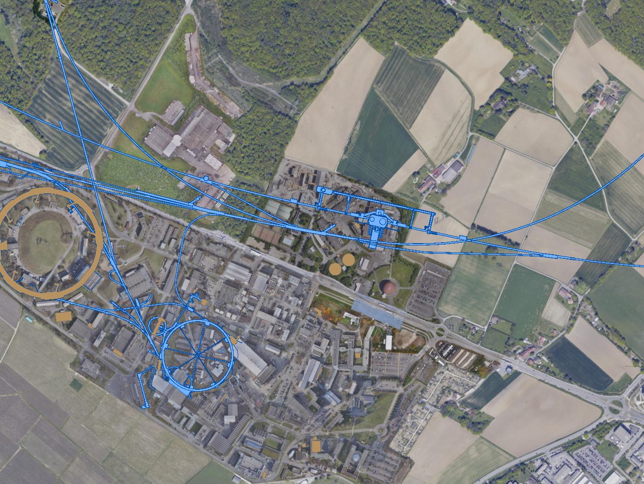
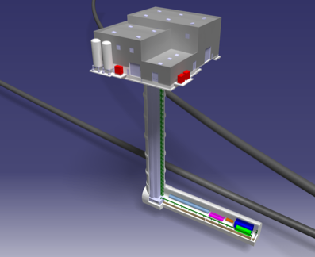
FPF LOCATION
Site selected: ~612 m to the west of ATLAS on CERN land in France.
Cavern: 65m long, 8m wide/high. Shaft: 88m-deep, 9.1m-diameter.
UJ18
ATLAS
SPS
UJ12
LHC
LOS
Kincso Balazs, CERN CE
CERN GIS

Slide 20
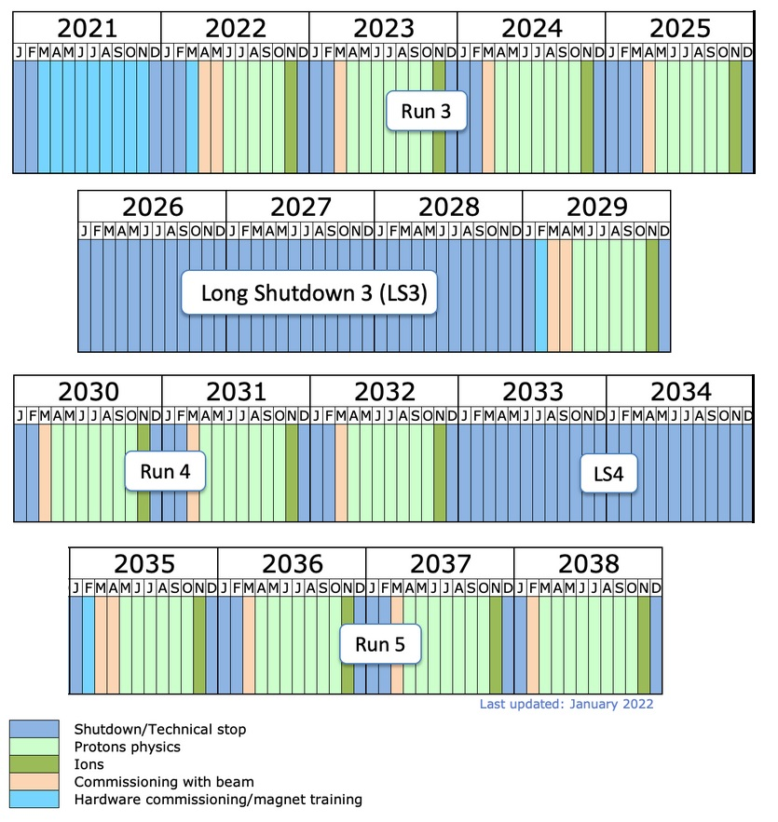
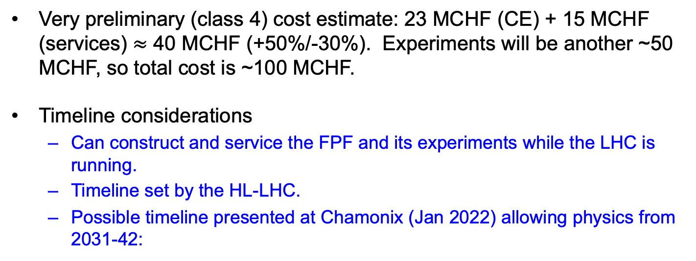
COST AND TIMELINE
Very preliminary (class 4) cost estimate: 23 MCHF (CE) + 15 MCHF (services) $≈$ 40 MCHF (+50%/-30%). Experiments will be another ~50 MCHF, so total cost is ~100 MCHF.
Timeline considerations
  Can construct and service the FPF and its experiments while the LHC is running.
  Timeline set by the HL-LHC.
  Possible timeline presented at Chamonix (Jan 2022) allowing physics from 2031-42:
Pure CE works
Construction of experiments
Installation
of services
by CERN
teams
Installation,
Commission-ing of experiments
Physics

Slide 21
SUMMARY
SM and new physics opportunities are currently being missed in the far-forward region at the LHC.
Modest investment in a few small experiments can solve this problem.
FASER and FASERν: 5 m long, ~$2M. Along with SND@LHC, will soon create the new field of LHC neutrino physics, and also look for many new particles.
In the future, the FPF and its experiments are being planned to carry this research program into the High Luminosity LHC era.
A’, a, mCPs, DM, …
π, K, D, $ν_{e}$ , $ν_{μ}$ , $ν_{τ}$

Slide 23

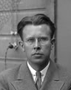
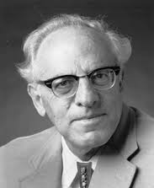
THE NEW PARTICLE LANDSCAPE
Particle
Colliders
Mass
MeV
GeV
TeV
1
Already
Discovered
Strongly Interacting
Heavy Particles
Interaction Strength
New Targets of Small Experiments
Traditional Targets
of Big Science
10⁻³
Weakly Interacting
Light Particles
Impossible to
Discover
10⁻⁶

Slide 24
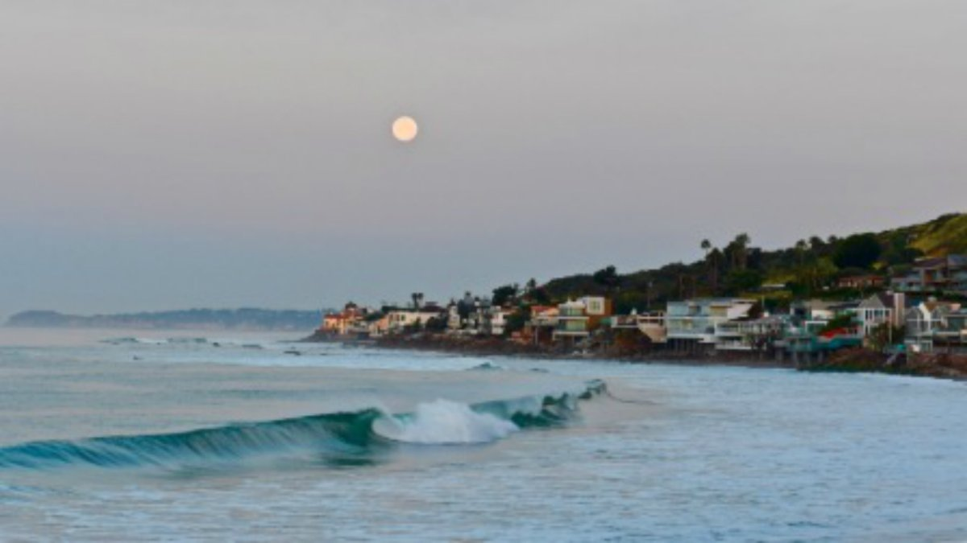
HOW BIG DOES THE DETECTOR HAVE TO BE?
Momentum:
Space:
250 MeV
1 TeV
12 cm
480 m
The opening angle is 0.2 mrad (η ~ 9); cf. the moon (7 mrad). Most of the signal passes through 1 sheet of paper at 480 m.
TeV dark photons (or any other new particles produced in π, η, K, D, B decay) are far more collimated than shown below, motivating a new, small, fast, cheap experiment at the LHC.

Slide 25
DARK PHOTON SENSITIVITY REACH
FASER
FASER has collected 10 fb⁻¹ and has started probing many new models.
Without upgrade, HL-LHC extends (Luminosity*Vol) by factor of 3000 – could detect as many as 10,000 dark photons.
Possible upgrade to FASER 2 (R=1m, L=20m) extends (Luminosity*Vol) by factor of ~10⁶ – could detect as many as 3 x 10⁶ dark photons.
_{FASER Collaboration (2018)}

Slide 26
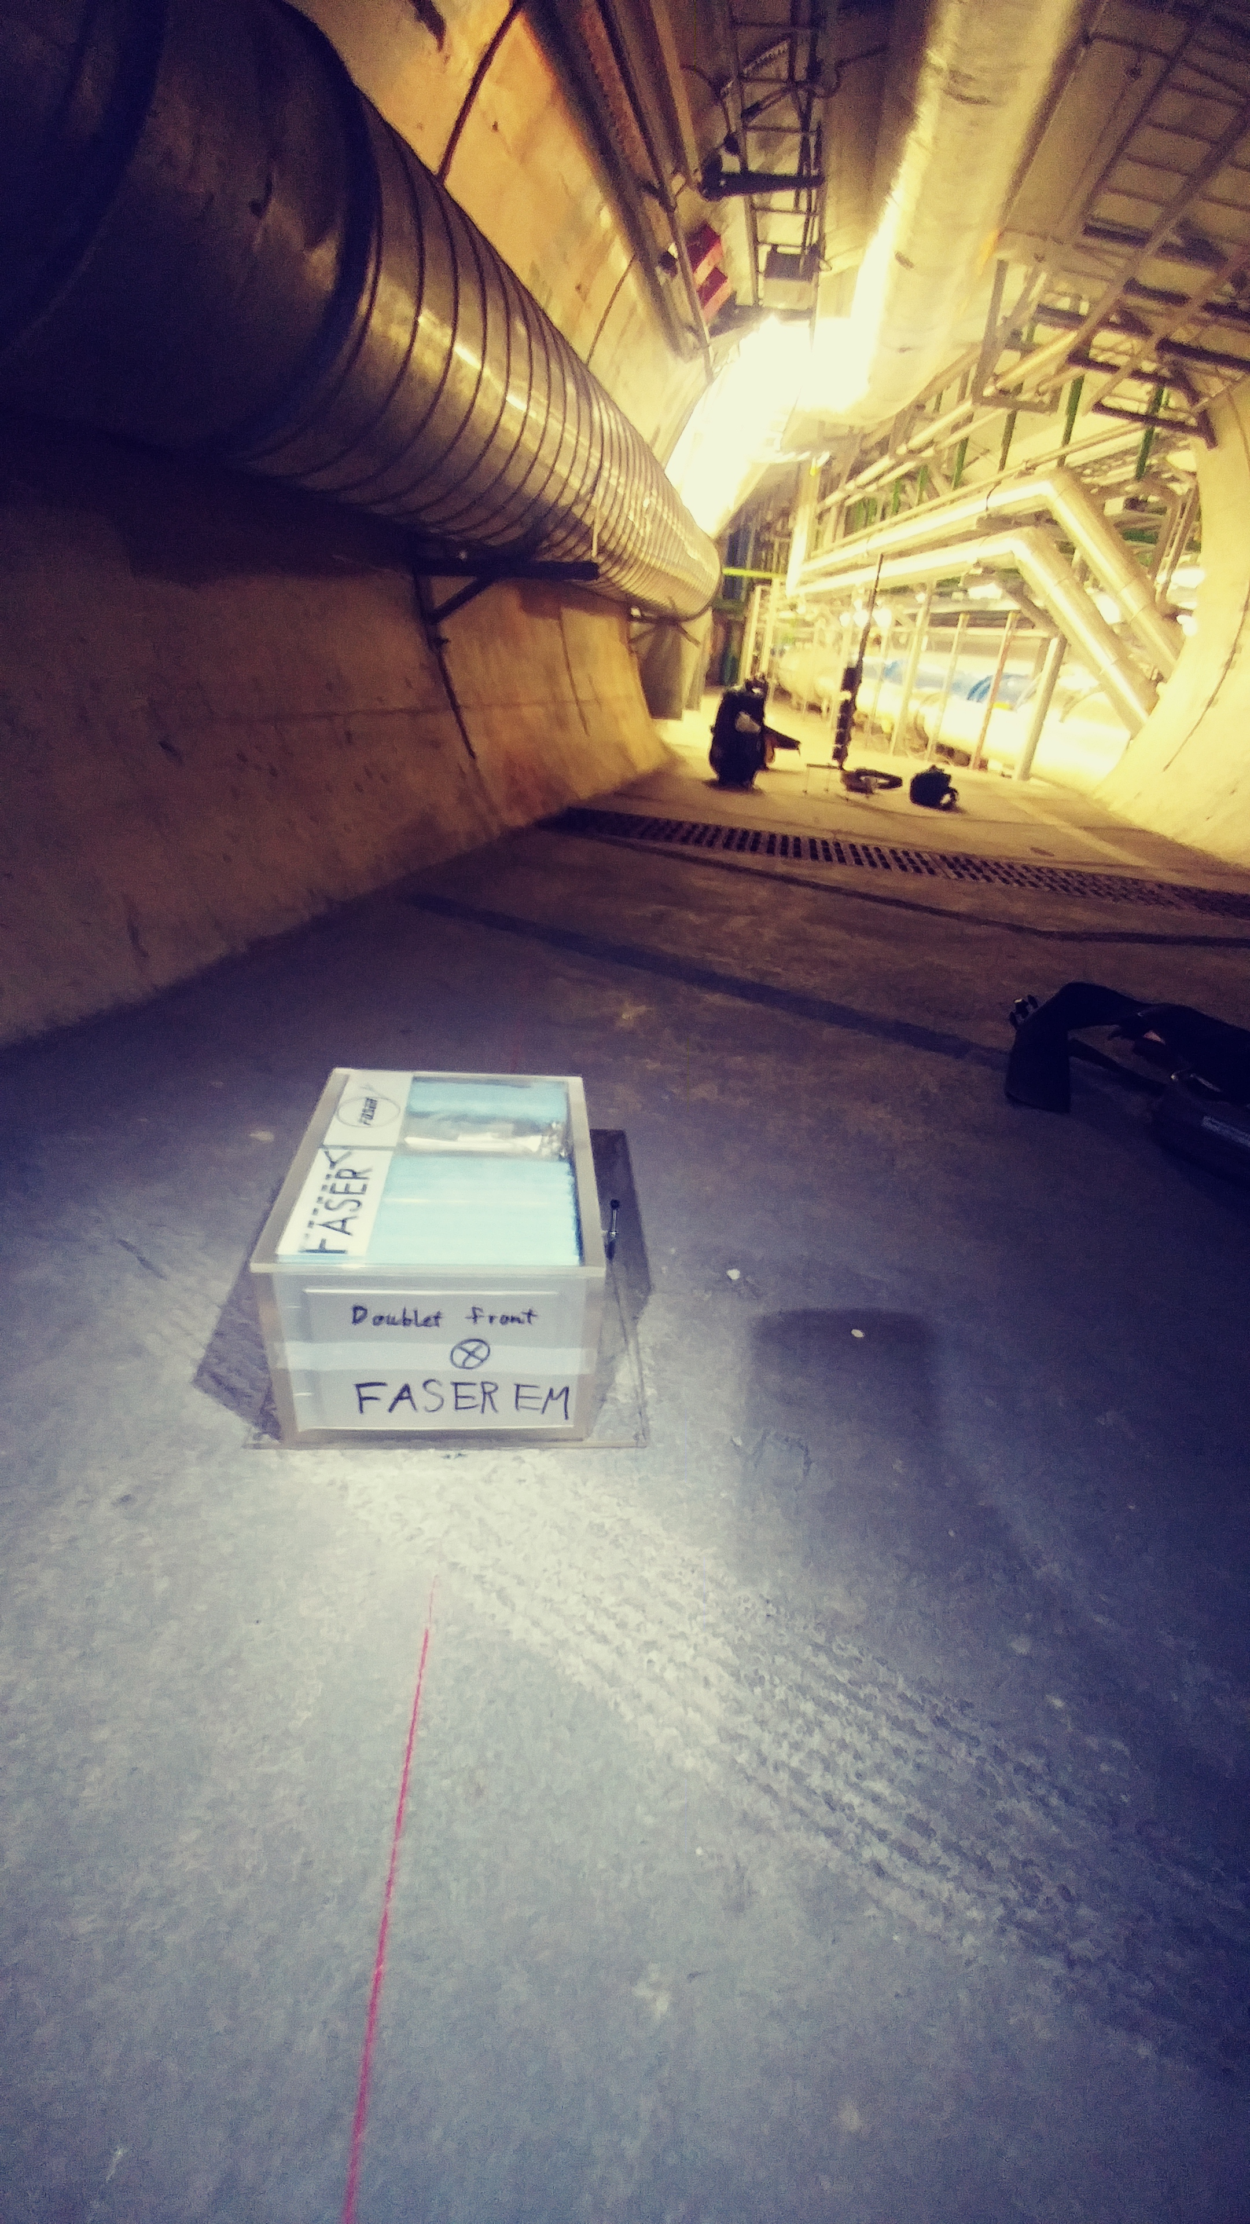
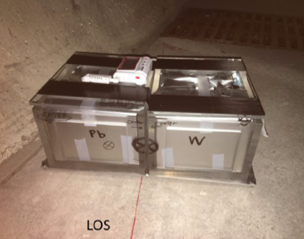
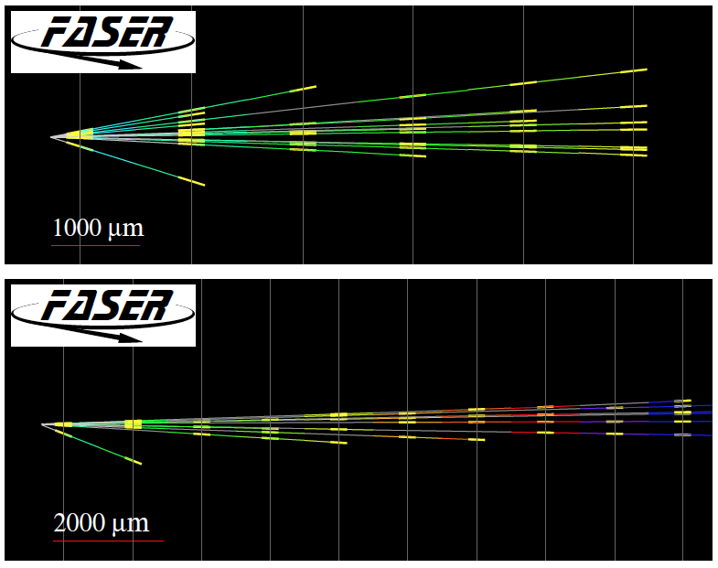
FIRST COLLIDER NEUTRINOS
In 2018 a FASER pilot emulsion detector with 11 kg fiducial mass collected 12.2 fb⁻¹ on the beam collision axis (installed and removed during Technical Stops).
In May 2021, the FASER Collaboration announced the direct detection of 6 candidate neutrinos above 12 expected neutral hadron background events (2.7σ).
This opens up a new field: neutrino physics at colliders.

Slide 27
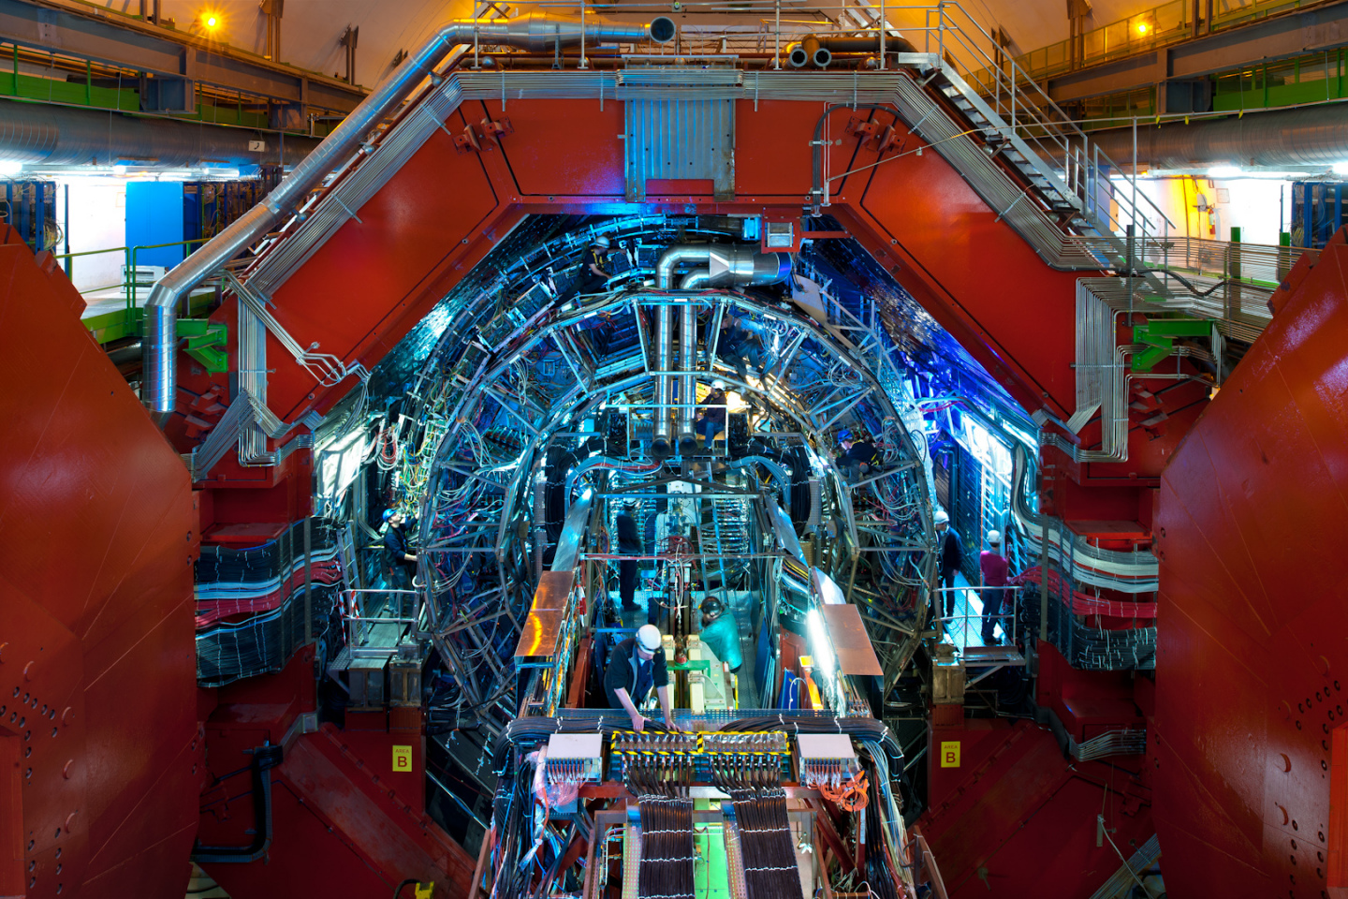
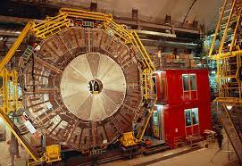
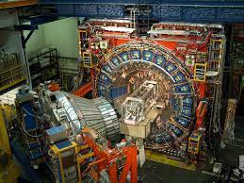
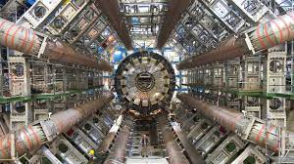
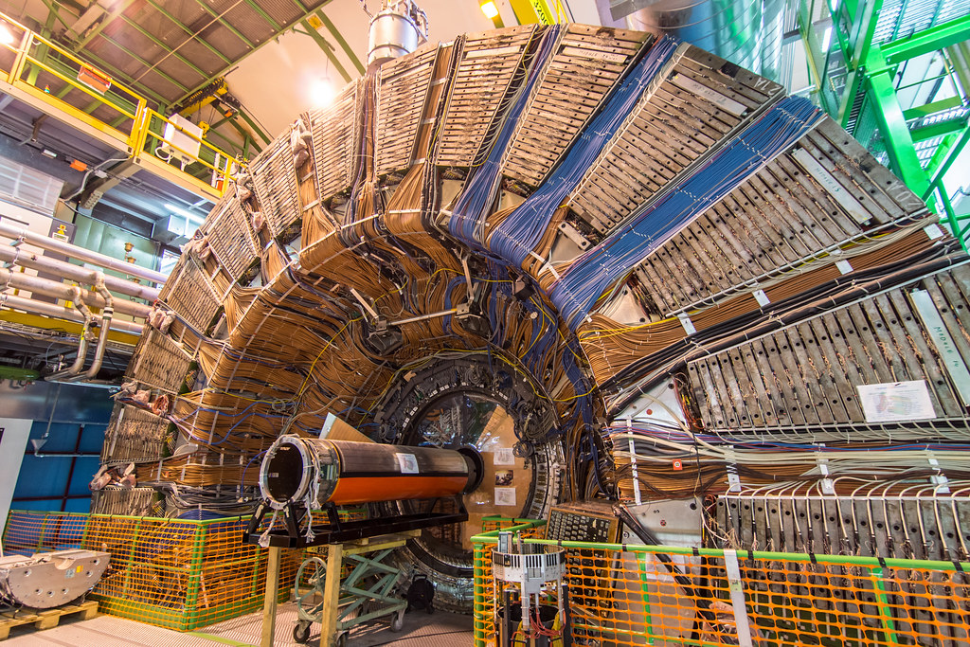
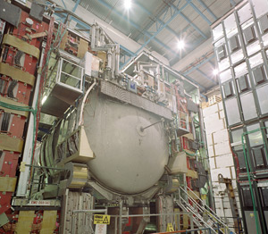
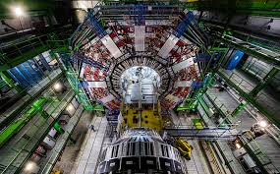
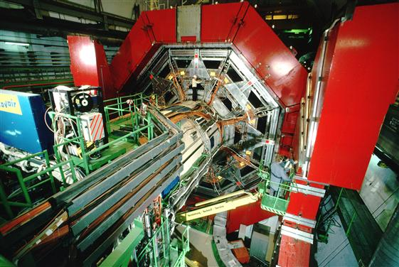
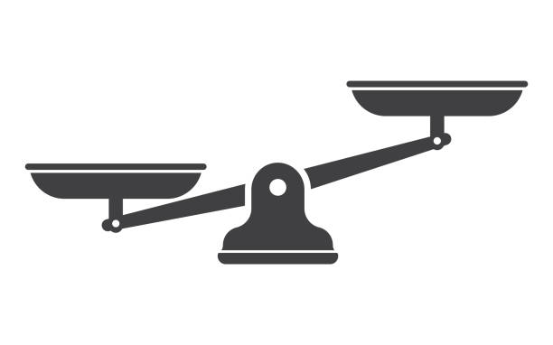
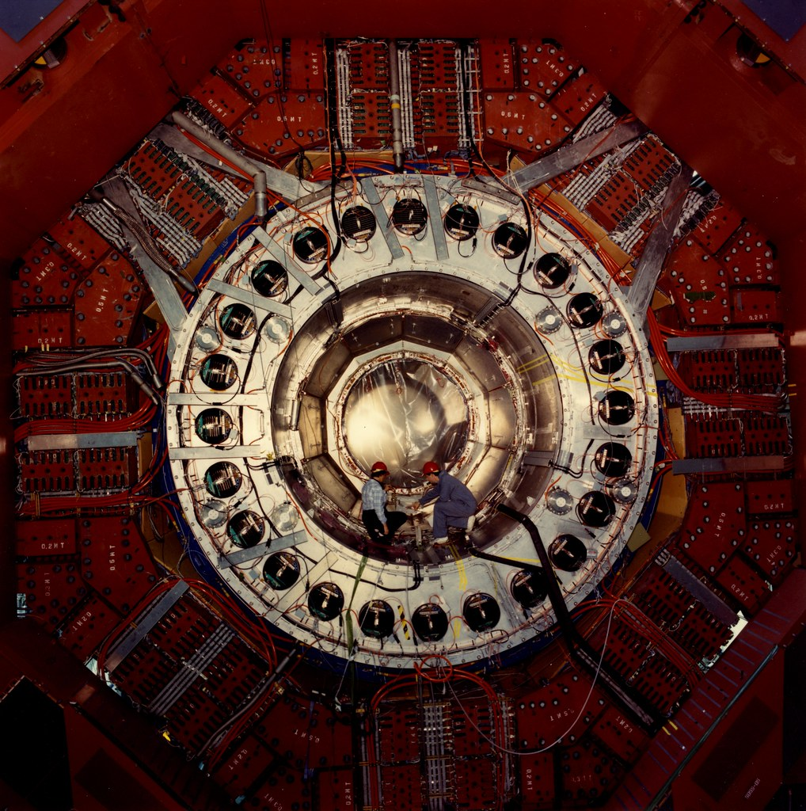
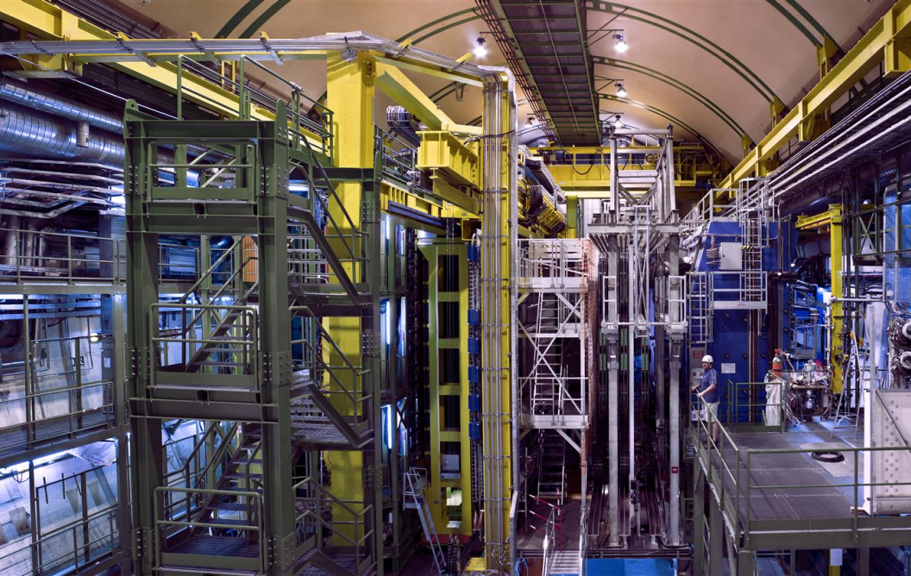
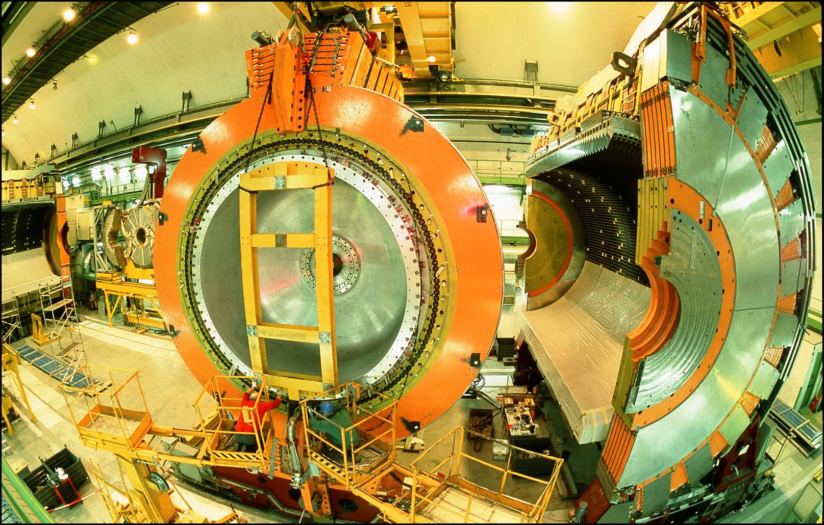
LOCATION, LOCATION, LOCATION
…
ALICE
ALEPH
CDF
FASER Pilot Detector
Suitcase-size, 4 weeks
$0 (recycled parts)
6 candidate neutrinos
ATLAS
DELPHI
D0
CMS
L3
LHCb
SLD
OPAL
All previous
collider detectors
Building-size, decades
~$10⁹
0 candidate neutrinos

Slide 28
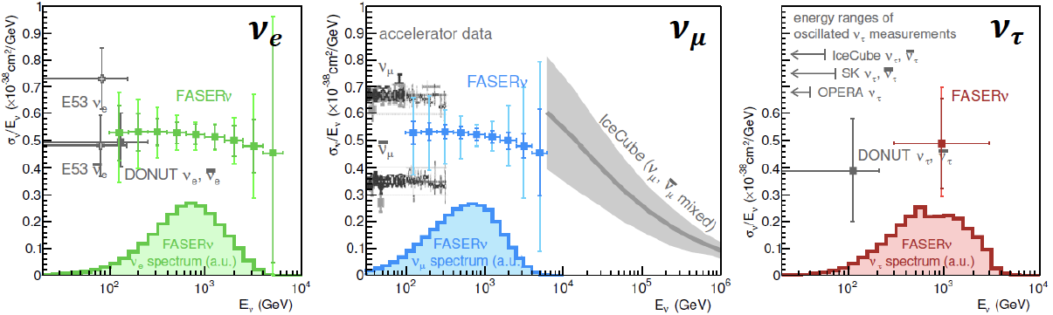
NEUTRINO PHYSICS
In Run 3 (2022-24), the goals of FASERν are to
  Detect the first collider neutrino.
  Record ~1000 ν_{e} , ~10,000 ν_{μ} , and ~10 ν_{τ} interactions at TeV energies, the first direct exploration of this energy range for all 3 flavors.
  Distinguish muon neutrinos from anti-neutrinos by combining FASER and FASERν data, and so measure their cross sections independently.
  Add significantly to the number of ν_{τ} and detect the first anti-ν_{τ} .
FASER Collaboration 1908.02310 (2019)

Slide 29
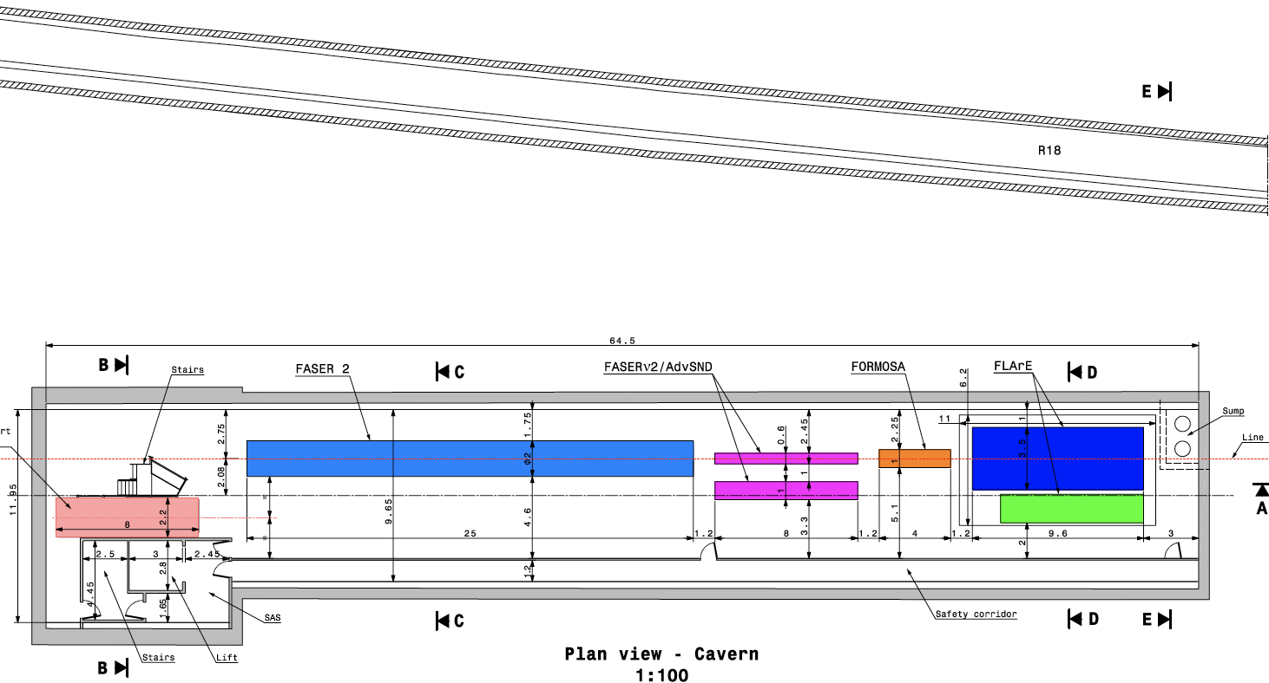
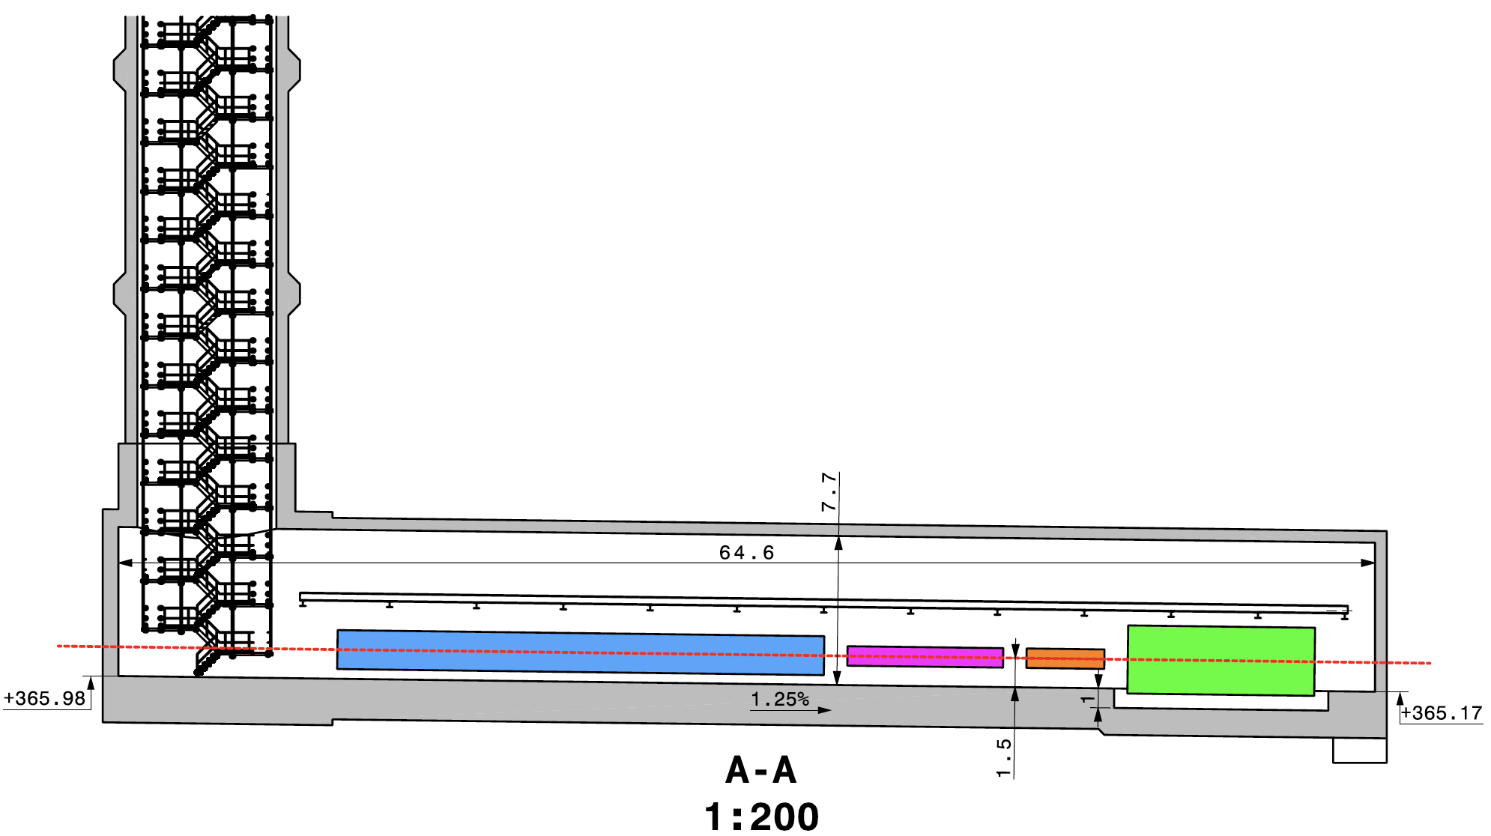
CAVERN AND SHAFT
Cavern: 65m long, 8m wide/high. Shaft: 88m-deep, 9.1m-diameter.
The FPF is completely decoupled from the LHC (as of today, no need for a safety corridor connecting FPF to the LHC).

