Slide 1



PARTICLE THEORY AND EXPERIMENT:
FORWARD PHYSICS, FASER, AND THE FPF
Jonathan Feng and Dave Casper
Pizza Seminar, 18 November 2022

Slide 2
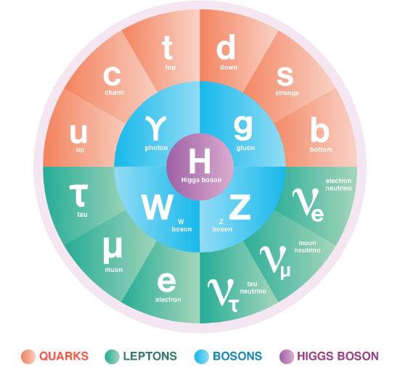
THE STANDARD MODEL OF PARTICLE PHYSICS
The Higgs boson discovery in 2012, completed the Standard Model of particle physics, but many fundamental questions remain.
Neutrino Masses
Dark Matter
Dark Energy
Matter–Anti-Matter Asymmetry
…
Many of the most outstanding questions are at the interface of particle physics and cosmology, are concerned with very weakly-interacting particles, and require new particles.

Slide 3
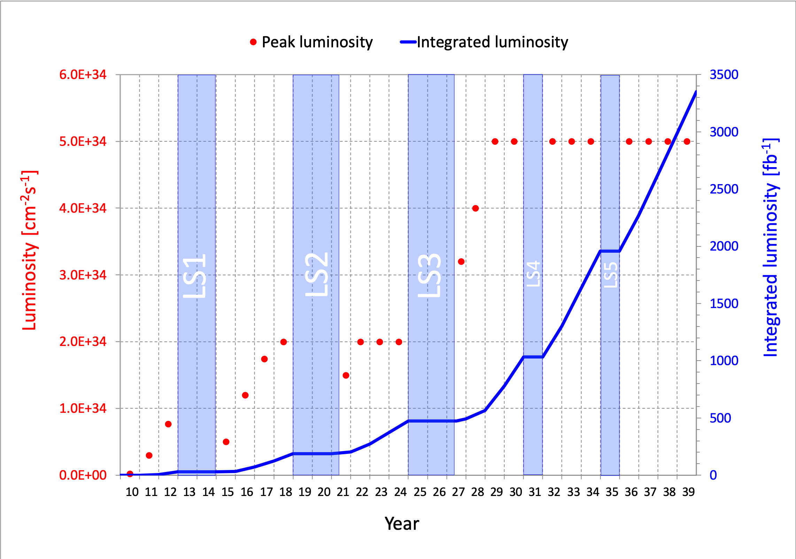
LARGE HADRON COLLIDER
Particle colliders have been key to progress for many decades. The latest and greatest particle collider is the Large Hadron Collider at CERN in Geneva.
The LHC started collecting data again in July 2022 and will run until ~2040. Will we find new particles?
More importantly, what can we do to enhance the prospects for discovering new physics?

Slide 4

THE LARGE HADRON COLLIDER
The current energy frontier is at the LHC in Geneva
.
FASER
Now colliding protons at 99.999999% the speed of light
Notes:
4

Slide 5

THE ATLAS DETECTOR
One of several giant detectors that observe particle collisions at the LHC
Notes:
5

Slide 6

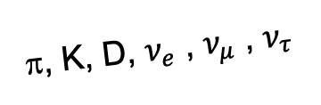
AN OBVIOUS QUESTION
Are we missing opportunities at the LHC?
In the last 5 years, we have discovered that the answer is YES: the LHC is far from operating at full potential.
By far the largest fluxes of high-energy light particles (e.g., pions, kaons, D mesons, neutrinos) are in the far-forward direction.
This may also be true of many interesting new particle candidates: dark photons, axion-like particles, millicharged particles, dark matter, …
All of these particles are dominantly produced along the beamline and escape through the blind spots of existing detectors.
A’, a, mCPs, χ, …
π, K, D, $ν_{e}$ , $ν_{μ}$ , $ν_{τ}$

Slide 7


Slide 8
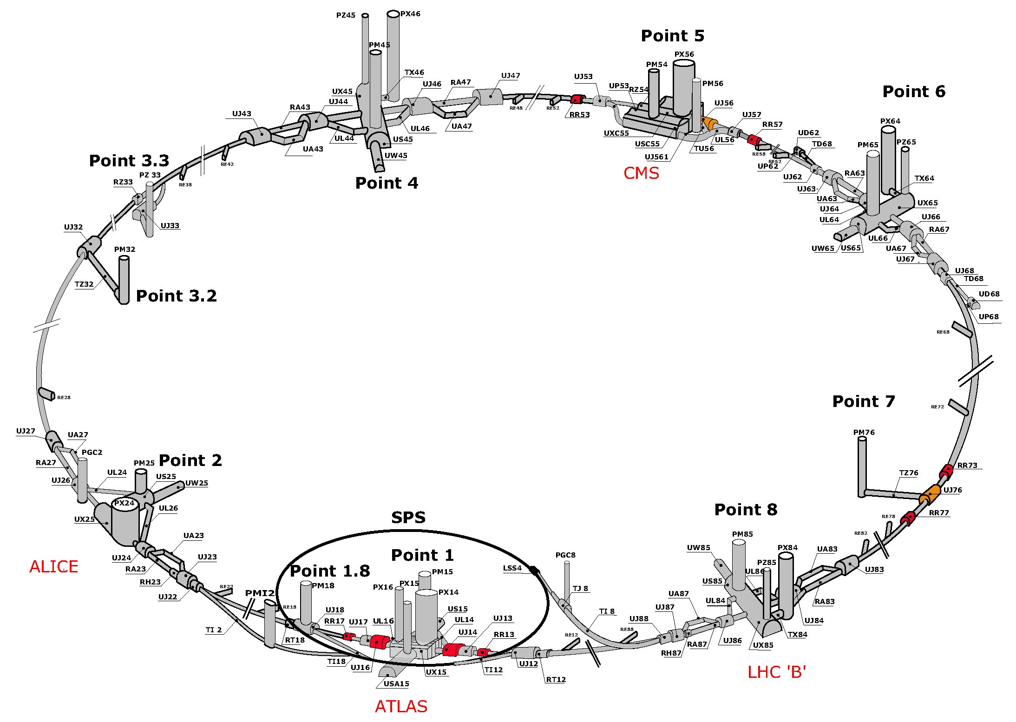
MAP OF LHC
!!!

Slide 9
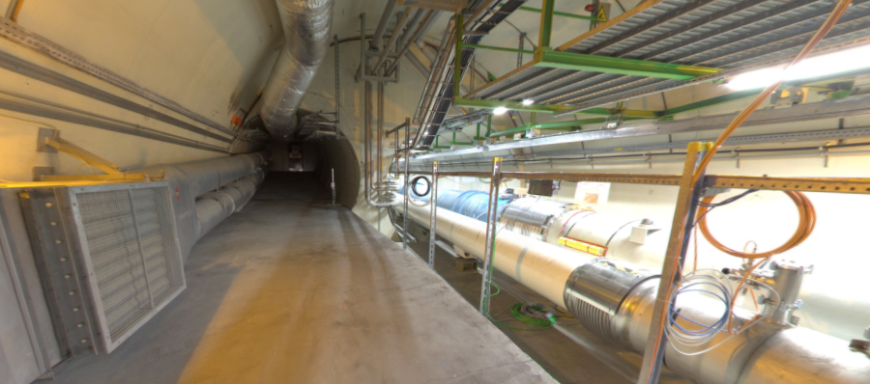
THE FAR-FORWARD REGION
Beam collision axis passes
through 100 m of rock, emerges in tunnel TI12, 480 m from ATLAS
UJ12
TI12 near UJ12
The view in UJ12 looking west (2019)
TI12
Beam collision axis
LHC beamline

Slide 10
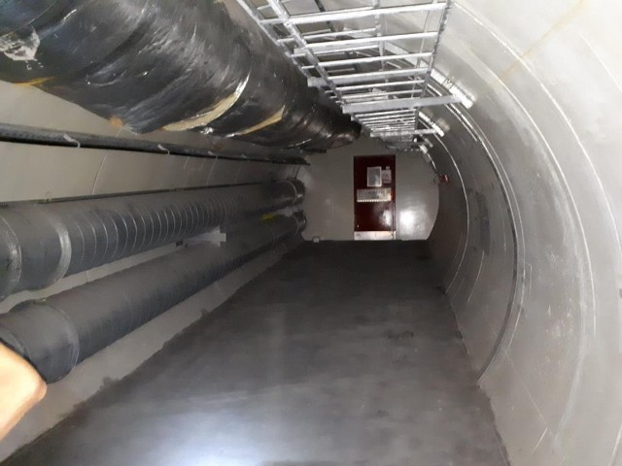
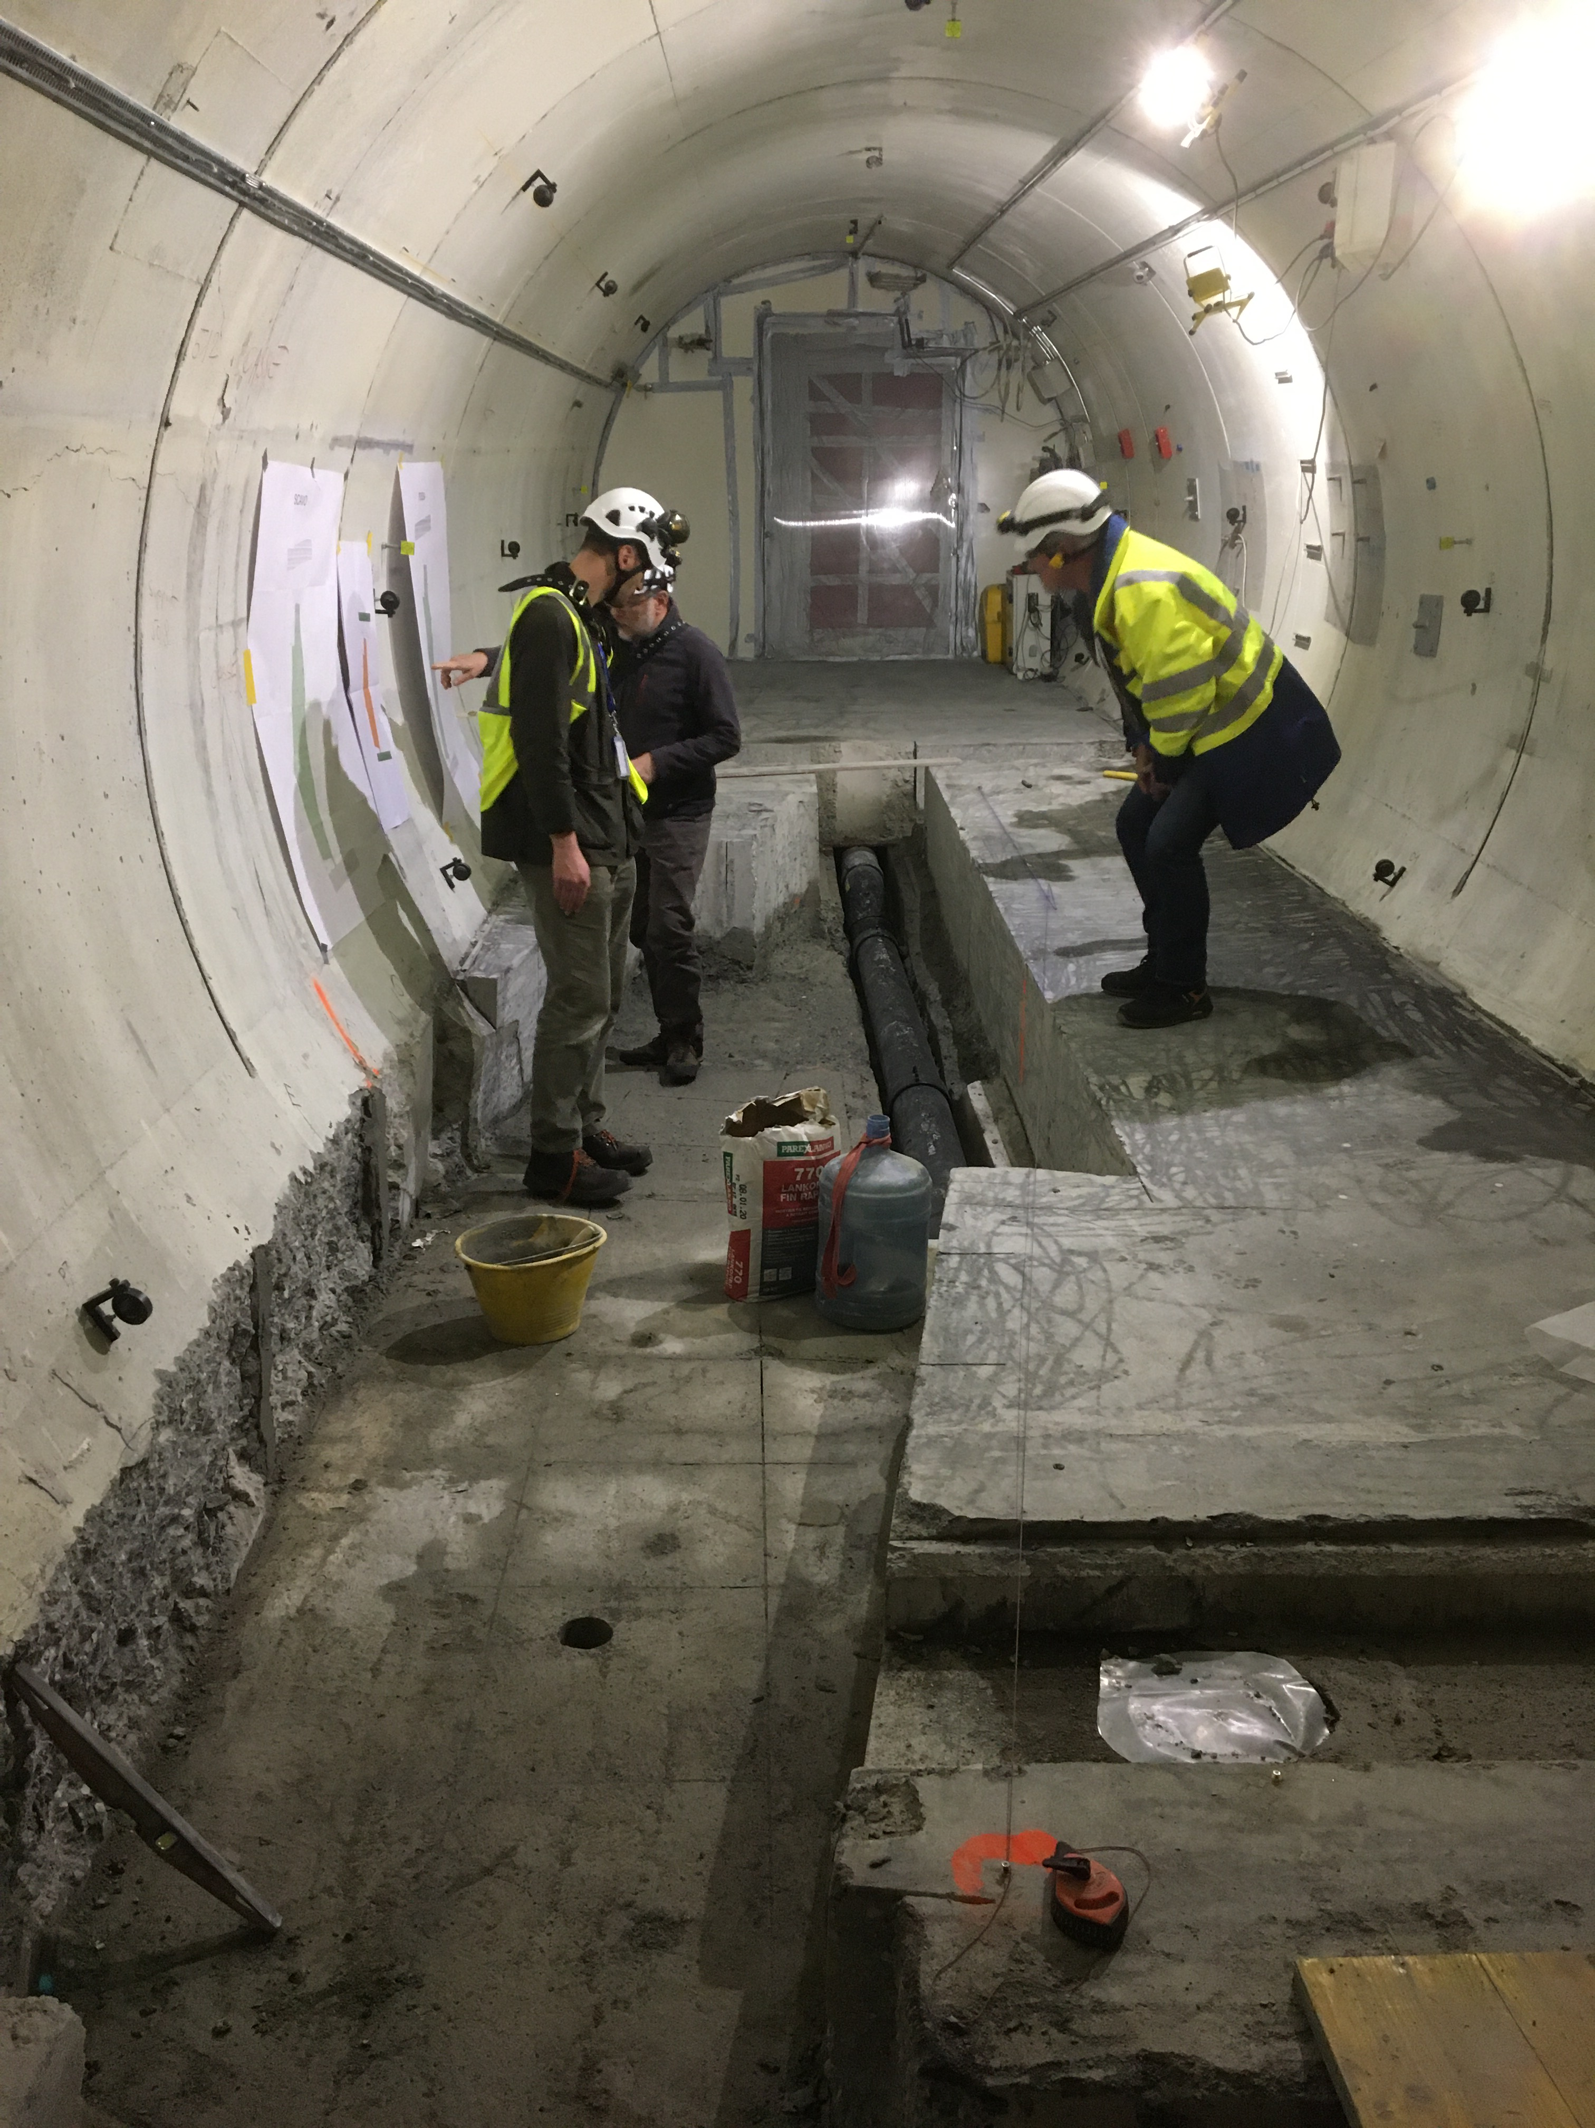
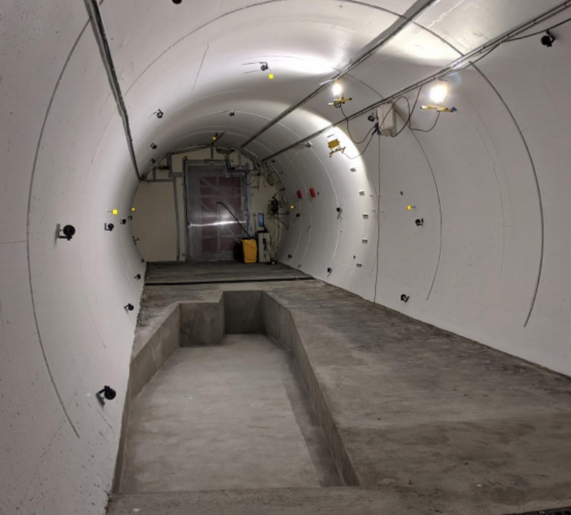
FASER IN TUNNEL TI12
The beam collision axis was located to mm accuracy by the CERN survey department. To place FASER on this axis, a trench was required to lower the floor by 46 cm.
The trench was completed by an Italian firm just hours before COVID shut down CERN in Spring 2020.
2019
Spring 2020
Summer 2020

Slide 11
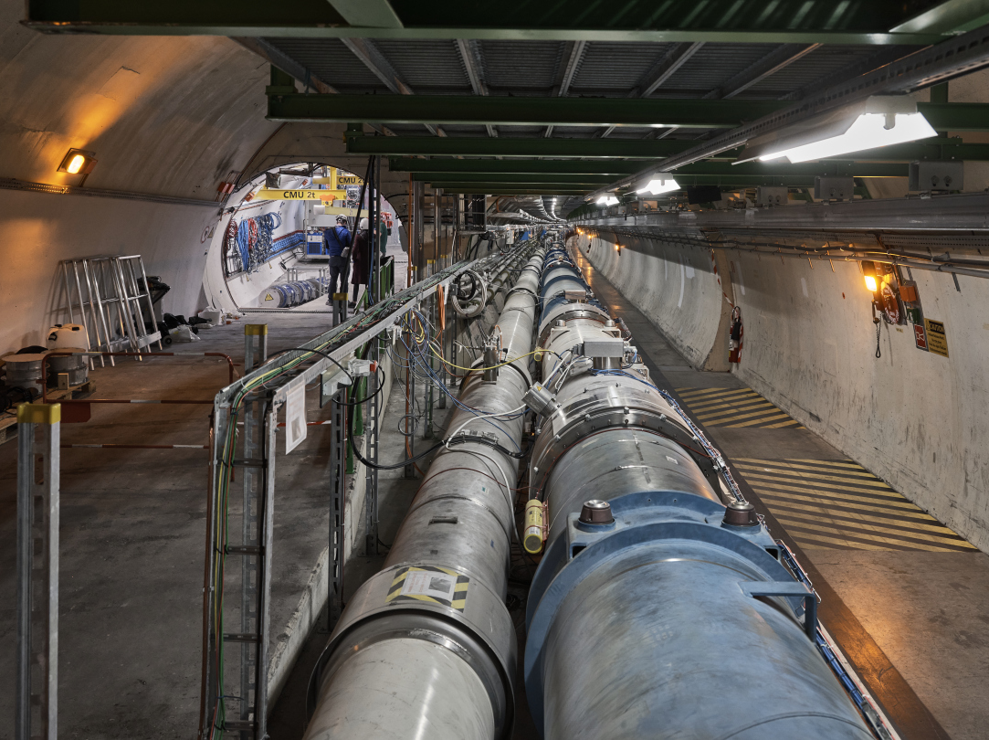
FASER CURRENT STATUS

Slide 12
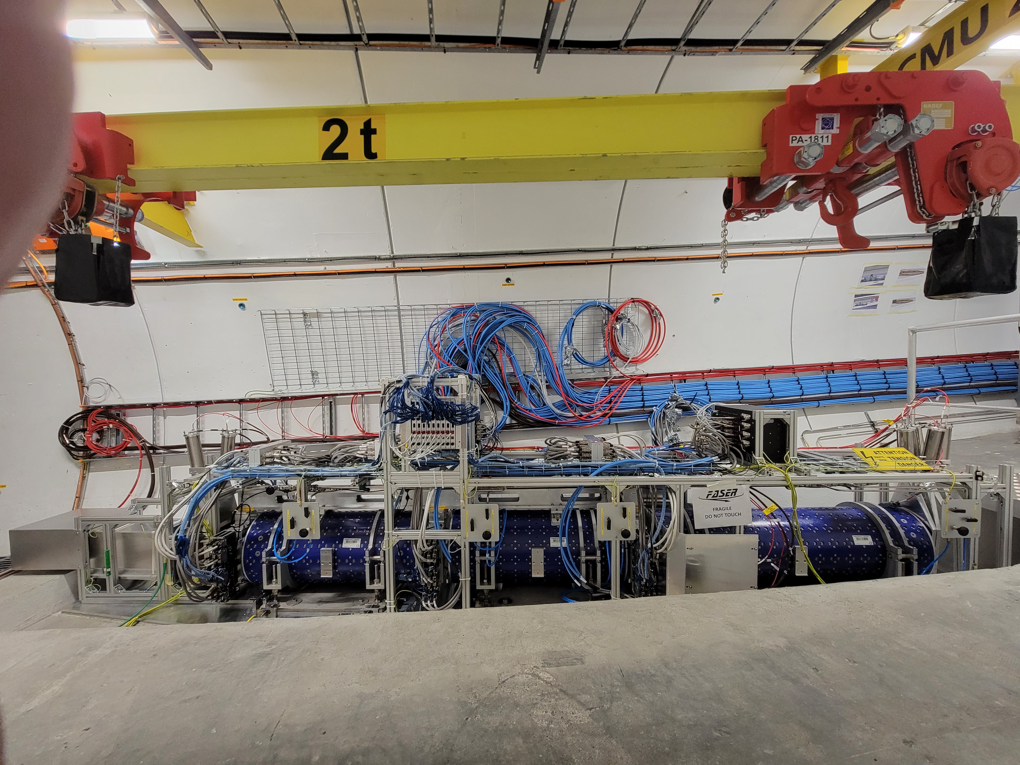
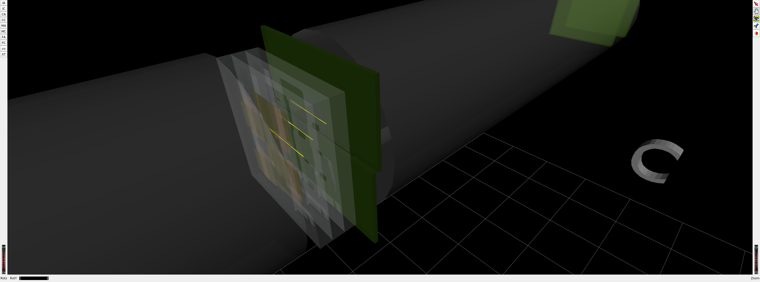
FASER CURRENT STATUS
1st Cosmic Ray
18 March 2021

Slide 13

ν

Slide 14
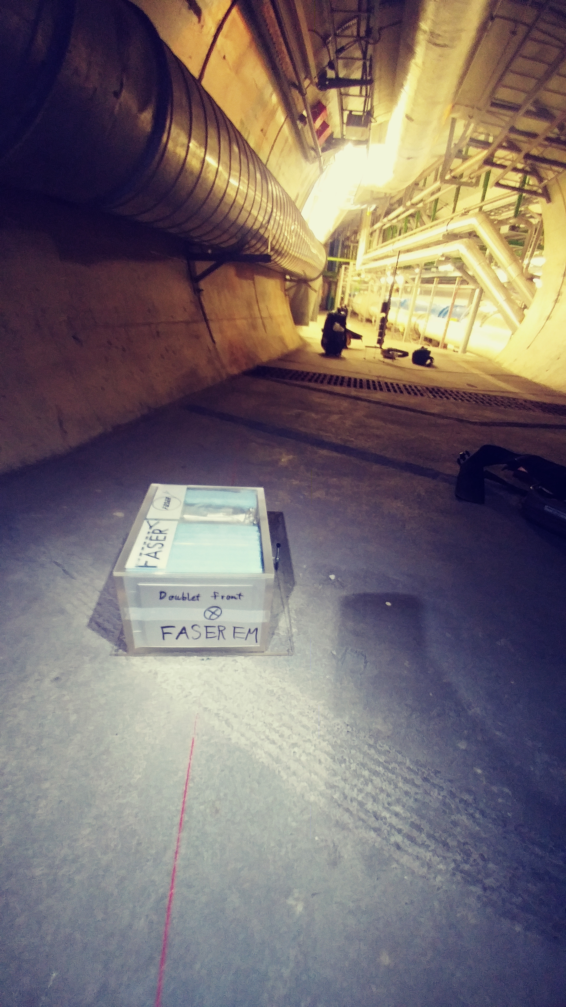
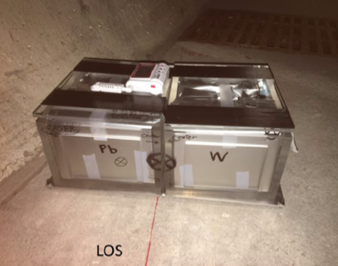
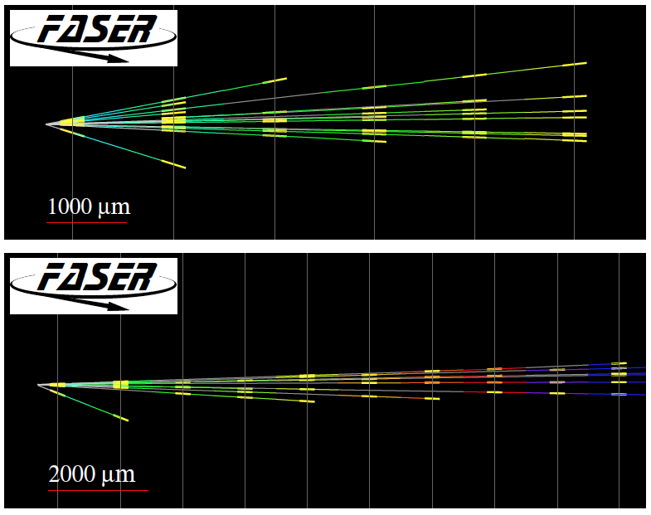
FIRST COLLIDER NEUTRINOS
In 2018 a FASER pilot emulsion detector with 11 kg fiducial mass collected 12.2 fb⁻¹ on the beam collision axis (installed and removed during Technical Stops).
In May 2021, the FASER Collaboration announced the direct detection of 6 candidate neutrinos above 12 expected neutral hadron background events (2.7σ).
Not the discovery of collider neutrinos, but a sign of things to come.

Slide 15
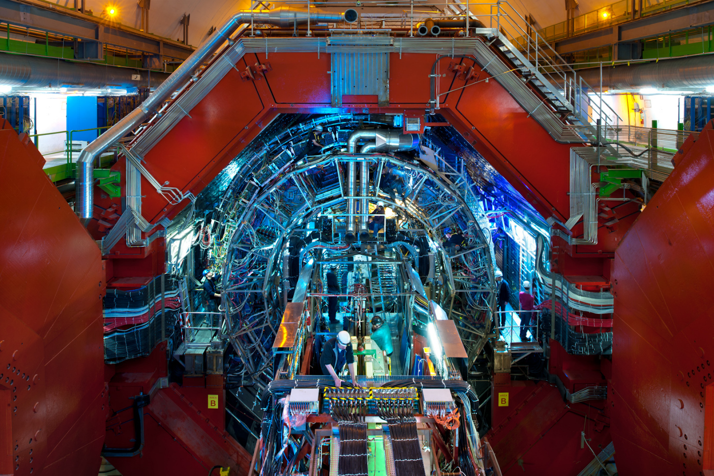
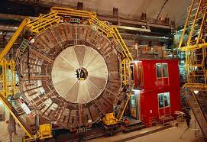
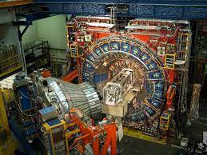
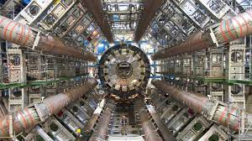
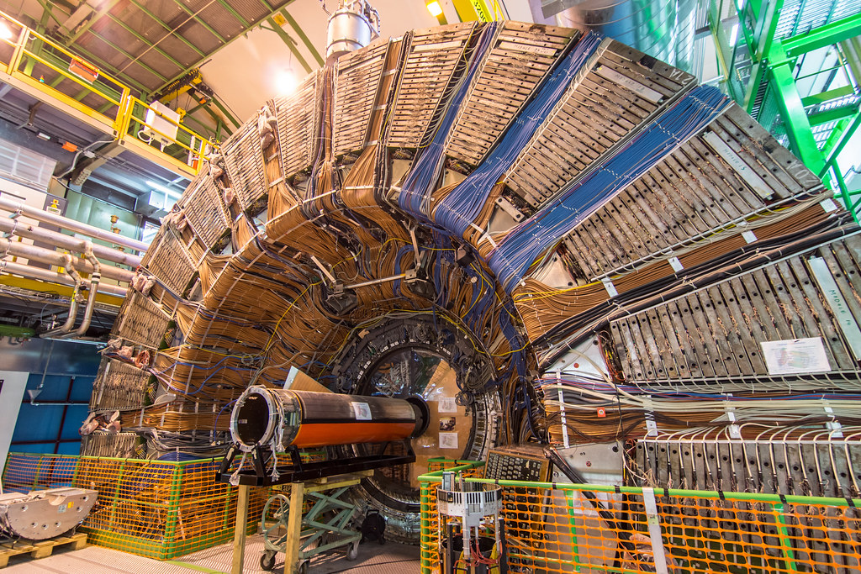
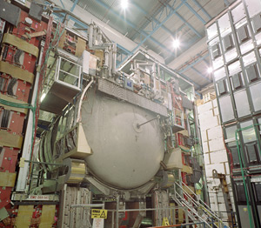
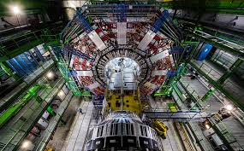
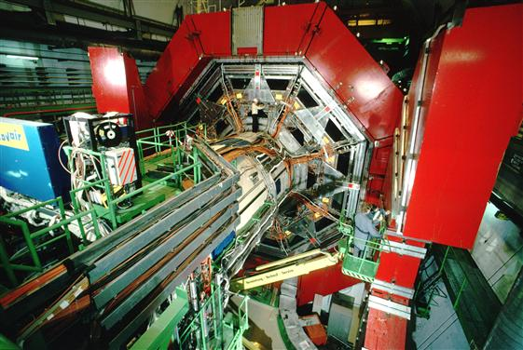

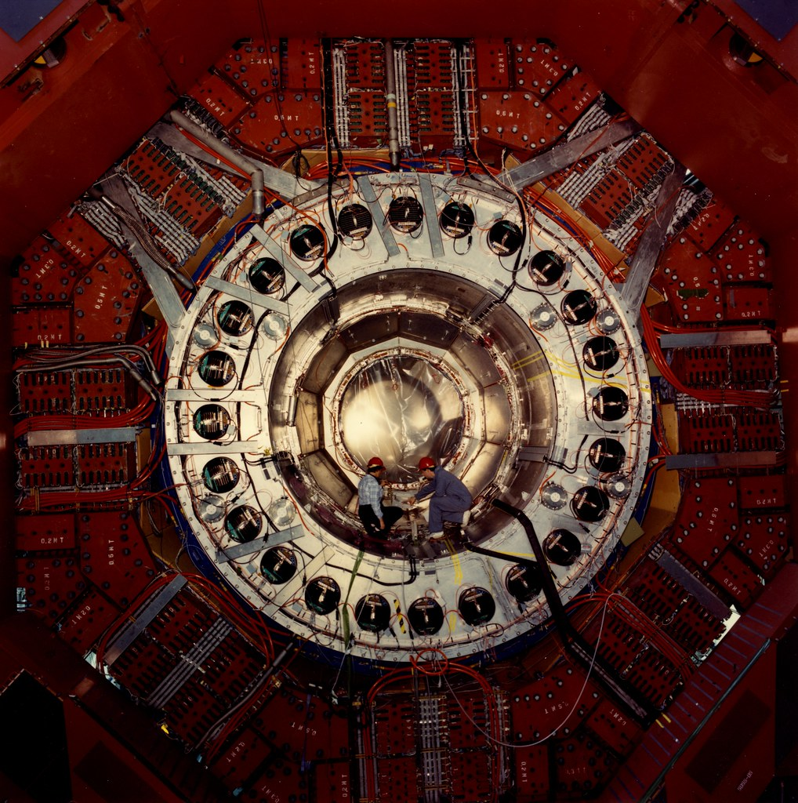
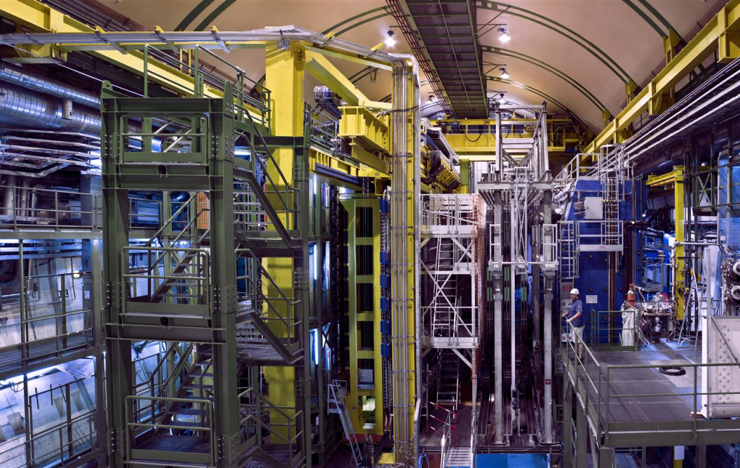
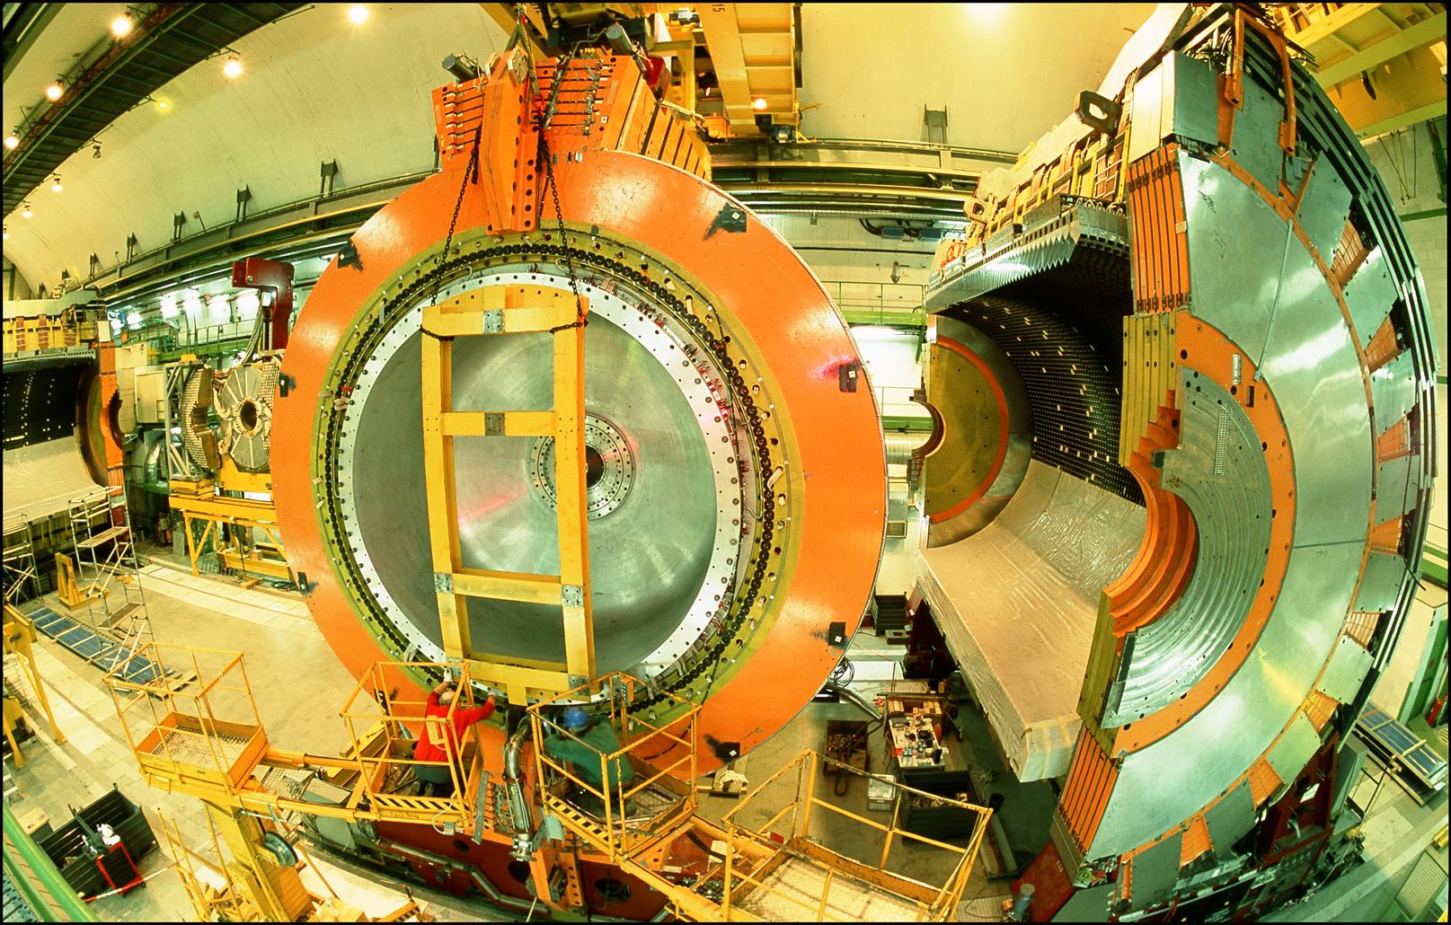
LOCATION, LOCATION, LOCATION
…
ALICE
ALEPH
CDF
FASER Pilot Detector
Suitcase-size, 4 weeks
$0 (recycled parts)
6 candidate neutrinos
ATLAS
DELPHI
D0
CMS
L3
LHCb
SLD
OPAL
All previous
collider detectors
Building-size, decades
~$10⁹
0 candidate neutrinos

Slide 17
SUMMARY
Forward physics provides a new frontier in high energy particle physics, many new opportunities for fundamental discoveries
  Standard Model: opens a new field of neutrino physics at colliders, with ~1000 ν_{e}, ~10,000 ν_{μ}, ~10 ν_{τ} at TeV energies in Run 3, ~100 times more in HL-LHC. Implications for neutrino properties, forward hadron production, cosmic rays and cosmic neutrino physics.
  Beyond the Standard Model: dark photons, sterile neutrinos, dark scalars, axion-like particles, milli-charged particles, dark matter, new forces.
Many ideas initiated at UC Irvine, research opportunities in both particle theory and experiment with Professors Feng, Casper, and Bian. Current researchers includes graduate students Max Fieg, Savannah Shively, Yiwen Xiao, Alejandro Yankelevich, as well as several postdocs.
Typically path includes 234AB, 235AB, reading courses. Positions available now; see any of the involved faculty for details.

Slide 18
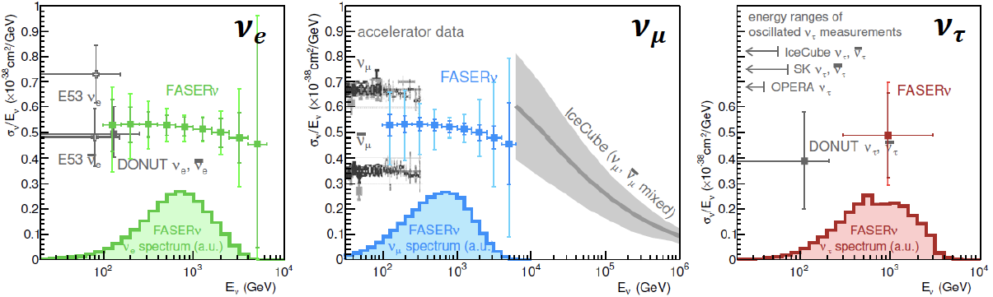
NEUTRINO PHYSICS
In Run 3 (2022-25), FASERν will
  Detect the first collider neutrino.
  Record ~1000 ν_{e} , ~10,000 ν_{μ} , and ~10 ν_{τ} interactions at TeV energies, the first direct exploration of this energy range for all 3 flavors.
  Distinguish muon neutrinos from anti-neutrinos by combining FASER and FASERν data, and so measure their cross sections independently.
  Add significantly to the number of ν_{τ} and detect the first anti-ν_{τ} .
FASER Collaboration 1908.02310 (2019)

Slide 19
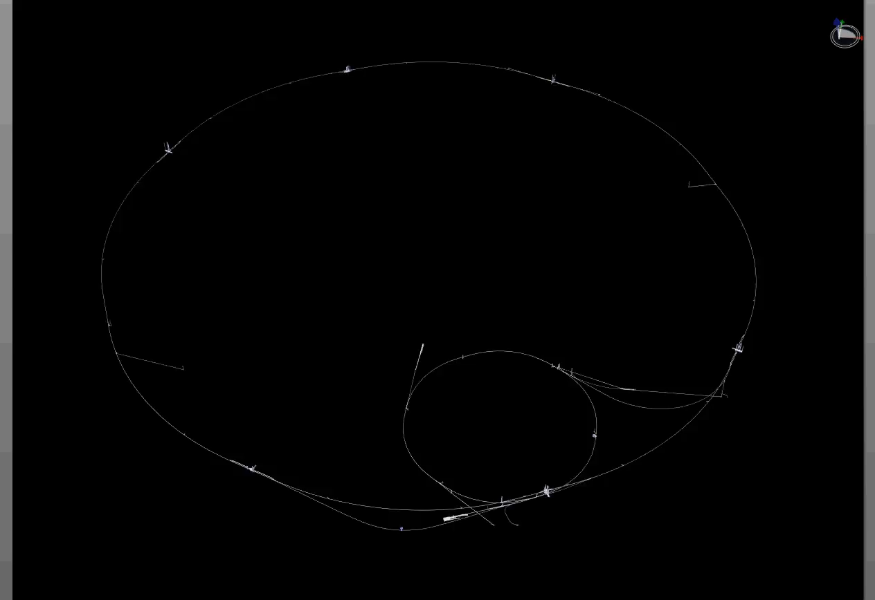
PARTICLE PATH FROM ATLAS TO TI12
Dougherty, CERN Integration (2019)

Slide 20


Slide 21
FORWARD PHYSICS FACILITY
The FPF is proposed to run at the HL-LHC with implications for
  Neutrinos: neutrino blind → neutrino factory (10⁶ neutrinos at the highest human-made energies ever).
  New particles: dark matter, dark sectors, milli-charged particles, new force particles, new Higgs-like particles, sterile neutrinos, quirks, …

Slide 22
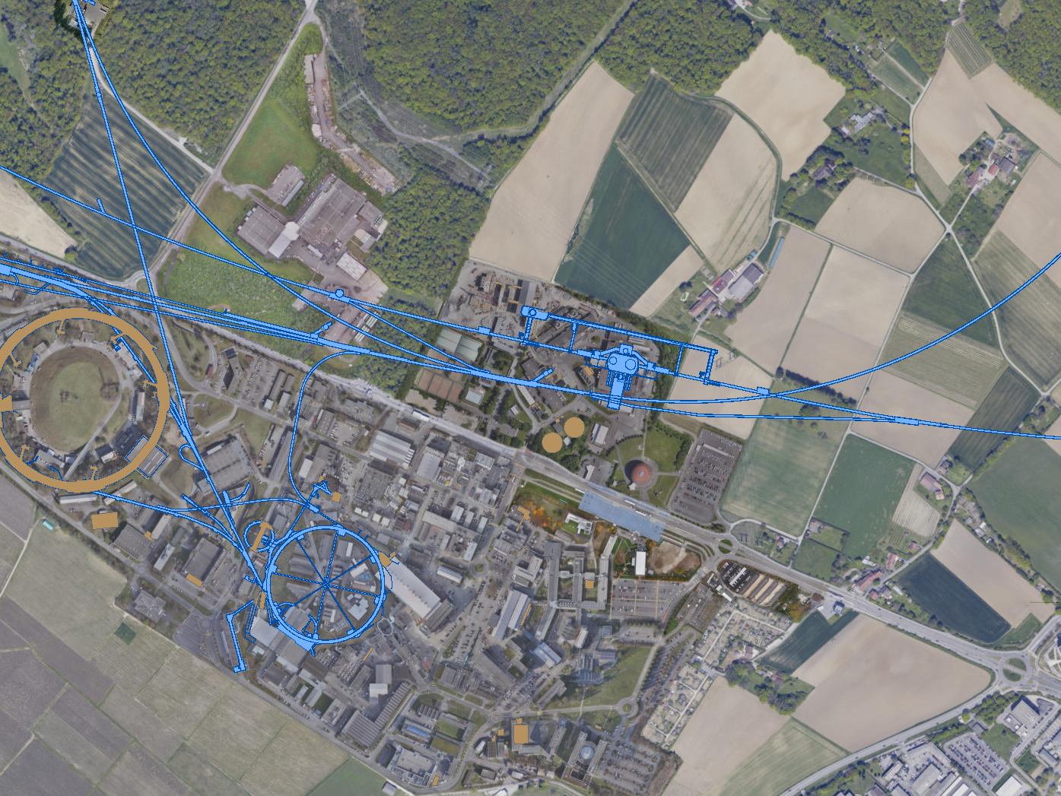
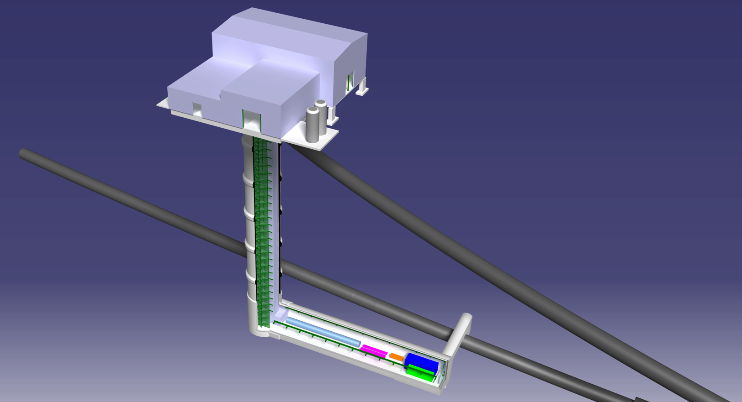
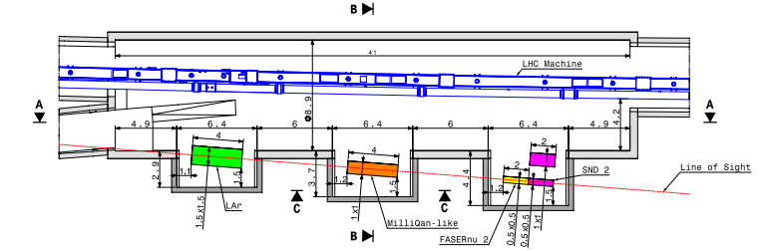
FORWARD PHYSICS FACILITY
The rich physics program in the far-forward region therefore strongly motivates creating a dedicated Forward Physics Facility to house far-forward experiments for the HL-LHC era from 2027-37.
UJ18
ATLAS
SPS
UJ12
LHC
LOS
Kincso Balazs, CERN CE
CERN GIS

Slide 23

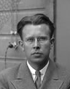
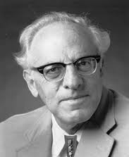
THE NEW PARTICLE LANDSCAPE
Particle
Colliders
Mass
MeV
GeV
TeV
1
Already
Discovered
Strongly Interacting
Heavy Particles
Interaction Strength
New Targets of Small Experiments
Traditional Targets
of Big Science
10⁻³
Weakly Interacting
Light Particles
Impossible to
Discover
10⁻⁶

Slide 24


AN EXAMPLE: DARK SECTORS
Suppose there is a dark sector that contains dark matter X and also a dark force: dark electromagnetism.
The force carriers of the SM and dark EM will mix
  perhaps suppressed, but completely generic, since a renormalizable operator
The result? Two possibilities:
  Dark photons A’, like photons, but with mass m_{A’}, couplings suppressed by ε.
  Milli-charged particles (mCPs), with charges suppressed by ε.
Finding either of these would imply new fundamental forces or new matter particles, possibly a “portal” to the dark sector.
SM
EM
Dark Sector
EM, X
A
$$εF_{μν}F_{D}^{μν}$$
A_{D}
Holdom (1986)

Slide 25
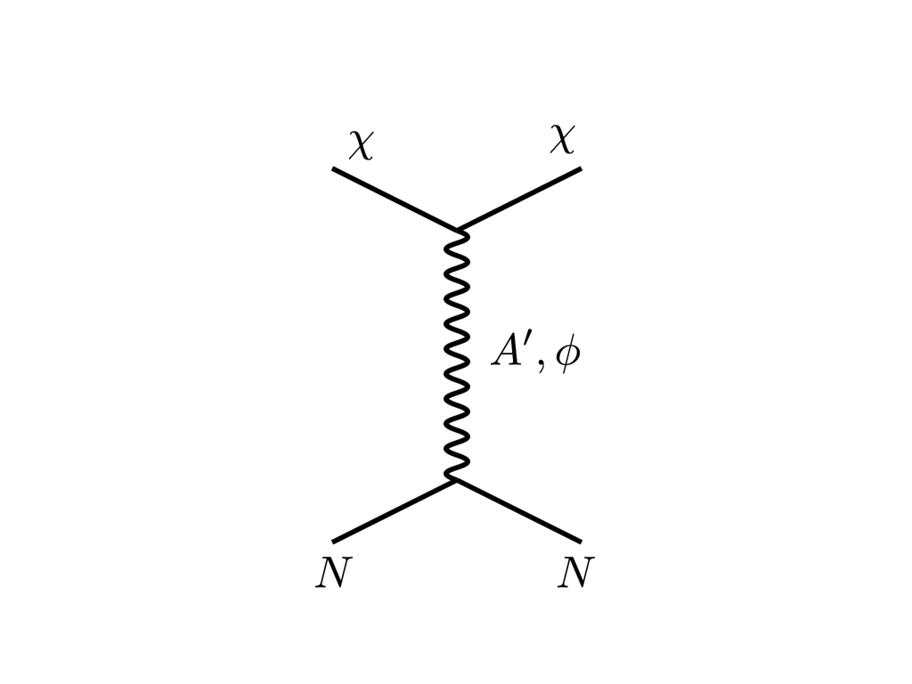





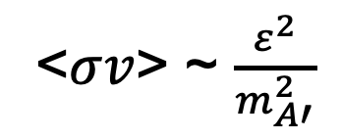
THE THERMAL RELIC LANDSCAPE
Particle
Colliders
Mass
MeV
GeV
TeV
1
Already
Discovered
Strongly Interacting
Heavy Particles
Too Little to be
Dark Matter
$$e$$
DM
$$ε$$
$$A’$$
$$ε$$
Interaction Strength
Just Right to
be Dark Matter
10⁻³
DM
$$e$$
<$σv$> ~ $\frac{ε^{2}}{m_{A′}^{2}}$
Weakly Interacting
Light Particles
Impossible to
Discover
10⁻⁶
Too Much to be
Dark Matter
Boehm, Fayet (2003)
Pospelov, Ritz, Voloshin (2007)
Feng, Kumar (2008)

Slide 26
FORWARD PHYSICS

Slide 27
SEARCHES FOR NEW LIGHT PARTICLES
If new particles are light and weakly interacting, the existing big LHC detectors are perfectly designed NOT to see them.
Existing detectors are designed to find new heavy particles. These particles are produced almost at rest and decay isotropically.
But new light particles are mainly produced in the decays of light particles: π, η, K, D and B mesons. These are mainly produced along the beamline, and so the new particles disappear through the holes that let the beams in.
Clearly we need a detector to exploit the “wasted” σ_{inel} ~ 100 mb and cover these “blind spots” in the forward region. If we go far enough away, the proton beams are bent by magnets (it’s a circular collider!), whereas the new light particles will go straight.

Slide 28
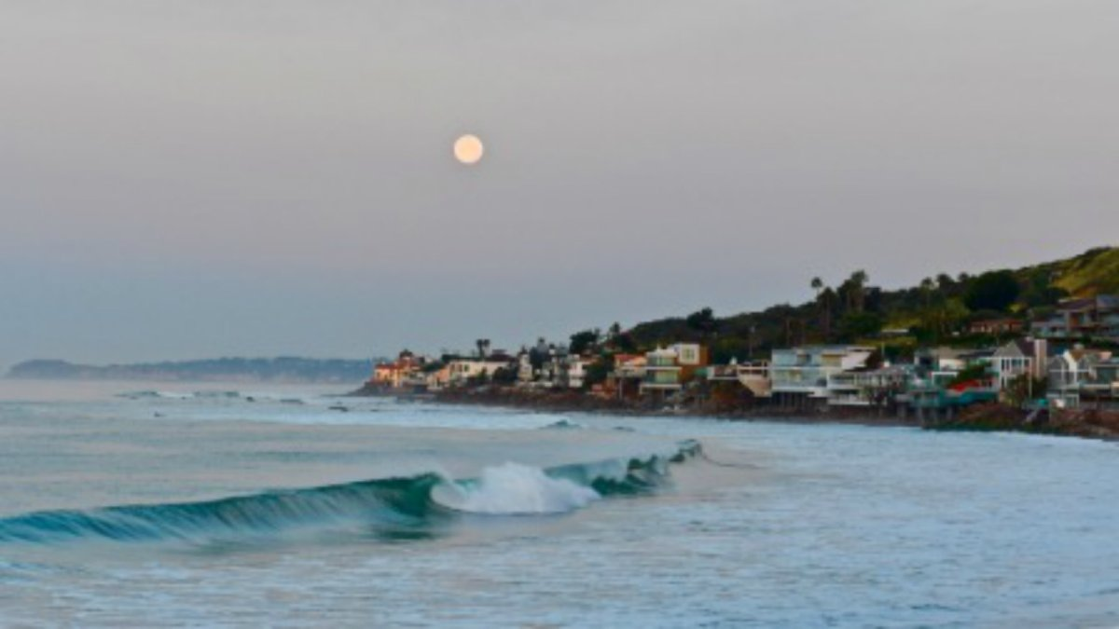
HOW BIG DOES THE DETECTOR HAVE TO BE?
Momentum:
Space:
250 MeV
1 TeV
12 cm
480 m
The opening angle is 0.2 mrad (η ~ 9); cf. the moon (7 mrad). Most of the signal passes through 1 sheet of paper at 480 m.
TeV dark photons (or any other new particles produced in π, η, K, D, B decay) are far more collimated than shown below, motivating a new, small, fast, cheap experiment at the LHC.

Slide 29
FASER TIMELINE
September 2017: Initial proposal (Feng, Galon, Kling, Trojanowski)
July 2018: Submitted LOI to CERN LHCC
October 2018: Approval from ATLAS SCT and LHCb Collaborations for use of spare detector modules
November 2018: Submitted Technical Proposal to LHCC
November 2018 – January 2019: Experiment funded by the Heising-Simons and Simons Foundations
March 2019: FASER approved as 8th LHC detector by CERN
December 2019: FASERν approved as 9th LHC detector by CERN
March 2021: FASER fully installed, commissioning of the detector begins
May 2021: FASERν announces first candidate collider neutrinos
Mid-2022: FASER and FASERν begin collecting data in Run 3

Slide 30
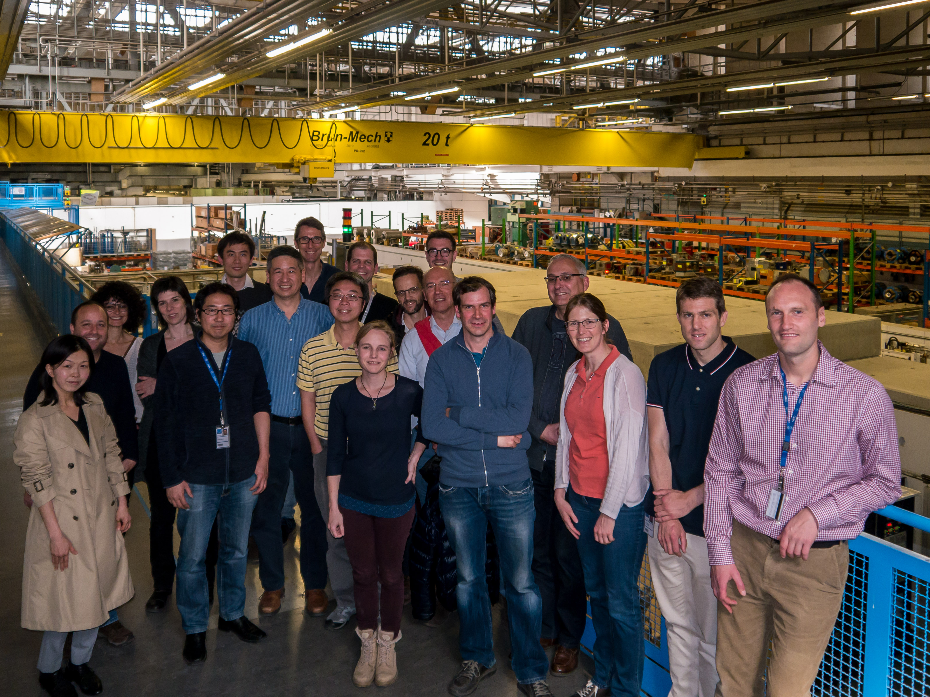
FIRST FASER COLLABORATION MEETING

Slide 31
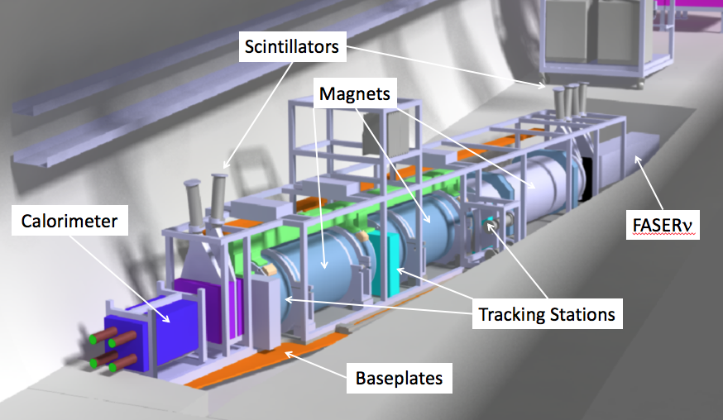
THE FASER DETECTOR
Nothing incoming and 2 ~TeV, opposite-sign charged tracks pointing back to the ATLAS IP: a “light shining through (100 m-thick) wall” experiment.
Scintillators veto incoming charged tracks (muons), magnets split the charged tracks, which are detected by tracking stations and a calorimeter.
LLP
ν
e⁺
e⁻

Slide 32
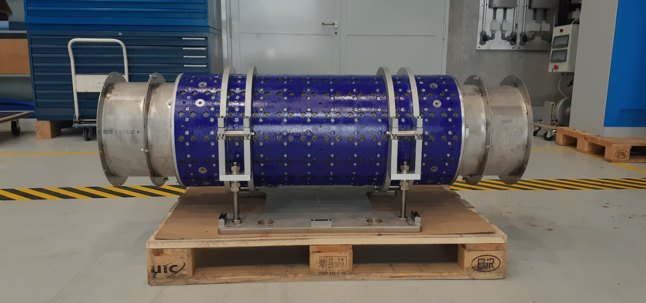
MAGNETS
FASER includes 3 magnets: 1.5 m, 1 m, and 1m long.
0.57 T permanent dipoles with an inner diameter of 20 cm, require little maintenance.
Constructed by the CERN magnet group.

Slide 33
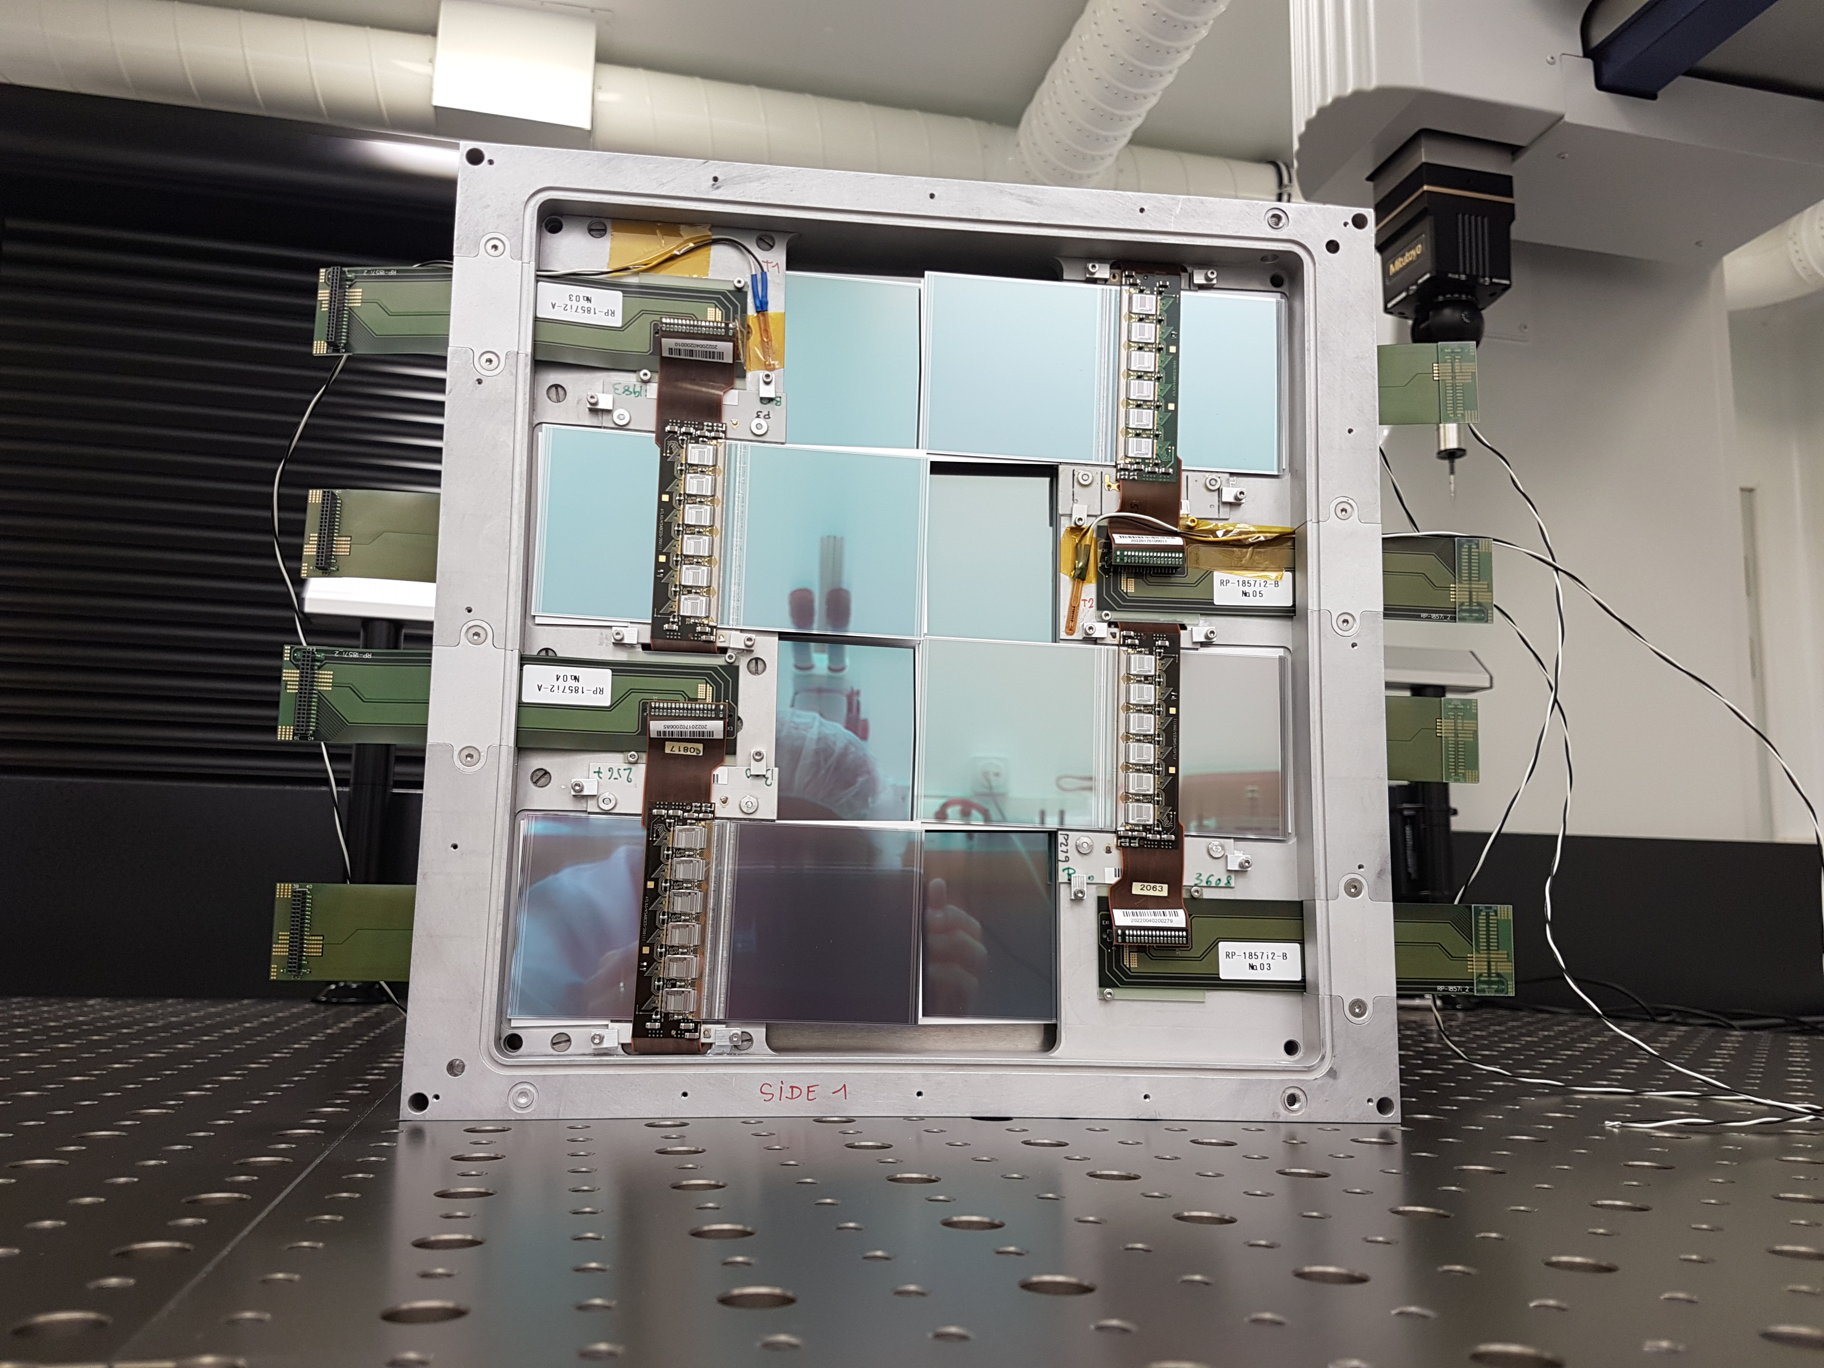
TRACKERS
ATLAS tracker consists of ~3000 SCT modules.
~300 spares were never used. ~100 of these were generously donated to FASER: 8 modules x 3 tracking planes x 4 tracking stations at FASER.

Slide 34
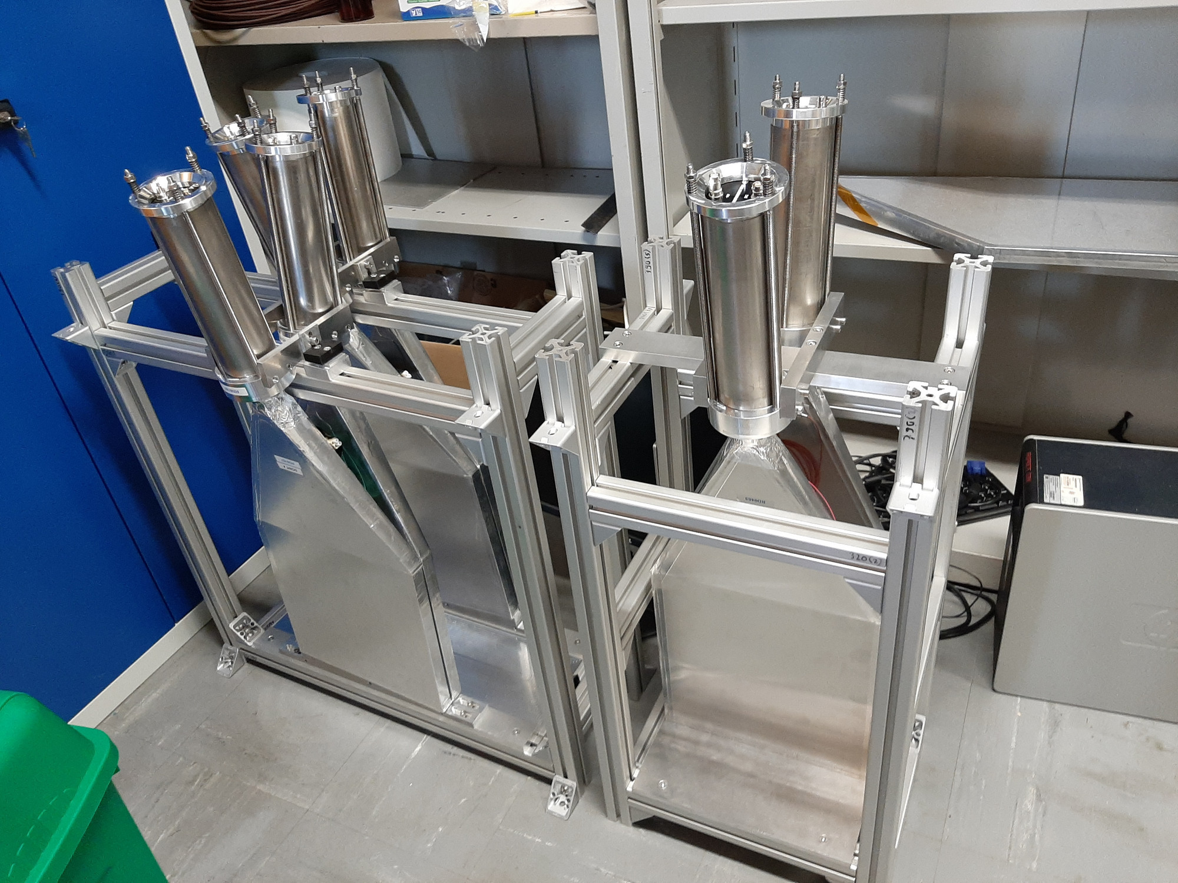
SCINTILLATORS
4 veto scintillators, each 2cm x 30cm x 30cm, upstream of the detector. Efficiency of each one is > 99.99%, makes muon background negligible.
Additional beam backgrounds, simulated with FLUKA and validated with pilot detectors in 2018, are also expected to be negligible.

Slide 35
DARK PHOTON SENSITIVITY REACH
FASER
FASER probes new parameter space with just 1 fb⁻¹ starting in 2022.
Without upgrade, HL-LHC extends (Luminosity*Vol) by factor of 3000 – could detect as many as 10,000 dark photons.
Possible upgrade to FASER 2 (R=1m, L=20m) extends (Luminosity*Vol) by factor of ~10⁶ – could detect as many as 3 x 10⁶ dark photons.
_{FASER Collaboration (2018)}

Slide 36
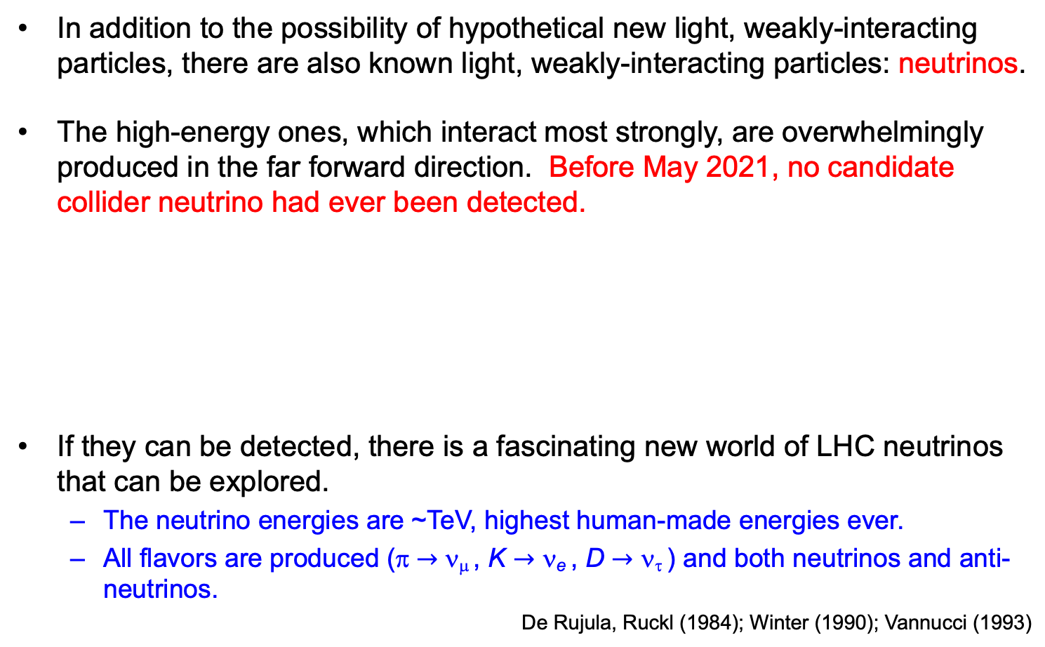
COLLIDER NEUTRINOS
In addition to the possibility of hypothetical new light, weakly-interacting particles, there are also known light, weakly-interacting particles: neutrinos.
The high-energy ones, which interact most strongly, are overwhelmingly produced in the far forward direction. Before May 2021, no candidate collider neutrino had ever been detected.
If they can be detected, there is a fascinating new world of LHC neutrinos that can be explored.
  The neutrino energies are ~TeV, highest human-made energies ever.
  All flavors are produced (π $→$ ν_{μ} , K $→$ ν_{e} , D $→$ ν_{τ} ) and both neutrinos and anti-neutrinos.
De Rujula, Ruckl (1984); Winter (1990); Vannucci (1993)

