Slide 1




PHYSICS REACH
Physics Beyond Colliders Annual Workshop
Jonathan Feng, UC Irvine, 8 November 2022

Slide 2
INTRODUCTION
The FPF will enhance the LHC physics program through (1) studies of very high energy neutrinos with guaranteed new insights into neutrinos, QCD, and astroparticle physics, and (2) the possibility of groundbreaking BSM discoveries.
Many of these opportunities rely essentially on the LHC’s high center-of-mass energy, are unique to the FPF, and will disappear for decades (or forever) if not explored at the HL-LHC.
The FPF is well-aligned with the recommendations of EPPSU and Snowmass:
2020 EPPSU 1st Recommendation
The successful completion of the high-luminosity upgrade of the machine and detectors should remain the focal point of European particle physics, together with continued innovation in experimental techniques. The full physics potential of the LHC and the HL-LHC, including the study of flavour physics and the quark-gluon plasma, should be exploited.
2022 Snowmass Energy Frontier Summary
Our highest immediate priority accelerator and project is the HL-LHC, the successful completion of the detector upgrades, operations of the detectors at the HL-LHC, data taking and analysis, including the construction of auxiliary experiments that extend the reach of HL-LHC in kinematic regions uncovered by the detector upgrades.
Resource needs and plan for the 5-year period starting 2025:
1. Prioritize HL-LHC physics program, including auxiliary experiments.

Slide 3
FORWARD PHYSICS FACILITY
The rich physics program in the far-forward region has been developed in a series of meetings and papers – thanks to all participants and authors!
FPF Meetings
  FPF Kickoff Meeting, 9-10 Nov 2020
  FPF2 Meeting, 27-28 May 2021
  FPF3 Meeting, 25-26 Oct 2021
  FPF4 Meeting, 31 Jan-1 Feb 2022
  FPF5 Meeting, 15-16 Nov 2022 https://indico.cern.ch/event/1196506
FPF Papers
  FPF “Short” Paper: 75 pages, 80 authors, Phys. Rept. 968, 1 (2022), 2109.10905.
  FPF White Paper: 429 pages, 392 authors+endorsers representing over 200 institutions, J. Phys. G (2022), 2203.05090.
There is much work to be done. We have recently set up infrastructure, including 10 working groups, to catalyze progress toward CDRs in 2023.

Slide 4
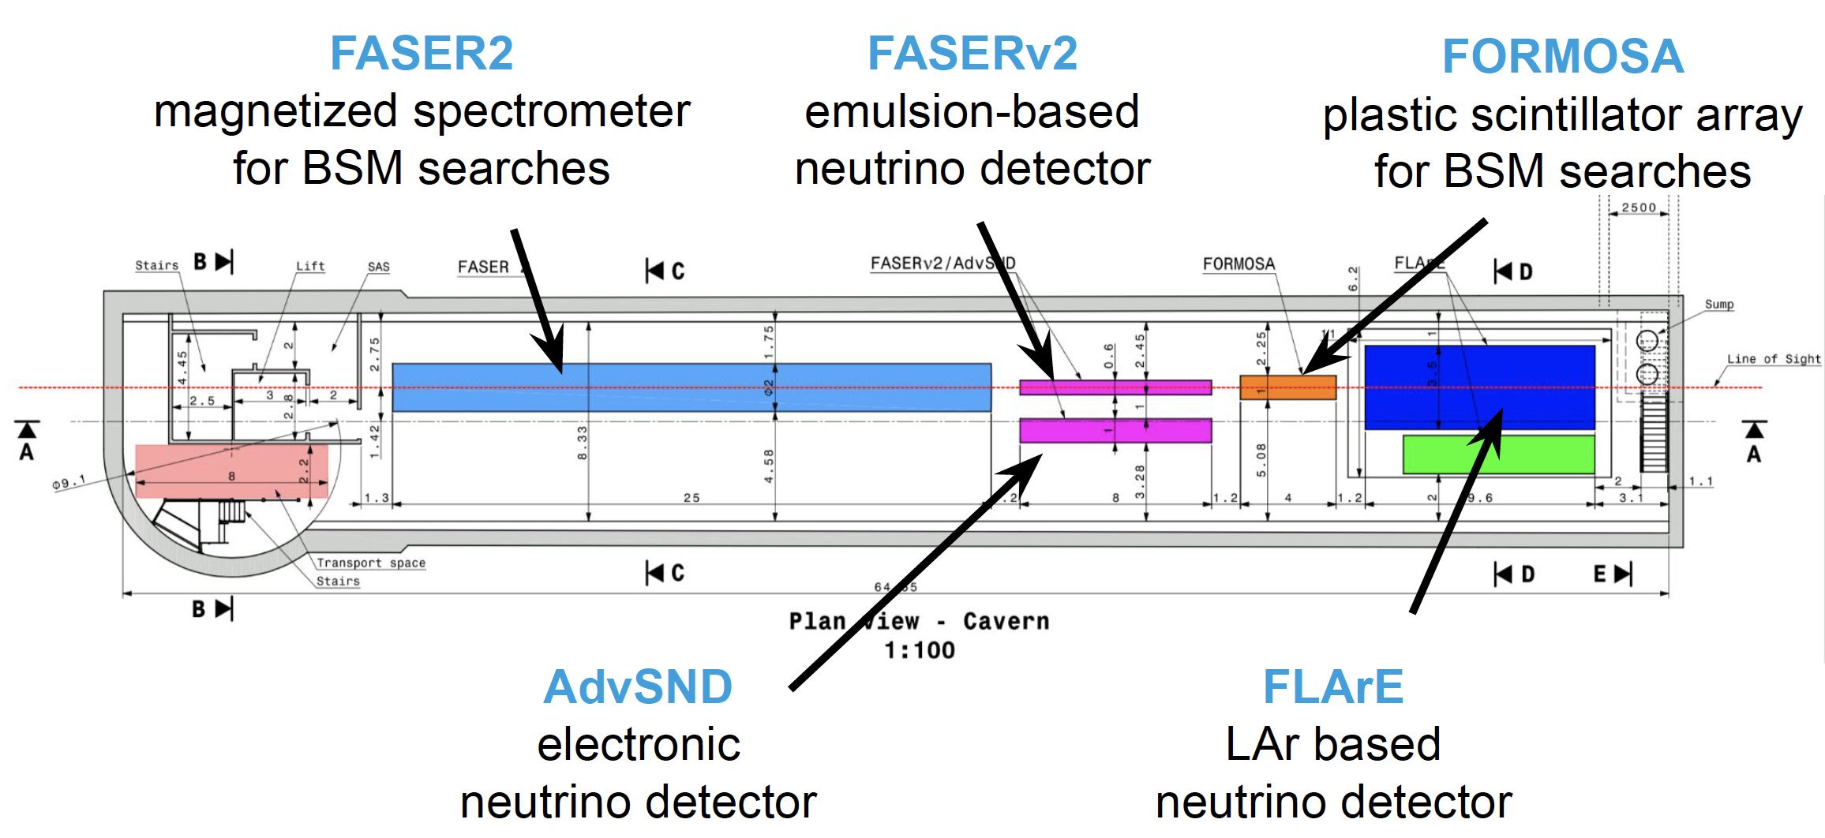

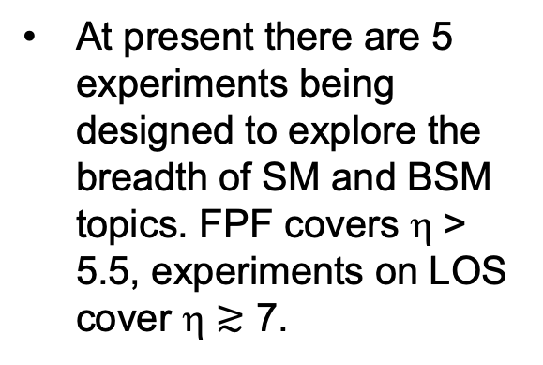
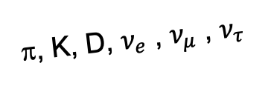
FPF EXPERIMENTS
At present there are 5 experiments being designed to explore the breadth of SM and BSM topics. FPF covers η > 5.5, experiments on LOS cover η $≳$ 7.
Large far-forward fluxes are automatically provided by the LHC and can be exploited with small and inexpensive detectors. For example,
  ~10⁶ TeV-neutrino interactions per 10 tonnes.
  ~10⁶ dark photon decays can be observed in currently viable regions of param space.
A’, a, mCPs, DM, …
π, K, D, $ν_{e}$ , $ν_{μ}$ , $ν_{τ}$

Slide 5
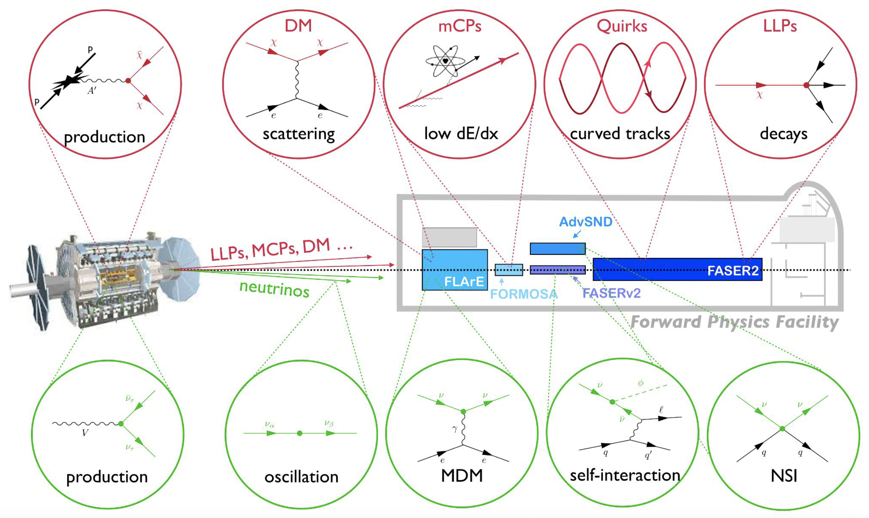
MANY TOPICS
Kling (2022)

Slide 6
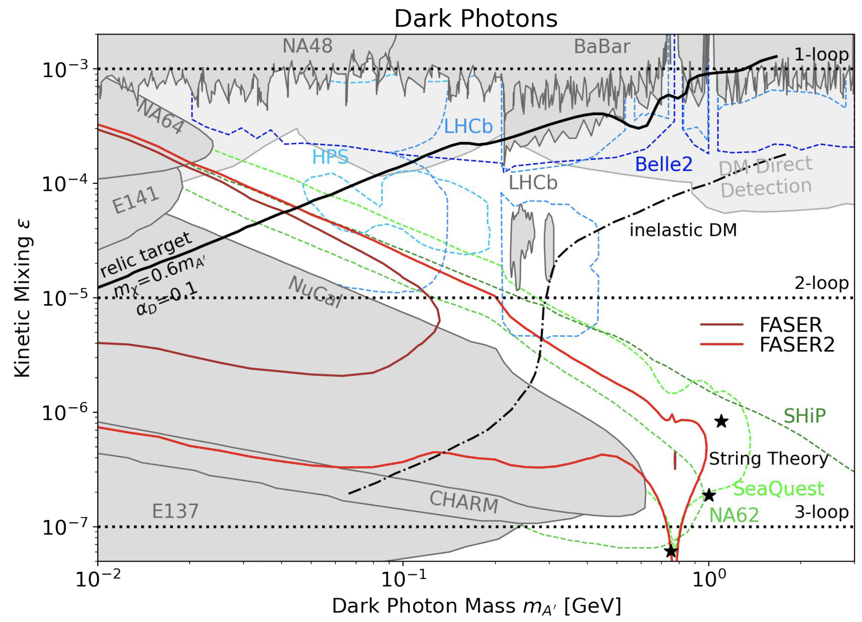
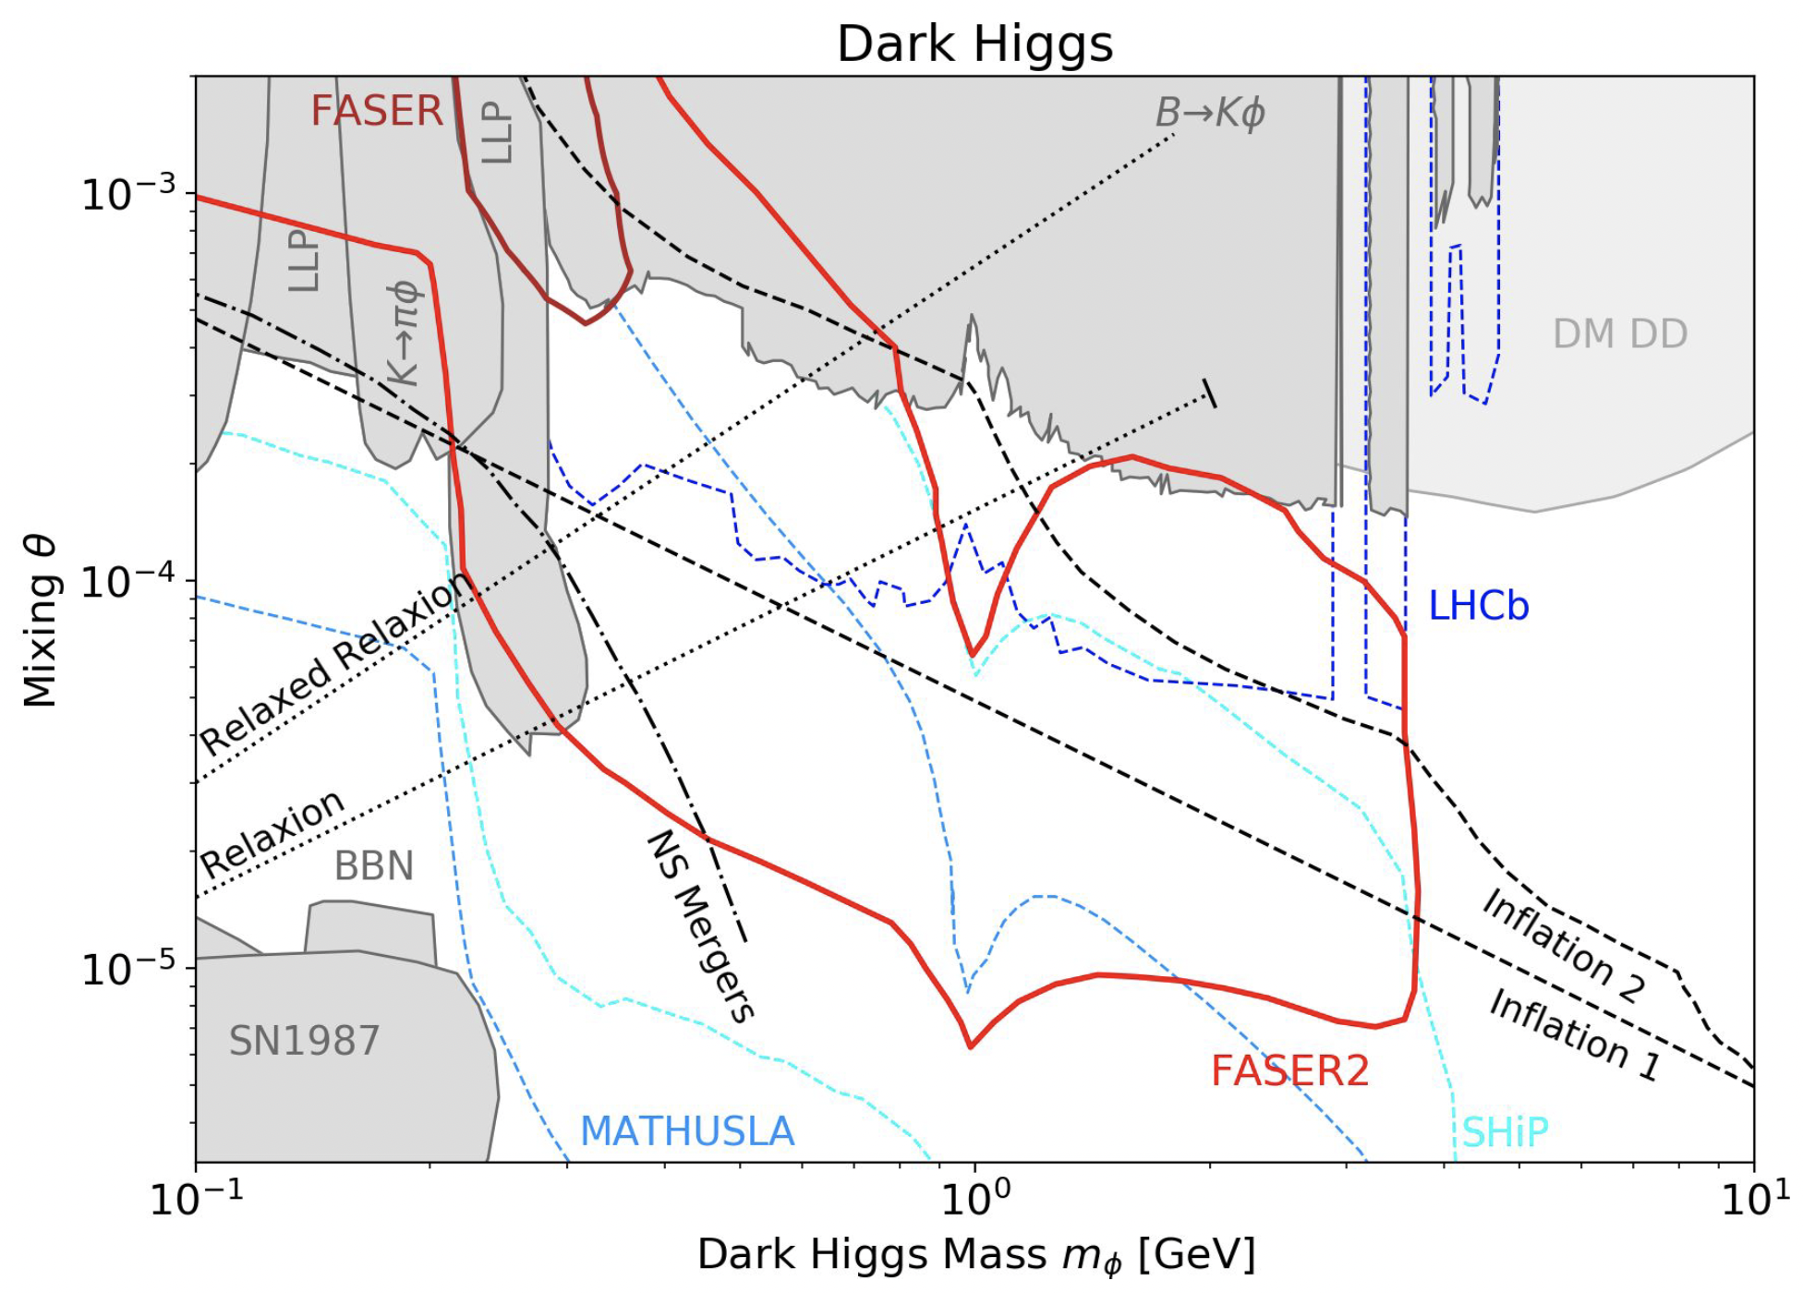
LONG-LIVED PARTICLES
FASER2 has significant discovery potential for a wide variety of LLP models: dark photons; B-L and related gauge bosons; dark Higgs bosons; HNLs with couplings to e, mu, tau; ALPs with photon, gluon, fermion couplings; light neutralinos, inflatons, relaxions, and many others.
PBC WG Report (2019), FPF White Paper (2022)

Slide 7
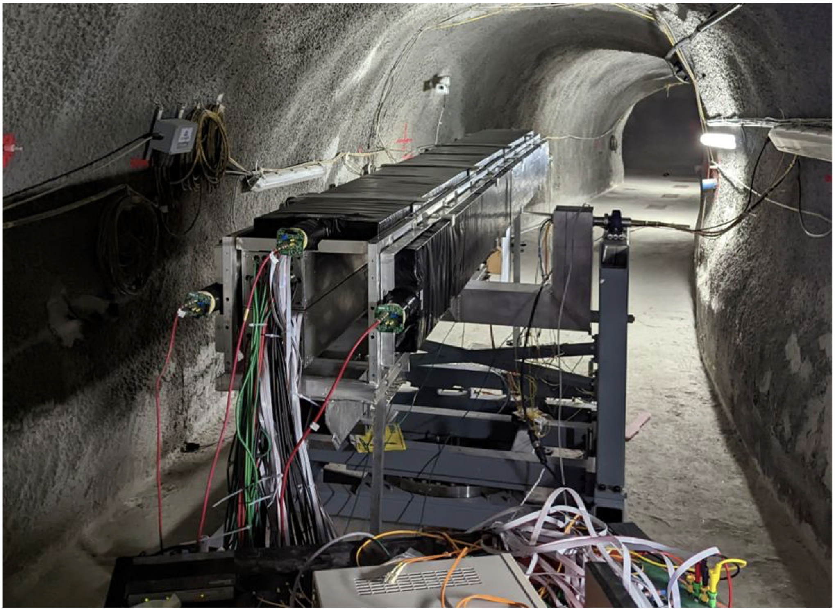
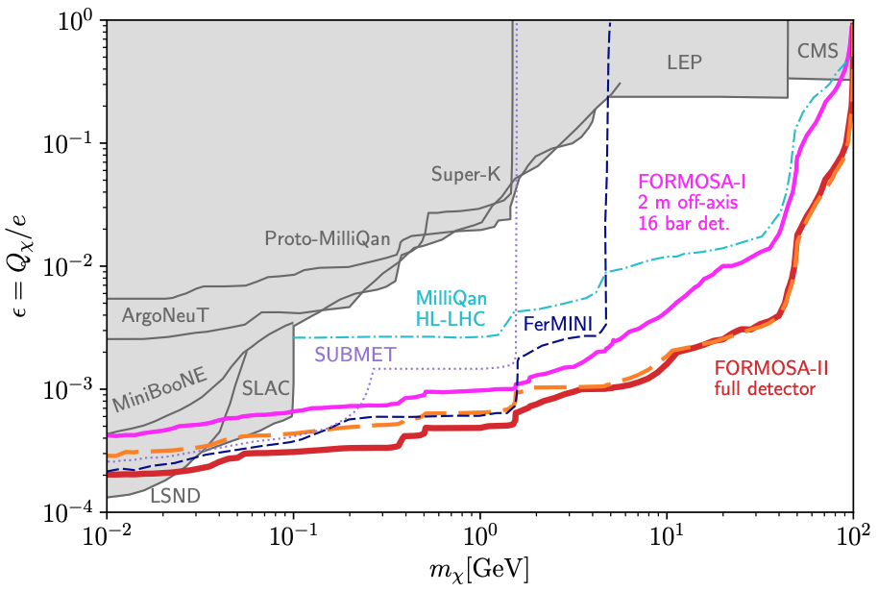

MILLI-CHARGED PARTICLES
A completely generic possibility motivated by dark sectors with massless dark photons, new particles with magnetic or electric dipole moments, …
Currently the target of MilliQan, which is being prepared for Run 3 near CMS in a tunnel at η $≈$ 0.1.
Could also run in this location in the HL-LHC era, but significantly better sensitivity if MilliQan is moved to the FPF (FORMOSA).
Foroughi-Abari, Kling, Tsai (2020)

Slide 8
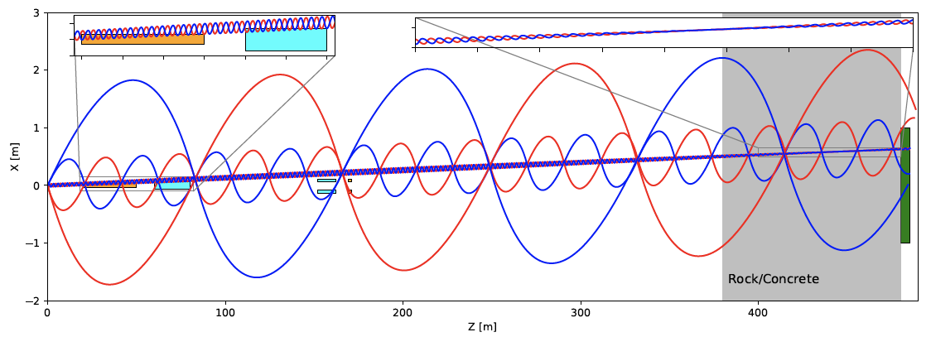
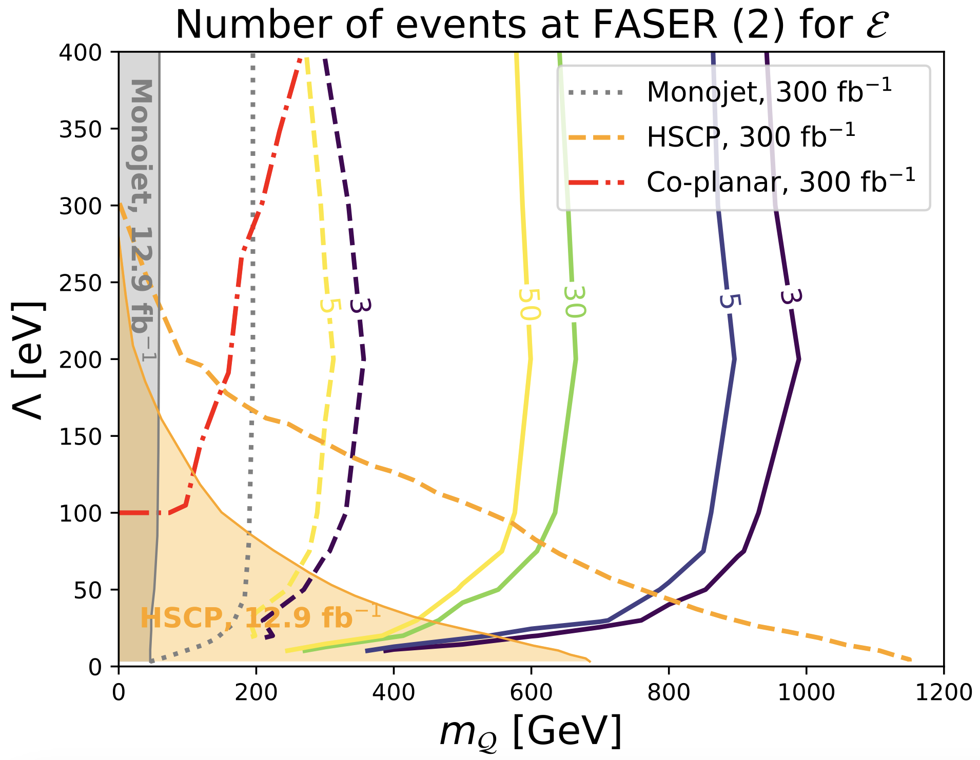
QUIRKS
If the hidden force is non-abelian, there may be quirks, matter particles charged under this force with mass m $≫$ Λ_{hidden} .
Kang, Luty (2008)
If quirks also have SM charges, they are pair produced at the LHC and then oscillate, connected by a hidden color string.
The quirk bound state has low p_{T}, travels down the beamline, leaving (strange!) tracks in far-forward detectors.
For some Λ_{hidden}, FASER2 extends reach from m ~ 200 GeV to 1 TeV.
Requires
  LHC energies to produce ~TeV quirks.
  Far-forward detectors to see the low p_{T} quirk-anti-quirk bound state tracks.
Li, Pei, Ran, Zhang (2021)

Slide 9
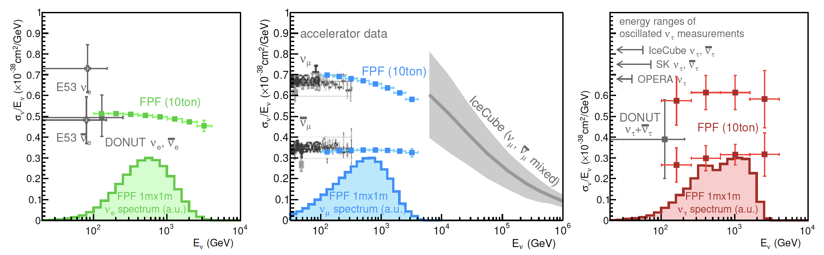
NEUTRINOS
At the FPF, three proposed ~10-ton detectors FASERν2, AdvSND, and FLArE will each detect ~100,000 ν_{e} , ~1,000,000 ν_{μ} , and ~1000 ν_{τ} interactions at TeV energies, providing high statistics samples for all three flavors in an energy range that has never been directly explored.
Will enable detailed studies of the tau and anti-tau neutrino, as well as searches for BSM effects in neutrino production, neutrino propagation and oscillation, and non-standard neutrino interactions.
FASER White Paper (2022)

Slide 10
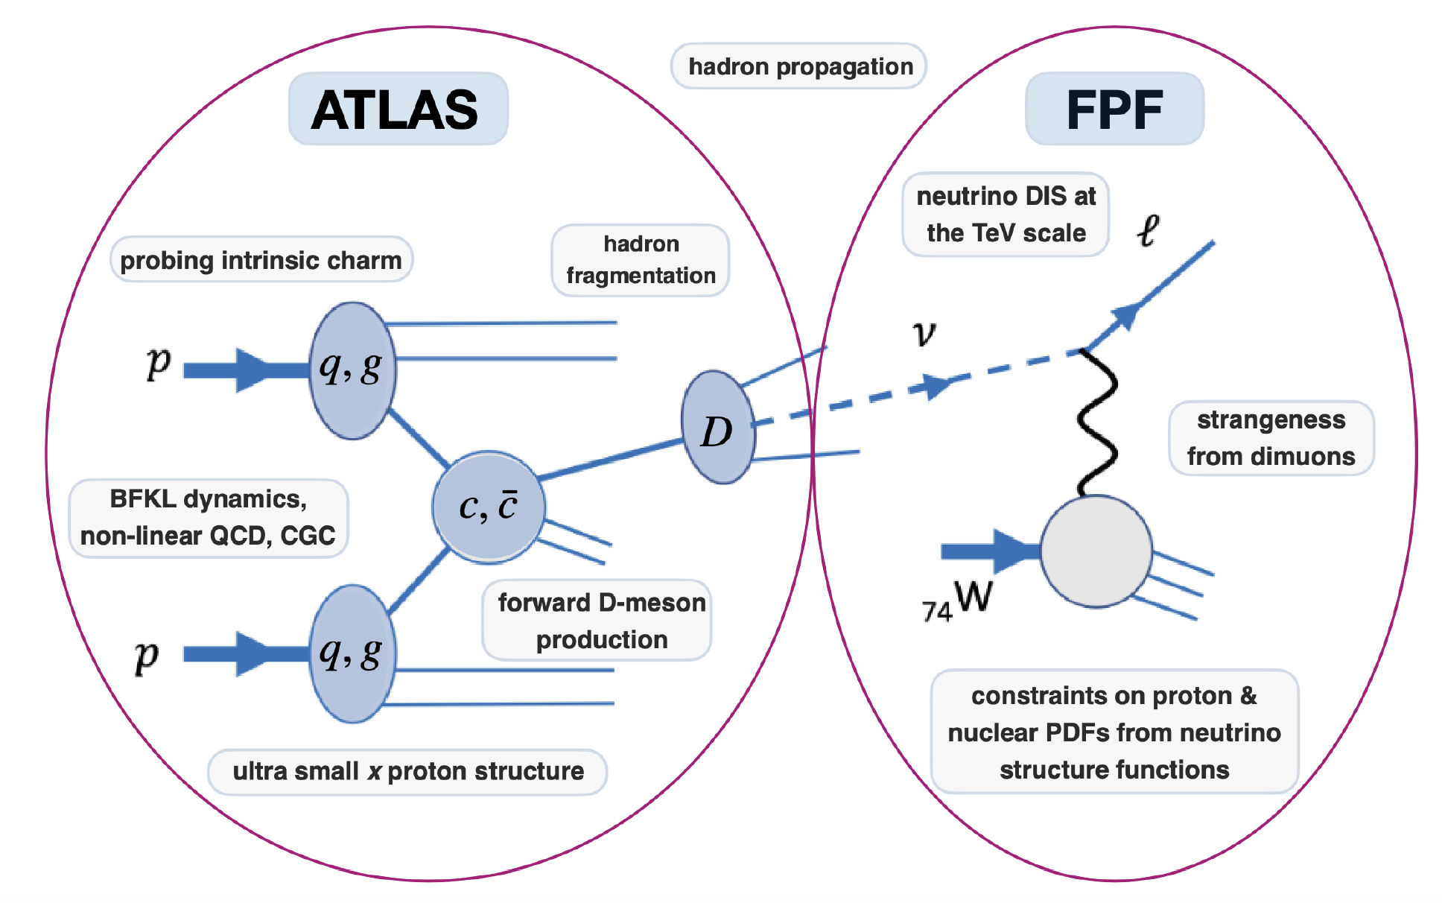
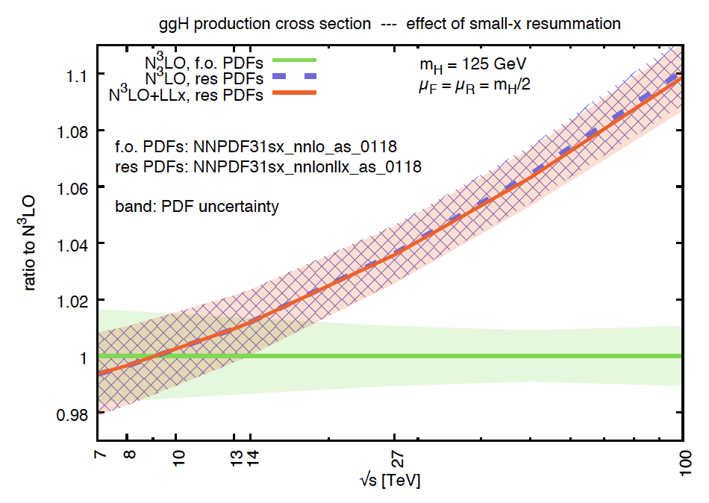
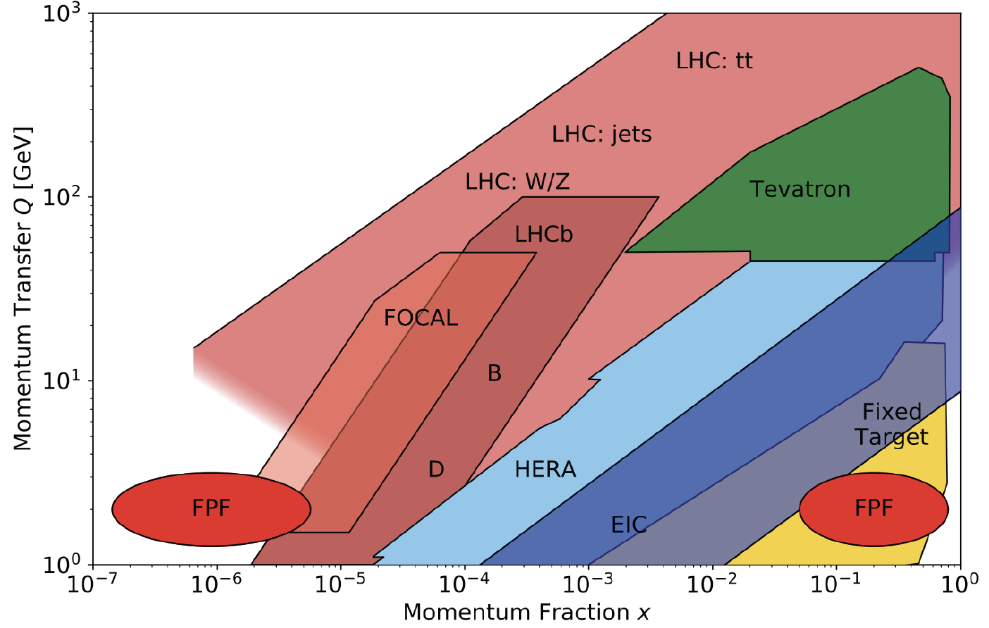

QCD
The FPF will also support a rich program of QCD and hadron structure studies.
Forward neutrino production is a probe of forward hadron production, BFKL dynamics, intrinsic charm, and proton structure at ultra small x ~ 10⁻⁷ to 10⁻⁶.
Important implications for studies relying on precision pdfs, 100 TeV pp collider, …
$$4m_{c}^{2 }\sim x_{1}x_{2}s$$
FASER White Paper (2022)

Slide 11
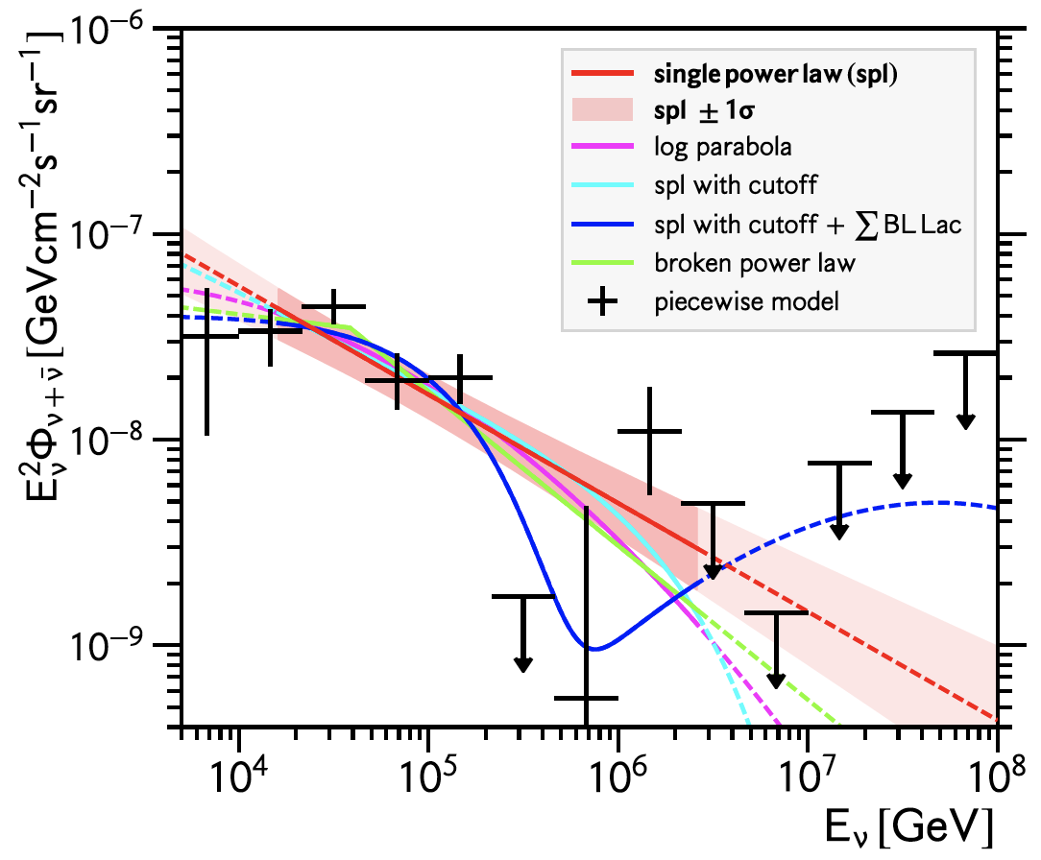
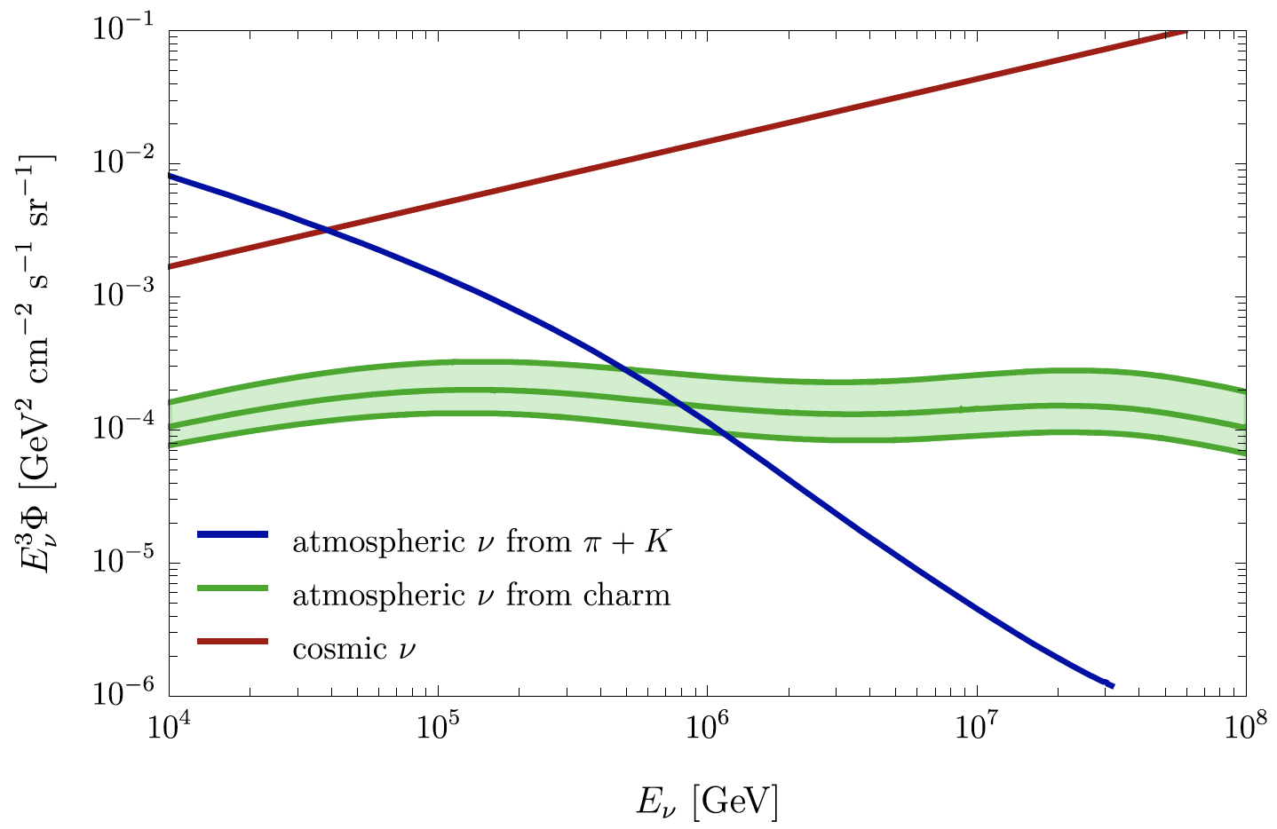
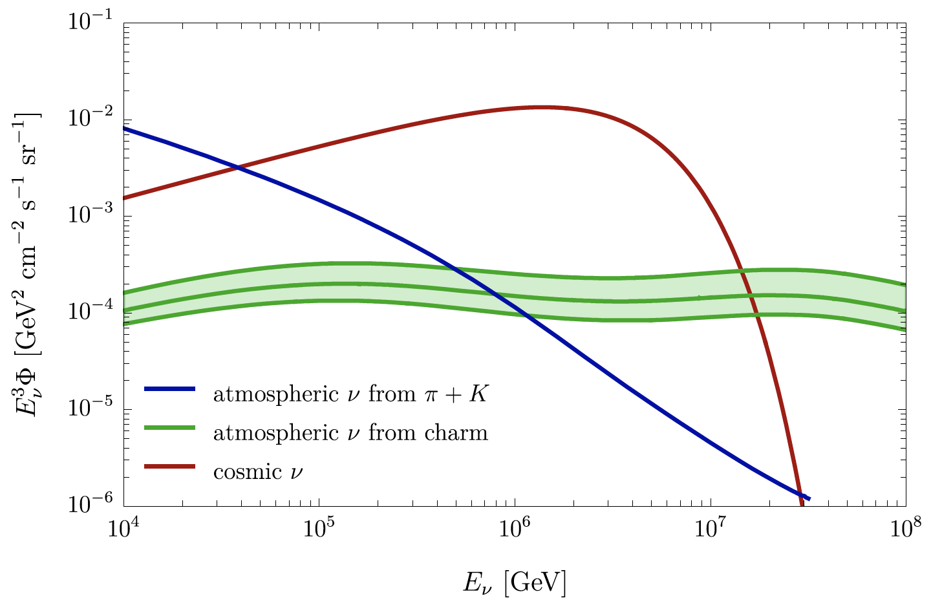
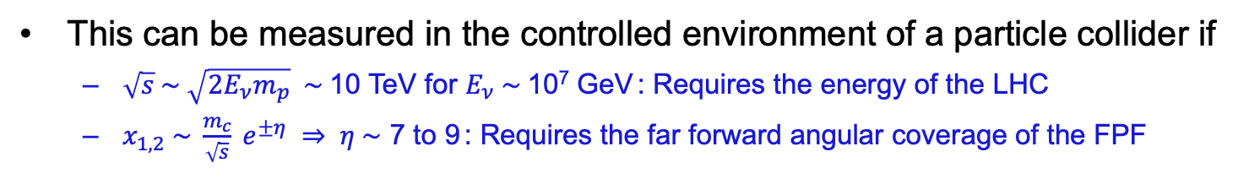
ASTROPARTICLE PHYSICS: COSMIC NEUTRINOS
The current IceCube cosmic nu flux can be fit by a power law, a power law with cutoff, ...
More data may be able to distinguish these, but only if the atmospheric neutrino background from charm is better determined.
IceCube
(2001.09520)
Bhattacharya et al. (1502.01076)
Power law
with cutoff
Power law
This can be measured in the controlled environment of a particle collider if
  $\sqrt{s} \sim \sqrt{2E_{ν}m_{p}} \sim$10 TeV for $E_{ν} \sim$10⁷ GeV : Requires the energy of the LHC
  $x_{1,2} \sim \frac{m_{c}}{\sqrt{s}} e^{±η} ⇒ η \sim$ 7 to 9 : Requires the far forward angular coverage of the FPF
Anchordoqui (2022)

Slide 12
FPF PHYSICS REACH SUMMARY
The highest priority for the immediate future is that the HL-LHC be exploited to its full potential.
The FPF will bring the HL-LHC much closer to this goal.
SM: The FPF will transform the HL-LHC from being blind to neutrinos to being a TeV-neutrino factory, with guaranteed new results for neutrinos, QCD, and astroparticle physics.
BSM: The FPF greatly enhances HL-LHC prospects for discovering new physics, e.g., extending its coverage in the ~MeV to GeV mass range, through dedicated searches for LLPs, dark matter, dark sectors, milli-charged particles, quirks, and many other new particles.

Slide 13
BACKUP

Slide 14
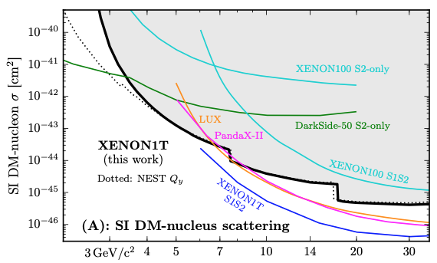
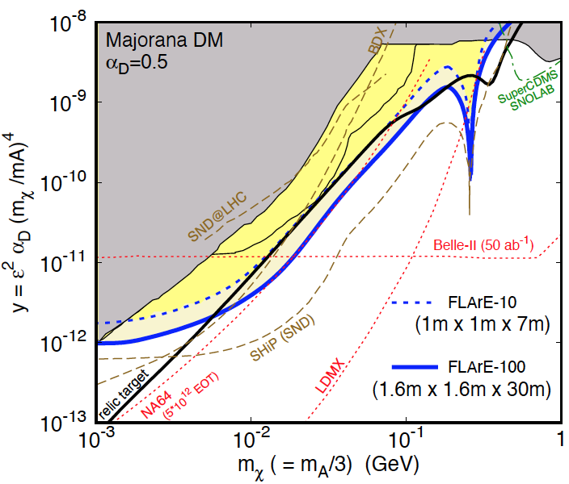
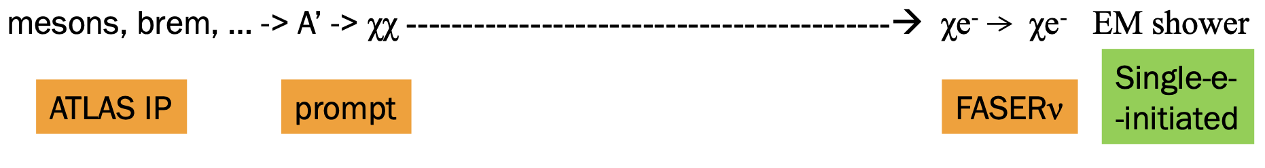
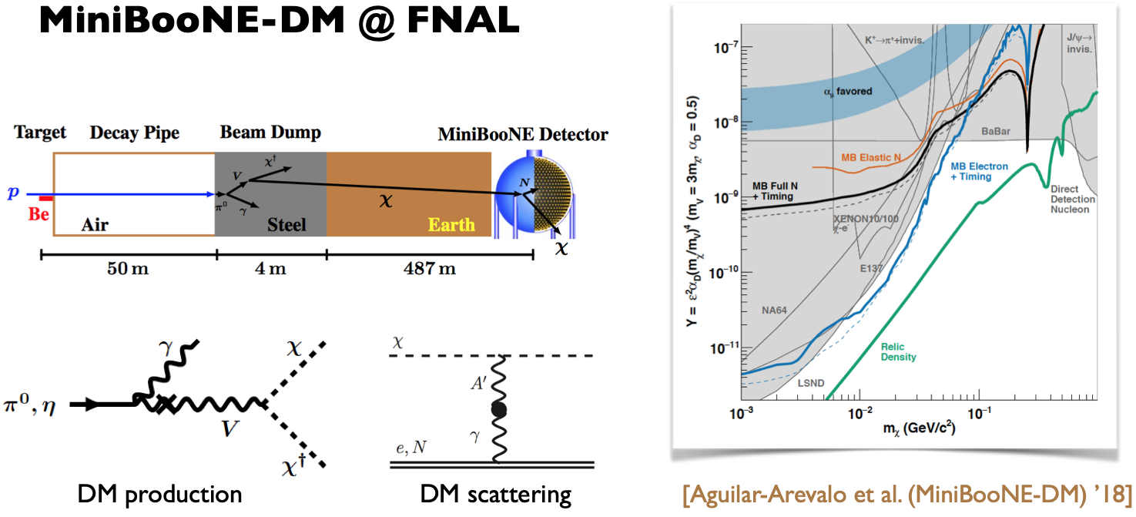
LIGHT DARK MATTER
Light DM with masses at the GeV scale and below is famously hard to detect.
  Galactic halo velocity ~ 10⁻³ c, so kinetic energy ~ keV or below.
At the LHC, we can produce DM at high energies, look for the resulting DM to scatter in FLArE, Forward Liquid Argon Experiment, a proposed 10 to 100 tonne LArTPC.
FLArE is powerful in the region favored/allowed by thermal freezeout.
Batell, Feng, Trojanowski (2021)

