Slide 1




RF-EF Cross Frontier Session: Long-Lived Particles
Snowmass, University of Washington
Jonathan Feng, UC Irvine, 20 July 2022

Slide 2

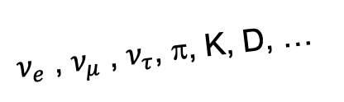
THE BASIC IDEA
The LHC’s physics potential should be exploited fully. This was a top recommendation of Snowmass 2013, and it will be of Snowmass 2022.
New since the last Snowmass: Although the LHC and its detectors are performing beautifully, we now realize that the LHC is far from operating at its full potential.
In particular, the existing large LHC detectors were designed to find strongly-interacting heavy particles.
But energetic light particles are primarily produced in the far-forward direction, and all particles with η > 4.5 escape down the beampipe.
  1% of pions with E > 10 GeV are produced in the forward 0.000001% of the solid angle (η > 9.2).
There is therefore a rich and unexplored physics program in the far-forward direction for weakly-interacting light particles: neutrinos, LLPs, dark sectors, ...
SUSY, top, Higgs, …
A’, a, mCPs, DM, …
$ν_{e}$ , $ν_{μ}$ , $ν_{τ}$, π, K, D, …

Slide 3
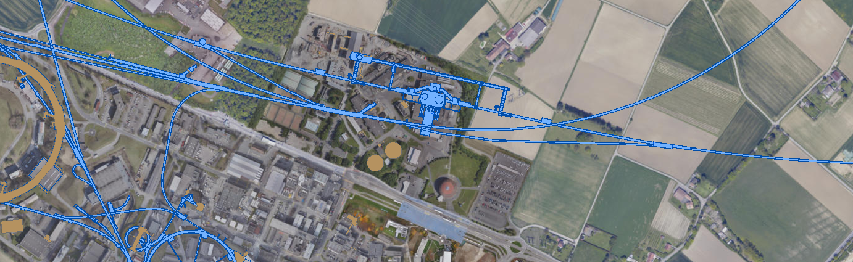
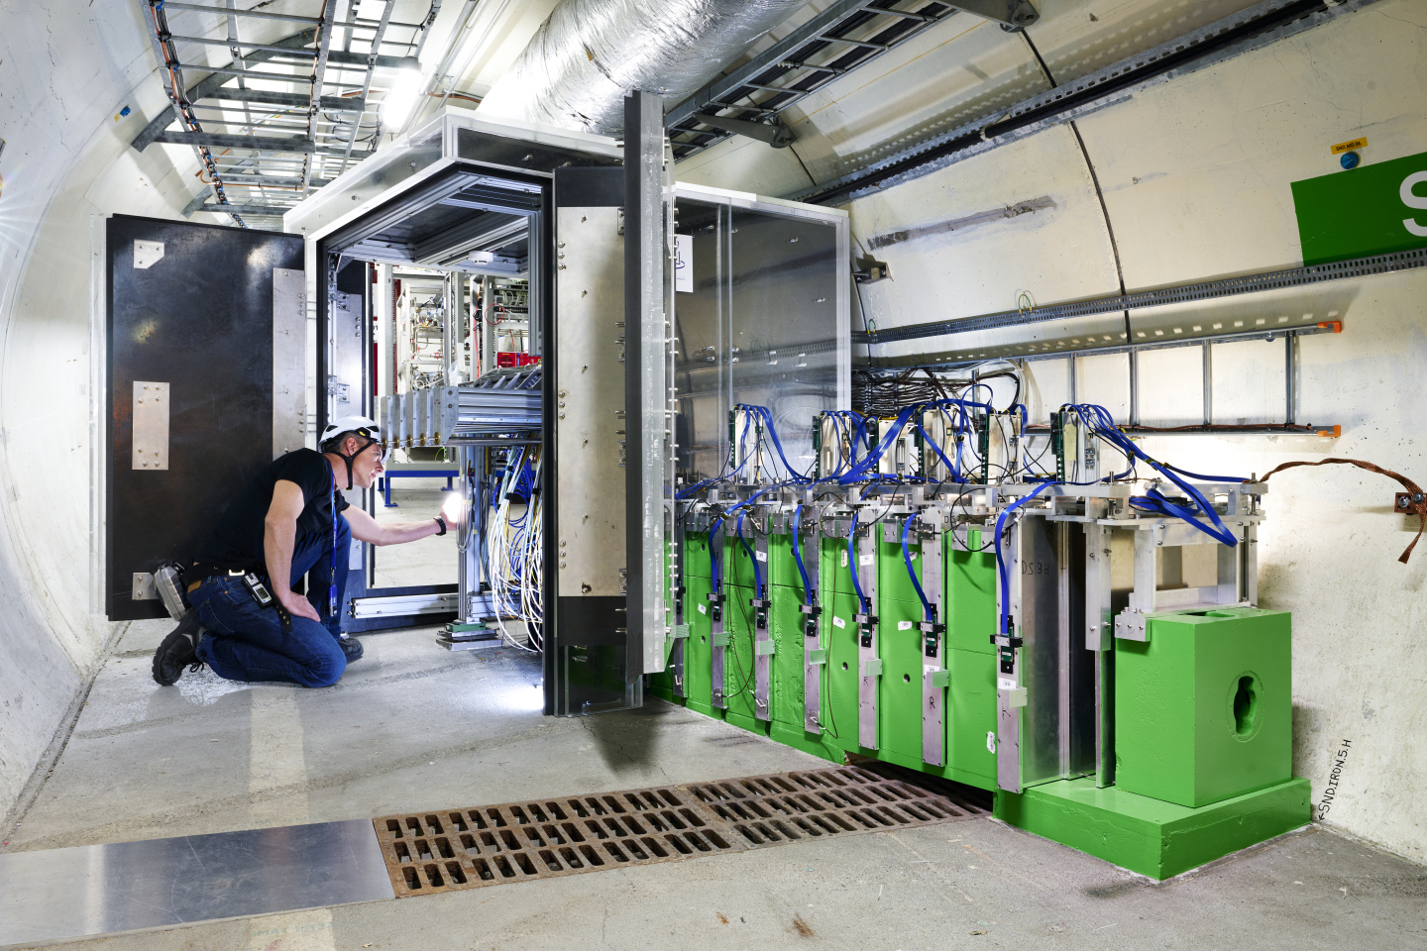
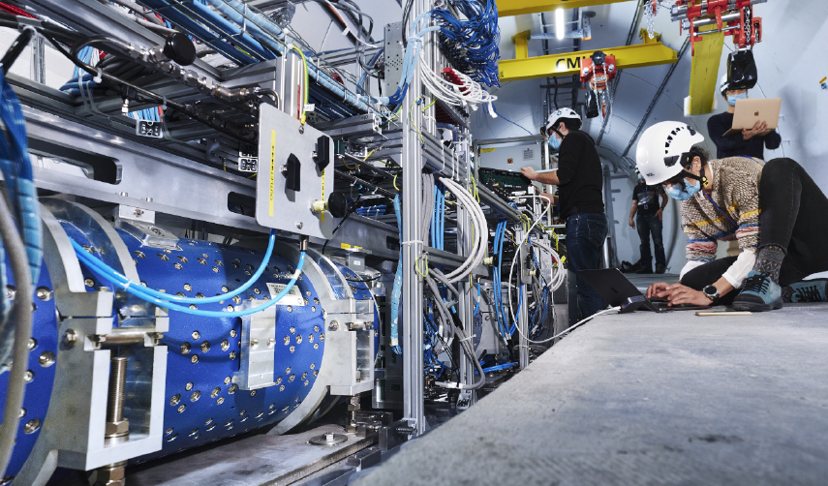
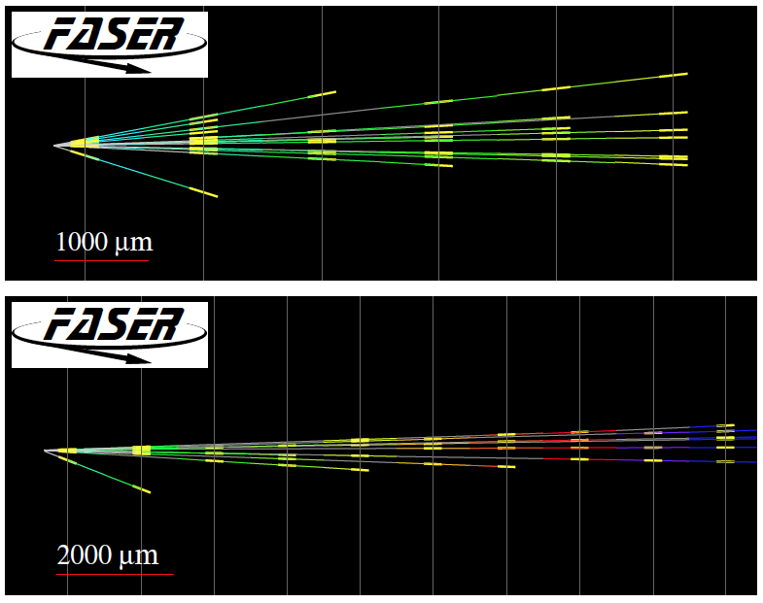
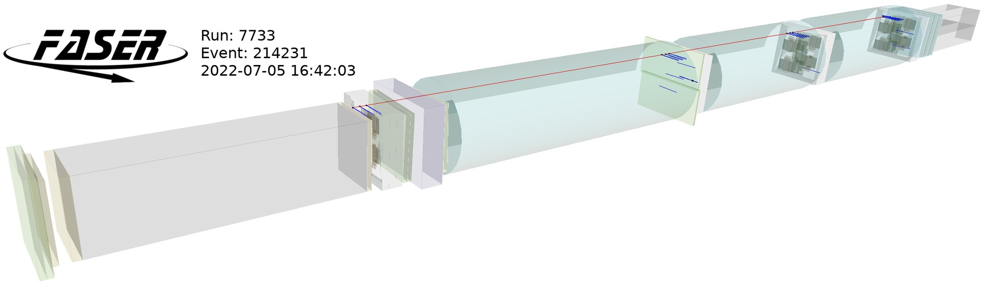
CURRENT EXPERIMENTS
SND@LHC
ATLAS
SPS
FASER/FASERν
LHC
LOS
SM: The first detection of collider neutrino candidates was in an 11-kg pilot emulsion detector made from recycled parts, taking data in the far-forward region for 4 weeks in 2018.
BSM: LHC Run 3 started (officially) on 5 July 2022. Muon backgrounds are within ~30% of expectations (i.e., negligible), and FASER already has enough data to exclude or discover proposed LLPs in new regions parameter space.
Baseline location: a dedicated facility ~612 m to the west of ATLAS on CERN land in France.
2105.06197
CERN GIS

Slide 4
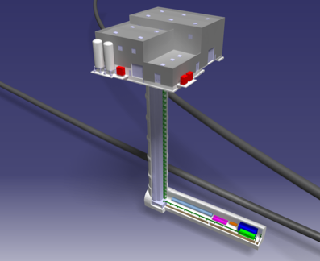
FORWARD PHYSICS FACILITY
The rich physics program in the far-forward region strongly motivates creating a dedicated Forward Physics Facility to house far-forward experiments for the HL-LHC era.
The CERN civil engineering team started with a blank slate, considering al locations around the LHC ring, and identified a preferred location on CERN land in France, 620-685 m west of the ATLAS IP, shielded by ~200 m of rock.
Cavern is 65 m-long, 8 m-wide, 10 m from the LHC, and disconnected from it.
Preliminary (class 4) cost estimate: 25 MCHF (CE) + 13 MCHF (services).

Slide 5
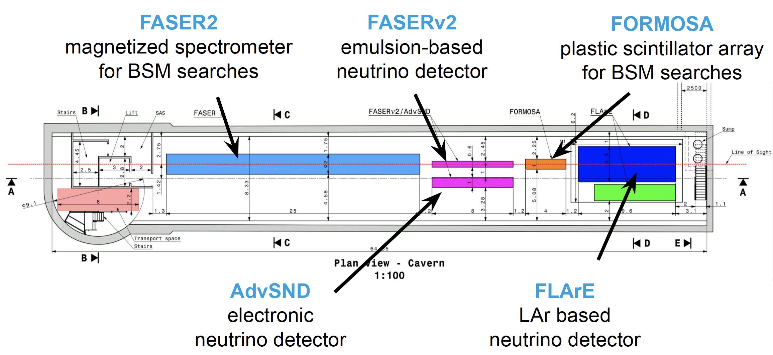
FPF EXPERIMENTS
At present there are 5 experiments being developed for the FPF.
Pseudo-rapidity coverage in the FPF is η > 5.5, with most experiments on the LOS covering η > 7.
  FASER2 increases FASER’s (decay volume * luminosity) by ~10⁴.
  FASERν2/AdvSND/FLARE increases FASERν/SND@LHC’s target mass by ~10².
Kling (2022)

Slide 6
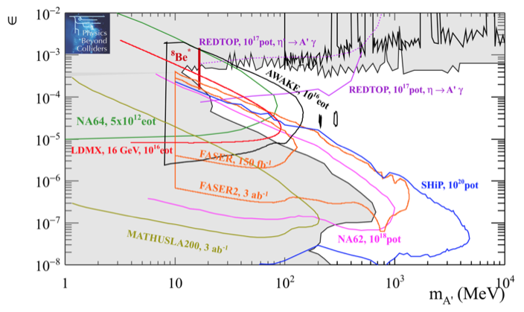
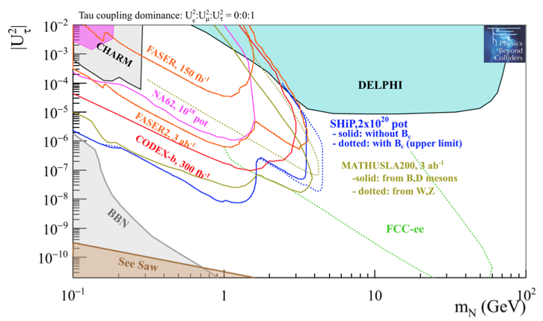
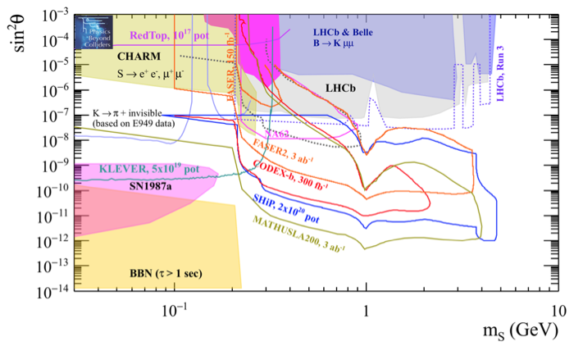
LLP SEARCHES
The dedicated detectors have significant discovery potential for a wide variety of BSM/LLP models: dark photons; B-L and related gauge bosons; dark Higgs bosons; HNLs with couplings to e, mu, tau; ALPs with photon, gluon, fermion couplings; light neutralinos, inflatons, relaxions, and many others.
_{FPF White Paper (2022)}
Dark Photon
Dark Fermion
Dark Scalar

Slide 7
FPF AND SNOWMASS
August 2020: Snowmass LoI authored by ~15% of Snowmass participants.
Nov 2020 (FPF1), May 2021 (FPF2), Oct 2021 (FPF3), Jan 2022 (FPF4): 4 dedicated, interdisciplinary meetings to develop the FPF’s potential. 5 physics themes: BSM, neutrinos, QCD, DM, and astroparticle physics.
FPF Short Paper: 75 pages, 80 authors, Anchordoqui et al., 2109.10905, Phys. Rept. 968, 1 (2022).
FPF Snowmass White Paper: 429 pages, 392 authors+endorsers, Feng, Kling, Reno, Rojo, Soldin et al., 2203.05090, J. Phys. G.
Useful Resources (software, old talks, …): PBC FPF webpage; FPF Twiki.
FPF-related talks at Snowmass
  Monday July 18: EF05-07, Hallsie Reno
  Wednesday, July 20: EF09/RF06, Jonathan Feng
  Thursday, July 21: NF02, Felix Kling
  Friday, July 22: EF/NF: Milind Diwan
  Sunday, July 24: NF04/CF07, Ina Sarcevic
  Tuesday, July 26: Small- and Mid-Scale Experiments/Facilities, Jonathan Feng
  Summary discussions, talks, panels.

Slide 8
SUMMARY
The LHC (and existing detectors) is operating beautifully, but it is not operating at full potential.
The FPF will bring it closer to this goal by adding a diverse array of small, inexpensive experiments with guaranteed SM physics results and BSM discovery potential. Additional examples, funding, timeline, etc. are in the White Paper and backup slides.

Slide 9
BACKUP

Slide 10
FUNDING AND TIMELINE
A possible split: CERN supports construction of the facility…
  Very preliminary (class 4) cost estimate: 25 MCHF (CE) + 13 MCHF (services).
…other funding agencies support R&D and construction of the experiments.
  Recently received funding from Brookhaven LDRD and Heising-Simons for FLArE R&D.
  Recently received funding from NSF for FASER and FASERnu operations. Additional funds received from JSPS, Swiss NSF, ERC, etc.
Timeline considerations
  Can access FPF while LHC is running (now with no connector, initial studies show no radiation problems, no vibration interference from FPF construction).
  Experiments can come online a different times with relatively little interference.
  Possible timeline
    LS3 (2026-28): Pure CE works, construction of experiments. (CERN teams busy during LS3, but pure CE works (excavation) is done by outside contractors.)
    Year 1 of Run 4 (2029): Installation of services by CERN teams.
    Year 2 of Run 4 (2030): Installation and commissioning of experiments.
    Year 3 of Run 4 to end of HL-LHC (2031-42): Physics in time to benefit from most of HL-LHC luminosity, impact planning for future colliders.

Slide 11
NEXT STEPS
CDRs for FPF and the 5 experiments in the next 6-12 months
  FASER2, FASERnu2, AdvancedSND, and FORMOSA (advanced MilliQan) build on existing experiments and existing collaborations.
  FLArE, the most novel experiment, has active groups working on it (BNL, UCI, …).
  All experiments must grow, many opportunities.
  CE studies for the Facility can progress quickly once experiments are defined.
Organizational structure (proto-collaborations) put in place in the next few months.
Submission of Expression of Interest to LHCC under discussion.
Set timeline and structure for review and possible approval of the FPF. HL-LHC sets a hard deadline. June 2022 meeting with CERN Directorate was very useful and encouraging. Next meeting set for 8 months from now.

Slide 12
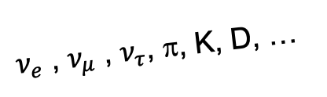
SEARCHES FOR NEW LIGHT PARTICLES
The existing large LHC detectors were designed to find strongly interacting heavy particles. Particles with η > 4.5 escape down the beampipe.
There is therefore a rich and unexplored physics program in the far forward direction for weakly interacting light particles.
  SM: TeV neutrinos of all flavors at the highest energies from a human-made source. Neutrinos also enable probes of QCD, proton and nuclear structure.
  BSM: world-leading sensitivities to LLPs, FIPs, dark sectors, including dark photons, axion-like particles, milli-charged particles, dark matter, …
SUSY, top, Higgs, …
A’, a, mCPs, DM, …
$ν_{e}$ , $ν_{μ}$ , $ν_{τ}$, π, K, D, …

Slide 13
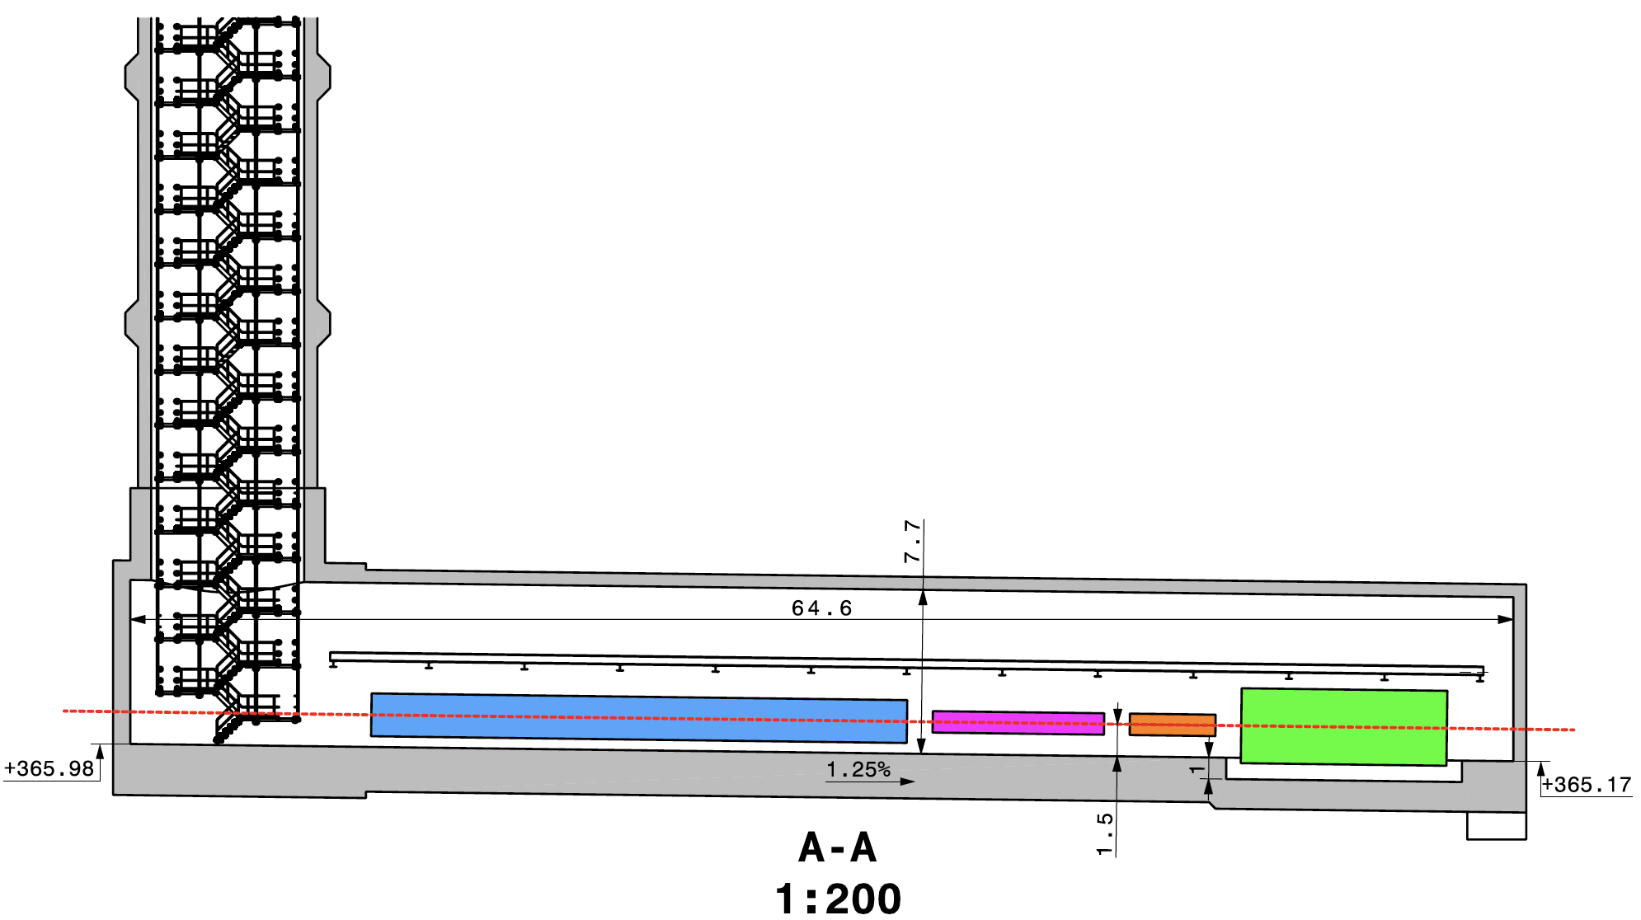
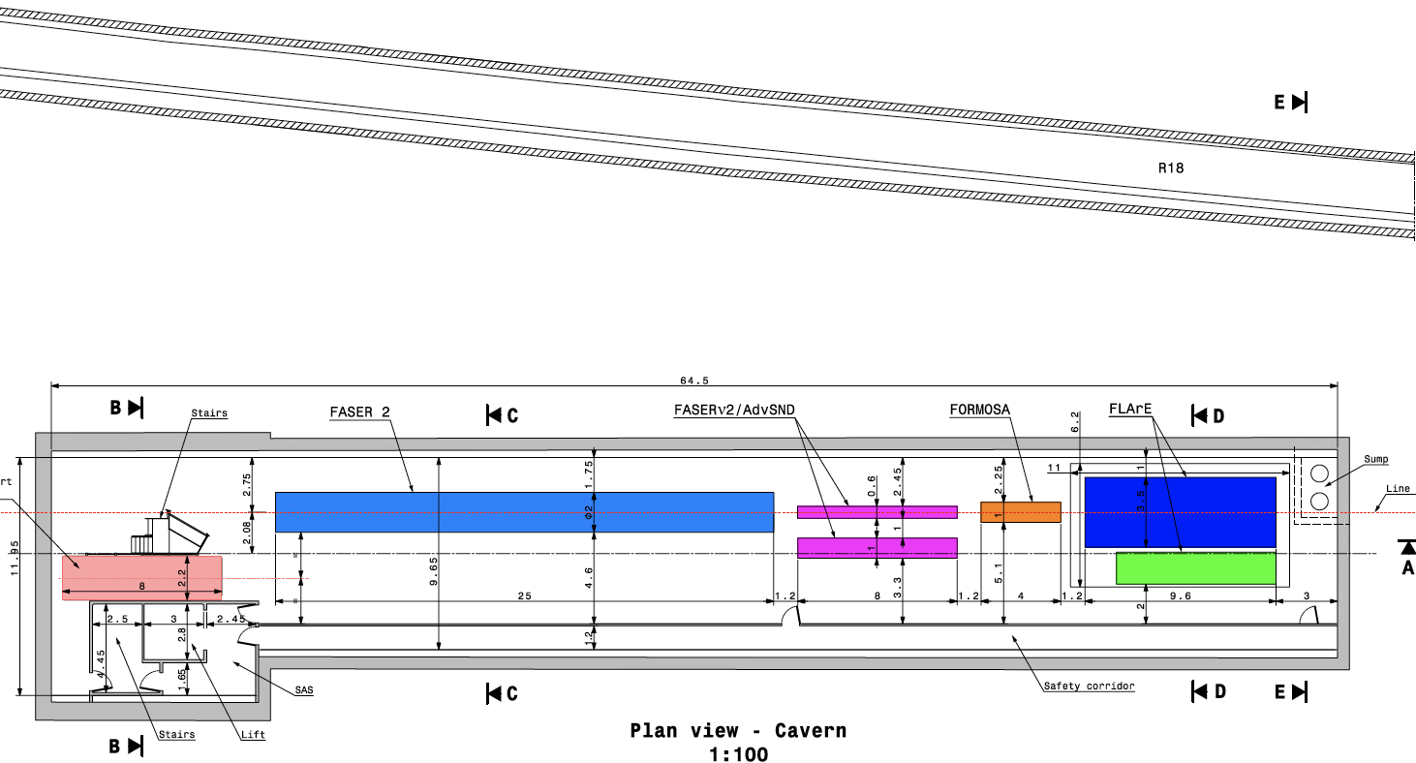
CAVERN AND SHAFT
Cavern: 65m long, 8m wide/high. Shaft: 88m-deep, 9.1m-diameter.
The FPF is completely decoupled from the LHC: no need for a safety corridor connecting the FPF to the LHC, preliminary RP and vibration studies indicate that FPF construction will have no significant impact on LHC operation.

Slide 14
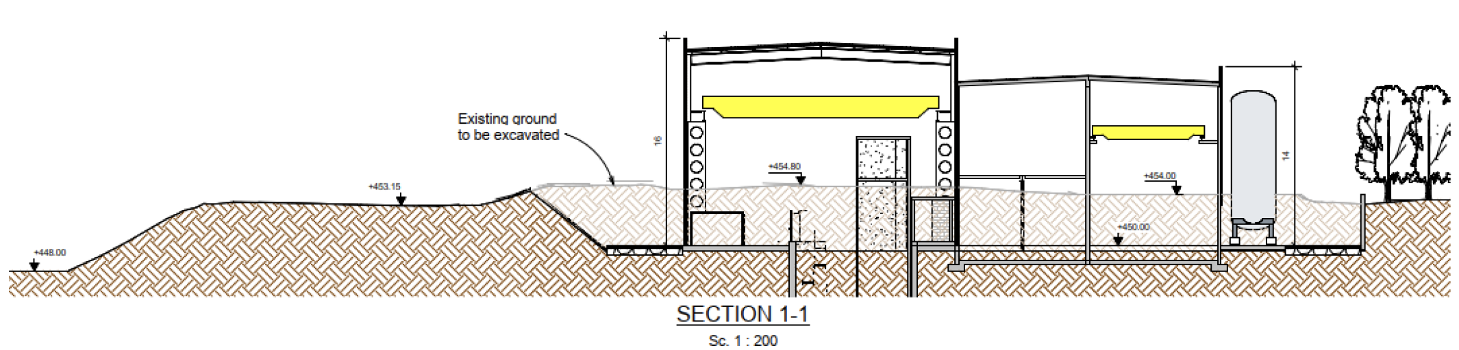
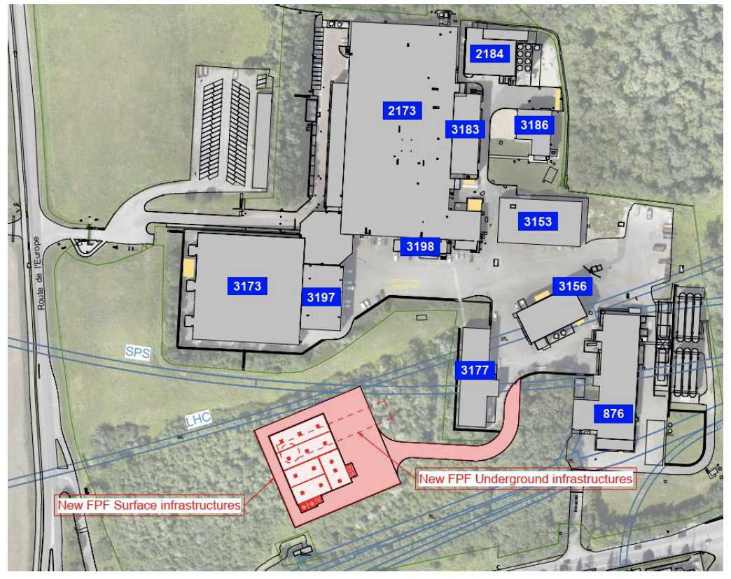
FPF CIVIL ENGINEERING
Balazs (2022)

Slide 15
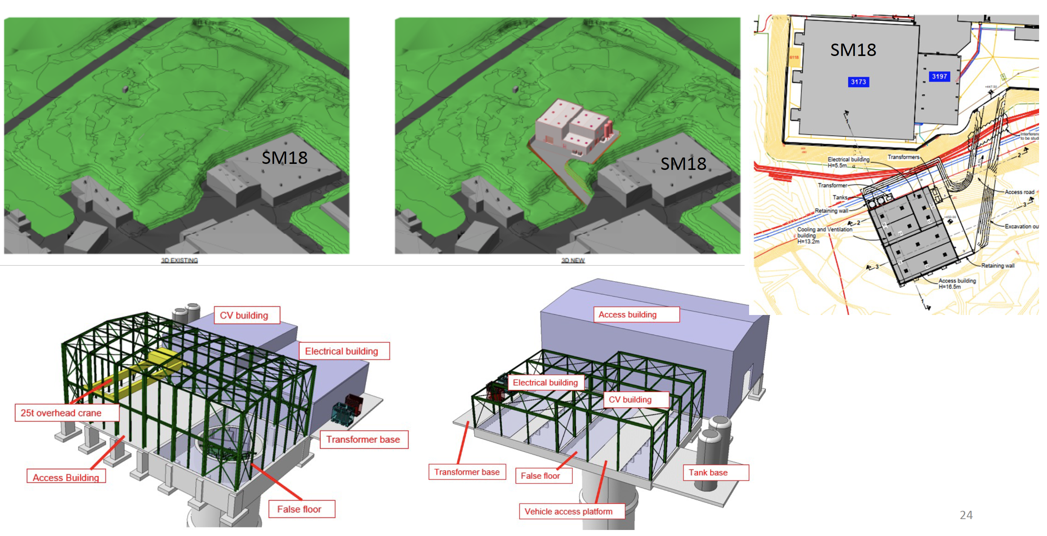
SURFACE BUILDINGS
Kincso Balazs,
John Osborne,
CERN CE (2022)

Slide 16

THE NEW PARTICLE LANDSCAPE
Particle
Colliders
Mass
MeV
GeV
TeV
1
(1) And (2) both contain SM and BSM opportunities, and both are well motivated by particle physics and cosmology.
But only (1) is being investigated well by current LHC detectors. (Cf. ISR and charm.)
Already
Discovered
(1) Strongly Interacting
Heavy Particles
(Higgs, top, SUSY, …)
Too Little to be
Dark Matter
Interaction Strength
Just Right to
be Dark Matter
10⁻³
(2) Weakly Interacting
Light Particles
(neutrinos, LLPs, …)
Impossible to
Discover
10⁻⁶
Too Much to be
Dark Matter

Slide 17
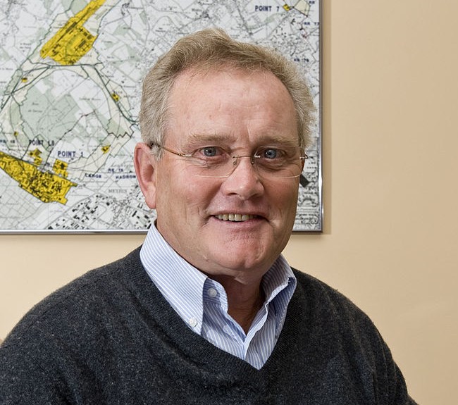
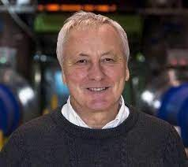
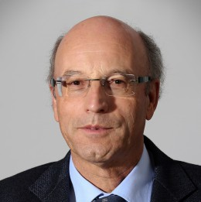
ISR AND CHARM
For the 50th anniversary of the ISR, there were many fascinating articles and talks by eminent physicists looking back on the ISR’s legacy.
  “Enormous impact on accelerator physics, but sadly little effect on particle physics.” – Steve Myers, talk at “The 50th Anniversary of Hadron Colliders at CERN,” October 2021.
  “There was initially a broad belief that physics action would be in the forward directions at a hadron collider…. It is easy to say after the fact, still with regrets, that with an earlier availability of more complete… experiments at the ISR, CERN would not have been left as a spectator during the famous November revolution of 1974 with the J/ψ discoveries at Brookhaven and SLAC .” – Lyn Evans and Peter Jenni, “Discovery Machines,” CERN Courier (2021).
Bottom line: charm was missed in part because detectors focused on the forward region.
Are we making the same (but opposite) mistake at the LHC?

Slide 18
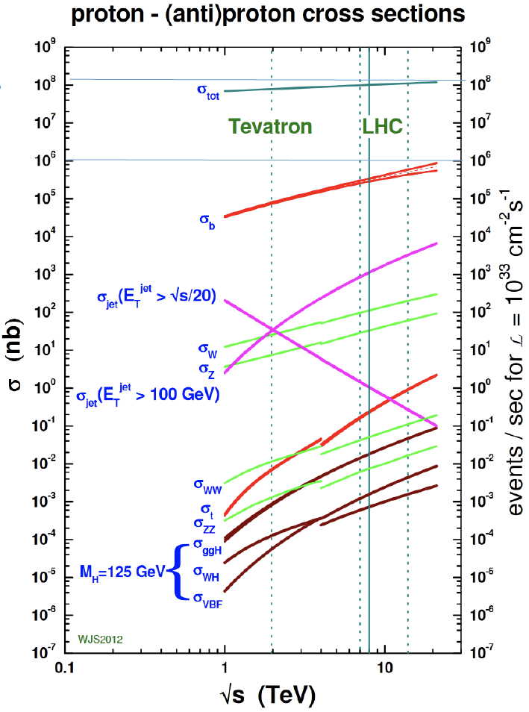
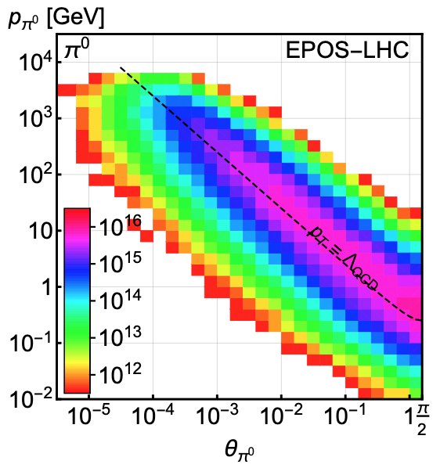
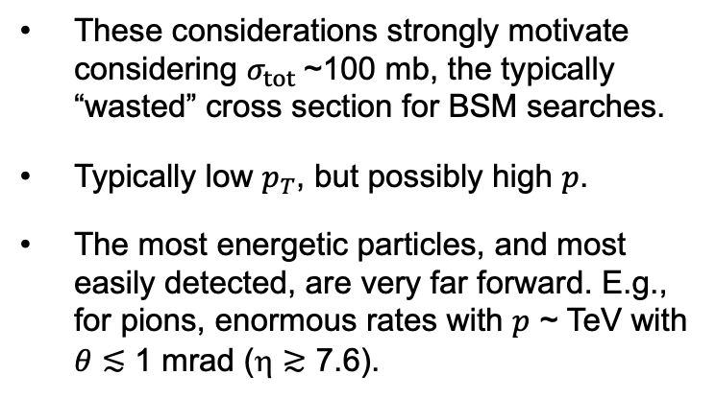
LIGHT, WEAKLY INTERACTING PARTICLES
300 fb⁻¹
Feng, Galon, Kling, Trojanowski (2017)
Most BSM searches focus on σ ~ fb, pb.
But if the new particles are
  light → can be produced in decays of light SM particles.
  weakly-interacting → need large numbers of SM particles to see rare processes.
These considerations strongly motivate considering $σ_{tot}$~100 mb, the typically “wasted” cross section for BSM searches.
Typically low $p_{T}$, but possibly high $p$.
The most energetic particles, and most easily detected, are very far forward. E.g., for pions, enormous rates with $p$ ~ TeV with $θ≲$ 1 mrad (η $≳$ 7.6).

Slide 19
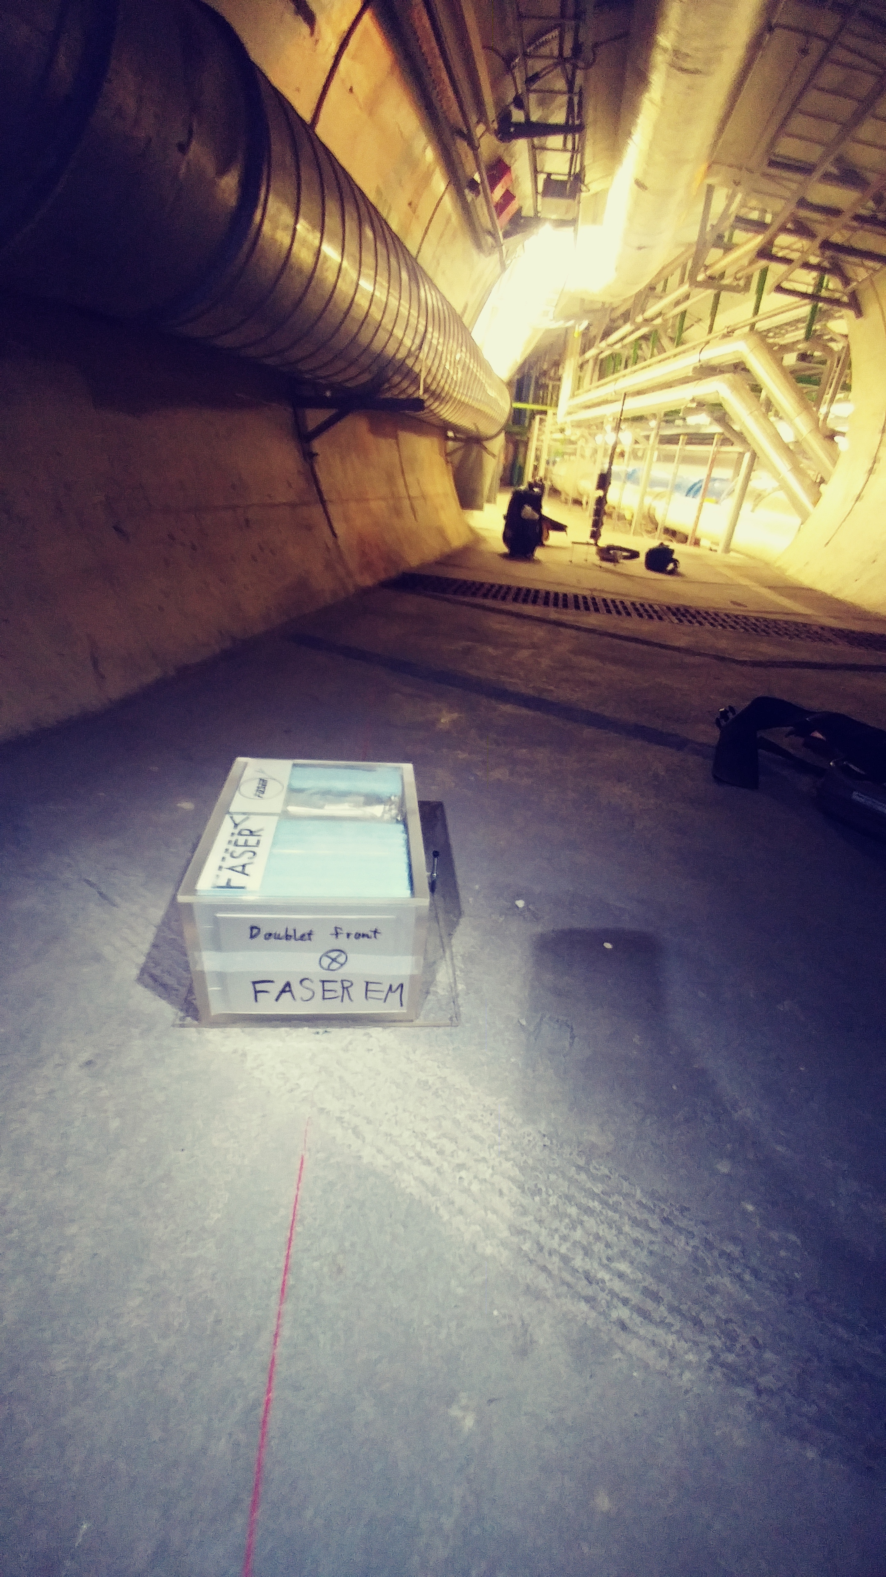
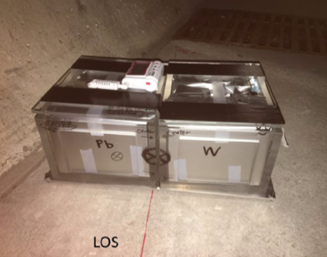
PROOF OF PRINCIPLE: 1ST COLLIDER NEUTRINOS
In 2018 an 11 kg emulsion detector was placed on the beam collision axis for 4 weeks, collecting 12.2 fb⁻¹ (installed and removed during TSs).
In May 2021, the FASER Collaboration announced the direct detection of 6 candidate neutrinos above the expected neutral hadron background events (2.7σ).
FASER Collaboration (2105.06197)

Slide 20
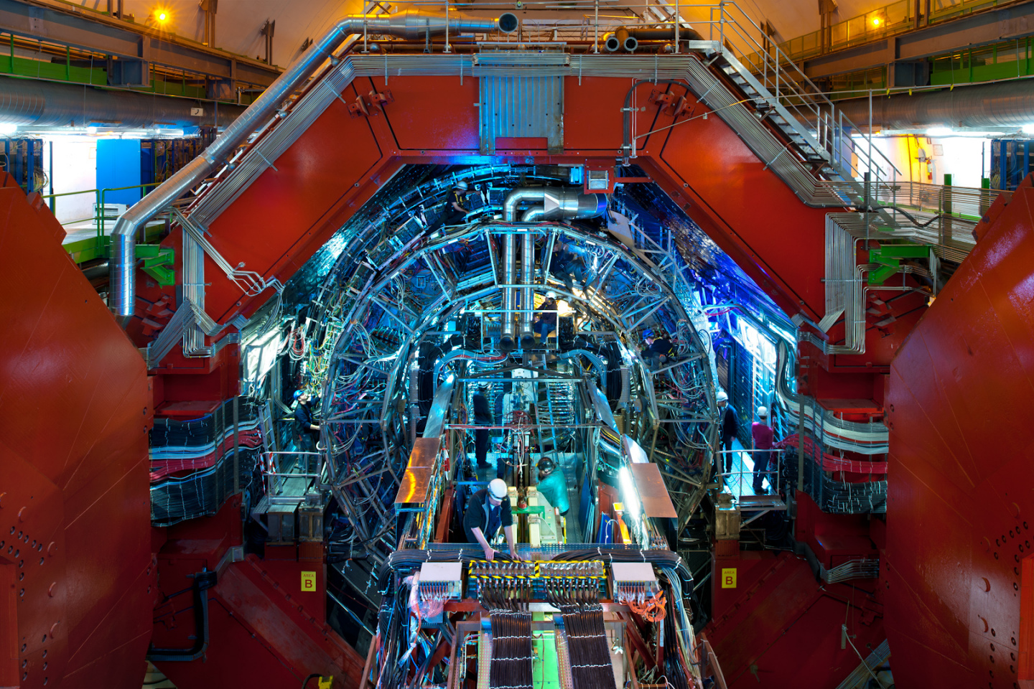
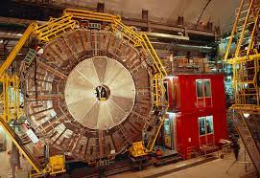
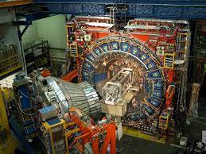
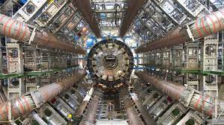
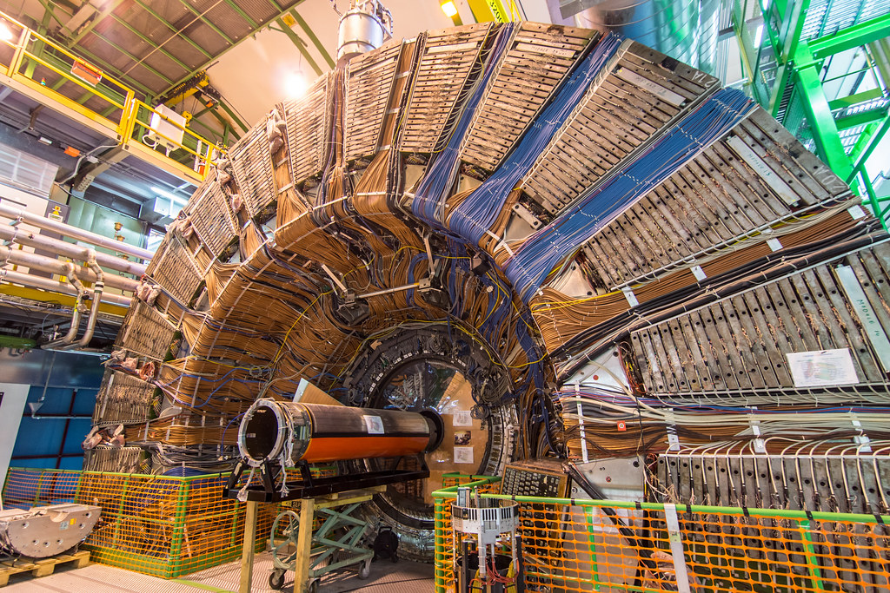
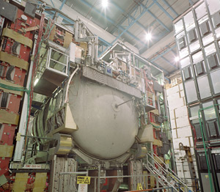
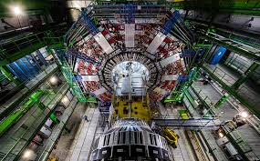
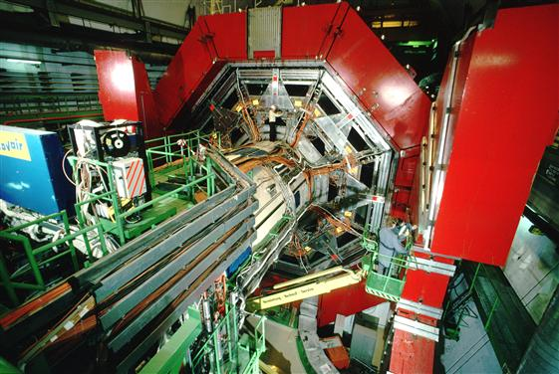

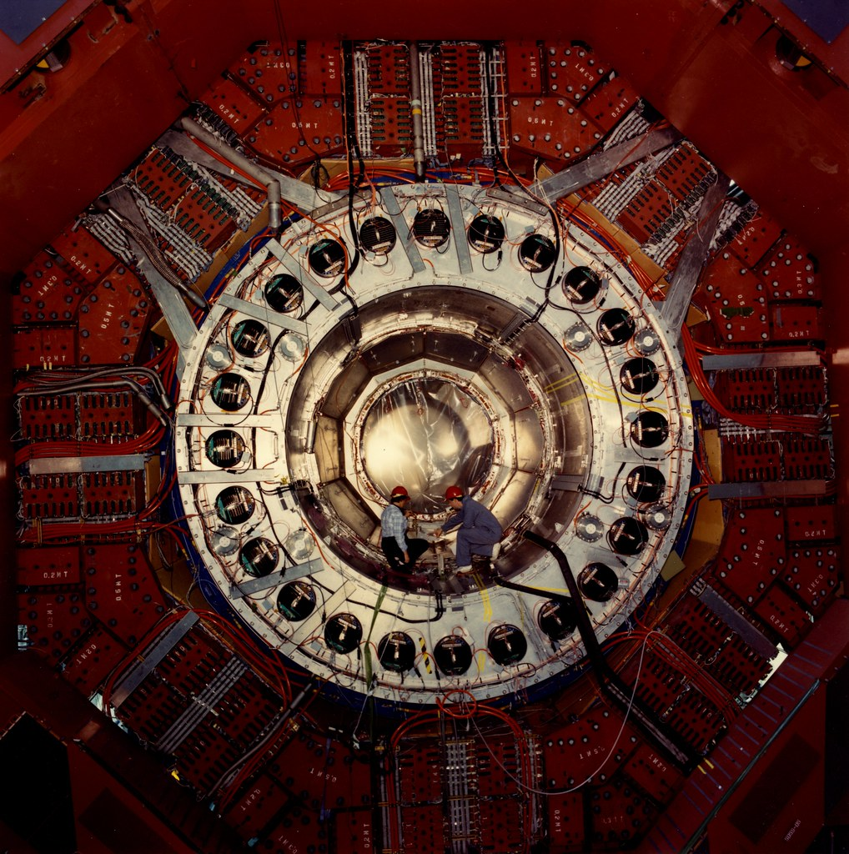
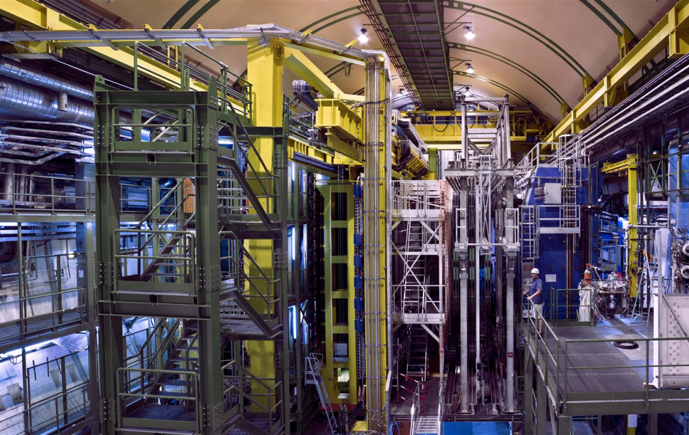
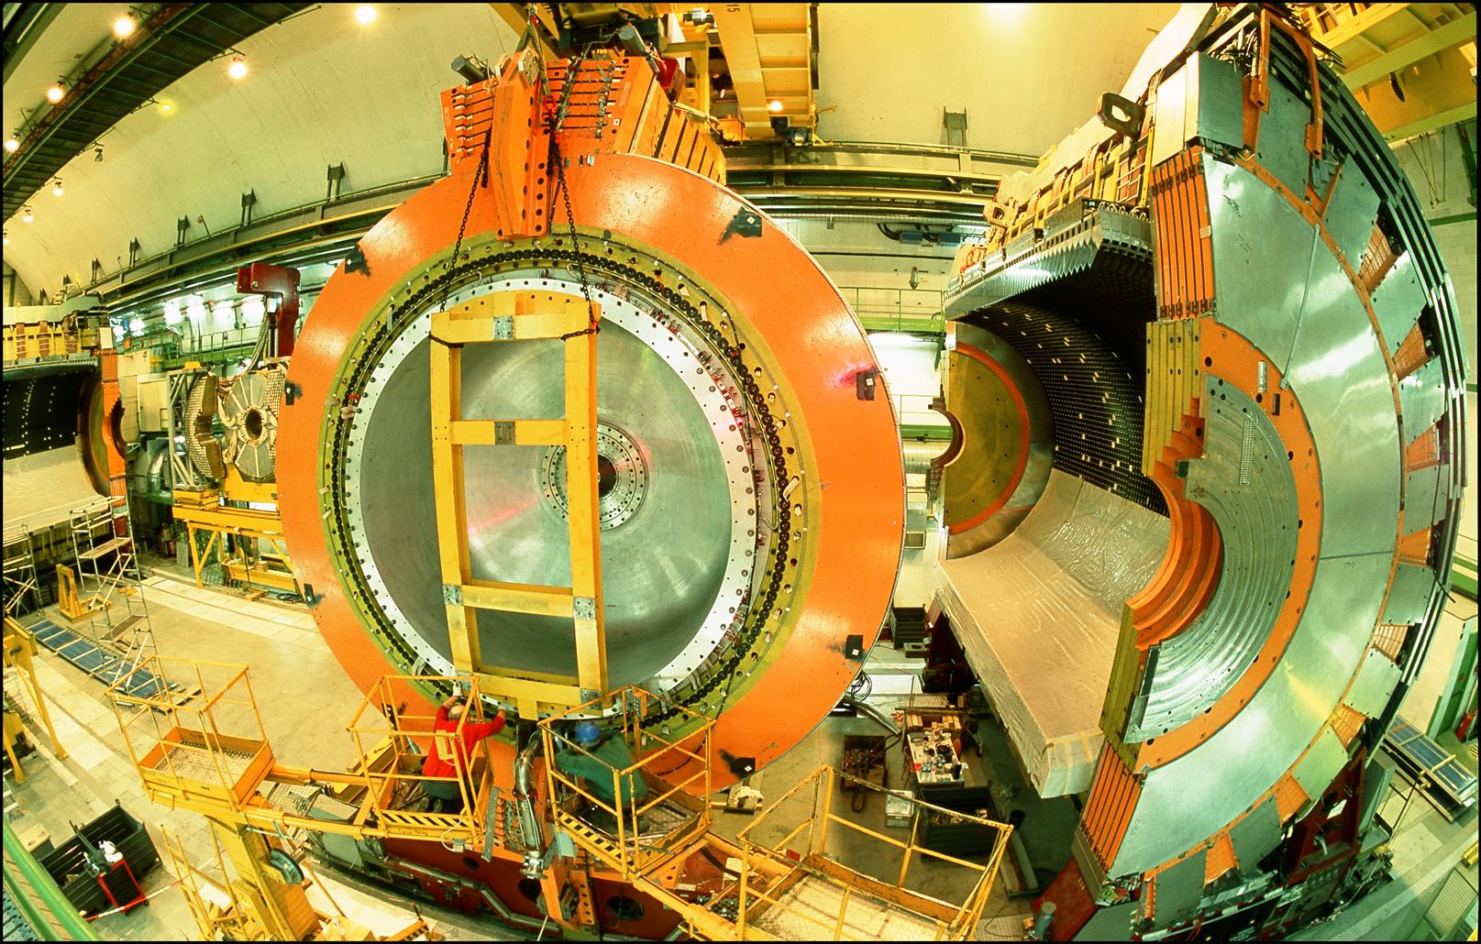
LOCATION, LOCATION, LOCATION
…
ALICE
ALEPH
CDF
FASER Pilot Detector
Suitcase-size, 4 weeks
$0 (recycled parts)
6 candidate neutrinos
ATLAS
DELPHI
D0
CMS
L3
LHCb
SLD
OPAL
All previous
collider detectors
Building-size, decades
~$10⁹
0 candidate neutrinos
This opens up a new field: neutrino physics at colliders

Slide 21
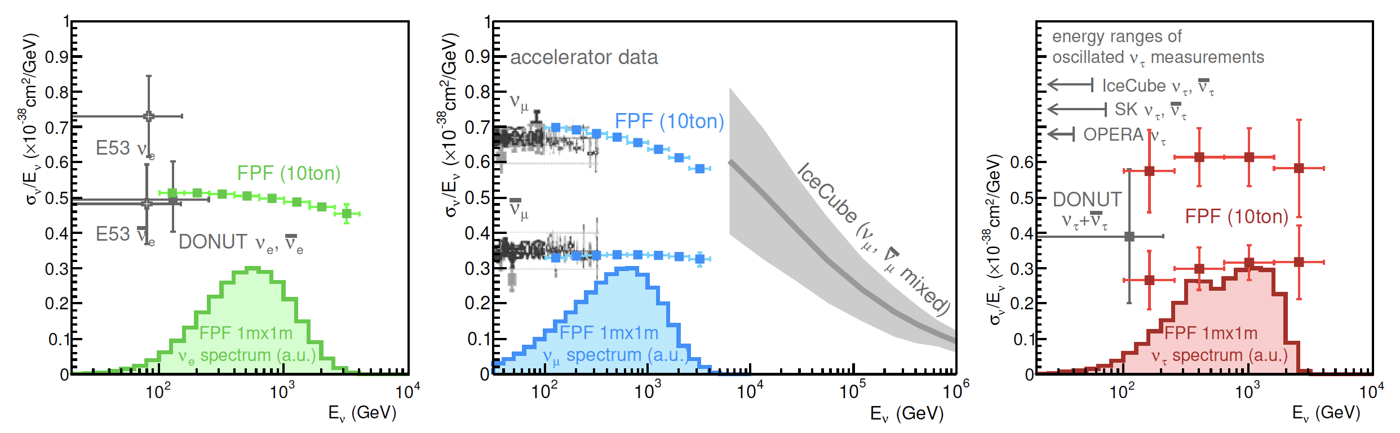
NEUTRINOS
At the FPF, three proposed ~10-ton detectors FASERν2, AdvSND, and FLArE will each detect ~100,000 ν_{e} , ~1,000,000 ν_{μ} , and ~1000 ν_{τ} interactions at TeV energies, providing high statistics samples for all three flavors in an energy range that has never been directly explored.
Will enable precision studies of the tau neutrino.
Can also distinguish neutrinos and anti-neutrinos for muon and tau.
FASER White Paper (2022)

Slide 22
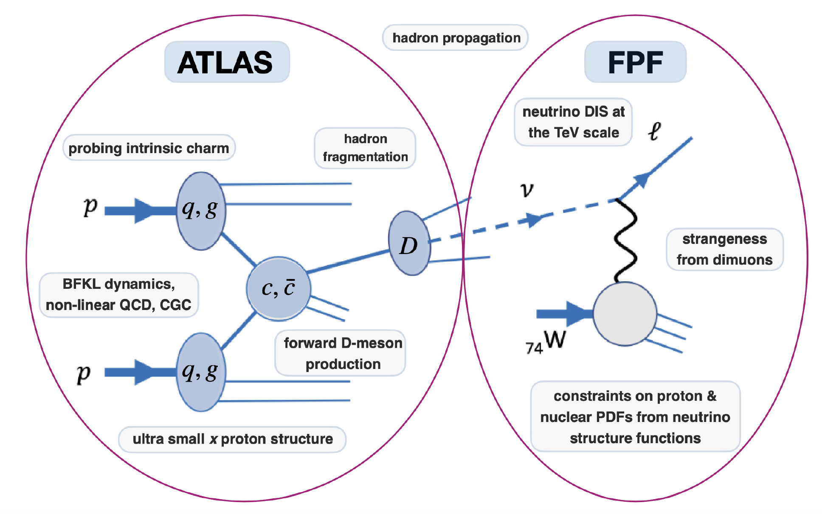
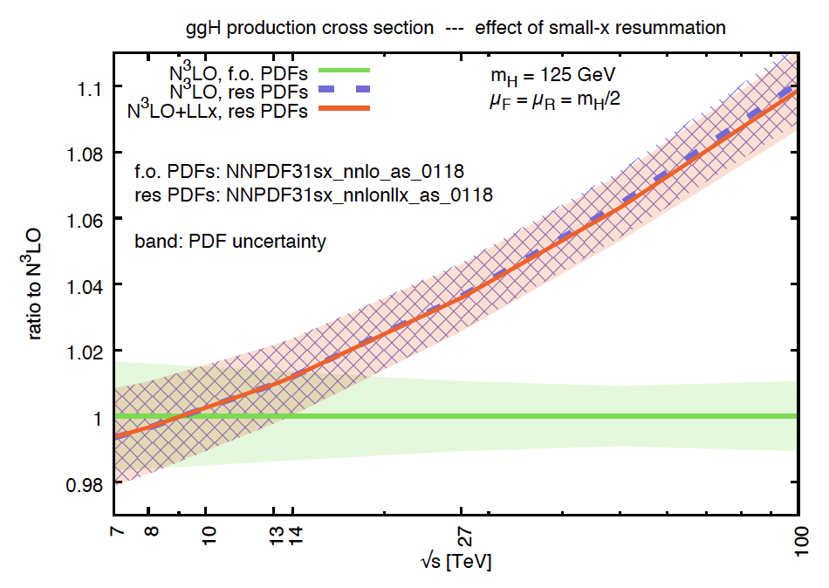
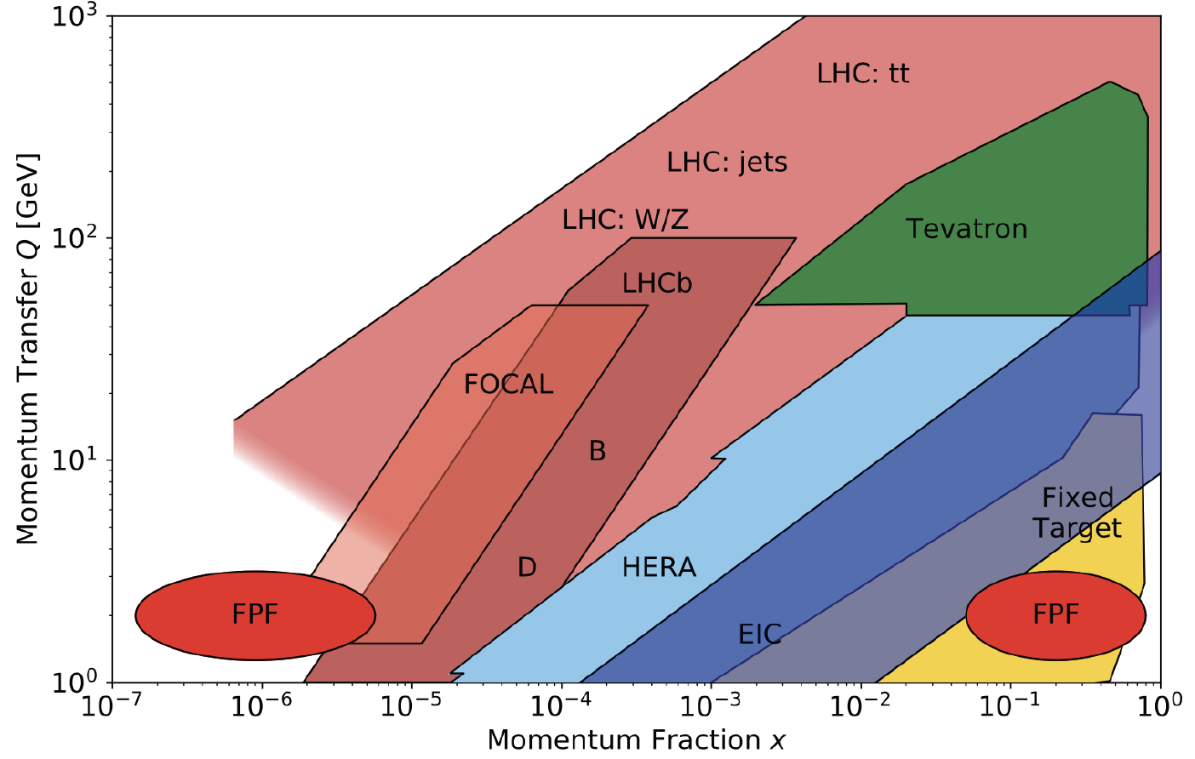

QCD
The FPF will also support a rich program of QCD and hadron structure studies.
Forward neutrino production is a probe of forward hadron production, BFKL dynamics, intrinsic charm, and proton structure at ultra small x ~ 10⁻⁷ to 10⁻⁶.
Important implications for UHE cosmic ray experiments, 100 TeV pp collider, …
$$4m_{c}^{2 }\sim x_{1}x_{2}s$$
FASER White Paper (2022)

Slide 23
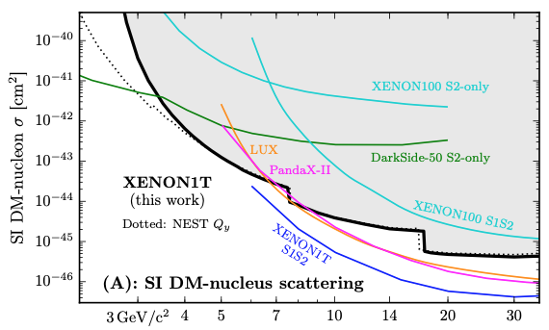
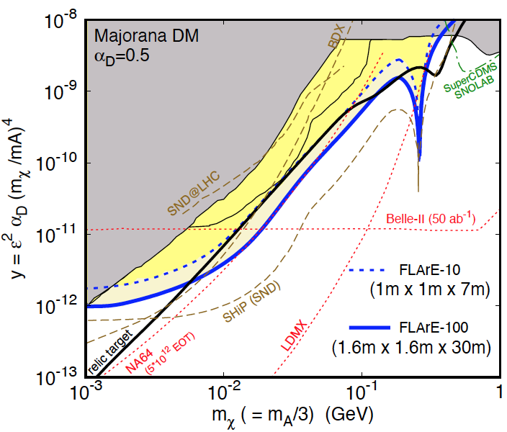
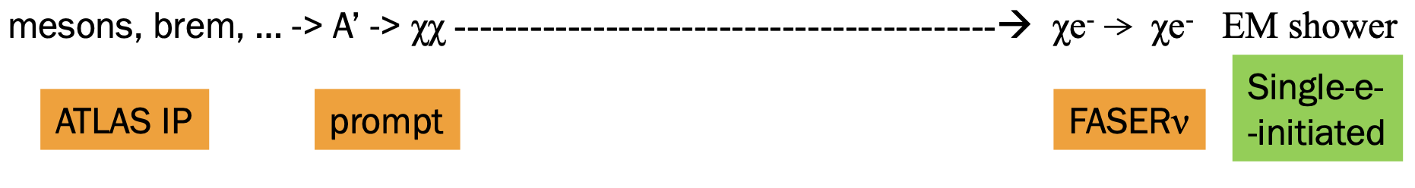
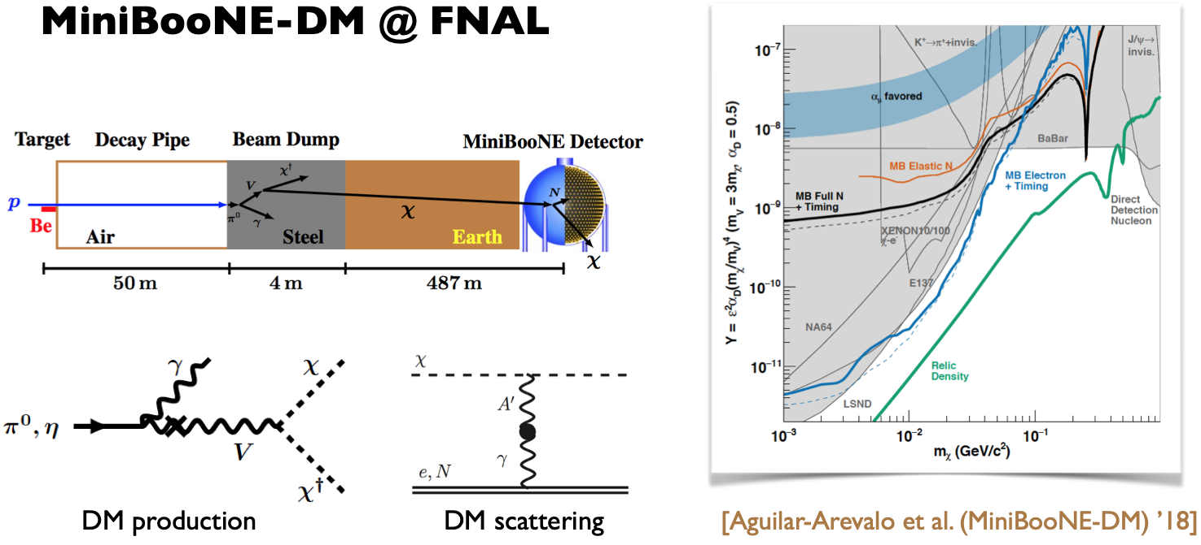
DARK MATTER DIRECT DETECTION
Light DM with masses at the GeV scale and below is famously hard to detect.
  Galactic halo velocity ~ 10⁻³ c, so kinetic energy ~ keV or below.
At the LHC, we can produce DM at high energies, look for the resulting DM to scatter in FLArE, Forward Liquid Argon Experiment, a proposed 10 to 100 tonne LArTPC.
FLArE is powerful in the region favored/allowed by thermal freezeout.
Batell, Feng, Trojanowski (2021)

Slide 24
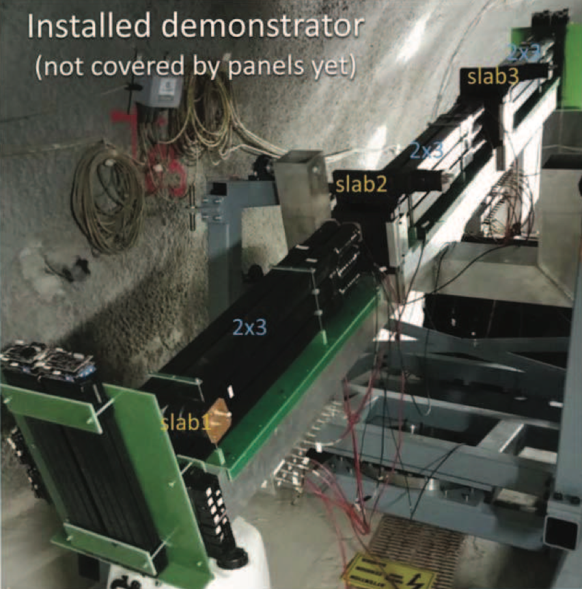
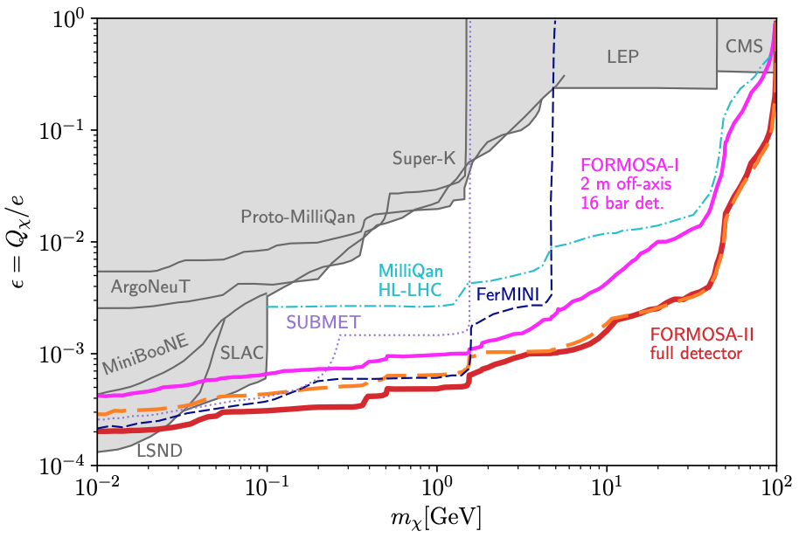
MILLI-CHARGED PARTICLES
A completely generic possibility motivated by dark matter, dark sectors. Currently the target of the MilliQan experiment, located at the LHC near the CMS experiment in a “non-forward” tunnel.
The MilliQan Demonstrator (Proto-MilliQan) already probes new region. Full MilliQan can also run in this location in the HL-LHC era, but the sensitivity may be improved significantly by moving it to the FPF (FORMOSA).
Foroughi-Abari, Kling, Tsai (2020)

Slide 25
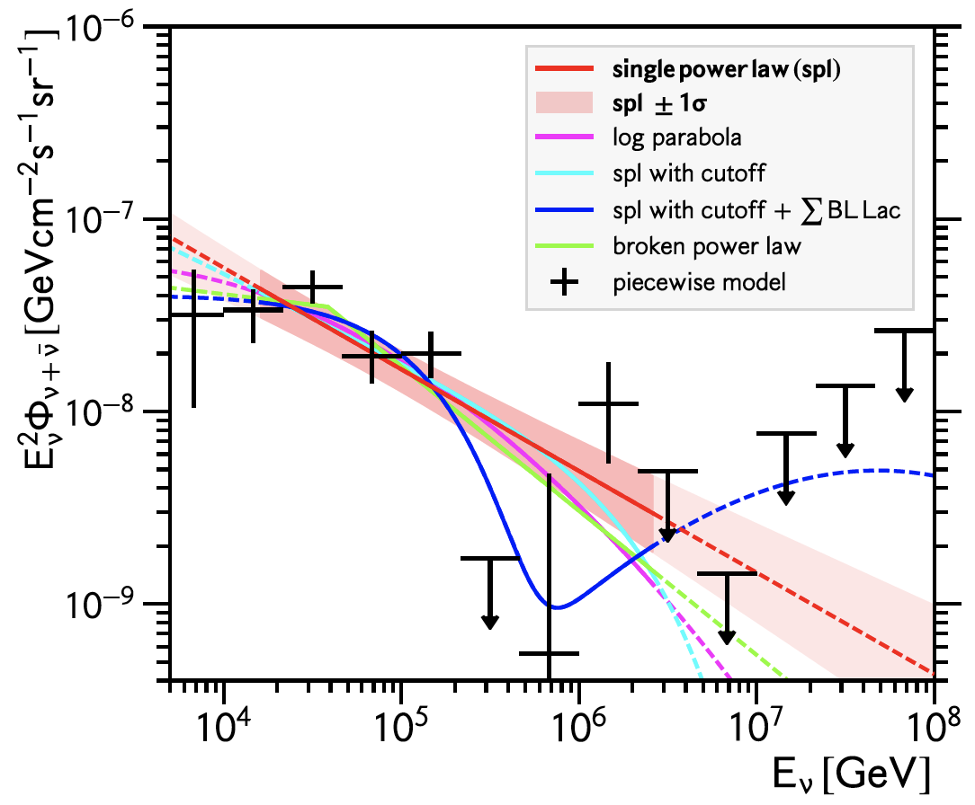
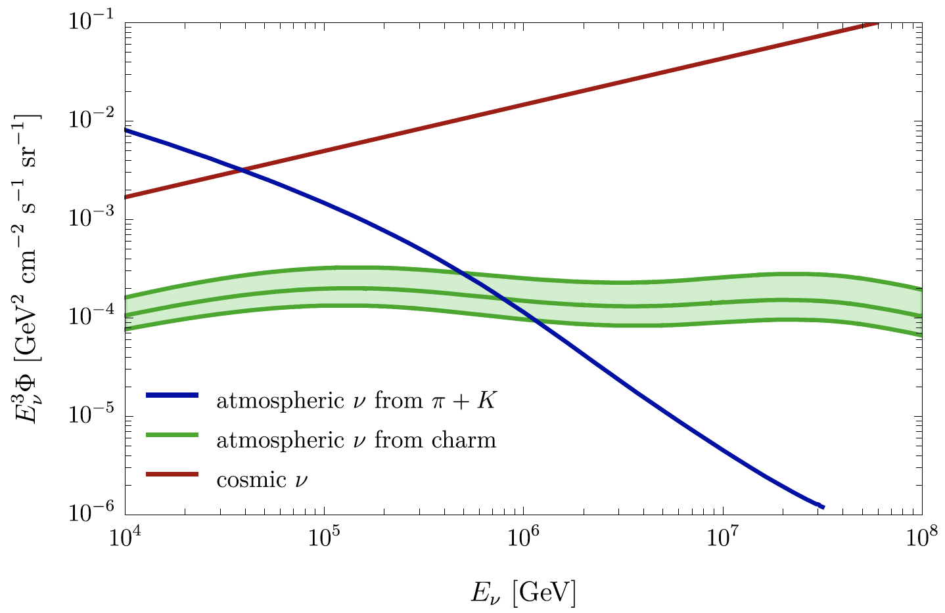
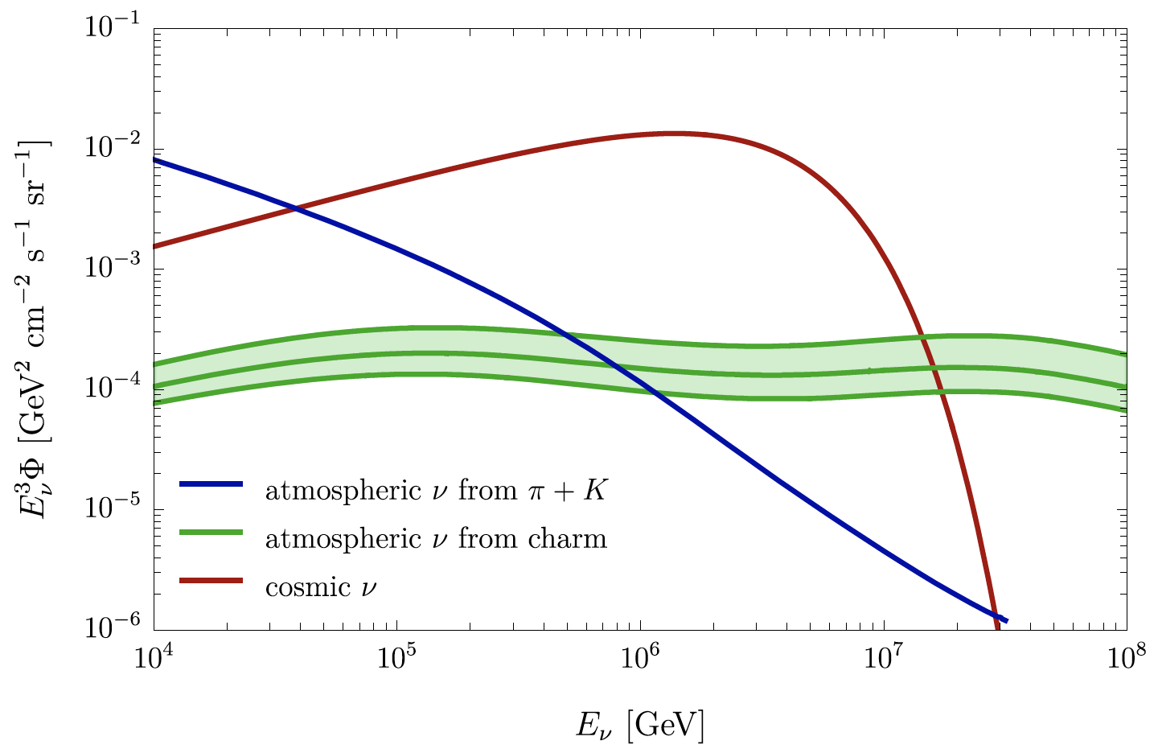
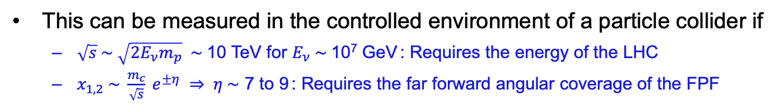
ASTROPARTICLE PHYSICS: COSMIC NEUTRINOS
The current IceCube cosmic nu flux can be fit by a power law, a power law with cutoff, ...
More data may be able to distinguish these, but only if the atmospheric neutrino background from charm is better determined.
IceCube 2001.09520
Power law
Power law
with cutoff
Bhattacharya et al. (1502.01076)
This can be measured in the controlled environment of a particle collider if
  $\sqrt{s} \sim \sqrt{2E_{ν}m_{p}} \sim$10 TeV for $E_{ν} \sim$10⁷ GeV : Requires the energy of the LHC
  $x_{1,2} \sim \frac{m_{c}}{\sqrt{s}} e^{±η} ⇒ η \sim$ 7 to 9 : Requires the far forward angular coverage of the FPF
Anchordoqui (2022)

