Slide 1

CURRENT STATUS
Jonathan Feng
13 July 2022

Slide 2
GOALS FOR THIS MEETING
Summarize the current status of the FPF.
Discuss (mainly) funding, timeline, organization, future plans.
Provide useful resources (links to previous meetings, papers, talks) for those giving talks or who want to give others more information.
Very little discussion of the experiments and physics case, but see backup slides here and talks on the FPF Twiki page; comments, corrections welcome.
FPF experiments and physics will be discussed in several talks at Snowmass, including
  Monday July 18: EF05-07, Hallsie Reno
  Wednesday, July 20: EF09/RF06, Jonathan Feng
  Thursday, July 21: NF02, Felix Kling
  Friday, July 22: EF/NF: Milind Diwan
  Sunday, July 24: NF04/CF07, Ina Sarcevic
  Tuesday, July 26: Small- and Mid-Scale Experiments/Facilities, Jonathan Feng
  Convener, summary discussions, talks, panels.

Slide 3
MEETING WITH CERN DIRECTORATE
On June 30, I met with
  Fabiola Gianotti, CERN Director General
  Joachim Mnich, CERN Director for Research and Computing
  Mike Lamont, CERN Director for Accelerators and Technology
  Jamie Boyd, CERN Staff Scientist and PBC FPF Chair
Following a presentation by Jamie Boyd at the Chamonix meeting in February 2022, this was the first presentation of the FPF directly to CERN management.
I presented slides on the origins and development of the FPF so far, the proposed site and civil engineering, the proposed experiments, and the physics case. There was then a general discussion of funding, timeline, and near-term goals.
The meeting was very helpful and encouraging, with a number of useful suggestions and comments. Some of the discussion points and outcomes are included below.

Slide 4
BRIEF HISTORY OF THE FPF
March 2020: COVID shuts down CERN. Director General encourages taking this opportunity to think about the future.
May 2020: FPF first presented at a FASER “brainstorming” meeting.
August 2020: Snowmass LoI authored by ~15% of Snowmass participants.
September 2020: CERN PBC civil engineering studies begin (Physics Beyond Colliders FPF subgroup chaired by Jamie Boyd set up in March 2021).
Nov 2020 (FPF1), May 2021 (FPF2), Oct 2021 (FPF3), Jan 2022 (FPF4): 4 dedicated, interdisciplinary meetings to develop the FPF’s potential. 5 physics themes emerge: BSM, neutrinos, QCD, DM, and astroparticle physics.
FPF Short Paper: 75 pages, 80 authors, 2109.10905, Anchordoqui et al., Phys. Rept. 968, 1 (2022).
FPF Snowmass White Paper: A 429-page, 392-author+endorser summary, Feng, Kling, Reno, Rojo, Soldin et al., 2203.05090, to appear in J. Phys. G.
Useful Resources (software, old talks, …): PBC FPF webpage; FPF Twiki.

Slide 5
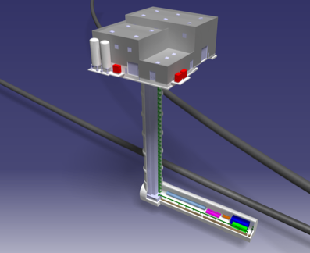
THE LOCATION
The CERN civil engineering team considered many sites around the LHC ring.
A preferred location was been identified on CERN land in France: ~620-680 m west of the ATLAS IP, shielded by ~200 m of rock.
Cavern is 65 m-long, 8 m-wide, disconnected and 10 m from the LHC.
Preliminary costing (Class 4): 25 MCHF for CE, 13 MCHF for services.
Updates since the FPF white paper: UJ12 Alcove option is no longer under active consideration; safety corridor connecting FPF to LHC is no longer needed; detailed FLUKA results for muon flux at FPF now available (~1.5 Hz/cm²); FASER, FASERnu, SND@LHC all taking data in Run 3, particle fluxes from IP are within ~30% of expectations.

Slide 6
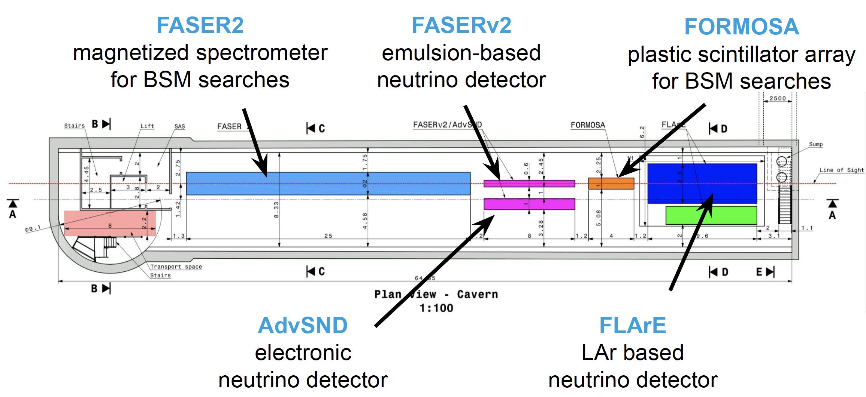
FPF EXPERIMENTS
At present there are 5 experiments being developed for the FPF.
Pseudo-rapidity coverage in the FPF is η > 5.5, with most experiments on the LOS covering η > 7.
Kling (2022)

Slide 7
FUNDING AND TIMELINE
A possible split: CERN supports construction of the facility…
  Very preliminary (class 4) cost estimate: 25 MCHF (CE) + 13 MCHF (services).
…other funding agencies support R&D and construction of the experiments.
  Recently received funding from Brookhaven LDRD and Heising-Simons for FLArE R&D.
  Recently received funding from NSF for FASER and FASERnu operations. Additional funds received from JSPS, Swiss NSF, ERC, etc.
Timeline considerations
  Can access FPF while LHC is running (now with no connector, initial studies show no radiation problems, no vibration interference from FPF construction).
  Experiments can come online a different times with relatively little interference.
  Possible timeline
    LS3 (2026-28): Pure CE works, construction of experiments. (CERN teams busy during LS3, but pure CE works (excavation) is done by outside contractors.)
    Beginning of Run 4 (2029): Installation of services by CERN teams.
    Middle of Run 4 (2030): Installation and commissioning of experiments.
    End of Run 4 to end of HL-LHC (2031-42): Physics in time to benefit from most of HL-LHC luminosity, impact planning for future colliders.

Slide 8
NEAR-TERM GOALS
The FPF extends HL-LHC potential, a top priority; adds diversity, small experiments, also a priority; is relatively inexpensive; makes essential use of the energy frontier; delivers a broad program with guaranteed physics.
CDRs for FPF and the 5 experiments in the next 6-12 months
  FASER2, FASERnu2, AdvancedSND, and FORMOSA (advanced MilliQan) build on existing experiments and existing collaborations.
  FLArE, the most novel experiment, has active groups working on it (BNL, UCI, …).
  All experiments must grow, many opportunities.
  CE studies for the Facility can progress quickly once experiments are defined.
Organizational structure (proto-collaborations) put in place in the next few months. Given its origins just 2 years ago, there is a significant and growing potential users community for the FPF.
Submission of Expression of Interest to LHCC under discussion.
Set timeline and structure for review and possible approval of the FPF. HL-LHC sets a hard deadline. Next meeting with CERN Directorate set for 8 months from now.

Slide 9
EXTRAS

Slide 10
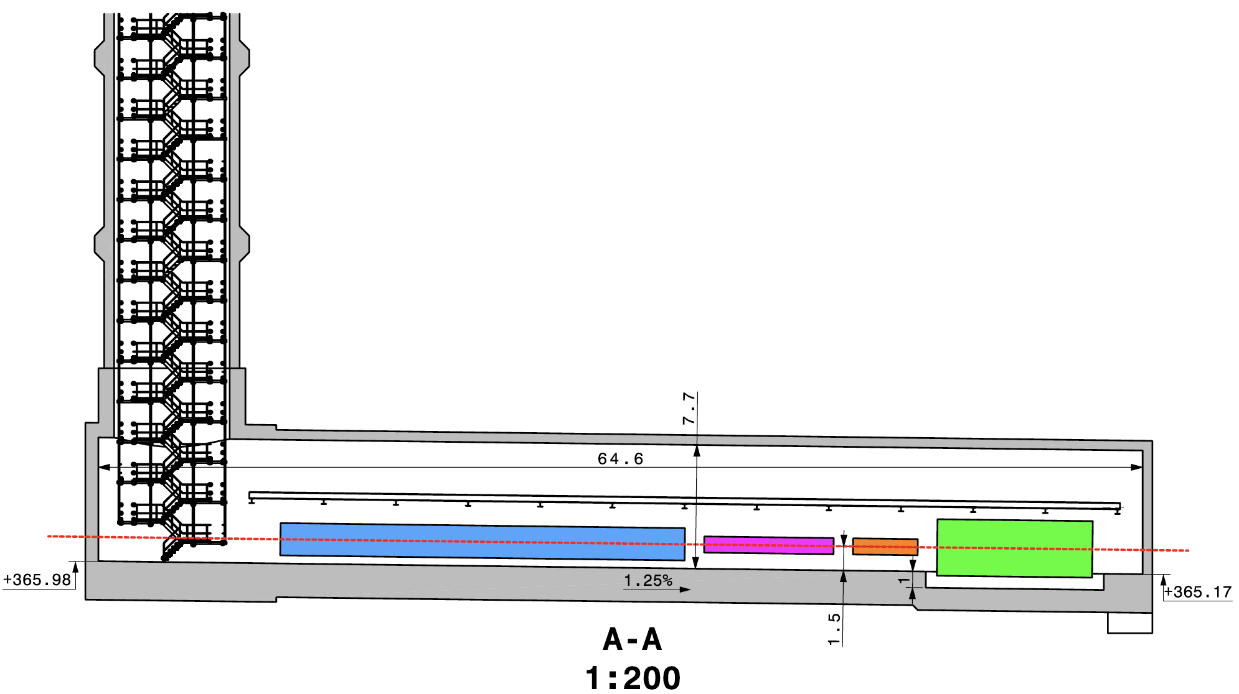
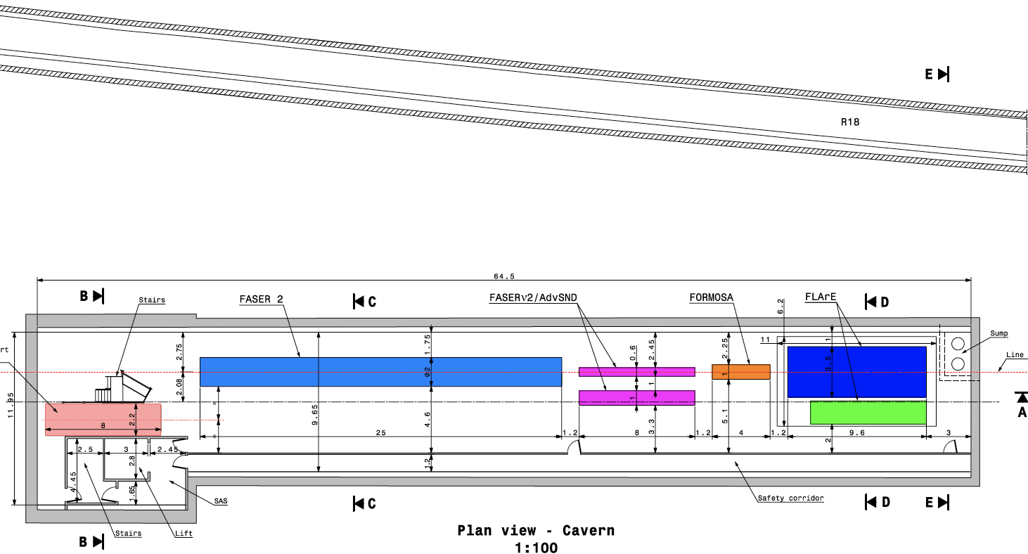
CAVERN AND SHAFT
Cavern: 65m long, 8m wide/high. Shaft: 88m-deep, 9.1m-diameter.
The FPF is completely decoupled from the LHC: no need for a safety corridor connecting the FPF to the LHC, preliminary RP and vibration studies indicate that FPF construction will have no significant impact on LHC operation.

Slide 11
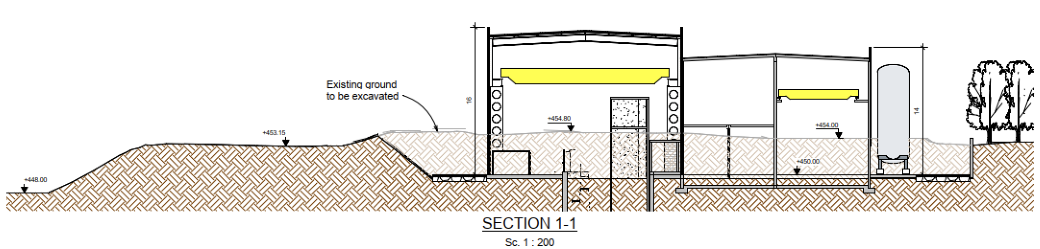
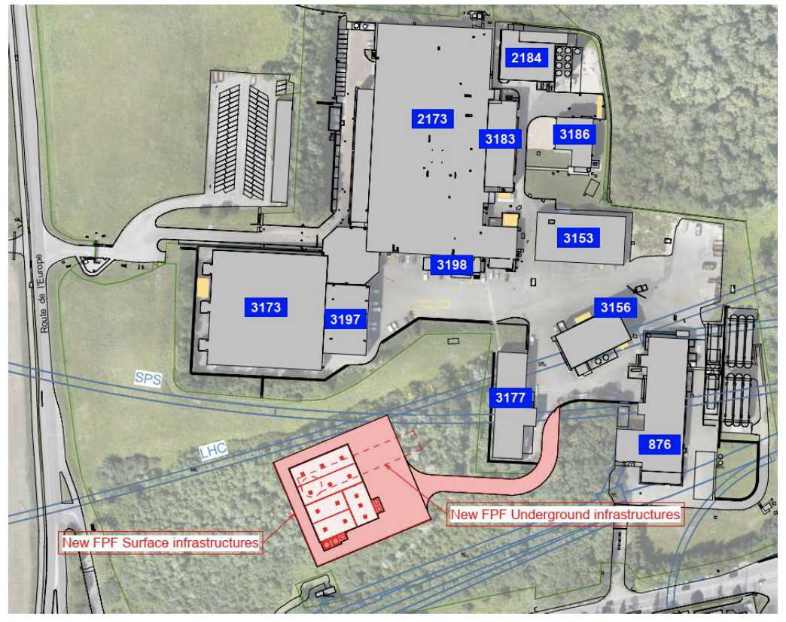
FPF CIVIL ENGINEERING
Balazs (2022)

Slide 12
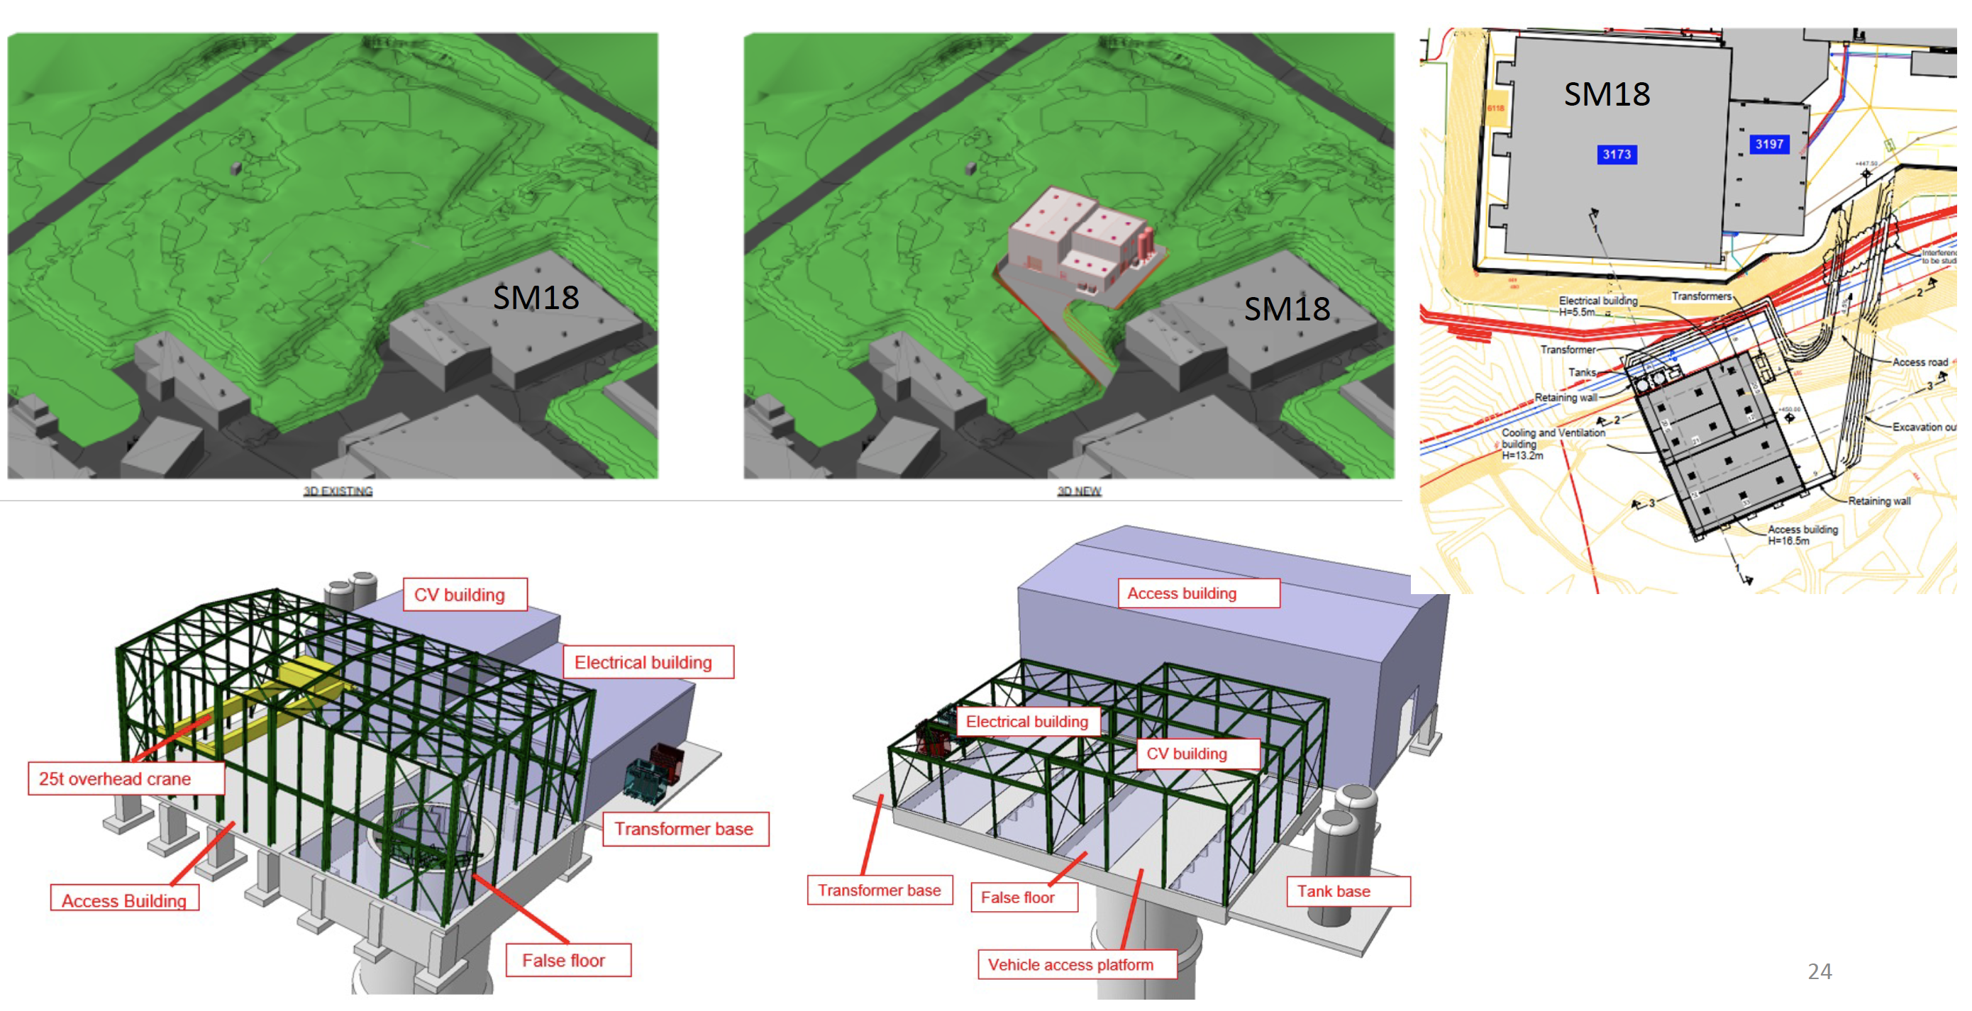
SURFACE BUILDINGS
Kincso Balazs,
John Osborne,
CERN CE (2022)

Slide 13
FPF PHYSICS SUMMARY
The FPF is a general purpose facility with a broad SM and BSM physics program. Additional examples are in the White Paper and backup slides.

Slide 14

THE NEW PARTICLE LANDSCAPE
Particle
Colliders
Mass
MeV
GeV
TeV
1
(1) And (2) both contain SM and BSM opportunities, and both are well motivated by particle physics and cosmology.
But only (1) is being investigated well by current LHC detectors. (Cf. ISR and charm.)
Already
Discovered
(1) Strongly Interacting
Heavy Particles
(Higgs, top, SUSY, …)
Too Little to be
Dark Matter
Interaction Strength
Just Right to
be Dark Matter
10⁻³
(2) Weakly Interacting
Light Particles
(neutrinos, LLPs, …)
Impossible to
Discover
10⁻⁶
Too Much to be
Dark Matter

Slide 15
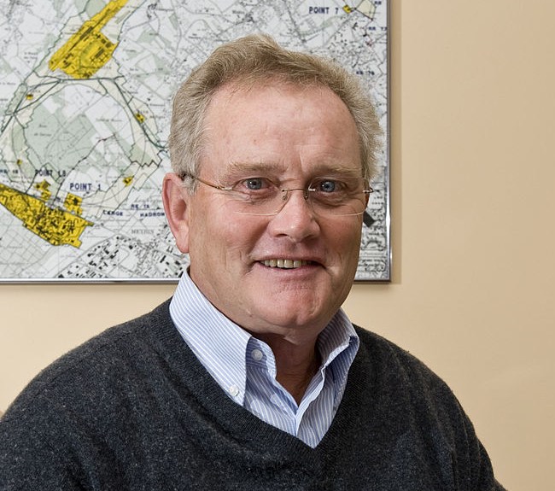
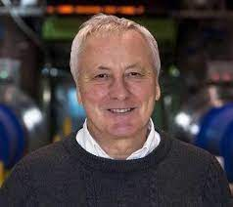
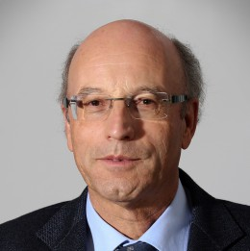
ISR AND CHARM
For the 50th anniversary of the ISR, there were many fascinating articles and talks by eminent physicists looking back on the ISR’s legacy.
  “Enormous impact on accelerator physics, but sadly little effect on particle physics.” – Steve Myers, talk at “The 50th Anniversary of Hadron Colliders at CERN,” October 2021.
  “There was initially a broad belief that physics action would be in the forward directions at a hadron collider…. It is easy to say after the fact, still with regrets, that with an earlier availability of more complete… experiments at the ISR, CERN would not have been left as a spectator during the famous November revolution of 1974 with the J/ψ discoveries at Brookhaven and SLAC .” – Lyn Evans and Peter Jenni, “Discovery Machines,” CERN Courier (2021).
Bottom line: charm was missed in part because detectors focused on the forward region.
Are we making the same (but opposite) mistake at the LHC?

Slide 16
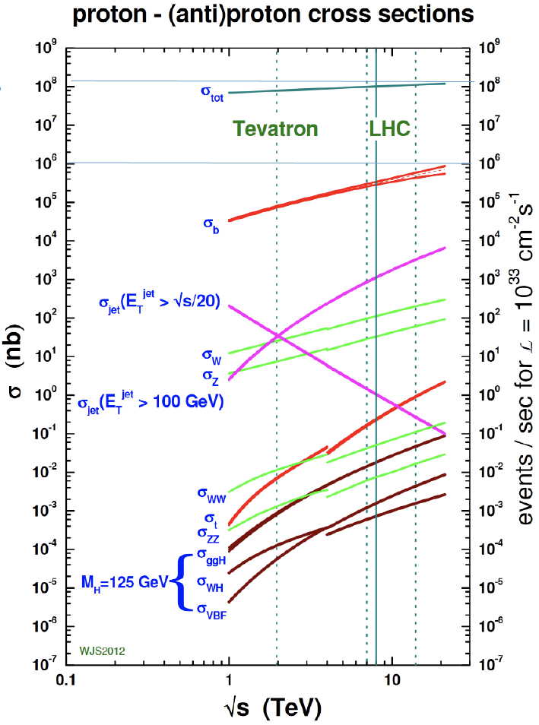
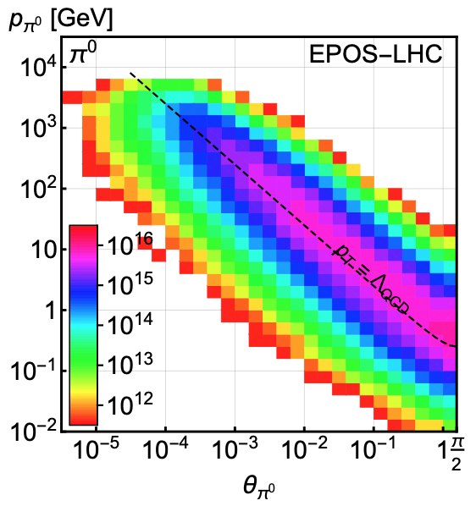
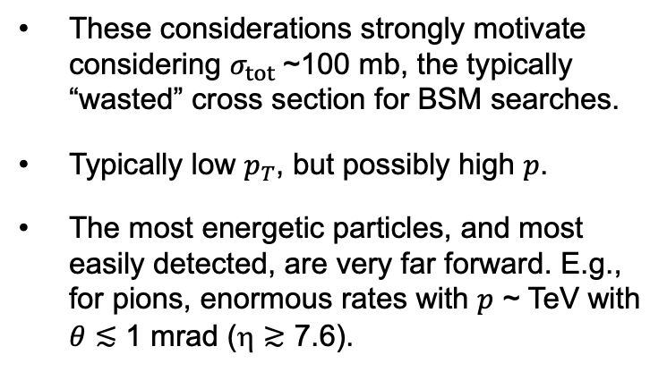
LIGHT, WEAKLY INTERACTING PARTICLES
300 fb⁻¹
Feng, Galon, Kling, Trojanowski (2017)
Most BSM searches focus on σ ~ fb, pb.
But if the new particles are
  light → can be produced in decays of light SM particles.
  weakly-interacting → need large numbers of SM particles to see rare processes.
These considerations strongly motivate considering $σ_{tot}$~100 mb, the typically “wasted” cross section for BSM searches.
Typically low $p_{T}$, but possibly high $p$.
The most energetic particles, and most easily detected, are very far forward. E.g., for pions, enormous rates with $p$ ~ TeV with $θ≲$ 1 mrad (η $≳$ 7.6).

Slide 17

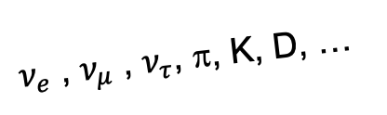
SEARCHES FOR NEW LIGHT PARTICLES
The existing large LHC detectors were designed to find strongly interacting heavy particles. Particles with η > 4.5 escape down the beampipe.
There is therefore a rich and unexplored physics program in the far forward direction for weakly interacting light particles.
  SM: TeV neutrinos of all flavors at the highest energyies from a human-made source. Neutrinos also enable probes of QCD, proton and nuclear structure.
  BSM: world-leading sensitivities to LLPs, FIPs, dark sectors, including dark photons, axion-like particles, milli-charged particles, dark matter, …
SUSY, top, Higgs, …
A’, a, mCPs, DM, …
$ν_{e}$ , $ν_{μ}$ , $ν_{τ}$, π, K, D, …

Slide 18
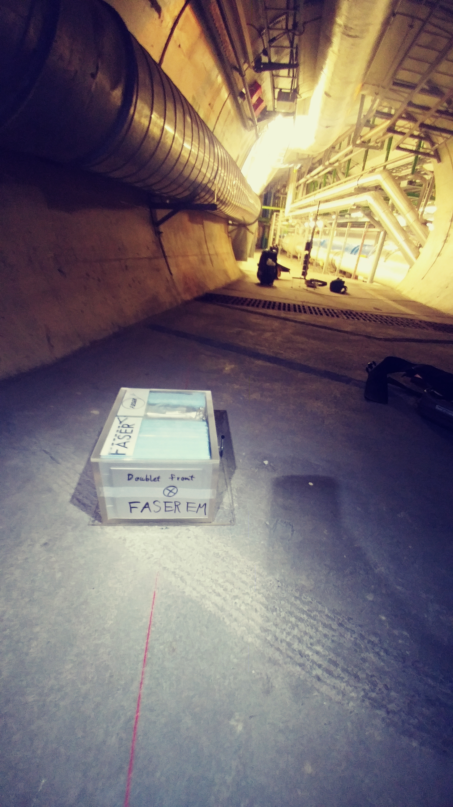
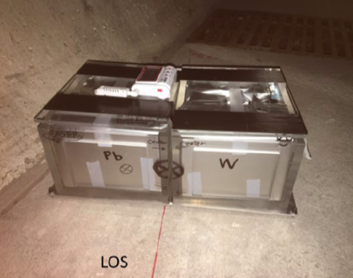
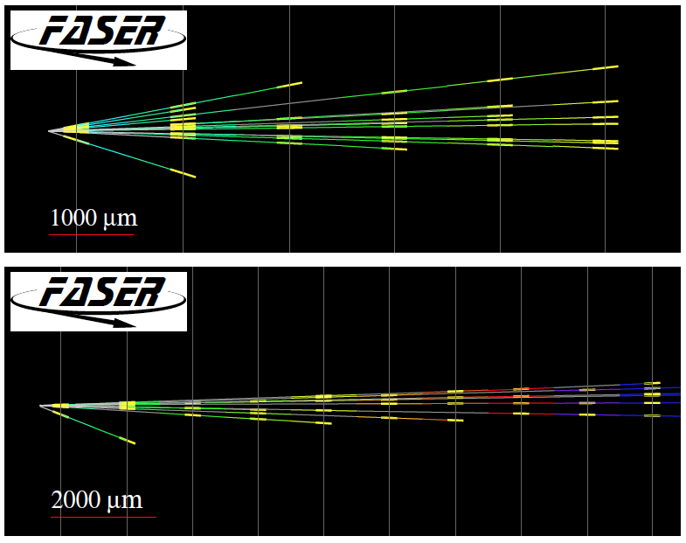
PROOF OF PRINCIPLE: 1ST COLLIDER NEUTRINOS
In 2018 an 11 kg emulsion detector was placed on the beam collision axis for 4 weeks, collecting 12.2 fb⁻¹ (installed and removed during TSs).
In May 2021, the FASER Collaboration announced the direct detection of 6 candidate neutrinos above the expected neutral hadron background events (2.7σ).
FASER Collaboration (2105.06197)

Slide 19
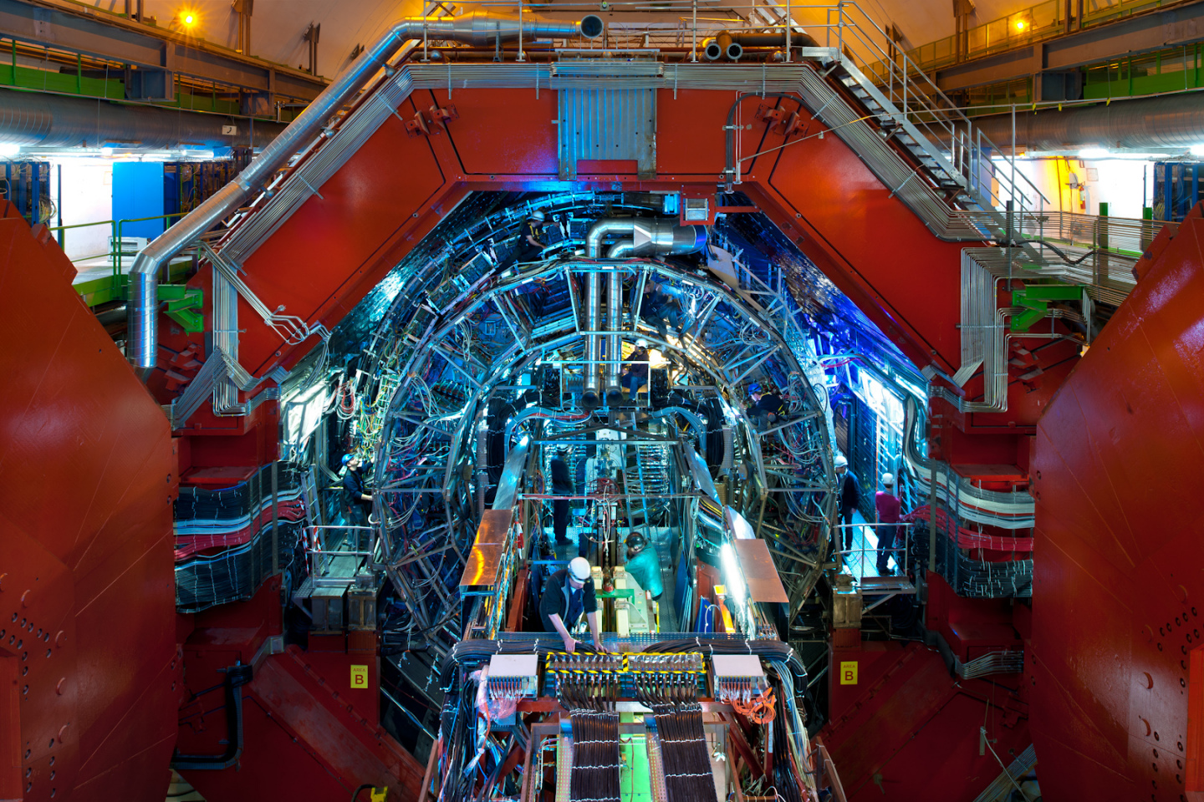
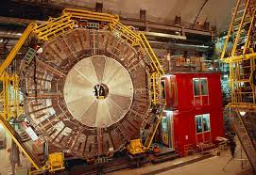
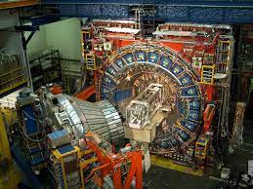
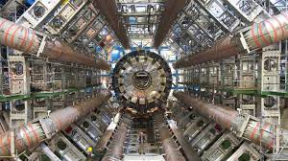
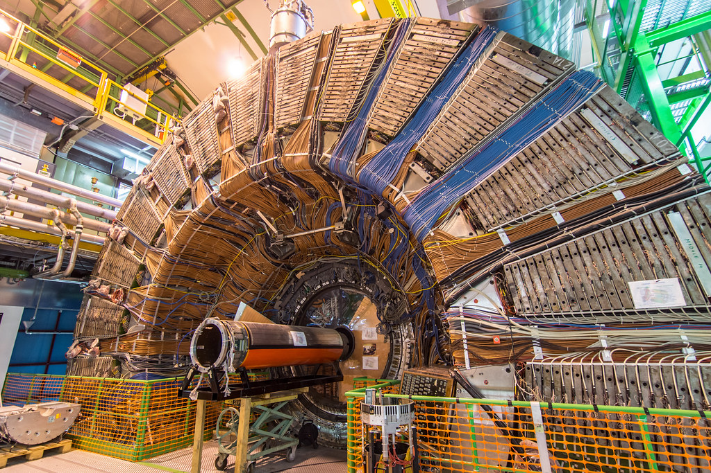
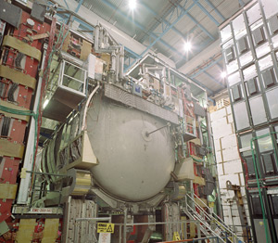
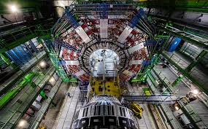
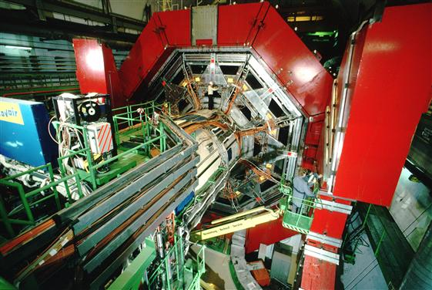

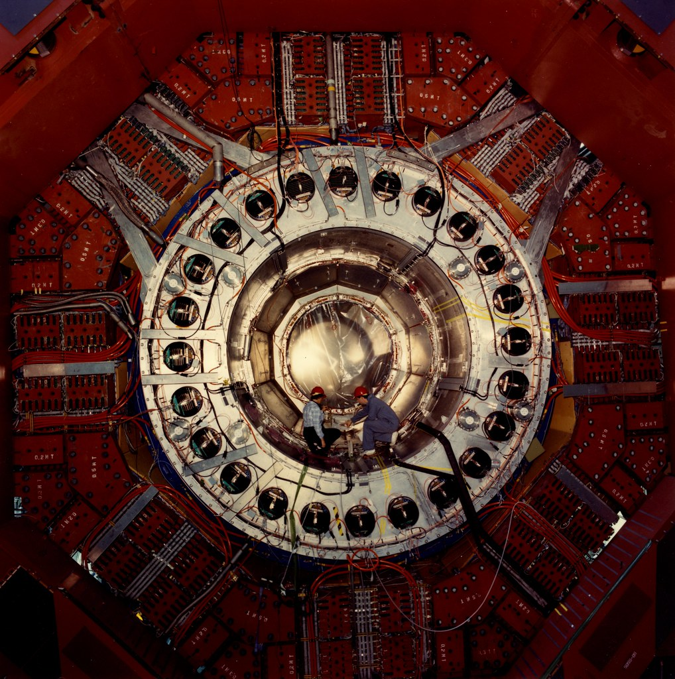
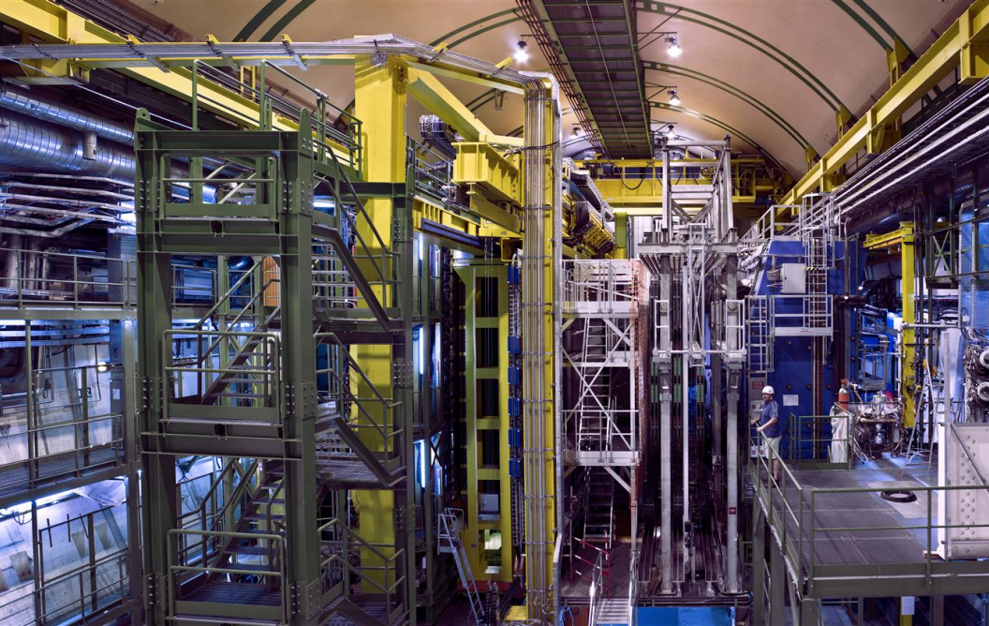
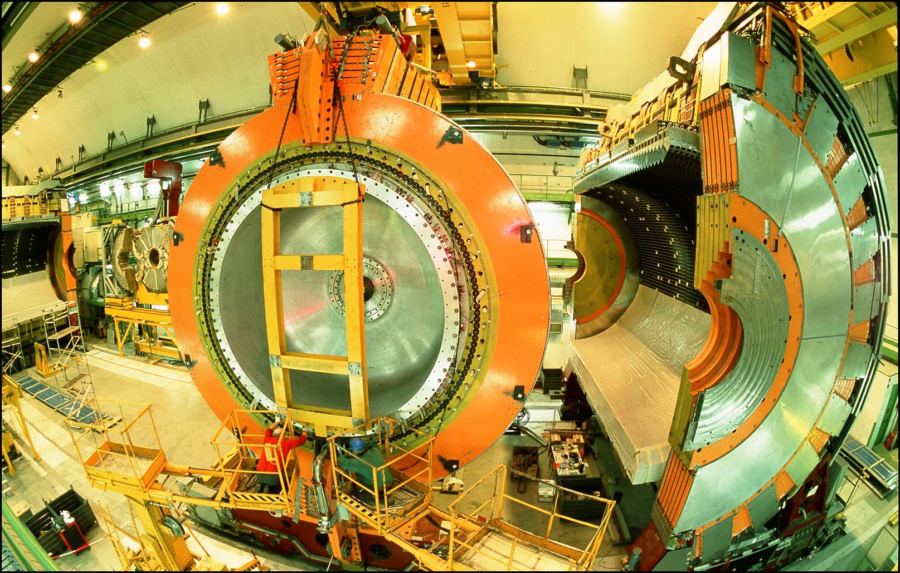
LOCATION, LOCATION, LOCATION
…
ALICE
ALEPH
CDF
FASER Pilot Detector
Suitcase-size, 4 weeks
$0 (recycled parts)
6 candidate neutrinos
ATLAS
DELPHI
D0
CMS
L3
LHCb
SLD
OPAL
All previous
collider detectors
Building-size, decades
~$10⁹
0 candidate neutrinos
This opens up a new field: neutrino physics at colliders

Slide 20
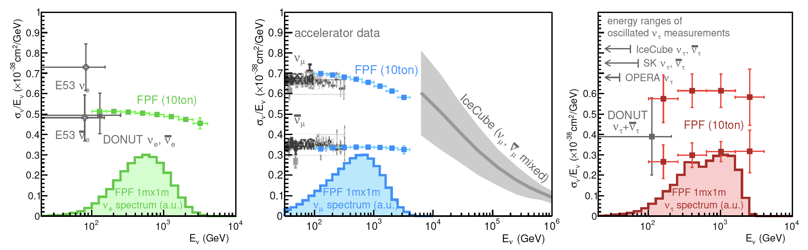
NEUTRINOS
At the FPF, three proposed ~10-ton detectors FASERν2, AdvSND, and FLArE will each detect ~100,000 ν_{e} , ~1,000,000 ν_{μ} , and ~1000 ν_{τ} interactions at TeV energies, providing high statistics samples for all three flavors in an energy range that has never been directly explored.
Will enable precision studies of the tau neutrino.
Can also distinguish neutrinos and anti-neutrinos for muon and tau.
FASER White Paper (2022)

Slide 21
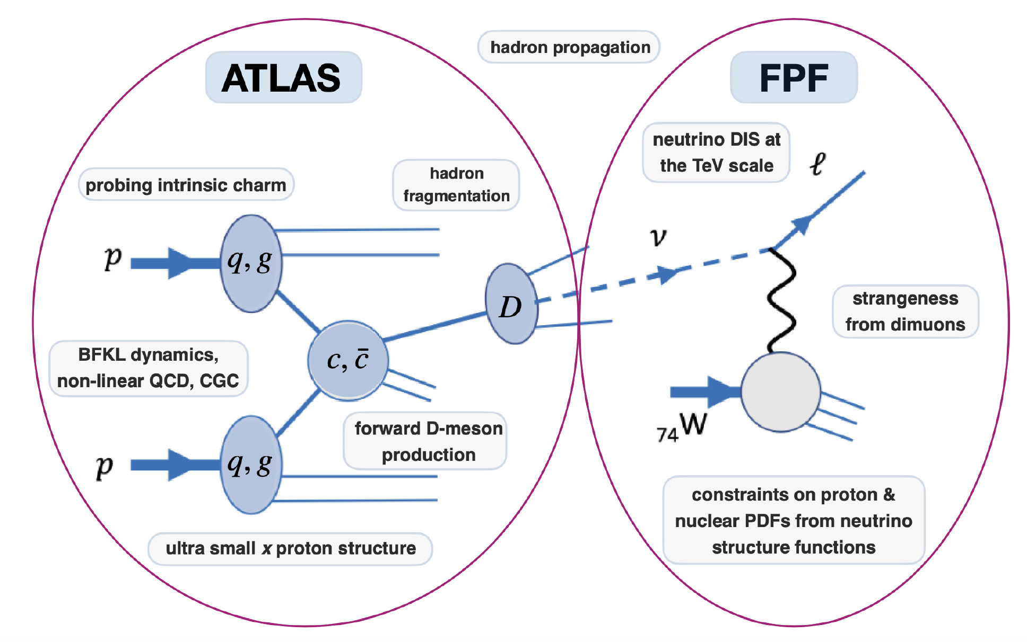
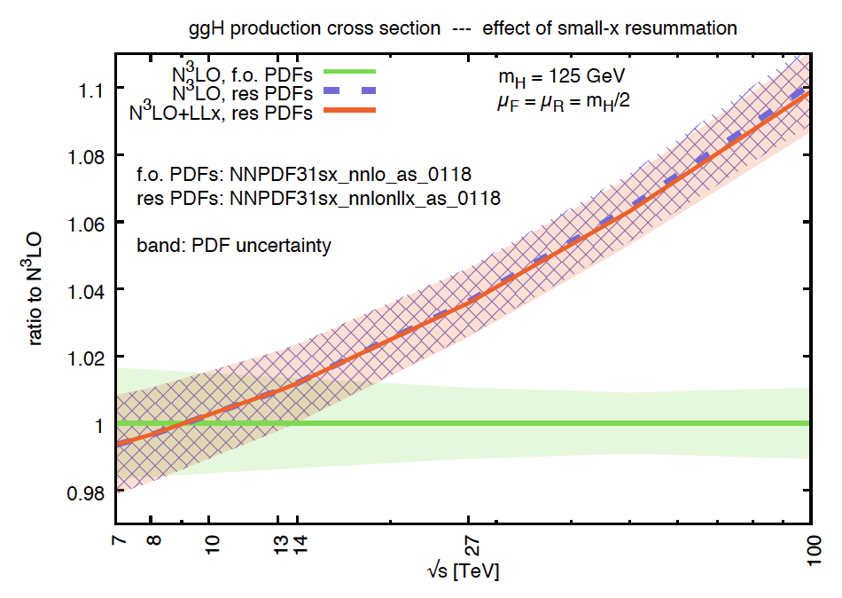
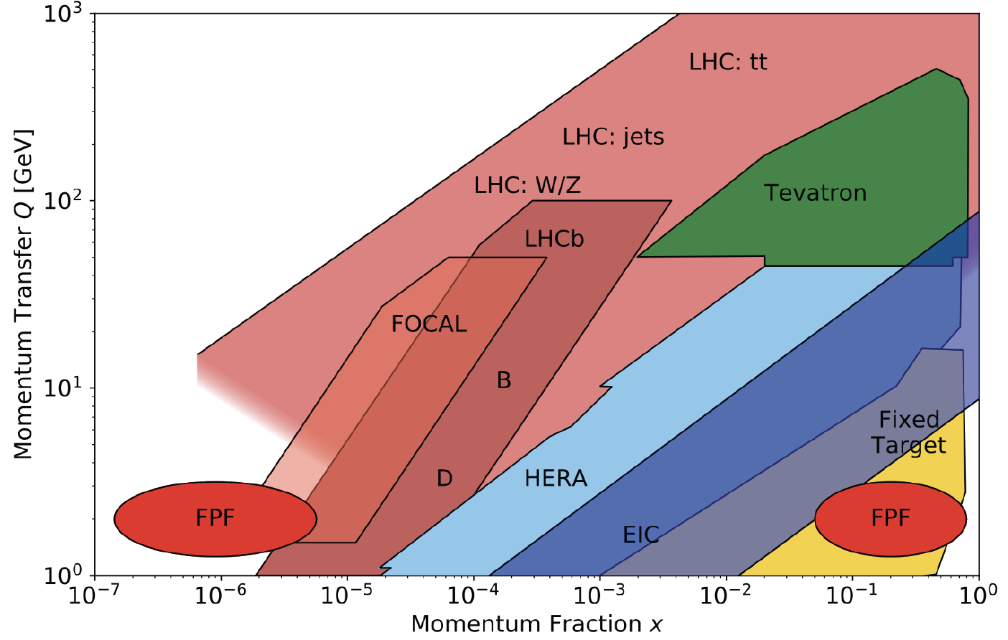

QCD
The FPF will also support a rich program of QCD and hadron structure studies.
Forward neutrino production is a probe of forward hadron production, BFKL dynamics, intrinsic charm, and proton structure at ultra small x ~ 10⁻⁷ to 10⁻⁶.
Important implications for UHE cosmic ray experiments, 100 TeV pp collider, …
$$4m_{c}^{2 }\sim x_{1}x_{2}s$$
FASER White Paper (2022)

Slide 22
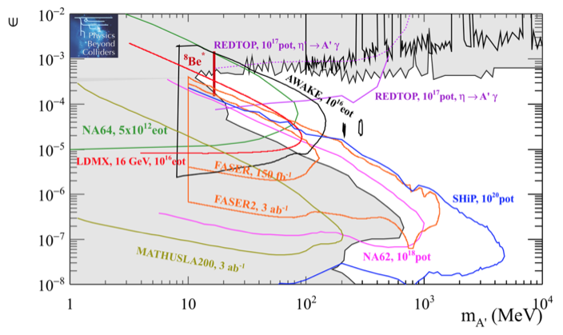
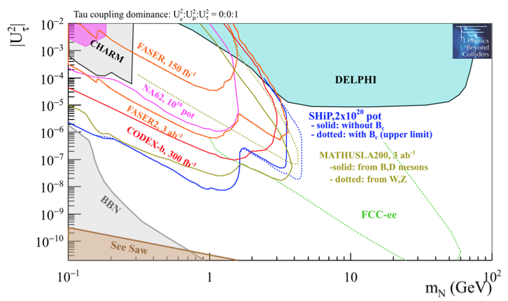
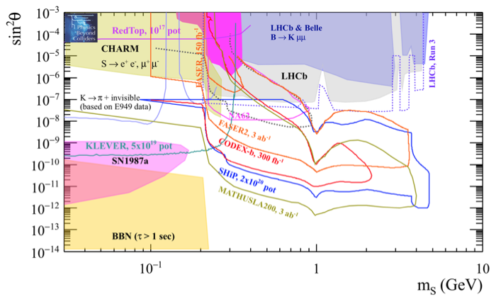
DARK SECTOR SEARCHES
The dedicated detectors have significant discovery potential for a wide variety of BSM/LLP models: dark photons; B-L and related gauge bosons; dark Higgs bosons; HNLs with couplings to e, mu, tau; ALPs with photon, gluon, fermion couplings; light neutralinos, inflatons, relaxions, and many others.
_{FPF White Paper (2022)}
Dark Photon
Dark Fermion
Dark Scalar

Slide 23
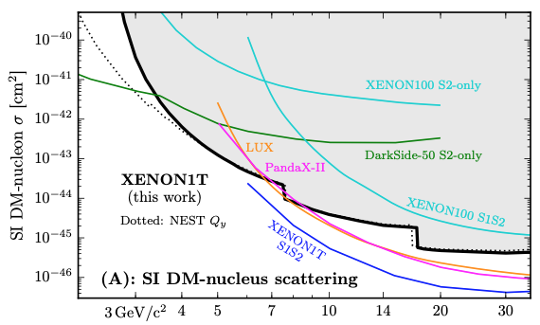
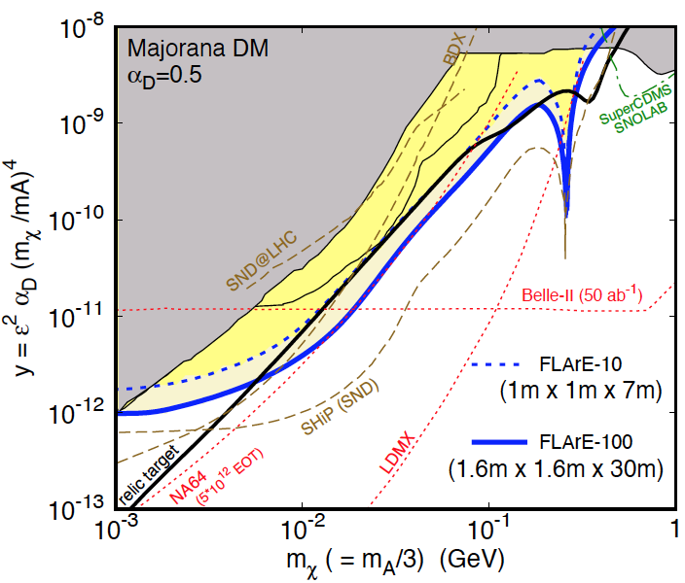
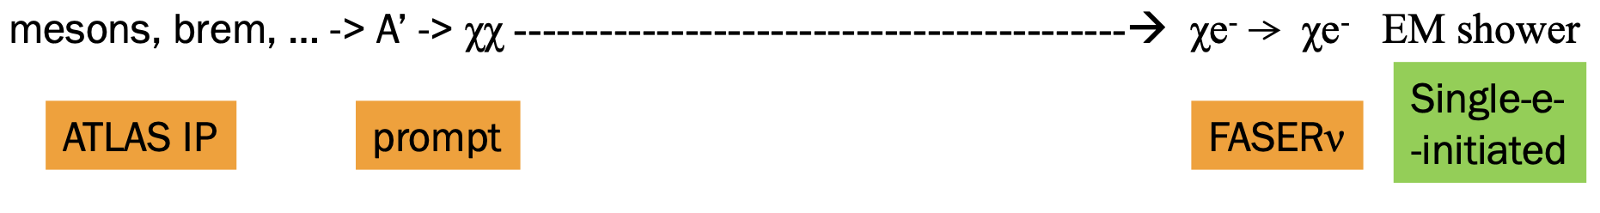
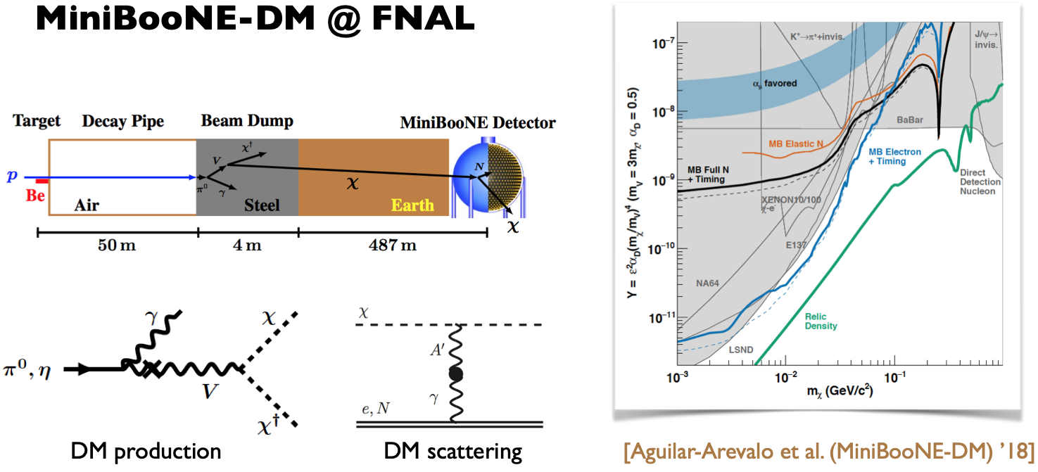
DARK MATTER DIRECT DETECTION
Light DM with masses at the GeV scale and below is famously hard to detect.
  Galactic halo velocity ~ 10⁻³ c, so kinetic energy ~ keV or below.
At the LHC, we can produce DM at high energies, look for the resulting DM to scatter in FLArE, Forward Liquid Argon Experiment, a proposed 10 to 100 tonne LArTPC.
FLArE is powerful in the region favored/allowed by thermal freezeout.
Batell, Feng, Trojanowski (2021)

Slide 24
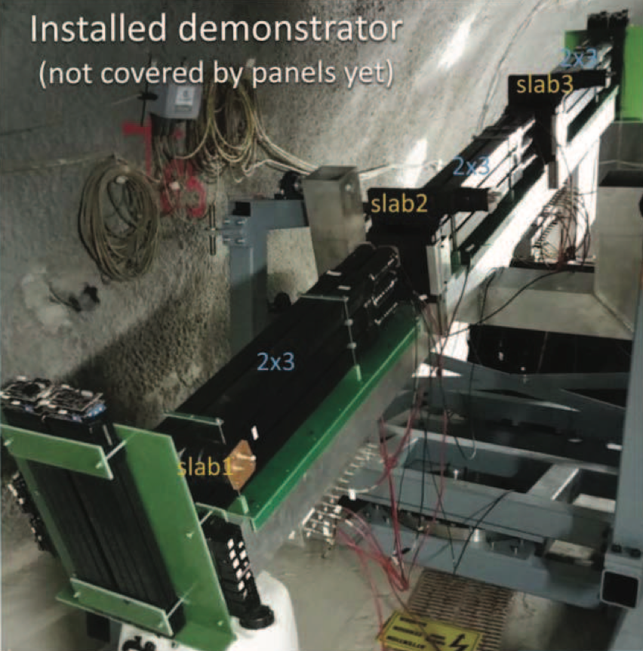
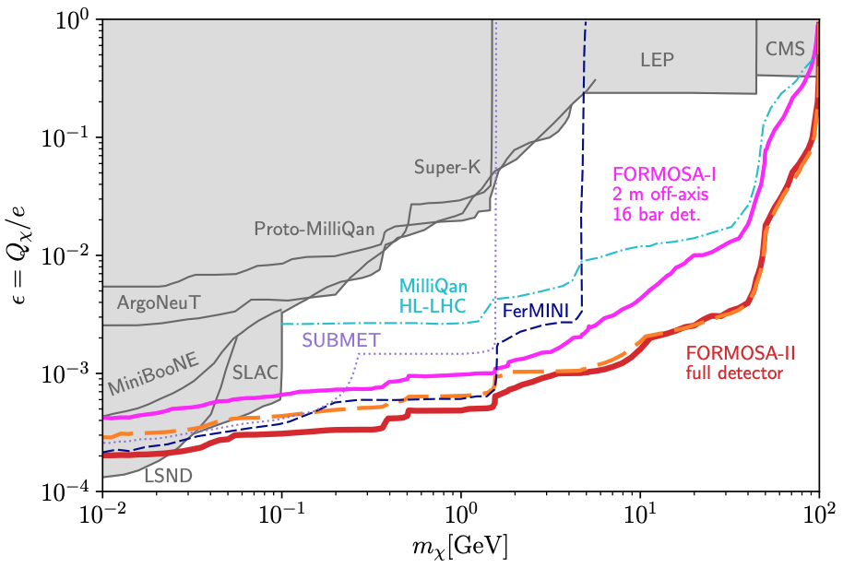
MILLI-CHARGED PARTICLES
A completely generic possibility motivated by dark matter, dark sectors. Currently the target of the MilliQan experiment, located at the LHC near the CMS experiment in a “non-forward” tunnel.
The MilliQan Demonstrator (Proto-MilliQan) already probes new region. Full MilliQan can also run in this location in the HL-LHC era, but the sensitivity may be improved significantly by moving it to the FPF (FORMOSA).
Foroughi-Abari, Kling, Tsai (2020)

Slide 25
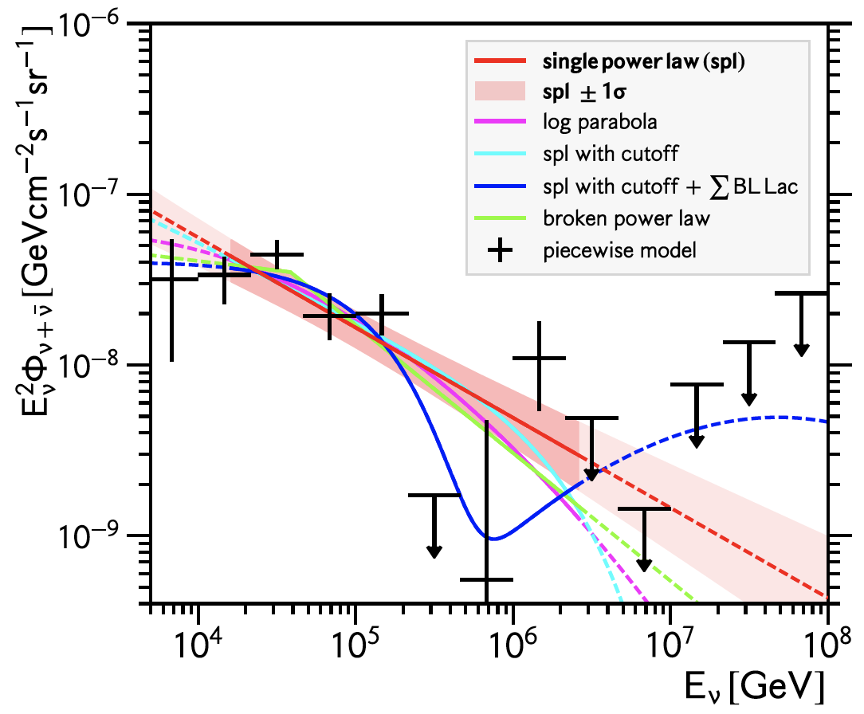
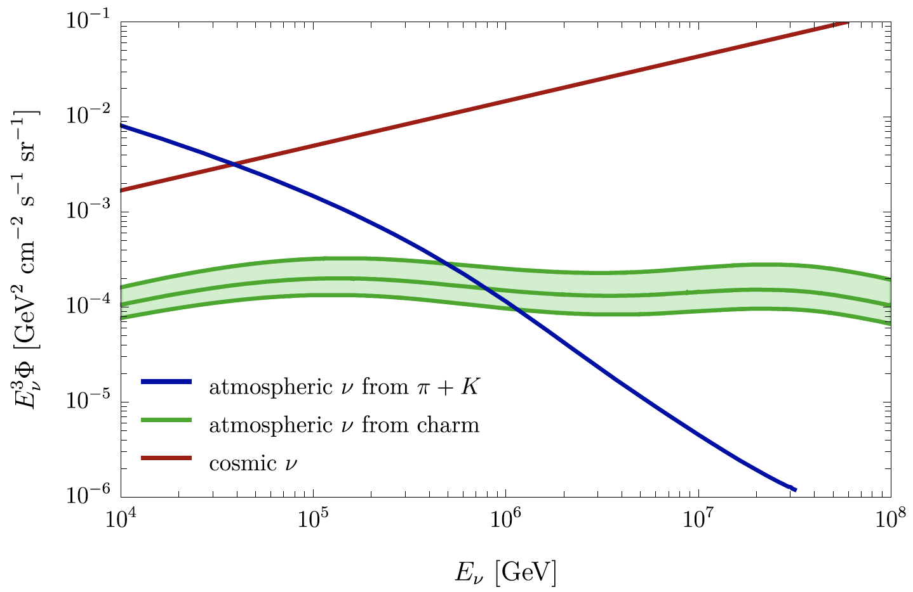
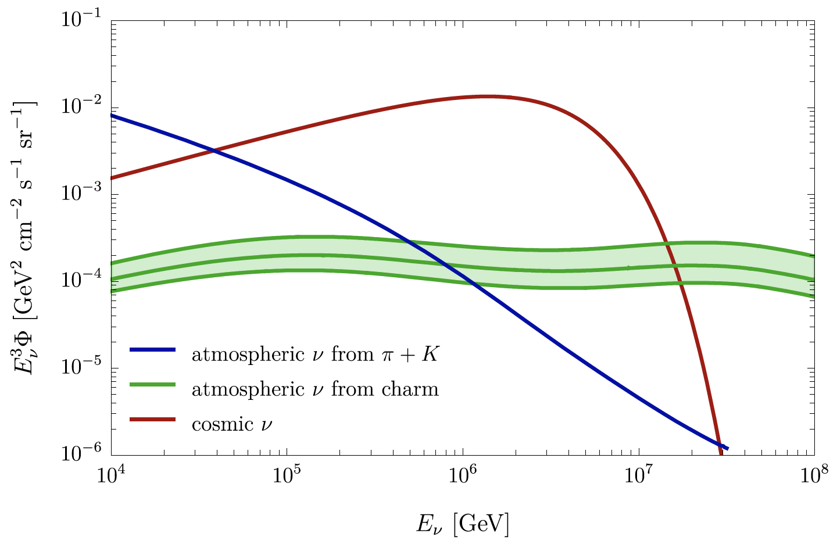
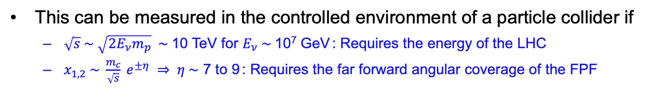
ASTROPARTICLE PHYSICS: COSMIC NEUTRINOS
The current IceCube cosmic nu flux can be fit by a power law, a power law with cutoff, ...
More data may be able to distinguish these, but only if the atmospheric neutrino background from charm is better determined.
IceCube 2001.09520
Power law
Power law
with cutoff
Bhattacharya et al. (1502.01076)
This can be measured in the controlled environment of a particle collider if
  $\sqrt{s} \sim \sqrt{2E_{ν}m_{p}} \sim$10 TeV for $E_{ν} \sim$10⁷ GeV : Requires the energy of the LHC
  $x_{1,2} \sim \frac{m_{c}}{\sqrt{s}} e^{±η} ⇒ η \sim$ 7 to 9 : Requires the far forward angular coverage of the FPF
Anchordoqui (2022)

