Slide 1




15th International Conference on Interconnections between
Particle Physics and Cosmology (PPC 2022)
Washington University, St. Louis
Jonathan Feng, UC Irvine, 10 June 2022

Slide 2
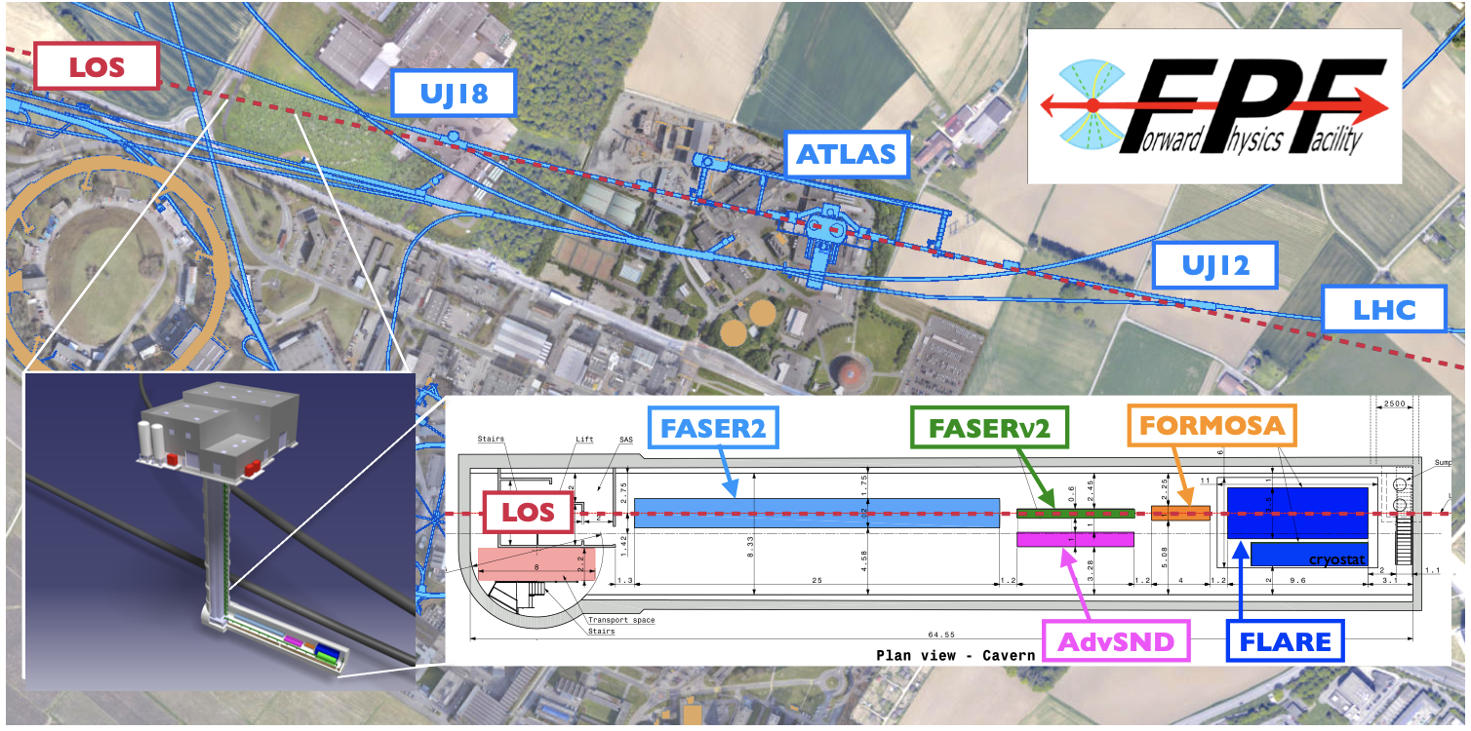
SUMMARY
We are currently missing half of the physics opportunities at the LHC.
This can be rectified by putting experiments in the far forward region to catch particles produced along the beamline.
The Forward Physics Facility is a proposal to do exactly this for the HL-LHC era from 2029-40.

Slide 3
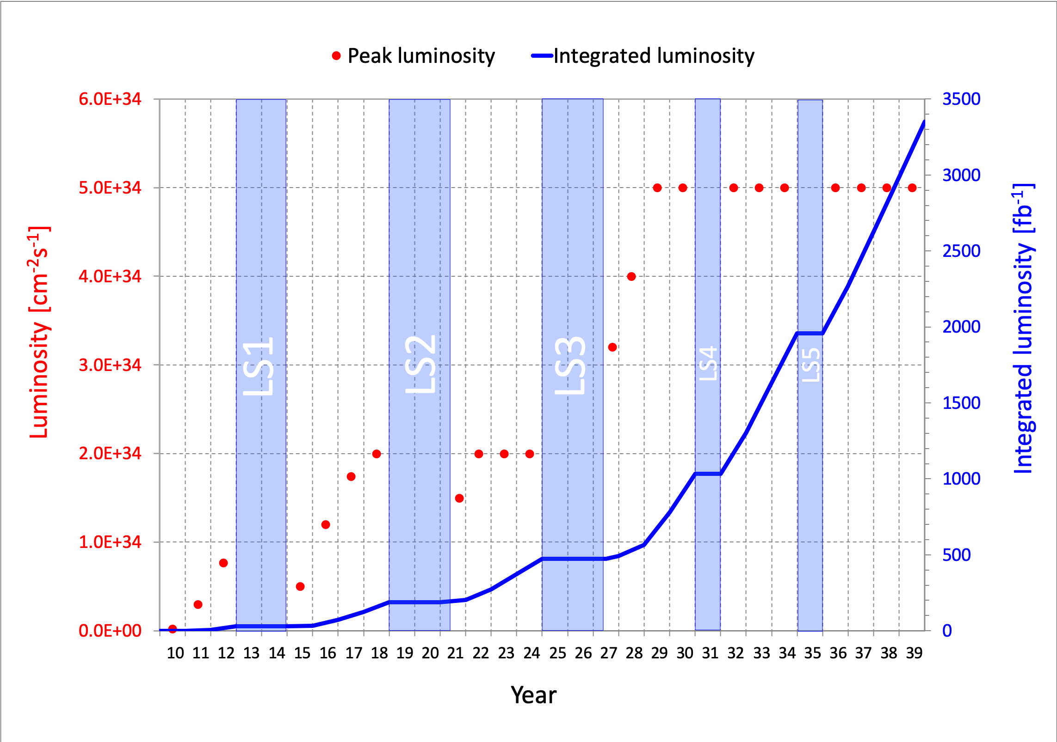
PARTICLE PHYSICS: CURRENT STATUS
This is a critical time in particle physics: the Higgs boson was discovered in 2012, but many fascinating problems remain (dark matter, neutrino masses, gauge and flavor hierarchy problems, …), and we have not discovered any other evidence of new particles.
At the energy frontier, the LHC has just emerged from Long Shutdown 2.
Much more to come:
Run 3, 2022-25, 150 fb⁻¹
HL-LHC, 2029-40, 3000 fb⁻¹
What can we do to enhance the prospects for discovering new physics?
[Askew, Han, Westhoff talks]

Slide 4

NEW PARTICLES
Particle
Colliders
Mass
MeV
GeV
TeV
1
Already
Discovered
Strongly Interacting
Heavy Particles
The WIMP Miracle motivates the upper right corner.
The WIMPless Miracle motivates the whole diagonal, including the lower left quadrant (LLPs, FIPs, portals, dark sectors…)
Too Little to be
Dark Matter
Interaction Strength
Just Right to
be Dark Matter
10⁻³
Weakly Interacting
Light Particles
Impossible to
Discover
10⁻⁶
Too Much to be
Dark Matter
Feng, Kumar (2008)
Boehm, Fayet (2003)
Pospelov, Ritz, Voloshin (2007)

Slide 5
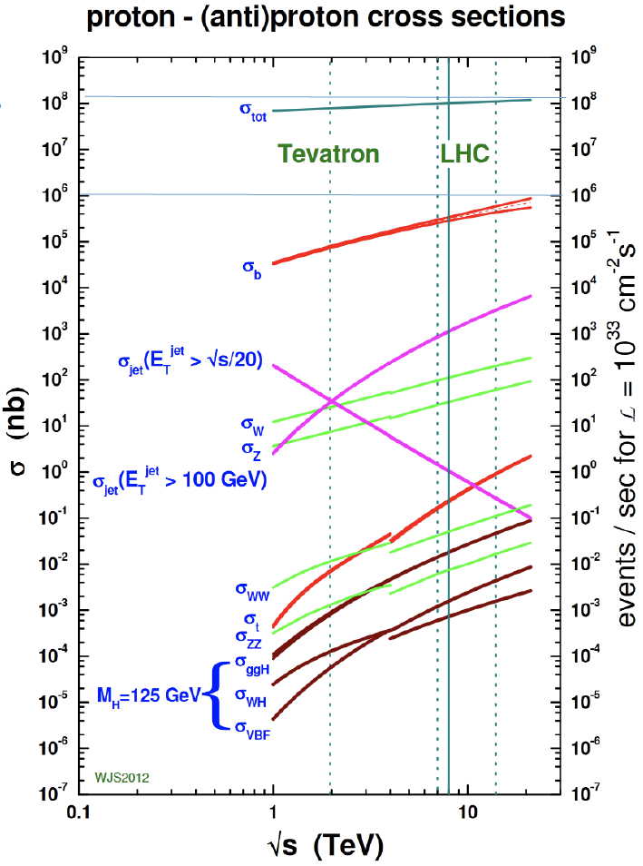
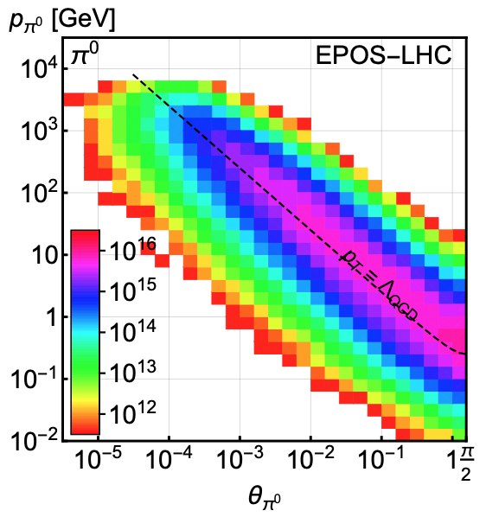
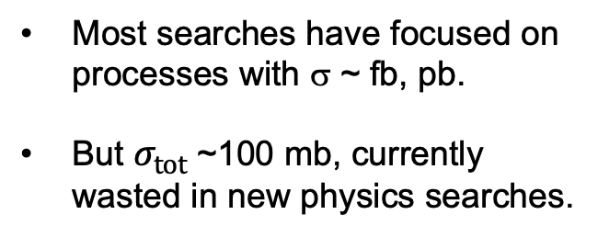
LHC PARTICLE PRODUCTION
300 fb⁻¹
Feng, Galon, Kling, Trojanowski (2017)
Most searches have focused on processes with σ ~ fb, pb.
But $σ_{tot}$~100 mb, currently wasted in new physics searches.
What do these events look like? Consider pions.
Enormous event rates. Typical p_{T} ~ 250 MeV, but many with p ~ TeV within 1 mrad (η > 7.6) of the beamline.

Slide 6

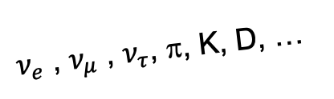
SEARCHES FOR NEW LIGHT PARTICLES
Particles that close to the beamline are not seen by existing large LHC detectors. They were designed to find strongly-interacting heavy particles.
But they are also perfectly designed to not find weakly-interacting light particles. These are dominantly produced in the rare decays of light particles (π, η, K, D, B, …) along the forward direction, and so the new particles escape through the blind spots down the beamline.
There are both SM and BSM motivations to explore the “wasted” σ_{tot} ~ 100 mb and cover these blind spots in the far forward region.
SUSY, top, Higgs, …
A’, a, mCPs, DM, …
$ν_{e}$ , $ν_{μ}$ , $ν_{τ}$, π, K, D, …

Slide 7
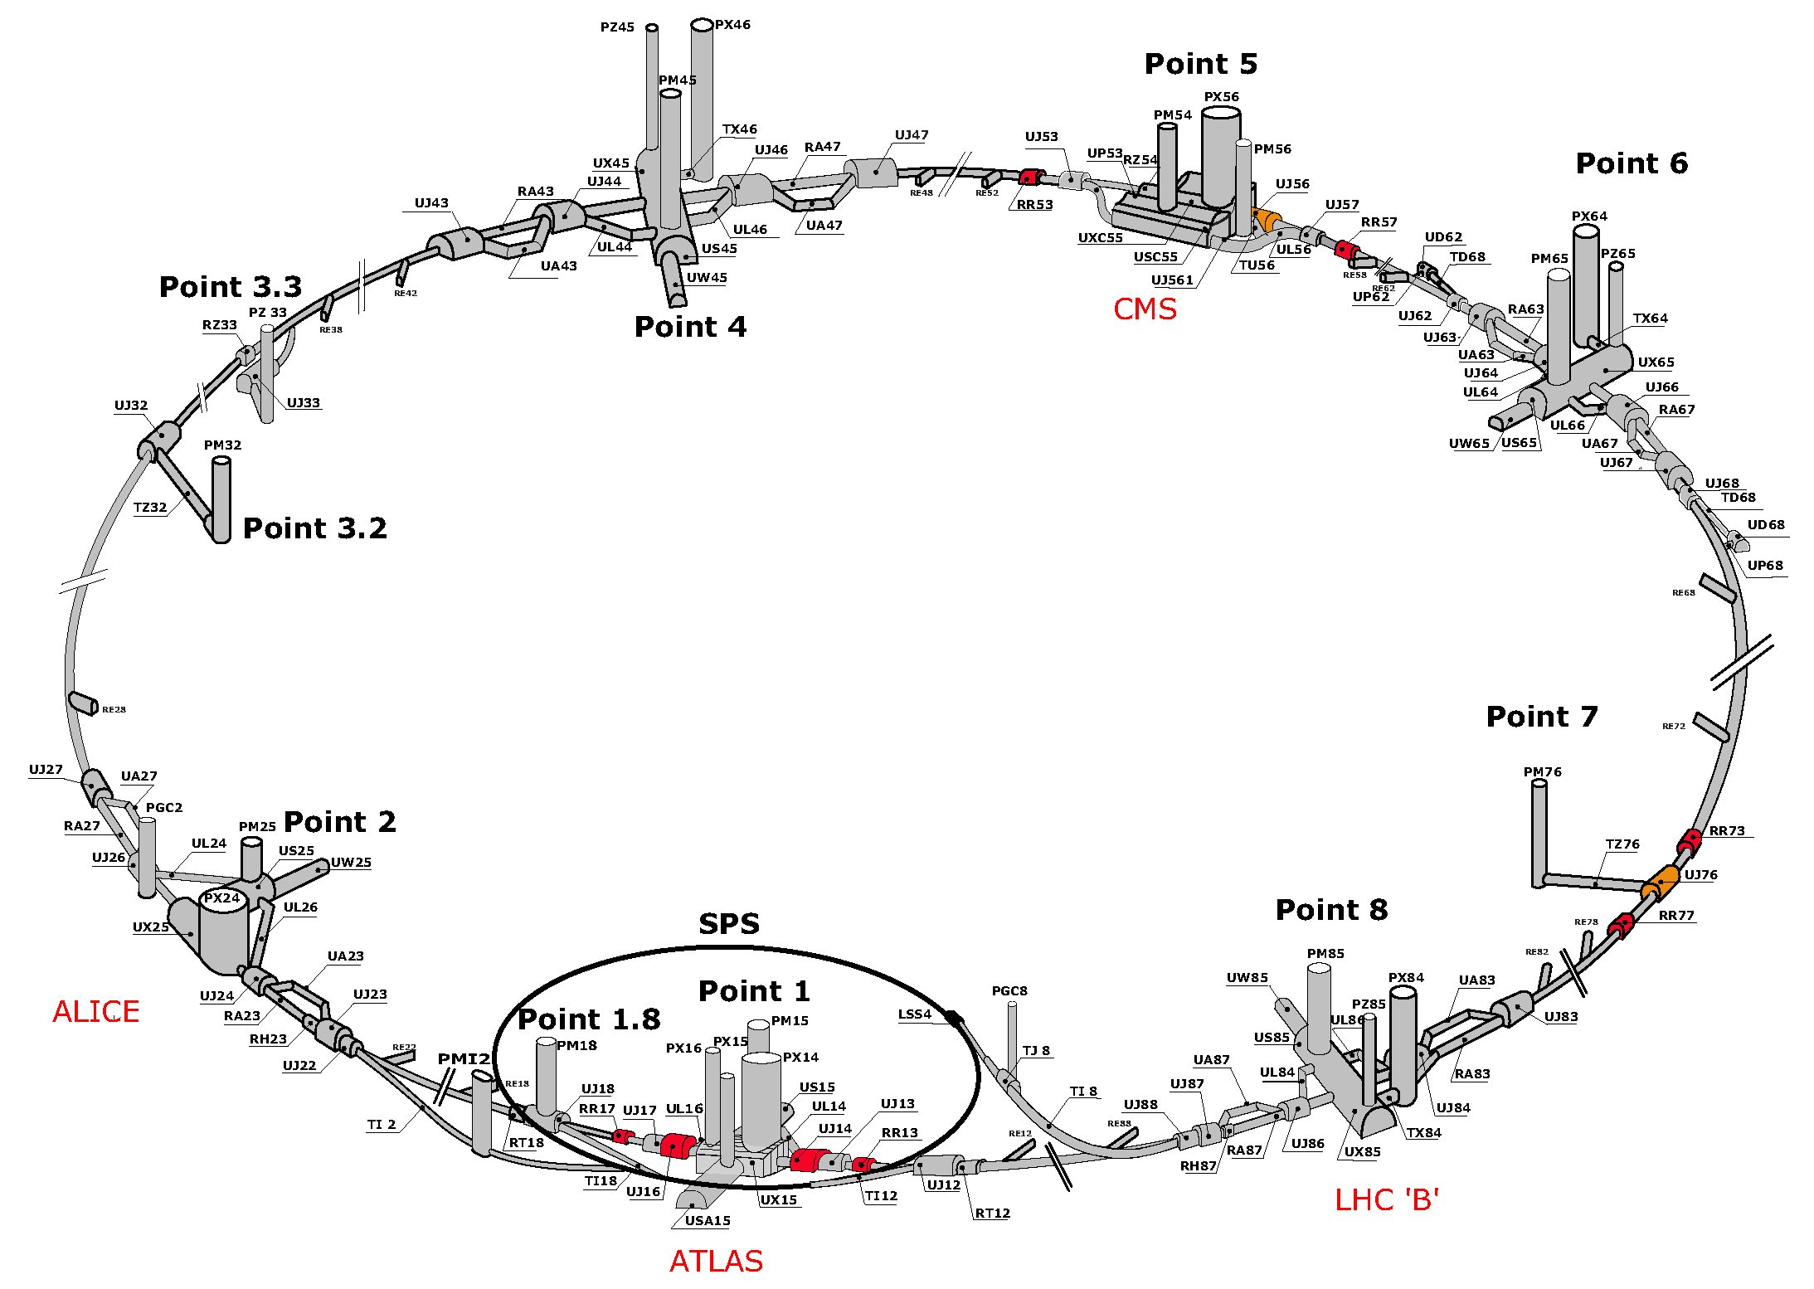
THE BASIC IDEA
We cannot block the beams, but if we go far away, the proton beams are bent by magnets, whereas light, weakly-interacting particles go straight.
$$A^{′}$$
$$A^{′}$$
Feng, Galon, Kling, Trojanowski (2017)
Kling, Trojanowski (2018)
Feng, Galon, Kling, Trojanowski (2018)
!!!

Slide 8
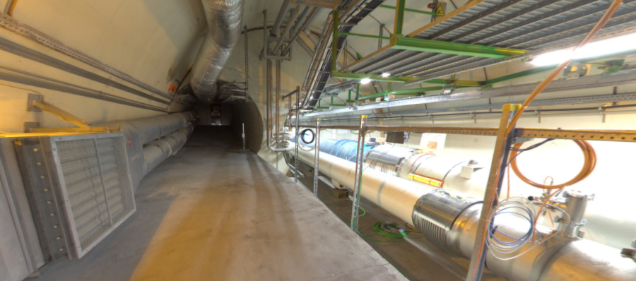


THE FAR-FORWARD REGION
New particle A’ is produced at ATLAS, travels along the beam collision axis and through 100 m of rock, and finally decays in tunnel TI12, 480 m from ATLAS
$π^{0}$→ $γ$A’
→ A’ →
A’ → $e^{+}e^{−}$
TI12 near UJ12
UJ12
The view in UJ12 looking west (2019)
TI12
$$e^{+}$$
$e^{−}$
Beam collision axis
LHC beamline

Slide 9
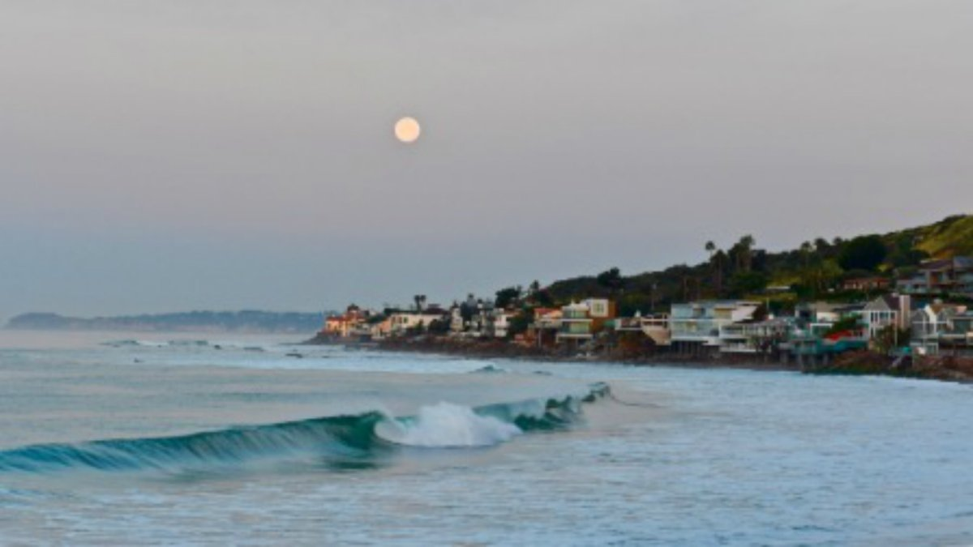
HOW BIG DOES THE DETECTOR HAVE TO BE?
Momentum:
Space:
250 MeV
1 TeV
12 cm
480 m
Particles produced in pion decays have θ ~ 0.2 mrad (η ~ 9); cf. the moon (7 mrad).
Particles produced in π, η, K, D, B decay are therefore far more collimated than shown below, motivating new, small, fast, and cheap experiments at the LHC.

Slide 10
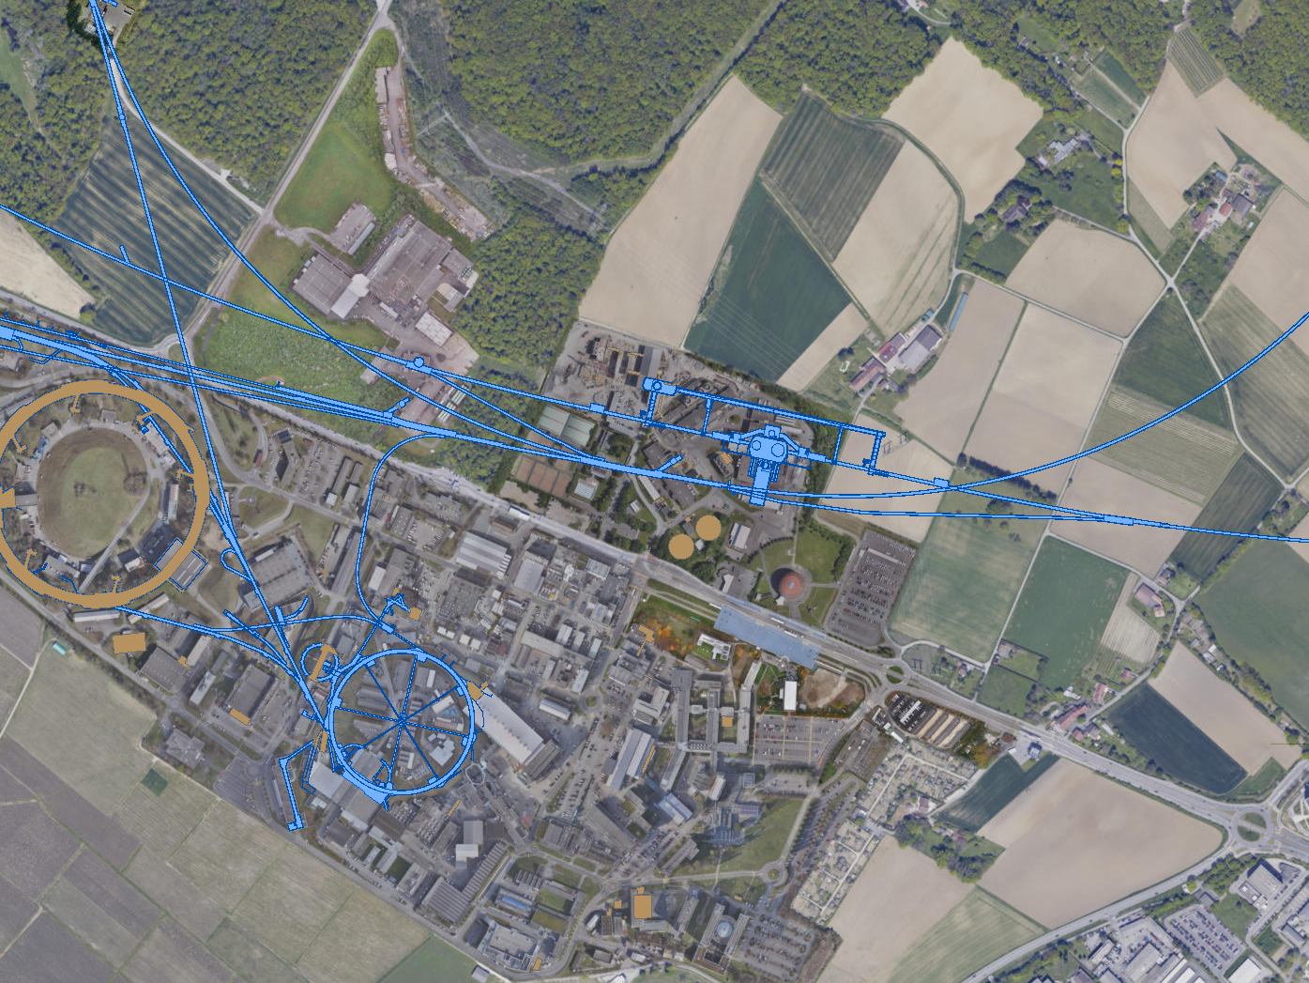
CURRENT FAR FORWARD DETECTORS
3 far forward detectors have been constructed and installed and are currently taking data in LHC Run 3: FASER, FASERν, and SND@LHC.
UJ18
ATLAS
SPS
SND@LHC
UJ12
LHC
FASER
FASERν
LOS
CERN GIS

Slide 11
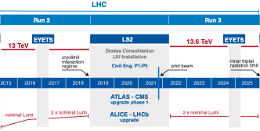
FASER AND FASERν TIMELINE
Spare detector parts from ATLAS and LHCb Collaborations
Funding from Heising-Simons and Simons Foundations
FASER and FASERν begin collecting data in Run 3
FASERν approved as 9th LHC detector by CERN
FASER approved as 8th LHC detector by CERN
Technical Proposal submitted to CERN LHCC
First paper: Feng, Galon, Kling, Trojanowski
FASERν fully constructed and installed
FASER fully constructed and installed
LOI submitted to CERN LHCC

Slide 12
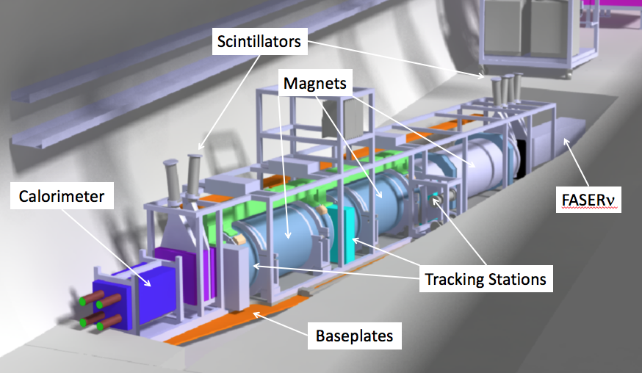
THE FASER DETECTOR
Nothing incoming and 2 ~TeV, opposite-sign charged tracks pointing back to the ATLAS IP: a “light shining through (100 m-thick) wall” experiment.
Scintillators veto incoming charged tracks (muons), magnets split the charged tracks, which are detected by tracking stations and a calorimeter.
LLP
ν
e⁺
e⁻

Slide 13
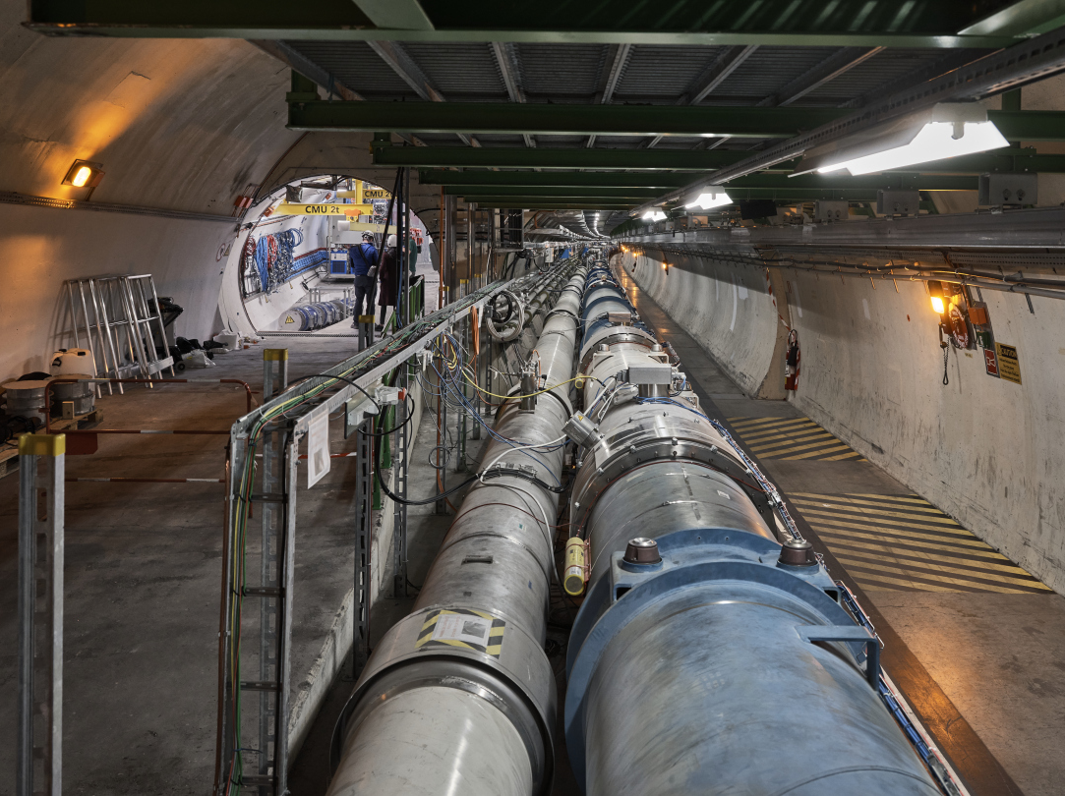
FASER CURRENT STATUS

Slide 14
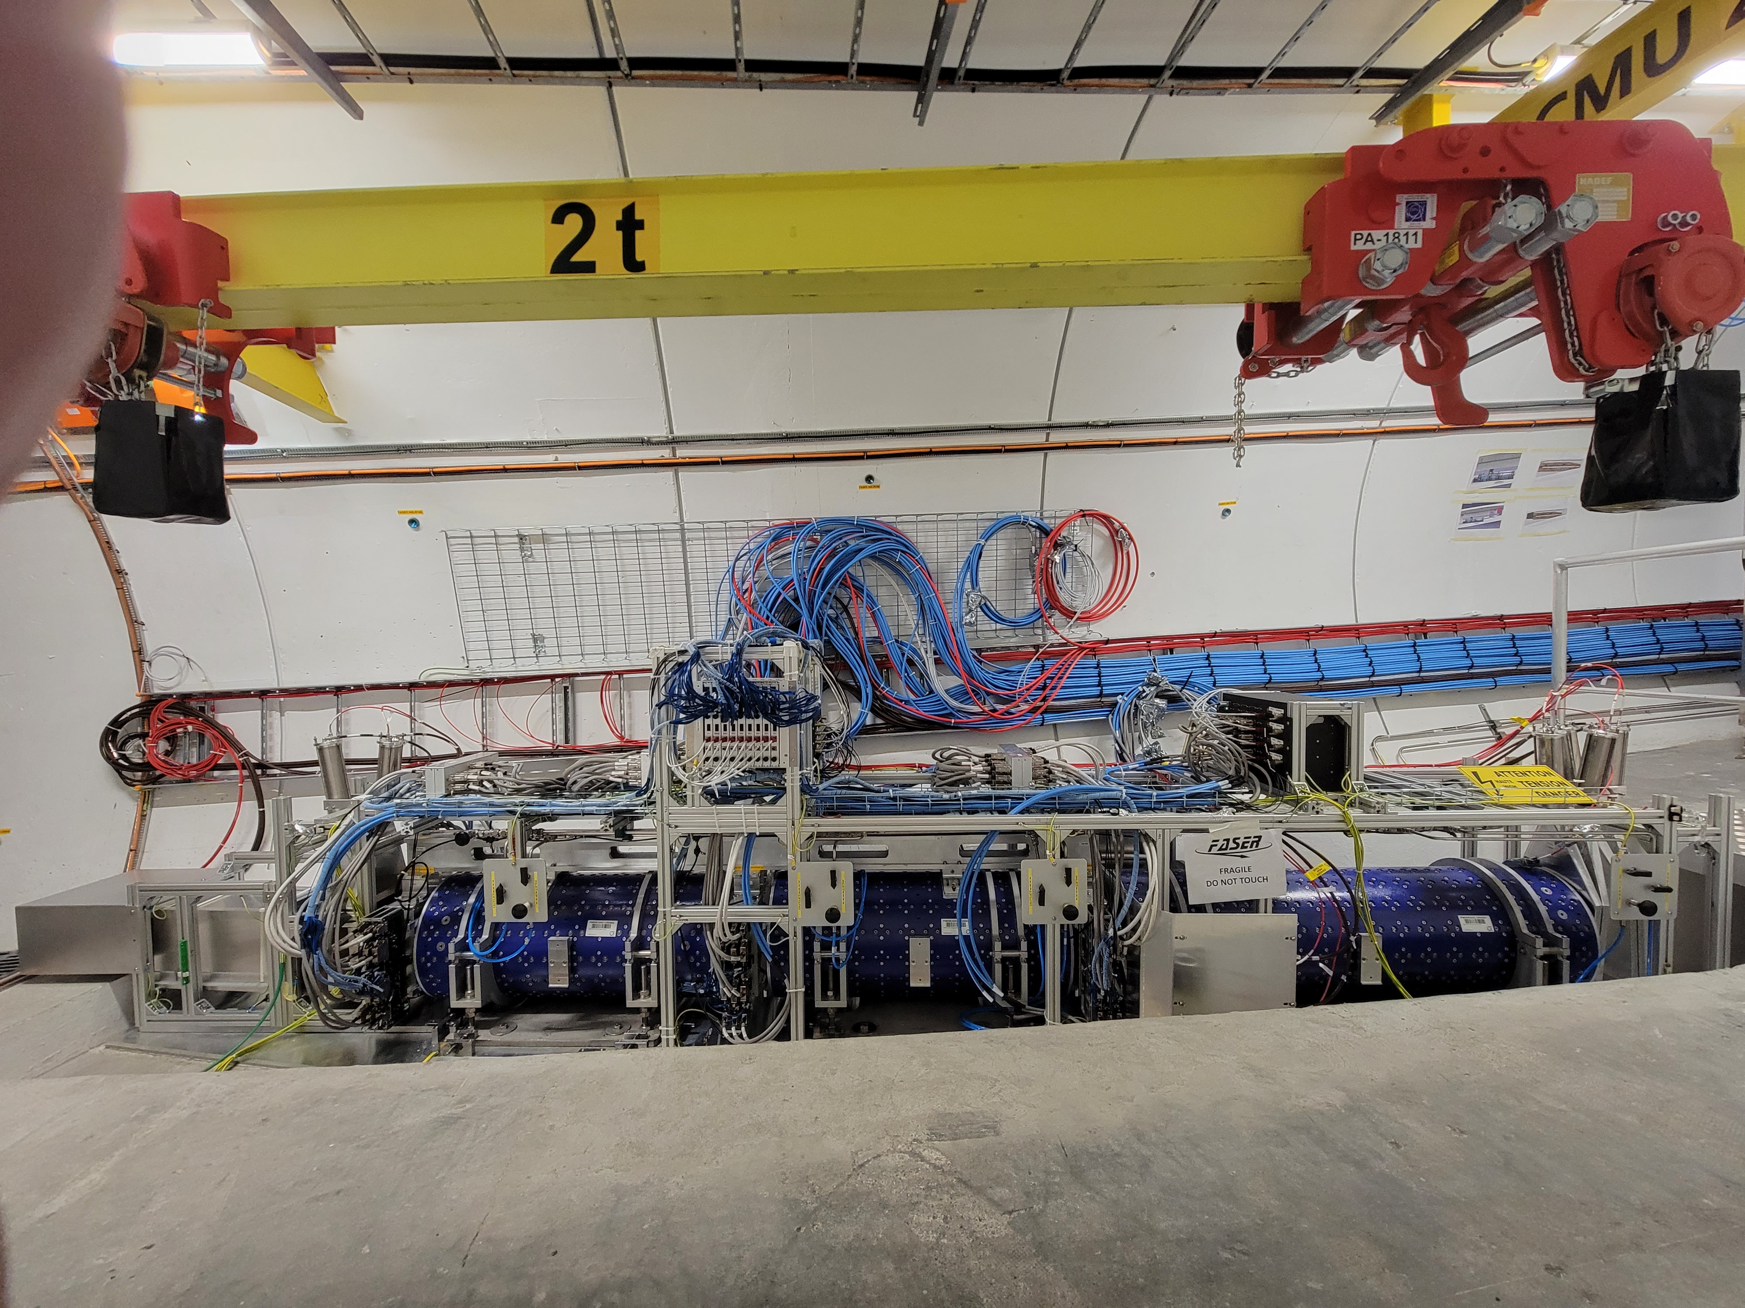
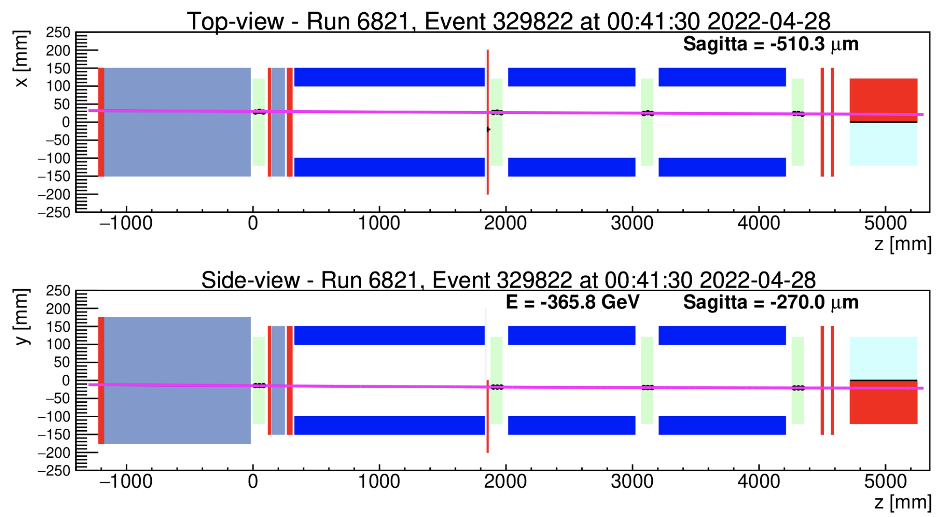
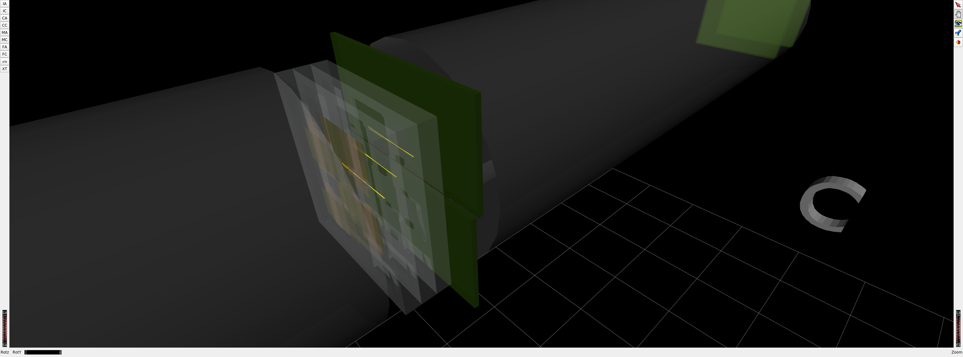
FASER CURRENT STATUS
1st Cosmic Ray
18 March 2021
Beam splash event 28 April 2022

Slide 15
DARK PHOTON SENSITIVITY REACH
FASER
FASER probes new parameter space with just 1 fb⁻¹ starting in July 2022.
In Run 3, will probe the MeV-GeV region favored by WIMPless miracle considerations, muon g-2 explanations, SIDM, ATOMKI anomalies, …
Even without a detector upgrade, the HL-LHC extends (Luminosity*Vol) by factor of 3000 – could detect as many as 10,000 dark photons.
_{FASER Collaboration (2018)}

Slide 16
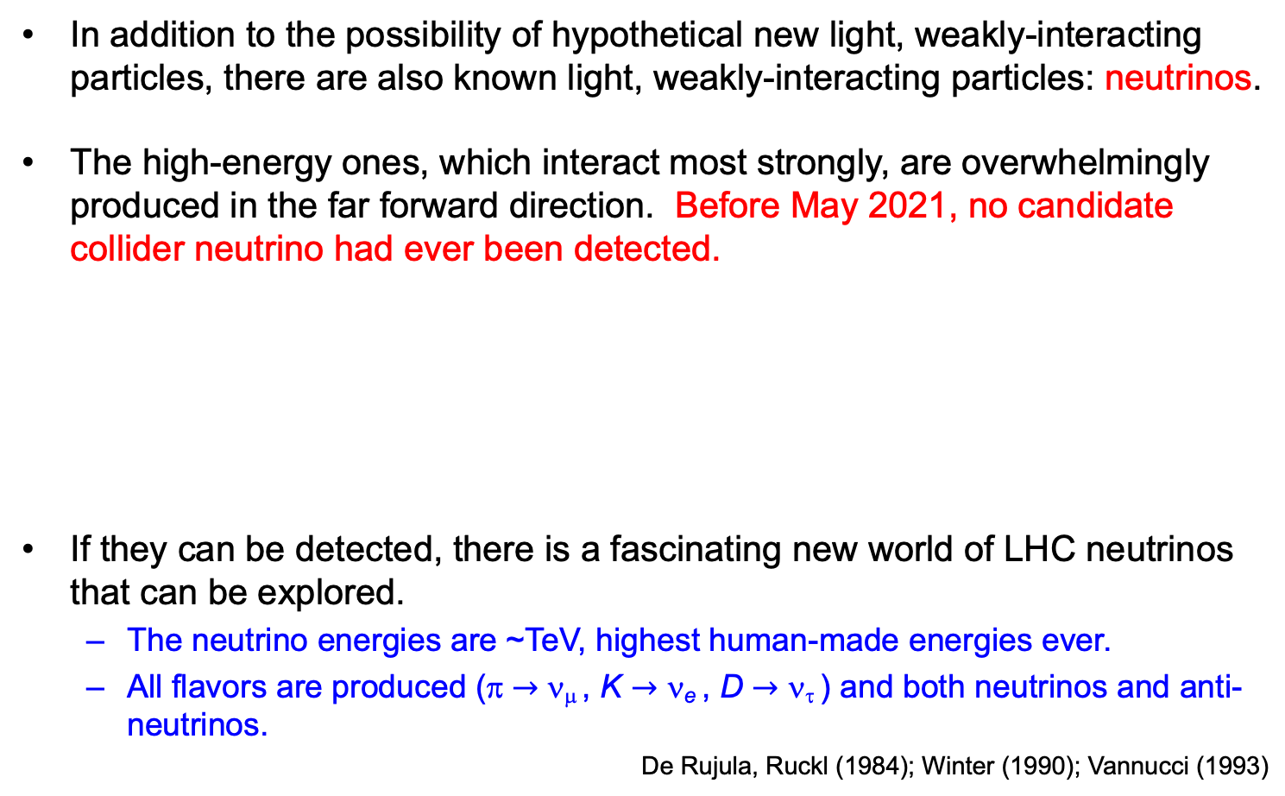
FASERν
In addition to the possibility of hypothetical new light, weakly-interacting particles, there are also known light, weakly-interacting particles: neutrinos.
The high-energy ones, which interact most strongly, are overwhelmingly produced in the far forward direction. Before May 2021, no candidate collider neutrino had ever been detected.
If they can be detected, there is a fascinating new world of LHC neutrinos that can be explored.
  The neutrino energies are ~TeV, highest human-made energies ever.
  All flavors are produced (π $→$ ν_{μ} , K $→$ ν_{e} , D $→$ ν_{τ} ) and both neutrinos and anti-neutrinos.
De Rujula, Ruckl (1984); Winter (1990); Vannucci (1993)

Slide 17
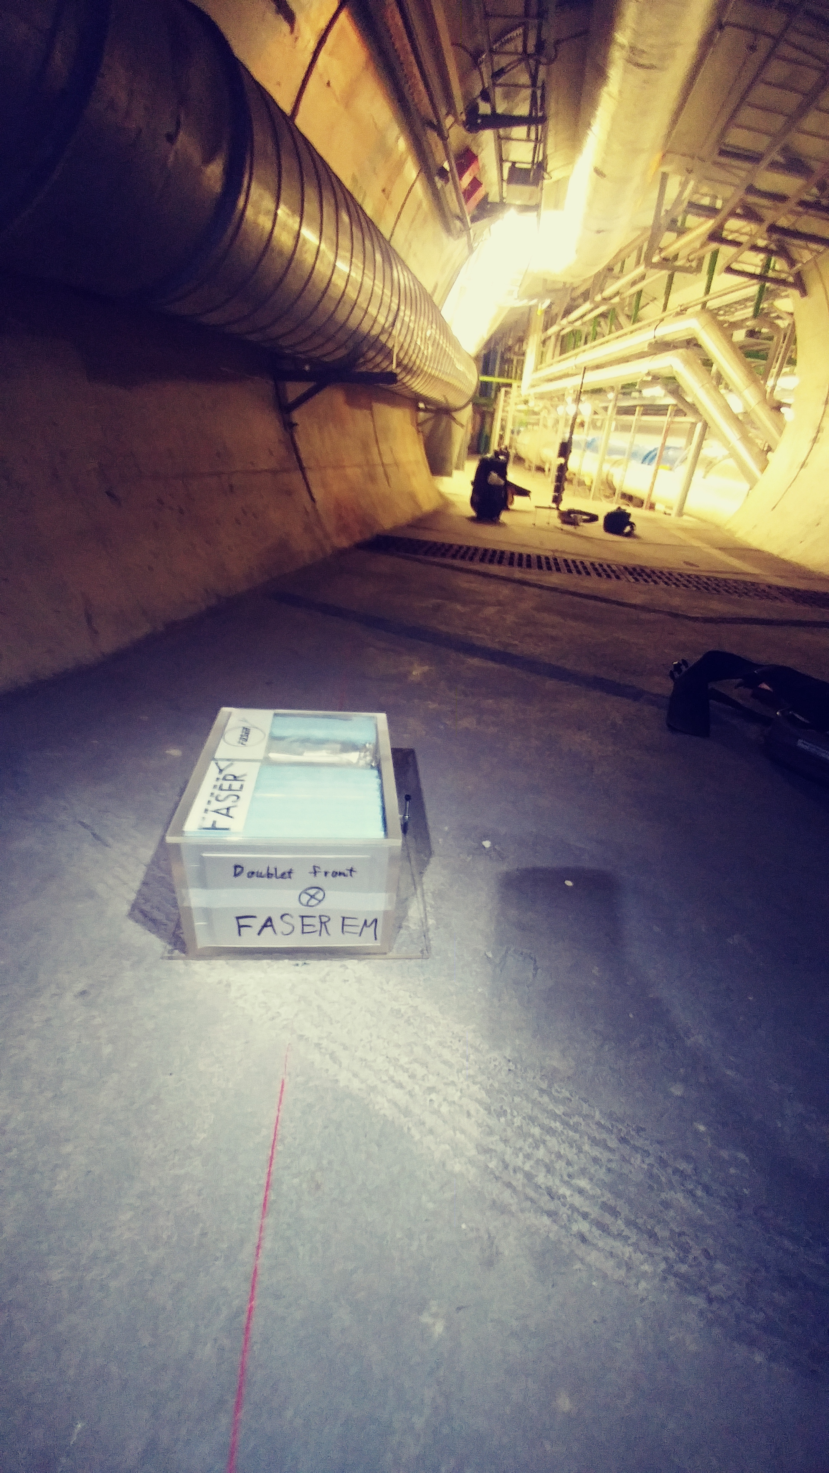
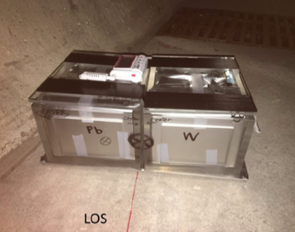
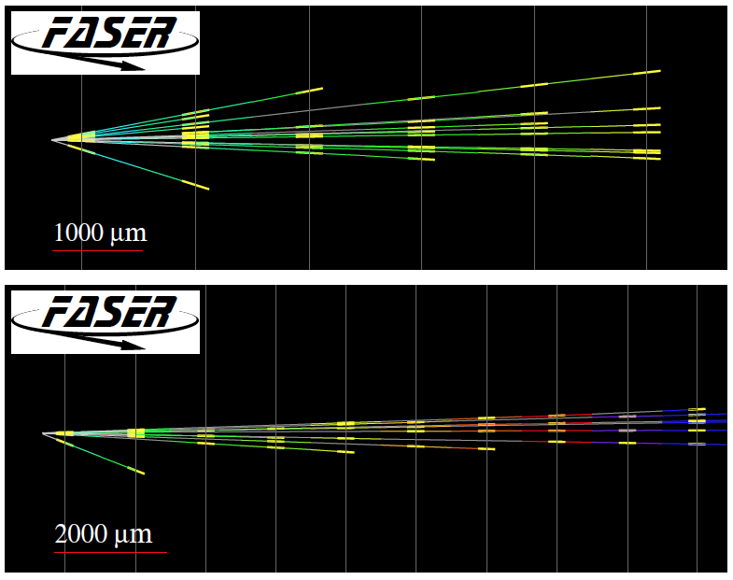
FIRST COLLIDER NEUTRINO CANDIDATES
In 2018 a FASER pilot emulsion detector with 11 kg fiducial mass collected 12.2 fb⁻¹ on the beam collision axis (installed and removed during Technical Stops).
In May 2021, the FASER Collaboration announced the direct detection of 6 candidate neutrinos above 12 expected neutral hadron background events (2.7σ).

Slide 18
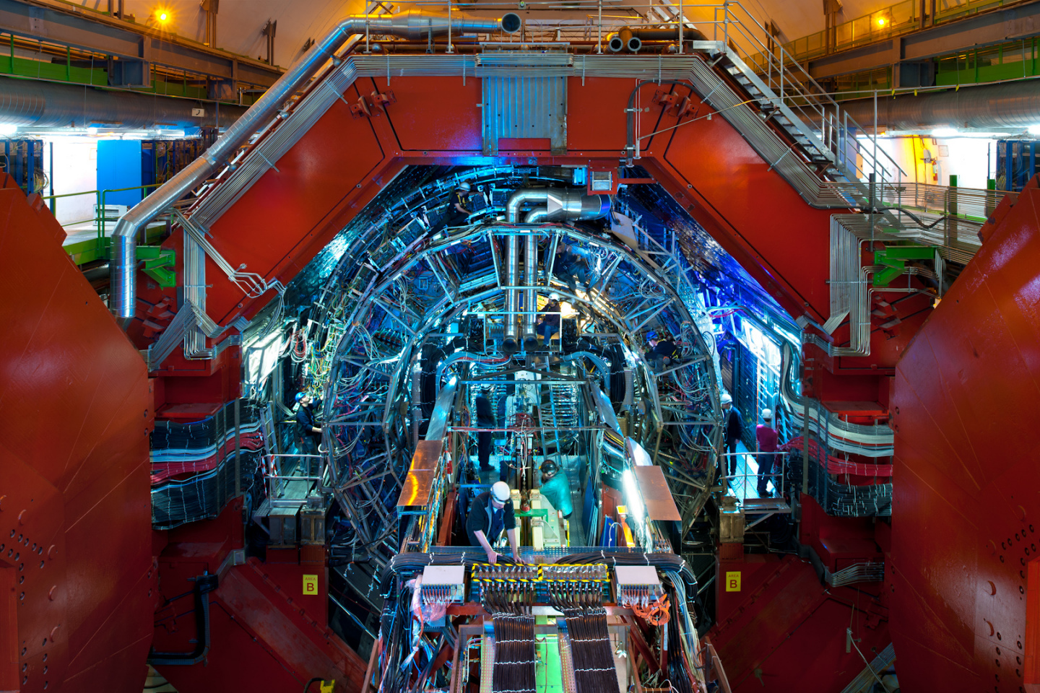
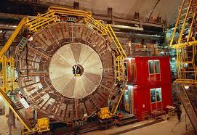
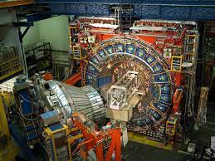
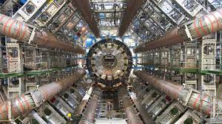
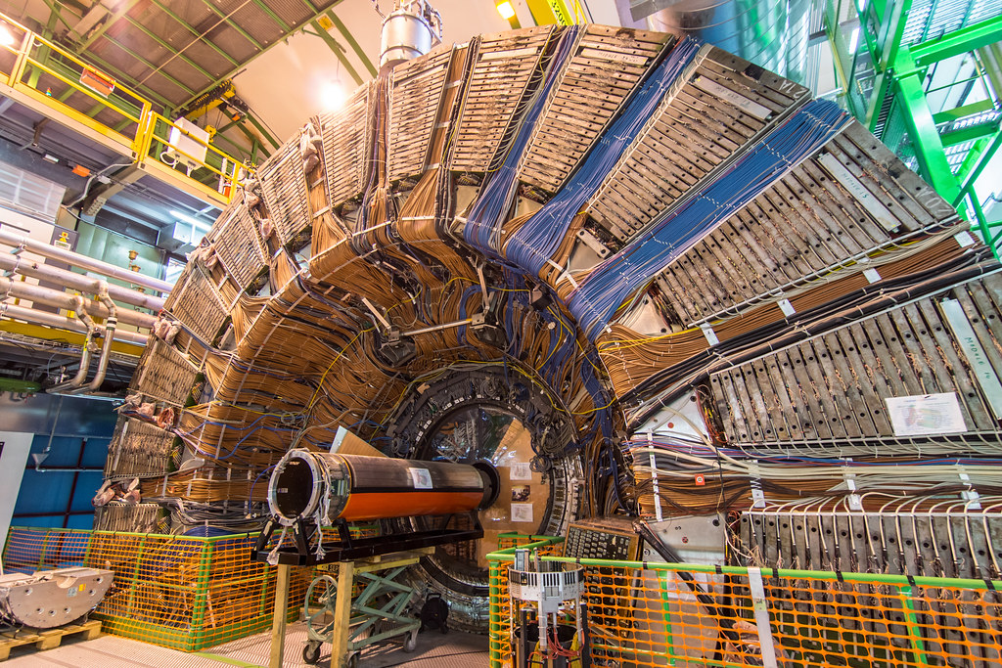
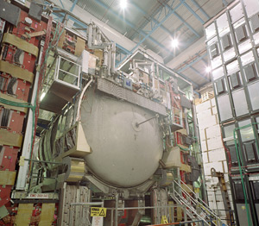
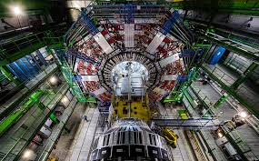
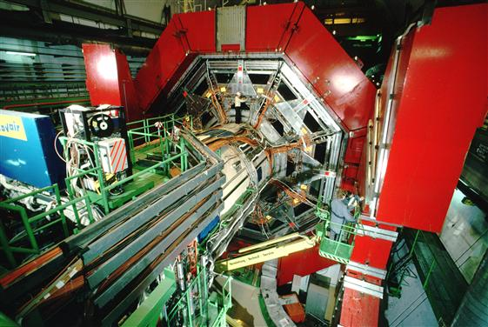

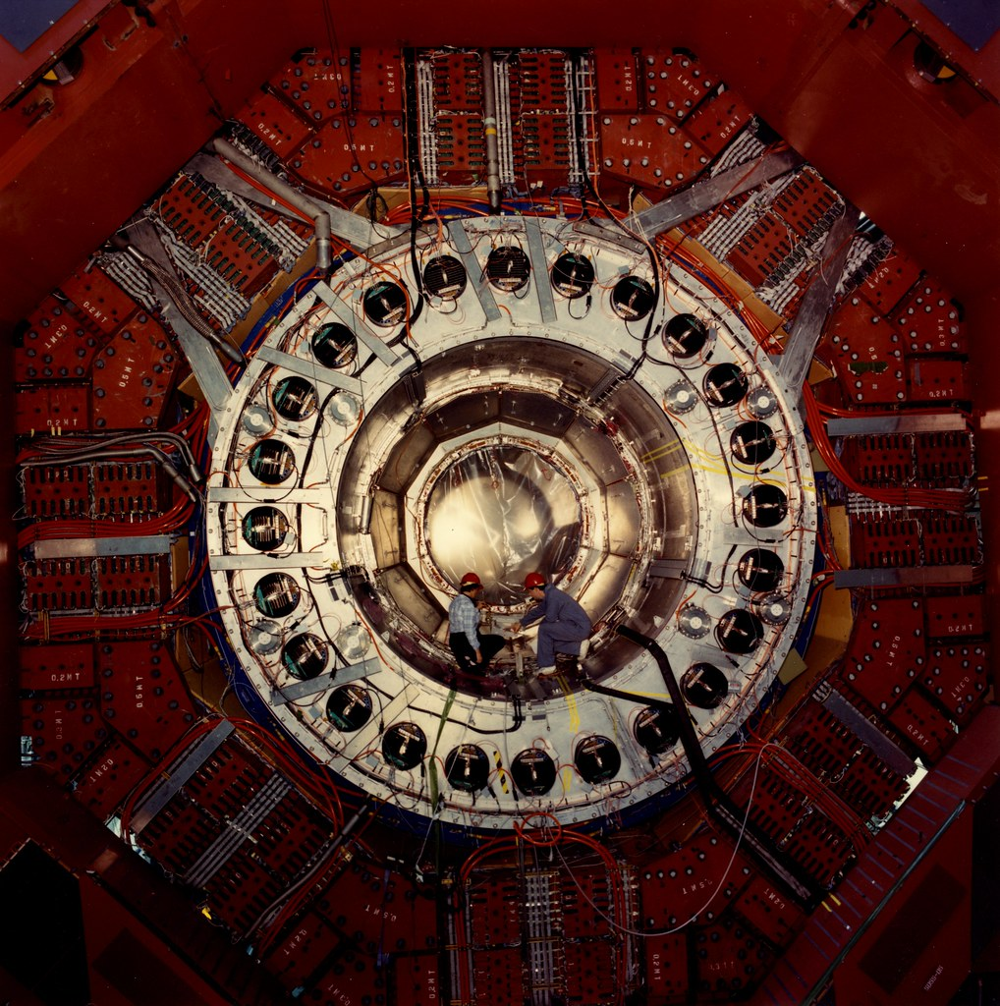
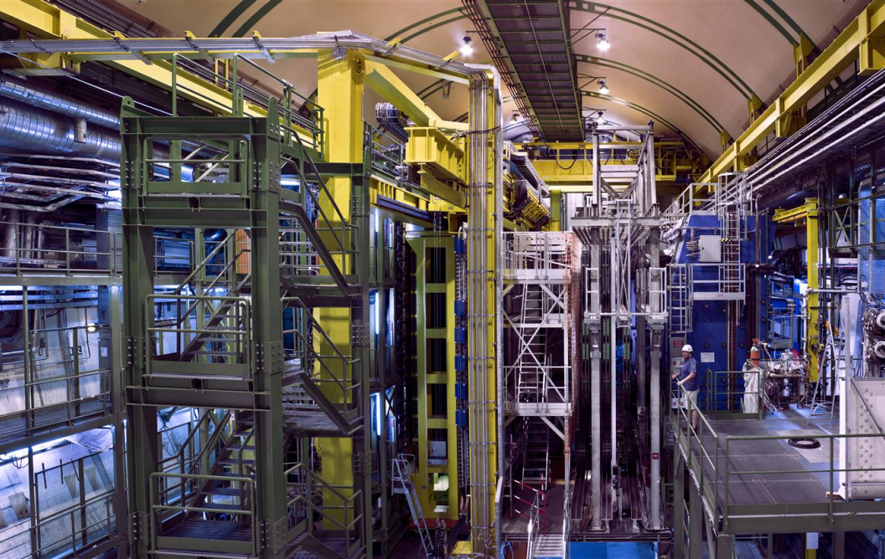
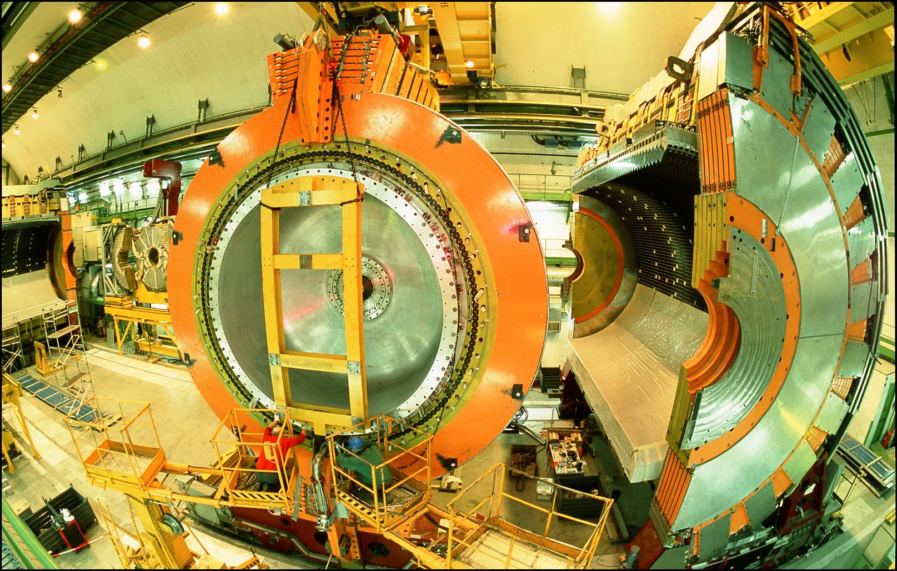
LOCATION, LOCATION, LOCATION
…
ALICE
ALEPH
CDF
FASER Pilot Detector
Suitcase-size, 4 weeks
$0 (recycled parts)
6 candidate neutrinos
ATLAS
DELPHI
D0
CMS
L3
LHCb
SLD
OPAL
All previous
collider detectors
Building-size, decades
~$10⁹
0 candidate neutrinos
This opens up a new field: neutrino physics at colliders

Slide 19
THE FASERν DETECTOR
FASERν will detect neutrinos of all flavors; also SND@LHC, a complementary, slightly off-axis experiment on the other side of ATLAS.
  25cm x 30cm x 1.1m detector consisting of 770 emulsion layers interleaved with 1 mm-thick tungsten plates; target mass = 1.1 tonnes.
  Emulsion swapped out every ~10-30 fb⁻¹, total 10 sets of emulsion for Run 3.
LLP
ν
e⁺
e⁻

Slide 20
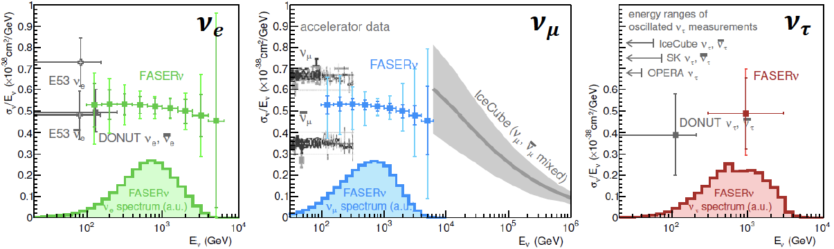
NEUTRINO PHYSICS
In Run 3, the goals of FASERν are to
  5σ discovery of collider neutrinos.
  Record ~1000 ν_{e} , ~10,000 ν_{μ} , and ~10 ν_{τ} interactions at TeV energies, the first direct exploration of this energy range for all 3 flavors.
  Distinguish muon neutrinos from anti-neutrinos by combining FASER and FASERν data, and so measure their cross sections independently.
  Add significantly to the number of ν_{τ} and identify the first anti-ν_{τ} .
FASER Collaboration 1908.02310 (2019)

Slide 22
FORWARD PHYSICS FACILITY
FASER, FASERν, and SND@LHC are currently highly constrained by 1980’s (LEP!) infrastructure that was never intended to support experiments.
The rich physics program in the far-forward region therefore strongly motivates creating a dedicated Forward Physics Facility to house far-forward experiments for the HL-LHC era from 2029-2040.
FPF Meetings
  FPF Kickoff Meeting, 9-10 Nov 2020, https://indico.cern.ch/event/955956
  FPF2 Meeting, 27-28 May 2021, https://indico.cern.ch/event/1022352
  FPF3 Meeting, 25-26 Oct 2021, https://indico.cern.ch/event/1076733
  FPF4 Meeting, 31 Jan-1 Feb 2022, https://indico.cern.ch/event/1110746
FPF Short Paper: 75 pages, 80 authors completed in Sep 2021 (2109.10905, Physics Reports 968, 1 (2022)).
FPF Snowmass White Paper: Feng, Kling, Reno, Rojo, Soldin et al. A comprehensive, 429-page, 392-author+endorser summary (2203.05090).

Slide 23
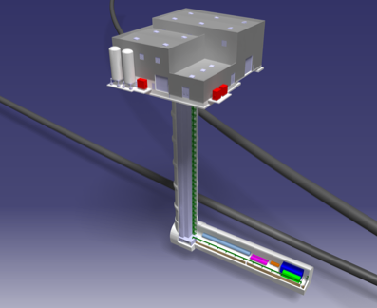
THE LOCATION
The CERN civil engineering team has considered many sites around the LHC ring that are on the beam collision axis of an IP.
A preferred location has been identified ~620-680 m west of the ATLAS IP, shielded by ~200 m of rock. The site is on CERN land in France.

Slide 24
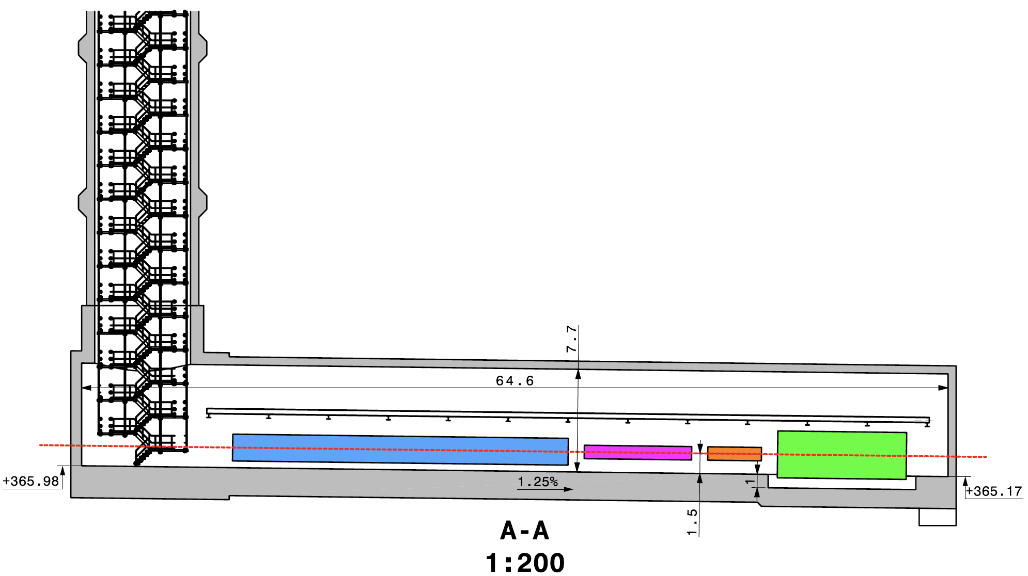
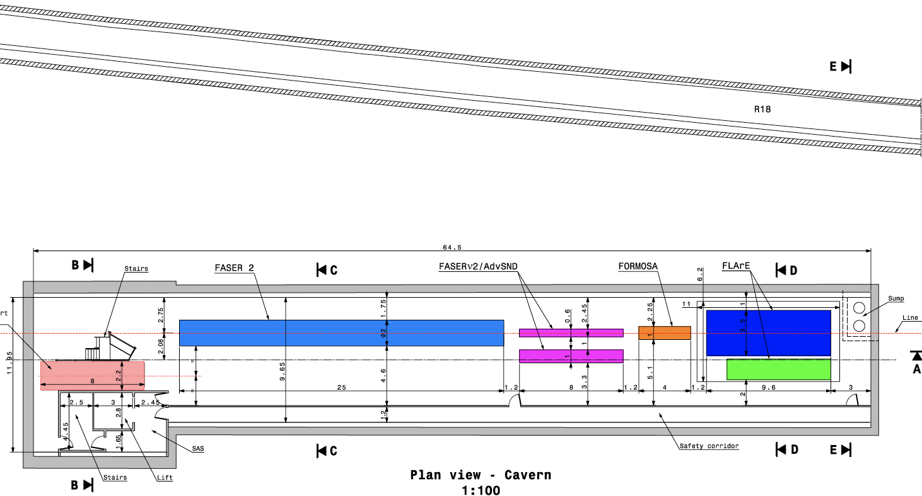
CAVERN AND SHAFT
Cavern: 65m long, 8m wide/high. Shaft: 88m-deep, 9.1m-diameter.
The FPF is completely decoupled from the LHC: no need for a safety corridor connecting the FPF to the LHC, preliminary RP and vibration studies indicate that FPF construction will have no significant impact on LHC operation.

Slide 25
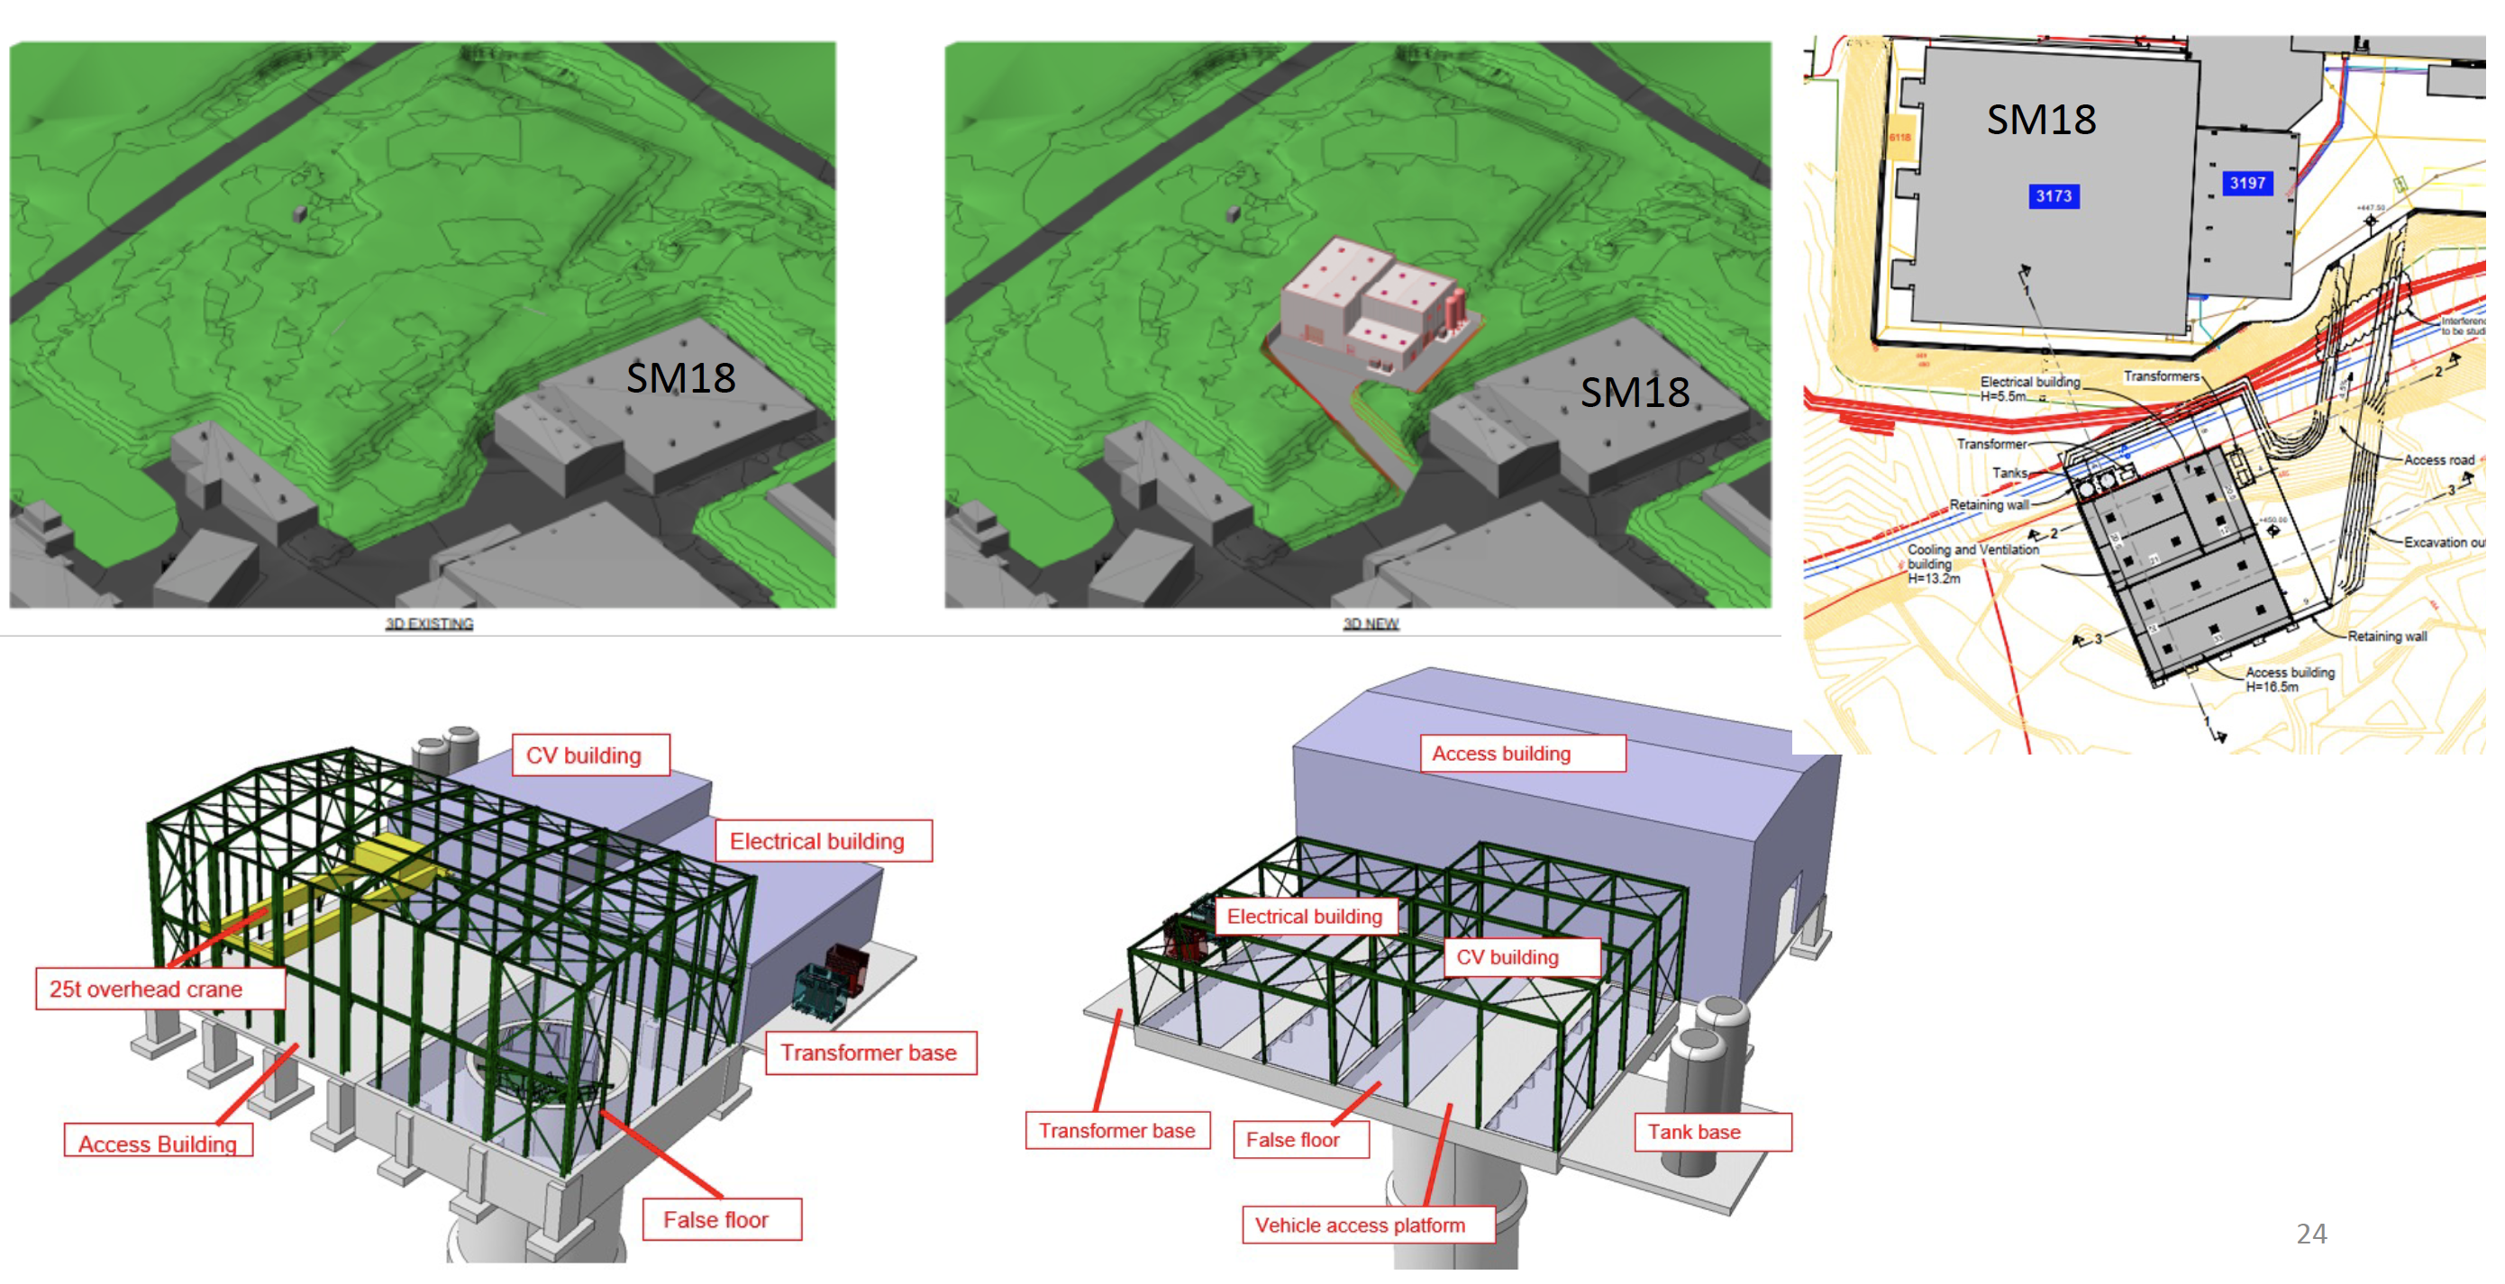
SURFACE BUILDINGS
Kincso Balazs,
John Osborne,
CERN CE (2022)

Slide 26
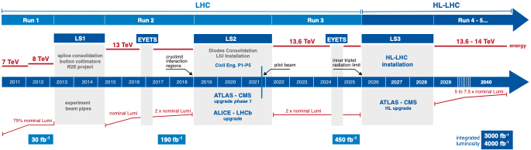
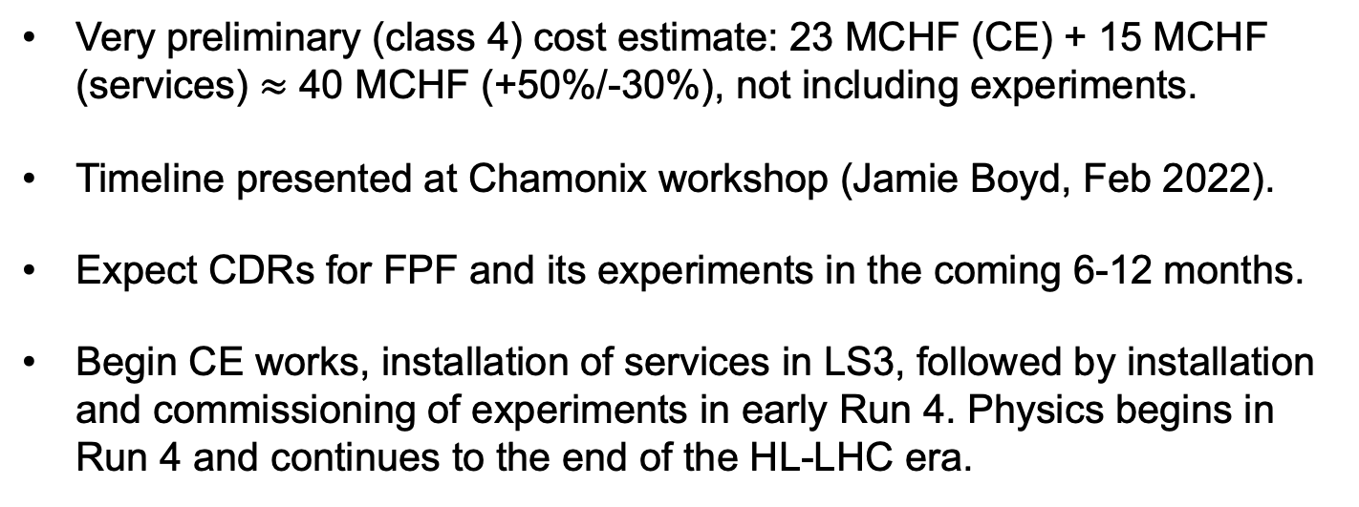
COST AND TIMELINE
Very preliminary (class 4) cost estimate: 23 MCHF (CE) + 15 MCHF (services) $≈$ 40 MCHF (+50%/-30%), not including experiments.
Timeline presented at Chamonix workshop (Jamie Boyd, Feb 2022).
Expect CDRs for FPF and its experiments in the coming 6-12 months.
Begin CE works, installation of services in LS3, followed by installation and commissioning of experiments in early Run 4. Physics begins in Run 4 and continues to the end of the HL-LHC era.

Slide 27
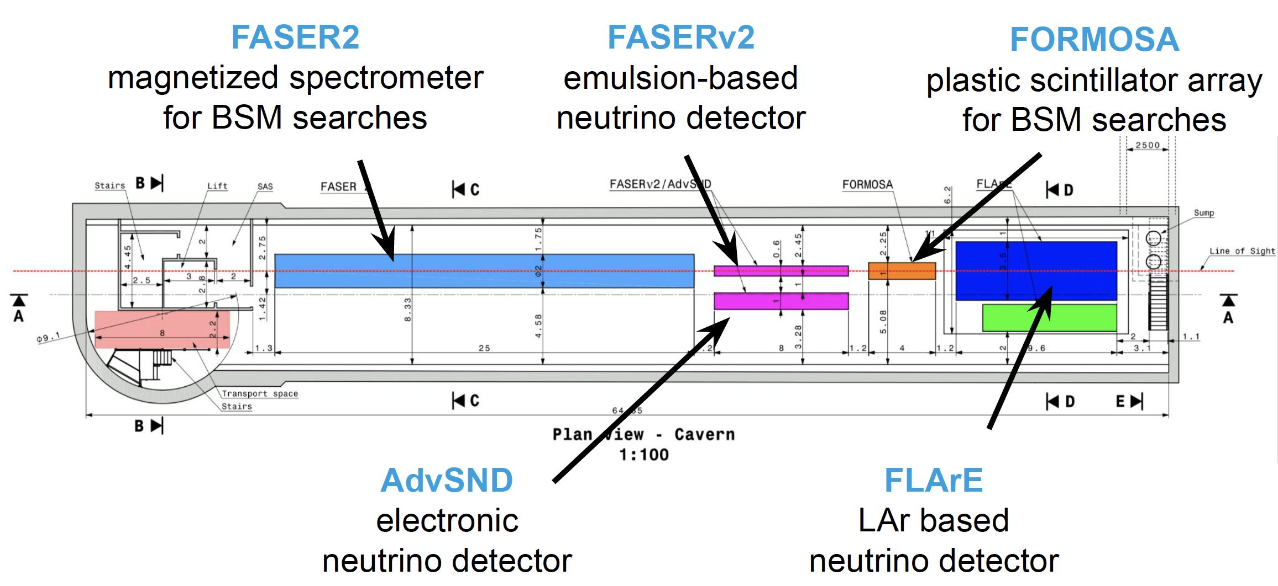
FPF EXPERIMENTS
At present there are 5 experiments being developed for the FPF.
Pseudo-rapidity coverage in the FPF is η > 5.5, with most experiments on the LOS covering η > 7.
Kling (2022)

Slide 28
FPF PHYSICS
The FPF is a general purpose facility with a broad SM and BSM physics program that expands on the physics of FASER and FASERν. Here I will just give a few examples. For more, see the FPF White Paper.

Slide 29
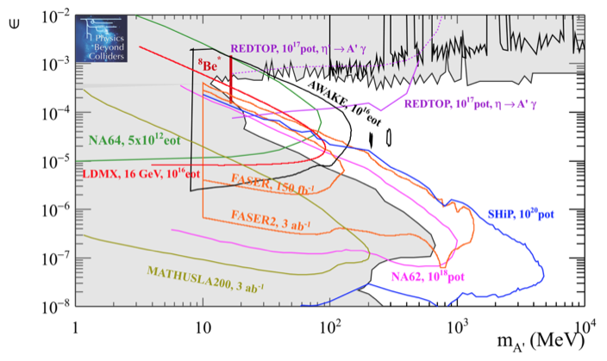
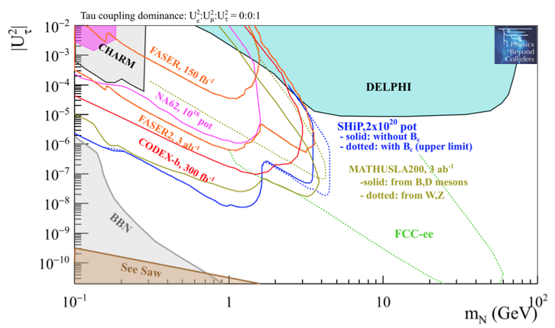
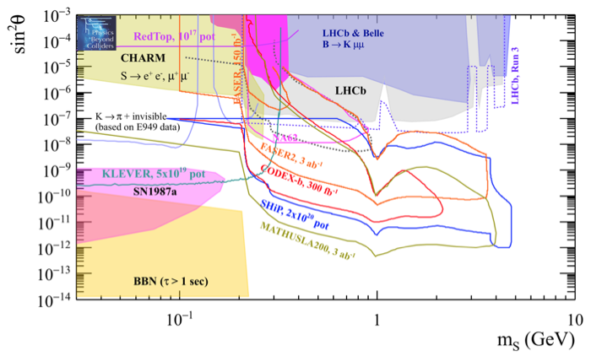
DARK SECTOR SEARCHES
The dedicated detectors have significant discovery potential for a wide variety of BSM/LLP models: dark photons; B-L and related gauge bosons; dark Higgs bosons; HNLs with couplings to e, mu, tau; ALPs with photon, gluon, fermion couplings; light neutralinos, inflaton, relaxion, and many others.
_{FPF White Paper (2022)}
Dark Photon
Dark Fermion
Dark Scalar

Slide 30
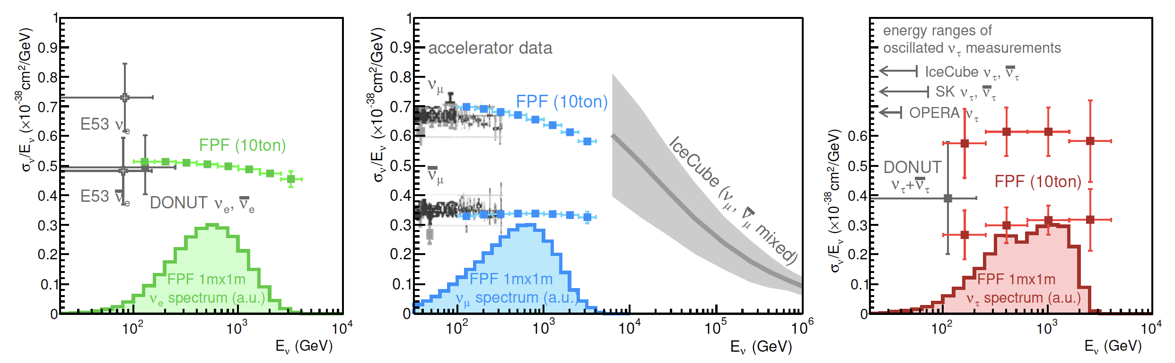
NEUTRINOS
At the FPF, three proposed ~10-ton detectors FASERν2, AdvSND, and FLArE will each detect ~100,000 ν_{e} , ~1,000,000 ν_{μ} , and ~1000 ν_{τ} interactions at TeV energies, providing high statistics samples for all three flavors in an energy range that has never been directly explored.
Will enable precision studies of the tau neutrino.
Can also distinguish neutrinos and anti-neutrinos for muon and tau.
FASER White Paper (2022)

Slide 31
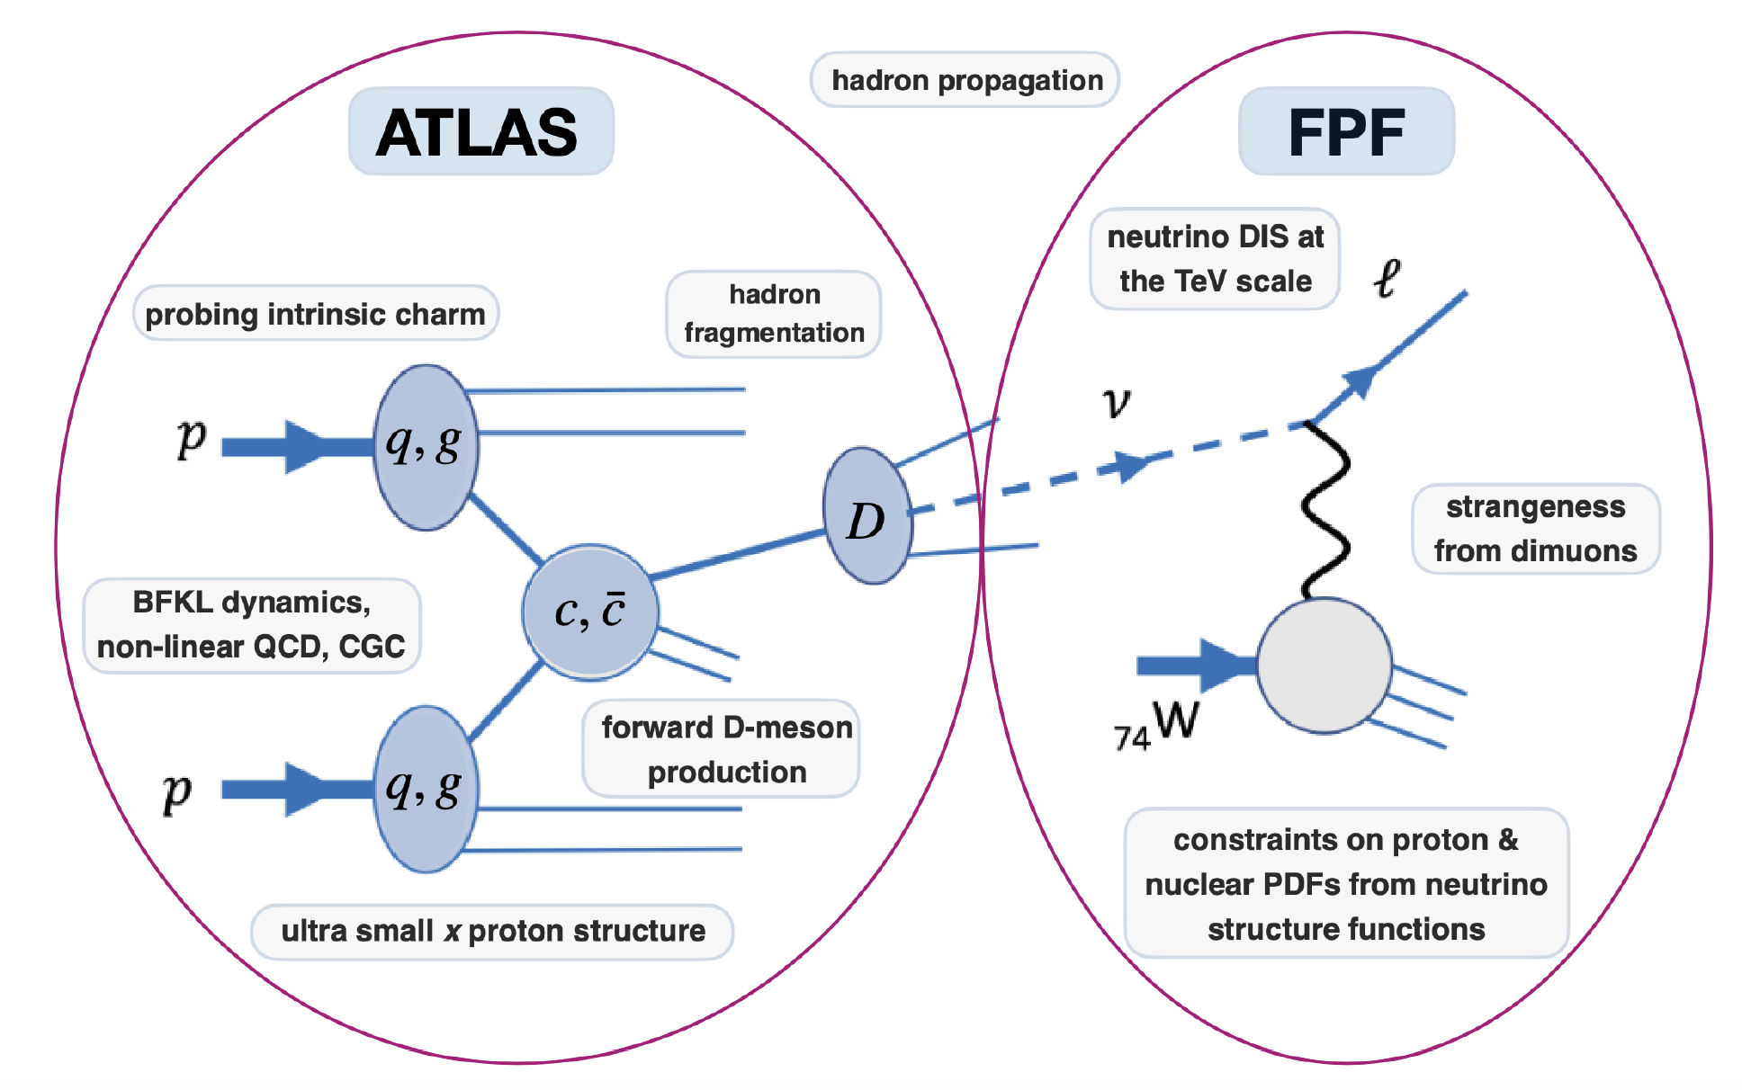
QCD
The FPF will also support a rich program of QCD and hadron structure studies.
Forward neutrino production is a a probe of forward hadron production, BFKL dynamics, intrinsic charm, ultra small x proton structure, with important implications for UHE cosmic ray experiments.
Neutrino interactions will probe DIS at the TeV-scale, constrain proton and nuclear structure, pdfs.
FASER White Paper (2022)

Slide 32
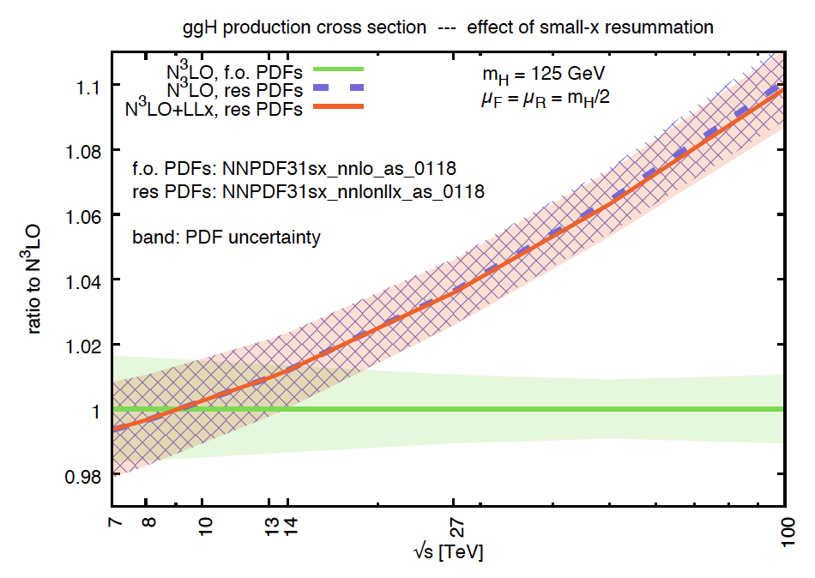
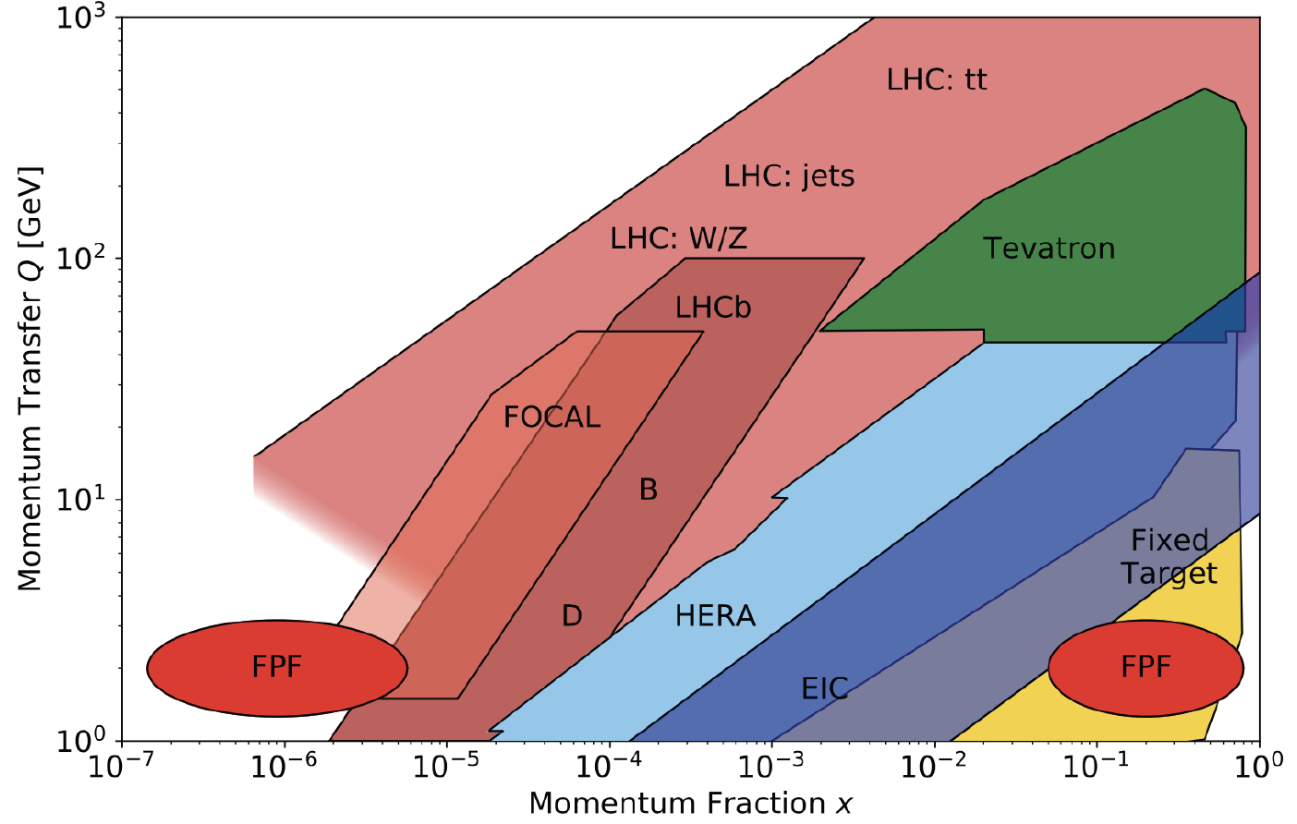
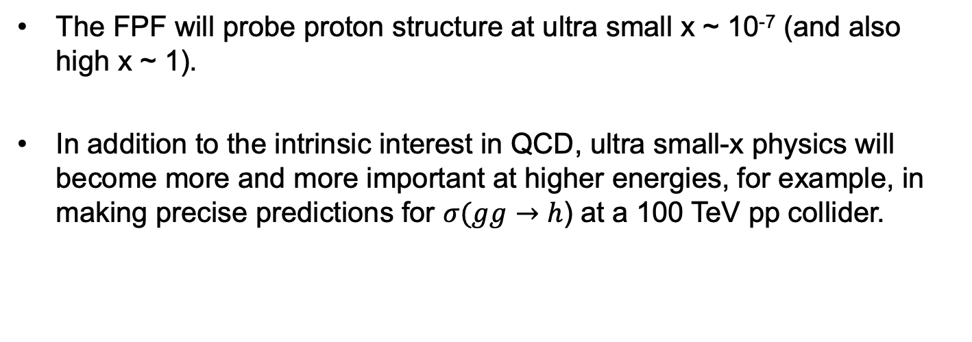
QCD
The FPF will probe proton structure at ultra small x ~ 10⁻⁷ (and also high x ~ 1).
In addition to the intrinsic interest in QCD, ultra small-x physics will become more and more important at higher energies, for example, in making precise predictions for $σ(gg→$ $h$) at a 100 TeV pp collider.
FPF White Paper (2022)

Slide 33
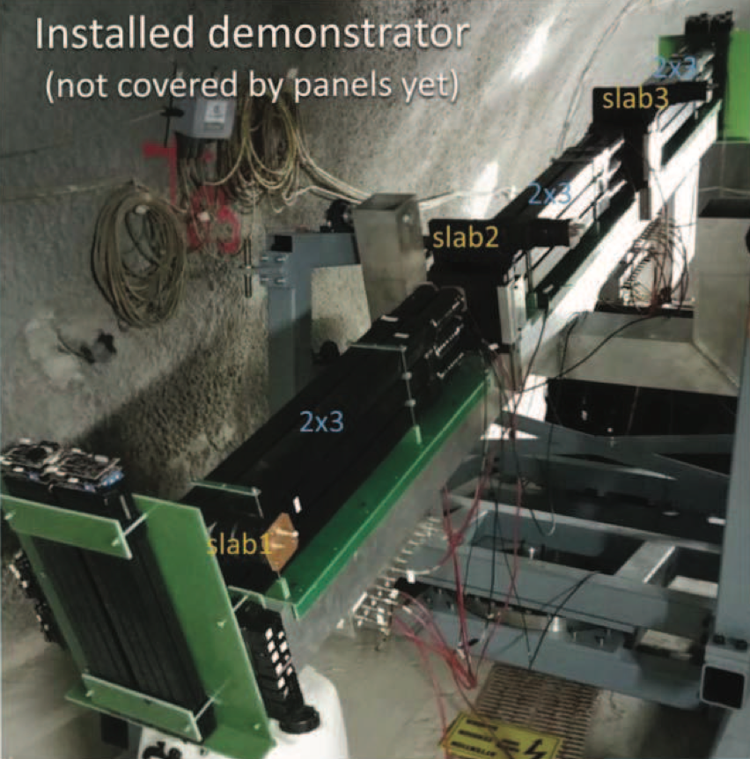
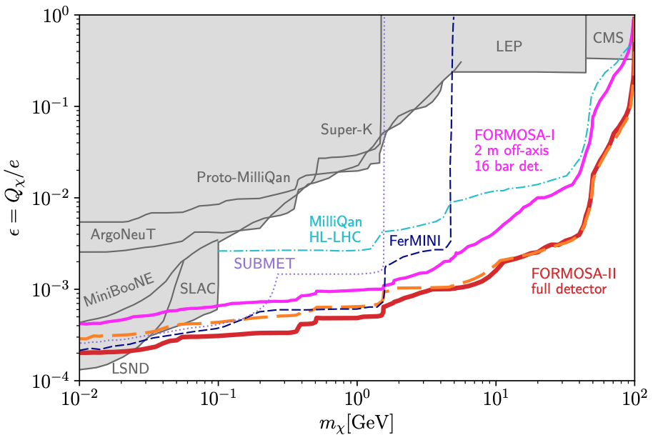
MILLI-CHARGED PARTICLES
A completely generic possibility motivated by dark matter, dark sectors. Currently the target of the MilliQan experiment, located at the LHC near the CMS experiment in a “non-forward” tunnel.
The MilliQan Demonstrator (Proto-MilliQan) already probes new region. Full MilliQan can also run in this location in the HL-LHC era, but the sensitivity may be improved significantly by moving it to the FPF (FORMOSA).
Foroughi-Abari, Kling, Tsai (2020)

Slide 34
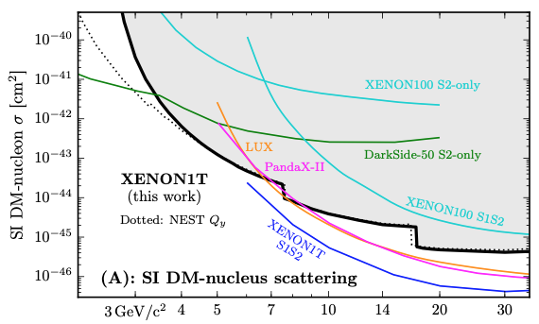



DARK MATTER DIRECT DETECTION
Light DM with masses at the GeV scale and below is famously hard to detect.
  Galactic halo velocity ~ 10⁻³ c, so kinetic energy ~ keV or below.
At the LHC, we can produce DM at high energies, look for the resulting DM to scatter in FLArE, Forward Liquid Argon Experiment, a proposed 10 to 100 tonne LArTPC.
FLArE is powerful in the region favored/allowed by thermal freezeout.
Batell, Feng, Trojanowski (2021)

Slide 35
SUMMARY
Half of the physics opportunities at the LHC are currently being missed.
This can be rectified by putting experiments in the far forward region to catch particles produced along the beamline.
The Forward Physics Facility is a proposal to do exactly this for the HL-LHC era (2029-40).

