Slide 1



CURIOUS RESULTS
BEYOND THE STANDARD MODEL AND DARK MATTER
IUPAP WG9 Nuclear Science Symposium
15 June 2022
Jonathan Feng, UC Irvine

Slide 2
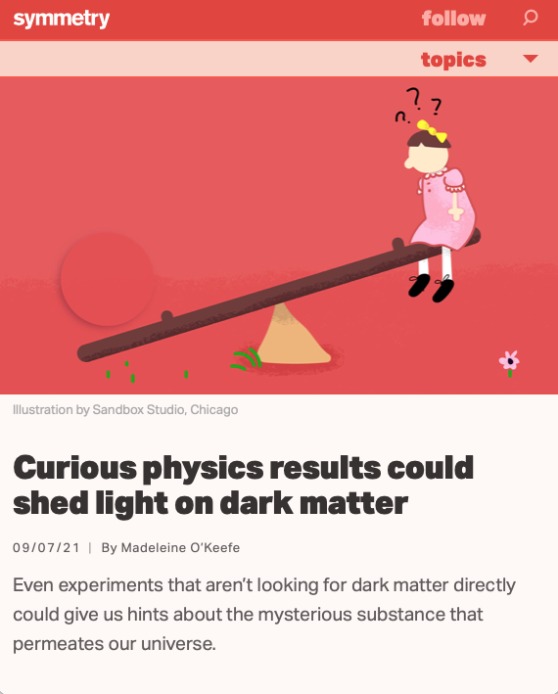
INTRODUCTION
I am a theorist, working primarily on physics beyond the standard model and dark matter. Recently I have also become the co-spokesperson of an experiment, FASER at the LHC.
The title of this talk is inspired (as I understand it!) by a short article in Symmetry Magazine.
The article interviewed a number of people about current anomalies and their possible relation to dark matter.

Slide 3
OUTLINE
A SNAPSHOT OF PARTICLE PHYSICS NOW
CURIOUS RESULTS
  Muon g-2
  ⁸Be and ⁴He ATOMKI Anomalies
  Strongly-Interacting DM
FASER AT THE LHC
FORWARD PHYSICS FACILITY
Summary: There has been a sea change in thinking about searches for new particles, with increasing focus on MeV to GeV energies, leading to new synergies between particle physics, cosmology, and nuclear physics.

Slide 4
A SNAPSHOT OF
PARTICLE PHYSICS NOW

Slide 5
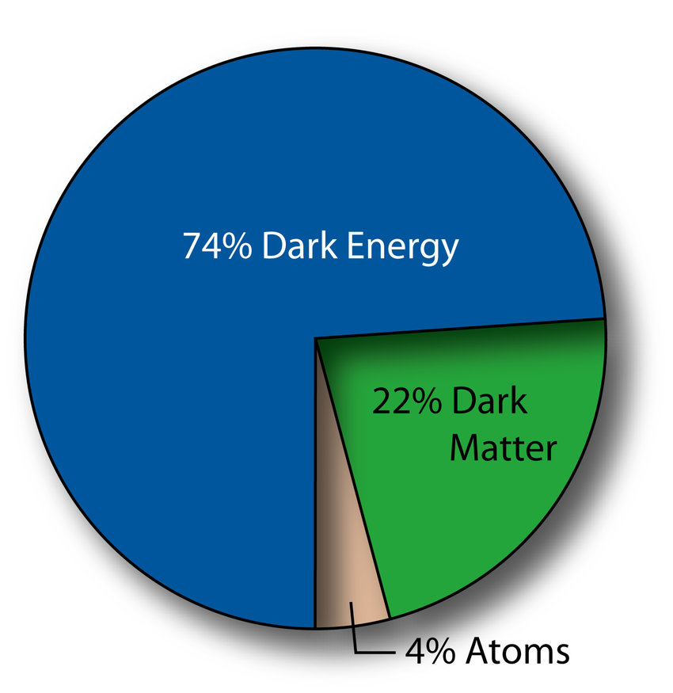
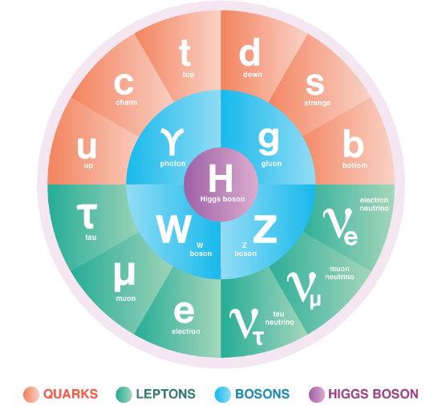
THE STANDARD MODEL
This is a critical time in particle physics
  the Higgs boson was discovered in 2012, completing the SM particle content
  but many fascinating problems remain: dark matter, neutrino masses, dark energy, matter–anti-matter asymmetry, strong CP problem, grand unification, gauge and flavor hierarchy problems, ...

Slide 6
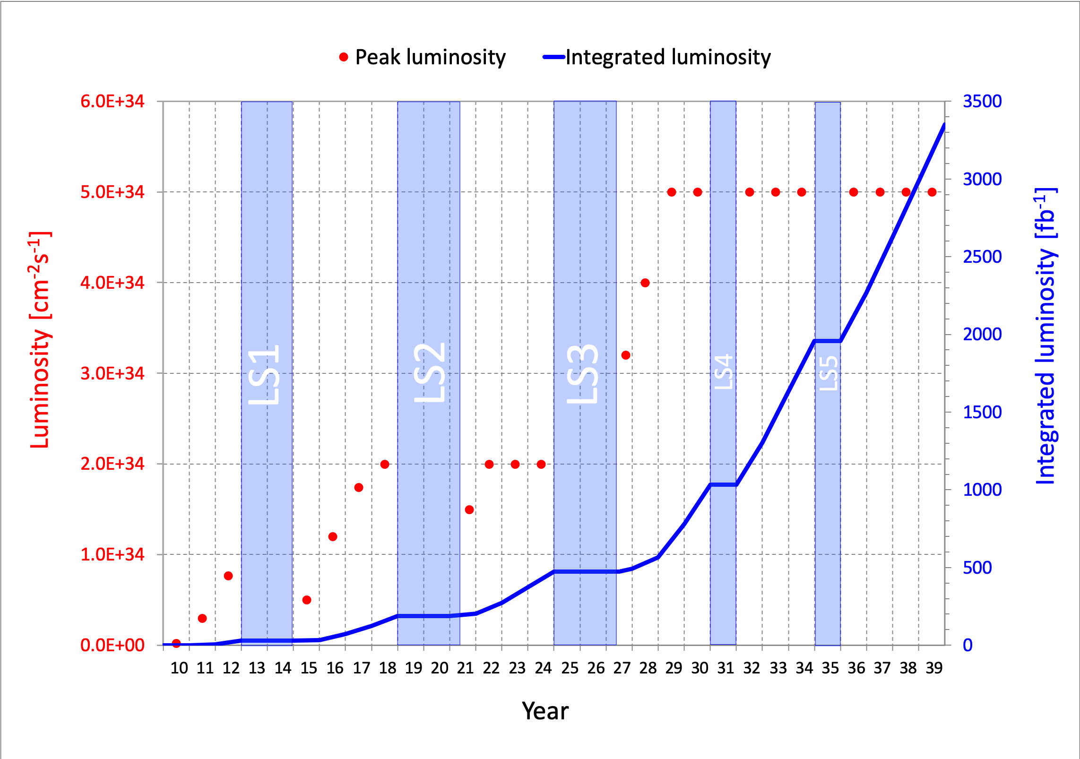
CURRENT STATUS OF THE LHC
At the energy frontier, following the Higgs boson discovery at the LHC, we have not discovered any other evidence of new particles.
The LHC has just emerged from Long Shutdown 2. Run 3 started in April 2022 and is ramping up to full power in July 2022.
Much more to come:
[Run 1/2, 2010-18, 200 fb⁻¹]
Run 3, 2022-25, 150 fb⁻¹
HL-LHC, 2029-40, 3000 fb⁻¹
What can we do to enhance the prospects for discovering new physics?
LHC Schedule (shift everything over 1 year for COVID)

Slide 7
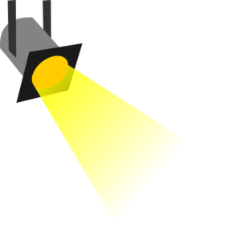
THE NEW PARTICLE LANDSCAPE
Particle
Colliders
Mass
MeV
GeV
TeV
1
Already
Discovered
Strongly Interacting
Heavy Particles
Interaction Strength
10⁻³
Weakly Interacting
Light Particles
Impossible to
Discover
10⁻⁶

Slide 8
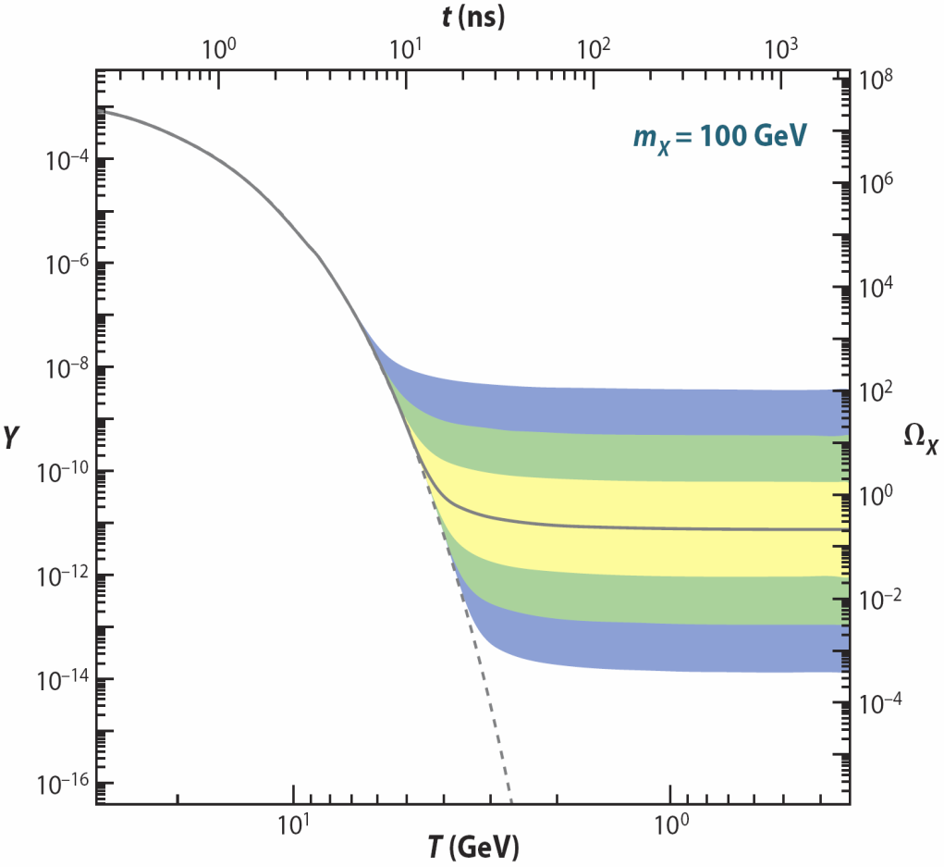
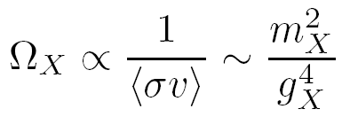
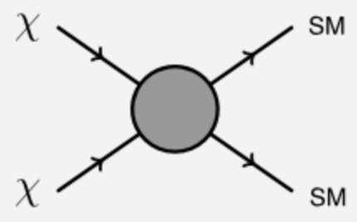

DARK MATTER
DM is among the most obvious hints for new particles. In principle, the dark matter mass can be almost anything.
However, there is a simple mechanism for generating dark matter: thermal relic freezeout.
In the early universe, dark matter pair annihilates until it becomes too dilute and then “freezes out.”
The final abundance is determined by the annihilation rate: the weaker the interaction, the more DM there is now.
Feng (2010)
By dimensional analysis, $\left\langle σv\right\rangle$ ~ $m_{X}^{−2}$, so the relic density is larger for heavy particles with weak interactions.

Slide 9
THE DARK MATTER LANDSCAPE
Particle
Colliders
Mass
MeV
GeV
TeV
1
The coincidence of cosmology and particle physics in the upper right corner is known as the WIMP Miracle. This has guided the field for decades.
But there is an entire diagonal to explore: the WIMPless Miracle.
Already
Discovered
Strongly Interacting
Heavy Particles
Too Little to be
Dark Matter
Interaction Strength
Just Right to
be Dark Matter
10⁻³
Feng (2001)
Weakly Interacting
Light Particles
Impossible to
Discover
10⁻⁶
Too Much to be
Dark Matter
Feng, Kumar (2008)

Slide 10

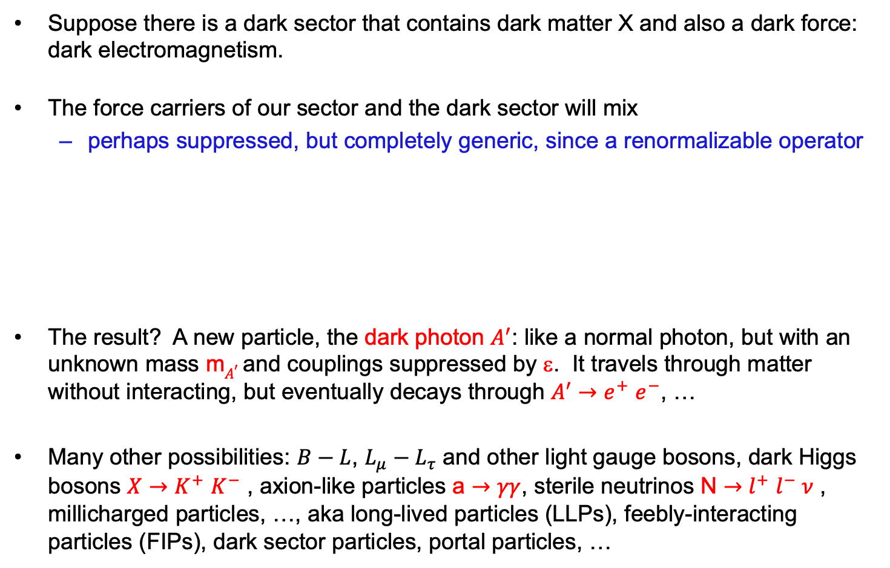

AN EXAMPLE: DARK PHOTONS
Suppose there is a dark sector that contains dark matter X and also a dark force: dark electromagnetism.
The force carriers of our sector and the dark sector will mix
  perhaps suppressed, but completely generic, since a renormalizable operator
The result? A new particle, the dark photon $A^{′}$: like a normal photon, but with an unknown mass m$A^{′}$ and couplings suppressed by ε. It travels through matter without interacting, but eventually decays through $A^{′}{→e}^{+}e^{−}$, …
Many other possibilities: $B−L$, $L_{μ}−L_{τ}$ and other light gauge bosons, dark Higgs bosons $X{→K}^{+}K^{−}$ , axion-like particles a $→γγ$, sterile neutrinos N ${→l}^{+}l^{−} ν$ , millicharged particles, …, aka long-lived particles (LLPs), feebly-interacting particles (FIPs), dark sector particles, portal particles, …
SM
EM
Dark Sector
EM, X
A
$$εF_{μν}F_{D}^{μν}$$
A_{D}
Holdom (1986)

Slide 11
CURIOUS RESULTS

Slide 12
Dark Sector Candidates, Anomalies, and Search Techniques
zeV
aeV
feV
peV
neV
μeV
meV
eV
keV
MeV
GeV
TeV
PeV
30M☉
≈
QCD Axion
Sterile Neutrino
WIMPs
Ultralight Dark Matter
Hidden Thermal Relics / WIMPless DM
Black Holes
SIMPs / ELDERS
Asymmetric DM
X-ray Line
Beryllium-8
Muon g-2
Small-Scale Structure
Coherent Field Searches
Nuclear and Atomic Physics
Microlensing
Direct Detection (Low-Threshold and Spin-Dependent)
Accelerators
≈
zeV
aeV
feV
peV
neV
μeV
meV
eV
keV
MeV
GeV
TeV
PeV
30M☉
Cosmic Visions Report (2017)
Notes:
Targets: Freeze-In, Inflation Mechanism, Misalignment Mechanism

Slide 13
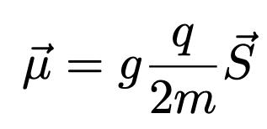

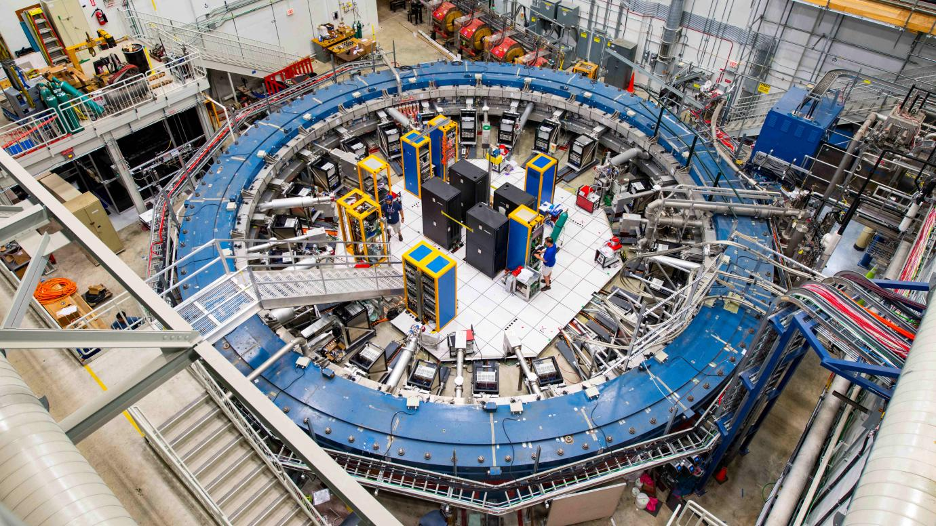
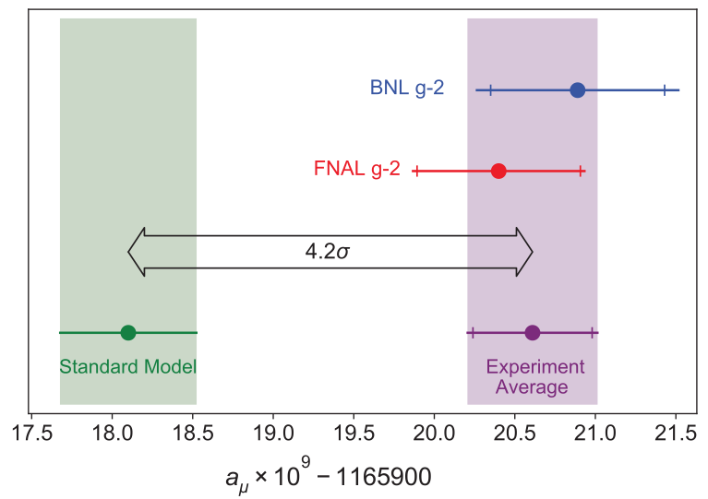
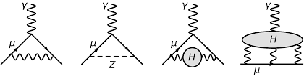
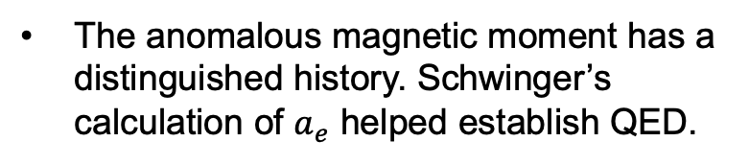
THE MUON’S ANOMALOUS MAGNETIC MOMENT
The anomalous magnetic moment has a distinguished history. Schwinger’s calculation of $a_{e}$ helped establish QED.
In 2021, the Muon g-2 Collaboration announced a high precision measurement that deviates from the SM prediction by 3.3σ.
It is sensitive to the weak interactions, but unlike other precision probes, it requires neither flavor nor CP violation, and so is a robust probe of new particles that couple to muons.

Slide 14
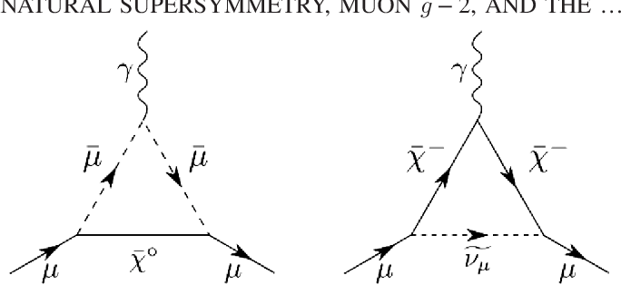
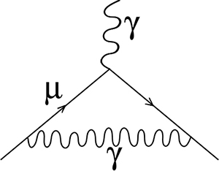
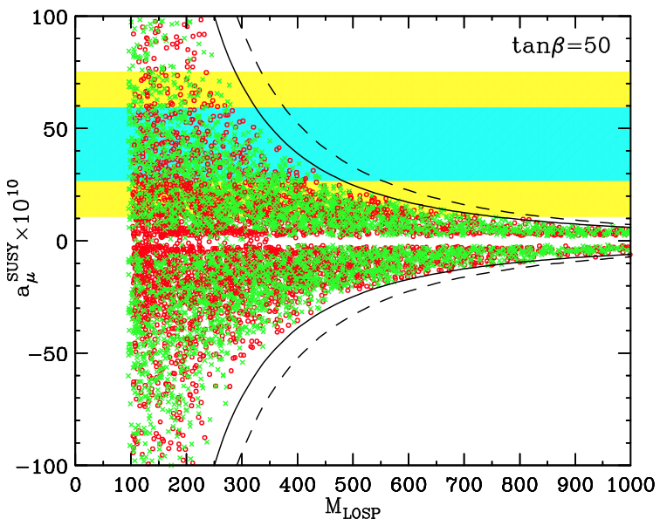
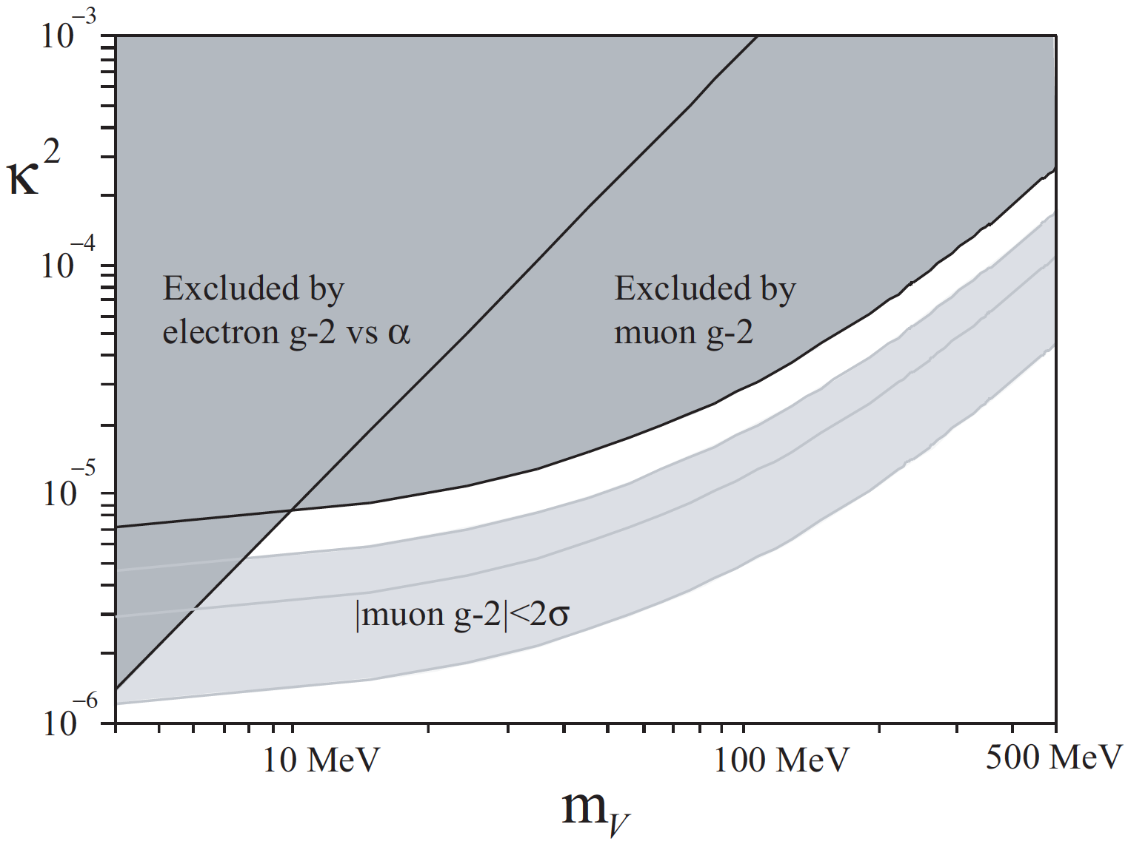
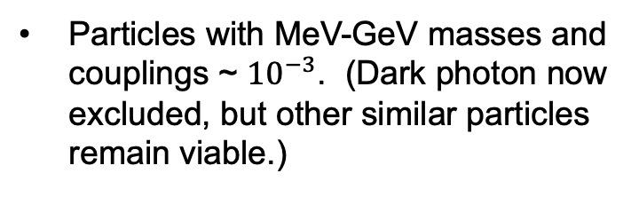

THE MUON’S ANOMALOUS MAGNETIC MOMENT
The discrepancy can be resolved by either heavy or light new particles.
Supersymmetry with superpartners below the TeV scale.
Particles with MeV-GeV masses and couplings ~ ${10}^{−3}$. (Dark photon now excluded, but other similar particles remain viable.)
$$γ, A’$$
Feng, Matchev (2001)
Boehm, Fayet (2003)

Slide 15
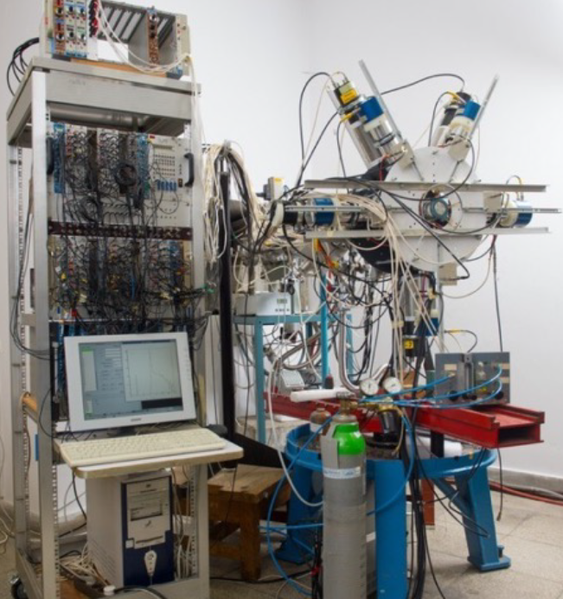
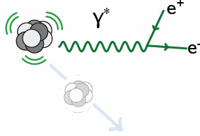
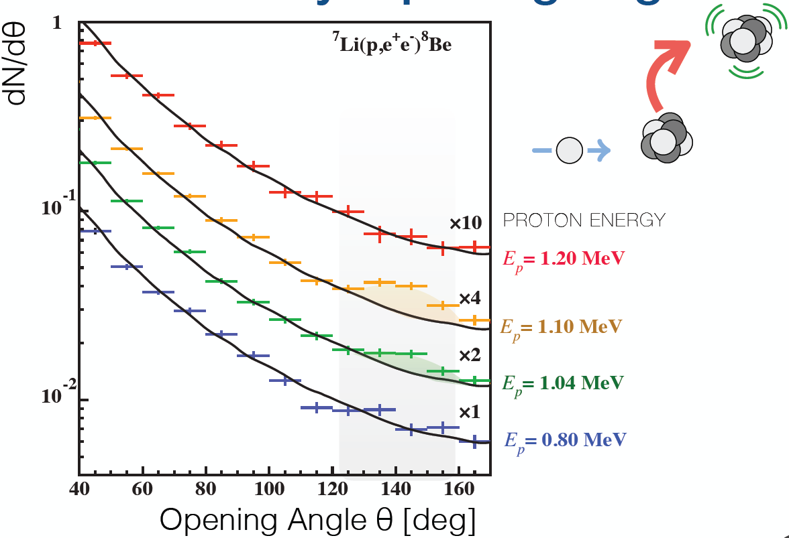
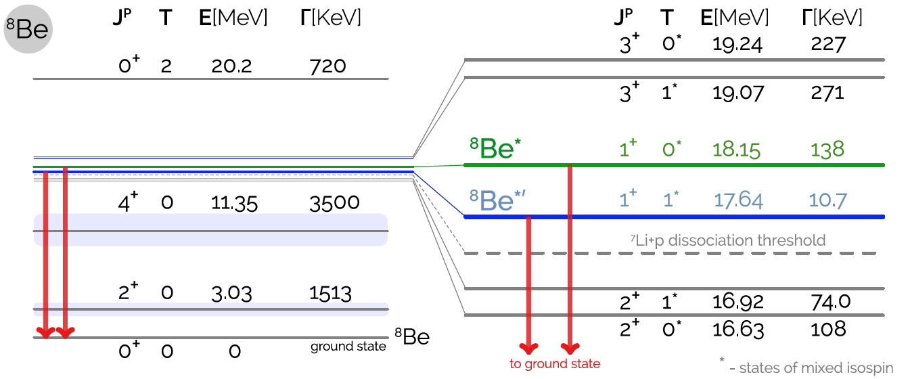
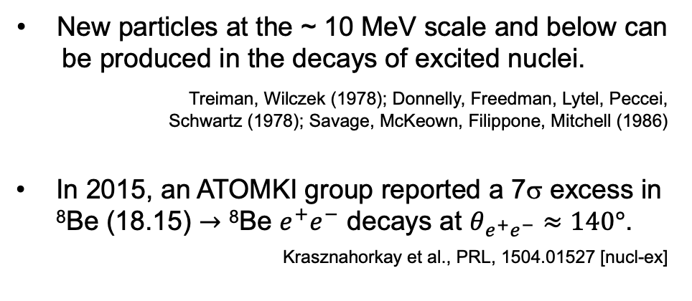
THE ⁸Be and ⁴He ATOMKI ANOMALIES
New particles at the ~ 10 MeV scale and below can be produced in the decays of excited nuclei. Treiman, Wilczek (1978); Donnelly, Freedman, Lytel, Peccei, Schwartz (1978); Savage, McKeown, Filippone, Mitchell (1986)
In 2015, an ATOMKI group reported a 7σ excess in ⁸Be (18.15) $→$ ⁸Be $e^{+}e^{−}$ decays at $θ_{e^{+}e^{−}}≈140°$.
Krasznahorkay et al., PRL, 1504.01527 [nucl-ex]
γ,X
θ

Slide 16
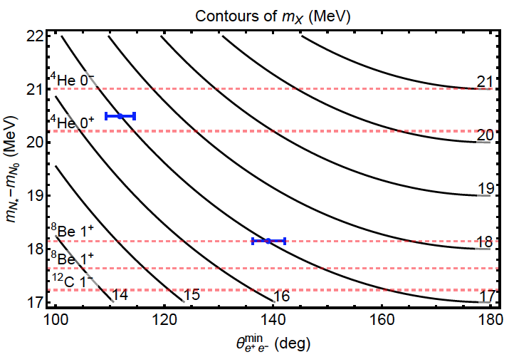
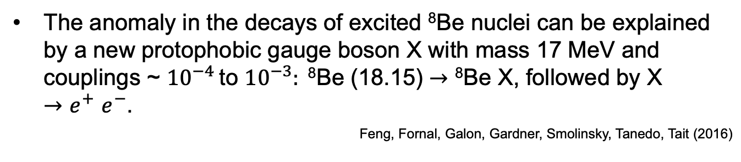
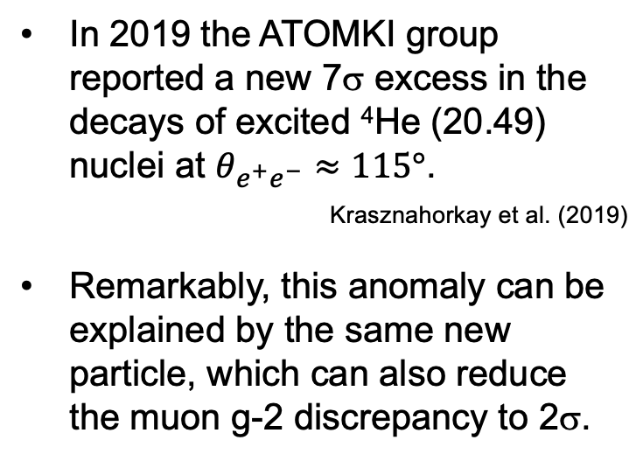
THE ⁸Be and ⁴He ATOMKI ANOMALIES
The anomaly in the decays of excited ⁸Be nuclei can be explained by a new protophobic gauge boson X with mass 17 MeV and couplings ~ ${10}^{−4}$ to ${10}^{−3}: \text{8}\text{Be}\text{ (18.15)}→\text{8}\text{Be} \text{X}\text{, }\text{followed} \text{by} \text{X} {→e}^{+}e^{−}$.
Feng, Fornal, Galon, Gardner, Smolinsky, Tanedo, Tait (2016)
In 2019 the ATOMKI group reported a new 7σ excess in the decays of excited ⁴He (20.49) nuclei at $θ_{e^{+}e^{−}}≈115°$.
_{Krasznahorkay et al. (2019)}
Remarkably, this anomaly can be explained by the same new particle, which can also reduce the muon g-2 discrepancy to 2σ.
Feng, Tait, Verhaaren (2020)
See also Zhang, Miller (2020)

Slide 17
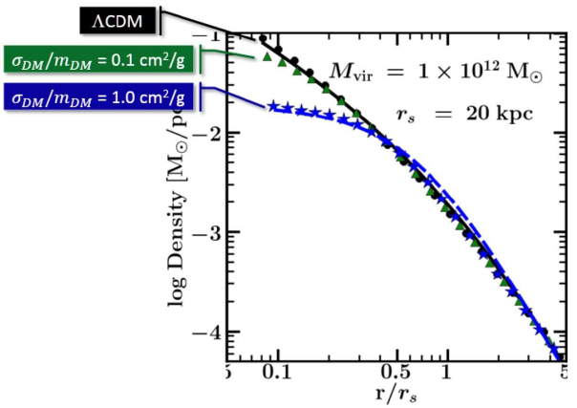
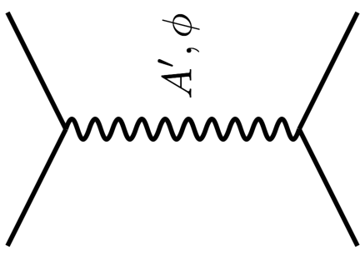


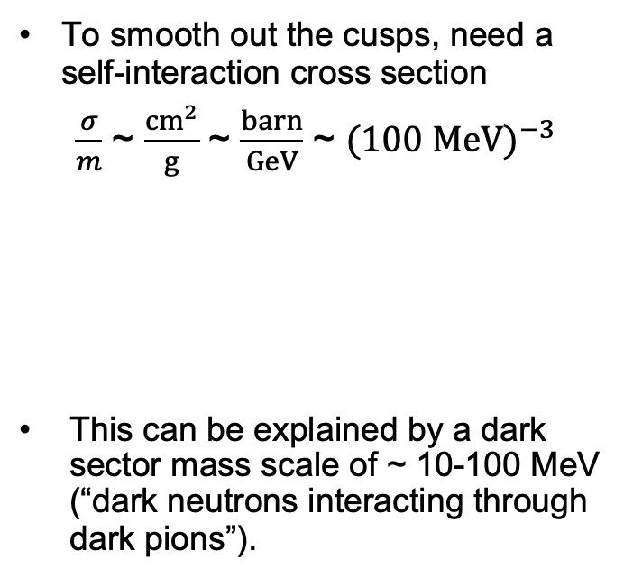

SELF-INTERACTING DARK MATTER
There are indications from small-scale structure that dark matter may be strongly self-interacting.
For example, there appear to be halo profiles that are not as cuspy (high central density) as predicted for standard collisionless cold dark matter (WIMPs, axions, sterile neutrinos, …).
To smooth out the cusps, need a self-interaction cross section
$\frac{σ}{m}$ ~ $\frac{{cm}^{2}}{g}$ ~ $\frac{barn}{GeV}$ ~ ${(100 MeV)}^{−3}$
This can be explained by a dark sector mass scale of ~ 10-100 MeV (“dark neutrons interacting through dark pions”).
DM
$$\text{DM}$$
$$A’$$
DM
$$\text{DM}$$
Tulin, Yu (2017)
Rocha et al. (2012); Peter et al. (2012)
Vogelsberger et al. (2012); Zavala et al. (2012)
Notes:
17

Slide 18
FASER AT THE LHC

Slide 19
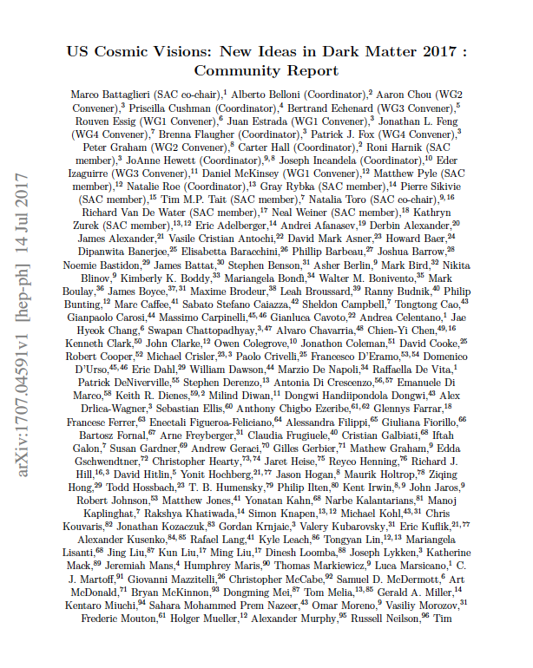
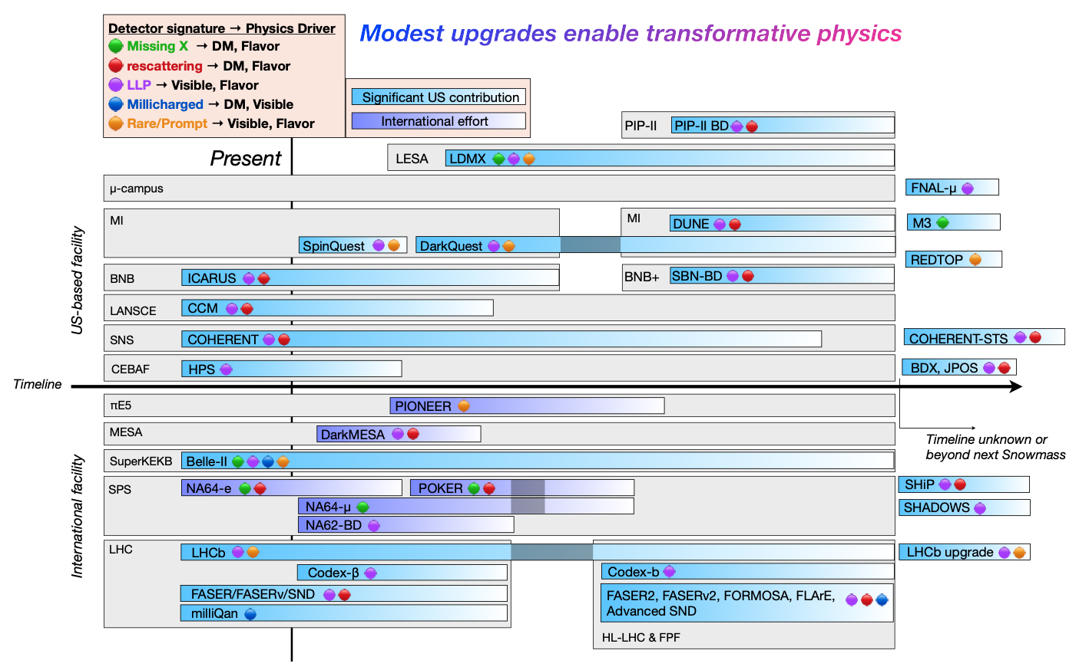
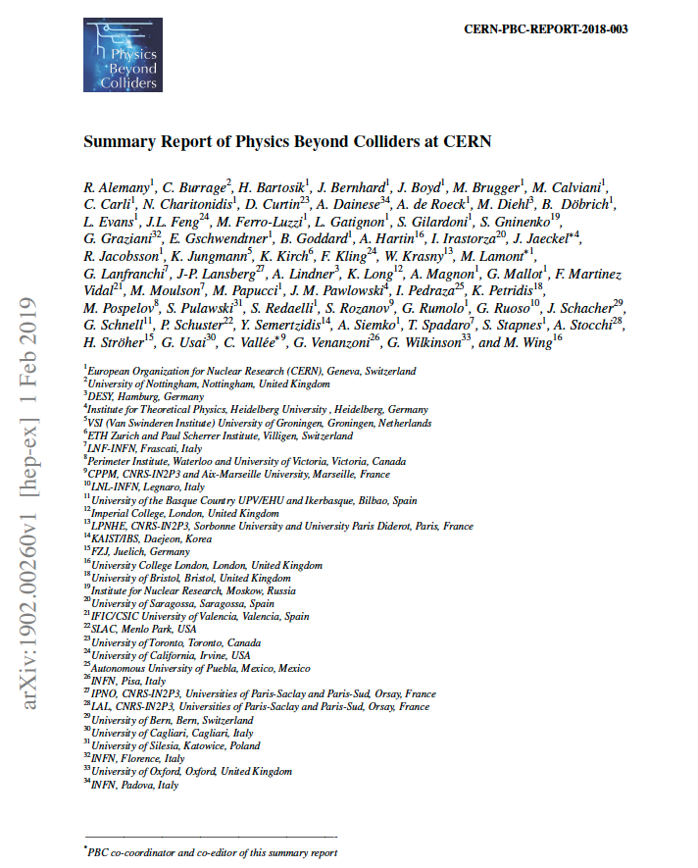
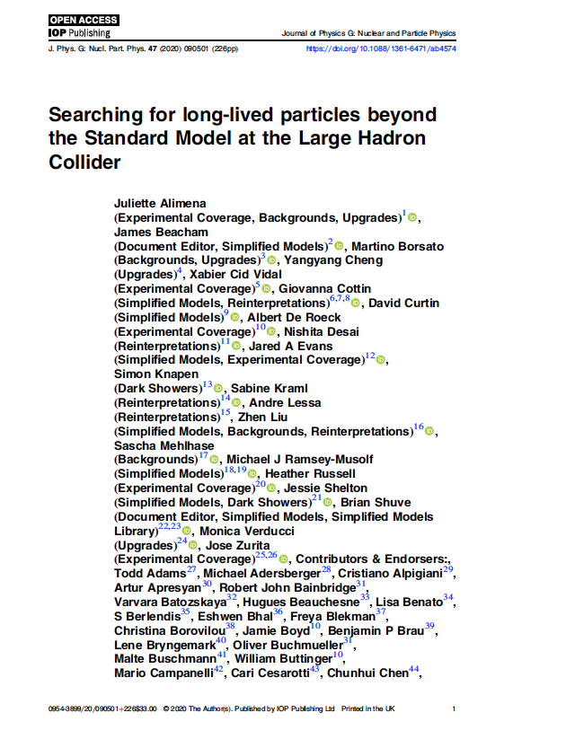
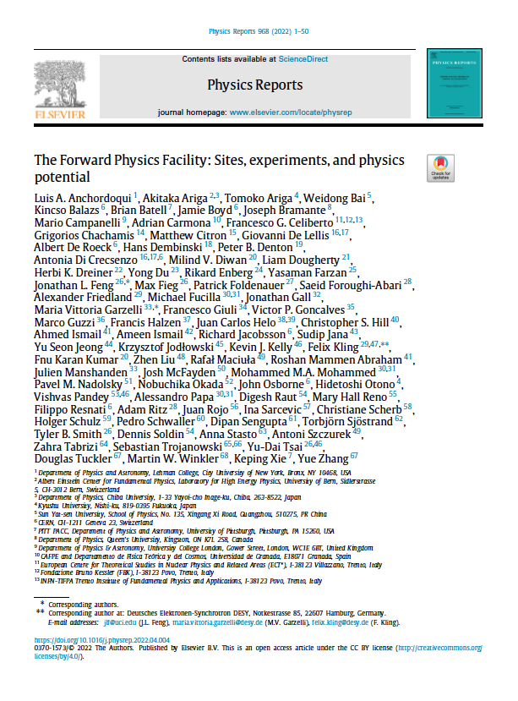
NEW SEARCHES FOR LIGHT PARTICLES
BSM physics has been re-invigorated by new ideas to search for Long-Lived Particles (LLPs), Feebly-Interacting Particles (FIPs), portal particles, dark sectors, …
Ilten, Tran et al. (2206.04220)

Slide 20
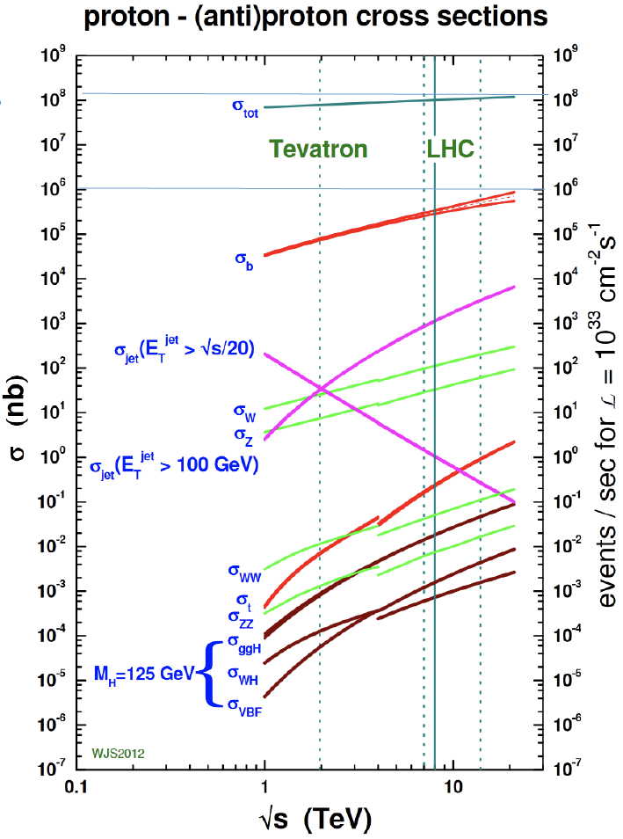
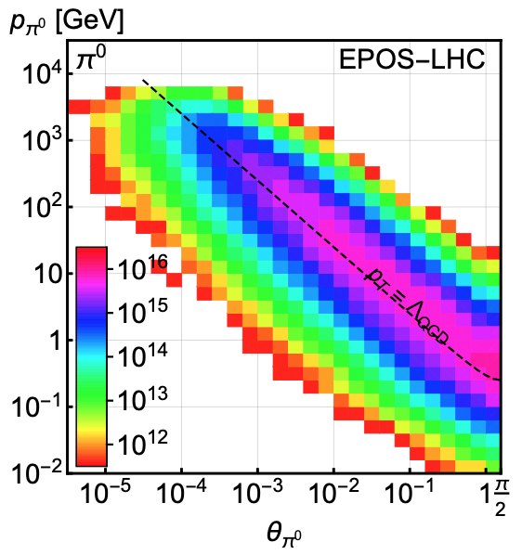
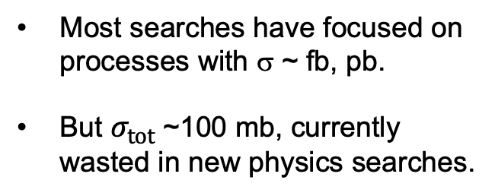
LIGHT PARTICLES AT THE LHC
300 fb⁻¹
Feng, Galon, Kling, Trojanowski (2017)
Most searches have focused on processes with σ ~ fb, pb.
But $σ_{tot}$~100 mb, currently wasted in new physics searches.
What do these events look like? Consider pions.
Enormous event rates. Typical p_{T} ~ 250 MeV, but many with p ~ TeV within 1 mrad (η > 7.6) of the beamline.

Slide 21
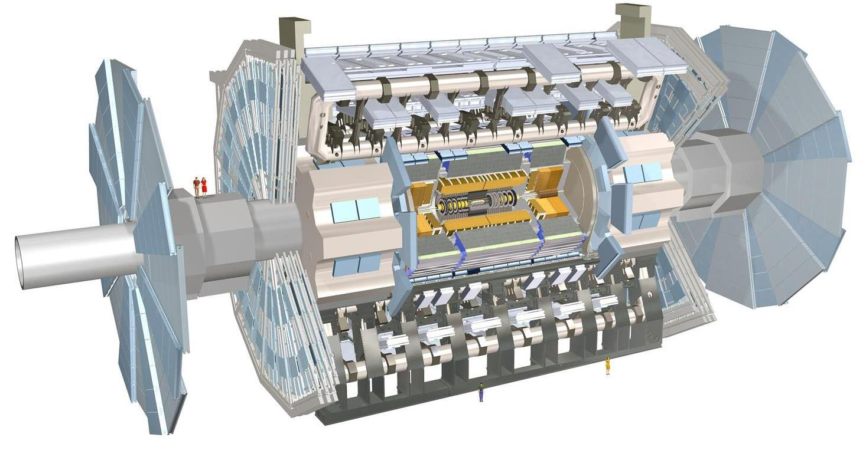
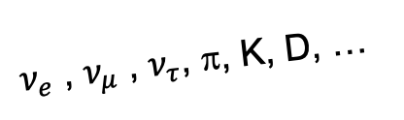
SEARCHES FOR NEW LIGHT PARTICLES
At the LHC, the existing large detectors were designed to find strongly-interacting heavy particles.
Unfortunately, they are also almost perfectly designed to not find weakly-interacting light particles. These are dominantly produced in the rare decays of light particles (π, η, K, D, B, …) along the forward direction, and so the new particles escape through the blind spots down the beamline.
There are both SM and BSM motivations to explore the “wasted” σ_{tot} ~ 100 mb and cover these blind spots in the far forward region.
SUSY, top, Higgs, …
A’, a, mCPs, DM, …
$ν_{e}$ , $ν_{μ}$ , $ν_{τ}$, π, K, D, …

Slide 22
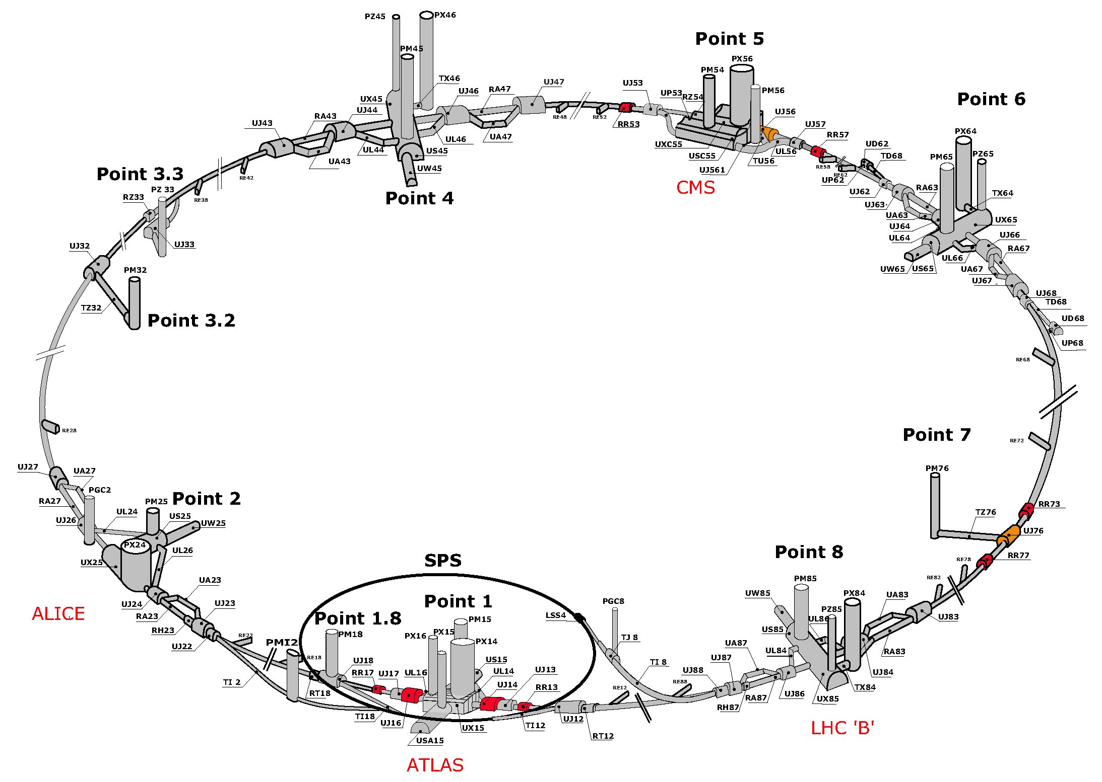
THE BASIC IDEA
We cannot block the beams, but if we go far away, the proton beams are bent by magnets, whereas light, weakly-interacting particles go straight.
$$A^{′}$$
$$A^{′}$$
Feng, Galon, Kling, Trojanowski (2017)
Kling, Trojanowski (2018)
Feng, Galon, Kling, Trojanowski (2018)
!!!

Slide 23
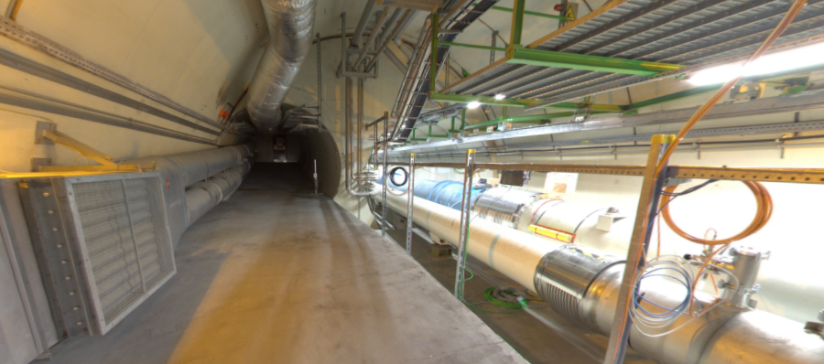


THE FAR-FORWARD REGION
New particle A’ is produced at ATLAS, travels along the beam collision axis and through 100 m of rock, and finally decays in tunnel TI12, 480 m from ATLAS
$π^{0}$→ $γ$A’
→ A’ →
A’ → $e^{+}e^{−}$
TI12 near UJ12
UJ12
The view in UJ12 looking west (2019)
TI12
$$e^{+}$$
$e^{−}$
Beam collision axis
LHC beamline

Slide 24
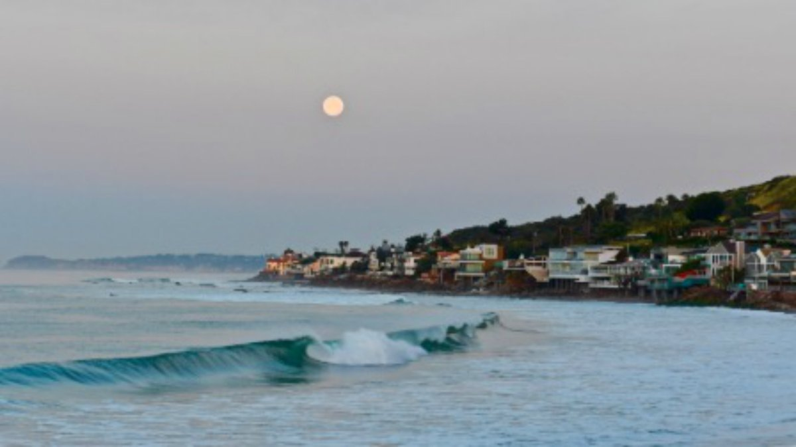
HOW BIG DOES THE DETECTOR HAVE TO BE?
Momentum:
Space:
250 MeV
1 TeV
12 cm
480 m
Particles produced in pion decays have θ ~ 0.2 mrad (η ~ 9); cf. the moon (7 mrad).
Particles produced in π, η, K, D, B decay are therefore far more collimated than shown below, motivating new, small, fast, and cheap experiments at the LHC.

Slide 25
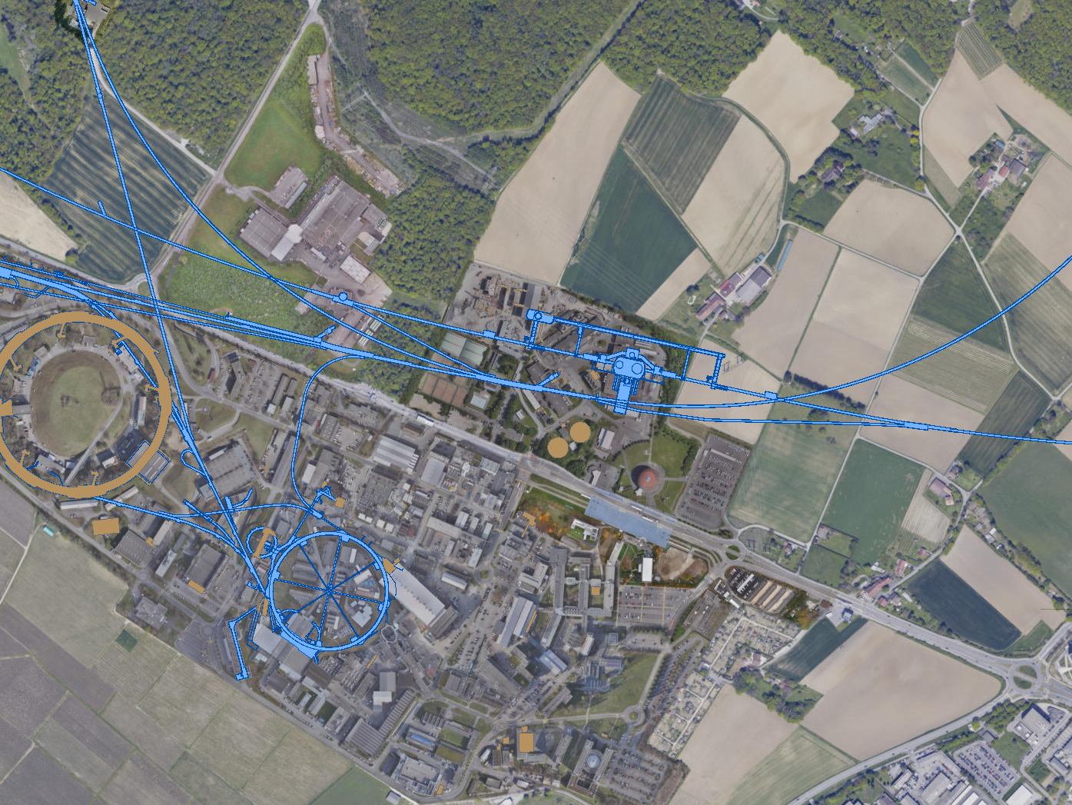
CURRENT FAR FORWARD DETECTORS
3 far forward detectors have been constructed and installed and are currently taking data in LHC Run 3: FASER, FASERν, and SND@LHC.
UJ18
ATLAS
SPS
SND@LHC
UJ12
LHC
FASER
FASERν
LOS
CERN GIS

Slide 26
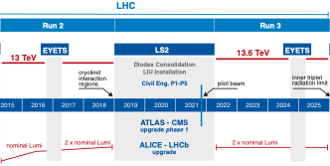
FASER AND FASERν TIMELINE
Spare detector parts from ATLAS and LHCb Collaborations
Funding from Heising-Simons and Simons Foundations
FASER and FASERν begin collecting data in Run 3
FASERν approved as 9th LHC detector by CERN
FASER approved as 8th LHC detector by CERN
Technical Proposal submitted to CERN LHCC
First paper: Feng, Galon, Kling, Trojanowski
FASERν fully constructed and installed
FASER fully constructed and installed
LOI submitted to CERN LHCC

Slide 27
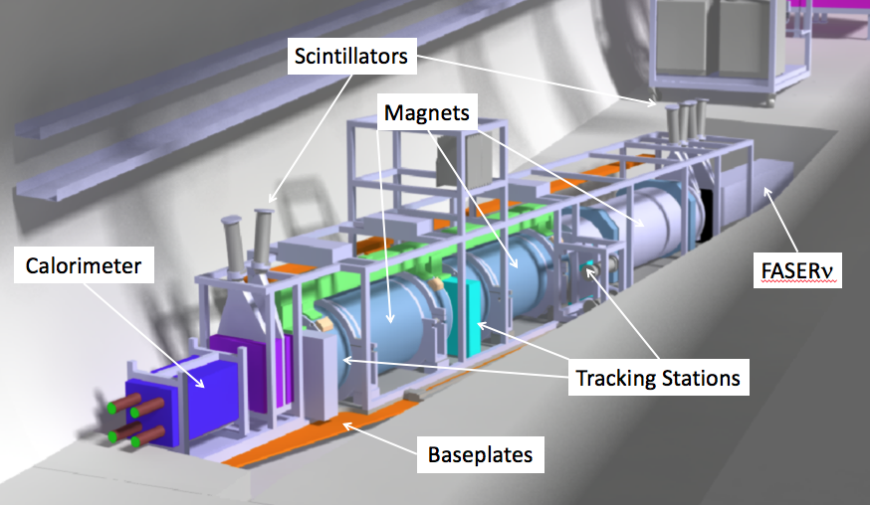
THE FASER DETECTOR
Nothing incoming and 2 ~TeV, opposite-sign charged tracks pointing back to the ATLAS IP: a “light shining through (100 m-thick) wall” experiment.
Scintillators veto incoming charged tracks (muons), magnets split the charged tracks, which are detected by tracking stations and a calorimeter.
LLP
ν
e⁺
e⁻

Slide 28
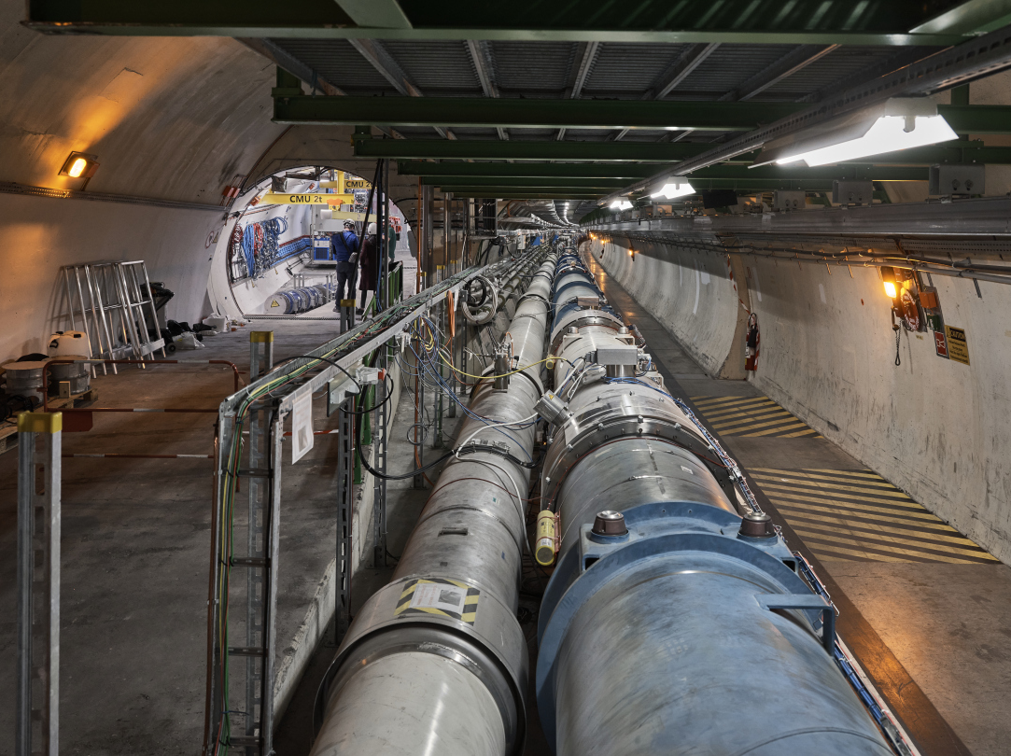
FASER CURRENT STATUS

Slide 29
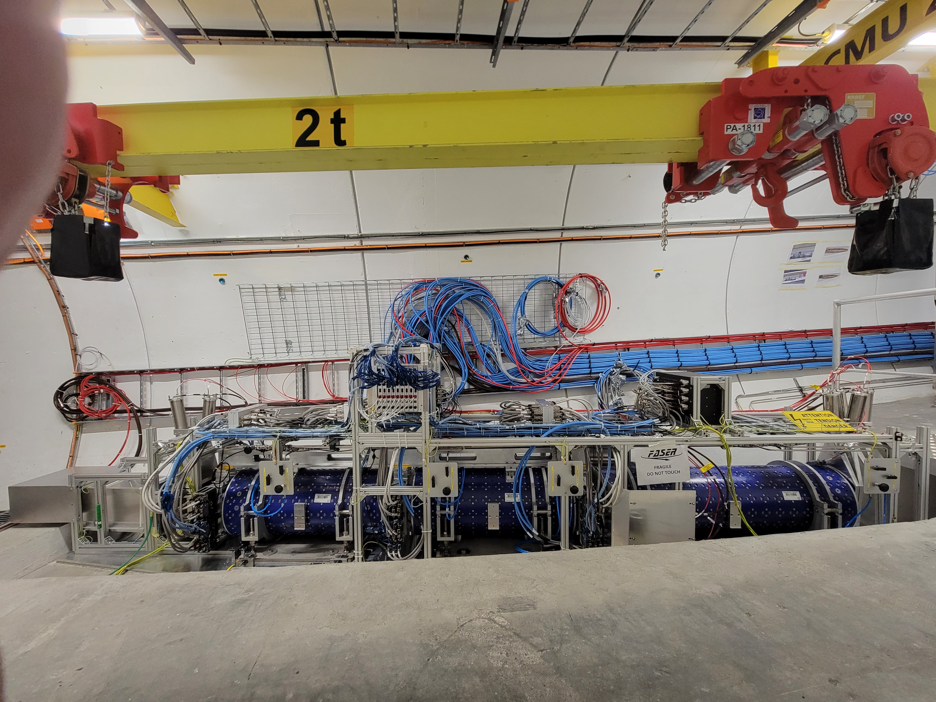
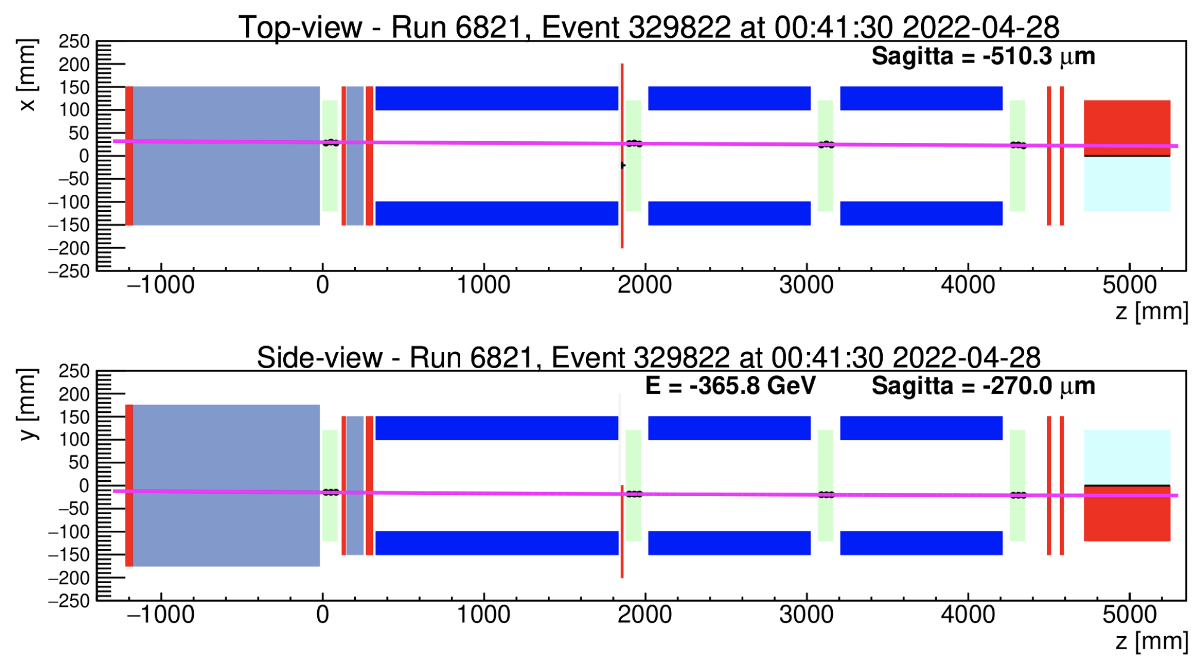
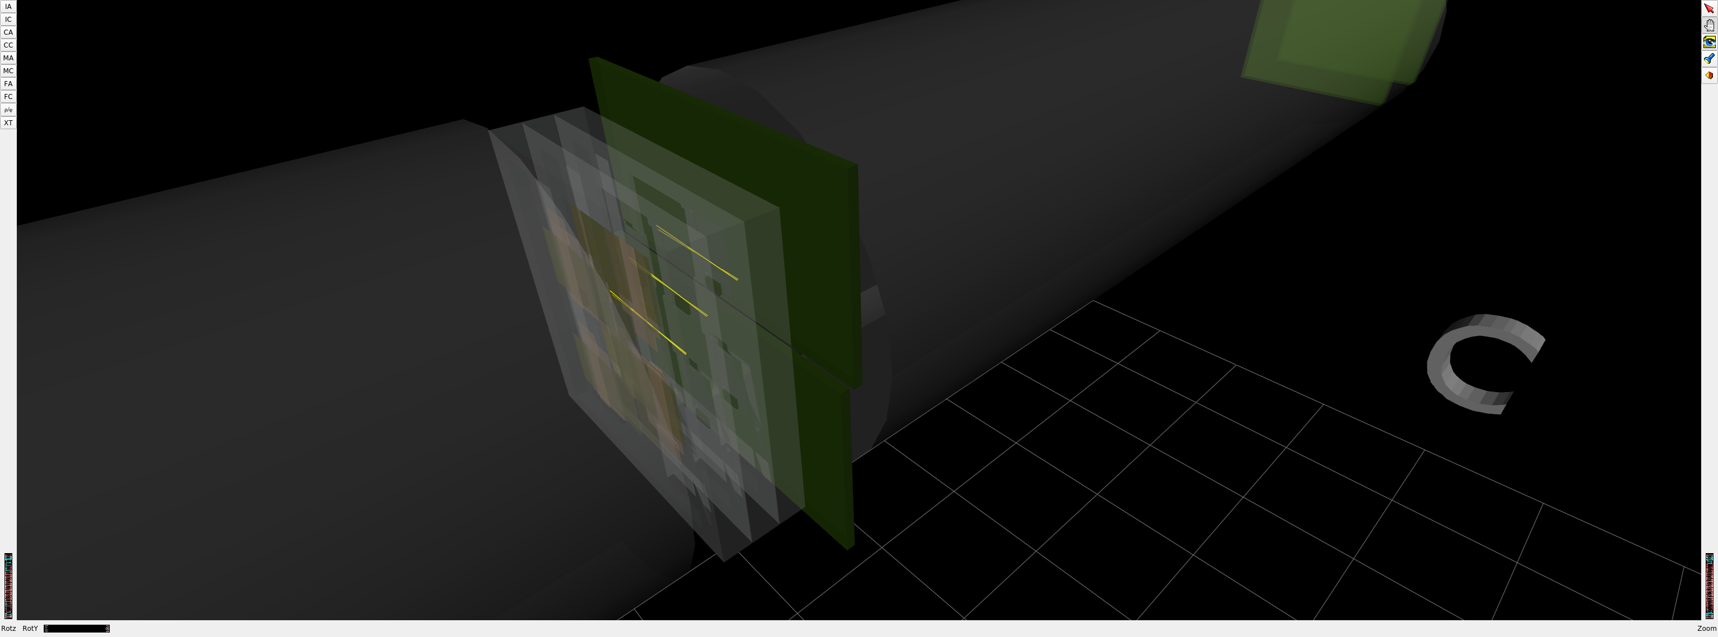
FASER CURRENT STATUS
1st Cosmic Ray
18 March 2021
Beam splash event 28 April 2022

Slide 30
DARK PHOTON SENSITIVITY REACH
FASER
FASER probes new parameter space with just 1 fb⁻¹ starting in July 2022.
In Run 3, will probe the MeV-GeV region favored by thermal relic considerations, muon g-2 explanations, SIDM, ATOMKI anomalies, …
Even without a detector upgrade, the HL-LHC extends (Luminosity*Vol) by factor of 3000 – could detect as many as 10,000 dark photons.
_{FASER Collaboration (2018)}

Slide 31

TARGETS IN DARK PHOTON PARAMETER SPACE
Muon
g-2 Anomaly
⁸Be and ⁴He
ATOMKI
Anomalies
Loop-induced
Coupling
Self-interacting
Dark Matter
FASER probes
an interesting
region, even with
the 1st fb⁻¹
of Run 3 data
Tim Nelson, Snowmass RP6 (2020)

Slide 32

FASERν
In addition to the possibility of hypothetical new light, weakly-interacting particles, there are also known light, weakly-interacting particles: neutrinos.
The high-energy ones, which interact most strongly, are overwhelmingly produced in the far forward direction. Before May 2021, no candidate collider neutrino had ever been detected.
If they can be detected, there is a fascinating new world of LHC neutrinos that can be explored.
  The neutrino energies are ~TeV, highest human-made energies ever.
  All flavors are produced (π $→$ ν_{μ} , K $→$ ν_{e} , D $→$ ν_{τ} ) and both neutrinos and anti-neutrinos.
De Rujula, Ruckl (1984); Winter (1990); Vannucci (1993)

Slide 33



FIRST COLLIDER NEUTRINO CANDIDATES
In 2018 a FASER pilot emulsion detector with 11 kg fiducial mass collected 12.2 fb⁻¹ on the beam collision axis (installed and removed during Technical Stops).
In May 2021, the FASER Collaboration announced the direct detection of 6 candidate neutrinos above 12 expected neutral hadron background events (2.7σ).

Slide 34












LOCATION, LOCATION, LOCATION
…
ALICE
ALEPH
CDF
FASER Pilot Detector
Suitcase-size, 4 weeks
$0 (recycled parts)
6 candidate neutrinos
ATLAS
DELPHI
D0
CMS
L3
LHCb
SLD
OPAL
All previous
collider detectors
Building-size, decades
~$10⁹
0 candidate neutrinos
This opens up a new field: neutrino physics at colliders

Slide 35


Slide 36
FORWARD PHYSICS FACILITY
FASER, FASERν, and SND@LHC are currently highly constrained by 1980’s (LEP!) infrastructure that was never intended to support experiments.
The rich physics program in the far-forward region therefore strongly motivates creating a dedicated Forward Physics Facility to house far-forward experiments for the HL-LHC era from 2029-2040.
FPF Meetings
  FPF Kickoff Meeting, 9-10 Nov 2020, https://indico.cern.ch/event/955956
  FPF2 Meeting, 27-28 May 2021, https://indico.cern.ch/event/1022352
  FPF3 Meeting, 25-26 Oct 2021, https://indico.cern.ch/event/1076733
  FPF4 Meeting, 31 Jan-1 Feb 2022, https://indico.cern.ch/event/1110746
FPF Short Paper: 75 pages, 80 authors completed in Sep 2021 (2109.10905, Physics Reports 968, 1 (2022)).
FPF Snowmass White Paper: Feng, Kling, Reno, Rojo, Soldin et al. A comprehensive, 429-page, 392-author+endorser summary (2203.05090).

Slide 37

THE LOCATION
The CERN civil engineering team has considered many sites around the LHC ring that are on the beam collision axis of an IP.
A preferred location has been identified ~620-680 m west of the ATLAS IP, shielded by ~200 m of rock. The site is on CERN land in France.

Slide 38


CAVERN AND SHAFT
Cavern: 65m long, 8m wide/high. Shaft: 88m-deep, 9.1m-diameter.
The FPF is completely decoupled from the LHC: no need for a safety corridor connecting the FPF to the LHC, preliminary RP and vibration studies indicate that FPF construction will have no significant impact on LHC operation.

Slide 39

SURFACE BUILDINGS
Kincso Balazs,
John Osborne,
CERN CE (2022)

Slide 40


COST AND TIMELINE
Very preliminary (class 4) cost estimate: 23 MCHF (CE) + 15 MCHF (services) $≈$ 40 MCHF (+50%/-30%), not including experiments.
Timeline presented at Chamonix workshop (Jamie Boyd, Feb 2022).
Expect CDRs for FPF and its experiments in the coming 6-12 months.
Begin CE works, installation of services in LS3, followed by installation and commissioning of experiments in early Run 4. Physics begins in Run 4 and continues to the end of the HL-LHC era.

Slide 41

FPF EXPERIMENTS
At present there are 5 experiments being developed for the FPF.
Pseudo-rapidity coverage in the FPF is η > 5.5, with most experiments on the LOS covering η > 7.
Kling (2022)

Slide 42
FPF PHYSICS
The FPF is a general purpose facility with a broad SM and BSM physics program that expands on the physics of FASER and FASERν. Here I will just give a few examples. For more, see the FPF White Paper.

Slide 43

NEUTRINOS
At the FPF, three proposed ~10-ton detectors FASERν2, AdvSND, and FLArE will each detect ~100,000 ν_{e} , ~1,000,000 ν_{μ} , and ~1000 ν_{τ} interactions at TeV energies, providing high statistics samples for all three flavors in an energy range that has never been directly explored.
Will enable precision studies of the tau neutrino.
Can also distinguish neutrinos and anti-neutrinos for muon and tau.
FASER White Paper (2022)

Slide 44

QCD
The FPF will also support a rich program of QCD and hadron structure studies.
Forward neutrino production is a a probe of forward hadron production, BFKL dynamics, intrinsic charm, ultra small x proton structure, with important implications for UHE cosmic ray experiments.
Neutrino interactions will probe DIS at the TeV-scale, constrain proton and nuclear structure, pdfs. Many synergies with the EIC.
FASER White Paper (2022)

Slide 45



QCD
The FPF will probe proton structure at ultra small x ~ 10⁻⁷ (and also high x ~ 1).
In addition to the intrinsic interest in QCD, ultra small-x physics will become more and more important at higher energies, for example, in making precise predictions for $σ(gg→$ $h$) at a 100 TeV pp collider.
FPF White Paper (2022)

Slide 46

SUMMARY
The possibility that new particles may be light and very weakly-interacting opens up new connections between particle physics, cosmology, and nuclear physics.
At the LHC, this has led to new interest in building experiments in the far forward region to catch particles produced along the beamline.
The Forward Physics Facility, proposed for the HL-LHC, will enhance the LHC’s potential for new physics searches, neutrinos physics, and QCD.

