Slide 1



Joint Experimental-Theoretical Physics Seminar
Fermilab
13 May 2022
Jonathan Feng, UC Irvine

Slide 2
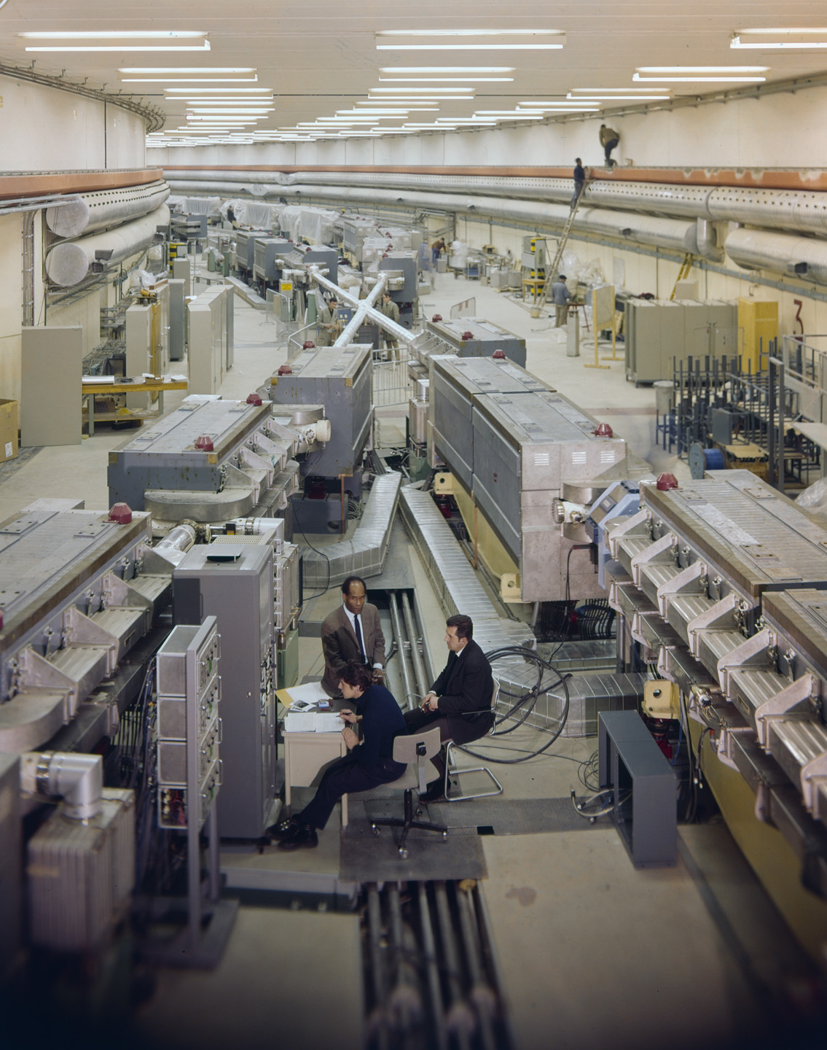
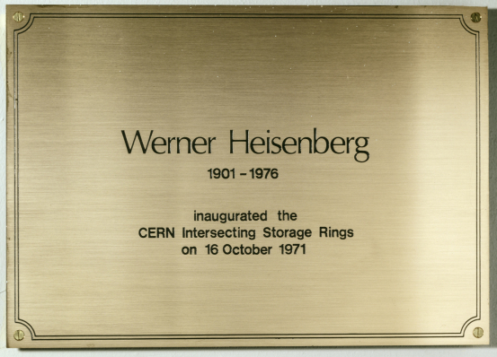
HISTORY
This talk will be very forward looking. But to look forward, let’s first look back.
Last year was the 50th anniversary of the birth of hadron colliders.
In 1971, CERN’s Intersecting Storage Rings (ISR), with a circumference of ~1 km, began colliding protons with protons at the center-of-mass energy of 30 GeV (later raised to 62 GeV).

Slide 3
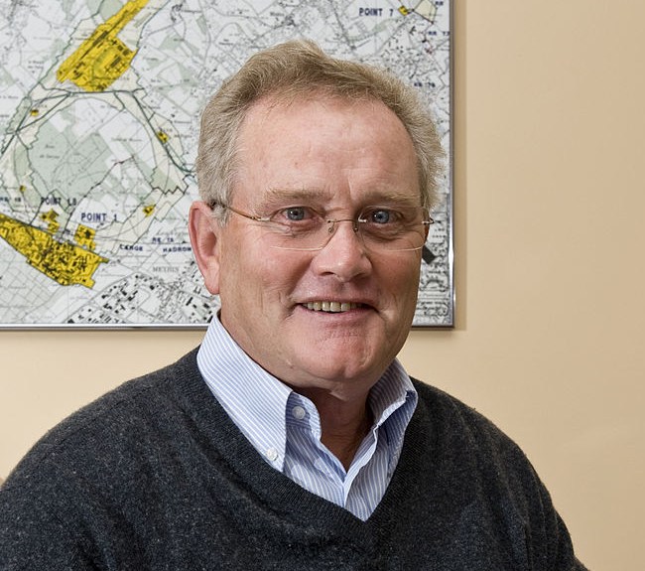
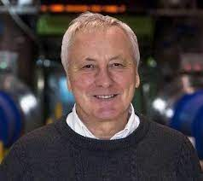
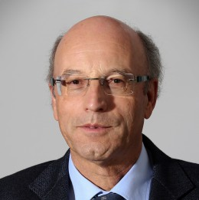
ISR’S LEGACY
50th anniversaries are fascinating. There have been many articles and talks by eminent physicists looking back on the ISR’s legacy.
  “Enormous impact on accelerator physics, but sadly little effect on particle physics.” – Steve Myers, talk at “The 50th Anniversary of Hadron Colliders at CERN,” October 2021.
  “There was initially a broad belief that physics action would be in the forward directions at a hadron collider…. It is easy to say after the fact, still with regrets, that with an earlier availability of more complete… experiments at the ISR, CERN would not have been left as a spectator during the famous November revolution of 1974 with the J/ψ discoveries at Brookhaven and SLAC .” – Lyn Evans and Peter Jenni, “Discovery Machines,” CERN Courier (2021).
An obvious question: Are we making a similar mistake right now at the LHC?

Slide 4

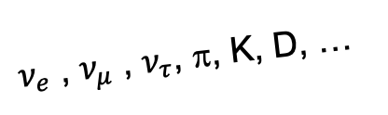
MISSED OPORTUNITIES AT THE LHC
Pop quiz: What process produces the highest energy neutrinos at the LHC?
Answer: It’s not W decays, but pion (and other meson) decays.
In contrast to the ISR days, there is now broad belief that the most interesting physics is at high p_{T} .
But by far the largest fluxes of high-energy light particles (e.g., neutrinos and anti-neutrinos of all flavors, pions, kaons, D mesons, …) are in the far-forward direction.
We are now currently missing a wide variety of SM opportunities to learn about neutrinos, QCD, and astroparticle physics.
We may also be missing BSM opportunities to discover new particles.
$ν_{e}$ , $ν_{μ}$ , $ν_{τ}$, π, K, D, …

Slide 5

NEW PARTICLES
Particle
Colliders
Mass
MeV
GeV
TeV
1
Already
Discovered
Strongly Interacting
Heavy Particles
The WIMP Miracle, which motivates new physics in the upper right corner, is a special case of the WIMPless Miracle, which motivates new physics along the whole diagonal.
Too Little to be
Dark Matter
Interaction Strength
Just Right to
be Dark Matter
10⁻³
Weakly Interacting
Light Particles
Impossible to
Discover
10⁻⁶
Too Much to be
Dark Matter
Feng, Kumar (2008)
Boehm, Fayet (2003)
Pospelov, Ritz, Voloshin (2007)

Slide 6
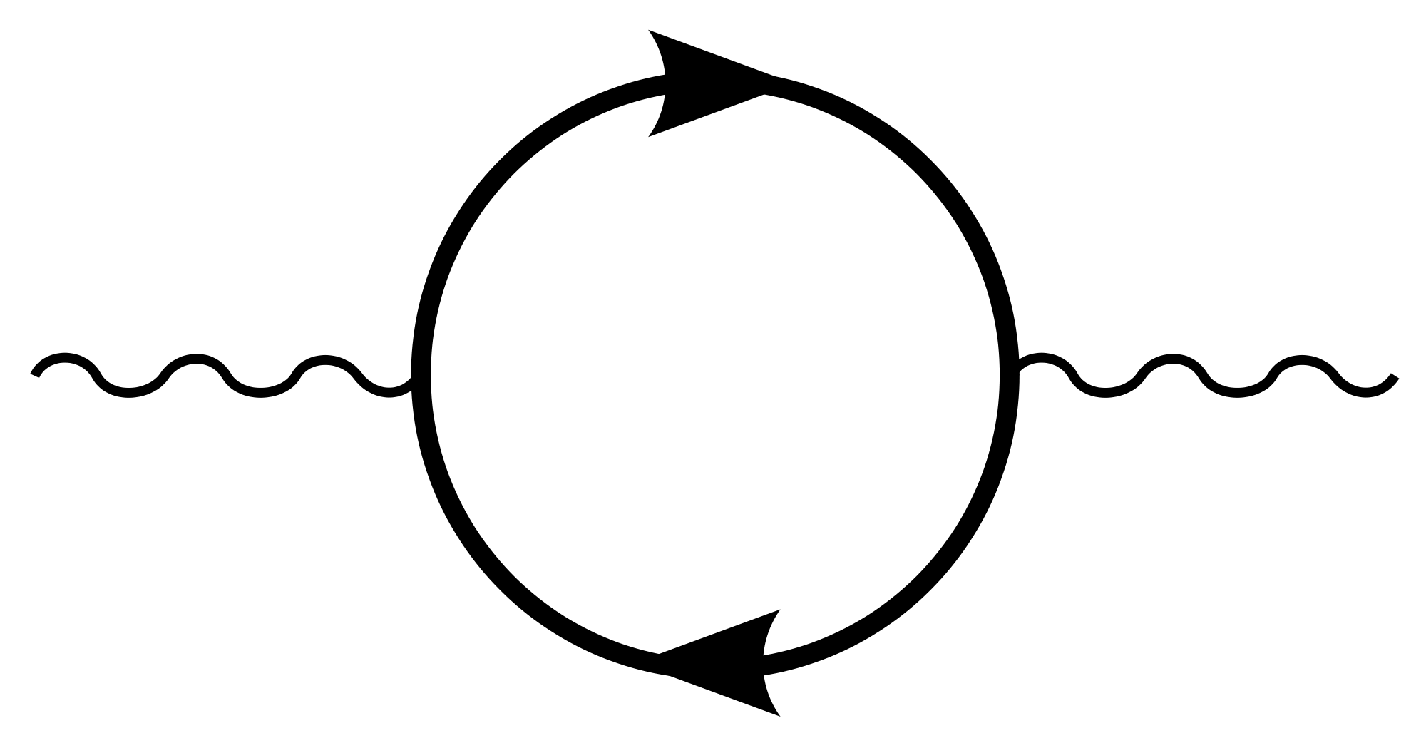
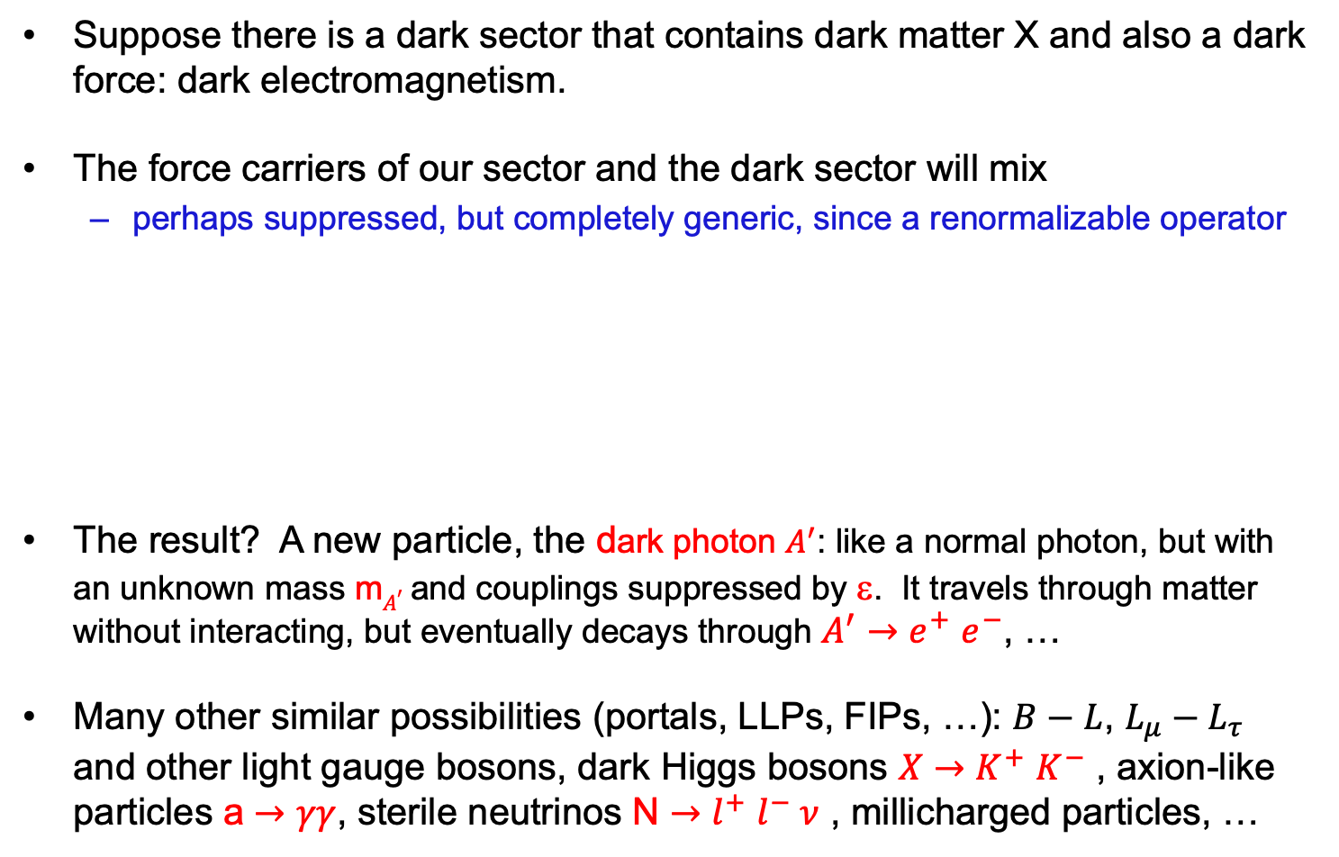

SPECIFIC EXAMPLES
Suppose there is a dark sector that contains dark matter X and also a dark force: dark electromagnetism.
The force carriers of our sector and the dark sector will mix
  perhaps suppressed, but completely generic, since a renormalizable operator
The result? A new particle, the dark photon $A^{′}$: like a normal photon, but with an unknown mass m$A^{′}$ and couplings suppressed by ε. It travels through matter without interacting, but eventually decays through $A^{′}{→e}^{+}e^{−}$, …
Many other similar possibilities (portals, LLPs, FIPs, …): $B−L$, $L_{μ}−L_{τ}$ and other light gauge bosons, dark Higgs bosons $X{→K}^{+}K^{−}$ , axion-like particles a $→γγ$, sterile neutrinos N ${→l}^{+}l^{−} ν$ , millicharged particles, …
SM
EM
Dark Sector
EM, X
A
$$εF_{μν}F_{D}^{μν}$$
A_{D}
Holdom (1986)

Slide 7
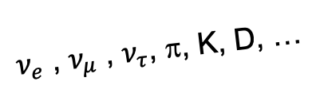
SEARCHES FOR NEW LIGHT PARTICLES
The existing large LHC detectors are beautifully designed to find strongly-interacting heavy particles.
But they are also perfectly designed to not find weakly-interacting light particles. These are dominantly produced in the rare decays of light particles: π, η, K, D and B mesons along the forward direction, and so the new particles escape through the blind spots down the beamline.
There are both SM and BSM motivations to explore the “wasted” σ_{inel} ~ 100 mb and cover these blind spots in the far forward region.
We cannot block the beams, but if we go far away, the proton beams are bent by magnets, whereas light, weakly-interacting particles go straight.
A’, a, mCPs, DM, …
$ν_{e}$ , $ν_{μ}$ , $ν_{τ}$, π, K, D, …

Slide 8
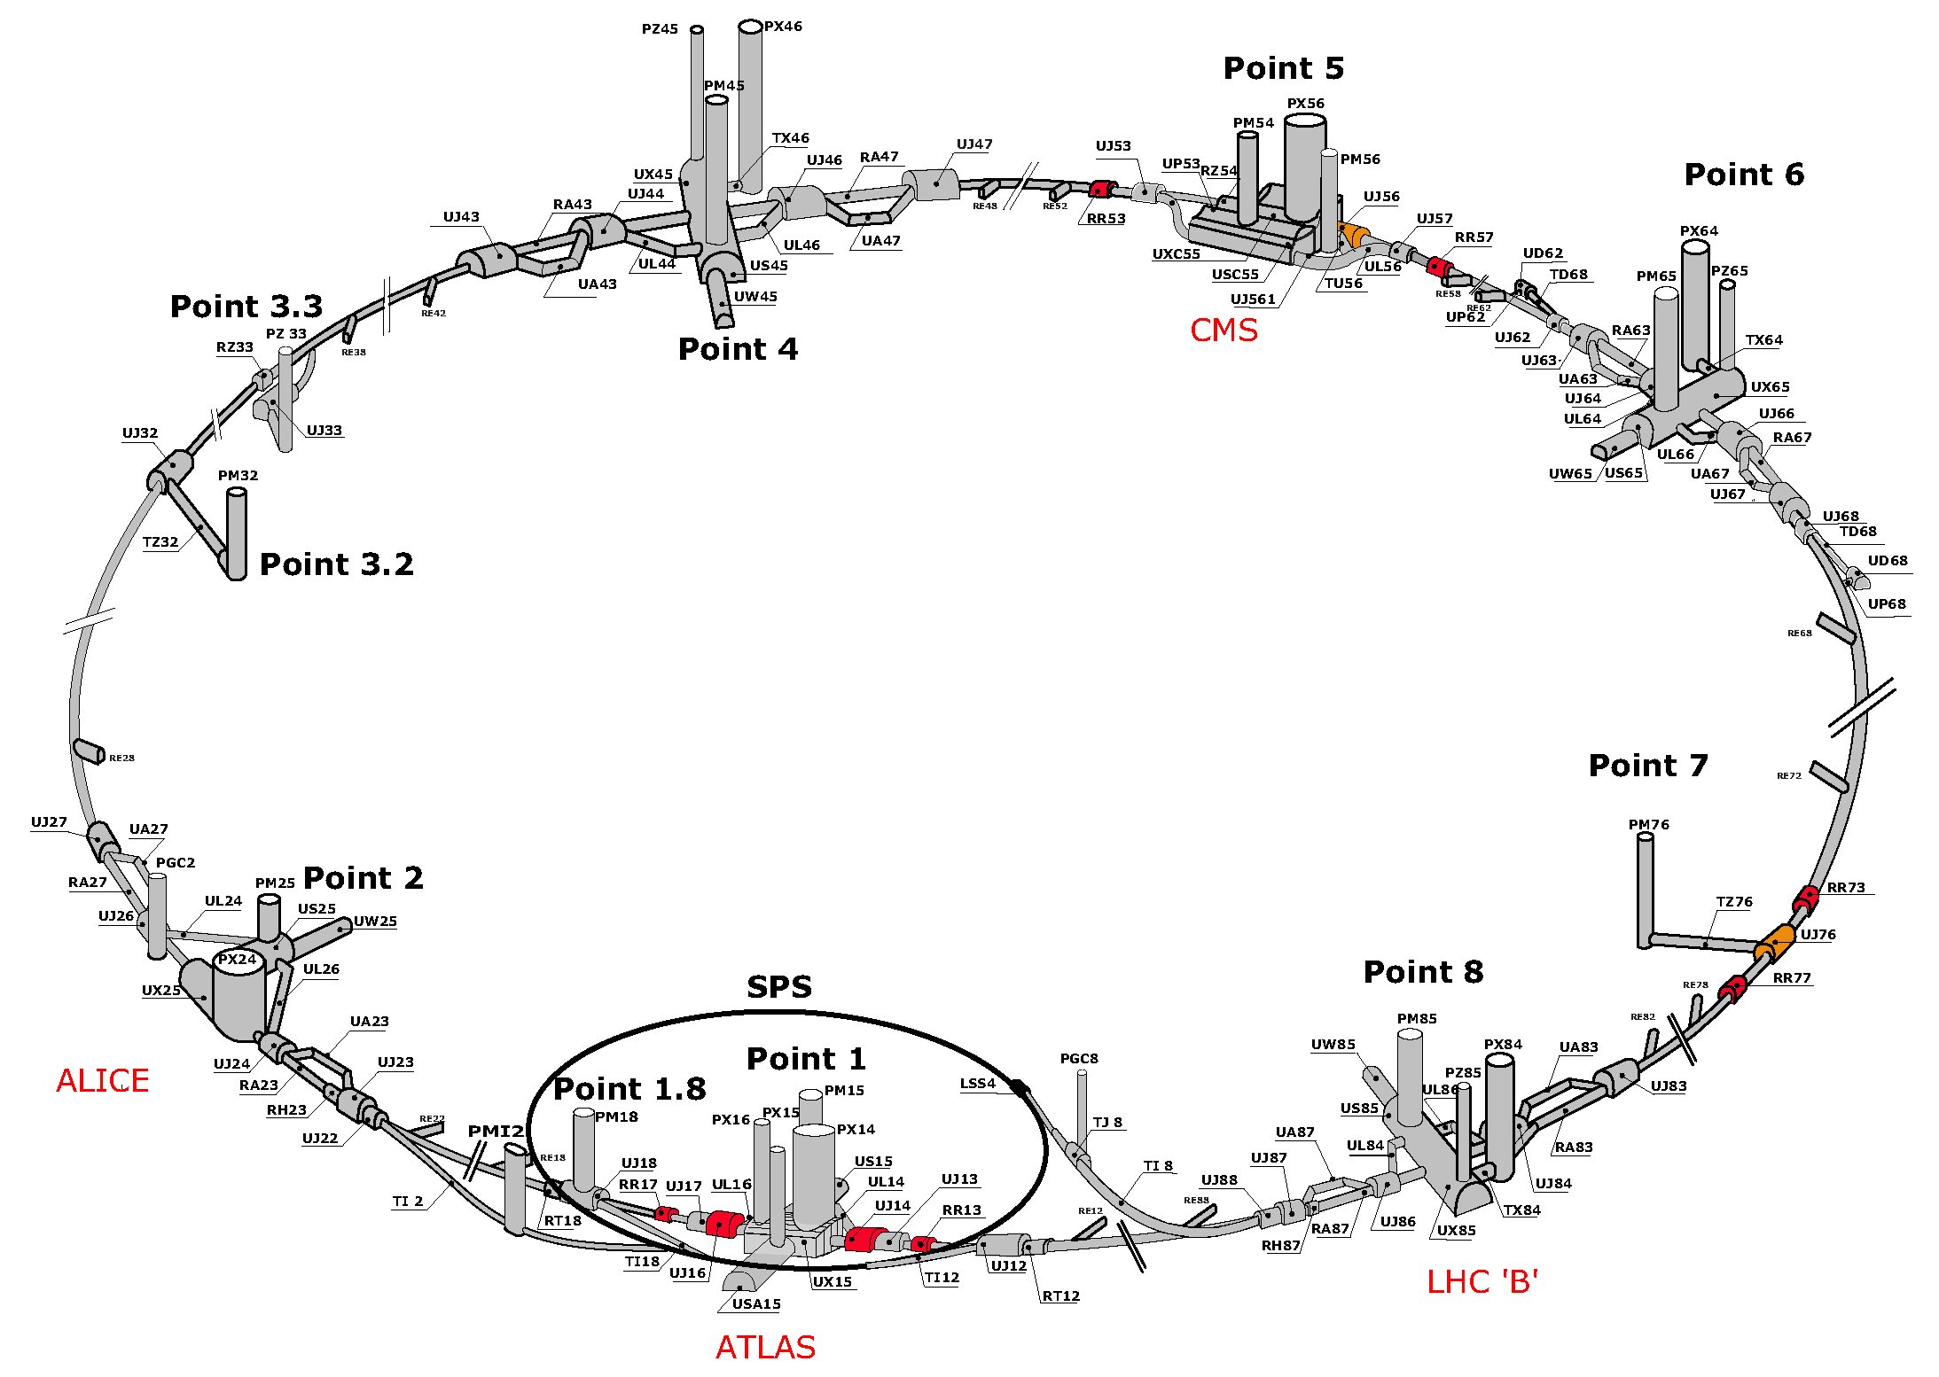
THE BASIC IDEA
Feng, Galon, Kling, Trojanowski (2017)
Kling, Trojanowski (2018)
Feng, Galon, Kling, Trojanowski (2018)
$$A^{′}$$
$$A^{′}$$
!!!

Slide 9
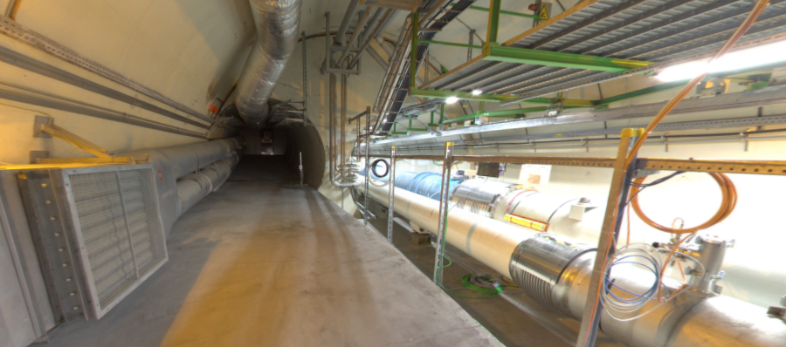


THE FAR-FORWARD REGION
New particle A’ is produced at ATLAS, travels along the beam collision axis and through 100 m of rock, and finally decays in tunnel TI12, 480 m from ATLAS
$π^{0}$→ $γ$A’
→ A’ →
A’ → $e^{+}e^{−}$
TI12 near UJ12
UJ12
The view in UJ12 looking west (2019)
TI12
$$e^{+}$$
$e^{−}$
Beam collision axis
LHC beamline

Slide 10
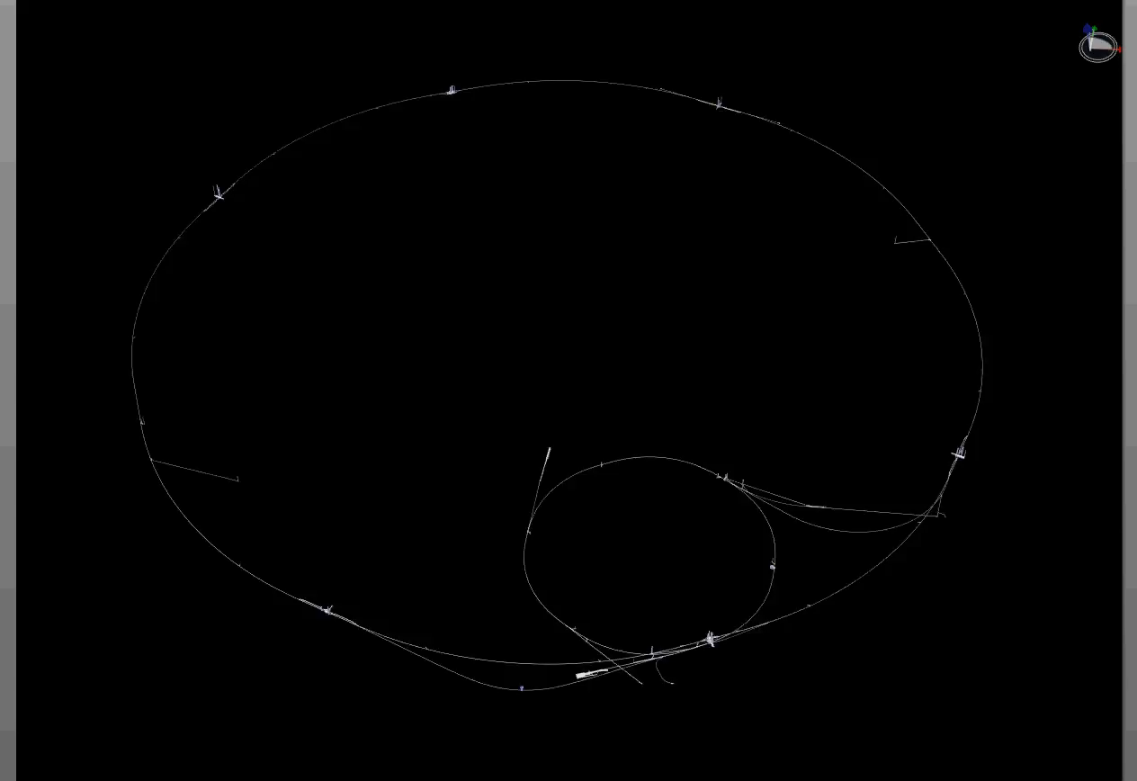
PARTICLE PATH FROM ATLAS TO TI12
Dougherty, CERN Integration (2019)

Slide 11
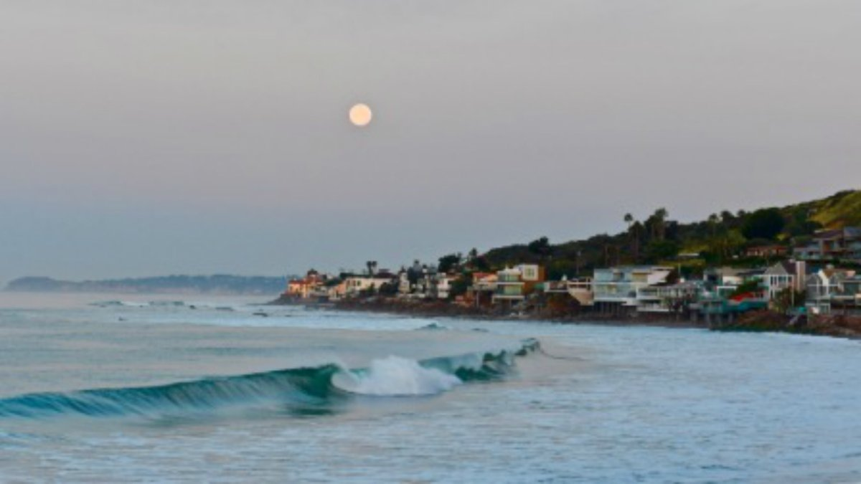
HOW BIG DOES THE DETECTOR HAVE TO BE?
Momentum:
Space:
250 MeV
1 TeV
12 cm
480 m
From pion decays, the opening angle is 0.2 mrad (η ~ 9); cf. the moon (7 mrad).
TeV dark photons (or any other new particles produced in π, η, K, D, B decay) are far more collimated than shown below, motivating a new, small, fast, cheap experiment at the LHC.

Slide 12


Slide 13
FASER TIMELINE
September 2017: Initial proposal
July 2018: LOI submitted to the CERN LHCC
October 2018: Approval from ATLAS SCT and LHCb Collaborations for use of spare detector modules
November 2018: Technical Proposal submitted to the LHCC
November 2018 – January 2019: Experiment funded by the Heising-Simons and Simons Foundations
March 2019: FASER approved as 8th LHC detector by CERN
December 2019: FASERν approved as 9th LHC detector by CERN
March 2021: FASER fully installed, commissioning of the detector begins
May 2021: FASERν finds first candidate collider neutrinos
April 2022: FASER and FASERν begin collecting data in Run 3

Slide 14
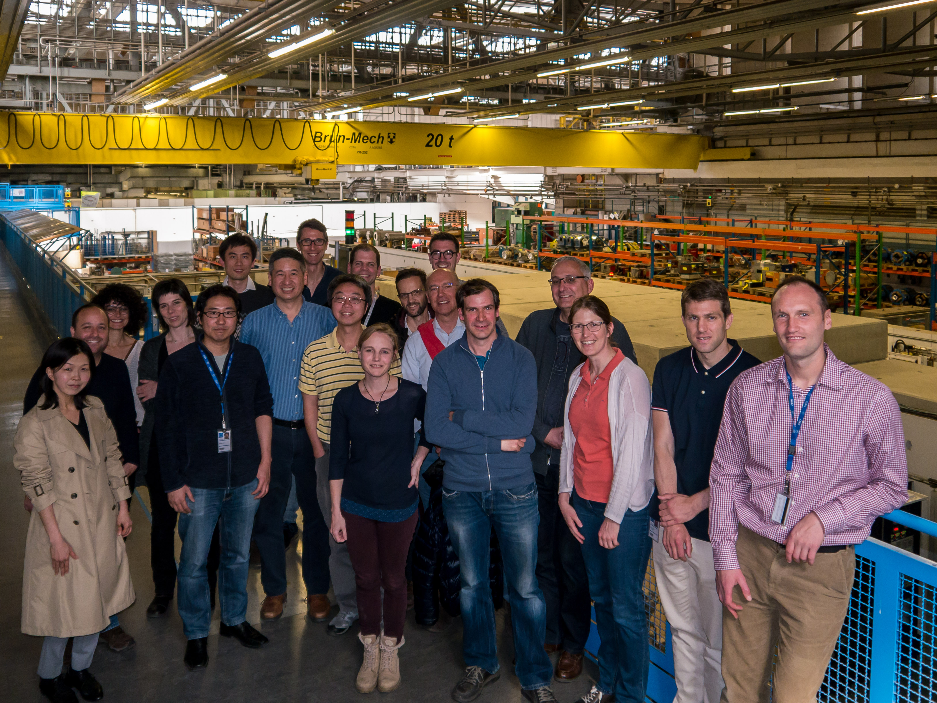
FIRST FASER COLLABORATION MEETING

Slide 15











FASER COLLABORATION TODAY
75 collaborators, 22 institutions, 9 countries

Slide 16
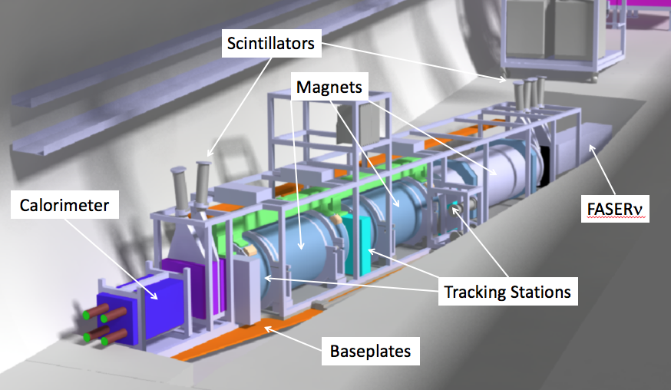
THE FASER DETECTOR
Nothing incoming and 2 ~TeV, opposite-sign charged tracks pointing back to the ATLAS IP: a “light shining through (100 m-thick) wall” experiment.
Scintillators veto incoming charged tracks (muons), magnets split the charged tracks, which are detected by tracking stations and a calorimeter.
LLP
ν
e⁺
e⁻

Slide 17
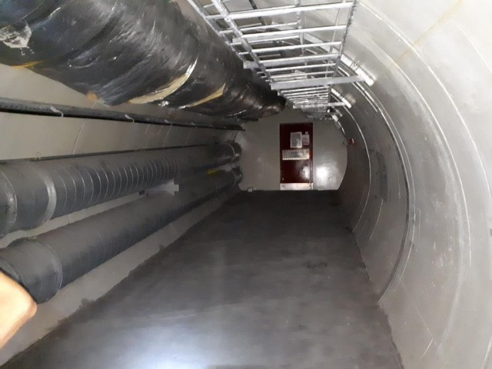
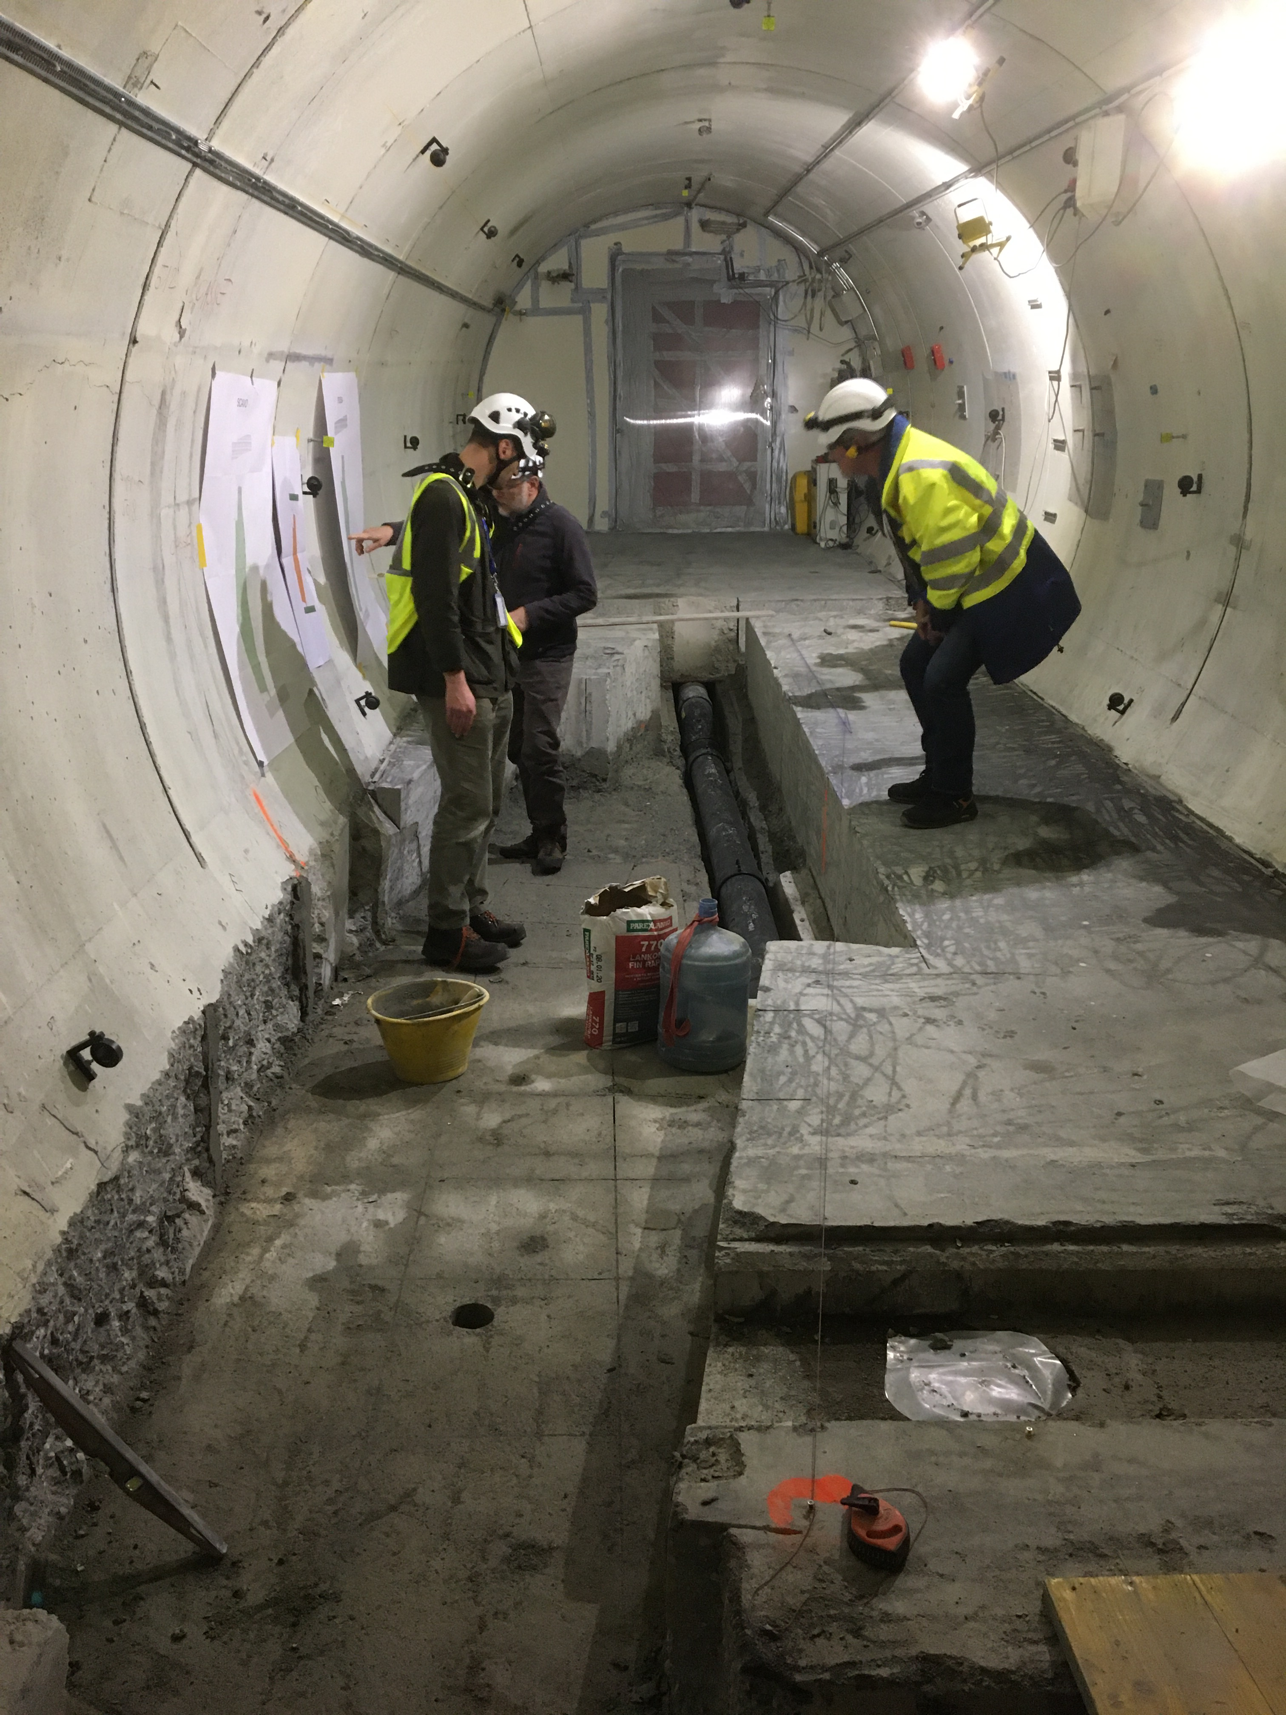
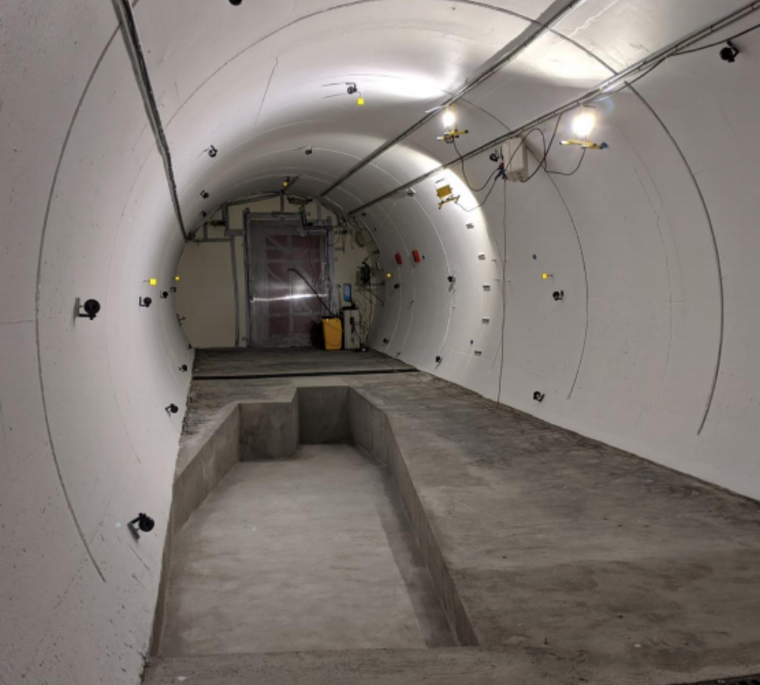
FASER IN TUNNEL TI12
The beam collision axis was located to mm accuracy by the CERN survey department. To place FASER on this axis, a trench was required to lower the floor by 46 cm.
The trench was completed by an Italian firm just hours before COVID shut down CERN in Spring 2020.
2019
Spring 2020
Summer 2020

Slide 18
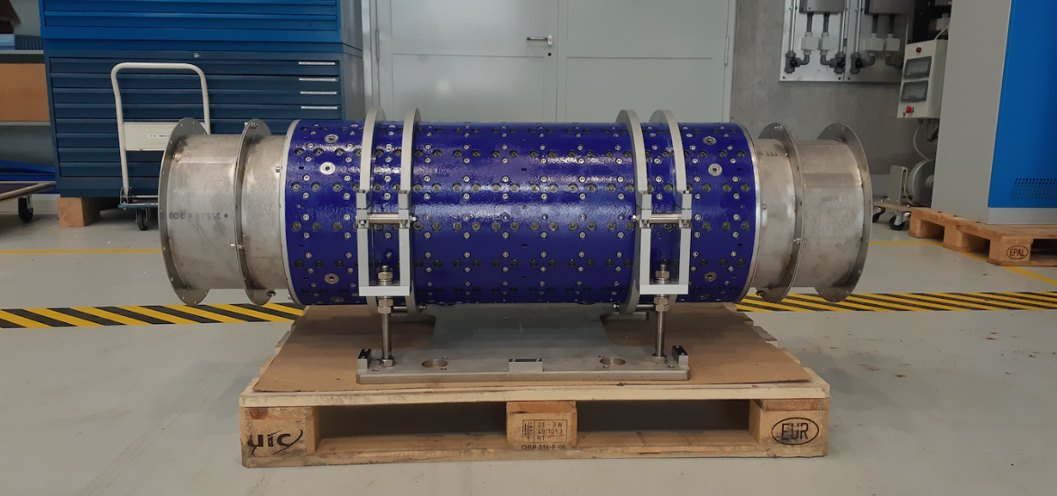
MAGNETS
FASER includes 3 magnets: 1.5 m, 1 m, and 1m long.
0.57 T permanent dipoles with an inner diameter of 20 cm, require little maintenance.
Constructed by the CERN magnet group.

Slide 19
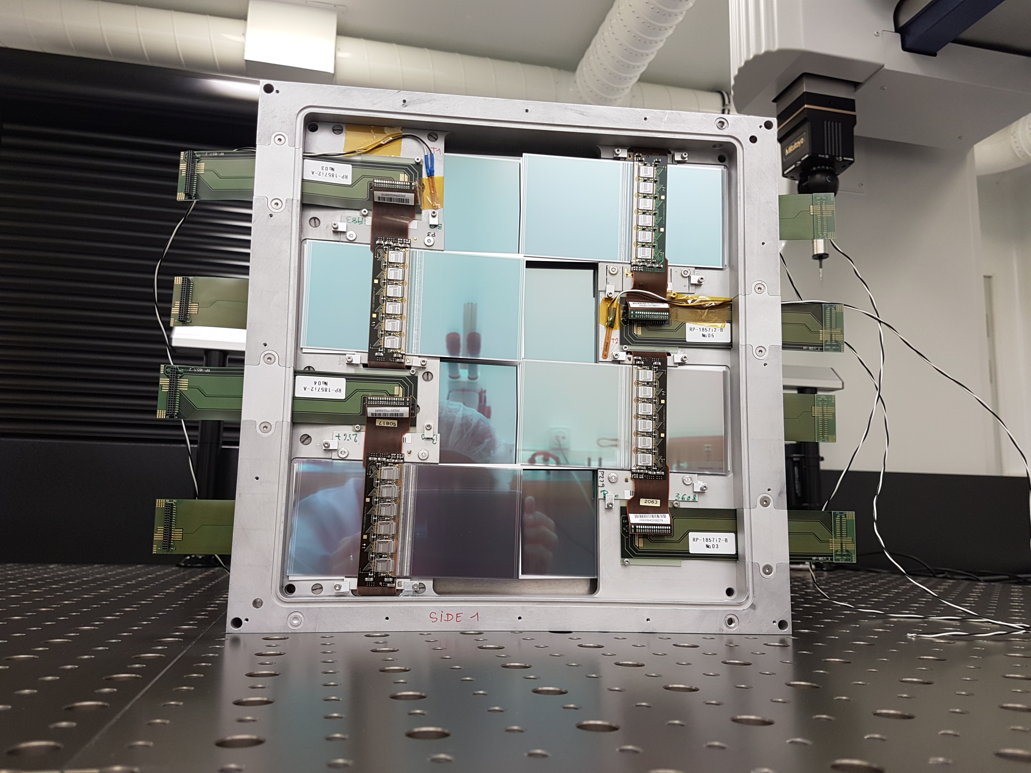
TRACKERS
ATLAS tracker consists of ~3000 SCT modules.
~300 spares were never used. ~100 of these were generously donated to FASER: 8 modules x 3 tracking planes x 4 tracking stations at FASER.

Slide 20
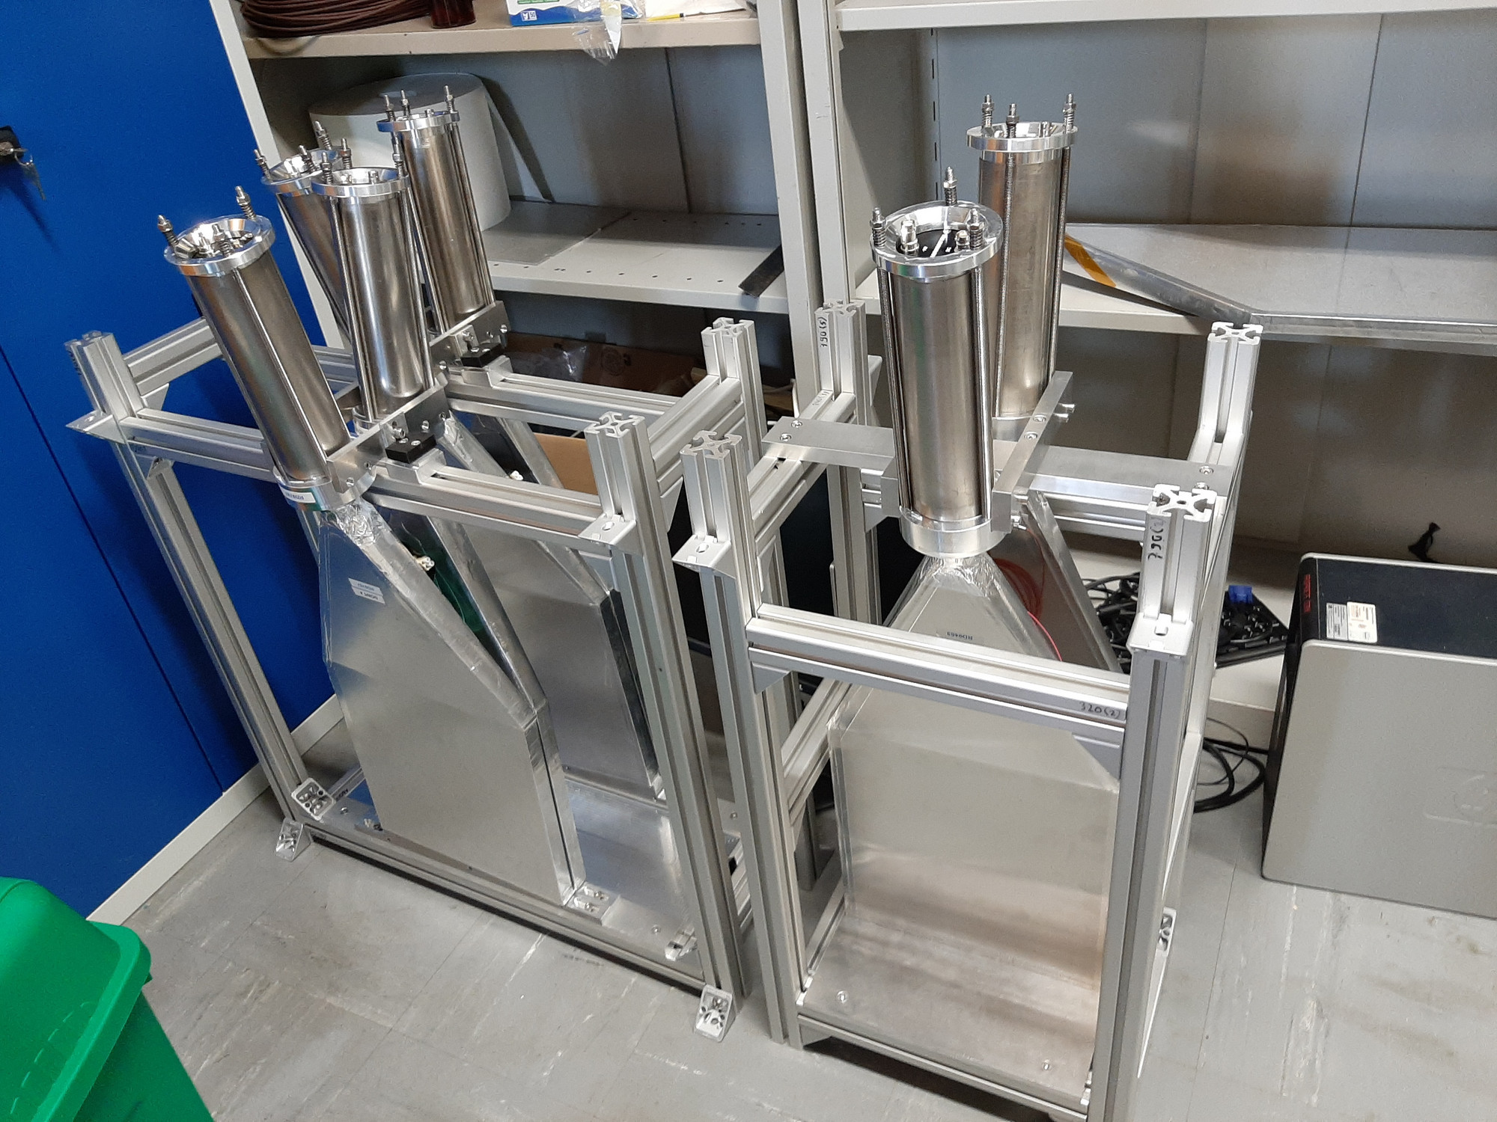
SCINTILLATORS
4 veto scintillators, each 2cm x 30cm x 30cm, upstream of the detector. Efficiency of each one is > 99.99%, makes muon background negligible.
Additional beam backgrounds, simulated with FLUKA and validated with pilot detectors in 2018, are also expected to be negligible.

Slide 21
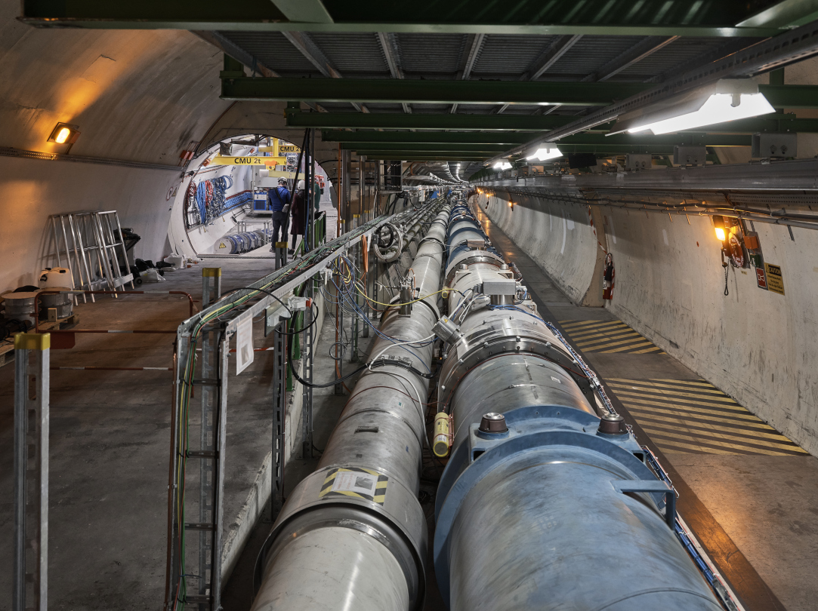
FASER CURRENT STATUS

Slide 22
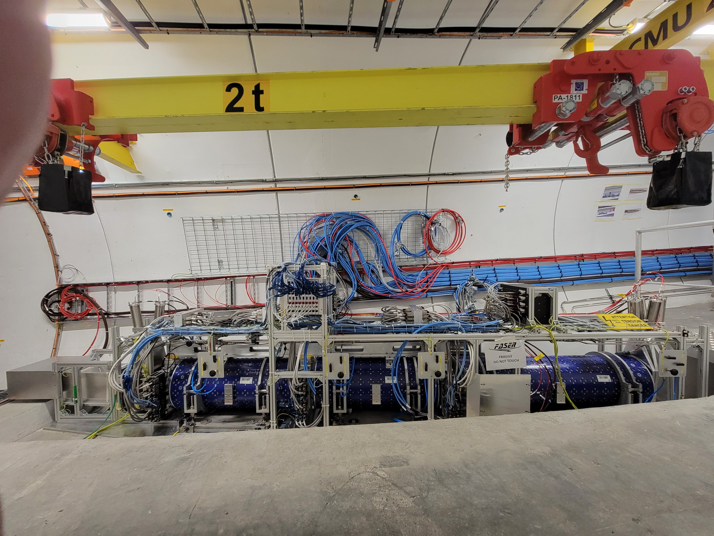
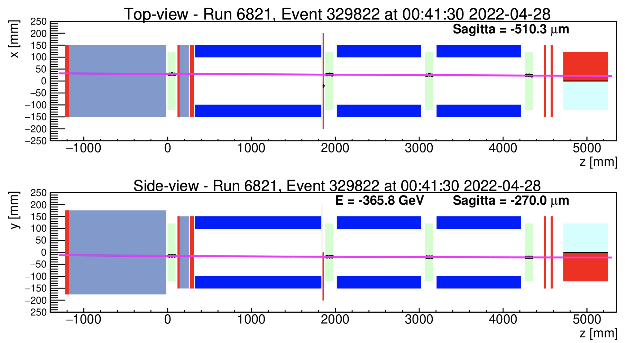
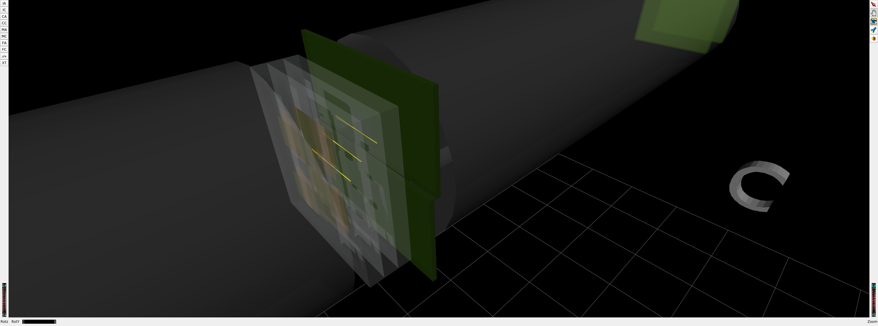
FASER CURRENT STATUS
1st Cosmic Ray
18 March 2021
Beam splash event 28 April 2022

Slide 23
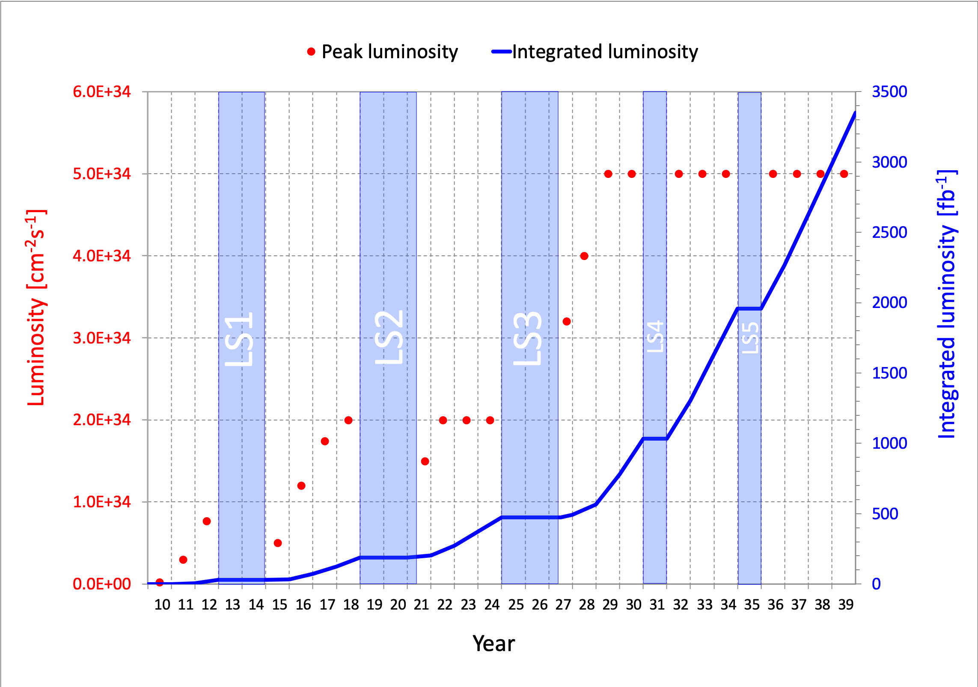
DARK PHOTON SENSITIVITY REACH
FASER
In the coming years, many current and proposed experiments will probe the MeV-GeV region favored by WIMPless miracle considerations, muon g-2 explanations, self-interacting DM, ATOMKI anomalies, …
FASER probes new parameter space with just 1 fb⁻¹ starting in July 2022.
Even without a detector upgrade, the HL-LHC extends (Luminosity*Vol) by factor of 3000 – could detect as many as 10,000 dark photons.
_{FASER Collaboration (2018)}

Slide 24

ν

Slide 25
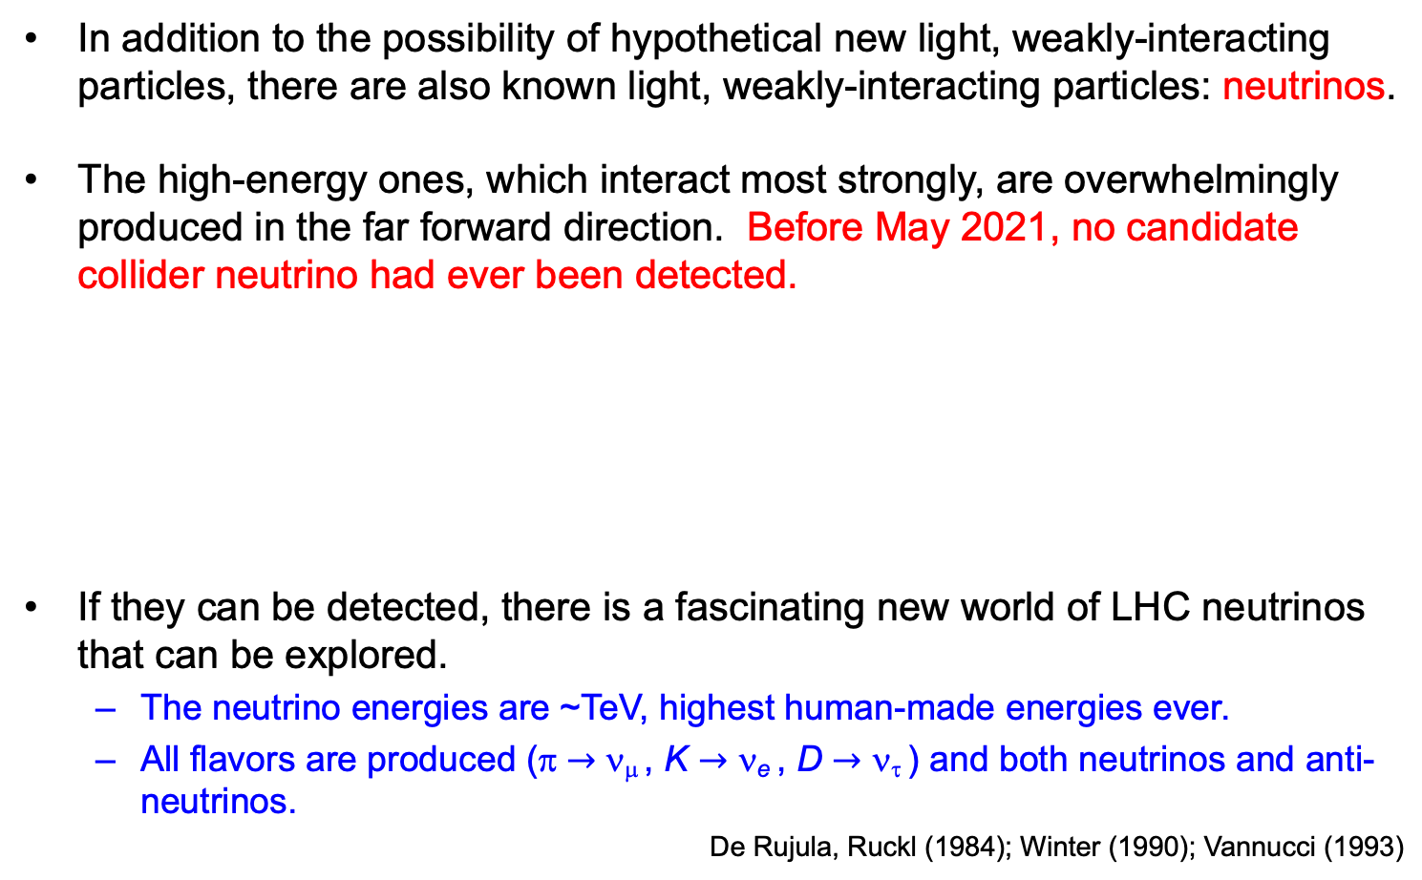
COLLIDER NEUTRINOS
In addition to the possibility of hypothetical new light, weakly-interacting particles, there are also known light, weakly-interacting particles: neutrinos.
The high-energy ones, which interact most strongly, are overwhelmingly produced in the far forward direction. Before May 2021, no candidate collider neutrino had ever been detected.
If they can be detected, there is a fascinating new world of LHC neutrinos that can be explored.
  The neutrino energies are ~TeV, highest human-made energies ever.
  All flavors are produced (π $→$ ν_{μ} , K $→$ ν_{e} , D $→$ ν_{τ} ) and both neutrinos and anti-neutrinos.
De Rujula, Ruckl (1984); Winter (1990); Vannucci (1993)

Slide 26
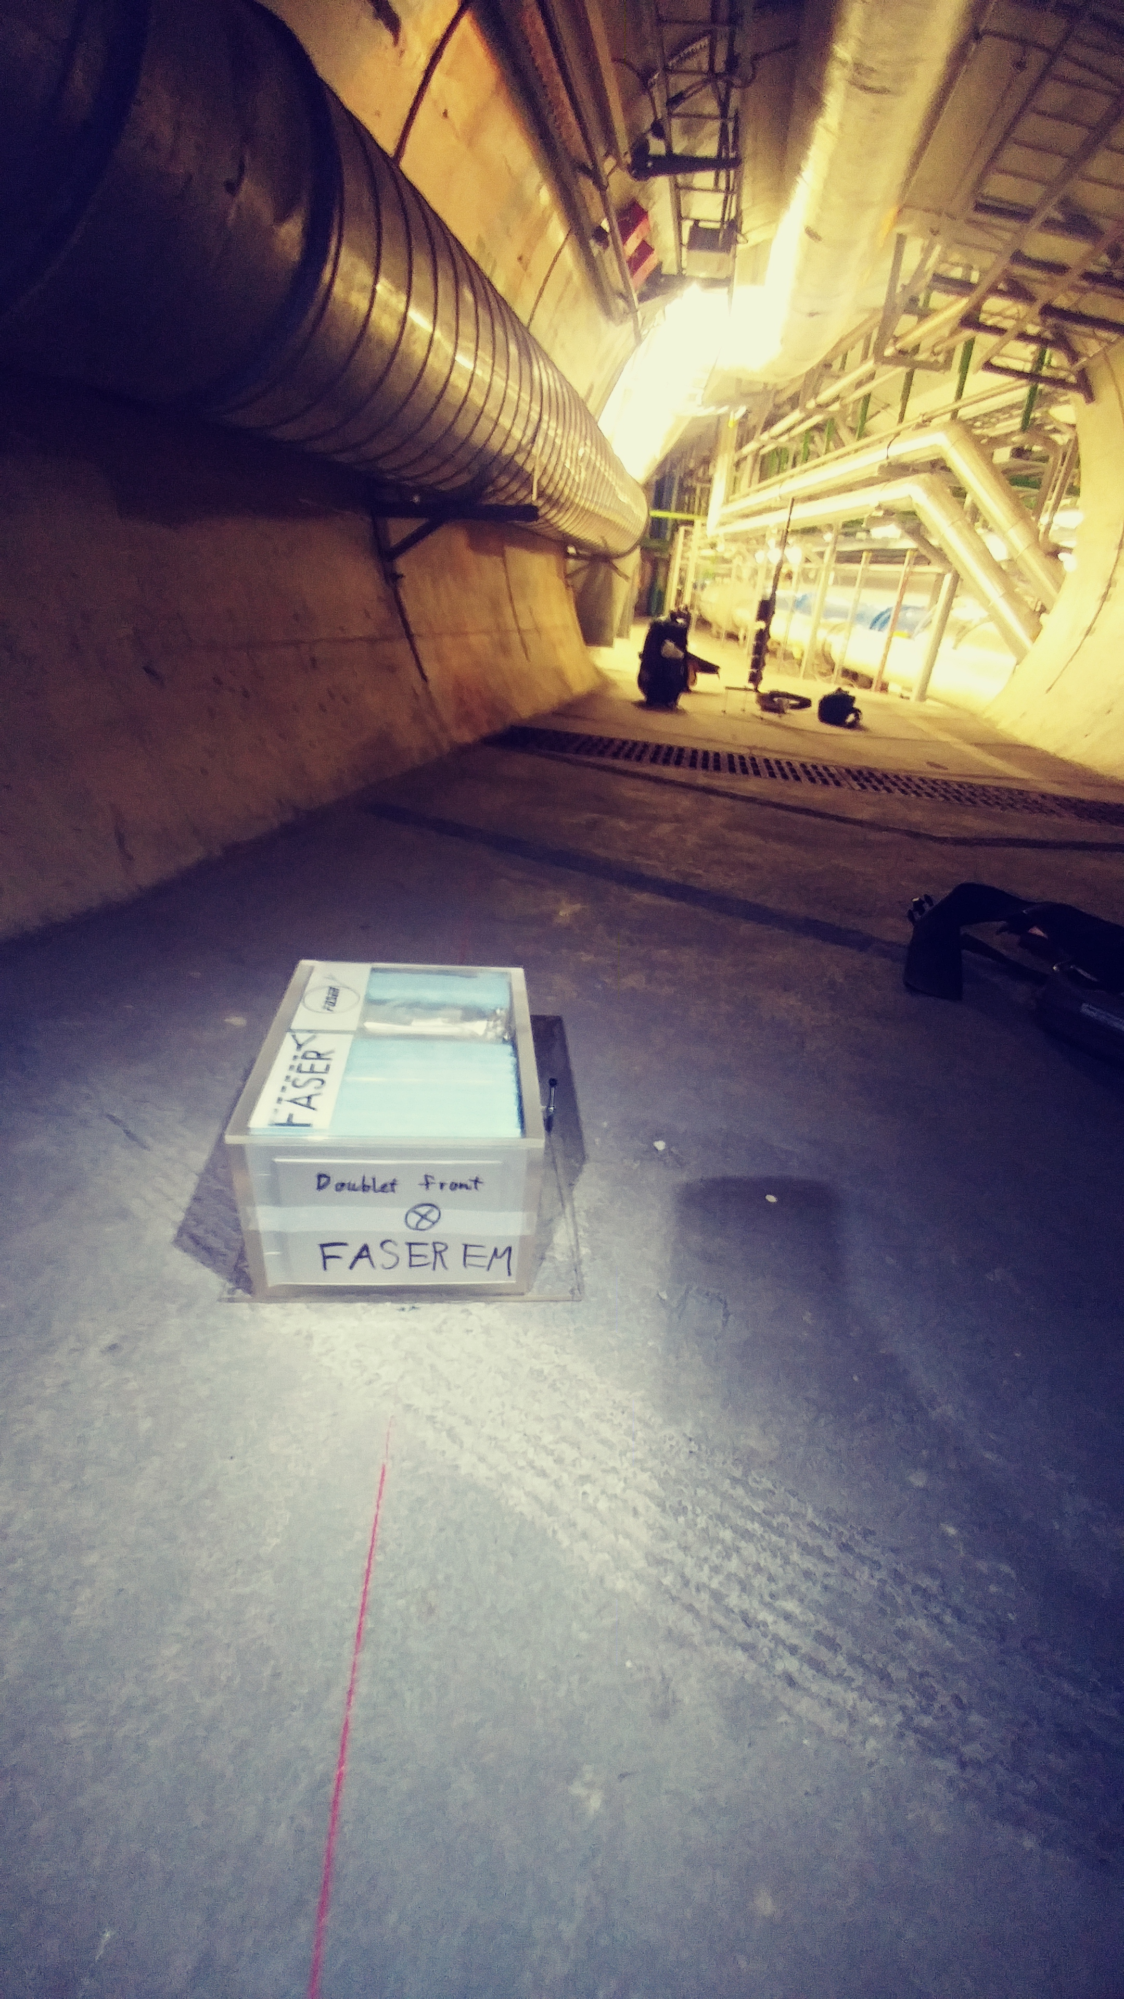
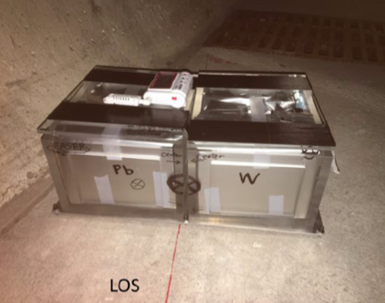
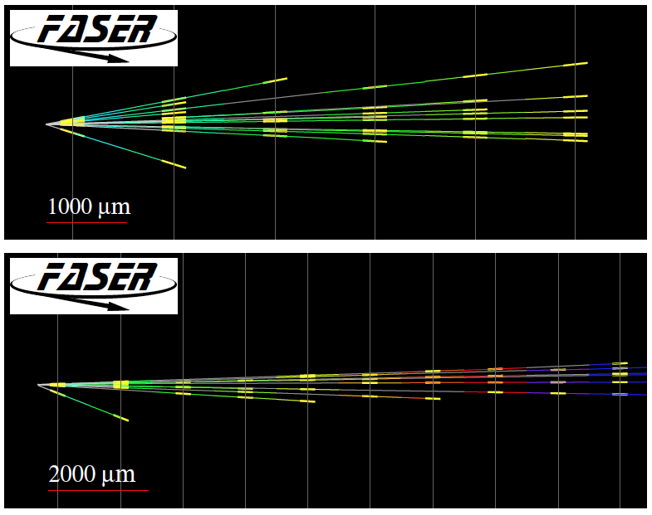
FIRST COLLIDER NEUTRINOS
In 2018 a FASER pilot emulsion detector with 11 kg fiducial mass collected 12.2 fb⁻¹ on the beam collision axis (installed and removed during Technical Stops).
In May 2021, the FASER Collaboration announced the direct detection of 6 candidate neutrinos above 12 expected neutral hadron background events (2.7σ).

Slide 27
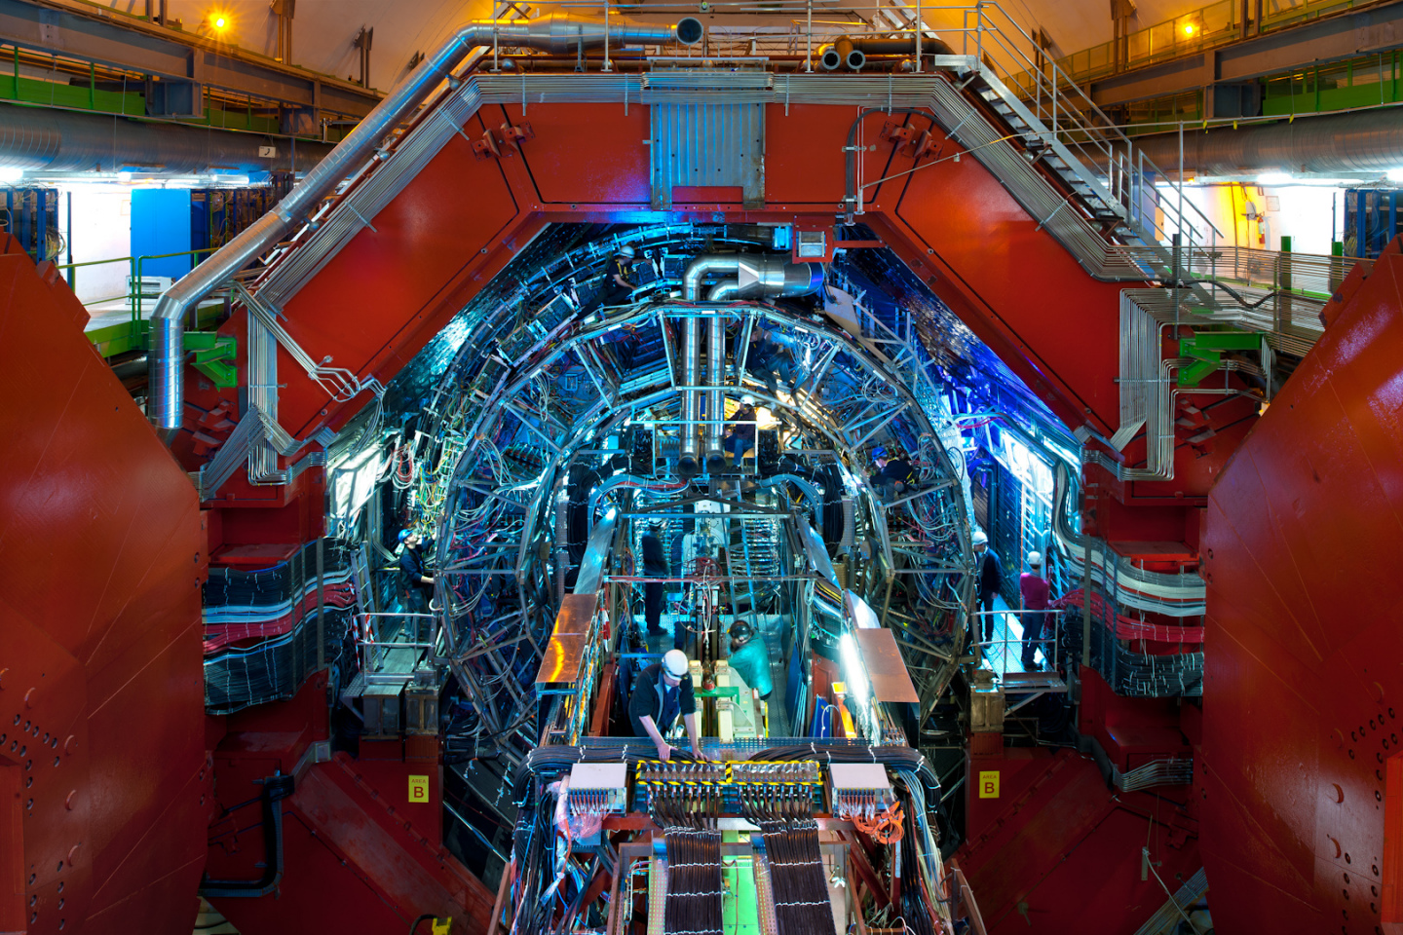
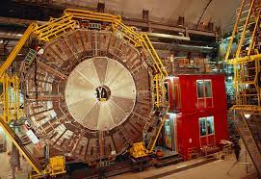
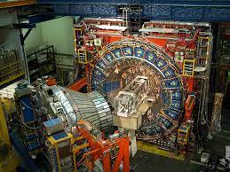
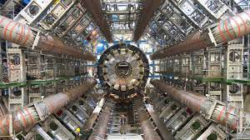
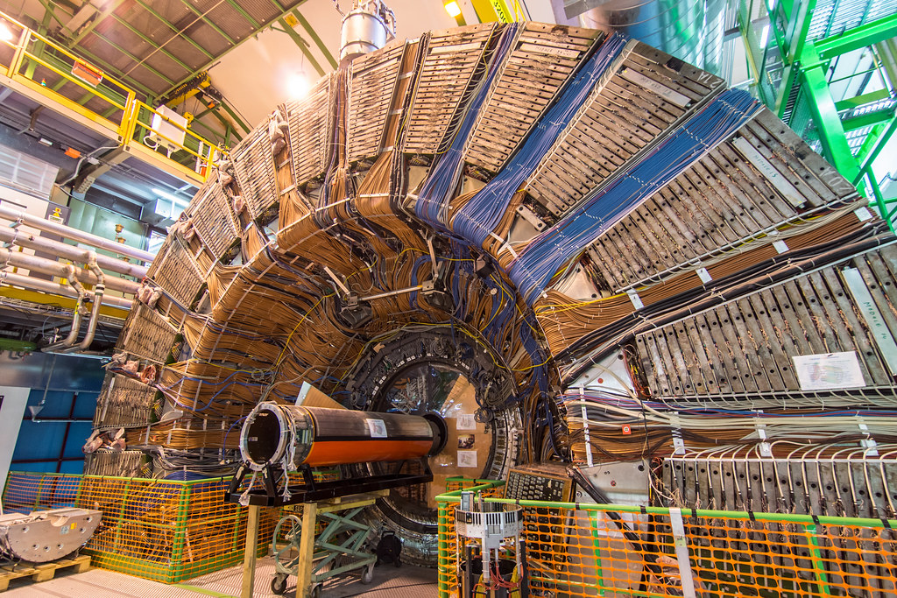
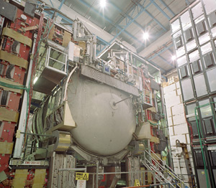
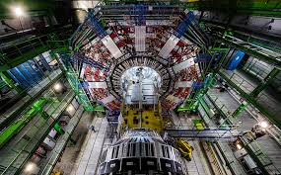
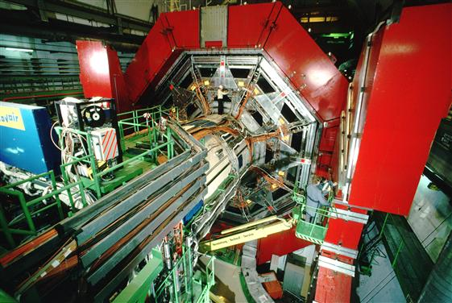

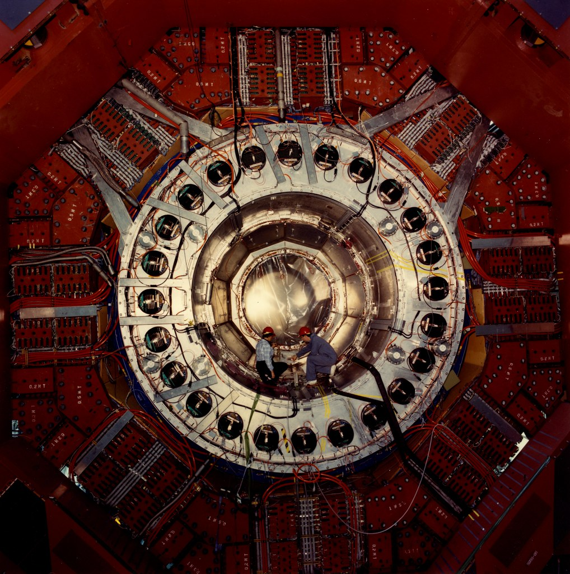
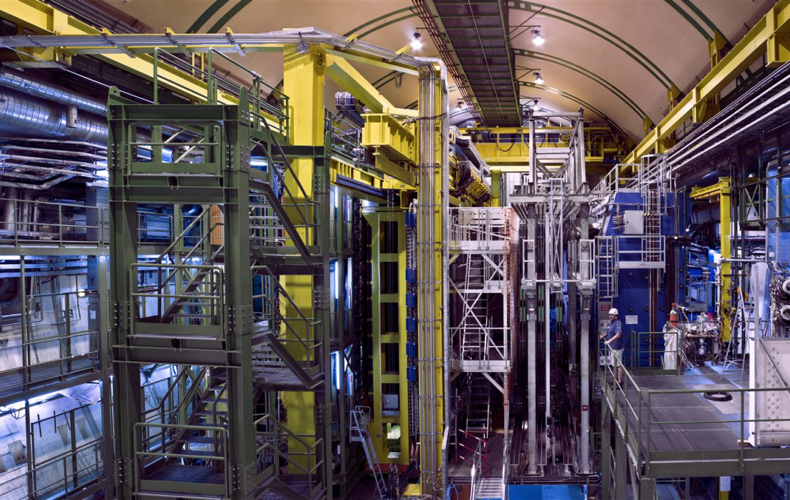
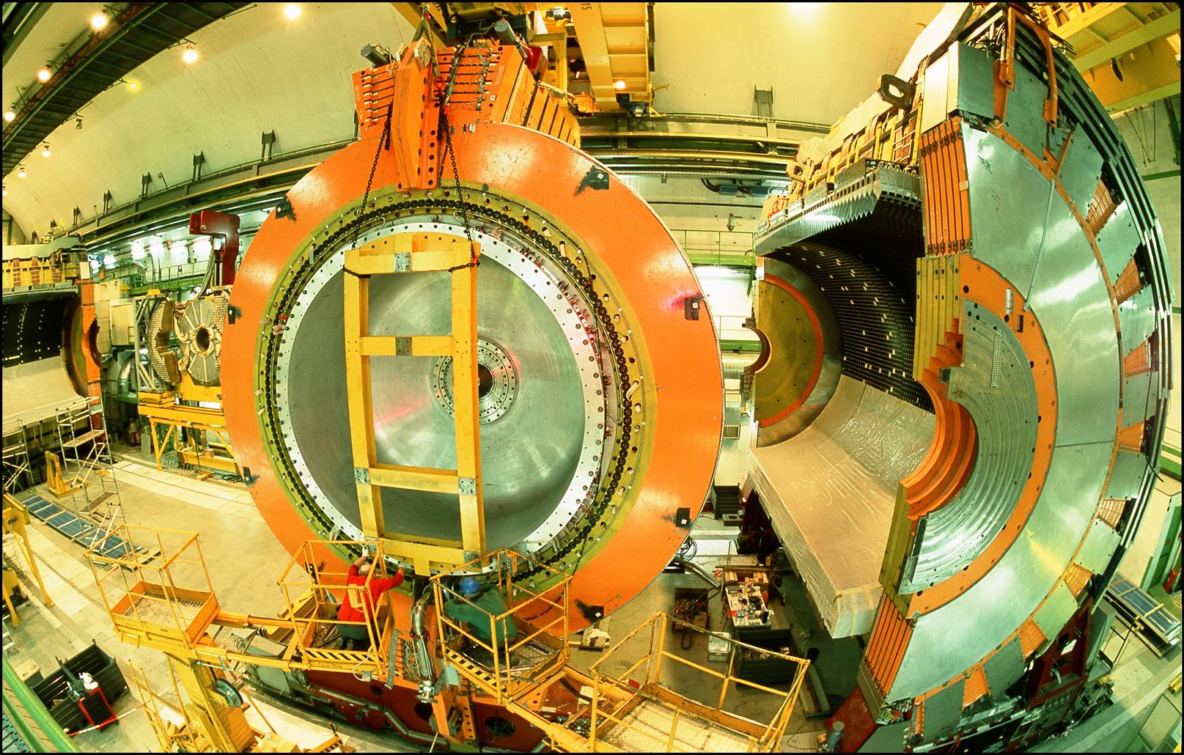
LOCATION, LOCATION, LOCATION
…
ALICE
ALEPH
CDF
FASER Pilot Detector
Suitcase-size, 4 weeks
$0 (recycled parts)
6 candidate neutrinos
ATLAS
DELPHI
D0
CMS
L3
LHCb
SLD
OPAL
All previous
collider detectors
Building-size, decades
~$10⁹
0 candidate neutrinos
This opens up a new field: neutrino physics at colliders

Slide 28
THE FASERν DETECTOR
FASERν will detect neutrinos of all flavors; also SND@LHC, a complementary, slightly off-axis experiment on the other side of ATLAS.
  25cm x 30cm x 1.1m detector consisting of 770 emulsion layers interleaved with 1 mm-thick tungsten plates; target mass = 1.1 tonnes.
  Emulsion swapped out every ~10-30 fb⁻¹, total 10 sets of emulsion for Run 3.
LLP
ν
e⁺
e⁻

Slide 29
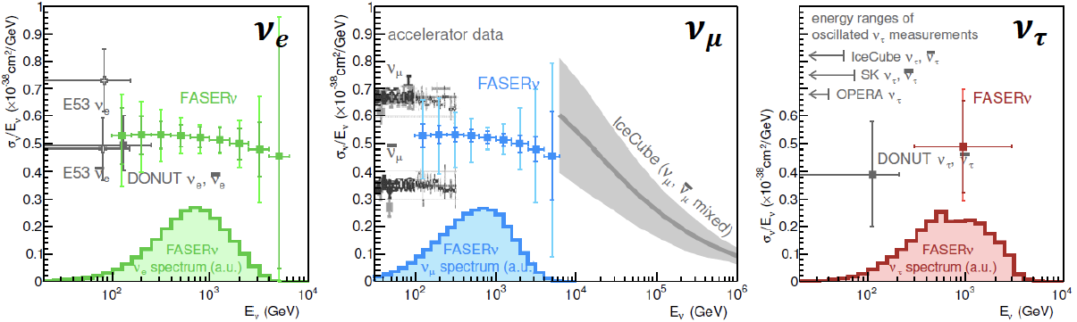
NEUTRINO PHYSICS
In Run 3 (2022-25), the goals of FASERν are to
  Detect the first collider neutrino.
  Record ~1000 ν_{e} , ~10,000 ν_{μ} , and ~10 ν_{τ} interactions at TeV energies, the first direct exploration of this energy range for all 3 flavors.
  Distinguish muon neutrinos from anti-neutrinos by combining FASER and FASERν data, and so measure their cross sections independently.
  Add significantly to the number of ν_{τ} and identify the first anti-ν_{τ} .
FASER Collaboration 1908.02310 (2019)

Slide 31
FORWARD PHYSICS FACILITY
FASER, FASERν, and SND@LHC are currently highly constrained by 1980’s (LEP!) infrastructure that was never intended to support experiments.
The rich physics program in the far-forward region therefore strongly motivates creating a dedicated Forward Physics Facility to house far-forward experiments for the HL-LHC era from 2029-2040.
FPF Meetings
  FPF Kickoff Meeting, 9-10 Nov 2020, https://indico.cern.ch/event/955956
  FPF2 Meeting, 27-28 May 2021, https://indico.cern.ch/event/1022352
  FPF3 Meeting, 25-26 Oct 2021, https://indico.cern.ch/event/1076733
  FPF4 Meeting, 31 Jan-1 Feb 2022, https://indico.cern.ch/event/1110746
FPF Short Paper: 75 pages, 80 authors completed in Sep 2021 (2109.10905, Physics Reports 968, 1 (2022)).
FPF Snowmass White Paper: Feng, Kling, Reno, Rojo, Soldin et al. A comprehensive, 429-page, 392-author+endorser summary (2203.05090).

Slide 32
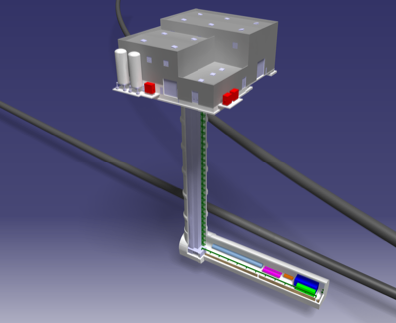
THE LOCATION
The CERN civil engineering team has considered many sites around the LHC ring that are on the beam collision axis of an IP.
A preferred location has been identified ~620-680 m west of the ATLAS IP, shielded by ~200 m of rock. The site is on CERN land in France.

Slide 33
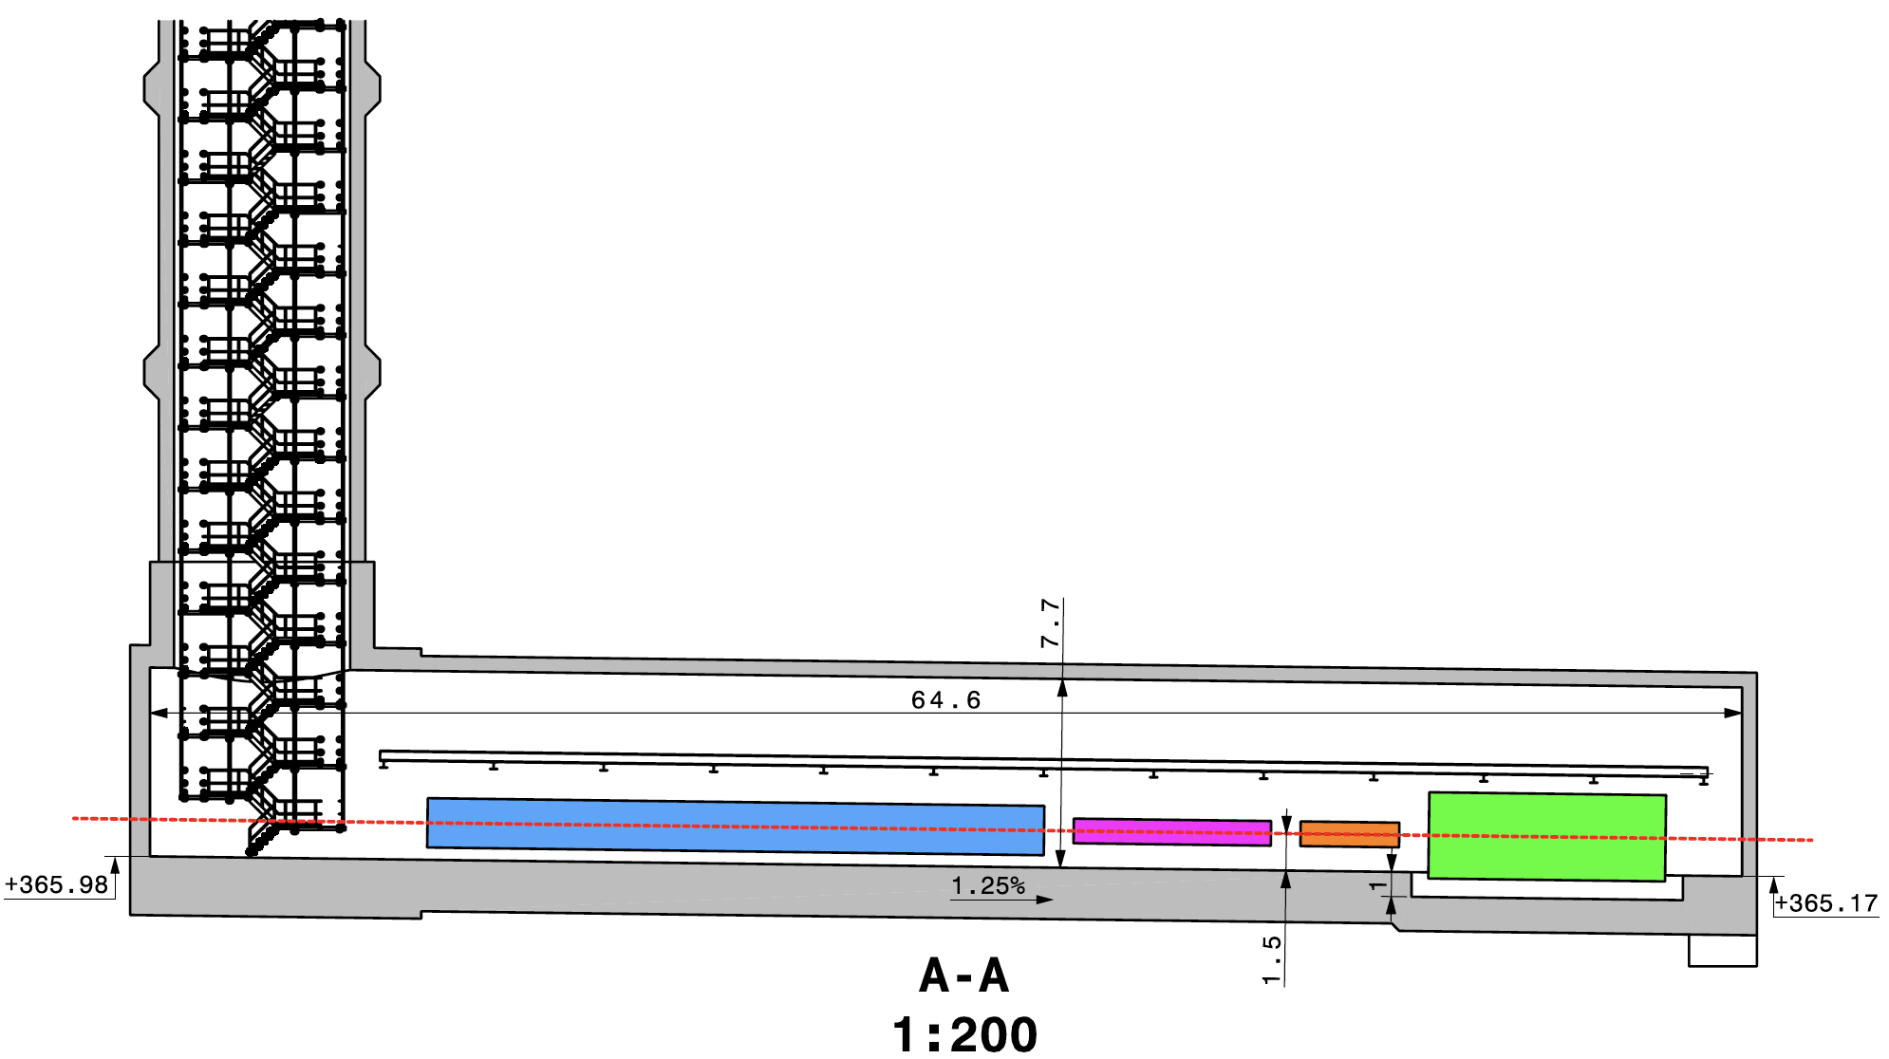
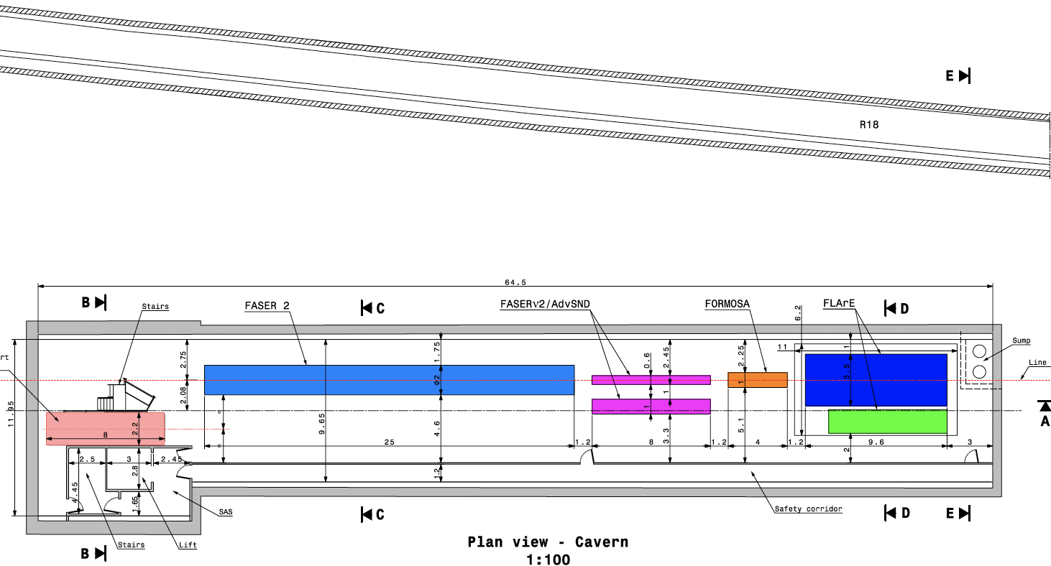
CAVERN AND SHAFT
Cavern: 65m long, 8m wide/high. Shaft: 88m-deep, 9.1m-diameter.
The FPF is completely decoupled from the LHC: no need for a safety corridor connecting the FPF to the LHC, preliminary RP and vibration studies indicate that FPF construction will have no significant impact on LHC operation.

Slide 34
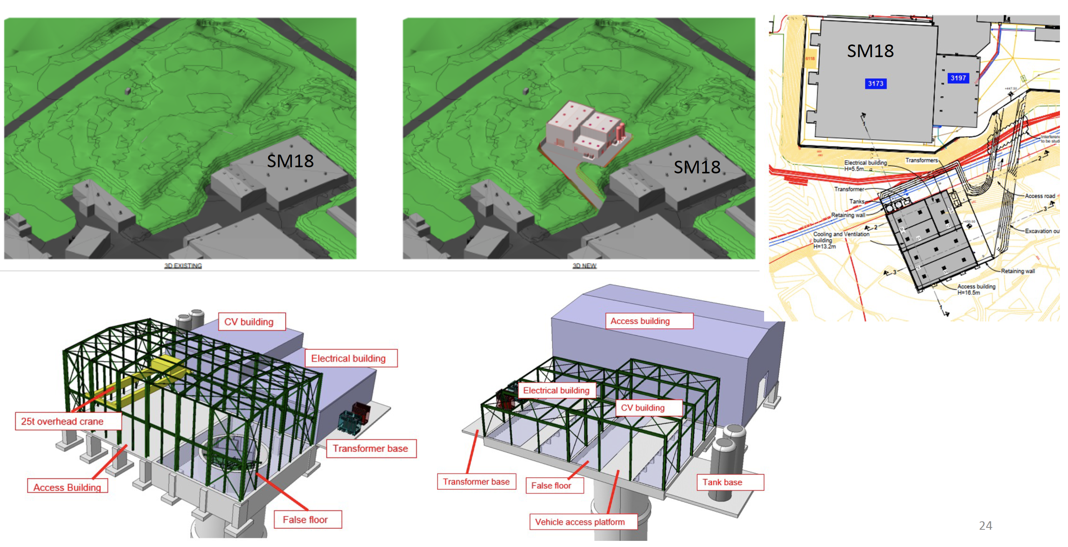
SURFACE BUILDINGS
Kincso Balazs,
John Osborne,
CERN CE (2022)

Slide 35
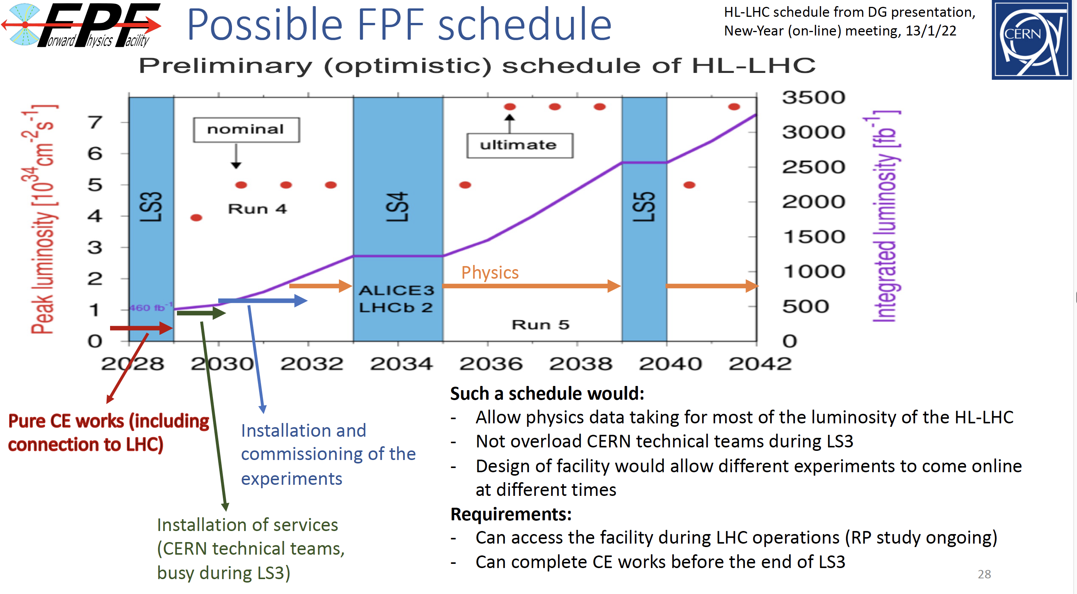

COST AND TIMELINE
Very preliminary (class 4) cost estimate: 23 MCHF (CE) + 15 MCHF (services) $≈$ 40 MCHF (+50%/-30%), not including experiments.
Timeline presented at Chamonix workshop (Feb 2022)
J. Boyd

Slide 36
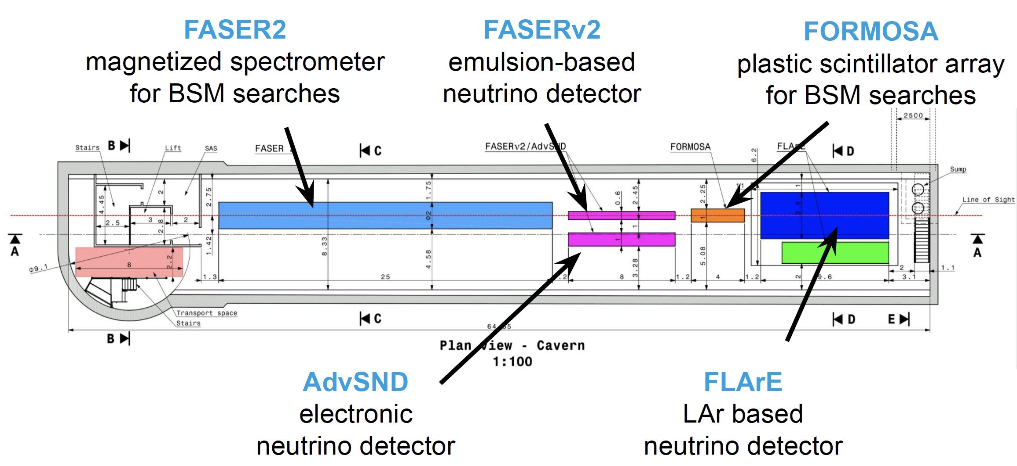
THE EXPERIMENTS
At present there are 5 experiments being developed for the FPF; these are works in progress, with much more work to be done.
Pseudo-rapidity coverage in the FPF is η > 5.5, with most experiments on the LOS covering η > 7.
Kling (2022)

Slide 37
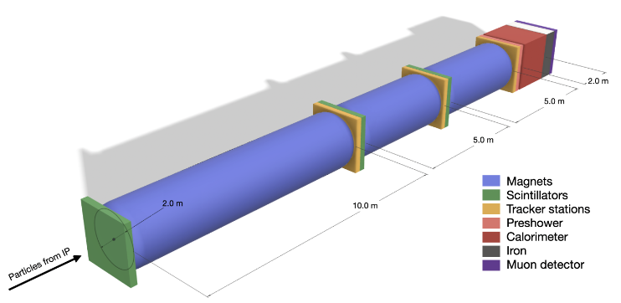


THE EXPERIMENTS
FASER2: upgraded FASER (tracker + magnetic spectrometer) 20 m long, targeting LLPs.
FASERν2, AdvSND: successors to FASERν and SND@LHC, ~few to 20 tonne detectors to study TeV neutrinos and differentiate flavors.
FASER2
AdvSND
FASERν2

Slide 38




THE EXPERIMENTS
FORMOSA: successor to MilliQan, 1m x 1m x 5m scintillator bars + PMTs looking for milli-charged particles, particles with EDMs, MDMs, and similar signatures.
FLArE: Forward Liquid Argon Experiment, ~1m x 1m x 7m noble liquid (Ar or Kr) TPC for neutrino studies, light DM searches.
1 TeV e LAr
UCI Group (Bian et al.)
1 TeV e LKr
BNL Group (Diwan et al.)

Slide 39
FPF PHYSICS
The FPF is a general purpose facility with a broad SM and BSM physics program that expands on the physics of FASER and FASERν. Here I will just give a few examples. For more, see the FPF White Paper.

Slide 40



DARK SECTOR SEARCHES
The dedicated detectors have significant discovery potential for a wide variety of BSM/LLP models: dark photons; B-L and related gauge bosons; dark Higgs bosons; HNLs with couplings to e, mu, tau; ALPs with photon, gluon, fermion couplings; light neutralinos, inflaton, relaxion, and many others.
_{FPF White Paper (2022)}
Dark Photon
Dark Fermion
Dark Scalar

Slide 41

NEUTRINO PHYSICS AT THE FPF
At the FPF, three proposed ~10-ton detectors FASERν2, AdvSND, and FLArE will each detect ~100,000 ν_{e} , ~1,000,000 ν_{μ} , and ~1000 ν_{τ} interactions at TeV energies, providing high statistics samples for all three flavors in an energy range that has never been directly explored.
Will enable precision studies of the tau neutrino.
Can also distinguish neutrinos and anti-neutrinos for muon and tau.
FASER White Paper (2022)

Slide 42

QCD
The FPF will also support a rich program of QCD and hadron structure studies.
Forward neutrino production is a a probe of forward hadron production, BFKL dynamics, intrinsic charm, ultra small x proton structure, with important implications for UHE cosmic ray experiments.
Neutrino interactions will probe DIS at the TeV-scale, constrain proton and nuclear structure, pdfs.
FASER White Paper (2022)

Slide 43



QCD
The FPF will probe proton structure at ultra small x ~ 10⁻⁷ (and also high x ~ 1).
In addition to the intrinsic interest in QCD, ultra small-x physics will become more and more important at higher energies, for example, in making precise predictions for $σ(gg→$ $h$) at a 100 TeV pp collider.
FPF White Paper (2022)

Slide 44


MILLI-CHARGED PARTICLES
A completely generic possibility motivated by dark matter, dark sectors. Currently the target of the MilliQan experiment, located at the LHC near the CMS experiment in a “non-forward” tunnel.
The MilliQan Demonstrator (Proto-MilliQan) already probes new region. Full MilliQan can also run in this location in the HL-LHC era, but the sensitivity may be improved significantly by moving it to the FPF (FORMOSA).
Foroughi-Abari, Kling, Tsai (2020)

Slide 45




DARK MATTER DIRECT DETECTION
Light DM with masses at the GeV scale and below is famously hard to detect.
  Galactic halo velocity ~ 10⁻³ c, so kinetic energy ~ keV or below.
At the LHC, we can produce DM at high energies, look for the resulting DM to scatter in FLArE, Forward Liquid Argon Experiment, a proposed 10 to 100 tonne LArTPC.
FLArE is powerful in the region favored/allowed by thermal freezeout.
Batell, Feng, Trojanowski (2021)

Slide 46

SUMMARY
Colliders can look for heavy, strongly-interacting particles and light, weakly-interacting particles; the LHC is currently missing half of these possibilities.
The FPF is uniquely positioned to fully realize the LHC’s physics potential for both SM and BSM physics in the far forward region, greatly extending the LHC physics program for relatively little cost.
Plan: CDRs for the facility and experiments in the next 12-18 months, construction in LS3, physics in HL-LHC Run 4. Much work to be done!

Slide 47
EXTRAS

Slide 48


FPF CIVIL ENGINEERING
Balazs (2022)

Slide 49



WHERE THE PIONS ARE
300 fb⁻¹
Feng, Galon, Kling, Trojanowski (2017)
Enormous $σ_{tot}$~100 mb, currently wasted in BSM searches.
Pions typically have p_{T} ~ 250 MeV, but large flux with p ~ TeV within 1 mrad (η > 7.6) of the beamline.

Slide 50

FPF NEUTRINO DISTRIBUTIONS
Kling (2022)

Slide 51

FPF NEUTRINO DISTRIBUTIONS
Kling (2022)

Slide 52

FPF MUON BACKGROUND FROM FLUKA
Cerutti, Sabate-Gilarte (2022)

Slide 53

FPF MUON BACKGROUND FROM FLUKA
Cerutti, Sabate-Gilarte (2022)

