Slide 1



CONNECTION TO THE
ENERGY FRONTIER
Accelerator-Based Dark Sector Searches Agora
Snowmass 2022
Jonathan Feng, UC Irvine, 22 April 2022

Slide 2

NEW PARTICLES
Particle
Colliders
Mass
MeV
GeV
TeV
1
Remarkable overlap of cosmology and the current experimental frontier: the WIMP Miracle (upper right corner), WIMPless Miracle (the entire diagonal).
Feng, Kumar (2008)
Boehm, Fayet (2003)
Pospelov, Ritz, Voloshin (2007)
Why explore dark sectors at EF? Given the current state of particle physics, we can’t afford to leave half of the EF’s physics potential unexplored.
Cautionary tale: charm non-discovery at the ISR.
Myers (2021)
Evans, Jenni (2021)
Already
Discovered
Strongly Interacting
Heavy Particles
Too Little to be
Dark Matter
Interaction Strength
Just Right to
be Dark Matter
10⁻³
Weakly Interacting
Light Particles
Dark Sectors
Impossible to
Discover
10⁻⁶
Too Much to be
Dark Matter

Slide 3
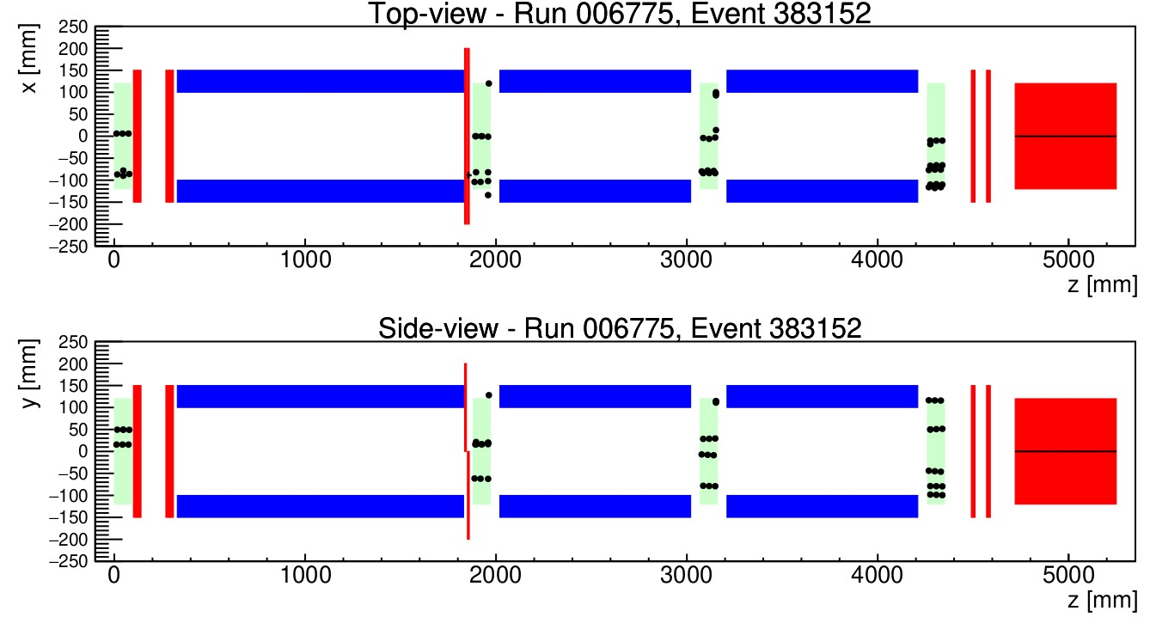
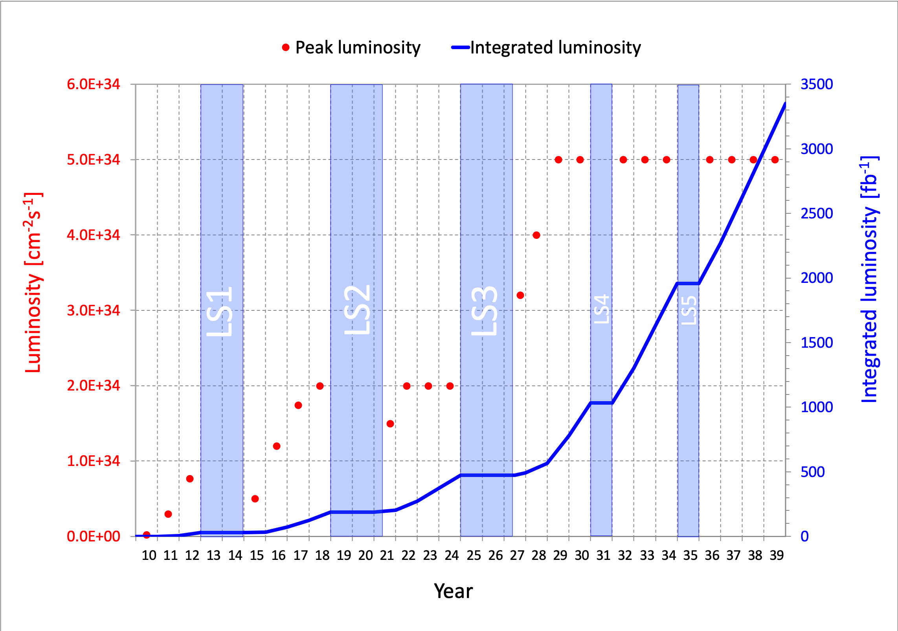
DARK SECTORS AT THE ENERGY FRONTIER
Energy frontier colliders provide multiple avenues for probing dark sectors, given timely preparation and relatively small investments.
LHC Run 3: Existing experiments will soon probe new parameter space. Beams started today! (Right: a beam splash event recorded by FASER 10 hours ago.)
HL-LHC: More world-leading dark sector searches, with complementary neutrino and QCD studies.
Future Colliders: Dark sector searches will be an integral part of any future collider program.

Slide 4
LHC RUN 3

Slide 5
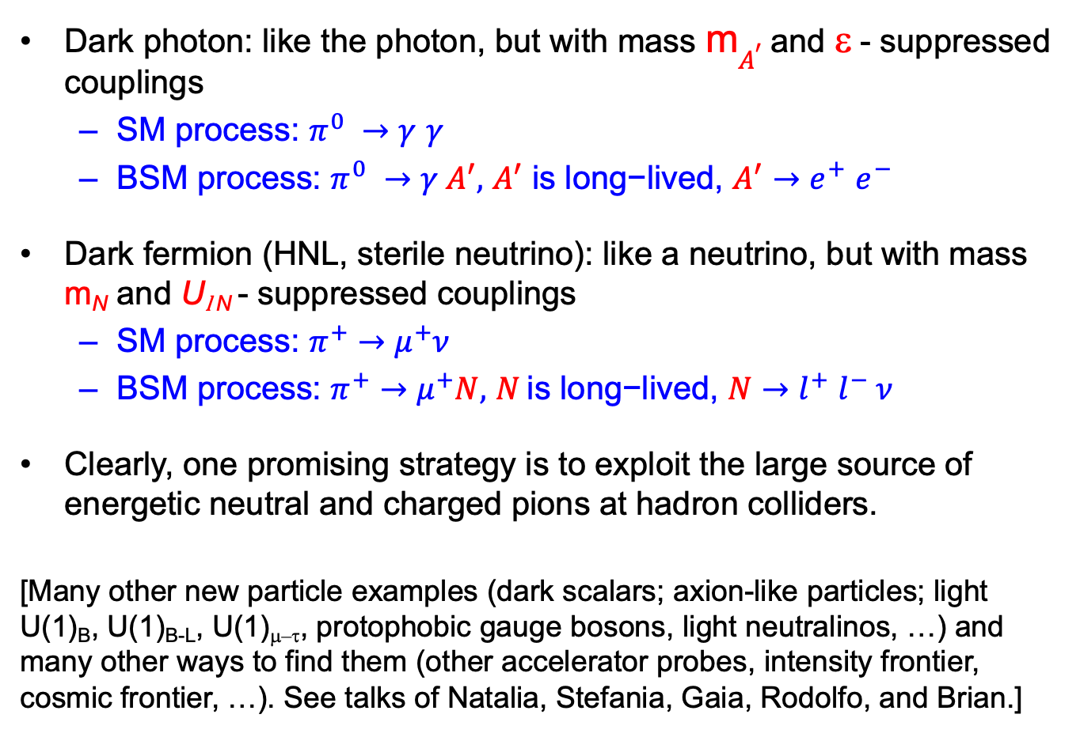
SPECIFIC EXAMPLES
Dark photon: like the photon, but with mass m$A^{′}$ and ε - suppressed couplings
  SM process: $π^{0} →γ$ $γ$
  BSM process: $π^{0} →γ{ A}^{′},$ $A^{′} \text{is} \text{long}\text{−}\text{lived}\text{,}$ $A^{′}{→e}^{+}e^{−}$
Dark fermion (HNL, sterile neutrino): like a neutrino, but with mass m_{N} and U_{l N} - suppressed couplings
  SM process: $π^{+}→μ^{+}ν$
  BSM process: $π^{+}→μ^{+}N,$ $N \text{is} \text{long}\text{−}\text{lived}\text{,}$ $N$ ${→l}^{+}l^{−} ν$
Clearly, one promising strategy is to exploit the large source of energetic neutral and charged pions at hadron colliders.
[Many other new particle examples (dark scalars; axion-like particles; light U(1)_{B}, U(1)_{B-L}, U(1)_{μ–τ}, protophobic gauge bosons, light neutralinos, …) and many other ways to find them (other accelerator probes, intensity frontier, cosmic frontier, …). See talks of Natalia, Stefania, Gaia, Rodolfo, and Brian.]

Slide 6
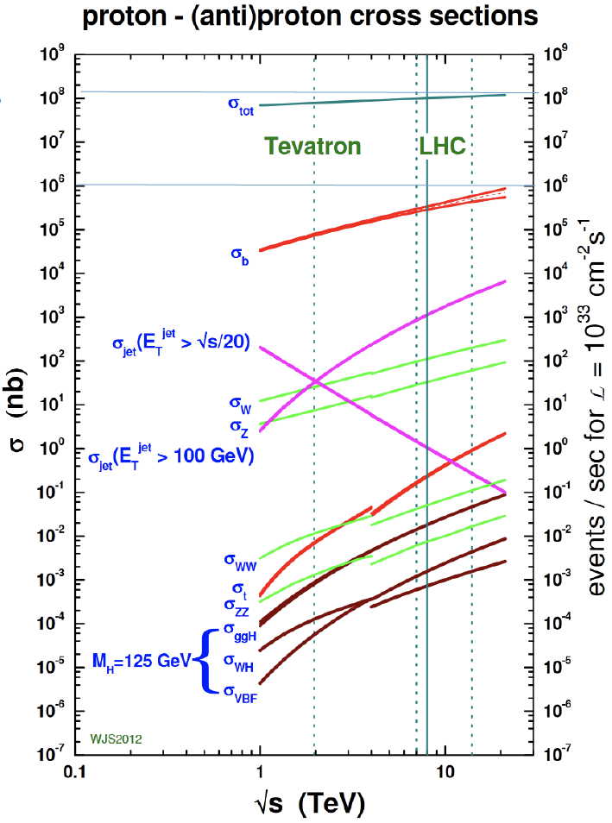
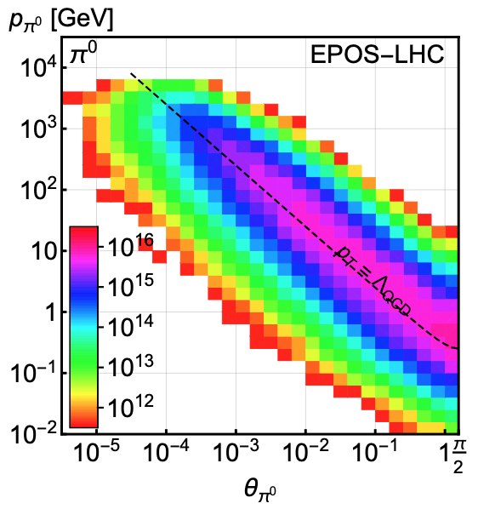
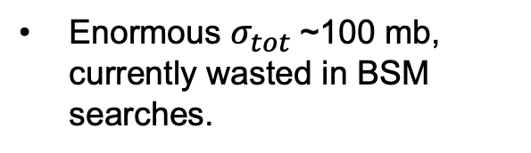
WHERE THE PIONS ARE
300 fb⁻¹
Feng, Galon, Kling, Trojanowski (2017)
Enormous $σ_{tot}$~100 mb, currently wasted in BSM searches.
Pions typically have p_{T} ~ 250 MeV, but large flux with p ~ TeV within 1 mrad (η > 7.6) of the beamline.

Slide 7
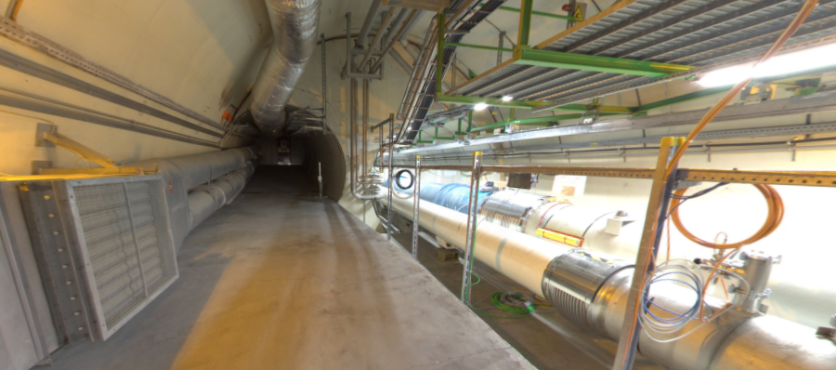


THE FAR-FORWARD REGION
New particle A’ is produced at ATLAS, travels along the beam collision axis and through 100 m of rock, and finally decays in tunnel TI12, 480 m from ATLAS
$π^{0}$→ $γ$A’
→ A’ →
A’ → $e^{+}e^{−}$
TI12 near UJ12
UJ12
The view in UJ12 looking west (2019)
TI12
$$e^{+}$$
$e^{−}$
Beam collision axis
LHC beamline

Slide 8
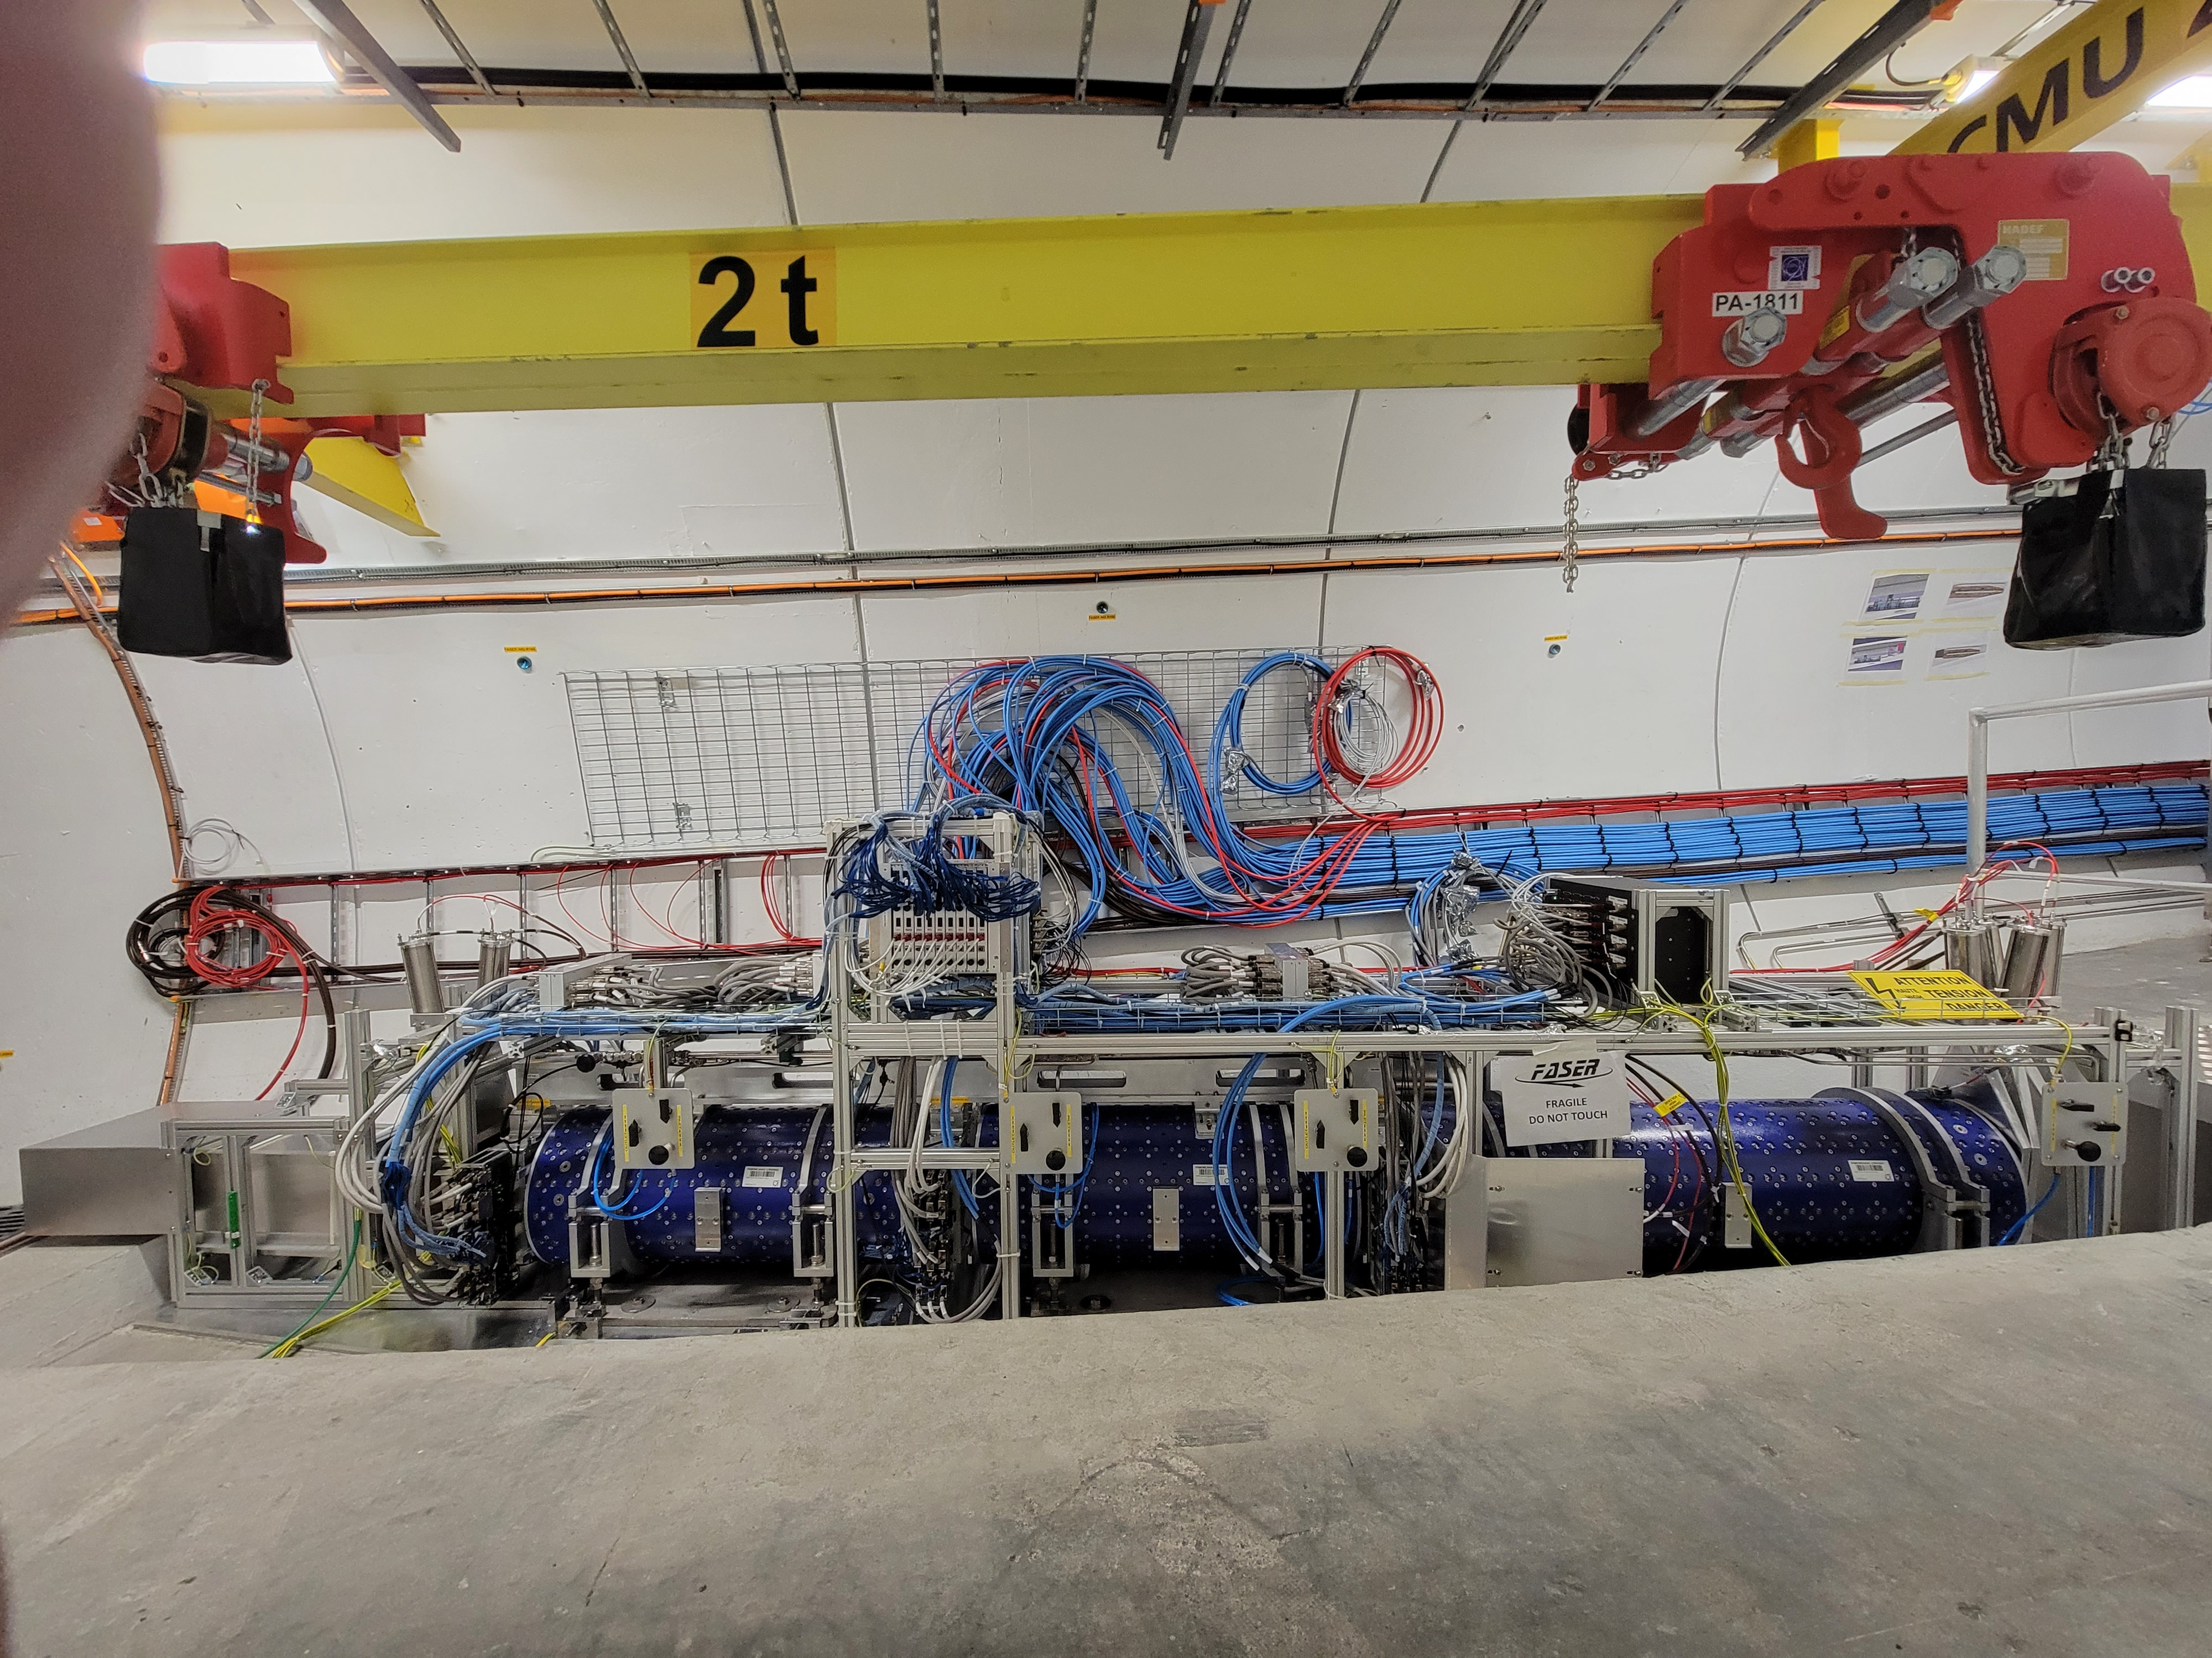
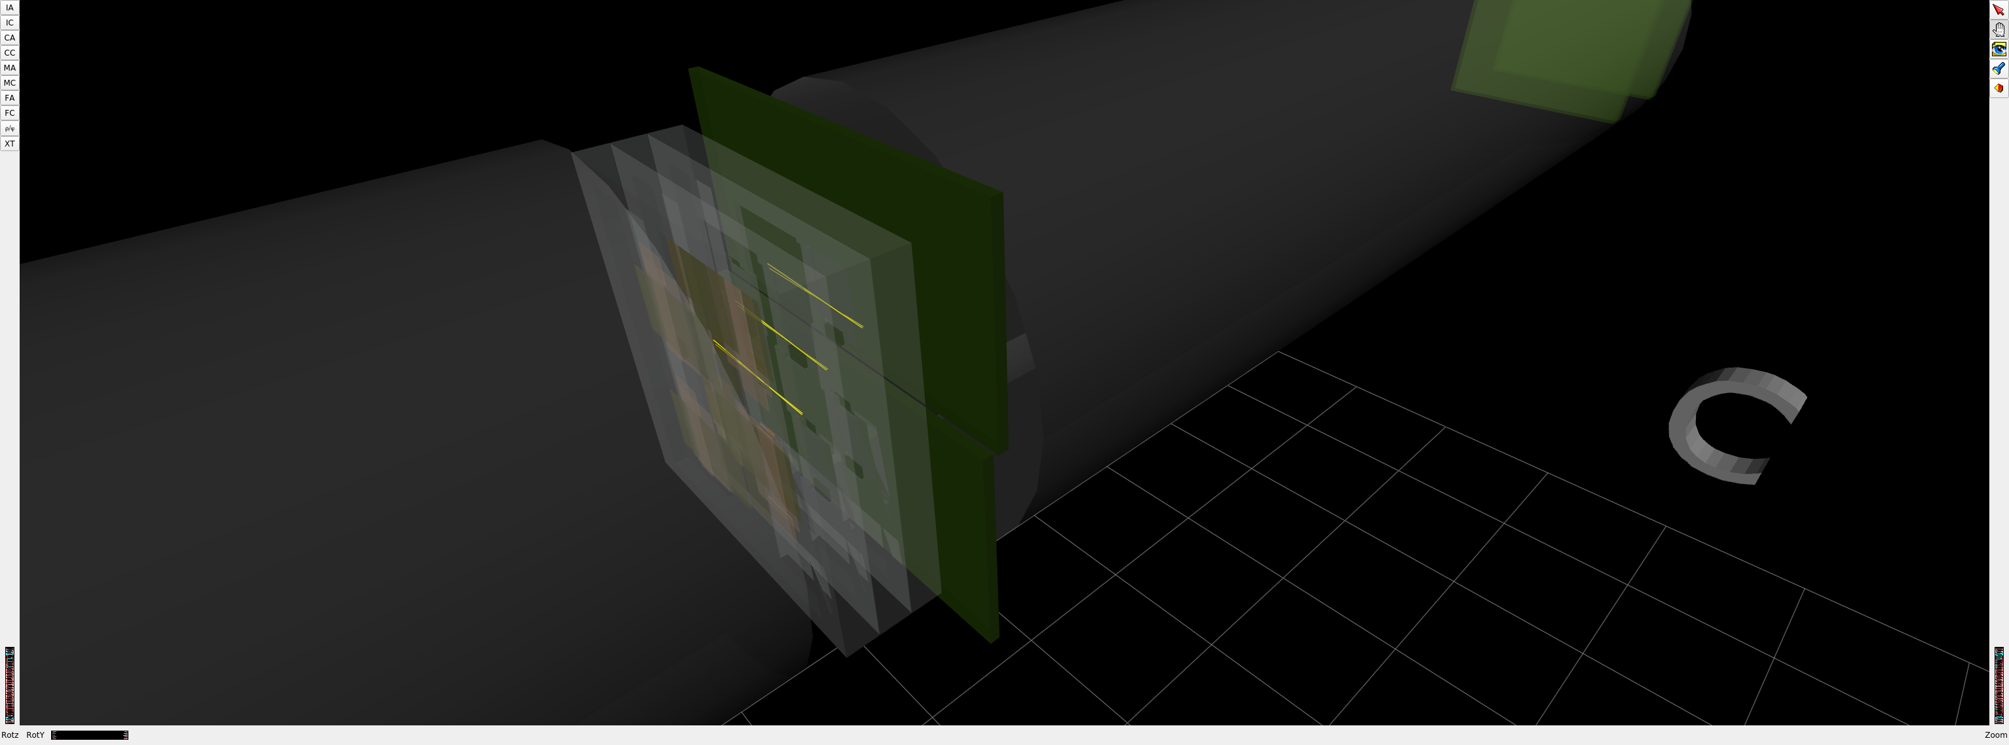
FASER COMPLETED IN 2021
1st Cosmic Ray
18 March 2021

Slide 9
DARK PHOTON SENSITIVITY REACH
Energy frontier experiments are among the most promising probes of dark photons in the coming years.
LHCb probes new parameter space starting at larger couplings.
FASER probes new parameter space starting at smaller couplings, with discovery or new limits with just 1 fb⁻¹ starting in June 2022.
_{FASER Collaboration (2018)}
FASER
Ilten, Soreq, Thaler, Williams, Xue (2016)

Slide 10
HL-LHC

Slide 11
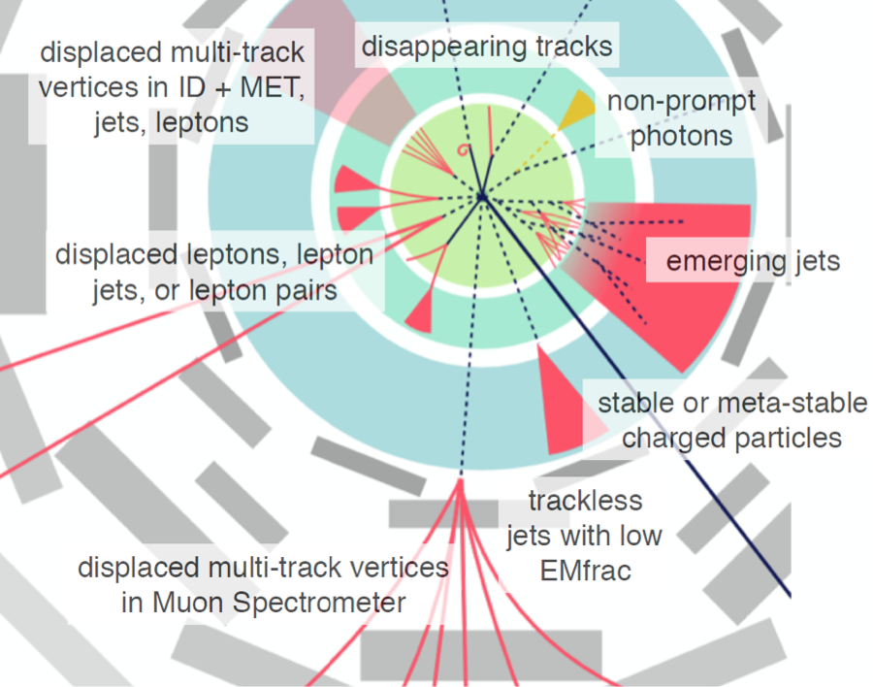
GENERAL PURPOSE DETECTORS
Dark sectors motivate long-lived particles, which, if produced transverse to the beam, can lead to a dizzying array of spectacular signatures at ATLAS and CMS. See LLP WG study, Alimena et al. (1903.04497)
Credit: Heather Russell
Notes:
11

Slide 12
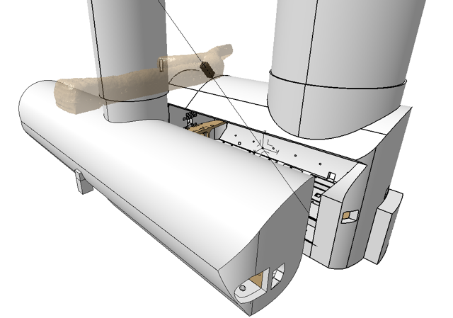

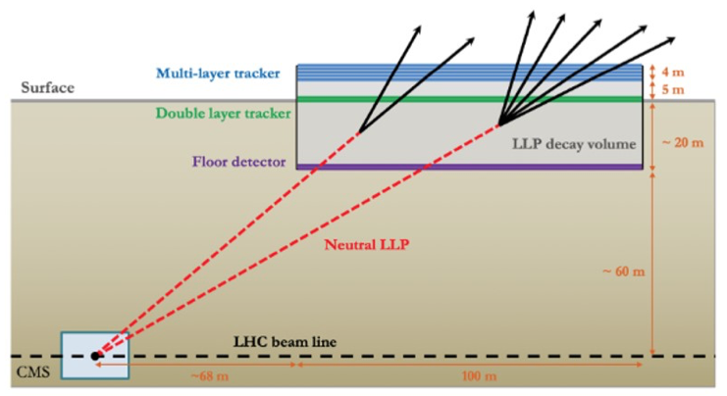
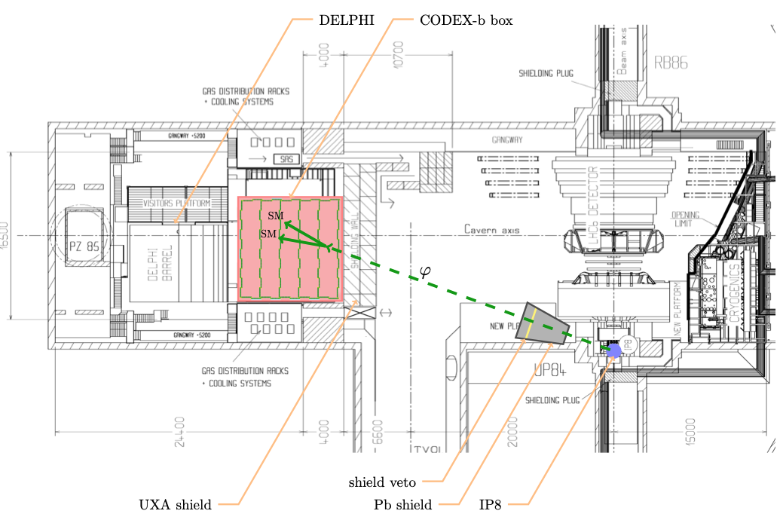
DEDICATED TRANSVERSE DETECTORS
Many ongoing and proposed detectors dedicated to searching for LLPs and milli-charged particles at large angles to the beamline.
MoeDAL/MAPP, MilliQan, MATHUSLA, Codex-b, ANUBIS, …
MATHUSLA White Paper (2203.08126)
CODEX-b White Paper (2203.07316)

Slide 13
DEDICATED FORWARD DETECTORS
A suite of dedicated far-forward detectors are proposed to be housed in the Forward Physics Facility. (See also FACET.)
FPF “Short” Paper (2109.10905) and White Paper (2203.05090)
A preferred location has been identified ~620-680 m west of the ATLAS IP, shielded by ~200 m of rock. The site is on CERN land in France.

Slide 14
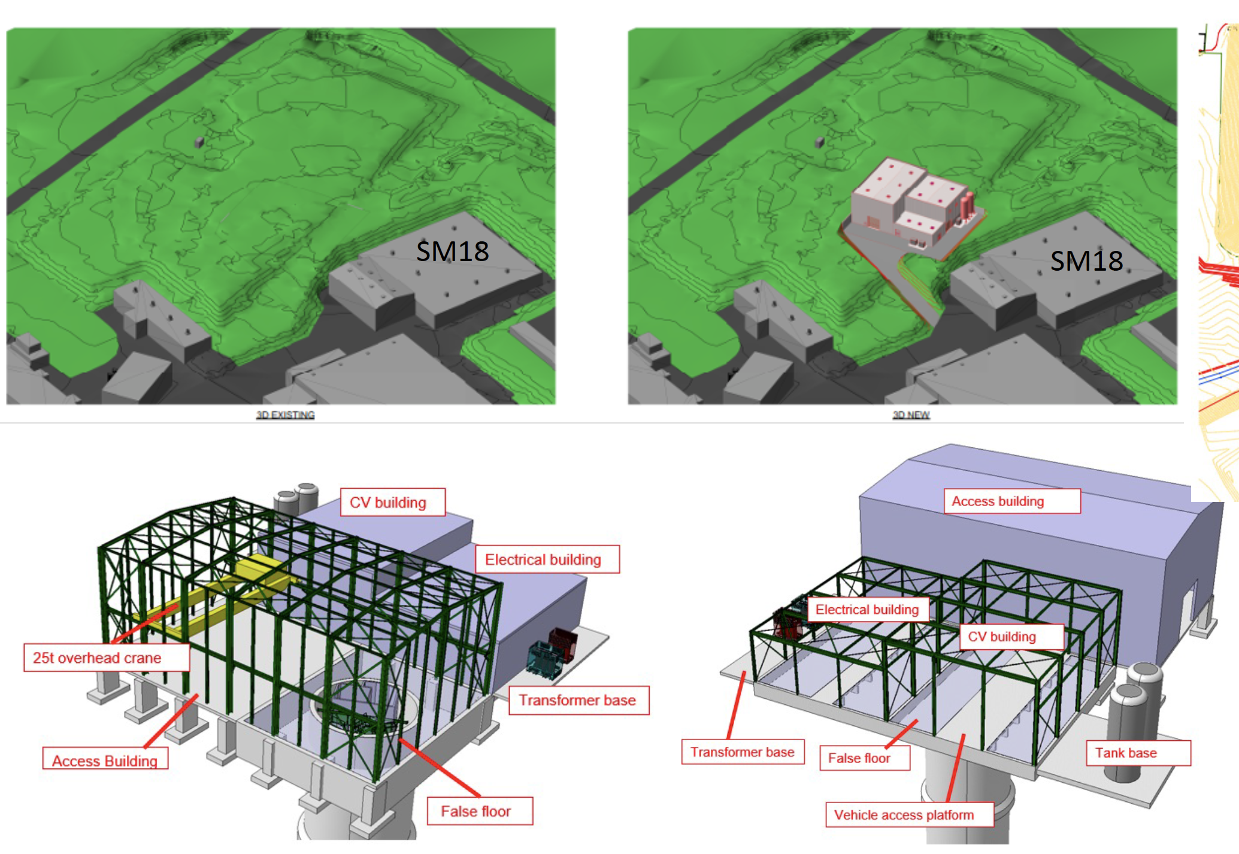
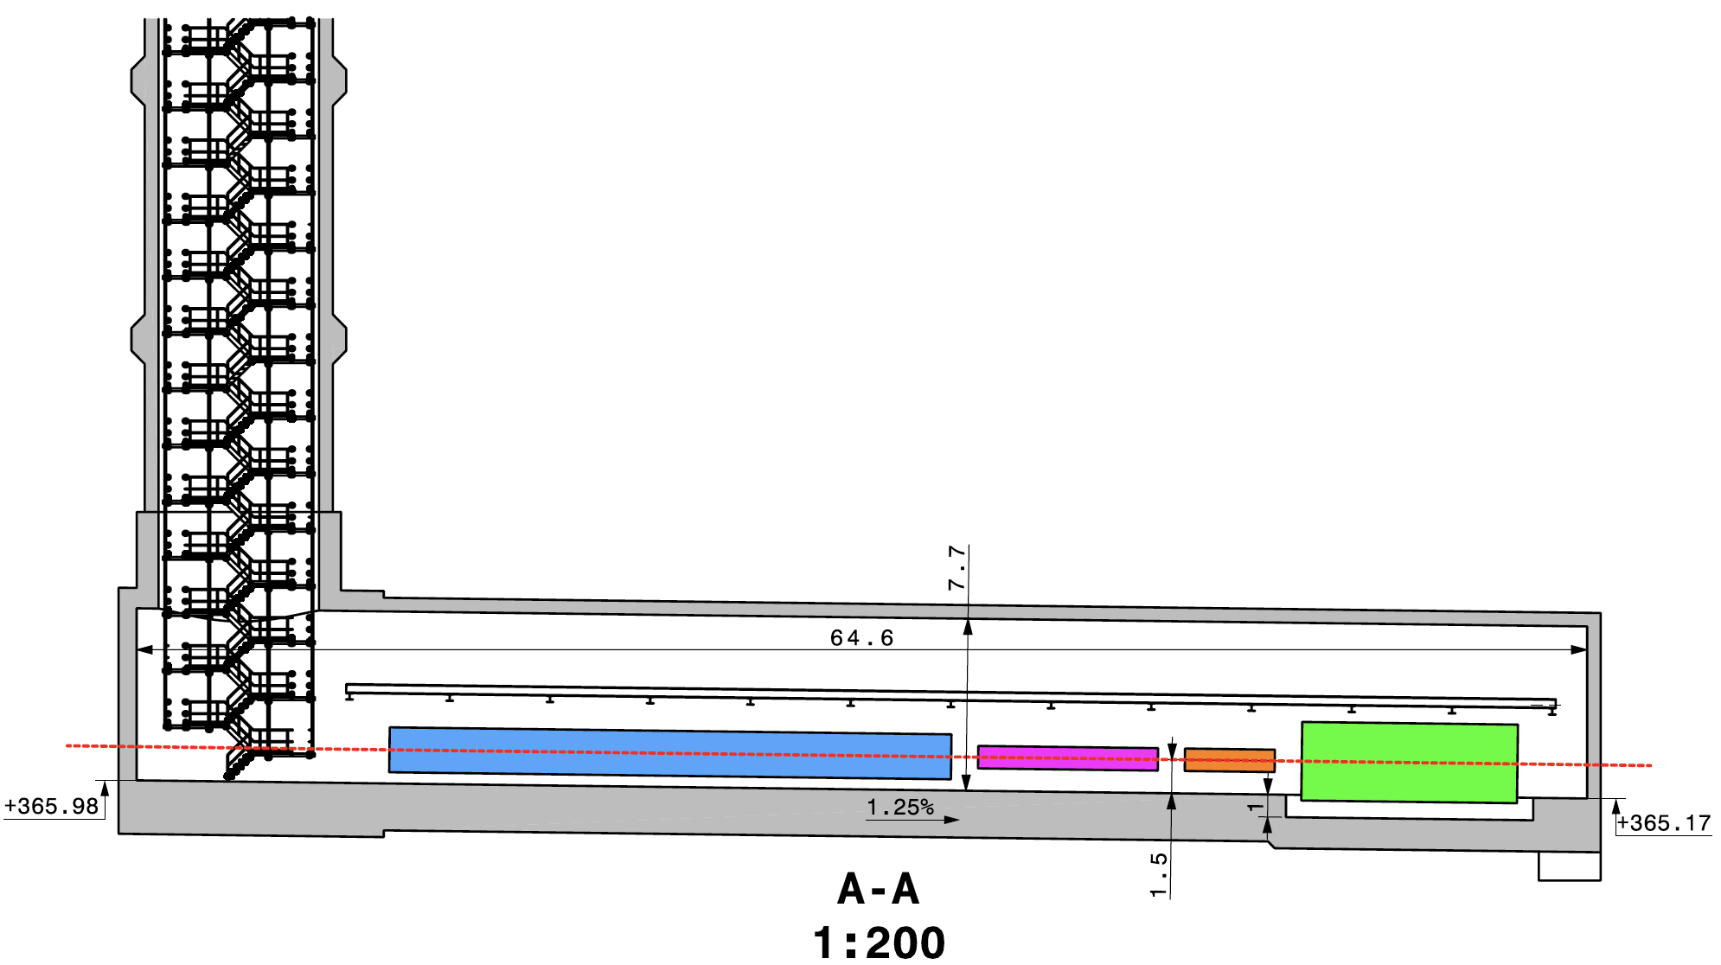
CAVERN AND SHAFT
Cavern: 65m long, 8m wide/high. Shaft: 88m deep, 9.1m diameter.
The FPF is completely decoupled from the LHC (no connecting tunnel), requires no modifications to the LHC.

Slide 15
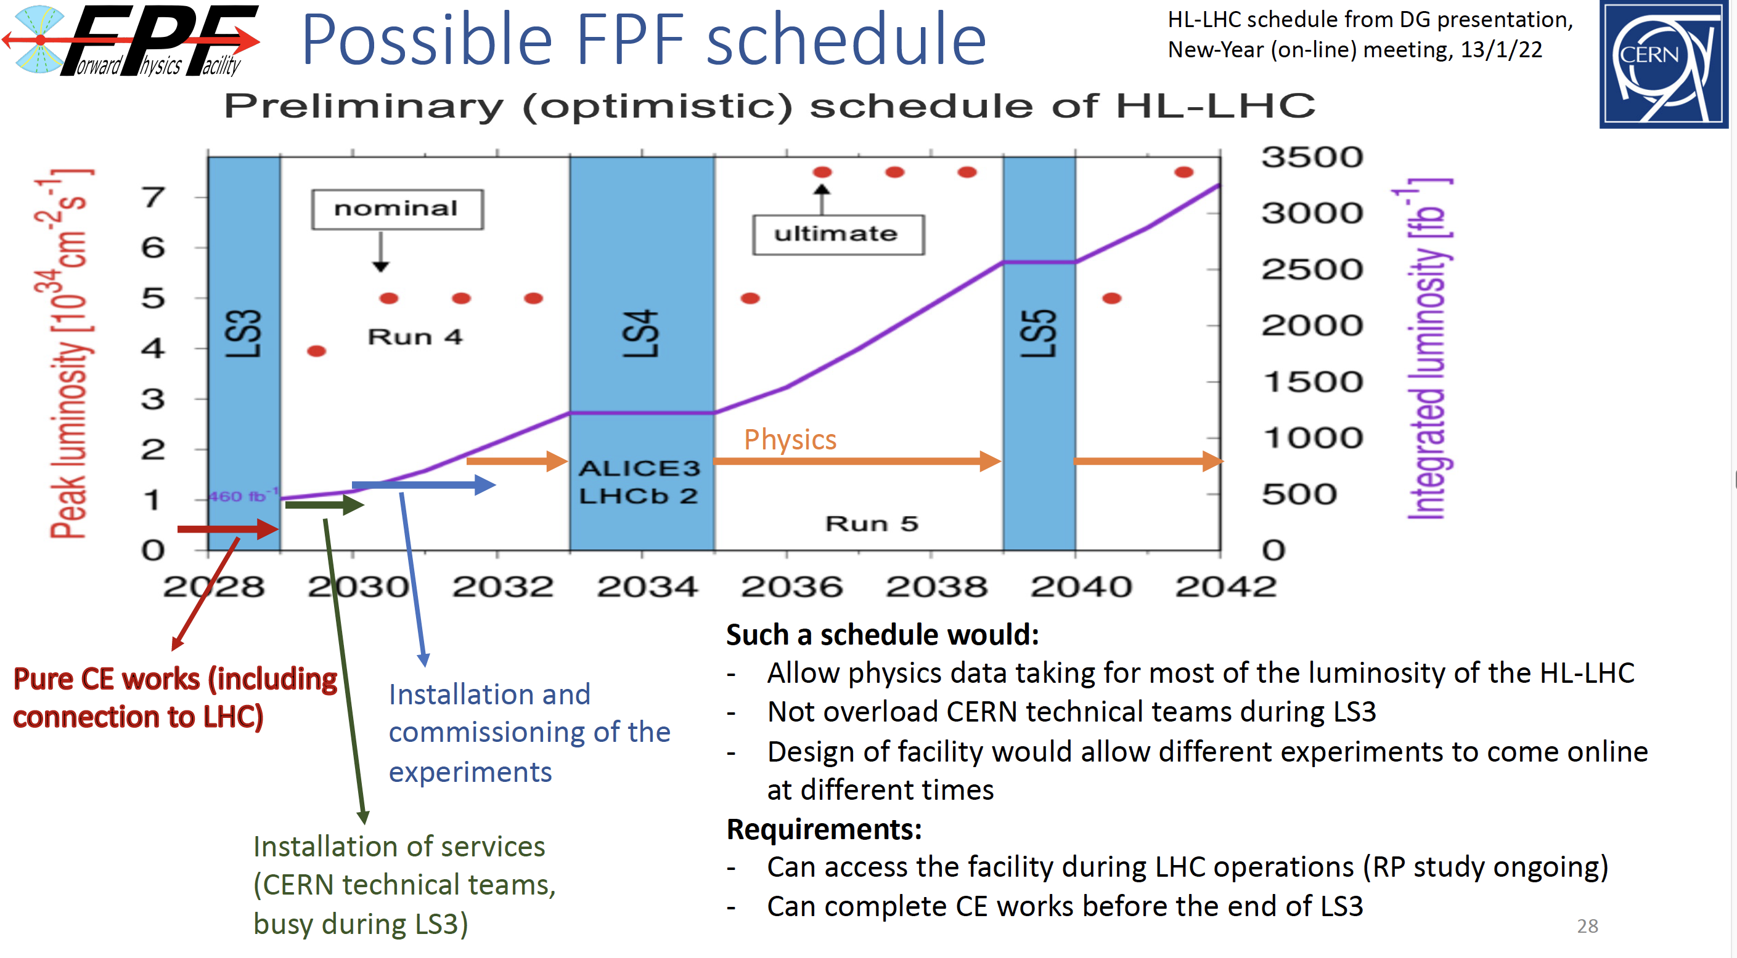

COST AND TIMELINE
Very preliminary (class 4) cost estimate: 23 MCHF (CE) + 15 MCHF (services) $≈$ 40 MCHF (+50%/-30%), not including experiments.
Possible timeline presented at Chamonix workshop in February 2022.
J. Boyd

Slide 16
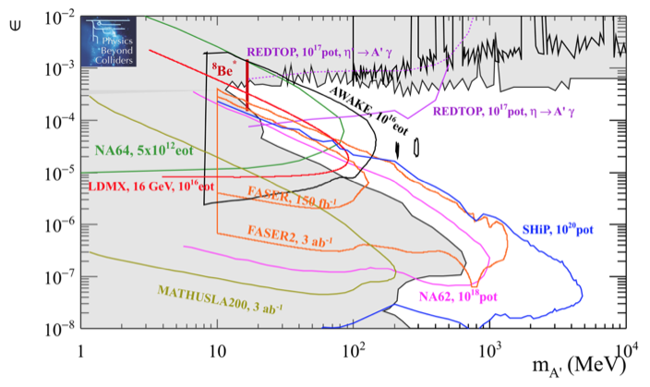
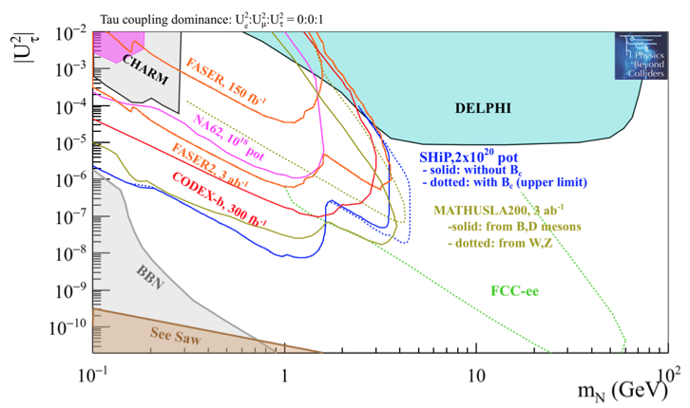
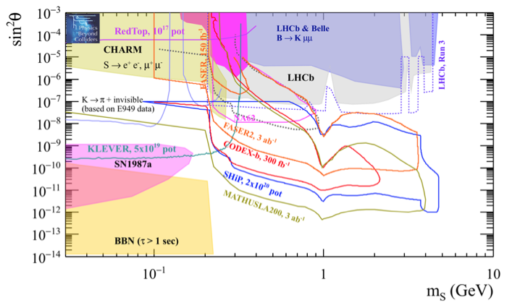
DARK SECTOR SEARCHES
The dedicated detectors have significant discovery potential for a wide variety of dark sector models.
See Physics Beyond Colliders and LLP WG studies (and previous talk of Gaia).
_{Beacham et al. (1901.09966)}
_{Alimena et al. (1903.04497)}
Dark Photon
Dark Fermion
Dark Scalar

Slide 17
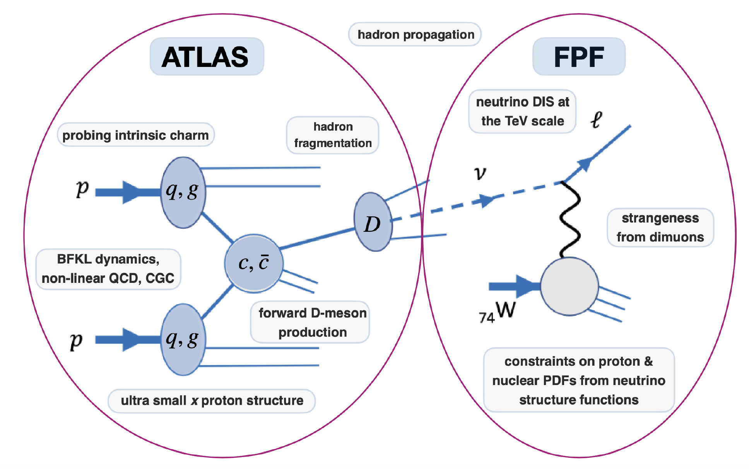
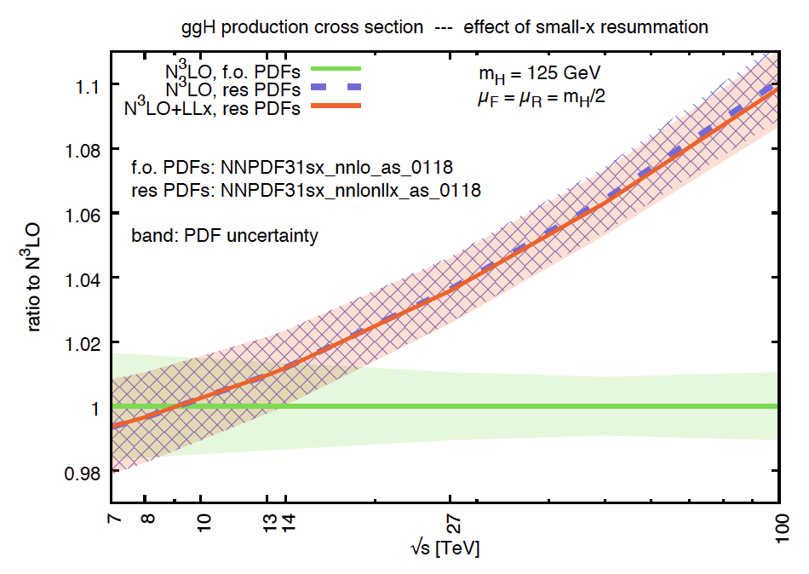
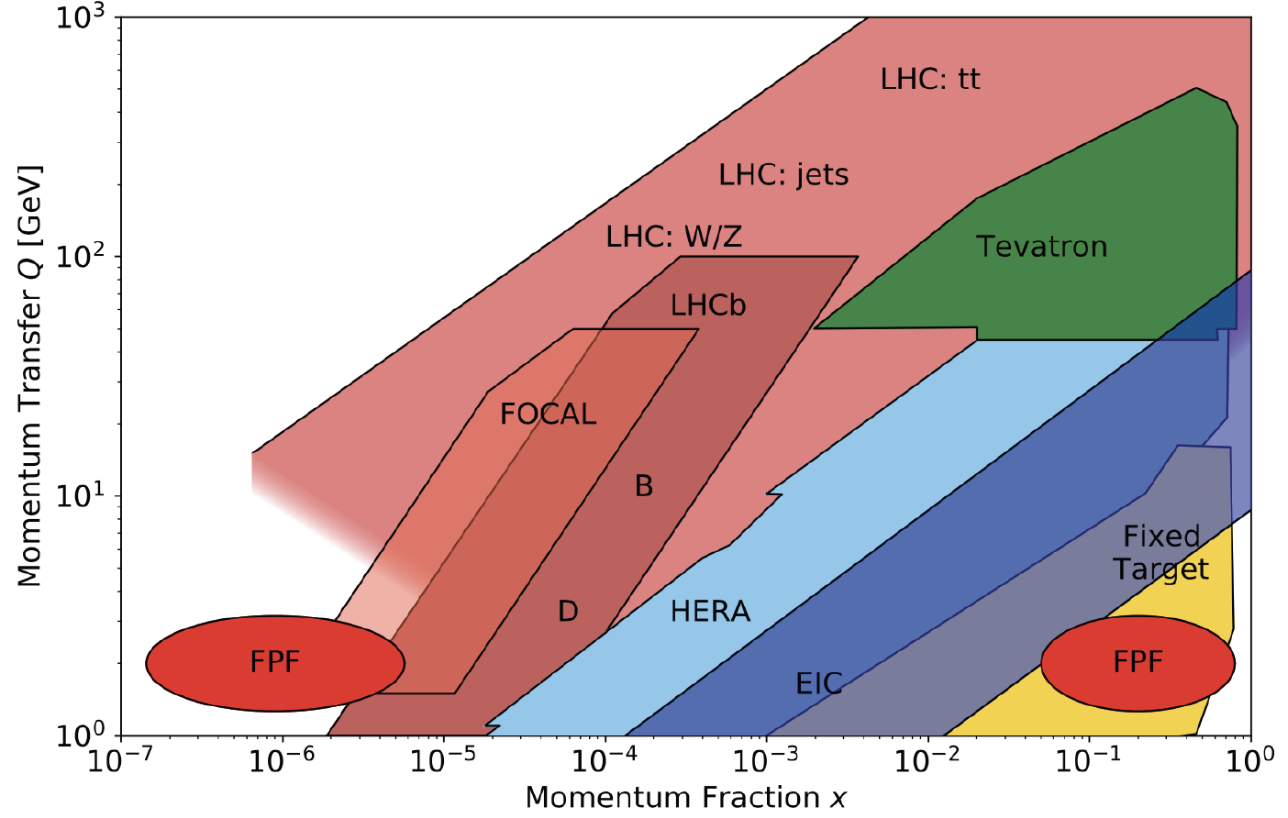
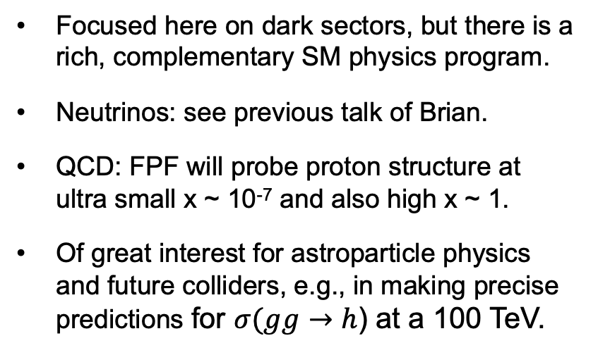
NEUTRINO AND QCD PHYSICS
Focused here on dark sectors, but there is a rich, complementary SM physics program.
Neutrinos: see previous talk of Brian.
QCD: FPF will probe proton structure at ultra small x ~ 10⁻⁷ and also high x ~ 1.
Of great interest for astroparticle physics and future colliders, e.g., in making precise predictions for $σ(gg→$ $h$) at a 100 TeV.
FPF White Paper (2203.05090)

Slide 18

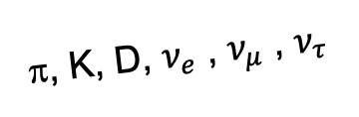
SUMMARY
Dark sectors, and weakly-interacting light particles in general, represent half of the discovery potential at the energy frontier.
We are currently missing physics opportunities at the LHC: neutrinos and QCD for sure, and maybe also the discovery of BSM physics.
With timely preparation and relatively small investments, we can cover these blind spots, with potentially strong implications for future plans for all of particle physics.
A’, a, mCPs, DM, …
π, K, D, $ν_{e}$ , $ν_{μ}$ , $ν_{τ}$

Slide 19
BACKUP

Slide 20
FPF PHYSICS
The FPF is a general purpose facility with a broad SM and BSM physics program that expands on the physics of the current experiments FASER, FASERν, and SND@LHC. See the FPF White Paper (2203.05090) .

Slide 21
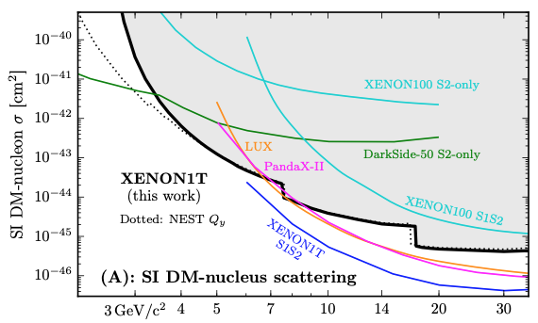
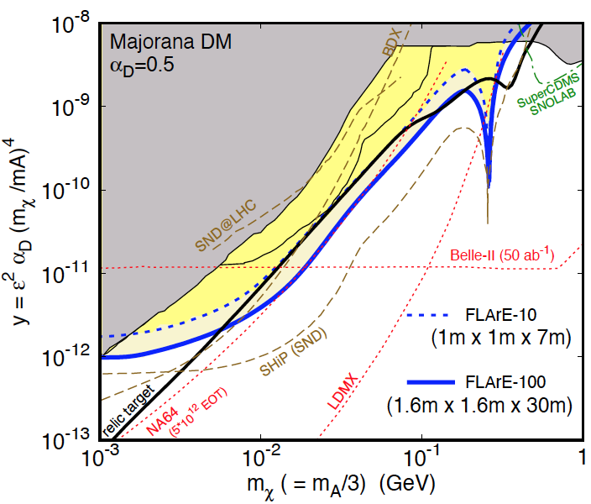
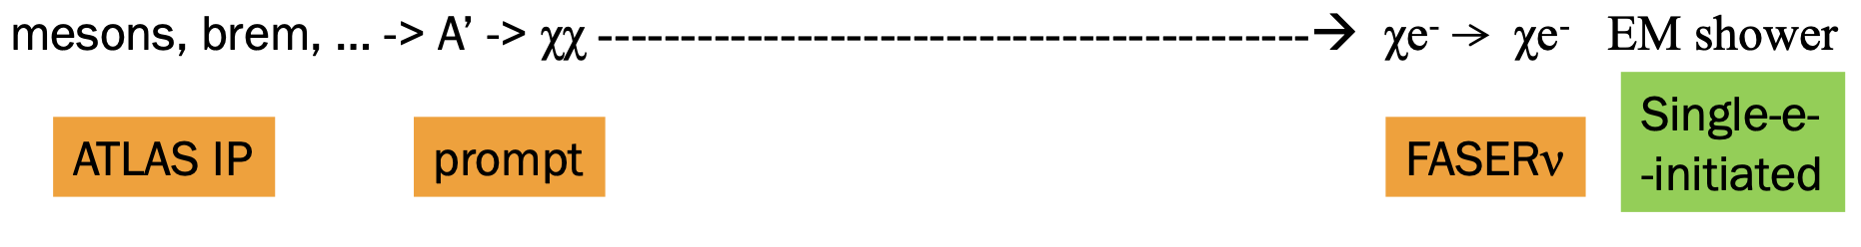
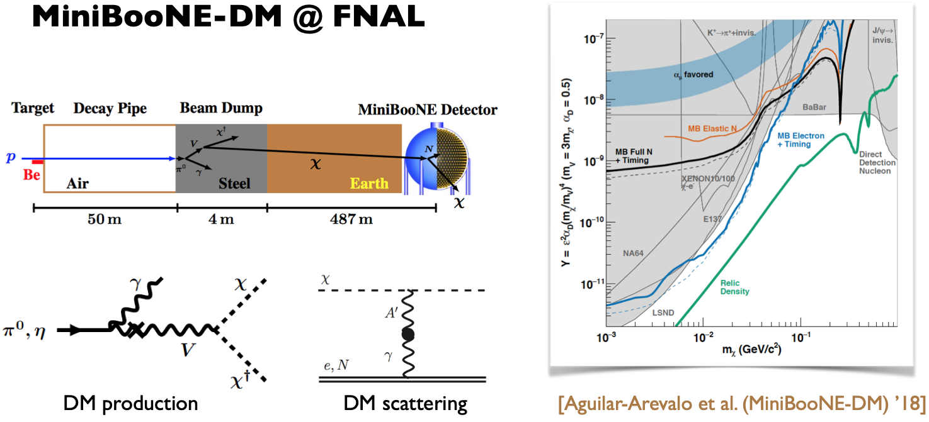
DARK MATTER
Light DM with masses at the GeV scale and below is famously hard to detect.
  Galactic halo velocity ~ 10⁻³ c, so kinetic energy ~ keV or below.
At the LHC, we can produce DM at high energies, look for the resulting DM to scatter in FLArE, Forward Liquid Argon Experiment, a proposed 10 to 100 tonne LArTPC.
FLArE is powerful in the region favored/allowed by thermal freezeout.
Batell, Feng, Trojanowski (2021)

Slide 22
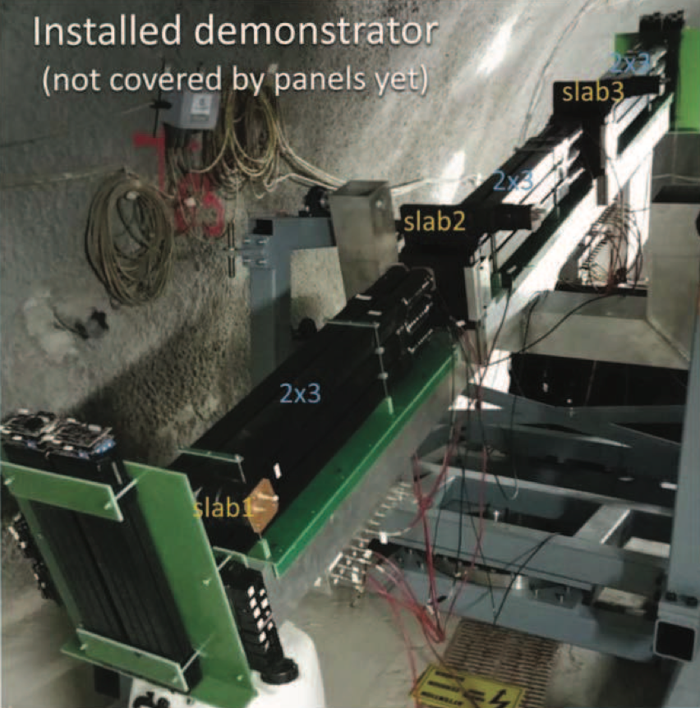
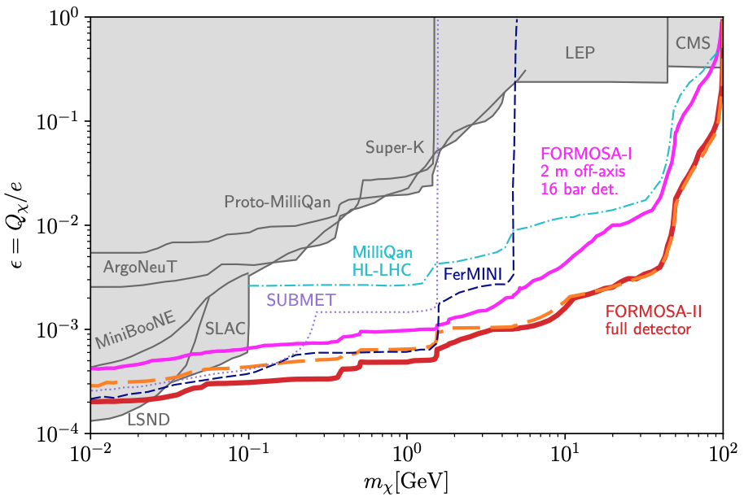
MILLI-CHARGED PARTICLES
A completely generic possibility motivated by dark matter, dark sectors. Currently the target of the MilliQan experiment, located at the LHC near the CMS experiment in a “non-forward” tunnel.
The MilliQan Demonstrator (Proto-MilliQan) already probes new region. Full MilliQan can also run in this location in the HL-LHC era, but the sensitivity may be improved significantly by moving it to the FPF (FORMOSA).
Foroughi-Abari, Kling, Tsai (2020)

Slide 23
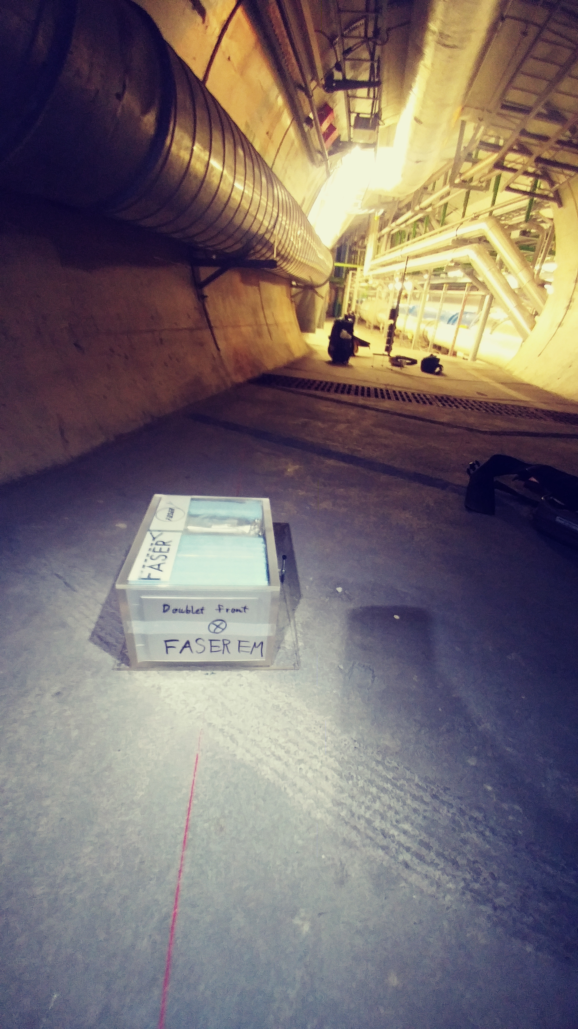
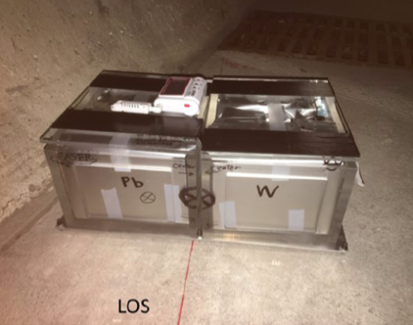
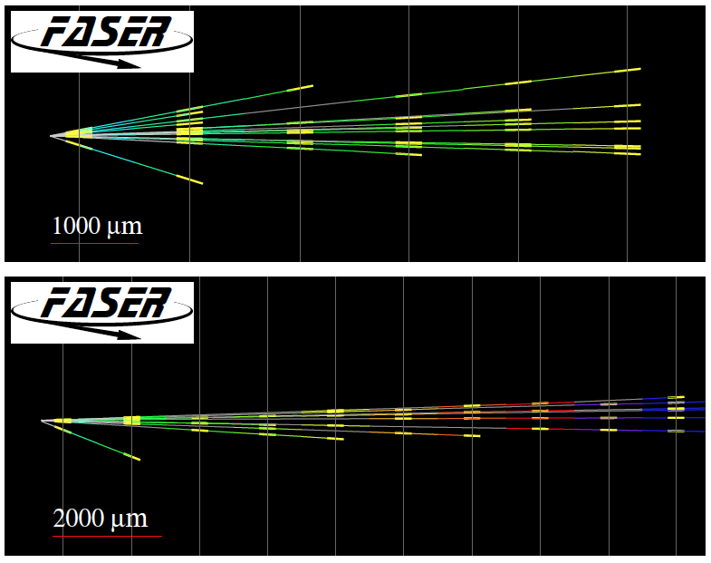
FIRST COLLIDER NEUTRINOS
In 2018 a FASER pilot emulsion detector with 11 kg fiducial mass collected 12.2 fb⁻¹ on the beam collision axis (installed and removed during Technical Stops).
In May 2021, the FASER Collaboration announced the direct detection of 6 candidate neutrinos above 12 expected neutral hadron background events (2.7σ).
At Run 3, FASERν and SND@LHC will open up a completely new field: neutrino physics at the LHC.

Slide 24
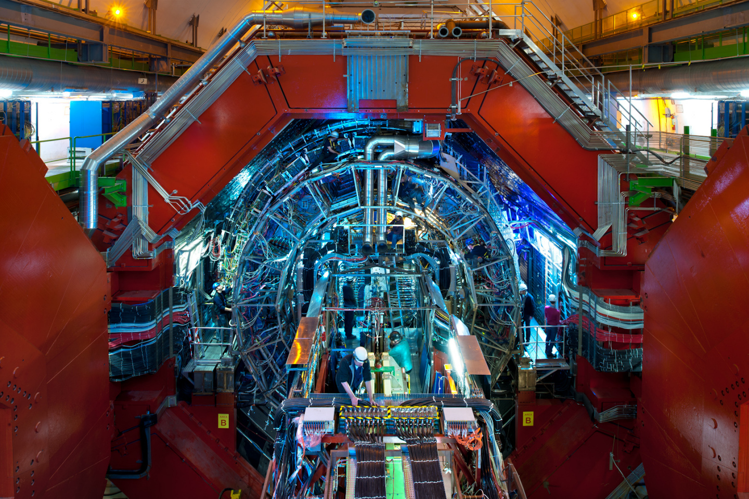
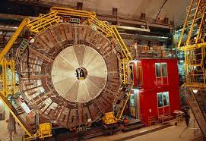
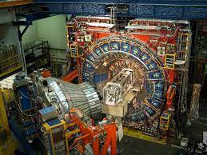
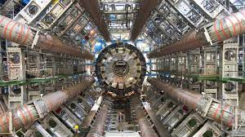
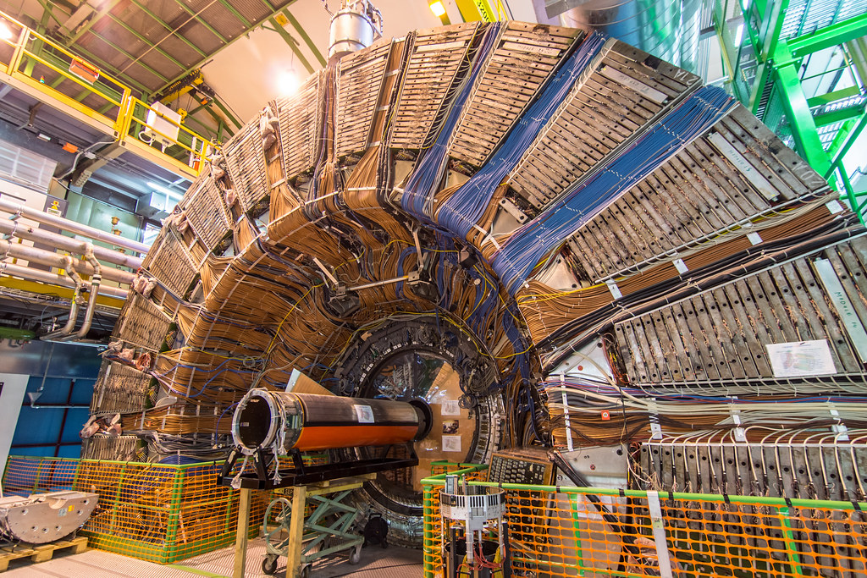
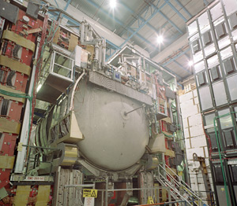
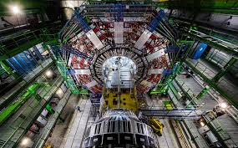
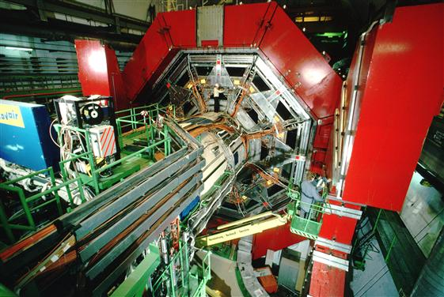

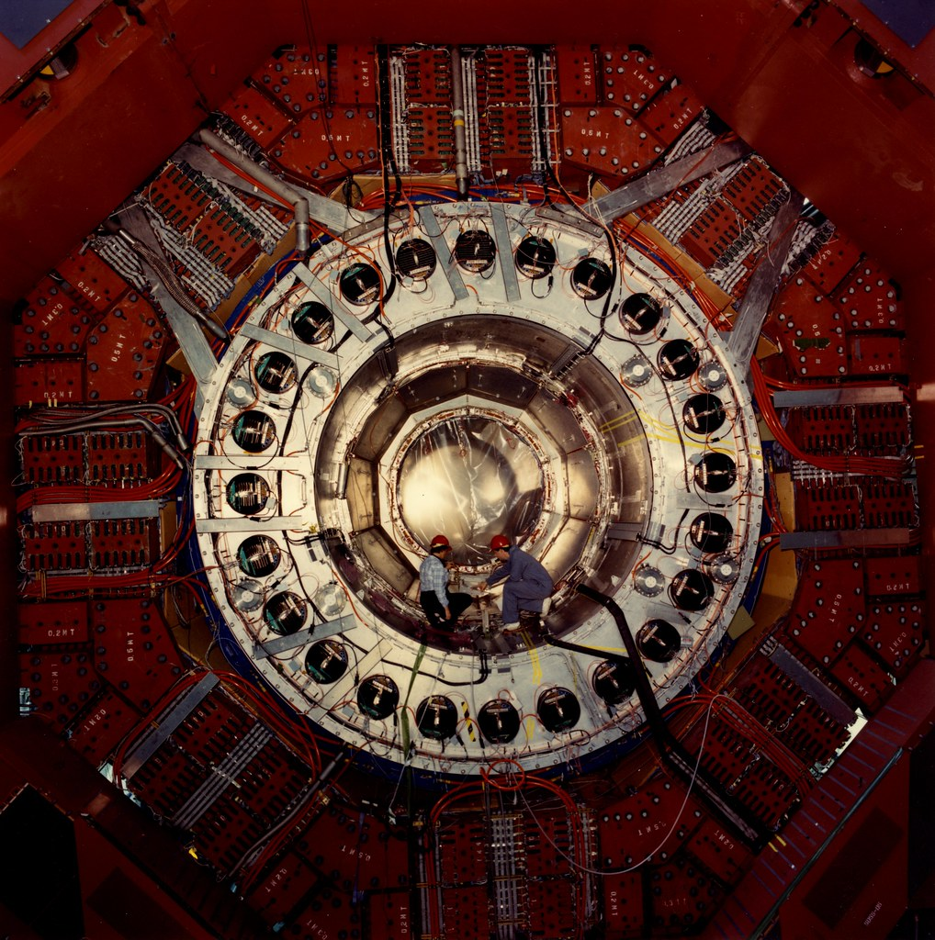
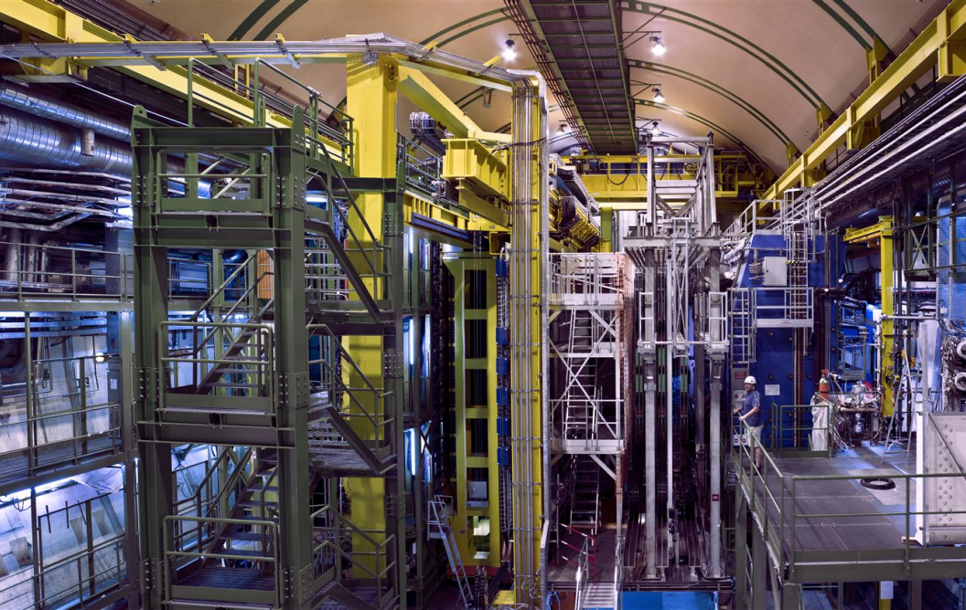
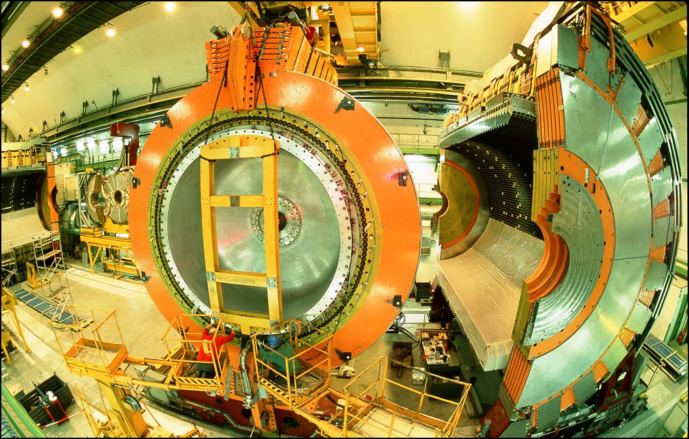
LOCATION, LOCATION, LOCATION
…
ALICE
ALEPH
CDF
FASER Pilot Detector
Suitcase-size, 4 weeks
$0 (recycled parts)
6 candidate neutrinos
ATLAS
DELPHI
D0
CMS
L3
LHCb
SLD
OPAL
All previous
collider detectors
Building-size, decades
~$10⁹
0 candidate neutrinos

Slide 25
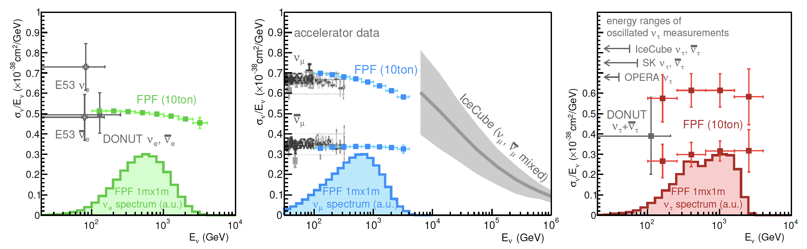
NEUTRINO PHYSICS AT THE FPF
At the FPF, three proposed ~10 tonne detectors FASERν2, Advanced SND, and FLArE will each detect ~100,000 ν_{e} , ~1,000,000 ν_{μ} , and ~1000 ν_{τ} interactions at TeV energies, providing high statistics samples for all three flavors in an energy range that has never been directly explored.
First precision studies of the tau neutrino.
Can also distinguish neutrinos and anti-neutrinos for muon and tau.
FASER White Paper (2022)

