Slide 1



FORWARD-LOOKING
PHYSICS AT THE LHC
Colloquium, Department of Physics, University of Florida
Jonathan Feng, UC Irvine, 14 April 2022

Slide 2
OUTLINE
MOTIVATIONS
FORWARD PHYSICS
FASER
FASERν
FORWARD PHYSICS FACILITY
SUMMARY

Slide 3
MOTIVATIONS

Slide 4
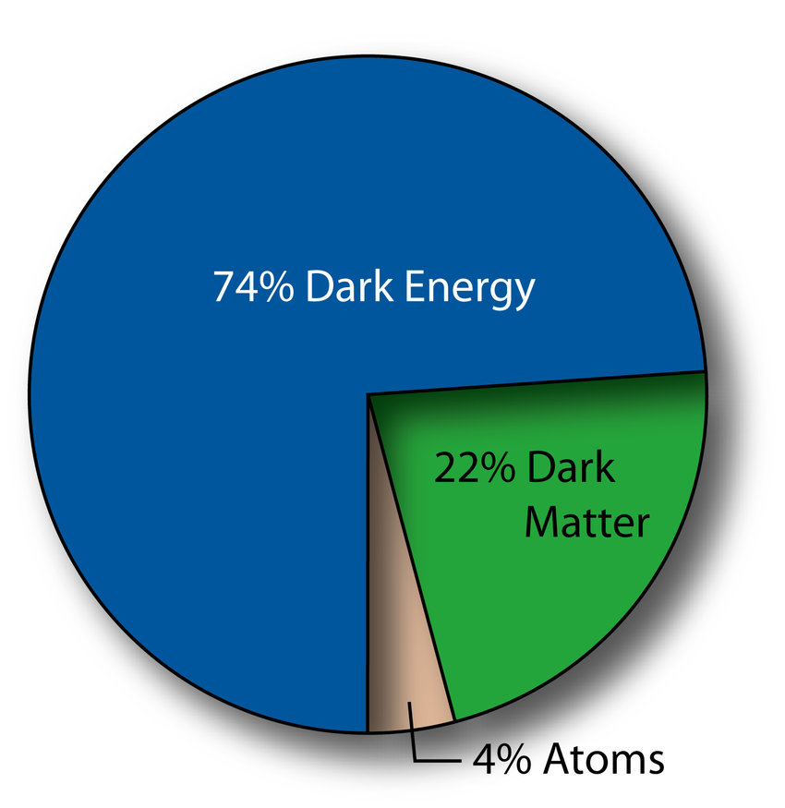
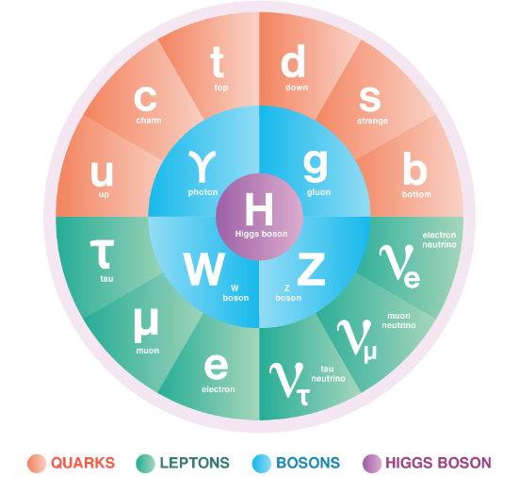
PARTICLE PHYSICS: CURRENT STATUS
This is a critical time in particle physics
  the Higgs boson was discovered in 2012, completing the standard model
  but many fascinating problems remain: dark matter, dark energy, matter–anti-matter asymmetry, strong CP problem, neutrino masses, grand unification, gauge and flavor hierarchy problems, ...

Slide 5
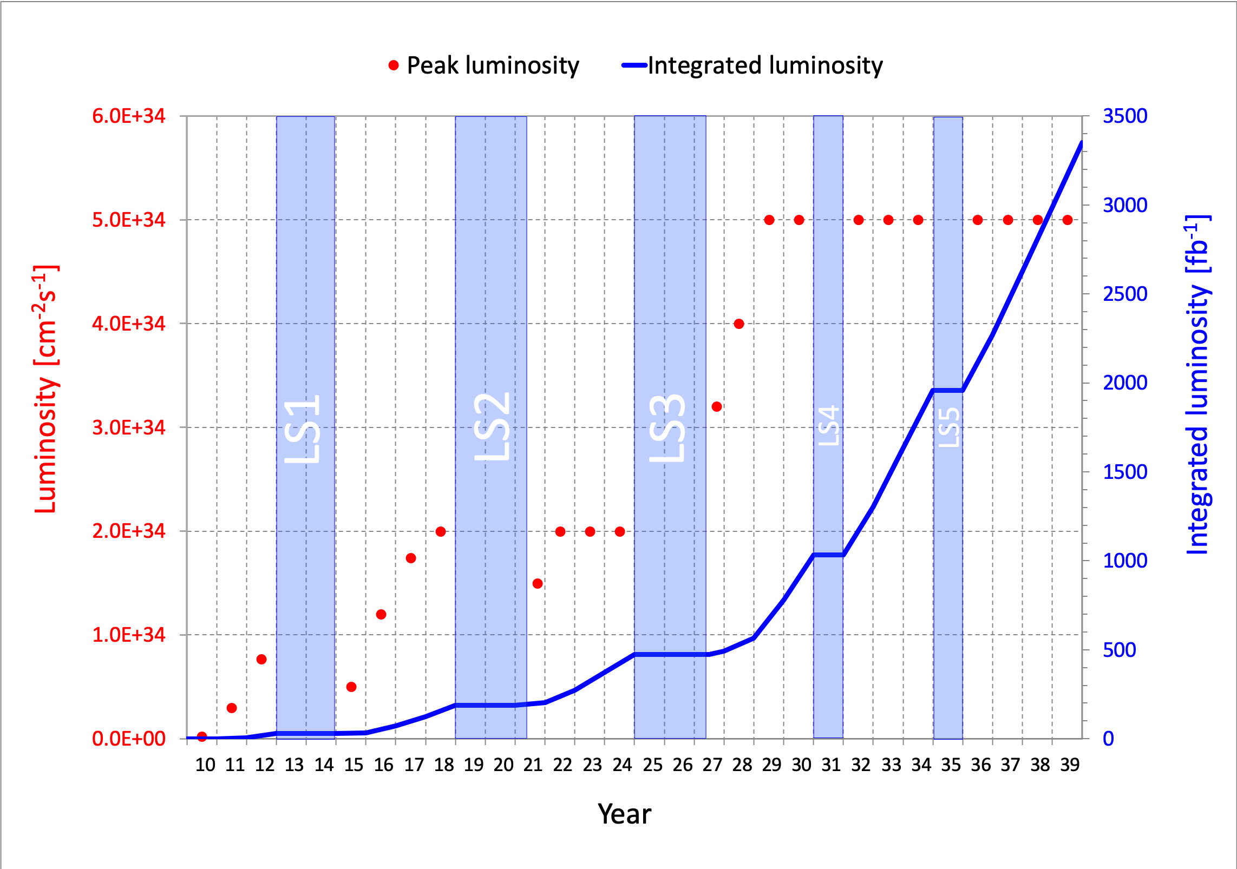
PARTICLE PHYSICS: CURRENT STATUS
At the energy frontier, the Large Hadron Collider at CERN is currently in Long Shutdown 2, but will start up again in a few months and run until ~2040.
What can we do to enhance the prospects for discovering new particles and shedding light on the many outstanding problems?

Slide 6
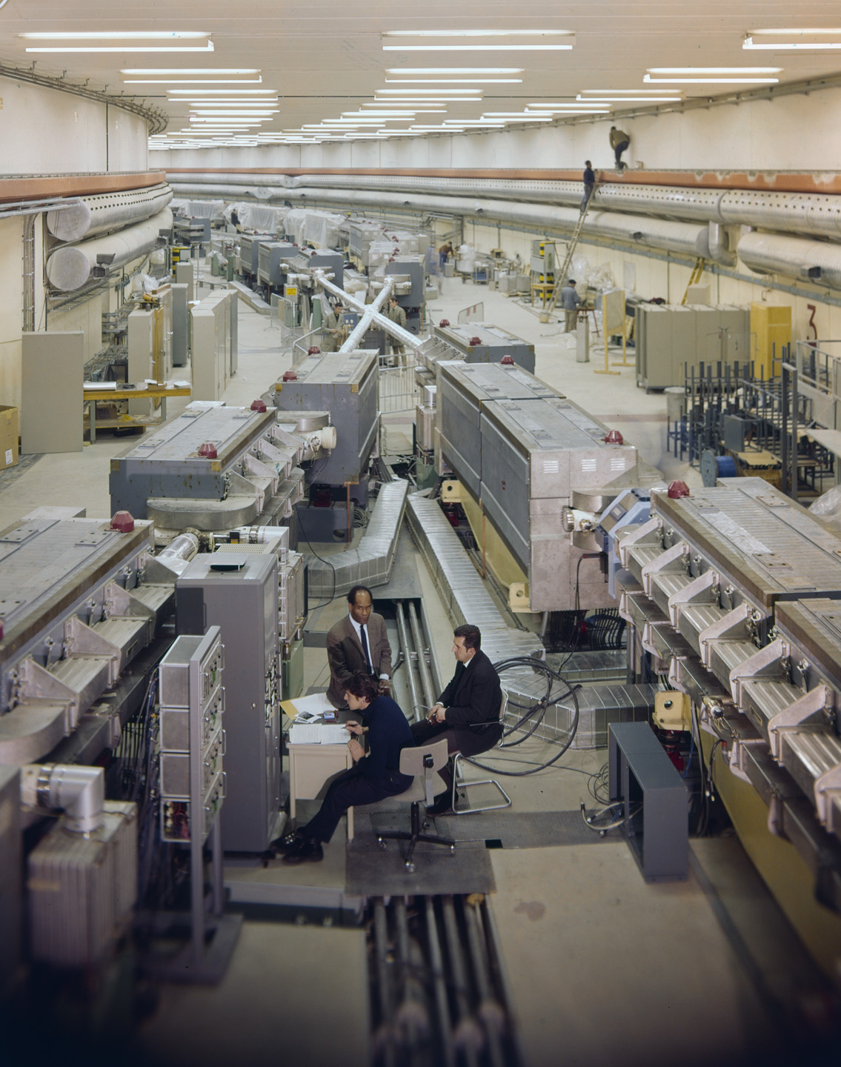
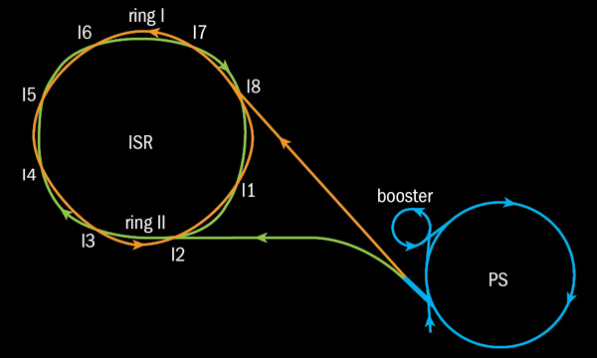
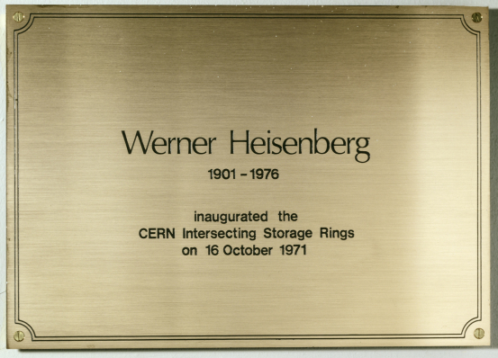
SOME HISTORY
Sometimes to look forward, it pays to first look back.
Last year was the 50th anniversary of the birth of hadron colliders.
In 1971, CERN’s Intersecting Storage Rings (ISR), with a circumference of ~1 km, collided protons with protons at center-of-mass energy 30 GeV.

Slide 7
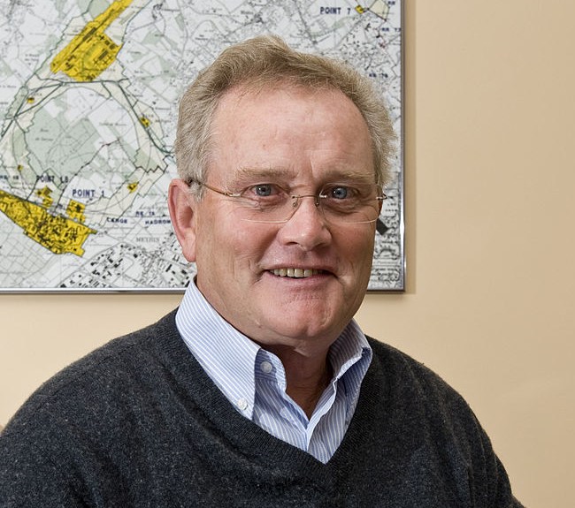
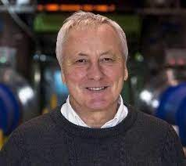
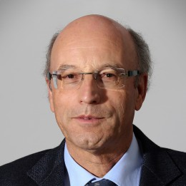
ISR’S LEGACY
On the occasion of the 50th anniversary of CERN’s ISR, there have been many fascinating articles and talks by eminent physicists looking back on the ISR’s legacy.
  “Enormous impact on accelerator physics, but sadly little effect on particle physics.” – Steve Myers, talk at “The 50th Anniversary of Hadron Colliders at CERN,” October 2021.
  “There was initially a broad belief that physics action would be in the forward directions at a hadron collider…. It is easy to say after the fact, still with regrets, that with an earlier availability of more complete… experiments at the ISR, CERN would not have been left as a spectator during the famous November revolution of 1974 with the J/ψ discoveries at Brookhaven and SLAC .” – Lyn Evans and Peter Jenni, “Discovery Machines,” CERN Courier (2021).
Bottom line: The collider was creating new forms of matter, but the detectors focused on the forward region (along the beamline) and missed them.

Slide 8

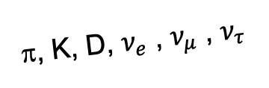
AN OBVIOUS QUESTION
Are we missing opportunities in a similar way at the LHC?
In contrast to the ISR days, there is now broad belief that the most interesting physics is at large angles relative to the beamline. But are we now missing revolutionary discoveries in the forward direction?
By far the largest fluxes of high-energy light particles (e.g., pions, kaons, D mesons, neutrinos of all flavors) are in the far-forward direction.
This may also be true of new particles if they are light: dark photons, axion-like particles, millicharged particles, dark matter, …
A’, a, mCPs, DM, …
π, K, D, $ν_{e}$ , $ν_{μ}$ , $ν_{τ}$

Slide 9

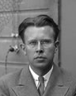
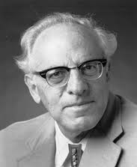
THE NEW PARTICLE LANDSCAPE
Particle
Colliders
Mass
MeV
GeV
TeV
1
Already
Discovered
Strongly Interacting
Heavy Particles
Interaction Strength
New Targets of Small Experiments
Traditional Targets
of Big Science
10⁻³
Weakly Interacting
Light Particles
Impossible to
Discover
10⁻⁶

Slide 10
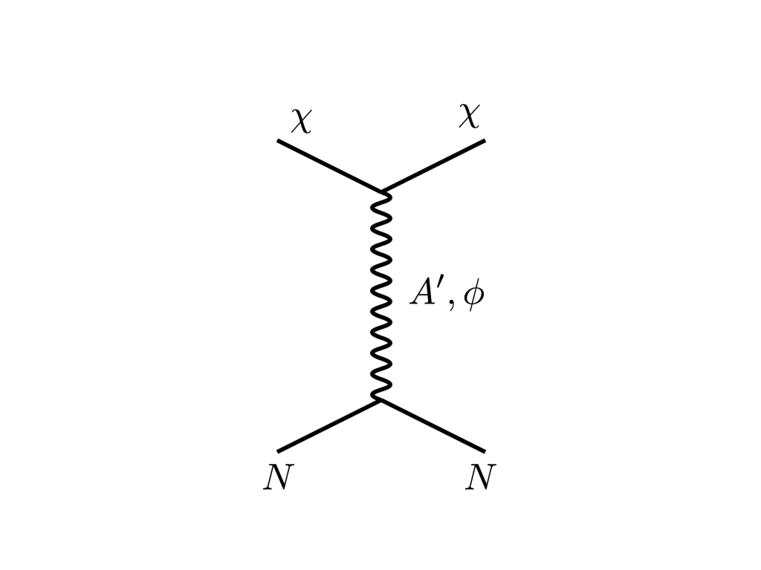





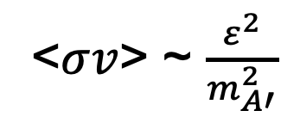
THE THERMAL RELIC LANDSCAPE
Particle
Colliders
Mass
MeV
GeV
TeV
1
Already
Discovered
Strongly Interacting
Heavy Particles
Too Little to be
Dark Matter
$$e$$
DM
$$ε$$
$$A’$$
$$ε$$
Interaction Strength
Just Right to
be Dark Matter
10⁻³
DM
$$e$$
<$σv$> ~ $\frac{ε^{2}}{m_{A′}^{2}}$
Weakly Interacting
Light Particles
Impossible to
Discover
10⁻⁶
Too Much to be
Dark Matter
“The WIMPless Miracle”
Feng, Kumar (2008)
Boehm, Fayet (2003)
Pospelov, Ritz, Voloshin (2007)

Slide 11

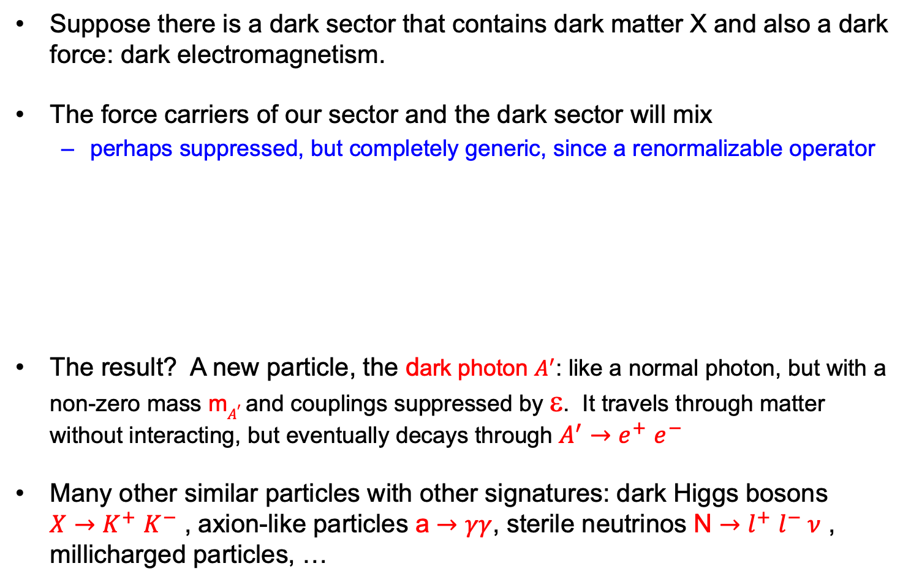

SPECIFIC EXAMPLES
Suppose there is a dark sector that contains dark matter X and also a dark force: dark electromagnetism.
The force carriers of our sector and the dark sector will mix
  perhaps suppressed, but completely generic, since a renormalizable operator
The result? A new particle, the dark photon $A^{′}$: like a normal photon, but with a non-zero mass m$A^{′}$ and couplings suppressed by ε. It travels through matter without interacting, but eventually decays through $A^{′}{→e}^{+}e^{−}$
Many other similar particles with other signatures: dark Higgs bosons $X{→K}^{+}K^{−}$ , axion-like particles a $→γγ$, sterile neutrinos N ${→l}^{+}l^{−} ν$ , millicharged particles, …
SM
EM
Dark Sector
EM, X
A
$$εF_{μν}F_{D}^{μν}$$
A_{D}
Holdom (1986)

Slide 12
FORWARD PHYSICS

Slide 13
SEARCHES FOR NEW LIGHT PARTICLES
If new particles are light and weakly interacting, the existing big LHC detectors are perfectly designed NOT to see them.
Existing detectors are designed to find new heavy particles. These particles are produced at low velocities and decay roughly isotropically.
But new light particles are mainly produced in the decays of light particles: π, η, K, D and B mesons. These are mainly produced along the beamline, and so the new particles disappear through the holes that let the beams in.
Clearly we need a detector to exploit the “wasted” σ_{inel} ~ 100 mb and cover these “blind spots” in the forward region. If we go far enough away, the proton beams are bent by magnets (it’s a circular collider!), whereas the new light particles will go straight.
A’, a, mCPs, DM, …
π, K, D, $ν_{e}$ , $ν_{μ}$ , $ν_{τ}$

Slide 14
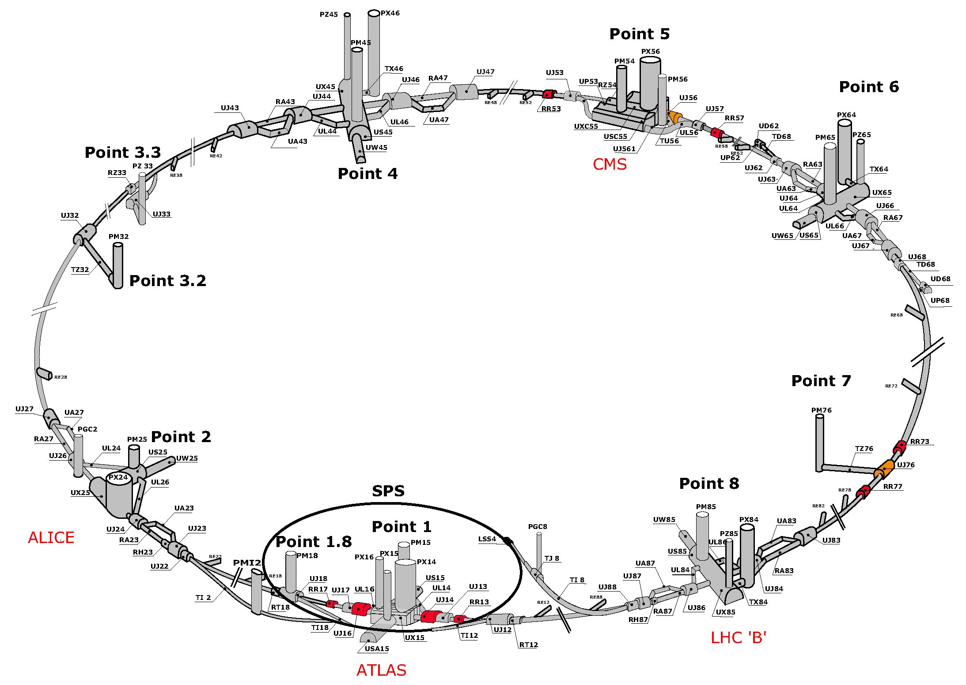
MAP OF LHC
$$A^{′}$$
$$A^{′}$$
!!!

Slide 15
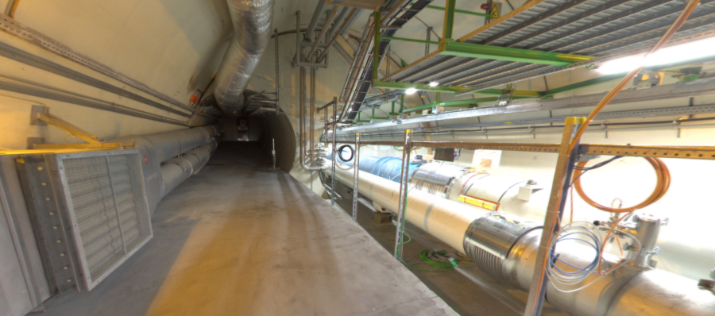


THE FAR-FORWARD REGION
New particle A’ is produced at ATLAS, travels along the beam collision axis and through 100 m of rock, and finally decays in tunnel TI12, 480 m from ATLAS
$π^{0}$→ $γ$A’
→ A’ →
A’ → $e^{+}e^{−}$
TI12 near UJ12
UJ12
The view in UJ12 looking west (2019)
TI12
$$e^{+}$$
$e^{−}$
Beam collision axis
LHC beamline

Slide 16
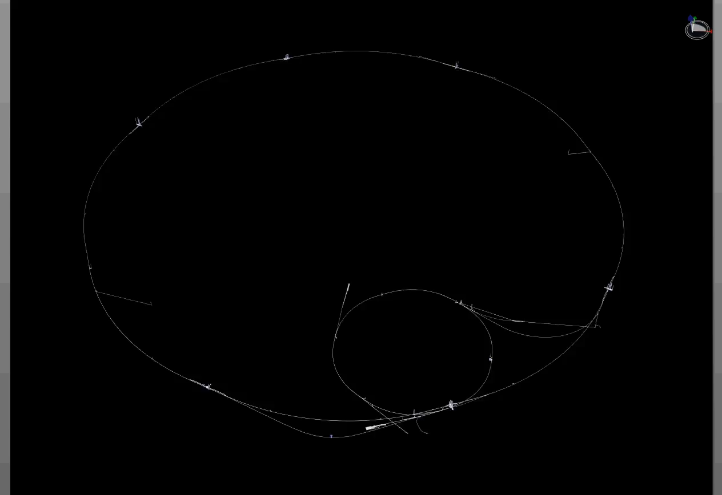
PARTICLE PATH FROM ATLAS TO TI12
Dougherty, CERN Integration (2019)

Slide 17
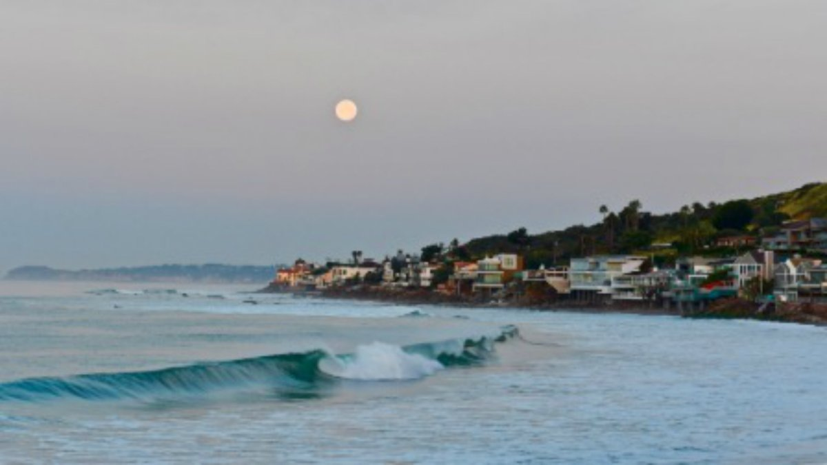
HOW BIG DOES THE DETECTOR HAVE TO BE?
Momentum:
Space:
250 MeV
1 TeV
12 cm
480 m
The opening angle is 0.2 mrad (η ~ 9); cf. the moon (7 mrad). Most of the signal passes through 1 sheet of paper at 480 m.
TeV dark photons (or any other new particles produced in π, η, K, D, B decay) are far more collimated than shown below, motivating a new, small, fast, cheap experiment at the LHC.

Slide 18


Slide 19
FASER TIMELINE
September 2017: Initial proposal (Feng, Galon, Kling, Trojanowski)
July 2018: Submitted LOI to CERN LHCC
October 2018: Approval from ATLAS SCT and LHCb Collaborations for use of spare detector modules
November 2018: Submitted Technical Proposal to LHCC
November 2018 – January 2019: Experiment funded by the Heising-Simons and Simons Foundations
March 2019: FASER approved as 8th LHC detector by CERN
December 2019: FASERν approved as 9th LHC detector by CERN
March 2021: FASER fully installed, commissioning of the detector begins
May 2021: FASERν announces first candidate collider neutrinos
Mid-2022: FASER and FASERν begin collecting data in Run 3

Slide 20
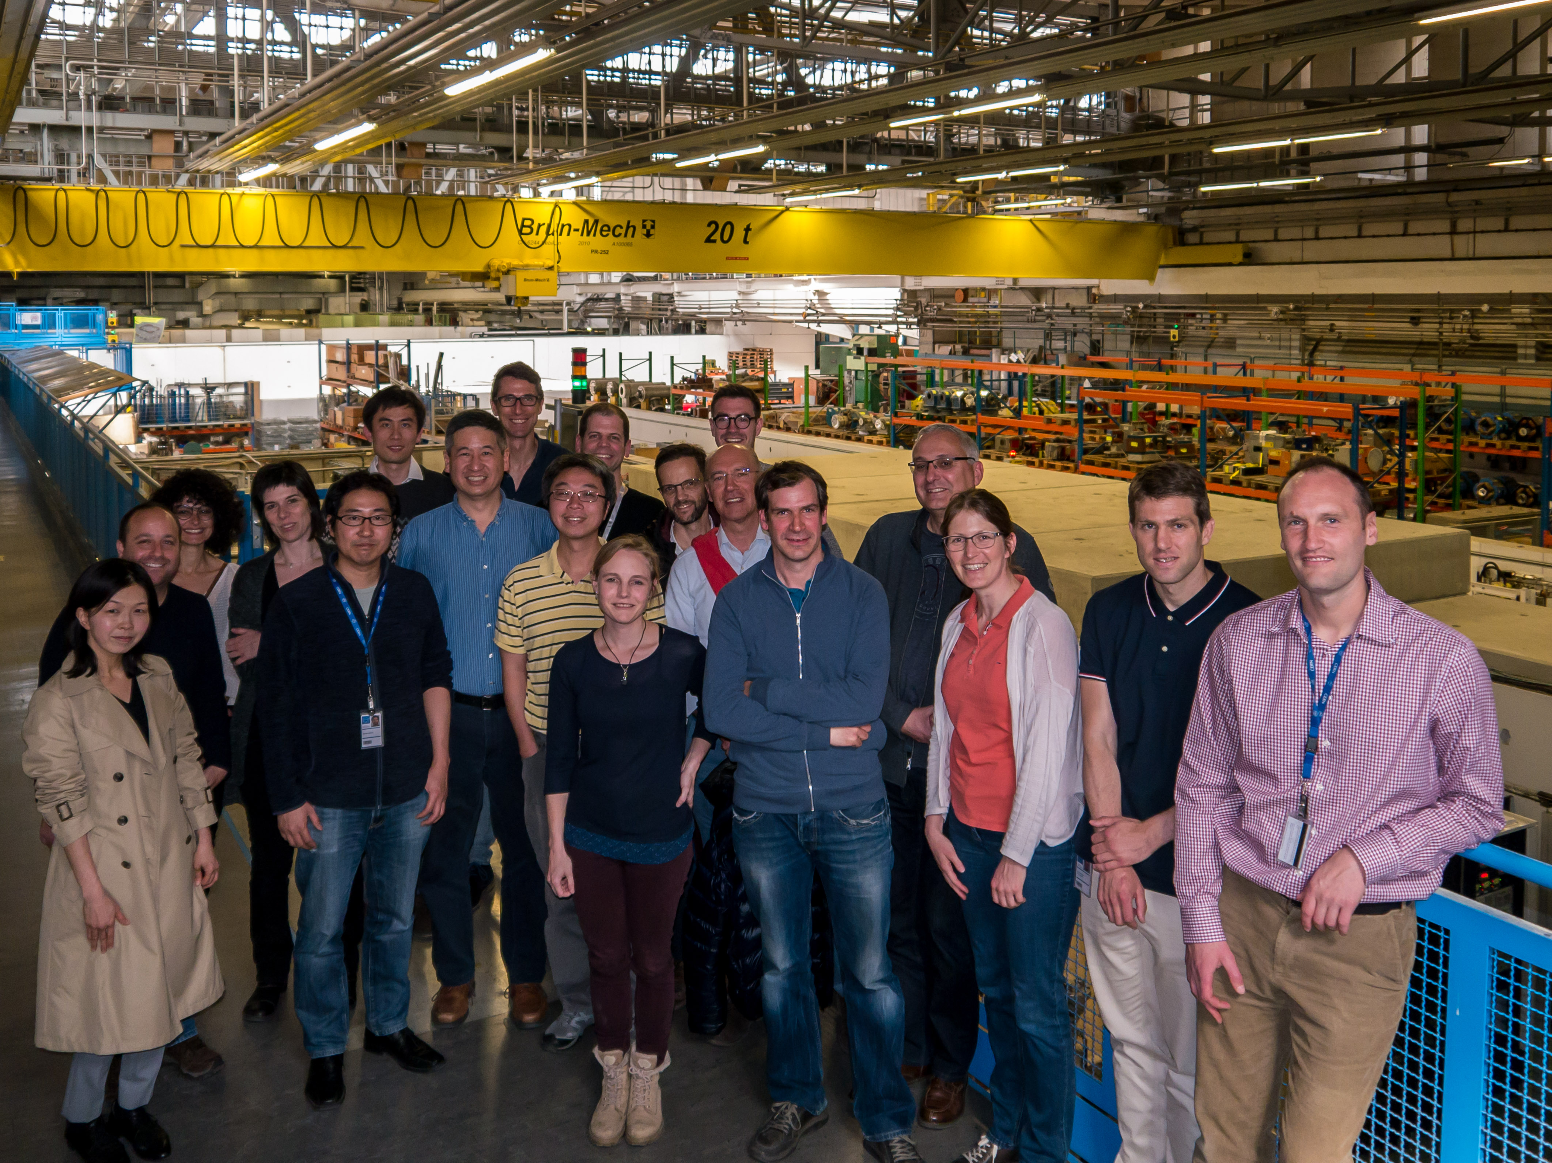
FIRST FASER COLLABORATION MEETING

Slide 21











FASER COLLABORATION TODAY
75 collaborators, 22 institutions, 9 countries

Slide 22
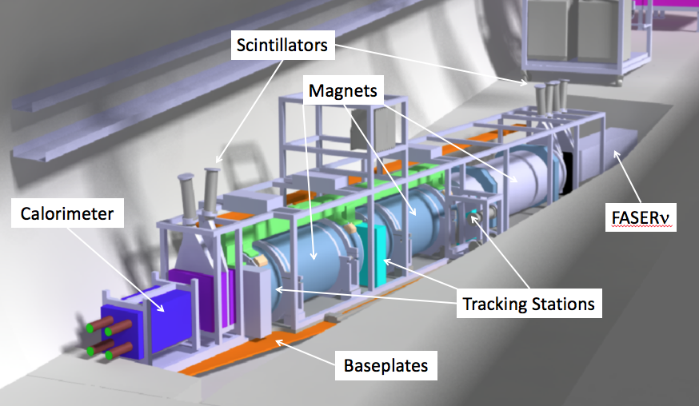
THE FASER DETECTOR
Nothing incoming and 2 ~TeV, opposite-sign charged tracks pointing back to the ATLAS IP: a “light shining through (100 m-thick) wall” experiment.
Scintillators veto incoming charged tracks (muons), magnets split the charged tracks, which are detected by tracking stations and a calorimeter.
LLP
ν
e⁺
e⁻

Slide 23
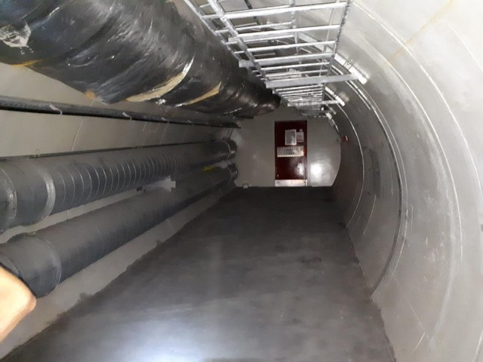
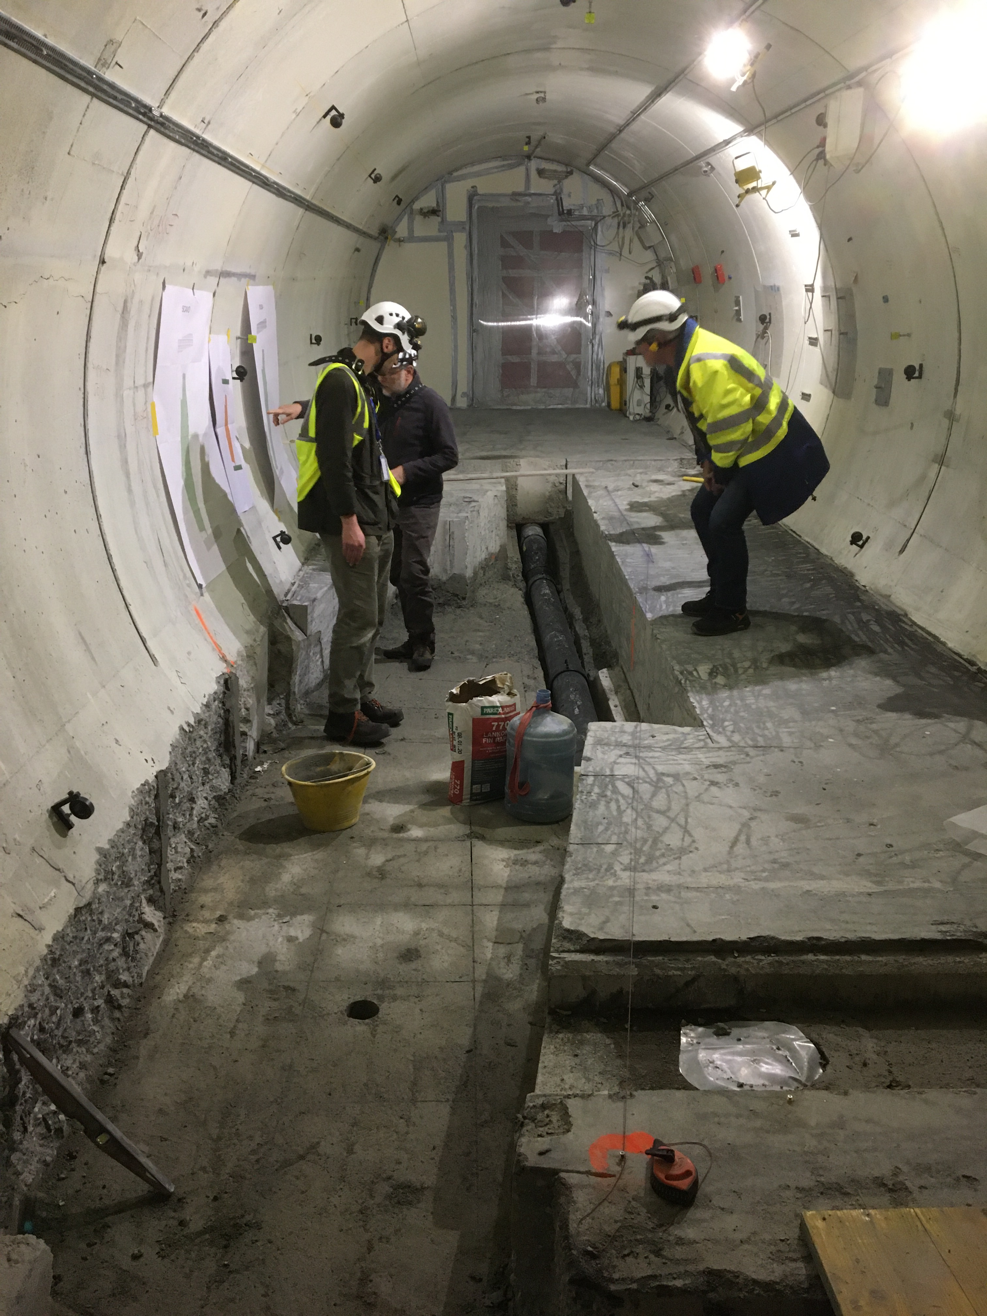
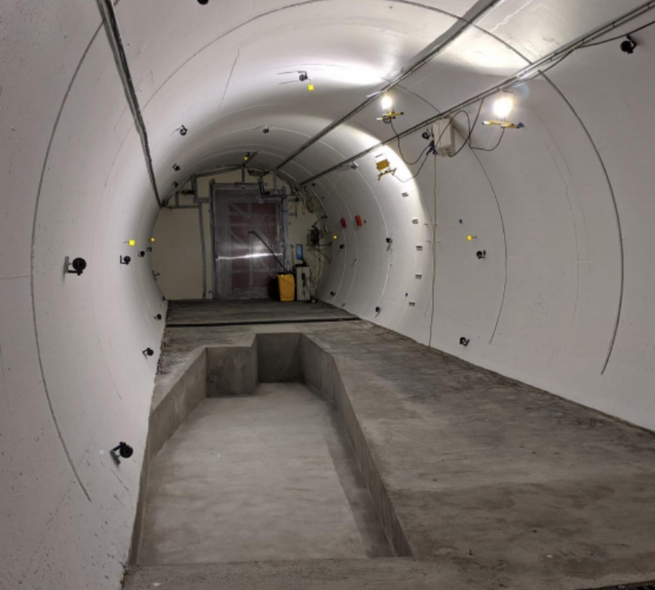
FASER IN TUNNEL TI12
The beam collision axis was located to mm accuracy by the CERN survey department. To place FASER on this axis, a trench was required to lower the floor by 46 cm.
The trench was completed by an Italian firm just hours before COVID shut down CERN in Spring 2020.
2019
Spring 2020
Summer 2020

Slide 24
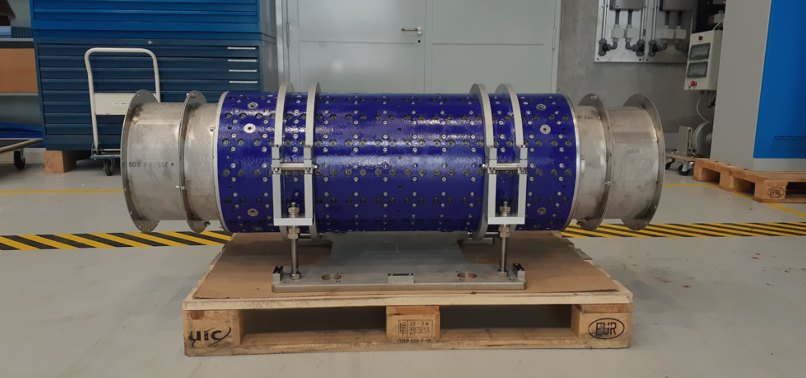
MAGNETS
FASER includes 3 magnets: 1.5 m, 1 m, and 1m long.
0.57 T permanent dipoles with an inner diameter of 20 cm, require little maintenance.
Constructed by the CERN magnet group.

Slide 25
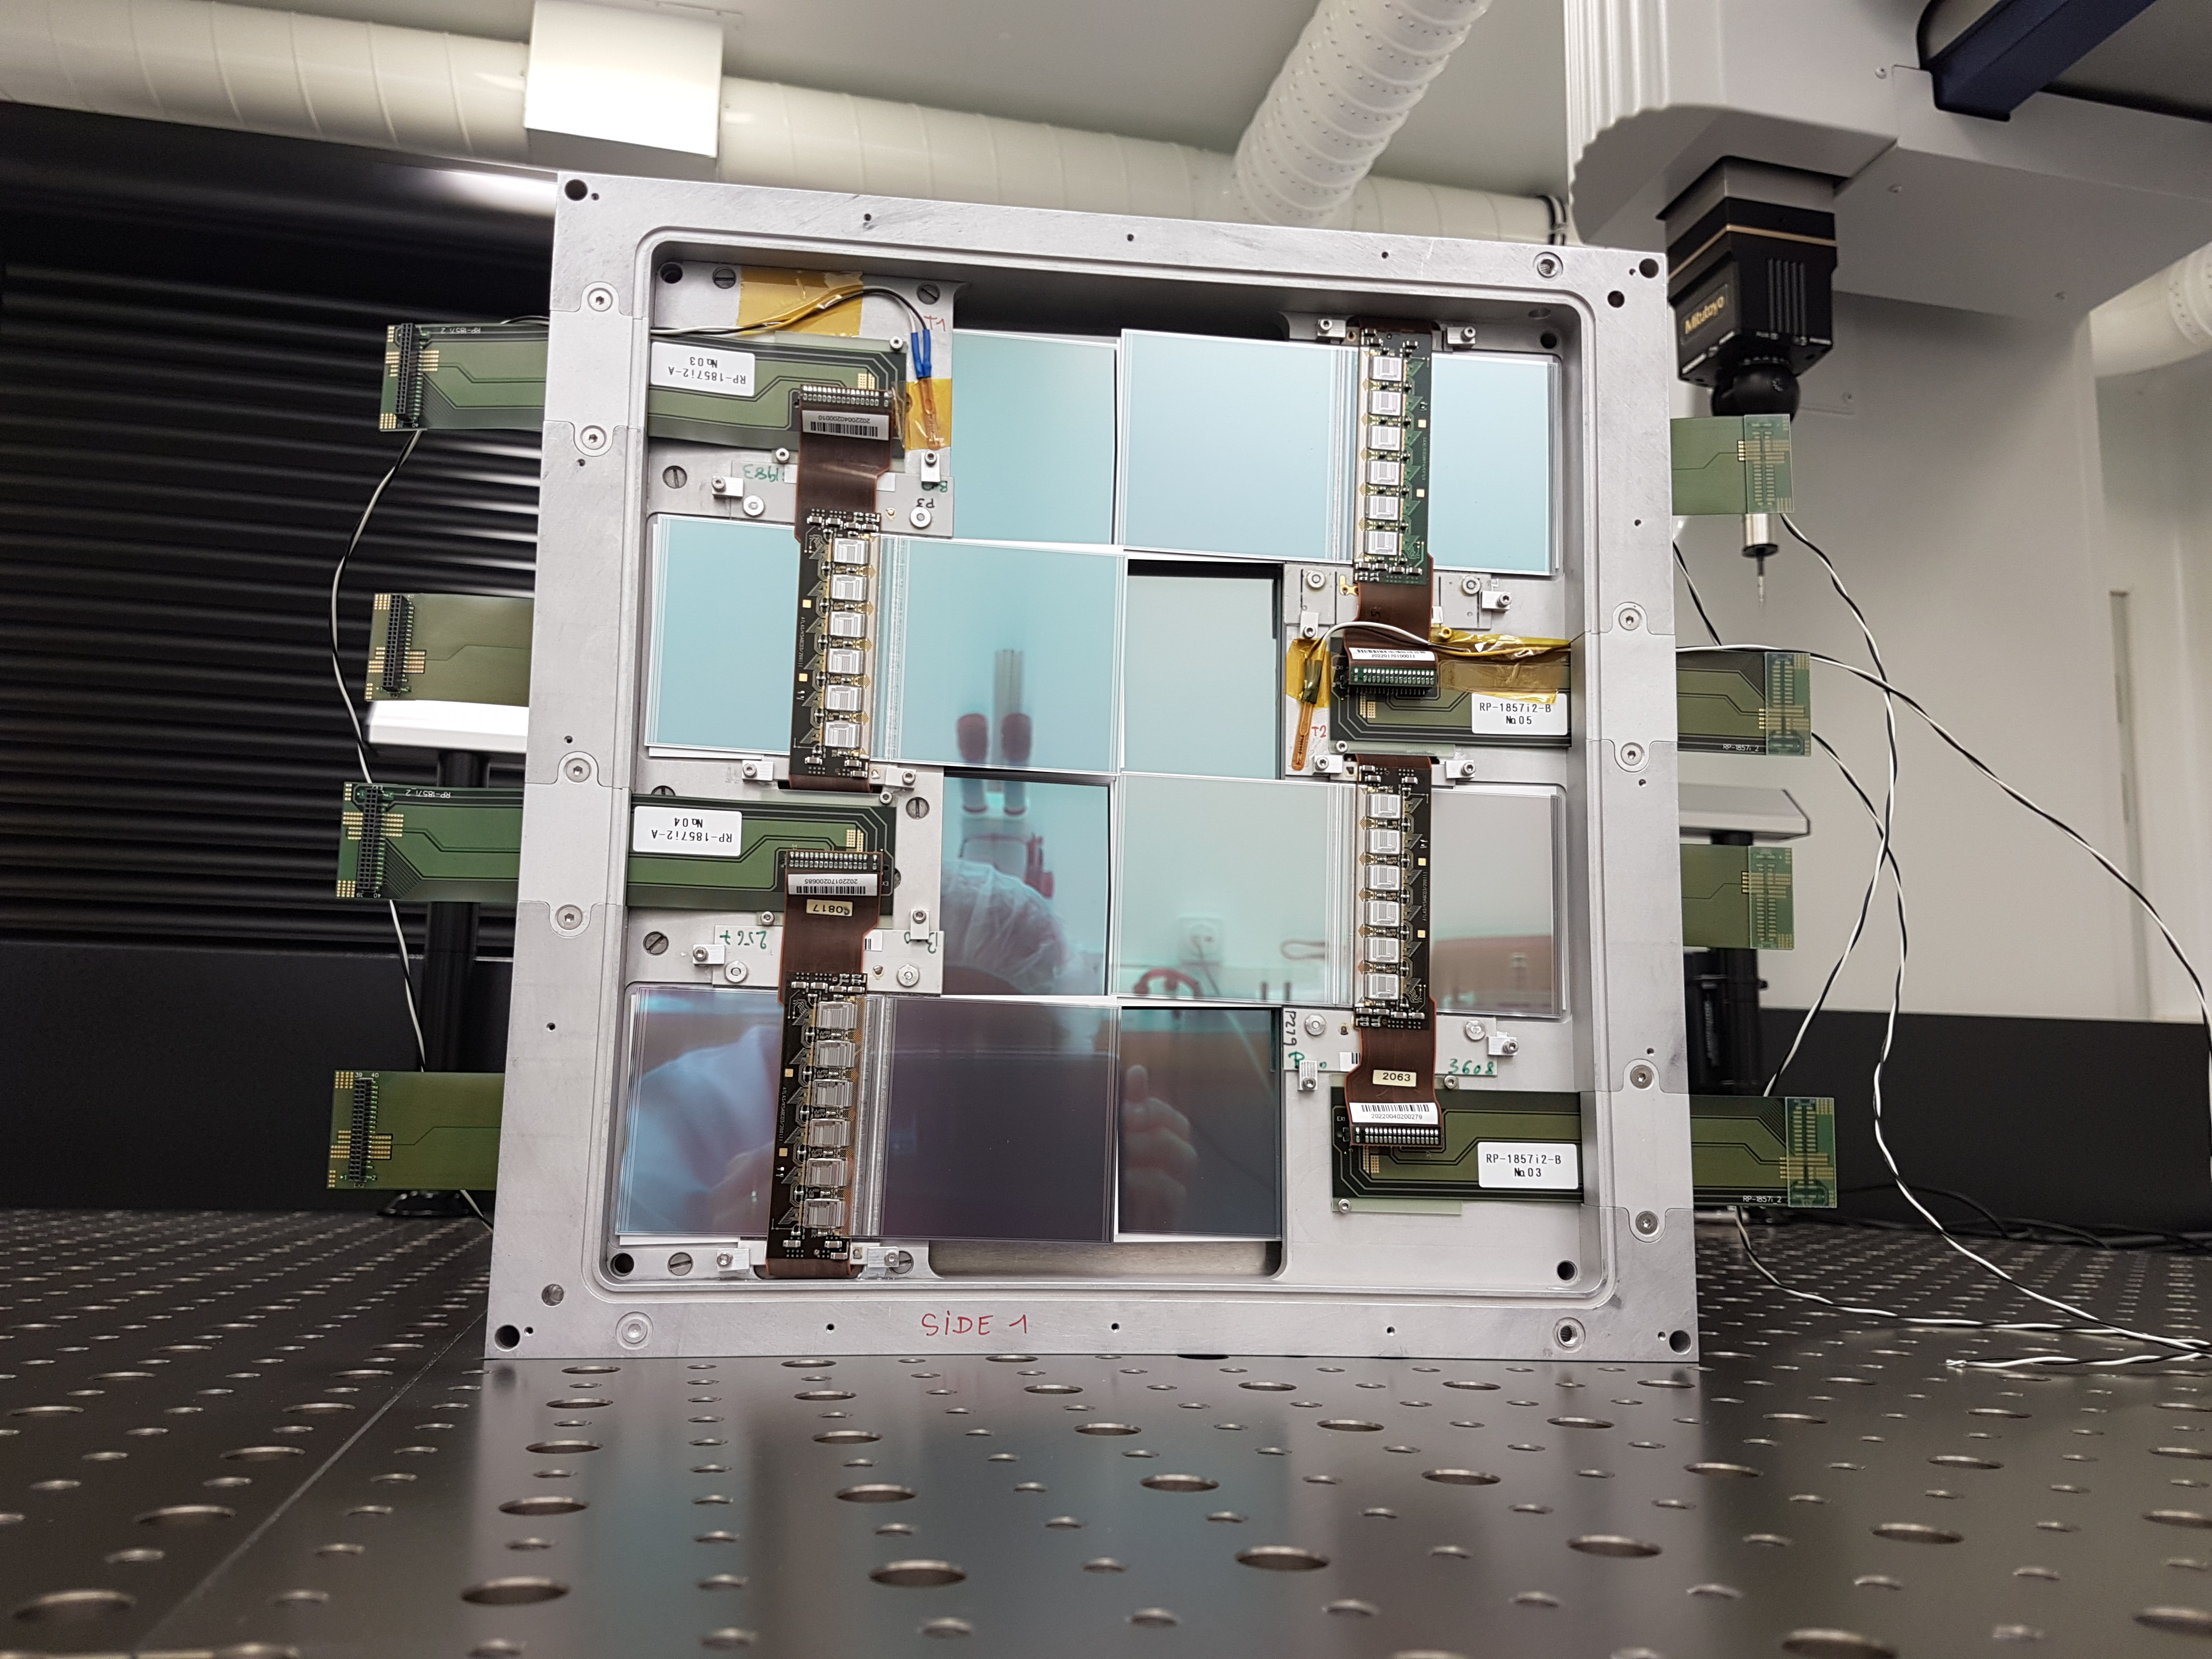
TRACKERS
ATLAS tracker consists of ~3000 SCT modules.
~300 spares were never used. ~100 of these were generously donated to FASER: 8 modules x 3 tracking planes x 4 tracking stations at FASER.

Slide 26
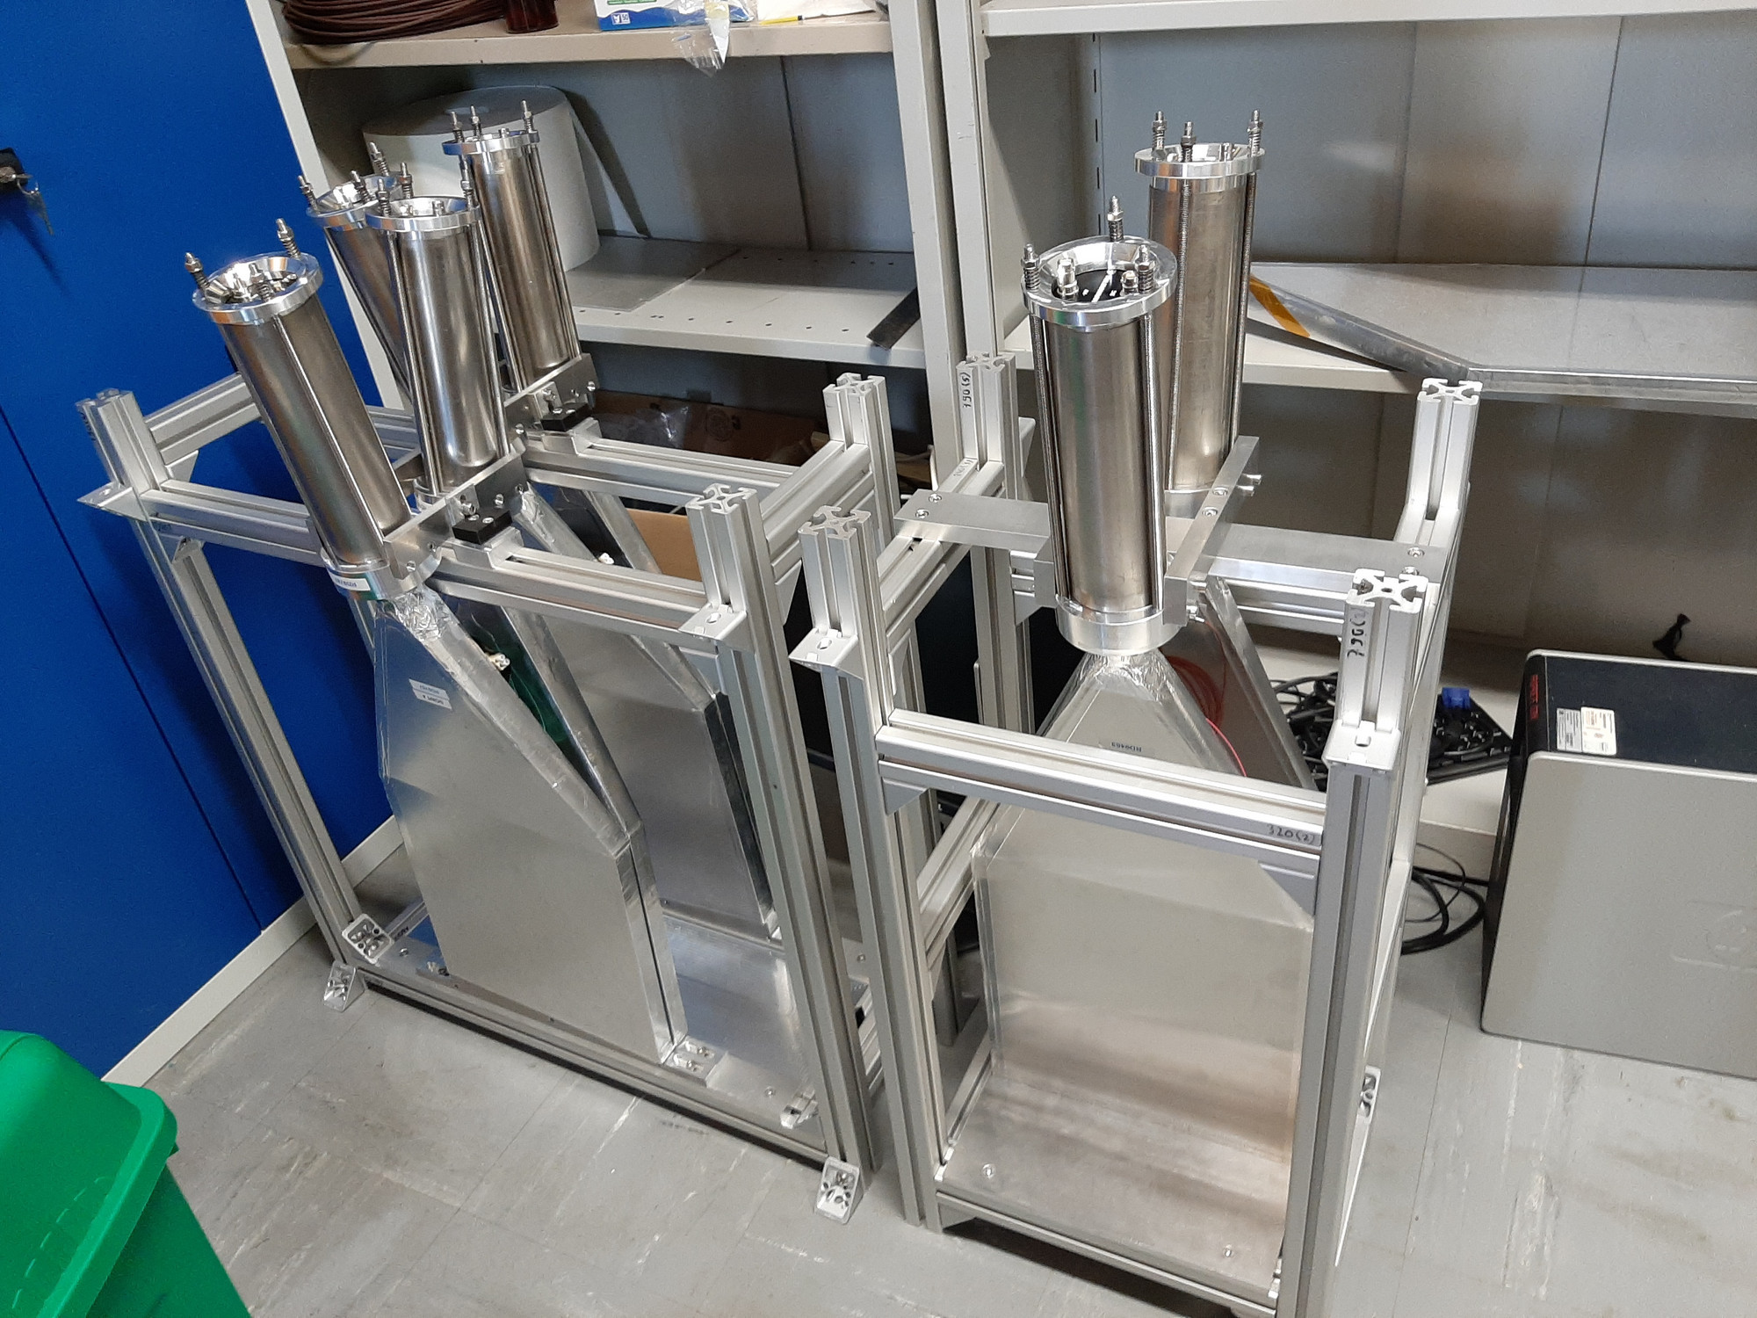
SCINTILLATORS
4 veto scintillators, each 2cm x 30cm x 30cm, upstream of the detector. Efficiency of each one is > 99.99%, makes muon background negligible.
Additional beam backgrounds, simulated with FLUKA and validated with pilot detectors in 2018, are also expected to be negligible.

Slide 27
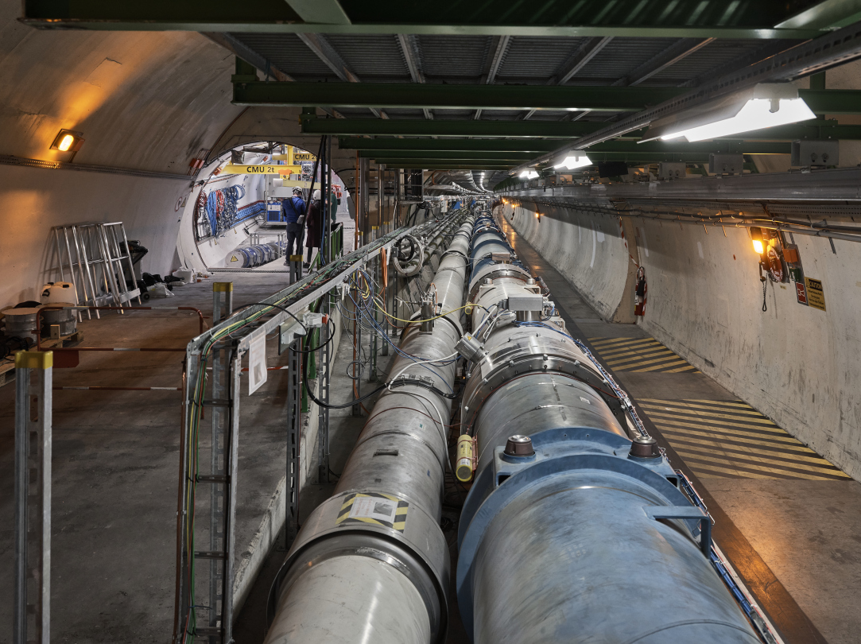
FASER CURRENT STATUS

Slide 28
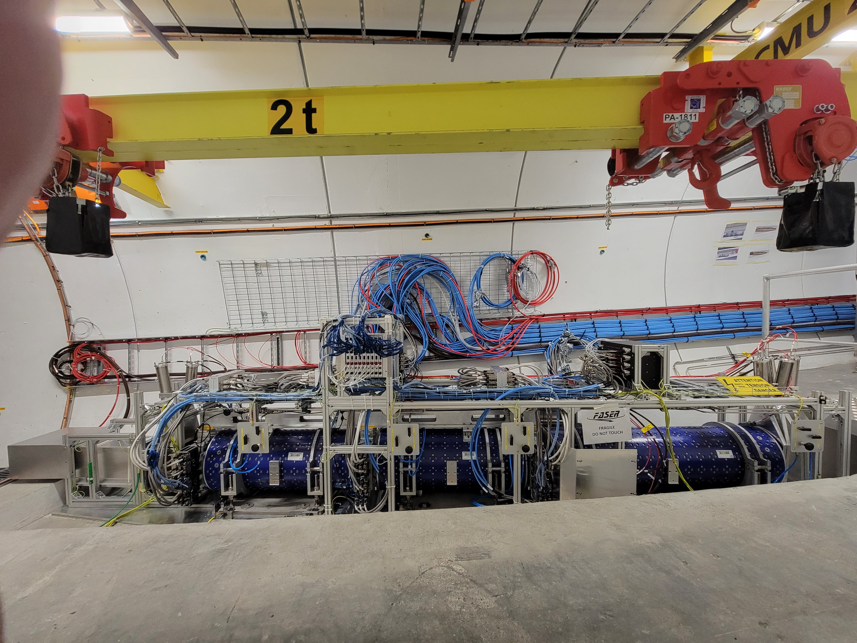
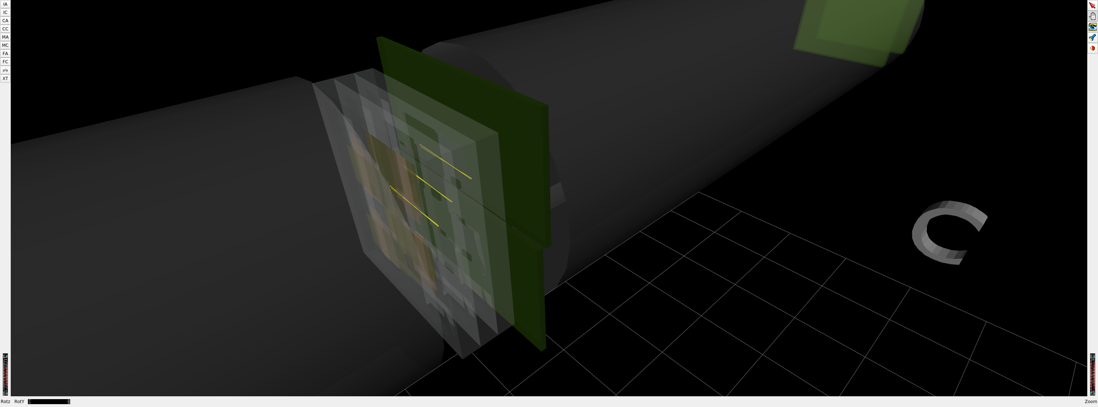
FASER CURRENT STATUS
1st Cosmic Ray
18 March 2021

Slide 29
DARK PHOTON SENSITIVITY REACH
FASER
FASER probes new parameter space with just 1 fb⁻¹ starting in 2022.
Without upgrade, HL-LHC extends (Luminosity*Vol) by factor of 3000 – could detect as many as 10,000 dark photons.
Possible upgrade to FASER 2 (R=1m, L=20m) extends (Luminosity*Vol) by factor of ~10⁶ – could detect as many as 3 x 10⁶ dark photons.
_{FASER Collaboration (2018)}

Slide 30

ν

Slide 31
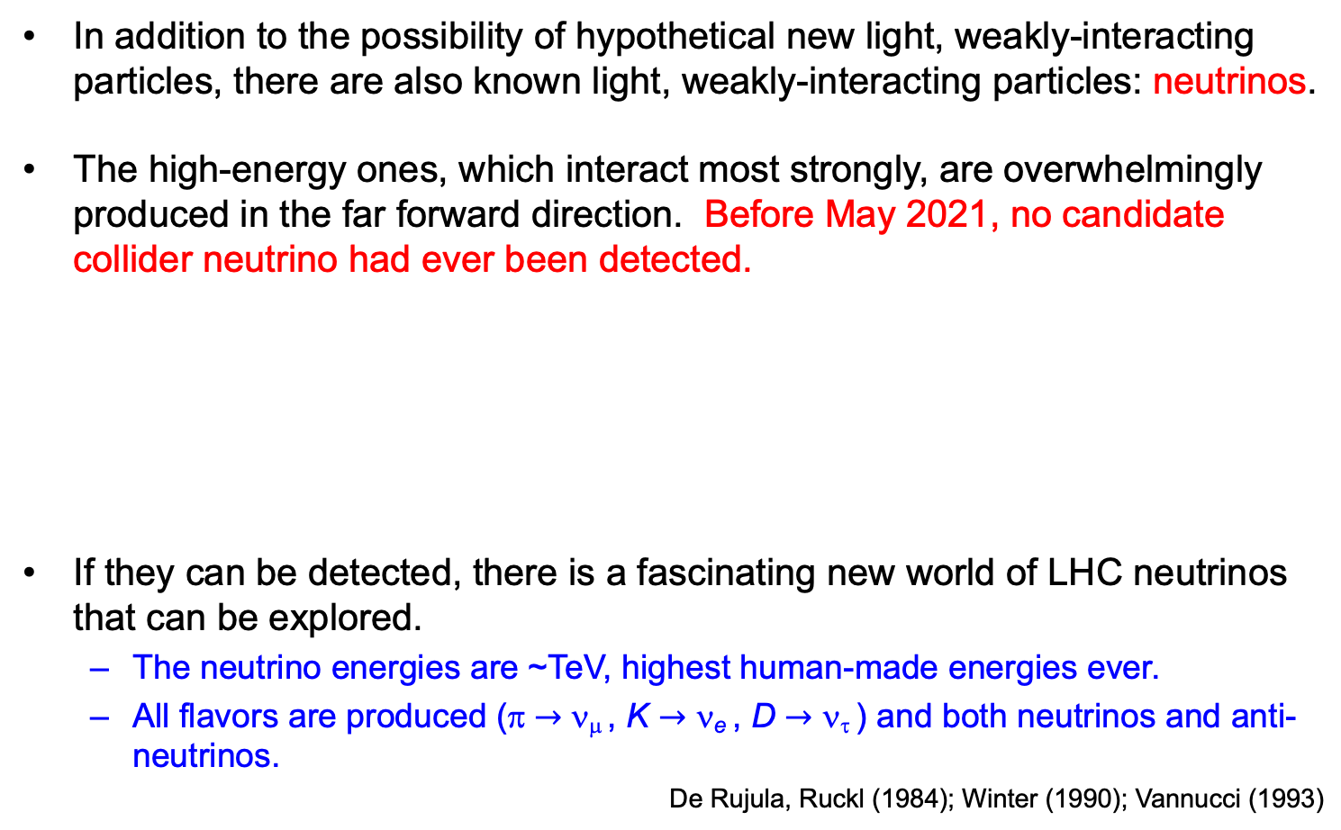
COLLIDER NEUTRINOS
In addition to the possibility of hypothetical new light, weakly-interacting particles, there are also known light, weakly-interacting particles: neutrinos.
The high-energy ones, which interact most strongly, are overwhelmingly produced in the far forward direction. Before May 2021, no candidate collider neutrino had ever been detected.
If they can be detected, there is a fascinating new world of LHC neutrinos that can be explored.
  The neutrino energies are ~TeV, highest human-made energies ever.
  All flavors are produced (π $→$ ν_{μ} , K $→$ ν_{e} , D $→$ ν_{τ} ) and both neutrinos and anti-neutrinos.
De Rujula, Ruckl (1984); Winter (1990); Vannucci (1993)

Slide 32
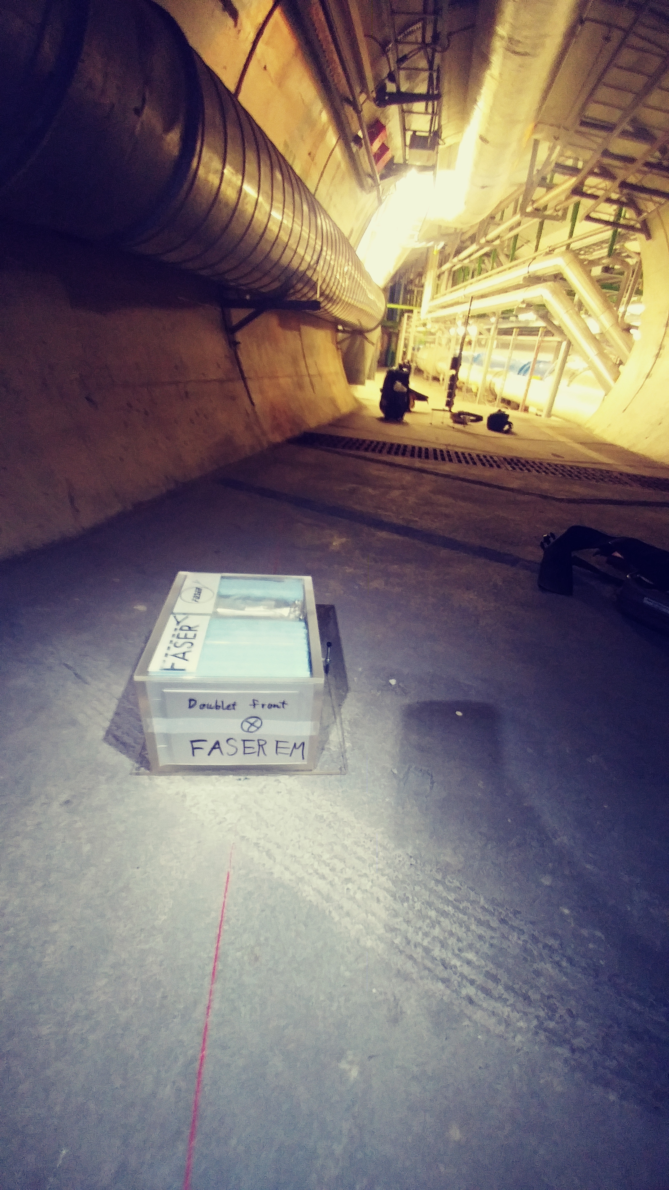
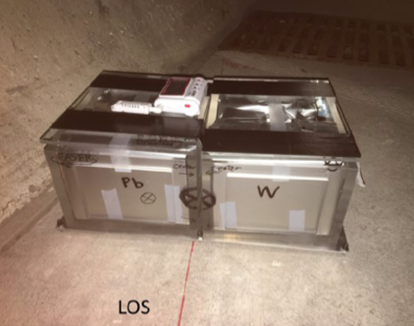
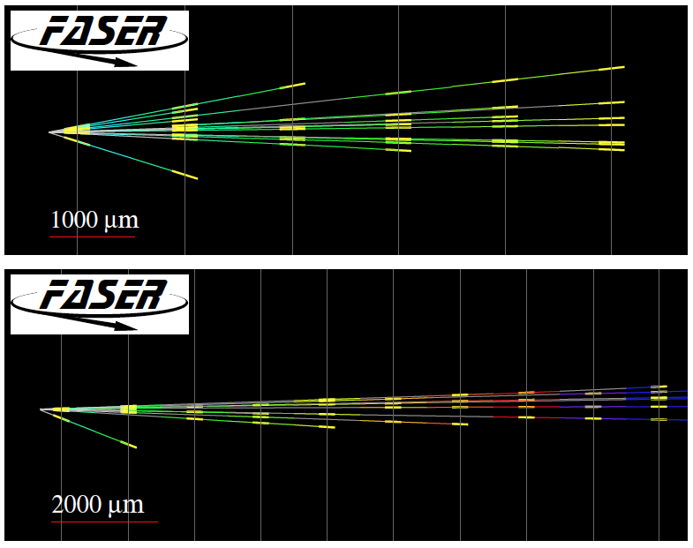
FIRST COLLIDER NEUTRINOS
In 2018 a FASER pilot emulsion detector with 11 kg fiducial mass collected 12.2 fb⁻¹ on the beam collision axis (installed and removed during Technical Stops).
In May 2021, the FASER Collaboration announced the direct detection of 6 candidate neutrinos above 12 expected neutral hadron background events (2.7σ).
This opens up a new field: neutrino physics at colliders.

Slide 33
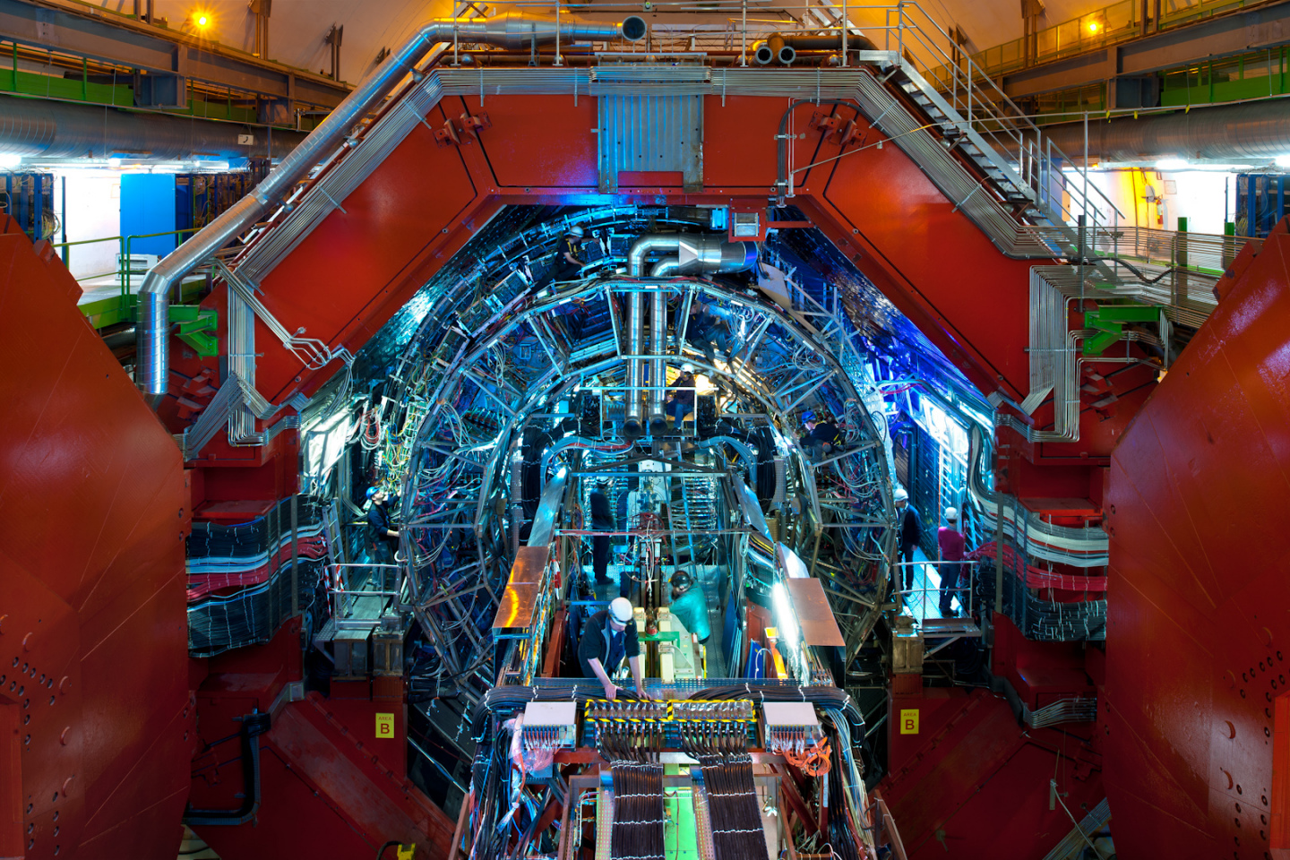
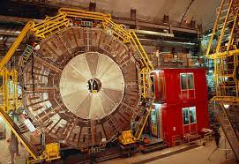
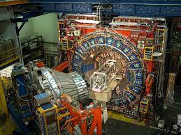
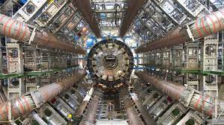
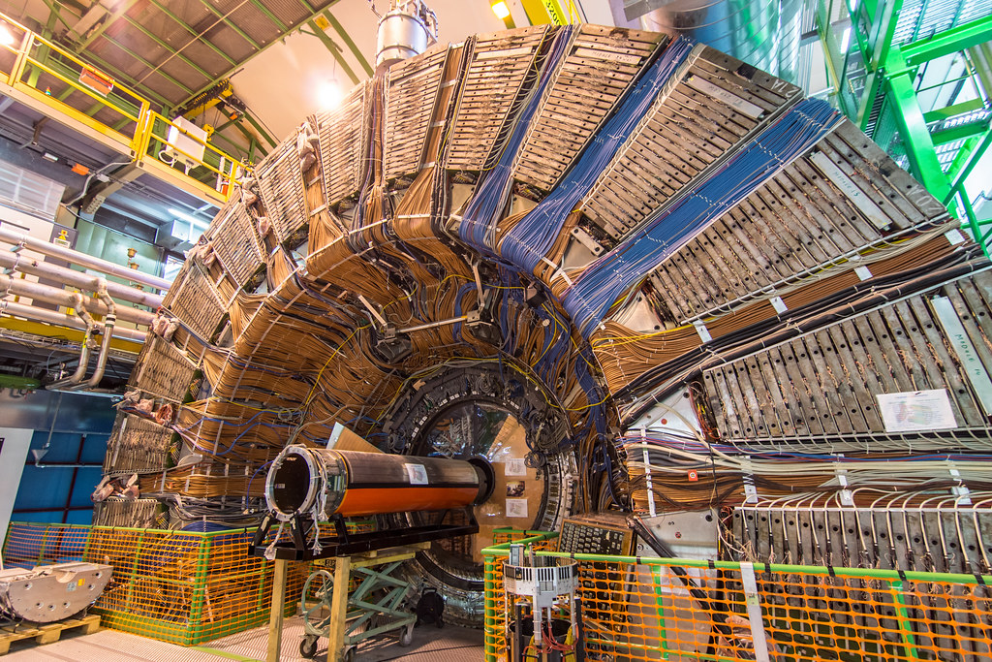
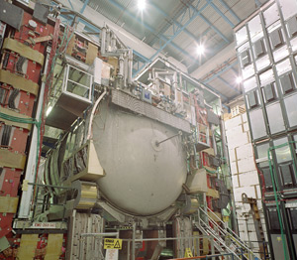
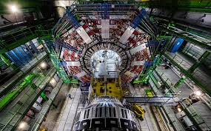
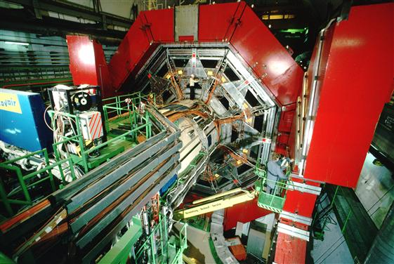

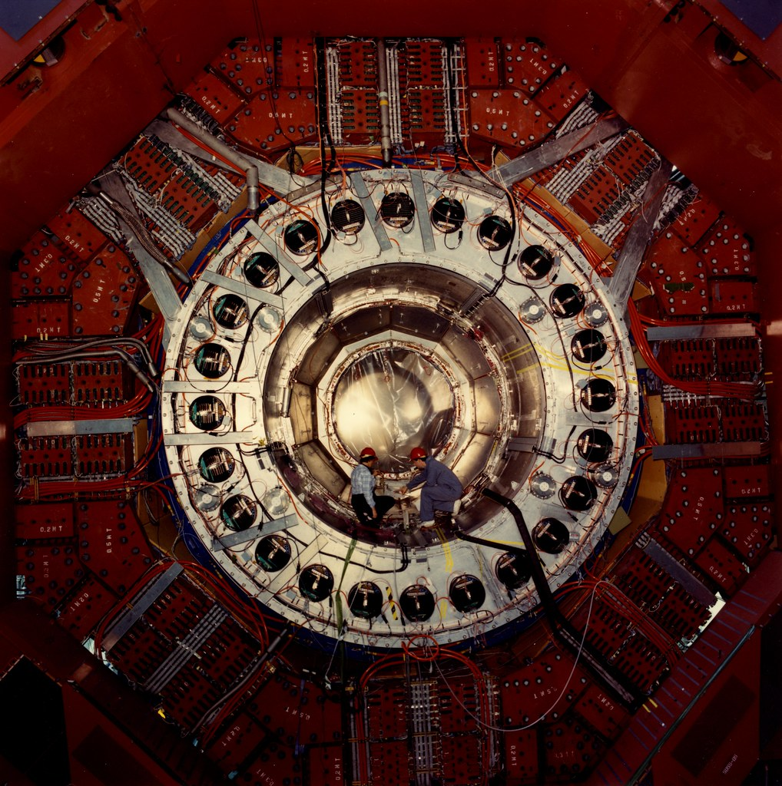
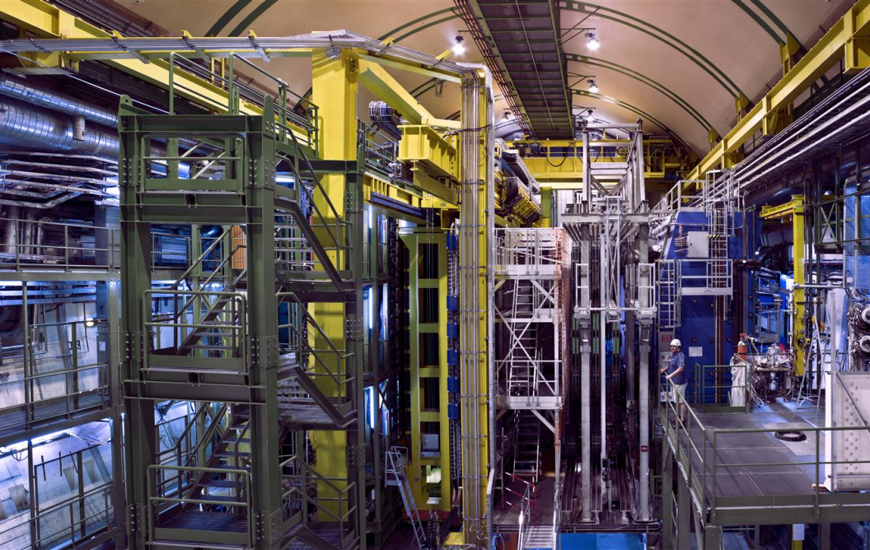
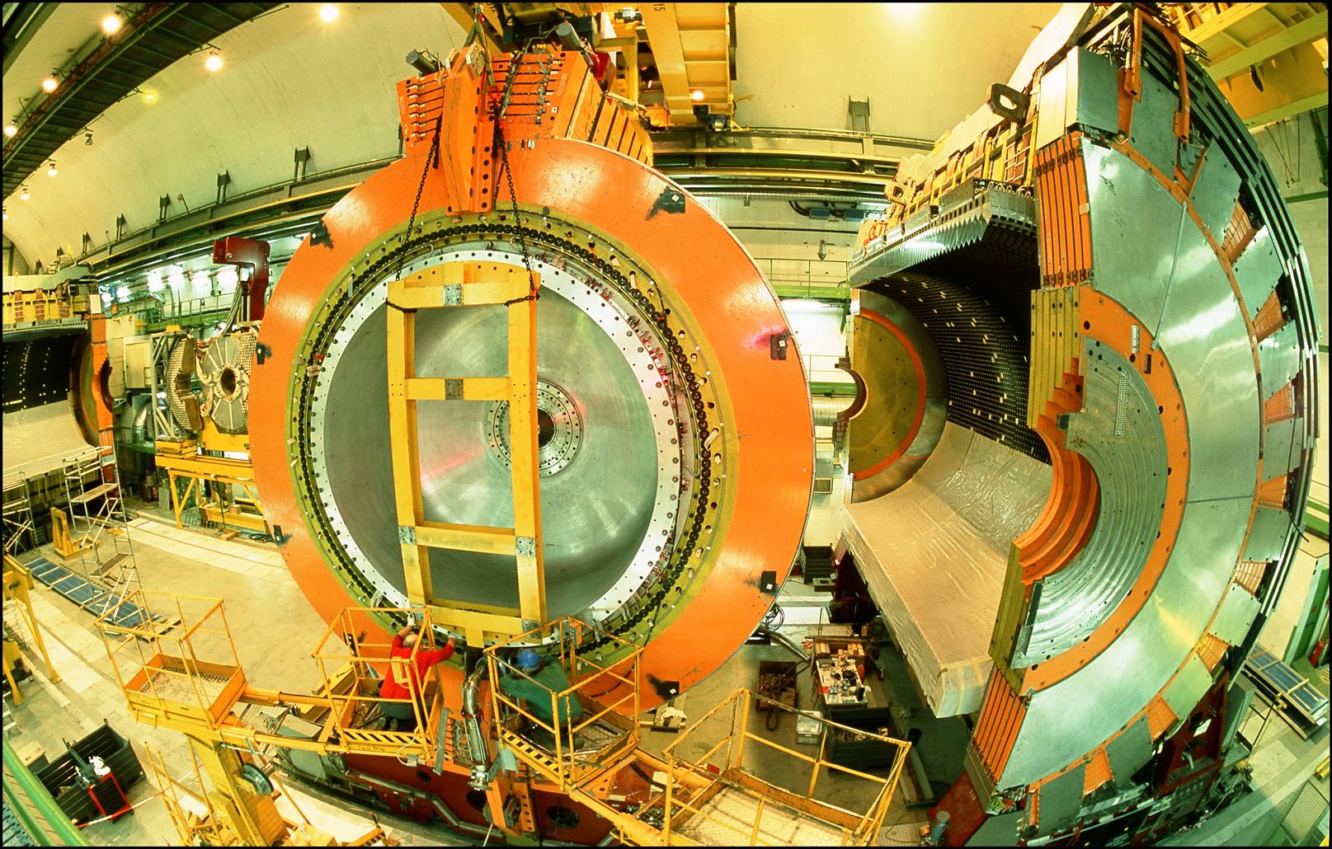
LOCATION, LOCATION, LOCATION
…
ALICE
ALEPH
CDF
FASER Pilot Detector
Suitcase-size, 4 weeks
$0 (recycled parts)
6 candidate neutrinos
ATLAS
DELPHI
D0
CMS
L3
LHCb
SLD
OPAL
All previous
collider detectors
Building-size, decades
~$10⁹
0 candidate neutrinos

Slide 34
THE FASERν DETECTOR
FASERν is designed to detect neutrinos of all flavors.
  25cm x 30cm x 1.1m detector consisting of 770 emulsion layers interleaved with 1 mm-thick tungsten plates; target mass = 1.1 tonnes.
  Emulsion swapped out every ~10-30 fb⁻¹, total 10 sets of emulsion for Run 3.
LLP
ν
e⁺
e⁻

Slide 35
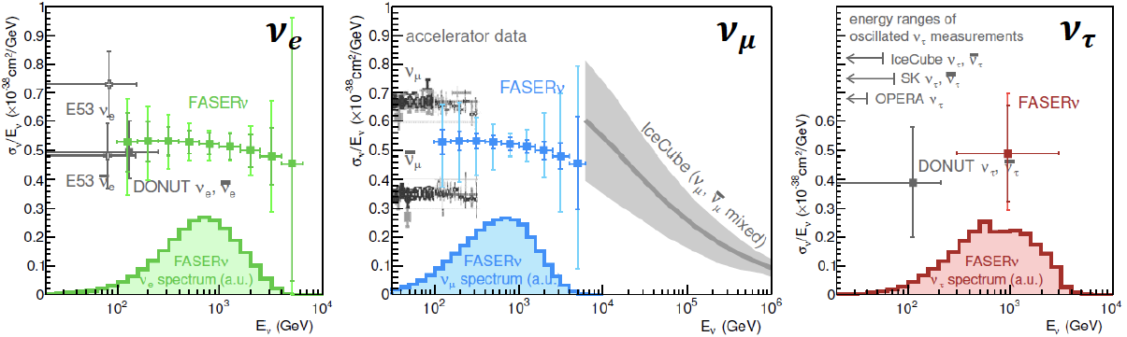
NEUTRINO PHYSICS
In Run 3 (2022-24), the goals of FASERν are to
  Detect the first collider neutrino.
  Record ~1000 ν_{e} , ~10,000 ν_{μ} , and ~10 ν_{τ} interactions at TeV energies, the first direct exploration of this energy range for all 3 flavors.
  Distinguish muon neutrinos from anti-neutrinos by combining FASER and FASERν data, and so measure their cross sections independently.
  Add significantly to the number of ν_{τ} and detect the first anti-ν_{τ} .
FASER Collaboration 1908.02310 (2019)

Slide 36
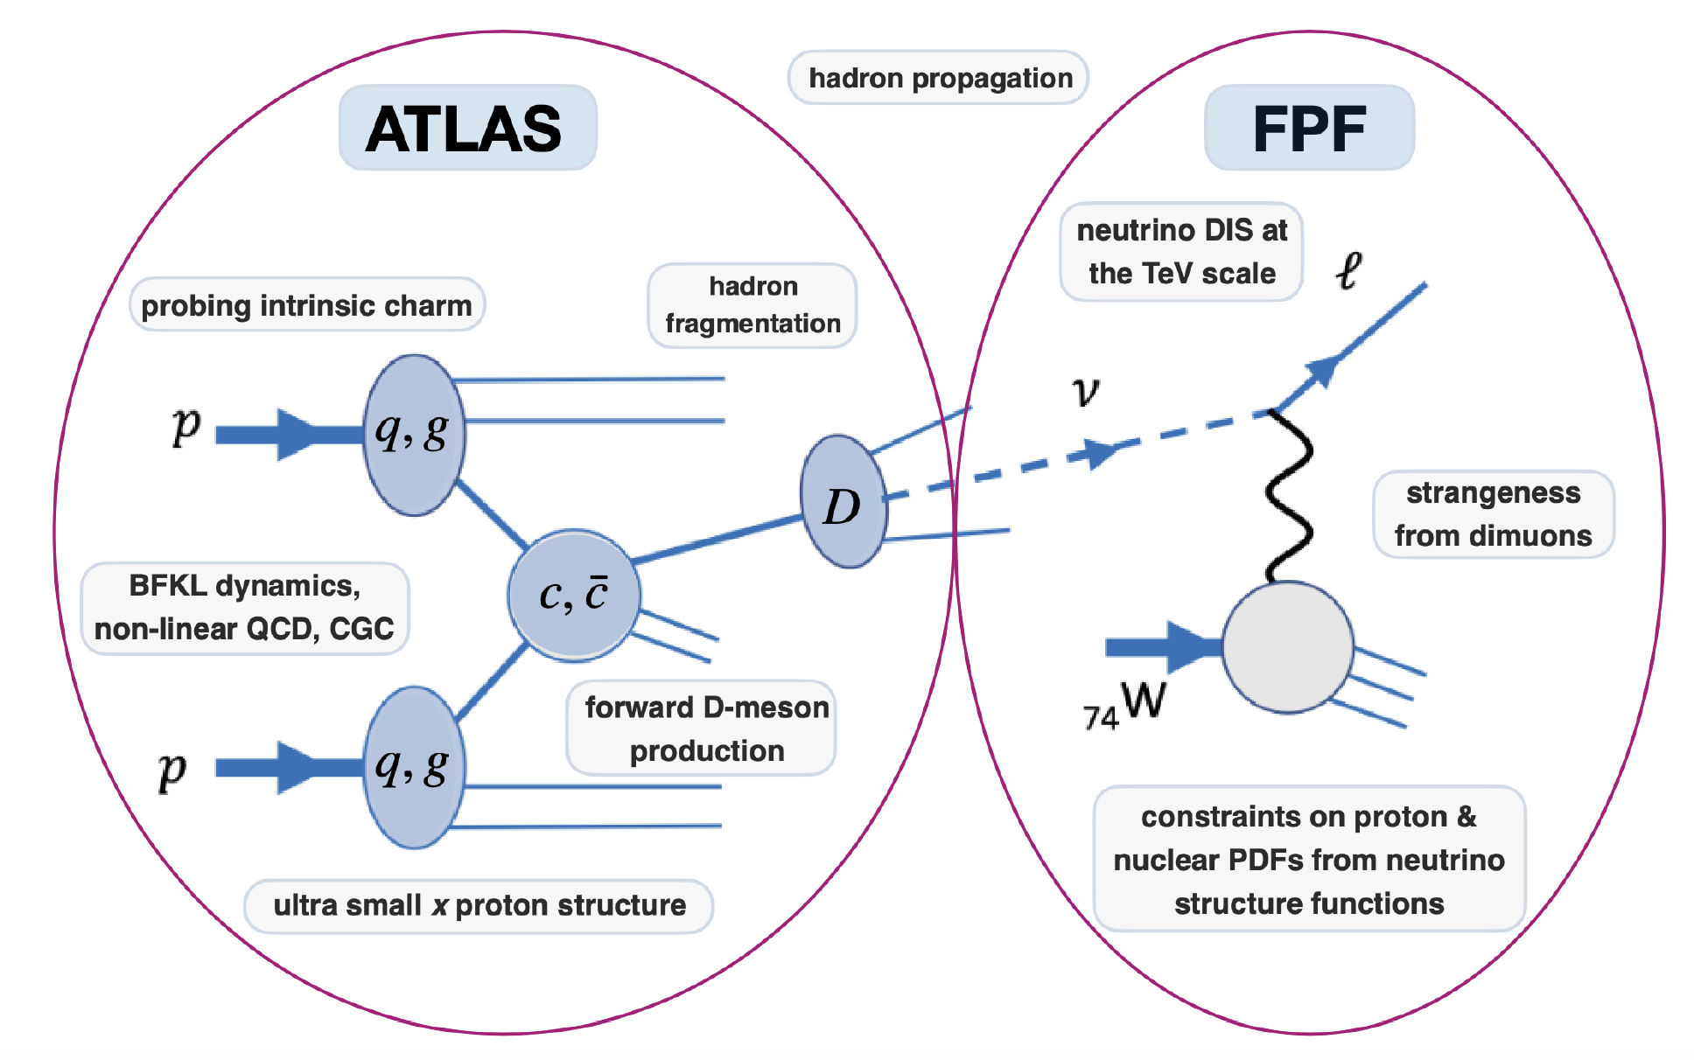
QCD
FASER will also have a rich program of QCD and hadron structure studies.
Forward neutrino production is a a probe of forward hadron production, BFKL dynamics, intrinsic charm, ultra small x proton structure, with important implications for UHE cosmic ray experiments.
Neutrino interactions will probe DIS at the TeV-scale, constrain proton and nuclear structure, pdfs.
FPF White Paper (2022)

Slide 37
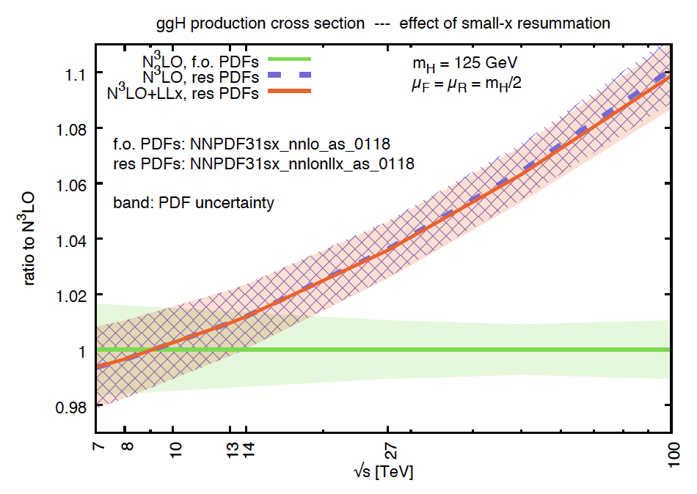
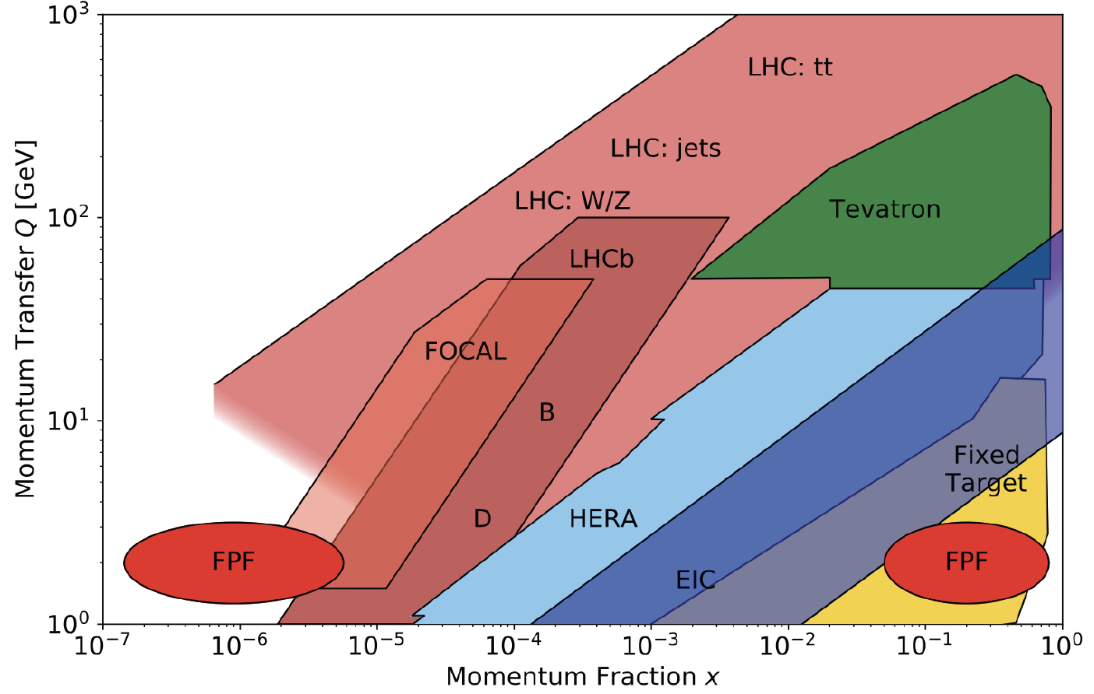
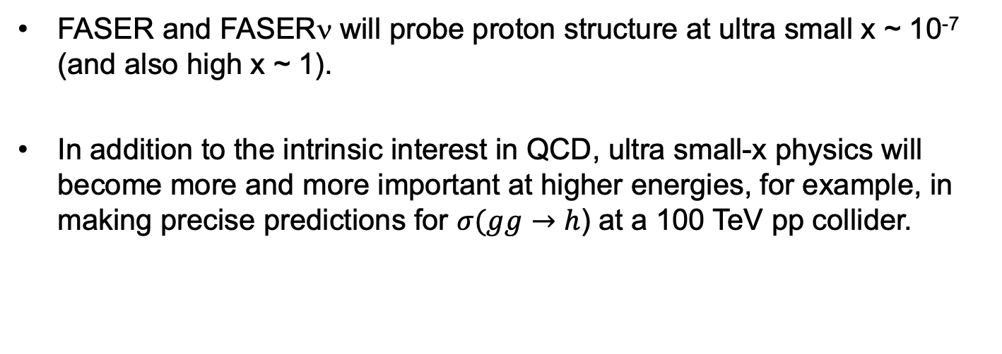
QCD
FASER and FASERν will probe proton structure at ultra small x ~ 10⁻⁷ (and also high x ~ 1).
In addition to the intrinsic interest in QCD, ultra small-x physics will become more and more important at higher energies, for example, in making precise predictions for $σ(gg→$ $h$) at a 100 TeV pp collider.
FPF White Paper (2022)

Slide 38


Slide 39
FORWARD PHYSICS FACILITY
FASER, FASERν, and other proposed far-forward detectors are currently highly constrained by 1980’s infrastructure that was never intended to support experiments.
The rich physics program in the far-forward region therefore strongly motivates creating a dedicated Forward Physics Facility to house far-forward experiments for the HL-LHC era from 2029-40.
FPF Meetings
  FPF Kickoff Meeting, 9-10 Nov 2020, https://indico.cern.ch/event/955956
  FPF2 Meeting, 27-28 May 2021, https://indico.cern.ch/event/1022352
  FPF3 Meeting, 25-26 Oct 2021, https://indico.cern.ch/event/1076733
  FPF4 Meeting, 31 Jan-1 Feb 2022, https://indico.cern.ch/event/1110746
FPF Short Paper: 75 pages, 80 authors completed in Sep 2021 (2109.10905).
The FPF Snowmass White Paper, Feng, Kling, Reno, Rojo, Soldin et al. (2203.05090), is now out. It is a comprehensive, 429-page, 392-author+ endorser summary of the status. Additional endorsers are welcome here.

Slide 40


FPF LOCATION
Baseline location: a dedicated facility ~612 m to the west of ATLAS on CERN land in France.
UJ18
ATLAS
SPS
UJ12
LHC
LOS
Kincso Balazs, CERN CE
CERN GIS

Slide 41


CAVERN AND SHAFT
Cavern: 65m long, 8m wide/high. Shaft: 88m-deep, 9.1m-diameter.
The FPF is completely decoupled from the LHC (as of today, no need for a safety corridor connecting FPF to the LHC).

Slide 42

SURFACE BUILDINGS

Slide 43


COST AND TIMELINE
Very preliminary (class 4) cost estimate: 23 MCHF (CE) + 15 MCHF (services) $≈$ 40 MCHF (+50%/-30%), not including experiments.
Timeline presented at Chamonix workshop (Feb 2022)
J. Boyd

Slide 44
FPF PHYSICS
The FPF is a general purpose facility with a broad SM and BSM physics program that expands on the physics of FASER and FASERν. Here I will just give a few additional examples. For more details, see the FPF White Paper.

Slide 45


MILLI-CHARGED PARTICLES
A completely generic possibility motivated by dark matter, dark sectors. Currently the target of the MilliQan experiment, located at the LHC near the CMS experiment in a “non-forward” tunnel.
The MilliQan Demonstrator (Proto-MilliQan) already probes new region. Full MilliQan can also run in this location in the HL-LHC era, but the sensitivity may be improved significantly by moving it to the FPF (FORMOSA).
Foroughi-Abari, Kling, Tsai (2020)

Slide 46




DARK MATTER
Light DM with masses at the GeV scale and below is famously hard to detect.
  Galactic halo velocity ~ 10⁻³ c, so kinetic energy ~ keV or below.
At the LHC, we can produce DM at high energies, look for the resulting DM to scatter in FLArE, Forward Liquid Argon Experiment, a proposed 10 to 100 tonne LArTPC.
FLArE is powerful in the region favored/allowed by thermal freezeout.
Batell, Feng, Trojanowski (2021)

Slide 47

SUMMARY
SM and new physics opportunities are currently being missed in the far-forward region at the LHC.
FASER and FASERν: 3.5 years from idea to completion, 5 m long, ~$2M. Along with SND@LHC, data-taking starts in mid-2022 and will create the new field of LHC neutrino physics, and also look for many new particles.
In the future, the FPF is uniquely positioned to fully realize the HL-LHC’s physics potential for both SM and new physics in the far-forward region. A very preliminary cost estimate is 40 MCHF + experiments. The construction can take place separate from the LHC, and no modifications to the LHC are needed.
A’, a, mCPs, DM, …
π, K, D, $ν_{e}$ , $ν_{μ}$ , $ν_{τ}$

