Slide 1



DISCOVERING THE UNIVERSE
ON A SHOESTRING BUDGET
Sigma Xi, Orange County Chapter
Jonathan Feng, Department of Physics and Astronomy
18 January 2022

Slide 2
THE DARK UNIVERSE

Slide 3

THIS IS WATER
In 2005 David Foster Wallace gave a commencement speech, “This is Water,” which some consider one of the best ever. He began with a story:
Two young fish are swimming along and they happen to meet an older fish swimming the other way.
The older fish says, “Morning, boys. How’s the water?”
The two young fish swim on, and then one says, “What the hell is water?”

Slide 4
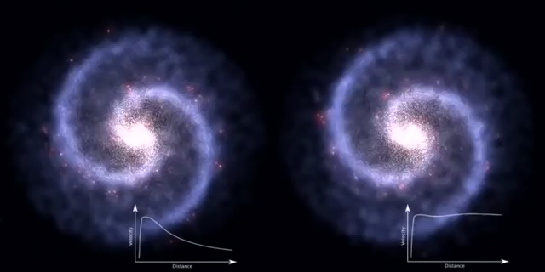
THIS IS DARK MATTER
In fact, like fish, we are also surrounded by a sea of stuff that many of us don’t even know is there. This stuff is dark matter.
We can see evidence of this when we observe rotating galaxies
Credit: Paul Robinson
What we expect
What we see

Slide 5

GALACTIC ROTATION CURVES
The stars on the outskirts are traveling too fast to be held in their orbits by the gravitational pull of the visible matter. There must be more matter that we cannot see.
This is the essential evidence for dark matter provided by Vera Rubin and others in the 1970s and 1980s.
All galaxies ever observed exhibit this property, and we have now “seen” dark matter in many other ways.

Slide 6
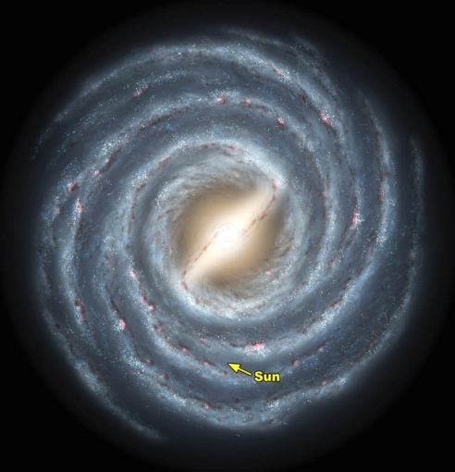
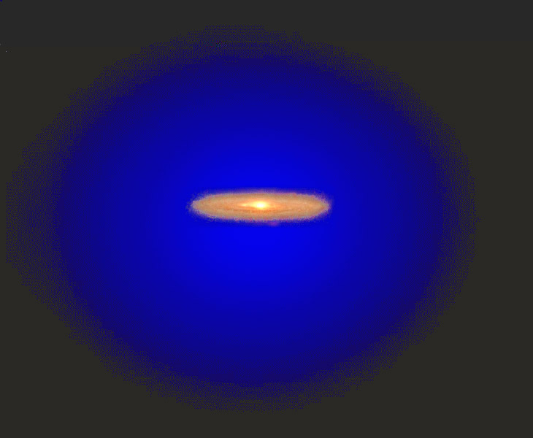
ISLANDS IN A SEA OF DARK MATTER
We now know that the stars we see are just islands in an ocean of invisible dark matter.
And it is not just “out there”: in some common dark matter theories, here on Earth, every coffee cup-sized volume contains one dark matter particle traveling at 10⁻³ c with a mass ~10³ m_{proton} .

Slide 7
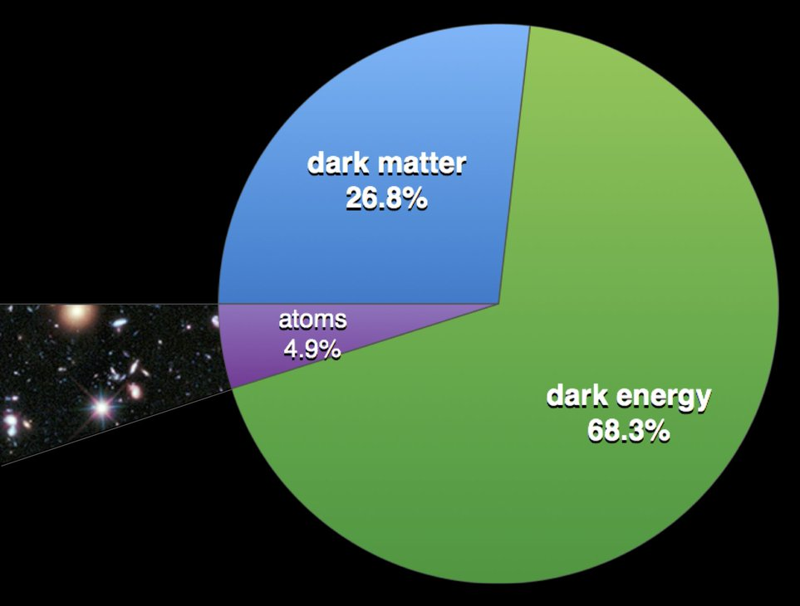
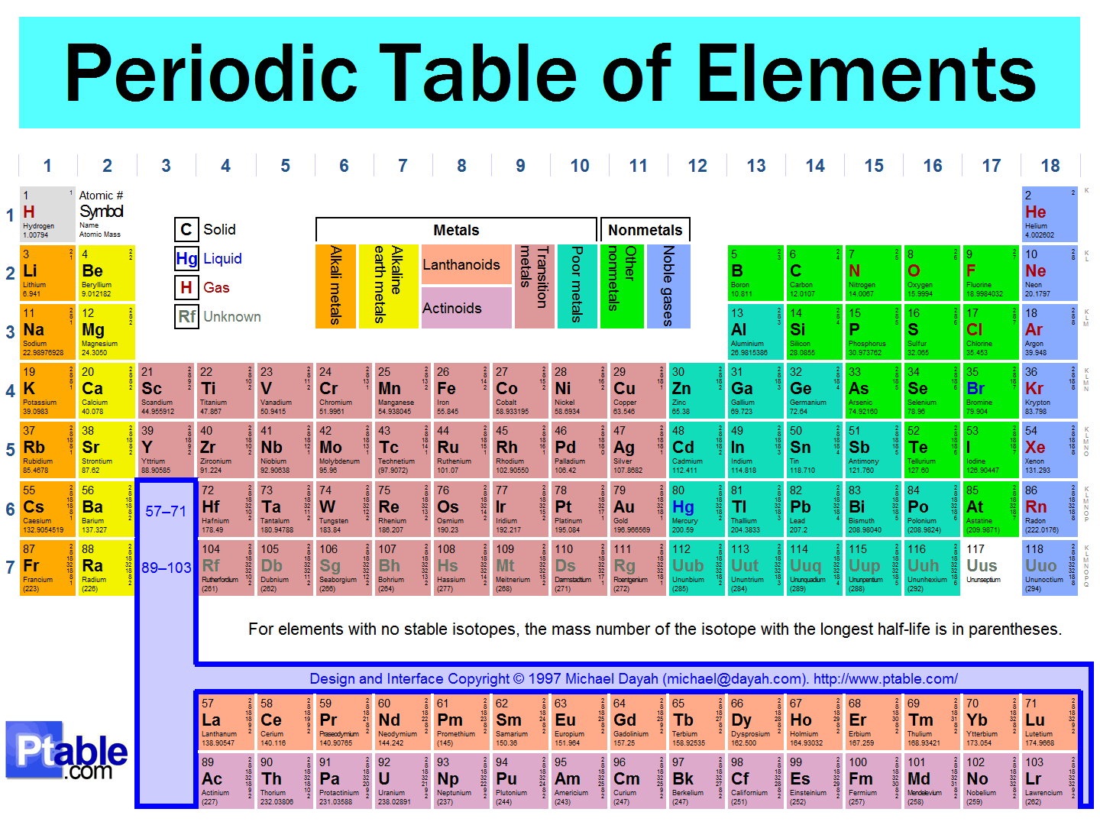
THE UNIVERSE TODAY
We now know that the elements of the periodic table make up only 5% of the universe. 27% of the universe is dark matter, and 95% of the universe is still to be discovered.
If we want to know where we came from, where we are going, and our place in the world, we need to find out what the dark universe is made of.

Slide 8
A BRIEF HISTORY OF PARTICLE PHYSICS

Slide 9
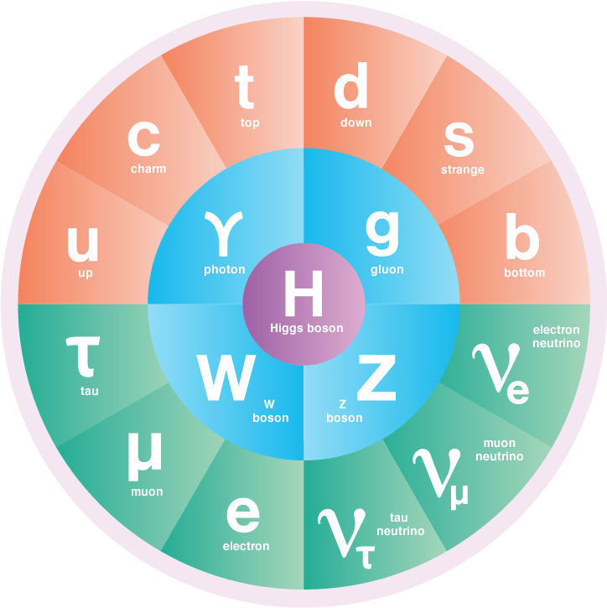
A BRIEF HISTORY OF PARTICLE PHYSICS
In the last century, we have been tremendously successful in discovering new particles and deepening our understanding of the laws of nature and the contents of the Universe.
The workhorse tools leading to much of this progress have been particle accelerators and colliders.

Slide 10
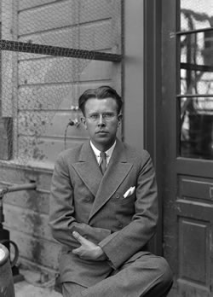
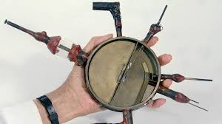
PARTICLE ACCELERATORS AND COLLIDERS
In the 1930’s, E. O. Lawrence made a cyclotron, which accelerated particles to higher velocities and energies.
The first cyclotron was small, but soon, bigger accelerators led to higher energies, which allowed heavier particles to be produced and discovered.

Slide 11

THE LARGE HADRON COLLIDER
The latest realization of Lawrence’s vision is the LHC in Geneva
.
FASER
Now colliding protons at 99.999999% the speed of light
Notes:
11

Slide 12

THE ATLAS DETECTOR
One of several giant detectors that observe particle collisions at the LHC
Notes:
12

Slide 13
HOW BIG IS BIG SCIENCE?
Size: Big. Colliders the size of cities, detectors the size of buildings.
Timescale: Long. The LHC was conceived in the 1980’s. It was constructed from 1998-2008, and has been running since 2008, with periodic shutdowns to upgrade and fix equipment.
Budget: Expensive. The cost of constructing the LHC and the various experiments was roughly $10 billion. The operations budget of CERN, the host laboratory, is about $1 billion per year, or roughly 1 coffee per year per EU citizen.
People: Many.

Slide 14
A RECENT CMS AUTHOR LIST

Slide 15
A RECENT CMS AUTHOR LIST (CONTINUED)

Slide 16
A RECENT CMS AUTHOR LIST (CONTINUED)

Slide 17
A RECENT CMS AUTHOR LIST (CONTINUED)

Slide 18
A RECENT CMS AUTHOR LIST (CONTINUED)
4000 collaborators from 230 institutions in 51 countries

Slide 19
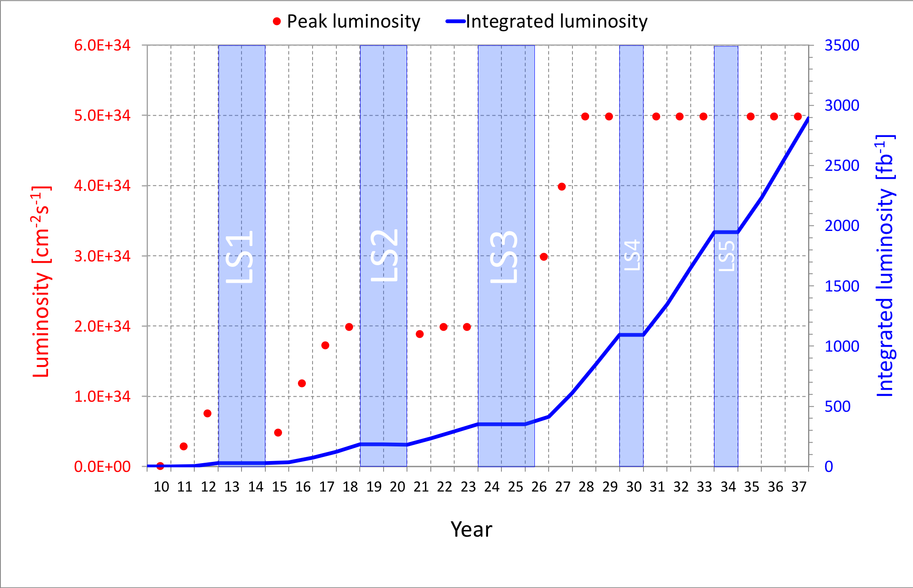
LHC: CURRENT STATUS
The discovery of the Higgs boson in 2012 completed the standard model of particle physics, an amazing achievement.
So far there has been no other evidence for new particles.
The LHC is currently in Long Shutdown 2, but will start up again in July 2022 and run till ~2037. Will we find new particles then?
What other approaches can enhance the prospects for discovering new particles?

Slide 20
BACK TO THE DRAWING BOARD

Slide 21

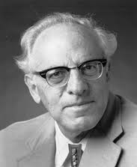
THE NEW PARTICLE LANDSCAPE
Particle
Colliders
Mass
MeV
GeV
TeV
1
Already
Discovered
Strongly Interacting
Heavy Particles
Interaction Strength
New Targets of Small Experiments
Traditional Targets
of Big Science
10⁻³
Weakly Interacting
Light Particles
Impossible to
Discover
10⁻⁶

Slide 22
DARK SECTORS
The case for weakly-interacting, light particles has been bolstered recently by the realization that dark matter might not be an isolated particle, but rather part of a dark sector, which contains also other particles and forces.
With dark sectors, there are generically portal particles that mediate between the visible and dark sectors.
Portal particles are not the dark matter, but they may provide our first glimpse of dark matter, and they are generically weakly-interacting, light particles.
Visible Sector
q, e⁻, γ
Portal
Particle
Dark Sector
dark matter X

Slide 23
THE NEW PARTICLE LANDSCAPE
Particle
Colliders
Mass
MeV
GeV
TeV
1
Already
Discovered
Strongly Interacting
Heavy Particles
Too Little to be
Dark Matter
Interaction Strength
10⁻³
Just Right to be Dark Matter
Weakly Interacting
Light Particles
Impossible to
Discover
Too Much to be Dark Matter
10⁻⁶

Slide 24

WEAKLY-INTERACTING, LIGHT PARTICLES
What are their properties? Assume an interaction strength of ~10⁻⁵ and a mass between MeV (the electron’s) and GeV (the proton’s).
  They are not bent by electric and magnetic fields
  They do not interact in matter
  They do decay, for example, to electrons and positrons, but only after traveling hundreds of meters.
  They are mainly produced in glancing collisions at the LHC
This is a nightmare for existing detectors at the LHC !

Slide 25
FASER

Slide 26
THE BASIC IDEA
Can we cover the “blind spot” of existing detectors? A detector on the beamline would block the proton beams.
Feng, Galon, Kling, Trojanowski (2017)
However, our target particles do not interact; they travel straight. We can therefore place the detector on the “line of sight,” a few 100 m away, after the LHC curves. Other particles will get stuck in the rock and concrete, but our signal will pass right through.
After hundreds of meters, the particles will decay, and we can look for their decay products, e.g., electrons and positrons.
The new particles are extremely collimated. Even after hundreds of meters, they are still within ~10 to 100 cm apart.
These considerations motivate a small, inexpensive experiment placed in the very forward region of ATLAS or CMS, a few 100m downstream.

Slide 27
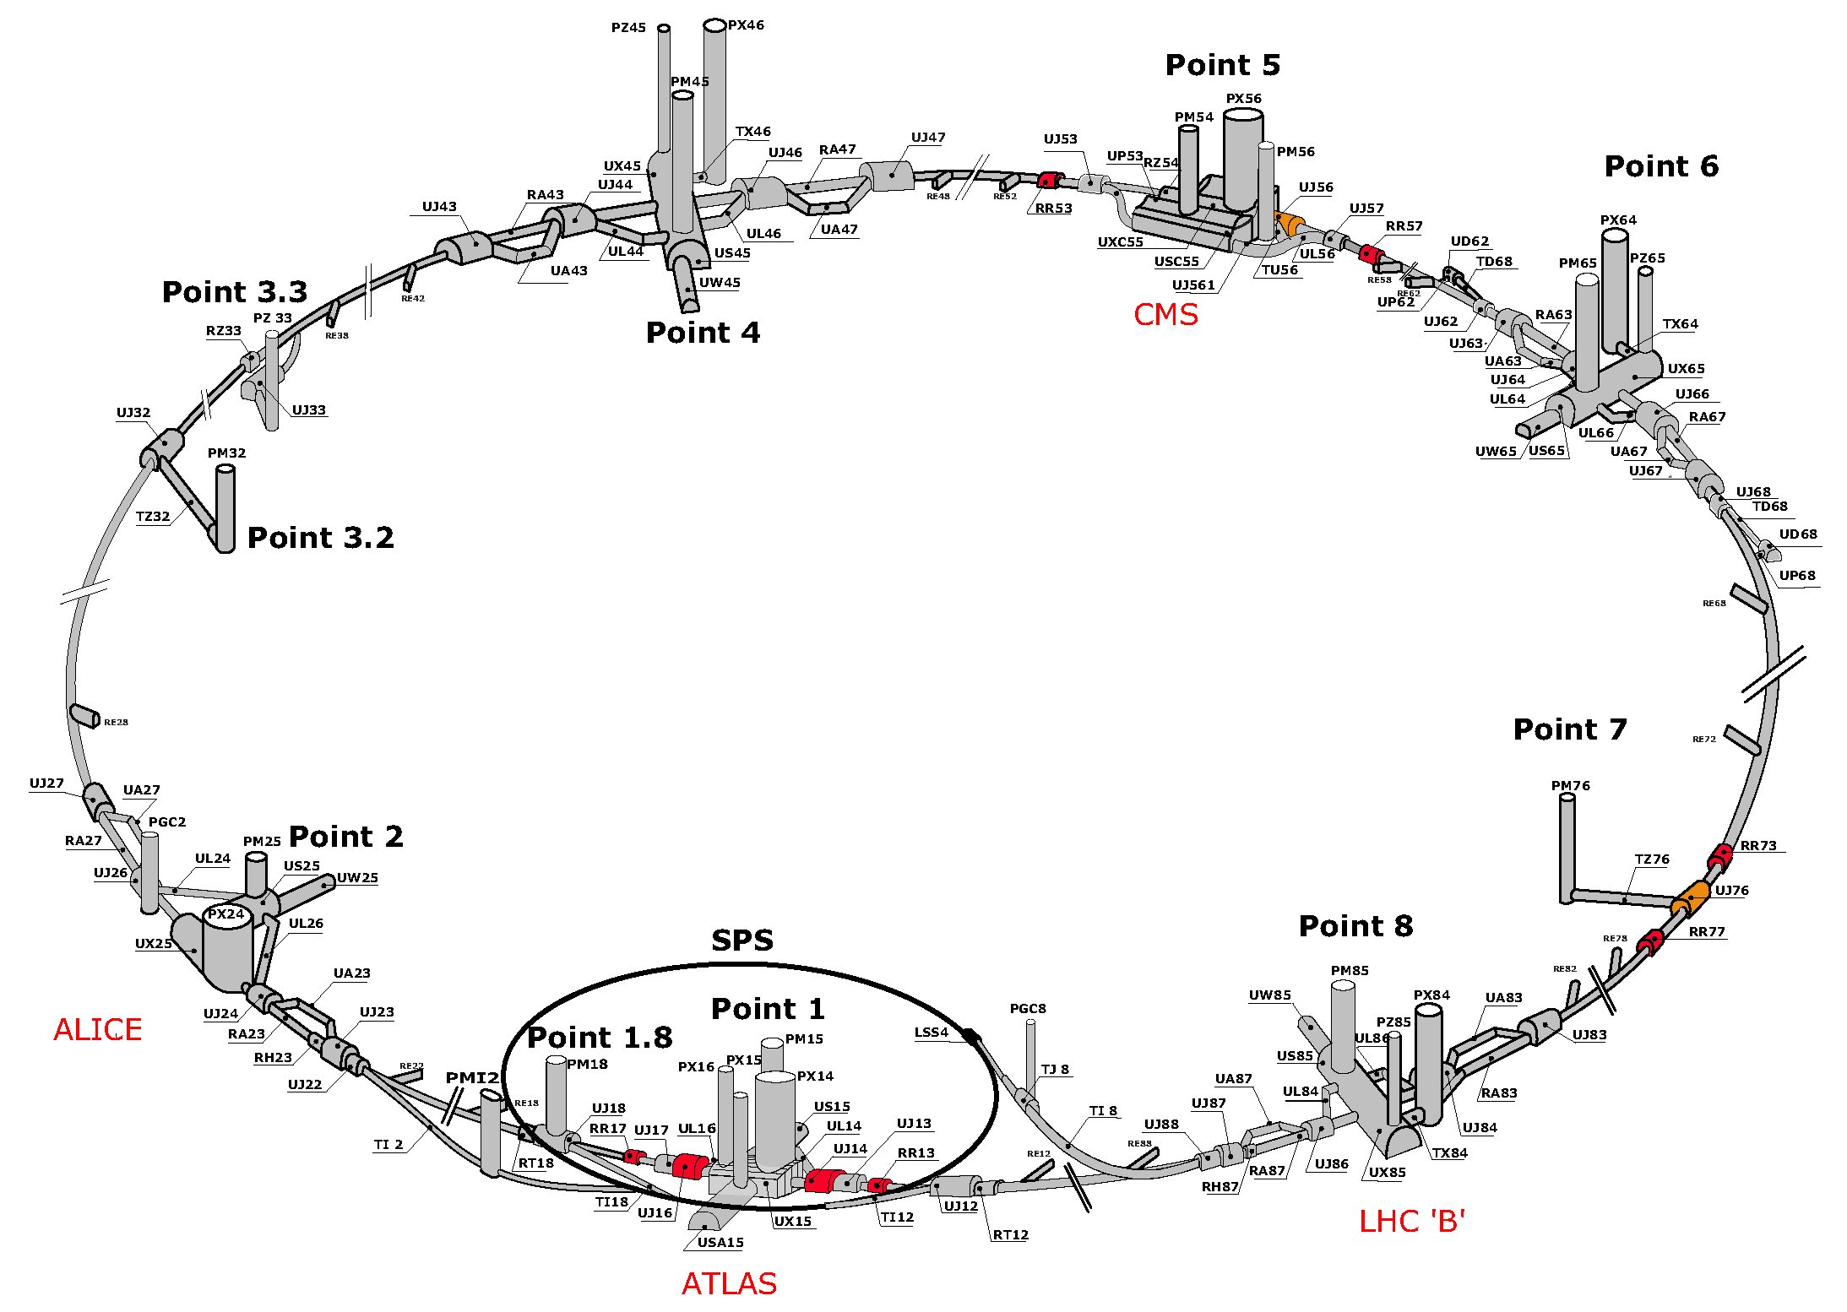
LOCATION, LOCATION, LOCATION
!!!!!!

Slide 28
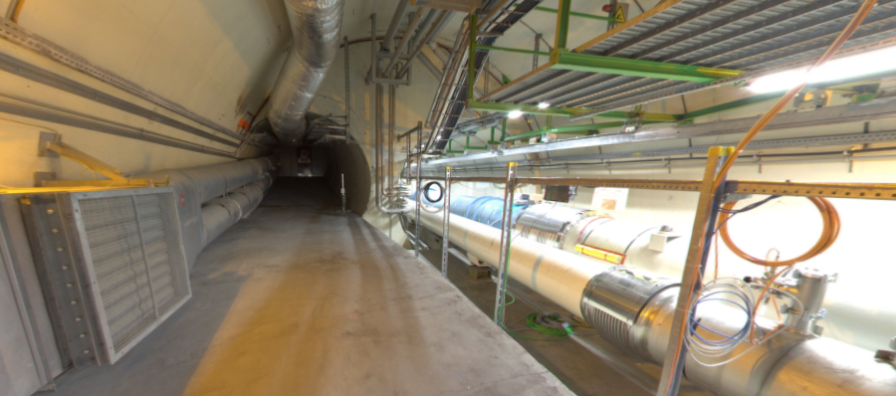
LOCATION, LOCATION, LOCATION
The view looking west
New Particles
(dark partices)
LHC Beamline
(protons)

Slide 29
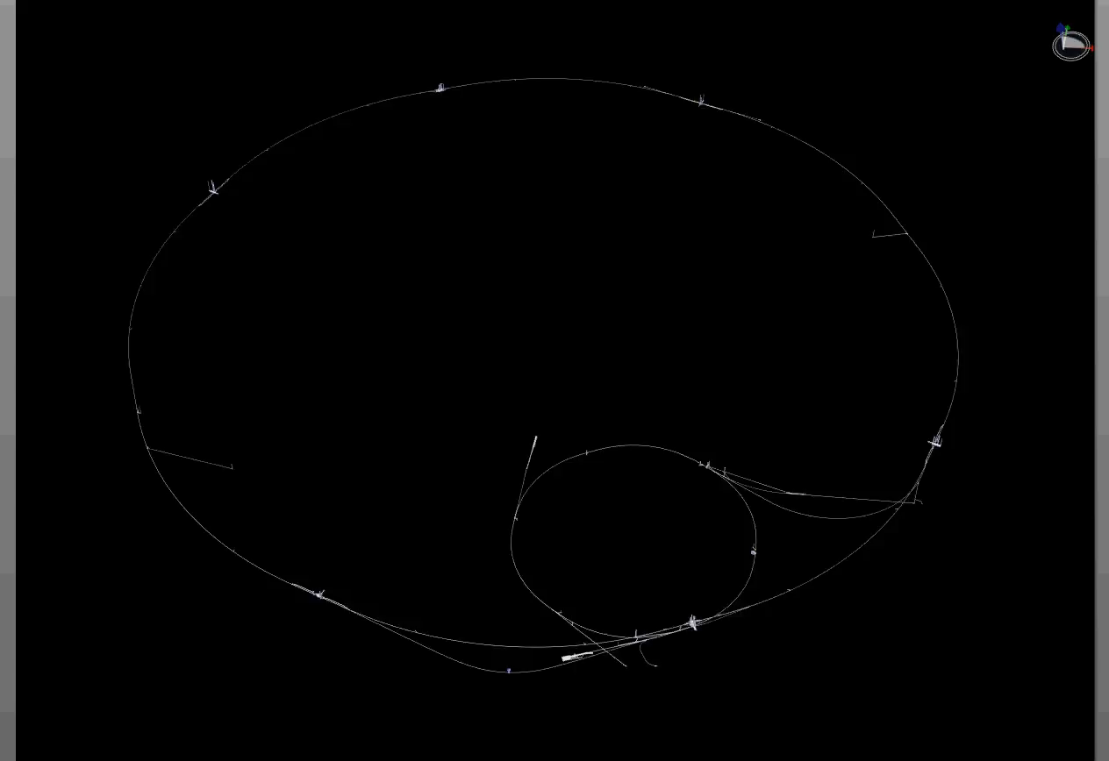
PARTICLE PATH FROM ATLAS TO FASER
Dougherty, CERN Integration (2019)

Slide 30

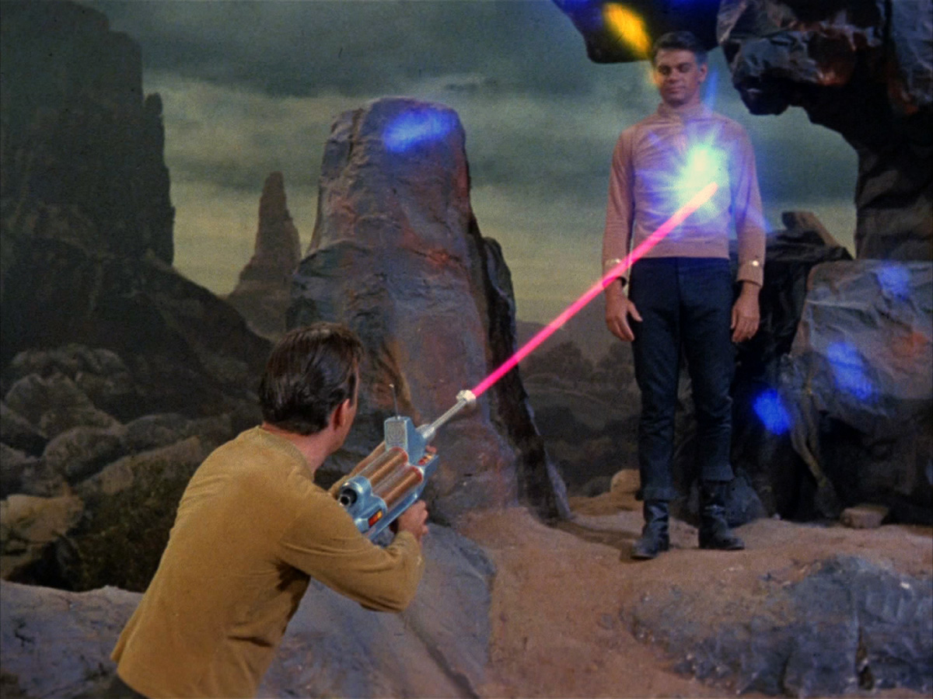
FORWARD SEARCH EXPERIMENT
“The acronym recalls another marvelous instrument that harnessed highly collimated particles and was used to explore strange new worlds.”
Feng, Galon, Kling, Trojanowski (2017)

Slide 31
FASER CONSTRUCTION

Slide 32
FASER TIMELINE
September 2017: First theory paper
November 2017: Support from the two most famous living physicists

Slide 33

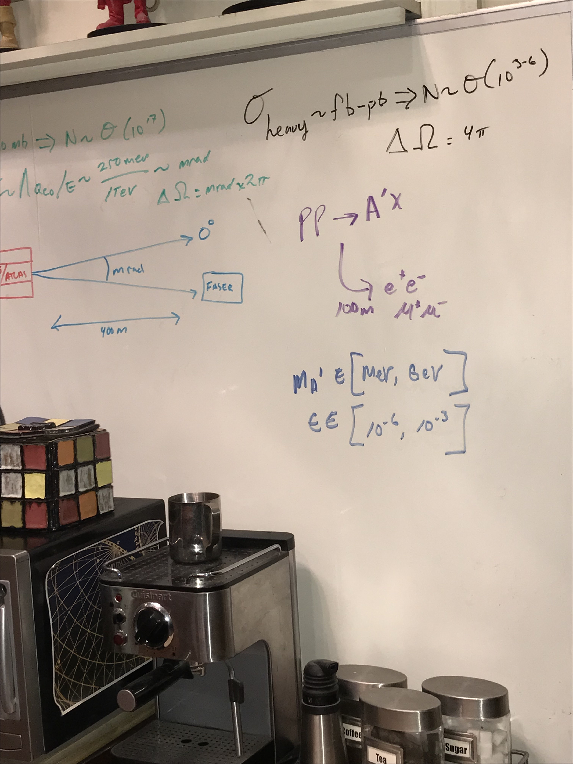
FASER ON BIG BANG THEORY
Credit: David Saltzberg
Season 11, Episode 9, “The Bitcoin Entanglement” (November 2017)

Slide 34
FASER TIMELINE
September 2017: First theory paper
November 2017: Support from the two most famous living physicists
July 2018: Submitted LOI to CERN LHCC
October 2018: Approval from ATLAS SCT and LHCb Collaborations for use of spare detector modules
November 2018: Submitted Technical Proposal to LHCC
November 2018 – January 2019: Experiment funded by $1M grants from the Heising-Simons and Simons Foundations
March 2019: FASER fully approved by CERN LHCC and Research Board along with support for infrastructure costs
April 2019: 1st FASER Collaboration Meeting
May 2020: Install FASER in tunnel before cool down in Long Shutdown 2, begin commissioning detector, begin collecting data in April 2021

Slide 35
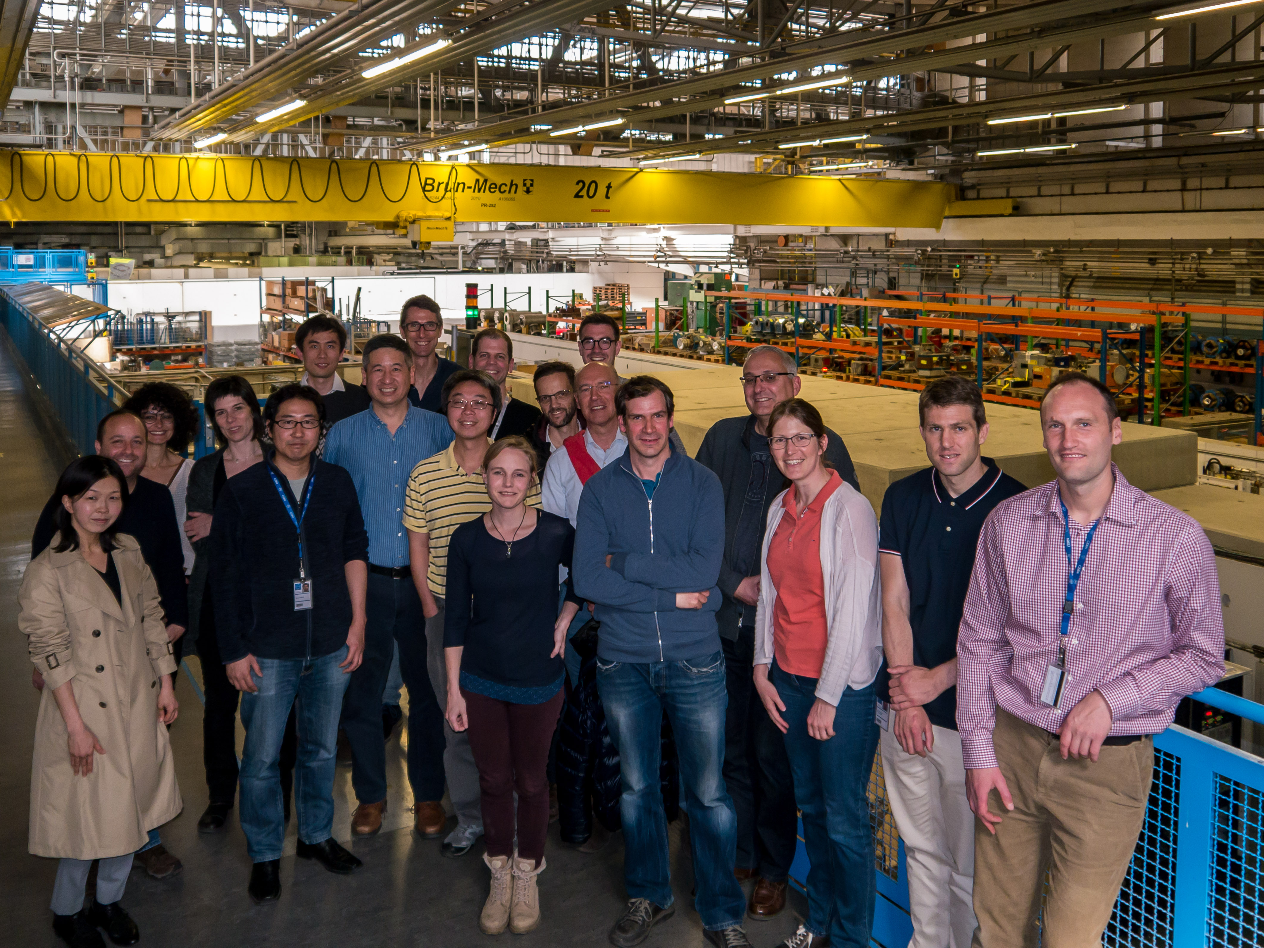
FIRST FASER COLLABORATION MEETING

Slide 36
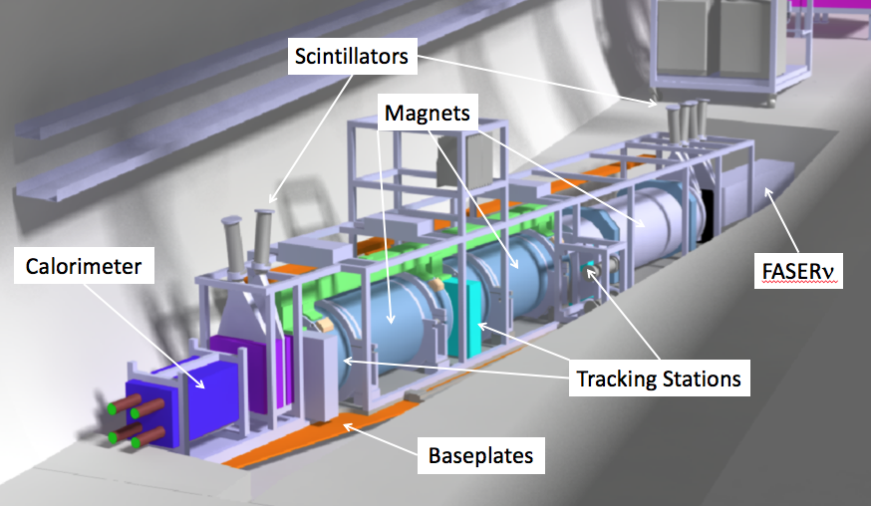
THE FASER DETECTOR
1m x 1m x 5m, composed of magnets, trackers, calorimeters, chillers, power supplies, and data acquisition electronics.
The signal: nothing incoming and 2 ~TeV, opposite-sign charged tracks pointing back to ATLAS through 100 m of rock and concrete.
LLP
ν
e⁺
e⁻

Slide 37
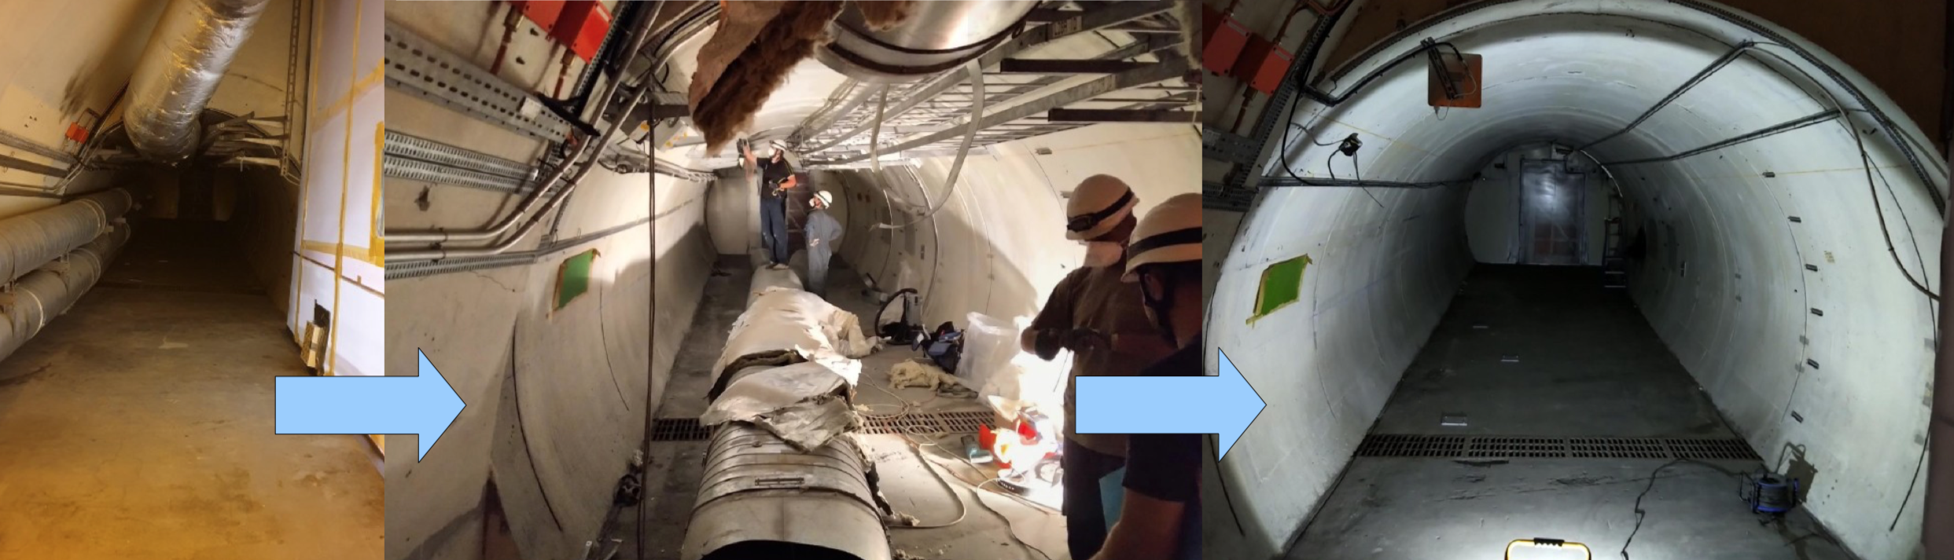
PREPARING THE TUNNEL
In TI12, unused ventilation ducts, cables, etc. had to be be removed to prepare for FASER trench excavation and installation.

Slide 38
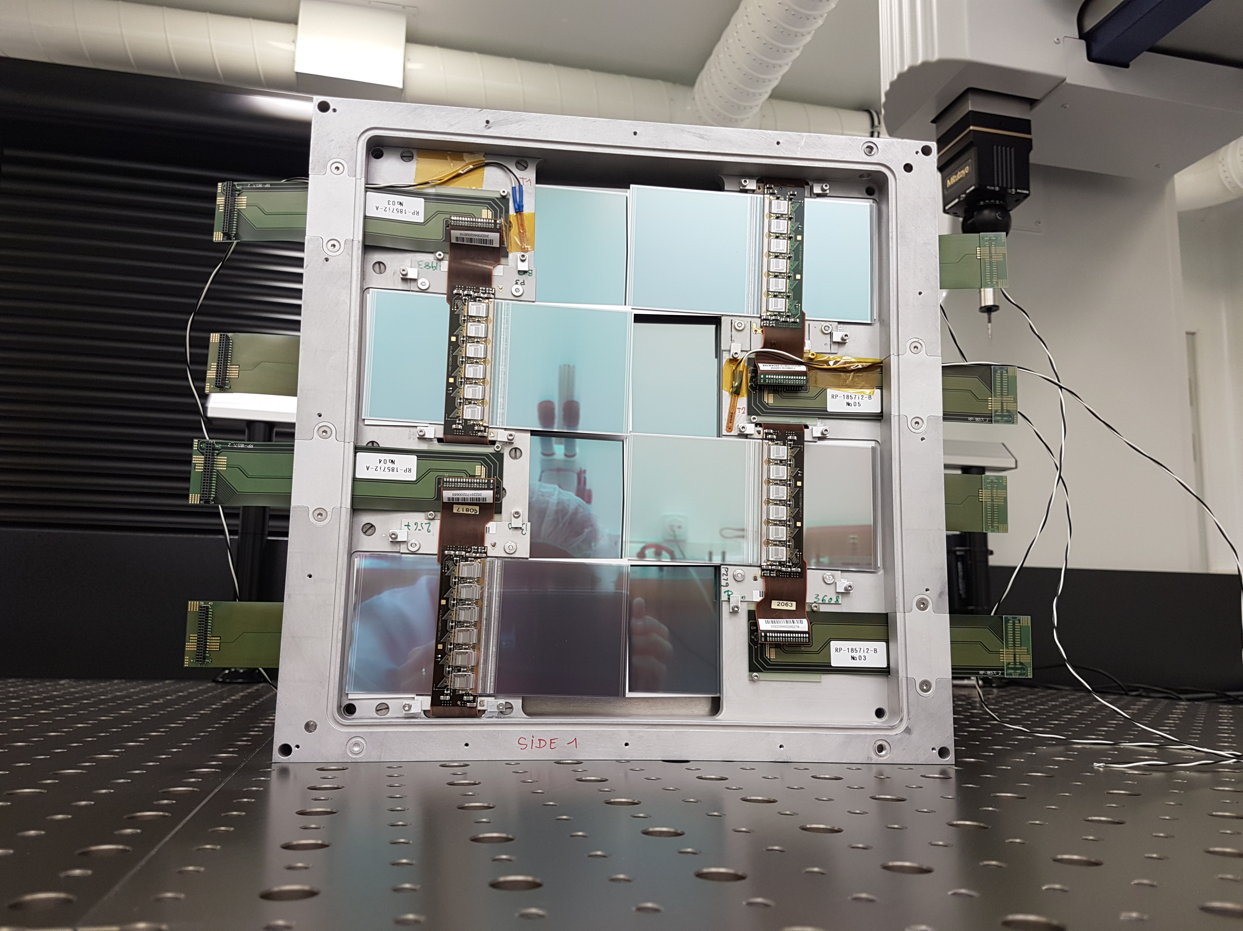
TRACKER
The FASER tracker is composed of spare modules from ATLAS. About 350 spares were prepared by ATLAS. They were not needed, and the ATLAS SCT collaboration generously allowed us to use 120 of them. 12 Tracking layers detect charged particles with ~100 μm spatial resolution.

Slide 39
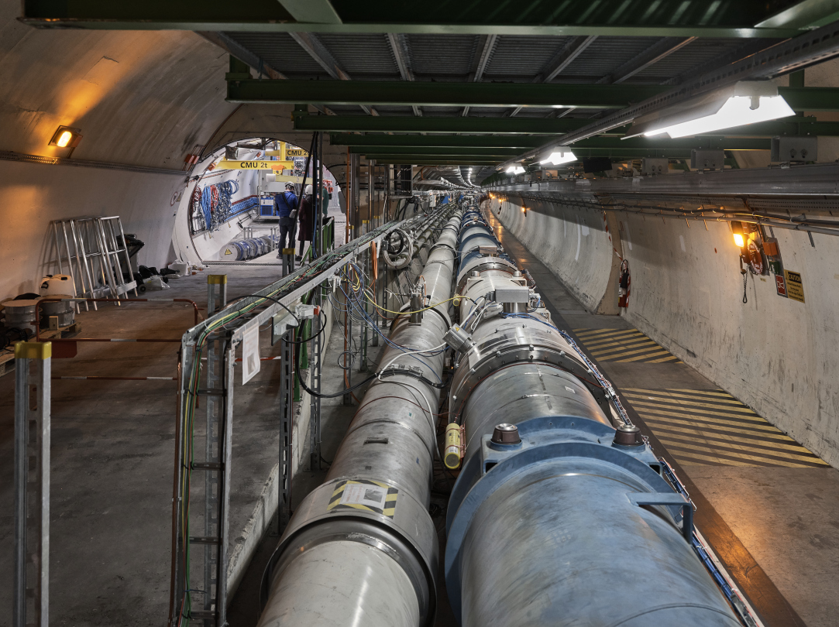
FASER INSTALLED IN TI12

Slide 40
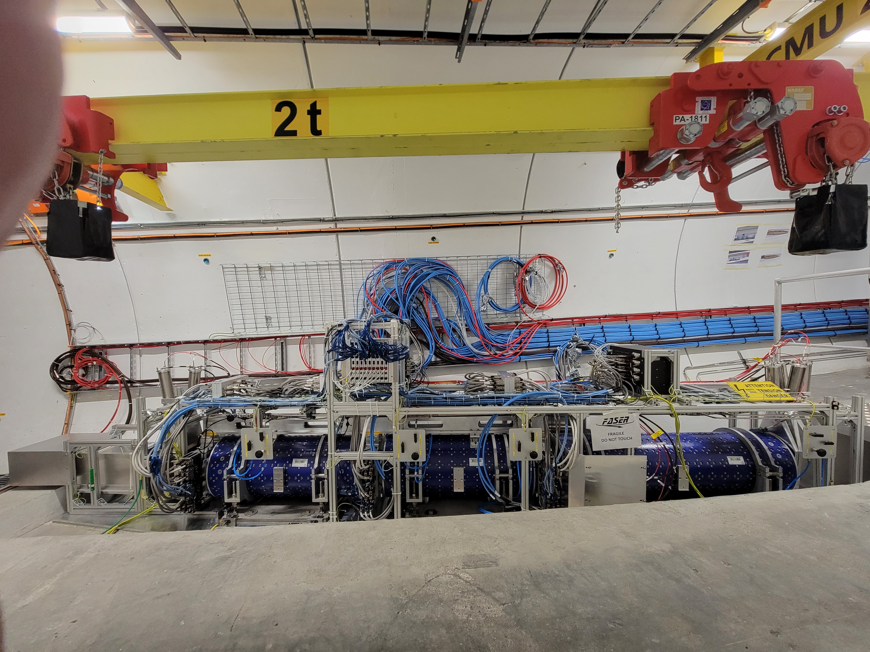
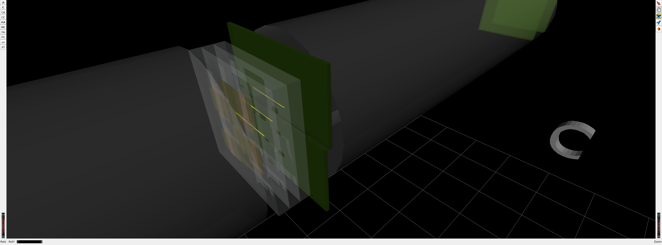
FASER INSTALLED IN TI12
1st Cosmic Ray
18 March 2021

Slide 41
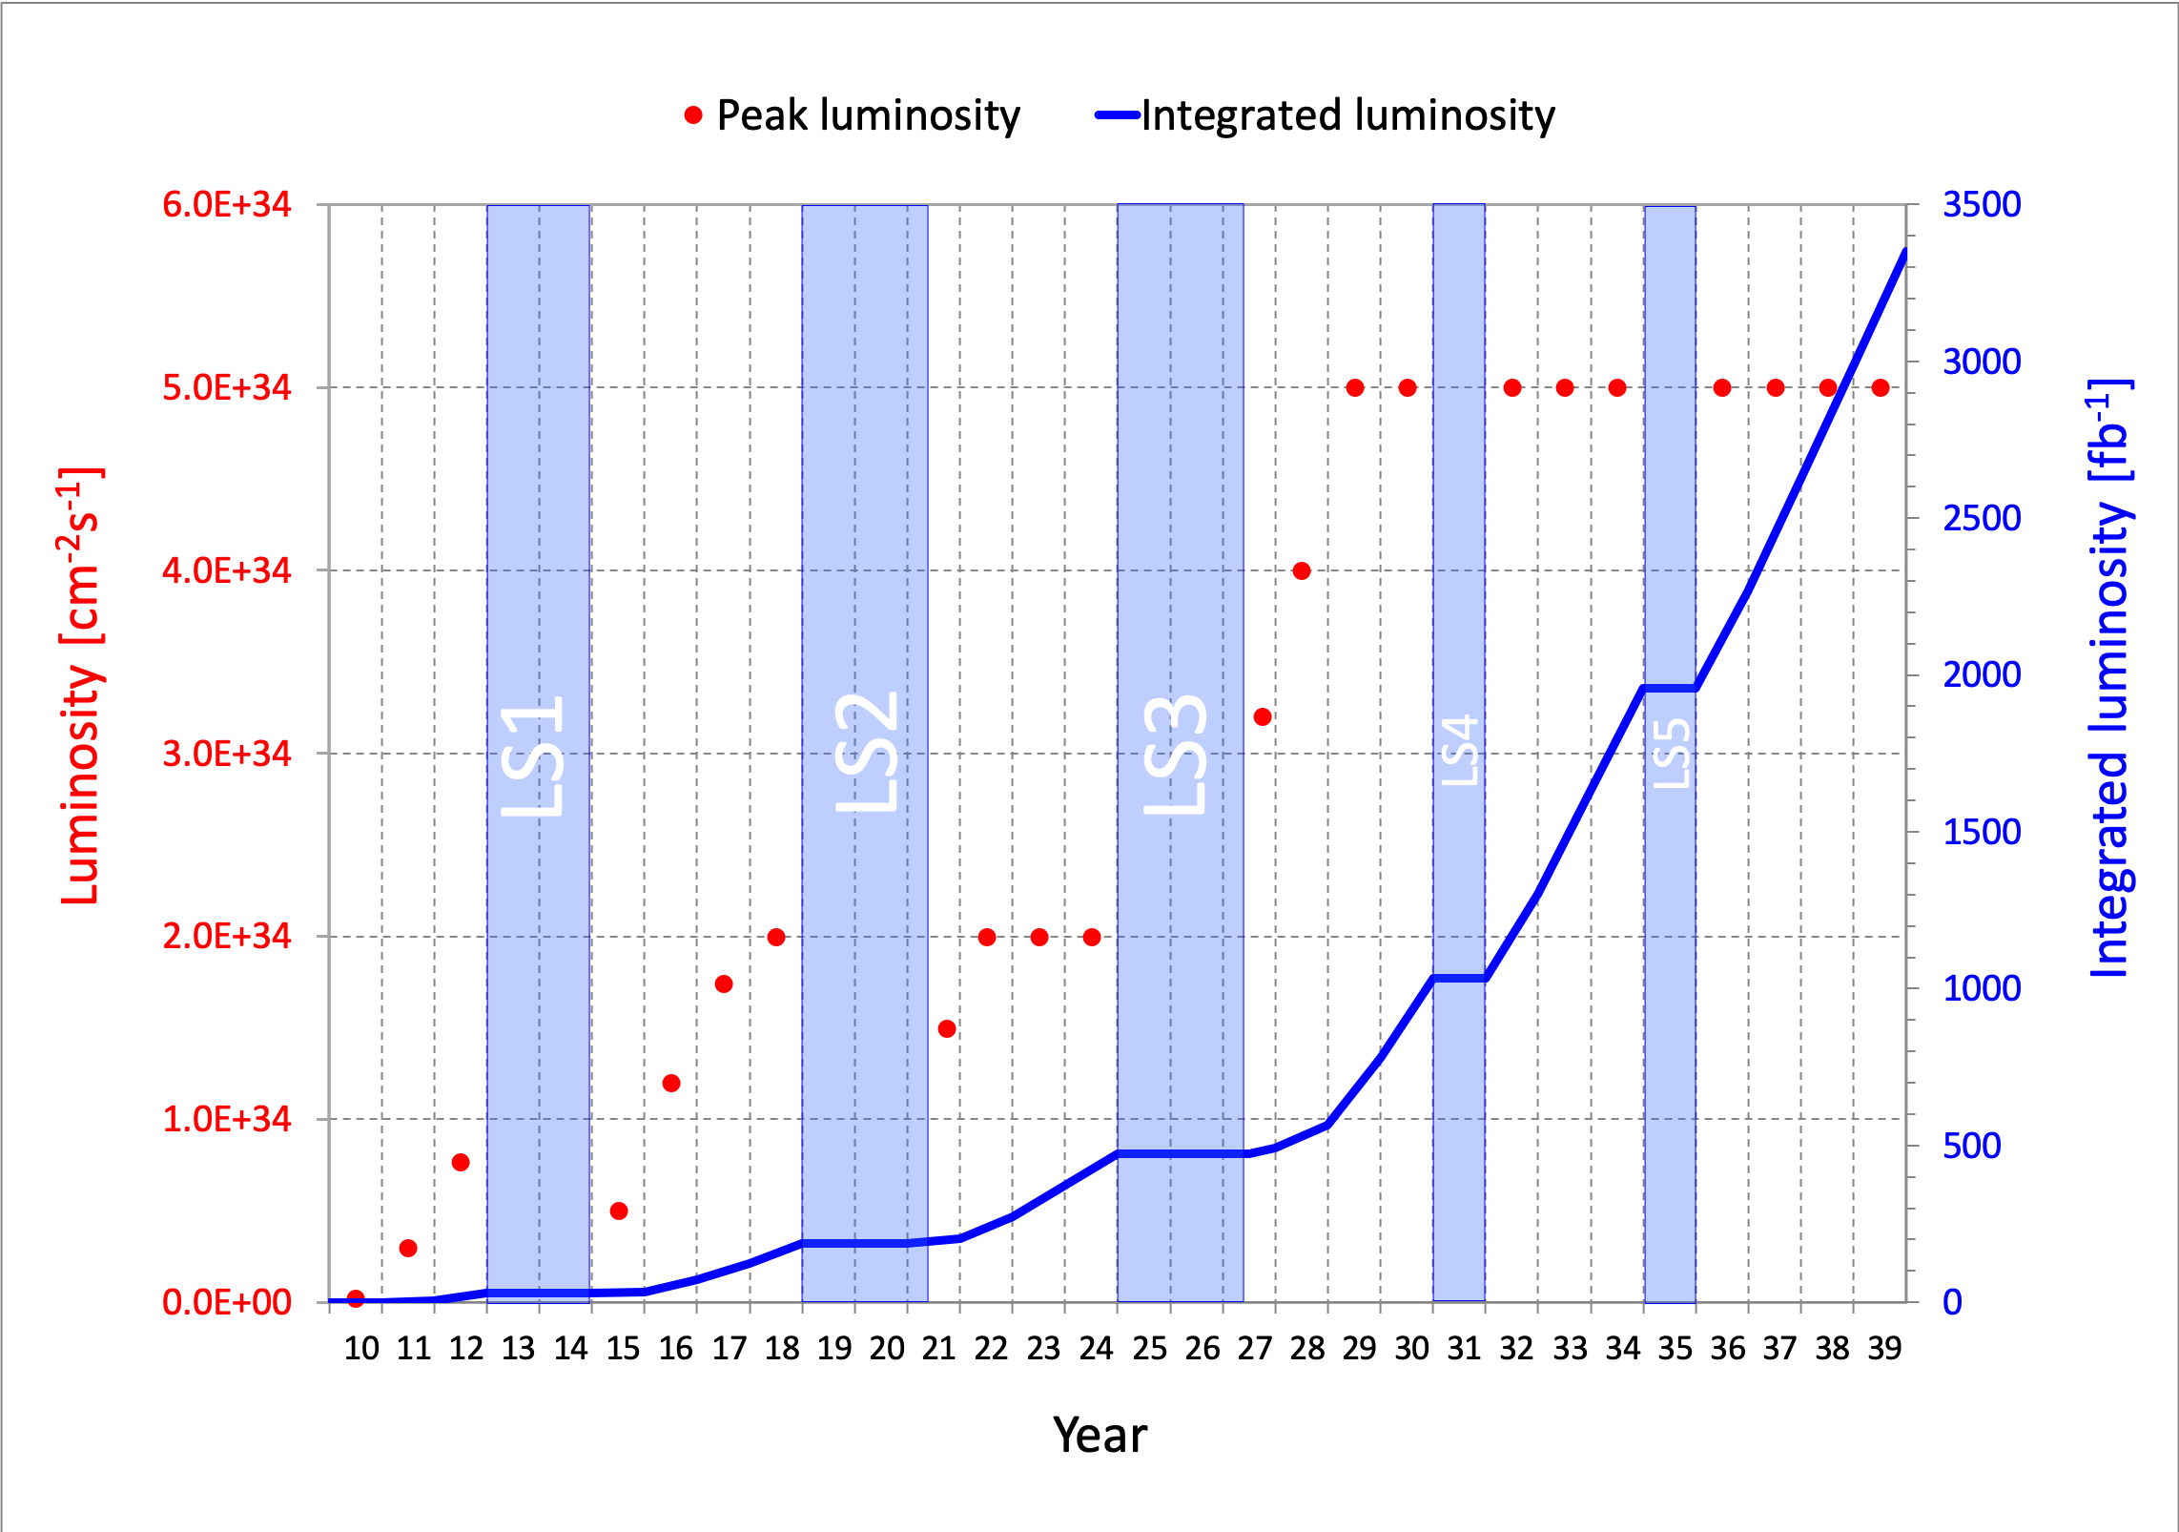
DARK PHOTON SENSITIVITY REACH
_{FASER Collaboration (2018)}
FASER probes new parameter space with just the first week of data.
If operating through 2037, FASER’s sensitivity will be extended by factor of 3000 – could detect as many as 10,000 dark photons.
Possible upgrade in 2028 will extend FASER’s sensitivity by factor of ~10⁶ – could detect as many as 3,000,000 dark photons.

Slide 42
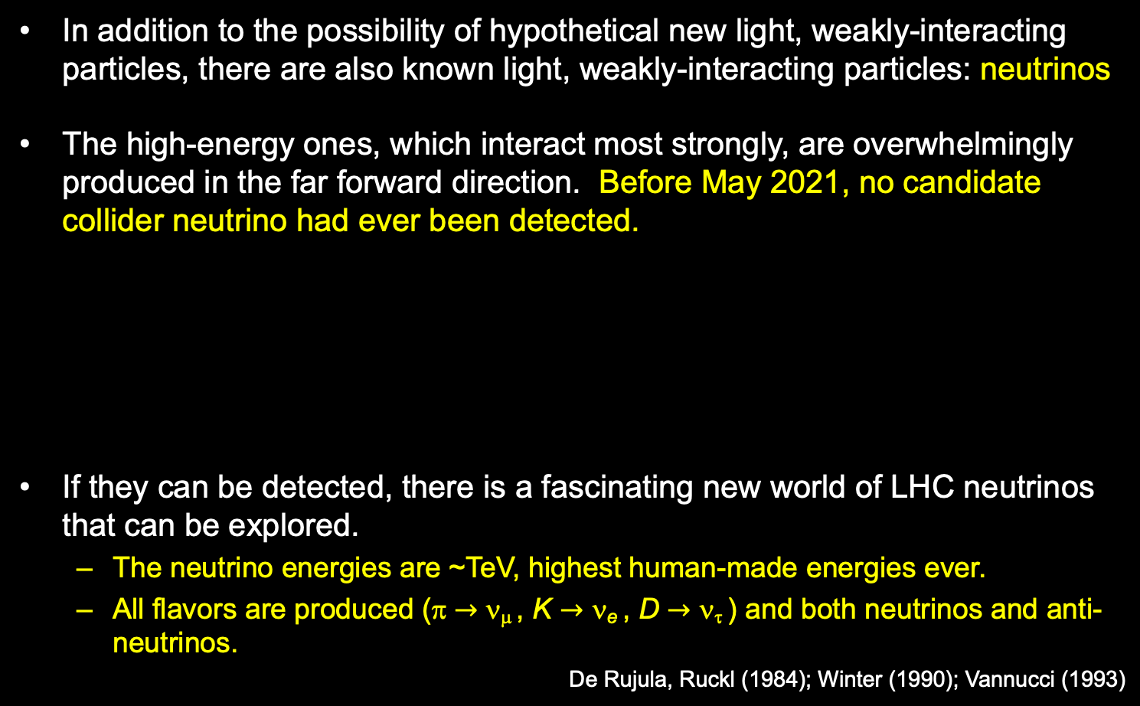
COLLIDER NEUTRINOS
In addition to the possibility of hypothetical new light, weakly-interacting particles, there are also known light, weakly-interacting particles: neutrinos.
The high-energy ones, which interact most strongly, are overwhelmingly produced in the far forward direction. Before May 2021, no candidate collider neutrino had ever been detected.
If they can be detected, there is a fascinating new world of LHC neutrinos that can be explored.
  The neutrino energies are ~TeV, highest human-made energies ever.
  All flavors are produced (π $→$ ν_{μ} , K $→$ ν_{e} , D $→$ ν_{τ} ) and both neutrinos and anti-neutrinos.
De Rujula, Ruckl (1984); Winter (1990); Vannucci (1993)

Slide 43
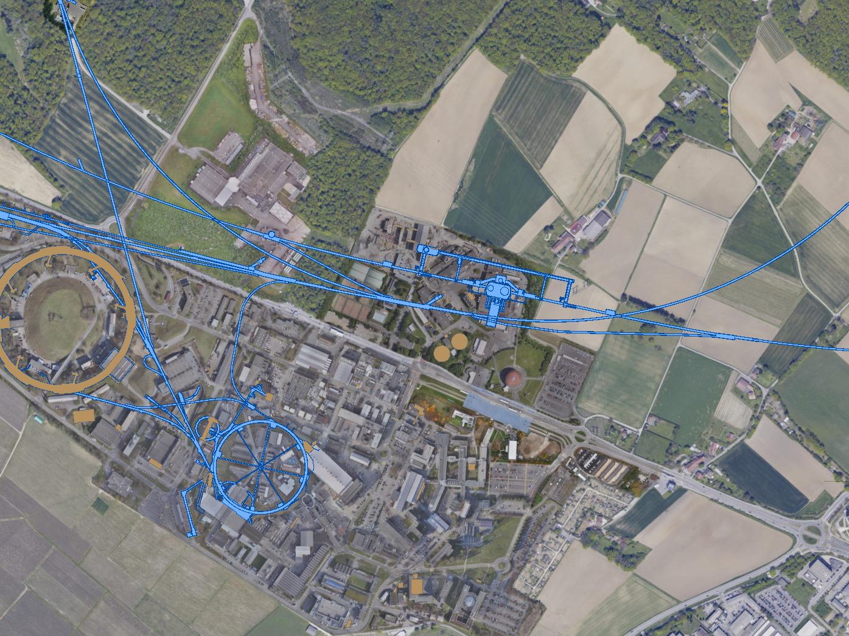
FASERν AND SND@LHC
UJ18
ATLAS
SPS
SND: approved March 2021
UJ12
LHC
FASER: approved March 2019
LOS
FASERν: approved December 2019
CERN GIS

Slide 44
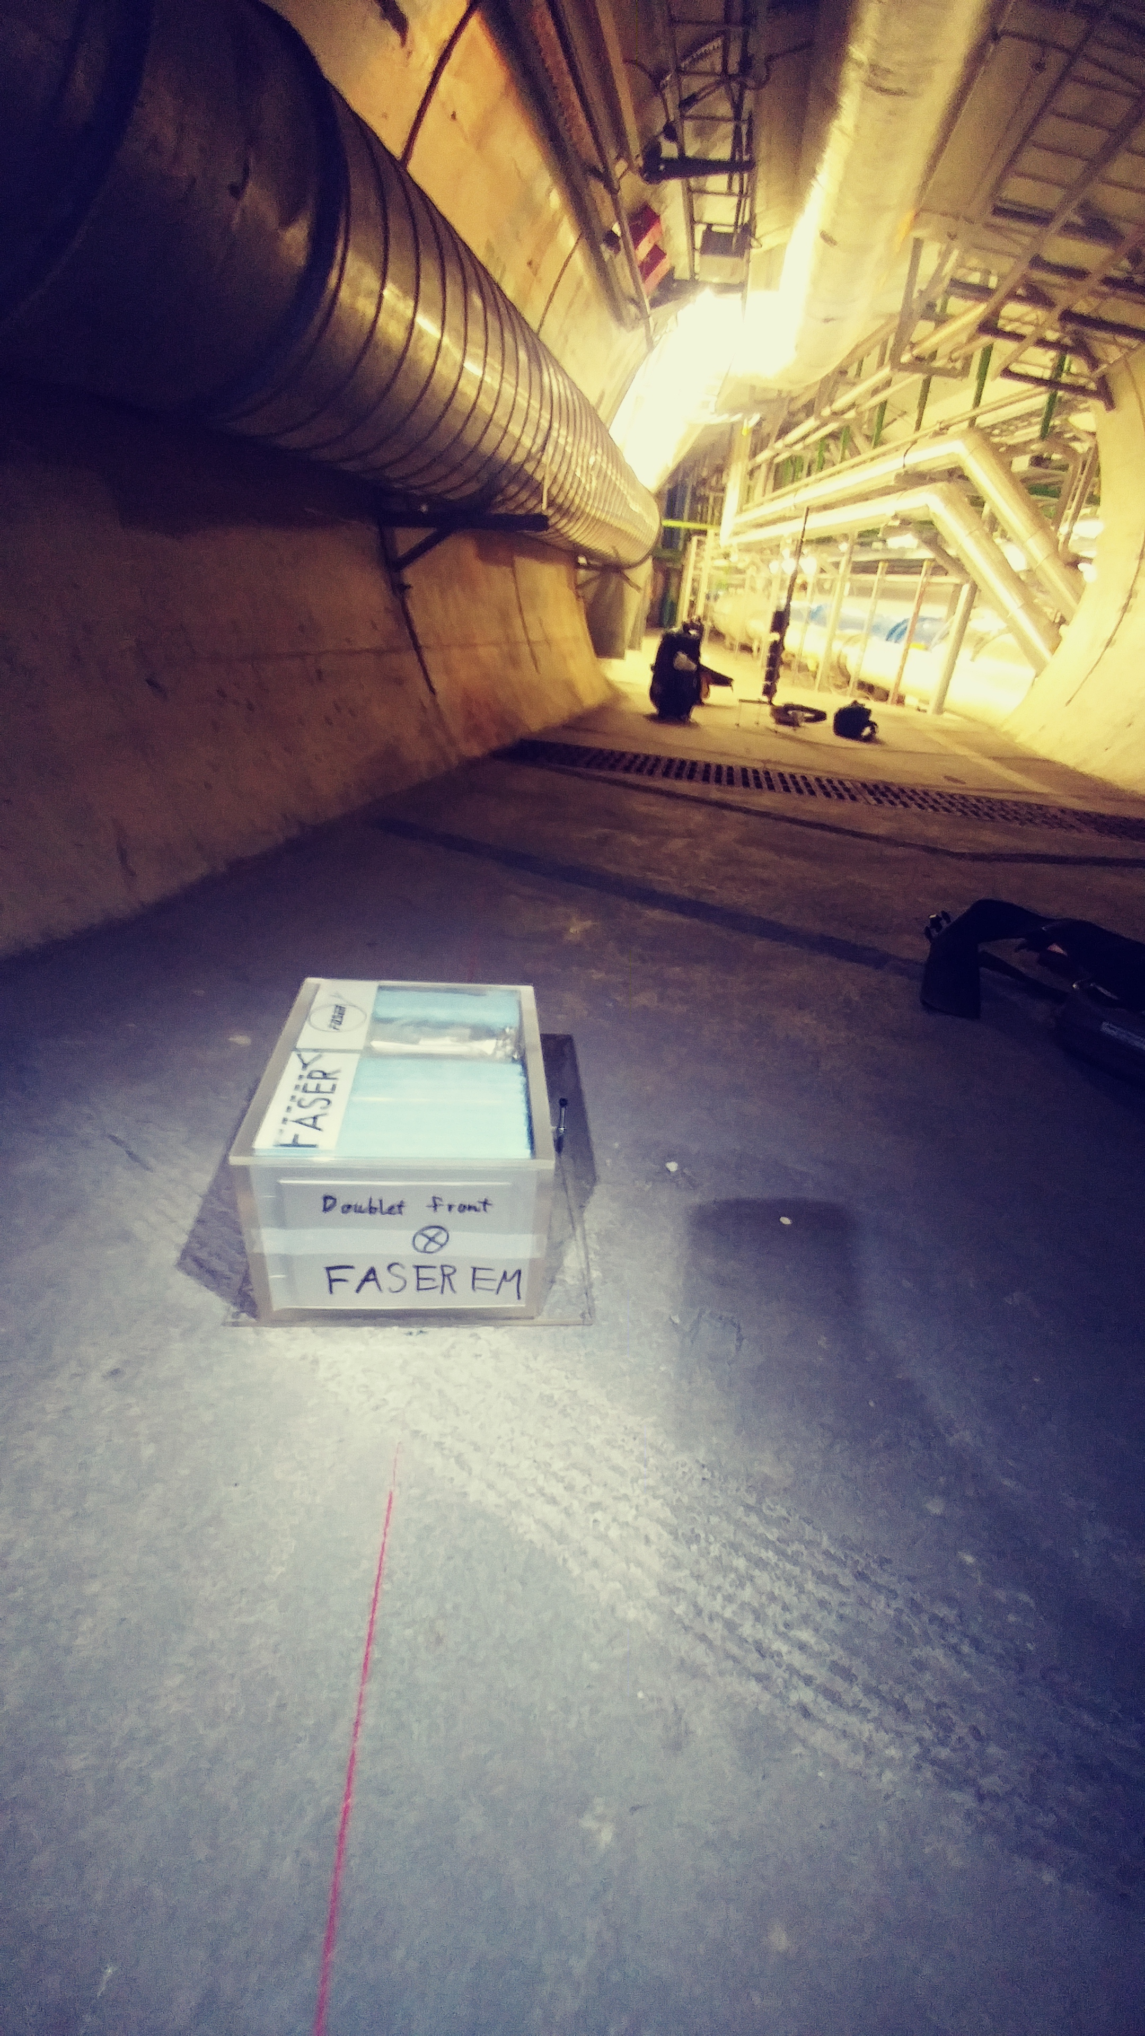
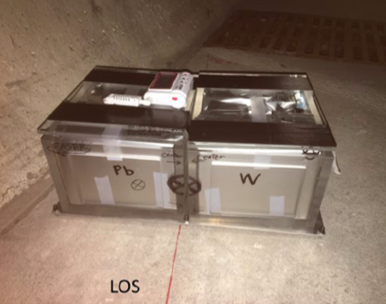
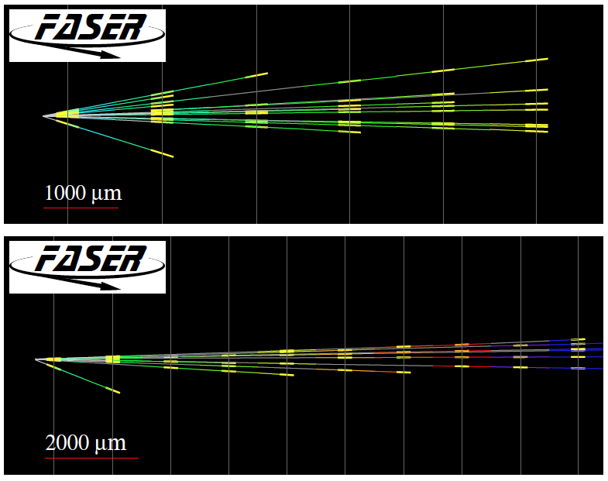
FIRST COLLIDER NEUTRINOS
In 2018 a FASER pilot emulsion detector with 11 kg fiducial mass collected 12.2 fb⁻¹ on the beam collision axis (installed and removed during Technical Stops).
In May 2021, the FASER Collaboration announced the direct detection of 6 candidate neutrinos above 12 expected neutral hadron background events (2.7σ).
Not the 5σ discovery of collider neutrinos, but a sign of things to come.

Slide 45
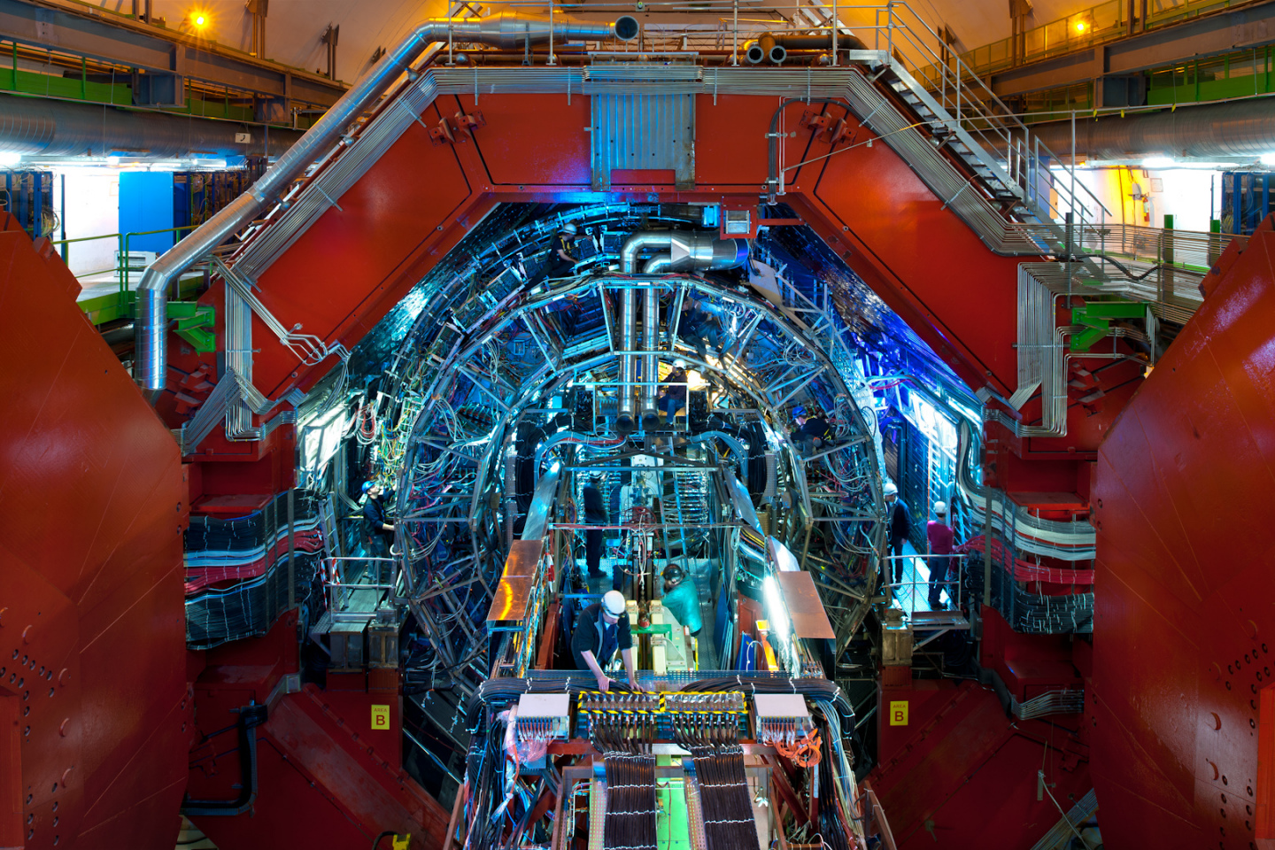
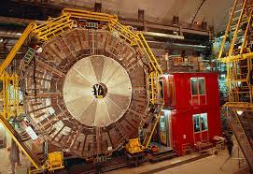
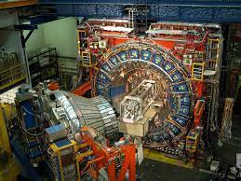
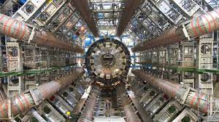
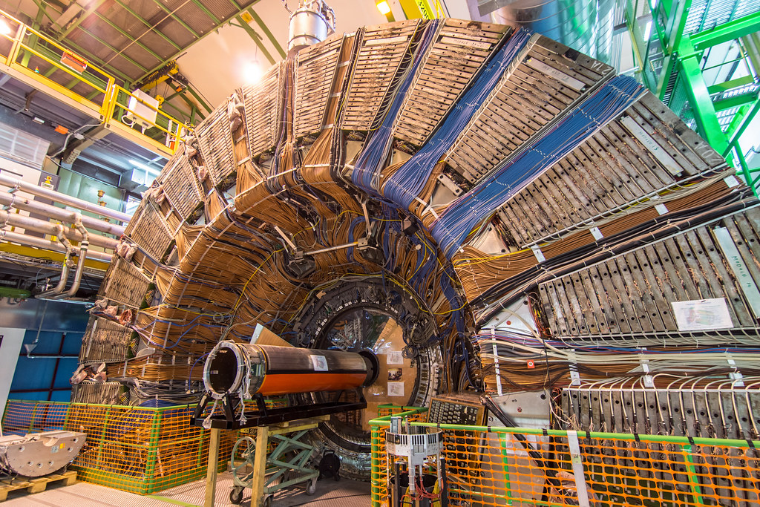
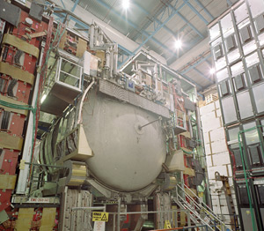
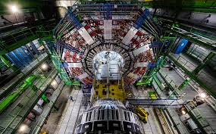
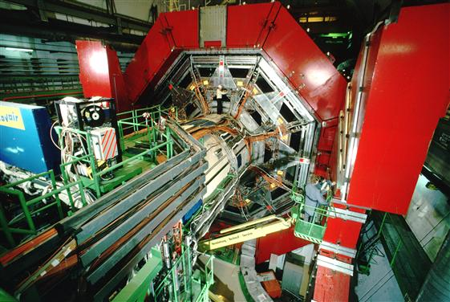

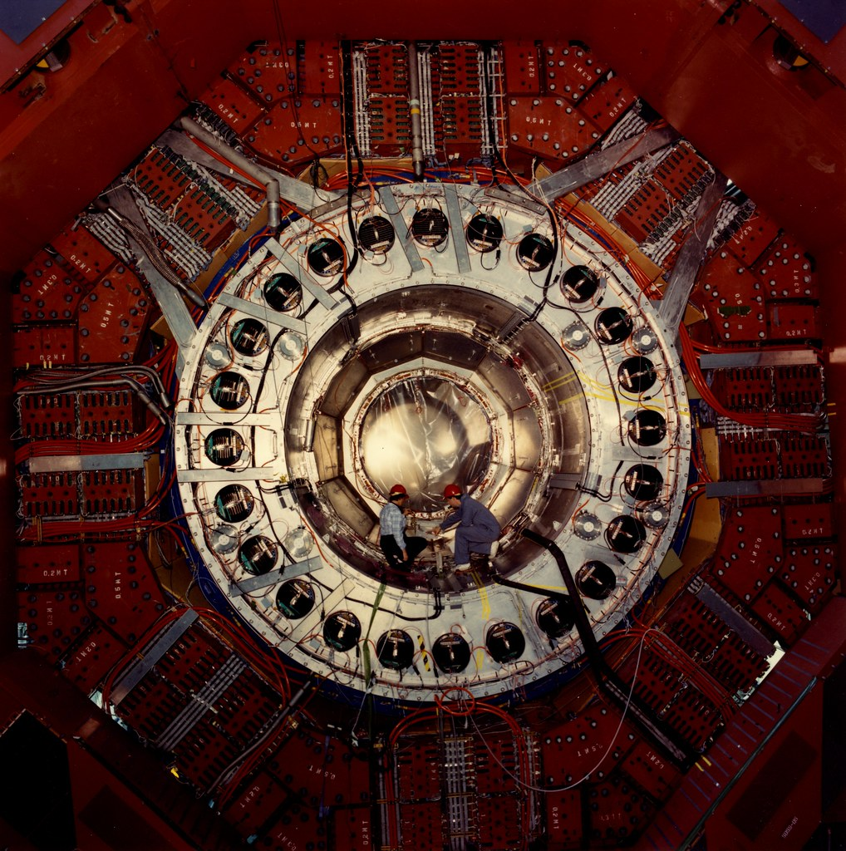
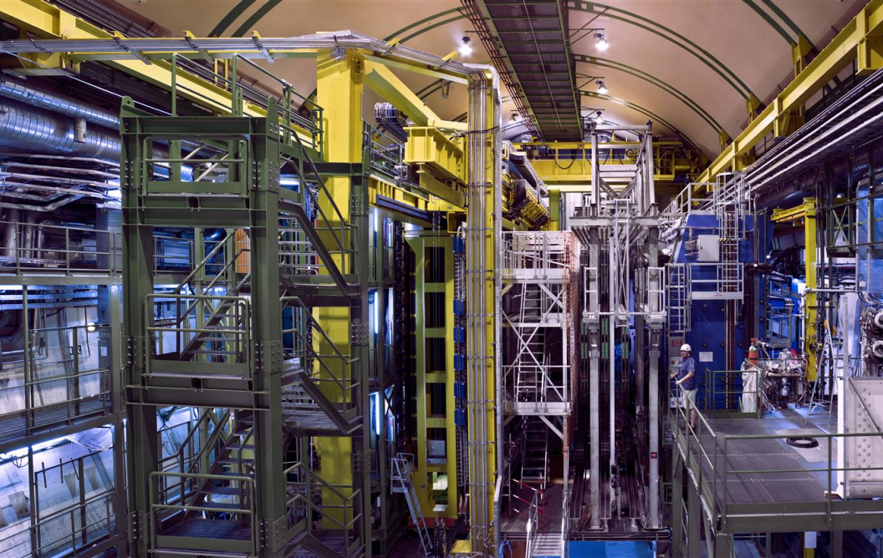
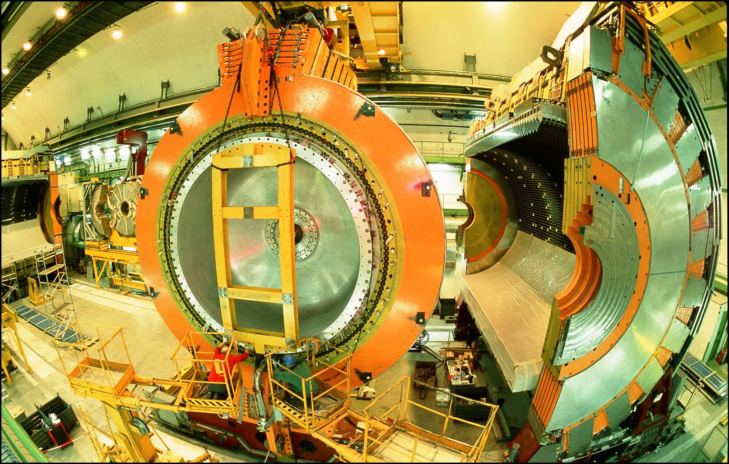
LOCATION, LOCATION, LOCATION
…
ALICE
ALEPH
CDF
FASER Pilot Detector
Suitcase-size, 4 weeks
$0 (recycled parts)
6 candidate neutrinos
ATLAS
DELPHI
D0
CMS
L3
LHCb
SLD
OPAL
All previous
collider detectors
Building-size, decades
~$10⁹
0 candidate neutrinos

Slide 46
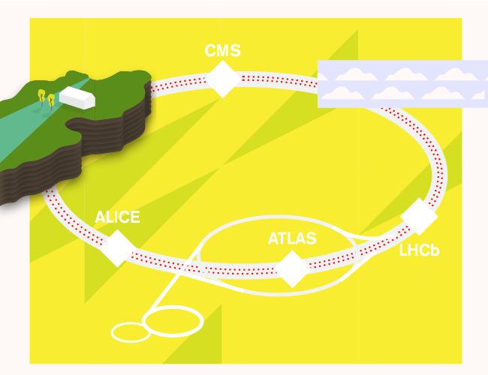
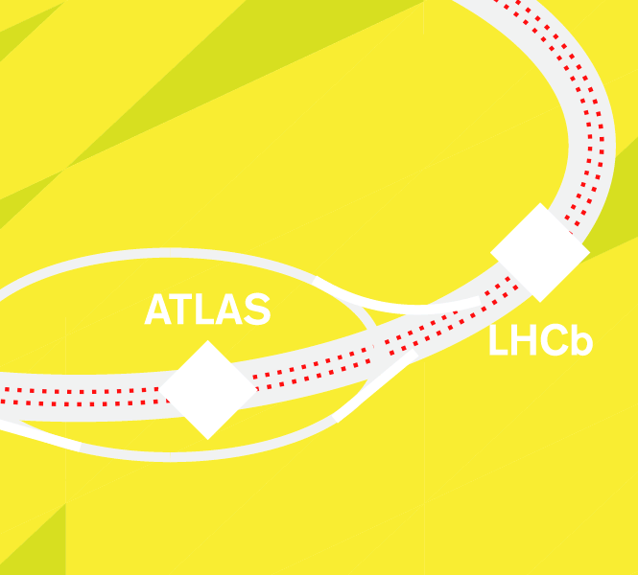

CONCLUSIONS
95% of the universe is waiting to be discovered.
Relatively fast, small, cheap experiments can provide world-leading sensitivities and perhaps, our first glimpse of the dark universe.
FASER: 18 months from theory paper to beginning of construction, fits on a tabletop, ~$2M for all hardware. Data-taking begins in July 2022 with neutrino measurements and discovery prospects for new particles.
More info: https://twiki.cern.ch/twiki/bin/viewauth/FASER/WebHome.
Branigan, Symmetry Magazine (2019)

