Slide 1



LONG-LIVED PARTICLES
AT (FUTURE) COLLIDERS
IAS Program on High Energy Physics (HEP 2022), Hong Kong
17 January 2022
Jonathan Feng, UC Irvine

Slide 2
EXECUTIVE SUMMARY
Long-Lived Particles (LLPs) are particles that travel macroscopic distances at colliders and then decay.
LLPs have long been considered to be exotica, but they are in fact ubiquitous in new physics models.
The LHC is currently not optimized to discover LLPs, especially light ones; new experiments and the proposed Forward Physics Facility will help.
Future colliders can improve their discovery potential by including LLP capabilities in their plans from the beginning.

Slide 3

LLPS IN OUR PAST
We have already discovered many LLPs.
In fact, LLPs have played an essential role in many of the conceptual breakthroughs that established the standard model of particle physics: n, $μ$, $π^{±}, K_{L, S}$, B, …
Alimena et al. (eds. Beacham, Shuve) (2019)

Slide 4
LLPS IN OUR FUTURE
The next breakthrough in particle physics is likely to involve LLPs
  LLPs are ubiquitous in BSM theories, especially those with cosmological significance.
  LLPs can be detected through a huge variety of signatures, many of which are truly spectacular – a few events can be a discovery.
  At the LHC, we have not yet reached the full LLP discovery potential, but there are many exciting initiatives now underway and proposed.

Slide 5
CAVEAT
This is by now a huge field, and it is impossible to give a complete overview of either the LLP candidates or the experiments proposed to look for them.
LLPs can emerge in many scenarios. In many BSM models, one can tune a coupling or a mass splitting to be very small to create an LLP.
In this talk, however, I will highlight scenarios in which LLPs have some independent reason to be long-lived and particularly focus on those that have some interesting cosmological connections.

Slide 6

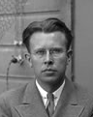
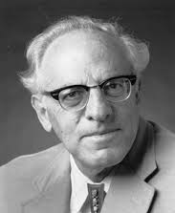
THE NEW PARTICLE LANDSCAPE
Particle
Colliders
Mass
MeV
GeV
TeV
1
Already
Discovered
Strongly Interacting
Heavy Particles
Interaction Strength
LLPs from Light Physics
LLPs from Weak-Scale Physics
10⁻³
Weakly Interacting
Light Particles
Impossible to
Discover
10⁻⁶

Slide 7
LLPS FROM
WEAK- SCALE PHYSICS

Slide 8
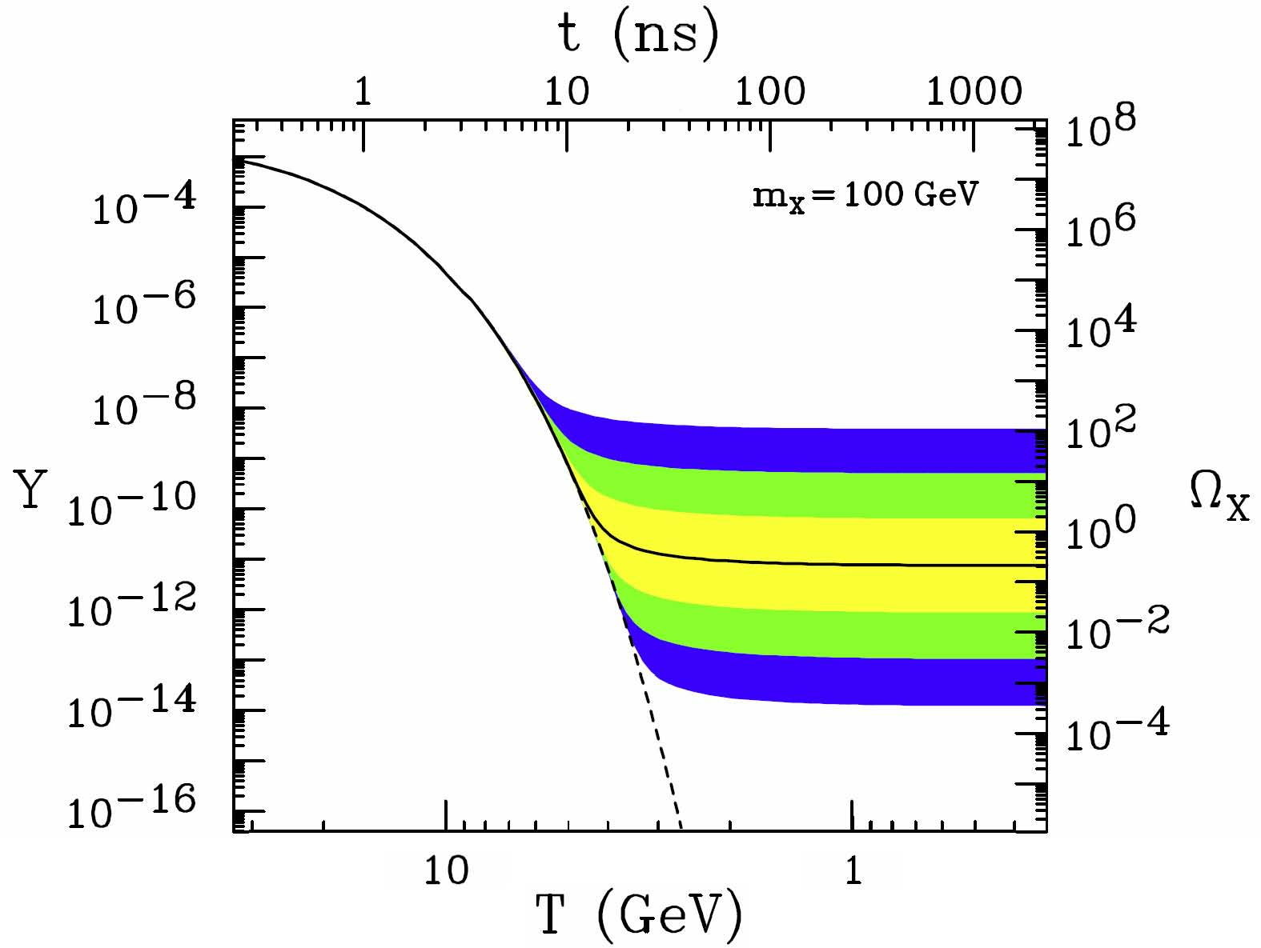
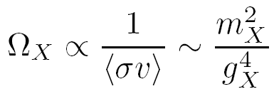
WEAK-SCALE PHYSICS AND COSMOLOGY
Particles with g ~ O(1) and mass ~ m_{W} are great DM candidates.
The resulting relic density is
For a WIMP, m_{X} ~ 100 GeV and g_{X} ~ 0.6 → Ω _{X} ∼ 0.1
X
f
X
f̅
This simple coincidence, the WIMP Miracle, ties together weak-scale physics and cosmology, and has led to the notion that BSM searches are largely missing E_{T} searches at colliders.

Slide 9
LLPS IN STANDARD SUSY
But this focus on missing E_{T} is a vast oversimplification.
Consider standard (gravity-mediated) supersymmetry. The gravitino has mass ~ 100 GeV, couplings ~ M_{W}/M_{Pl} ~ 10⁻¹⁶ .
G̃ not LSP
Assumption of most of literature
G̃ LSP
Completely different cosmology and particle physics
SM
SM
G̃
NLSP
LSP
G̃

Slide 10
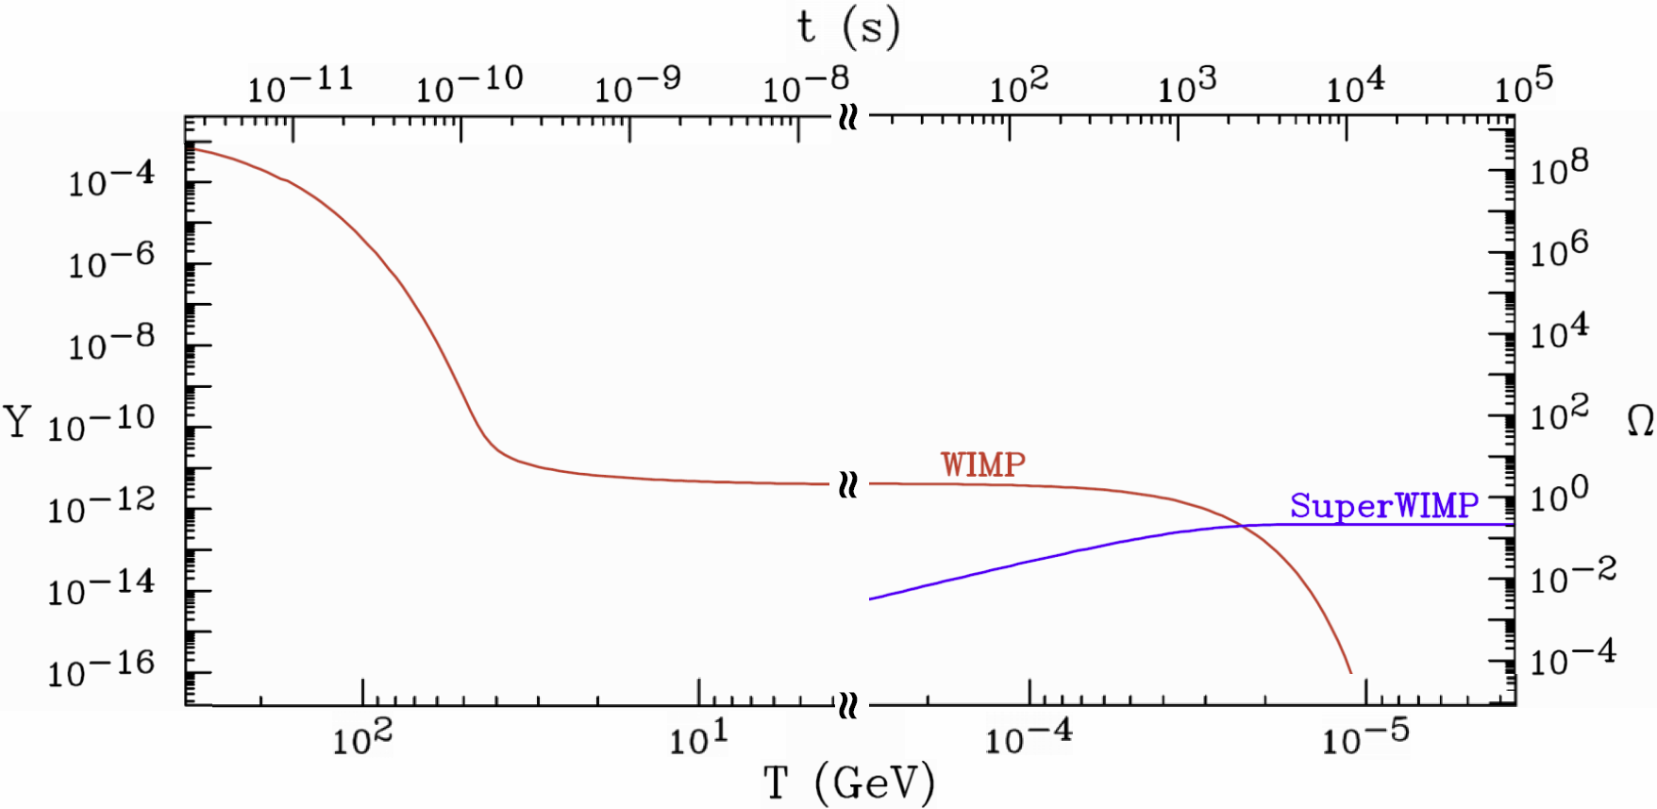
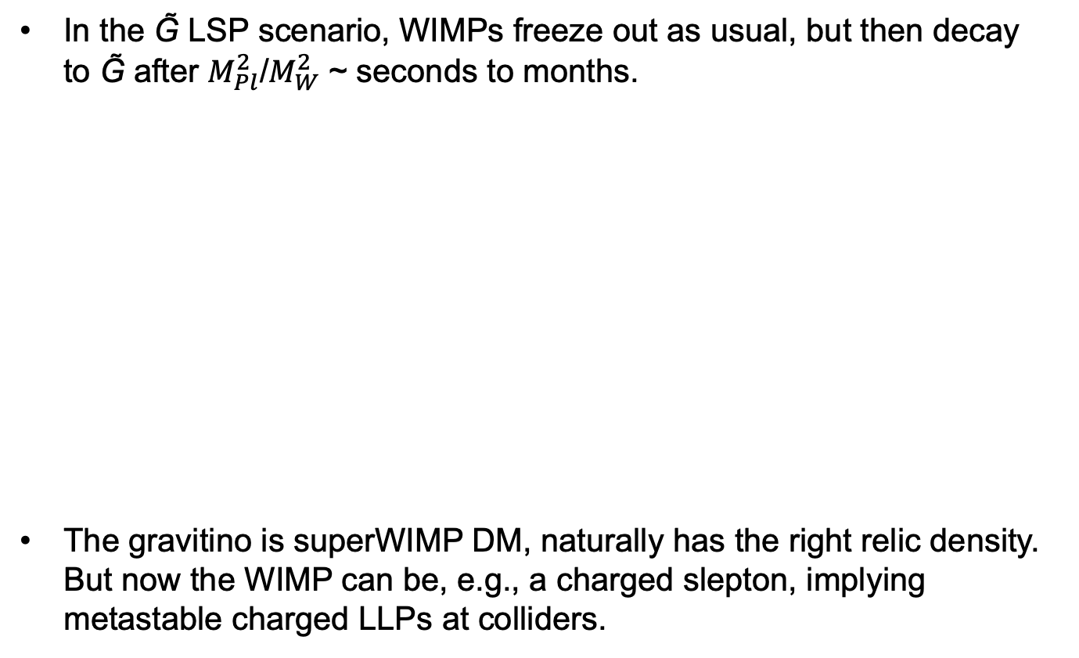
LLPs IN SUPERWIMP SCENARIOS
Feng, Rajaraman, Takayama (2003)
In the G̃ LSP scenario, WIMPs freeze out as usual, but then decay to G̃ after $M_{Pl}^{2}$/$M_{W}^{2}$ ~ seconds to months.
The gravitino is superWIMP DM, naturally has the right relic density. But now the WIMP can be, e.g., a charged slepton, implying metastable charged LLPs at colliders.

Slide 11
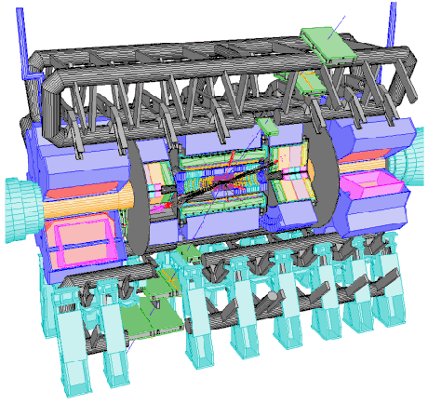
LLPs AND ADD-ON DETECTORS
If we see metastable charged LLPs, we know they must decay.
We can collect these particles and study their decays.
Several ideas have been proposed
  Catch sleptons in a 1m thick water tank (up to 1000/year) and then move them to a quiet place to observe their decays
  Feng, Smith (2004)
  Catch sleptons in LHC detectors
Hamaguchi, Kuno, Nakawa, Nojiri (2004)
  Dig sleptons out of detector hall walls
De Roeck, Ellis, Gianotti, Moortgat, Olive, Pape (2005)
Charged particle trap
Reservoir
Notes:
11

Slide 12
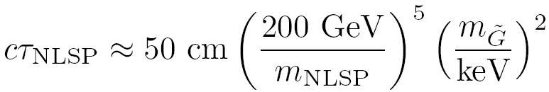
LLPs IN GAUGE-MEDIATED SUSY
Scenarios with gauge-mediated SUSY breaking are among the most famous of those predicting LLPs.
NLSPs decay to light G̃ LSPs. The G̃ mass and the NLSP decay length are correlated. For G̃ masses ~ keV (motivated, with caveats, by G̃ DM), the decay lengths are macroscopic
Dine, Nelson, Nir, Shirman (1994, 1995); Dimopoulos, Dine, Raby, Thomas (1996); …
 | Neutralino NLSP | Slepton NLSP
Prompt | Prompt photons | Multi-leptons
Intermediate | Displaced photons Displaced conversion | Displaced lepton Track kinks
Long-Lived | Missing E_{T} | Time-of-flight High dE/dx
Notes:
12

Slide 13
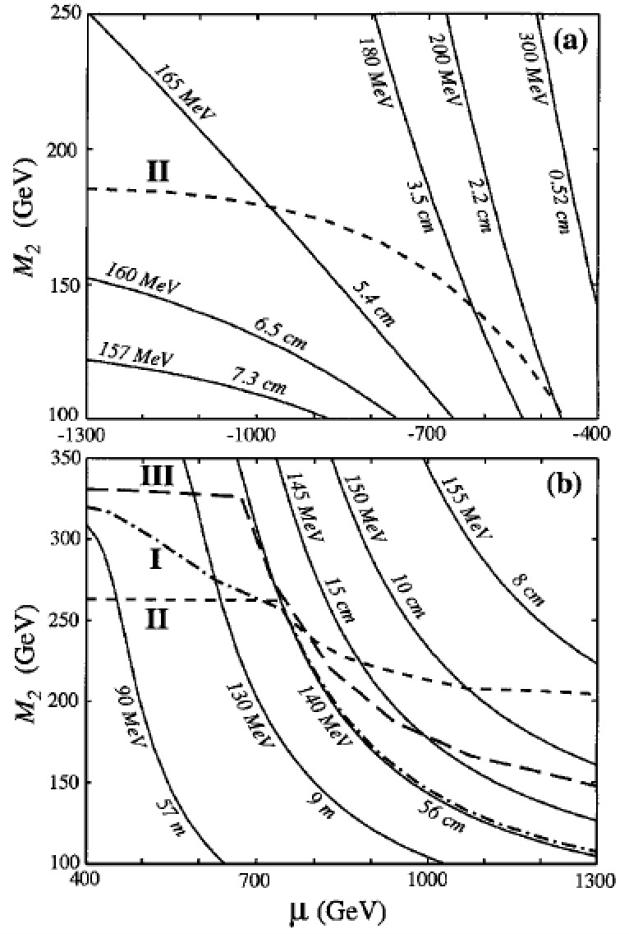
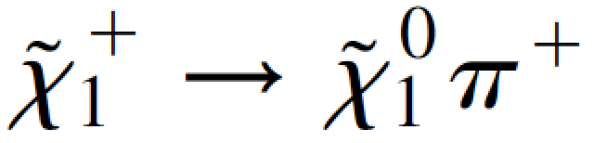
LLPs IN ANOMALY-MEDIATED SUSY
Scenarios with anomaly-mediated SUSY breaking give additional interesting LLPs signals.
Randall, Sundrum (1998); Giudice, Luty, Murayama, Rattazzi (1998); …
The LSPs are a highly degenerate Wino triplet with Δmloop >> Δmtree .
Typically, there are 2-body decays
and disappearing tracks after ~10cm.
This is an example of the generic possibility that a symmetry enforces small mass splittings, leading LLPs.
Feng, Moroi, Randall, Strassler, Su (1999)
Notes:
13

Slide 14
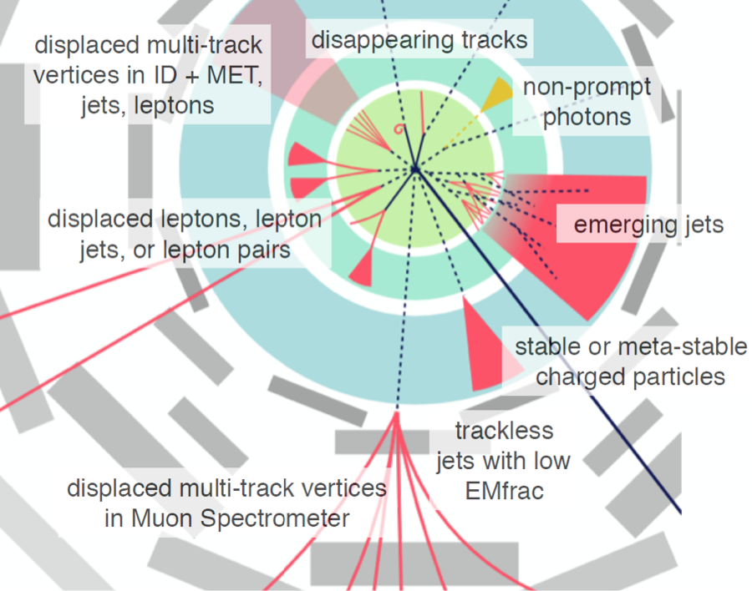
LLPs IN OTHER WEAK-SCALE MODELS
By considering a few standard models of weak-scale physics, we have motivated a plethora of possible LLP signatures.
Of course, there are many other motivated weak-scale models with LLPs.
In SUSY: e.g., R-parity violating SUSY and compressed SUSY, which have become more motivated as generic, sub-TeV SUSY becomes more constrained.
Extra dimensional scenarios typically have similar possibilities (e.g., viewing universal extra dimensions as bosonic supersymmetry), and naturally compressed spectra.
Credit: Heather Russell
Notes:
14

Slide 15
LLPS FROM
LIGHT PHYSICS

Slide 16
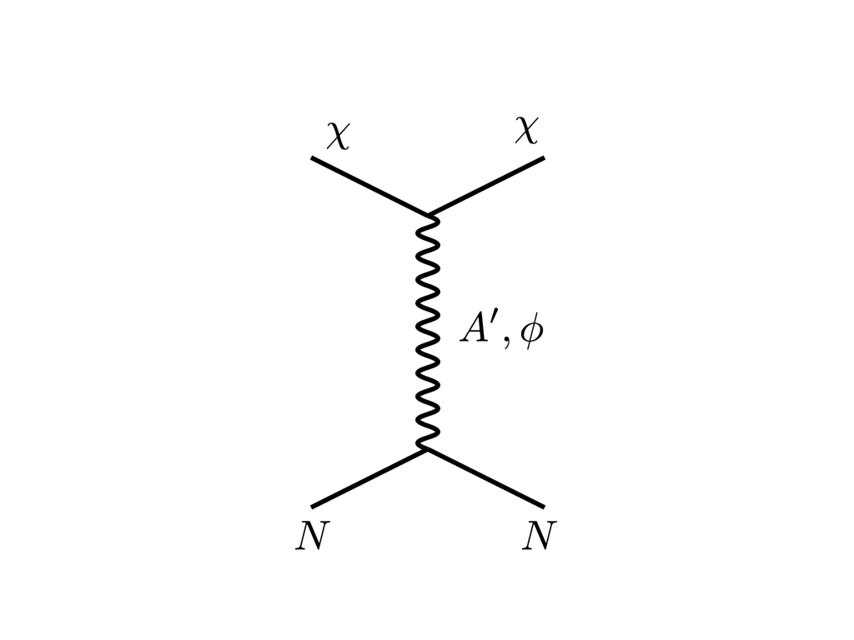





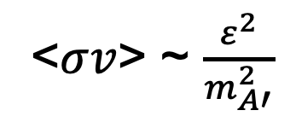
THE THERMAL RELIC LANDSCAPE
Particle
Colliders
Mass
MeV
GeV
TeV
1
Already
Discovered
Strongly Interacting
Heavy Particles
Too Little to be
Dark Matter
$$e$$
DM
$$ε$$
$$A’$$
$$ε$$
Interaction Strength
Just Right to
be Dark Matter
10⁻³
DM
$$e$$
<$σv$> ~ $\frac{ε^{2}}{m_{A′}^{2}}$
Weakly Interacting
Light Particles
Impossible to
Discover
10⁻⁶
Too Much to be
Dark Matter
“The WIMPless Miracle”
Feng, Kumar (2008);
see also Boehm, Fayet (2003)
Pospelov, Ritz, Voloshin (2007)

Slide 17
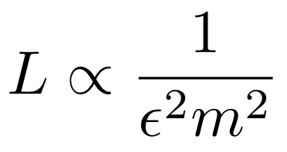
THE NEW PARTICLE LANDSCAPE
Particle
Colliders
Mass
MeV
GeV
TeV
1
Already
Discovered
Strongly Interacting
Heavy Particles
MUCH LONGER
LIFETIMES
Interaction Strength
10⁻³
Weakly Interacting
Light Particles
Impossible to
Discover
10⁻⁶

Slide 18
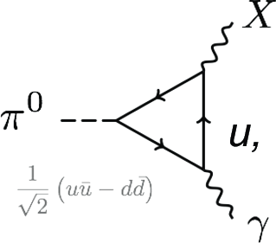
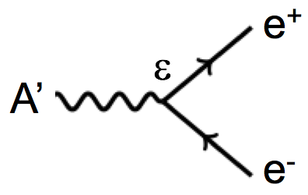
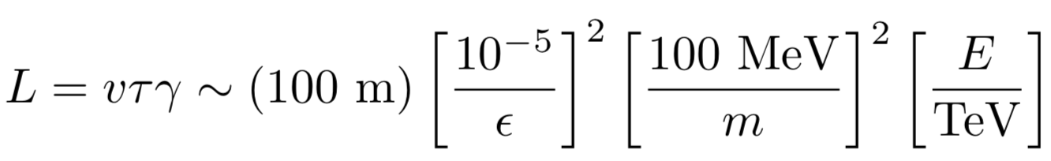
LIGHT LLP PHENOMENOLOGY
The advent of dark sectors (along with axion-like particles, light gauge bosons, etc.) highlights a new class of LLPs.
As an example, consider a dark photon A’ with energy E ~ TeV, mass m ~ 100 MeV, coupling ε ~ 10⁻⁵ .
ε
A’
It can be produced in large numbers through the decays of light particles, like pions.
It passes through matter essentially without interacting: radiation length is (10 cm) ε⁻² ~ 10⁹ m, the distance to the moon!
It decays to visible particles, but only after traveling a long distance.

Slide 19
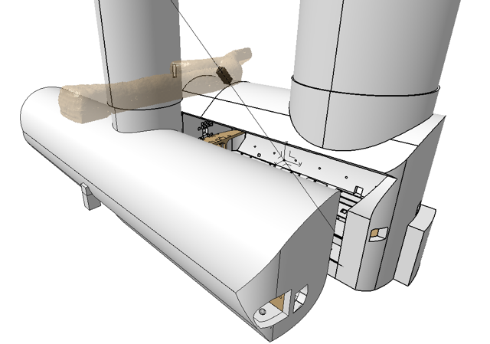

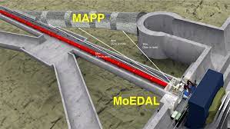
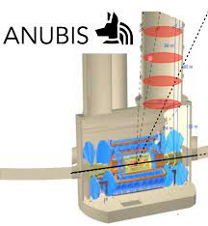
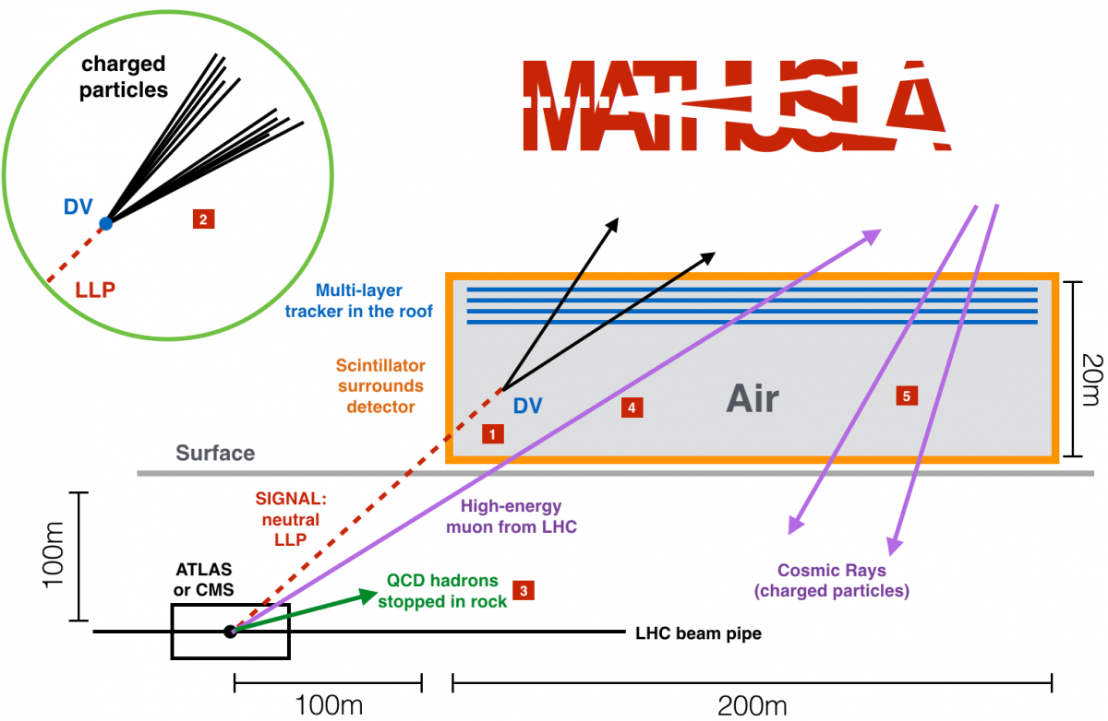
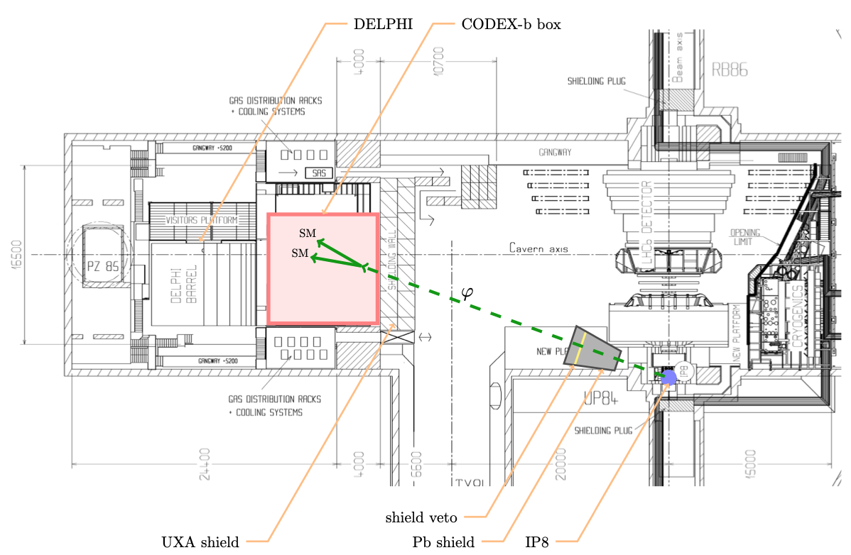
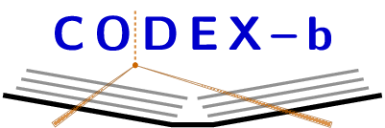
LIGHT LLPS AT THE LHC
How can we find light LLPs at colliders?
Many ideas for new detectors at the LHC
  Transverse detectors: MoeDAL/MAPP, MilliQan, MATHUSLA, Codex-b, ANUBIS, …
  Far-forward detectors: FASER, FASERν, SND@LHC

Slide 20


Slide 21

SEARCHES FOR NEW LIGHT PARTICLES
If new particles are light and weakly interacting, the existing big LHC detectors are perfectly designed NOT to see them.
Existing detectors are designed to find new heavy particles. These particles are produced almost at rest and decay isotropically.
But new light particles are mainly produced in the decays of light particles: π, η, K, D and B mesons. These are mainly produced along the beamline, and so the new particles disappear through the holes that let the beams in.
Clearly we need a detector to exploit the “wasted” σ_{inel} ~ 100 mb and cover these “blind spots” in the forward region. If we go far enough away, the proton beams are bent by magnets (it’s a circular collider!), whereas the new light particles will go straight.

Slide 22
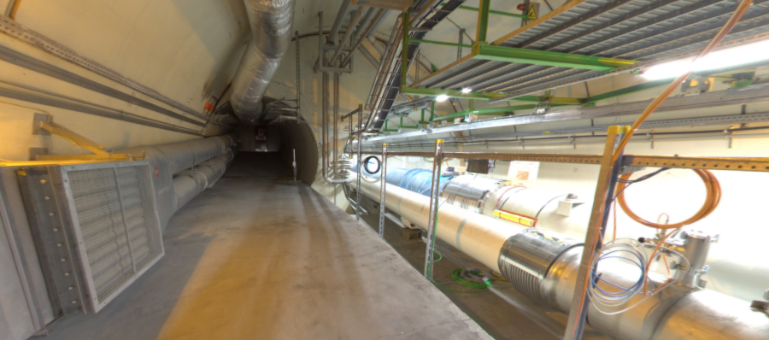
THE FAR-FORWARD REGION
Beam collision axis passes
through 100 m of rock, emerges in tunnel TI12, 480 m from ATLAS
UJ12
TI12 near UJ12
The view in UJ12 looking west (2019)
TI12
Beam collision axis
LHC beamline

Slide 23
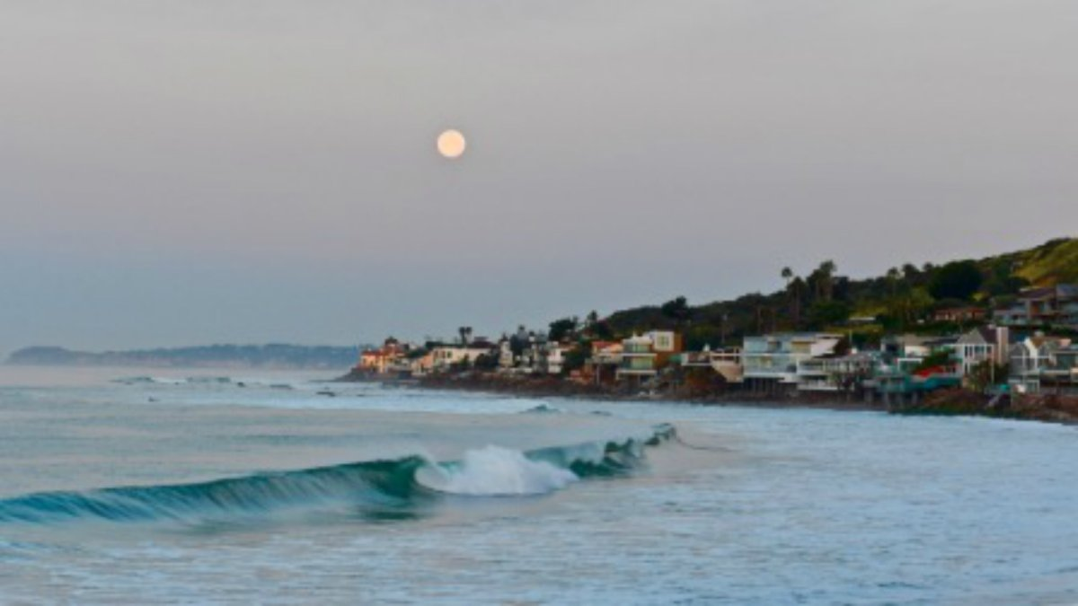
HOW BIG DOES THE DETECTOR HAVE TO BE?
Momentum:
Space:
250 MeV
1 TeV
12 cm
480 m
The opening angle is 0.2 mrad (η ~ 9); cf. the moon (7 mrad). Most of the signal passes through 1 sheet of paper at 480 m.
TeV dark photons (or any other new particles produced in π, η, K, D, B decay) are far more collimated than shown below, motivating a new, small, fast, cheap experiment at the LHC.

Slide 24
FASER TIMELINE
September 2017: Initial proposal (Feng, Galon, Kling, Trojanowski)
July 2018: Submitted LOI to CERN LHCC
October 2018: Approval from ATLAS SCT and LHCb Collaborations for use of spare detector modules
November 2018: Submitted Technical Proposal to LHCC
November 2018 – January 2019: Experiment funded by the Heising-Simons and Simons Foundations
March 2019: FASER approved as 8th LHC detector by CERN
March 2021: FASER fully installed, commissioning of the detector begins
Mid-2022: FASER to begin collecting data in Run 3

Slide 25
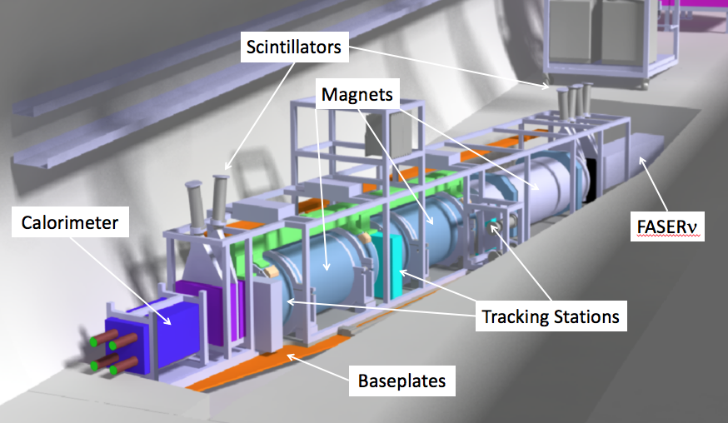
THE FASER DETECTOR
The signal: nothing incoming and 2 ~TeV, opposite-sign charged tracks pointing back to ATLAS: a “light shining through (100 m) wall” experiment.
Scintillators veto incoming charged tracks (muons), magnets split the charged tracks, which are detected by tracking stations and a calorimeter.
LLP
ν
e⁺
e⁻

Slide 26
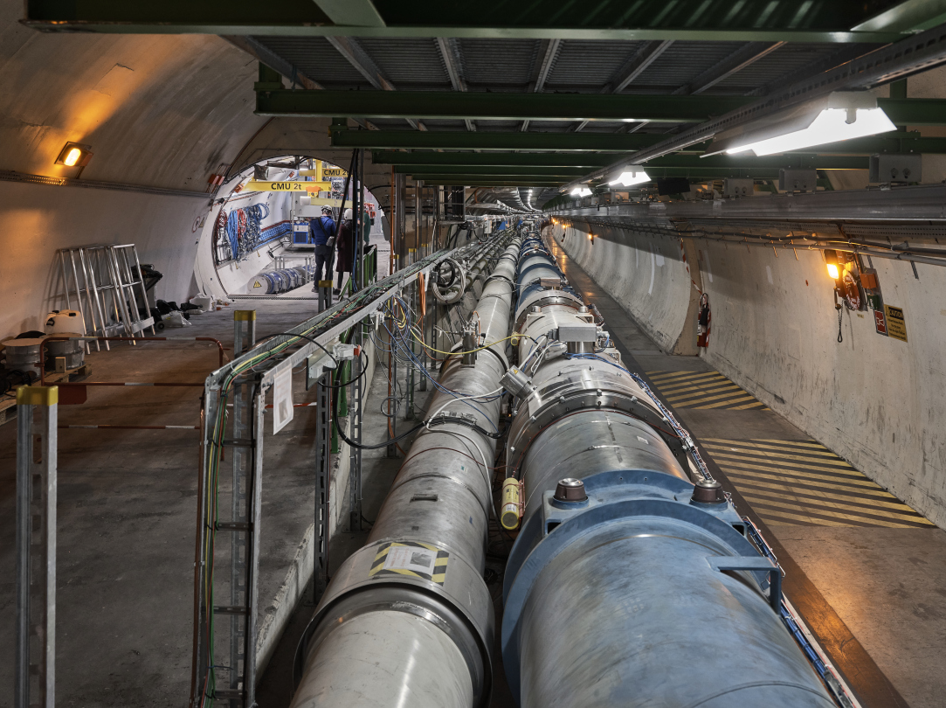
FASER INSTALLED IN TI12

Slide 27
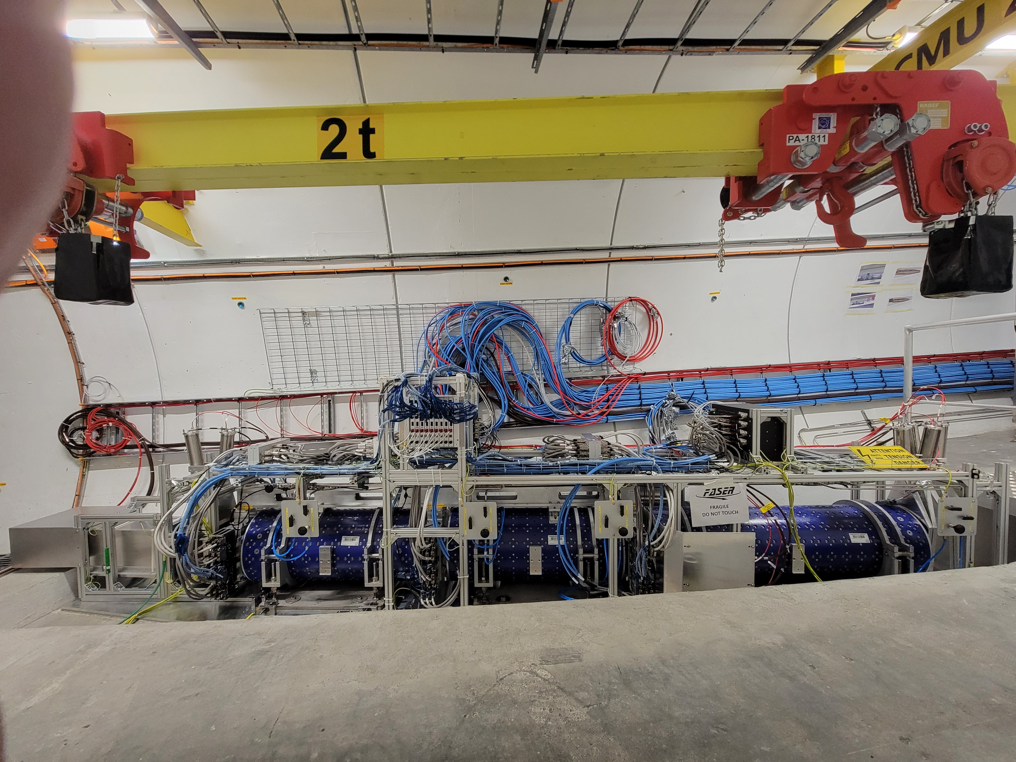
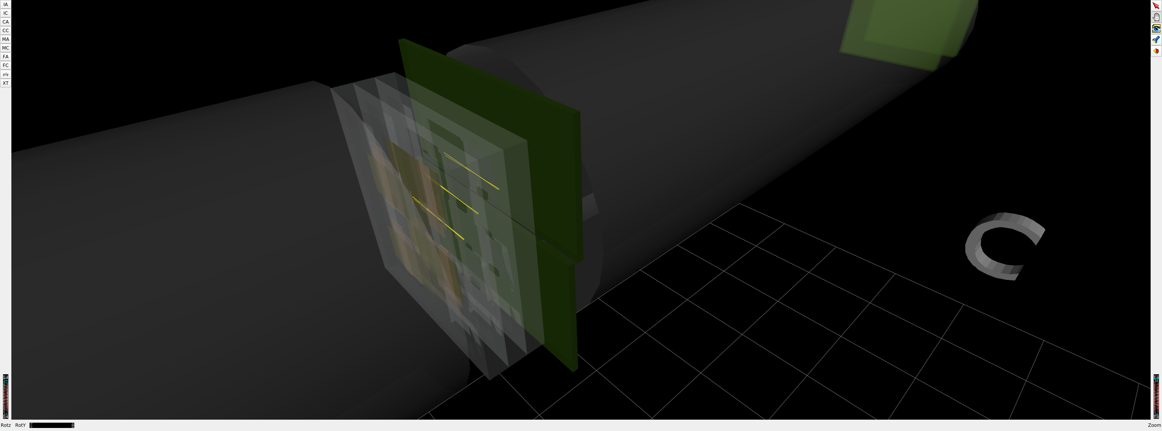
FASER INSTALLED IN TI12
1st Cosmic Ray
18 March 2021

Slide 28
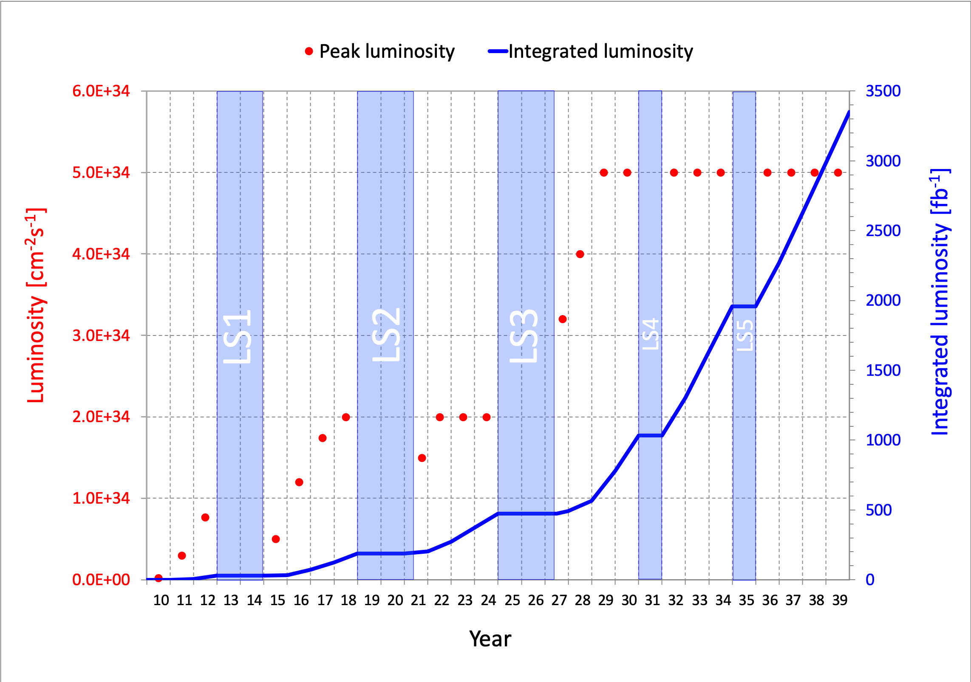
DARK PHOTON SENSITIVITY REACH
FASER
FASER probes new parameter space with just 1 fb⁻¹ starting in 2022.
Without upgrade, HL-LHC extends (Luminosity*Vol) by factor of 3000 – could detect as many as 10,000 dark photons.
Possible upgrade to FASER 2 (R=1m, L=20m) extends (Luminosity*Vol) by factor of ~10⁶ – could detect as many as 3,000,000 dark photons.
_{FASER Collaboration (2018)}

Slide 29
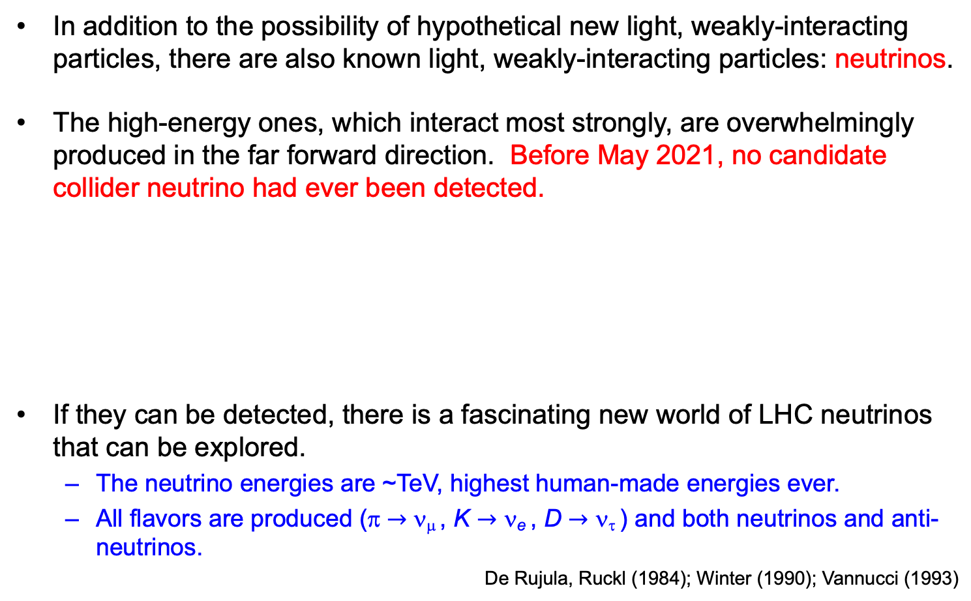
COLLIDER NEUTRINOS
In addition to the possibility of hypothetical new light, weakly-interacting particles, there are also known light, weakly-interacting particles: neutrinos.
The high-energy ones, which interact most strongly, are overwhelmingly produced in the far forward direction. Before May 2021, no candidate collider neutrino had ever been detected.
If they can be detected, there is a fascinating new world of LHC neutrinos that can be explored.
  The neutrino energies are ~TeV, highest human-made energies ever.
  All flavors are produced (π $→$ ν_{μ} , K $→$ ν_{e} , D $→$ ν_{τ} ) and both neutrinos and anti-neutrinos.
De Rujula, Ruckl (1984); Winter (1990); Vannucci (1993)

Slide 30
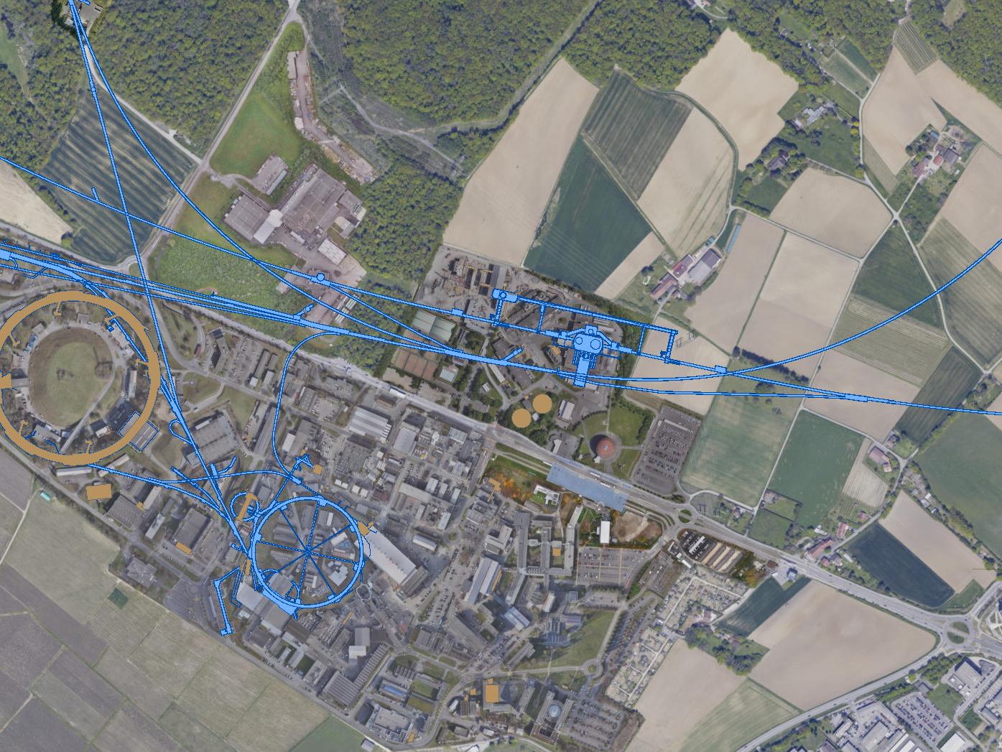
FASERν AND SND@LHC
UJ18
ATLAS
SPS
SND: approved March 2021
UJ12
LHC
FASER: approved March 2019
LOS
FASERν: approved December 2019
CERN GIS

Slide 31
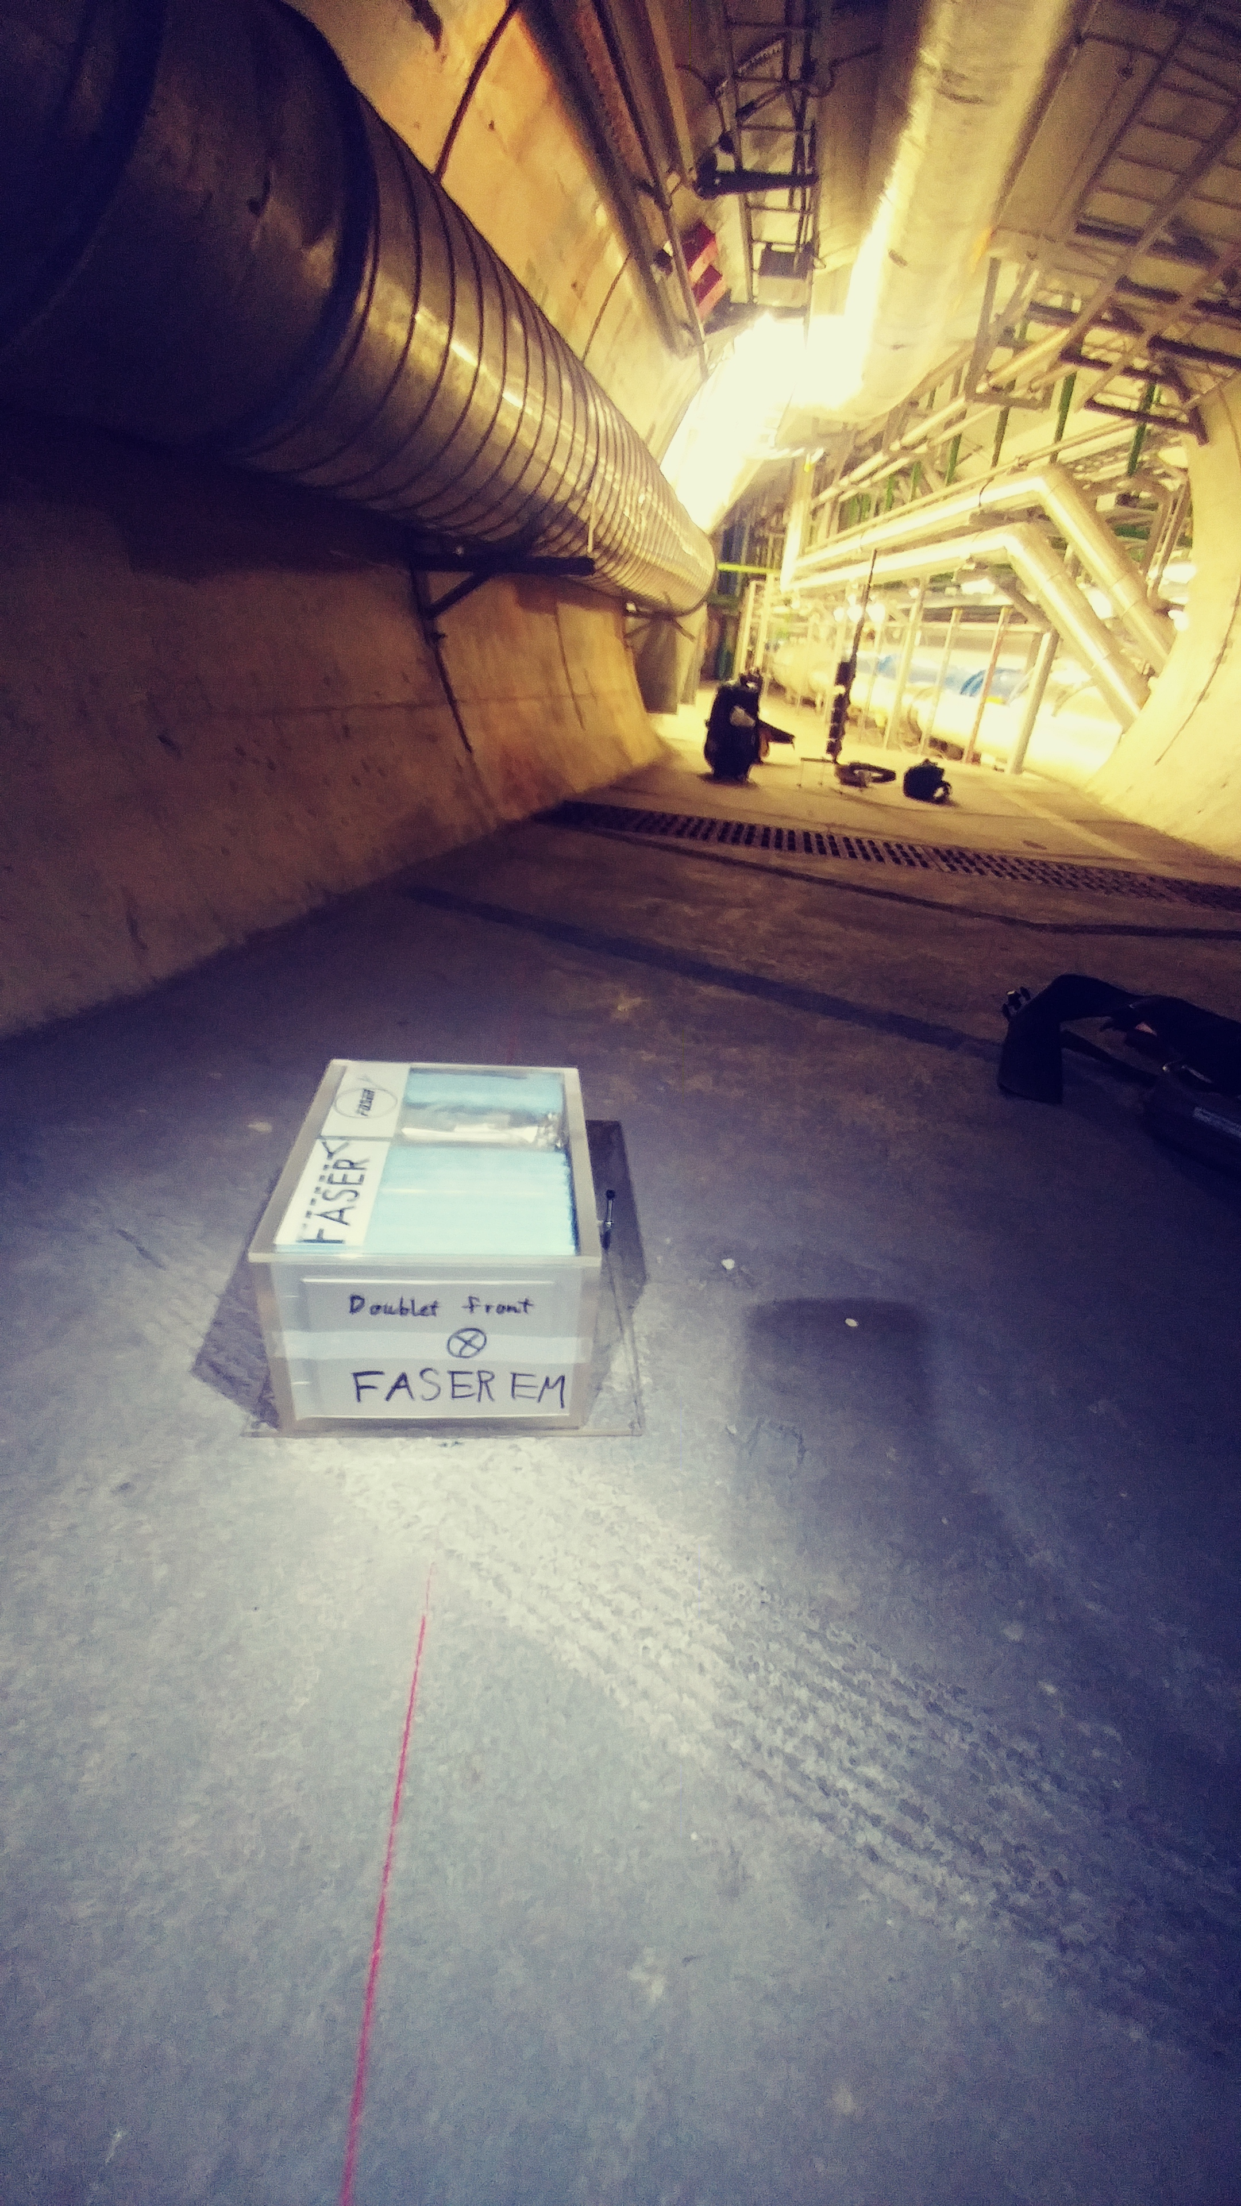
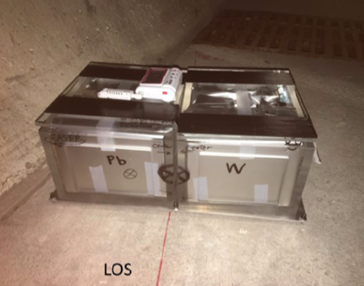
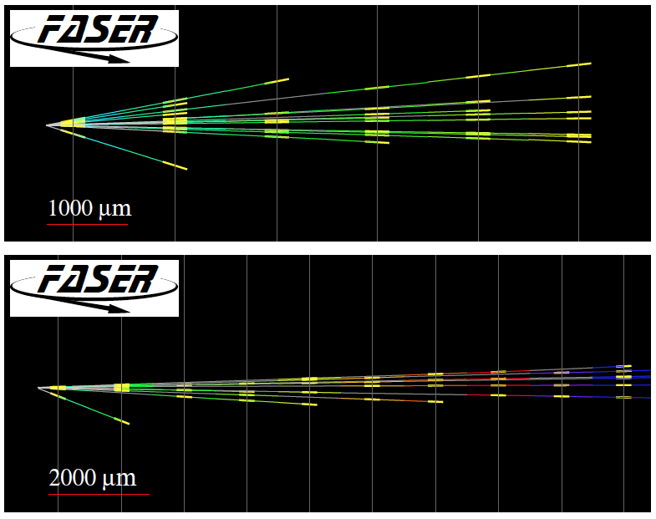
FIRST COLLIDER NEUTRINOS
In 2018 a FASER pilot emulsion detector with 11 kg fiducial mass collected 12.2 fb⁻¹ on the beam collision axis (installed and removed during Technical Stops).
In May 2021, the FASER Collaboration announced the direct detection of 6 candidate neutrinos above 12 expected neutral hadron background events (2.7σ).
Not the discovery of collider neutrinos, but a sign of things to come.

Slide 32
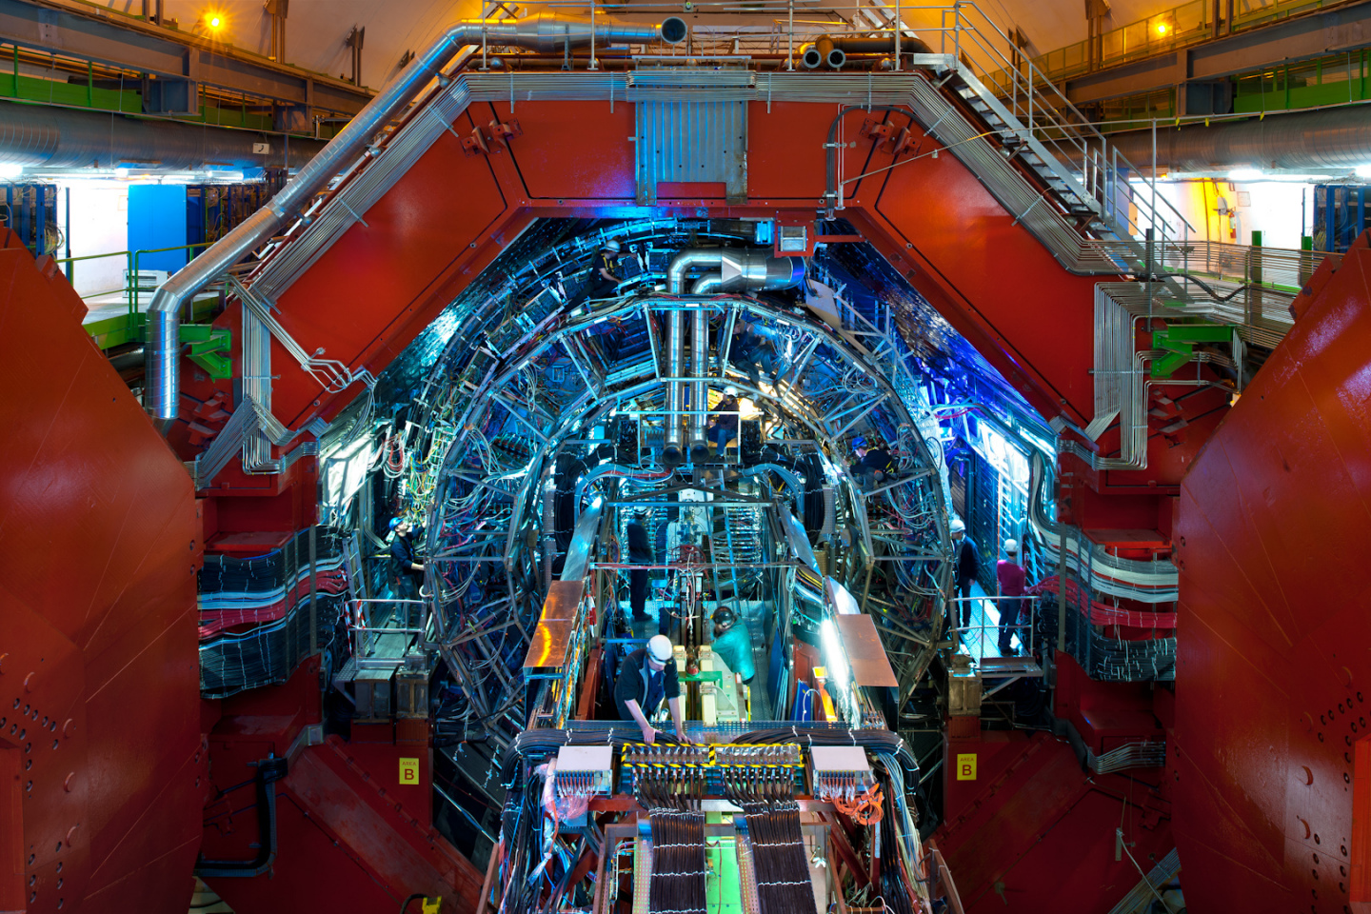
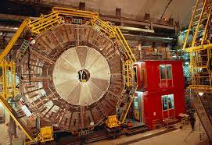
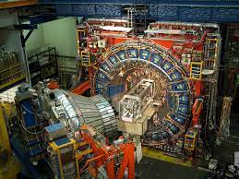
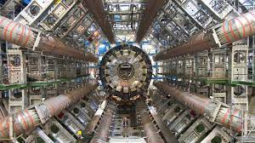
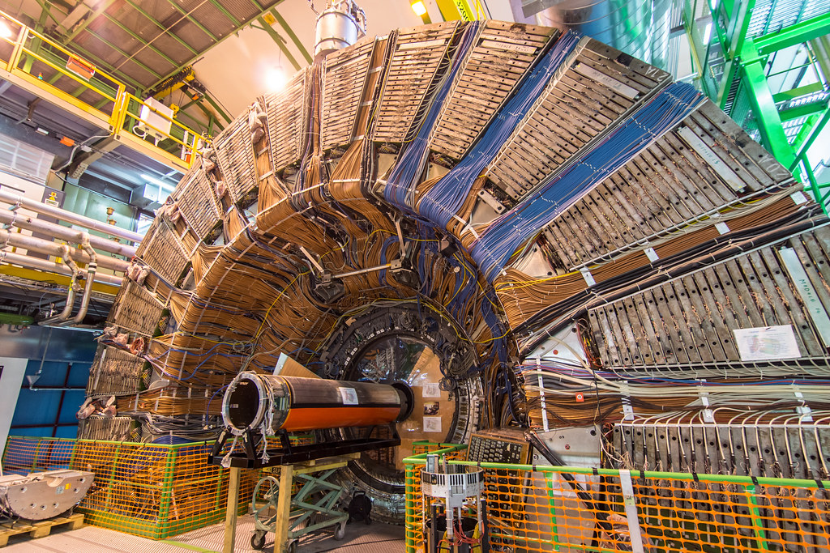
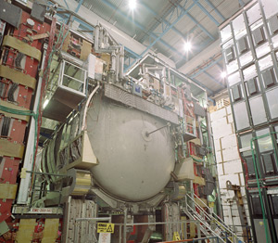
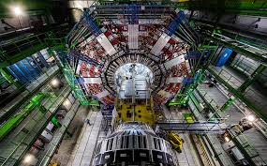
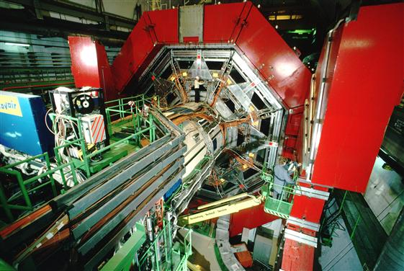

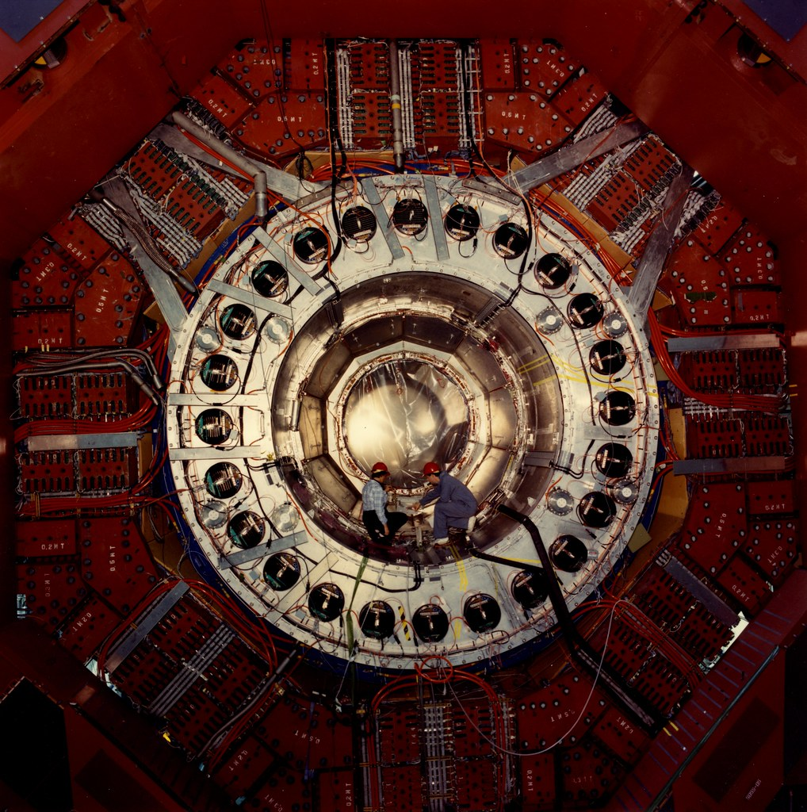
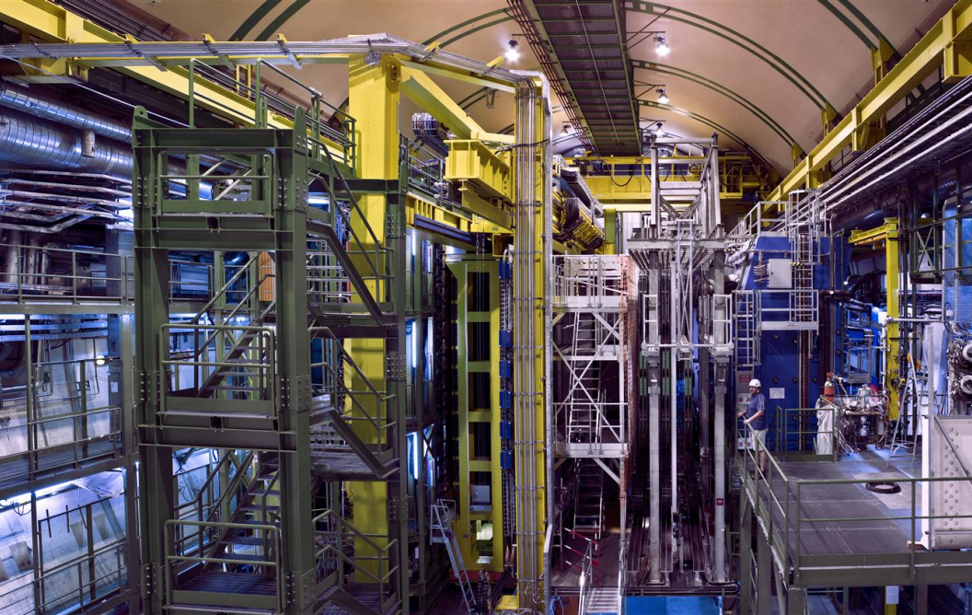
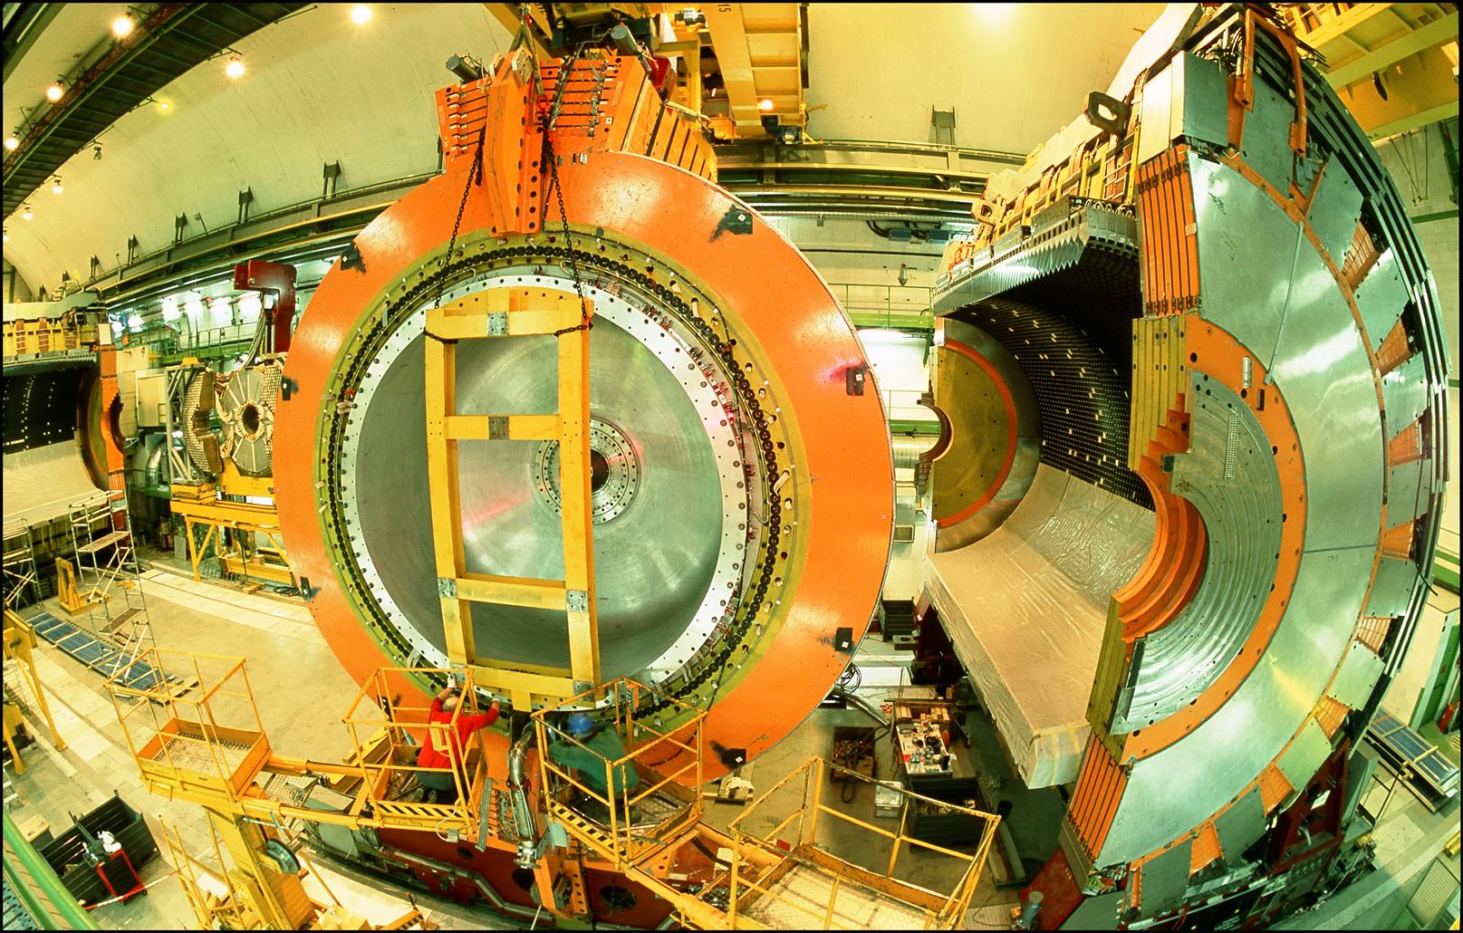
LOCATION, LOCATION, LOCATION
…
ALICE
ALEPH
CDF
FASER Pilot Detector
Suitcase-size, 4 weeks
$0 (recycled parts)
6 candidate neutrinos
ATLAS
DELPHI
D0
CMS
L3
LHCb
SLD
OPAL
All previous
collider detectors
Building-size, decades
~$10⁹
0 candidate neutrinos

Slide 33
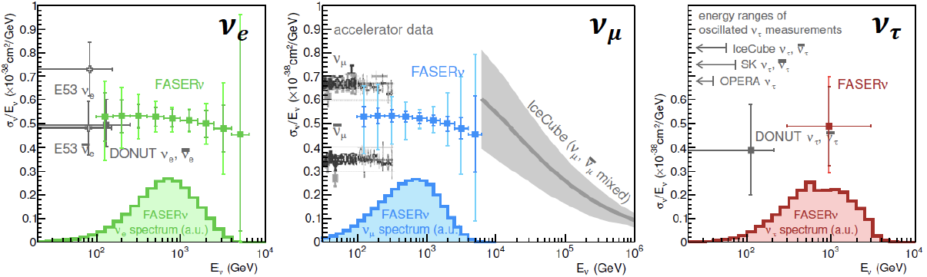
NEUTRINO PHYSICS
In Run 3 (2022-24), the goals of FASERν are to
  Detect the first collider neutrino.
  Record ~1000 ν_{e} , ~10,000 ν_{μ} , and ~10 ν_{τ} interactions at TeV energies, the first direct exploration of this energy range for all 3 flavors.
  Distinguish muon neutrinos from anti-neutrinos by combining FASER and FASERν data, and so measure their cross sections independently.
  Add significantly to the number of ν_{τ} and detect the first anti-ν_{τ} .
FASER Collaboration 1908.02310 (2019)

Slide 34


Slide 35
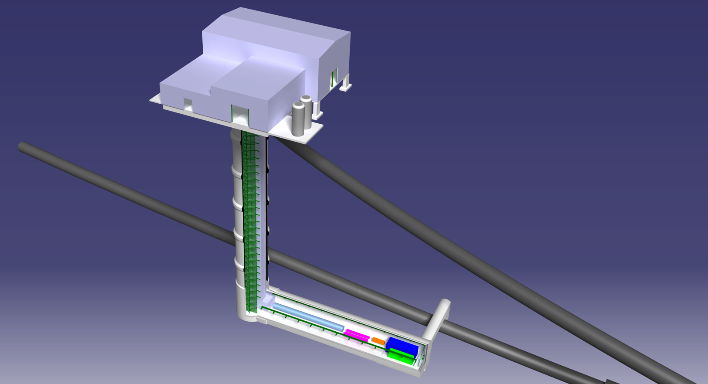
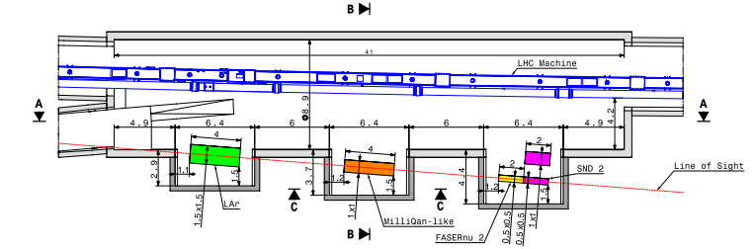
FORWARD PHYSICS FACILITY
The rich physics program in the far-forward region strongly motivates creating a dedicated Forward Physics Facility to house far-forward experiments for the HL-LHC era from 2027-37.
UJ18
ATLAS
SPS
UJ12
LHC
LOS
Kincso Balazs, CERN CE
CERN GIS

Slide 36



Jonathan Gall, FPF Workshop
FORWARD PHYSICS FACILITY
Currently envisioned to house 5 experiments, including upgrades of FASER, FASERnu, and SND, as well as
  FORMOSA, targeting milli-charged particles
  FLArE, targeting neutrinos and dark matter
Very preliminary (class 4) cost estimate for cavern and services: 40M CHF.
Design by Liam Dougherty (EN-ACE-INT)

Slide 37
FPF PLANS
The FPF is being studied in both the Physics Beyond Colliders framework at CERN and as part of the Snowmass community exercise in the US.
FPF meetings
  FPF Kickoff Meeting, 9-10 Nov 2020, https://indico.cern.ch/event/955956
  FPF2 Meeting, 27-28 May 2021, https://indico.cern.ch/event/1022352
  FPF3 Meeting, 25-26 Oct 2021, https://indico.cern.ch/event/1076733
  FPF4 Meeting, 31 Jan -1 Feb 2022, https://indico.cern.ch/event/1110746
FPF Short Paper: 75 pages, 80 authors completed in Sept 2021 (2109.10905).
The FPF White Paper (~200-300 pages) is being prepared to be submitted to Snowmass in February-March 2022.

Slide 38
EXECUTIVE SUMMARY
Long-Lived Particles (LLPs) are particles that travel macroscopic distances at colliders and then decay.
LLPs have long been considered to be exotica, but they are in fact ubiquitous in new physics models.
The LHC is currently not optimized to discover LLPs, especially light ones; new experiments and the proposed Forward Physics Facility will help.
Future colliders can improve their discovery potential by including LLP capabilities in their plans from the beginning.

