Slide 1
STANDARD WIMPS
Dark Matter
Les Houches Summer School
Jonathan Feng, UC Irvine, 27-29 July 2021

Slide 2
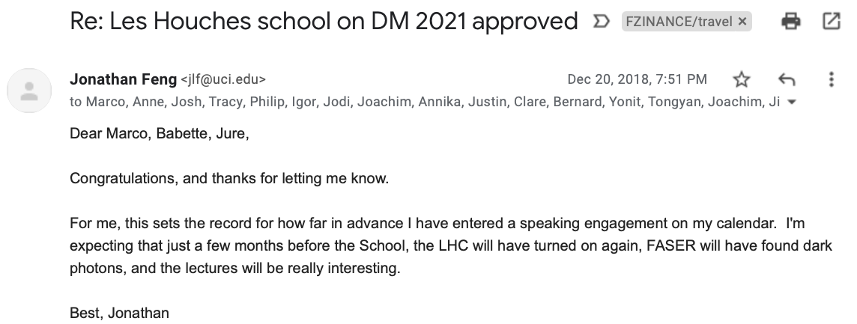
CONGRATULATIONS TO THE ORGANIZERS
…

Slide 3
STEVEN WEINBERG (1933-2021)
His 1987 Loeb Lectures, including the anthropic prediction of the cosmological constant, were the first physics talks I ever attended.
Four Golden Lessons
_{Weinberg (2003)}
No one knows everything, and you don't have to.
Head for the messes.
Forgive yourself for wasting time [working on the wrong questions].
Learn some of the history of your field.

Slide 4
OUTLINE
I. Why WIMPs?
The Weak Scale
The WIMP Miracle
The Discrete WIMP Miracle
II. WIMPs in Supersymmetry
Supersymmetry
Stability and LSPs
Neutralino Freezeout
Cosmologically-Preferred Supersymmetry
III. WIMP Detection
Direct Detection
Indirect Detection
Collider Searches
IV. WIMP Variations
Inelastic WIMPs
Isospin-Violating WIMPs
SuperWIMPs
WIMPless Dark Matter
3 90-minute lectures; questions welcome!

Slide 5
I. WHY WIMPS?

Slide 6
WHY WIMPS?
zeV
aeV
feV
peV
neV
μeV
meV
eV
keV
MeV
GeV
TeV
PeV
30M☉
≈
QCD Axion
Sterile Neutrino
WIMPs
Ultralight Dark Matter
Hidden Thermal Relics / WIMPless DM
Black Holes
SIMPs / ELDERS
Asymmetric DM
X-ray Line
Beryllium-8
Muon g-2
Small-Scale Structure
Coherent Field Searches
Nuclear and Atomic Physics
Microlensing
Direct and Indirect Detection
Accelerators, Colliders
≈
zeV
aeV
feV
peV
neV
μeV
meV
eV
keV
MeV
GeV
TeV
PeV
30M☉
Modified from the Cosmic Visions Report (2017)
Notes:
Targets: Freeze-In, Inflation Mechanism, Misalignment Mechanism

Slide 7
GOALS
WIMPs have dominated the particle dark matter landscape for decades.
It would be inconceivable to lecture about
DM production (Ruderman) without talking about WIMP freeze out.
DM direct detection (Cooley) without talking about WIMP direct detection.
DM indirect detection (Slatyer) without talking about WIMP indirect detection.
DM at accelerators (Harris) without talking about WIMPs at colliders.
So there will be a lot of overlap with other lectures. The goal here is to
explain why WIMPs have been a dominant paradigm for so long,
gather together some of their basic features,
highlight the example of WIMPs in supersymmetry,
and present some of the variations on the WIMP theme that have by now suffused the literature and illustrate the richness of this circle of ideas.
These lectures are targeted to graduate students starting DM research, but I hope there will be something of interest to others as well.

Slide 8
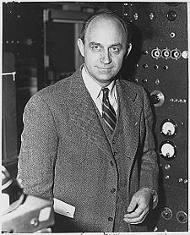
THE WEAK SCALE
Fermi’s constant G_{F} was introduced in the 1930s to describe nuclear beta decay
n $→$ p $e^{−} \overline{ν}$ .
The measured value, G_{F} ~ ${10}^{−5}$ ${GeV}^{−2}$, introduces a new mass scale in nature, the weak scale:
m_{weak} ~ 100 GeV .
We still don’t understand the origin of this mass scale, but every reasonable attempt so far introduces new particles at the weak scale.
Notes:
8

Slide 9
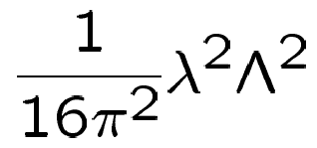
NATURALNESS
We have now discovered a particle that looks like a fundamental scalar with a mass $m_{h}≃$125 GeV: the Higgs boson. Scalars are different:
For Λ ~ m_{Planck} ~ 10¹⁹ GeV, and f = top (λ ~ 1), the classical and quantum contributions must cancel to 1 part in 10³² to yield the physical Higgs mass.
This is the naturalness, fine-tuning, or gauge hierarchy problem of the Standard Model. Its resolution likely requires new particles at the weak scale that introduce new quantum contributions to cancel the existing ones.
Classical
Quantum
λ
=
+
f f
λ
=
−

Slide 10
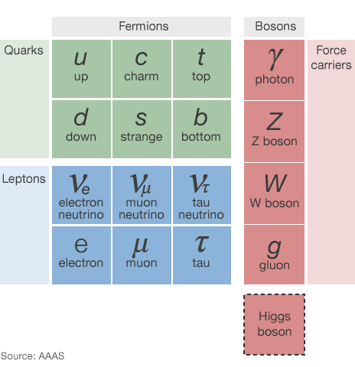
DARK MATTER
Known DM properties
Gravitationally interacting
Not short-lived
Not hot
Not baryonic
None of the known particles can be cold DM.

Slide 11
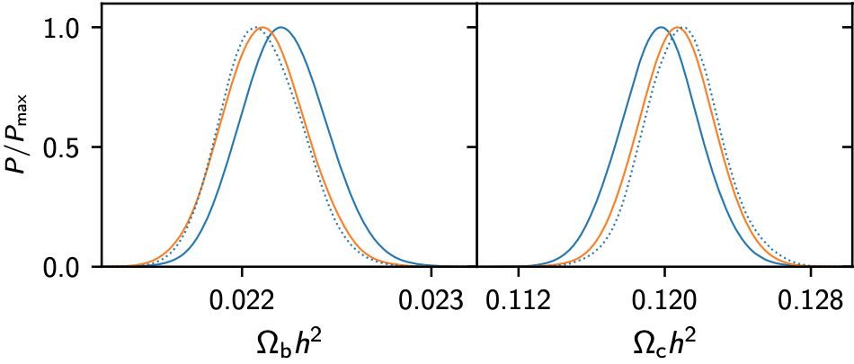
RELIC DENSITY
We know little about dark matter. We know more about what it isn’t than what it is.
The one thing we do know precisely is the dark matter’s relic density: $ΩDMh2=0.1200±0.0012$.
_{Planck Collaboration (2018)}
What can we learn from this about dark matter’s particle properties?
Generically: nothing.
But if the dark matter now is a surviving relic of the hot Big Bang through thermal freeze out: a lot.

Slide 12
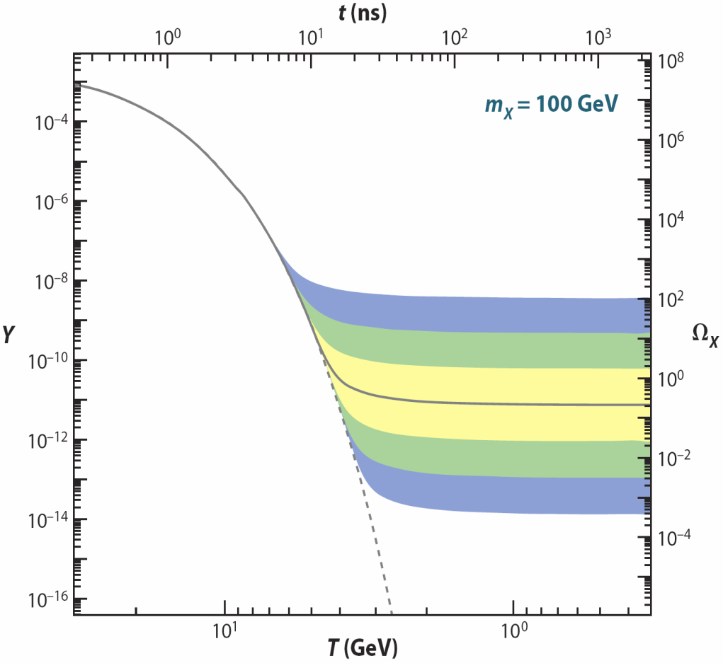
THERMAL FREEZE OUT
(1) Assume a new heavy particle X is initially in thermal equilibrium:
XX ↔ $f\overline{f}$
(2) Universe cools:
XX $f\overline{f}$
(3) Universe expands:
XX $f\overline{f}$
(1)
Increasing
annihilation
strength
↓
(2)
←
(3)
/
→
→
/
←
/
Feng (2010)
Zeldovich et al. (1960s)

Slide 13
THERMAL FREEZE OUT
The Boltzmann equation:
Dilution from
expansion
χχ → $f\overline{f}$
$f\overline{f}$→ χχ
n ≈ n_{eq} until interaction rate drops below expansion rate:
Might expect freeze out shortly after T drops below m, when n_{eq} becomes exponentially (Boltzmann) suppressed. But M_{Pl} is large, and the universe expands slowly! First guess is pretty good:

Slide 14
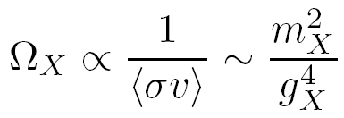
THE WIMP MIRACLE
It turns out that the relation between Ω_{X} and annihilation strength is wonderfully simple:
where we’ve assumed that the annihilation is characterized by a single mass scale.
X
q
_
X
q
Keeping track of the constants, we find $mX \sim 100 GeV, gX \sim 0.6 → ΩX \sim 0.1$.
A remarkable coincidence: particles with the right thermal relic density are now at the energy frontier! The LHC is a big DM search experiment.

Slide 15
THE WIMP MIRACLE
In more detail, at freeze out, $\frac{m}{T}$ ~ 20, so
K.E. = $\frac{3}{2}$ $kT$ → $T$~ $\frac{1}{3}$ ${mv}^{2}$~ $\frac{1}{20} m$ → $v$ ~ $\frac{1}{3}$ .
At freezeout, dark matter was neither ultra-relativistic, nor non-relativistic. But it was far more relativistic then than it is now in our neighborhood, where $v$ ~${10}^{−3}$. This is a key difference to keep in mind!
Freeze out is at $T$ ~ 5 GeV and t ~ ns, not at T ~ 100 GeV and t ~ ps.
This is also called chemical freeze out (no number changing), which is distinct from kinetic freeze out (no energy exchange through $fX$ $→$ $fX$).
The WIMP miracle is not a precise coincidence. But it is tantalizing, and it is our strongest quantitative hint that our attempts to understand the universe on the largest and smallest scales may be related.

Slide 16
WIMP STABILITY
The WIMP miracle is well appreciated. But its success relies on another less well-advertised “miracle.”
DM must be stable.
How natural is this? A priori, not very: the only stable particles we know about are very light.
But there are reasons, based on experimental data, to think that at least one weak scale particle might be stable.
New Particle States
Stable
Standard Model
Particles

Slide 17
THE DISCRETE WIMP MIRACLE
Gauge Hierarchy requires
Precision EW constrains
new
particle
SM
SM
Higgs
Higgs
new
particle
SM
SM
The 4-point SM interactions are highly constrained by many experiments, notably those at LEP through precision electroweak data.
Simple solution: impose a discrete parity, so all interactions require pairs of new particles. This also makes the lightest new particle stable: Discrete Symmetry ↔ Stability.
Cheng, Low (2003); Wudka (2003)
Remarkable coincidence: particle physics independently motivates particles that are stable enough to be dark matter.

Slide 18
II. WIMPS IN SUPERSYMMETRY

Slide 19
WIMPS IN BSM MODELS
For the reasons mentioned above, WIMPs appear generically in many BSM theories
Propose some new weak scale particles.
They help some things, but strain electroweak fits.
Impose a discrete symmetry to improve fits.
An ideal DM candidate emerges!
Many examples
Neutralinos in supersymmetry
Goldberg (1983); Elllis et al. (1983)
KK B1 (“KK photons”) in universal extra dimensions
Servant, Tait (2004); Cheng, Feng, Matchev (2004)
Lightest T-odd particle in little Higgs theories
Cheng, Low (2004)
Here focus on supersymmetry as an interesting example.

Slide 20
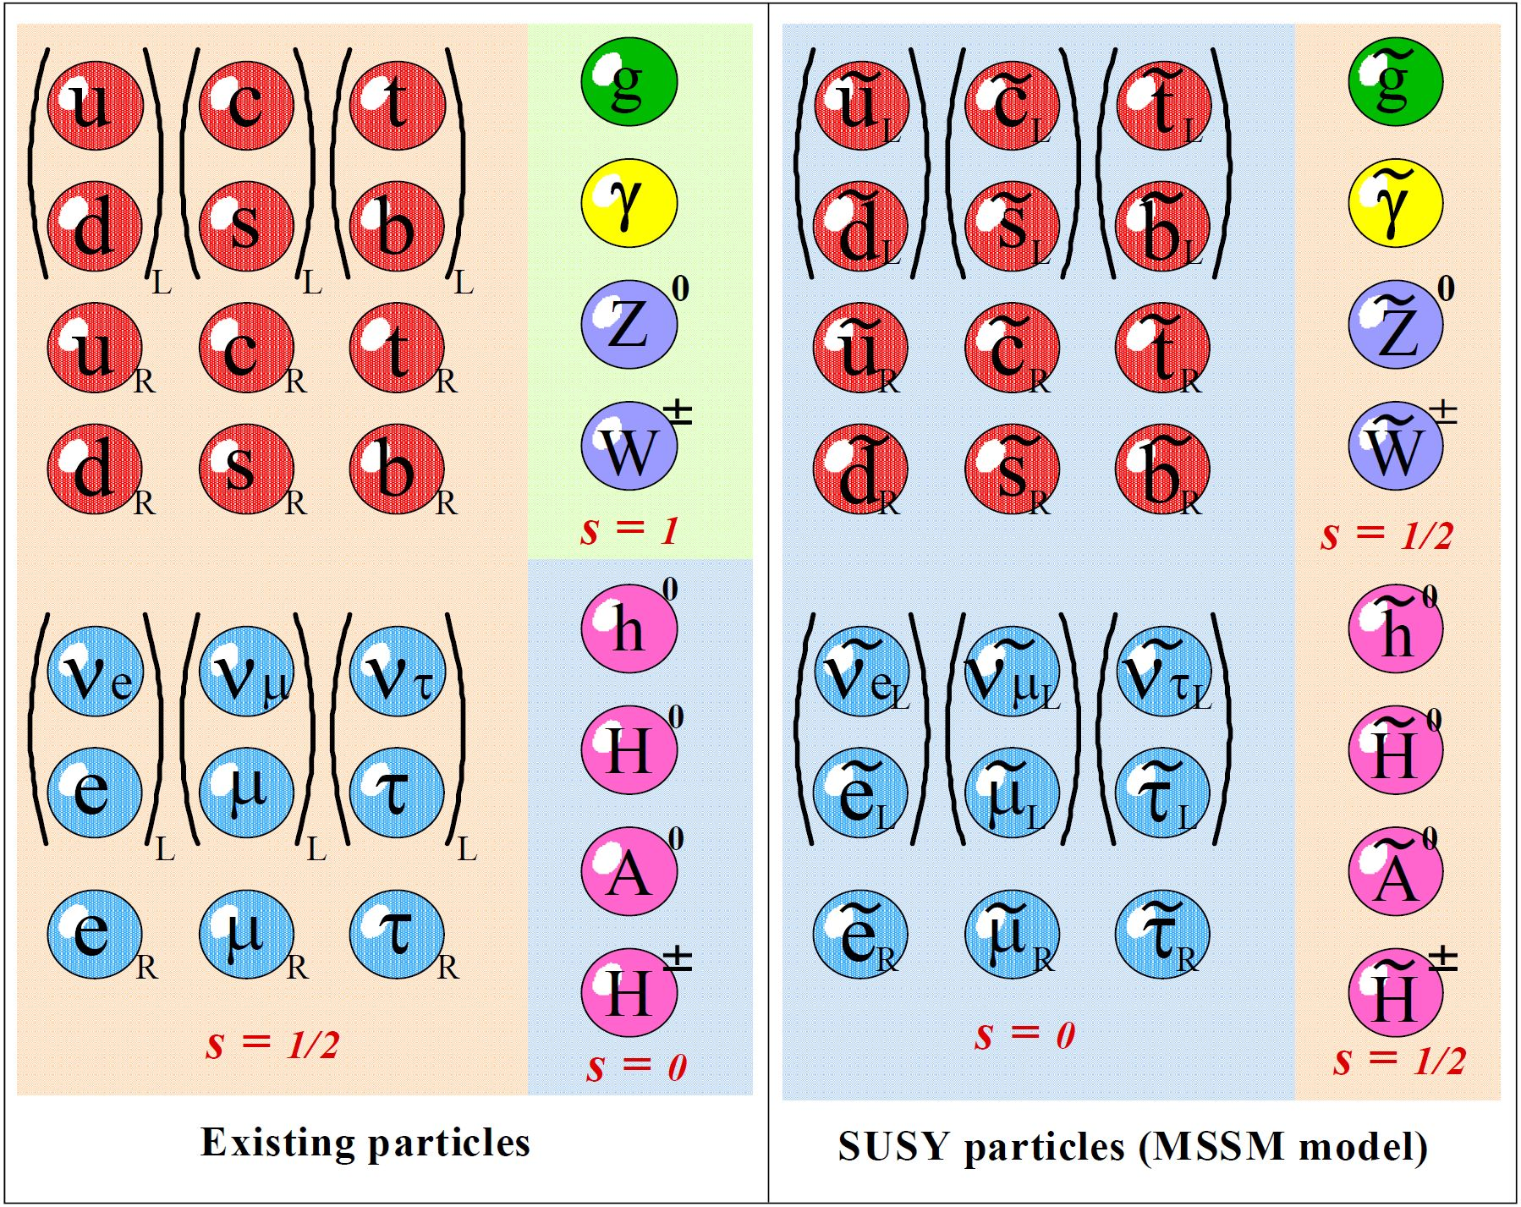
SUPERSYMMETRY
Supersymmetry predicts a partner particle for every known particle: Spin 0 $↔$ Spin $\frac{1}{2}$ , Spin $\frac{1}{2}$ $↔$ Spin 1.
New particles
Spin 0 squarks
Spin 0 sleptons
Spin $\frac{1}{2}$ gauginos:
Bino, Winos, gluinos
Spin $\frac{1}{2}$ Higgsinos
The Higgsino partner of the SM Higgs boson is a new fermion that introduces anomalies. In the Minimal Supersymmetric Standard Model (MSSM), we must add an additional Higgs boson and Higgsino to cancel these anomalies, but no more.

Slide 21
NATURALNESS IN SUPERSYMMETRY
Classical
Quantum
Quantum
λ
$\tilde{f}$ λ²
=
+
$$f f$$
+
λ
=
−
+
For Λ ~ m_{Pl} (m_{W}), and $f$ = top, 1% fine-tuning → m_{t̃} < 1 (3) TeV
Also, bounds on other sfermions are much weaker: m_{f̃} < 10 (30) TeV
Drees (1986); Dimopoulos, Giudice (1995); Pomoral, Tomasini (1996)

Slide 22
R-parity and Stable LSPs
One immediate problem: supersymmetric particles mediate proton decay $p→π^{0}e^{+}$and similar decay modes.
d_{R}
e_{L}⁺
s̃_{R}
p
‾
u_{R}
u_{L}
π⁰
u
u
Forbid this with R-parity conservation: R_{p} = (−1)^{3(B-L)+2S}
SM particles have R_{p} = 1, SUSY particles have R_{p} = −1.
Require Π R_{p} = 1 at all vertices.
Consequences
This eliminates proton decay and also many troubling 4-point interactions of SM particles.
The lightest SUSY particle (LSP) is stable and a potential DM candidate.
Farrar, Fayet (1978)

Slide 23
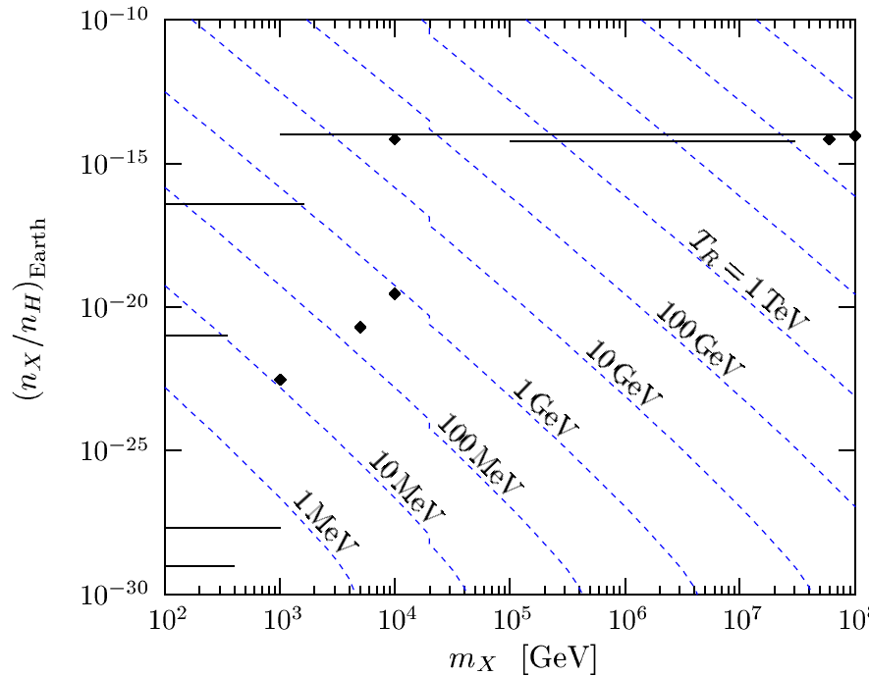
WHAT IS THE LSP?
Should be neutral. Yes, but why? The story is more nuanced and interesting than is commonly appreciated.
A colored LSP (say, a gluino) will bind with quarks to form a color-neutral state.
Yes, but there are severe bounds on exotic nuclei from sea water searches (solid lines and dots in figure), where the constraint is strengthened by testing deep sea water.
But inflation can dilute this away.
Yes, but they are regenerated by reheating. Masses < TeV are excluded by T_{RH} > 1 MeV, but masses > TeV are allowed.
Kudo, Yamaguchi (2001)
Bottom line: for m < TeV, the LSP should be color and electrically neutral.

Slide 24
Neutral SUSY Particles
Spin | U(1) | SU(2) | Up-type | Down-type
2 |  |  |  |  |  | G graviton
3/2
1 | B | W ⁰
1/2 |  |  |  |  | ν
0 |  |  |  | H_{d}
Spin | U(1) M₁ | SU(2) M₂ | Up-type μ | Down-type μ | m_{ν̃} | m_{3/2}
2 |  |  |  |  |  | G graviton
3/2 |  |  |  |  |  | G̃ gravitino
1 | B | W ⁰
1/2 | B̃ Bino | W̃ ⁰ Wino | H̃_{u} Higgsino | H̃_{d} Higgsino | ν
0 |  |  | H_{u} | H_{d} | ν̃ sneutrino
Neutralinos: {χ≡χ₁, χ₂, χ₃, χ₄}

Slide 25
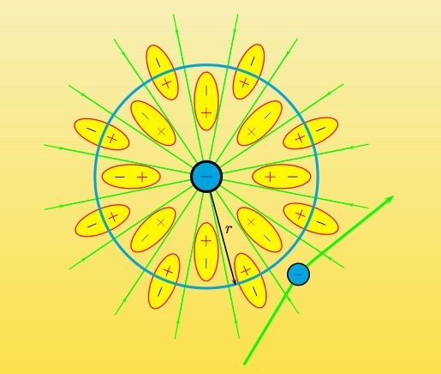
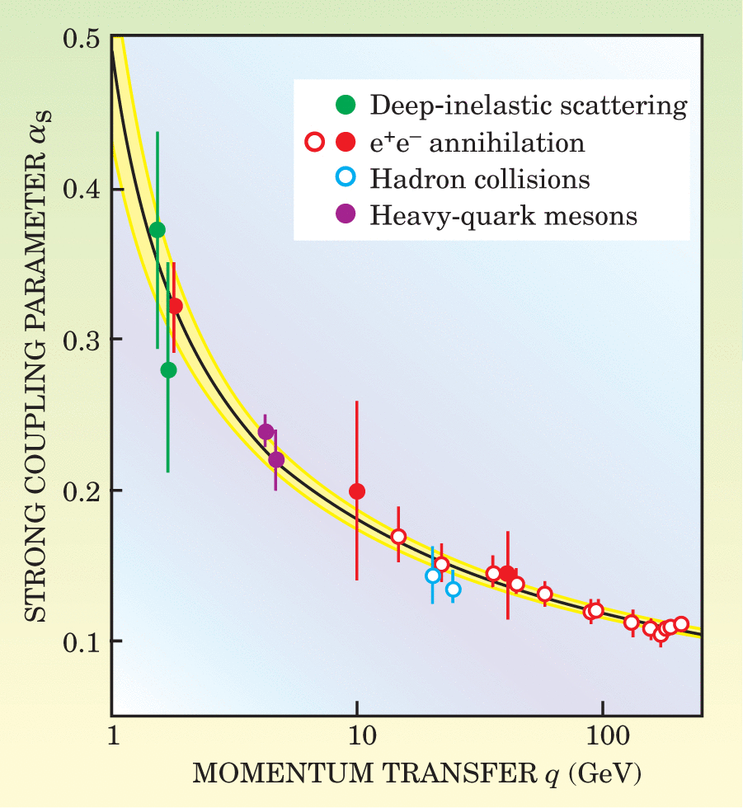
RENORMALIZATION GROUP EQUATIONS
RGEs play a crucial role in all of physics.
For gauge couplings, it can be thought of as the effect of putting a charge in a dielectric, where in QFT, the vacuum is the dielectric.
The most famous example may be the asymptotic freedom of the QCD coupling.

Slide 26
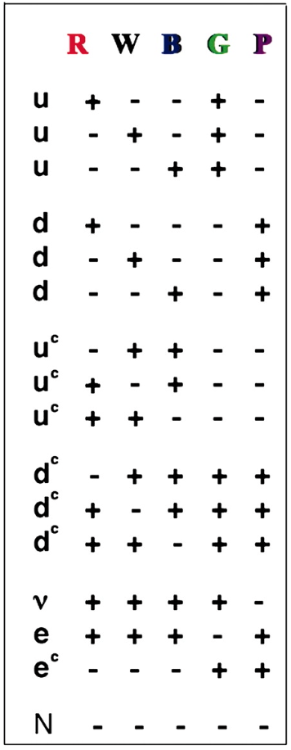
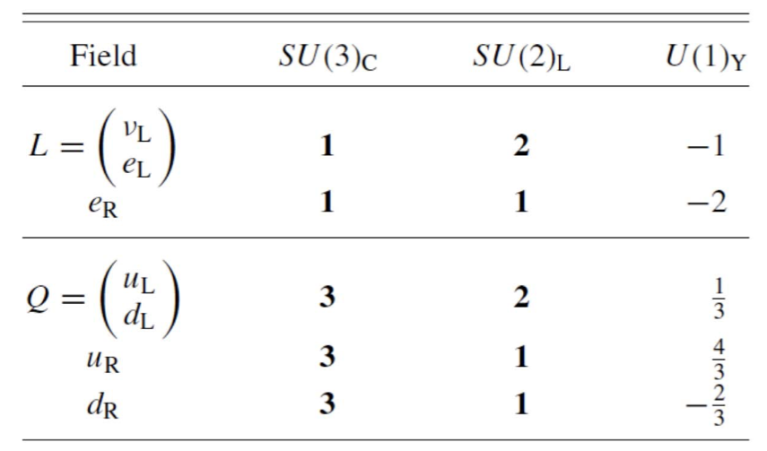
COUPLING CONSTANT UNIFICATION
In supersymmetry, RGEs play an especially important role.
It is well known that the seemingly arbitrary quantum numbers of matter in the SM can be explained by grand unification.
SU(3) x SU(2) x U(1) SU(5) SO(10)
[ N ] 1 1 1
[ 1 $≡$ N ]

Slide 27
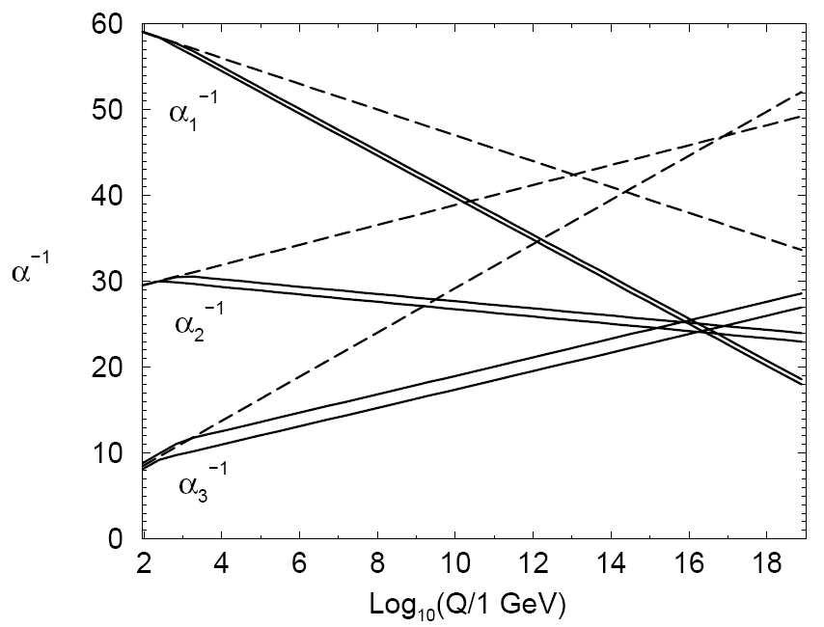
COUPLING CONSTANT UNIFICATION
A requirement of grand unification is that the SU(3), SU(2), and U(1) gauge couplings unify at some scale.
With the SM particle content, they don’t.
But with the addition of SUSY particles at the ~TeV scale, they do at Q ~ 10¹⁶ GeV.
Unifies at a coupling in the perturbative regime.
Unifies below the Planck scale.
But not too far below the Planck scale to induce too-fast proton decay.
Martin (1997)
Dimopoulos, Raby, Wilczek (1981)
Coupling constant unification is beautifully consistent with the fact that SM particles fit neatly into GUT multiplets, and it explains why g₃ > g₂ > g₁.

Slide 28
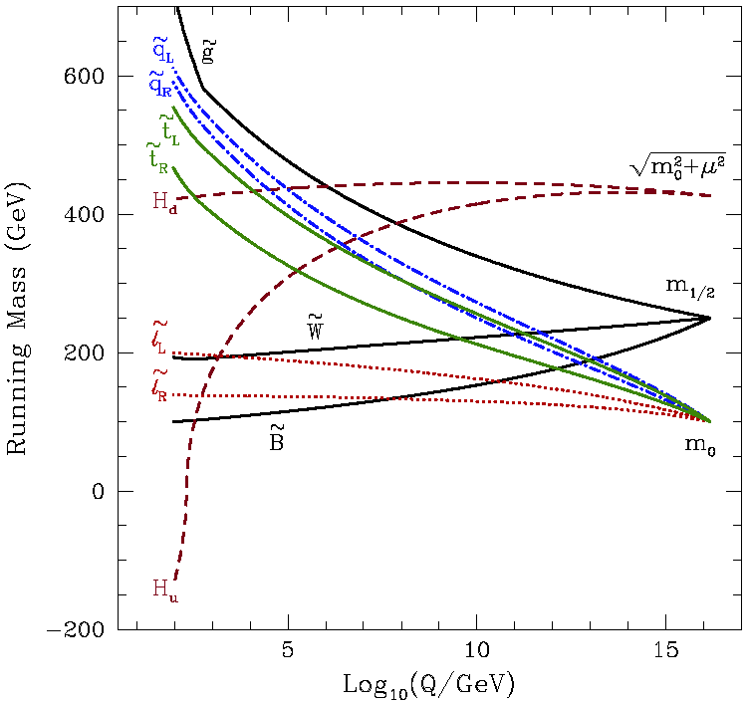
RGES AND BINO DARK MATTER
All other couplings and masses also RG evolve in SUSY. Essential fact: gauge couplings increase masses, Yukawa couplings decrease masses.
Depending on the initial conditions at the GUT scale, the lightest superpartners are typically the stau and the Bino.
The Bino therefore emerges as a neutral, stable, cold DM candidate!
Olive (2003)

Slide 29
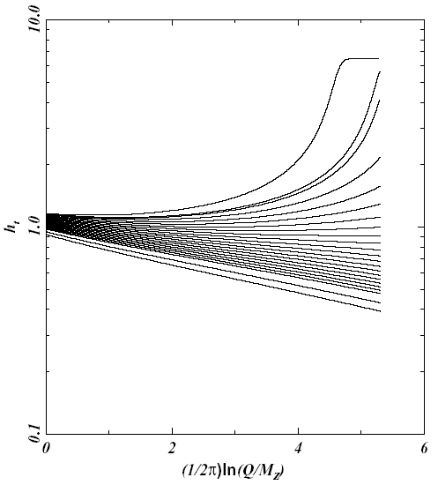
OTHER INTERESTING RGE IMPLICATIONS
Colored superpartners are typically heavier than uncolored superpartners. Squarks are expected to be heavier than sleptons.
The Higgs mass² parameter evolves to negatlve values, explains why SU(2) is broken, and not SU(3) or U(1), and why m_{W} << M_{Pl} .
The top quark Yukawa coupling generically runs to λ $≈$ 1, explains why $m_{t}≃$173 GeV.
Olive (2003)
Polonsky (2001)

Slide 30
NEUTRALINO RELIC DENSITY
If the Bino is WIMP dark matter, we can determine its thermal relic density in a well-defined supersymmetry model.
The resulting research program is, then, clear:
The regions of parameter space that give too much dark matter are excluded.
The regions that give too little are allowed, but Binos aren’t all the dark matter.
The regions that give just the right amount are cosmologically preferred and deserve special attention in search experiments, colliders, etc.
We just need to determine how the Bino annihilates, calculate its annihilation rate in the early universe, evolve its number density to the present day, and calculate its thermal relic density.

Slide 31
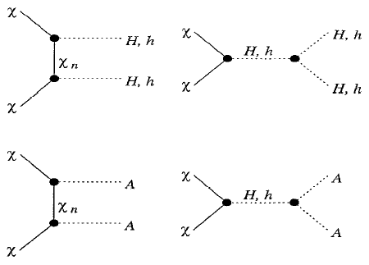
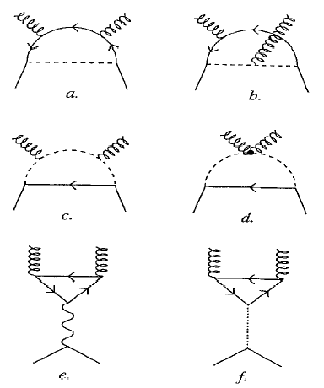
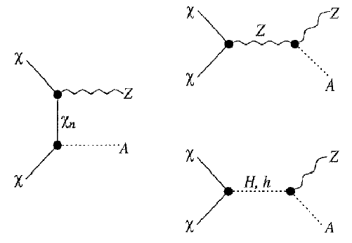
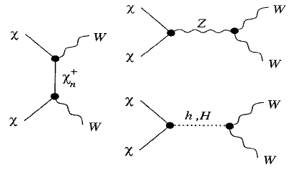
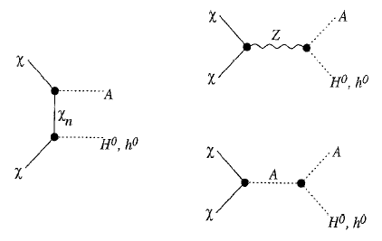
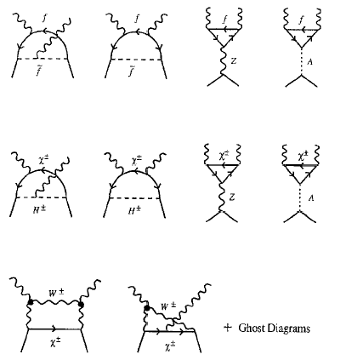
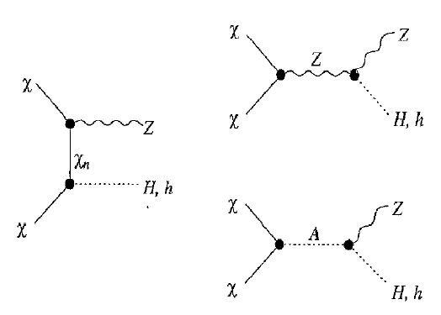
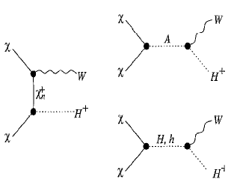
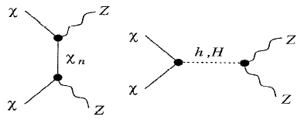
Neutralino Annihilation
Jungman, Kamionkowski, Griest (1995)

Slide 32
RELIC DENSITY
This is a mess! But we can bring order to chaos in the following way. Typically there are two dominant classes of annihilation processes:
Gauge boson diagrams. These are absent for χ ≈ Bino, because U(1) gauge bosons do not have 3- and 4-point self-interactions.
Fermion diagrams. χ are Majorana fermions, so Pauli exclusion → the initial state has J=0. The final state therefore cannot be $f_{L}$ + ${\overline{f}}_{R}$in an S-wave. Need
P -wave: σv ~ σ₀ + σ₁v², v² ~ 0.1, or
Chiral flip: m_{f} /m_{W .}
Bottom line: annihilation is typically suppressed, Ω_{DM}h² is typically too high.

Slide 33
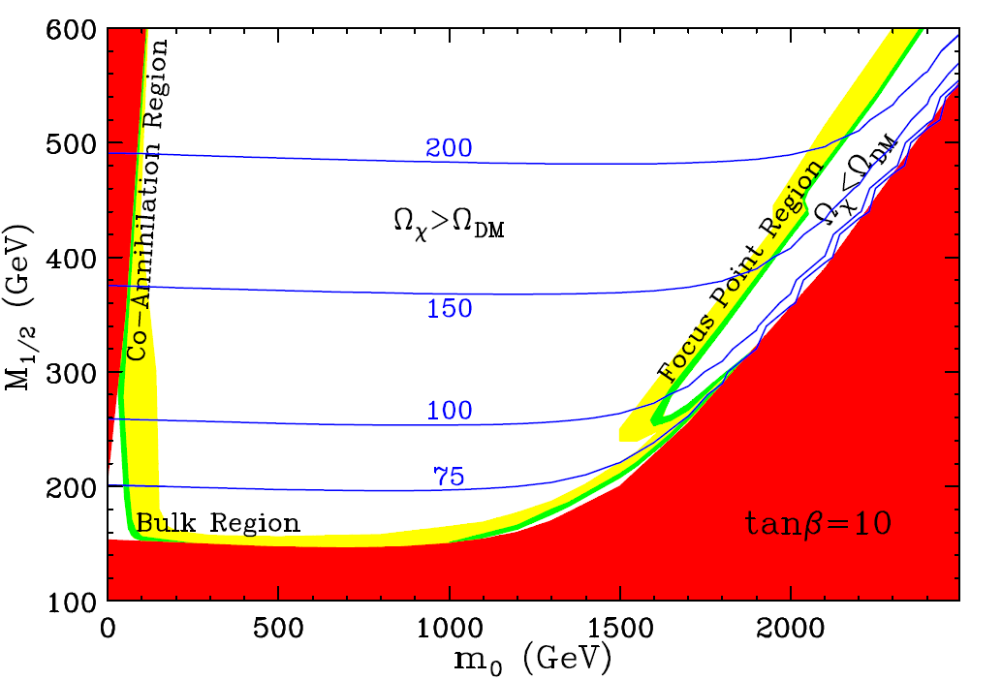
COSMOLOGICALLY-PREFERRED SUSY
There are a number of ways to enhance the annihilation. 3 instructive examples are shown here for the constrained MSSM model, also known as minimal supergravity.
Excluded:
Stau LSP
Green: correct relic density
Yellow: almost correct relic density
Blue contours: fine tuning
χ
τ
τ
τ̃
γ
Focus point SUSY:
Bino mixes with Higgsinos
Co-annihilation:
stau and Bino are 5% degenerate, so staus are present a freeze out T ~ m/20, help Binos annihilate.
Feng, Matchev, Wilczek (2003)
Light SUSY: Bino and sfermion masses around 100 GeV

Slide 34
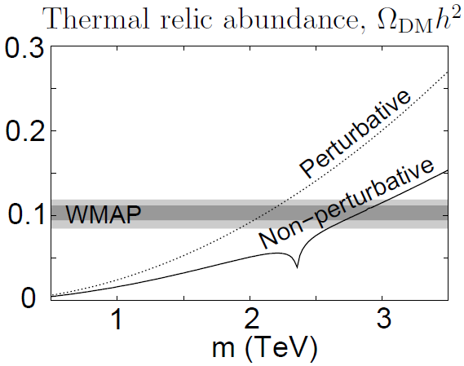
STATUS OF COSMOLOGICALLY-PREFERRED SUSY
Light SUSY: Excluded by collider searches for 100 GeV sleptons.
Focus-point DM: Stringently probed by direct detection.
Bino-Higgsino mixture, m < 1 TeV.
Co-annihilating DM: still viable.
χ , τ̃_{R} degenerate, m < 600 GeV.
Can explain muon g-2.
Outside of CMSSM: Wino-like DM with m ~ 2.7-3 TeV. Stringently probed by indirect detection.
Winos
Hisano et al. (2006)
Many other interesting scenarios outside of CMSSM. Note that SUSY can always be heavier, but in this context, cosmology provides upper bounds. This is an essential synergy between particle physics and cosmology – WIMPs cannot be decoupled away without sacrificing the WIMP miracle.

Slide 35
III. WIMP DETECTION

Slide 36
WIMP DETECTION
Correct relic density → Efficient annihilation then
χ
χ
Efficient production now
(Particle colliders)
Efficient annihilation now
(Indirect detection)
q
q
Efficient scattering now
(Direct detection)
Feng (2008)

Slide 37
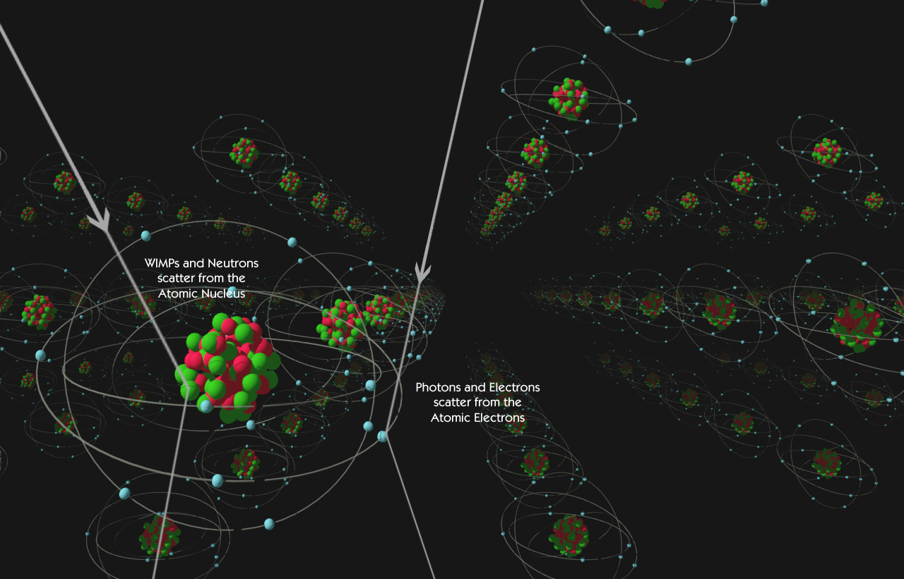
DIRECT DETECTION
WIMP properties
m ~ 100 GeV, v ~ 10⁻³
local density is 0.3 GeV/cm³, or ~1 per liter
K.E. ~ 100 keV
Look for normal matter recoiling from WIMP collisions in detectors deep underground
For dark matter masses ~ 100 GeV, best is elastic scattering off nuclei
Nuclear recoils detected by phonons, scintillation, ionization, …, …
DM
e, γ
Attisha

Slide 38
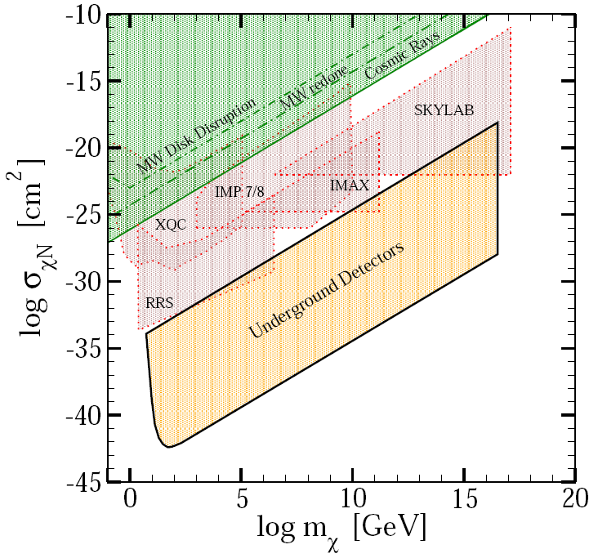
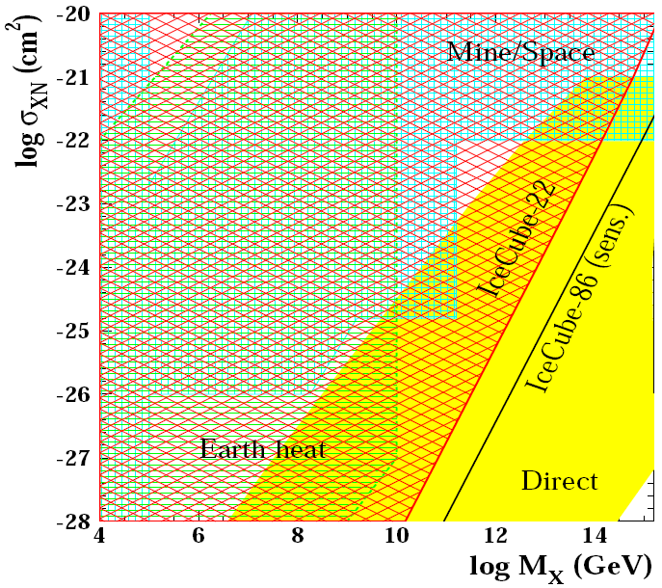
THE BIG PICTURE: UPPER BOUND
The event rates depend on the interaction cross section. What is the upper bound? Another fascinating and underappreciated story.
Strongly-interacting DM does not reach underground detectors.
_{Mack, Beacom, Bertone (2007)}
But the strongly-interacting window is now closed.
Albuquerque, de los Heros (2010)

Slide 39
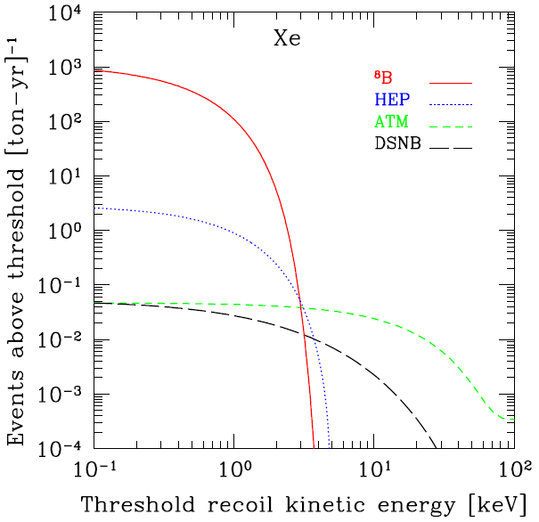
THE BIG PICTURE: LOWER BOUND
Is there (effectively) a lower bound?
Solar, atmospheric, and diffuse supernova background neutrinos provide a difficult background: the “neutrino floor.”
The limits of background-free, non-directional direct detection searches (and also the metric prefix system!) will be reached by ~10 ton experiments probing
~ 1 yb
(10⁻³ zb, 10⁻¹² pb,10⁻⁴⁸ cm²)
Strigari (2009); Gutlein et al. (2010)

Slide 40
WIMP SCATTERING
Consider WIMPs with quark interactions
DM particles now have $v$ ~${ 10}^{−3}$. In the non-relativistic limit, the first terms reduce to spin-spin interactions, and so are called spin-dependent (SD) interactions.
The second terms are spin-independent (SI) interactions; focus on these here.

Slide 41
SPIN-INDEPENDENT THEORY
Theories give DM-quark interactions, but experiments measure DM-nucleus cross sections
,
where is the reduced mass, and
is the fraction of the nucleon’s mass carried by quark q.
This may be parameterized by
,
where f_{p,n} are the nucleon level couplings. Note that f_{p} and f_{n} are not necessarily equal.

Slide 42
SPIN-INDEPENDENT EXPERIMENT
The rate observed in a detector is , where
Results are typically reported assuming f_{p}=f_{n}, so σ_{A} ~ A² , and scaled to a single nucleon. DM sees the whole nucleus, doesn’t resolve nucleons, and so in this approximation, bigger nuclei are better.
Experiment:
number
of target
nuclei
Experiment:
recoil
energy
Astrophysics:
DM velocity
distribution
Nuclear
physics:
form factor
Astrophysics:
local DM
number
density

Slide 43
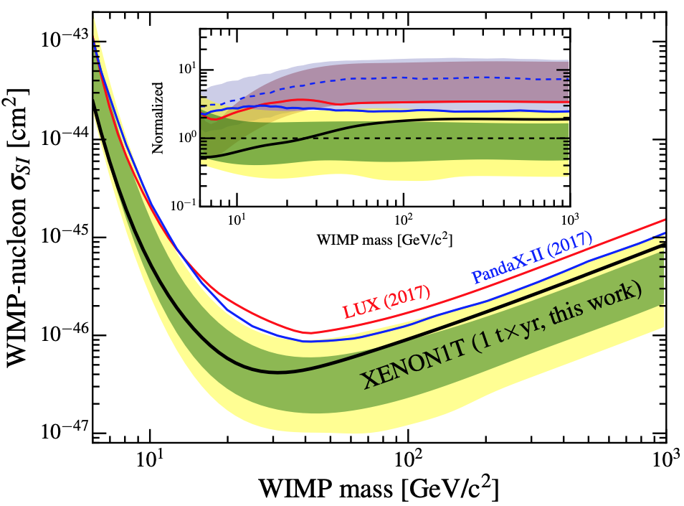
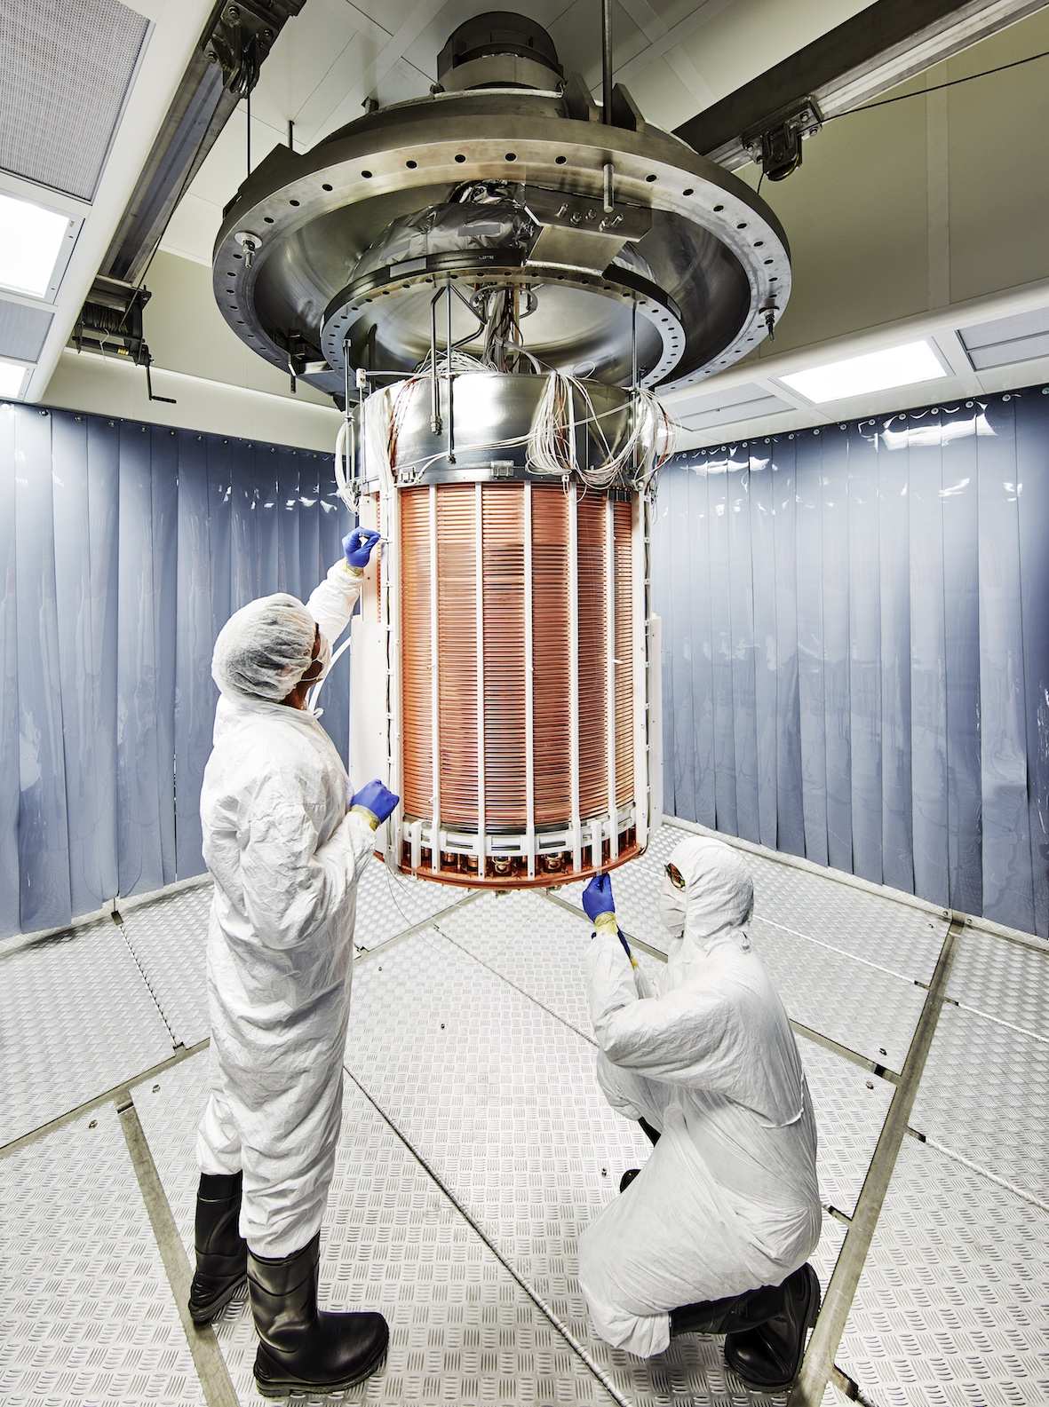
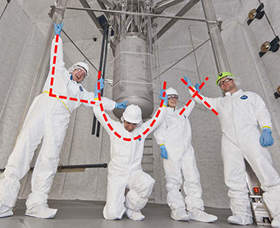
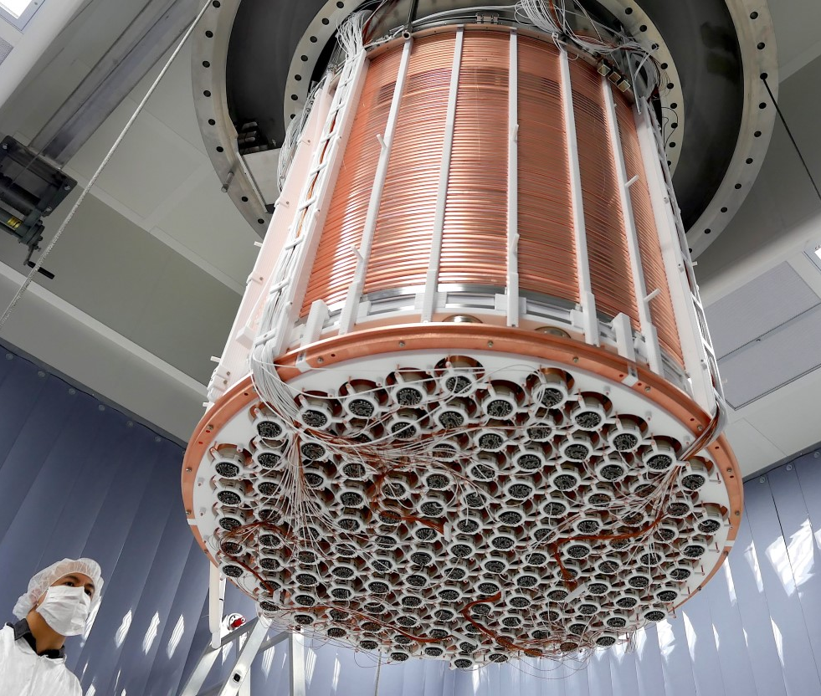
DETECTION STRATEGIES
The state-of-the-art: large, underground, background-free experiments, looking for a few events each year.
Currently leading constraints at m_{X} ~ 100 GeV are from ~ 1 tonne experiments using liquid noble gases: XENON, LUX, and PandaX.
XENON (2018)

Slide 44
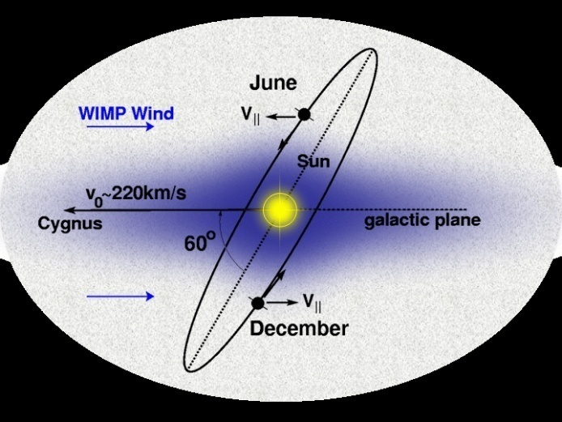
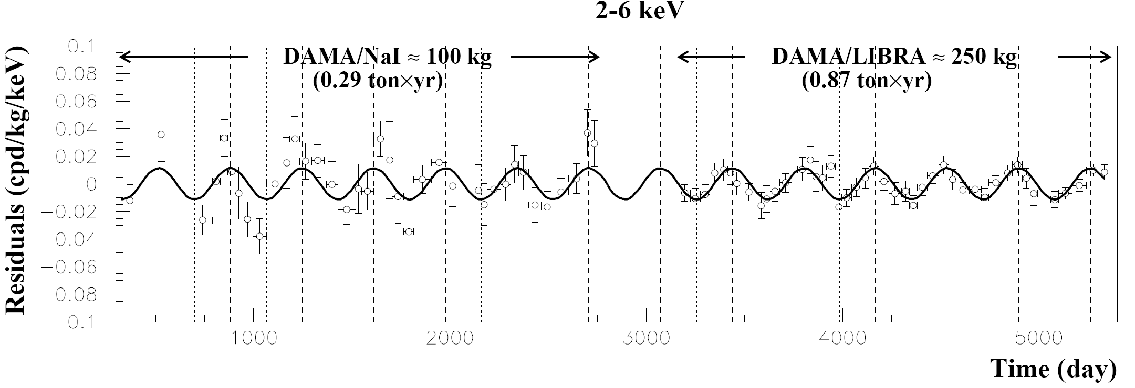
DETECTION STRATEGIES
An alternative strategy: look for annual modulation, where the collision rate changes as the Earth’s velocity adds with the Sun’s.
Drukier, Freese, Spergel (1986)
DAMA: many σ signal with period T ~ 1 year, and maximum ~ June 2
A few % modulation on top of a large constant background.
DAMA (2013)

Slide 45
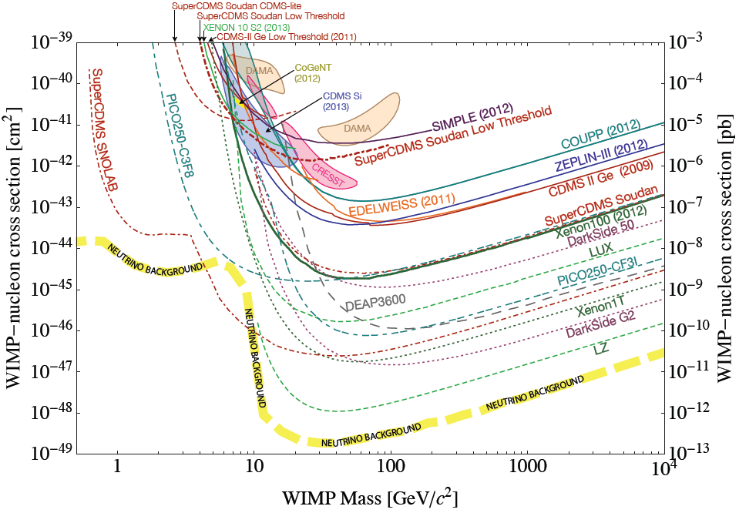
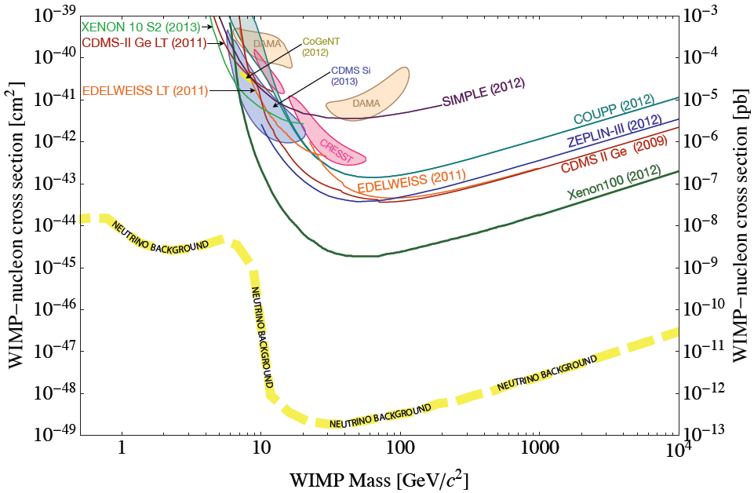
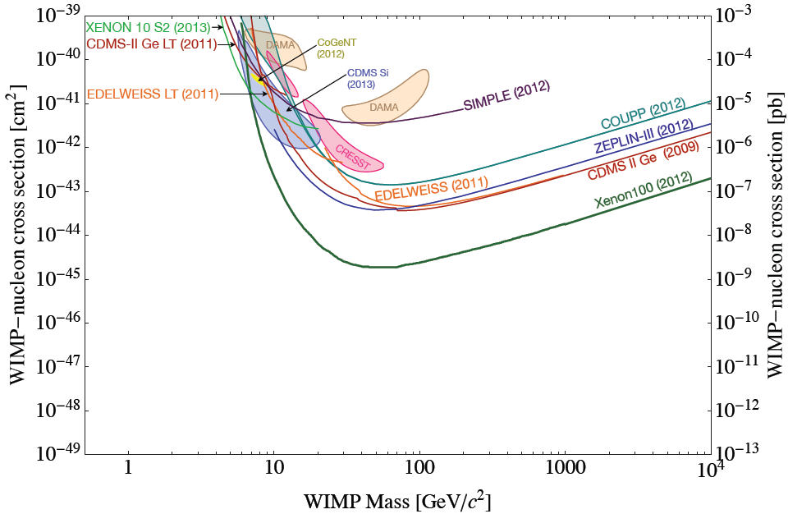
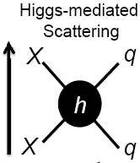
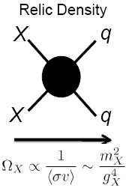
FUTURE PROSPECTS

Slide 46
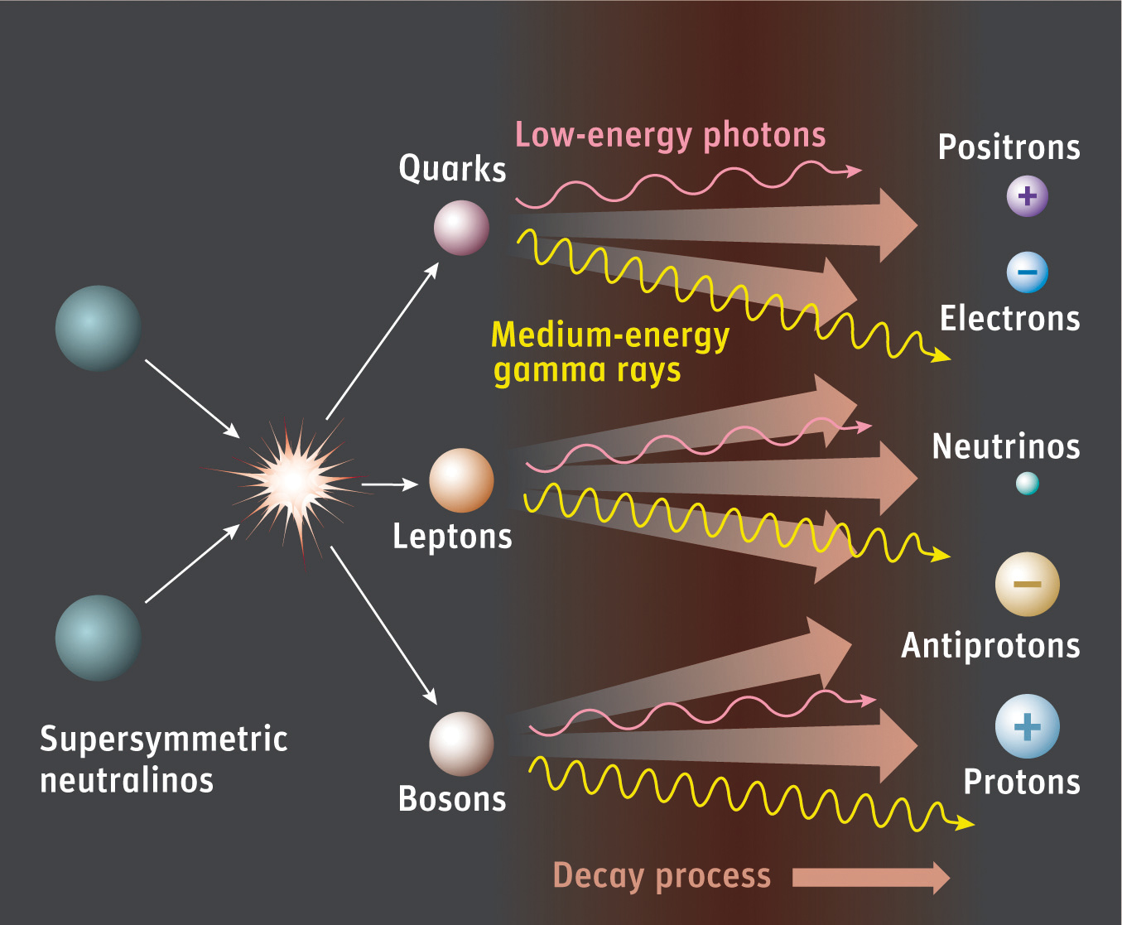
INDIRECT DETECTION
Dark matter may pair annihilate in our galactic neighborhood to
Photons
Neutrinos
Positrons
Antiprotons
Antideuterons
The relic density provides a target annihilation cross section
⟨σ_{A} v⟩ ~ (2 to 3) x 10⁻²⁶ cm³/s

Slide 47
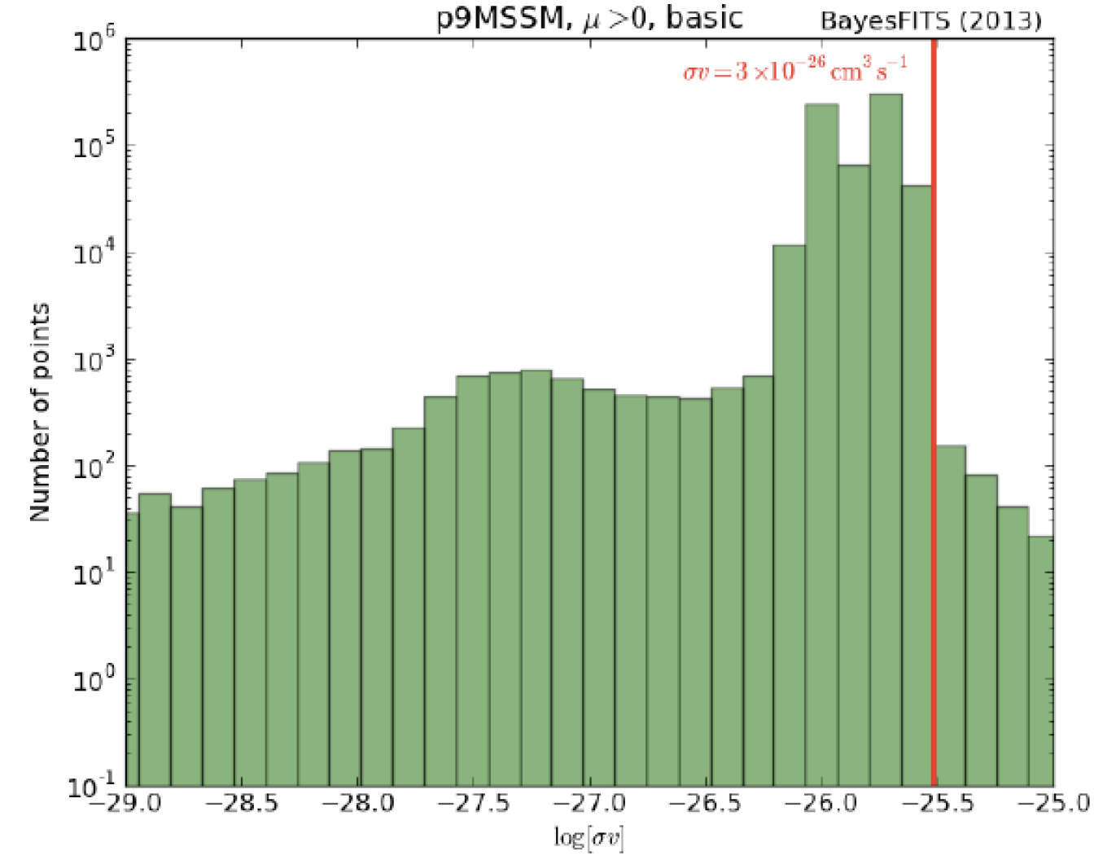
ROBUSTNESS OF THE TARGET CROSS SECTION
Relative to direct detection, indirect rates typically have smaller particle physics uncertainties (but larger astrophysical uncertainties), since annihilation determines both the relic density and the rate. The correspondence is not perfect, though, because v ~ 1/3 is not v ~ 10⁻³ .
Roszkowski (2013);
See 1307.1567 for details

Slide 48
Indirect Detection
FILL IN THE BLANKS
Dark matter annihilates in ________________ to
a place
__________ , which are detected by _____________ .
particles an experiment

Slide 49
PHOTONS
Dark Matter annihilates in the GC / dwarf galaxies to
a place
photons , which are detected by Fermi, CTA, … .
some particles an experiment
The flux factorizes:
Particle
Physics
Astro-
Physics
Particle physics: two kinds of signals
Lines from XX → γγ, γZ: loop-suppressed rates, but distinctive signal.
Continuum from XX → ff → γ: τree-level rates, but a broad signal.

Slide 50
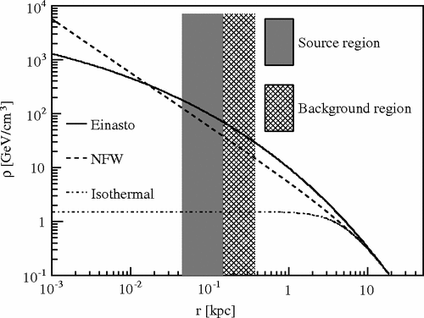
HALO PROFILES
Astrophysics: two kinds of sources
Galactic Center: close, large signal, but large backgrounds.
Dwarf Galaxies: farther and smaller, so smaller signal, but DM dominated, so smaller backgrounds.
In both cases, halo profiles are not well-determined at the center, introduces an uncertainty in flux of up to ~100

Slide 51
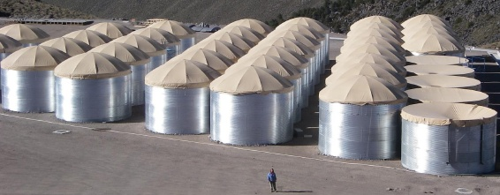
PHOTONS: EXPERIMENTS
Veritas, Fermi-LAT, HAWC, and others

Slide 52
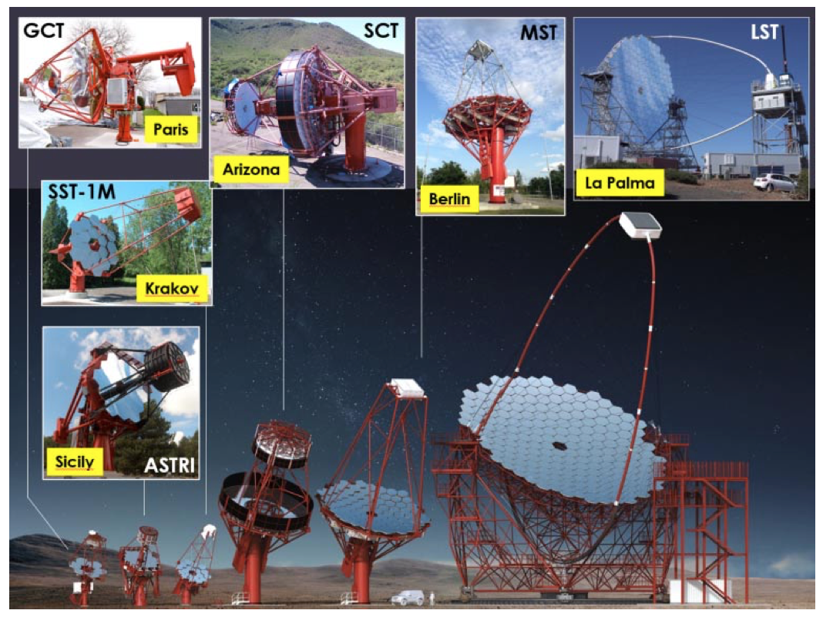
PHOTONS: EXPERIMENTS
Cerenkov Telescope Array

Slide 53
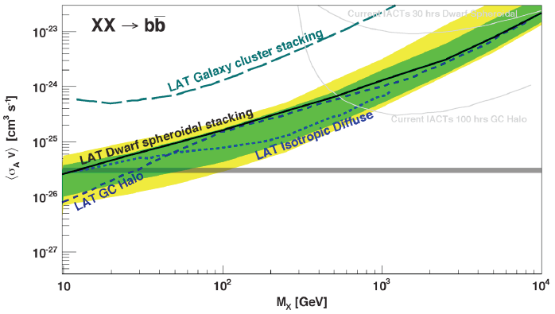
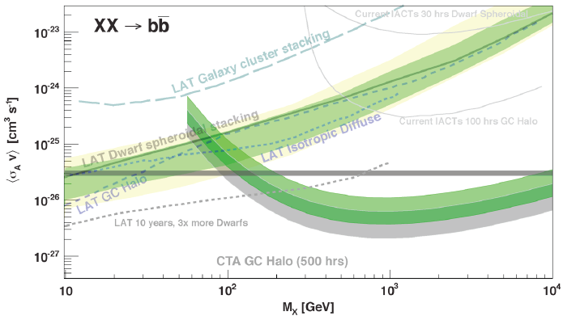
PHOTONS: STATUS AND PROSPECTS
Funk (2013), CTA (2020)
Fermi-LAT has excluded a light WIMP with the target annihilation cross section for certain annihilation channels
CTA extends the reach to WIMP masses above 10 TeV

Slide 54
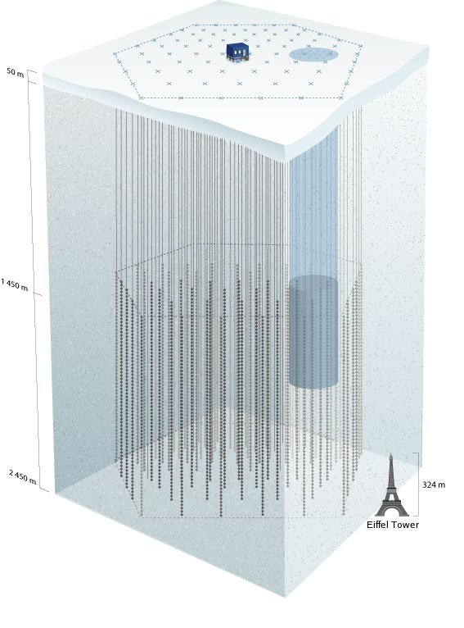
INDIRECT DETECTION: NEUTRINOS
Dark Matter annihilates in the center of the Sun to
a place
neutrinos , which are detected by Ice Cube / DeepCore .
some particles an experiment

Slide 55
NEUTRINOS: EXPERIMENTS
Current: IceCube/DeepCore,
ANTARES
The Sun is typically in equilibrium
Spin-dependent scattering off hydrogen → capture rate → annihilation rate
Neutrino indirect detection results are typically plotted in the (m_{X}, σ_{SD}) plane, compared with direct detection experiments.
Future experiments may discover the smoking-gun signal of HE neutrinos from the Sun, or set stringent σ_{SD} limits.

Slide 56
INDIRECT DETECTION: ANTI-MATTER
Dark Matter annihilates in to
a place
, which are detected by .
some particles an experiment
the halo
positrons
Fermi/AMS/…
In contrast to photons and neutrinos, anti-matter does not travel in straight lines, but rather bumps around the local halo before arriving in our detectors.
For example, positrons, created with energy E₀, detected with energy E

Slide 57
ANTI-MATTER: EXPERIMENTS
Positrons (PAMELA, Fermi-LAT, AMS)
Anti-Protons (PAMELA, AMS)
Anti-Deuterons (GAPS)
GAPS

Slide 58
PARTICLE COLLIDERS

Slide 59
FULL MODELS AND SIMPLIFIED MODELS
Consider full models (e.g., SUSY), or simplified models (e.g., minimal DM model) that have just a few particles and parameters. Produce other particles that decay to DM, look for missing $ET$ signatures.

Slide 60
WIMP EFFECTIVE THEORY
Alternatively, produce the DM directly, but in association with something else that can be seen. Model the blob as an effective operator, look for mono-$X$, where $X=$ photon, jet, $W, Z, h, b, t$, ….
Allows comparison of direct detection, indirect detection, and collider searches with various signatures, but requires that the EFT is valid (mediator is heavy), which is not always true for colliders.
Birkedal, Matchev, Perelstein (2004)
Goodman, Ibe, Rajaraman, Shepherd, Tait, Yu (2010)
_{Bai, Fox, Harnik (2010)}

Slide 61
IV. WIMP VARIATIONS

Slide 62
WIMP VARIATIONS
The WIMP paradigm has spawned many spin-offs that preserve the WIMP miracle to various extents, but have vastly different implications for particle physics and astrophysics.

Slide 63
INELASTIC DARK MATTER
The DAMA signal, whatever its ultimate fate, has been a fantastic driver for new ideas in dark matter.
A prominent example: inelastic dark matter. Grew out of considerations of another SUSY WIMP candidate, the (messenger) sneutrino, a complex scalar, which could be split into two real scalars.
Han, Hempfling (1997); Hall, Moroi, Murayama (1998); Tucker-Smith, Weiner (2001)
Consider two highly-degenerate WIMPy particles X and Y, and assume there are only off-diagonal couplings:
X
X
Y
Y
X
Y
SM
SM
SM

Slide 64
INELASTIC DARK MATTER
Suppose m_{X}, m_{Y} ~ 100 GeV, but Δ = m_{Y} – m_{X} ~ MeV.
In the early universe, and particularly at freeze out, Δ << T, so X and Y freeze out as usual. Eventually all Y’s decay to X’s, X is the DM.
But now, since v ~ 10⁻³, K.E. ~ 100 keV, there is not enough energy for X’s to up-scatter to Y’s, and so X dark matter escapes all direct and indirect searches, opening up new parameter for other searches.
For Δ ~ 100 keV, can suppress scattering off of Ge (CDMS), preserve scattering off of I (DAMA), reconcile DAMA with other null results.
X
X
Y
Y
X
Y
SM
SM
SM

Slide 65
ISOSPIN-VIOLATING DARK MATTER
Recall that DM scattering off nuclei is
σ_{A} ~ [ f_{p} Z + f_{n} (A-Z) ]²
Typically assume f_{n} = f_{p} , σ_{A} ~ A² .
But there is no model-independent reason that f_{n} and f_{p} are equal, or even that they have the same sign.
IVDM relaxes this assumption, introduces 1 new parameter: f_{n} / f_{p .}
Feng, Kumar, Marfatia, Sanford (2013)
Can decouple any given isotope by a suitable choice of f_{n} / f_{p} , and isotope distributions in each target become important. At one time could reconcile DAMA with all null results with IVDM, but not now.
Lasting lesson: one should take all comparisons across different target materials and different techniques with a grain of salt.

Slide 66
GRAVITINO DM AND LONG-LIVED PARTICLES
In all supersymmetric models, there is yet another new neutral particle: the gravitino $\tilde{G}$. Its mass can be anything from eV to PeV, but its couplings are typically superweak (weaker than weak), as expected for the graviton’s partner.
$G$̃ not LSP
Assumption of most of literature
$G$̃ LSP
Completely different cosmology and particle physics
SM
SM
$G$̃
NLSP
LSP
$G$̃
Dine, Nelson, Nir, Shirman (1994, 1995); Dimopoulos, Dine, Raby, Thomas (1996)

Slide 67
FREEZE OUT WITH SUPERWIMPS
Feng, Rajaraman, Takayama (2003)
If the WIMP and superWIMP masses are similar, the superWIMPs naturally inherit the right density through the WIMP miracle, share all the motivations of WIMPs, but DM becomes superweakly interacting.
WIMPs freeze out as usual…
…but then decay to superWIMPs
M_{Pl}²/M_{W}³ ~ 10³-10⁶ s

Slide 68
WARM DARK MATTER
SuperWIMPs are produced in late decays with large velocity (0.1c – c).
This motion prevents them from forming potential wells, suppresses small scale structure.
Hot DM, like active neutrinos, is excluded, but superWIMPs could be warm DM with cold DM pedigree.
Also implications for BBN, CMB.
Sterile ν
Dodelson, Widrow (1993)
SuperWIMP
Kaplinghat (2005)

Slide 69
LATE DECAYS AND BBN
Late decays deposit energy into the Universe, potentially destroy light elements
Simple way around this is to make decays before T ~ MeV, t ~ 1s
More ambitious: ⁷Li does not agree with standard BBN prediction
Too low by factor of 3, ~5σ at face value
May be solved by convection in stars, but then why so uniform?
Also the standard BBN prediction for ⁶Li may be too low
Decays after 1 s can possibly fix both
Bailly, Jedamzik, Moultaka (2008)

Slide 70
LATE DECAYS and CMB
Late decays may also distort the black body CMB spectrum
For 10⁵ s < τ < 10⁷ s, get
“μ distortions”:
μ=0: Planckian spectrum
μ≠0: Bose-Einstein spectrum
_{Hu, Silk (1993)}
Current bound: |μ| < 9 x 10⁻⁵
_{COBE-FIRAS (1996)}
Future: possibly |μ| ~ 10⁻⁸
Feng, Rajaraman, Takayama (2003)

Slide 71
IMPLICATIONS FOR THE LHC
If DM is a superWIMP, the parent particle is metastable, and can also be charged.
Signature of new physics is “stable,” charged, massive particles, not missing E_{T} .
If stable on timescales of seconds to months, can collect these particles and study their decays. Several ideas:
Catch sleptons in a 1m thick water tank _{Feng, Smith (2004)}
Catch sleptons in LHC detectors
Hamaguchi, Kuno, Nakawa, Nojiri (2004)
Dig sleptons out of detector hall walls
De Roeck, Ellis, Gianotti, Moortgat, Olive, Pape (2005)
Charged particle trap
Reservoir
Notes:
71

Slide 72
WIMPLESS DARK MATTER
Feng, Kumar (2008)
Recall the WIMP miracle: the relation between Ω_{X} and annihilation strength is wonderfully simple:
$$mX \sim 100 GeV, gX \sim 0.6 → ΩX \sim 0.1$$
Consider SUSY with a hidden sector. In models that suppress flavor violation (GMSB, AMSB…), m_{X} ~ g_{X}²
X
q
_
X
q
The hidden sector superpartner masses and gauge couplings can be vastly different from the MSSM, but the thermal relic density is the same.

Slide 73
WIMPLESS DARK MATTER
Feng, Kumar (2008)
WIMPless miracle: with a hidden sectors, the gauge coupling may not be ~ 1. But light, weakly-coupled DM can also have the correct thermal relic density, opening up a whole new set of dark sector signals in particle physics and cosmology, all with the same WIMP miracle pedigree.
_{WIMPs}
Feng, Tu, Yu (2008)
_{WIMPless DM}

Slide 74
SELF-INTERACTING DARK MATTER
WIMPless DM (and related scenarios) open up sub-GeV DM, self-interacting DM, strongly-interacting DM with a host of new implications.
For example: there are indications from small-scale structure that dark matter may be strongly self-interacting (cuspy halo profiles, etc.)
To make a difference, the required self-interaction cross section is
$\frac{σ}{m}$ ~ $\frac{{cm}^{2}}{g}$ ~ $\frac{barn}{GeV}$ ~ ${(100 MeV)}^{−3}$
This can be explained by a characteristic dark sector mass scale of ~ 10-100 MeV.
DM
$$\text{DM}$$
$$A’$$
DM
$$\text{DM}$$
Tulin, Yu (2017)
Rocha et al. (2012), Peter et al. (2012);
Vogelsberger et al. (2012); Zavala et al. (2012)
Notes:
74

Slide 75
THE THERMAL RELIC LANDSCAPE
Particle
Colliders
Mass
MeV
GeV
TeV
1
Already
Discovered
Strongly Interacting
Heavy Particles
Too Little to be
Dark Matter
$$e$$
DM
$$ε$$
$$A’$$
$$ε$$
Interaction Strength
Just Right to
be Dark Matter
10⁻³
DM
$$e$$
<$σv$> ~ $\frac{ε^{2}}{m_{A′}^{2}}$
Weakly Interacting
Light Particles
Impossible to
Discover
10⁻⁶
Too Much to be
Dark Matter

Slide 76
SUMMARY
I. Why WIMPs?
The WIMP miracle, and discrete WIMP miracle imply that WIMPs emerge naturally as stable, cold, collisionless DM candidates with the correct thermal relic density from connections to central problems in particle physics.
II. WIMPs in Supersymmetry
The neutralino is the leading supersymmetric WIMP candidate, with the WIMP miracle realized in a variety of regions of parameter space.
III. WIMP Detection
The WIMP miracle suggests promising signal rates in many direct, indirect, and collider search experiments.
IV. WIMP Variations
Variations on the WIMP theme have new and extremely interesting implications:
Inelastic DM (motivates collider searches)
Isospin-violating DM (motivates diversity of direct detection targets)
SuperWIMPs (warm DM, BBN, CMB)
WIMPless DM (light DM, self-interacting DM, strongly-interacting DM)

