Slide 1




AND THE
FORWARD PHYSICS FACILITY
Particle and Nuclear Physics Seminar, University of Geneva
Jonathan Feng, UC Irvine, 15 June 2021

Slide 2
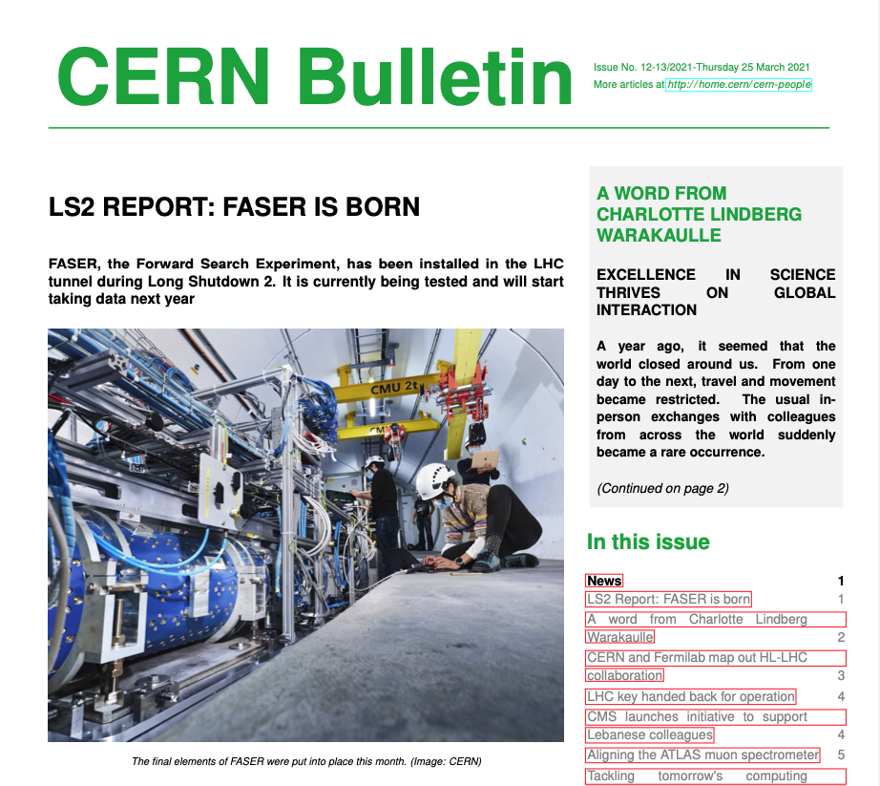
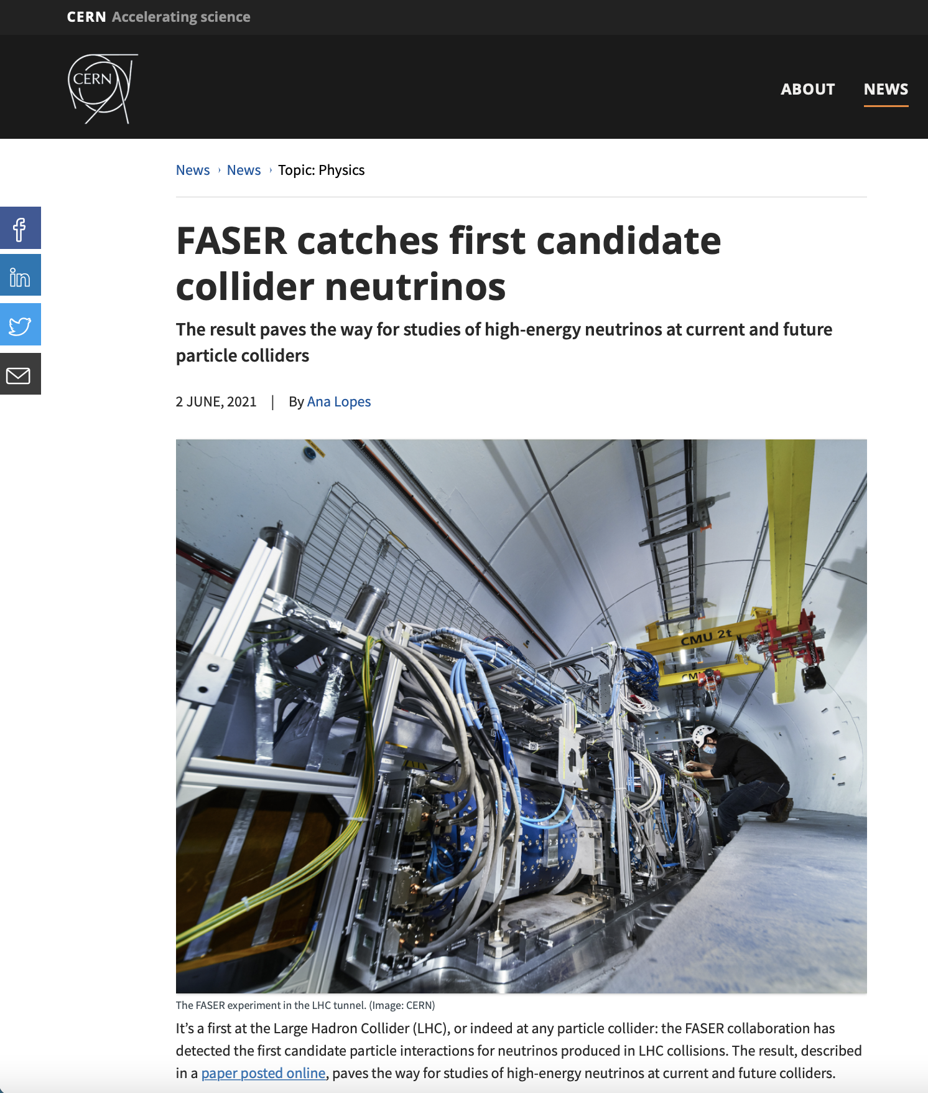
RECENT NEWS
25 March 2021
3 June 2021

Slide 3
OUTLINE
MOTIVATIONS
FORWARD PHYSICS
FASER
FASERν
FORWARD PHYSICS FACILITY
SUMMARY

Slide 4
MOTIVATIONS

Slide 5
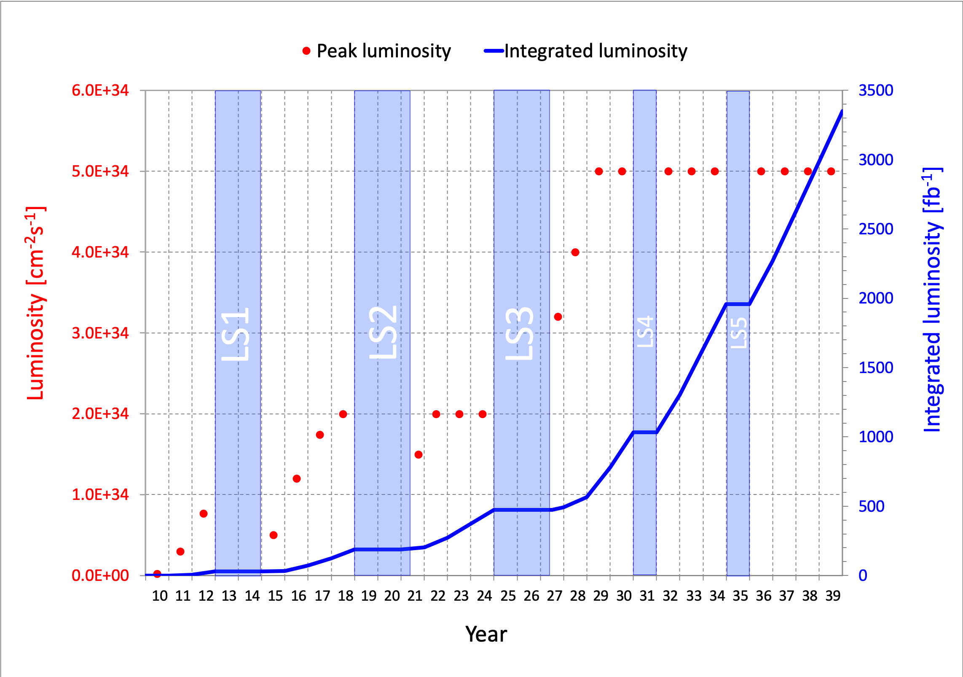
LHC: CURRENT STATUS
This is a critical time in particle physics: the Higgs boson was discovered in 2012, but so far there has been no other direct evidence for new particles from the LHC.
The LHC is currently in Long Shutdown 2, but will start up again in 2022 and run until ~2037. Will we find new particles?
More importantly, what other approaches can enhance the prospects for discovering new physics?

Slide 6
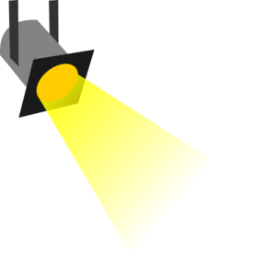
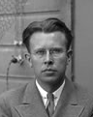
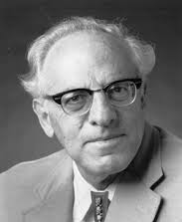
THE NEW PARTICLE LANDSCAPE
Particle
Colliders
Mass
MeV
GeV
TeV
1
Already
Discovered
Strongly Interacting
Heavy Particles
Interaction Strength
New Targets of Small Experiments
Traditional Targets
of Big Science
10⁻³
Weakly Interacting
Light Particles
Impossible to
Discover
10⁻⁶

Slide 7

AN EXAMPLE: DARK PHOTONS
Suppose there is a dark sector that contains dark matter X and also a dark force: dark electromagnetism.
Generically, the force carriers of the SM and dark EM will mix
The resulting theory contains a new particle, the dark photon A’. It’s like a normal photon, except that it can have a small mass, m_{A’}, and its couplings to charged particles are suppressed by a small parameter ε: it is a weakly-interacting, light particle. [Note: non-decoupling!]
Finding a dark photon would imply the discovery of a new fundamental force and also our first “portal” through which to view the dark sector.
SM
EM
Dark Sector
EM, X
M
A
A_{D}
Holdom (1986)

Slide 8
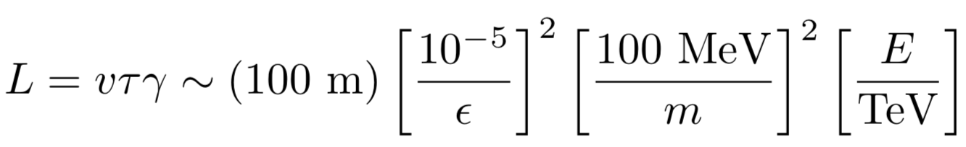


DARK PHOTON PROPERTIES
Consider mass m_{A’} ~ 1-100 MeV and coupling ε ~ 10⁻⁶ - 10⁻³.
Production: through meson decay, dark bremsstrahlung, ….
Propagation: they pass through matter without interacting, and they go straight, unaffected by E and B fields.
ε
A’
ε
π, η
A’
γ
Decay: they may decay to visible particles, but only after a long time:
They are generically long-lived particles (LLPs) !
ε
$$e^{+}$$
A’
$$e^{−}$$

Slide 9
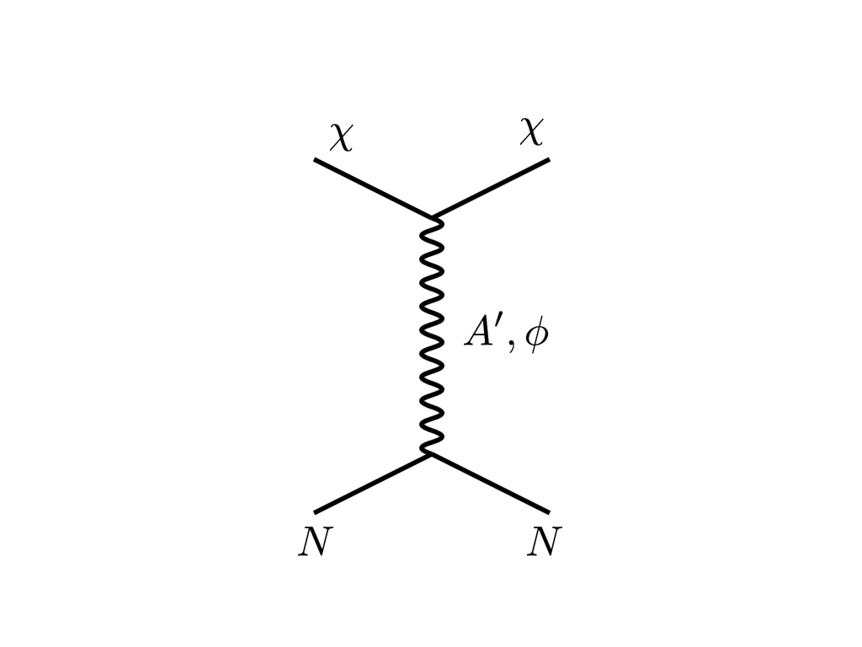





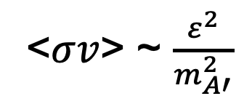
THE THERMAL RELIC LANDSCAPE
Particle
Colliders
Mass
MeV
GeV
TeV
1
Already
Discovered
Strongly Interacting
Heavy Particles
Too Little to be
Dark Matter
$$e$$
DM
$$ε$$
$$A’$$
$$ε$$
Interaction Strength
Just Right to
be Dark Matter
10⁻³
DM
$$e$$
<$σv$> ~ $\frac{ε^{2}}{m_{A′}^{2}}$
Weakly Interacting
Light Particles
Impossible to
Discover
10⁻⁶
Too Much to be
Dark Matter
Boehm, Fayet (2003)
Pospelov, Ritz, Voloshin (2007)
Feng, Kumar (2008)

Slide 10
FORWARD PHYSICS

Slide 11

SEARCHES FOR NEW LIGHT PARTICLES
If new particles are light and weakly interacting, existing LHC detectors are perfectly designed NOT to see them.
Existing detectors are designed to find new heavy particles. These particles are produced almost at rest and decay isotropically.
But new light particles are mainly produced in the decays of light particles: π, η, K, D and B mesons. These are mainly produced along the beamline, and so the new particles disappear through the holes that let the beams in.
Clearly we need a detector to exploit the “wasted” σ_{inel} ~ 100 mb and cover these “blind spots” in the forward region. If we go far enough away, the proton beams are bent by magnets (it’s a circular collider!), whereas the new light particles will go straight.

Slide 12
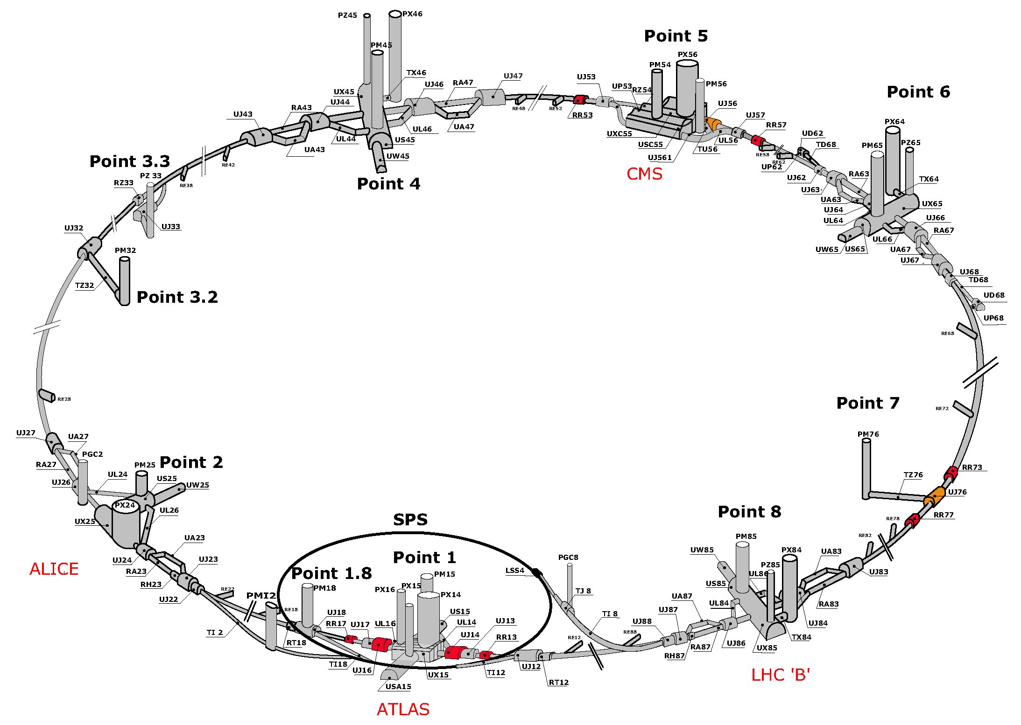
MAP OF LHC
!!!

Slide 13
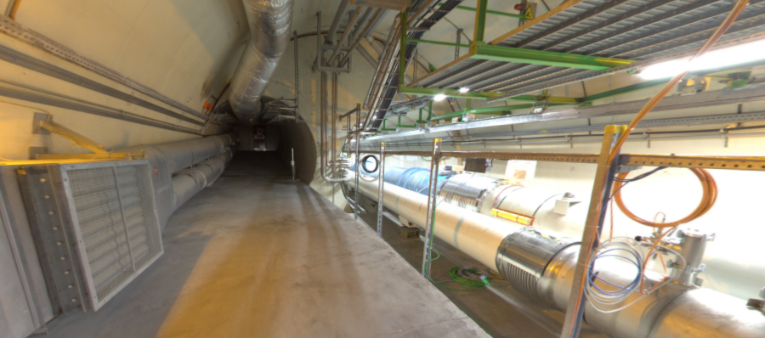
THE FAR-FORWARD REGION
Beam collision axis passes
through 100 m of rock, emerges in tunnel TI12, 480 m from ATLAS
UJ12
TI12 near UJ12
The view in UJ12 looking west (2019)
TI12
Beam collision axis
LHC beamline

Slide 14
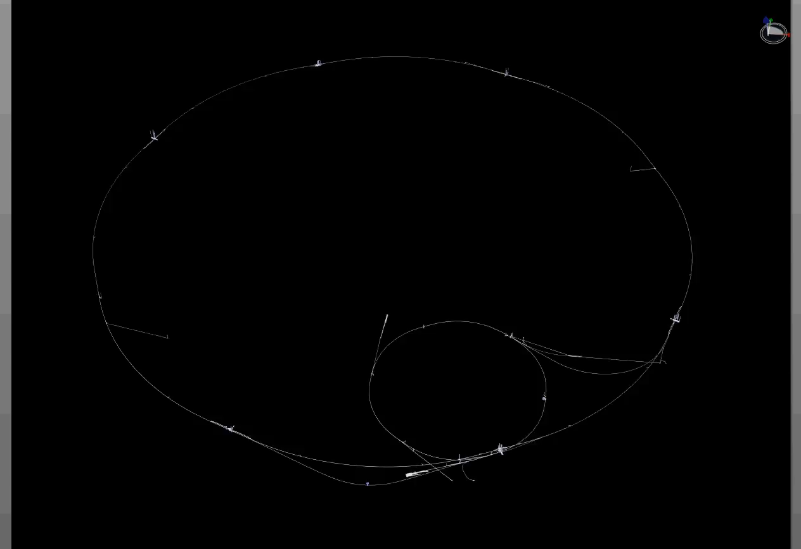
PARTICLE PATH FROM ATLAS TO TI12
Dougherty, CERN Integration (2019)

Slide 15
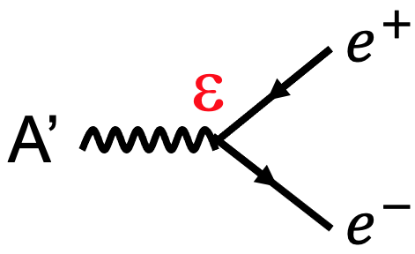
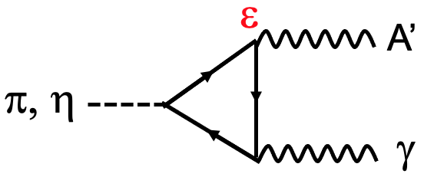
SIGNAL RATE
480 m
Produced Pions
Enormous event rates: N_{π}~10¹⁵ per bin
Huge range of p, but p_{T} is peaked at ~250 MeV
Produced A’s
Decays to A’ are rare:
N_{A’} ~ ε² N_{π}
But still N_{A’} ~ 10⁵ per bin
A’s decay in [480m, 483m]
Only highly boosted, ~TeV A’s decay in the tunnel
But still many events, and highly collimated along the beam collision axis
300 fb⁻¹
Feng, Galon, Kling, Trojanowski (2017)

Slide 16
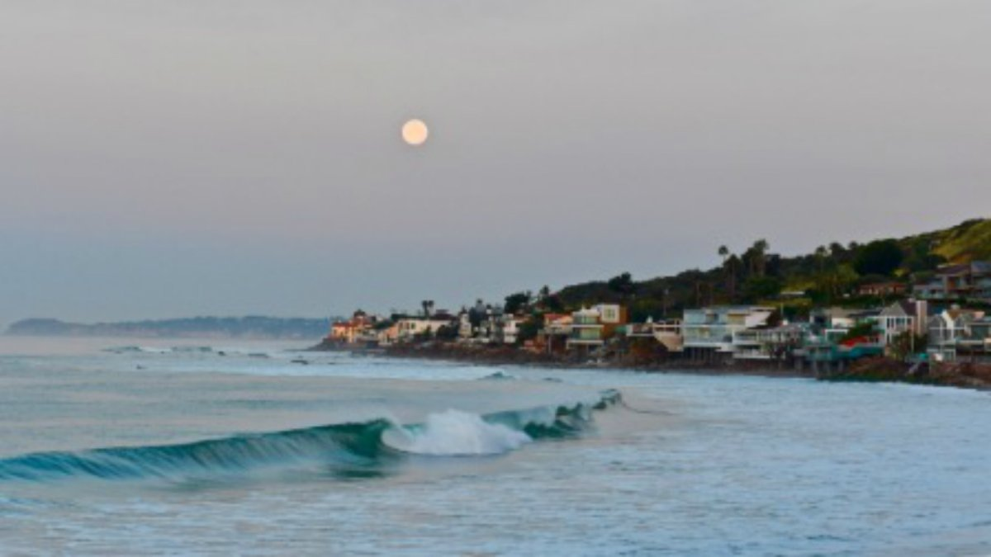
HOW BIG DOES THE DETECTOR HAVE TO BE?
Momentum:
Space:
250 MeV
1 TeV
12 cm
480 m
The opening angle is 0.2 mrad (η ~ 9); cf. the moon (7 mrad). Most of the signal passes through 1 sheet of paper at 480 m.
TeV dark photons (or any other new particles produced in π, η, K, D, B decay) are far more collimated than shown below, motivating a new, small, fast, cheap experiment at the LHC.

Slide 17
FASER

Slide 18
FASER TIMELINE
September 2017: Proposed by Feng, Galon, Kling, Trojanowski.
July 2018: Submitted LOI to CERN LHCC
October 2018: Approval from ATLAS SCT and LHCb Collaborations for use of spare detector modules
November 2018: Submitted Technical Proposal to LHCC
November 2018 – January 2019: Experiment funded by the Heising-Simons and Simons Foundations
March 2019: FASER approved by CERN along with host lab costs
December 2019: FASERν approved by CERN along with host lab costs
March 2021: FASER fully installed, commissioning of the detector begins
April 2021: FASERν announces first candidate collider neutrinos
Early 2022: FASER and FASERν begin collecting data in Run 3

Slide 19
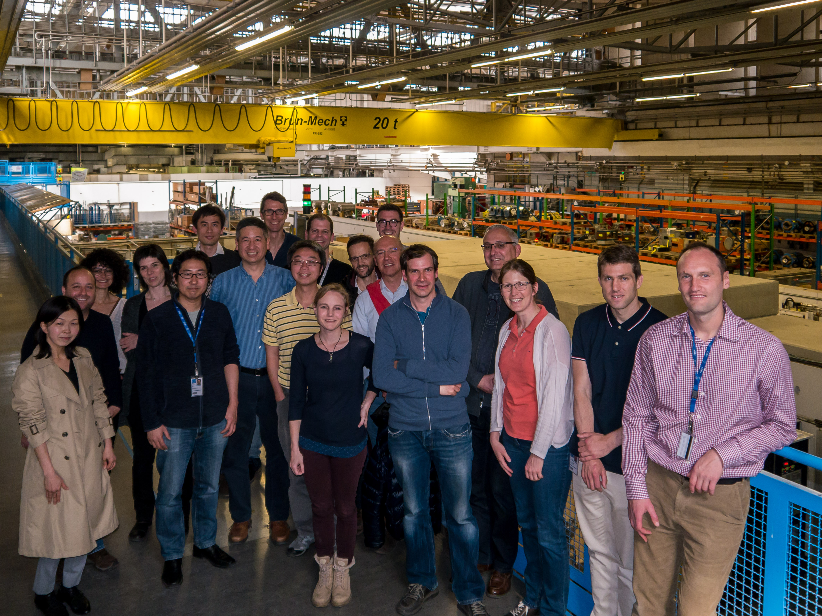
FIRST FASER COLLABORATION MEETING

Slide 20









THE FASER COLLABORATION TODAY
72 collaborators, 20 institutions, 8 countries
Henso Abreu (Technion), Yoav Afik (Technion), Claire Antel (Geneva), Akitaka Ariga (Chiba/Bern), Tomoko Ariga (Kyushu/Bern), Florian Bernlochner (Bonn), Tobias Boeckh (Bonn), Jamie Boyd (CERN), Lydia Brenner (CERN), Franck Cadoux (Geneva), Dave Casper (UC Irvine), Charlotte Cavanagh (Liverpool), Xin Chen (Tsinghua), Elisa Ruiz Cholis (Mainz), Andrea Coccaro (INFN), Monica D’Onofrio (Liverpool), Candan Dozen (Tsinghua), Yannick Favre (Geneva), Deion Fellers (Oregon), Jonathan Feng (UC Irvine), Didier Ferrere (Geneva), Stephen Gibson (Royal Holloway), Sergio Gonzalez-Sevilla (Geneva), Carl Gwilliam (Liverpool), Shih-Chieh Hsu (Washington), Zhen Hu (Tsinghua), Peppe Iacobucci (Geneva), Tomohiro Inada (Tsinghua), Sune Jakobsen (CERN), Enrique Kajomovitz (Technion), Felix Kling (SLAC), Umut Kose (CERN), Susanne Kuehn (CERN), Helena Lefebvre (Royal Holloway), Lorne Levinson (Weizmann), Ke Li (Washington), Jinfeng Liu (Tsinghua), Chiara Magliocca (Geneva), Josh McFayden (CERN), Dimitar Mladenov (CERN), Mitsuhiro Nakamura (Nagoya), Toshiyuki Nakano (Nagoya), Marzio Nessi (CERN), Friedemann Neuhaus (Mainz), Laurie Nevay (Royal Holloway), Hidetoshi Otono (Kyushu), Lorenzo Paolozzi (Geneva), Carlo Pandini (Geneva), Hao Pang (Tsinghua), Brian Petersen (CERN), Francesco Pietropaolo (CERN), Johanna Paine (UC Irvine), Markus Prim (Bonn), Michaela Queitsch-Maitland (CERN), Filippo Resnati (CERN), Chiara Rizzi (Geneva), Hiroki Rokujo (Nagoya), Jakob Salfeld-Nebgen (CERN), Osamu Sato (Nagoya), Paola Scampoli (Bern), Kristof Schmieden (Mainz), Matthias Schott (Mainz), Anna Sfyrla (Geneva), Savannah Shively (UC Irvine), John Spencer (Washington), Yosuke Takubo (KEK), Ondrej Theiner (Geneva), Eric Torrence (Oregon), Serhan Tufanli (CERN), Benedikt Vormvald (CERN), Di Wang (Tsinghua), Gang Zhang (Tsinghua)

Slide 21
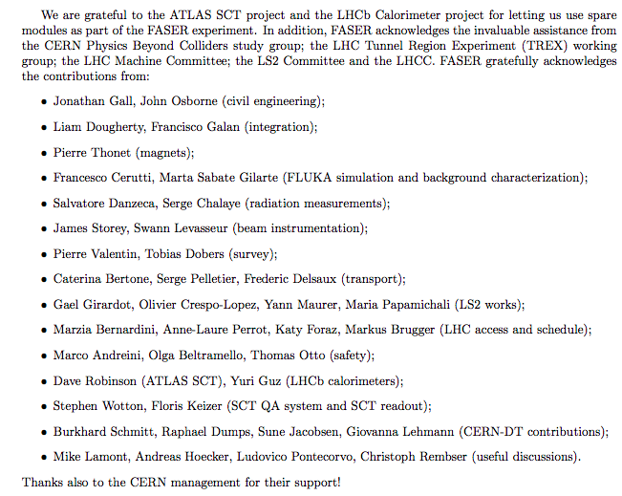
HELP FROM MANY OTHERS
The FASER Collaboration has received essential support from the Heising-Simons and Simons Foundations, CERN, the ATLAS SCT and LHCb Collaborations, and also many others at CERN and elsewhere

Slide 22
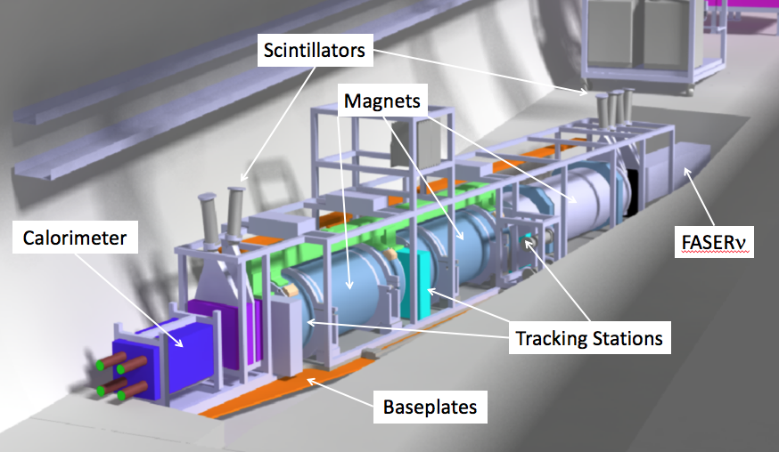
THE SIGNAL
Nothing incoming and 2 ~TeV, opposite-sign charged tracks pointing back to the ATLAS IP: a “light shining through (100 m-thick) wall” experiment.
Scintillators veto incoming charged tracks (muons), and permanent dipole magnets split the charged tracks, which are detected by 3 tracking stations and a calorimeter.
LLP
ν
e⁺
e⁻

Slide 23
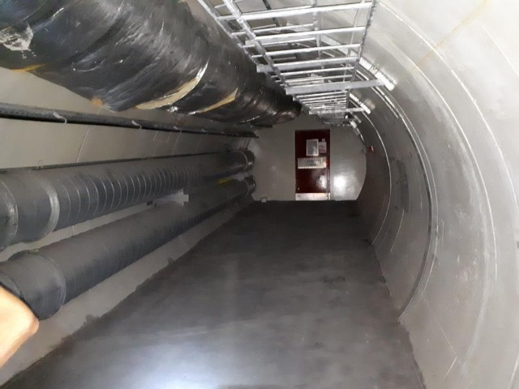
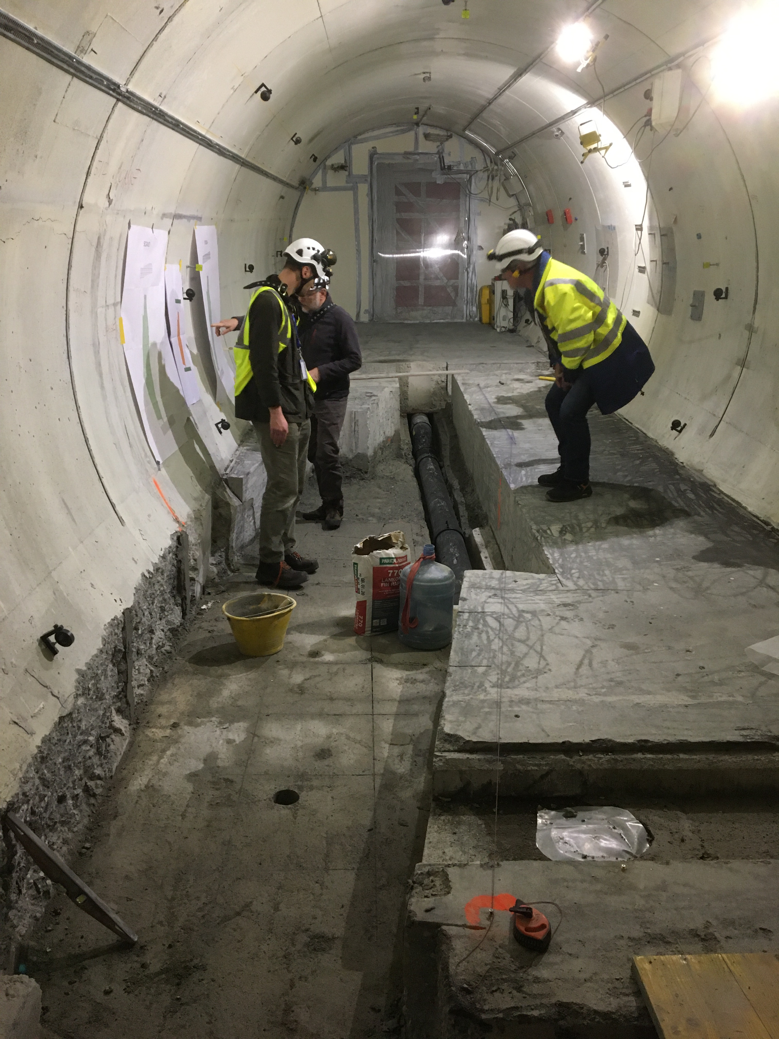
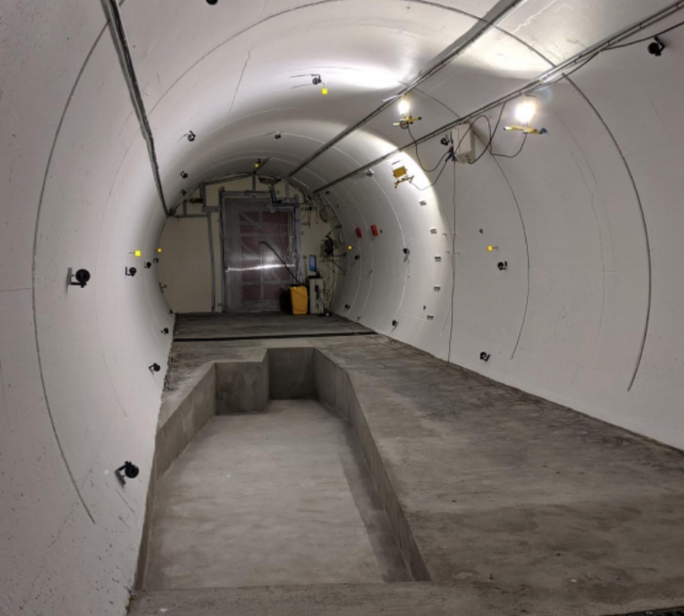
FASER IN TUNNEL TI12
The beam collision axis has been located to mm accuracy by the CERN survey department. To place FASER on this axis, a trench was required to lower the floor by 46 cm.
The trench was completed by an Italian firm just hours before COVID shut down CERN in Spring 2020.
2019
Spring 2020
Summer 2020

Slide 24
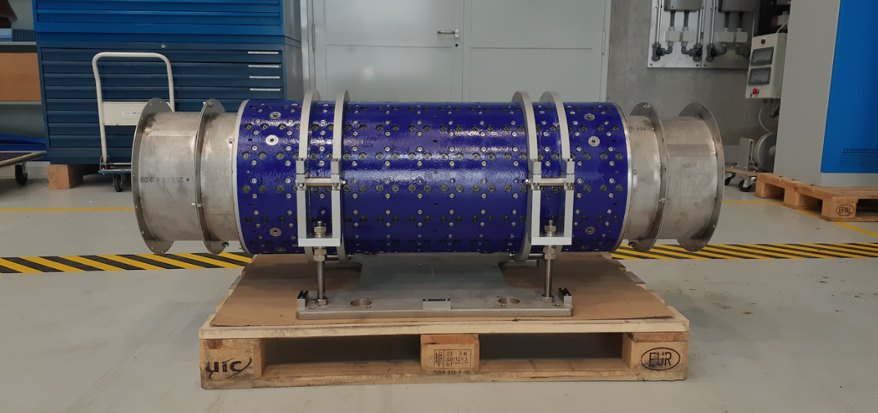
MAGNETS
FASER includes 3 magnets: 1.5 m, 1 m, and 1m long.
These magnets are 0.57 T permanent dipoles with an inner diameter of 20 cm, require little maintenance.
Constructed by the CERN magnet group.

Slide 25
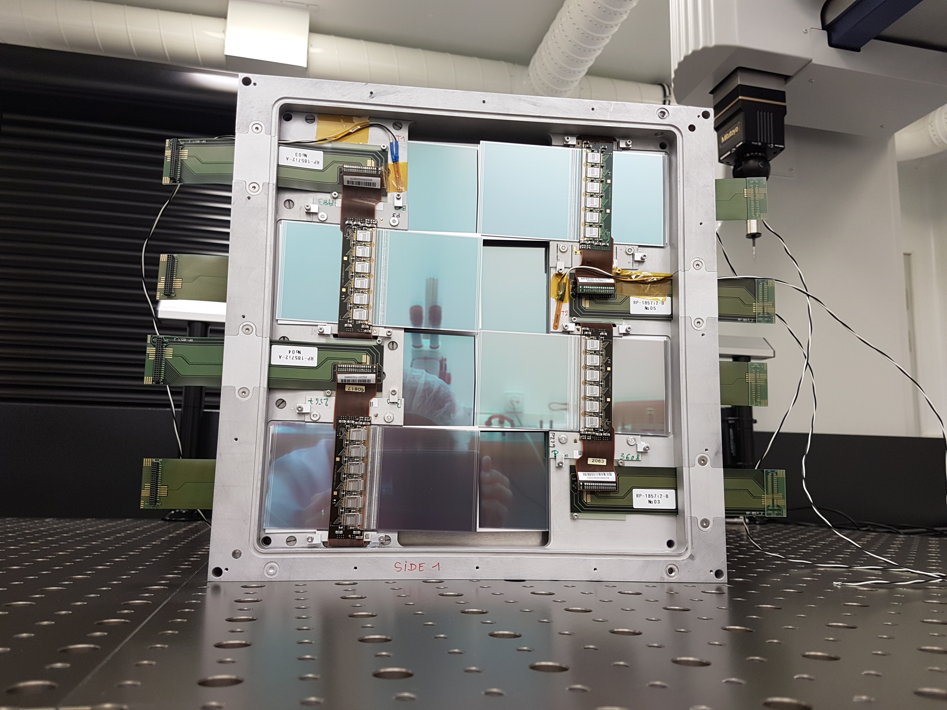
TRACKERS
8 ATLAS SCT modules per tracking plane, 3 tracking planes per tracking station, 3 tracking stations at FASER.

Slide 26
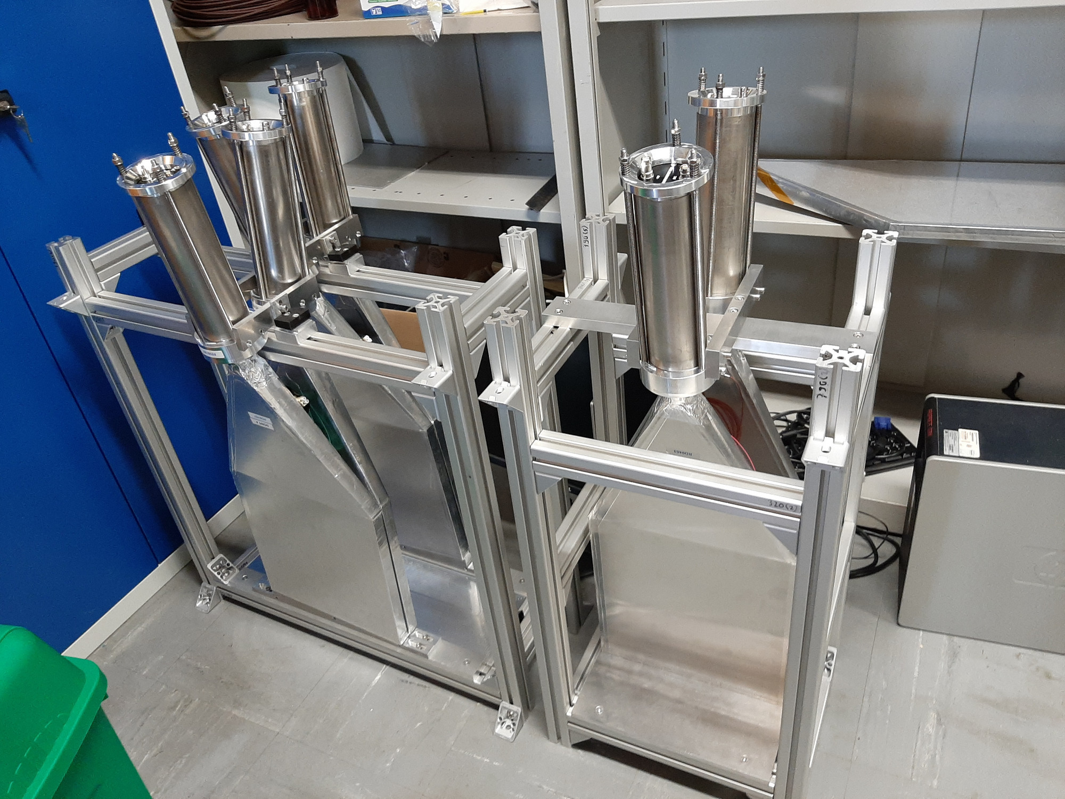
SCINTILLATORS
4 veto scintillators, each 2cm x 30cm x 30cm, upstream of the detector. Efficiency of each one is > 99.99%, which, barring correlations, reduces muon background to negligible levels.
Additional beam backgrounds, simulated with FLUKA and validated with pilot detectors in 2018, are also expected to be negligible.

Slide 27
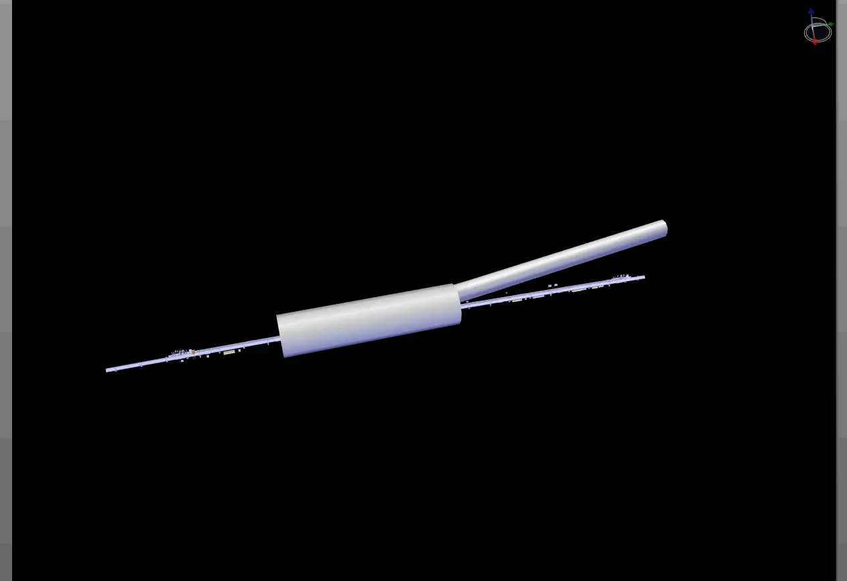
FASER INSTALLATION
Dougherty, CERN Integration (2019)

Slide 28
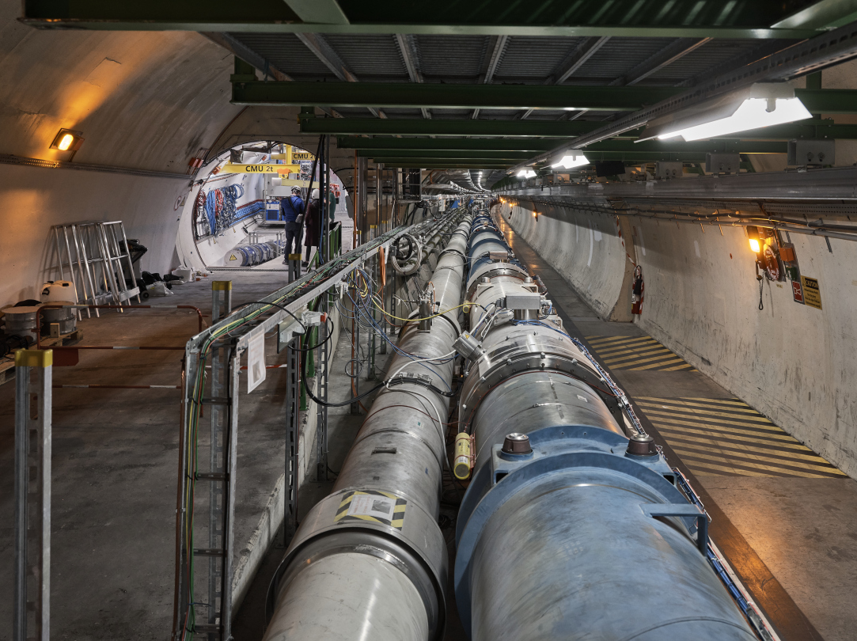
FASER CURRENT STATUS

Slide 29
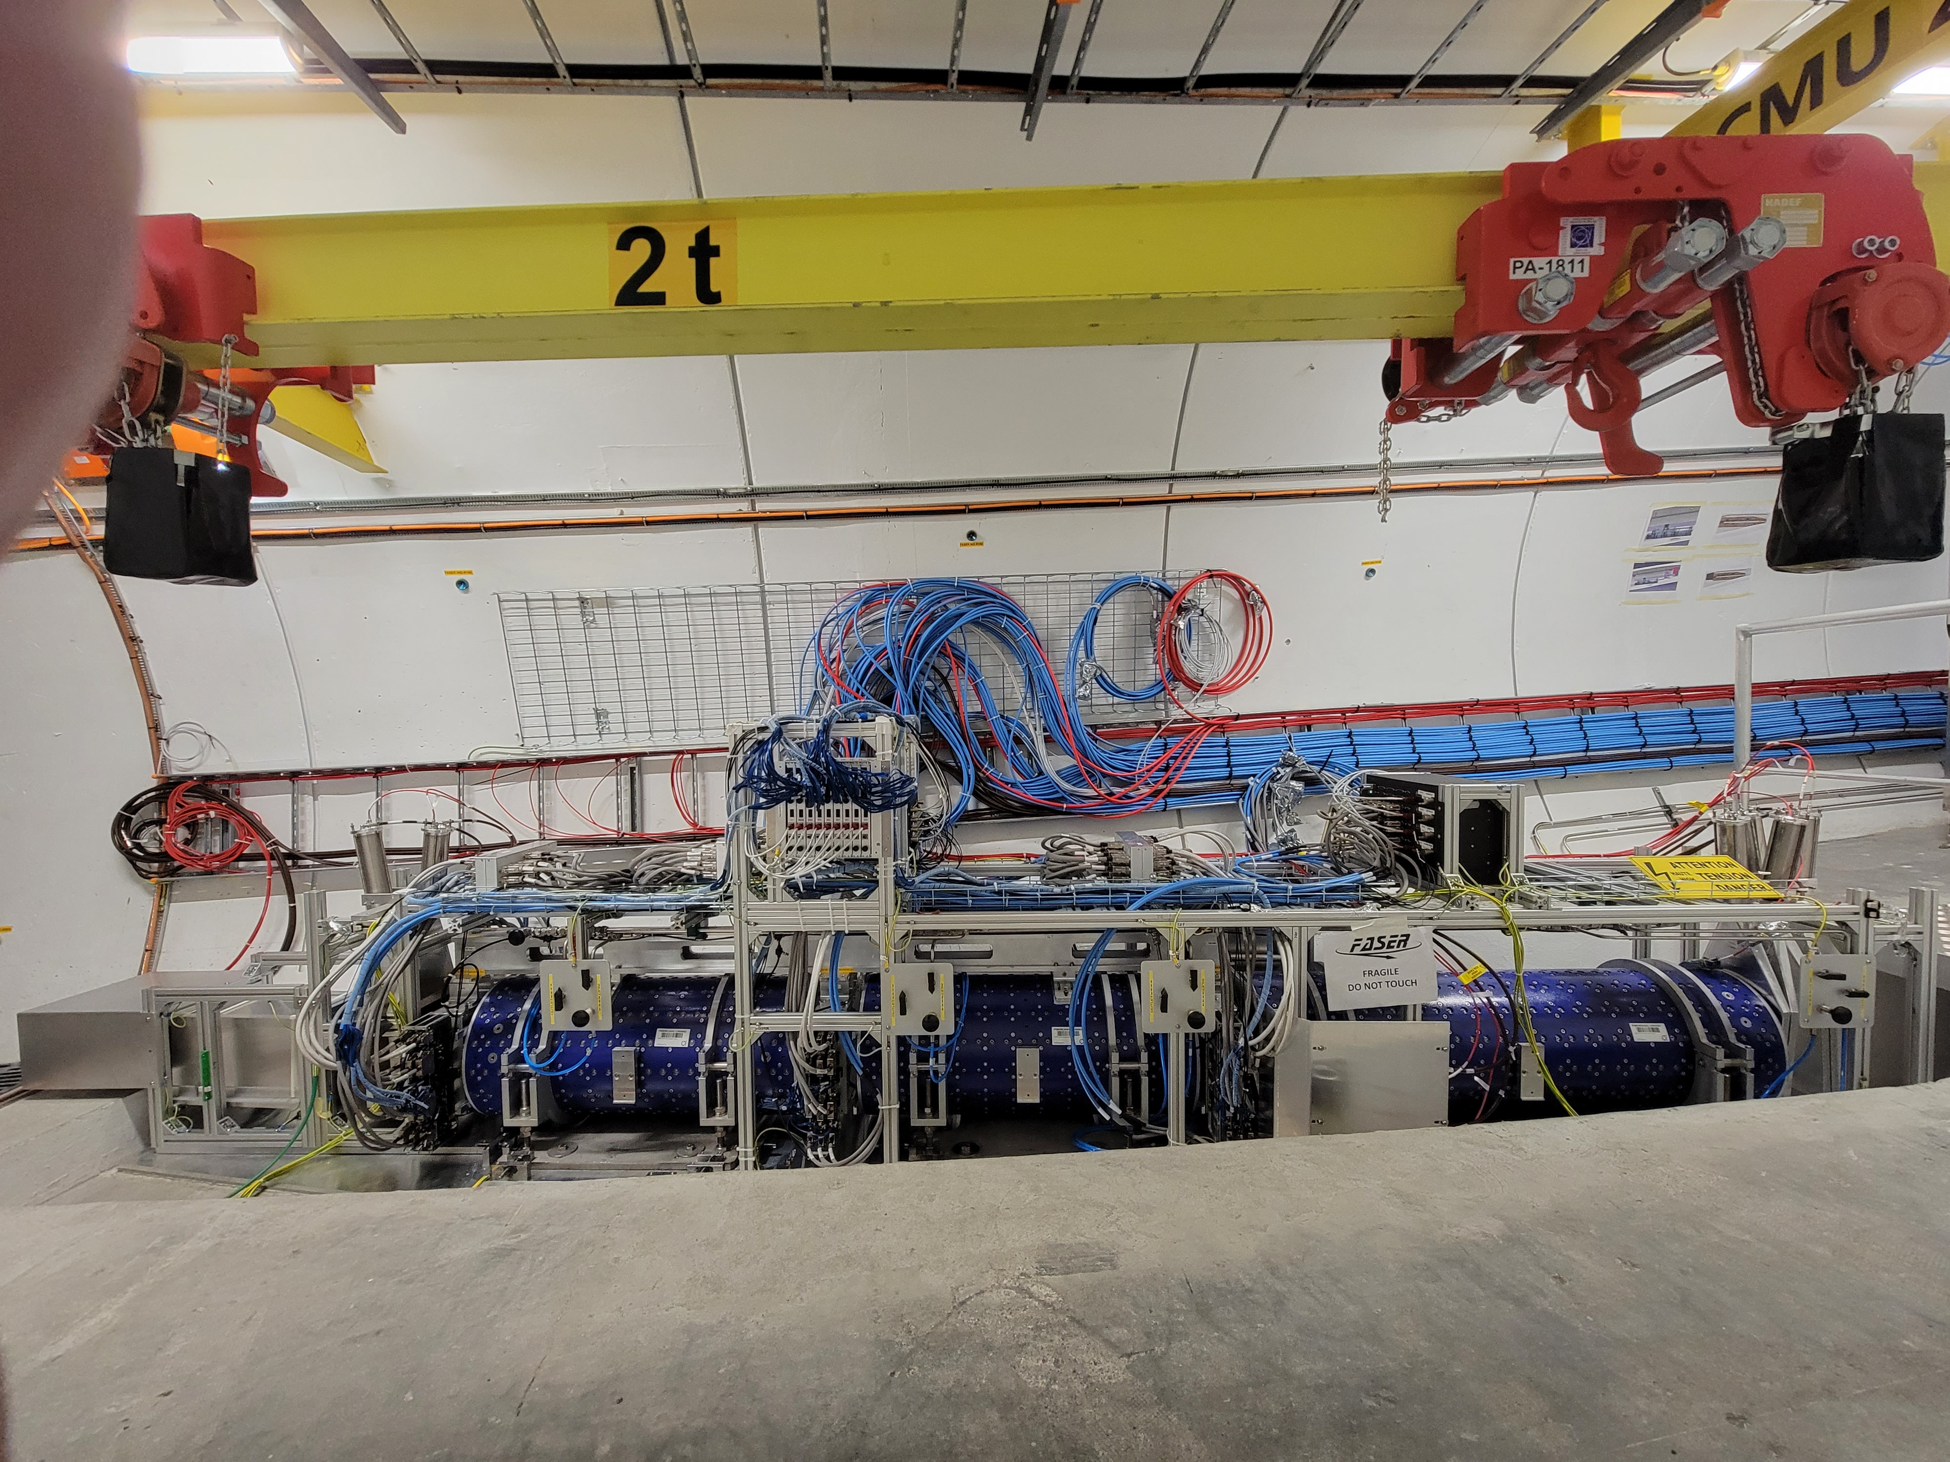
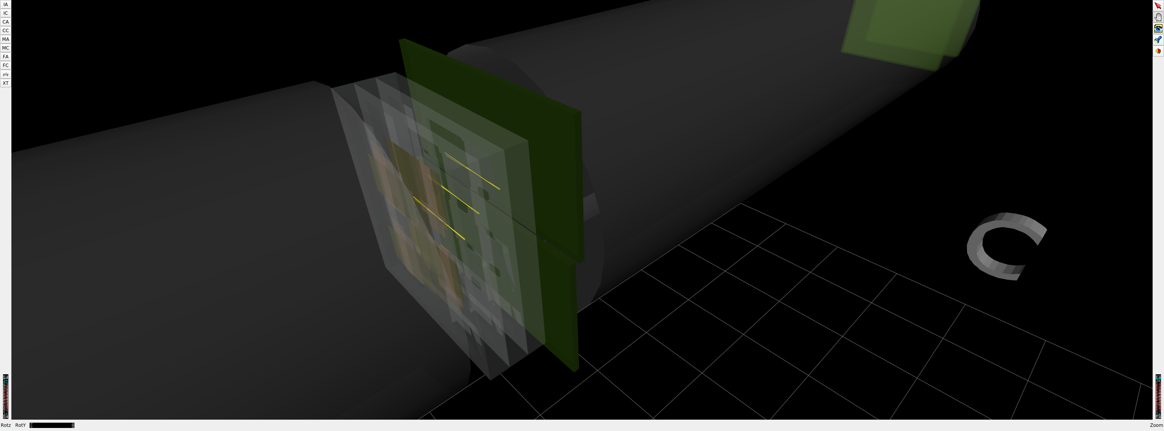
FASER CURRENT STATUS
1st Cosmic Ray
18 March 2021

Slide 30
DARK PHOTON SENSITIVITY REACH
FASER
FASER probes new parameter space with just 1 fb⁻¹ starting in 2022.
Without upgrade, HL-LHC extends (Luminosity*Vol) by factor of 3000 – could detect as many as 10,000 dark photons.
Possible upgrade to FASER 2 (R=1m, L=10m) extends (Luminosity*Vol) by factor of ~10⁶ – could detect as many as 3 x 10⁶ dark photons.
_{FASER Collaboration (2018)}

Slide 31
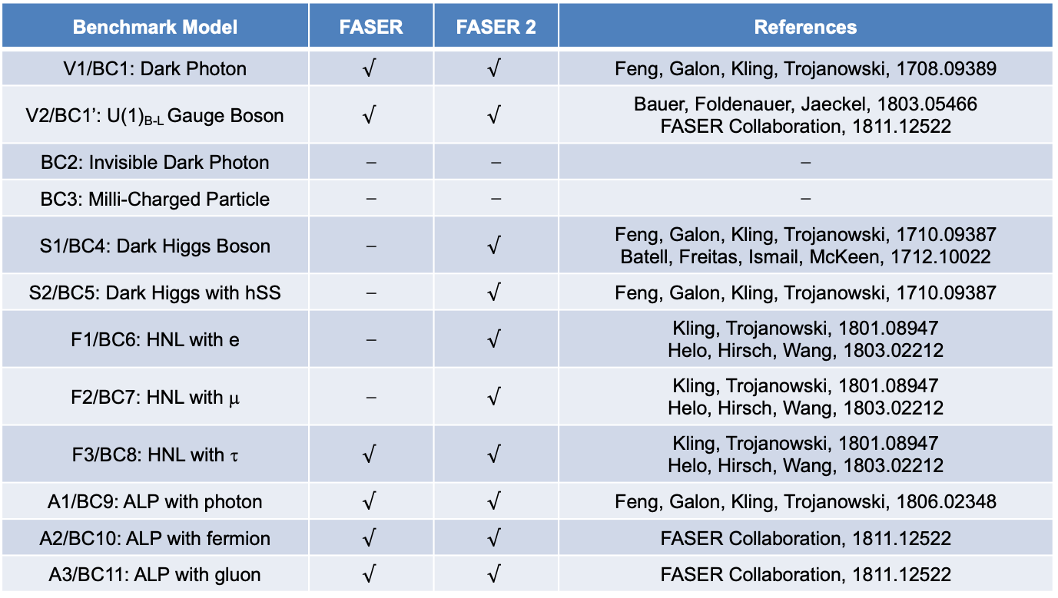
PHYSICS SUMMARY
Many other models have also be studied: FASER can discover axion-like particles, sterile neutrinos, new force particles; see 1811.12522.
Benchmark Model | FASER | FASER 2 | References
V1/BC1: Dark Photon | $$√$$ | $$√$$ | Feng, Galon, Kling, Trojanowski, 1708.09389
V2/BC1’: U(1)_{B-L} Gauge Boson | $$√$$ | $$√$$ | Bauer, Foldenauer, Jaeckel, 1803.05466 FASER Collaboration, 1811.12522
BC2: Invisible Dark Photon | ⎼ | ⎼ | ⎼
BC3: Milli-Charged Particle | ⎼ | ⎼ | ⎼
S1/BC4: Dark Higgs Boson | ⎼ | $$√$$ | Feng, Galon, Kling, Trojanowski, 1710.09387 Batell, Freitas, Ismail, McKeen, 1712.10022
S2/BC5: Dark Higgs with hSS | ⎼ | $$√$$ | Feng, Galon, Kling, Trojanowski, 1710.09387
F1/BC6: HNL with e | ⎼ | $$√$$ | Kling, Trojanowski, 1801.08947 Helo, Hirsch, Wang, 1803.02212
F2/BC7: HNL with μ | ⎼ | $$√$$ | Kling, Trojanowski, 1801.08947 Helo, Hirsch, Wang, 1803.02212
F3/BC8: HNL with τ | $$√$$ | $$√$$ | Kling, Trojanowski, 1801.08947 Helo, Hirsch, Wang, 1803.02212
A1/BC9: ALP with photon | $$√$$ | $$√$$ | Feng, Galon, Kling, Trojanowski, 1806.02348
A2/BC10: ALP with fermion | $$√$$ | $$√$$ | FASER Collaboration, 1811.12522
A3/BC11: ALP with gluon | $$√$$ | $$√$$ | FASER Collaboration, 1811.12522

Slide 32
FASERν

Slide 33
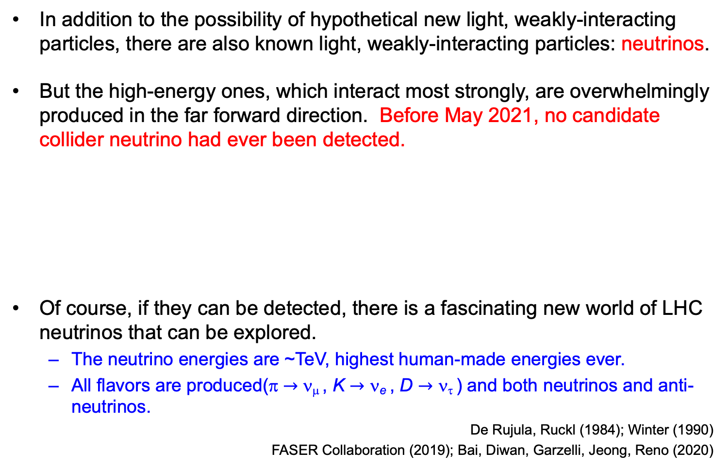
COLLIDER NEUTRINOS
In addition to the possibility of hypothetical new light, weakly-interacting particles, there are also known light, weakly-interacting particles: neutrinos.
But the high-energy ones, which interact most strongly, are overwhelmingly produced in the far forward direction. Before May 2021, no candidate collider neutrino had ever been detected.
Of course, if they can be detected, there is a fascinating new world of LHC neutrinos that can be explored.
  The neutrino energies are ~TeV, highest human-made energies ever.
  All flavors are produced(π $→$ ν_{μ} , K $→$ ν_{e} , D $→$ ν_{τ} ) and both neutrinos and anti-neutrinos.
De Rujula, Ruckl (1984); Winter (1990)
FASER Collaboration (2019); Bai, Diwan, Garzelli, Jeong, Reno (2020)

Slide 34
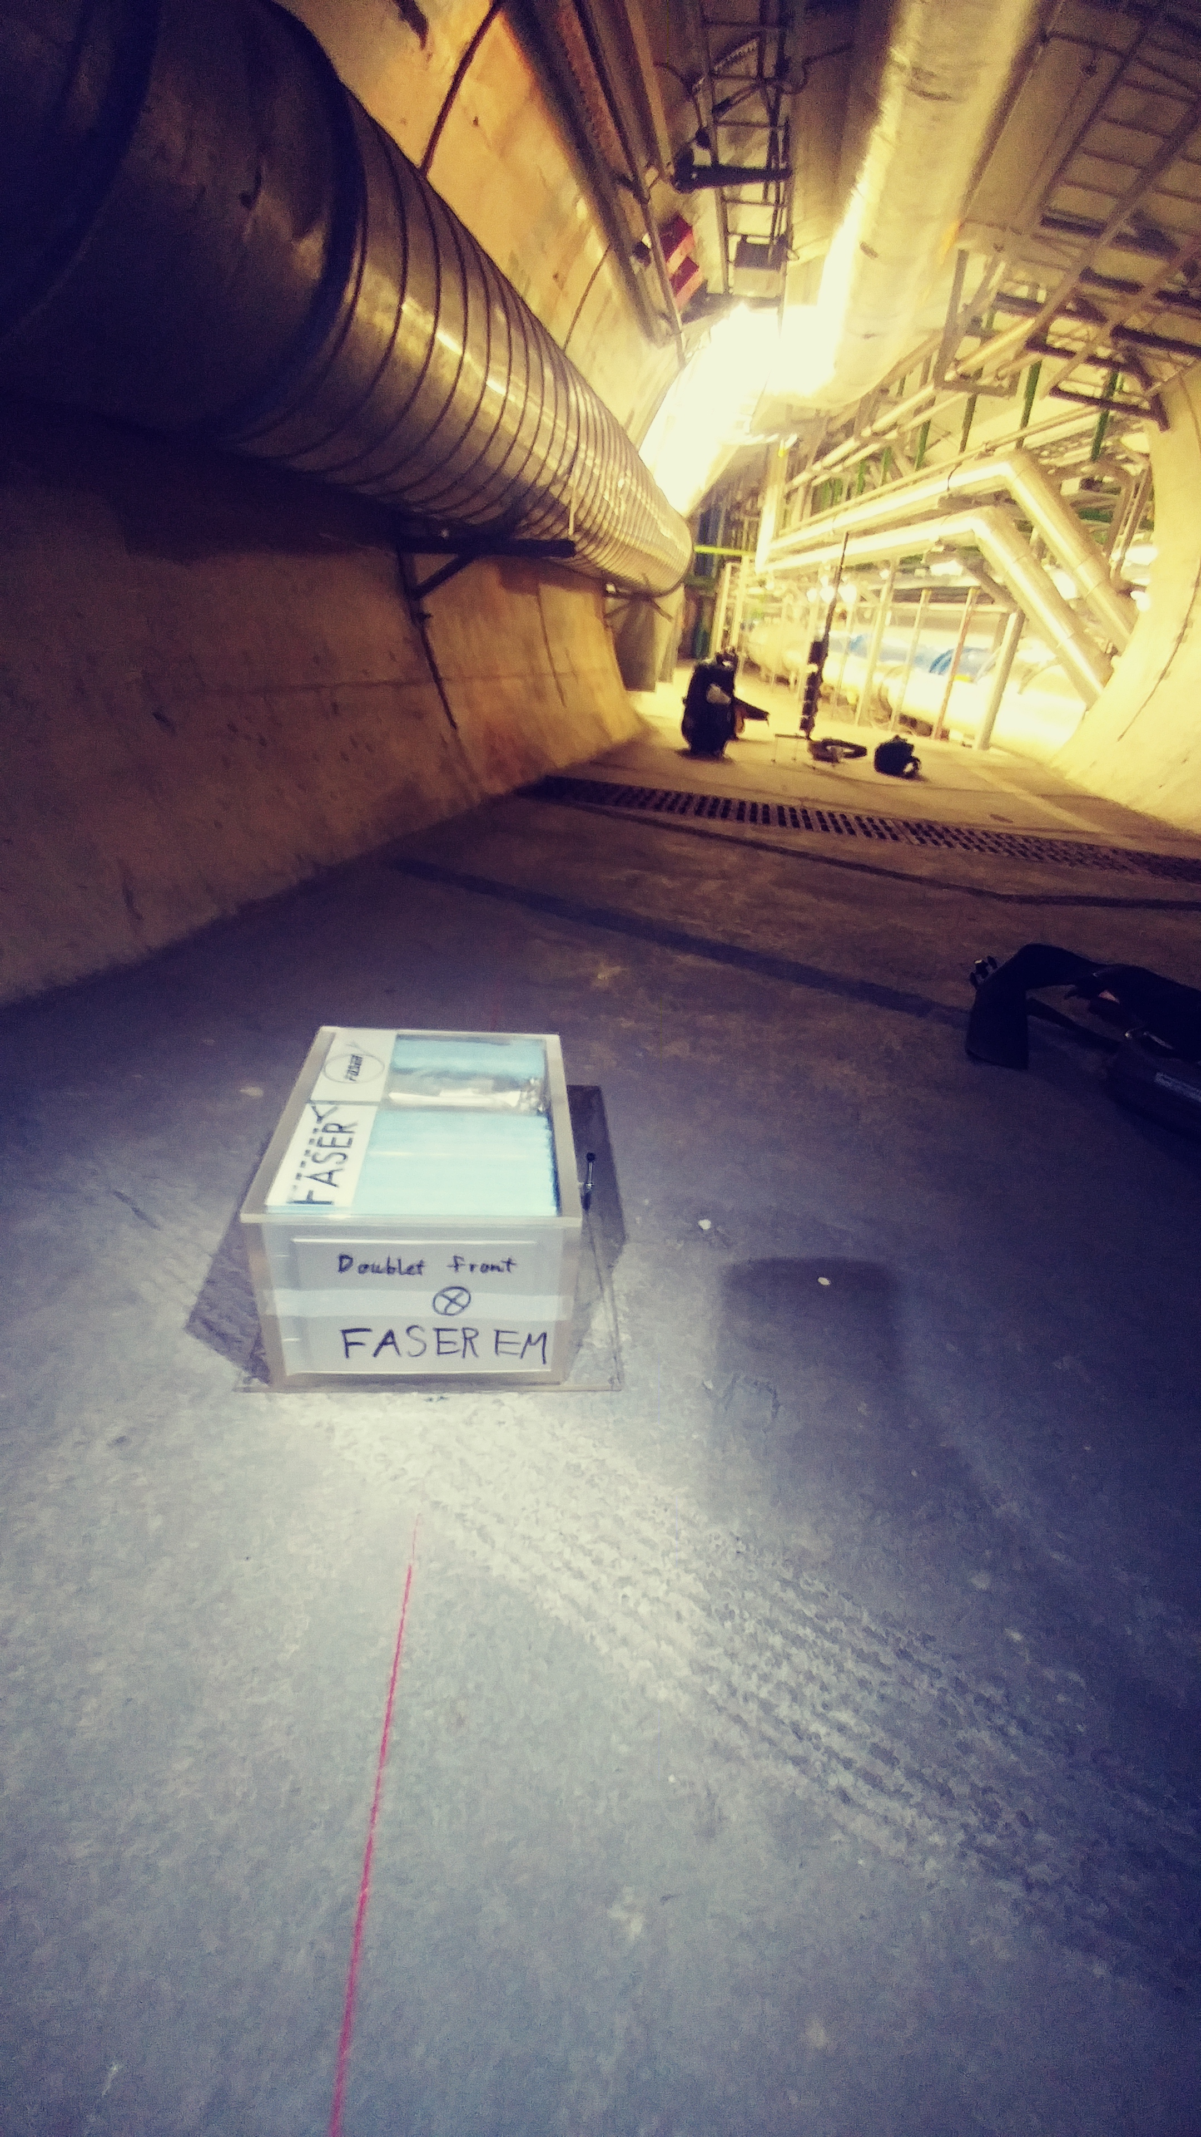
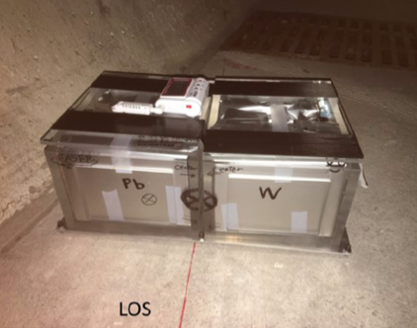
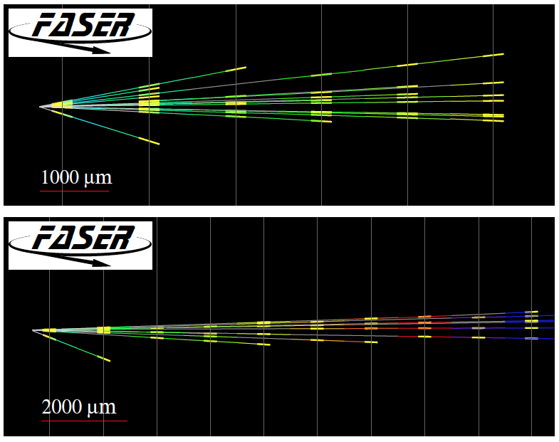
FIRST COLLIDER NEUTRINOS
In 2018 a FASER pilot emulsion detector with 11 kg fiducial mass collected 12.2 fb⁻¹ on the beam collision axis (installed and removed during Technical Stops).
On 14 May 2021, we announced the direct detection of 6 candidate collider neutrinos above 12 expected neutral hadron background events (2.7σ).
Not the discovery of collider neutrinos, but a sign of things to come.

Slide 35
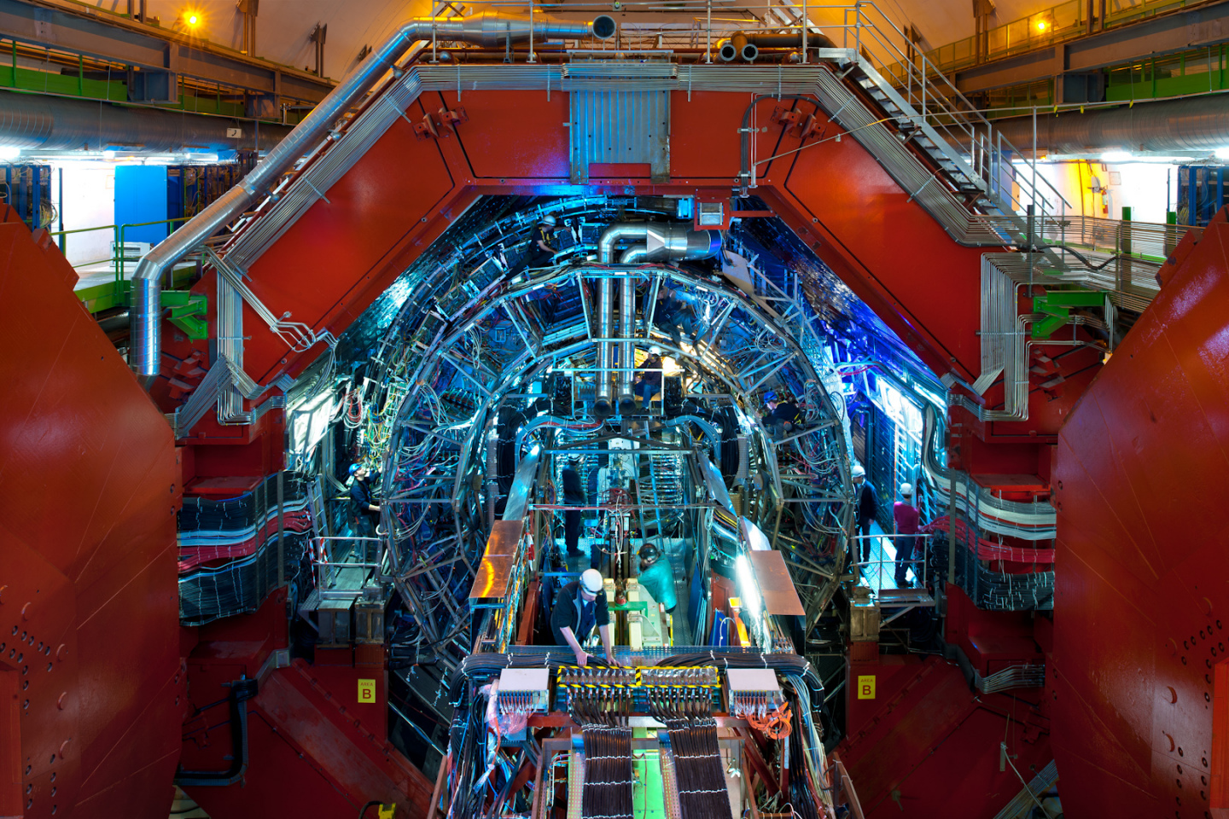
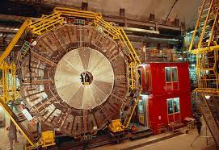
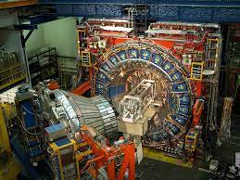
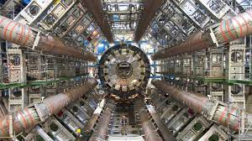
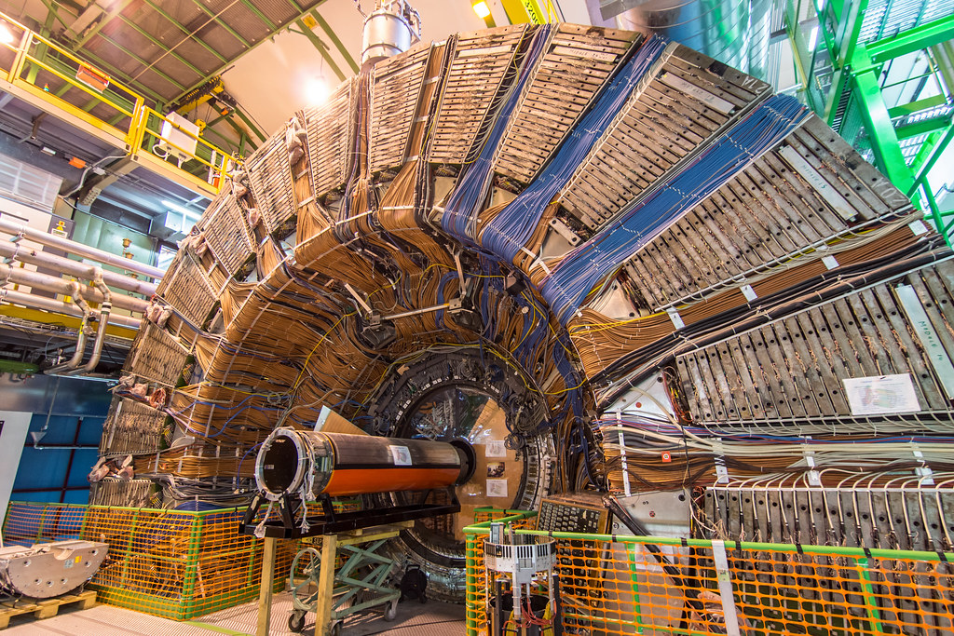
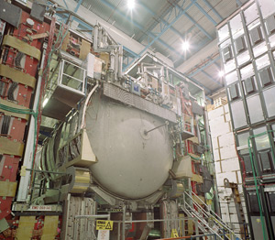
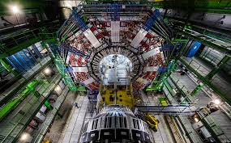
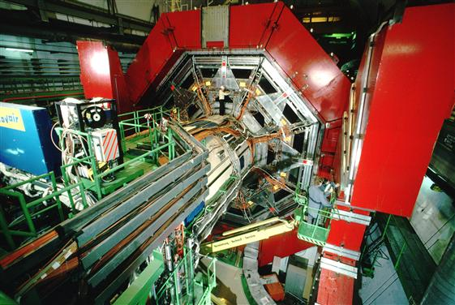

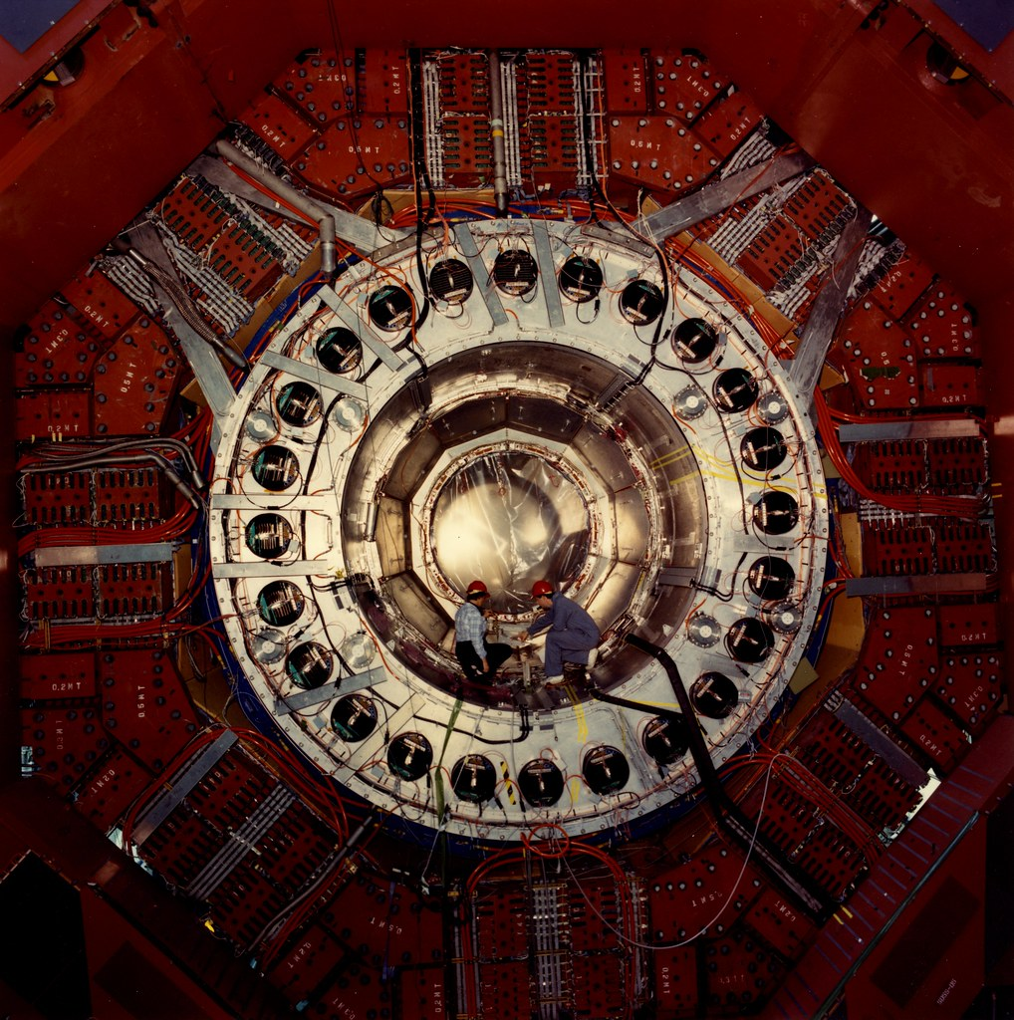
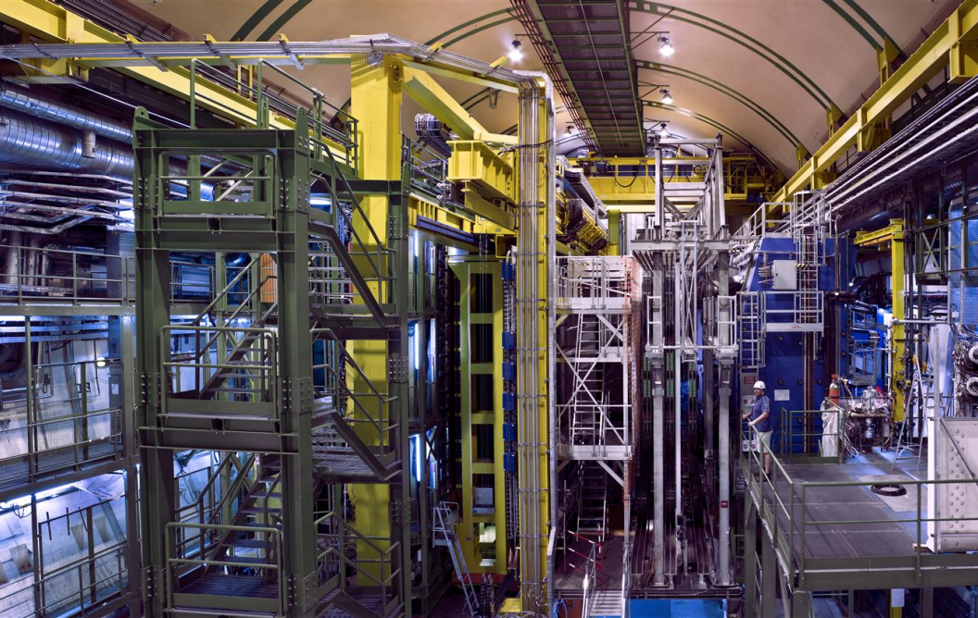
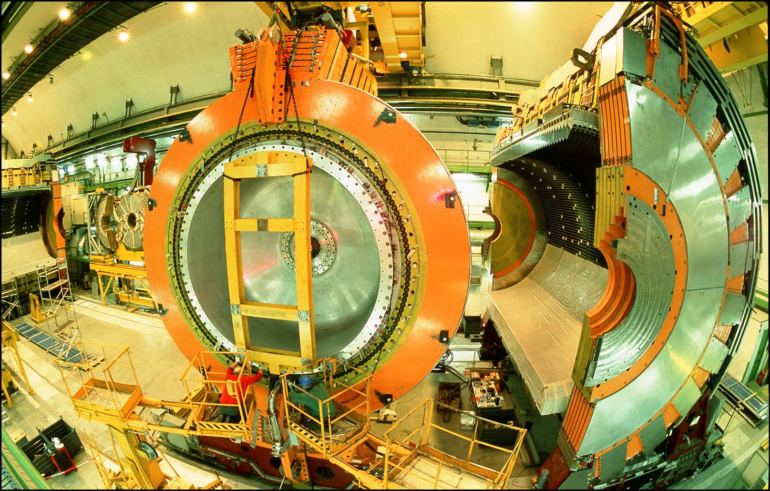
LOCATION, LOCATION, LOCATION !
…
ALICE
ALEPH
CDF
FASER Pilot Detector
Suitcase-size, 4 weeks
$0 (recycled parts)
6 candidate neutrinos
ATLAS
DELPHI
D0
CMS
L3
LHCb
SLD
OPAL
All previous
collider detectors
Building-size, decades
~$10⁹
0 candidate neutrinos

Slide 36
THE FASERν DETECTOR
FASERν is designed to detect neutrinos of all flavors.
  25cm x 30cm x 1.1m detector consisting of 770 emulsion layers interleaved with 1mm-thick tungsten plates; target mass = 1.1 tonne.
  Emulsion swapped out every ~10-30 fb⁻¹, total 10 sets of emulsion for Run 3.
LLP
ν
e⁺
e⁻

Slide 37
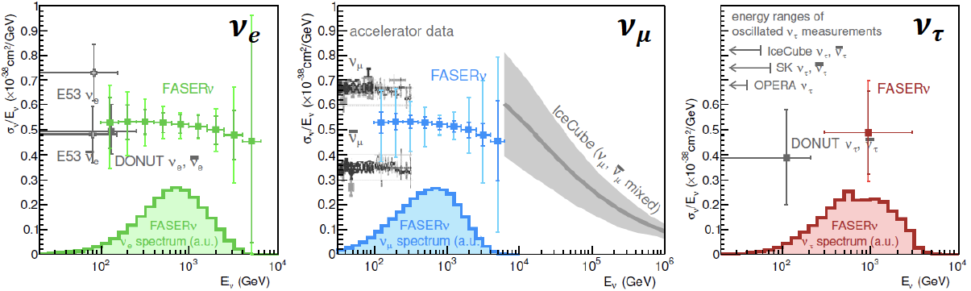
NEUTRINO PHYSICS
In Run 3 (2022-24), FASERν will
  Detect the first collider neutrino.
  Record ~1000 ν_{e} , ~10,000 ν_{μ} , and ~10 ν_{τ} interactions at TeV energies, the first direct exploration of this energy range for all 3 flavors.
  Double the world’s supply of tau neutrinos.
  Distinguish muon neutrinos from anti-neutrinos by combining FASER and FASERν data, and so measure their cross sections independently.
FASER Collaboration 1908.02310 (2019)

Slide 38
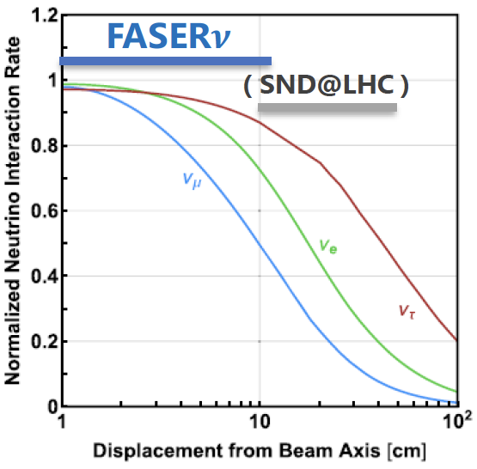
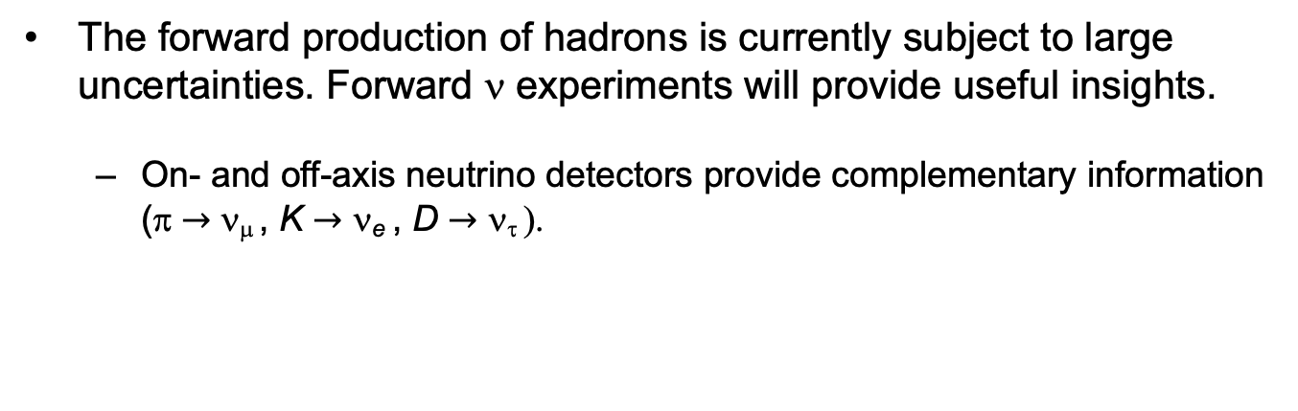
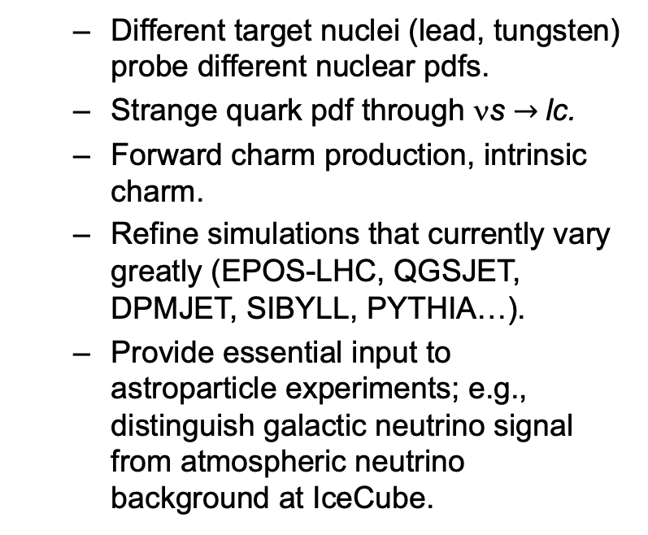
QCD PHYSICS
The forward production of hadrons is currently subject to large uncertainties. Forward ν experiments will provide useful insights.
  On- and off-axis neutrino detectors provide complementary information (π $→$ ν_{μ} , K $→$ ν_{e} , D $→$ ν_{τ} ).
  Different target nuclei (lead, tungsten) probe different nuclear pdfs.
  Strange quark pdf through νs $→$lc.
  Forward charm production, intrinsic charm.
  Refine simulations that currently vary greatly (EPOS-LHC, QGSJET, DPMJET, SIBYLL, PYTHIA…).
  Provide essential input to astroparticle experiments; e.g., distinguish galactic neutrino signal from atmospheric neutrino background at IceCube.

Slide 39
FORWARD PHYSICS FACILITY

Slide 40
FORWARD PHYSICS FACILITY
FASER, FASERν, and other proposed far-forward detectors are currently highly constrained by 1980’s infrastructure that was never intended to support experiments.
At the same time, it is becoming clear that there is a rich physics program in the far-forward region.
  New particle searches, neutrinos, QCD, MC event generators, milli-charged particles, dark matter, dark sector, cosmic neutrinos, …
Strongly motivates creating a dedicated facility to house far-forward experiments for the HL-LHC era from 2027-37.
  Snowmass LOI: 240 authors from many different communities
  FPF Kickoff Meeting: 9-10 Nov 2020, https://indico.cern.ch/event/955956, 2nd FPF Workshop: 27-28 May 2021, https://indico.cern.ch/event/1022352.
  1st paper on the physics potential of the FPF will be completed July 2021, Snowmass white paper to be completed February 2022.

Slide 41
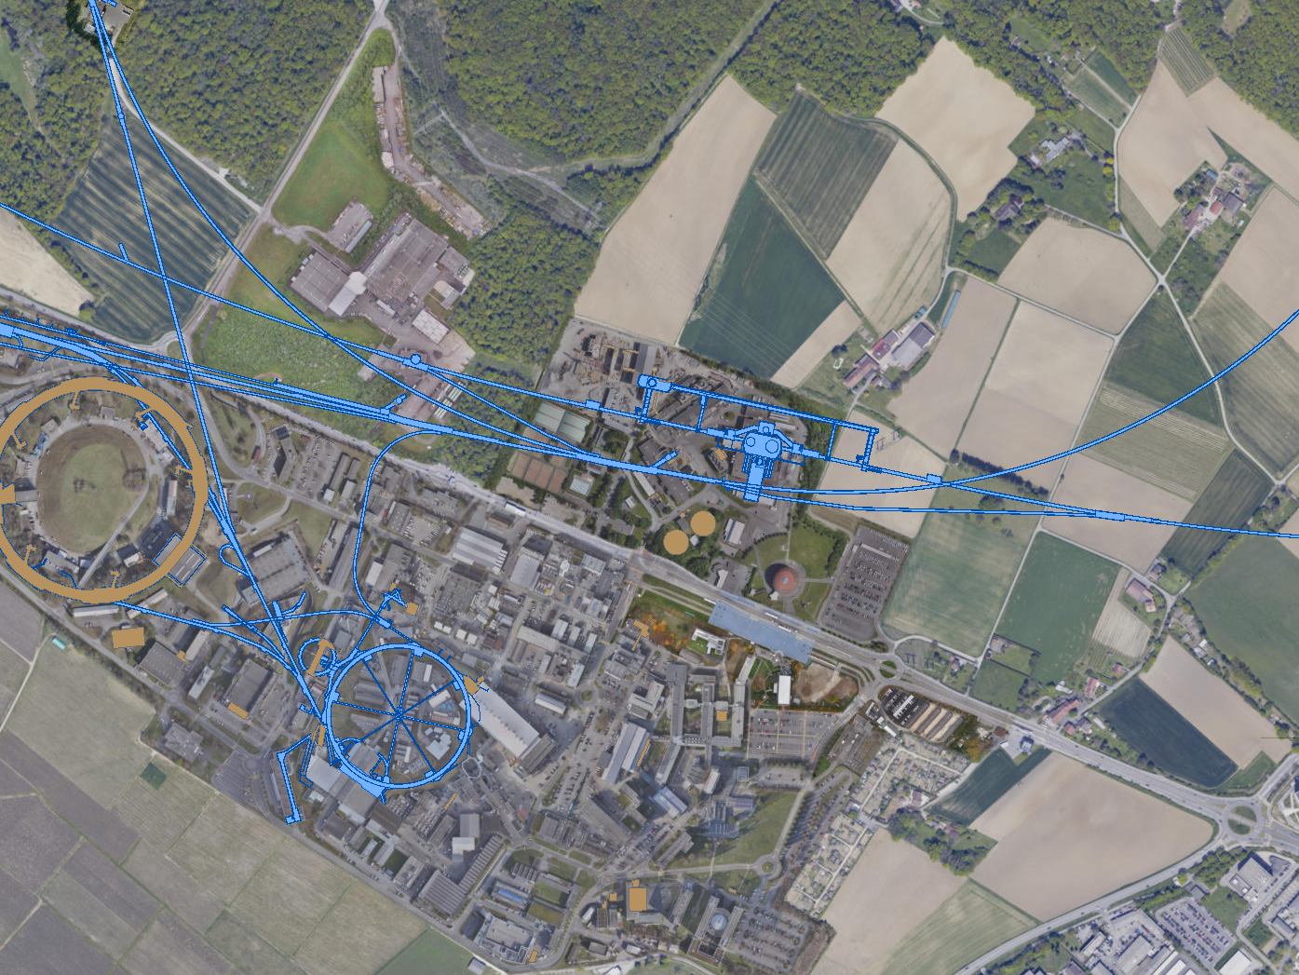
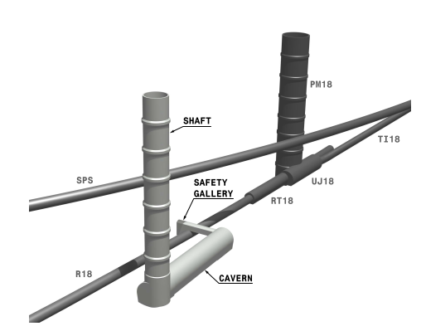

FPF LOCATION
Possibilities under active investigation: enlarge existing cavern UJ12, 480 m from ATLAS and shielded from the ATLAS IP by ~100 m of rock; or create a new shaft and cavern ~612 m from ATLAS past UJ18.
UJ18
ATLAS
SPS
UJ12
LHC
LOS
See Kincso Balazs talk, FPF2 Meeting
CERN GIS

Slide 42



Jonathan Gall, FPF Workshop
FPF: NEW SHAFT AND CAVERN
Many advantages
  Construction access far easier
  Access possible during LHC operations
  Size and length of cavern more flexible
  Designed around needs of the experiments
Design by Liam Dougherty (EN-ACE-INT)

Slide 43

NEW PHYSICS SEARCHES AT THE FPF
The FPF will house a number of experiments
FASER 2, an upgraded FASER with R = 1 m, L = 10 m, can discover all candidates with renormalizable couplings (dark photon, dark Higgs, HNL); ALPs with all types of couplings (γ, f, g); and many other particles.
Other experiments can probe neutrinos and many other interesting ideas.
Benchmark Model | Underway | FPF
BC1: Dark Photon | $$\text{FASER}$$ | FASER 2
BC1’: U(1)_{B-L} Gauge Boson | $$\text{FASER}$$ | $$\text{FASER}\text{ 2}$$
BC2: Dark Matter | ⎼ | FLArE
BC3: Milli-Charged Particle | ⎼ | FORMOSA
BC4: Dark Higgs Boson | ⎼ | $$\text{FASER}\text{ 2}$$
BC5: Dark Higgs with hSS | ⎼ | $$\text{FASER}\text{ 2}$$
BC6: HNL with e | ⎼ | $$\text{FASER}\text{ 2}$$
BC7: HNL with μ | ⎼ | $$\text{FASER}\text{ 2}$$
BC8: HNL with τ | $$\text{FASER}$$ | $$\text{FASER}\text{ 2}$$
BC9: ALP with photon | $$\text{FASER}$$ | $$\text{FASER}\text{ 2}$$
BC10: ALP with fermion | $$\text{FASER}$$ | $$\text{FASER}\text{ 2}$$
BC11: ALP with gluon | $$\text{FASER}$$ | $$\text{FASER}\text{ 2}$$

Slide 44


BC2: MILLI-CHARGED PARTICLES
Currently the target of the MilliQan experiment near the CMS IP.
MilliQan Demonstrator (Proto-MilliQan) already probes new region. Full MilliQan planned to run in this location at HL-LHC, but the sensitivity can be improved significantly by moving it to the FPF (FORMOSA).
Foroughi-Abari, Kling, Tsai (2020)

Slide 45




BC3: DARK MATTER
If m_{LLP} > 2m_{DM} , the LLP will typically decay to dark matter, leading to a highly collimated beam of dark matter particles.
Can look for the resulting DM to scatter off electrons at FLArE, Forward Liquid Argon Experiment, a proposed 10 to 100 tonne LArTPC.
FLArE probes most of the favored/ allowed relic target region. Complementary to missing energy experiments that probe more of the “too large $Ω_{χ}h^{2}$” region, but don’t detect DM scattering.
Batell, Feng, Trojanowski (2021)

Slide 46
SUMMARY
New target for discovery: neutrinos and light and weakly-interacting particles probed by fast, small, cheap experiments in the far-forward region of the LHC.
FASER and FASERν: 3.5 years from idea to completion, 5 m long, ~$2M. Data-taking starts in 2022 with a rich physics program.
  BSM: searches for dark photons, HNLs, ALPs, new forces.
  SM: opens the new field of LHC neutrino physics. ~1000 ν_{e}, ~10,000 ν_{μ}, ~10 ν_{τ} at TeV energies. Implications for neutrino properties, forward hadron production, cosmic ray and cosmic neutrino physics.
Forward Physics Facility: Proposed facility to house a suite of far-forward experiments for the HL-LHC era from 2027-37, including upgrades of FASER, FASERν, SND, but also millicharged particle searches and FLArE: Forward Liquid Argon Experiment.

