Slide 1





AND THE
FORWARD PHYSICS FACILITY
Light Dark World International Forum 2020
Jonathan Feng, UC Irvine, 15 December 2020

Slide 2
OUTLINE
INTRODUCTION AND MOTIVATION
FASER AND FASERν
FORWARD PHYSICS FACILITY

Slide 3
INTRODUCTION AND MOTIVATION

Slide 4
INTRODUCTION
We are living in interesting times: the Higgs boson has been discovered, but many of the grand motivations for new physics, although still interesting, are not as compelling as they once were.
  Gauge hierarchy problem
  Supersymmetry
  WIMP dark matter
In terms of major experiments and projects, we are also at a crossroads.
  In Asia, we are waiting for a decision about the ILC
  In Europe, the European Strategy Update for Particle Physics pushed definitive decisions to the future
  In North America, the Snowmass process is underway, but its conclusion may be postponed to 2022, given COVID-19 delays
For all these reasons, perhaps it’s a good time to go back to the drawing board and re-evaluate where we’ve been and where we are.

Slide 5

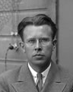
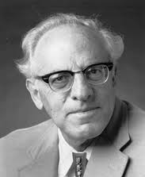
THE PARTICLE PHYSICS LANDSCAPE
Particle
Colliders
Mass
MeV
GeV
TeV
1
Already
Discovered
Strongly Interacting
Heavy Particles
Interaction Strength
New Targets,
Not Well-Explored
Traditional Targets,
Well-Explored
10⁻³
Weakly Interacting
Light Particles
Impossible to
Discover
10⁻⁶

Slide 6
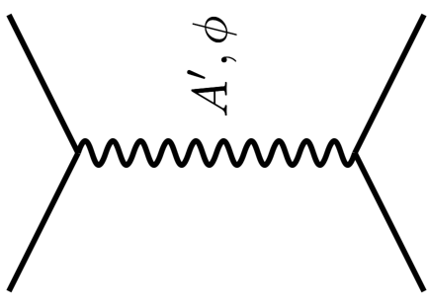
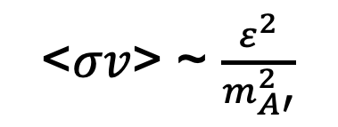




THE THERMAL RELIC LANDSCAPE
Particle
Colliders
Mass
MeV
GeV
TeV
1
Already
Discovered
Strongly Interacting
Heavy Particles
Too Little to be
Dark Matter
DM
$$e$$
Just Right to
be Dark Matter
$$A’$$
$$ε$$
Interaction Strength
10⁻³
DM
$$e$$
<$σv$> ~ $\frac{ε^{2}}{m_{A′}^{2}}$
Weakly Interacting
Light Particles
Impossible to
Discover
10⁻⁶
Too Much to be
Dark Matter
Boehm, Fayet (2003)
Pospelov, Ritz, Voloshin (2007)
Feng, Kumar (2008)

Slide 7
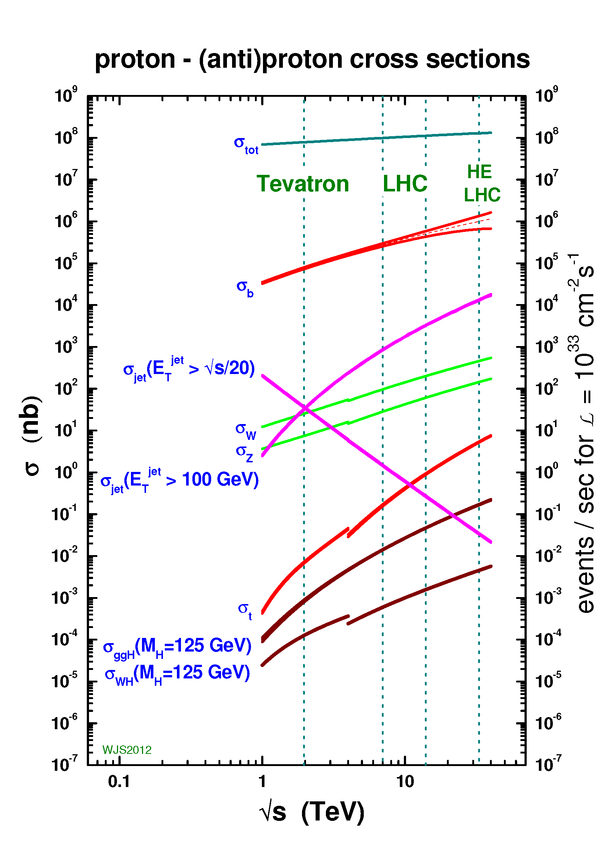
LIGHT, WEAKLY-INTERACTING PARTICLES
To search for light and very weakly-interacting particles, we need very large event rates.
The traditional place for this is the (low-energy) intensity frontier.
But this is not the only possibility: there is a enormous event rate of σ_{tot} ~ 100 mb at high energy colliders.
Most of this goes down the beam pipe in the forward direction, where existing detectors are blind.
We are missing half of the LHC’s discovery potential if we don’t bother to look!

Slide 8

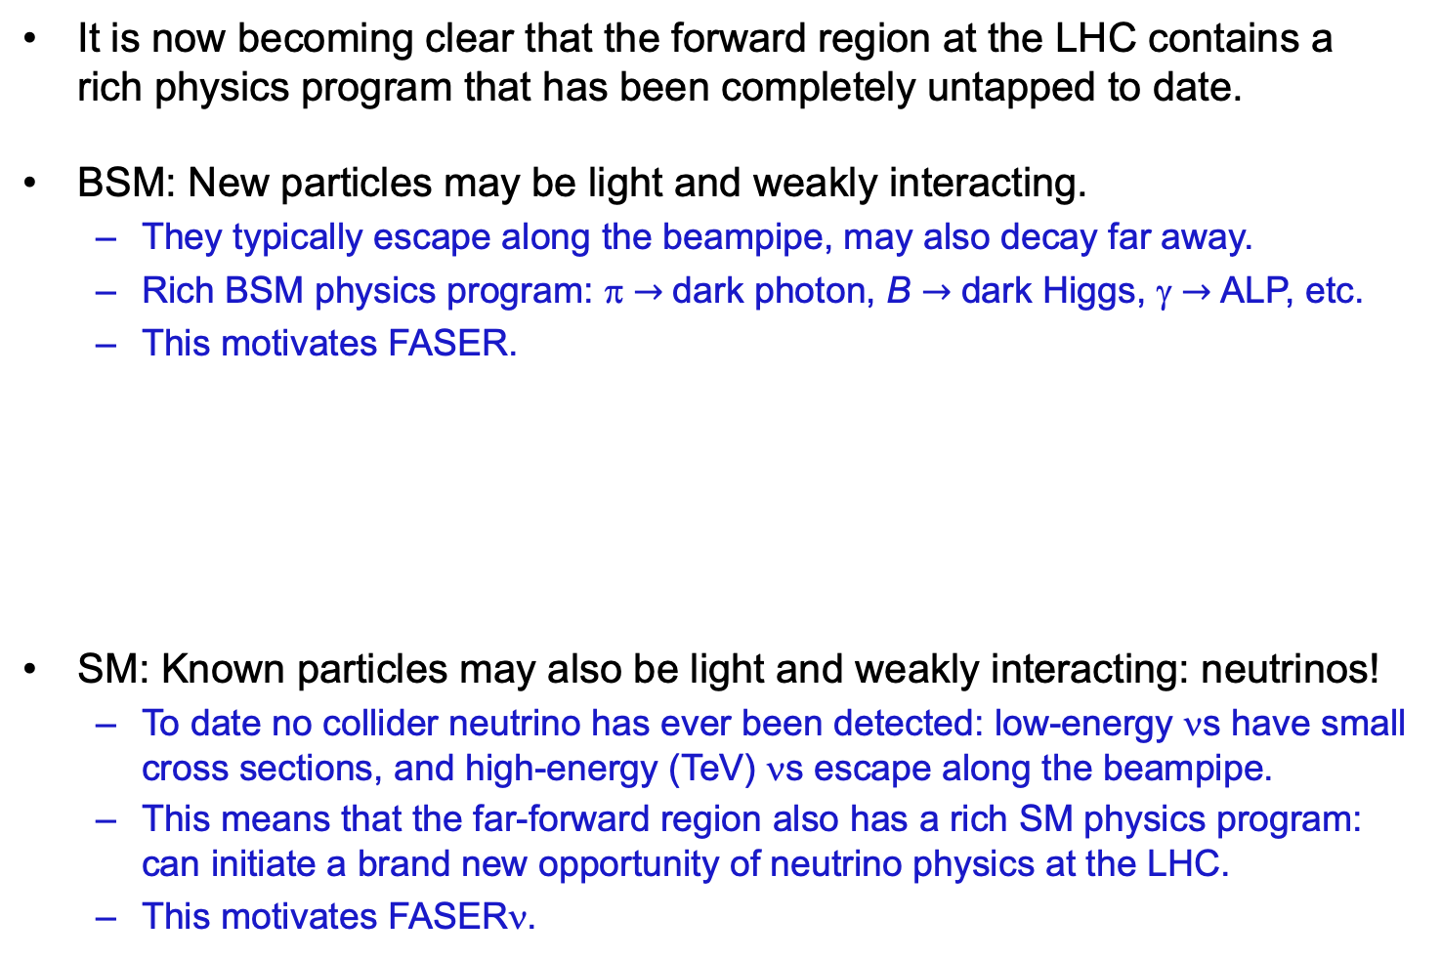
MOTIVATIONS FOR NEW EXPERIMENTS
It is now becoming clear that the forward region at the LHC contains a rich physics program that has been completely untapped to date.
BSM: New particles may be light and weakly interacting.
  They typically escape along the beampipe, may also decay far away.
  Rich BSM physics program: π $→$ dark photon, B $→$ dark Higgs, γ $→$ ALP, etc.
  This motivates FASER.
SM: Known particles may also be light and weakly interacting: neutrinos!
  To date no collider neutrino has ever been detected: low-energy νs have small cross sections, and high-energy (TeV) νs escape along the beampipe.
  This means that the far-forward region also has a rich SM physics program: can initiate a brand new opportunity of neutrino physics at the LHC.
  This motivates FASERν.

Slide 9
FASER AND FASERν

Slide 10
THE BASIC IDEA
For decades, new physics searches have focused on high p_{T}, “low cross section physics” (fb, pb, nb).
But new particles may be light and very weakly interacting.
  Weakly-interacting → need large SM event rate to see them
  Light → we can produce them in π, K, D, B decays
Conclusion: look where the pions (and kaons and D and B mesons) are.
  For 13-14 TeV pp collisions, σ_{tot} ~ 100 mb
  For the upcoming Run 3 from 2022-24, expect 150 fb⁻¹. The LHC will produce an enormous number of pions (N_{π} ~ 10¹⁷), and most of them are at low p_{T}.
Feng, Galon, Kling, Trojanowski (2017)

Slide 11
THE BASIC IDEA
Of course, we can’t put a reasonably-sized detector on the beamline near the IP – it would block the proton beams.
However, weakly-interacting particles also typically travel a long distance before interacting or decaying, so we can place the detector ~500 m away, after the beam curves away.
Consider TeV-energy particles produced in pion decay.
  Typical p_{T} : m_{π} (or Λ_{QCD})
  Typical angle relative to the beam axis: Λ_{QCD} / TeV ~ 0.2 mrad.
  Typical spread in transverse plane after 500 m: 500 m (0.2 mrad) ~ 10 cm !
These general considerations motivate a small, fast, inexpensive experiment placed ~500 m downstream of an interaction point: FASER, the Forward Search Experiment at the LHC.

Slide 12
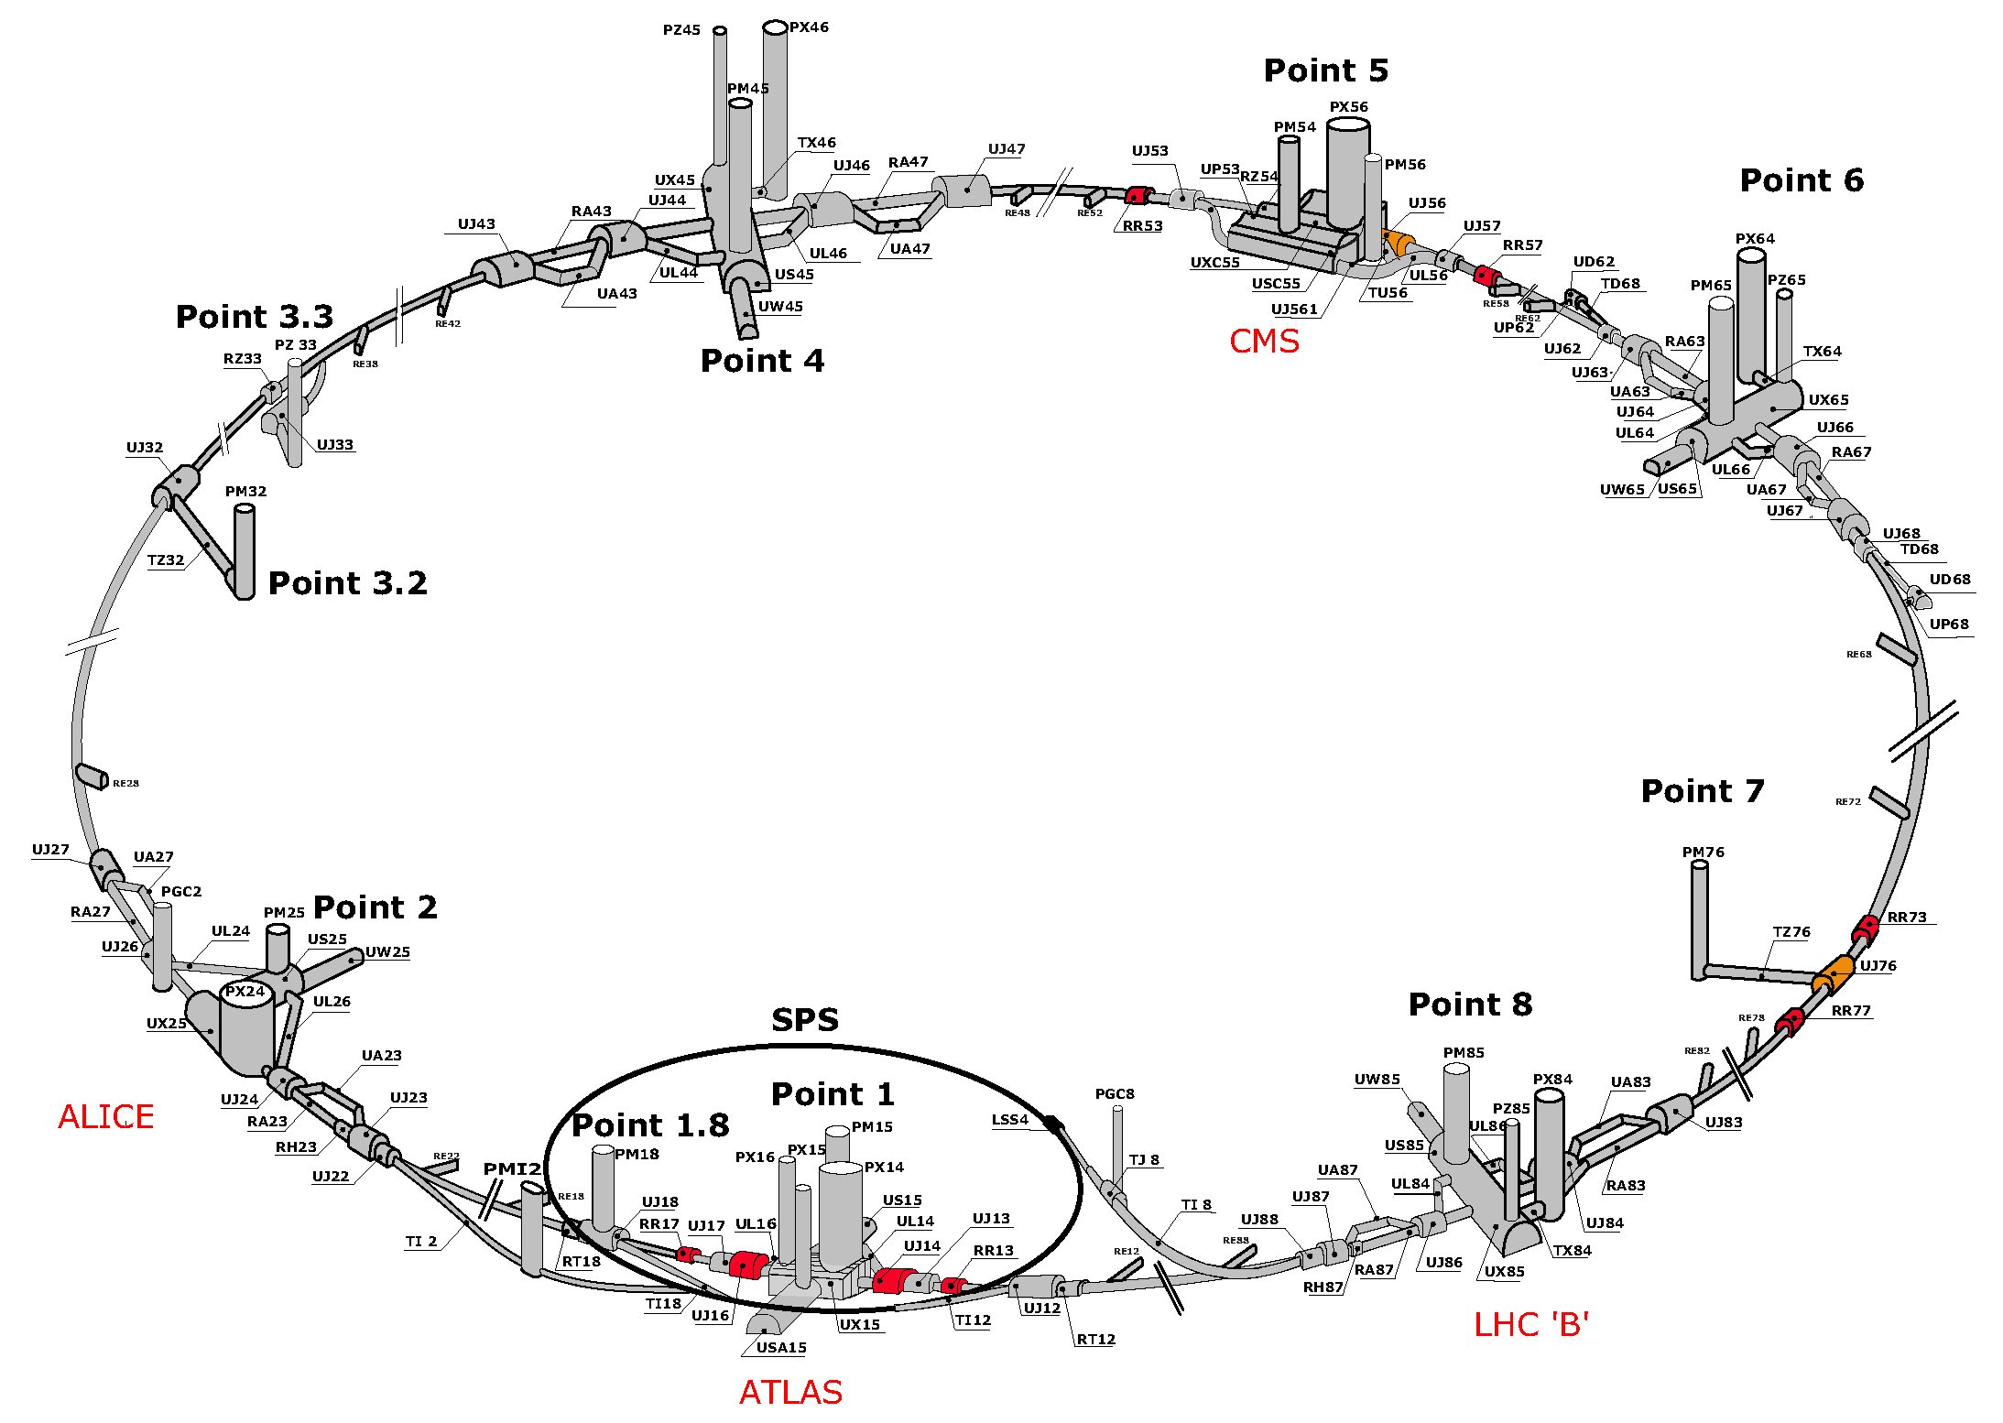
FASER LOCATION

Slide 13
FASER LOCATION
FASER

Slide 14
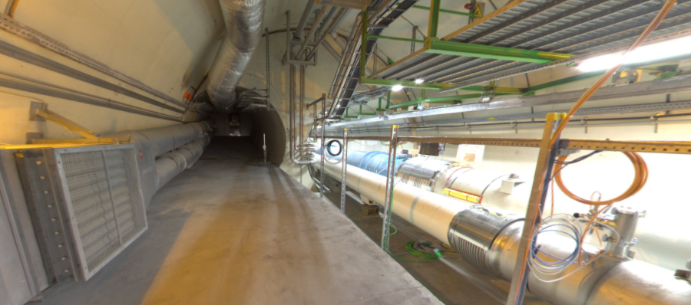
LOCATION OF FASER
Beam collision axis passes
through 100 m of rock, emerges in tunnel TI12 near cavern UJ12
UJ12
TI12 near UJ12
The view in UJ12 looking west
TI12
Beam collision axis
LHC beamline

Slide 15
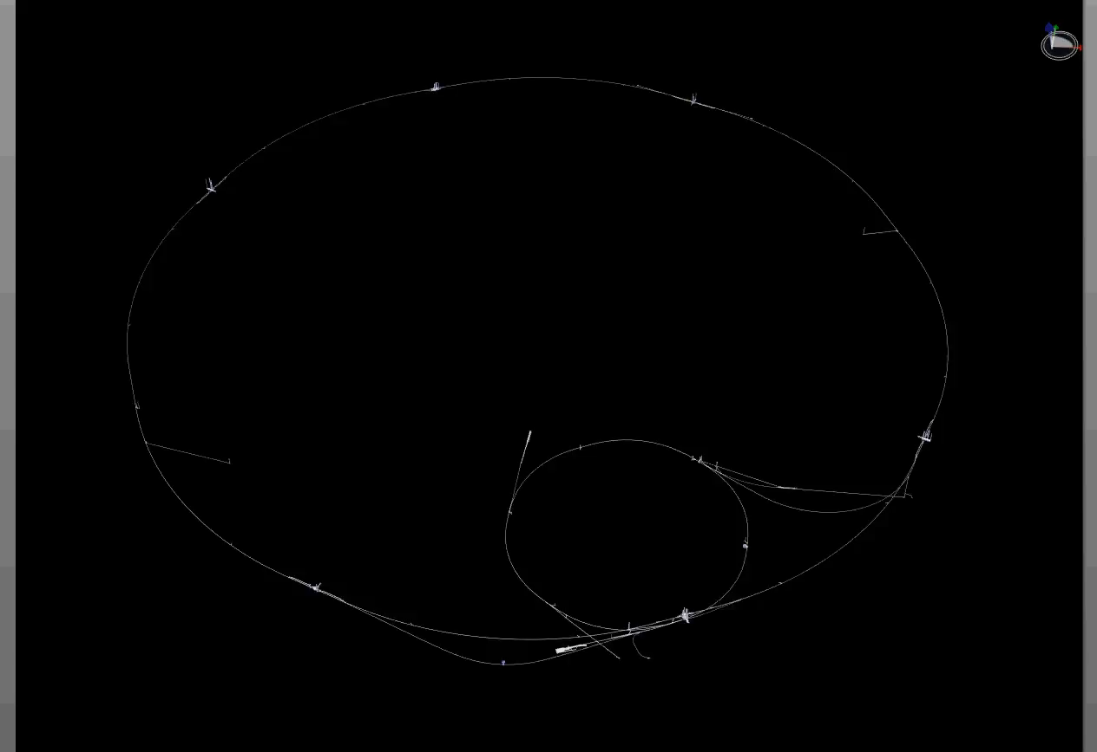
PARTICLE PATH FROM ATLAS TO FASER
Dougherty, CERN Integration (2019)

Slide 16
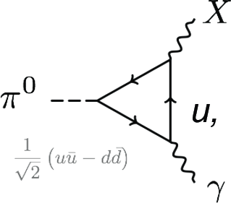
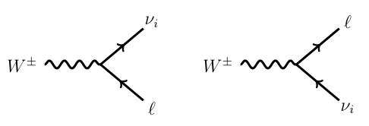
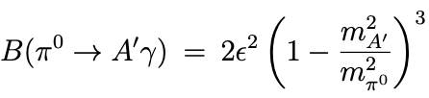
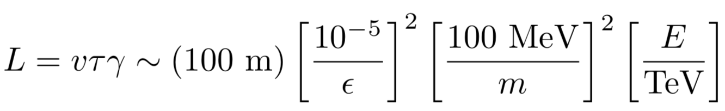


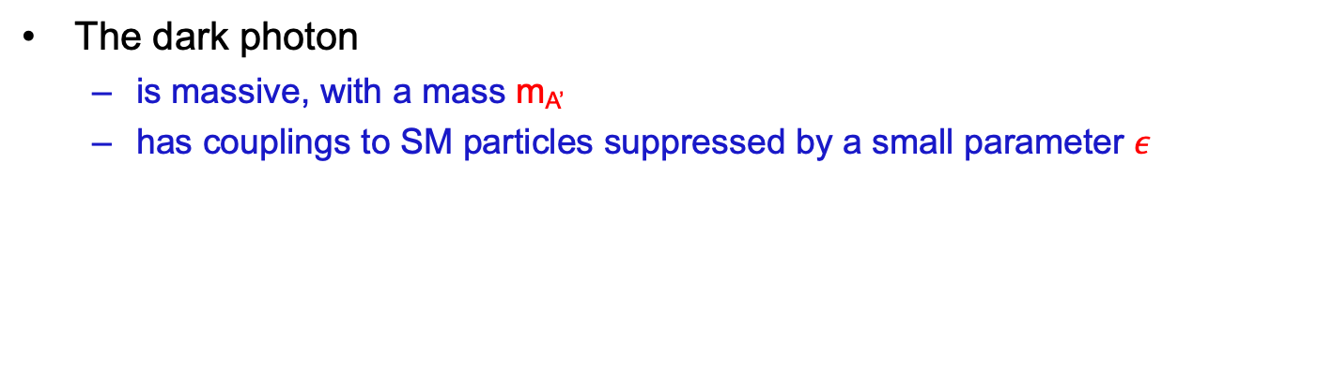
AN EXAMPLE: DARK PHOTONS AT FASER
The dark photon
  is massive, with a mass m_{A’}
  has couplings to SM particles suppressed by a small parameter $ε$
It can be produced, for example, in pion decay:
It can decay to particle/anti-particle pairs:
$$ε$$
A’
e⁺
$$ε$$
A’
e⁻

Slide 17
AN EXAMPLE: DARK PHOTONS AT FASER
Pions at the IP
Production is peaked at p_{T} ~ Λ_{QCD} ~ 250 MeV
Enormous event rates: N_{π}~10¹⁵ per bin
Simulations greatly refined by LHC data
A’s at the IP
Production is peaked at p_{T} ~ Λ_{QCD} ~ 250 MeV
Rates highly suppressed by ε² ~ 10⁻¹⁰
But still N_{A’} ~ 10⁵ per bin
A’s decay in [480m, 483m]
Only highly boosted ~TeV A’s decay in FASER
Rates again suppressed by decay requirement
But still N_{A’} ~ 100 signal events, and almost all are within ~10 cm of “on axis”
300 fb⁻¹

Slide 18
  FASER’S DISCOVERY POTENTIAL
The signal is spectacular: 2 opposite-sign ~TeV charged tracks emerging from 100 m of rock, pointing back to the ATLAS IP.
In Run 3, FASER will start probing new dark photon parameter space with the first fb⁻¹, and extend its sensitivity in the 10 – 100 MeV mass range.
N=3 contours

Slide 19
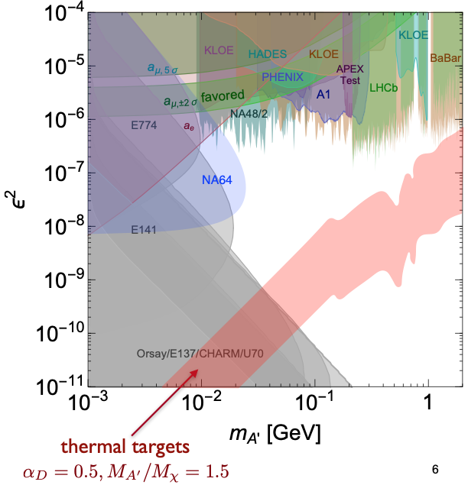
TARGETS IN DARK PHOTON PARAMETER SPACE
Muon
g-2 Anomaly
⁸Be and ⁴He
ATOMKI
Anomalies
Loop-induced
Coupling
Self-interacting
Dark Matter
FASER probes
an interesting
region, beginning
with the 1st fb⁻¹
of Run 3 data
Tim Nelson (2020)

Slide 20
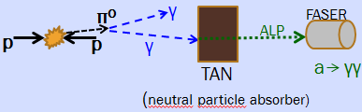
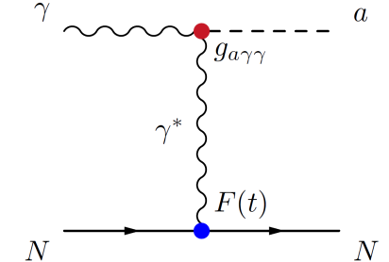
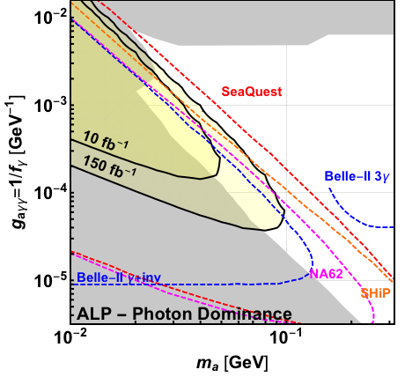
ANOTHER EXAMPLE: AXION-LIKE PARTICLES
FASER is sensitive to many other LLP signals.
For example, ALPs coupled to photons
  ~TeV photon from IP travels 130 m, collides with the TAN
  Creates ALP through Primakoff process
  ALP decays through a → γγ in FASER: a “light shining through (100 m) wall experiment.”
Feng, Galon, Kling, Trojanowski (2018)

Slide 21
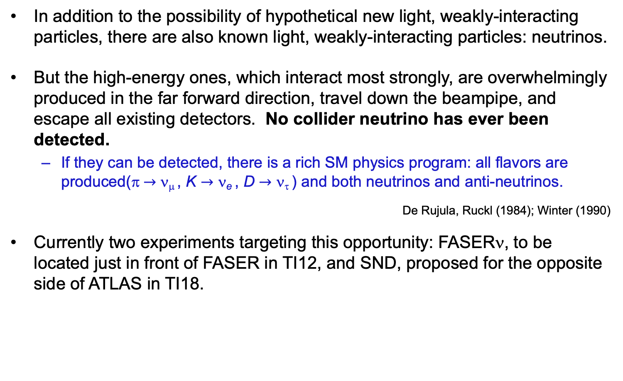
SM PHYSICS: FAR-FORWARD NEUTRINOS
In addition to the possibility of hypothetical new light, weakly-interacting particles, there are also known light, weakly-interacting particles: neutrinos.
But the high-energy ones, which interact most strongly, are overwhelmingly produced in the far forward direction, travel down the beampipe, and escape all existing detectors. No collider neutrino has ever been detected.
  If they can be detected, there is a rich SM physics program: all flavors are produced(π $→$ ν_{μ} , K $→$ ν_{e} , D $→$ ν_{τ} ) and both neutrinos and anti-neutrinos.
De Rujula, Ruckl (1984); Winter (1990)
Currently two experiments targeting this opportunity: FASERν, to be located just in front of FASER in TI12, and SND, proposed for the opposite side of ATLAS in TI18.

Slide 22
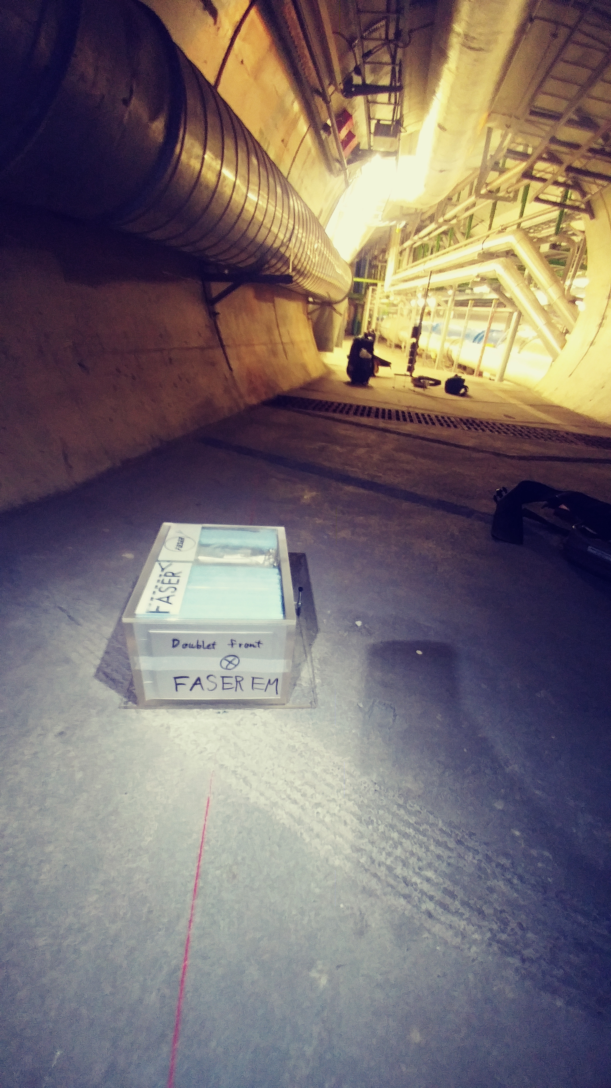
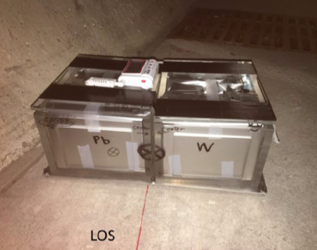
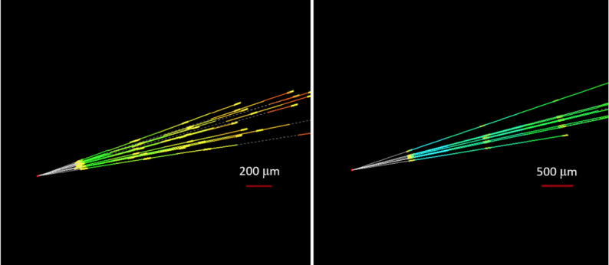
NEUTRINO FLUXES
In fact, we have probably already seen our first TeV collider neutrino.
2018: FASER pilot ~30 kg emulsion detectors collected 12.5 fb⁻¹ on the beam collision axis (installed and removed during Technical Stops).
Expect ~10 neutrino interactions. Several neutral vertices identified, likely to be neutrinos. Analysis ongoing.

Slide 23
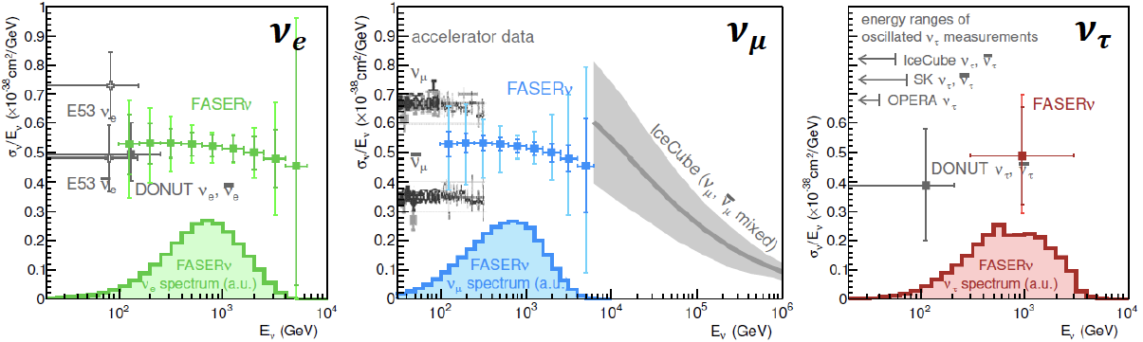
NEUTRINO PHYSICS
2022-24: FASERν will collect data with 1.1-tonne detector in Run 3
  Will detect the first collider neutrino.
  Will record ~1000 ν_{e} , ~10,000 ν_{μ} , and ~10 ν_{τ} interactions at TeV energies, the first direct exploration of this energy range for all 3 flavors.
  Will double the world’s supply of tau neutrinos.
  Will be able to distinguish muon neutrinos from anti-neutrinos by combining FASER and FASERν data, and so measure their cross sections independently.
FASER Collaboration 1908.02310 (2019)

Slide 24
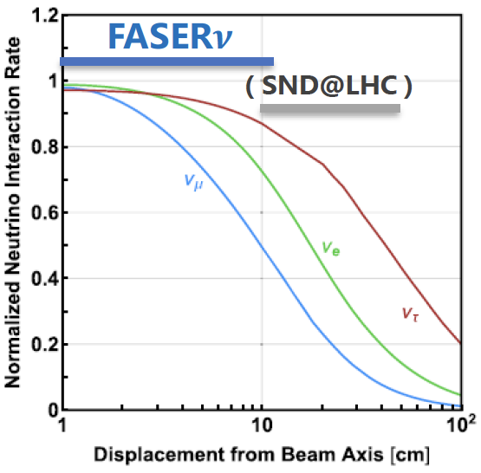
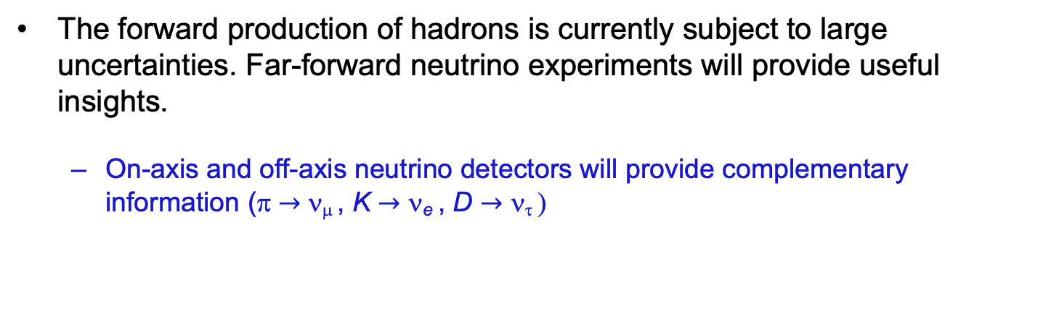
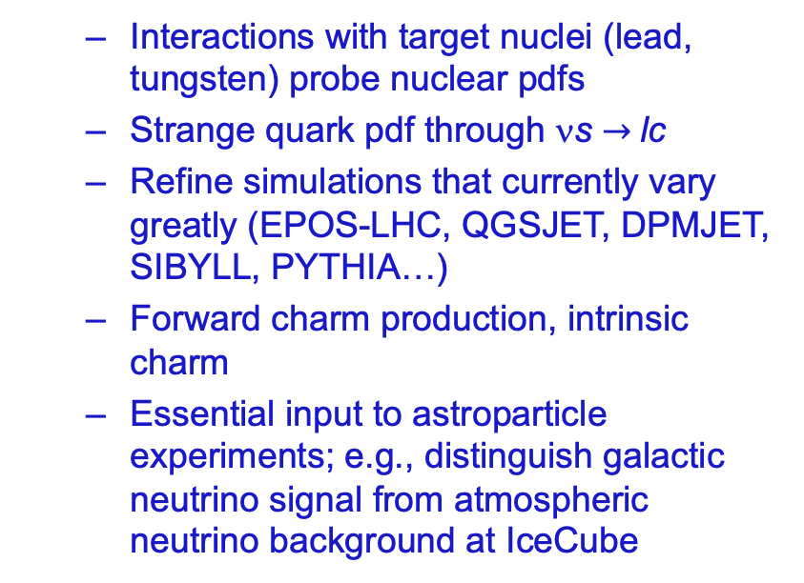
QCD PHYSICS
The forward production of hadrons is currently subject to large uncertainties. Far-forward neutrino experiments will provide useful insights.
  On-axis and off-axis neutrino detectors will provide complementary information (π $→$ ν_{μ} , K $→$ ν_{e} , D $→$ ν_{τ} )
  Interactions with target nuclei (lead, tungsten) probe nuclear pdfs
  Strange quark pdf through νs $→$lc
  Refine simulations that currently vary greatly (EPOS-LHC, QGSJET, DPMJET, SIBYLL, PYTHIA…)
  Forward charm production, intrinsic charm
  Essential input to astroparticle experiments; e.g., distinguish galactic neutrino signal from atmospheric neutrino background at IceCube

Slide 25
FASER TIMELINE AND ACKNOWLEDGEMENTS
September 2017: First theory paper.
July 2018: FASER LOI submitted to LHCC.
October 2018: ATLAS SCT and LHCb Collaborations generously agree to let FASER use spare detector tracker and calorimeter modules, respectively.
November 2018: FASER Technical Proposal submitted to LHCC.
December 2018: FASER construction fully funded by the Heising-Simons and Simons Foundations.
March 2019: FASER approved by CERN along with host lab costs.
December 2019: FASERν approved by CERN along with host lab costs.
September 2020: FASERν construction fully funded by Heising-Simons Foundation.
November 2020: FASER installation underground 1st phase completed.
March 2021: FASER installation underground 2nd phase scheduled.
Fall 2021: FASERν installation underground expected.
Early 2022: FASER and FASERν begin collecting data with the start of LHC Run 3.

Slide 26








THE FASER COLLABORATION
66 collaborators, 19 institutions, 8 countries
Henso Abreu (Technion), Yoav Afik (Technion), Claire Antel (Geneva), Akitaka Ariga (Bern), Tomoko Ariga (Kyushu/Bern), Florian Bernlochner (Bonn), Tobias Boeckh (Bonn), Jamie Boyd (CERN), Lydia Brenner (CERN), Franck Cadoux (Geneva), Dave Casper (UC Irvine), Charlotte Cavanagh (Liverpool), Xin Chen (Tsinghua), Andrea Coccaro (INFN), Monica D’Onofrio (Liverpool), Candan Dozen (Tsinghua), Yannick Favre (Geneva), Deion Fellers (Oregon), Jonathan Feng (UC Irvine), Didier Ferrere (Geneva), Stephen Gibson (Royal Holloway), Sergio Gonzalez-Sevilla (Geneva), Carl Gwilliam (Liverpool), Shih-Chieh Hsu (Washington), Zhen Hu (Tsinghua), Peppe Iacobucci (Geneva), Sune Jakobsen (CERN), Enrique Kajomovitz (Technion), Felix Kling (SLAC), Umut Kose (CERN), Susanne Kuehn (CERN), Helena Lefebvre (Royal Holloway), Lorne Levinson (Weizmann), Ke Li (Washington), Jinfeng Liu (Tsinghua), Chiara Magliocca (Geneva), Josh McFayden (Sussex), Sam Meehan (CERN), Dimitar Mladenov (CERN), Mitsuhiro Nakamura (Nagoya), Toshiyuki Nakano (Nagoya), Marzio Nessi (CERN), Friedemann Neuhaus (Mainz), Laurie Nevay (Royal Holloway), Hidetoshi Otono (Kyushu), Carlo Pandini (Geneva), Hao Pang (Tsinghua), Brian Petersen (CERN), Francesco Pietropaolo (CERN), Markus Prim (Bonn), Michaela Queitsch-Maitland (CERN), Filippo Resnati (CERN), Jakob Salfeld-Nebgen (CERN), Osamu Sato (Nagoya), Paola Scampoli (Bern), Kristof Schmieden (Mainz), Matthias Schott (Mainz), Anna Sfyrla (Geneva), Savannah Shively (UC Irvine), John Spencer (Washington), Yosuke Takubo (KEK), Ondrej Theiner (Geneva), Eric Torrence (Oregon), Serhan Tufanli (CERN), Benedikt Vormvald (CERN), Di Wang (Tsinghua), Gang Zhang (Tsinghua)

Slide 27
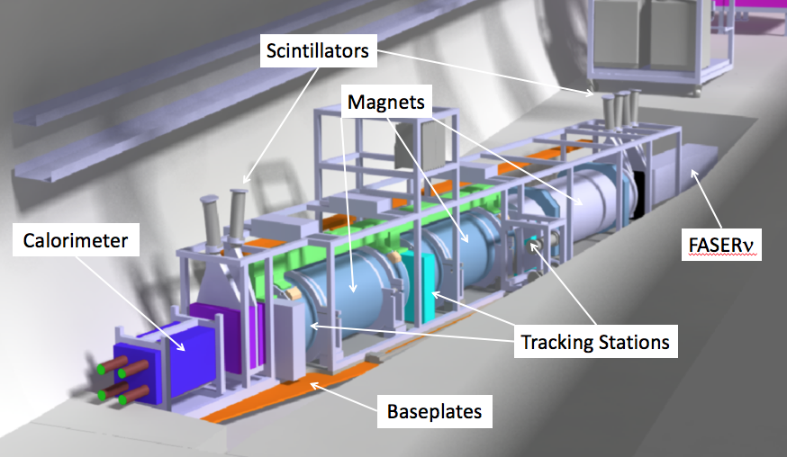
FASER AND FASERν DETECTORS
FASER and FASERν are designed to detect charged tracks and neutrinos.
  50cm deep trench puts the detectors on axis. Coverage: η > 9, total length: 6 m.
  FASER: tracker and calorimeter, detects LLP decay to pair of TeV charged tracks. Background negligible (FLUKA simulations validated by prototype detector in 2018).
  FASERν: emulsion detector, detects CC and NC neutrino interactions.
LLP
ν
e⁺
e⁻

Slide 28
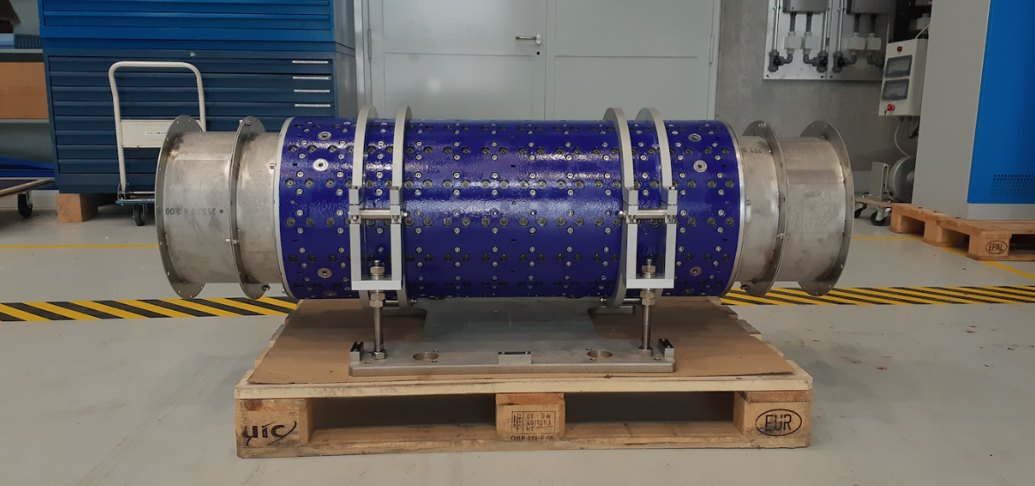
MAGNETS
FASER includes 3 magnets: 1.5 m, 1 m, and 1m long.
These magnets have an inner diameter of 20cm, are 0.57 T permanent dipoles, separate oppositely-charged tracks, require little maintenance.
Constructed by the CERN magnet group.

Slide 29
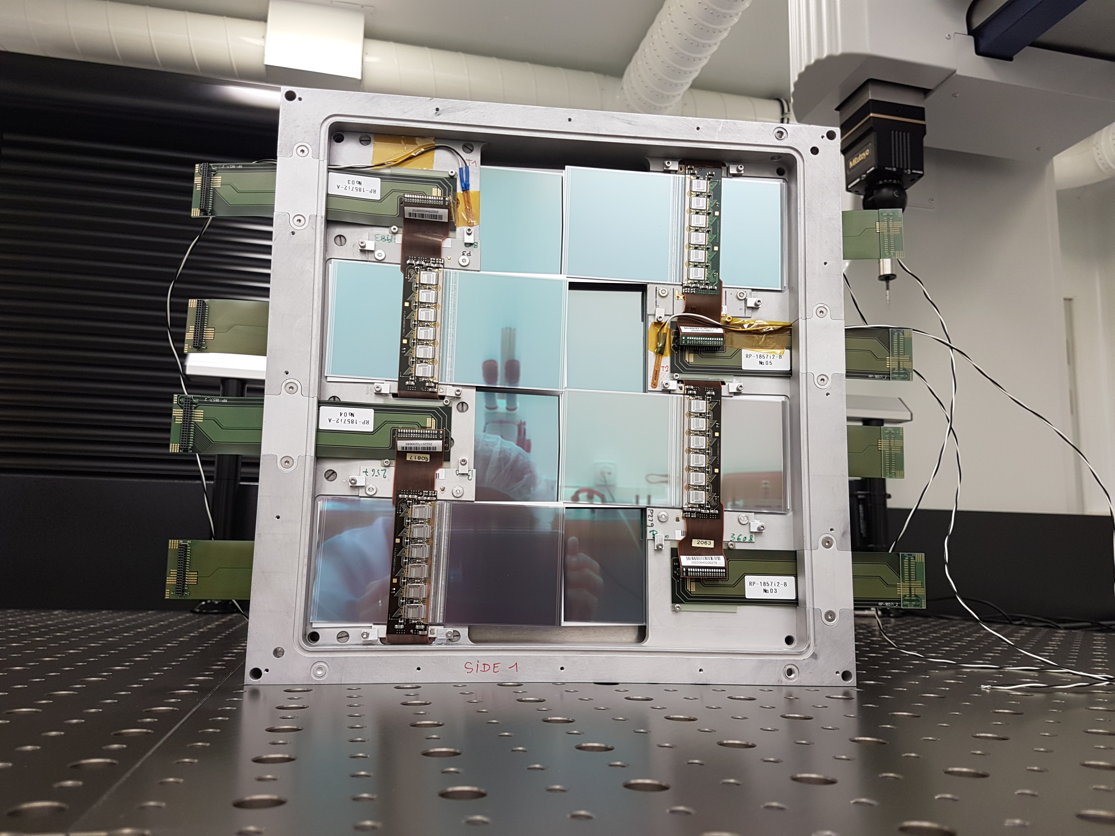
TRACKERS
8 ATLAS SCT modules per tracking plane, 3 tracking planes per tracking station, 3 tracking stations at FASER.

Slide 30
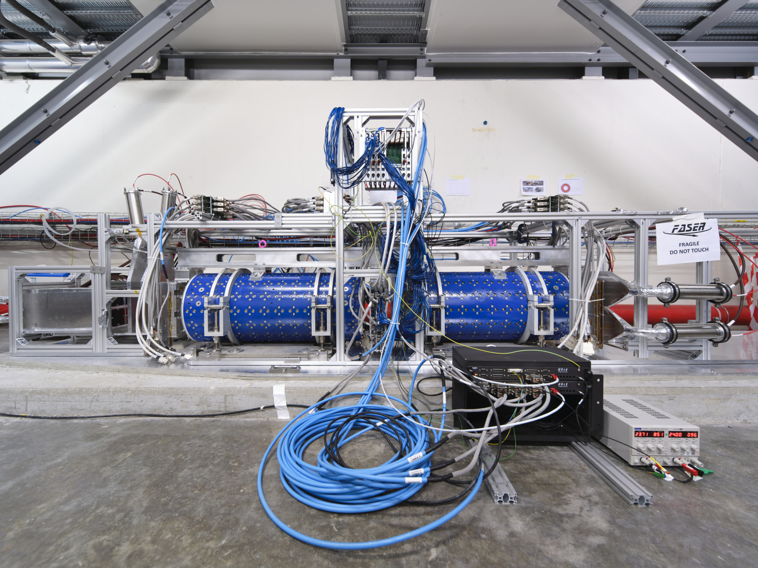
FASER CONSTRUCTION STATUS

Slide 31
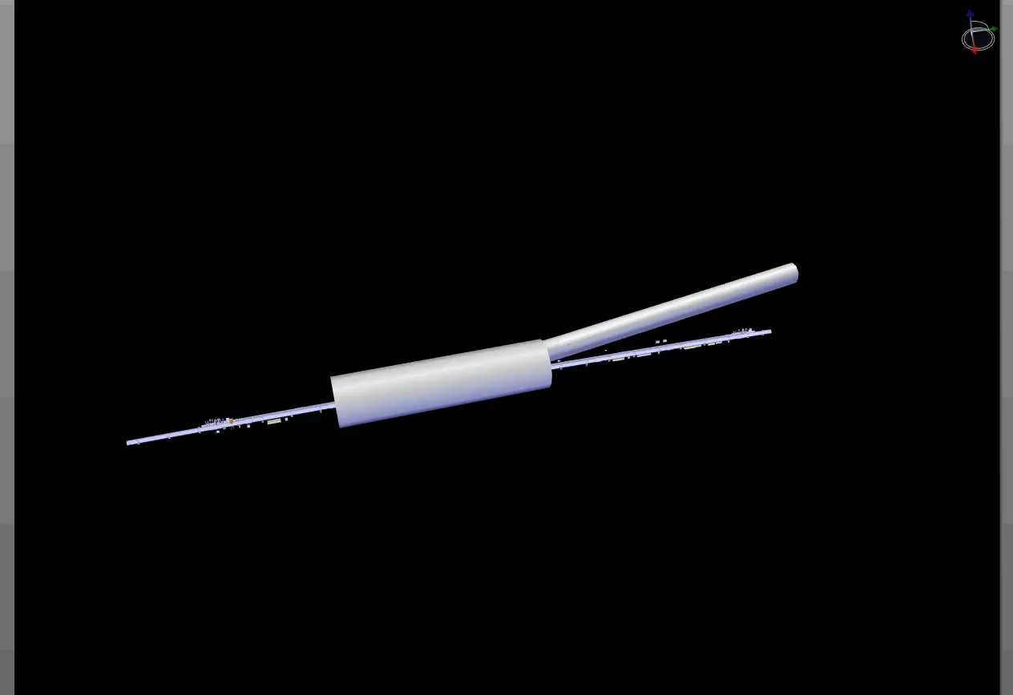
FASER INSTALLATION
Dougherty, CERN Integration (2019)

Slide 32
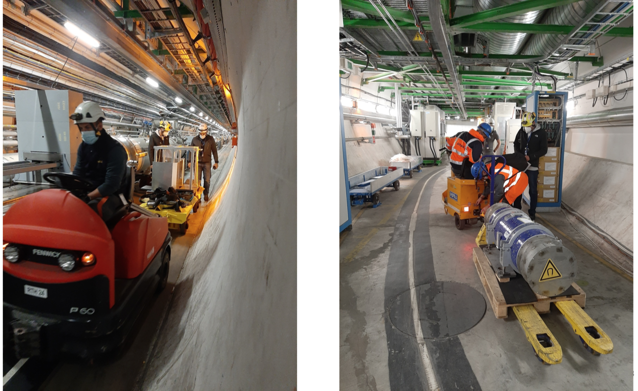
FASER INSTALLATION

Slide 33
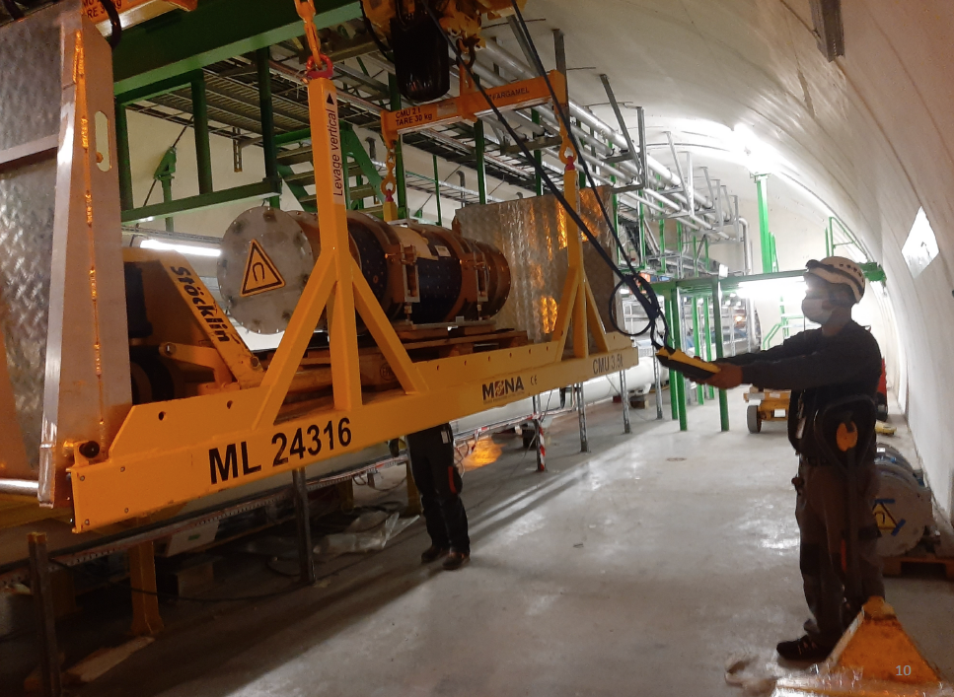
FASER INSTALLATION

Slide 34
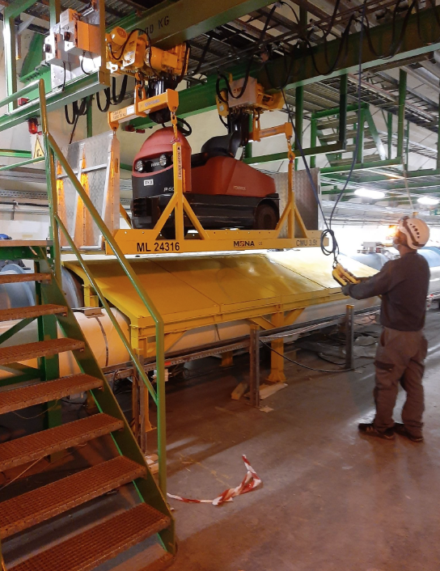
FASER INSTALLATION

Slide 35
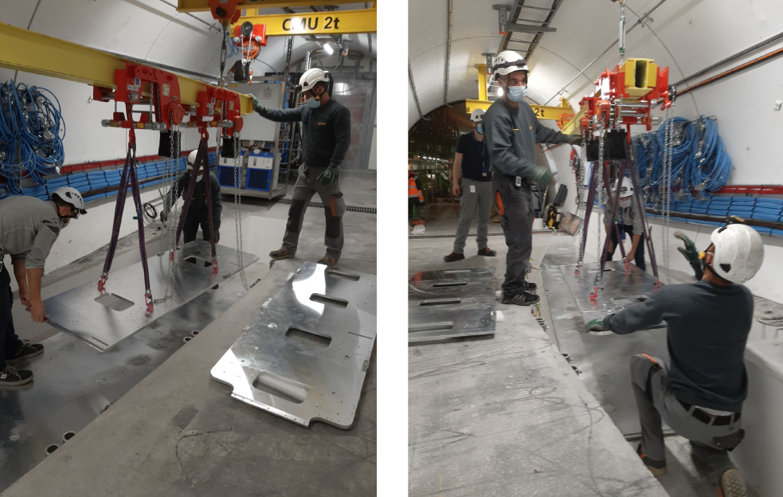
FASER INSTALLATION

Slide 36
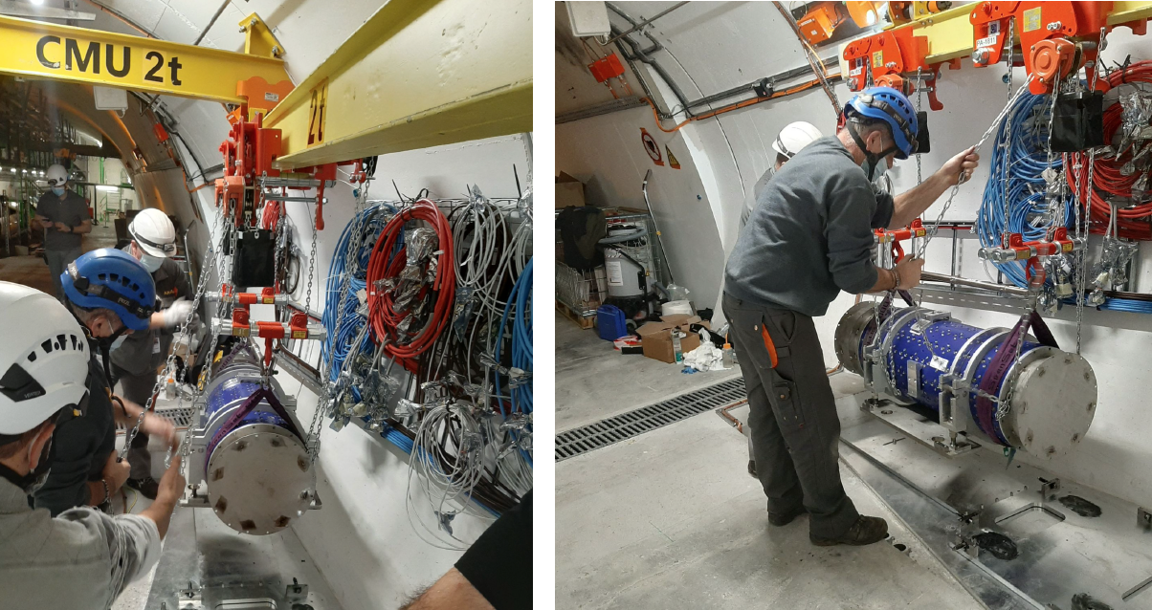
FASER INSTALLATION

Slide 37
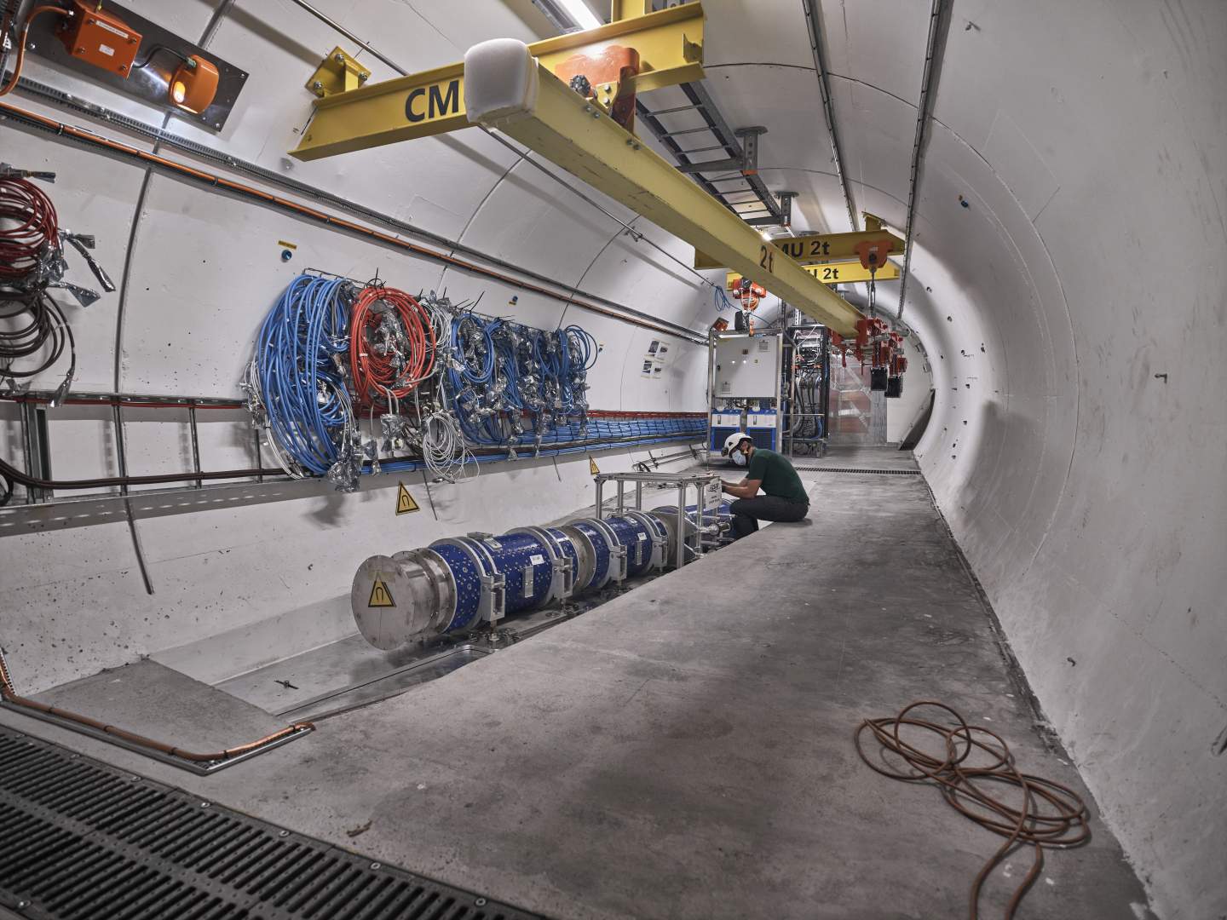
FASER CURRENT STATUS

Slide 38
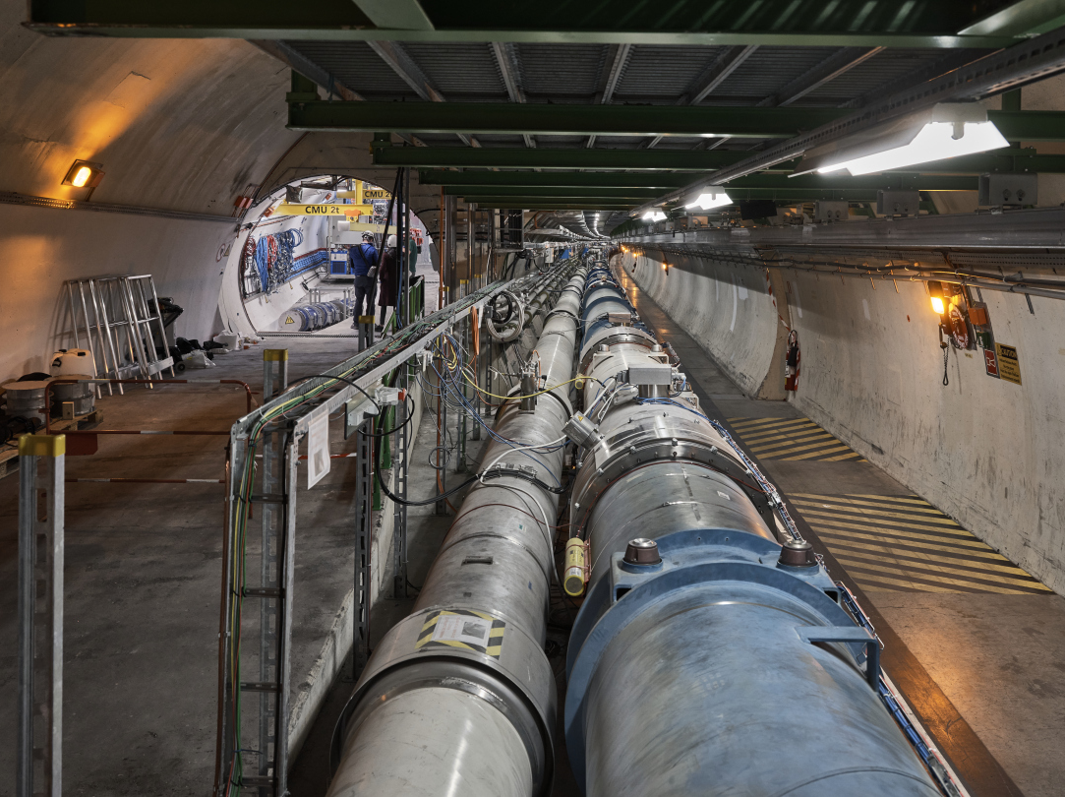
FASER CURRENT STATUS

Slide 39
FORWARD PHYSICS FACILITY

Slide 40
FORWARD PHYSICS FACILITY
FASER, FASERν, and other proposed detectors are currently highly constrained by tunnels and infrastructure that was never designed to support experiments.
At the same time, it is becoming clear that there is a rich physics program in the far-forward region, spanning long-lived particle searches, neutrinos, QCD, dark matter, dark sector, cosmic rays, and cosmic neutrinos.
Strongly motivates enlarging UJ12 (or UJ18) to create a dedicated facility to house several far-forward experiments.
LHC beamline
TI12
UJ12
Beam Collision Axis

Slide 41
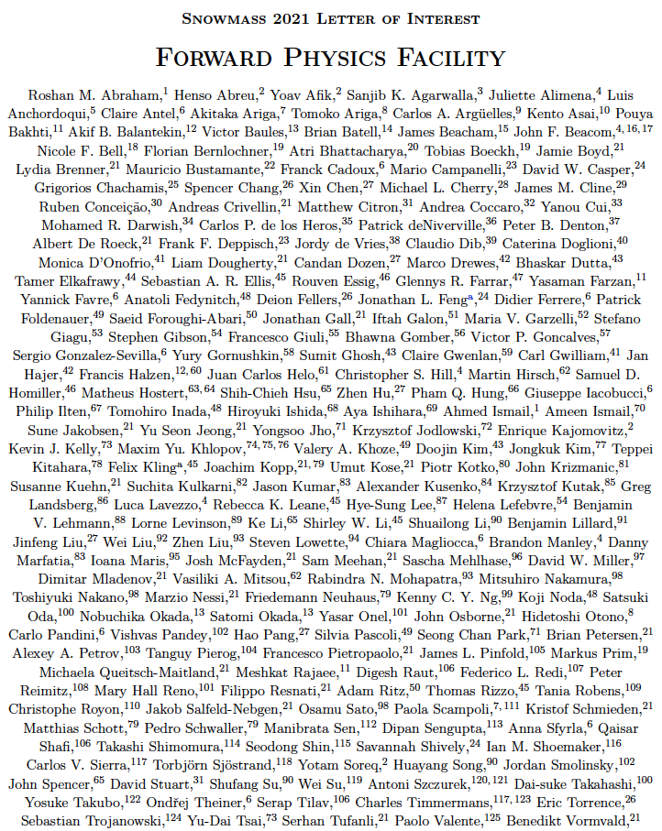
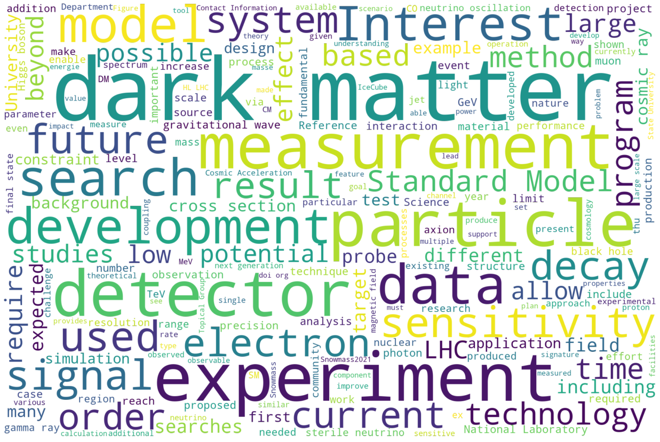
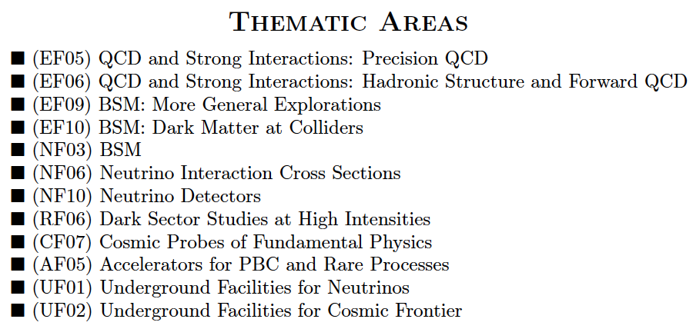
FORWARD PHYSICS FACILITY: SNOWMASS LOI
One of 1578 Snowmass LOIs
240 authors with interest from many communities.

Slide 42
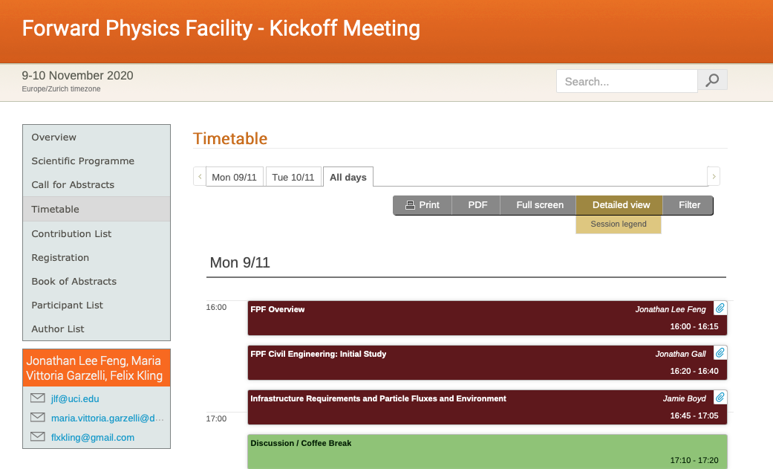
FPF KICKOFF MEETING
The FPF Kickoff Meeting was held on 9-10 November 2020.
40 talks, lots of fascinating discussion, brought together people studying dark matter, dark sectors, LLPs, milli-charged particles, MC event generators, QCD, neutrinos, and cosmic ray and cosmic neutrino physics.
For talk slides and Zoom recordings, see https://indico.cern.ch/event/955956.

Slide 43
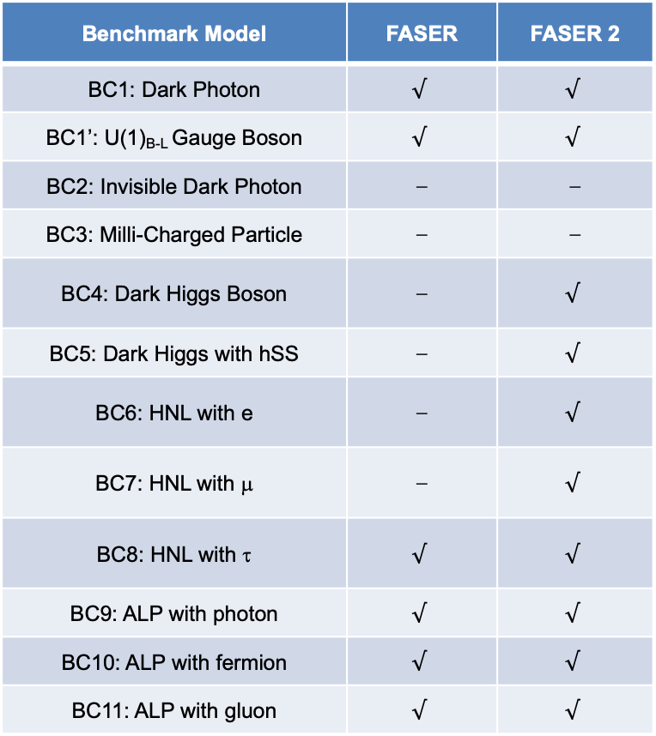
NEW PHYSICS SEARCHES AT THE FPF
FASER 2, an upgraded FASER with R = 1 m, L = 10 m, can discover all candidates with renormalizable couplings (dark photon, dark Higgs, HNL); ALPs with all types of couplings (γ, f, g); and many other particles.
Among the PBC benchmark scenarios, FASER2’s discovery potential extends to all benchmark scenarios, except BC2 and BC3.
Benchmark Model | FASER | FASER 2
BC1: Dark Photon | $$√$$ | $$√$$
BC1’: U(1)_{B-L} Gauge Boson | $$√$$ | $$√$$
BC2: Invisible Dark Photon | ⎼ | ⎼
BC3: Milli-Charged Particle | ⎼ | ⎼
BC4: Dark Higgs Boson | ⎼ | $$√$$
BC5: Dark Higgs with hSS | ⎼ | $$√$$
BC6: HNL with e | ⎼ | $$√$$
BC7: HNL with μ | ⎼ | $$√$$
BC8: HNL with τ | $$√$$ | $$√$$
BC9: ALP with photon | $$√$$ | $$√$$
BC10: ALP with fermion | $$√$$ | $$√$$
BC11: ALP with gluon | $$√$$ | $$√$$

Slide 44
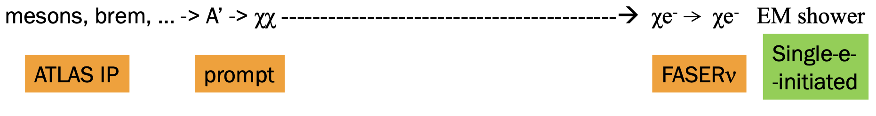
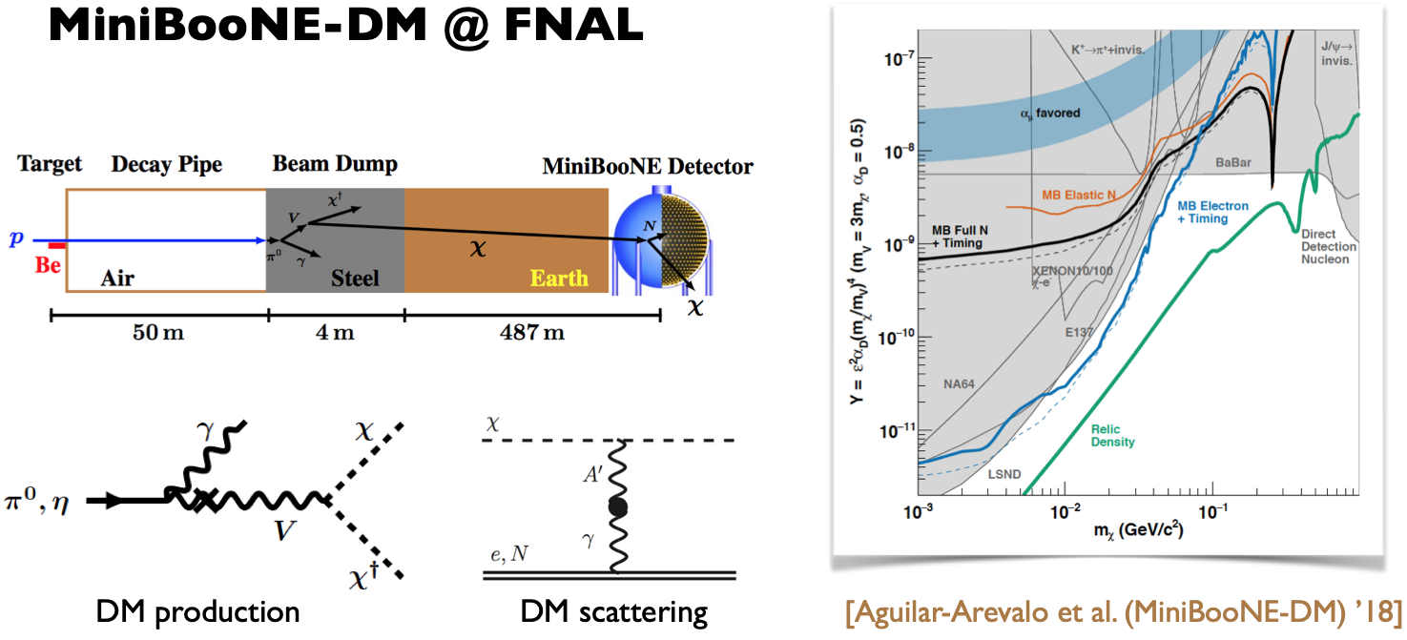

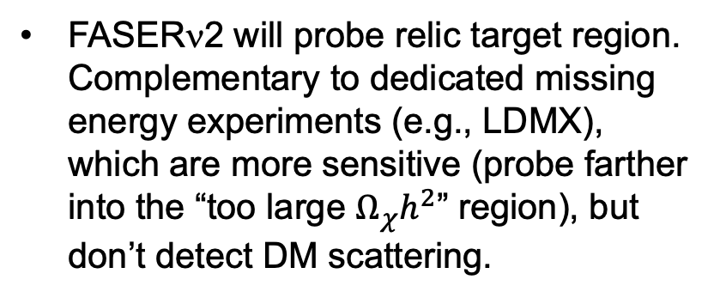
BC2: INVISIBLE DARK PHOTONS AT THE FPF
If m_{LLP} > 2m_{DM} , the LLP will typically decay in the dark sector to dark matter, leading to invisible decays.
Can look for the resulting DM to scatter off electrons at FASERν 2 or in a LArTPC. Dominant background from neutrinos reduced for 1 < $E_{e}$ < 20 GeV.
Batell, Feng, Trojanowski (in progress)
FASERν2 will probe relic target region. Complementary to dedicated missing energy experiments (e.g., LDMX), which are more sensitive (probe farther into the “too large $Ω_{χ}h^{2}$” region), but don’t detect DM scattering.

Slide 45
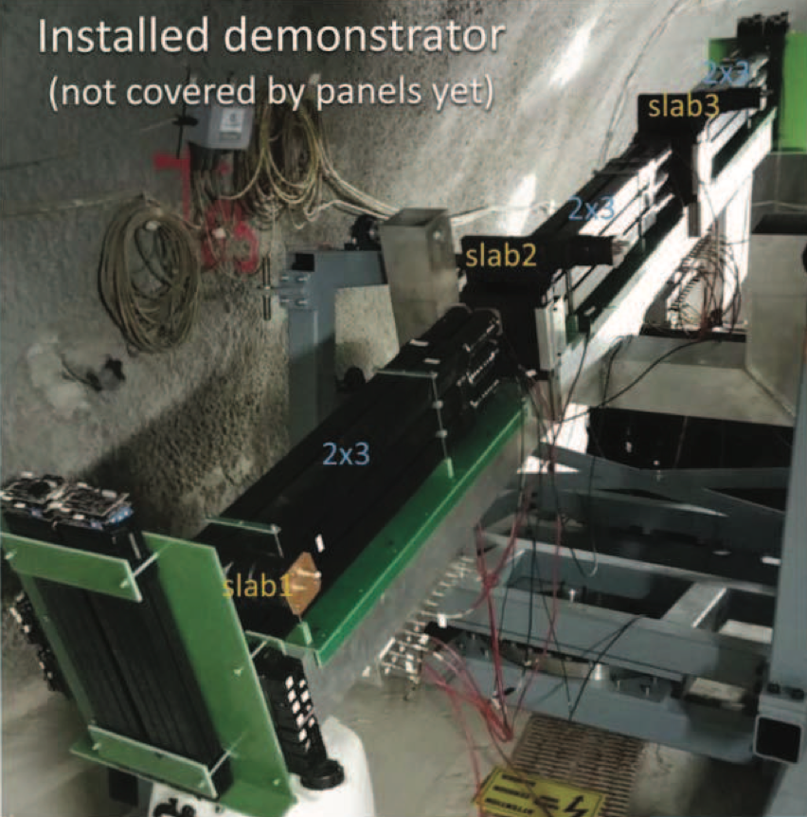
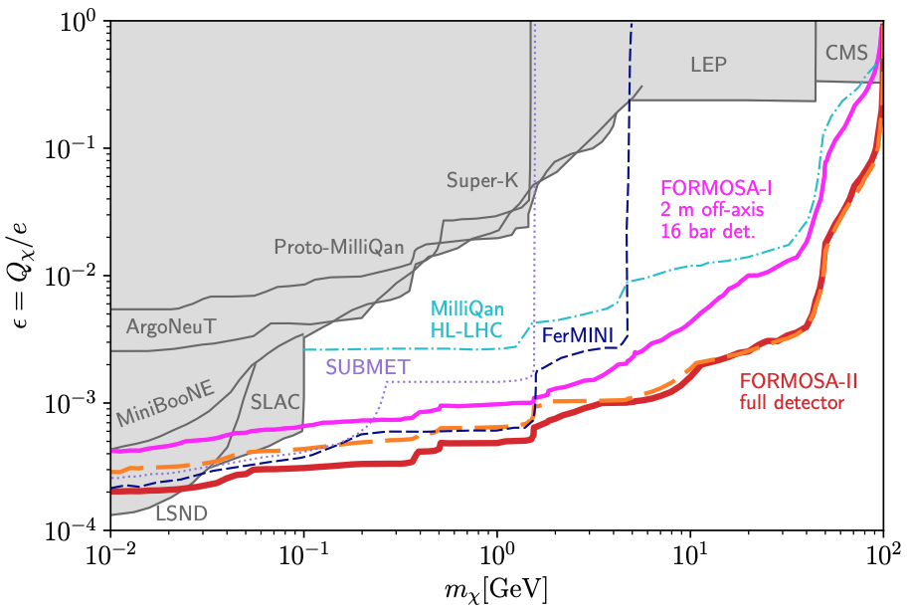
BC3: MILLICHARGED PARTICLES AT THE FPF
Currently the target of the MilliQan experiment near the CMS IP.
MilliQan Demonstrator (Proto-MilliQan) already probes new region. Full MilliQan planned to run in this location at HL-LHC, but the sensitivity can be improved greatly by moving it to the FPF (FORMOSA).
Foroughi-Abari, Kling, Tsai (2020)

Slide 46
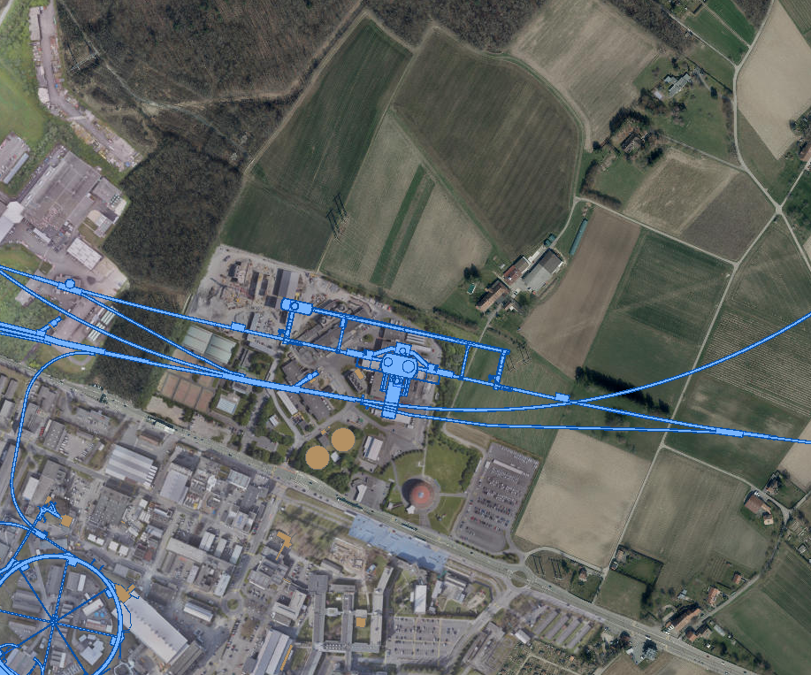
FPF LOCATION
FORWARD PHYSICS FACILITY
Two promising locations: caverns UJ12 and UJ18, each ~500 m from ATLAS and shielded from the ATLAS IP by ~100 m of rock, creating extremely quiet environments.
FPF would require enlarging these caverns to the south by a few meters. Alternatively, could construct a new cavern and new shaft to the surface.
UJ18
TI18
ATLAS
SPS
UJ12
TI12
CERN GIS

Slide 47


UJ12
UJ12: POSSIBLE SITE OF THE FPF
East

Slide 48




Option 1.1
Demolition/ widening
Jonathan Gall, FPF Workshop
Plan view showing widening required

Slide 49




Option 1.2
Widening plus alcoves
Jonathan Gall, FPF Workshop
Plan view showing widening and alcoves
Alcove Cross Section at A-A
Typical Alcove Cross Section B-B
Widened Section @C-C

Slide 50



New shaft to consider
Jonathan Gall, FPF Workshop
Siting for new shaft to consider
Distance from LoS and LHC
Land ownership
Switzerland/ France
Geology

Slide 51
SUMMARY
The far forward region at the LHC contains a rich physics program that has been underappreciated for decades.
  BSM: searches for dark matter, dark photons, dark Higgs bosons, HNLs, ALPs, milli-charged particles, new gauge bosons, ...
  SM: guaranteed discovery of the first collider neutrino, ~1000 ν_{e} ~10,000 ν_{μ} , ~10 ν_{τ} at TeV energies where there are no or little existing measurements. Implications for BSM neutrino properties, forward hadron production, cosmic ray and cosmic neutrino physics.
New experiments and facilities
  Current experiments: FASER and FASERν are under construction, SND proposed, to collect data in LHC Run 3 from 2022-24.
  Future initiative: the Forward Physics Facility is proposed to house a suite of far-forward experiments for the HL-LHC era from 2027-36.

