Slide 1




THEORY UPDATE
FASER 3rd Collaboration Meeting
Jonathan Feng, UC Irvine, 3 September 2020

Slide 2
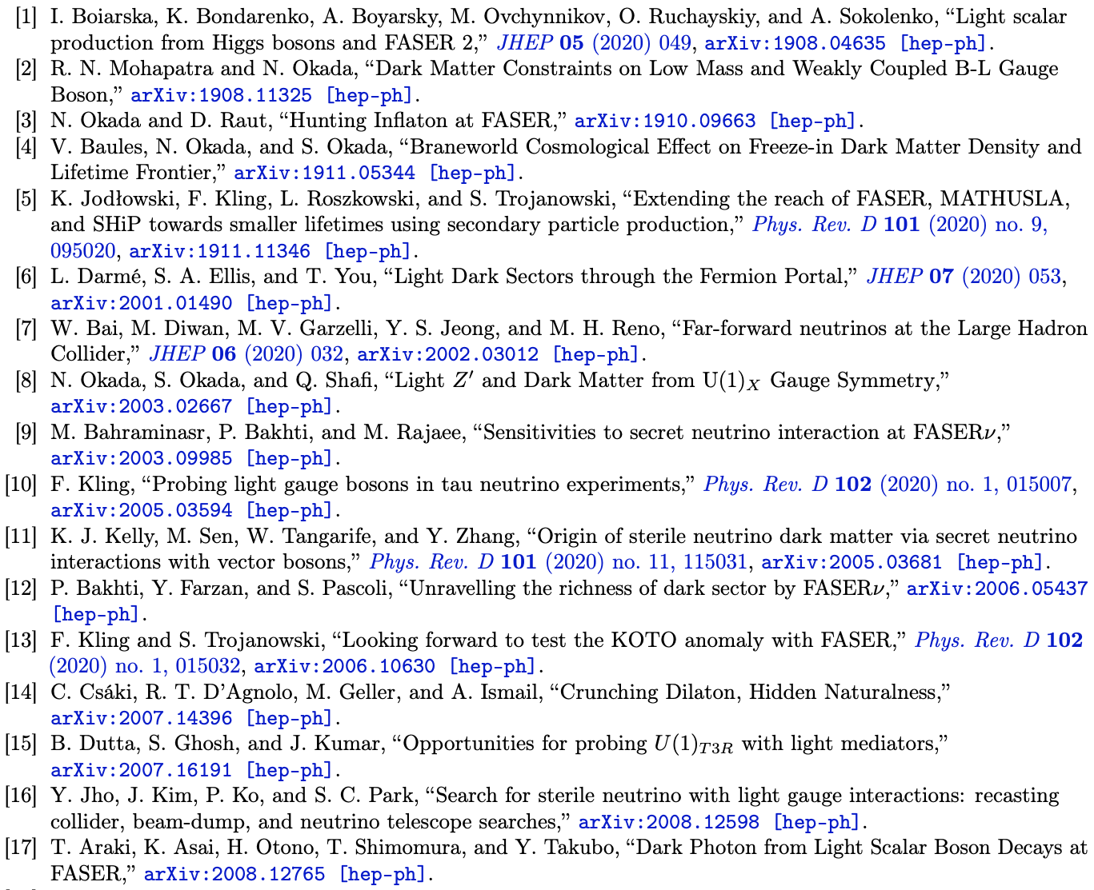
INTRODUCTION
Many theory papers exploring the physics potential of FASER and FASERν. A sampling from the last year:
!!
!!

Slide 3
INTRODUCTION
Here cover a few topics inspired by the following questions:
How likely is FASER to discover new physics at Run 3?
What are the prospects for the HL-LHC era?

Slide 4
How likely is FASER to discover new physics at Run 3?

Slide 5
  FASER’S DISCOVERY POTENTIAL
FASER can probe many models. Consider dark photons.
In Run 3, FASER will start probing new dark photon parameter space with the first fb⁻¹, and extend its sensitivity in the 10 – 100 MeV mass range.
Is this an interesting part of parameter space?

Slide 6
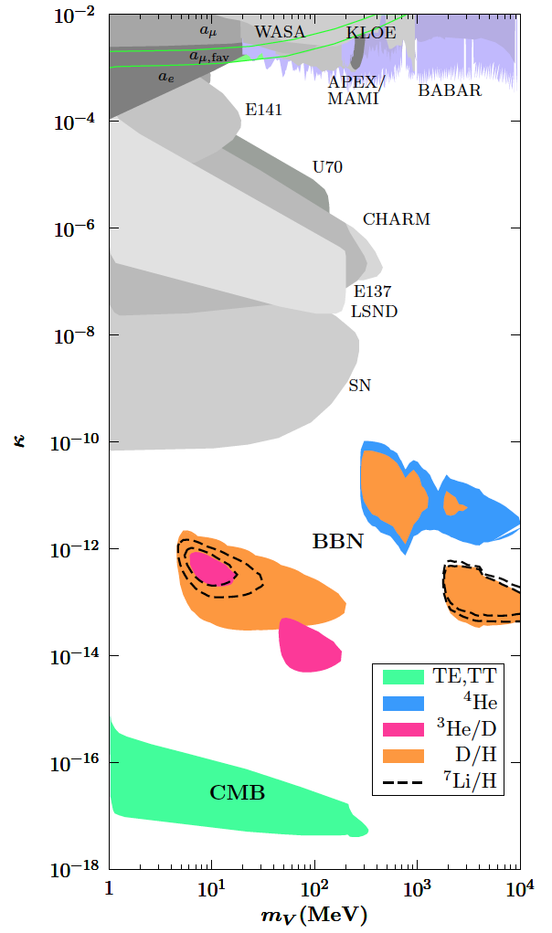
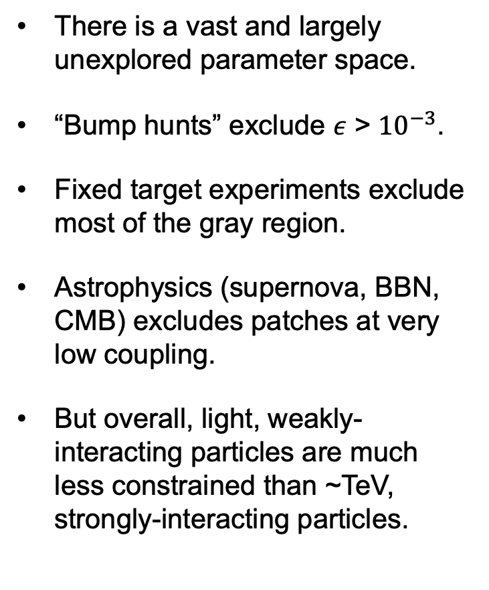
EXISTING CONSTRAINTS ON DARK PHOTONS
There is a vast and largely unexplored parameter space.
“Bump hunts” exclude $ε$ > ${10}^{−3}$.
Fixed target experiments exclude most of the gray region.
Astrophysics (supernova, BBN, CMB) excludes patches at very low coupling.
But overall, light, weakly-interacting particles are much less constrained than ~TeV, strongly-interacting particles.
Fradette, Pospelov, Pradler, Ritz (2014)

Slide 7
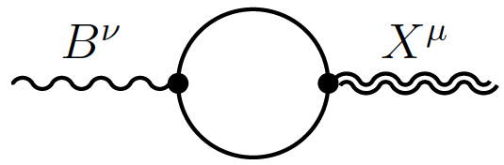
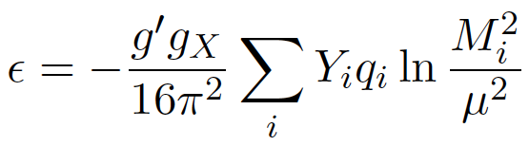
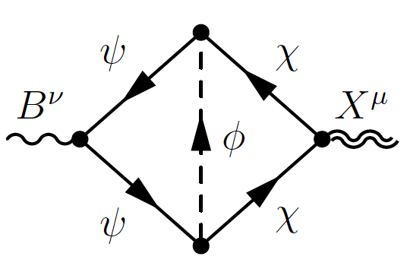
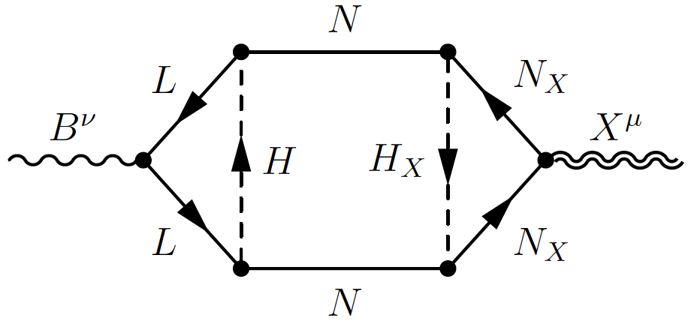
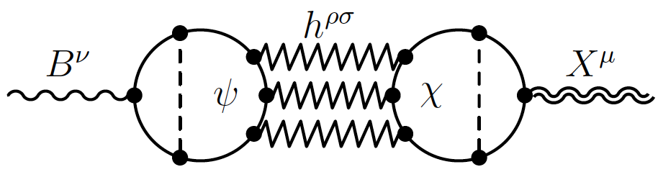
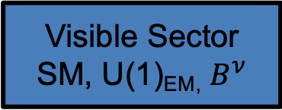
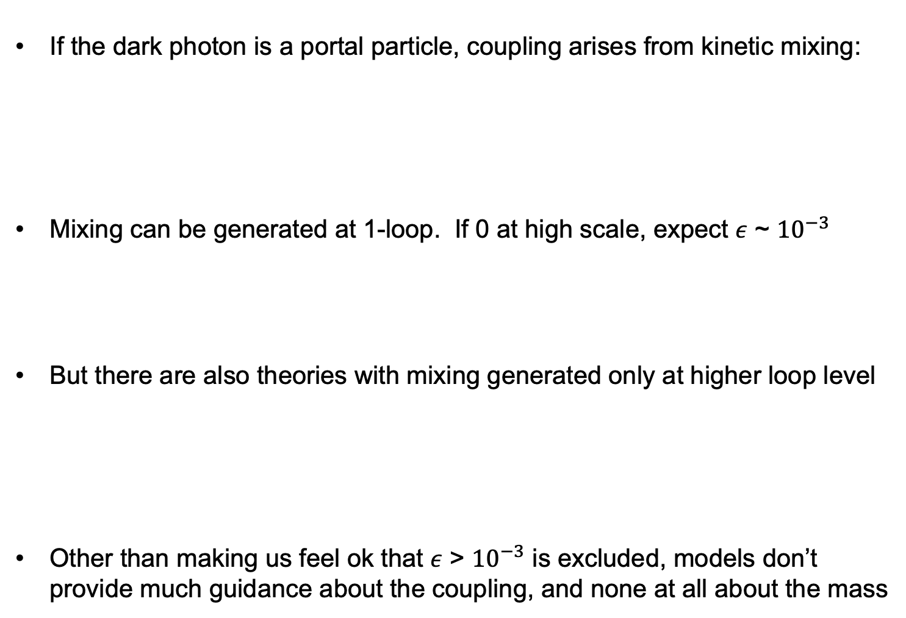
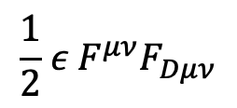
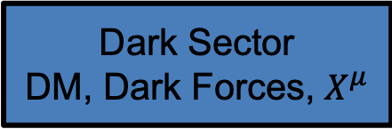
DARK PHOTON MODELS
If the dark photon is a portal particle, coupling arises from kinetic mixing:
Mixing can be generated at 1-loop. If 0 at high scale, expect $ε$ ~ ${10}^{−3}$
But there are also theories with mixing generated only at higher loop level
Other than making us feel ok that $ε$ > ${10}^{−3}$ is excluded, models don’t provide much guidance about the coupling, and none at all about the mass
Visible Sector
SM, U(1)_{EM,} $B^{ν}$
$$\frac{1}{2}{ ε{ F}^{μν}F}_{Dμν}$$
Dark Sector
DM, Dark Forces, $X^{μ}$
Holdom (1986)
Gherghetta, Kersten, Olive, Pospelov (2019)

Slide 8

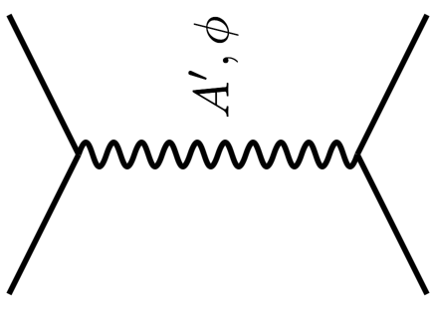
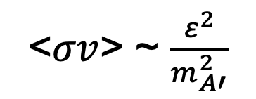




THE THERMAL RELIC LANDSCAPE
Particle
Colliders
Mass
MeV
GeV
TeV
1
Already
Discovered
Strongly Interacting
Heavy Particles
Too Little to be
Dark Matter
DM
$$e$$
Just Right to
be Dark Matter
$$A’$$
$$ε$$
Interaction Strength
10⁻³
DM
$$e$$
Weakly Interacting
Light Particles
Impossible to
Discover
<$σv$> ~ $\frac{ε^{2}}{m_{A′}^{2}}$
10⁻⁶
Too Much to be
Dark Matter

Slide 9
Dark Sector Candidates, Anomalies, and Search Techniques
zeV
aeV
feV
peV
neV
μeV
meV
eV
keV
MeV
GeV
TeV
PeV
30M☉
≈
QCD Axion
Sterile Neutrino
WIMPs
Ultralight Dark Matter
Hidden Thermal Relics / WIMPless DM
Black Holes
SIMPs / ELDERS
Asymmetric DM
X-ray Line
Beryllium-8
Muon g-2
Small-Scale Structure
Coherent Field Searches
Nuclear and Atomic Physics
Microlensing
Direct Detection (Low-Threshold and Spin-Dependent)
Accelerators
≈
zeV
aeV
feV
peV
neV
μeV
meV
eV
keV
MeV
GeV
TeV
PeV
30M☉
Cosmic Visions Report (2017)
Notes:
Targets: Freeze-In, Inflation Mechanism, Misalignment Mechanism

Slide 10
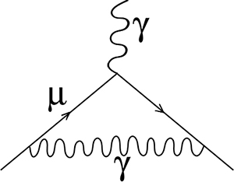
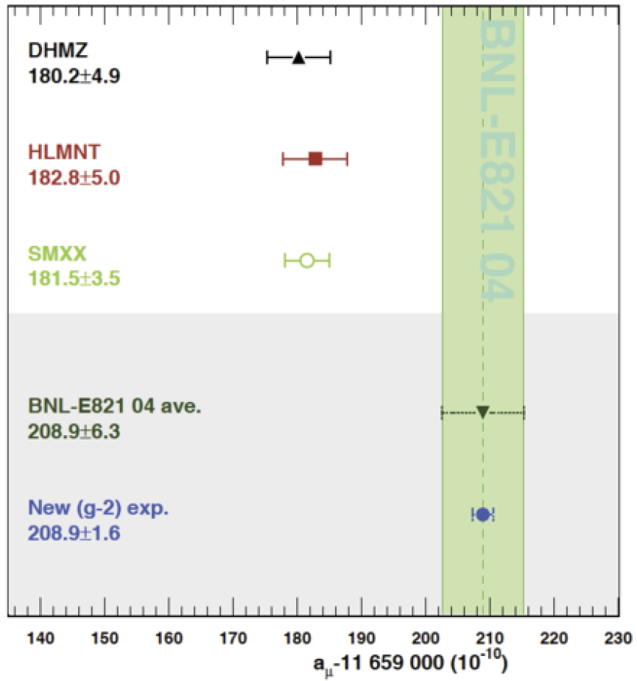
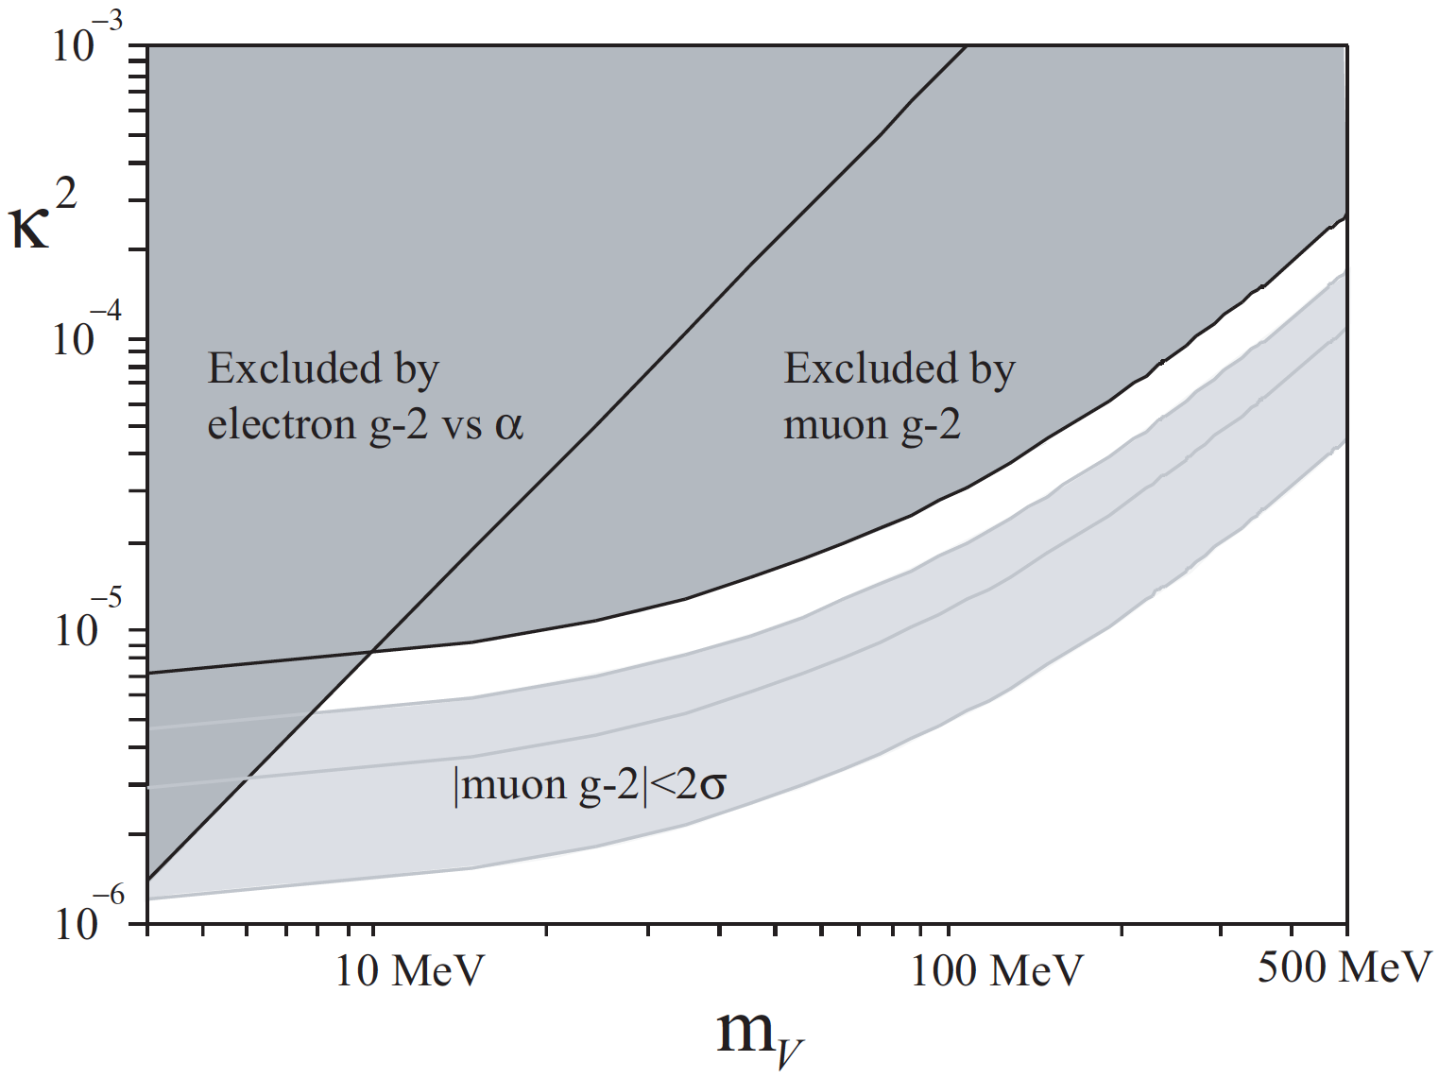

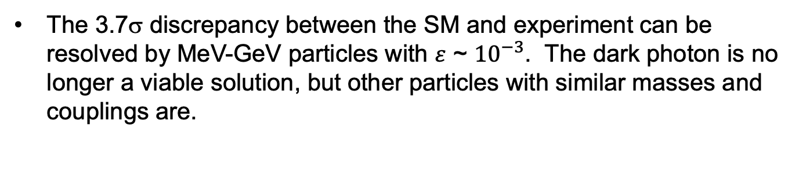
THE MUON’S ANOMALOUS MAGNETIC MOMENT
The 3.7σ discrepancy between the SM and experiment can be resolved by MeV-GeV particles with $ε$ ~ ${10}^{−3}$. The dark photon is no longer a viable solution, but other particles with similar masses and couplings are.
$$γ, A’$$
Hagiwara et al. (2017); Aoyama et al. (2020)
Boehm, Fayet (2003)

Slide 11
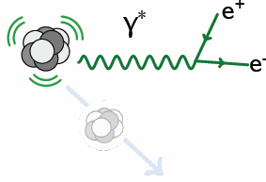
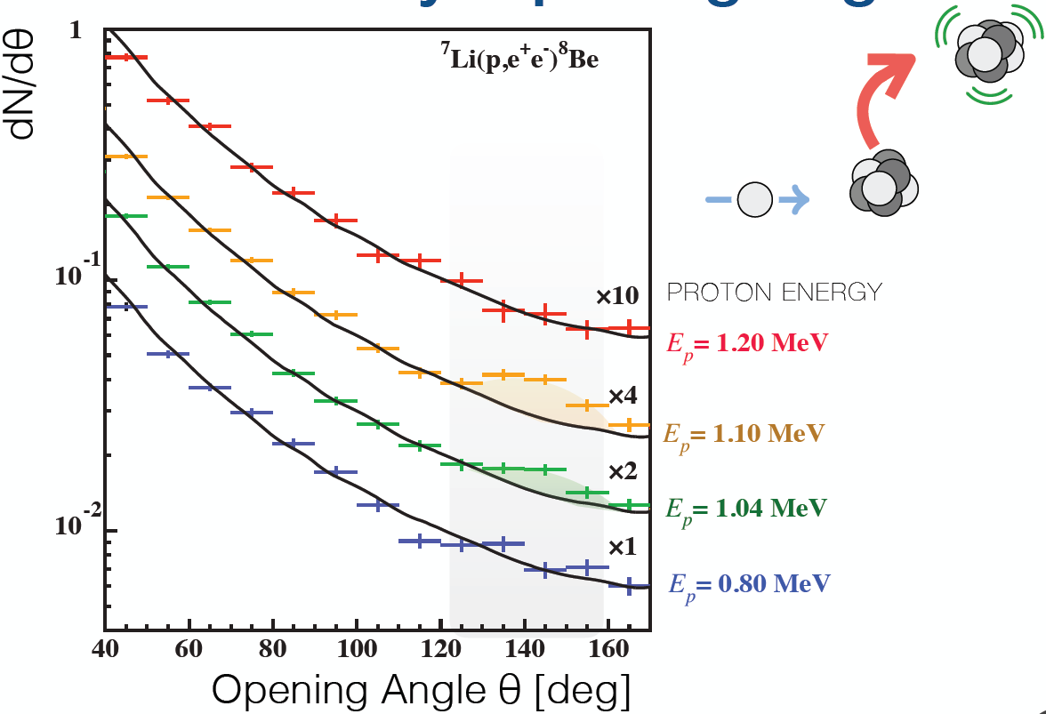
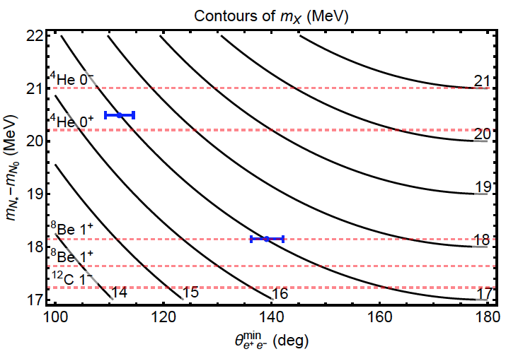
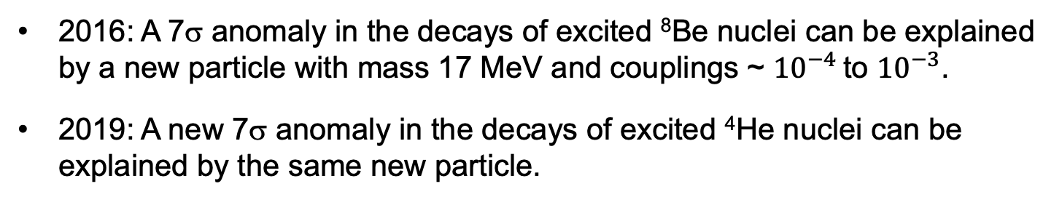
THE ⁸Be and ⁴He ATOMKI ANOMALIES
2016: A 7σ anomaly in the decays of excited ⁸Be nuclei can be explained by a new particle with mass 17 MeV and couplings ~ ${10}^{−4}$ to ${10}^{−3}$.
2019: A new 7σ anomaly in the decays of excited ⁴He nuclei can be explained by the same new particle.
X
$$θ$$
Krasznahorkay et al. (2015, 2019)
Feng, Fornal, Galon, Gardner, Smolinsky, Tanedo, Tait (2016)
Feng, Tait, Verhaaren (2020); Batell, Feng, Verhaaren (in progress)
See also Zhang, Miller (2020)

Slide 12
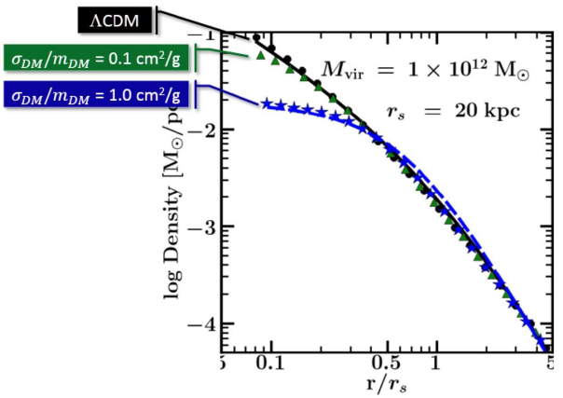


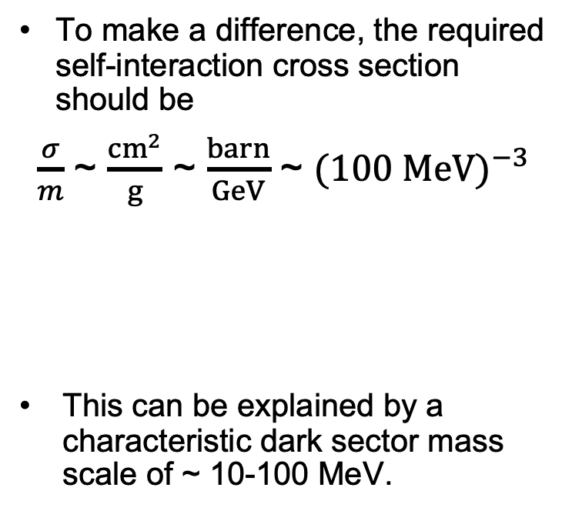

SELF-INTERACTING DARK MATTER
There are indications from small-scale structure that dark matter may be strongly self-interacting.
For example, there appear to be halo profiles that are not as cuspy (high central density) as predicted by standard cold dark matter.
To make a difference, the required self-interaction cross section should be
$\frac{σ}{m}$ ~ $\frac{{cm}^{2}}{g}$ ~ $\frac{barn}{GeV}$ ~ ${(100 MeV)}^{−3}$
This can be explained by a characteristic dark sector mass scale of ~ 10-100 MeV.
DM
$$\text{DM}$$
$$A’$$
DM
$$\text{DM}$$
Tulin, Yu (2017)
Rocha et al. (2012); Peter et al. (2012)
Vogelsberger et al. (2012); Zavala et al. (2012)
Notes:
12

Slide 13
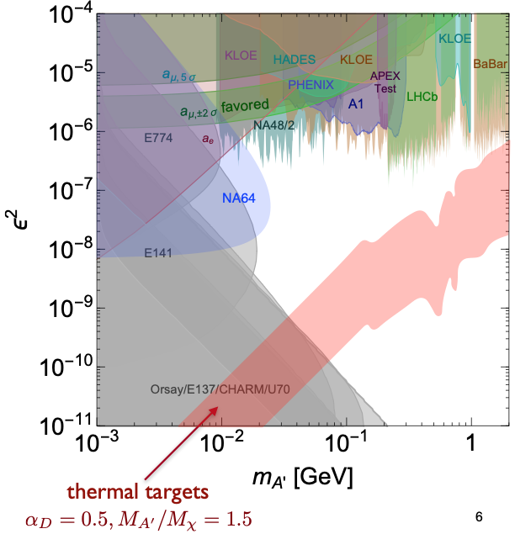
TARGETS IN DARK PHOTON PARAMETER SPACE
Muon
g-2 Anomaly
⁸Be and ⁴He
ATOMKI
Anomalies
Loop-induced
Coupling
Self-interacting
Dark Matter
FASER probes
an interesting
region, even with
the 1st fb⁻¹
of Run 3 data
Tim Nelson, Snowmass RP6 (2020)

Slide 14
What are the prospects for the HL-LHC era?

Slide 15
FORWARD PHYSICS FACILITY
FASER, FASERν , and other proposed detectors are currently highly constrained by tunnels and infrastructure that was never designed to support experiments.
At the same time, it is becoming clear that there is a rich physics program in the far-forward region, spanning long-lived particle searches, neutrinos, QCD, dark matter, dark sector, cosmic rays, and cosmic neutrinos.
Strongly motivates enlarging UJ12 (or UJ18) to create a dedicated facility to house several far-forward experiments.
LHC beamline
TI12
UJ12
Beam Collision Axis

Slide 16
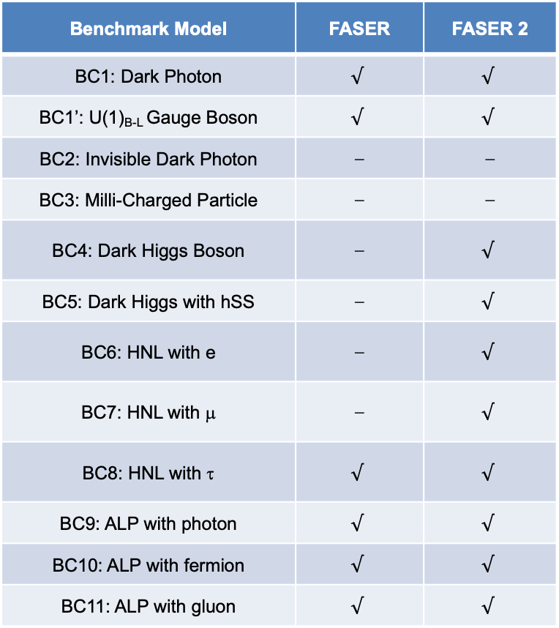
NEW PHYSICS SEARCHES AT THE FPF
FASER 2 (R = 1 m, L = 5-20 m) can discover all candidates with renormalizable couplings (dark photon, dark Higgs, HNL); ALPs with all types of couplings (γ, f, g); and many other particles.
Among the PBC benchmark scenarios, FASER2’s discovery potential extends to all benchmark scenarios, except BC2 and BC3.
Benchmark Model | FASER | FASER 2
BC1: Dark Photon | $$√$$ | $$√$$
BC1’: U(1)_{B-L} Gauge Boson | $$√$$ | $$√$$
BC2: Invisible Dark Photon | ⎼ | ⎼
BC3: Milli-Charged Particle | ⎼ | ⎼
BC4: Dark Higgs Boson | ⎼ | $$√$$
BC5: Dark Higgs with hSS | ⎼ | $$√$$
BC6: HNL with e | ⎼ | $$√$$
BC7: HNL with μ | ⎼ | $$√$$
BC8: HNL with τ | $$√$$ | $$√$$
BC9: ALP with photon | $$√$$ | $$√$$
BC10: ALP with fermion | $$√$$ | $$√$$
BC11: ALP with gluon | $$√$$ | $$√$$

Slide 17
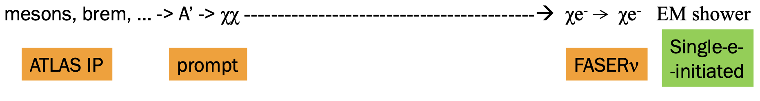
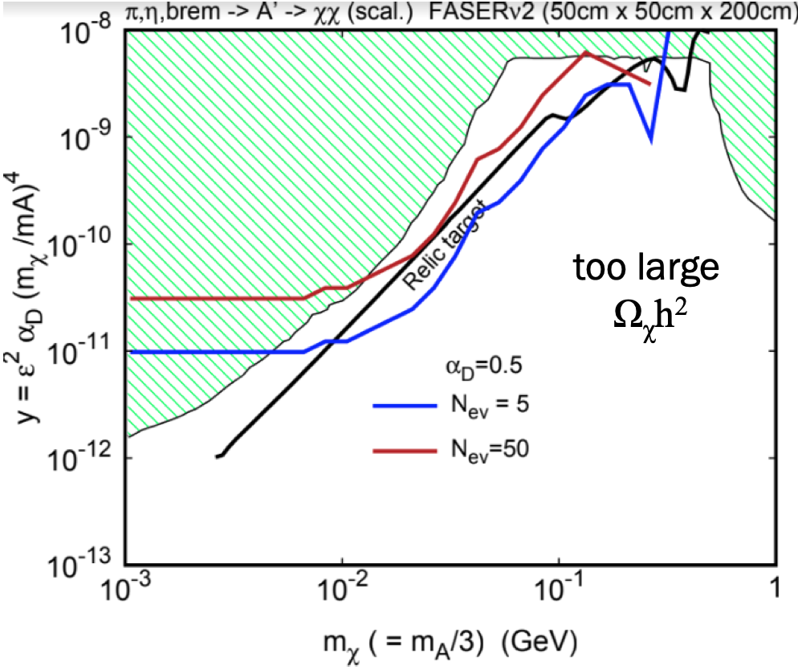
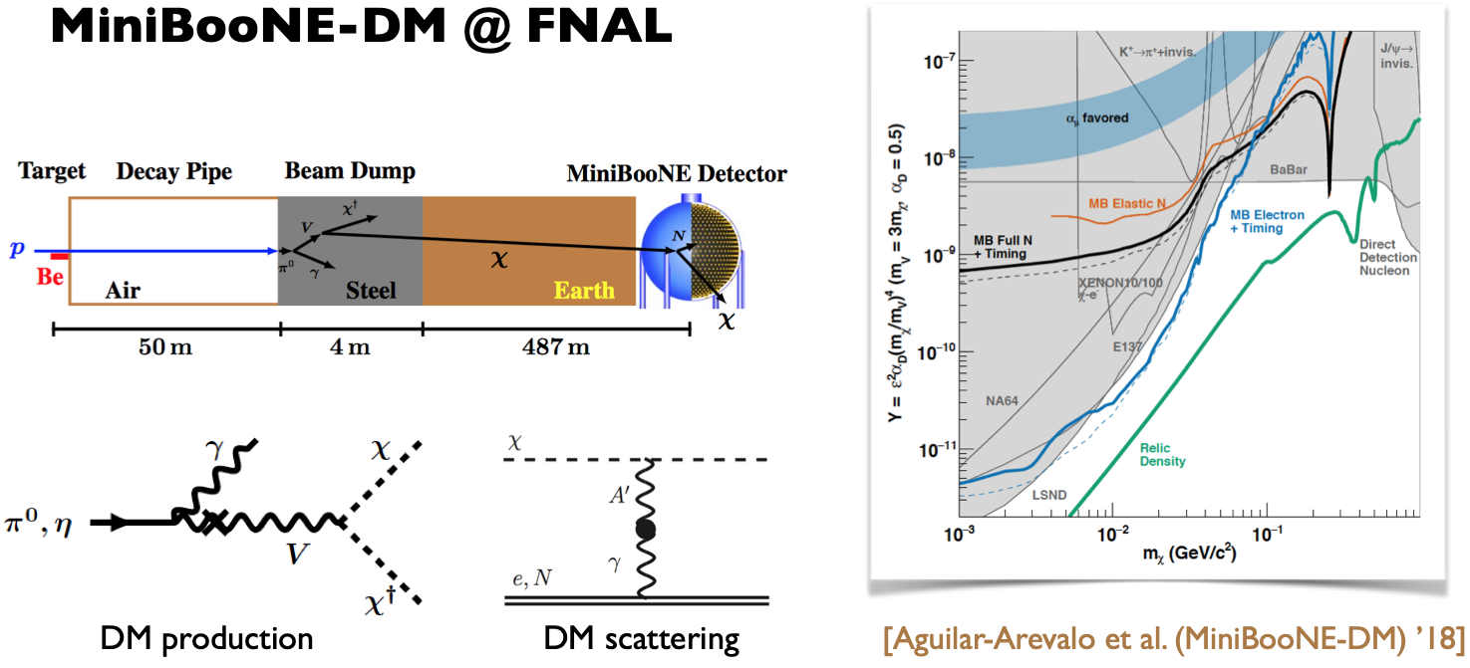

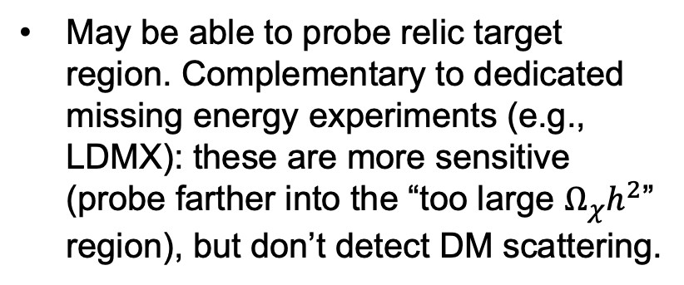
BC2: INVISIBLE DARK PHOTONS AT THE FPF
If m_{LLP} > 2m_{DM} , the LLP will typically decay in the dark sector to dark matter, leading to invisible decays.
Can look for the resulting DM to scatter off electrons at FASERν 2. Dominant background from neutrinos reduced for 1 < $E_{e}$ < 20 GeV.
10 ton
Batell, Feng, Trojanowski (in progress)
May be able to probe relic target region. Complementary to dedicated missing energy experiments (e.g., LDMX): these are more sensitive (probe farther into the “too large $Ω_{χ}h^{2}$” region), but don’t detect DM scattering.

Slide 18
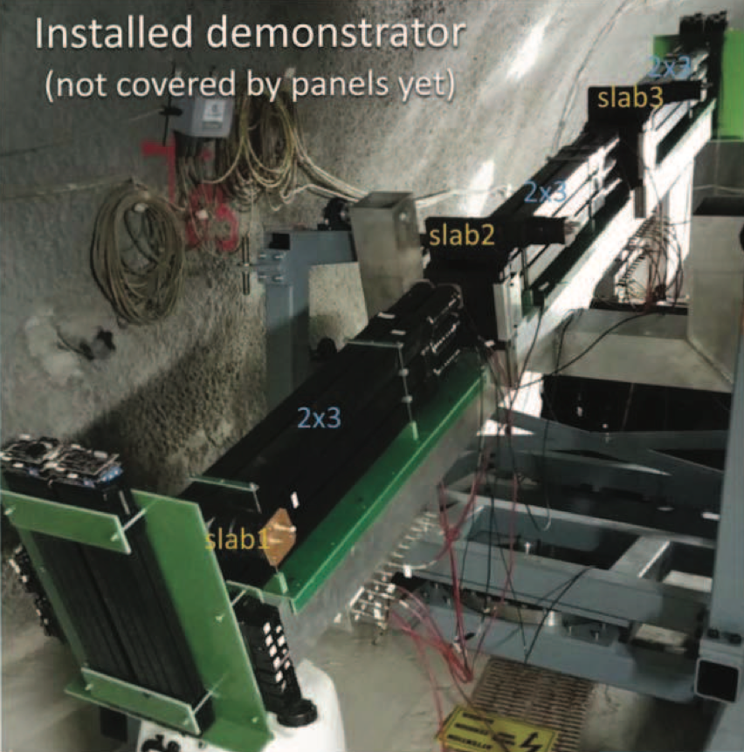
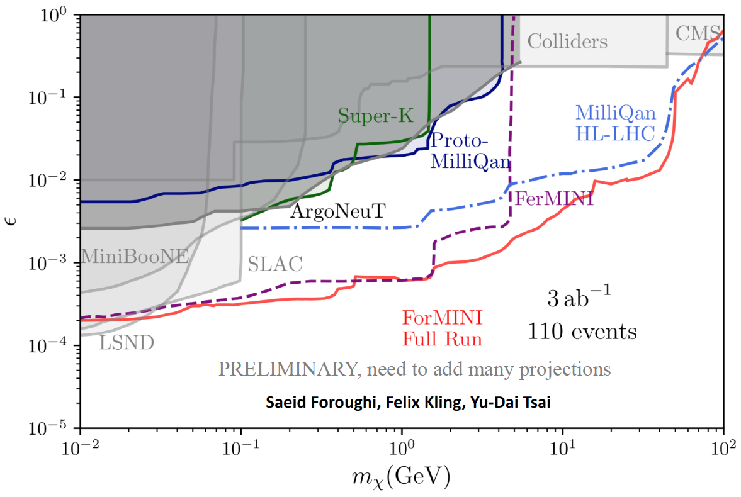
BC3: MILLICHARGED PARTICLES AT THE FPF
Currently the target of the MilliQan experiment near the CMS IP.
MilliQan Demonstrator (Proto-MilliQan) already probes new region. Full MilliQan planned to run in this location at HL-LHC, but it appears that sensitivity can be improved greatly by moving it to the FPF (ForMINI).

Slide 19
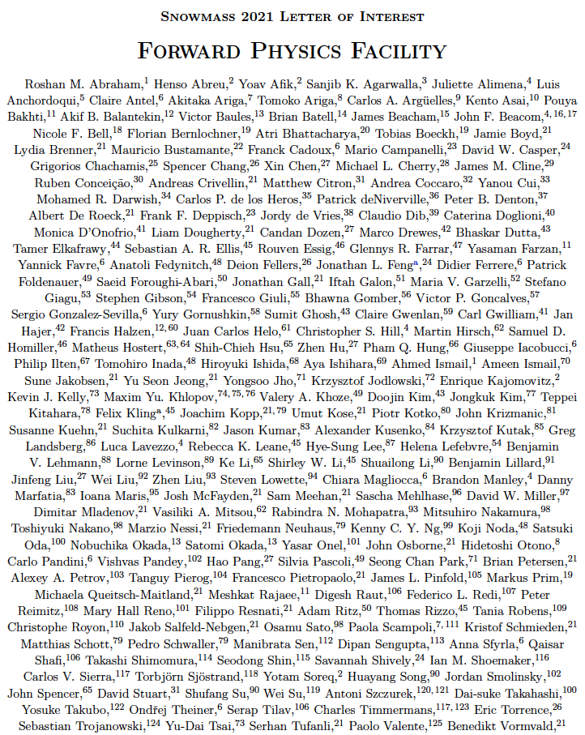
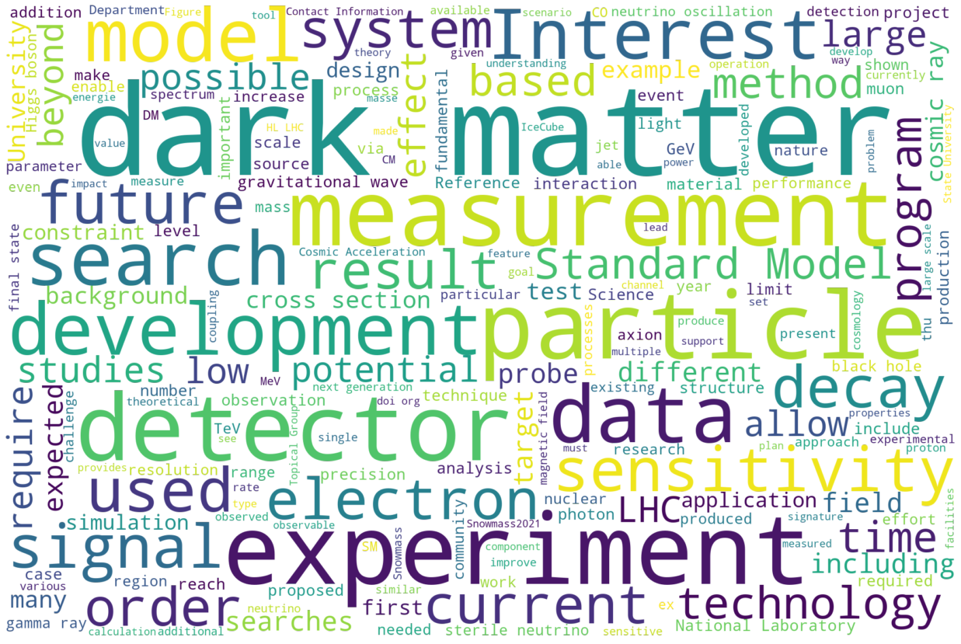
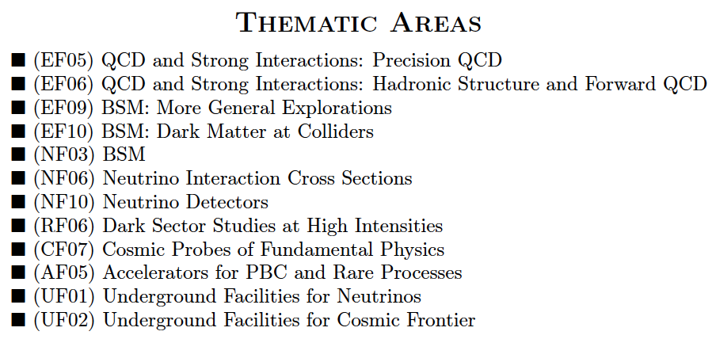
FORWARD PHYSICS FACILITY: SNOWMASS LOI
One of 1578 Snowmass LOIs
FPF LOI had 240 authors with interest from many communities. An FPF workshop is being planned for the coming months.

