Slide 1
LLP UBIQUITY
New Physics with Exotic and Long-Lived Particles
Joint ICISE-CBPF Workshop, Quy Nhon, Vietnam
Jonathan Feng, UC Irvine
2 July 2019

Slide 2
INTRODUCTION
We have already discovered many Long-Lived Particles
In fact, LLPs have played an essential role in many of the conceptual breakthroughs that established the standard model of particle physics: e, p, n, μ, K, ν, …
Alimena et al. (eds. Beacham, Shuve) (2019)

Slide 3
INTRODUCTION
The next breakthrough in particle physics is likely to involve LLPs
  LLPs are ubiquitous in BSM theories, especially those with cosmological significance
  LLPs can be detected through a huge variety of signatures
  Many of these signals are truly spectacular – a few events can be a discovery
  For existing experiments, we have not yet reached the full LLP discovery potential
  And LLPs present many opportunities for new and clever experiments (and new and clever experimentalists!)

Slide 4
INTRODUCTION
This is by now a huge field and it is impossible to give a proper theory overview. Here I will present a small sampling of theoretical ideas that have led to my personal optimism about LLPs.
In many cases, LLPs scenarios are “too flexible”; couplings, mass splittings can be tuned to be arbitrarily small and voila – LLP! This is fine (we should look where we can look at this point), but for a short talk…
Also cosmology provides both a motivation for LLPs and a way to focus the discussion.
So here I will attempt to highlight scenarios in which LLPs have some independent reason to be long-lived and have some interesting cosmological implications.

Slide 5

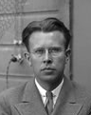
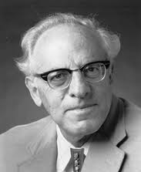
THE NEW PARTICLE LANDSCAPE
Particle
Colliders
Mass
MeV
GeV
TeV
1
Already
Discovered
Strongly Interacting
Heavy Particles
Interaction Strength
LLPs from Light Physics
LLPs from Weak-Scale Physics
10⁻³
Weakly Interacting
Light Particles
Impossible to
Discover
10⁻⁶

Slide 6
LLPs FROM
WEAK- SCALE PHYSICS

Slide 7
WEAK-SCALE PHYSICS AND LLPs
Why should there be LLPs at the weak scale? After all, the natural decay length is cτ ~ c/m_{W} ~ 10⁻¹⁷ m!
But hierarchy problem → new physics at 100 GeV, and precision EW → no new physics below few TeV in 4-pt ints.
Simple solution: impose a discrete parity, so all interactions require pairs of new particles.
Gauge Hierarchy
new
particle
Higgs
Higgs
Precision EW
SM
SM
new
particle
SM
SM
This makes the lightest new particle stable. This is a general argument. It may be augmented in specific contexts, e.g., in SUSY, p decay → R-parity → stable LSP.
Cheng, Low (2003); Wudka (2003); Farrar, Fayet (1974)

Slide 8
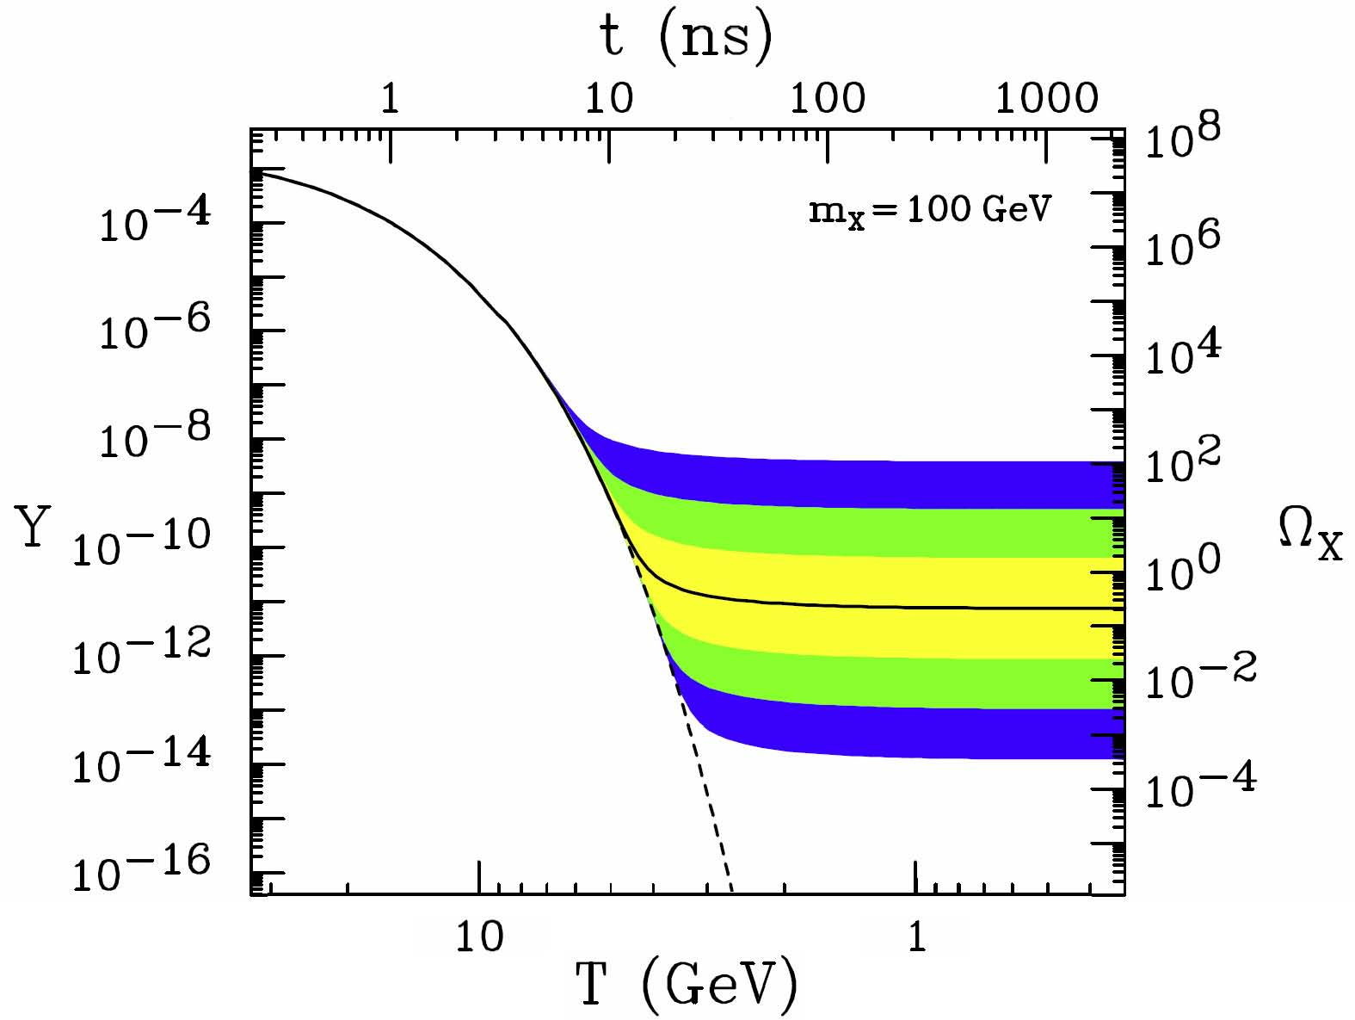
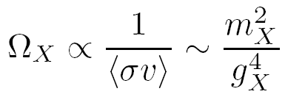
WEAK-SCALE PHYSICS AND COSMOLOGY
What good is a stable weak-scale state? Dark matter!
The resulting relic density is
For a WIMP, m_{X} ~ 100 GeV and g_{X} ~ 0.6 → Ω _{X} ∼ 0.1
X
f
X
f̅
This simple coincidence, the WIMP Miracle, ties together weak-scale physics, LLPs, and cosmology, and has led to the prominence of missing E_{T} searches and DM at colliders.

Slide 9
LLPs IN STANDARD SUSY
But this focus on missing E_{T} is a vast oversimplification.
Consider standard (gravity-mediated) supersymmetry. The gravitino has mass ~ 100 GeV, couplings ~ M_{W}/M_{Pl} ~ 10⁻¹⁶ .
G̃ not LSP
Assumption of most of literature
G̃ LSP
Completely different cosmology and particle physics
SM
SM
G̃
NLSP
LSP
G̃

Slide 10
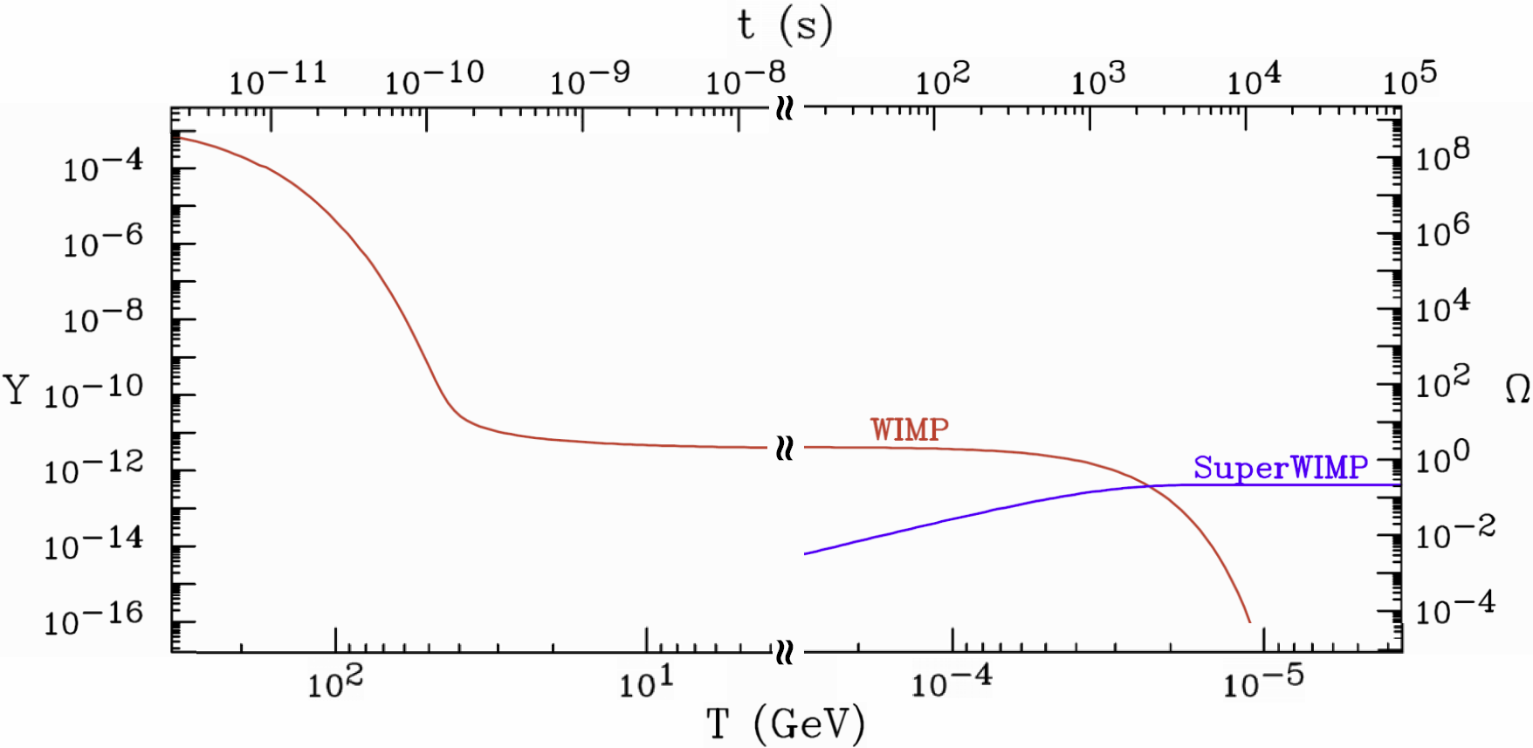
LLPs IN SUPERWIMP SCENARIOS
In the G̃ LSP scenario, WIMPs freeze out as usual, but then decay to G̃ after M_{Pl}²/M_{W}³ ~ seconds to months.
The gravitino is superWIMP DM, naturally has the right relic density. But now the WIMP can be charged, implying metastable charged LLPs at colliders.
Feng, Rajaraman, Takayama (2003)

Slide 11
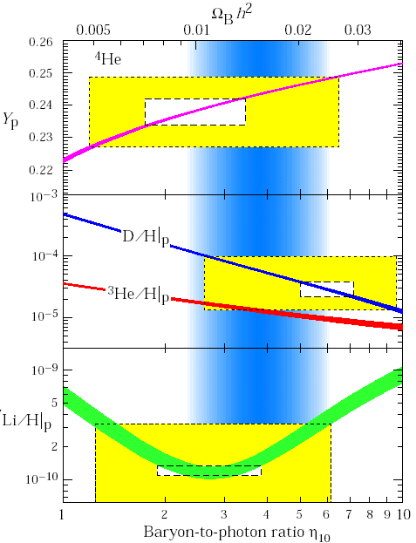
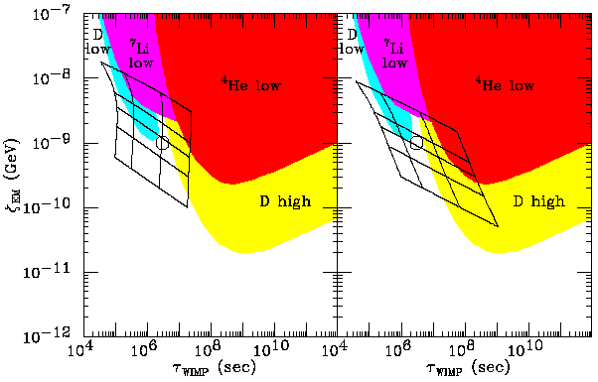
LLPs AND BBN
Decays to superWIMPs can impact light element abundances
BBN excludes χ → ZG̃, but l̃ → lG̃ may be ok and may even fix the longstanding lithium anomaly! It is not true that BBN categorically excludes LLP lifetimes > 1s.
Late decays may also distort the CMB, resolve small-scale structure: many interesting cosmological imprints.
Feng, Rajaraman, Takayama (2003); Kaplinghat (2004); Cembranos et al. (2004); …
Fields, Sarkar, PDG (2002)
Feng, Rajaraman, Takayama (2003)

Slide 12
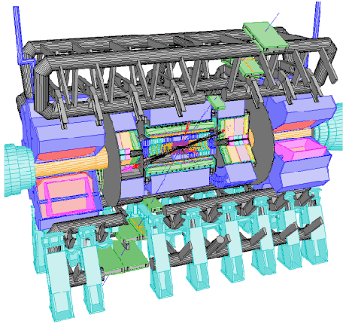
LLPs AND ADD-ON DETECTORS
If we see metastable charged LLPs, we know they must decay.
We can collect these particles and study their decays.
Several ideas have been proposed
  Catch sleptons in a 1m thick water tank (up to 1000/year) and then move them to a quiet place to observe their decays Feng, Smith (2004)
  Catch sleptons in LHC detectors
Hamaguchi, Kuno, Nakawa, Nojiri (2004)
  Dig sleptons out of detector hall walls
De Roeck, Ellis, Gianotti, Moortgat, Olive, Pape (2005)
Charged particle trap
Reservoir
Notes:
12

Slide 13
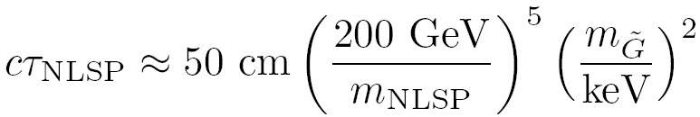
LLPs IN GAUGE-MEDIATED SUSY
Scenarios with gauge-mediated SUSY breaking are among the most famous of those predicting LLPs.
NLSPs decay to light G̃ LSPs. The G̃ mass and the NLSP decay length are correlated. For G̃ masses ~ keV (motivated, with caveats, by G̃ DM), the decay lengths are macroscopic
Dine, Nelson, Nir, Shirman (1994, 1995); Dimopoulos, Dine, Raby, Thomas (1996); …
 | Neutralino NLSP | Slepton NLSP
Prompt | Prompt photons | Multi-leptons
Intermediate | Displaced photons Displaced conversion | Displaced lepton Track kinks
Long-Lived | Missing E_{T} | Time-of-flight High dE/dx
Notes:
13

Slide 14
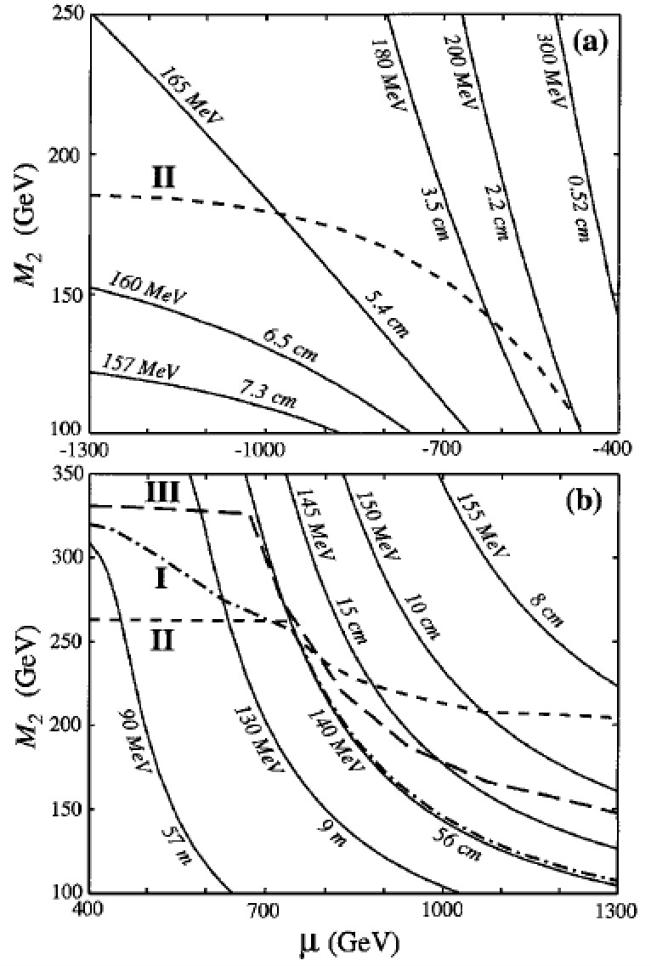
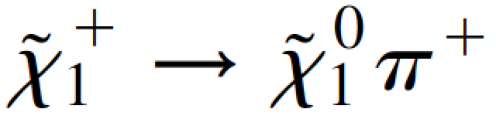
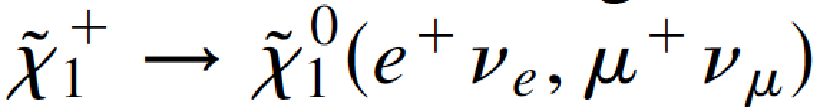
LLPs IN ANOMALY-MEDIATED SUSY
Scenarios with anomaly-mediated SUSY breaking give additional interesting LLPs signals
Randall, Sundrum (1998); Giudice, Luty, Murayama, Rattazzi (1998); …
The LSPs are a highly degenerate Wino triplet with Δmloop >> Δmtree
Typically, there are 2-body decays
and disappearing tracks after ~10cm
In exotic cases, there can be even greater degeneracy, leading to very long decay lengths and 3-body decays
Feng, Moroi, Randall, Strassler, Su (1999)
Notes:
14

Slide 15
LLPs IN OTHER WEAK-SCALE MODELS
By considering a few standard models of weak-scale physics, we have motivated a plethora of possible LLP signatures.
Of course, there are many other motivated weak-scale models with LLPs.
In SUSY: e.g., R-parity violating SUSY and compressed SUSY, which have become more motivated as generic, sub-TeV SUSY becomes excluded.
Extra dimensional scenarios typically have similar possibilities (e.g., viewing universal extra dimensions as bosonic supersymmetry), and naturally compressed spectra.
Many other motivations and cosmological connections: leptogenesis, neutrino masses, etc.
Notes:
15

Slide 16
LLPs FROM
LIGHT PHYSICS

Slide 17
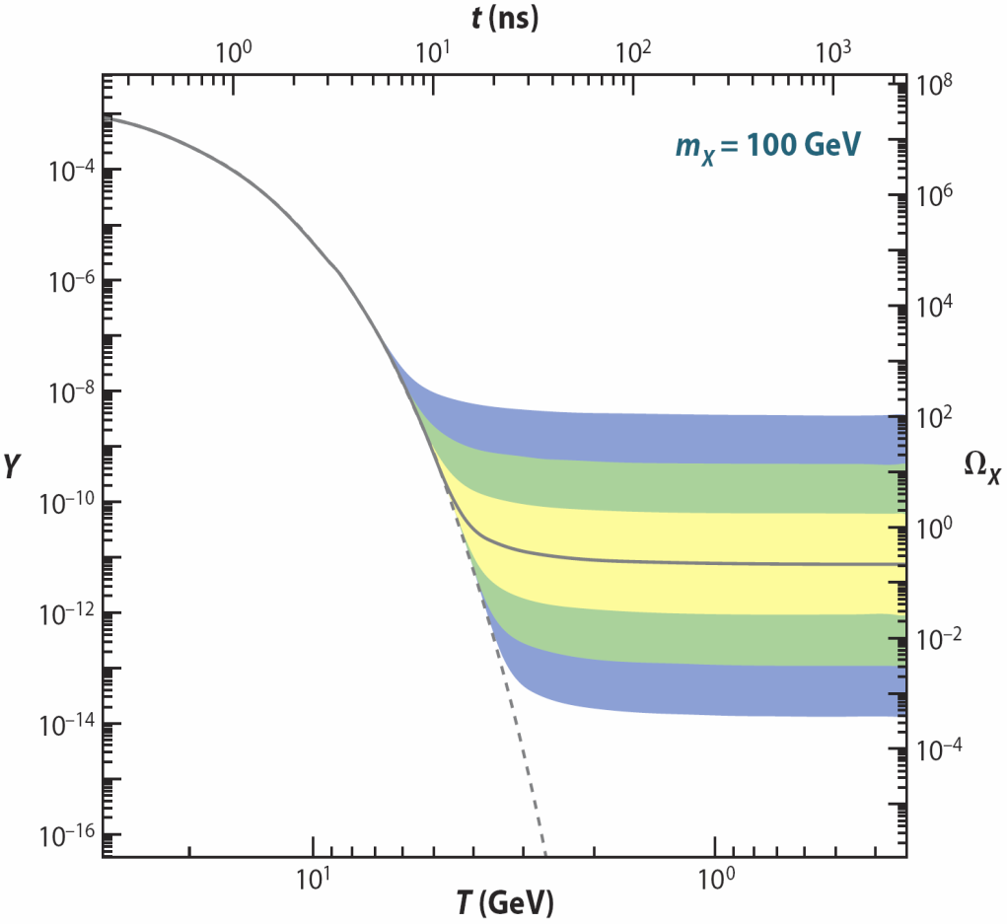
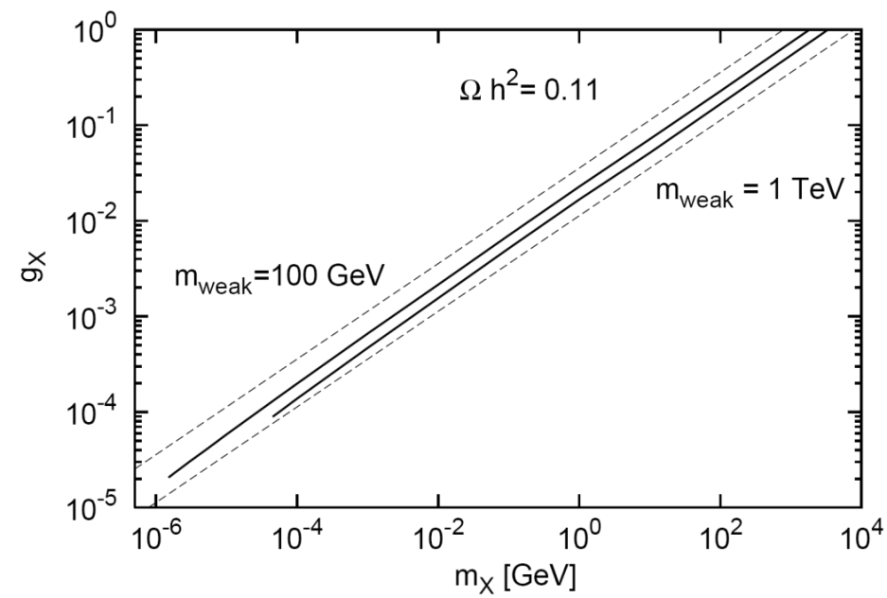
DARK SECTORS
In recent years, dark matter → dark sectors. What do we know about its properties?
In general, nothing. But suppose DM freezes out in the dark sector just as we discussed above for WIMPs in the visible sector:
Dark
Sector
WIMP Miracle: g_{X} ~ 1, m_{X} ~ 100 GeV → right abundance.
WIMPless Miracle: But with a dark sector, we don’t need to fix g_{X} ~ 1. The dark sector can have lighter particles and weaker interactions and still have the right abundance.
_{WIMP DM}
Feng, Tu, Yu (2010)
_{WIMPless DM}
Boehm, Fayet (2003); Feng, Kumar (2008)

Slide 18
THE NEW PARTICLE LANDSCAPE
Particle
Colliders
Mass
MeV
GeV
TeV
1
Already
Discovered
Strongly Interacting
Heavy Particles
Too Little to be
Dark Matter
Interaction Strength
10⁻³
Just Right to be Dark Matter
Weakly Interacting
Light Particles
Impossible to
Discover
Too Much to be Dark Matter
10⁻⁶

Slide 19

PORTALS
Dark sectors need not talk with us. But if they do, what are the most likely non-gravitational interactions?
Suppose the dark sector has U(1) electromagnetism. There are infinitely many possible SM-dark sector interactions, but one is induced by arbitrarily heavy mediators:
It is “most likely” because it is non-decoupling. Cf.
It is also naturally small, since it is induced by a loop.
SM
Dark
U(1)
M
Okun (1982), Galison, Manohar (1984), Holdom (1986)

Slide 20
DARK PHOTON, DARK HIGGS, STERILE NUS
This provides an organizing principle that motivates specific examples of new, weakly interacting light particles. There are just a few options:
Spin 1
→ dark photon, couples to SM fermions with suppressed couplings proportional to charge: εq_{f}. _{Holdom (1986)}
Spin 0
→ dark Higgs boson, couples to SM fermions with suppressed coupling proportional to mass: sin θ m_{f}. _{Patt, Wilczek (2006)}
Spin 1/2
→ sterile neutrino, mixes with SM neutrinos with suppressed mixing sin θ.
SM
Dark
Force
SM
Dark
Scalar
SM
Dark
Fermion

Slide 21
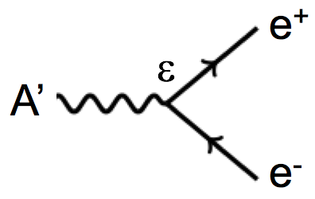
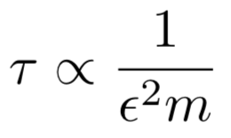
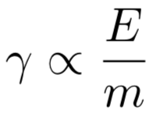

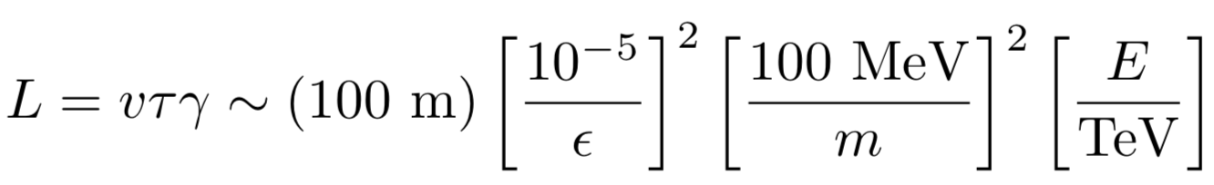
LIGHT LLP DECAYS
The advent of dark sectors, along with axion-like particles, light gauge bosons, etc., has highlighted a new class of LLPs. Consider a neutral particle with energy E ~ TeV, mass m ~ 100 MeV, coupling ε ~ 10⁻⁵ .
It passes through matter essentially without interacting: radiation length is (10 cm) ε⁻² ~ 10⁹ m, the distance to the moon!
It may decay to visible particles, but only after traveling a long distance.
Velocity near the speed of light
Rest lifetime enhanced by small mass, small ε
Lifetime further enhanced by time dilation

Slide 22
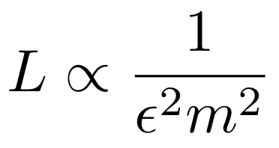
THE NEW PARTICLE LANDSCAPE
Particle
Colliders
Mass
MeV
GeV
TeV
1
Already
Discovered
Strongly Interacting
Heavy Particles
MUCH LONGER
LIFETIMES
Interaction Strength
10⁻³
Weakly Interacting
Light Particles
Impossible to
Discover
10⁻⁶

Slide 23
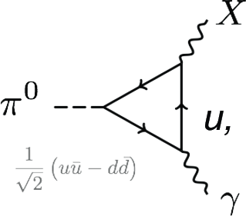
LIGHT LLP PRODUCTION
The advent of light and weakly interacting particles greatly increases the possible modes of production.
Production in weak-scale processes remains interesting.
But now production through light SM particle decays is also possible, opening up the floodgates to experiments at both the energy frontier and the intensity frontier.
LLP
LLP
ε
h
LLP

Slide 24
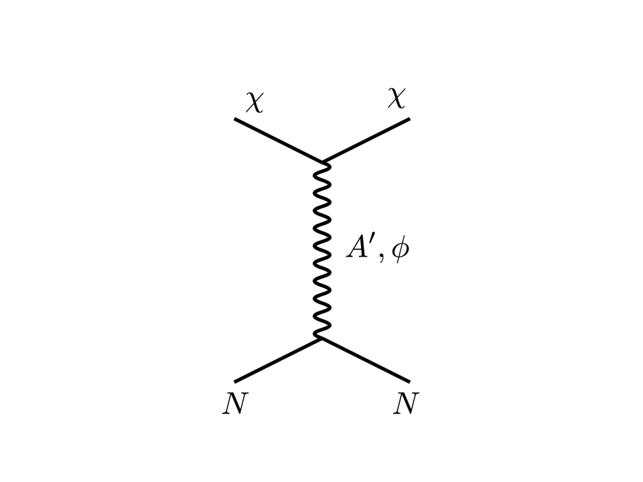
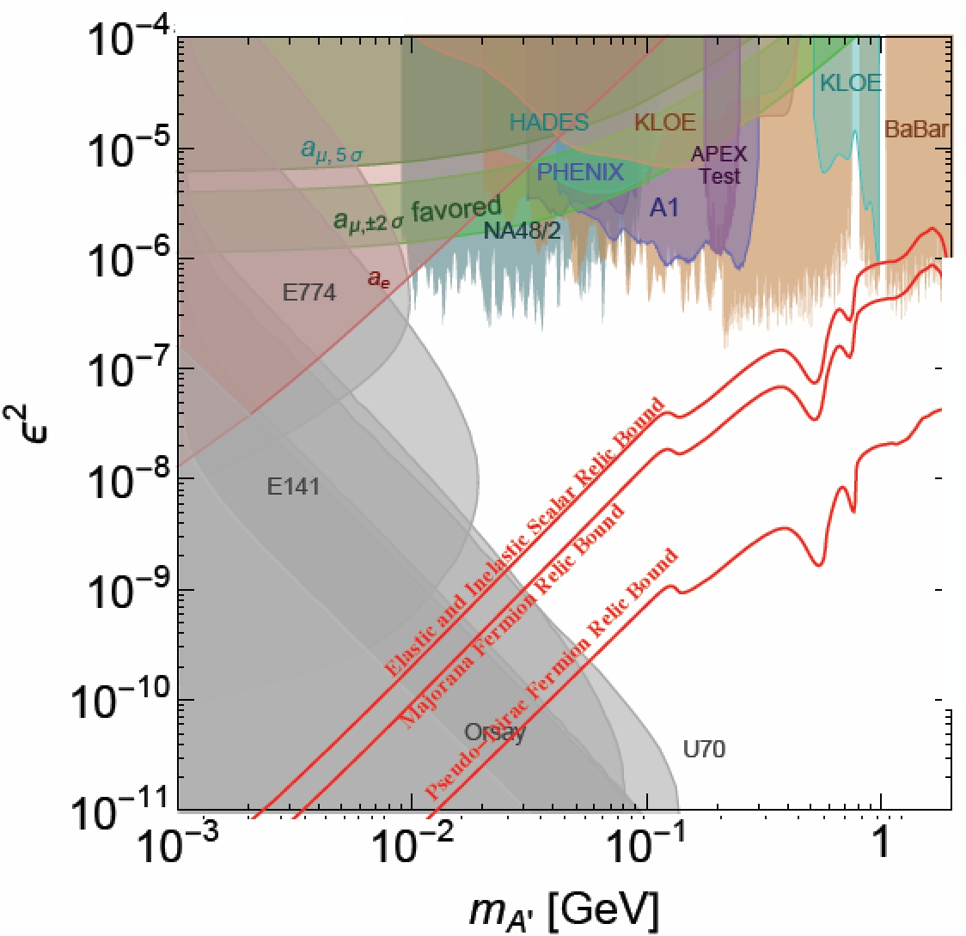
THERMAL TARGETS: VISIBLE DECAYS
LLP
f
If m_{LLP} < 2m_{DM} , the LLP will decay to the SM, and the most promising signal is visible particle-anti-particle pairs.
The introduction of dark sector-SM interactions modifies DM freeze out, since the DM can annihilate to the SM.
To determine the thermal relic targets, must work in a definite model.
E.g., for dark photons decaying visibly to SM particles, the thermal targets focus attention on
masses m ~10 MeV – many GeV
couplings ε ~ 10⁻⁵ – 10⁻³
f
DM
f
LLP
DM
f
Toro (SUSY 2019)
m_{DM}=3m_{LLP}
α_{D} = 0.5

Slide 25
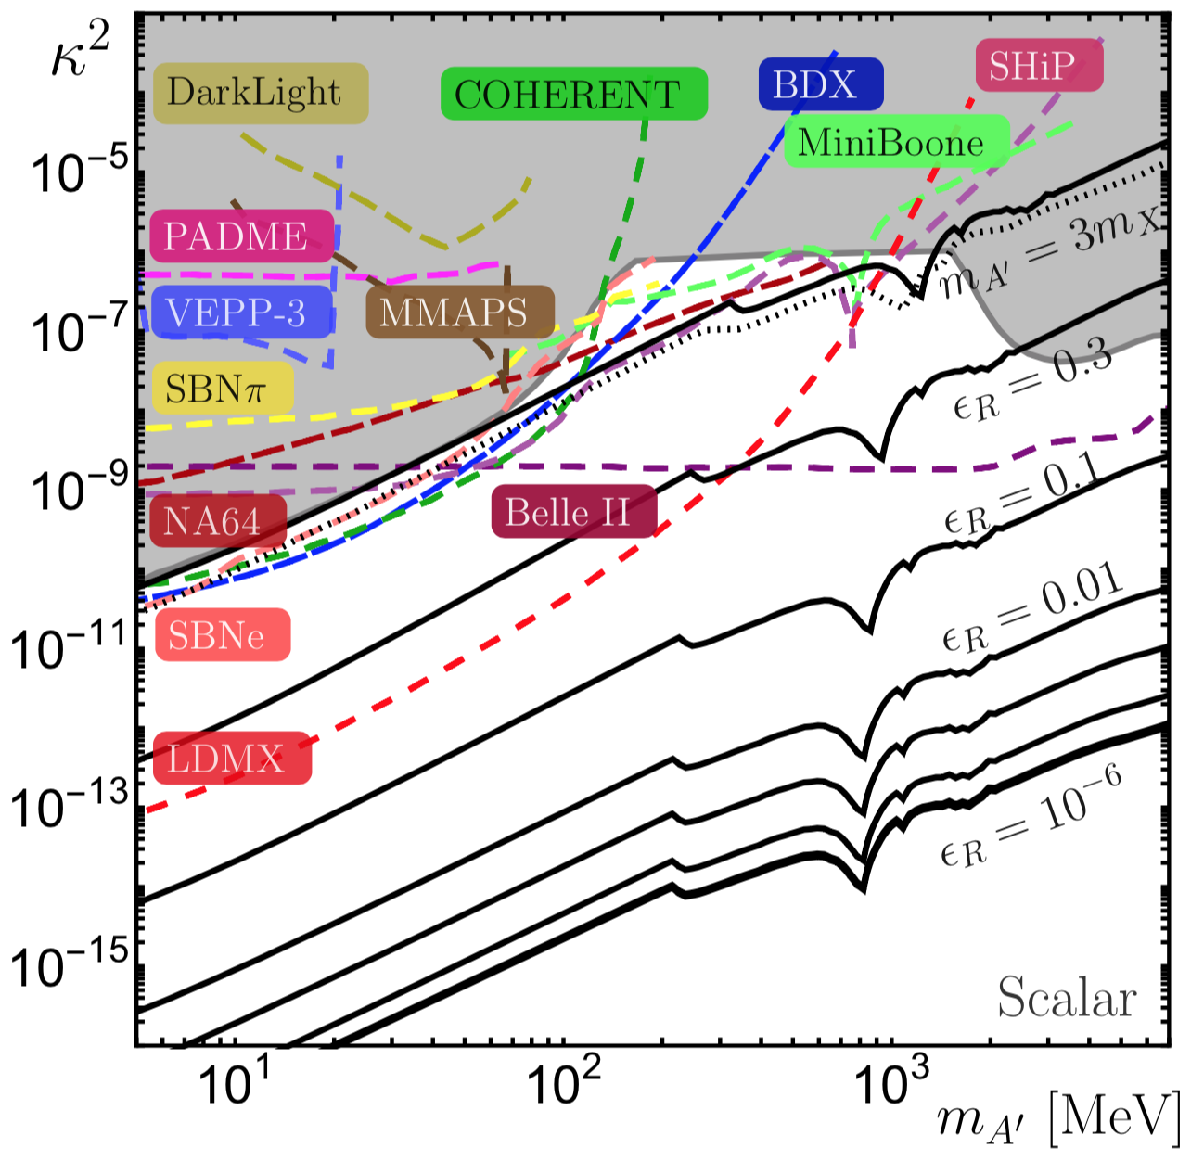
THERMAL TARGETS: VISIBLE DECAYS
DM
If m_{LLP} > 2m_{DM} , the LLP will typically decay invisibly to DM, and the most promising signal is missing mass or missing energy.
Again freeze out sets some thermal relic targets, but there is a new possibility: resonant annihilation for m_{LLP} ~ 2m_{DM} .
For dark photons decaying invisibly to DM, the thermal targets are again typically around
masses m ~10 MeV – manu GeV
couplings ε ~ 10⁻⁵ – 10⁻³
But for even 10% fine-tuning, e.g., m_{LLP} ~ 2.2 m_{DM}, the thermal targets can shift down to couplings ε ~ 10⁻⁷ – 10⁻⁵, beyond any proposed experiment.
LLP
DM
DM
DM
LLP
DM
DM
Feng, Smolinsky (2017)

Slide 26
SUMMARY
The next breakthrough in particle physics is likely to involve LLPs
  LLPs are ubiquitous in BSM theories, especially those with cosmological significance
  LLPs can be detected through a huge variety of signatures
  Many of these signals are truly spectacular – a few events can be a discovery
  For existing experiments, we have not yet reached the full LLP discovery potential
  And LLPs present many opportunities for new and clever experiments (and new and clever experimentalists!)

