Slide 1





SUSY2019, Texas A&M Corpus Christi, 22 May 2019
Jonathan Feng (UC Irvine) for the FASER Collaboration

Slide 2

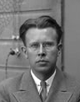
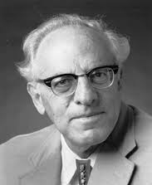
THE NEW PARTICLE LANDSCAPE
Particle
Colliders
Mass
MeV
GeV
TeV
1
Already
Discovered
Strongly Interacting
Heavy Particles
Interaction Strength
New Targets of Small Experiments
Traditional Targets
of Big Science
10⁻³
Weakly Interacting
Light Particles
Impossible to
Discover
10⁻⁶

Slide 3
THE NEW PARTICLE LANDSCAPE
Particle
Colliders
Mass
MeV
GeV
TeV
1
Already
Discovered
Strongly Interacting
Heavy Particles
Too Little to be
Dark Matter
Interaction Strength
10⁻³
Just Right: WIMPless and WIMP Miracles
Weakly Interacting
Light Particles
Impossible to
Discover
Too Much to be Dark Matter
10⁻⁶

Slide 4
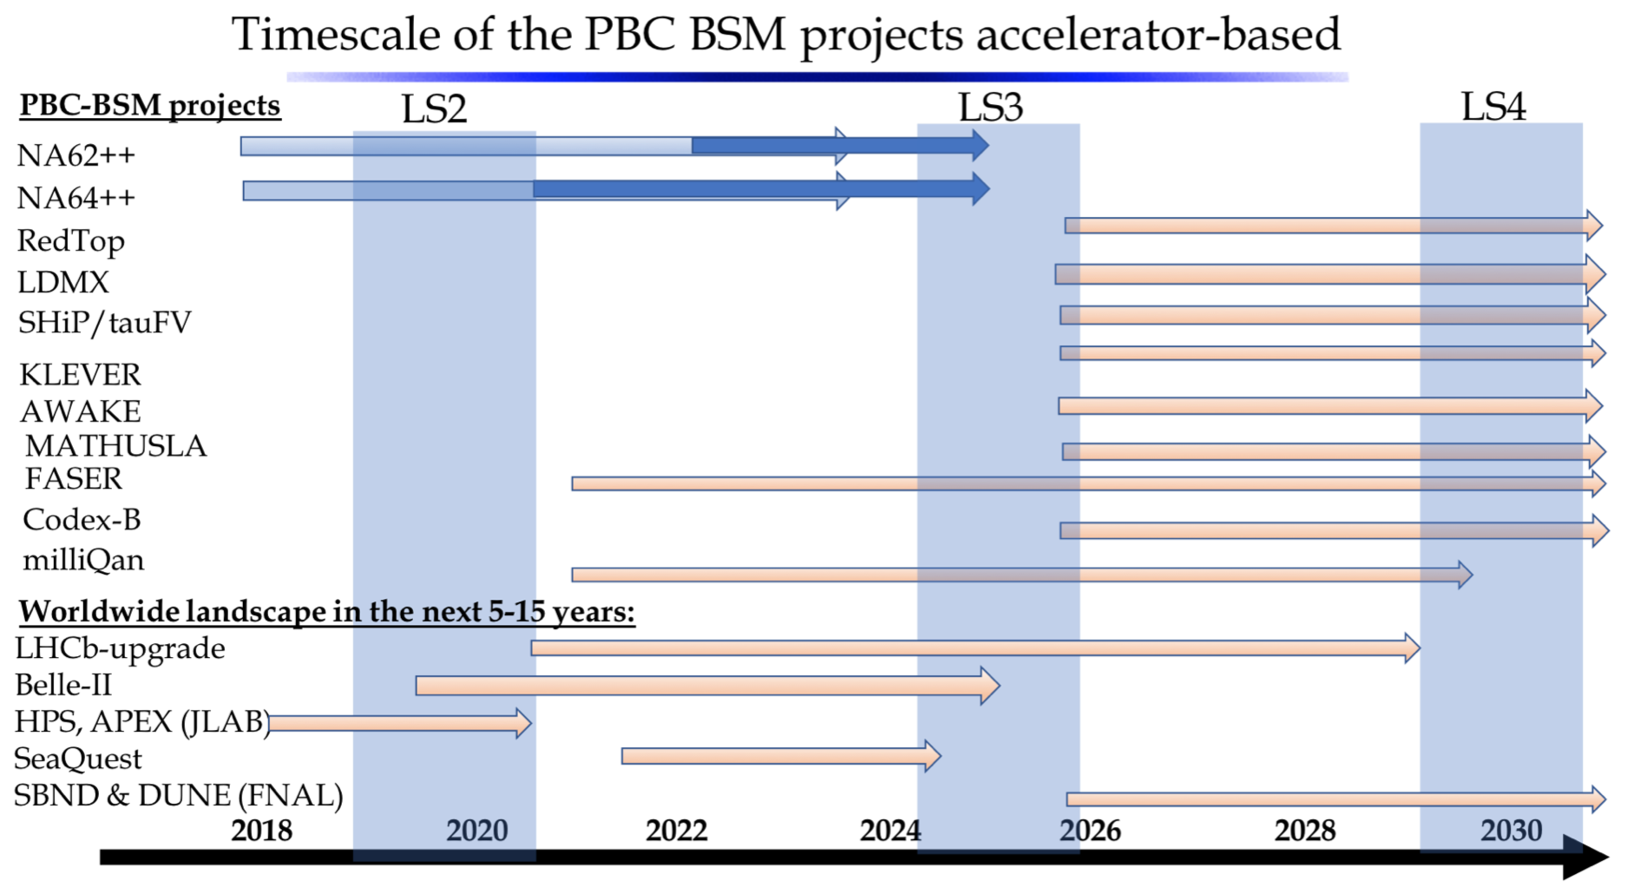
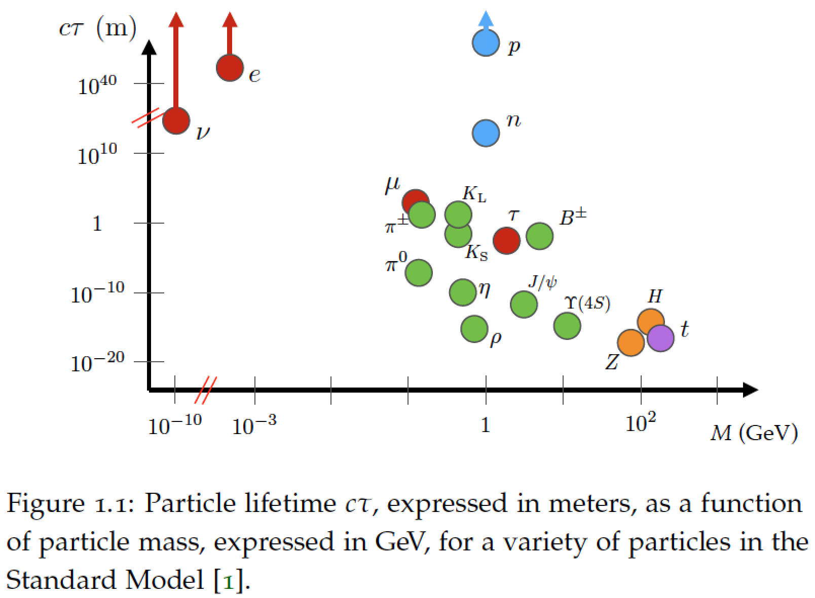
LOTS OF ACTIVITY
LLPs at LHC (1903.00497)
Physics Beyond Colliders (1901.09966)

Slide 5

THE IDEA
New physics searches at the LHC focus on high p_{T} . This is appropriate for heavy, strongly interacting particles
  σ ~ fb to pb → N_{events} ~ 10³ – 10⁶, produced ~isotropically
However, if new particles are light and weakly interacting, this may be completely misguided
  Light → we can produce them in π, K, D, B decays
  Weakly-interacting → need extremely large SM event rate to see them
Conclusion: we should go where the pions are: at low p_{T} along the beamline
  σ_{inel} ~ 100 mb → N_{events} ~ 10¹⁷, and 10% of the pions are produced within 2 mrad of the beamline

Slide 6
THE IDEA
Of course, we can’t put a reasonably-sized detector on the beamline near the IP – it would block the proton beams.
However, weakly-interacting particles also do not interact with matter and are long-lived, so we can place the detector O(100) m away along the “line of sight” after the beams curve
(100 m) (mrad) = 10 cm → particles are still highly collimated.
These simple considerations motivate a small, fast, cheap experiment placed a few 100 m downstream of ATLAS/CMS: FASER, the ForwArd Search ExpeRiment at the LHC.
Feng, Kling, Galon, Trojanowski (2017)

Slide 7
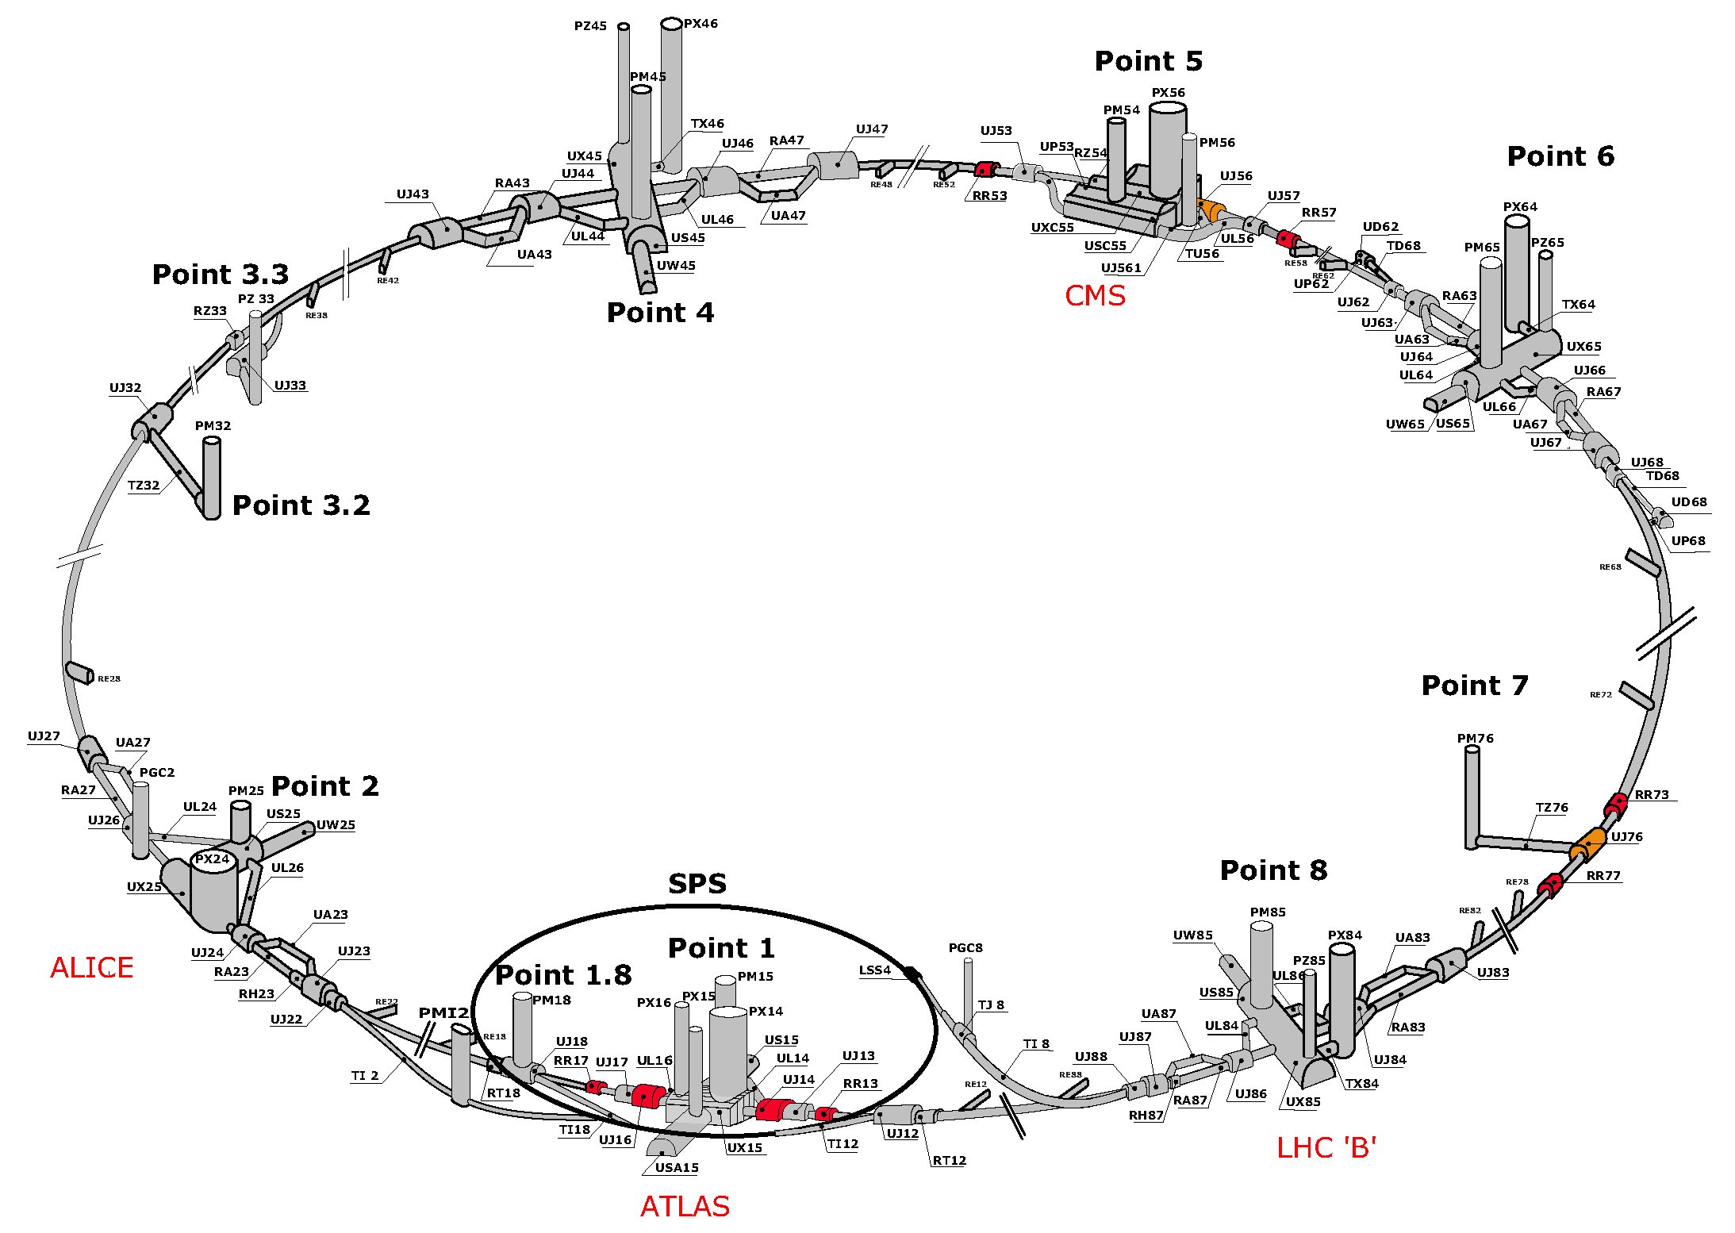
FASER LOCATION
FASER

Slide 8
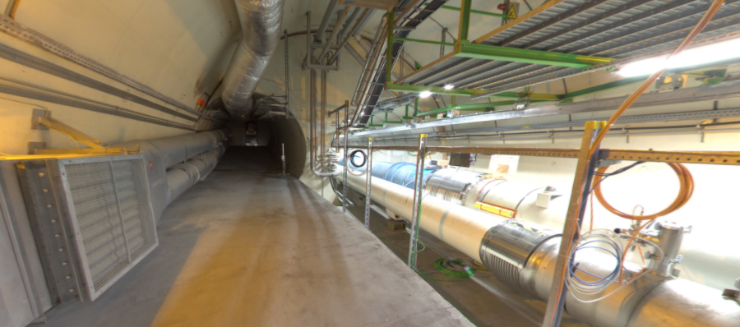
FASER LOCATION
The view looking west
New Physics
(Dark Sector)
LHC Beamline
(Visible Sector)

Slide 9
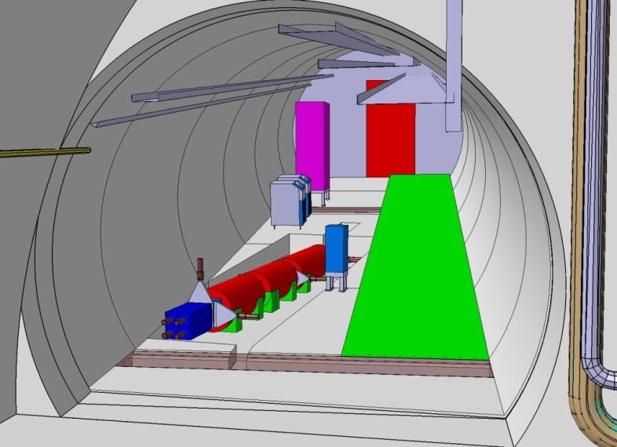
FASER IN TUNNEL TI12
The beam collision axis has been located to mm accuracy by the CERN survey department. To place FASER on this axis, a little digging is required to lower the floor by 46 cm.
The beam crossing angle also matters: if 285 (590) μrad, the “on axis” location at FASER shifts by 6 (12) cm.

Slide 10
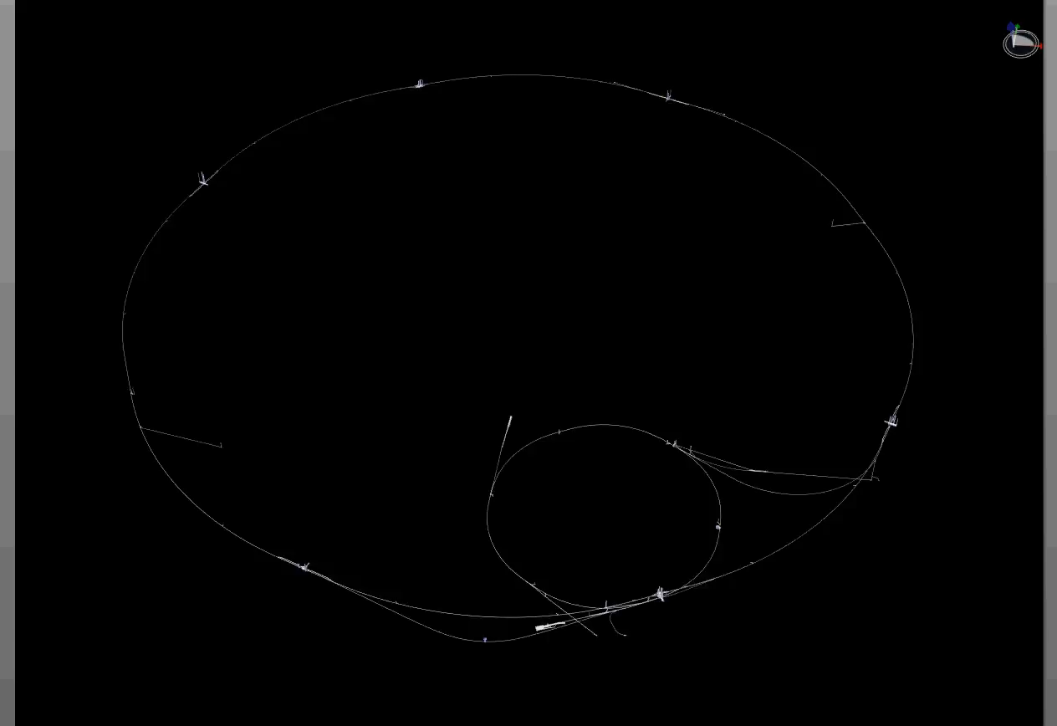
FASER LOCATION
Dougherty, CERN Integration (2019)

Slide 11
FASER TIMELINE
September 2017: First theory paper
July 2018: Submitted LOI to CERN LHCC
October 2018: Approval from ATLAS SCT and LHCb Collaborations for use of spare detector modules – thank you!
November 2018: Submitted Technical Proposal to LHCC
November – December 2018: Construction fully funded by the Heising-Simons and Simons Foundations
March 2019: FASER fully approved by CERN Research Board along with support for infrastructure costs
April 2019: 1st FASER Collaboration Meeting
2019-20: Install FASER in Long Shutdown 2
2021-23: Collect data in Run 3 with the potential to discover new particles starting with the first fb⁻¹ of luminosity

Slide 12



FASER COLLABORATION
The FASER Collaboration: 39 collaborators, 16 institutions, 8 countries
Henso Abreu (Technion), Claire Antel (Geneva), Akitaka Ariga (Bern), Tomoko Ariga (Kyushu/Bern), Jamie Boyd* (CERN), Dave Casper (UC Irvine), Franck Cadoux (Geneva), Xin Chen (Tsinghua), Andrea Coccaro (INFN), Candan Dozen (Tsinghua), Yannick Favre (Geneva), Jonathan Feng* (UC Irvine), Didier Ferrere (Geneva), Iftah Galon (Rutgers), Sergio Gonzalez-Sevilla (Geneva), Shih-Chieh Hsu (Washington), Zhen Hu (Tsinghua), Peppe Iacobucci (Geneva), Sune Jakobsen (CERN), Roland Jansky (Geneva), Enrique Kajomovitz (Technion), Felix Kling (UC Irvine), Susanne Kuehn (CERN), Lorne Levinson (Weizmann), Josh McFayden (CERN), Sam Meehan (CERN), Friedemann Neuhaus (Mainz), Hidetoshi Otono (Kyushu), Lorenzo Paolozzi (Geneva), Brian Petersen (CERN), Osamu Sato (Nagoya), Matthias Schott (Mainz), Anna Sfyrla (Geneva), Jordan Smolinsky (UC Irvine), Aaron Soffa (UC Irvine), Yosuke Takubo (KEK), Eric Torrence (Oregon), Sebastian Trojanowski (Sheffield), Gang Zhang (Tsinghua)

Slide 13
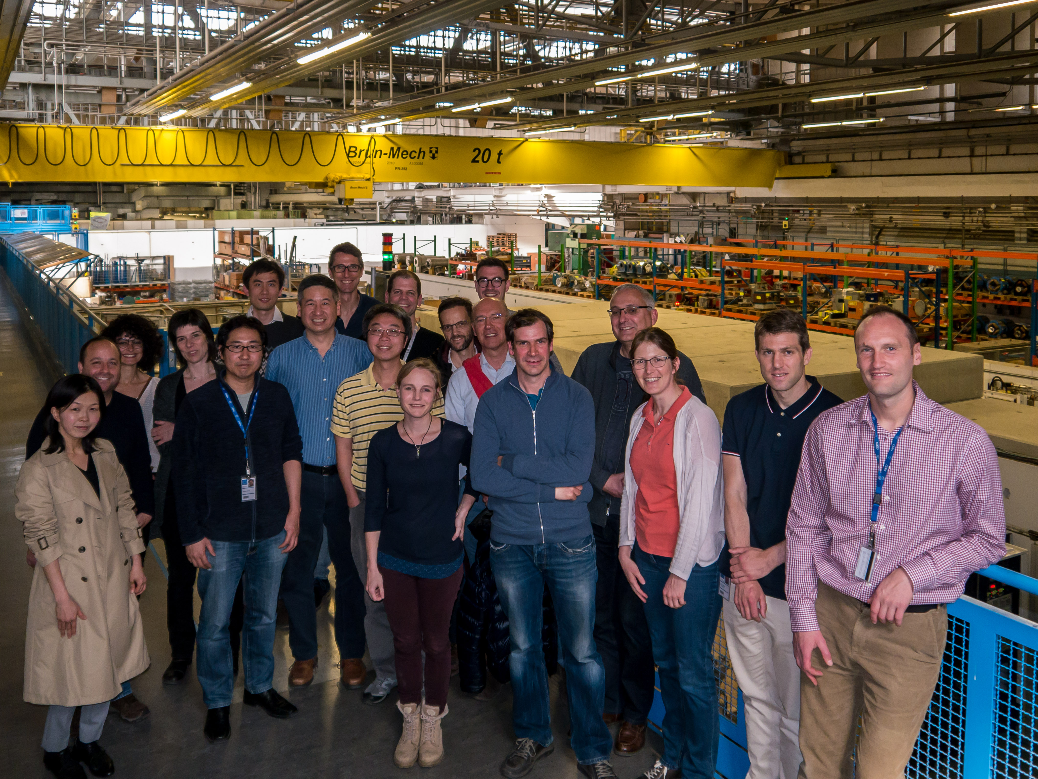
FIRST FASER COLLABORATION MEETING

Slide 14
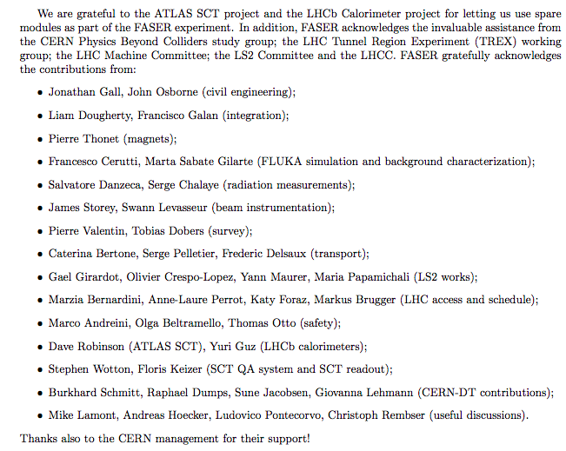
ACKNOWLEDGEMENTS
The FASER Collaboration has also received essential support from many others

Slide 15
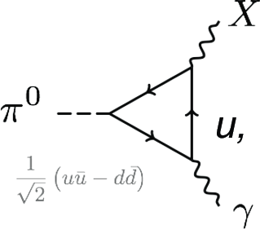
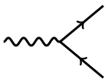
AN EXAMPLE: DARK PHOTONS
Fayet (1980); Okun (1982); Galison, Manohar (1984); Holdom (1986)
The dark photon is like the standard photon, but
  It is massive, with a mass m_{A’}
  Its couplings to SM particles are suppressed by a small coupling ε
It can be produced, for example, in pion decay:
It can decay to particle/anti-particle pairs:
A’
e⁺
ε
ε
A’
e⁻

Slide 16
DARK PHOTON SIGNAL RATES
Pions at the IP
Simulations now grounded in LHC data
Production is peaked at p_{T} ~ Λ_{QCD} ~ 250 MeV
Enormous event rates: N_{π}~10¹⁵ per bin
A’s at the IP
Production is peaked at p_{T} ~ Λ_{QCD} ~ 250 MeV
Rates highly suppressed by ε² ~ 10⁻¹⁰
But still N_{A’} ~ 10⁵ per bin, LHC can be a dark photon factory!
A’s decay in [480m, 483m]
Only highly boosted ~TeV A’s decay in FASER
Rates again suppressed by decay requirement
But still N_{A’} ~ 100 signal events, and almost all are within 20 cm of “on axis”
300 fb⁻¹

Slide 17
DARK PHOTON SENSITIVITY REACH
Combine π,η → A’γ, qq → qqA’, etc., plot N_{S}=3 (10 makes little difference)
FASER: R=10cm, L=1.5m, Run 3; FASER 2: R=1m, L=5m, HL-LHC
FASER probes new parameter space with just 1 fb⁻¹ starting in 2021
Without upgrade, HL-LHC extends (L*Volume) by factor of 3000; with possible upgrade to FASER 2, HL-LHC extends (L*Volume) by ~10⁶
FASER
FASER and FASER 2
_{FASER Collaboration (2018)}
Feng, Galon, Kling, Trojanowski (2017)

Slide 18
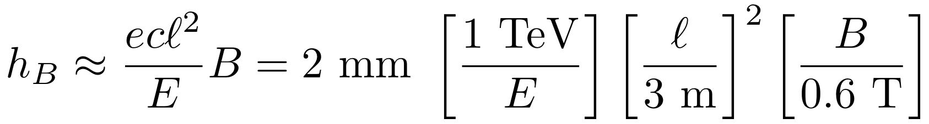
THE SIGNAL
A’
e⁺
e⁻
The signal is spectacular: 2 ~TeV-energy, oppositely-charged tracks originating in the decay volume and pointing back to IP
Initial scintillators: veto entering tracks
Tracker: detect charged tracks
Magnets: separate the 2 charged tracks sufficiently to resolve them in the tracker
Calorimeter: differentiate e from μ, detect γ, measure energy

Slide 19
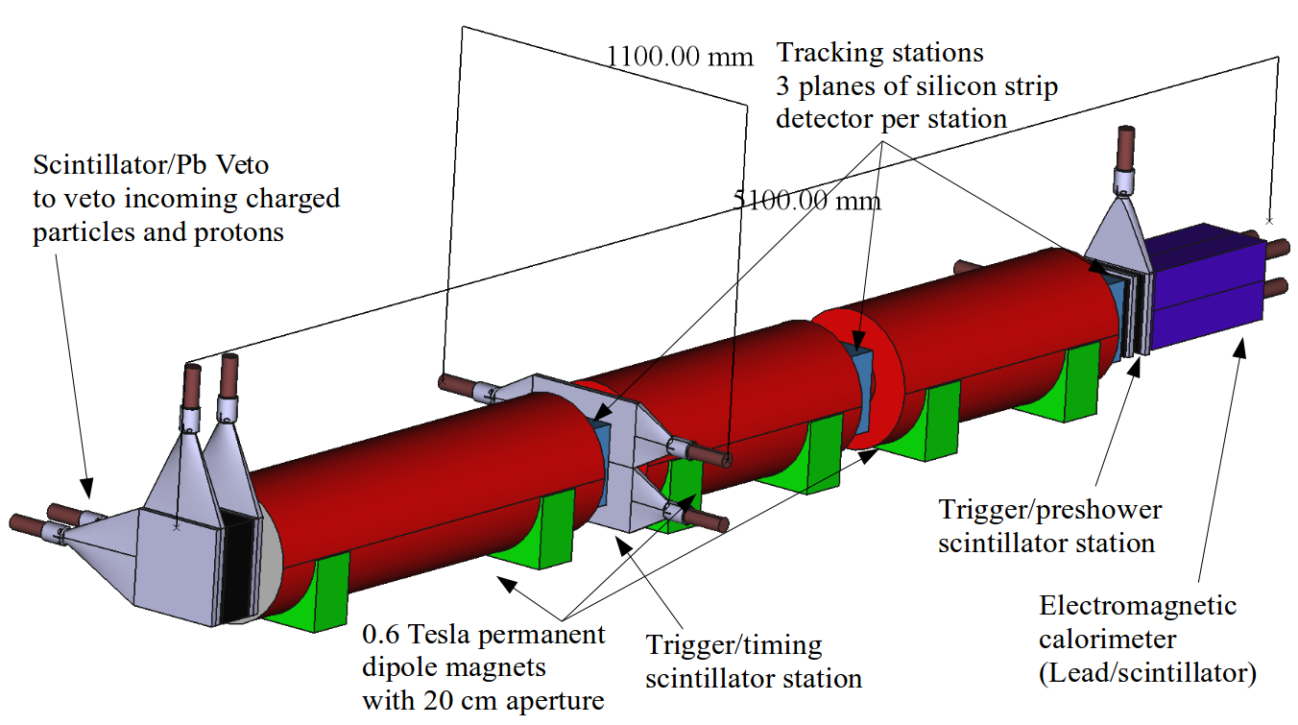
THE FASER DETECTOR
The entire detector is 5.5 m long. It consists of
  Scintillator veto
  1.5 m-long decay volume
  2 m-long spectrometer
  3 tracking stations
  EM calorimeter
Empty Decay Volume
particles from IP1

Slide 20
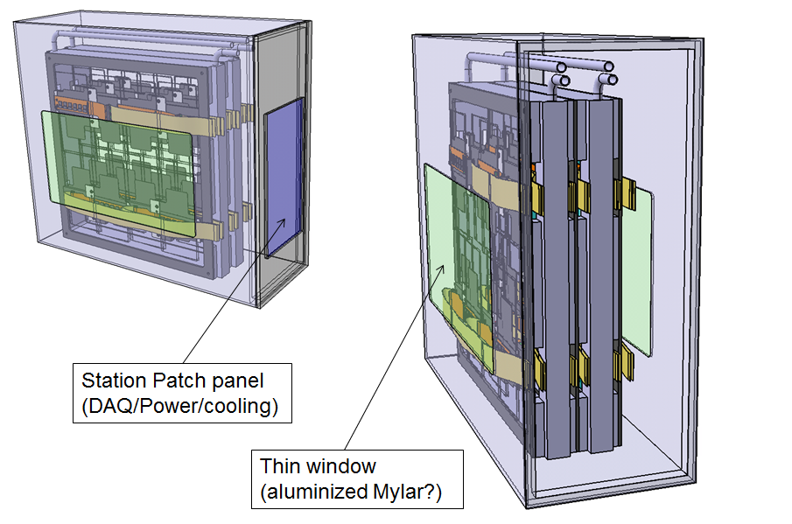
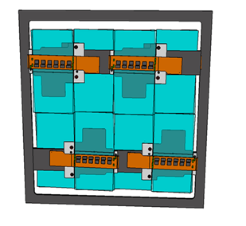
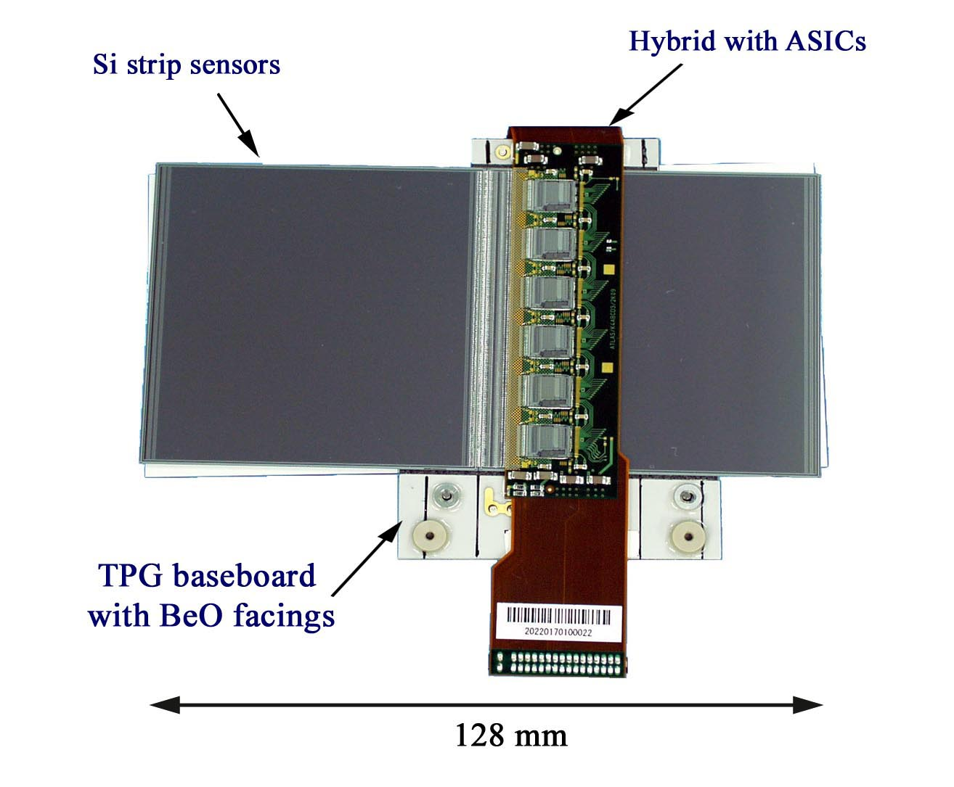
FASER TRACKER
The FASER tracker is composed of spare SCT modules from ATLAS. About 350 spares were prepared. They were not needed, and the ATLAS SCT collaboration generously allowed us to use 80 of them. QA now completed.
8 SCT modules make up a 24cm x 24cm tracking layer, 3 layers make up a tracking station, and FASER has 3 tracking stations.
SCT module
Tracking layer
Tracking station

Slide 21
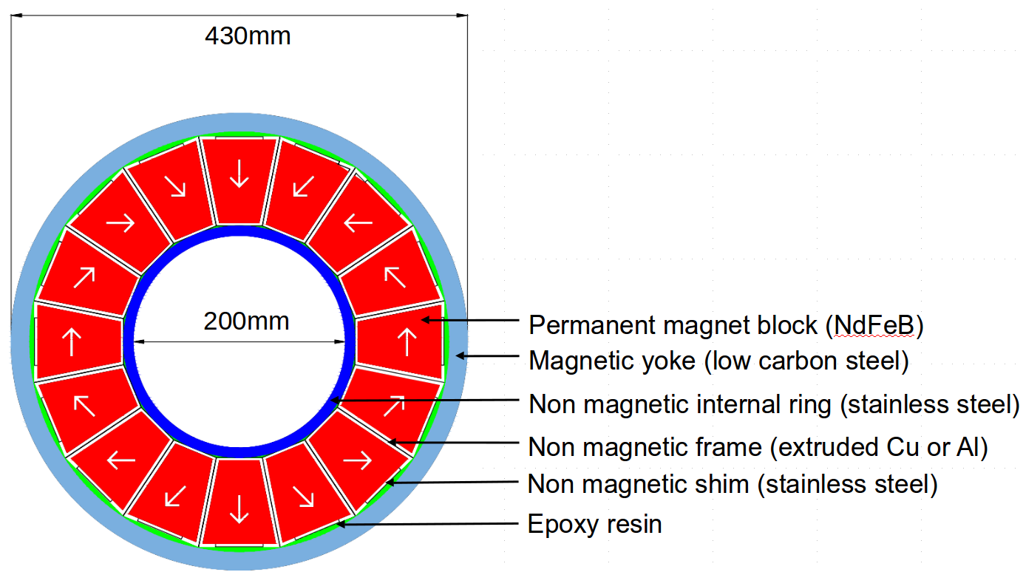
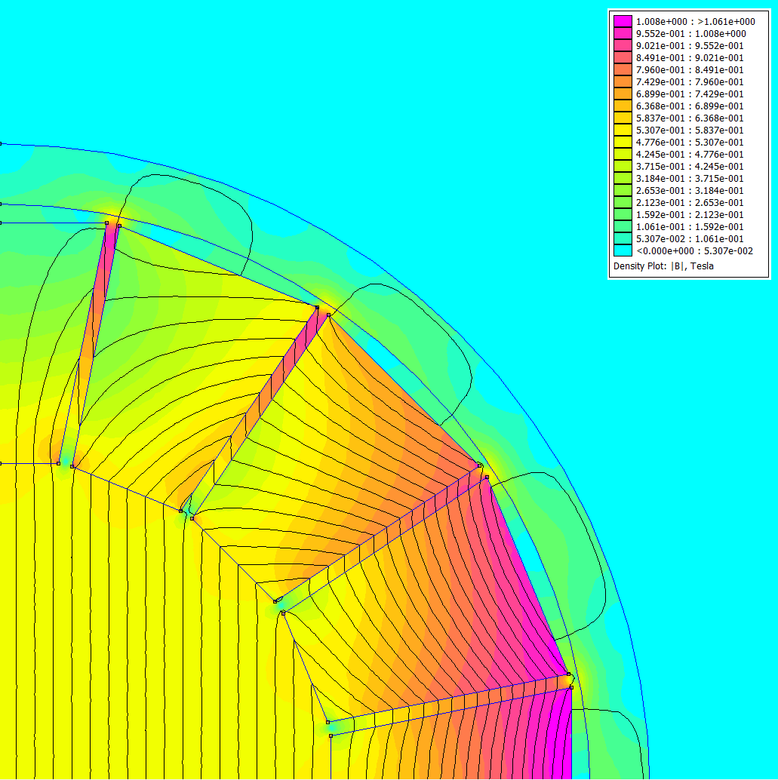
FASER MAGNETS
The FASER magnets are 0.6T SmCo permanent dipole magnets based on the Halbach array design.
  Thin enough to allow the LOS to pass through the magnet center with minimum lowering of the floor in TI12
  Minimizes needed services (power, cooling, etc.)
Design and construction by the CERN magnet group.

Slide 22
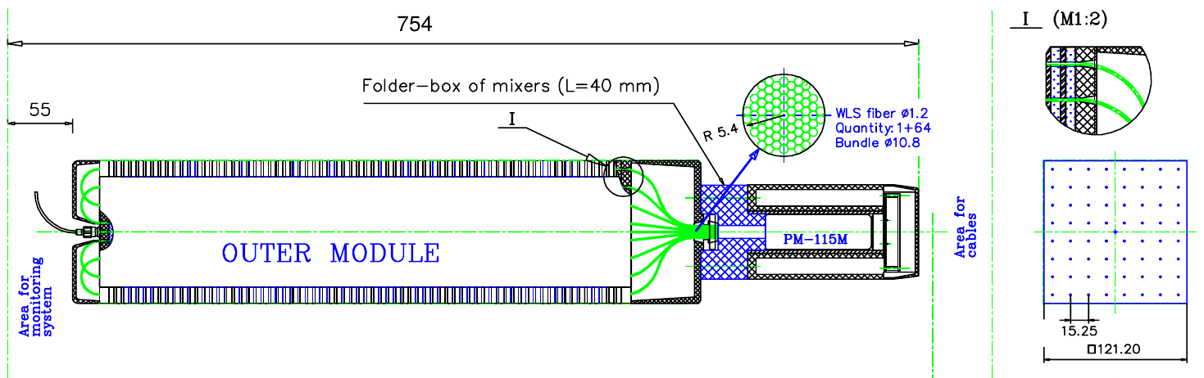
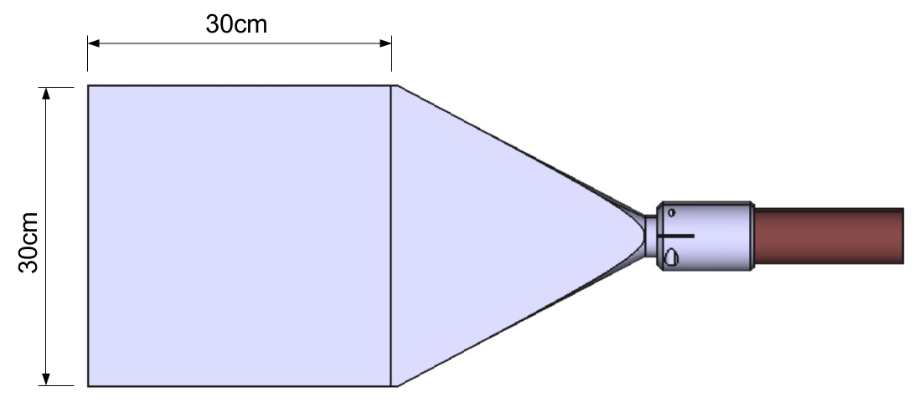
FASER CALORIMETER / SCINTILLATORS
PMT
light guide
The FASER ECAL consists of spare LHCb outer ECAL modules, which the LHCb Collaboration generously allowed us to use.
  Dimensions: 12cm x 12cm – 75cm long (25 radiation lengths)
  66 layers of lead/scintillator, light out by wavelength shifting fibres, and read out by PMT (no longitudinal shower information)
  Provides ~1% energy resolution for 1 TeV electrons
  QA now complete
Scintillators used for vetoing charged particles entering the decay volume and for triggering, to be produced by the CERN scintillator lab.

Slide 23
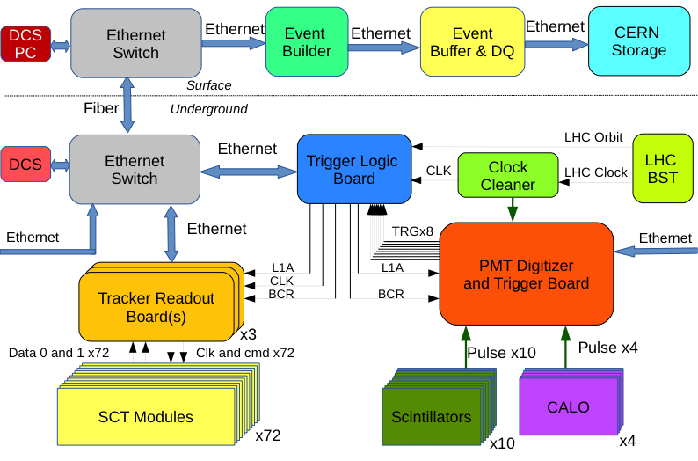
FASER TDAQ
Trigger rate expected to be ~600 Hz, dominated by muons from IP.
Trigger will be an OR of triggers from scintillators and from the ECAL.
Largely independent of ATLAS; only need to know bunch crossing time and ATLAS luminosity for off-line analysis.

Slide 24
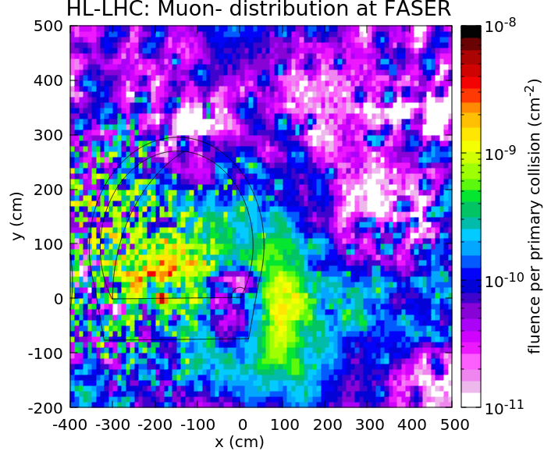
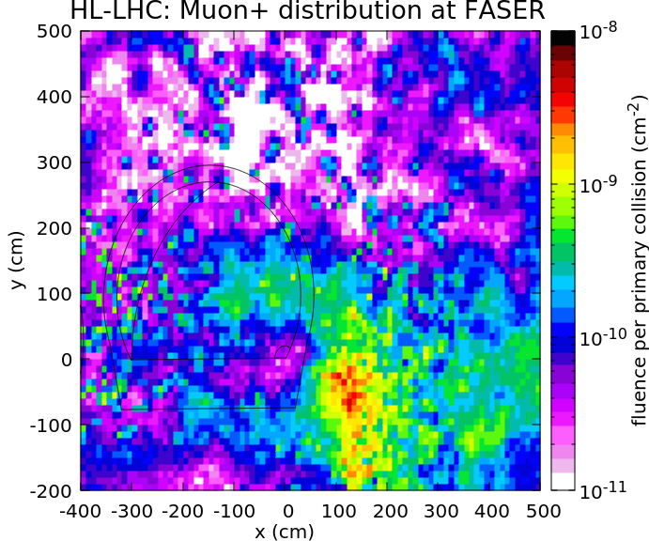
BACKGROUNDS
FASER’s location is very quiet – the only SM particles that get through from the IP are muons and neutrinos, and FASER is (fortuitously) in a remarkably quiet spot for muons.
A high-energy muon that brems off a photon or an EM or hadronic jet is a leading background if the incoming muon is not vetoed.
FASER
But assuming each of 4 scintillator layers gives an uncorrelated 10⁻² veto suppression for muons entering the detector, the resulting backgrounds are negligible.
FLUKA study: Sabate-Gilarte, Cerutti, Tsinganis (2018)

Slide 25
MORE BACKGROUNDS
The FLUKA study also finds that beam-gas background (from “beam 2” traveling in the other direction) is also negligible.
The dispersion of the machine means activity near FASER from diffractive proton losses is very small. It would be much higher 50m along LHC in either direction. The radiation level is low (<10⁻² Gy/year), which is encouraging for detector electronics.
Sabate-Gilarte, Cerutti, Tsinganis (2018)

Slide 26
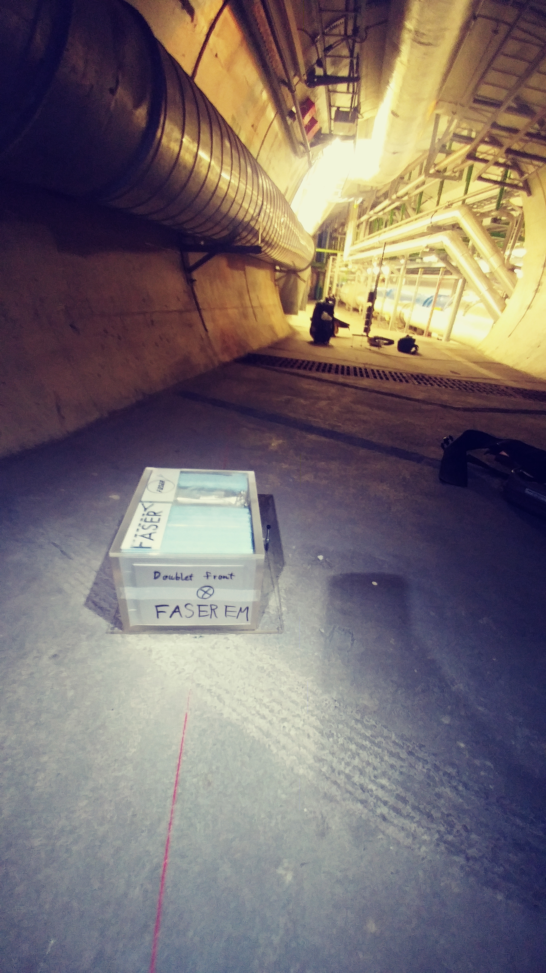
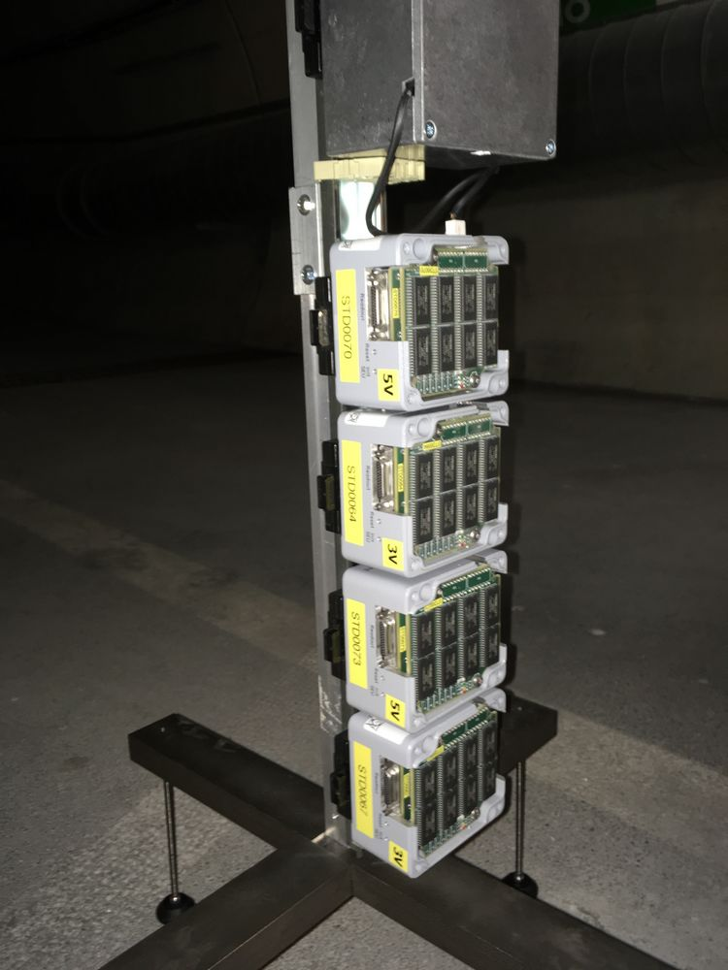
IN SITU MEASUREMENTS
To validate the FLUKA study, in 2018 we installed emulsion detectors in (weeklong) Technical Stops 1 and 2 to provide the first in situ measurements at the FASER site.
The emulsion detector results are within measurement accuracy (factor of 2) of the FLUKA predictions.
A BatMon (battery-operated radiation monitor) was also installed. Results for low-energy radiation are also promisingly low.

Slide 27
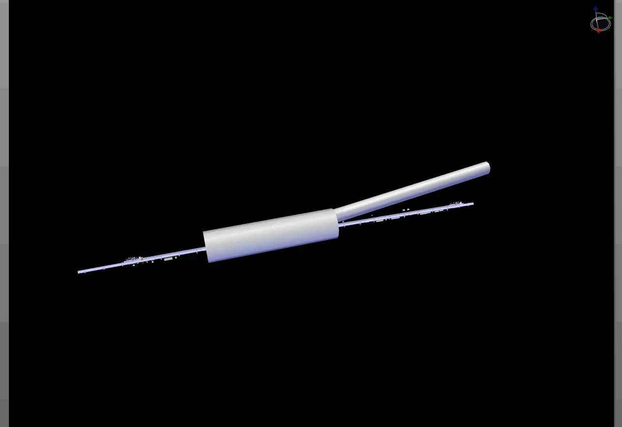
FASER INSTALLATION
Dougherty, CERN Integration (2019)

Slide 28
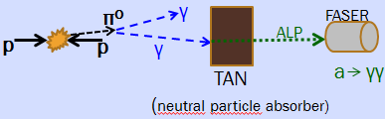
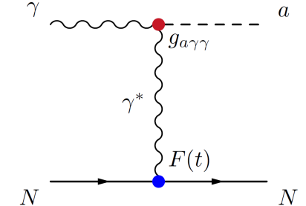
MORE FASER PHYSICS: ALPS WITH PHOTONS
FASER can also discover ALPs and other LLPs produced not at the IP, but further downstream
For example: ~TeV photon from IP collides with TA(X)N ~140 m downstream (between beams), creates Axion-Like Particle, which decays through a → γγ, detected in FASER calorimeters
“Photon beam dump” or “light shining through walls”
FASER, N_{S}=3

Slide 29
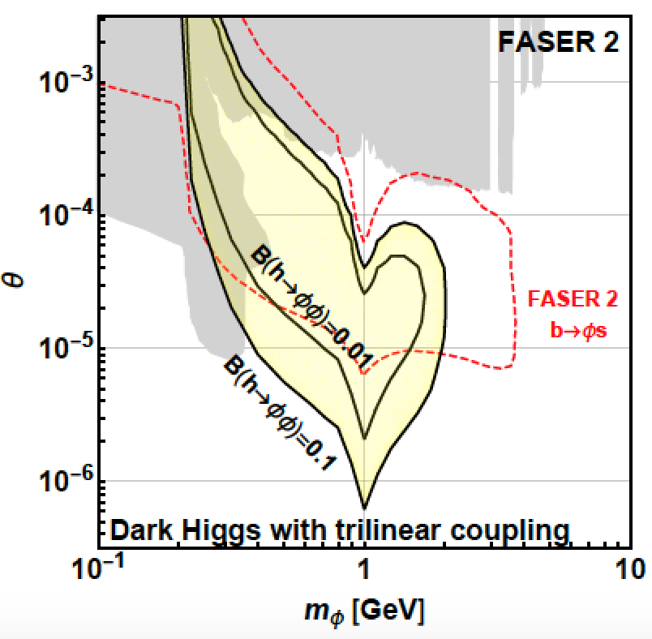
MORE FASER PHYSICS: DARK HIGGS BOSONS
SINGLE PRODUCTION
Dark Higgs produced in B decays. N_{B}/N_{π}~10⁻² at FASER
(cf. N_{B}/N_{π}~10⁻⁷ at beam dumps)
Reach is complementary to other experiments
DOUBLE PRODUCTION
Probes hφφ trilinear coupling
Complementary to probes of exotic Higgs decays h→φφ
FASER probes SM Higgs properties, exotic decays!
φ
Feng, Galon, Kling, Trojanowski (2017)

Slide 30
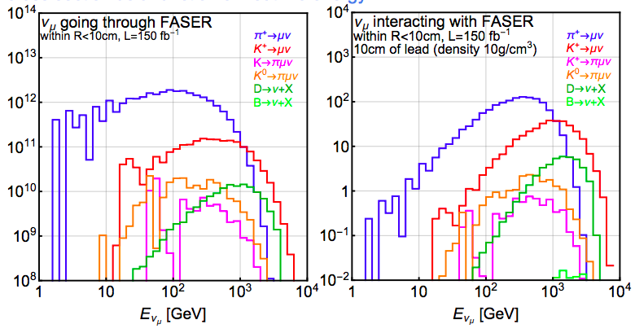
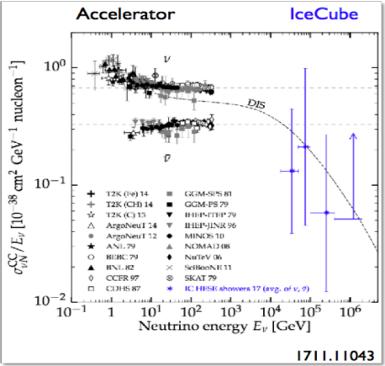
MORE FASER PHYSICS: NEUTRINO PHYSICS
Huge flux of high-energy neutrinos through FASER could allow for the 1st detection of an LHC neutrino and other interesting measurements.
E.g., ν_{μ} CC cross section in unexplored region E>400 GeV, ν_{τ} events.
In fact, we are already looking for neutrino interactions in the 30 kg emulsion detectors installed in TI12 in 2018. In 12.8 fb⁻¹ of data, we expect ~10 ν_{μ} events.

Slide 31
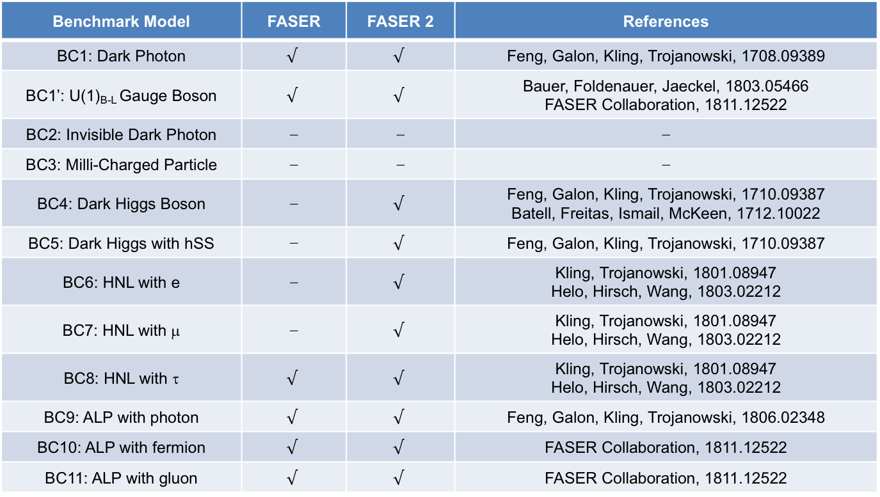
PHYSICS SUMMARY
FASER and FASER 2 have full physics programs: can discover all candidates with renormalizable couplings (dark photon, dark Higgs, HNL); ALPs with all types of couplings (γ, f, g); and many other examples.
Benchmark Model | FASER | FASER 2 | References
BC1: Dark Photon | $$√$$ | $$√$$ | Feng, Galon, Kling, Trojanowski, 1708.09389
BC1’: U(1)_{B-L} Gauge Boson | $$√$$ | $$√$$ | Bauer, Foldenauer, Jaeckel, 1803.05466 FASER Collaboration, 1811.12522
BC2: Invisible Dark Photon | ⎼ | ⎼ | ⎼
BC3: Milli-Charged Particle | ⎼ | ⎼ | ⎼
BC4: Dark Higgs Boson | ⎼ | $$√$$ | Feng, Galon, Kling, Trojanowski, 1710.09387 Batell, Freitas, Ismail, McKeen, 1712.10022
BC5: Dark Higgs with hSS | ⎼ | $$√$$ | Feng, Galon, Kling, Trojanowski, 1710.09387
BC6: HNL with e | ⎼ | $$√$$ | Kling, Trojanowski, 1801.08947 Helo, Hirsch, Wang, 1803.02212
BC7: HNL with μ | ⎼ | $$√$$ | Kling, Trojanowski, 1801.08947 Helo, Hirsch, Wang, 1803.02212
BC8: HNL with τ | $$√$$ | $$√$$ | Kling, Trojanowski, 1801.08947 Helo, Hirsch, Wang, 1803.02212
BC9: ALP with photon | $$√$$ | $$√$$ | Feng, Galon, Kling, Trojanowski, 1806.02348
BC10: ALP with fermion | $$√$$ | $$√$$ | FASER Collaboration, 1811.12522
BC11: ALP with gluon | $$√$$ | $$√$$ | FASER Collaboration, 1811.12522

Slide 32
SUMMARY AND OUTLOOK
The possibility of new light and weakly-interacting particles opens up exciting opportunities for small, cheap, and fast search experiments.
FASER: “Tabletop” experiment, ~$2M, 18 months from idea to beginning of construction
Current: Install FASER in LS2 (2019-20) for Run 3 (2021-23, 150 fb⁻¹)
    Decay volume: R = 10 cm, L = 1.5 m. Total length is 5.5 m.
    Discovery potential starting with the 1st fb⁻¹ of luminosity in 2021.
Future: Install FASER 2 in LS3 (2023-25) for HL-LHC (2026-35, 3 ab⁻¹)
    Decay volume: R = 1 m, L = 5 m. Requires extension of existing tunnel (widening of UJ12 or UJ18 areas).
    Extends FASER’s initial 1 fb⁻¹ sensitivity (L*Vol) by factor of ~10⁶, probes full physics program: dark photons, B-L, ALPs, dark Higgs, HNLs, SM neutrinos, etc.
More info: https://twiki.cern.ch/twiki/bin/viewauth/FASER/WebHome.

