Slide 1
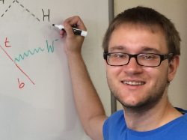
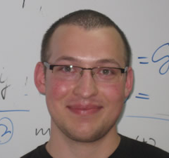
FASER:
FORWARD SEARCH EXPERIMENT AT THE LHC
UCLA
Jonathan Feng, UC Irvine
Based on 1708.09389 and 1710.09387 with
21 November 2017
Iftah Galon
Felix Kling
Sebastian Trojanowski

Slide 2
LAMPPOST LANDSCAPE
1
Already
Discovered
Strongly Interacting
Heavy Particles
10⁻³
Coupling Strength
Weakly Interacting
Light Particles
Impossible to
Discover
10⁻⁶
MeV
GeV
TeV
Mass

Slide 3
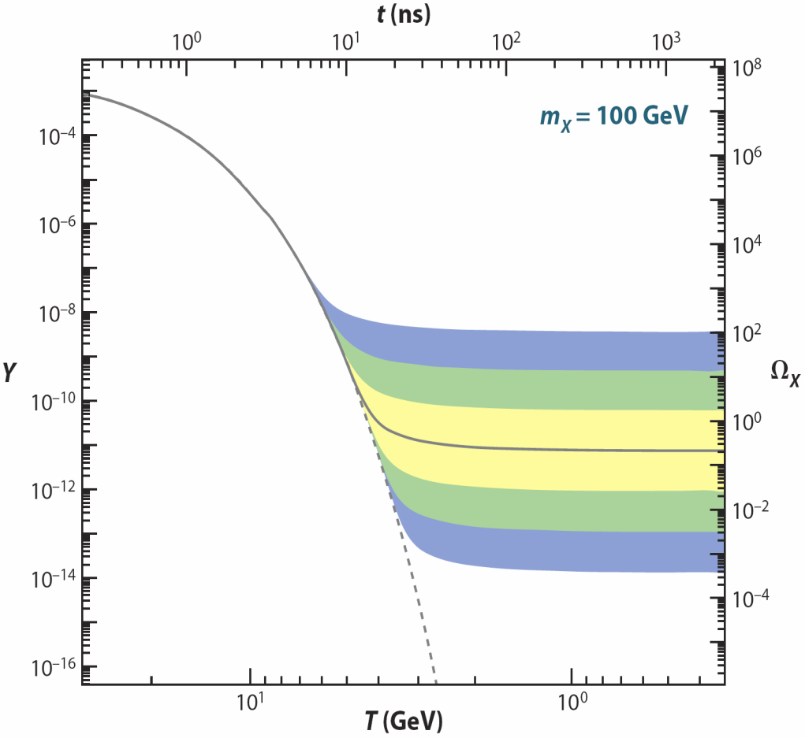
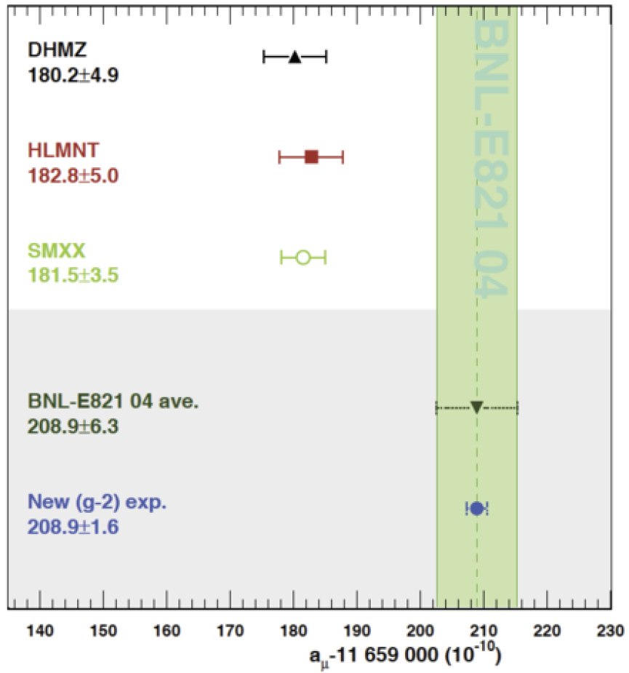
STRONGLY INTERACTING, HEAVY PARTICLES
The traditional target for new physics searches: the high energy frontier
Motivations: WIMP miracle, gauge hierarchy, anomalies (muon g-2, ...)
Hagiwara et al. (2017)
new
particle
Higgs
Higgs

Slide 4
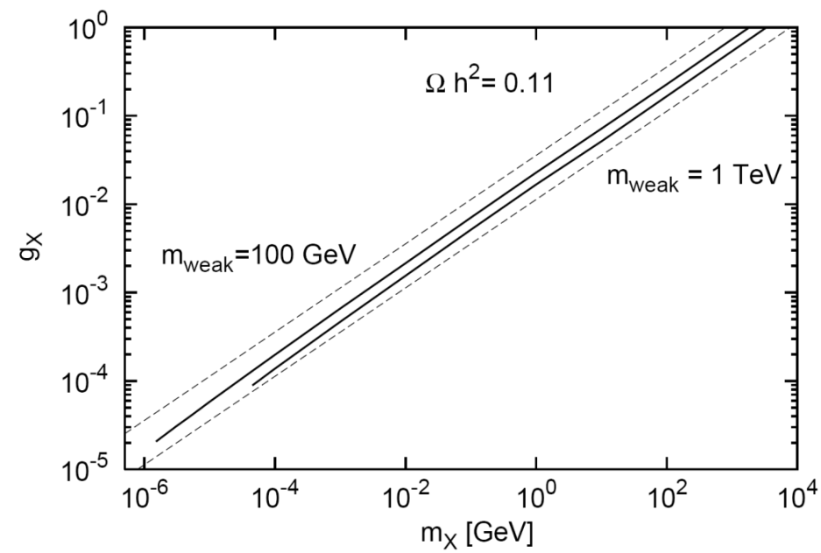
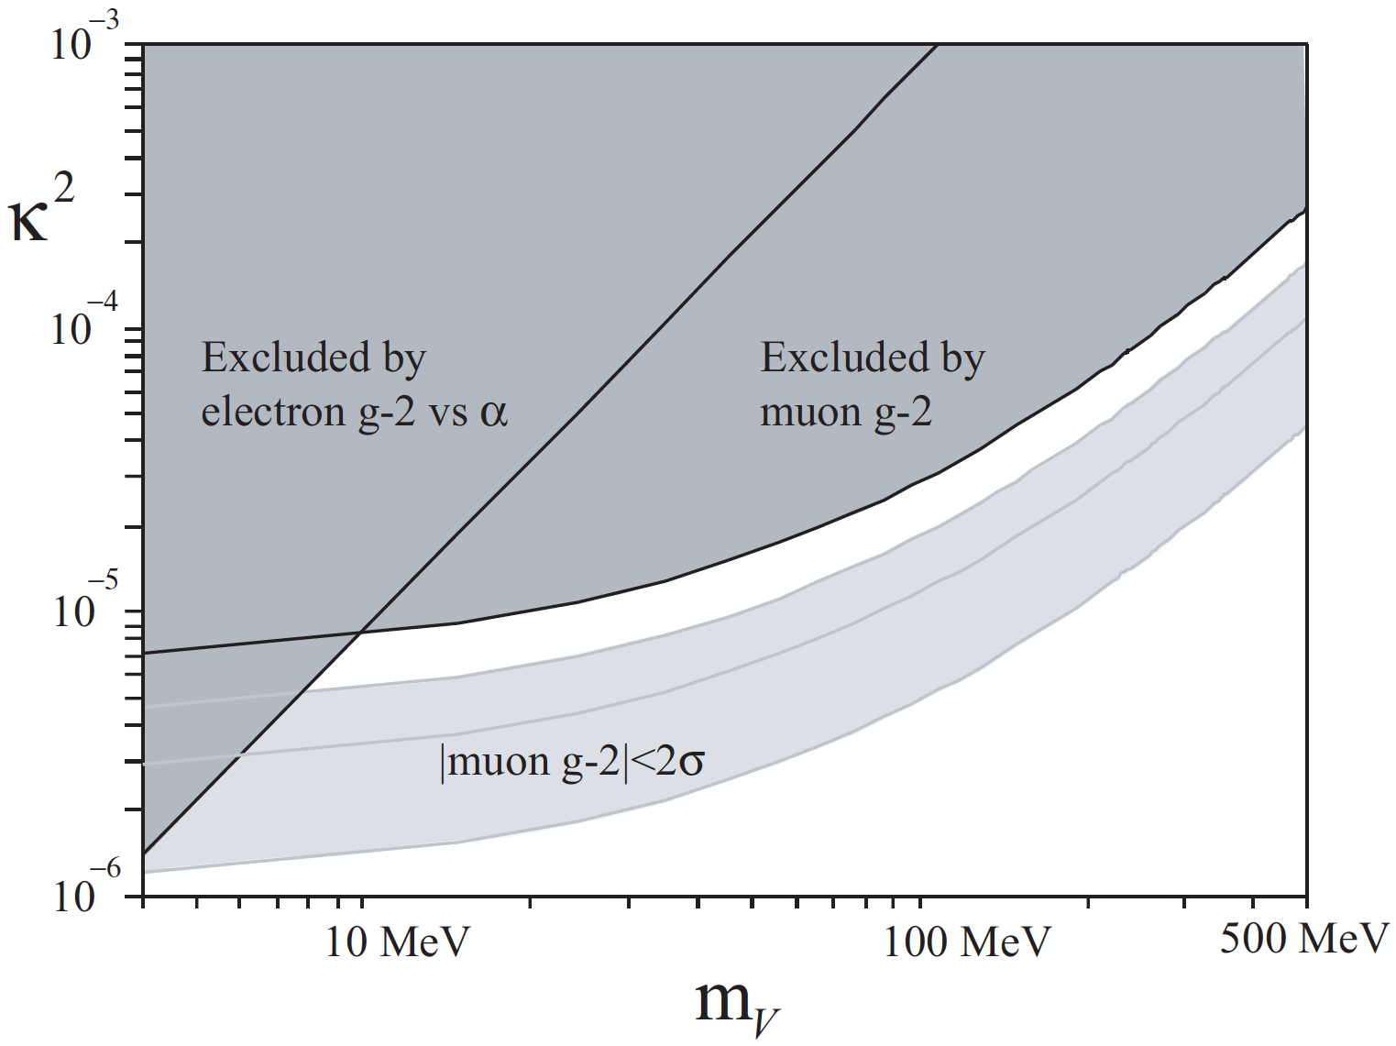
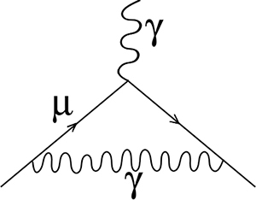
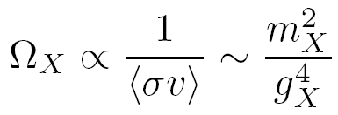
WEAKLY INTERACTING, LIGHT PARTICLES
A new target for new physics searches
Similar motivations: WIMPless miracle, anomalies (muon g-2, ⁸Be, ...)
Feng, Kumar (2008)
Feng, Tu, Yu (2008)
_{WIMPs}
Fayet (2007); Pospelov (2008)
Feng, Fornal, Galon, Gardner
Tait, Tanedo, Smolinsky (2016)
A’,
_{WIMPless DM}
⁸Be
Weakly interacting, light particles can be thermal relic dark matter, resolve anomalies, open new possibilities for experimental detection

Slide 5
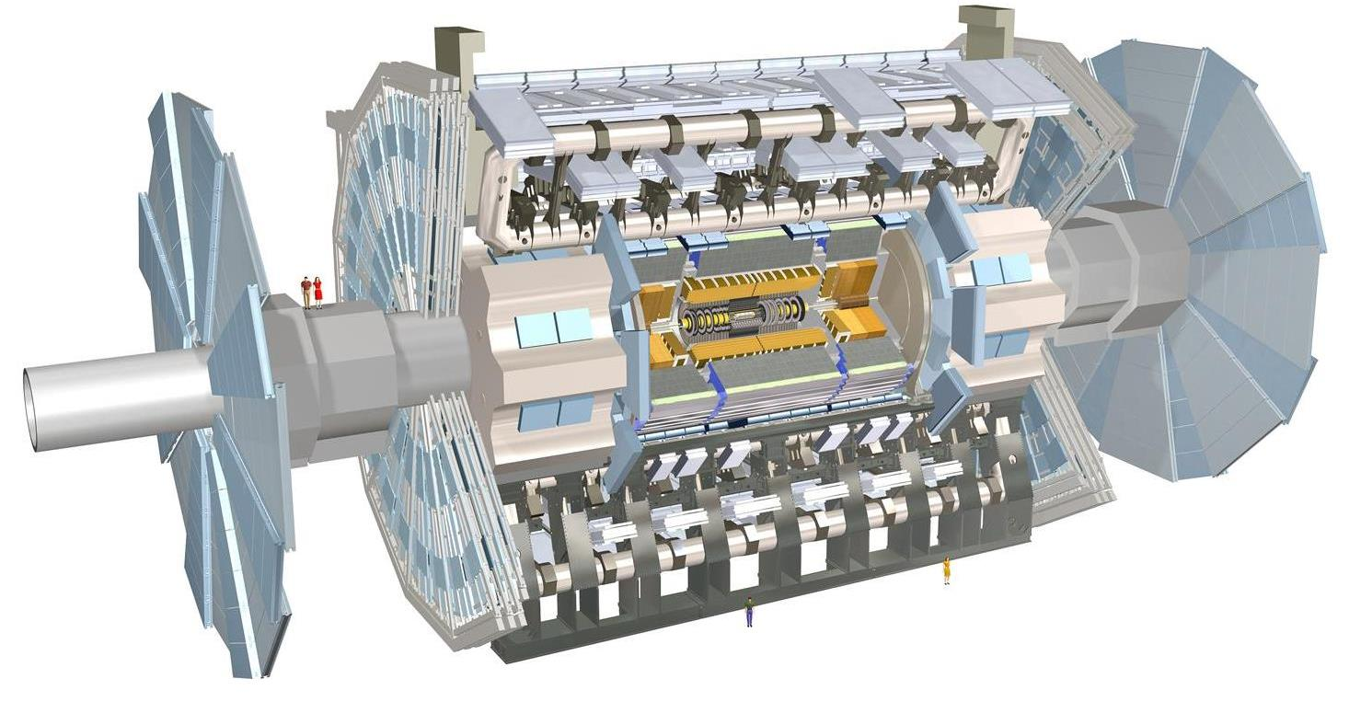
THE IDEA
New physics searches at the LHC focus on high p_{T}. This is appropriate for heavy, strongly interacting particles
σ ~ fb to pb → N ~ 10³ – 10⁶, produced ~isotropically
However, if new particles are light and weakly interacting, this may be completely misguided. Instead should exploit
σ_{inel} ~ 100 mb → N ~ 10¹⁷, θ ~ Λ_{QCD} / E ~ 250 MeV / TeV ~ mrad
We propose a small, inexpensive experiment, FASER, to be placed in the very forward region of ATLAS/CMS, a few 100m downstream of the IP, and analyze its discovery potential

Slide 6
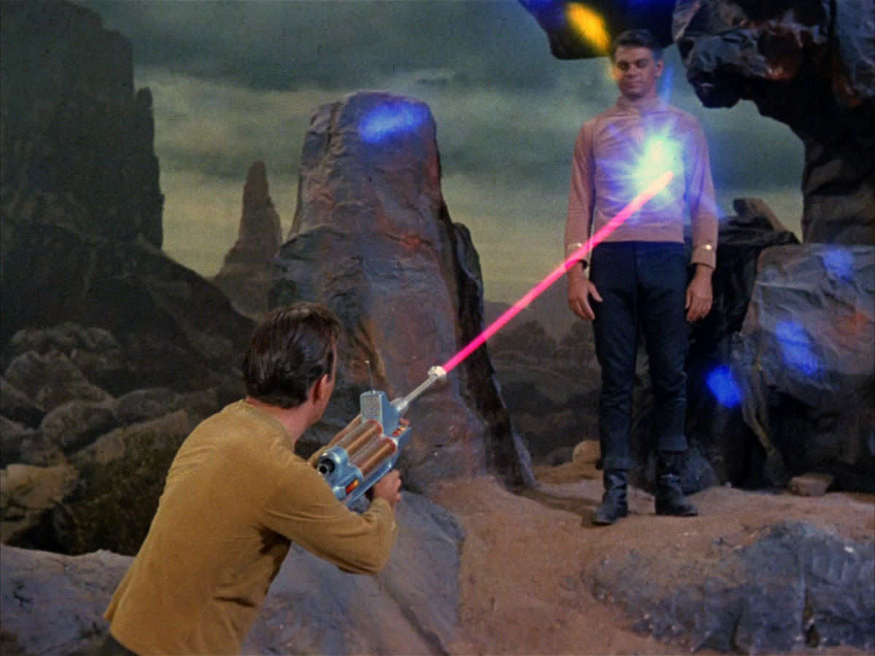
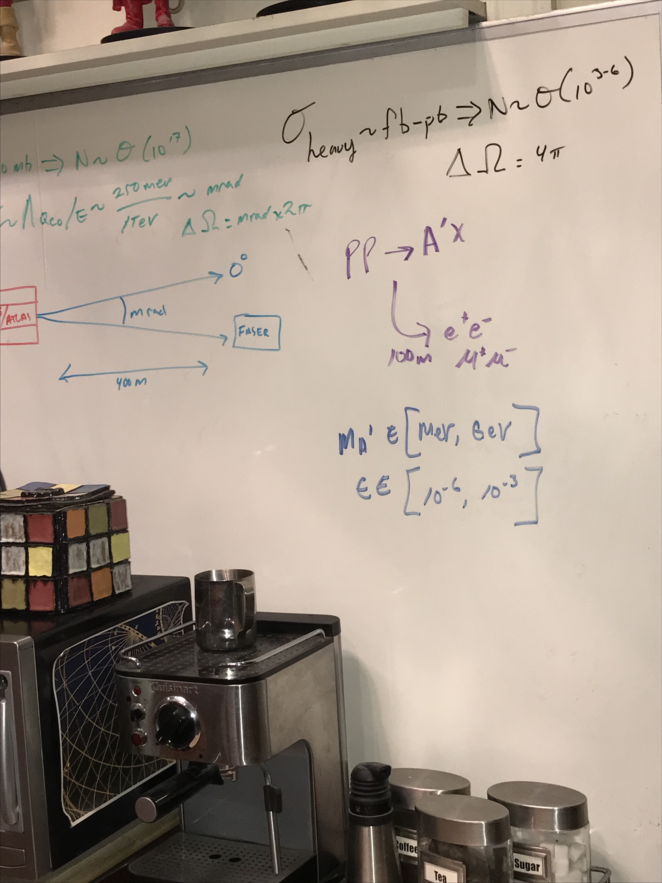
THE LIFETIME FRONTIER
Increasing worldwide interest. At CERN: LHCb, NA62, SHiP, MilliQan, MATHUSLA, Codex-b, ...
FASER: “The acronym recalls another marvelous instrument that harnessed highly collimated particles and was used to explore strange new worlds.”

Slide 7
OUTLINE
Very Forward Region Infrastructure
New Physics Example: Dark Photons
Signal
Backgrounds
Results
New Physics Example: Dark Higgs Bosons
Summary and Outlook

Slide 8
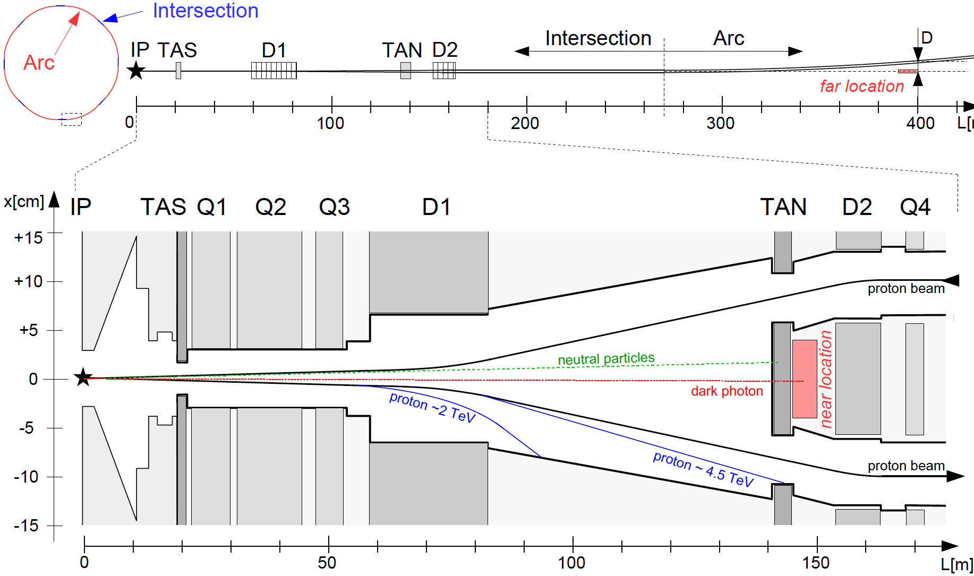
VERY FORWARD REGION INFRASTRUCTURE
LHC ring consists of 8 straight 545 m intersections and 8 curved arcs. The infrastructure common to IP1 and IP5 (also have CASTOR, LHCf, ALFA, TOTEM, etc.):
TAS: front quadrupole
absorbers (θ > 0.85 mrad)
D1: dipole magnet, splits
beams, deflects μ, p, ...
TAN: neutral target
absorbers (n, γ)
Feng, Galon, Kling, Trojanowski (2017)
Note the extreme difference in longitudinal and transverse scales

Slide 9
FASER LOCATIONS
We want to place FASER along the beam collision axis
Far location: 400 m from IP, after beams curve, 2.6 m from the beams
Near location: 150 m, after TAN, between the beams
ATLAS/CMS beams cross at 285 μrad in vertical/horizontal plane → shifts far (near) location by 5.7 (2.1) cm
HL-LHC: 285→590 μrad, TAN→TAXN moves forward 10 m,... We assume current parameters, FASER is exactly on-axis

Slide 10
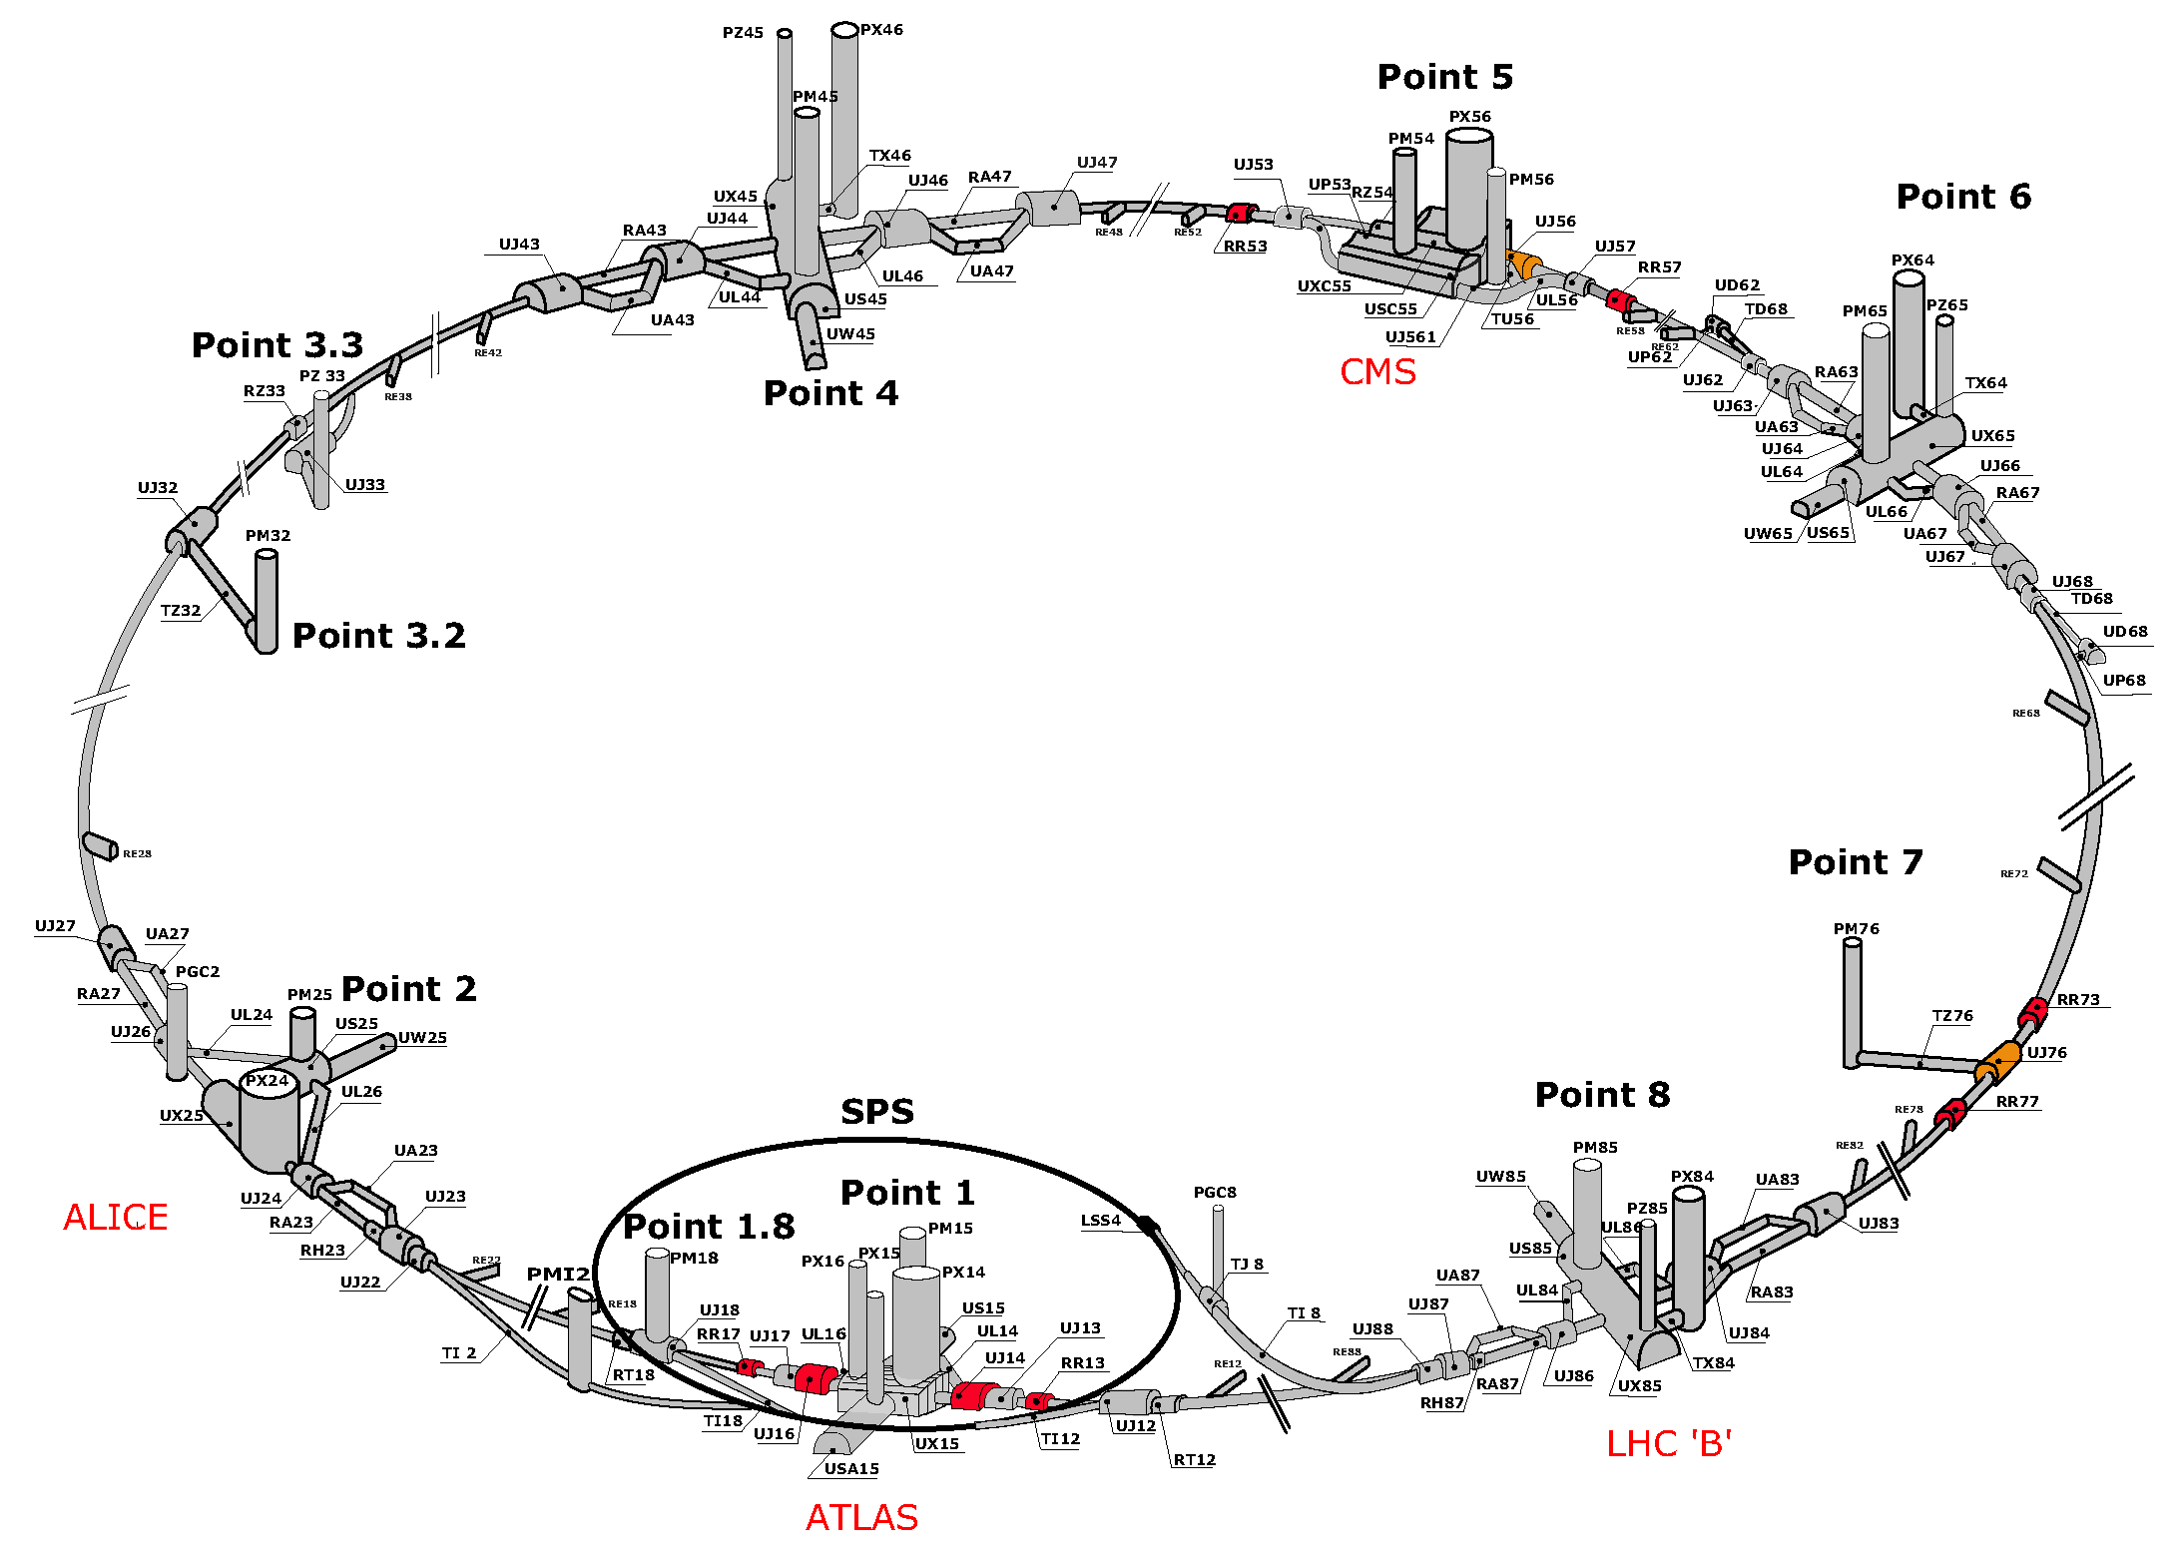
LHC RING

Slide 11
SERVICE TUNNEL TI18
TI18
TI18

Slide 12
DARK PHOTONS
Dark matter is our most solid evidence for new particles. In recent years, the idea of dark matter has been generalized to dark sectors
Dark sectors motivate light, weakly coupled particles (WIMPless miracle, SIMP miracle, small-scale structure, ..)
A prominent example: vector portal, leading to dark photons
The resulting theory contains a new gauge boson A’ with mass m_{A’} and εQ_{f} couplings to SM fermions f
SM
Hidden
U(1)

Slide 13
DARK PHOTON PROPERTIES
Produced in meson decays, e.g.,
, ,
and also through dark bremsstrahlung pp → p A’ X and direct QCD processes qq → A’ X (requires pdfs at low Q², x)
Travels long distances through matter without interacting, decays mainly to e⁺e⁻ (and μ⁺μ⁻ for m_{A’} > 2 m_{μ} )
The essential tension: low ε → low event rate, high ε → decays too fast. Is there a happy middle ground?

Slide 14
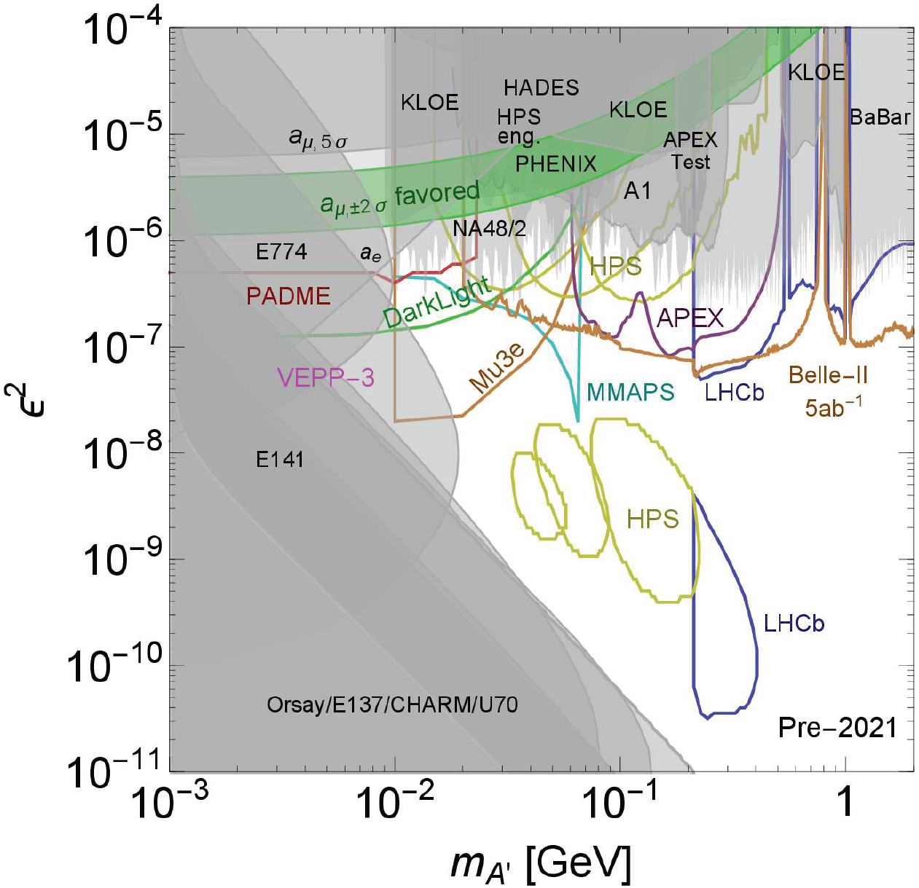
DARK PHOTON STATUS
Lots of unconstrained parameter space with
m_{A’} > 10 MeV
~ 10⁻⁶ – 10⁻³
E.g., 2 representative model points: (m_{A’}, ε) =
(20 MeV, 10⁻⁴)
(100 MeV, 10⁻⁵)
Cosmic Visions White Paper (2017)

Slide 15
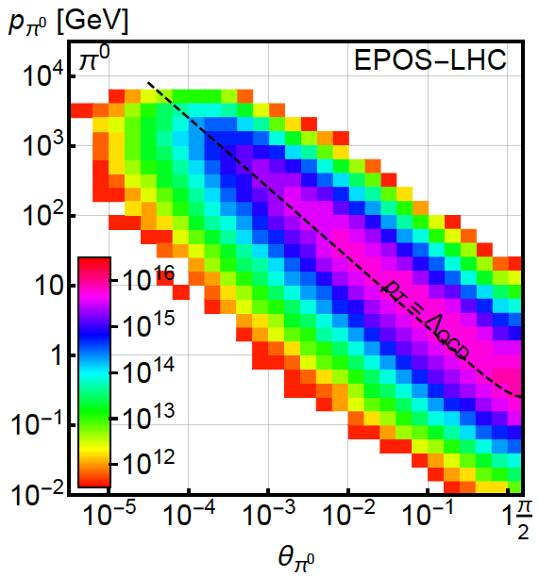
PION PRODUCTION AT THE LHC
Forward particle production simulations and models have been greatly constrained by LHC data
EPOS-LHC, SIBYLL 2.3, QGSJETII-04 agree very well
Enormous event rates (σ_{inel}~70 mb, N_{inel}~10¹⁷), production is peaked at p_{T} ~ Λ_{QCD} , but with significant width
300 fb⁻¹

Slide 16
DARK PHOTON PRODUCTION
Consider π⁰ decay, η decay, dark bremsstrahlung
Results for 1st model point: (m_{A’}, ε) = (20 MeV, 10⁻⁴)
From π⁰ → γ A’, E_{A’} ~ E_{π} / 2 ( no surprise)
But note rates: even after ε² suppression, N_{A’} ~ 10⁸ ; LHC may be a dark photon factory!

Slide 17
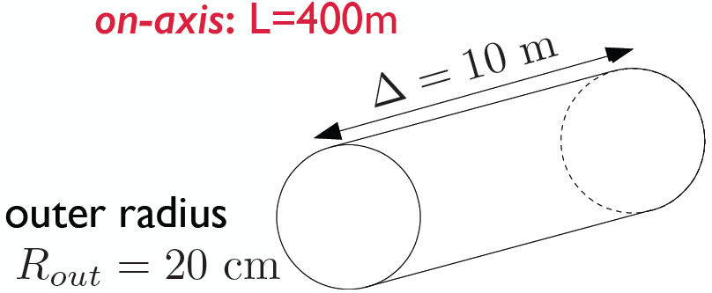
DARK PHOTONS IN THE FAR DETECTOR
Now require dark photons to decay in the far detector: consider cylindrical detector with volume ~1 m²
Only the highest energy A’s survive, but there are still many of them, and they are highly collimated

Slide 18
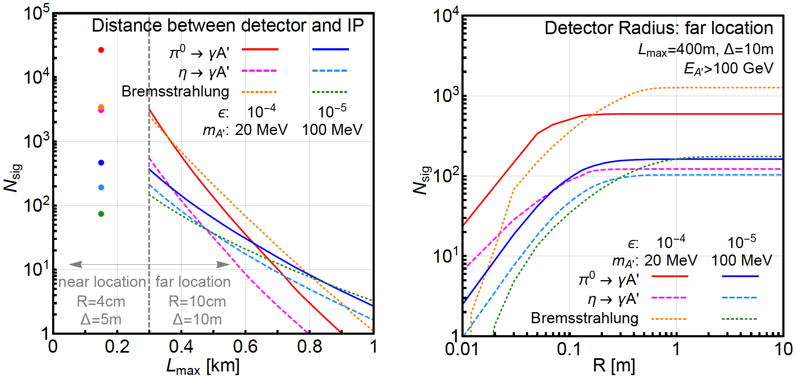
SIGNAL DEPENDENCE ON DETECTOR SPECS
For dark photons, moving the detector closer helps
At the far location, R = 20 cm captures almost all the A’

Slide 19
DARK PHOTONS IN THE NEAR DETECTOR
Now require dark photons to decay in the near detector: detector volume only ~0.1 m² !
150m
5 m
4 cm
Moving the detector closer → more dark photons decay in the detector, even though the near detector is much smaller

Slide 20
BACKGROUNDS
The signal is two simultaneous, opposite-sign, highly-energetic (E > 500 GeV) charged particles that start in the detector at a vertex and point back to IP → a tracker-based technology
The opening angle is θ_{ee} ~ m_{A’} / E ~ 10 μrad. After traveling ~1 m, this leads to 10 μm separation, too small to resolve, so we need a small magnetic field
Many backgrounds are eliminated simply by virtue of FASER’s location. Cosmic ray background is negligible, charged particles from IP are bent away by D1 magnet
Leading backgrounds: neutrino-induced backgrounds and beam-induced backgrounds

Slide 21
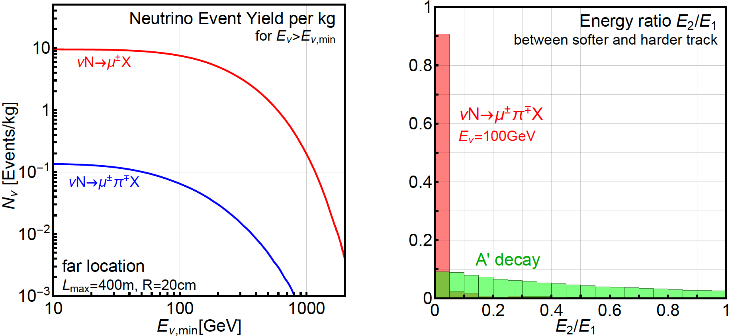
NEUTRINO-INDUCED BACKGROUNDS
If π⁺ → μν before D1 magnet, resulting neutrinos can propagate into FASER, interact through
Coincident single tracks that fake double tracks: negligible
Second process eliminated by requiring no other activity, tracks start in the detector and have high and symmetric energies
ν → K_{S,L} → 2 charged tracks also negligible with same cuts
GENIE

Slide 22
BEAM-INDUCED BACKGROUNDS: FAR LOCATION
Depends on exact configuration. At 400m, line of sight is 2.6 m from beam, outside tunnel. With sufficient shielding, hadrons, electrons are stopped, only muons are relevant
A 2013 ATLAS study based on 2011 data can be used to determine muon background at far location. Requiring E_{μ} > 100 GeV, the flux is
The muon arrival times correspond to bunch crossings. Accounting for the bunch structure and assuming a timing resolution of 100 (10) ps, get ~0.1 (~0.01) coincident μ⁺μ⁻ pairs in 1 LHC year
No significant backgrounds identified for far location

Slide 23
BEAM-INDUCED BACKGROUNDS: NEAR LOCATION
Far more challenging environment
Dedicated simulation using MARS/FLUKA/etc. should be used, but we can use published results to get an estimate
Mokhov, Rakhno, Kerby, Strait (2003)
Hadrons and electrons absorbed in the TAN
Coincident muon background ~10⁸ per LHC year. Can be greatly suppressed by requiring tracks to start in the detector and reconstruct a vertex, and requiring high and symmetric energies
Electron background greatly reduced if electrons can be distinguished from muons

Slide 24
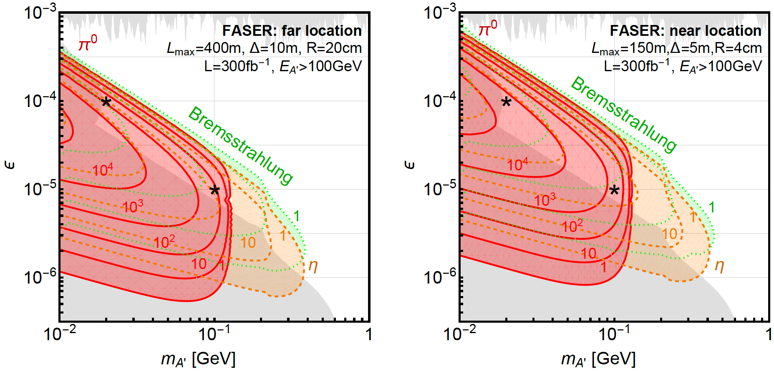
DARK PHOTON EVENT RATES
Up to 10⁵ dark photons arrive in FASER in 300 fb⁻¹ in currently unconstrained regions of dark photon parameter space

Slide 25
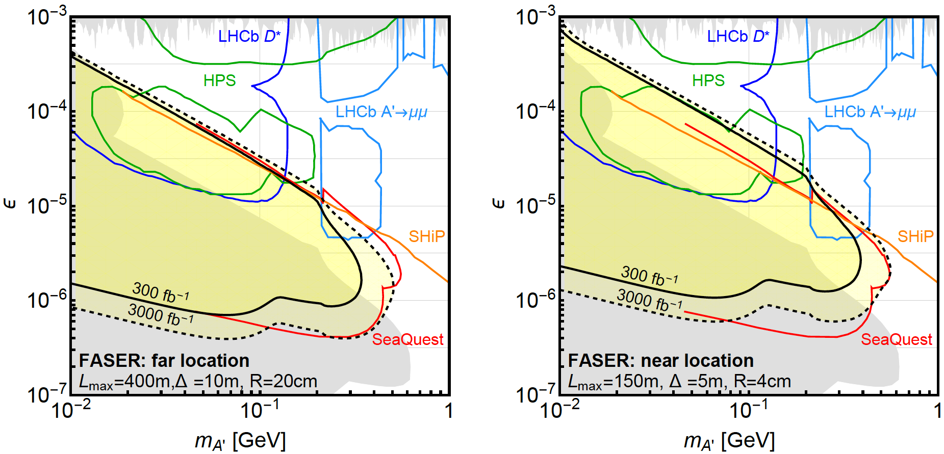
DARK PHOTON REACH
Assuming negligible background, FASER may probe parameter space with m_{A’} ~ 10 - 500 MeV, ε ~ 10⁻⁶ – 10⁻³
SHiP much more sensitive at very low ε, but much of this is excluded already. SHiP reach at high m_{A’} is from direct QCD production, which we have neglected
N=3 contours

Slide 26
DARK HIGGS BOSONS
Another renormalizable coupling: Higgs portal
The resulting theory contains a new scalar boson φ with mass m_{φ} , Higgs-like couplings suppressed by sin θ, and a trilinear coupling λ
SM
Hidden
Higgs

Slide 27
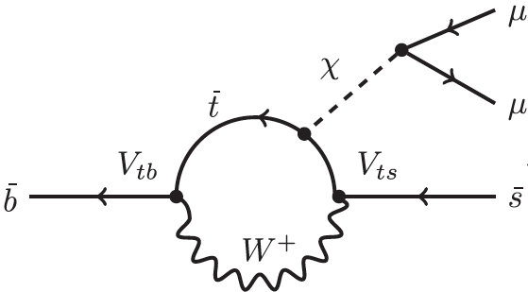
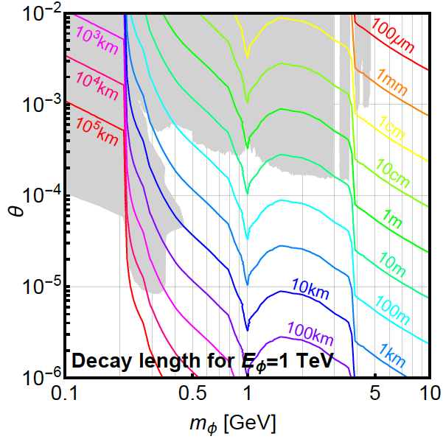
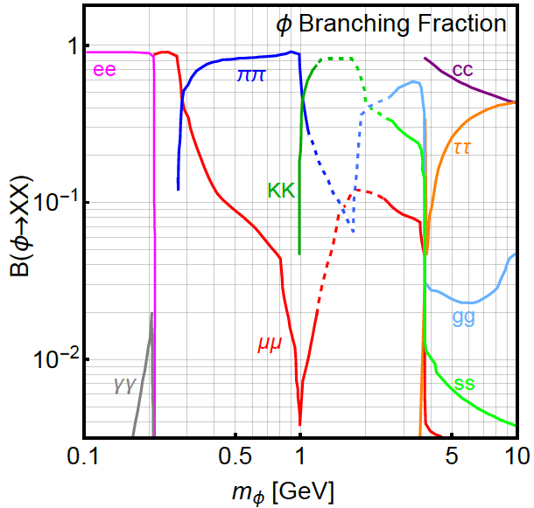
DARK HIGGS PROPERTIES
N_{B} << N_{K} ~ N_{π ,} but dark Higgs couples to mass, so
Turns out B and K are similar and the dominant sources of dark Higgses
Decays to heaviest possible states
φ

Slide 28
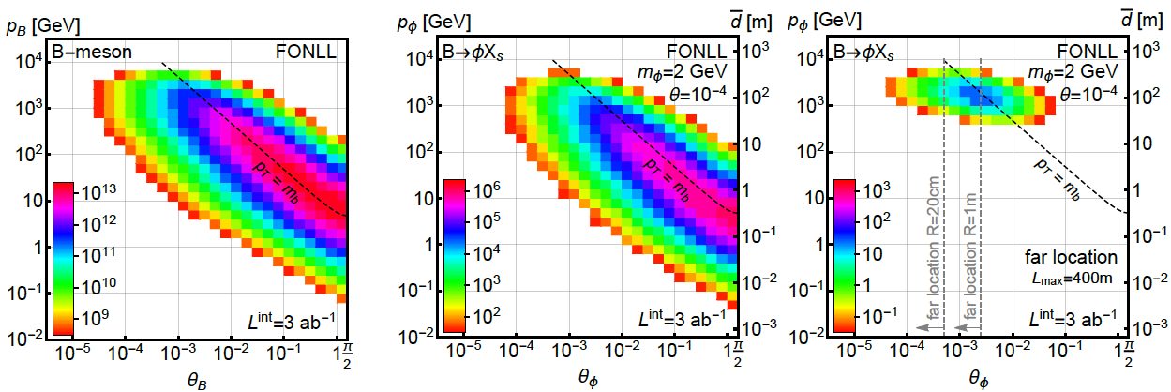
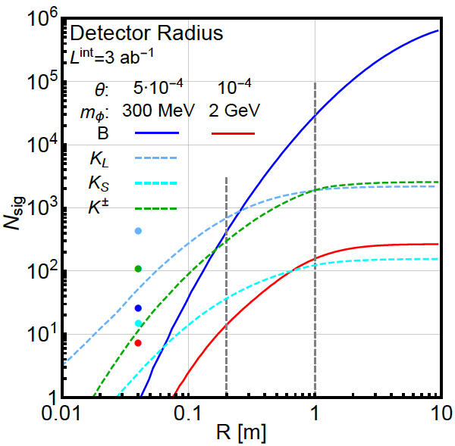
B MESON AND DARK HIGGS PRODUCTION
In B decays, p_{T} ~ m_{B}, dark Higgs bosons are less collimated than dark photons

Slide 29
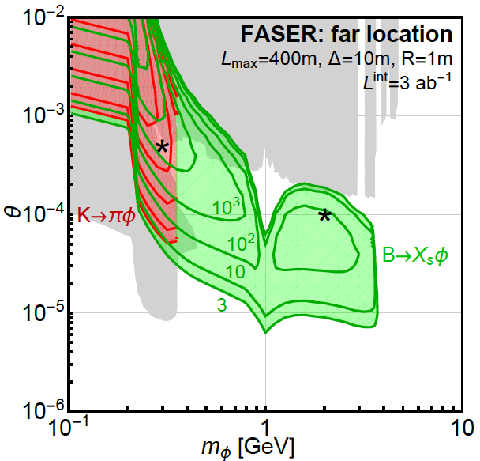
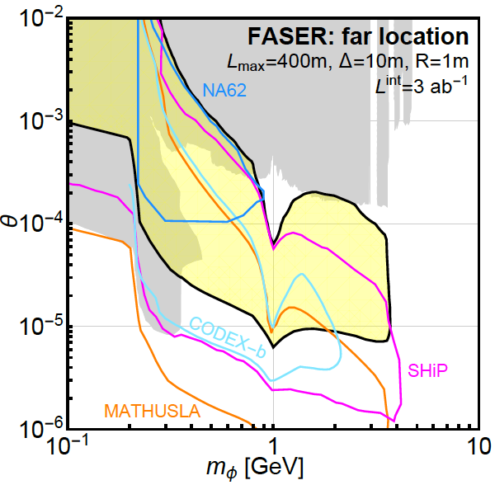
DARK HIGGS EVENT RATES AND REACH
LHCb
FASER probes a large swath of new parameter space and is complementary to other current and proposed experiments

Slide 30
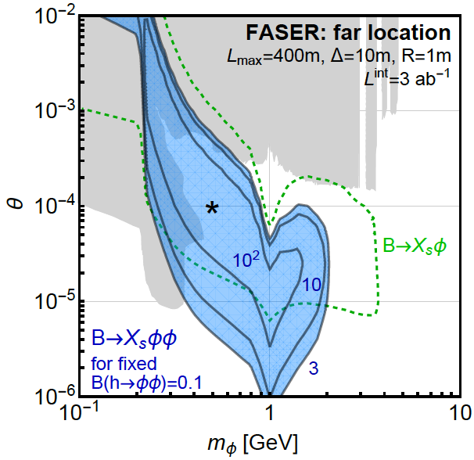
TRILINEAR COUPLINGS REACH
FASER can also probe the trilinear couplings through
φ
h
φ
This competes with
h → φφ (invisible)
Can get 100s of events from “double dark Higgs” production

Slide 31
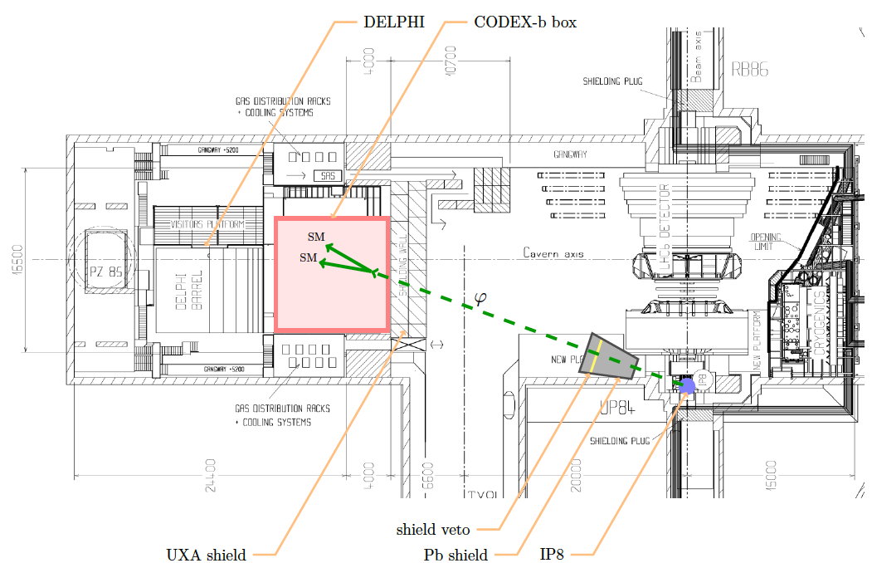
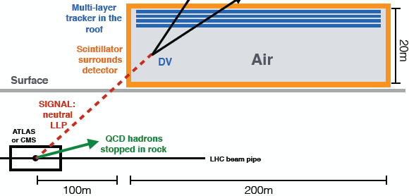
COMPLEMENTARY PROPOSED EXPERIMENTS
SHiP
CODEX-b
~1000 m³, ~100M CHF
Alekhin et al. (2015)
~1000 m³
Gligorov, Knapen, Papucci, Robinson (2017)
FASER
MATHUSLA
~1 m³ ~ 5 μIKEAs
~200,000 m³ ~ 1 IKEA, ~$50M
Feng, Galon, Kling, Trojanowski (2017)
Chou, Curtin, Lubatti (2016)

Slide 32
SUMMARY AND OUTLOOK
The LHC has seen no new physics. Adding inexpensive, small detectors to improve discovery prospects is a good idea
FASER: targets light, weakly-coupled new particles at low p_{T} , runs simultaneously with ATLAS/CMS, and is small and inexpensive
No significant backgrounds identified for the far location; near location requires more study
FASER will probe significant new regions of dark photon and dark Higgs parameter space. Other models?
Much work to do. Possible timeline: install prototype in LS2, install full detector in LS3 in time for the HL-LHC era

