Slide 1
THEORY IN THE LHC ERA
2017 ICFA Seminar
Ottawa, Canada
Jonathan Feng, University of California, Irvine
8 November 2017

Slide 2
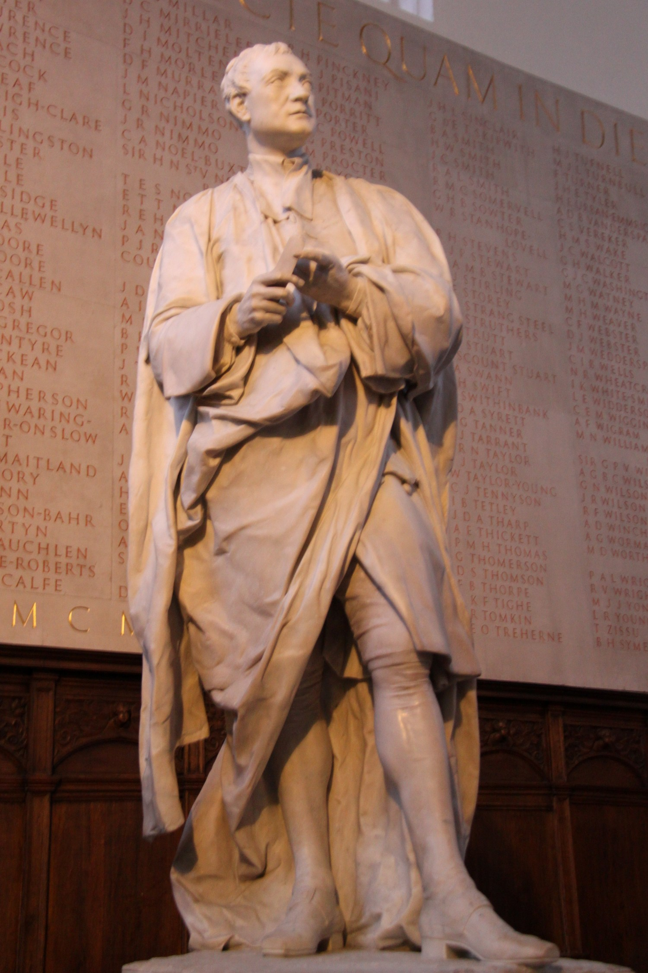

NEWTON AND NATURALNESS
In 1687, Isaac Newton published the Principia. 5 years later, a clergyman, Robert Bentley, asked him how the law of universal gravitation could be consistent with a static universe.
Newton’s rueful reply: “That there should be a central particle, so accurately placed in the middle, as to be always equally attracted on all sides, and thereby continue without motion, seems to me a supposition fully as hard as to make the sharpest needle stand upright on its point upon a looking-glass.”

Slide 3
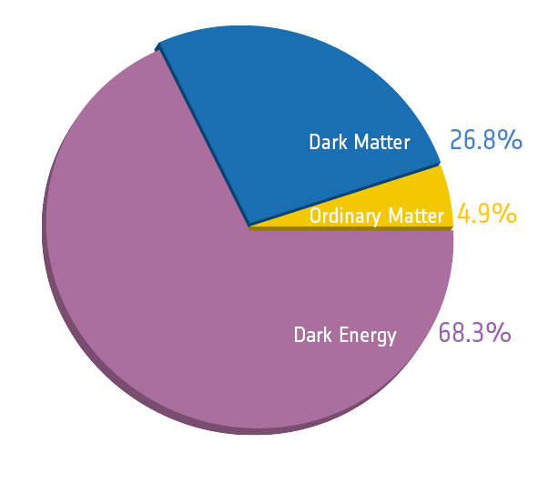
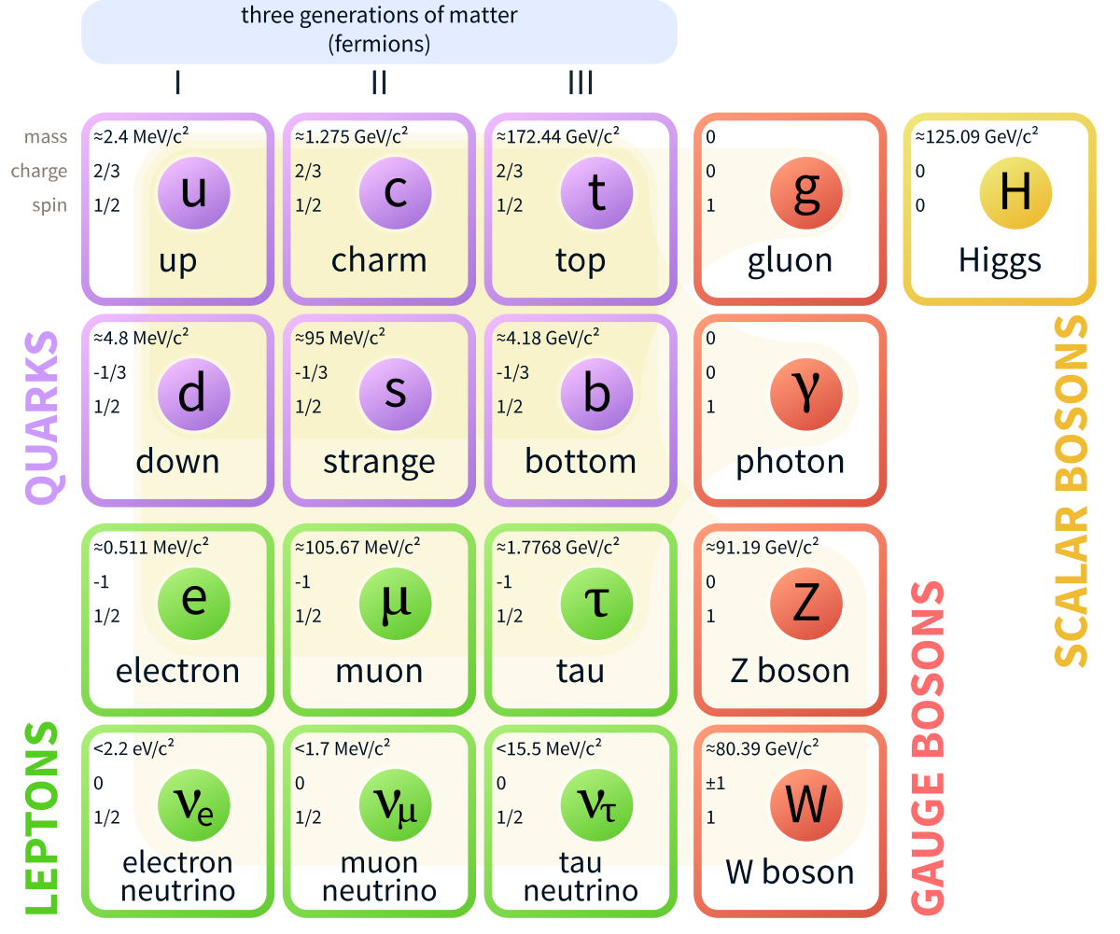
THE PRESENT
Like Newton, we have just completed a monumental achievement, the completion of the standard models of cosmology and particle physics, and 5 years later, we also have a naturalness problem
Naturalness

Slide 4
OUTSTANDING PROBLEMS
Actually, we have an embarrassment of riches: naturalness is just one of the many deep and interesting puzzles we have the privilege to think about
Dark Matter
Flavor, CP, Strong CP
Grand Unification
Inflation
Naturalness
Baryogenesis
Dark Energy
Neutrino Mass
G?
Quantum Gravity

Slide 5
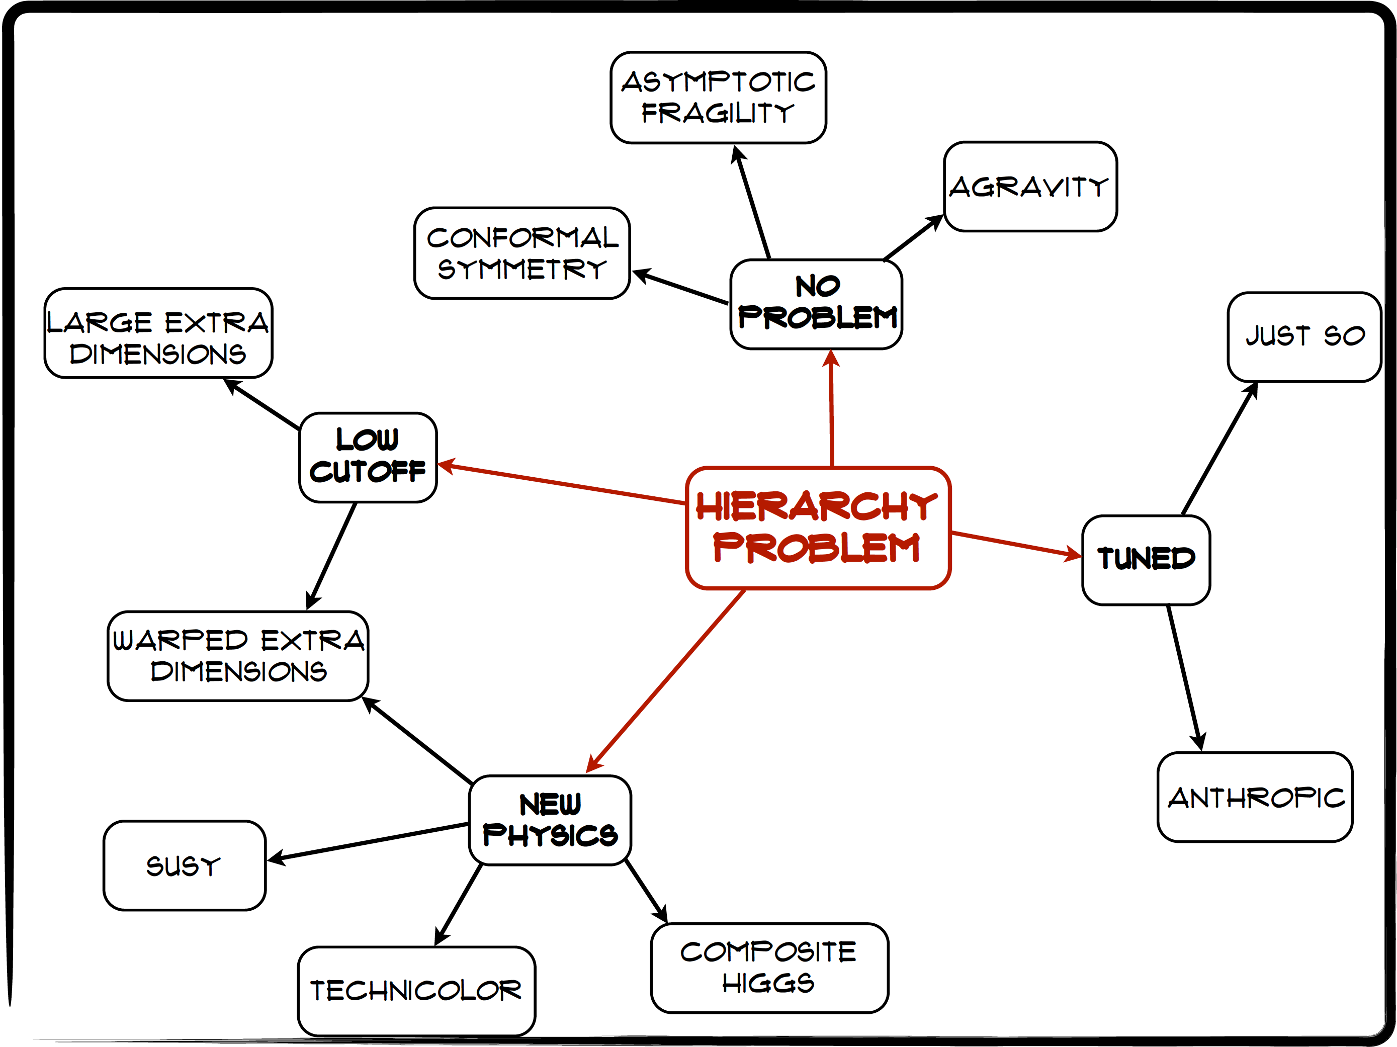
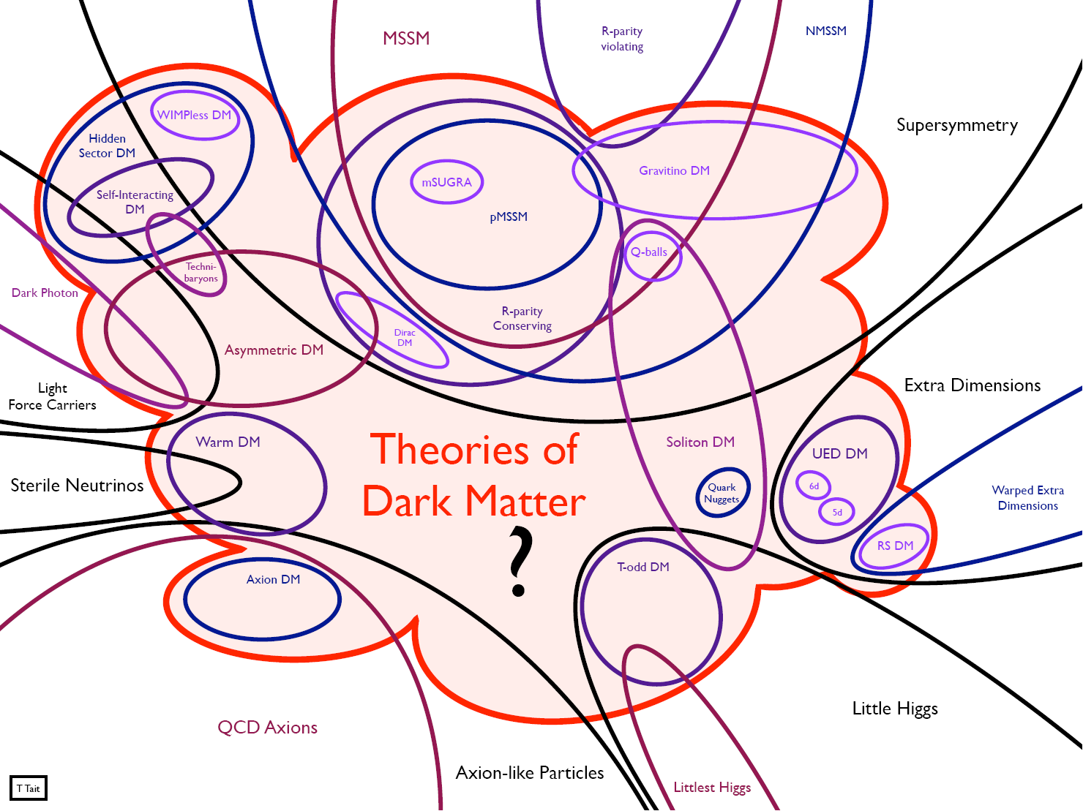
OUTSTANDING OPPORTUNITIES
In particle theory, this is a time of great creativity, new ideas, and best of all, new proposals for experiments and connections to other fields (cosmology, astrophysics, nuclear physics, condensed matter, atomic physics, ...)
Craig
Tait

Slide 6
LOOKING UNDER THE LAMPPOST
1
Already
Discovered
Strongly Interacting
Heavy Particles
10⁻³
Coupling Strength
Weakly Interacting
Light Particles
Impossible to
Discover
10⁻⁶
MeV
GeV
TeV
Mass

Slide 7
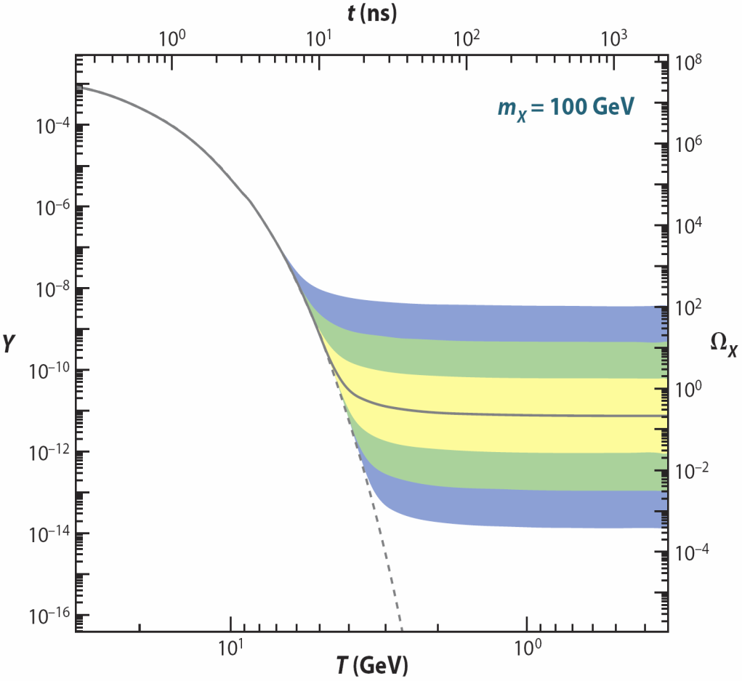
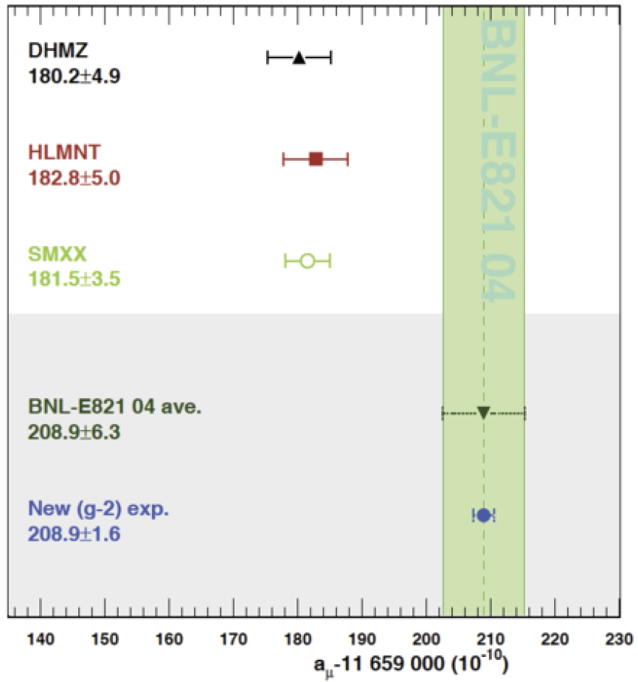
STRONGLY INTERACTING, HEAVY PARTICLES
The traditional target for new physics searches, with strong motivations
WIMP Miracle
~TeV particles with O(1) couplings have the right thermal relic densities to be dark matter
Anomalies
~TeV particles with O(1) couplings can explain the ~3.5σ discrepancy in the muon anomalous magnetic moment
Hagiwara et al. (2017)

Slide 8
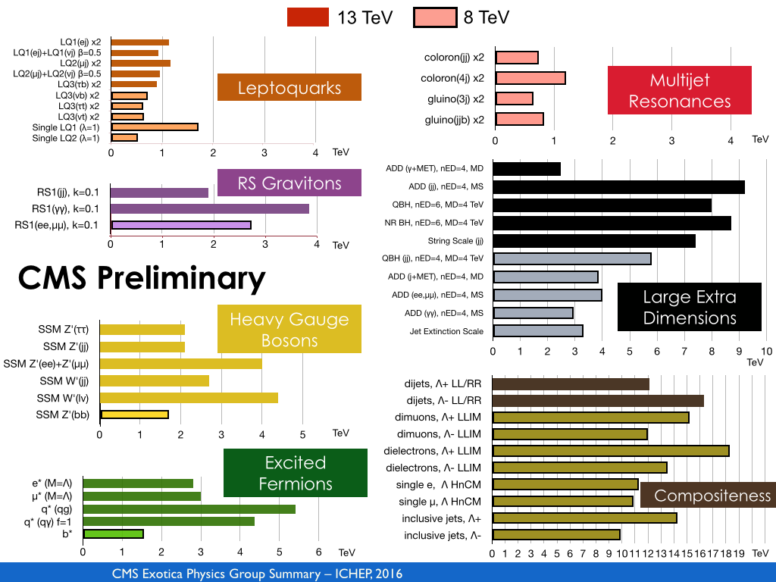
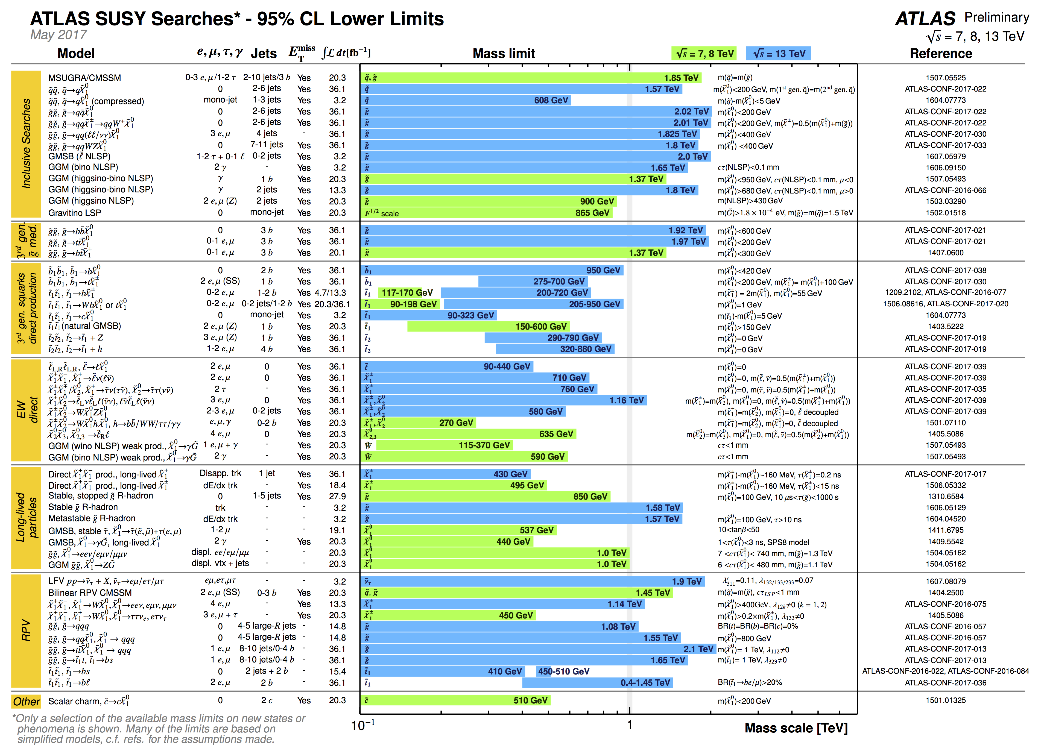
STRONGLY INTERACTING, HEAVY PARTICLES
Naturalness
~TeV particles with O(1) couplings can explain why m_{h} << M_{Pl}
new
particle
Higgs
Higgs
Is this motivation spoiled by the lack of new particles at the LHC so far?
E.g., “gluino mass > 2 TeV >> m_{h} , fine tuning > 100, 1000...”

Slide 9
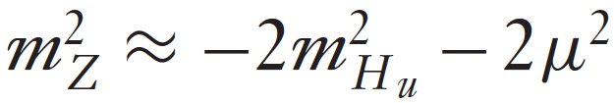
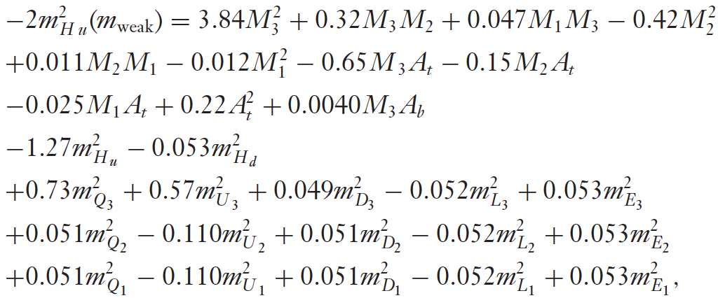
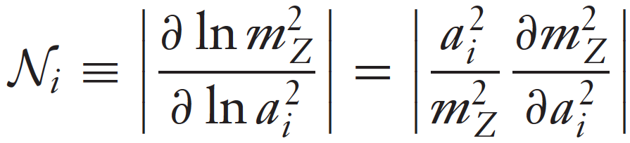

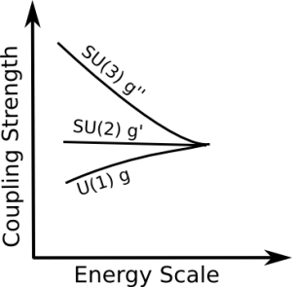

QUANTIFYING NATURALNESS
Quantifying fine tuning is fraught with subjective choices. E.g., SUSY
Step | Systematic Error
Choose a framework with some fundamental parameters a_{i} | ~10
Define sensitivity coefficients and combine them | ~10
Normalize to average fine tuning | ~10
Ellis, Enqvist, Nanopoulos, Zwirner (1986)
Barbieri, Giudice (1988)
De Carlos, Casas (1993)
Anderson, Castano (1995)

Slide 10
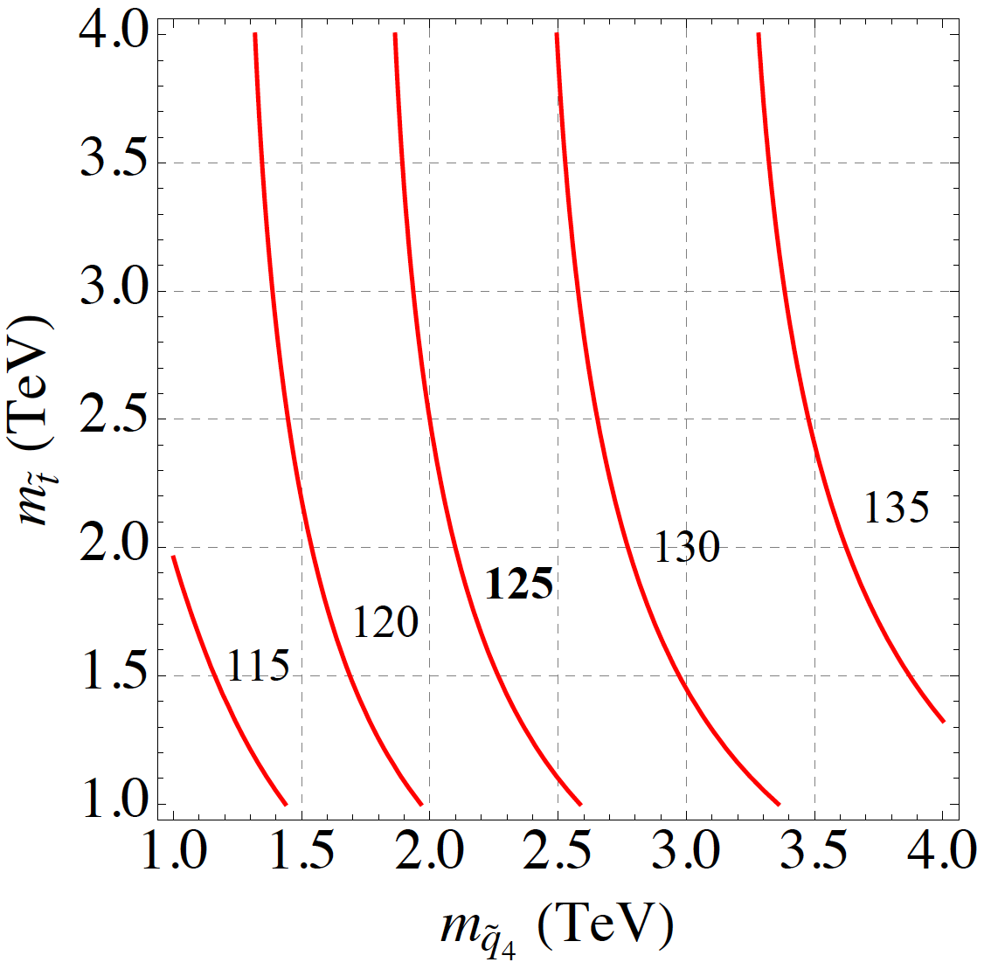
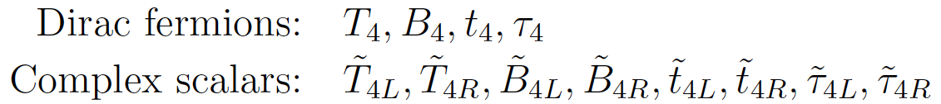
A NATURAL, VIABLE EXAMPLE: MSSM4G
Naturalness suggests light stops and sbottoms, m_{h} = 125 GeV suggests heavy stops and sbottoms
A resolution: introduce a 4th generation of particles to raise the Higgs mass _{Moroi, Okada (1992)}
m_{h} (GeV)
Chiral 4th generation particles are highly constrained. Instead, add vector-like 4th generation particles. For example, add a 10 of SU(5) consistent with gauge coupling unification:
_{Martin (2010)}

Slide 11
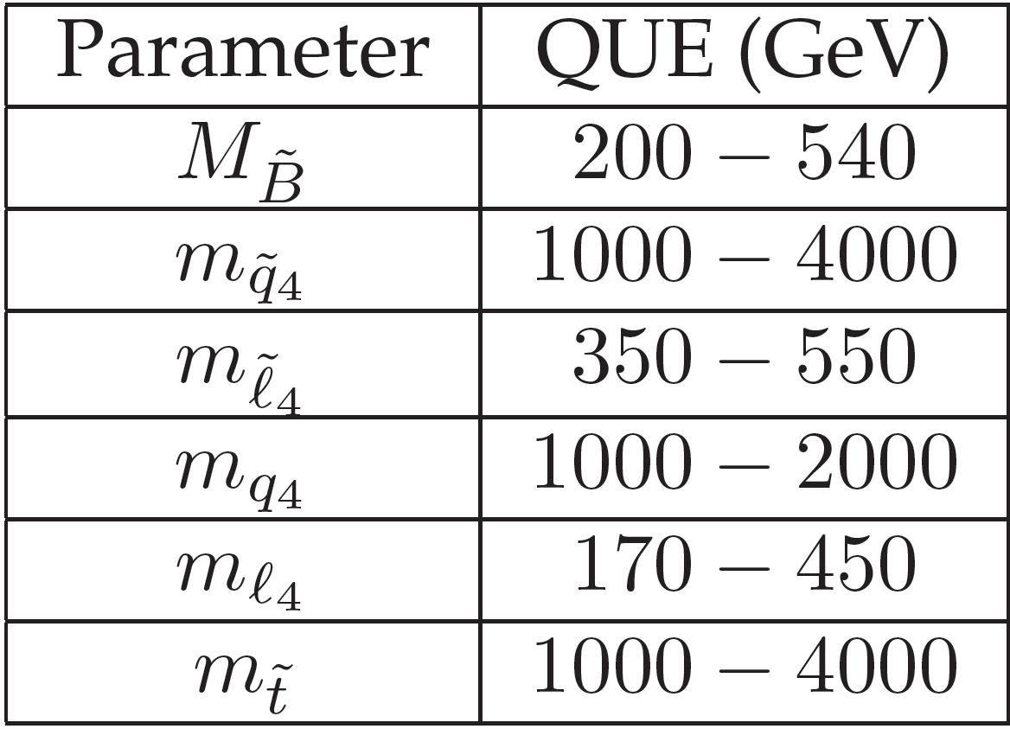
MSSM4G AT THE LHC
MSSM4G models imply a wealth of signals at the LHC
4th generation particles must decay, but can decay to any of the 1st three generations with a variety of lifetimes. Possible signals:
  Quarks, squarks, gluinos in the 1-3 TeV range, cascading down to MET signatures
  τ₄ τ₄ Drell-Yan production, followed by decays τ₄ → τ Z, ν W, τ h, etc.
  τ̃₄ τ̃₄ Drell-Yan production, followed by decays τ̃₄ → e χ, μ χ, τ χ
  τ̃₄ τ̃₄ Drell-Yan production, leading to long-lived charged particles, displaced vertices
Kumar, Martin (2015); Abdullah, Feng, Iwamoto, Lillard ( 2016)

Slide 12
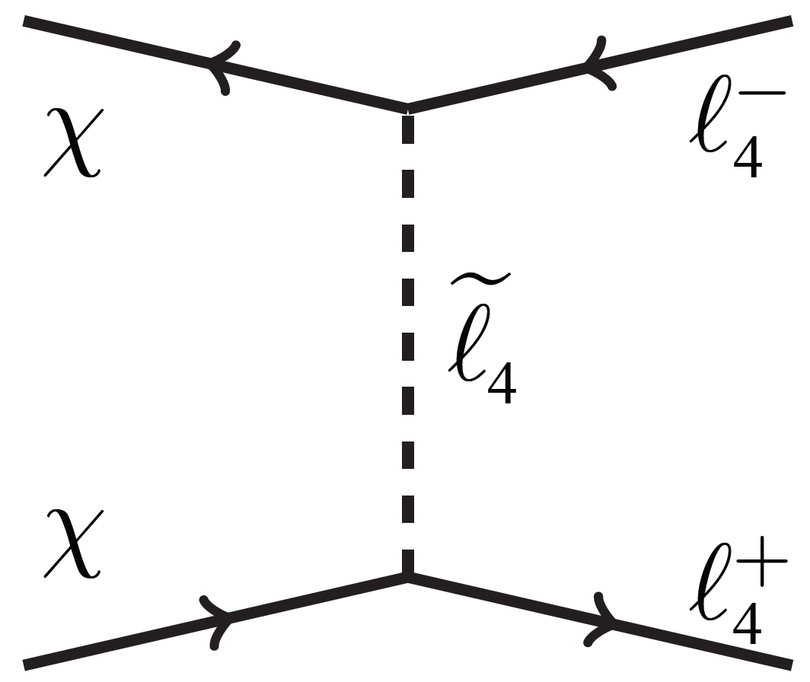
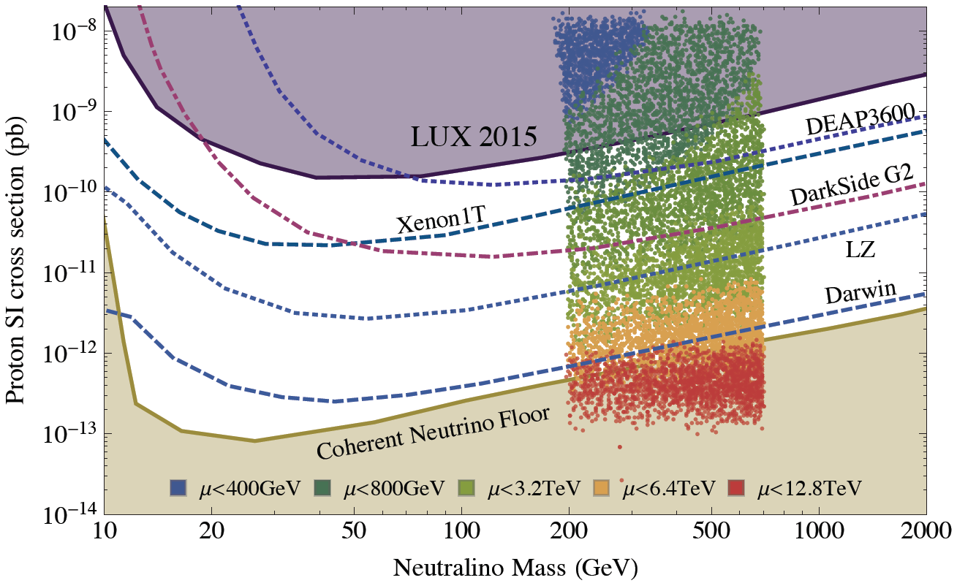
MSSM4G DARK MATTER
MSSM4G predicts heavy neutralino dark matter that freezes out with the right thermal relic density through χχ → τ₄τ₄
Direct detection cross sections naturally fall between current bounds and the neutrino floor
Interesting signals for indirect detection also (CTA)
Models like these have strong theoretical motivations and promise an exciting program of discovery for DM searches, the LHC, and future colliders

Slide 13
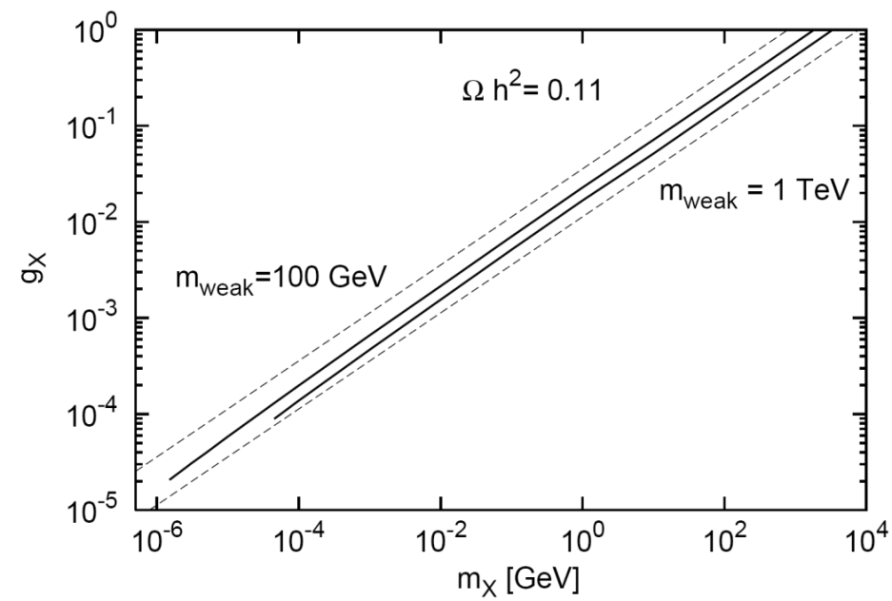
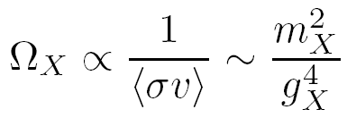
WEAKLY INTERACTING, LIGHT PARTICLES
A new target for new physics searches, but with similarly strong motivations
WIMPless Miracle
Anomalies
_{WIMPs}
_{WIMPless DM}
Weakly interacting, light particles can be thermal relic dark matter and open connections to the intensity frontier, nuclear, AMO, and CM physics

Slide 14
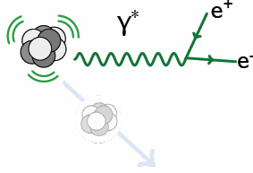
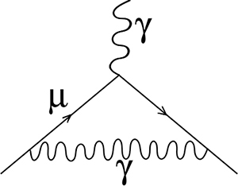
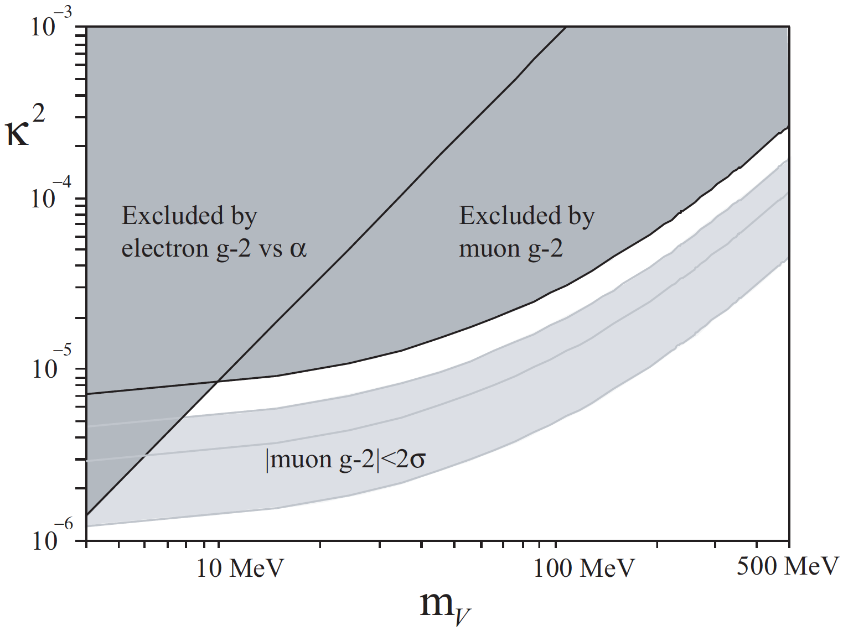
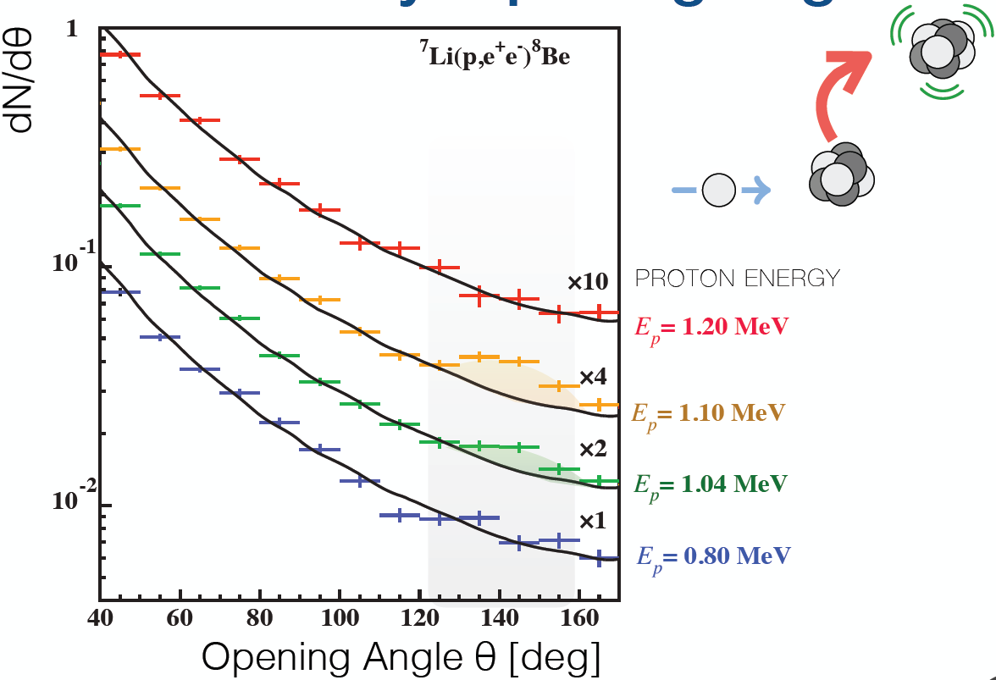
WEAKLY INTERACTING, LIGHT PARTICLES
Anomalies
Muon g-2
X
⁸Be
6.8σ anomaly now seen in two decays → milli-charged, 17 MeV boson
γ, A’
Fayet (2007), Pospelov (2008)
Krasznahorkay et al. (2015, 2017)

Slide 15
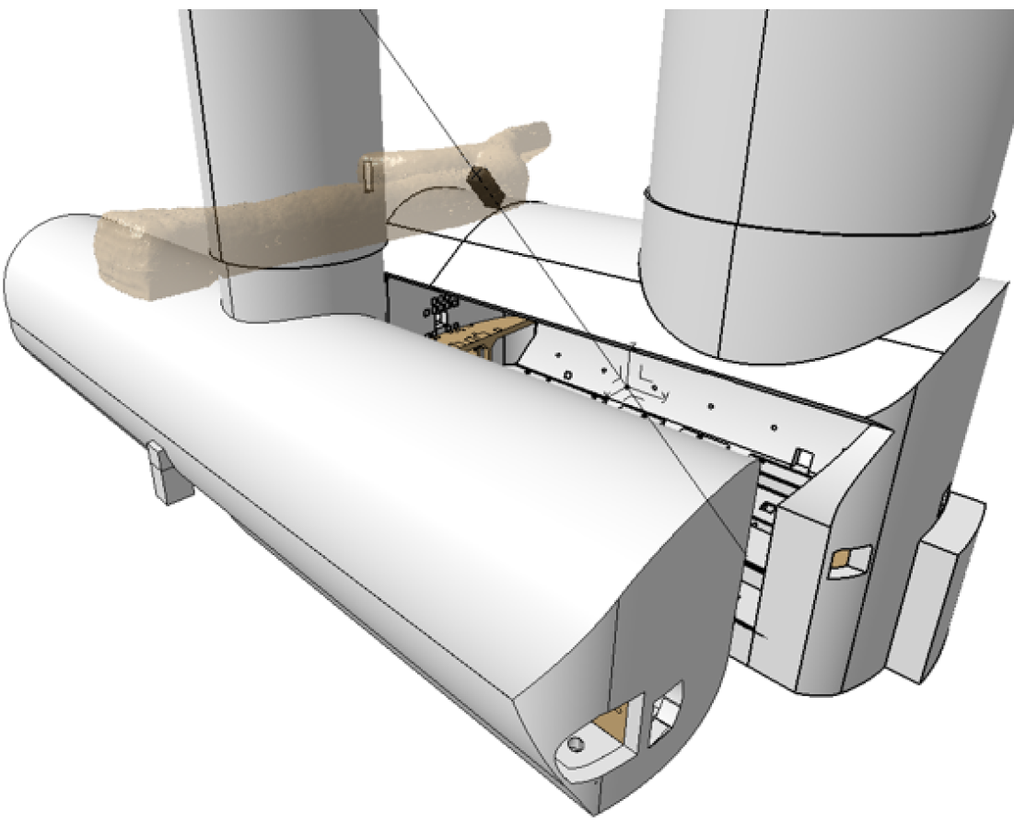
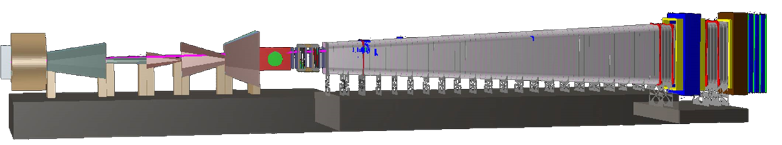
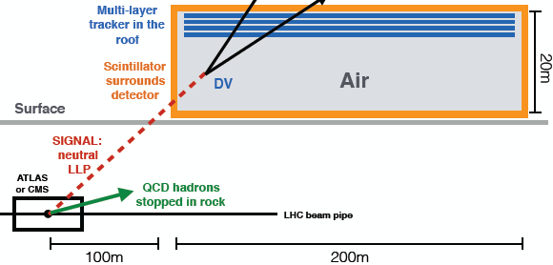
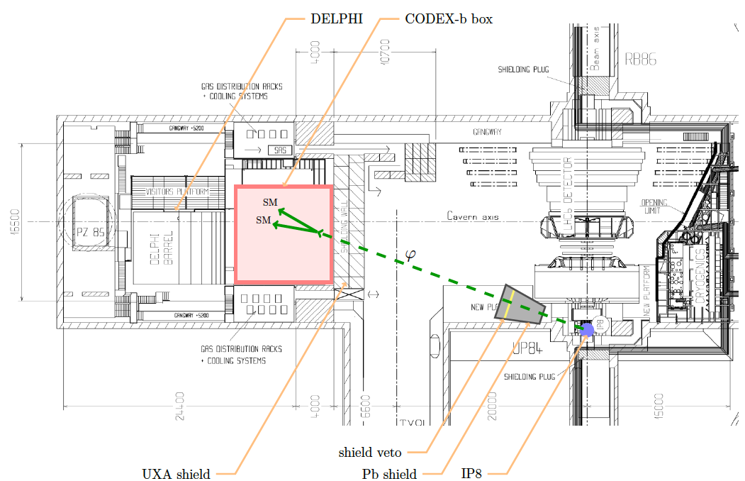
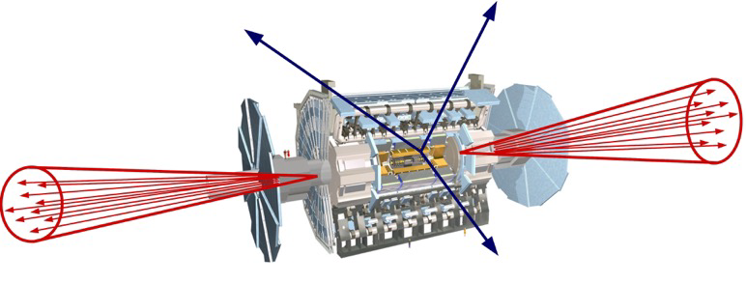
WEAKLY INTERACTING LIGHT PARTICLES AT LHC
Weakly interacting light particles, produce striking signals
These have motivated many new proposals for experiments, including some for the LHC
SHiP
MilliQan
MATHUSLA
CODEX-b
FASER

Slide 16
FASER: FORWARD SEARCH EXPERIMENT
New physics searches at ATLAS, CMS focus on high p_{T}. This is appropriate for strongly interacting, heavy particles
  σ ~ fb to pb → N ~ 10³ – 10⁶, produced ~isotropically
However, if new particles are weakly interacting and light, they are predominantly produced at low p_{T} (e.g., in π, K, B decay), better to look in the forward region
  σ_{inel} ~ 100 mb → N ~ 10¹⁷, θ ~ Λ_{QCD} / E ~ 250 MeV / TeV ~ mrad
Feng, Galon, Kling, Trojanowski (2017)

Slide 17
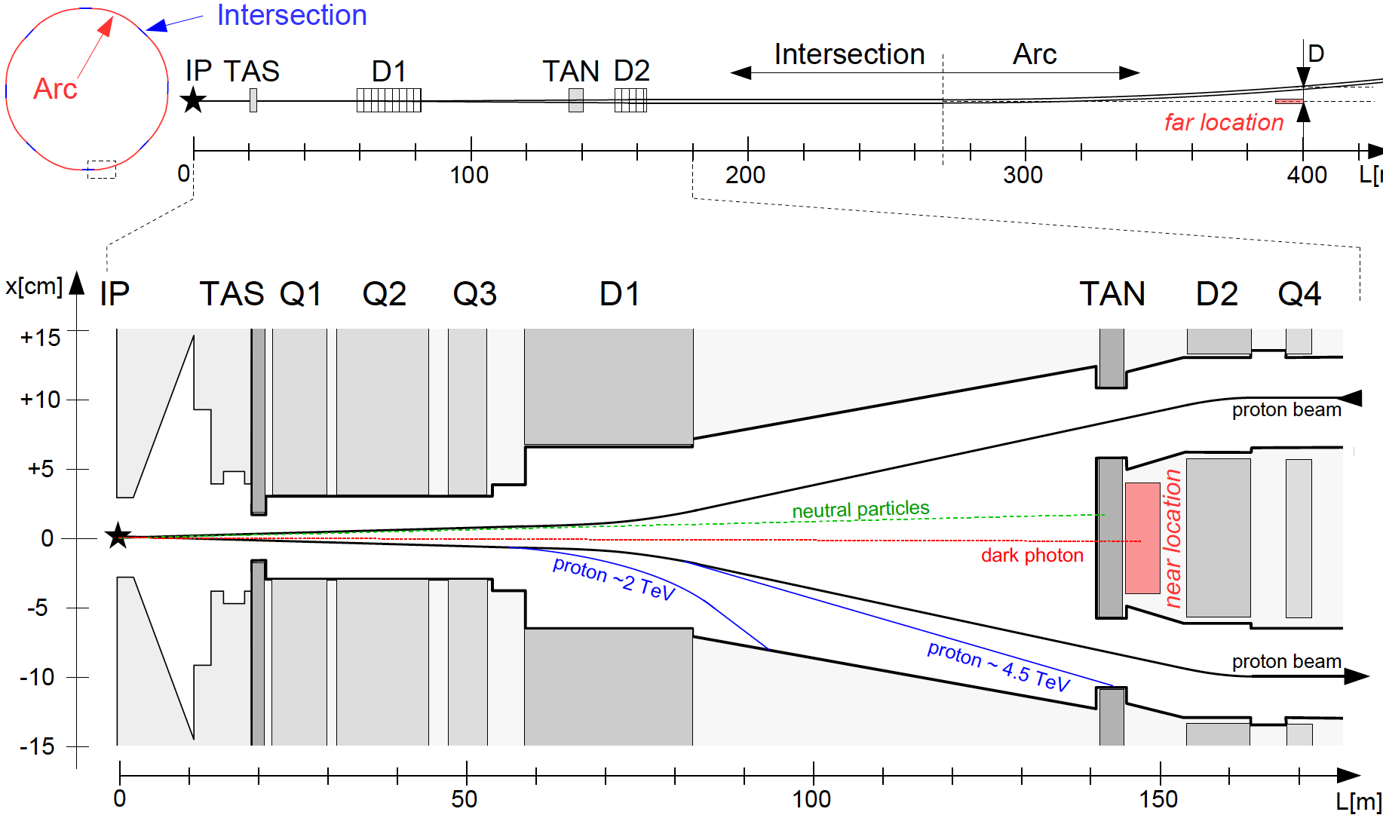
FASER: FORWARD SEARCH EXPERIMENT
A small, inexpensive detector, appropriately placed, could have great reach. Two “extremes”:
Near location: 150 m downstream, between the beams
Far location: 400 m downstream, after the beam curves

Slide 18
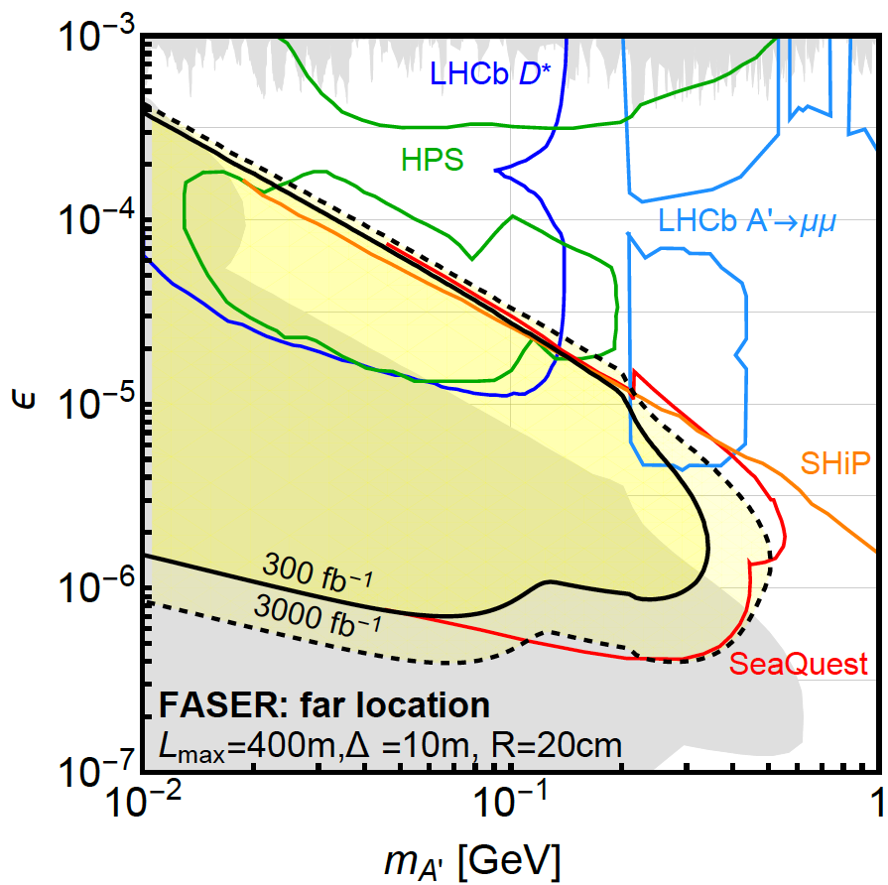
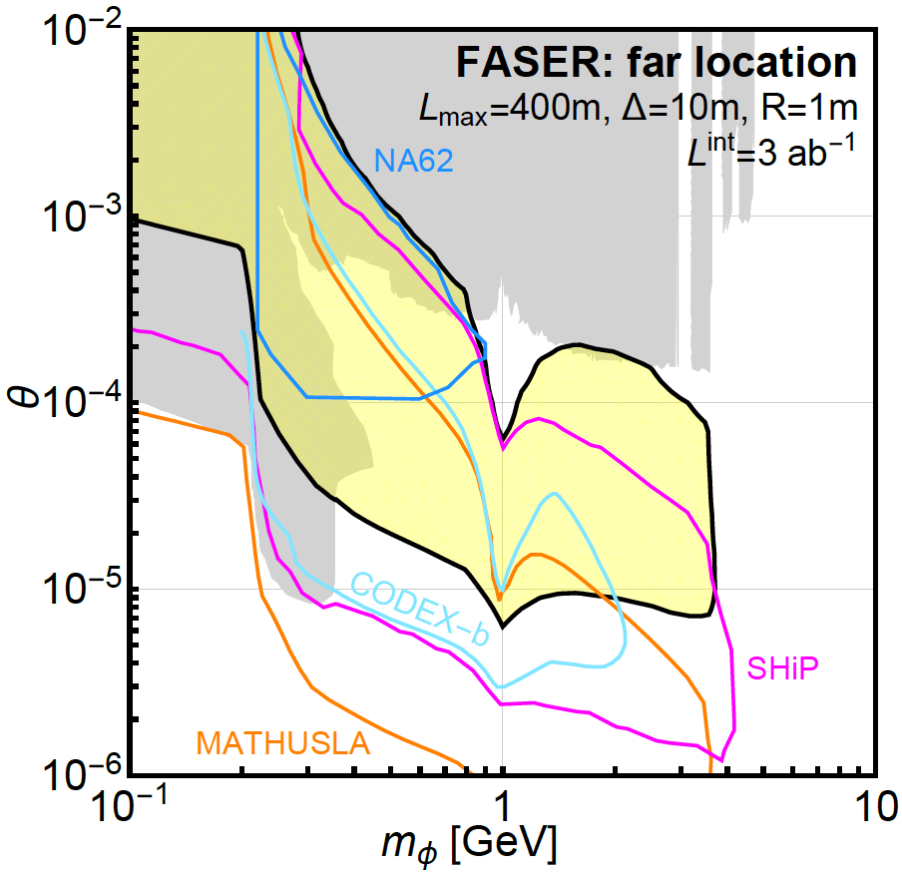
DISCOVERY POTENTIAL
Dark Photons
Dark Higgs Bosons
LHCb

Slide 19

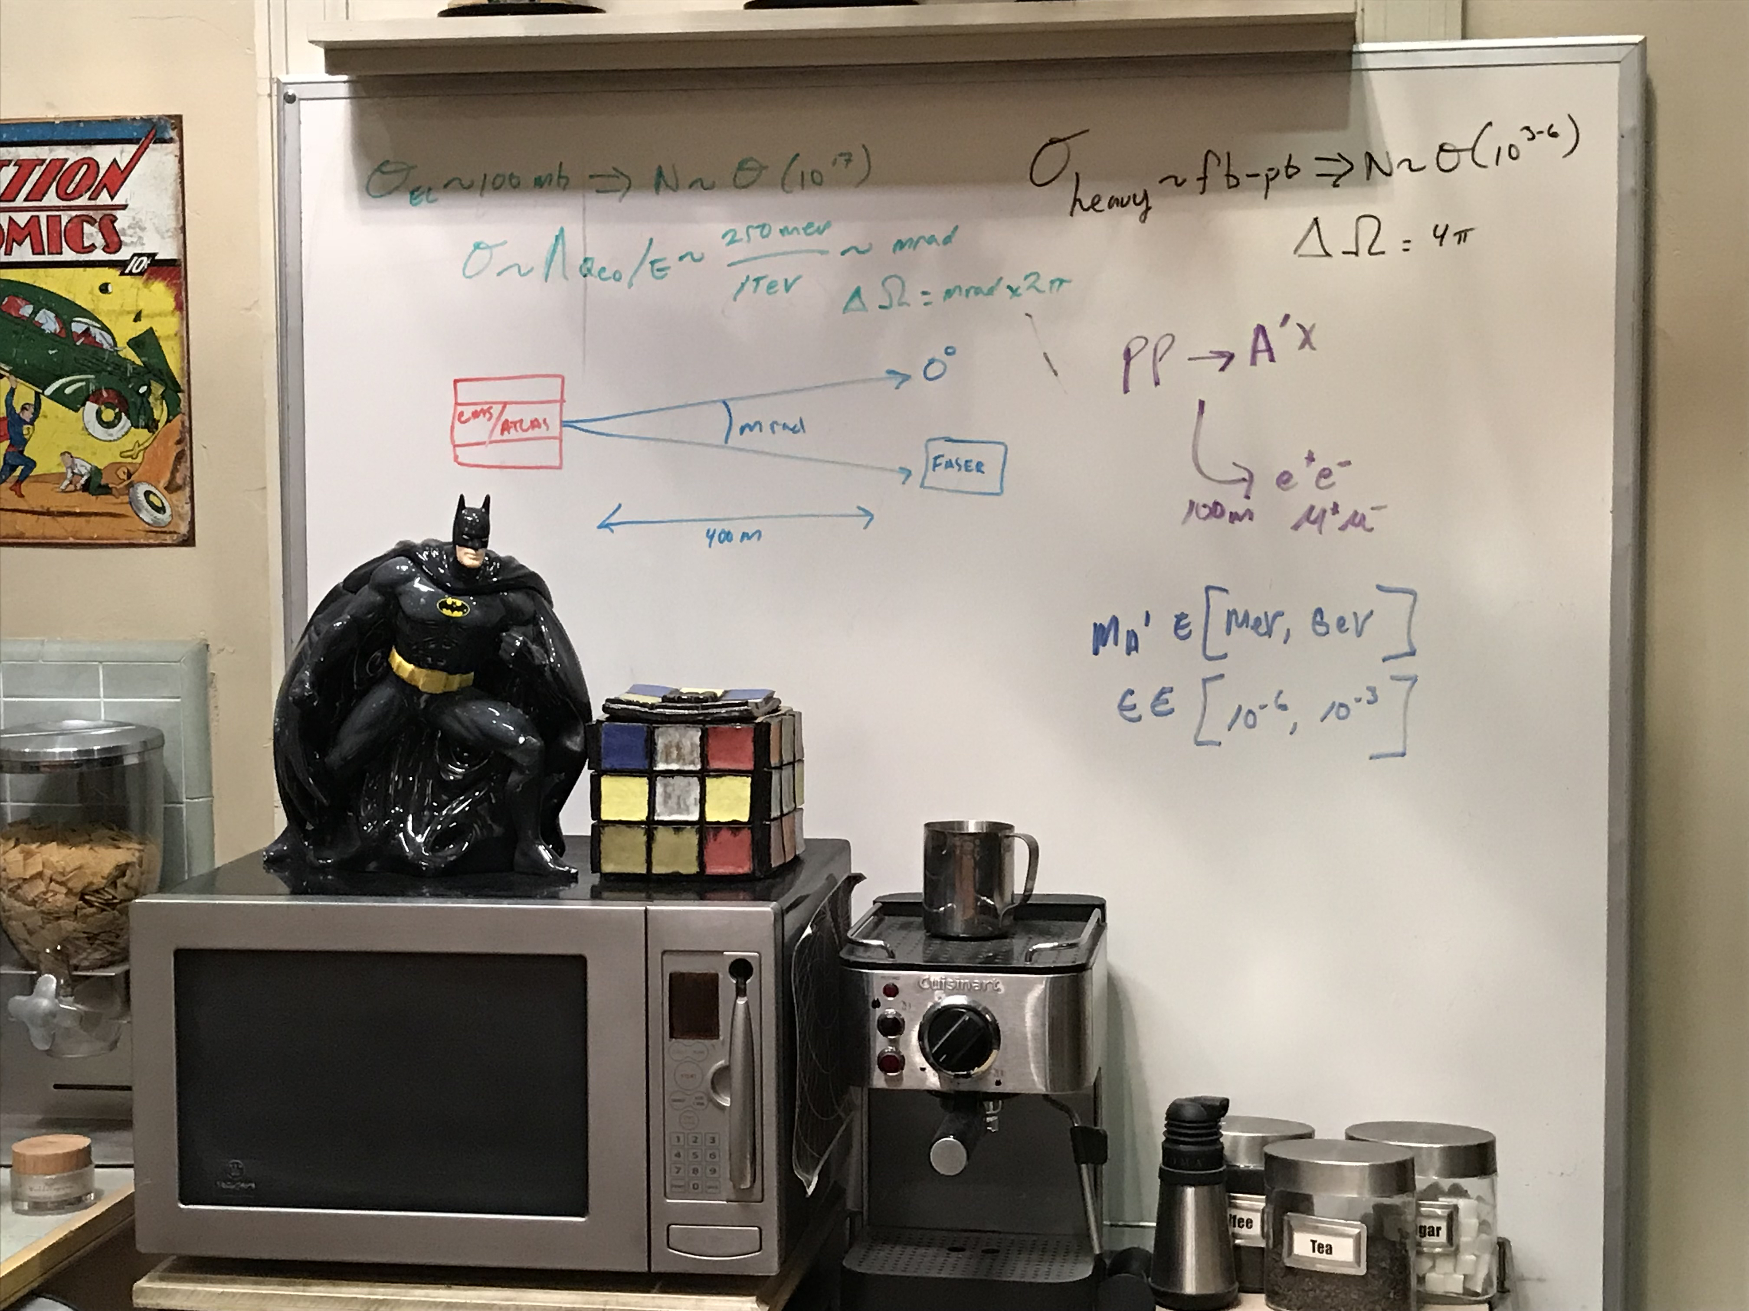
WEAKLY INTERACTING, LIGHT PARTICLES
These experiments will significantly extend the discovery potential of the LHC program in the HL-LHC era and they are already attracting the attention of some of the world’s best known physicists
Leonard and Sheldon from “The Big Bang Theory” !

Slide 20
CONCLUSIONS
We have many deep and important problems
The current lack of one dominant paradigm for their solution is leading to a flowering of creative theoretical ideas
Many new connections between theory and experiment
Many new connections to other fields

