Slide 1
DARK MATTER – THEORY
Cosmic Opportunities – 45th SLAC Summer Institute
Jonathan Feng, UC Irvine
16 August 2017

Slide 2
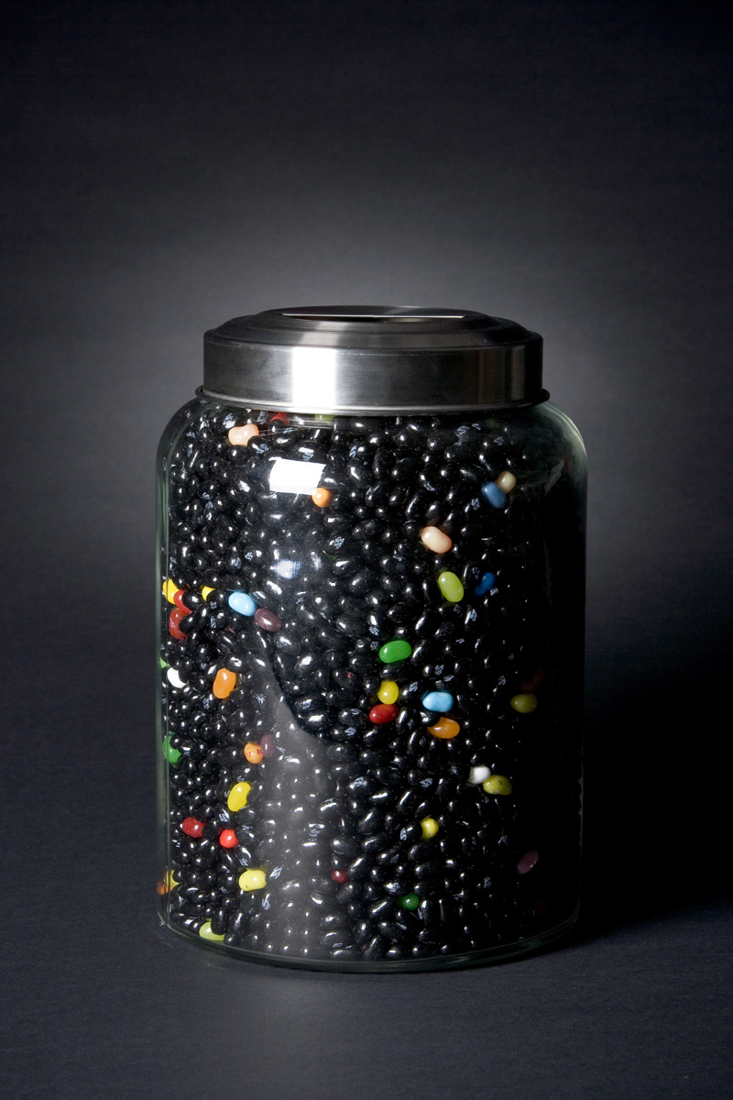
INTRODUCTION
We’ve learned a lot about the Universe
Dark Matter: 23% ± 4%
Dark Energy: 73% ± 4%
Normal Matter: 4% ± 0.4%
Neutrinos: 0.2% (Σm_{ν}/0.1 eV)
But there is still a lot missing. In particular dark matter implies
There is a big problem with our standard theory of particle physics, or
There is a big problem with our standard theory of gravity,
Or both!
Here assume new particle physics is part of the answer
See McGaugh talk

Slide 3
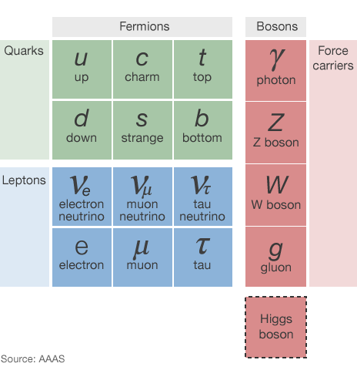
DARK MATTER
See Frieman, Olive talks
Known DM properties
Gravitationally interacting
Not short-lived
Not hot
Not baryonic
None of the known particles can be cold DM

Slide 4
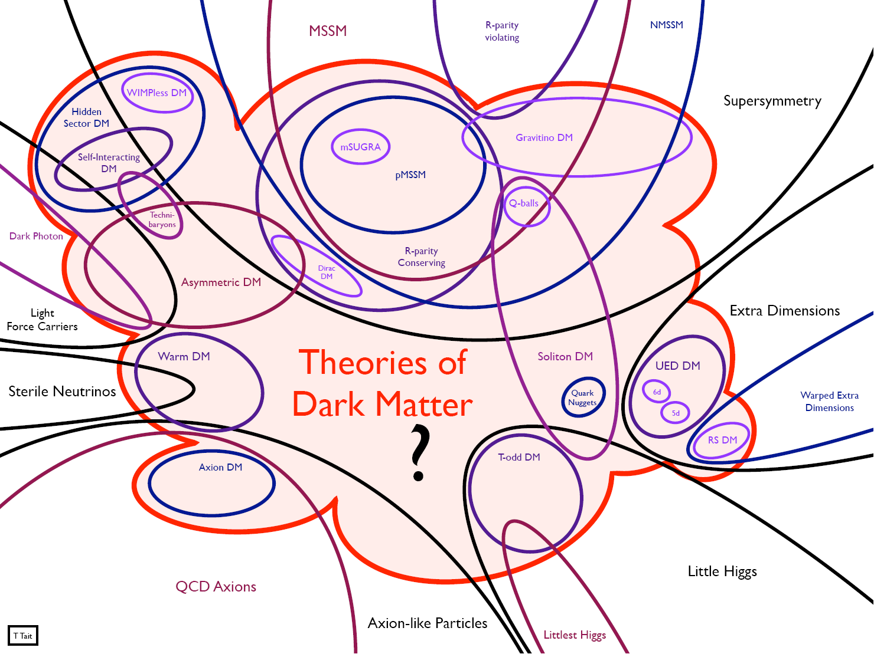
SO WHAT COULD DARK MATTER BE?
The goal of this talk: to provide a brief introduction to this chaos
with many important topics deferred to later lectures

Slide 5
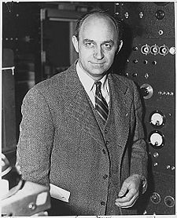
THE WEAK SCALE
Much of the attention has focused on WIMPs. Why?
Fermi’s constant G_{F} introduced in 1930s to describe beta decay
n → p e⁻ ν
G_{F} ~ 10⁻⁵ GeV⁻² → a new mass scale in nature
m_{weak} ~ 100 GeV
We still don’t understand the origin of this mass scale, but every attempt so far introduces new particles at the weak scale
_
Notes:
5

Slide 6
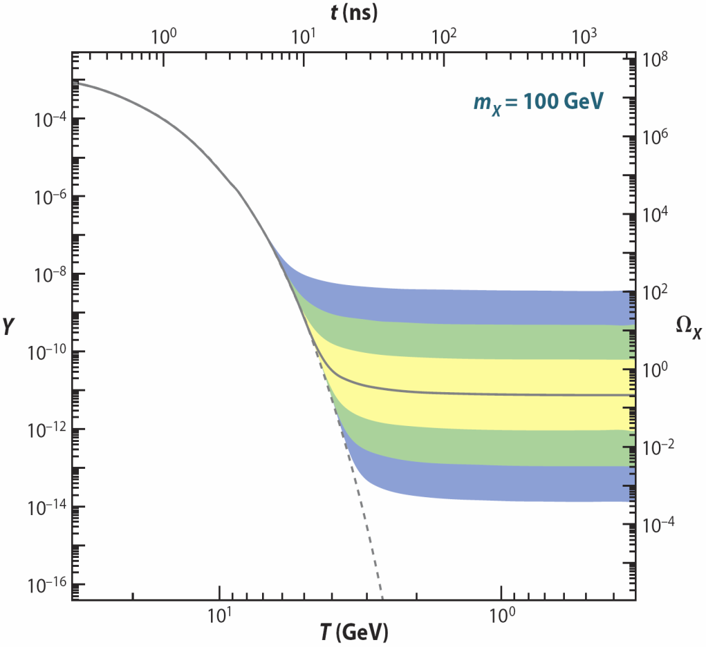
FREEZE OUT: QUALITATIVE
(1) Assume a new heavy particle X is initially in thermal equilibrium:
XX ↔ qq
(2) Universe cools:
XX qq
(3) Universe expands:
XX qq
(1)
Increasing
annihilation
strength
↓
(2)
←
(3)
/
→
→
/
←
/
Feng (2010)
Zeldovich et al. (1960s)

Slide 7





FREEZE OUT: MORE QUANTITATIVE
The Boltzmann equation:
Dilution from
expansion
‾
‾
χχ → f f
f f → χχ
n ≈ n_{eq} until interaction rate drops below expansion rate:
Might expect freeze out at T ~ m, but the universe expands slowly! First guess: m/T ~ ln (M_{Pl}/m_{W}) ~ 40
(numerical results: ~25, v ~ 0.3c)

Slide 8
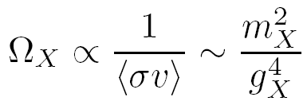
THE WIMP MIRACLE
It turns out that the relation between Ω_{X} and annihilation strength is wonderfully simple:
m_{X} ~ 100 GeV, g_{X} ~ 0.6 → Ω_{X} ~ 0.1
X
q
_
X
q
Remarkable coincidence: particle physics independently motivates particles with the right density to be dark matter

Slide 9
WIMP STABILITY
The WIMP Miracle is well appreciated. But its success relies another less well-advertised “miracle”
DM must be stable
How natural is this? A priori, not very: the only stable particles we know about are very light
New Particle States
Stable
Standard Model
Particles

Slide 10
THE DISCRETE WIMP MIRACLE
Gauge Hierarchy requires
Precision EW excludes
new
particle
SM
SM
Higgs
Higgs
new
particle
SM
SM
In some cases, there are even stronger reasons to exclude these 4-particle interactions (e.g., proton decay in SUSY)
Simple solution: impose a discrete parity, so all interactions require pairs of new particles. This also makes the lightest new particle stable: Discrete Symmetry ↔ Stability
Cheng, Low (2003); Wudka (2003)
Remarkable coincidence: particle physics independently motivates particles that are stable enough to be dark matter

Slide 11
WIMP DETECTION
Correct relic density → Efficient annihilation then
χ
χ
Efficient production now
(Particle colliders)
Efficient annihilation now
(Indirect detection)
q
q
Efficient scattering now
(Direct detection)
Feng (2008)

Slide 12
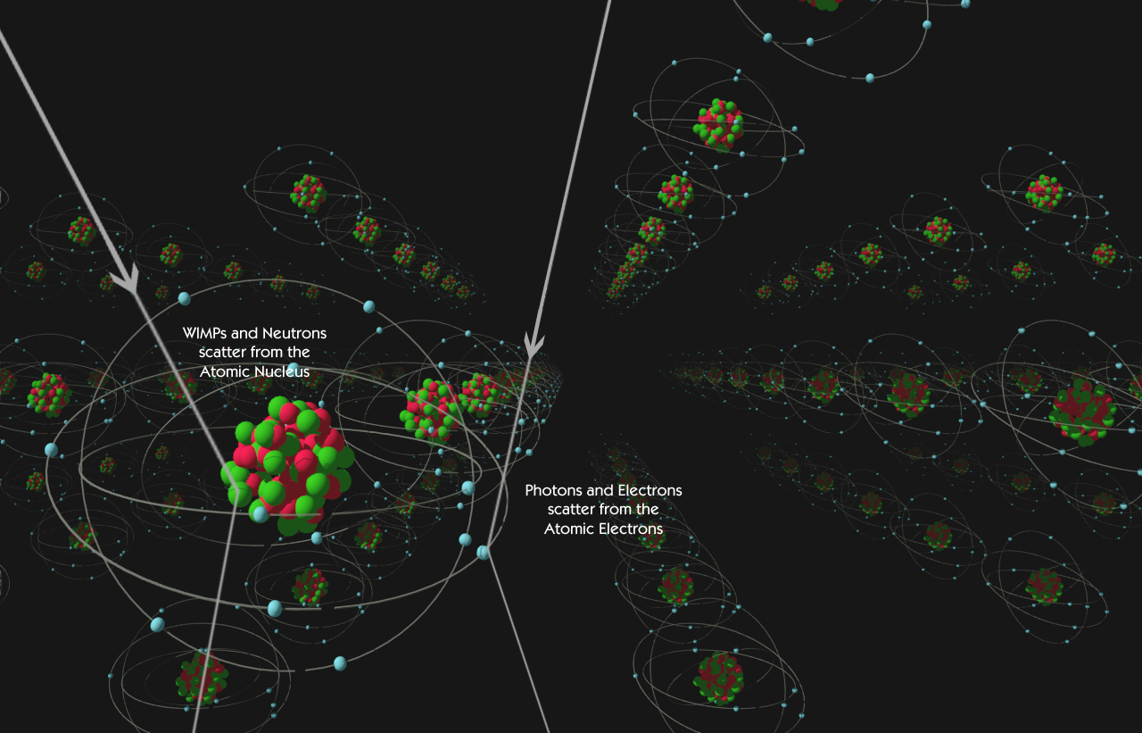
DIRECT DETECTION
WIMP properties
If mass is 100 GeV, local density is ~1 per liter
velocity ~ 10⁻³ c
Look for normal matter recoiling from WIMP collisions in detectors deep underground
Dark matter elastically scatters off nuclei
Nuclear recoils detected by phonons, scintillation, ionization, …, …
DM
e, γ
Attisha

Slide 13

SPIN-(IN)DEPENDENT SCATTERING
Consider neutralinos with quark interactions
DM particles now have v ~ 10⁻³ c, so are highly non-relativistic
In this limit, the first terms reduce to a spin-spin interactions, and so are called spin-dependent interactions; the second terms are spin-independent interactions
Experiments probing both are important
See Tunnell, Dahl, Monzani, Pyle talks

Slide 14



SPIN-INDEPENDENT EXPERIMENT
The rate observed in a detector is , where
Results are typically reported assuming f_{p}=f_{n}, so σ_{A} ~ A² , and scaled to a single nucleon
Particle theory:
Coupling to p, n
Experiment:
number
of target
nuclei
Experiment:
recoil
energy
Astrophysics:
DM velocity
distribution
Nuclear
physics:
form factor
Astrophysics: local DM number density

Slide 15
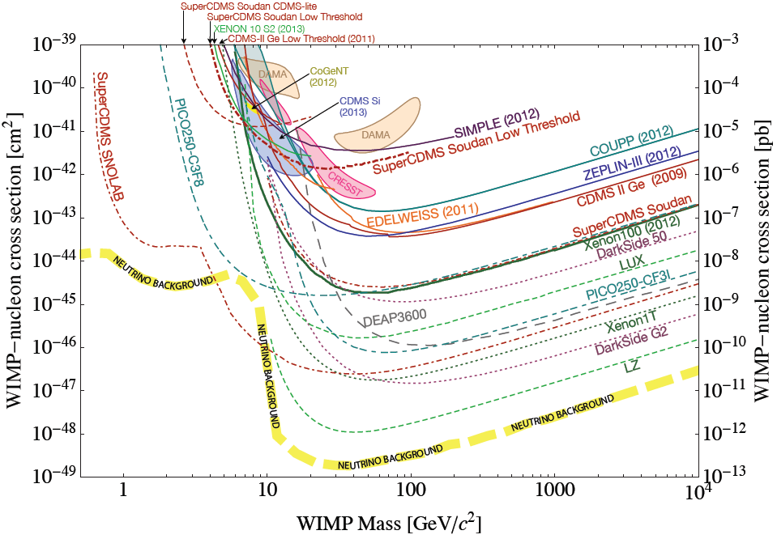
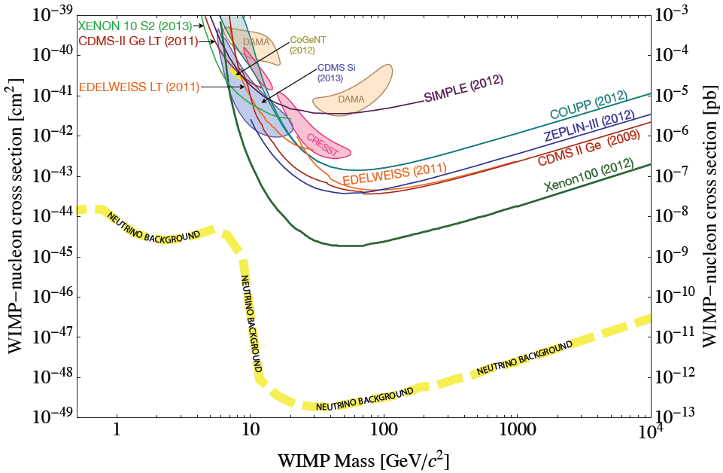
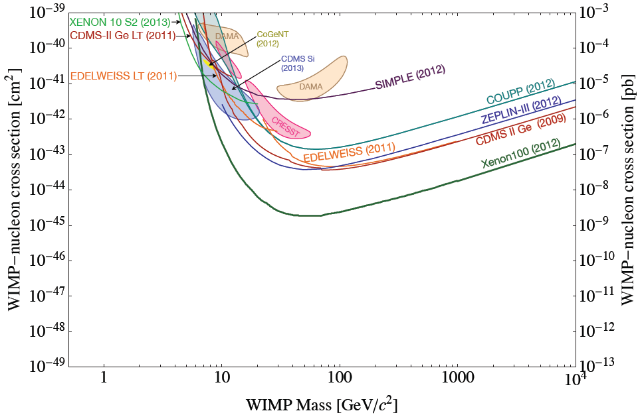
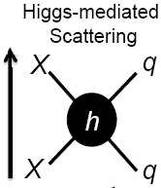
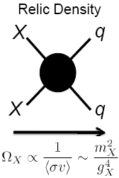
DIRECT DETECTION EXPERIMENTS
Asymmetric
n_{DM} ~ n_{B}

Slide 16
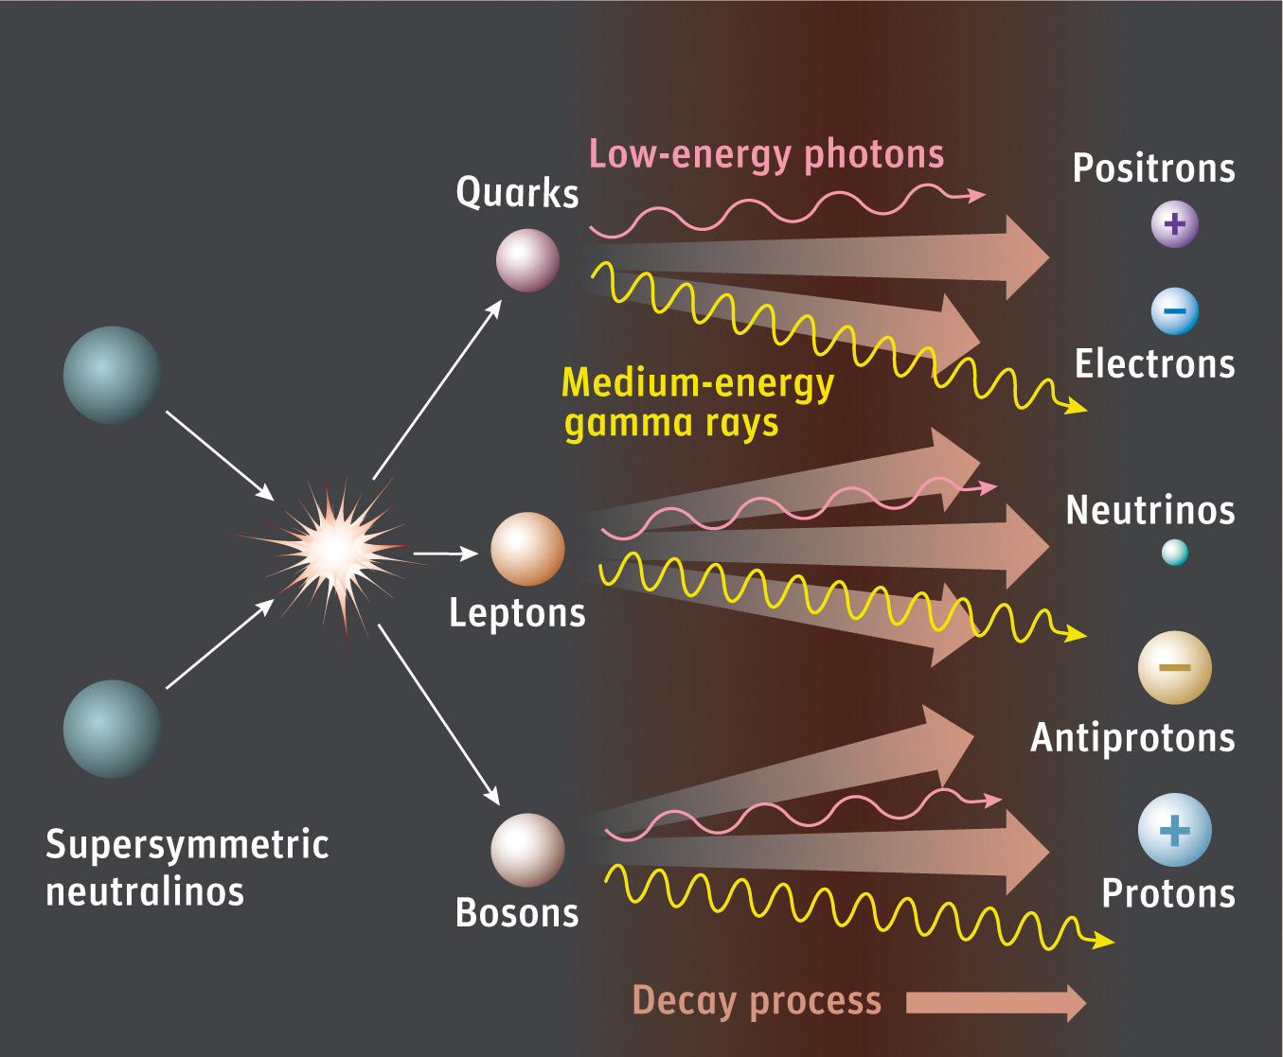
INDIRECT DETECTION
See Klein, Albert talks
Dark matter may pair annihilate in our galactic neighborhood to
Photons
Neutrinos
Positrons
Antiprotons
Antideuterons
The relic density provides a target annihilation cross section
⟨σ_{A} v⟩ ~ 3 x 10⁻²⁶ cm³/s

Slide 17
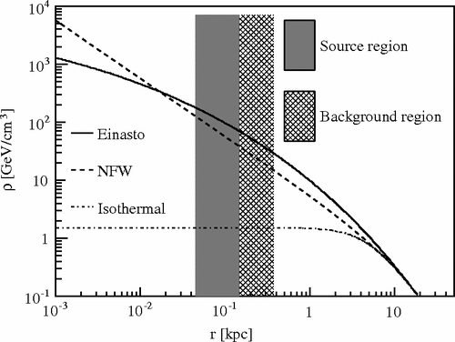
AN EXAMPLE: PHOTONS
Two kinds of sources
Galactic Center: close, large signal, but large backgrounds
Dwarf Galaxies: farther and smaller, so smaller signal, but DM dominated, so smaller backgrounds
Two kinds of signal
Continuum photons: XX → SM → γ
Line photons: XX → γγ, γZ through loop processes
In all cases, halo profiles are not well-determined at the center, introduces an uncertainty in flux of up to ~100

Slide 18
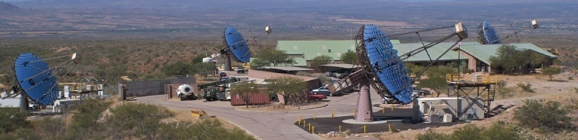

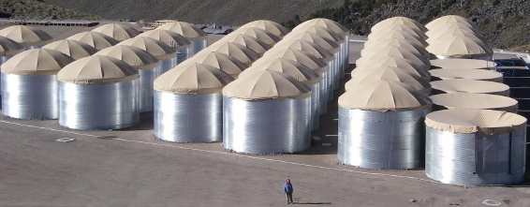
PHOTONS: CURRENT EXPERIMENTS
Veritas, Fermi-LAT, HAWC, and others

Slide 19
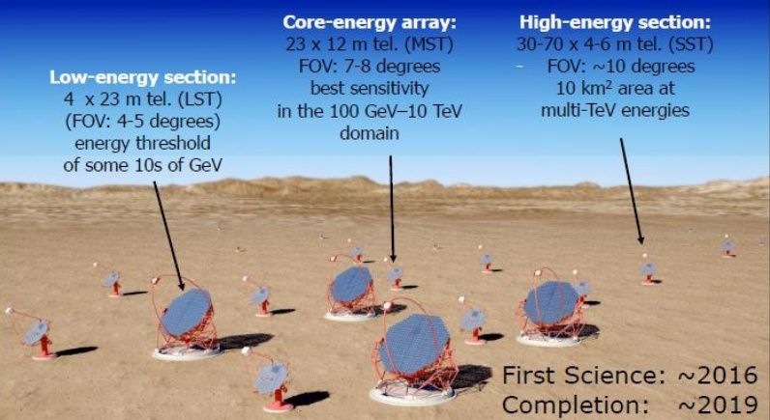
PHOTONS: FUTURE EXPERIMENTS
Cerenkov Telescope Array

Slide 20
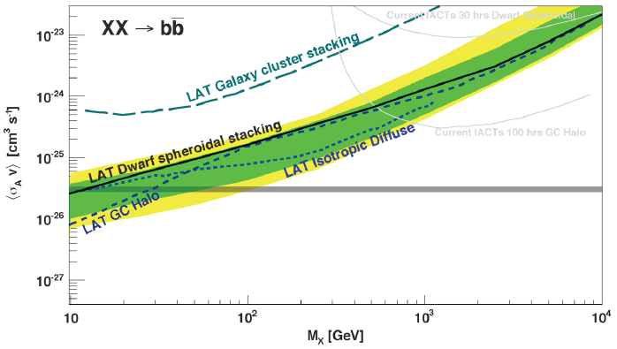
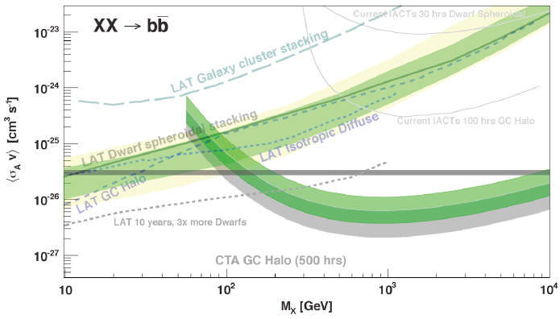
PHOTONS: STATUS AND PROSPECTS
Funk (2013)
Fermi-LAT has excluded a light WIMP with the target annihilation cross section for certain channels, halo profiles
CTA extends the reach to WIMP masses ~ 10 TeV

Slide 21
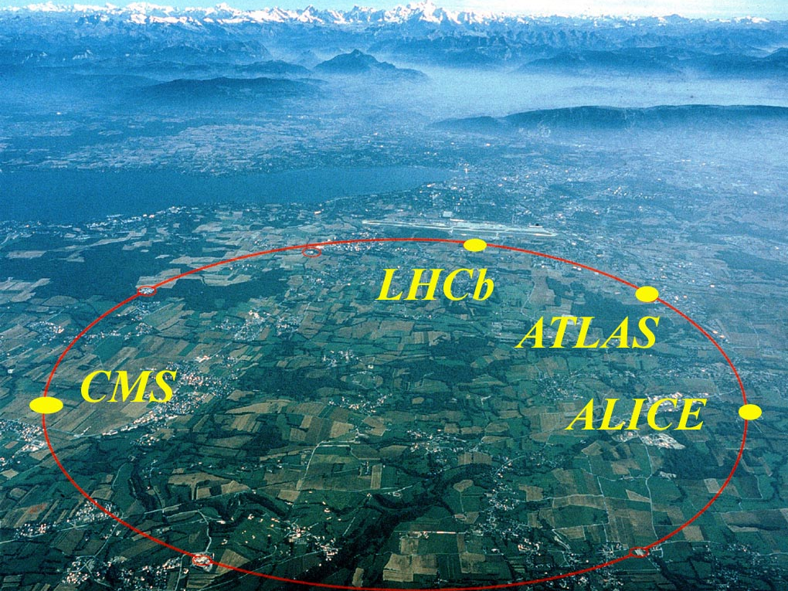
PARTICLE COLLIDERS

Slide 22
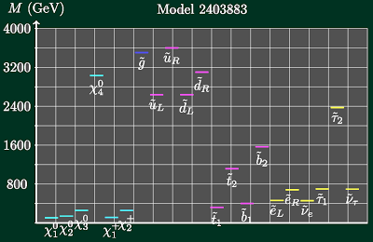
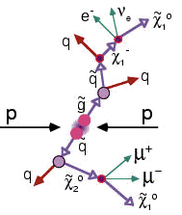
DARK MATTER AT COLLIDERS
Full Models, Simplified Models
See Eno, Toro talk
Produce other particles, which decay to DM

Slide 23
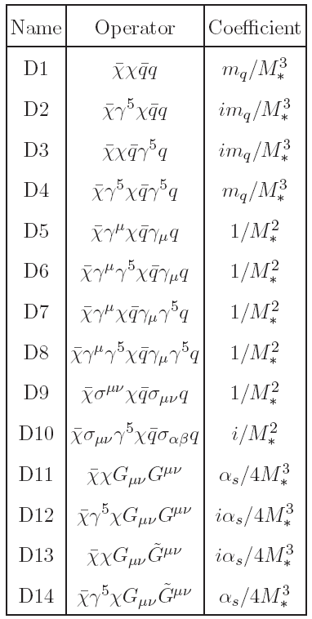
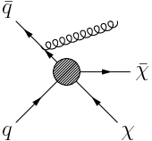
DARK MATTER AT COLLIDERS
DM Effective Theories (Bare Bones Dark Matter)
Now systematically classify all possible 4-pt interactions
Produce DM directly,
but in association with
something else so it
can be seen:
Mono-γ, jet,W,Z,h,b,t
Goodman, Ibe, Rajaraman, Shepherd, Tait, Yu (2010)
_{Bai, Fox, Harnik (2010)}
Birkedal, Matchev, Perelstein (2004)

Slide 24
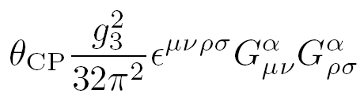

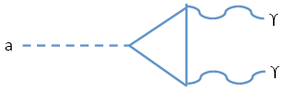
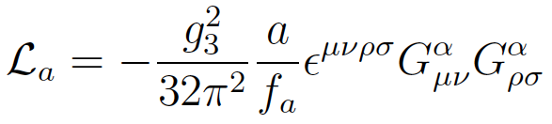
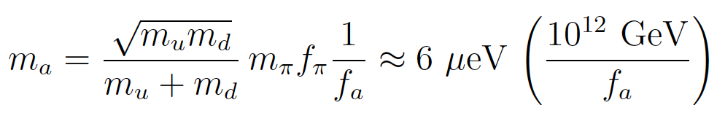
AXIONS
Strongly motivated by the strong CP problem
Current bound from electric dipole moments is
Motivates introduction of the axion field, a pseudoscalar
The axion couples to gluons and quarks, and also to photons through
The axion’s properties are largely determined by f_{a}
Peccei, Quinn (1977)
Wilczek (1978)
Weinberg (1978)

Slide 25
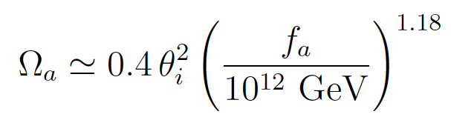
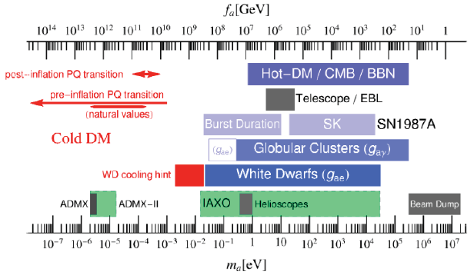
AXION DARK MATTER
The relic density is
If misalignment is θ_{i} ~1, then f_{a} ~ 10¹² GeV, m_{a} ~ 1-100 μeV
More generally, f_{a} < M_{planck ,} and supernovae and red giant constraints require f_{a} > 10⁹ GeV,, so m_{a} ~ peV to eV
PDG (2016)

Slide 26
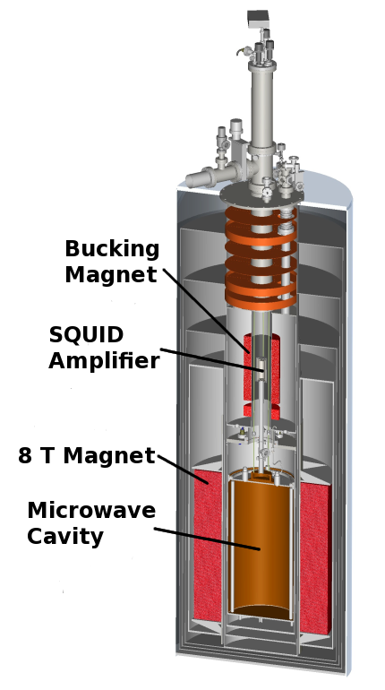
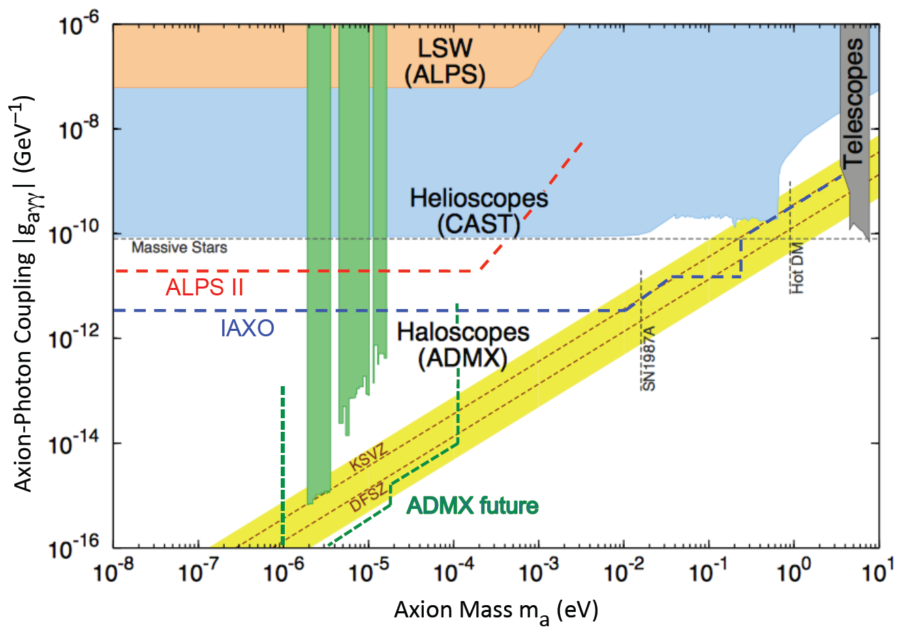
AXION SEARCHES
See van Bibber, Graham talks
4m
Graham, Irastorza, Lamoreaux, Lindner, va Bibber (2016)

Slide 27
RECENT DEVELOPMENTS
In the last few years, there has been a flurry of activity
Classic candidates have been generalized to broad classes of dark matter
Axions → Axion-like Particles (ALPs) → Ultralight DM
WIMPs → WIMPless DM→ Hidden Sector DM
New anomalies have been reported and new experimental search techniques have been proposed
See Schuster, Toro, Perez talks

Slide 28
DM CANDIDATES, ANOMALIES, SEARCH TECHNIQUES
zeV
aeV
feV
peV
neV
μeV
meV
eV
keV
MeV
GeV
TeV
PeV
30M☉
≈
QCD Axion
WIMPs
Ultralight Dark Matter
Hidden Sector Dark Matter
Black Holes
Hidden Thermal Relics / WIMPless DM
Asymmetric DM
Freeze-In DM
SIMPs / ELDERS
Beryllium-8
Muon g-2
Small-Scale Structure
Coherent Field Searches, Direct Detection, Nuclear and Atomic Physics, Accelerators
Microlensing
≈
zeV
aeV
feV
peV
neV
μeV
meV
eV
keV
MeV
GeV
TeV
PeV
30M☉
Cosmic Visions White Paper (2017)

Slide 29
HIDDEN SECTOR DARK MATTER
All evidence for dark matter is gravitational. Perhaps it’s in a hidden sector, composed of particles with no SM gauge interactions (electromagnetic, weak, strong)
This hidden sector may have a rich structure with matter and forces of its own
It may also have non-gauge interactions with the SM
SM
Hidden
X

Slide 30
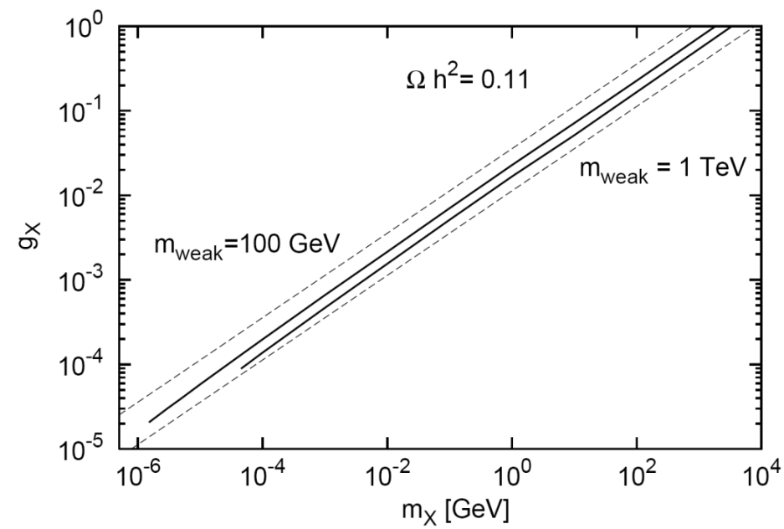
WIMPLESS DARK MATTER
Feng, Kumar (2008)
Recall the WIMP miracle: the relation between Ω_{X} and annihilation strength is wonderfully simple:
m_{X} ~ 100 GeV, g_{X} ~ 0.6 → Ω_{X} ~ 0.1
In a hidden sector, the coupling g_{X} doesn’t have to be 0.6
_{WIMPs}
X
q
_
_{WIMPless DM}
X
q
WIMPless dark matter: light, weakly-coupled DM can also have the correct relic density, sets “thermal targets,” opens connections to low-energy particle, nuclear, AMO, CM physics

Slide 31
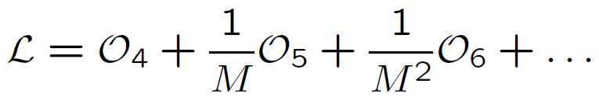



EFFECTIVE INTERACTIONS
There are many ways the hidden particles could couple to us. Use effective operators as an organizing principle:
where the operators are grouped by their mass dimension, with
[scalar] = 1, [fermion] = 3/2, [F_{μν}] = 2
M is a (presumably) large “mediator mass,” so start with dimension 4 operators. There are not too many:
Neutrino portal Higgs portal Photon portal

Slide 32
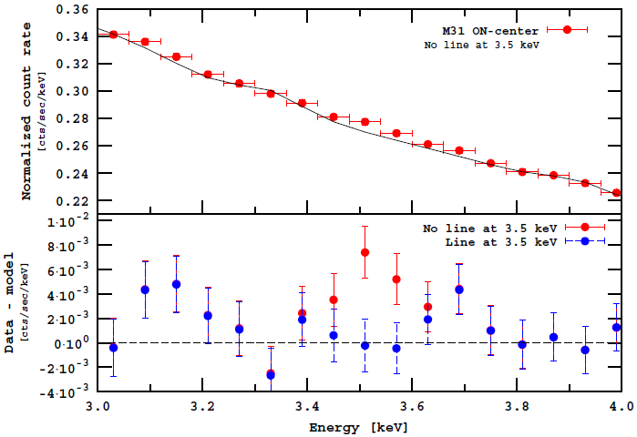
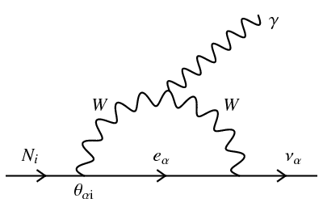
NEUTRINO PORTAL
See Grossman, Kaufman, Friedland, Tanaka, Blucher talks
One possibility is
N is a total gauge singlet, the right-handed, or sterile, neutrino, and may be dark matter
If N is dark matter, its favored mass range is ~keV
This has received renewed attention from the 3.5 keV X-ray line seen from galaxies and galaxy clusters
Abazajian, Fuller, Tucker (2001)
Boyarsky, Ruchayskiy, Iakubovskyi, Franse (2014)
Bulbul, Markevitch, Foster, Smith, Loewenstein, Randall (2014)

Slide 33
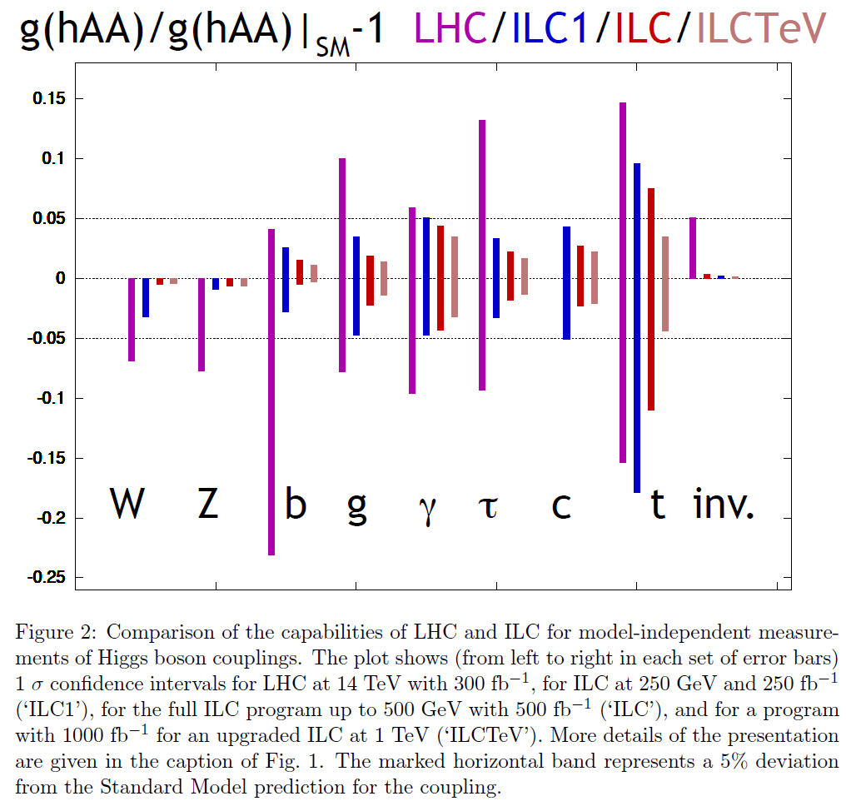
HIGGS PORTAL
See Gray talk
Patt, Wilczek (2006)
Another possibility is
where the h subscript denotes “hidden”
When EW symmetry is broken, h → v + h, this leads to invisible Higgs decays
A leading motivation for precision Higgs studies and future colliders, such as ILC, CLIC, FCC
Peskin (2012)

Slide 34
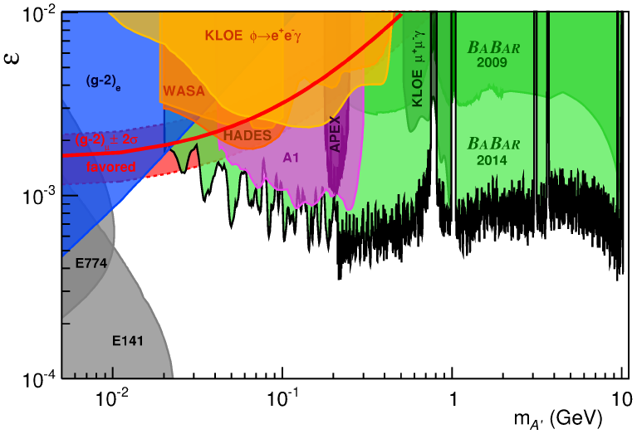
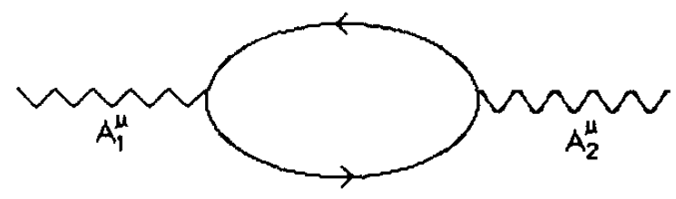

PHOTON PORTAL
Okun (1982)
Galison, Manohar (1984)
Holdom (1986)
Another possibility is
which leads to kinetic mixing between the SM photon and a hidden photon A’, which must have a mass
Diagonalizing, one finds that SM particles have hidden charge proportional to ε
ε ~ 10⁻³ from 1-loop effects, even for arbitrarily heavy particles in the loop (non-decoupling)
A’ cannot be DM, but may be a portal to the dark sector, motivates searches at the “intensity frontier”
BaBar (2014)

Slide 35
CONCLUSIONS
Dark matter is one of the great scientific puzzles of our time and is now leading evidence for new particles and forces. Much of BSM physics is now also DM physics
Classic candidates (sterile neutrinos, axions, WIMPs) remain viable, many powerful searches ongoing
Many new candidates are emerging, motivating new search techniques and connections to other subfields of physics

