Slide 1
INVITATION: DM AT THE LHC
DM@LHC 2017
University of California, Irvine
Jonathan Feng, UC Irvine
3 April 2017

Slide 2

INTRODUCTION
Motivations for new physics
  Gauge hierarchy problem
  Dark matter
  Dark energy
  Baryon asymmetry
  Inflation
  Flavor problem
  Neutrino masses and mixings
  ...
In the last few years, the cosmic questions have risen in importance, and among these, dark matter has become the dominant motivation to expect new particles and forces

Slide 3




DARK MATTER AT THE LHC
1997
2007
2017
LHC
LHC
LHC
Standard Model
Higgs Boson
Gauge Hierarchy
Dark Matter
Higgs Boson
Gauge Hierarchy
Higgs Boson
Dark Matter
Gauge Hierarchy
Why has dark matter become so important?
Ancient history ahead!

Slide 4
A BRIEF HISTORY OF DM AT COLLIDERS
~1984: LHC Conception
1993: SSC Canceled, future hadron colliders = LHC. LHC program:
  Discover and study the Higgs boson
  Precisely study SM particles, e.g., the top quark
  Discover and study new particles that solve the gauge hierarchy problem
1993: SLAC demonstrates highly polarized beams, linear collider efforts in Asia, Europe, and America start becoming the ILC. ILC program:
  Precisely study the Higgs boson
  Precisely study SM particles, e.g., the top quark
  Discover and precisely study new particles that solve the gauge hierarchy problem with mass up to E_{beam}
Why build the ILC? What does precision study of new particles buy you?

Slide 5
THE ANSWER: DARK MATTER
1998: Accelerating universe discovered
2001-: rapid rise in precision cosmology from CMB experiments, etc.
Late 1990’s-: a new boom in DM candidates begins (Q balls, WIMPzillas, inelastic DM, KK dark matter, T-odd dark matter, superWIMPs, etc.)
New collider goals
  What can colliders tell us about cosmology?
  How well can dark matter properties be determined?
  For example, how precisely can m_{X} and Ω_{X} be determined?
A shift in thinking
  old: lightest neutralino = cascade endpoint, missing E_{T} signature
  new: lightest neutralino = dark matter, critically importance
Most LHC physicists were too busy doing real work, and so this largely fell to ILC study groups to investigate

Slide 6
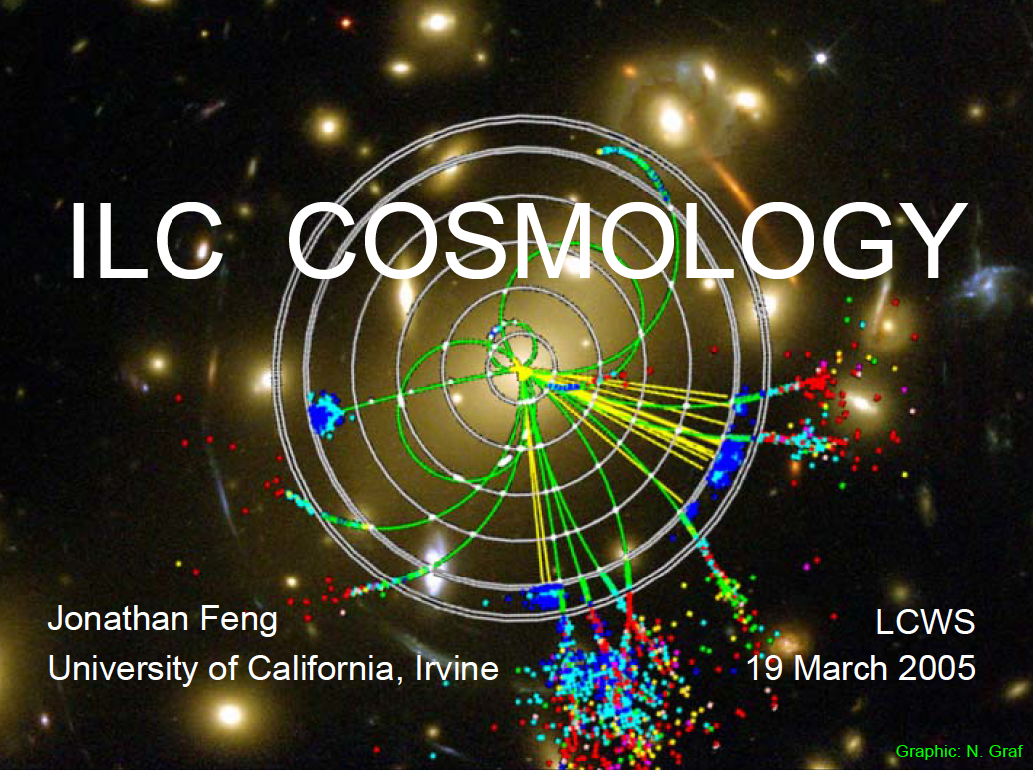
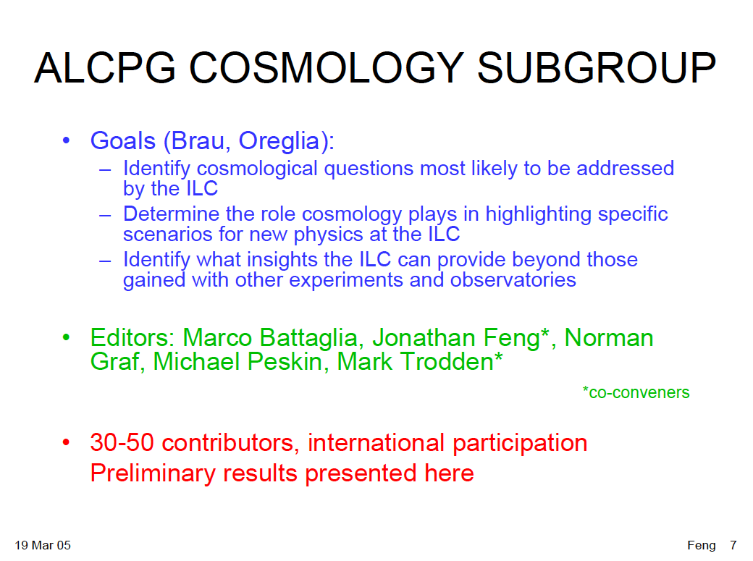
ILC COSMOLOGY GROUP 2004-05

Slide 7
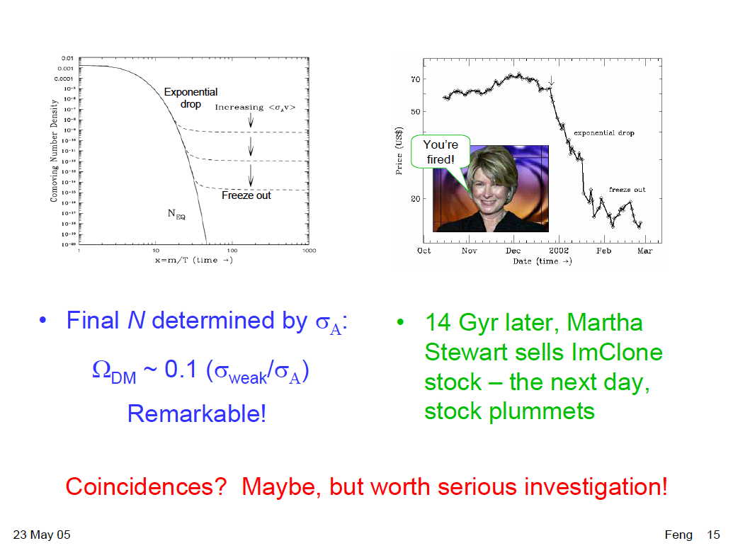
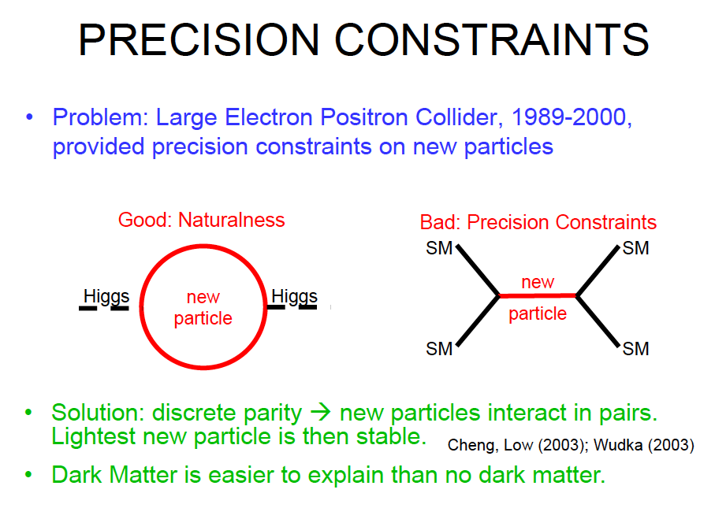
THE WIMP MIRACLE
“Determine the role cosmology plays in highlighting specific scenarios for new physics”
The WIMP miracle: Continuous (relic density) and Discrete (stability)
Irrespective of the gauge hierarchy problem, cosmology → weak scale, and the LHC is ideally suited to probing this scale definitively

Slide 8
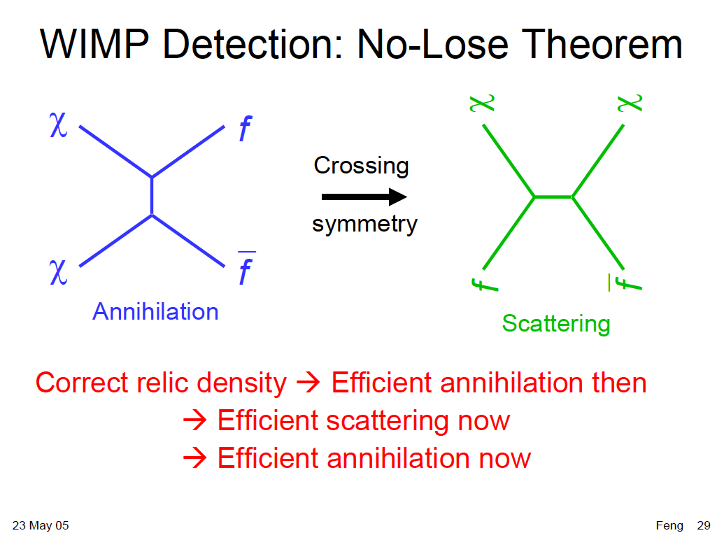
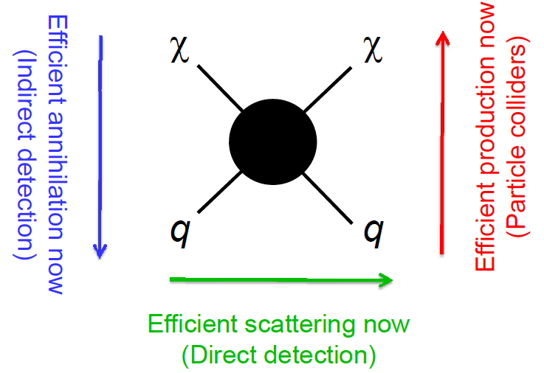
COMPLEMENTARITY
“Identify what insights the ILC can provide beyond those gained with other experiments and observations”
essentially required understanding what the LHC, direct detection, and indirect detection could do: complementarity
The LHC is an integral part of any comprehensive program to understand dark matter
_{Feng (2008)}

Slide 9
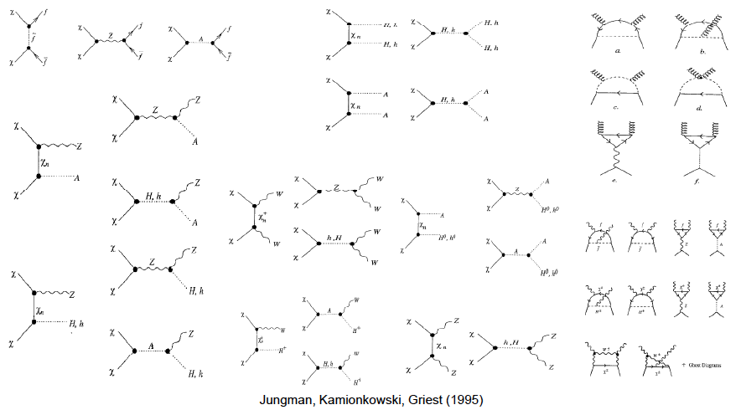
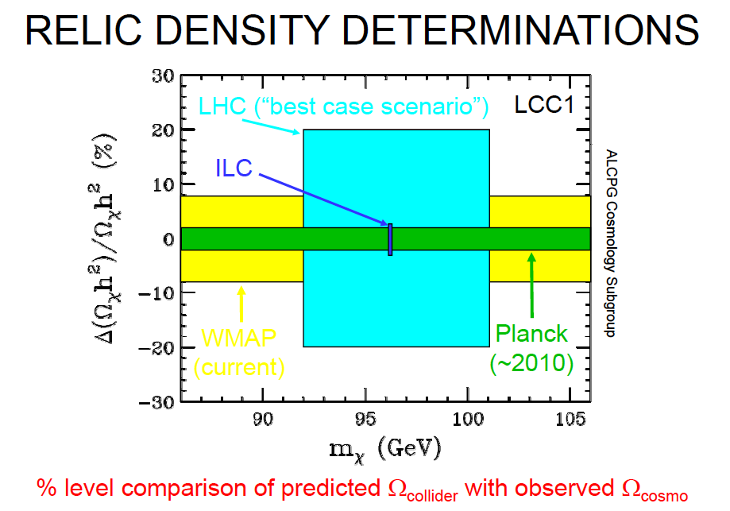
RELIC DENSITY AND COMPLETE MODELS
A crowning achievement: given a complete model, determine the relic density to % level, compare with cosmological measurements
Baltz, Battaglia, Peskin, Wizansky (2006)
Addressed many now famous slogans: “colliders can’t discover dark matter”, “dark matter might be multi-component”, “the dark sector could be complicated”
The LHC can determine if missing particles are all of the DM, probe the Universe’s history back to t ~ 1 ps (cf. BBN and 1 s)

Slide 10
COMPLETE MODELS
How is the WIMP paradigm doing now?
“Rumors of its death have been greatly exaggerated.” -- Dark Twain
Naturalness is highly subjective. Within the considerable variation of what constitutes a good definition of naturalness, there are natural, viable models. For example, in SUSY:
  Effective SUSY
  Focus point SUSY
  Compressed SUSY
  R-parity violating SUSY
  Dirac gaugino SUSY
  ...
A new personal favorite: 4th generation SUSY

Slide 11
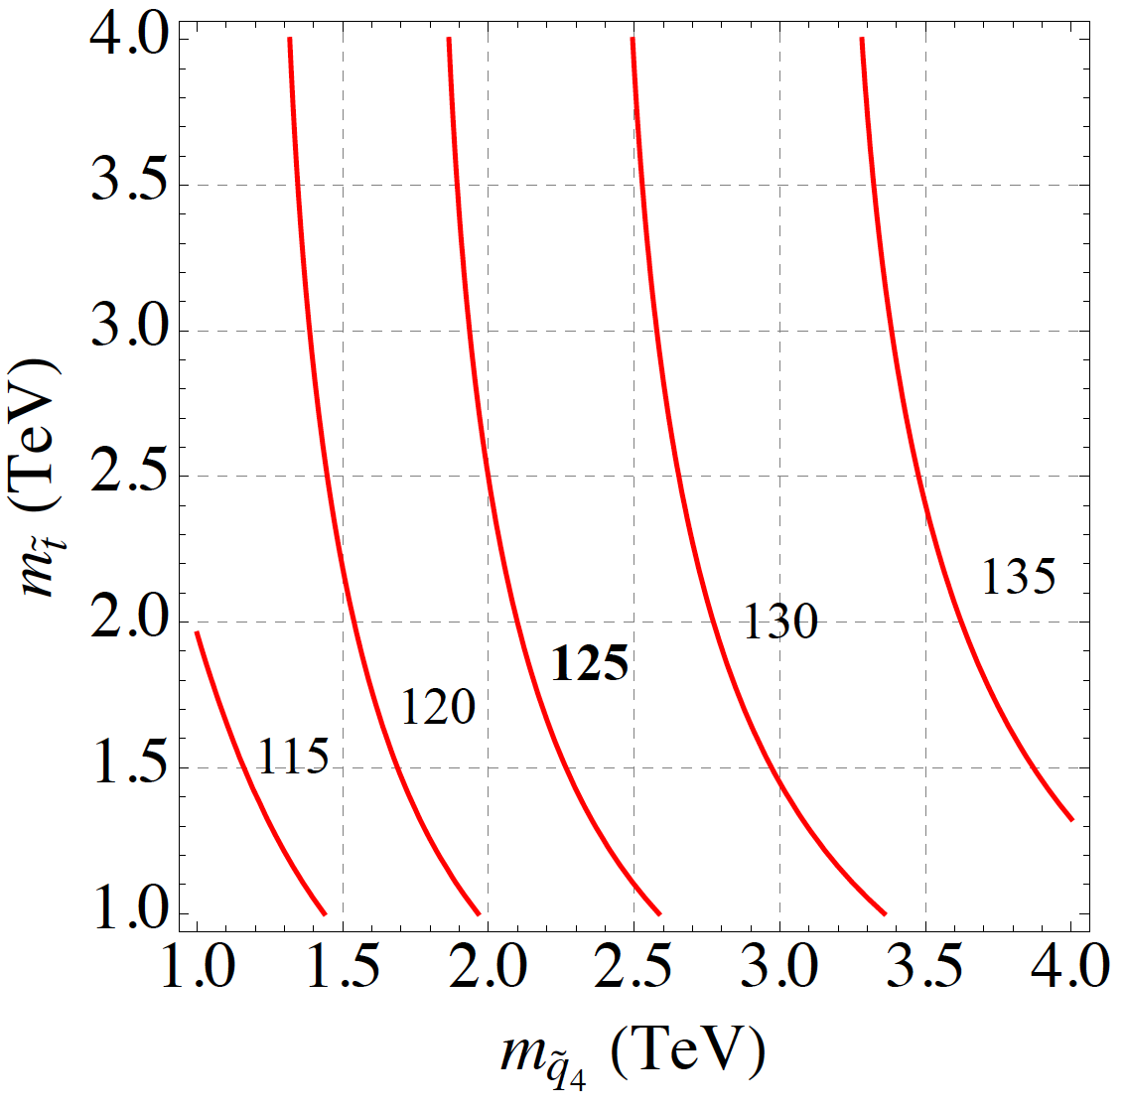
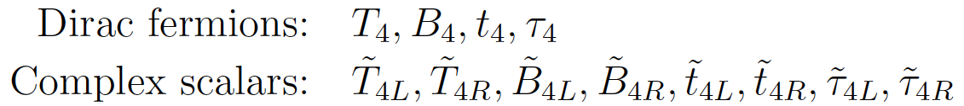
MSSM4G
Naturalness suggests light stops and sbottoms, m_{h} = 125 GeV suggests heavy stops and sbottoms
A resolution: introduce a 4th generation of particles to raise the Higgs mass _{Moroi, Okada (1992)}
Chiral 4th generation particles are possible, but highly constrained. Instead, add vector-like 4th generation particles Kribs, Plehn, Spannowsky, Tait (2007)
Remarkably, requiring gauge coupling unification, there are only two options: the QUE and QDEE models. E.g., QUE:
_{Martin (2010)}
m_{h} (GeV)

Slide 12
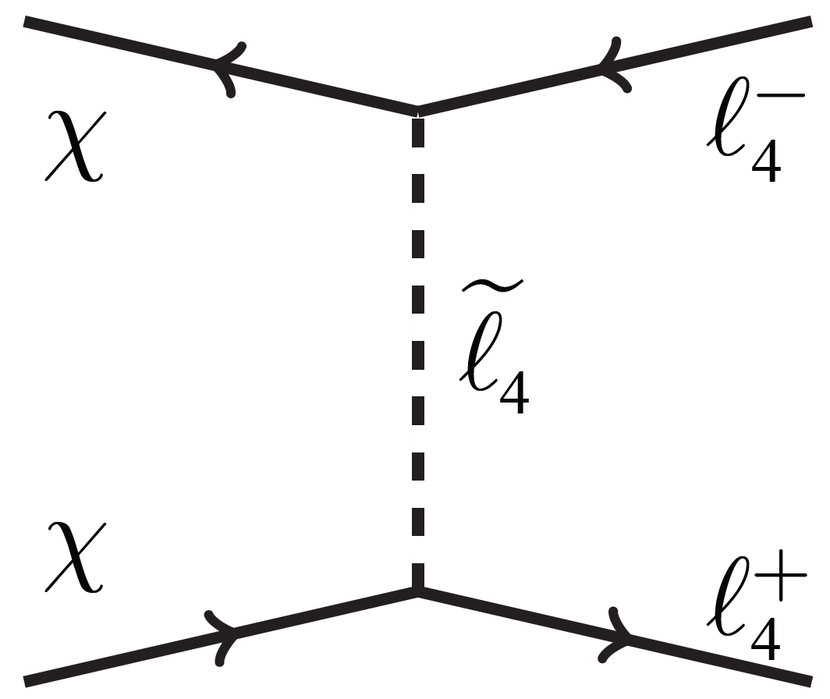
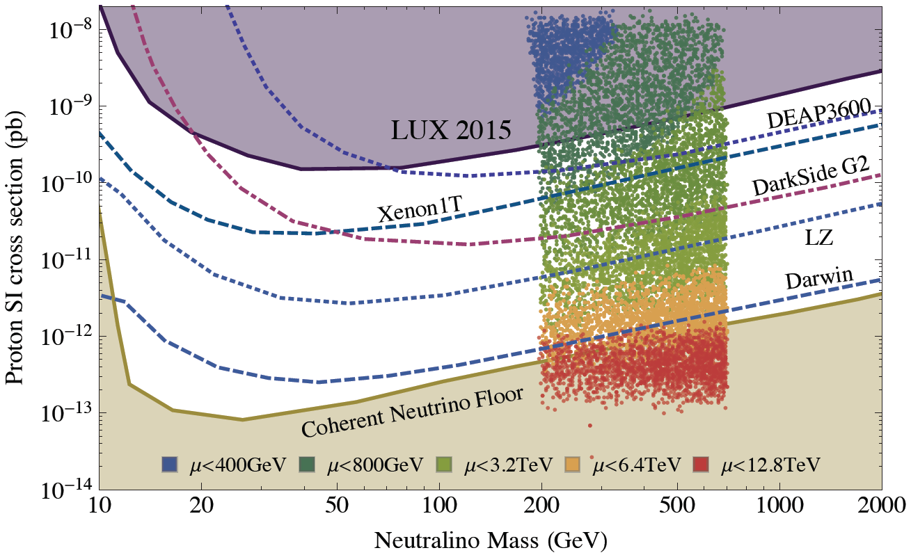
MSSM4G COSMOLOGY
Abdullah, Feng (2015); Abdullah, Feng, Iwamoto, Lillard (2016)
The introduction of a heavy 4th generation completely changes the cosmology
The single process χχ → τ₄τ₄ dominates all SM processes combined
The resulting DM is a Bino-like neutralino, but heavier
Direct detection cross sections are Higgs-mediated and Higgsino-fraction suppressed, naturally fall between current bounds and the neutrino floor

Slide 13
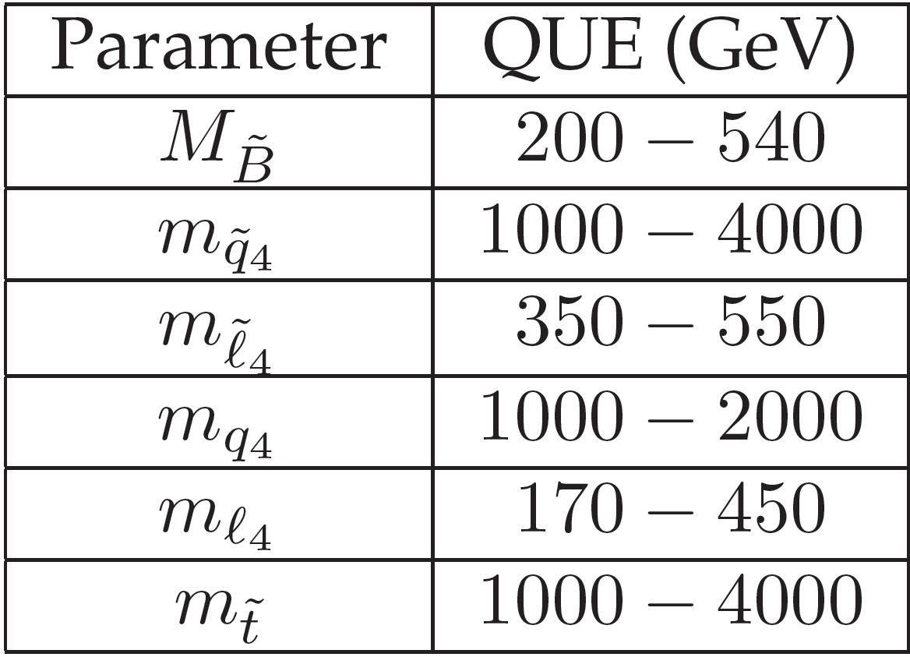
MSSM4G AT THE LHC
see Mo Abdullah and Ben Lillard’s poster
A broad range of interesting LHC signals. 4th generation particles must decay, but can decay to any of the 1st three generations with a variety of lifetimes
Quarks and squarks in the 1-2 TeV range
τ̃₄ τ̃₄ Drell-Yan production, leading to long-lived charged particles, displaced vertices, etc.
τ̃₄ τ̃₄ Drell-Yan production, followed by decays τ̃₄ → e χ, μ χ, τ χ
τ₄ τ₄ Drell-Yan production, followed by decays τ₄ → τ Z, ν W, τ h, etc.

Slide 14
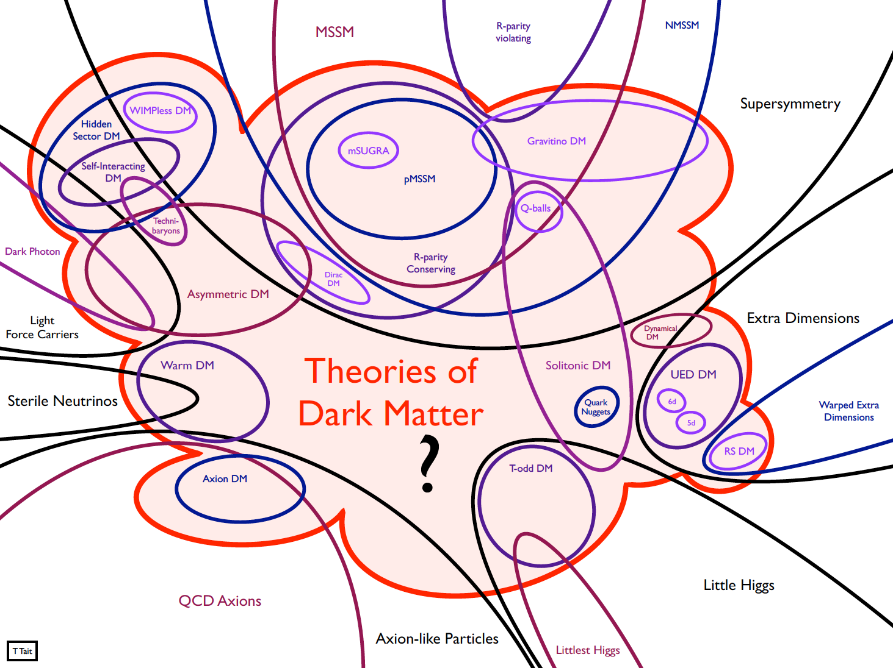
OTHER COMPLETE MODELS

Slide 15
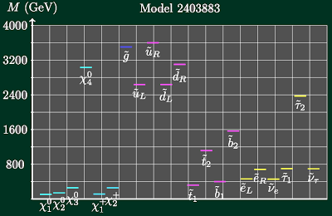
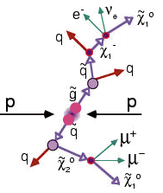
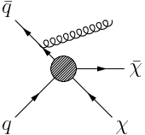
DM EFFECTIVE THEORIES & SIMPLIFIED MODELS
Complete Models
Effective Theories
Produce other
particles, which
decay to DM
Produce DM
directly

Slide 16
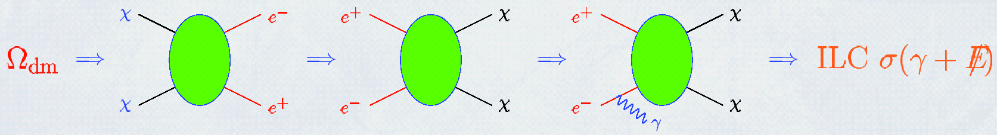
PROTO-EFFECTIVE THEORIES AT THE ILC
Thermal relic WIMPs annihilate to SM particles, and so should be produced directly at colliders
  First considered at the ILC: pair production is invisible, so consider photon radiation
  Birkedal, Matchev, Perelstein (2004)
  Also (less successfully) mono-jets and mono-photons at the Tevatron and LHC
_{Feng, Su, Takayama (2005)}

Slide 17
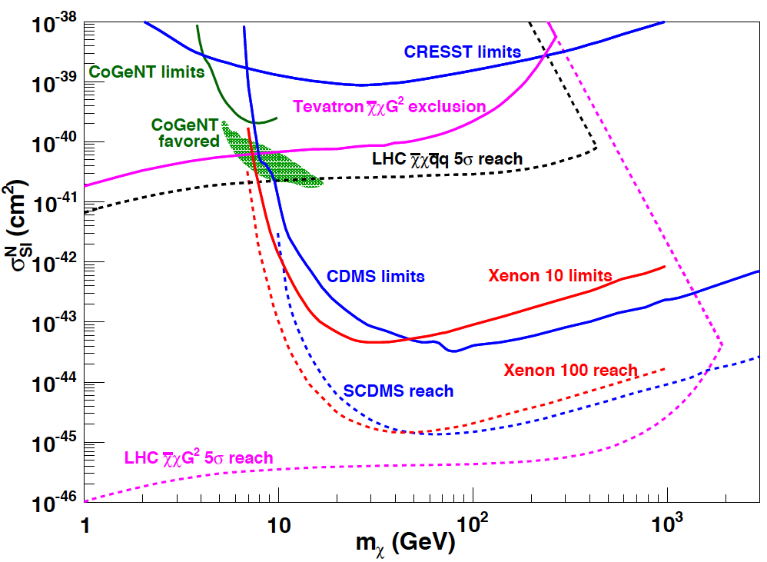
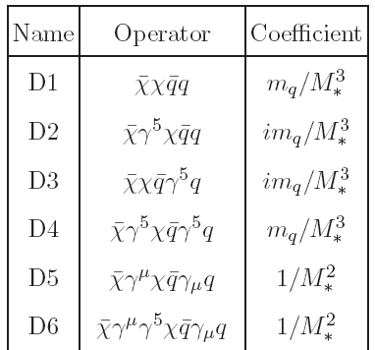
DM EFFECTIVE THEORY
This approach received a huge boost when hints of light DM motivated a hierarchy between the DM and mediator masses
Beltran, Hooper, Kolb,Krusberg, Tait (2006)
Goodman, Ibe, Rajaraman, Shepherd, Tait, Yu (2010)
_{Bai, Fox, Harnik (2010)}
...
These have motivated a plethora of mono-γ,j,b,t,W,Z,h searches, probing dark matter at the LHC one operator at a time
DM effective theory allows comparison to indirect, direct search results; LHC does very well for some operators, low DM masses
Goodman et al. (2010)
…

Slide 18
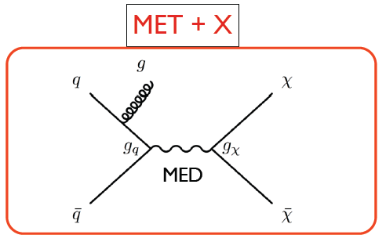
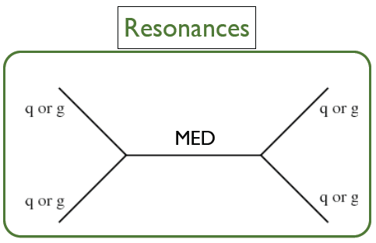
DM SIMPLIFIED MODELS
Abercrombie et al. (2015)
Extends coverage to include explicit dark mediators/forces, signatures include dijets, etc.
Provides simple framework to interpret searches in terms of
  Discrete choices of couplings: vector, axial, scalar, pseudoscalar
  Continuous choices of a small set of parameters: g_{q}, g_{χ}, m_{χ}, m_{MED}

Slide 19
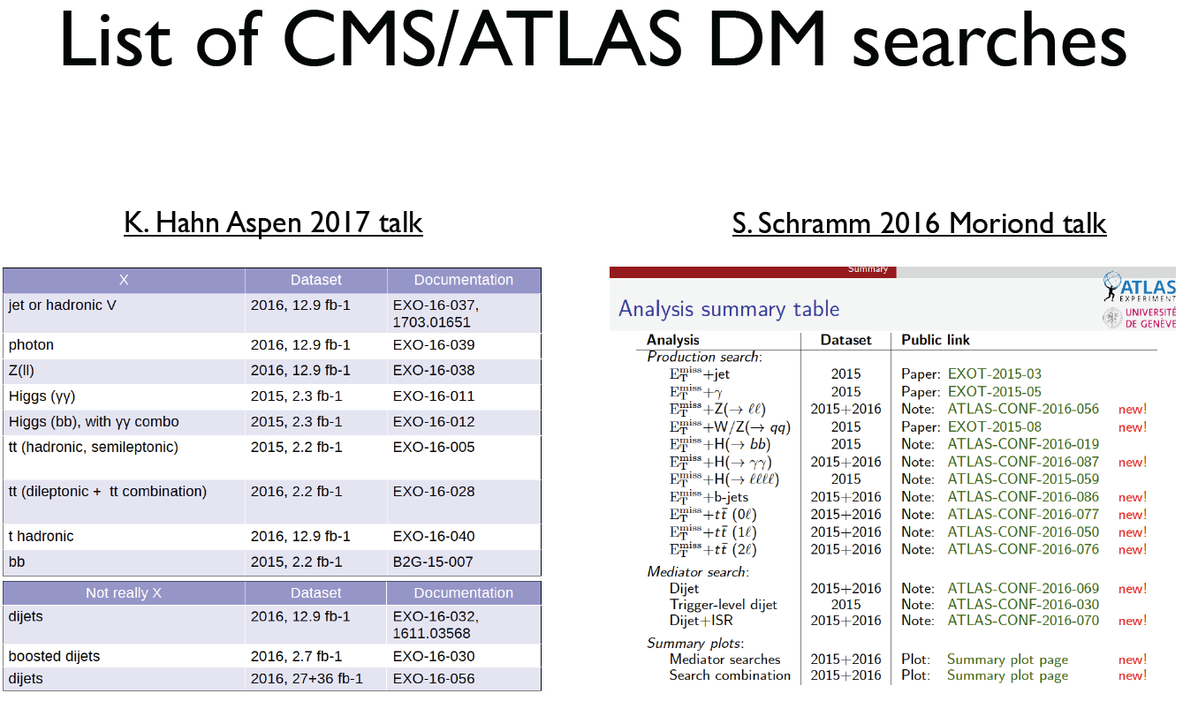
RECENT LHC RESULTS
Trovato, Cosmic Visions talk (2017)

Slide 20
CONCLUSIONS
Dark matter has long been one of the great scientific problems of our time, but it has become leading evidence for new particles and forces. Much of BSM physics is now also DM physics
Irrespective of the gauge hierarchy problem, cosmology → weak scale, and the LHC is ideally suited to probing this scale definitively
The LHC is an integral part of any comprehensive program to understand dark matter and may probe the Universe’s history back to t ~ 1 ps (cf. BBN and 1 s)
Recent progress continues to make the DM/LHC interface an incredibly fertile area for creative ideas connecting theory/experiment and astrophysics/particle physics, with dark matter motivating many interesting scenarios that the LHC is ideally suited to probe. Lots of fascinating work ahead!

