Slide 1
FIFTH FORCES
Symmetry Tests in Nuclei and Atoms
KITP, Santa Barbara
Jonathan Feng, UC Irvine
19 September 2016

Slide 2

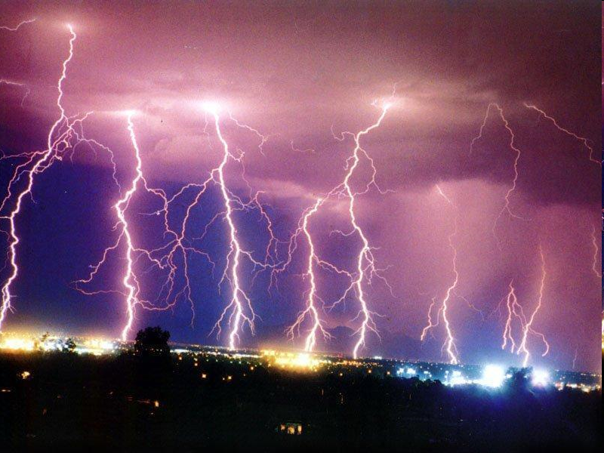
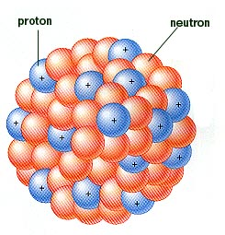
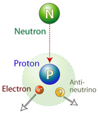
FUNDAMENTAL FORCES
We know of four fundamental forces
A fifth one would be a big deal
Forces can be mediated by a host of particles: pions, Higgs boson, dilaton, towers of KK gravitons,...
In this talk, “5th force” refers to a force mediated by a new spin-1 gauge boson
Gravity
Electromagnetism
Strong
Weak

Slide 3
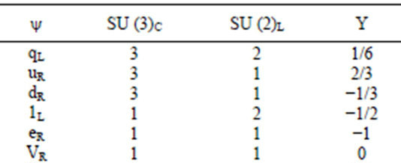
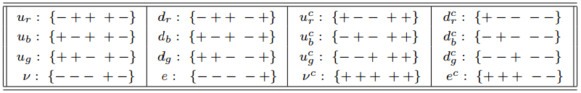
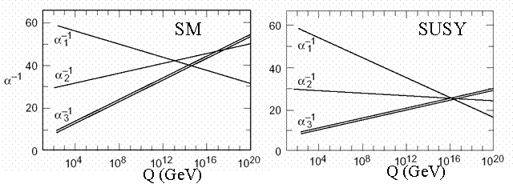
5TH FORCE MOTIVATION: UNIFICATION
Quantum numbers: e.g., SU(3) x SU(2) x U(1) → SO(10)
Unification of couplings: at a perturbative value and at a scale below M_{planck} but high enough to satisfy proton decay
Any GUT group SO(10) or bigger has rank > 4, implies 5th force: U(1)_{B-L} , Z’ gauge bosons, etc.

Slide 4
5TH FORCE MOTIVATION: DARK MATTER
All evidence for dark matter is gravitational. Perhaps its in a hidden sector, composed of particles with no SM gauge interactions (electromagnetic, weak, strong)
This hidden sector may have a rich structure with matter and forces of its own
SM
Hidden
X
Lee, Yang (1956); Kobsarev, Okun, Pomeranchuk (1966); Blinnikov, Khlopov (1982);
Foot, Lew, Volkas (1991); Hodges (1993); Berezhiani, Dolgov, Mohapatra (1995); …

Slide 5
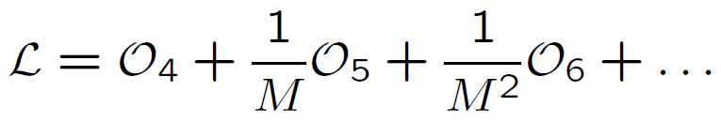



DM PORTALS
Astrophysics is sensitive to DM-DM interactions, but particle and nuclear physics are determined by DM-SM interactions
There are many ways the hidden particles could couple to us. Use effective operators as an organizing principle:
where the operators are grouped by their mass dimension, with [scalar] = 1, [fermion] = 3/2, [F_{μν}] = 2
M is a (presumably) large “mediator mass,” so start with dimension 4 operators. Some of the few possibilities:
Neutrino portal Higgs portal Vector portal

Slide 6
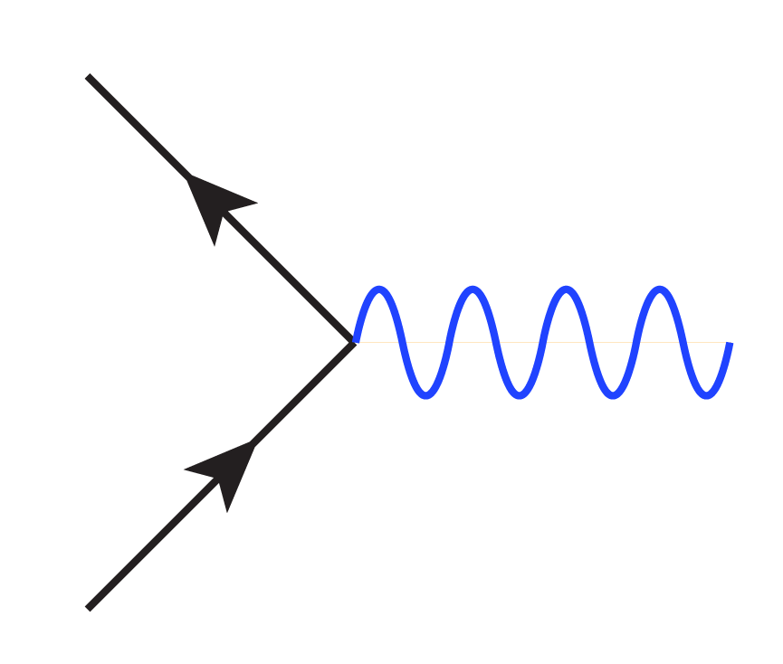
VECTOR PORTAL
Holdom (1986)
The operator leads to kinetic mixing between the SM photon and the massive hidden photon
Diagonalizing, one finds that the physical states are the massless SM photon γ and a massive “dark photon” A’
SM particles f have hidden charge proportional to εeQ_{f}, but hidden particles f_{h} are SM-neutral
f
f_{h}
γ
A’
f
f_{h}

Slide 7
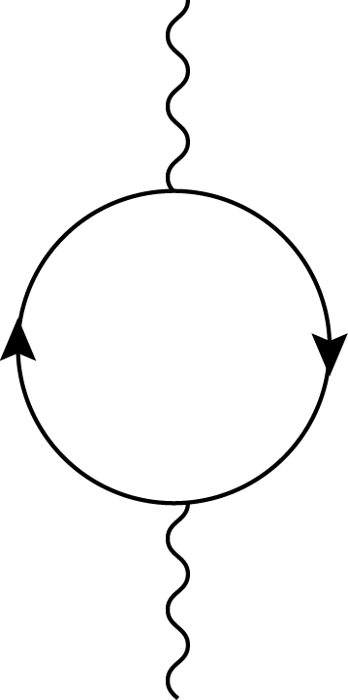
DARK FORCE
ε ~ 10⁻³ N from 1-loop effects, where N is the number of particles in the loop, even for arbitrarily heavy particles in the loop (non-decoupling)
Dark matter distributions (halo profiles) may indicate strong DM self-interactions with a force carrier of mass ~ 1-100 MeV
This motivates searches for a “dark force” mediated by dark photons, a 5th force parameterized by (m_{A’}, ε), with, perhaps, a region of special interest with m_{A’} ~ 1-100 MeV and ε ~ 10⁻³
A’
N
γ

Slide 8
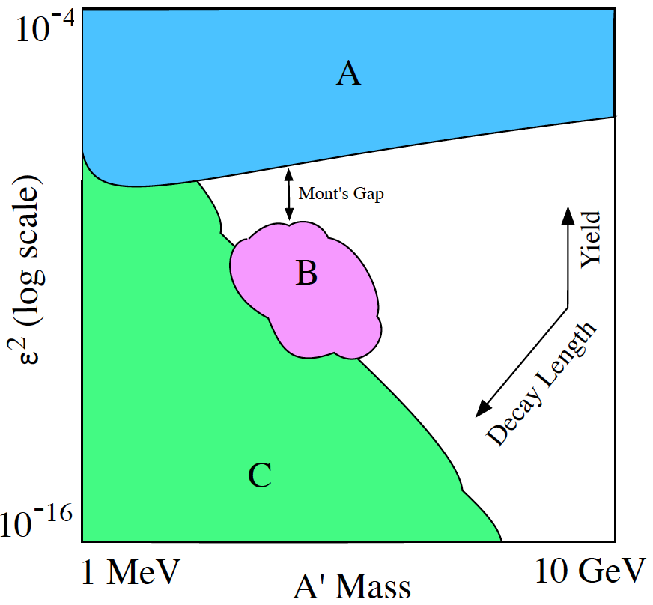
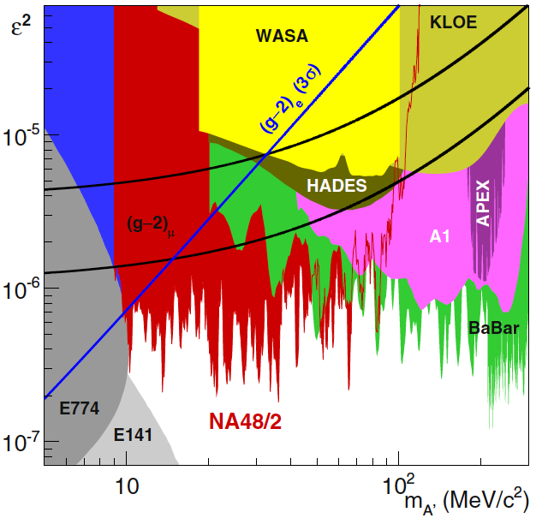
CURRENT CONSTRAINTS
This has motivated a world-wide program to search for A’
Dark Sectors Report (2016)
A: Bump hunts
B: Displaced vertices (short decays)
C: Beam dumps (long decays)

Slide 9
FIFTH FORCE IN NUCLEAR TRANSITIONS
Nuclear transitions are natural places to look for MeV-scale new particles
Treiman, Wilczek (1978)
Donnelly, Freedman, Lytel, Peccei, Schwartz (1978)
Savage, McKeown, Filippone, Mitchell (1986)
A recent 6.8σ experimental anomaly might indicate the production of new particles in excited ⁸Be decays
A. J. Krasznahorkay et al., PRL, 1504.01527 [nucl-ex]
Could these be 5th force gauge bosons?
Feng, Fornal, Galon, Gardner, Smolinsky, Tait, Tanedo,
PRL, 1604.07411 [hep-ph], 1608.03591 [hep-ph]

Slide 10
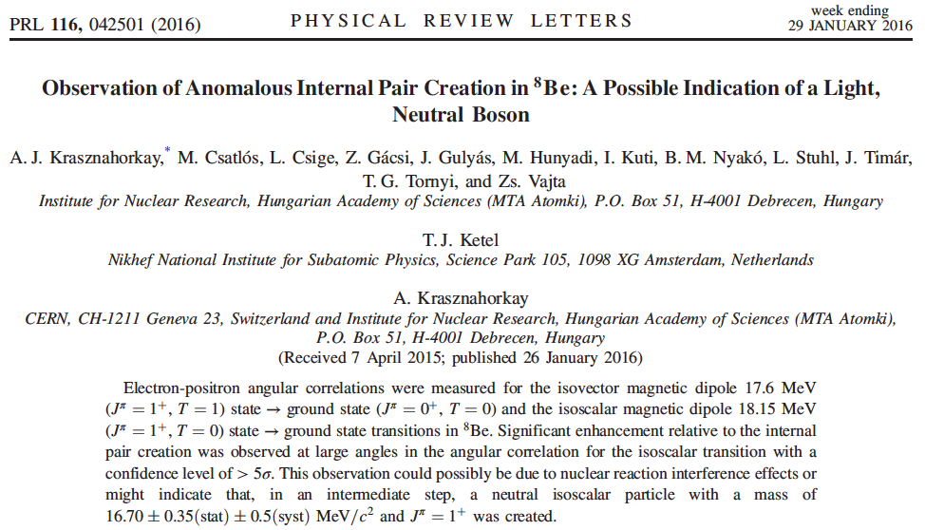
THE EXPERIMENTAL RESULT
A. J. Krasznahorkay et al., 1504.01527 [nucl-ex]

Slide 11
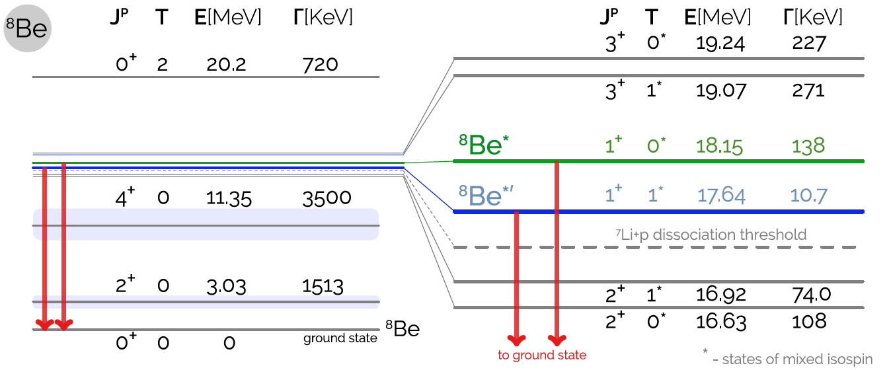
⁸BE SPECTRUM
Tilley et al. (2004); National Nuclear Data Center, http://www.nndc.bnl.gov/nudat2/

Slide 12
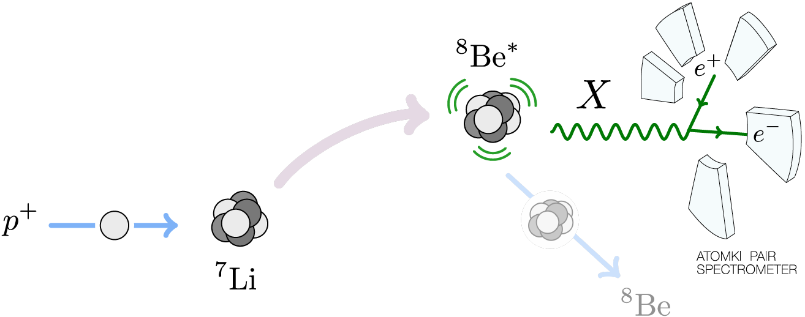
THE ⁸BE EXPERIMENT AT MTA ATOMKI
1 μA proton beam hits thin ⁷Li targets
E_{p} = 1.03 MeV → ⁸Be* resonance, which then decays:
  Hadronic: B(p ⁷Li) ≈ 100%
  Electromagnetic: B(⁸Be γ) ≈ 1.5 x 10⁻⁵
  Internal Pair Conversion: B(⁸Be e⁺ e⁻) ≈ 5.5 x 10⁻⁸

Slide 13
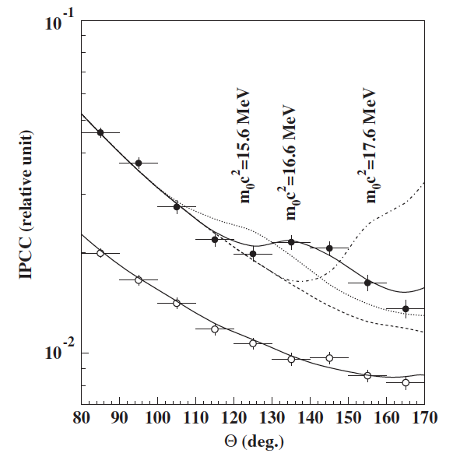
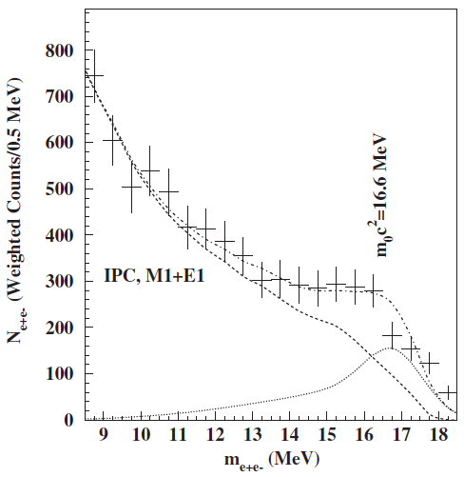
THE ⁸BE IPC ANOMALY
Measure the e⁺e⁻ opening angle θ (and invariant mass)
Background fluctuation probability: 5.6 x 10⁻¹² (6.8σ)
Best fit to new particle: χ²/dof = 1.07
  m = 16.7 ± 0.35 (stat) ± 0.5 (sys) MeV
  B(⁸Be* → ⁸Be X) / B(⁸Be* → ⁸Be γ) = 5.6 x 10⁻⁶
Krasznahorkay et al. (2015)

Slide 14
SIGNAL CHARACTERISTICS
The excess consists of hundreds of events in each bin; this is not a statistical fluctuation, clearly all possible explanations (nuclear physics, experimental setup, particle physics) should be explored
The excess is not a “last bin” effect: bump, not smooth excess
In scan through p resonance energy, excess rises and falls
Excess is seen in the expected event subsamples: events with symmetric e⁻ and e⁺ energies, events passing the 18 MeV gate
Peaks in opening angle θ and invariant mass correspond; required for particle interpretation, not for all backgrounds
Comparable excess not seen for 17.64 MeV state; explainable by phase-space suppression for > 17 MeV particle

Slide 15
INTERESTING QUESTIONS
What kinds of neutral bosons are possible?
What are the required parton-level couplings?
Is this consistent with all other experiments?
Is there an anoamly-free model that predicts this?
What other experiments can check this?
Feng, Fornal, Galon Gardner, Smolinsky, Tait, Tanedo (2016) Gu, He (2016);
Chen, Liang, Qiao (2016); Jia, Li (2016); Kitahara, Yamamoto (2016); Ellwanger, Moretti (2016)

Slide 16
SPIN 0 NEUTRAL BOSONS
SCALARS
“DARK HIGGS”
J^{P} Assignments: 1⁺ → 0⁺ 0⁺
L Conservation:
L = 1
Parity Conservation:
P = (-1)^{L} = 1
Forbidden in parity-conserving theories
PSEUDOSCALARS
“AXION-LIKE PARTICLES”
Requires re-analysis of constraints on aγγ couplings
Ellwanger, Moretti (2016)
Dobrich et al. (2015)

Slide 17
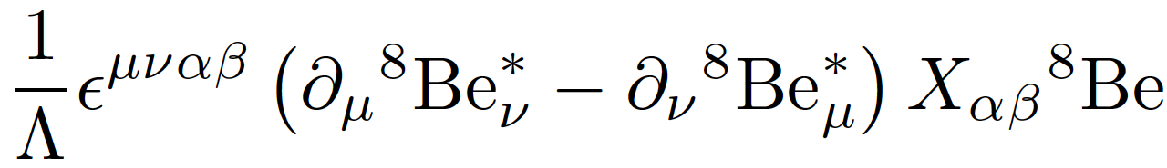

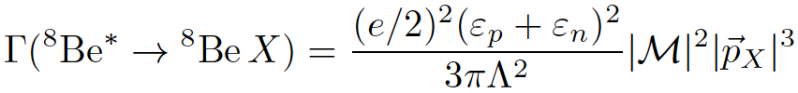
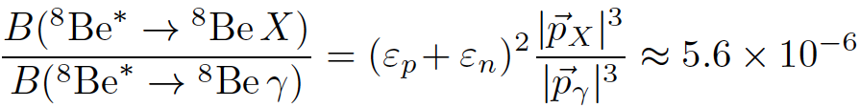


SPIN-1 GAUGE BOSONS
What quark-, nucleon-level couplings are required? In general requires calculating nuclear matrix elements
But for 1⁻ vector, in the EFT, there is only 1 operator
Neglecting isospin mixing,
The nuclear matrix elements and Λ cancel in the ratio
where and are the nucleon X-charges (in units of e)

Slide 18






EFFECT OF ISOSPIN MIXING
There are strong indications that the ⁸Be 1⁺ states are isospin-mixed
Barker (1966); Oothoudt, Garvey (1977); Pastore, Wiringa, Pieper, Schiavilla (2014)
In general, this can have a large effect on the width, changing
to
In the protophobic limit, however, the effect is O(10%)
Feng, Fornal, Galon Gardner, Smolinsky, Tait, Tanedo (2016)

Slide 19


THE REQUIRED PARTON-LEVEL COUPLINGS
To get the right signal strength:
The observed width is completely dominated by experimental effects, but the decay must happen within ~ 1 cm:
This cannot be a dark photon
??

Slide 20
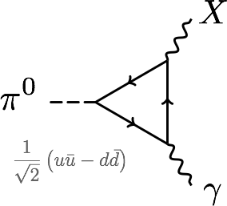
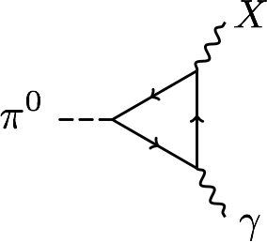
PROTOPHOBIA
The dominant constraints are null results from searches for π⁰ → X γ → e⁺ e⁻ γ
Eliminated if Q_{u}X_{u}– Q_{d}X_{d} ≈ 0 or 2X_{u} + X_{d} ≈ 0 or X_{p} ≈ 0
A protophobic gauge boson with couplings to neutrons, but suppressed couplings to protons, can explain the ⁸Be signal without violating other constraints
u, d
p, n

Slide 21
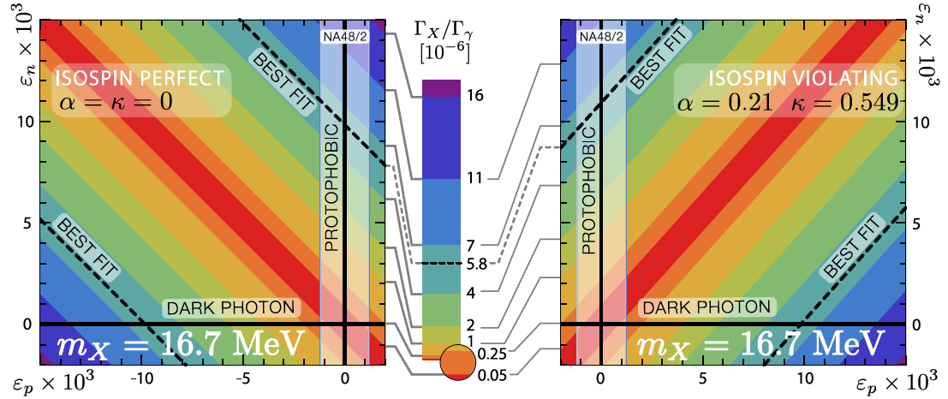
5TH FORCE EXPLANATIONS OF ⁸BE
Feng, Fornal, Galon Gardner, Smolinsky, Tait, Tanedo (2016)

Slide 22
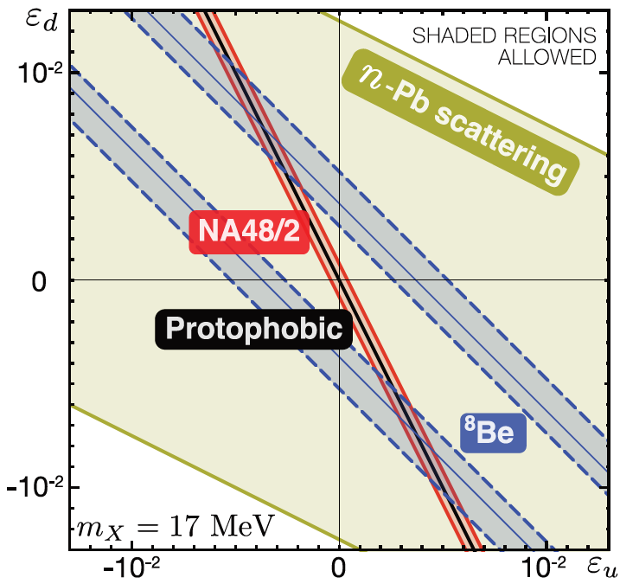
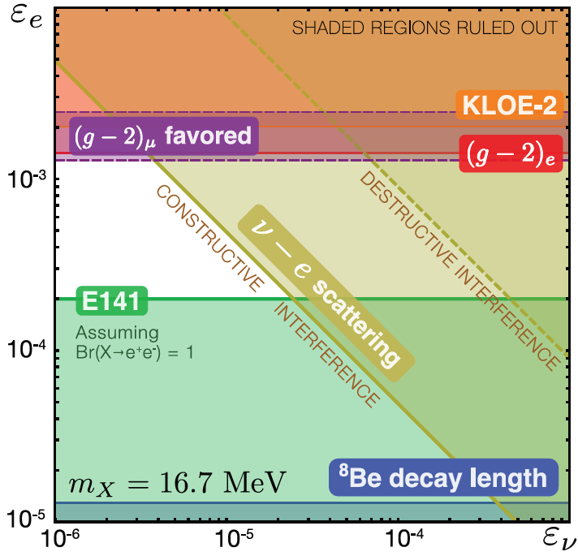
COUPLING CONSTRAINTS
Consider all constraints and also the region favored by (g-2)μ
In the end, require ε_{u}, ε_{d} ~ few 10⁻³ with cancelation to ~10% for protophobia, 10⁻⁴ < ε_{e} < 10⁻³, and |ε_{e}ε_{ν}|^{1/2} < 3 x 10⁻⁴
Feng, Fornal, Galon, Gardner, Smolinsky, Tait, Tanedo (2016)

Slide 23
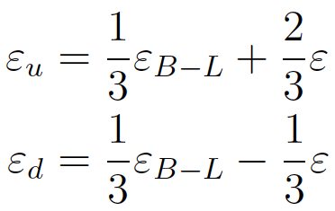
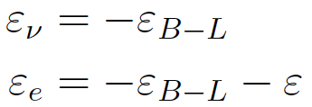
ANOMALY-FREE MODELS
Feng, Fornal, Galon Gardner, Smolinsky, Tait, Tanedo (2016)
How strange is protophobia? Z is protophobic at low energies, as is any gauge boson coupling to B-Q or B-L-Q
Example: gauge the U(1)_{B-L} global symmetry of the SM. This is anomaly-free with the addition of 3 sterile neutrinos
Generically the B-L boson kinetically mixes with the photon:
For ε ≈ -ε_{B-L}, we get B-L-Q charges: ε_{u} ≈ ε/3 and ε_{d} ≈ -2ε/3 (protophobia) and ε_{e} << ε_{u,d} . The neutrino X-charge can be suppressed by mixing with vector-like leptons

Slide 24
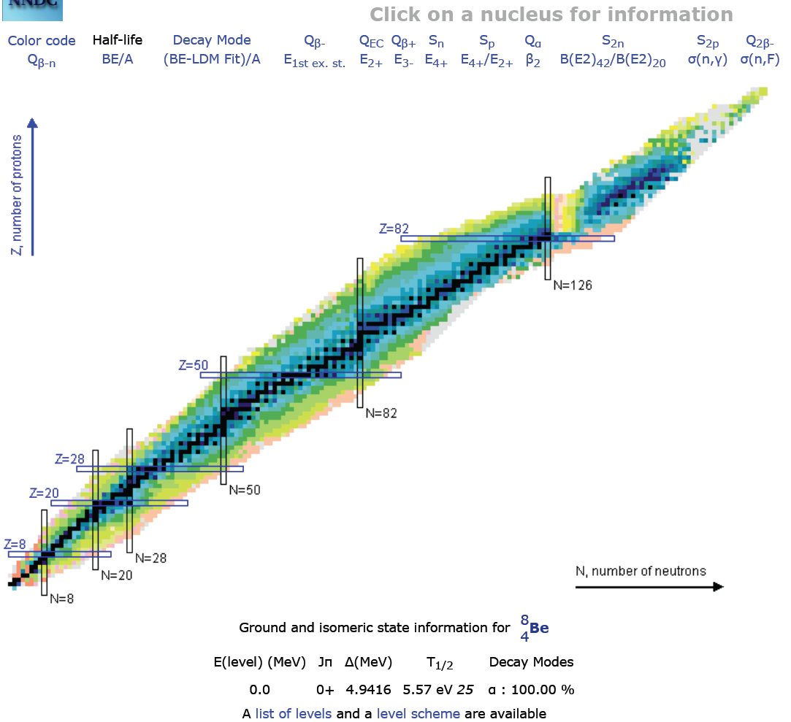
FUTURE TESTS: NUCLEAR PHYSICS
The most direct test would be to look for other nuclear IPC transitions
The ⁸Be 18.15 and 17.64 transitions are among the largest known with discrete gamma rays
Are others possible? E.g., ¹⁰B (19.3), ¹⁰Be (17.8)

Slide 25
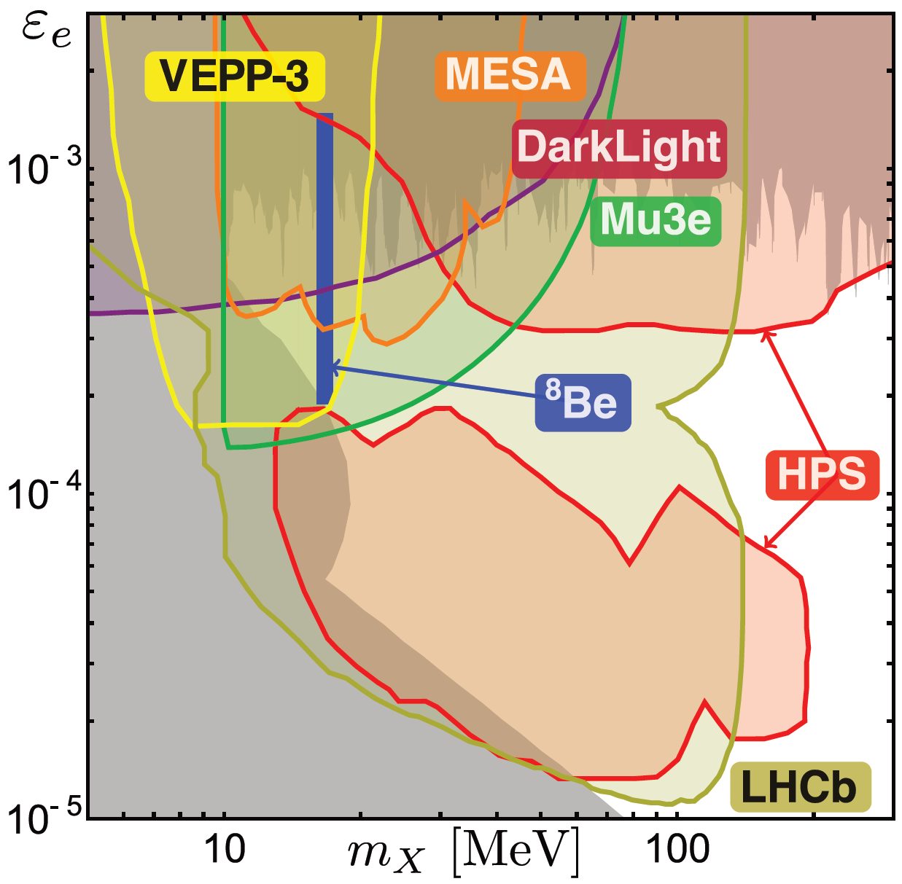
FUTURE TESTS: “DARK PHOTON” EXPTS
Feng et al. (2016)
Also KLOE-2, SHiP, SeaQuest, PADME, …

Slide 26
CONCLUSIONS
5th forces are motivated by unification and dark matter and may be probed in “intensity frontier” experiments and nuclear decays
There is currently a 6.8σ anomaly in ⁸Be* IPC decays. A particle interpretation yields a χ²/dof = 1.07 best fit with
  m = 16.7 ± 0.35 (stat) ± 0.5 (sys) MeV
  B(⁸Be* → ⁸Be X) / B(⁸Be* → ⁸Be γ) = 5.6 x 10⁻⁶
The data are consistent with a protophobic gauge boson that mediates a 5th force and explains (g-2)_{μ}
In simple SM extensions, the gauge boson is a U(1)_{B-L} or U(1)_{B} gauge boson that kinetically mixes with the photon
Many opportunities for near future experimental tests

