Slide 1
EVIDENCE FOR A
PROTOPHOBIC FIFTH FORCE
Mitchell Workshop on Collider, Dark Matter, and Neutrino Physics
Texas A&M
Jonathan Feng, UC Irvine
23 May 2016

Slide 2







COLLABORATORS
Jonathan
Feng
Bart
Fornal
Iftah
Galon
Susan
Gardner
Jordan
Smolinsky
Tim
Tait
Flip
Tanedo
Based on 1604.07411, “Evidence for a Protophobic Fifth Force
From ⁸Be Nuclear Transitions,” and work in progress

Slide 3
MOTIVATIONS FOR A FIFTH FORCE
FORCE UNIFICATION
The quantum numbers of SM matter fields are explained by GUTs:
SU(3) x SU(2) x U(1) → SU(5), SO(10), E6, E8, …
SO(10) ... → 5th force
DARK MATTER
Dark sector: new matter and new forces
Mediator → weakly-coupled 5th force
SM
DM
These beautiful ideas have focused a great deal attention on the search for a fifth force: Z’ bosons, dark photons, dark Z’s, and general light, weakly-coupled particles

Slide 4
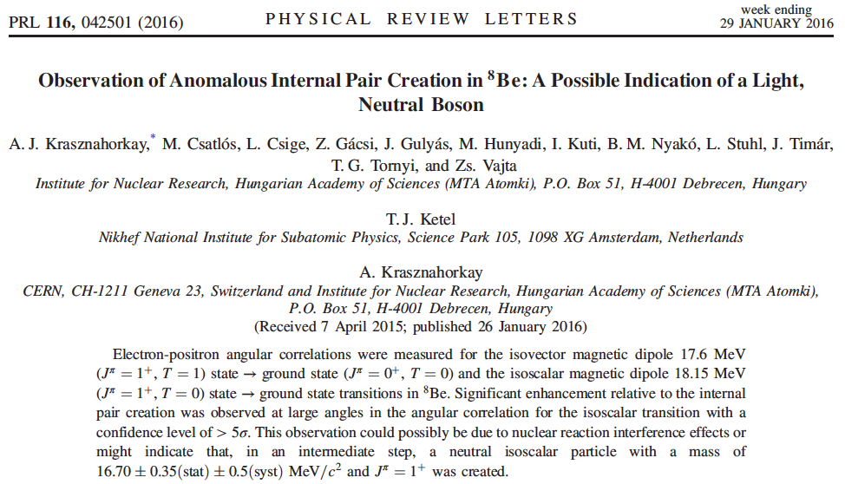
MAYBE IT’S ALREADY BEEN FOUND
A. J. Krasznahorkay et al., 1504.01527 [nucl-ex]

Slide 5
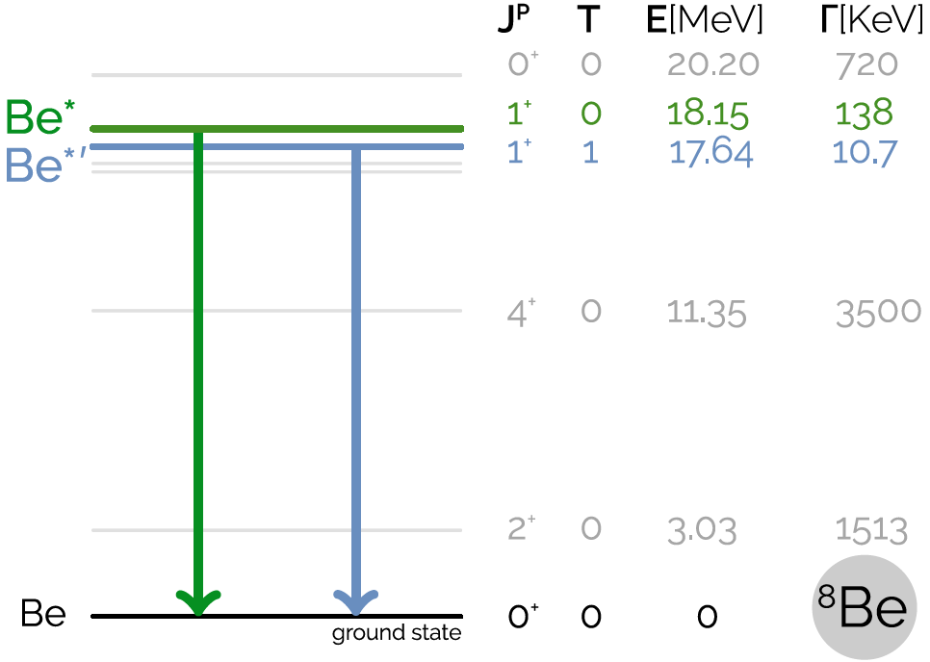
BERYLLIUM-8 PRIMER
⁸Be: 4 protons + 4 neutrons
Perhaps best known for its supporting role in α + α + α → ¹²C
The entire ⁸Be spectrum is well studied
Tilley et al. (2004); National Nuclear Data Center, http://www.nndc.bnl.gov/nudat2/

Slide 6
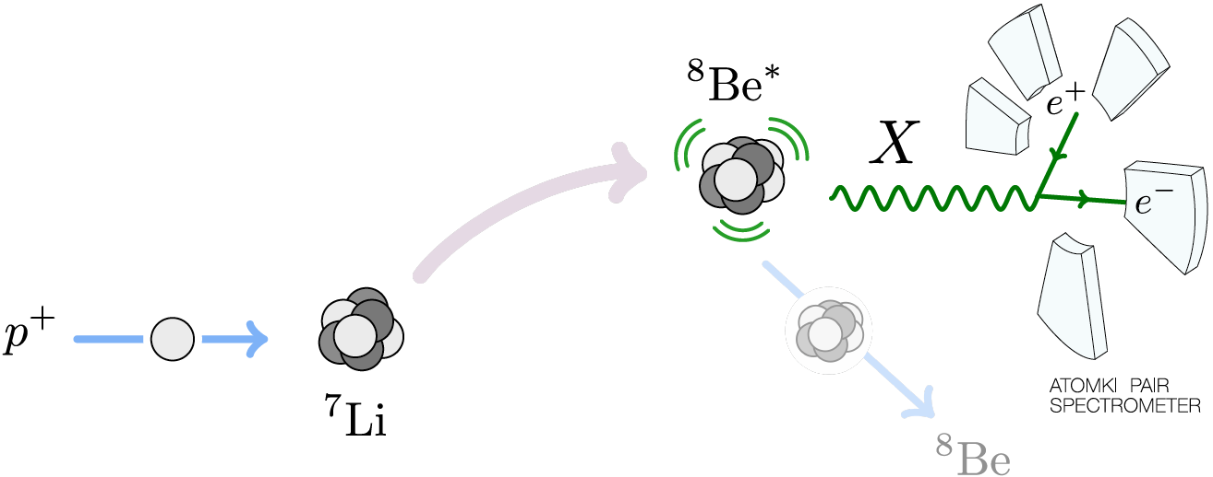
THE ⁸BE EXPERIMENT AT MTA ATOMKI
1 μA proton beam hits thin ⁷Li targets
E_{p} = 1.025 MeV → 8Be* resonance, which then decays:
  Hadronic: B(p ⁷Li) ≈ 100%
  Electromagnetic: B(⁸Be γ) ≈ 1.5 x 10⁻⁵
  Internal Pair Conversion: B(⁸Be e⁺ e⁻) ≈ 5.5 x 10⁻⁸

Slide 7
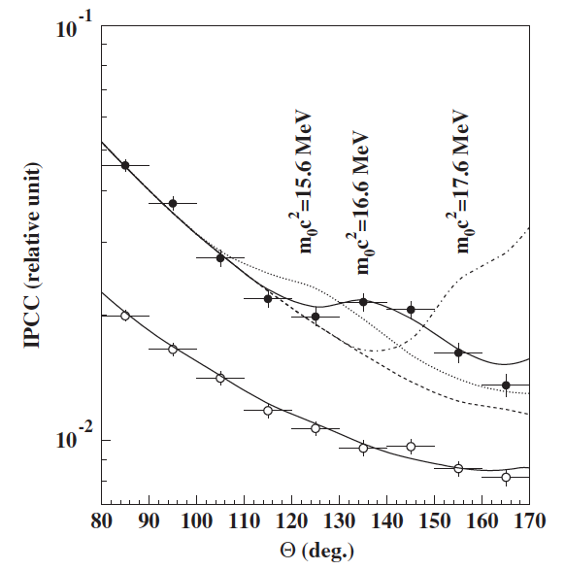
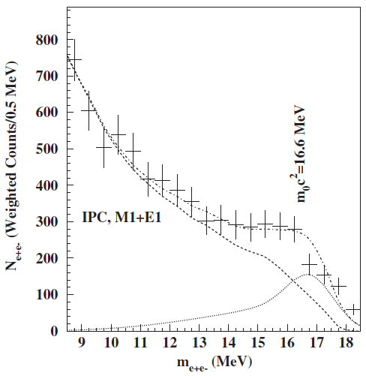
THE ⁸BE IPC ANOMALY
Measure the e⁺e⁻ opening angle θ and invariant mass
Background fluctuation probability: 5.6 x 10⁻¹² (6.8σ)
Best fit to new particle: χ²/dof = 1.07
  m = 16.7 ± 0.35 (stat) ± 0.5 (sys) MeV
  B(⁸Be* → ⁸Be X) / B(⁸Be* → ⁸Be γ) = 5.6 x 10⁻⁶
Krasznahorkay et al. (2015)

Slide 8
SIGNAL CHARACTERISTICS
The excess is not a “last bin” effect: bump, not smooth excess
In scan through p resonance energy, excess rises and falls
Peaks in opening angle θ and invariant mass correspond; required for particle interpretation, not for all backgrounds
LiF₂, LiO₂ target “impurities” understood, do not lead to such energetic photon and IPC events
Comparable excess not seen for 17.64 MeV state; explainable by phase-space suppression for 17 MeV state
Completely different from previous claims of excesses: different experiment, different collaboration, different claimed mass, extraordinary statistics, and a bump, not smooth excess

Slide 9
OPEN QUESTIONS
What kinds of neutral bosons are possible?
What are the required parton-level couplings?
Is this consistent with all other experiments?
Is there a UV-complete model that predicts this?
What other experiments can check this?

Slide 10
SPIN 0 NEUTRAL BOSONS
SCALARS
“DARK HIGGS”
J^{P} Assignments: 1⁺ → 0⁺ 0⁺
L Conservation:
L = 1
Parity Conservation:
P = (-1)^{L} = 1
Forbidden in parity-conserving theories
PSEUDOSCALARS
“AXION-LIKE PARTICLES”
Forbidden for large range of aγγ couplings
Dobrich et al. (2015)

Slide 11
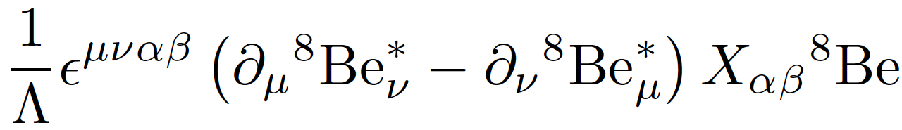

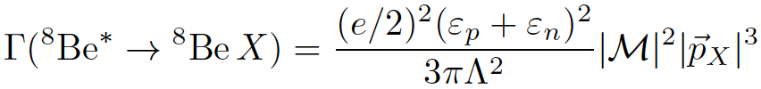
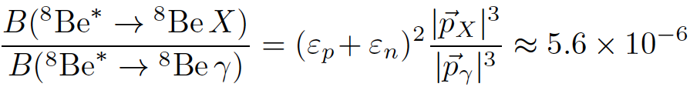


VECTORS: SPIN-1 GAUGE BOSONS
What quark-, nucleon-level couplings are required? In general requires calculating nuclear matrix elements
But for 1⁻ vector, in the EFT, there is only 1 operator
The width is
The nuclear matrix elements and Λ cancel in the ratio
where and are the nucleon X-charges (in units of e)

Slide 12
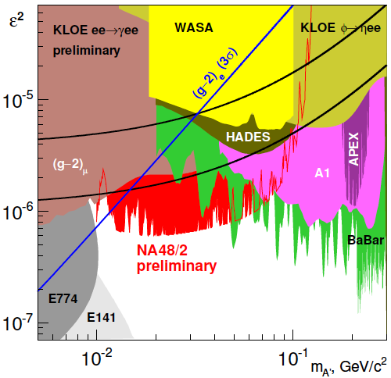


THE REQUIRED PARTON-LEVEL COUPLINGS
To get the right signal strength:
To decay within 1 cm:
This cannot be a dark photon
NA48/2, Raggi (2015)

Slide 13
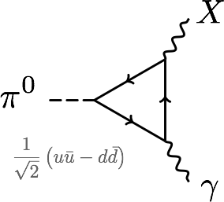
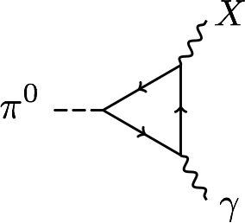
PROTOPHOBIA
The dominant constraints are null results from searches for π⁰ → X γ → e⁺ e⁻ γ
Eliminated if Q_{u}X_{u}– Q_{d}X_{d} ≈ 0 or 2X_{u} + X_{d} ≈ 0 or X_{p} ≈ 0
A protophobic gauge boson with couplings to neutrons, but suppressed couplings to protons, can explain the ⁸Be signal without violating other constraints
u, d
p, n

Slide 14
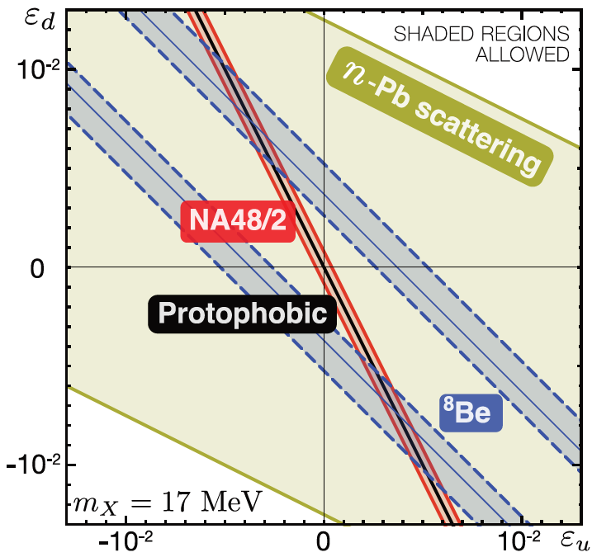
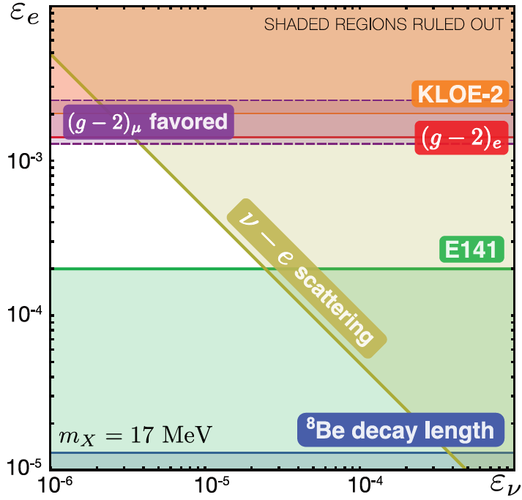
COUPLING CONSTRAINTS
Consider all constraints and also the region favored by (g-2)μ
In the end, require ε_{u}, ε_{d} ~ few 10⁻³ with ~10% cancelation for protophobia, 10⁻⁴ < ε_{e} < 10⁻³, and |ε_{e}ε_{ν}|^{1/2} < 3 x 10⁻⁴
Feng, Fornal, Galon, Gardner, Smolinsky, Tait, Tanedo (2016)

Slide 15
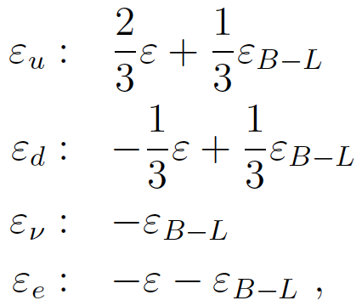
AN ANOMALY-FREE, UV-COMPLETE MODEL
Feng, Fornal, Galon Gardner, Smolinsky, Tait, Tanedo (2016)
Gauge the U(1)_{B-L} global symmetry of the SM
This is anomaly-free with the addition of 3 sterile neutrinos
Generically the B-L boson mixes with the photon:
For ε + ε_{B-L} ≈ 0, we get both ε_{u} ≈ ε/3 and ε_{d} ≈ -2ε/3 (protophobia) and ε_{e} << ε_{u,d} !
The neutrino X-charge can be suppressed in a number of ways, e.g., by mixing with X-charged sterile neutrinos

Slide 16
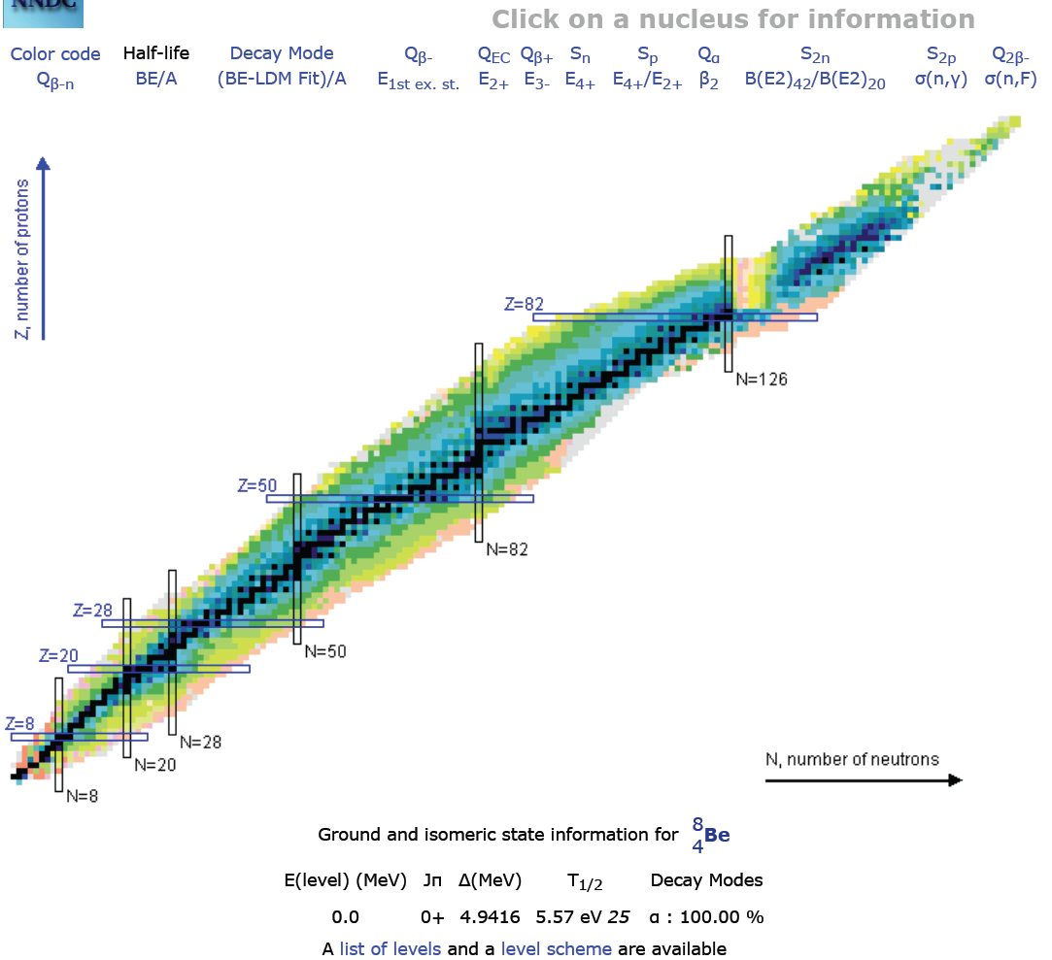
FUTURE TESTS: NUCLEAR PHYSICS
The most direct test would be to look for other nuclear IPC transitions
The ⁸Be 18.15 and 17.64 transitions are the largest known with discrete gamma rays
Would likely need to re-examine the ⁸Be 18.15 transition

Slide 17
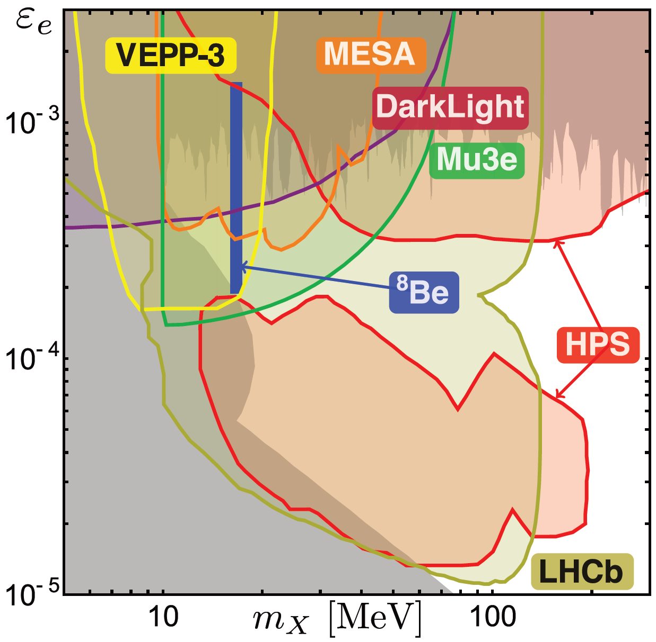
FUTURE TESTS: “DARK PHOTON” EXPTS
Feng et al. (2016)
Also KLOE-2, SHiP, SeaQuest, PADME, …

Slide 18
CONCLUSIONS
The 6.8σ ⁸Be IPC signal currently has no known experimental or nuclear physics explanations
Particle interpretation yields a χ²/dof = 1.07 best fit with
  m = 16.7 ± 0.35 (stat) ± 0.5 (sys) MeV
  B(⁸Be* → ⁸Be X) / B(⁸Be* → ⁸Be γ) = 5.6 x 10⁻⁶
The data are consistent with a protophobic gauge boson that mediates a 5th force with range 12 fm, milli-charged couplings to quarks and leptons, and explains (g-2)_{μ}
A UV-complete, anomaly-free model: B-L gauge boson that kinetically mixes with the photon, with active ν mixing with X-charged sterile neutrinos
Many upcoming experimental tests

