Slide 1




NEW EYES FOR THE LHC
Minnesota Physics and Astronomy Colloquium
Jonathan Feng, UC Irvine, 21 November 2024

Slide 2
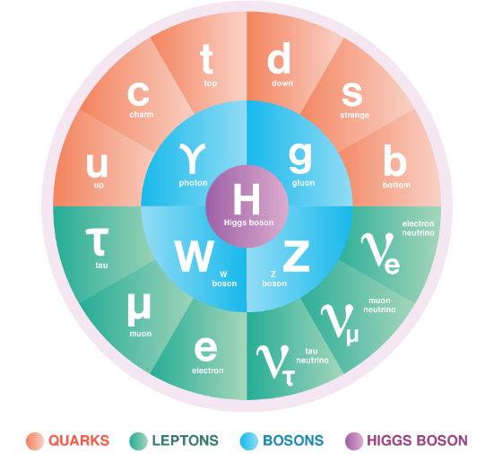
THE STANDARD MODEL OF PARTICLE PHYSICS
The Standard Model is the reigning theory of fundamental particles and their interactions. The last particle predicted by the SM, the Higgs boson, was discovered at CERN in 2012.
But the SM is not the last word, because many fundamental questions remain. For example:
  Neutrino Masses: the SM predicts that neutrinos are massless, but they aren’t.
  Dark Matter: The particles of the SM make up only ~15% of the matter in the universe.
These questions imply that there are more particles left to discover, and probably many more.

Slide 3


THE LARGE HADRON COLLIDER
.
FASER
Particle colliders have been key to progress for many decades. The state of the art is currently the LHC, which collides protons with protons at a center-of-mass energy of 13.6 TeV (v $≈$ 0.9999999905 c).
Notes:
3

Slide 4

LHC DETECTORS
The protons collide at 4 points around the LHC, and each point is surrounded by a large detector to view the results of the collisions. These detectors are were constructed over decades by thousands of collaborators.
The ATLAS Detector
Notes:
4

Slide 5
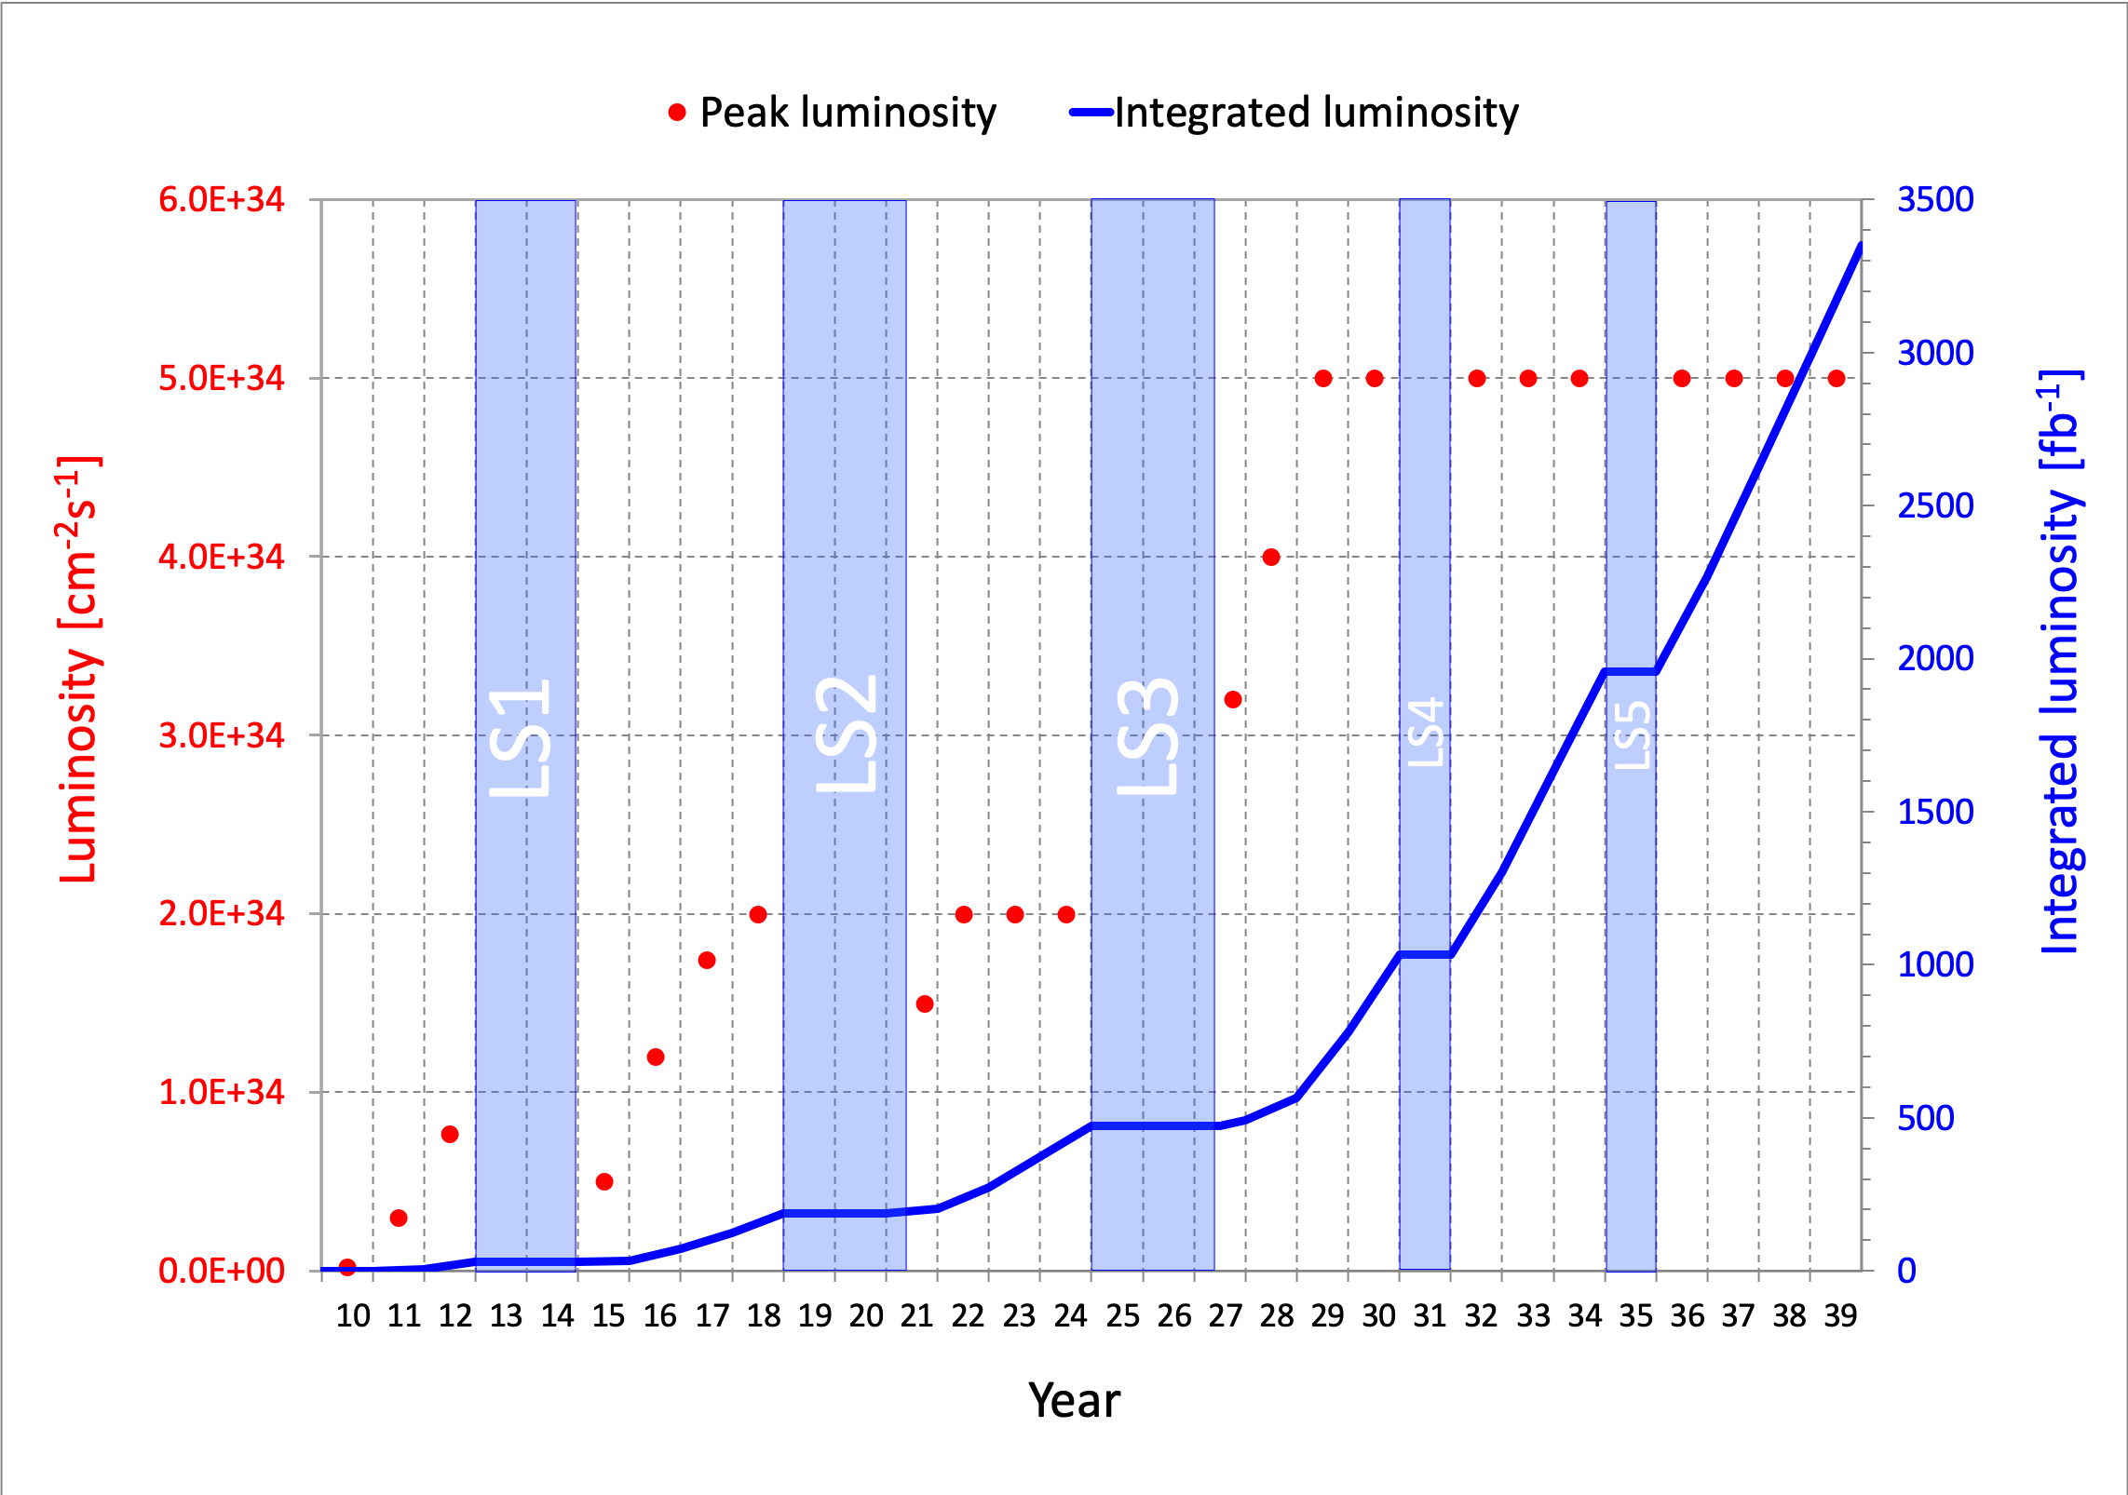
LIFETIME OF THE LHC
The LHC became the future of particle colliders in 1993 when the US canceled the SSC, which was being built in Texas.
The LHC started running in 2010 and is scheduled to run until the 2040s.
  Middle-aged in terms of years
  But a 4th grader in terms of number of collisions (integrated luminosity)
Are we using the LHC to its full potential? If not, what can we do to enhance its discovery prospects?
COVID

Slide 6
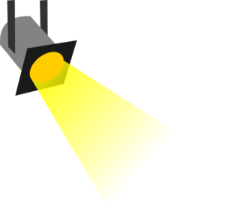
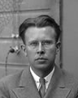
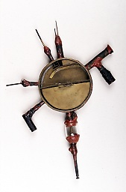
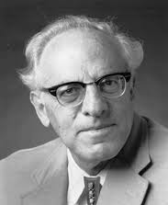





















THE PARTICLE LANDSCAPE
Particle
Expts
Mass
MeV
GeV
TeV
1
$$←$$
$$g$$
$$u$$
$$d$$
$$s$$
$$p$$
$$n$$
$$c$$
$$b$$
$$t$$
$$←$$
$$γ$$
$$e$$
$$μ$$
$$τ$$
$$W$$
$$Z$$
$$h$$
Already
Discovered
Strongly Interacting
Heavy Particles
Interaction Strength
10⁻³
$$ν_{e}$$
$$ν_{μ}$$
$$ν_{τ}$$
$$←$$
Weakly Interacting
Light Particles
Impossible to
Discover
10⁻⁶

Slide 7
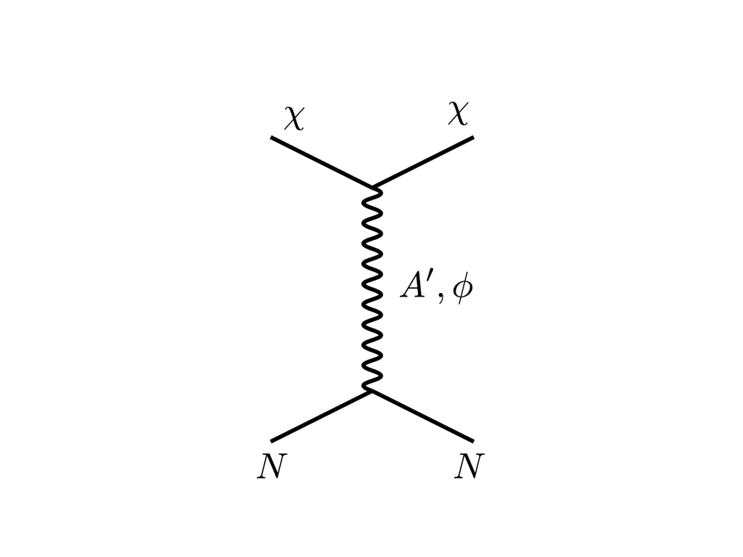



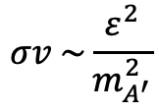


THE COSMOLOGICAL LANDSCAPE
Particle
Colliders
Mass
MeV
GeV
TeV
1
Already
Discovered
Strongly Interacting
Heavy Particles
Too Little to be
Dark Matter
DM
$$e$$
$$ε$$
$$ε$$
Interaction Strength
Just Right to
be Dark Matter
10⁻³
$$A′$$
$$e$$
DM
$$σv \sim \frac{ε^{2}}{m_{A^{′}}^{2}}$$
Weakly Interacting
Light Particles
Impossible to
Discover
10⁻⁶
Too Much to be
Dark Matter
Boehm, Fayet (2003)
Pospelov, Ritz, Voloshin (2007)
Feng, Kumar (2008)

Slide 8

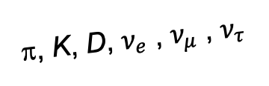
FORWARD PHYSICS
In 2017, we realized that the large LHC detectors, while beautifully optimized to discover new heavy particles, are also almost optimally configured NOT to find new light particles.
Heavy particles (W, Z, t, h, …) are produced at low velocity and decay roughly isotropically to other particles.
But high-energy light particles are dominantly produced in the forward direction and escape through the blind spots of these large detectors.
  This is true for all known light particles: pions, kaons, D mesons, all neutrinos.
  It is also true for many proposed new particles, especially those motivated by neutrino mass and dark matter.
These blind spots are the Achilles heels of the large LHC detectors.
Feng, Galon, Kling, Trojanowski (2017)
A’, a, mCPs, χ, …
π, K, D, $ν_{e}$ , $ν_{μ}$ , $ν_{τ}$
De Rujula, Ruckl (1984)

Slide 9
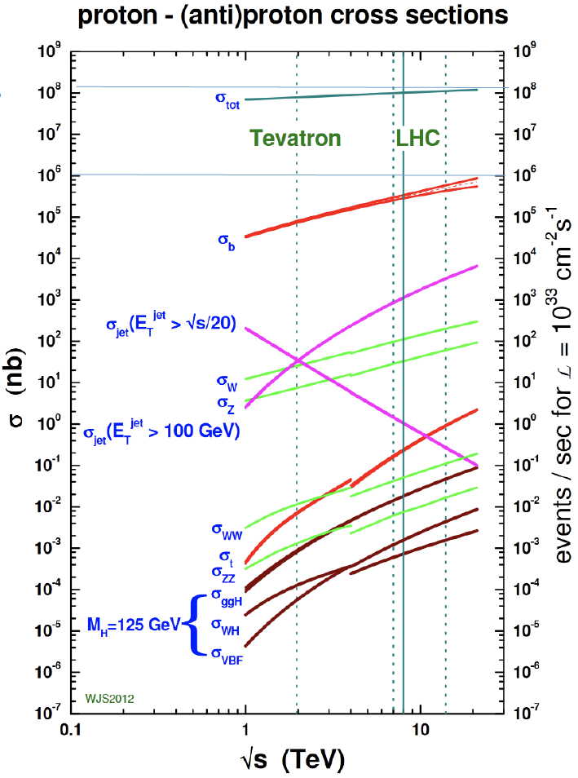
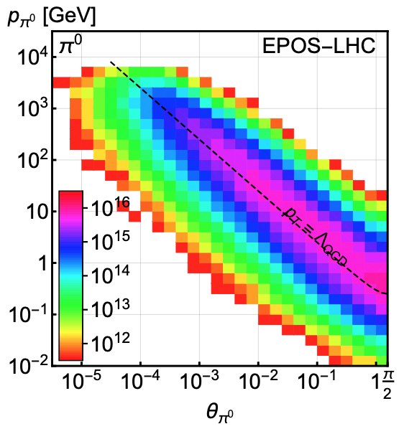
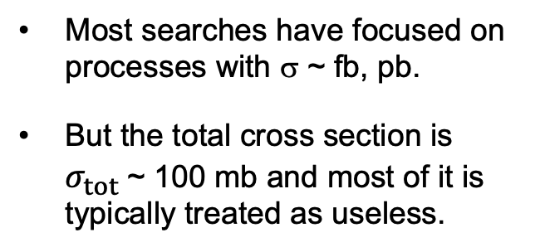
LIGHT PARTICLES AT THE LHC
300 fb⁻¹
Feng, Galon, Kling, Trojanowski (2017)
Most searches have focused on processes with σ ~ fb, pb.
But the total cross section is $σ_{tot}$~ 100 mb and most of it is typically treated as useless.
What do these events look like? Consider pions (decays to ν, BSM).
Enormous event rates. Typical p_{T} ~ 250 MeV, but many with p ~ TeV within 1 mrad (η > 7.6) of the beamline.

Slide 10
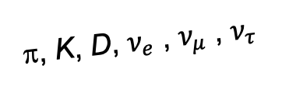
DETECTING FORWARD PARTICLES
To capture the enormous forward flux, we need to detect particles that are produced in the forward direction along the beamline.
Problem: we can’t just put the detector there: they will block the protons from coming in.
Solution: the LHC is a circular collider! If we go far enough away, the LHC proton beam will curl away, while all the light, weakly-interacting particles we are looking for will go straight.
A’, a, mCPs, χ, …
π, K, D, $ν_{e}$ , $ν_{μ}$ , $ν_{τ}$

Slide 11

SOPHISTICATED RESEARCH

Slide 12
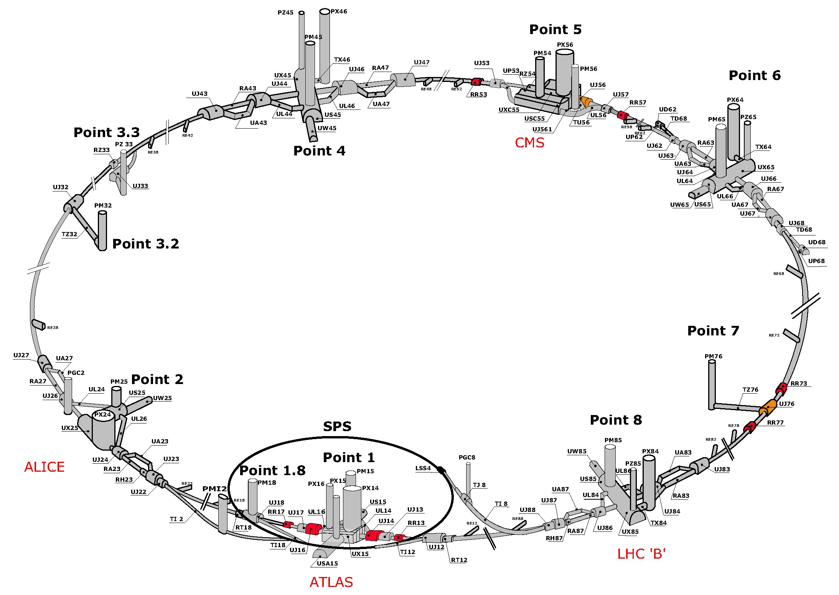
SOPHISTICATED RESEARCH

Slide 13
MAP OF LHC
!!!

Slide 14
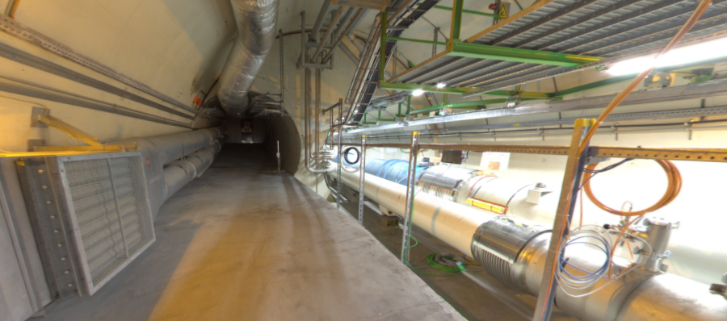
THE FORWARD REGION
Beam collision axis passes
through 100 m of rock, emerges in tunnel TI12, 480 m from ATLAS
UJ12
TI12 near UJ12
The view in UJ12 looking west in 2018
TI12
Beam collision axis:
dark matter, new particles could be streaming through this tunnel!
LHC beamline

Slide 15
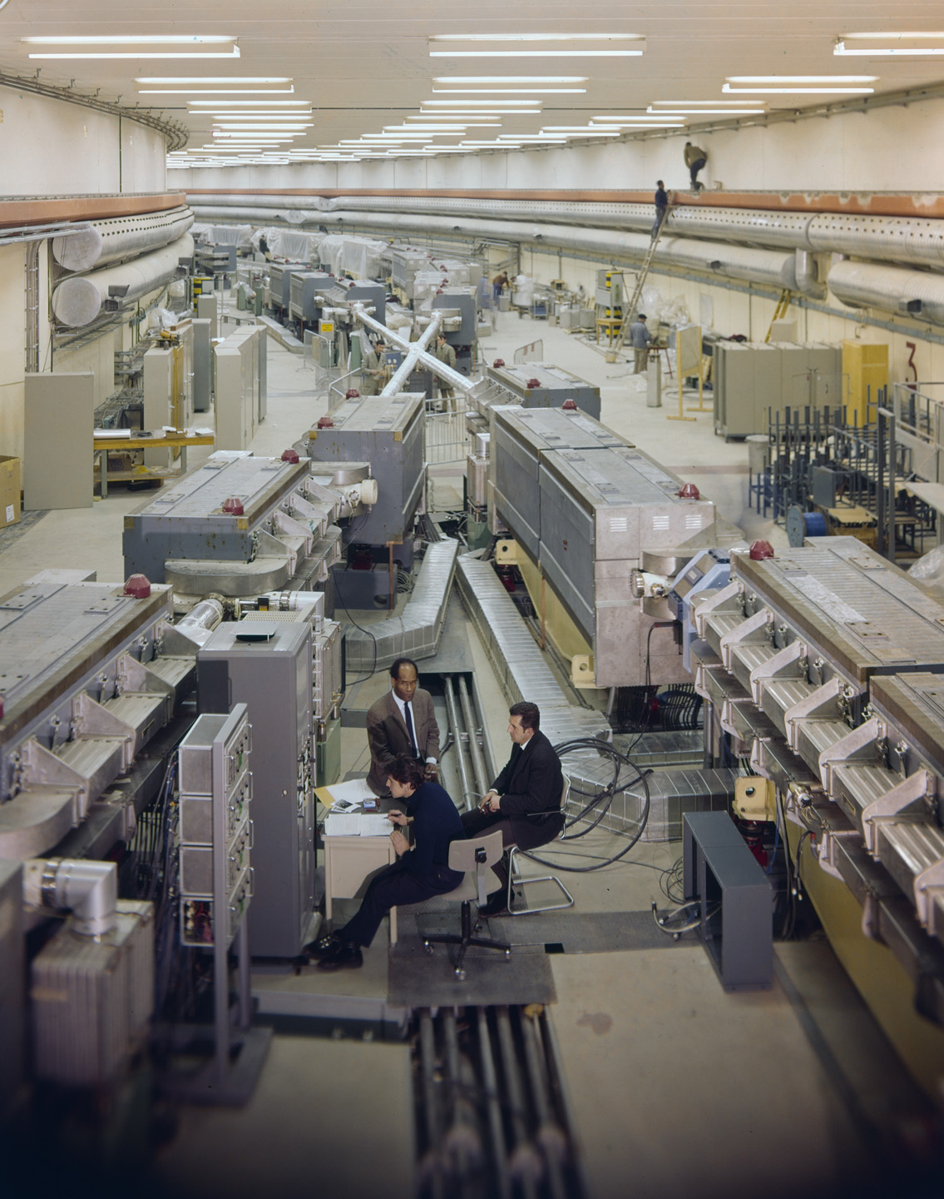
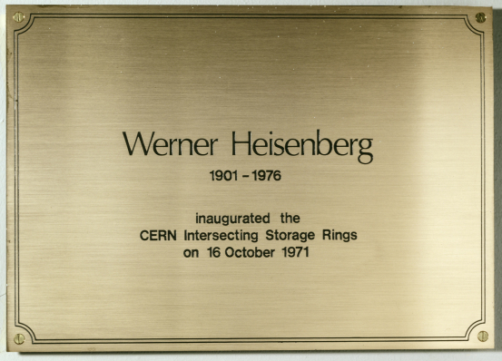
HISTORY: THE FALL OF FORWARD PHYSICS
Is it really possible that a collider is making new particles, and we are missing them simply because we are looking in the wrong place?
Yes. In fact, it happened before at CERN.
In 1971, the first hadron collider, CERN’s Intersecting Storage Rings (ISR), began operation.
It had a circumference of ~1 km, collided protons with protons at center-of-mass energy 30 GeV.

Slide 16

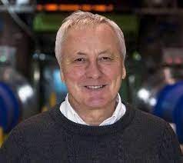
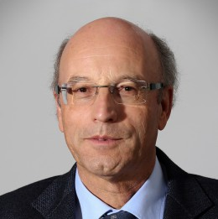
HISTORY: THE FALL OF FORWARD PHYSICS
During ISR’s 50th anniversary, there were many fascinating articles and talks by eminent physicists
  “Enormous impact on accelerator physics, but sadly little effect on particle physics.” – Steve Myers, talk at “The 50th Anniversary of Hadron Colliders at CERN,” October 2021.
  “There was initially a broad belief that physics action would be in the forward directions at a hadron collider…. It is easy to say after the fact, still with regrets, that with an earlier availability of more complete… experiments at the ISR, CERN would not have been left as a spectator during the famous November revolution of 1974 with the J/ψ discoveries at Brookhaven and SLAC .” – Lyn Evans and Peter Jenni, “Discovery Machines,” CERN Courier (2021).
Bottom line: The collider was creating charm quarks, but, based on theoretical prejudice, experimentalists focused on the forward region and so missed them.
Since that time, forward physics at colliders has been almost completely ignored for new particle searches.
But are we making the same mistake now (in reverse)? And could there be another November revolution waiting for us in the forward direction?

Slide 17


Slide 18
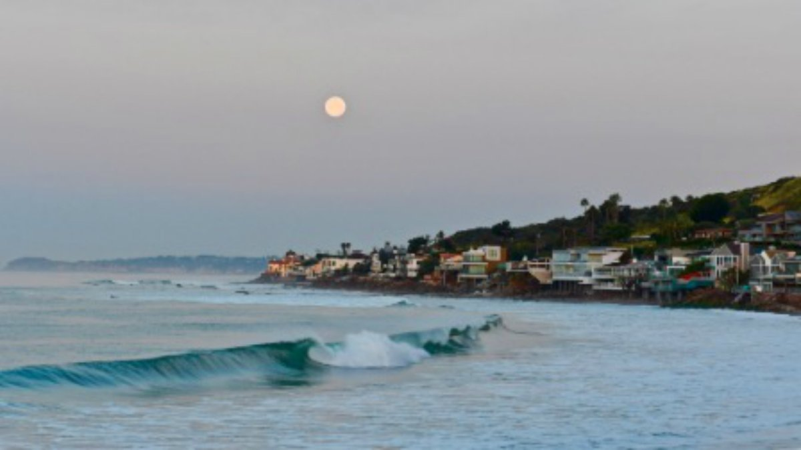
HOW BIG DOES THE DETECTOR HAVE TO BE?
Momentum:
Space:
250 MeV
1 TeV
12 cm
480 m
The opening angle is 0.2 mrad (the moon is 7 mrad). Even 480 m away, most of the signal passes through an 8.5” x 11” (A4) sheet of paper.
Neutrinos and many new particles are therefore much more collimated than shown below, motivating a relatively small, fast, and inexpensive experiment at the LHC: the ForwArd Search ExpeRiment (FASER).

Slide 19
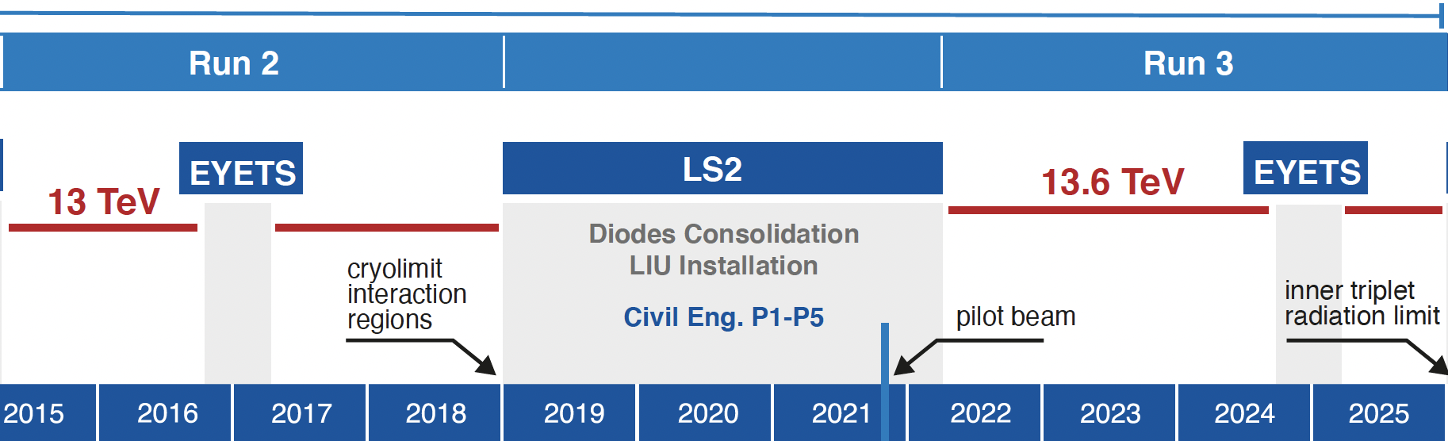
FASER AND FASERν TIMELINE
LOI submitted to CERN LHCC
FASER fully constructed and installed
FASERν fully constructed and installed
Technical Proposal submitted to CERN LHCC
FASER approved as 8th LHC detector by CERN
Concept paper: Feng, Galon, Kling, Trojanowski
FASERν approved as 9th LHC detector by CERN
FASER and FASERν announce first physics results
FASER and FASERν begin collecting data in Run 3
Funding from Heising-Simons and Simons Foundations
FASER and FASERν announce more physics results
Spare detector parts from ATLAS and LHCb Collaborations

Slide 20

















FASER COLLABORATION
112 collaborators, 28 institutions, 11 countries
International laboratory covered by a cooperation agreement with CERN

Slide 21
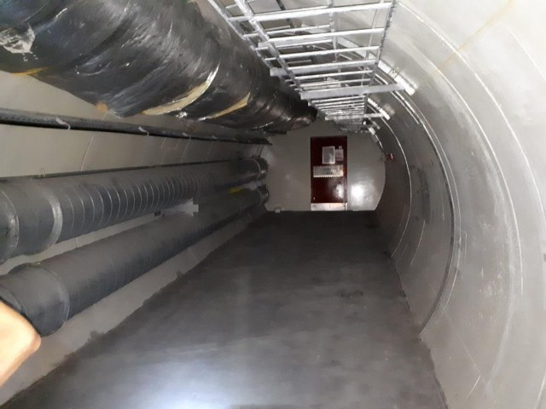
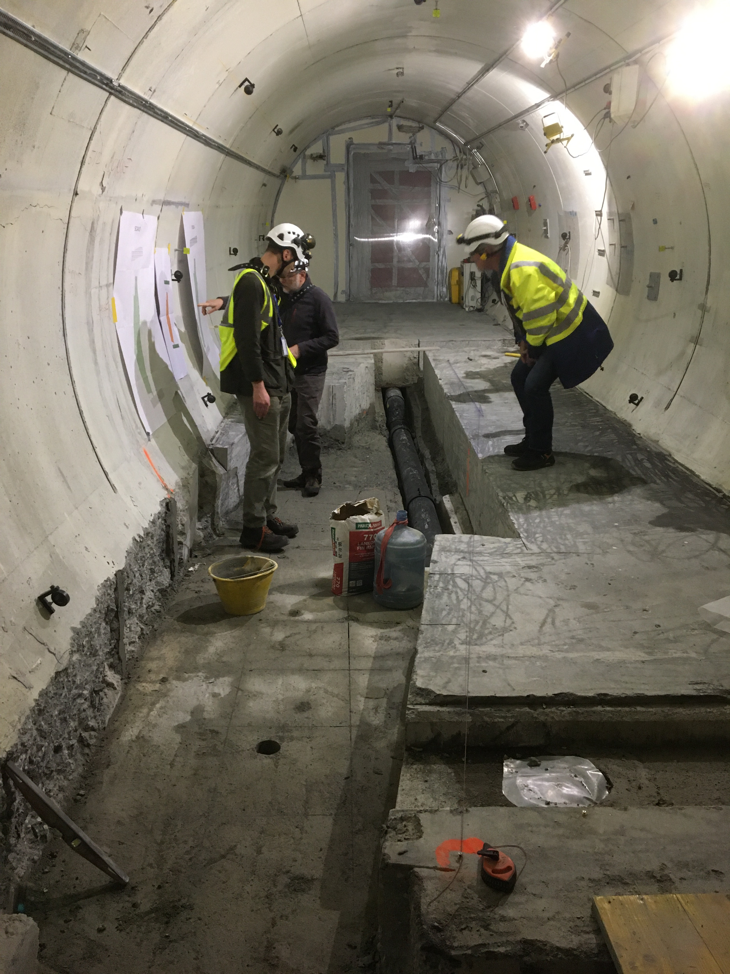
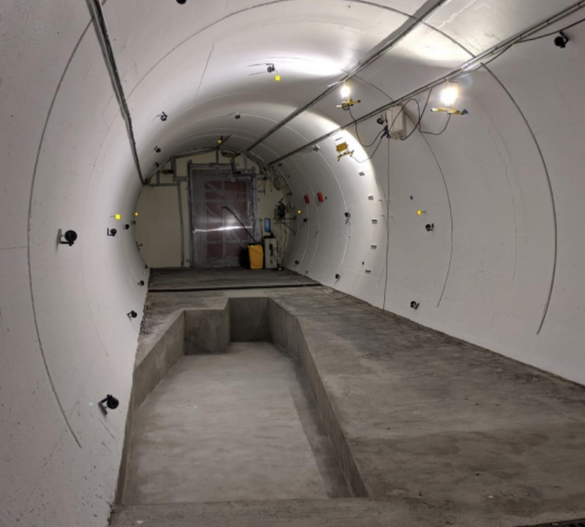
PREPARATION OF THE FASER LOCATION
The nominal beam collision axis was located to mm accuracy by the CERN survey department. (In fact, it goes up and down by a few cm, depending on the beam crossing angle.) To place FASER on this axis, a trench was required to lower the floor by 46 cm.
The trench was completed by an Italian firm just hours before COVID shut down CERN in March 2020.
2019
Spring 2020
Summer 2020

Slide 22
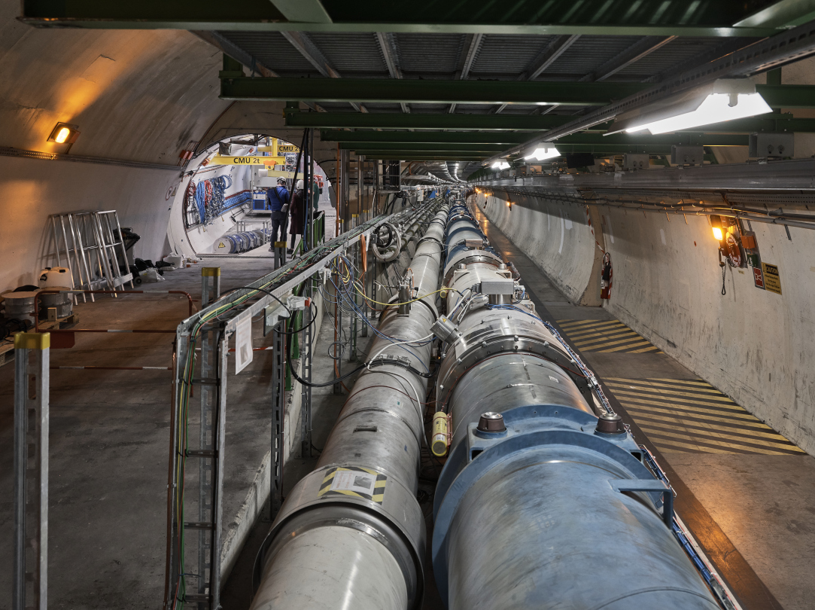
FASER AND THE LHC

Slide 23
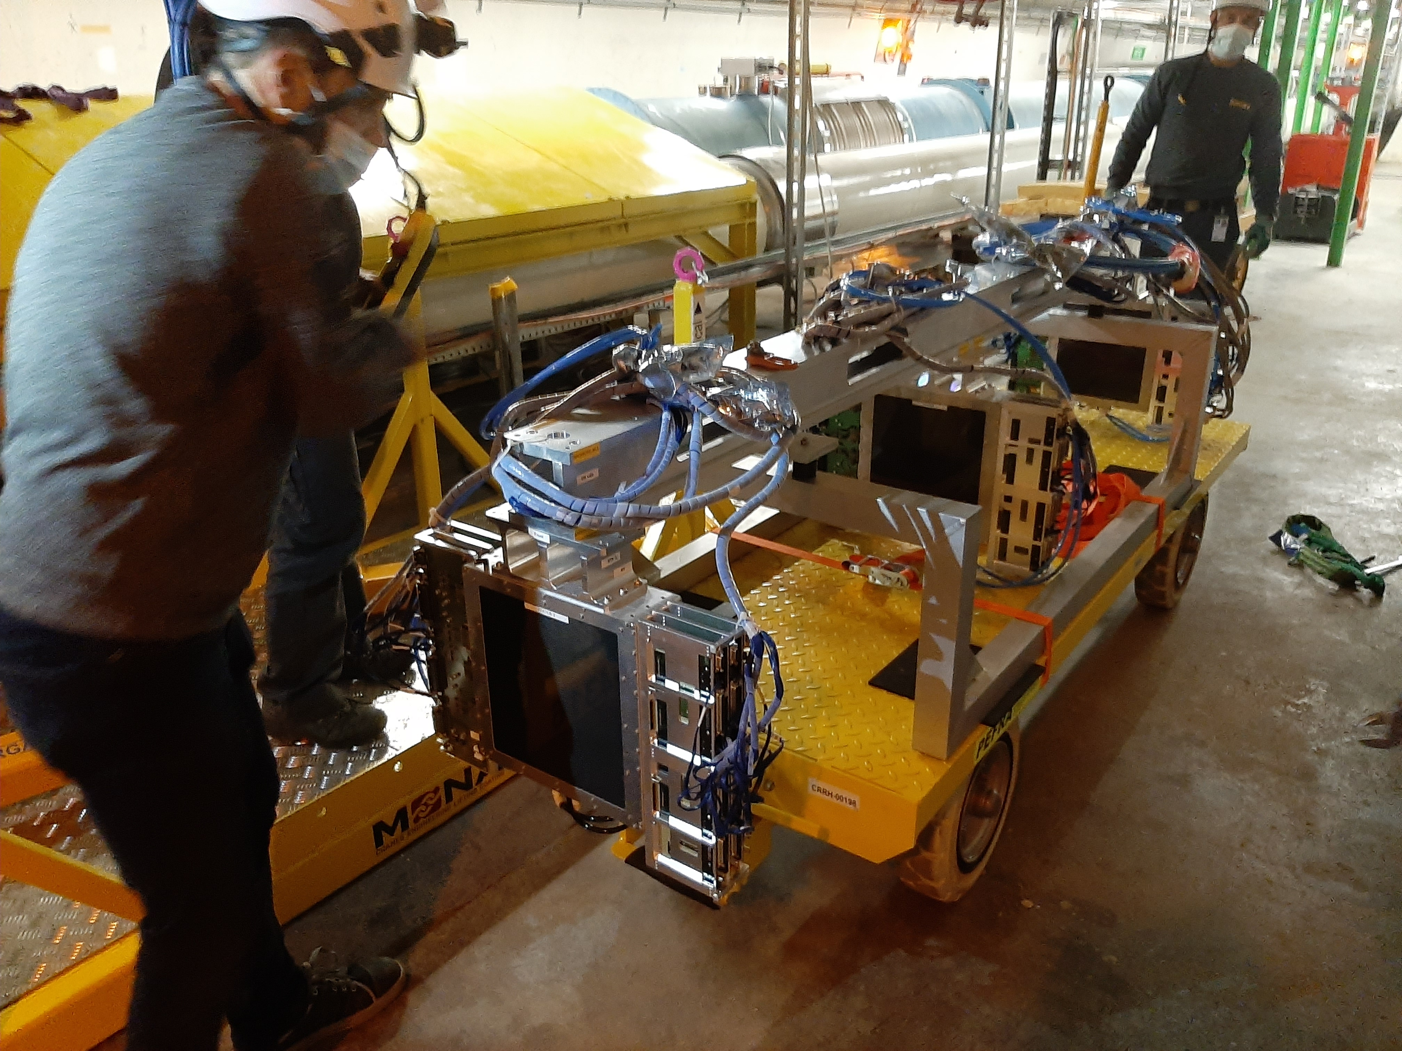
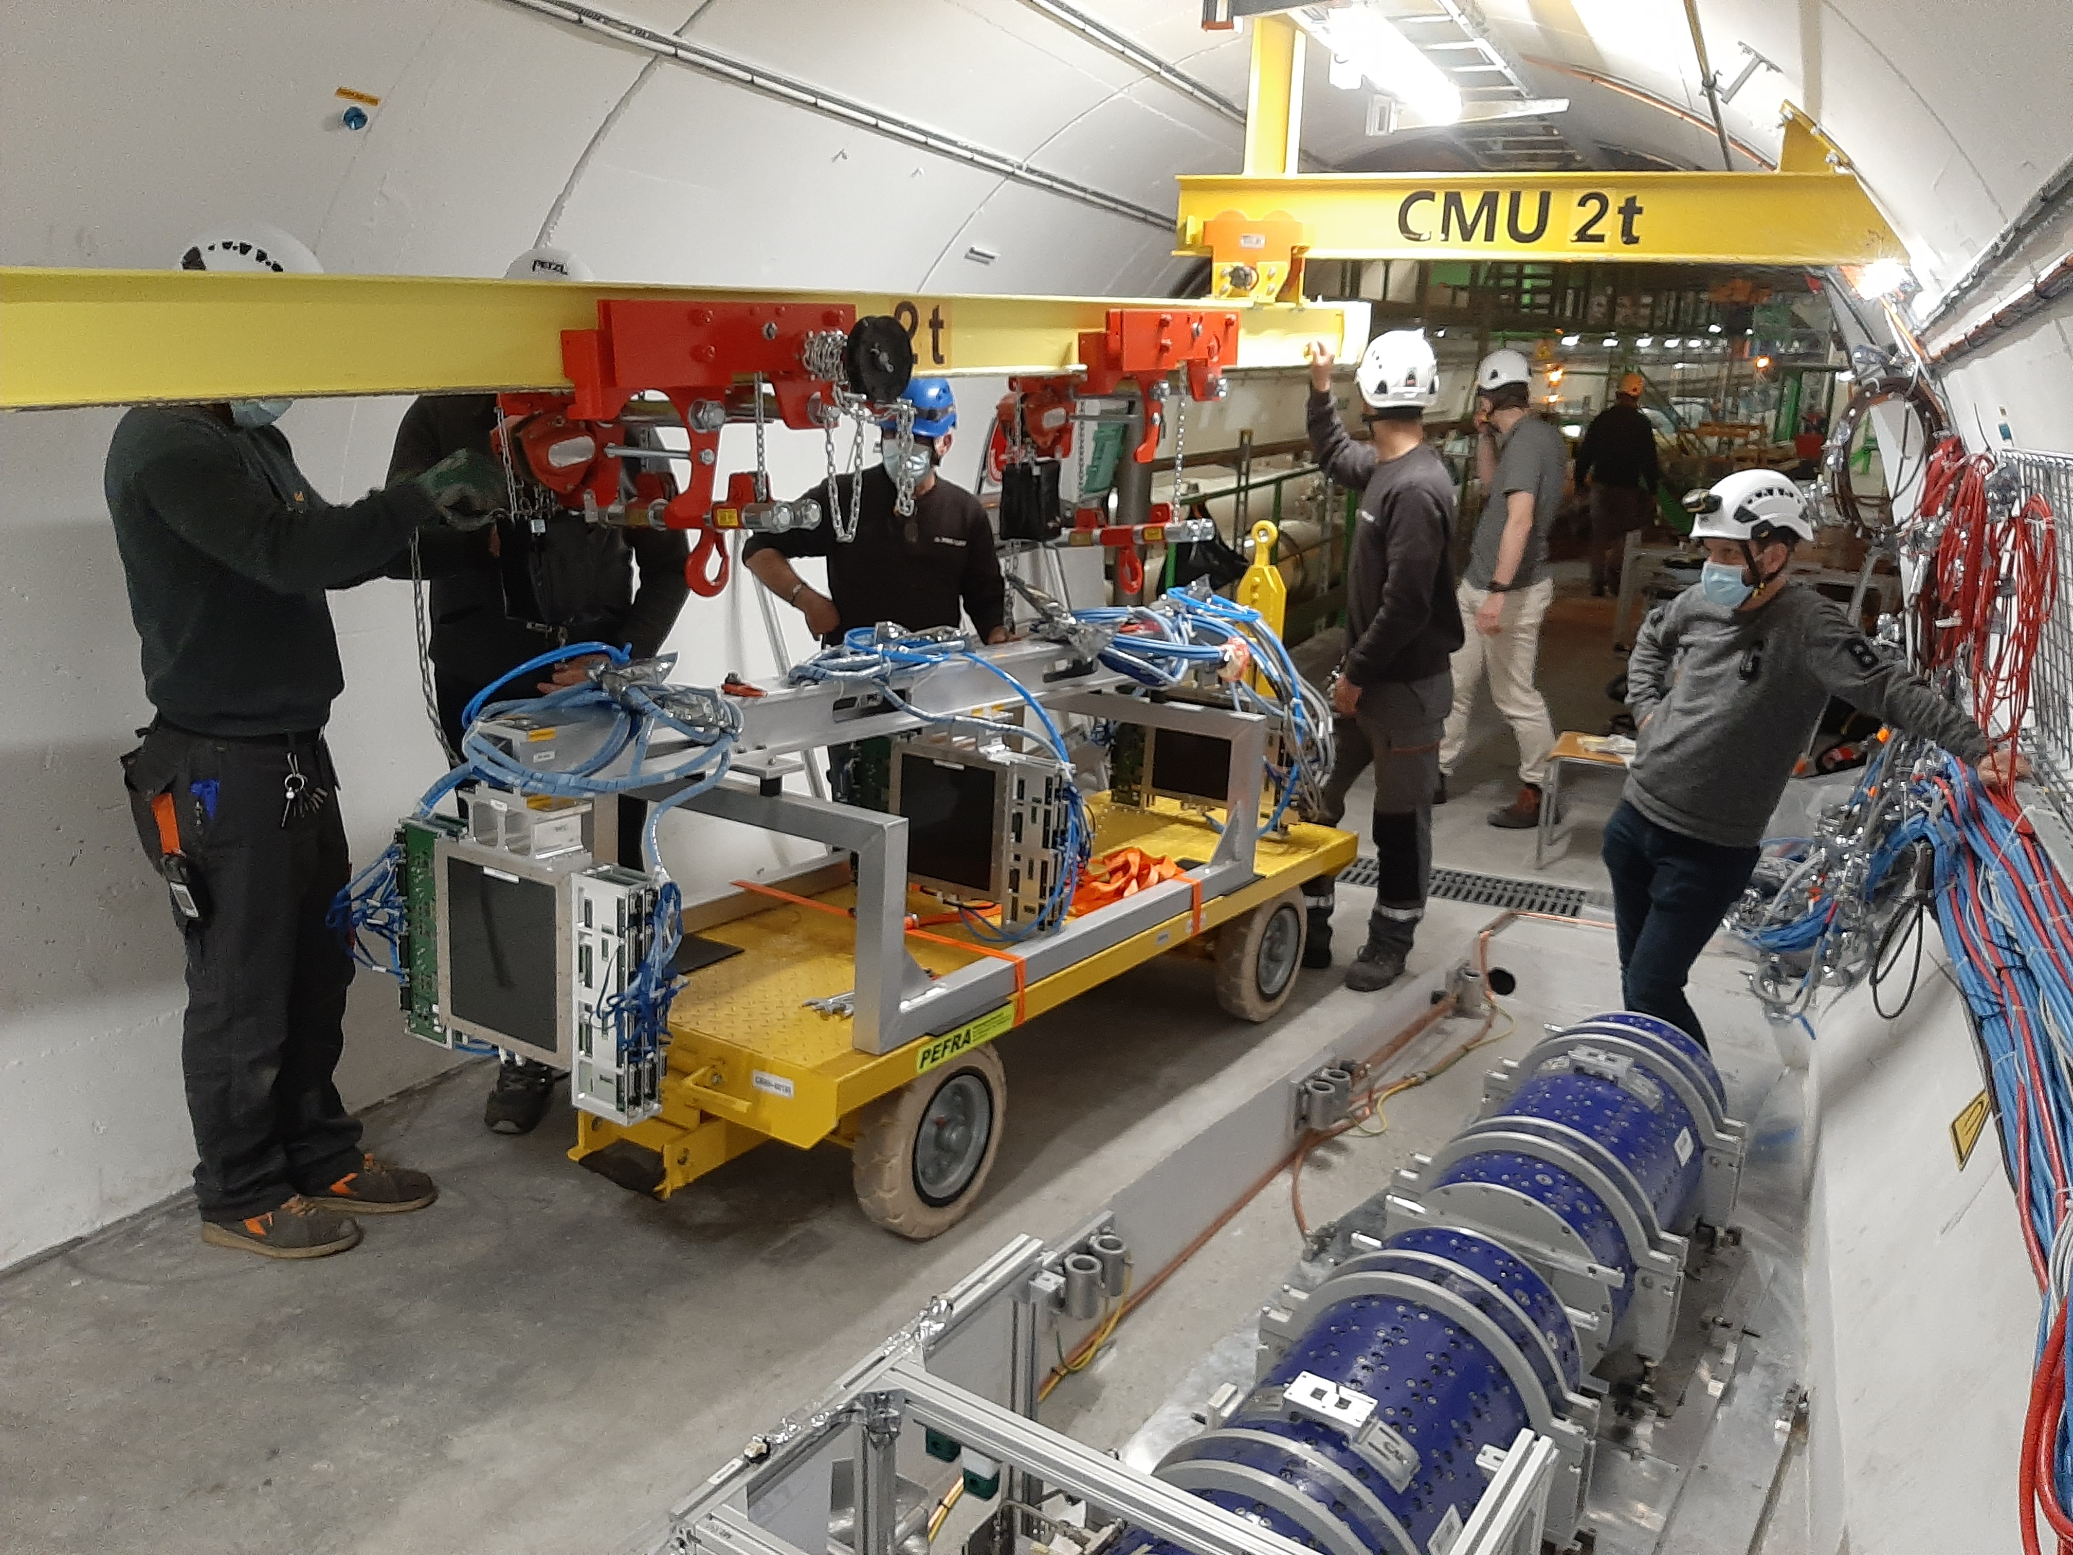
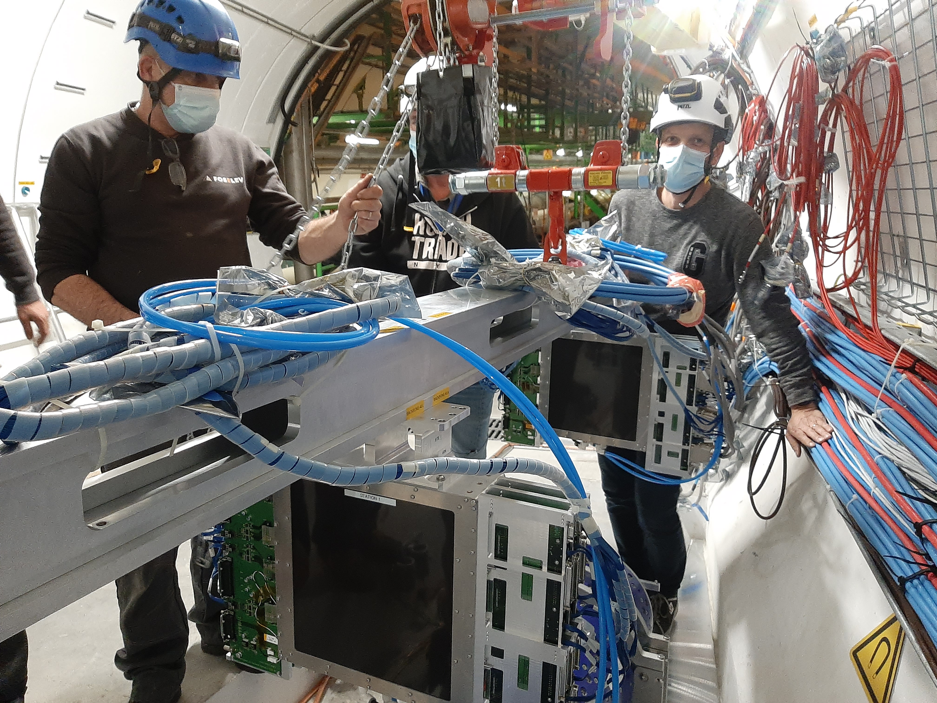
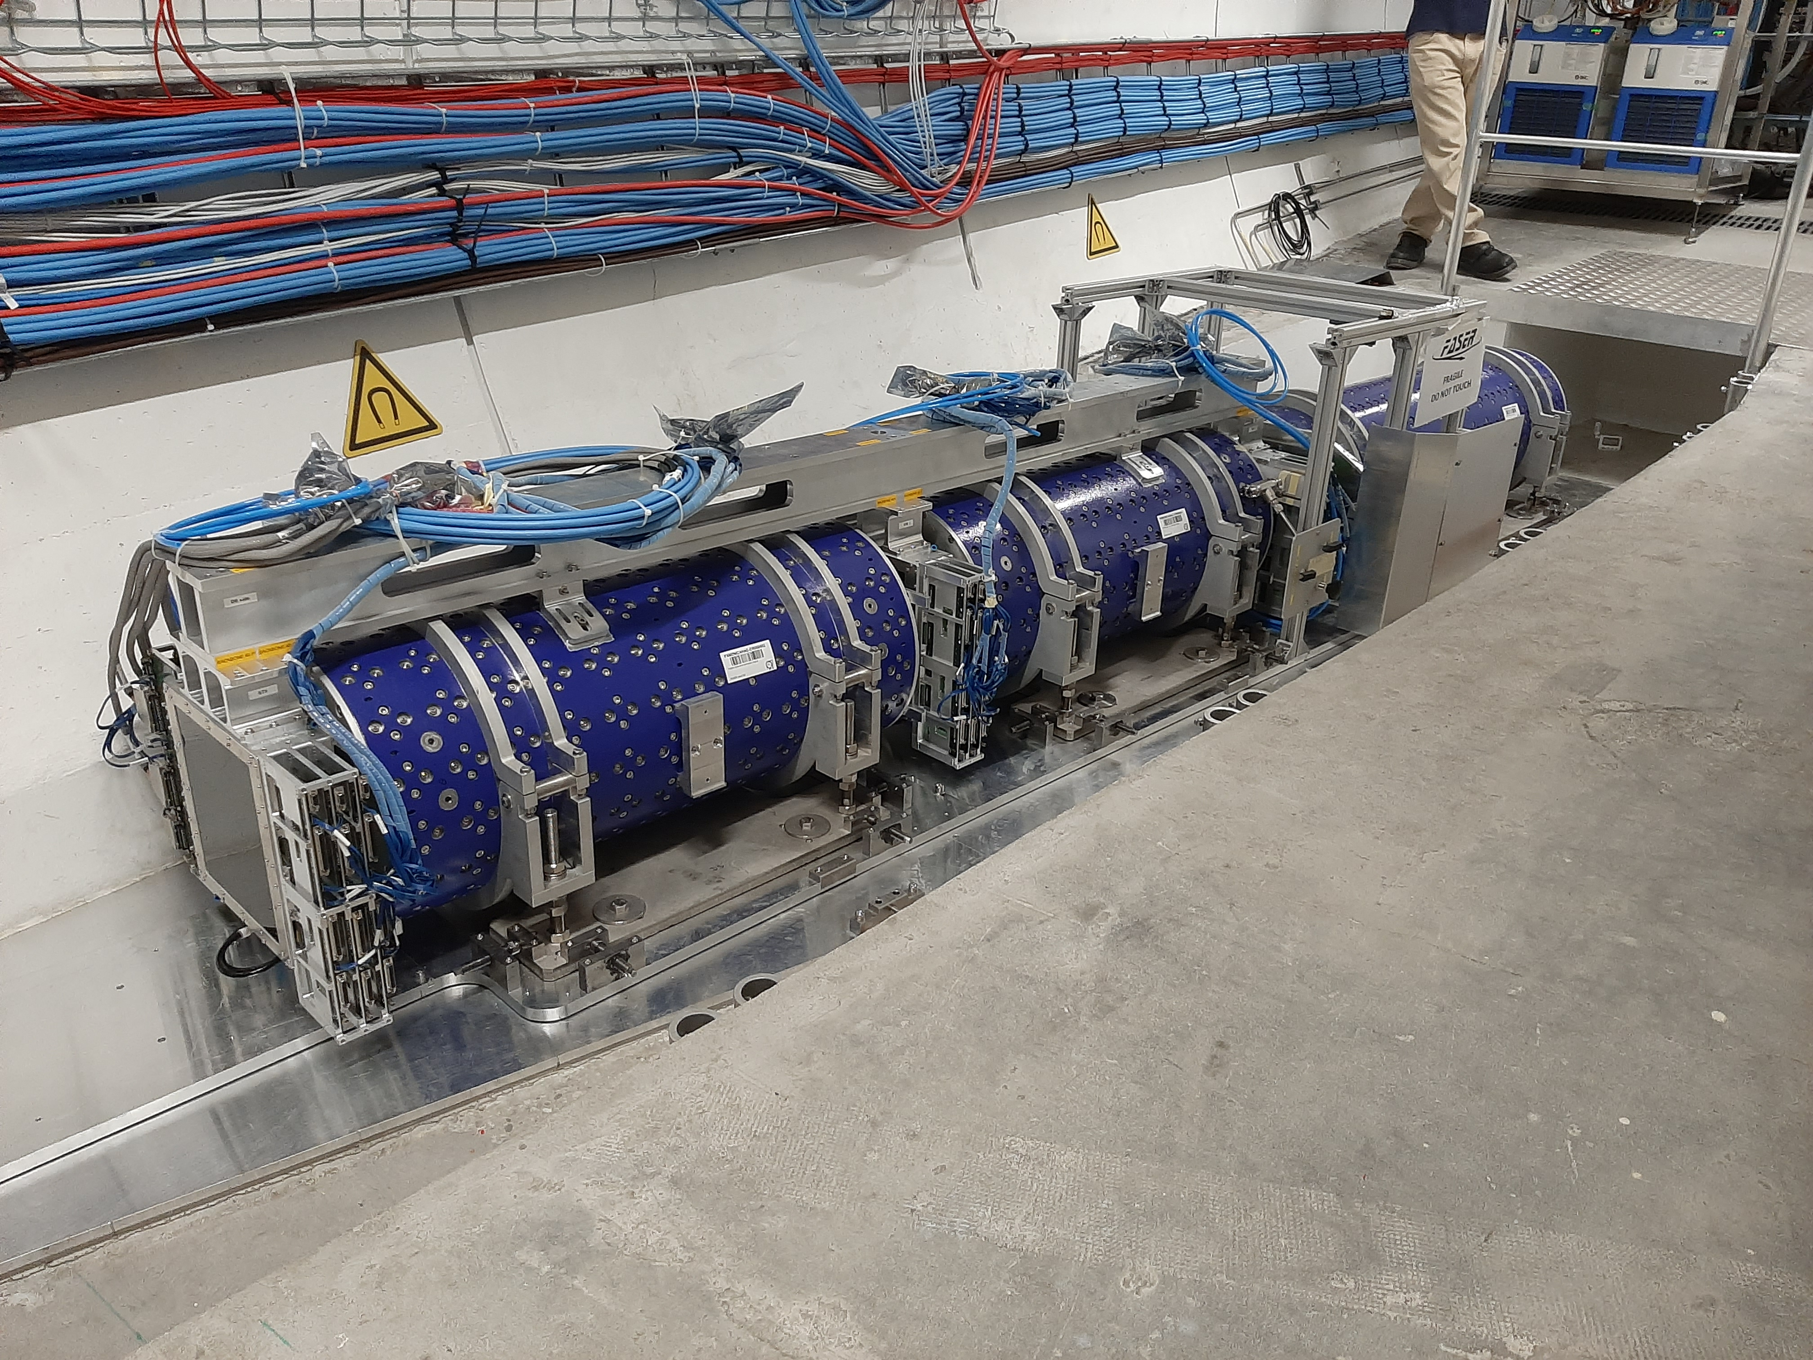
FASER INSTALLATION

Slide 24
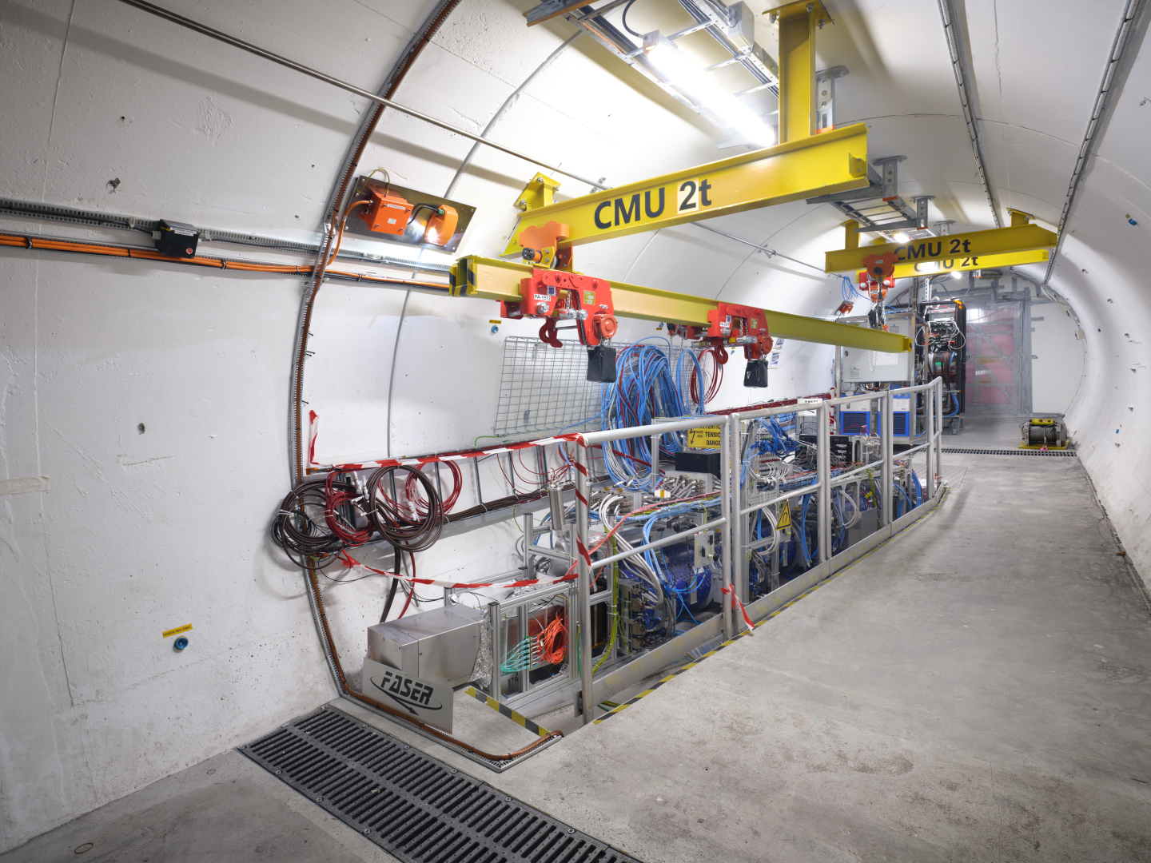
THE FASER DETECTOR

Slide 25
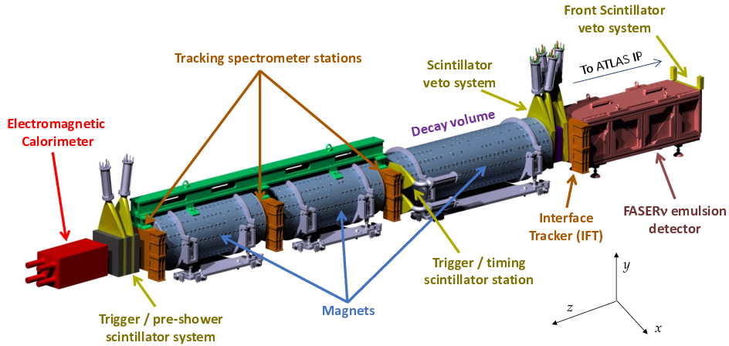
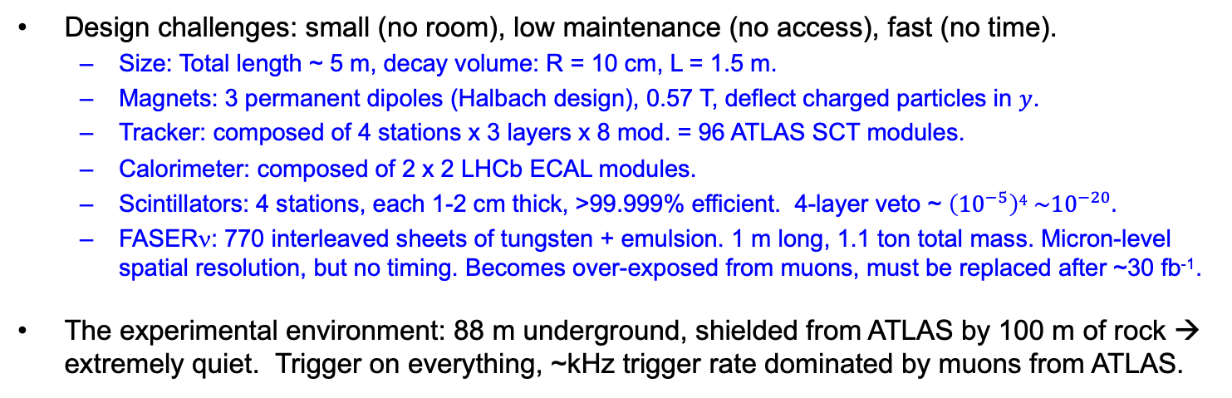
THE FASER DETECTOR
Design challenges: small (no room), low maintenance (no access), fast (no time).
  Size: Total length ~ 5 m, decay volume: R = 10 cm, L = 1.5 m.
  Magnets: 3 permanent dipoles (Halbach design), 0.57 T, deflect charged particles in $y$.
  Tracker: composed of 4 stations x 3 layers x 8 mod. = 96 ATLAS SCT modules.
  Calorimeter: composed of 2 x 2 LHCb ECAL modules.
  Scintillators: 4 stations, each 1-2 cm thick, >99.999% efficient. 4-layer veto ~ $\left({10}^{−5}\right)4 \sim {10}^{−20}.$
  FASERν: 770 interleaved sheets of tungsten + emulsion. 1 m long, 1.1 ton total mass. Micron-level spatial resolution, but no timing. Becomes over-exposed from muons, must be replaced after ~30 fb⁻¹.
The experimental environment: 88 m underground, shielded from ATLAS by 100 m of rock → extremely quiet. Trigger on everything, ~kHz trigger rate dominated by muons from ATLAS.
FASER Collaboration
(2207.11427)

Slide 26
FASER DATA TAKING IN 2022 AND 2023
FASER was constructed in 18 months and was ready to go when LHC Run 3 started in 2022.
FASER has now been running for 3 years.
  Recorded 97% of delivered luminosity.
  Largely automated: no control room, 2 shifters controlling and monitoring the expt from their laptops.
FASERν emulsion exchanged periodically to prevent overexposure
  2 boxes in 2022 (10, 30 fb⁻¹)
  2 boxes in 2023 (20, 10 fb⁻¹)
  3 boxes in 2024 (10, 10, 10 fb⁻¹)

Slide 27
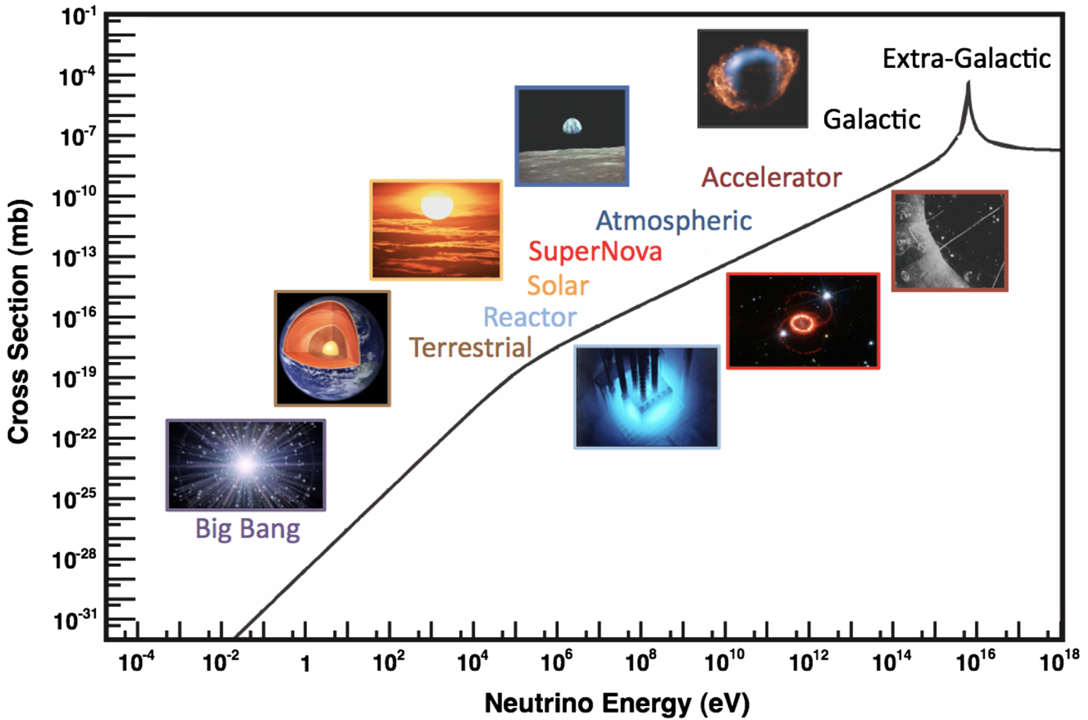
COLLIDER NEUTRINOS
Neutrinos are the least understood of all known particles, and the only ones with confirmed BSM properties.
They have been discovered from many sources, each time with stunning implications for particle physics, astrophysics, and cosmology.
Formaggio, Zeller (2012)
But before FASER, neutrinos produced at a particle collider had never been directly observed.
  Conventional wisdom: neutrinos interact very weakly so cannot be detected.
  The truth: the highest energy ones, which are most likely to interact, pass through the blind spots of existing detectors.

Slide 28
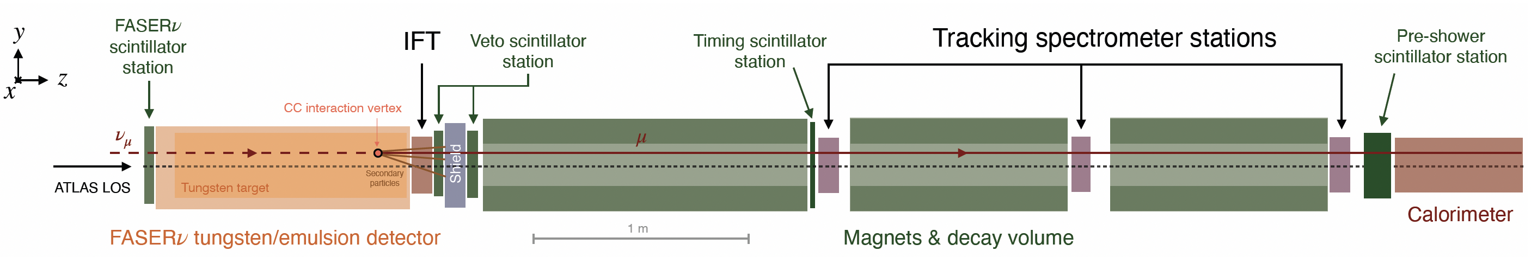
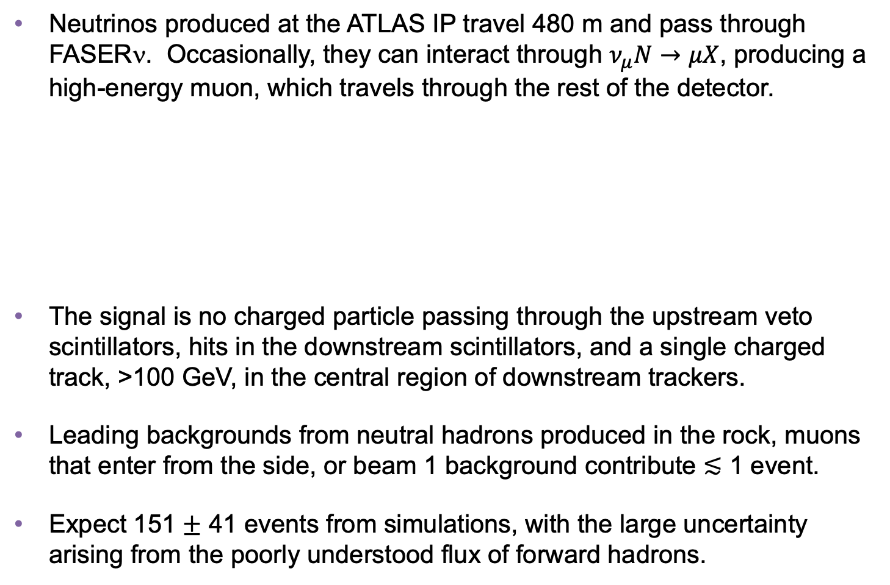
COLLIDER NEUTRINO SEARCH
Neutrinos produced at the ATLAS IP travel 480 m and pass through FASERν. Occasionally, they can interact through $ν_{μ}N→μX$, producing a high-energy muon, which travels through the rest of the detector.
The signal is no charged particle passing through the upstream veto scintillators, hits in the downstream scintillators, and a single charged track, >100 GeV, in the central region of downstream trackers.
Leading backgrounds from neutral hadrons produced in the rock, muons that enter from the side, or beam 1 background contribute $≲$ 1 event.
Expect 151 $±$ 41 events from simulations, with the large uncertainty arising from the poorly understood flux of forward hadrons.
FASER Collaboration (2303.14185, PRL)
Notes:
typical A’ that decays in FASER has ~TeV energy

Slide 29
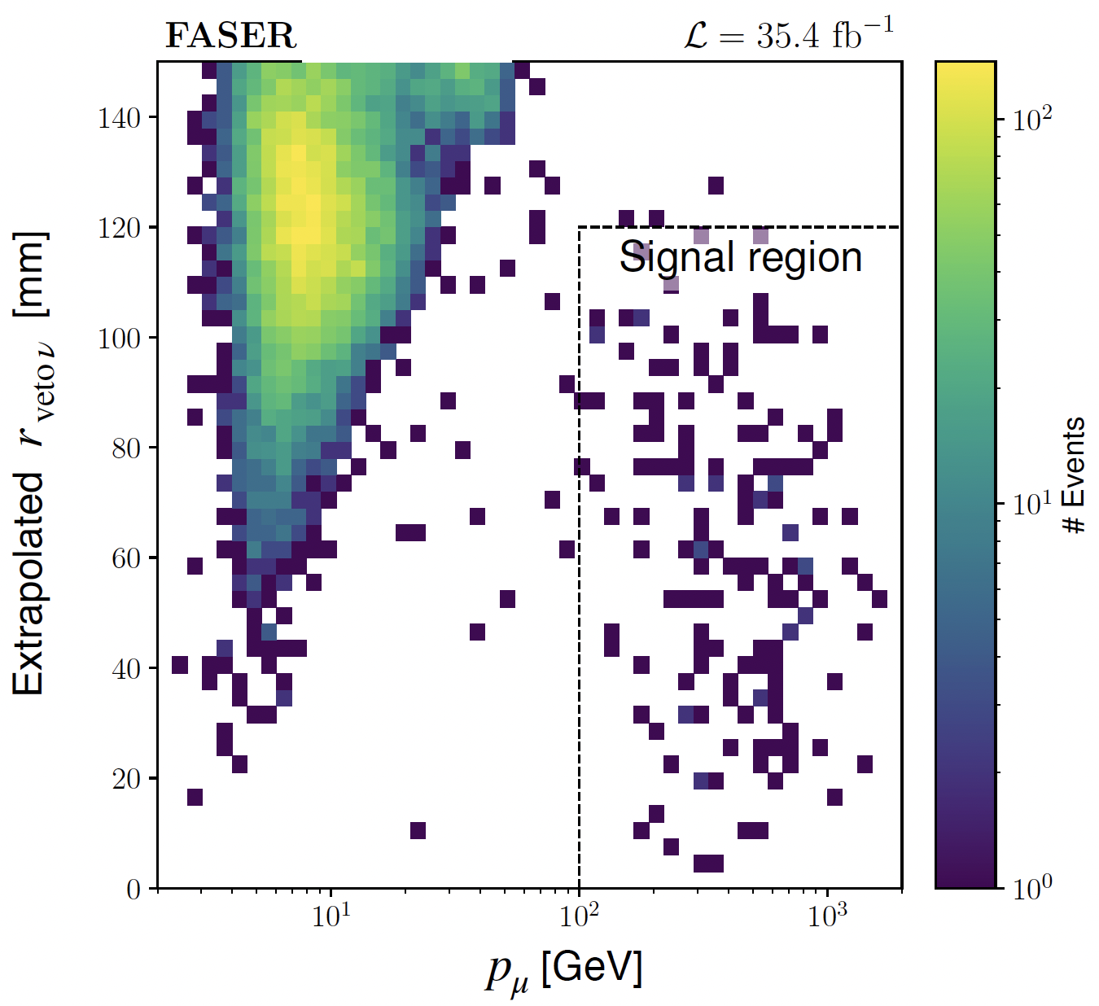
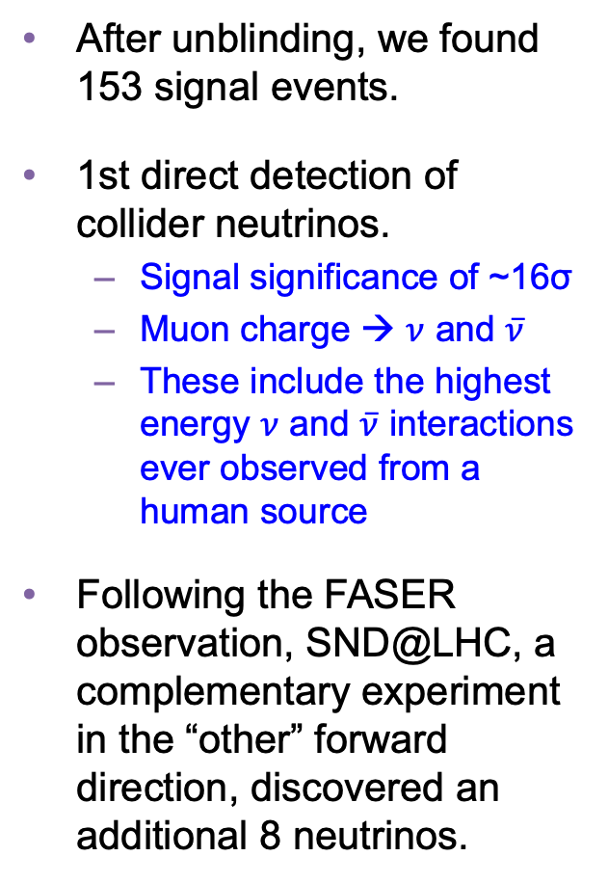
COLLIDER NEUTRINO RESULTS
After unblinding, we found 153 signal events.
1st direct detection of collider neutrinos.
  Signal significance of ~16σ
  Muon charge → $ν$ and $\overline{ν}$
  These include the highest energy $ν$ and $\overline{ν}$ interactions ever observed from a human source
Following the FASER observation, SND@LHC, a complementary experiment in the “other” forward direction, discovered an additional 8 neutrinos.
FASER Collaboration (2303.14185, PRL)

Slide 30
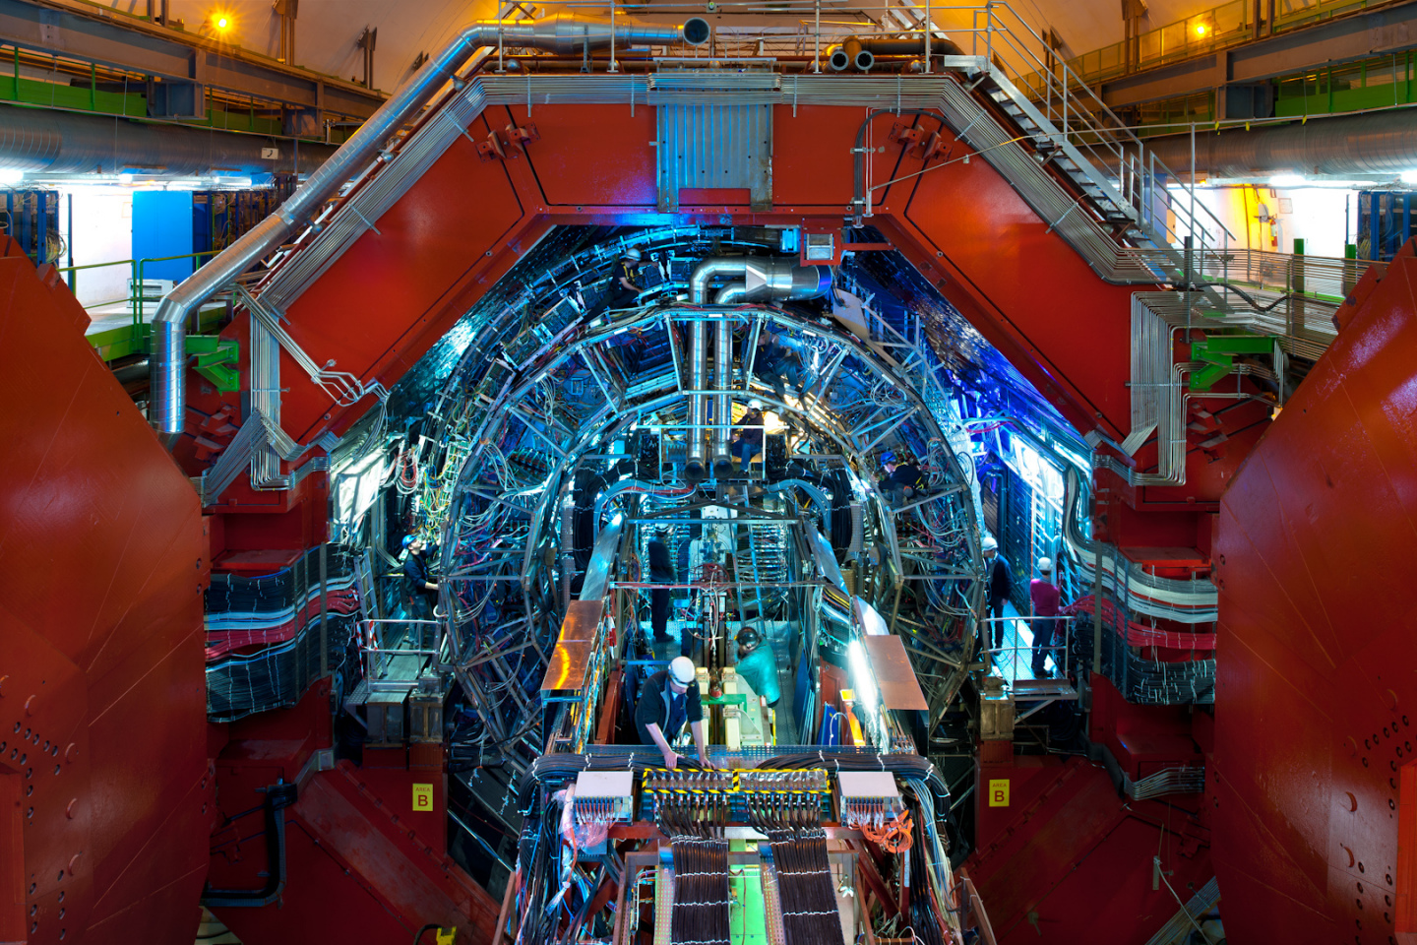
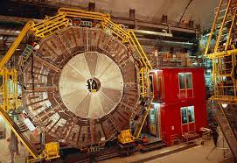
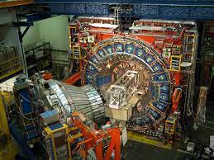
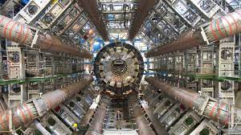
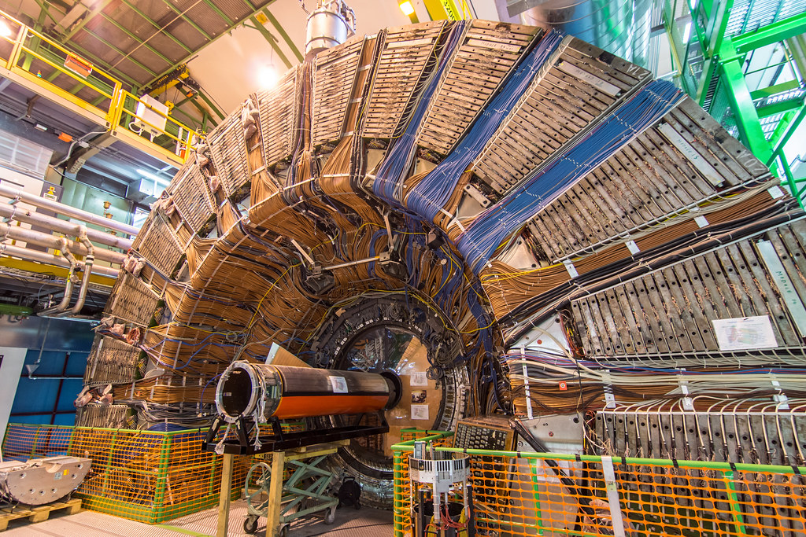
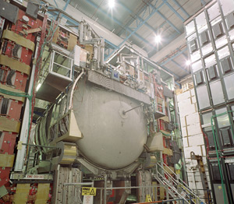
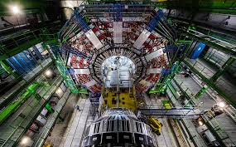
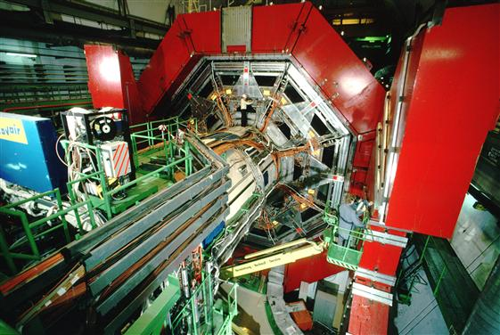

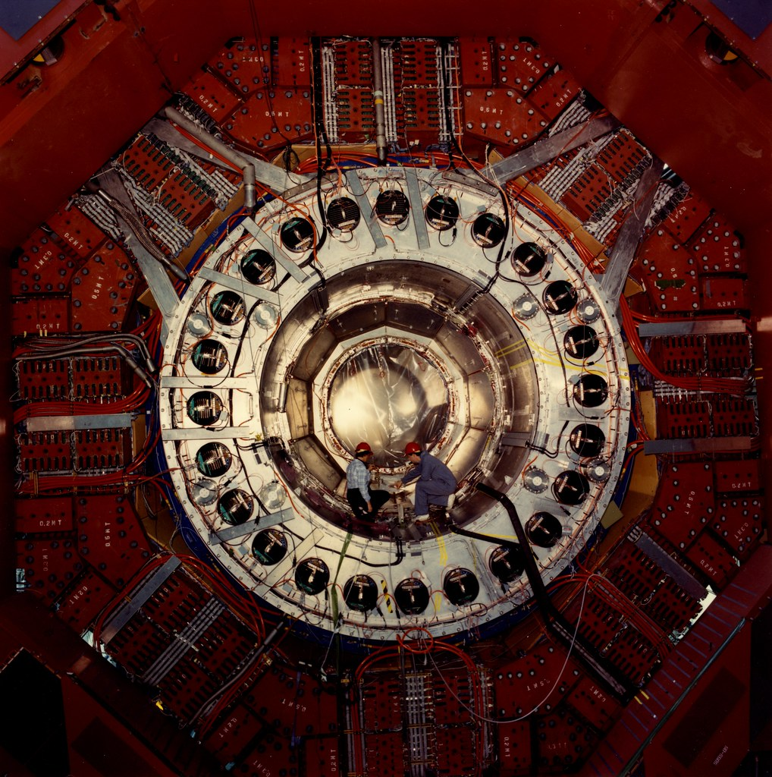
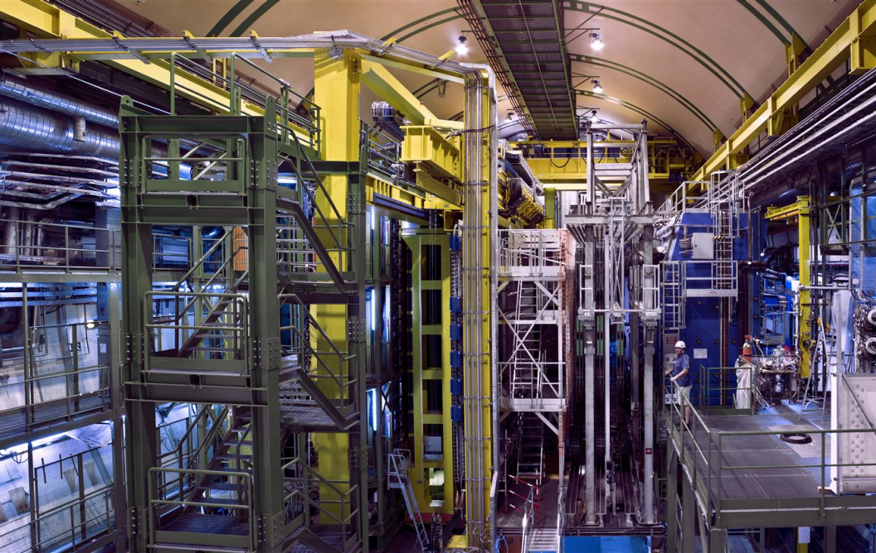
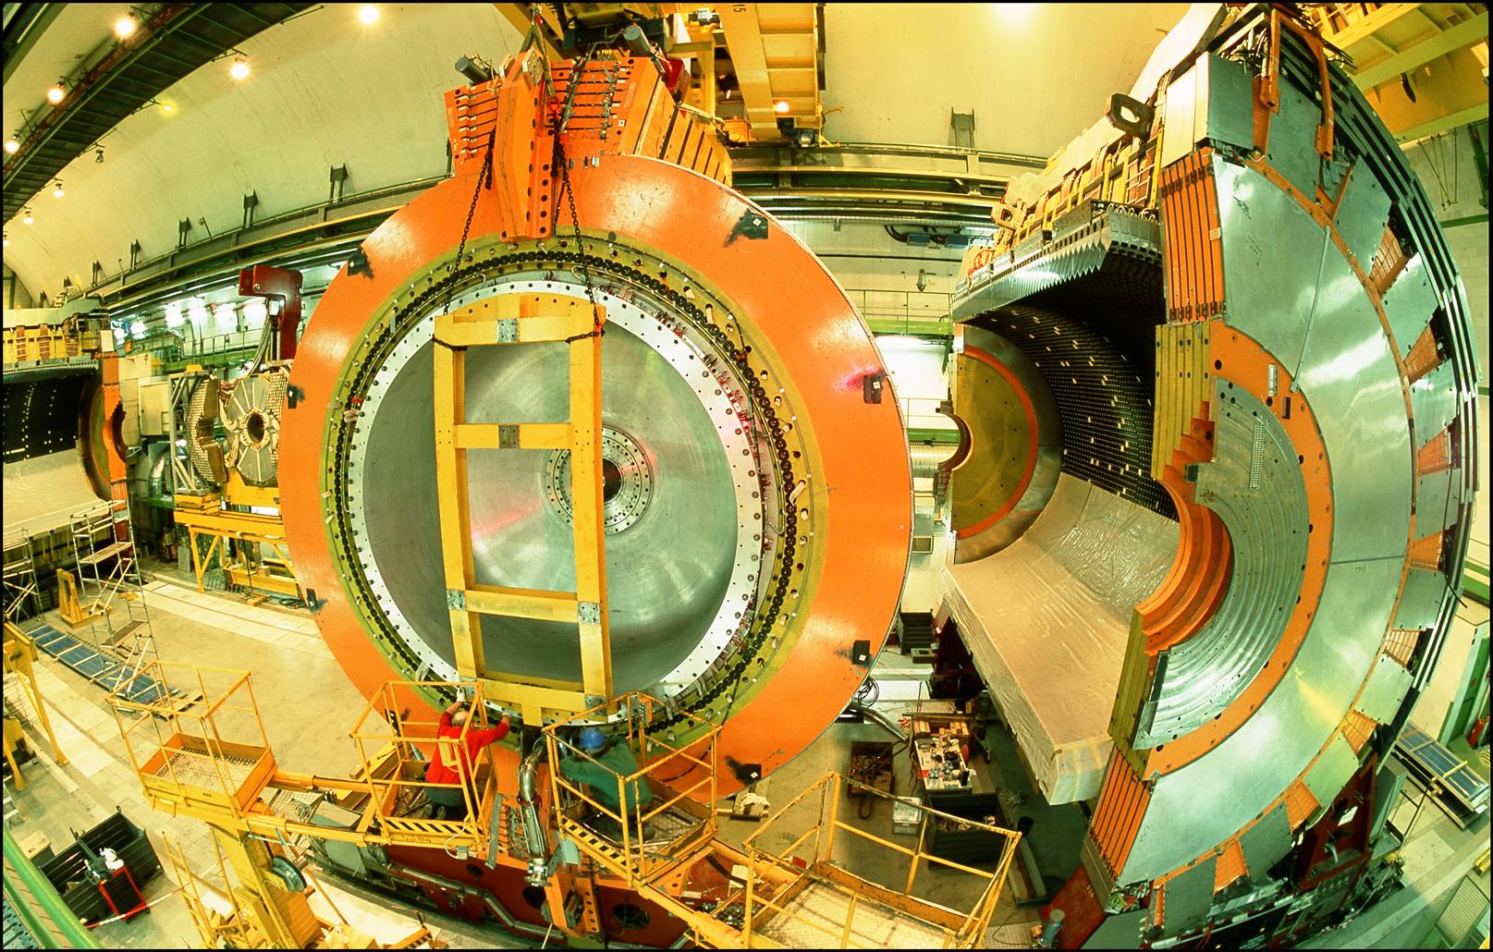
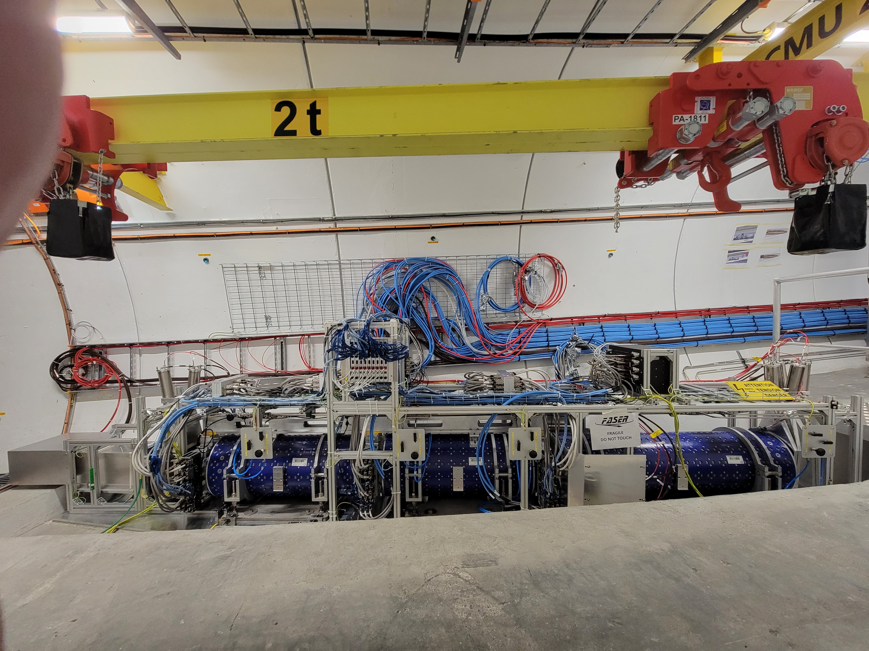
LOCATION, LOCATION, LOCATION
…
ALICE
ALEPH
CDF
FASER
“Tabletop,” 18 months,
~$1M
153 neutrinos
ATLAS
DELPHI
D0
CMS
L3
LHCb
SLD
OPAL
All previous
collider detectors
Building-size, decades,
~$1B
0 neutrinos
16σ discovery, opening a new window at the high energy frontier

Slide 31
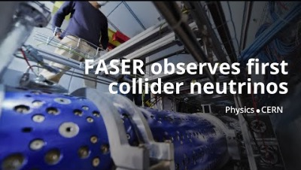
DISCOVERY OF COLLIDER NEUTRINOS

Slide 32


NEUTRINOS IN FASERν
At the front of FASER is FASERν, a 1.1-ton block of interleaved tungsten and emulsion plates. The first neutrino analysis treated this as a big block of matter, but the emulsion provides far more detailed information.
Emulsion is essentially old-fashioned photographic film, has unmatched spatial resolution (~0.5 microns).

Slide 33





NEUTRINOS IN FASERν
With the emulsion, we have now observed the first collider electron neutrinos, including the “Pika-$ν$” event, the highest energy (1.5 TeV) electron neutrino ever seen from a lab source.
Side View
Vertex with 11 tracks
  615 µm inside tungsten
e-like track from vertex
  Single track for 2X₀
  Shower max @ 7.8Χ₀
  θ_{e} = 11 mrad to beam
Back-to-back topology
  175° between e & rest
$$e$$
Beam View
FASER Collaboration (2403.12520)

Slide 34


TEV NEUTRINO CROSS SECTIONS
Following these discoveries, we can then move on to studies, including the first measurement of neutrino cross sections at TeV energies.
Results are consistent with SM DIS predictions.
These measurements use only 1.1% of the data already collected so far. Much more to come; we expect to triple the world’s supply of tau neutrinos, identify the first anti-tau neutrino, …
FASER Collaboration (2403.12520)

Slide 35



NEW PARTICLE SEARCHES
FASER can also look for new light and weakly-interacting particles.
For example: suppose there is a dark sector that contains dark matter X and also a dark force: dark electromagnetism.
The result? Dark photons $A′$ , like photons, but with mass $m_{A′}$, couplings suppressed by $ε$.
For low $ε$, dark photons are long-lived particles (LLPs), can be produced in ATLAS, pass through rock and magnetic fields unhindered, and decay in FASER.
SM
EM
Dark Sector
EM, X
A
$${εF}_{μν}F_{D}^{μν}$$
A_{D}
Holdom (1986)

Slide 36


DARK PHOTON SIGNAL
Focus on masses in the 10-100 MeV range.
Produced through meson decay $π/η→A^{′}γ$ or “dark bremsstrahlung” $pp→{ppA}^{′}$.
Travel straight and unimpeded through 480 m of rock/concrete.
Then decay through $A^{′}$ $→ e^{+}e^{−}$.
The signal is no charged particle passing through the upstream veto scintillator detectors, followed by two very energetic (100s of GeV) charged tracks in downstream trackers. Tracks are very collimated, but magnet splits them sufficiently to be seen as 2 tracks in trackers.
Notes:
typical A’ that decays in FASER has ~TeV energy

Slide 37

DARK PHOTON RESULTS
After unblinding, no events seen, FASER sets limits on previously unexplored parameter space.
First new probe of the parameter space favored by dark matter from low coupling since the 1990’s.
Bodes well for the future
  Background-free analysis
  Started probing new parameter space with the first day of data
  Ended up ~100 times more sensitive than previous experiments
  Improvements in analysis and 40 times more data to come
Existing bounds from DarkCast
FASER Collaboration (2308.05587, PLB)

Slide 38






MORE SEARCH RESULTS
Also many other search results: axion-like particles with W, photon, gluon couplings, U(1)_{B} gauge bosons, up-philic scalars, two Higgs doublet models.
Qualitatively different signals: some with charged tracks, some with only photons, some mainly produced in pion decay, some mainly produced in B decay. Shows the characteristic versatility of searches at high-energy colliders.
FASER Collaboration 2410.10363

Slide 39


Slide 40



FORWARD PHYSICS FACILITY
Following the results of FASER and SND@LHC, CERN is considering the possibility of creating a dedicated Forward Physics Facility to house far-forward experiments for the rest of the LHC era from 2028-2040s.
UJ18
ATLAS
SPS
LHC
LOS
FPF site selection study and core study have identified an ideal site in France just outside the CERN main gate
https://cds.cern.ch/record/2851822
CERN GIS

Slide 41



THE FACILITY
A cylindrical cavern surrounding the LOS, 620-695 m west of the ATLAS IP.
75 m long, 12 m in diameter, covers $η>5.1$.
Preliminary (Class 4) cost estimate: 35 MCHF.
Can be constructed independently of the LHC, does not disrupt LHC running.
Timeline: construct in LS3/early Run 4, physics starts in late Run 4.
Bud, Magazinik, Pál, Osborne, et al. CERN CE (2024)

Slide 42

FPF EXPERIMENTS
At present there are 4 experiments being designed for the FPF
  FASER2: magnetized spectrometer for BSM searches
  FASERν2: emulsion-based neutrino detector
  FLArE: LArTPC neutrino detector
  FORMOSA: scintillator array for BSM searches (successor to MilliQan)
These represent a huge jump relative to the existing experiments:
  10,000 times greater (decay volume * luminosity) for BSM searches.
  Will detect miilions of TeV neutrinos (~1000 neutrinos/day!), including 10,000 ν_{τ}

Slide 43




NEUTRINOS AT THE FPF
The FPF experiments will see ${10}^{5} ν_{e}$, ${10}^{6} ν_{μ}$, and ${10}^{4} ν_{τ}$ interactions at TeV energies. The last chance to probe this in a controlled environment for at least 50 years.
Neutrinos are produced by forward hadron production: $π, K, D, …$. Dependence on E, $η$ will inform
  Neutrino oscillations: $ν_{s}$ with $∆m^{2}\sim {10}^{3}$ ${eV}^{2}$
  QCD: pdfs at x $\sim {10}^{−1}$, x $\sim {10}^{−7}$, intrinsic charm, small-x gluon saturation, …
  Astroparticle physics: muon puzzle, …

Slide 44

UNIQUE DISCOVERY OPPORTUNTIES
FPF experiments will enhance the LHC’s discovery potential, looking somewhere new where no other LHC experiments (or any other experiments) can look. Many examples:
Millicharged particles: a completely generic possibility motivated by dark matter, dark sectors. Currently the target of the MilliQan experiment, located at the LHC near the CMS experiment in a “non-forward” tunnel.
FORMOSA is a dedicated experiment in the forward region with much greater sensitivity for a wide range of masses from 10 MeV to 100 GeV.
Currently being explored with the FORMOSA Demonstrator behind FASER.
Foroughi-Abari, Kling, Tsai (2020)

Slide 45






DARK MATTER
In the last few decades, there has been an intense effort to detect dark matter through non-gravitational couplings, all yielding null results.
One generic possibility that is infamously hard to detect: inelastic dark matter, where there are two nearly-degenerate dark states with off-diagonal couplings to the SM.
These generically lead to long-lived particles, but with soft decay products, but these are highly boosted to observable levels at the FPF.
Bottom line: the FPF can discover DM (or any compressed spectrum), which cannot be seen anywhere else (ATLAS/CMS, SHiP and other fixed target expts, direct and indirect DM searches, …)
$$m_{1}$$
$$χ_{1} →χ_{0}γ$$
$$m_{0}$$
0
Dienes et al. (2023)

Slide 46


QUIRKS
There may be another strong (non-Abelian) force.
Quirks are particles charged under both the SM and another strong force, with $m≫Λ$.
Quirks can be pair-produced at the LHC, but then are bound by a color string, oscillate about their center-of-mass and travel down the beamline.
By looking for 2 coincident slow or delayed tracks (out of time with the bunch crossing), FPF experiments can discover quirks with masses up to ~TeV, as motivated by neutral naturalness solutions to the gauge hierarchy problem.
Unique discovery potential at the FPF: very challenging at ATLAS/CMS, not possible at fixed target experiments.
Feng, Li, Liao, Ni, Pei (2024)

Slide 47

COMPLEMENTARITY WITH HIGH P_{T} PHYSICS
The FPF will provide new constraints on pdfs that will sharpen studies at ATLAS and CMS.
For example, W, Z, and Higgs boson studies.
Will remove degeneracies between pdfs and new physics (“fitting away new physics”), enhancing the reach for new particle searches.
_{FPF Working Groups (2024)}
Cruz-Martinez, Fieg, Giani, Krack, Makela, Rabemananjara, Rojo (2023)

Slide 48

SUMMARY
Neglected for decades, the forward region at particle colliders turns out to be a treasure trove of interesting physics that can be mined with small, fast, inexpensive experiments. Much more to come!
FASER Collaboration Meeting, Bonn, 25-27 June 2024

