Slide 1

Joint BSM/FPC Meeting, Physics Beyond Colliders
Jonathan Feng, UC Irvine, 20 November 2024

Slide 2
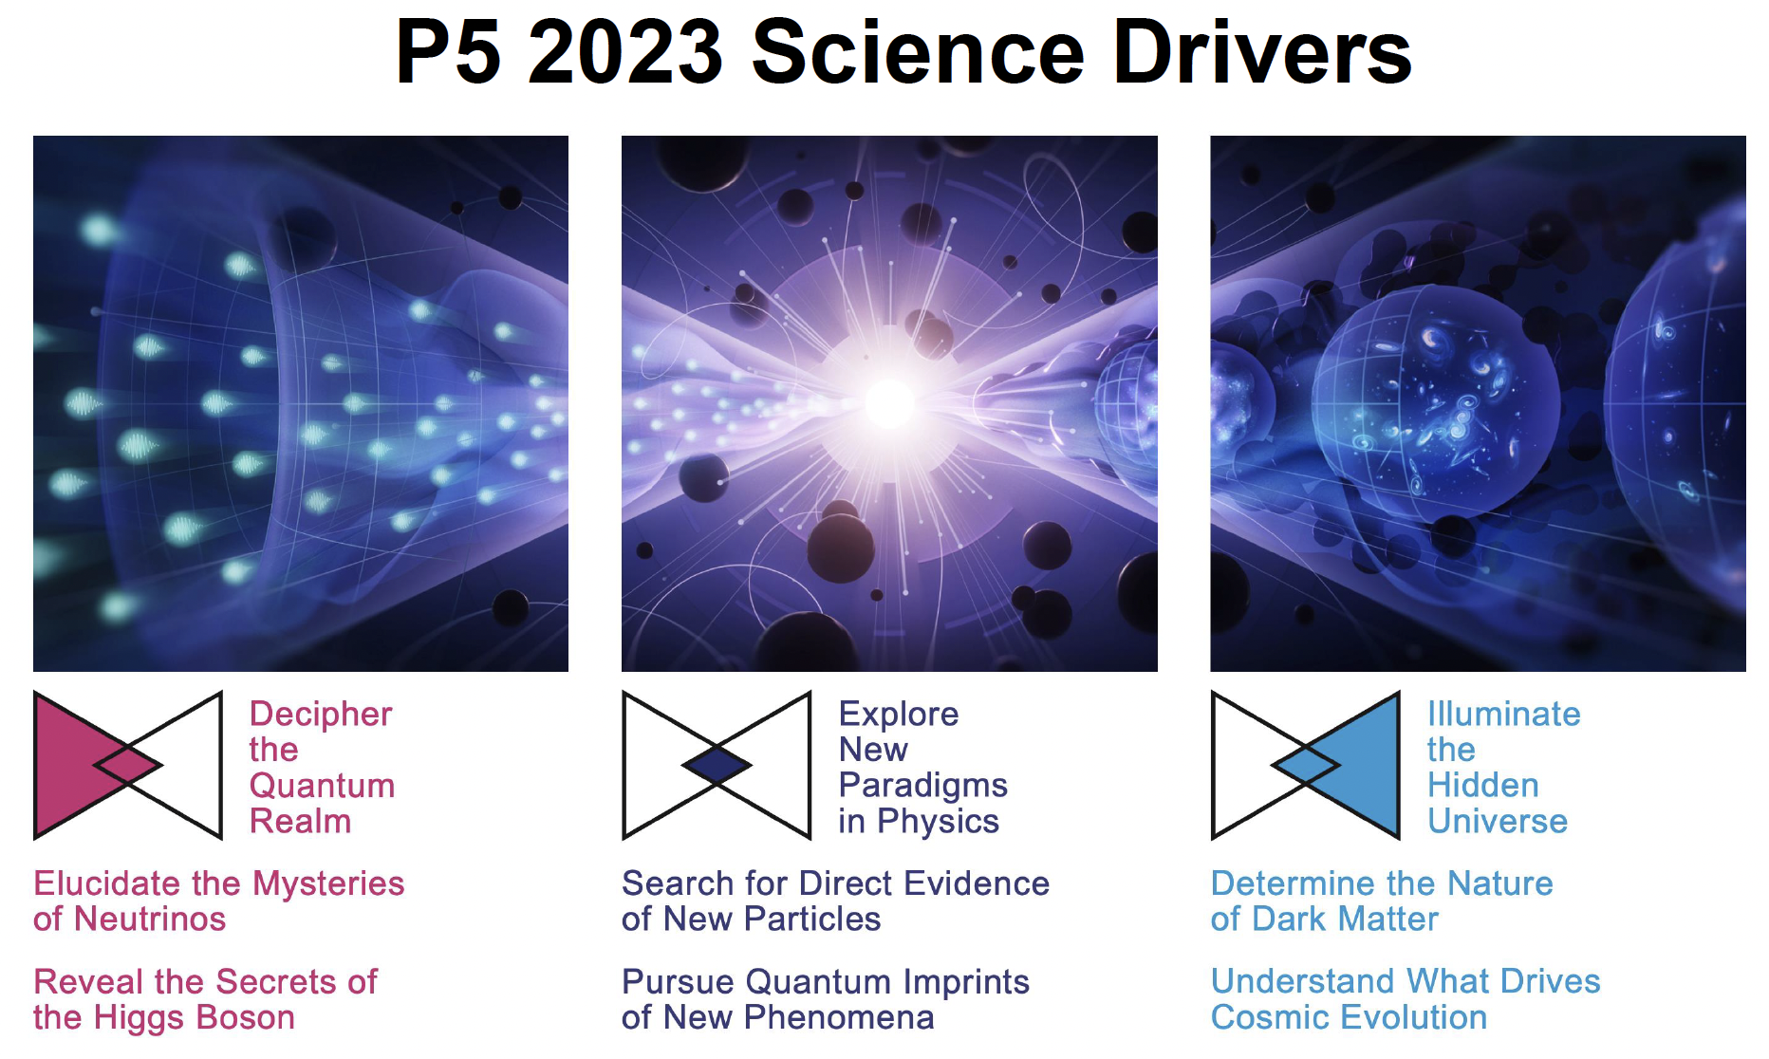
INTRODUCTION
In the last few years, there has been a transformation in our understanding of forward physics at colliders.
Previously: luminosity measurements, pomerons, odderons, …
Now: we understand that the forward region contains a treasure trove of both SM and BSM physics, addressing many of our most urgent questions.
To fully exploit the physics potential of the LHC, forward detectors are required, just like trackers and calorimeters. The Forward Physics Facility is proposed to house a suite of such detectors at the HL-LHC.

Slide 3
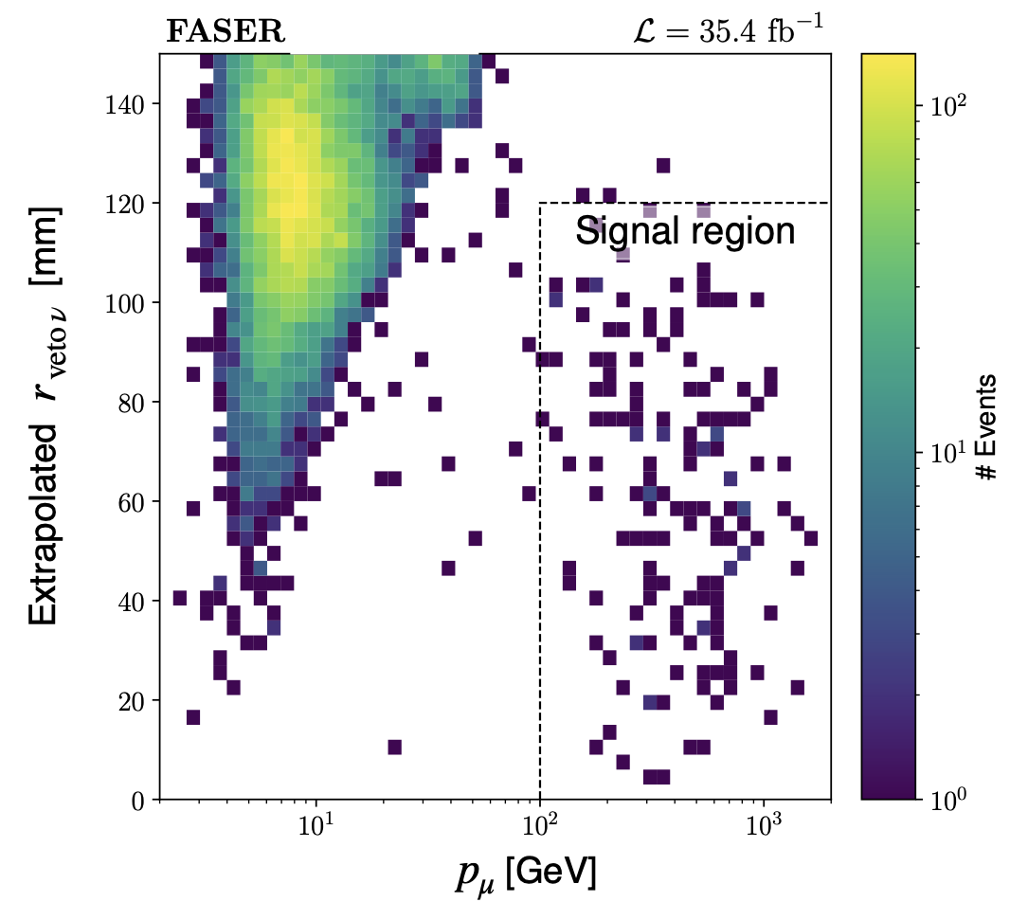
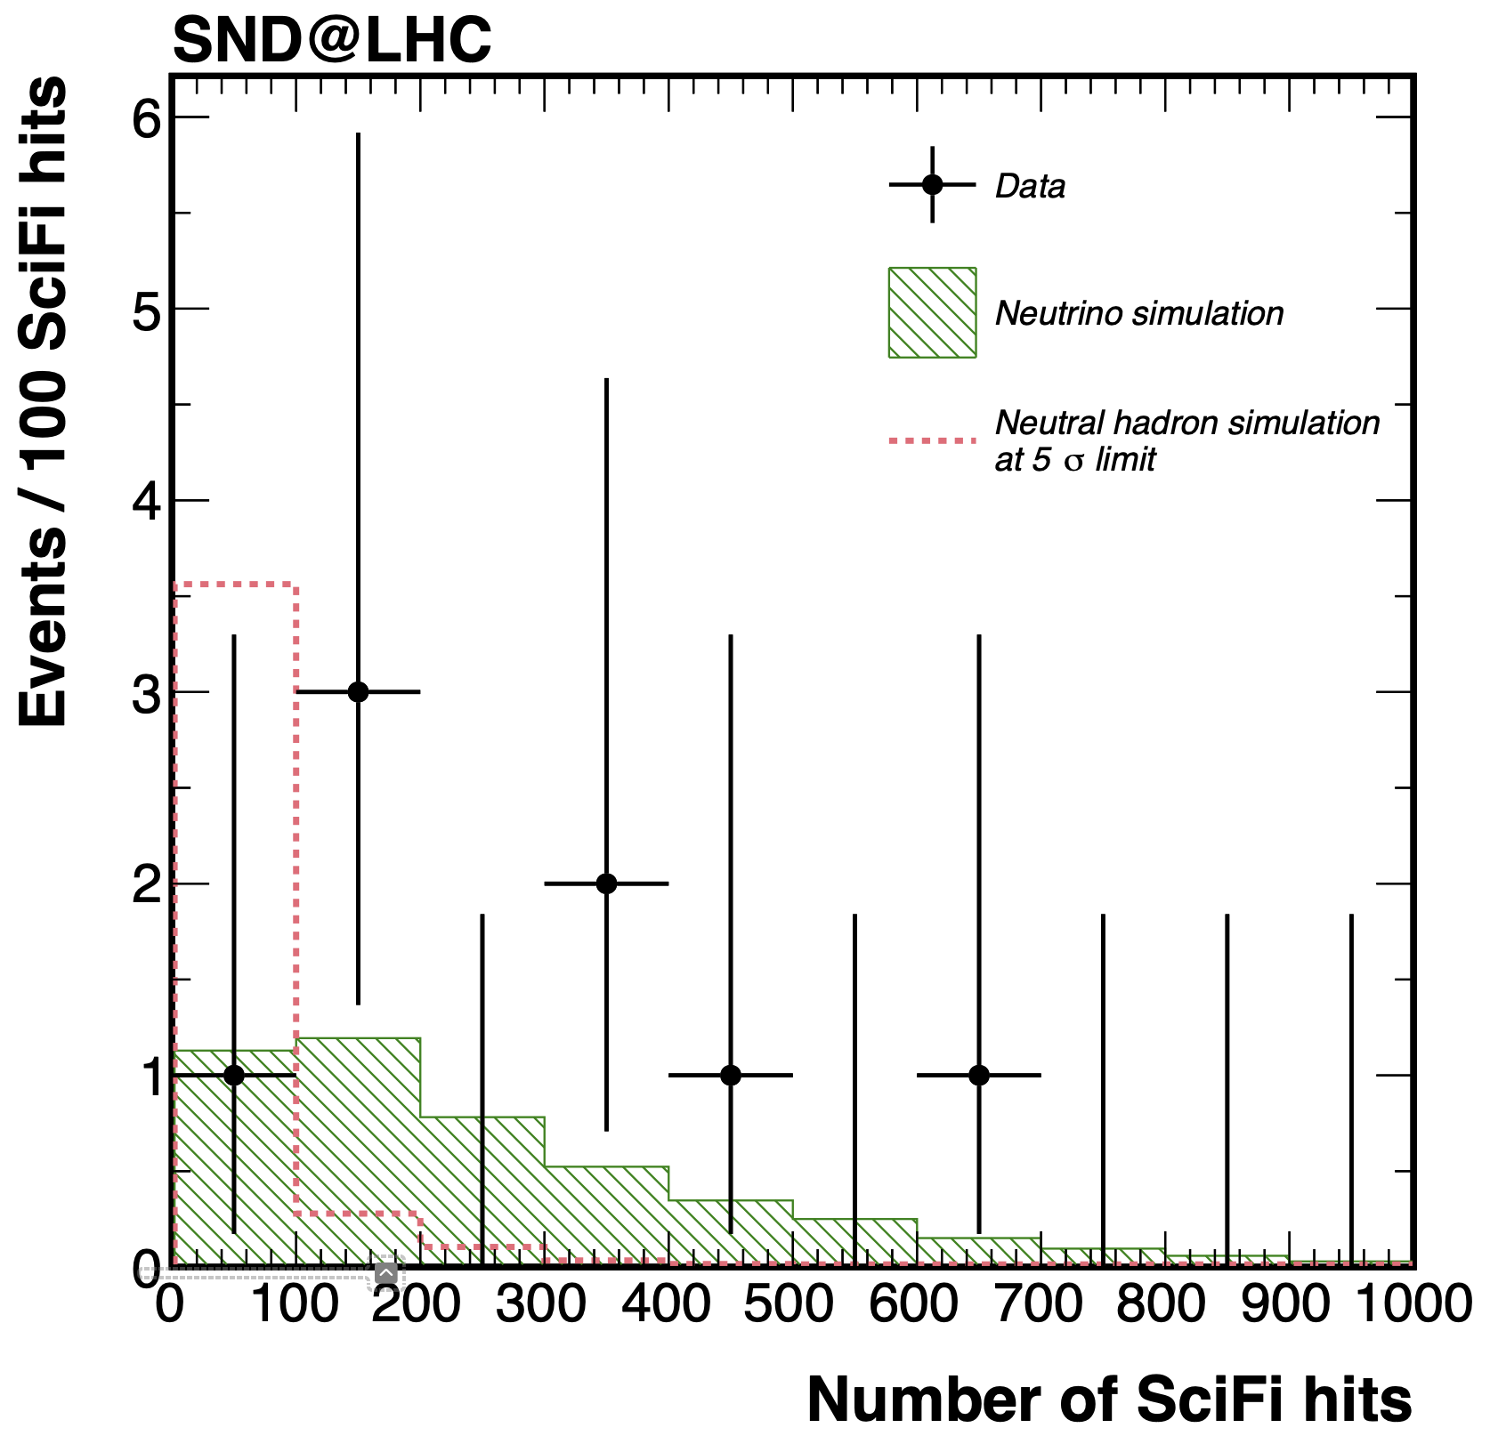
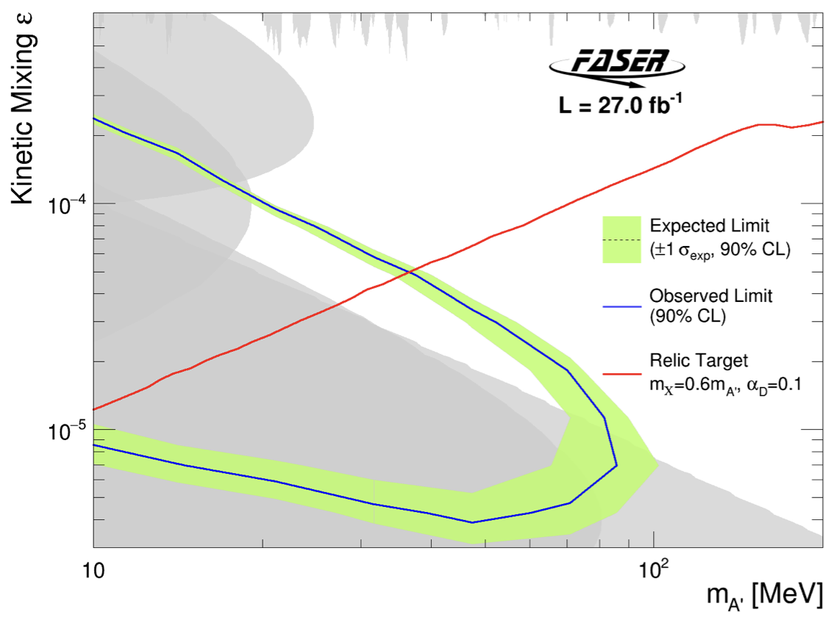
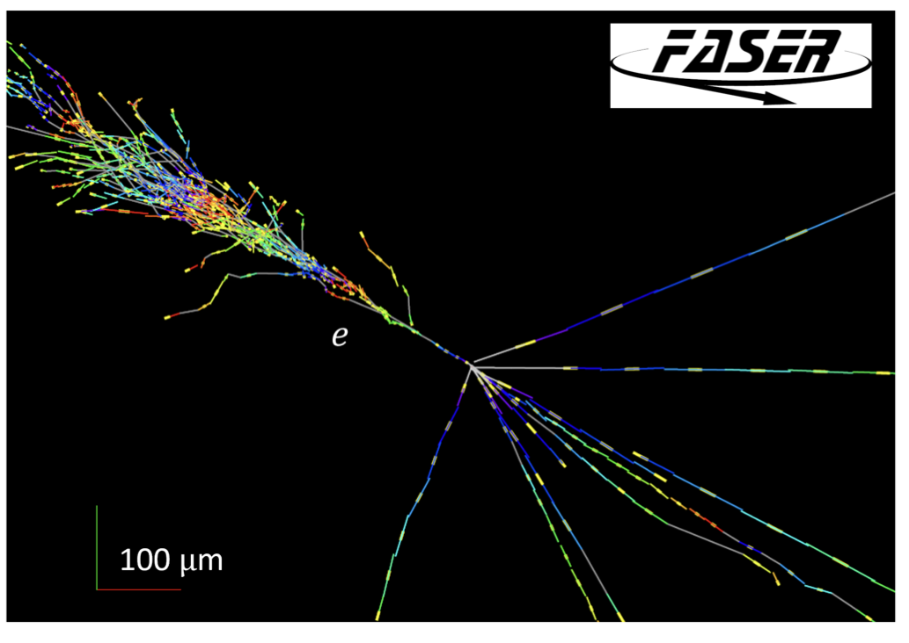
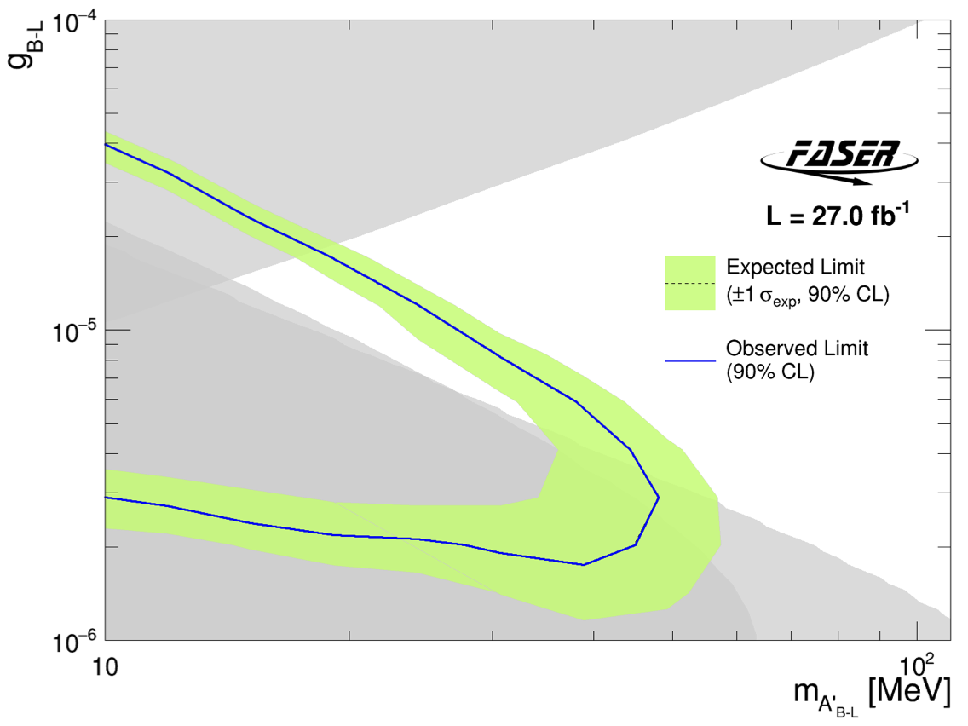
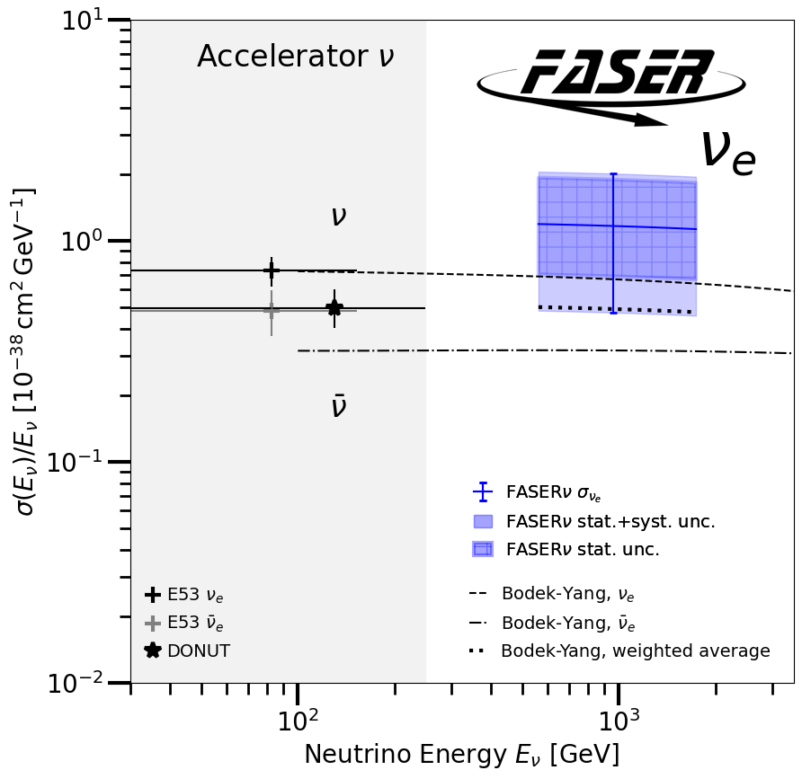
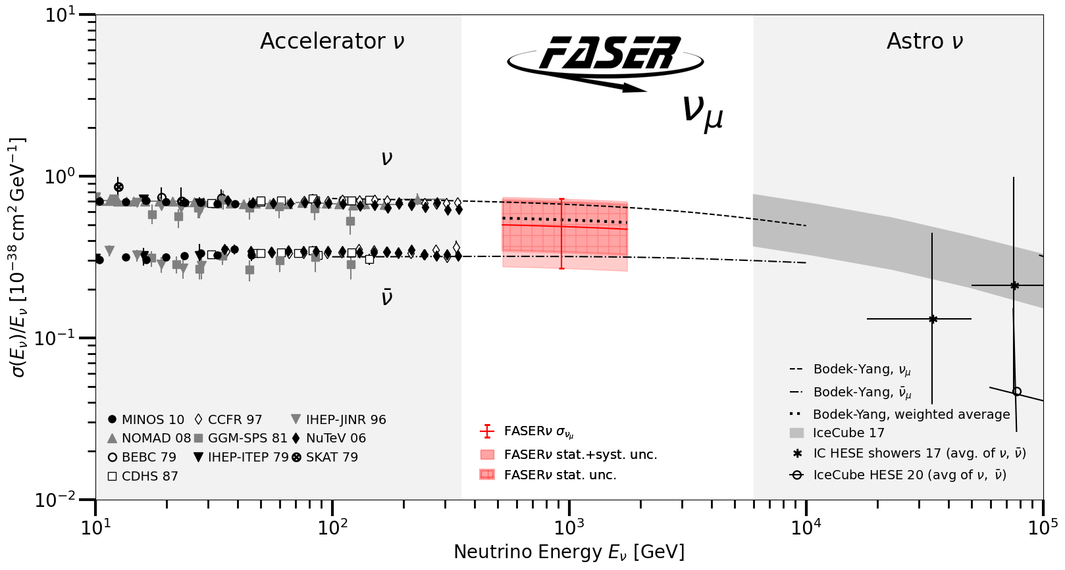
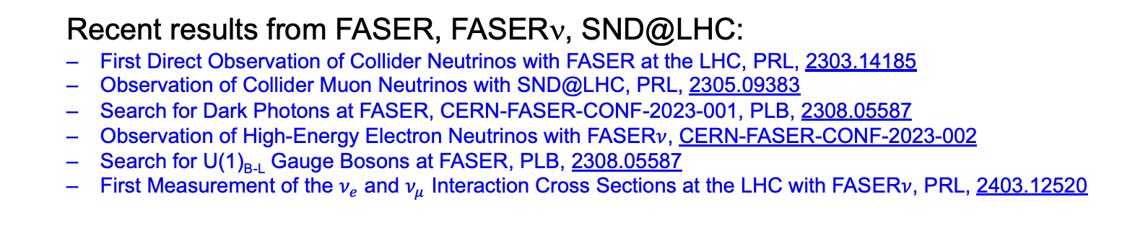
A GOOD YEAR FOR FORWARD PHYSICS
Recent results from FASER, FASERν, SND@LHC:
  First Direct Observation of Collider Neutrinos with FASER at the LHC, PRL, 2303.14185
  Observation of Collider Muon Neutrinos with SND@LHC, PRL, 2305.09383
  Search for Dark Photons at FASER, CERN-FASER-CONF-2023-001, PLB, 2308.05587
  Observation of High-Energy Electron Neutrinos with FASER$ν$, CERN-FASER-CONF-2023-002
  Search for U(1)_{B-L} Gauge Bosons at FASER, PLB, 2308.05587
  First Measurement of the $ν_{e}$ and $ν_{μ}$ Interaction Cross Sections at the LHC with FASER$ν$, PRL, 2403.12520

Slide 4
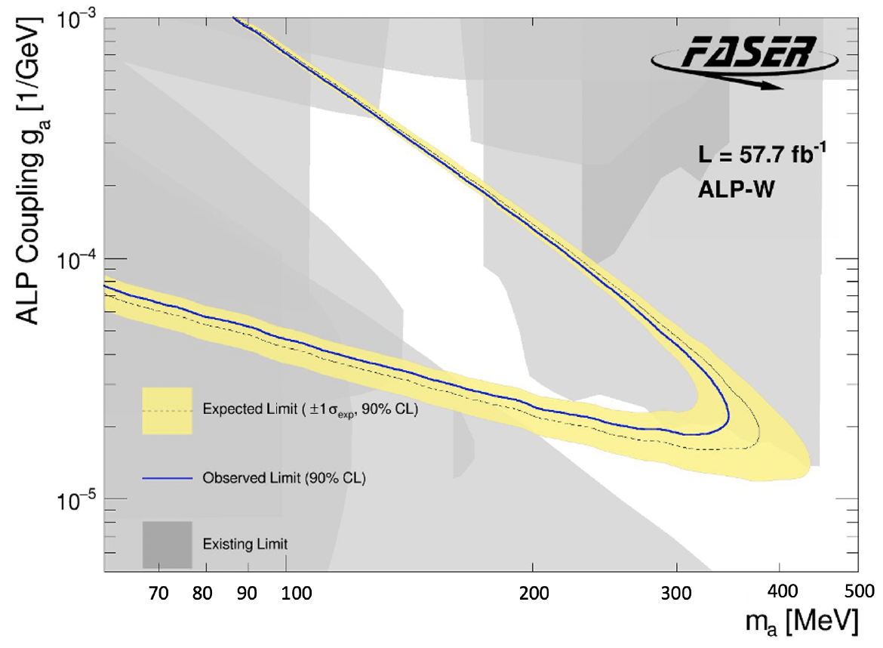
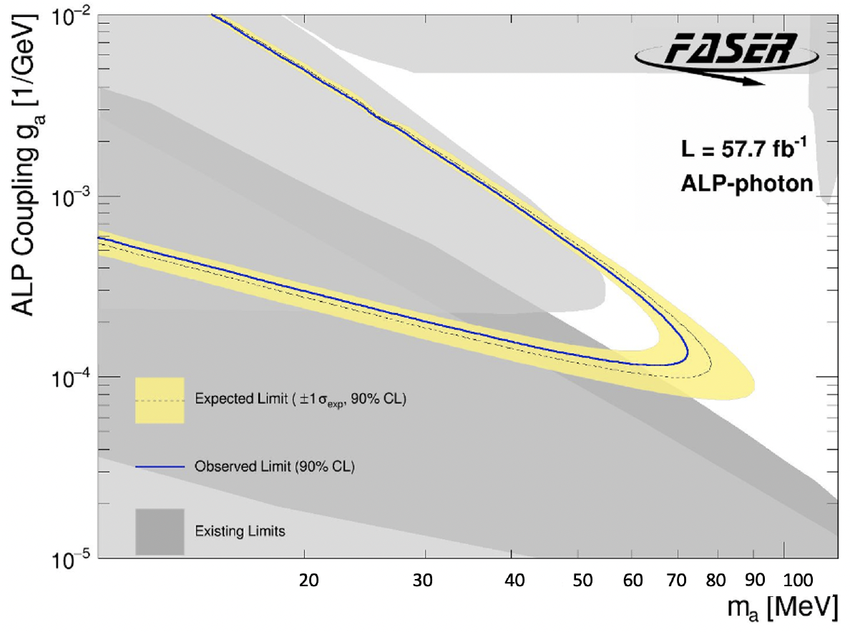
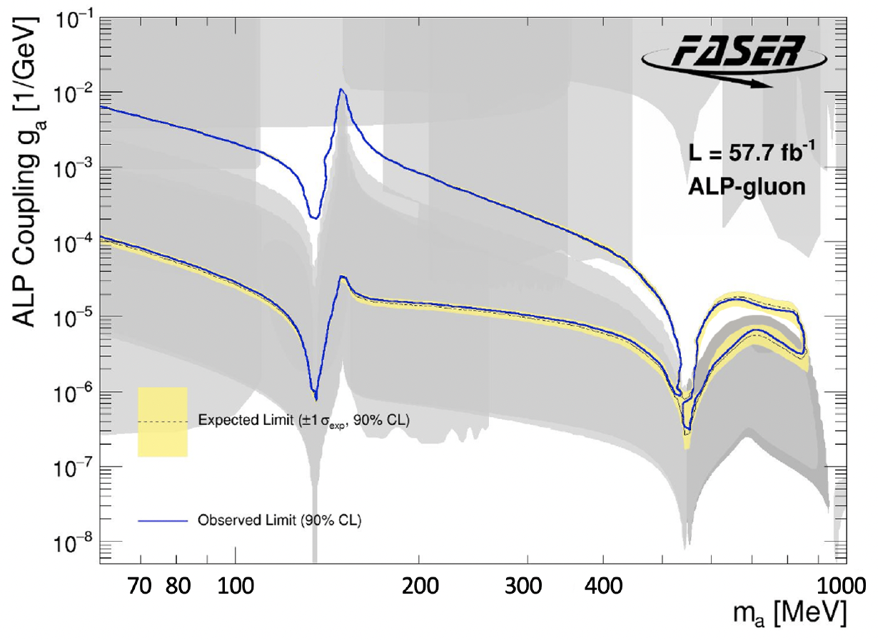
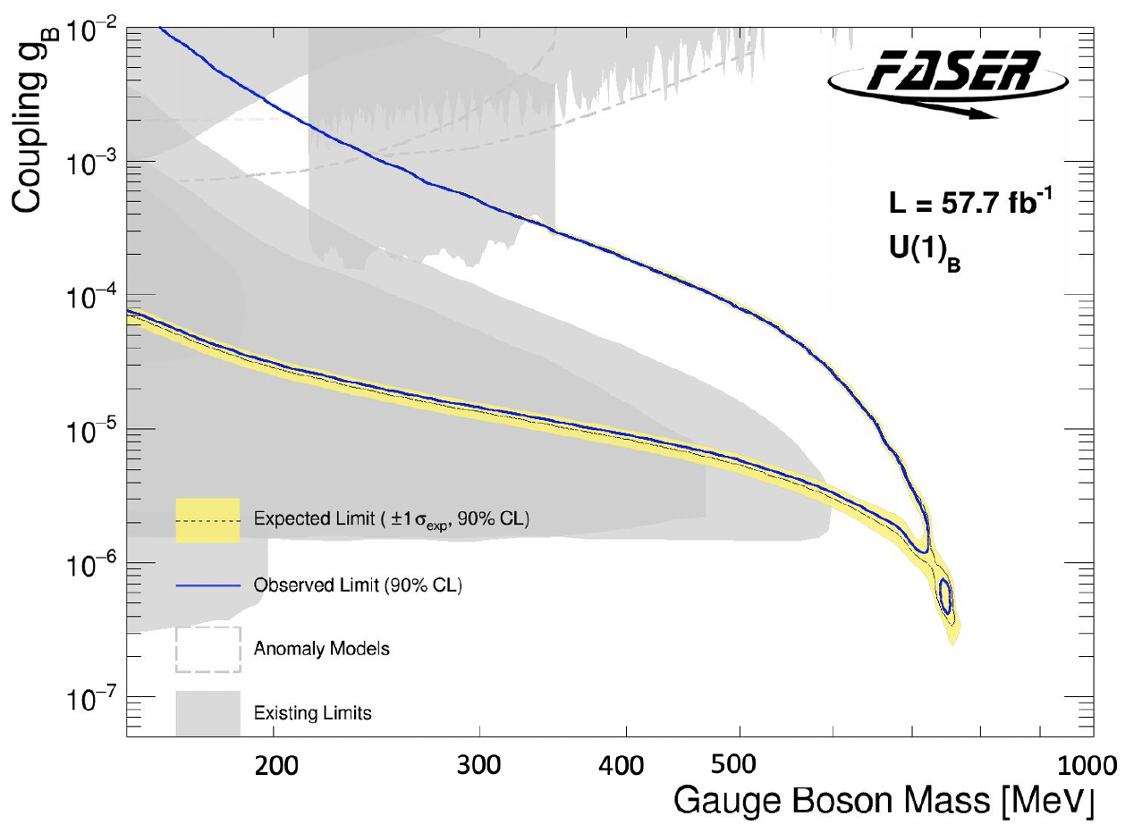
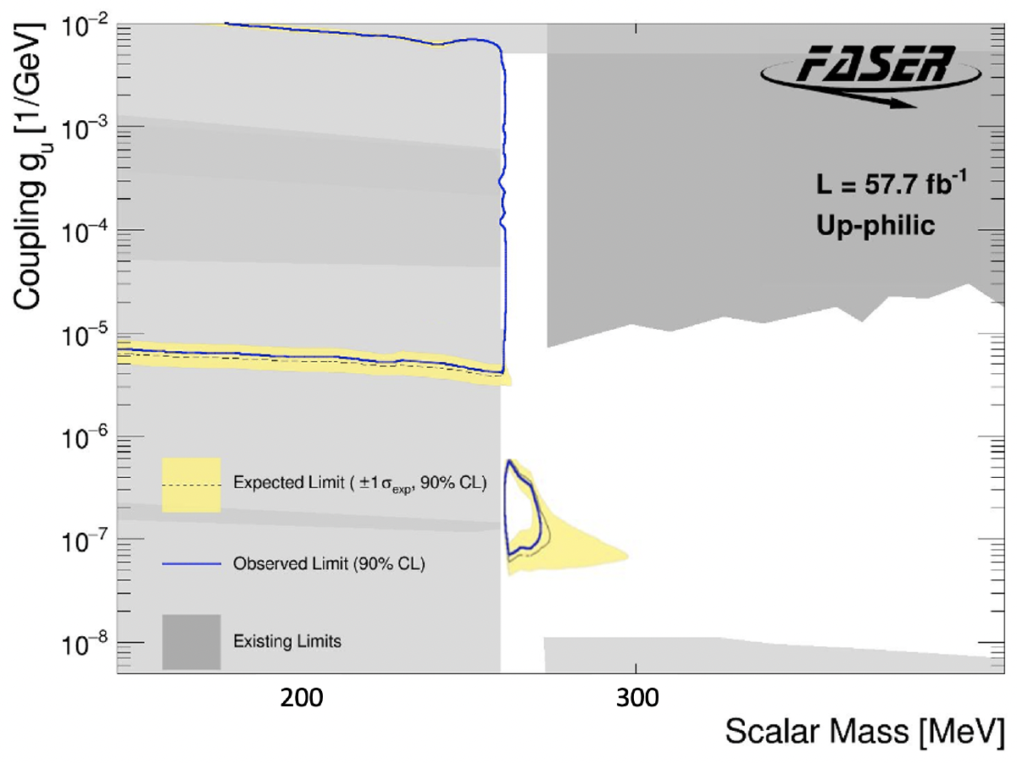
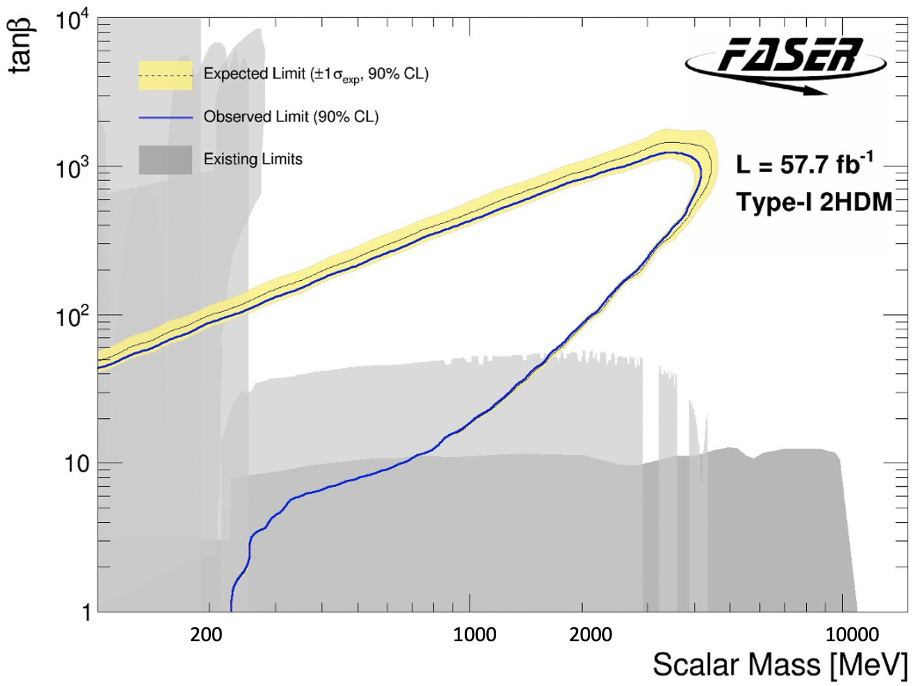
MORE BSM RESULTS
Also many other search results: axion-like particles with W, photon, gluon couplings, U(1)_{B} gauge bosons, up-philic scalars, two Higgs doublet models.
Qualitatively different signals: some with charged tracks, some with only photons, some mainly produced in pion decay, some mainly produced in B decay. Shows the characteristic versatility of searches at high-energy colliders.
FASER Collaboration 2410.10363

Slide 5
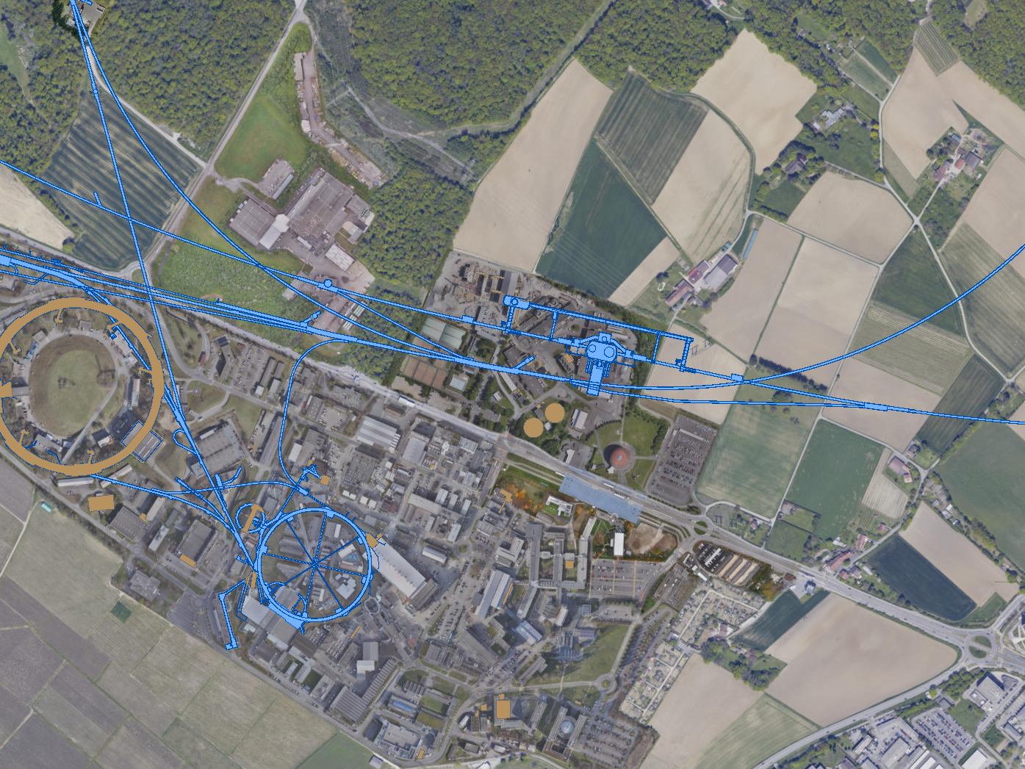


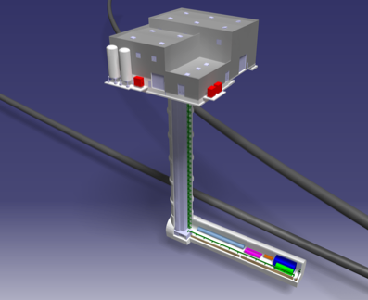
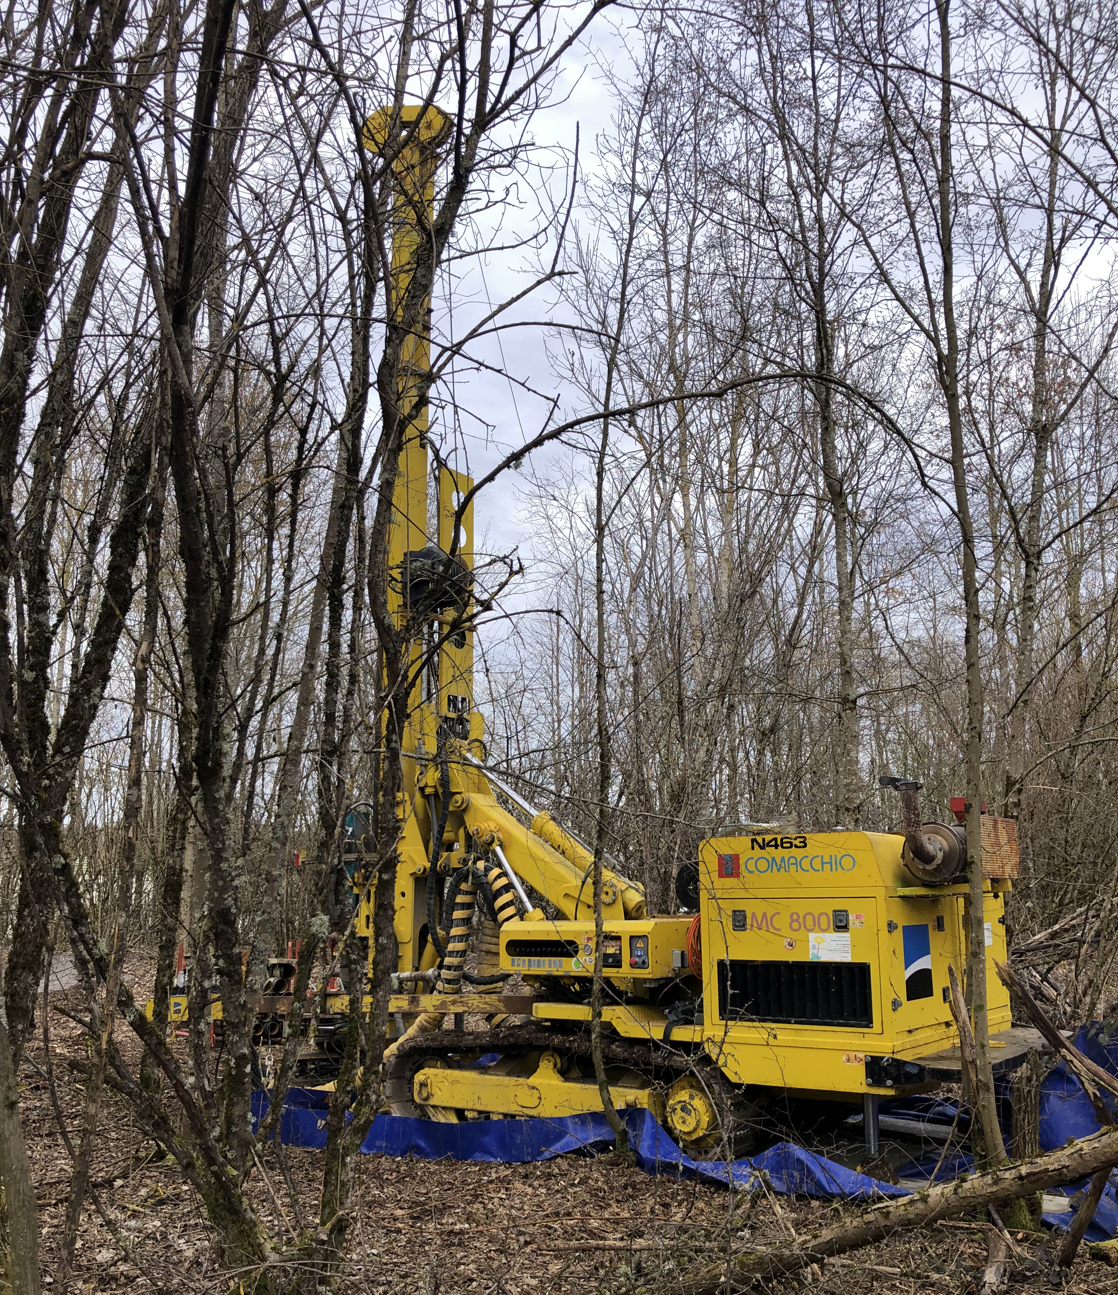
FORWARD PHYSICS FACILITY
Motivated by the results of FASER and SND@LHC, a dedicated Forward Physics Facility has been proposed to house far-forward experiments for the rest of the LHC era from 2030-2040s.
UJ18
ATLAS
SPS
LHC
LOS
PBC: FPF site selection study and core study have identified an ideal site in France just outside the CERN main gate
https://cds.cern.ch/record/2851822
CERN GIS

Slide 6
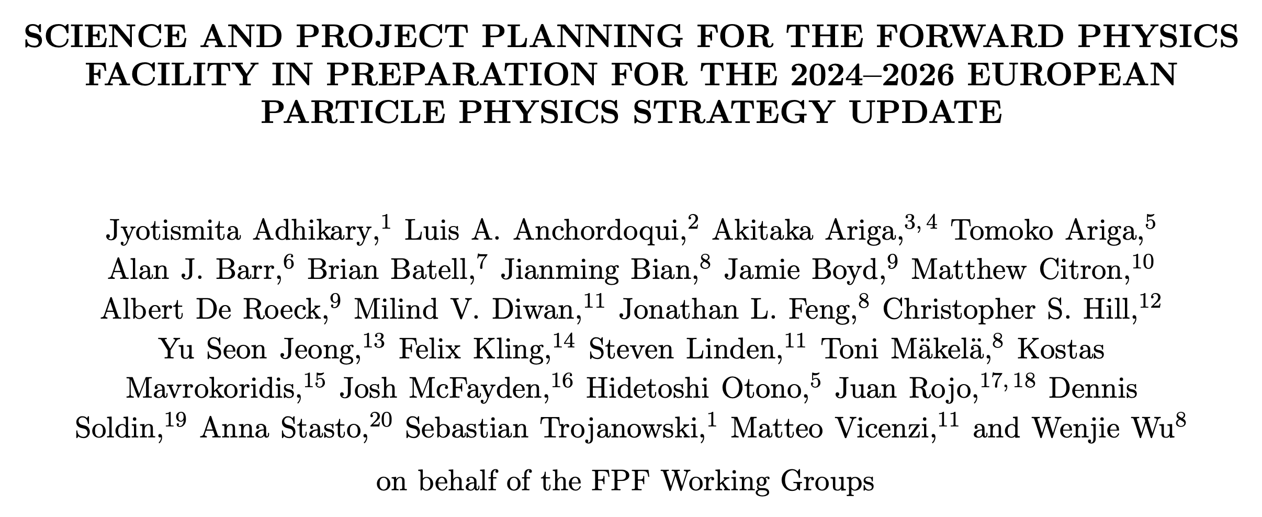
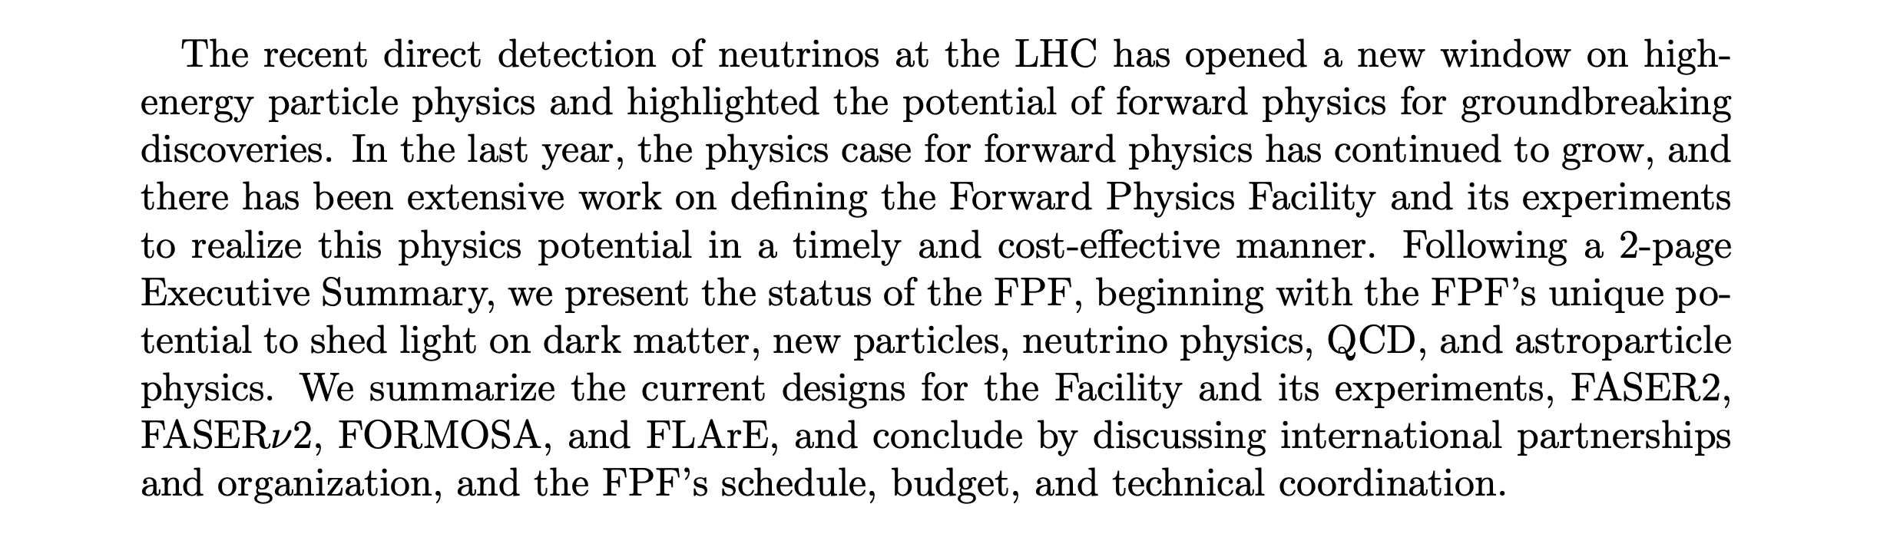
FORWARD PHYSICS FACILITY
The FPF status has been summarized recently in 2411.04175.

Slide 7
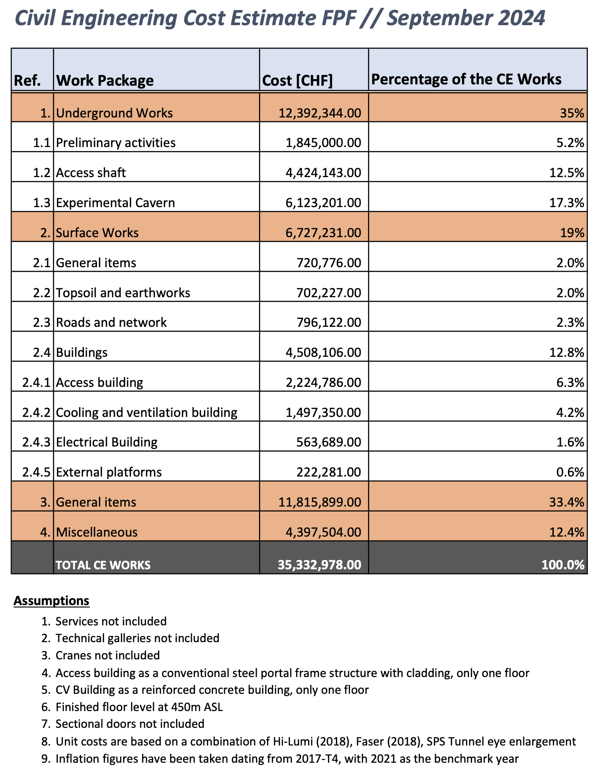
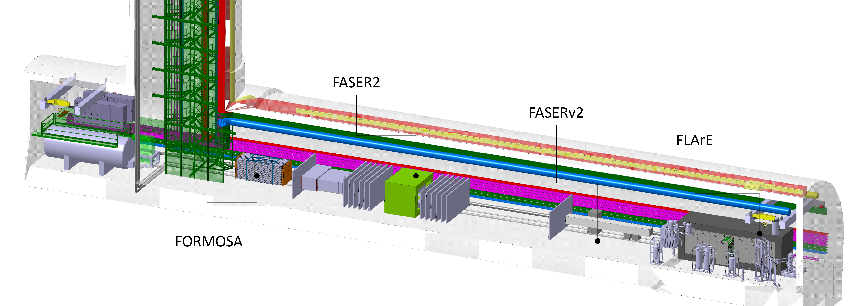
THE FPF CAVERN
Continued excellent work by the PBC to refine the Facility.
New developments
  Slightly enlarged to 12 m wide, 75 m long.
  Includes a service cavern on the other side of the shaft.
  Moved back slightly to 627 m from ATLAS IP to maintain 10 m from LHC tunnel.
Estimated (Class 4) cost is 35 MCHF (not including experiments and outfitting).

Slide 8
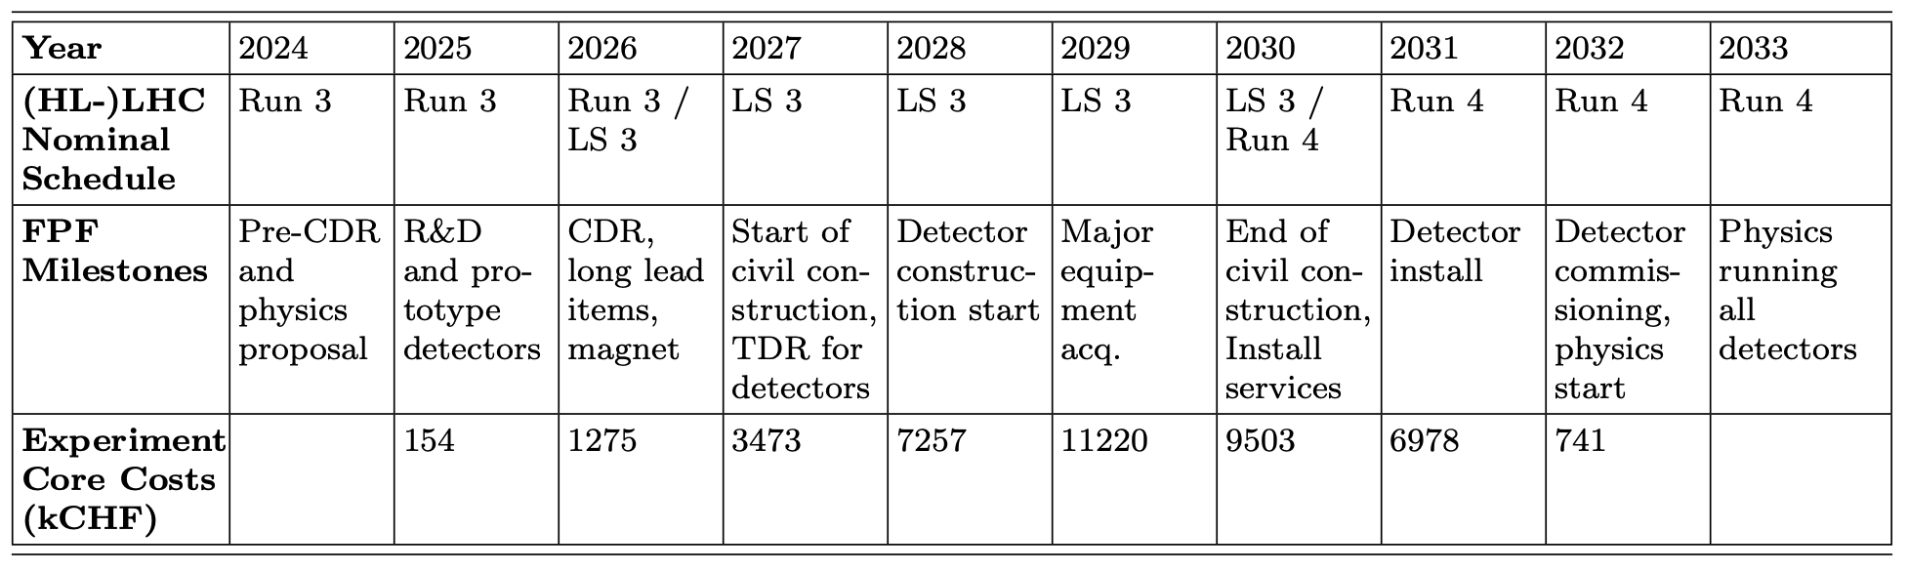
FPF EXPERIMENTS
There are 4 experiments being designed for the FPF
  FASER2: magnetized spectrometer for BSM searches
  FASERν2: emulsion-based neutrino detector
  FLArE: LArTPC neutrino detector
  FORMOSA: scintillator array for BSM searches (successor to MilliQan)
Core costs of the experiments vary from 2 to 15 MCHF, total is 41 MCHF.
Timeline: Physics in Run 4

Slide 9
BSM PHYSICS AT THE FPF
The FPF at the HL-LHC will have many unique capabilities:
  10,000 times greater (decay volume * luminosity) for BSM searches (10x greater in every spacetime dimension).
  Will detect millions of TeV neutrinos, including ~10,000 tau neutrinos, ~1000 neutrinos of all flavors/day.
The new document presents unique opportunities beyond the PBC benchmarks, complementarity with SHiP and other experiments. Some examples are given here.

Slide 10
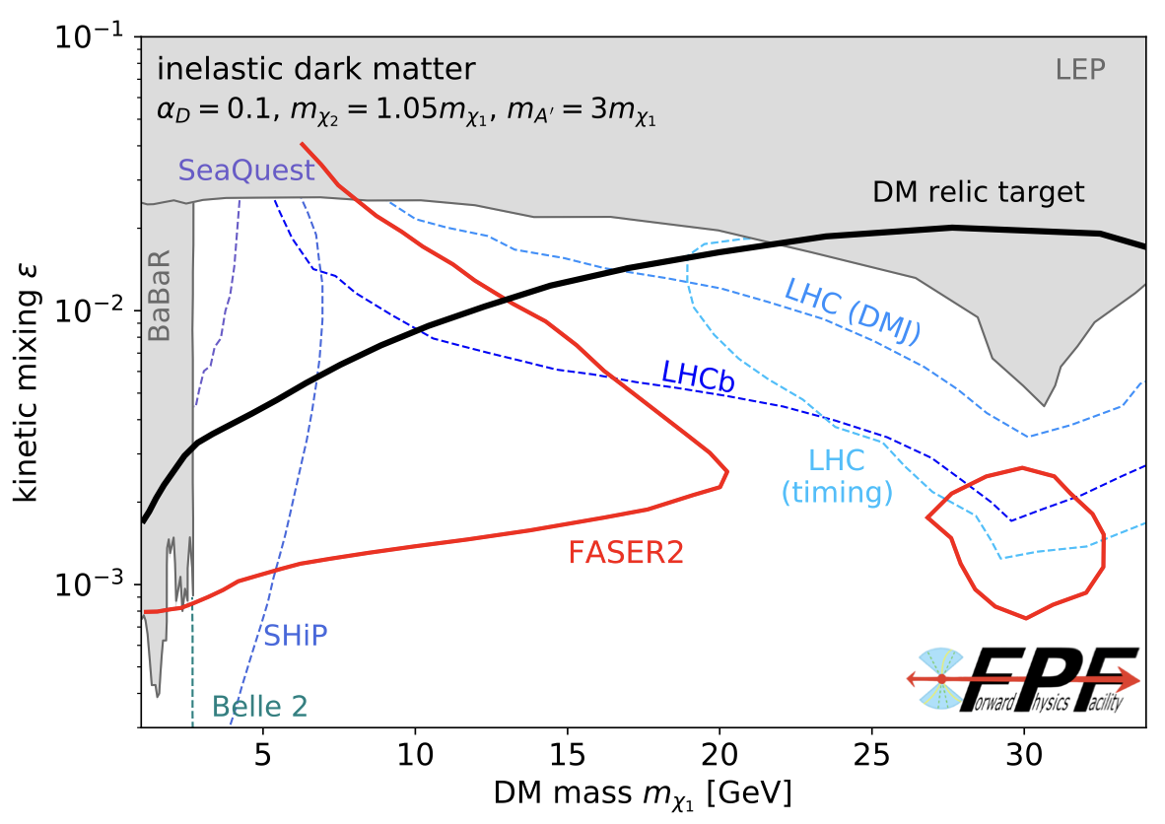
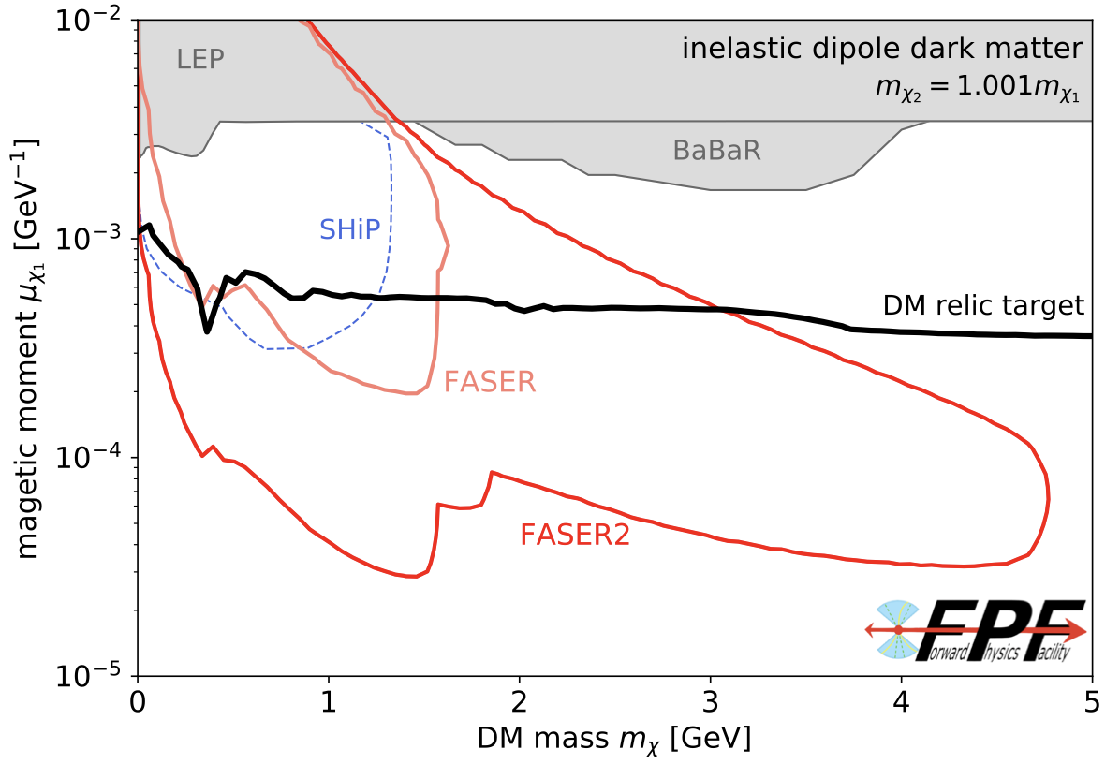
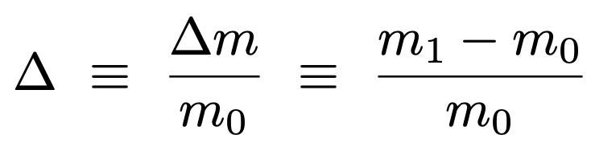
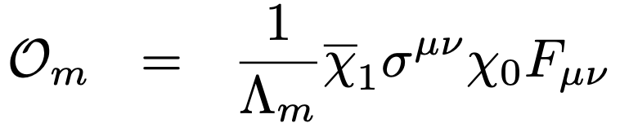



COMPRESSED SPECTRA / INELASTIC DARK MATTER
Very generically: LLPs can result from
  small couplings (many studies)
  compressed spectra (few studies)
Prominent example of the 2nd possibility: inelastic dark matter, where there are two nearly-degenerate dark states with off-diagonal couplings to the SM.
Viable scenarios with m ~ tens of GeV. Only probed at LHC (FASER, MATHUSLA,…).
Viable scenarios with very soft decay products, which can be seen only if highly boosted. E.g., require E_{γ} > 300 MeV.
$$m_{1}$$
$$χ_{1} →χ_{0}γ$$
$$m_{0}$$
0

Slide 11

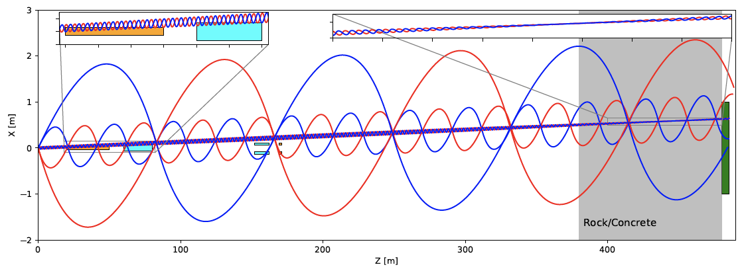
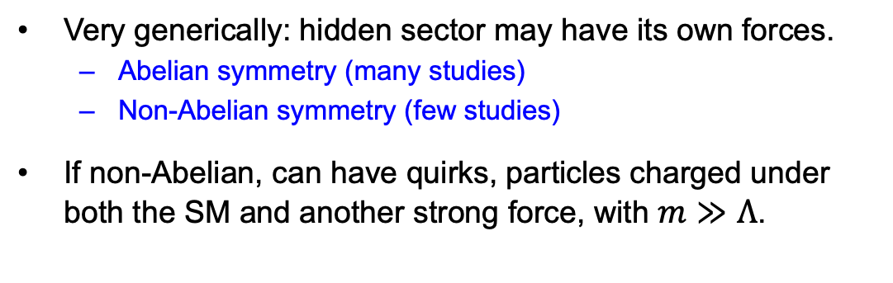
QUIRKS
Very generically: hidden sector may have its own forces.
  Abelian symmetry (many studies)
  Non-Abelian symmetry (few studies)
If non-Abelian, can have quirks, particles charged under both the SM and another strong force, with $m≫Λ$.
Quirks can be pair-produced at the LHC, but then are bound by a color string, oscillate about their center-of-mass and travel down the beamline.
By looking for 2 coincident slow or delayed tracks, FPF experiments can discover quirks with masses up to ~TeV, as motivated by neutral naturalness.
Unique discovery potential at the FPF: very challenging at ATLAS/CMS, not possible at fixed target experiments.

Slide 12
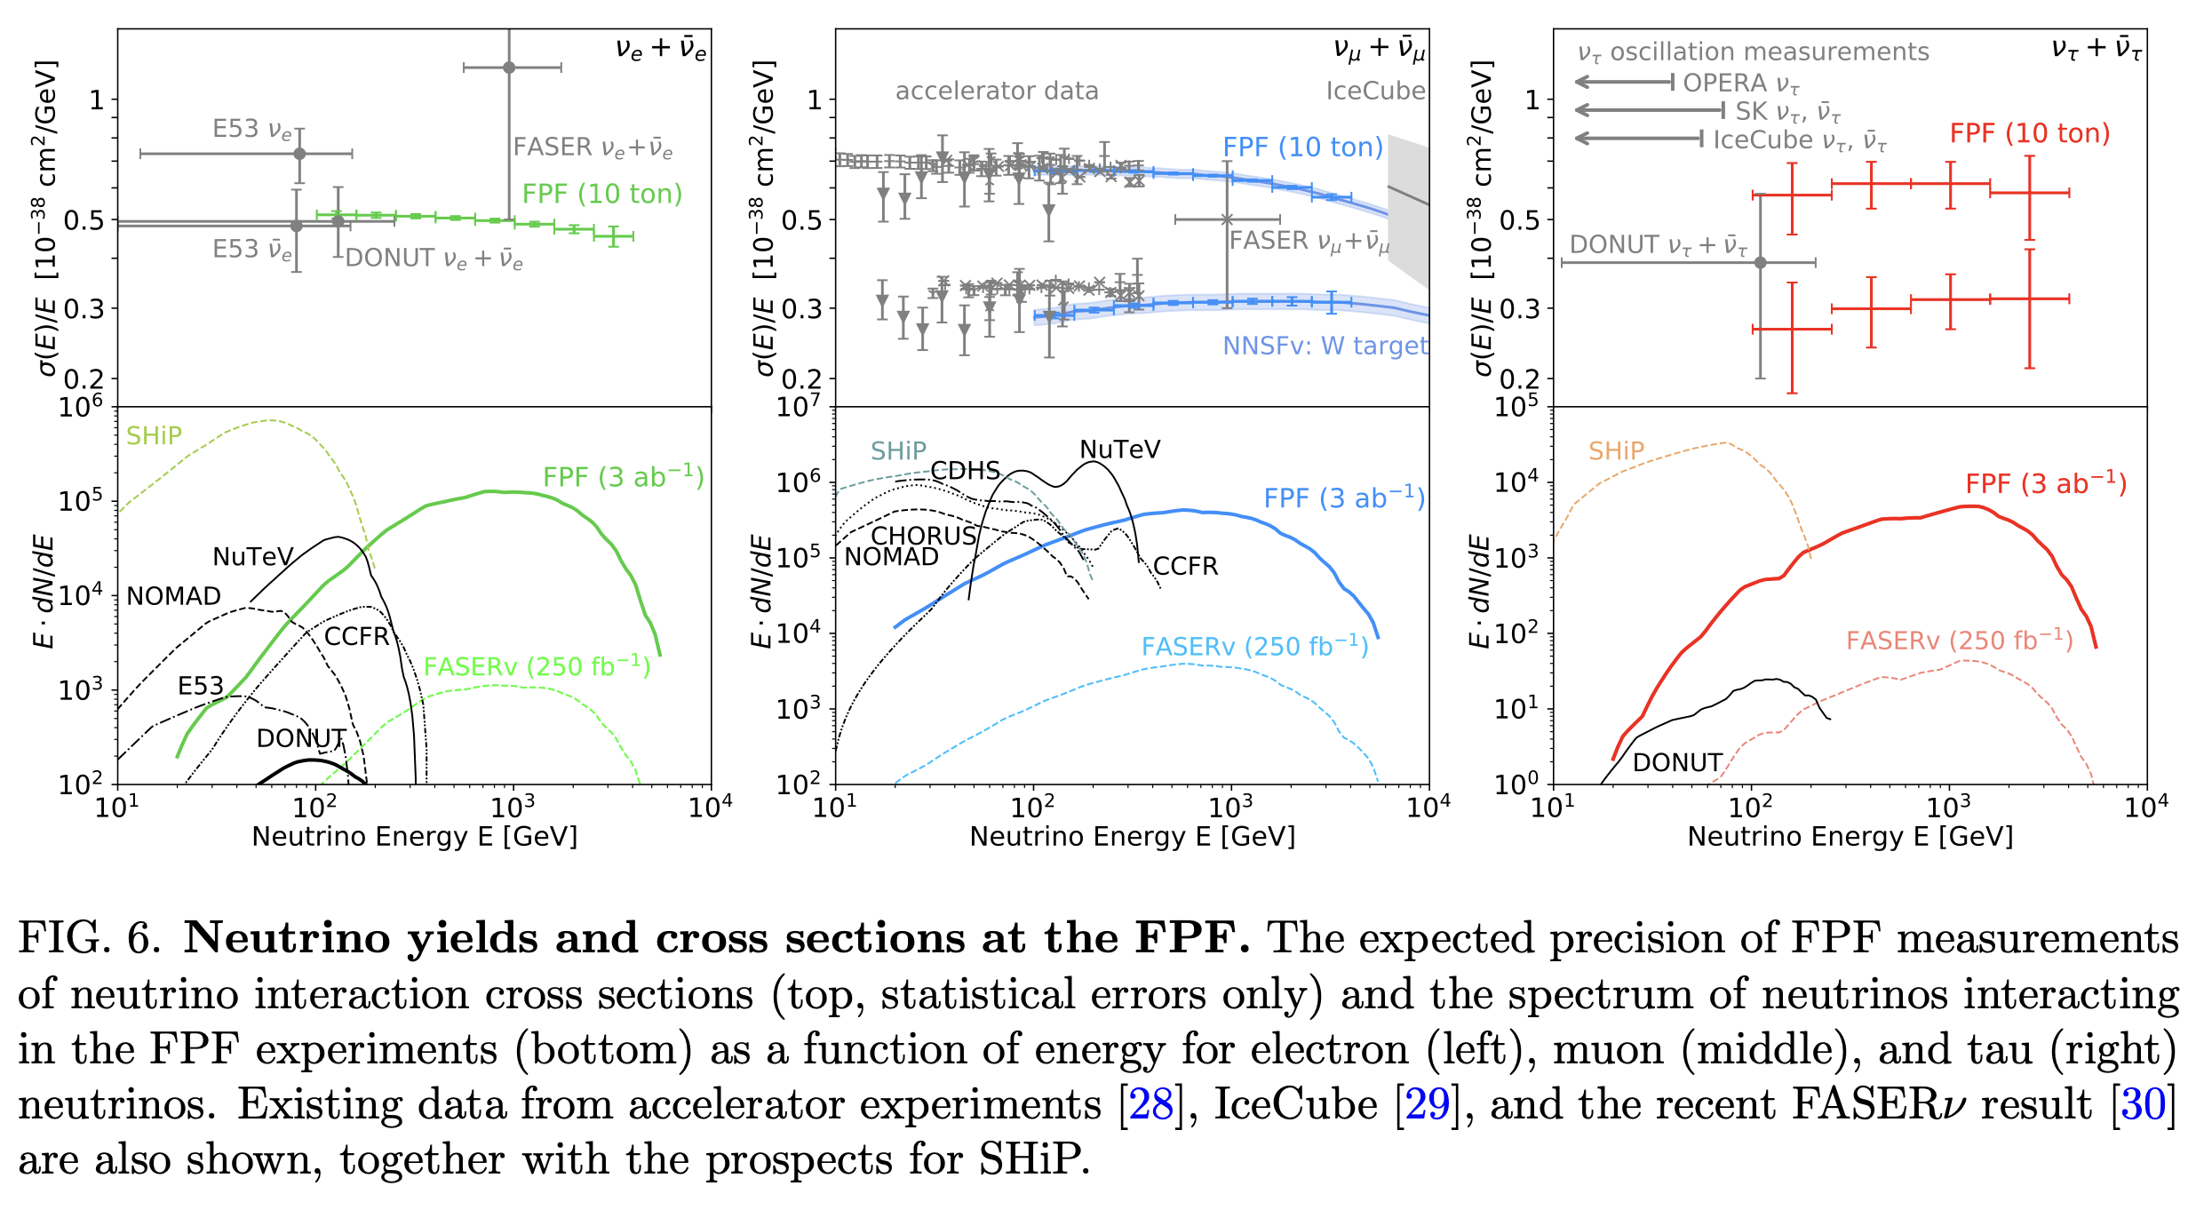
NEUTRINO STUDIES
FPF will constrain neutrino properties at TeV energies, where there is currently little or no data.

Slide 13
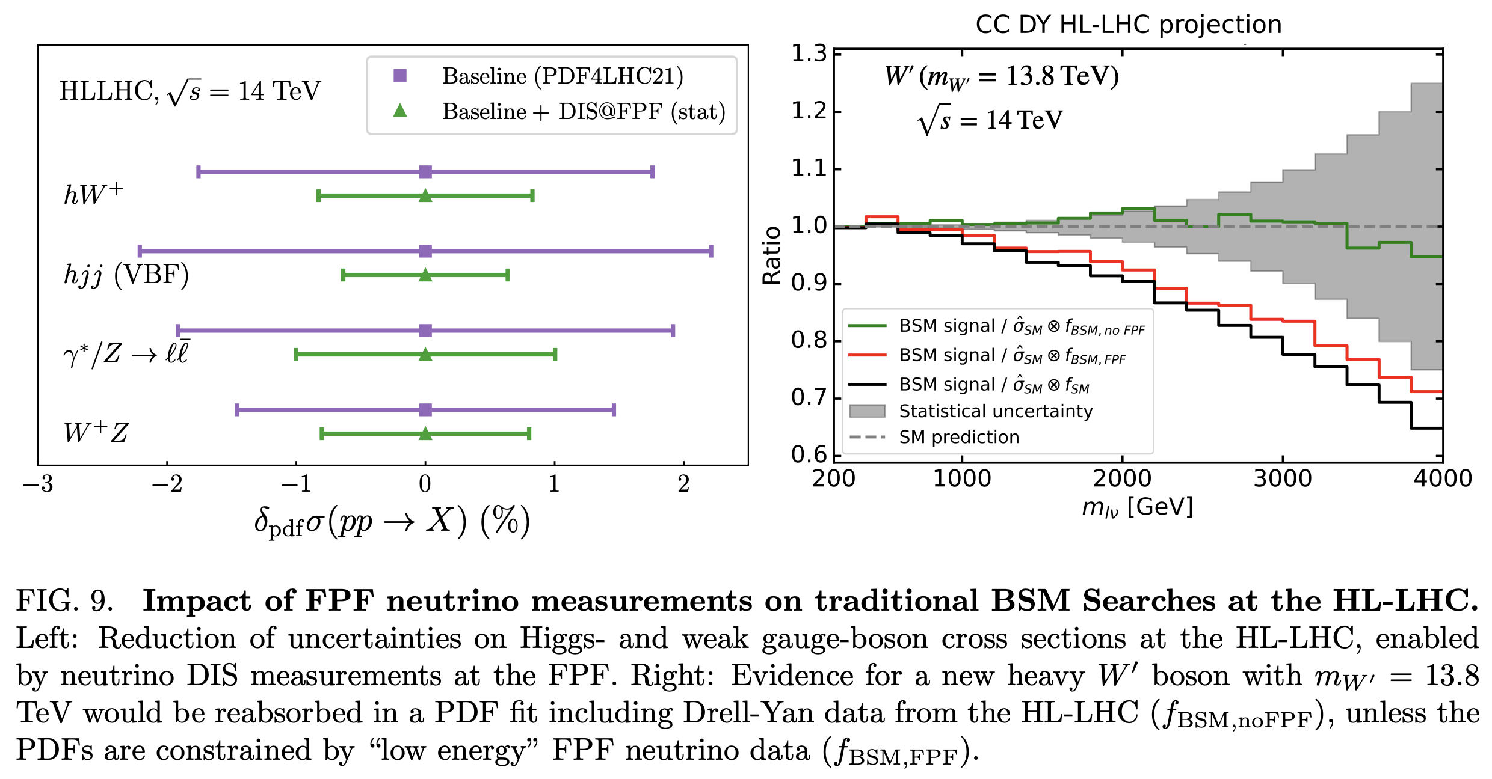
COMPLEMENTARITY WITH HIGH P_{T} PHYSICS
FPF neutrino studies will constrain pdfs, which will sharpen predictions for ATLAS and CMS.
For example, W, Z, and Higgs boson cross sections.
Will also remove degeneracies between pdfs and new physics (“fitting away new physics”), enhancing the reach for new particle searches.

Slide 14
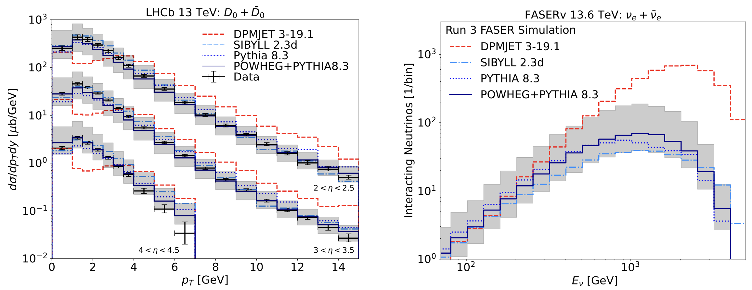
SUGGESTIONS FOR BSM/FPC COORDINATED ACTIVITIES
Adopt new PBC benchmarks. Simple models that illustrate something generic, but is not represented by existing benchmarks
  Compressed spectra: LLPs from reduced phase space.
  Quirks: Non-Abelian forces in the hidden sector.
Adopt a uniform neutrino flux model to compare prospects across different experiments. FASER has presented a prescription in 2402.13318, which can be an input to this effort.

