Slide 1



FASER AND THE FPF
NEW EYES FOR THE LHC
Brookhaven Physics Colloquium
Jonathan Feng, UC Irvine, 15 October 2024

Slide 2
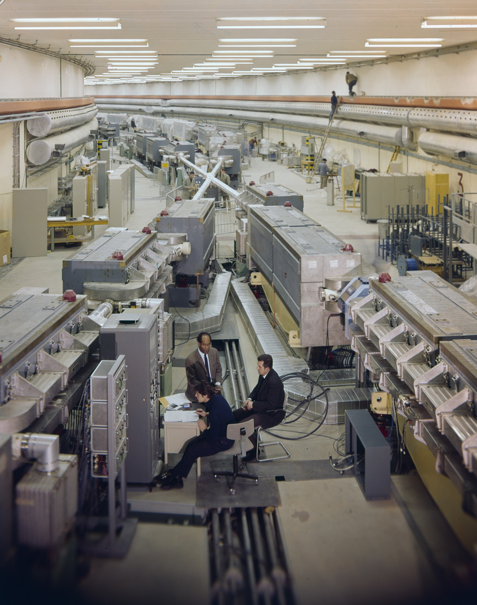
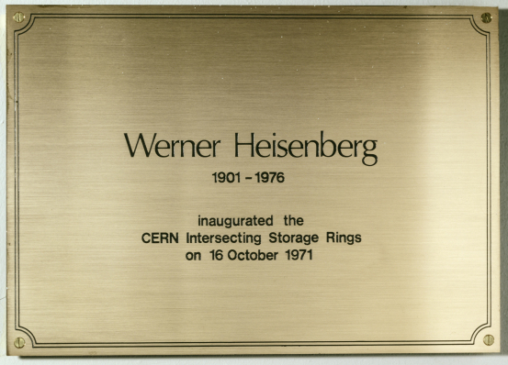
LESSONS FROM CHARM
The charm quark was discovered here 50 years ago. What can we learn from that remarkable discovery?
3 years before, in 1971, the first hadron collider, CERN’s Intersecting Storage Rings (ISR), began operation.
It had a circumference of ~1 km, collided protons with protons at center-of-mass energy 30 GeV.
During ISR’s 50th anniversary, there were many fascinating articles and talks by eminent physicists.

Slide 3

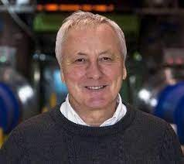
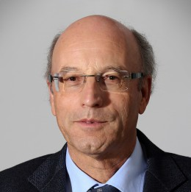
ISR’S LEGACY
“Enormous impact on accelerator physics, but sadly little effect on particle physics.” – Steve Myers, talk at “The 50th Anniversary of Hadron Colliders at CERN,” October 2021.
“There was initially a broad belief that physics action would be in the forward directions at a hadron collider…. It is easy to say after the fact, still with regrets, that with an earlier availability of more complete… experiments at the ISR, CERN would not have been left as a spectator during the famous November revolution of 1974 with the J/ψ discoveries at Brookhaven and SLAC .” – Lyn Evans and Peter Jenni, “Discovery Machines,” CERN Courier (2021).
Bottom line: The collider was creating charm quarks, but, based on theoretical prejudice, experimentalists focused on the forward region and so missed them.
Could we be making the same mistake now?
If so, can we fix it?
Could there be another November Revolution waiting for us at the LHC?

Slide 4
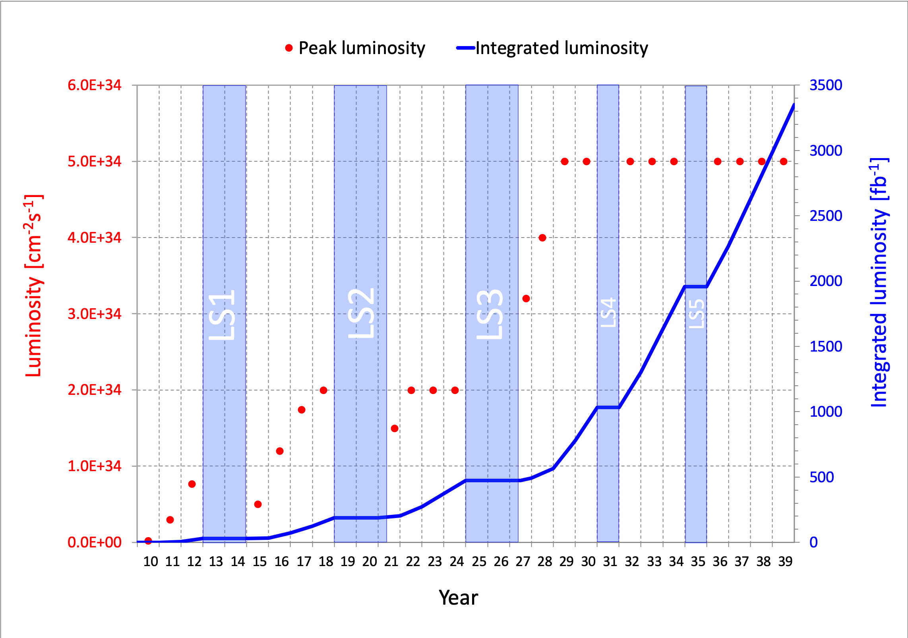
LIFETIME OF THE LHC
Since their invention 70 years ago, particle colliders have been a steady source of discoveries, and the LHC is the latest example.
The LHC started running in 2010. It is scheduled to run until the 2040s, but still has a long way to go
  Middle-aged in terms of years
  But a 4th grader in terms of integrated luminosity
Are we using the LHC to its full potential? If not, what can we do to enhance its discovery prospects?
COVID

Slide 5
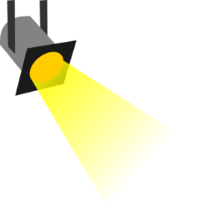
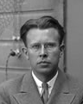
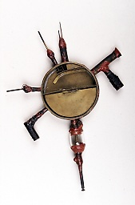
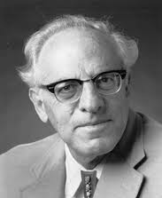





















THE PARTICLE LANDSCAPE
Particle
Expts
Mass
MeV
GeV
TeV
1
$$←$$
$$g$$
$$u$$
$$d$$
$$s$$
$$p$$
$$n$$
$$c$$
$$b$$
$$t$$
$$←$$
$$γ$$
$$e$$
$$μ$$
$$τ$$
$$W$$
$$Z$$
$$h$$
Already
Discovered
Strongly Interacting
Heavy Particles
Interaction Strength
10⁻³
$$ν_{e}$$
$$ν_{μ}$$
$$ν_{τ}$$
$$←$$
Weakly Interacting
Light Particles
Impossible to
Discover
10⁻⁶

Slide 6
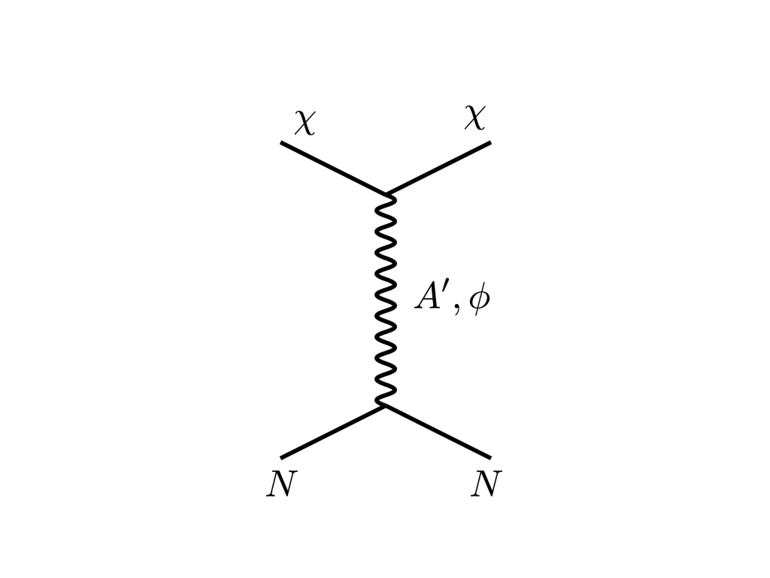



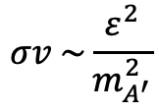


THE COSMOLOGICAL LANDSCAPE
Particle
Colliders
Mass
MeV
GeV
TeV
1
Already
Discovered
Strongly Interacting
Heavy Particles
Too Little to be
Dark Matter
DM
$$e$$
$$ε$$
$$ε$$
Interaction Strength
Just Right to
be Dark Matter
10⁻³
$$A′$$
$$e$$
DM
$$σv \sim \frac{ε^{2}}{m_{A^{′}}^{2}}$$
Weakly Interacting
Light Particles
Impossible to
Discover
10⁻⁶
Too Much to be
Dark Matter
Boehm, Fayet (2003)
Pospelov, Ritz, Voloshin (2007)
Feng, Kumar (2008)

Slide 7

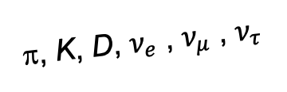
FORWARD PHYSICS
In 2017, we realized that the large LHC detectors, while beautifully optimized to discover new heavy particles, are also almost optimally configured not to find new light particles.
Heavy particles (W, Z, t, h, …) are produced at low velocity and decay roughly isotropically to other particles.
But high-energy light particles are dominantly produced in the forward direction and escape through the blind spots of these large detectors.
  This is true for all known light particles: pions, kaons, D mesons, all neutrinos.
  It is also true for many proposed new particles, especially those motivated by neutrino mass and dark matter.
These blind spots are the Achilles heels of the large LHC detectors.
Feng, Galon, Kling, Trojanowski (2017)
A’, a, mCPs, χ, …
π, K, D, $ν_{e}$ , $ν_{μ}$ , $ν_{τ}$
De Rujula, Ruckl (1984)

Slide 8
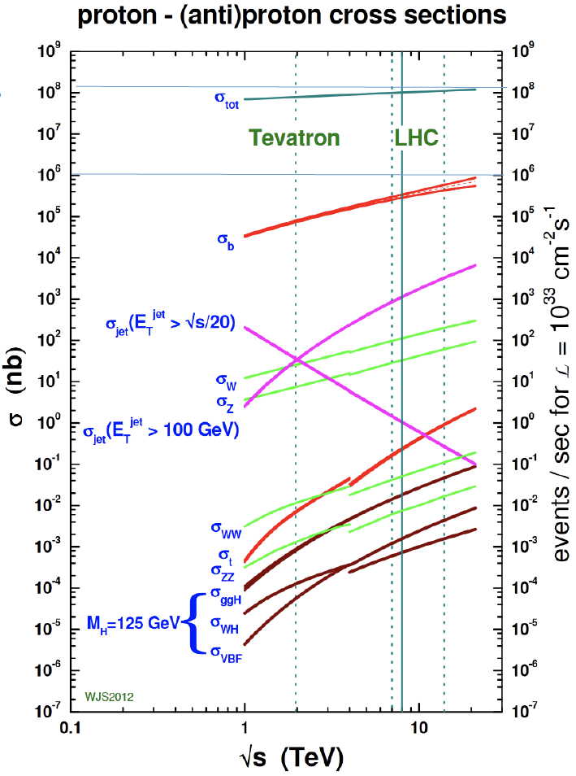
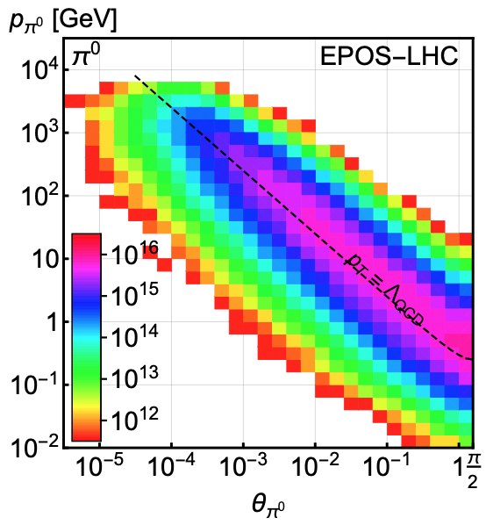
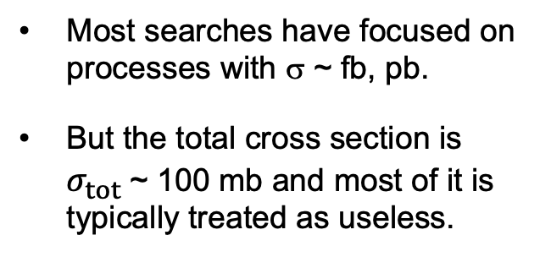
LIGHT PARTICLES AT THE LHC
300 fb⁻¹
Feng, Galon, Kling, Trojanowski (2017)
Most searches have focused on processes with σ ~ fb, pb.
But the total cross section is $σ_{tot}$~ 100 mb and most of it is typically treated as useless.
What do these events look like? Consider pions (decays to ν, BSM).
Enormous event rates. Typical p_{T} ~ 250 MeV, but many with p ~ TeV within 1 mrad (η > 7.6) of the beamline.

Slide 9
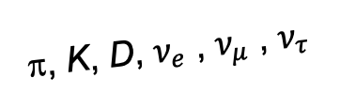
DETECTING FORWARD PARTICLES
To capture the enormous forward flux, we need to detect particles that are produced in the forward direction along the beamline.
Problem: we can’t just put the detector there: they will block the protons from coming in.
Solution: the LHC is a circular collider! If we go far enough away, the LHC proton beam will curl away, while all the light, weakly-interacting particles we are looking for will go straight.
A’, a, mCPs, χ, …
π, K, D, $ν_{e}$ , $ν_{μ}$ , $ν_{τ}$

Slide 10
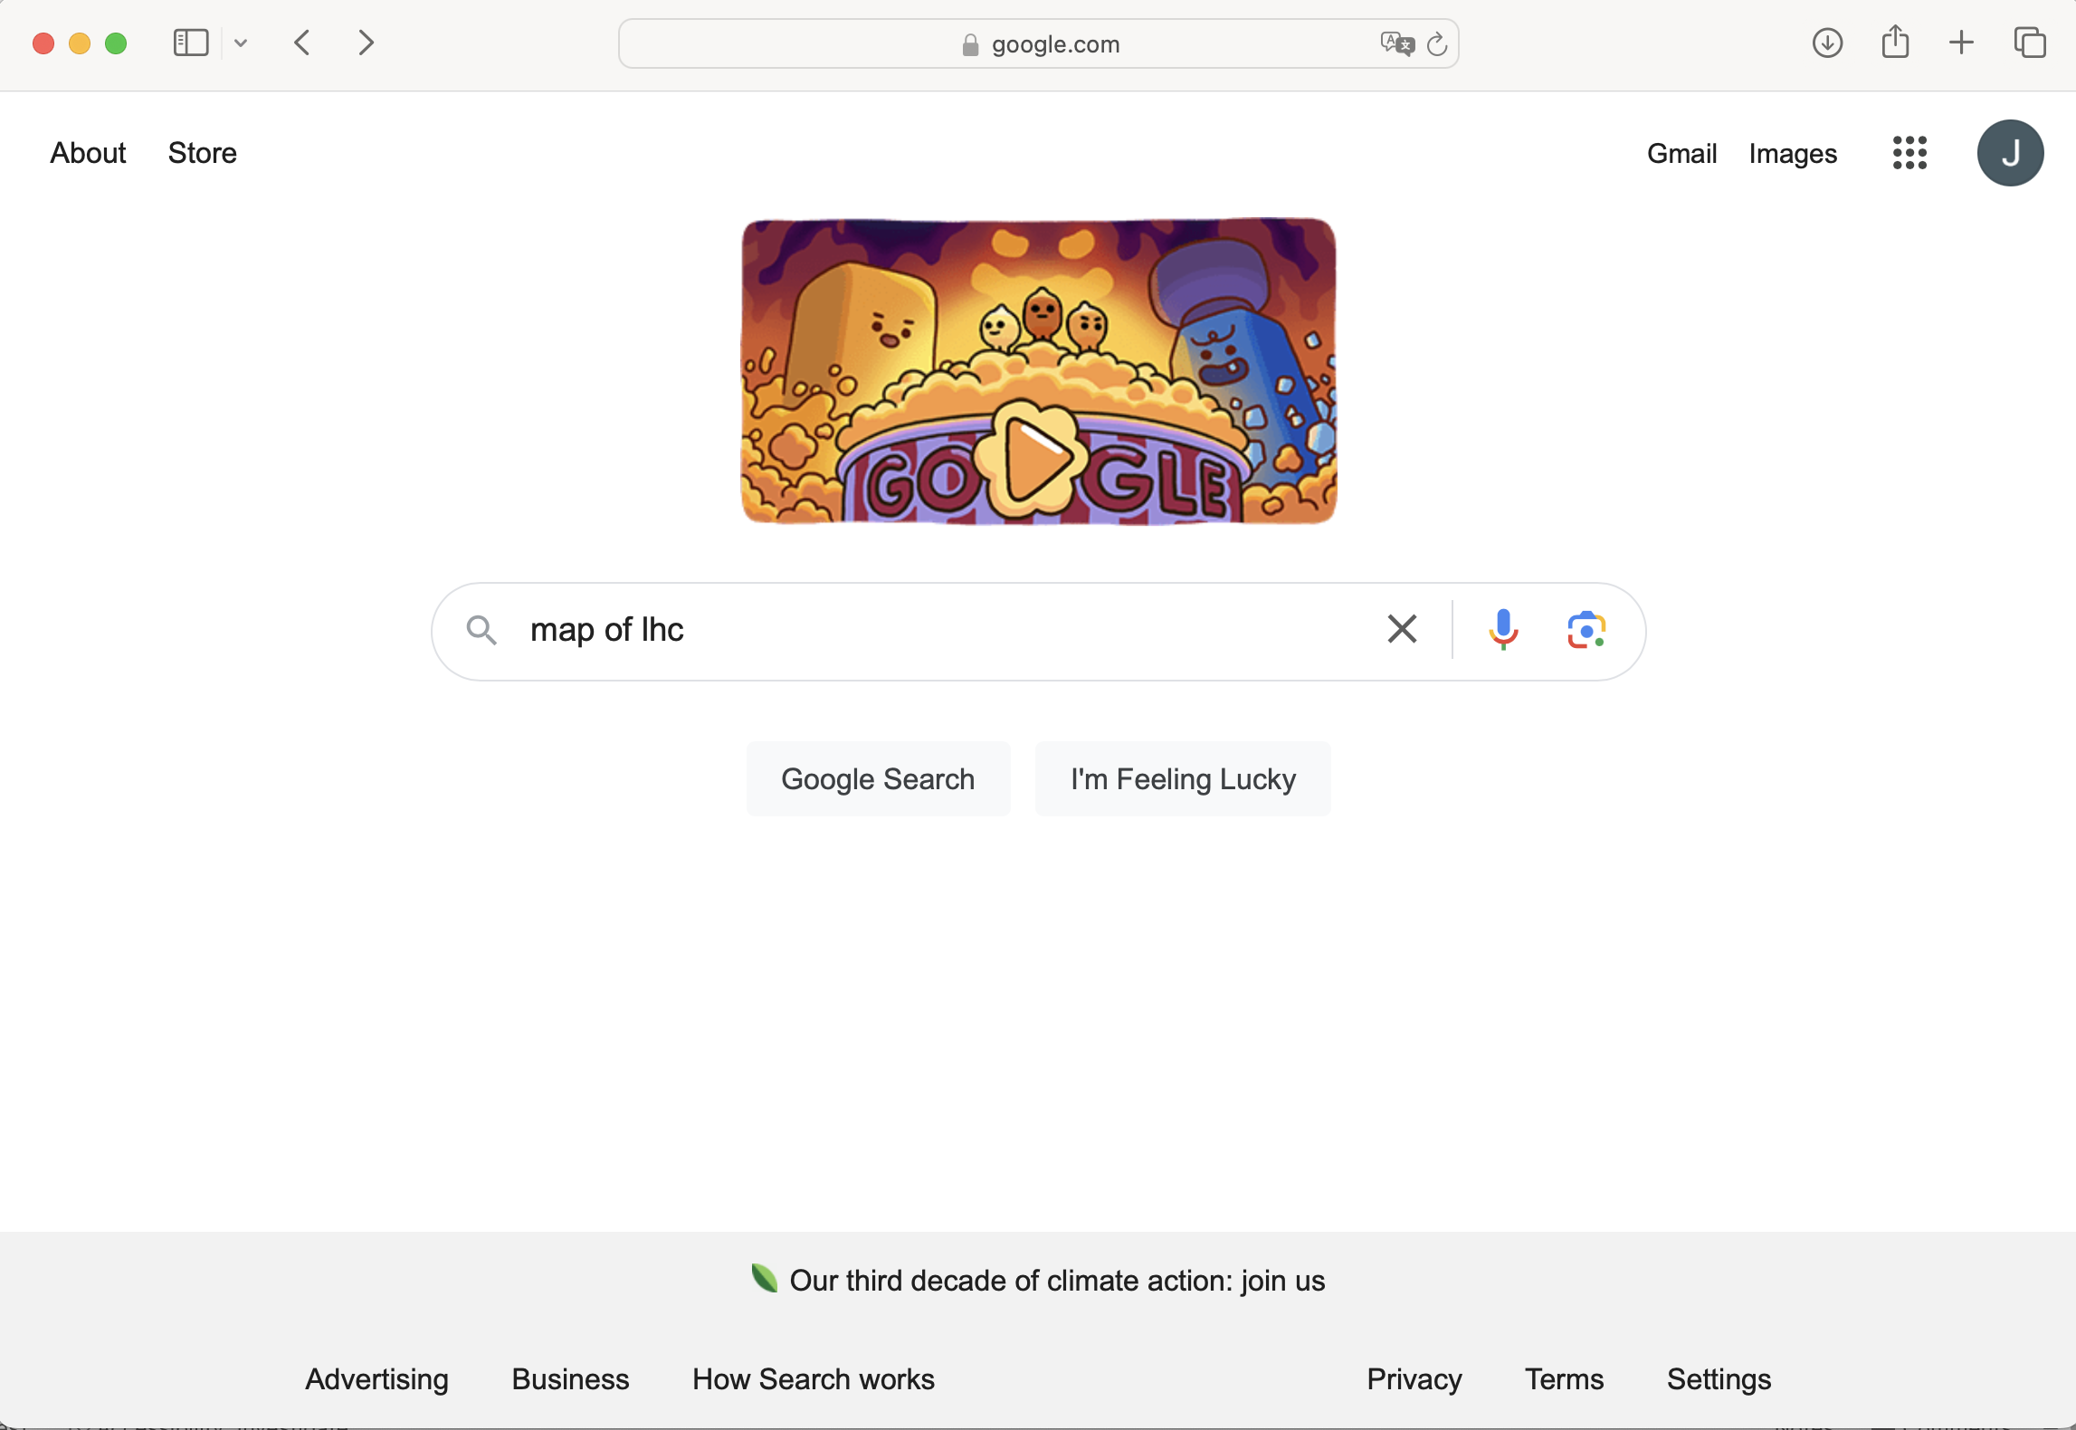
SOPHISTICATED RESEARCH

Slide 11
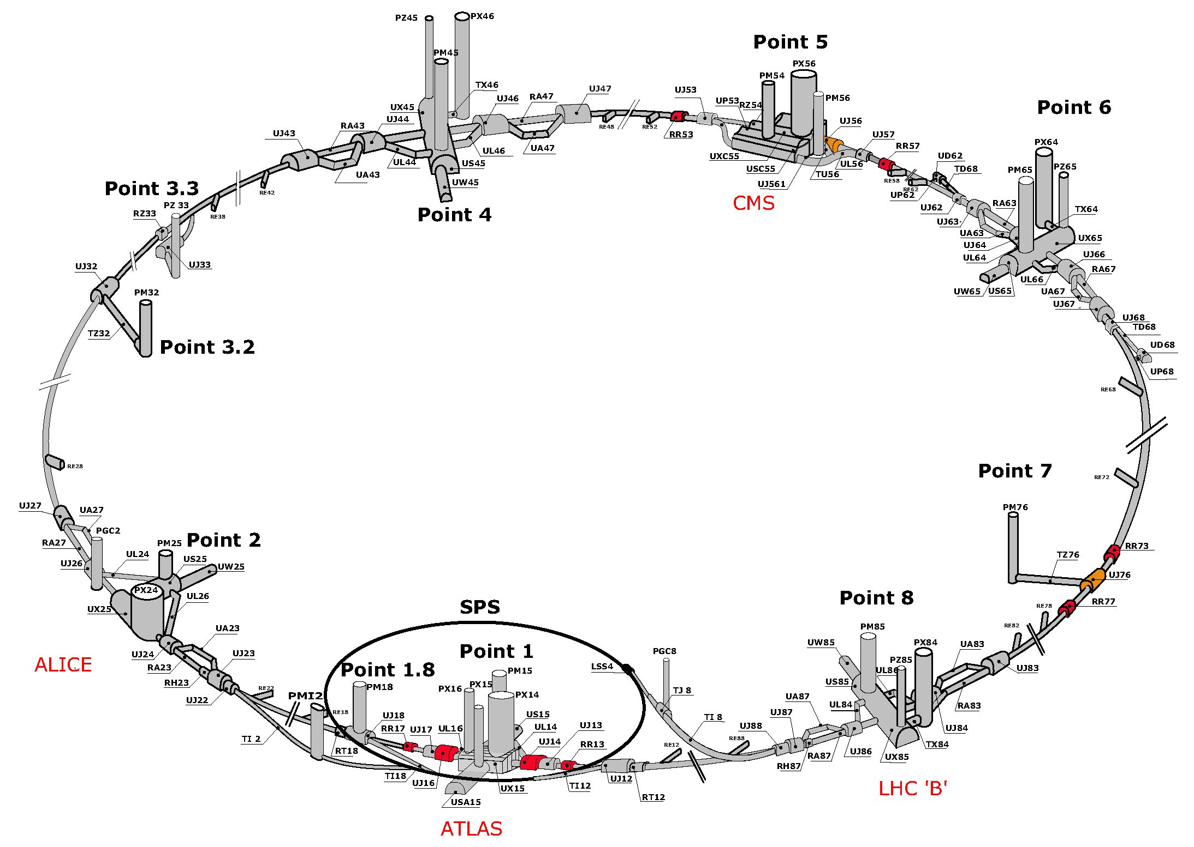
MAP OF LHC

Slide 12
MAP OF LHC
!!!

Slide 13
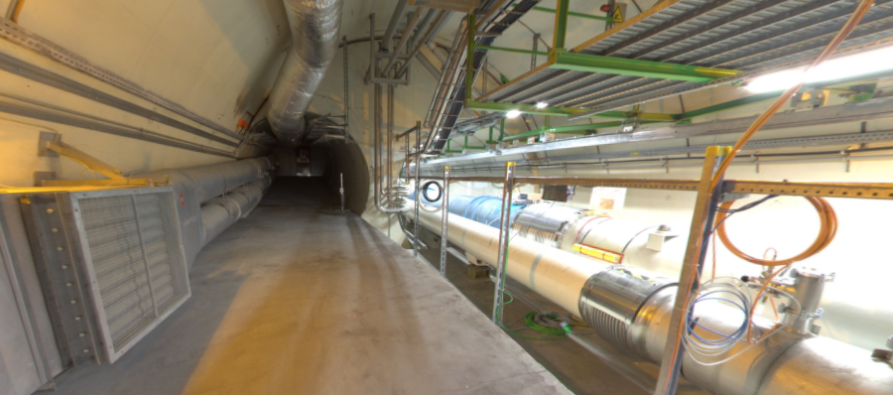
THE FORWARD REGION
Beam collision axis passes
through 100 m of rock, emerges in tunnel TI12, 480 m from ATLAS
UJ12
TI12 near UJ12
The view in UJ12 looking west in 2018
TI12
Beam collision axis:
dark matter, new particles could be streaming through this tunnel!
LHC beamline

Slide 14
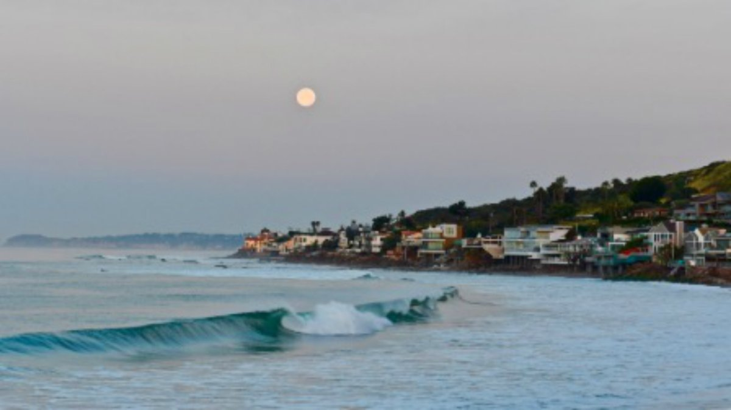
HOW BIG DOES THE DETECTOR HAVE TO BE?
Momentum:
Space:
250 MeV
1 TeV
12 cm
480 m
The opening angle is 0.2 mrad (the moon is 7 mrad). Even 480 m away, most of the signal passes through an 8.5” x 11” (A4) sheet of paper.
Neutrinos and many new particles are therefore much more collimated than shown below, motivating a relatively small, fast, and inexpensive experiment at the LHC: the ForwArd Search ExpeRiment (FASER).

Slide 15
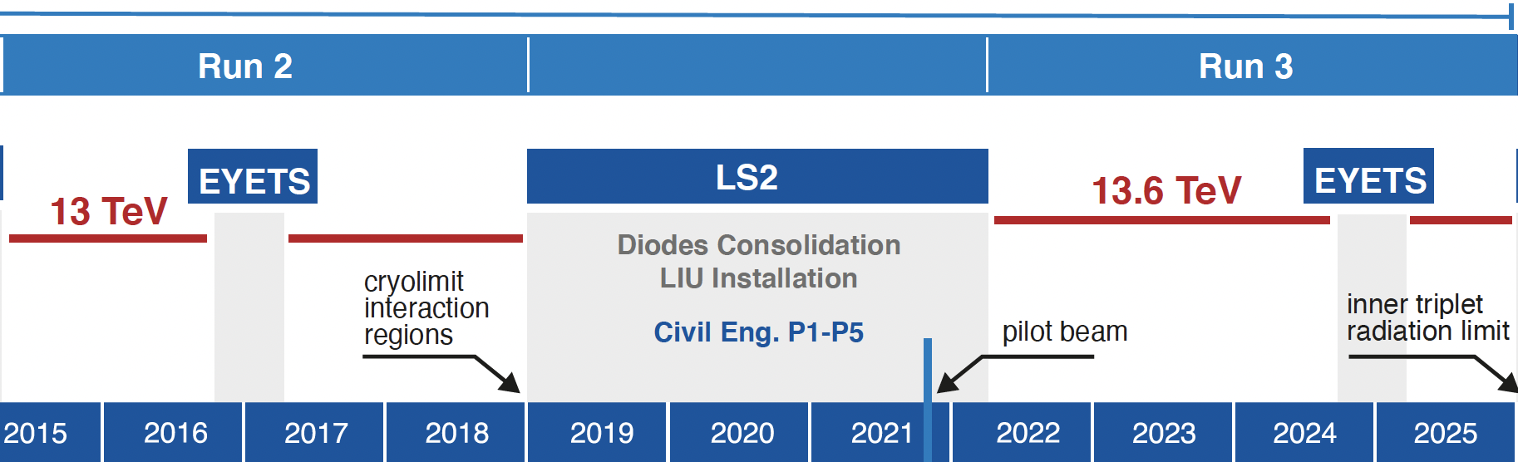
FASER AND FASERν TIMELINE
LOI submitted to CERN LHCC
FASER fully constructed and installed
FASERν fully constructed and installed
Technical Proposal submitted to CERN LHCC
FASER approved as 8th LHC detector by CERN
Concept paper: Feng, Galon, Kling, Trojanowski
FASERν approved as 9th LHC detector by CERN
FASER announces first physics results
FASER and FASERν begin collecting data in Run 3
Funding from Heising-Simons and Simons Foundations
FASER and FASERν announce more physics results
Spare detector parts from ATLAS and LHCb Collaborations

Slide 16

















FASER COLLABORATION
111 collaborators, 28 institutions, 11 countries
International laboratory covered by a cooperation agreement with CERN

Slide 17
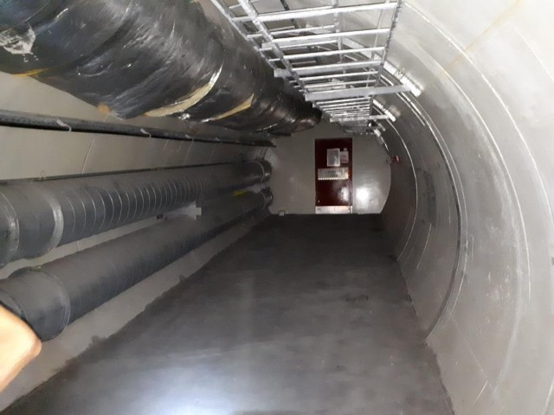
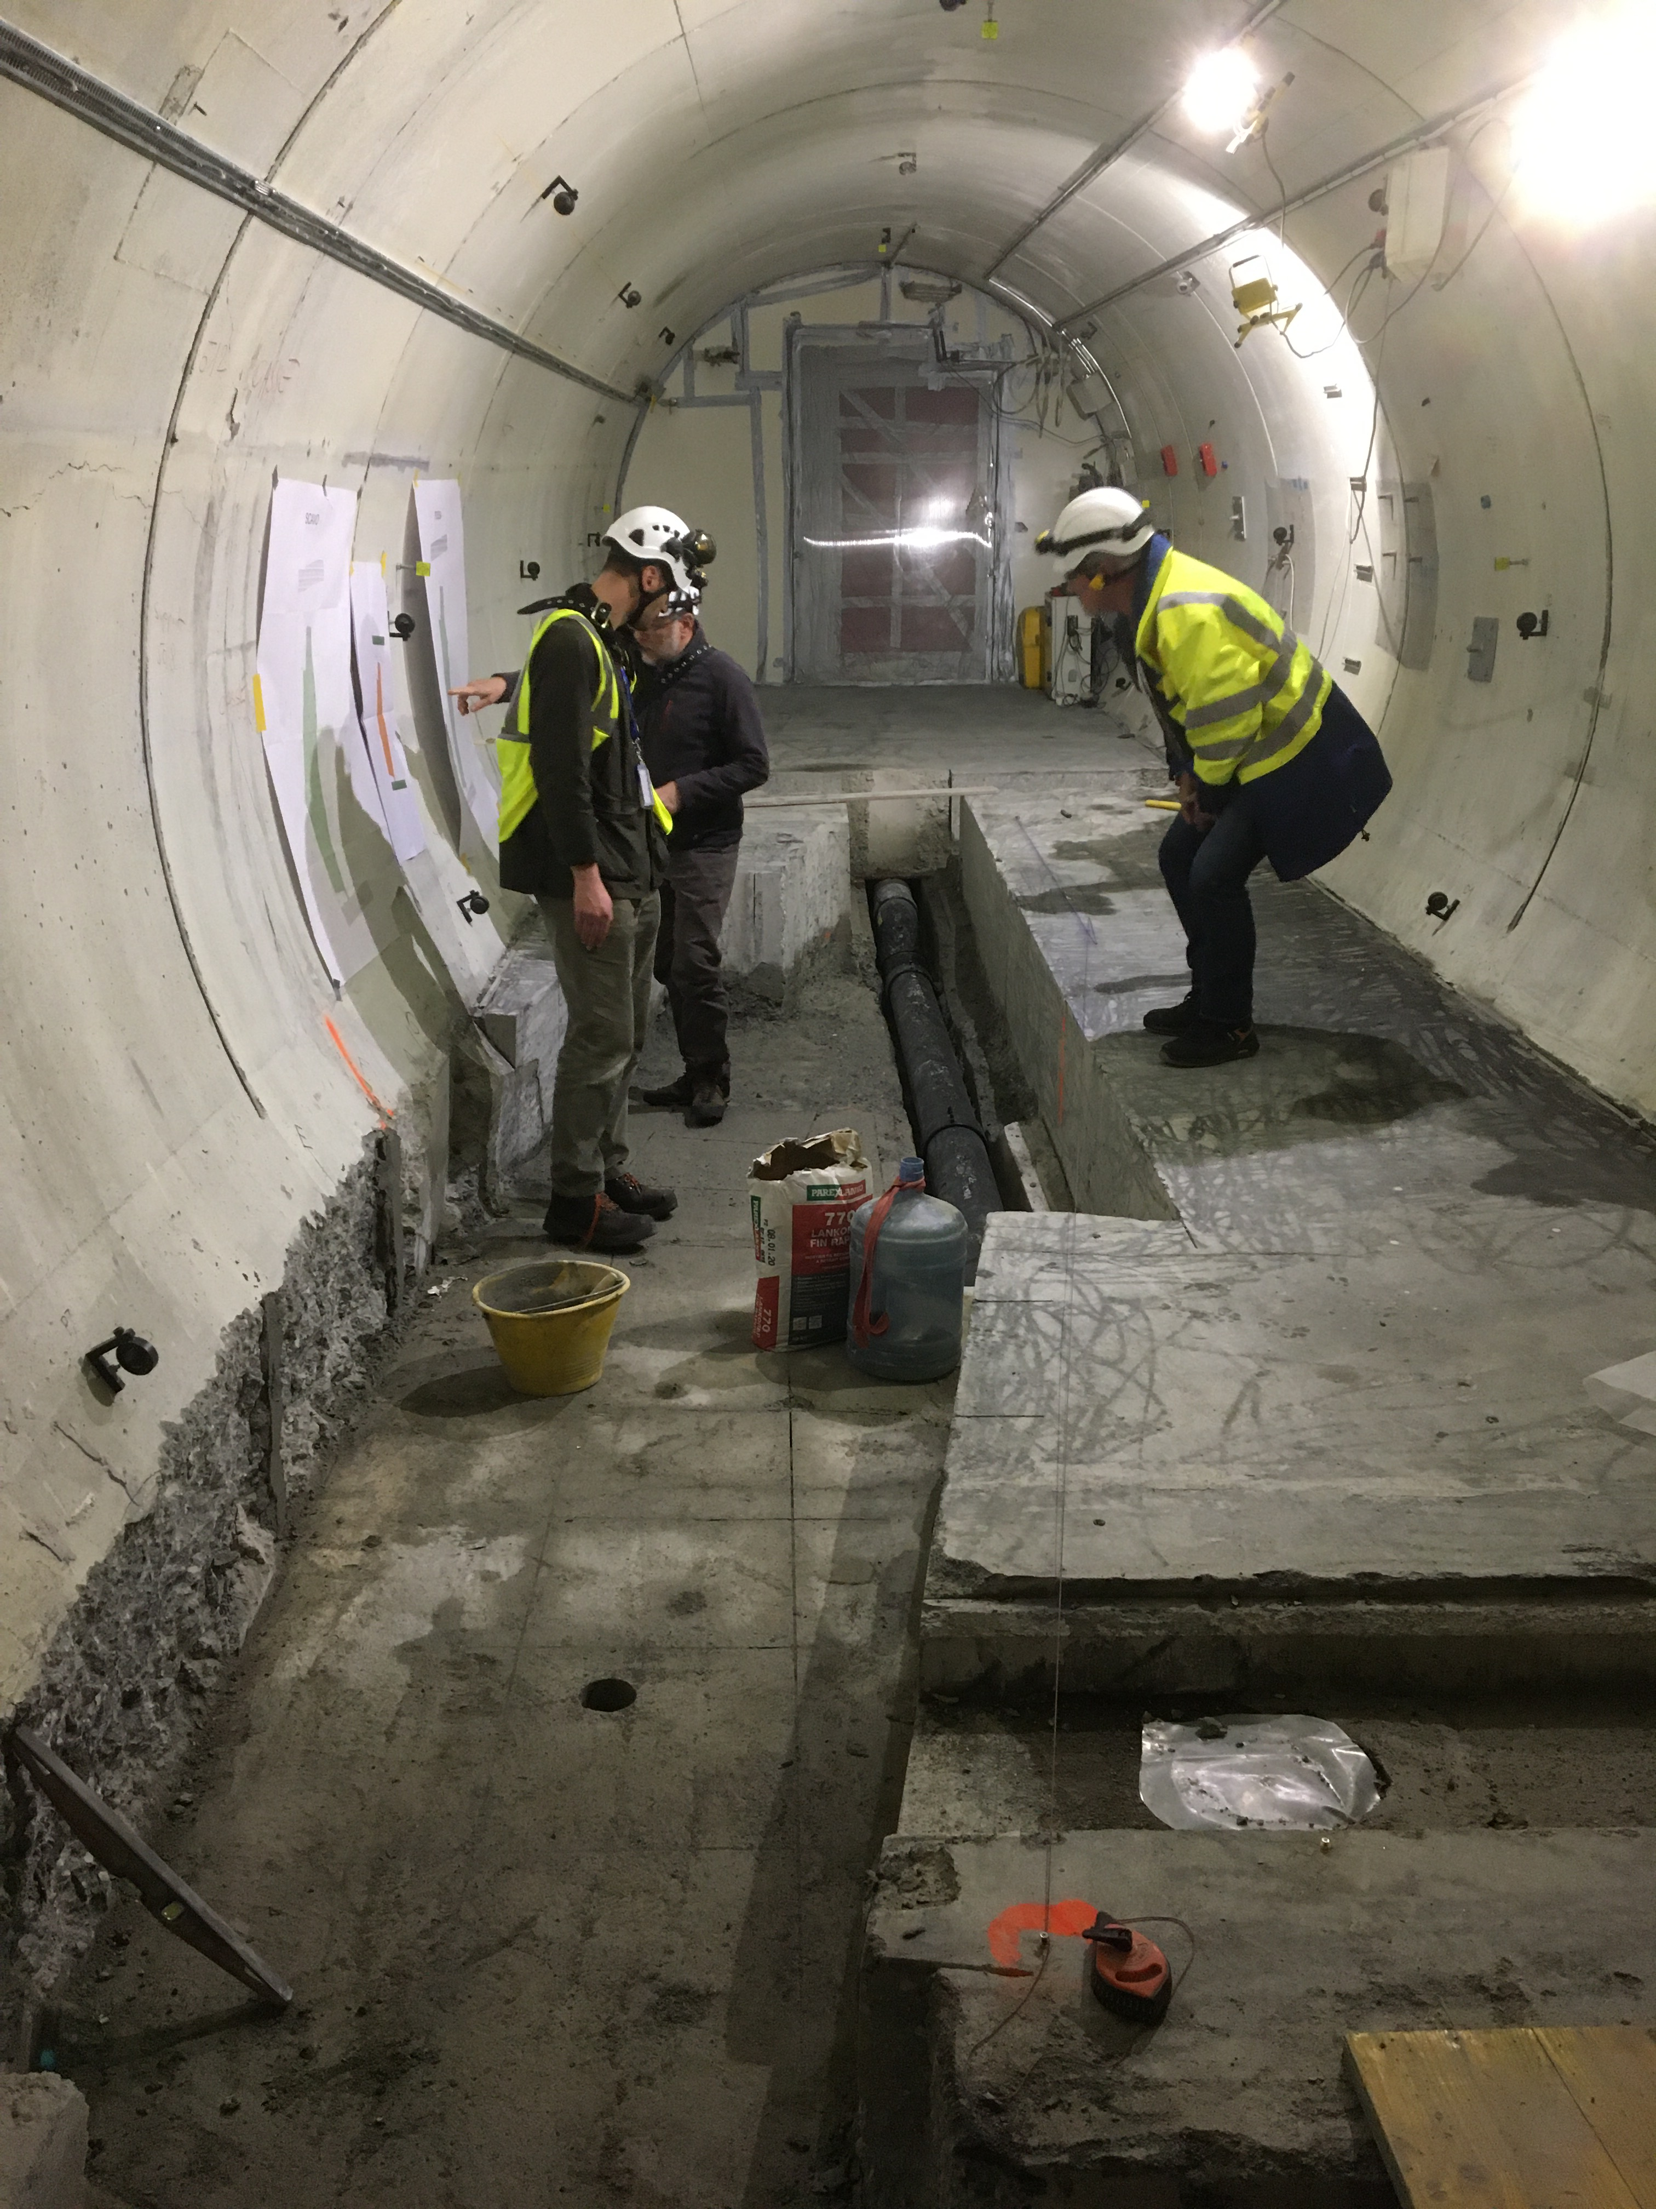
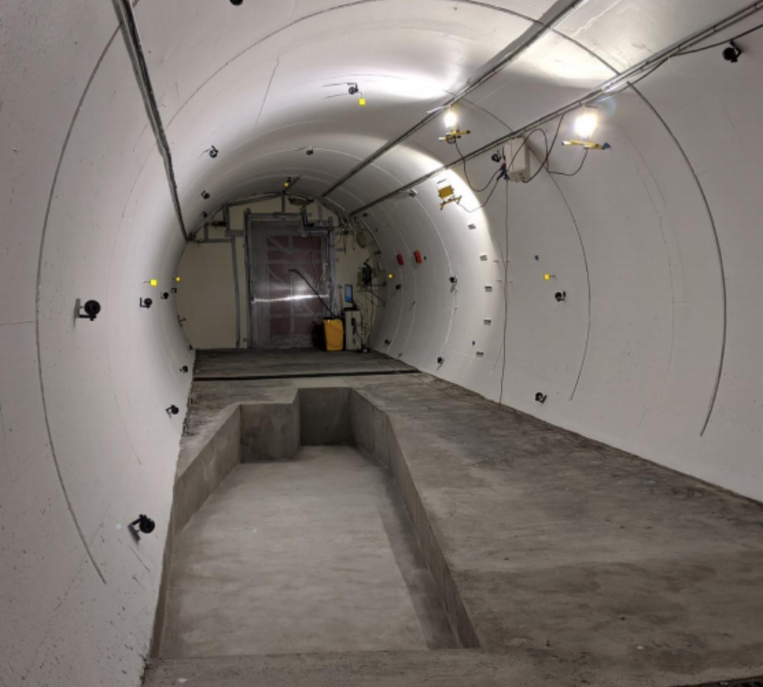
PREPARATION OF THE FASER LOCATION
The nominal beam collision axis was located to mm accuracy by the CERN survey department. (In fact, it goes moves around by several cm, depending on the beam crossing angle and orientation.) To place FASER on this axis, a trench was required to lower the floor by 46 cm.
The trench was completed by an Italian firm just hours before COVID shut down CERN in March 2020.
2019
Spring 2020
Summer 2020

Slide 18
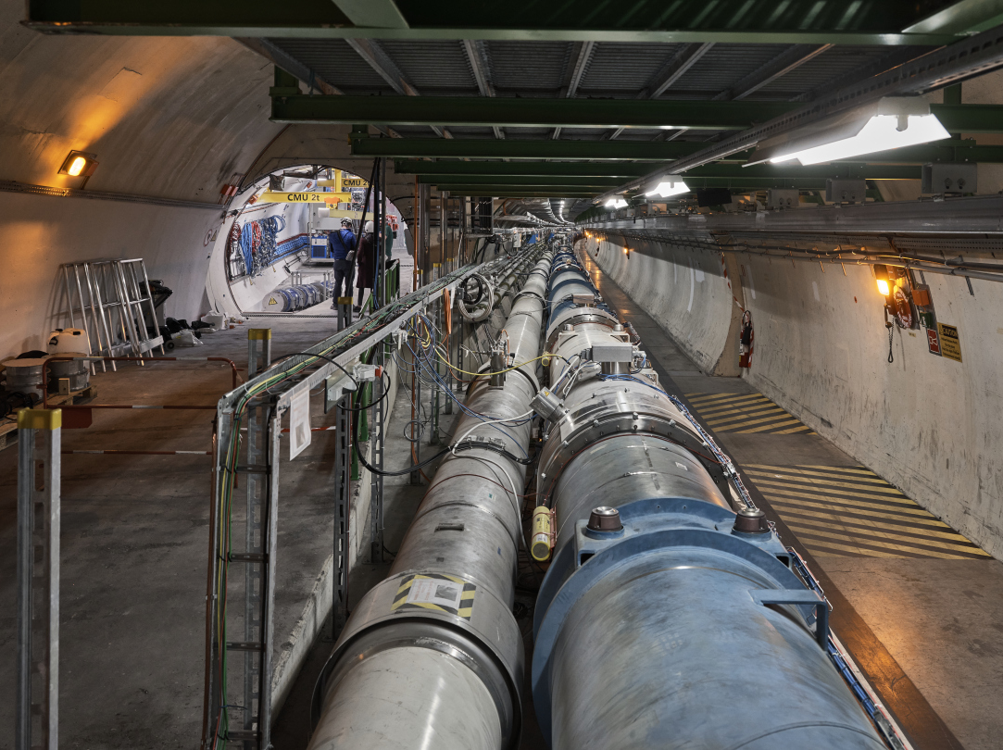
FASER AND THE LHC

Slide 19
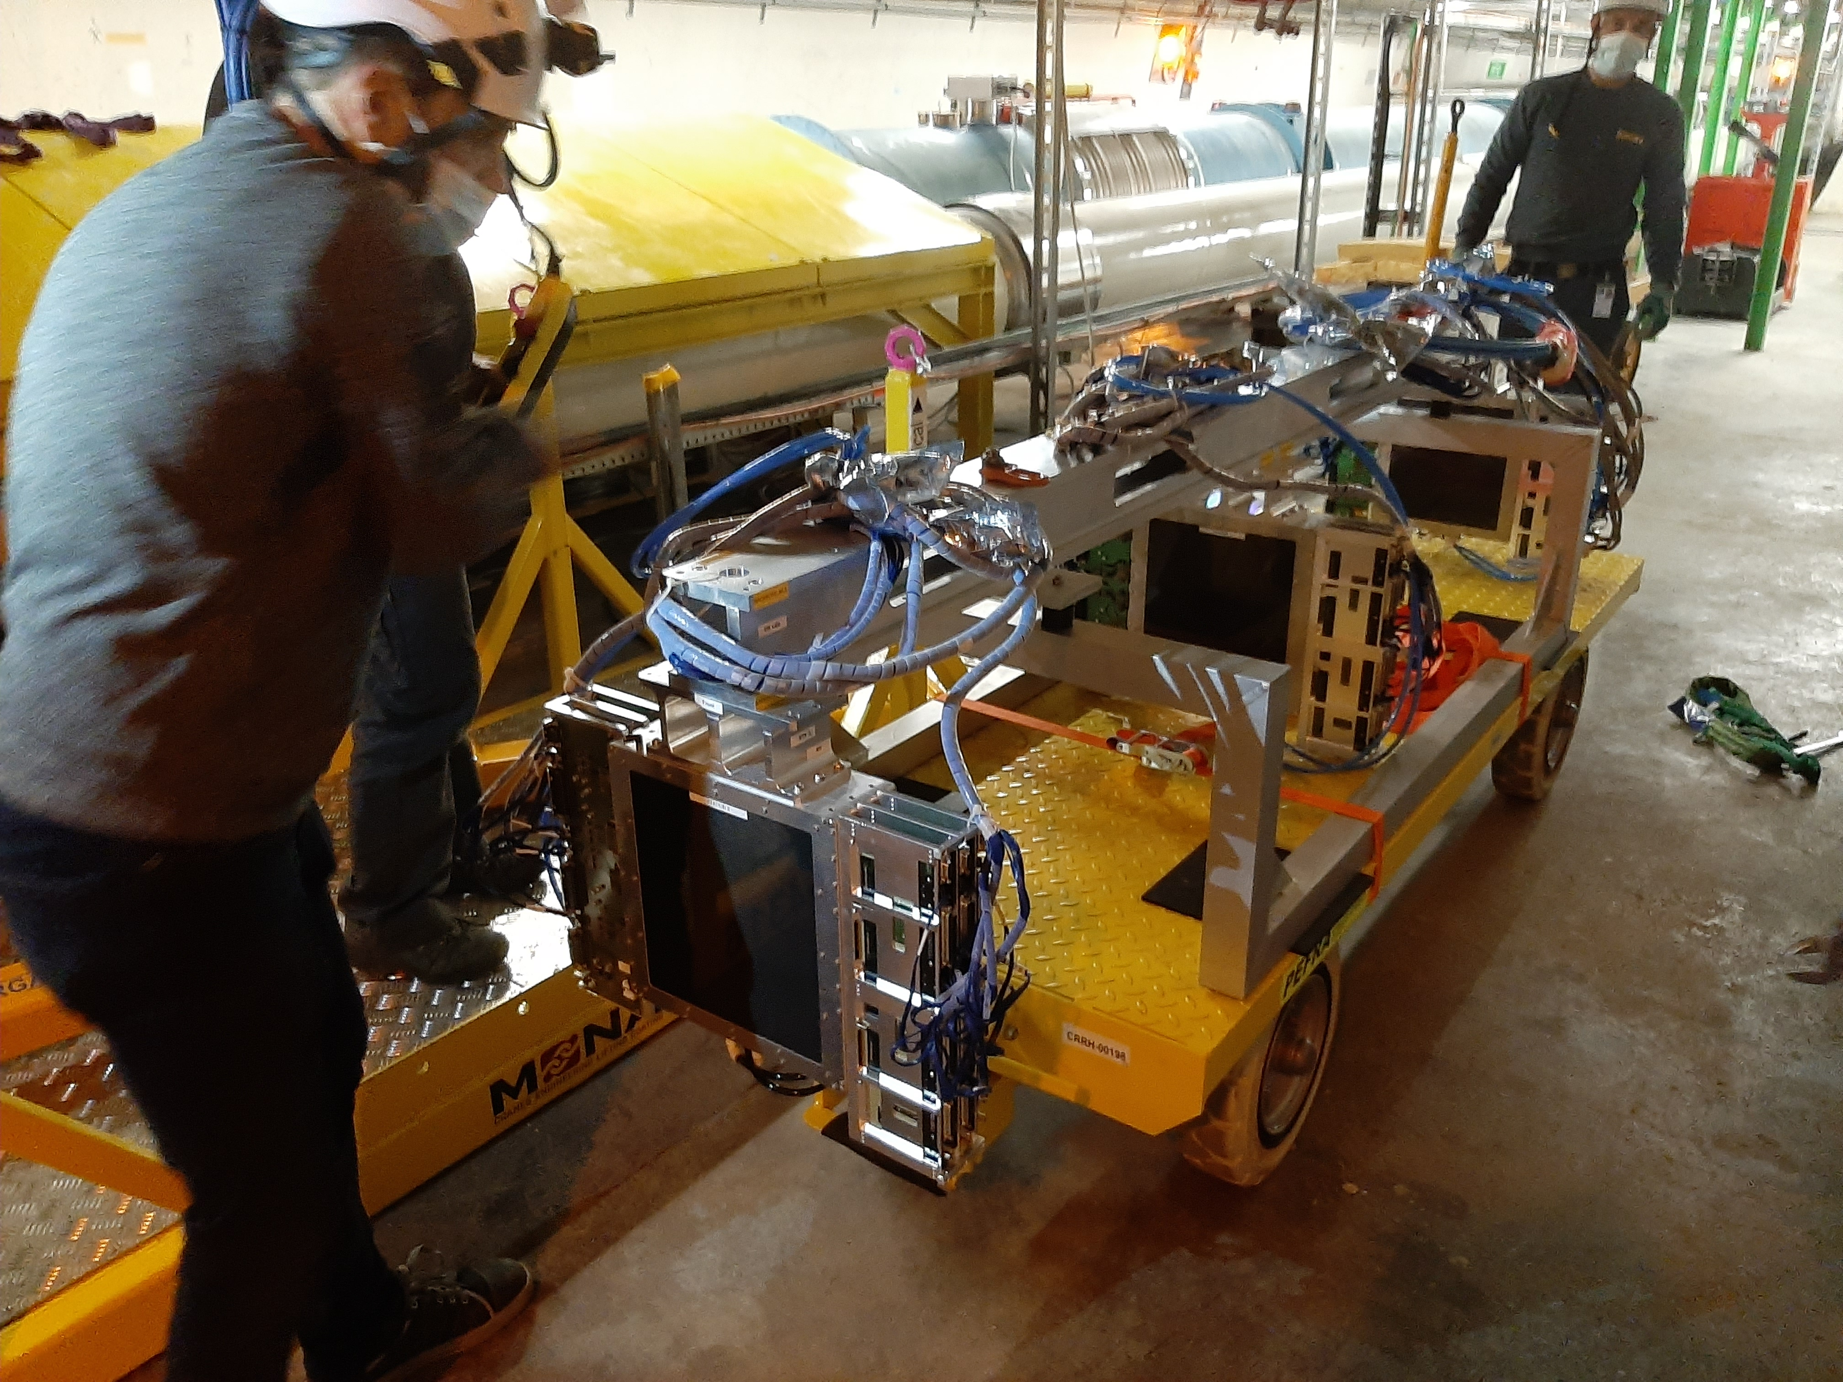
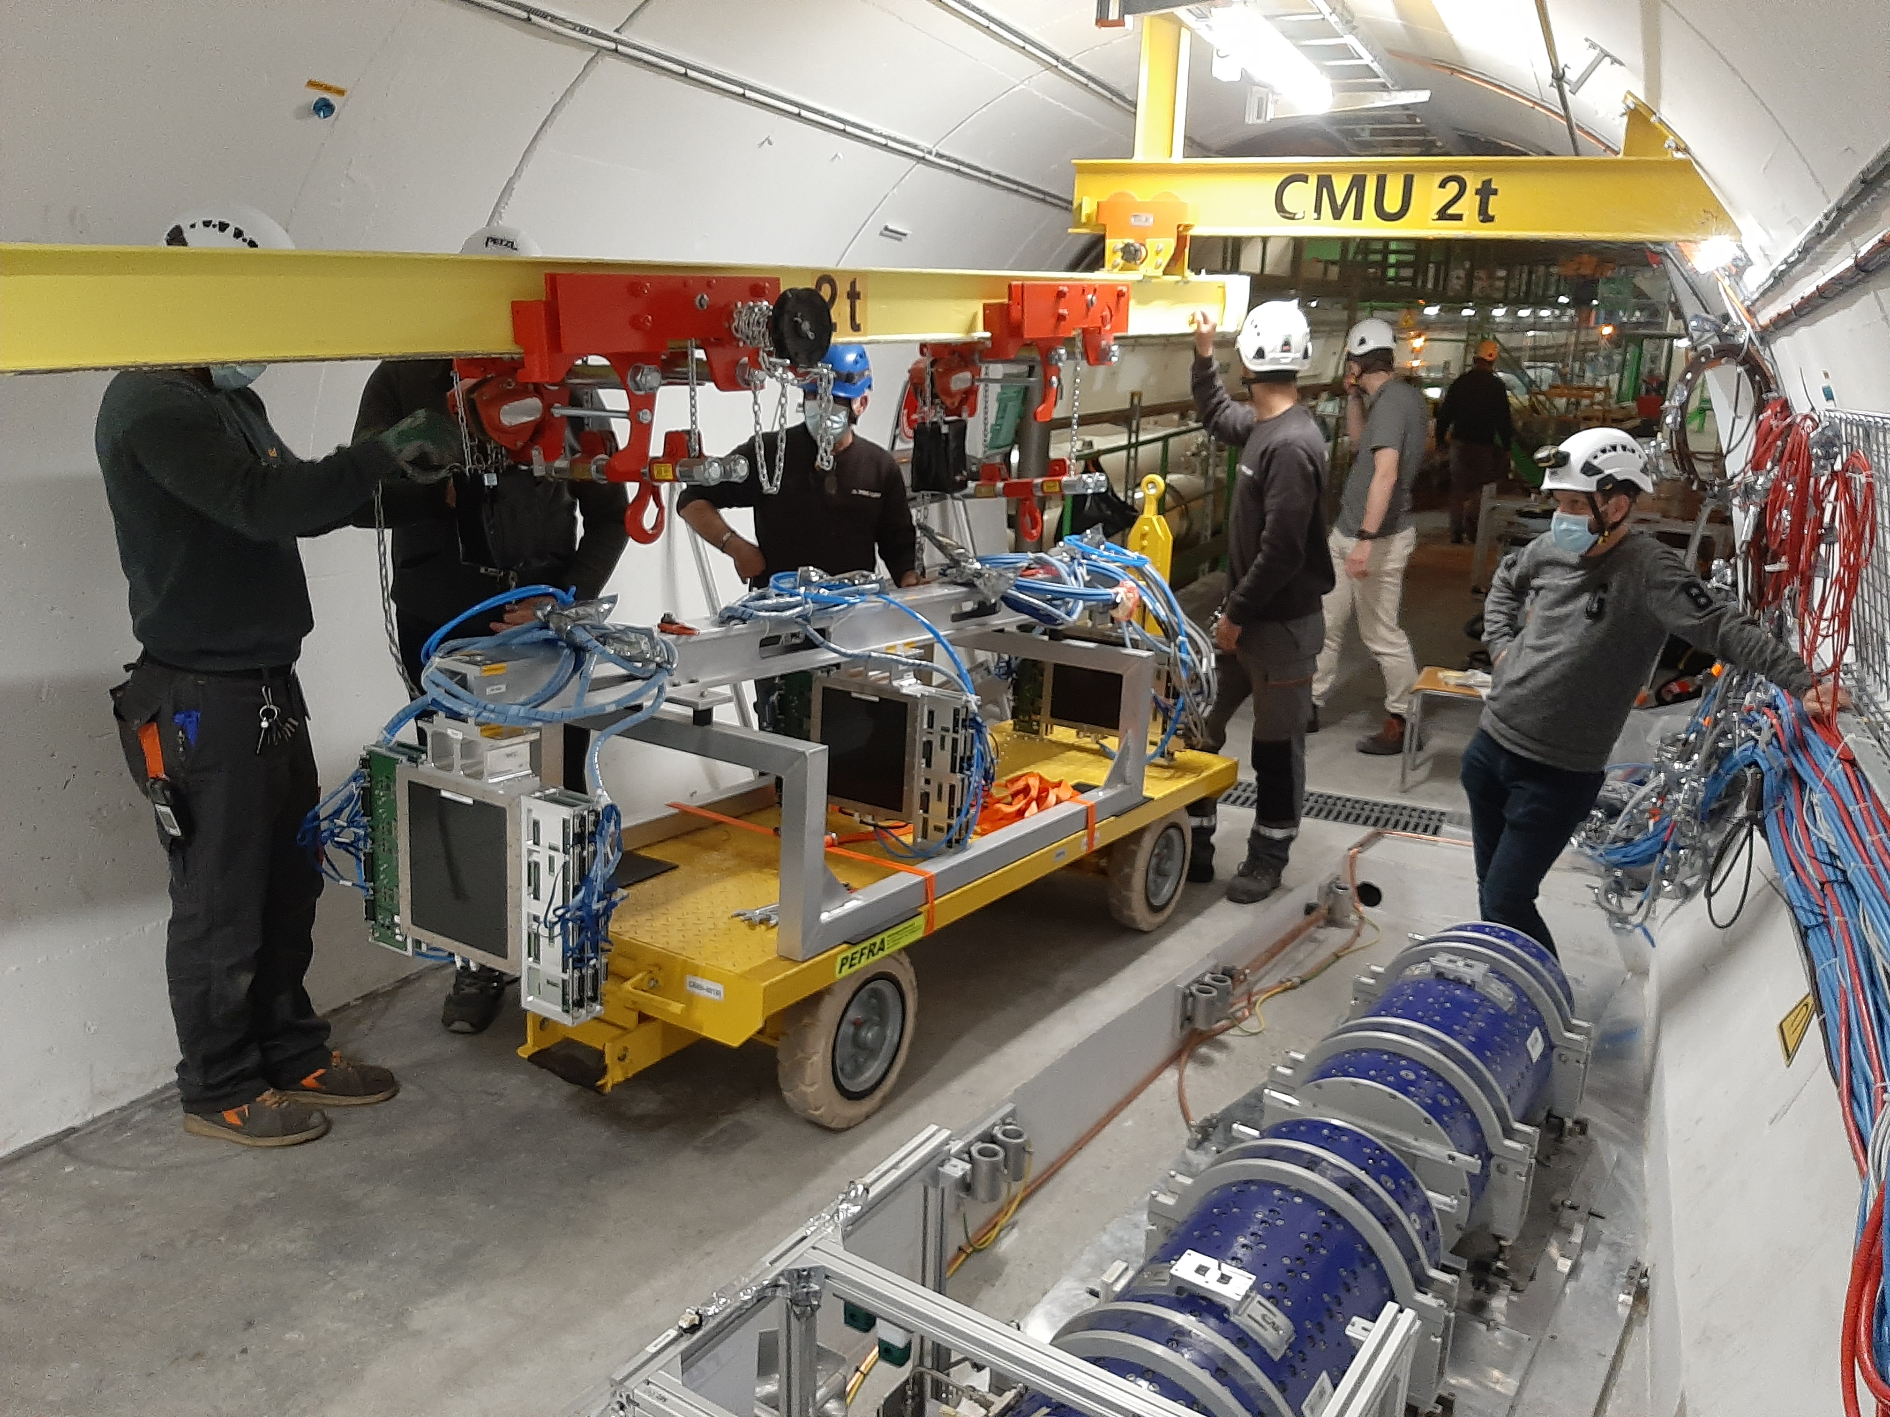
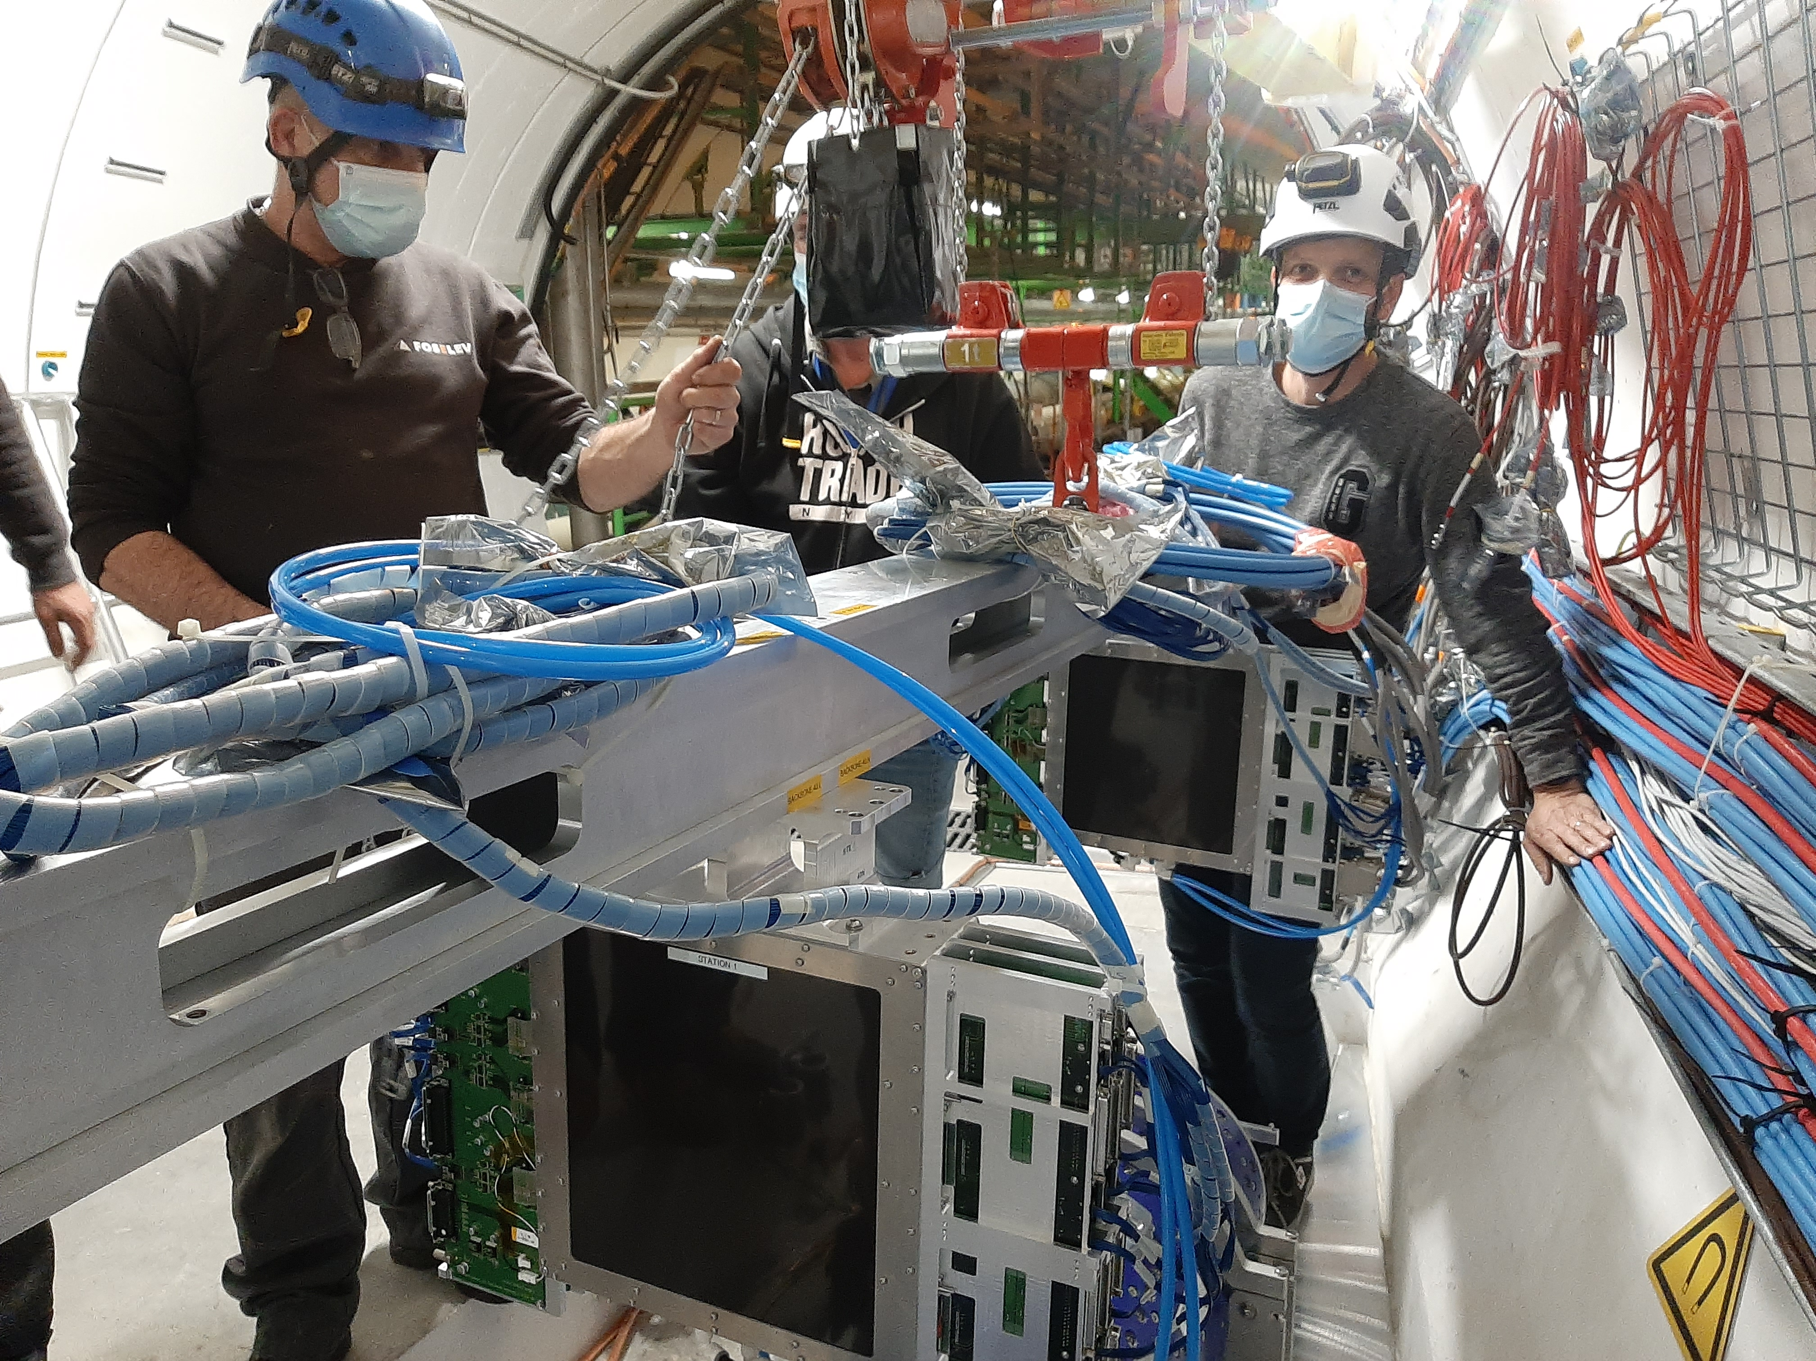
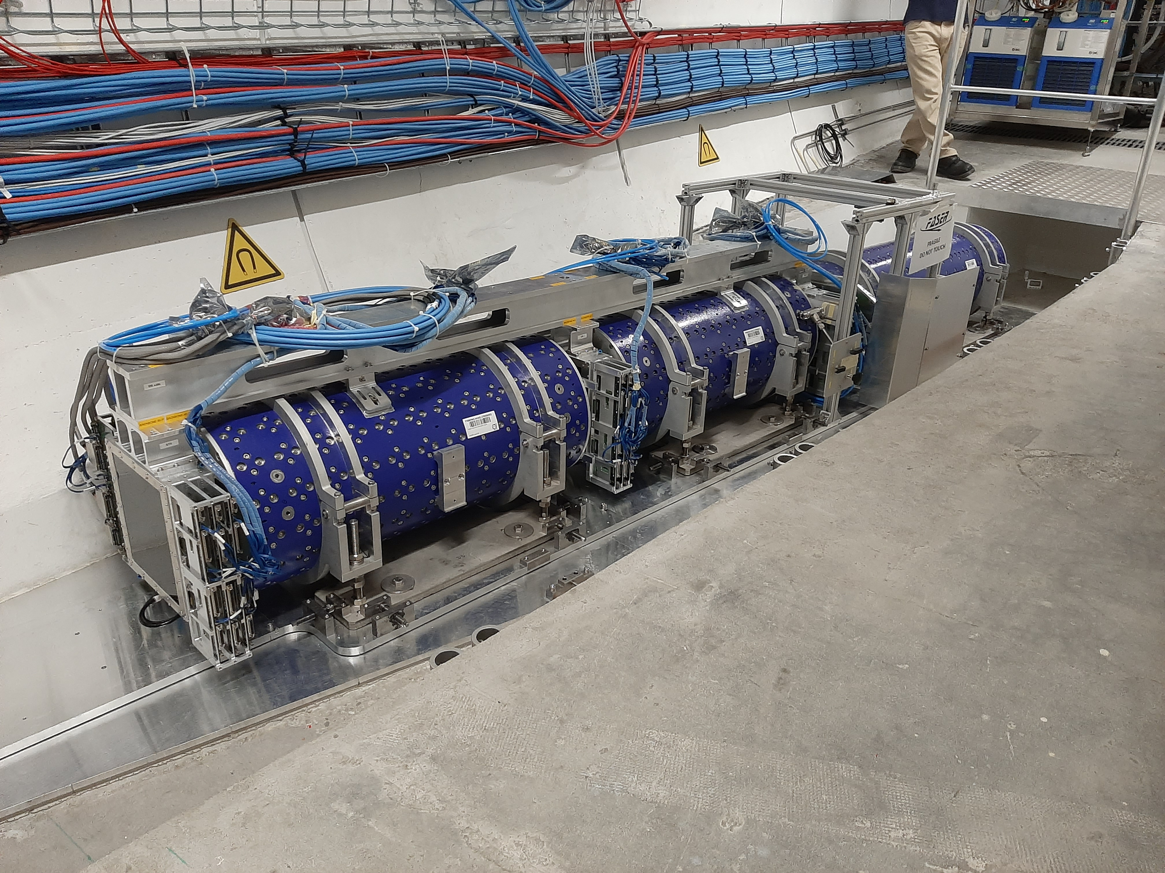
FASER INSTALLATION

Slide 20
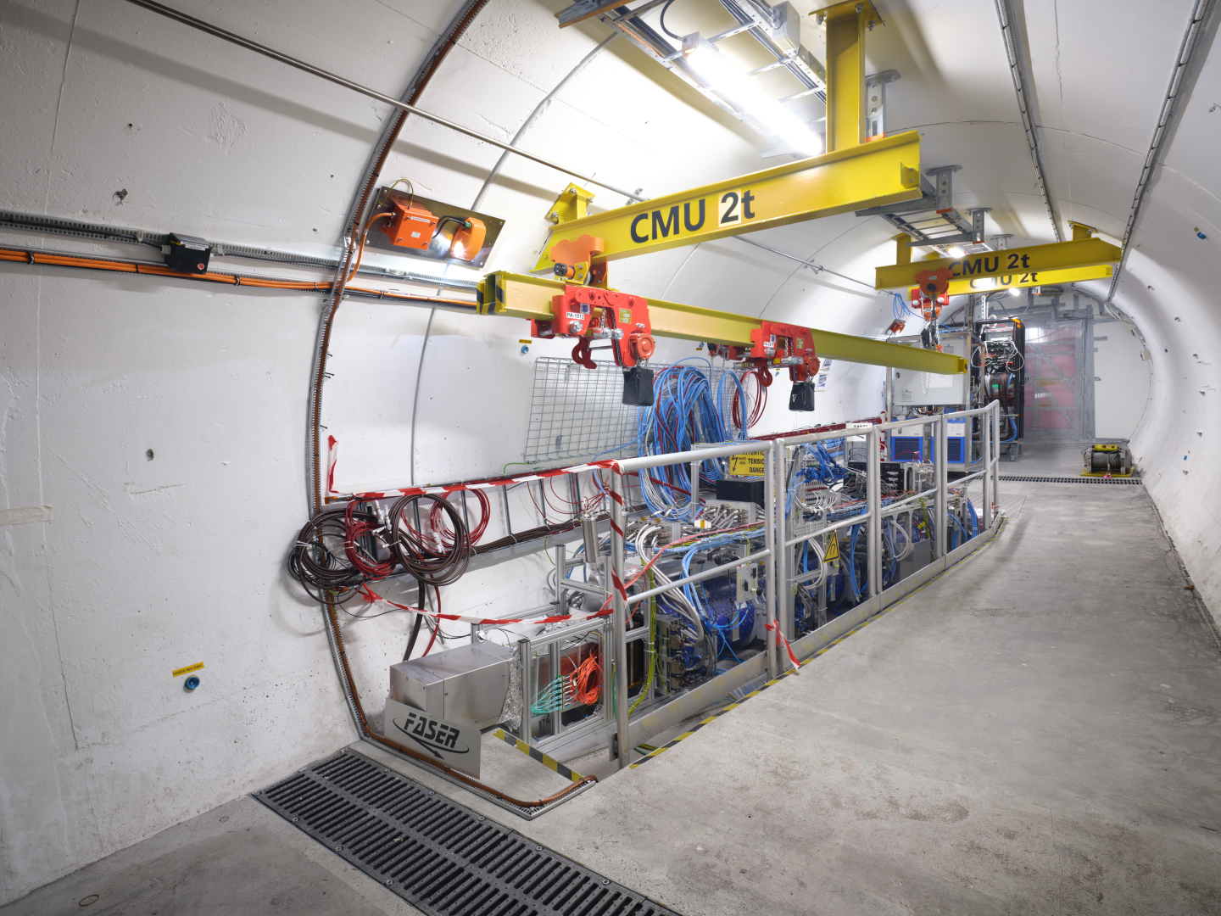
THE FASER DETECTOR

Slide 21
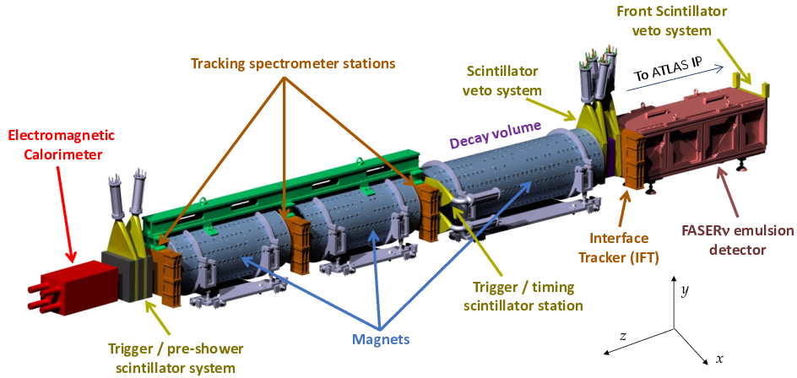
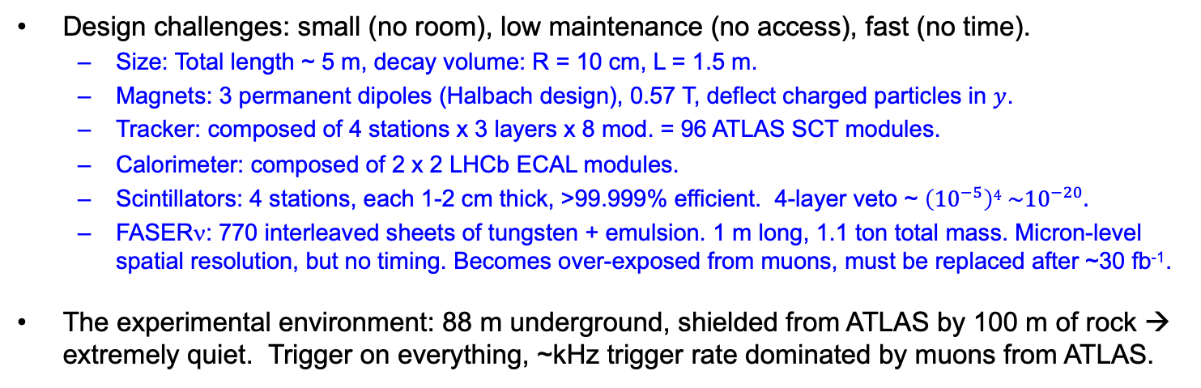
THE FASER DETECTOR
Design challenges: small (no room), low maintenance (no access), fast (no time).
  Size: Total length ~ 5 m, decay volume: R = 10 cm, L = 1.5 m.
  Magnets: 3 permanent dipoles (Halbach design), 0.57 T, deflect charged particles in $y$.
  Tracker: composed of 4 stations x 3 layers x 8 mod. = 96 ATLAS SCT modules.
  Calorimeter: composed of 2 x 2 LHCb ECAL modules.
  Scintillators: 4 stations, each 1-2 cm thick, >99.999% efficient. 4-layer veto ~ $\left({10}^{−5}\right)4 \sim {10}^{−20}.$
  FASERν: 770 interleaved sheets of tungsten + emulsion. 1 m long, 1.1 ton total mass. Micron-level spatial resolution, but no timing. Becomes over-exposed from muons, must be replaced after ~30 fb⁻¹.
The experimental environment: 88 m underground, shielded from ATLAS by 100 m of rock → extremely quiet. Trigger on everything, ~kHz trigger rate dominated by muons from ATLAS.
FASER Collaboration
(2207.11427)

Slide 22
FASER DATA TAKING 2022 - PRESENT
FASER was constructed in 18 months. We saw our first cosmic ray event on 18 March 2021.
After LS2 from 2018-2021, the LHC started running again in Jul 2022, and again in 2023 and in 2024.
FASER began recording data immediately.
  Recorded 97% of delivered luminosity
  Largely automated: no control room, 2 shifters controlling and monitoring the expt from their laptops
FASERν emulsion exchanged periodically to prevent overexposure
  3 boxes in 2022 (0.5, 10, 30 fb⁻¹)
  2 boxes in 2023 (20, 10 fb⁻¹)
  2 boxes in 2024 (10, 10 fb⁻¹)

Slide 23
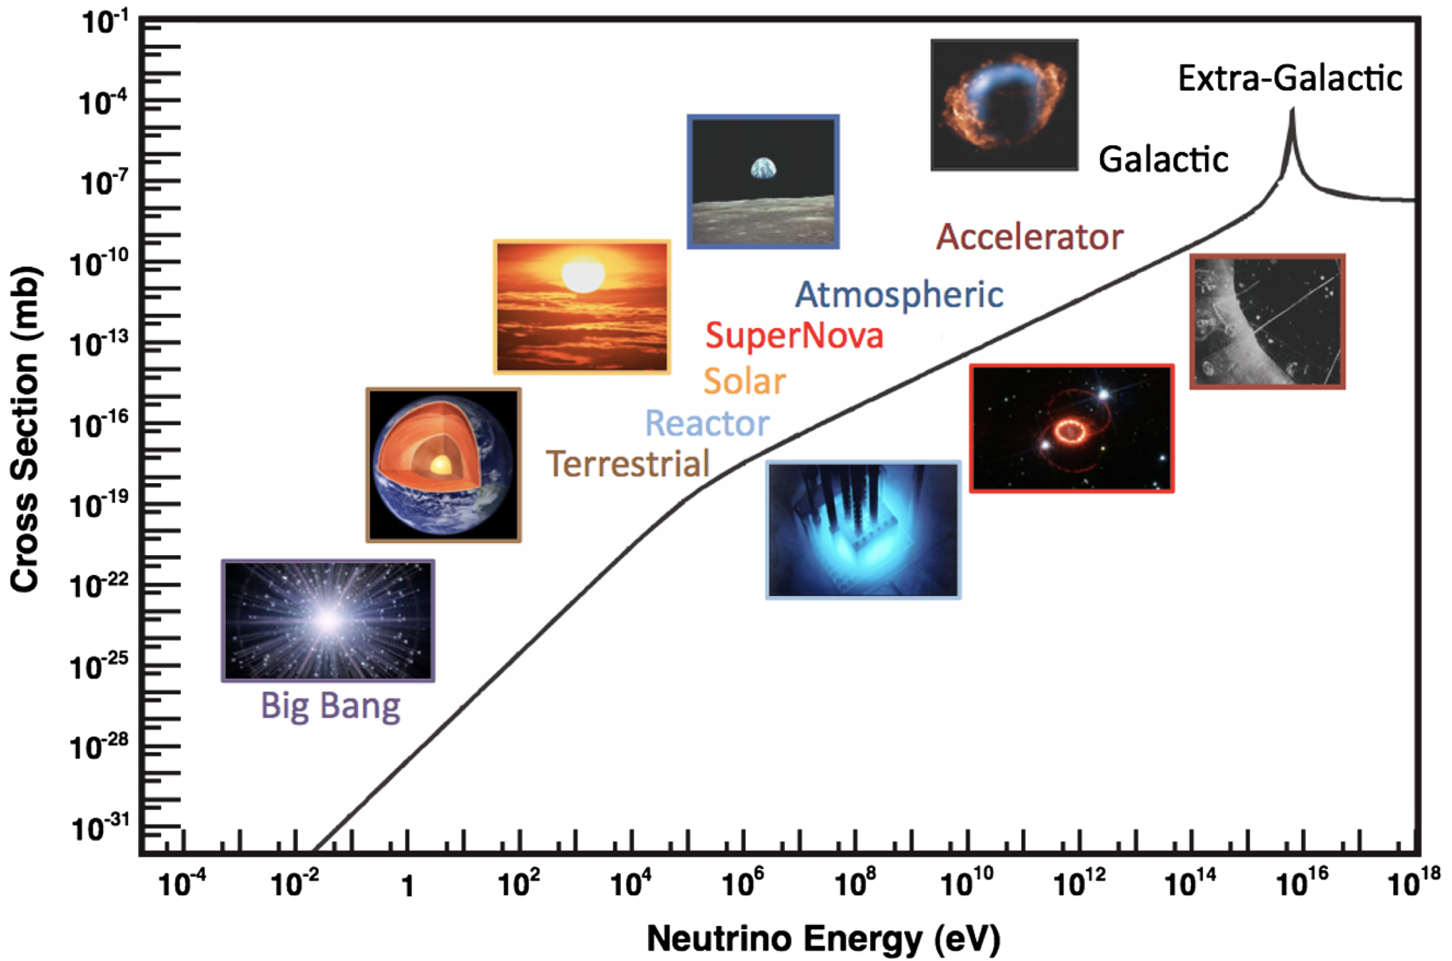
COLLIDER NEUTRINOS
Neutrinos are the least understood of all known particles, and the only ones with confirmed BSM properties.
They have been discovered from many sources, each time with stunning implications for particle physics, astrophysics, and cosmology.
Formaggio, Zeller (2012)
But before FASER, neutrinos produced at a particle collider had never been directly observed
  Conventional wisdom: neutrinos interact very weakly so cannot be detected.
  The reality: the highest energy ones, which are most likely to interact, pass through the blind spots of existing detectors.

Slide 24
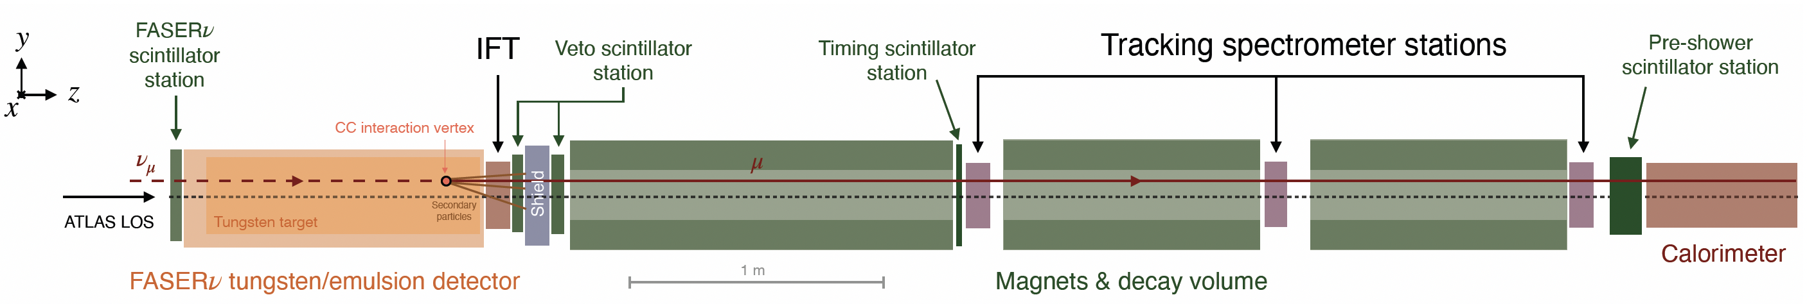
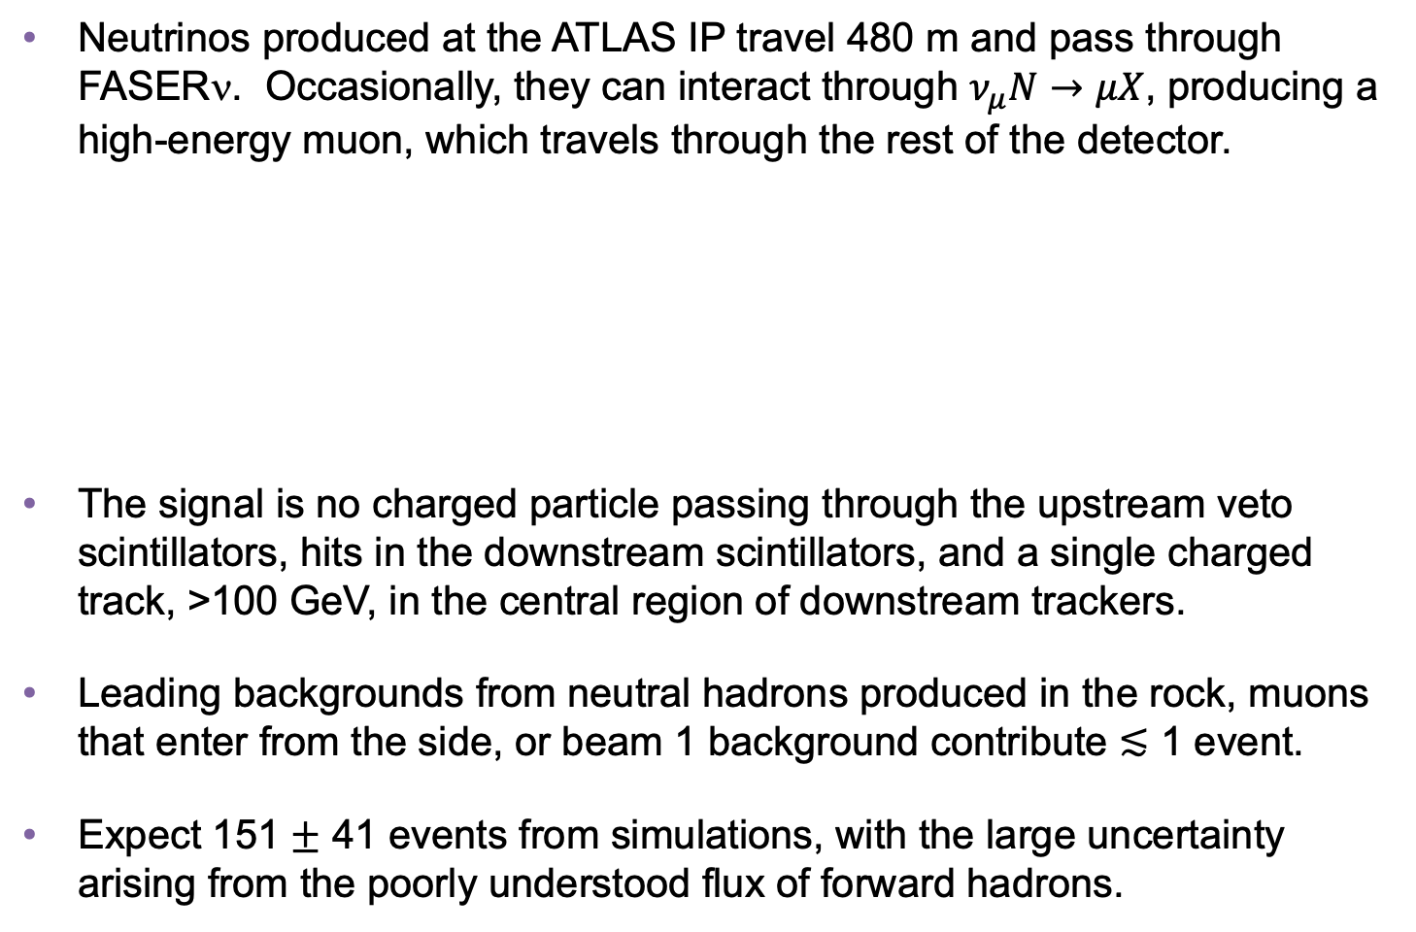
COLLIDER NEUTRINO SEARCH
Neutrinos produced at the ATLAS IP travel 480 m and pass through FASERν. Occasionally, they can interact through $ν_{μ}N→μX$, producing a high-energy muon, which travels through the rest of the detector.
The signal is no charged particle passing through the upstream veto scintillators, hits in the downstream scintillators, and a single charged track, >100 GeV, in the central region of downstream trackers.
Leading backgrounds from neutral hadrons produced in the rock, muons that enter from the side, or beam 1 background contribute $≲$ 1 event.
Expect 151 $±$ 41 events from simulations, with the large uncertainty arising from the poorly understood flux of forward hadrons.
FASER Collaboration (2303.14185, PRL)
Notes:
typical A’ that decays in FASER has ~TeV energy

Slide 25
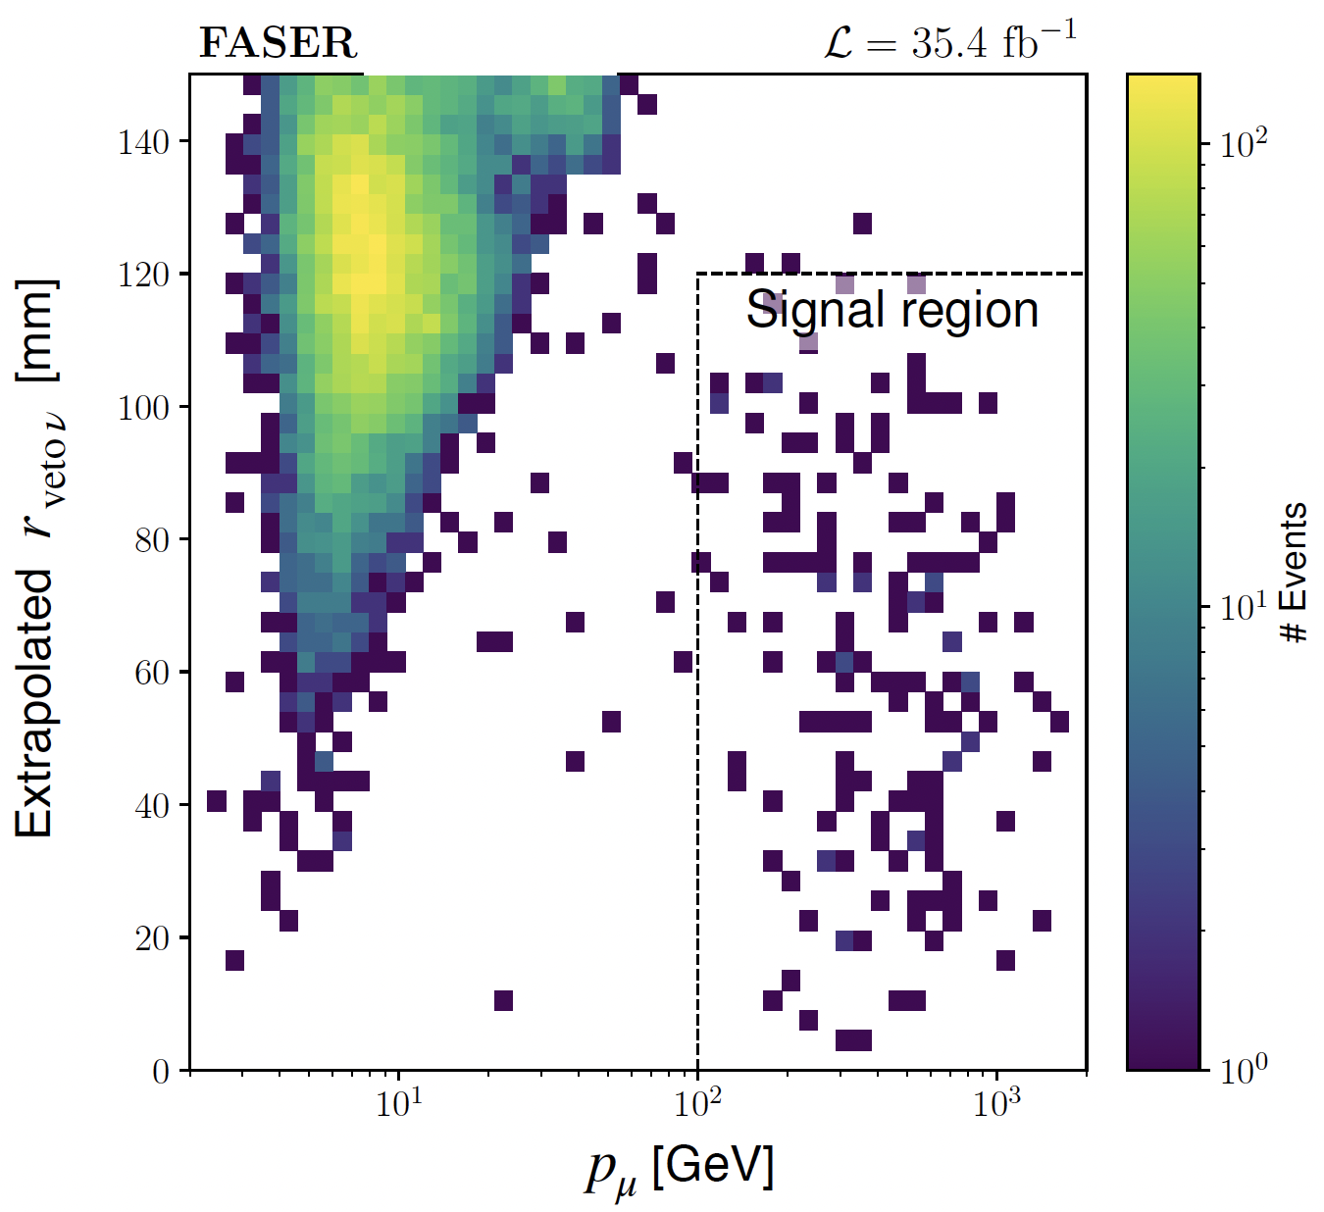
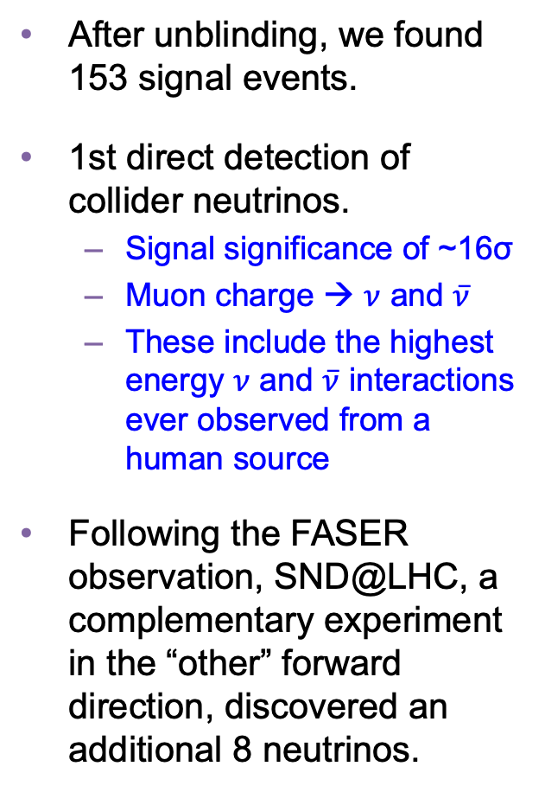
COLLIDER NEUTRINO RESULTS
After unblinding, we found 153 signal events.
1st direct detection of collider neutrinos.
  Signal significance of ~16σ
  Muon charge → $ν$ and $\overline{ν}$
  These include the highest energy $ν$ and $\overline{ν}$ interactions ever observed from a human source
Following the FASER observation, SND@LHC, a complementary experiment in the “other” forward direction, discovered an additional 8 neutrinos.
FASER Collaboration (2303.14185, PRL)

Slide 26
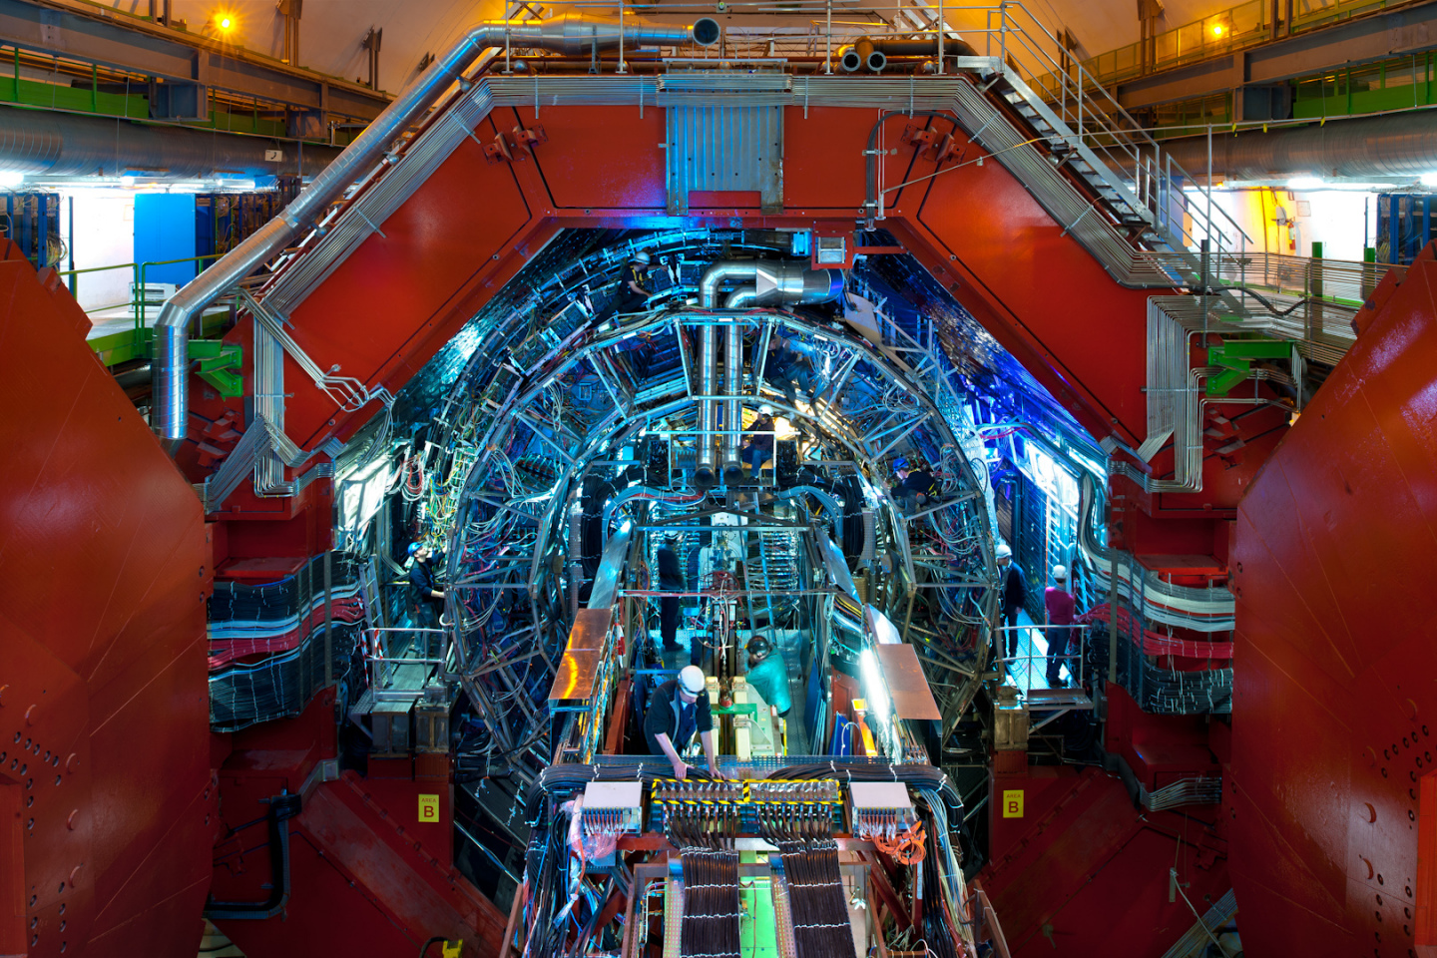
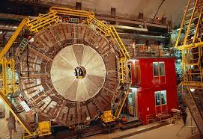
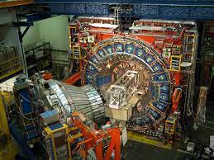
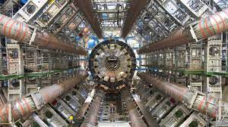
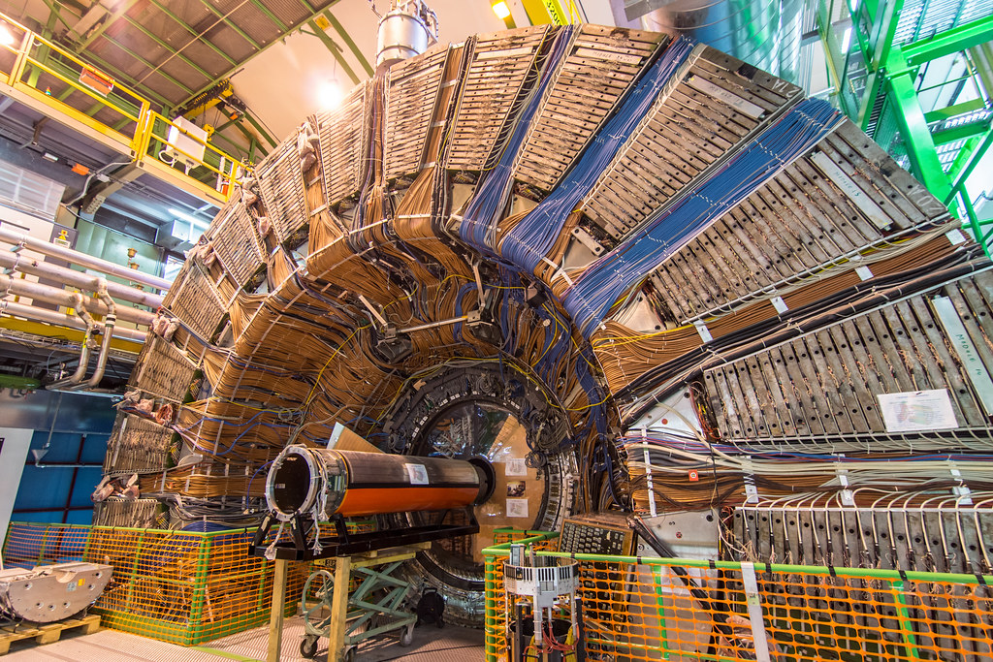
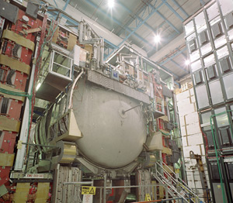
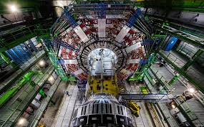
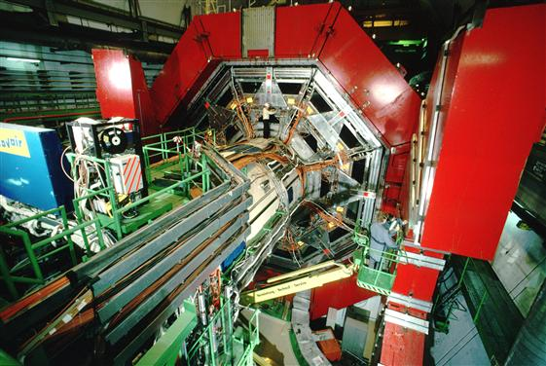

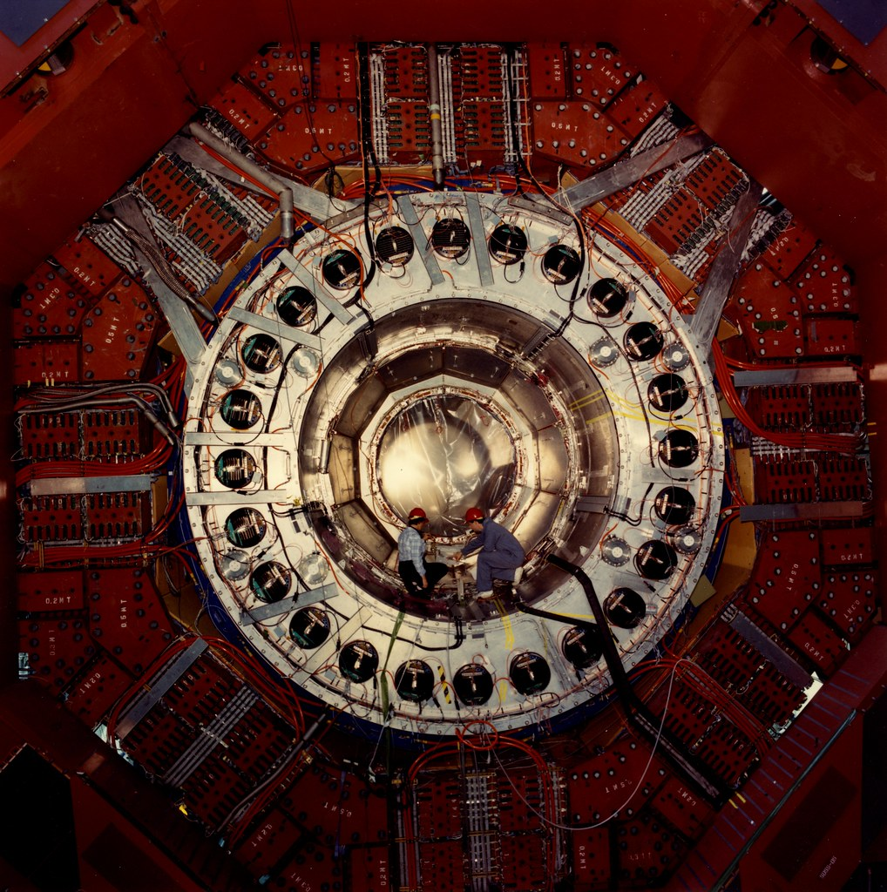
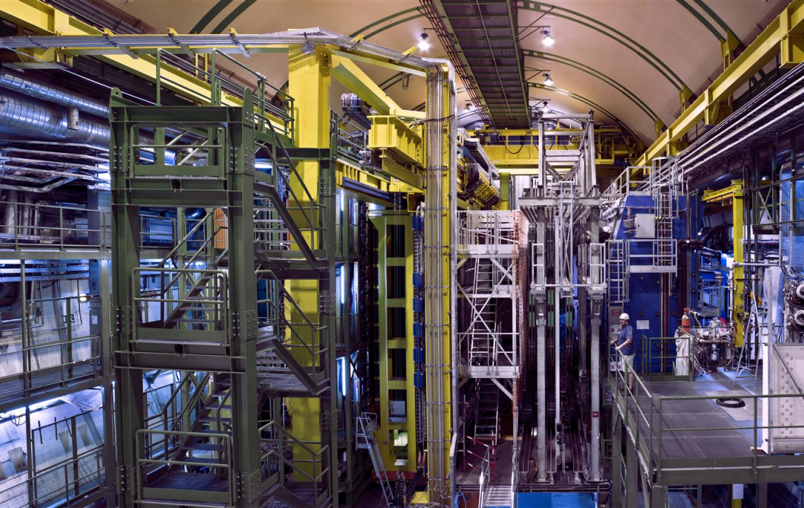
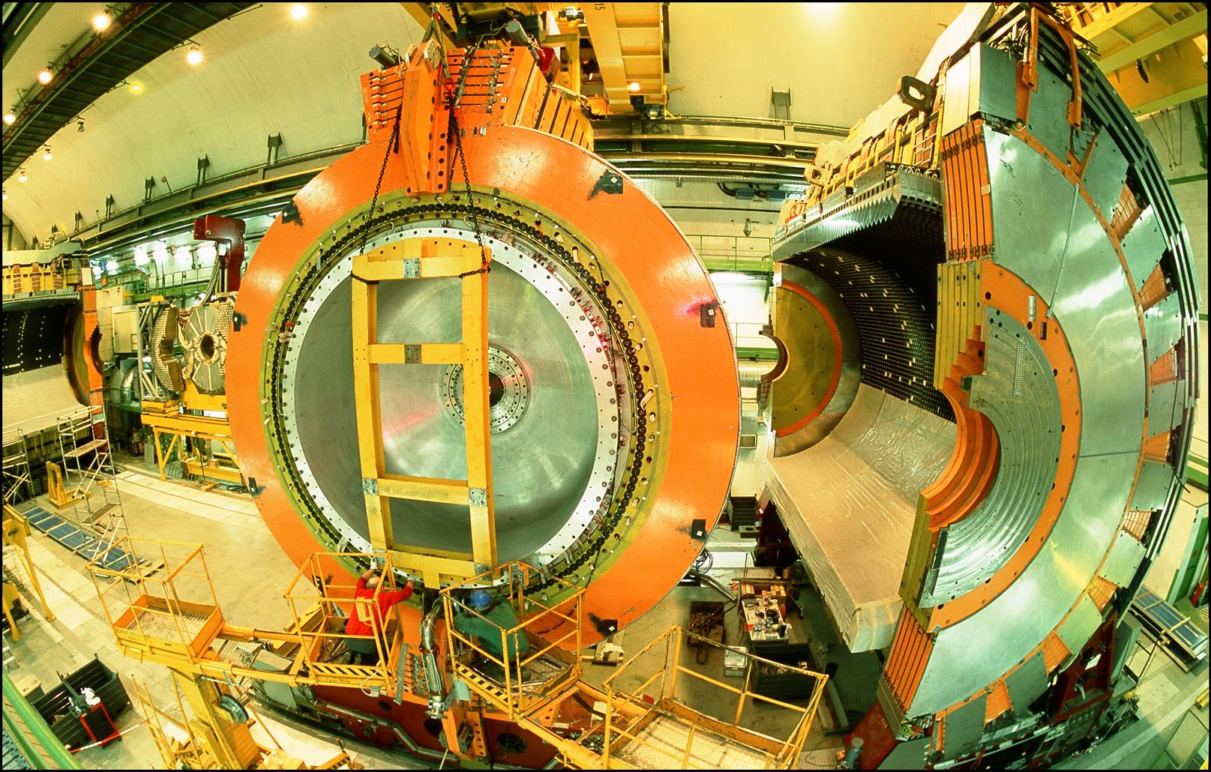
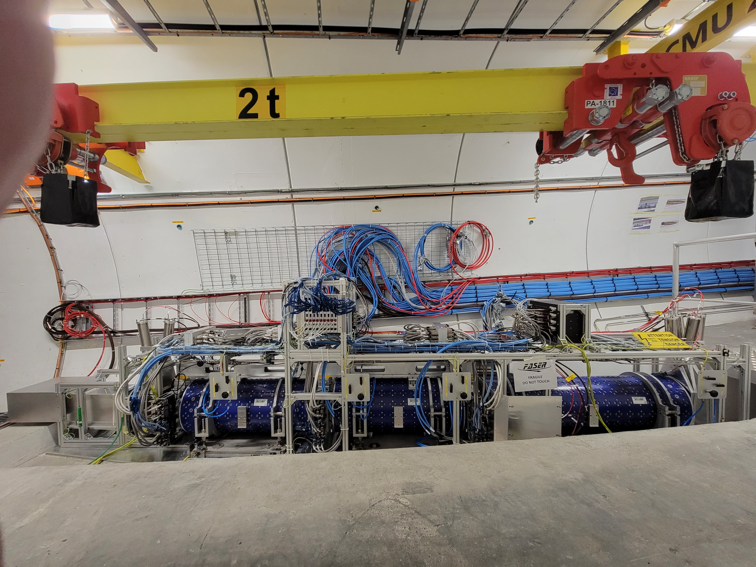
LOCATION, LOCATION, LOCATION
…
ALICE
ALEPH
CDF
FASER
“Tabletop,” 18 months,
~$1M
153 neutrinos
ATLAS
DELPHI
D0
CMS
L3
LHCb
SLD
OPAL
All previous
collider detectors
Building-size, decades,
~$1B
0 neutrinos
16σ discovery, opening a new window at the high energy frontier

Slide 27
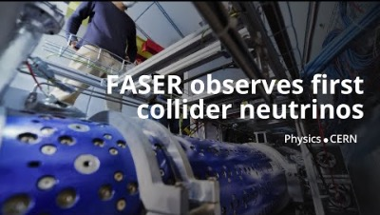
DISCOVERY OF COLLIDER NEUTRINOS

Slide 28

NEUTRINOS IN FASERν
At the front of FASER is FASERν, a 1.1-ton block of interleaved tungsten and emulsion plates. The first neutrino analysis treated this as a big block of matter, but the emulsion provides far more detailed information.
Emulsion is essentially old-fashioned photographic film, has unmatched spatial resolution (~0.5 microns).

Slide 29





NEUTRINOS IN FASERν
With the emulsion, we have now observed the first collider electron neutrinos, including the “Pika-$ν$” event, the highest energy (1.5 TeV) electron neutrino ever seen from a lab source.
Side View
Vertex with 11 tracks
  615 µm inside tungsten
e-like track from vertex
  Single track for 2X₀
  Shower max @ 7.8Χ₀
  θ_{e} = 11 mrad to beam
Back-to-back topology
  175° between e & rest
$$e$$
Beam View
FASER Collaboration (2403.12520)

Slide 30


TEV NEUTRINO CROSS SECTIONS
Following these discoveries, we can then move on to studies, including the first measurement of neutrino cross sections at TeV energies.
Results are consistent with SM DIS predictions.
These measurements use only 1.7% of the data collected in 2022 and 2023. Much more to come; we expect to triple the world’s supply of tau neutrinos, identify the first anti-tau neutrino, ….
FASER Collaboration (2403.12520)

Slide 31



NEW PARTICLE SEARCHES
FASER can also look for new light and weakly-interacting particles.
For example: suppose there is a dark sector that contains dark matter X and also a dark force: dark electromagnetism.
The result? Dark photons $A′$ , like photons, but with mass $m_{A′}$, couplings suppressed by $ε$.
For low $ε$, dark photons are long-lived particles (LLPs), can be produced in ATLAS, pass through rock and magnetic fields unhindered, and decay in FASER.
SM
EM
Dark Sector
EM, X
A
$${εF}_{μν}F_{D}^{μν}$$
A_{D}
Holdom (1986)

Slide 32


DARK PHOTON SIGNAL
Focus on masses in the 10-100 MeV range.
Produced through meson decay $π/η→A^{′}γ$ or “dark bremsstrahlung” $pp→{ppA}^{′}$.
Travel straight and unimpeded through 480 m of rock/concrete.
Then decay through $A^{′}$ $→ e^{+}e^{−}$.
The signal is no charged particle passing through the upstream veto scintillator detectors, followed by two very energetic (100s of GeV) charged tracks in downstream trackers. Tracks are very collimated, but magnet splits them sufficiently to be seen as 2 tracks in trackers.
Notes:
typical A’ that decays in FASER has ~TeV energy

Slide 33

DARK PHOTON RESULTS
After unblinding, no events seen, FASER sets limits on previously unexplored parameter space.
First new probe of the parameter space favored by dark matter from low coupling since the 1990’s.
Bodes well for the future
  Background-free analysis
  Started probing new parameter space in the first day of running
  Ended up ~100 times more sensitive than previous experiments
  Improvements in analysis and 40 times more data to come
Existing bounds from DarkCast
FASER Collaboration (2308.05587, PLB)

Slide 34




ALP-W SEARCH RESULTS
Can also look for LLPs with purely photonic final states. E.g., ALP-Ws
production
decay
Signal is no hits in veto scintillators, >1 TeV energy deposit in ECAL.
Background: Expect 0.42 $±$ 0.32 from $ν$ interactions in 58 fb⁻¹ (yesterday’s signal, today’s background)
1 event seen, excludes new parameter space. Benefits from LHC’s high energy, lots of B’s.
FASER Collaboration (CERN-FASER-CONF-2024-001)
FASER is approved to run through Run 4 (2030-33), with hardware upgrades, improvements in analysis. We will be testing many other new ideas, e.g., other new force carriers (U(1)_{B-L}, U(1)_{B}, protophobic), ALP-γ, ALP-g, light-shining-through-walls axions, dark Higgs bosons, sterile neutrinos, light neutralinos, inflatons, quirks, etc., all with world leading sensitivities.

Slide 35


Slide 36




FORWARD PHYSICS FACILITY
Following the results of FASER and SND@LHC, CERN is considering the possibility of creating a dedicated Forward Physics Facility to house far-forward experiments for the rest of the LHC era from 2029-2040s.
UJ18
ATLAS
SPS
LHC
LOS
FPF site selection study and core study have identified an ideal site in France just outside the CERN main gate
https://cds.cern.ch/record/2851822
CERN GIS

Slide 37



THE FACILITY
A cylindrical cavern surrounding the LOS, 620-695 m west of the ATLAS IP.
75 m long, 12 m in diameter, covers $η>5.1$.
Class 4 cost estimate: 35 MCHF.
Can be constructed independently of the LHC, does not disrupt LHC running.
Timeline: construct in LS3/early Run 4, physics starts in late Run 4.
Bud, Magazinik, Pál, Osborne, et al. CERN CE (2024)

Slide 38

FPF EXPERIMENTS
At present there are 4 experiments being designed for the FPF
  FASER2: magnetized spectrometer for BSM searches
  FASERν2: emulsion-based neutrino detector
  FLArE: LArTPC neutrino detector
  FORMOSA: scintillator array for BSM searches (successor to MilliQan)
The total of core costs for the 4 experiments is ~40 MCHF.

Slide 39


FPF EXPERIMENTS
The FPF experiments will deliver a huge jump in physics reach relative to the existing experiments:
  10,000 times greater (decay volume * luminosity) for BSM searches.
  Will detect miilions of TeV neutrinos, ~1000 neutrinos/day!
  Highly flexible program: In the event of a discovery at FPF or elsewhere, FPF experiments will be able to adapt, measure the properties of the new particles, explore possible connections to dark matter, dark sectors.
FASER2, FASERν2, FORMOSA are based on experience with the corresponding “pathfinder” experiments (FASER, FASERν, milliQan).
FLArE does not benefit from a pathfinder experiment, but there has been impressive progress, led by BNL.

Slide 40
PHYSICS AT THE FPF
The FPF at the HL-LHC will have many unique capabilities:
  New physics in neutrino properties: neutrino blind → neutrino factory: 10⁶ neutrinos at the highest human-made energies ever.
  New particles: enhancement of conventional LHC searches, and many searches for particles that cannot be round anywhere else.

Slide 41




NEUTRINOS AT THE FPF
The FPF experiments will see ${10}^{5} ν_{e}$, ${10}^{6} ν_{μ}$, and ${10}^{4} ν_{τ}$ interactions at TeV energies. The last chance to probe this in a controlled environment for at least 50 years.
Neutrinos are produced by forward hadron production: $π, K, D, …$. Dependence on E, $η$ will inform
  Astroparticle physics: muon puzzle, …
  QCD: pdfs at x $\sim {10}^{−1}$, x $\sim {10}^{−7}$, intrinsic charm, small-x gluon saturation, …
  Neutrino oscillations: $ν_{s}$ with $∆m^{2}\sim {10}^{3}$ ${eV}^{2}$

Slide 42

ENHANCEMENT OF HIGH P_{T} SEARCHES
The FPF will provide new constraints on pdfs that will sharpen studies at ATLAS and CMS.
For example, W, Z, and Higgs boson studies.
Will also remove degeneracies between pdfs and new physics (“fitting away new physics”), extending the reach for new particle searches (e.g., ~10 TeV $W^{′}, Z′$ ).
Cruz-Martinez, Fieg, Giani, Krack,
Makela, Rabemananjara, Rojo (2023)

Slide 43

UNIQUE DISCOVERY OPPORTUNTIES
FPF experiments have the potential to discovery BSM physics that cannot be seen anywhere else. Many examples:
Millicharged particles: a completely generic possibility motivated by dark matter, dark sectors. Currently the target of the MilliQan experiment, located at the LHC near the CMS experiment in a “non-forward” tunnel.
Can be explored at the FPF with both FLArE and FORMOSA, a dedicated experiment in the forward region with much greater sensitivity for a wide range of masses from 10 MeV to 100 GeV.
Foroughi-Abari, Kling, Tsai (2020)
Currently being investigated with the FORMOSA Demonstrator behind FASER.

Slide 44





DARK MATTER
In the last few decades, there has been an intense effort to detect dark matter through non-gravitational couplings, all yielding null results.
One generic possibility that is infamously hard to detect: inelastic dark matter, where there are two nearly-degenerate dark states with off-diagonal couplings to the SM.
These generically lead to long-lived particles, but with soft decay products, but these are highly boosted to observable levels at the FPF.
Bottom line: the FPF can discover DM (or any compressed spectrum), which cannot be seen anywhere else (ATLAS/CMS, SHiP and other fixed target expts, direct and indirect DM searches, …)
$$m_{1}$$
$$χ_{1} →χ_{0}γ$$
$$m_{0}$$
0
Dienes, Fieg, et al. (2023)

Slide 45


QUIRKS
There may be another strong (non-Abelian) force.
Quirks are particles charged under both the SM and another strong force, with $m≫Λ$.
Quirks can be pair-produced at the LHC, but then are bound by a color string, oscillate about their center-of-mass and travel down the beamline.
By looking for 2 coincident slow or delayed tracks (out of time with the bunch crossing), FPF experiments can discover quirks with masses up to ~TeV, as motivated by neutral naturalness solutions to the gauge hierarchy problem.
Unique discovery potential at the FPF: very challenging at ATLAS/CMS, impossible at fixed target experiments.
Feng, Li, Liao, Ni, Pei (2024)

Slide 46

SUMMARY
The forward region is a treasure trove of interesting physics.
  Collider neutrinos at TeV energies, with implications for neutrino properties, QCD, astroparticle physics, and high $p_{T}$ physics.
  Opportunities for breakthrough discoveries of light (and also heavy), weakly-interacting BSM particles, including many motivated by dark matter.
FASER has shown that this dataset can be mined by small, fast, and inexpensive detectors. Many more results coming in the next few days, months, and years.
The Forward Physics Facility will enable the LHC to fully realize its physics potential before it shuts down in the 2040s.
see the FPF status report for EPPSU, on arxiv soon

