Slide 1



MULTI-MESSENGER
COLLIDER PHYSICS
IceCube Fall 2024 Collaboration Meeting, Madison, Wisconsin
Jonathan Feng, UC Irvine, 26 September 2024

Slide 2
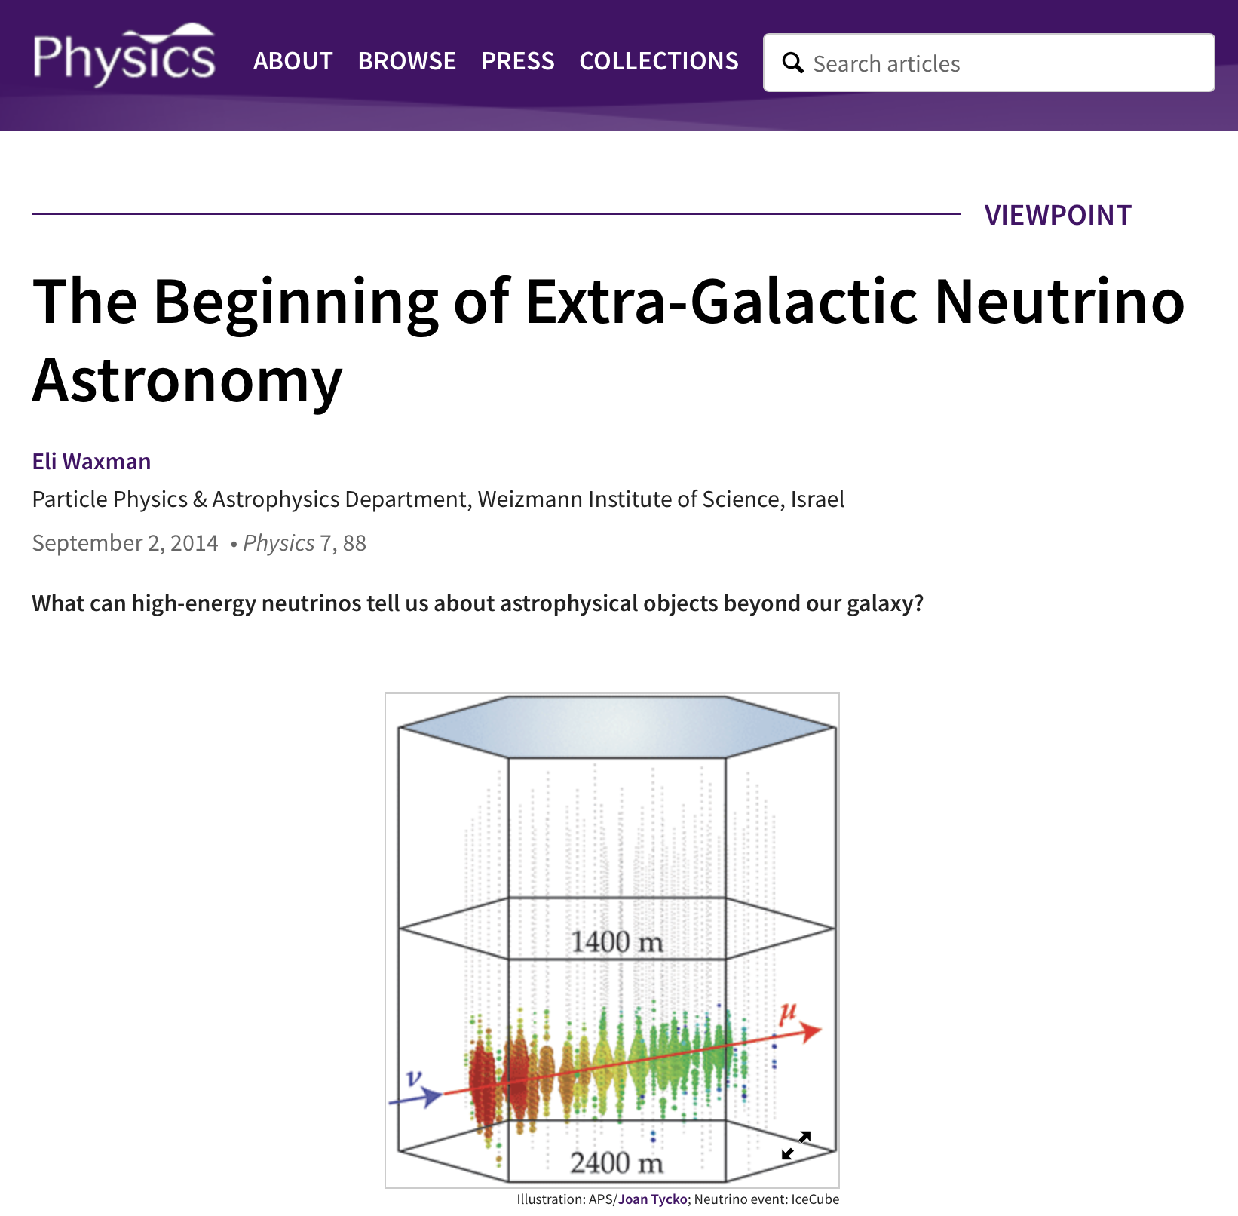
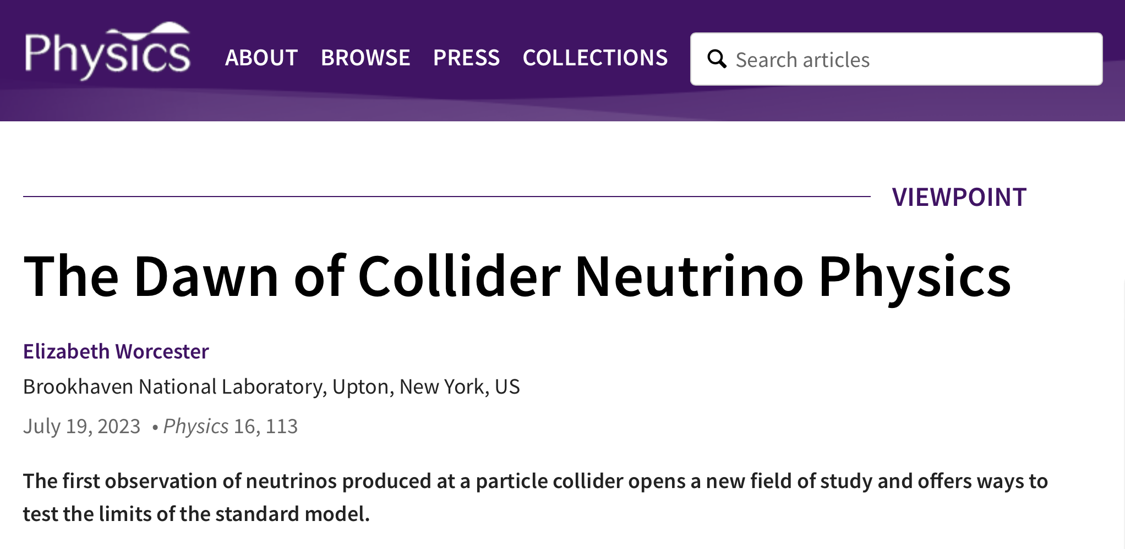
THE MULTI-MESSENGER ERA
Astronomy
  ~1000 years ago: optical photons
  ~100 years ago: multi-wavelength photons
  ~10 years ago: neutrinos (IceCube), gravitational waves (LIGO)
  Multi-messenger astronomy provides new probes of outer space
Collider Physics
  ~70 years ago: photons, charged particles
  12 years ago: Higgs bosons (ATLAS/CMS)
  1 year ago: neutrinos (FASER)
  Multi-messenger collider physics provides new probes of inner space
Many areas of overlap between IceCube and FASER: neutrinos, but also searches for dark matter, other new particles

Slide 3
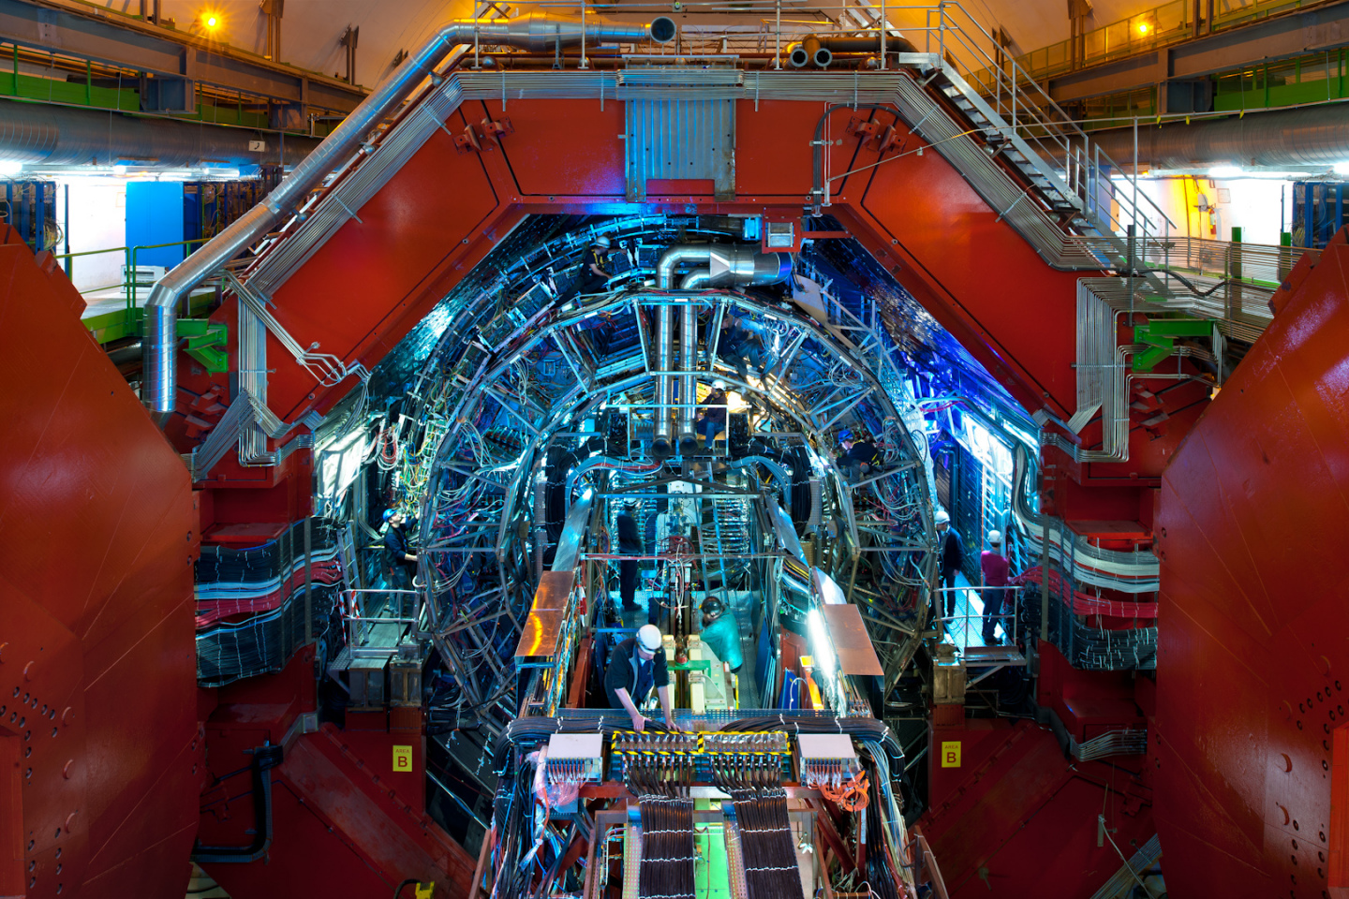
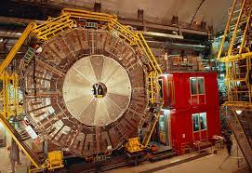
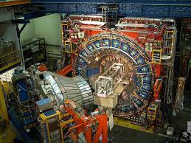
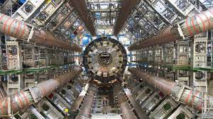
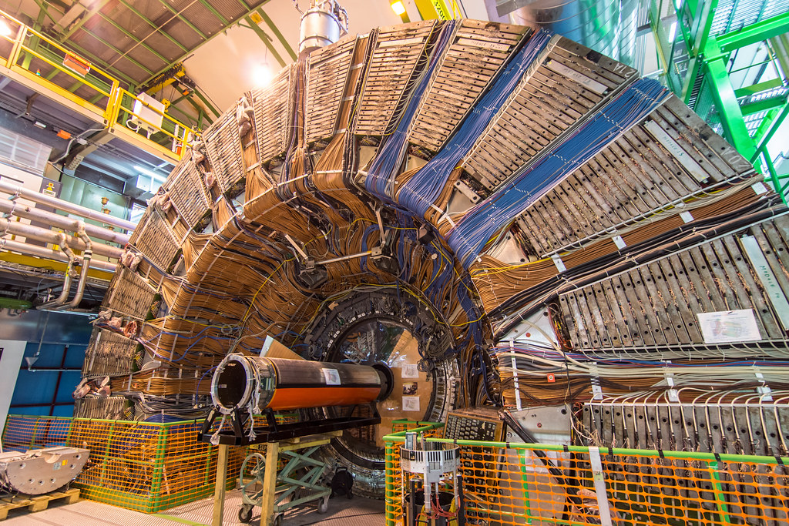
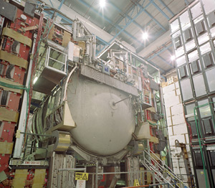
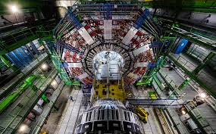
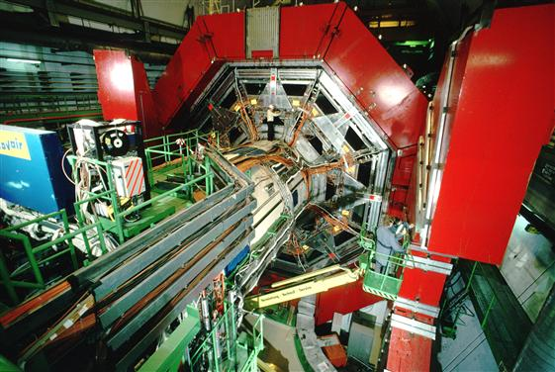

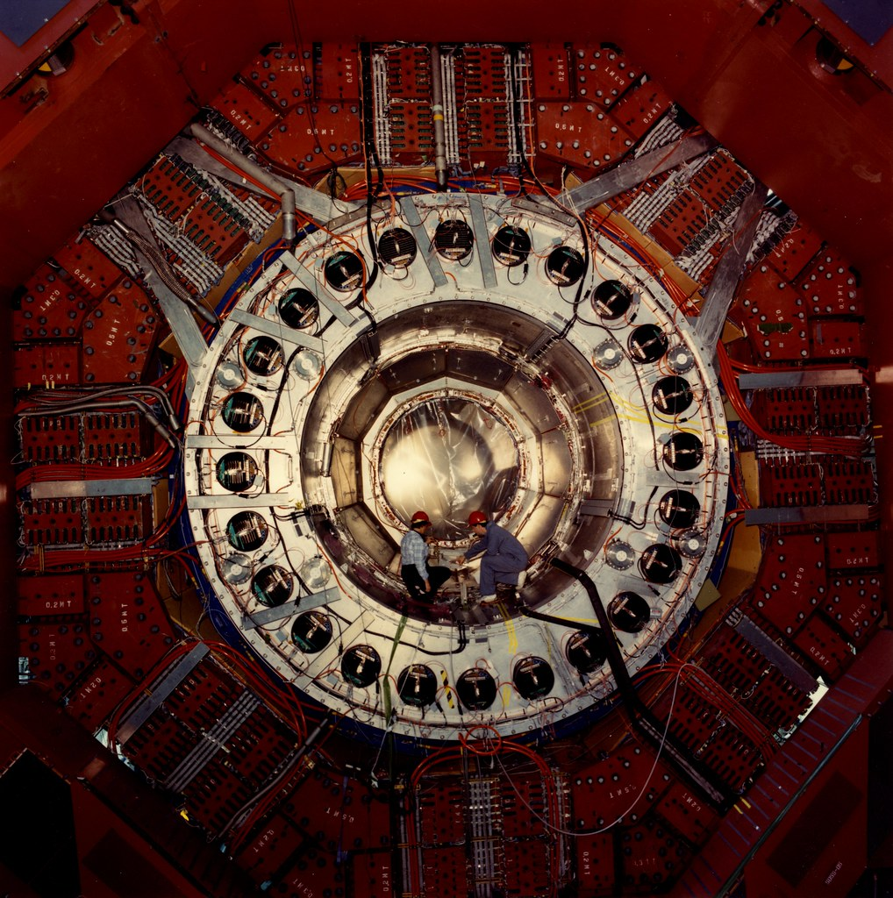
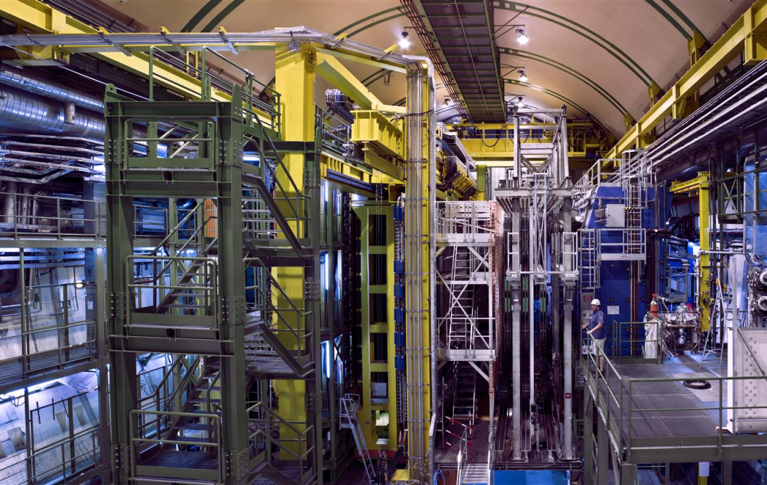
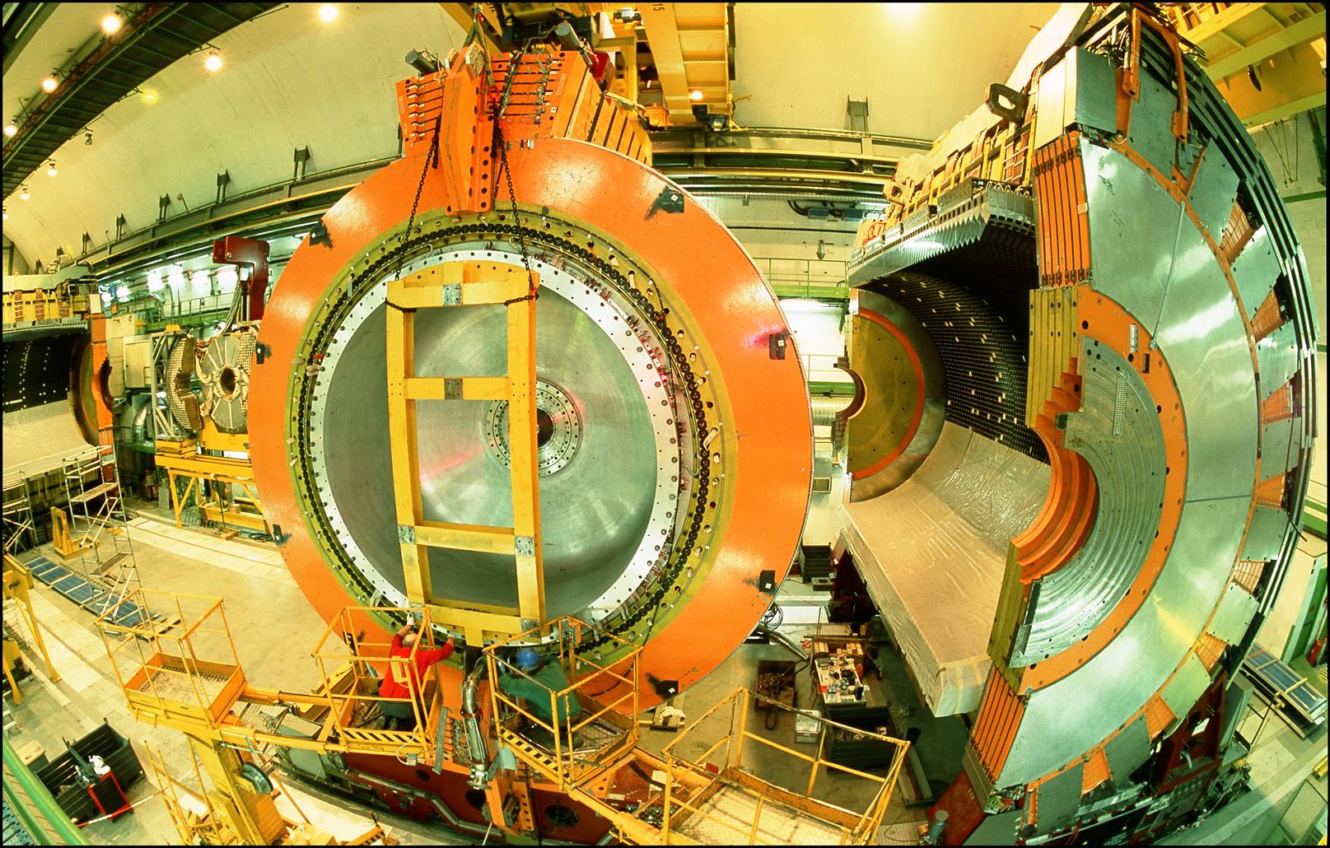
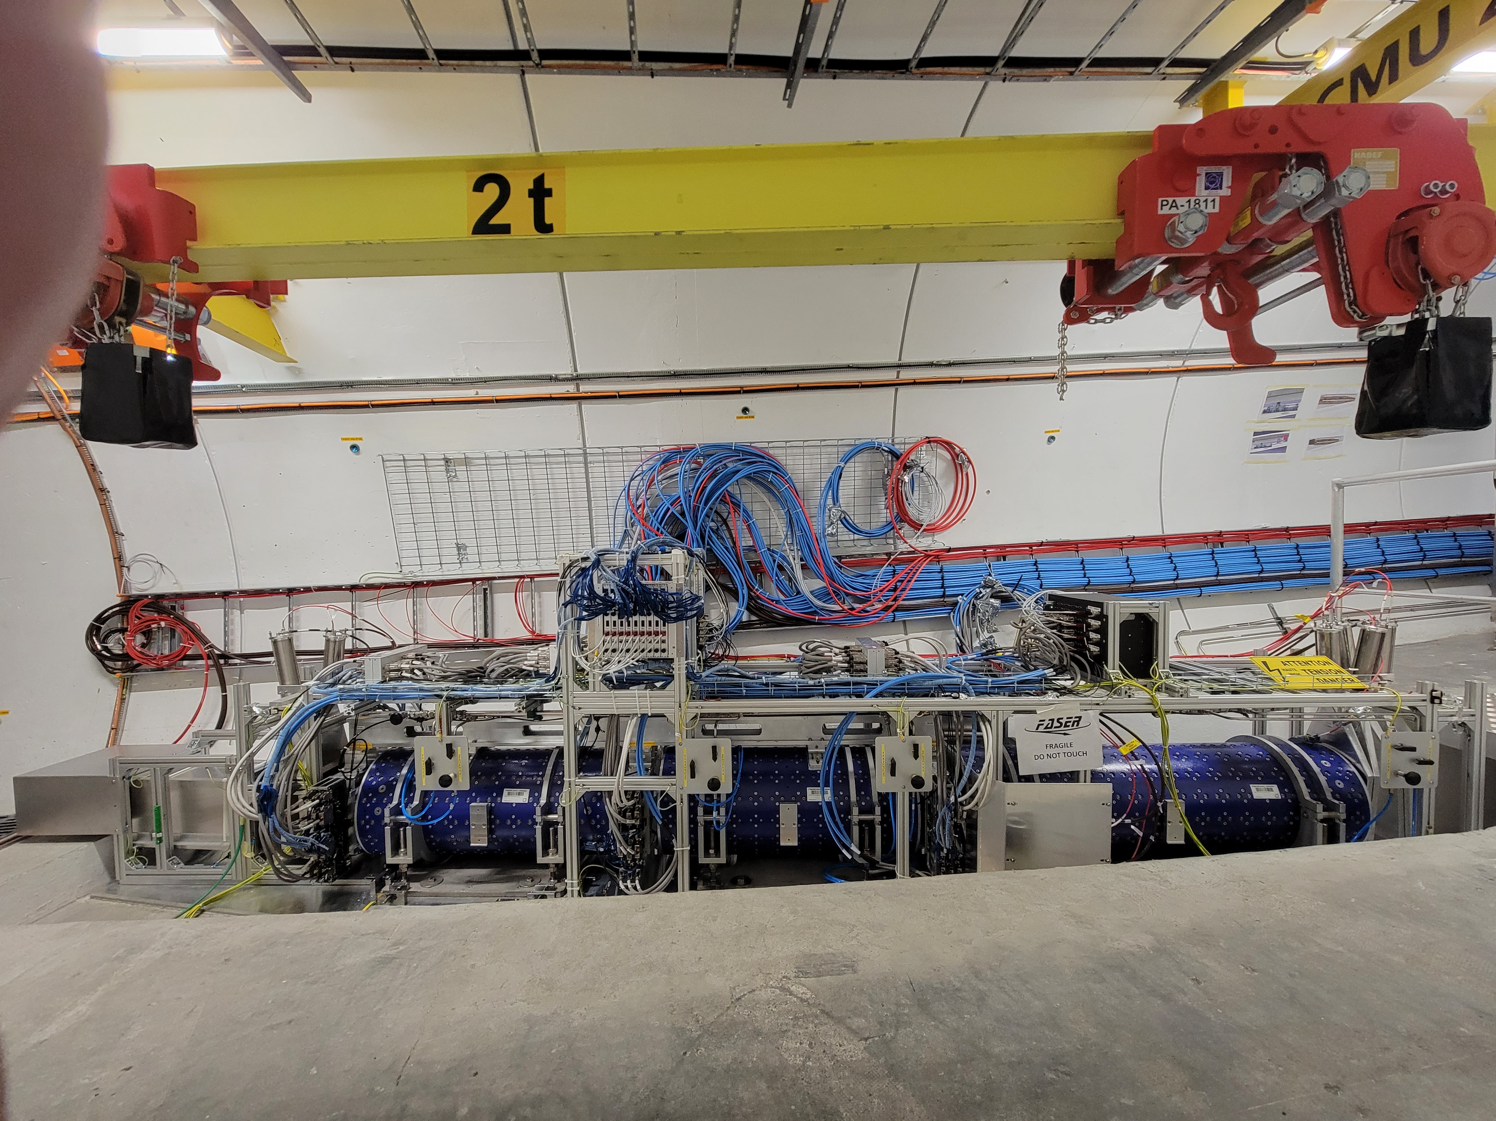
THE DAWN OF COLLIDER NEUTRINO PHYSICS
…
ALICE
ALEPH
CDF
FASER
“Tabletop,” 18 months,
~$1M
153 neutrinos, 16σ discovery
ATLAS
DELPHI
D0
CMS
L3
LHCb
SLD
OPAL
All previous
collider detectors
Building-size, decades,
~$1B
0 neutrinos
In retrospect, collider neutrinos were discovered “easily.” Lots of room for progress

Slide 4

THE LARGE HADRON COLLIDER
.
FASER
The LHC started running in 2010, and is scheduled to run until the 2040s. It is halfway through its lifetime in years, but only 10% through its lifetime in terms of integrated luminosity.
Notes:
4

Slide 5

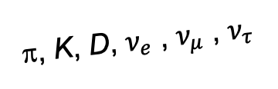
FORWARD PHYSICS
In 2017, we realized that the large LHC detectors, while optimally configured to discover new heavy particles, are also optimally configured to miss new light particles.
Heavy particles (W, Z, t, h, …) are produced at low velocity and decay roughly isotropically to other particles.
But high-energy light particles are dominantly produced in the forward direction and escape through the blind spots of these large detectors.
  This is true for all known light particles: pions, kaons, D mesons, all neutrinos.
  It is also true for many proposed particles, especially light, weakly-interacting ones motivated by neutrino mass and dark matter.
These blind spots are the Achilles heels of the large LHC detectors.
Feng, Galon, Kling, Trojanowski (2017)
A’, a, mCPs, χ, …
π, K, D, $ν_{e}$ , $ν_{μ}$ , $ν_{τ}$
De Rujula, Ruckl (1984)

Slide 6
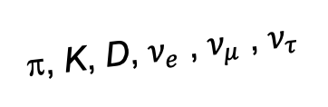
DETECTING FORWARD PARTICLES
To capture the enormous forward flux, we need to detect particles that are produced in the forward direction along the beamline.
Problem: we can’t just put the detector there: they will block the protons from coming in.
Solution: the LHC is a circular collider! If we go far enough away, the LHC proton beam will curve away, while all the light, weakly-interacting particles we are looking for will go straight.
A’, a, mCPs, χ, …
π, K, D, $ν_{e}$ , $ν_{μ}$ , $ν_{τ}$

Slide 7
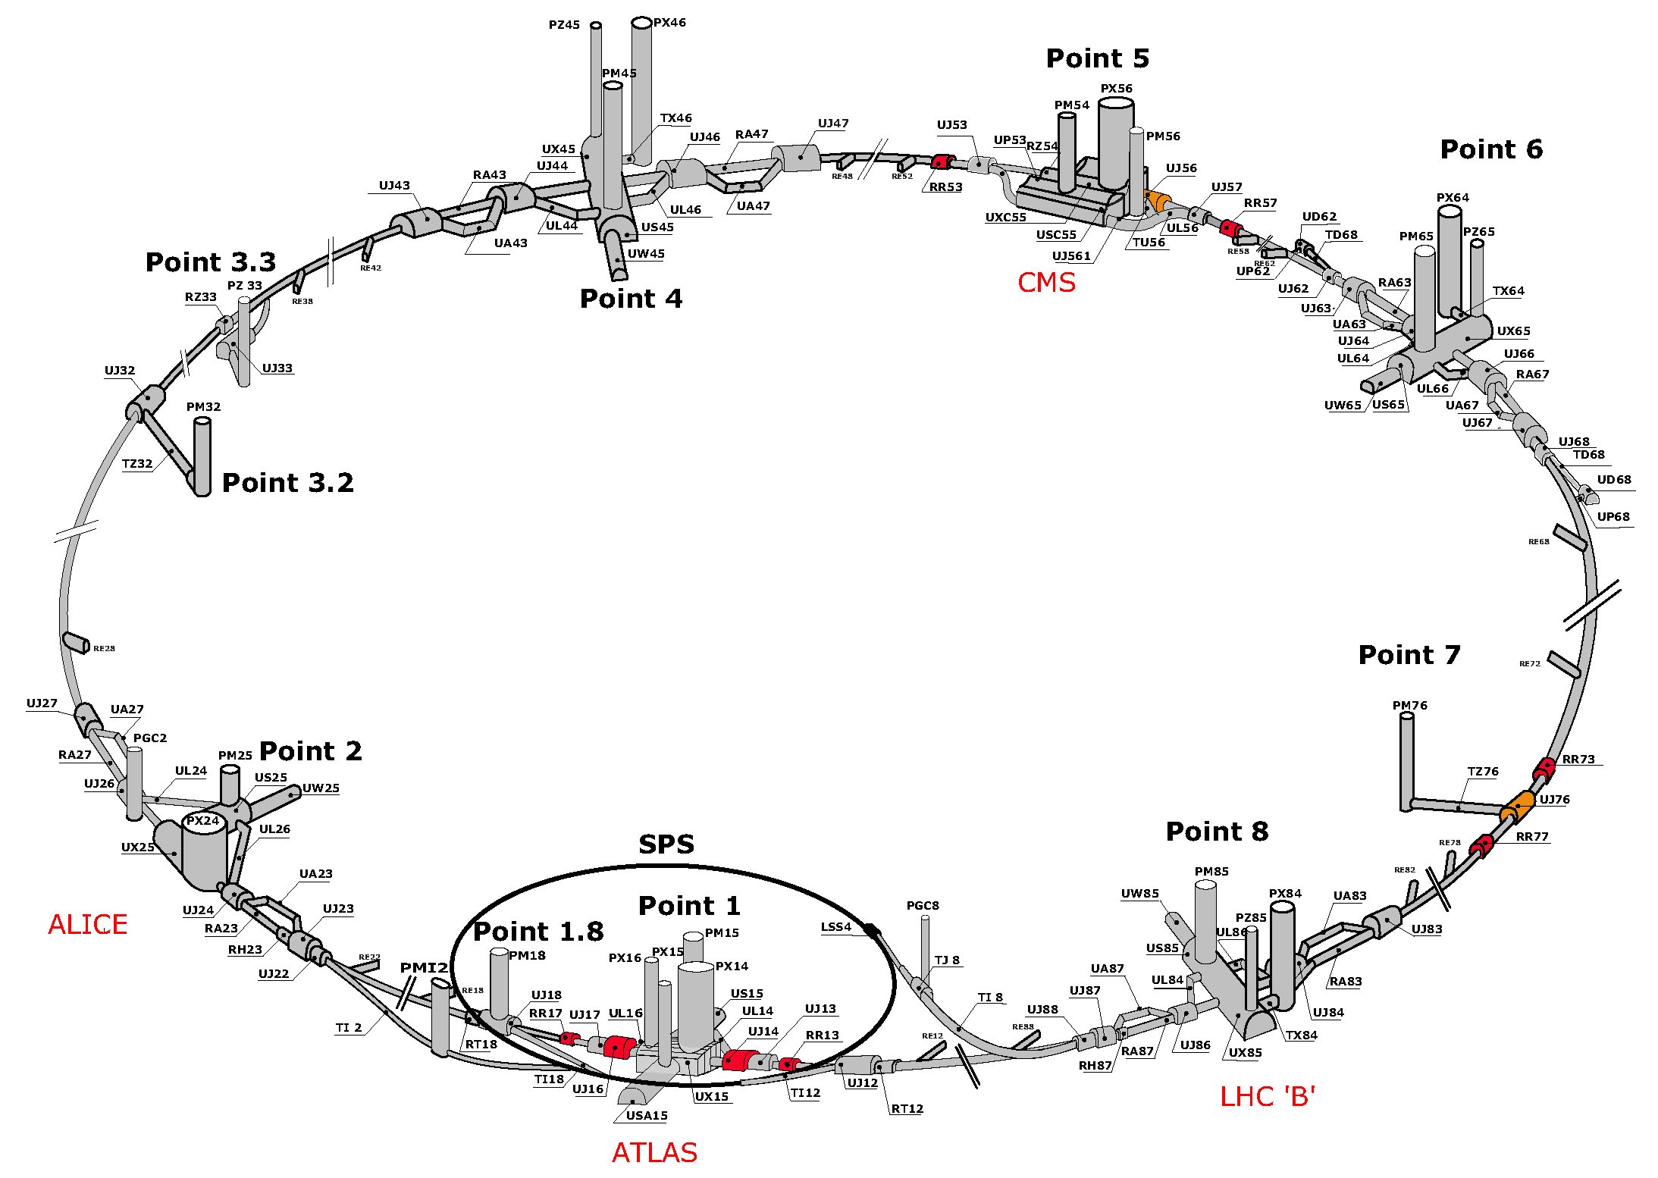
MAP OF THE LHC
!!!

Slide 8
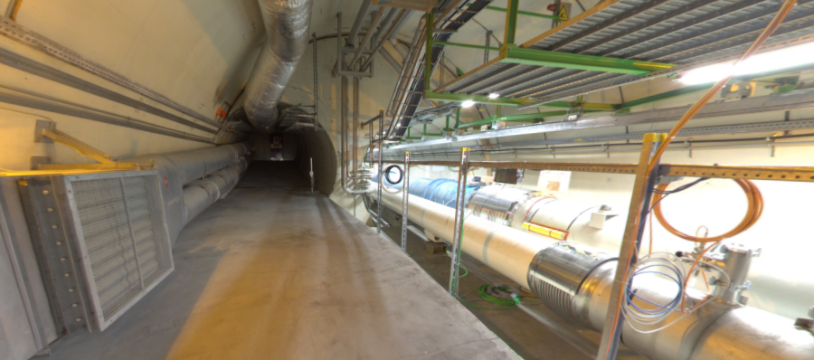
THE FORWARD REGION
Beam collision axis passes
through 100 m of rock, emerges in tunnel TI12, 480 m from ATLAS
UJ12
TI12 near UJ12
The view in UJ12 looking west in 2018
TI12
Beam collision axis
LHC beamline

Slide 9
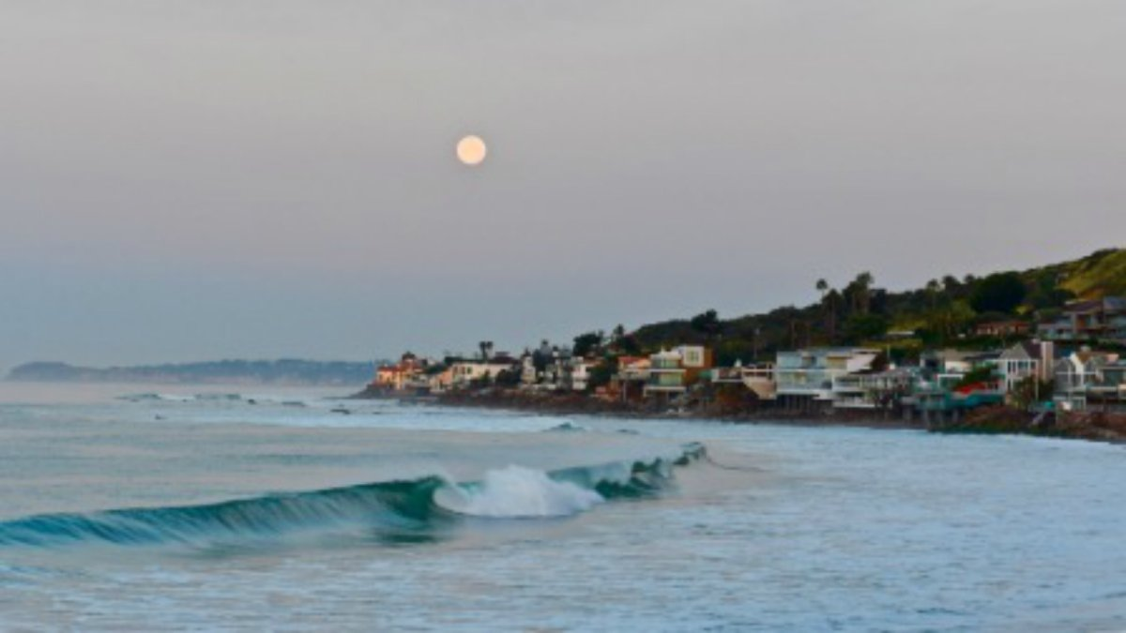
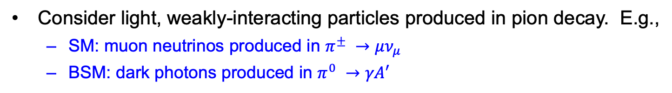
HOW BIG DOES THE DETECTOR HAVE TO BE?
Consider light, weakly-interacting particles produced in pion decay. E.g.,
  SM: muon neutrinos produced in $π^{±} →μν_{μ}$
  BSM: dark photons produced in $π^{0} →γA′$
Momentum:
Space:
250 MeV
1 TeV
12 cm
480 m
The opening angle is 0.2 mrad (the moon is 7 mrad). Even 480 m away, most of the signal passes through an 8.5” x 11” sheet of paper.
Neutrinos and light new particles are therefore extremely collimated, motivating a relatively small, fast, and inexpensive experiment at the LHC: the ForwArd Search ExpeRiment (FASER).

Slide 10
















FASER COLLABORATION
108 collaborators, 27 institutions, 11 countries
International laboratory covered by a cooperation agreement with CERN

Slide 11
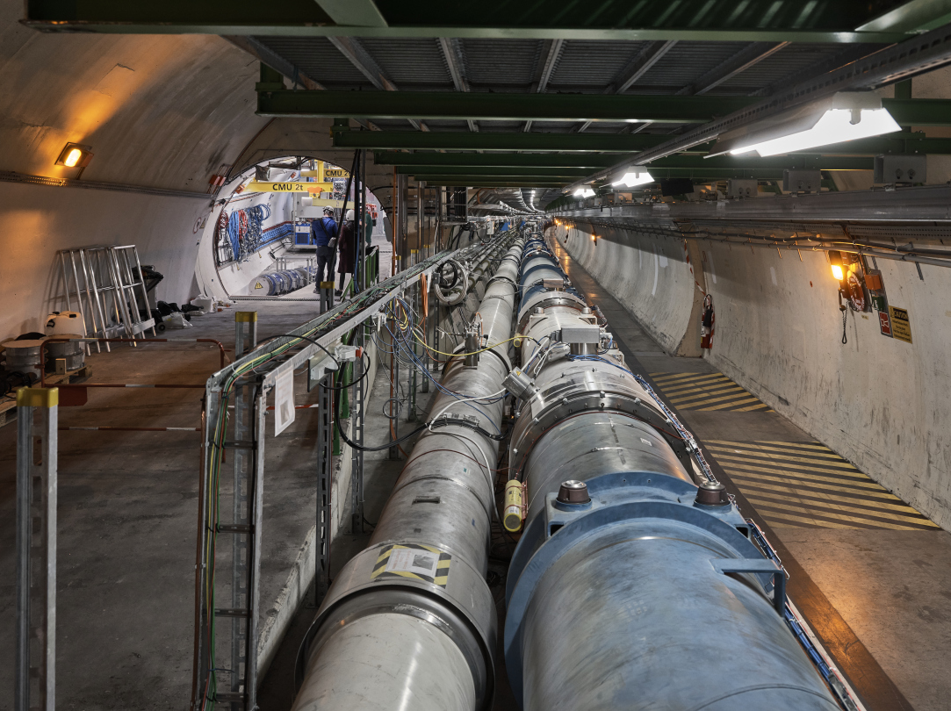
FASER AND THE LHC

Slide 12
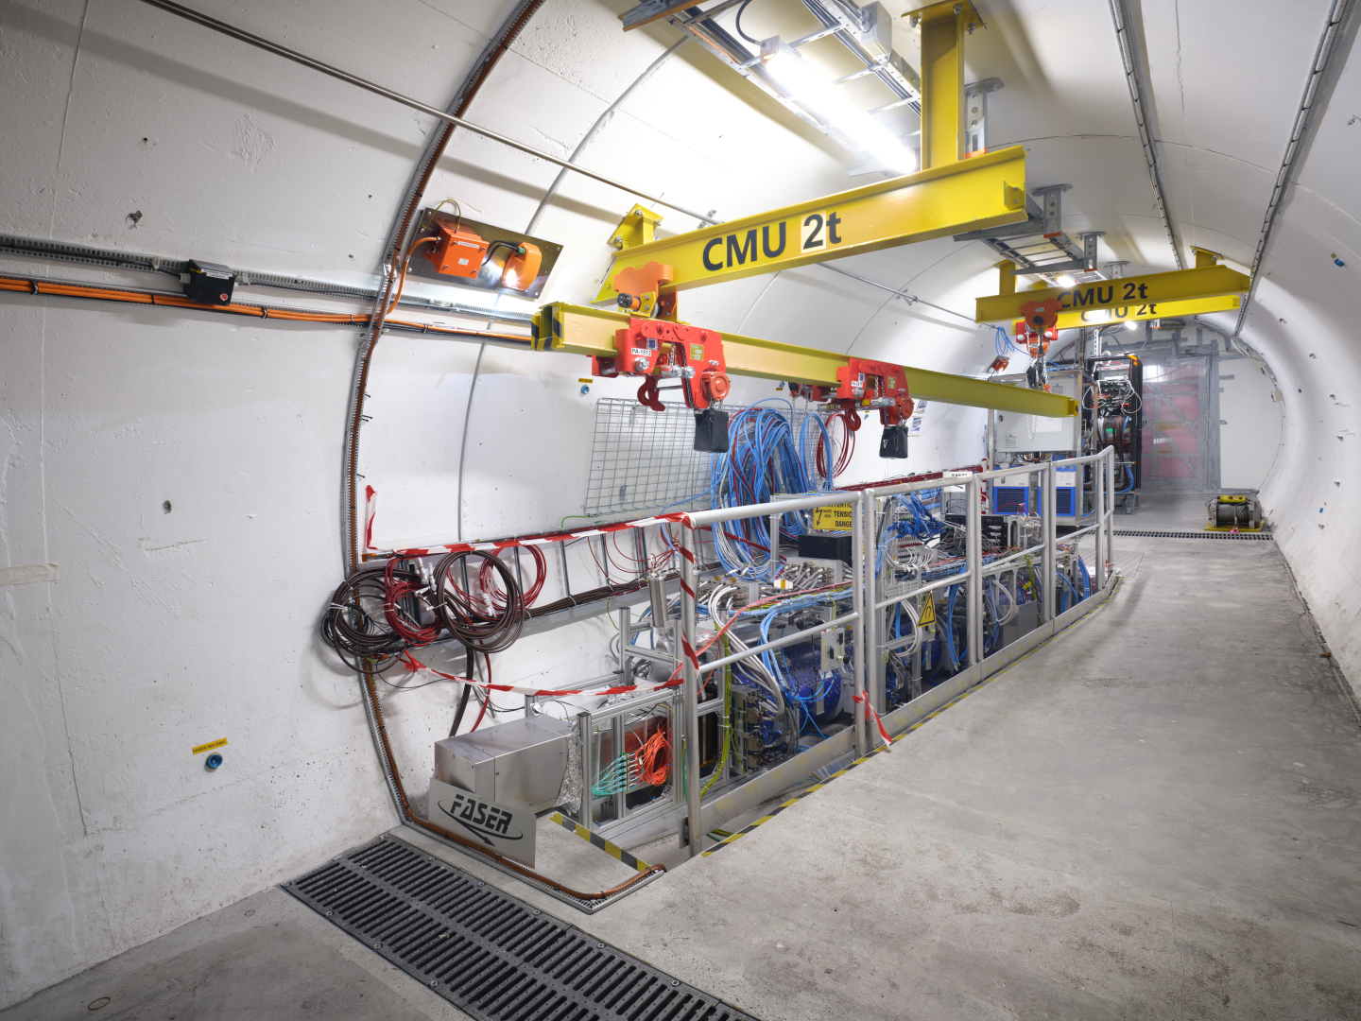
THE FASER DETECTOR

Slide 13
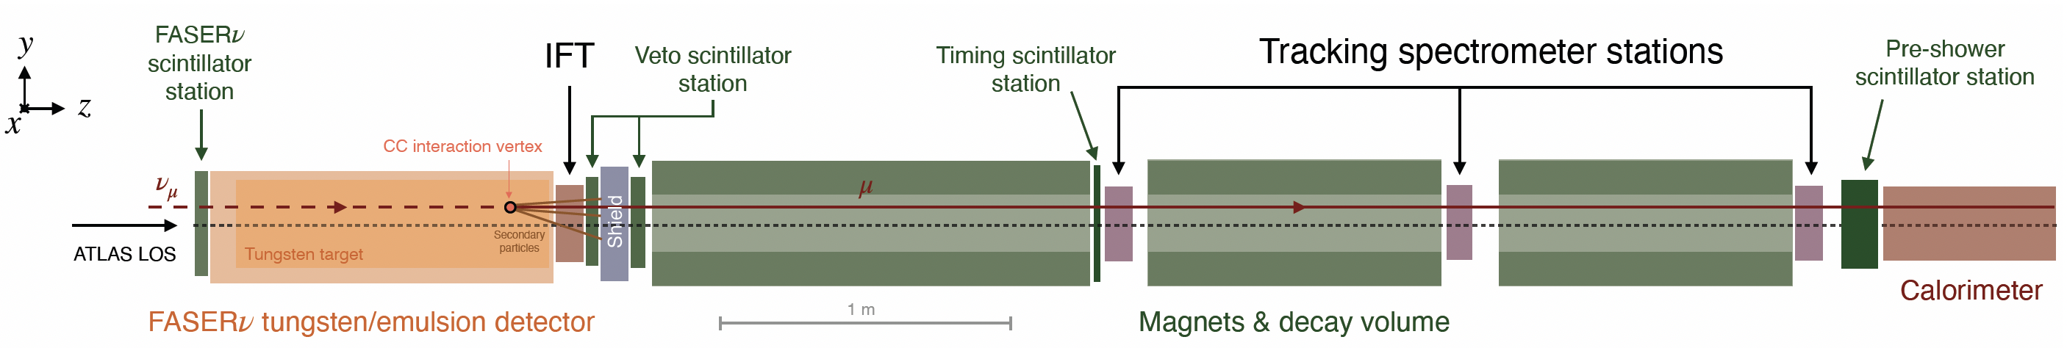
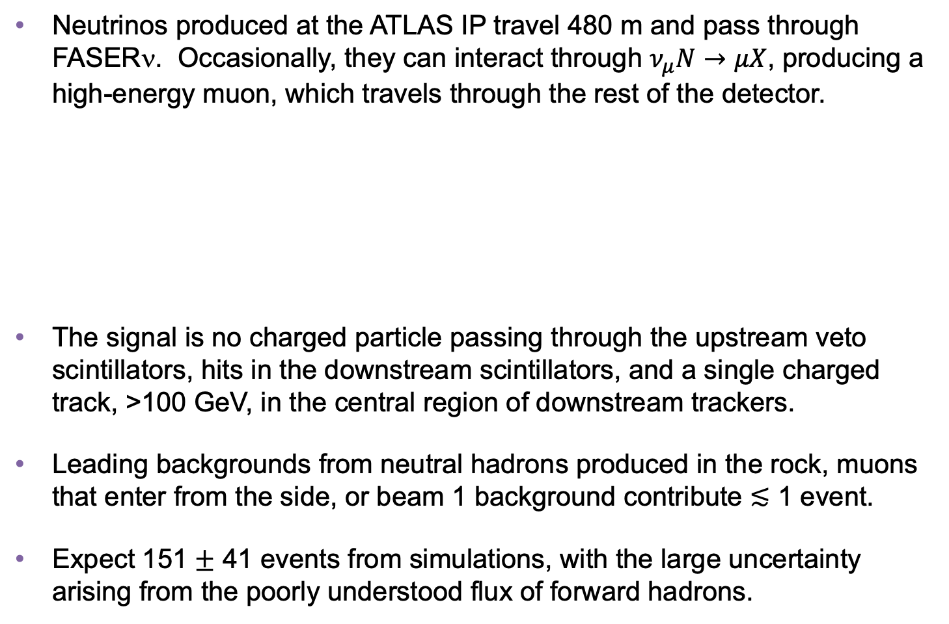
COLLIDER NEUTRINO SEARCH
Neutrinos produced at the ATLAS IP travel 480 m and pass through FASERν. Occasionally, they can interact through $ν_{μ}N→μX$, producing a high-energy muon, which travels through the rest of the detector.
The signal is no charged particle passing through the upstream veto scintillators, hits in the downstream scintillators, and a single charged track, >100 GeV, in the central region of downstream trackers.
Leading backgrounds from neutral hadrons produced in the rock, muons that enter from the side, or beam 1 background contribute $≲$ 1 event.
Expect 151 $±$ 41 events from simulations, with the large uncertainty arising from the poorly understood flux of forward hadrons.
FASER Collaboration (2303.14185, PRL)
Notes:
typical A’ that decays in FASER has ~TeV energy

Slide 14
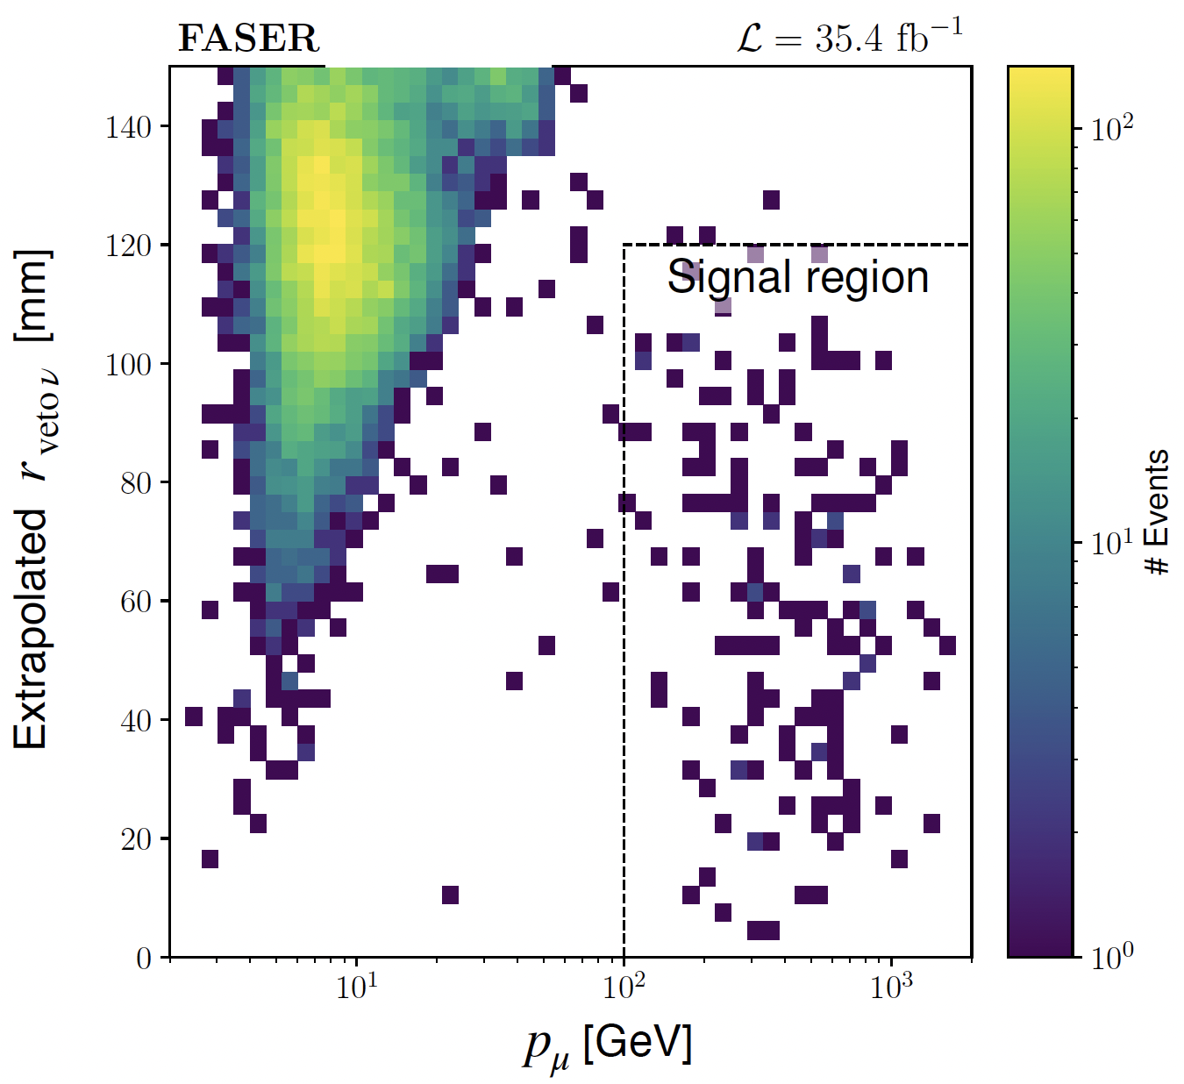
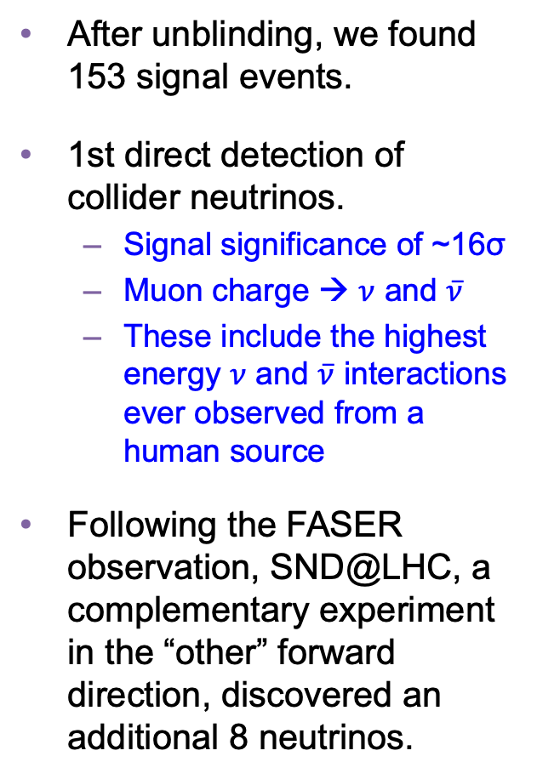
COLLIDER NEUTRINO RESULTS
After unblinding, we found 153 signal events.
1st direct detection of collider neutrinos.
  Signal significance of ~16σ
  Muon charge → $ν$ and $\overline{ν}$
  These include the highest energy $ν$ and $\overline{ν}$ interactions ever observed from a human source
Following the FASER observation, SND@LHC, a complementary experiment in the “other” forward direction, discovered an additional 8 neutrinos.
FASER Collaboration (2303.14185, PRL)

Slide 15
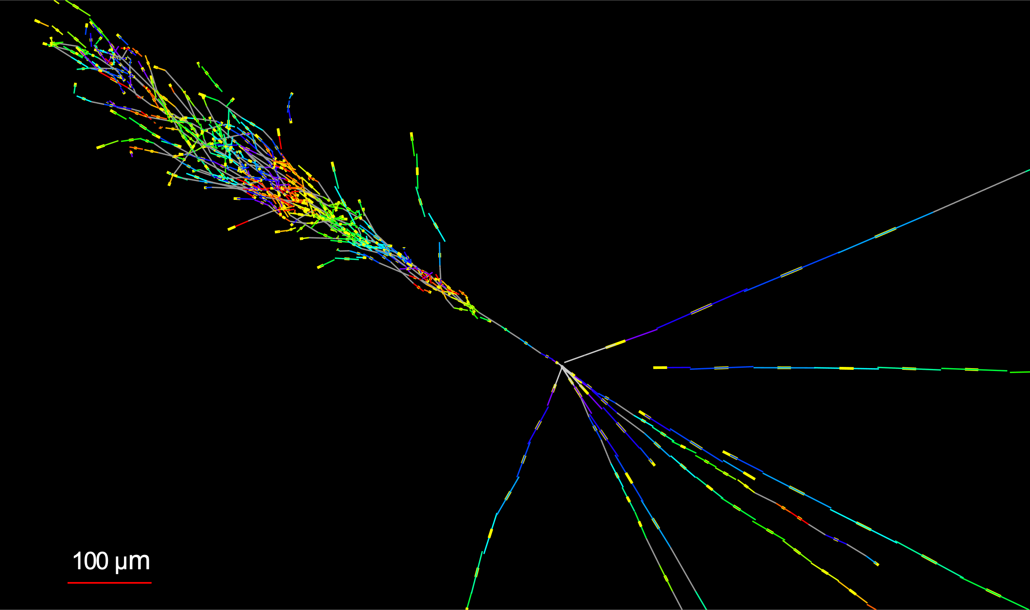

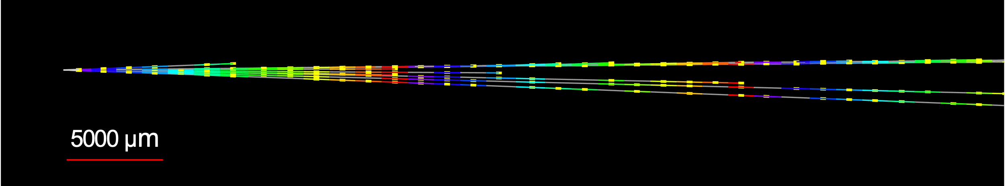


NEUTRINOS FROM EMULSION IN FASERν
The discovery analysis did not even use the emulsion detector! With the emulsion, we have now observed the first collider electron neutrinos, including the “Pika-$ν$” event, the highest energy (1.5 TeV) electron neutrino from a lab source.
Side View
Vertex with 11 tracks
  615 µm inside tungsten
e-like track from vertex
  Single track for 2X₀
  Shower max @ 7.8Χ₀
  θ_{e} = 11 mrad to beam
Back-to-back topology
  175° between e & rest
$$e$$
Beam View
FASER Collaboration (2403.12520)

Slide 16
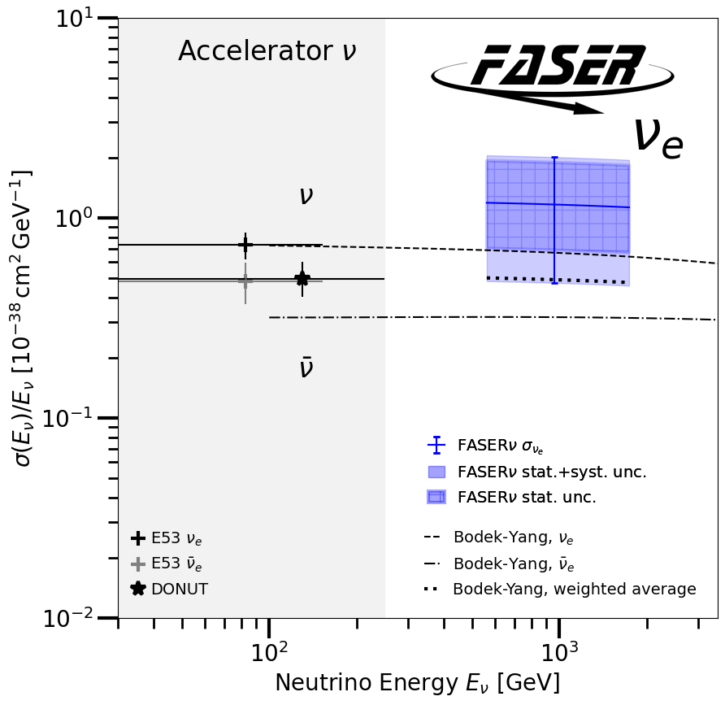
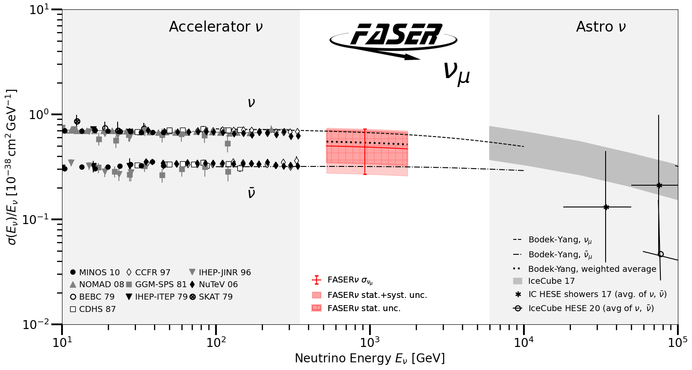
TEV NEUTRINO CROSS SECTIONS
Following these discoveries, we can then move on to studies, including the first measurement of neutrino cross sections at TeV energies.
Results are consistent with SM DIS predictions.
Xie, Gao, Hobbs, Stump, Yuan (2024)
These measurements use only 1.7% of the data collected in 2022 and 2023.
FASER Collaboration (2403.12520)

Slide 17
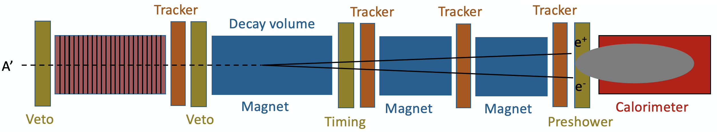
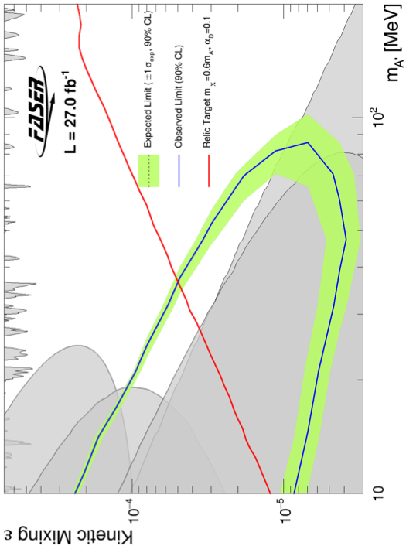
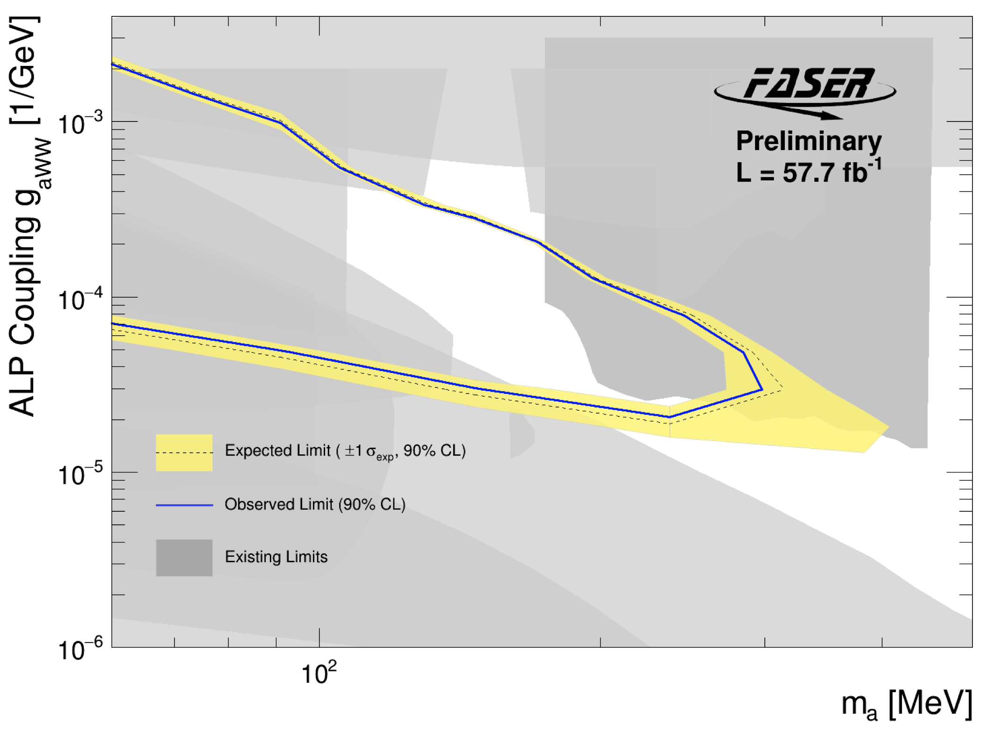

NEW PARTICLE SEARCHES
FASER is also sensitive to an entire zoo of light, weakly-interacting new particles. For example:
  Dark photons produced through $π/η→A^{′}γ$ or $pp→{ppA}^{′},$then decay $A^{′}$ $→ e^{+}e^{−}$.
  ALPs coupled to Ws, produced through $B→K a$, then decay $a$ $→γγ$.
FASER started probing new parameter space after 1 day of LHC running.
FASER Collaboration (2308.05587, PLB)
FASER Collaboration (CERN-FASER-CONF-2024-001)
Notes:
typical A’ that decays in FASER has ~TeV energy

Slide 18
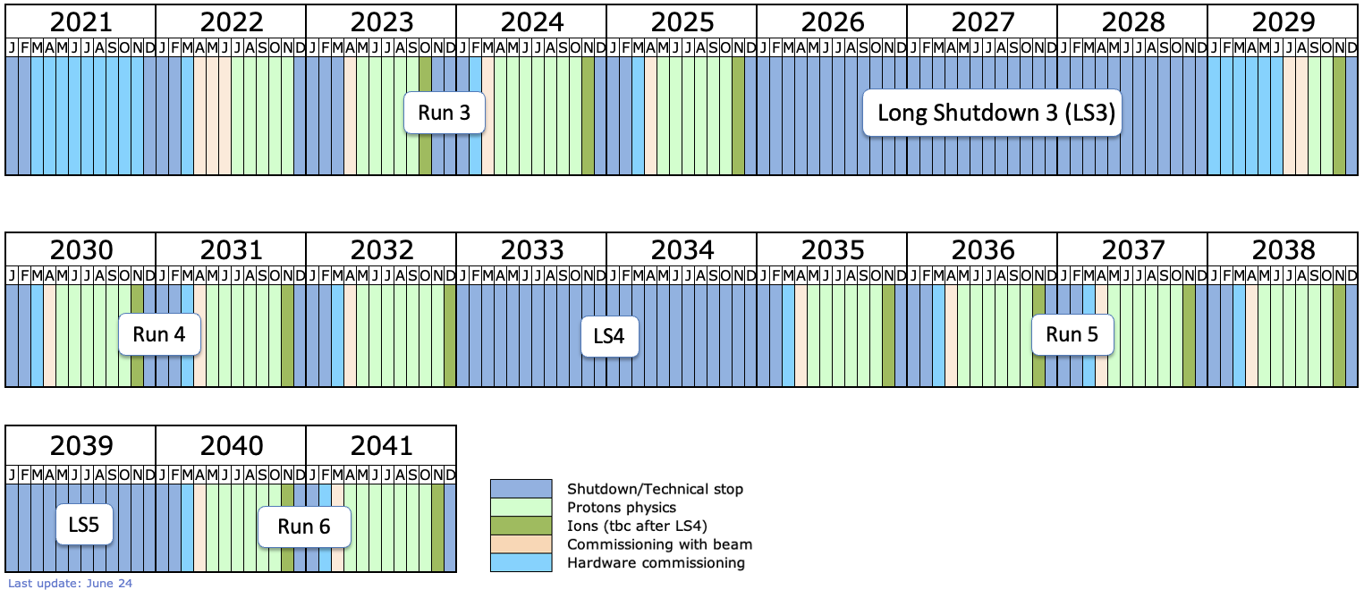
WHAT’S NEXT
FASER is running now, will collect data through the rest of 2024 and 2025 (and 2026, if LS3 is delayed), for a total of ~300 fb⁻¹.
FASER is approved for LHC Run 4, when High-Luminosity LHC running will add ~700 fb⁻¹, with various detector upgrades in the works.
For the rest of the HL-LHC era, the proposed Forward Physics Facility, will enable the LHC to fully realize the potential of forward physics.

Slide 19
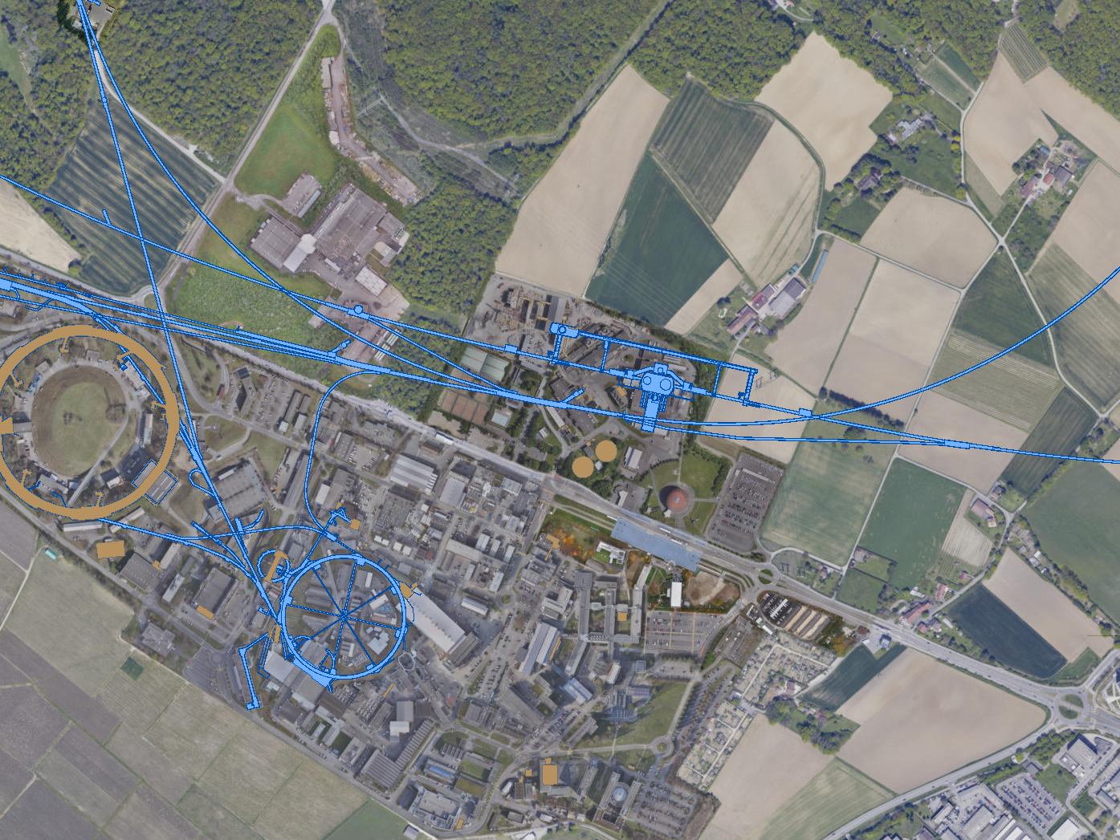
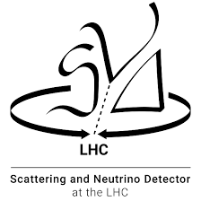

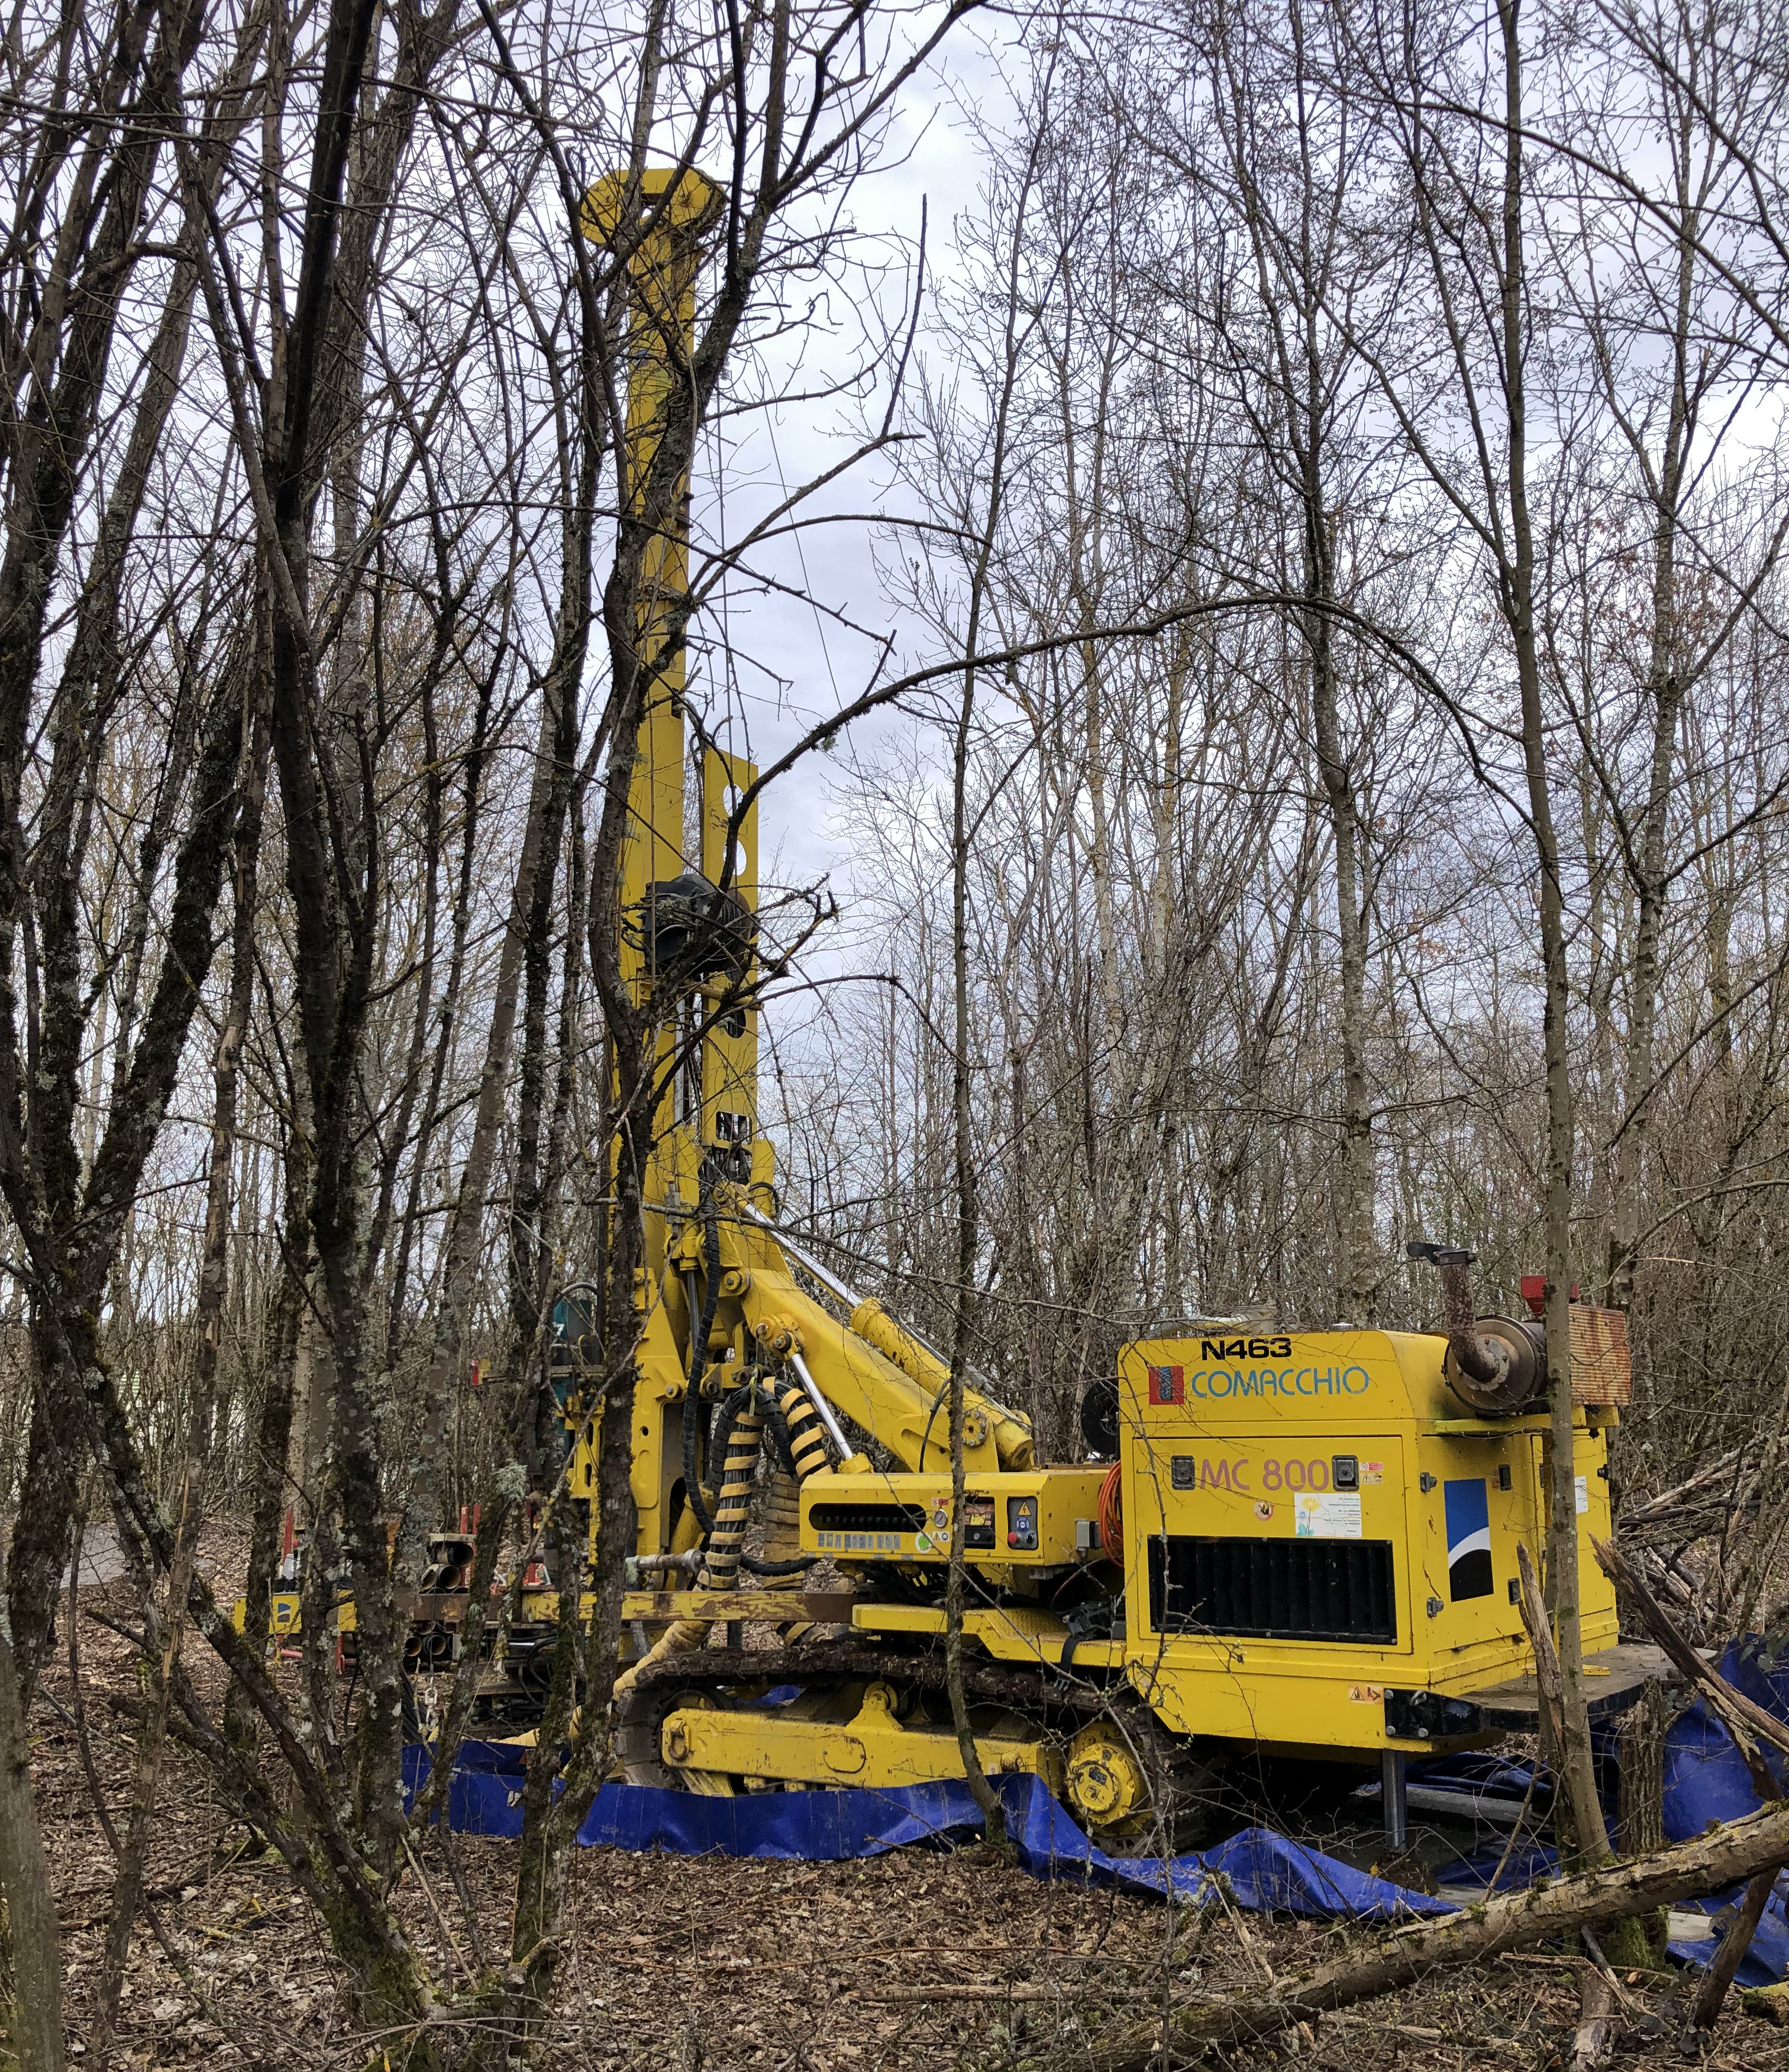

FORWARD PHYSICS FACILITY
Following the results of FASER and SND@LHC, CERN is considering the possibility of creating a dedicated Forward Physics Facility to house far-forward experiments for the rest of the LHC era from 2028-2040s.
UJ18
ATLAS
SPS
LHC
LOS
FPF site selection study and core study have identified an ideal site in France just outside the CERN main gate
https://cds.cern.ch/record/2851822
CERN GIS

Slide 20
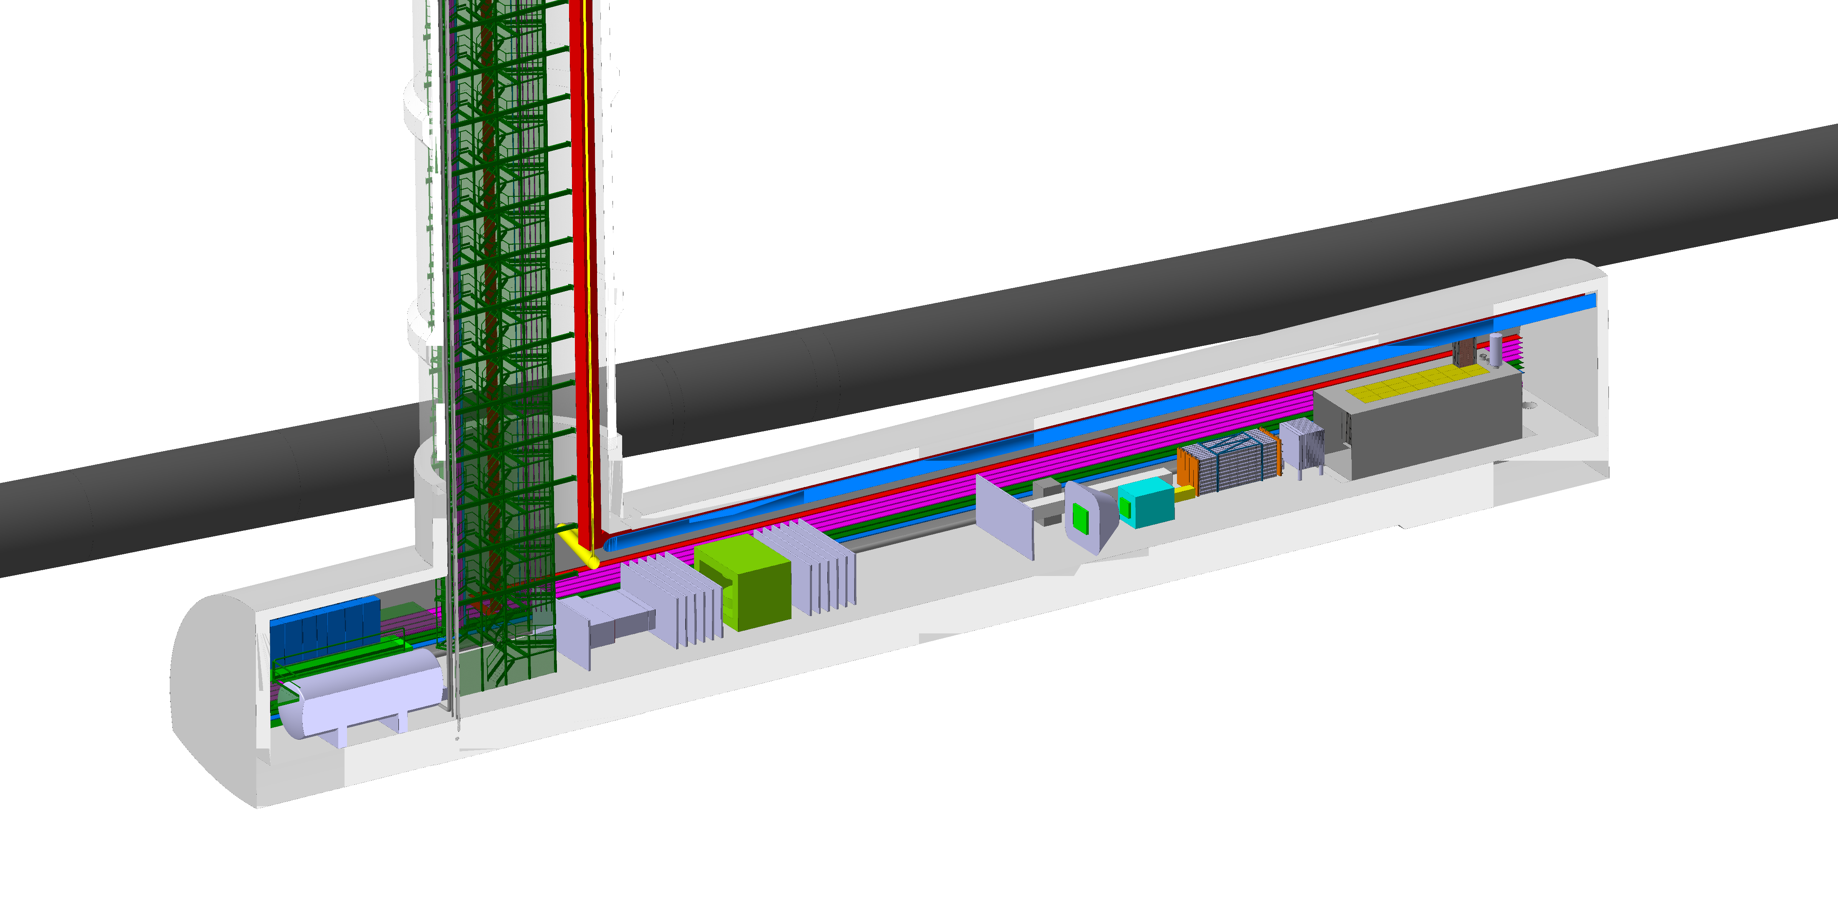
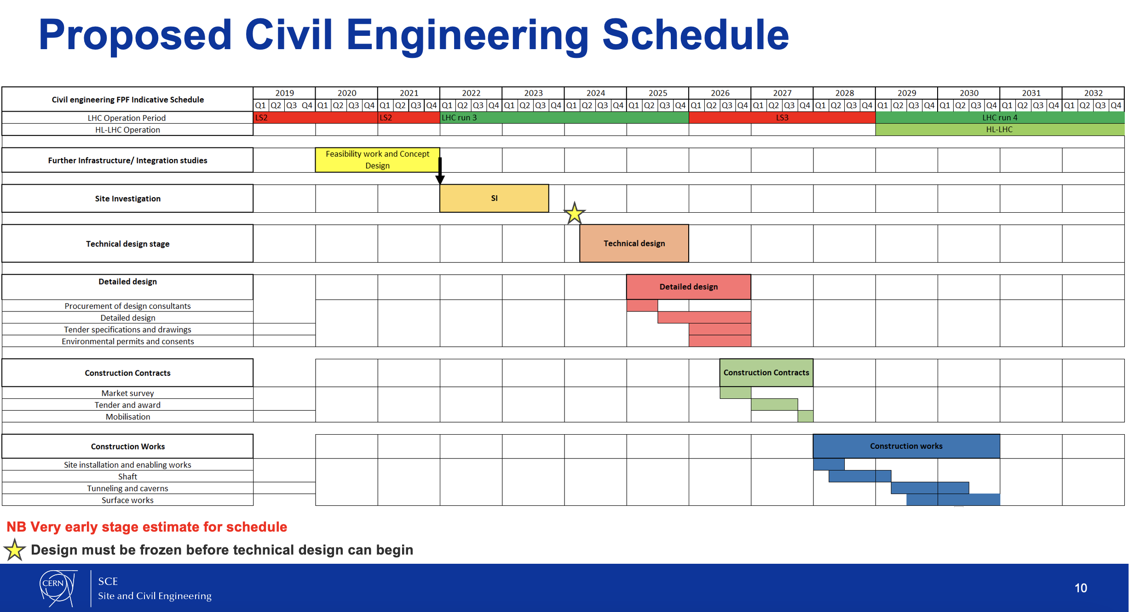
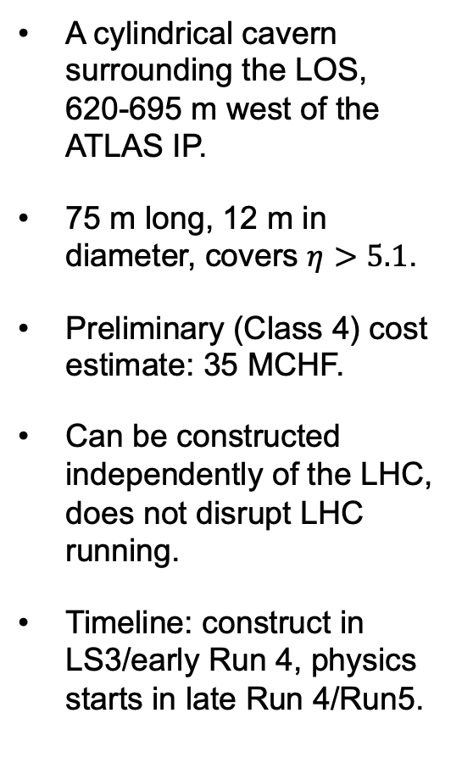
THE FACILITY
A cylindrical cavern surrounding the LOS, 620-695 m west of the ATLAS IP.
75 m long, 12 m in diameter, covers $η>5.1$.
Preliminary (Class 4) cost estimate: 35 MCHF.
Can be constructed independently of the LHC, does not disrupt LHC running.
Timeline: construct in LS3/early Run 4, physics starts in late Run 4/Run5.
Bud, Magazinik, Pál, Osborne, et al. CERN CE (2024)

Slide 21
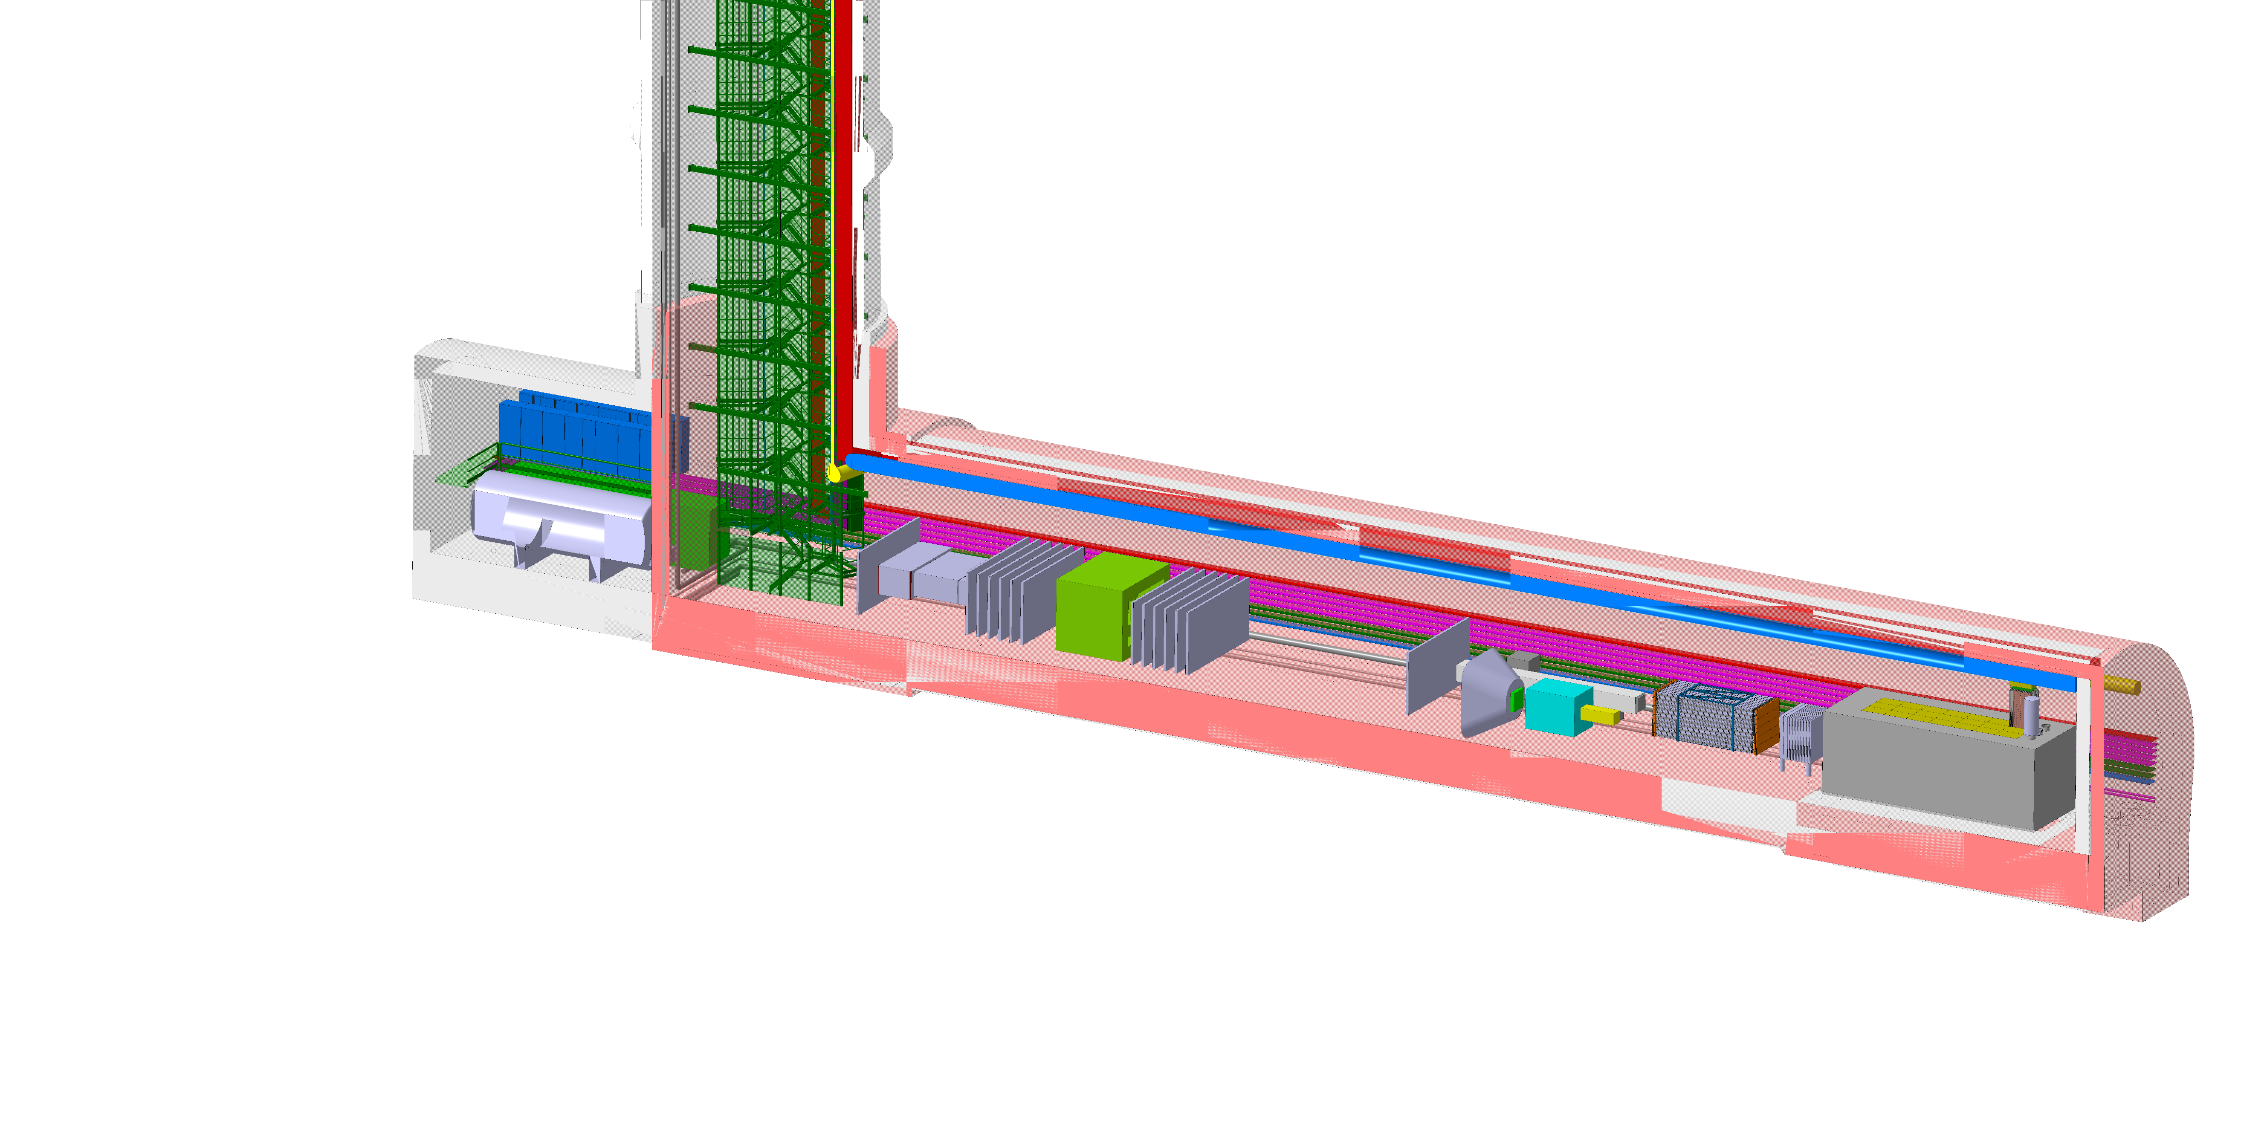
FPF EXPERIMENTS
At present there are 4 experiments being designed for the FPF
  FASER2: magnetized spectrometer for BSM searches
  FASERν2: emulsion-based neutrino detector
  FLArE: LArTPC neutrino detector
  FORMOSA: scintillator array for BSM searches (successor to MilliQan)
These represent a huge jump relative to the existing experiments:
  10,000 times greater (decay volume * luminosity) for BSM searches, unique discovery potential in many models of dark matter and new particles.

Slide 22
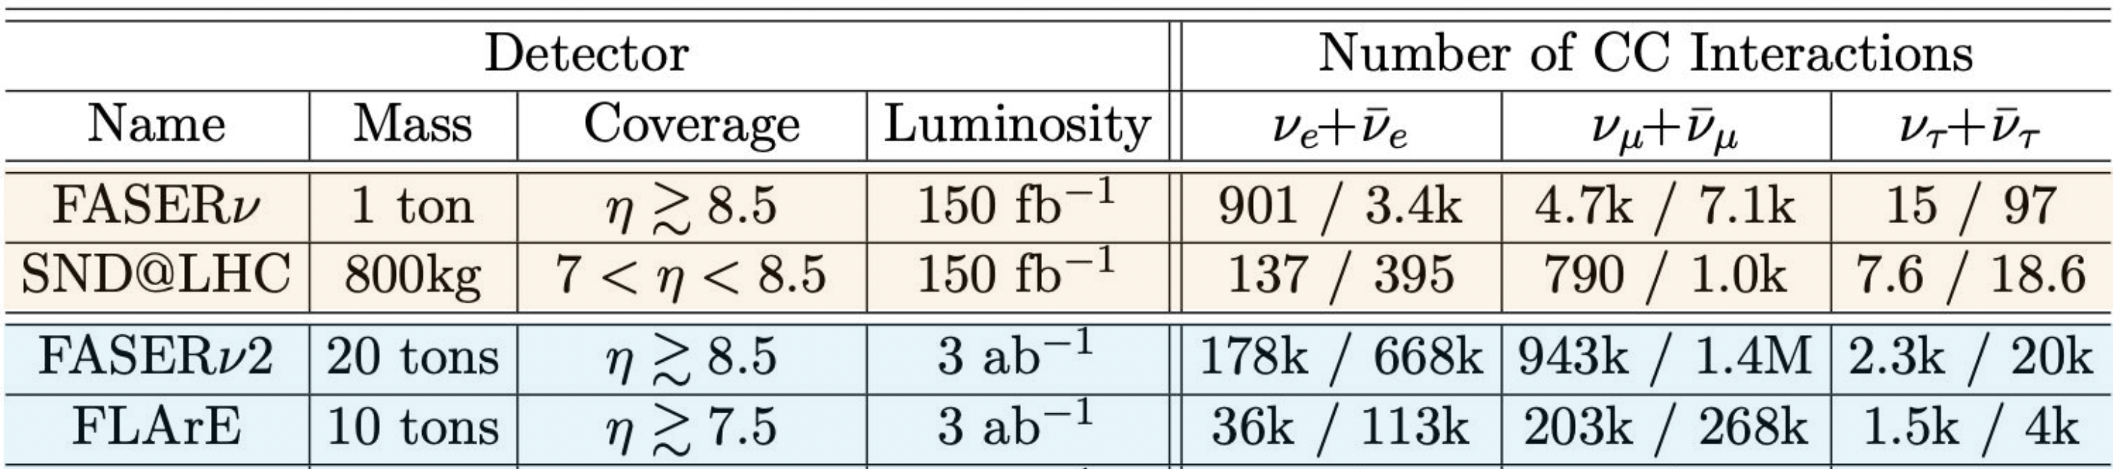
IMPLICATIONS FOR ASTROPARTICLE PHYSICS
Current and future LHC neutrino detectors will detect many neutrinos, determine their flavor, and distinguish nu from anti-nu (at least for mu and tau)
Current LHC neutrino detectors: ~10,000 TeV neutrinos
Future LHC neutrino detectors: ~1,000,000 TeV neutrinos (~1,000 per day!)
What can we do with these?
Many interesting probes of neutrino properties, QCD, and complementarities with IceCube and other astroparticle experiments.
FPF WG4 conveners: Luis Anchordoqui, Dennis Soldin
Other FPF workshop participants: Halzen, Engel, Pierog, Fedynitch, Sarkar, Lu, …
Kling, Nevay (2021); FASER Collaboration (2024)

Slide 23
PRODUCTION, PROPAGATION, INTERACTION
The large statistics will allow for double differential event rates as a function of energy and pseudorapidity for each neutrino flavor.
These differential distributions probe a vast number of interconnected topics.
Rojo (2024)

Slide 24
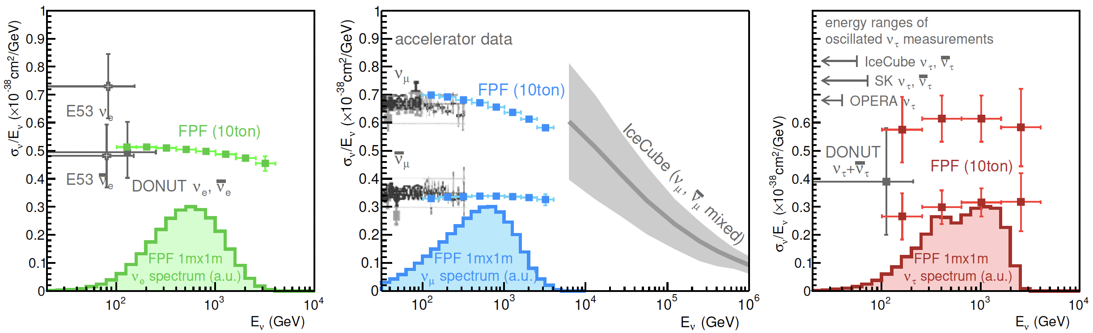
NEUTRINO PROPERTIES
Assuming known forward hadron production, the large event rates will enable precise measurements of neutrino interaction cross section at TeV energies between fixed target experiments and IceCube.
Can confirm neutrino deep-inelastic scattering or test non-standard neutrino interactions, enable precision tau neutrino studies.

Slide 25
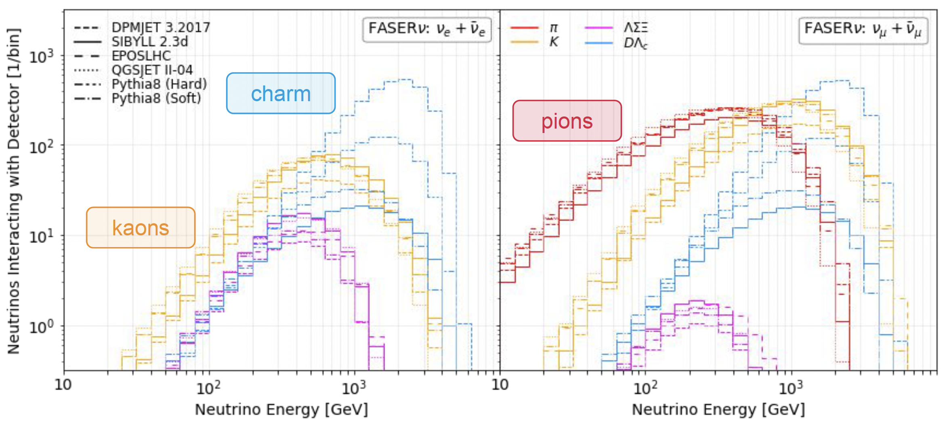
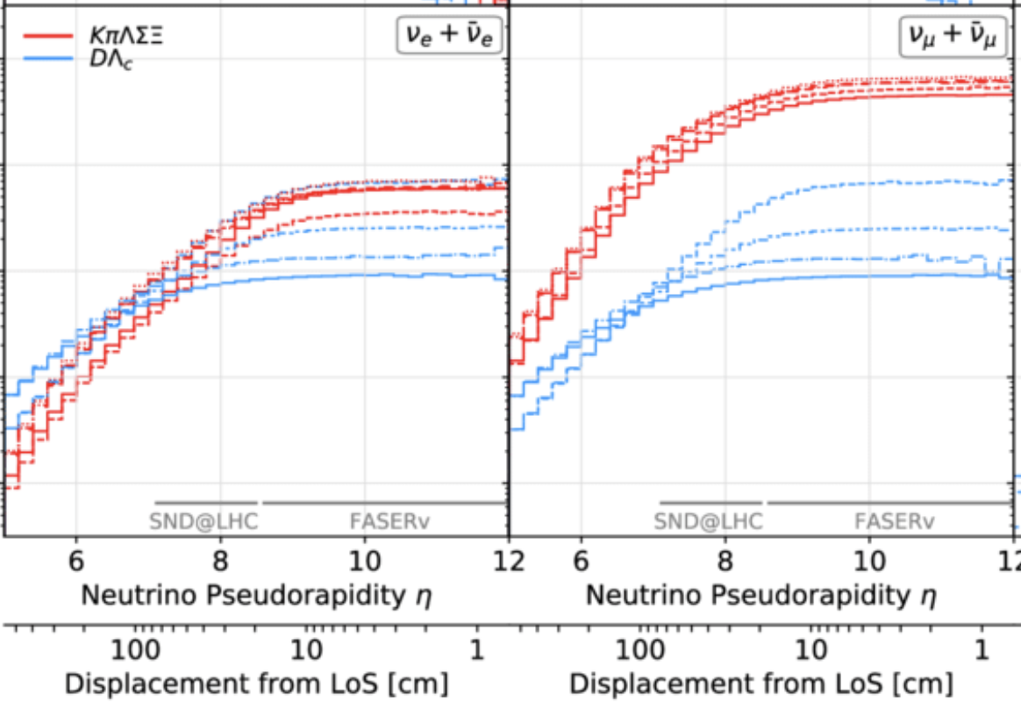
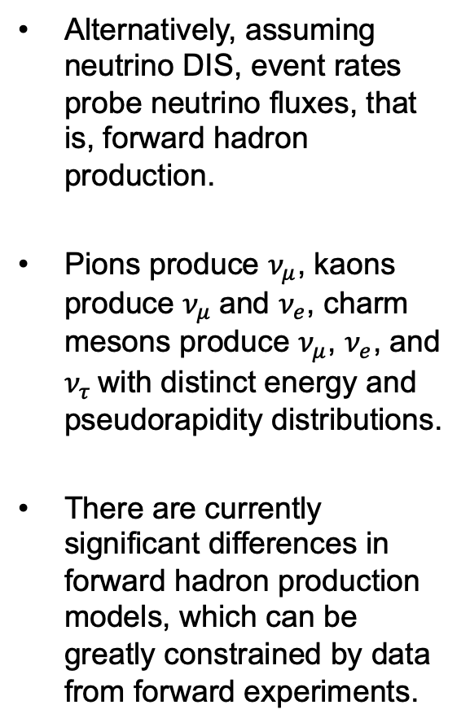
NEUTRINOS AS TRACERS OF HADRON PRODUCTION
Alternatively, assuming neutrino DIS, event rates probe neutrino fluxes, that is, forward hadron production.
Pions produce $ν_{μ}$, kaons produce $ν_{μ}$and $ν_{e}$, charm mesons produce $ν_{μ}$, $ν_{e}$, and $ν_{τ}$with distinct energy and pseudorapidity distributions.
There are currently significant differences in forward hadron production models, which can be greatly constrained by data from forward experiments.
Kling, Nevay (2021)

Slide 26
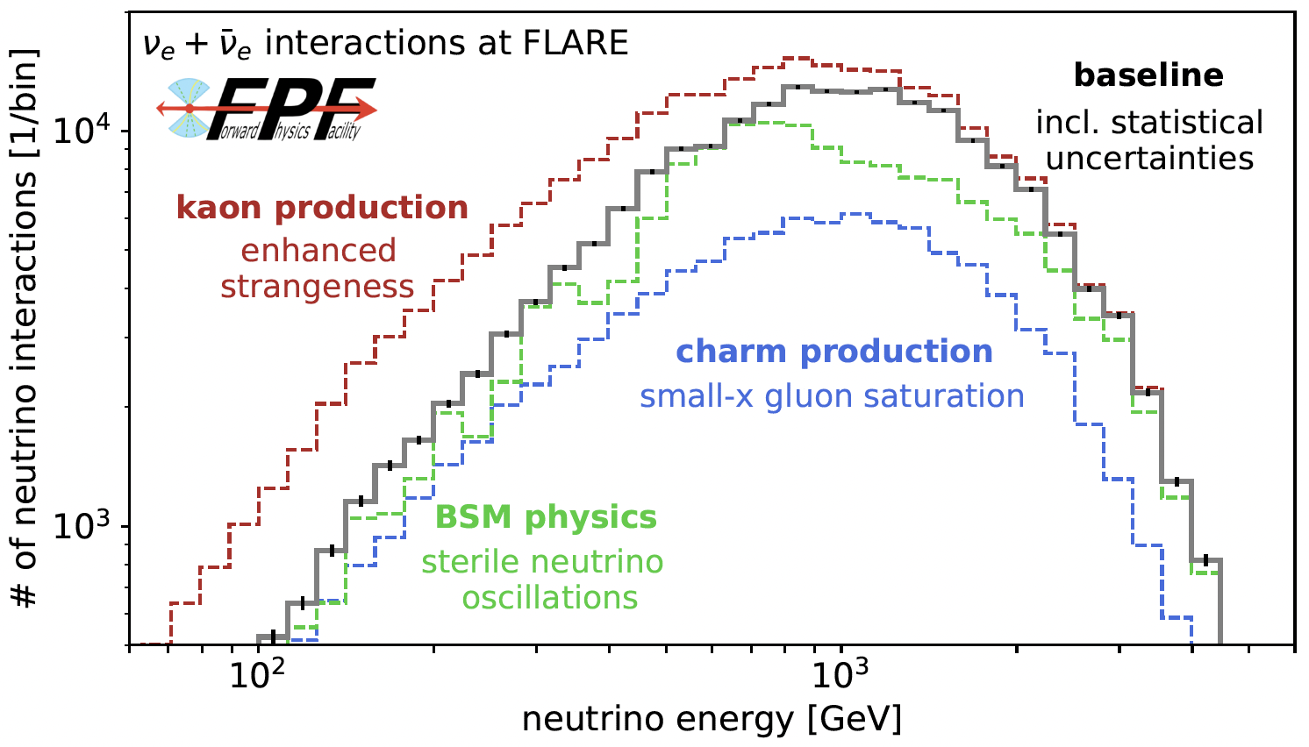
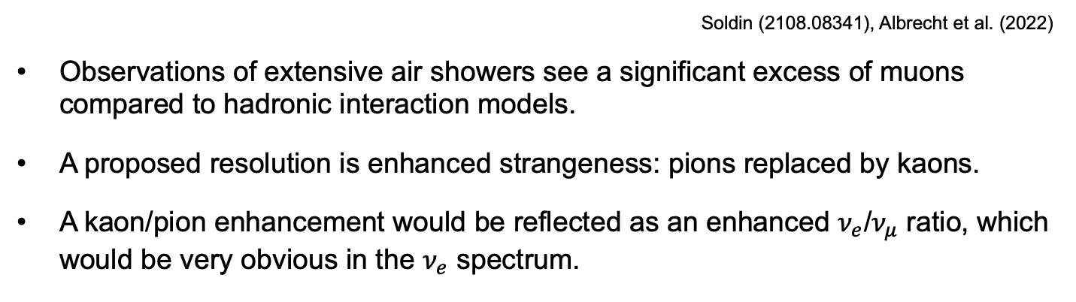
LIGHT FLAVORS AND COSMIC MUON PUZZLE
Soldin (2108.08341), Albrecht et al. (2022)
Observations of extensive air showers see a significant excess of muons compared to hadronic interaction models.
A proposed resolution is enhanced strangeness: pions replaced by kaons.
A kaon/pion enhancement would be reflected as an enhanced $ν_{e}$/$ν_{μ}$ ratio, which would be very obvious in the $ν_{e}$ spectrum.
Anchordoqui, Garcia Canal, Kling, Sciutto, Soriano (2022)

Slide 27
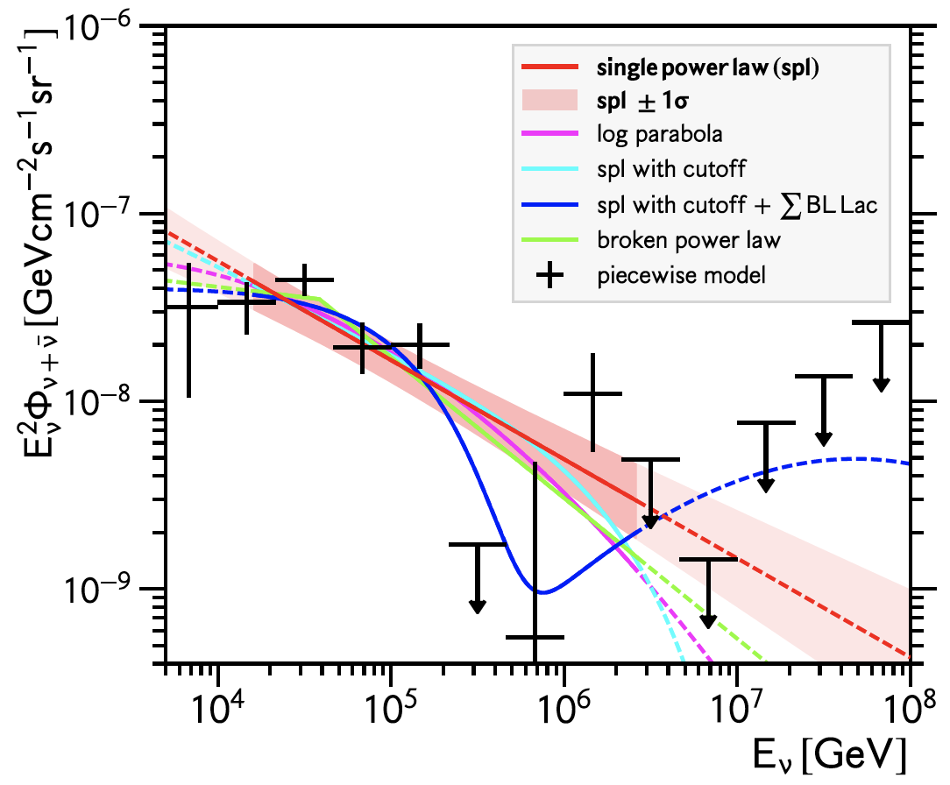




CHARM AND PROMPT ATMOSPHERIC NEUTRINOS
Prompt atmospheric neutrino production is a difficult background to extragalactic astrophysical neutrinos at IceCube, with similar zenith angle distribution (isotropic).
$gg →cc$is perturbative, but a leading uncertainty is the gluon pdf at small x. This can be measured in the controlled environment of a collider if
IceCube (2001.09520)
  $\sqrt{s} \sim \sqrt{2E_{ν}m_{p}} \sim$10 TeV for $E_{ν} \sim$10⁷ GeV : Requires the energy of the LHC
  $x_{1,2} \sim \frac{m_{c}}{\sqrt{s}} e^{±η} ⇒ η \sim$ 7 to 9 : Requires the far forward angular coverage of the FPF
$$4m_{c}^{2 }\sim x_{1}x_{2}s$$
FASER White Paper (2022); Rojo et al. (2024)

Slide 28
SUMMARY
The forward region, previously thought of as uninteresting, is in fact a treasure trove of interesting physics.
  Collider neutrinos at TeV energies, with implications for neutrino properties, QCD, and astroparticle physics.
  Unique searches for new light, weakly-interacting particles and other BSM particles, including many motivated by dark matter.
Particularly interesting interplay with astroparticle physics, will shed light on forward hadron interaction models, the cosmic muon puzzle, prompt atmospheric neutrinos, …
FASER and SND@LHC are currently operating, with many more results to come. The proposed Forward Physics Facility will be able to fully realize the LHC’s forward physics potential in the HL-LHC era from 2028-2042.

