Slide 1




MULTI-MESSENGER
COLLIDER PHYSICS AT THE
DPF-PHENO 2024: Mini-Symposium on Forward Physics
Jonathan Feng, UC Irvine, 15 May 2024

Slide 2
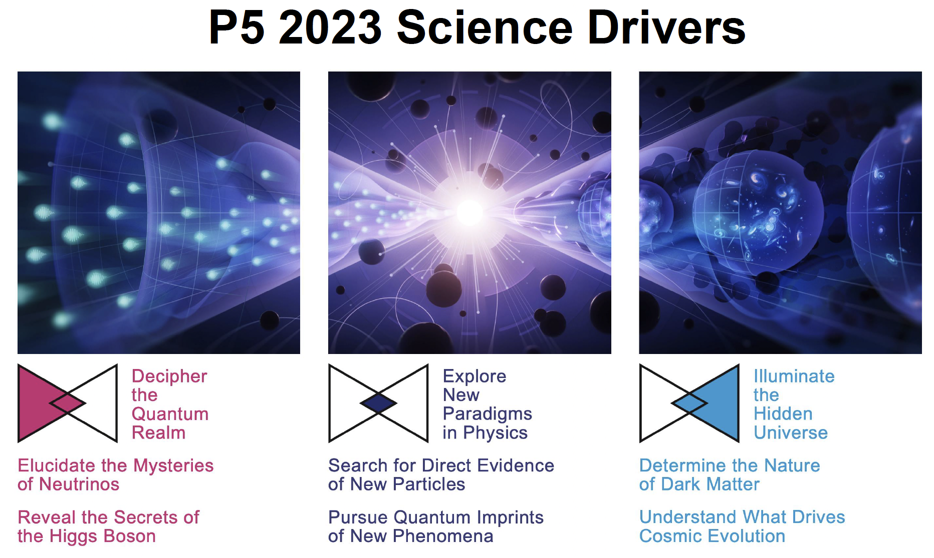
EXECUTIVE SUMMARY
In the last few years, there has been a complete transformation in our understanding of forward physics at colliders.
Previously: luminosity measurements, pomerons, odderons, …
Now: we understand that the forward region contains a treasure trove of both SM and BSM physics, addressing all of our top science drivers.
We have entered the era of multi-messenger collider physics with the discovery of collider neutrinos.
To fully exploit the physics potential of the LHC, neutrino detectors are required, just like trackers and calorimeters. The Forward Physics Facility is proposed to house a suite of such detectors at the HL-LHC.

Slide 3
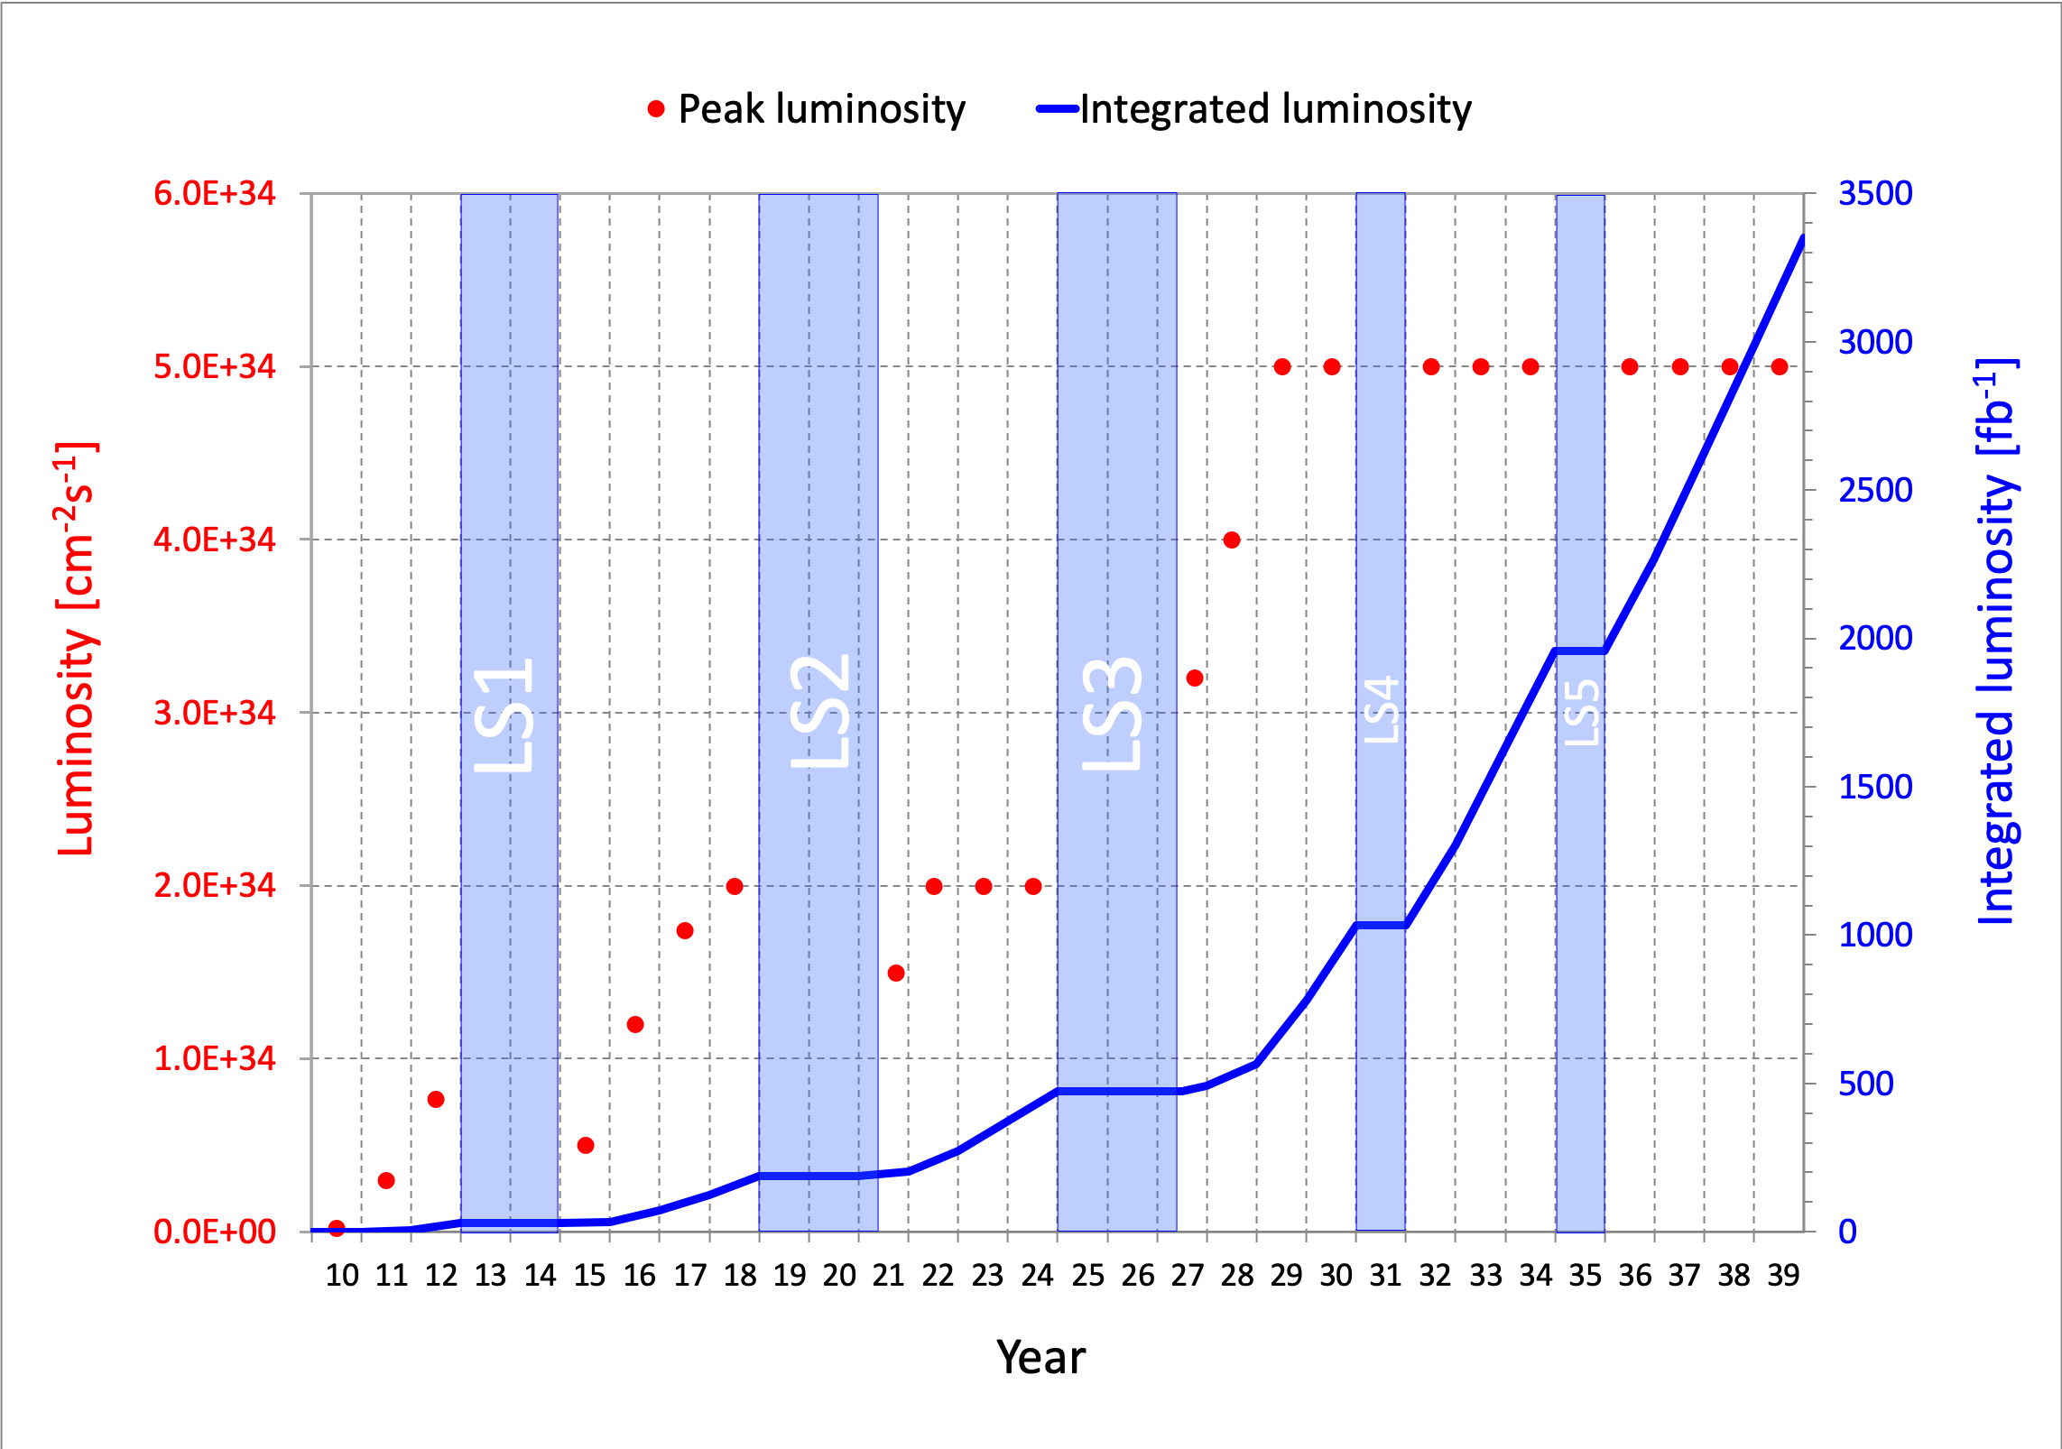
LIFETIME OF THE LHC
The LHC is an amazing achievement.
While we are planning for colliders to build in the rest of the century, we should also make sure we are using the LHC well. By doing so, we advance physics now, and we may also discover something new that will greatly clarify and smooth the path forward.
The LHC is still in its youth!
  a postdoc in terms of years
  a kindergartener in terms of integrated luminosity
Are we using the LHC to its full potential? If not, what can we do to enhance its discovery prospects?
COVID

Slide 4
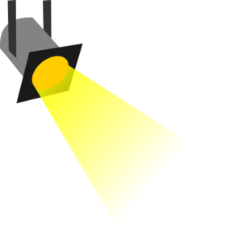
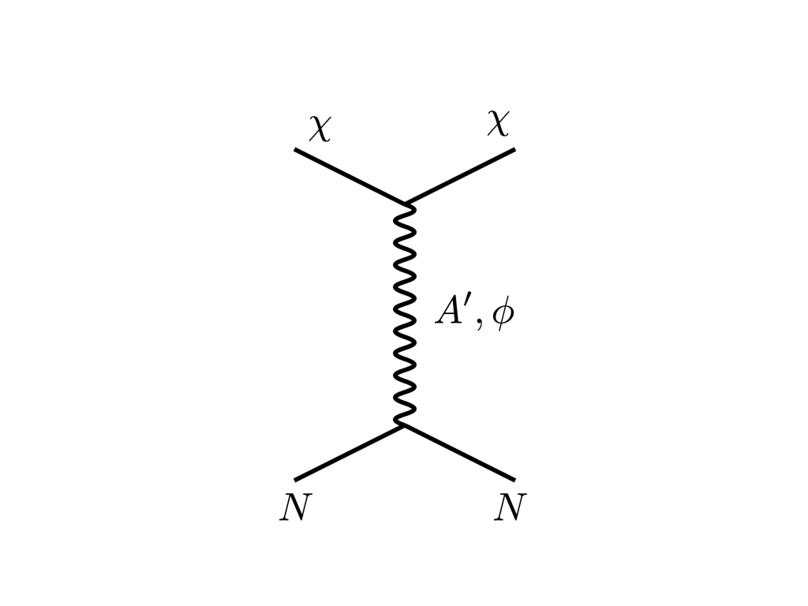






THE PARTICLE LANDSCAPE
Particle
Colliders
Mass
MeV
GeV
TeV
1
Already
Discovered
Strongly Interacting
Heavy Particles
Too Little to be
Dark Matter
$$e$$
DM
$$ε$$
$$A’$$
$$ε$$
Interaction Strength
Just Right to
be Dark Matter
10⁻³
DM
$$e$$
<$σv$> ~ $\frac{ε^{2}}{m_{A′}^{2}}$
Weakly Interacting
Light Particles
Impossible to
Discover
10⁻⁶
Too Much to be
Dark Matter
Boehm, Fayet (2003)
Pospelov, Ritz, Voloshin (2007)
Feng, Kumar (2008)

Slide 5

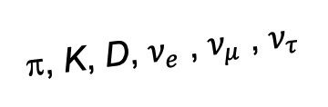
FORWARD PHYSICS
We now know that the large LHC detectors, while beautifully optimized to discover and study heavy particles, are not at all optimally configured to discover and study light particles.
Heavy particles (W, Z, t, h, …) are produced ~slow, decay ~isotropically.
But high-energy light particles are dominantly produced in the forward direction and escape through the blind spots of these large detectors.
  This is true for all known light particles, including neutrinos, which had never been directly detected at a collider before 2023.
  It is also true for many proposed new particles, especially those motivated by neutrino mass and dark matter.
These blind spots are the Achilles heels of the large LHC detectors.
Feng, Galon, Kling, Trojanowski (2017)
A’, a, mCPs, χ, …
π, K, D, $ν_{e}$ , $ν_{μ}$ , $ν_{τ}$
De Rujula, Ruckl (1984)

Slide 6
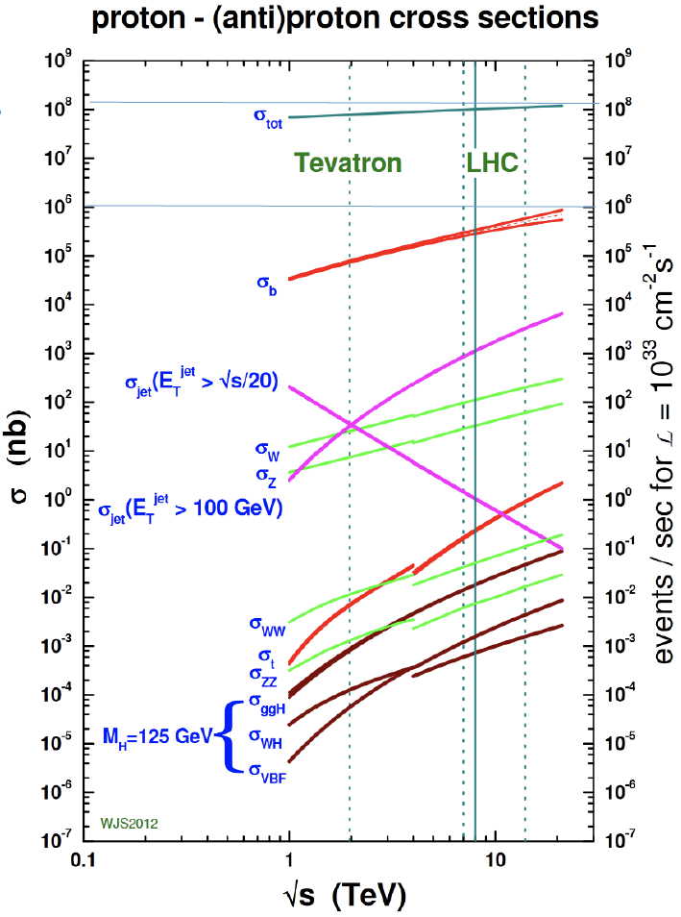
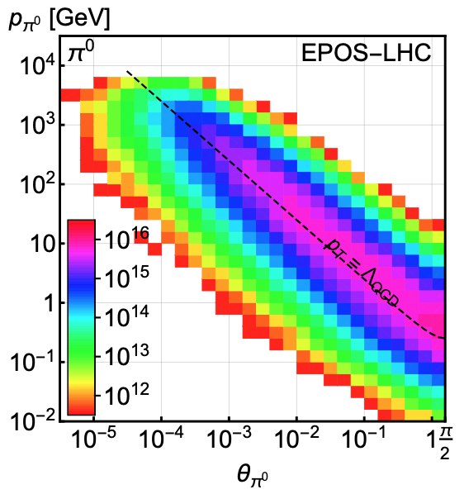
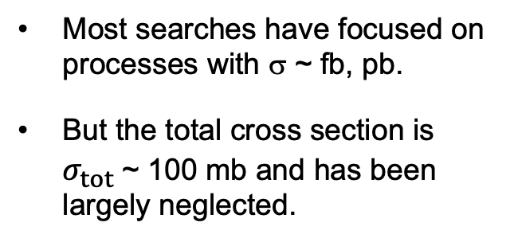
LIGHT PARTICLES AT THE LHC
300 fb⁻¹
Feng, Galon, Kling, Trojanowski (2017)
Most searches have focused on processes with σ ~ fb, pb.
But the total cross section is $σ_{tot}$~ 100 mb and has been largely neglected.
What do these events look like? Consider pions (decays to ν, BSM).
Enormous event rates: IF at the EF! Typical p_{T} ~ 250 MeV, but p ~ TeV within 1 mrad (η > 7.6) of the beamline.

Slide 7
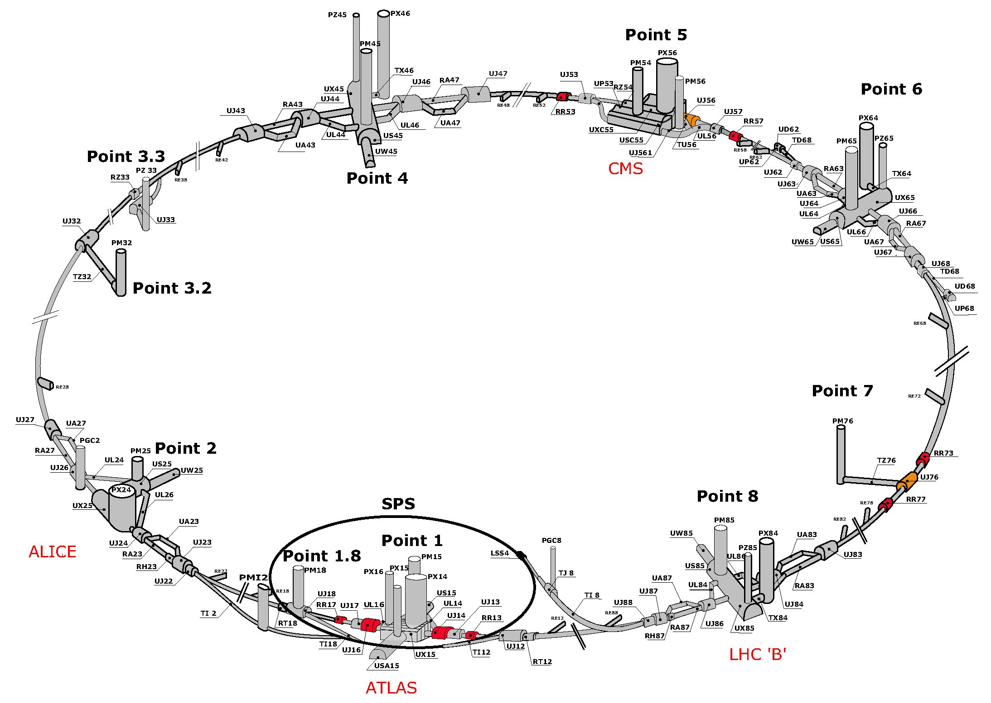
MAP OF THE LHC
To instrument the forward region, one can’t simply plug up the holes – we need to let the protons in. But the LHC is a circular collider!
!!!

Slide 8
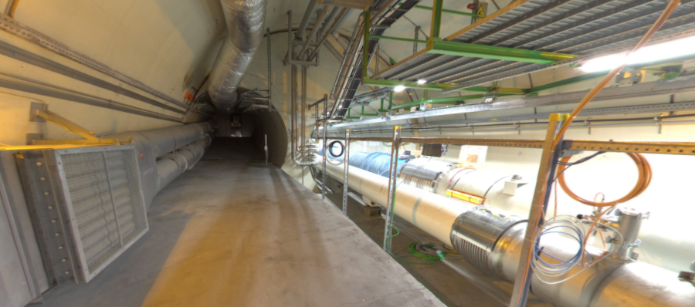
THE FORWARD REGION
Beam collision axis passes
through 100 m of rock, emerges in tunnel TI12, 480 m from ATLAS
UJ12
TI12 near UJ12
The view in UJ12 looking west in 2018
TI12
Beam collision axis
LHC beamline

Slide 9
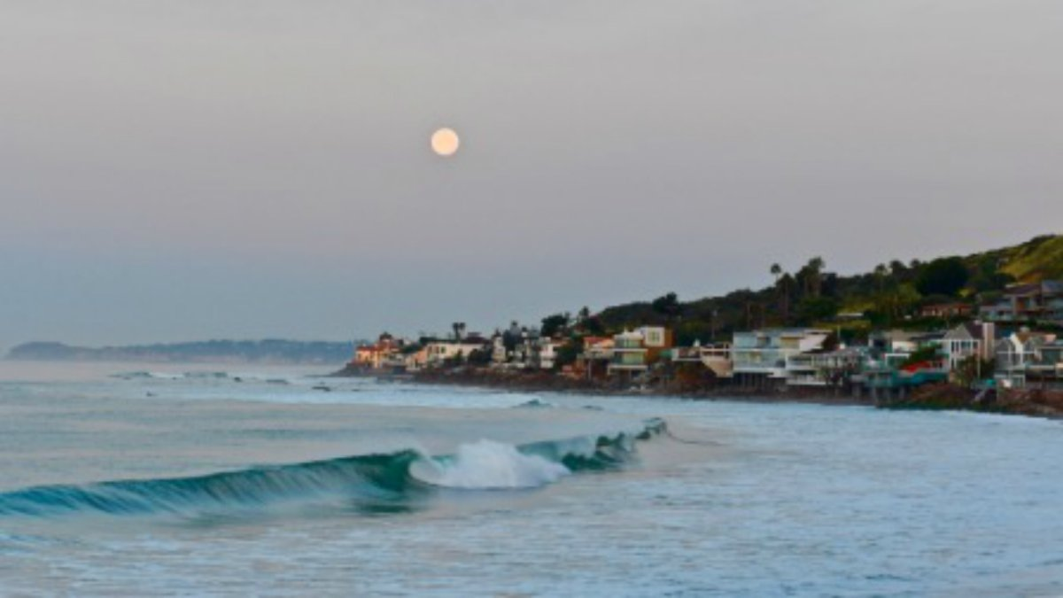
HOW BIG DOES THE DETECTOR HAVE TO BE?
Momentum:
Space:
250 MeV
1 TeV
12 cm
480 m
The opening angle is 0.2 mrad (the moon is 7 mrad). Even 480 m away, most of the signal passes through an 8.5” x 11” (A4) sheet of paper.
Neutrinos and many new particles are therefore much more collimated than shown below, motivating a relatively small, fast, and inexpensive experiment at the LHC: the ForwArd Search ExpeRiment (FASER).

Slide 10
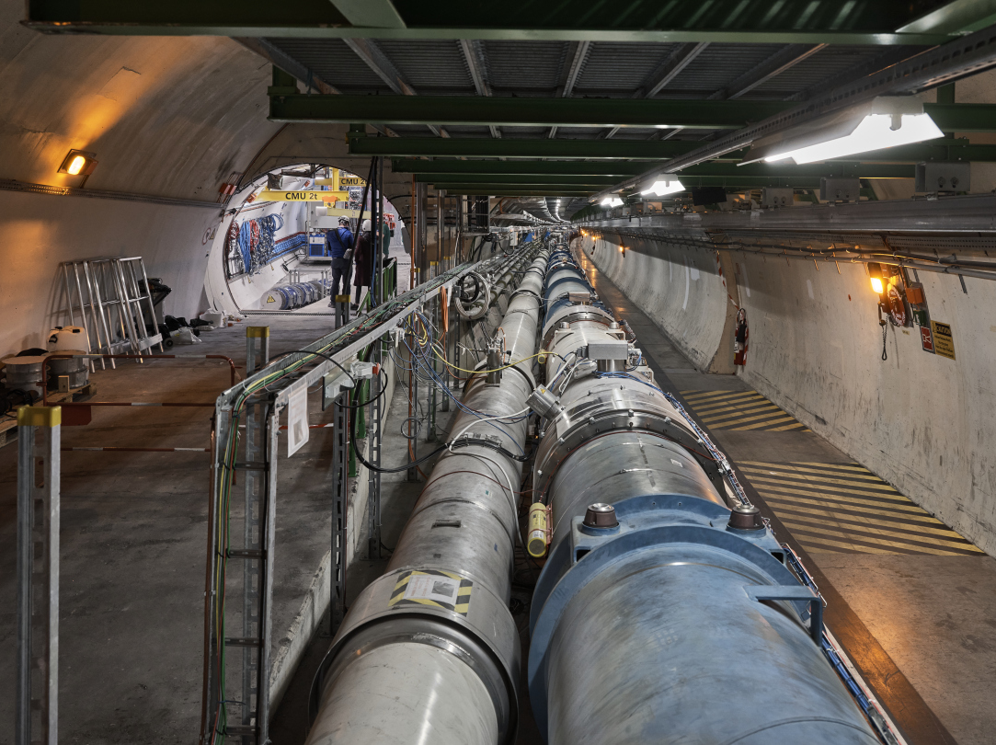
FASER AT THE LHC

Slide 11
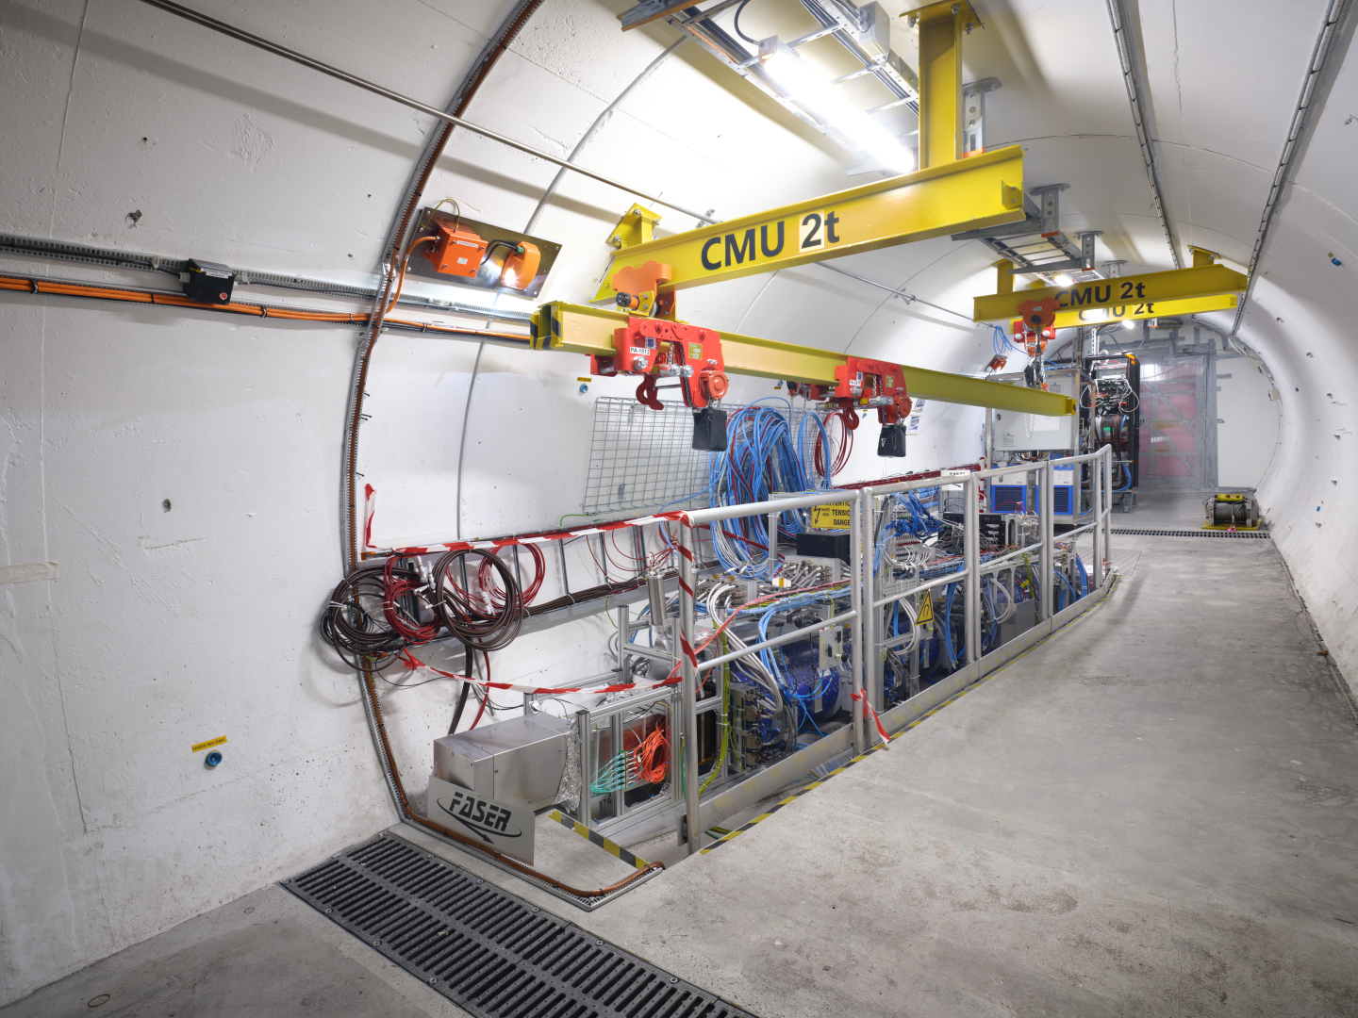
THE FASER DETECTOR

Slide 12
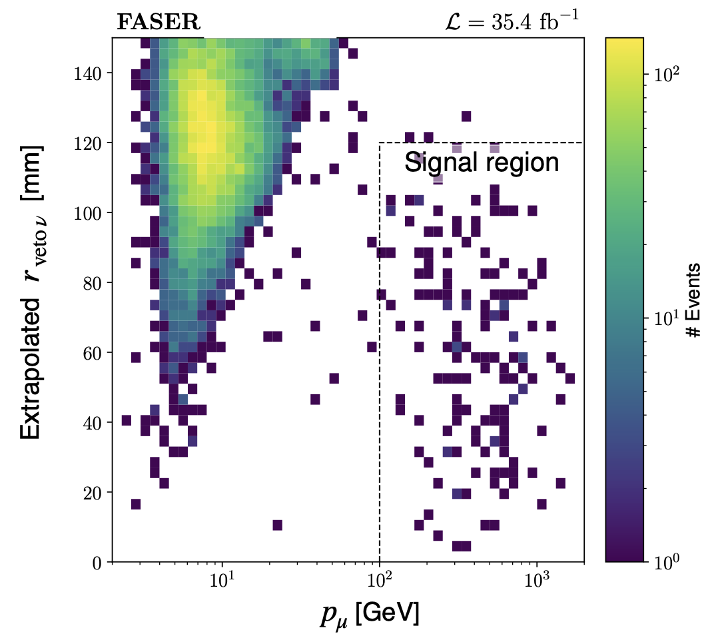
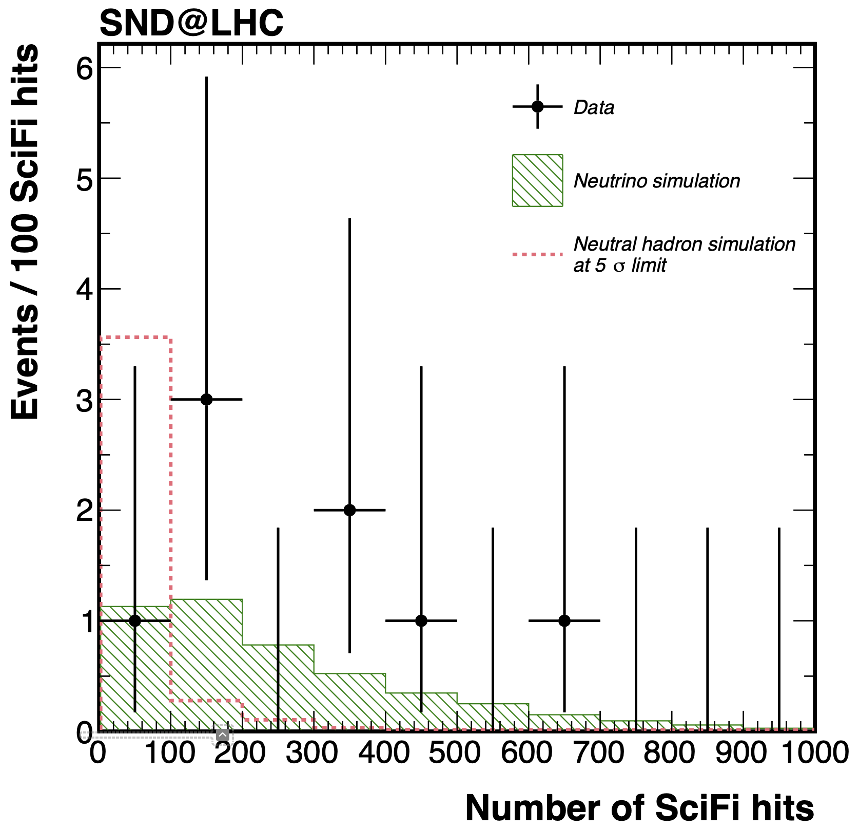
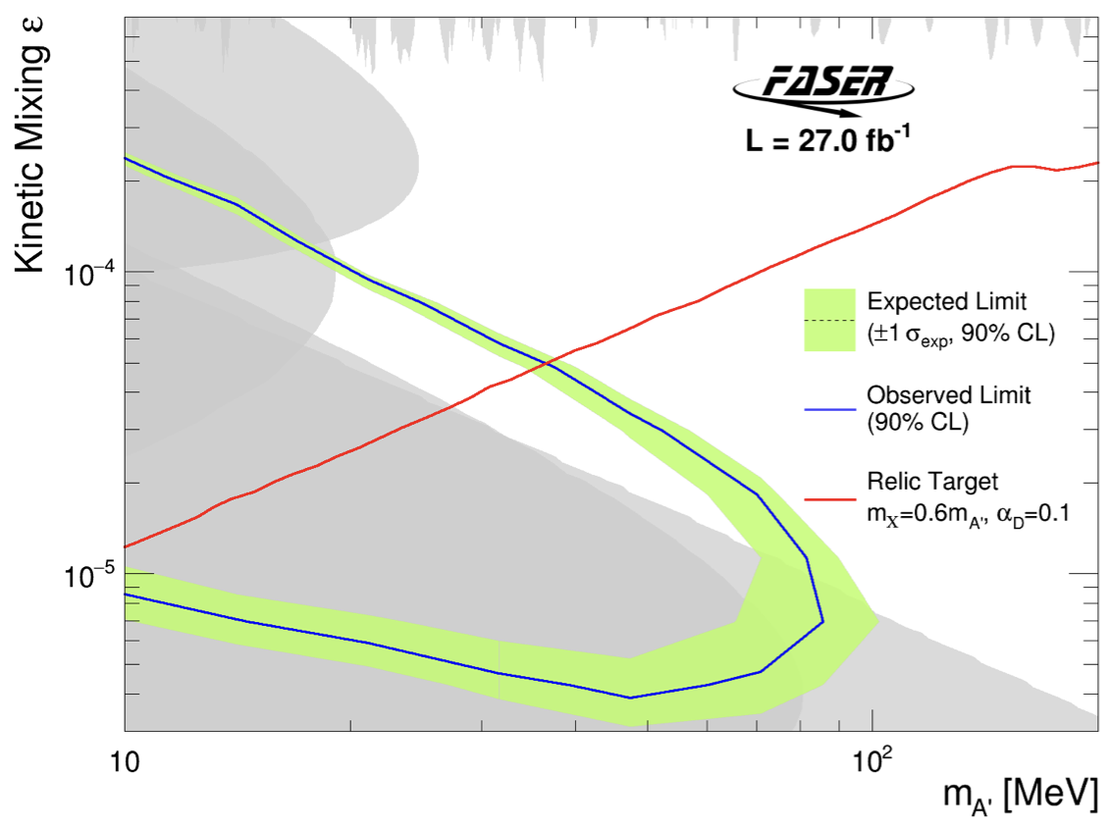
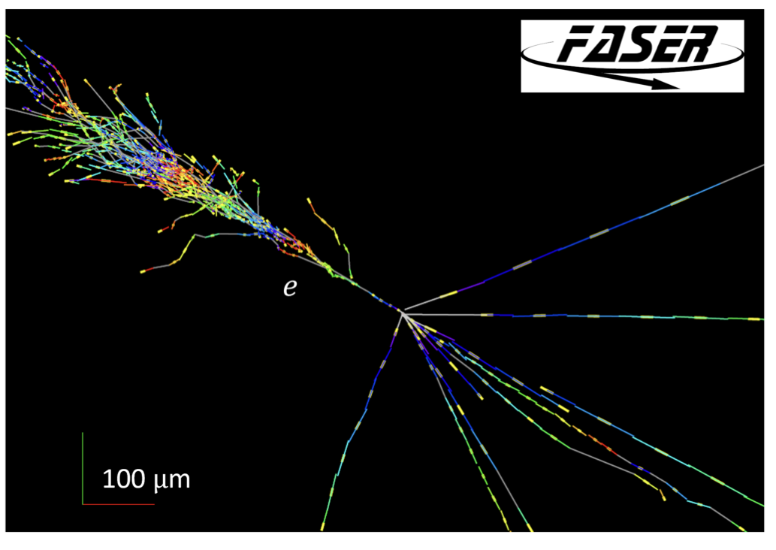
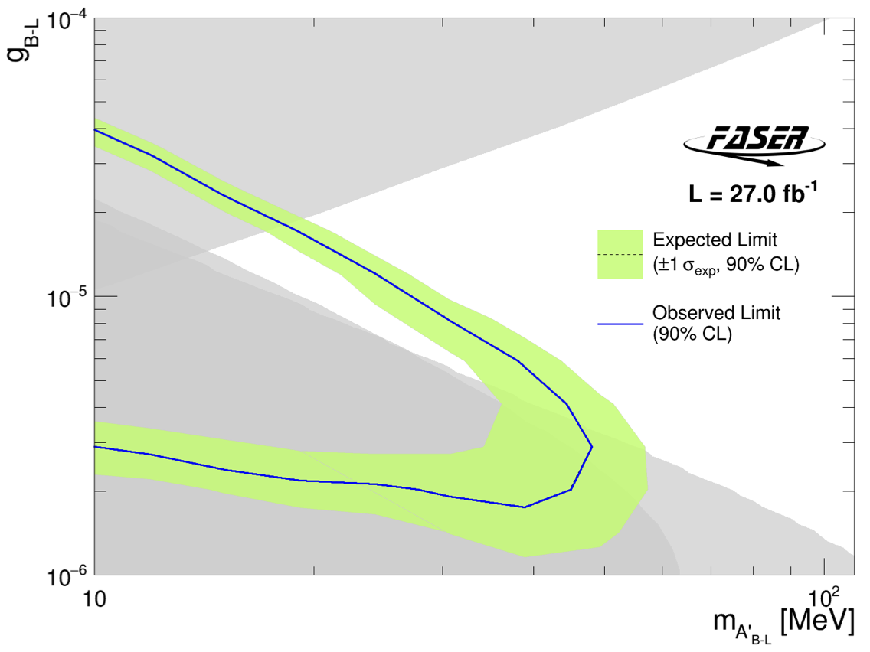
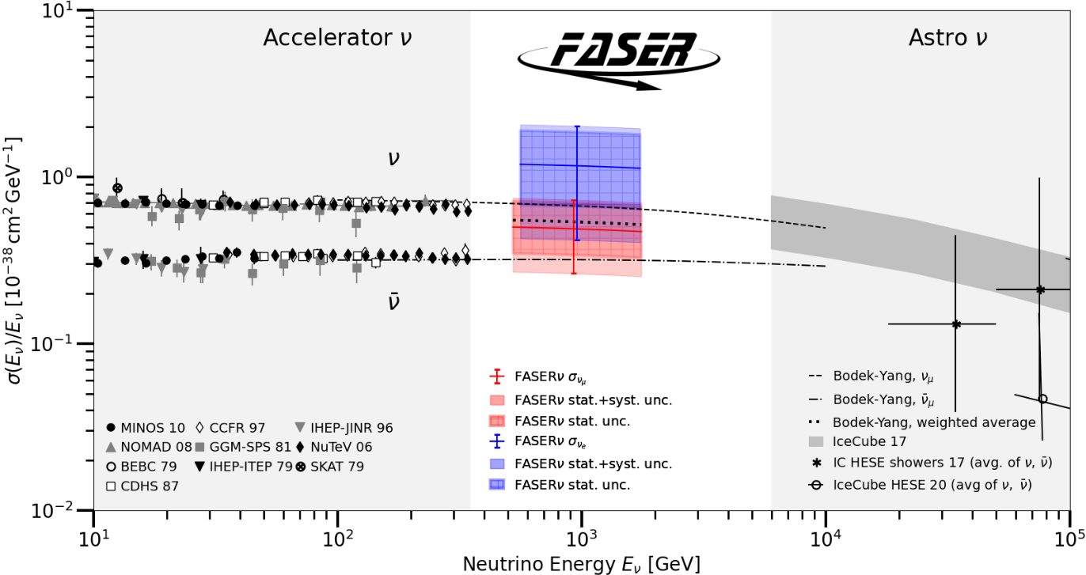
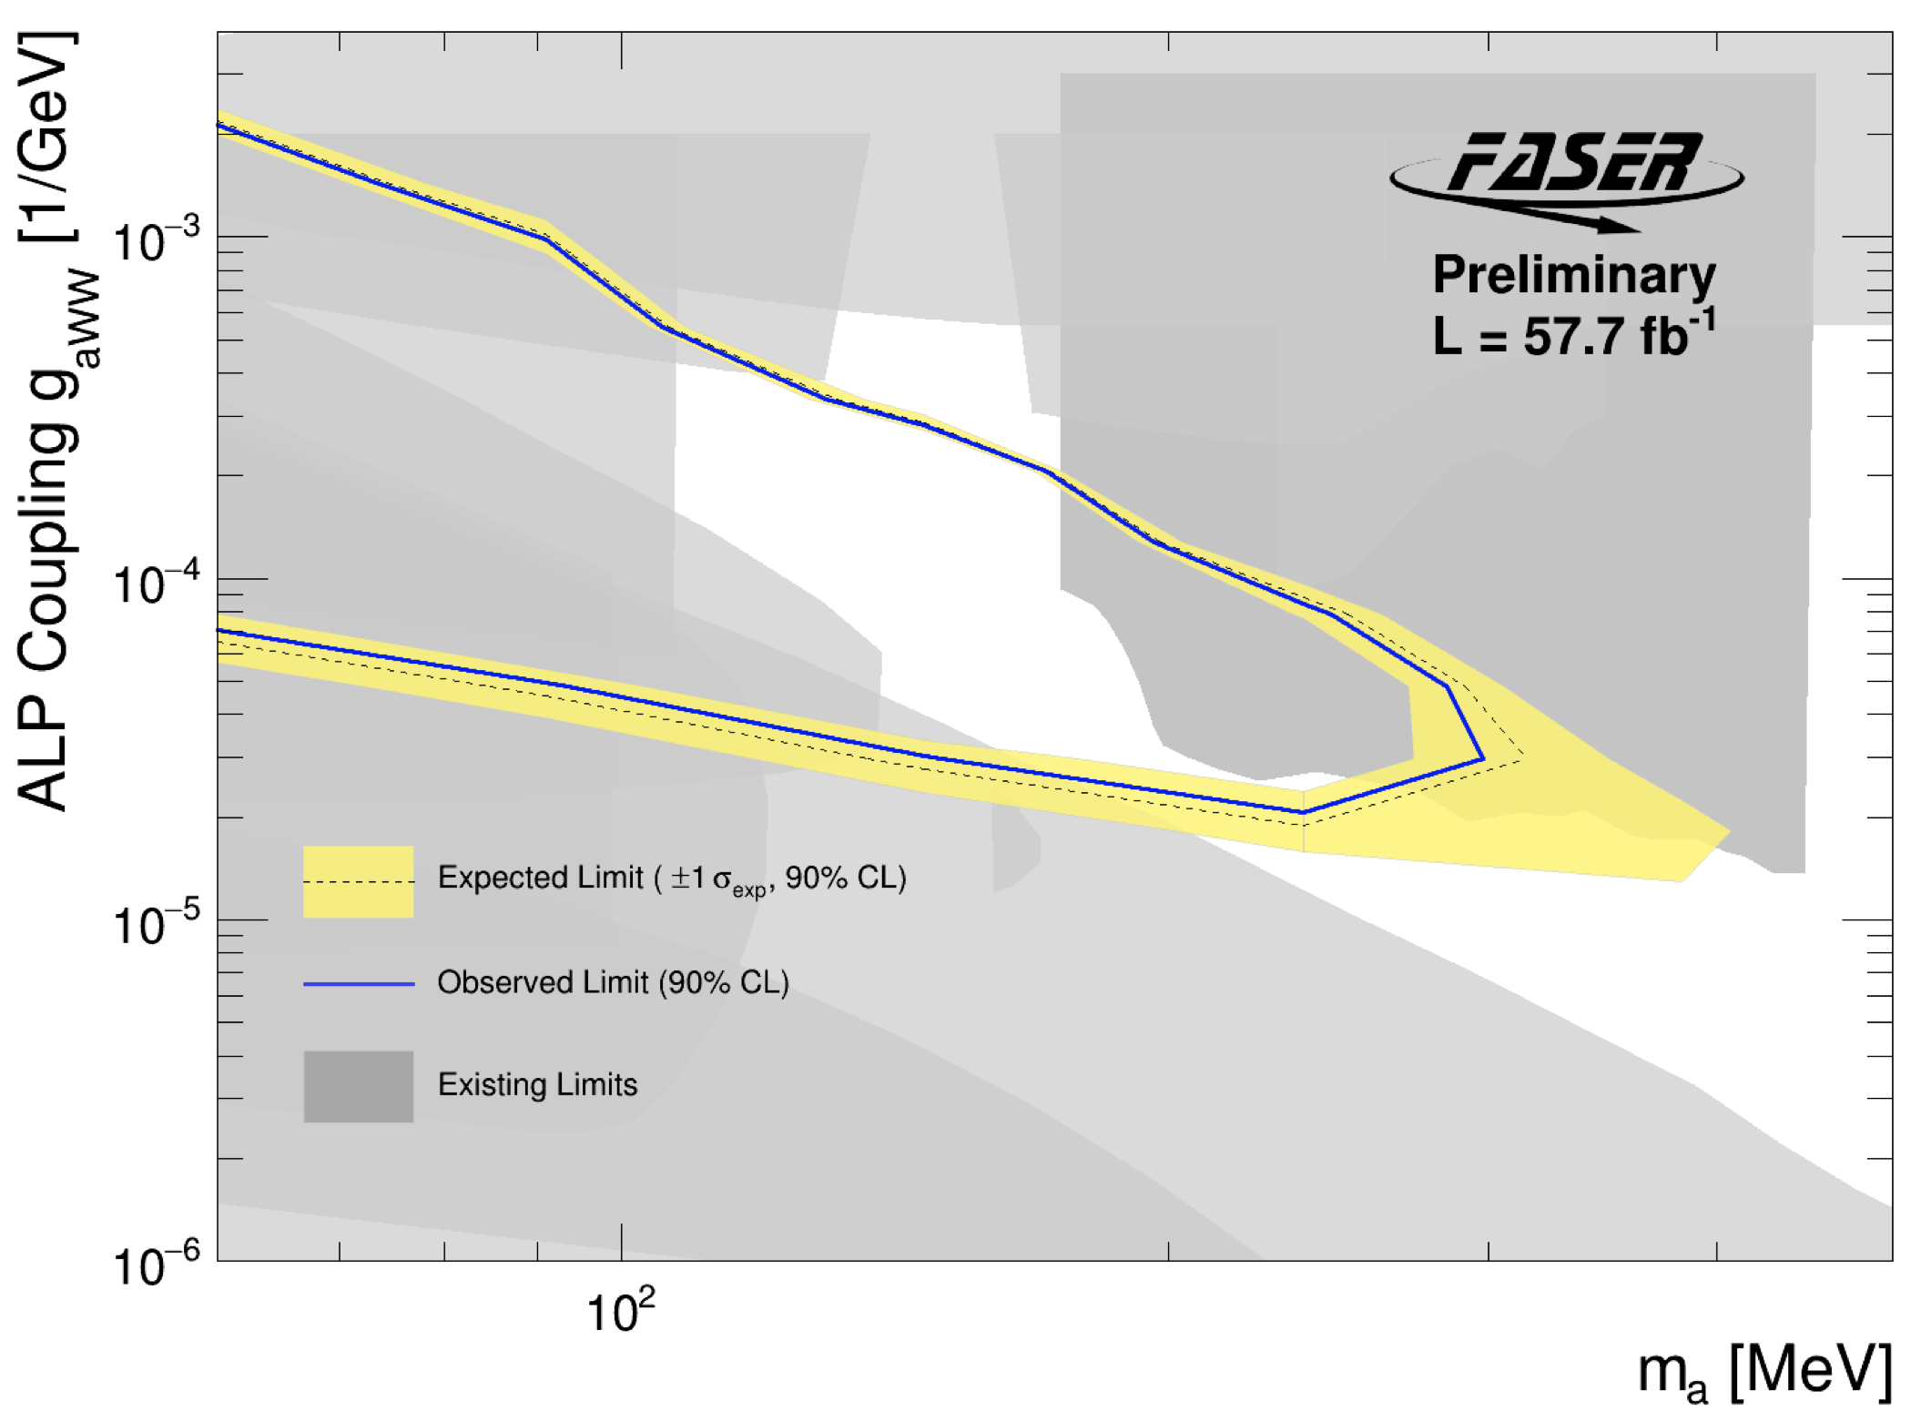
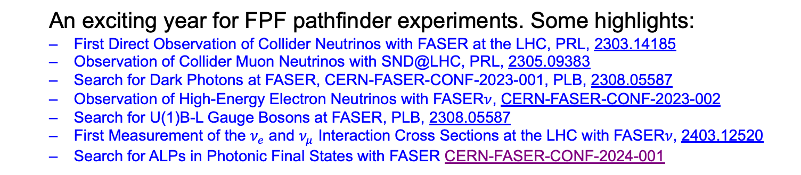
FIRST RESULTS FROM RUN 3
An exciting year for FPF pathfinder experiments. Some highlights:
  First Direct Observation of Collider Neutrinos with FASER at the LHC, PRL, 2303.14185
  Observation of Collider Muon Neutrinos with SND@LHC, PRL, 2305.09383
  Search for Dark Photons at FASER, CERN-FASER-CONF-2023-001, PLB, 2308.05587
  Observation of High-Energy Electron Neutrinos with FASER$ν$, CERN-FASER-CONF-2023-002
  Search for U(1)B-L Gauge Bosons at FASER, PLB, 2308.05587
  First Measurement of the $ν_{e}$ and $ν_{μ}$ Interaction Cross Sections at the LHC with FASER$ν$, 2403.12520
  Search for ALPs in Photonic Final States with FASER CERN-FASER-CONF-2024-001
See the following talks

Slide 13
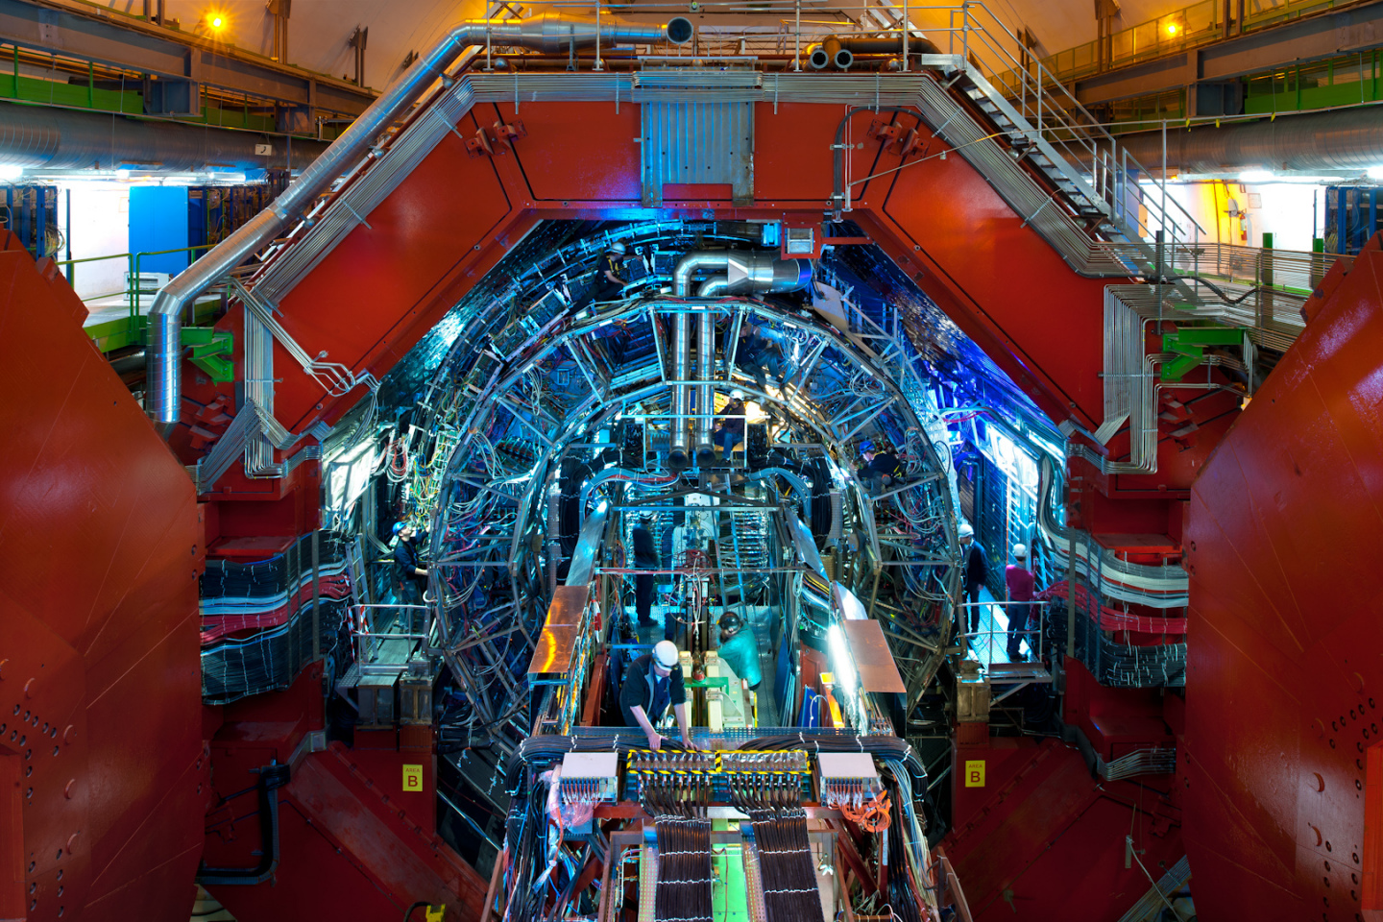
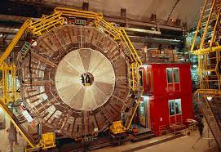
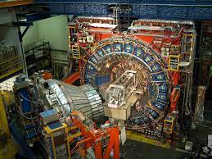
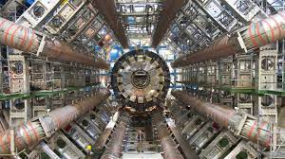
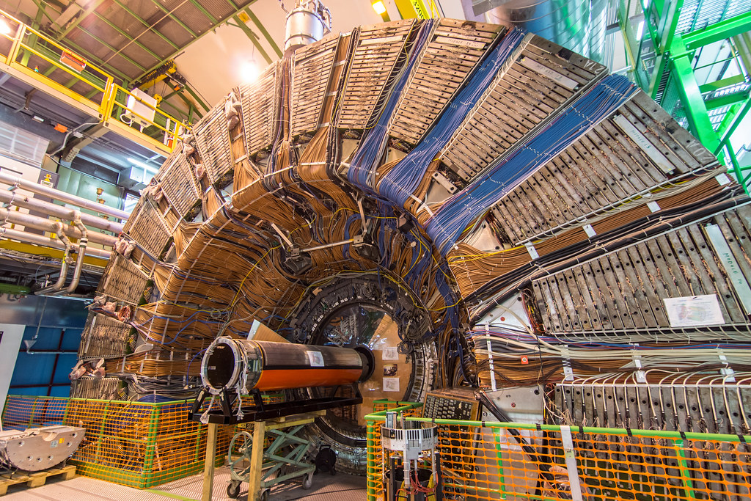
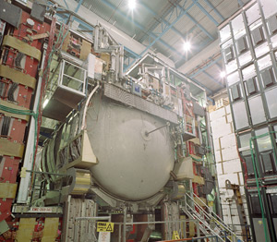
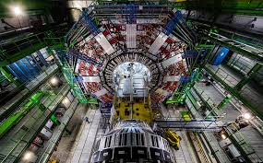
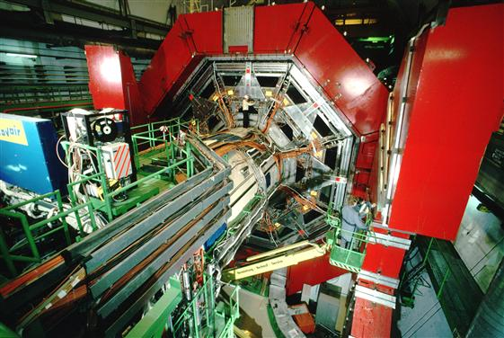

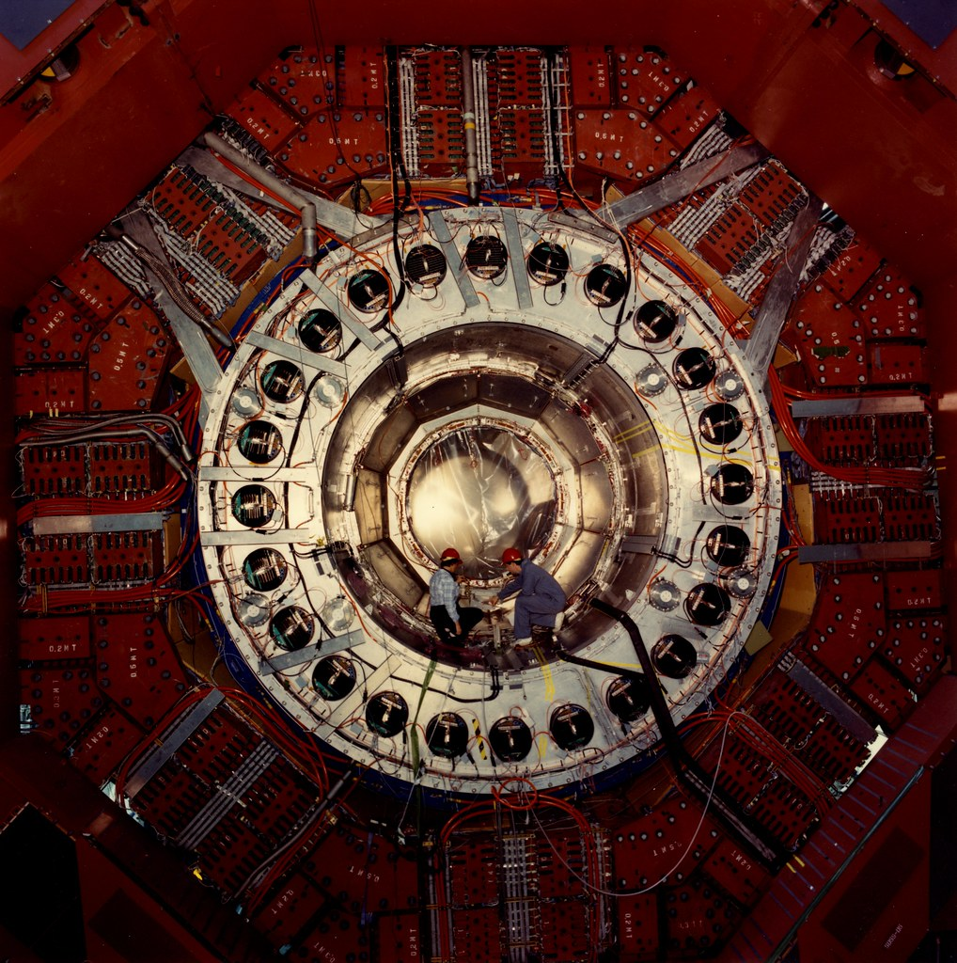
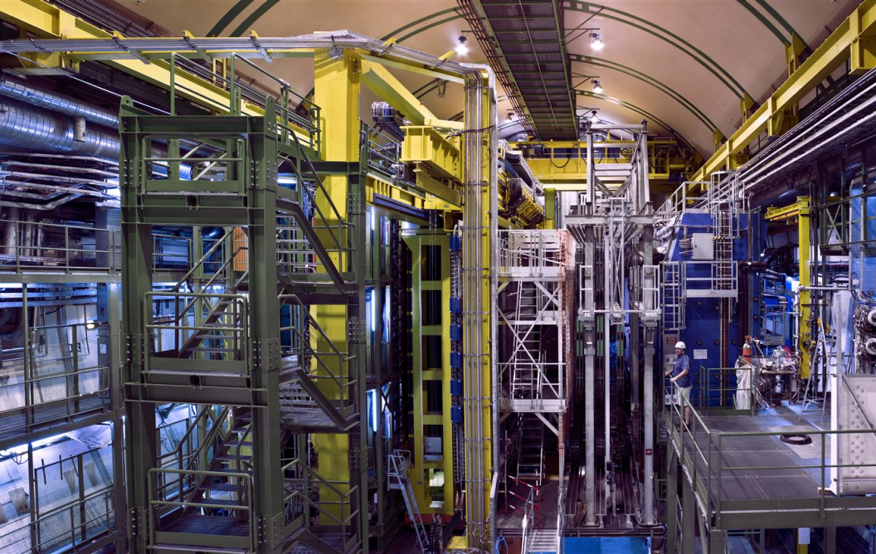
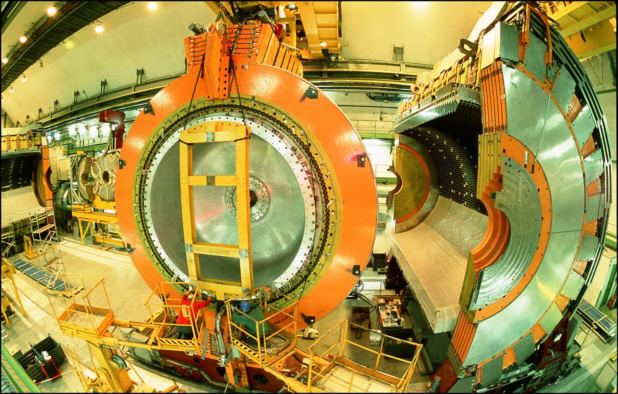
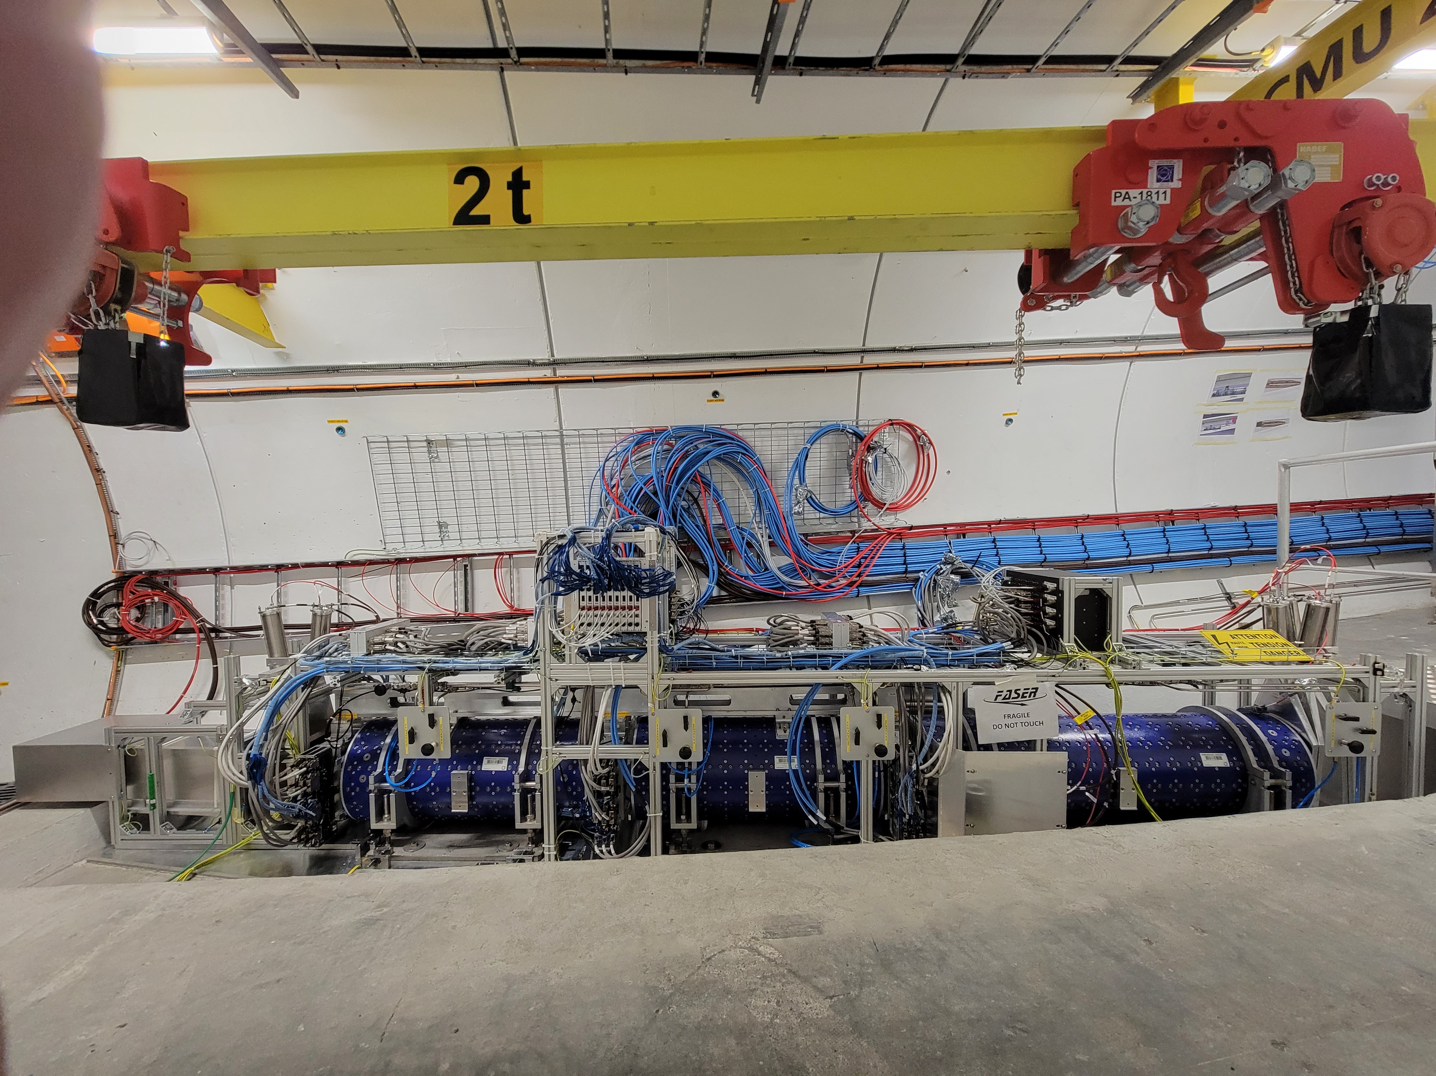
LOCATION, LOCATION, LOCATION
…
ALICE
ALEPH
CDF
FASER
“Tabletop,” 18 months,
~$1M
153 neutrinos
ATLAS
DELPHI
D0
CMS
L3
LHCb
SLD
OPAL
All previous
collider detectors
Building-size, decades,
~$1B
0 neutrinos
16σ discovery, opening a new window at the high energy frontier

Slide 14
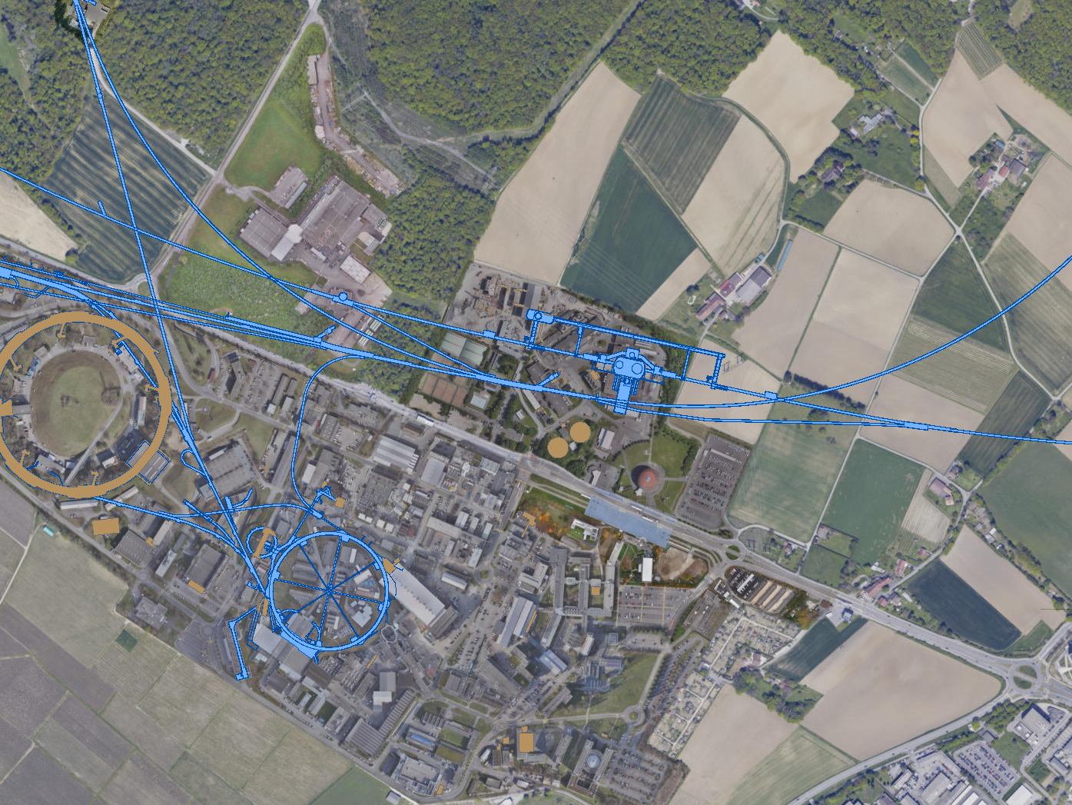
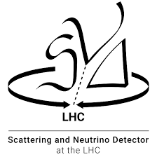

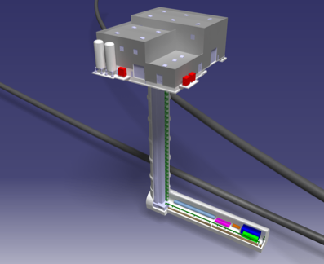
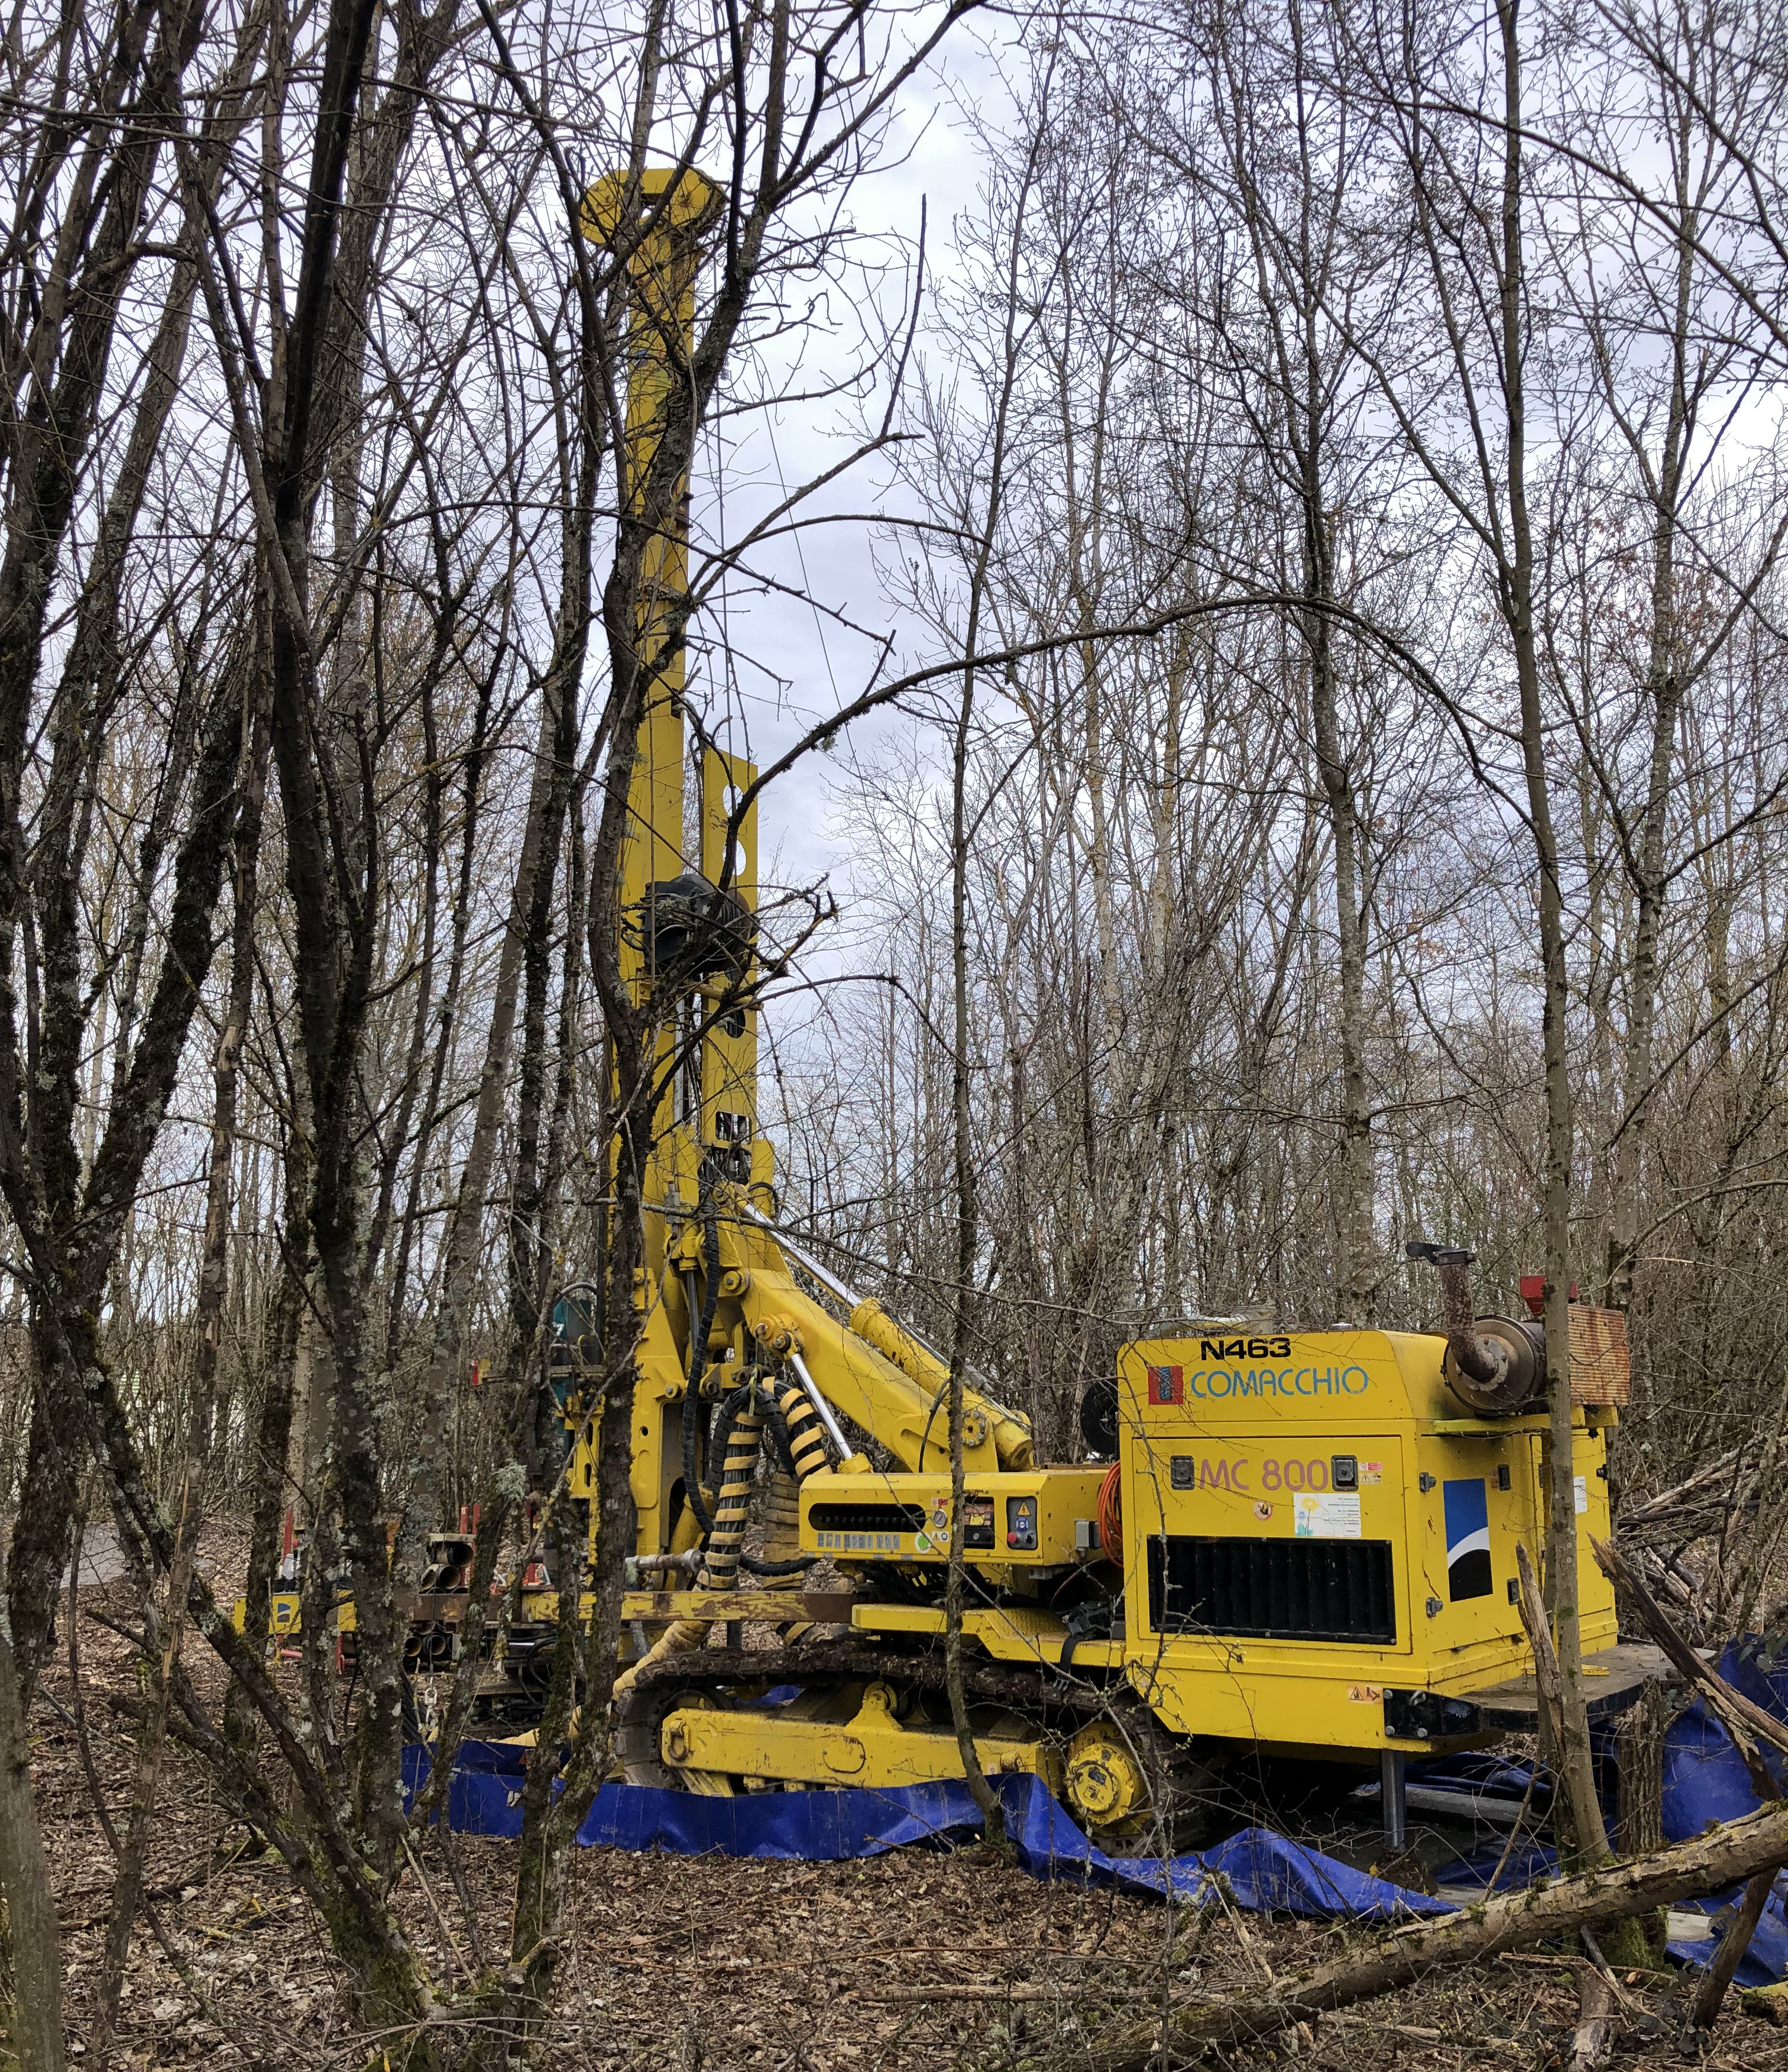
FORWARD PHYSICS FACILITY
Following the results of FASER and SND@LHC, CERN is considering the possibility of creating a dedicated Forward Physics Facility to house far-forward experiments for the rest of the LHC era from 2028-2040s.
UJ18
ATLAS
SPS
LHC
LOS
FPF site selection study and core study have identified an ideal site in France just outside the CERN main gate
https://cds.cern.ch/record/2851822
CERN GIS

Slide 15
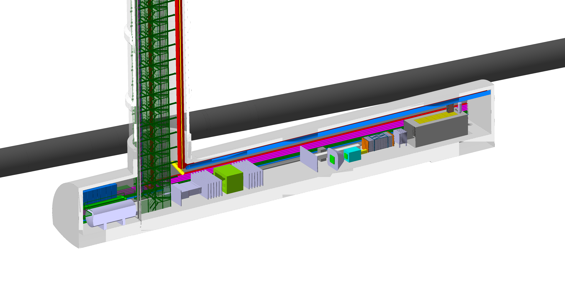
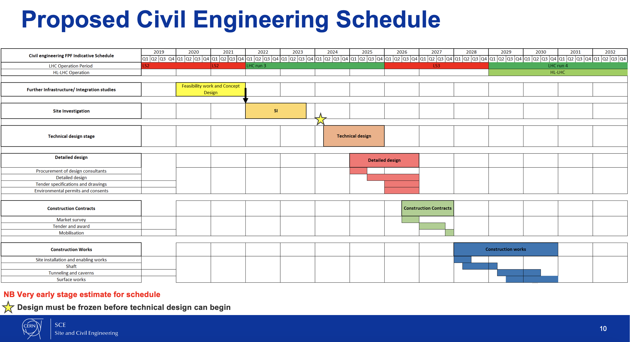
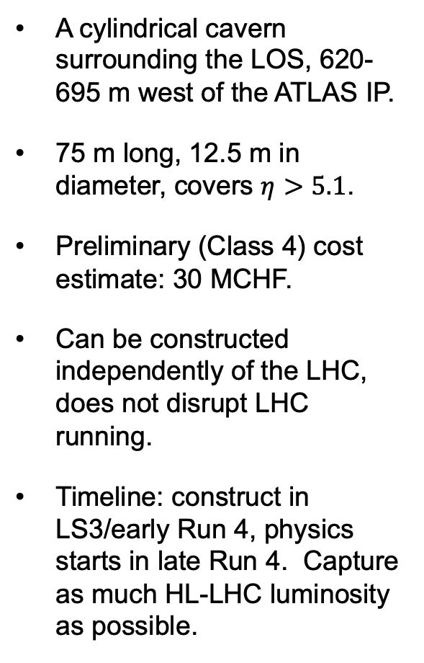
THE FACILITY
A cylindrical cavern surrounding the LOS, 620-695 m west of the ATLAS IP.
75 m long, 12.5 m in diameter, covers $η>5.1$.
Preliminary (Class 4) cost estimate: 30 MCHF.
Can be constructed independently of the LHC, does not disrupt LHC running.
Timeline: construct in LS3/early Run 4, physics starts in late Run 4. Capture as much HL-LHC luminosity as possible.
Bud, Magazinik, Pál, Osborne, et al. CERN CE (2024)

Slide 16
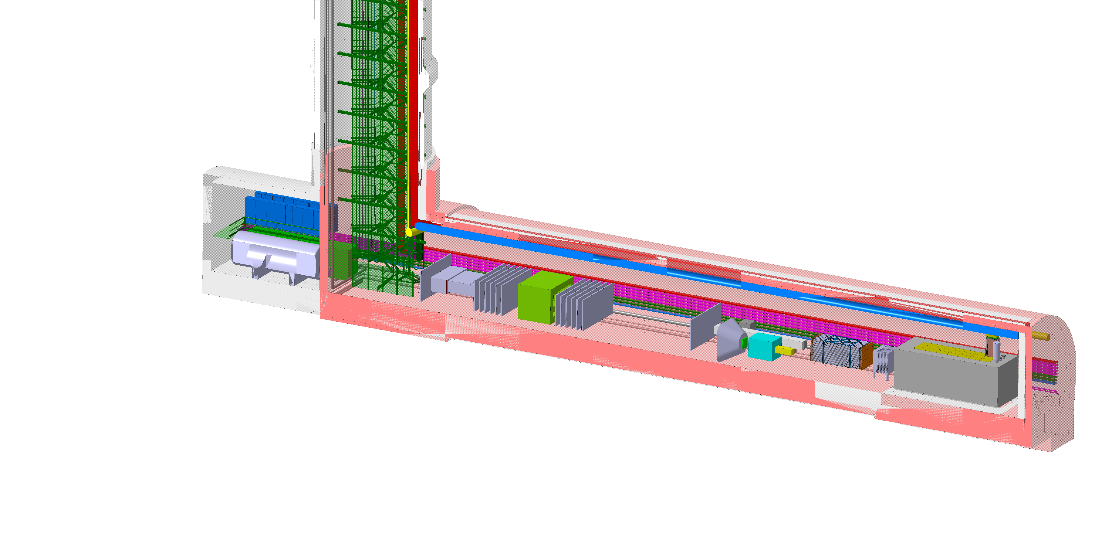
FPF EXPERIMENTS
At present there are 4 experiments being designed for the FPF
  FASER2: magnetized spectrometer for BSM searches
  FASERν2: 10-ton emulsion-based neutrino detector
  FLArE: 10-ton LArTPC neutrino detector
  FORMOSA: scintillator array for BSM searches (successor to MilliQan)
See the following talks
These represent a huge jump relative to the existing experiments:
  10,000 times greater (decay volume * luminosity) for BSM searches.
  Will detect miilions of TeV neutrinos, ~1000 neutrinos/day!

Slide 17
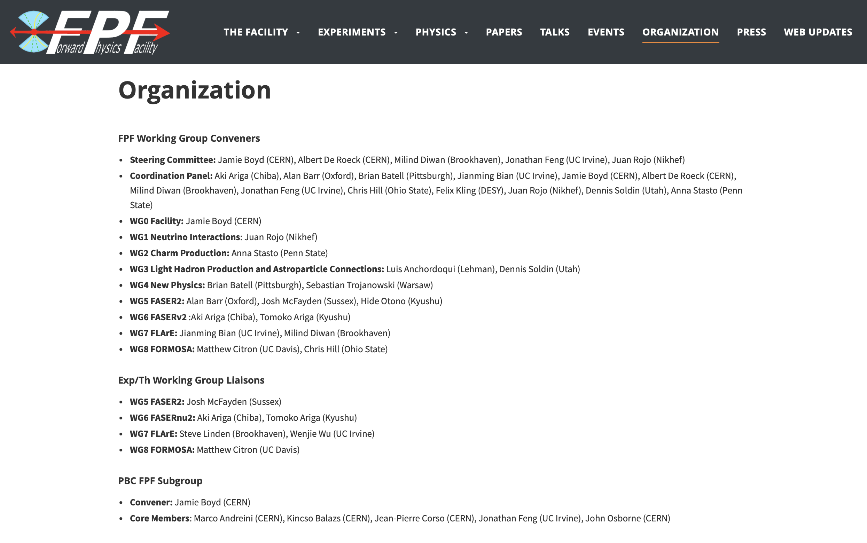
FPF ORGANIZATION
The FPF activities are organized into 9 WGs consisting of hundreds of experimentalists on pathfinder experiments, theorists, and multiple CERN technical teams, with active exp/th interactions and optimization between experiments. For more, see fpf.web.cern.ch.

Slide 18
FORWARD PHYSICS FACILITY
The physics program has been defined by a large and broad community.
FPF Meetings
  FPF Kickoff Meeting, 9-10 Nov 2020
  FPF2 Meeting, 27-28 May 2021
  FPF3 Meeting, 25-26 Oct 2021
  FPF4 Meeting, 31 Jan - 1 Feb 2022
  FPF5 Meeting, 15-16 Nov 2022
  FPF6 Meeting, 8-9 Jun 2023
  FPF Theory Workshop, 19-20 Sep 2023
  FPF7 Meeting, 29 Feb – 1 Mar 2024
FPF Papers
  FPF “Short” Paper: 75 pages, 80 authors, Phys. Rept. 968, 1 (2022), 2109.10905.
  FPF White Paper: 429 pages, 392 authors+endorsers representing over 200 institutions, J. Phys. G (2023), 2203.05090.
Far too much physics to discuss comprehensively here – I will give some fun examples, but for more, see these papers and meeting indico pages.

Slide 19
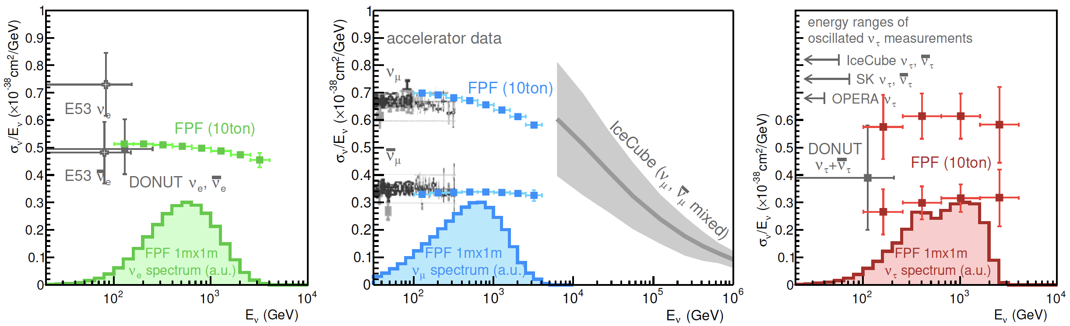
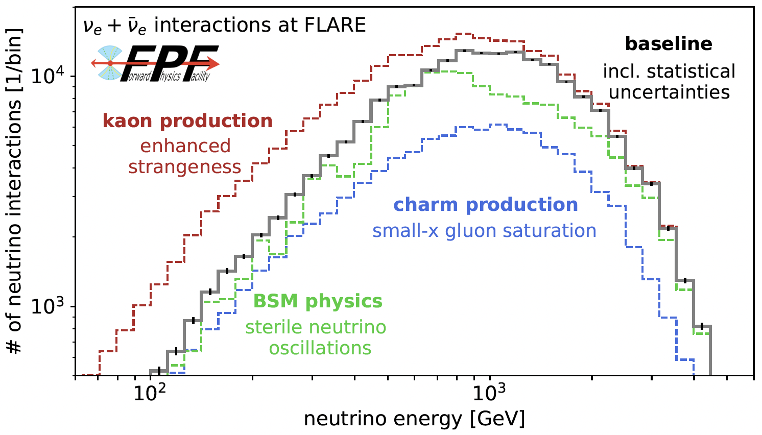
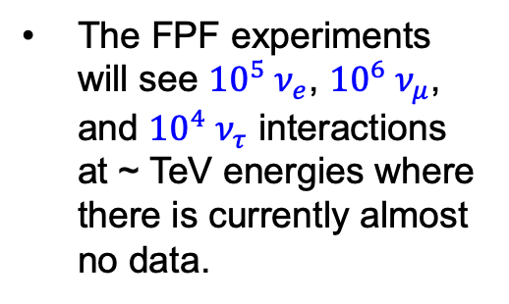
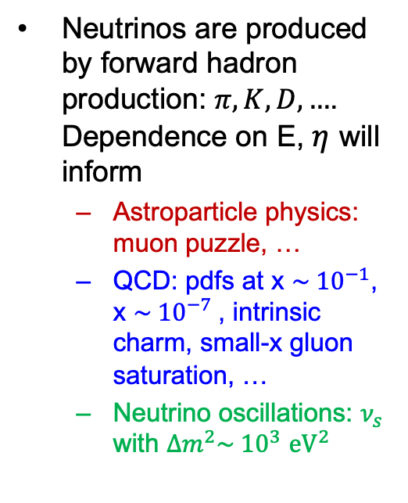
NEUTRINOS AT THE FPF
The FPF experiments will see ${10}^{5} ν_{e}$, ${10}^{6} ν_{μ}$, and ${10}^{4} ν_{τ}$ interactions at ~ TeV energies where there is currently almost no data.
Neutrinos are produced by forward hadron production: $π, K, D, …$. Dependence on E, $η$ will inform
  Astroparticle physics: muon puzzle, …
  QCD: pdfs at x $\sim {10}^{−1}$, x $\sim {10}^{−7}$, intrinsic charm, small-x gluon saturation, …
  Neutrino oscillations: $ν_{s}$ with $∆m^{2}\sim {10}^{3}$ ${eV}^{2}$

Slide 20
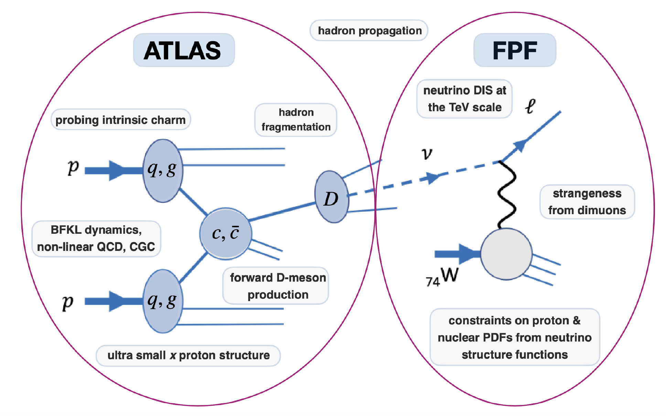
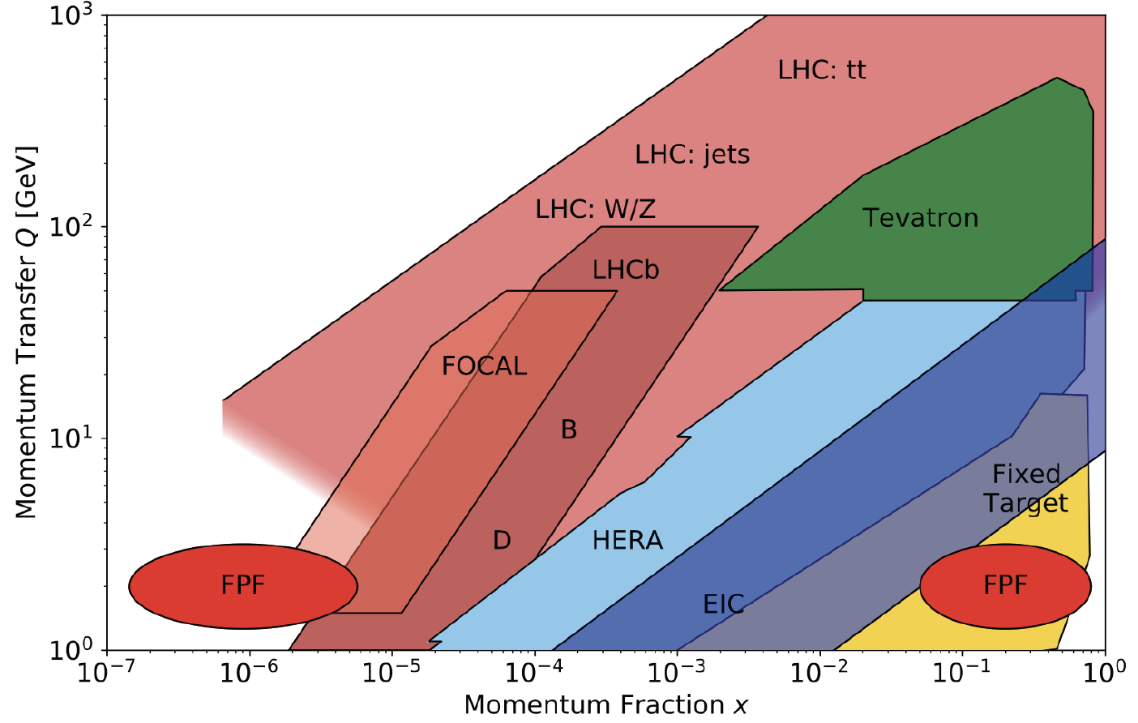
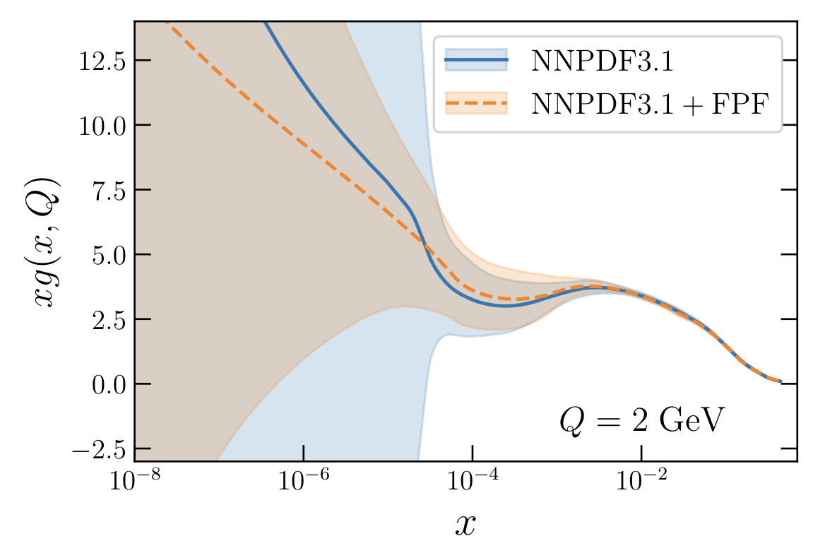

QCD AT THE FPF
The FPF will enable a rich program of QCD and hadron structure studies.
Forward neutrino production is a probe of forward hadron production, BFKL dynamics, intrinsic charm, and proton structure at ultra small x ~ 10⁻⁷ to 10⁻⁶.
Important implications for UHE cosmic ray experiments, ATLAS/CMS at HL-LHC, …
$$4m_{c}^{2 }\sim x_{1}x_{2}s$$
FASER White Paper (2022); Rojo et al. (2024)

Slide 21


OPTIMIZING HIGH P_{T} STUDIES AND SEARCHES
The FPF will provide new constraints on pdfs that will sharpen studies at ATLAS and CMS.
For example, W, Z, and Higgs boson studies.
Will also remove degeneracies between pdfs and new physics (“fitting away new physics”), enhancing the reach for new particle searches.
_{Ubiali et al., in progress}
Cruz-Martinez, Fieg, Giani, Krack, Makela, Rabemananjara, Rojo (2023);
see talk by Max Fieg

Slide 22



QUIRKS: STRONGLY-INTERACTING DARK SECTORS
Quirks are particles charged under both the SM and a strong-interacting dark force, with $m≫Λ$.
Quirks can be pair-produced at the LHC, but the quirk-anti-quirk pair is bound together and has $p_{T} ≈0.$ They therefore preferentially travel down the beampipe, and may pass through FPF detectors.
By looking for 2 coincident slow or delayed tracks (out of time with the bunch crossing), FASER and FASER2 can discover quirks with masses up to ~ hundreds of GeV to TeV, as motivated by neutral naturalness solutions to the gauge hierarchy problem.
Only possible at the EF, not at fixed target experiments.
Feng, Li, Liao, Ni, Pei (2024)

Slide 23







LLPS FROM COMPRESSED SPECTRA
LLPs can result from weak couplings.
But they can also arise generically from compressed spectra (e.g., inelastic DM), where decays are phase-space suppressed by degeneracies.
$$m_{1}$$
$$χ_{1} →χ_{0}γ$$
$$m_{0}$$
0
In this case, decays $χ_{1} →χ_{0}γ$ lead to very soft photons that can be difficult to detect.
But these are boosted at the LHC by $γ \sim 1000$, FASER2 can detect GeV particles with even ~MeV mass splittings, thermal relic target.
Difficult at SHiP (sensitivity contour assumes $E_{γ}$ threshold of 300 MeV, 2 10²⁰ POT).
Dienes et al. (2023)

Slide 24


MILLI-CHARGED PARTICLES
The FPF accommodates a suite of experiments that can be optimized for various physics cases. This diversity is essential in probing a broad range of BSM physics possibilities.
For example: FORMOSA, targeting milli-charged particles.
Motivated by dark sectors with massless dark photons, but also new particles with magnetic or electric dipole moments, …
World-leading sensitivity for masses from ~100 MeV to 100 GeV.
Will not be probed by SHiP (and no fixed target experiment can produce particles with mass > 10-20 GeV).
Foroughi-Abari, Kling, Tsai (2020)

Slide 25

SUMMARY
The forward region, previously largely neglected, is in fact a treasure trove of interesting physics.
  Collider neutrinos at TeV energies, opening a new window on neutrino properties, QCD, astroparticle physics, and high $p_{T}$ physics.
  World-leading searches for light (and also heavy) BSM particles, including many motivated by dark matter.
The multi-messenger era in collider physics: FASER and SND@LHC have shown that this treasure can be mined by small, fast, and cheap detectors, producing world-leading, background-free results on budget and on time.
These results imply a paradigm shift: forward experiments are not auxiliary experiments hunting for exotica; they are neutrino detectors that are integral to fully exploiting the energy frontier, just like trackers and calorimeters.
The Forward Physics Facility is now being considered to fully exploit this new capability for the HL-LHC era from 2028-2042. Without it, the LHC will be blind to neutrinos. With it, we will see 1000’s of TeV neutrinos each day.

Slide 27



A CAUTIONARY TALE
Sometimes to look forward, it pays to first look back.
2021 was the 50th anniversary of the birth of hadron colliders.
In 1971, CERN’s Intersecting Storage Rings (ISR), with a circumference of ~1 km, collided protons with protons at center-of-mass energy 30 GeV.

Slide 28



ISR’S LEGACY
During ISR’s 50th anniversary, there were many fascinating articles and talks by eminent physicists looking back on the ISR’s legacy.
  “Enormous impact on accelerator physics, but sadly little effect on particle physics.” – Steve Myers, talk at “The 50th Anniversary of Hadron Colliders at CERN,” October 2021.
  “There was initially a broad belief that physics action would be in the forward directions at a hadron collider…. It is easy to say after the fact, still with regrets, that with an earlier availability of more complete… experiments at the ISR, CERN would not have been left as a spectator during the famous November revolution of 1974 with the J/ψ discoveries at Brookhaven and SLAC .” – Lyn Evans and Peter Jenni, “Discovery Machines,” CERN Courier (2021).
Bottom line: The collider was creating new forms of matter (charm quarks), but the detectors focused on the forward region (along the beamline) and so missed them. Let’s not follow this precedent!

Slide 29





THE FASER DETECTOR
Total length ~ 5 m, decay volume: R = 10 cm, L = 1.5 m.
3 permanent dipole magnets, Halbach design, constructed at CERN, 0.57 T, deflects charged particles in $y$.
Tracker: 4 stations x 3 layers x 8 mod. = 96 ATLAS SCT modules. Resolution = 16 $μm$ in $y$, 820 $μm$ in $x$.
Calorimeter: 2 x 2 LHCb ECAL modules.
Scintillators: 4 stations, multiple layers, each 2 cm thick, >99.999% efficient. 4-layer veto ~ $\left({10}^{−5}\right)4 \sim {10}^{−20}.$
FASERν: 770 interleaved sheets of tungsten + emulsion. 1 m long, 1.1 ton total mass. Micron-level spatial resolution, but no timing. Becomes over-exposed from muon tracks after ~20-30 fb⁻¹, must be replaced.
88 m underground, shielded from ATLAS by 100 m of rock and concrete → extremely quiet environment. Trigger on everything, ~kHz trigger rate dominated by muons
produced at the ATLAS IP, also some beam
backgrounds, cosmic muons.
$$y$$
$$x$$
$$z$$
FASER Collaboration (2207.11427)

Slide 30

COLLIDER NEUTRINOS
Neutrinos are the least understood of all known particles, and the only ones with confirmed BSM properties.
They have been discovered from many sources, each time with stunning implications for particle physics, astrophysics, and cosmology.
Formaggio, Zeller (2012)
But before FASER, neutrinos produced at particle colliders had never been direct observed before: they interact very weakly, and the highest energy ones pass through the blind spots of existing detectors.

Slide 31


COLLIDER NEUTRINO SEARCH
Neutrinos produced at the ATLAS IP travel 480 m and pass through FASERν. Occasionally, they can interact through $ν_{μ}N→μX$, producing a high-energy muon, which travels through the rest of the detector.
The signal is no charged particle passing through the upstream veto scintillator detectors, hits in the downstream scintillators, and a single charged track, >100 GeV, in the central region of downstream trackers.
Leading backgrounds from neutral hadrons produced in the rock, muons that enter from the side, or beam 1 background contribute $≲$ 1 event.
Expect 151 $±$ 41 events from simulations, with the large uncertainty arising from the poorly understood flux of forward hadrons.
FASER Collaboration (2303.14185, PRL)
Notes:
typical A’ that decays in FASER has ~TeV energy

Slide 32


COLLIDER NEUTRINO RESULTS
After unblinding, we found 153 signal events
1st direct detection of collider neutrinos
  Signal significance of ~16σ
  Muon charge → $ν$ and $\overline{ν}$
  These include the highest energy $ν$ and $\overline{ν}$ interactions ever observed from a human source
Following the FASER observation, SND@LHC, a complementary experiment in the “other” forward direction, discovered an additional 8 neutrinos.
FASER Collaboration (2303.14185, PRL)

Slide 33





NEUTRINOS FROM EMULSION IN FASERν
The discovery analysis did not even use the emulsion data! With the emulsion, we have now observed the first collider electron neutrinos, including the “Pika-$ν$” event, the highest energy (1.5 TeV) electron neutrino from a lab source.
Side View
Vertex with 11 tracks
  615 µm inside tungsten
e-like track from vertex
  Single track for 2X₀
  Shower max @ 7.8Χ₀
  θ_{e} = 11 mrad to beam
Back-to-back topology
  175° between e & rest
$$e$$
Beam View
FASER Collaboration (2403.12520)

Slide 34


TEV NEUTRINO CROSS SECTIONS
Following these discoveries, we can then move on to studies, including the first measurement of neutrino cross sections at TeV energies.
Results are consistent with SM DIS predictions.
These measurements use only 1.7% of the data already collected in 2022 and 2023.
FASER Collaboration (2403.12520)

Slide 35

P5 REPORT
The P5 table listed “FPF trio” with N#’s, where # indicates that “can be considered as part of ASTAE with reduced scope.”
The “trio” are the FPF experiments with most US involvement: FASER2 and FORMOSA fit as is; FLArE will benefit from international partners to reduce the US cost.
P5’s Summary (20-year Vision): “The program described in this section consists of a combination of large and small projects and holds great promise for discovery. By the end of this 20-year period we will have ultimate LHC results from the general purpose experiments and a constellation of agile auxiliary experiments.”

Slide 36
FPF TIMELINE AT CERN
In June 2023, CERN management and the LHCC and PBC conveners agreed on a review timeline for the FPF.
August 2023 – Early 2024
  Core study results.
  A document summarizing the core study results, additional facilities updates, revised estimate for CERN host lab costs.
  A unified plan for size and placement of experiments in the cavern.
  Completion of “flagship” physics studies that emphasize core strengths and also complementarity with the rest of the world-wide program.
June 2024: Document on the Facility (CE and Integration) to be submitted to the PBC.
Early 2025: LOI to be submitted to the LHCC.
March 2025: input to be submitted to European Strategy Update.

