Slide 1



FASER AND THE
FORWARD PHYSICS FACILTY
NEW EYES FOR THE LHC
Argonne Physics Division Colloquium
Jonathan Feng, UC Irvine, 10 May 2024

Slide 2
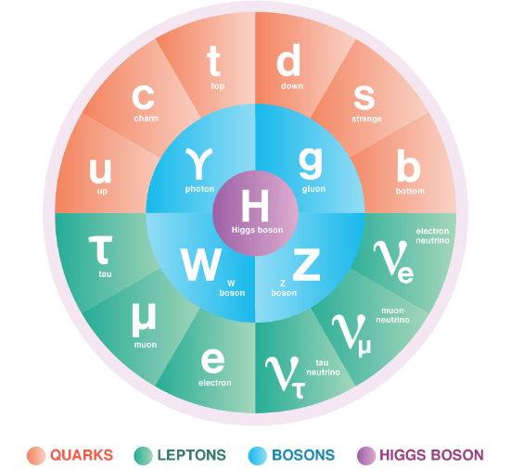
THE STANDARD MODEL OF PARTICLE PHYSICS
The Standard Model is the reigning theory of fundamental particles and their interactions. The last particle predicted by the SM, the Higgs boson, was discovered at CERN in 2012.
But the SM is not the last word, because many fundamental questions remain. For example:
  Neutrino Masses: the SM predicts that neutrinos are massless, but they aren’t.
  Dark Matter: The particles of the SM make up only ~15% of the matter in the universe.
These questions imply that there are more particles left to discover, and probably many more.

Slide 3

THE LARGE HADRON COLLIDER
.
FASER
Particle colliders have been key to progress for many decades. The state of the art is currently the LHC, currently colliding protons with protons at a center-of-mass energy of 13.6 TeV.
Notes:
3

Slide 4

LHC DETECTORS
The protons collide at 4 points around the LHC, and each point is surrounded by a large detector to view the results of the collisions. These detectors cost ~$1B, and were constructed over decades by thousands of collaborators.
The ATLAS Detector
Notes:
4

Slide 5
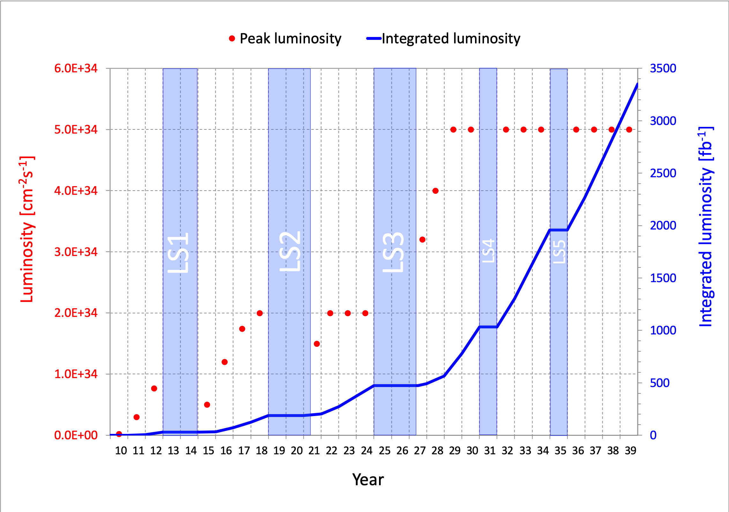
LIFETIME OF THE LHC
The LHC became the future of particle colliders in 1993 when the US canceled the SSC, which was being built in Texas.
But although the LHC started running in 2010, it is scheduled to run until the 2040s and is still in its youth
  a postdoc in terms of years
  a kindergartener in terms of number of collisions (integrated luminosity)
Are we using the LHC to its full potential? If not, what can we do to enhance its discovery prospects?
COVID

Slide 6
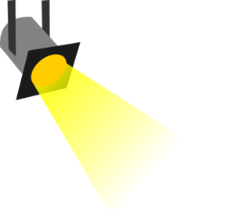
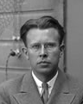
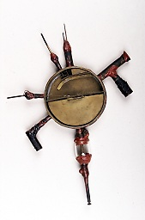
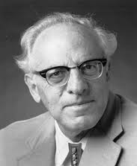





















THE PARTICLE LANDSCAPE
Particle
Expts
Mass
MeV
GeV
TeV
1
$$←$$
$$g$$
$$u$$
$$d$$
$$s$$
$$p$$
$$n$$
$$c$$
$$b$$
$$t$$
$$←$$
$$γ$$
$$e$$
$$μ$$
$$τ$$
$$W$$
$$Z$$
$$h$$
Already
Discovered
Strongly Interacting
Heavy Particles
Interaction Strength
10⁻³
$$ν_{e}$$
$$ν_{μ}$$
$$ν_{τ}$$
$$←$$
Weakly Interacting
Light Particles
Impossible to
Discover
10⁻⁶

Slide 7
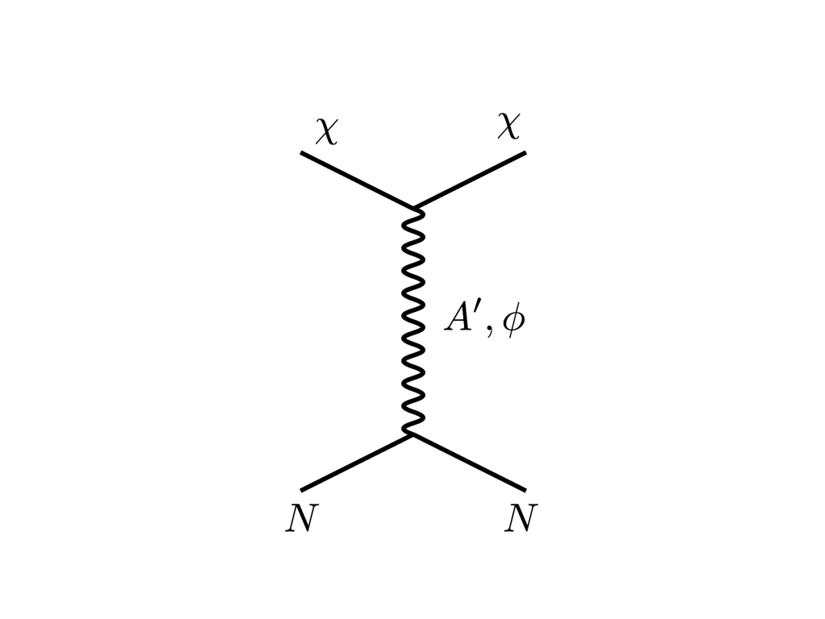



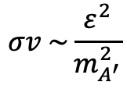


THE COSMOLOGICAL LANDSCAPE
Particle
Colliders
Mass
MeV
GeV
TeV
1
Already
Discovered
Strongly Interacting
Heavy Particles
Too Little to be
Dark Matter
DM
$$e$$
$$ε$$
$$ε$$
Interaction Strength
Just Right to
be Dark Matter
10⁻³
$$A′$$
$$e$$
DM
$$σv \sim \frac{ε^{2}}{m_{A^{′}}^{2}}$$
Weakly Interacting
Light Particles
Impossible to
Discover
10⁻⁶
Too Much to be
Dark Matter
Boehm, Fayet (2003)
Pospelov, Ritz, Voloshin (2007)
Feng, Kumar (2008)

Slide 8

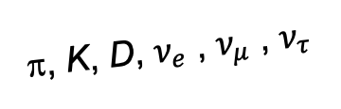
FORWARD PHYSICS
In 2017, we realized that the large LHC detectors, while beautifully optimized to discover new heavy particles, are also not at all optimally configured to find new light particles.
Heavy particles (W, Z, t, h, …) are produced at low velocity and decay roughly isotropically to other particles.
But high-energy light particles are dominantly produced in the forward direction and escape through the blind spots of these large detectors.
  This is true for all known light particles: pions, kaons, D mesons, all neutrinos.
  It is also true for many proposed new particles, especially those motivated by neutrino mass and dark matter.
These blind spots are the Achilles heels of the large LHC detectors.
Feng, Galon, Kling, Trojanowski (2017)
A’, a, mCPs, χ, …
π, K, D, $ν_{e}$ , $ν_{μ}$ , $ν_{τ}$
De Rujula, Ruckl (1984)

Slide 9
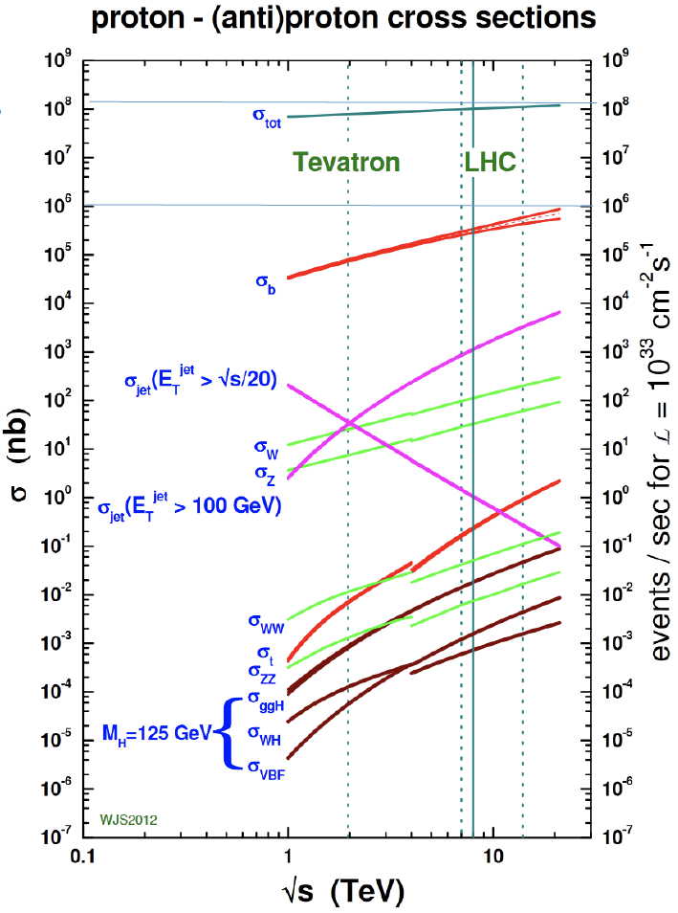
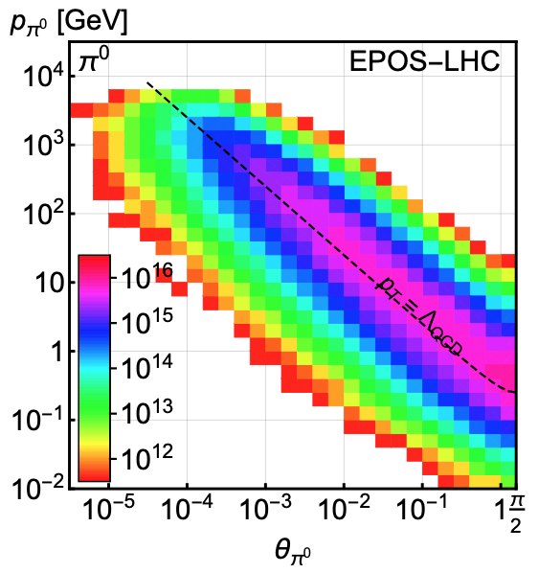
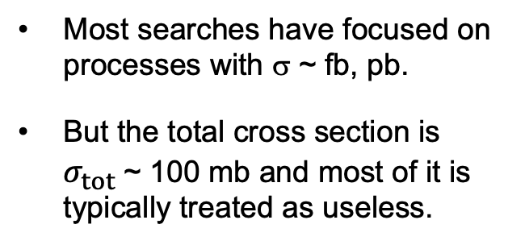
LIGHT PARTICLES AT THE LHC
300 fb⁻¹
Feng, Galon, Kling, Trojanowski (2017)
Most searches have focused on processes with σ ~ fb, pb.
But the total cross section is $σ_{tot}$~ 100 mb and most of it is typically treated as useless.
What do these events look like? Consider pions (decays to ν, BSM).
Enormous event rates. Typical p_{T} ~ 250 MeV, but many with p ~ TeV within 1 mrad (η > 7.6) of the beamline.

Slide 10
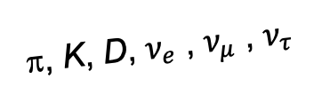
DETECTING FORWARD PARTICLES
To capture the enormous forward flux, we need to detect particles that are produced in the forward direction along the beamline.
Problem: we can’t just put the detector there: they will block the protons from coming in.
Solution: the LHC is a circular collider! If we go far enough away, the LHC proton beam will curl away, while all the light, weakly-interacting particles we are looking for will go straight.
A’, a, mCPs, χ, …
π, K, D, $ν_{e}$ , $ν_{μ}$ , $ν_{τ}$

Slide 11
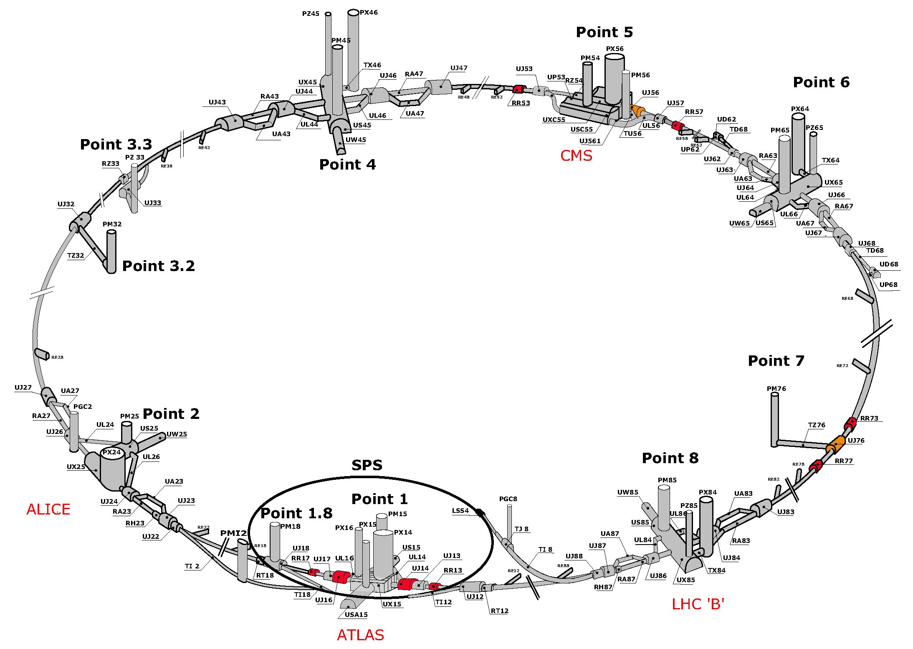
MAP OF THE LHC
!!!

Slide 12
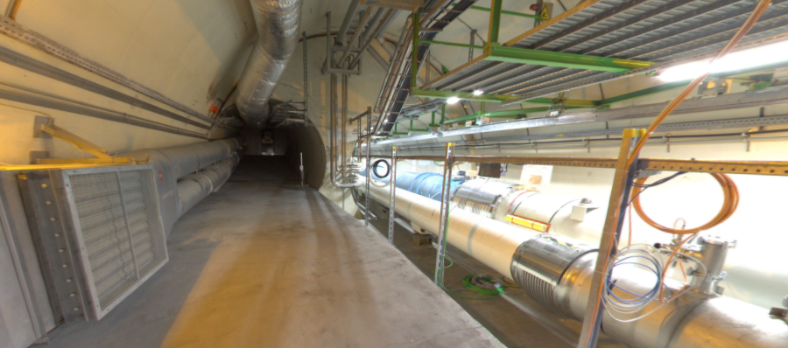
THE FORWARD REGION
Beam collision axis passes
through 100 m of rock, emerges in tunnel TI12, 480 m from ATLAS
UJ12
TI12 near UJ12
The view in UJ12 looking west in 2018
TI12
Beam collision axis
LHC beamline

Slide 13
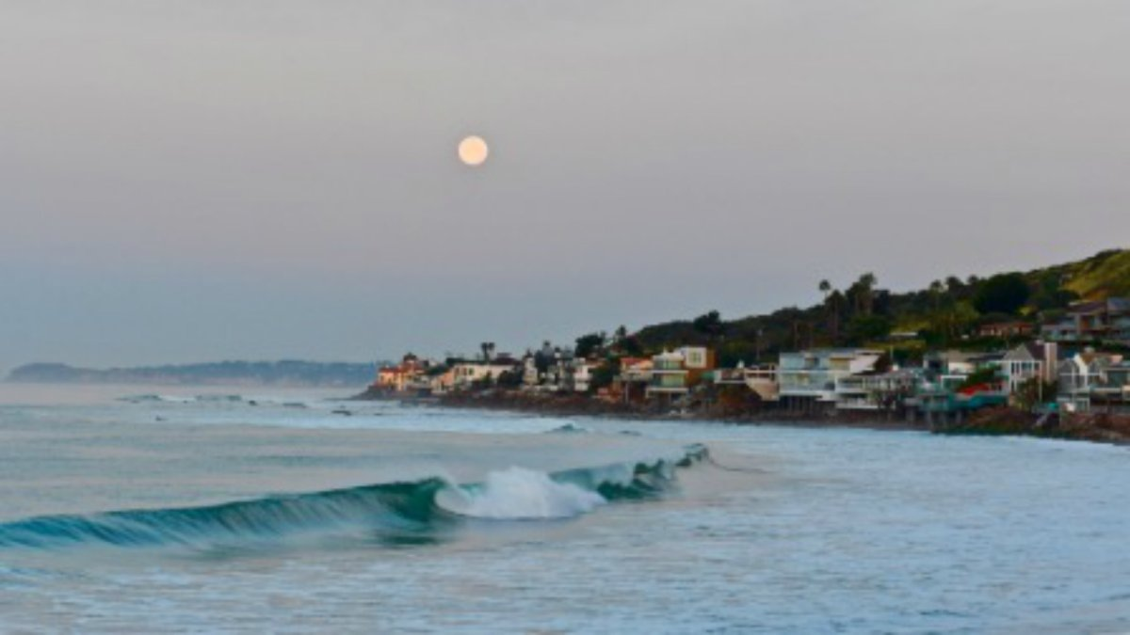
HOW BIG DOES THE DETECTOR HAVE TO BE?
Momentum:
Space:
250 MeV
1 TeV
12 cm
480 m
The opening angle is 0.2 mrad (the moon is 7 mrad). Even 480 m away, most of the signal passes through an 8.5” x 11” (A4) sheet of paper.
Neutrinos and many new particles are therefore much more collimated than shown below, motivating a relatively small, fast, and inexpensive experiment at the LHC: the ForwArd Search ExpeRiment (FASER).

Slide 14
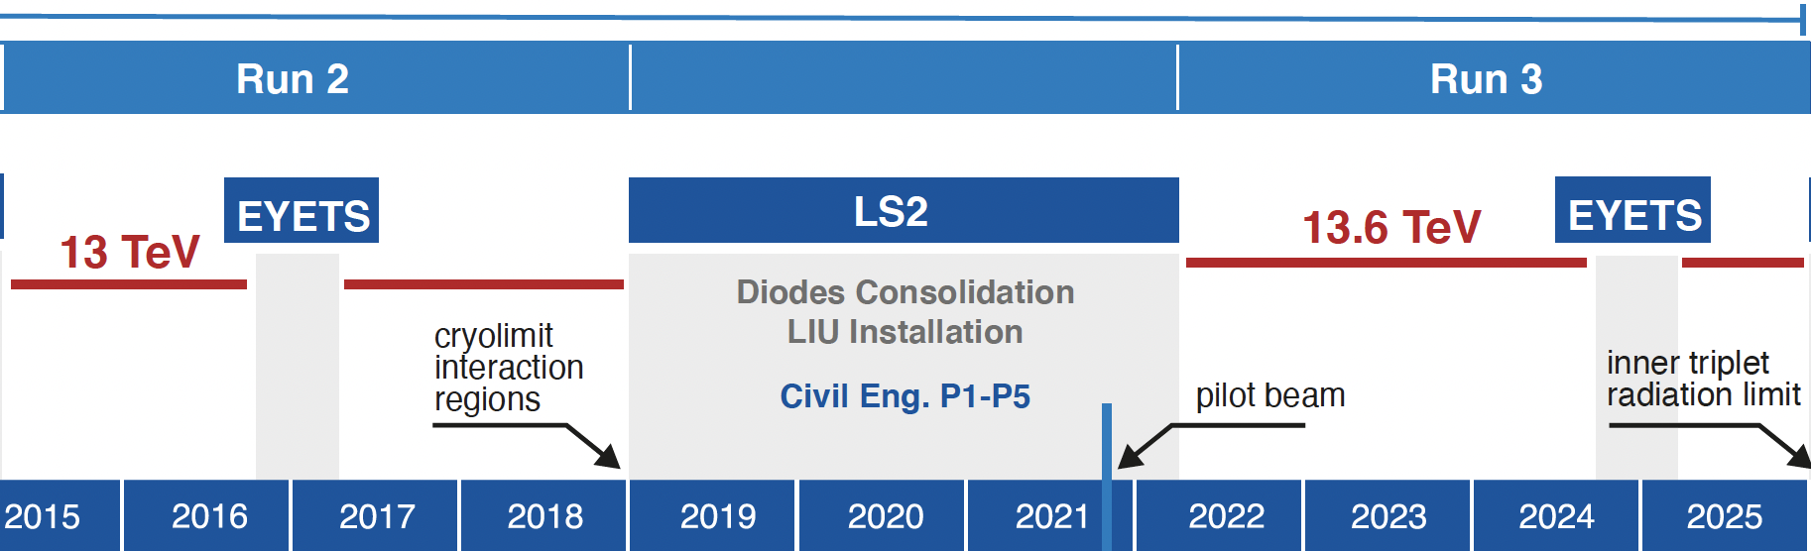
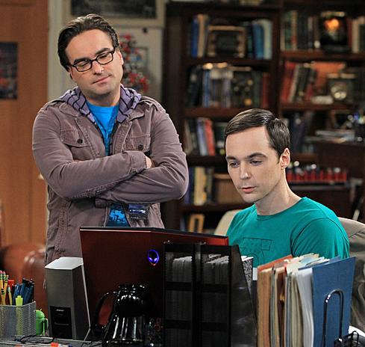
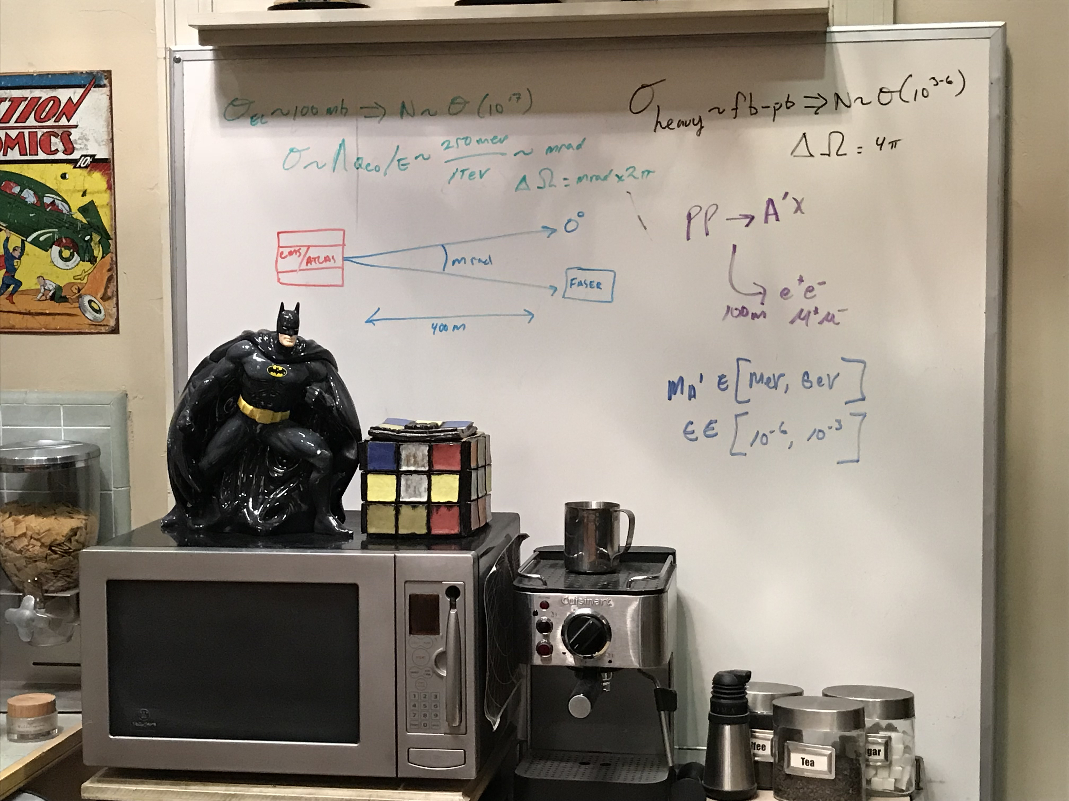
FASER AND FASERν TIMELINE
LOI submitted to CERN LHCC
FASER fully constructed and installed
FASERν fully constructed and installed
Technical Proposal submitted to CERN LHCC
FASER approved as 8th LHC detector by CERN
Concept paper: Feng, Galon, Kling, Trojanowski
FASERν approved as 9th LHC detector by CERN
FASER and FASERν announce first physics results
FASER and FASERν begin collecting data in Run 3
Funding from Heising-Simons and Simons Foundations
FASER and FASERν announce more physics results
Spare detector parts from ATLAS and LHCb Collaborations

Slide 15














THE FASER COLABORATION NOW
97 collaborators, 26 institutions, 10 countries
International laboratory covered by a cooperation agreement with CERN

Slide 16
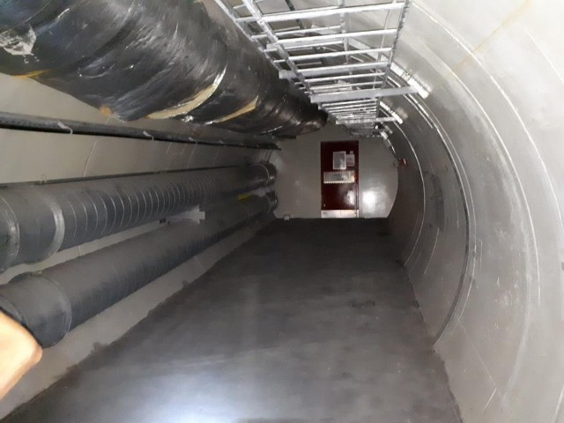
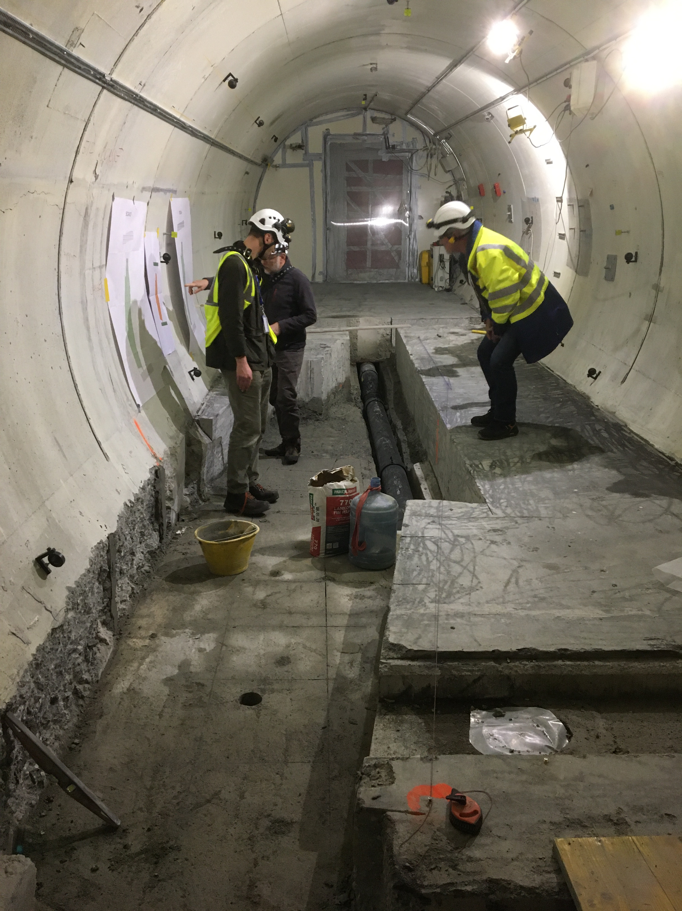
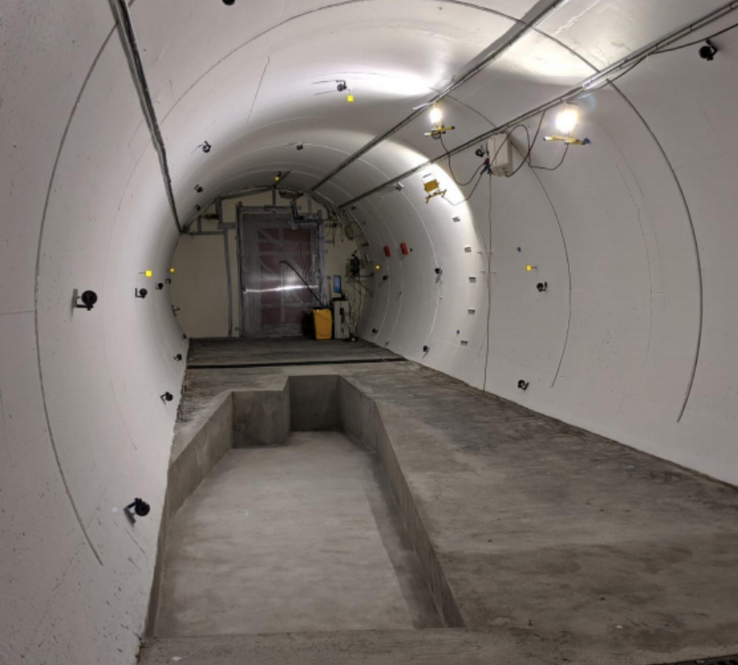
PREPARATION OF THE FASER LOCATION
The beam collision axis was located to mm accuracy by the CERN survey department. To place FASER on this axis, a trench was required to lower the floor by 46 cm.
The trench was completed by an Italian firm just hours before COVID shut down CERN in March 2020.
2019
Spring 2020
Summer 2020

Slide 17
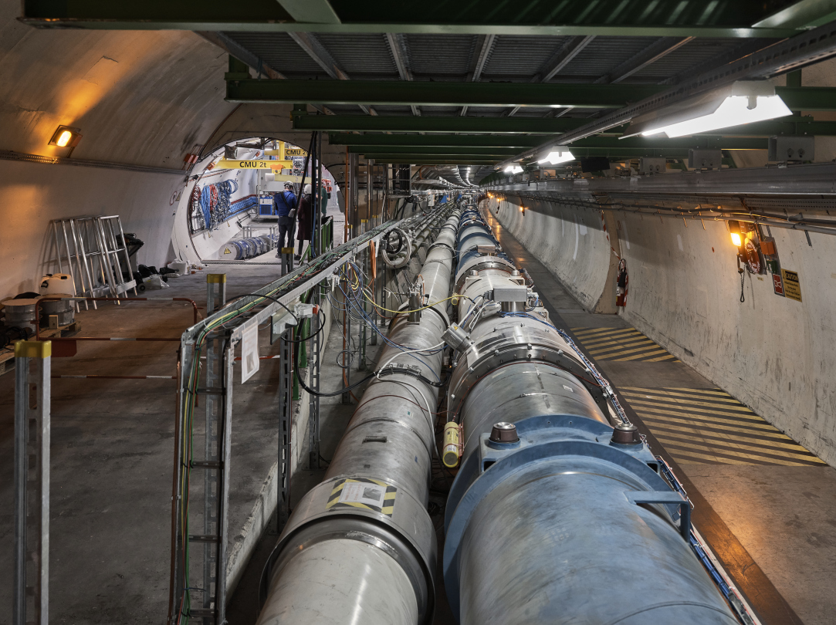
FASER AND THE LHC

Slide 18
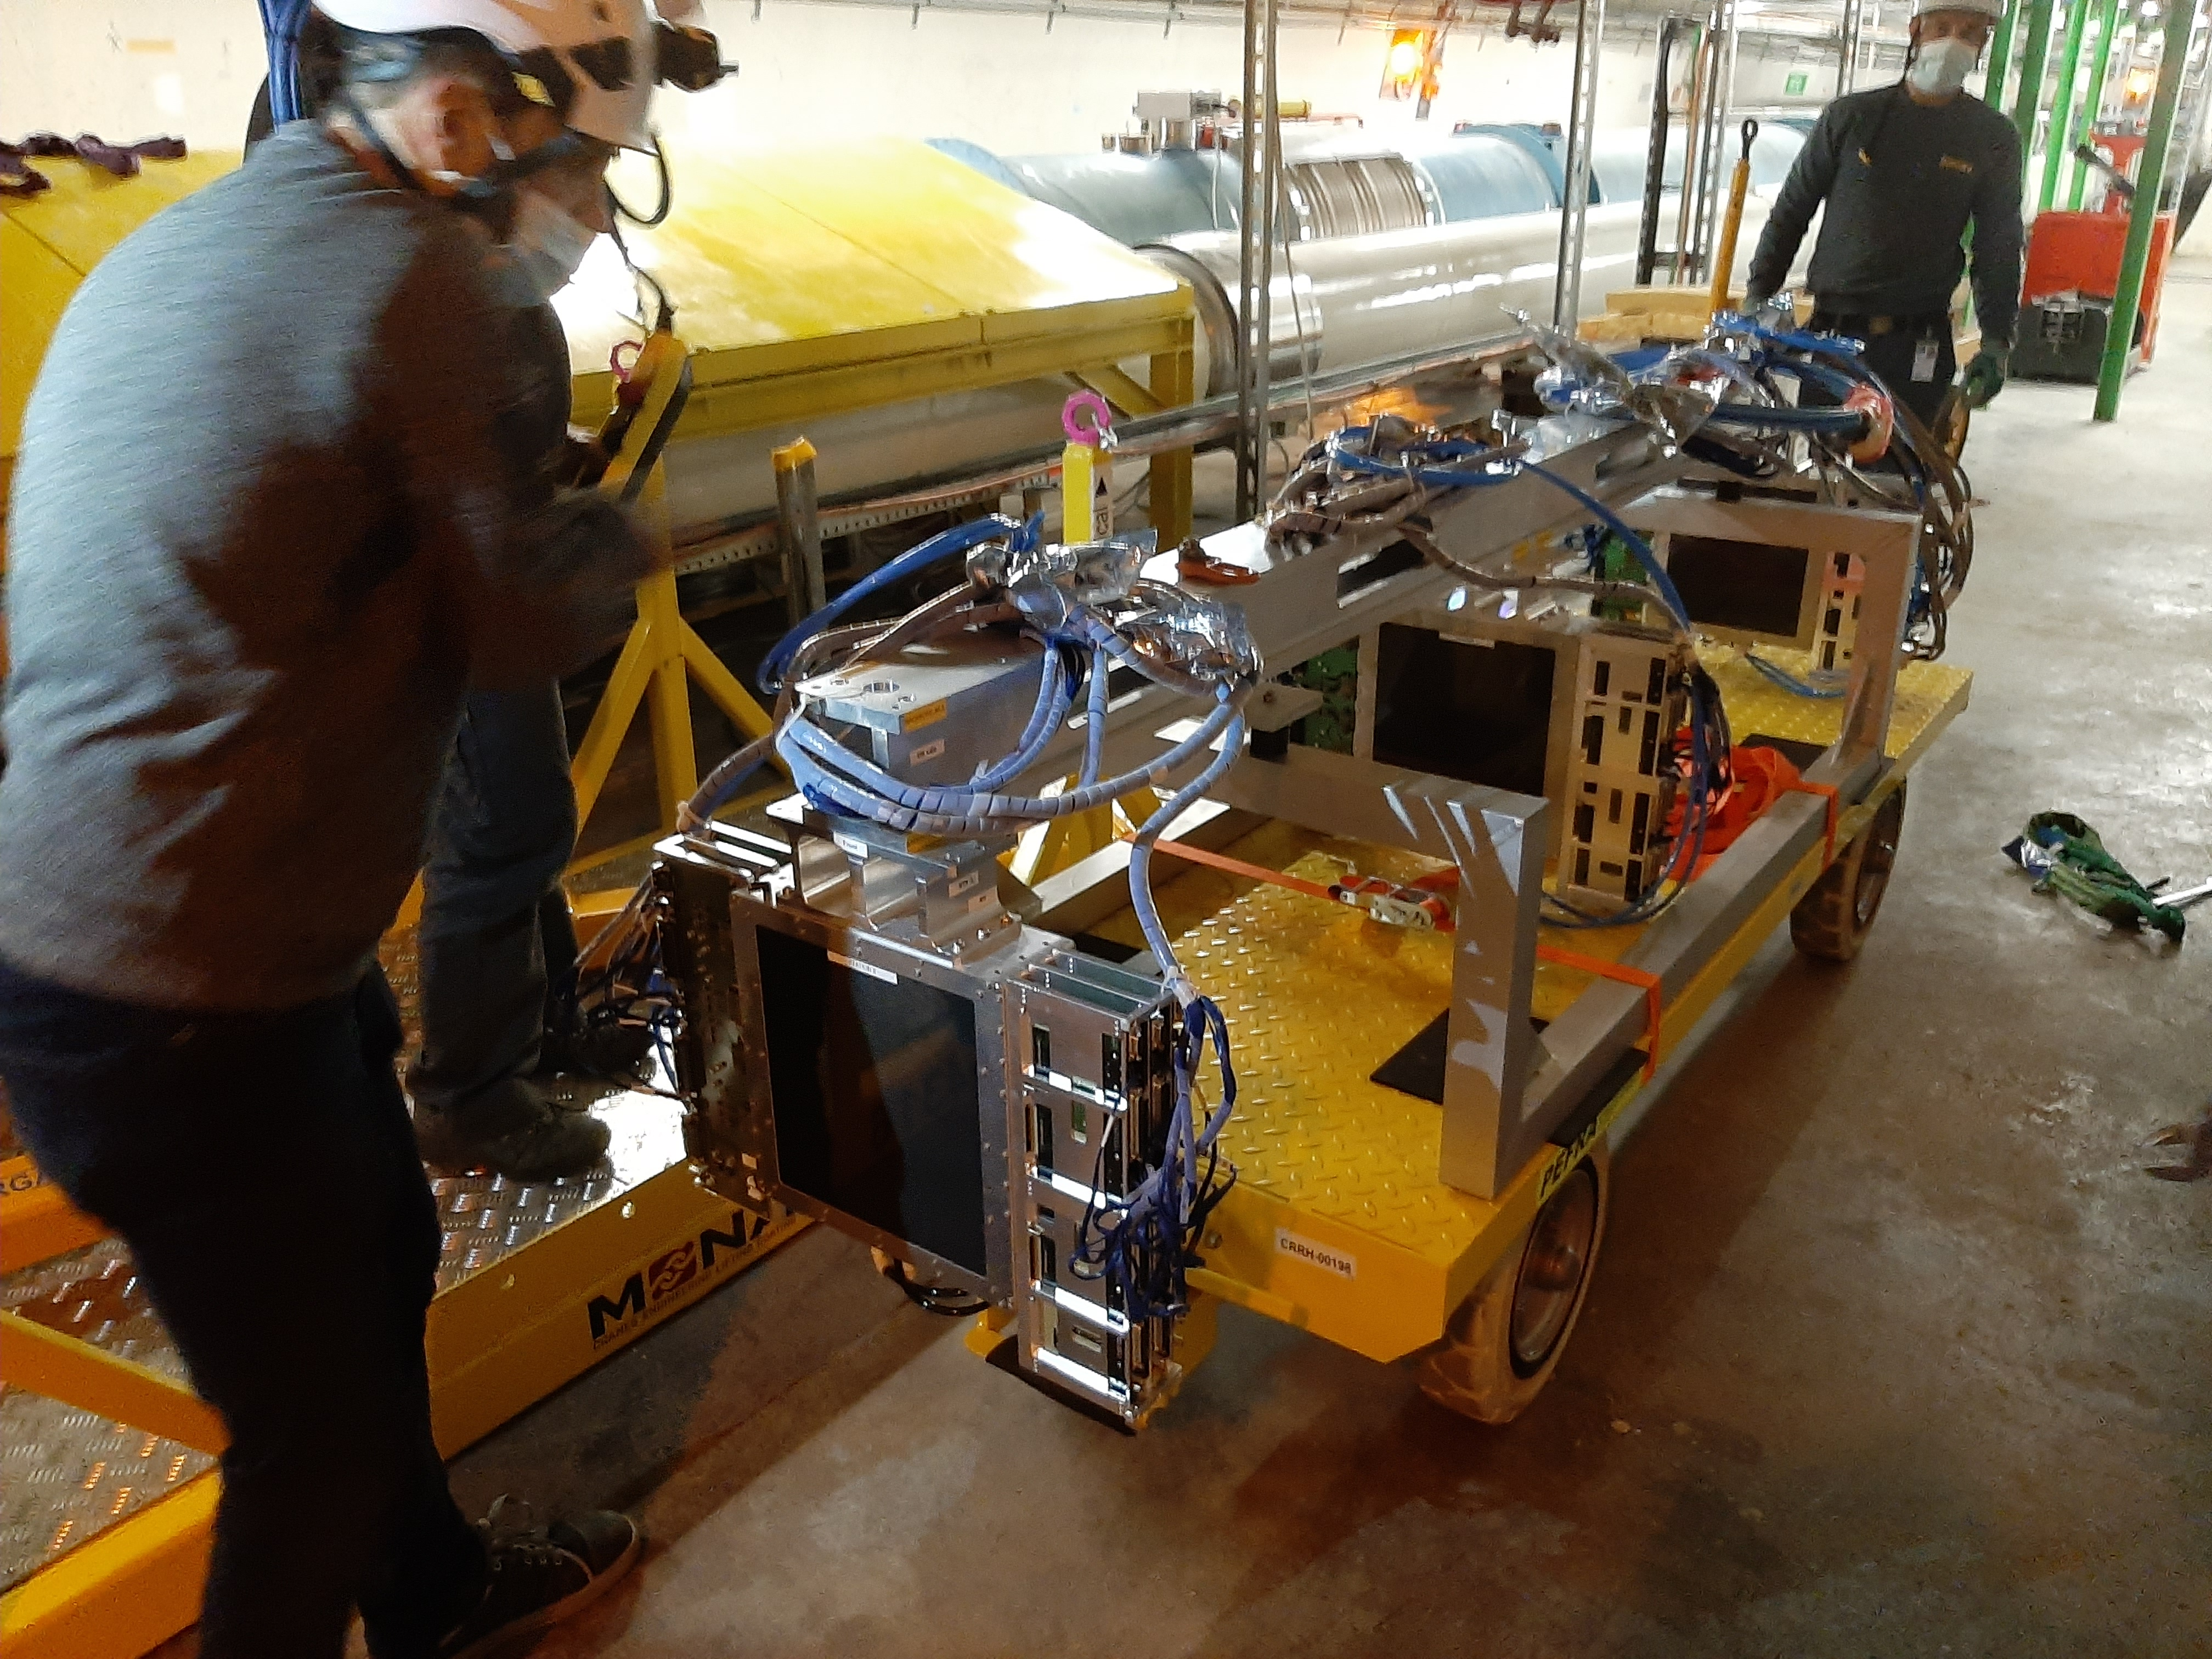
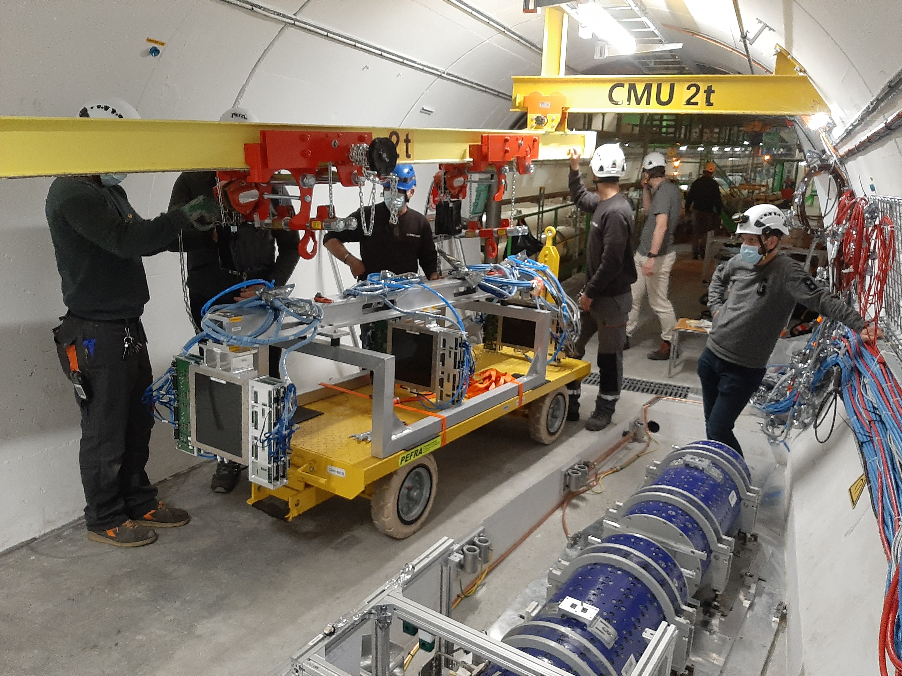
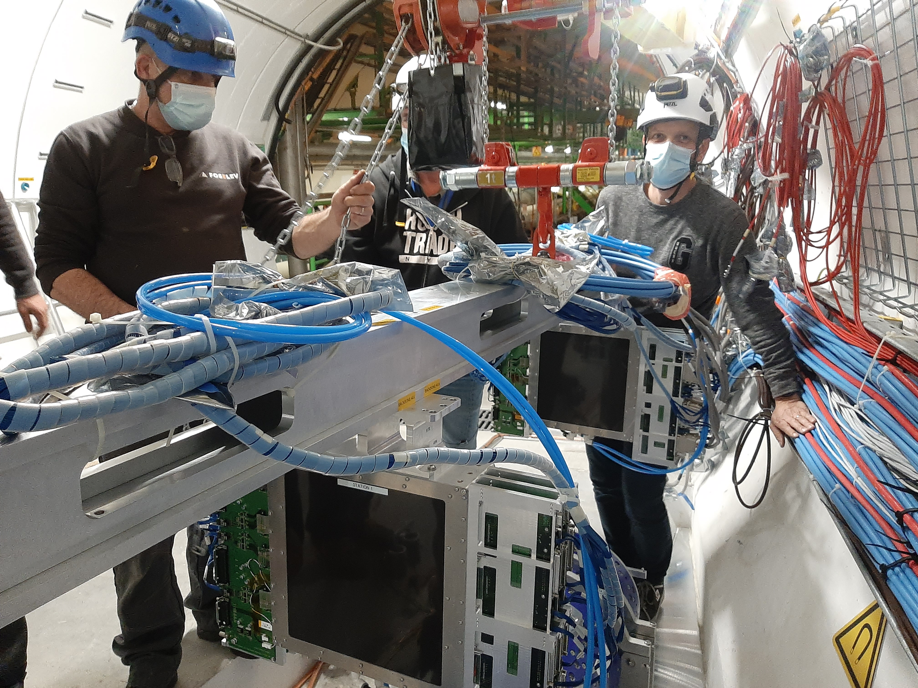
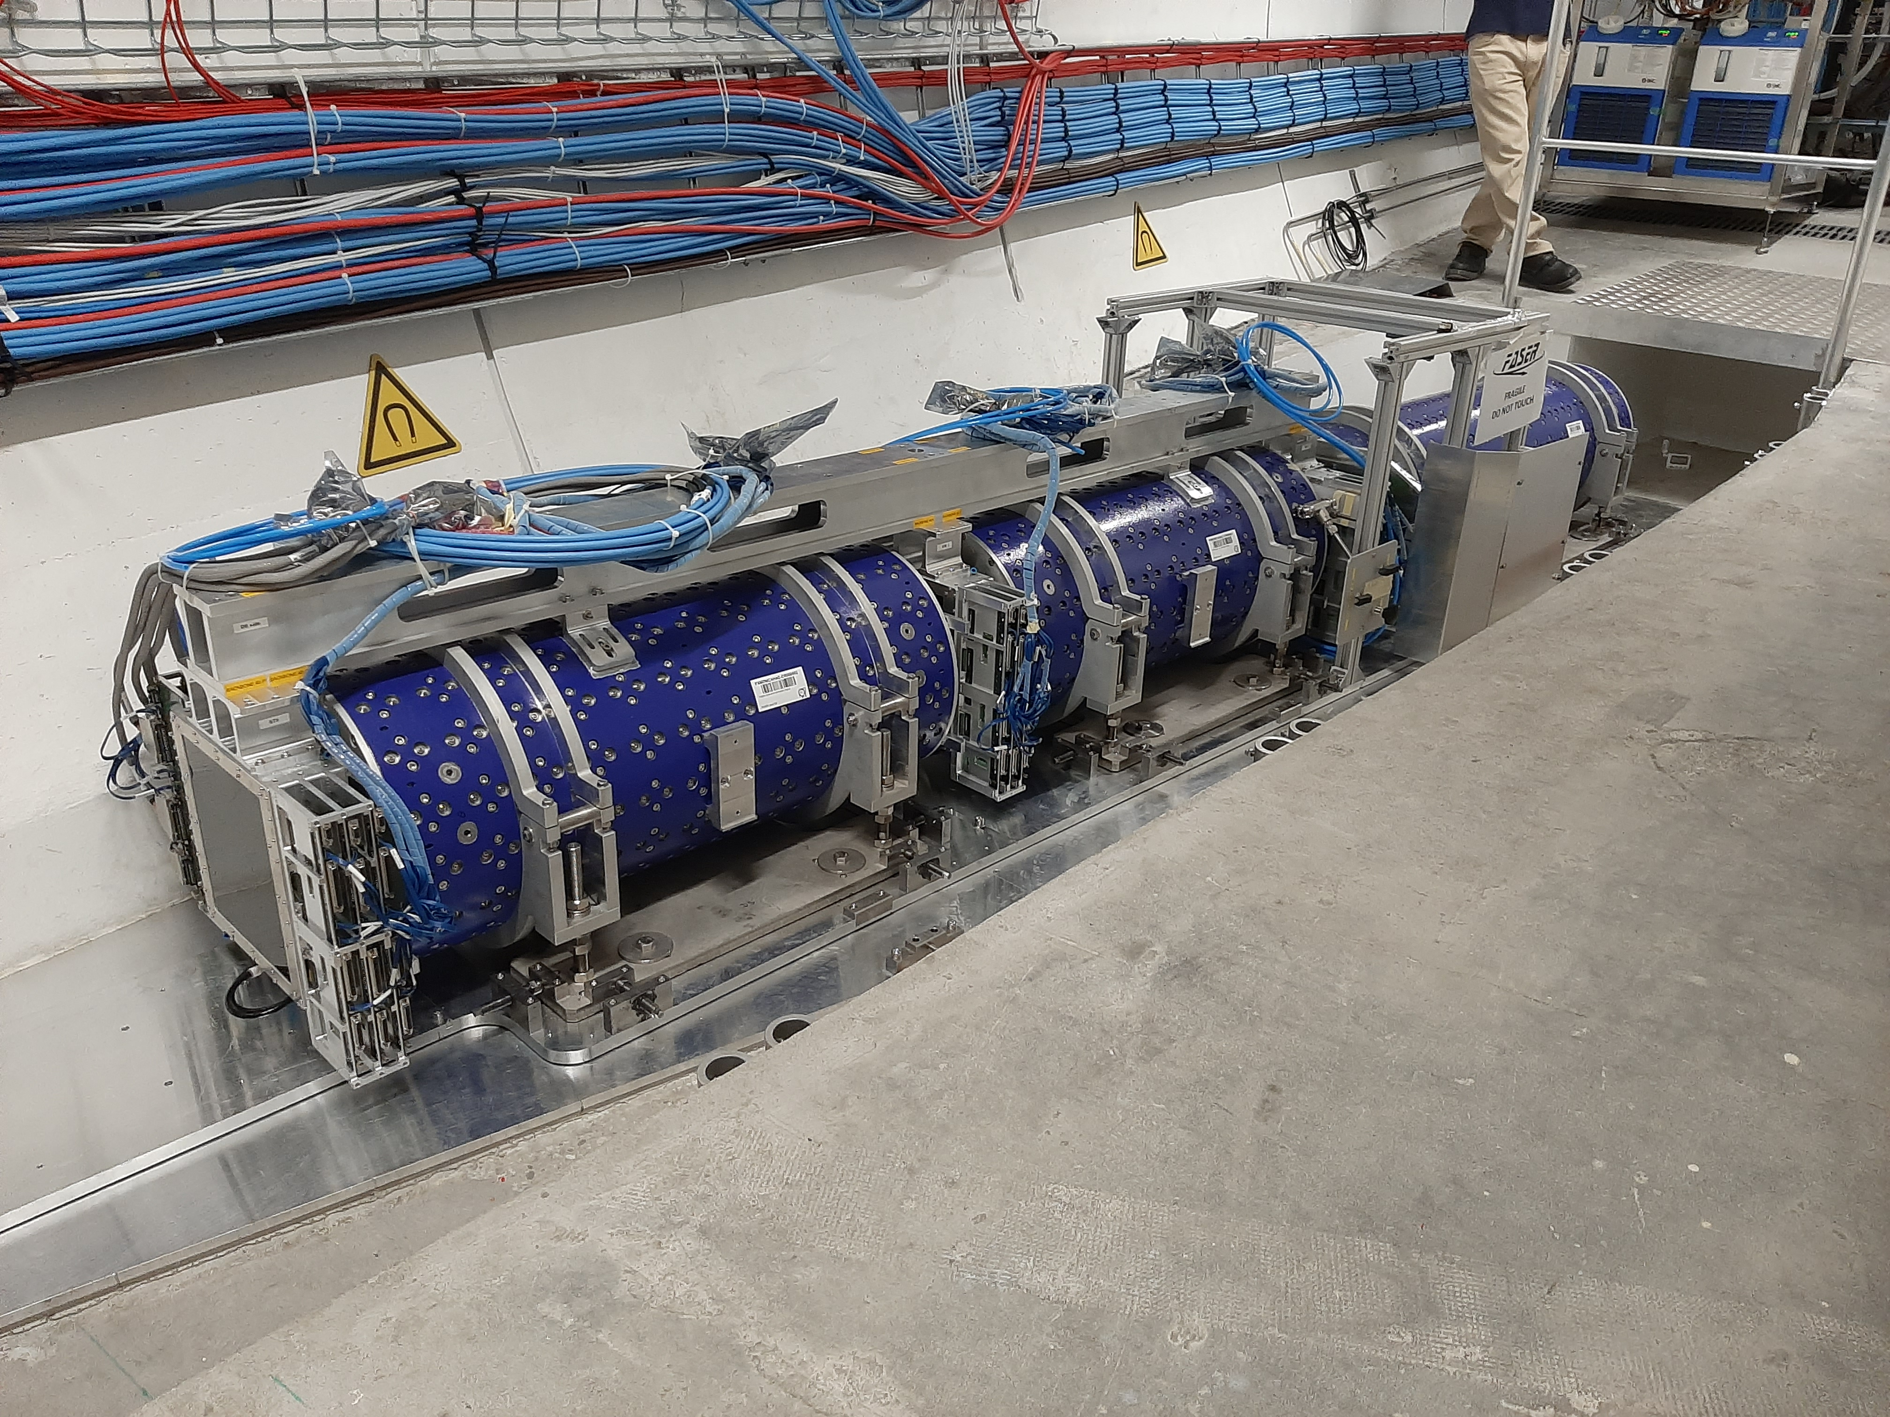
FASER INSTALLATION

Slide 19
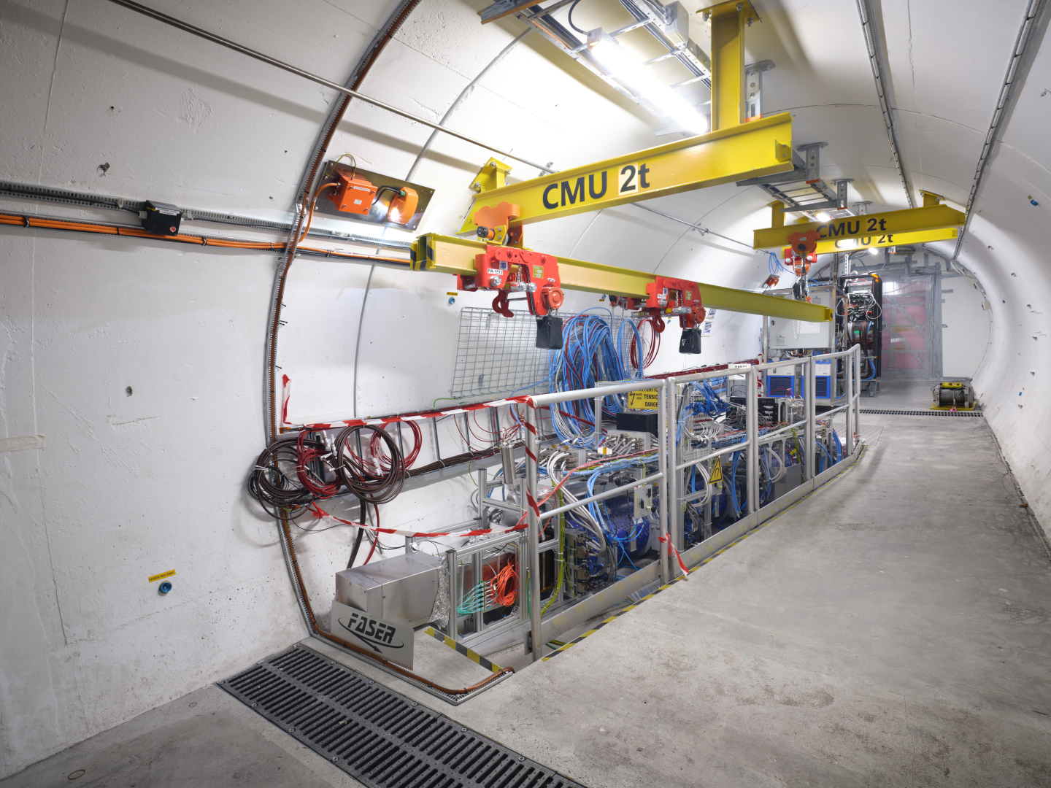
THE FASER DETECTOR

Slide 20
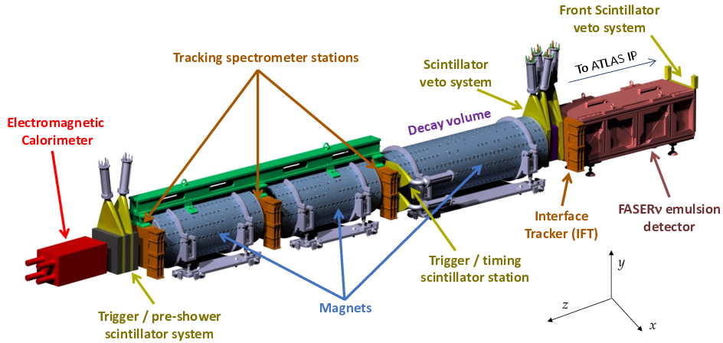
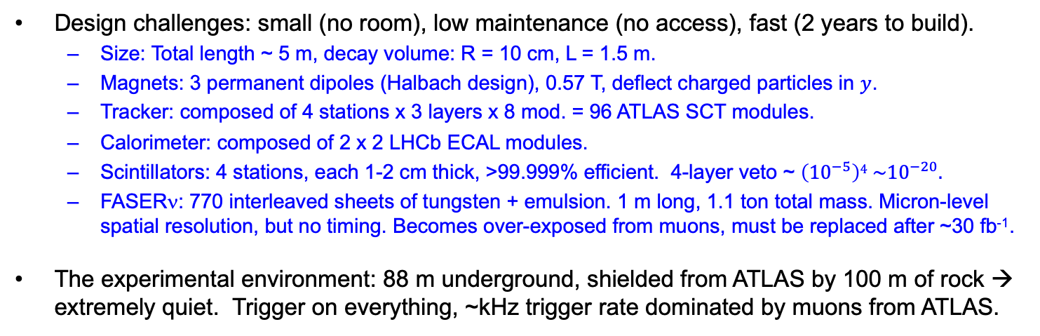
THE FASER DETECTOR
Design challenges: small (no room), low maintenance (no access), fast (2 years to build).
  Size: Total length ~ 5 m, decay volume: R = 10 cm, L = 1.5 m.
  Magnets: 3 permanent dipoles (Halbach design), 0.57 T, deflect charged particles in $y$.
  Tracker: composed of 4 stations x 3 layers x 8 mod. = 96 ATLAS SCT modules.
  Calorimeter: composed of 2 x 2 LHCb ECAL modules.
  Scintillators: 4 stations, each 1-2 cm thick, >99.999% efficient. 4-layer veto ~ $\left({10}^{−5}\right)4 \sim {10}^{−20}.$
  FASERν: 770 interleaved sheets of tungsten + emulsion. 1 m long, 1.1 ton total mass. Micron-level spatial resolution, but no timing. Becomes over-exposed from muons, must be replaced after ~30 fb⁻¹.
The experimental environment: 88 m underground, shielded from ATLAS by 100 m of rock → extremely quiet. Trigger on everything, ~kHz trigger rate dominated by muons from ATLAS.
FASER Collaboration
(2207.11427)

Slide 21
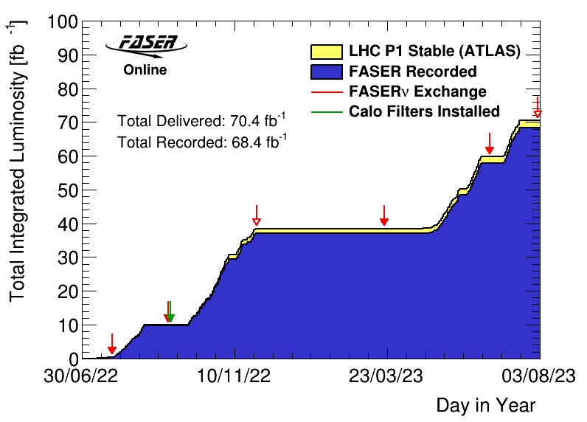
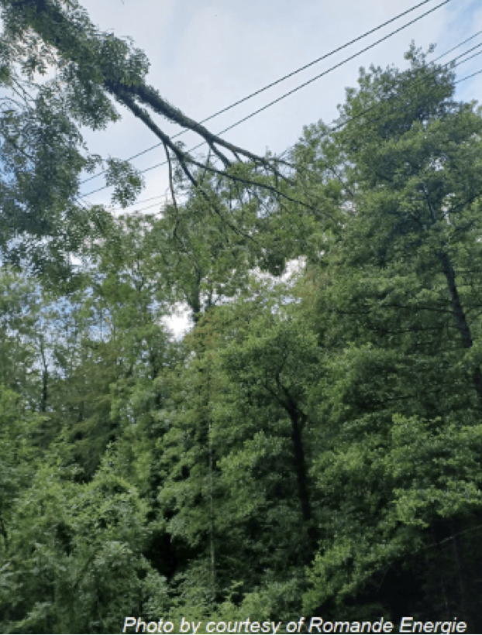
FASER DATA TAKING IN 2022 AND 2023
FASER was constructed in 18 months. We saw our first cosmic ray event on 18 March 2021.
After LS2 from 2018-2021, the LHC started running again from Jul to Nov 2022 and Apr to Jul 2023.
FASER began recording data immediately.
  Recorded 97% of delivered luminosity
  Largely automated: no control room, 2 shifters controlling and monitoring the expt from their laptops
FASERν emulsion exchanged periodically to prevent overexposure
  3 boxes in 2022 (0.5, 10, 30 fb⁻¹)
  2 boxes in 2023 (20, 10 fb⁻¹)

Slide 22
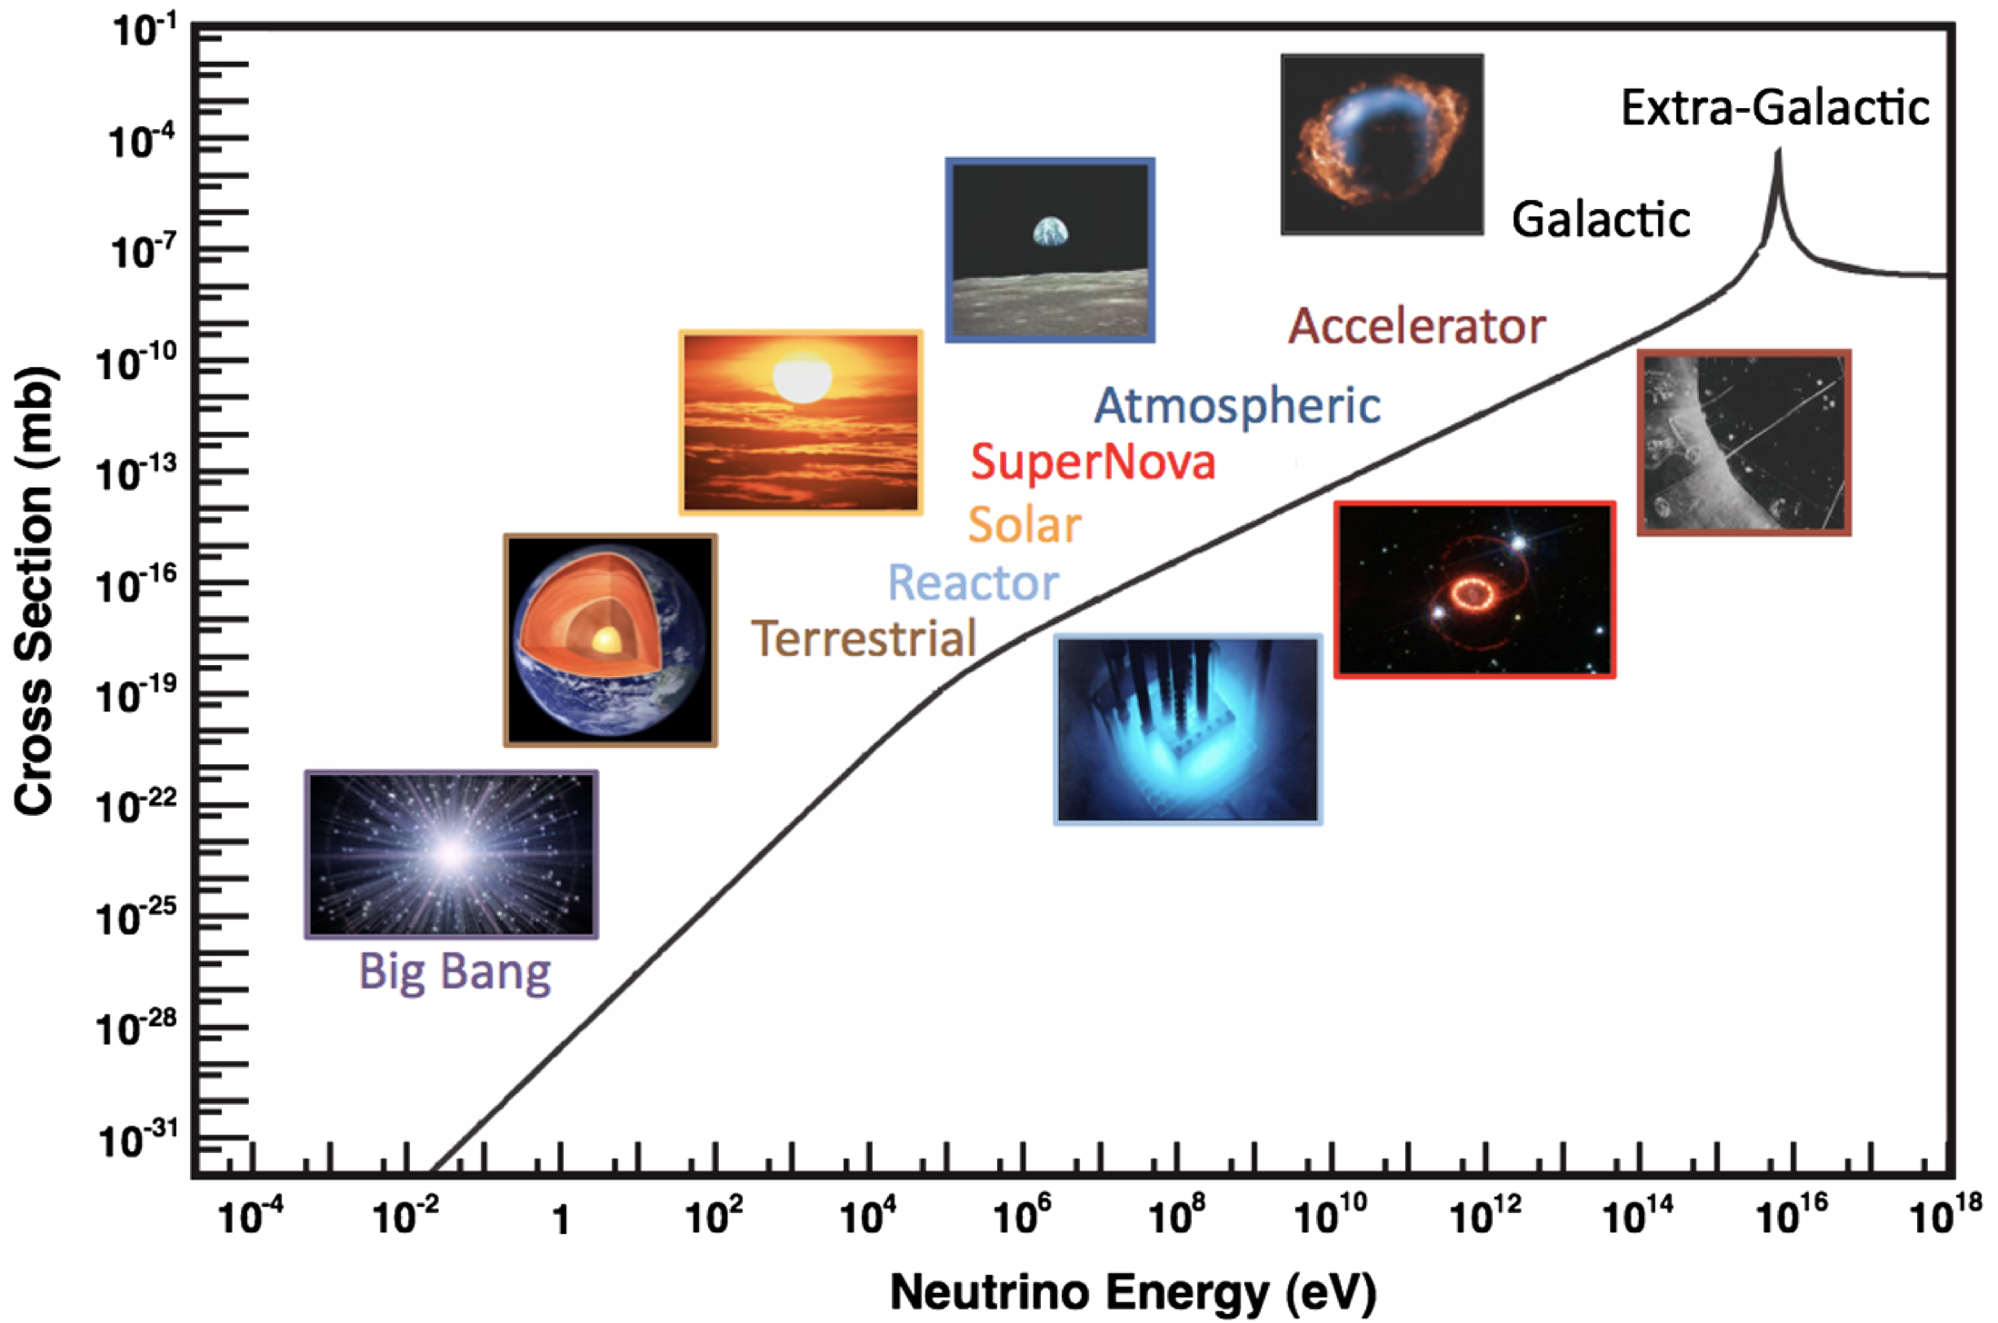
COLLIDER NEUTRINOS
Neutrinos are the least understood of all known particles, and the only ones with confirmed BSM properties.
They have been discovered from many sources, each time with stunning implications for particle physics, astrophysics, and cosmology.
Formaggio, Zeller (2012)
But before FASER, neutrinos produced at a particle collider (since 1971) had never been directly observed: they interact very weakly, and the highest energy ones, which are most likely to interact, pass through the blind spots of existing detectors.

Slide 23
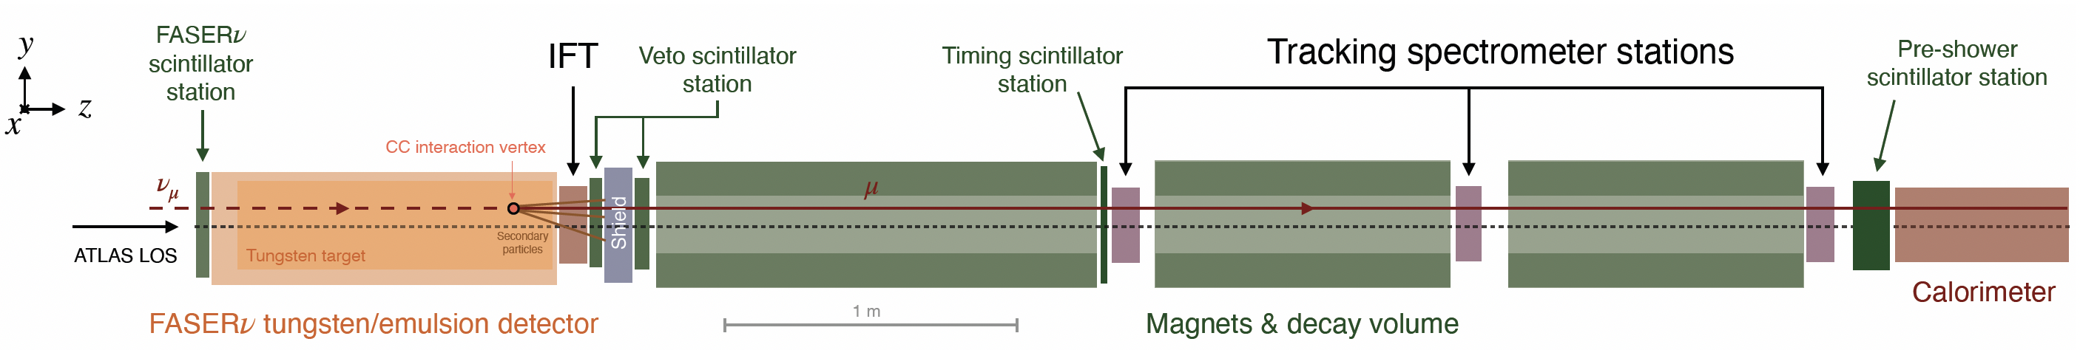
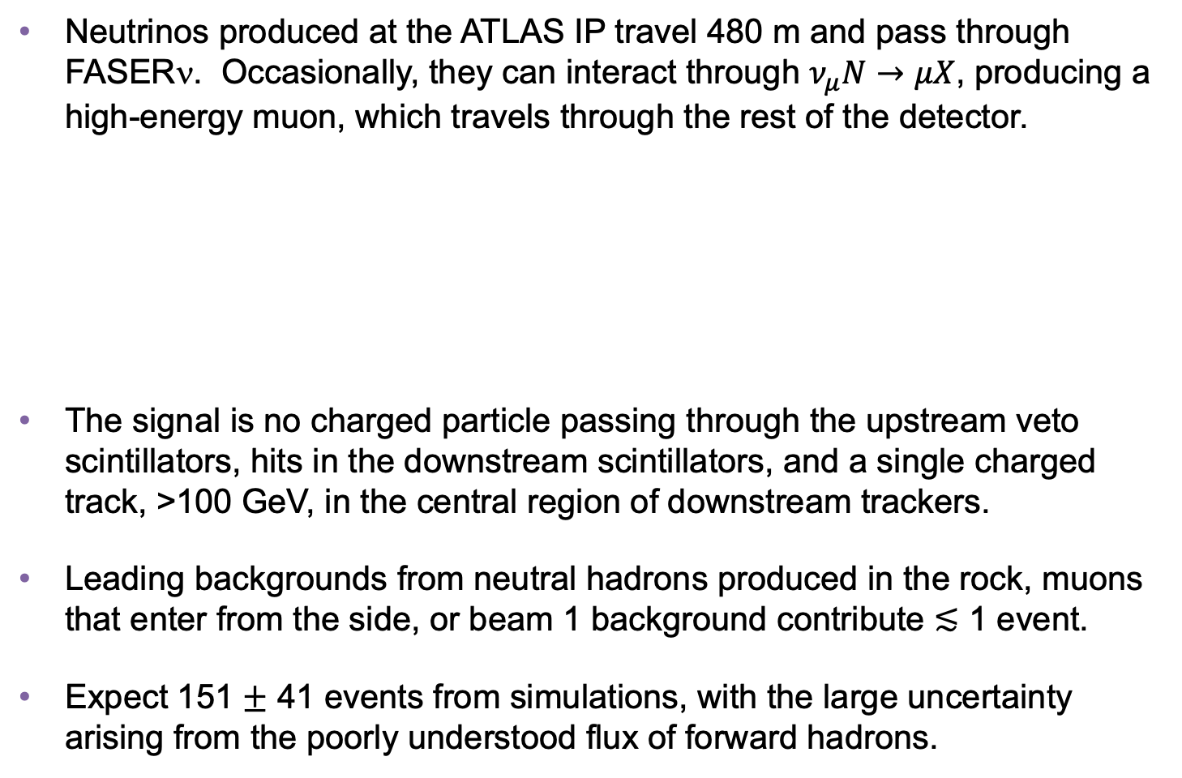
COLLIDER NEUTRINO SEARCH
Neutrinos produced at the ATLAS IP travel 480 m and pass through FASERν. Occasionally, they can interact through $ν_{μ}N→μX$, producing a high-energy muon, which travels through the rest of the detector.
The signal is no charged particle passing through the upstream veto scintillators, hits in the downstream scintillators, and a single charged track, >100 GeV, in the central region of downstream trackers.
Leading backgrounds from neutral hadrons produced in the rock, muons that enter from the side, or beam 1 background contribute $≲$ 1 event.
Expect 151 $±$ 41 events from simulations, with the large uncertainty arising from the poorly understood flux of forward hadrons.
FASER Collaboration (2303.14185, PRL)
Notes:
typical A’ that decays in FASER has ~TeV energy

Slide 24
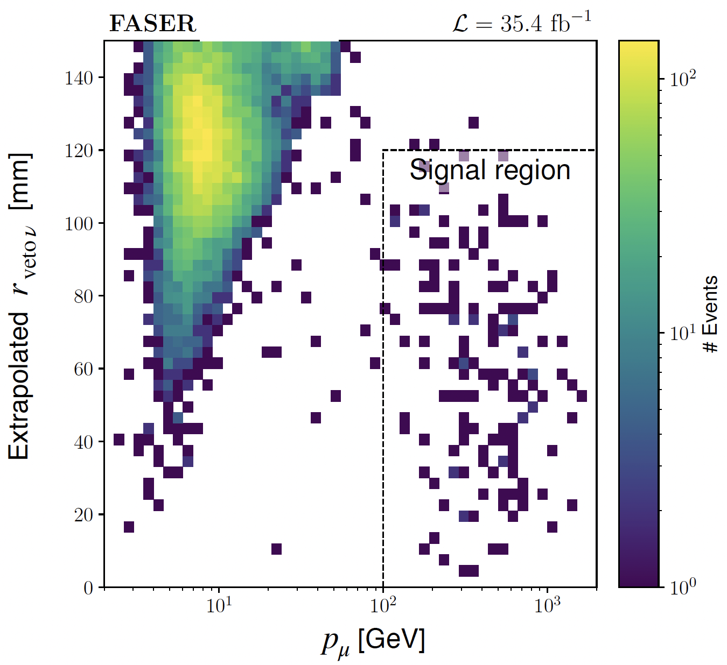
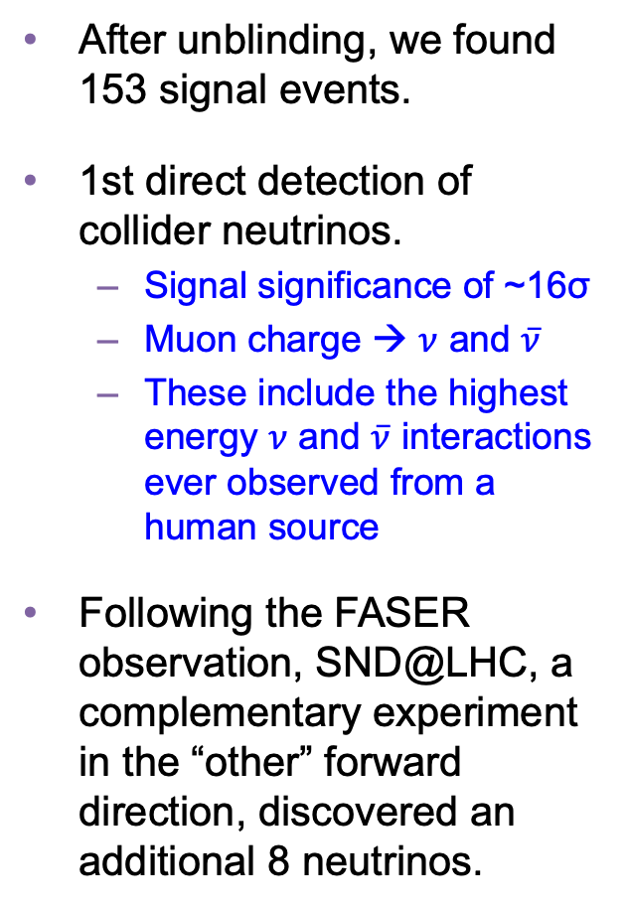
COLLIDER NEUTRINO RESULTS
After unblinding, we found 153 signal events.
1st direct detection of collider neutrinos.
  Signal significance of ~16σ
  Muon charge → $ν$ and $\overline{ν}$
  These include the highest energy $ν$ and $\overline{ν}$ interactions ever observed from a human source
Following the FASER observation, SND@LHC, a complementary experiment in the “other” forward direction, discovered an additional 8 neutrinos.
FASER Collaboration (2303.14185, PRL)

Slide 25
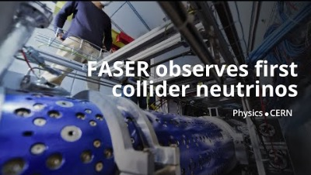
DISCOVERY OF COLLIDER NEUTRINOS

Slide 26
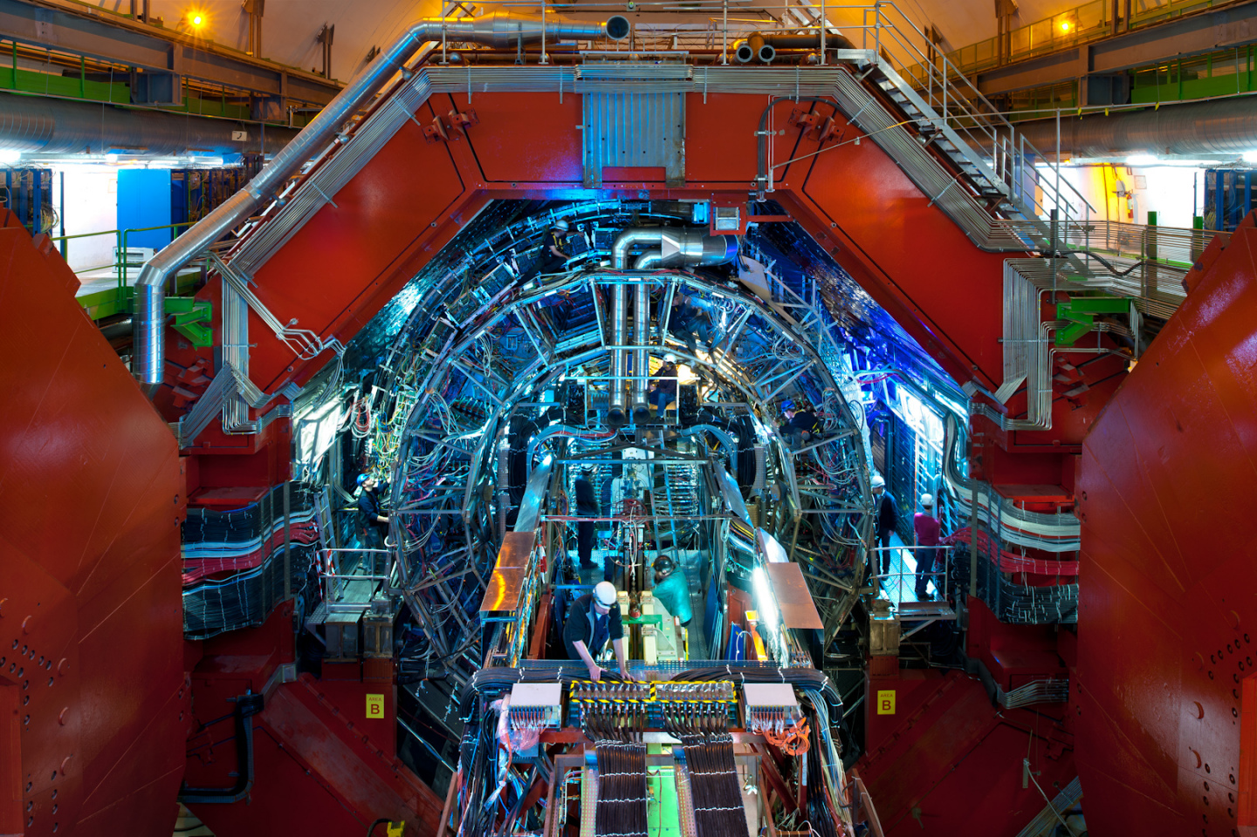
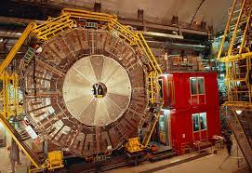
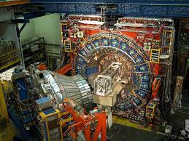
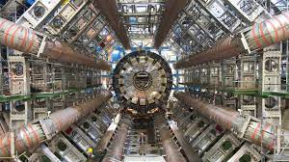
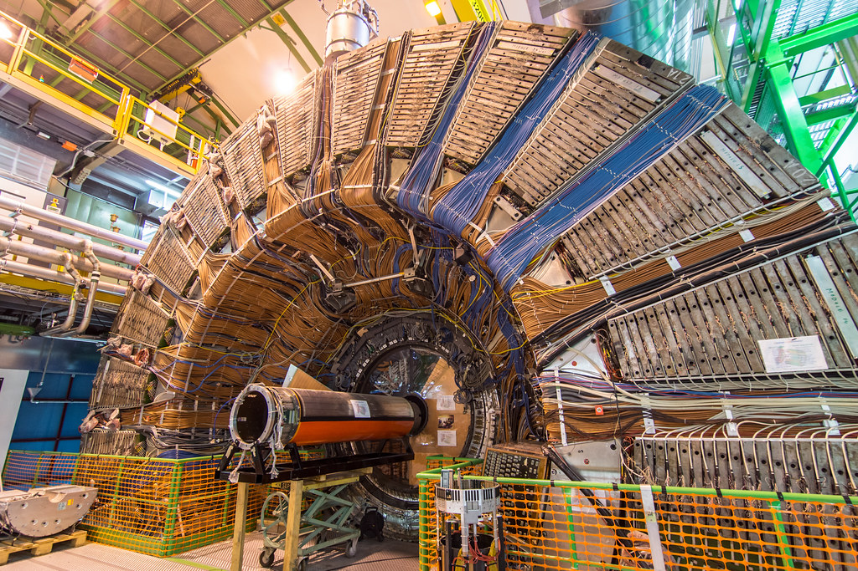
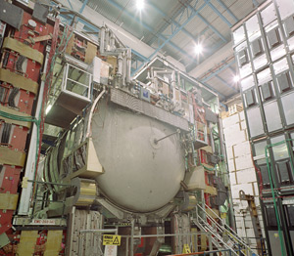
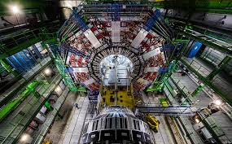
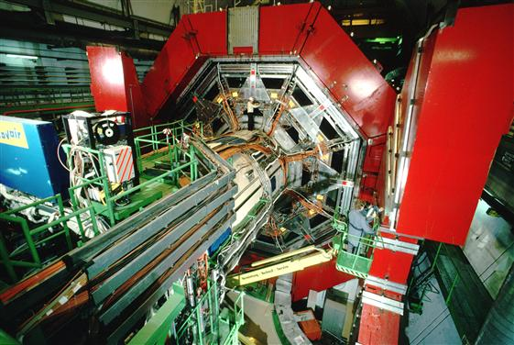

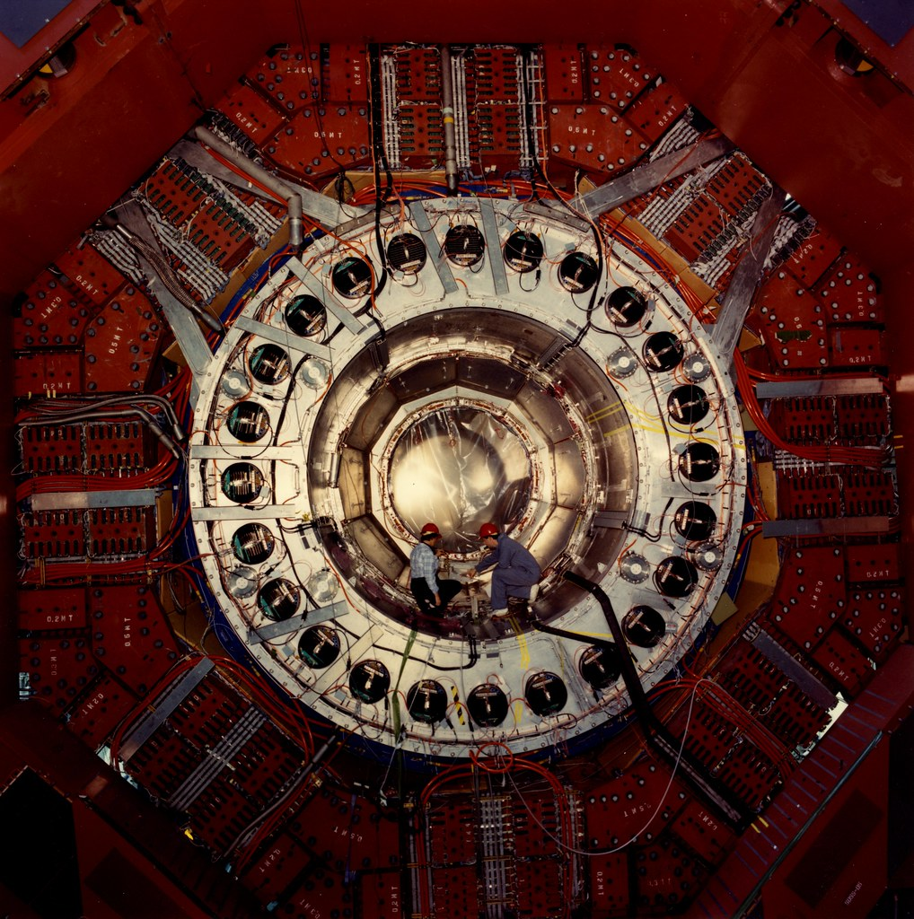
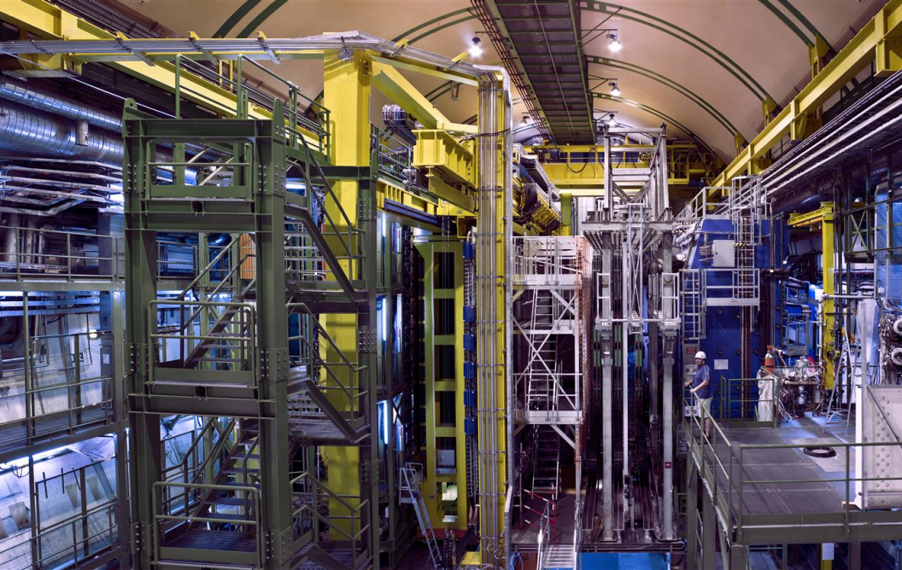
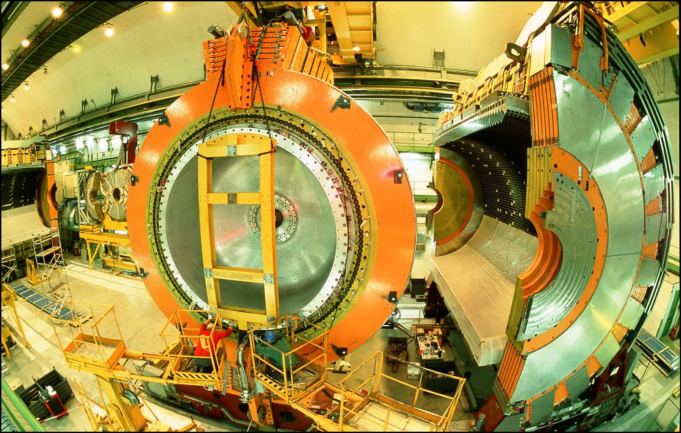
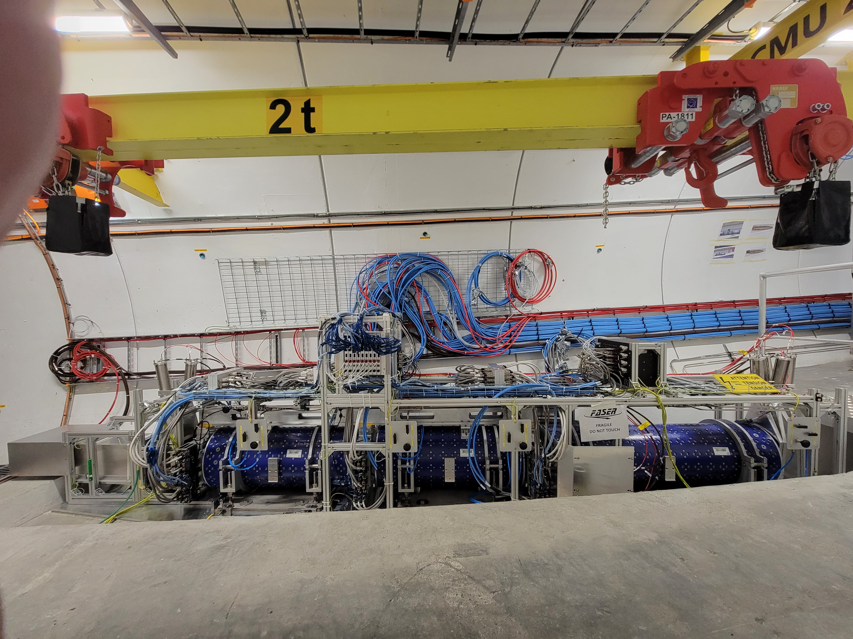
LOCATION, LOCATION, LOCATION
…
ALICE
ALEPH
CDF
FASER
“Tabletop,” 18 months,
~$1M
153 neutrinos
ATLAS
DELPHI
D0
CMS
L3
LHCb
SLD
OPAL
All previous
collider detectors
Building-size, decades,
~$1B
0 neutrinos
16σ discovery, opening a new window at the high energy frontier

Slide 27





NEUTRINOS FROM EMULSION IN FASERν
The discovery analysis did not even use the emulsion data! With the emulsion, we have now observed the first collider electron neutrinos, including the “Pika-$ν$” event, the highest energy (1.5 TeV) electron neutrino from a lab source.
Side View
Vertex with 11 tracks
  615 µm inside tungsten
e-like track from vertex
  Single track for 2X₀
  Shower max @ 7.8Χ₀
  θ_{e} = 11 mrad to beam
Back-to-back topology
  175° between e & rest
$$e$$
Beam View
FASER Collaboration (2403.12520)

Slide 28


TEV NEUTRINO CROSS SECTIONS
Following these discoveries, we can then move on to studies, including the first measurement of neutrino cross sections at TeV energies.
Results are consistent with SM DIS predictions.
Xie, Gao, Hobbs, Stump, Yuan (2024)
These measurements use only 1.7% of the data already collected in 2022 and 2023. Much more to come; we expect to triple the world’s supply of tau neutrinos, identify the first anti-tau neutrino, …
FASER Collaboration (2403.12520)

Slide 29



NEW PARTICLE SEARCHES
FASER can also look for new light and weakly-interacting particles.
For example: suppose there is a dark sector that contains dark matter X and also a dark force: dark electromagnetism.
The result? Dark photons $A′$ , like photons, but with mass $m_{A′}$, couplings suppressed by $ε$.
For low $ε$, dark photons are long-lived particles (LLPs), can be produced in ATLAS, pass through rock and magnetic fields unhindered, and decay in FASER.
SM
EM
Dark Sector
EM, X
A
$${εF}_{μν}F_{D}^{μν}$$
A_{D}
Holdom (1986)

Slide 30


DARK PHOTON SIGNAL
Focus on masses in the 10-100 MeV range.
Produced through meson decay $π/η→A^{′}γ$ or “dark bremsstrahlung” $pp→{ppA}^{′}$.
Travel straight and unimpeded through 480 m of rock/concrete.
Then decay through $A^{′}$ $→ e^{+}e^{−}$.
The signal is no charged particle passing through the upstream veto scintillator detectors, followed by two very energetic (100s of GeV) charged tracks in downstream trackers. Tracks are very collimated, but magnet splits them sufficiently to be seen as 2 tracks in trackers.
Notes:
typical A’ that decays in FASER has ~TeV energy

Slide 31

DARK PHOTON RESULTS
After unblinding, no events seen, FASER sets limits on previously unexplored parameter space.
First new probe of the parameter space favored by dark matter from low coupling since the 1990’s.
Bodes well for the future
  Background-free analysis
  Started probing new parameter space with the first day of data
  Ended up ~100 times more sensitive than previous experiments.
  Improvements in analysis and 50 times more data to come
Existing bounds from DarkCast
FASER Collaboration (2308.05587, PLB)

Slide 32




ALP-W SEARCH RESULTS
Can also look for LLPs with purely photonic final states. E.g., ALP-Ws
production
decay
Signal is no hits in veto scintillators, >1 TeV energy deposit in ECAL.
Background: Expect 0.42 $±$ 0.32 from $ν$ interactions in 58 fb⁻¹ (yesterday’s signal, today’s background)
1 event seen, excludes new parameter space. Benefits from LHC’s high energy, lots of B’s.
FASER Collaboration (CERN-FASER-CONF-2024-001)
FASER is approved to run through Run 4 (-2031), with improvements in analysis, hardware upgrades (high granularity pre-shower). We will be testing many other new ideas, e.g., other new force carriers (U(1)_{B-L}, U(1)_{B}, protophobic), ALP-γ, ALP-g, light-shining-through-walls axions, dark Higgs bosons, sterile neutrinos, light neutralinos, inflatons, quirks, etc., all with world leading sensitivities.

Slide 33


Slide 34





FORWARD PHYSICS FACILITY
Following the results of FASER and SND@LHC, CERN is considering the possibility of creating a dedicated Forward Physics Facility to house far-forward experiments for the rest of the LHC era from 2028-2040s.
UJ18
ATLAS
SPS
LHC
LOS
FPF site selection study and core study have identified an ideal site in France just outside the CERN main gate
https://cds.cern.ch/record/2851822
CERN GIS

Slide 35



THE FACILITY
A cylindrical cavern surrounding the LOS, 620-695 m west of the ATLAS IP.
75 m long, 12.5 m in diameter, covers $η>5.1$.
Preliminary (Class 4) cost estimate: 30 MCHF.
Can be constructed independently of the LHC, does not disrupt LHC running.
Timeline: construct in LS3/early Run 4, physics starts in late Run 4/Run5.
Bud, Magazinik, Pál, Osborne, et al. CERN CE (2024)

Slide 36

FPF EXPERIMENTS
At present there are 4 experiments being designed for the FPF
  FASER2: magnetized spectrometer for BSM searches
  FASERν2: emulsion-based neutrino detector
  FLArE: LArTPC neutrino detector
  FORMOSA: scintillator array for BSM searches (successor to MilliQan)
These represent a huge jump relative to the existing experiments:
  10,000 times greater (decay volume * luminosity) for BSM searches.
  Will detect miilions of TeV neutrinos, ~1000 neutrinos/day!

Slide 37
FORWARD PHYSICS FACILITY
The physics program has been defined by a large and broad community.
FPF Meetings
  FPF Kickoff Meeting, 9-10 Nov 2020
  FPF2 Meeting, 27-28 May 2021
  FPF3 Meeting, 25-26 Oct 2021
  FPF4 Meeting, 31 Jan - 1 Feb 2022
  FPF5 Meeting, 15-16 Nov 2022
  FPF6 Meeting, 8-9 Jun 2023
  FPF7 Meeting, 29 Feb – 1 Mar 2024
FPF Papers
  FPF “Short” Paper: 75 pages, 80 authors, Phys. Rept. 968, 1 (2022), 2109.10905.
  FPF White Paper: 429 pages, 392 authors+endorsers representing over 200 institutions, J. Phys. G (2023), 2203.05090.
Snowmass 2022: “Our highest immediate priority accelerator and project is the HL-LHC, … including the construction of auxiliary experiments that extend the reach of HL-LHC in kinematic regions uncovered by the detector upgrades.”

Slide 38

NEW PHYSICS AT THE FPF
The FPF is proposed to run at the HL-LHC with implications for
  New physics in neutrino properties: neutrino blind → neutrino factory (10⁶ neutrinos at the highest human-made energies ever).
  New particles: dark matter, dark sectors, milli-charged particles, new force particles, new Higgs-like particles, sterile neutrinos, quirks, …

Slide 39




NEUTRINOS AT THE FPF
The FPF experiments will see ${10}^{5} ν_{e}$, ${10}^{6} ν_{μ}$, and ${10}^{4} ν_{τ}$ interactions at ~ TeV energies where there is currently almost no data.
Neutrinos are produced by forward hadron production: $π, K, D, …$. Dependence on E, $η$ will inform
  Astroparticle physics: muon puzzle, …
  QCD: pdfs at x $\sim {10}^{−1}$, x $\sim {10}^{−7}$, intrinsic charm, small-x gluon saturation, …
  Neutrino oscillations: $ν_{s}$ with $∆m^{2}\sim {10}^{3}$ ${eV}^{2}$

Slide 40




QCD AT THE FPF
The FPF will enable a rich program of QCD and hadron structure studies.
Forward neutrino production is a probe of forward hadron production, BFKL dynamics, intrinsic charm, and proton structure at ultra small x ~ 10⁻⁷ to 10⁻⁶.
Important implications for UHE cosmic ray experiments, ATLAS/CMS at HL-LHC, …
$$4m_{c}^{2 }\sim x_{1}x_{2}s$$
FASER White Paper (2022); Rojo et al. (2024)

Slide 41


COMPLEMENTARITY WITH HIGH P_{T} PHYSICS
The FPF will provide new constraints on pdfs that will sharpen studies at ATLAS and CMS.
For example, W, Z, and Higgs boson studies.
Will also remove degeneracies between pdfs and new physics (“fitting away new physics”), enhancing the reach for new particle searches.
_{Ubiali et al., in progress}
Cruz-Martinez, Fieg, Giani, Krack, Makela, Rabemananjara, Rojo (2023)

Slide 42


MILLI-CHARGED PARTICLES AT THE FPF
A completely generic possibility motivated by dark matter, dark sectors. Currently the target of the MilliQan experiment, located at the LHC near the CMS experiment in a “non-forward” tunnel.
The MilliQan Demonstrator (Proto-MilliQan) already probes new region. Full MilliQan can also run in this location in the HL-LHC era, but the sensitivity may be improved significantly by moving it to the FPF (FORMOSA).
Foroughi-Abari, Kling, Tsai (2020)

Slide 43




ASTROPARTICLE PHYSICS AT THE FPF
The current IceCube cosmic nu flux can be fit by a power law, a power law with cutoff, ...
More data may be able to distinguish these, but only if the atmospheric neutrino background from charm is better determined.
IceCube 2001.09520
Power law
Power law
with cutoff
Bhattacharya et al. (1502.01076)
This can be measured in the controlled environment of a particle collider if
  $\sqrt{s} \sim \sqrt{2E_{ν}m_{p}} \sim$10 TeV for $E_{ν} \sim$10⁷ GeV : Requires the energy of the LHC
  $x_{1,2} \sim \frac{m_{c}}{\sqrt{s}} e^{±η} ⇒ η \sim$ 7 to 9 : Requires the far forward angular coverage of the FPF
Anchordoqui (2022)

Slide 44



QUIRKS: STRONGLY-INTERACTING DARK SECTORS
Quirks are particles charged under both the SM and a strong-interacting dark force, with $m≫Λ$.
Quirks can be pair-produced at the LHC, but the quirk-anti-quirk pair is bound together and has $p_{T} ≈0.$ They therefore preferentially travel down the beampipe, and may pass through FPF detectors.
By looking for 2 coincident slow or delayed tracks (out of time with the bunch crossing), FASER and FASER2 can discover quirks with masses up to ~ hundreds of GeV to TeV, as motivated by neutral naturalness solutions to the gauge hierarchy problem.
Only possible at the EF, not at fixed target experiments.
Feng, Li, Liao, Ni, Pei (2024)

Slide 45







LLPS FROM COMPRESSED SPECTRA
LLPs can result from weak couplings.
But they can also arise generically from compressed spectra (e.g., inelastic DM), where decays are phase-space suppressed by degeneracies.
$$m_{1}$$
$$χ_{1} →χ_{0}γ$$
$$m_{0}$$
0
In this case, decays $χ_{1} →χ_{0}γ$ lead to very soft photons that can be difficult to detect.
But these are boosted at the LHC by $γ \sim 1000$, FASER2 can detect GeV particles with even ~MeV mass splittings, thermal relic target.
Difficult at SHiP (sensitivity contour assumes $E_{γ}$ threshold of 300 MeV, 2 10²⁰ POT).
Dienes et al. (2023)

Slide 46




DARK MATTER DIRECT DETECTION AT THE FPF
Light DM with masses at the GeV scale and below is famously hard to detect.
  Galactic halo velocity ~ 10⁻³ c, so kinetic energy ~ keV or below.
At the LHC, we can produce DM at high energies, look for the resulting DM to scatter in FLArE, Forward Liquid Argon Experiment, a proposed 10 to 100 tonne LArTPC.
FLArE is powerful in the region favored/allowed by thermal freezeout.
Batell, Feng, Trojanowski (2021)

Slide 47



A CAUTIONARY TALE
Sometimes to look forward, it pays to first look back.
2021 was the 50th anniversary of the birth of hadron colliders.
In 1971, CERN’s Intersecting Storage Rings (ISR), with a circumference of ~1 km, collided protons with protons at center-of-mass energy 30 GeV.

Slide 48



ISR’S LEGACY
During ISR’s 50th anniversary, there were many fascinating articles and talks by eminent physicists looking back on the ISR’s legacy.
  “Enormous impact on accelerator physics, but sadly little effect on particle physics.” – Steve Myers, talk at “The 50th Anniversary of Hadron Colliders at CERN,” October 2021.
  “There was initially a broad belief that physics action would be in the forward directions at a hadron collider…. It is easy to say after the fact, still with regrets, that with an earlier availability of more complete… experiments at the ISR, CERN would not have been left as a spectator during the famous November revolution of 1974 with the J/ψ discoveries at Brookhaven and SLAC .” – Lyn Evans and Peter Jenni, “Discovery Machines,” CERN Courier (2021).
Bottom line: The collider was creating new forms of matter (charm quarks), but the detectors focused on the forward region (along the beamline) and so missed them. Let’s not follow this precedent!

Slide 49

SUMMARY
The forward region, previously thought of as uninteresting, is in fact a treasure trove of interesting physics.
  Collider neutrinos at TeV energies, with implications for neutrino properties, QCD, astroparticle physics, and high $p_{T}$ physics.
  Possibly also light (and also heavy), weakly-interacting BSM particles, including many motivated by dark matter.
FASER has shown that this dataset can be mined by small, fast, inexpensive detectors, on budget and on time, producing background-free results providing new eyes at the energy frontier.
In the future, all collider plans will include neutrino detectors, just like they include trackers and calorimeters. The Forward Physics Facility is now being considered to fully exploit this new capability for the HL-LHC era from 2028-2042.

Slide 50









ACKNOWLEDGEMENTS
We also thank
  The LHC for excellent performance in 2022
  ATLAS for luminosity information
  ATLAS for use of ATHENA s/w framework
  ATLAS SCT for spare tracker modules
  LHCb for spare ECLA modules
  CERN FLUKA team for bkgrd simulations
  CERN PBC and technical infrastructure groups for excellent support during FASER’s design, construction, installation

Slide 52
LESSONS FROM THE PAST
We are not now in a golden age of particle physics.
But particle physics is still fascinating, and the possibilities for deep connections to cosmology have never been stronger.
The discovery of new particles is the gold standard for progress in particle physics. (Precision measurements are also very important.)
Buoyed by past successes, we have been looking for strongly-interacting heavy particles, and this should continue.
But typically, unless these are in a narrow window of masses (e.g., ~2-4 TeV for gluinos), we will not find them in the next two decades. And the most robust problems, neutrino masses and dark matter, naturally point toward very weakly-interacting particles.
To bring us to a new golden age, we need to try new things now and diversify our searches for new particles without breaking the bank.

Slide 53

THE FASER COLLABORATION
97 collaborators, 26 institutions, 10 countries
FASER Collaboration Meeting, CERN, 5-7 June 2023

Slide 54

NEUTRINO PHYSICS
In Run 3 (2022-25), FASER’s goals are to
  Record ~3000 ν_{e} , ~10,000 ν_{μ} , and ~70 ν_{τ} interactions at TeV energies, the first direct exploration of this energy range for all 3 flavors.
  Distinguish muon neutrinos from anti-neutrinos by combining FASER and FASERν data, and so measure their cross sections independently.
  Add significantly to the number of ν_{τ} detected and detect the first anti-ν_{τ} .
FASER Collaboration 1908.02310 (2019)

