Slide 1

STATUS OF THE COLLABORATION
AND PROSPECTS AFTER P5
PBC Annual Meeting, CERN
Jonathan Feng, UC Irvine, 25 March 2024

Slide 2
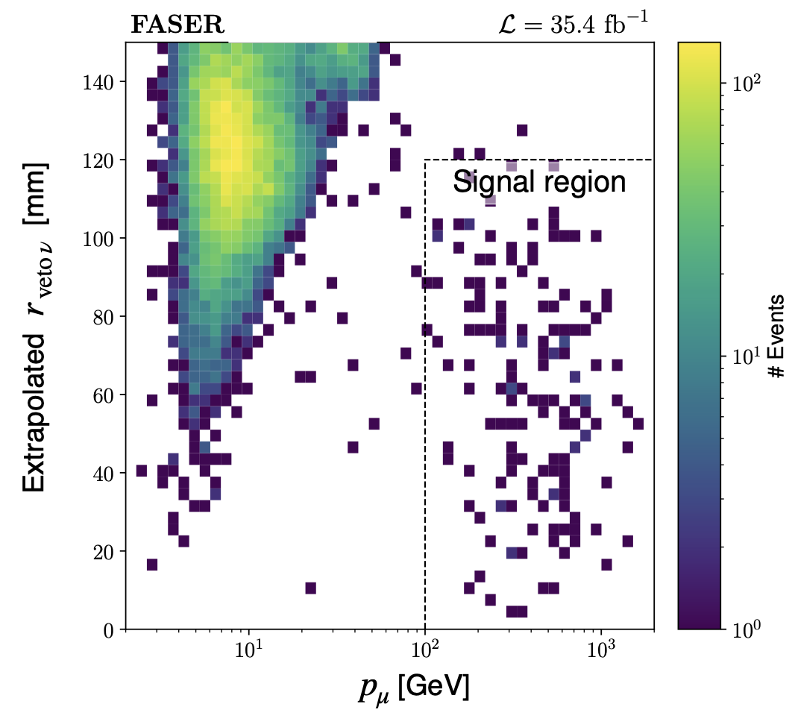
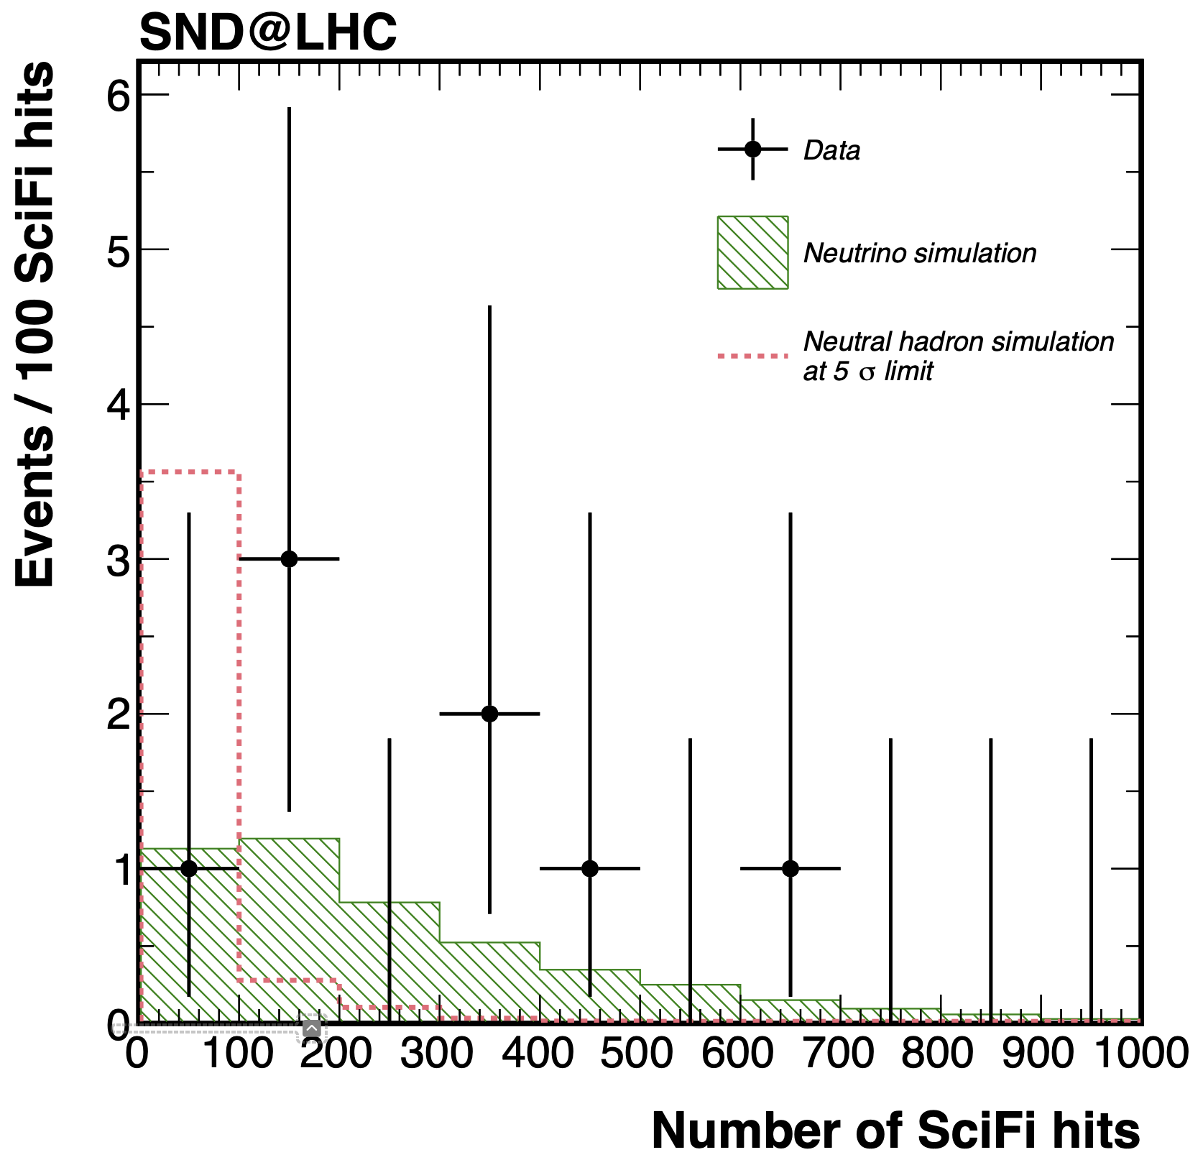
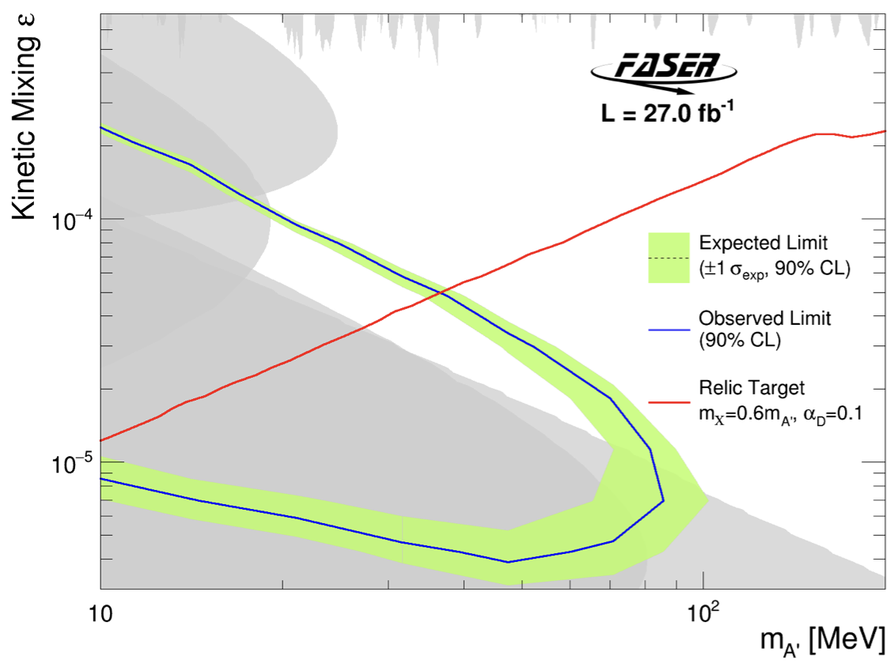
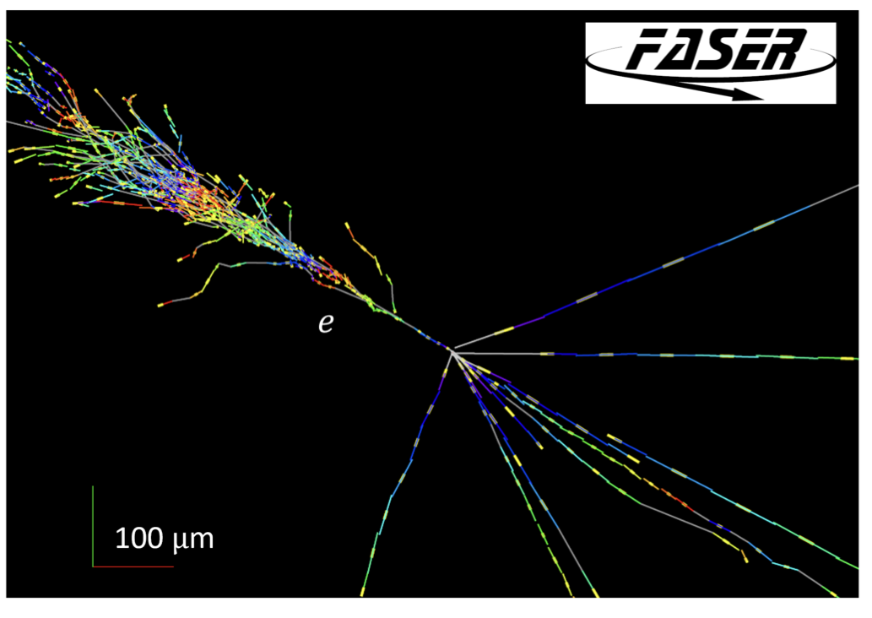
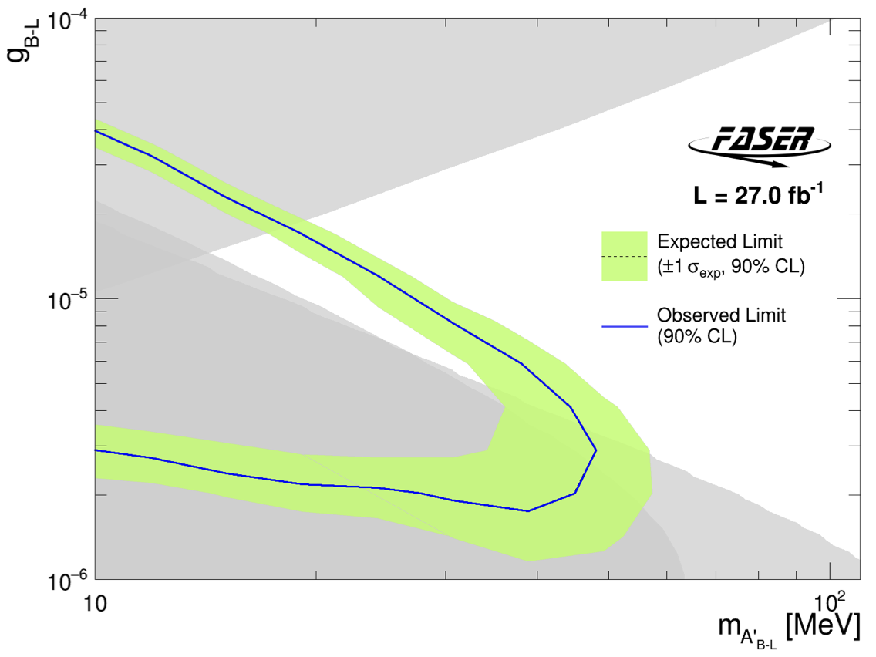
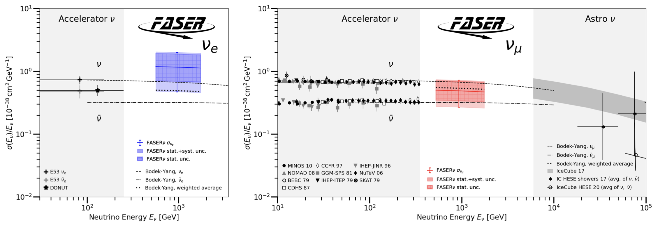
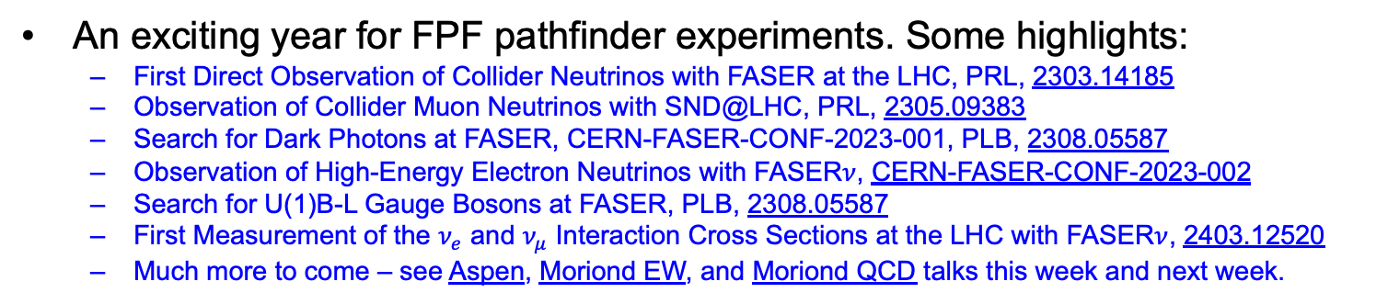
PROGRESS SINCE LAST PBC MEETING
An exciting year for FPF pathfinder experiments. Some highlights:
  First Direct Observation of Collider Neutrinos with FASER at the LHC, PRL, 2303.14185
  Observation of Collider Muon Neutrinos with SND@LHC, PRL, 2305.09383
  Search for Dark Photons at FASER, CERN-FASER-CONF-2023-001, PLB, 2308.05587
  Observation of High-Energy Electron Neutrinos with FASER$ν$, CERN-FASER-CONF-2023-002
  Search for U(1)B-L Gauge Bosons at FASER, PLB, 2308.05587
  First Measurement of the $ν_{e}$ and $ν_{μ}$ Interaction Cross Sections at the LHC with FASER$ν$, 2403.12520
  Much more to come – see Aspen, Moriond EW, and Moriond QCD talks this week and next week.

Slide 3
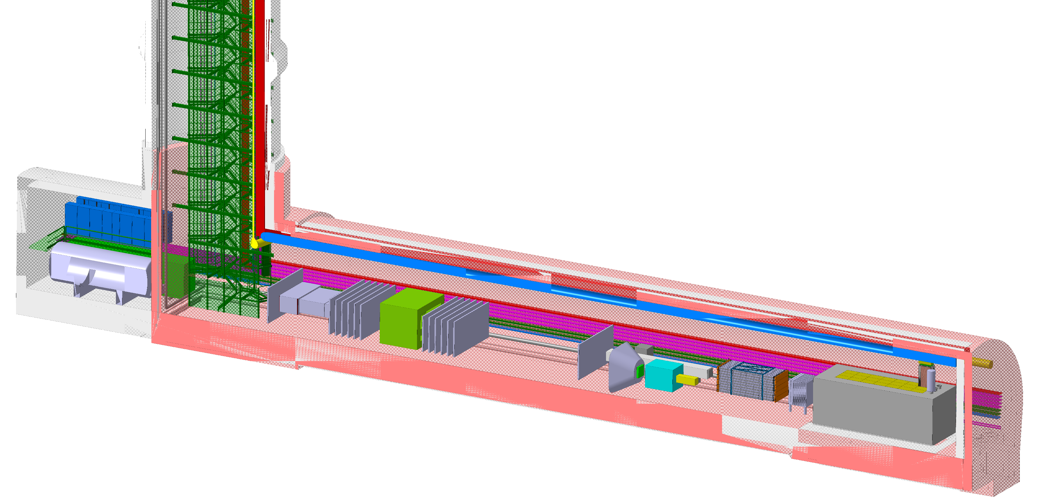
FORWARD PHYSICS FACILITY
These experiments have demonstrated the ability to detect thousands of TeV neutrinos and carry out background-free BSM searches with tabletop-size far-forward experiments on time and on budget.
They have opened a new window at the energy frontier.
Similar to the discovery of cosmic neutrinos or gravitational waves, the appropriate question is not whether we should follow up on these discoveries, but how can we best exploit this new way of learning about the Universe.
The proposed Forward Physics Facility at the HL-LHC
is located 620m west of ATLAS, 75m long, 12.5m wide, ~$30 MCHF (facility) (see J. Boyd’s talk)
will increase BSM sensitivity (decay vol * lumi) by factor of ~10,000 over FASER
will detect ~1000 TeV-energy neutrinos per day

Slide 4
FPF PHYSICS PROGRAM
The FPF physics program is extremely broad, impacting almost every area of particle and astroparticle physics.
FPF experiments have discovery potential in every one of the PBC benchmark scenarios. These have been useful in comparing different experiments.
But they do not span the full range of BSM possibilities, and they do not come close to capturing the breadth of the FPF physics program (cf. mSUGRA in SUSY).
Below are a few generic examples (one PBC benchmark, two not) of the FPF physics potential that make essential use of LHC energies and demonstrate the complementarity to the rest of the worldwide program (e.g., fixed target experiments like SHiP).
For more, see J. Rojo’s talk, and also the FPF White Paper.

Slide 5
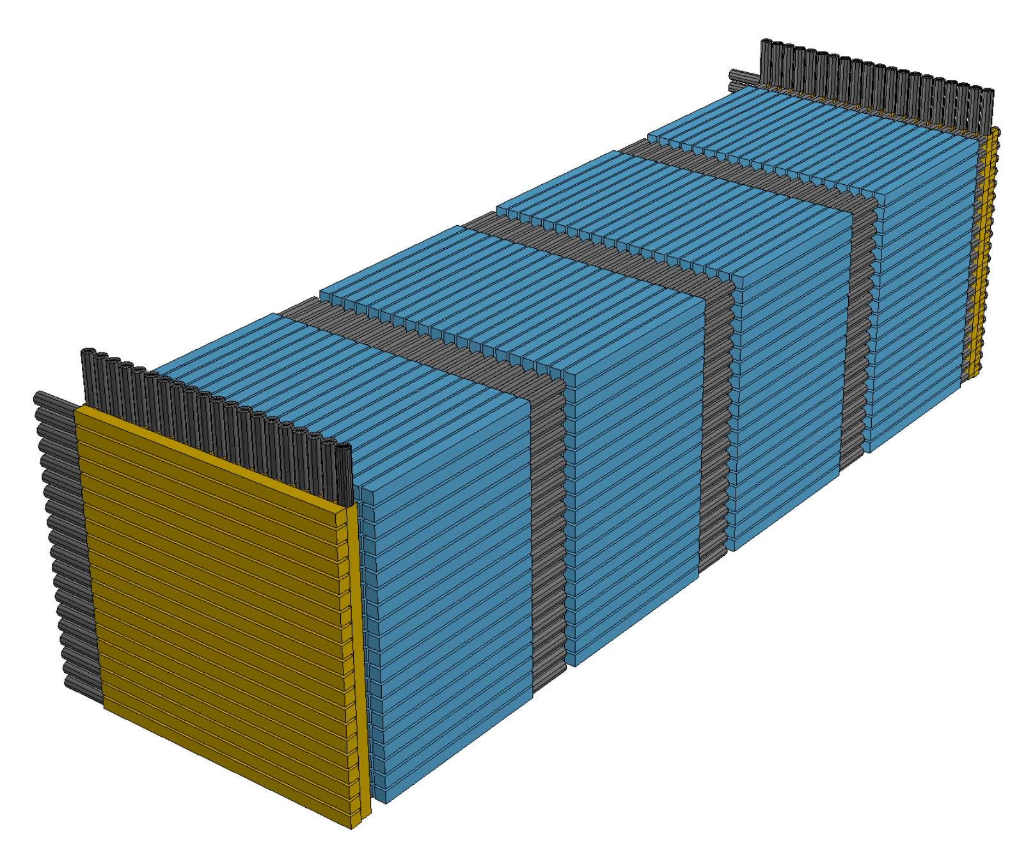
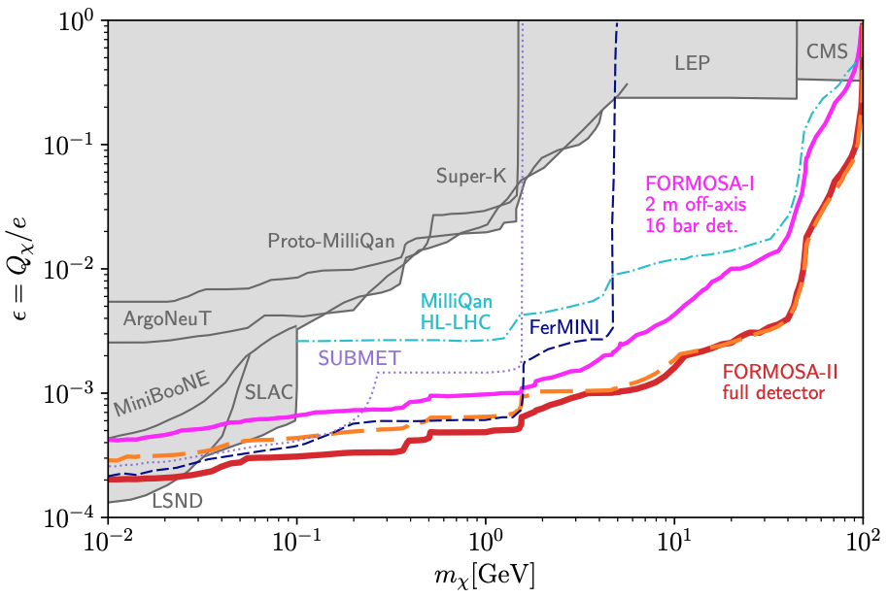
MILLI-CHARGED PARTICLES
The FPF accommodates a suite of experiments that can be optimized for various physics cases. This diversity is essential in probing a broad range of BSM physics possibilities.
For example: FORMOSA, targeting milli-charged particles.
Motivated by dark sectors with massless dark photons, but also new particles with magnetic or electric dipole moments, …
World-leading sensitivity for masses from ~100 MeV to 100 GeV.
Will not be probed by SHiP (and no fixed target experiment can produce particles with mass > 10-20 GeV).
Foroughi-Abari, Kling, Tsai (2020)

Slide 6

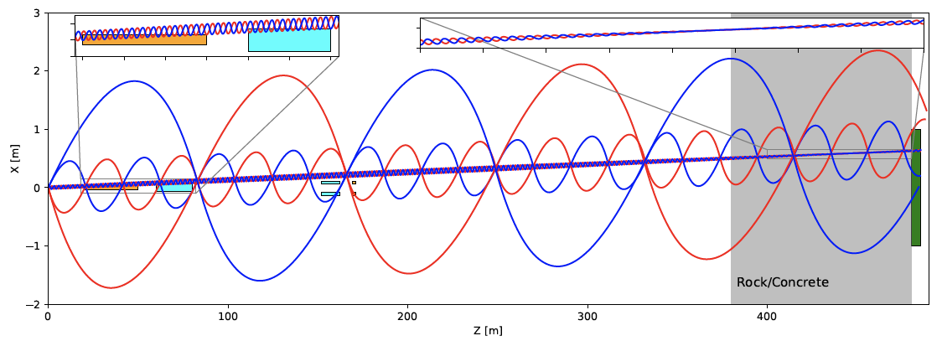
STRONGLY-INTERACTING DARK SECTORS
U(1) dark force → dark photons, milli-charged particles.
Any other dark force → strongly-interacting dark sector. Dark particles (“quirks”) can be pair-produced at the LHC, but then oscillate down the beampipe, bound together by the dark color force.
FASER2 can discover quirks with masses up to ~TeV, as motivated by the gauge hierarchy problem (neutral naturalness).
Requires LHC energies to produce new TeV particles, impossible to see at fixed target experiments.
Li, Pei, Ran, Zhang (2021); Li et al. (in progress)

Slide 7
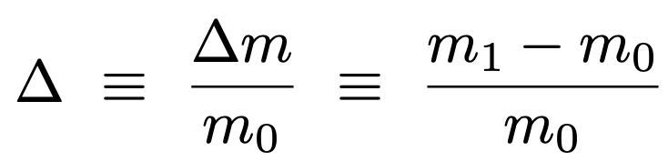
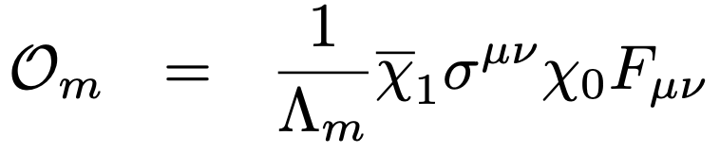
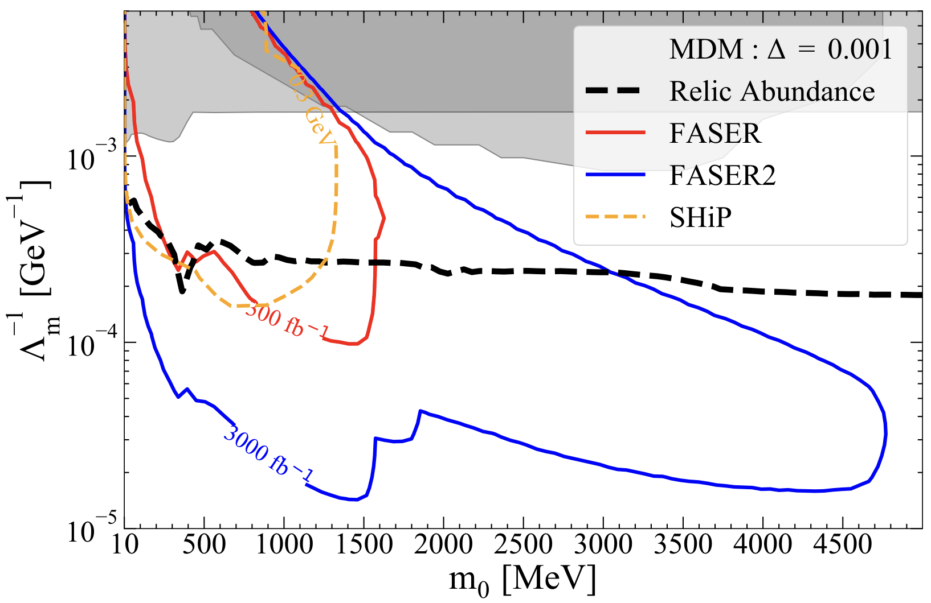


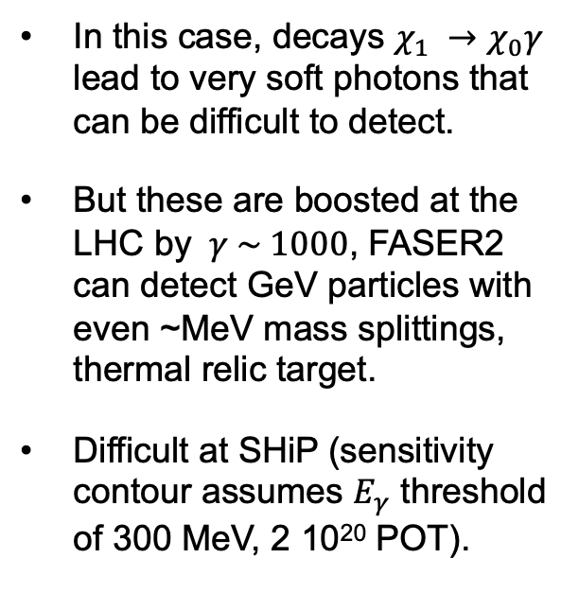

LLPS FROM COMPRESSED SPECTRA
LLPs can result from weak couplings.
But they can also arise generically from compressed spectra (e.g., inelastic DM), where decays are phase-space suppressed by degeneracies.
$$m_{1}$$
$$χ_{1} →χ_{0}γ$$
$$m_{0}$$
0
In this case, decays $χ_{1} →χ_{0}γ$ lead to very soft photons that can be difficult to detect.
But these are boosted at the LHC by $γ \sim 1000$, FASER2 can detect GeV particles with even ~MeV mass splittings, thermal relic target.
Difficult at SHiP (sensitivity contour assumes $E_{γ}$ threshold of 300 MeV, 2 10²⁰ POT).
Dienes et al. (2023)

Slide 8
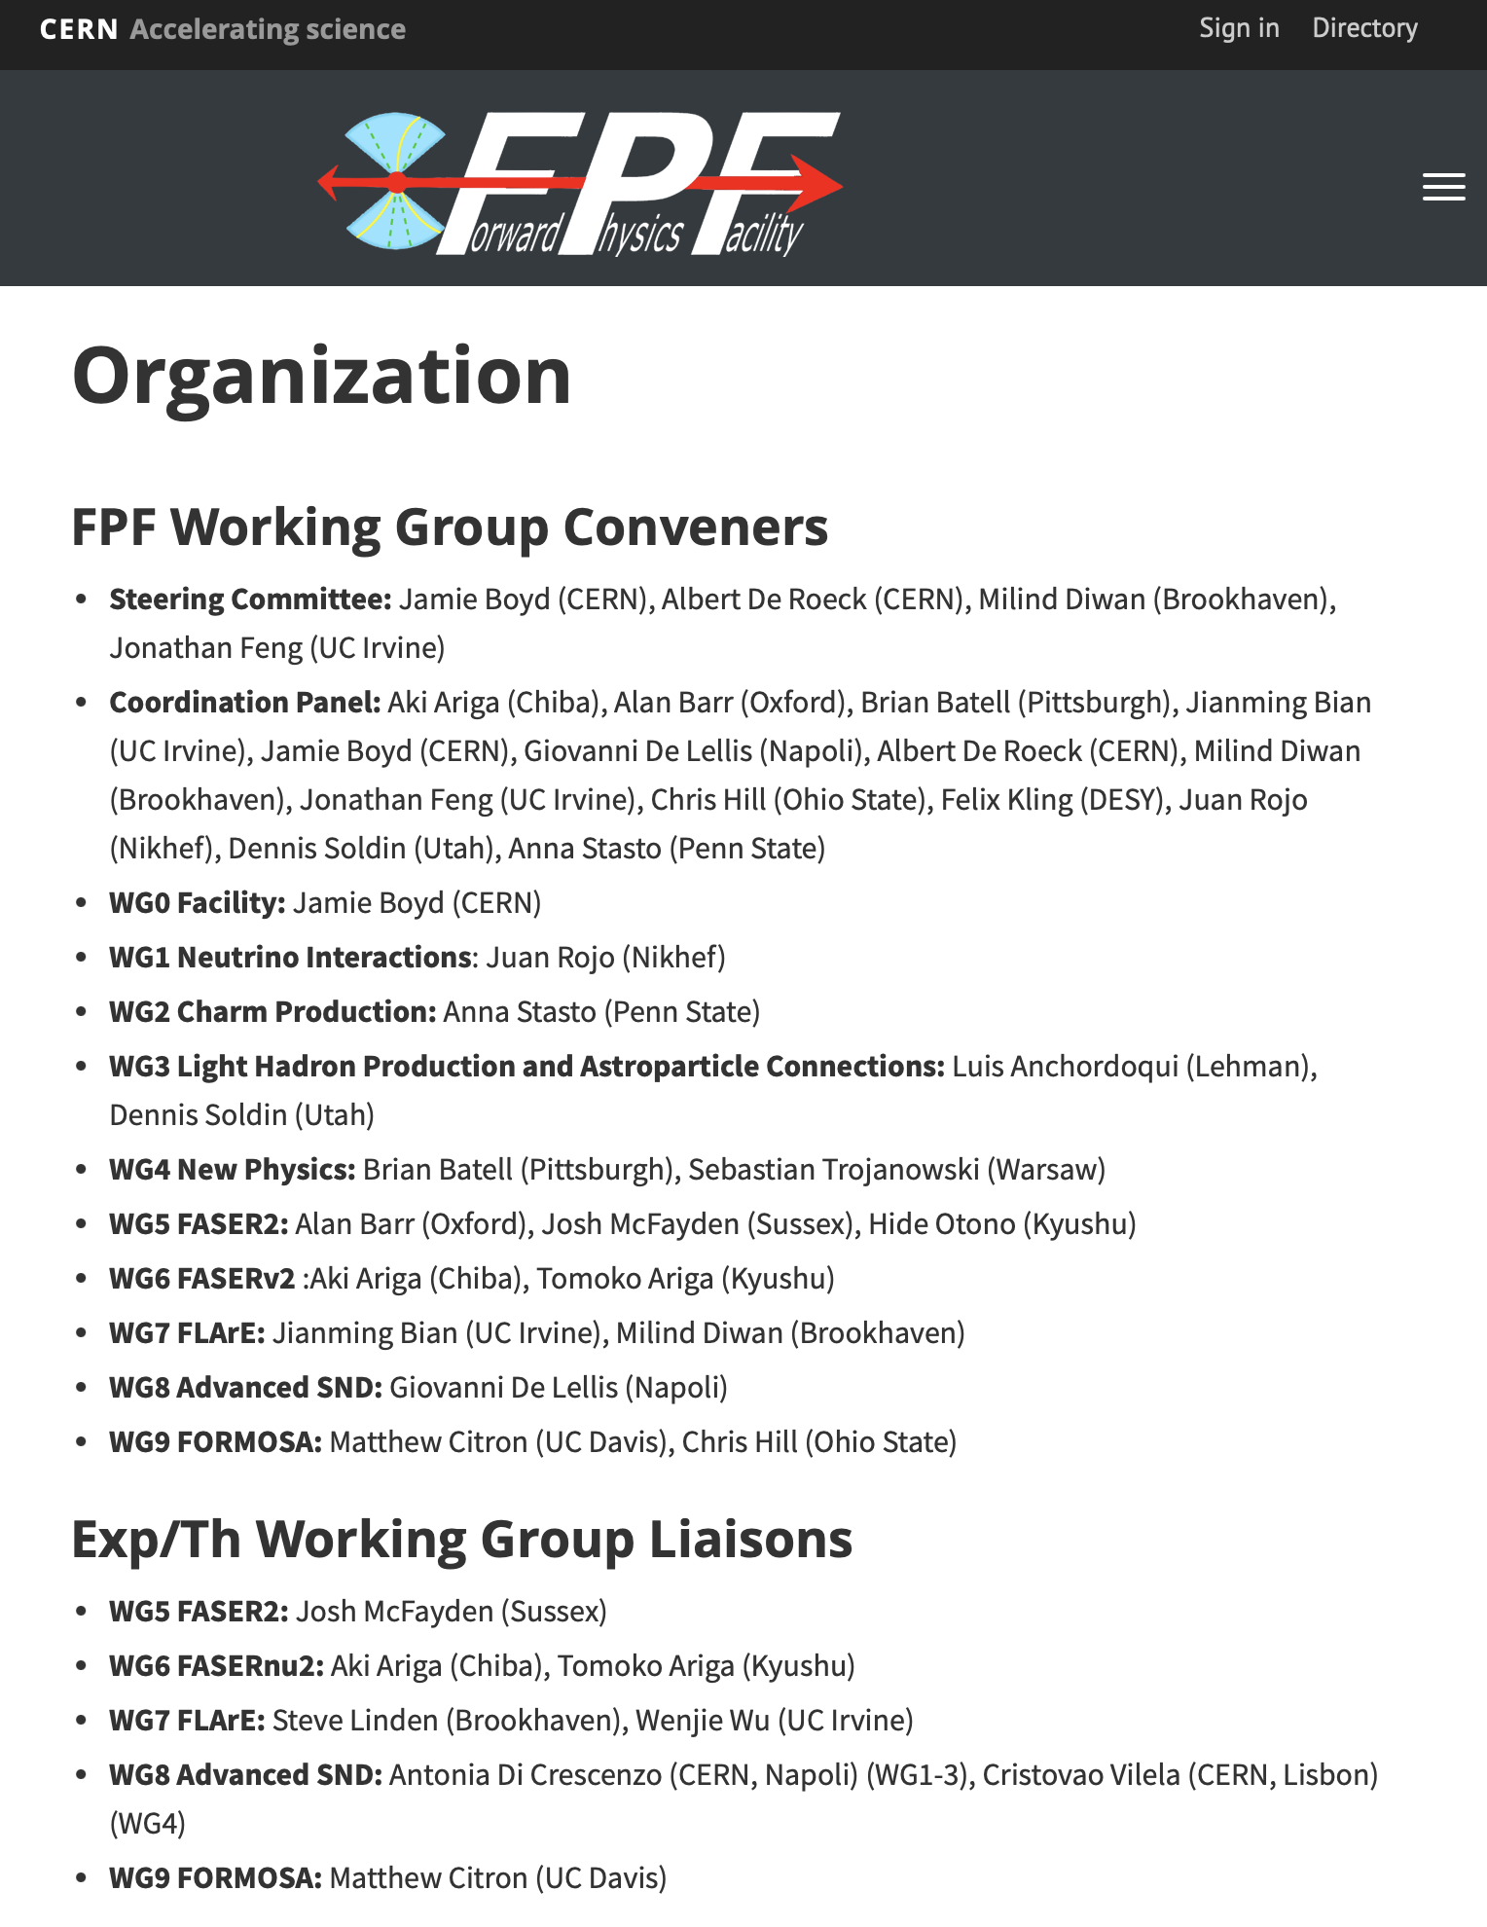
FPF ORGANIZATION
The FPF activities are organized into 10 WGs consisting of ~300 experimentalists on pathfinder experiments, ~200 theorists, and multiple CERN technical teams, with active exp/th interactions and optimization between experiments. For more, see fpf.web.cern.ch.
FPF Meetings
  FPF Kickoff Meeting, 9-10 Nov 2020
  FPF2 Meeting, 27-28 May 2021
  FPF3 Meeting, 25-26 Oct 2021
  FPF4 Meeting, 31 Jan-1 Feb 2022
  FPF5 Meeting, 15-16 Nov 2022
  FPF6 Meeting, 8-9 Jun 2023
  FPF Theory Workshop, 19-20 Sep 2023
  FPF7 Meeting, 29 Feb-1 Mar 2024
FPF Papers
  FPF “Short” Paper: 75 pages, 80 authors, Phys. Rept. 968, 1 (2022), 2109.10905.
  FPF White Paper: 429 pp, 392 authors + endorsers representing over 200 institutes, J. Phys. G 3, 030501 (2023), 2203.05090.

Slide 9
SNOWMASS AND P5 PROCESS
In the US, particle physics priorities are established in a two-step process, most recently consisting of Snowmass from 2020-22 and P5 from 2022-23.
“Our highest immediate priority accelerator and project is the HL-LHC, …including the construction of auxiliary experiments that extend the reach of HL-LHC in kinematic regions uncovered by the detector upgrades.” – 2022 Snowmass Energy Frontier Report
P5 was then convened to prioritize medium-scale ($50-250M) and large-scale (>$250M) projects. Small-scale projects are not discussed individually and not explicitly recommended by P5.
The FPF proposal to P5 was for a medium-scale project supporting FASER2 (1/2), FORMOSA, and FLArE, under the assumption that CERN would build the facility as host lab, and other nations/regions would fund FASER2 (1/2), FASERnu2, and AdvSND.

Slide 10
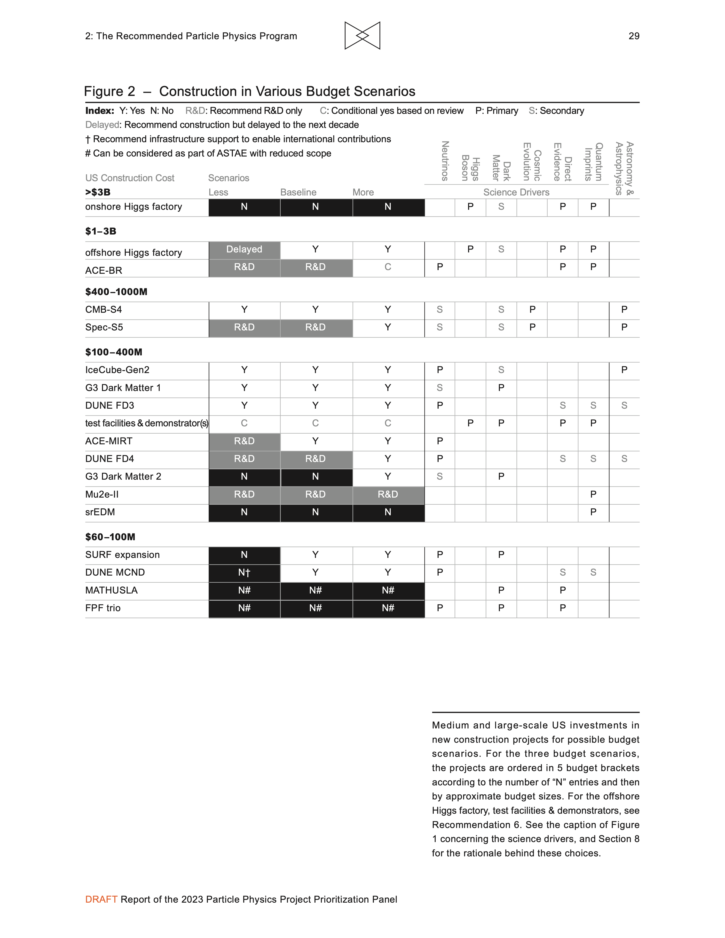
P5 REPORT
P5 decided that they could not recommend funding given that CERN has approved the Facility.
The “FPF trio” was given N#’s, where # indicates that “can be considered as part of ASTAE with reduced scope.”
ASTAE is a new small projects portfolio recommended to be funded at $35M/year.
FASER2 and FORMOSA fit as is; FLArE will benefit from international partners to reduce the US cost.
P5’s Summary (20-year Vision): “The program described in this section consists of a combination of large and small projects and holds great promise for discovery. By the end of this 20-year period we will have ultimate LHC results from the general purpose experiments and a constellation of agile auxiliary experiments.”

Slide 11
FPF TIMELINE
In June 2023, CERN management and the LHCC and PBC conveners agreed on a review timeline for the FPF.
August 2023 – Early 2024
  Core study results.
  A document summarizing the core study results, additional facilities updates, revised estimate for CERN host lab costs.
  A unified plan for size and placement of experiments in the cavern.
  Completion of “flagship” physics studies that emphasize core strengths and also complementarity with the rest of the world-wide program.
June 2024: Document on the Facility (CE and Integration) to be submitted to the PBC.
Early 2025: LOI to be submitted to the LHCC.
With this timeline, and with successful following reviews and approval, aim for construction in time for physics in Run 4.

