Slide 1




AND THE FUTURE OF PARTICLE PHYSICS
UCLA Physics and Astronomy Colloquium
Jonathan Feng, UC Irvine, 2 November 2023

Slide 2
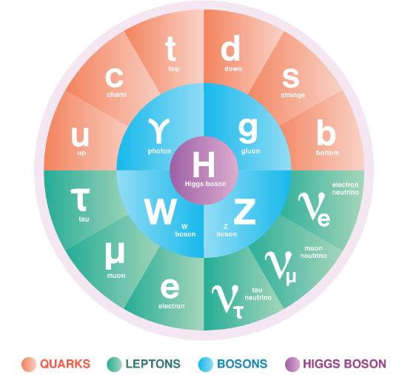
THE STANDARD MODEL OF PARTICLE PHYSICS
The Standard Model is the reigning theory of fundamental particles and their interactions. The last particle predicted by the SM, the Higgs boson, was discovered at CERN in 2012.
But the SM is not the last word, because many fundamental questions remain. For example:
  Neutrino Masses: the SM predicts that neutrinos are massless, but they aren’t.
  Dark Matter: The particles of the SM make up only ~15% of the matter in the universe.
These questions imply that there are likely (many) more particles left to discover.

Slide 3

THE LARGE HADRON COLLIDER
.
FASER
Particle colliders have been key to progress for many decades. The state of the art is currently the LHC, accelerating protons to 0.99999999c and producing collisions at 13.6 TeV.
Notes:
3

Slide 4

LHC DETECTORS
The protons collide at 4 points around the LHC, and each point is surrounded by a large detector to view the results of the collisions. These detectors cost ~$1B, and were constructed over decades by thousands of collaborators.
The ATLAS Detector
Notes:
4

Slide 5
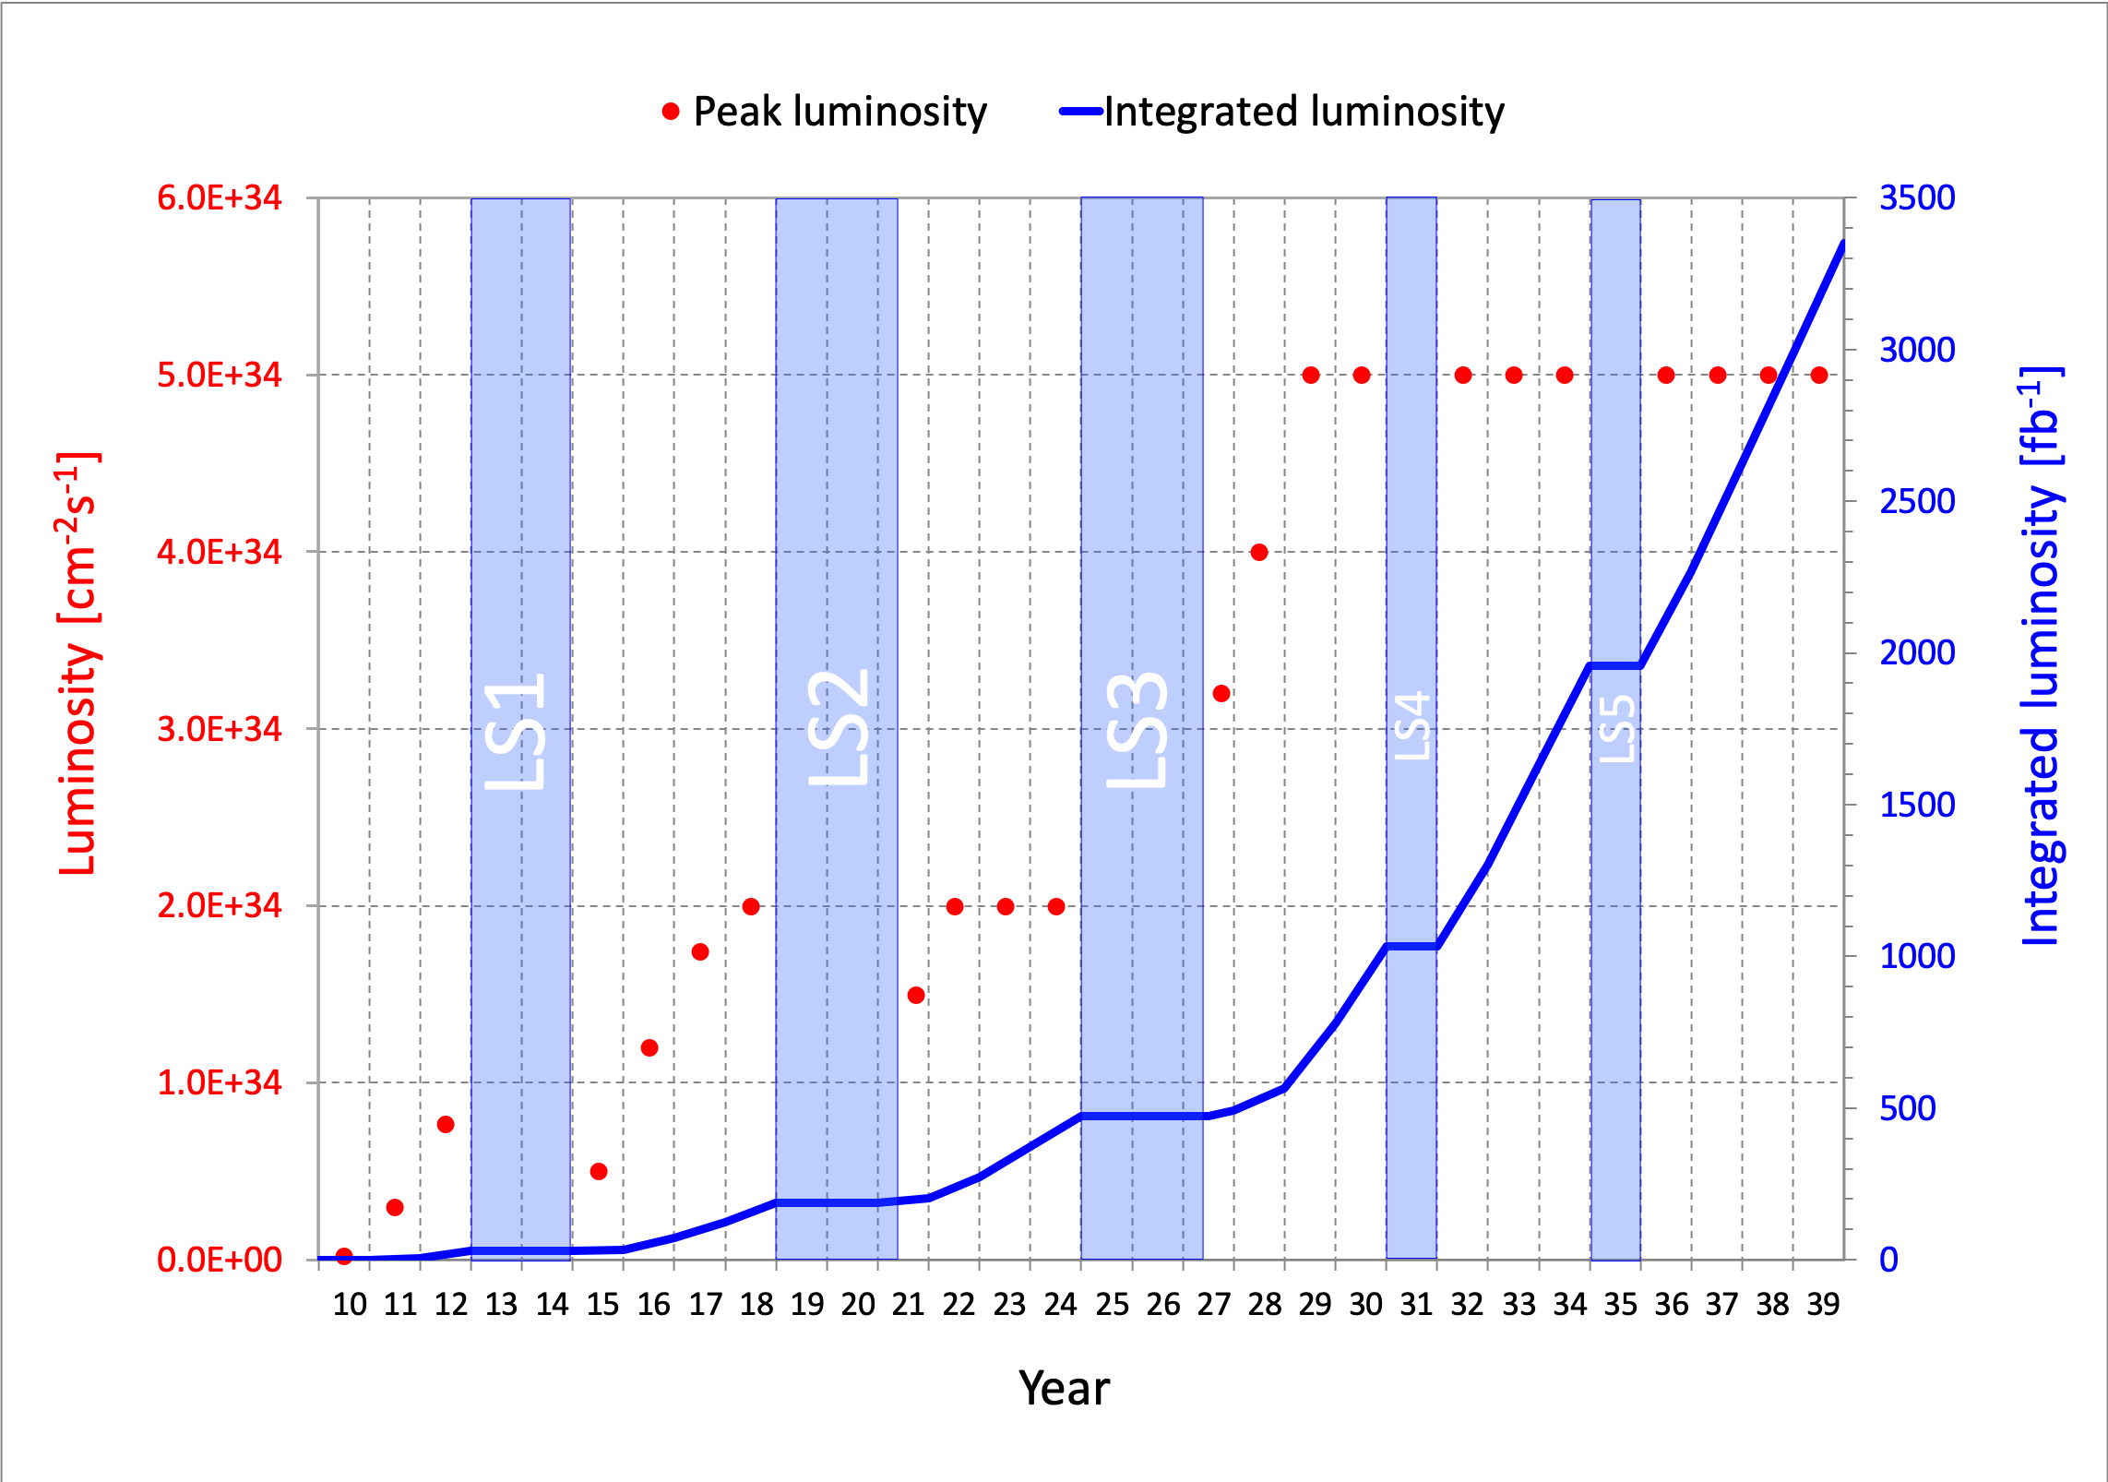
LIFETIME OF THE LHC
The LHC became the future of particle colliders in 1993 when the US canceled the SSC, which was being built in Texas.
But although the LHC started running in 2010, it is scheduled to run until ~2040s and is still in its youth
  a postdoc in terms of years
  a kindergartener in terms of number of collisions (integrated luminosity)
Are we using the LHC to its full potential? If not, what can we do to enhance its discovery prospects?
COVID

Slide 6
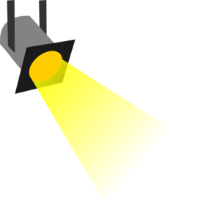
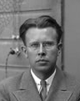
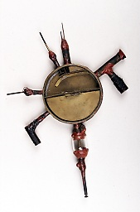
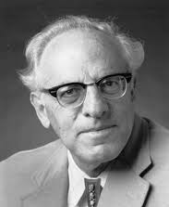





















THE PARTICLE LANDSCAPE
Particle
Expts
Mass
MeV
GeV
TeV
1
$$←$$
$$g$$
$$u$$
$$d$$
$$s$$
$$p$$
$$n$$
$$c$$
$$b$$
$$t$$
$$←$$
$$γ$$
$$e$$
$$μ$$
$$τ$$
$$W$$
$$Z$$
$$h$$
Already
Discovered
Strongly Interacting
Heavy Particles
Interaction Strength
10⁻³
$$ν_{e}$$
$$ν_{μ}$$
$$ν_{τ}$$
$$←$$
Weakly Interacting
Light Particles
Impossible to
Discover
10⁻⁶

Slide 7
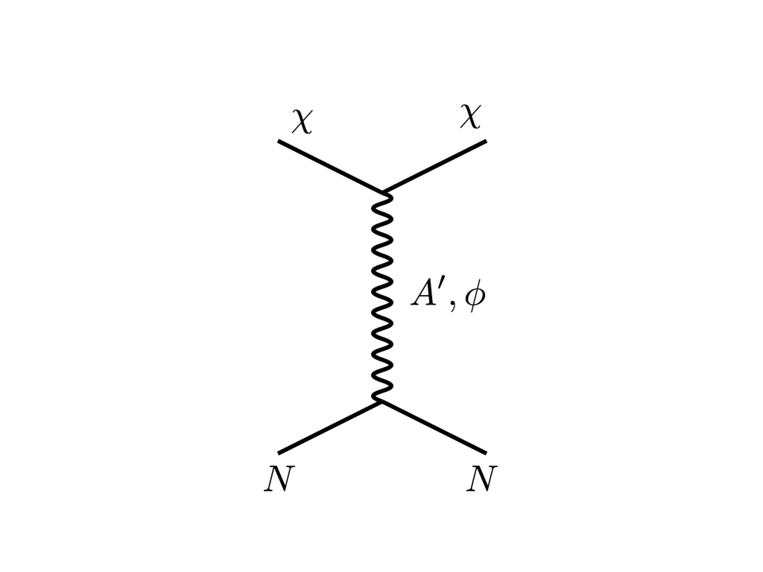





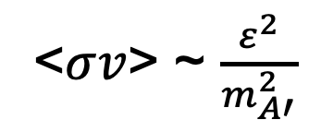
THE COSMOLOGICAL LANDSCAPE
Particle
Colliders
Mass
MeV
GeV
TeV
1
Already
Discovered
Strongly Interacting
Heavy Particles
Too Little to be
Dark Matter
$$e$$
DM
$$ε$$
$$A’$$
$$ε$$
Interaction Strength
Just Right to
be Dark Matter
10⁻³
DM
$$e$$
<$σv$> ~ $\frac{ε^{2}}{m_{A′}^{2}}$
Weakly Interacting
Light Particles
Impossible to
Discover
10⁻⁶
Too Much to be
Dark Matter
Boehm, Fayet (2003)
Pospelov, Ritz, Voloshin (2007)
Feng, Kumar (2008)

Slide 8
LESSONS FROM THE PAST
We are not now in a golden age of particle physics.
But particle physics is still fascinating, and the possibilities for deep connections to cosmology have never been stronger.
The discovery of new particles is the gold standard for progress in particle physics. (Precision measurements are also very important.)
Buoyed by past successes, we have been looking for strongly-interacting heavy particles, and this should continue.
But typically, unless these are in a narrow window of masses (e.g., ~2-4 TeV for gluinos), we will not find them in the next two decades. And the most robust problems, neutrino masses and dark matter, naturally point toward very weakly-interacting particles.
To bring us to a new golden age, we need to try new things now and diversify our searches for new particles without breaking the bank.

Slide 9

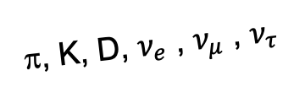
FORWARD PHYSICS
In 2017, we realized that the large LHC detectors, while beautifully optimized to discover new heavy particles, are almost optimally configured to miss new light particles.
Heavy particles are produced at low velocity and then decay roughly isotropically to other particles.
But high-energy light particles are dominantly produced in the forward direction and escape through the blind spots of existing detectors.
  This is true for all known light particles: pions, kaons, D mesons, neutrinos.
  It is also true for many hypothetical new particles, especially those motivated by neutrino mass and dark matter.
These blind spots are the Achilles heels of the large LHC detectors.
Feng, Galon, Kling, Trojanowski (2017)
A’, a, mCPs, χ, …
π, K, D, $ν_{e}$ , $ν_{μ}$ , $ν_{τ}$

Slide 10
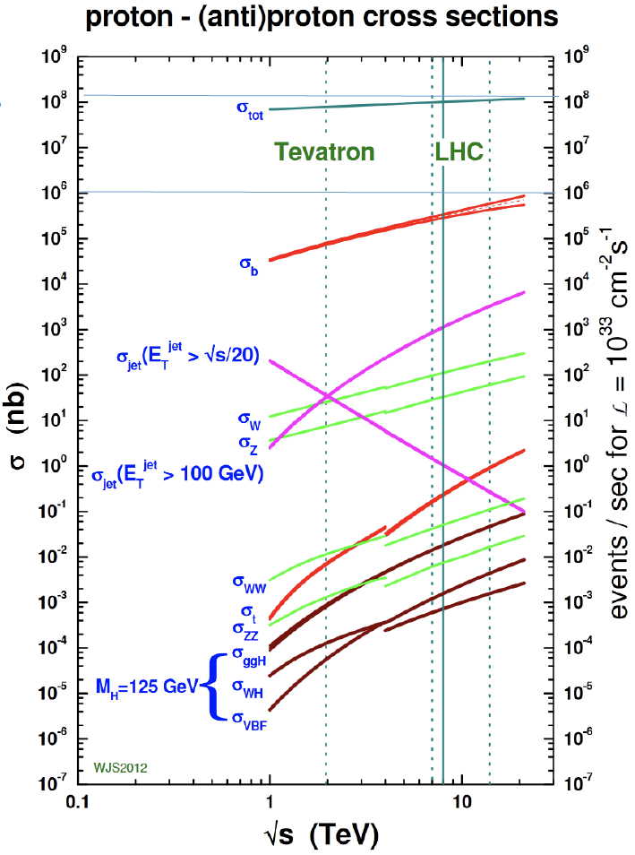
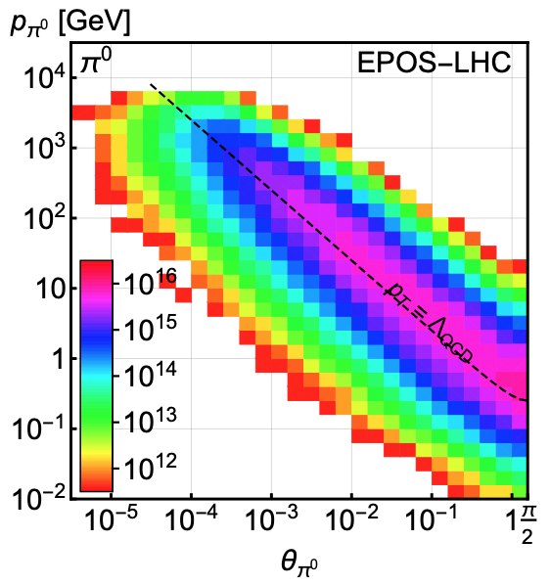
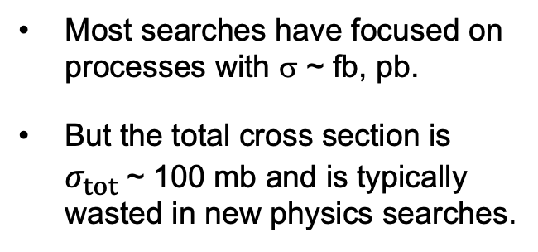
LIGHT PARTICLES AT THE LHC
300 fb⁻¹
Feng, Galon, Kling, Trojanowski (2017)
Most searches have focused on processes with σ ~ fb, pb.
But the total cross section is $σ_{tot}$~ 100 mb and is typically wasted in new physics searches.
What do these events look like? Consider pions.
Enormous event rates. Typical p_{T} ~ 250 MeV, but many with p ~ TeV within 1 mrad (η > 7.6) of the beamline.

Slide 11
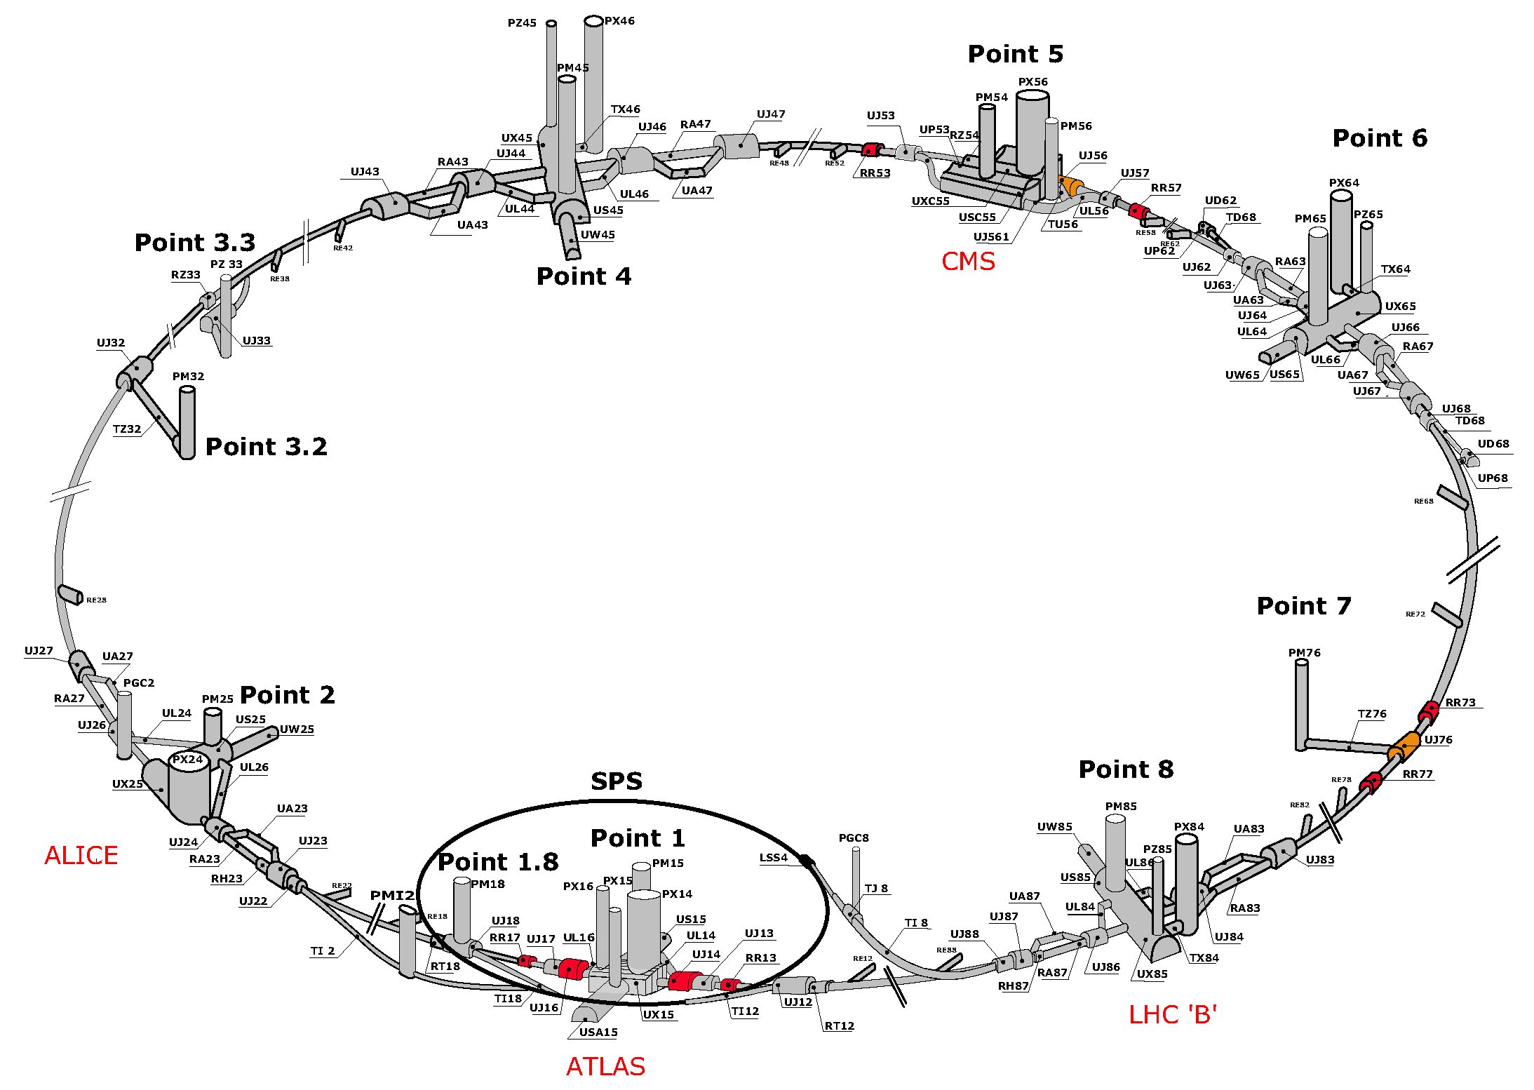
MAP OF THE LHC
!!!

Slide 12
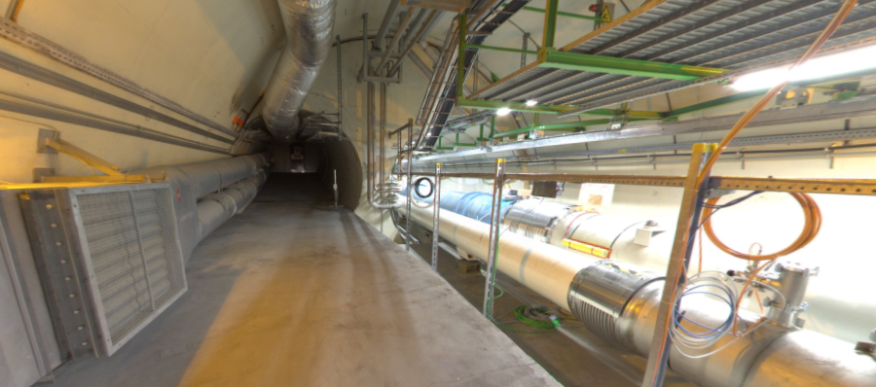
THE FORWARD REGION
Beam collision axis passes
through 100 m of rock, emerges in tunnel TI12, 480 m from ATLAS
UJ12
TI12 near UJ12
The view in UJ12 looking west (2018)
TI12
Beam collision axis
LHC beamline

Slide 13
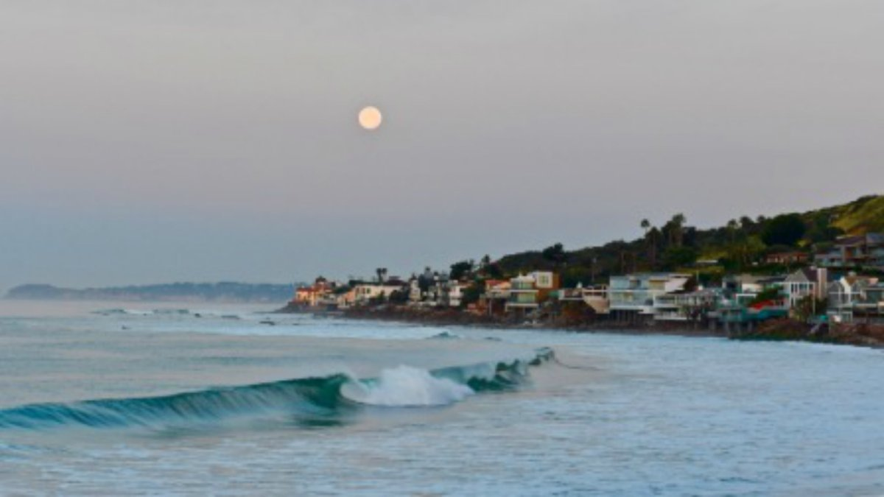
HOW BIG DOES THE DETECTOR HAVE TO BE?
Momentum:
Space:
250 MeV
1 TeV
12 cm
480 m
The opening angle is 0.2 mrad (the moon is 7 mrad). Even 480 m away, most of the signal passes through an 8.5” x 11” (A4) sheet of paper.
Neutrinos and many new particles are therefore far more collimated than shown below, motivating a relatively small, fast, and inexpensive experiment at the LHC: the ForwArd Search ExpeRiment (FASER).

Slide 14
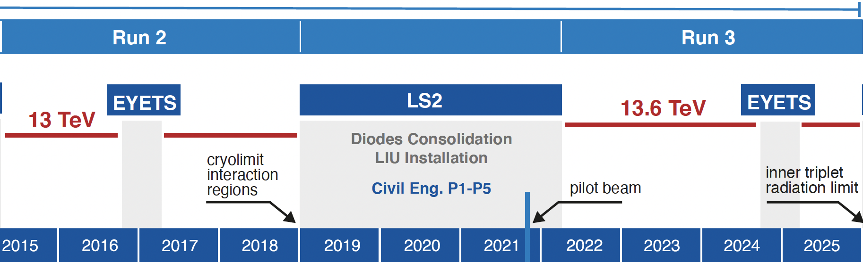
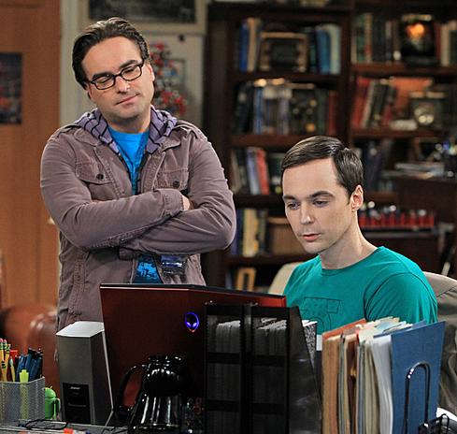
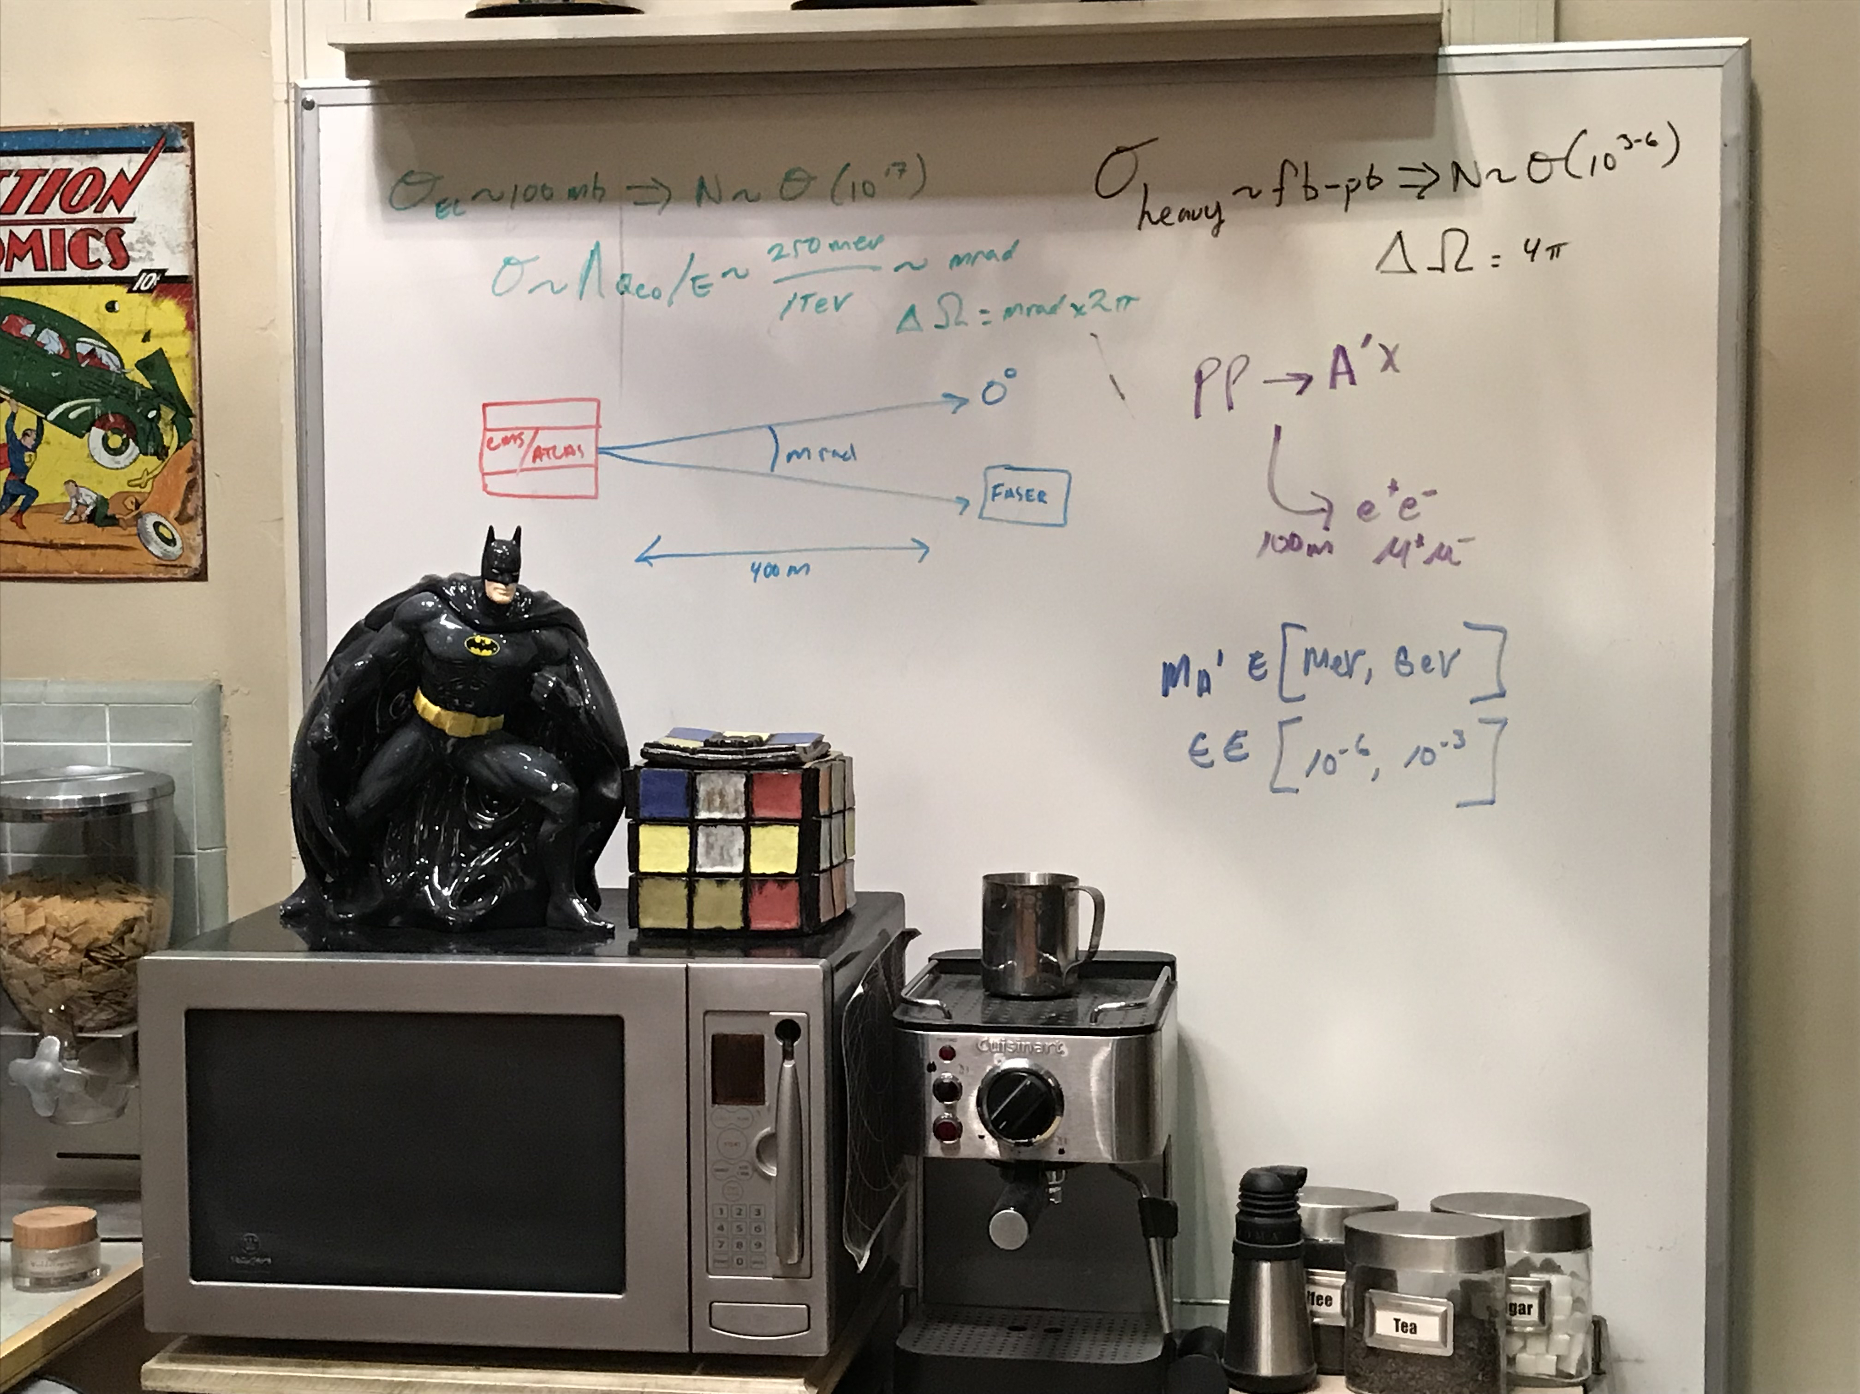
FASER AND FASERν TIMELINE
LOI submitted to CERN LHCC
FASER fully constructed and installed
FASERν fully constructed and installed
First paper: Feng, Galon, Kling, Trojanowski
Technical Proposal submitted to CERN LHCC
FASER approved as 8th LHC detector by CERN
FASERν approved as 9th LHC detector by CERN
FASER and FASERν announce first physics results
Funding from Heising-Simons and Simons Foundations
FASER and FASERν begin collecting data in Run 3
Spare detector parts from ATLAS and LHCb Collaborations

Slide 15













THE FASER COLLABORATION
89 collaborators, 25 institutions, 10 countries
International laboratory covered by a cooperation agreement with CERN

Slide 16
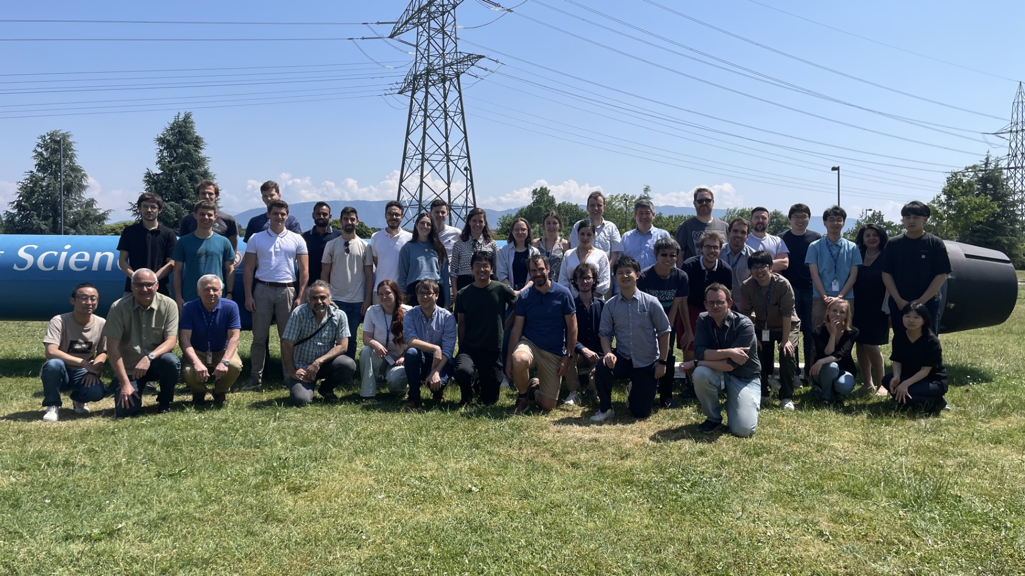
THE FASER COLLABORATION
89 collaborators, 25 institutions, 10 countries
FASER Collaboration Meeting, CERN, 5-7 June 2023

Slide 17
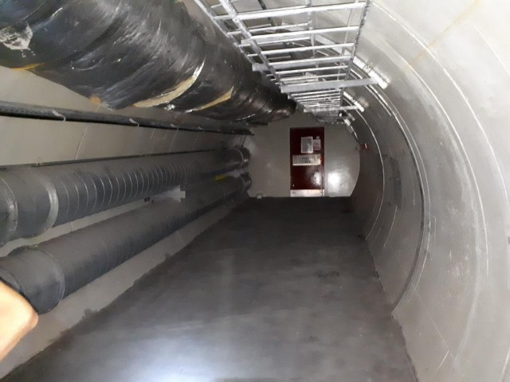
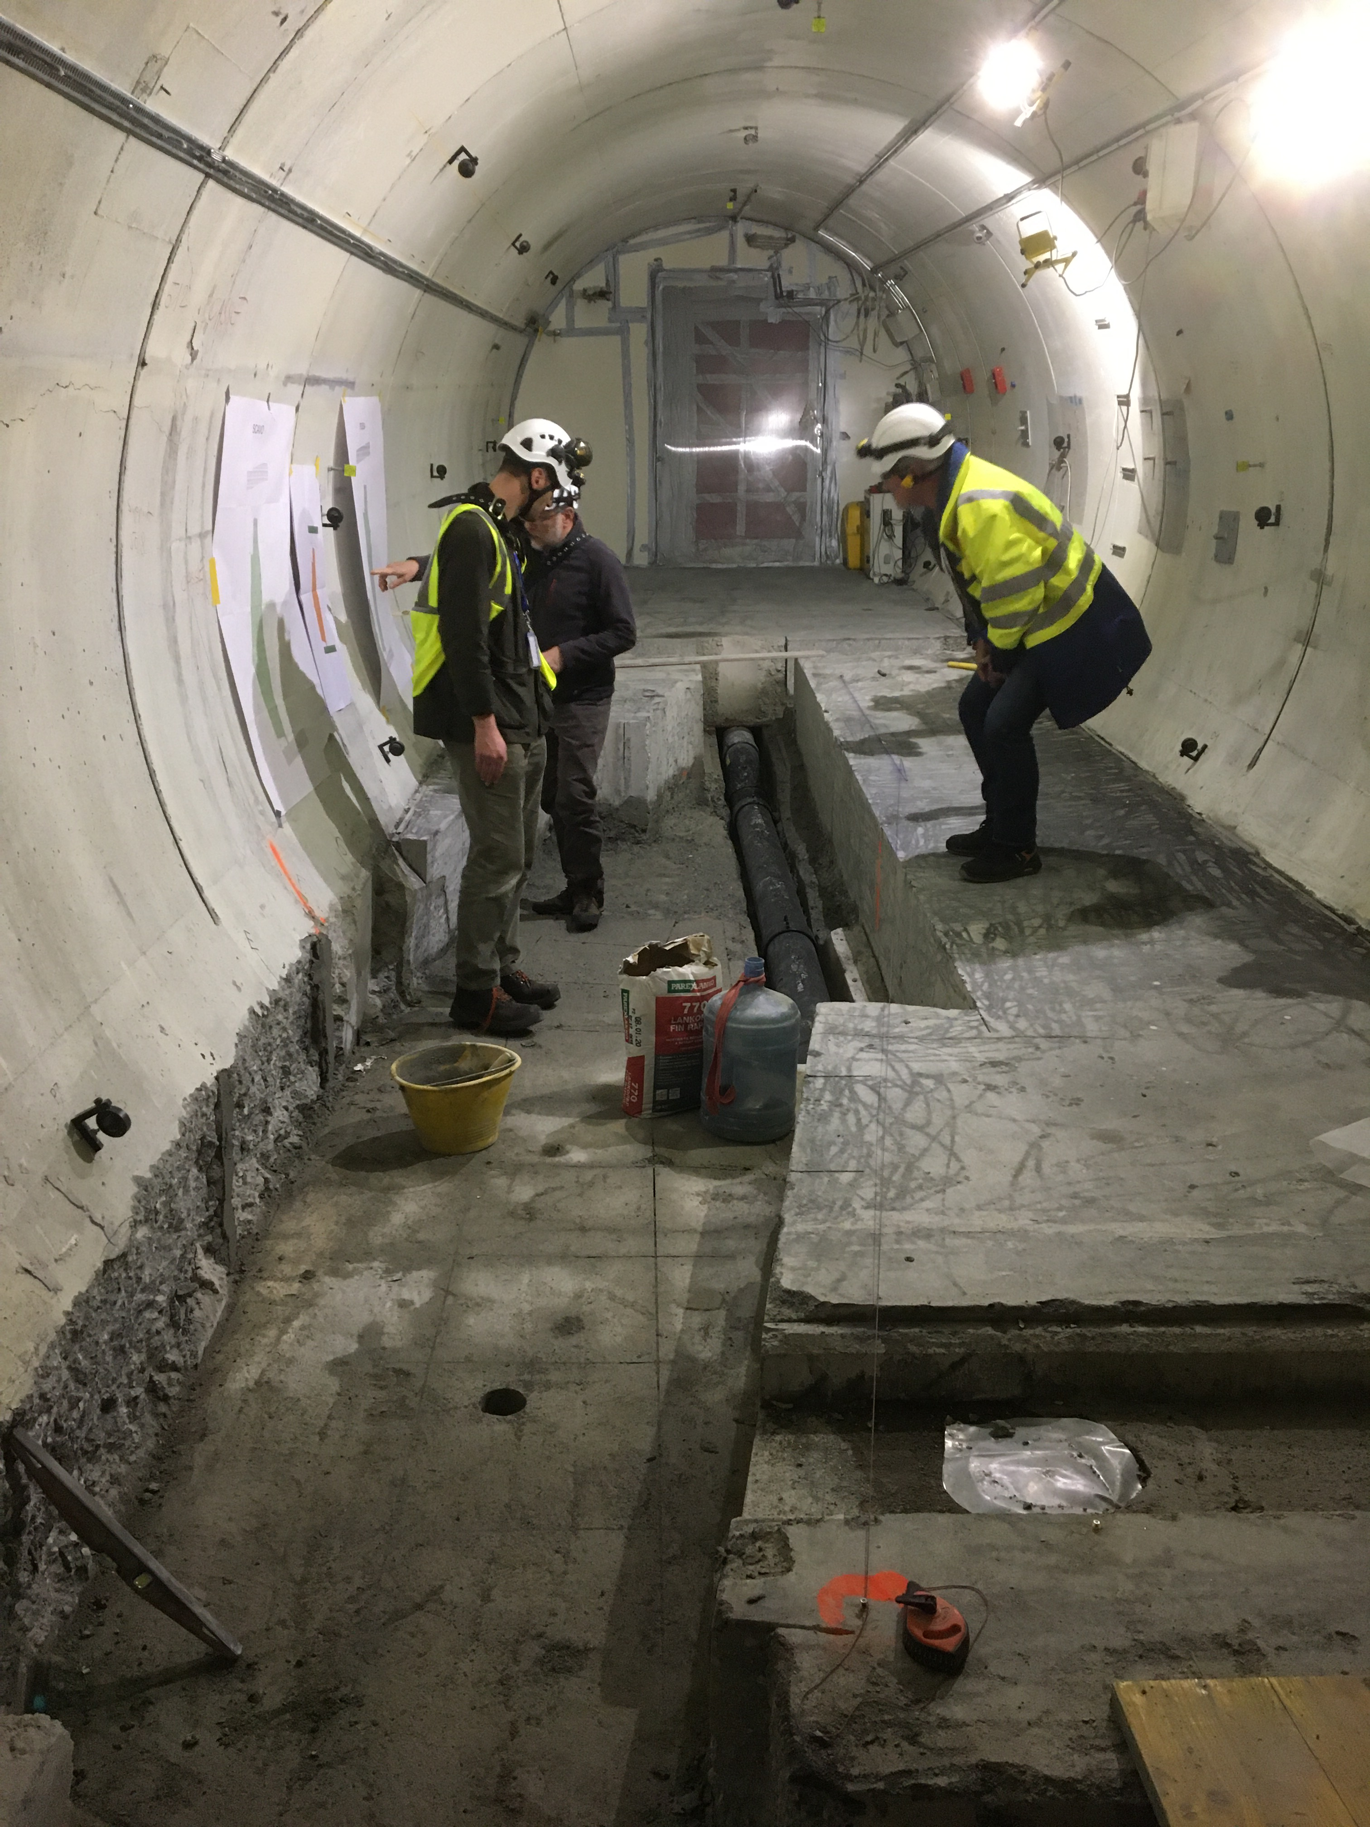
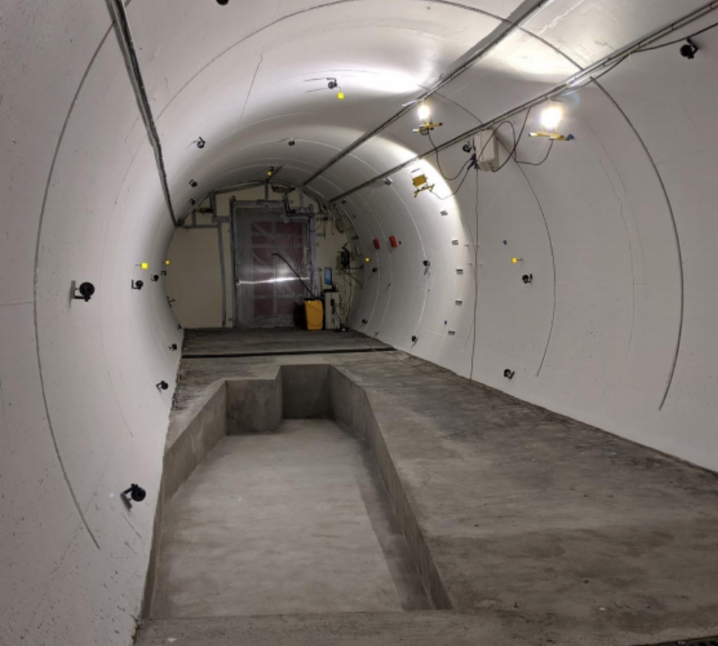
PREPARATION OF THE FASER LOCATION
The beam collision axis was located to mm accuracy by the CERN survey department. To place FASER on this axis, a trench was required to lower the floor by 46 cm.
The trench was completed by an Italian firm just hours before COVID shut down CERN in March 2020.
2019
Spring 2020
Summer 2020

Slide 18
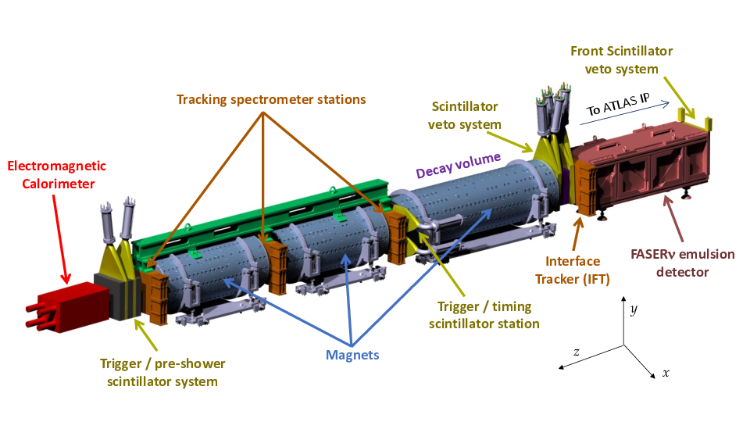
FASER DETECTOR

Slide 19
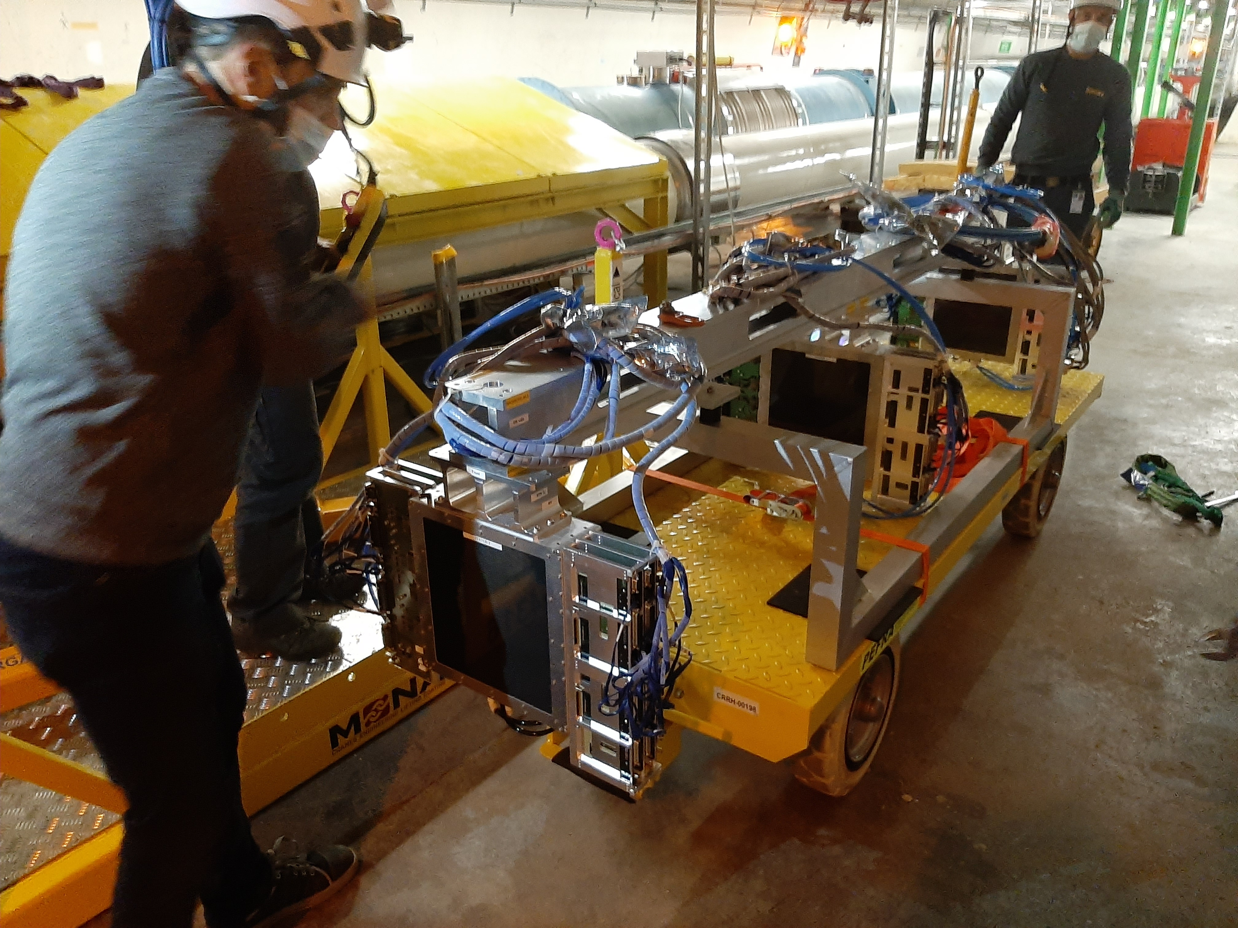
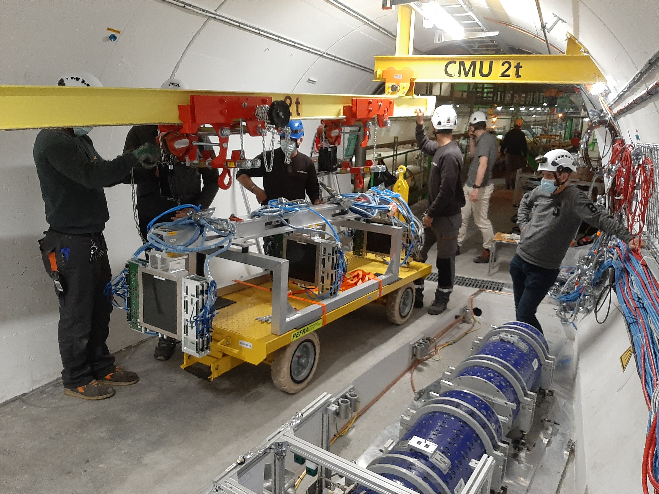
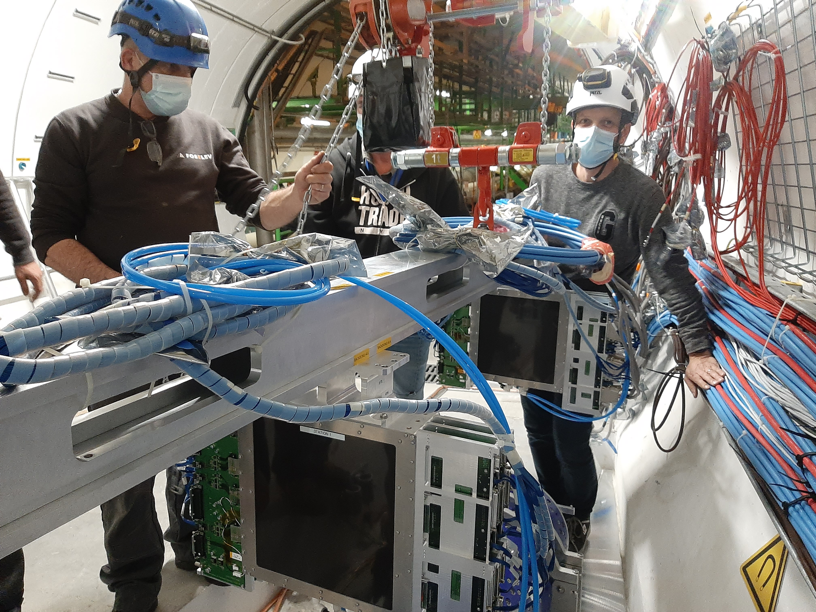
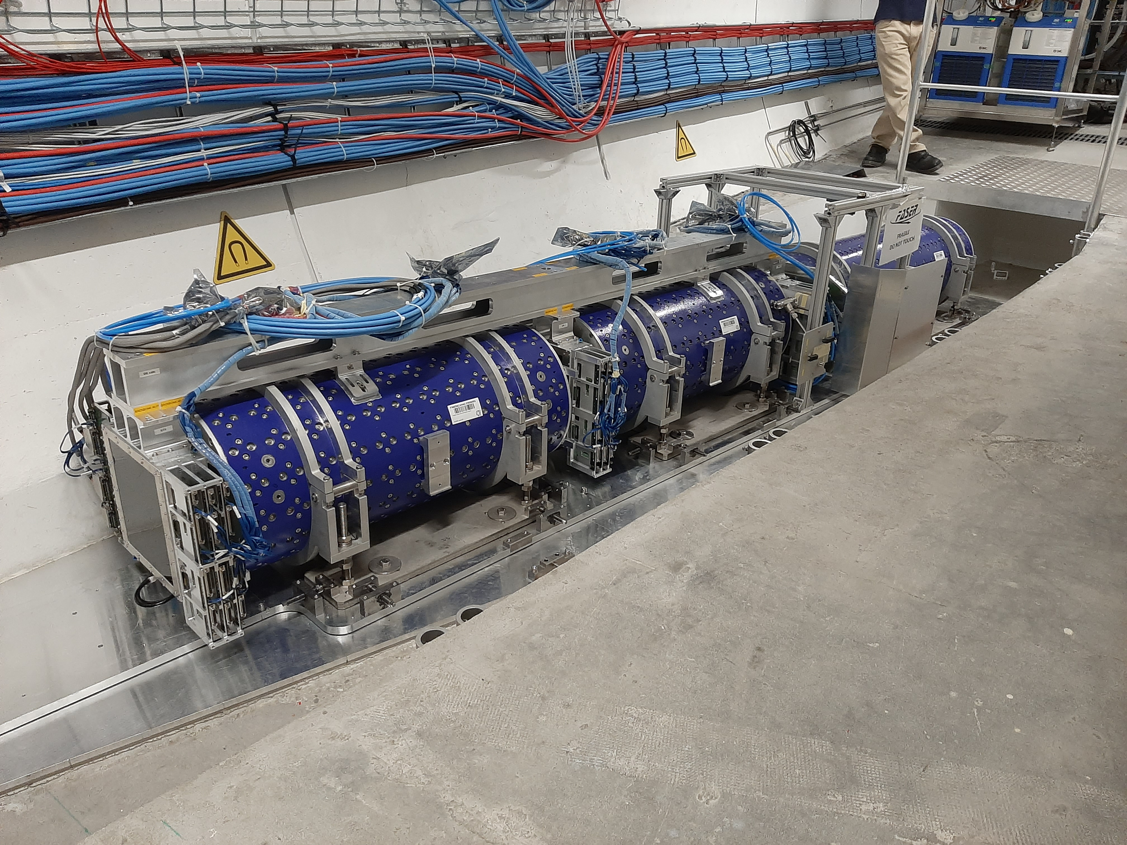
FASER INSTALLATION

Slide 20
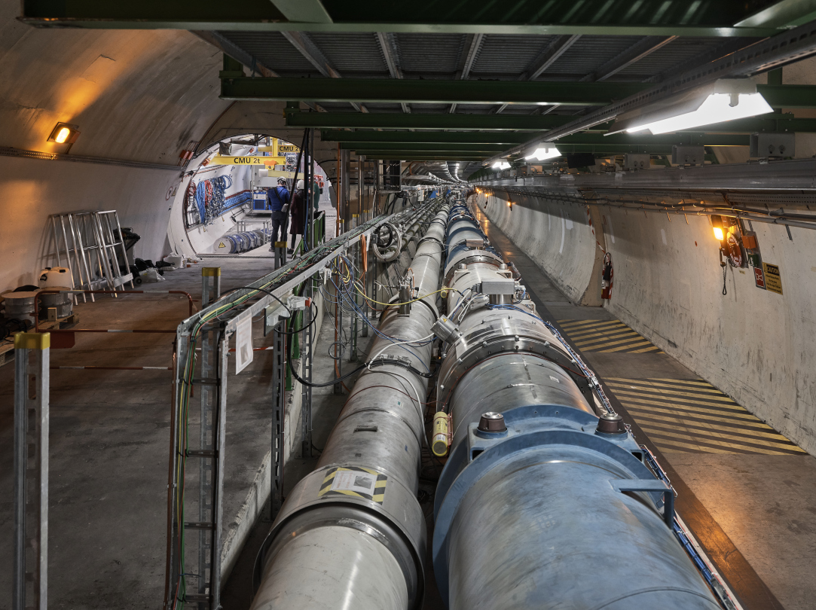
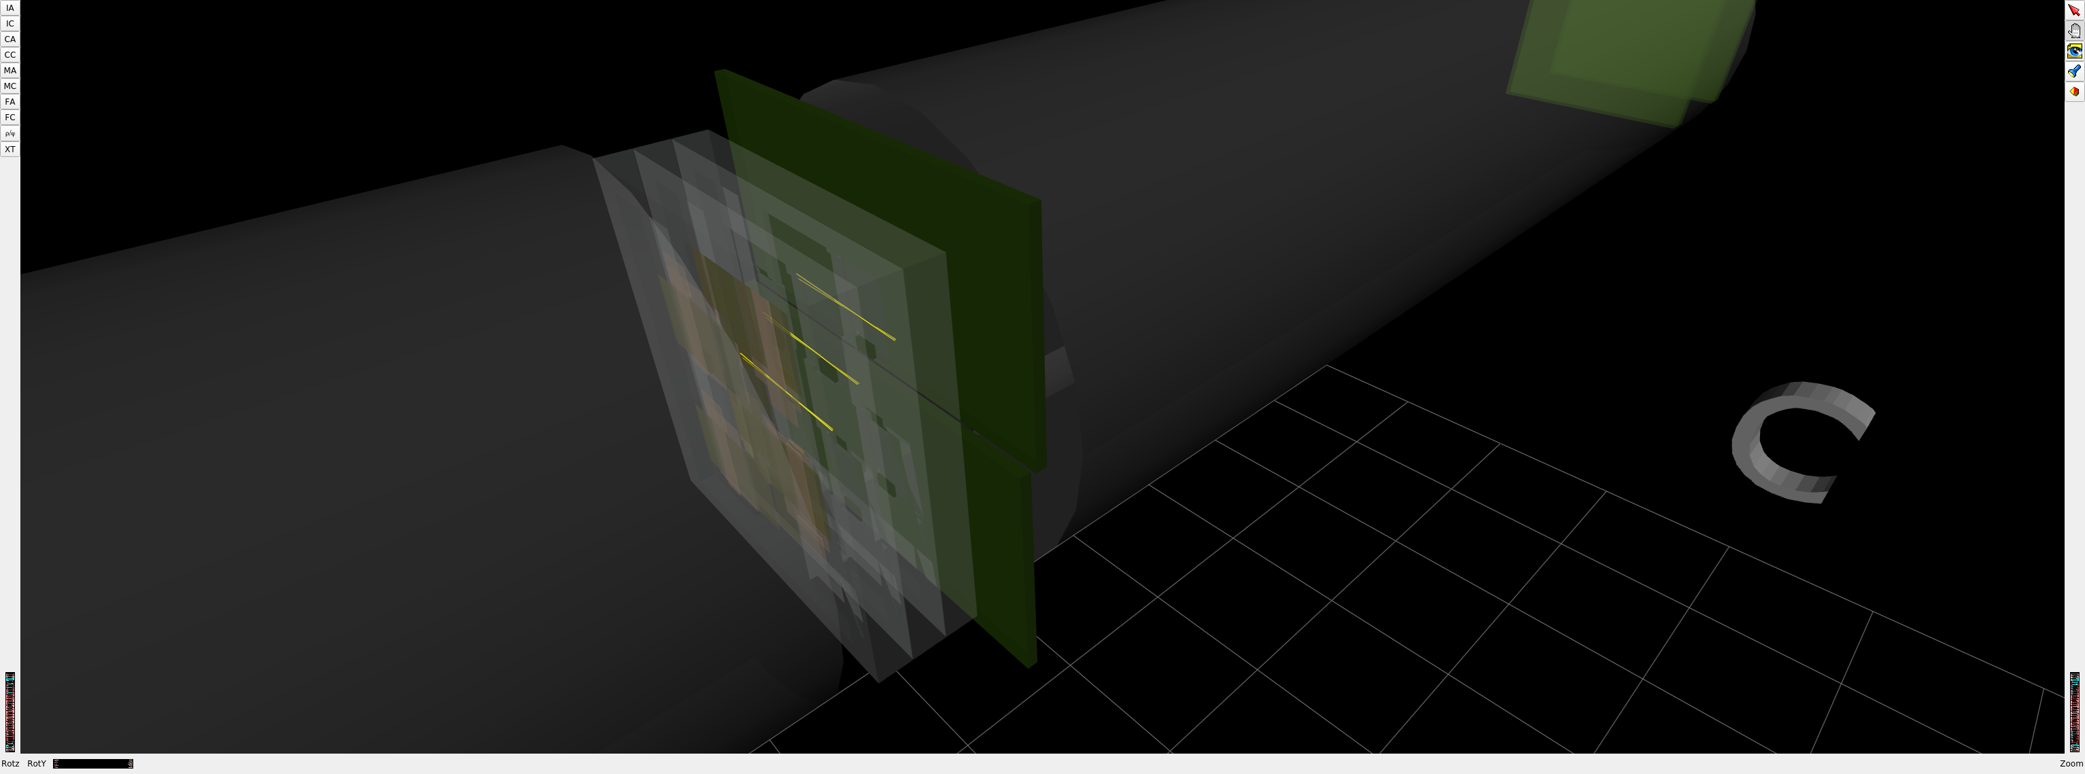
FASER AND THE LHC
1st Cosmic Ray
18 March 2021

Slide 21
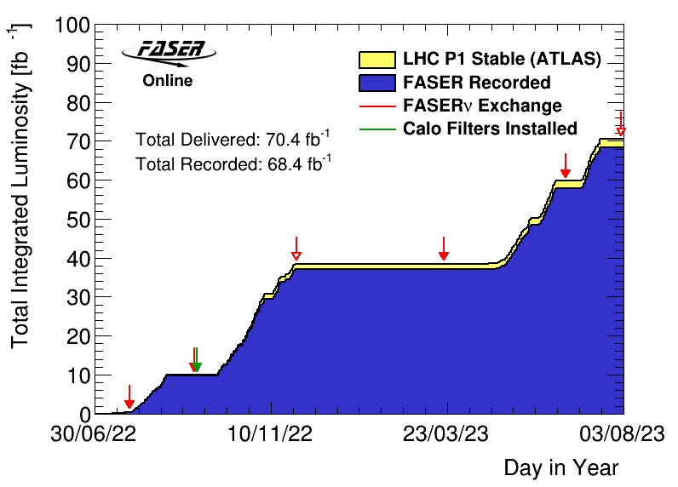
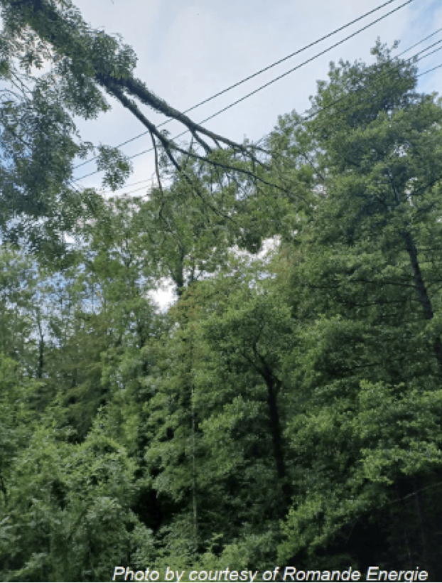
FASER DATA TAKING IN 2022 AND 2023
After Long Shutdown 2 from 2018-2021, the LHC started running again from July to November 2022 and April to July 2023.
FASER began recording data immediately after beam turn on and operated beautifully after that.
  Recorded 97% of delivered luminosity
  Largely automated: no control room, 2 shifters controlling and monitoring the experiment from their laptops.
FASERν emulsion exchanged periodically to prevent overexposure
  3 boxes in 2022 (0.5, 10, 30 fb⁻¹)
  2 boxes in 2023 (20, 10 fb⁻¹)

Slide 22
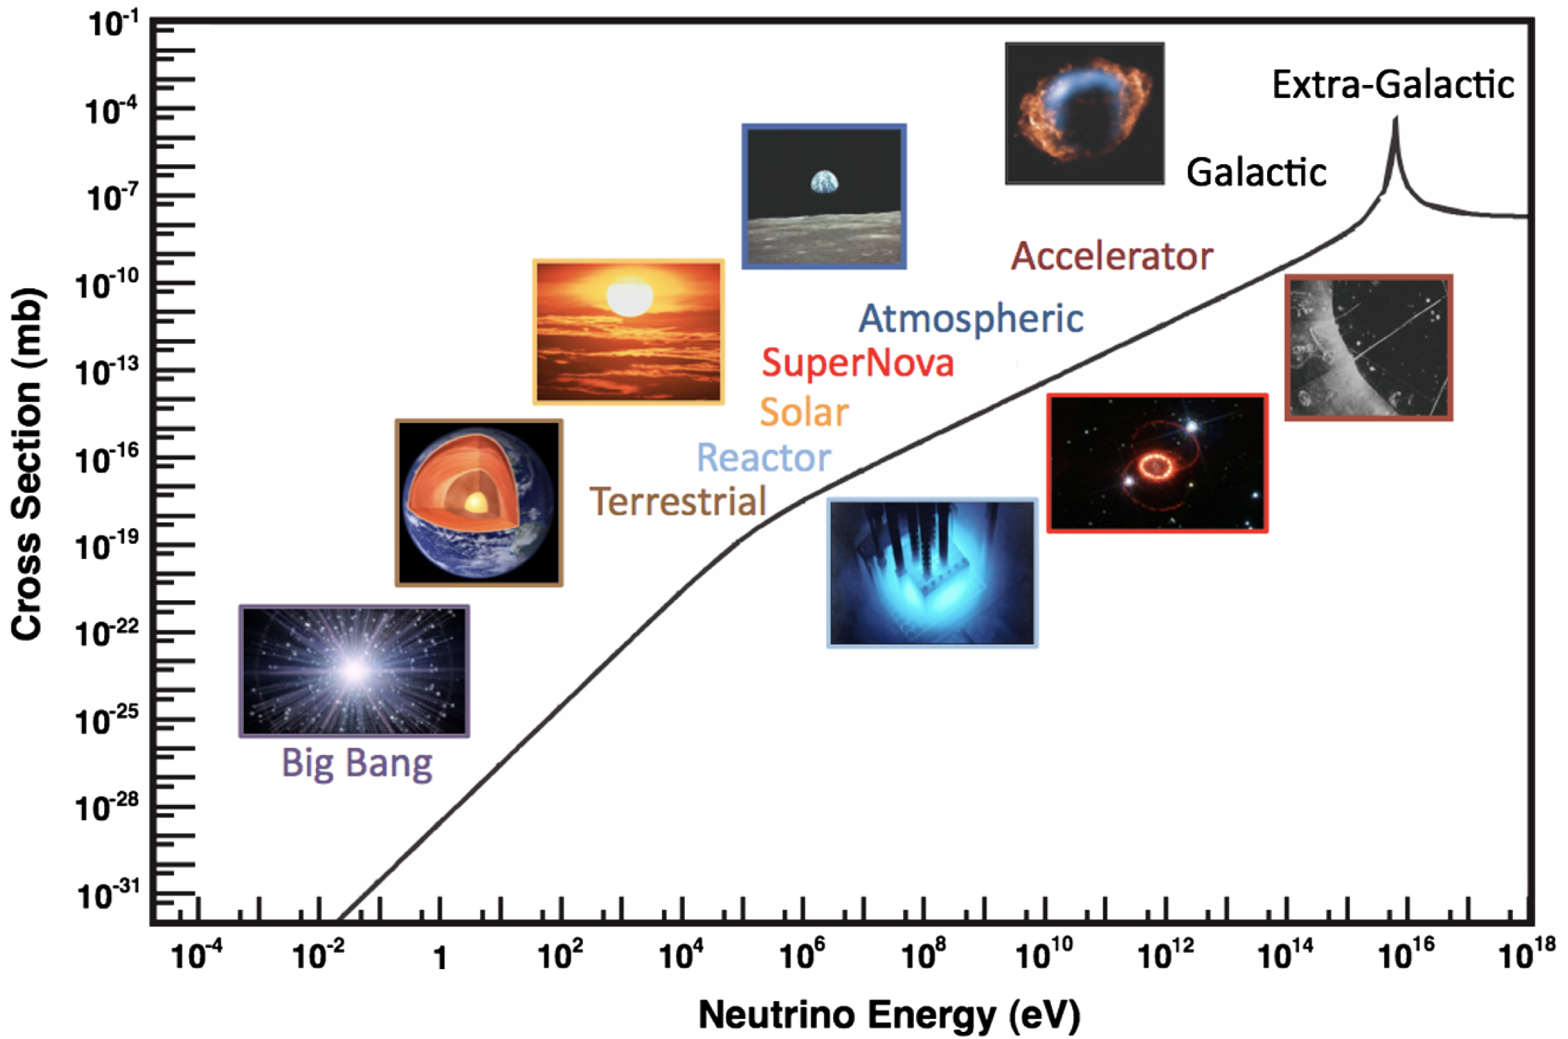
COLLIDER NEUTRINOS
Neutrinos are the least understood of all known particles.
They have been discovered from many sources, each time with stunning implications for particle physics, astrophysics, and cosmology.
Formaggio, Zeller (2012)
But before FASER, neutrinos produced at particle colliders had never been direct observed before, because they interact very weakly, and the highest energy ones, which are the most strongly interacting, pass through the blind spots of existing detectors.

Slide 23
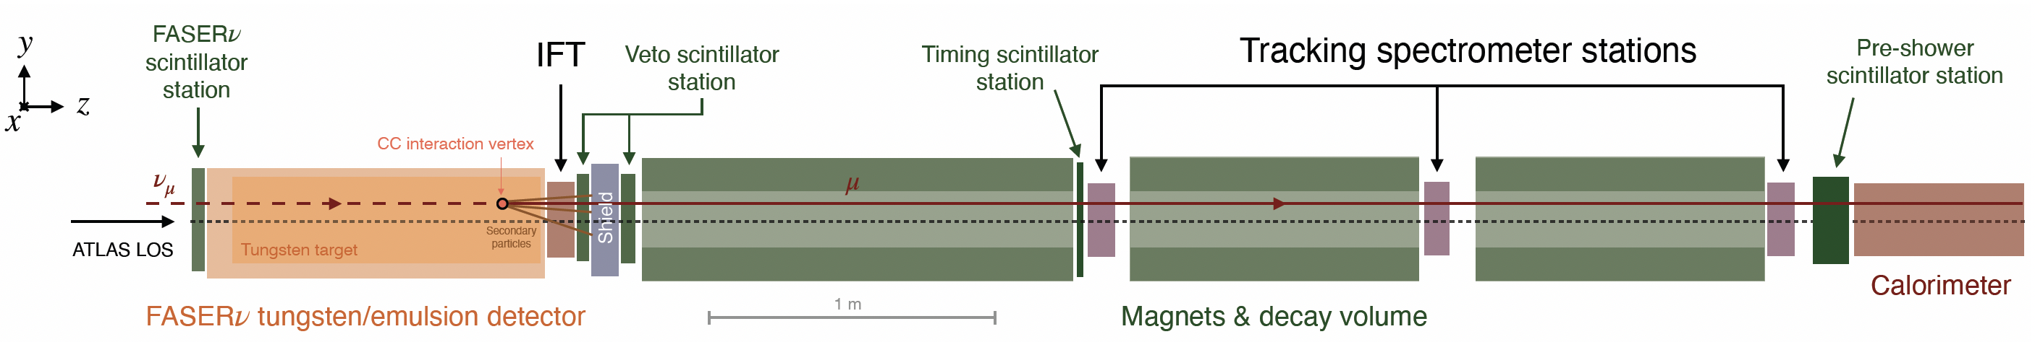
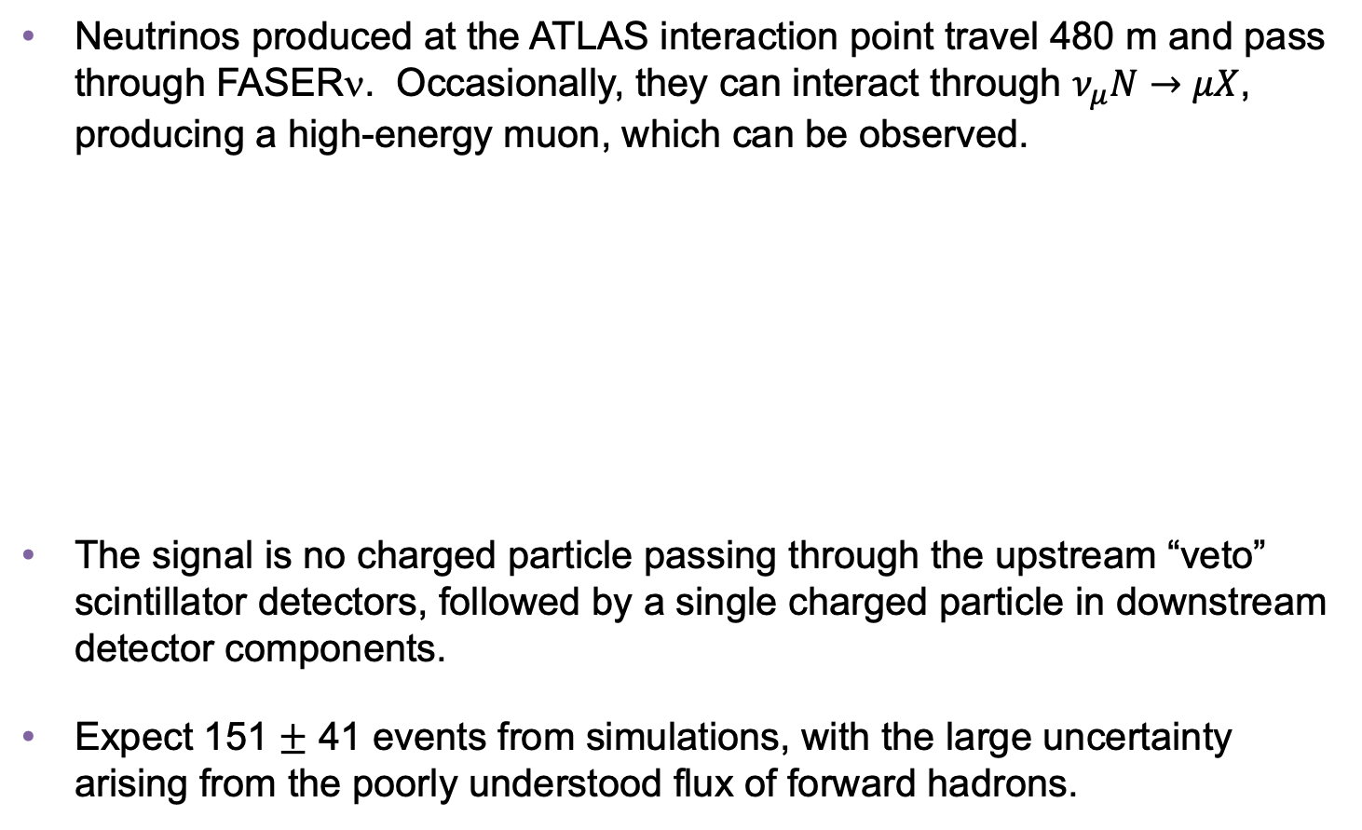
COLLIDER NEUTRINO SEARCH
Neutrinos produced at the ATLAS interaction point travel 480 m and pass through FASERν. Occasionally, they can interact through $ν_{μ}N→μX$, producing a high-energy muon, which can be observed.
The signal is no charged particle passing through the upstream “veto” scintillator detectors, followed by a single charged particle in downstream detector components.
Expect 151 $±$ 41 events from simulations, with the large uncertainty arising from the poorly understood flux of forward hadrons.
De Rujula, Ruckl (1984)
FASER Collaboration (2303.14185, PRL)
Notes:
typical A’ that decays in FASER has ~TeV energy

Slide 24
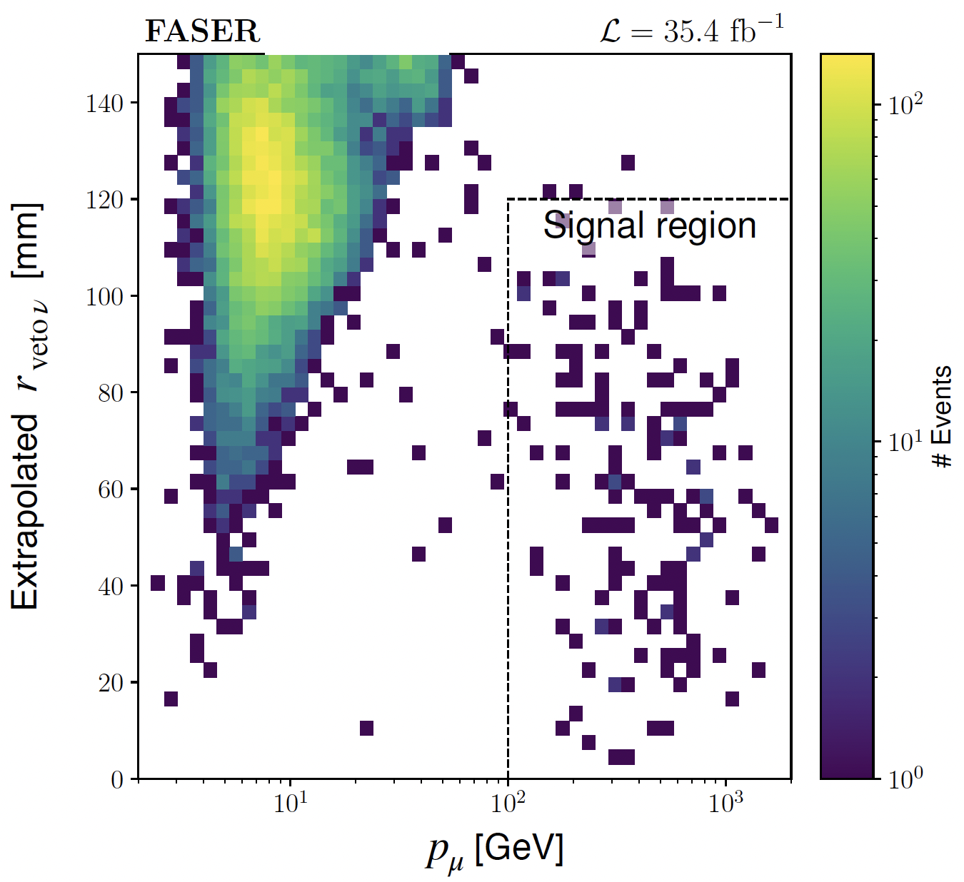
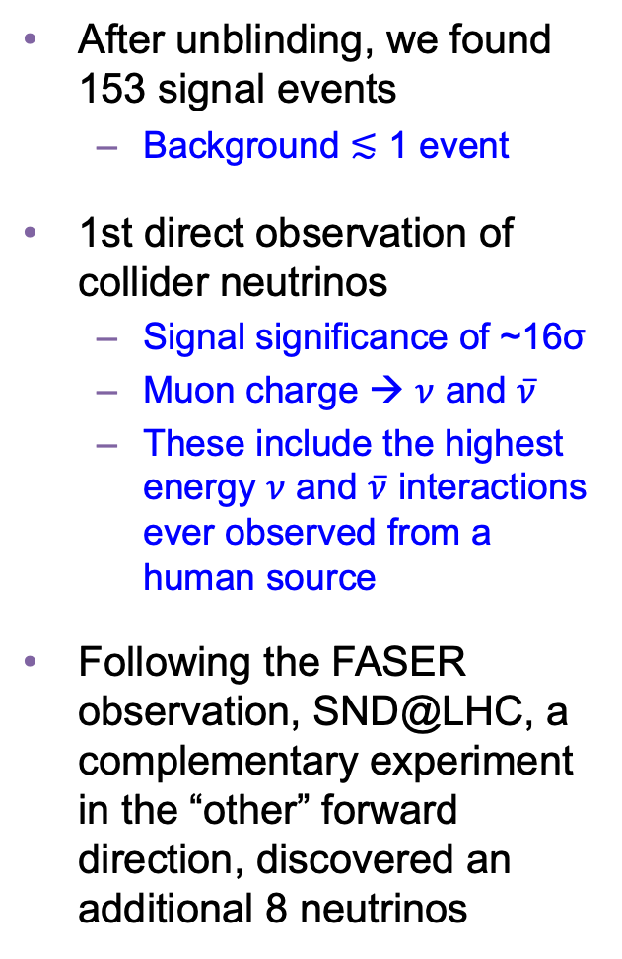
COLLIDER NEUTRINO RESULTS
After unblinding, we found 153 signal events
  Background $≲$ 1 event
1st direct observation of collider neutrinos
  Signal significance of ~16σ
  Muon charge → $ν$ and $\overline{ν}$
  These include the highest energy $ν$ and $\overline{ν}$ interactions ever observed from a human source
Following the FASER observation, SND@LHC, a complementary experiment in the “other” forward direction, discovered an additional 8 neutrinos
FASER Collaboration (2303.14185, Physical Review Letters)

Slide 25
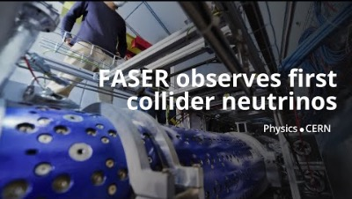
DISCOVERY OF COLLIDER NEUTRINOS

Slide 26
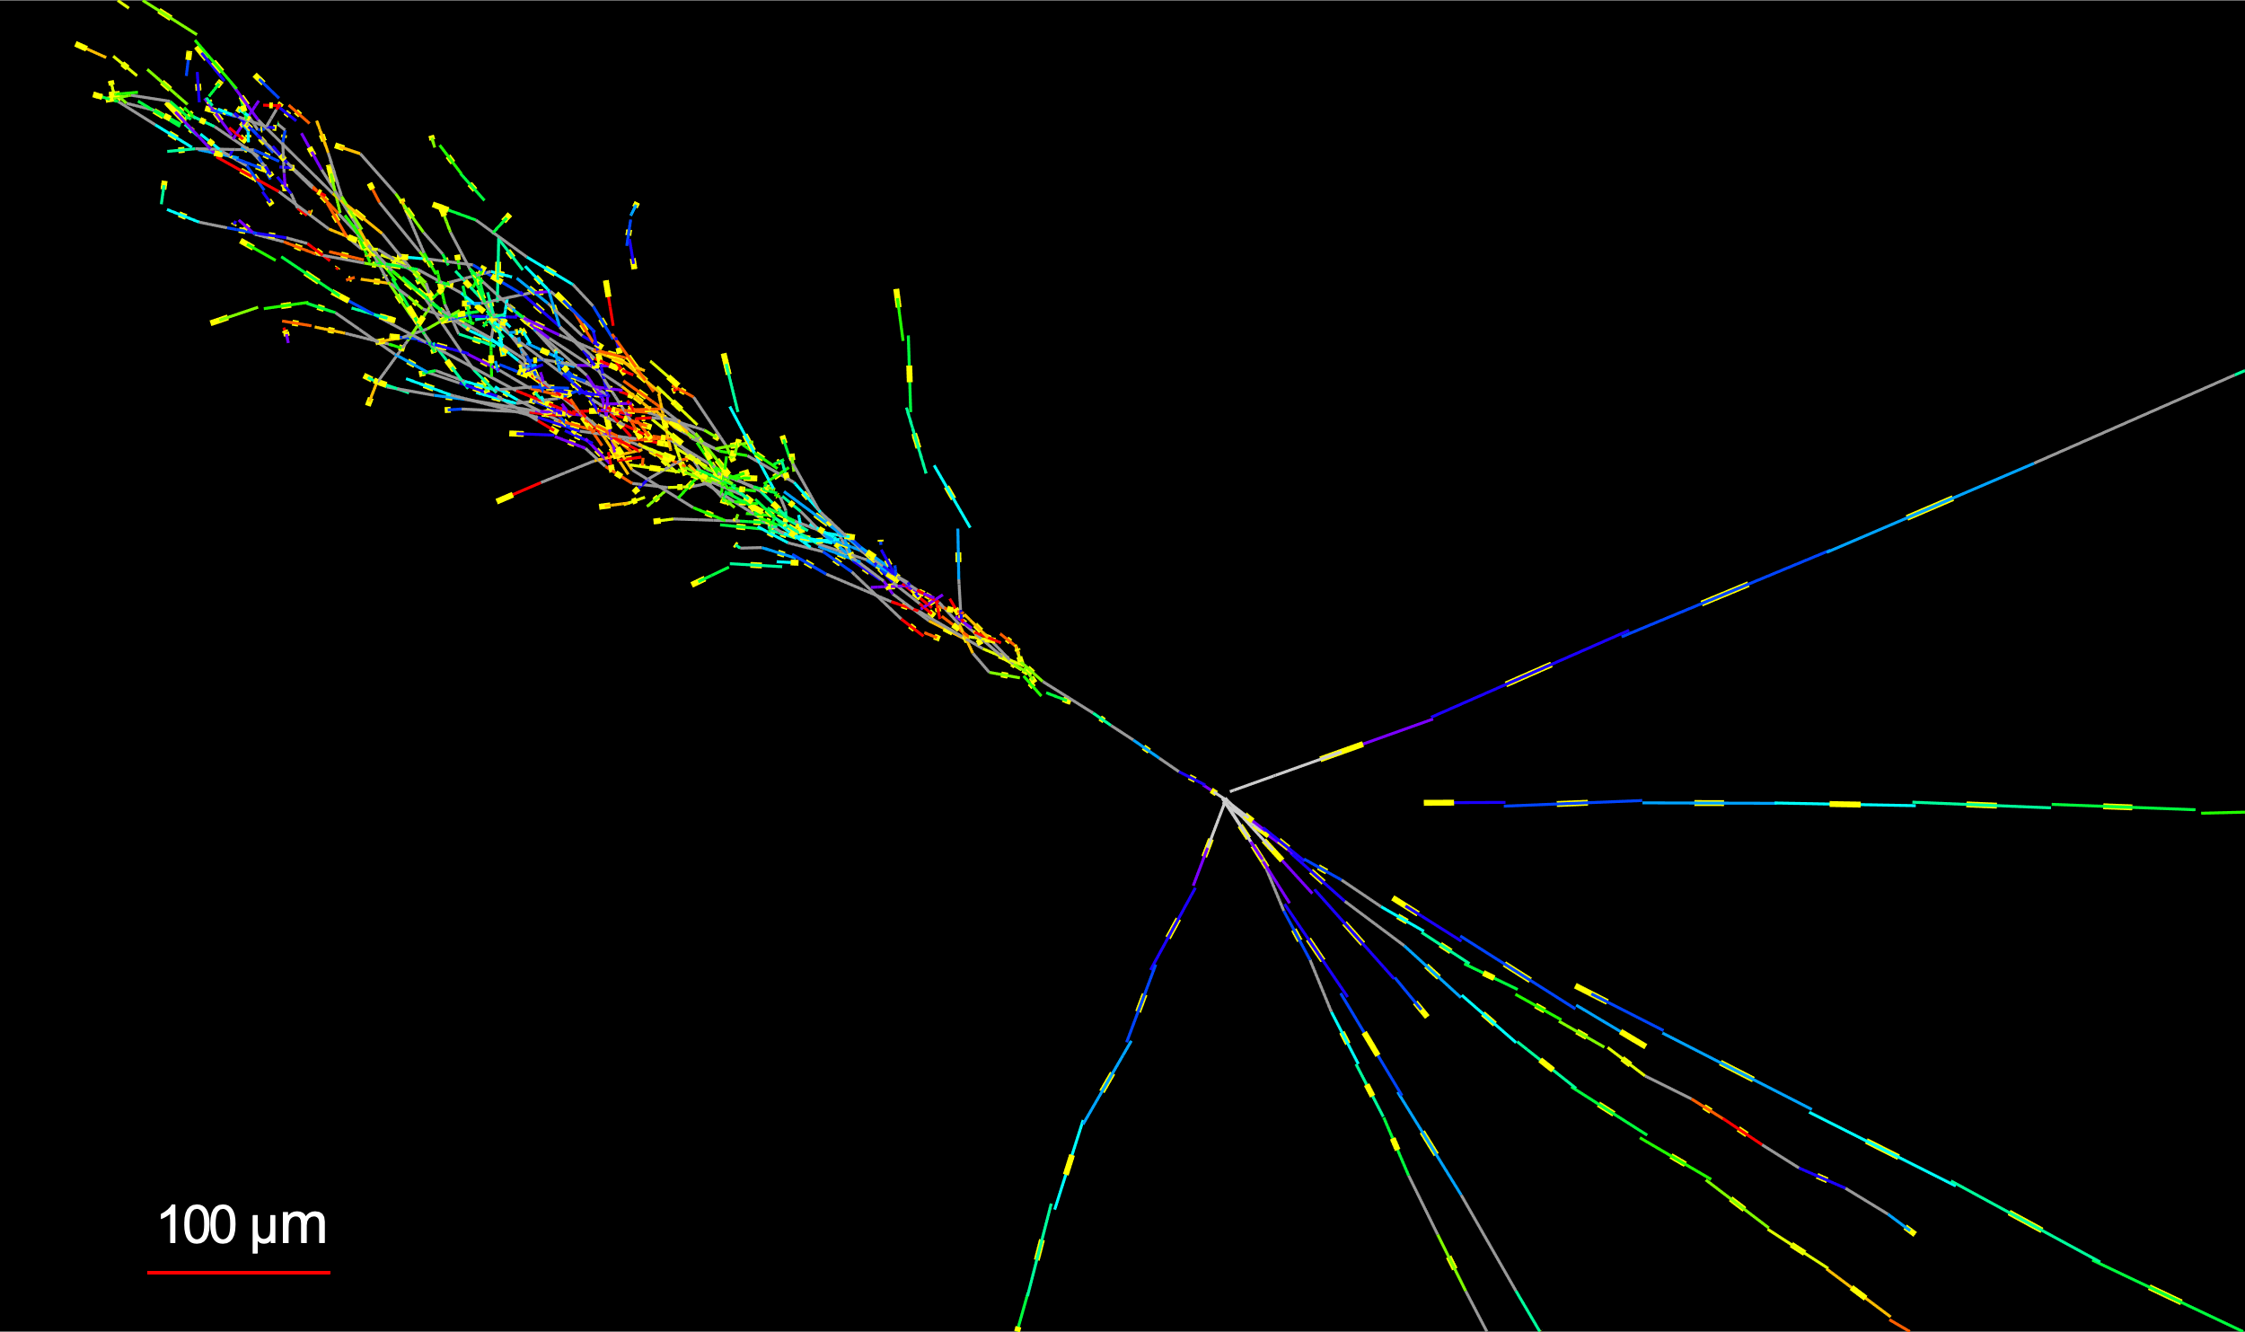

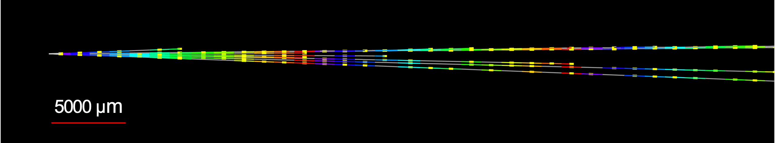

NEUTRINOS FROM EMULSION IN FASERν
Much more to come: the discovery analysis did not even use the emulsion data! With the emulsion, we have now observed many additional neutrinos, including this event, which is the highest energy (~2 TeV) electron neutrino ever observed.
Side View
Vertex with 11 tracks
  615 µm inside tungsten
e-like track from vertex
  Single track for 2X₀
  Shower max @ 7.8Χ₀
  θ_{e} = 11 mrad to beam
Back-to-back topology
  175° between e & rest
Beam View

Slide 27
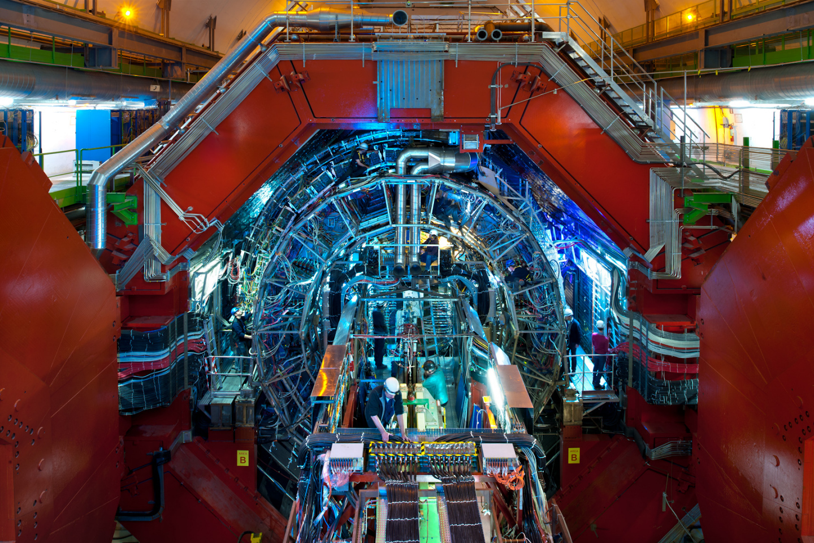
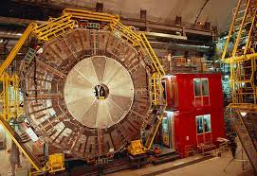
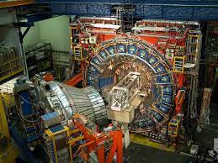
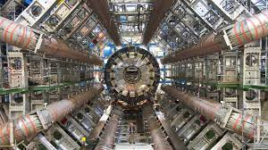
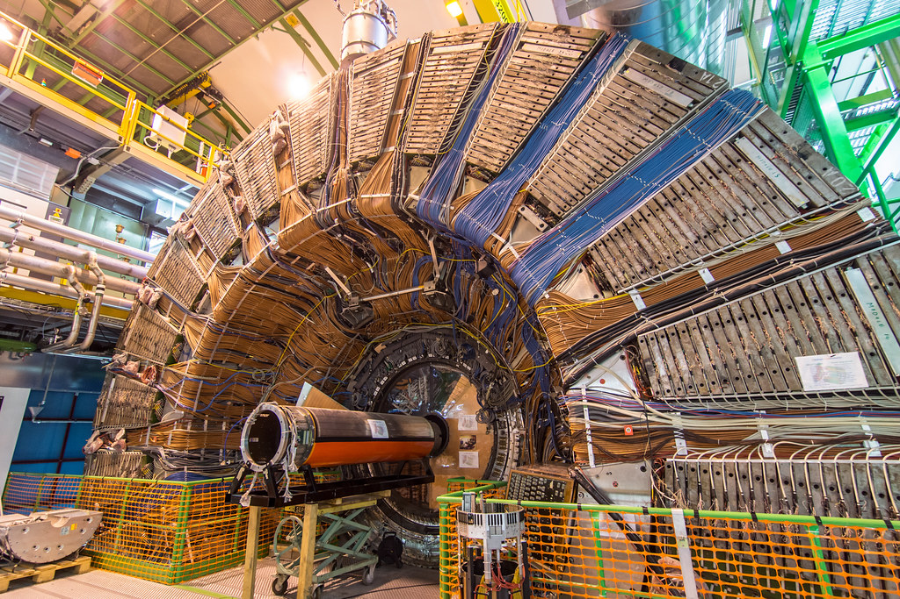
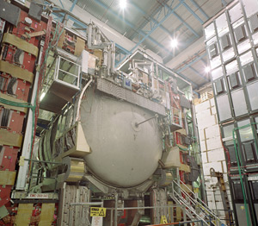
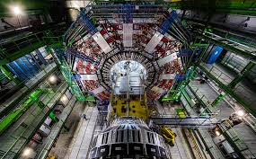
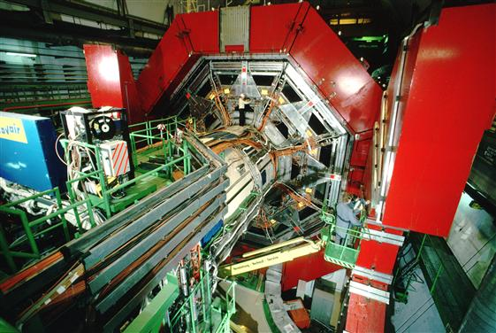

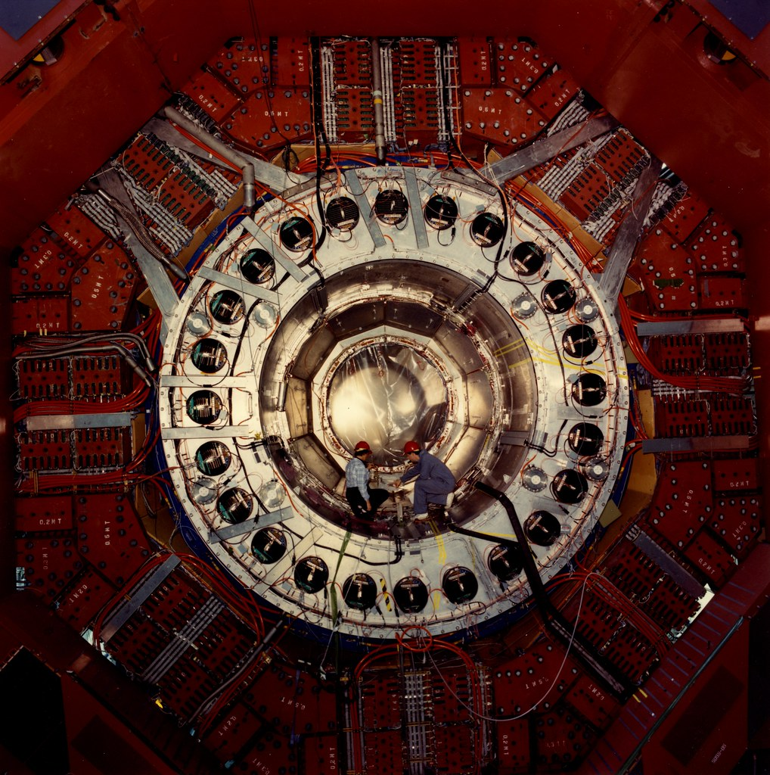
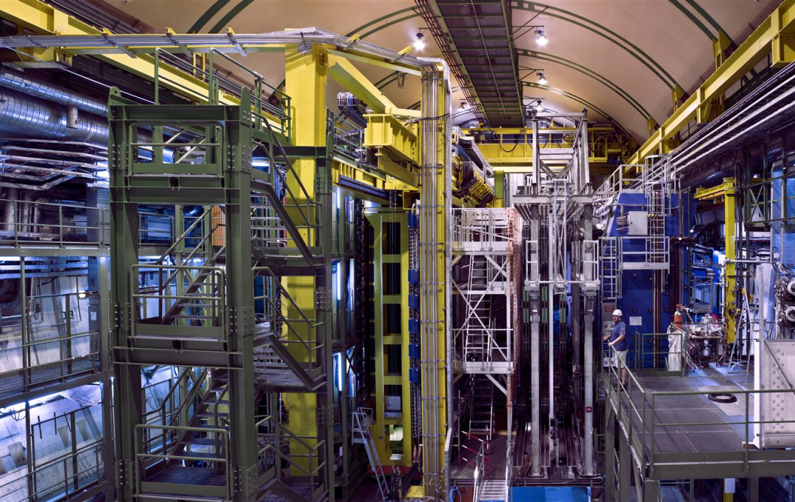
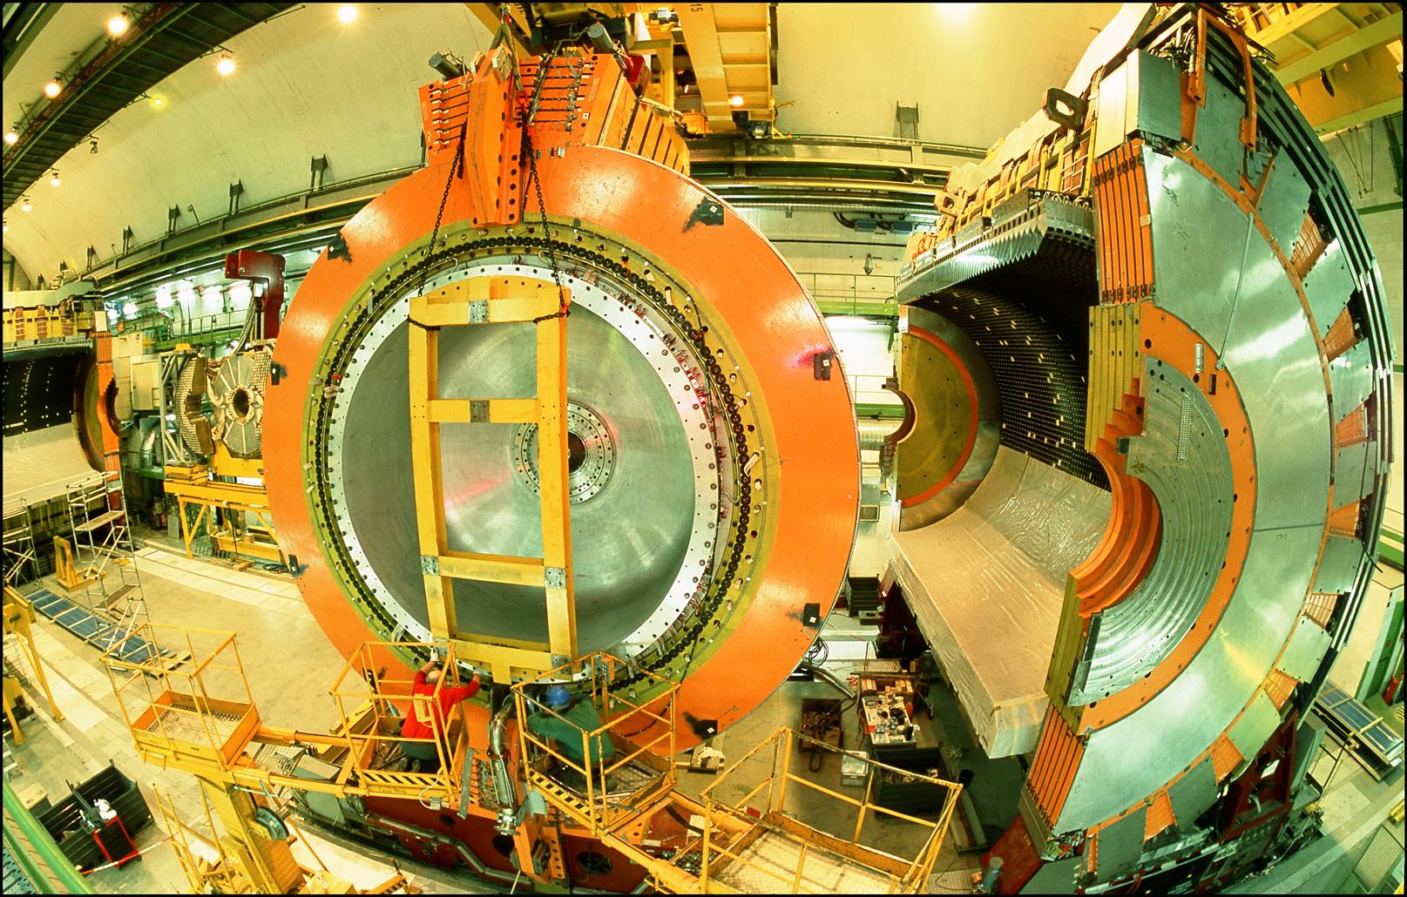

LOCATION, LOCATION, LOCATION
…
ALICE
ALEPH
CDF
FASER
“Tabletop,” 18 months,
~$1M
153 neutrinos
ATLAS
DELPHI
D0
CMS
L3
LHCb
SLD
OPAL
All previous
collider detectors
Building-size, decades,
~$1B
0 neutrinos
16σ discovery, opening a new field: collider neutrino physics

Slide 28

NEUTRINO PHYSICS
In Run 3 (2022-25), FASER’s goals are to
  Record ~3000 ν_{e} , ~10,000 ν_{μ} , and ~70 ν_{τ} interactions at TeV energies, the first direct exploration of this energy range for all 3 flavors.
  Distinguish muon neutrinos from anti-neutrinos by combining FASER and FASERν data, and so measure their cross sections independently.
  Add significantly to the number of ν_{τ} detected and detect the first anti-ν_{τ} .
FASER Collaboration 1908.02310 (2019)

Slide 29


NEW PARTICLE SEARCHES
FASER can also search for many types of new light and weakly-interacting particles.
For example: suppose there is a dark sector that contains dark matter X and also a dark force: dark electromagnetism.
The force carriers of the SM and dark EM will mix
  perhaps suppressed, but completely generic, since a renormalizable operator
The result? Dark photons A’, like photons, but with mass m_{A’}, couplings suppressed by ε.
Finding a dark photon would imply a new fundamental force and possibly a “portal” to the dark sector.
SM
EM
Dark Sector
EM, X
A
$$εF_{μν}F_{D}^{μν}$$
A_{D}
Holdom (1986)

Slide 30


DARK PHOTON SIGNAL
Produced through meson decay $π/η→A^{′}γ$ or “dark bremsstrahlung” $pp→{ppA}^{′}$.
Travels straight and unimpeded through 480 m of rock/concrete.
Then decays, e.g., through $A^{′}$ $→ e^{+}e^{−}$.
The signal is no charged particle passing through the upstream veto scintillator detectors, followed by two very energetic (100s of GeV) charged particles in downstream detector components.
Notes:
typical A’ that decays in FASER has ~TeV energy

Slide 31

DARK PHOTON RESULTS
After unblinding, no events seen, FASER sets limits on previously unexplored parameter space.
First new probe of the parameter space favored by dark matter from low coupling since the 1990’s; with 2022 data alone, ~100 times the sensitivity of previous experiments.
Background-free analysis bodes well for the future. Factor of ~10 more luminosity and other improvements in Run 3 from 2023-25 data.
Existing bounds from DarkCast
Searches also underway for many other new particles: other light force carriers (U(1)_{B-L}, U(1)_{B}, protophobic), sterile neutrinos/heavy neutral leptons, dark Higgs bosons, axion-like particles with photon/W/gluon couplings, up-philic scalars, quirks, etc.

Slide 32


Slide 33




FORWARD PHYSICS FACILITY
Following the results of FASER and SND@LHC, CERN is considering the possibility of creating a dedicated Forward Physics Facility to house far-forward experiments for the rest of the LHC era from 2028-2040s.
UJ18
ATLAS
SPS
LHC
LOS
FPF core sample to study site geology, refine cost estimates
https://cds.cern.ch/record/2851822
CERN GIS

Slide 34

FORWARD PHYSICS FACILITY EXPERIMENTS
At present there are 5 experiments being designed to explore the breadth of physics topics.
  Millions of TeV-energy neutrinos will provide new probes of neutrino properties, quantum chromodynamics, and astroparticle physics.
  Roughly 10,000 times greater sensitivity for new particles (new force carriers, axion-like particles, light dark matter, millicharged particles, …)

Slide 35
FORWARD PHYSICS FACILITY
The physics program in the far-forward region has been developed in a series of meetings and papers.
FPF Meetings
  FPF Kickoff Meeting, 9-10 Nov 2020
  FPF2 Meeting, 27-28 May 2021
  FPF3 Meeting, 25-26 Oct 2021
  FPF4 Meeting, 31 Jan-1 Feb 2022
  FPF5 Meeting, 15-16 Nov 2022
  FPF6 Meeting, 8-9 June 2023
FPF Papers
  FPF “Short” Paper: 75 pages, 80 authors, Phys. Rept. 968, 1 (2022), 2109.10905.
  FPF White Paper: 429 pages, 392 authors+endorsers representing over 200 institutions, J. Phys. G (2023), 2203.05090.
Snowmass 2022: “Our highest immediate priority accelerator and project is the HL-LHC, … including the construction of auxiliary experiments that extend the reach of HL-LHC in kinematic regions uncovered by the detector upgrades.”

Slide 36

NEW PHYSICS AT THE FPF
The FPF is proposed to run at the HL-LHC with implications for
  New physics in neutrino properties: neutrino blind → neutrino factory (10⁶ neutrinos at the highest human-made energies ever).
  New particles: dark matter, dark sectors, milli-charged particles, new force particles, new Higgs-like particles, sterile neutrinos, quirks, …

Slide 37




NEUTRINOS AT THE FPF
The FPF experiments will see ${10}^{5} ν_{e}$, ${10}^{6} ν_{μ}$, and ${10}^{4} ν_{τ}$ interactions at ~ TeV energies where there is currently almost no data.
Neutrinos are produced by forward hadron production: $π, K, D, …$. Energy spectra will inform
  Astroparticle physics: muon puzzle, …
  QCD: pdfs at x $\sim {10}^{−1}$, x $\sim {10}^{−7}$, intrinsic charm, small-x gluon saturation, …
  Neutrino oscillations: $ν_{s}$ with $∆m^{2}\sim {10}^{3}$ ${eV}^{2}$

Slide 38




QCD AT THE FPF
The FPF will also support a rich program of QCD and hadron structure studies.
Forward neutrino production is a probe of forward hadron production, BFKL dynamics, intrinsic charm, and proton structure at ultra small x ~ 10⁻⁷ to 10⁻⁶.
Important implications for UHE cosmic ray experiments, 100 TeV pp collider, …
$$4m_{c}^{2 }\sim x_{1}x_{2}s$$
FASER White Paper (2022)

Slide 39




DARK MATTER DIRECT DETECTION AT THE FPF
Light DM with masses at the GeV scale and below is famously hard to detect.
  Galactic halo velocity ~ 10⁻³ c, so kinetic energy ~ keV or below.
At the LHC, we can produce DM at high energies, look for the resulting DM to scatter in FLArE, Forward Liquid Argon Experiment, a proposed 10 to 100 tonne LArTPC.
FLArE is powerful in the region favored/allowed by thermal freezeout.
Batell, Feng, Trojanowski (2021)

Slide 40


MILLI-CHARGED PARTICLES AT THE FPF
A completely generic possibility motivated by dark matter, dark sectors. Currently the target of the MilliQan experiment, located at the LHC near the CMS experiment in a “non-forward” tunnel.
The MilliQan Demonstrator (Proto-MilliQan) already probes new region. Full MilliQan can also run in this location in the HL-LHC era, but the sensitivity may be improved significantly by moving it to the FPF (FORMOSA).
Foroughi-Abari, Kling, Tsai (2020)

Slide 41




ASTROPARTICLE PHYSICS AT THE FPF
The current IceCube cosmic nu flux can be fit by a power law, a power law with cutoff, ...
More data may be able to distinguish these, but only if the atmospheric neutrino background from charm is better determined.
IceCube 2001.09520
Power law
Power law
with cutoff
Bhattacharya et al. (1502.01076)
This can be measured in the controlled environment of a particle collider if
  $\sqrt{s} \sim \sqrt{2E_{ν}m_{p}} \sim$10 TeV for $E_{ν} \sim$10⁷ GeV : Requires the energy of the LHC
  $x_{1,2} \sim \frac{m_{c}}{\sqrt{s}} e^{±η} ⇒ η \sim$ 7 to 9 : Requires the far forward angular coverage of the FPF
Anchordoqui (2022)

Slide 42



A CAUTIONARY TALE
Sometimes to look forward, it pays to first look back.
2021 was the 50th anniversary of the birth of hadron colliders.
In 1971, CERN’s Intersecting Storage Rings (ISR), with a circumference of ~1 km, collided protons with protons at center-of-mass energy 30 GeV.

Slide 43



ISR’S LEGACY
During ISR’s 50th anniversary, there were many fascinating articles and talks by eminent physicists looking back on the ISR’s legacy.
  “Enormous impact on accelerator physics, but sadly little effect on particle physics.” – Steve Myers, talk at “The 50th Anniversary of Hadron Colliders at CERN,” October 2021.
  “There was initially a broad belief that physics action would be in the forward directions at a hadron collider…. It is easy to say after the fact, still with regrets, that with an earlier availability of more complete… experiments at the ISR, CERN would not have been left as a spectator during the famous November revolution of 1974 with the J/ψ discoveries at Brookhaven and SLAC .” – Lyn Evans and Peter Jenni, “Discovery Machines,” CERN Courier (2021).
Bottom line: The collider was creating new forms of matter (charm), but the detectors focused on the forward region (along the beamline) and so missed them. Let’s not follow this precedent!

Slide 44
SUMMARY
The FASER experiment is a new way of studying collisions at the LHC to probe fundamental physics.
  Discovery and study of collider neutrinos, interacting at the highest human-made energies ever observed.
  Searches for light, weakly-interacting new particles, including many motivated by dark matter.
Compared to other LHC experiments, FASER is inexpensive, small, and fast.
  The detector was designed, constructed, and installed in ~2 years.
  First physics data taken in 2022, first physics results in March 2023, many more to come.
Following the success of FASER, the Forward Physics Facility is now being considered to fully exploit the forward region of the LHC collisions through the rest of the LHC’s lifetime (2028-2040s).

Slide 45









ACKNOWLEDGEMENTS
We also thank
  The LHC for excellent performance in 2022
  ATLAS for luminosity information
  ATLAS for use of ATHENA s/w framework
  ATLAS SCT for spare tracker modules
  LHCb for spare ECLA modules
  CERN FLUKA team for bkgrd simulations
  CERN PBC and technical infrastructure groups for excellent support during FASER’s design, construction, installation

