Slide 1



DARK MATTER SEARCHES
AT ACCELERATORS
Jonathan Feng, UC Irvine
UCLA Dark Matter 2023, 29 March 2023

Slide 2
INTRODUCTION
“Dark Matter Searches at Accelerators”: why should our experiments on Earth have any hope of telling us about what the universe looks like a Gpc away?
In fact, one of the wonders of our field is that there are reasons for optimism.
  The existence of dark matter is now one of the strongest reasons to expect not only that new particles exists, but also that new particles will appear at the particle experiments we are now building.
  General arguments have motivated a huge number of new ideas for experiments at accelerators and colliders in the coming years.
  DM is now a leading motivation for accelerator experiments. This was not always the case…
Accelerators
Particle Physics
L ~ 10⁻¹⁸ m
Dark Matter
Cosmology
L ~ 10²⁵ m

Slide 3

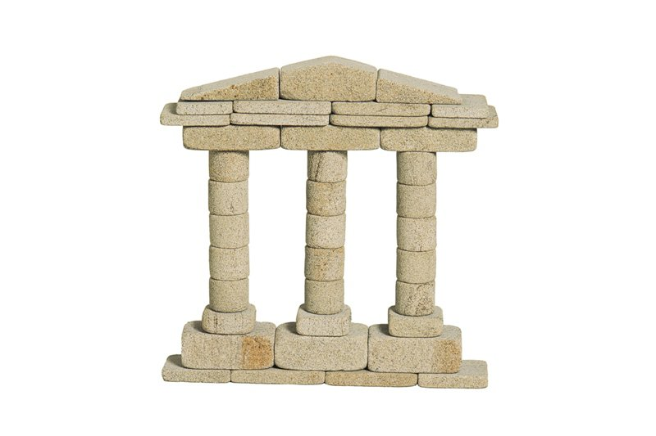

DARK MATTER AT THE LHC
1990’s
2000’s
Now
LHC
LHC
LHC
Standard Model
Higgs Boson
Gauge Hierarchy
Dark Matter
Higgs Boson
Gauge Hierarchy
Higgs Boson
Dark Matter
Gauge Hierarchy

Slide 4
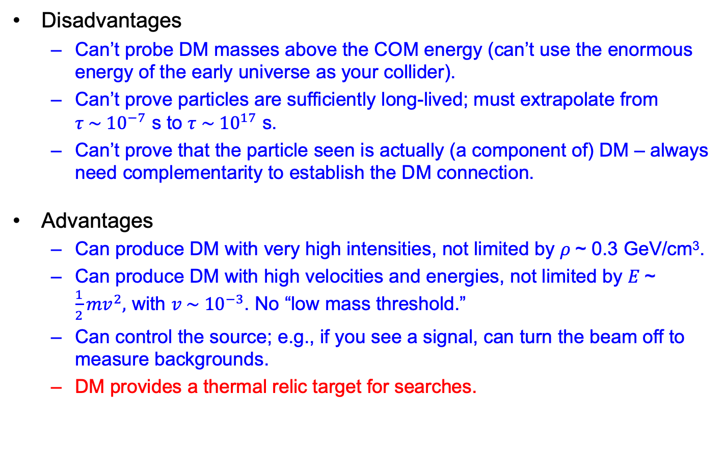
ACCELERATOR SEARCHES FOR DM
Disadvantages
  Can’t probe DM masses above the COM energy (can’t use the enormous energy of the early universe as your collider).
  Can’t prove particles are sufficiently long-lived; must extrapolate from $τ \sim {10}^{−7}$ s to $τ \sim {10}^{17}$ s.
  Can’t prove that the particle seen is actually (a component of) DM – always need complementarity to establish the DM connection.
Advantages
  Can produce DM with very high intensities, not limited by $ρ$~ 0.3 GeV/cm³.
  Can produce DM with high velocities and energies, not limited by $E$~ $\frac{1}{2}{mv}^{2},$ with $v \sim {10}^{−3}$. No “low mass threshold.”
  Can control the source; e.g., if you see a signal, can turn the beam off to measure backgrounds.
  DM provides a thermal relic target for searches.

Slide 5
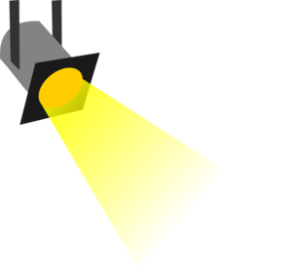
THE THERMAL RELIC LANDSCAPE
Particle
Colliders
Mass
MeV
GeV
TeV
1
Already
Discovered
WIMPs and other
Heavy Particles
Too Little to be
Dark Matter
Interaction Strength
Just Right to
be Dark Matter
10⁻³
Dark Sectors and other
Light Particles
Impossible to
Discover
10⁻⁶
Too Much to be
Dark Matter

Slide 6
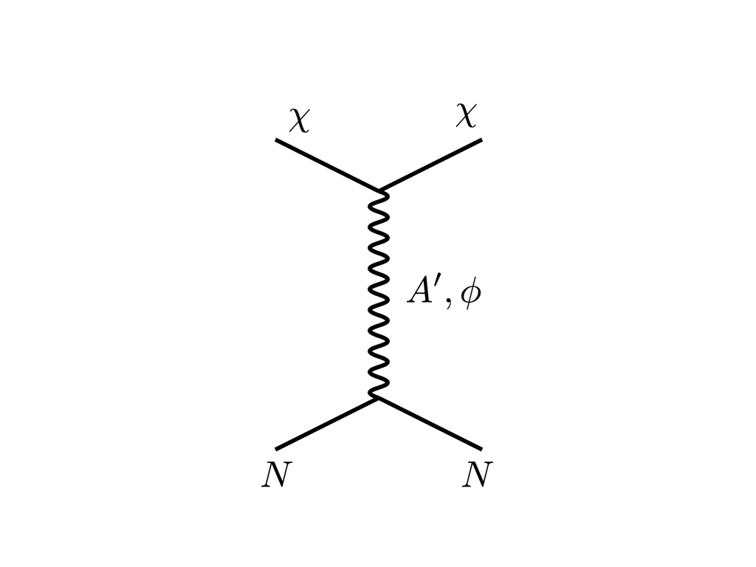
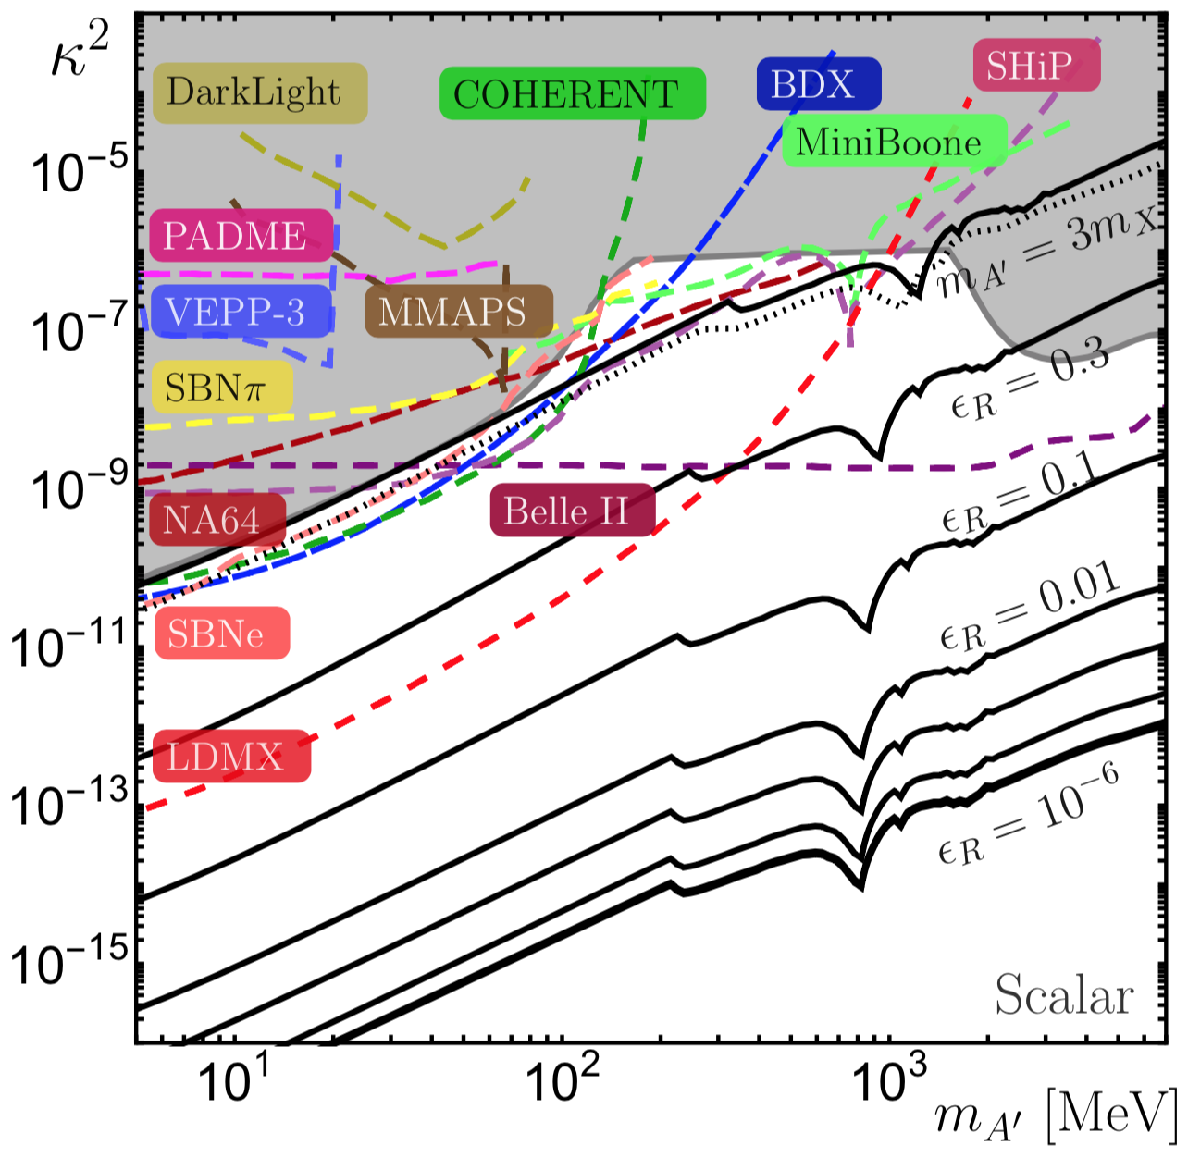


THERMAL RELIC CAVEATS
Thermal relic targets rely on assumptions
  We don’t know that much about very early cosmology
  There are other ways to produce dark matter
  Even within the thermal freeze out framework, there are “loopholes”
Still, no one likes a bottomless pit, and in a world of uncertainty, thermal relic targets provide a welcome guidepost to what parts of parameter space are of special interest.
DM
SM
$$A′$$
DM
SM
$ε_{R}$ $≈$ $(m_{A′}−2m_{DM}$) / $m_{A′}$
Feng, Smolinsky (2017)

Slide 7
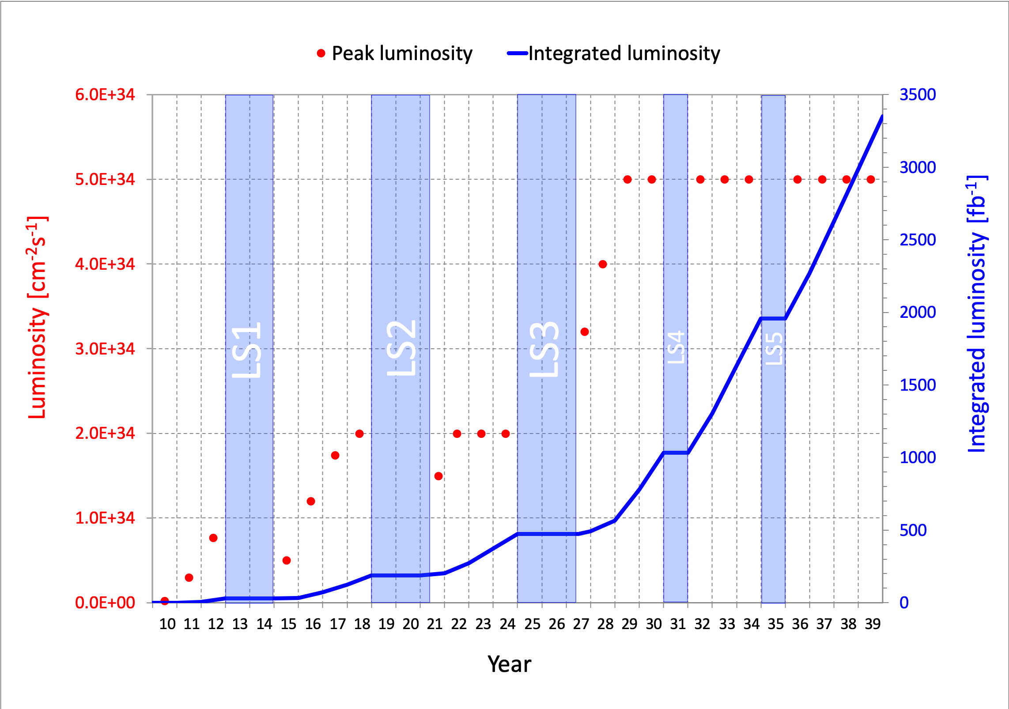
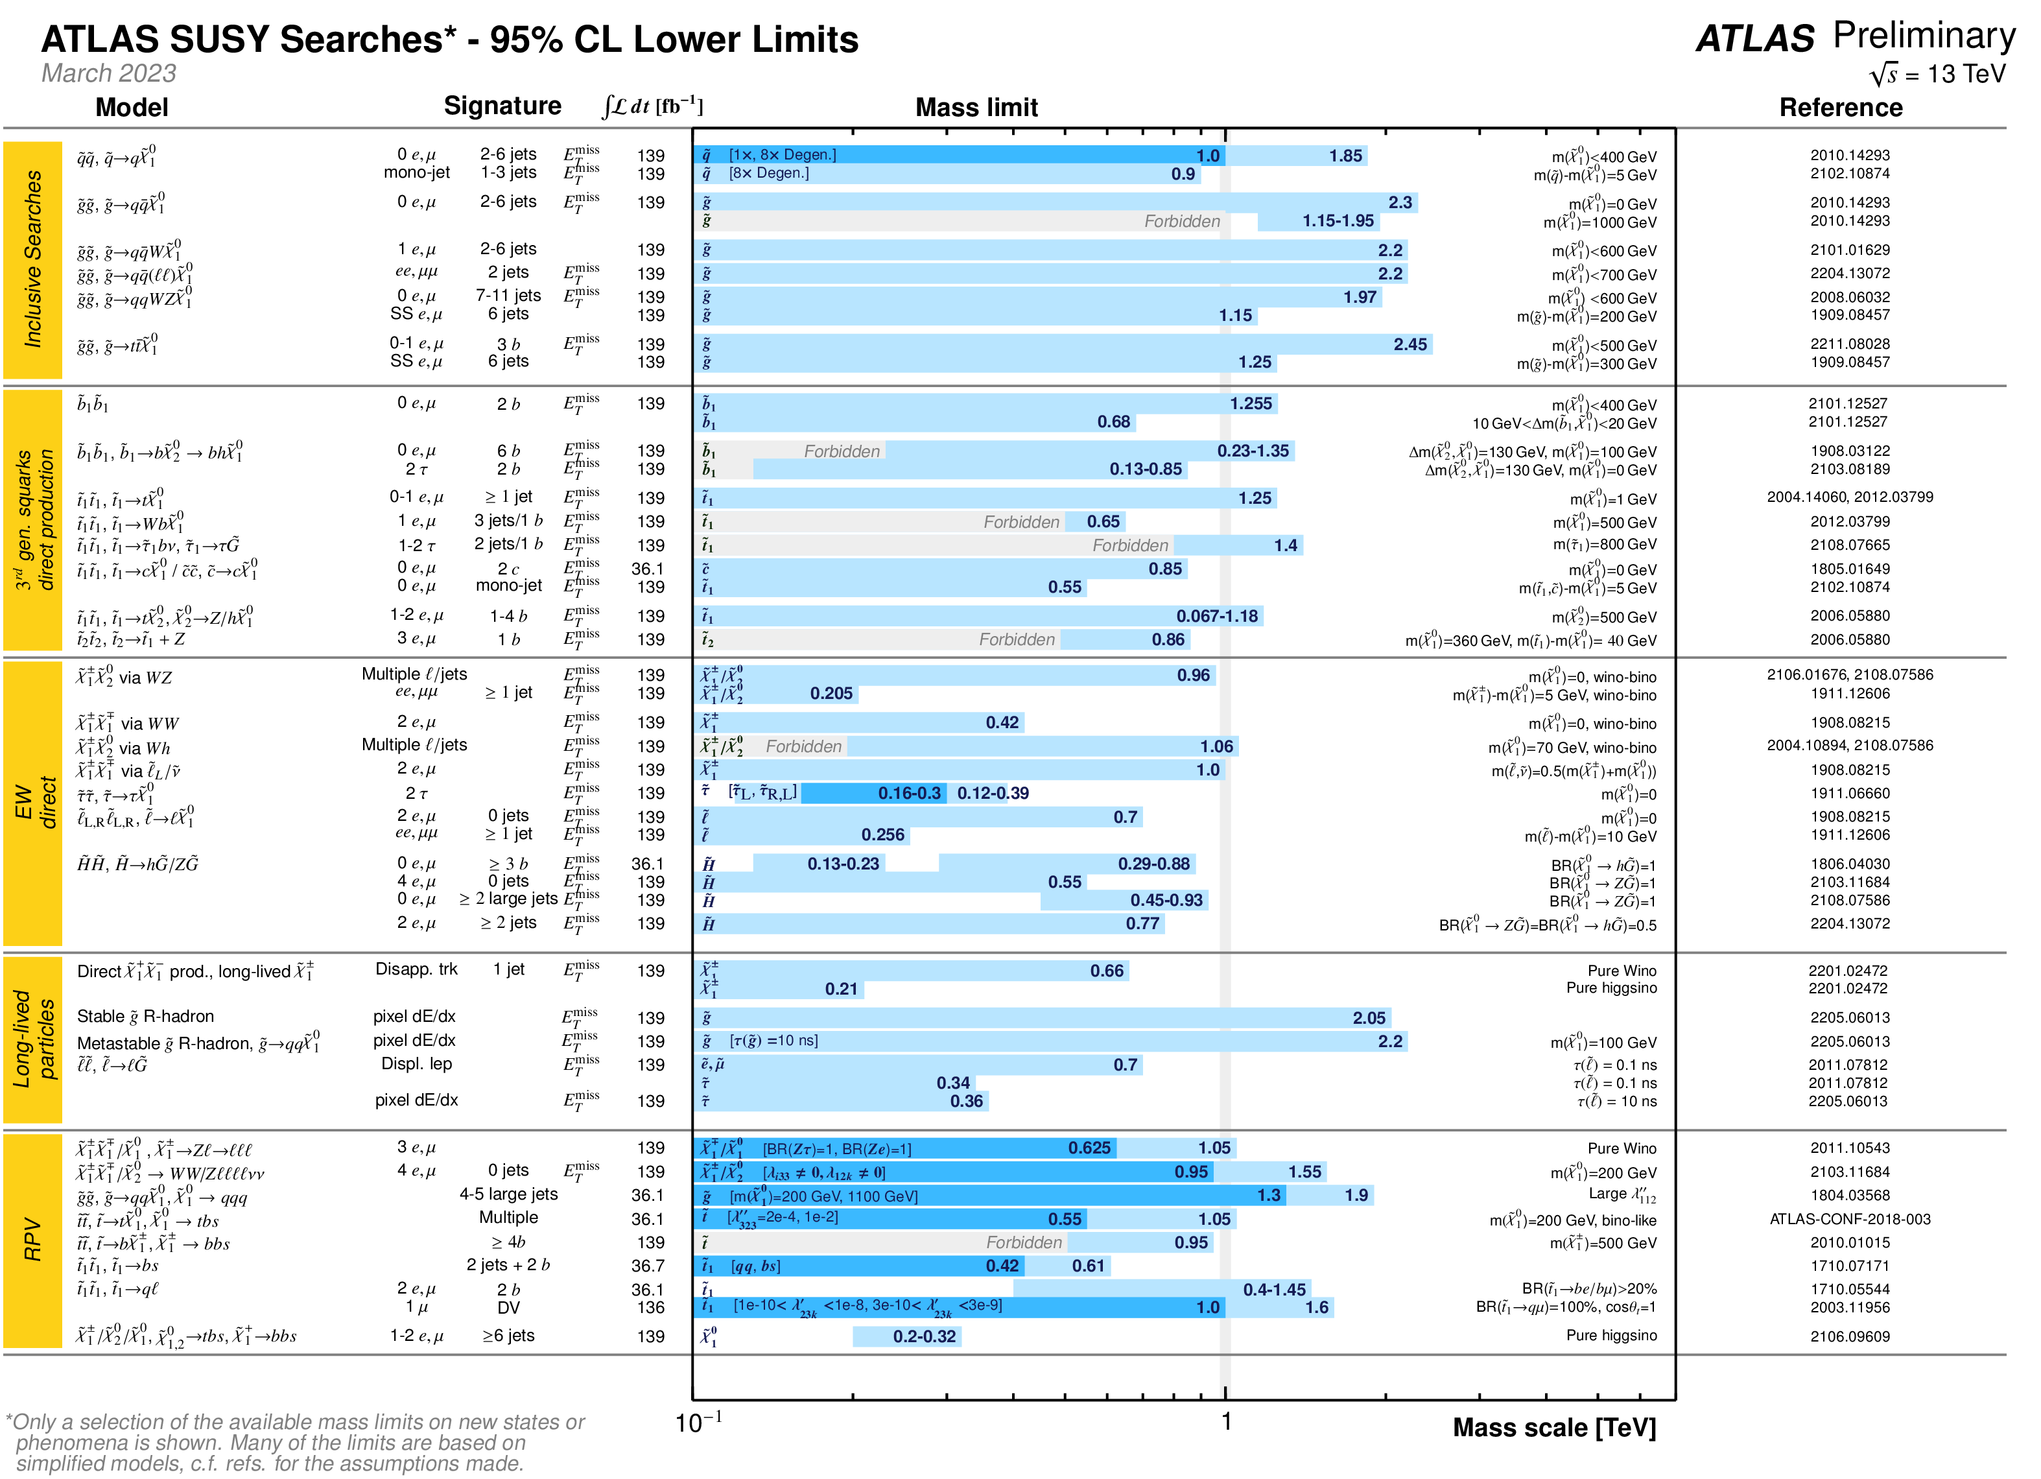
HEAVY DM: WIMPS
WIMPs are heavy, so the LHC is the primary source of the strongest constraints.
The LHC is a postdoc by year, but a kindergartener by luminosity.
Run 3 started July-November 2022 at 13.6 TeV, continues through 2025.
High-Luminosity LHC is from ~2028-40.
Many, many searches; most do not yet include Run 3 data.
RUN 1
RUN 2
RUN 3
RUN 4
RUN 5
RUN 6
(+1 for COVID)

Slide 8
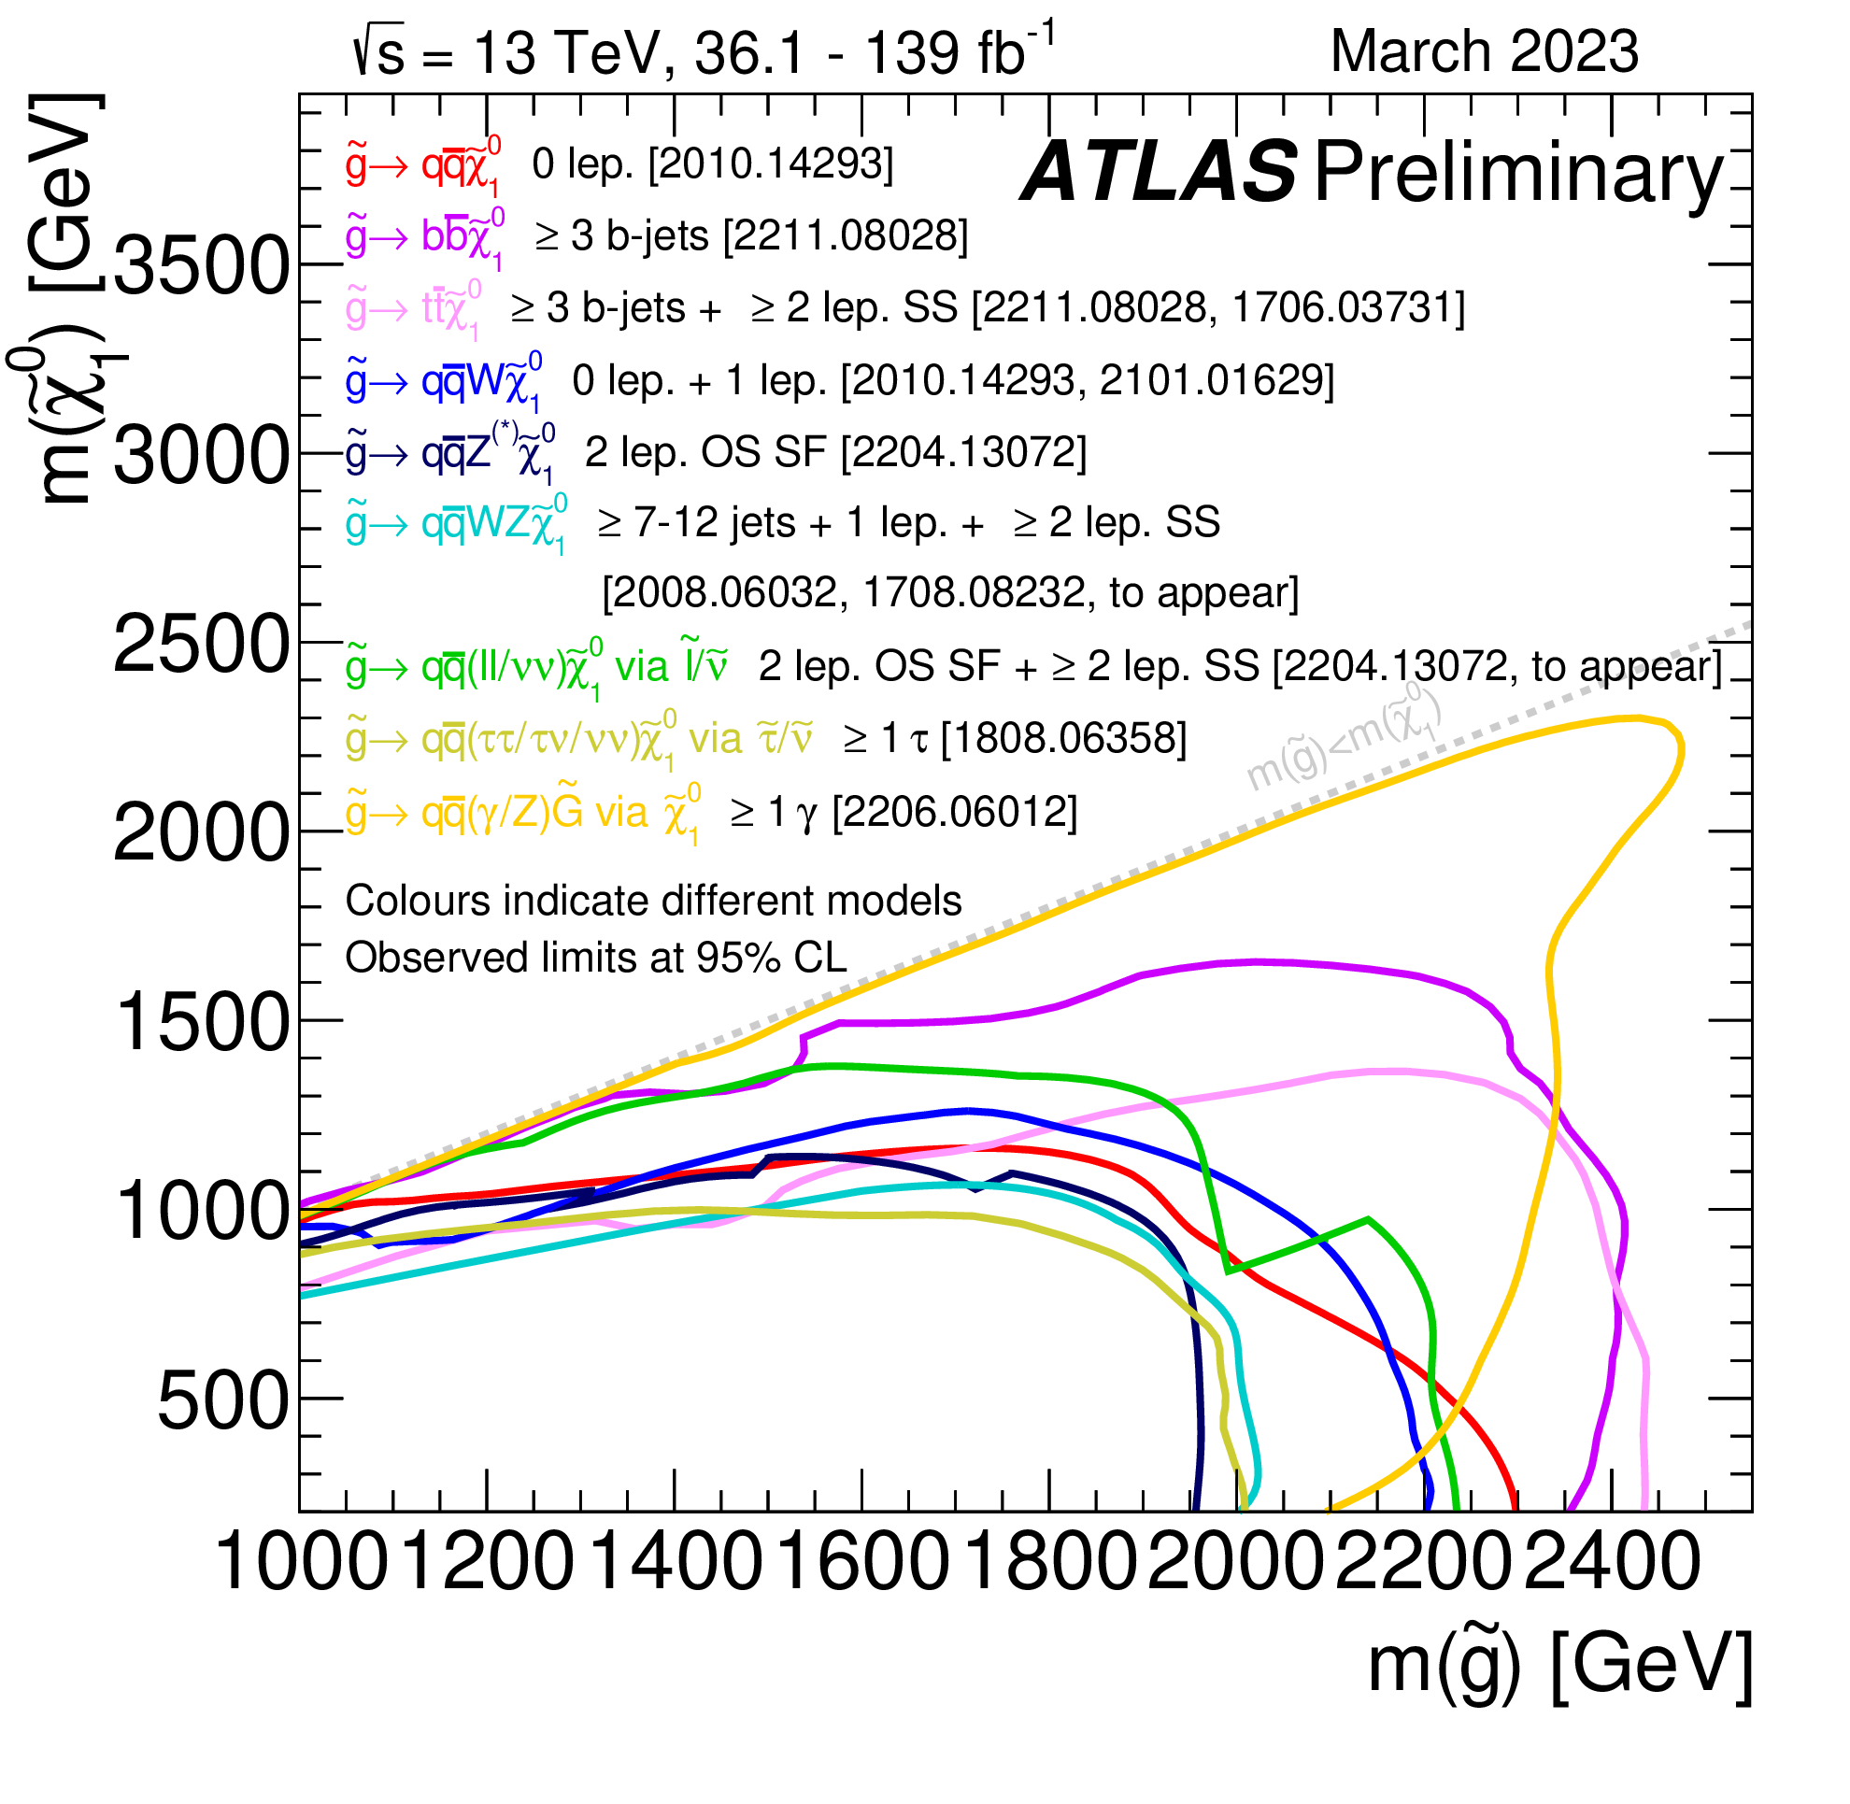
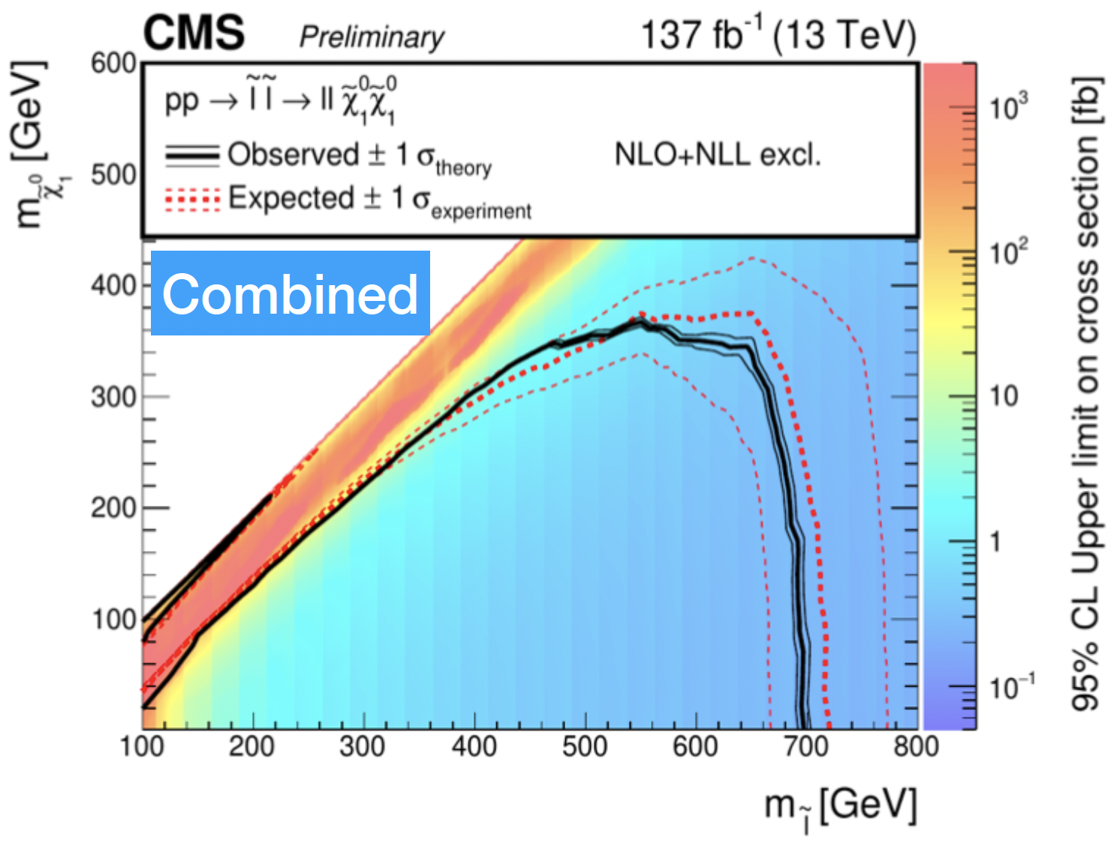
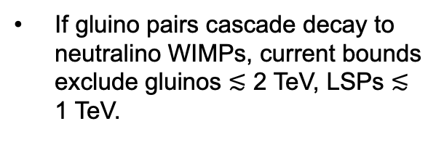
SUSY WIMPS AT THE LHC
Expect missing E_{T} signature. Consider SUSY.
See Baer and Heinemeyer talks
If gluino pairs cascade decay to neutralino WIMPs, current bounds exclude gluinos $≲$ 2 TeV, LSPs $≲$ 1 TeV.
If sleptons decay to neutralino WIMPs, current bounds exclude sleptons up to ~ 700 GeV, LSPs ~ 300 GeV, but bounds degrade with degeneracy (215 GeV for Δm = 5 GeV).

Slide 9
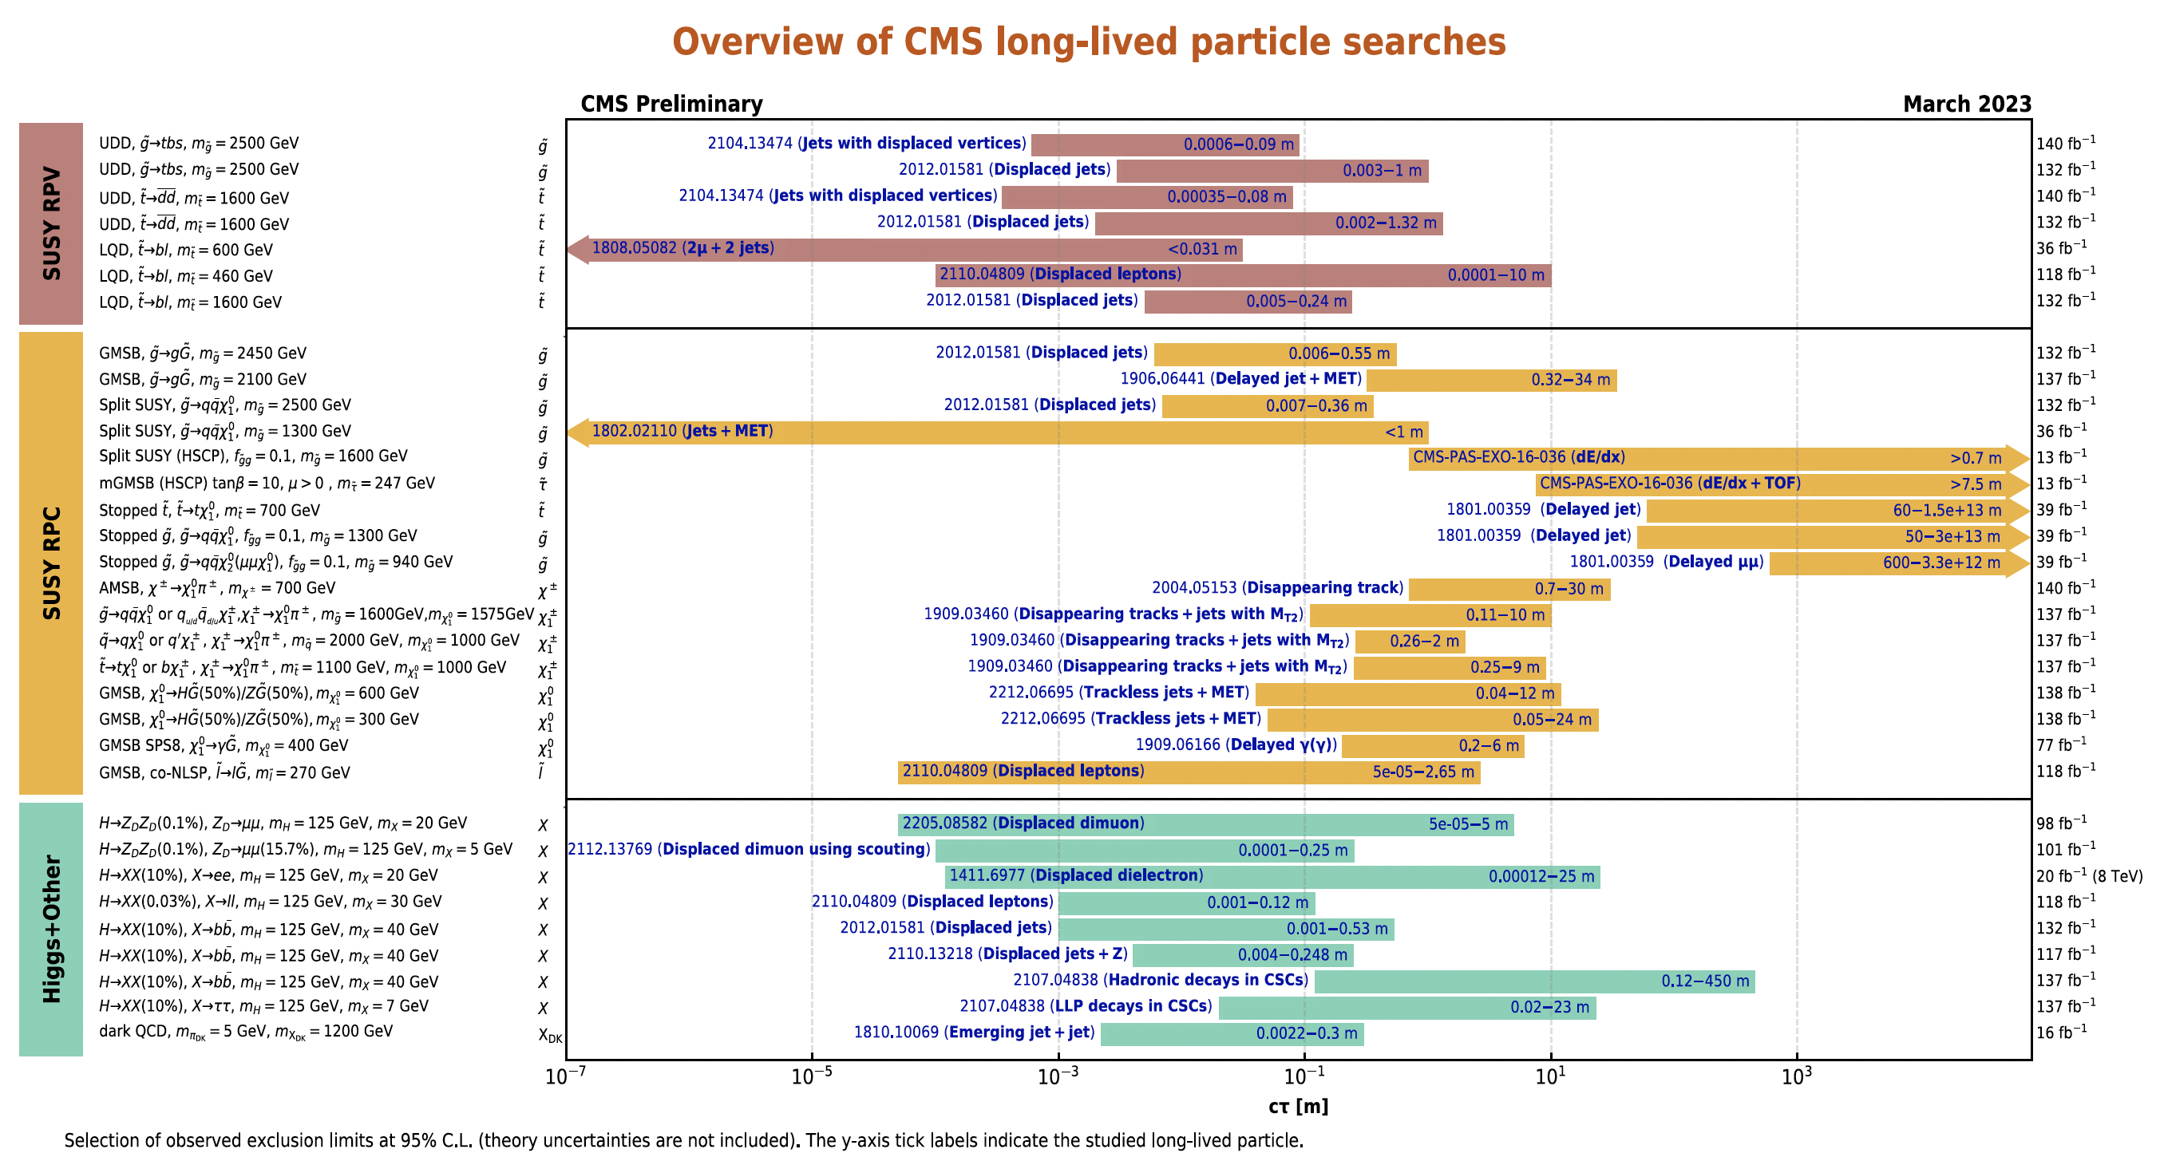
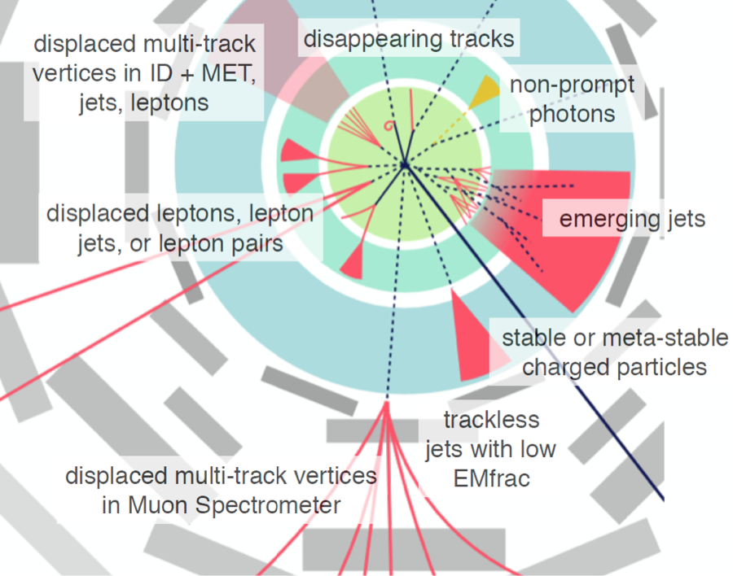
LONG-LIVED PARTICLES AT THE LHC
The search for DM at the LHC has broadened to include many other signatures beyond missing E_{T}.
For example, NLSP →gravitino DM can naturally have decay lengths from mm to km, lead to final state jets, leptons, or photons.
Credit: Heather Russell

Slide 10
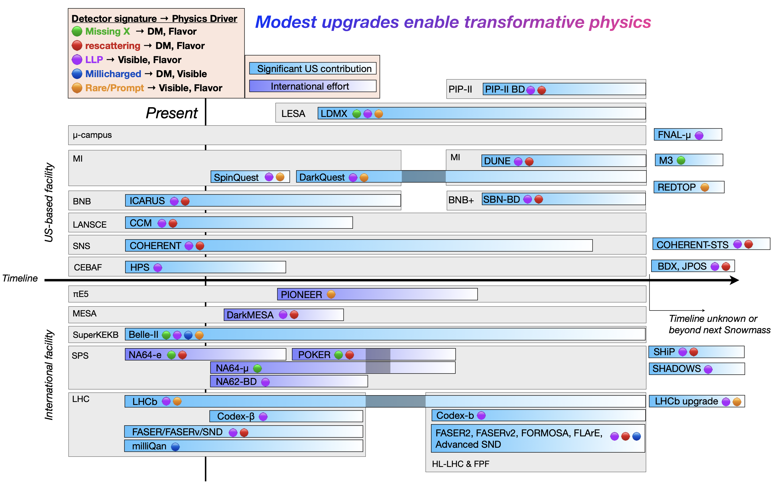
LIGHT DM: DARK SECTORS
Dark sector particles from MeV to GeV can also be thermal relics.
But, because they are light, there are an enormous number of past, current, and proposed accelerator experiments that can be relevant.
Ilten, Tran, et al., Snowmass Report, 2206.04220

Slide 11
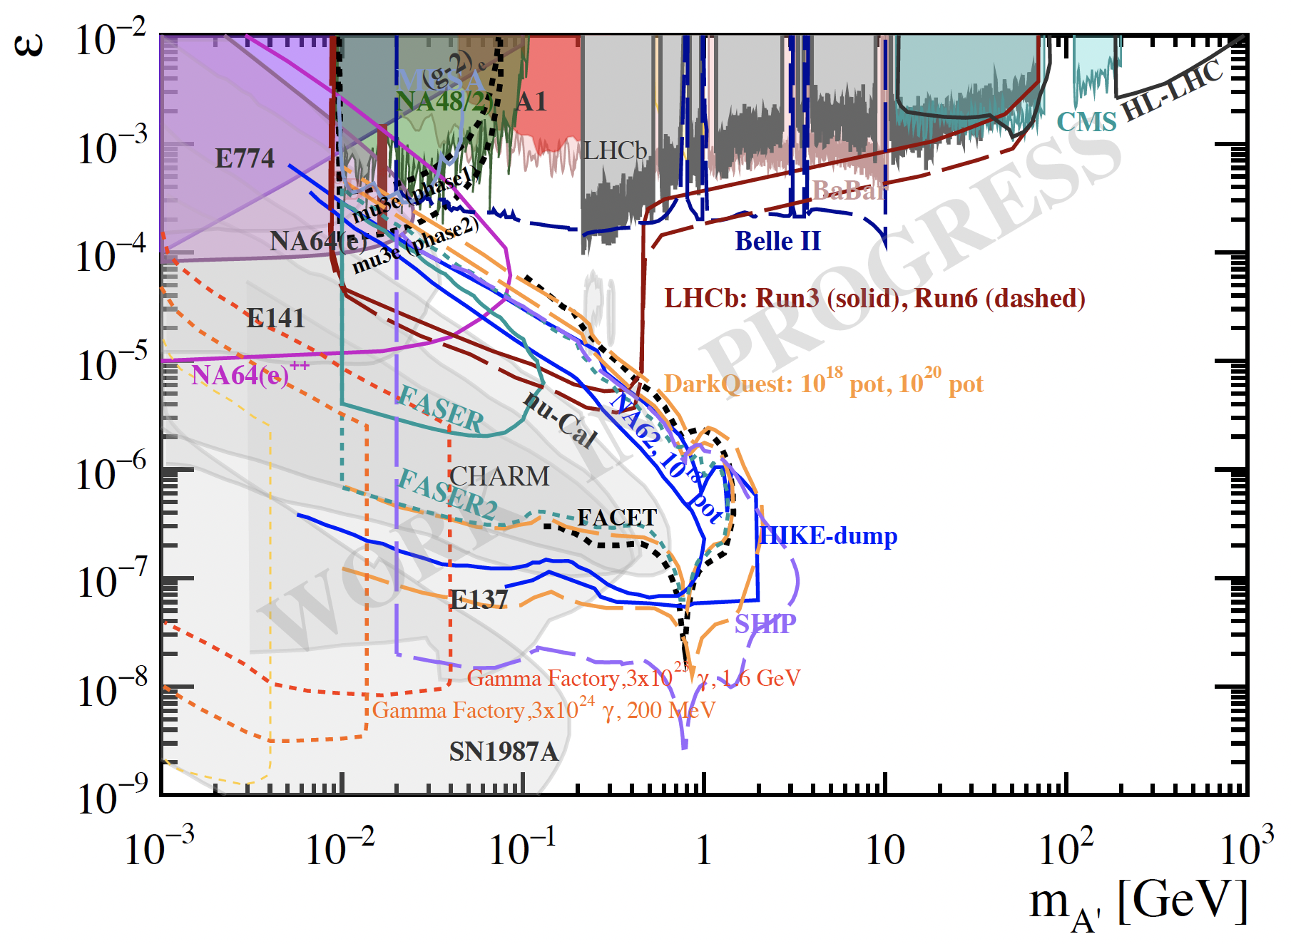
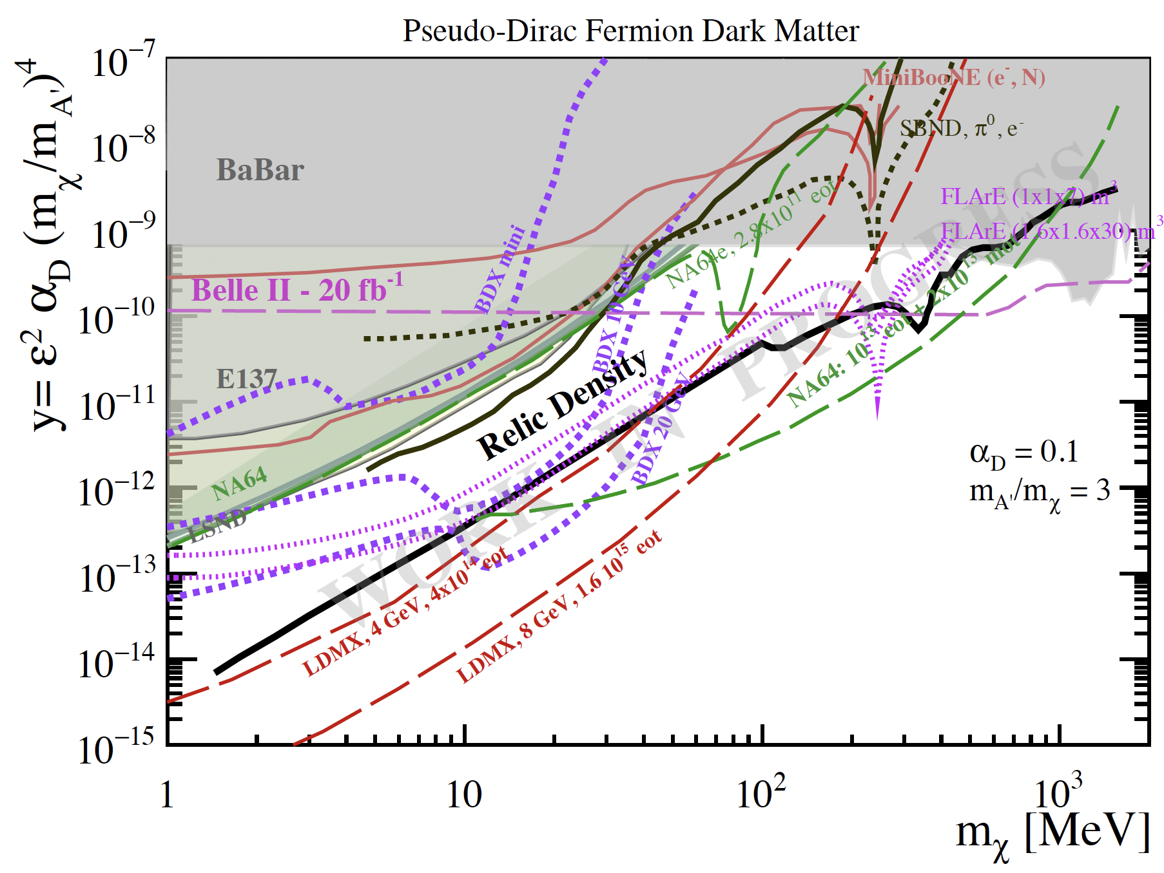
DARK SECTOR BENCHMARKS
Won’t be able to even superficially cover all these, but will give some examples.
Each of these experiments can be evaluated for its reach in various dark sector benchmark models. For example:
Dark photon with visible decays to SM particles:
Dark photon with invisible decays to dark sector particles:
Lanfranchi, Pospelov et al., FIPs 2022 Workshop summary, in preparation

Slide 12
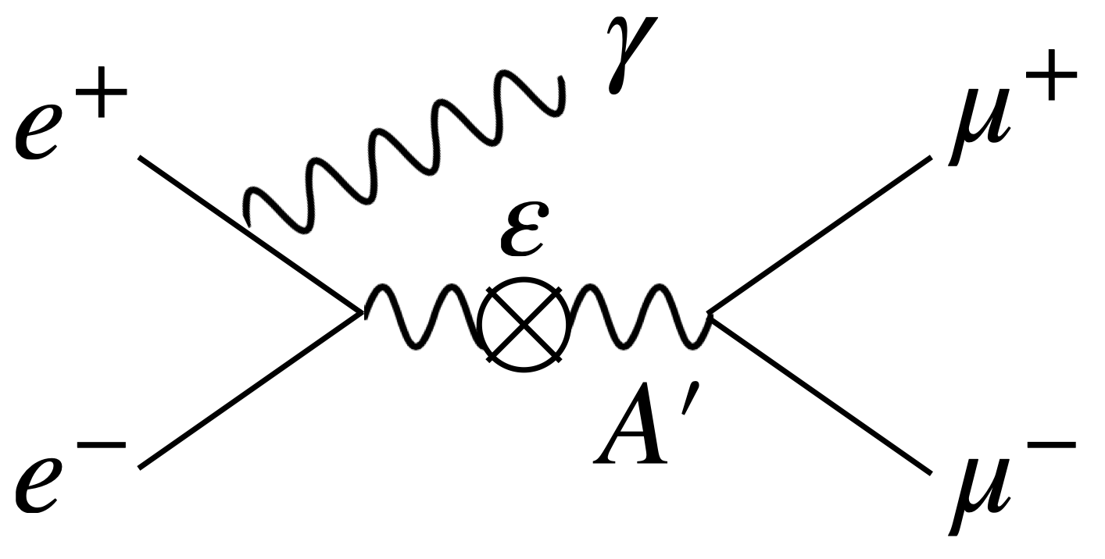
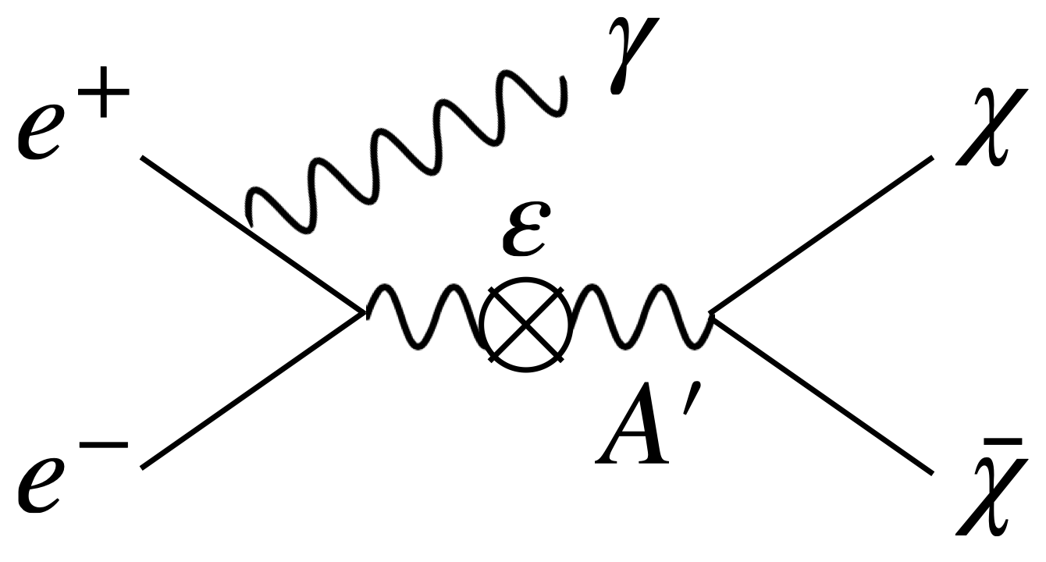
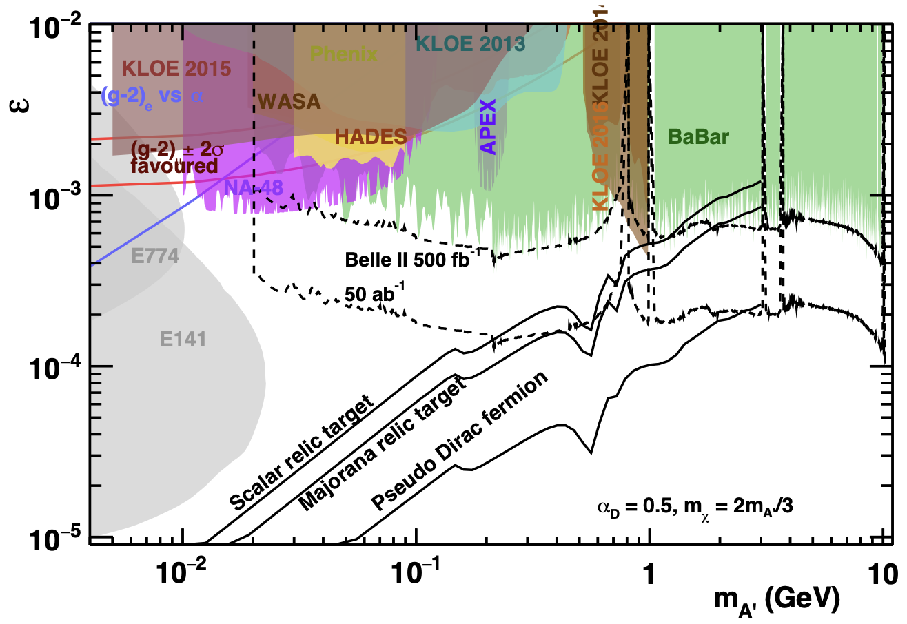
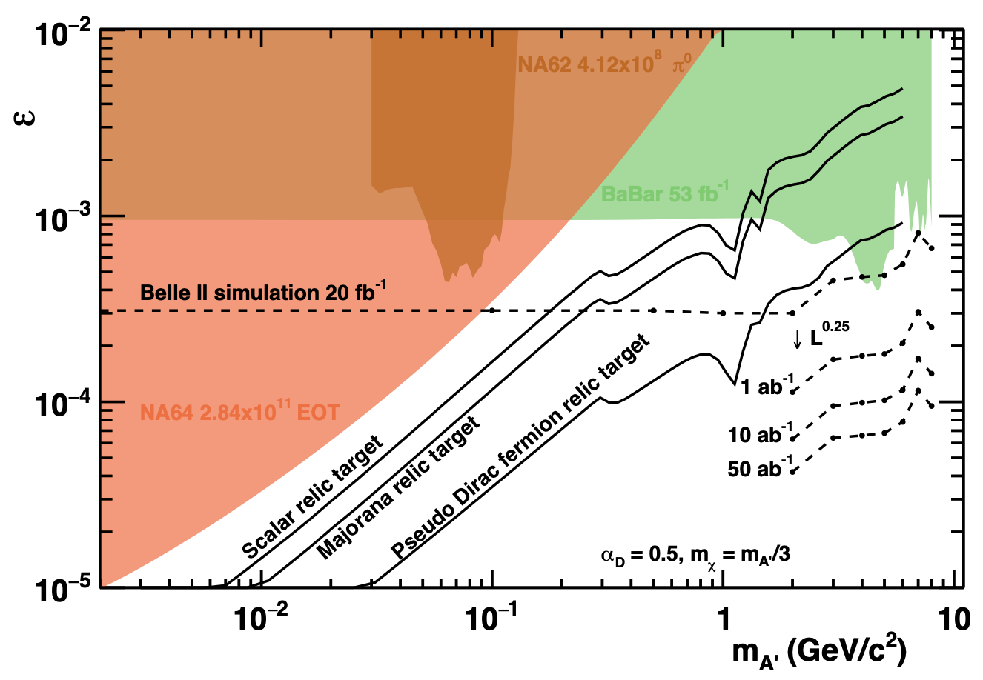
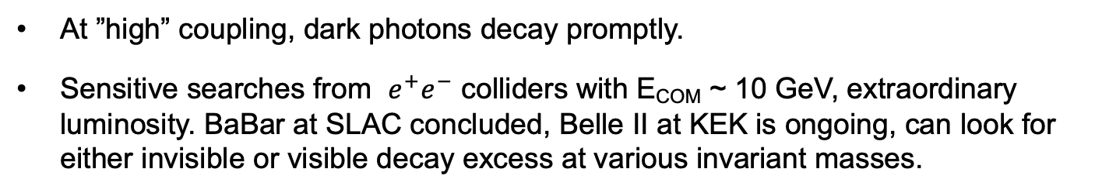
SEARCHES AT HIGH COUPLING: BABAR AND BELLE II
At ”high” coupling, dark photons decay promptly.
Sensitive searches from $e^{+}e^{−}$ colliders with E_{COM} ~ 10 GeV, extraordinary luminosity. BaBar at SLAC concluded, Belle II at KEK is ongoing, can look for either invisible or visible decay excess at various invariant masses.
Dark photon with visible decays to SM particles:
Dark photon with invisible decays to dark sector particles:
Hearty (2022)
See Robertson and Shuve talks

Slide 13
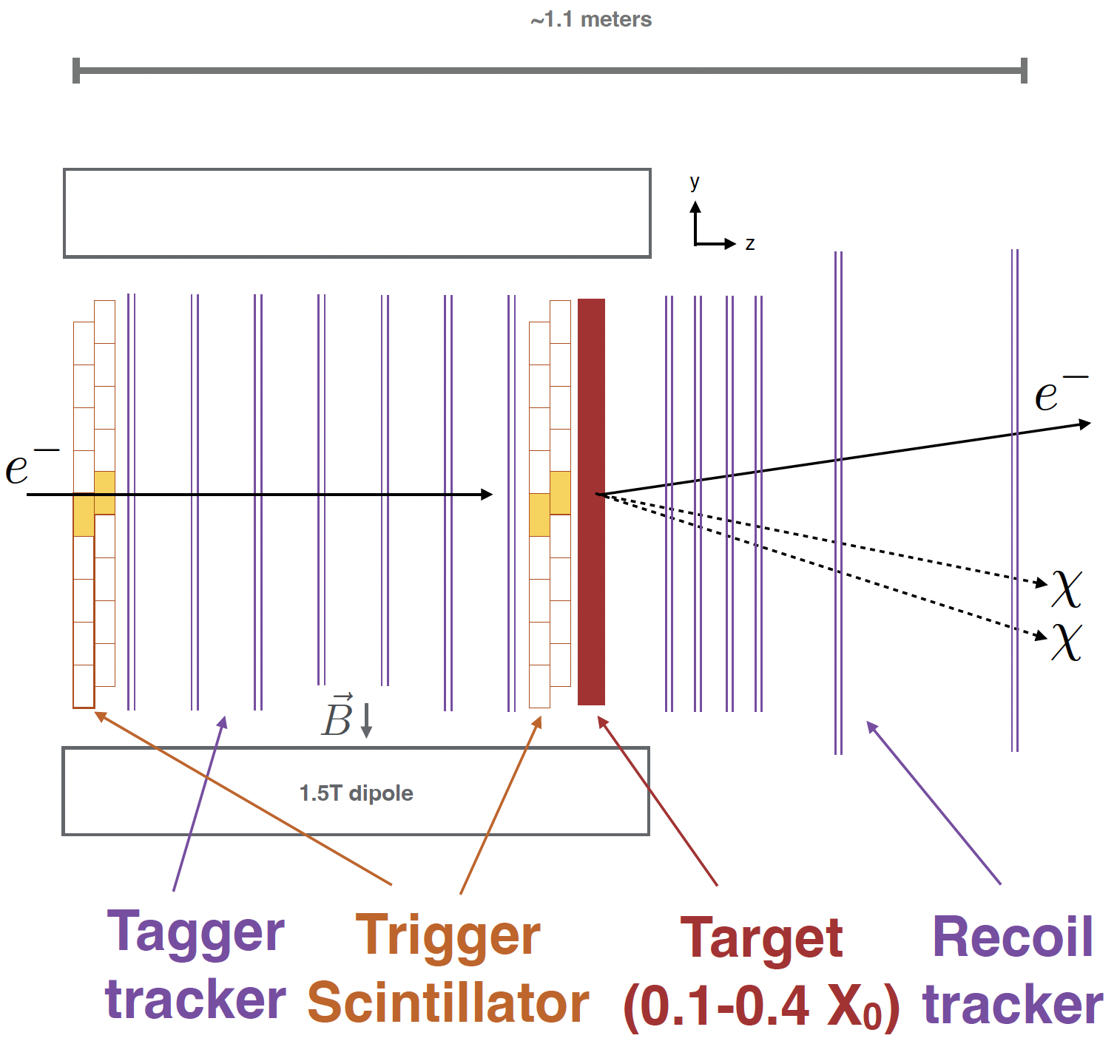
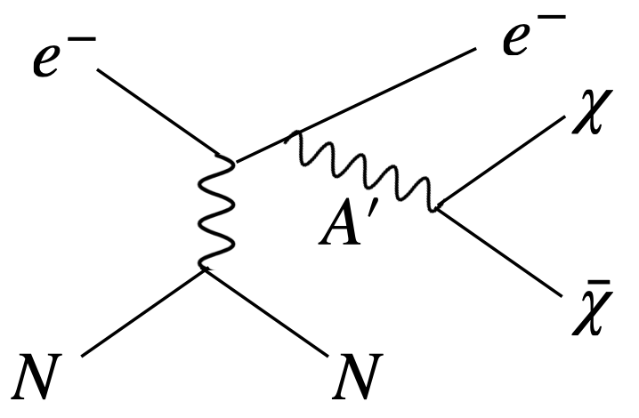
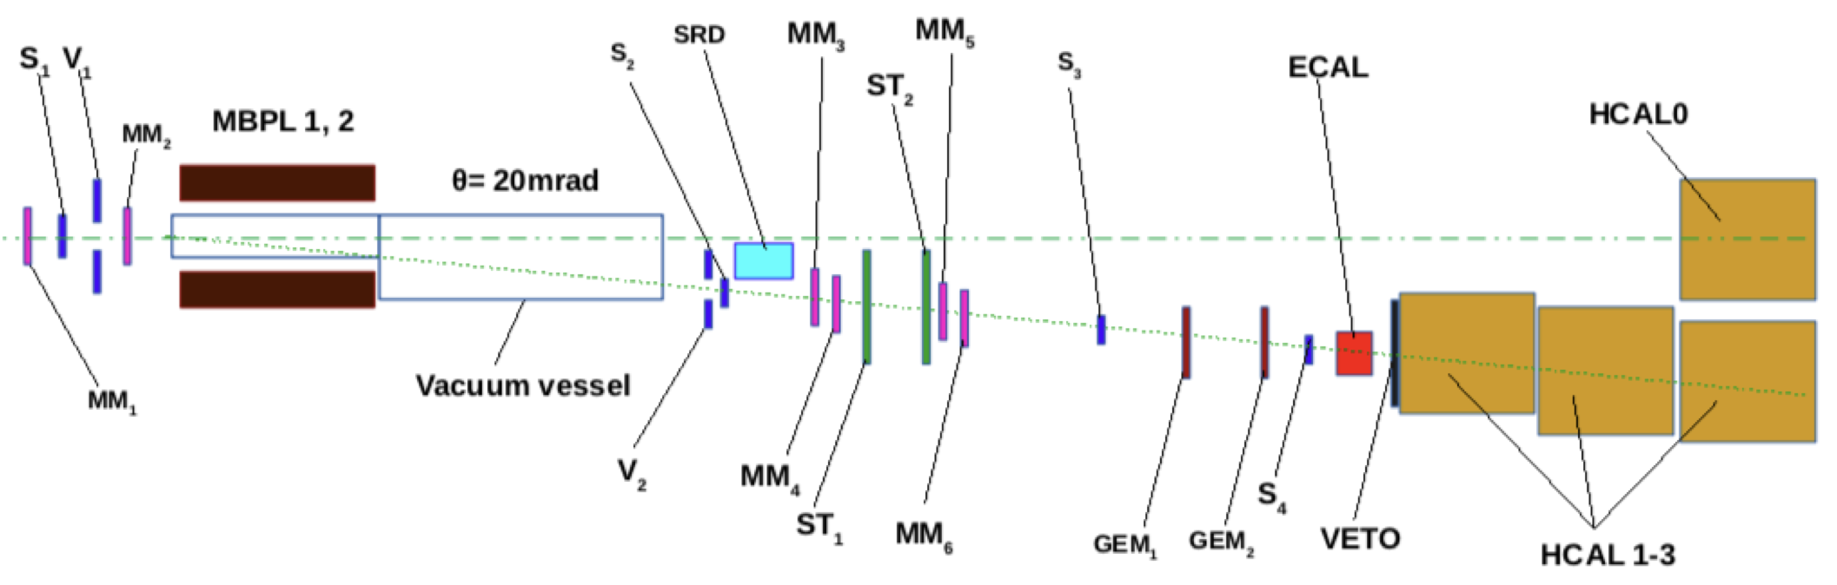
SEARCHES FOR INVISIBLE DECAYS: NA64 AND LDMX
Can look specifically for electrons recoiling from nuclei, search for missing energy/momentum/mass. DM interaction is not detected.
NA64 is an ongoing electron beam dump experiment at the SPS at CERN.
LDMX is a proposed missing momentum experiment at LCLS-II at SLAC.

Slide 14
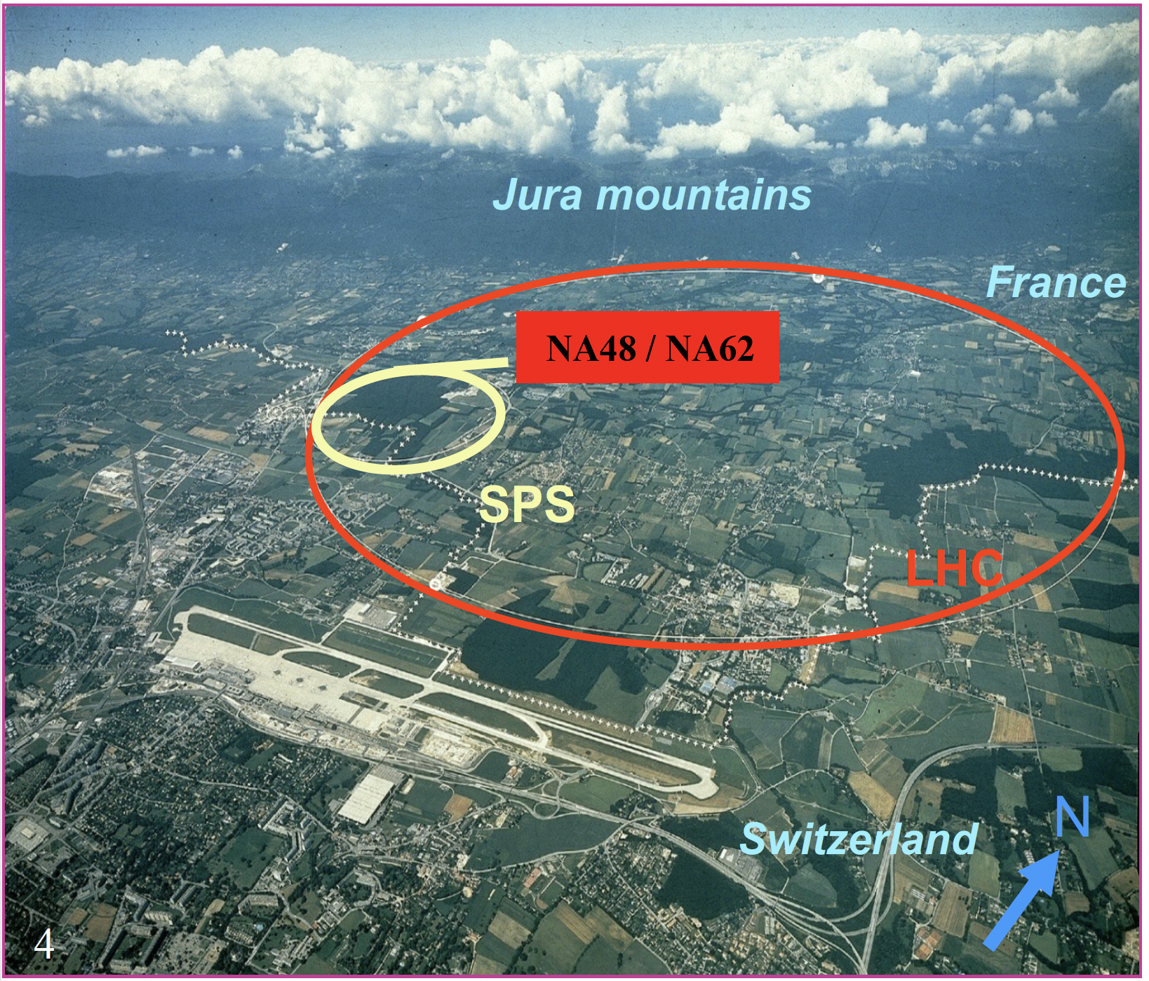
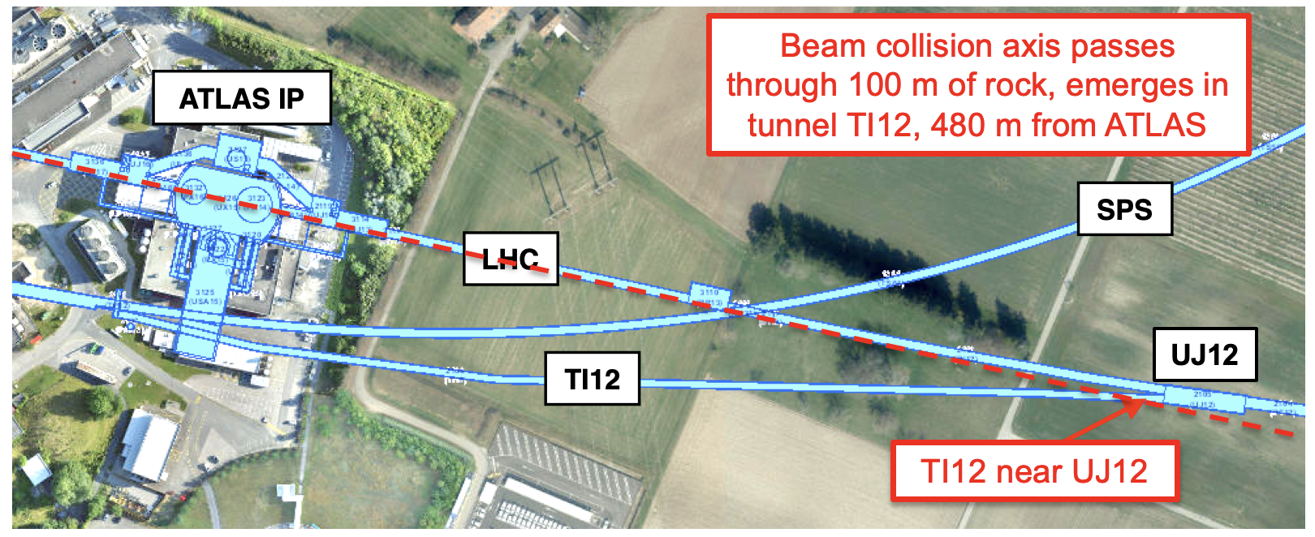
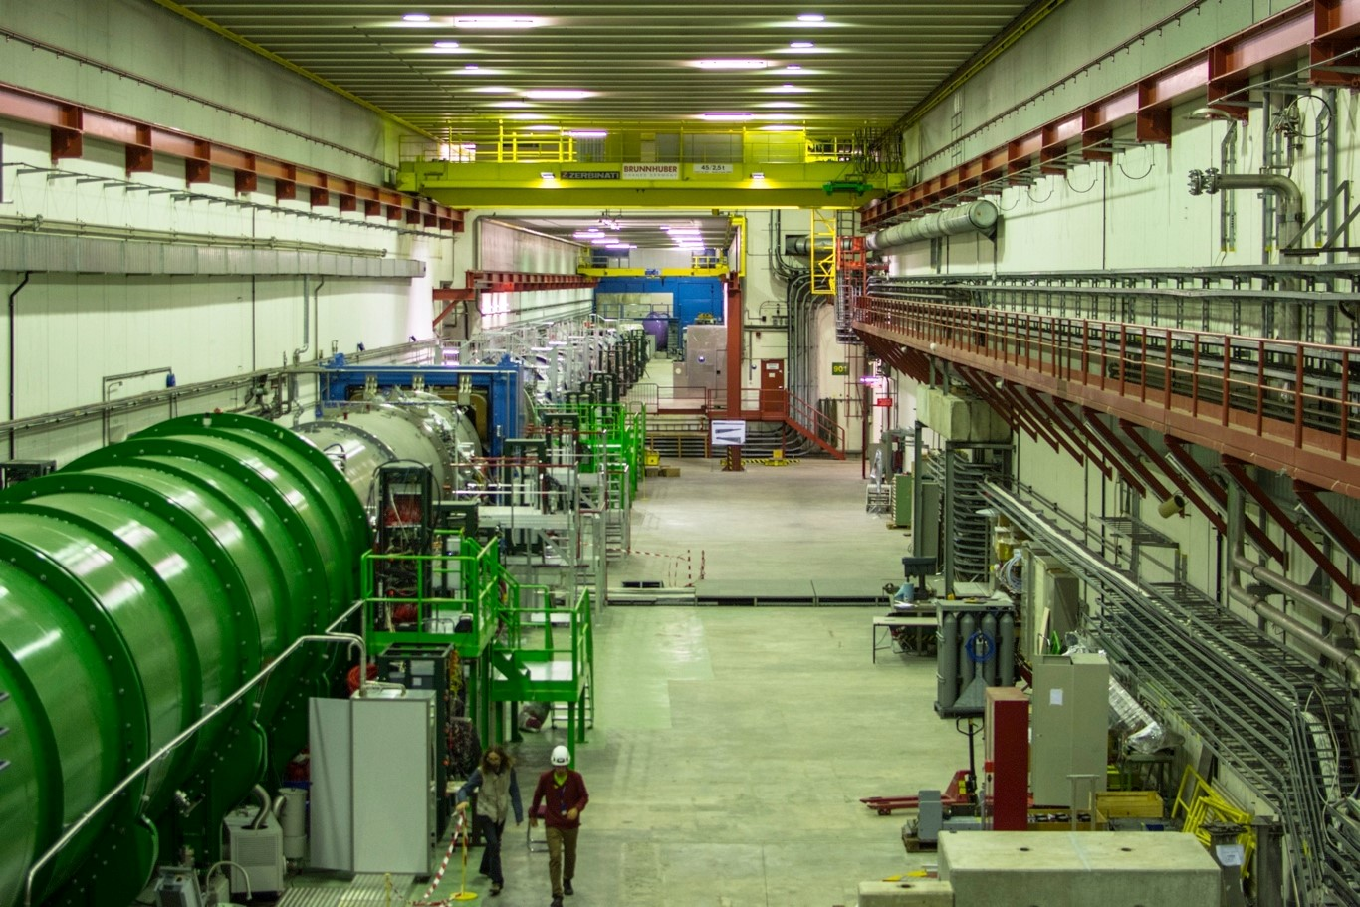
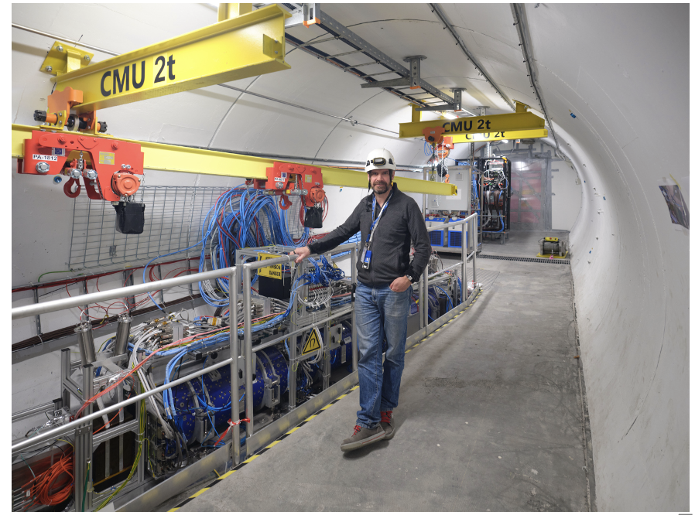
SEARCHES AT LOW COUPLING: NA62 AND FASER
At low coupling, the decay length can be macroscopic. Can look for $π/η→A^{′}γ$ or $pp→{ppA}^{′}$, $A^{′}$travels far, then decays $A^{′}$ $→ e^{+}e^{−}$.
NA62 is an ongoing proton beam dump experiment at the SPS at CERN.
FASER is a current experiment in the forward region near ATLAS at the LHC at CERN.

Slide 15
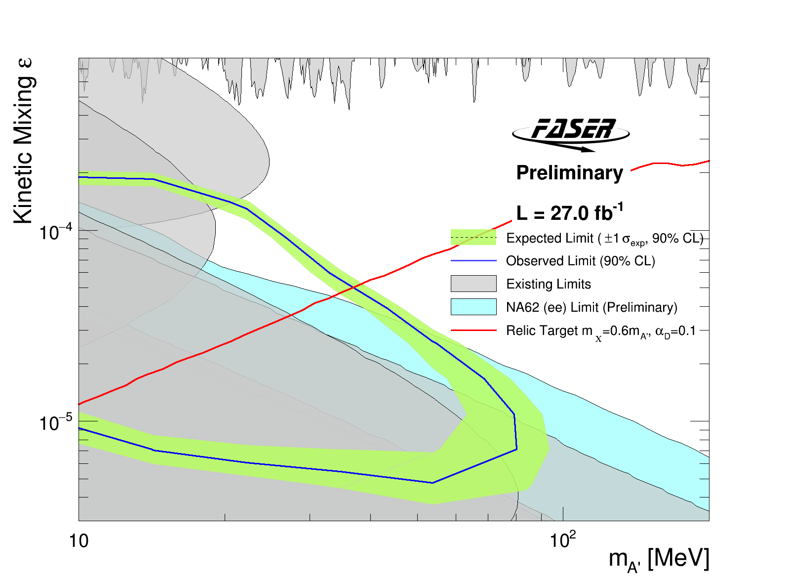

NEW DARK PHOTON RESULTS
FASER and NA62 presented new bounds in last 2 weeks, FASER paper out today!
Together they are the first incursion into the thermal relic region from low coupling since the 1990’s.
Background-free analysis bodes well for future sensitivity. Expect factor of ~10 more luminosity in Run 3 from 2022-25.
FASER Collaboration,
CERN-FASER-CONF-2023-001
See Casper talk
Existing bounds from DarkCast

Slide 16
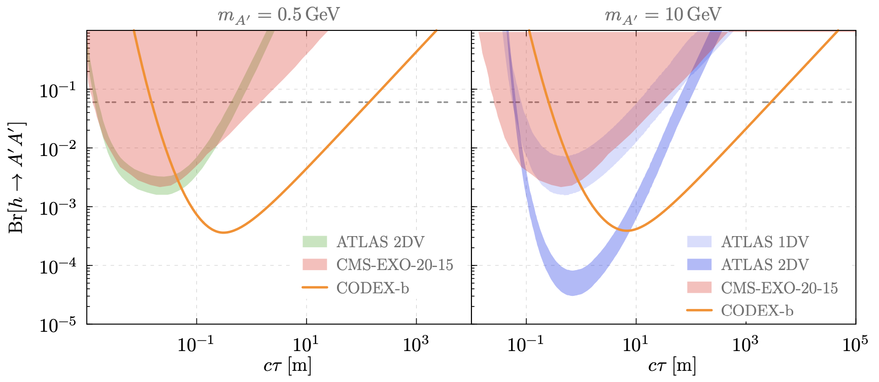
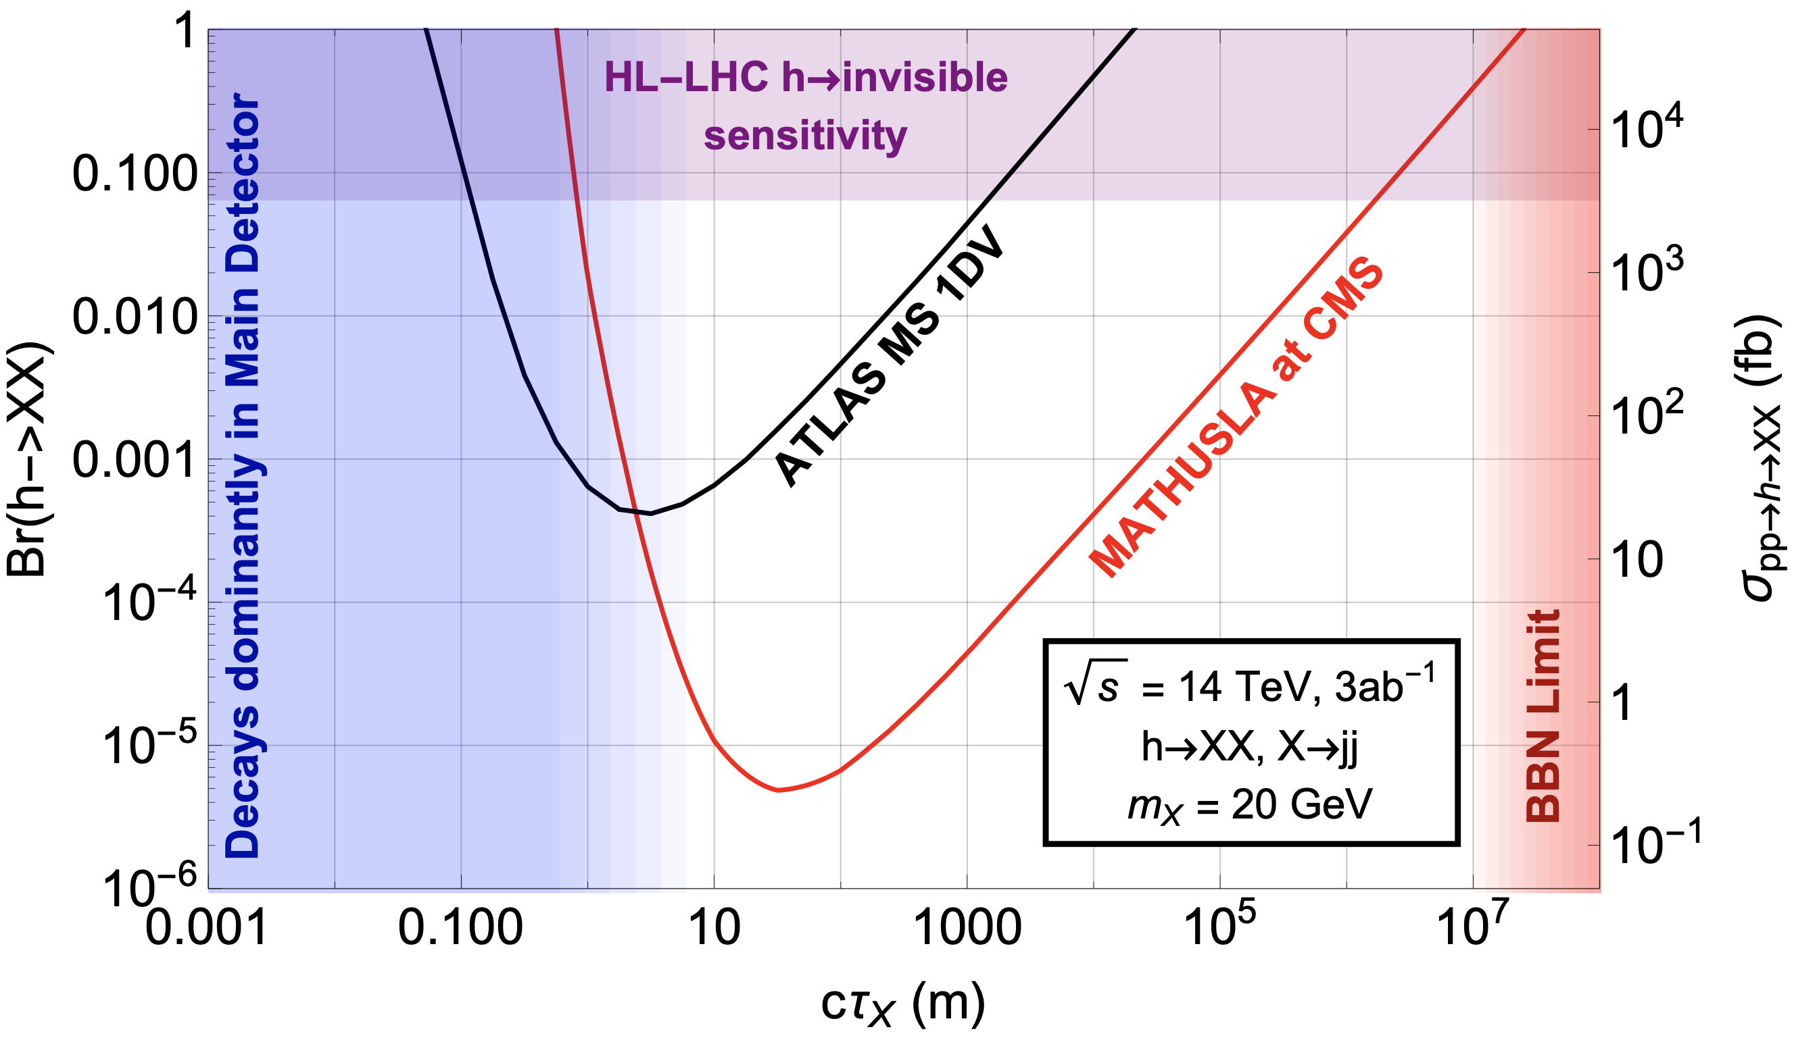
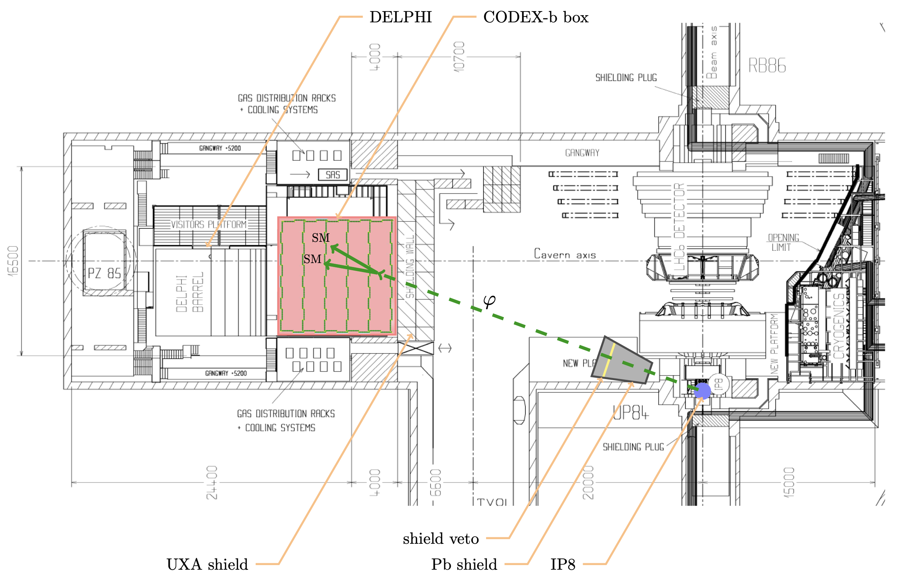
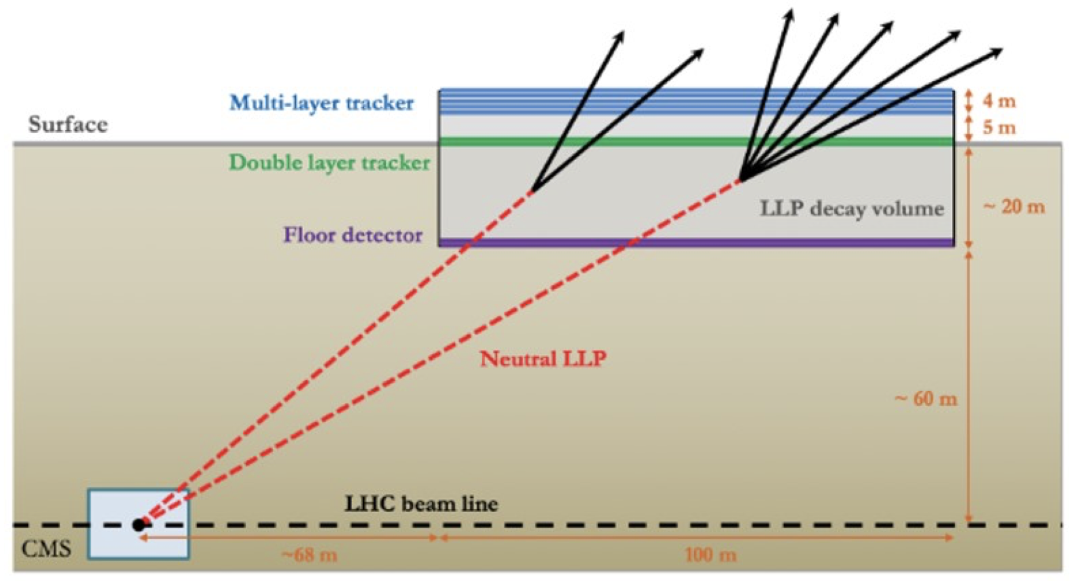
HIGH P_{T} LLPS AT LHC: CODEX-B AND MATHUSLA
Codex-b is a proposed 10 m x 10 m x 10 m experiment, underground in a unused room 25 m from LHCb at CERN.
MATHUSLA is a proposed 100 m x 100 m x 30 m experiment located 20 m deep at a surface site ~100 m from CMS at CERN.

Slide 17
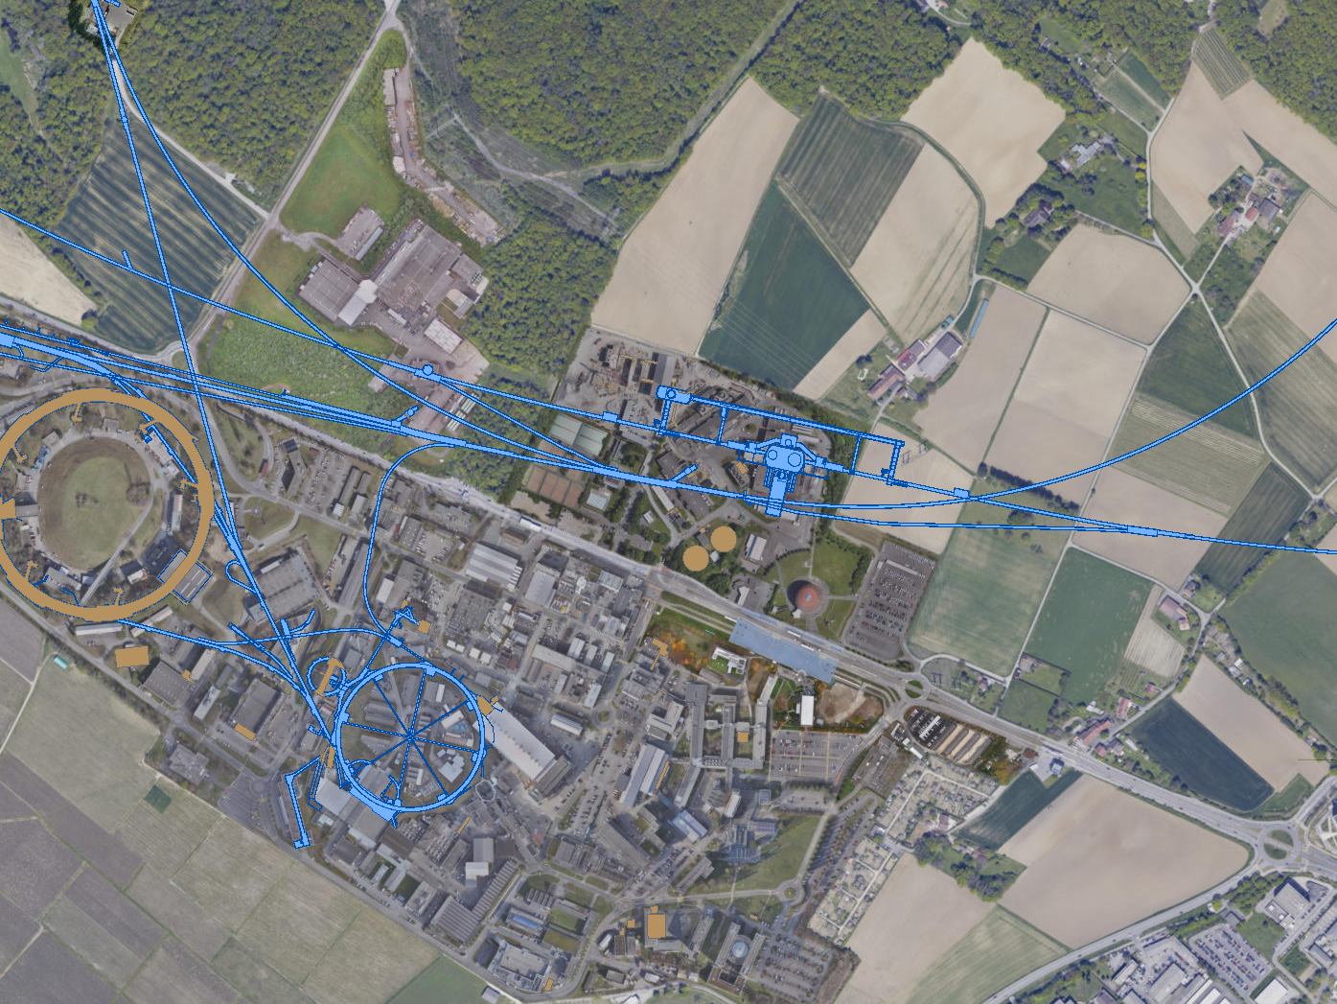

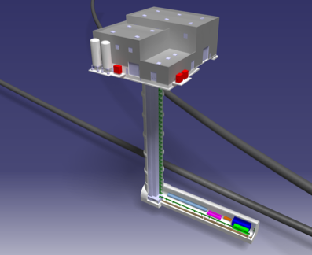
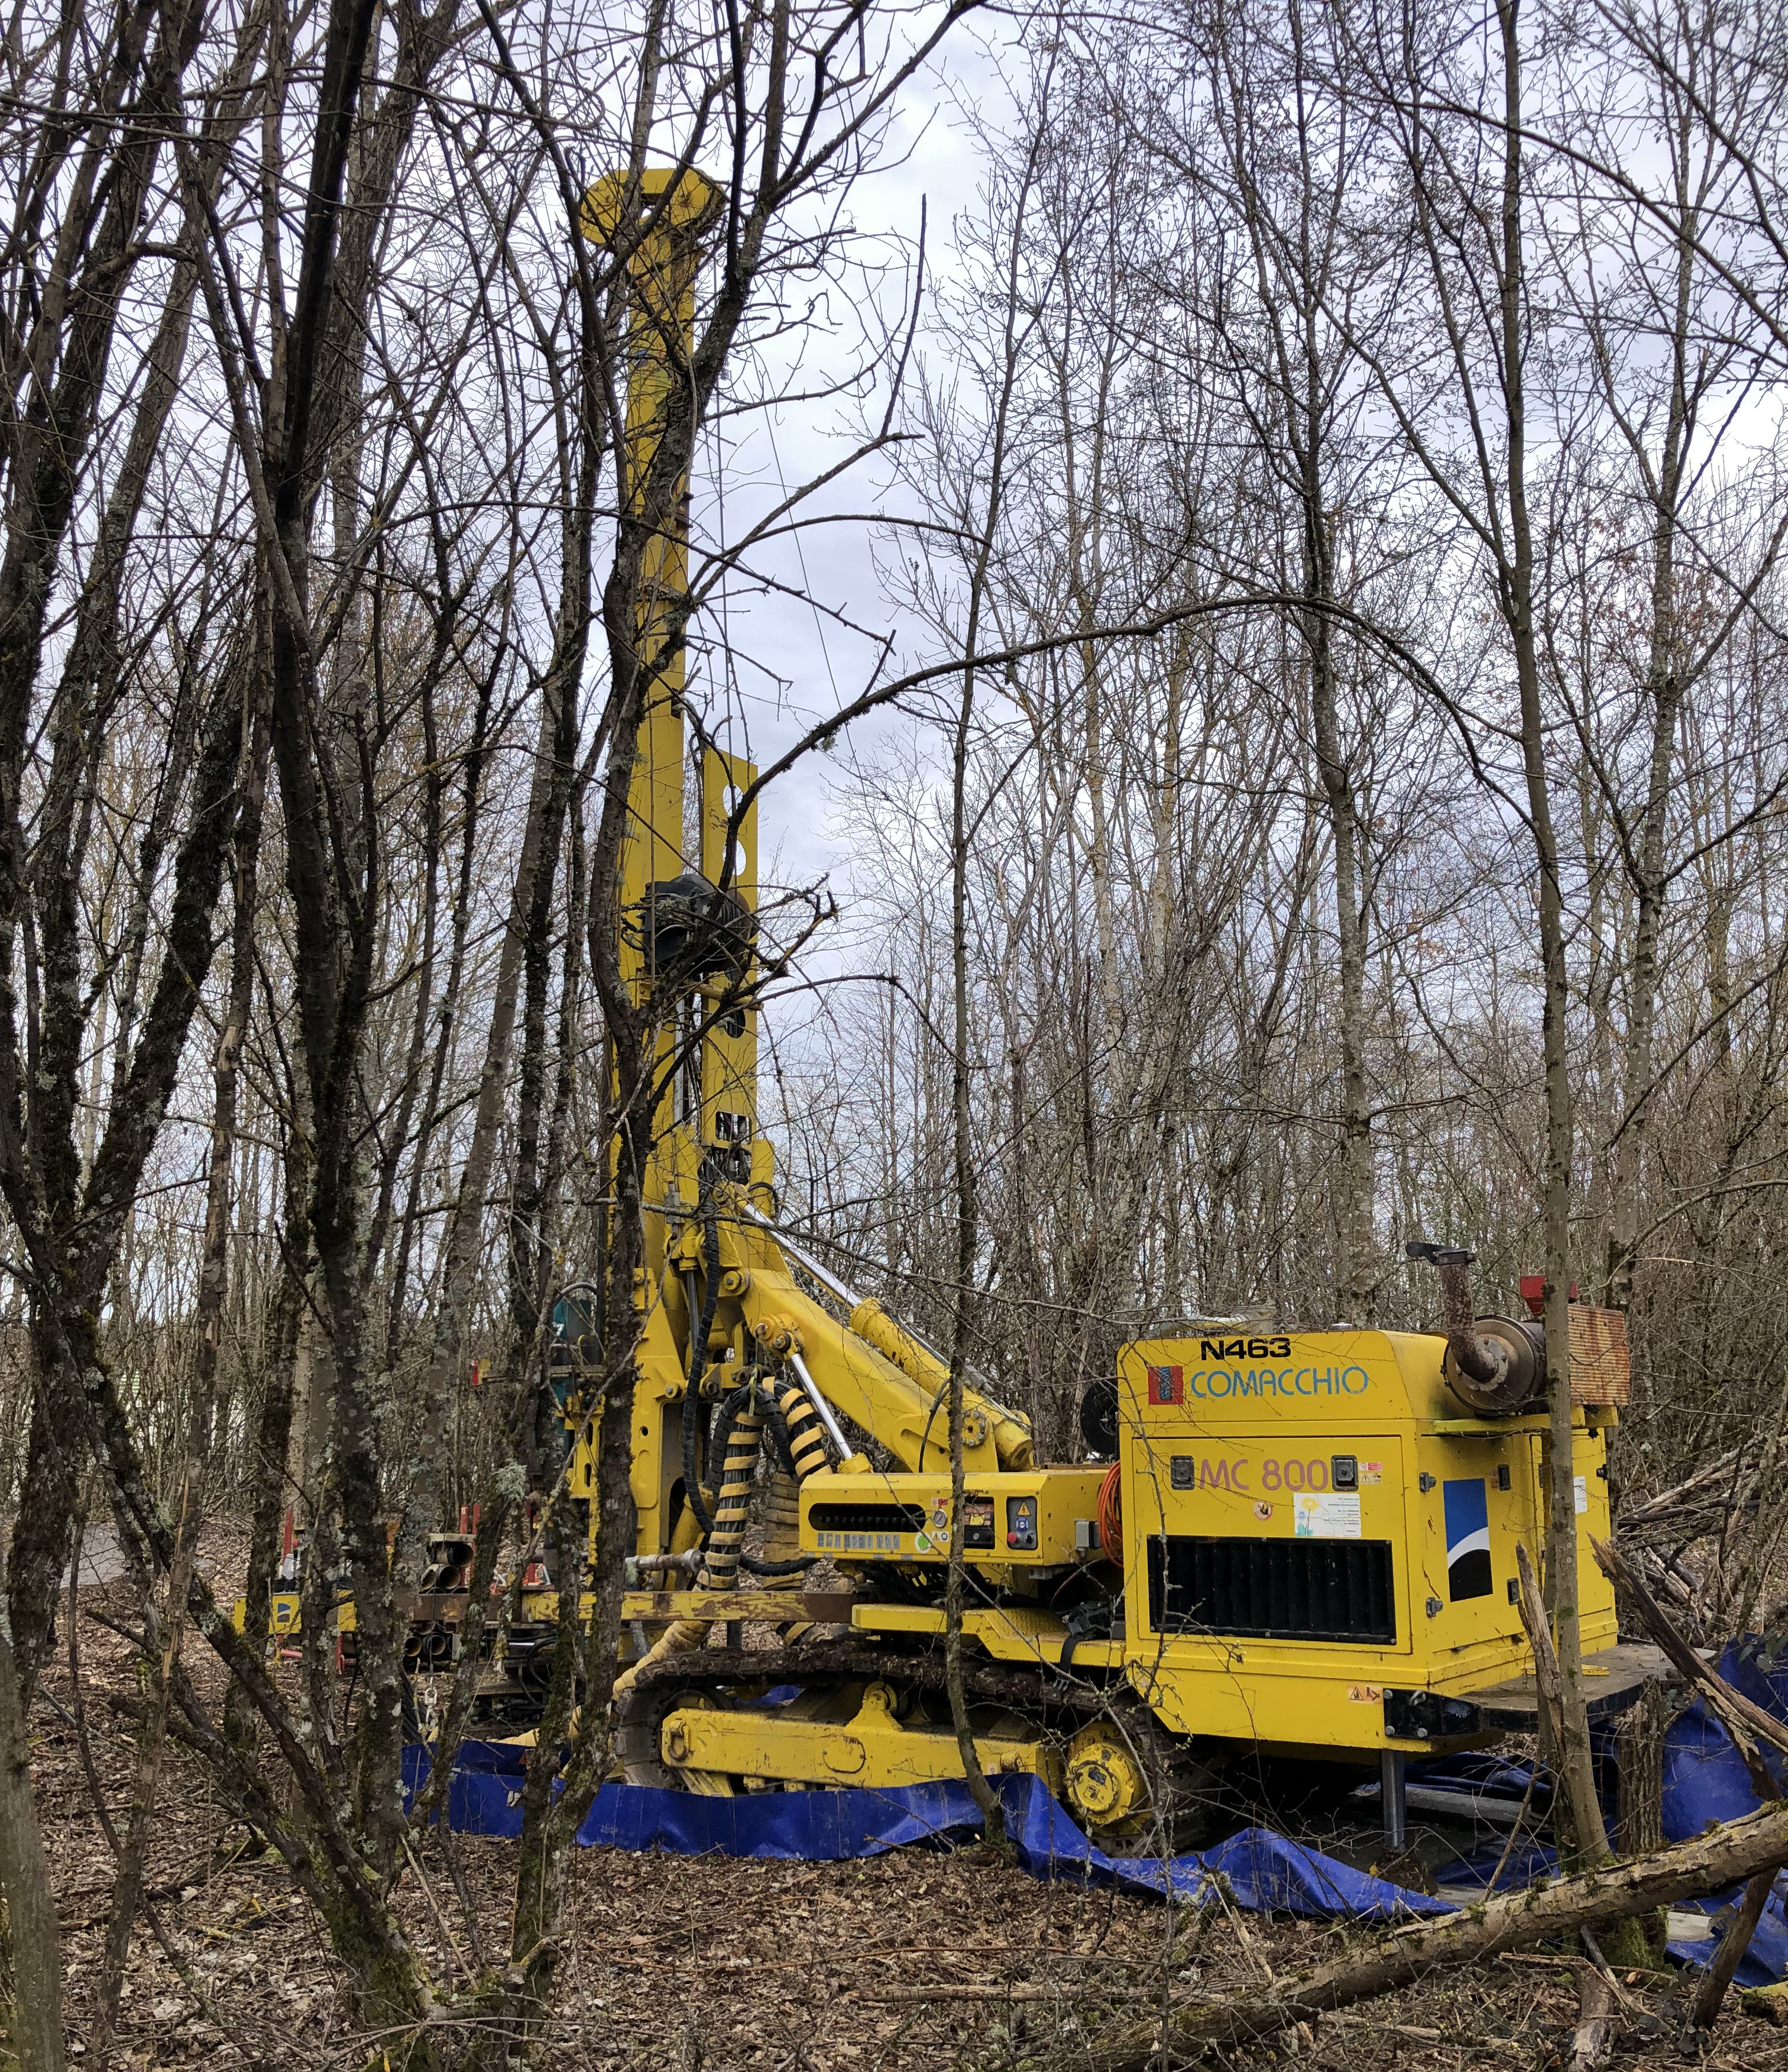
FORWARD PHYSICS FACILITY
The rich physics program in DM and BSM, as well as in neutrinos and SM, strongly motivates creating a new, dedicated underground Forward Physics Facility at CERN for the HL-LHC era from 2028-2040s.
UJ18
ATLAS
SPS
LHC
LOS
FPF core sample to study site geology, refine cost estimates
https://cds.cern.ch/record/2851822
CERN GIS

Slide 18
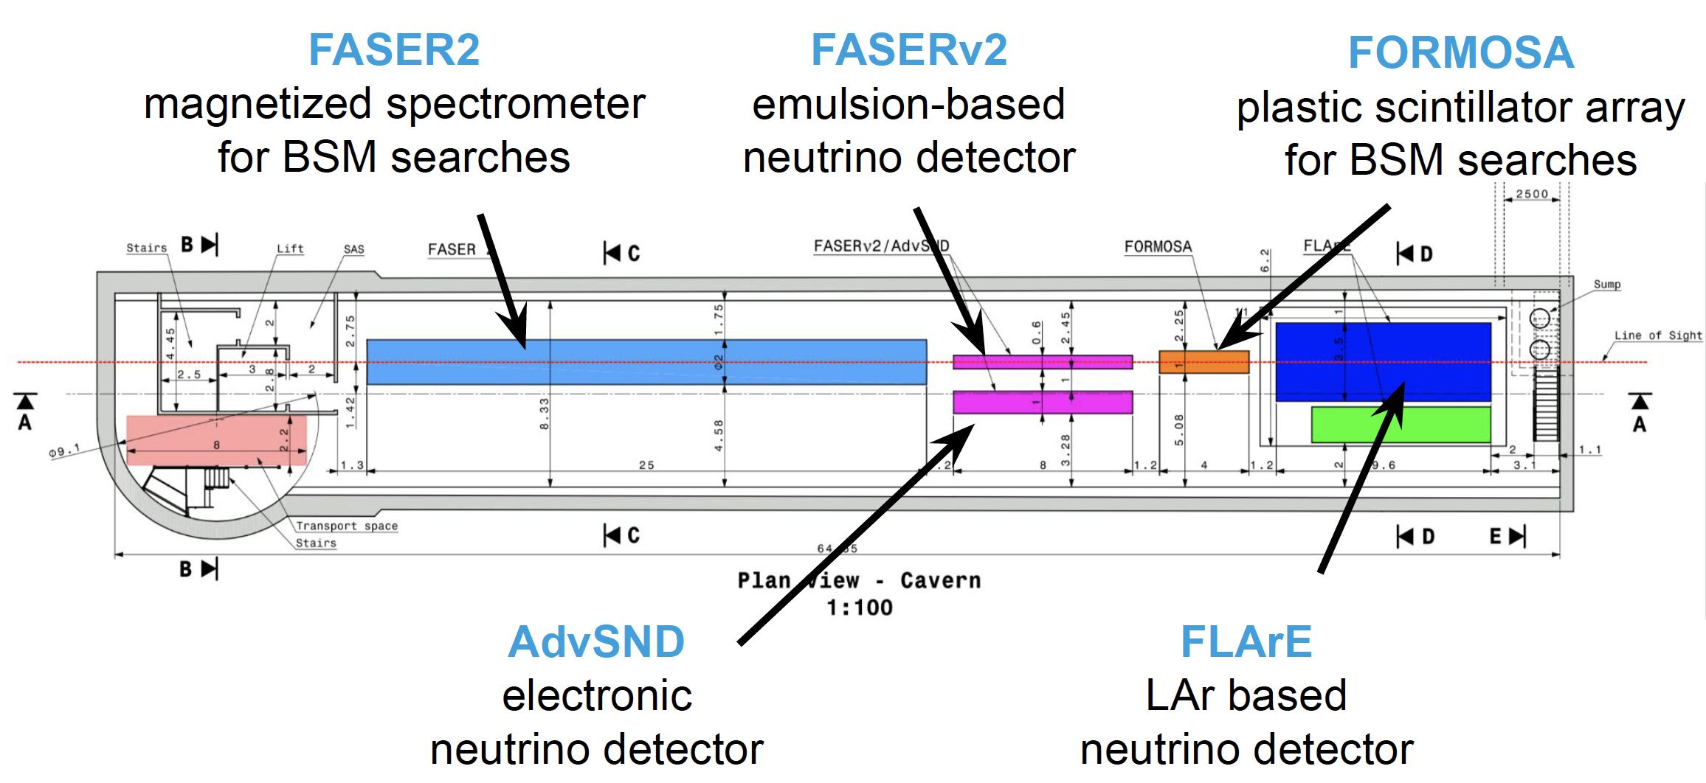

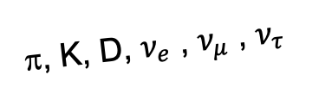
FORWARD PHYSICS FACILITY EXPERIMENTS
At present there are 5 experiments being designed to explore the breadth of SM and BSM topics. FPF covers η > 5.5, experiments on LOS cover η $≳$ 7.
Large far-forward fluxes are automatically provided by the LHC and can be exploited with small and inexpensive detectors. For example,
  ~10⁶ TeV-neutrino interactions per 10 tons.
  ~10⁴ dark photon decays can be observed in currently viable regions of param space.
A’, a, mCPs, DM, …
π, K, D, $ν_{e}$ , $ν_{μ}$ , $ν_{τ}$

Slide 19
FORWARD PHYSICS FACILITY
The physics program in the far-forward region has been developed in a series of meetings and papers.
FPF Meetings
  FPF Kickoff Meeting, 9-10 Nov 2020
  FPF2 Meeting, 27-28 May 2021
  FPF3 Meeting, 25-26 Oct 2021
  FPF4 Meeting, 31 Jan-1 Feb 2022
  FPF5 Meeting, 15-16 Nov 2022
FPF Papers
  FPF “Short” Paper: 75 pages, 80 authors, Phys. Rept. 968, 1 (2022), 2109.10905.
  FPF White Paper: 429 pages, 392 authors+endorsers representing over 200 institutions, J. Phys. G (2022), 2203.05090.
Snowmass 2022: “Our highest immediate priority accelerator and project is the HL-LHC, … including the construction of auxiliary experiments that extend the reach of HL-LHC in kinematic regions uncovered by the detector upgrades.”

Slide 20
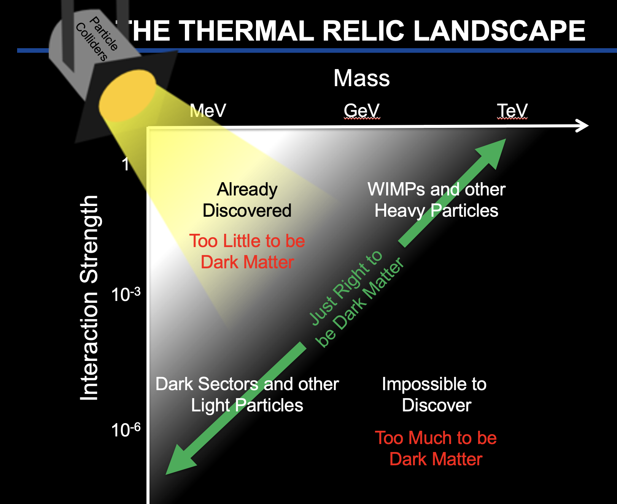
SUMMARY
DM at accelerators is an extremely diverse and active topic, thermal relic targets are now being probed.
Heavy DM, ~100 GeV–TeV, WIMPs
  missing E_{T} searches will continue at the LHC now through the 2040s.
  Many more exotic, LLP signals also being studied with great activity.
Light DM, ~ MeV – GeV, Dark Sectors
  Many new accelerator and collider experiments with exciting prospects, new results are probing thermal relic target from both high and low coupling.
  Motivate a new underground facility: the Forward Physics Facility at CERN.

