Slide 1





FIRST FASER PHYSICS RESULTS
AND
THE FORWARD PHYSICS FACILITY
Jonathan Feng, UC Irvine
on behalf of the FASER Collaboration and the FPF Working Groups
Aspen Winter Conference, 27 March 2023

Slide 2

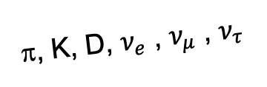
LOOKING FORWARD
In the last few years, we’ve increasingly realized that LHC detectors are beautifully optimized to discover heavy particles, but not light particles.
_{De Rujula, Ruckl (1984)}
Heavy particles are produced at low velocity and then decay roughly isotropically to other particles.
But high-energy light particles are dominantly produced in the forward direction, escape through un-instrumented regions of existing detectors.
  The existing large detectors are blind to neutrinos.
  They are also blind to many other new physics possibilities: dark photons, dark Higgs bosons, sterile neutrinos, ALPs, millicharged particles, new force carriers, dark matter, dark sectors, LLPs, FIPs,… (see PBC benchmarks).
A’, a, mCPs, χ, …
π, K, D, $ν_{e}$ , $ν_{μ}$ , $ν_{τ}$

Slide 3
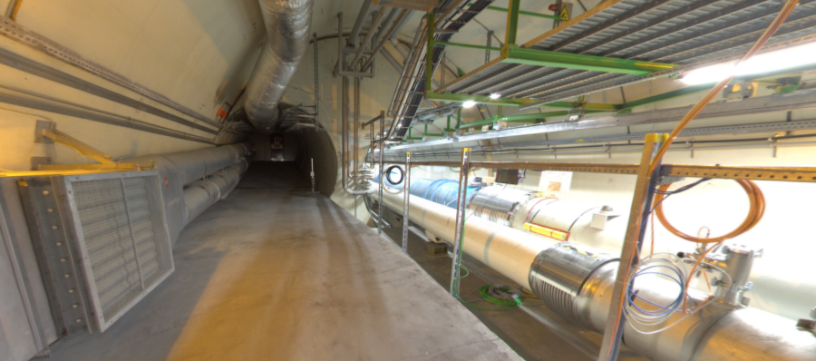
THE FAR-FORWARD REGION
Beam collision axis passes
through 100 m of rock, emerges in tunnel TI12, 480 m from ATLAS
UJ12
TI12 near UJ12
The view in UJ12 looking west (2019)
TI12
Beam collision axis
LHC beamline

Slide 4
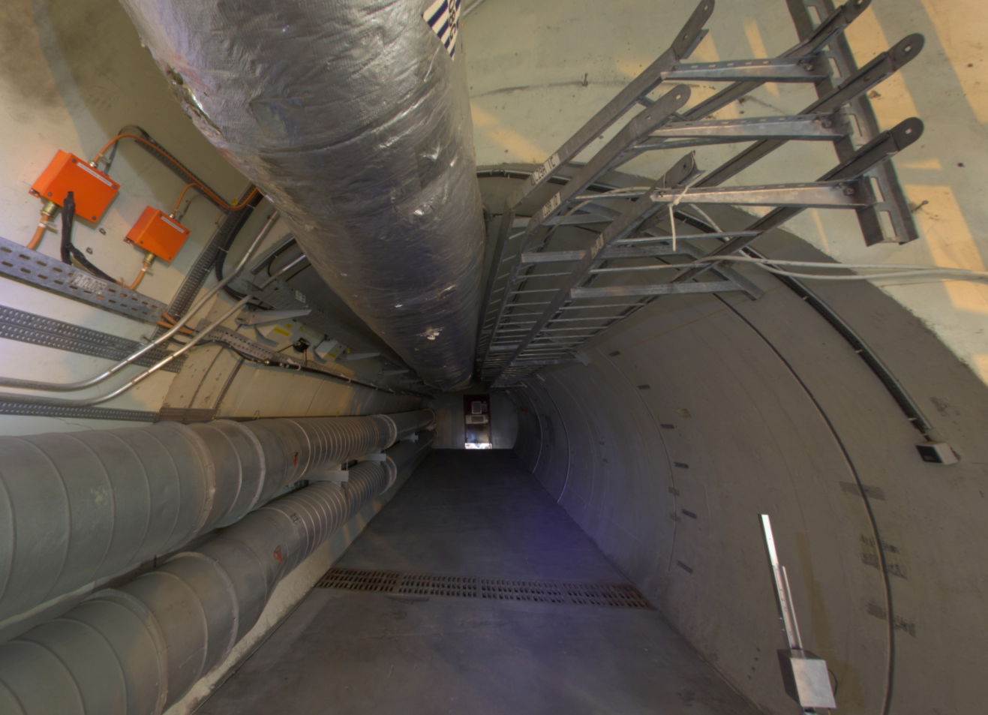
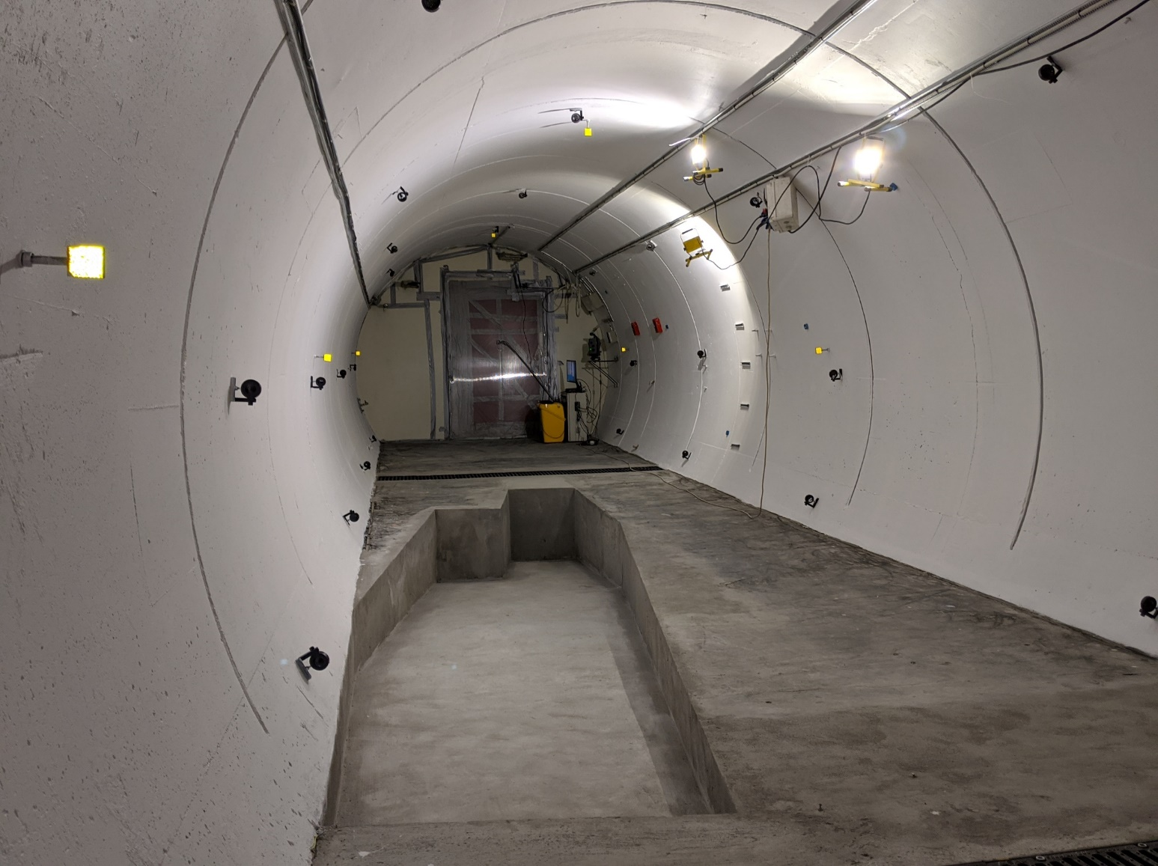
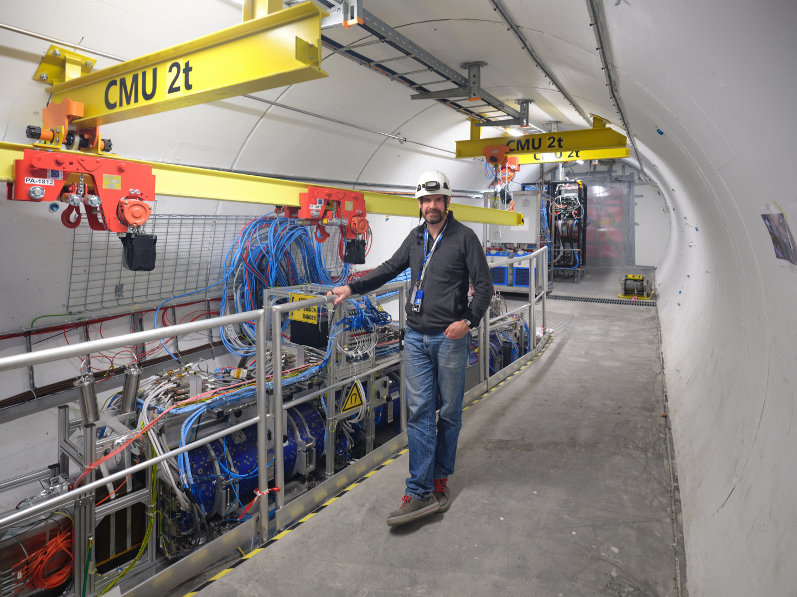
FASER PROGRESS 2019-21
Jamie Boyd, FASER Co-Spokesperson

Slide 5
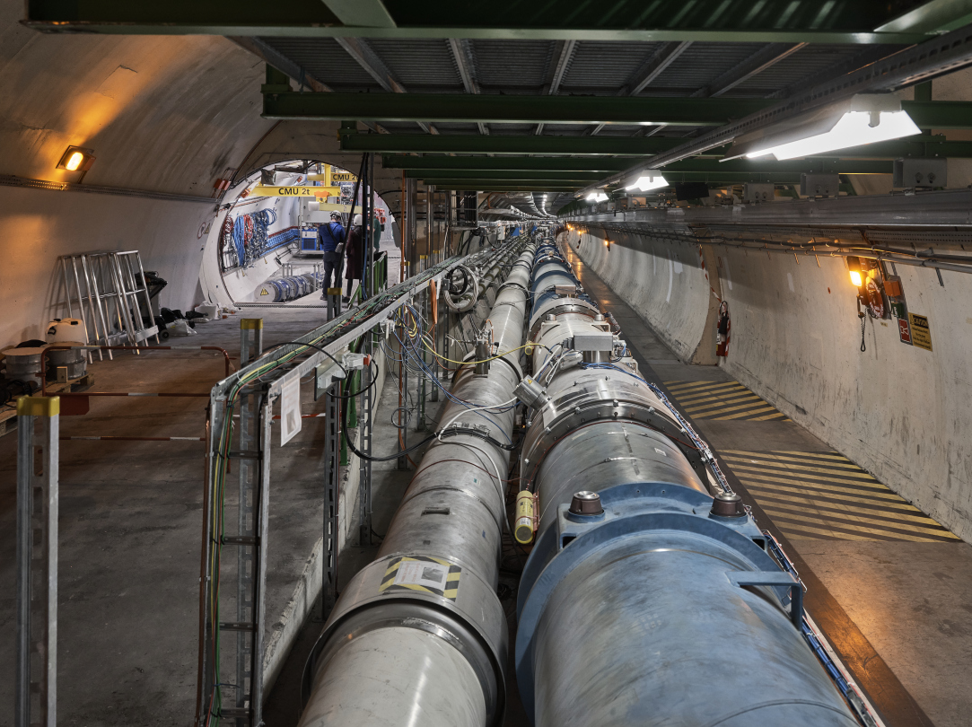
FASER NOW

Slide 6











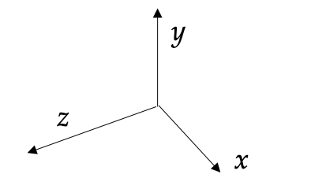
THE FASER DETECTOR
Small, fast, inexpensive
  10 cm radius, 7 m long
  Constructed with essential help from ATLAS SCT, LHCb
  Designed to differentiate signals from incoming muons
FASER Collaboration (2207.11427)
2 x 20 mm thick
35 x 30 cm area
3 x 3 layers of ATLAS SCT strip modules
2 x 20 mm thick
30 x 30 cm area
4 LHCb outer
ECAL modules
730 layers of 1.1 mm tungsten + emulsion
(1.1 metric tons)
10mm thick + dual PMT readout (σ = 400 ps)
0.57 T dipoles
1.5 m decay volume

Slide 7
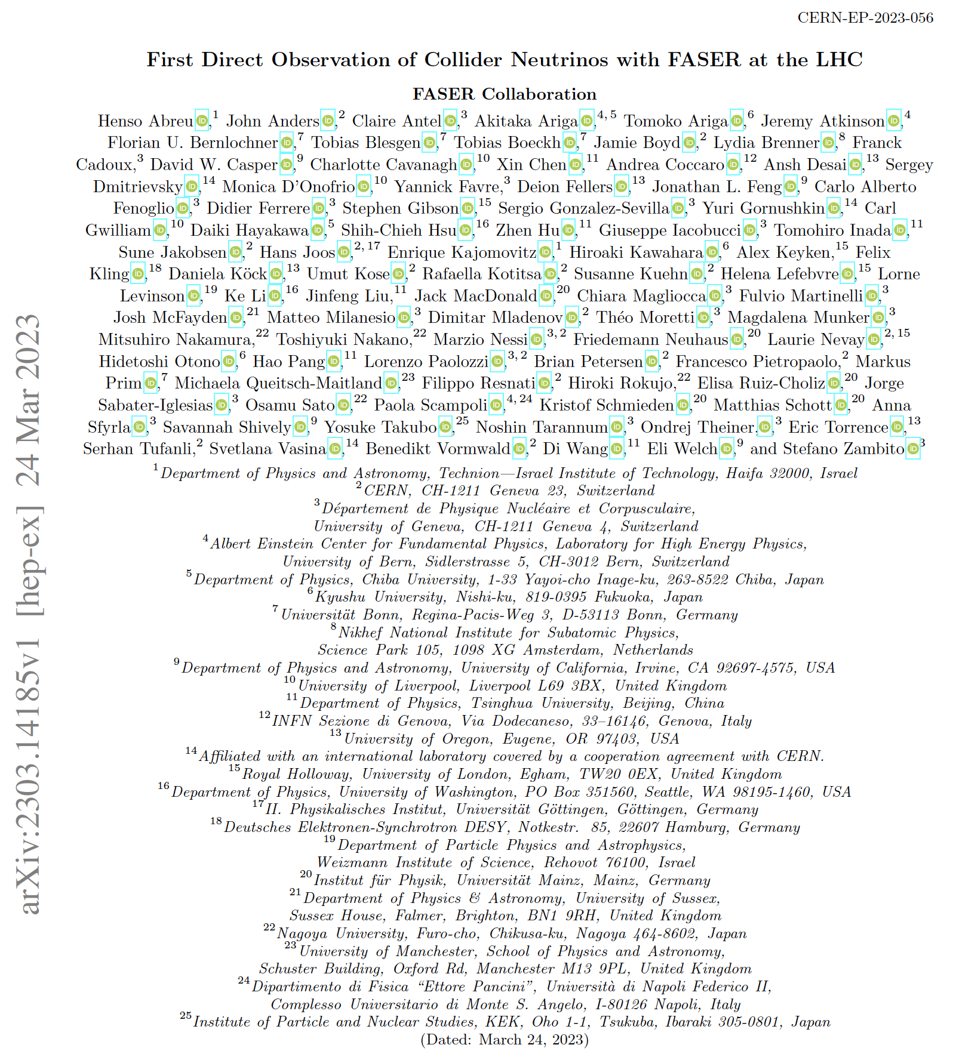
FIRST PHYSICS RESULTS FROM FASER
With 2022 Run 3 data
  First direct observation of collider neutrinos (2303.14185, last night!)
  New dark photon limits in the thermal relic region
See full talks at other winter conferences
  Brian Petersen, Moriond EW, 19 March 2023
  Carl Gwilliam, Moriond QCD, 29 March 2023
  Dave Casper, UCLA DM, 30 March 2023
Notes:
Forward-peaked light particle production

Slide 8
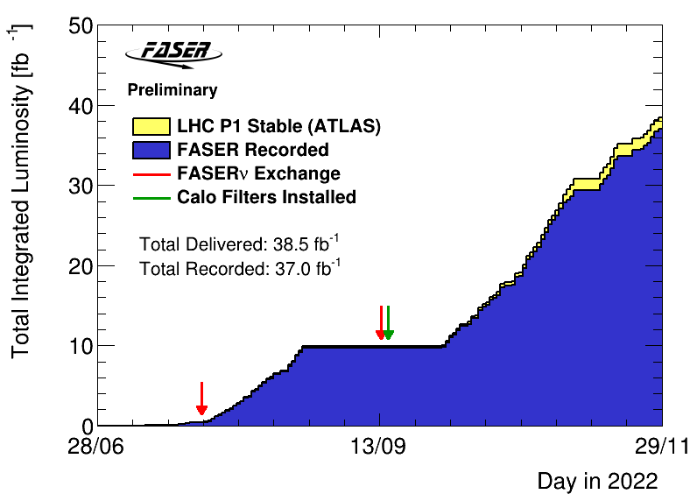
FASER OPERATIONS
Successfully operated throughout 2022
  Continuous data taking
  Largely automated
  Up to 1.3 kHz
  350M single muons recorded
Recorded 96.1% of delivered lumi.
  DAQ dead-time of 1.3%
  A couple of DAQ crashes
Emulsion detector exchanged twice
  Needed to manage occupancy
  First box only partially filled
Calorimeter gain optimised for:
  Low E (< 300 GeV) before 2nd exchange
  High E (up to 3 TeV) after 2nd exchange
Analyses presented use 27.0 fb⁻¹ or 35.4 fb⁻¹

Slide 9
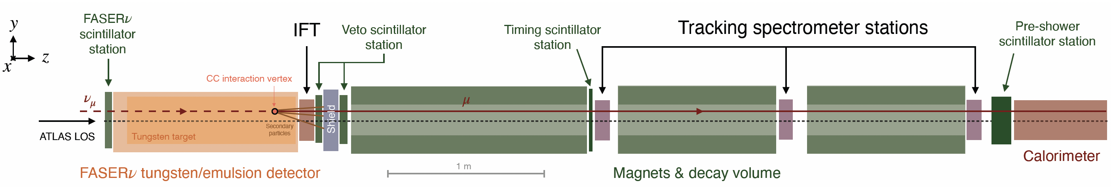
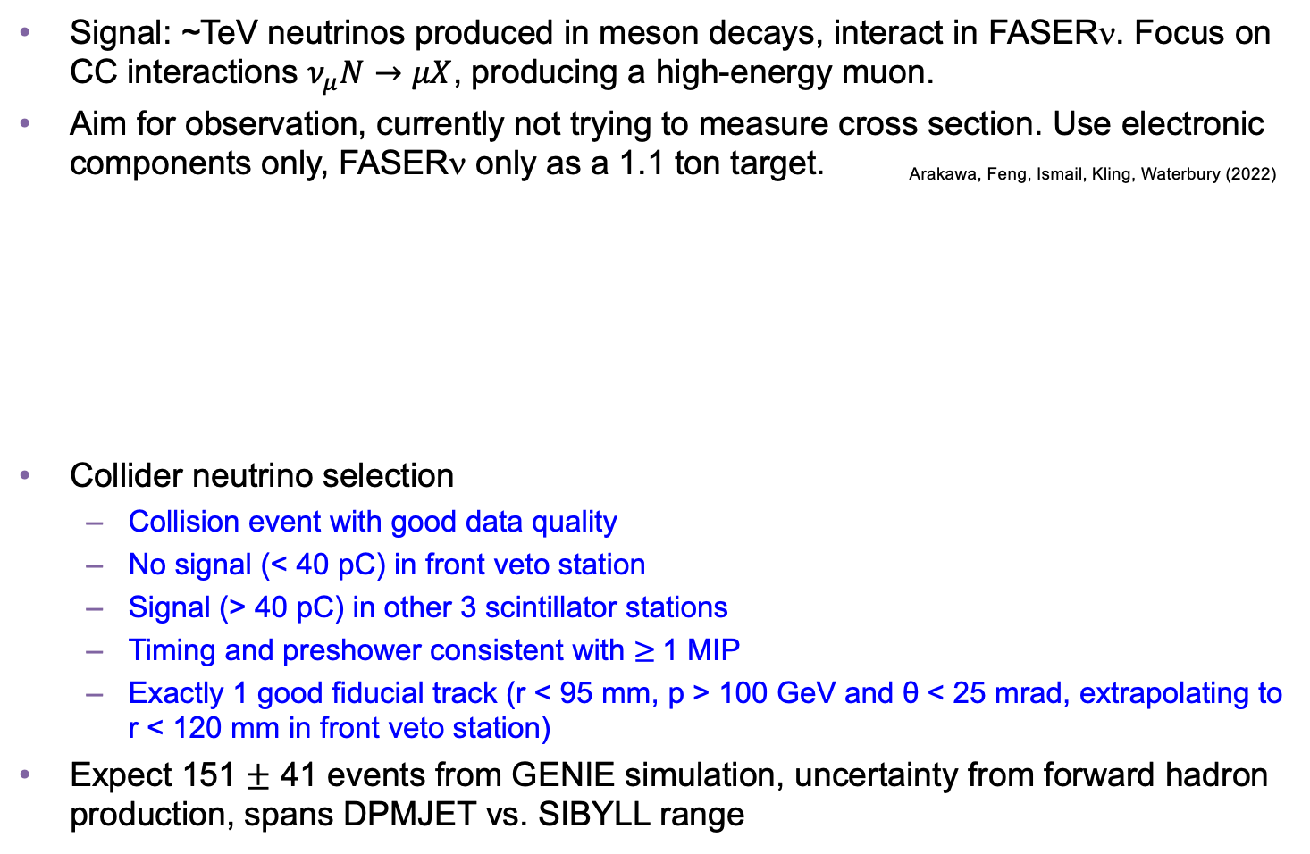
COLLIDER NEUTRINO SEARCH
Signal: ~TeV neutrinos produced in meson decays, interact in FASERν. Focus on CC interactions $ν_{μ}N→μX$, producing a high-energy muon.
Aim for observation, currently not trying to measure cross section. Use electronic components only, FASERν only as a 1.1 ton target. Arakawa, Feng, Ismail, Kling, Waterbury (2022)
Collider neutrino selection
  Collision event with good data quality
  No signal (< 40 pC) in front veto station
  Signal (> 40 pC) in other 3 scintillator stations
  Timing and preshower consistent with $≥$1 MIP
  Exactly 1 good fiducial track (r < 95 mm, p > 100 GeV and θ < 25 mrad, extrapolating to r < 120 mm in front veto station)
Expect 151 $±$ 41 events from GENIE simulation, uncertainty from forward hadron production, spans DPMJET vs. SIBYLL range
FASER Collaboration (2303.14185)
Notes:
typical A’ that decays in FASER has ~TeV energy

Slide 10
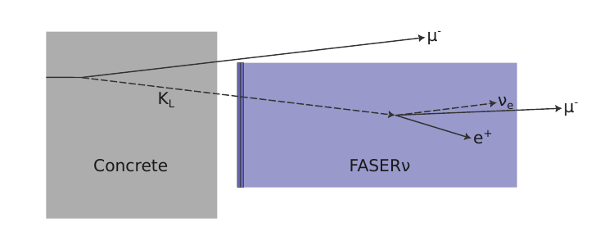
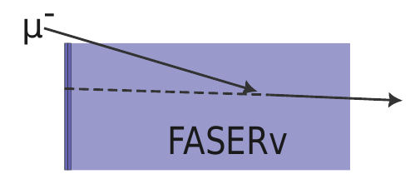
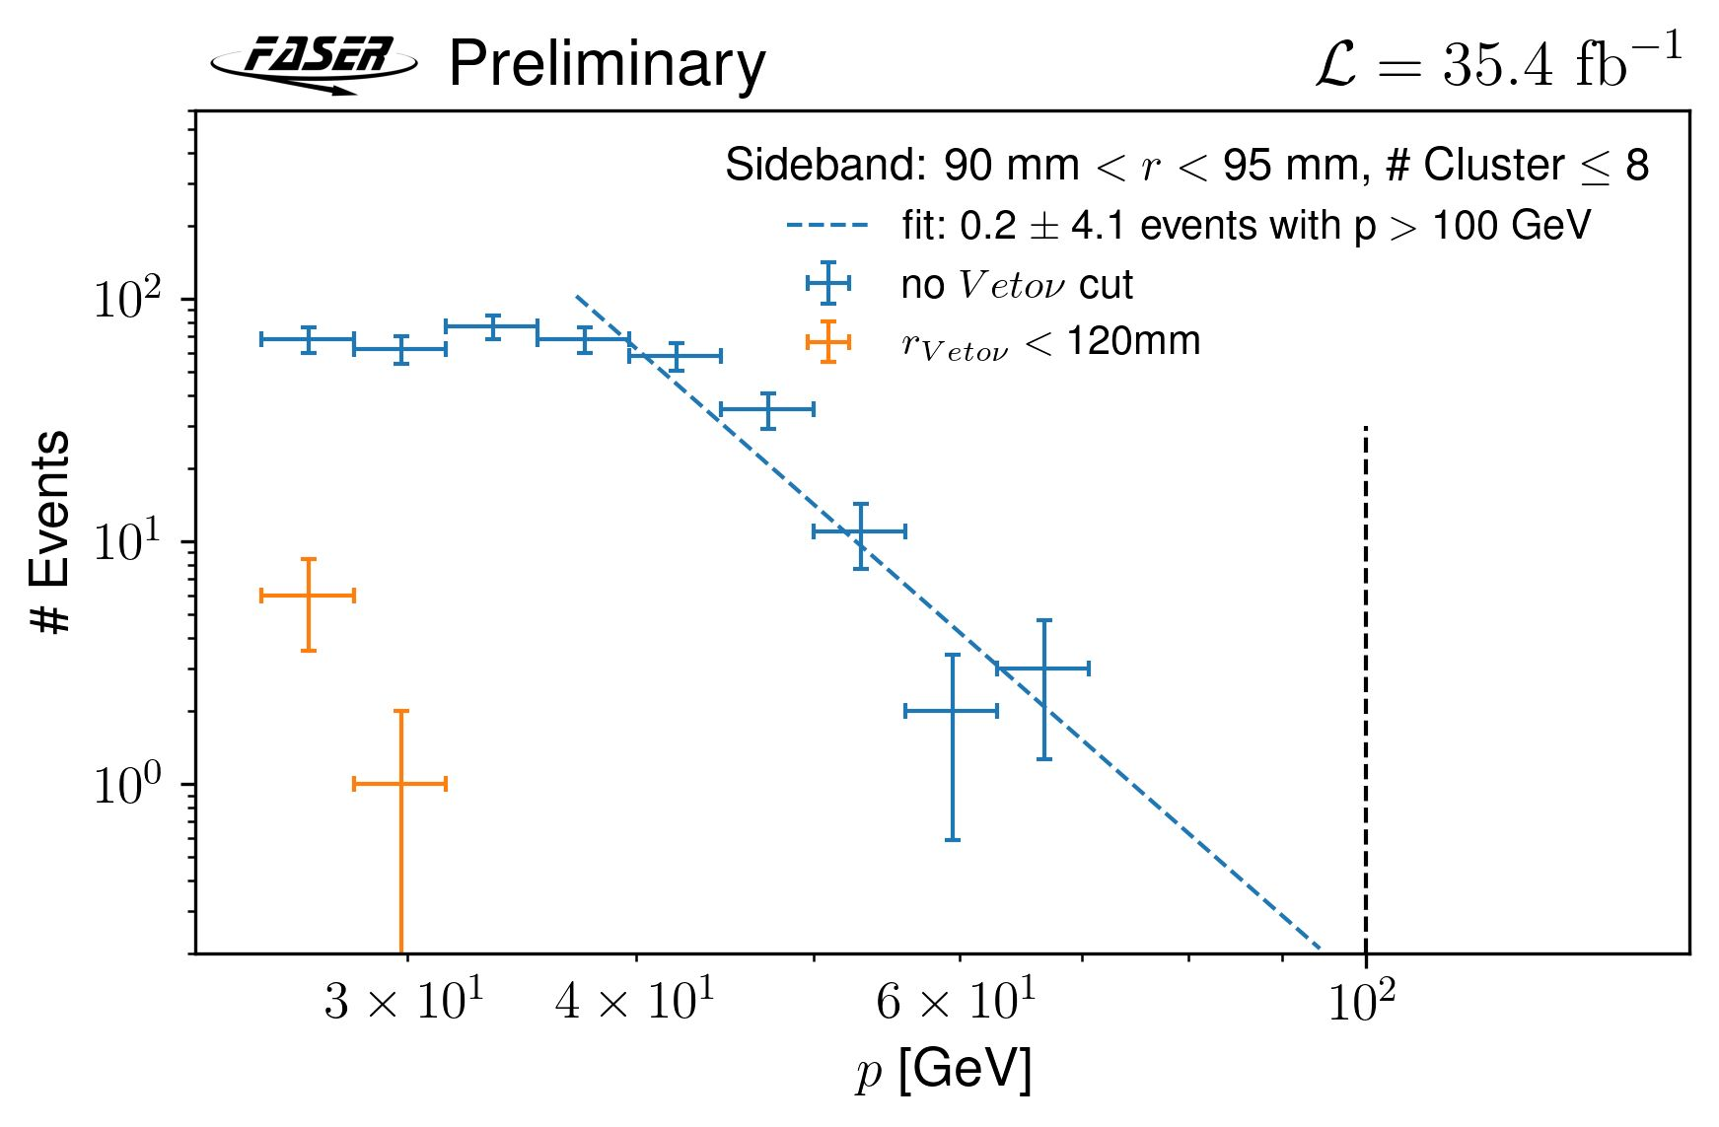
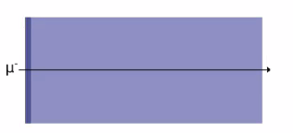
COLLIDER NEUTRINO BACKGROUNDS
Neutral hadrons estimated from simulation
  Expect ~300 neutral hadrons with E > 100 GeV reaching FASERν, most accompanied by μ, but conservatively assume missed
  Estimate fraction of these passing event selection, most are absorbed in tungsten with no high-momentum track
  Predict N = 0.11 ± 0.06 events
Scattered muons estimated from data sideband
  Take events w/o front veto radius requirement and single track segment in first tracker station with 90 < r < 95 mm, extrapolate to higher momentum
  Scale by number of events with front veto cut, use MC to extrapolate to signal region
  Predict N = 0.08 ± 1.83 events
Veto inefficiency estimated from final fit
  Scintillator eff. > 99.999%, bkgrd is negligible
Notes:
typical A’ that decays in FASER has ~TeV energy

Slide 11
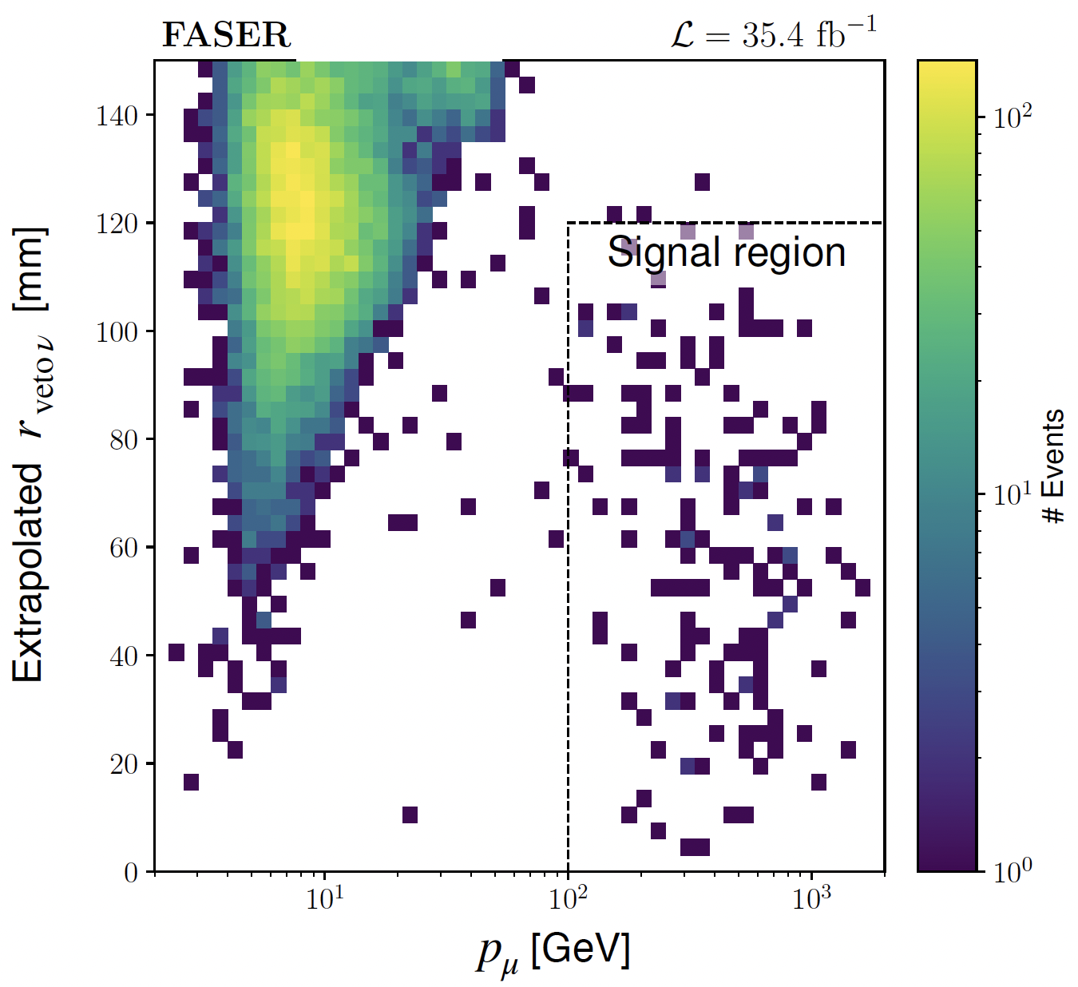
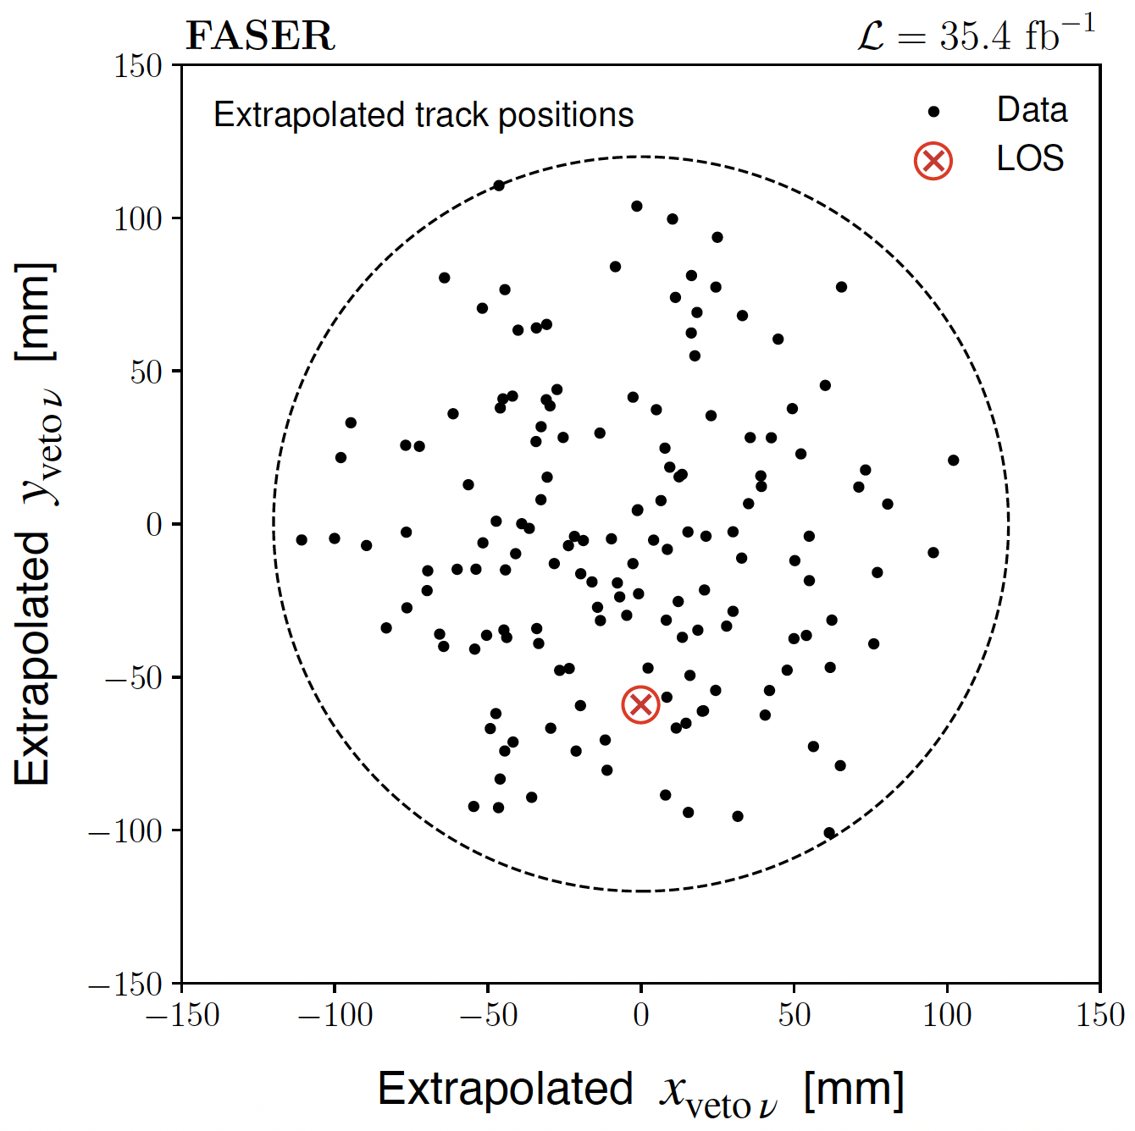
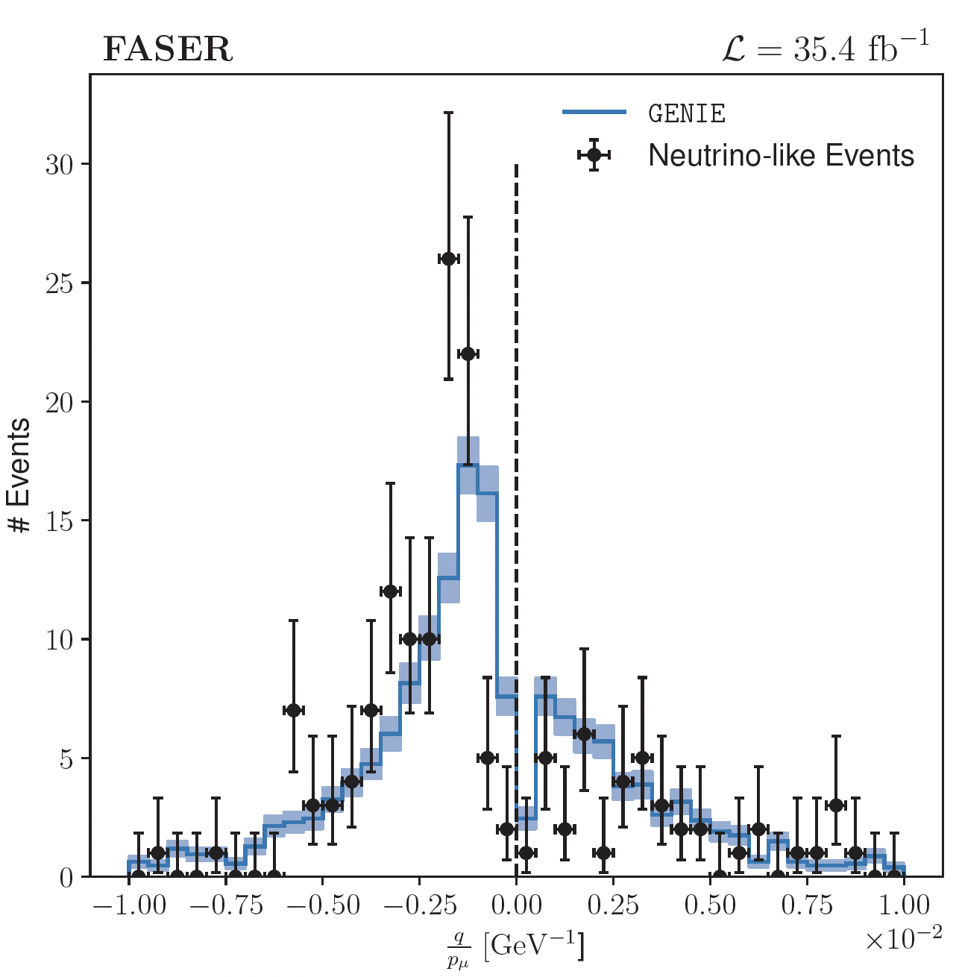
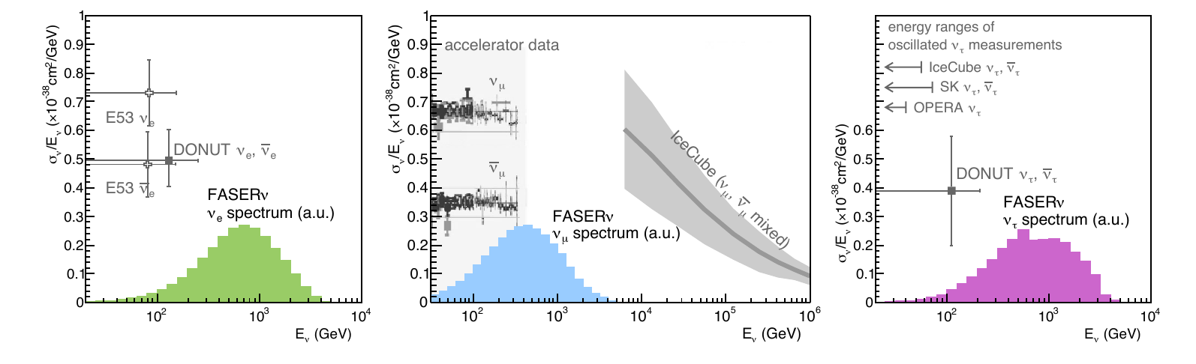
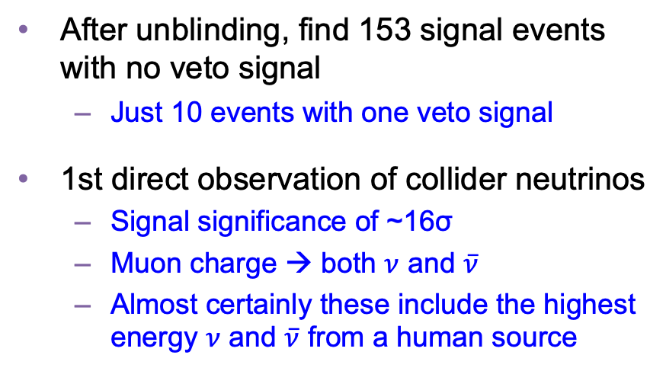
COLLIDER NEUTRINO RESULTS
After unblinding, find 153 signal events with no veto signal
  Just 10 events with one veto signal
1st direct observation of collider neutrinos
  Signal significance of ~16σ
  Muon charge → both $ν$ and $\overline{ν}$
  Almost certainly these include the highest energy $ν$ and $\overline{ν}$ from a human source
FASER Collaboration (2303.14185)

Slide 12
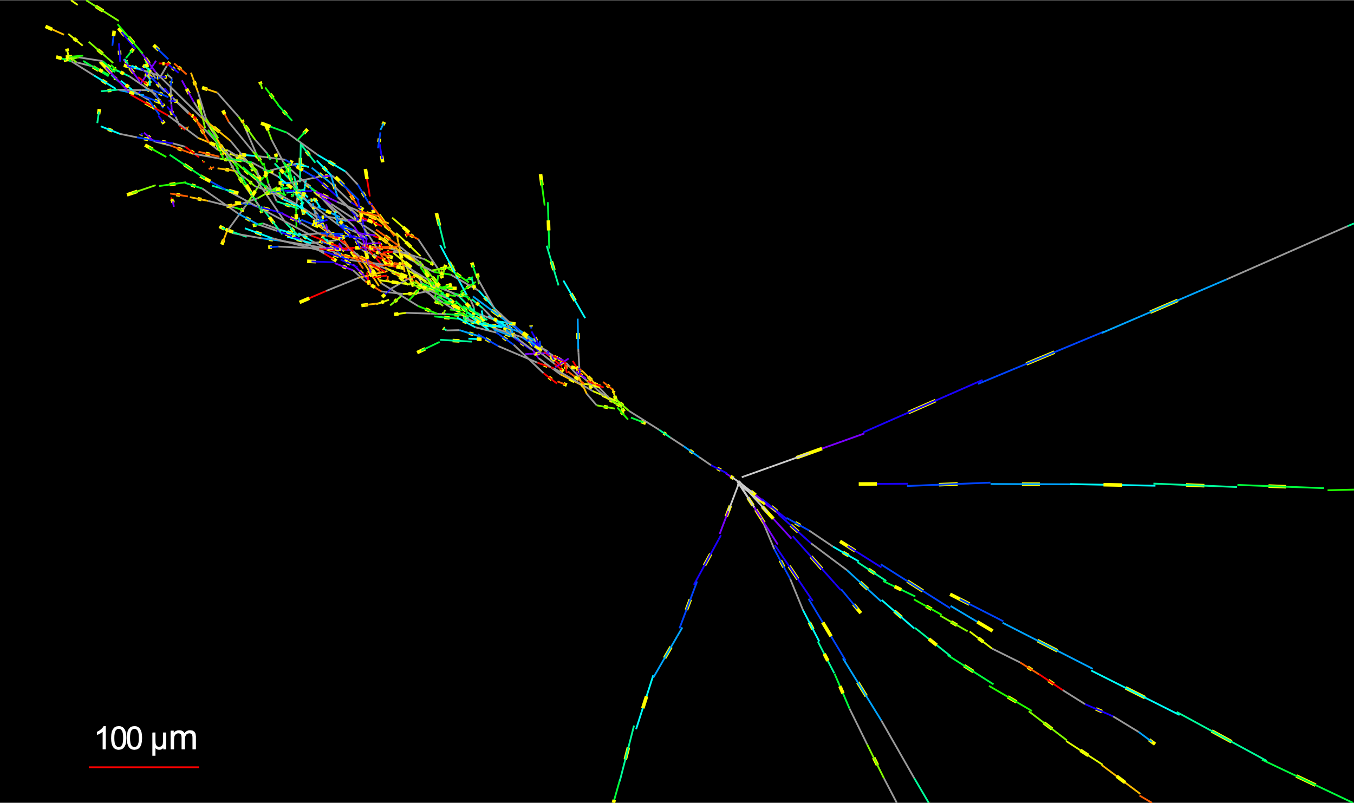

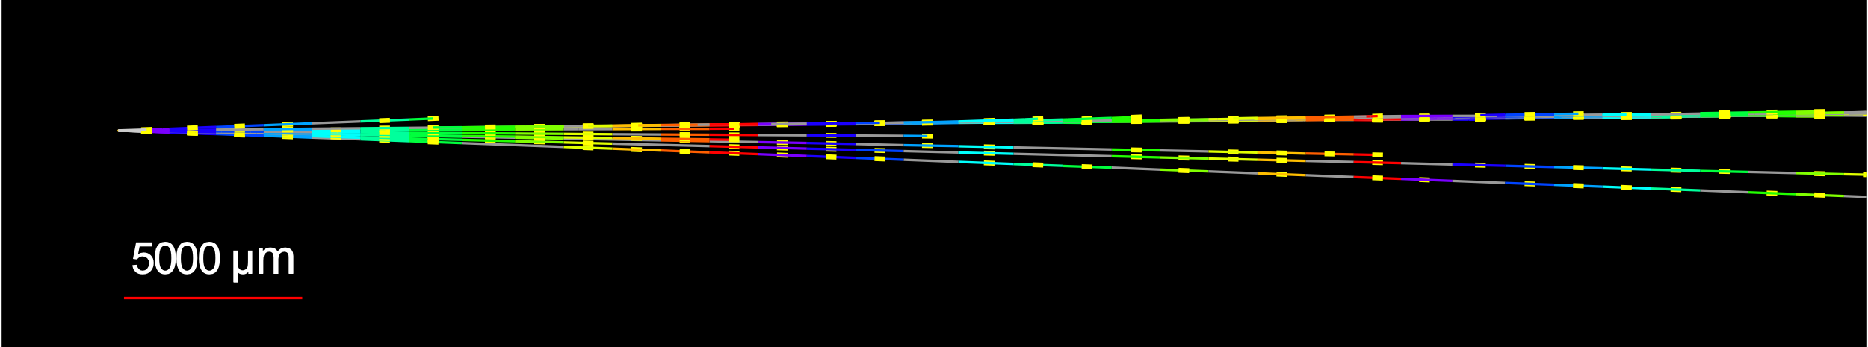


NEUTRINOS FROM EMULSION IN FASERν
Much more to come: this analysis does not even use the emulsion data! Analysis underway, but already many neutrino candidates, including this highly $ν_{e}$–like (and very high energy) CC event
Side View
Vertex with 11 tracks
  615 µm inside tungsten
e-like track from vertex
  Single track for 2X₀
  Shower max @ 7.8Χ₀
  θ_{e} = 11 mrad to beam
Back-to-back topology
  175° between e & rest
Beam View

Slide 13
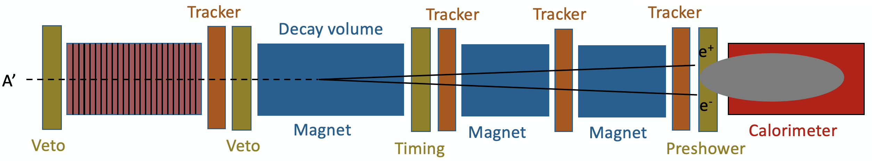
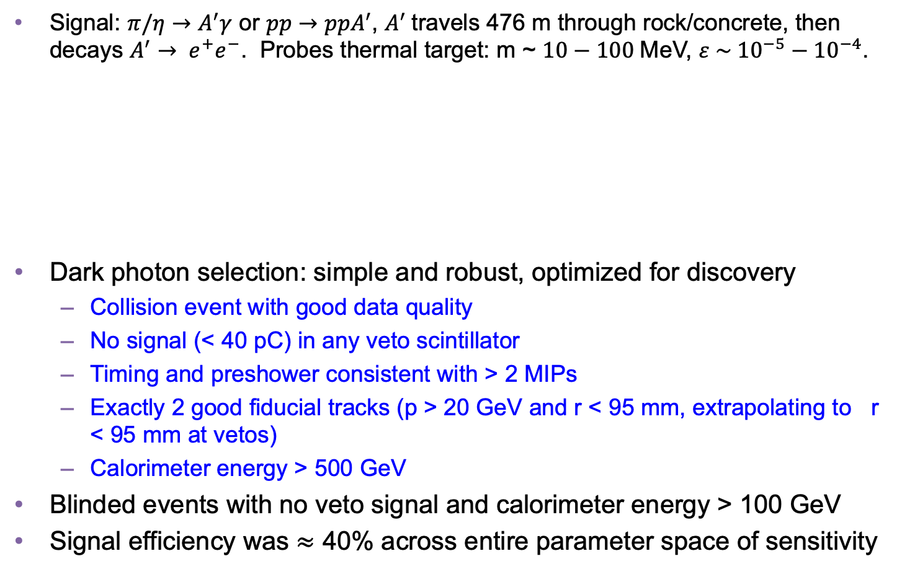
DARK PHOTON SEARCH
Signal: $π/η→A^{′}γ$ or $pp→{ppA}^{′}$, $A^{′}$travels 476 m through rock/concrete, then decays $A^{′}$ $→ e^{+}e^{−}$. Probes thermal target: m ~ $10−100$MeV, $ε \sim {10}^{−5}−{10}^{−4}$.
Dark photon selection: simple and robust, optimized for discovery
  Collision event with good data quality
  No signal (< 40 pC) in any veto scintillator
  Timing and preshower consistent with > 2 MIPs
  Exactly 2 good fiducial tracks (p > 20 GeV and r < 95 mm, extrapolating to r < 95 mm at vetos)
  Calorimeter energy > 500 GeV
Blinded events with no veto signal and calorimeter energy > 100 GeV
Signal efficiency was $≈$ 40% across entire parameter space of sensitivity
Notes:
typical A’ that decays in FASER has ~TeV energy

Slide 14
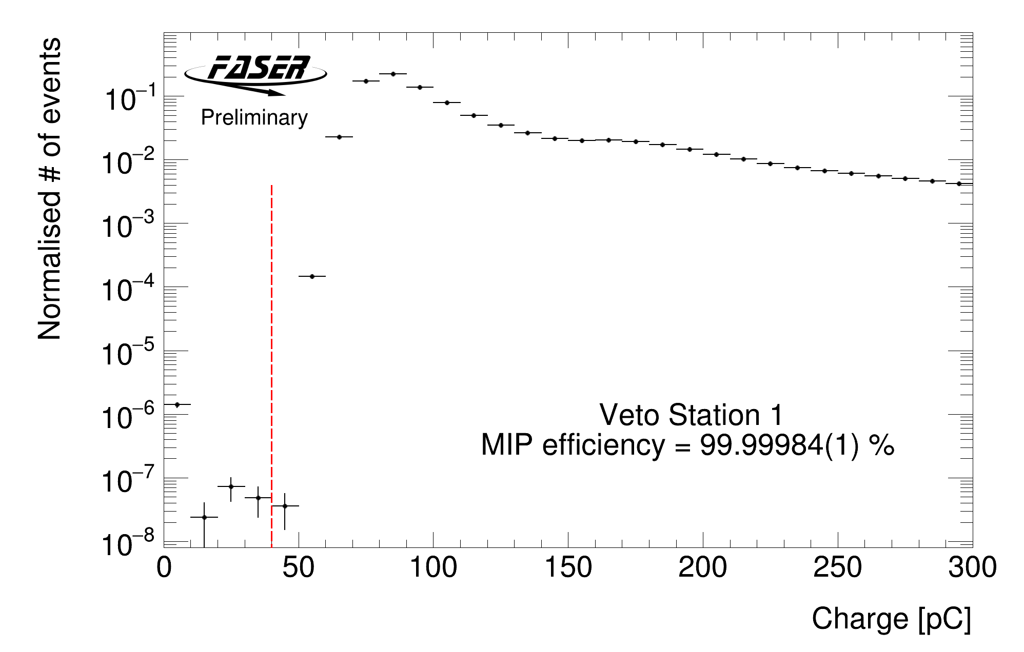
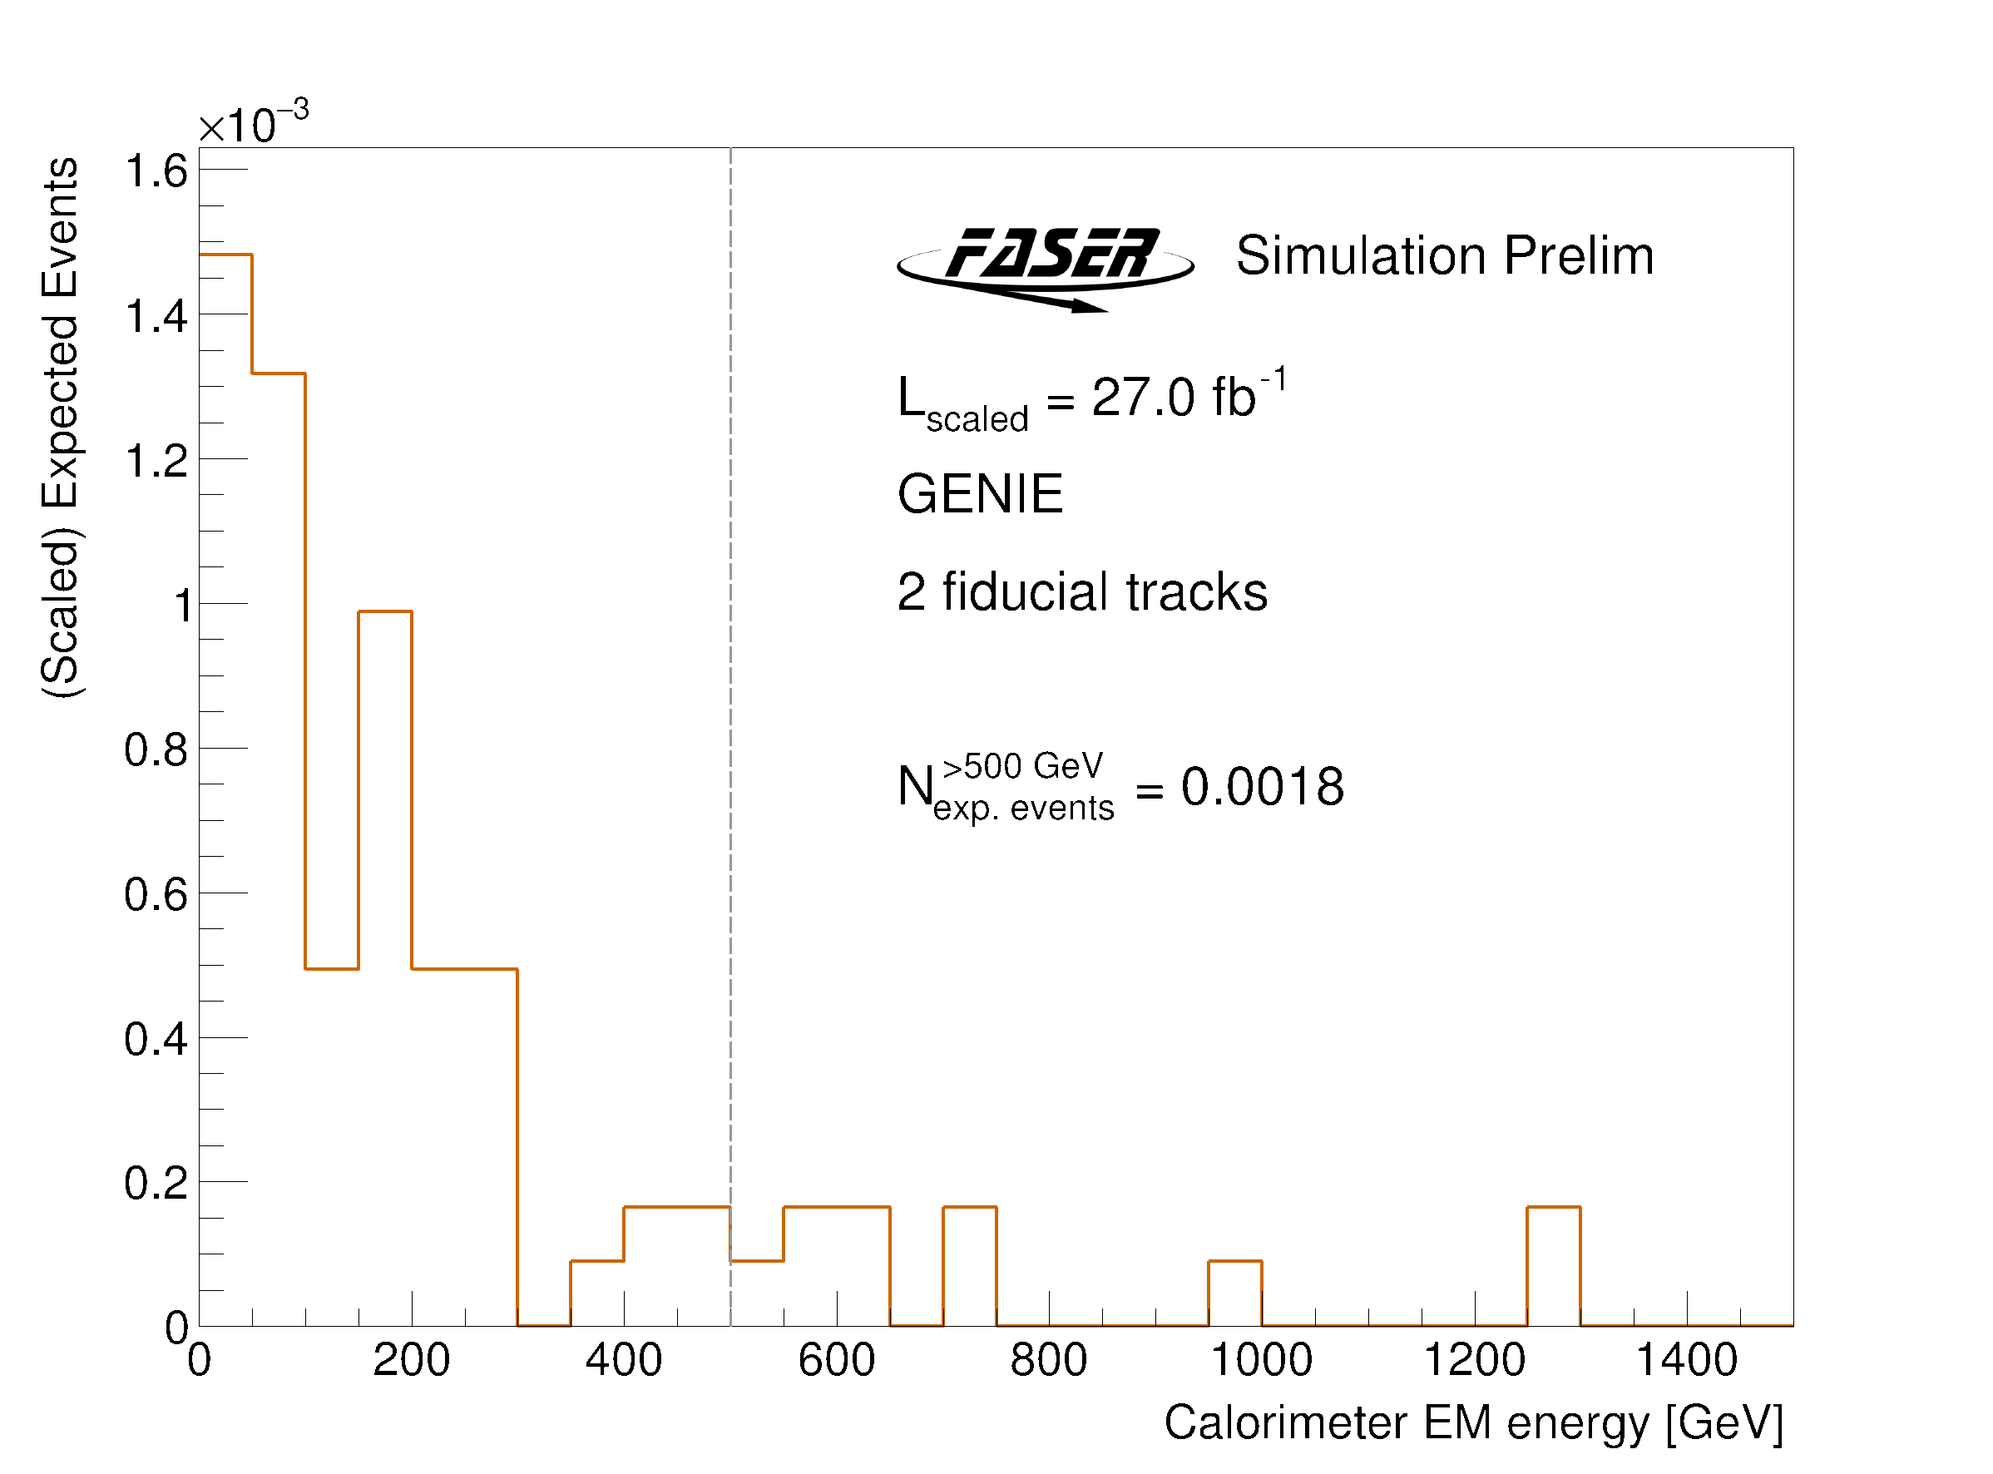
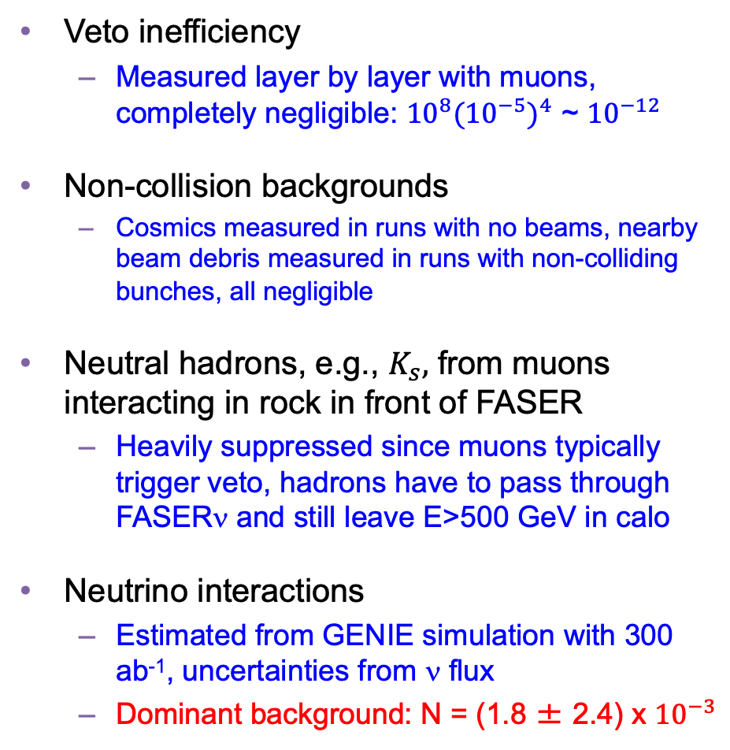
DARK PHOTON BACKGROUNDS
Veto inefficiency
  Measured layer by layer with muons, completely negligible: ${10}^{8}({10}^{−5})^{4}$ ~ ${10}^{−12}$
Non-collision backgrounds
  Cosmics measured in runs with no beams, nearby beam debris measured in runs with non-colliding bunches, all negligible
Neutral hadrons, e.g., $K_{s},$ from muons interacting in rock in front of FASER
  Heavily suppressed since muons typically trigger veto, hadrons have to pass through FASERν and still leave E>500 GeV in calo
Neutrino interactions
  Estimated from GENIE simulation with 300 ab⁻¹, uncertainties from ν flux
  Dominant background: N = (1.8 ± 2.4) x ${10}^{−3}$
Cosmics from
no-beam runs
Notes:
typical A’ that decays in FASER has ~TeV energy

Slide 15
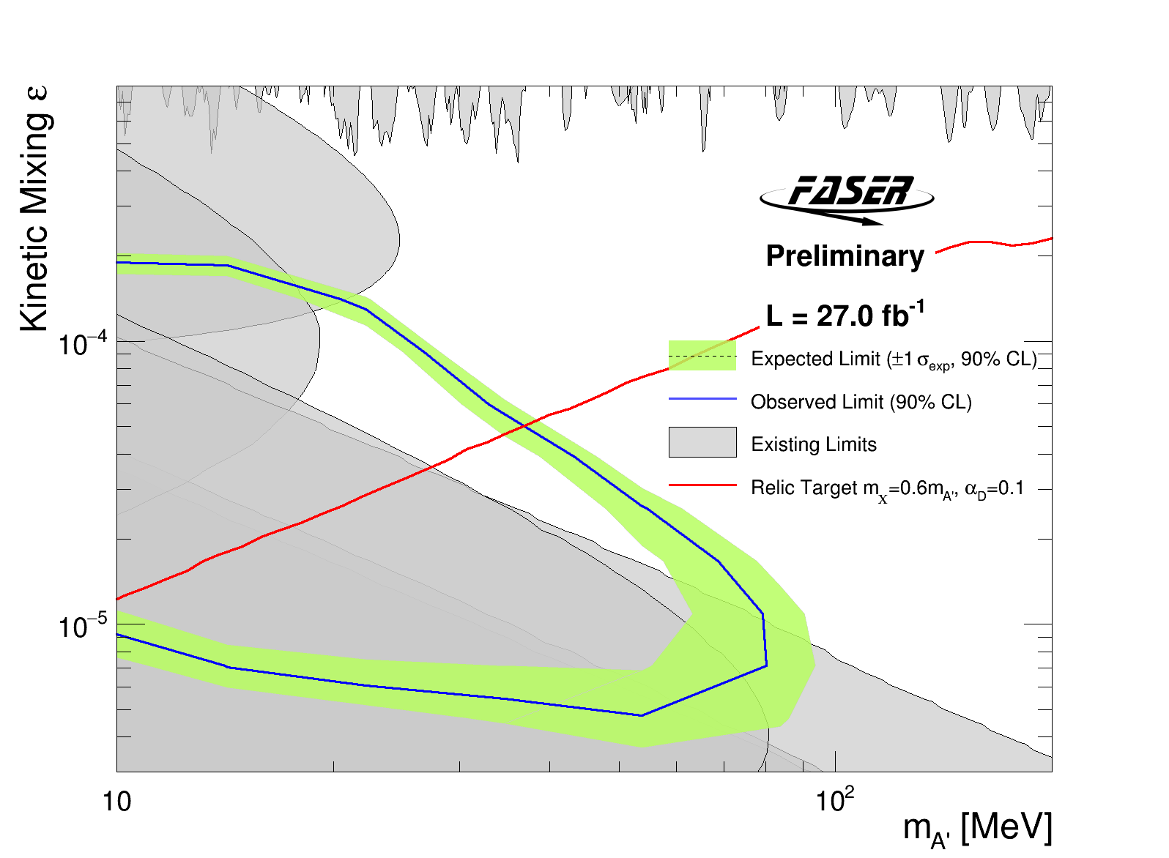
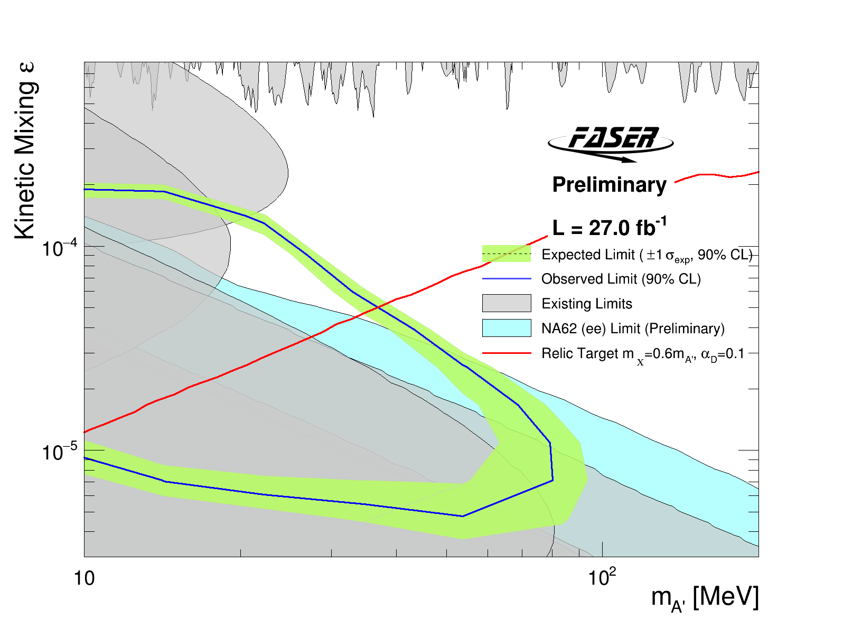
DARK PHOTON RESULTS
After unblinding, no events seen in signal region, FASER sets limits on previously unexplored parameter space.
First incursion (along with NA62, announced at La Thuile) into the thermal relic region from low coupling since the 1990’s.
Background-free analysis bodes well for future sensitivity. Expect factor of ~10 more luminosity in Run 3 from 2022-25.
Existing bounds from DarkCast

Slide 16
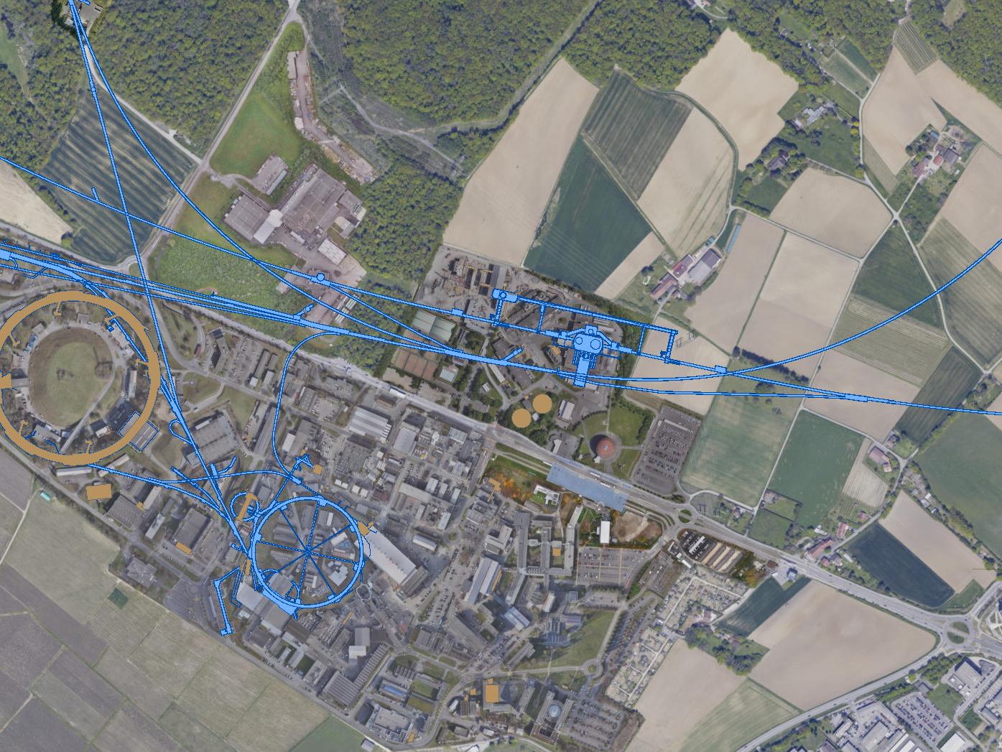
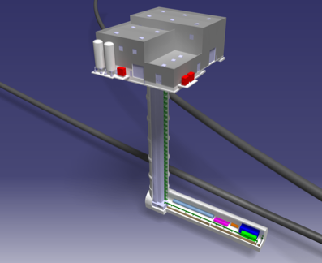
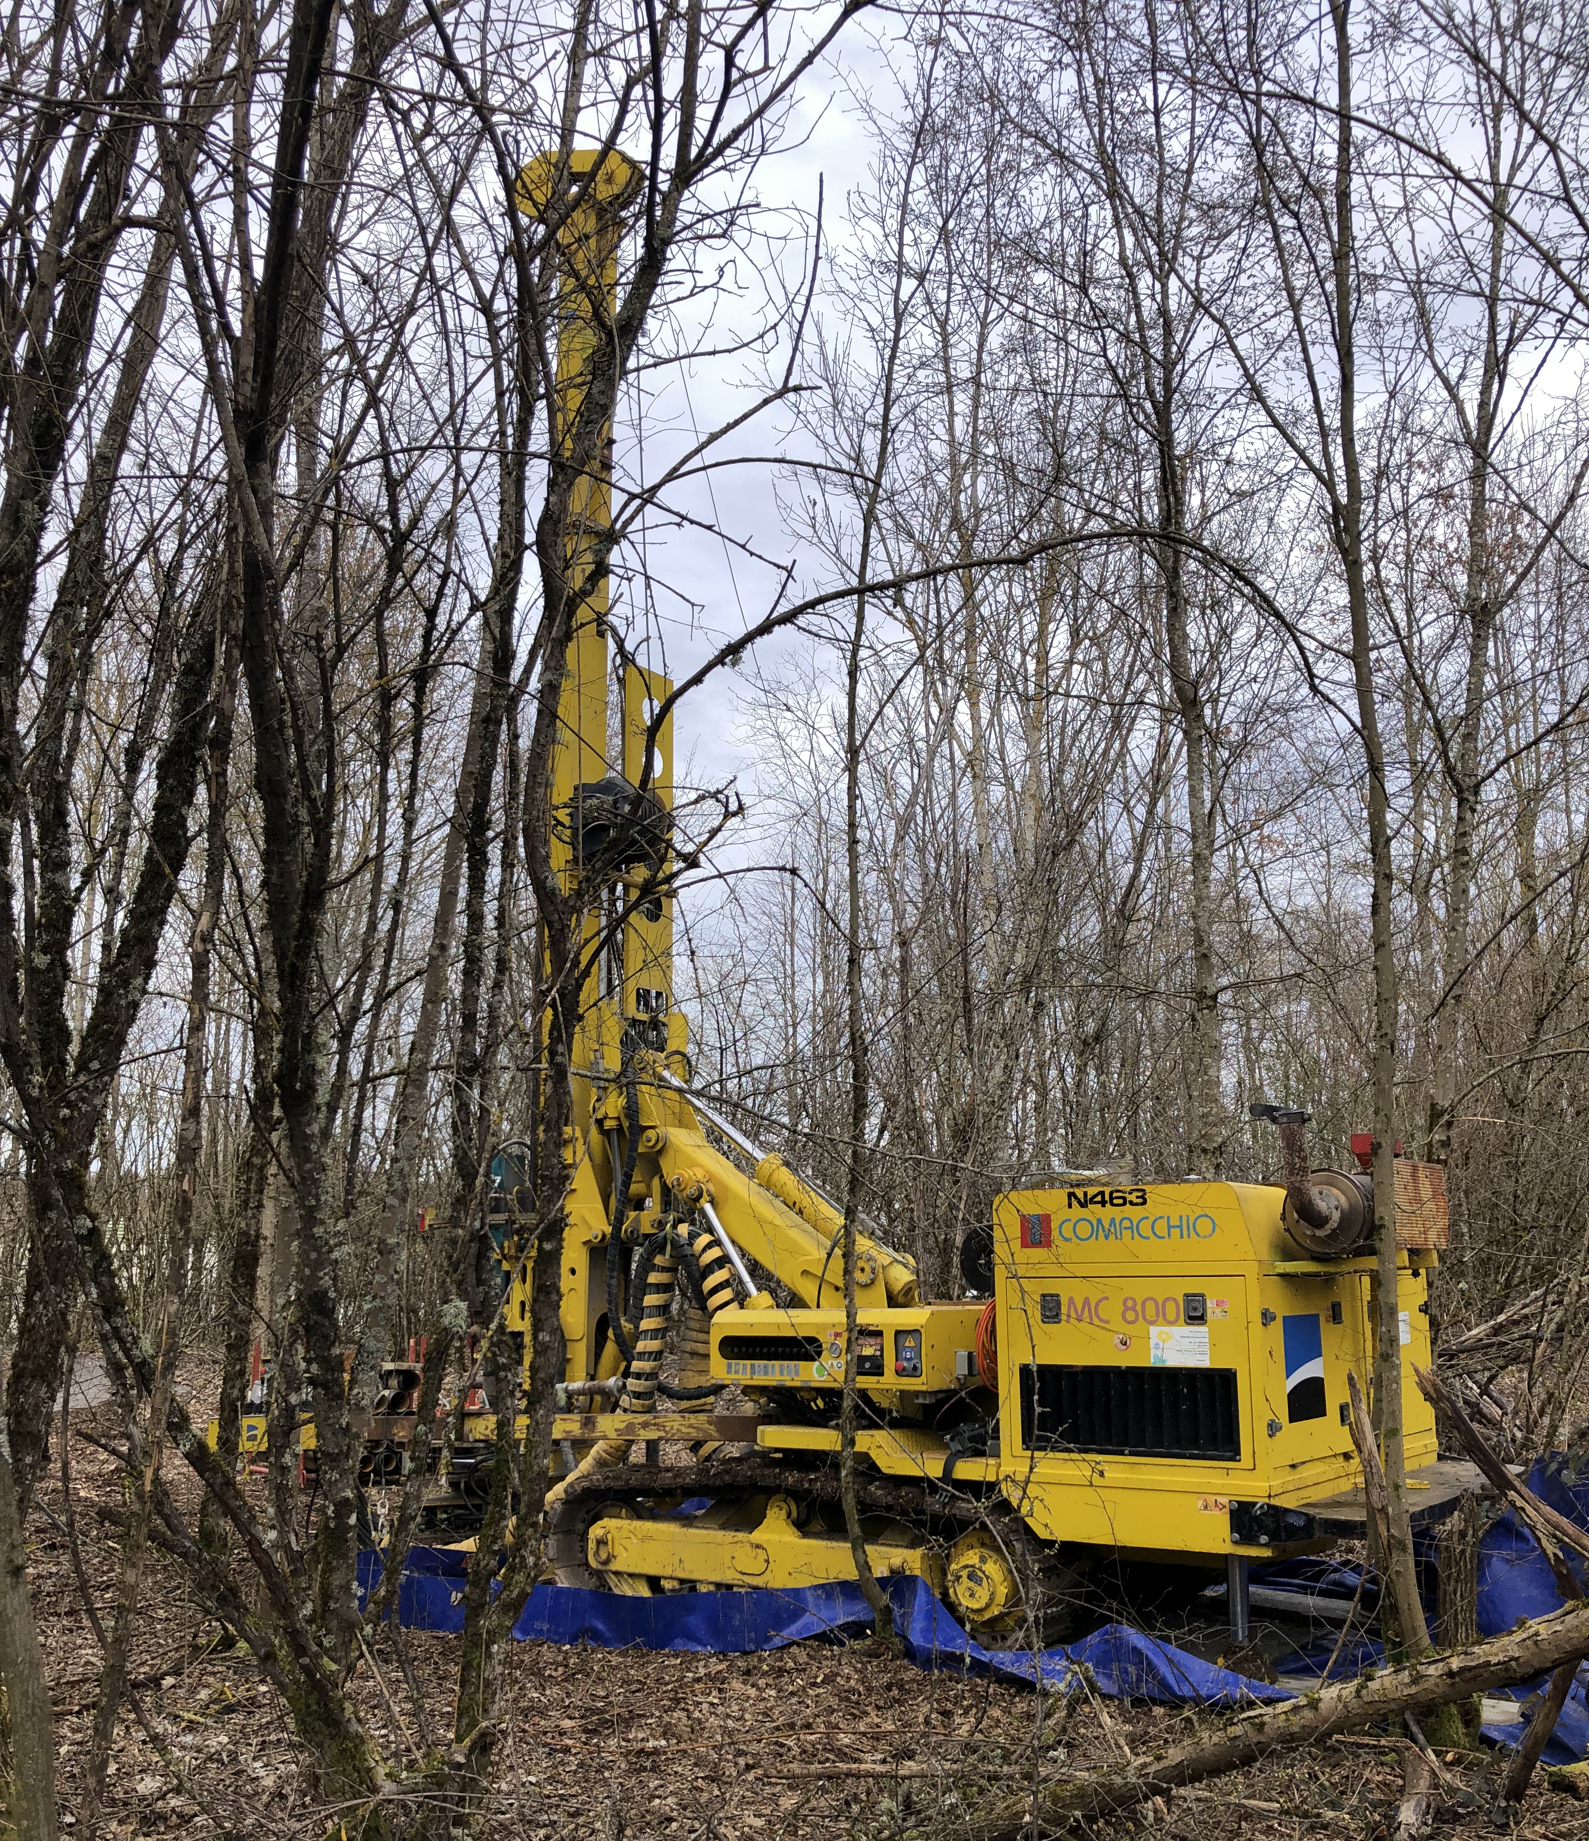
FORWARD PHYSICS FACILITY
The rich physics program in the far-forward region strongly motivates creating a dedicated Forward Physics Facility to house far-forward experiments for the HL-LHC era from 2028-2040s.
UJ18
ATLAS
SPS
LHC
LOS
FPF core sample to study site geology, refine cost estimates
https://cds.cern.ch/record/2851822
CERN GIS

Slide 17
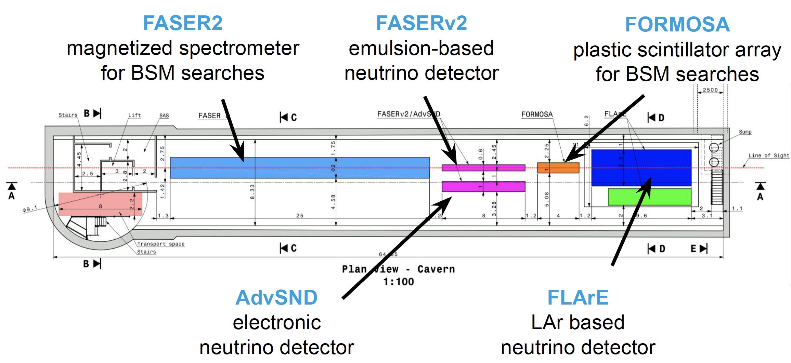
FPF EXPERIMENTS
At present there are 5 experiments being designed to explore the breadth of SM and BSM topics. FPF covers η > 5.5, experiments on LOS cover η $≳$ 7.
Large far-forward fluxes are automatically provided by the LHC and can be exploited with small and inexpensive detectors. For example,
  ~10⁶ TeV-neutrino interactions per 10 tons.
  ~10⁴ dark photon decays can be observed in currently viable regions of param space.
A’, a, mCPs, DM, …
π, K, D, $ν_{e}$ , $ν_{μ}$ , $ν_{τ}$

Slide 18
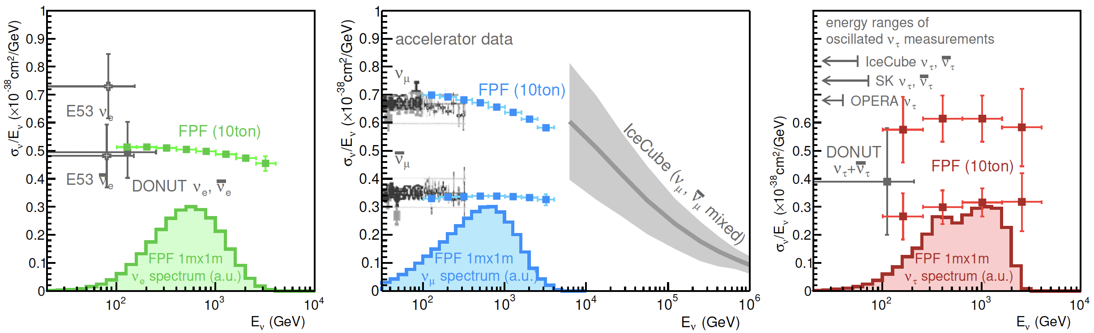
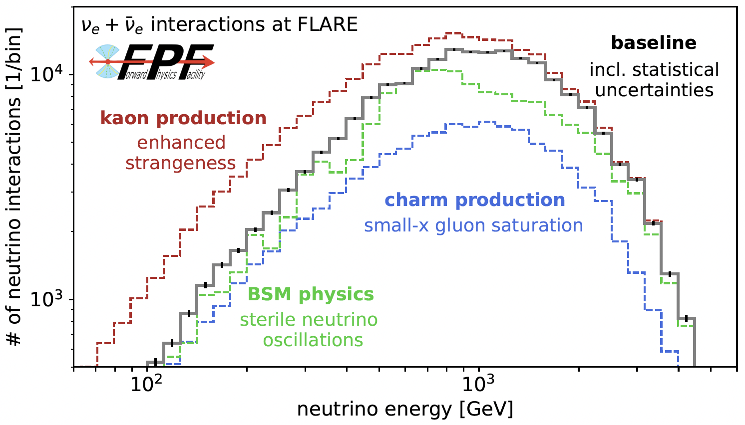
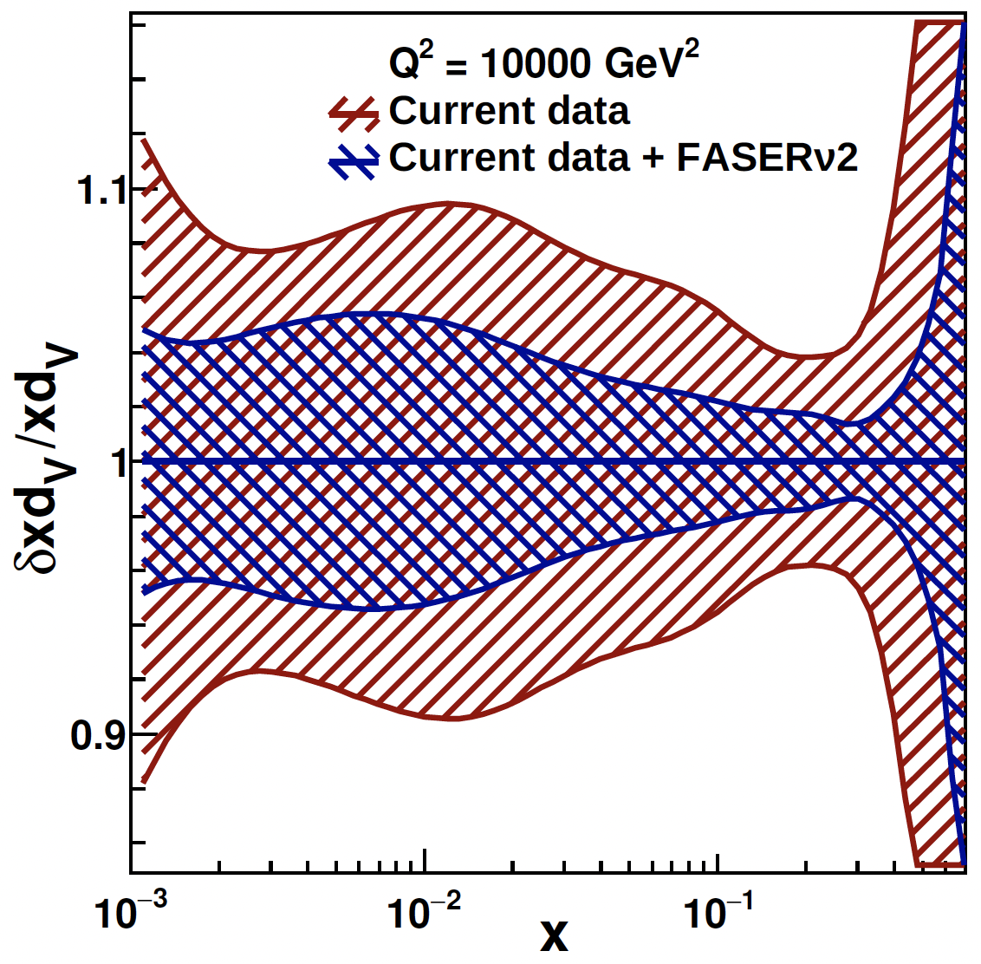
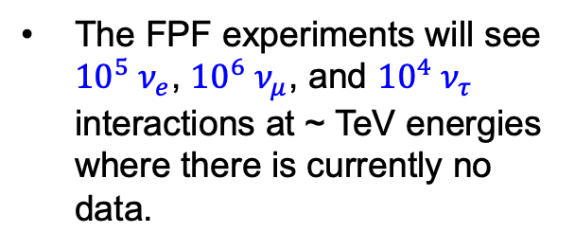
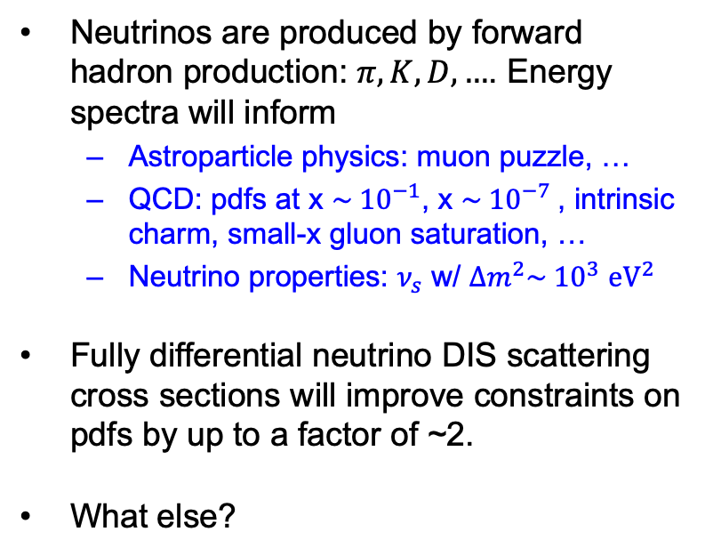
THE FPF NEUTRINO PROGRAM
The FPF experiments will see ${10}^{5} ν_{e}$, ${10}^{6} ν_{μ}$, and ${10}^{4} ν_{τ}$ interactions at ~ TeV energies where there is currently no data.
Neutrinos are produced by forward hadron production: $π, K, D, …$. Energy spectra will inform
  Astroparticle physics: muon puzzle, …
  QCD: pdfs at x $\sim {10}^{−1}$, x $\sim {10}^{−7}$, intrinsic charm, small-x gluon saturation, …
  Neutrino properties: $ν_{s}$ w/ $∆m^{2}\sim {10}^{3}$ ${eV}^{2}$
Fully differential neutrino DIS scattering cross sections will improve constraints on pdfs by up to a factor of ~2.
What else?
FPF WGs, PDF4LHC21,
stat uncertainty only

Slide 19
FORWARD PHYSICS FACILITY
The physics program in the far-forward region has been developed in a series of meetings and papers.
FPF Meetings
  FPF Kickoff Meeting, 9-10 Nov 2020
  FPF2 Meeting, 27-28 May 2021
  FPF3 Meeting, 25-26 Oct 2021
  FPF4 Meeting, 31 Jan-1 Feb 2022
  FPF5 Meeting, 15-16 Nov 2022
FPF Papers
  FPF “Short” Paper: 75 pages, 80 authors, Phys. Rept. 968, 1 (2022), 2109.10905.
  FPF White Paper: 429 pages, 392 authors+endorsers representing over 200 institutions, J. Phys. G (2022), 2203.05090.
Snowmass 2022: “Our highest immediate priority accelerator and project is the HL-LHC, … including the construction of auxiliary experiments that extend the reach of HL-LHC in kinematic regions uncovered by the detector upgrades.”

Slide 20
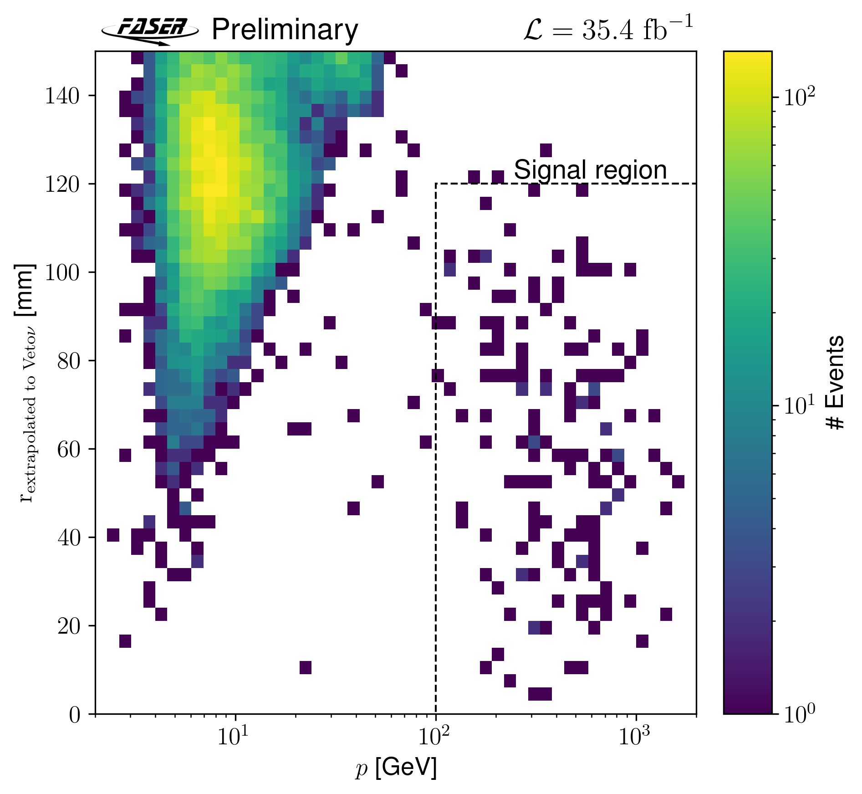
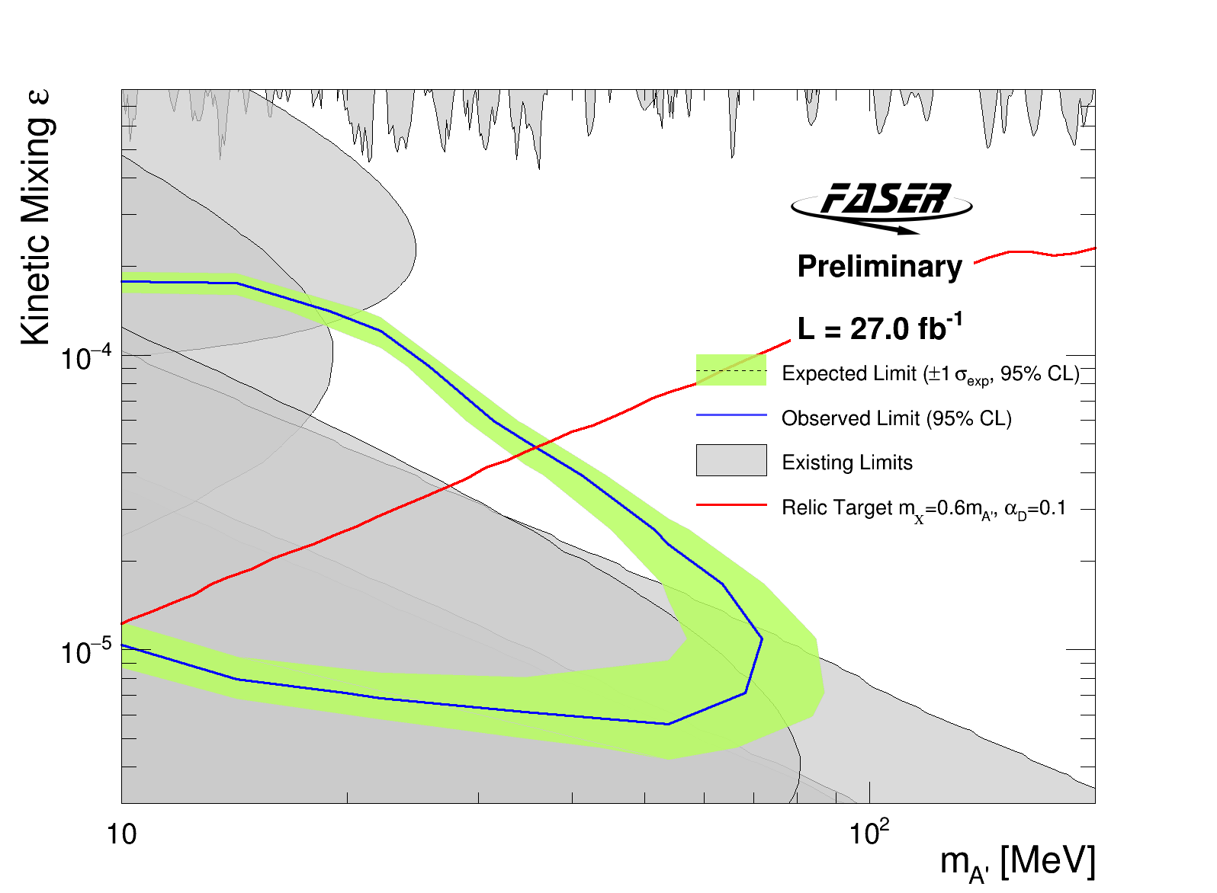
SUMMARY
FASER successfully took data in 1st year of Run 3
  Running with fully functional detector and very good efficiency
First direct observation of collider neutrinos
  ~153 events with ~0 background, 16 sigma
  Opens a new field: neutrino physics at the LHC
Excluded A’ in region of 10-100 MeV mass and really small coupling
  First incursion into the thermal relic region from low coupling in 30 years
More neutrino studies and BSM searches to come
  Including first results from emulsion detector
  Searches for ALPs, light gauge bosons, …
Strongly motivates FPF for the HL-LHC era

Slide 21








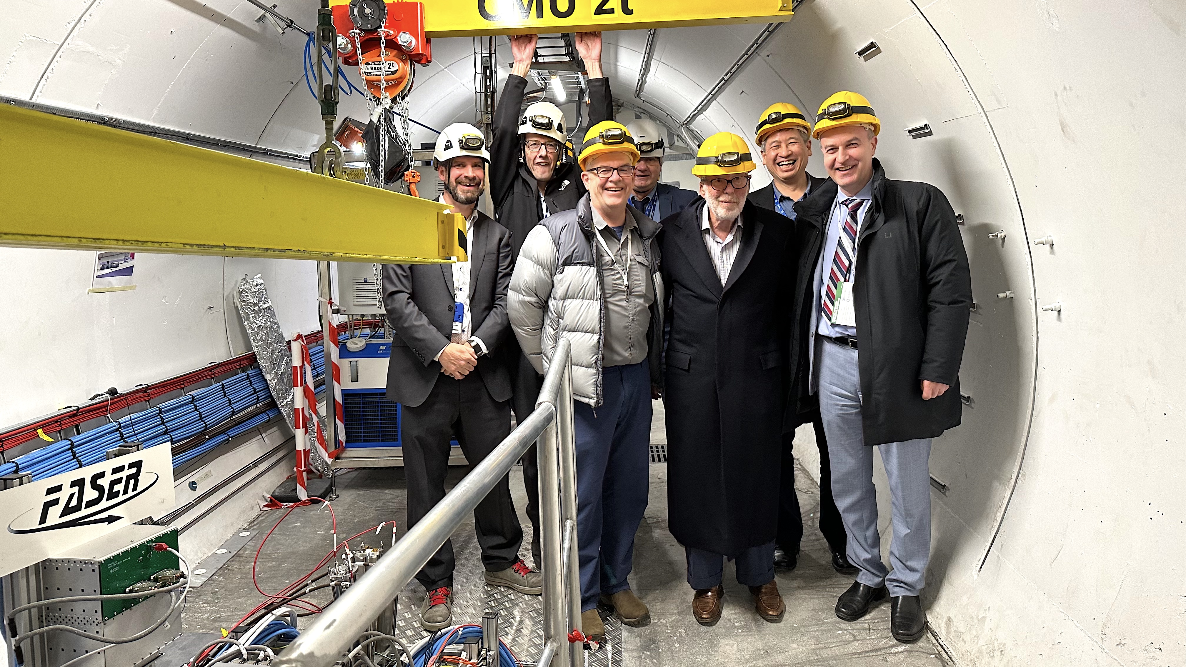
ACKNOWLEDGEMENTS
We also thank
  The LHC for excellent performance in 2022
  ATLAS for luminosity information
  ATLAS for use of ATHENA s/w framework
  ATLAS SCT for spare tracker modules
  LHCb for spare ECLA modules
  CERN FLUKA team for bkgrd simulations
  CERN PBC and technical infrastructure groups for excellent support during FASER’s design, construction, installation

