Slide 1




INTRODUCTION AND GOALS
5th Forward Physics Facility Meeting
Jonathan Feng, UC Irvine, 15 November 2022

Slide 2
INTRODUCTION
The FPF will greatly enhance the HL-LHC physics program
  Neutrinos: Neutrino blind → Neutrino factory, insights into neutrinos, QCD, astroparticle physics.
  BSM: Modest extension of weak-scale searches → New sensitivity to MeV-GeV FIPs, LLPs, milli-charged particles, quirks, light dark matter, and many other groundbreaking discoveries.
Many of these opportunities rely essentially on the LHC’s high center-of-mass energy, are therefore inaccessible at fixed target experiments and unique to the FPF, and will disappear for decades (or forever) if not explored at the HL-LHC.
The FPF is well-aligned with the recommendations of EPPSU and Snowmass:
2020 EPPSU 1st Recommendation
The successful completion of the high-luminosity upgrade of the machine and detectors should remain the focal point of European particle physics, together with continued innovation in experimental techniques. The full physics potential of the LHC and the HL-LHC, including the study of flavour physics and the quark-gluon plasma, should be exploited.
2022 Snowmass Energy Frontier Summary
Our highest immediate priority accelerator and project is the HL-LHC, the successful completion of the detector upgrades, operations of the detectors at the HL-LHC, data taking and analysis, including the construction of auxiliary experiments that extend the reach of HL-LHC in kinematic regions uncovered by the detector upgrades.
Resource needs and plan for the 5-year period starting 2025:
1. Prioritize HL-LHC physics program, including auxiliary experiments.

Slide 3
CERN NEWS
CERN and PBC support for the FPF (and for FASER, FASERnu, SND@LHC) has been generous and essential.
Jamie Boyd and I had a first meeting about the FPF with CERN Directors Fabiola Gianotti, Joachim Mnich, and Mike Lamont in June 2022. The meeting was encouraging and very useful, and we planned to meet again 8 months after that meeting (~Feb, Mar 2023).
LHCC Minutes, Sept 2022 (following discussions with LHCC Chair Frank Simon)
  A proposal on the Forward Physics Facility (FPF), a large underground experimental facility, well shielded in the line of sight of the ATLAS interaction point, is being put forward. First informal discussions about the next steps with this proposal have taken place between the proponents and the LHCC chair.
  Given the scope of the proposed facility and the scientific overlap with projects that fall into the responsibility of other committees, the LHCC proposes to discuss the FPF together with other proposals, in an appropriate forum such as the Physics Beyond Colliders study group, prior to moving towards reviews by the scientific committees to ensure a comprehensive and aligned view of the strategy for CERN moving forward. Considering the implications for the long-term scientific strategy and the future development of the CERN infrastructure, a discussion in the SPC may be appropriate to help define priorities prior to further steps.
Takeaway: FPF will be discussed with other proposals, particularly HIKE + SHADOWS and SHiP@ECN3, in the coming year. We understand that details of this discussion and its timing are currently being discussed.

Slide 4
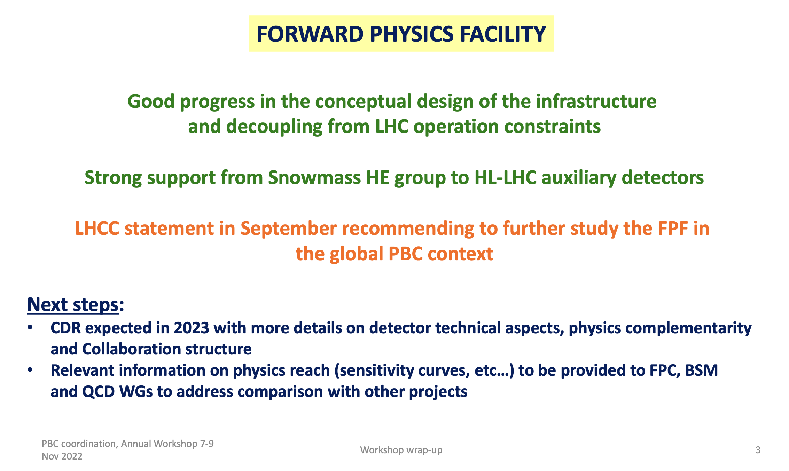
CERN NEWS
FPF and other projects were discussed at length at the PBC Annual Workshop, held last week at CERN (https://indico.cern.ch/event/1137276). From Claude Vallee’s summary talk (for more, see also the next talk):

Slide 5
FORWARD PHYSICS FACILITY
The rich physics program in the far-forward region has been developed in a series of meetings and papers – thanks to all participants and authors!
FPF Meetings
  FPF Kickoff Meeting, 9-10 Nov 2020
  FPF2 Meeting, 27-28 May 2021
  FPF3 Meeting, 25-26 Oct 2021
  FPF4 Meeting, 31 Jan-1 Feb 2022
  FPF5 Meeting, 15-16 Nov 2022 https://indico.cern.ch/event/1196506
FPF Papers
  FPF “Short” Paper: 75 pages, 80 authors, Phys. Rept. 968, 1 (2022), 2109.10905.
  FPF White Paper: 429 pages, 392 authors+endorsers representing over 200 institutions, J. Phys. G (2022), 2203.05090.
Excellent progress in a short time, but much work to be done to prepare for CDRs and anticipated prioritization and funding decisions in 2023.

Slide 6
ORGANIZATIONAL INFRASTRUCTURE
New working group structure established to organize the work and provide contact names for new people interested in the FPF.
Steering Committee: Jamie Boyd, Jonathan Feng, Felix Kling
WG0 Facility: Jamie Boyd
WG1 Neutrino Interactions: Juan Rojo
WG2 Charm Production: Hallsie Reno
WG3 Light Hadron Prod: Luis Anchordoqui, Dennis Soldin
WG4 BSM: Brian Batell, Sebastian Trojanowski
WG5 FASER2: Josh McFayden
WG6 FASERnu2: Aki Ariga, Tomoko Ariga
WG7 FLArE: Jianming Bian, Milind Diwan
WG8 AdvSND: Giovanni De Lellis
WG9 FORMOSA: Matthew Citron, Chris Hill
Detector WGs
Physics WGs
WG Liaisons | WG5 FASER2 | WG6 FASERnu2 | WG7 FLArE | WG8 AdvSND | WG9 FORMOSA
WG1 | Josh McFayden | Aki Ariga, Tomoko Ariga | Steve Linden, Wenjie Wu | Antonia Di Crescenzo | Matthew Citron
WG2 | Josh McFayden | Aki Ariga, Tomoko Ariga | Steve Linden, Wenjie Wu | Antonia Di Crescenzo | Matthew Citron
WG3 | Josh McFayden | Aki Ariga, Tomoko Ariga | Steve Linden, Wenjie Wu | Antonia Di Crescenzo | Matthew Citron
WG4 | Josh McFayden | Aki Ariga, Tomoko Ariga | Steve Linden, Wenjie Wu | Cristovao Vilela | Matthew Citron

Slide 7
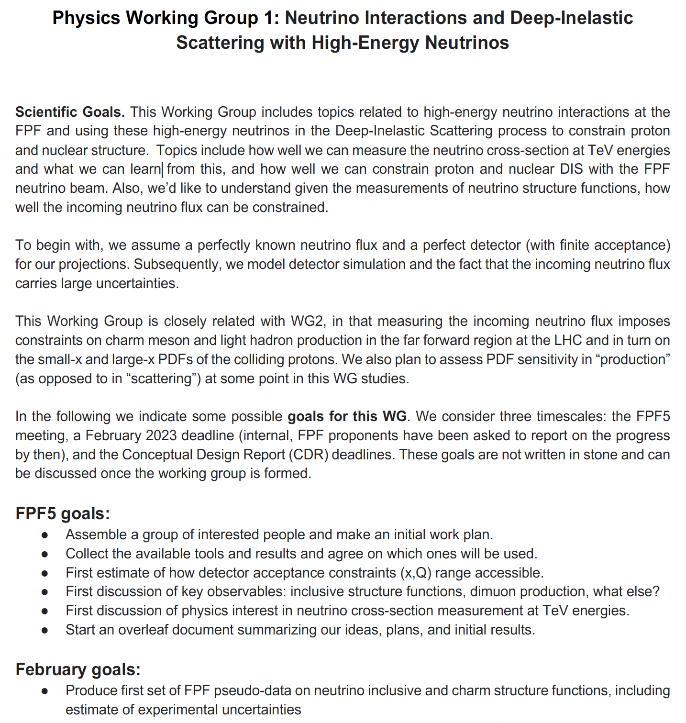
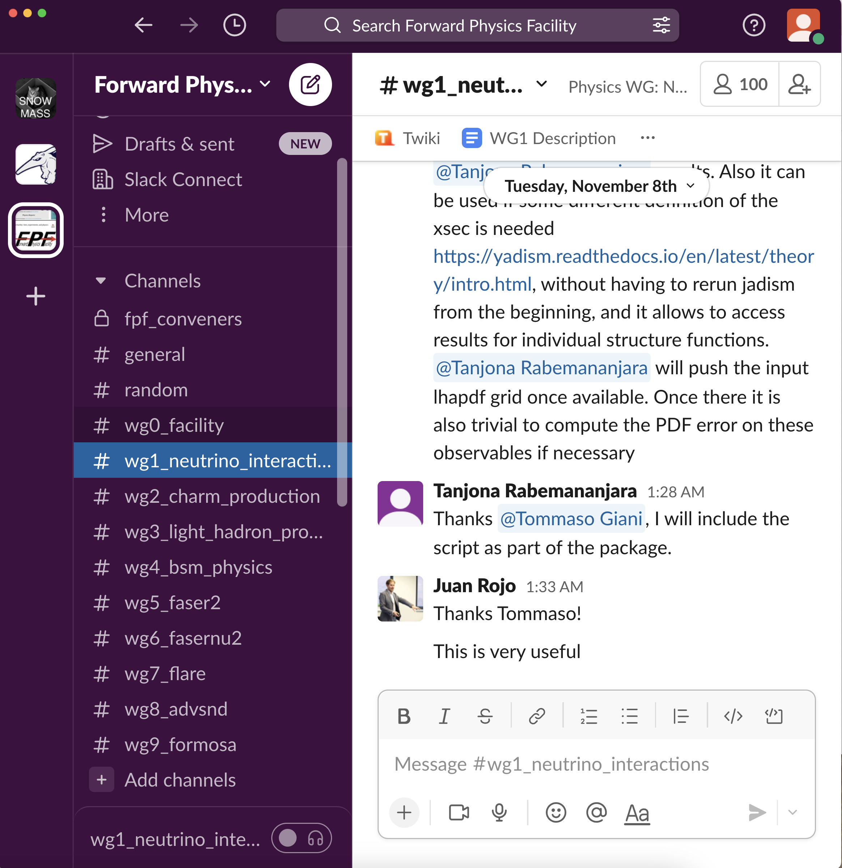
WG GOALS
Each Physics WG has established goals for FPF5, February 2023, and the CDRs, with detector WG liaisons providing detector performance input.
To join, contact the WG leaders and join the (free) Slack workspace.
…

Slide 8
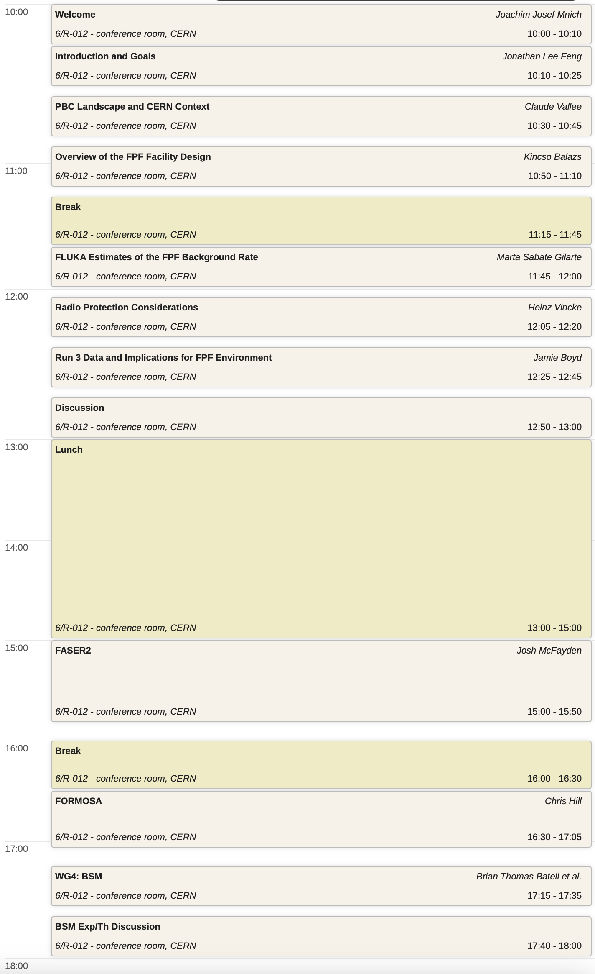
FPF5 TUESDAY
Morning
  CERN Welcome
  Introduction and Goals
  CERN Context
    Relationship to other PBC projects, including ECN3, HIKE/SHADOWS, SHiP
  Facilities Talks
    New site investigation plans
    Studies to understand the experimental environment better
Afternoon
  FASER2
  FORMOSA
  WG4: BSM
  BSM Exp/Th Discussion
    New models that merit attention
    New foci, e.g., complementarity with other CERN projects

Slide 9
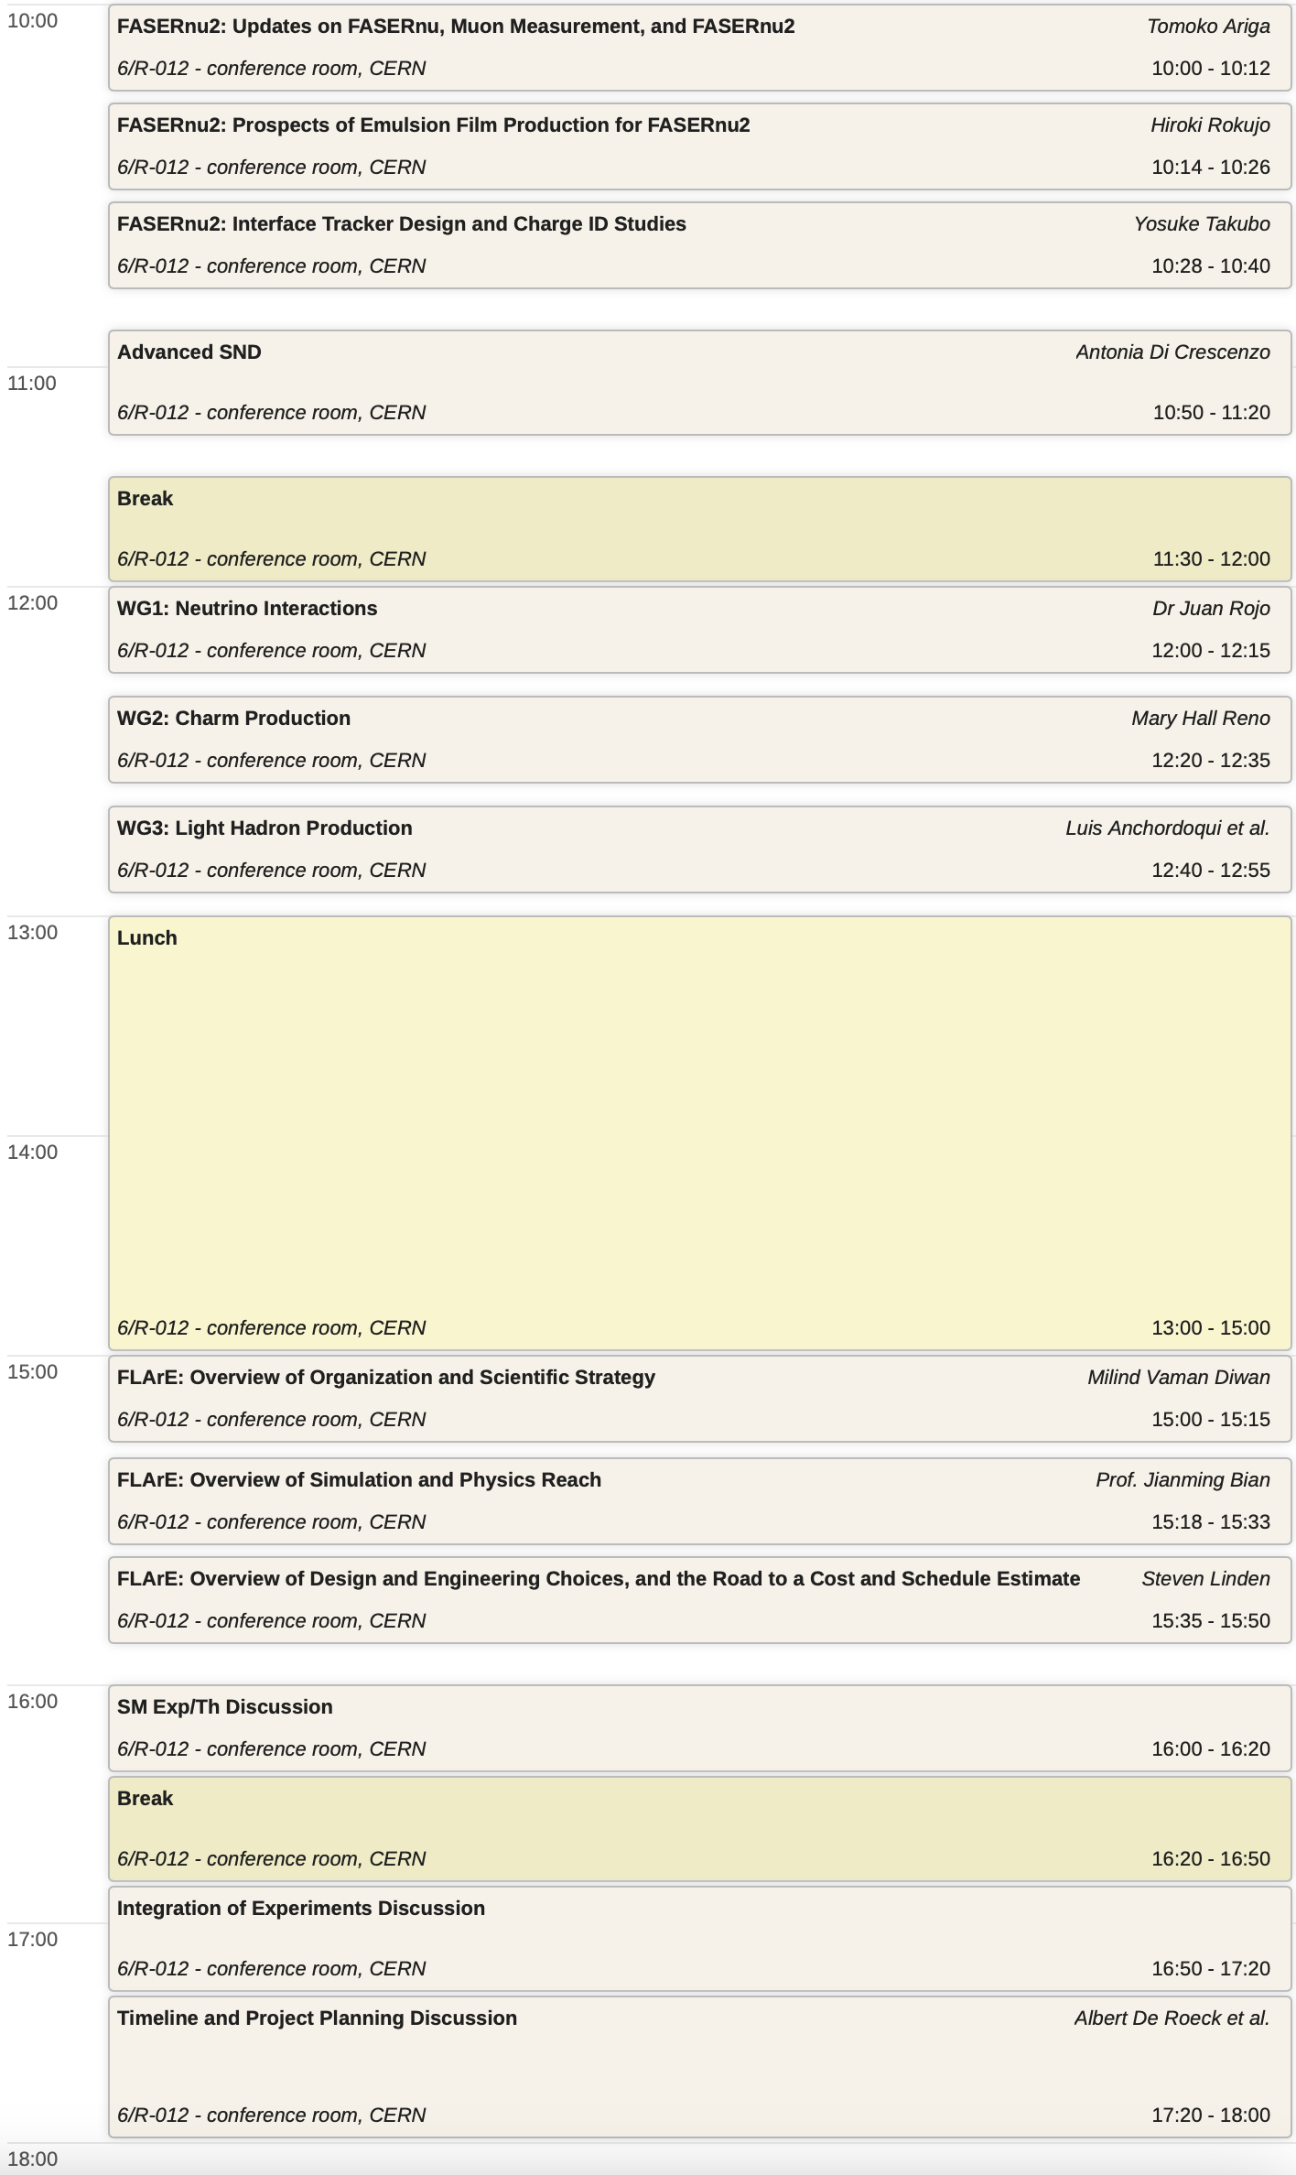
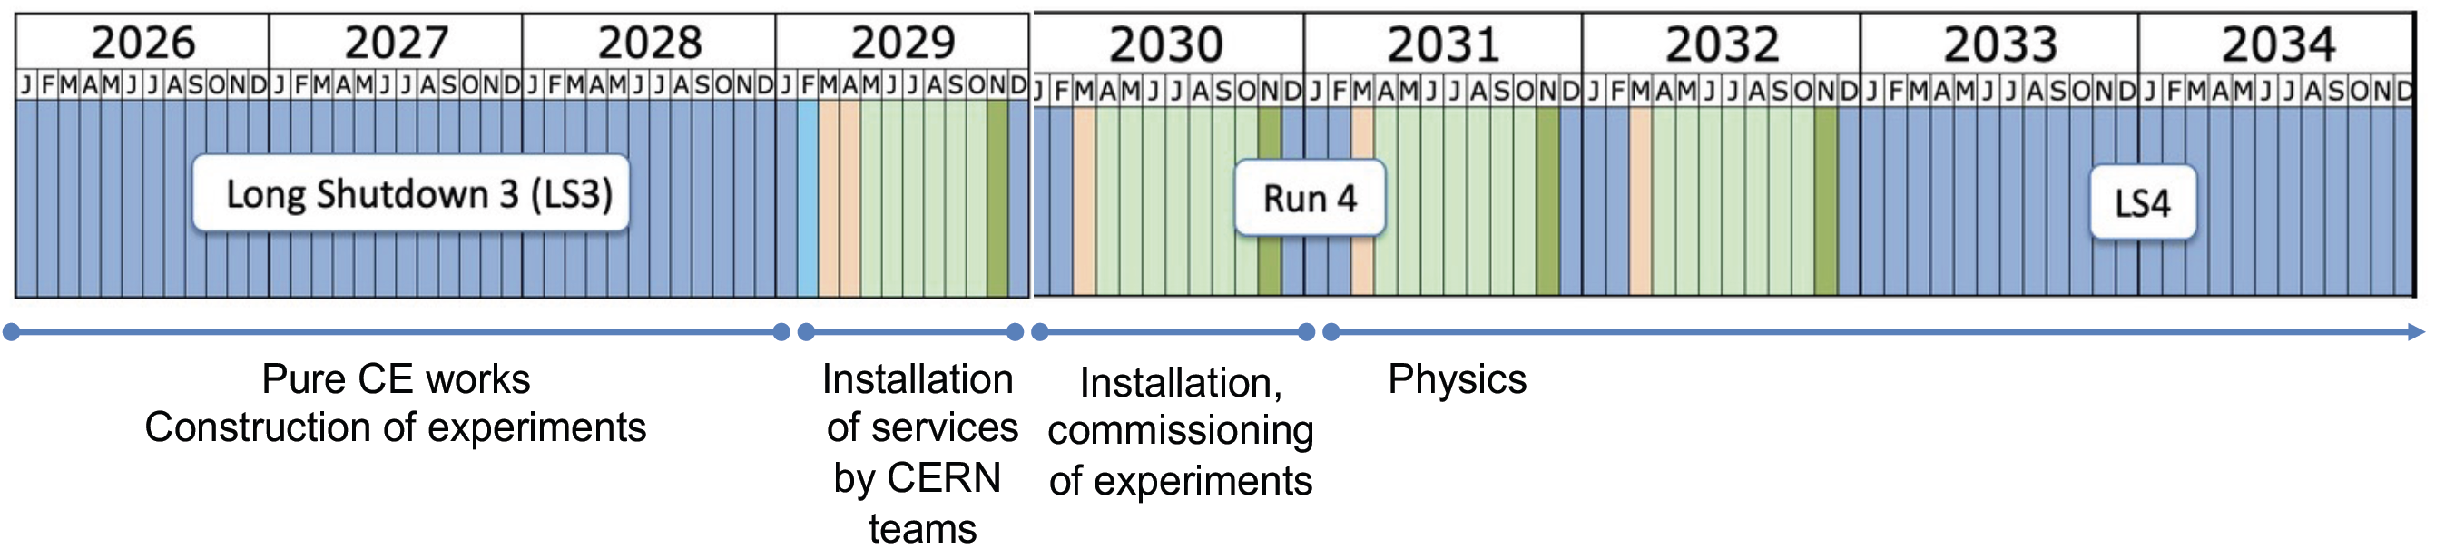
FPF5 WEDNESDAY
Morning
  FASERnu2
  Advanced SND
  WG1: Neutrino Interactions
  WG2: Charm Production
  WG3: Light Hadron Production
Afternoon
  FLArE
  SM Exp/Th Discussion
    Exp-Th connections, WG liaisons
  Integration of Experiments Discussion
    Synergies between experiments
  Timeline and Physics Planning Discussion
    Upcoming milestones, next goals

