Slide 1




NEUTRINOS AND FAR-FORWARD PHYSICS AT THE LHC
Physics/Theory Colloquium, Los Alamos National Laboratory
Milind Diwan (BNL) and Jonathan Feng (UC Irvine), 11 August 2022

Slide 2
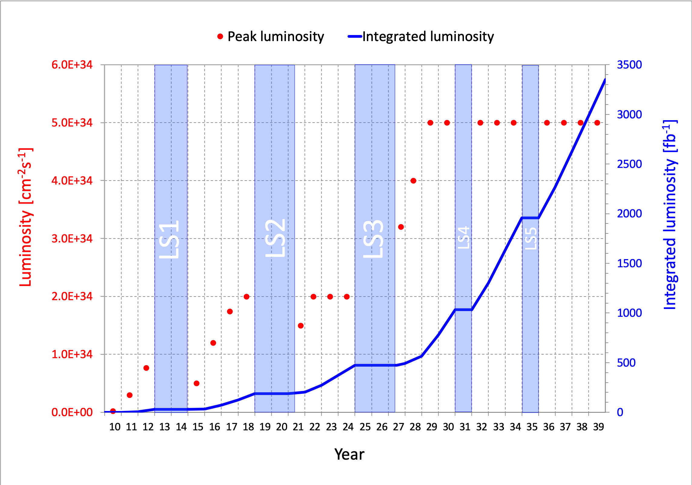
PARTICLE PHYSICS: CURRENT STATUS
This is a critical time in particle physics: the Higgs boson was discovered in 2012, but we have not discovered any other evidence of new particles, and many fascinating problems remain (neutrino masses, dark matter, gauge and flavor hierarchy problems, …).
At the energy frontier, the LHC has just emerged from Long Shutdown 2.
Much more to come:
Run 3, 2022-25, 300 fb⁻¹
HL-LHC, 2029-42, 3-4 ab⁻¹
What can we do to enhance the physics potential of the (HL-)LHC?

Slide 3
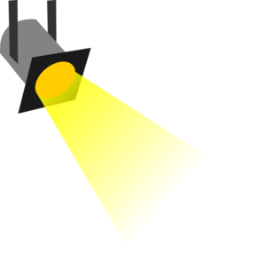
THE PHYSICS LANDSCAPE
Particle
Colliders
Mass
MeV
GeV
TeV
1
Already
Discovered
Strongly Interacting
Heavy Particles
(Higgs, top, SUSY, …)
The WIMP Miracle motivates the upper right corner.
The WIMPless Miracle motivates the whole diagonal, including the lower left quadrant (LLPs, FIPs, portals, dark sectors…)
Too Little to be
Dark Matter
Interaction Strength
Just Right to
be Dark Matter
10⁻³
Weakly Interacting
Light Particles
(neutrinos, LLPs, ...)
Impossible to
Discover
10⁻⁶
Too Much to be
Dark Matter
Feng, Kumar (2008)
Boehm, Fayet (2003)
Pospelov, Ritz, Voloshin (2007)

Slide 4
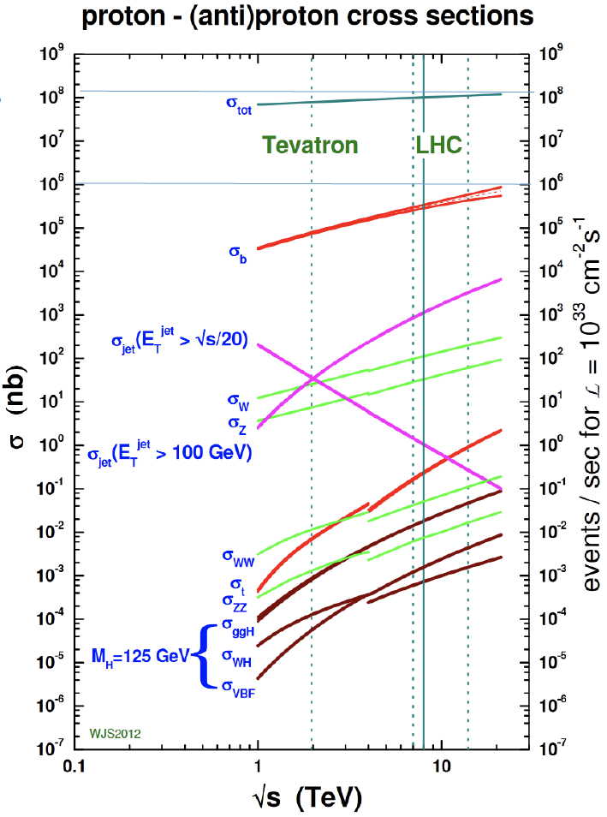
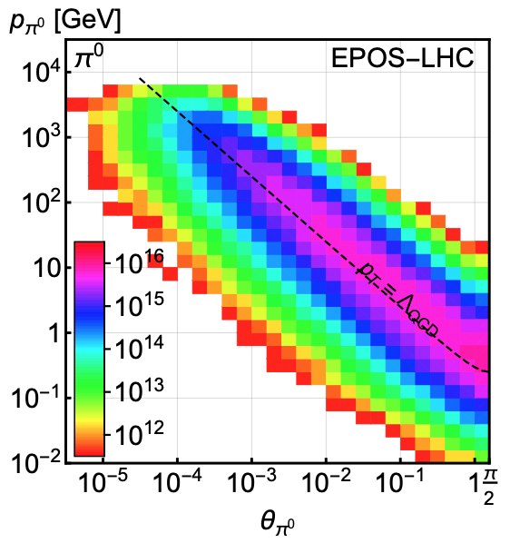
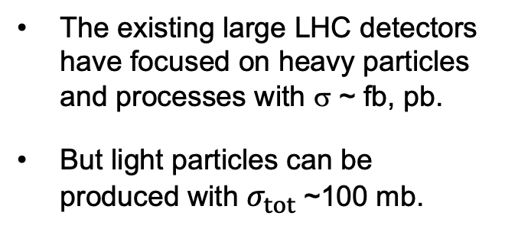
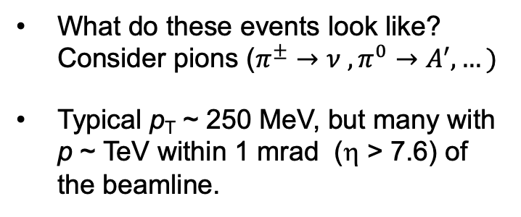
LHC PARTICLE PRODUCTION
300 fb⁻¹
Feng, Galon, Kling, Trojanowski (2017)
The existing large LHC detectors have focused on heavy particles and processes with σ ~ fb, pb.
But light particles can be produced with $σ_{tot}$~100 mb.
What do these events look like? Consider pions ($π^{±}→ν ,π^{0}→A^{′}, …)$
Typical p_{T} ~ 250 MeV, but many with p ~ TeV within 1 mrad (η > 7.6) of the beamline.

Slide 5

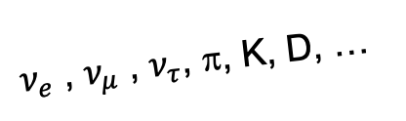
THE PROMISE OF FAR-FORWARD PHYSICS
Particles that close to the beamline are not seen by existing large LHC detectors. They were designed to find strongly-interacting heavy particles.
But weakly-interacting light particles are dominantly produced in the rare decays of light particles (π, η, K, D, B, …) along the forward direction, and so escape through the blind spots down the beamline.
There are both SM and BSM motivations to explore the “wasted” σ_{tot} ~ 100 mb and cover these blind spots in the far forward region.
SUSY, top, Higgs, …
A’, a, mCPs, DM, …
$ν_{e}$ , $ν_{μ}$ , $ν_{τ}$, π, K, D, …

Slide 6
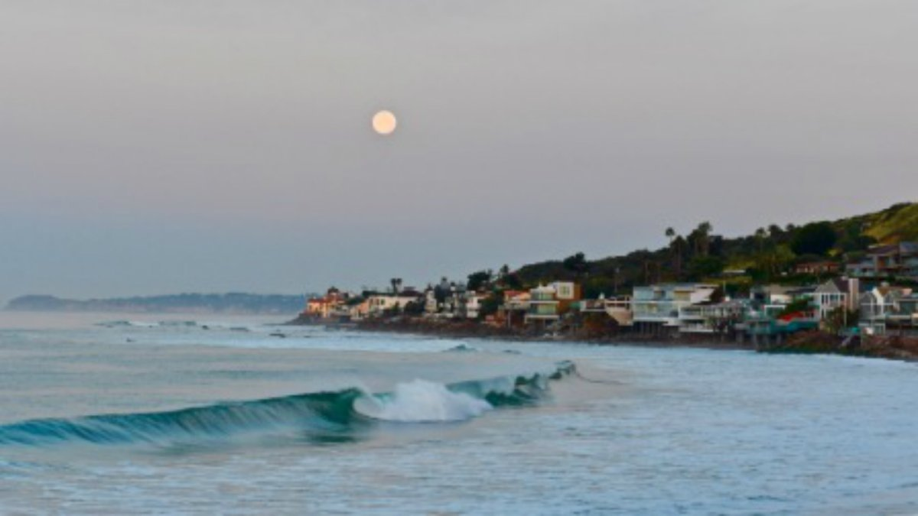
HOW BIG DO THE DETECTORS HAVE TO BE?
Momentum:
Space:
250 MeV
1 TeV
12 cm
480 m
Particles produced in pion decays have θ ~ 0.2 mrad (η ~ 9); cf. the moon (7 mrad).
Particles produced in π, η, K, D, B decay are therefore far more collimated than shown below, motivating new, small, fast, and cheap experiments at the LHC.

Slide 7
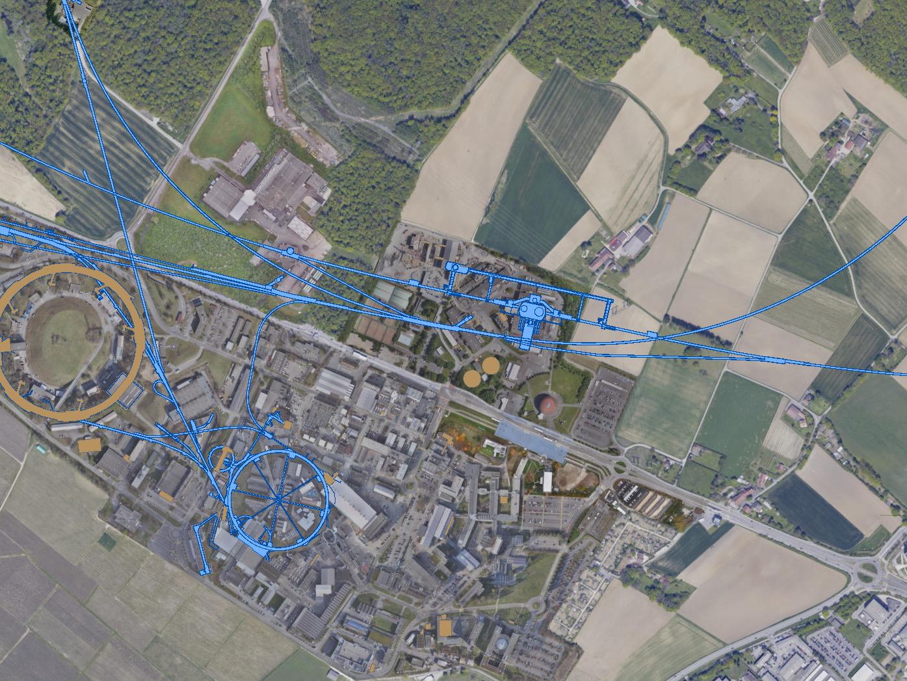
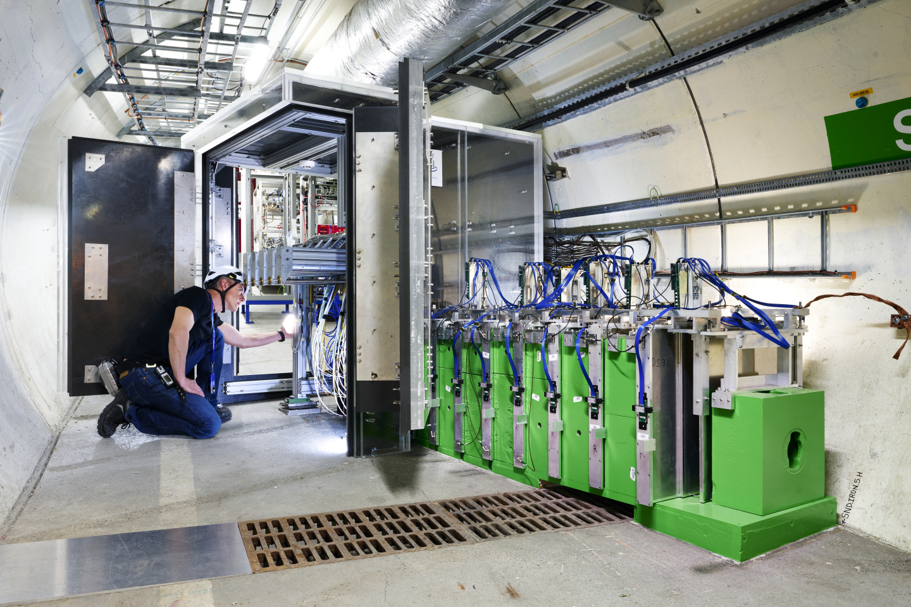
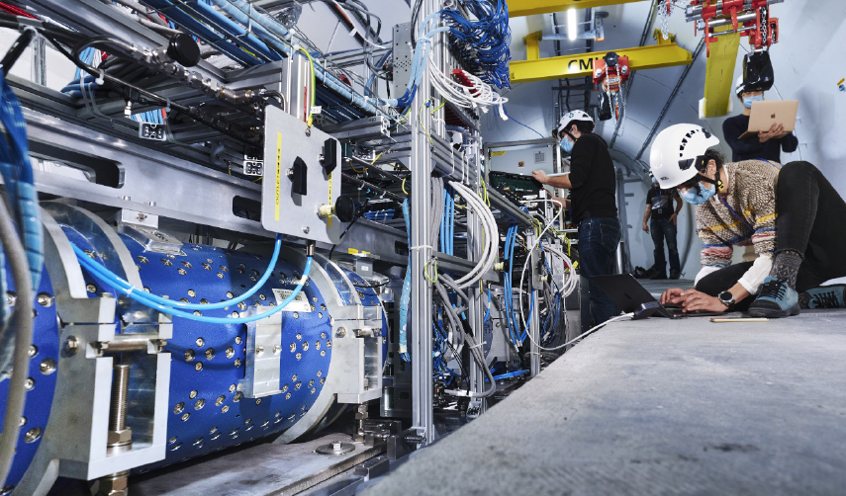
CURRENT FAR FORWARD DETECTORS
3 far forward detectors have been constructed and installed and are currently taking data in LHC Run 3: FASER, FASERν, and SND@LHC.
UJ18
ATLAS
SPS
SND@LHC
UJ12
LHC
FASER
FASERν
LOS
CERN GIS

Slide 8
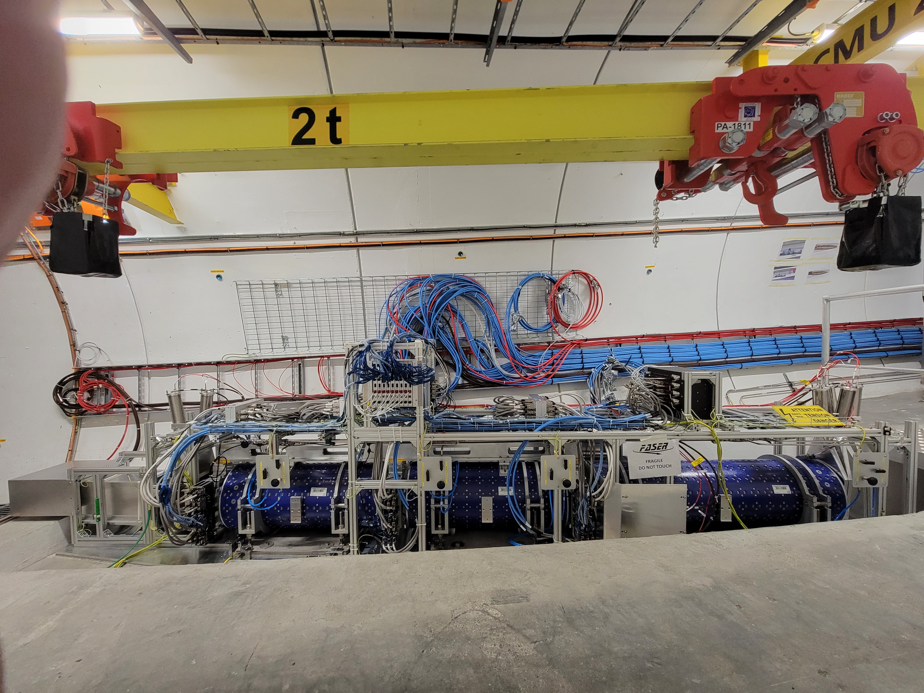
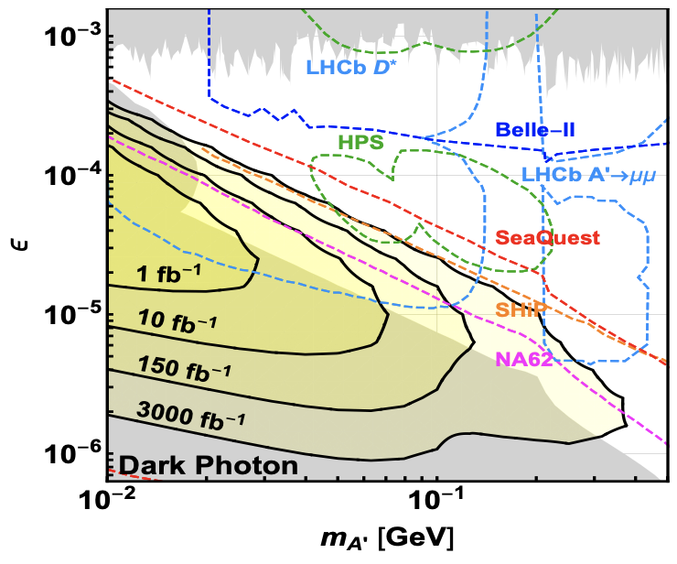
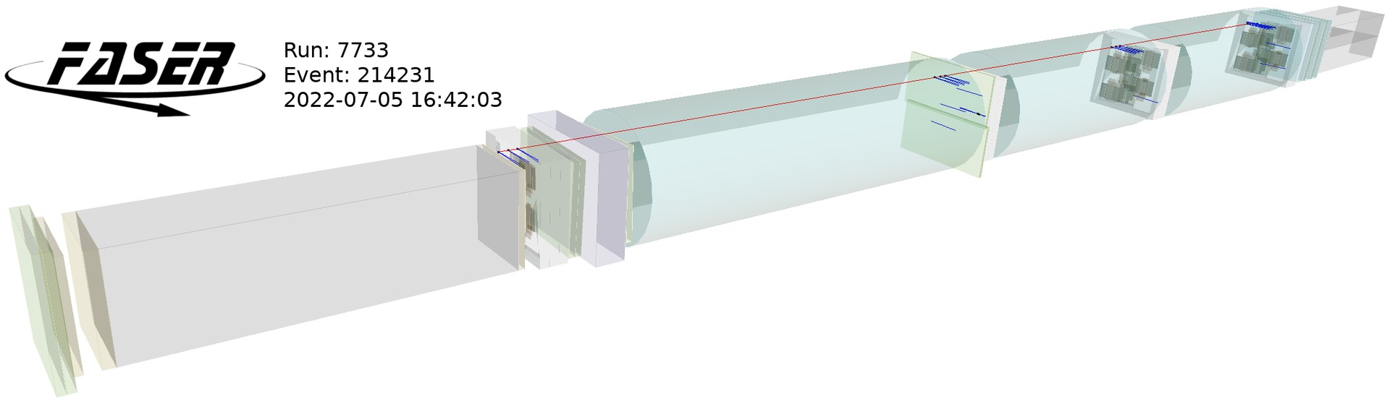
FASER CURRENT STATUS
LHC Run 3 started (officially) on 5 July 2022. Muon backgrounds are within ~30% of expectations (i.e., negligible), and FASER already has enough data to exclude or discover proposed LLPs in new regions parameter space.

Slide 9
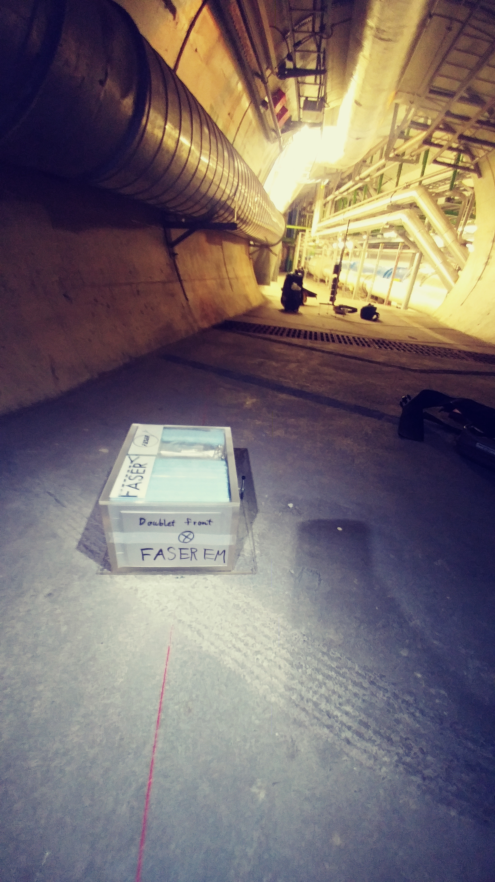
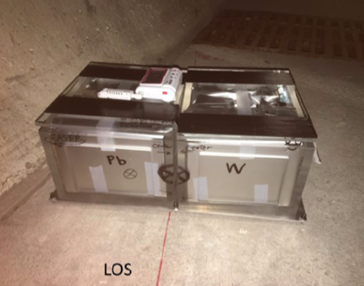
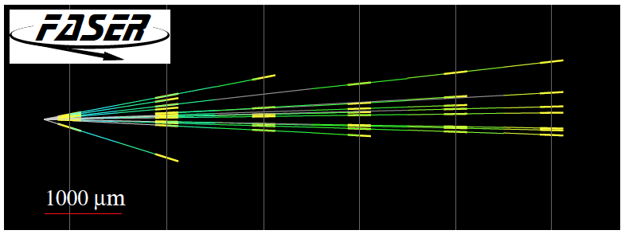
FASERν CURRENT STATUS
In 2018 a FASER pilot emulsion detector with 11 kg fiducial mass collected 12.2 fb⁻¹ on the beam collision axis (installed and removed during Technical Stops).
In May 2021, the FASER Collaboration announced the direct detection of 6 candidate neutrinos above 12 expected neutral hadron background events (2.7σ).
In LHC Run 3, FASERν will observe ~10,000 TeV-neutrino interactions.

Slide 10
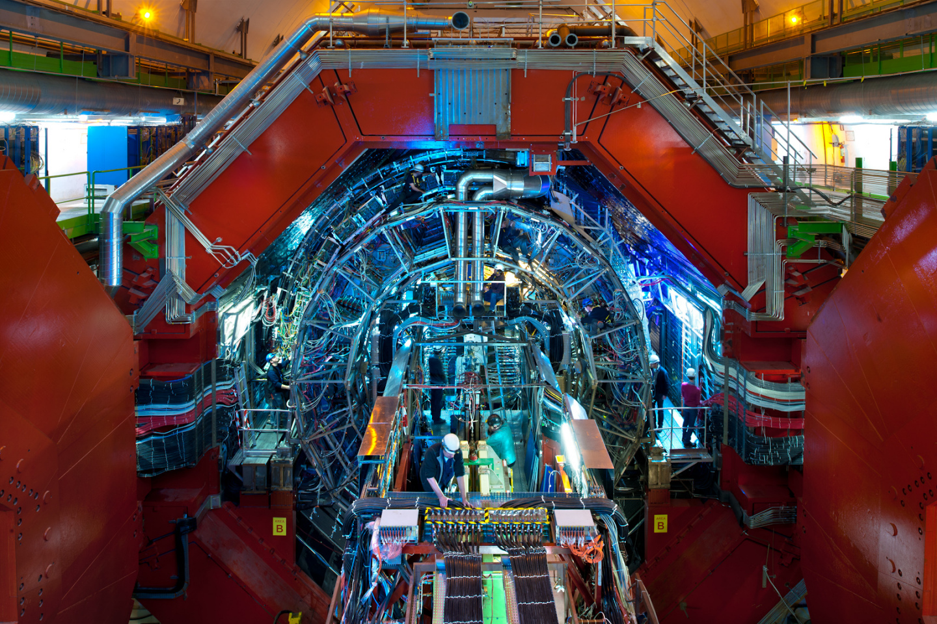
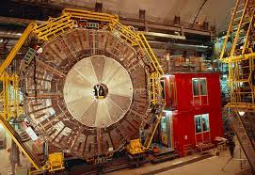
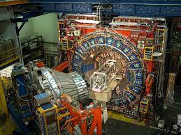
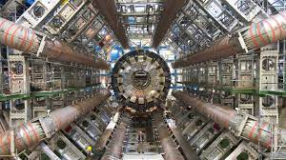
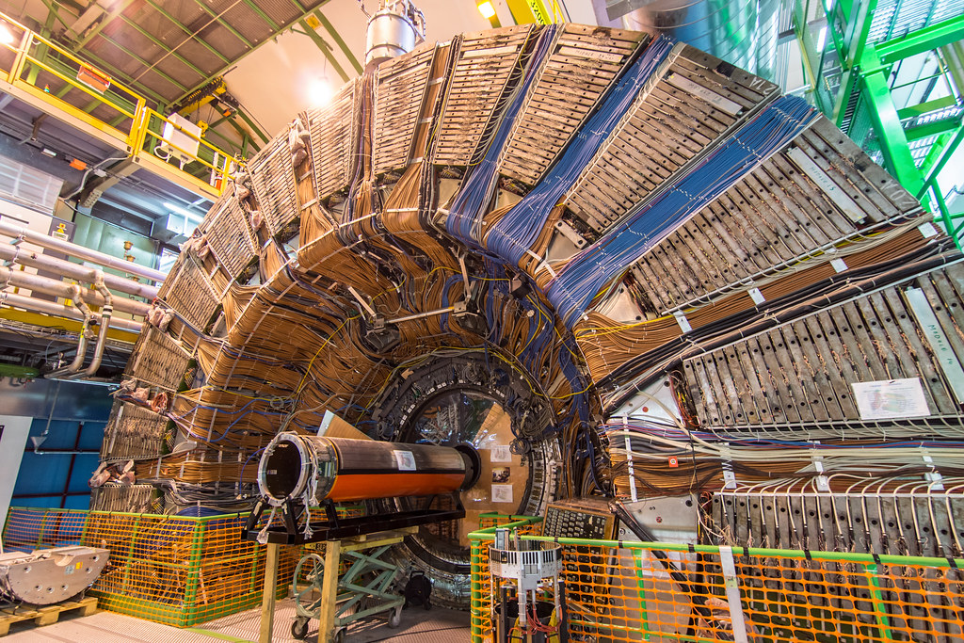
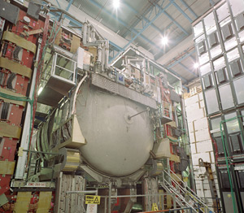
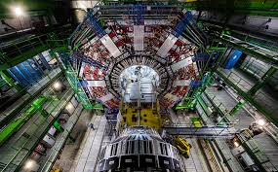
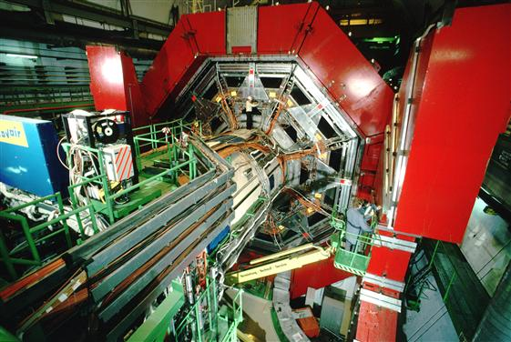

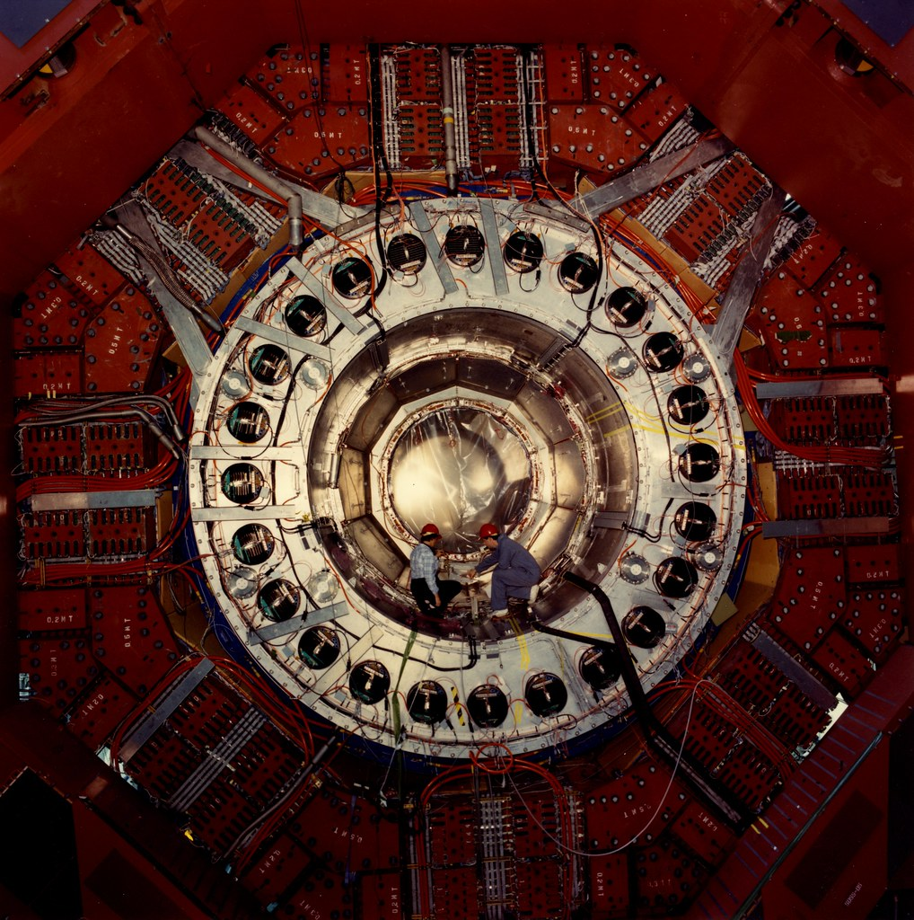
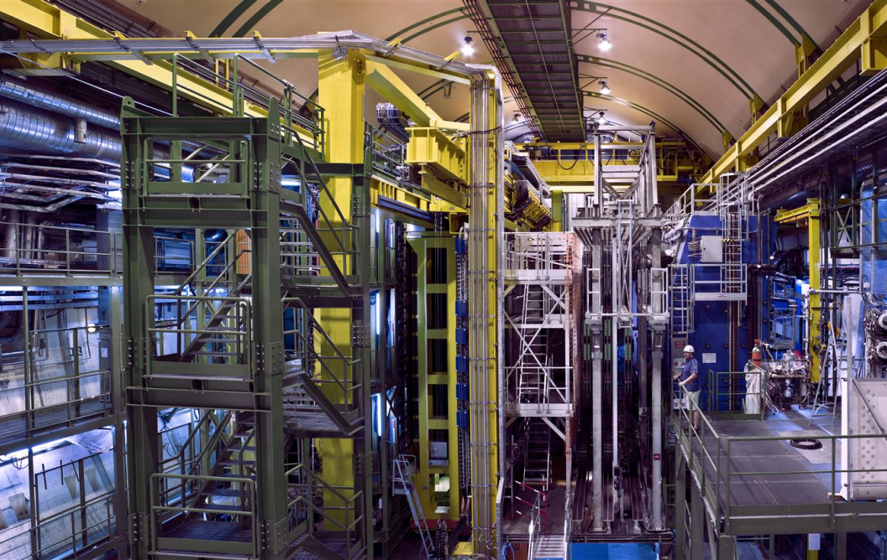
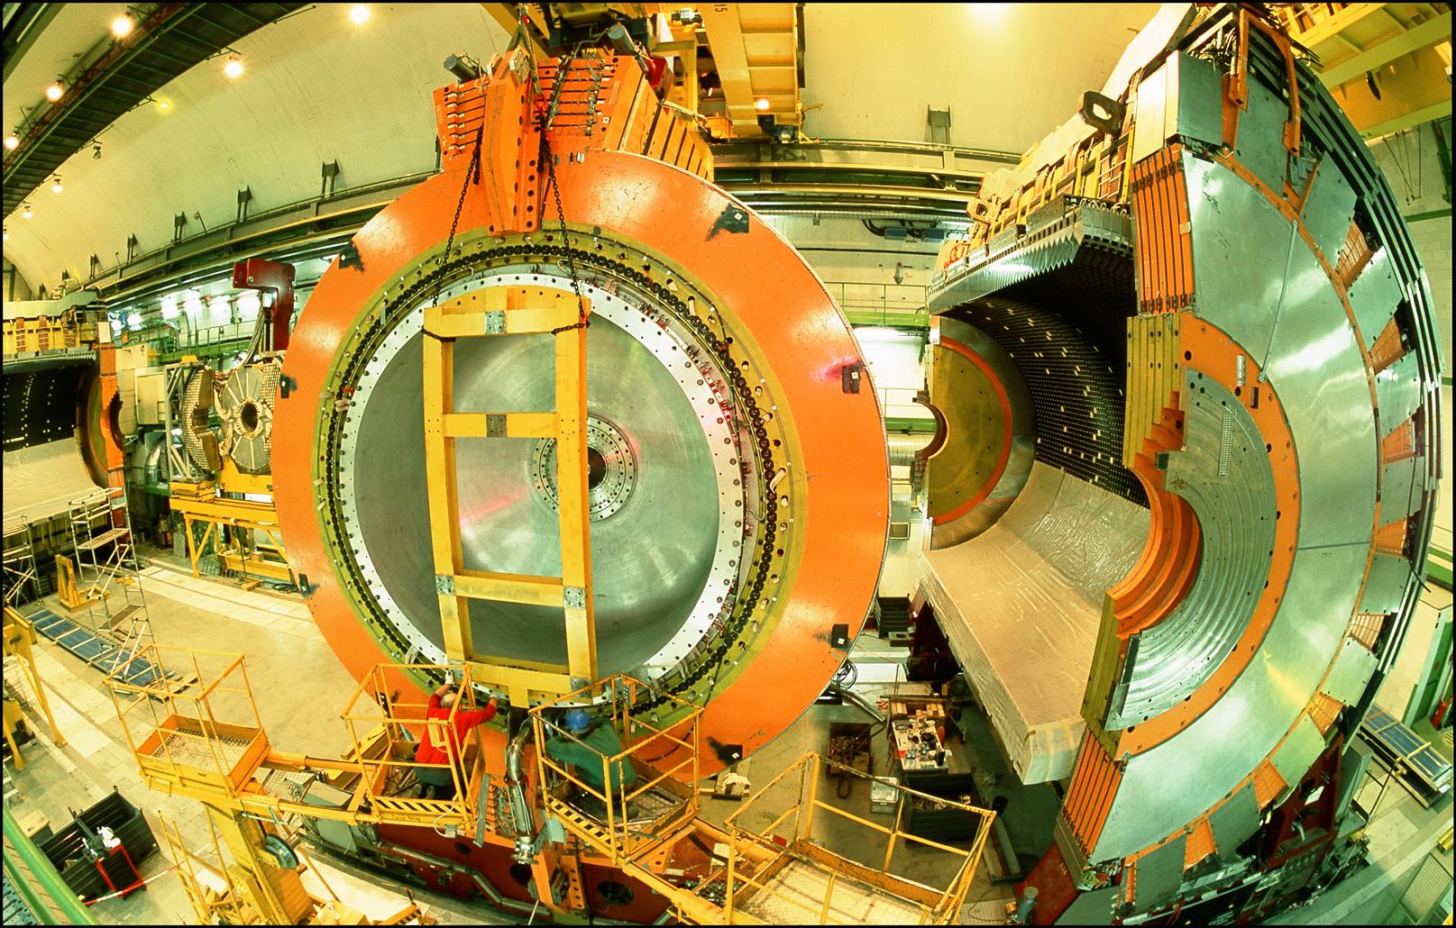
LOCATION, LOCATION, LOCATION
…
ALICE
ALEPH
CDF
FASER Pilot Detector
Suitcase-size, 4 weeks
$0 (recycled parts)
6 candidate neutrinos
ATLAS
DELPHI
D0
CMS
L3
LHCb
SLD
OPAL
All previous
collider detectors
Building-size, decades
~$10⁹
0 candidate neutrinos
This opens up a new field: neutrino physics at colliders

Slide 11
FORWARD PHYSICS FACILITY
FASER, FASERν, and SND@LHC are currently highly constrained by 1980’s (LEP!) infrastructure that was never intended to support experiments.
The rich physics program therefore strongly motivates creating a dedicated Facility to house far-forward experiments for the HL-LHC era from 2029-2042.
FPF Meetings
  FPF Kickoff Meeting, 9-10 Nov 2020, https://indico.cern.ch/event/955956
  FPF2 Meeting, 27-28 May 2021, https://indico.cern.ch/event/1022352
  FPF3 Meeting, 25-26 Oct 2021, https://indico.cern.ch/event/1076733
  FPF4 Meeting, 31 Jan-1 Feb 2022, https://indico.cern.ch/event/1110746
FPF Papers
  “Short” Paper: 75 pages, 80 authors (2109.10905, Physics Reports 968, 1 (2022)).
  Snowmass White Paper: 429 pages, 392-authors+endorsers (2203.05090, J. Phys. G).
FPF-related talks at Snowmass
  July 18: EF05-07, Hallsie Reno
  July 20: EF09/RF06, Jonathan Feng
  July 21: NF02, Felix Kling
  July 22: EF/NF: Milind Diwan
  July 24: NF04/CF07, Ina Sarcevic
  July 26: Small- and Mid-Scale Experiments/Facilities, Jonathan Feng
  Many summary discussions, talks, panels

Slide 12
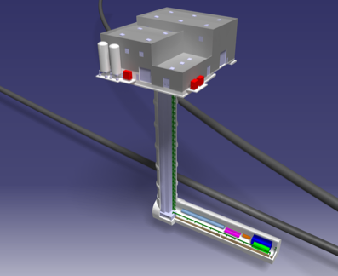
THE FPF SITE
Site selection has been completed: the CERN civil engineering team considered and documented promising sites and identified a preferred location on CERN land in France, 620-685 m west of the ATLAS IP, shielded by ~200 m of rock.

Slide 13
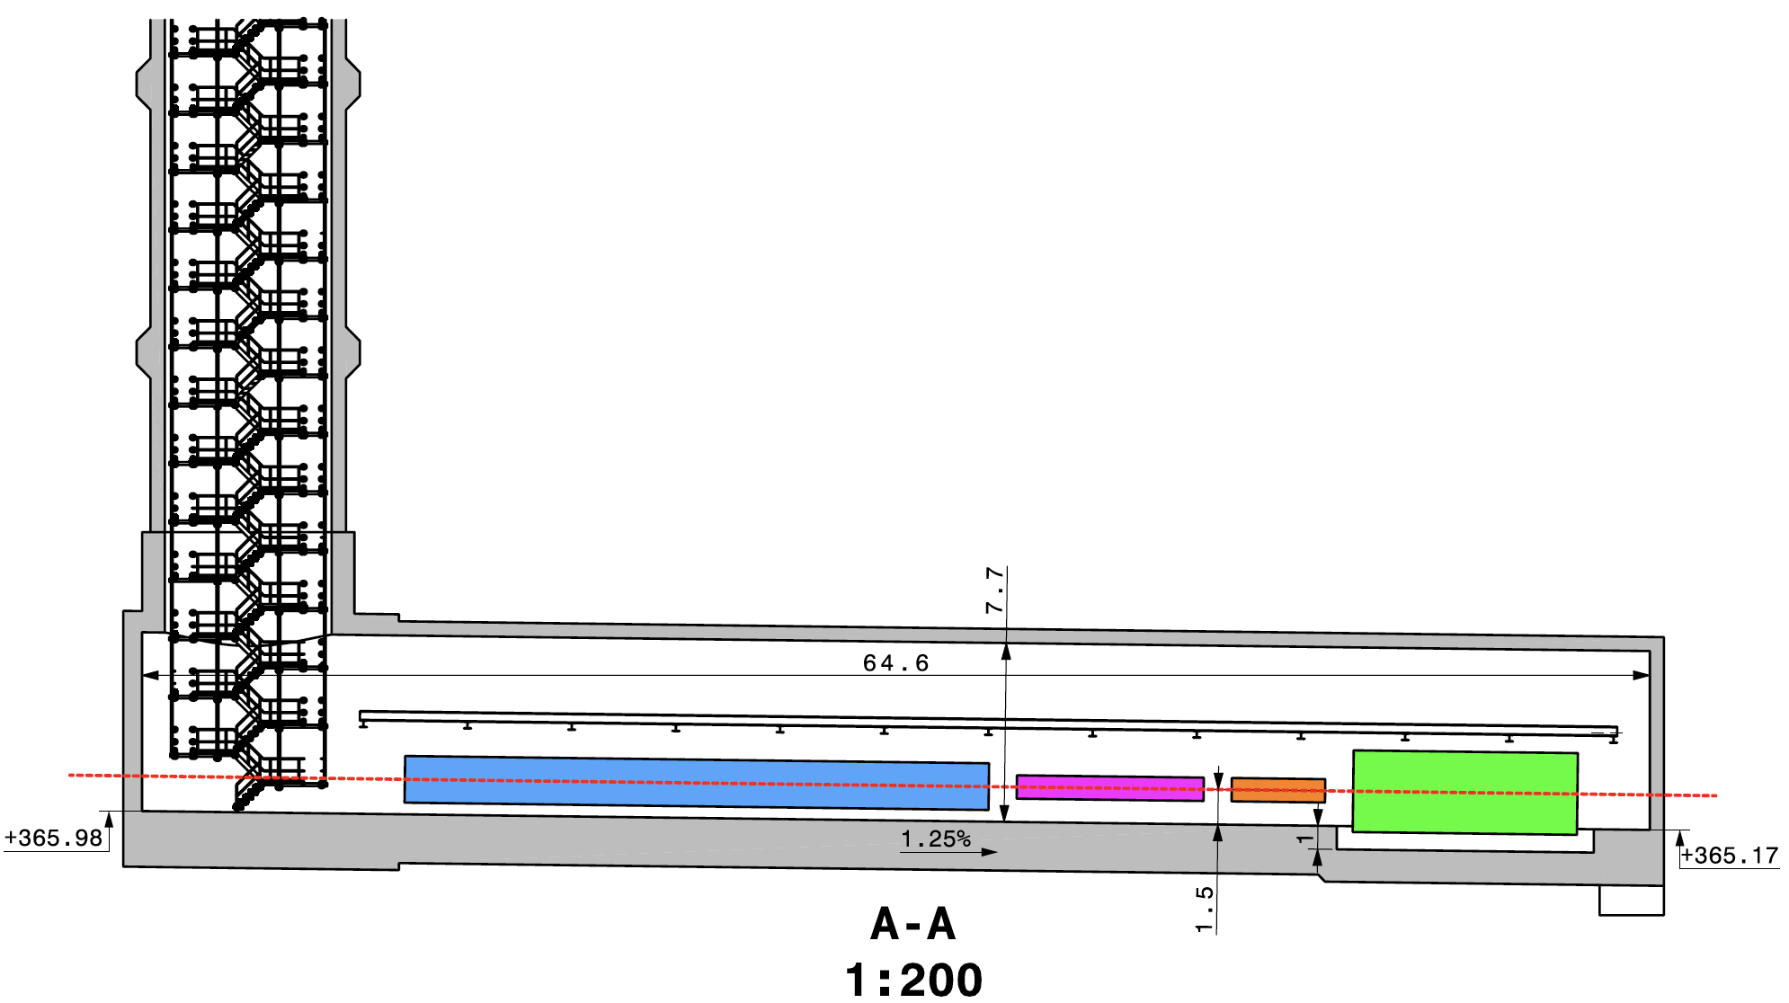
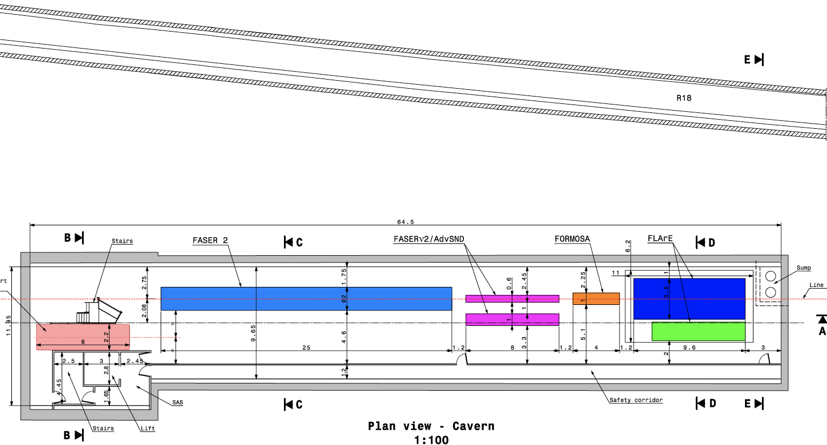
CAVERN AND SHAFT
Cavern: 65m long, 8m wide/high. Shaft: 88m-deep, 9.1m-diameter.
The FPF is completely decoupled from the LHC: no need for a safety corridor connecting the FPF to the LHC, preliminary RP and vibration studies indicate that FPF construction will have no significant impact on LHC operation.

Slide 14
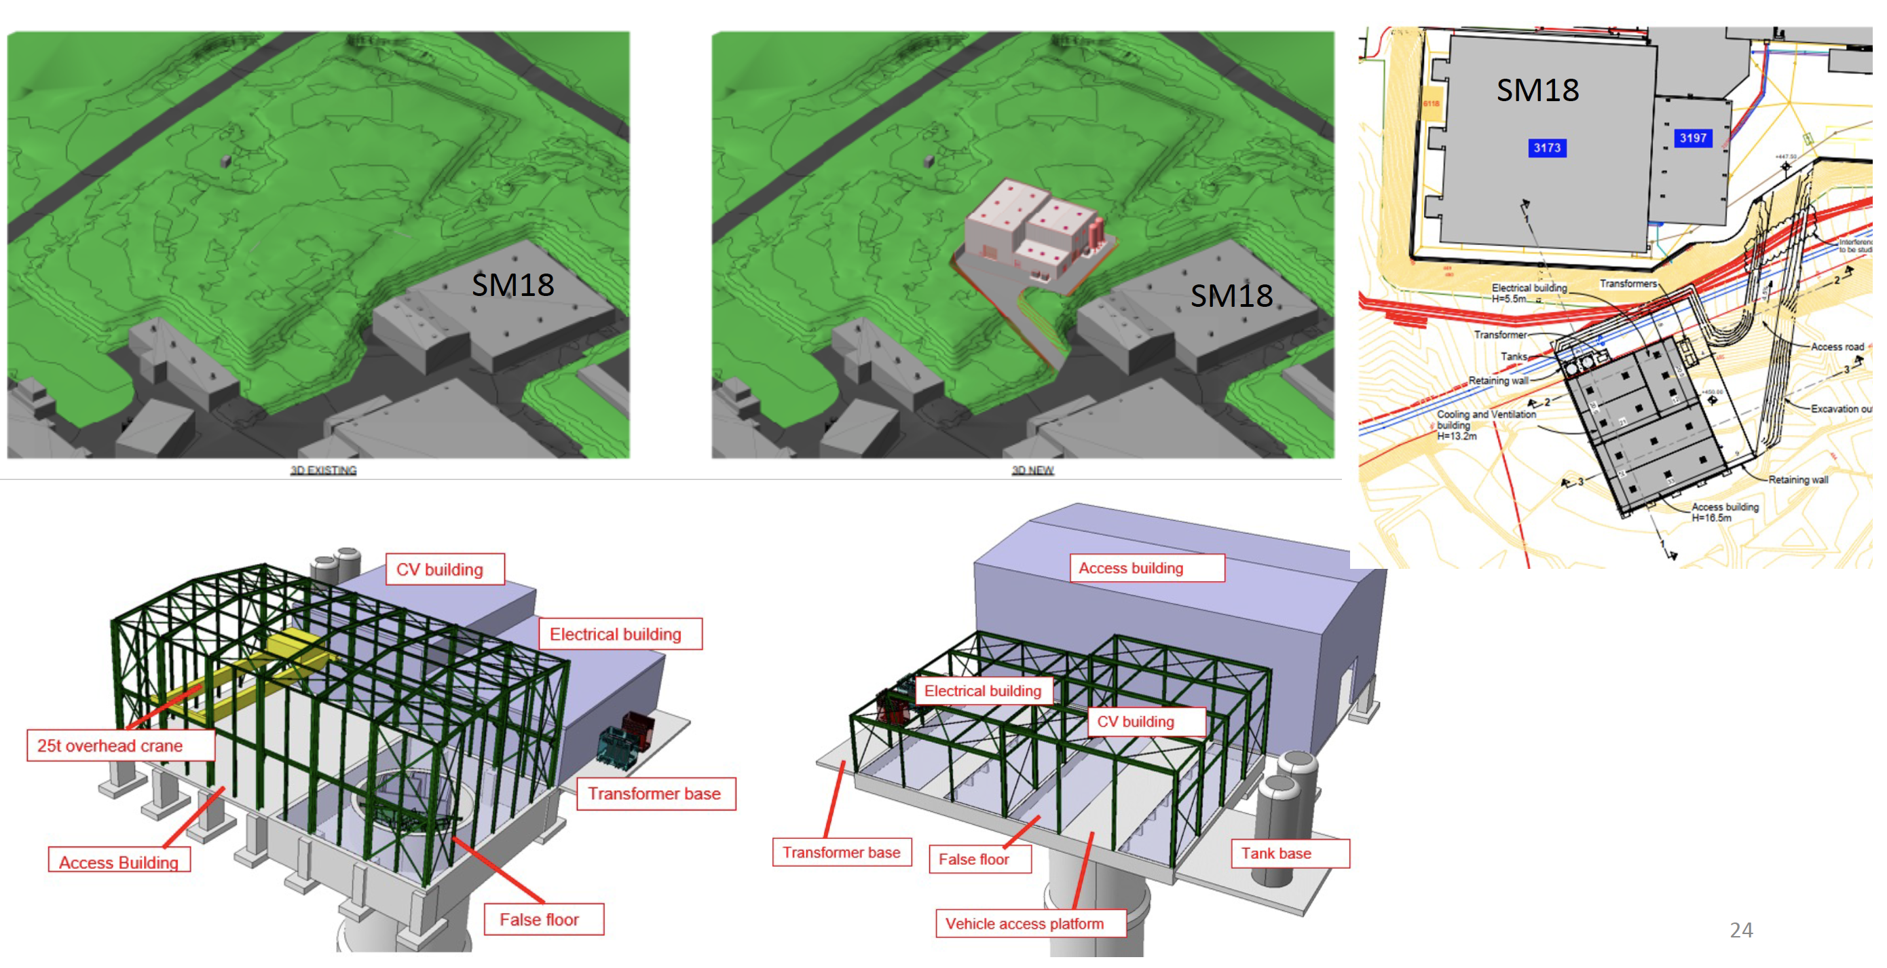
SURFACE BUILDINGS
Kincso Balazs,
John Osborne,
CERN CE (2022)

Slide 15
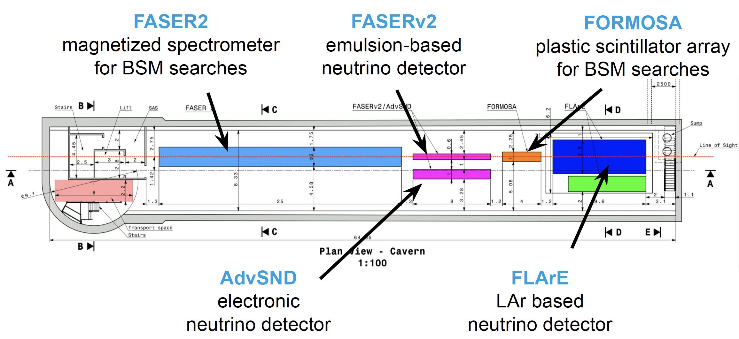
FPF EXPERIMENTS
At present there are 5 experiments being developed for the FPF.
Pseudo-rapidity coverage in the FPF is η > 5.5, with most experiments on the LOS covering η > 7.
Kling (2022)

Slide 16
FPF PHYSICS
The FPF is a general purpose facility with a broad SM and BSM physics program that expands on the physics of FASER and FASERν. For details, see the FPF White Paper.

