Slide 1



DARK MATTER AND
DARK SECTORS
Theory Frontier Session, Snowmass 2022
23 July 2022
Jonathan Feng, UC Irvine

Slide 2
INTRODUCTION
Dark Matter and Dark Sectors is currently a topic of great interest.
Many talks at Snowmass, including several talks with almost the identical title:
  Dark Matter and Dark Sectors: from Theory to Discovery in the Lab, Wednesday, Masha Baryakhtar
  Dark Matter and Dark Sectors: from Theory to Discovery in the Sky, Wednesday, Joshua Foster
  Understanding Dark Matter and Dark Sectors at RP Frontier, Wednesday, Stefania Gori
  Dark Matter and Dark Sectors, Saturday, Jonathan Feng
Some of the interest follows null results from LHC and ton-scale WIMP searches. But, as I will discuss, there are strong independent reasons to consider dark sectors, and much of the initial interest preceded these null results.
Connections to almost every frontier, and also to adjacent fields (nuclear physics, condensed matter physics, AMO, and, of course, astrophysics).
A beautiful example of what can result from the serious and persistent interaction of theorists and experimentalists.

Slide 3
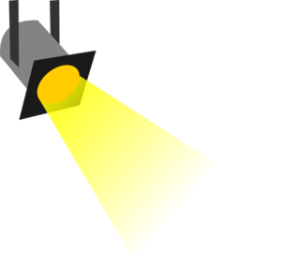
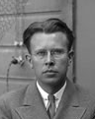





WHERE IS THE NEW PHYSICS?
Particle
Colliders
Mass $M$
MeV
GeV
TeV
1
Already
Discovered
(1) Strongly Interacting
Heavy Particles
(Higgs, top, SUSY, …)
Interaction Strength $g$
10⁻³
$\frac{g^{2}}{M^{2}}$ ~ $G_{F}$ ~ $\frac{1}{M_{W}^{2}}$
(2) Weakly Interacting
Light Particles
(neutrinos, LLPs, …)
Impossible to
Discover
10⁻⁶
$\frac{g^{2}}{M^{2}}$ ~ $G_{N}$ ~ $\frac{1}{M_{Pl}^{2}}$

Slide 4

DARK SECTORS
DM is one of the strongest BSM motivations. In general, it is part of a dark sector. What are its most likely non-gravitational interactions?
Suppose the dark sector has U(1) electromagnetism. There are infinitely many possible SM-dark sector interactions, but one is induced by arbitrarily heavy mediators:
It is “most likely” because it is non-decoupling. Cf.
Note that it is also naturally small, since it is induced by a loop. This whole story is special to U(1).
SM
Dark
U(1)
M
Okun (1982), Galison, Manohar (1984), Holdom (1986)

Slide 5
DARK PHOTON, DARK HIGGS, STERILE NUS
This provides an organizing principle that motivates specific examples of new, weakly interacting light particles. There are just a few options:
Spin 1
→ dark photon, couples to SM fermions with suppressed couplings proportional to charge: εq_{f}. _{Holdom (1986)}
Spin 0
→ dark Higgs boson, couples to SM fermions with suppressed coupling proportional to mass: sin θ m_{f}. _{Patt, Wilczek (2006)}
Spin 1/2
→ sterile neutrino, mixes with SM neutrinos with suppressed mixing sin θ.
SM
Dark
Force
SM
Dark
Scalar
SM
Dark
Fermion

Slide 6
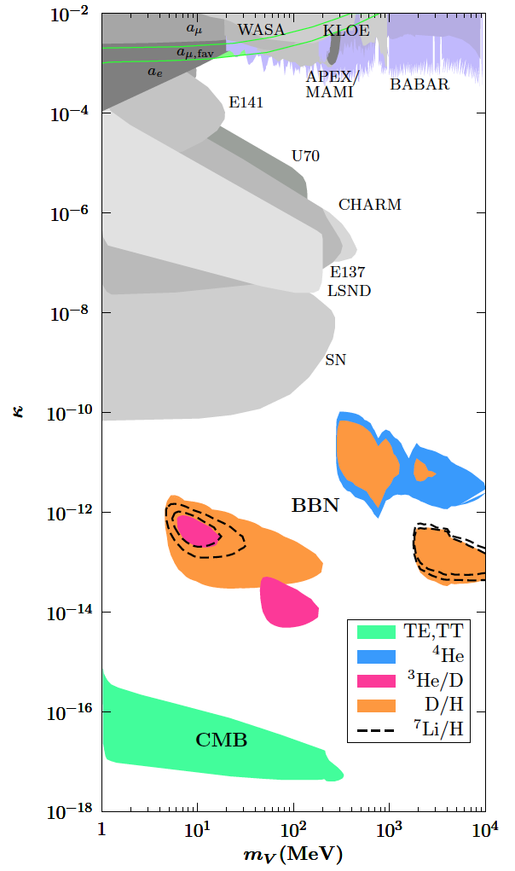
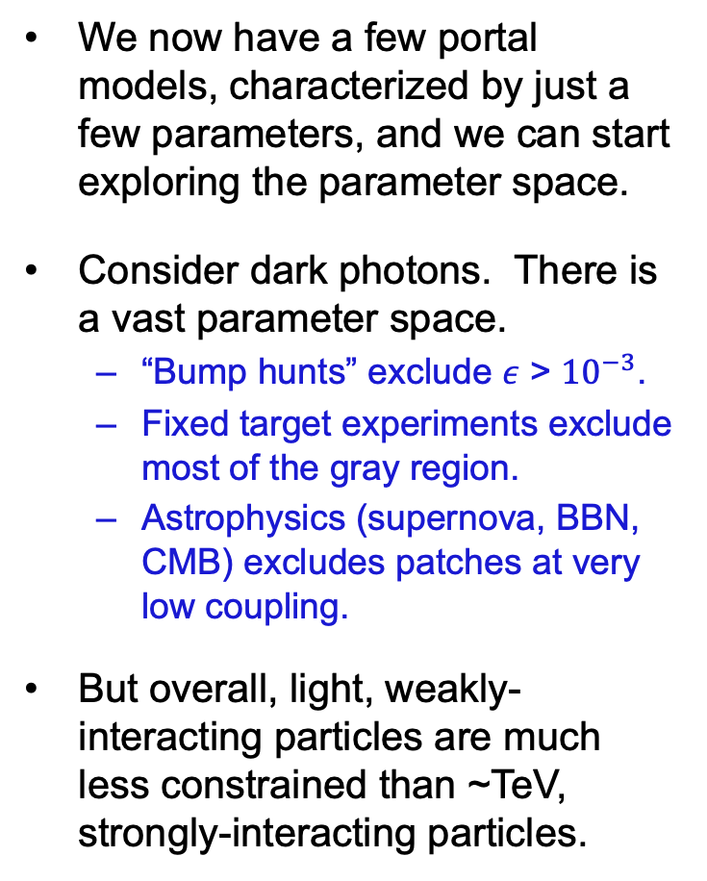
EXISTING CONSTRAINTS
We now have a few portal models, characterized by just a few parameters, and we can start exploring the parameter space.
Consider dark photons. There is a vast parameter space.
  “Bump hunts” exclude $ε$ > ${10}^{−3}$.
  Fixed target experiments exclude most of the gray region.
  Astrophysics (supernova, BBN, CMB) excludes patches at very low coupling.
But overall, light, weakly-interacting particles are much less constrained than ~TeV, strongly-interacting particles.
Fradette, Pospelov, Pradler, Ritz (2014)

Slide 7
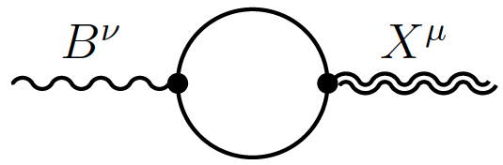
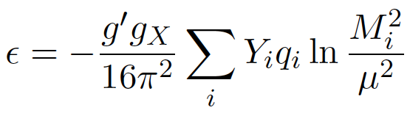
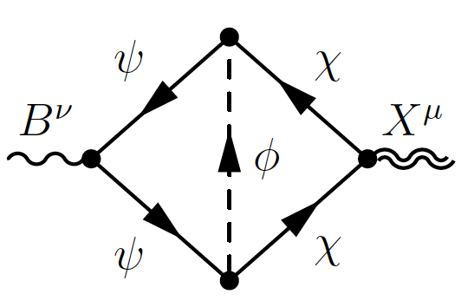
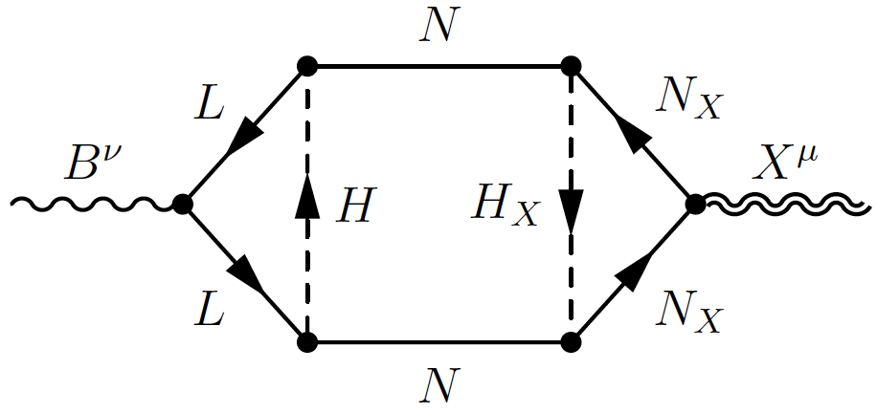
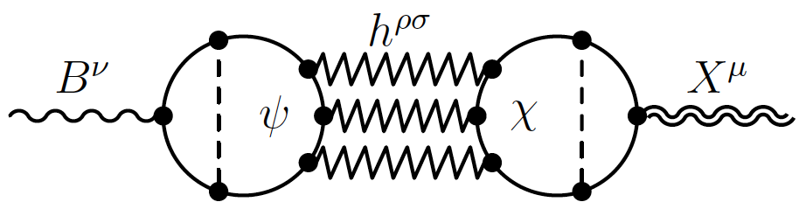
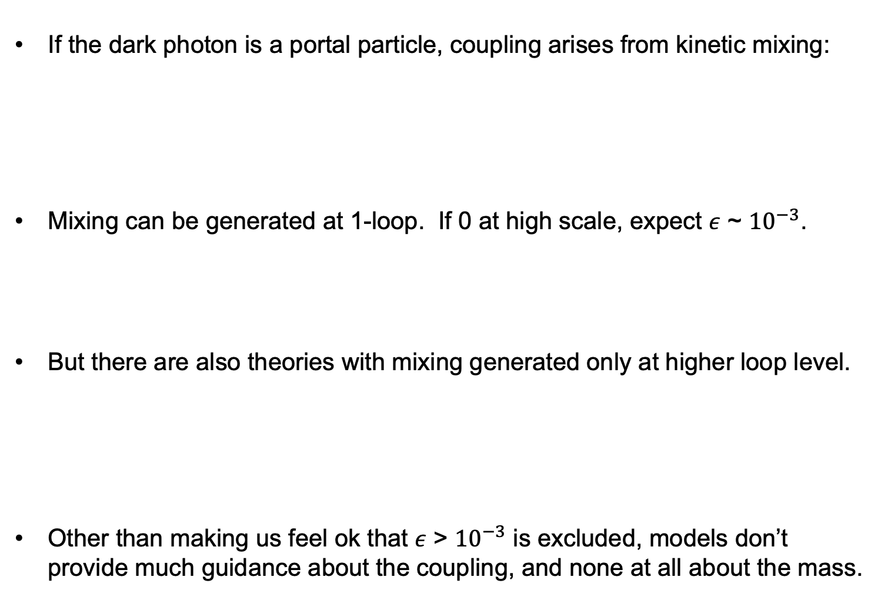
DARK PHOTON MODELS
If the dark photon is a portal particle, coupling arises from kinetic mixing:
Mixing can be generated at 1-loop. If 0 at high scale, expect $ε$ ~ ${10}^{−3}$.
But there are also theories with mixing generated only at higher loop level.
Other than making us feel ok that $ε$ > ${10}^{−3}$ is excluded, models don’t provide much guidance about the coupling, and none at all about the mass.
Visible Sector
SM, U(1)_{EM,} $B^{ν}$
$$\frac{1}{2}{ ε{ F}^{μν}F}_{Dμν}$$
Dark Sector
DM, Dark Forces, $X^{μ}$
Holdom (1986)
Gherghetta, Kersten, Olive, Pospelov (2019)

Slide 8
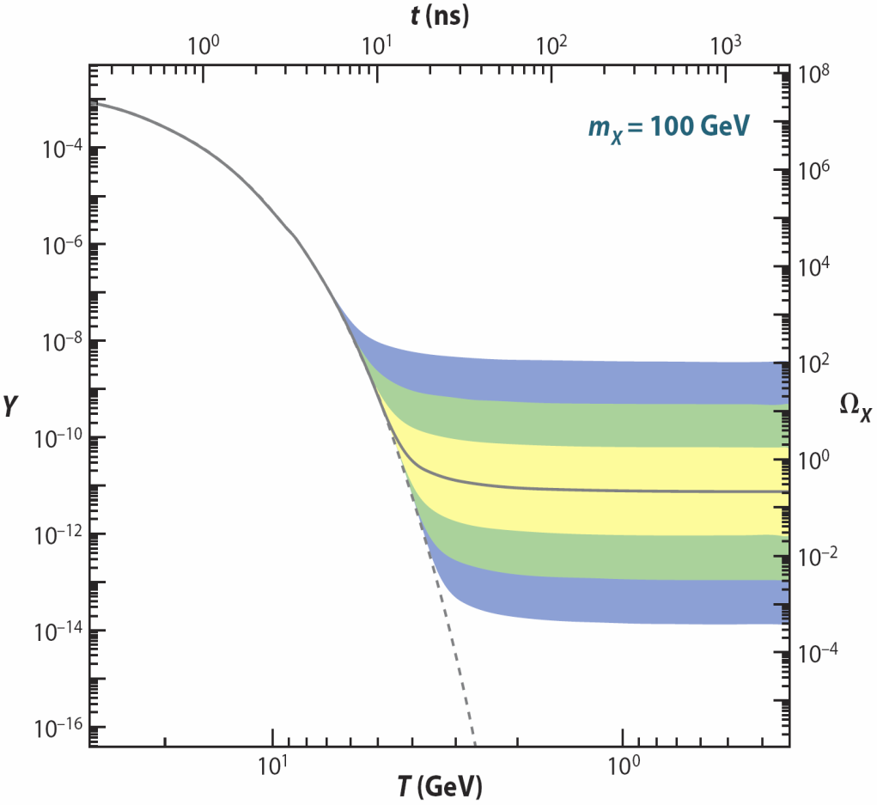
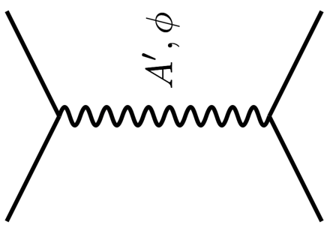

DARK MATTER
Particle
Colliders
Mass
MeV
GeV
TeV
1
Already
Discovered
(1) Strongly Interacting
Heavy Particles
(Higgs, top, SUSY, …)
Too Little to be
Dark Matter
Interaction Strength
Just Right to
be Dark Matter
10⁻³
DM
$$e$$
$$A’$$
(2) Weakly Interacting
Light Particles
(neutrinos, LLPs, …)
Impossible to
Discover
DM
$$e$$
10⁻⁶
Too Much to be
Dark Matter
<$σv$> ~ $\frac{ε^{2}}{m_{A′}^{2}}$

Slide 9
Dark Sector Candidates, Anomalies, and Search Techniques
zeV
aeV
feV
peV
neV
μeV
meV
eV
keV
MeV
GeV
TeV
PeV
30M☉
≈
QCD Axion
Sterile Neutrino
WIMPs
Ultralight Dark Matter
Hidden Thermal Relics / WIMPless DM
Black Holes
SIMPs / ELDERS
Asymmetric DM
X-ray Line
Beryllium-8
Muon g-2
Small-Scale Structure
Coherent Field Searches
Nuclear and Atomic Physics
Microlensing
Direct Detection (Low-Threshold and Spin-Dependent)
Accelerators
≈
zeV
aeV
feV
peV
neV
μeV
meV
eV
keV
MeV
GeV
TeV
PeV
30M☉
Cosmic Visions Report (2017)
Notes:
Targets: Freeze-In, Inflation Mechanism, Misalignment Mechanism

Slide 10
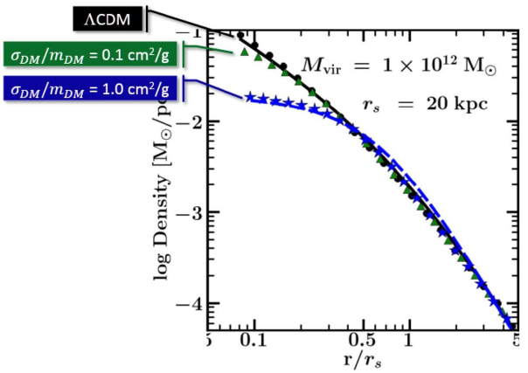




SELF-INTERACTING DARK MATTER
WIMP DM is in the “strongly interacting heavy particles” category. But there are indications that DM may not be WIMPs. No discovery so far, and also evidence from small-scale structure that dark matter may be strongly self-interacting.
For example, there appear to be halo profiles that are not as cuspy (high central density) as predicted for standard collisionless cold dark matter (WIMPs, axions, sterile neutrinos, …).
To smooth out the cusps, need a self-interaction cross section
$\frac{σ}{m}$ ~ $\frac{{cm}^{2}}{g}$ ~ $\frac{barn}{GeV}$ ~ ${(100 MeV)}^{−3}$
This can be explained by a dark sector mass scale of ~ 10-100 MeV (“dark neutrons interacting through dark pions”).
DM
$$\text{DM}$$
$$A’$$
DM
$$\text{DM}$$
Tulin, Yu (2017)
Rocha et al. (2012); Peter et al. (2012)
Vogelsberger et al. (2012); Zavala et al. (2012)
Notes:
10

Slide 11
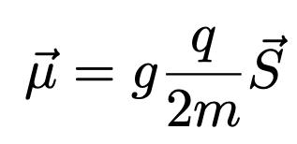

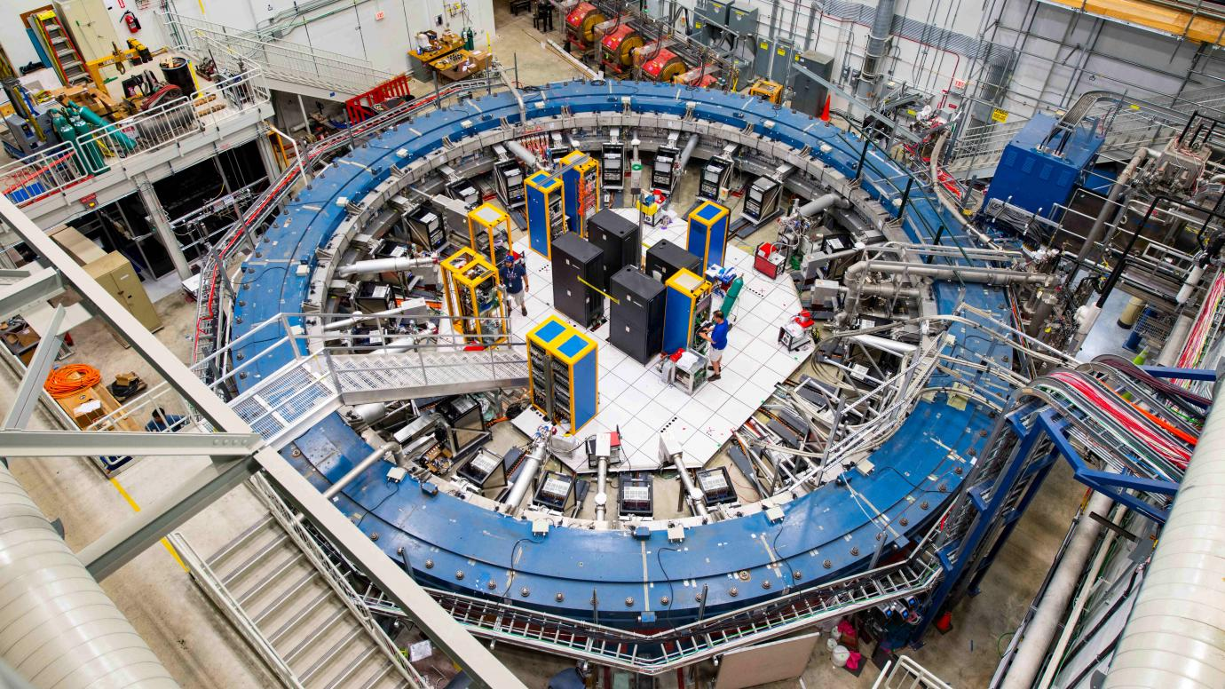
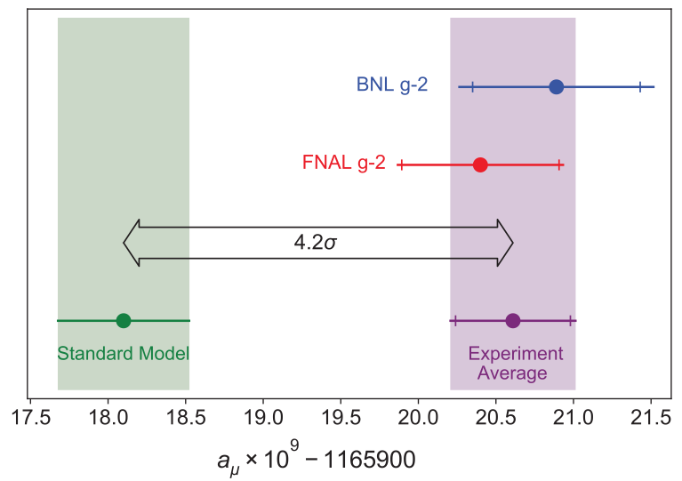
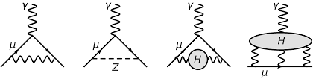
THE MUON’S ANOMALOUS MAGNETIC MOMENT
In 2021, the Muon g-2 Collaboration announced a high precision measurement that deviates from the SM prediction by 3.3σ.
It is sensitive to the weak interactions, but unlike other precision probes, it requires neither flavor nor CP violation, and so is a “natural” place for new particles to appear, provided they couple to muons.

Slide 12
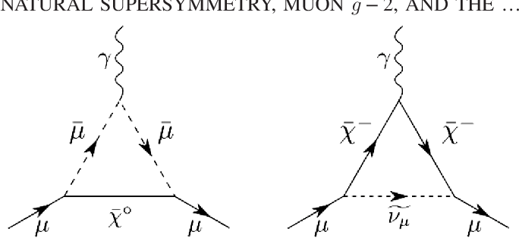
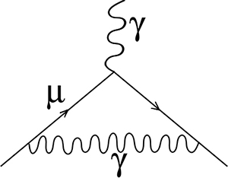
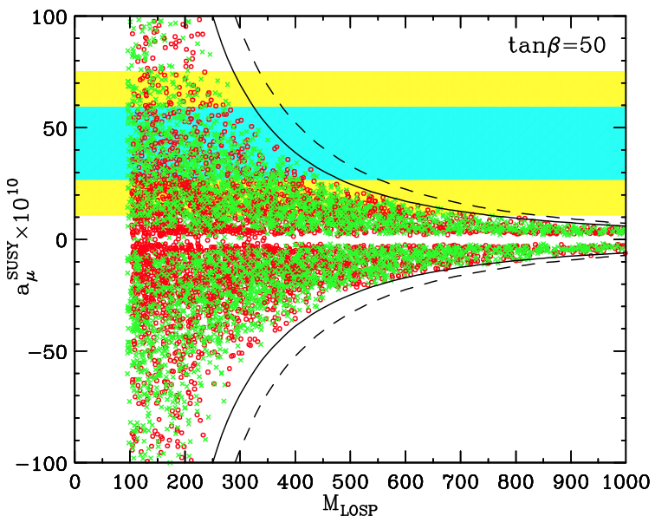
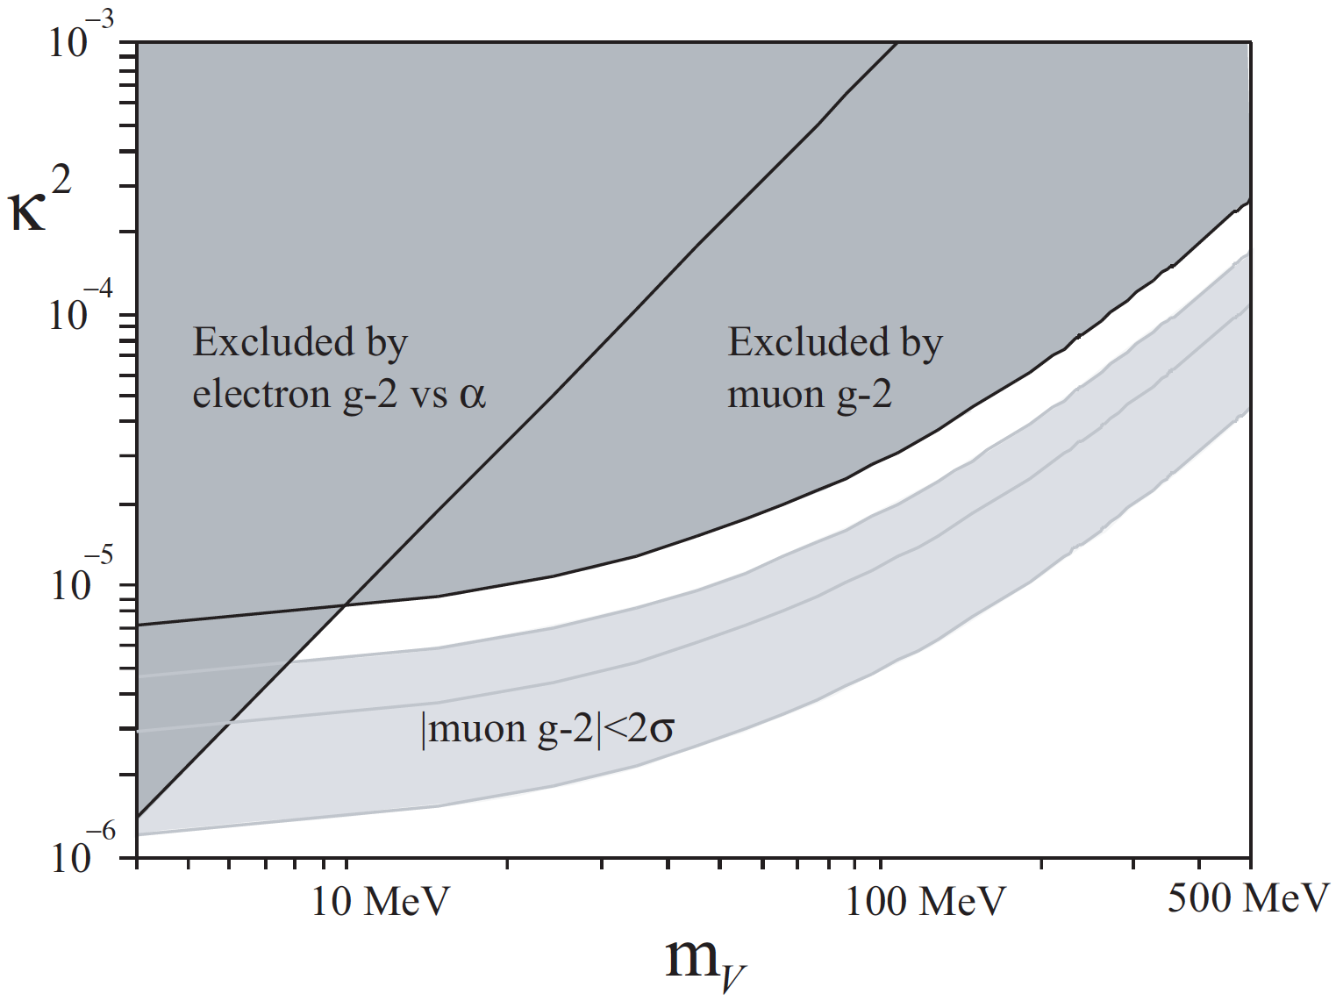
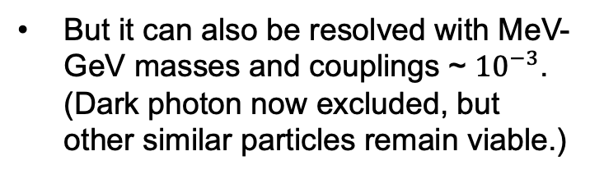

THE MUON’S ANOMALOUS MAGNETIC MOMENT
The discrepancy can be resolved by heavy particles, e.g., SUSY with superpartners at the 100s of GeV to TeV scale.
But it can also be resolved with MeV-GeV masses and couplings ~ ${10}^{−3}$. (Dark photon now excluded, but other similar particles remain viable.)
$$γ, A’$$
Feng, Matchev (2001)
Boehm, Fayet (2003)

Slide 13
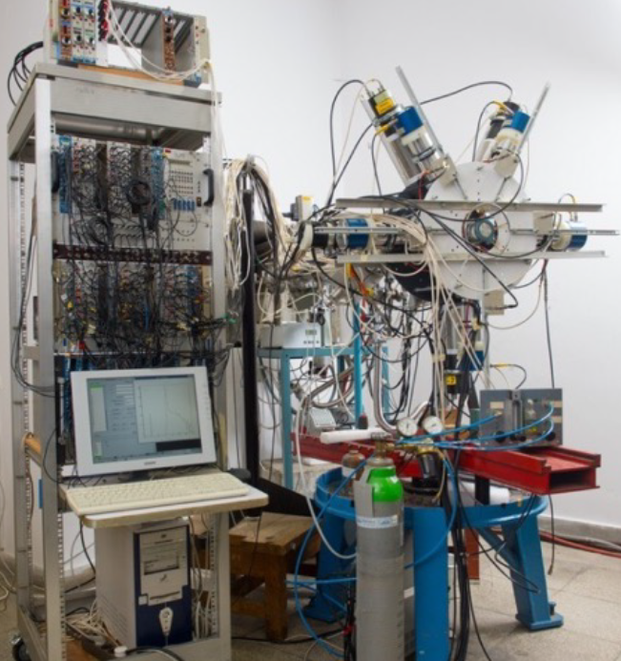
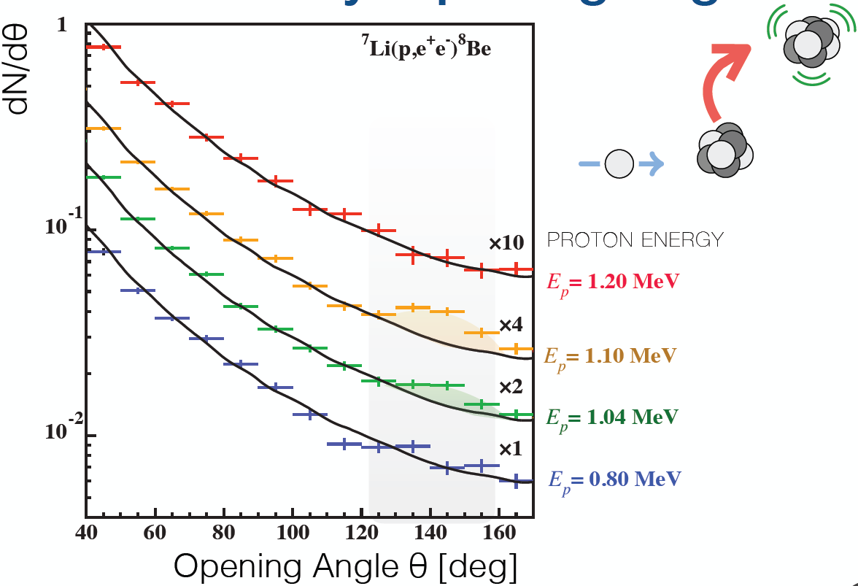
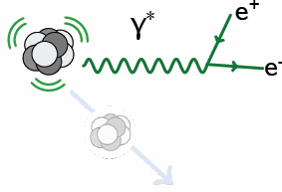
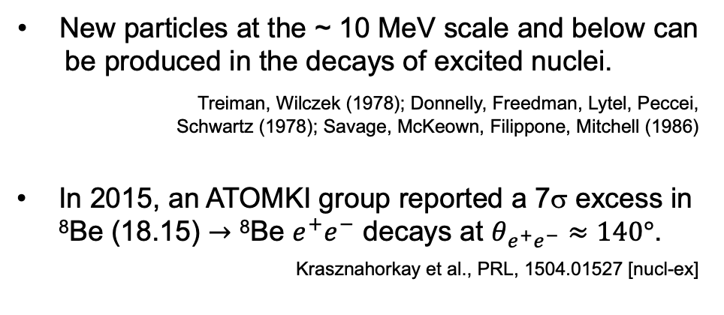
THE ⁸BE AND ⁴HE ATOMKI ANOMALIES
New particles at the ~ 10 MeV scale and below can be produced in the decays of excited nuclei. Treiman, Wilczek (1978); Donnelly, Freedman, Lytel, Peccei, Schwartz (1978); Savage, McKeown, Filippone, Mitchell (1986)
In 2015, an ATOMKI group reported a 7σ excess in ⁸Be (18.15) $→$ ⁸Be $e^{+}e^{−}$ decays at $θ_{e^{+}e^{−}}≈140°$.
Krasznahorkay et al., PRL, 1504.01527 [nucl-ex]
γ, X
θ

Slide 14
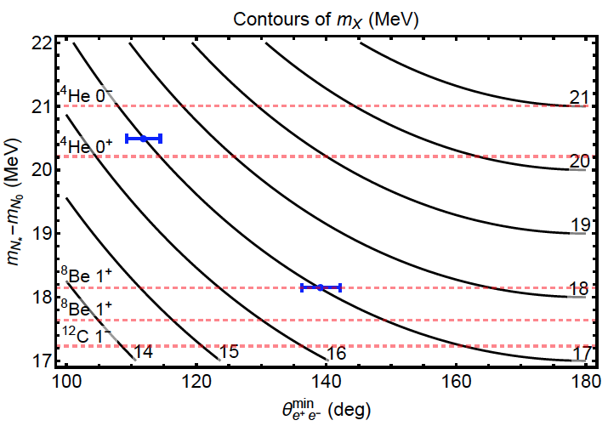
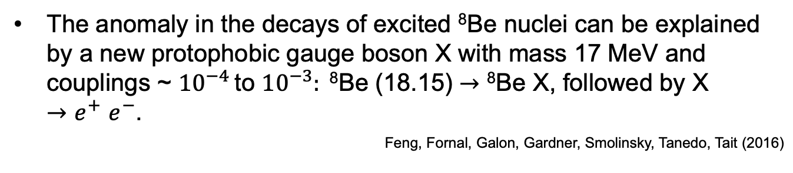
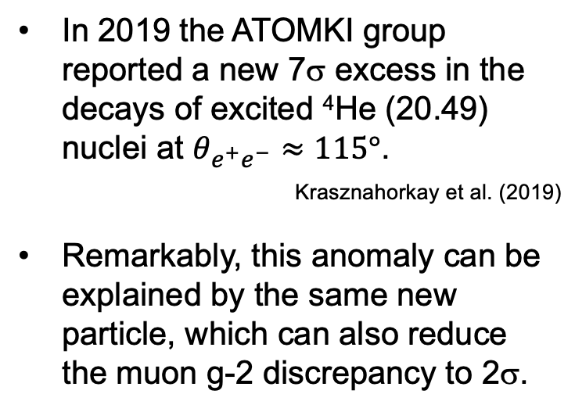
THE ⁸BE AND ⁴HE ATOMKI ANOMALIES
The anomaly in the decays of excited ⁸Be nuclei can be explained by a new protophobic gauge boson X with mass 17 MeV and couplings ~ ${10}^{−4}$ to ${10}^{−3}: \text{8}\text{Be}\text{ (18.15)}→\text{8}\text{Be} \text{X}\text{, }\text{followed} \text{by} \text{X} {→e}^{+}e^{−}$.
Feng, Fornal, Galon, Gardner, Smolinsky, Tanedo, Tait (2016)
In 2019 the ATOMKI group reported a new 7σ excess in the decays of excited ⁴He (20.49) nuclei at $θ_{e^{+}e^{−}}≈115°$.
_{Krasznahorkay et al. (2019)}
Remarkably, this anomaly can be explained by the same new particle, which can also reduce the muon g-2 discrepancy to 2σ.
Feng, Tait, Verhaaren (2020)
See also Zhang, Miller (2020)

Slide 15
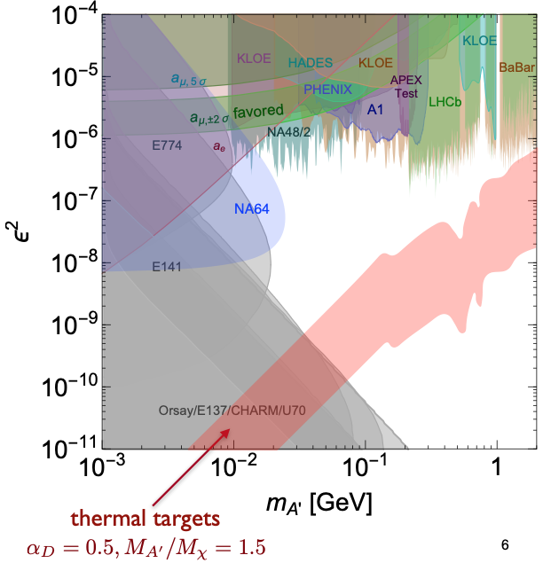
TARGETS IN DARK PHOTON PARAMETER SPACE
Muon
g-2 Anomaly
⁸Be and ⁴He
ATOMKI
Anomalies
Loop-induced
Coupling
Self-interacting
Dark Matter
The region with
m ~ 10 MeV – GeV
ε ~ 10⁻⁶ – 10⁻³
is interesting!
Tim Nelson, Snowmass RP6 (2020)

Slide 16
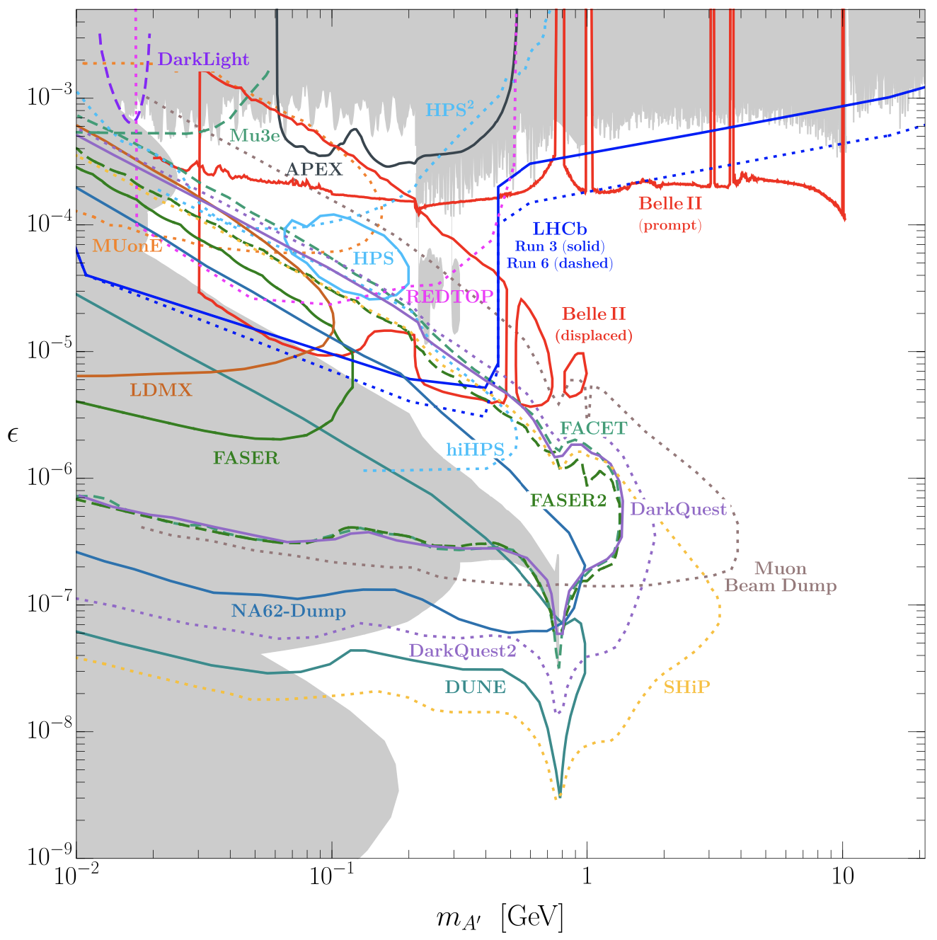
CURRENT EXPERIMENTAL SEARCHES
In the next few years, this region will be probed by currently running experiments (LHCb, Belle2, NA64, FASER, …) and also proposed experiments. This is the low-hanging fruit of dark sectors – similar to Z-mediated WIMP cross sections. Soon this parameter space will look completely different.
Batell et al. (2207.06905)

Slide 17
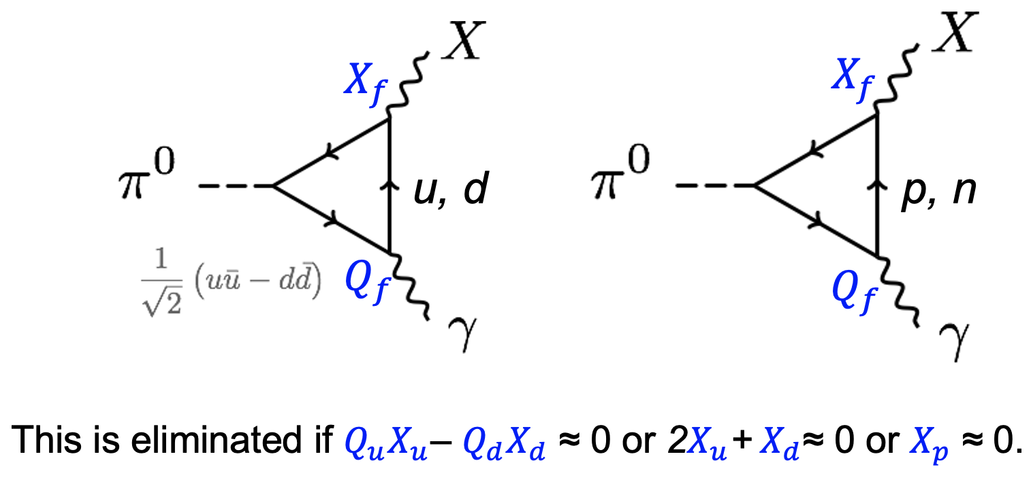
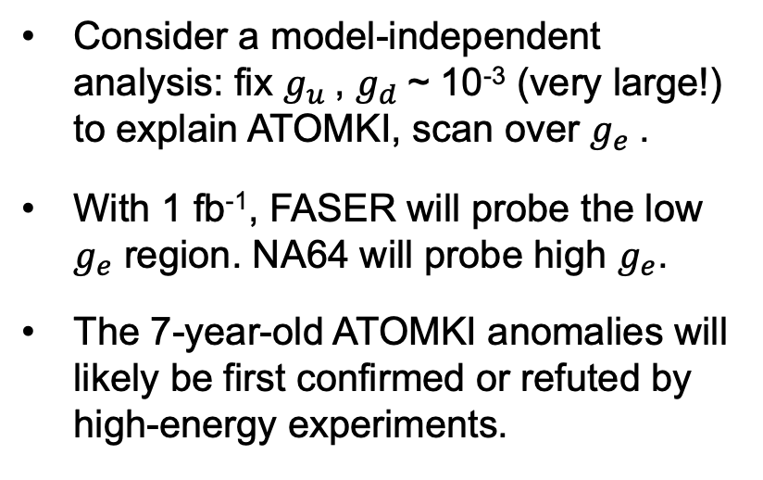

PROTOPHOBIC GAUGE BOSONS
Feng, Kling (2022)
Photophobic gauge bosons X are quite different from dark photons
  No production by dark bremsstrahlung off protons
  No production in pion decays: protophobic → pion-phobic
  Dominantly produced in η / η’ decays.
Consider a model-independent analysis: fix $g_{u}$, $g_{d}$~ 10⁻³ (very large!) to explain ATOMKI, scan over $g_{e}$.
With 1 fb⁻¹, FASER will probe the low $g_{e}$ region. NA64 will probe high $g_{e}$.
The 7-year-old ATOMKI anomalies will likely be first confirmed or refuted by high-energy experiments.
Kling
$X →μ^{+}$ $μ^{−}$for $2m_{μ}<m_{X}<{2m}_{π}$

Slide 18
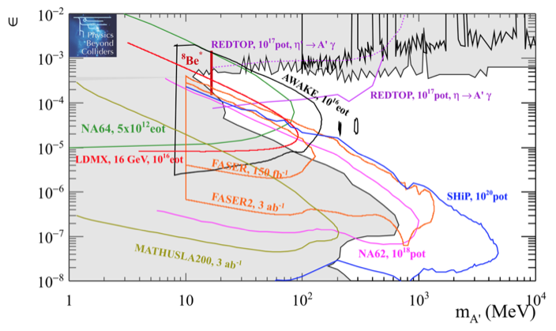
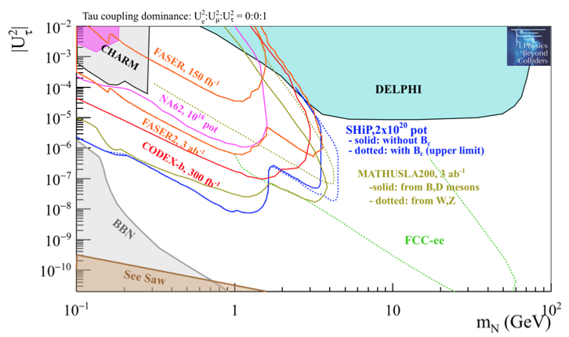
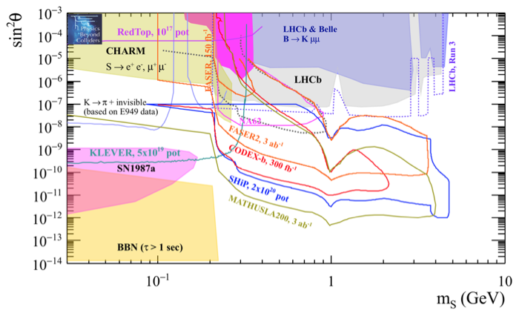
FUTURE EXPERIMENTAL SEARCHES
For the future, dedicated detectors have significant discovery potential for a wide variety of dark sector particles: dark photons; B-L and related gauge bosons; dark Higgs bosons; HNLs with couplings to e, mu, tau; ALPs with photon, gluon, fermion couplings; light neutralinos, inflatons, relaxions, and many others.
_{FPF White Paper (2022)}
Dark Photon
Dark Fermion
Dark Scalar

Slide 19
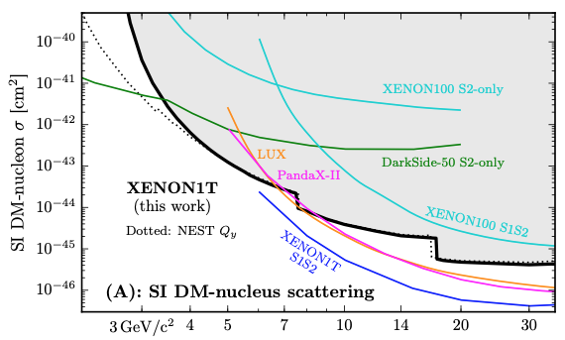
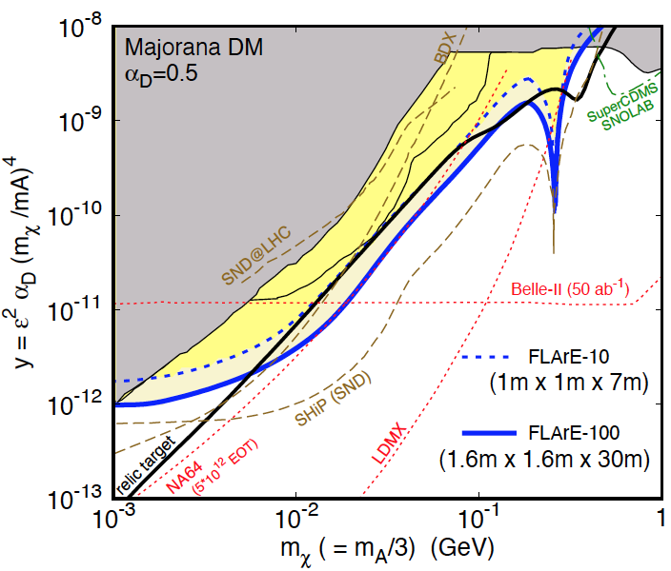
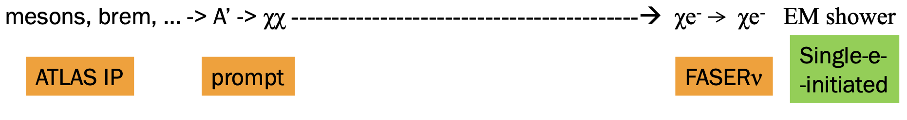
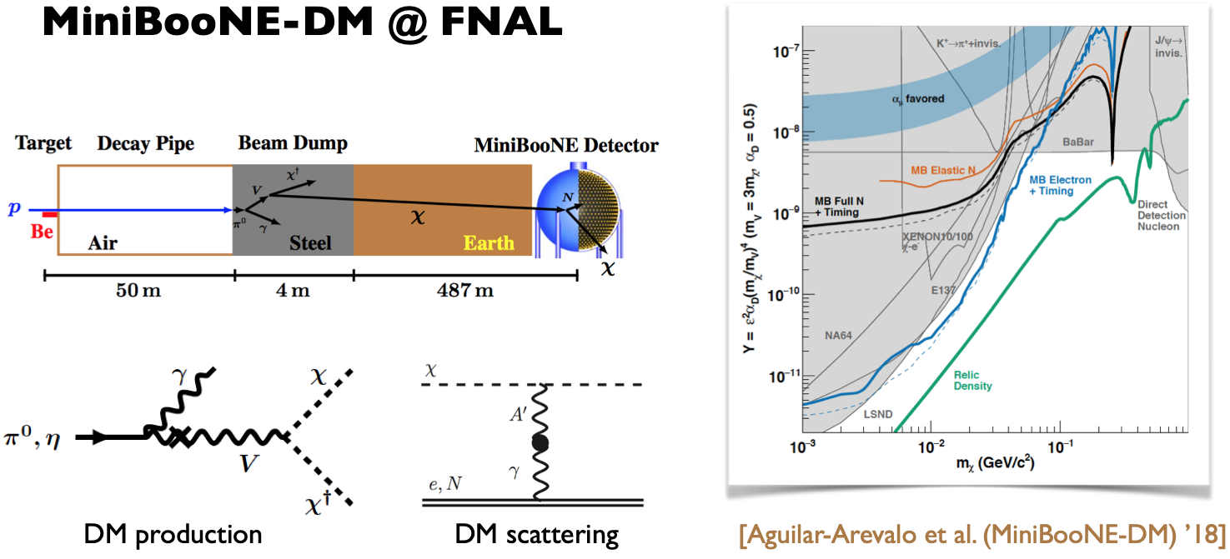
DARK MATTER DIRECT DETECTION
What if the portal particle decays back to the dark sector? Light DM with masses at the GeV scale and below is famously hard to detect, but there is a great deal of creative work going on in this area.
See Asher Berlin’s talk
At the LHC, we can produce DM at high energies, look for the resulting DM to scatter in FLArE, Forward Liquid Argon Experiment, a proposed 10 to 100 tonne LArTPC.
FLArE is powerful in the region favored/allowed by thermal freezeout. Note complementarity: q vs. e coupling, direct detection vs. missing X, etc.
Batell, Feng, Trojanowski (2021)

Slide 20
SUMMARY
Dark matter and dark sectors are currently among the leading motivations for BSM searches.
In general, dark sectors predict new particles with an enormous range of masses and interaction strengths and also many qualitatively different possibilities; milli-charged particles, hadrophilic gauge bosons, quirks, …; see backup slides.
But there is a relatively small region of parameter space that has motivations comparable to WIMPs: masses ~ MeV to GeV, couplings ~ micro to milli.
  WIMPs: coincidence of particle experiment (current threshold of what is observable), particle theory (gauge hierarchy problem), cosmology (WIMP miracle), astrophysics (large-scale structure), anomalies
  Dark sectors: coincidence of particle experiment (current threshold of what is observable), particle theory (portals), cosmology (WIMPless miracle), astrophysics (small-scale structure), anomalies
Most importantly, this region can be probed by many experiments in the coming 10 years. Just as WIMP DM became the subject of a world-wide research program in the 2000’s and 2010’s, dark sectors will become the subject of a world-wide research program in the 2020’s and 2030’s.

Slide 21
BACKUP

Slide 22
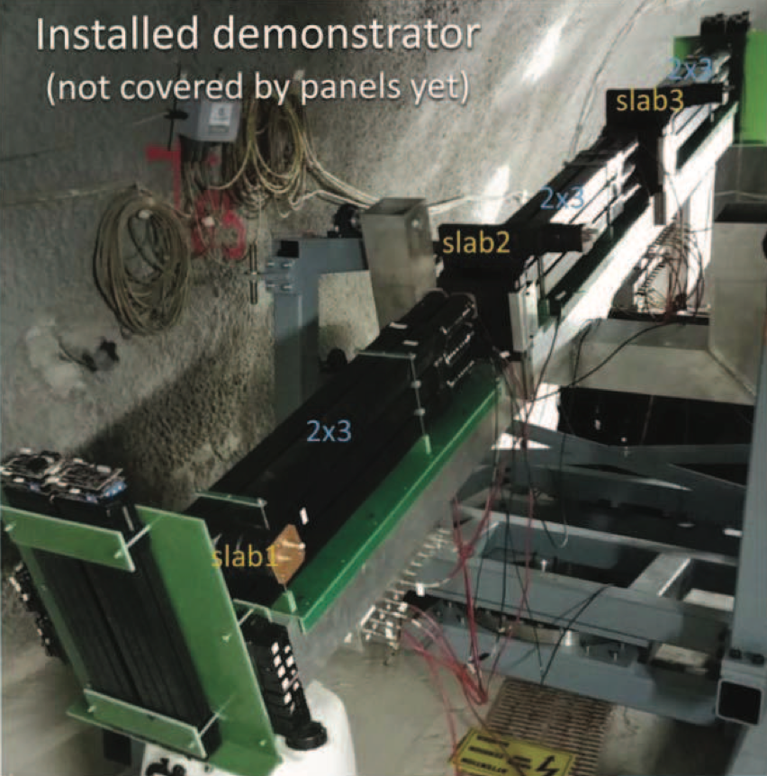
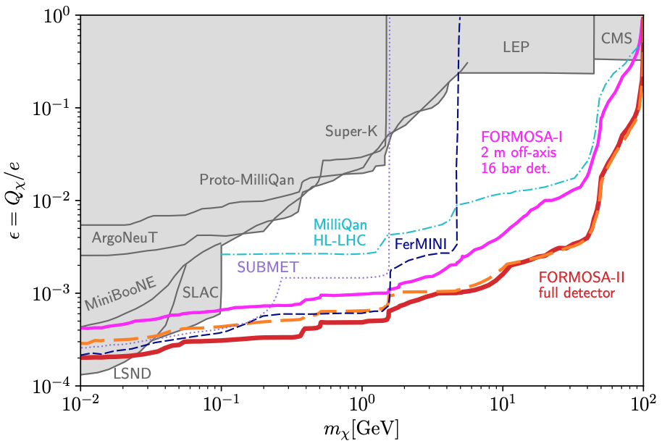
MILLI-CHARGED PARTICLES
A completely generic possibility motivated by dark matter, dark sectors. Currently the target of the MilliQan experiment, located at the LHC near the CMS experiment in a “non-forward” tunnel.
The MilliQan Demonstrator (Proto-MilliQan) already probes new region. Full MilliQan can also run in this location in the HL-LHC era, but the sensitivity may be improved significantly by moving it to the FPF (FORMOSA).
Foroughi-Abari, Kling, Tsai (2020)

Slide 23
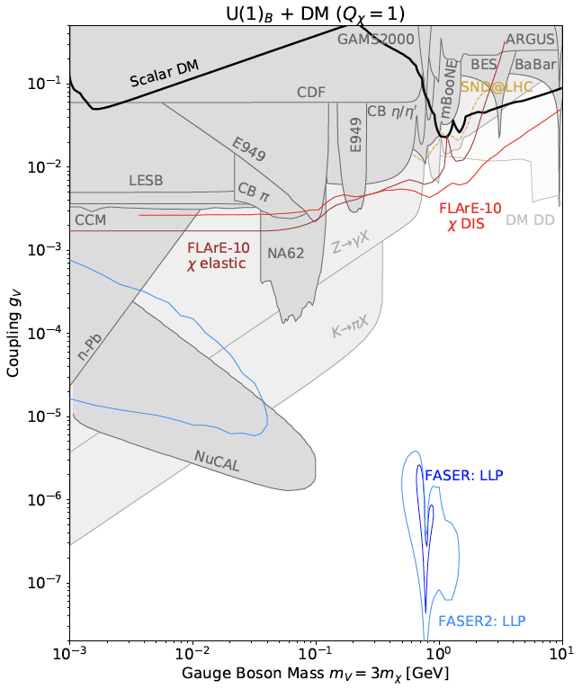
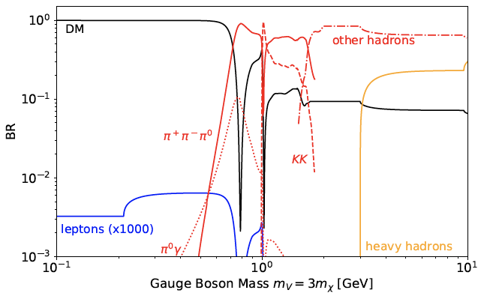
NEW SIGNALS: B AND B-3τ GAUGE BOSONS
Consider a light gauge boson coupled to baryon number
Produced through $q\overline{q} →V$
Many interesting hadronic decays
  ${V → π}^{0}γ, π^{+}π^{−}π^{0}$ $, K^{+}K^{−}, K_{S}$ $K_{L}$
Greatly expands the standard $e^{+}e^{−}$, $γγ$ signatures; similar signatures for “anomaly-free” gauge bosons
Li, Pei, Ran, Zhang, 2108.06748
Batell, Feng, Fieg, Ismail, Kling, Abraham, Trojanowski, 2111.10343;
see also Boyarsky, Mikulenko, Ovchynnikov, Shchutska, 2104.09688

Slide 24
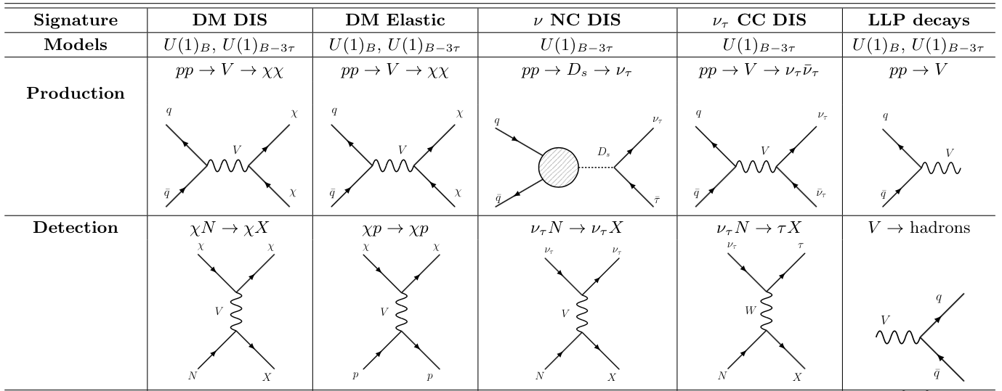
SIGNATURES FOR OTHER FPF EXPERIMENTS
Batell, Feng, Fieg, Ismail, Kling, Abraham, Trojanowski, 2111.10343

Slide 25
NEW SIGNALS: QUIRKS
Kang, Luty (2008)
Quirks are matter particles charged under a hidden strong force with mass m >> Λ_{hidden}. E.g., m ~ 100 GeV – TeV, Λ_{hidden} ~ keV.
Quirks may also have SM charge and color. They are then pair produced at the LHC, and are connected by a hidden color string.
For quarks and standard QCD, m << Λ_{QCD}, and so it becomes energetically favorable to pair produce new quarks from the vacuum. Quarks hadronized.
But for quirks, since m >> Λ_{hidden} , it is never energetically favorable to break the string by pair producing quirks from the vacuum: quirks do not hadronize, they oscillate.

Slide 26
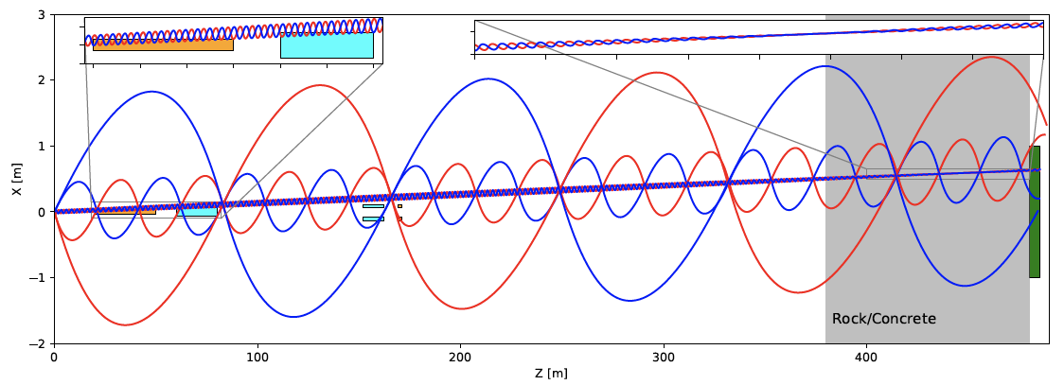
QUIRK SIGNATURE
Of course, the quirk – anti-quirk system has low p_{T}.
The pair therefore oscillates, with length scale ~ 1/ Λ_{hidden}.
For a range of Λ_{hidden} , the quirk system travels down the beamline, escaping most LHC detectors, but ultimately leaving (strange!) tracks in FASER.
Li, Pei, Ran, Zhang, 2108.06748

Slide 27
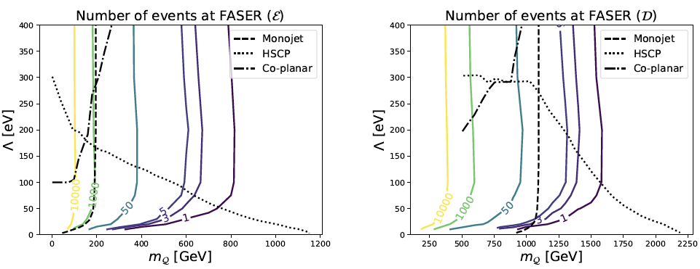
QUIRK DISCOVERY PROSPECTS
Far-forward detectors at the LHC are ideally suited to search for quirks.
  Like heavy particles, they require the LHC to be produced
  Like light particles, they are dominantly produced along the beamline
~1000 of events possible at FASER in Run 3
Li, Pei, Ran, Zhang, 2108.06748

