Slide 1
Mid- and Small-Scale Experiments and Facilities
and the Proposed Timescales
ENERGY FRONTIER
Snowmass, University of Washington
Jonathan Feng, UC Irvine, 26 July 2022
Captions

Slide 2

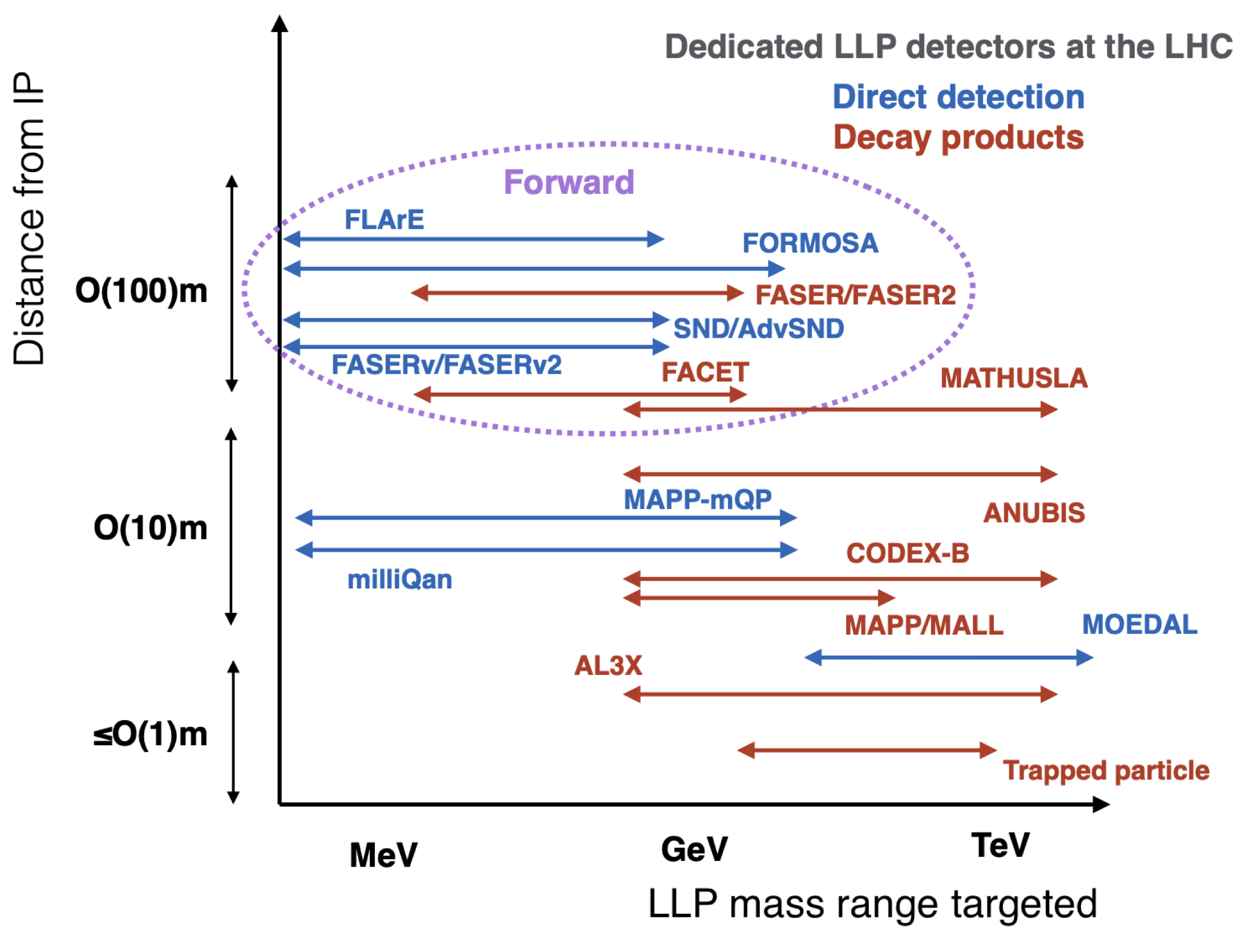
EF RECOMMENDATIONS
A top recommendation of Snowmass 2013 and again in Snowmass 2022: The LHC’s physics program should be exploited to its full potential.
New since Snowmass 2013: The LHC and its existing detectors are performing beautifully, but we now know that the physics potential of the LHC can be greatly enhanced by mid- and small-scale experiments.
EF recommendations (EF Summary, highlights added):
Many experiments; see figure and EF/NF/RF/CF/TF summaries for more.
Our highest immediate priority accelerator and project is the HL-LHC, the successful completion of the detector upgrades, operations of the detectors at the HL-LHC, data taking and analysis, including the construction of auxiliary experiments that extend the reach of HL-LHC in kinematic regions uncovered by the detector upgrades.
EF BSM Summary
Resource needs and plan for the five year period starting 2025:
1. Prioritize HL-LHC physics program, including auxiliary experiments

Slide 3
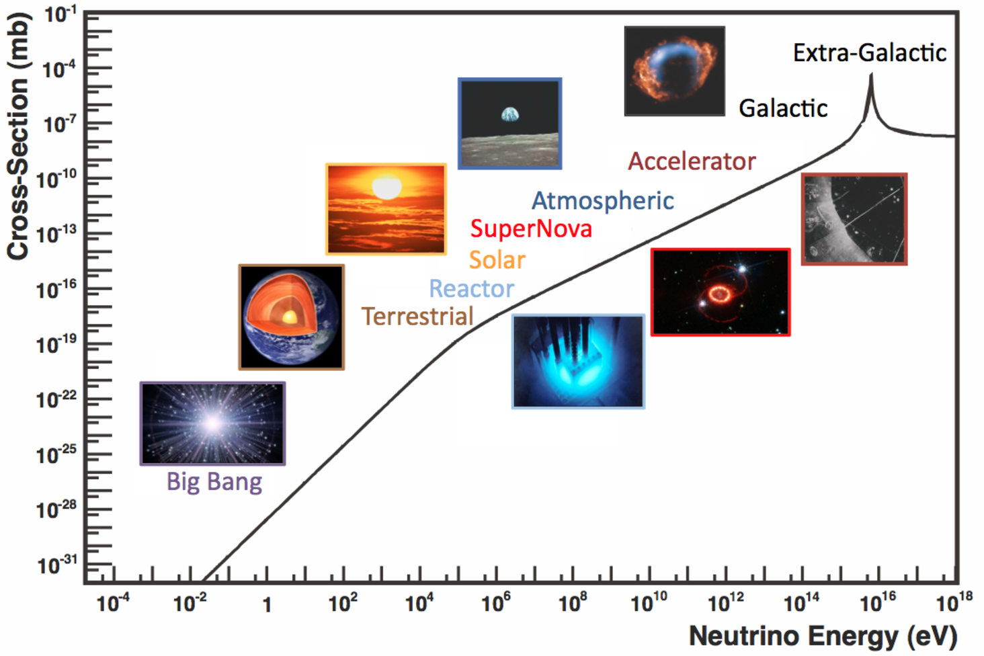
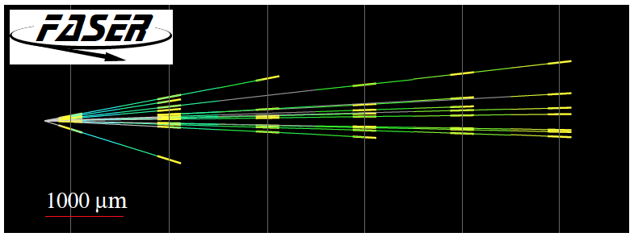
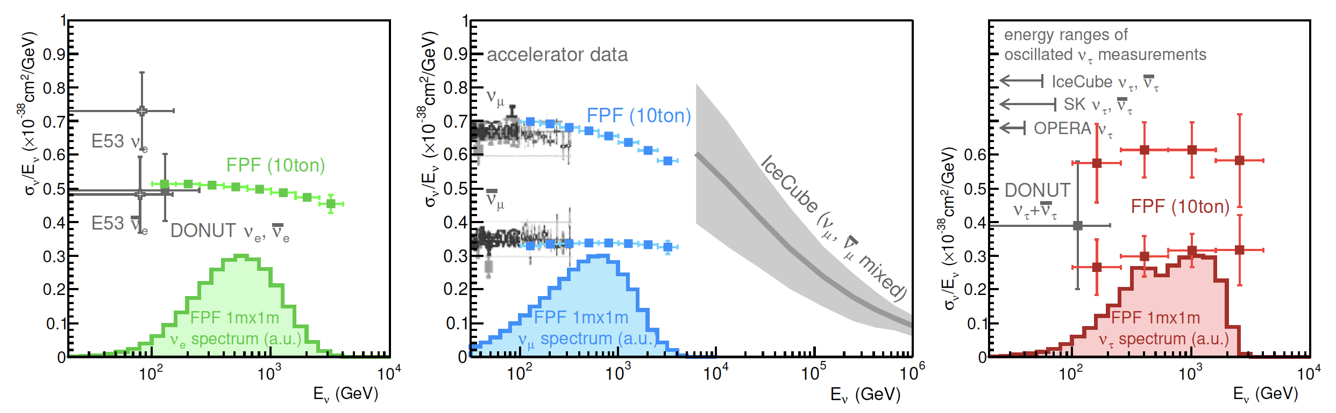
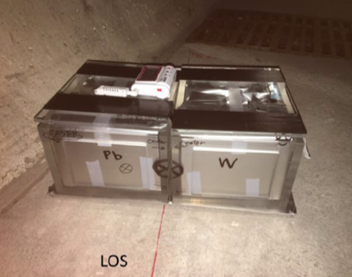
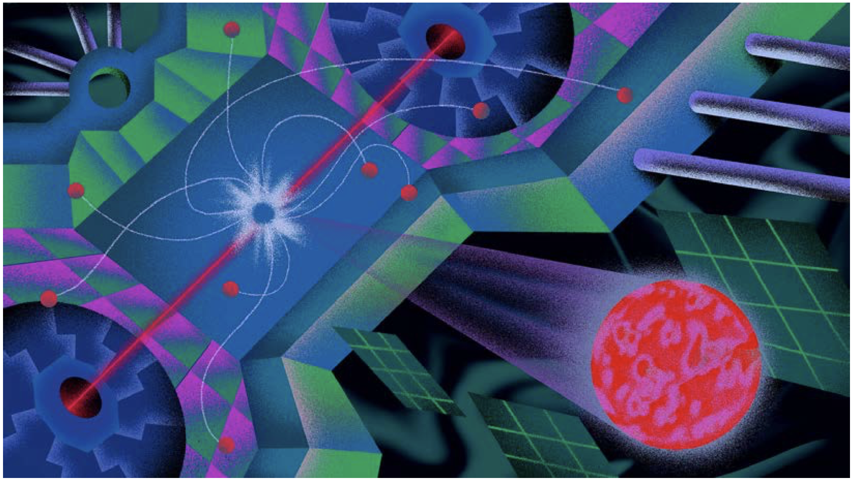
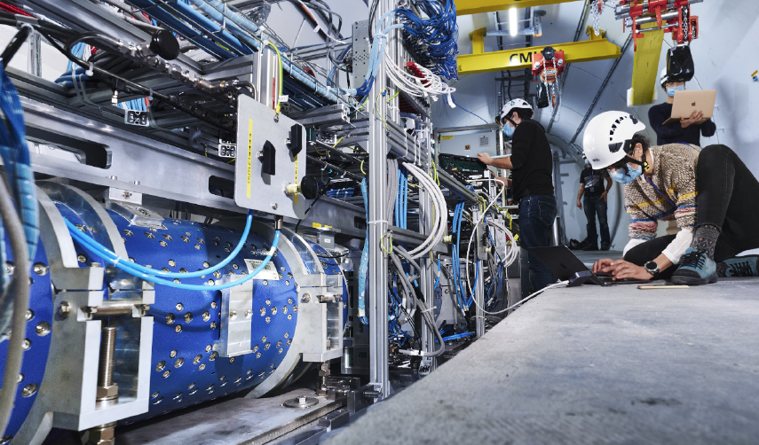
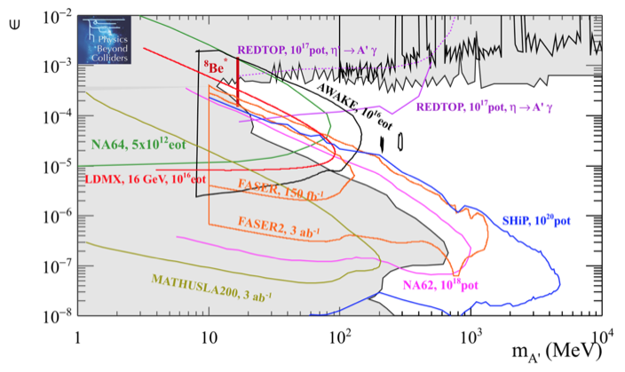
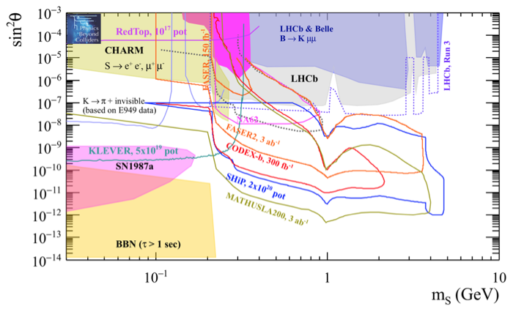
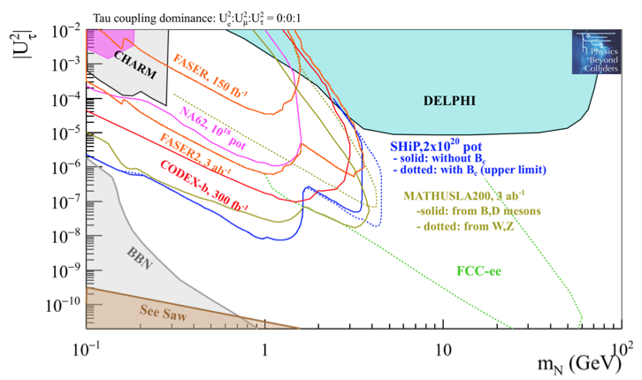
THE POWER OF AUXILIARY EF EXPERIMENTS
EXAMPLE
CURRENT STATUS
FUTURE PROSPECTS
SM Until last year, no collider neutrino signal had ever been detected.
In 2021, an 11-kg detector placed in the far-forward region for 4 weeks detected 6 neutrino candidates.
At the HL-LHC, 10-ton ν detectors will detect 10⁶ TeV-scale neutrinos, enabling new explorations of neutrino properties, QCD, astroparticle physics.
Formaggio, Zeller (2013)
2105.06197
BSM Light weakly-interacting particles (LLPs, FIPs, portals), are ubiquitous in BSM models.
With 0.5 fb⁻¹ from LHC Run 3, FASER (vol ~ 0.05 m³) is already probing new regions of LLP parameter space.
At the HL-LHC, auxiliary experiments will improve by orders of magnitude the LHC’s sensitivity to dark photons, milli-charged particles, exotic Higgs decays, dark scalars, HNLs, ALPs, LLPs, DM, neutralinos, …
Baseline location: a dedicated facility ~612 m to the west of ATLAS on CERN land in France.
Symmetry (2020)

Slide 4
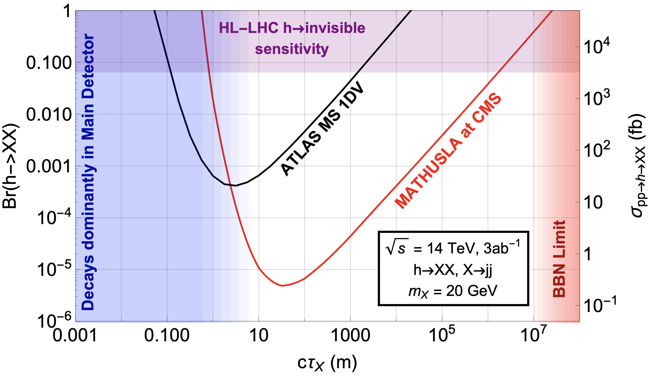
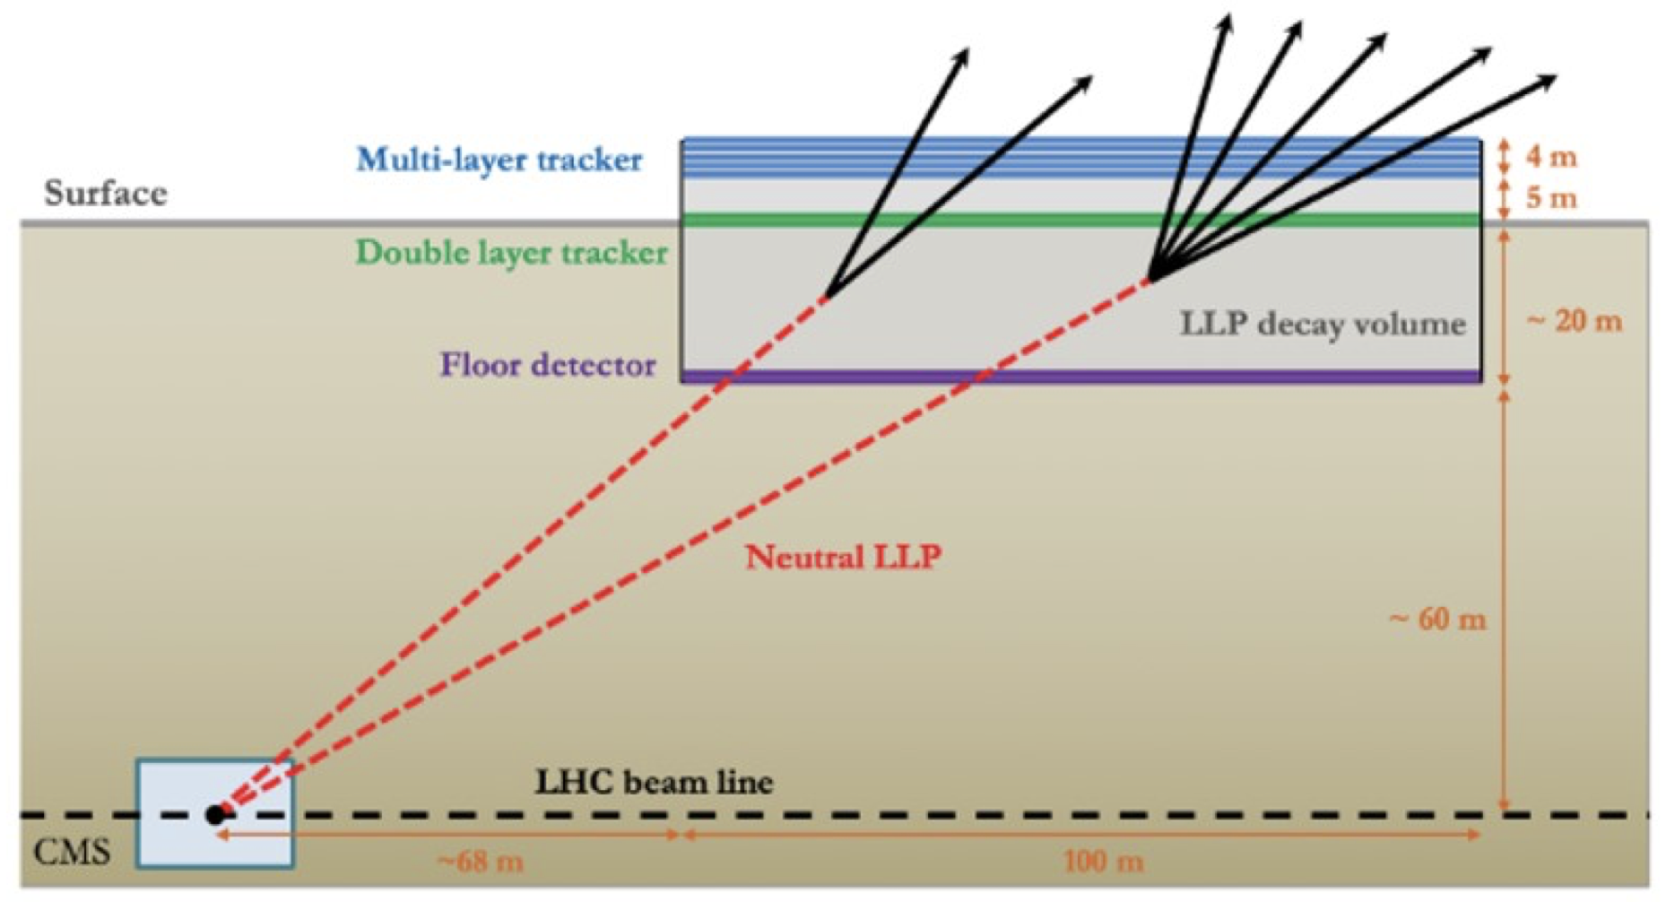
MATHUSLA
[Thanks: David Curtin]
Snowmass White Paper: 2203.08126, 88 authors.
Primary Physics Goals: Searches for LLPs with lifetimes up to near the BBN bound (e.g., exotic Higgs decays, neutral naturalness, dark Higgs, …)
Transverse detector: 0.64 < η < 1.8.
100 m x 100 m x 30 m, 20 m deep at a surface site on CERN land, ~100 m from CMS, 10 layers of scintillating planes.
Recent progress
  Improved understanding of backgrounds.
  Significant R&D on designing the scintillator detectors and understanding their performance.
On track for preparing TDR, plan for construction in and physics in HL-LHC era.

Slide 5
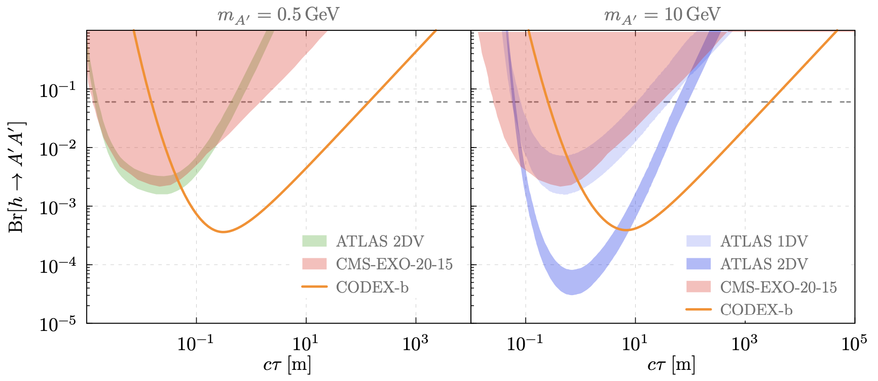
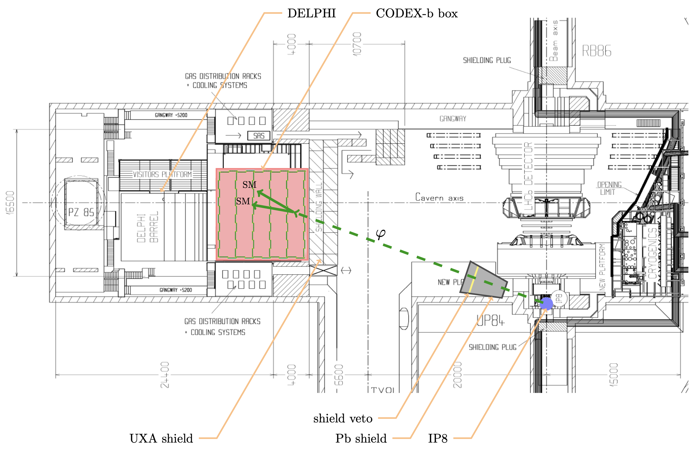
CODEX-b
[Thanks: Phil Ilten, Simon Knapen]
Snowmass White Paper: 2203.07316, 39 authors.
Primary Physics Goals: Searches for LLPs in the transverse direction (e.g., rare Higgs decays, dark Higgs, HNLs, ALPs, …)
Pseudorapidity coverage: 0.13 < η < 0.54.
10 m x 10 m x 10 m, 25 m from LHCb, uses RPC technology from ATLAS that is already developed.
Recent progress
  optimization strategies for the detector, shielding design.
  development of new fast and full simulation frameworks.
Preparing a technical design for a smaller demonstrator detector (CODEX-β), a 2 m x 2 m x 2 m detector to measure backgrounds and develop and test reconstruction algorithms and simulation for installation in early 2023.
Installation of full CODEX-b planned for late 2020’s for physics in the HL-LHC era.

Slide 6
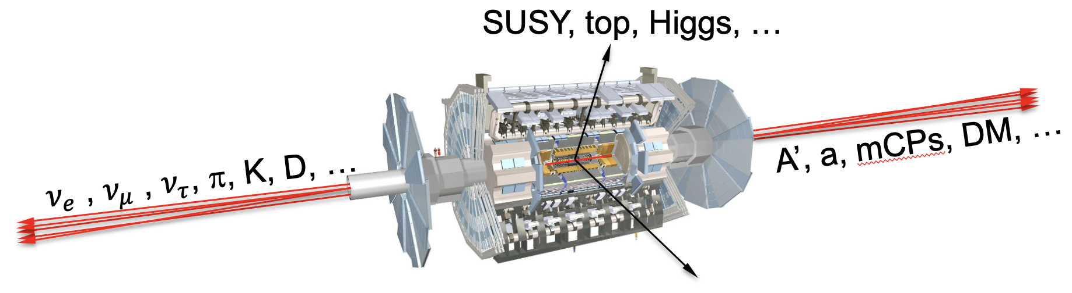
FORWARD PHYSICS FACILITY
Snowmass White Paper: 2203.05090, 392 authors + endorsers.
Energetic weakly-interacting light particles are primarily produced in the far-forward direction and escape from existing LHC detectors.
There is therefore a rich and unexplored physics program in the far-forward direction.
Physics Goals:
  Laboratory measurements of neutrinos at the TeV scale for the first time.
  Detect thousands of tau neutrino interactions for the first time.
  Probe forward hadron production, QCD, intrinsic charm, proton structure down to x~10⁻⁷.
  Light DM direct detection.
  Discovery potential for dark photons, millicharged particles, dark scalars, sterile neutrinos, axion-like particles, light gauge bosons, light neutralinos, inflatons, and many others.

Slide 7
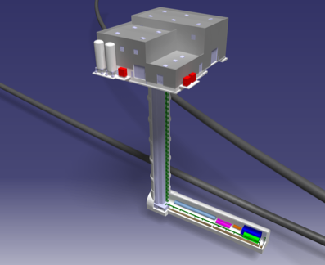
THE FORWARD PHYSICS FACILITY
The FPF is proposed to house 5 small, diverse, far-forward experiments for the HL-LHC era.
Site selection has been completed: the CERN civil engineering team considered and documented promising sites and identified a preferred location on CERN land in France, 620-685 m west of the ATLAS IP, shielded by ~200 m of rock.
The cavern is 65 m-long, 8 m-wide, 10 m from the LHC, and disconnected from it.
Recent progress
  Muon background at FASER is within ~30% of FLUKA simulations (<1.5 Hz/cm², completely manageable).
  RP and ground vibration studies (strong support from CERN Physics Beyond Colliders group) indicate that FPF construction and servicing can be done during LHC running.
Preliminary (class 4) cost estimate: 25 MCHF (CE) + 13 MCHF (services).

Slide 8
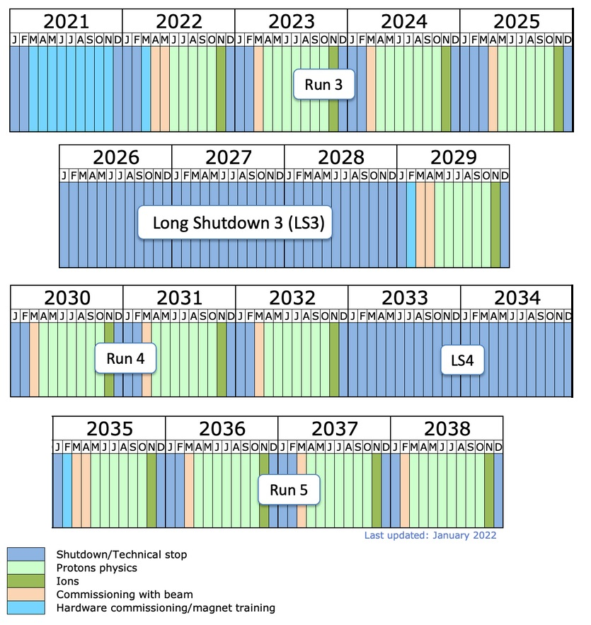
FPF TIMESCALE
Conceptual designs for the FPF and its 5 experiments ready by mid-2023.
  FASER2, FASERnu2, AdvSND, FORMOSA build on existing experiments and collaborations.
  FLArE R&D is very active and supported by BNL LDRD and Heising-Simons Foundation funds.
Timeline considerations
  Can construct and service the FPF and its experiments while the LHC is running.
  Timeline set by the HL-LHC.
  Possible timeline presented at Chamonix (Jan 2022) allowing physics from 2031-42:
Pure CE works
Construction of experiments
Installation
of services
by CERN
teams
Installation,
commissioning
of experiments
Physics

Slide 9
SUMMARY
The highest priority for the immediate future is that the (HL-)LHC be exploited to its full potential.
A modest investment in small, auxiliary experiments will bring us much closer to this goal.
These make essential use of the energy frontier, with guaranteed SM payoff (TeV neutrinos, QCD, astroparticle physics) and enhanced BSM discovery prospects (LLPs, dark sectors, dark matter).

