Slide 1

Snowmass Energy Frontier Workshop, Brown University
29 March 2022
Jonathan Feng, UC Irvine

Slide 2
OUTLINE
Introduction
The Physics
The Experiments
The Facility
Executive Summary

Slide 3
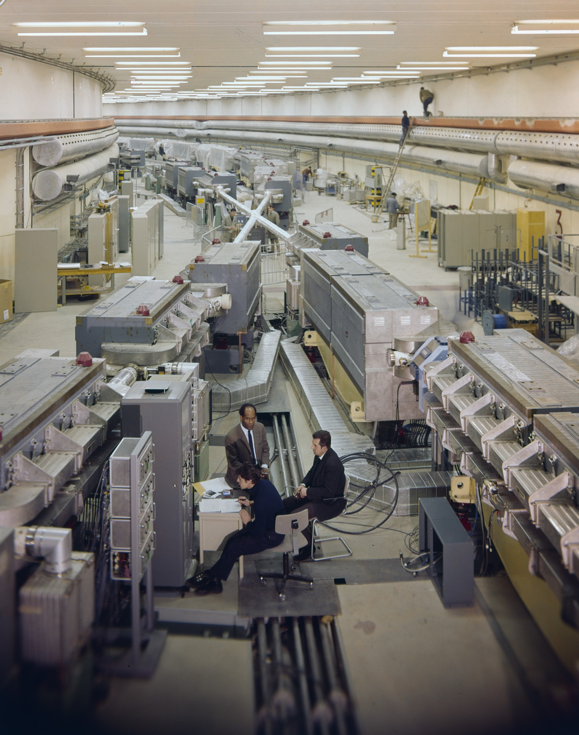
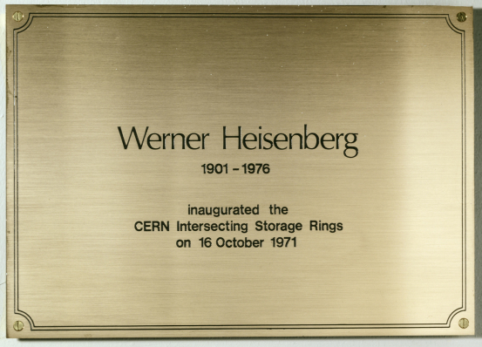
INTRODUCTION
Snowmass is all about the future. But as we look forward, it also pays to look back.
Last year was the 50th anniversary of the birth of hadron colliders.
In 1971, CERN’s Intersecting Storage Rings (ISR), with a circumference of ~1 km, began colliding protons with protons at the center-of-mass energy of 30 GeV (later raised to 62 GeV).

Slide 4
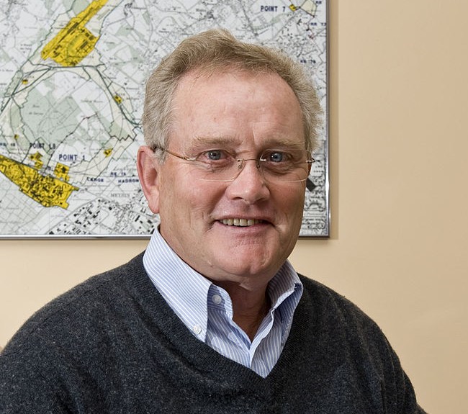
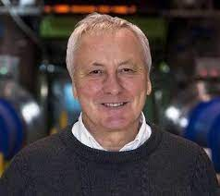
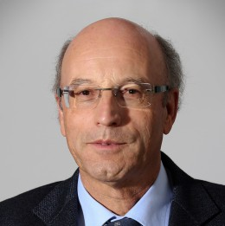
ISR’S LEGACY
There have been many fascinating articles and talks by eminent physicists looking back on the ISR’s legacy.
  “Enormous impact on accelerator physics, but sadly little effect on particle physics.” – Steve Myers, talk at “The 50th Anniversary of Hadron Colliders at CERN,” October 2021.
  “There was initially a broad belief that physics action would be in the forward directions at a hadron collider…. It is easy to say after the fact, still with regrets, that with an earlier availability of more complete… experiments at the ISR, CERN would not have been left as a spectator during the famous November revolution of 1974 with the J/ψ discoveries at Brookhaven and SLAC .” – Lyn Evans and Peter Jenni, “Discovery Machines,” CERN Courier (2021).

Slide 5

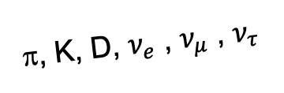
AN OBVIOUS QUESTION
Are we missing opportunities in a similar way at the LHC?
The answer: Yes, but in the opposite way. In contrast to the ISR days, there is now broad belief that the most interesting physics is at high p_{T} . But we are now missing opportunities in the forward direction.
By far the largest fluxes of high-energy light particles (e.g., pions, kaons, D mesons, neutrinos of all flavors) are in the far-forward direction.
This may also be true of new particle candidates: dark photons, axion-like particles, millicharged particles, dark matter, and many others.
All of these particles will pass through the “blind spots” of existing large LHC detectors and escape detection.
A’, a, mCPs, DM, …
π, K, D, $ν_{e}$ , $ν_{μ}$ , $ν_{τ}$

Slide 6
THE FORWARD PHYSICS FACILITY
The FPF is a proposal to create an underground cavern to house a suite of far-forward experiments during the HL-LHC era. No modification to the LHC is needed.
The FPF is uniquely positioned to fully realize the LHC’s physics potential for both SM and BSM physics in the far forward region, greatly extending the LHC physics program for relatively little cost.

Slide 7
FPF AND SNOWMASS
The FPF was first proposed in May 2020 and has been the subject of 4 dedicated meetings
  FPF1 Meeting, 9-10 Nov 2020, https://indico.cern.ch/event/955956
  FPF2 Meeting, 27-28 May 2021, https://indico.cern.ch/event/1022352
  FPF3 Meeting, 25-26 Oct 2021, https://indico.cern.ch/event/1076733
  FPF4 Meeting, 31 Jan-1 Feb 2022, https://indico.cern.ch/event/1110746
These meetings have taken place within the frameworks of
  Snowmass 2021: https://snowmass21.org
  Physics Beyond Colliders: https://pbc.web.cern.ch
FPF1 and FPF2 led to “The Forward Physics Facility: Sites, Experiments, and Physics Potential” (2109.10905), a 75-page, 80-author document distilling key progress on the FPF.
The FPF Snowmass White Paper, Feng, Kling, Reno, Rojo, Soldin et al. (2203.05090), is now out. It is a comprehensive, 429-page, 392-author+ endorser summary of the status. Additional endorsers are welcome here.

Slide 8
THE PHYSICS
The FPF is a general purpose facility with a broad SM and BSM physics program that spans all of the Snowmass frontiers. Here I will just give a few (not even representative) examples. For more details, see the FPF White Paper.

Slide 9
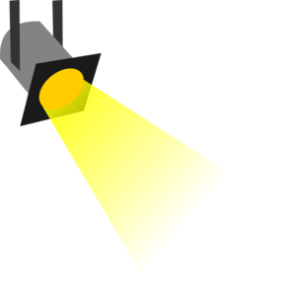
NEW PARTICLES
Particle
Colliders
Mass
MeV
GeV
TeV
1
Already
Discovered
Strongly Interacting
Heavy Particles
Too Little to be
Dark Matter
Remarkably,
cosmology
motivates the
same parameter
space.
Interaction Strength
Just Right to
be Dark Matter
10⁻³
“The WIMPless Miracle”
Feng, Kumar (2008)
Boehm, Fayet (2003)
Pospelov, Ritz, Voloshin (2007)
Weakly Interacting
Light Particles
Impossible to
Discover
10⁻⁶
Too Much to be
Dark Matter

Slide 10
SEARCHES FOR NEW LIGHT PARTICLES
The existing large LHC detectors are beautifully designed to find strongly-interacting heavy particles.
But weakly-interacting light particles are dominantly produced in the rare decays of light particles: π, η, K, D and B mesons. These are mainly produced along the beamline, and the new particles also escape down the beamline.
Clearly we need to exploit the “wasted” σ_{inel} ~ 100 mb and cover these blind spots in the forward region. If we go far enough away, the proton beams are bent by magnets (it’s a circular collider!), whereas the new light particles will go straight.

Slide 11
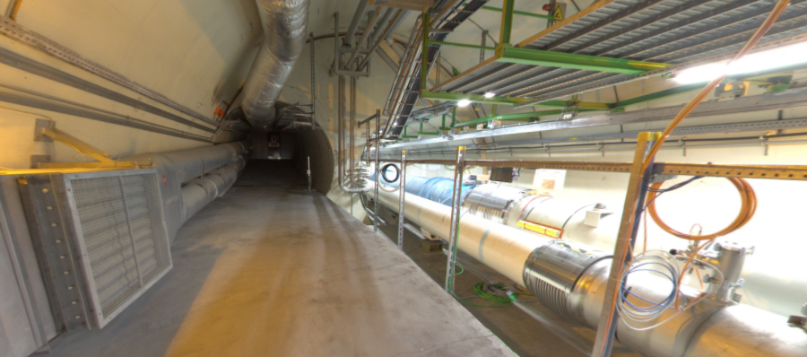


THE FAR-FORWARD REGION
New particle A’ is produced at ATLAS, travels along the beam collision axis and through 100 m of rock, and finally decays in tunnel TI12, 480 m from ATLAS
$π^{0}$→ $γ$A’
→ A’ →
A’ → $e^{+}e^{−}$
TI12 near UJ12
UJ12
The view in UJ12 looking west (2019)
TI12
$$e^{+}$$
$e^{−}$
Beam collision axis
LHC beamline

Slide 12
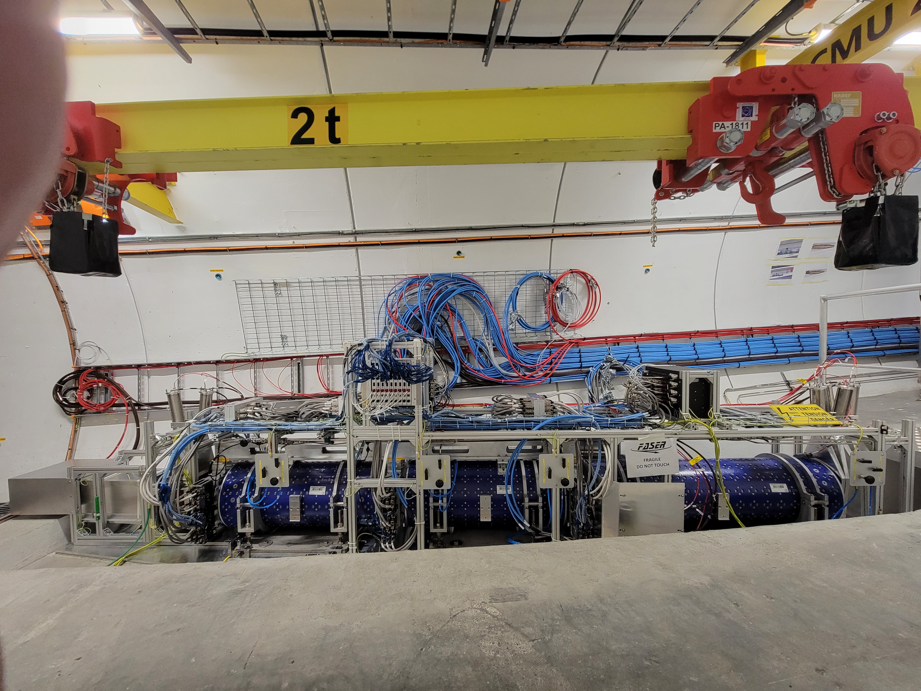
FASER
FASER has been built to look for these signals. It was approved, constructed, installed, and commissioned from 2019-21. In a few months, it will begin probing new parameter space with discovery prospects starting with the first fb⁻¹.

Slide 13
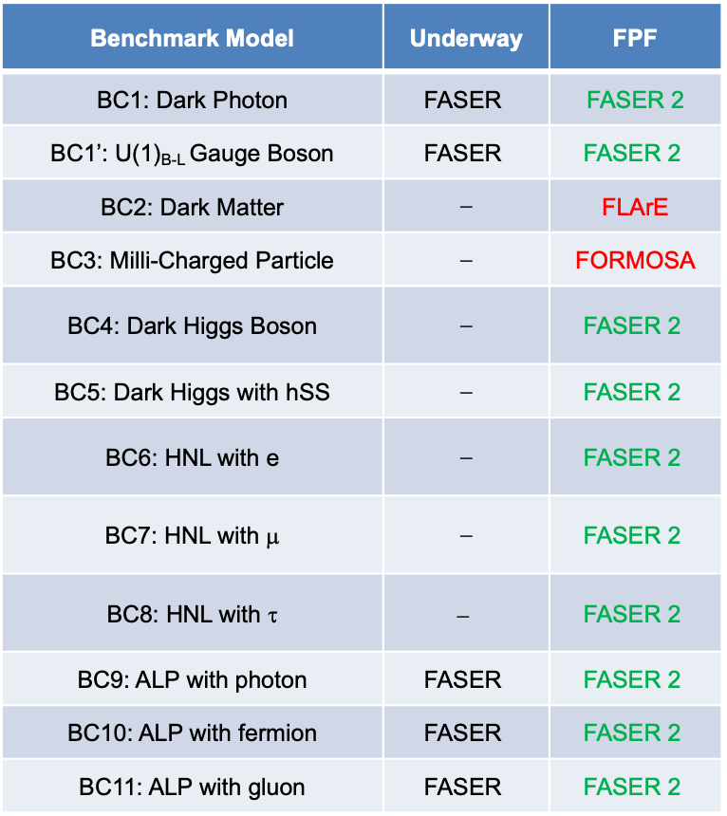
NEW PARTICLES AT THE FPF
The FPF will extend the current BSM program by housing larger and a more diverse array of experiments.
FASER 2, with R = 1 m, L = 20 m, can discover all portal particles with renormalizable couplings (dark photon, dark Higgs, HNL); ALPs with all types of couplings (γ, f, g); and many other particles.
Other experiments can discover mCPs, dark matter, and many other interesting ideas.
Benchmark Model | Underway | FPF
BC1: Dark Photon | $$\text{FASER}$$ | FASER 2
BC1’: U(1)_{B-L} Gauge Boson | $$\text{FASER}$$ | $$\text{FASER}\text{ 2}$$
BC2: Dark Matter | ⎼ | FLArE
BC3: Milli-Charged Particle | ⎼ | FORMOSA
BC4: Dark Higgs Boson | ⎼ | $$\text{FASER}\text{ 2}$$
BC5: Dark Higgs with hSS | ⎼ | $$\text{FASER}\text{ 2}$$
BC6: HNL with e | ⎼ | $$\text{FASER}\text{ 2}$$
BC7: HNL with μ | ⎼ | $$\text{FASER}\text{ 2}$$
BC8: HNL with τ | $$\text{⎼}$$ | $$\text{FASER}\text{ 2}$$
BC9: ALP with photon | $$\text{FASER}$$ | $$\text{FASER}\text{ 2}$$
BC10: ALP with fermion | $$\text{FASER}$$ | $$\text{FASER}\text{ 2}$$
BC11: ALP with gluon | $$\text{FASER}$$ | $$\text{FASER}\text{ 2}$$

Slide 14
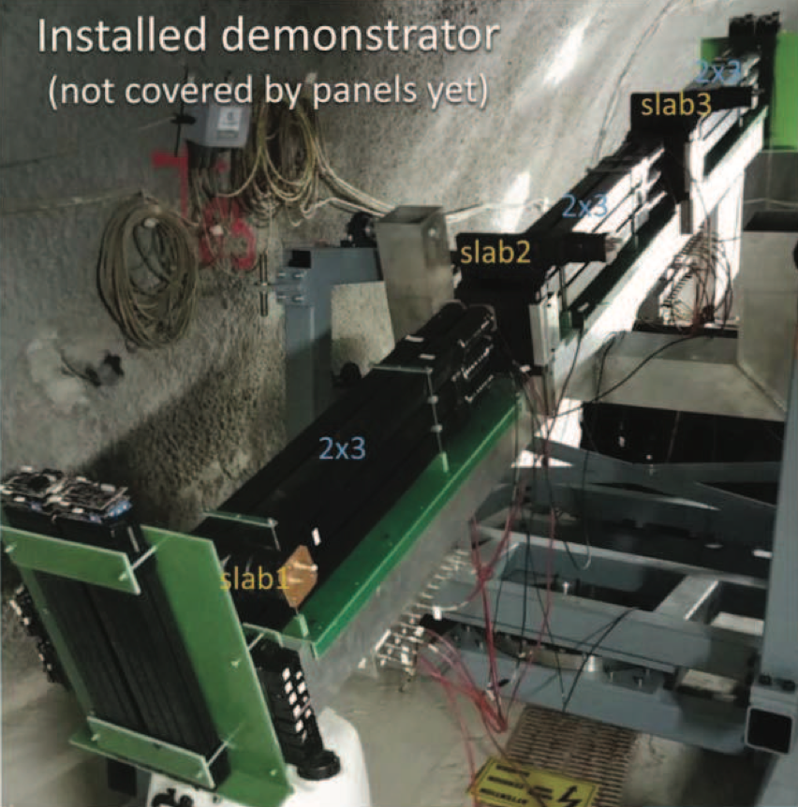
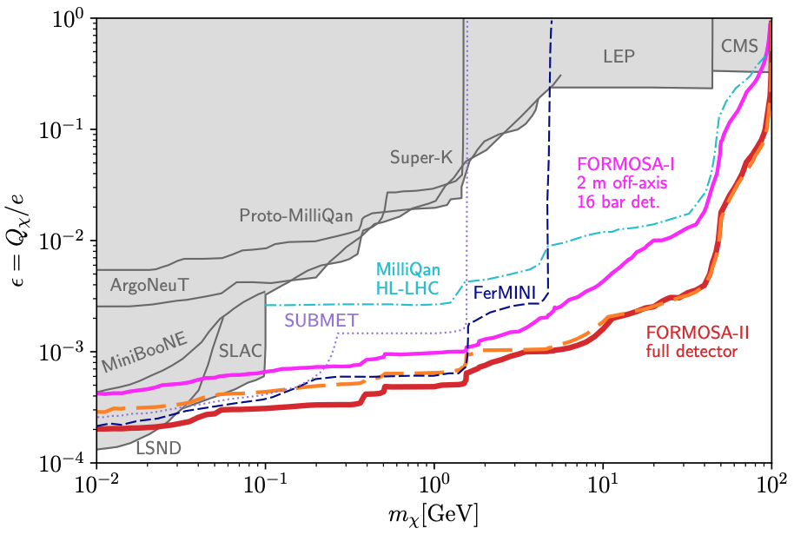
MILLI-CHARGED PARTICLES
A completely generic possibility motivated by dark matter, dark sectors. Currently the target of the MilliQan experiment, located at the LHC near the CMS experiment in a non-forward tunnel.
Full MilliQan can also run in this location in the HL-LHC era, but the sensitivity may be improved greatly by moving it to the FPF (FORMOSA).
Foroughi-Abari, Kling, Tsai (2020)

Slide 15
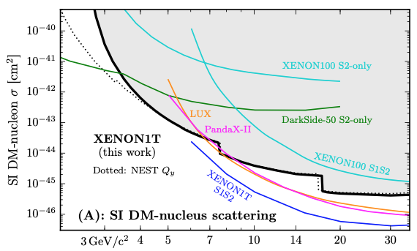
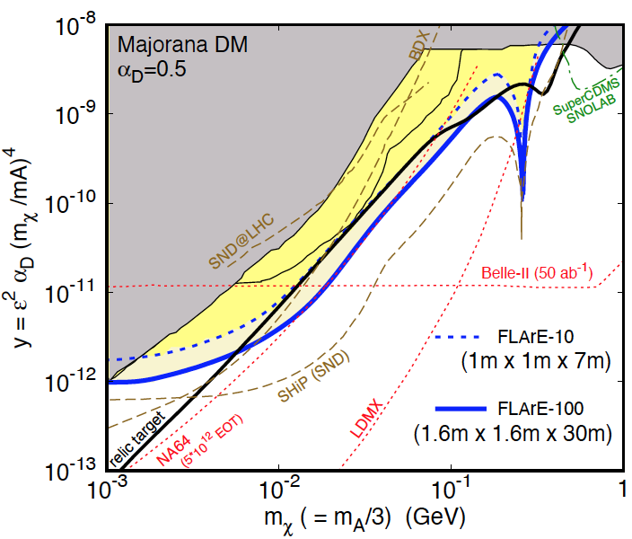
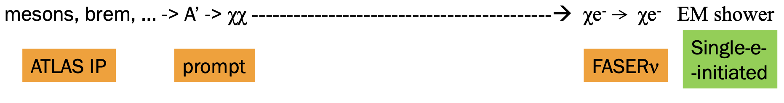
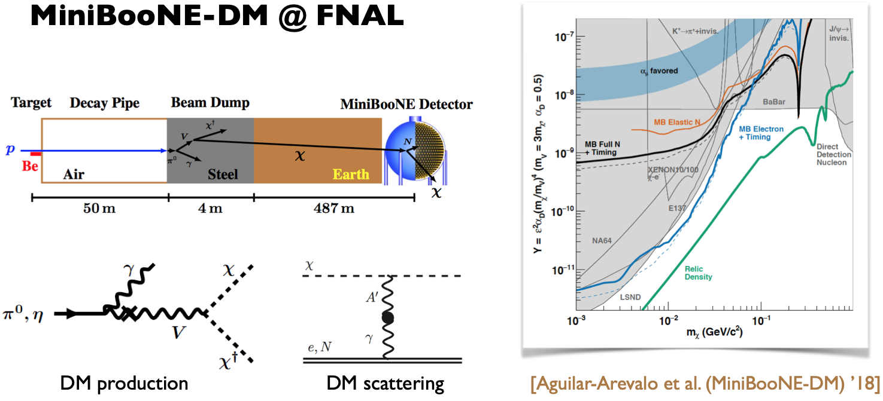
DARK MATTER
Light DM with masses below the GeV scale is famously hard to detect, since galactic DM has v ~ 10⁻³ c.
At the LHC, we can produce DM at high energies, look for the resulting DM to scatter in FLArE, Forward Liquid Argon Experiment, a proposed ~10 tonne LArTPC.
FLArE probes most of the region favored by thermal freezeout.
Batell, Feng, Trojanowski (2021)

Slide 16
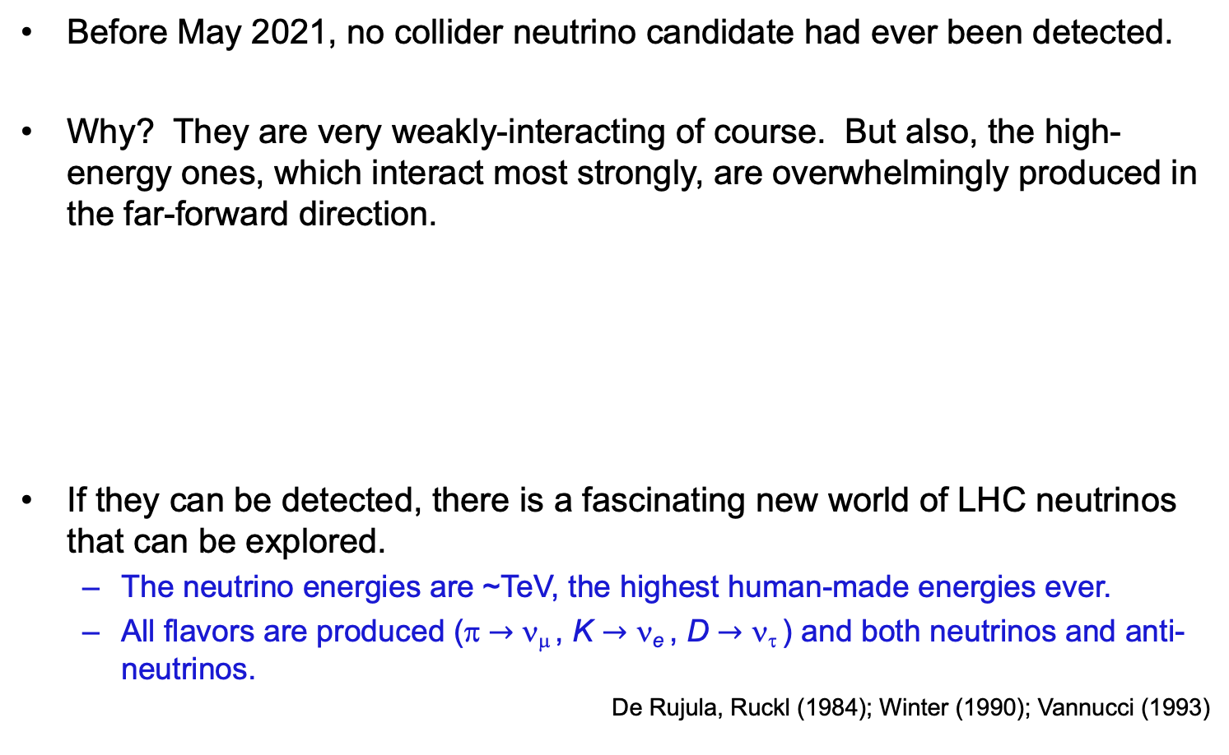
NEUTRINOS
Before May 2021, no collider neutrino candidate had ever been detected.
Why? They are very weakly-interacting of course. But also, the high-energy ones, which interact most strongly, are overwhelmingly produced in the far-forward direction.
If they can be detected, there is a fascinating new world of LHC neutrinos that can be explored.
  The neutrino energies are ~TeV, the highest human-made energies ever.
  All flavors are produced (π $→$ ν_{μ} , K $→$ ν_{e} , D $→$ ν_{τ} ) and both neutrinos and anti-neutrinos.
De Rujula, Ruckl (1984); Winter (1990); Vannucci (1993)

Slide 17
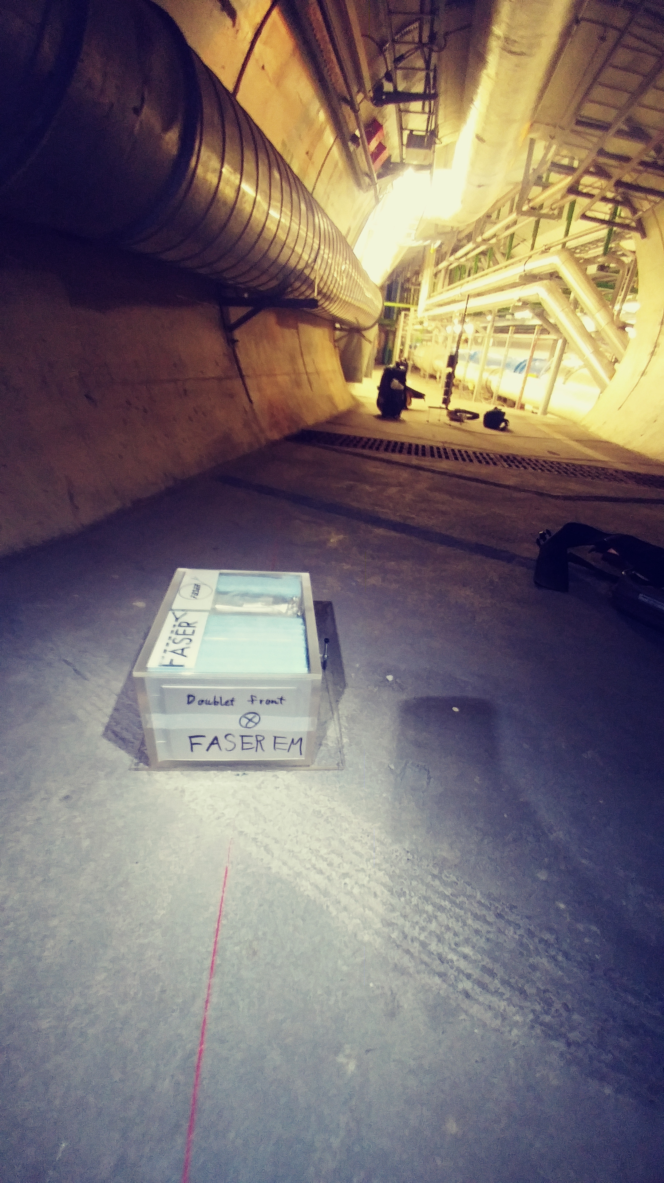
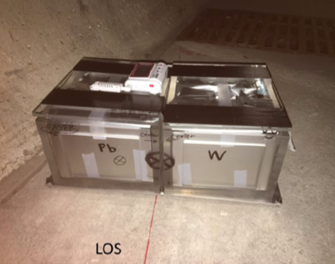
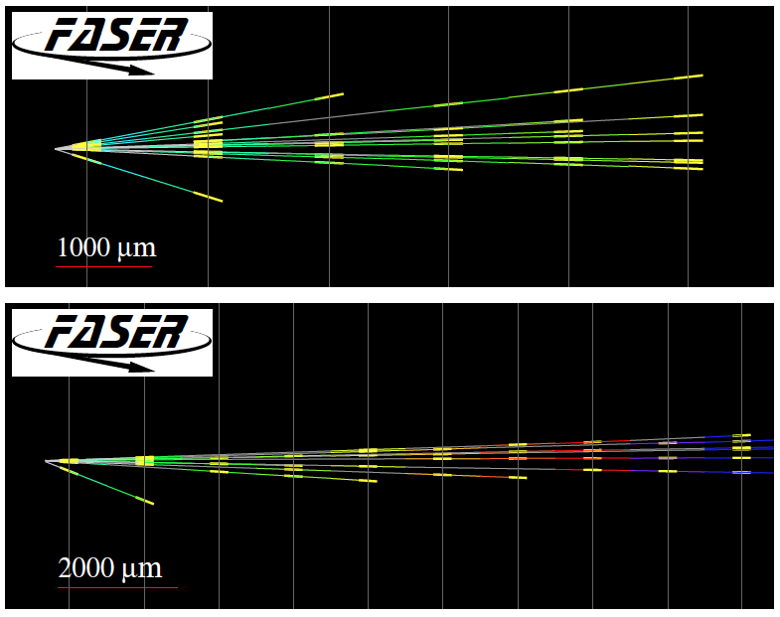
FIRST COLLIDER NEUTRINOS
In 2018 a FASER pilot emulsion detector with 11 kg fiducial mass collected 12.2 fb⁻¹ on the beam collision axis (installed and removed during Technical Stops).
In May 2021, the FASER Collaboration announced the direct detection of 6 candidate neutrinos above 12 expected neutral hadron background events (2.7σ).
At Run 3, FASERν and SND@LHC will open up a completely new field: neutrino physics at the LHC.

Slide 18
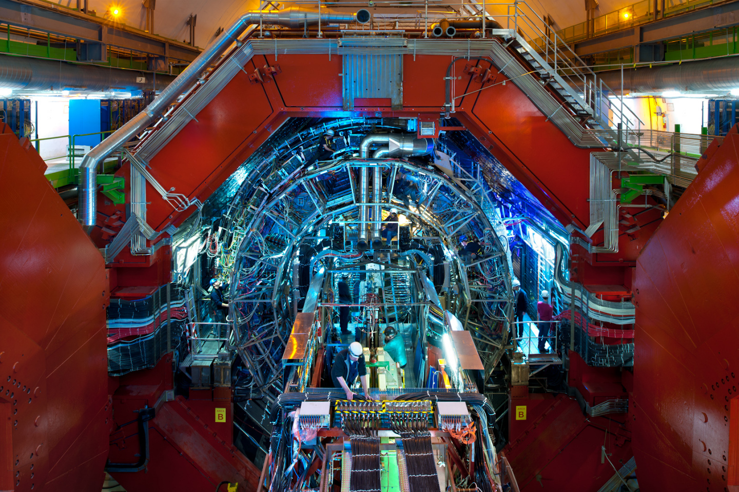
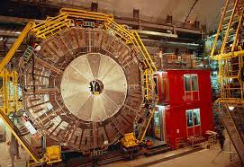
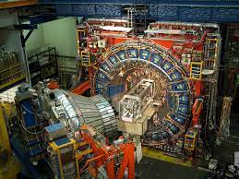
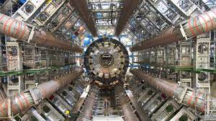
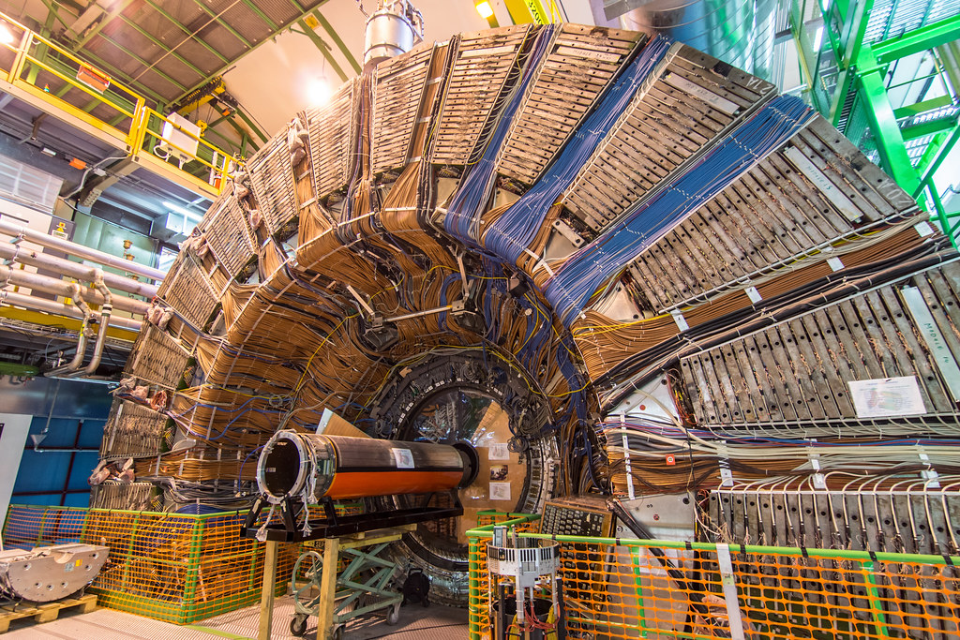
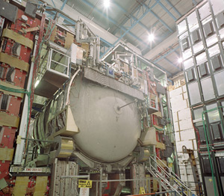
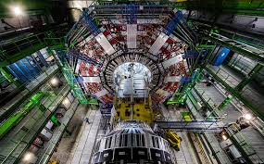
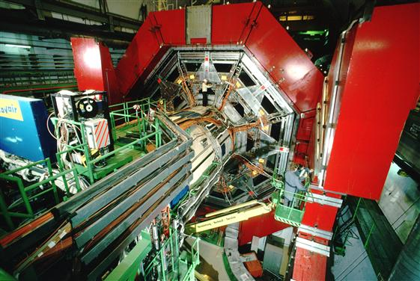

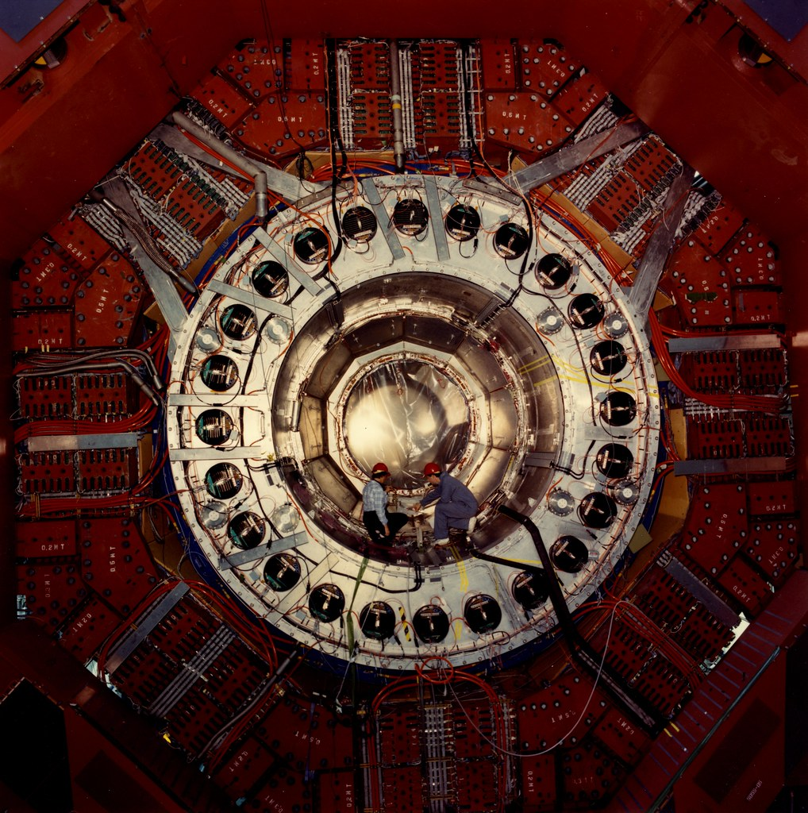
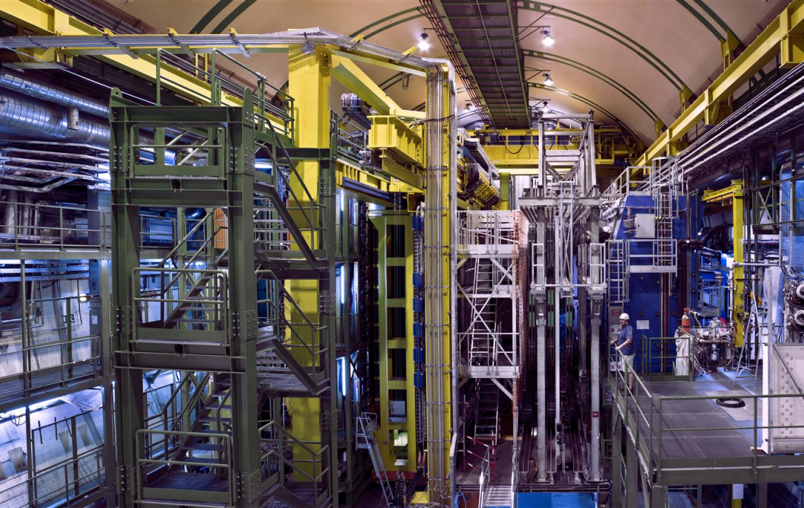
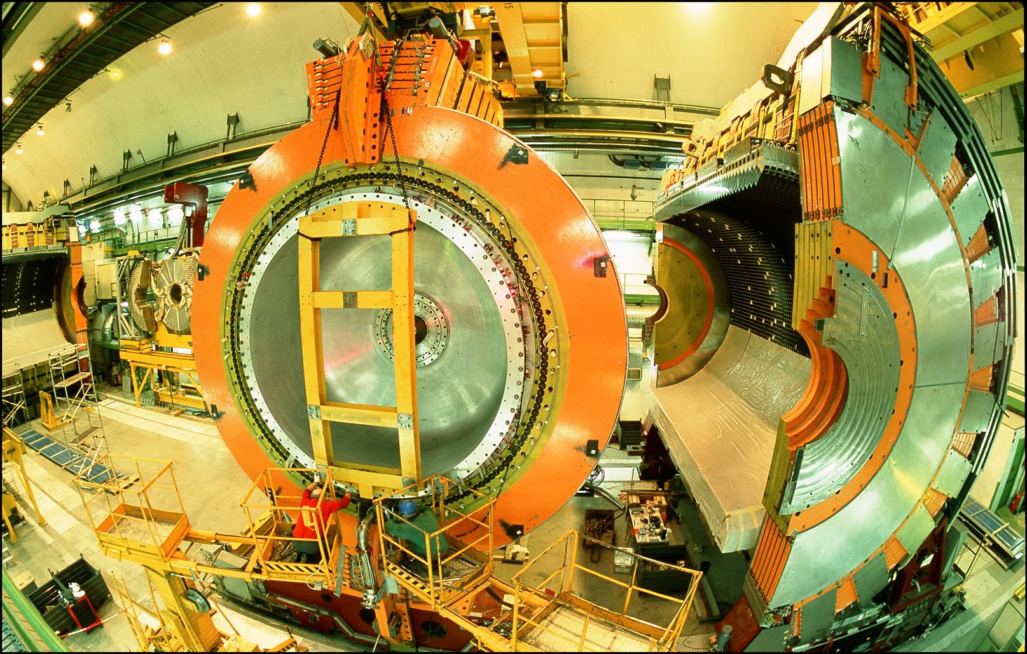
LOCATION, LOCATION, LOCATION
…
ALICE
ALEPH
CDF
FASER Pilot Detector
Suitcase-size, 4 weeks
$0 (recycled parts)
6 candidate neutrinos
ATLAS
DELPHI
D0
CMS
L3
LHCb
SLD
OPAL
All previous
collider detectors
Building-size, decades
~$10⁹
0 candidate neutrinos

Slide 19
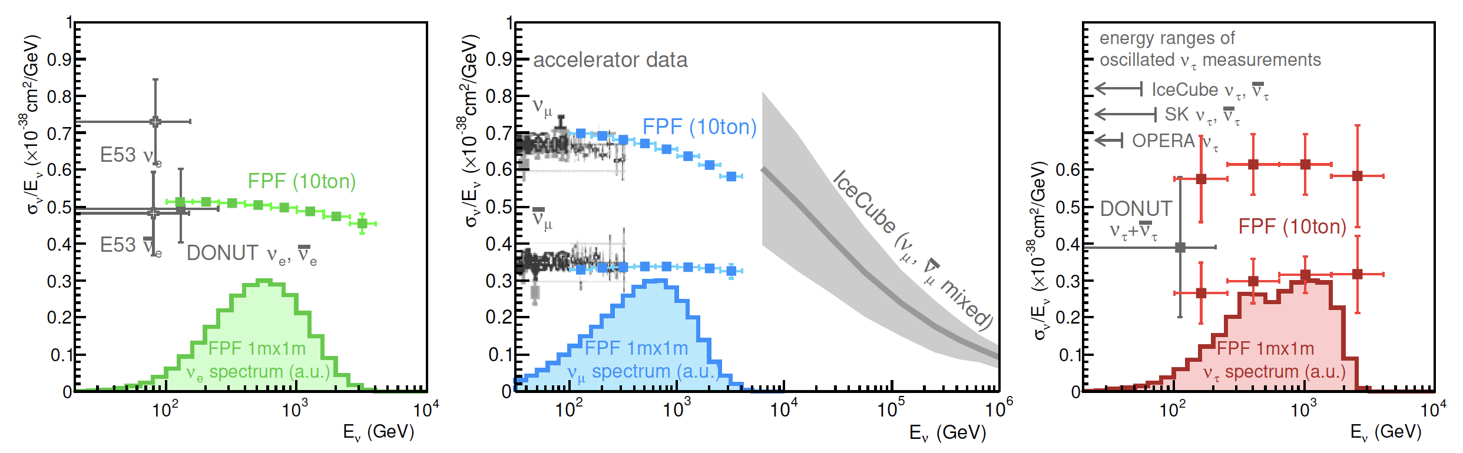
NEUTRINO PHYSICS AT THE FPF
At the FPF, three proposed ~10 tonne detectors FASERν2, Advanced SND, and FLArE will each detect ~100,000 ν_{e} , ~1,000,000 ν_{μ} , and ~1000 ν_{τ} interactions at TeV energies, providing high statistics samples for all three flavors in an energy range that has never been directly explored.
First precision studies of the tau neutrino.
Can also distinguish neutrinos and anti-neutrinos for muon and tau.
FASER White Paper (2022)

Slide 20
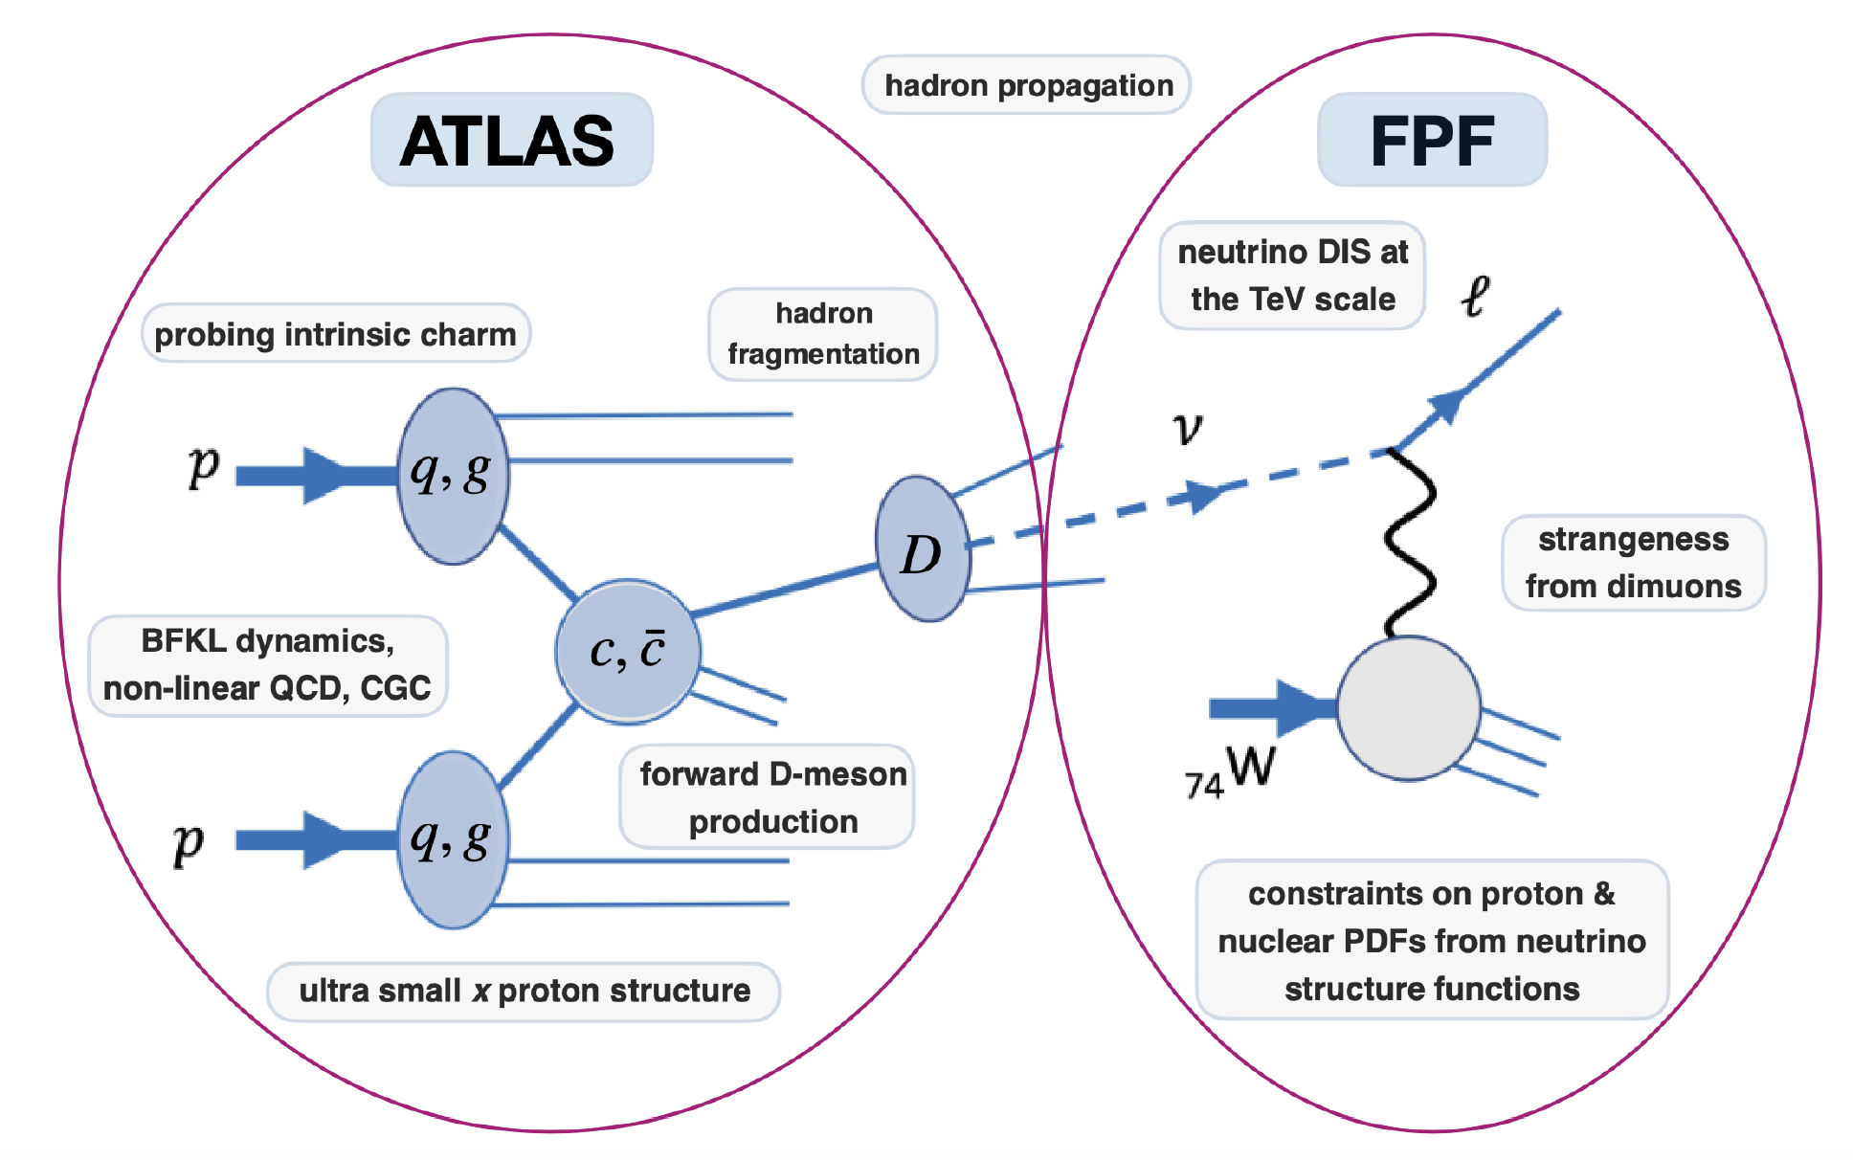
QCD
The FPF will also support a rich program of QCD and hadron structure studies.
Forward neutrino production is a a probe of forward hadron production, BFKL dynamics, intrinsic charm, ultra small x proton structure, with important implications for UHE cosmic ray experiments.
Neutrino interactions will probe DIS at the TeV-scale, constrain proton and nuclear structure, pdfs.
FASER White Paper (2022)

Slide 21
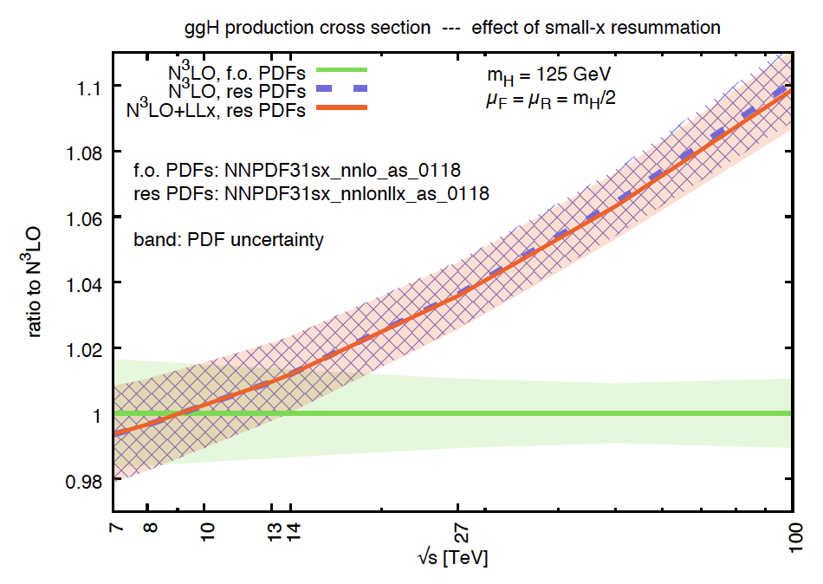
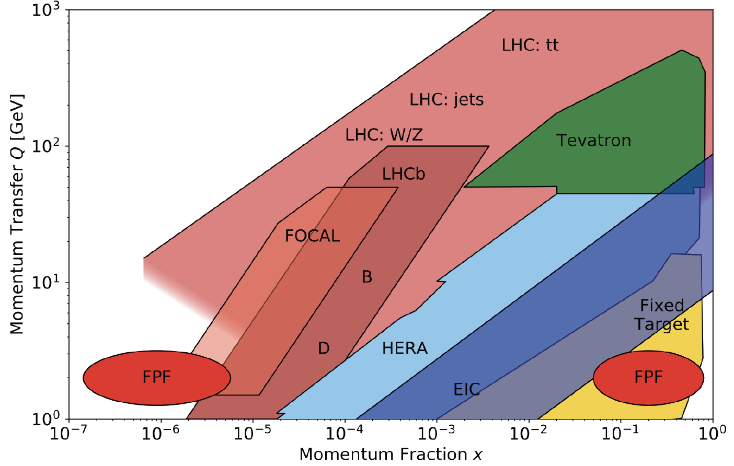
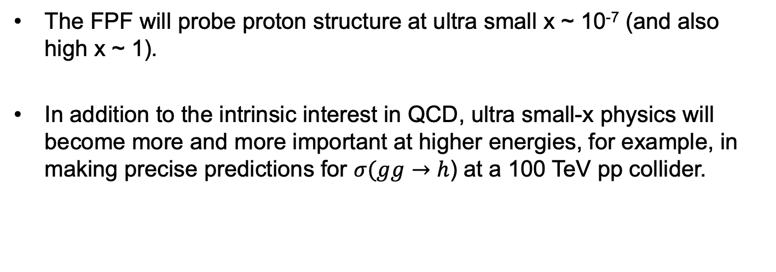
QCD
The FPF will probe proton structure at ultra small x ~ 10⁻⁷ (and also high x ~ 1).
In addition to the intrinsic interest in QCD, ultra small-x physics will become more and more important at higher energies, for example, in making precise predictions for $σ(gg→$ $h$) at a 100 TeV pp collider.
FASER White Paper (2022)

Slide 22
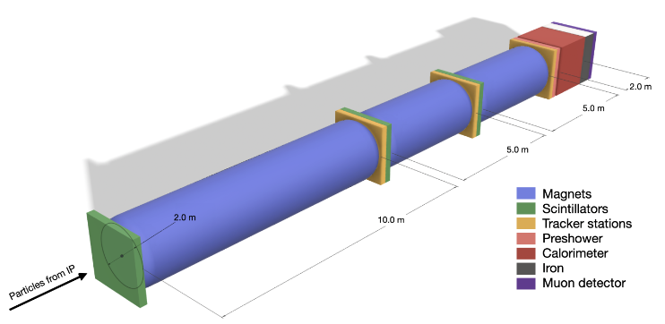
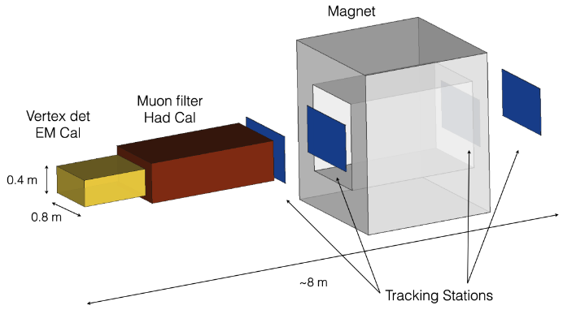
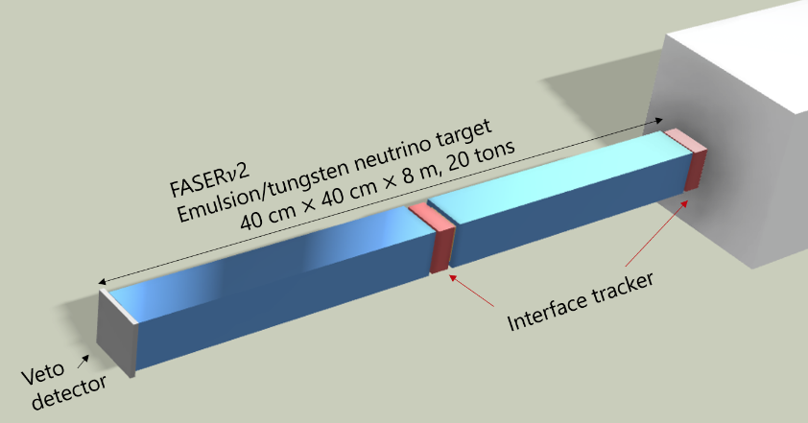
THE EXPERIMENTS
At present there are 5 experiments being developed for the FPF; these are works in progress, with much more work to be done.
FASER2: upgraded FASER (tracker + magnetic spectrometer) 20 m long, targeting LLPs.
AdvSND, FASERν2: successors to SND@LHC and FASERν, ~10 tonne detectors to study TeV neutrinos and differentiate flavors.
FASER2
AdvSND
FASERν2

Slide 23
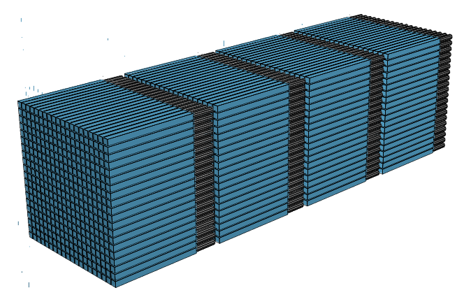
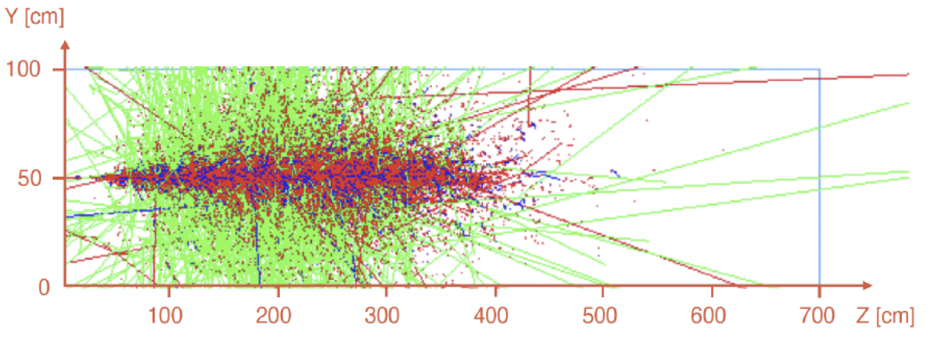
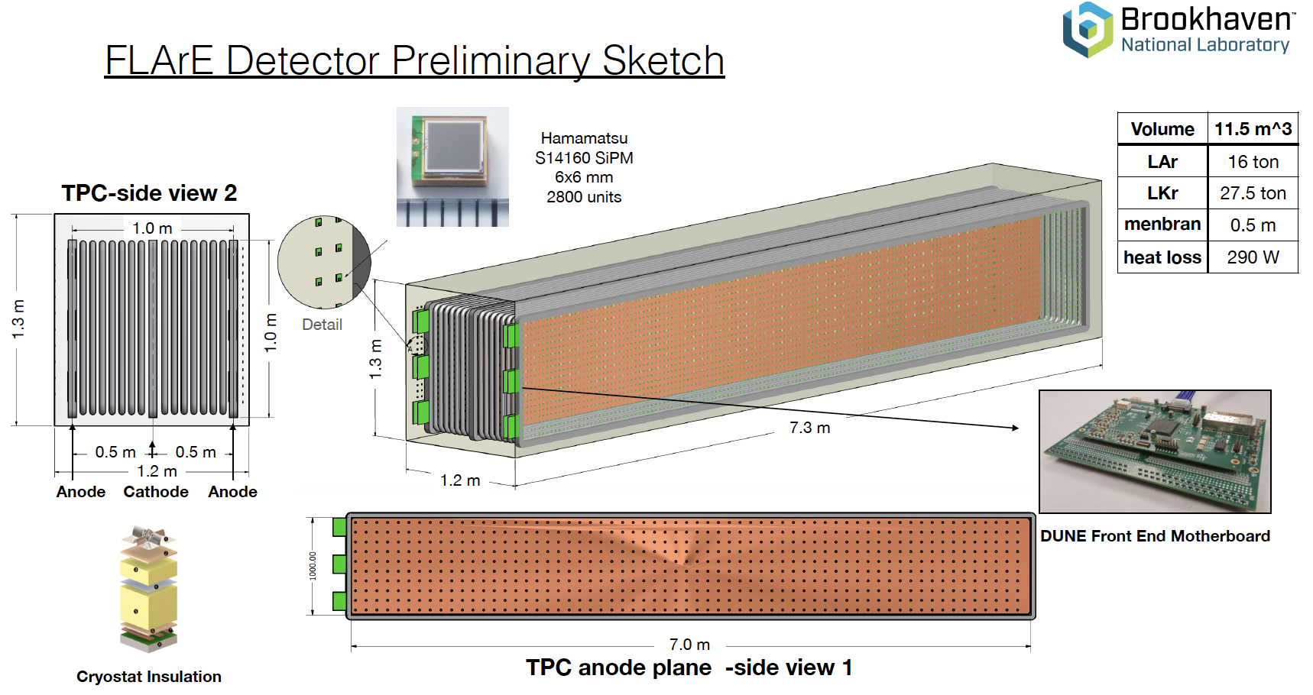
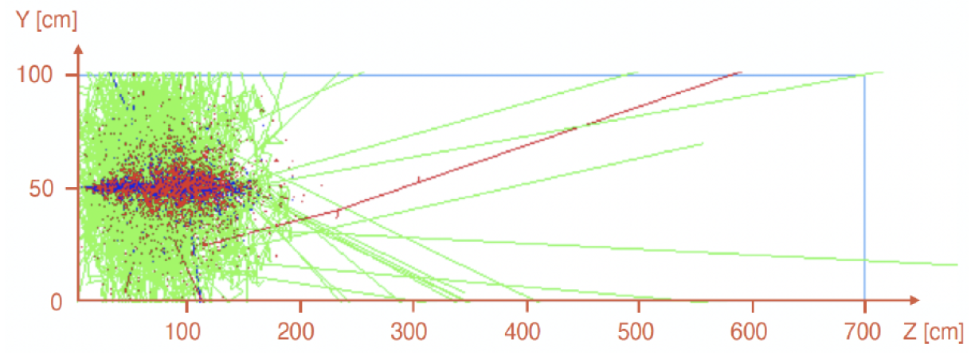
THE EXPERIMENTS
FORMOSA: 1m x 1m x 5m scintillator bars+ PMTs looking for milli-charged particles, particles with EDMs, MDMs, and similar signatures.
FLArE: ~1m x 1m x 7m noble liquid (Ar or Kr) TPC for neutrino studies, light DM searches.
1 TeV e LAr
1 TeV e LKr

Slide 24
THE FACILITY
The CERN civil engineering team has considered many sites around the LHC ring that are on the beam collision axis of an IP.
A preferred location has been identified ~620-680 m west of the ATLAS IP, shielded by ~200 m of rock. The site is on CERN land in France.

Slide 25
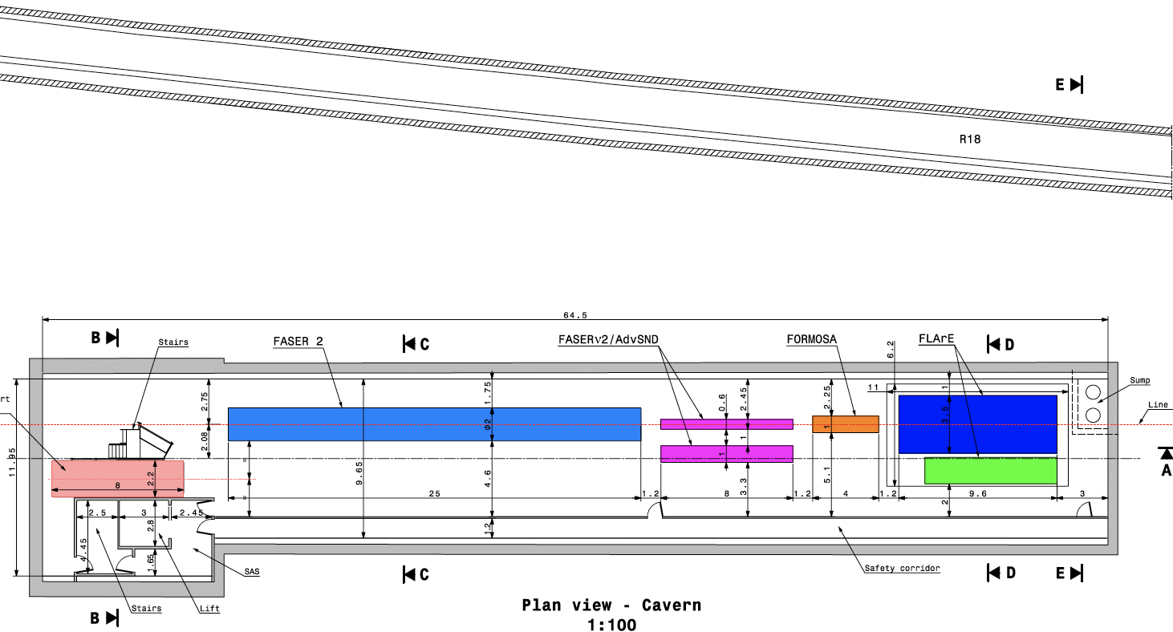
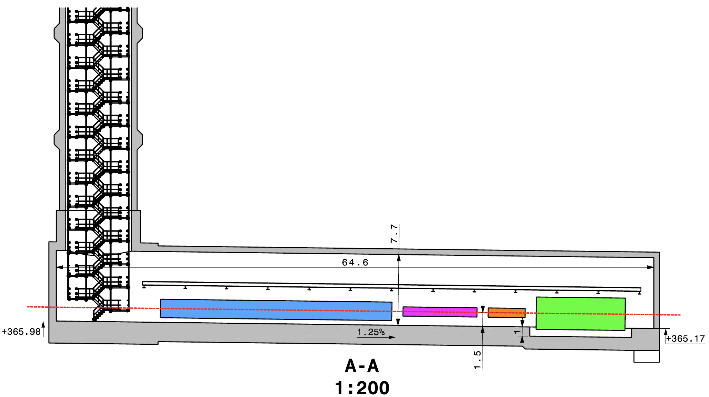
CAVERN AND SHAFT
Cavern: 65m long, 8m wide/high. Shaft: 88m-deep, 9.1m-diameter.
The FPF is completely decoupled from the LHC (as of today, no need for a safety corridor connecting FPF to the LHC).

Slide 26
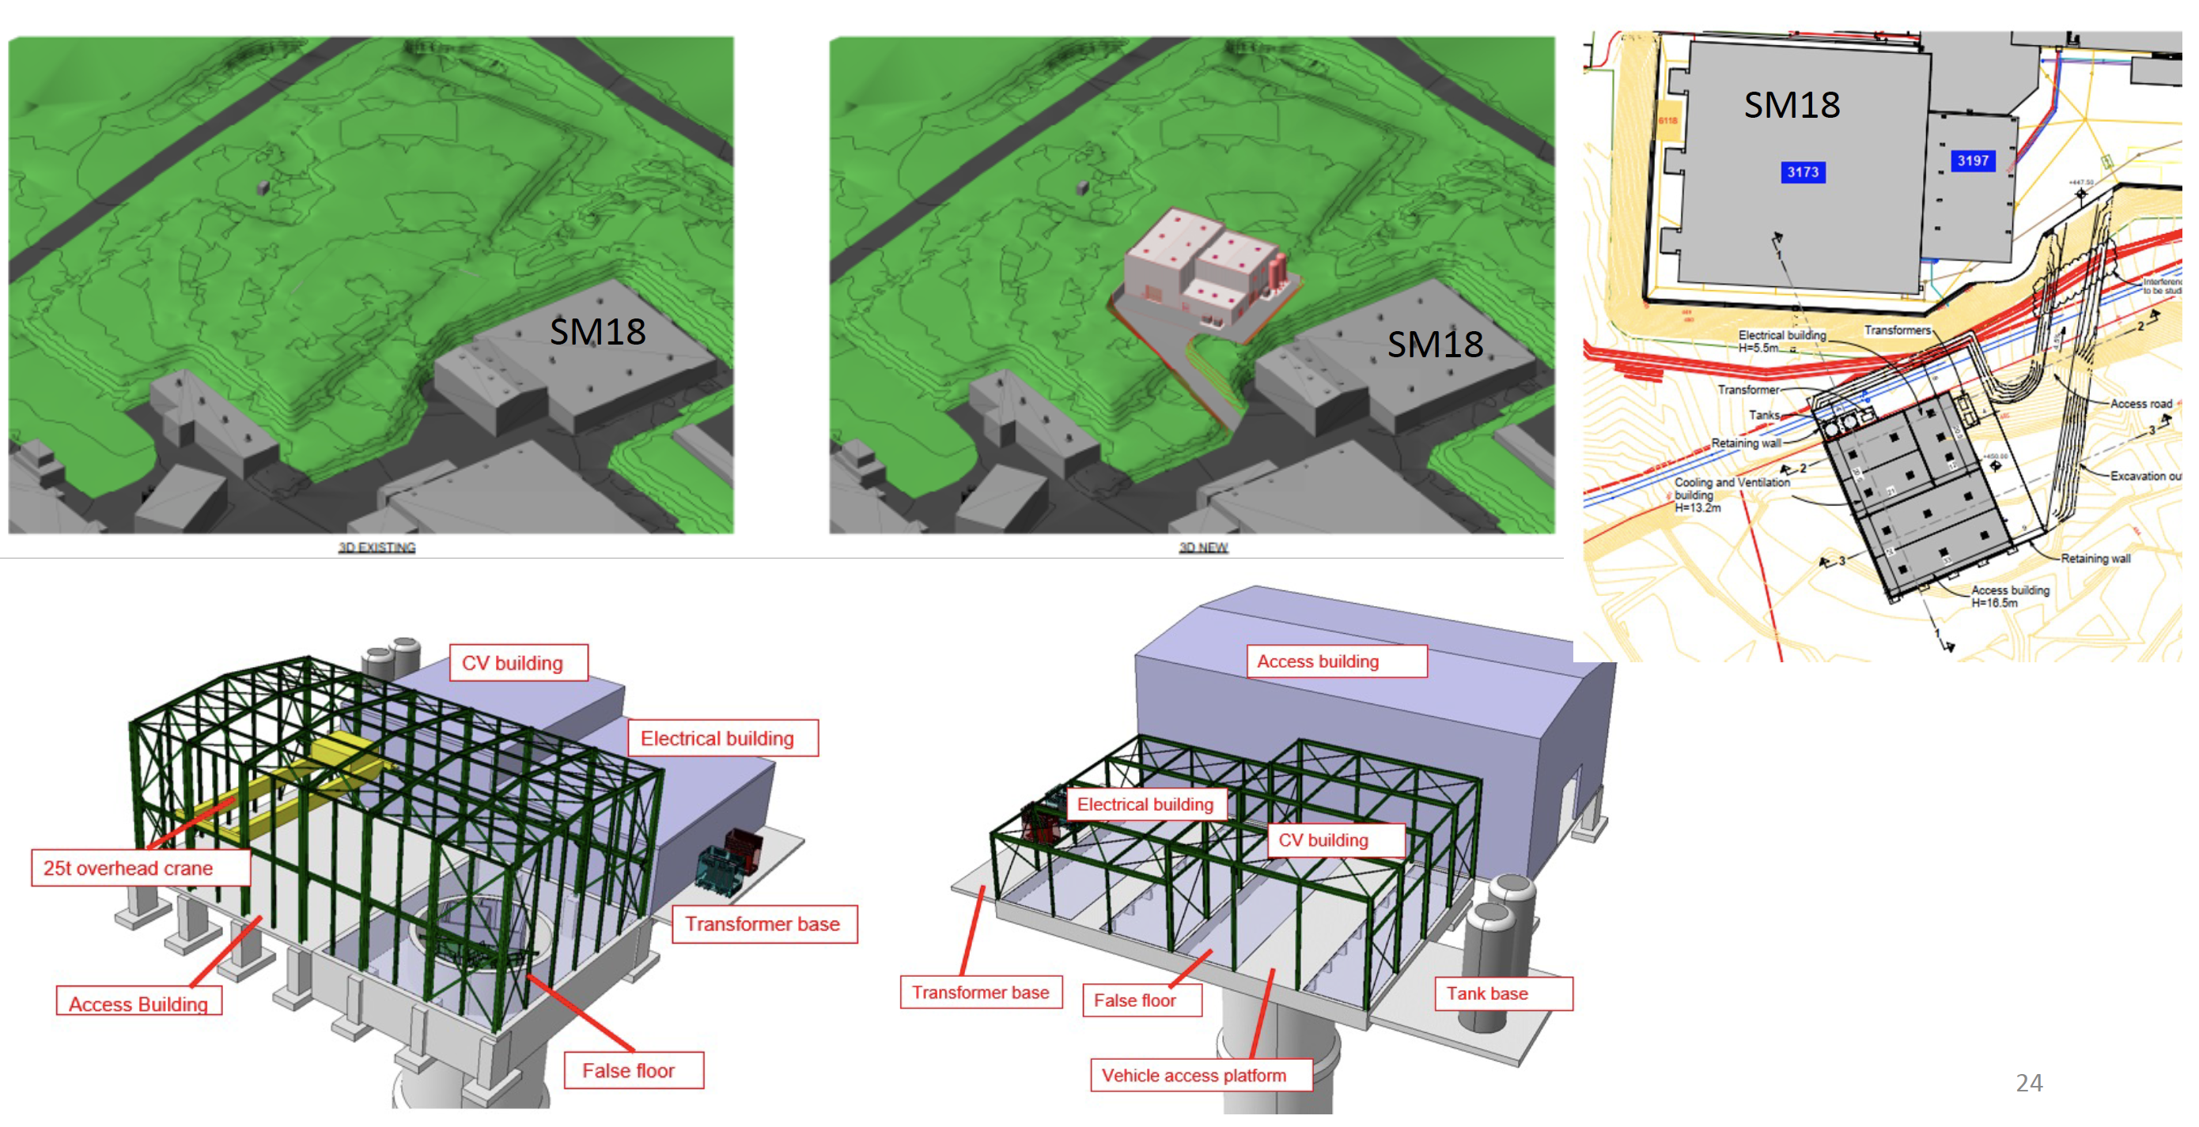
SURFACE BUILDINGS

Slide 27
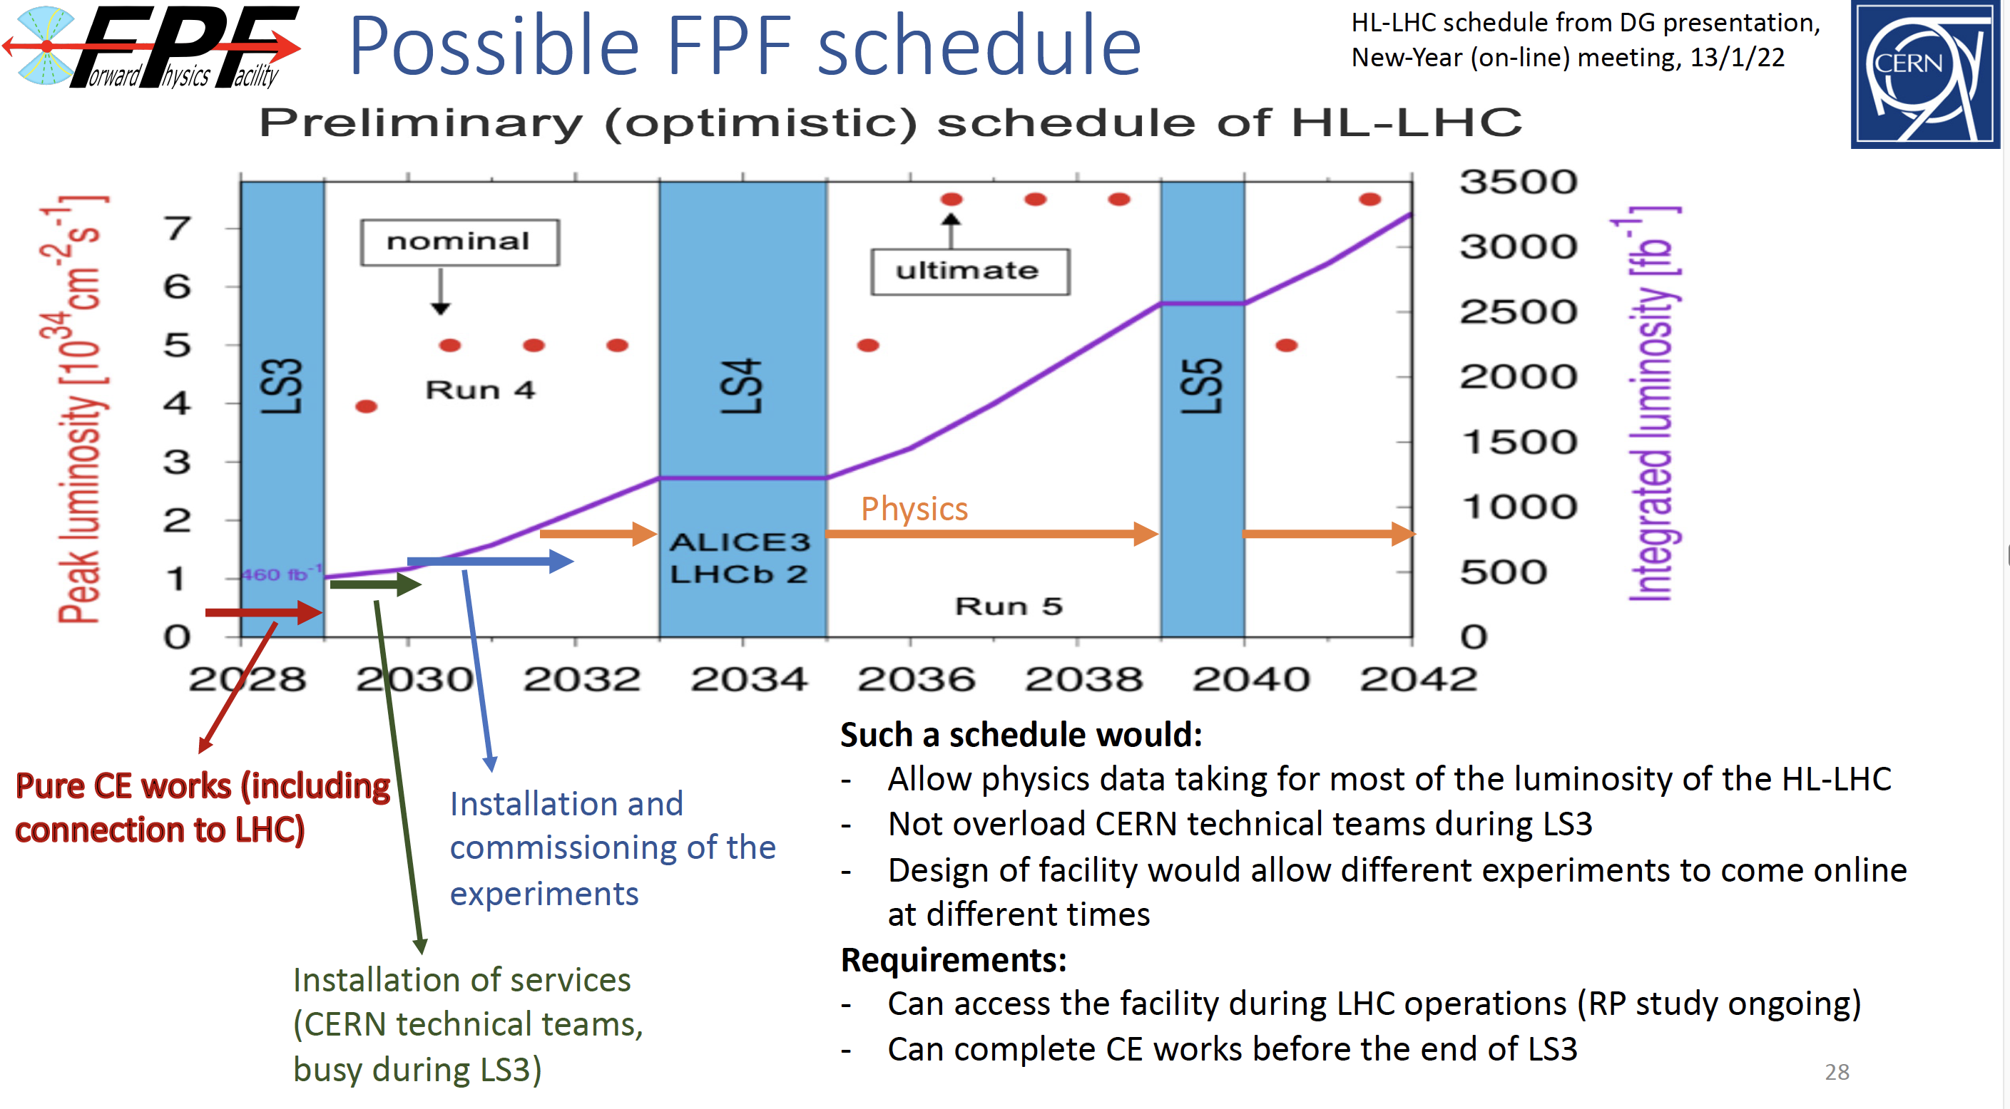

COST AND TIMELINE
Very preliminary (class 4) cost estimate: 23 MCHF (CE) + 15 MCHF (services) $≈$ 40 MCHF (+50%/-30%), not including experiments.
Timeline presented at Chamonix workshop (Feb 2022)
J. Boyd

Slide 28
EXECUTIVE SUMMARY
Physics opportunities are currently being missed in the far-forward region at the LHC.
The proposed FPF will be an underground cavern constructed to house a suite of far-forward experiments for the HL-LHC era.
The FPF is uniquely positioned to fully realize the LHC’s physics potential for both SM and BSM physics in the far-forward region.
A very preliminary cost estimate is 40 MCHF + experiments. The construction can take place separate from the LHC, and no modifications to the LHC are needed.
A’, a, mCPs, DM, …
π, K, D, $ν_{e}$ , $ν_{μ}$ , $ν_{τ}$

