Slide 1



NEW SIGNALS AT
FASER AND FASER2
PBC General Meeting, 3 December 2021
Jonathan Feng, UC Irvine

Slide 2
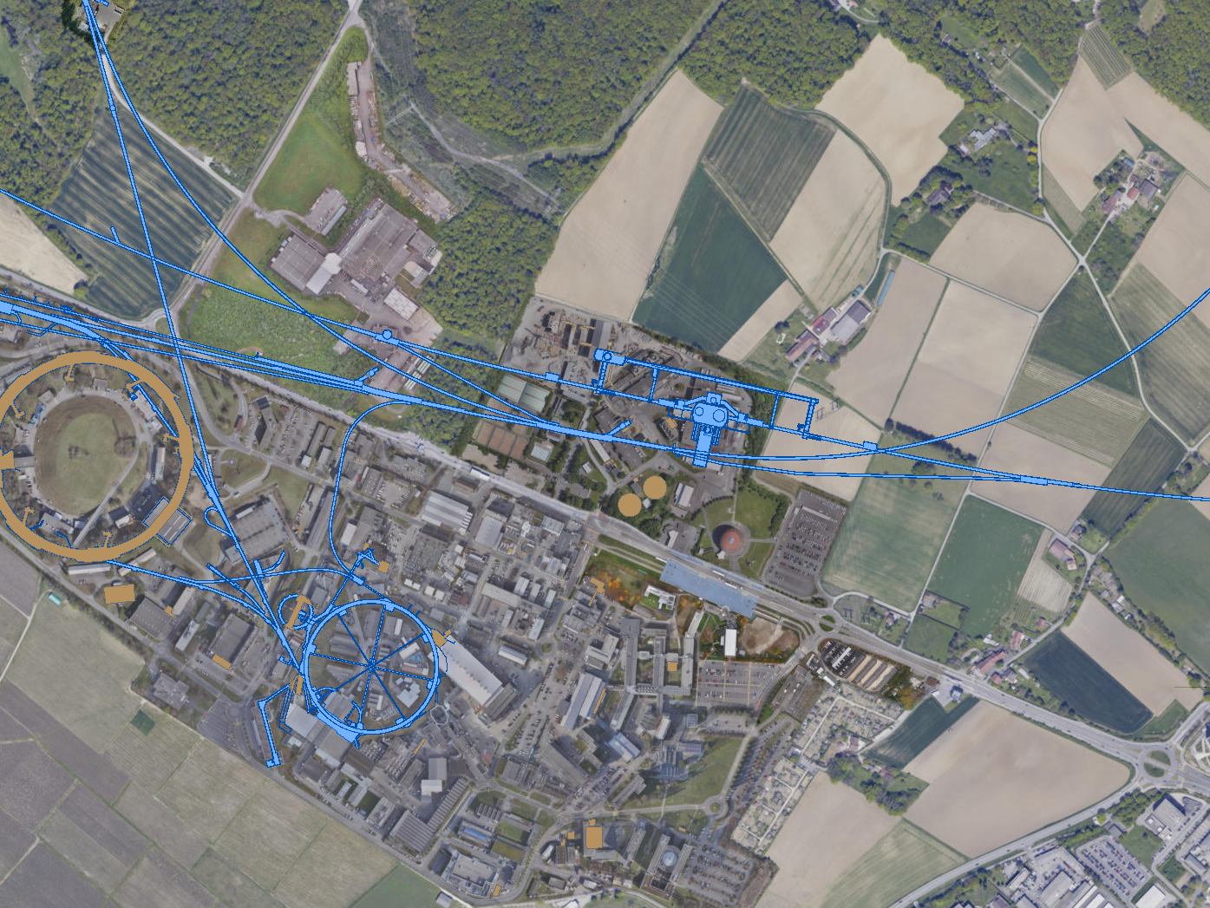
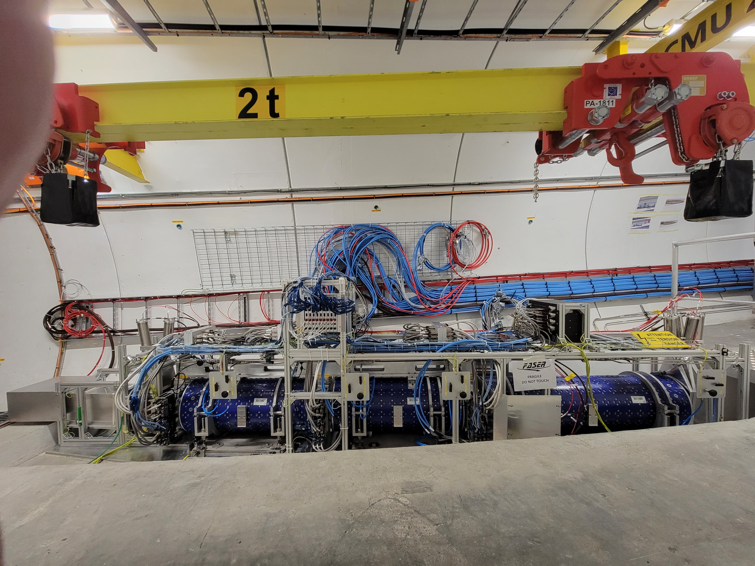
FASER
One of 3 far-forward detectors approved for LHC Run 3
480 m to the east of ATLAS IP; constructed, installed, ready to go
Active volume: cylinder with 10 cm radius, 1.5 m long
UJ18
ATLAS
SPS
SND: approved March 2021
UJ12
LHC
FASER: approved March 2019
LOS
FASERν: approved December 2019
CERN GIS

Slide 3
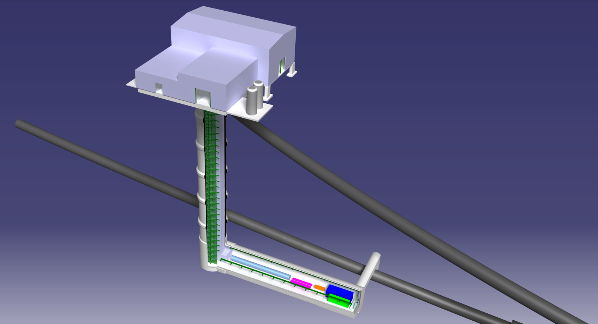
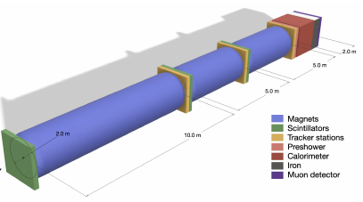
FASER2
One of ~5 far-forward detectors proposed for the HL-LHC
640 m to the west of the ATLAS IP in the Forward Physics Facility
Active Volume: cylinder with 1 m radius, 20 m long
UJ18
ATLAS
SPS
UJ12
LHC
LOS
CERN GIS

Slide 4


BSM SIGNALS
FASER and FASER2 have discovery prospects for many PBC Benchmarks. For FASER, the dominant signatures considered have been $A^{′}→ e^{+}e^{−}$ , and $a →γγ$.
Benchmark Model | Underway | FPF | References
BC1: Dark Photon | $$\text{FASER}$$ | $$\text{FASER}\text{ 2}$$ | Feng, Galon, Kling, Trojanowski, 1708.09389
BC1’: U(1)_{B-L} Gauge Boson | $$\text{FASER}$$ | $$\text{FASER}\text{ 2}$$ | Bauer, Foldenauer, Jaeckel, 1803.05466 FASER Collaboration, 1811.12522
BC2: Dark Matter | ⎼ | FLArE | Batell, Feng, Trojanowski, 2101.10338 Batell et al., 2107.00666
BC3: Milli-Charged Particle | ⎼ | FORMOSA | Foroughi-Bari, Kling, Tsai, 2010.07941
BC4: Dark Higgs Boson | ⎼ | $$\text{FASER}\text{ 2}$$ | Feng, Galon, Kling, Trojanowski, 1710.09387 Batell, Freitas, Ismail, McKeen, 1712.10022
BC5: Dark Higgs with hSS | ⎼ | $$\text{FASER}\text{ 2}$$ | Feng, Galon, Kling, Trojanowski, 1710.09387
BC6: HNL with e | ⎼ | $$\text{FASER}\text{ 2}$$ | Kling, Trojanowski, 1801.08947 Helo, Hirsch, Wang, 1803.02212
BC7: HNL with μ | ⎼ | $$\text{FASER}\text{ 2}$$ | Kling, Trojanowski, 1801.08947 Helo, Hirsch, Wang, 1803.02212
BC8: HNL with τ | $$\text{⎼}$$ | $$\text{FASER}\text{ 2}$$ | Kling, Trojanowski, 1801.08947 Helo, Hirsch, Wang, 1803.02212
BC9: ALP with photon | $$\text{FASER}$$ | $$\text{FASER}\text{ 2}$$ | Feng, Galon, Kling, Trojanowski, 1806.02348
BC10: ALP with fermion | $$\text{⎼}$$ | $$\text{FASER}\text{ 2}$$ | FASER Collaboration, 1811.12522
BC11: ALP with gluon | $$\text{FASER}$$ | $\text{FASER}$ 2 | FASER Collaboration, 1811.12522

Slide 5
NEW SIGNALS: QUIRKS
Kang, Luty (2008)
Quirks are matter particles charged under a hidden strong force with mass m >> Λ_{hidden}. E.g., m ~ 100 GeV – TeV, Λ_{hidden} ~ keV.
Quirks may also have SM charge and color. They are then pair produced at the LHC, and are connected by a hidden color string.
For quarks and standard QCD, m << Λ_{QCD}, and so it becomes energetically favorable to pair produce new quarks from the vacuum. Quarks hadronized.
But for quirks, since m >> Λ_{hidden} , it is never energetically favorable to break the string by pair producing quirks from the vacuum: quirks do not hadronize, they oscillate.

Slide 6
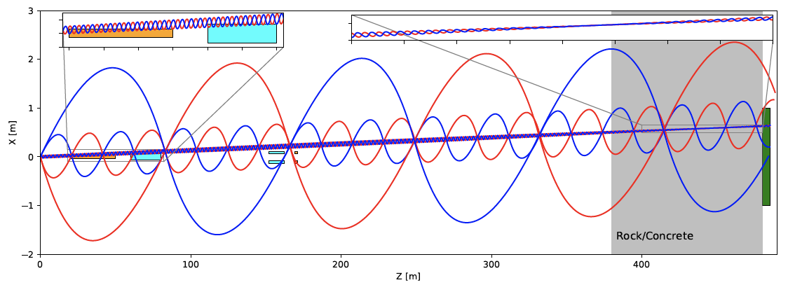
QUIRK SIGNATURE
Of course, the quirk – anti-quirk system has low p_{T}.
The pair therefore oscillates, with length scale ~ 1/ Λ_{hidden}.
For a range of Λ_{hidden} , the quirk system travels down the beamline, escaping most LHC detectors, but ultimately leaving (strange!) tracks in FASER.
Li, Pei, Ran, Zhang, 2108.06748

Slide 7
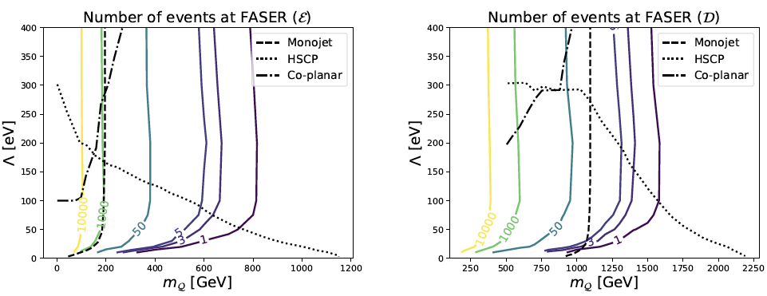
QUIRK DISCOVERY PROSPECTS
Far-forward detectors at the LHC are ideally suited to search for quirks.
  Like heavy particles, they require the LHC to be produced
  Like light particles, they are dominantly produced along the beamline
~1000 of events possible at FASER in Run 3
Li, Pei, Ran, Zhang, 2108.06748

Slide 8
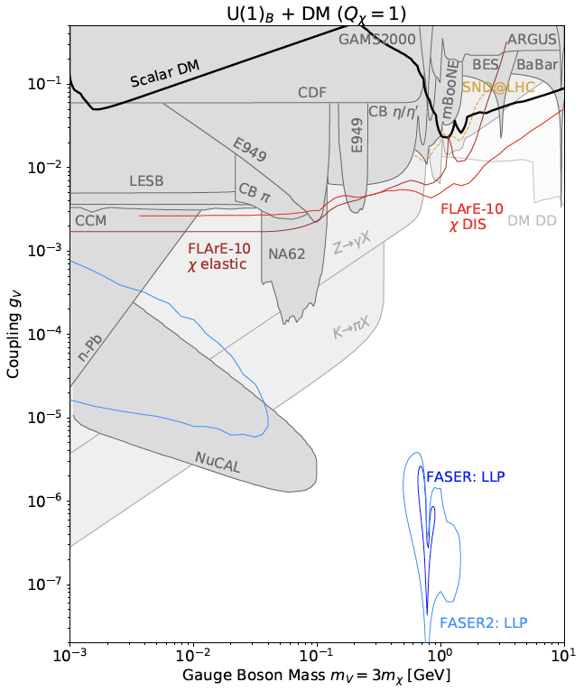
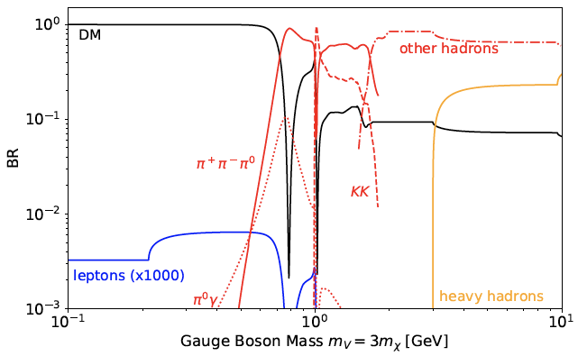
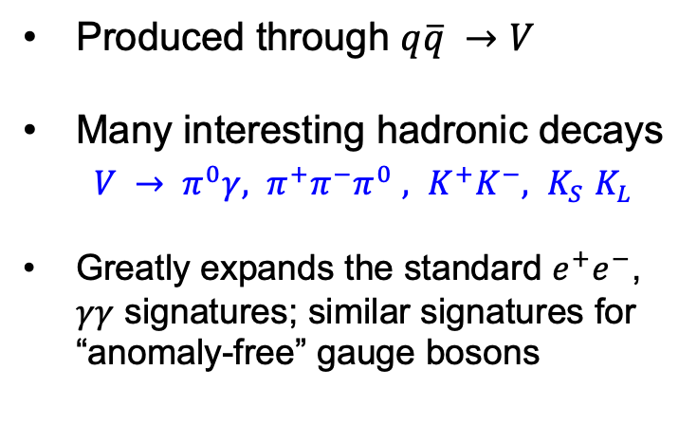
NEW SIGNALS: B AND B-3τ GAUGE BOSONS
Consider a light gauge boson coupled to baryon number
Produced through $q\overline{q} →V$
Many interesting hadronic decays
  ${V → π}^{0}γ, π^{+}π^{−}π^{0}$ $, K^{+}K^{−}, K_{S}$ $K_{L}$
Greatly expands the standard $e^{+}e^{−}$, $γγ$ signatures; similar signatures for “anomaly-free” gauge bosons
Li, Pei, Ran, Zhang, 2108.06748
Batell, Feng, Fieg, Ismail, Kling, Abraham, Trojanowski, 2111.10343;
see also Boyarsky, Mikulenko, Ovchynnikov, Shchutska, 2104.09688

Slide 9
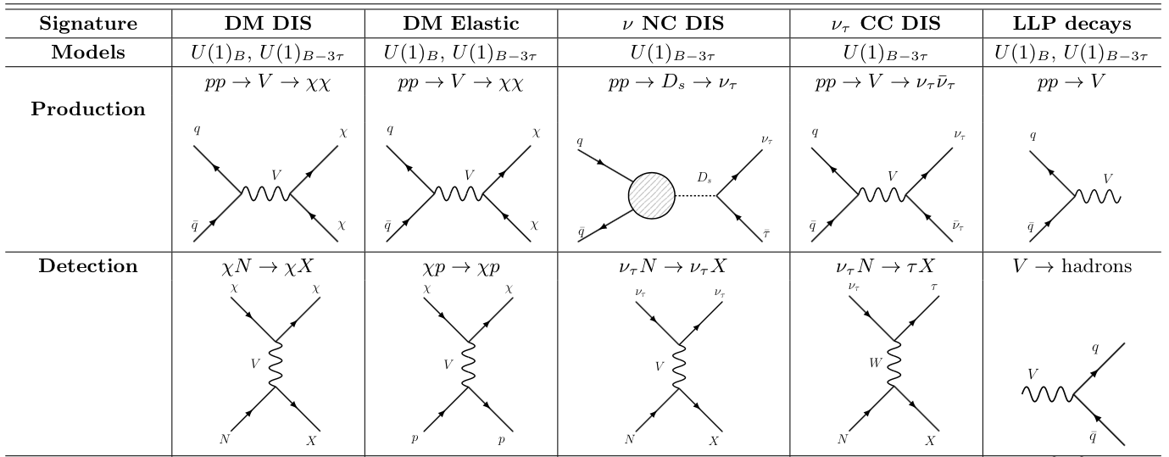
SIGNATURES FOR OTHER FPF EXPERIMENTS
Batell, Feng, Fieg, Ismail, Kling, Abraham, Trojanowski, 2111.10343

Slide 10

PLANS
The physics case for far-forward experiments at the LHC (FASER, FASER2, FASERν, FASERν2, SND@LHC, Advanced SND, FLArE, FORMOSA, …) continues to be studied and continues to grow.
Looking forward to continued progress within the PBC framework and also the Snowmass community exercise.
FPF meetings
  FPF Kickoff Meeting, 9-10 Nov 2020, https://indico.cern.ch/event/955956
  FPF2 Meeting, 27-28 May 2021, https://indico.cern.ch/event/1022352
  FPF3 Meeting, 25-26 Oct 2021, https://indico.cern.ch/event/1076733
FPF Short Paper: 75 pages, 80 authors completed in Sept 2021 (2109.10905).
The FPF White Paper (~200-300 pages) is being prepared to be submitted to Snowmass in February-March 2022.

