Slide 1




PBC BSM Meeting, 20 October 2021
Jonathan Feng, UC Irvine

Slide 2
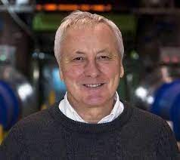
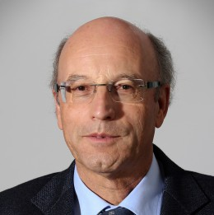

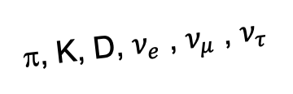
SOME HISTORY
On the Occasion of the 50th Anniversary of CERN’s ISR:
  “There was initially a broad belief that physics action would be in the forward directions at a hadron collider…. It is easy to say after the fact, still with regrets, that with an earlier availability of more complete…experiments at the ISR, CERN would not have been left as a spectator during the famous November revolution of 1974 with the J/ψ discoveries at Brookhaven and SLAC.” -- Lyn Evans and Peter Jenni, “Discovery Machines,” CERN Courier (2021).
Are we missing opportunities in a similar (but opposite) way at the LHC?
  By far the largest flux of energetic light particles (pions, neutrinos, and maybe also dark photons, ALPs, dark matter, …) is in the far-forward direction.
A’, a, χ, …
π, K, D, $ν_{e}$ , $ν_{μ}$ , $ν_{τ}$

Slide 3
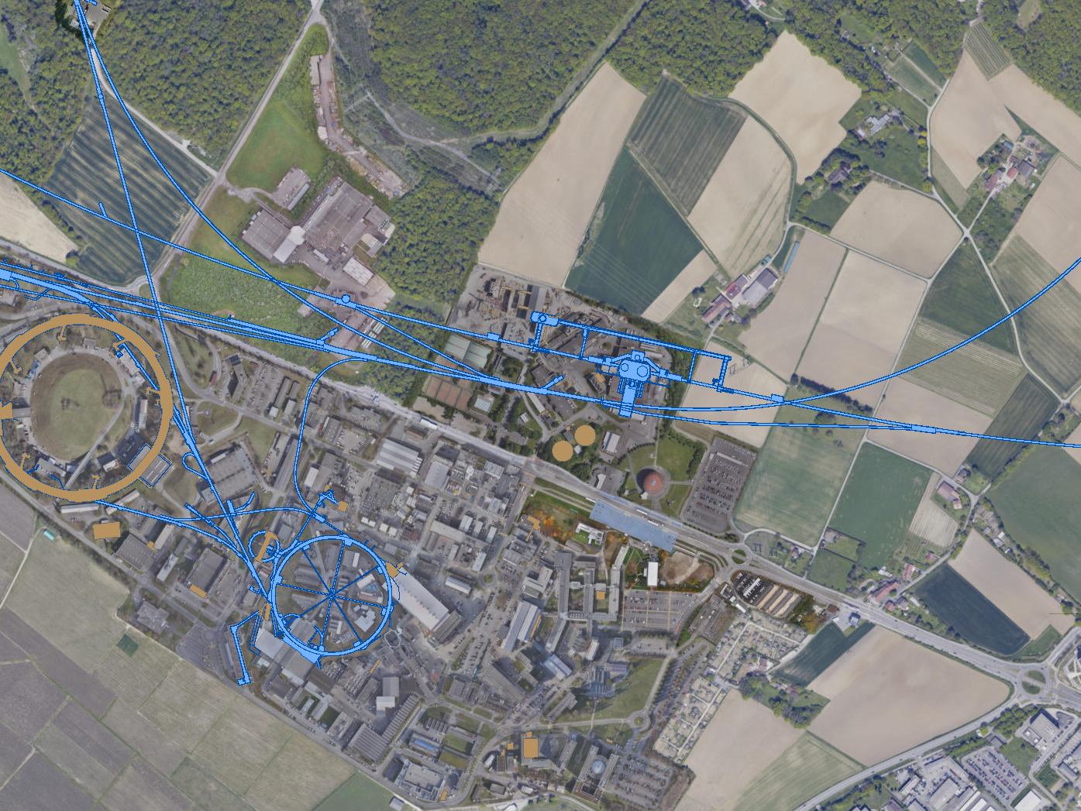
FAR FORWARD EXPERIMENTS FOR LHC RUN 3
The existing caverns UJ12 and UJ18 and adjacent tunnels are good locations for experiments along the LOS: 480 m from ATLAS and shielded from the ATLAS IP by ~100 m of rock.
UJ18
ATLAS
SPS
SND: approved March 2021
UJ12
LHC
FASER: approved March 2019
LOS
FASERν: approved December 2019
CERN GIS

Slide 4
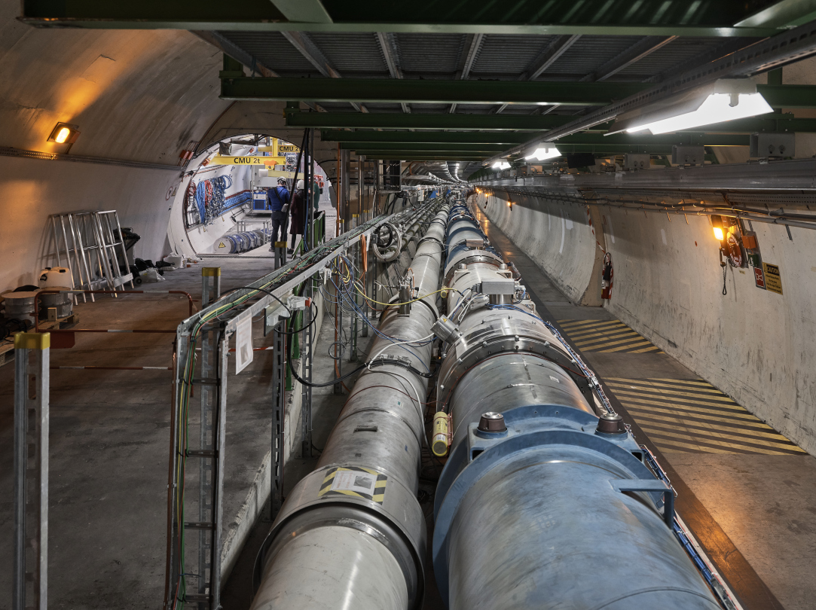
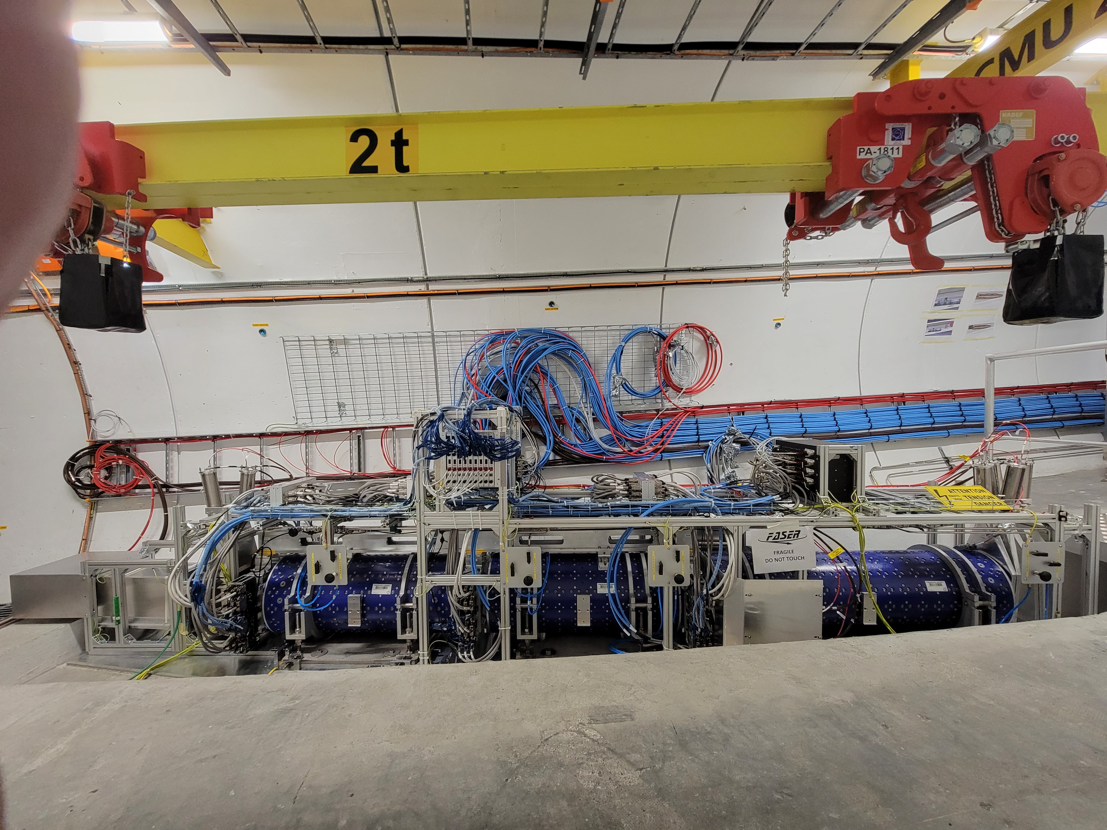
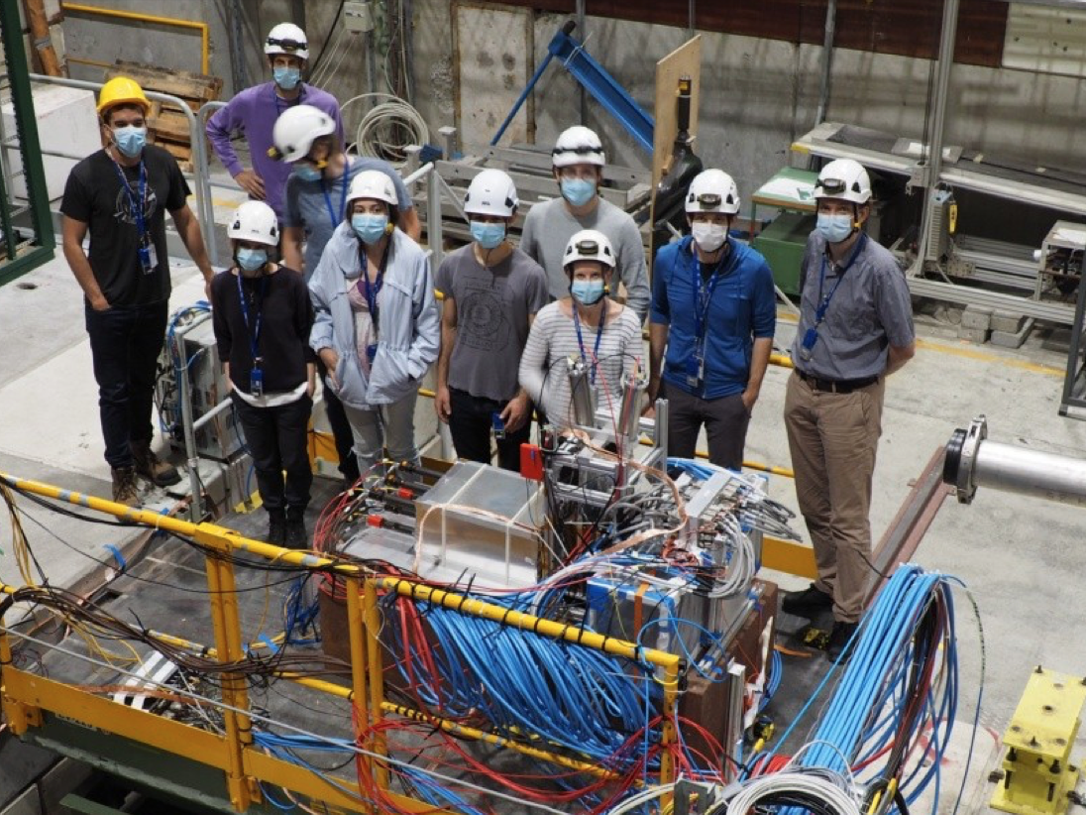
FASER INSTALLATION COMPLETED IN MARCH 2021
TEST BEAM RUN COMPLETED AUGUST 2021

Slide 5
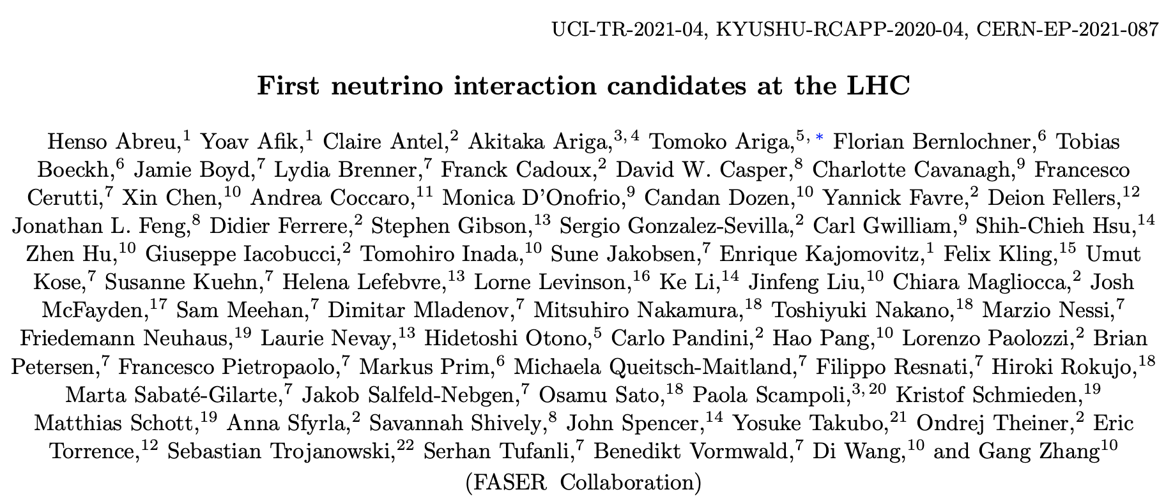
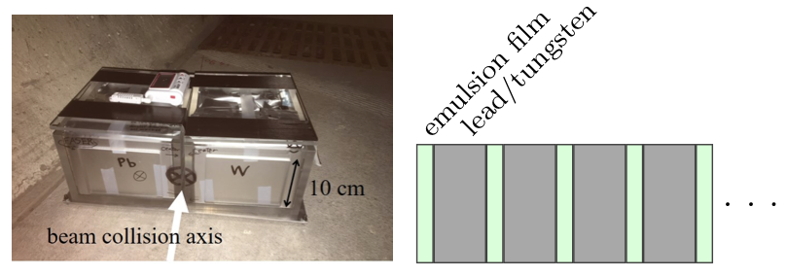
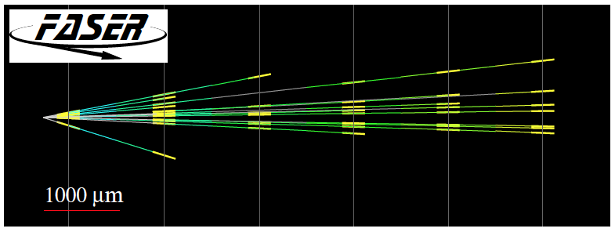
FASERν
In 2018 a 29 kg (11 kg fiducial) FASERν pilot emulsion detector collected data for 4 weeks on the beam collision axis.
In May 2021, we announced the first direct detection of 6 neutrino candidates above expected background events (2.7σ).
Not the 5σ discovery of collider neutrinos, but a promising sign of things to come!
2105.06197

Slide 6
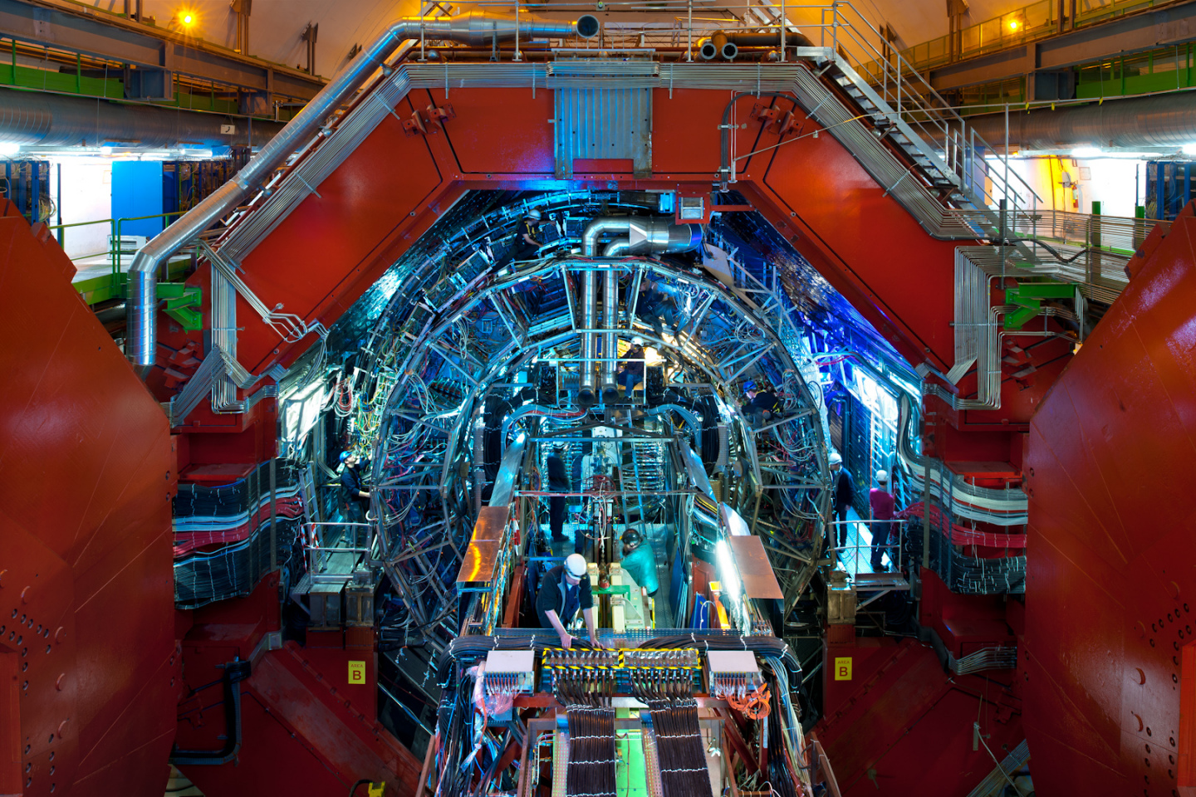
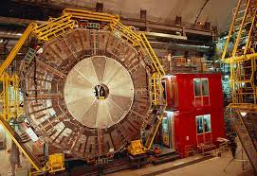
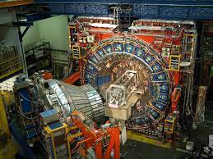
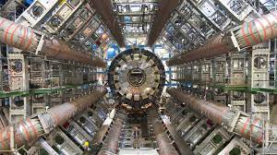
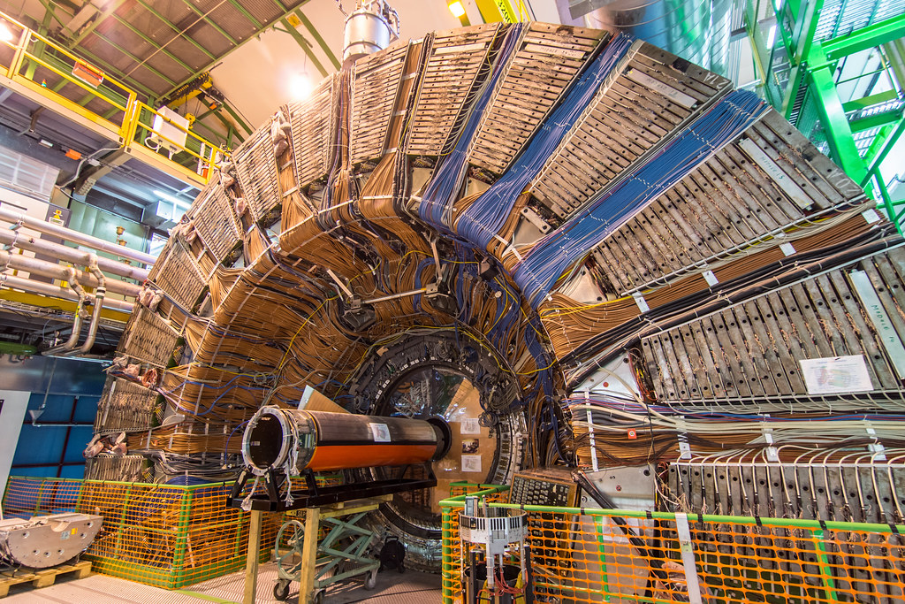
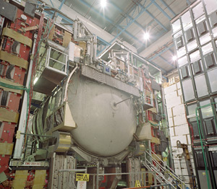
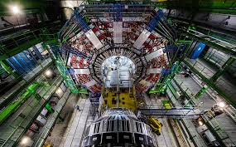
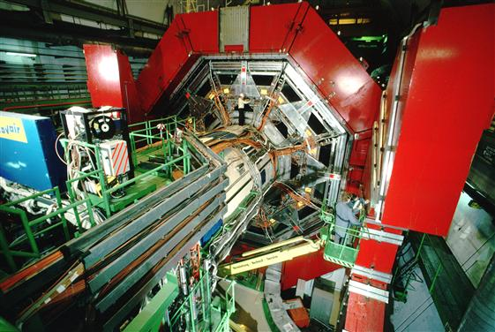

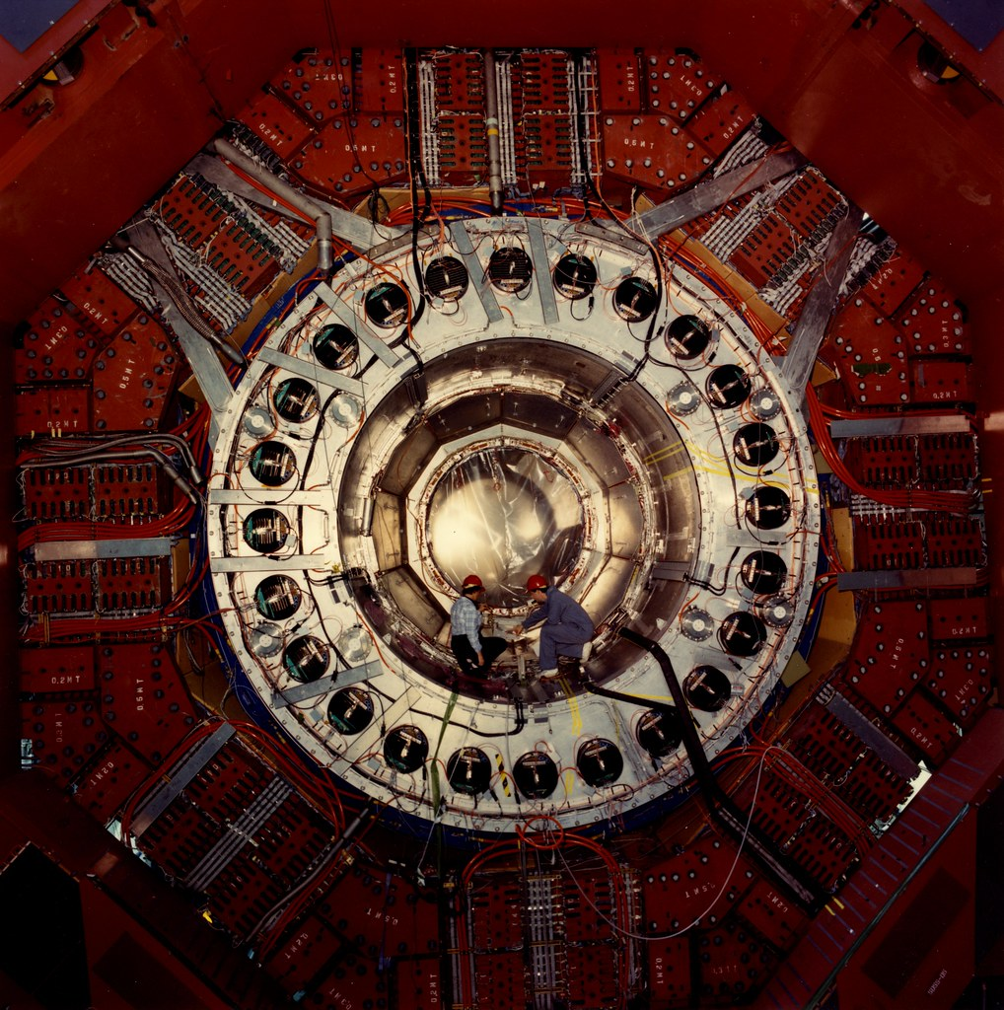
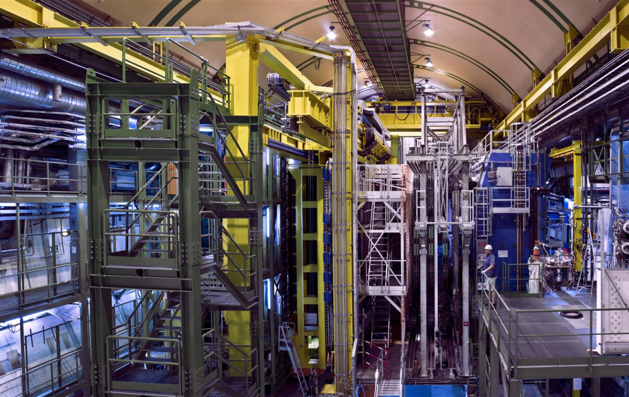
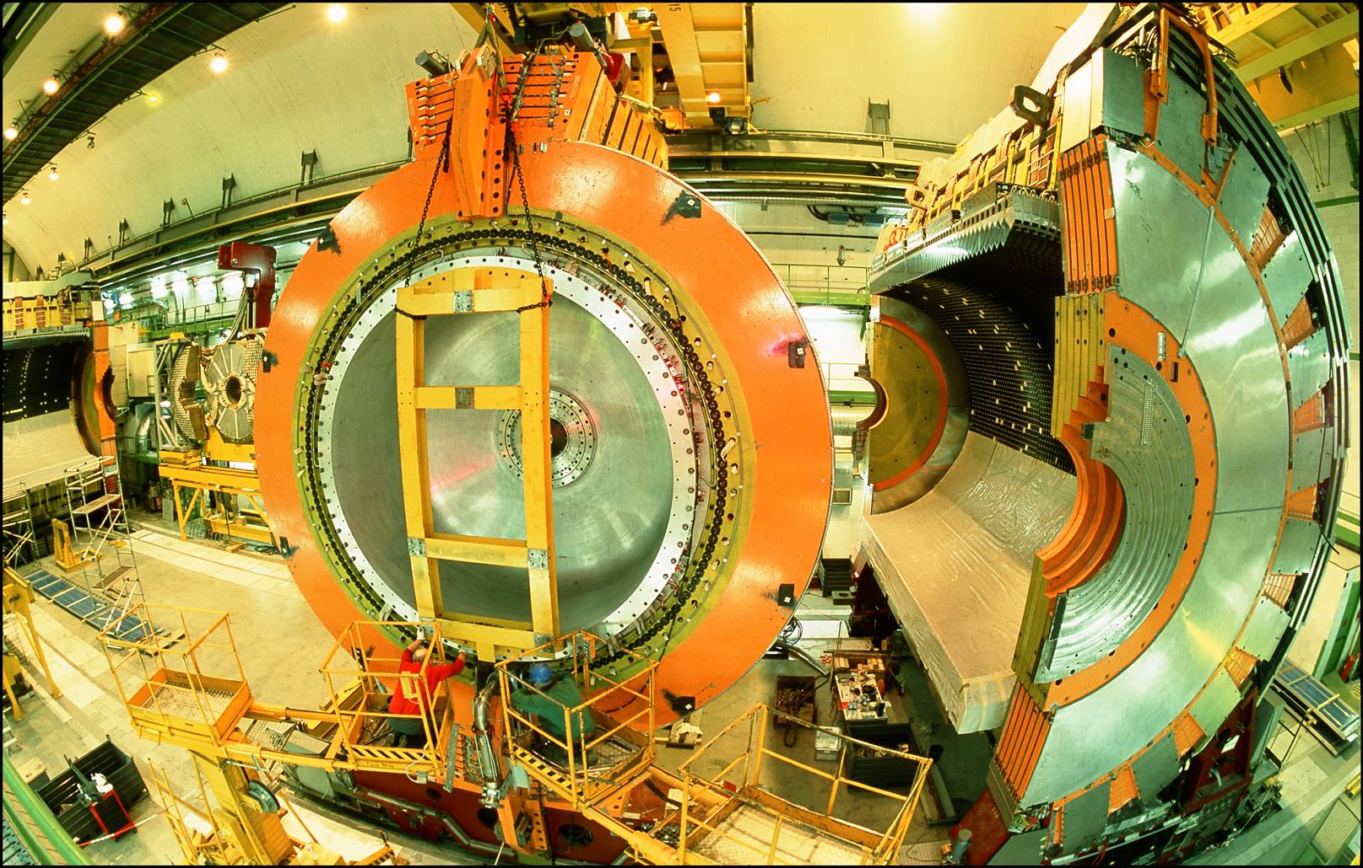
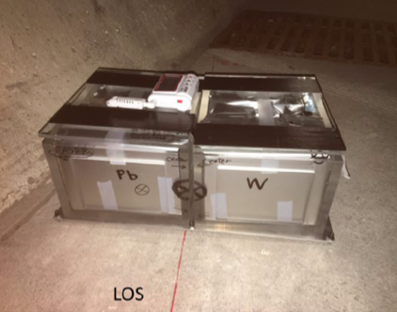
LOCATION, LOCATION, LOCATION
…
ALICE
ALEPH
CDF
FASERν Pilot Detector
Suitcase-size, 4 weeks
$0 (recycled parts)
6 neutrino candidates
ATLAS
DELPHI
D0
CMS
L3
LHCb
SLD
OPAL
All previous
collider detectors
Building-size, decades
~$10⁹
0 neutrino candidates

Slide 7
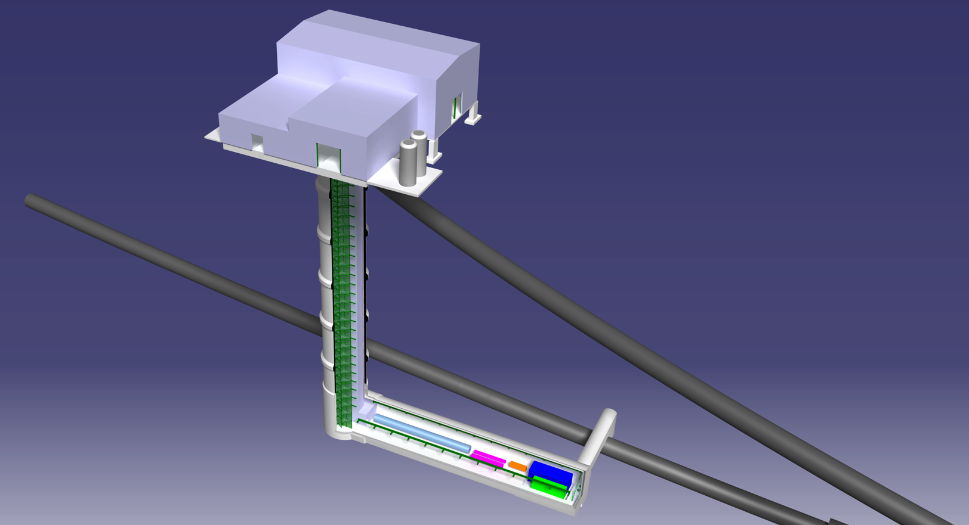
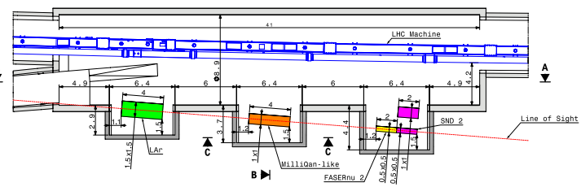
FORWARD PHYSICS FACILITY FOR HL-LHC
Possibilities presented by CERN CE at FPF2 Meeting:
enlarge existing cavern UJ12 with alcoves for each experiment
create a new shaft and cavern ~617 m from ATLAS past UJ18
UJ18
ATLAS
SPS
UJ12
LHC
LOS
See Kincso Balazs talk,
FPF2 Meeting, 27-28 May 2021
CERN GIS

Slide 8
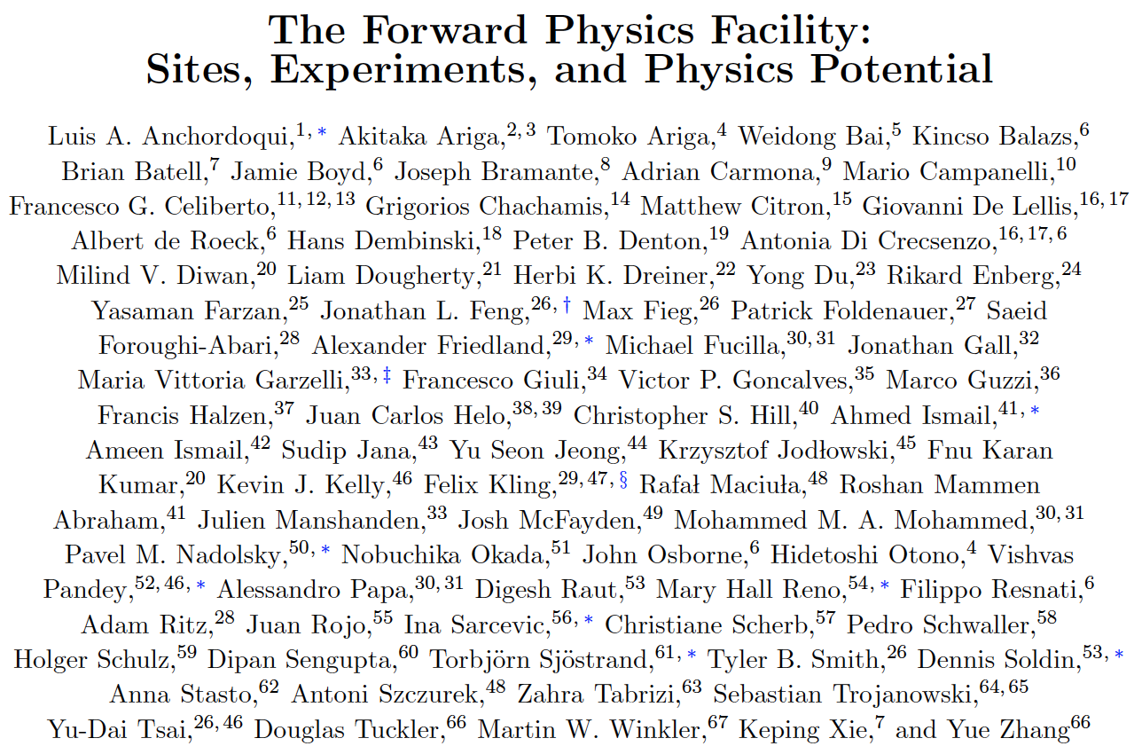
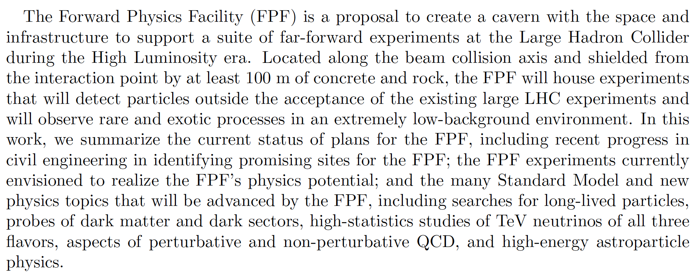
FPF “SHORT PAPER”
The status of the FPF has been summarized in a 75-page “short paper”: not a compilation of every relevant study, but rather a distillation of key progress on the FPF so far.
Written over ~3 months by ~80 co-authors, it summarizes the facility, experiments, and physics potential of the FPF.
2109.10905

Slide 9
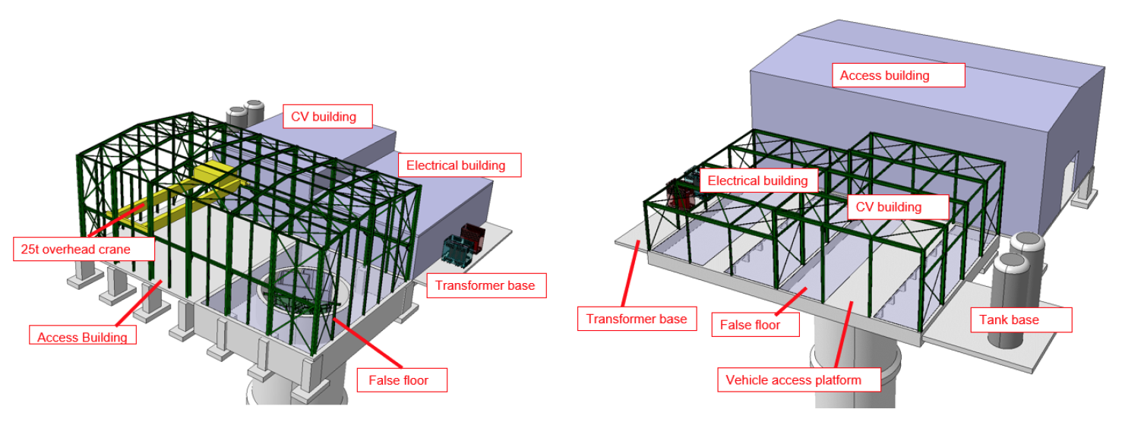
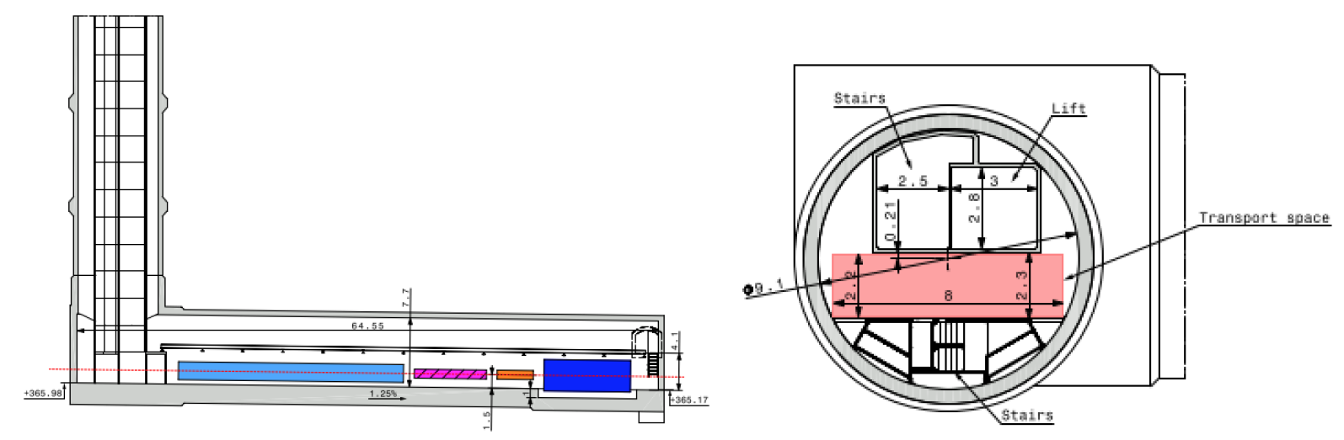
FPF SHORT PAPER: FACILITY
Purpose-Built Facility on CERN land in France, 620 m east of ATLAS IP.
~70m long experimental hall along the LOS
Description of the hall, shaft, surface buildings, services, safety.
Very preliminary Class 4 cost estimate (including all services): 40 MCHF.

Slide 10
FPF SHORT PAPER: EXPERIMENTS
FASER2: tracker, magnetic spectrometer, BSM LLP search
FASERν2: ~20 tonne emulsion/tungsten detector, neutrinos, especially tau
AdvSND: 2 ~2-10 tonne detectors (AdvSND1 in FPF, AdvSND2 at η~4.5), neutrinos
FORMOSA: scintillator detector, millicharged particles, neutrino EDMs, etc.
FLArE: ~10 tonne LArTPC, neutrinos, DM direct detection

Slide 11
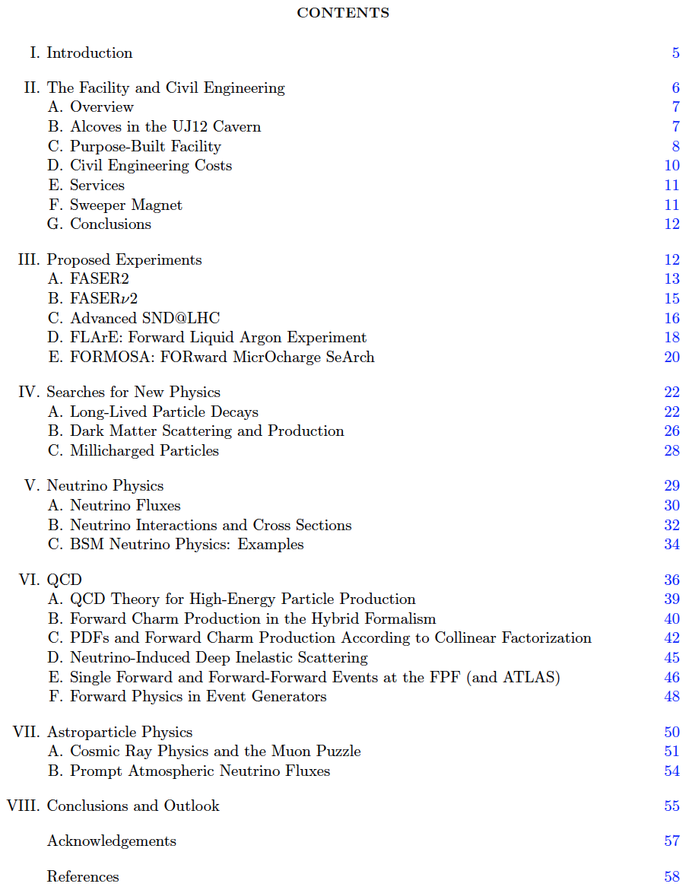
FPF SHORT PAPER: PHYSICS
Searches for New Physics
Neutrino Physics
QCD
Astroparticle Physics

Slide 12
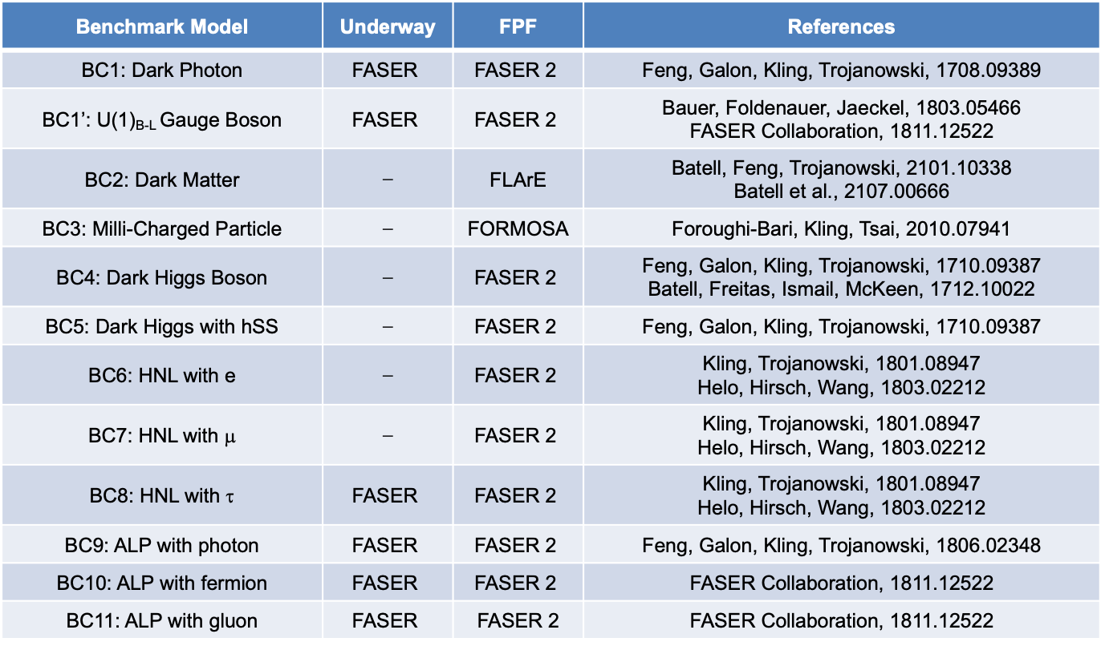
FPF BSM PHYSICS
The FPF will accommodate experiments with sensitivity to BSM phenomena through LLP searches, but also through DM direct detection, and neutrino properties.
Benchmark Model | Underway | FPF | References
BC1: Dark Photon | $$\text{FASER}$$ | $$\text{FASER}\text{ 2}$$ | Feng, Galon, Kling, Trojanowski, 1708.09389
BC1’: U(1)_{B-L} Gauge Boson | $$\text{FASER}$$ | $$\text{FASER}\text{ 2}$$ | Bauer, Foldenauer, Jaeckel, 1803.05466 FASER Collaboration, 1811.12522
BC2: Dark Matter | ⎼ | FLArE | Batell, Feng, Trojanowski, 2101.10338 Batell et al., 2107.00666
BC3: Milli-Charged Particle | ⎼ | FORMOSA | Foroughi-Bari, Kling, Tsai, 2010.07941
BC4: Dark Higgs Boson | ⎼ | $$\text{FASER}\text{ 2}$$ | Feng, Galon, Kling, Trojanowski, 1710.09387 Batell, Freitas, Ismail, McKeen, 1712.10022
BC5: Dark Higgs with hSS | ⎼ | $$\text{FASER}\text{ 2}$$ | Feng, Galon, Kling, Trojanowski, 1710.09387
BC6: HNL with e | ⎼ | $$\text{FASER}\text{ 2}$$ | Kling, Trojanowski, 1801.08947 Helo, Hirsch, Wang, 1803.02212
BC7: HNL with μ | ⎼ | $$\text{FASER}\text{ 2}$$ | Kling, Trojanowski, 1801.08947 Helo, Hirsch, Wang, 1803.02212
BC8: HNL with τ | $$\text{FASER}$$ | $$\text{FASER}\text{ 2}$$ | Kling, Trojanowski, 1801.08947 Helo, Hirsch, Wang, 1803.02212
BC9: ALP with photon | $$\text{FASER}$$ | $$\text{FASER}\text{ 2}$$ | Feng, Galon, Kling, Trojanowski, 1806.02348
BC10: ALP with fermion | $$\text{FASER}$$ | $$\text{FASER}\text{ 2}$$ | FASER Collaboration, 1811.12522
BC11: ALP with gluon | $$\text{FASER}$$ | $\text{FASER}$ 2 | FASER Collaboration, 1811.12522

Slide 13
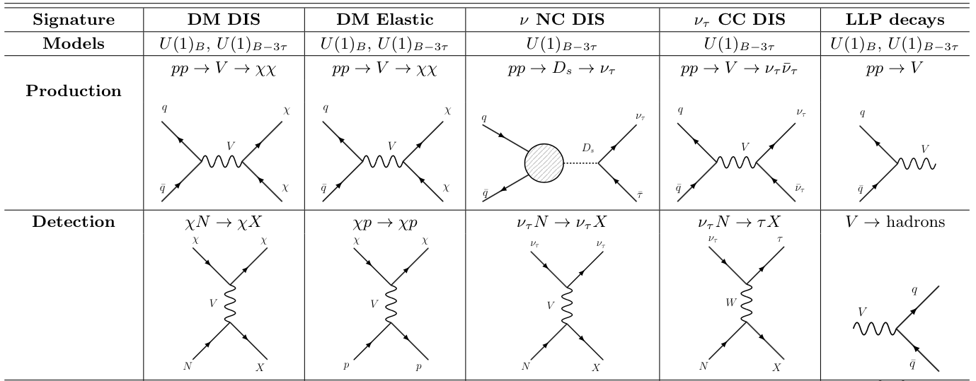
BSM EXAMPLE: LIGHT U(1)_{B-3τ} GAUGE BOSON
Batell, Feng, Fieg, Ismail, Kling, Abraham, Trojanowski (in progress); see also talk of Sebastian Trojanowski

Slide 14
PLANS
The FPF and related experiments have benefited greatly from PBC support. Hope for continued progress within the PBC framework and also the Snowmass community exercise.
FPF meetings
  FPF Kickoff Meeting, 9-10 Nov 2020, https://indico.cern.ch/event/955956
  FPF2 Meeting, 27-28 May 2021, https://indico.cern.ch/event/1022352
  FPF3 Meeting, 25-26 Oct 2021, https://indico.cern.ch/event/1076733
The next meeting is this coming week and will include
  Updates from civil engineering, RP studies, sweeper magnet
  Progress from the experiments
  New physics motivations from BSM, QCD, neutrino, astroparticle physics
A white paper (~200-300 pages) will be submitted to Snowmass in February-March 2022.

